Slide 1
Óbuda University
John von Neumann Faculty of Informatics
Institute of Applied Mathematics
Master in Engineering Informatics and Applied Mathematics
Course System Level Modeling for Cyber-Physical Engineering Structures in the Cloud
Lecture and laboratory No. 03
Shape model
Dr. László Horváth
http://users.nik.uni-obuda.hu/lhorvath/

Slide 2
This presentation is intellectual property. It is available only for students in my courses.
The screen shots in this presentation were made in the CATIA V5 and the V6 PLM systems as well as the 3DEXPERIENCE platform at the Laboratory of Intelligent Engineering systems, in the course of active modeling process.
The CATIA V5 és V6 PLM systems as well as the 3DEXPERIENCE platform are operated at the above laboratory with the support of Dassult Systémes Inc. and CAD-Terv Ltd.
László Horváth UÓ-JNFI-IAM http://users.nik.uni-obuda.hu/lhorvath/

Slide 3
Contents
Lecture
Boundary representation
Topological rules
Euler's formula
Build topology by Euler operators
Parametric curve
B-spline curve
Parametric equation of surface
Continuity
Laboratory tasks
Definition of thematic model and its analysis and understanding for lecture issues as individual work of each student.
László Horváth UÓ-JNFI-IAM http://users.nik.uni-obuda.hu/lhorvath/

Slide 4
Boundary representation
E – edge (coedge)
Closed chain of edges
V - vertex
F - face
Shell
Shell+material=body
Curve mapped to edge
Surface mapped to edge
Body in this case = four lumps
László Horváth UÓ-JNFI-IAM http://users.nik.uni-obuda.hu/lhorvath/

Slide 5
Topological rules to verify a body
Number of edges at a vertex is two or more
Edge is mapped to two faces
Non-manifold topologies
V
V
2
E
E
E
1
3
F
1
If not
fulfilled
E
2
F
2
V
1
Face is bordered by closed chain of edges
E
4
E
1
F
E
3
E
2
László Horváth UÓ-JNFI-IAM http://users.nik.uni-obuda.hu/lhorvath/

Slide 6
Euler's formula for topology
Examples for the Euler's formula
Leonhard Euler (1707-1783) Swiss mathematician:
Euler characteristic of body boundary :
V - E + F= constant.
Where shape does not include separated bodies and break-through V - E + F=2. This is the Euler's formula
V-E+F=8-12+6=2
V-E+F=10-15+7=2
V-E+F=2-3+3=2
Generalization of the Euler's formula: Euler-Poincaré formula
The h0, h1 and h2 Betti-numbers are applied.
h1 is twice of number of through holes.
ho a number of separated bodies.
In usual cases it can be supposed: h2= h0.
The generalized Euler formula:
V - E + F - R = 2(S- H).
Where H=h1/2, S=h0, R number of blind holes.
László Horváth UÓ-JNFI-IAM http://users.nik.uni-obuda.hu/lhorvath/

Slide 7
Build topology by Euler operators
Edge removal and vertex fusion operations result single vertex and single polygon structure
Topological structure is built by operators named after Euler
Local Euler operators: act on vertex, edge and face.
Global Euler operators:
connect shells
László Horváth UÓ-JNFI-IAM http://users.nik.uni-obuda.hu/lhorvath/

Slide 8
Local Euler operators
They act on vertices, edges and faces.
MEV – make edge and vertex!
MEF– make edge and face!
KEMR – remove edge and make ring (closed chaing of edges)!
László Horváth UÓ-JNFI-IAM http://nik.uni-obuda.hu/lhorvath/

Slide 9
Parametric curve and its local characteristics
Parametric equation of a three dimensional curve
u
max
Y
P(u)=[x(u) y(u) z(u)]
x=x(u), y=y(u) és z=z(u)
P (x,y,z)
Cartesian space
P_{u} is the position vector to point P.
u
min
P
(
u
)
n
X
t
Z
r
b
Local characteristics at a point with parameter value u:
Tangent (t),
Normal (n)
Binormal (b)
Curvature (r)
László Horváth UÓ-JNFI-IAM http://nik.uni-obuda.hu/lhorvath/

Slide 10
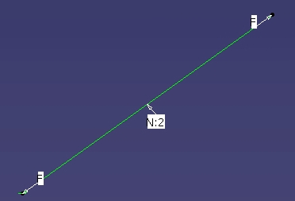
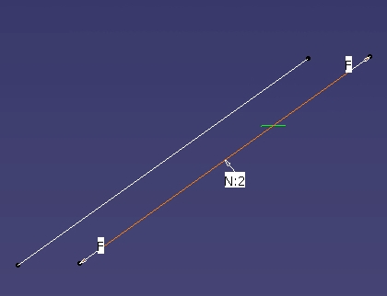
Parametric curve and its global characteristics
Control polygon consists of a single line.
Control
Local
Global
Degree (D)
Class (N=D+1)
Free or engaged end
Shape of line is not allowed to change
László Horváth UÓ-JNFI-IAM http://nik.uni-obuda.hu/lhorvath/

Slide 11
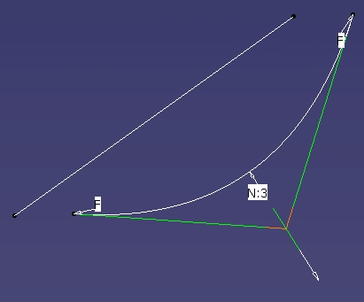
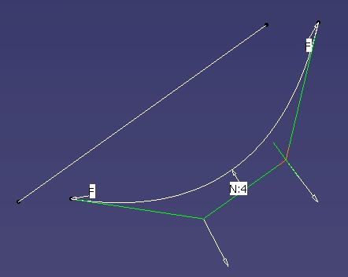
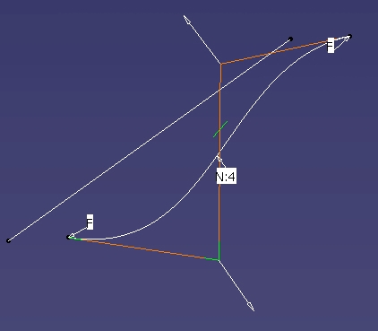
Parametric curve and its global characteristics
Control polygon consists of 3 lines.
Degree changed to 2. Shape of line is allowed to change accordingly
Degree changed to 3. Shape of line is allowed to change accordingly
László Horváth UÓ-JNFI-IAM http://nik.uni-obuda.hu/lhorvath/

Slide 12
B-spline curve
Spline
Flexible steel ribbon in ship building.
It was modeled as B spline.
B-spline curve
Consists of segments.
Continuity at segment borders.
Local control.
Spline base functions.
Degree of the curve is same as degree of the base function. Different degree of segments is allowed.
Curve goes through of the first and last control points only in case of special parameterization.
i
-1 segment
i
segment
P
i
-1
P
i
P
i
+1
u
0
u
1
u
2
u
3
László Horváth UÓ-JNFI-IAM http://nik.uni-obuda.hu/lhorvath/

Slide 13
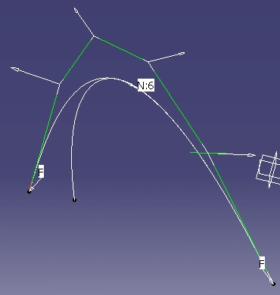
Local control of B-spline curve
B-spline base (blending) function is defined within a parameter range.
It is attached to control point
V
V
1
2
Segment 1
Segment 2
V
V
0
3
V
V
5
4
Segment 1 is controlled by V0-V2.
Segment 2 is controlled by V1-V3.
László Horváth UÓ-JNFI-IAM http://nik.uni-obuda.hu/lhorvath/

Slide 14
Polynomials as base functions
The only group of functions in current geometrical modeling
For all analytical and free form shapes
Differentiation of the function is easy: suitable for determination of tangent, normal, and curvature.
General form of a polynomial of degree n is
p
(
x
)
=
a
x
n
+
a
x
n
−
1
+
+
a
x
+
a
=
…
n
n
−
1
1
0
(
)
n
=
=
∑
i
p
x
a
x
i
i
=
0
László Horváth UÓ-JNFI-IAM http://nik.uni-obuda.hu/lhorvath/

Slide 15
Parameterization of B-spline curve
The parameter range of curve is divided into intervals for segments:
The knot vector:
{
}
u
:
i
=
0,1,
.
.
.
,
n
+
k
i
where:
u
≤
u
u₀
u₁
u₂
u₃
i
i
+
1
The curve passes over given number of segment border points. These points are called as knots. Knots carry the parameter values for segment border points.
In case of control points n + 1 , order k, degree k-1, number of knots m:
(m+1) = (n+1) + k
Number of knots: m = n + k
The allocation of parameter range can be uniform or non-uniform. Non uniform allocation serves more sophisticated representation of geometry.
Periodic curve: The parameter intervals are repeated. The uniform B-spline is periodic.
Non-periodic curve: Inside knots are uniform. However, intervals are repeated at beginning and end of the vector. Maximum number of repetition is the order of curve.
The rational B-spline curves are characterized by knot and weight vectors.
At representation of analytical curves value of w determines the shape of curve segment.
László Horváth UÓ-JNFI-IAM http://users.nik.uni-obuda.hu/lhorvath/

Slide 16
Parametric equation of surface
u=1
v=0
u=1
,
v=0
u=0,4
P
v
v=0,8
u=1
P
(x,y,z)
,
v=1
P
u
u=0
u=0
v=1
v=0
P
(
u, v
)
Y
u=0
v=1
X
Isoperimetric curves
Z
Model coordinate system
General form of parametric equation of surface:
P(u,v)=[x(u,v) y(u,v) z(u,v)]
where u_{min} <= u <= u_{max} and v_{min} <= v <= _{vmax}
x=x(u,v), y=y(u,v) és z=z(u,v)
László Horváth UÓ-JNFI-IAM http://users.nik.uni-obuda.hu/lhorvath/

Slide 17
Continuity
Cases of connection of two curves:
Non continuous: there is no common point.
O order continuity: there is common point.
1 order continuity: tangents are the same at the connection point.
2 order continuity: tangents and curvatures are the same at the connection point.
Continuity at mating of surfaces:
One of the above cases at any point of the intersection curve.
László Horváth UÓ-JNFI-IAM http://nik.uni-obuda.hu/lhorvath/

Slide 18
Slm_CS_03 case study: control of geometry
Definition of thematic model and its analysis and understanding for lecture issues as individual work of each student.
László Horváth UÓ-JNFI-IAM http://users.nik.uni-obuda.hu/lhorvath/

Slide 19
Control of geometry
László Horváth UÓ-JNFI-IAM http://users.nik.uni-obuda.hu/lhorvath/

Slide 20
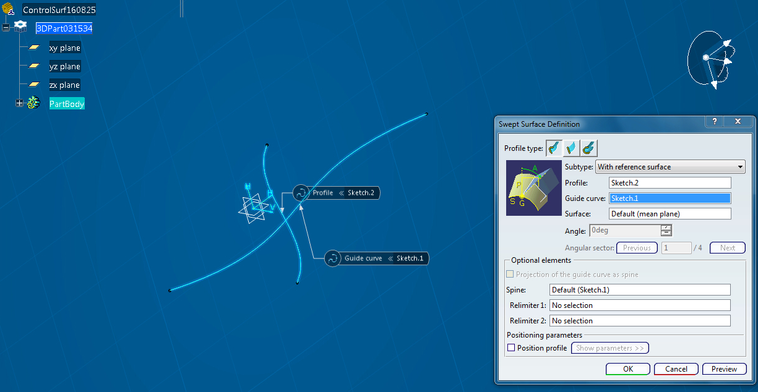
Control of geometry
László Horváth UÓ-JNFI-IAM http://users.nik.uni-obuda.hu/lhorvath/

Slide 21
Control of geometry
László Horváth UÓ-JNFI-IAM http://users.nik.uni-obuda.hu/lhorvath/

Slide 22
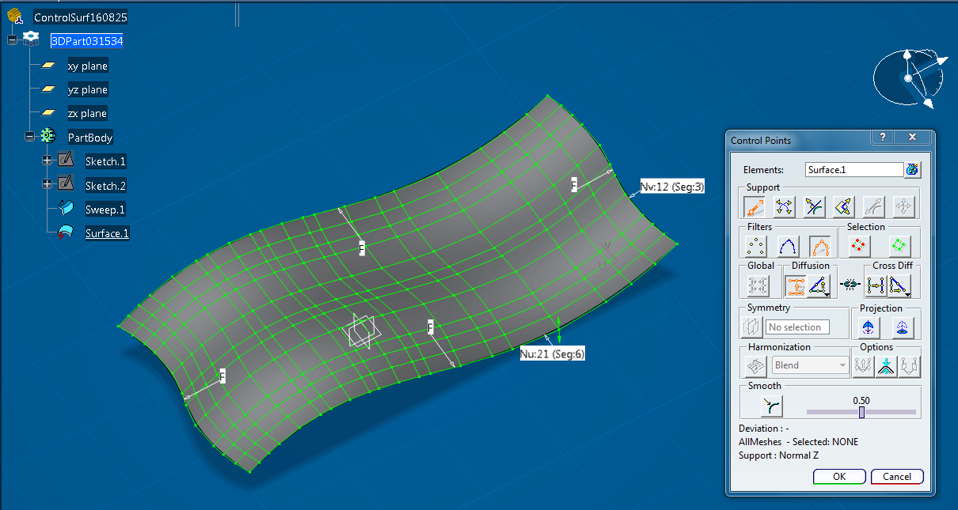
Control of geometry
László Horváth UÓ-JNFI-IAM http://users.nik.uni-obuda.hu/lhorvath/

Slide 23
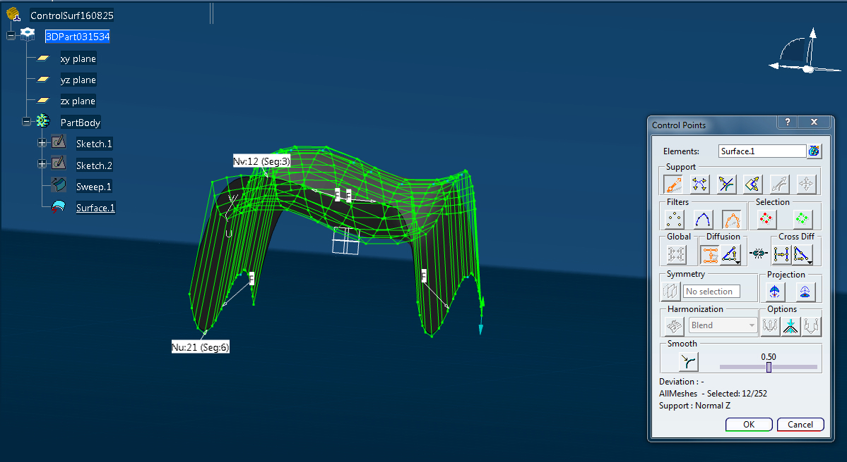
Control of geometry
László Horváth UÓ-JNFI-IAM http://users.nik.uni-obuda.hu/lhorvath/

Slide 24
Control of geometry
László Horváth UÓ-JNFI-IAM http://users.nik.uni-obuda.hu/lhorvath/

Slide 25
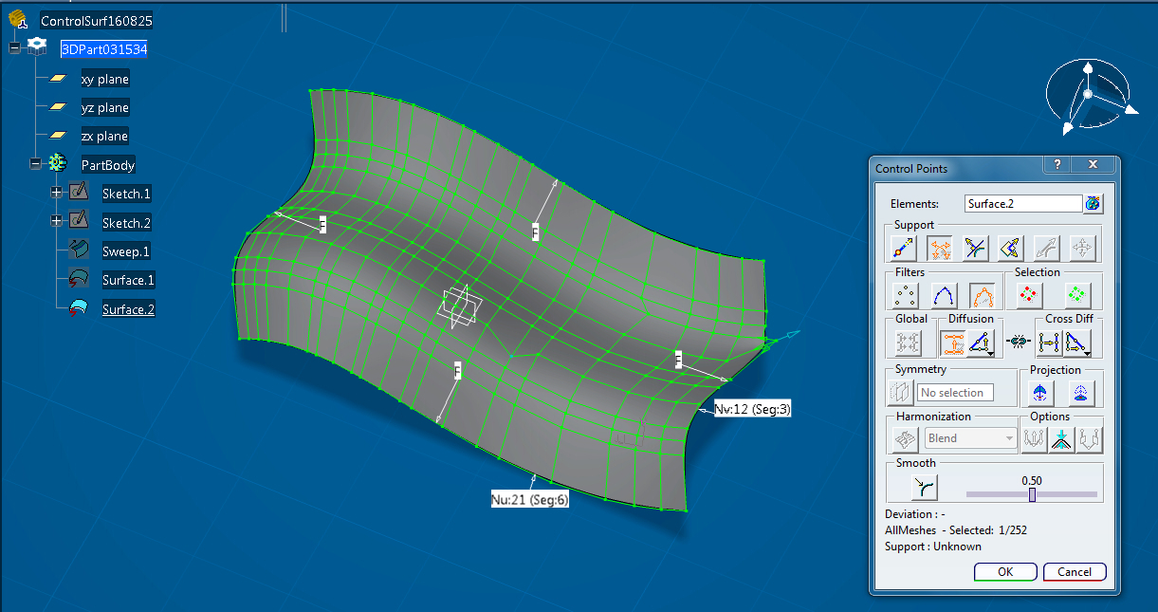
Control of geometry
László Horváth UÓ-JNFI-IAM http://users.nik.uni-obuda.hu/lhorvath/

Slide 26
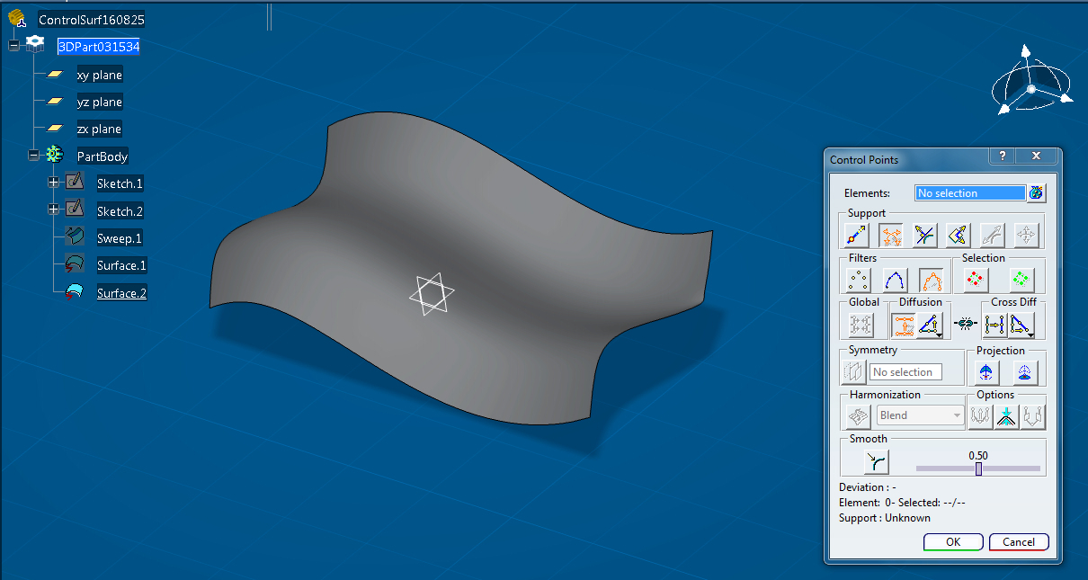
Control of geometry
László Horváth UÓ-JNFI-IAM http://users.nik.uni-obuda.hu/lhorvath/

Slide 27
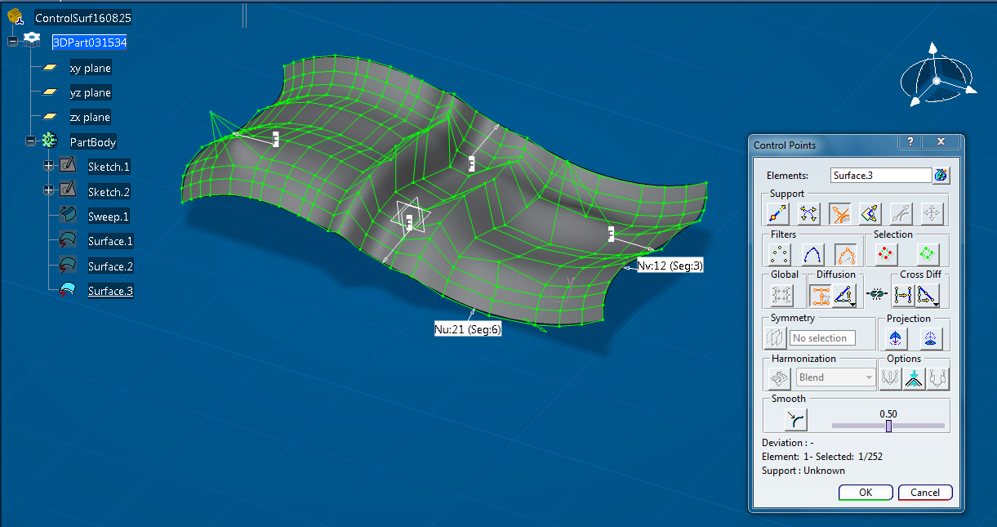
Control of geometry
László Horváth UÓ-JNFI-IAM http://users.nik.uni-obuda.hu/lhorvath/

Slide 28
Control of geometry
László Horváth UÓ-JNFI-IAM http://users.nik.uni-obuda.hu/lhorvath/

Slide 29
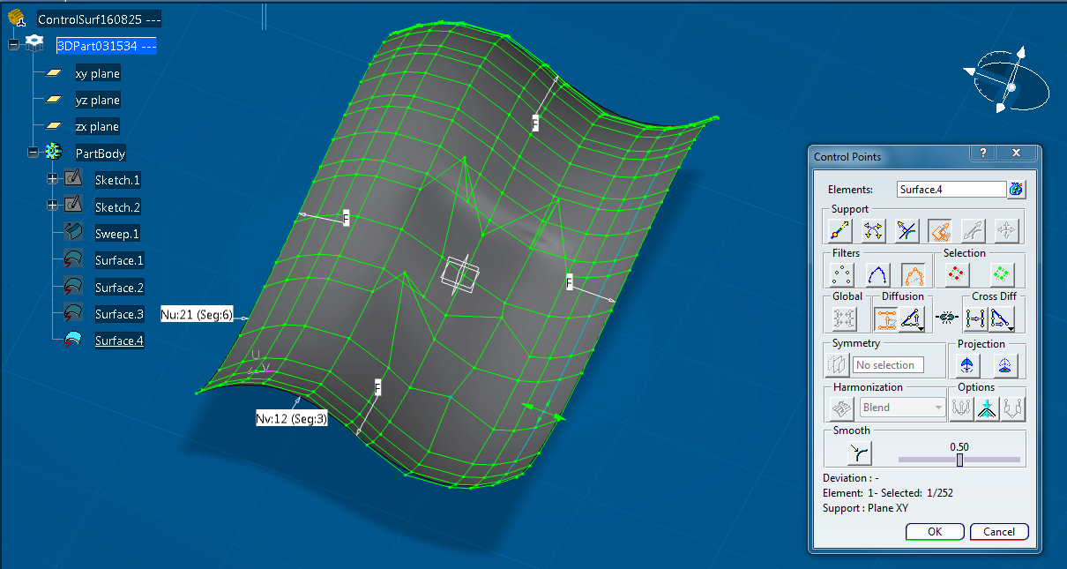
Control of geometry
László Horváth UÓ-JNFI-IAM http://users.nik.uni-obuda.hu/lhorvath/

Slide 30
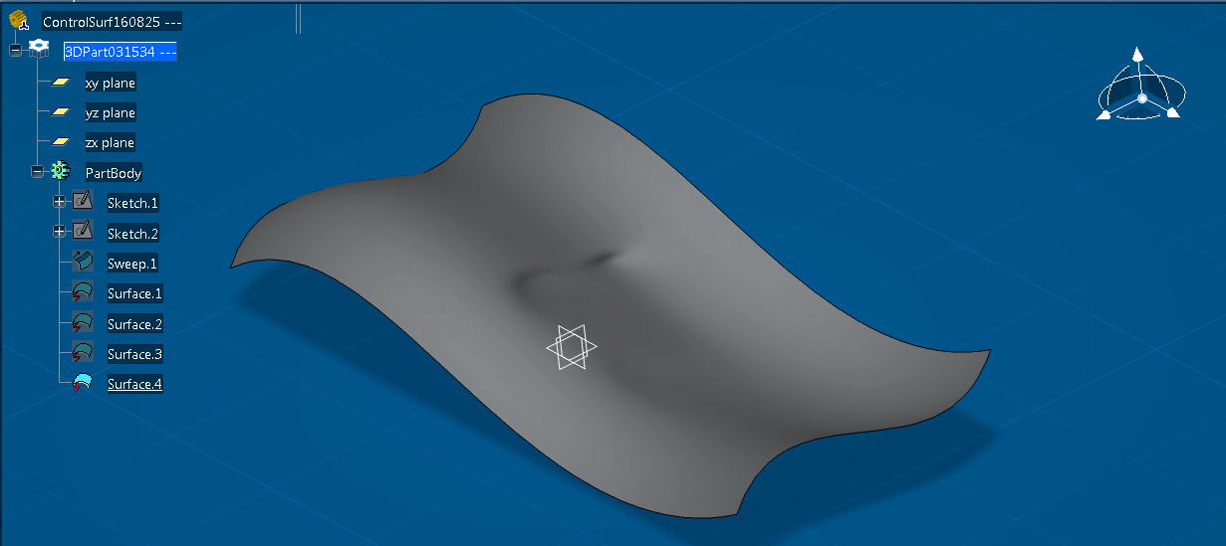
Control of geometry
László Horváth UÓ-JNFI-IAM http://users.nik.uni-obuda.hu/lhorvath/

Slide 31
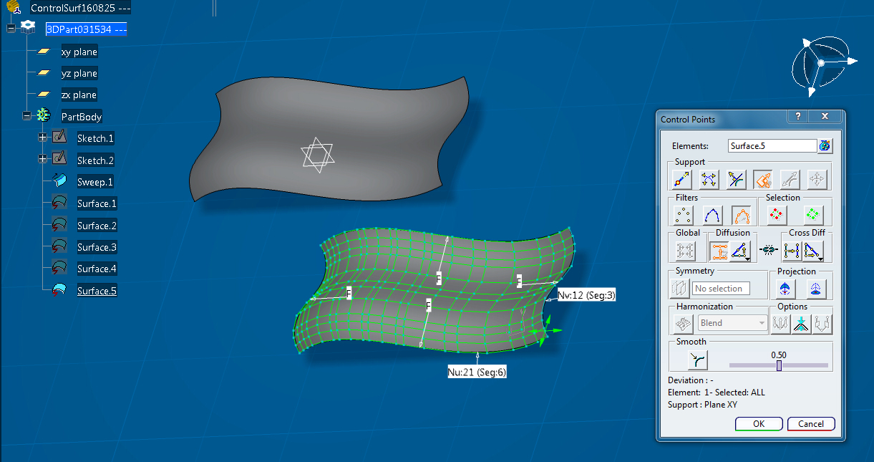
Control of geometry
László Horváth UÓ-JNFI-IAM http://users.nik.uni-obuda.hu/lhorvath/

Slide 32
Control of geometry
László Horváth UÓ-JNFI-IAM http://users.nik.uni-obuda.hu/lhorvath/

Slide 33
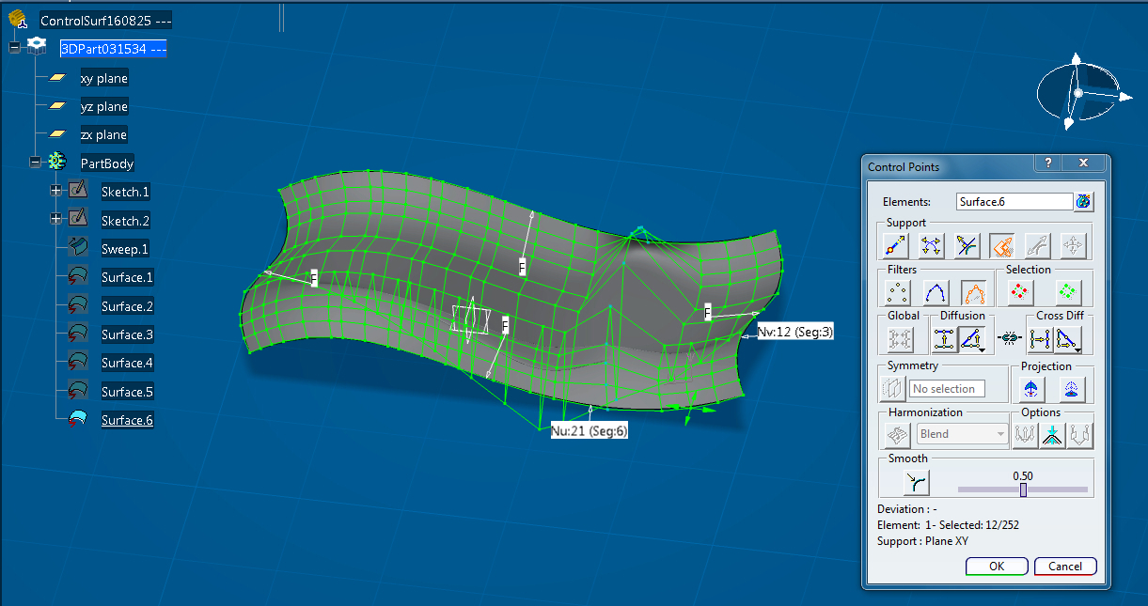
Control of geometry
László Horváth UÓ-JNFI-IAM http://users.nik.uni-obuda.hu/lhorvath/

Slide 34
Control of geometry
László Horváth UÓ-JNFI-IAM http://users.nik.uni-obuda.hu/lhorvath/

Slide 35
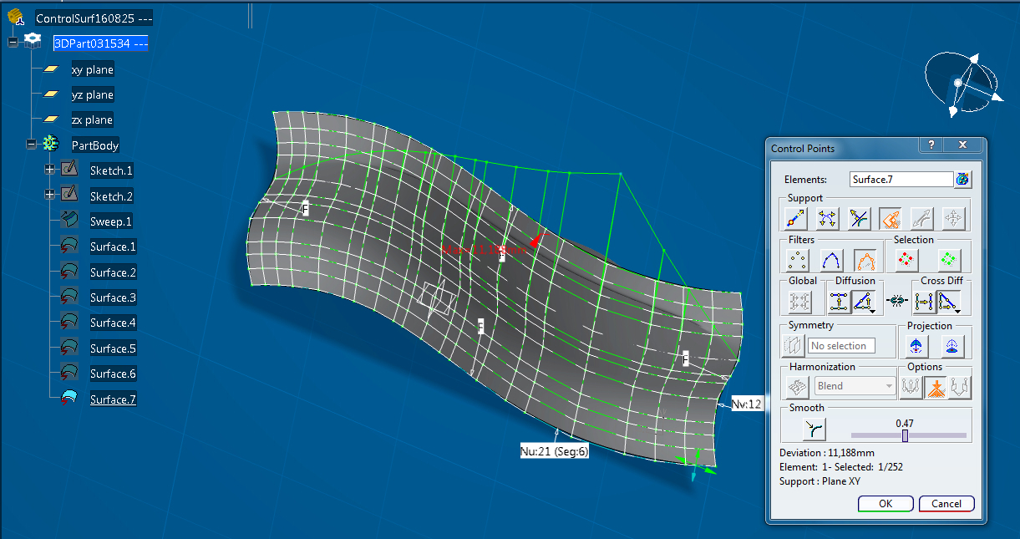
Control of geometry
László Horváth UÓ-JNFI-IAM http://users.nik.uni-obuda.hu/lhorvath/

Slide 36
Control of geometry
László Horváth UÓ-JNFI-IAM http://users.nik.uni-obuda.hu/lhorvath/

Slide 37
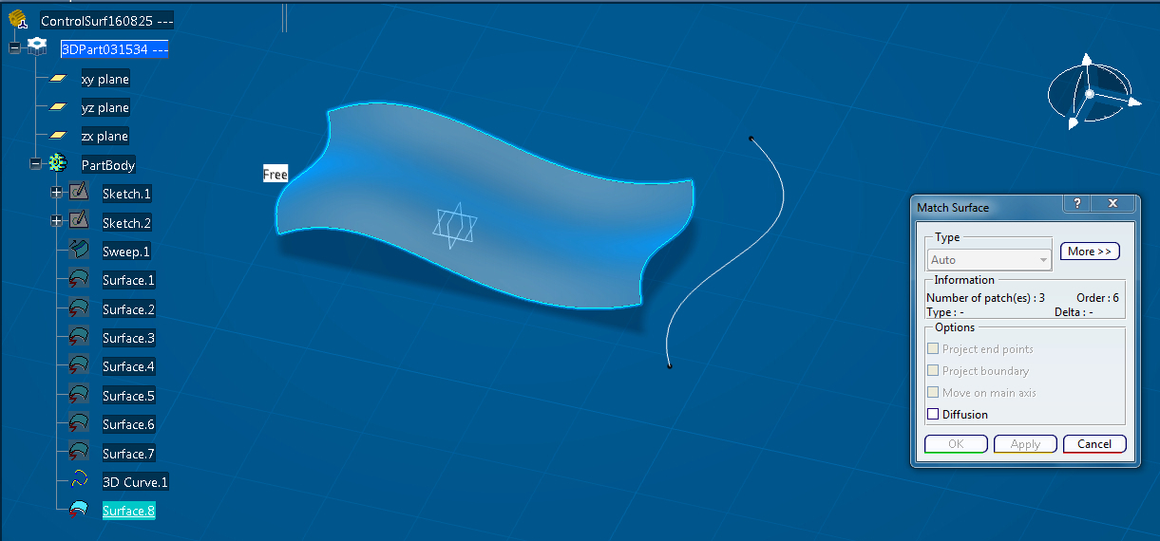
Control of geometry
László Horváth UÓ-JNFI-IAM http://users.nik.uni-obuda.hu/lhorvath/

Slide 38
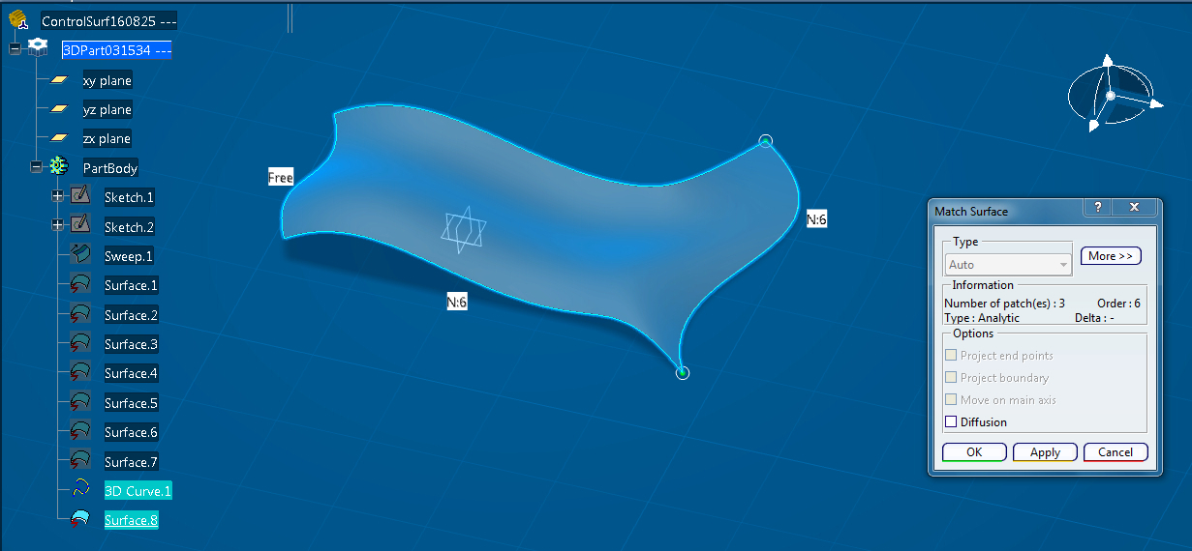
Control of geometry
László Horváth UÓ-JNFI-IAM http://users.nik.uni-obuda.hu/lhorvath/

