Slide 1
Óbuda University
John von Neumann Faculty of Informatics
Institute of Applied Mathematics
Master in Engineering Informatics and Applied Mathematics
Course System Level Modeling for Cyber-Physical Engineering Structures in the Cloud
Lecture and laboratory No. 06
Modeling capabilities
Dr. László Horváth
http://users.nik.uni-obuda.hu/lhorvath/

Slide 2
This presentation is intellectual property. It is available only for students in my courses.
The screen shots in this presentation were made in the CATIA V5 and the V6 PLM systems as well as the 3DEXPERIENCE platform at the Laboratory of Intelligent Engineering systems, in the course of active modeling process.
The CATIA V5 és V6 PLM systems as well as the 3DEXPERIENCE platform are operated at the above laboratory with the support of Dassult Systémes Inc. and CAD-Terv Ltd.
László Horváth UÓ-JNFI-IAM http://users.nik.uni-obuda.hu/lhorvath/

Slide 3
Contents
Lecture
Roles of participants in engineering project.
Roles and groups of modeling capabilities for role
Groups of modeling capabilities for model space available on dashboard
Groups of modeling capabilities for simulation available on dashboard
Groups of modeling capabilities for collaboration available on dashboard
Role and related task on the example of Aesthetical Shape Modeler.
Role and related task on the example of Systems Behavior Optimization.
Role and related task on the example of Software Engineer
Role and related task on the example of Ergonomics Specialist
Laboratory task
Slm_CS_06 case study: Mathematical surface representations as contexts of solid
László Horváth UÓ-JNFI-IAM http://users.nik.uni-obuda.hu/lhorvath/

Slide 4
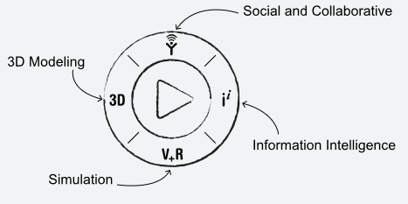
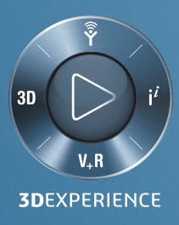
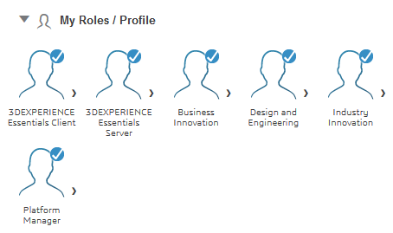
Roles of participants in engineering project
Source: Dassault Systémes
László Horváth UÓ-JNFI-IAM http://users.nik.uni-obuda.hu/lhorvath/

Slide 5
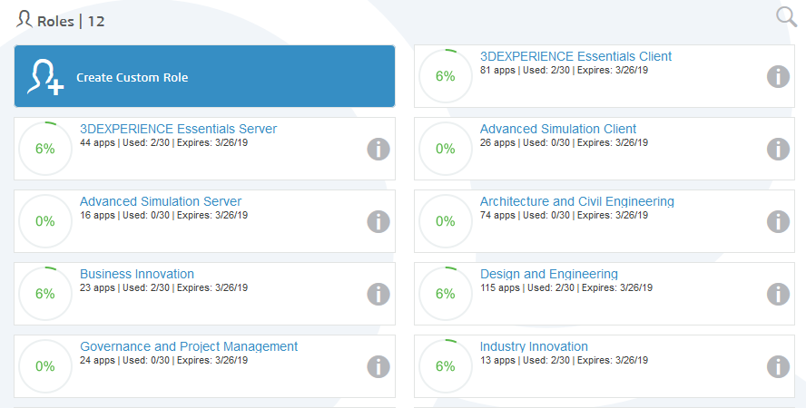
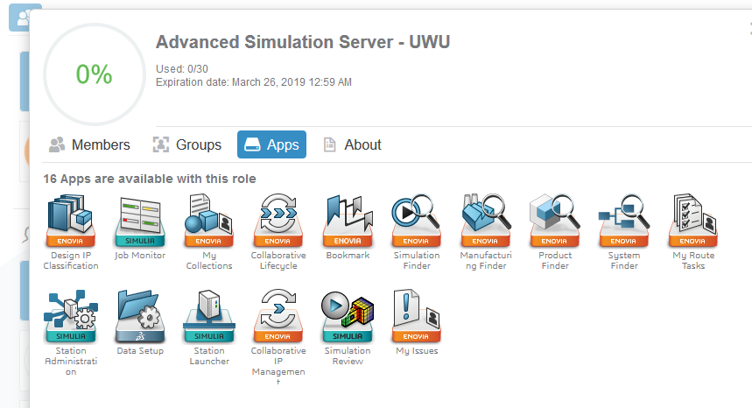
Roles and groups of modeling capabilities for role
Source: Dassault Systémes
László Horváth UÓ-JNFI-IAM http://users.nik.uni-obuda.hu/lhorvath/

Slide 6
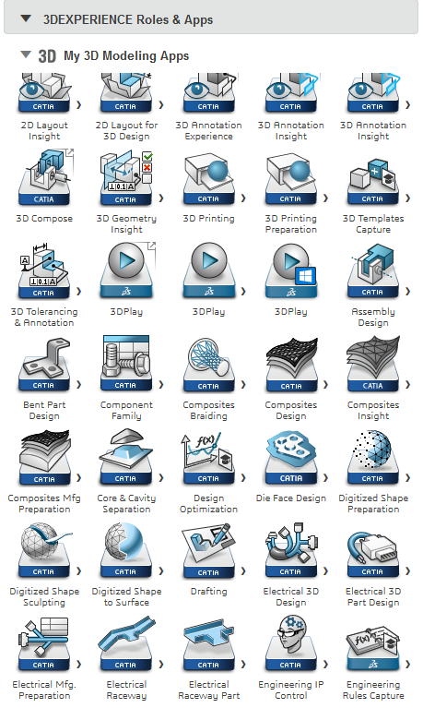
Groups of modeling capabilities for model space available on dashboard
Source: Dassault Systémes
László Horváth UÓ-JNFI-IAM http://users.nik.uni-obuda.hu/lhorvath/

Slide 7
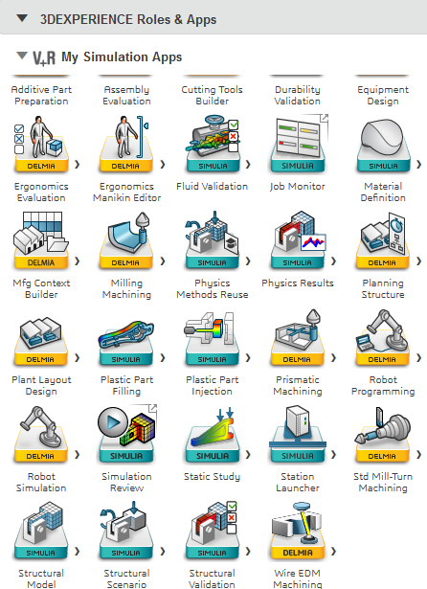
Groups of modeling capabilities for simulation available on dashboard
Source: Dassault Systémes
László Horváth UÓ-JNFI-IAM http://users.nik.uni-obuda.hu/lhorvath/

Slide 8
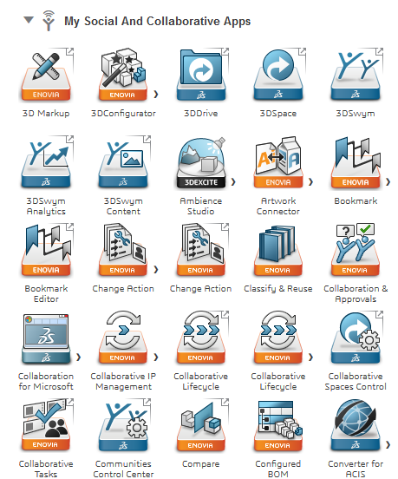
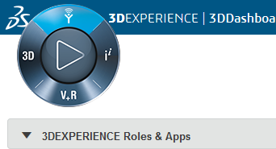
Groups of modeling capabilities for collaboration available on dashboard
Source: Dassault Systémes
László Horváth UÓ-JNFI-IAM http://users.nik.uni-obuda.hu/lhorvath/

Slide 9
Role and related task on the example of Aesthetical Shape Modeler
DESIGN/STYLING Aesthetical Shape Modeler
Achieve high level surface quality while respecting aesthetic and technical constraints with a set of specific surface modeling applications, functions and analysis tools.
Increase shape quality and precision to improve the final product’s perceived quality.
Experience specific surface modeling, reverse engineering functions and analysis tools to create surfaces and deliver a new level of surface quality.
Re-use and re-work geometry to reduce and optimize the iteration with creative designers.
Creation of subdivision surfaces, technical surface and advanced explicit surface modeling tools.
Dedicated features for shape quality conversion and improvement.
Source: Dassault Systémes
László Horváth UÓ-JNFI-IAM http://users.nik.uni-obuda.hu/lhorvath/

Slide 10
Role and related task on the example of Systems Behavior Optimization
SYSTEMS ENGINEERING Systems Behavior Optimization
Optimize and tune systems parameters of a device or its controller to improve system dynamics for multiple criteria and multiple cases.
Tune Modelica model parameters for better systems performance, e.g. the gear ratio of a gearbox or the parameters of a system controller.
Optimize system parameters so that the overall system behavior is improved.
Derive mathematical optimization criteria from simulation results, by frequency responses or by Eigenvalue analysis.
Source: Dassault Systémes
László Horváth UÓ-JNFI-IAM http://users.nik.uni-obuda.hu/lhorvath/

Slide 11
Role and related task on the example of Software Engineer
INTELLIGENT PRODUCT CONFIGURATIONS Software Engineer
Collaborative connected environment to implement software in the context of a multi-discipline product development.
Improve Multi-discipline collaboration
Enforce Best Practices by incorporating enterprise governance and process flows
Gain transparency to the latest software content submitted against a software item release for better code reviews, knowledge transfer and root cause analysis.
Ensure integration and connection to upstream and downstream process, including change requirements management.
Source: Dassault Systémes
László Horváth UÓ-JNFI-IAM http://users.nik.uni-obuda.hu/lhorvath/

Slide 12
Role and related task on the example of Ergonomics Specialist
INDUSTRIAL ENGINEERING Ergonomics Specialist
Human-Centric Product and Workplace Design
Fully utilize the Ergonomics data libraries faster and easier
Easily manipulate manikins
Provides enhanced experience for posturing capabilities
Switch manikin population
Assess manikin vision
Calculate the moments and forces with bio-mechanics analysis
Provides push, pull and carry analysis
Detect risks with rapid upper limb assessment
Evaluate with clash analysis
Manage manikin attribute data
Source: Dassault Systémes
László Horváth UÓ-JNFI-IAM http://users.nik.uni-obuda.hu/lhorvath/

Slide 13
Slm_CS_06 case study: Mathematical surface representations as contexts of solid
Definition of thematic model and its analysis and understanding for lecture issues as individual laboratory work of each student.
Issues
Work planes for position of shape in model space
Rule based surface definitions and their contexts
Surface combinations
Surface based solid form features.
László Horváth UÓ-JNFI-IAM http://users.nik.uni-obuda.hu/lhorvath/

Slide 14
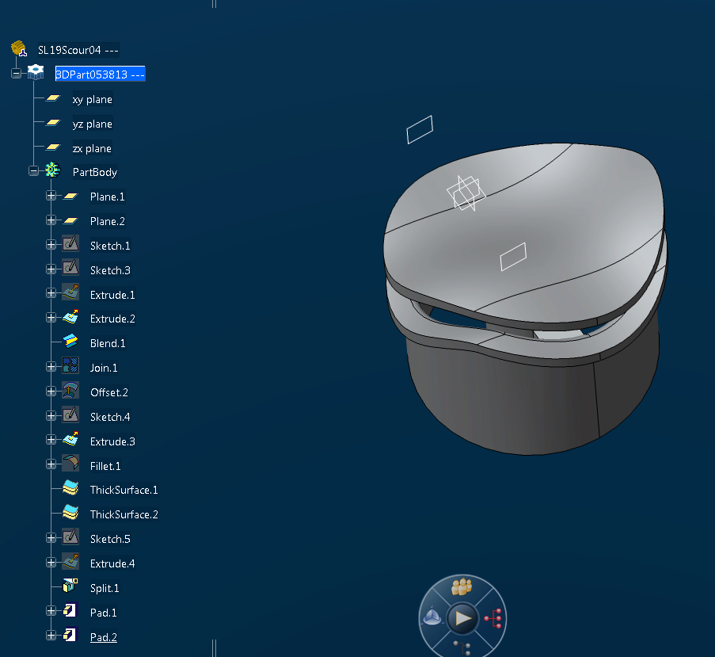
Slm_CS_06 case study: Mathematical surface representations as contexts of solid
László Horváth UÓ-JNFI-IAM http://users.nik.uni-obuda.hu/lhorvath/

Slide 15
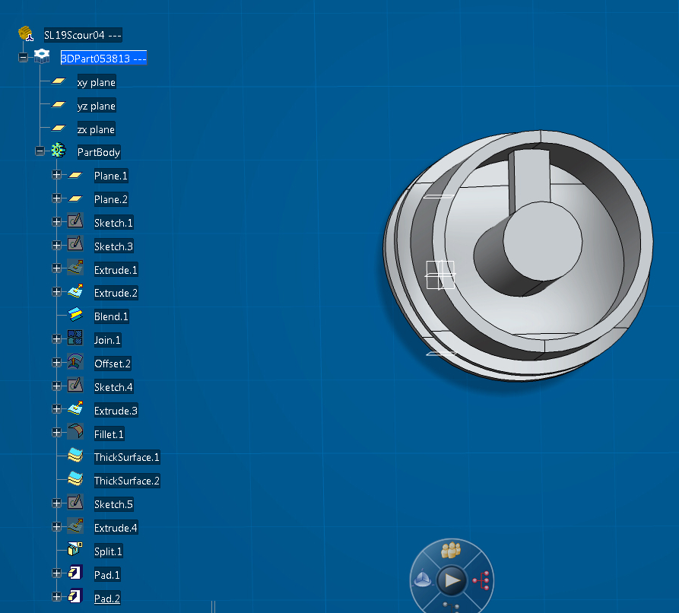
Slm_CS_06 case study: Mathematical surface representations as contexts of solid
László Horváth UÓ-JNFI-IAM http://users.nik.uni-obuda.hu/lhorvath/

Slide 16
Slm_CS_06 case study: Mathematical surface representations as contexts of solid
László Horváth UÓ-JNFI-IAM http://users.nik.uni-obuda.hu/lhorvath/

Slide 17
Slm_CS_06 case study: Mathematical surface representations as contexts of solid
Structure of connected shape model
László Horváth UÓ-JNFI-IAM http://users.nik.uni-obuda.hu/lhorvath/

Slide 18
Slm_CS_06 case study: Mathematical surface representations as contexts of solid
Structure of connected shape model
László Horváth UÓ-JNFI-IAM http://users.nik.uni-obuda.hu/lhorvath/

Slide 19
Slm_CS_06 case study: Mathematical surface representations as contexts of solid
Structure of connected shape model
László Horváth UÓ-JNFI-IAM http://users.nik.uni-obuda.hu/lhorvath/

