Slide 1
Advanced Development Techniques
Expectations
Delegate – recap
Using Delegates using modern syntax

Slide 2
Expectations
We want to emphasize: the lecture is NOT a lecture of a subject with an exam, where “we will learn it during the exam season”, but a combined format of the first 45 minutes of the practices!
  It is a pre-requirement for the practices (we don’t have an entry exam YET)
  Before the practices, watching the lecture PPT and video is obligatory
  You can expect a Moodle questionbank ZH at the end of the semester
The Java part is separated
  All Java-related questions ➔ nagy.gabriella@nik.uni-obuda.hu
C# ZH, can be re-tried on the last week
  Electronical, must be uploaded on the same day for a deadline
Mid-semester Project
  Previous knowledge: OOP, Inheritance, Interfaces, Data structures
  Current project: Git, Unit tests, Layered app development, SOLID principles
  Data, Repository, Logic, Program, Tests

Slide 3
Mid-semester project
Details: prog3_layers_requirements.pdf (Milestones!!!)
  We can start working on it after the fifth practice
  Needed: Database + EF, the database must have minimum 3 inter-connected tables
  Code-First approach
The task: full management of those three tables
  List + Insert + Remove + Modify something
  Minimum 3 functionality that go beyond simple listings, and require multi-table joins and/or groupby operators
Other requirements
  Layered architecture, SOLID, Dependency Injection
  Doxygen, Stylecop
  Unit tests with nUnit + MOQ
  Git repository (with a goot project name!), Gitstat true
  Video

Slide 4
Delegate
A type that is capable of storing multiple methods inside
  The delegate type determines the signature of the method it can contain
  The specific delegate variable will actually store the methods
  (in the background: class=type and instance+variable+list)
  The delegate variable has a null value until it has no added methods
delegate double MyDelegate(int param1, string param2);
double funct(int first, string second)
{
return first + second.Length;
}
MyDelegate del = new MyDelegate(funct); //long syntax
MyDelegate del = funct; //short syntax
Notes:
4
NEM KEVERNI ÖSSZE A DELEGÁLTAT ÉS A DELEGÁLT TÍPUSÁT!!!! -> OSZTÁLY VS PÉLDÁNY
Fontos: ez még csak egy típusdeklaráció ➔
Változó nélkül nem használható
Referenciatípus
Metóduson belül nem deklarálható
Osztályon belül és kívül is deklarálható

Slide 5
Usage of delegates
C# delegates are multicast delegates, it is capable of storing multiple methods – we can add/remove methods:
Call the methods inside the delegate:
  The calling order is not guaranteed, must not rely on it! (.NET 4.5: queue order)
  If there is a return value, then the lastly returned value is used
del += new MyDelegate(Function1); //long syntax
del += Function1; //short syntax
del -= new MyDelegate(Function1); //long syntax
del -= Function1; //short syntax
MyDelegate temp = del; //The temporary variable is
if (temp != null) //needed because of thread safety
temp(0, "alma"); //
del?.Invoke(0, "alma"); //New syntax, ATOMIC operation
Notes:
5
Azt, h a delegáltban több függvény is lehet, multicast tulajdonságnak hívják. NEM AZT HÍVJÁK MULTICAST TULAJDONSÁGNAK, HOGY TÉNYLEG TÖBB FÜGGVÉNY VAN BENNE! A multicast kifejezés a képességét jelzi, .NET-ben van unicast delegált is, de C#-ban csak multicast van (=minden delegáltban több függvény lehet)

Slide 6
Self-made vs. built-in delegate types
We can define delegate types now:
  „It is capable of storing methods where the return value is a double, and the parameters are int + string”
Almost never used, as the framework has many built-in delegate types, we always use those!
So the type of the delegate-variable will NOT be MyDelegate, but instead some framework class that fixes that what method signatures can be used with the variable (must define the result + parameter types)
delegate double MyDelegate(int param1, string param2);
Notes:
6

Slide 7
Built-in delegate types
Predicate<T> | bool(T) | List<T>.Find(), .Exists(), RemoveAll()…
Comparison<T> | int(T1,T2) | List<T>.Sort(), Array.Sort()
MethodInvoker | void()
EventHandler | void(object,EventArgs)
EventHandler<T> | void(object,T) (T EventArgs utód)
Action | void()
Action<T> | void(T)
Action<T1,T2> | void(T1,T2)
Action<T1,T2,...,T16> | void(T1,T2,...,T16)
Func<TRes> | TRes()
Func<T, TRes> | TRes(T)
Func<T1, T2, TRes> | TRes(T1,T2)
Func<T1, T2, ... T16, TRes> | TRes(T1,T2,...,T16)
Notes:
7
A felső harmadik oszlop az adott delegált típusok használatára mutat példát

Slide 8
Using delegates
Many times as parameters!
private bool IsItEven(int i)
{
return i % 2 == 0;
}
private int EvenNumbersGoFirst(int i1, int i2)
{
bool i1Even = IsItEven(i1);
bool i2Even = IsItEven(i2);
if (i1Even && !i2Even) return -1;
else if (!i1Even && i2Even) return 1;
else return 0;
}
int[] myArray; List<int> myList;
// ...
int firstEven = myList.Find(IsItEven);
List<int> allEvenNumbers = myList.FindAll(IsItEven);
bool isThereAnEven = myList.Exists(IsItEven);
Array.Sort(myArray, EvenNumbersGoFirst);
Notes:
8

Slide 9
Let’s re-implement Array.Sort
delegate bool MyComparer(object left, object right);
class SimpleReplaceSort
{
public static void Sort(object[] array, MyComparer isLarger)
public static void Sort(object[] array, Func<object, object, bool> isLarger)
{
for (int i = 0; i < array.Length; i++)
for (int j = i + 1; j < array.Length; j++)
if (isLarger?.Invoke(array[j], array[i]))
{
object temp = array[i];
array[i] = array[j];
array[j] = temp;
}
}
}
Notes:
9
A látható kód apró hiányossága, hogy a delegate-et NULL ellenőrzés nélkül hajtja végre – inicializálatlan delegate esetén ez nullreferenceexception-t jelent

Slide 10
Let’s re-implement Array.Sort
class Student
{
public string Name { get; set; }
public int Credits { get; set; }
public Student(string name, int credits)
{
this.Name = name; this.Credits = credits;
}
}
Student[] group = new Student[] {
new Student("Első Egon", 52),
new Student("Második Miksa", 97),
new Student("Harmadik Huba", 10),
new Student("Negyedik Néró", 89),
new Student("Ötödik Ödön", 69)
};

Slide 11
Let’s re-implement Array.Sort
bool ByCredits(object first, object second)
{
return ((first as Student).Credits <
(second as Student).Credits);
}
SimpleReplaceSort.Sort(group, ByCredits);

Slide 12
Event vs Delegate
Delegate member variable in a class:
DelegateType variableName;
Event member variable in a class:
event DelegateType eventName;
The event is simply a delegate with the keyword “event”, which is there for protection, as the event is usually public
Delegate | Event
Can be called from anywhere | Can only be called from within the containing class
Can be overwritten (with =) | Cannot be overwritten, only the operators += and -= are allowed
Simple property with get and set keywords | Event property with add (+=) and remove (-=) keywords
Cannot be in an interface | Can be in an interface

Slide 13
Event handling – Naming conventions
Role | Name | Location
Event Parameter | ...EventArgs (PropertyChangedEventArgs) | In the namespace or event source class
Delegate | ...EventHandler (PropertyChangedEventHandler) | In the namespace or event source class
Event variable | ... (PropertyChanged) | In the event source class
Method that directly calls the event | On... (OnPropertyChanged) | In the event source class
Handle events | --- | In the event handler class
Notes:
ValamiEventArgs: opcionális. Mese: van olyan esemény, ahol elég az esemény maga (pl. Click, Connect), és ez elmondja, hogy valami történt. Van olyan esemény, ahol az esemény mellé extra információkat akarunk adni (pl. MouseClick, MouseMove). Erre való az eseményparaméter. Ha nem kell saját, akkor: EventArgs (amúgy is ez az ős)
ValamiEventHandler: object sender + eventargs paraméterű, void visszatérési típusú
OnValami: opcionális, általában akkor, ha az esemény több helyen is bekövetkezhet a kódban, és nem akarjuk a NULL-ellenőrzést ismételni, vagy az esemény-loggolást ismételni --- Ez a külön metódus CSAK az esemény meghívását végzi el
Esemény lekezelése az eseményt lekezelő osztályban: automata elnevezést fogunk többnyire használni

Slide 14
Anonymous functions
We use delegates for:
  Events
  Use methods as parameters
Problem: the many single-use methods are hard to follow, they make the code hard to read and understand
Solution: anonymous functions, define methods in-place
http://msdn.microsoft.com/en-us/library/bb882516.aspx
Not to mix up with: local/inline functions, which are BAD
anonymous methods ☺
Anonymous functions
lambda expressions

Slide 15
Anonymous methods
int firstEvenNumber =
myList.Find(delegate(int i) { return i % 2 == 0; });
List<int> allEvenNumbers =
myList.FindAll(delegate(int i) { return i % 2 == 0; });
bool isThereAnEvenNumber =
myList.Exists(delegate(int i) { return i % 2 == 0; });
Array.Sort(myArray,
delegate(int i1, int i2)
{
bool i1Even = i1 % 2 == 0;
bool i2Even = i2 % 2 == 0;
if (i1Even && !i2Even) return -1;
else if (!i1Even && i2Even) return 1;
else return 0;
});
Not really used (rather: lambda expressions)
Notes:
C# 2.0 megoldás

Slide 16
Lambda expressions
New operator: => (Lambda operator)
  Connects the input and the output
  “If the input is a number called X, then the output is …”
Syntax: parameter[s] => expression to determine the output
Usage:
  delegate type (self-made or framework), this is usually a parameter type
  create a delegate variable, and we can specify the method using lambda expression syntax, then call the method
delegate double SingleParamMathOp(double x)
Func<double, double>
SingleParamMathOp operation = x => x * x;
double j = operation(5);
Notes:
C# 3.0-tól kezdve

Slide 17
Lambda expressions
Using built-in delegate types:
If there are multiple parameters, we must use parentheses
Specifying the parameter types is only needed in special circumstances
delegate double TwoParamMathOp(double x, double y);
TwoParamMathOp myFunc = (x, y) => x + y;
double j = myFunc(5, 10); //j = 15
Func<int, int> myFunc = (x) => x * x;
int j = myFunc(5); //j = 25
Func<int, int, int> myFunc2 = (x, y) => x + y;
int j2 = myFunc2(5, 10); //j = 15
Notes:
Funct: utolsó helyen van a visszatérési típus, előtte a bemenő paraméterek (max. 4)
A Func párja az Action, amely szintén maximum négy bemenő paramétert kaphat, de nem lehet visszatérési értéke Speciális eset: amikor a fordító nem tudja a delegate-ből eldönteni, hogy milyen típusúak a paraméterek

Slide 18
Lambda expressions
int firstEvenNumber =
myList.Find(i => i % 2 == 0);
List<int> allEvenNumbers =
myList.FindAll(i => i % 2 == 0);
bool IsThereAnEvenNumber =
myList.Exists(i => i % 2 == 0);
Array.Sort(myArray,
(i1, i2) =>
{
bool i1Even = i1 % 2 == 0;
bool i2Even = i2 % 2 == 0;
if (i1Even && !i2Even) return -1;
else if (!i1Even && i2Even) return 1;
else return 0;
});

Slide 19
Lambda expressions
Subtypes:
  Expression Lambda
    One statement on the right side to determine the return value
  x => x * x
  Statement Lambda
    Multiple statements on the right side; anything is possible between curly braces
  x => { Console.WriteLine(x); }
  Difference:
    The expression lambda in some locations (e.g. communication with databases) is not compiled to a delegate, but rather into an Expression Tree
    This Expression Tree can be translated into an SQL statement that can be sent out to the Database

Slide 20
Lambda expressions
Pros:
  The method is instantly readable where it’s used
  Less “trash” methods in the class
Only use it with single-use, and possibly short operations:
  Long code is hard to read
  Not re-useable method
Do not ember lambda inside lambda inside lambda … or anonymous method inside anonymous method inside anonymous method…
Possible bug: Outer Variable Trap

Slide 21
Outer Variable Trap
You can use external variables on the right side of the lambda expression (closure), but this needs special attention
„Expected” output: 0, 1, 2, 3, 4, 5, …
BUT all external variables are passed as references – the value typed variables TOO!
Real output: 10, 10, 10, 10, 10 …
Solution: must introduce a local temporary variable (that is not changed later)
Action numberWriter = null;
for (int i = 0; i < 10; i++)
{
numberWriter += () => { Console.WriteLine(i); };
}
numberWriter();
// ...
int f = i;
numberWriter += () => { Console.WriteLine(f); };
// ...

Slide 22
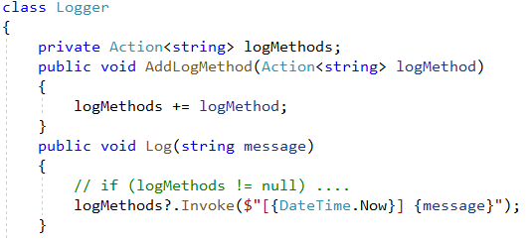
Example
We want to write a logger application, where the Logger class does not know, exactly what logger methods we have
(email, database, local OS event log, syslog-ng, …)

Slide 23
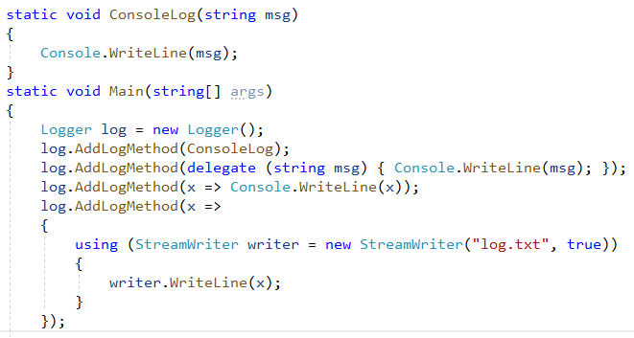
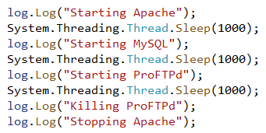
Example – Main method

Slide 24
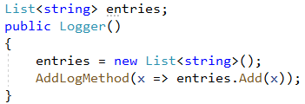
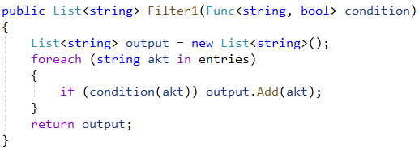
Addition: Filter

Slide 25


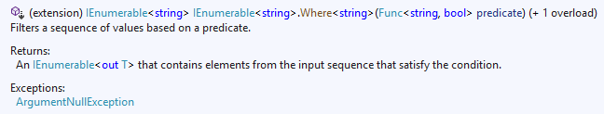
Reinvent the wheel???

Slide 26
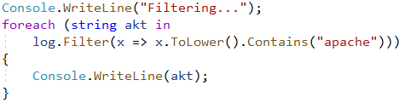
Filter – Main method

Slide 27
Practice
We want to handle feedbacks
(Opinion, Bugreport, FeatureRequest)
All feedback types can have various multiple handler methods
Periodically after every tenth (on the practice: third) feedback, we have to call the handler methods
Let’s store the handler methods in a Dictionary<Category, Action<Feedback>>

