Slide 1
Advanced Development Techniques
XML format
JSON format
Datastructure-independent operations: LINQ
XLINQ

Slide 2
XML (w3schools.com)
<?xml version="1.0"?>
<bookstore>
<book category="COOKING">
<title lang="en">Everyday Italian</title>
<author>Giada De Laurentiis</author>
<year>2005</year>
<price>30.00</price>
</book>
<book category="WEB">
<title lang="en">Learning XML</title>
<author>Erik T. Ray</author>
<year>2003</year>
<price>39.95</price>
</book>
</bookstore>
Hierarchic data descriptor format
XML declaration + elements/nodes + attributes
Nodes: <bookstore></bookstore>... = <tag></tag>
Attributes: in <book> there is category=“…”
Notes:
XAML elmagyarázása előtt tudni kell, mi az az XML…

Slide 3
XML
<book category="COOKING">
<title lang="en">Everyday Italian</title>
<author>Giada De Laurentiis</author>
<year>2005</year>
<price>30.00</price>
</book>
The description of an object is done by embedded sub-nodes and attributes
Using sub-nodes (children nodes) we can also represent hierarchy and composition – it all depends on the interpretation of the XML data
<?xml version="1.0"?>
<bookstore>
<book category="COOKING"> ... </book>
<book category="WEB"> ... </book>
</bookstore>

Slide 4
XML
Strict rules (Well-formed XML vs Valid XML)
First row: xml declaration (optional), with charset definition: <?xml version="1.0" encoding="ISO-8859-1"?> <?xml version="1.0" encoding="UTF-8"?>
All nodes can have:
Text content
Children nodes
Attributes
A single root node is obligatory that surrounds the whole document (<bookstore> node)
Must properly close all nodes (<tag></tag> or <tag />)
Must respect the nesting order of the nodes
BAD: <a><b></a></b>
GOOD: <a><b></b></a>
Upper and lowercase characters are considered different
Notes:
Ezt igazából nem most akarjuk leadni.

Slide 5
XML + .NET
Three different approaches
XmlReader, XmlWriter
Fast, requires less memory
Only one-way operations
It’s hard to handle complex XML files
XML transformations are terrible (editing/exchanging nodes)
XmlDocument, XmlNode, XmlElement, Xml*...
Slow, requires A LOT of memory (builds up the whole XML tree)
Modification is possible, but not necessarily easy
Exchanging nodes is very easy
XDocument, XElement, XAttribute, XDeclaration, X*...
Efficient and LINQ-compatible!

Slide 6
XElement
Flexible constructor (with the “params” keyword) ➔ almost any XML can be created with a single constructor call
var xe = new XElement("person", "Joe");
<person>Joe</person>
var xe2 = new XElement("person", new XElement("name", "Joe"), new XElement("age", 25));
<person>
<name>Joe</name>
<age>25</age>
</person>
Notes:
Params ➔ el kell magyarázni

Slide 7
XAttribute
With constructor: var xe = new XElement("person",
new XAttribute("id", 43984),
new XElement("name", "Joe"),
new XElement("age", 25));
Later: var xe2 = new XElement("person",
new XElement("name", "Joe"),
new XElement("age", 25));
xe2.SetAttributeValue("id", 43984);
<person id="43984">
<name>Joe</name>
<age>25</age>
</person>

Slide 8
Saving an XDocument
XDocument outDoc = new XDocument(
new XElement("people",
new XElement("person",
new XAttribute("id", 1),
new XElement("name", "Joe"),
new XElement("age", 22)),
new XElement("person",
new XAttribute("id", 2),
new XElement("name", "Quagmire"),
new XElement("age", 34))));
outDoc.Save("people.xml");
Load from file/url: XDocument doc = XDocument.Load ("http://users.nik.uni-obuda.hu/prog3/data/people.xml");
Load from string: XDocument doc = XDocument.Parse(str);

Slide 9
Simple XML processing
<people>
<person id="43984">
<name>Joe</name>
<age>25</age>
<phone>0618515133</phone>
</person>
…
</people>
.Element(name)
.Attribute(name)
.Elements(name)
.Attributes(name)
string personName = xDoc.Element("people").Element("person")
.Element("name").Value;
int id = int.Parse(xDoc.Element("people").Element("person")
.Attribute("id").Value);
... OR typecasting ... (not only with attributes; also works with elements)
int id = (int)(xDoc.Element("people").Element("person")
.Attribute("id"));

Slide 10
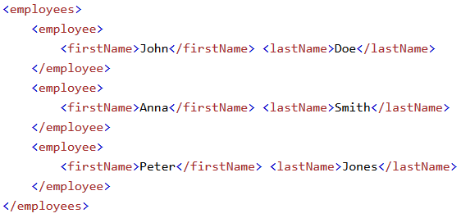
JSON
XML:
JSON:

Slide 11
JSON
JavaScript Object Notation
Hierarchic data descriptor format ➔ Just like the XML
In JSON
No closing tag → shorter
Has native syntax for arrays
There is no easy way for cyclic / recursive data structures
It is possible to handle errors
Natively supported by browsers
But all modern languages have JSON support
Usage in .NET
DataContractJsonSerializer – almost never
Newtonsoft.JSON / JSON.NET – even Microsoft uses this
Can be easily used with LINQ methods
Very simple usage for full serialization / deserialization
Can be indexed if using JObject/JArray/JToken

Slide 12
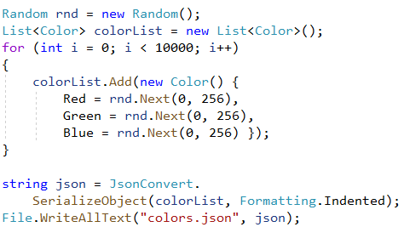
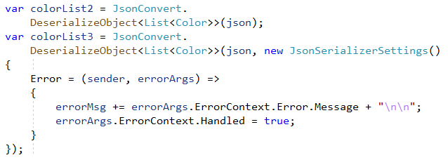
Simple JSON

Slide 13
LINQ (Language Integrated Queries)
Provides a simple syntax to handle collections independent from their source and structure
Simple syntax: “operators” that perform common operations that are typically solved with loops/conditions
Structure-independent: array, list, XML, database …
LINQ To Objects, LINQ To XML, LINQ to Entities, ...
Parts and language elements
Lambda expressions
var keyword, anonymous classes
Extension methods
LINQ operators (that are actually extension methods)
Procedural/OOP vs DECLARATIVE
LINQ query syntax (from, where, select, join, orderby...)
Notes:
.NET Framework version 3.5-ben jött
Forrásfüggetlenségnél az adatbázis után említsd, hogy azért queries, mert a szintaxis eléggé hasonlít a standard SQL szintaxisra.
... = a lánc folytatható, félkövérrel amit ezen az órán veszünk
LINQ operátorok = igazából egy csapat függvény
LINQ lekérdezések kulcsszavai = where, orderby ...
Ezek tartoznak igazából a linq-hoz. A másik három „támogató technológia” ☺
A kiegészítő metódusokat (extension methods) nem tanuljuk

Slide 14
Var keyword and anonymous classes
var: we want the compiler to decide the type of the variable
Value assignment is obligatory in the same statement
anonymous classes: instead of temporary, small classes that are only used to store data
We can also set the properties using the same syntax with regular everyday classes as well (object initializer)
var x = 6;
var z = new Student();
var PersonalData = new
{
Name = "Béla",
Age = 23,
Address = "Budapest Bécsi út 96/B"
};

Slide 15
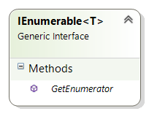
Adding methods
?
We want to add new methods to existing collections, BUT
… modifying the interface definition will have unwanted consequences (must be backwards-compatible)
… we cannot add implemented methods to interfaces

Slide 16
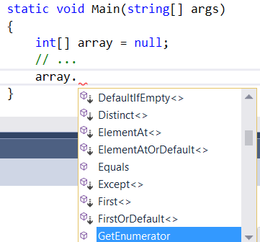
Extension methods

Slide 17
With extension methods…
We can call the same LINQ method for the typical operations, independent from the actual collection that we have
The method that we call is an extension method of the interface, it will perform the same operation (filter/sort/etc) independent from the type of the collection
List<T>, XML file ➔ IEnumerable extension methods ➔ Func<T, xxxxxx> parameter types ➔ Practice, second week
Database ➔ IQueryable<T> extension methods ➔ Expression<Func<T, xxxxxx>> parameter types (same syntax) ➔ Practice, fourth week

Slide 18
LINQ operators
Extension methods for the IEnumerable<T> interface
... LINQ To Objects, LINQ To XML, LINQ to Entities, ...
They work on IEnumerable<T>, the output is:
Rarely T vagy X (selection, conversion …)
But more often IEnumerable<T> or IEnumerable<X>, they can be chained
Very often the parameters are methods = lambda expressions
They perform common operations
Selecting an item from the collection – first, last, single, ...
Filter – according to conditions...
Sort – ascending, descending, reverse, ...
Handling of sets – union, intersect, ...
Aggregation (~calculations) – max, min, ...
Groupings
Notes:
T: a típus, amin dolgozom. X: másik (bármilyen) típus, pl Selectből, Min-ből, Max-ból nem ugyanaz a típus jön vissza értelemszerűen!
Még egy tulajdonságot tudsz mondani: azt, hogy ELÉG GYAKRAN METÓDUSSAL PARAMÉTEREZHETŐK (pl. lambdák!!!)
Ha akarsz, próbáltass ki velük itt pár egyszerű metódust és a láncolást. Utána talán a lambdát is.
List<Hallgato> vegzettHallgatok = ...
List<Hallgato> aktivHallgatok = ...
IEnumerable<Hallgato> osszesHallgato = vegzettHallgatok.Concat(aktivHallgatok);
int maxKredit = osszesHallgato.Max(x => x.Kredit);
IEnumerable<string> aktivHallgatokNevei = aktivHallgatok.Select(x => x.Nev);
IEnumerable<Hallgato> hallgatokAtlagSorrendben = aktivHallgatok.OrderBy(x => x.Atlag);
IEnumerable<Hallgato> elsoHuszAtlagSzerint = hallgatokAtlagSorrendben.Reverse().Take(20);

Slide 19
Using lambda expressions with LINQ methods
The lambda expressions…
Are parameters for the LINQ extension methods
We must separate: parameter and result of the extension method; parameter and result of the lambda expression
E.g. when we use a filter (Where) :
The extension method works with List<int> (=IEnumerable<T>)
The parameter for the extension method is a lambda of Func<T, bool>
The result of the extension method is IEnumerable<T>
The parameter of the lambda expression is T (one element: int)
The result of the lambda expression is bool (is the element wanted?)
The lambda expression (or: the method described with the expression) is called for all elements of the collection
The elements with TRUE as the result of the lambda expression will be in the resulting IEnumerable<T>

Slide 20
LINQ operator examples
int[] first = new int[] { 2, 4, 6, 8, 2, 1, 2, 3 };
int[] second = new int[] { 1, 3, 5, 7, 1, 1, 2, 3 };
string[] strArray = new string[] { "Béla", "Jolán", "Bill", "Shakespeare", "Verne", "Jókai" };
List<Student> students = new List<Student>();
students.Add(new Student("Első Egon", 52));
students.Add(new Student("Második Miksa", 97));
students.Add(new Student("Harmadik Huba", 10));
students.Add(new Student("Negyedik Néró", 89));
students.Add(new Student("Ötödik Ödön", 69));
Notes:
Ezeket a gyűjteményeket fogjuk használni a példákban

Slide 21
LINQ operator examples - sets
Concatenate two collections (not as sets = repeated elements) : var allNumbers = first.Concat(second);
Check for existance: bool doesContainFour = first.Contains(4);
Leave out repeated elements (convert to set): var onlyDifferentNumbers = first.Distinct();
Intersection of sets: var sameItems = first.Intersect(second);
Union of sets: var unionOfSets = first.Union(second);
Difference of sets: var diffOfSets = first.Except(second);
Notes:
Elmondani:
* Concat() esetén nincsenek kivágva az ismétlődések, csak sima egymás után másolás
* halmazelméleti kifejezésnél automatikusan kivágja az ismétlődéseket

Slide 22
LINQ operator examples - sort
OrderBy
As a parameter it wants a method (lambda) that will determine the key from an element (key = the data that will be used for sorting – this must be IComparable)
The result is always IEnumerable<T>
Int array, sort by the numbers themselves:
var result = first.OrderBy(x => x);
String array, sort by the length of the strings:
var result = strArray.OrderBy(x => x.Length);
List of students, order by names:
var result = students.OrderBy(x => x.Name);
Exception, because its not Student : IComparable
var result = students.OrderBy(x => x);
Notes:
Második paraméter: nem fogjuk használni
Elmondani: x=>x , Lambda kifejezés: bemenet=kimenet … Az „x” változóval fogjuk jelezni ezentúl az „atuális elem”-et
Elmondani: a fordító meg az intellisense is ugyanúgy működik: érzékelik, hogy milyen gyűjteménynek hívom meg a metódusát. string[] esetén x=>x.Length jó, de x=>x.nev nem, ez utóbbi csak diak[] vagy List<diak> esetén jó

Slide 23
LINQ operator examples – filter, count
Where / Count
The parameter lambda expression has a bool result
The result of the Where is a collection of elements where this lambda results in TRUE
The result of the Count is the number (int!), and it can be called without parameters ➔ total number of elements
Int array, the odd numbers:
var result = first.Where(x => x % 2 == 1);
String array, the four-letter elements:
int result= strArray.Count(x => x.Length == 4);
Notes:
Második paraméter: nem fogjuk használni
Elmondani: x=>x , Lambda kifejezés: bemenet=kimenet
Elmondani: a fordító meg az intellisense is ugyanúgy működik: érzékelik, hogy milyen gyűjteménynek hívom meg a metódusát. string[] esetén x=>x.Length jó, de x=>x.nev nem, ez utóbbi csak diak[] vagy List<diak> esetén jó

Slide 24
LINQ operator examples – filter, selection
List of students, where the number of credits is a prime number:
var result = students.Where(x =>
{
if (x.Credits <= 1) return false;
for (int i = 2; i <= Math.Sqrt(x.Credits); i++) { if (x.Credits % i == 0) return false; }
return true;
});
// Második Miksa - 97, Negyedik Néró – 89
Select a property / conversion:
var nameCollection = students.Select(x => x.Name); var jsonCollection = students.Select(x => x.ToJson());

Slide 25
LINQ operator examples – chaining, query syntax
List of students, only the odd credit numbers, sorted by names descending, show only the uppercase names:
var result= students.Where(x => x.Credits % 2 == 1) .OrderBy(x => x.Name) .Reverse() .Select(x => x.Name.ToUpper());
Same result, same intermediate code, DECLARATIVE approach:
var result = from x in students
where x.Credits % 2 == 1
orderby x.Name descending
select x.Name.ToUpper();
Notes:
Elmondani: NEM SQL! Azonos kulcsszavak, mert azonos feladatot látnak el, de más a sorrend, más a használat

Slide 26
LINQ operator examples - aggregation
Aggregate methods
int totalSum = first.Sum(); //28
double averageOfItems = second.Average(); //2.875
int sumOfEvenItems = first .Where(x => x % 2 == 0).Sum(); //24
int sumOfOddItems = second .Where(x => x % 2 == 1).Sum(); //4
The example above is common: I want to group my collection according to some feature, and execute the same aggregate for all groups
We have to use multiple similar statements…
It’s possible to call Sum/Average with a Func<T, bool> parameter, but it doesn’t help much …
Instead, let’s use automatic group creation: GroupBy

Slide 27
LINQ operator examples - GroupBy
Grouping, according to parity (even/odd) :
var groups = first.GroupBy(x => x % 2);
// IEnumerable<IGrouping<TKey, TElement>>
foreach (var g in groups)
{
Console.WriteLine("Remainder: " + g.Key + ", Number of items: " + g.Count());
}
This is a lot better with a query syntax
var result = from x in first
group x by x % 2 into g
select new {Remainder=g.Key, NumItems=g.Count()};

Slide 28
LINQ operator examples – inner join
If two collections have a common data field, then we can join them together (e.g. practice and Db-Linq and Databases lesson)
This is typically a feature only used with query syntax, would be too complex without (a generic method with 4 generic type parameters, 2 collections and 3 lambda expressions…)
var result = from firstItem in firstCollection join secondItem in secondCollection on firstItem.X equals secondItem.Y
For the rest of the query, every firstItem will be connected to the appropriate secondItem element, and both is useable (e.g. we join the appropriate brand for a car)
var result = from car in carCollection join brand in brandCollection on car.brandId equals brand.Id

Slide 29
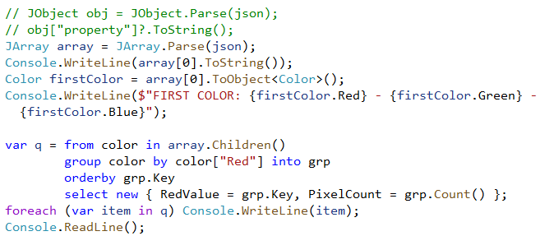
JSON Linq

Slide 30
LINQ to XML, XLINQ
X* classes: strong LINQ support!
Lots of methods have IEnumerable<T> results that can be used with LINQ extension methods
Pl. XElement xe2:
xe2.Descendants()
All children (including children of children) nodes
xe2.Descendants("note")
Children (including children of children) nodes with the specified name
xe2.Elements()
All immediate children nodes
xe2.Elements("note")
Immediate children nodes with the specified name
xe2.Attributes(), xe2.Ancestors() …
Notes:
Descendants() ➔ paraméterezés nélkül minden gyermekelemen (a gyermekelem gyermekelemein is!) végigmegy

Slide 31
LINQ to XML
<people>
<person id="43984">
<name>Joe</name>
<age>25</age>
<phone>0618515133</phone>
</person>
…
</people>
XDocument XDoc = ...
var q = from node in XDoc.Descendants("person")
where node.Element("name").Value.StartsWith("J")
select node;

Slide 32
Example
http://users.nik.uni-obuda.hu/prog3/_data/people.xml
Notes:
Ezen fogunk dolgozni

Slide 33
Example
List those who are NOT working in the BA building (Alternatives: use the XML directly or with a data class representation?)
XDocument XDoc = XDocument.Load("http://users.nik.uni-obuda.hu/prog3/_data/people.xml");
var q0 = from node in XDoc.Descendants("person")
let room=node.Element("room").Value
where !room.StartsWith("BA")
select node.Element("name").Value;
foreach (var item in q0) { Console.WriteLine(item); }

Slide 34
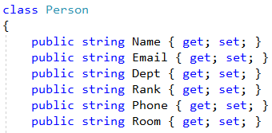
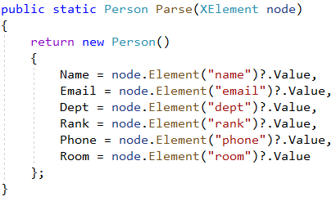
Example
By using a data class, we first convert the XML node into a typed instance, so we move back from XML processing to Linq To Objects methods

Slide 35
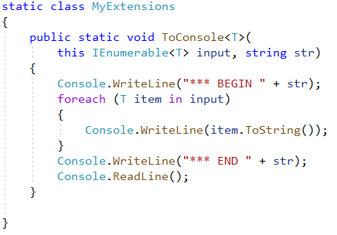
Example – Extension Method

Slide 36
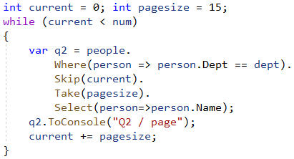
Example – Number of workers; paginated list

Slide 37
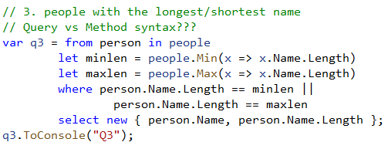
Example – Shortest and longest names

Slide 38
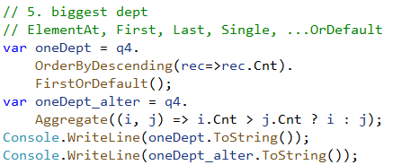
Example – Groups; Biggest group

Slide 39
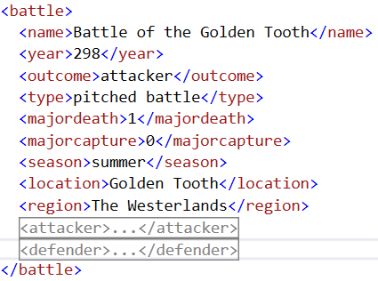
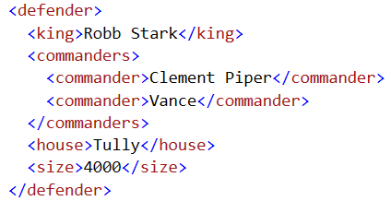
Practice
http://users.nik.uni-obuda.hu/prog3/_data/war_of_westeros.xml
Notes:
Ezen fogunk dolgozni

Slide 40
Practice
In the war of five kings …
How many houses participated?
List the battles with the „ambush” type!
How many battles are there where the defending army won and there was a major capture?
How many battles were won by the Stark house?
Which battles had more than 2 participating houses?
Which are the 3 most violent regions?
Which one is the most violent region?
In the 3 most violent region, which battles had more than 2 participating houses? (Q5 join Q6)
List the houses ordered descending by the number of battles won!
Which battle had the biggest known army?
List the three commanders who attacked the most often!

Slide 42
Források
Lambda expressions: http://msdn.microsoft.com/en-us/library/bb397687.aspx
Lambda expressions: http://geekswithblogs.net/michelotti/archive/2007/08/15/114702.aspx
Why use Lambda expressions: http://stackoverflow.com/questions/167343/c-lambda-expression-why-should-i-use-this
Recursive lambda expressions: http://blogs.msdn.com/b/madst/archive/2007/05/11/recursive-lambda-expressions.aspx
Standard query operators: http://msdn.microsoft.com/en-us/library/bb738551.aspx
Linq introduction: http://msdn.microsoft.com/library/bb308959.aspx
101 Linq samples: http://msdn.microsoft.com/en-us/vcsharp/aa336746
Lambda: Reiter István: C# jegyzet (http://devportal.hu/content/CSharpjegyzet.aspx) , 186-187. oldal
Linq: Reiter István: C# jegyzet (http://devportal.hu/content/CSharpjegyzet.aspx) , 250-269. oldal
Fülöp Dávid XLinq prezentációja
Linq to XML in 5 minutes: http://www.hookedonlinq.com/LINQtoXML5MinuteOverview.ashx
Access XML data using Linq: http://www.techrepublic.com/blog/programming-and-development/access-xml-data-using-linq-to-xml/594
Simple XML parsing examples: http://omegacoder.com/?p=254 , http://gnaresh.wordpress.com/2010/04/08/linq-using-xdocument/
XML: Reiter István: C# jegyzet (http://devportal.hu/content/CSharpjegyzet.aspx) , 224. oldal (A könyv az XMLReader/Writer, illetve az XmlDocument használatát mutatja be)

