Slide 1
Advanced Development Techniques
DLL
Reflection

Slide 2
Advanced Development Techniques
DLL
Reflection

Slide 3
Executable files
Binary executables
  https://en.wikipedia.org/wiki/Comparison_of_executable_file_formats
  Container format: executable code and all required data in one bundle
  Same parts: Header, Imports, Data (RW/RO), Code Segment/.Text
Linux: ELF = Executable and Linkable Format
  Typically a binary executable (not a script executable!) or SO file
  Extra feature: fatELF = several platform-dependent executables in one platform-independent file
Windows: PE = Portable Executable
  All EXE/DLL file
  Extra feature: icon in the file (with ELF: elfres), „more simple” (non-global) import namespaces
  https://storage.googleapis.com/google-code-archive-downloads/v2/code.google.com/corkami/PE101-v20L.png

Slide 4
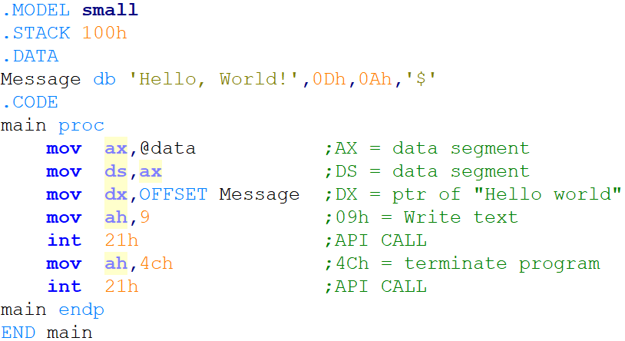
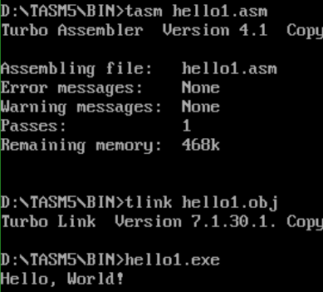
The most simple „Hello, World”
Hello1.asm

Slide 5
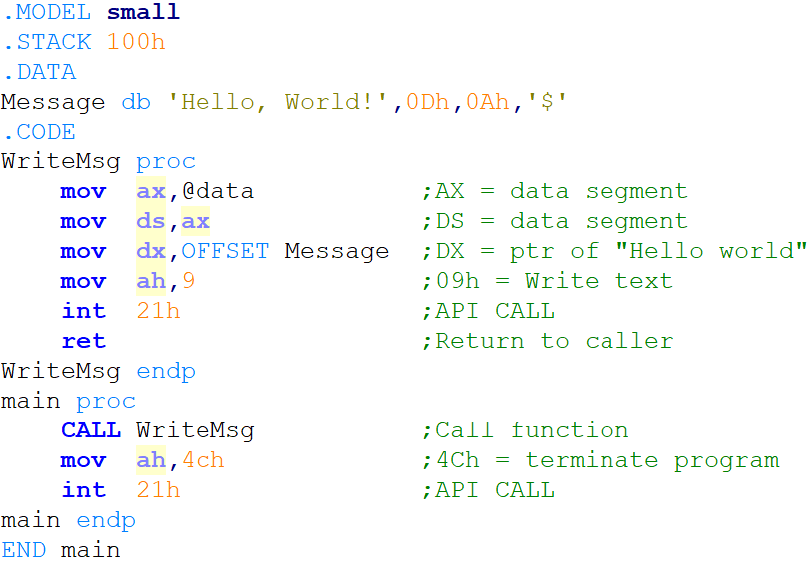
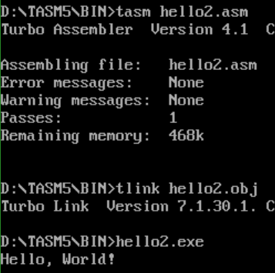
With subroutine call
Hello2.asm

Slide 6
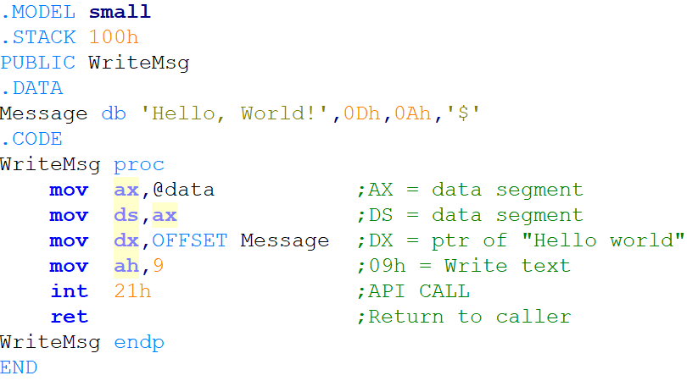
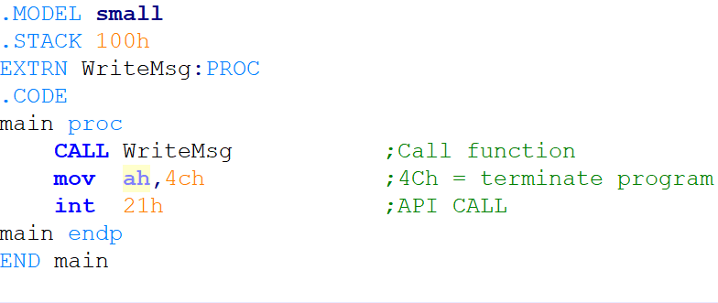
If methods are not in the same module…
Hello3a.asm
Hello3b.asm

Slide 7
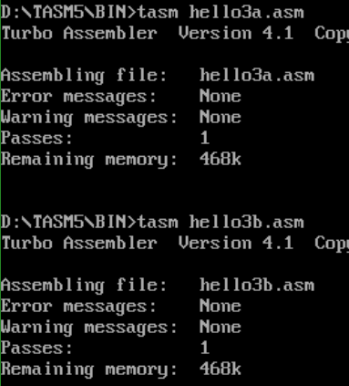
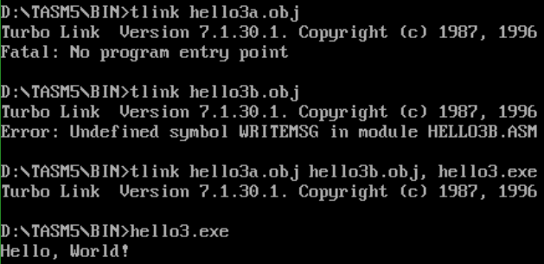
Code, Compile, LINK – static linking!

Slide 8
Classic compile process
Object File: An intermediate binary machine code representation, generated by the compiler from the source
Contains: the compiled code, relocation data, used by the linker to generate the executable
The external library code is merged into the EXE file if static linking is used. It is contained in an external file if dynamic linking is used
SOURCE
(.cpp, .pas, .c, .cs, .*)
PREPROCESSING,
COMPILE
EXTERNAL
OBJECT/LIBRARY
FILES
(.o, .obj, .so, .dll)
OBJECT FILE
(.o, .obj)
LINKING
Executable file
(.exe)
Notes:
Relokációs adatok: az adott modulból fordított 0-s cím helye alapján a metódus entry point-ok elhelyezkedése a végső EXE file-ban
http://en.wikipedia.org/wiki/Relocation_%28computing%29

Slide 9
Static linking
All functions/resources are within the executable file
The location of those are known to the compiler
So the references to those can be pre-defined, because all functions are located in the same address space
The same function/resource is loaded by all programs using the given feature ➔ waste of resources
All classic (non-overlay) DOS programs (e.g.: Turbo Pascal)
Program
SomeFunct1
SomeFunct2
SomeFunct3
Constant1
Constant2
Constant3
Main Code
.
@SomeFunct3
.
.
@SomeFunct1
.
.

Slide 10
Dynamic linking
Some methods/resources are outside the memory allocated to the process
The exact location of those are not known to the compiler
The reference to those methods are dynamic, determined during run-time (not known during compile-time, the DLL will be loaded by the OS on demand)
The same method can be used by multiple processes ➔ shared (~ Shared Object)
Most of the modern programs work this way (static linking: rare)
Program 1
.
@SomeFunct2
.
DLL
SomeClass1
SomeFunct2
SomeFunct3
SomeClass2
Program 2
.
@SomeFunct3
.

Slide 11
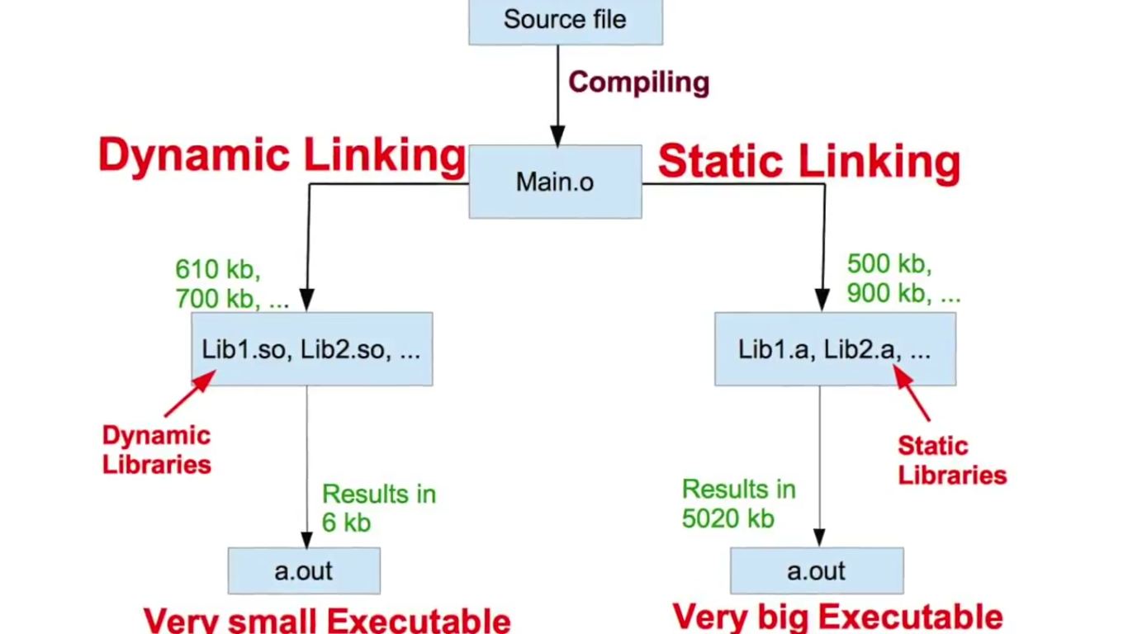
Static vs Dynamic Linking

Slide 12
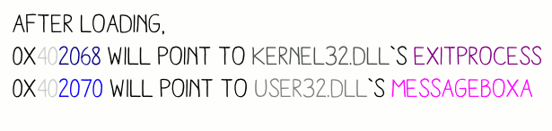
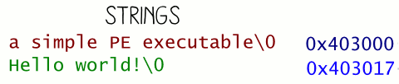
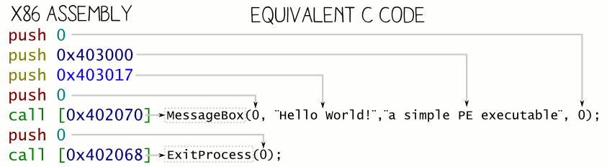
RDATA, DATA, CODE/TEXT

Slide 13
Dynamic Link Library / Shared Object
Almost all modern applications work this way; static linking is still possible but almost never used
Same task: Windows has DLL files, Linux has SO files
  Separately compiled, only attached to the executable during the execution
  (= dynamic, true for both)
  Only loaded to the memory once, multiple programs can use the same file
  (= shared, true for both, in.NET only partially (AppDomain))
Windows OS: distinguish between native and managed executables:
  Native / Unmanaged: It contains binary code that is processed directly by the OS/CPU; procedural code, simple types, direct HW access
  Language-independent (anything can be compiled to this kind of EXE/DLL files), but platform-independent
  Managed: Contains one (or more) classes, only the .NET/JVM framework can work with it
  Language- and platform-independent (if the.NET/JVM system is available)
  With .NET, these are DLL/EXE files, in JVM these are CLASS/JAR files
Notes:
„Korlátozottan igaz” = AppDomain –enként egyszer
https://msdn.microsoft.com/en-us/library/vstudio/43wc4hhs%28v=vs.100%29.aspx

Slide 14
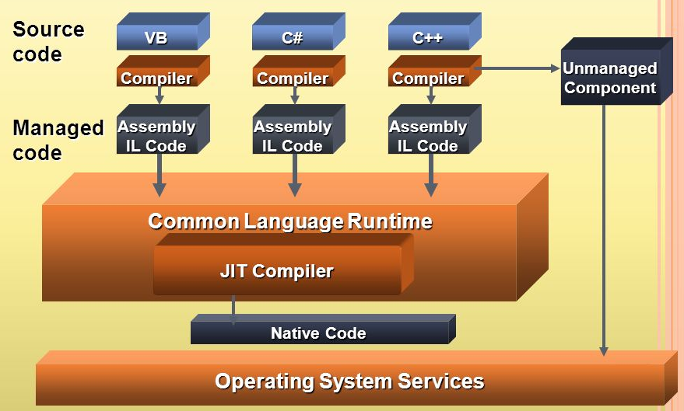
Managed/Unmanaged

Slide 15
Native DLL files
Loaded from the current directory or from %PATH%
  %PATH% = a WINDOWS, SYSTEM, SYSTEM32 folders
Slow load time
DLL HELL
  No solution for versioning
  Different apps require different versions of the same DLL
  The different versions might cause problems, especially when uninstalling
  „Solution”: DLL stomping OR all DLL next to the EXE…
  Linux solution: file-level package manager + versioned symlinks
  .NET solution: GAC = Global Assembly Cache
Windows API
  A set of unmanaged DLL files, containing system methods
  Low-level operations, HW access
  All public functionality of the OS is available
  The more important features have.NET wrappers, but the lowest level still uses WINAPI calls (e.g. System.Diagnostics.Stopwatch = QueryPerformanceCounter)

Slide 16
Calling a native DLL
Platform-dependent
  32 / 64 bits (CPU bit length)
  OS dependent
Language independent?
  Theoretically yes, but…
  Passing parameters
  Returning a result (complex types?)
  Who frees what?
  Possibilities: cdecl, stdcall, fastcall, …
  https://en.wikipedia.org/wiki/X86_calling_conventions
Accessible methods?
  Cannot be queried from code, must be verified during development
  dumpbin /exports
The dependencies of the used DLL
  Cannot be queried from code, must be verified during development
  Dependency Walker

Slide 17
Calling native DLL in C#
Attached during execution time
No verification (for existence of the DLL/Entry point) is performed by the compiler
Platform Invoke (P/Invoke: call native DLL method from managed environment) ➔ DllImport attribute
  using System.Runtime.InteropServices;
  [DllImport("winmm.dll", SetLastError = true)]
  static extern bool PlaySound(string pszSound,
  UIntPtr hmod, uint fdwSound);
  string fname = @"c:\Windows\Media\tada.wav";
  PlaySound(fname, UIntPtr.Zero, 1);
WINAPI signatures, imports: www.pinvoke.net

Slide 18
Managed executables
EVERY method call we ever had in C# was a DLL call
  A project’s „References” part will store which DLLs are accessible from the project
  The compiler checks the existence of the DLL and the class/method
  Fast load time, the same speed as with our own code
Calling managed DLL files
  Project/Add reference
  OR: install via Nuget
  After this, the namespaces and the classes/methods in the DLL are accessible
EXE or DLL?
  In .NET, no big difference, both contain managed classes, and same IL code
  The classic (PE) part of the EXE only loads up the CLR interpreter
  The EXE must contain a single static void/int Main()
  Project types: Console App / WPF or Windows Forms / Class Library
Notes:
DLL HELL: verziózás hiánya, régi verzióval történő felülírás, nincs központi tár
http://en.wikipedia.org/wiki/DLL_Hell

Slide 19
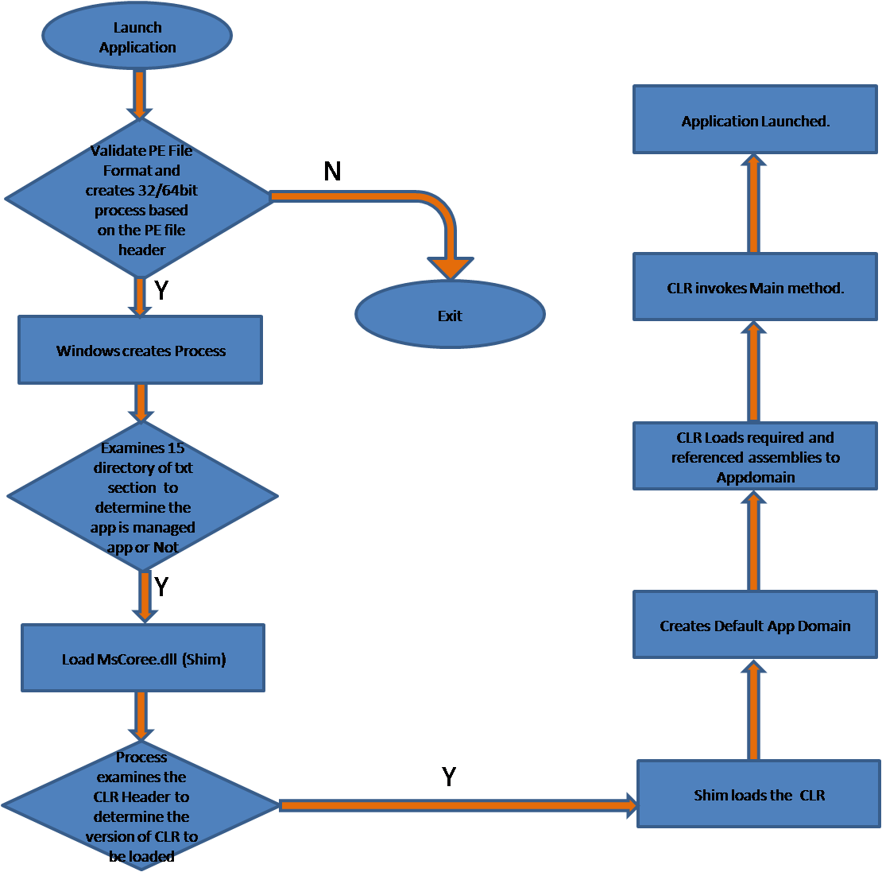
Executing an EXE file (.NET)

Slide 20
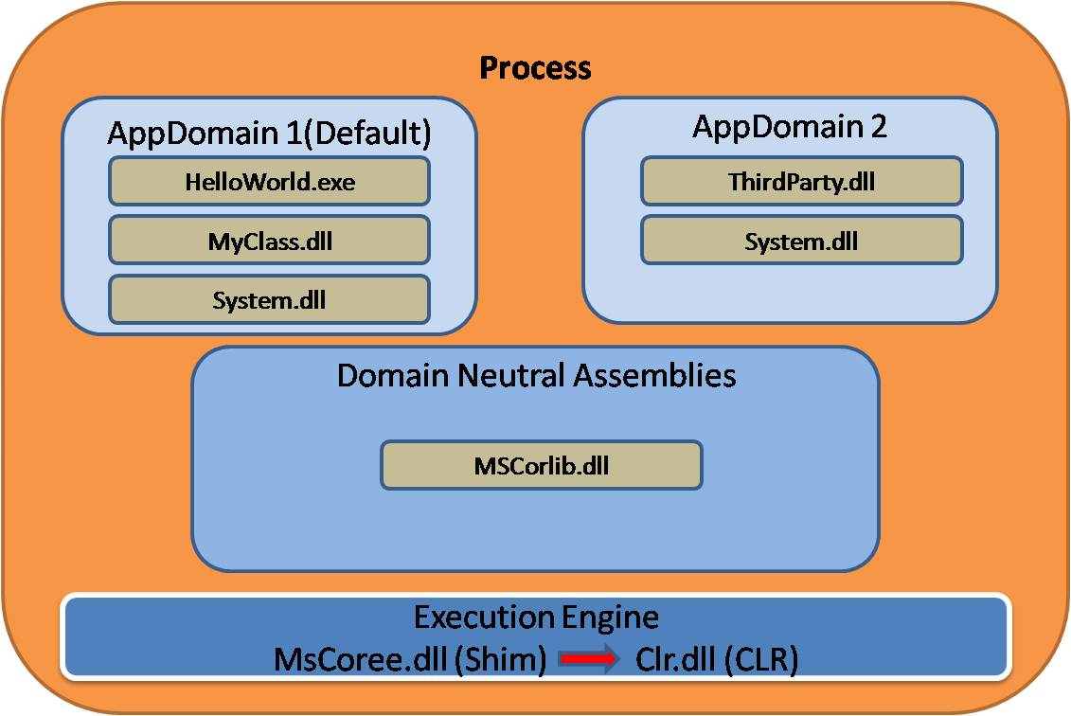
Managed Assembly - Sandboxing
AppDomain
  A security layer between the .NET assembly and the OS process
  Regulates the execution of the code and the access of resources
  For example when using a web application, the .NET applications of a single website (Virtual Directory) can access the same resources even if they are different assemblies. Different websites can access different resources, even if the same .EXE file is launched
  There can be multiple
  AppDomain inside a single
  Win32 process
  Separation of resources
  ➔ sandboxing
Notes:
DLL HELL: verziózás hiánya, régi verzióval történő felülírás, nincs központi tár
http://en.wikipedia.org/wiki/DLL_Hell

Slide 21
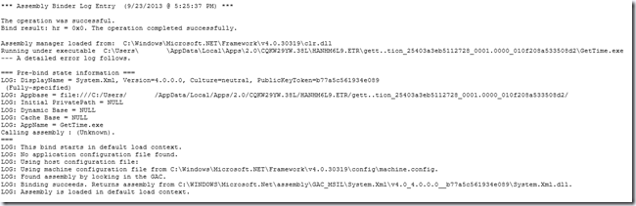
Loading managed DLL files
Fusion
  A .NET module that performs the loading of managed DLL files
  „Assembly binding”: the series of steps that are executed when an executable’s external references are searched and loaded
  Enable logs: fuslogvw.exe / Registry entries
Notes:
DLL HELL: verziózás hiánya, régi verzióval történő felülírás, nincs központi tár
http://en.wikipedia.org/wiki/DLL_Hell

Slide 22
Tools
gacutil.exe
  Register / unregister DLL files from the GAC; this includes official .NET DLLs
  Possibility to handle versions and dependencies
  In the docs it can be checked that a class/namespace is found in which DLL
NuGet
  Central .NET package manager, typically for managed DLL files
  Tools/NuGet Package Manager/Manage NuGet Packages for Solution
  Can be used from a Powershell commandline (Install-Package)
  Almost all C# library/tool is downloadable
  Handles dependencies/updates
  Consolidate: handle different versions in one solution
Dotpeek (ILDasm, Reflector …)
  They allow the inspection of IL codes inside .NET DLL/EXE files
  Can show information accessed via Reflection (later)
  Reverse engineer into C# code (usually in a readable format, except if a Code Obfuscator is used)

Slide 23
Managed Asembly contents
Assembly ~ Executable unit ~ managed .NET EXE/DLL file (Absolutely no relations with the assembly language!)
Assembly Manifest/Metadata
  Name
  Version
  Culture/Localization info
  Internal file/resource list
  Type metadata
  List of references
Type metadata
  All information about the contained classes/types
  Can be processed using reflection
IL/CLR code (decompile: with DotPeek/ILDasm…)
Resources

Slide 24
Advanced Development Techniques
DLL
Reflection

Slide 25
Reflection
A program/class can analyze and change its own structure and behavior in run-time
  High-level language (Java, PHP, … C#)
  Different approaches / support in different languages
C#: System.Reflection namespace
In .NET, we usually use it to analyze types during run-time
  It would be possible to create type/methods/blocks: System.Reflection.Emit
This is possible because of the meta-data (descriptor information) located next to the types in the .NET assemblies
  Assembly: .exe, .dll (sort-of)
  Assembly metadata: references, types, namespaces ...
  Type metadata: interfaces, base classes, members
  Member metadata: visibility, parameters, property methods...
Used by multiple .NET technologies
  Tests, Intellisense, Serialization, WCF, EF
Notes:
Hátránya: NAGYON LASSÚ!!!

Slide 26
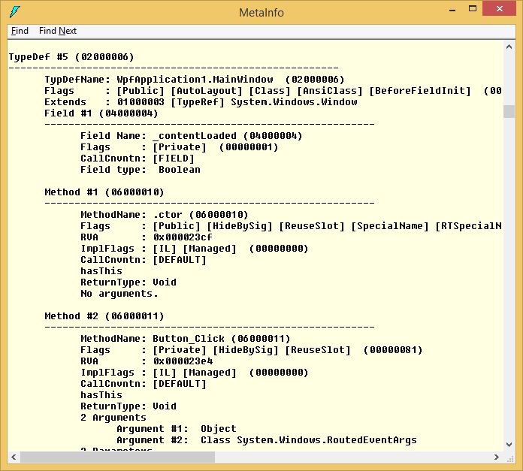
Metadata
Visual Studio Command Prompt / Ildasm.exe, Ctrl+M

Slide 27
Assembly
Assembly a = Assembly.GetExecutingAssembly();
Assembly a = Assembly.LoadFrom(„Path.To.Assembly”);
Assembly a = Assembly.Load(bytes);
Assembly a = type.Assembly;
a.GetTypes() – types in the assembly
a.EntryPoint – entry point (Main() in exe files)

Slide 28
Type
Type t = assembly.GetType(„Type.Name.In.Assembly”);
Type t = typeof(int);
Type t = typeof(T);
Type t = obj.GetType();
Type t = Type.GetType(„Type.Name.In.Any.Assembly”);
  Full „assembly-qualified name” might be required
t.FullName, t.AssemblyQualifiedName – name of type
t.BaseType, t.IsSubclassOf(anotherType), t.IsAssignableFrom(anotherType) – examine base/inheritance
Notes:
typeName can be the type name qualified by its namespace or an assembly-qualified name that includes an assembly name specification. See AssemblyQualifiedName.
If typeName includes the namespace but not the assembly name, this method searches only the calling object's assembly and Mscorlib.dll, in that order. If typeName is fully qualified with the partial or complete assembly name, this method searches in the specified assembly. If the assembly has a strong name, a complete assembly name is required.
TopNamespace.SubNameSpace.ContainingClass+NestedClass, MyAssembly, Version=1.3.0.0, Culture=neutral, PublicKeyToken=b17a5c561934e089

Slide 29
MethodInfo, PropertyInfo, FieldInfo
PropertyInfo pi = t.GetProperty("PropName");
PropertyInfo[] pis = t.GetProperties();
FieldInfo fi = t.GetField("FieldName");
FieldInfo[] fis = t.GetFields();
MethodInfo mi = t.GetMethod("MethodName");
MethodInfo mis = t.GetMethods();
We can use the BindingFlags parameter to filter the results
PropertyInfo pi = t.GetProperty("PropName", BindingFlags.Static | BindingFlags.NonPublic)
  We can access non-public members
  SHOULD NOT BE USED to bypass visibility
  VERY SLOW!!!

Slide 30
Example
The accessed types/members can be used in execution time
List<int> something = new List<int>();
something.Add(8);
int cnt = something.Count;
Type listType = typeof(List<int>);
MethodInfo addMethod = listType.GetMethod("Add");
PropertyInfo countProperty = listType.GetProperty("Count");
object listInstance = Activator.CreateInstance(listType);
object methodResult = addMethod.Invoke(listInstance,
new object[] { 8 }); // null
object propertyResult = countProperty.GetValue(listInstance); // 1
Slower than the normal code ➔ Only if not doable in any other way (e.g. we want to work with SOMETHING that has an Add method and a Count property)
Flexible code, less overhead, no compiler/intellisense support, not in our schedule: dynamic (DLR)

Slide 31
Attributes
We can add custom metadata
  Assembly, type or member metadata
System.Attribute descendants
  Several pre-existing attributes exist
  We can create our own attributes
Special usage
  ABOVE the namespace, class, method, property, field
  We use the text [XXX], if the class is named XXXAttribute
  Later we can use the attributes with reflection
[Obsolete("Do not use this method, use New() instead.")]
static void OldMethod()
{ }
static void NewMethod() { }
static void Main(string[] args)
{
OldMethod(); //Warningot eredményez
}
Notes:
Példa src: http://www.codeproject.com/Articles/2933/Attributes-in-C

Slide 32
Typical use cases
The attribute does not affect the normal use of the decorated code
  All methods, properties, etc. can be accessed/called in a normal way
We need “someone else” that will use reflection to check for the existence of the attribute, and perform operations
Typical use case: automatic operations/checks
  Help other programmer: Obsolete, DisplayName, Description
  Affect the behavior of the Visual Studio debugger: DebuggerDisplay, DebuggerStepThrough
  Visual Studio, automatic code generation: WebMethod, ServiceContract, OperationContract, FaultContract, DataContract, DataMeber
  Usage of code: Serializable, Flags, ThreadStatic, DllImport
  Support various automatic features: TestClass, TestMethod, Key, ForeignKey, Column
  Other (self-made) metadata: with self-made attribute classes
Notes:
Obsolete – elavult tag jelzése
DisplayName – PropertyGrid vezérlőkben használt tipikusan
Description – vajonmi
DebuggerDisplay – ezt jeleníti meg debug közben
DebuggerStepThrough – nem lehet belelépni F11 gombbal
WebMethod – WCF REST kívülről hívható metódus; a többi WCF SOAP attribútum
Serializable – vajonmi
DllImport – DLL-ből való export használata
Flags – Enumra rakható, használható a bitwise OR
ThreadStatic – Szálanként statikus
TestClass, TestMethod – Unit teszteknél ezekkel jelöljük h hol vannak a tesztek
Key, ForeignKey, Column – EF code-first esetén ezzel jelölhetjük a későbbi táblák kulcsait, vagy esetleg az oszlop-leképezést

Slide 33
Attributes
CallerMemberName
  If the parameter is not specified, then the caller name will be substituted
protected void OnPropertyChanged([CallerMemberName] string propertyName = null)
{
if (PropertyChanged != null)
{
PropertyChanged(this, new PropertyChangedEventArgs(propertyName));
}
}
class Settings : Bindable
{
private string setting1;
public string Setting1
{
get { return setting1; }
set { setting1 = value; OnPropertyChanged(); }
}
}

Slide 34
Attributes
Serialization (binary, xml, json...)
[Serializable]
class Settings
{
public string Setting1 { get; set; }
public int Setting2 { get; set; }
[NonSerialized]
private int temp;
}
class Program
{
static void Main(string[] args)
{
Settings settings = new Settings();
//...
BinaryFormatter formatter = new BinaryFormatter();
using (FileStream stream =
new FileStream("settings.dat", FileMode.Create))
{
formatter.Serialize(stream, settings);
}
}
}
Notes:
A példában bináris, de van még csomó más féle.

Slide 35
Self-made attribute
Create the attribute class, specifying where it can be applied to
Access the attribute with reflection
  Memberinfo is required, all the other attributes are used this way too (by VS)
[AttributeUsage(AttributeTargets.Property)]
class HelpAttribute : Attribute
{
public string HelpURL { get; private set; }
public HelpAttribute( string helpURL)
{
this.HelpURL = helpURL;
}
}
[Help("http://path.to.my.help.for.setting1.html")]
public string Setting1 { get; set; }
//PropertyInfo propertyInfo = typeof(Settings).GetProperty("Setting1");
HelpAttribute helpAttribute =
propertyInfo.GetCustomAttribute<HelpAttribute>();
Console.WriteLine(helpAttribute.HelpURL);

Slide 36
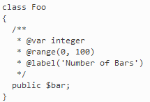

Annotations
A similar language construct in other languages (Java/PHP)
PHP
  In the comment section
  Typically used by the IDE/external tools
  Not really used in run-time
Java
  Interpreted by the compiler
  Stays in the compiled classes too
  Useable during run-time: https://en.wikipedia.org/wiki/Java_annotation

Slide 37

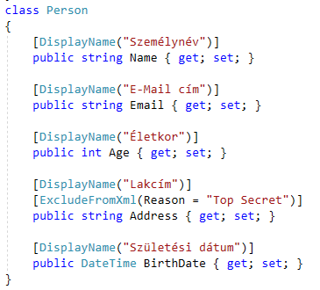
Example - XmlSerializer

Slide 38
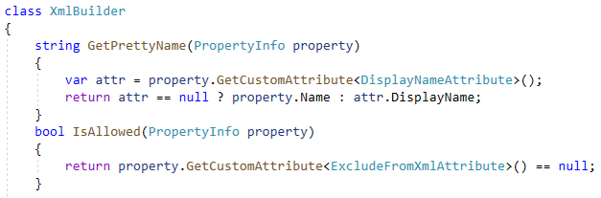
Example - XmlSerializer

Slide 39

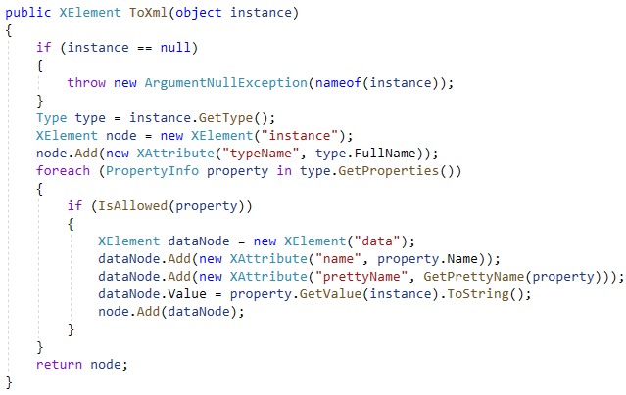
Example - XmlSerializer

Slide 40
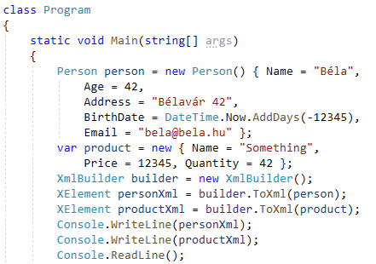
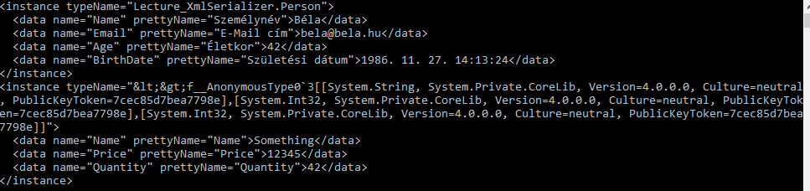
Example - XmlSerializer

Slide 41
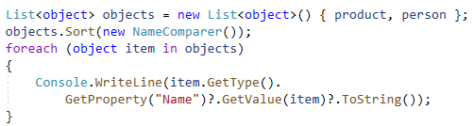
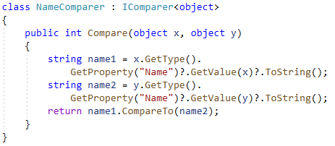
Example - Sort by names

Slide 42
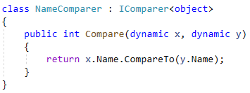
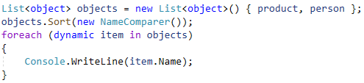
Example - Sort by names

Slide 43
Exercise / Reflection
Create a class that is capable of checking a custom object instance if it fulfils a set of custom rules (~ validation)
Use reflection
  Using the RangeAttribute we want to set an upper and lower limit for an int property
  Using the MaxLengthAttribute we want to set the maximum length of a string property
  The matching MaxLengthValidation and RangeValidation classes will perform the true validation. Both classes should implement the IValidation interface, and the validtation should be done using a Validate(xxx) method
  The ValidationFactory class is responsible for creating the good validator for the specified attribute instance
  The Validator class should have a public bool Validate(object instance) method that actually performs the validation. It should get the appropriate validator instances from the factory, and call the Validate(xxx) method to perform the necessary checks
Notes:
„Korlátozottan igaz” = AppDomain –enként egyszer
https://msdn.microsoft.com/en-us/library/vstudio/43wc4hhs%28v=vs.100%29.aspx

Slide 44
SOLID principles
S = Single Responsibility

