Slide 1
Advanced Programming Techniques
Layering, SOLID principles
Accessing databases using the DbConnection/DbReader method
Accessing LocalDb using Entity Framework Core (ORM + LINQ)

Slide 2
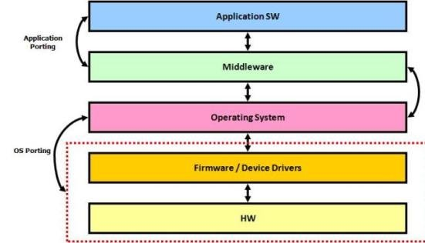
Layering
Aim: hide the implementation details so that the “upper” layer does not depend on the “lower” layer that is far away
Same principle: OS/Network, different abstraction layers
Notes:
Az „Alapvető műveletek” listán fogunk mindegyik módszernél végigmenni

Slide 3
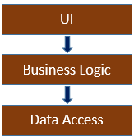
Tier vs Layer
Layer: logical separation of classes
The classes belonging to the same layer serve a “higher purpose” together (e.g. user interface, data management, logic…)
It is clearly defined which classes/operations are accessible externally from other layers
The external (used and provided) functionalities are described using interfaces
We have a well written software if a layer (as a whole) can be fully replaced with a different one that works with the same interfaces
Tier: physical separation of the application components
Software or hardware components that execute layers
Not necessarily the same structure as the layers
Notes:
Az „Alapvető műveletek” listán fogunk mindegyik módszernél végigmenni

Slide 4
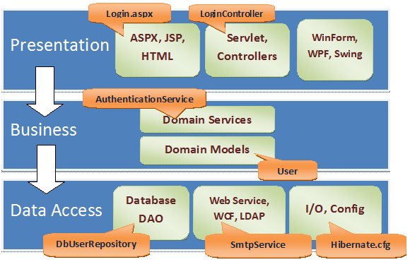
Typical Software Layers
All can be split up into sub-layers / classes
Connecting points: using interfaces
Notes:
Az „Alapvető műveletek” listán fogunk mindegyik módszernél végigmenni

Slide 5
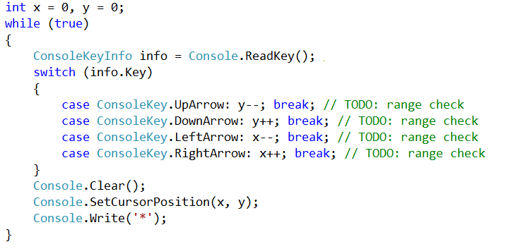
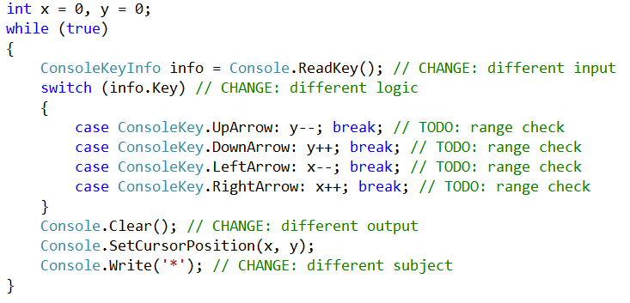
Non-Layered application

Slide 6
Layered + Reuseable solution
STAR (SUBJECT)
MOVE
(DIR)
SHOW (X,Y,C)
MOVER (LOGIC)
CONSOLE MOVER (ENVIRONMENT)

Slide 7
SOLID principles
S = Single Responsibility (*)
A good class only has a single area of responsibility
We must not create a class that does data processing, user display, executes operations, hosts a web service, …
O = Open/Closed principle
A good class is simultaneously CLOSED (= useable) and OPEN (= extensible)
By overriding virtual methods and using descendent classes
L = Liskov substitution
Any descendant instance must be useable in place of a base instance
I = Interface segregation
Multiple smaller interfaces are better than a few large ones
D = Dependency inversion (*)
Should not depend on concrete classes, rather on interfaces/abstract classes
Creation of concrete dependencies should be done by SOMEONE ELSE...
More details: Prog4 (marked ones are the main aims for prog3)

Slide 8
D = Dependency Inversion
Should not depend on the concrete class, but on the functionality
Using an interface type OR using an abstract base class reference
Not the same: Dependency INVERSION vs Dependency INJECTION
The dependency inversion principle has multiple implementations
Dependency injection (Prog3: using interface-typed ctor parameters)
Factory design patterns (Prog4)
Using an Inversion of Control (IoC) container/component (Prog4)
The main aim of this semester is to create a data processing app that complies with the SOLID principles
Layered and datasouce-independent (uses an ORM)
The logic layer uses the Repository Pattern and interface-typed dependencies to access the data-layer
The logic layer receives the data layer using dependency injection
The logic layer is testable: the data layer can be a physical database or only a “fake” data source useable for testing purposes

Slide 9
MSSQL
MSSQL: a relational database management server used by smaller and medium-sizedlevel companies
SQL Express: smaller & free: max 10GB/database, max 1 CPU, max 1GB RAM
When installing VS (min. Community) „Data Storage and Processing”, or if lacking HDD space SQL Server Data Tools + SQL Server 2016 Express LocalDB
LocalDb: Instead of a service, an on-demand loaded library that uses a database file – this is what we will use this semester!
Inside a VS project, in-solution „Service Based Database”
LocalDB supported MDF+LDF files, inside the project folder (do NOT use the in-profile method)
Project / Add New Item / Service-based Database
Organization
Must be part of the GIT repo (edit the .gitignore!!!)
Must be copied next to the EXE file: both the MDF and LDF files should have right click / Properties / Content + Copy Always
The tables are reset to originals at every execution!
SQL First vs Code First
Notes:
MSSQL: aki akarja, az elmondja itt, hogy ez fully ACID compliant :P
SQL Express = MS SQL kisebb változata
(Oracle, IBM, MSSQL, Sybase, Teradata ; Free: MySQL, PostgreSQL, MariaDB)

Slide 10
ADO.NET: DbConnection/DbReader
Connected Data-Access Architecture
Advantage: fast, simple
Disadvantage: hard to modify and to change technology/storage method; must handle the loss of tcp connection
Different implementations for different database servers
Common base classes for various tasks
Database connection: DbConnection
Execution of SQL/RPC statements: DbCommand
Read results of Select statements: DbDataReader
Specific descendent classes for the various servers
SqlConnection (MSSQL System.Data.SqlClient)
MySqlConnection (MySQL MySql.Data.MySqlClient)
NpgsqlConnection (PostgreSQL - Npgsql)
OracleConnection (Oracle System.Data.OracleClient)
Notes:
Connected: bármilyen művelet végrehajtásához kapcsolódsz vagy folyamatosan életben tartod a kapcsolatod

Slide 11
1. Initialization
string connStr = @"Data Source=(LocalDB)\v11.0;AttachDbFilename=path\to\empdept.mdf;Integrated Security=True;";
SqlConnection conn;
private void Connect()
{
conn = new SqlConnection(connStr);
conn.Open();
Console.WriteLine("CONNECTED");
}

Slide 12
2. INSERT
private void Insert()
{
SqlCommand cmd = new SqlCommand("insert into EMP (ENAME, MGR, DEPTNO, EMPNO) values ('BELA', NULL, 20, 1000)", conn);
int affected=cmd.ExecuteNonQuery();
Console.WriteLine(affected.ToString());
}

Slide 13
3. UPDATE
private void Update()
{
SqlCommand cmd = new SqlCommand("update EMP set ENAME='JOZSI' where EMPNO=1000", conn);
int affected=cmd.ExecuteNonQuery();
Console.WriteLine(affected.ToString());
}

Slide 14
4. DELETE
private void Delete()
{
SqlCommand cmd = new SqlCommand("delete from EMP where EMPNO=1000", conn);
int affected=cmd.ExecuteNonQuery();
Console.WriteLine(affected.ToString());
}

Slide 15
5. SELECT
private void Select()
{
SqlCommand cmd = new SqlCommand("select * from EMP where SAL>=3000 order by ENAME", conn);
SqlDataReader reader = cmd.ExecuteReader();
while (reader.Read())
{
Console.WriteLine(reader["ENAME"].ToString());
}
reader.Close();
}
Notes:
Cél: azon nevekkel feltölteni egy listboxot, akiknek a fizetése >= 3000

Slide 16
5. SELECT
for (int i = 0; i < reader.FieldCount; i++) {
string coltext = reader.GetName(i).ToLower();
Console.WriteLine(coltext);
}
for (int i = 0; i < reader.FieldCount; i++)
{
Console.WriteLine(reader[i].ToString());
Console.WriteLine(reader.GetValue(i));
Console.WriteLine(reader.GetDecimal(i));
}

Slide 17
Disadvantages of direct SQL communication
SQL Injection: Must be careful NEVER to interpret any user input as part of the SQL statement
string uName = "yyy", uPass = "xxx"; string sql = $"SELECT * FROM users WHERE username='{uName}' AND userpass=sha2('{uPass}');
uPass = "x') OR 1=1 OR 1<>sha2('x";
We must put the SQL code mixed up with the logic code
No built-in protection against SQL Injection
We must modify it when changing SQL dialect or data structure
Aim: the business logic must NEVER depend on the physical data storage!
We must put a layer above the SQL layer that hides the SQL code
Prepared statements (sql command parameters)
We need a strongly typed layer that supports the same (or similar) functionalities as the SQL language
Dialect-independent queries = LINQ

Slide 18
DbConnection vs DataSet vs Entity Framework
Aim: handle database connections, process SQL statements and results
DbConnection
Basic SQL access with string SQL statements and object-array results
Connected mode
DataSet
A strongly typed, UI-centered layer above the SQL layer
Operations are done using typed methods
Unique approach, not used any more
Entity Framework
A strongly typed ORM (Object Relational Mapping) layer above the SQL layer: we treat tables as generic storages for typed object instance
General design approach that uses multiple design patterns
Connected/Disconnected mode
Notes:
Az „Alapvető műveletek” listán fogunk mindegyik módszernél végigmenni

Slide 19
ORM = Object Relational Mapping – task
HIDDEN physical data access that works with SQL statements
Externally accessible operations: dialect-independent
Dialect-independent conversion: the execution of the operations must be independent from the used SQL dialect / storage methods
The upper layer should not see the SQL language: Lambda expressions (Java Stream Api/C# LINQ) or a self-made query language (Doctrine) or simple CRUD methods (Active Record systems)
Object-storage
The upper layer only sees typed objects
The query results are converted to objects/collections
Which can be shared between operations
Using the ORM approach, the upper layer can handle the database as an in-memory object storage, independent from the actual physical storage

Slide 20
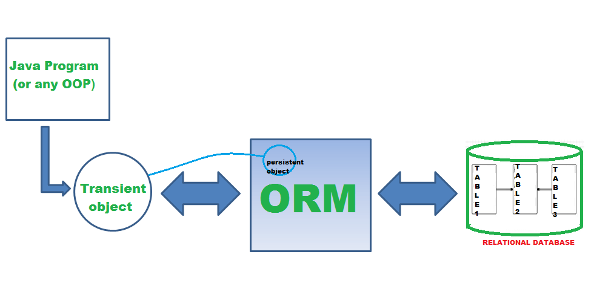
ORM = Object Relational Mapping – systems
C#: Entity Framework
Java: Hibernate/JPA
Python: Django ORM, SQLAlchemy
Ruby on Rails
PHP: Eloquent, Propel, Doctrine

Slide 21
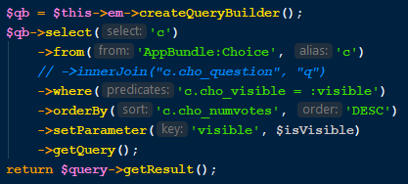
Doctrine DQL

Slide 22
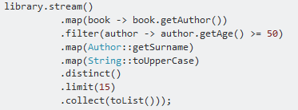
Java + Hibernate + Stream API

Slide 23
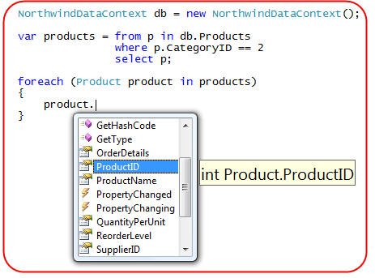
C# + Entity Framework + LINQ

Slide 24
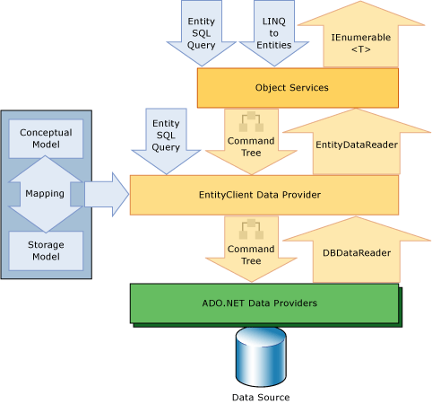
EF layers

Slide 25
ORM disadvantages
“ORM is a terrible anti-pattern that violates all principles of object-oriented programming, tearing objects apart and turning them into dumb and passive data bags. There is no excuse for ORM existence in any application” http://www.yegor256.com/2014/12/01/orm-offensive-anti-pattern.html
This is only one opinion, but there are typical pitfalls:
Harder to configure
Bigger memory load
Bigger CPU load
Weak/no support for very complex queries/methods
Harder to optimize

Slide 26
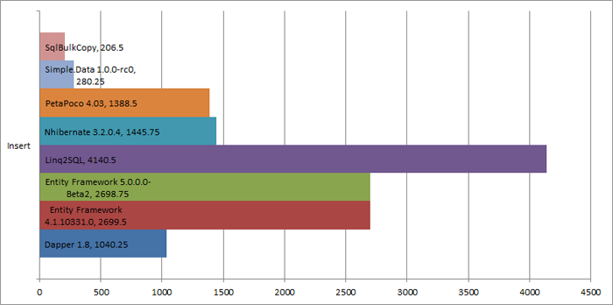
ORM speed (C#)

Slide 27
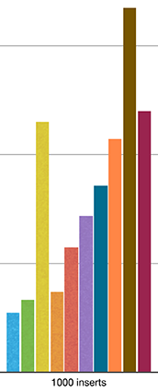
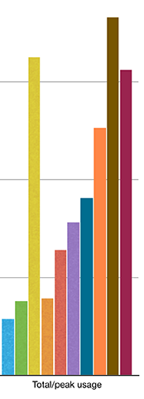
ORM speed (PHP)

Slide 28
Advantages of using an ORM
In the code we don’t use dialect-dependent SQL statements
We can always switch dialect/server without changing the code
Using a self-made EF/Linq provider we can implement any storage methods
Instead of using string SQL statements, we use a format that is syntax-checked by the compiler before execution
All syntax errors are revealed during development time
Instead of using string SQL parameters (string interpolation) we can use variables as query parameters
Avoid SQL injection by design
The query results are not general object / object[] / associative arrays / typeless Dictionary collections
Instead, we receive known strongly typed instances / collections (!!!)
By adding +1 layer on top of the ORM, we can have a data layer that can help us in exchanging the data layer and test the logic
Repository with Dependency Injection

Slide 29
+1 layer ???
It is an advantage that the same LINQ query can be executed
Independent from the actual data storage (List<T>, XML, MySQL/Oracle/MSSQL Database …)
Easier to separate the data processing code from the business logic code
Our aim: the LINQ query should refer to the data source so that it doesn’t have to use the actual physical database
Aim: write a Logic code where the actual data source can be defined during run-time
Aim: write a Logic code, where it’s easy to write truly good unit tests (we want to test the logic without having a working data access layer)
(Maybe solution, but not this semester: EF Core In-Memory Providers)
This is what we need in the project work!!!
Actual solution: Repository Design Pattern + Moq

Slide 30
Entity Framework versions
https://docs.microsoft.com/en-us/ef/ef6/what-is-new/past-releases
Linq To SQL: Similar syntax, „Not a complete implementation”
EF1 = EF3.5 ➔ .NET 3.5 (2008)
EF4 ➔ .NET 4 (2010) „POCO support, lazy loading, testability improvements, customizable code generation and the Model First workflow”
EF4.1 ➔ „first to be published on NuGet. This release included the simplified DbContext API and the Code First workflow” (2011) ➔ the weird ObjectContext api is replaced with the great DbContext api!
EF4.3 ➔ „Code First Migrations” (2012) ➔ a complete ORM!
EF5 (2012), API changes …
EF6 (2013), API changes …
EF 6.1 (2014), EF 6.2 (2017), EF 6.4 (2019) ➔ widespread and GOOD!

Slide 31
Entity Framework Core
EF7: RC1 2015 …
„You should view the move from EF6.x to EF Core as a port rather than an upgrade”
EF Core 1.0 (2016), 2.0 (2017), 2.1 (2018) (all with ASP.NET Core) ➔ LAZY LOAD + GROUP BY, we reached the level of EF 6.1
EF Core 2.2 (2018), 3.0, 3.1 (2019)
https://docs.microsoft.com/en-us/ef/core/what-is-new/ef-core-3.x/breaking-changes
https://www.infoq.com/news/2019/06/EF-Core-3-Breaking-Changes/
Currently: EF 6.4 ➔ old codebase EF Core 3.1 ➔ En route towards .NET Framework 5
https://docs.microsoft.com/en-us/ef/efcore-and-ef6/
Almost all functionality is available, smaller missing features, good additions
Limited inheritance models (planned for 5.0), No change Tracking Proxies (merged in 5.0), limited many-to-many (planned for 5.0), No database.log (merged in 5.0)
In the backlog: Update model from database, Stored procedures

Slide 32
DbContext API
For every table we need a class with “similar structure”: Entity class / Entity model
The essence of the „Data Mapper” is that tables and classes can be different
N:M relations will have an „entityless” mode: connector table without entity
In this semester, we shouldn’t try these: 1 table = 1 entity class, SQL data fields = C# properties
DbContext (Model / Entity Model)
The class that represents the database itself
It must handle the Connection and encapsulate the tables
Our own database will be handled by a descendent class
OnConfiguring() method to configure the connection itself
OnModelCreating() method to setup tables/entities: FLUENT API
DbSet<T> : IQueryable<T>
Class to represent a table ( = a collection of instances typed T)
In the DbContext there is a single property for all tables

Slide 33
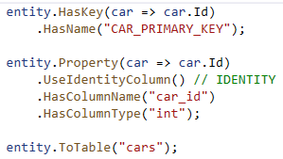
Fluent API vs Annotations
Common aim: we want to use C# code to define that the C# properties in the entity classes map to which SQL data fields, including the occasional SQL-specific extras
Annotations / Attributes: we extend the properties of the entity class with specific attributes
Cars + Brands example
Fluent API: In the OnModelCreating() method of the DbContext descendent class
More modern, better suited for the EF Core philosophy
EmpDept example
MUCH BETTER for foreign keys (With…Has…)
In the project work it doesn’t matter which one we use
Even if using attributes, we will need the OnModelCreating()
Because of Foreign Keys and Database Seeding

Slide 34
Generating the model (OLD SQL first)
Pre-requirement: EF 6.x and pre-existing tables http://msdn.microsoft.com/en-us/data/jj206878
Project, Add new Item, ADO.NET Entity Data Model <ADD>
Generate from database <NEXT>
Have the MDF file in the drop-down + save connection settings <NEXT>;
EF6.0 <NEXT>;
Checkbox near all tables + Model namespace = EmpDeptModel <FINISH>
Depending on config: Template can harm your computer, click ok to run ... <OK> <OK>
Result: automatically generated strongly typed classes, these are either typed versions of generic classes or rather POCO classes ➔ ~30KB for a two-table database (DataSet: 10x larger)
Notes:
http://users.nik.uni-obuda.hu/hp/SQL_empdept.sql

Slide 35
Generating the model (NEW EF Core SQL first)
EmpDept.mdf; pre-existing tables; Content+Copy Always
Server Explorer ➔ EmpDept ➔ Right click ➔ Properties
"Data Source = (LocalDB)\MSSQLLocalDB; AttachDbFilename = |DataDirectory|\EmpDept.mdf; Integrated Security = True"
„Close Connection” is important in the Server Explorer!!!
Manage Nuget Packages for Solution => NOT prerelease
Microsoft.EntityFrameworkCore.SqlServer
Microsoft.EntityFrameworkCore.Tools
Microsoft.EntityFrameworkCore.Proxies
Nuget Package Manager Console
Scaffold-DbContext "CONNECTION_STRING" Microsoft.EntityFrameworkCore.SqlServer -OutputDir Models
When using Code first approach, exactly the same classes should be written manually as the generated ones by the Scaffold-DbContext
We need blank MDF+LDF files, and the connection string
Notes:
http://users.nik.uni-obuda.hu/hp/SQL_empdept.sql

Slide 36
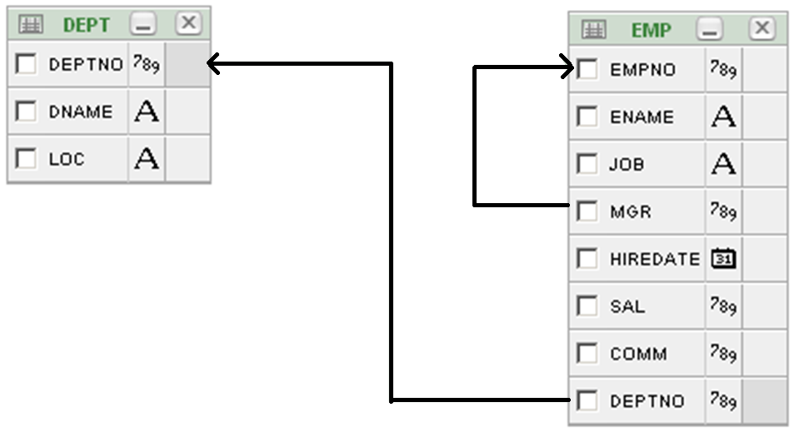
Example Tables

Slide 37
1. Initialization
ED = new EmpDeptEntities();
Console.WriteLine("Connect OK");
// DbSet<T> type, with LINQ extension methods // Can use LINQ query syntax too
// IEnumerable<T> vs IQueryable<T>
Dept dept = ED.Dept.First();
Console.WriteLine(dept.Dname);
// Lazy loading
string deptName = ED.Emp.First().Dept.Dname;

Slide 38
2. INSERT
Emp newWorker = new Emp()
{
Ename = "BELA",
Mgr = null,
Deptno = 20,
Empno = 1000
};
ED.Emp.Add(newWorker);
ED.SaveChanges(); // Save via change tracking!
Console.WriteLine("Insert OK");

Slide 39
3. UPDATE
Emp someone = ED.Emp.Single(x => x.Empno == 1000);
someone.ENAME = "JOZSI"; // Change tracking!
ED.SaveChanges();
Console.WriteLine("Update OK");

Slide 40
4. DELETE
Emp someone = ED.Emp.Single(x => x.Empno == 1000);
ED.Emp.Remove(someone);
ED.SaveChanges();
Console.WriteLine("Delete OK");

Slide 41
5. SELECT / Eager vs Lazy Loading
Eager Loading: Better performance, BUT we must know the connections that we’ll use later and we must reference them when querying the data
Lazy Loading: Weaker performance (especially if MANY records), but A LOT more comfortable to use, as we don’t have to reference anything when querying the data
We need UseLazyLoadingProxies() in the OnConfiguring() and then either we have to iterate over the .ToList() or we need to put „MultipleActiveResultSets = true” into the connection string

Slide 42
Example: in the EmpDept database…
Create and fill the database, then use SQL First approach to generate the model Examine the generated Entity and DbContext classes
List the workers names with their departments name
List the workers name, salary, job, and the job’s average income (income = Sal + Comm)
List the workers name, their departments name, and the number of workers in that department
Double the salary of the company leader (PRESIDENT)
Delete those who joined the company less than 30 days after the hiredate of the president

Slide 43
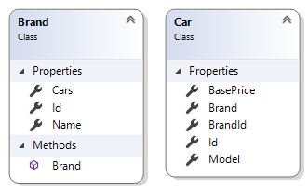
Practice: Cars + Brands database creation
Create the database, and then use fully Code First approach to create the tables and fill the data (use annotations if you want – but the Fluent API is equally good)
List all brands
List all cars, including the brand names (using Lazy Load)
List the cars, along with the average basePrice for every brand

