Slide 1
Advanced Development Techniques
Project Work / Mid-Semester Exercise / FF

Slide 2
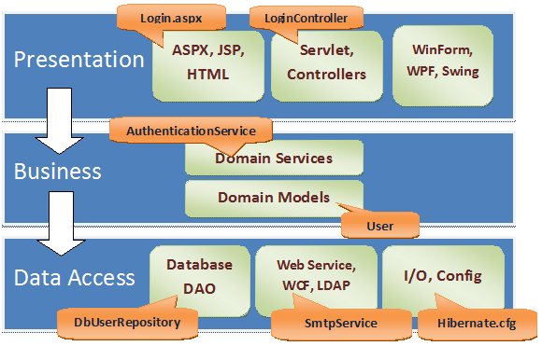
Typical Software Layers
All layers can be split up into layers/classes (SOLID!)
Connecting points: using interfaces
Notes:
Az „Alapvető műveletek” listán fogunk mindegyik módszernél végigmenni

Slide 3
Tools and structure
Project task: the roadmap + requirements are downloadable
Rules: use the /prog3 website to download the prog_tools and prog3_requirements documents
Tools that you have to learn (see later)
A single-user, single-branch GIT repository
The code must be FXCop/StyleCop-valid, ZERO warning/build error
Must have HTML developer documentation generated by DoxyGen
Layered project structure, min. 5 dotnet core C# projects
Data: Database + Entity Framework to access it
Repository: EF data handler methods (IQueryable results)
Logic: BL methods that use one or more repository methods (CRUD + Non-Crud, the latter typically with LINQ queries, and list-typed results)
Test: Unit testable code (for the business logic methods, mocked Crud and mocked/asserted Non-Crud tests)
Program: Menu-driven (ConsoleMenu-simple, EasyConsole) console app, creates instances using a separated Factory class

Slide 4
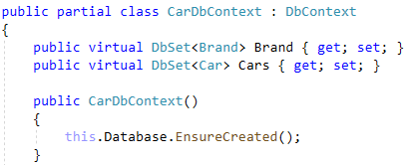
Layers: DATA (+ MDF, LDF via .gitignore!)

Slide 5
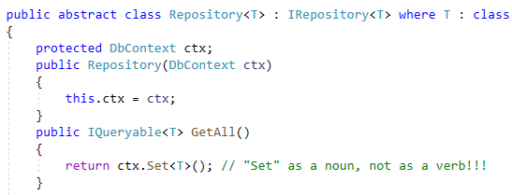
Layers: REPOSITORY

Slide 6
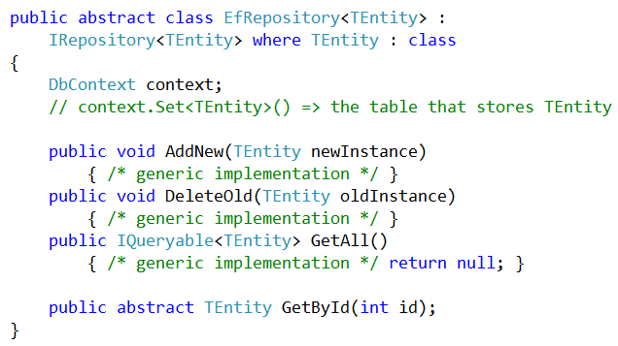
Layers: REPOSITORY

Slide 7
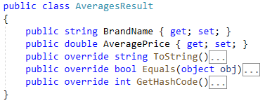
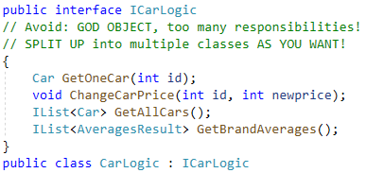
Layers: LOGIC – SOLID

Slide 8
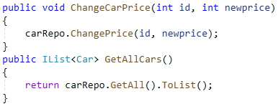
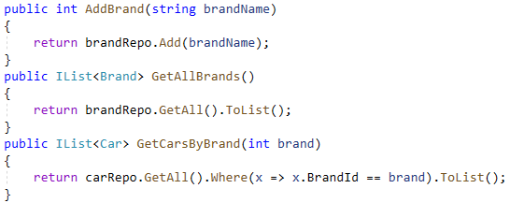
Layers: LOGIC – SOLID + DI + CRUD

Slide 9
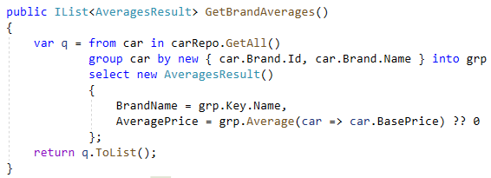
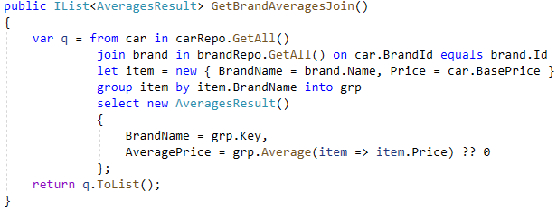
Layers: LOGIC – NON-CRUD

Slide 10
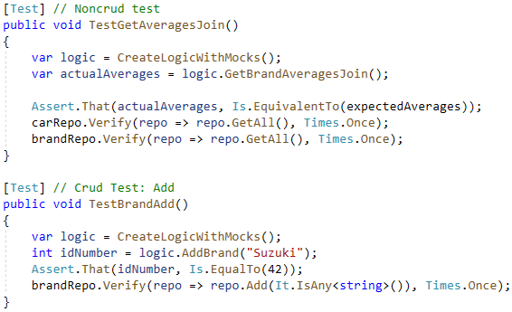
Layers: TEST

Slide 11
Layers: PROGRAM
The Console App can only call Logic methods, the Logic will forward the CRUD operations to the Repo, and the Repo calls the DbContext methods
Every layer MUST only communicate with the layer directly below (occasional upwards communication: with events, not needed now)
All DbContext/Repository/Logic instance creation is done here, preferably using a separated Factory class
Only ONE instance from the DbContext descendant will be used by all Repositories (Singleton Design Pattern is possible, for caveats see Prog4)!
The Logic classes use the same Repo instances from the Repo types
Complies with the SOLID principles
NO other project than the Console App can use Console.Read/Write operations
The Logic and the Console App MUST NOT USE dbContext methods, only the Repository can do so
Menu-driven: ConsoleMenu-simple / EasyConsole

Slide 12
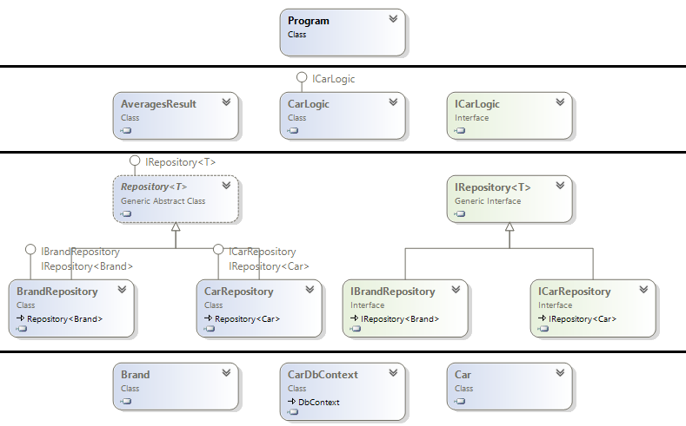
Layered application

Slide 13
Problems between layers
It can be problematic if the ORM Entity instances are available above the Data/Repo layers
E.g. we cannot modify a worker’s salary in the Logic, but there is a method to relocate a department
EMP singleEmp = myLogic.GetEmp(7788); singleEmp.SAL = 10000; myLogic.RelocateDept(30, ”Budapest”);
The SaveChanges() in the RelocateDept() will save the modified salary!
This is not a problem in this project work, but in real-world applications you should use intermediate Business Model / DTO classes
Solutions for passing instances between layers:
Pass functionally-restricted entity instances (e.g. without setters)
Visibility: inside a layer you can see the internals too, outside only the public
Manual conversion (reflection … Performance?)
Automatic Conversion (AutoMapper … Production-Ready?)
Signaling errors (layer-specific exception handling)
InnerException / AggregateException

Slide 14
Inner structure of layers
Currently only obligatory in the Repository layer
Logic ➔ split it up somehow and „PERFECT” …
Minimal requirements
Avoid Spagetthi code / Big Ball Of Mud ➔ that’s why we use layering
EF + IRepository<T>/IEmpRepository + ILogic/IEmpLogic + Console
Problem: the Repository can be good, but the Logic…
God Object: Too many responsibilities for a single class
Typical symptom: too long class
Typical symptom: class with many dependencies / ctor parameters
Solution: Refactor to individual classes
EmpLogic, DeptLogic, PremiumCalculationLogic …
Ravioli code: small and easy classes in theory, but they make understanding the system as a whole difficult (… Repository AntiPattern??? ☹ )
Lasagna Code: layered code at the first glance, but impossible to handle due to the inner chaos and crazy internal cross-references
MAIN GOAL: Find the middle ground ➔ REUSEABLE CODE!

Slide 15
Git
Git repository
Version control: to know which row was edited by who/when
Local repository, remote repository, commit, push, pull, branch, fork, merge
Use any GIT client you want (command line / Sourcetree / TortoiseGit / VS)
Currently: Single-branch, Single-user
Simple „mirror”, we’ll use more branches/users only next semester
Bitbucket.org , Private repository
Must add with an admin permission: oe_nik_prog
Must add using an email address: nikprog@iar.nik.uni-obuda.hu
Git conflicts
When merging, problem between two commits if they affect the same file
If the same file, but different area, many times it can be resolved automatically (automatic merge)
For commits changing same parts of the file, manual: keep A/local/ours, keep B/remote/theirs, run mergetool (kdiff3, Meld, Kompare) ➔ Prog4
GITSTATS – Must be TRUE, a code that everywhere compiles !!!

Slide 16
Stylecop.Analyzers + Microsoft.CodeAnalysis.FxCopAnalyzers
EXPECTED to be included in ALL projects in the solution
Not only the result/performance of the code is important, but the style/format/readability of the code too (~ coding guidelines)
https://docs.microsoft.com/en-us/visualstudio/code-quality/code-analysis-for-managed-code-overview
Sections, linebreaks, names, visibilities
Mark code blocks ALWAYS with curly braces
Comments: in front of all public members (class, method, property)
Explain parameters/results with method definitions
Look out for length of classes/methods/lines!
„Zero violations” code is suggested, but not obligatory
Do not have too many suppressions or suppressions that break basic rules
Do not leave code analysis to the last minute, suddenly seeing 8571 warnings can be devastating…
YOU MUST HAVE zero compile warnings and zero build errors!
GitStats doesn’t care why it is non-zero…

Slide 17
Doxygen
Because of Stylecop, all class/method/property will have XML documentation comments
When you have a new method/class, type „///” to auto-generate
The filled XML documentation is also shown by IntelliSense
Enable XML documentation file in Project Properties / Build
The language for comments and code (all names) : ENGLISH
Doxygen will use those to generate a “prettier” document
Uses the HTML output format by default (this is what we want)
You can use HTML Help builder to generate CHM documentation
Using LaTeX you can easily generate PDF documentation
To be used with commandline or the Doxywizard GUI
Exporting only the public members is not enough, you have to enable the internal members too (EXTRACT_PACKAGE + EXTRACT_STATIC)
Put the HTML output into the GIT repository, and push all with a commit a couple of hours/days before the deadline (Documentation/Doxygen/index.html and a lot more files in the same dir)

