Slide 1
Advanced development techniques
.NET Framework: CLR, MSIL, JIT, AOT
.NET memory management: GC
.NET ecosystem: .NET Framework, .NET Core, Mono, .NET Standard
.NET vNext
Notes:
1

Slide 2
.NET Architecture
Compiler
.NET Framework Class Library
IL Code
Common Language Runtime
Garbage Collector
JIT Compiler

Slide 3
Today…
.NET Framework: „managed execution environment”
Operates using standardized methods (ECMA 334, 335)
Contains:
Virtual machine
Run-time services
Class libraries
„.NET Framework Dev Pack”
The SDK itself (Software Development Kit)
Supports „Workloads”
.NET Framework
.NET Framework
WPF
Console
Windows Forms
ASP.NET
.NET Framework Class Library
Common Language Runtime
(CLR)
Notes:
Fájlkezelés, stream-ek, hálózat, grafika, biztonság, konzol, xml, adatbázis, ...

Slide 4
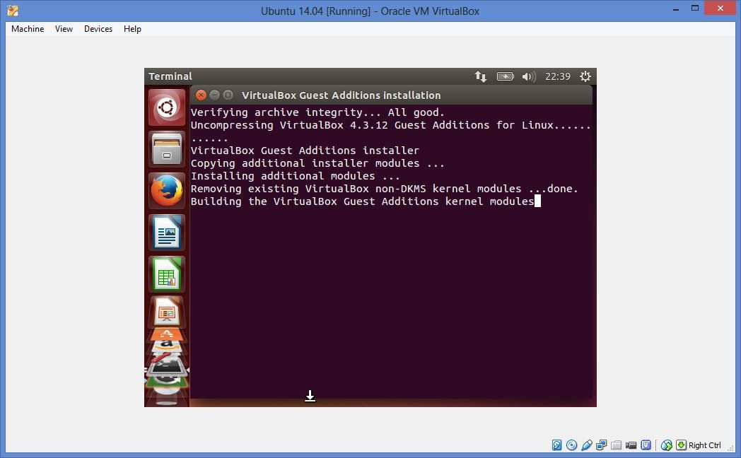
Virtual machine???

Slide 5
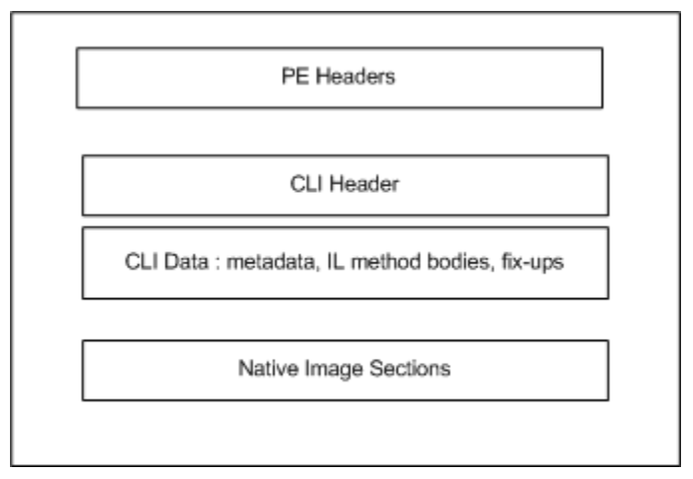
Common Language Runtime
Supports process-level virtualization
Executes bytecode with stack-based execution
Intermediate Language, IL / CIL, MSIL
Generated by the C# / VB / F# / Visual C++ / etc. compilers
Analyzed and compiled by the .NET CLR, compiled into machine code and then executed by the OS
Format: PE (Portable Executable), just like all normal Windows .exe and .dll files!
.NET 1 was not part of the OS, Windows knew nothing about the framework …
So native code loads the CLR that processes the rest of the file
Most of the conventional PE parts are empty/pre-defined
Notes:
System virtual machines exist as fully-functional operating systems and are typically created as a substitute for using a physical machine. In this way multiple environments can run on the same machine simultaneously. But, that doesn’t sound like our beloved CLR and JVM.
The Common Language Runtime (CLR) and Java Virtual Machine (JVM) are both process virtual machines. That means that rather than executing an entire operating system, they are specifically designed to run a process or program without being dependent on the platform environment.
Kép: https://blog.takipi.com/clr-vs-jvm-how-the-battle-between-net-and-java-extends-to-the-vm-level/

Slide 6
Common Language Runtime
PROCESS ADDDRESS SPACE
IL code
metadata
THREAD POOL
HEAP
.NET .exe
Bytecode
PE header
Bytecode
Bytecode
IL code
metadata
Bytecode
Bytecode
Bytecode
CLR
JIT compiler: on-demand, the machine code is generated at the first execution of the method…
Optimizable using: NGEN
Image source: Mike Woodring: CLR Fundamentals @ Pluralsight
Notes:
.NET exe végrehajtása:
1. Exe duplaklikk -> windows felsetupolja a Process Address Space-t
2. És elindít egy szálat
Szál hol kezdi a végrehajtást? Ez a PE headerben van
.NET exe esetében a compiler betesz oda egy kódot a CLR betöltésére
1 CLR/processz, mehet több verzió is egymás mellett
Platform / server version / desktop version / installált .NET framework verziók / konfiguráció alapján betöltődik a megfelelő verzió
3. CLR init: heap, thread pool etc.
4. Majd betölti az assemblynket, és nekikészül a futtatáshoz
5. Minden metódus úgy van fordítva, hogy a JIT-et hivatkozza, így hív abba bele. A JIT után ennek a kódnak a helyére a metódus normális gépi kódja kerül

Slide 7
(… vs Java JAR)
The main aim was an OS-independent format: a self-made, easy-to-process file
Java .class files + metadata, compressed using simple ZIP
Extractable: jar -xf foo.jar
Metadata: META_INF/MANIFEST.MF
.java ➔ build ➔ .class ➔ JIT ➔ JVM ➔ OS
Android DEX: same approach, JAVA syntax, but the result is a different bytecode (NO JRE!)
Java/Dart code (maybe preprocessed: Kotlin/Flutter) ➔ build ➔ DEX/APK ➔ JIT/AOT ➔ originally DVM (Dalvik VM), later ART (Android RunTime)

Slide 8
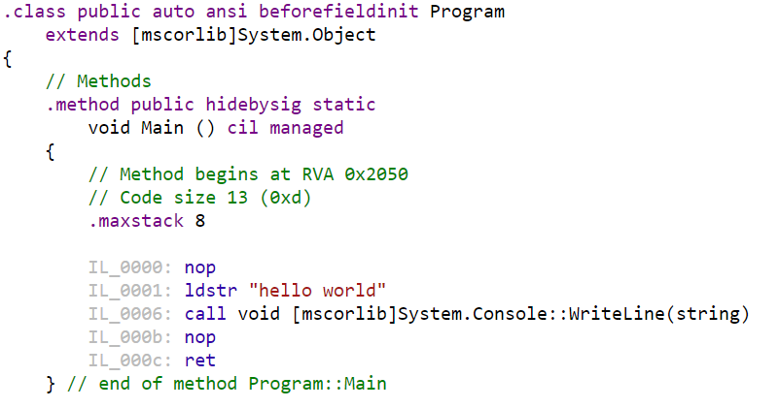
.NET IL code
public class Program
{
static void Main()
{
Console.WriteLine("hello world");
}
}
Object-oriented, low-level (assembly-like) language
Generated by the .NET compilers (C# / VB / F# / Visual C++ / etc.)
Compiled into CPU/OS bytecode by the JIT (or NGEN)
Platform-independent: stack operations
Notes:
using System;
public class Program {
public static void Main()
{
Console.WriteLine("hello world");
}
}

Slide 9
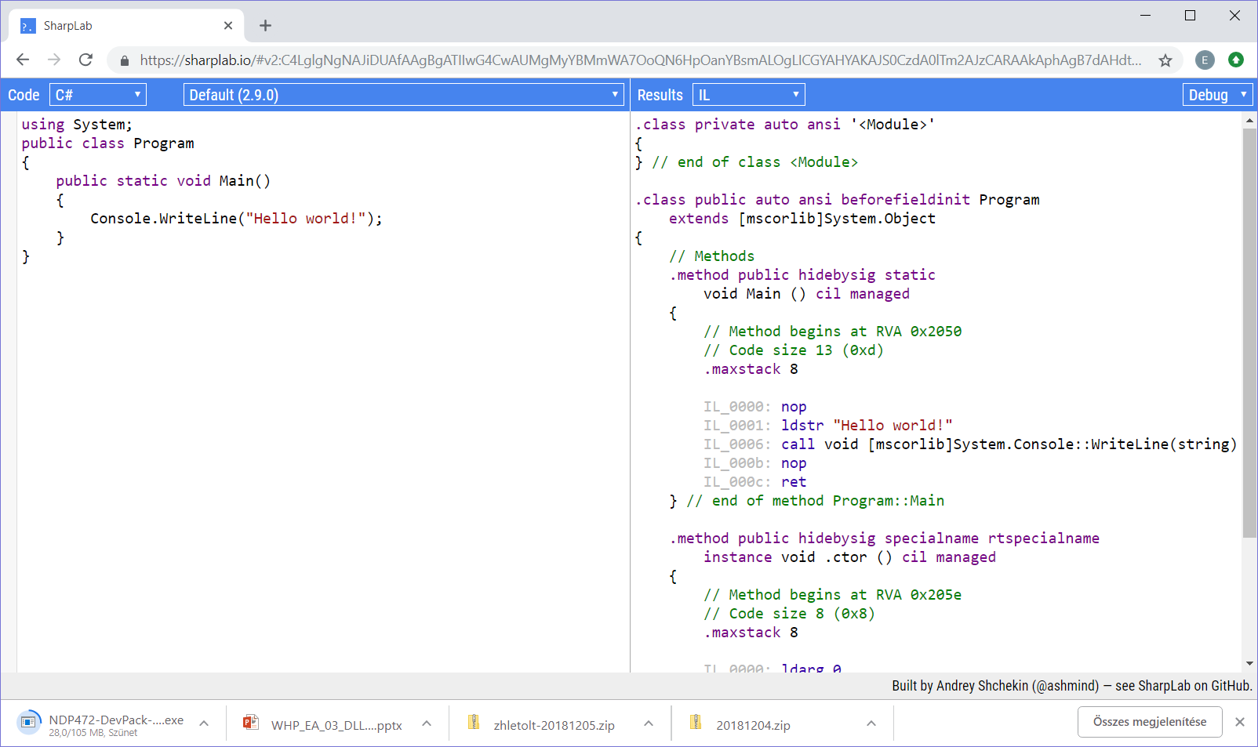
C# → IL → bytecode
IL code:
ildasm.exe (from a .NET assembly)
ILSpy / Reflector / DotPeek … (from a .NET assembly)
http://www.sharplab.io (from manually typed code)
JIT-processed bytecode:
Visual Studio: Debug / Windows / Disassembly (during execution/break)
http://www.sharplab.io (from manually typed code)

Slide 10
.NET Architecture
Compiler
IL Code
Common Language Runtime
Garbage Collector
JIT Compiler

Slide 11
.NET memory management – recap…
class Program
{
static void Main(string[] args)
{
int i = 7;
string s = "árvíztűrő";
int[] arr = { 1, 2, 3, 4, 5 };
MyClass c = new MyClass();
}
}
c (ref to MyClass)
c (MyClass)
…
s (string) „árvíztűrő”
arr (int[])
1,2,3,4,5
s (ref to string)
arr (ref to int[])
Value vs reference typed variables in the memory…
Value-typed variables in the stack (actual values)
Reference-typed variables in the stack (pointers only)
Reference-typed values in the heap (actual values)
Raw pointer vs typed references
Heap
i (int) 7
Stack
Notes:
Heap: igazából a sorrend mindegy!!! Ebben az esetben mondjuk sorban vannak…

Slide 12
.NET memory management – details
class Program
{
// ...
static void DoSomething()
{
int i1 = 12;
MyClass m1 = new MyClass();
// do something...
}
}
class MyClass
{
public int number = 4;
public string smallData = "0123456789";
public byte[] bigData = new byte[86000];
}
m1 (ref to MyClass)
smallData (string)
…
m1 (MyClass)
number (int)
…
bigData (byte[])
i1 (int)
…
Heap/stack allocation depends on the declaration…
Local variable: stack
Member of value type (e.g. Point.X): stack (not shown here!!!)
Member of reference type: heap
…
Heap
…
Stack
Notes:
Supposing args[] is null ☺

Slide 13
.NET memory management – details
class Program
{
// ...
static void DoSomething()
{
int i1 = 12;
MyClass m1 = new MyClass();
// do something...
}
}
class MyClass
{
public int number = 4;
public string smallData = "0123456789";
public byte[] bigData = new byte[86000];
}
m1 (ref to MyClass)
SOH
smallData (string)
…
m1 (MyClass)
number (int)
…
i1 (int)
…
LOH
(>85000 bytes)
…
bigData (byte[])
…
…
…
Stack
Heap
Notes:
Supposing args[] is null ☺

Slide 14
.NET memory management – details
Stack is „self managed”
Elements are pushed/popped during execution
Pop=remove, so nothing stays there forever…
1 stack/thread
The heap is managed by the Garbage Collector (GC)
Asks memory from the OS, and returns memory that is no longer used
Gives memory to the user processes
Decides which memory parts are still in use
The unused parts are cleared (so that they can be re-used)
…
…
Main() stuff…
Stack
SOH
…
LOH
…
Heap
Notes:
GC = nem csak gyűjtő. A .NET memóriamenedzsere.

Slide 15
.NET memory management
“unused parts are cleared”… When?
At an unknown time
„Not part of the documented, guaranteed behavior”
Approximately
When physical memory is low (OS signal)
When the objects in heap consume memory over a given limit
This changes over the execution time of the program
When GC.Collect() is called
A very well-built mechanism, in theory you don’t have to worry about these → IDisposable interface???
Notes:
The GC does a collection when it feels like it's a good time to do a collection; its internal policies are not part of the documented, guaranteed behavior. If you're just curious, that's one thing. If you intend to develop software that depends on a particular GC policy, you are skating on some pretty thin ice
Garbage collection occurs when one of the following conditions is true:
* The system has low physical memory.
* The memory that is used by allocated objects on the managed heap surpasses an acceptable threshold. This threshold is continuously adjusted as the process runs.
* The GC.Collect method is called. In almost all cases, you do not have to call this method, because the garbage collector runs continuously. This method is primarily used for unique situations and testing.

Slide 16
Process of the garbage collection
GC assumes that everything is a waste
Using reference tracking, it decides which objects are still in use
Reference tracking is executed from the root objects:
Stack references
Static instance references
„Finalization queue” instance references
CPU registers
References to interop instances
Memory leak is STILL possible, if references are kept in unexpected locations
.NET event/delegate – if we forget to unsubscribe…
Static references (e.g. via a singleton!)
Compiler-generated constructs: e.g. lambda closures, outer variable trap

Slide 17
Enumerating references
„Graph of reachable objects”
root
a
b
c
d
e
f

Slide 18
Enumerating references
„Graph of reachable objects”
root
a
b
c
d
e
f

Slide 19
Enumerating references
„Graph of reachable objects”
root
a
b
c
d
e
f

Slide 20
Enumerating references
„Graph of reachable objects”
root
a
b
c
d
e
f

Slide 21
Enumerating references
„Graph of reachable objects”
root
a
b
c
d
e
f

Slide 22
Garbage collection
g
???
root
b
c
e
f

Slide 23
Compression
Except: LOH (<.NET 4.5.1)
Too big objects…
Except: „pinned” objects
Faster allocation, bigger continuous blocks, no fragmentation
root
b
c
e
f
g

Slide 24
.NET memory leak with events
public class MyClassWithEvent
{
public event EventHandler MyEvent;
}
public class MySubscriberClass
{
public void OnMyEvent(object sender, EventArgs eventArgs)
{
Console.WriteLine($"{sender} fired MyEvent!");
}
}
static MyClassWithEvent myClassWithEvent = new MyClassWithEvent();
public static void Main()
{
MySubscriberClass subscriber = new MySubscriberClass();
myClassWithEvent.MyEvent += subscriber.OnMyEvent;
// myClassWithEvent keeps reference to subscriber until
// myClassWithEvent.MyEvent -= subscriber.OnMyEvent;
// ... No problem, everything is freed after the Main() ...
}

Slide 25
.NET memory leak with events
static MyClassWithEvent myClassWithEvent = new MyClassWithEvent();
public static void OtherMethod()
{
MySubscriberClass subscriber = new MySubscriberClass();
myClassWithEvent.MyEvent += subscriber.OnMyEvent;
// ...
}
// subscriber should be gone from the memory after the method ➔ ???
You must always either
Be 1000% sure that the subscriber and the event source can be both disposed at the same time (the two has the same lifespans)
Unsubscribe from the event using manual unsubscription (using -= )
Unsubscribe from the event using a properly implemented IDisposable interface (full IDisposable pattern, later today)
Allow normal Garbage Collection of the subscriber using the Weak Delegates design pattern (prog4), and then properly unsubscribe when the subscriber happens to be freed

Slide 26
Generations
Problem: GC execution is SLOW…
Assumption: most of the objects are short-lived
The age of the objects are tracked via counting „generations”
gen0: short-lived → gen2: older objects
Garbage collection is executed by generation
gen0 GC: only gen0 objects
gen1 GC: gen0 + gen1 objects
gen2 GC: gen0 + gen1 + gen2 objects
If the object survives the collection, it is “promoted” to the next generation
Notes:
Lassú: szálak leállnak, kompaktálás stb…

Slide 27
GC.Collect()
Only in special situations ( = never ☺ )!
class MyGCCollectClass
{
private const long maxGarbage = 1000;
void MakeSomeGarbage()
{
Version vt;
for (int i = 0; i < maxGarbage; i++)
{
vt = new Version();
}
}
static void Main()
{
MyGCCollectClass myGCCol = new MyGCCollectClass();
myGCCol.MakeSomeGarbage();
GC.Collect(); // trigger GC manually
GC.KeepAlive(myGCCol); // do not clean up myGCCol
}
}
Notes:
In almost all cases, you do not have to call this method, because the garbage collector runs continuously. This method is primarily used for unique situations and testing.

Slide 28
Performance issues – GC settings
During GC execution, all threads are suspended
E.g. during data processing/display are affected…
LOH compression (>.NET Framework 4.5.1)
GCSettings.LatencyMode = GCLatencyMode.SustainedLowLatency;
Batch | Gen2 collection in a foreground thread
Interactive | Gen2 collection in a background thread
LowLatency | No gen2 collection please (if must, use a foreground thread)
SustainedLowLatency | No gen2 collection please (if must, use a background thread)
NoGCRegion | No GC please
GCSettings.LargeObjectHeapCompactionMode =
GCLargeObjectHeapCompactionMode.CompactOnce;
GC.Collect();
Console.WriteLine(GCSettings.LargeObjectHeapCompactionMode);
Notes:
While Gen2 collections are slower by default (they analyze more memory segments
Pl animáció renderelés…
non-concurrent garbage collection, which is optimized for throughput
The LOH is used for allocating memory for large objects (such as arrays) that require more than 85,000 bytes. Because of the performance impact of copying large blocks of memory, the garbage collector ordinarily sweeps the LOH, which involves creating a list of the memory locations that were occupied by dead objects and that can be reused to satisfy future requests for allocation of memory for large objects. However, in apps that make extensive use of the LOH to store transient objects, memory fragmentation can also adversely impact performance. In this case, it is possible to use the LargeObjectHeapCompactionMode property to compact rather than simply sweep the LOH during a garbage collection.

Slide 29
Performance issues – GC settings
static void Main()
{
// NoGCRegion
if (GC.TryStartNoGCRegion(maxGarbage*16))
{
try
{
// ... do extremely performance critical allocations...
}
finally
{
if (GCSettings.LatencyMode == GCLatencyMode.NoGCRegion)
{
GC.EndNoGCRegion();
}
}
}
}
Notes:
In almost all cases, you do not have to call this method, because the garbage collector runs continuously. This method is primarily used for unique situations and testing.

Slide 30
Performance issues – destructor
Unmanaged resource == anything the GC doesn’t know about
E.g.: FileStream -> Win32.CreateFile() -> IntPtr…
Or a native call’s result (e.g.: unmanaged DLLs)…
Normal: FileStream.Dispose()
Fallback: ~FileStream()
Special GC algorithm…
Every instance with a destructor is referenced from +1 location: from the „finalization queue”
During GC, if there is no other reference, then moved to the „fReachable queue”
„Finalization thread” will execute the destructors…
… and then only freed after the next GC execution
Consequences:
Temporary root object (all referenced instances are kept until the root is freed)
TWO GC execution is needed
The instance is promoted after the first GC…
Gen2 instances have a more rare GC execution
Called at an unknown time (by the GC)
Notes:
Finalization queue oka: lassú dolgok lehetnek a destruktorban
A sorrend bármi lehet, max futási idő ~2mp, ez beállítható (rossz ötlet)
Következmények:
Az összes hivatkozott objektum is meg kell maradjon a destruktor futásáig: ideiglenes root objektum!
2 GC kell az objektum kitakarításához
Gen2 objektumoknál a GC eleve ritka
Az első GC után elő is lép!

Slide 31
Dispose
Do not write destructor if you don’t have to!
→ Simple Dispose pattern (if you have only managed resources)
public class ClassWithBasicDispose : IDisposable
{
public void Dispose()
{
Dispose(true); // usually not needed – put all code here
GC.SuppressFinalize(this); // take object off the finalization q
}
protected virtual void Dispose(bool disposing)
{
if (disposing)
{
// Dispose() all managed resources
}
}
}
Notes:
Note that classes without unmanaged resources should not have a finalizer. (They should still call SuppressFinalize, unless they're sealed; this allows inherited classes to add unmanaged resources)

Slide 32
Dispose
→ Full Dispose pattern (if you have unmanaged resources too)
public class ClassWithFullDispose : IDisposable
{
private bool disposed = false;
protected virtual void Dispose(bool disposing)
{
if (this.disposed) return;
if (!this.disposed)
{
if (disposing)
{
// Dispose() all managed resources
}
// Cleanup all unmanaged resources - e.g. close handles,
// free pointers, set large fields to null
disposed = true;
}
}
// … public void Dispose()
// … ~ClassWithFullDispose()
Notes:
public class DisposeExample
{
// A base class that implements IDisposable.
// By implementing IDisposable, you are announcing that
// instances of this type allocate scarce resources.
public class MyResource : IDisposable
{
// Pointer to an external unmanaged resource.
private IntPtr handle;
// Other managed resource this class uses.
private StreamReader streamReader;
// Track whether Dispose has been called.
private bool disposed = false;
// The class constructor.
public MyResource(IntPtr handle)
{
this.handle = handle;
}
// Implement IDisposable.
// Do not make this method virtual.
// A derived class should not be able to override this method.
public void Dispose()
{
Dispose(true);
// This object will be cleaned up by the Dispose method.
// Therefore, you should call GC.SupressFinalize to
// take this object off the finalization queue
// and prevent finalization code for this object
// from executing a second time.
GC.SuppressFinalize(this);
}
// Dispose(bool disposing) executes in two distinct scenarios.
// If disposing equals true, the method has been called directly
// or indirectly by a user's code. Managed and unmanaged resources
// can be disposed.
// If disposing equals false, the method has been called by the
// runtime from inside the finalizer and you should not reference
// other objects. Only unmanaged resources can be disposed.
protected virtual void Dispose(bool disposing)
{
// Check to see if Dispose has already been called.
if (!this.disposed)
{
// If disposing equals true, dispose all managed
// and unmanaged resources.
if (disposing)
{
// Dispose managed resources.
// managedResource.Dispose();
}
// Call the appropriate methods to clean up
// unmanaged resources here.
// If disposing is false,
// only the following code is executed.
CloseHandle(handle);
handle = IntPtr.Zero;
// Note disposing has been done.
disposed = true;
}
}
// Use interop to call the method necessary
// to clean up the unmanaged resource.
[System.Runtime.InteropServices.DllImport("Kernel32")]
private extern static Boolean CloseHandle(IntPtr handle);
// Use C# destructor syntax for finalization code.
// This destructor will run only if the Dispose method
// does not get called.
// It gives your base class the opportunity to finalize.
// Do not provide destructors in types derived from this class.
~MyResource()
{
// Do not re-create Dispose clean-up code here.
// Calling Dispose(false) is optimal in terms of
// readability and maintainability.
Dispose(false);
}
}
public static void Main()
{
// Insert code here to create
// and use the MyResource object.
}
}

Slide 33
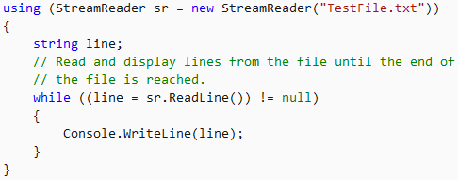
Dispose
→ Full Dispose pattern (if you have unmanaged resources too)
public class ClassWithFullDispose : IDisposable
{
// … protected virtual void Dispose(bool disposing)
public void Dispose()
{
Dispose(true);
GC.SuppressFinalize(this); // take object off the finalization q
}
~MyResource()
{
Dispose(false);
}
}
Notes:
public class DisposeExample
{
// A base class that implements IDisposable.
// By implementing IDisposable, you are announcing that
// instances of this type allocate scarce resources.
public class MyResource : IDisposable
{
// Pointer to an external unmanaged resource.
private IntPtr handle;
// Other managed resource this class uses.
private StreamReader streamReader;
// Track whether Dispose has been called.
private bool disposed = false;
// The class constructor.
public MyResource(IntPtr handle)
{
this.handle = handle;
}
// Implement IDisposable.
// Do not make this method virtual.
// A derived class should not be able to override this method.
public void Dispose()
{
Dispose(true);
// This object will be cleaned up by the Dispose method.
// Therefore, you should call GC.SupressFinalize to
// take this object off the finalization queue
// and prevent finalization code for this object
// from executing a second time.
GC.SuppressFinalize(this);
}
// Dispose(bool disposing) executes in two distinct scenarios.
// If disposing equals true, the method has been called directly
// or indirectly by a user's code. Managed and unmanaged resources
// can be disposed.
// If disposing equals false, the method has been called by the
// runtime from inside the finalizer and you should not reference
// other objects. Only unmanaged resources can be disposed.
protected virtual void Dispose(bool disposing)
{
// Check to see if Dispose has already been called.
if (!this.disposed)
{
// If disposing equals true, dispose all managed
// and unmanaged resources.
if (disposing)
{
// Dispose managed resources.
// managedResource.Dispose();
}
// Call the appropriate methods to clean up
// unmanaged resources here.
// If disposing is false,
// only the following code is executed.
CloseHandle(handle);
handle = IntPtr.Zero;
// Note disposing has been done.
disposed = true;
}
}
// Use interop to call the method necessary
// to clean up the unmanaged resource.
[System.Runtime.InteropServices.DllImport("Kernel32")]
private extern static Boolean CloseHandle(IntPtr handle);
// Use C# destructor syntax for finalization code.
// This destructor will run only if the Dispose method
// does not get called.
// It gives your base class the opportunity to finalize.
// Do not provide destructors in types derived from this class.
~MyResource()
{
// Do not re-create Dispose clean-up code here.
// Calling Dispose(false) is optimal in terms of
// readability and maintainability.
Dispose(false);
}
}
public static void Main()
{
// Insert code here to create
// and use the MyResource object.
}
}

Slide 34
Code smells for bad GC performance…
Unnecessary destructors
Too many allocations
E.g. multiple string.Split()[ind] vs lots of Substring() calls … -> more frequent GC
Too big allocations
E.g. arrays bigger than required -> longer GC
Instances referencing each-other “randomly”
Especially if they are short-lived -> GC tracks them all (graph traversal), gen0 instances are processed A LOT
Too many root objects
E.g. deep recursion/call chain with many local variable references
„Middle-lived” objects
Harder to free them from gen2, as GC is executed rarely for gen2

Slide 35
.NET Architecture
Compiler
.NET Framework Class Library
IL Code
Common Language Runtime
Garbage Collector
JIT Compiler

Slide 36
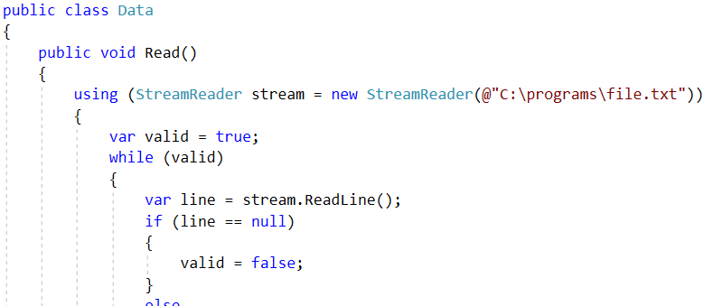
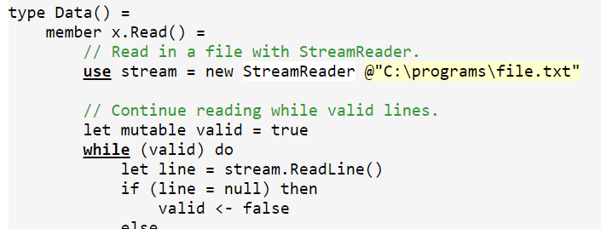
.NET Framework Class Library
Set of all types provided by the Framework (classes, interfaces, delegates, value types)
Most of them follows the standard called CLS: Common Language Specification (to ensure interoperability between languages)
Notes:
Fájlkezelés, stream-ek, hálózat, grafika, biztonság, konzol, xml, adatbázis, ...
To facilitate interoperability between languages, most .NET types are CLS-compliant and can therefore be used from any programming language whose compiler conforms to the common language specification (CLS).
To start from the beginning, remember that a .NET implementation is language agnostic. This doesn’t just mean that a programmer can write her code in any language that can be compiled to IL. It also means that she needs to be able to interact with code written in other languages that are able to be used on a .NET implementation.
In order to do this transparently, there has to be a common way to describe all supported types. This is what the Common Type System (CTS) is in charge of doing. It was made to do several things:
* Establish a framework for cross-language execution.
* Provide an object-oriented model to support implementing various languages on a .NET implementation.
* Define a set of rules that all languages must follow when it comes to working with types.
* Provide a library that contains the basic primitive types that are used in application development (such as, Boolean, Byte, Char etc.)
CTS defines two main kinds of types that should be supported: reference and value types. Their names point to their definitions.

Slide 37
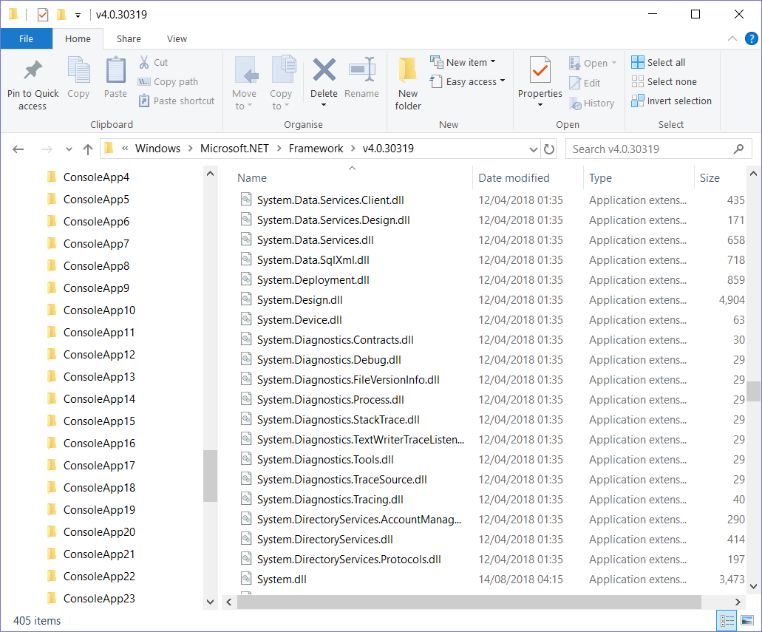
.NET Framework Class Library

Slide 38
.NET ecosystem
.NET 1.0: 2002. FEB. 13. (.NET Framework + Visual Studio)
→ .NET Framework 4.8: 2019. APR. 18. („the last one”)
Now: … Web, mobile, cloud …
.NET Framework
Framework Class Library
Portable Class Libraries
.NET Core
Roslyn Compiler
.NET Standard
…
???
Notes:
MS dolgozott h a .NET a web, mobil, felhő etc világban is egy jó opció maradjon -> .NET ökoszisztéma nagy lett és zavaros
Ismerjük a .NET Frameworköt, de ez hogy viszonyul a BCL-hez? Mik a Portable Class Library-k, és mikor kellene ezeket használni? Mi az a .NET Core, és hogy különbözik a .NET Frameworktől? Mi az a Roslyn Compiler? Kellene hogy érdekeljen? És mi az a .NET Standard? Része a .NET Core-nak? Ez 1 olyan valami, amit installálsz?

Slide 39
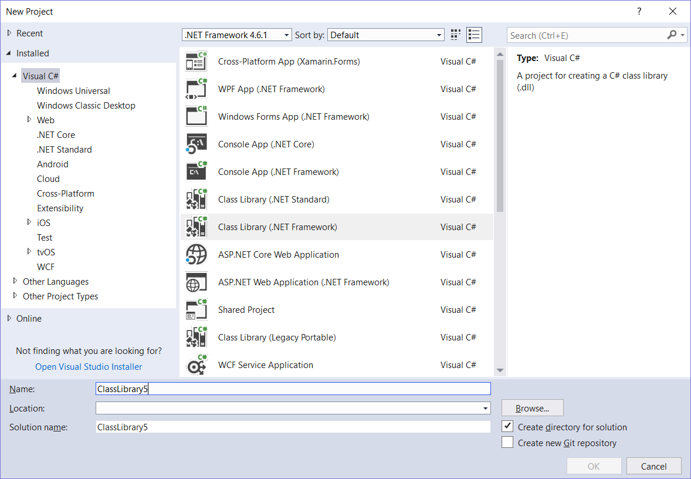

Slide 40
.NET ecosystem
Various runtimes
.NET Framework
.NET Core
Mono
Runtime
WPF
Console
Console
Windows Forms
ASP.NET Core
Console
ASP.NET
Windows Forms
ASP.NET
UWP
Xamarin IOS, OSX, Android
Framework
.NET Framework Class Library
.NET Core Class Library
Mono Class Library
Platform
Common Infrastructure & Tooling
CLR for .NET Framework
Common Infrastructure & Tooling
CoreCLR
Common Infrastructure & Tooling
Mono Runtime
Windows-centered
Windows-based API subsystems
Crossplatform framework (… app. Workloads are not…)
Performance-oriented
Crossplatform
Xamarin: specific APIs: IOS, Android, Mac
Notes:
A legrégebbi. .NET Framework – konfúzió egyből kezdődik: ezt Frameworknek hívják, de runtime,
framework, platform egyben.
Talán screenshotokat ide?
A FELSOROLÁS NEM TELJES PL .NET Compact!!!
Az egész == .NET Development platform. A .NET FW, etc Runtime-ok.

Slide 41
.NET Framework
2002
For a long time, this was the only one
Limitedly open-source: https://github.com/microsoft/referencesource
vs. .NET Core?
Supports different use-cases
The widest range of workloads
Console
WCF (web services, communication)
WWF (autmatization of business processes)
WPF (complex GUI)
Windows Forms (simple GUI)
ASP.NET (Forms, MVC, WebApi) (web)
Azure (WebJobs, Cloud Services) (cloud)
Most of the workloads are Windows-specific
.NET Framework
WPF
Console
Windows Forms
ASP.NET
.NET Framework Class Library
Common Infrastructure & Tooling
CLR for .NET Framework
Notes:
Korlátozottan open-source: nem lehet contribute-olni, csak nézegetni lehet részeit.

Slide 42
Mono
2004 / 2011(Xamarin)
Open-source: https://github.com/mono/mono
Crossplatform
The Mono BCL only supports a part of the .NET Framework FCL
Workloads:
Console
Windows Forms
Apple IOS
Apple Mac OS X (Desktop GUI Mac-re)
Android
Mono
Windows Forms
Console
ASP.NET
Xamarin IOS, OSX, Android
Mono Class Library
Common Infrastructure & Tooling
Mono Runtime
Notes:
2016
Windows dev számára: .NET Framework-re készült programjait linuxon/unixokon akarja futtatni
Xamarin fejlesztés!!

Slide 43
.NET Core
2016
Open-source: https://github.com/dotnet/core
Crossplatform:
Windows client, server, IoT
Linux, FreeBSD, Mac OS X
ORIGINALLY not the “new version” of.NET Framework – built for different use cases
A .NET Core FCL only supports parts of the .NET Framework FCL
Workloads:
Since the beginnings: Console
Since the beginnings: ASP.NET Core (MVC, Api)
Since 2.1: normal ORM (EF core)
.NET Core
Console
ASP.NET Core
UWP
.NET Core Class Library
Common Infrastructure & Tooling
Application Host, CoreCLR
Notes:
It will not replace .NET Framework. It just offers different use-cases than the .NET Framework.
Application host: emiatt tud a .NET Core több platformon is futni. Ez hosztolja a CLR-t és a libraryt, és a runtime által futtatja az appot.
A CLR is más, mint a .NET Framework-ben a CLR. Lightweight-ebb, crossplatform és cross-architecture (x86, x64, ARM CPU) módon fut az application host segítségével.
Filozófia: az app alapja lightweight, és komonenseket be lehet húzni nugettel
Workloadok
No ASP.NET Forms, mert annak a kontroljai a Windowshoz vannak kötve és a .NET Core crossplatform.

Slide 44
.NET Core
Must be installed on the target machine OR it can be self-contained
Truly side-by-side
User-level, computer-level
App
App
App
.NET Core 1
CLR v1
Library v1
AppHost v1
.NET Core 1.1
CLR v1.1
Library v1.1
AppHost 1.1
.NET Core 2
CLR v2
Library v2
AppHost 2
OS
Notes:
It will not replace .NET Framework. It just offers different use-cases than the .NET Framework.
Application host: emiatt tud a .NET Core több platformon is futni. Ez hosztolja a CLR-t és a libraryt, és a runtime által futtatja az appot.
A CLR is más, mint a .NET Framework-ben a CLR. Lightweight-ebb, crossplatform és cross-architecture (x86, x64, ARM CPU) módon fut az application host segítségével.
Filozófia: az app alapja lightweight, és komonenseket be lehet húzni nugettel
Workloadok
No ASP.NET Forms, mert annak a kontroljai a Windowshoz vannak kötve és a .NET Core crossplatform.
Ha installálok egy .NET Core-ot, akkor kapok egy AppHostot, CLR-t és Libraryt, együtt ezek futtatják az alkalmazásomat.
De a .NETCore installálása nélkül is tudunk .NETCore-os appot futtatni: self-contained. Minden komponenst hoznak magukkal, ami a futtatásukhoz szüksége
A .NEtCore console applicationja, elvileg csak egy dll-t csinál, amelyet a dotnet.exe futtat. csak a self-containednél van exe, ahol viszont meg kell mondani milyen platform(ok)ra akarom fordítani. A platformokra külön-külön kell lefordítani.s.

Slide 45
.NET Standard
.NET Framework
.NET Core
Mono
.NET Framework Class Library
.NET Core Class Library
Mono Class Library
The FCLs are different
Difficult to share code between two runtimes (C# code, but…)
A code written for one runtime might not compile/run on a different one
Evolution of old “Portable Class Library” …
.NET Standard: specification that describes the APIs/classes that have to be provided
All runtimes implement a certain level of the standard
Eg. .NET Framework 4.5 → .NET Standard <= 1.1
Notes:
.NET Standard vs PCL:
.NET Standard: curated set of APIs chosen by Microsoft vs. APIs only determined by targeted platforms
.NET Standard: platform-agnosztikus, vs. Limited set of platforms

Slide 46
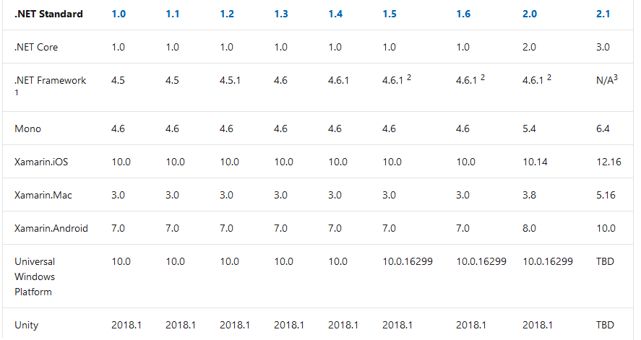
.NET Standard
https://docs.microsoft.com/en-us/dotnet/standard/net-standard
(2019.10.16.)

Slide 47
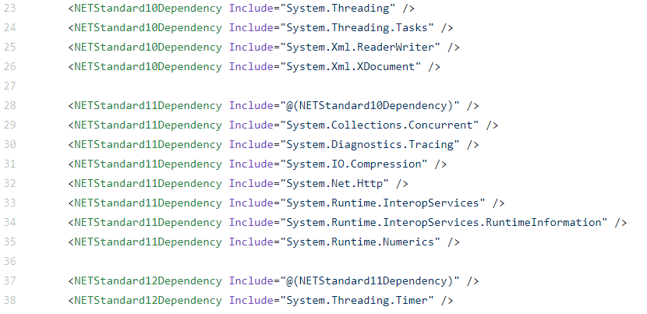
.NET Standard
Additive versioning
https://github.com/dotnet/standard/blob/master/netstandard/pkg/NETStandard.Library.dependencies.props
Fixed, never changing: a released API never changes
…
1.0
1.1
1.2
Notes:
Additív verziózás: Magasabb verziók tartalmazzák az összes funkcionalitást (API-t), amit az alacsonyabb verziók tartalmaztak
Immutábilis verziók: Kiadott API nem változik soha többet, verziók között sincs breaking change
Konkrétan: https://github.com/dotnet/standard/blob/master/netstandard/pkg/NETStandard.Library.dependencies.props

Slide 48
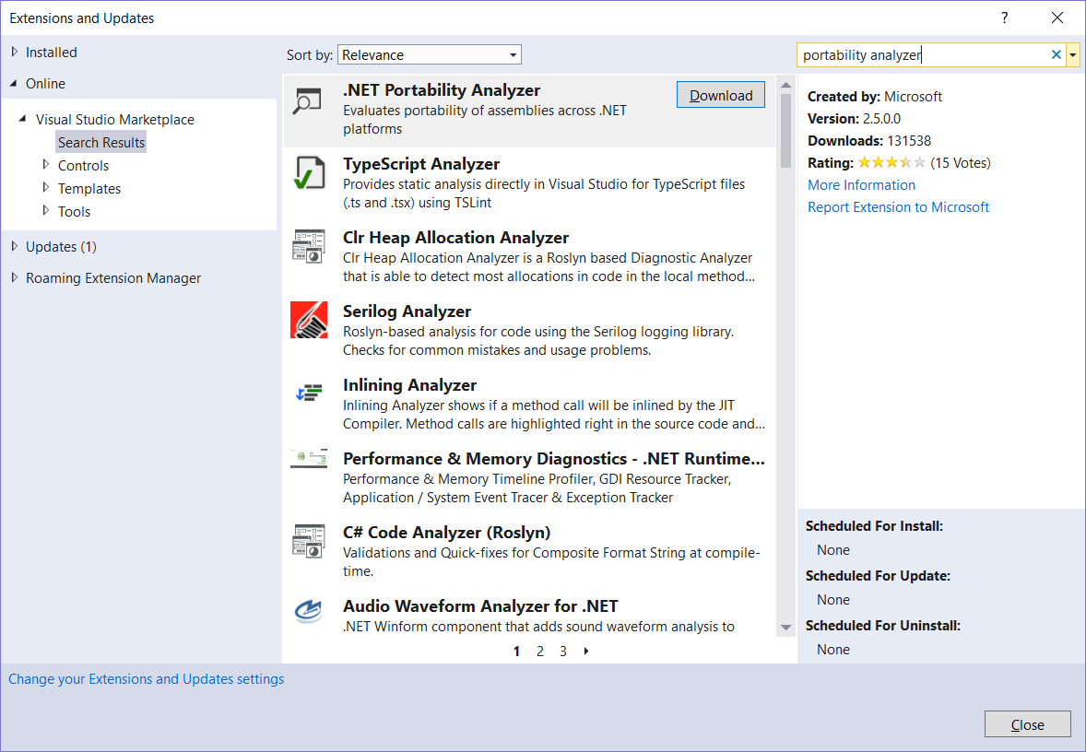
.NET Standard

Slide 49
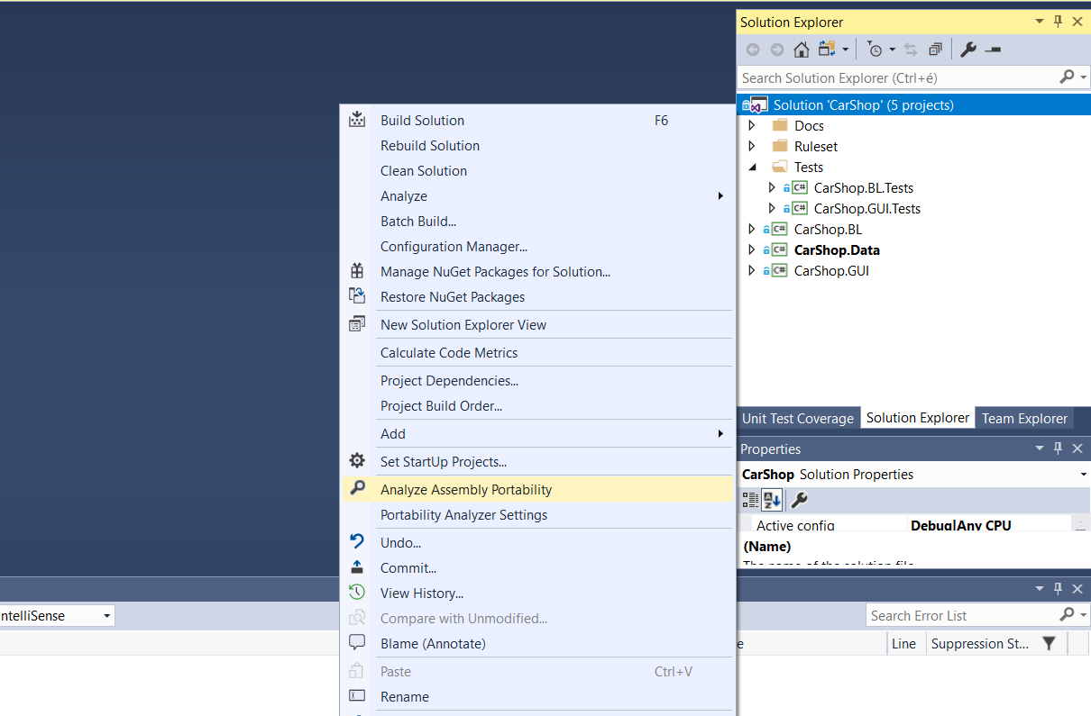
.NET Standard

Slide 50
.NET Standard

Slide 51
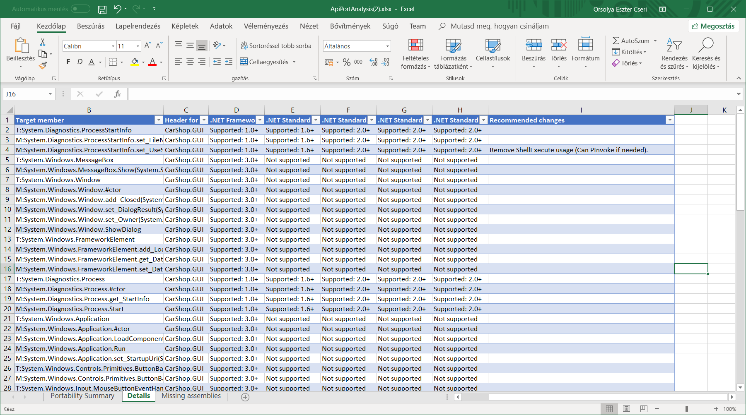
.NET Standard

Slide 52
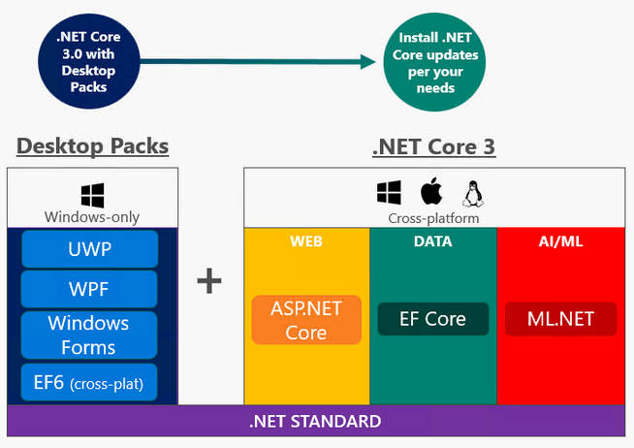
.NET Core 3…
.NET Core 3: 2019. SEP. 23.
WCF ➔ gRPC
WWF ➔ UiPath/coreWF
ASP Blazor: BETA
New Workload: Machine Learning/AI/Azure
New Workload: UI (Windows Forms, WPF, WinUI (ex UWP)), XAML islands
Platform-dependent UI technologies
Notes:
It will not replace .NET Framework. It just offers different use-cases than the .NET Framework.
Application host: emiatt tud a .NET Core több platformon is futni. Ez hosztolja a CLR-t és a libraryt, és a runtime által futtatja az appot.
A CLR is más, mint a .NET Framework-ben a CLR. Lightweight-ebb, crossplatform és cross-architecture (x86, x64, ARM CPU) módon fut az application host segítségével.
Filozófia: az app alapja lightweight, és komonenseket be lehet húzni nugettel
Workloadok
No ASP.NET Forms, mert annak a kontroljai a Windowshoz vannak kötve és a .NET Core crossplatform.
Ha installálok egy .NET Core-ot, akkor kapok egy AppHostot, CLR-t és Libraryt, együtt ezek futtatják az alkalmazásomat.
De a .NETCore installálása nélkül is tudunk .NETCore-os appot futtatni: self-contained. Minden komponenst hoznak magukkal, ami a futtatásukhoz szüksége
A .NEtCore console applicationja, elvileg csak egy dll-t csinál, amelyet a dotnet.exe futtat. csak a self-containednél van exe, ahol viszont meg kell mondani milyen platform(ok)ra akarom fordítani. A platformokra külön-külön kell lefordítani.s.

Slide 53
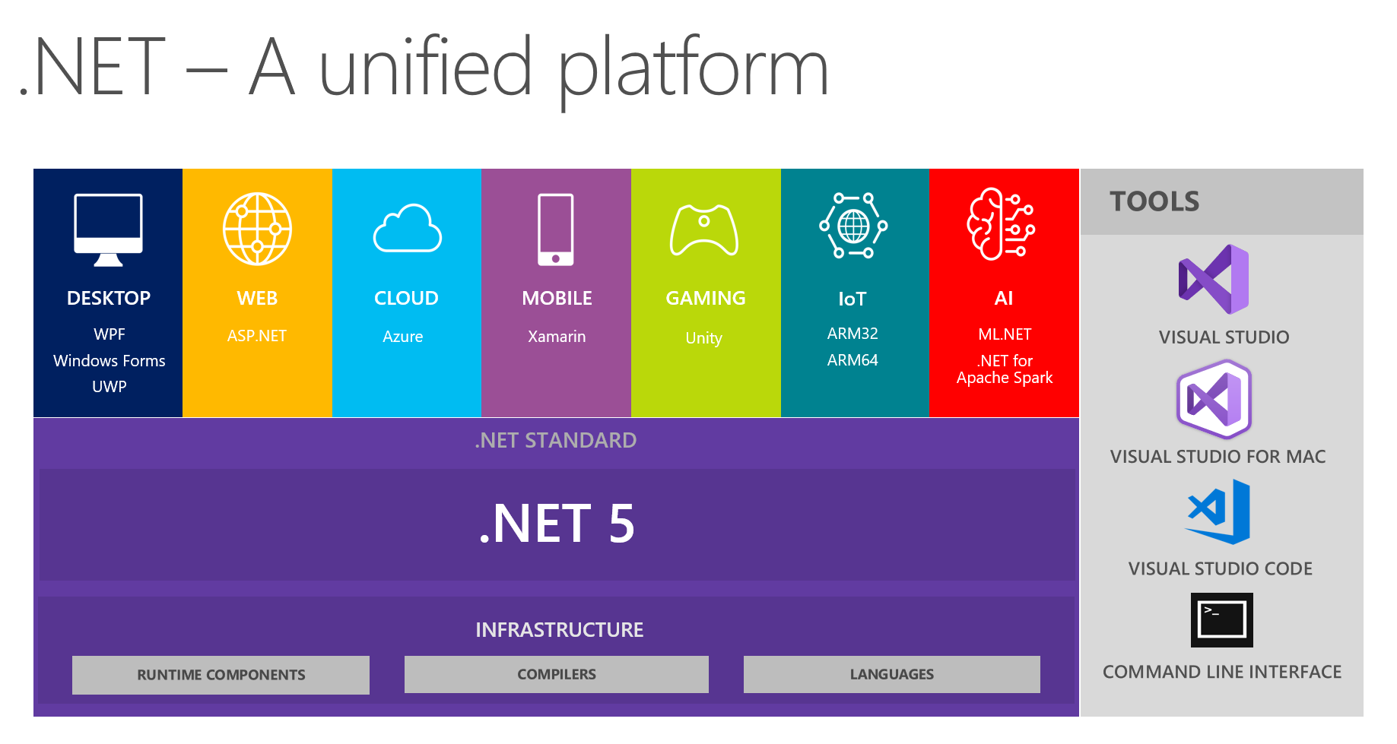
… and beyond
2019. November: .NET Core 3.1 (bugfix, LTS)
2020. November: .NET FRAMEWORK 5
2021. November: .NET 6, LTS

Slide 54
.NET 5 and C# 9
v5.0.0-preview.8 (2020.08.25 = „feature complete”) v5.0.0-rc.1 (2020.09.14)
https://devblogs.microsoft.com/dotnet/announcing-net-5-0-rc-1/
Init property accessors, Pattern matching (switch), Records, System.Text.Json
GetGCMemoryInfo() method to get detailed GC info
Better RyuJIT
https://docs.microsoft.com/en-us/ef/core/what-is-new/ef-core-5.0/whatsnew
Many-to-many, Better Migrations, Better Mapper, Better inheritance, Indexes, Easy Logging, [KeyLess]
https://github.com/dotnet/runtime/milestones
„99% complete, 15 open, 5,761 closed”
„Due by November 30, 2020”
https://www.dotnetconf.net/ ➔ November 10-12

Slide 55
Sources
https://www.red-gate.com/simple-talk/blogs/anatomy-of-a-net-assembly-pe-headers/
https://blog.takipi.com/clr-vs-jvm-how-the-battle-between-net-and-java-extends-to-the-vm-level/
https://en.wikipedia.org/wiki/Virtual_machine
Chris Farrell, Nick Harrison: Under the hood of .NET Memory Management, ISBN: 978-1-906434-74-8
http://www.informit.com/articles/article.aspx?p=1409801
https://msdn.microsoft.com/en-us/library/ms973837.aspx
https://msdn.microsoft.com/en-us/library/system.object.finalize(v=vs.71).aspx
https://docs.oracle.com/javase/9/gctuning/introduction-garbage-collection-tuning.htm#JSGCT-GUID-A48F272E-A6C1-45A0-9A8B-6D5790EB454C

