Slide 1
Advanced development techniques
Simple Unit Tests
NUnit
Notes:
1

Slide 2
„Testing = I will try it manually”

Slide 3
Automatic tests are required
Number of test cases?
>
2^n
…?
if (condition1)
{
// something happens
if (condition2)
{
// something happens
if (condition3)
{
// something happens
}
}
}
Random
exception
Can change condition3
Access to file/network
Uses user input
Database access
Projects are usually A LOT BIGGER than 3 blocks!
Automatic tests are developed during the development phase (“later” will mean “never”, so that is NOT an option!)
Notes:
Órai munka (150-300); féléves beadandó (CarShop 4841); 1 fős kisprojekt (n*10e); avg projekt (n*100e); nagy projekt

Slide 4
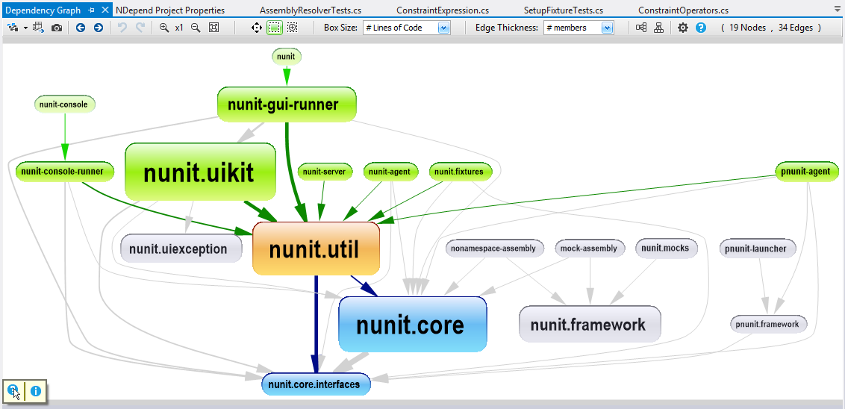
Different test types
UI tests
Integration tests
Component tests
Unit tests
(Names might differ from team to team)
DoSomething()
DoSomething()
DoSomething()
Notes:
Forrás: https://www.ndepend.com/docs/visual-studio-dependency-graph

Slide 5
„The tester will test the code”

Slide 6
Testing in the development work process
Testing moved closer to the implementation, because:
Gives us an earlier feedback
Protects the covered code against bugs introduced later by accident
Helps us in clearing up requirements
Enforces us to write clear and well-structured code
(In some approaches, testing is even done BEFORE coding)
„Agile crossfunctional team”
The team is responsible for all aspects of the product/functionality: planning, implementation, quality check, testing…
More and more the maintenance and the support is also included
The boundaries between the old roles are grey or missing – „crossfunctional team”

Slide 7
NUnit
Instead: unit test framework for .NET languages (Java: jUnit)
Part of a bigger family of utilities
Unit testing: NUnit (vs. Visual Studio Unit Testing Framework)
Mocking: NSubstitute (vs. Moq, Rhino Mocks)
IoC container: NInject (vs. Spring.Net, Castle Windsor, Unity)
Test coverage: NCover (vs. dotCover)
More widespread (…)
Better/readable syntax
Good for almost all different types of tests (Unit, Integration, Performance…)
GUI support
Command line Test Runner (Dotnet Core: beta)
Test Explorer inside VisualStudio (with NUnit3TestAdapter)
Notes:
Félkövér, amit megnézünk. Moq a következő órán.
Általában a fejlesztői közösség összeválogatja a toolkészletet, nem feltétlenül együtt használják az N... családot
NUnit nemigen különbözik az összes hasonló célú keretrendszertől, igazából tökmindegy, melyiket választják.

Slide 8
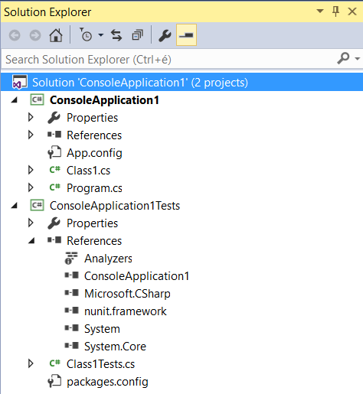
Simple unit test project
Live project(s) + test project(s) (Class Library)
References of the test project:
The project to be tested
Test framework
In the test project we want to test the public parts of the other project
Internal parts: [InternalsVisibleTo(„ConsoleApplication1Tests”)]
Class Library

Slide 9
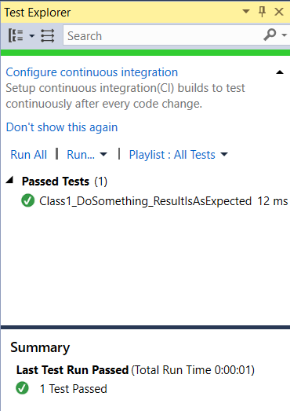
Simple unit test project
Test / Windows / Test Explorer
NUnit3TestAdapter required! (Nuget)
Depending on the development team and the tests, execute tests
always,
or after an important change in the code,
before/after a merge,
Before push ALWAYS.
NEVER PUSH NON-PASSING CODE!
Notes:
„ConsoleApplication1Tests” projektben, „Class1Tests” osztályban van ez a teszt.

Slide 10
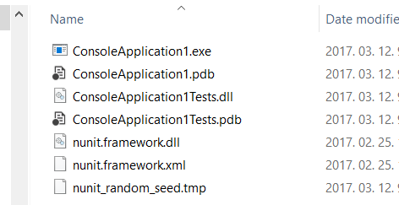
How does it work?
Reflection
Studio Test Explorer => NUnit
NUnit uses reflection to look for the [TestFixture] attribute in all classes in the solution (exe/dll)
The [TestFixture] class has methods marked with [Test], those methods are located via reflection
It interprets the additional configuration attributes ([TestCaseSource], [Explicit], ... ... ... ) that change the input/operation/…
Then the test methods are executed using reflection

Slide 11
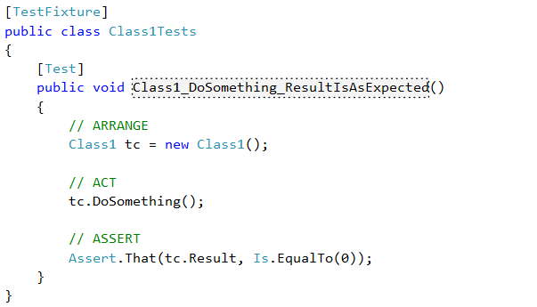
NUnit
Common test parts („AAA”)
Arrange: preparation, instance creation, setting values, etc.
Act: executing the single step that we want to test
Assert: comparing the actual result with the expected outcome of the call: result / state change / behaviour (exceptions, events) / circumstance (backend calls)
Given…When…Then()
Spec / SpecFlow (BDD)

Slide 12
NUnit
Lot of possibilities
// Values:
Assert.That(result, Is.EqualTo("MyResult"));
Assert.That(result, Is.Null);
Assert.That(result, Is.LessThan(2));
Assert.That(result, Is.SameAs(otherReferenceToTheSameObject));
Assert.That(result, Is.Not.Null); // Negate
// Exceptions:
Assert.That(() => t.MyTestedMethod(),
Throws.TypeOf<NullReferenceException>());
Assert.That(() => t.MyTestedMethod(), Throws.Nothing);
// Old syntax: (same, as Is.EqualTo)
Assert.AreEqual(result, 42);
Notes:
Assert.That után a második paraméterben mondatszerűen olvasható/írható („fluent”) szintaktika.
Volt egy régi szintaktika is, régi NUnit még csak ezt tudta (utolsó sor). Assert.AreEqual, Assert.AreSame, Assert.IsNull, Assert.IsNotNull ... stb.

Slide 13
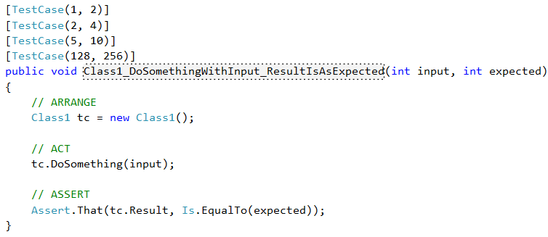
NUnit
An arbitrary number of arguments are possible in a test method – we have to use the same number of arguments in the TestCase attribute
Here we can use only constants -> TestCaseSource!
Similar:
[Sequential] – the input parameters are used sequentially
[Combinatorial] – The input parameters are taken with all possible combinations
[Pairwise] – optimized (results in smaller number of test cases)

Slide 14
NUnit
TestCaseSource
To use dynamically generated parameters for test cases
If wanted, can be used in alternative ways: instead of object[], we can use a TestCaseData descendant; instead of a property we can use a method/class...
public static IEnumerable<TestCaseData> MyTestCases
{
get
{
List<TestCaseData> testCases = new List<TestCaseData>();
for (int i = 0; i < 10; i++)
{
testCases.Add(new TestCaseData(new object[] { i, i * 2 }));
}
return testCases;
}
}
[TestCaseSource(nameof(MyTestCases))]
public void Class1_DoSomethingWithInput_ResultIsAsExpected(int input, int expected)
{
// ... Test method here ...
}

Slide 15
NUnit
[Setup]
The marked method will be executed before every single test or test case
[TearDown]
The marked method will be executed after every single test or test case
[TestFixtureSetUp] / [OneTimeSetUp]
The marked method will be executed once before the tests of a [TestFixture]
We can create common resources – look out, the tests must be independent!
[TestFixtureTearDown] / [OneTimeTearDown]
The marked method will be executed once after the tests of a [TestFixture]
[SetUpFixture]
Can be applied to a class, namespace-level setup/teardown
Notes:
OneTime... : NUnit 3.0-tól kezdve ez a neve

Slide 16
It is hard to write a good test!
The tests must be fast
Slow tests are impossible to run over and over again → test will not be executed, bugs will be found later
The tests must be independent
Order, timing, etc. must not affect the results
Naming convention must be easy-to-read
A good test list is basically a requirement-list that documents the capabilities of the program
We must not cover every possible inputs
Examples are good
Finding the corner cases are important!
Only test a single feature of a single class
Always independent from the live data (database/settings)
We can substitute the dependencies too: Dependency Injection + fake dependencies, mocking... (=> Moq)
Notes:
Ránézésre olvasható nevekkel: + ránézésre olvasható teszt is legyen
Az egymástól való függetlenítés miatt akár kódduplikáció is simán megengedett

Slide 17
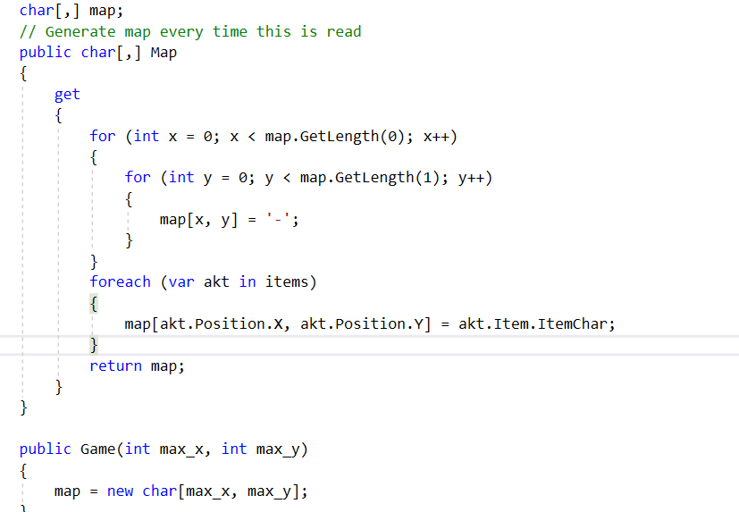
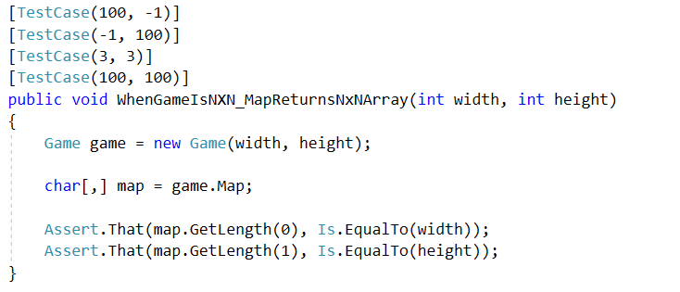
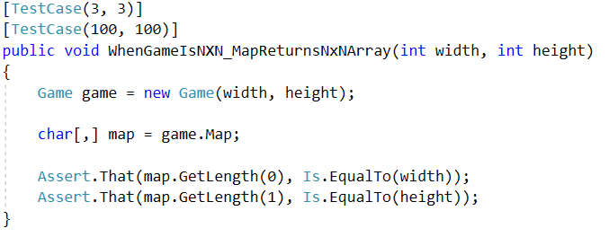
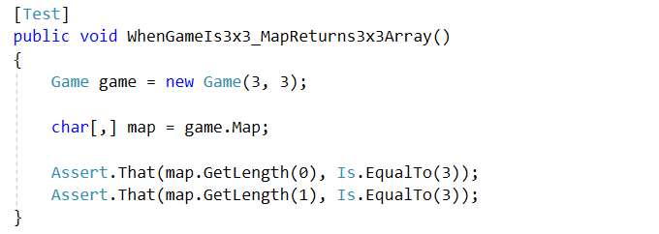
Test Cases – simple code?
if (max_x < 0 || max_y < 0) throw new ArgumentException("...");

Slide 18
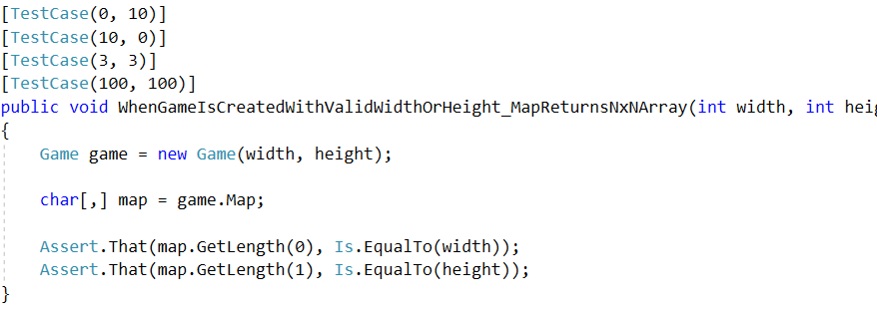
Test Cases – simple code?
if (max_x < 0 || max_y < 0) throw new ArgumentException("...");
if (max_x <= 0 || max_y <= 0) throw new ArgumentException("...");

Slide 19
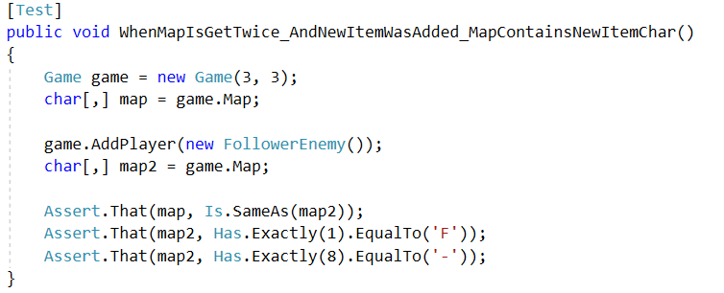
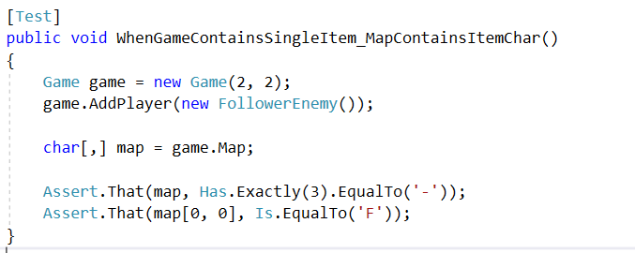
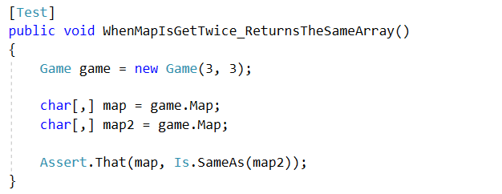
Test Cases – more complex code
// Warning – not a real unittest!
// Warning – not a real unittest!
if (max_x <= 0 || max_y <= 0) throw new ArgumentException("...");

Slide 20
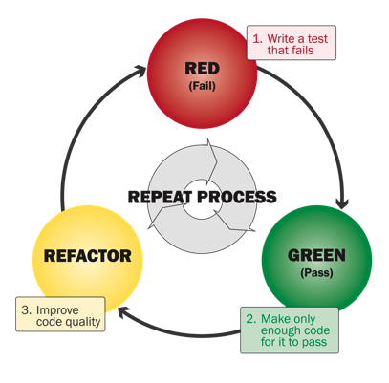
Testing while developing
First the code, then the test
Hard and not effective – also, “later” is many times “never”
Test First: create the tests first, then the code
The requirements must be fixed beforehand – they have to be cleared up first!
This also ensures keeping the operational requirements when re-writing
TDD (Test-Driven Development):
Done in pair programming
The code is written to be 100% “testable”
Development time: twice, but better quality
Not a generic all-around solution (typically good for the „algorithmic” tasks)
BDD, ATDD...
Notes:
„Nehéz, nem hatékony” : tipikusan sokszori kódmódosítást igényel utólag a tesztelhetőség biztosítása, vagy csak kis coverage lesz.
TDD: Egyszerre egy tesztet írnak (pirosra), majd úgy alakítják a kódot, hogy csak azt + az addig már megírt teszteket teljesítse. Utána refaktorálnak a tesztek zölden tartása mellett
TDD gyakorlása: http://www.cyber-dojo.org

Slide 21
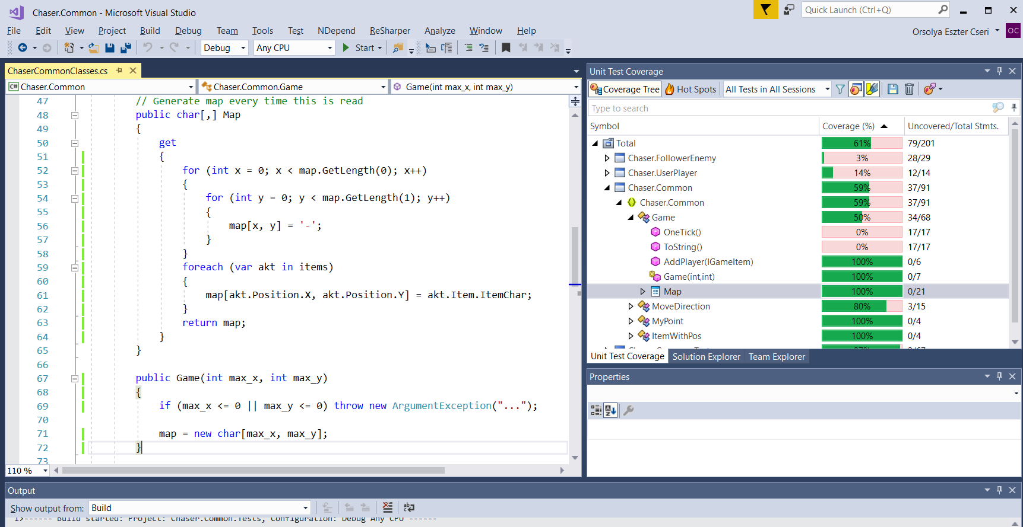
Coverage
dotCover
NCover
OpenCover
Notes:
Code coverage is collected by using a specialized tool to instrument the binaries to add tracing calls and run a full set of automated tests against the instrumented product. A good tool will give you not only the percentage of the code that is executed, but also will allow you to drill into the data and see exactly which lines of code were executed during a particular test.

Slide 22
Coverage
Usually there is a minimum, but also a maximum (don’t aim the 100%, and also don’t be content if the coverage is 100%)
More important measurements
Statement Coverage: statements (if, while, for – excluded)
Branch Coverage: Conditions (if, else)
Condition Coverage: Every bool expression had true and false as well
Loop Coverage: Every loop was executed 0x, 1x and >1x, and if possible, then with the maximum limit and max+1 as well
Parameter Value Coverage: All significant values (e.g. string null, empty, whitespace…)
Inheritance Coverage: test for all possible return types
Use case coverage
Notes:
ust remember, having "100% code-coverage" doesn't mean everything is tested completely - while it means every line of code is tested, it doesn't mean they are tested under every (common) situation..
I would use code-coverage to highlight bits of code that I should probably write tests for. For example, if whatever code-coverage tool shows myImportantFunction() isn't executed while running my current unit-tests, they should probably be improved.
Basically, 100% code-coverage doesn't mean your code is perfect. Use it as a guide to write more comprehensive (unit-)tests.
Condition coverage: All boolean expressions to be evaluated for true and false.
Decision coverage: Not just boolean expressions to be evaluated for true and false once, but to cover all subsequent if-elseif-else body.
Loop Coverage: means, has every possible loop been executed one time, more than once and zero time. Also, if we have assumption on max limit, then, if feasible, test maximum limit times and, one more than maximum limit times.
Entry and Exit Coverage: Test for all possible call and its return value.
Parameter Value Coverage (PVC). To check if all possible values for a parameter are tested. For example, a string could be any of these commonly: a) null, b) empty, c) whitespace (space, tabs, new line), d) valid string, e) invalid string, f) single-byte string, g) double-byte string. Failure to test each possible parameter value may leave a bug. Testing only one of these could result in 100% code coverage as each line is covered, but as only one of seven options are tested, means, only 14.2% coverage of parameter value.
Inheritance Coverage: In case of object oriented source, when returning a derived object referred by base class, coverage to evaluate, if sibling object is returned, should be tested.

Slide 23
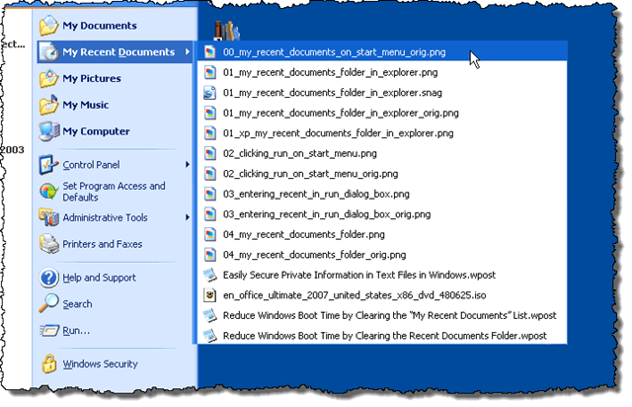
Exercise
Create a class that implements the Last Recently Used (LRU) functionality
The class contains a list with a maximum capacity, and must have a public void Add(object instance) method
During the development, follow the TDD approach
Create an „it barely works” class
Write tests until we run into a red test
Fix the class to make the test green, then write tests…

Slide 24
Practice Exercise
A bookshop wants to sell a 5-part book series. One copy of any of the five books costs 8 EUR. Discounts:
2 different books → 5% discount on those two books.
3 different books → 10% discount on all three books.
4 different books → 20% discount on all four books.
5 different books → 25% discount on all five books
If you buy, four books, of which 3 are different titles, you get a 10% discount on the 3 that form part of a set, but the fourth book still costs 8 EUR:
1, 2, 3, 1 => (1, 2, 3) 10% discount, (1) 0% discount => 3x7.2 + 8 = 29.6
Some „baskets” can be grouped multiple ways!
1, 1, 2, 2, 3, 3, 4, 5 => (1, 2, 3, 4, 5) (1, 2, 3) or (1, 2, 3, 4) (1, 2, 3, 5) ?
Write a class (and tests) to calculate the price of a “basket”
Grouping using the most simple way (always create the biggest group, even if this might not be the cheapest price)

