Slide 1
Advanced development techniques
Dependency Injection
Test Doubles, Moq
Notes:
1

Slide 2
„Testing = I will try it manually”

Slide 3
„The tester will test the code”

Slide 4
It is hard to write a good test!
The tests must be fast
Slow tests are impossible to run over and over again → test will not be executed, bugs will be found later
The tests must be independent
Order, timing, etc. must not affect the results
Naming convention must be easy-to-read
A good test list is basically a requirement-list that documents the capabilities of the program
We must not cover every possible inputs
Examples are good
Finding the corner cases are important!
Only test a single feature of a single class
Always independent from the live data (database/settings)
We can substitute the dependencies too: Dependency Injection + fake dependencies, mocking... (=> Moq)
Notes:
Ránézésre olvasható nevekkel: + ránézésre olvasható teszt is legyen
Az egymástól való függetlenítés miatt akár kódduplikáció is simán megengedett

Slide 5
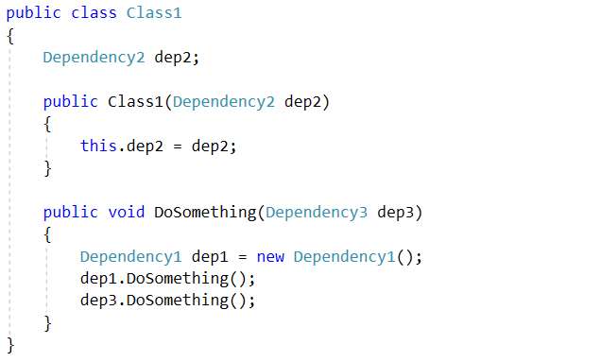
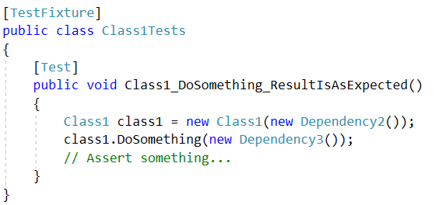
Warning – not a real unittest!

Slide 6
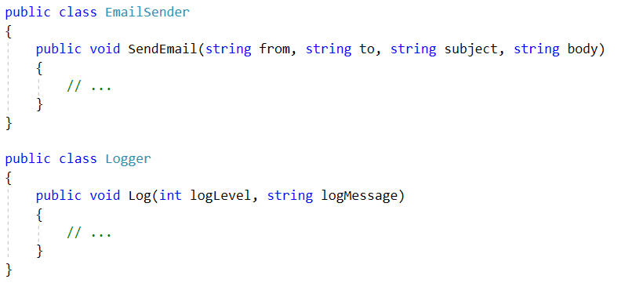
Example

Slide 7
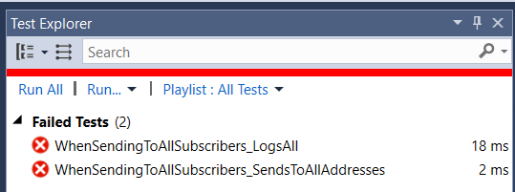
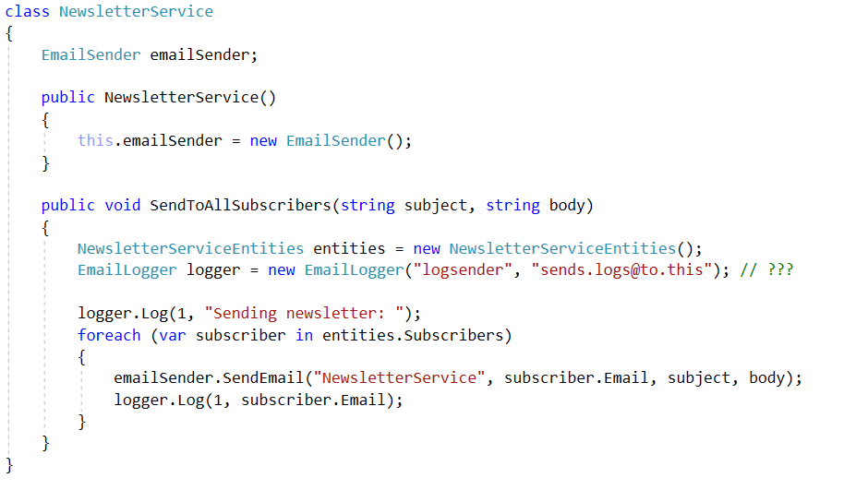
Aim: Refactoring
Tight coupling
Refactoring = changing the structure of the code without modifying the behavior of the class/method/product
Refactoring for testability

Slide 8
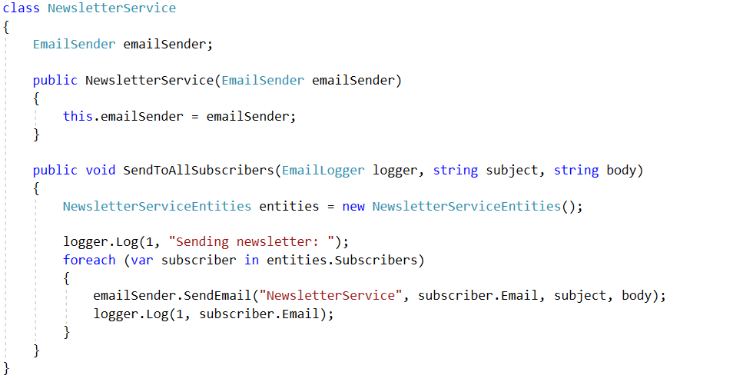
1. Using parameters

Slide 9
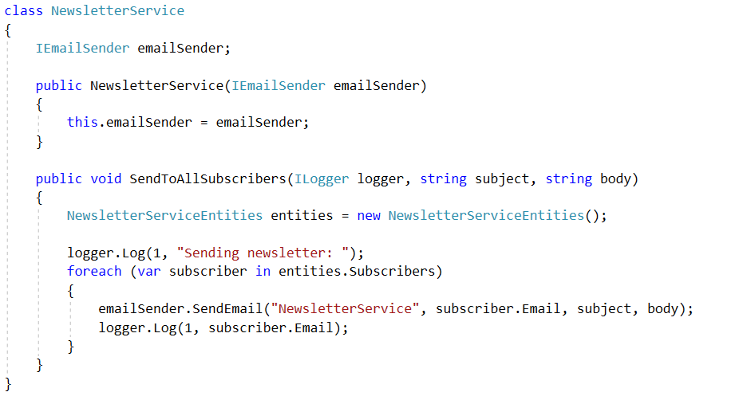
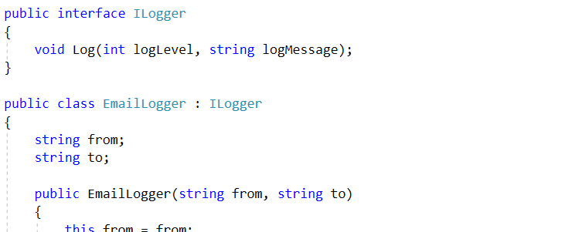
2. Interface-typed parameters

Slide 10
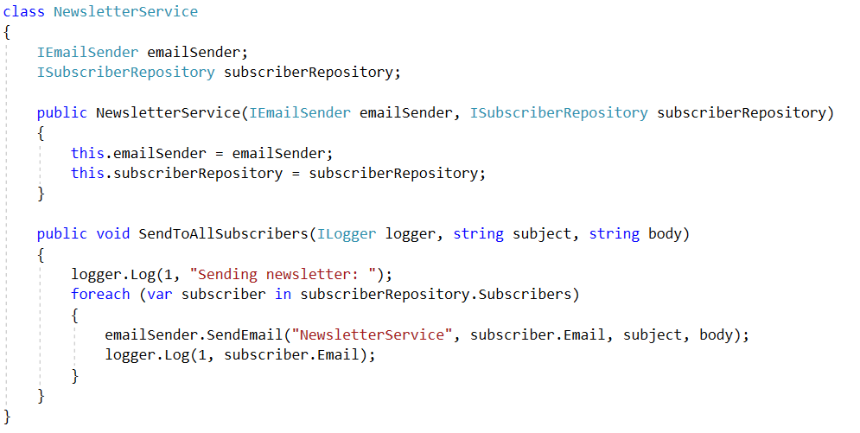
3. Avoid hidden dependencies
Loose coupling
!!! Dependency Injection !!!

Slide 11
Constructor Injection
interface IMyDependency
{
string DoSomething();
}
class MyClass
{
private IMyDependency dependency;
public MyClass(IMyDependency dependency)
{
this.dependency = dependency;
}
// in methods: dependency.DoSomething()
}
// usage
IMyDependency myDependency; // assignment, instance creation...
MyClass myClass = new MyClass(myDependency);

Slide 12
Method Injection, Setter Injection
class MyClass
{
public void DoSomethingUsingDependency(IMyDependency dependency)
{
// ... dependency.DoSomething() ...
}
}
class MyClass
{
public IMyDependency Dependency { get; set; }
// in the methods: dependency.DoSomething()
}
Constructor Injection – common, if the dependency is required multiple times
Method Injection – common, in case of a one-time requirement
Setter Injection – rare
Must check always: is set?
Even harder in multi-threaded environment

Slide 13
Dependency Injection
„
I give you dependency injection for five-year-olds.
When you go and get things out of the refrigerator for yourself, you can cause problems. You might leave the door open, you might get something Mommy or Daddy doesn't want you to have. You might even be looking for something we don't even have or which has expired.
What you should be doing is stating a need, "I need something to drink with lunch," and then we will make sure you have something when you sit down to eat.
” https://stackoverflow.com/questions/1638919/how-to-explain-dependency-injection-to-a-5-year-old/1638961#1638961
(Injection vs Inversion, In this semester we only need the Injection)

Slide 14
Dependency Injection
We provide the dependencies of the classes externally – via interfaces, which allows us
To exchange the dependency later at any time to another class – while keeping the interface
To perform “truly” independent individual unit-tests
When testing, we replace the dependency with a known and simple object solely created for the tests
The class will be independent from the dependency
Speed: we use a simple class representing only the tested methods instead of a complex logic
Independent: 1 test ➔ 1 exchange-object, usable for all operations
Various techniques: Dummy, Stub, Spy, Fake, Mock: Same interface, different philosophy
Notes:
A DI nem (elsősorban) teszt célú dolog, de a tesztelhetőség egy lényeges előny. A DI-t teljesen betartó kód írása bonyolult, a Main()-nek ismernie kéne minden függőséget? => IoC containerek

Slide 15
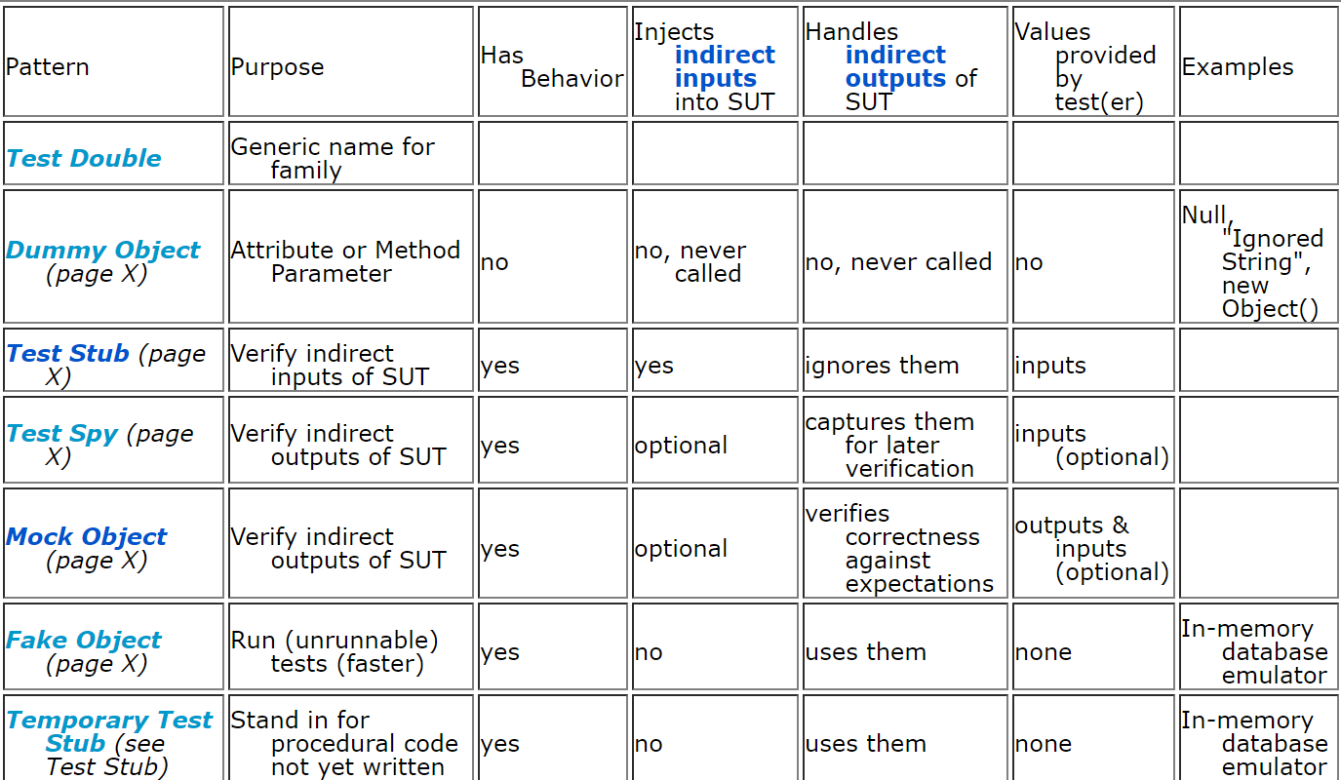
Test doubles
Forrás: http://xunitpatterns.com/Mocks,%20Fakes,%20Stubs%20and%20Dummies.html
Notes:
http://xunitpatterns.com/Mocks,%20Fakes,%20Stubs%20and%20Dummies.html

Slide 16
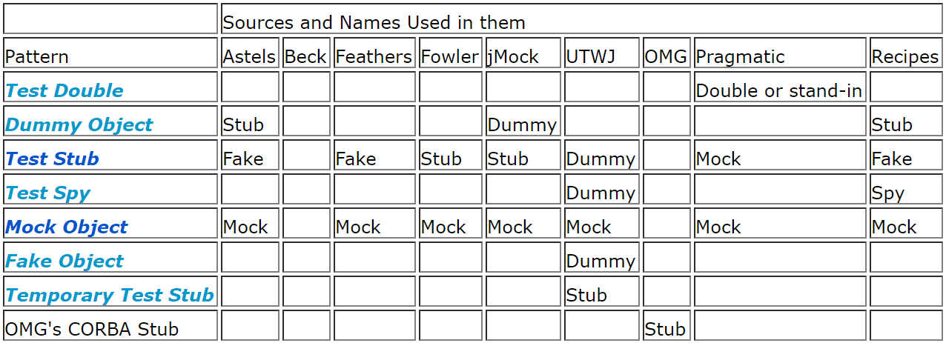
Test doubles
Astels = David Astels: Test-Driven Development - A practical guide
Beck = Kent Beck: Test-Driven Development By Example
Feathers = Michael Feathers: Working Effectively with Legacy Code
Fowler = Martin Fowler: Mocks are Stubs
jMock = Steve Freeman, Tim Mackinnon, Nat Pryce, Joe Walnes: Mock Roles, Not Objects
UTWJ = Morgan Kaufmann: Unit Testing With Java
OMG = Object Management Group's CORBA specs
Pragmatic = Andy Hunt, Dave Thomas: Pragmatic Unit Testing with Nunit
Recipes = J.B.Rainsberger: JUnit Recipes
Notes:
Forrás: http://xunitpatterns.com/Mocks,%20Fakes,%20Stubs%20and%20Dummies.html

Slide 17
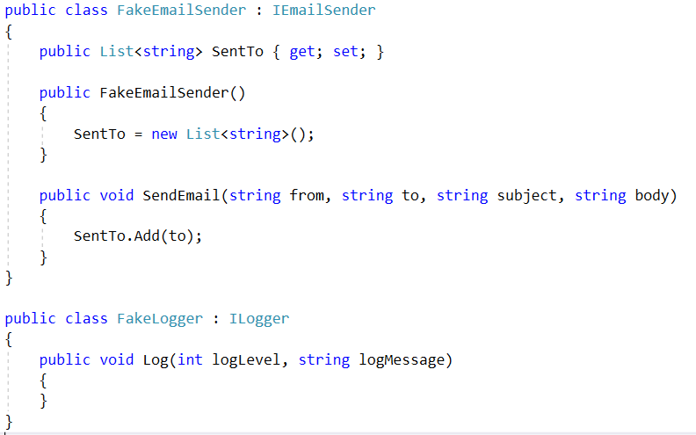
Fake
Implements the same interface as the substituted object, but it implements an intentionally simplified logic with different “target”

Slide 18
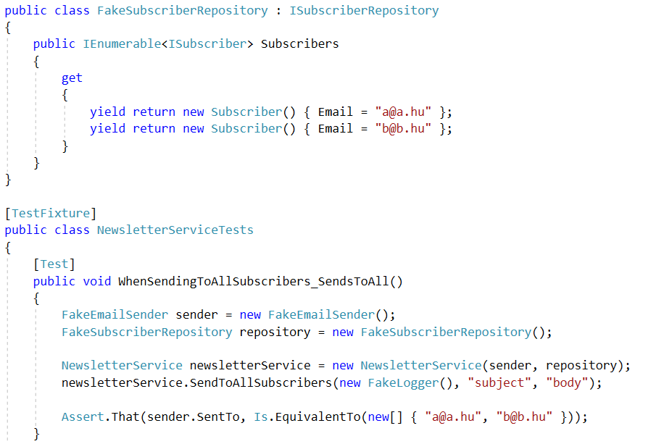
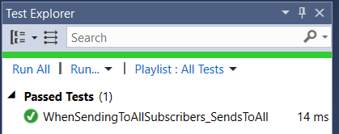
Fake
Fake Repository ➔ too much code, hard to make a universal fake

Slide 19
Mock
„Partially” implement an interface with a substitute object – no logic, fixed data
Usually we use a Mocking framework
Due to the professional Mocking frameworks, the boundaries between mock, fake, stub etc. is very gray
Mocks can be used as fakes (without expectation checks)
One of the most widespread .NET Mocking Framework: Moq
ONLY interface can be mocked (even if the newer Moq can mock classes)
Gives us ways to observe the logic that is executed
Expectations: „the DoSomething() method was called once”
Mock<IEmailSender> mockMailSender = new Mock<IEmailSender>();
// Setup the expected behavior of the mock...
NewsletterService service = new NewsletterService(mockMailSender.Object);

Slide 20
Mock
Create an interface implementation without a real class
Methods are callable by default, no exception is thrown, default is returned (MockBehavior.Loose vs Strict)
The properties are readable/writeable, but the values are not remembered
Use the .Setup/.SetupAllProperties method to change the behavior
We can create different mocks for different test cases
We only have to setup the required operations with the appropriate data
Mock<ISubscriberRepository> repositoryMock = new Mock<ISubscriberRepository>();
Mock<IEmailSender> senderMock = new Mock<IEmailSender>();
// Setup the behavior of the mock
repositoryMock.Setup(m => m.Subscribers).Returns(expectedSubscribers);
repositoryMock.Setup(m => m.Subscribers).Returns(Enumerable.Empty<Subscriber>());
repositoryMock.Setup(m => m.Subscribers).Throws<NullReferenceException>();
senderMock.Setup(
m => m.SendEmail("a@a.hu", "to", "subject", "body")).Returns(true);
senderMock.Setup(
m => m.SendEmail(null, It.IsAny<string>(), It.IsAny<string>(), It.IsAny<string>()))
.Throws<NullReferenceException>();
Notes:
ARRANGE fázisban csinálod ezt. A fenti Setup-ok egyszerre nyilván nem fognak működni, csak példák. Ha egyszer setupoltál, akkor csak a konkrétan megadott módokon tudod hívni a függvényt, különben exception!!!

Slide 21
Testing with a mock (after Setup)
// ARRANGE
Mock<IEmployeeBusinessLogic> mbl = new Mock<IEmployeeBusinessLogic>();
// ... Call .Setup() for the required methods/properties
// ACT ...
// ASSERT
// Called once with a@a.hu
senderMock.Verify(
m => m.SendEmail("a@a.hu", It.IsAny<string>(), It.IsAny<string>(), It.IsAny<string>()),
Times.Once);
// Never called with null
senderMock.Verify(
m => m.SendEmail(null, It.IsAny<string>(), It.IsAny<string>(), It.IsAny<string>()),
Times.Never);
// Zero logs with bigger than one first parameter
loggerMock.Verify(
m => m.Log(It.Is<int>(i => i > 1), It.IsAny<string>()), Times.Never);
Notes:
ASSERT fázisban csinálod ezt

Slide 22
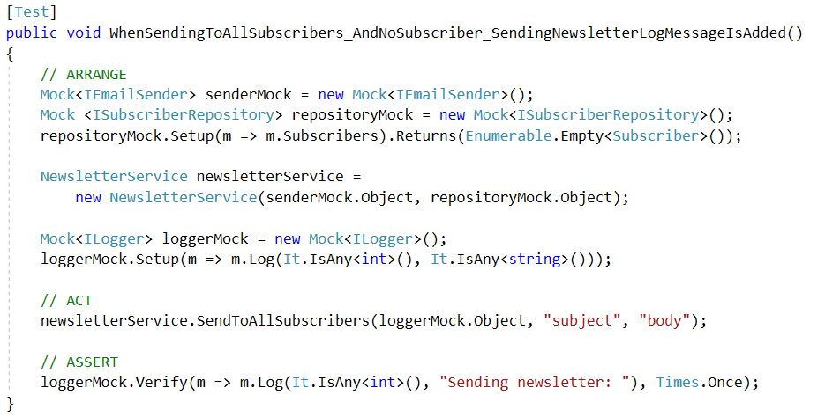
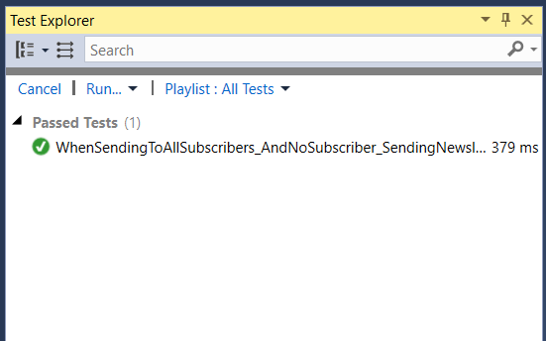
Testing with a mock

Slide 23
Testability Code Smells
References/parameters with class-typed variables
Refactor to interface-typed variables
new()
Refactor to use DI (usually a Factory pattern)
DI: too many parameters
The class is responsible for too many things, refactor/split
Or: merge the parameters into one class
Usage of static methods and variables (Singleton pattern)
Refactor to use instances
Too much/too long static helper methods
This is not OO, refactor to nonstatic class
User interaction mixed with logic
Separate them, refactor to separated classes (Humble Object pattern)
Database, file IO, resources all mixed with logic…
Separate them, refactor to classes (Repository, Humble Object pattern)
Too many mocks created in one test
Too many responsibilities, refactor/split
Direct access to mock.Object ➔ FORBIDDEN
Notes:
“A code smell is a surface indication that usually corresponds to a deeper problem in the system.” ~ Martin Fowler

Slide 24
Exercise
Create a business logic for the Cars and Brands tables
Access the data using a Repository
Create the interfaces that describe the expected repository operations
The logic should be capable of filtering for a brand and calculate the averages for brands
To test the logic, do NOT access the real database!
Using Moq, during the Arrange phase create a mocked repository
The data access method of the repository should return data suitable for the current test case
During the test, we should check if the logic returns with good values, and also that it correctly uses the data access methods of the repository

