Slide 1
Advanced development techniques
Fundamentals of parallel execution
Processes
Threads
Tasks
Async/Await
Thread synchronization

Slide 2
Advanced development techniques
Fundamentals of parallel execution
Processes
Threads
Tasks
Async/Await
Thread synchronization

Slide 3
Fundamentals of parallel execution
The Neumann-based computers are executing programs in a purely sequential way
To execute multiple programs simultaneously
More than one CPUs / cores
Hyperthreading
Time sharing
Number of concurrent operations > number of execution units
Separation of “concurrently” executing programs
Processes: high-level separation
One program (or a set of resources used by a program task)
Separated memory area
When faults, only that process is damaged (not the others, nor the OS)
No simple way for InterProcess Communication
Threads: low-level separation
Parallelism inside the processes
Partially shared memory area for threads in one process
P₁ process
T₁₃ thread
T₁₁ thread
T₁₂ thread
Notes:
A Hyper-threading a processzor bizonyos részeinek megduplázásával működik – azoknak a részeknek, amelyek a processzor állapotát tartalmazzák – ugyanakkor a fő számítási erőforrásokból egy marad. Így egy hyper-threadinggel ellátott processzor egy extra "logikai" processzort tartalmaz. Azok az operációs rendszerek, amelyek nincsenek felkészítve a hyper-threadingre, két különálló processzorként látják. Ez lehetővé teszi, hogy az operációs rendszer két szálat ütemezzen be futtatásra. A processzor átállhat a másik szál végrehajtására, ha az egyik szál végrehajtása valamilyen okból áll. Tipikus ilyen okok lehetnek a gyorsítótár-tévesztés, hibás előrejelzések vagy adatfüggőség.
Ez a technológia az operációs rendszer és a felhasználói programok számára transzparens. A felhasználásához az operációs rendszernek csak több processzort kell tudnia kezelni, mivel a logikai processzor fizikai processzornak látszik.
A folyamatok adminisztrációja és váltása igen erőforrásigényes művelet, viszont az általuk nyújtott elszigetelés szintje egy programon belül csaknem mindig szükségtelen. Ezt az ellentmondást oldják fel a szálak, amelyek elszigetelést nem nyújtanak, gyors párhuzamos végrehajtást azonban igen.

Slide 4
Time sharing
P₁ process
P₂ process
Interrupt / system call
Running state
Ready or Standby
Save state (PCB₁)
Restore state (PCB₂)
Ready or Standby
Running state
Interrupt / system call
Save state (PCB₂)
Restore state (PCB₁)
Ready or Standby
Running state
Original image © 2000-2005 David A. Solomon and Mark Russinovich
this figure is generic (DOS/Unix/Windows) and overly simplified; in Windows the base unit of the parallel execution is the thread

Slide 5
.NET processes, threads, AppDomain
In the .NET framework the processes are equivalents with the OS processes
System.Diagnostics.Process, System.Diagnostics.ProcessStartInfo
The .NET threads are (currently) equivalent with the OS threads
It is not limited to this – one OS thread could execute multiple .NET threads
In .NET there is an additional level from in-process parallelism, the „application domain” for multiple processes
The managed programs are supervised by the framework, so they cannot affect each other negatively
Thus, there is no need for truly executing some as physically separate processes
Due to speed and memory requirements, it can be advantageous (the creation and maintaining of processes takes up many CPU and memory resources)
Not in our schedule

Slide 6
Advanced development techniques
Fundamentals of parallel execution
Processes
Threads
Tasks
Async/Await
Thread synchronization

Slide 7
Processes (fragment)
System.Diagnostics.Process class
Methods
Start()
CloseMainWindow() | Only with GUI processes
Kill()
GetCurrentProcess()
GetProcesses() | List of all processes
WaitForExit()
Properties
StartInfo | The assigned ProcessStartInfo instance
PriorityClass
EnableRaisingEvents
HasExited
ExitCode, ExitTime
StandardInput, StandardOutput | Streams
Events
Exited
Notes:
Összefoglalás: új processzek egyszerű vezérlése (létrehozás, leállítás), ill. processzekről/ből információnyerésre.

Slide 8
Processes (fragment)
System.Diagnostics.ProcessStartInfo class
Properties
FileName | Executable (on its own or using its associated program)
Arguments, WorkingDirectory
Domain, UserName, Password
RedirectStandardInput, RedirectStandardOutput | Redirect the specified stream?
ErrorDialog | True/false, if the execution fails
UseShellExecute | Use the OS shell execute method (Advantage: more clever execution, independent execution. Disadvantage: cannot read output)
Verb | Examples of verbs are "Edit", "Open", "OpenAsReadOnly", "Print", and "Printto"
WindowStyle | Initial window size (minimized, maximized)
Notes:
Számos paraméter és beállítás adható meg a folyamatként elindítani kívánt programhoz
UseShellExecute: shell indítást használjuk-e? Ha igen, akkor: nem kell hogy futtatható állomány legyen (nem futtathatót a társított programmal indít el; mint kettős kattintás a windows explorerben). ErrorDialog csak így megy. Ha UseShellExecute==false, akkor csak futtatható indítható, ÉS megengedi a RedirectStandardInput/Output/Errort. Teljes elérési út kell.

Slide 9
Example: new process
using System;
using System.Diagnostics;
class Program
{
static void Main()
{
Process newProcess = new Process();
newProcess.StartInfo = new ProcessStartInfo("hello.exe", "Joe");
newProcess.StartInfo.ErrorDialog = true;
newProcess.StartInfo.UseShellExecute = false;
newProcess.StartInfo.RedirectStandardOutput = true;
newProcess.Start();
newProcess.WaitForExit();
Console.WriteLine("The messages from the new process:");
Console.Write(newProcess.StandardOutput.ReadToEnd());
Console.ReadLine();
}
}
1
2
3
4
5
6
7
8
9
10
11
12
13
14
15
16
17
18
19
20
21
22

Slide 10
Exercises
Create a console application that executes an arbitrary number of traceroute (tracert) processes so the individual calls do not block the main application
Use the netstat command’s output to list the currently opened network communication channels for an arbitrary process

Slide 11
Advanced development techniques
Fundamentals of parallel execution
Processes
Threads
Tasks
Async/Await
Thread synchronization

Slide 12
Possibilities for multi-threaded processing
Asynchronous method call (not in our schedule)
We can call delegates and special methods supporting this pattern
Thread class
Low-level management of threads
Simple (simply “execute this method in another thread”), but requires lots of accuracy and planning (Concurrency? Return values?)
ThreadPool class (not in our schedule)
There is a set/pool of threads waiting for usage
No need for individually creating/destroying threads
Simple and very efficient, but lacks functionality (e.g. thread identification)
BackgroundWorker class (not in our schedule)
Typically used to separate the UI thread from long operations
Very limited functionality
TPL / Task class
High-level thread management, unified API with high functionality
TPL / Parallel class
Data-parallel execution, Parallel loops
Async/Await (not in the practices)
Notes:
Threadpool vs task: http://stackoverflow.com/questions/9200573/threadpool-queueuserworkitem-vs-task-factory-startnew

Slide 13
Threads (fragment)
System.Threading.Thread class
Methods
Start()
Suspend(), Resume()
Abort() | Rarely used
GetHashCode() | Usable for identification
Sleep() | Wait a given timespan
Join() | Wait for a thread to finish
Properties
CurrentCulture, CurrentUICulture
IsBackground | The execution of a program is finished when the last foreground thread is finished (the background threads are aborted)
IsThreadPoolThread
ManagedThreadID
Name
Priority
ThreadState

Slide 14
System.Threading.Thread example
1
2
3
4
5
6
7
8
9
10
11
12
13
14
15
16
17
18
19
20
21
22
23
using System;
using System.Threading;
class Program
{
static void Main(string[] args)
{
Console.WriteLine("Now we create a thread");
Console.WriteLine("Main thread ({0})", Thread.CurrentThread.GetHashCode());
Thread newThread = new Thread(ThreadMethod);
newThread.Name = "NewThread";
newThread.Start();
newThread.Join();
}
static void ThreadMethod()
{
Console.WriteLine("{0} (ID: {1})",
Thread.CurrentThread.Name,
Thread.CurrentThread.GetHashCode());
}
}
Notes:
Megj. hívjátok fel a figyelmet, hogy a kód nem jó (Start(), Join() egymás utáni sorokban egyből ki is nyírja a párhuzamosságot)

Slide 15
Exercise
Create a console application that is capable of measuring the speed of a webpage throughout 10 seconds by executing System.Net.WebClient().DownloadString(url) calls in separate threads
Create a console application that is capable of concurrently downloading several RSS feeds and looking for user-specified keywords in them.

Slide 16
Advanced development techniques
Fundamentals of parallel execution
Processes
Threads
Tasks
Async/Await
Thread synchronization

Slide 17
Single threading / Multi threading?
Multi-threading is essential for the responsiveness of the program / OS, but...
It is expensive (depending on the OS)
Thread overhead < process overhead, especially in Windows OS
Memory allocated for each thread:
Stack, thread context (stb.)
Context changes → Increased number of “cache miss” events
There are lots of context changes, lots of cache miss events...
Every managed DLL is notified when creating/destroying a thread
Dll_Main(DLL_THREAD_ATTACH), Dll_Main(DLL_THREAD_DETACH) calls
powerpnt.exe 147 dll!!!! ... VS 2012: 183 dll...
Wasted CPU time:
Management of the time sharing
Ideally: number of active threads = number of cores
You never know the ideal number of threads!!!
Notes:
Konklúzió: alapos előny/hátrány mérlegelés után használjuk csak

Slide 18
Task
Older solution: ThreadPool
There are pre-assigned threads that can have work items
The number of pre-assigned threads depends on the system load / usage
Disadvantages:
Individual threads are not accessible (ready? priority?)
No support for returning values
The Task instances are (usually) mapped to the ThreadPool threads by the TaskScheduler
In case of long operations, independent threads will be created
Pre-defined API for all of the aforementioned shortcomings
static void Main(string[] args)
{
ThreadPool.QueueUserWorkItem(ComputeBoundOp, 5);
}
private static void ComputeBoundOp(object state)
{ /* Long running operation */ }
Notes:
Mindkét hátrány megkerülhető, de kellemetlenek.
When a thread calls the Wait method, the system checks if the Task that the
thread is waiting for has started executing. If it has, then the thread calling Wait will block
until the Task has completed running. But if the Task has not started executing yet, then
the system may (depending on the TaskScheduler) execute the Task by using the thread
that called Wait. If this happens, then the thread calling Wait does not block; it executes
the Task and returns immediately.
To help you
detect unobserved exceptions, you can register a callback method with TaskScheduler’s
static UnobservedTaskException event.
The task infrastructure is very flexible, and TaskScheduler objects are a big part of this flexibility. A
TaskScheduler object is responsible for executing scheduled tasks and also exposes task information
to the Visual Studio debugger. The FCL ships with two TaskScheduler-derived types: the thread
pool task scheduler and a synchronization context task scheduler. By default, all applications use the
thread pool task scheduler. This task scheduler schedules tasks to the thread pool’s worker threads
and is discussed in more detail in this chapter’s “How the Thread Pool Manages Its Threads” section.
You can get a reference to the default task scheduler by querying TaskScheduler’s static Default
property.
The synchronization context task scheduler is typically used for applications sporting a graphical
user interface, such as Windows Forms, Windows Presentation Foundation (WPF), Silverlight, and
Windows Store applications. This task scheduler schedules all tasks onto the application’s GUI thread
so that all the task code can successfully update UI components like buttons, menu items, and so on.
The synchronization context task scheduler does not use the thread pool at all. You can get a reference
to a synchronization context task scheduler by querying TaskScheduler’s static FromCurrentSynchronizationContext
method.

Slide 19
Regular threads vs. Tasks
Task advantages (“impossible” thread operations)
Parameter handling In Thread: nothing or object, always typecast In Task: custom type(s), compiler supported
Returned-value handling In Thread: nothing, difficult to return value to the main thread In Task: Task vs Task<T>
Detection of end-of-operation, continue with other operation In Thread: usually with events, hard to synchronize In Task: continuation, continue with a new Task
Exception handling In Thread: thread dies, not trivial to handle in other thread In Task: can be handled when reading the result or with continuation
Async/Await: language-integrated parallelism – only with Task
Notes:
A szál extrém hosszú műveletet végez (pl. az alkalmazás teljes élettartama alatt futnia kell)
Ebben amúgy nem vagyok biztos, hogy még most is így van, lásd LongRunning (ilyenkor nem threadpoolra teszi). De mindenesere ilyenkor nem árt meg a nem Task szál.
Abort: _azonnali_ kinyírása a szálnak, ez a tasknál nincs, csak cancel. Mellesleg threadeknél meg egyebeknél is nagyon ellenjavallt az abort.
You need the thread to run with a non-normal thread priority. All thread pool threads run at
normal priority. Although you can change this, it is not recommended, and the priority change
does not persist across thread pool operations.
■■ You need the thread to behave as a foreground thread, thereby preventing the application
from dying until the thread has completed its task. For more information, see the ”Foreground
Threads vs. Background Threads” section later in this chapter. Thread pool threads are always
background threads, and they may not complete their task if the CLR wants to terminate the
process.
■■ The compute-bound task is extremely long-running; this way, I would not be taxing the thread
pool’s logic as it tries to figure out whether to create an additional thread.
■■ You want to start a thread and possibly abort it prematurely by calling Thread’s Abort
method (discussed in Chapter 22, “CLR Hosting and AppDomains”).

Slide 20
Regular threads vs. Tasks
Use regular threads if:
When the thread must run with non-default priority – every ThreadPool thread has normal priority … Usually not a problem
The usage of the immediate Abort() is required – NEVER EVER!
The thread performs an extremely long operation (e.g. Throughout the execution of the application) – TaskCreationOptions.LongRunning
A foreground thread is necessary – every ThreadPool thread is a background thread –THE ONLY VALID REASON!
(almost) ALWAYS use Task instances!
Notes:
A szál extrém hosszú műveletet végez (pl. az alkalmazás teljes élettartama alatt futnia kell)
Ebben amúgy nem vagyok biztos, hogy még most is így van, lásd LongRunning (ilyenkor nem threadpoolra teszi). De mindenesere ilyenkor nem árt meg a nem Task szál.
Abort: _azonnali_ kinyírása a szálnak, ez a tasknál nincs, csak cancel. Mellesleg threadeknél meg egyebeknél is nagyon ellenjavallt az abort.
You need the thread to run with a non-normal thread priority. All thread pool threads run at
normal priority. Although you can change this, it is not recommended, and the priority change
does not persist across thread pool operations.
■■ You need the thread to behave as a foreground thread, thereby preventing the application
from dying until the thread has completed its task. For more information, see the ”Foreground
Threads vs. Background Threads” section later in this chapter. Thread pool threads are always
background threads, and they may not complete their task if the CLR wants to terminate the
process.
■■ The compute-bound task is extremely long-running; this way, I would not be taxing the thread
pool’s logic as it tries to figure out whether to create an additional thread.
■■ You want to start a thread and possibly abort it prematurely by calling Thread’s Abort
method (discussed in Chapter 22, “CLR Hosting and AppDomains”).

Slide 21
Creation of a new Task
Not necessary on a separate thread – the TaskScheduler decides
Many different ways, same result but different parameters
new Task: Action or Action<object>; Task.Run: only Action!
Creating a new Task with return value:
Reading the Result property is a blocking operation, so we should not access it directly after creating the Task
Exceptions occurring during the task execution are re-thrown
new Task(LongOperation).Start();
new Task(LongOperationWithParam, 15).Start();
Task t = Task.Run(() => LongOperation()); //.NET 4.5
Task t = Task.Run(() => LongOperationWithParam(15)); //.NET 4.5
Task t = new TaskFactory().StartNew(LongOperation);
Task<int> task = new Task<int>(LongOperationWithReturnValue);
task.Start(); // Func<Tresult> !
// ... Other operations ...
int result = task.Result;
Console.WriteLine(result);
Notes:
Factory-s megoldásnak sok-sok overloadja van. Valamint egy factory-t felparaméterezhetünk, ahogy akarunk, és az adott paraméterekkel indíthatunk akár több darab Taskot is. (A példa nem mutatja meg ennek a kihasználását)
Task.Run, new segítségével is lehet visszatérési értékkel rendelkező Taskot indítani.

Slide 22
Waiting for Tasks
In any cases, when we need to wait for the completion of one or more operations (e.g. Result calculation, filling arrays, setting values, file I/O…)
Warning: all of these are blocking calls
Solution: Task “Continuation”s
task.Wait(); //wait for a single Task (blocking)
Task.WaitAll(taskArray); //wait for all Tasks (blocking)
Task.WaitAny(taskArray); //wait for at least one Task (blocking)
//or
Task.WaitAll(task1, task2, task3); //same as above
Task.WaitAny(task1, task2, task3); //same as above

Slide 23
Continuations
After the completion of a Task, execute another (where ”t” is a reference to the previous Task)
Conditional continuations:
Task<int> continuedTask = new Task<int>(LongOperationWithReturnValue);
//non-blocking:
continuedTask.ContinueWith(t => Console.WriteLine("The result was: " +
t.Result));
//only if successful completion:
continuedTask.ContinueWith(t => Console.WriteLine("The result was: " +
t.Result),
TaskContinuationOptions.OnlyOnRanToCompletion);
//only if the first Task was canceled:
continuedTask.ContinueWith(t => Console.WriteLine("The task was canceled!"),
TaskContinuationOptions.OnlyOnCanceled);
//only if the first Task was halted because of an Exception :
continuedTask.ContinueWith(t => Console.WriteLine("The task threw " +
"an exception: " + t.Exception.InnerException),
TaskContinuationOptions.OnlyOnFaulted);

Slide 24
Error handling
If there is an Exception in a Task, it is not raised
When calling for Wait() or reading the Result, an AggregateException is thrown
One Task can have multiple children Tasks, thus the multiple Exceptions
There is an InnerExceptions property, that is a collection for the actual Exception instances
Task<int> taskWithException =
new Task<int>(LongOperationWithReturnValueAndException);
taskWithException.Start();
try
{
result = taskWithException.Result;
}
catch (AggregateException ex)
{
foreach (Exception innerException in ex.InnerExceptions)
Console.WriteLine(ex.Message);
}
Notes:
Érdekes még, és ha akarod, mutasd meg: ex.Handle(). Bár van rá példa a cancelnél később!
https://msdn.microsoft.com/en-us/library/dd537614%28v=vs.110%29.aspx

Slide 25
Error handling
Another possibility, with a conditional continuation:
Task taskWithContinuation = new Task(LongOperationWithException);
taskWithContinuation.ContinueWith((t) =>
{
Console.WriteLine("THERE WAS AN EXCEPTION: {0}", t.Exception.Message);
},
TaskContinuationOptions.OnlyOnFaulted);
taskWithContinuation.Start();

Slide 26
Canceling a Task
No abort! The code must handle the cancel requests
Requests are done using a CancellationToken
Possible usages:
cancellationToken.IsCancellationRequested: bool property. If true, we must return from the Task method
cancellationToken.ThrowIfCancellationRequested(): an Exception is thrown (thus, quits the Task method)
Advantage: the Exception clearly shows that the Task was forcibly canceled
static void CancellableLongOperation(CancellationToken cancellationToken)
{
for (int i = 0; i < 100; i++)
{
cancellationToken.ThrowIfCancellationRequested();
Thread.Sleep(100);
}
}
static void CancellableLongOperation(CancellationToken cancellationToken)
{
for (int i = 0; i < 100 && !cancellationToken.IsCancellationRequested; i++)
{
Thread.Sleep(100);
}
}
Notes:
The Microsoft .NET Framework offers a standard pattern for canceling operations. This pattern is
cooperative, meaning that the operation that you want to cancel has to explicitly support being canceled.

Slide 27
Canceling a Task
CancellationTokenSource source = new CancellationTokenSource();
Task taskWithCancel = Task.Run(() => CancellableLongOperation(source.Token),
source.Token);
source.Cancel();
try
{
taskWithCancel.Wait();
}
catch (AggregateException ex)
{
ex.Handle(e => e is OperationCanceledException);
Console.WriteLine(“The operation was aborted.");
}
ex.Handle marks the inner exception as handled if the condition is true
If there is any other exception, a new exception is thrown
If there is no other exceptions => the Console.WriteLine() is executed
We can use CancellationToken.None to disable the cancellation

Slide 28
Exercises
Measure the download speeds of multiple websites http://microsoft.com, http://bing.com, http://google.com, http://uni-obuda.hu, http://baidu.com
Measure the size & number of files of multiple directories

Slide 29
Advanced development techniques
Fundamentals of parallel execution
Processes
Threads
Tasks
Async/Await
Thread synchronization

Slide 30
Language-Level Parallelisation
Add automatic parallelisation into the language itself
Parallel loops: Parallel.Invoke, Parallel.For, Parallel.ForEach
Parallel LINQ
Keywords for parallelization: async/await
Principle: the developer should not…
Create physical threads ➔ create tasks
Create actual work items (tasks) ➔ use automatic parallel loops
Know about parallel execution at all ➔ use automatic async/await
Even if we use simpler and simpler parallel execution models, synchronization is something we still have to worry about
Deadlock
Race Condition
Starvation
Must use thread/process-level synchronization methods
➔ see later

Slide 31
Parallel (source: Joe Albahari)
Parallel.Invoke
ParallelOptions: CancellationToken, MaxDegreeOfParallelism, TaskScheduler
Parallel.For
Parallel.ForEach
The execution order in these loops is NOT deterministic, we can only use them if we do not care about the execution order
It is not guaranteed that the parallel loop will be faster

Slide 32
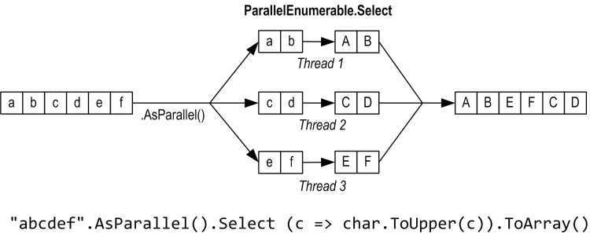
Parallel Linq (source: Joe Albahari)
Move special methods that affect automatic threading to the beginning of the LINQ query from item in collection ➔ from item in collection.AsParallel()
.AsParallel() / .AsSequential() / .AsParallel().WithDegreeOfParallelism(6)
.AsOrdered() / .AsUnordered()

Slide 33
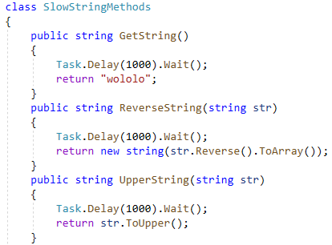
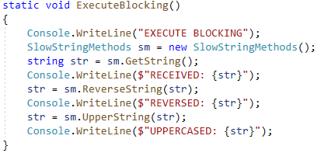
Async/Await
Assume we have long operations, with blocking calls:

Slide 34
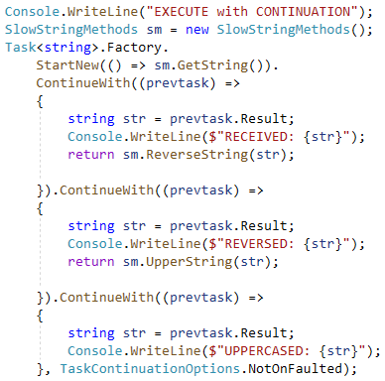
With Continuation

Slide 35
Continuation?
Continuation makes code hard to read, async/await keywords are simple syntax gems to make prettier code from continuations
They do not add anything extra!
async = method modifier, ‘this method can contain await keywords’
await = statement prefix, ‘this statement should not block the main thread’
CODE1 await LONG OPERATION WRAPPED IN A TASK
CODE2
CODE1
new Task(LONG OPERATION).ContinueWith(CODE2)

Slide 36
Without continuation ➔ async/await

Slide 37
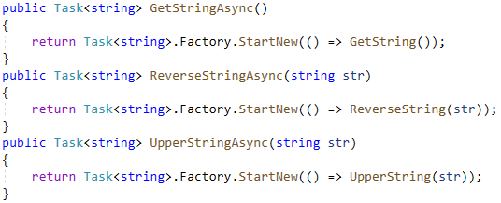
Wrapping slow operations in Tasks
If a class knows that operations might take long to finish, then it is advised to wrap those methods into tasks WITHIN the class
This way, the async/await code will be A LOT prettier
Inside the class, this can be done very easily: HttpClient, WCF …

Slide 38
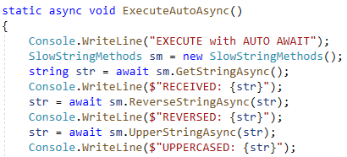
Language-integrated parallelisation

Slide 39
Advanced development techniques
Fundamentals of parallel execution
Processes
Threads
Tasks
Async/Await
Thread synchronization

Slide 40
Problems in multi-threaded environment
Race Condition
To facilitate the communication between threads, we need some resources (memory/variables, ports, IO devices, files) that are accessible by all threads
However, when multiple threads access these simultaneously, the result can be bad data or incomplete results
This usually depends on the exact timing of the parallel threads ➔ unpredictable result, hard to detect
Deadlock
A thread is waiting for a resource that will never be available
Typically: two or more threads are waiting for each other, thus none will step forward
Starvation
A thread is waiting for a data that will never/rarely be available
Typically: one thread is slower than the other, thus the performance is nowhere near the estimated maximum
Notes:
Live lock occurs when threads continually conflict with each other and back off.

Slide 41
Race condition
We have to be careful whenever different threads access the same memory: same variables, non-thread-safe collections
Simple operations: mathematical operators, collection add/remove
Common resource: console (WriteLine is threadsafe, SetForegroundColor + WriteLine is not!)
Common resource: files for writing (reading is not a problem)
Types: threadsafe vs non-threadsafe types, it is mentioned in every manual page
Unpredictable behavior
E.g. in queue, items might be lost
In Dictionary, a NullReferenceException might be thrown
In WebClient, a custom exception might be thrown

Slide 42
Race condition
One command != One instruction, a simple language construct can lead to a race condition bug!
X++
Read + Increment + WriteBack
X += 2
Read + Increment + WriteBack
A[i] += 1
Index + Read + Increment + WriteBack
If multiple threads are accessing different indices, then no problem
Multiple commands can have the same vulnerability
if (!list.Contains(key))
list.Add(key);
Source: http://www.drdobbs.com/tools/avoiding-classic-threading-problems/231000499
Other thread can insert the same key

Slide 43
Race condition
 | Thread 1 | Thread 2
Original code | t = x x = t + 1 | u = x x = u + 2
Possible outcome #1 | (x is 0) t = x x = t + 1 (x is 1) | u = x x = u + 2 (x is 2)
Possible outcome #2 | t = x x = t + 1 | (x is 0) u = x x = u + 2 (x is 2)
Possible outcome #3 | (x is 0) t = x x = t + 1 (x is 1) | u = x x = u + 2 (x is 3)

Slide 44
Avoiding race condition and deadlocks
Race condition: if multiple threads are accessing the same data
If possible, avoid using the same instance from multiple threads (not easy, especially with classes... Use value types OR different thread-assigned instances if possible)
If this is not avoidable, then we have to use synchronization: two threads should not write the same instance at the same time
In non-threadsafe types, simply accessing the instances from multiple threads is forbidden too
No need for synchronization if there is maximum one writer-thread (if all threads are read-only, then no problem. If only one writer: results might be non up-to-date, but usually it is not a problem)

Slide 45
Synchronization
We have to ensure that some operations are not executed in a parallel way; some sections must be “exclusive” / “Interlocked” / “atomic”
Several possible ways (we only need: lock / Monitor / Interlocked)
Very problematic area of multithreading
Requires lots of attention
Extremely error-prone
Hard to test – some errors are very rare, some errors will not appear on every configuration (often we have a deadlock hidden in a race condition)
Developer machines are less affected (developers “know” how to use the application, and developer machines are stronger/less infected)
User feedback is only “It got stuck” “Where?” “When I was using it”
Slow
Bad effect on parallelism, if threads have to wait a lot...
It is possible that the multithreaded version will be slower than the sequential; but surely it will be far away from the theoretical maximum

Slide 46
Synchronization
Critical section
Marked sections of the code cannot be overlapped even if executed in multi-threaded environments. .NET classes: System.Threading.Monitor (= C# „lock” statement), System.Threading.Mutex, System.Threading.ReaderWriterLock, etc.
The lock keyword calls Monitor.Enter at the start of the block and Monitor.Exit at the end of the block.
In general, avoid locking on a public type, or instances beyond your code's control. The common constructs lock (this), lock (typeof (MyType)), and lock ("myLock") violate this guideline
Interlocked execution
Some simple operations have atomic versions. Uses references for operations, very fast, no need of lock
.NET class: System.Threading.Interlocked
Notes:
A lista nem teljes. Sztem ezen még pontosítani kéne.

Slide 47
Synchronization (not needed)
Semaphore
Generalization of the lock statement (in case of multiple-instance resources, it can allow the execution of multiple threads, if needed).
.NET class: System.Threading.Semaphore
Pipe, concurrent collections
R/W storages that implement concurrent access
.NET classes: in System.Collections.Concurrent
Events
Advanced timing, one thread can notify the other that it is done.
.NET classes: System.Threading.AutoResetEvent, System.Threading.ManualResetEvent etc.
Timers
Relative or absolute timing.
.NET classes: System.Windows.Forms.Timer, System.Timers.Timer, System.Threading.Timer etc.
Notes:
Event: Ez NEM a szokott .NET „esemény”-fogalom!
Timerből már illene említeni a DispatcherTimer-t is, ezért inkább kivettem a táblázatot. Már a számok se biztos, hogy igazak azóta.
Időzítők jellemzői
Windows.Forms.Timer
Timers.Timer
Threading.Timer
Pontosság
~10 ms
~100 ns (!)
~1 ms
Futtatás saját szálon
–
+
+
Csak egyszeri aktiválás
–
+
+
Beállítható első aktiválás
–
–
+
Vizuális komponens
+
–
–
Platformfüggetlen
–
–
+

Slide 48
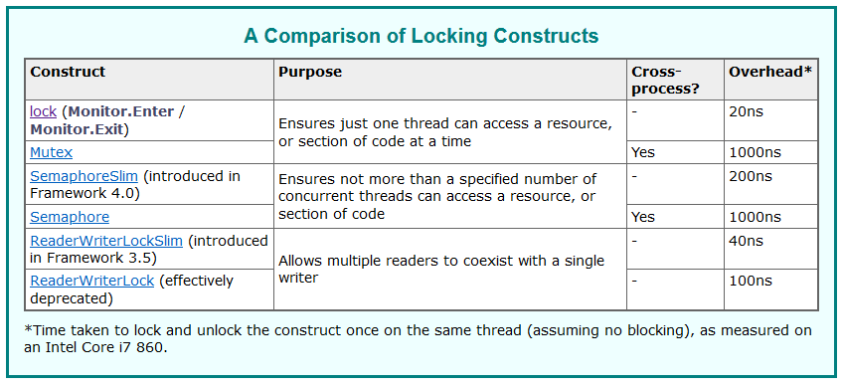
Joe Albahari http://www.albahari.com/threading/

Slide 49
Deadlock
Cause:
Two threads are both waiting for the other one to complete
Possible with processes too (e.g. processes waiting for each other)
No built-in solution (THINK before coding, or when you run into one…)
Classic deadlock (when using lock)
Thread1: ...Something1... lock (obj) ( ... Something2 ... } ...Something3... Thread2: ...Something4... lock (obj) { ... Something5 ... } ...Something6...
Something2 and Something5 MUST NOT be executed at the same time (because the same object is used for lock
Thread2 will wait at the lock statement until Thread1 finishes Something2, and vice versa … But what if…
lock (b)
{
// something
lock (a)
{
// something
}
}
lock (a)
{
// something
lock (b)
{
// something
}
}
Thread 2
Thread 1

Slide 50
Exercises
Let’s demonstrate the classic Producer/Consumer problem: One thread should Enqueue a work item, the other thread should Dequeue a work item
Since multiple threads are using the same queue, we have to use lock (or: ConcurrentQueue, which is a little different, because of the TryDequeue())
In our case, work item = characters
... Later, let’s write a multithreaded prime locator
… using the most automated way possible

Slide 51
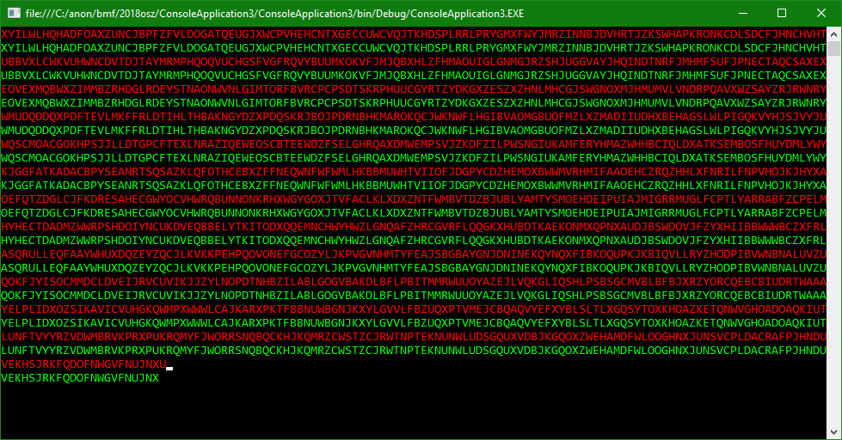
Solution

