Slide 1
Advanced development techniques
Data-encoding methods
Network data sharing methods
SOAP, REST

Slide 2

Serverside programming
Client (browser)
Server
REQUEST
ACCEPT
URL address
SEARCH FILE
PARSE FILE
DISPLAY
GENERATE
REPLY
SEND

Slide 3
GET/POST
https://www.google.hu/search?biw=1356&bih=780&tbm=isch&sa=1&ei=Co8IWu-4JIee6ASd-rC4DA&q=get+request+php&oq=get+request+php&gs_l=psy-ab.3..0i24k1.31945.32304.0.32490.4.4.0.0.0.0.137.457.2j2.4.0....0...1.1.64.psy-ab..0.4.456...0i19k1j0i30i19k1j0i5i30i19k1j0i8i30i19k1.0.E0Bilc-HLVE#imgrc=avXEoB6d96FGaM
[protocol]://[web_server_host_ip]/[file]?
action=sendEmail&action2=thenDelete
Variable
Variable

Slide 4
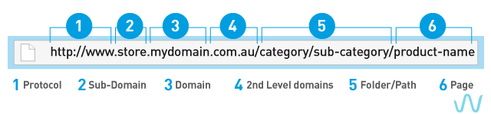
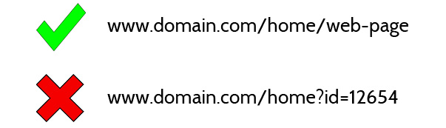
SEO

Slide 5
Web services
Traditional input: GET/POST/SESSION/COOKIES
(extra input: nowadays the other HTTP methods are used too)
Regular output: HTML
Many times we don’t want to download a simple file, but we want to execute a method/ask for special data
Aim: do this in a simple, platform and language-independent way!
First question: data encoding
Second question: data transfer

Slide 6
Low-level data encoding
Language dependent – From the most simple type
bool
  „Encode as string” vs „Binary encoding”
  If string: 0/F/False/FALSE/HAMIS? If binary: how many bits?
int/long
  „Encode as string” vs „Binary encoding”
  If binary: MSB first vs LSB first?
float/double
  „Encode as string” vs „Binary encoding”
  If string: decimal separator, normalized or not?
string/char
  In modern high-level languages (C#, Java) usually fixed and well defined encoding (UTF8 / Unicode)
  In less modern high-level languages (PHP) usually fixed, with strange behavior (e.g. strtoupper vs mb_strtoupper)
  In low level languages (C++) arbitrary encoding and LOTS of weirdness (char[], char*, wchar_t*, std::string, std::wstring, QString, CString, fbstring)

Slide 7
Encoding more complex data - XML
<?xml version="1.0"?>
<bookstore>
<book category="COOKING">
<title lang="en">Everyday Italian</title>
<author>Giada De Laurentiis</author>
<year>2005</year>
<price>30.00</price>
</book>
<book category="WEB">
<title lang="en">Learning XML</title>
<author>Erik T. Ray</author>
<year>2003</year>
<price>39.95</price>
</book>
</bookstore>
Strict format
XML declaration + XML nodes + XML attributes
Can encode anything!
„Encode as string”
Any encoding (UTF8!!!)
Schema/DTD is possible, advised

Slide 8
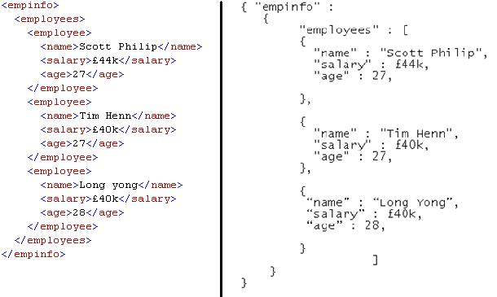
Encoding more complex data - JSON
No schema = more flexible (schema is possible nowadays)
„Encode as string”
UTF8 encoding, not obligatory, not defined

Slide 9
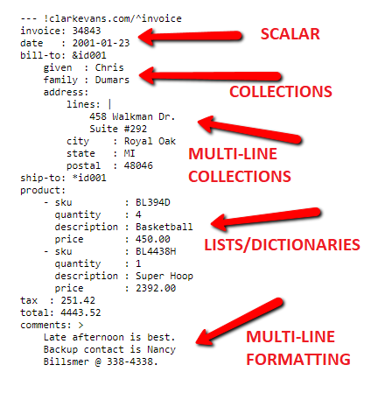
Encoding more complex data - YAML
Rarely used: ROS, PHP Symfony, Amazon AWS
Schema is not possible
„Encode as string”, UTF8 encoding recommended

Slide 10
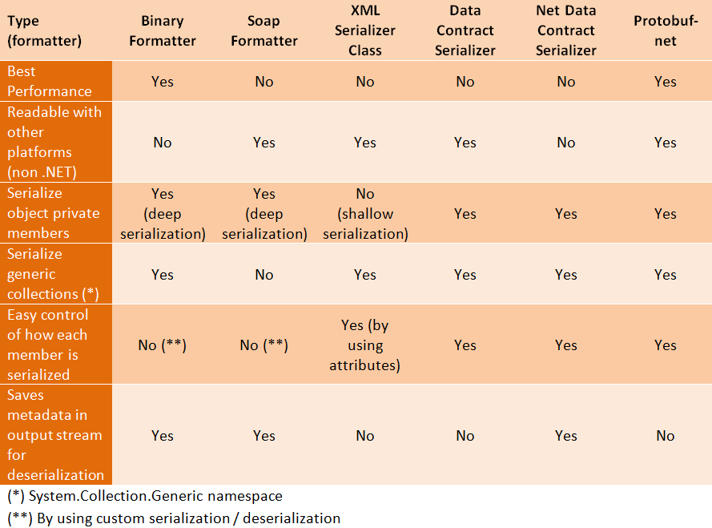
Encoding more complex data - serialization

Slide 11
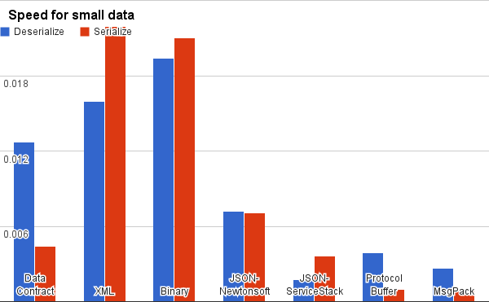
Serialization - speed
Notes:
https://maxondev.com/serialization-performance-comparison-c-net-formats-frameworks-xmldatacontractserializer-xmlserializer-binaryformatter-json-newtonsoft-servicestack-text/

Slide 12
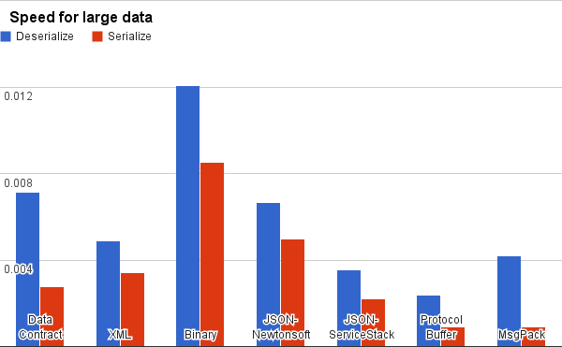
Serialization - speed
Notes:
https://maxondev.com/serialization-performance-comparison-c-net-formats-frameworks-xmldatacontractserializer-xmlserializer-binaryformatter-json-newtonsoft-servicestack-text/

Slide 13
Data transfer – Low level
TCP/UDP: reliable and ordered stream OR quicker/smaller datagrams
„Encode as binary”
Every case, encoding, format has to be manually treated
(e.g.: I want to call GetModelExtras method with the car that has the brand „BMW”, the model is „i8”. As a result, I need the list of extras ➔ every encoding is custom)
 | TCP/UDP
Overhead (format) | SMALL (binary)
Overhead (comm) | SMALL (raw tcp/udp)
MS/C# specific | NO
Complex types? | NO (manual)
Code generation | NO
Webserver needed | NO
Bi-directional | YES
Mature? | YES!!
Implementation diff. | HARD!!

Slide 14
DO NOT reinvent the wheel…
SOAP
  A LOT older
  Pre-defined SOAP XML formats to call methods and pass arbitrary parameters/results (array, list, object)
  The XML messages can be sent using any protocol, typically HTTP
  Very easy to implement (language+IDE support!), slow, big overhead
REST
  Most of the data needed for the methods are string/int parameters ➔ HTTP GET URL, nothing else is needed
  The HTTP methods can be used for extra info: PATCH, PUT, DELETE, OPTIONS, HEAD …
  Complex data can be sent: in HTTP POST, send a JSON (rarely XML)
  The reply is JSON (rarely XML)
  Easy to implement (needs more work than the SOAP), medium speed, medium overhead (HTTP, not raw TCP)
Notes:
Ez a dia még nem a WCF –ről szól, csak általánosságban a távoli eljáráshívásos/adateléréses módszerekről

Slide 15
SOAP: EVERYTHING is hidden/automatic
Simple Object Access Protocol
There is a SOAP library for almost all programming environment
Proxy classes are automatically generated
The server proxy defines methods, the client proxy contains these methods
The XML communication during the method call is COMPLETELY hidden
Client
application
Logical connection
Web
Service
Proxy class
IIS/ASP.NET
SOAP
SOAP
HTTP
HTTP
TCP/IP
TCP/IP
Other OSI layers

Slide 16
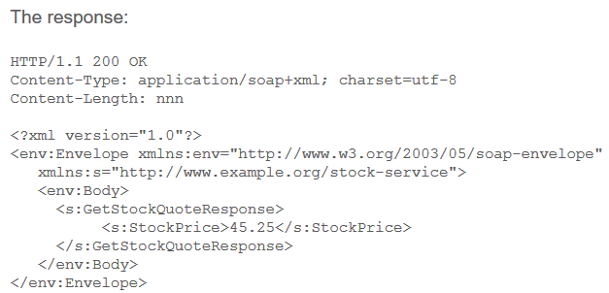
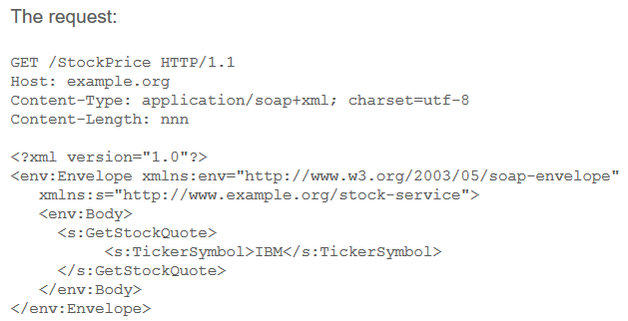
SOAP vs REST
The SOAP had great potentials, with many supporting protocols (DISCO, UDDI) – nowadays rarely used, mainly because of speed and configuration problems
There are hardly any open endpoints, typically used in intranet communication (except: OTP cardpay,
MNB exchange rates http://www.mnb.hu/arfolyamok.asmx)

Slide 17
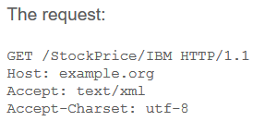
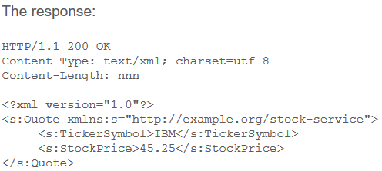
SOAP vs REST
Representative State Transfer
SOAP = strict protocol, REST = suggested architectural structure
Simpler messages, custom encoding, no code generation (exception: WCF – MEX endpoint; Swashbuckle/NSwag)

Slide 18
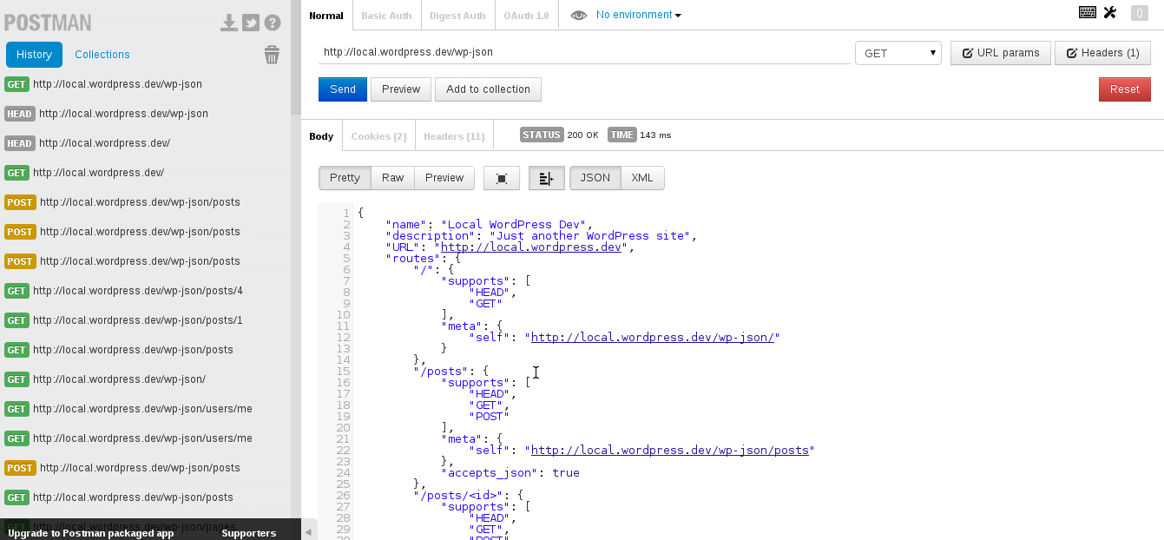
To test web method calls: Postman, SoapUI

Slide 19
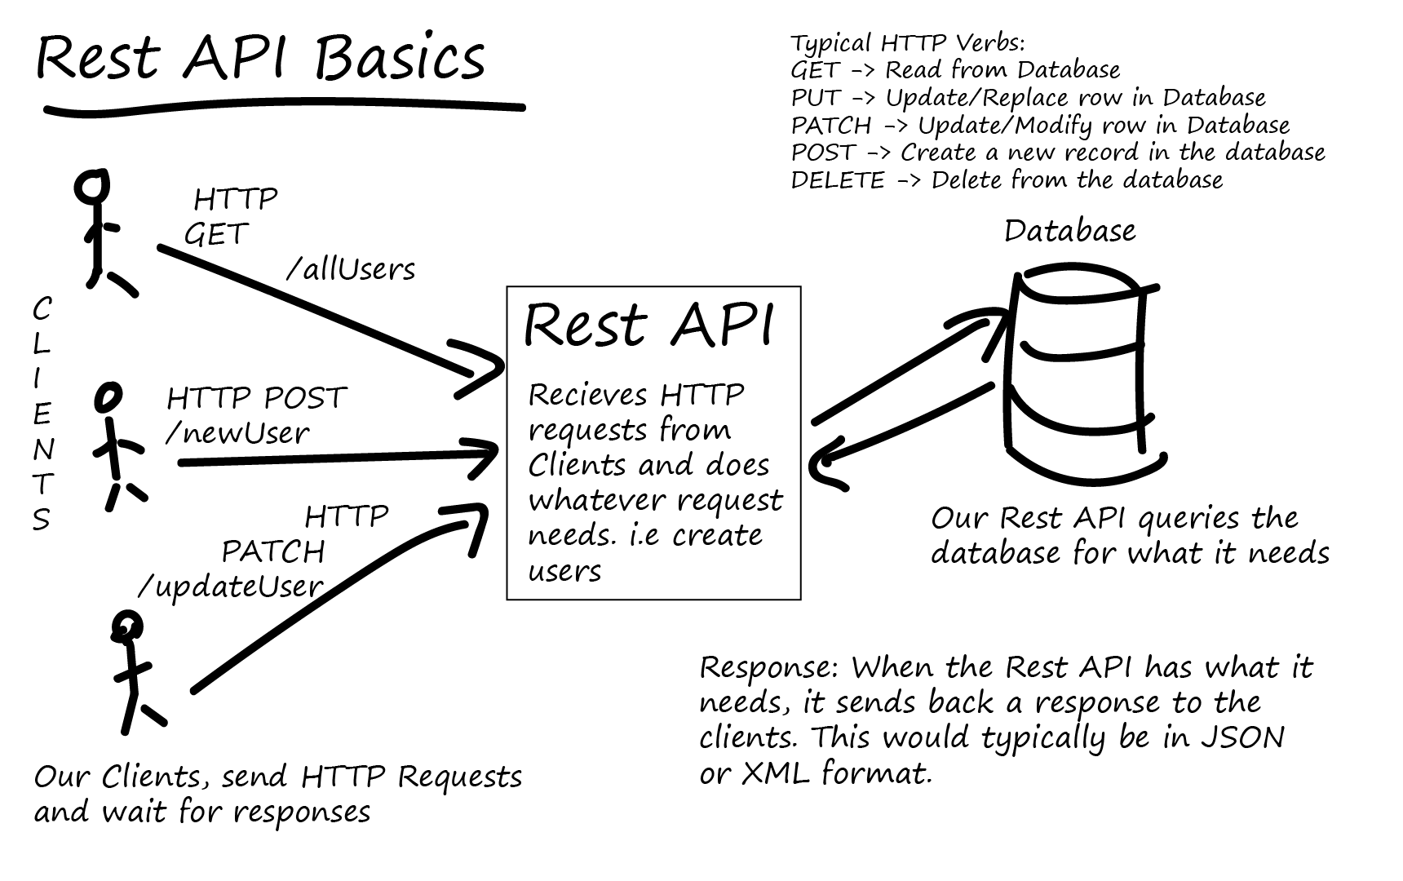
REST = Access anything

Slide 20
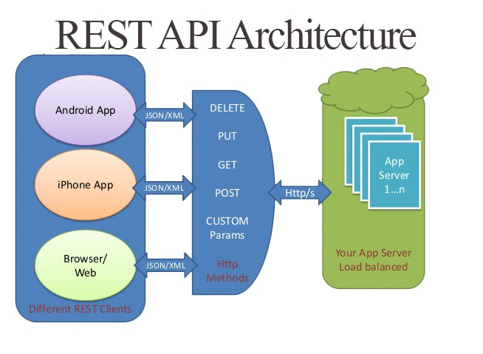
REST = Access anywhere

Slide 21
REST examples
Company-specific
Facebook: graph API, marketing API
Google: 138 API categories
(https://developers.google.com/apis-explorer/#p/)
Twitter: ~200 API endpoints
(https://developer.twitter.com/en/docs/api-reference-index)
https://www.programmableweb.com/apis/directory
Non vendor-specific
Linked Open Data (LOD)
OpenGraph
Odata, Oauth

Slide 22
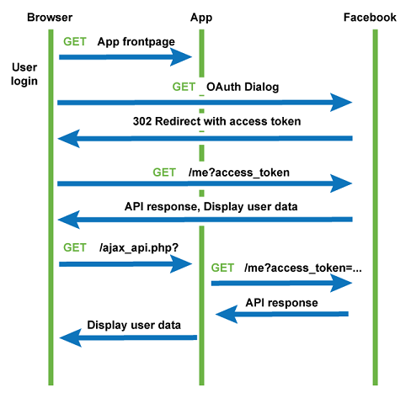
Oauth flow

Slide 23
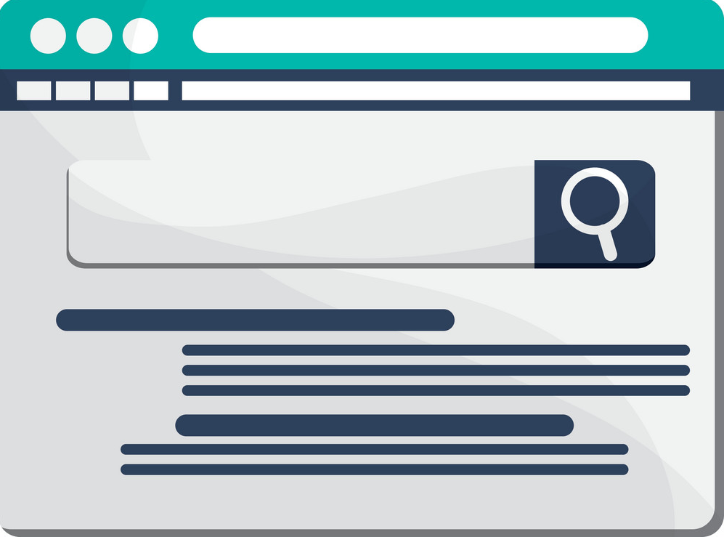
Classic websites
LINK
GET
SERVERSIDE TEMPLATE / ROUTE
SUBMIT
FORM
GET / POST
... Then the next page loads …
(which can be the same URL)

Slide 24
Modern websites
LINK
NEXT PAGE
JS?
CLIENTSIDE TEMPLATE / ROUTE
SUBMIT JSON
REDIRECT
(JS?)
GET JSON FROM API ENDPOINT

Slide 25
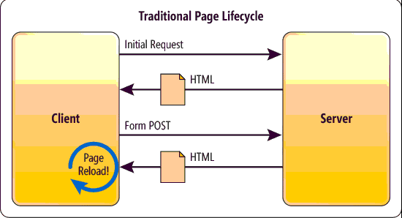
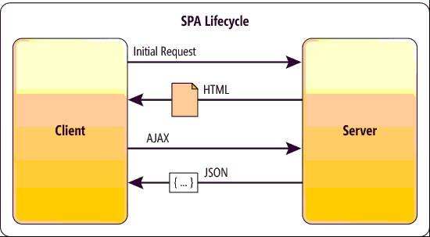
Redirect / JS?

Slide 26
SOAP, REST
 | SOAP | REST
Overhead (format) | BIG (XML) | OK (JSON)
Overhead (comm) | BIG | BIG (?)
MS/C# specific | NO | NO
Complex types? | YES | YES
Code generation | YES | NO (?)
Webserver needed | YES (?) | YES
Bi-directional | NO | NO
Mature? | YES!! | YES
Implementation diff. | EASY!! | OK

Slide 27
WCF
Genius principle, not so genius implementation…
Principle: ABC – Address, Binding, Contract.
  Address: Where can it be accessed (ip/host + port), and using what data protocol (http://, tcp://, udp://)
  Binding: how is the data encoded and transmitted (WsHttpBinding, NetTcpBinding, MsMqBinding, NetPeerTcpBinding, MEX)
  Contract: what methods/parameters/results are used…
  The Contract needs an everyday interface+classes, the Address/Binding can be set in a Config file
  The source code is COMPLETELY INDEPENDENT FROM THE PROTOCOL
Implementation
  Windows Communication Foundation
  Complex config (if you need extras. SOAP is very simple)
  Full SOAP support, almost full (weird) REST support, integration of MS/.NET technologies/protocols into the same system
Support
  Not widespread, as not fully MS-free, and SPA+REST was not taken seriously

Slide 28
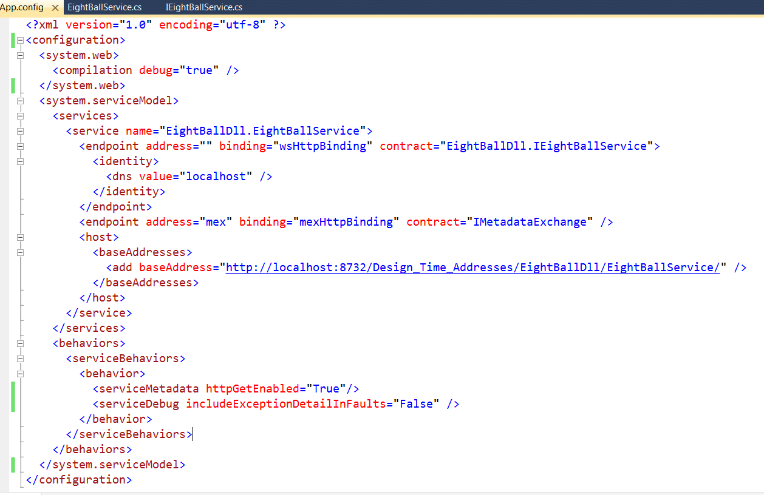
App.config file
ABC
baseAddress + Binding
MEX endpoint
Behavior config

Slide 29
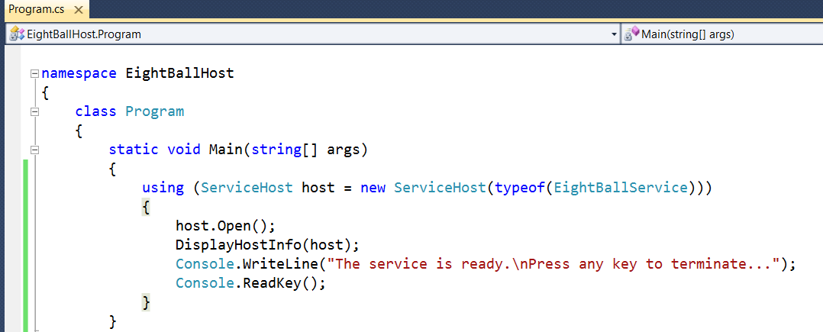
WCF Host
Needs System.ServiceModel dll
  Must be added as a reference
The App.Config file is needed
The host is simply created by specifying the service type
  ServiceHost host = new ServiceHost(typeof(EightBallService))

Slide 30
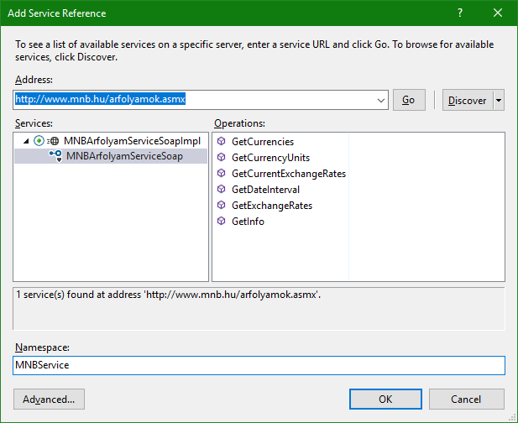
WCF Client

Slide 31
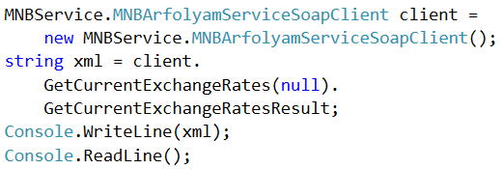
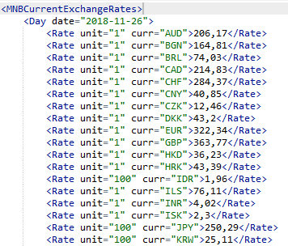
WCF Client

Slide 32
Current MS trend: WebAPI + SignalR
ASP History
  ASP.NET MVC: Traditional webpages, which should be enough as WCF handles the API…
  Later: ASP.NET WebApi: JSON API endpoints
  … Separated approaches, frameworks, base classes, config …
  ASP.NET Core: Merge all into one
SignalR
  From the previous solutions, only TCP/UDP is bi-directional
  A HTTP/1 is one-way... So SOAP/REST is basically one-way too
  (Long polling, XHR polling, forever frame, server sent events)
  WCF net.tcp binding and WsDualHttpBinding is two-way (ms specific!)…
  Older ASP.NET + SignalR ➔ jQuery + duplex communication
  New ASP.NET Core + SignalR ➔ npm + typeScript + duplex communication
  Web or self-hosted server, Web or self-hosted client
  In theory, language and platform-independent…
  ALSO used with BLAZOR!!!

Slide 33
WCF + SignalR
 | WCF (net.tcp) | SignalR
Overhead (format) | SMALL (custom) | OK (JSON)
Overhead (comm) | SMALL (custom) | BIG (?)
MS/C# specific | YES | NO? (JS)
Complex types? | YES | YES
Code generation | YES | NO (?)
Webserver needed | NO | YES (?)
Bi-directional | YES | YES
Mature? | YES? | NO?
Implementation diff. | EASY? | OK?

Slide 34
To summarize…
 | TCP/UDP | SOAP | REST | WCF (net.tcp) | SignalR
Overhead (format) | SMALL (binary) | BIG (XML) | OK (JSON) | SMALL (custom) | OK (JSON)
Overhead (comm) | SMALL (raw tcp/udp) | BIG | BIG (?) | SMALL (custom) | BIG (?)
MS/C# specific | NO | NO | NO | YES | NO? (JS)
Complex types? | NO (manual) | YES | YES | YES | YES
Code generation | NO | YES | NO (?) | YES | NO (?)
Webserver needed | NO | YES (?) | YES | NO | YES (?)
Bi-directional | YES | NO | NO | YES | YES
Mature? | YES!! | YES!! | YES | YES? | NO?
Implementation diff. | HARD!! | EASY!! | OK | EASY? | OK?

Slide 35
gRPC
There is NO wcf in .NET CORE 3
(Maybe, there will never be?)
  SignalR is in ASP.NET core, imho it will not be widespread in non-ms
  WCF net.tcp binary: ??????
REST api is accessible, many libraries
  WebClient / HTTPClient
  NSwag (class generation from json replies / schema)
gRPC library: HTTP/2
  Grpc.io, opensource, MS suggestion when releasing .NET CORE 3 !
  Protobuf-net, grpc-net (github: protobuf-net.Grpc): no automatic MEX
  MyServer : IMyAmazingService
  client = http.CreateGrpcService<IMyAmazingService>();
  Equally simple (no config, so maybe more simple), than the WCF
The future of WCF: doubtful

