Slide 1
Neural Network Processors
Sima Dezső
2018 September
(Ver. 1.1)
© Sima Dezső, 2018

Slide 2
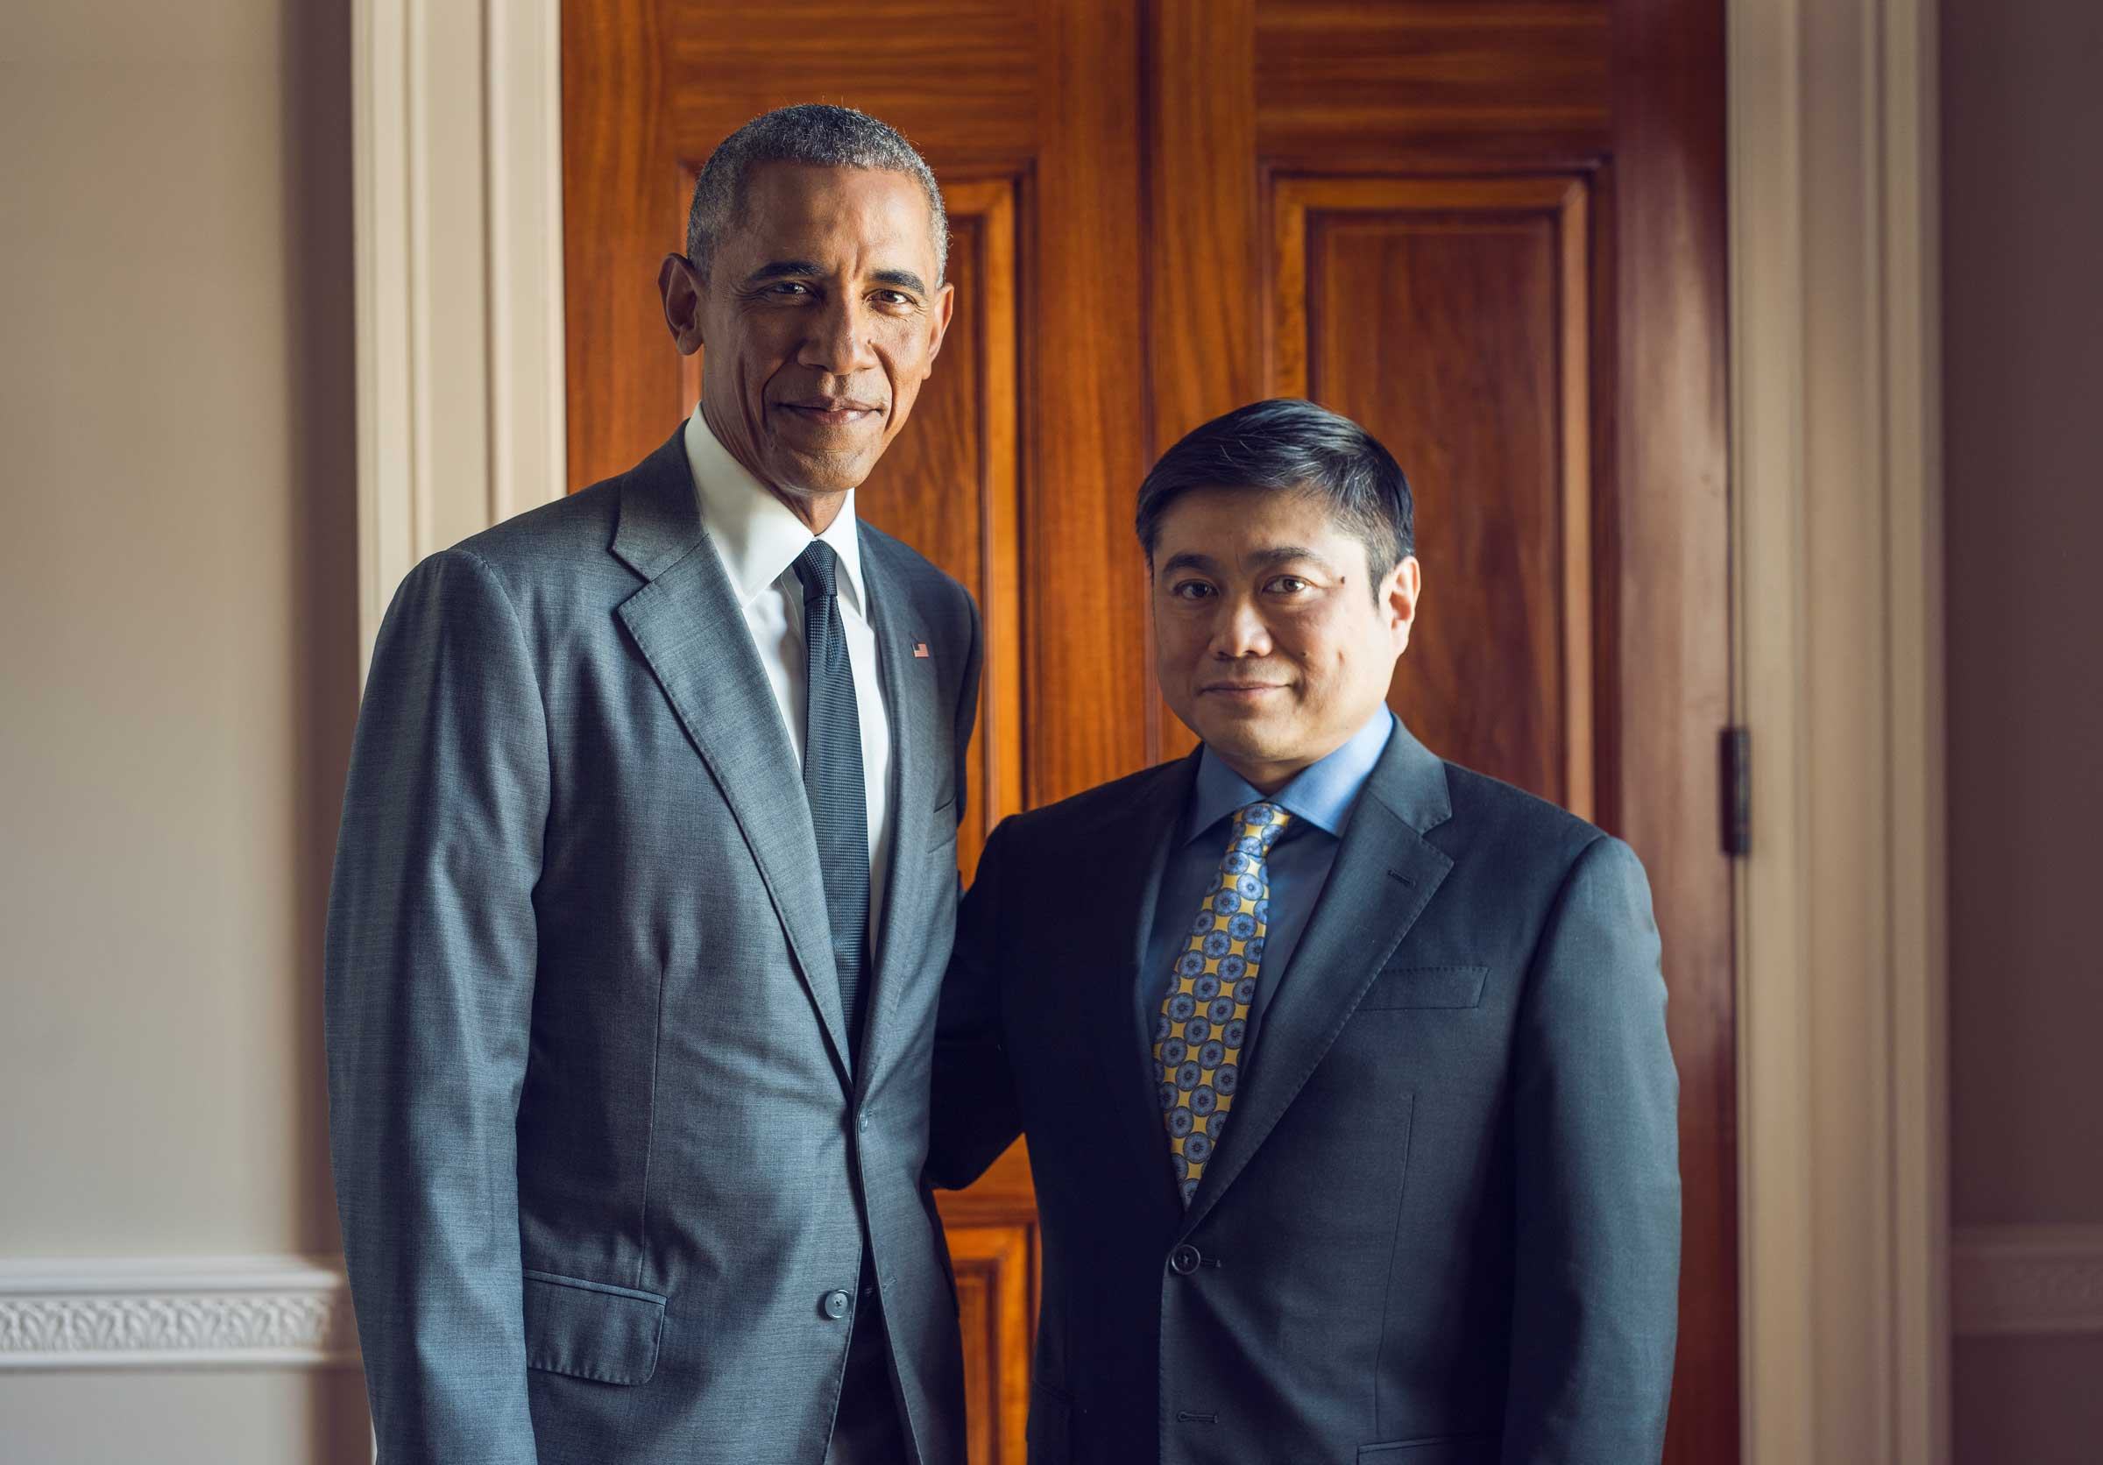
Neural Network Processors (1)
Significance of AI (as seen already in the in the politics)
Report on a talk of US president Obama and MIT Media Lab director Joi Ito in 10/2016
IT’S HARD TO think of a single technology that will shape our world more in the next
50 years than artificial intelligence. As machine learning enables our computers
to teach themselves, a wealth of breakthroughs emerge, ranging from medical
diagnostics to cars that drive themselves.
A whole lot of worry emerges as well. Who controls this technology? Will it take over
our jobs? Is it dangerous?
President Obama was eager to address these concerns. The person he wanted to talk
to most about them? Entrepreneur and MIT Media Lab director Joi Ito [45].

Slide 3

Neural Network Processors (2)
Significance of AI (as seen already in the in the politics)
09/2017 Putin while speaking to students
“Artificial intelligence is the future, not only for Russia, but for all mankind.
It comes with colossal opportunities, but also threats that are difficult to predict.
Whoever becomes the leader in this sphere will become the ruler of the world.”
(Source: The Verge, Sep 4, 2017

Slide 4
Contents
1. Introduction to neural networks
2. NN processing
3. References

Slide 5
1. Introduction to neural networks
1.1 Overview
1.2 Feedforward NNs
1.3 Convolutional NNs
.
1.4 Application of NNs
Only Sections 1.1 and 1.4 will be discussed.

Slide 6
1.1 Overview

Slide 7
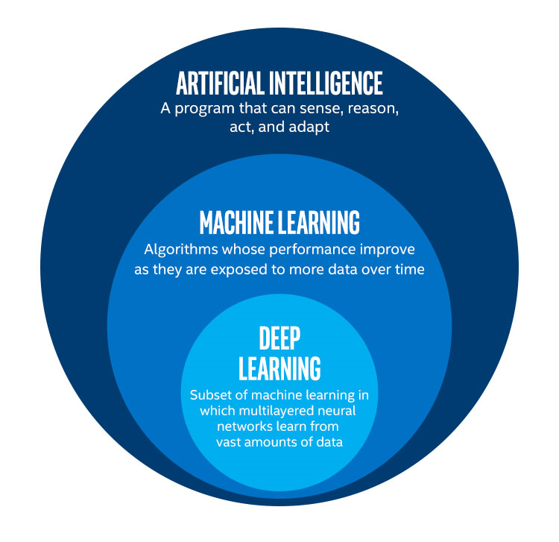
1.1 Overview (1)
1.1 Overview
Neural networks (NN) and related notions [46]

Slide 8
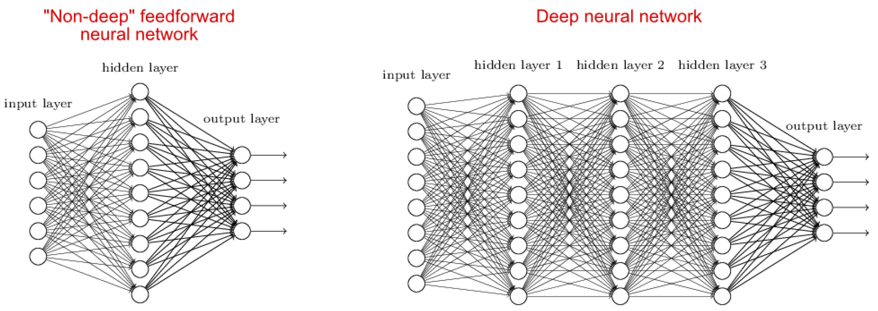
1.1 Overview (2)
The notion of deep learning
It is connected with the concepts of depth of NNs [2]
Deep learning means using deep NNs for Machine learning.
Deep NNs may be of various type, like feedforward or convolutional NNs, as
discussed in the Sections 1.2 and 1.3.
(feedforward: előrecsatolt)
(hidden layer: rejtett réteg)

Slide 9
1.1 Overview (3)
First seminal publications in NNs
1957 Rosenblatt (Cornell Aeronautical Laboratory) : Perceptron
1969 Minsky, Papert (MIT Media Lab): Perceptrons
Ackley, Hinton, Sejnowski (Carnegie-Mellon University): A Learning Algorith
for Boltzmann Machines
LeCun & al. (AT&T Bell Labs): ”Backpropagation Applied to Handwritten
Zip Code Recognition”

Slide 10
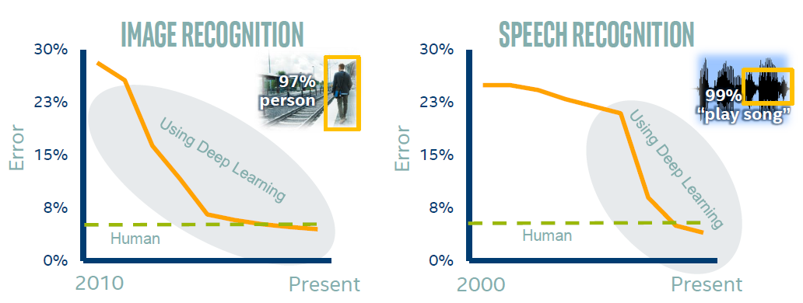
1.1 Overview (4)
Achievements of deep learning in image and speech recognition [3]

Slide 11
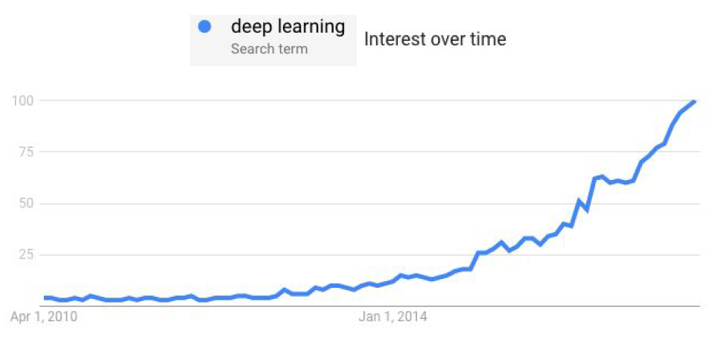
1.1 Overview (5)
Interest in deep learning (based on internet searches) [4]

Slide 12
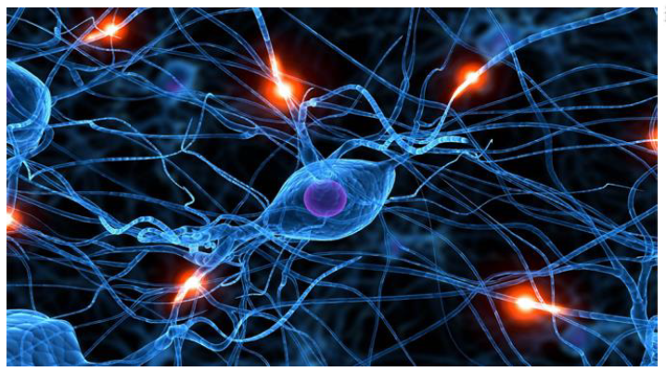
1.1 Overview (6)
Neural net in the brain [2]

Slide 13
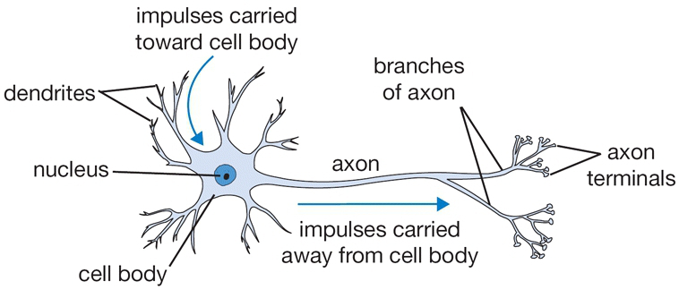
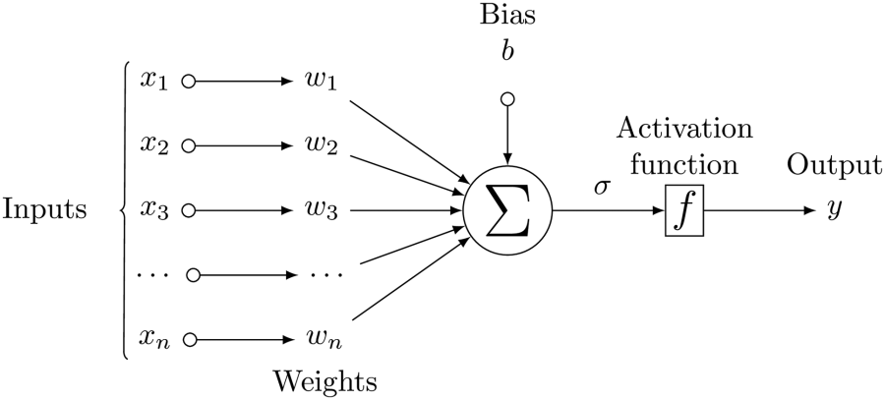
1.1 Overview (7)
Neurons and their modelling
Neuron [5]
A simple NN [6]
(Perceptron)
z
Σ
wi * xi + b
z =
i

Slide 14
1.1 Overview (8)
Example of a simple NN
w1 = 0.5
w2 = 0
w3 = 0.25
x1 = 1
x2 = 2
x3 = 1
b =1
Then
Σ
z =
wi * xi + b
= 0.5*1 +0*2 +0.25*1 +1 =1.75
i
As the Activation function let’s presume the Step function,
it „activates” y if z > T (Threshold) with y = 1 else y = 0.

Slide 15

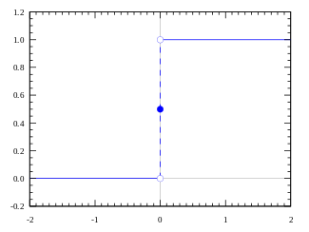
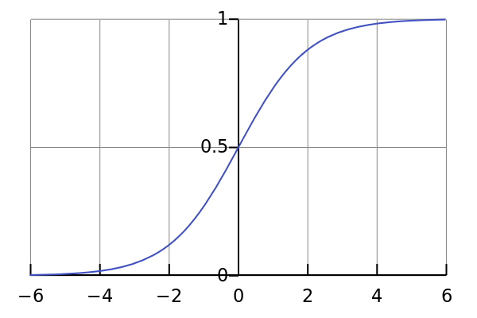
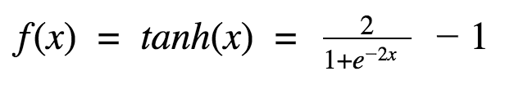
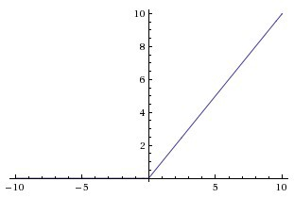
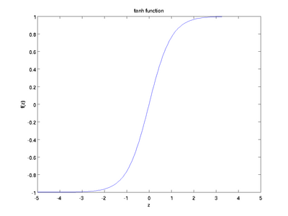
1.1 Overview (9)
Popular activation functions -1 [7]
Step function:
y = 1 if z > threshold, 0 otherwise
Sigmoid:
y
z
ReLu): y = max(0,z)
(Rectified Linear Unit)
Tanh:
y
z
2z

Slide 16
1.1 Overview (10)
Popular activation functions -2
Here we do’nt want to go into details of the activation functions as this issue
is out of the scope of the present lecture note.

Slide 17
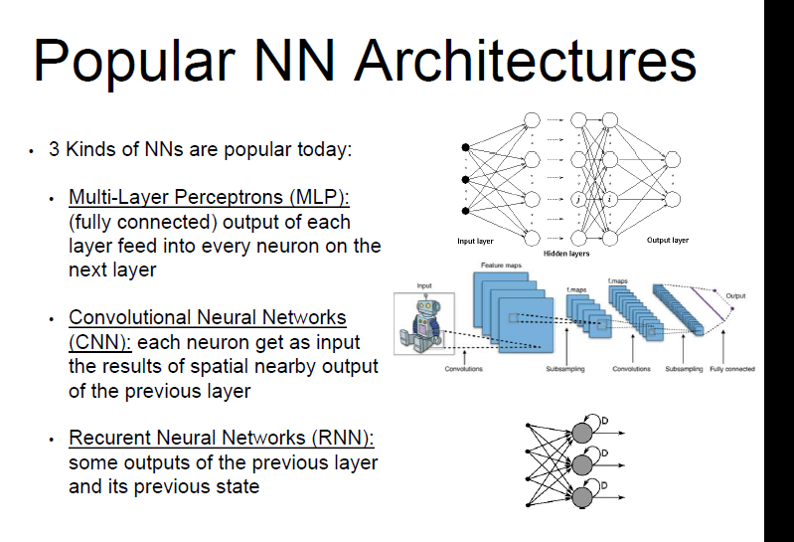
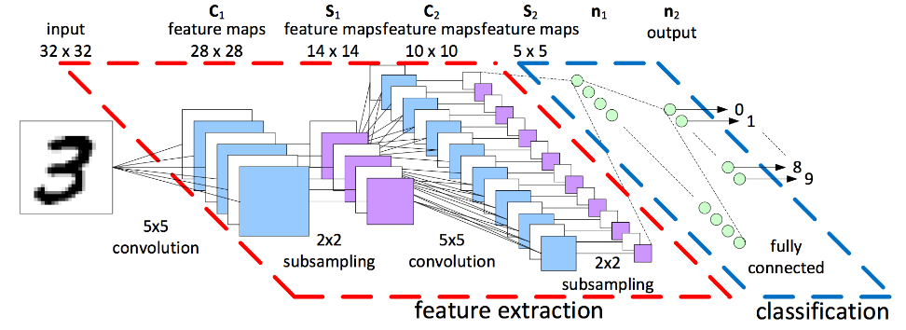
1.1 Overview (11)
Popular NN models [8]
Popular NN models
Feedforward NN
Convolutional NNs
(CNNs)
Recurrent NNs
(RNNs)
Fully connected NN.
Output of each layer is fed
into every neuron on the next layer
The are two-phase NNs,
consiting of feature extraction layers and classification layers,
as discussed subsequently.
There are some outputs
of the previous layer
and its previous state
(Section 1.2)
(Section 1.3)
(Will not be discussed)
(konvolúciós)
(feature extracton: lényegkiemelés)
(előrecsatolt)
(visszacsatolt)

Slide 18
1.2 Feedforward NNs

Slide 19
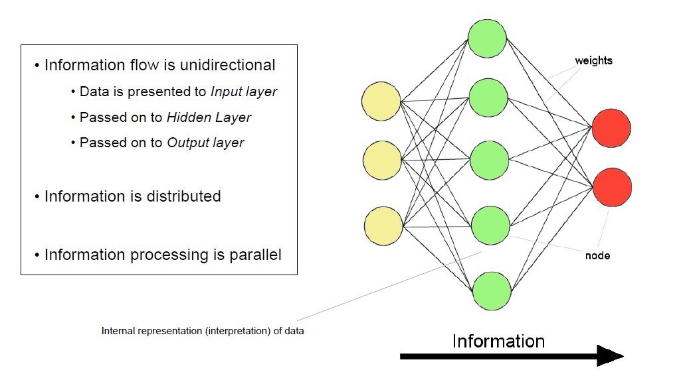
1.2 Feedforward NNs (1)
1.2 Feedforward NNs
Example 1: A simple feedforward NN with a single hidden layer [2]
Input nodes
Output nodes
Note: It is a fully connected NN.

Slide 20
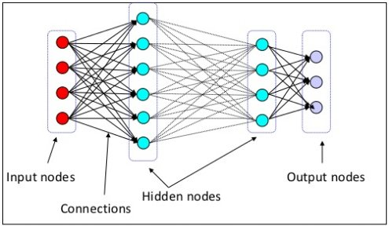
1.2 Feedforward NNs (2)
Example 2: A feedforward NN with two hidden layers [9]

Slide 21
1.2 Feedforward NNs (3)
The learning rule in feedforward NNs
It provides a scheme for updating the weights wij’ in the learning phase.
Below we will presume a widely used approach for that, called the gradient
descent NN learning approach.

Slide 22
1.2 Feedforward NNs (4)
Principle of the Gradient descent NN learning approach -1
Let’s concider a simple one-layer feedforward NN with a single output node,
one as seen below.
z
with
z = b + ∑ xi * wi
y = f(z)
i
Figure: The assumed simple one-layer feedforward NN with a single output node [6]

Slide 23
1.2 Feedforward NNs (5)
Principle of the Gradient descent NN learning approach -2
Let’s take for granted that one of the weights, say wi will be modified and the
error (E) will be calculated by
E = ½ (t – y)²
where
t is the target value of the output node
y is the actual value of the output node
Obviously, when wi will be modified along the gradient ∂E/∂wi in the appropriate
direction the error will be reduced, in this way the NN can be trained.
E
x
∂E/∂wi
x
x
wi
wi
wi’ – η ∂E/∂wi

Slide 24
1.2 Feedforward NNs (6)
Principle of the Gradient descent NN learning approach -3
Accordingly, based on the gradient descent learning rule a NN can be trained
when a weight wi will be updated iteraratively such that
wi’ = wi – η ∂E/∂wi
where ∂E/∂wi: is the gradient in respect to wi and
η: is the learning rate
E
x
∂E/∂wi
x
x
wi
wi
wi’ = wi – η ∂E/∂wi
Note that in the example above the derivative is negative, thus – η ∂E/∂wi becomes
positive (needed to move wi in the appropriate direction).

Slide 25
1.2 Feedforward NNs (7)
Principle of adapting the weights (Based on [10])
w₁
Bias
b
x₁
Activation
function
x₂
w₂
Inputs
...
Σ
Z
ƒ
x_{i}
w_{i}
y
Output
...
w_{n}
x_{n}
Weights
Adapting
the weights
+
Σ
Target value of y
-
t

Slide 26
1.2 Feedforward NNs (8)
Calculating ∂E/∂wi -1
Let’s consider the straightforward case when there is
a simple feedforward NN with no hidden layers,
only a single output node and
A single training pattern
as indicated below.
z
with
z = b + ∑ xi * wi
y = f(z)
i
Figure: The assumed simple feedforward NN [6]

Slide 27
1.2 Feedforward NNs (9)
Calculating ∂E/∂wi -2
Assumed errror function (E):
E = ½ (t – y)²
with
t: true (expected) value
Then we get (as shown subsequently):
∂E/∂wi = -xi*(t - y)*f’(z)
If we assume that
and
wi’ = wi + ∆wi
∆wi = η ∂E/∂wi
(Gradient descent approach)
we obtain for ∆wi:
∆wi = - η*(t - y)*f’(z)*xi
where ∂E/∂wi: is the gradient in respect to wi
η is the learning rate
t is the target value of the output node
y is the actual value of the output node
f’(zj) is the derivative of the activation function
z is the weighted sum of the inputs
xi is the ith input
The expression for ∆wi is designated as the delta rule, it was first published
in 1986 by (McClelland and Rumelhart) [11].

Slide 28
1.2 Feedforward NNs (10)
Remarks to the derivative of the activation function f(z)’ [2]
For the Sigmoid activation function:
Sigmoid:
y
z
f’(z) = y* (1-y)

Slide 29

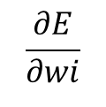

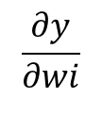
1.2 Feedforward NNs (11)
Derivation of the delta rule -1
Assumptions:
a simple feedforward NN with no hidden layers,
only a single output node and
a single training pattern
with
z = b + ∑ xi * wi
and
y = f(z)
i
In addition we presume the following error function E:
E = ½ (t – y)²
First, let’s apply the chain rule as follows:
$$\frac{∂E}{∂wi}$$
$$\frac{∂E}{∂y}$$
$$\frac{∂y}{∂wi}$$
=
Then
$$\frac{∂E}{∂y}$$
= - (t-y)

Slide 30
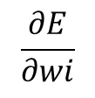





1.2 Feedforward NNs (12)
Derivation of the delta rule -2
A repeated use of the chain rule yields:
$$\frac{∂y}{∂wi}$$
$$\frac{dy}{dz}$$
$$\frac{∂z}{∂wi}$$
=
Now let’s take into account that
$$\frac{dy}{dz}$$
f’(z)
=
and
$$\frac{∂z}{∂wi}$$
=
xi
It follows then:
$$\frac{∂E}{∂wi}$$
=
- (t-y)*f’(z)*xi
I.e.:
∂E/∂wi = -xi*(t - y)*f’(z)

Slide 31
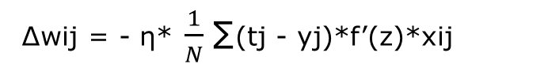

1.2 Feedforward NNs (13)
Extension of the delta rule to multiple output nodes
In this case there is a need for a two-dimensional indexing for the weights
considering both the input nodes (i) and the output nodes (j).
Accordingly, zi becomes:
zi = bi + ∑ xi(T) * wi,j
i
Furthermore, the error function (E) has to be modified as well to represent
all errors occuring with all outputs:
E =$\frac{1}{2N} ∑$ (tj – yj)²
j
It follows then for ∆wij:
∆wij = - η* $\frac{1}{N}$∑(tj - yj)*f’(z)*xij
j

Slide 32


1.2 Feedforward NNs (14)
Extension of the delta rule to multiple output nodes and multiple
test patterns
If ther are multiple test patters (as usual) the error accumulates for all test patterns, i.e.:
E =$\frac{1}{2N} ∑∑$ (tj – yj)²
j
t
Consequently
∆wij = - η* $\frac{1}{N}$∑∑(tj - yj)*f’(z)*xij
t
j
Remark
Extensions to multi-layer NNs is out of the scope of this lecture note.

Slide 33
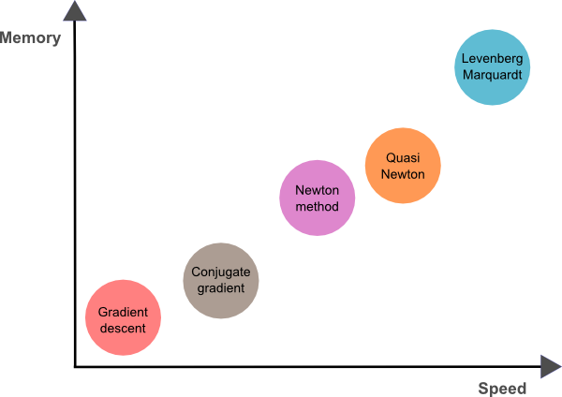
1.2 Feedforward NNs (15)
Further learning schemes [12]
Beyond the Gradient descent approach there are a number of further learning
approaches used for NNs, as indicated below.
These approaches differ in speed and memory size demand, as seen in the Figure.
Nevertheless, related details are out of the scope of this lecture note.
Figure: Learning approaches used for NNs [12]

Slide 34
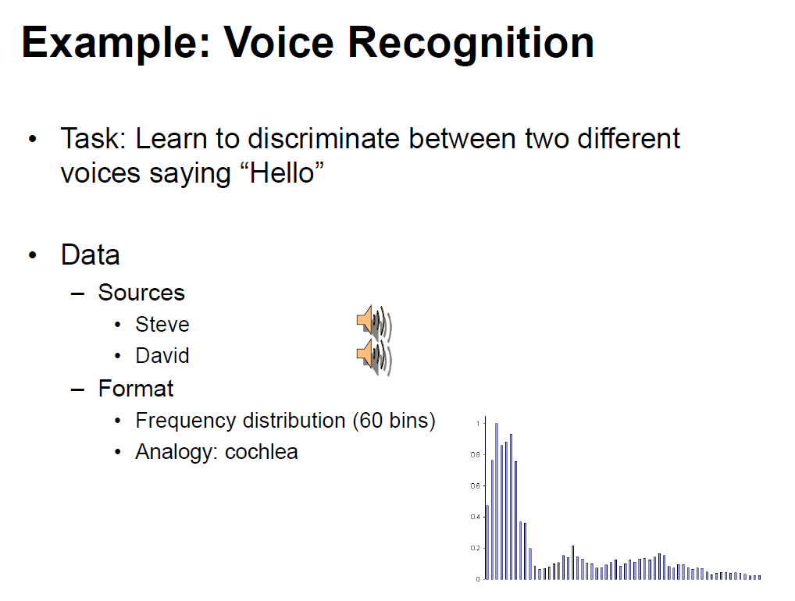
1.2 Feedforward NNs (16)
Example: Voice recognition -1 [2]

Slide 35
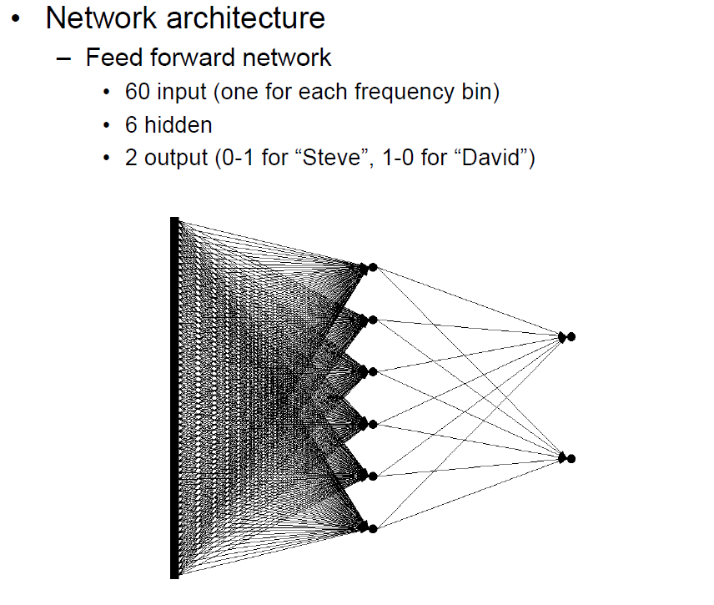
1.2 Feedforward NNs (17)
Example: Voice recognition -2 [2]
(1 hidden layer)
6 hidden nodes

Slide 36
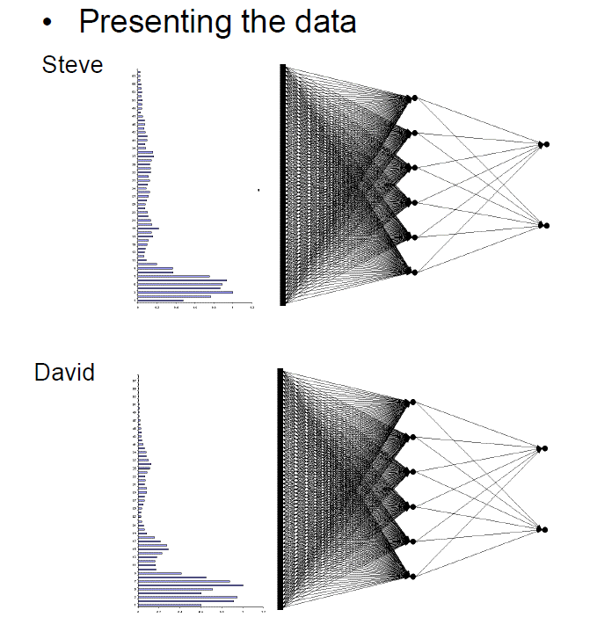
1.2 Feedforward NNs (18)
Example: Voice recognition -3 [2]

Slide 37
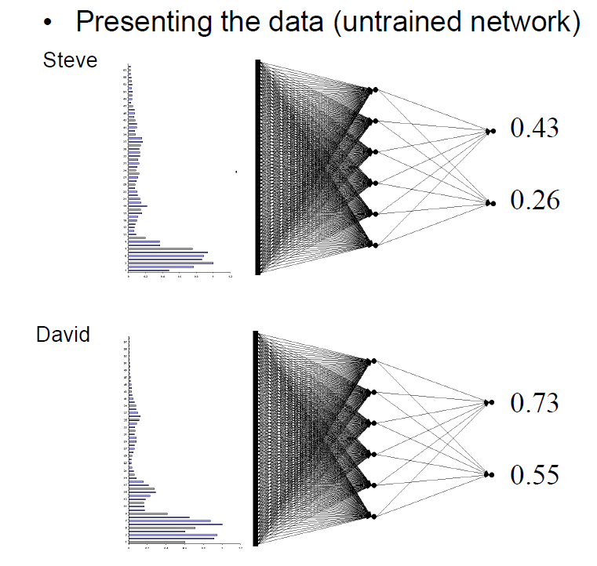
1.2 Feedforward NNs (19)
Example: Voice recognition -4 [2]

Slide 38
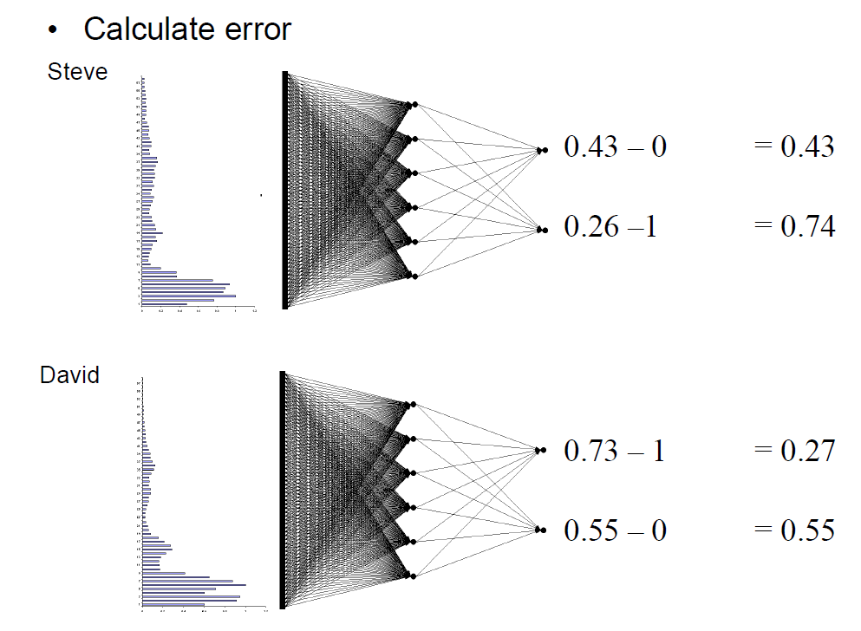
1.2 Feedforward NNs (20)
Example: Voice recognition -5 [2]

Slide 39
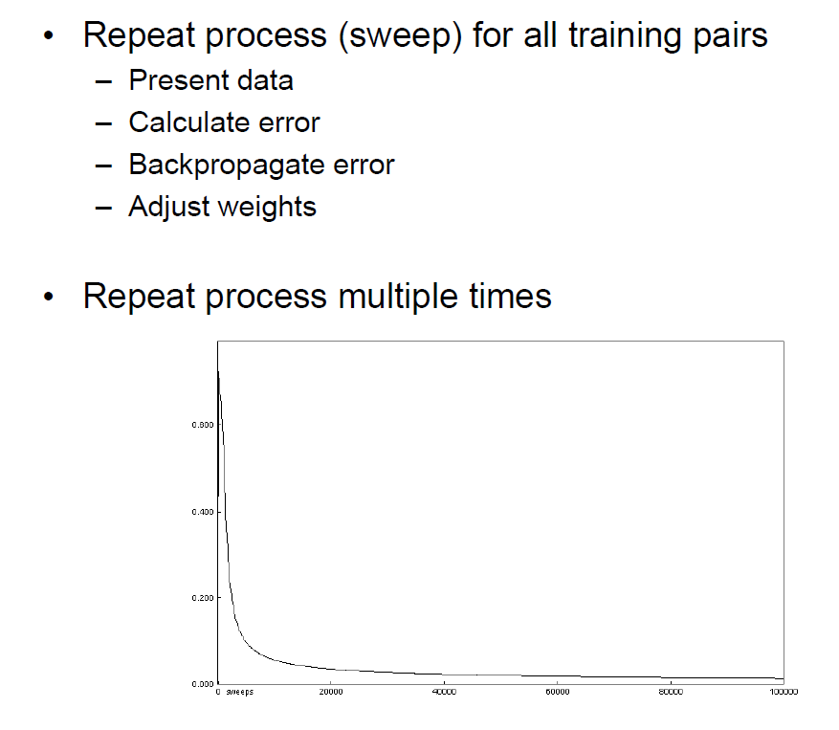
1.2 Feedforward NNs (21)
Example: Voice recognition -6 [2]

Slide 40
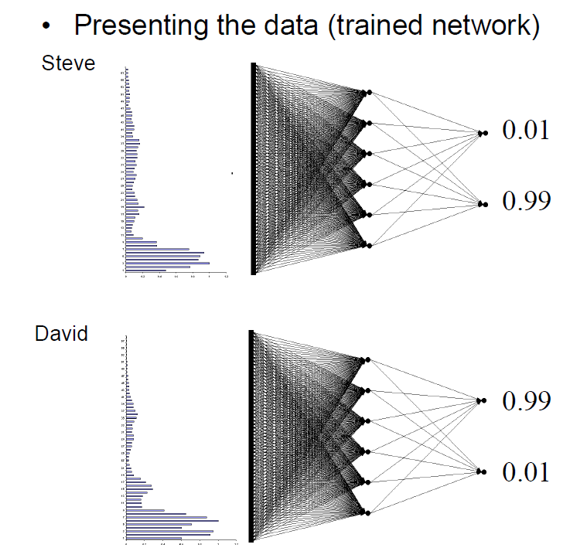
1.2 Feedforward NNs (22)
Example: Voice recognition -7 [2]

Slide 41
1.3 Convolutional NNs

Slide 42
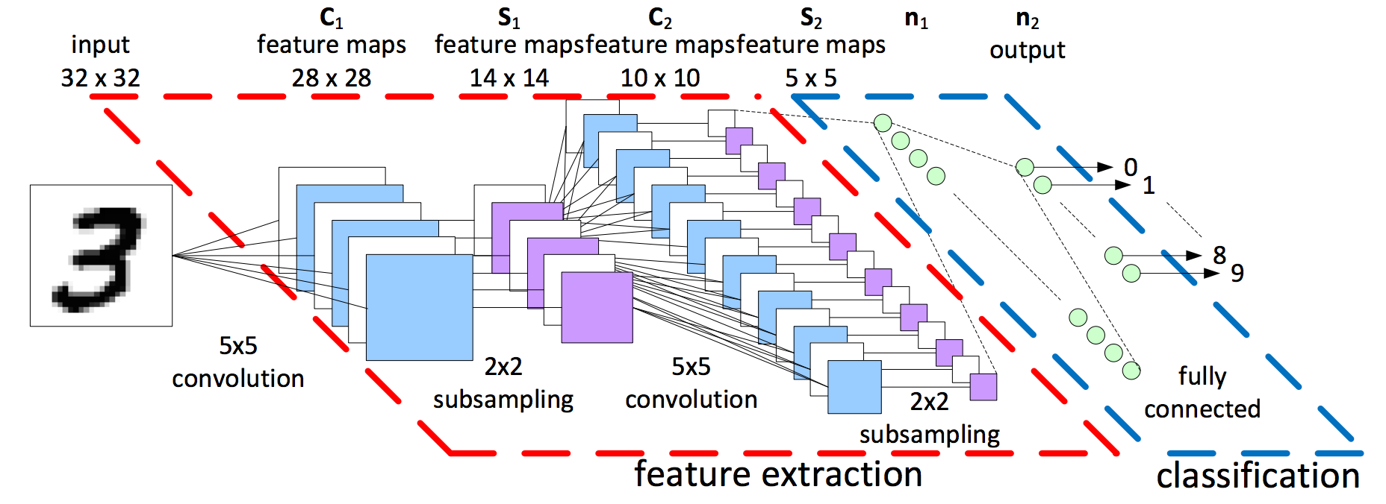
1.3 Convolutional NNs (1)
1.3 Convolutional NNs
Example of a Convolutional NN [13]

Slide 43

1.3 Convolutional NNs (2)
Basic concepts used in convolutional NNs
Convolutional NNs perform a feature extration phase before classification, as
seen in the Figure below.
Figure: Example convolutional NN [13]

Slide 44
1.3 Convolutional NNs (3)
Feature extraction
Features are distinct patterns (observations) in images, like edges or circles
in generic object classification or even a pair of eyes in human face detection.
Feature extraction is performed by computing the convolution of the input data with
appropriately chosen filters.

Slide 45

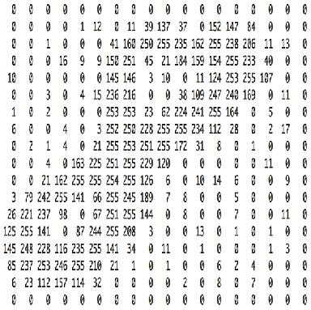
1.3 Convolutional NNs (4)
Example 1: Input data for recognition of hadwritten digits [14]
Note that the value of each pixel in the matrix will range from 0 to 255,
zero indicating black and 255 white.

Slide 46

1.3 Convolutional NNs (5)
Example 2: Input data for face recognition [15]

Slide 47
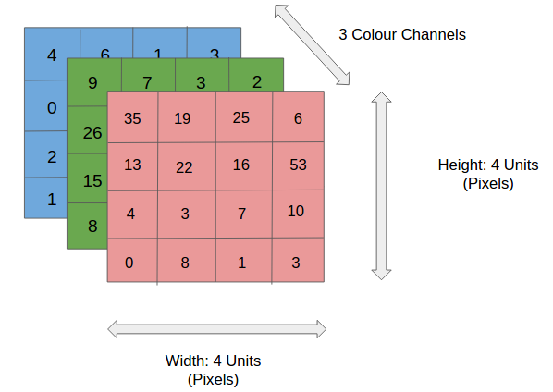
1.3 Convolutional NNs (6)
Example 3: Color input data for an image segment [16]

Slide 48
1.3 Convolutional NNs (7)
Filters [16]
A filter (or kernel) is a small-sized matrix (e.g. a 3x3 or 5x5 matrix) that is
convolved with the input image to obtain an activation map.
On activation maps specific pixel regions are identified, i.e. they contribute to
feature extraction.
Filters have to be chosen according to the targeted classification task, as shown below.
In Convolutional NNs typically multiple suitable filters are chosen.

Slide 49
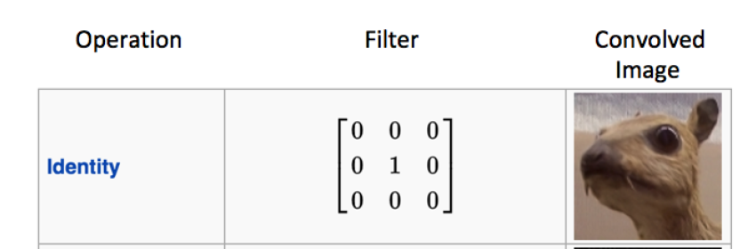
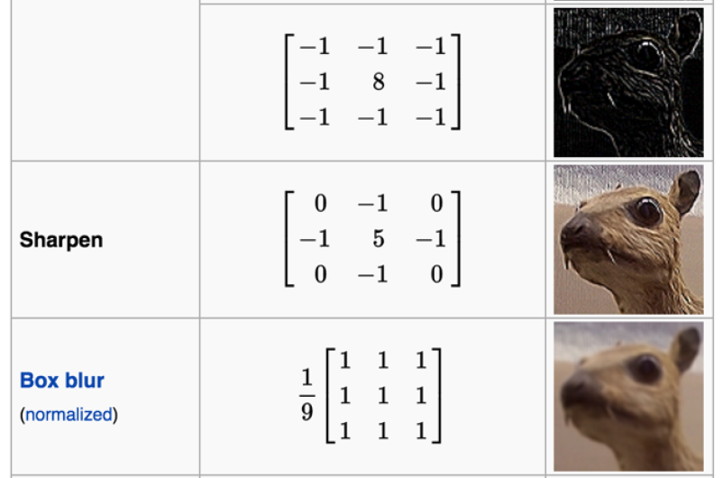


1.3 Convolutional NNs (8)
Examples for filtering [14]
Input image

Slide 50
1.3 Convolutional NNs (9)
Convolution as used in NNs
Convolution is in fact a mathematical concept, used in many disciplines, like
signal analysist, signal processing, image processing etc., we want’t not
discuss here.
Convolution in NNs is understood slightly differently.
In convolutional NNs a number of Filter matrices Fi are appropriately chosen and the convolution of each Filter matrix and the Input matrix is computed giving an Activation matrix as follows:
The convolution is calculated while the small Filter matrix (say e.g. 5x5) is slided
stepwise across the width and the heigh of the Input matrix, beginning e.g. at
the upper left corner, and in each position the dot product between the raws of
the Input matrix that is covered by the Filter matrix and the raws of the Filter
matrix will be calculated.
The dot product gives in each position one element of the 2-dimensional
Activation matrix and represents the response of the filter at that spatial
position.
The filter will be trained to contribute for the identification of specific features,
like edges of some orientation etc.
Subsequently, we demonstrate on an example how the convolution of an Input matrix and a Filter matrix is calculated.

Slide 51
1.3 Convolutional NNs (10)
Remark
The dot product of two N-dimensional vectors (e.g. u and v) is calculated as shown
below:
N-1
∑ ui * vi
i=0

Slide 52
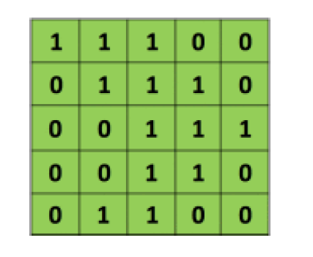
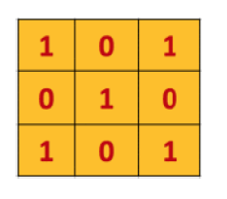
1.3 Convolutional NNs (11)
Example for calculating the convolution [14] -1
Let demonstrate the way of calculting the convolution of an Input matrix and
a Filter matrix on an example.
Let the Input matrix (I) and the Filter matrix (F) be as shown below.
I(5,5)
F(3,3)
1.3 Convolutional NNs ()

Slide 53
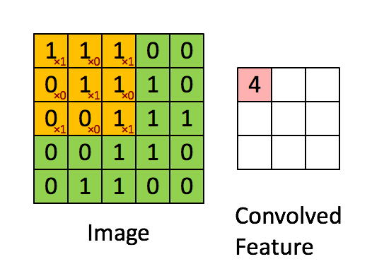
1.3 Convolutional NNs (12)
Example for calculating the convolution [14] -2
First let place the Filter matrix F to the left upper corner of the Input matrix I and
calculate the sum of the dot products of the row vectors, to get the A0,0
element of the Actvation matrix, as indicated below, i.e.
A0,0 = ∑ Fi,j * Ii,j
i = 0, 2
j = 0, 2
A(3,3)
I(5,5)

Slide 54
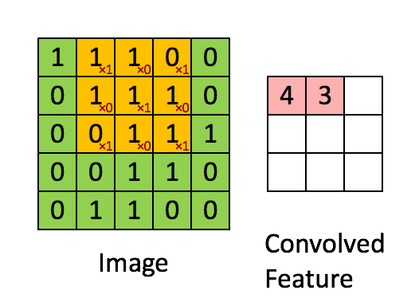
1.3 Convolutional NNs (13)
Example for calculating the convolution [14] -3
Then the Filter matrix is slided towards the right by one (or more positions,
called the stride) and the calculation is repeated for the A0,1 element, as
seen below for a stride of 1.
A0,1 = ∑ Fi,j * Ii,j
i = 1, 3
J = 0, 2
I(5,5)
A(3.3)

Slide 55
1.3 Convolutional NNs (14)
Example for calculating the convolution [14] -4
Subsequently, the Filter matrix is slided repeatedly towards the right until the
boundary of the Input matrix is reached.
Next the Filter matrix F is slided one row below the left corner and the process is
repeated until the entire Input matrix has been processed, as indicated in the
next Figure.

Slide 56
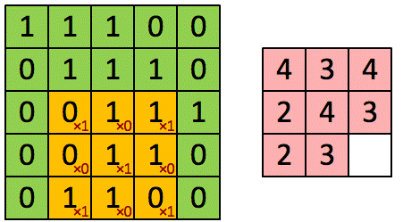
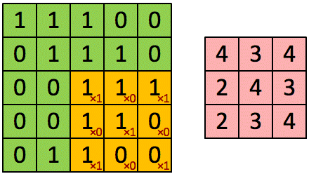
1.3 Convolutional NNs (15)
Example for calculating the convolution [14] -5
A(0,0)
A(3.3)
I(5,5)
I(5,5)
A(3.3)
A(3.3)
I(5,5)
I(5,5)

Slide 57
1.3 Convolutional NNs (16)
Computing the convolution (here dot product) of the image and the
filter matrix [14]
In general, the convolution of a filter matrix F(u,v) and the Input matrix (I(n,m)
results in the Activation matrix (A(n-u, m-v)) that is calculated as follows:
Ai,j = ∑ Fi,j * Ii+k,j+l
i = 0, u-1
j = 0, v-1
k = 0,n-u-1
l = 0, m-v-1

Slide 58
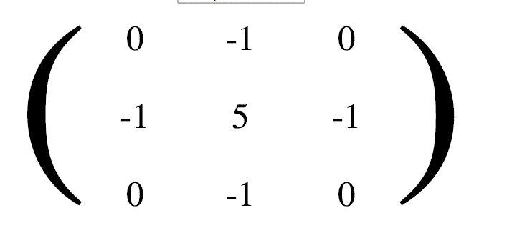
1.3 Convolutional NNs (17)
Another example for calculating the convolution on a real life image
Let choose the Filter matrix as follow [15]:
F(3,3)
We note that the above filter sharpens the contours, as seen below.

Slide 59
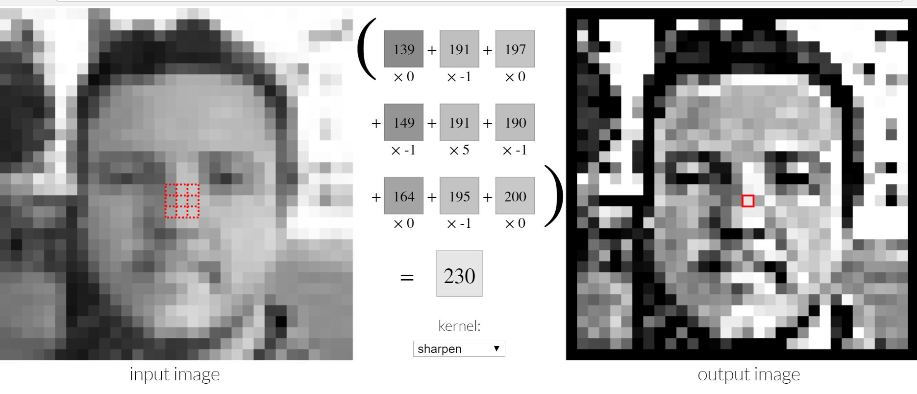
1.3 Convolutional NNs (18)
Example 2 for calculating the convolution [15]
Note that indexing is chosen in the above Figure differently than before.
We would get the same kind of indexing as before if the Input matrix would be
padded before calculating the convolution on all four sides by 00-valued pixels.

Slide 60
1.3 Convolutional NNs (19)
Subsampling (Down sampling) -1
It is performed on layers following a convolutional layer, as seen in the example
Convolutional NN (see below).
Figure: Example convolutional NN [13]
Its aim is to reduce the spatial dimension of the Activation layer (Feature map)
and thus to reduce the computational overhead.

Slide 61
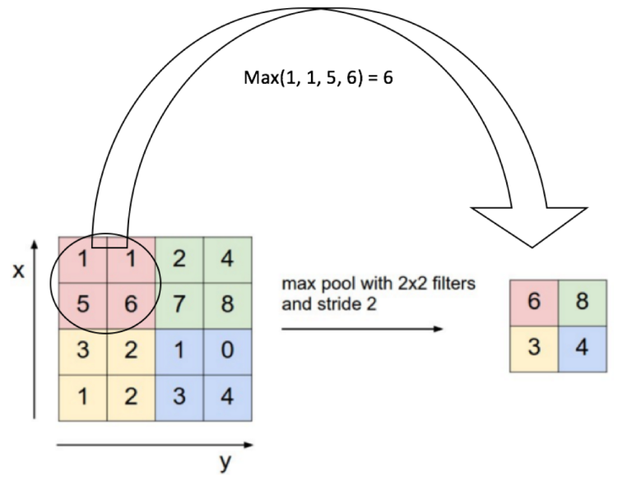
1.3 Convolutional NNs (20)
Subsampling (Down sampling) [16] -2
Subsamling is performed much like the convolution operation by using a sliding
window (e.g. A 2x2 window) that is moved accross the activation layer by
one or multiple units (called strides).
Subsampling replaces the values within the window by a single value that is
typically the maximum value observable in the window (called max polling),
as seen in the Figure below.
Figure: Principle of
subsampling [14]
Max pooling with a
2x2 window and a stride of 2

Slide 62
1.3 Convolutional NNs (21)
Classification
In convolutional NNs feature extraction is followed by classification that is
performed by a fully connected NN, as indicated below.
Figure: Example convolutional NN [13]

Slide 63
1.4 Application of NNs

Slide 64
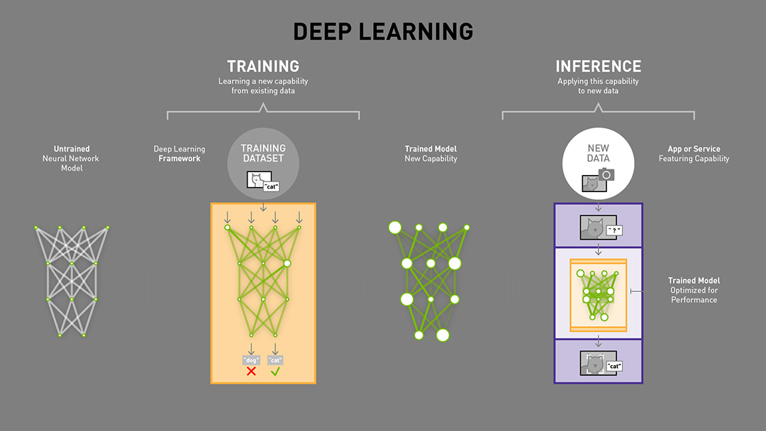
1.4 Application of NNs (1)
1.4 Application of NNs
Principle of using NNs for recognition [17]
(gyakorlás/tanítás)
tanító adathalmaz)
(következtetés/felismerés)

Slide 65
1.4 Application of NNs (2)
Main steps in using NNs for recognition
Choose an appropriate NN model
Choose an appropriate activation function
Select an appropriate framework (HW/SW) for writing and running the program
Write the program for training the NN while using an NN framework (e.g. Coffe2)
Collect an input dataset and perform the training of the NN
Use the NN for recognition
Improve the model and/or the activation function to raise precision
or reduce run time for training or inference
Use the trained model with a given dataset for recognition (inference)

Slide 66
1.4 Application of NNs (3)
Remark on the computational demand of training and inference
According to Google’s scientists, published in 05/2017 [18]:
„Training a machine learning model is even more difficult than running it, and days
or weeks of computation on the best available CPUs and GPUs are commonly
required to reach state-of-the-art levels of accuracy”.
We cite also another remarkable statement for the compute demand of training
from the chief scientisf at Baidu (Andrew Ng) [17]:
„Training one of Baidu’s Chinese speech recognition models requires not only four
terabytes of training data, but also 20 exaflops of compute — that’s 20 billion times
billion math operations — across the entire training cycle”.
tera: 10¹²
peta: 10¹⁵
exa: 10¹⁸

Slide 67
1.4 Application of NNs (4)
Note that matrix multiplications and convolutions (computing dot products) are the
typical elementary operations in NNs.
(dot product: skalár szorzat)

Slide 68

1.4 Application of NNs (5)
AI programming frameworks [1]
Remarks
Neon: Intel (originally from Nervana Systems, Python based), released: 05/2015
TensorFlow: Google, released 11/2015
Caffe: Facebook, originally developed at U. of California, Berkeley,
release vo: 12/2013
Caffe2: Facebook, 04/2017
Caffe2 Go: Facebook, 10/2017
MXNet (originated at the Carnegie Mellon U. and U. of Washington.
It is now developed in cooperation by multiple universities and companies,
including Amazon, Baidu, Intel, Microsoft and Nvidia.
Supports building and training models in Python, R, Scala, Julia, and C++).

Slide 69
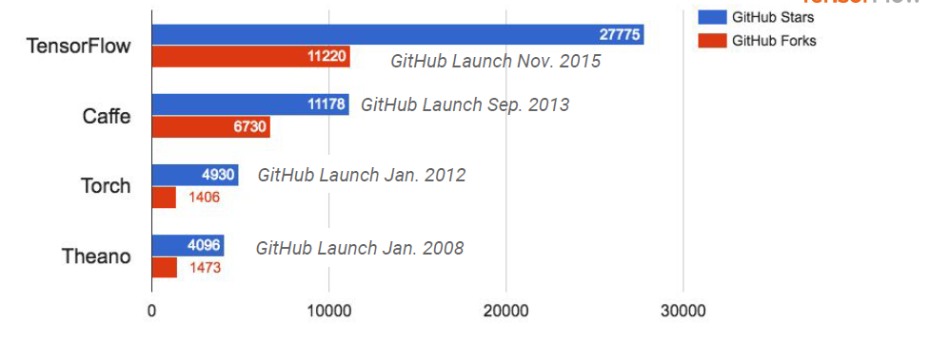
1.4 Application of NNs (6)
Adoption of deep learning tools on GitHub development platform in 2017 [19]
GitHub is a development platform inspired by the way you work. From open source to business, you can host and review code, manage projects, and build software alongside millions of other developers.

Slide 70
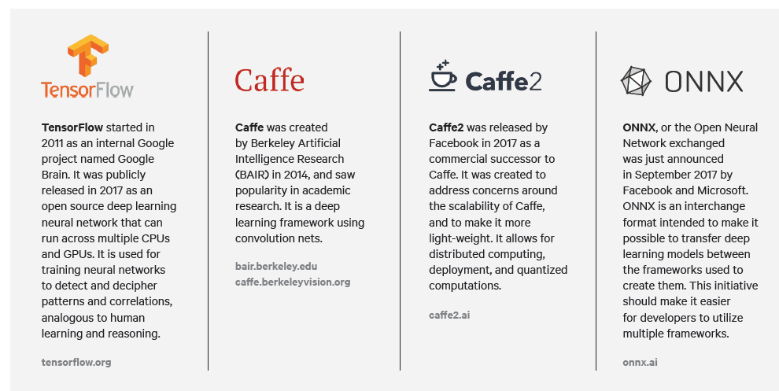
1.4 Application of NNs (7)
Certain facts about popular development frameworks [20]

Slide 71
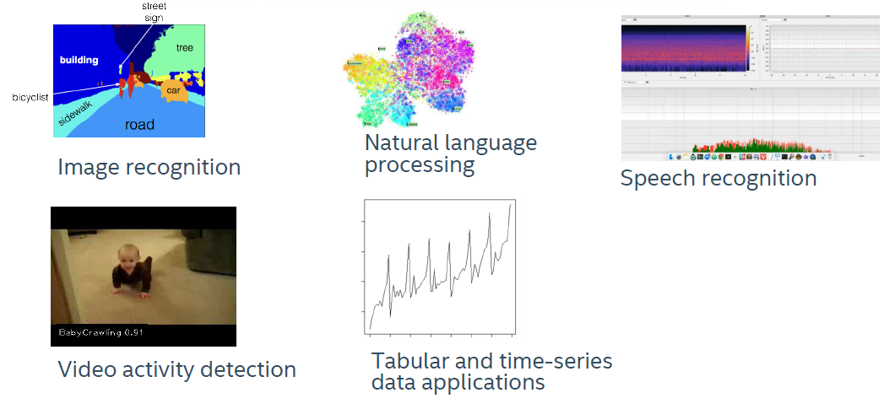
1.4 Application of NNs (8)
Select deep learning applications [3]

Slide 72
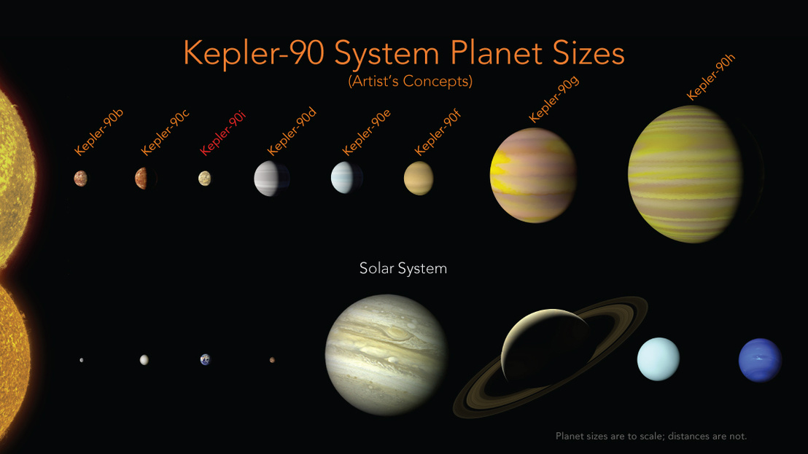
1.4 Application of NNs (9)
Example: Discovering a new planet system by using NN techniques [21]

Slide 73
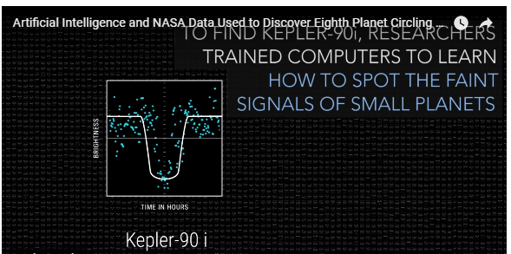
1.4 Application of NNs (10)
Example: Discovering a new planet system by using NN techniques [21]

Slide 74

1.4 Application of NNs (11)
Possibility to use deep learning to improve heuristics in techniques [22]
(heuristics: nem algoritmikus, hanem egy szabályrendszeren alapuló)

Slide 75
1.4 Application of NNs (12)
Achievements by utilizing deep learning in image and speech recognition [3]

Slide 76
2. NN processing
2.1 NN processing units implemented in mobiles
2.2 On-board NN co-processors

Slide 77
2.1 NN processing units implemented in mobiles
2.1.1 Overview
2.1.2 The NPU of Huawei’s Kirin 970 processor

Slide 78
2.1.1 Overview

Slide 79
2.1.1 Overview (1)
2.1.1 Overview
Firm | Part of the processor | Used in | Launched | Designation | Origin | SDK
Huawei | Kirin 970 | Mate 10 Mate 10 Pro Honor V10 | 10/2017 | NPU (Neural Processing Unit) | Cambricon 1A | Open Platform for Mobile AI (Huawei's API/ TensorFlow/Caffe2)
Qualcomm | Snapdragoon 845 | Galaxy S9? | 07/2018 | NP (Neural Processing Engine) | DeePhi Techn. ? | NPE SDK (Caffe/Caffe2/TensorFlow)
Apple | A11 (Bionic) | iPhone 8 iPhone 8 Plus iPhone X | 09/2017 | Neural Engine (dual cores)
Note
Recent capabilities of the the NN processing units implemented in mobiles allow
to use these on-chip accelerators only for inference tasks, like face recognition
on already trained NNs whereas training needs much higher computing potential,
e.g. servers supported by on-board GPUs or NN units.

Slide 80
2.1.1 Overview (2)
Remark
Until now (1/2018) no details became available about the NN processing units
of Qualcomm and Apple so subsequently, we discuss only Huawei’s Neural
Processing Unit (NPU) that is part of the Kirin 970 processor.

Slide 81
2.1.2 The NPU of Huawei’s Kirin 970 processor

Slide 82
2.1.2 The NPU of Huawei’s Kirin 970 processor (1)
2.1.2 The NPU of Huawei’s Kirin 970 processor
Kirin 970's NPU (Neural Processing unit) is licensed from Cambricon
Technologies Ltd. (a Chinese upstart founded in 2016).
The licenced Cambricon-1A NPU can perform 1.92 TFLOPS FP16 operations.
At the moment, there are no technical details available regarding this NPU,
only some details are public about its predecessor, which is a prototype design
(on 65 nm technology).
Nevertheless, to give an insight of Kirin 970's NPU, below we discuss briefly
the previous prototype design.

Slide 83

2.1.2 The NPU of Huawei’s Kirin 970 processor (2)
Remark
Cambricon is named after the Cambrian explosion, a relatively short epoch when
animal diversity sudden exploded, roughly 540 million years ago, as indicated below.
Phylum:
Group of
related organisms
Figure: The Cambrian explosion [23]

Slide 84
2.1.2 The NPU of Huawei’s Kirin 970 processor (3)
Overview of a previous design to the 1A NPU (a prototype design) [24] -1
Key feature of the prototype NPU design is the capability to perform matrix
operations by means of 1024 multipliers and 1024 adders, while data are
kept an an on-die scratchpad memory of 768 KB.

Slide 85

2.1.2 The NPU of Huawei’s Kirin 970 processor (4)
Overview of the instruction types of Cambricon [24]

Slide 86
2.1.2 The NPU of Huawei’s Kirin 970 processor (5)
Overview of a previous design to the 1A NPU (a prototype design) [24] -2
The similarity to GPUs: both NPUs and GPUs are capable to perform
operations on matrices.
Significant difference between NPUs and GPUs:
GPUs hold the data to be processed in the main memory, whereas
the implemented prototype NPU keeps data in an on-die scratchpad memory.
This results in notable higher performance and efficiency compared to GPU
execution.

Slide 87
2.1.2 The NPU of Huawei’s Kirin 970 processor (6)
Holding data during matrix computations
Holding data during matrix computations
Matrices kept
in the main memory
Matrices kept
in HBMs
Matrices kept
in a scratchpad memory
Integrated or discrete
GPUs
Google's TPUv2 (2017)
Google’s TPUv3 (2018 announced)
Cambricon Prototype (2016)
Cambricon A1 in
Huawei Kirin 970 (2017)
Google’s TPU (2015)

Slide 88

2.1.2 The NPU of Huawei’s Kirin 970 processor (7)
Block diagram of the Cambricon prototype NPU [24]
64 KB
Issue width: 2
32x24 KB

Slide 89
2.1.2 The NPU of Huawei’s Kirin 970 processor (8)
Overview of a previous design to the 1A NPU (a prototype design) [24] -3
A further difference between NPUs and GPUs:
GPUs have to process basically FP32 data (for 3D representation) or FP64 data
for scientific computing by means of OpenCL or CUDA) whereas
NPUs process mainly FP16 or FP8 data considering the point how precisely
NN weights need to be represented.

Slide 90
2.1.2 The NPU of Huawei’s Kirin 970 processor (9)
Implementation of the matrix computational unit [24] -1
The 1 K adders and 1 K multipliers has been divided into 32 separate
computational blocks to avoid excessive wire congestion and power
consumption on long distance data transfers.
The 32 computational blocks are connected through an h-tree bus that
broadcasts input values to each computational block and collects output
values from each block.

Slide 91
2.1.2 The NPU of Huawei’s Kirin 970 processor (10)
Remark: Tree-based distribution networks (DNs) [25]
Tree-based DNs
Binary-tree based DNs
H-tree based DNs
Binary tree
H-tree

Slide 92

2.1.2 The NPU of Huawei’s Kirin 970 processor (11)
Implementation of the matrix computational unit [24] -2
Each computational block possesses a 24 KB scratchpad, thus 32 computational
blocks have altogether 32 x 24 = 768 KB scratchpad memory.
Figure: Layout of the Cambricon prototype chip implemented in TSMC 65 nm
technology (55 mm²) [24]

Slide 93

2.1.2 The NPU of Huawei’s Kirin 970 processor (12)
Open Mobile AI Platform [26]
To attract 3rd party interest in the Ai capabilities of the Kirin 970 Huawei
announced an "Open Platform for mobile AI" initiatives.
This allows developers to use either Huawei's own APIs, Google's TensorFlow or
Facebook's Caffe2.
Figure: Huawei's announcement of the "Open Mobile AI platform" in 9/2017 [27]

Slide 94
2.2 On-board NN co-processors
2.2.1 Overview
2.2.2 Google’s TPU
2.2.3 Google's TPUv2
2.2.4 Google's TPUv3
2.2.5 Intel's Nervana

Slide 95
2.2.1 Overview

Slide 96
2.2.1 Overview (1)
2.2.1 On-board NN-co-processors
Overview
Until now the following on-board NN co-processors became known:
On-board co-processors
Google’s designes
Intel’s design
TPU (2015)
TPUv2 (2017)
TPUv3 (2018)
Nervana (2017?)
(Sections 2.2.2/2.2.3/2.2.4)
(Section 2.2.5)

Slide 97
2.2.2 Google’s TPU

Slide 98
2.2.2 Google’s TPU ()
2.2.2 Google's TPU [29]
TPU is an abbreviation of Tensor Processing Unit.
It is actually an an external accelerator card that fits into an SATA hard disk slot
for drop-in installation.
The TPU is connected to its host via a PCIe Gen3 x16 bus that provides 12.5 GB/s
of effective bandwidth.
TPUs are operational inside Google since 2015.
A TPU card can compute 92 T FX8 operations/sec.
Google's TPUs are proprietary, they are not commercially available.
Remark
Google hired world known scientists to design the TPU, including David Patterson,
(U. of California (until 2016), he developed one of the first RISC machines and
coined the term RISC) or Norman Jouppi (he was one of the architects of the MIPS
RISC machine at Stanford and designer of four high speed computers at various
firms).

Slide 99
2.2.2 Google’s TPU (2)
Deployment of TPUs within Google [30]
The TPUs were suitable for inference on already trained NN models rather than
for training.
Training was done separately on top-end GPUs and CPUs since training time on
on these high-end equipment still took days or weeks.
The use of TPUs notable improved the quality of language translations, searches
or image recognition by Google.
An indication for the efficiency of TPUs is the statement that an individual TPU
can process over 100 million photos a day [31].

Slide 100

2.2.2 Google’s TPU (3)
TPU's block diagram [8]
The Matrix Multiply Unit is
the TPU’s heart, it contains
256 x 256 MACs
Weight FIFO (4 x 64 KB tiles
deep) uses 8 GB off-chip
DRAM to provide weights
to the MMU
Unified Buffer (24 MB)
keeps activation input/
output of the MMU & host
Accumulators: (4 MB) =
4096 x 256 x 32-bit) collect
the 16-bit MMU products

Slide 101
2.2.2 Google’s TPU (4)
Operation of the TPU [8], [32]
The TPU is controlled by the host by high-level instructions specifically designed
for NN inference.
The heart of the TPU is its Matrix Multiplier Unit (MMU) that includes 64 K 8-bit
FX multiply-and-add units.
The MMU operates like a systolic array, i.e. data flows through the MMU in waves
reminiscent of the way how the heart pumps blood (for details see [8], [32]).
The TPU can perform 64 K 8-bit FX multiply-and-add operations every cycle with
16-bit results.
It runs at 700 MHz, thus the TPU can compute 64 K x 2 x 0.7 = 92 Tops per sec.
The TPU is built on a 28 nm process and consumes 40W when running.

Slide 102


2.2.2 Google’s TPU (5)
Implementation of the TPU
a) A TPU card [32]
b) Size of a TPU card [33]
T IA NJ IE S U N (T S 755) T IA NZE J IA NG (TJ 273) J U S E ONG KIM (J K2528)

Slide 103

2.2.2 Google’s TPU (6)
Deployment of TPU accelerator cards in a Google datacenter [29]

Slide 104

2.2.2 Google’s TPU (7)
Performance of the TPU cards [8]
According to Google, a TPU card is about 15 - 30 times faster at inference than
Nvidia's G80 GPU or Intel's Haswell CPU.
At the same time the related performance/Watt figures of the TPU card are
30 - 80 times higher than those of the cited devices.
CPU
GPU
TPU

Slide 105
2.2.3 Google's TPUv2

Slide 106
2.2.3 Google's TPU2 (1)
2.2.3 Google's TPUv2 [30]
Announced in 05/2017.
Previous TPU accelerator cards (2015) have been used to run already trained NN models for tasks like language translation, searches or image recognition, i.e.
to run inferences, whereas NN models were trained on high performance
installations including GPPUs.
By contrast, Google interconnected 64 TPU2 accelerator cards with 64 Intel Skylake-based Xeon processor cards to a TPU Pod computer that is aimed at both training NN models and running already trained models.
TPU2 has a different architecture compared to the TPU, as described next.
The TPU Pod has a mximum performance of 15.5 PLOPS for FP32 operations
with reduced precision for multiplications.
Note that in 2008 the highest performance supercomputer of the world (IBM’s
Roadrunner) achieved a sustained DP FP performance of about 1 PLOPS!
At this time (12/2017) there are only very little details available about the
architecture of the TPU2.
PFLOPS: 10¹⁵ FP oprations/sec

Slide 107

2.2.3 Google's TPUv2 (2)
The TPU2 chip [34]
16 K bfloat16 units

Slide 108

2.2.3 Google's TPUv2 (2b)
The bfloat16 data format [44]
It is a truncated version of the IEEE754 fp32 format: the mantissa of the 23 bit
mantissa of the fp32 is truncated to 7 bits in order to accelerate MI computations.
(Google Brain was an internal AI project of the firm)
The bfloat16 format is used in Intel’s Nervana NNP-L1000, Google’s Cloud TPUv2/v3
discussed so far and in Google’s TensorFlow.

Slide 109

2.2.3 Google's TPUv2 (3)
The TPUv2 card [22]
Each TPUv2 card consists of four TPUv2 chips, offering
4x45 = 180 TFLOPS of 32-bit FP matrix multiplication with reduced precision
for multiplications,
4x16 = 64GB high-bandwidth memory, and 4x600 = 2,400 GB/s mem. bandwidth.

Slide 110

2.2.3 Google's TPUv2 (4)
TPUv2 card side view with the coolers [35]
The huge coolers are liquid coolers expected to dissipate about 200 W.

Slide 111

2.2.3 Google's TPUv2 (5)
Connection of the TPUv2 cards into a 8x8 2D toroidal mesh
Principle of connecting units into a toroidal mesh network [36]

Slide 112

2.2.3 Google's TPUv2 (6)
TPUv2 cards with connecting cables [18]

Slide 113

2.2.3 Google's TPUv2 (7)
The TPU Pod assebled as a 8x8 toroidal mesh of TPUv2 cards [4]
64 TPUv2 cards provide a total performance of 64 x 180 = 11.5 TFLOPS
of 32-bit FP computation with reduced precision for multiplications.

Slide 114

2.2.3 Google's TPUv2 (8)
The TPU Pod racks [35]
Google’s TPUv2 stamp: A is a CPU rack, B is a TPUv2 rack, C is a TPUv2 rack, and D is a CPU rack; the solid box (blue): rack uninterruptable power supply (UPS); the dashed box (red) is a
power supply; and the dotted boxes (green): rack network switches and top of rack switch

Slide 115

2.2.3 Google's TPUv2 (9)
The TPU Pod [4]

Slide 116
2.2.4 Google’s TPUv3

Slide 117
2.2.4 Google's TPUv3 (1)
2.2.4 Google’s TPUv3 [44]
It is designated also as the TPU 3.0.
It is announced in 05/2018.
The TPUv3 chip and TPUv3 Pod are redesigned versions of the 2. generation with the following features:
the TPUv3 chip has water cooling
the TPUv3 Pod (system) is 8x more powerful than the TPUv2 Pod
the TPUv3 Pod has a performance potential of 100 PFLOPS.

Slide 118

2.2.4 Google's TPUv3 (2)
Evolution of the TPU chips []

Slide 119

2.2.4 Google's TPUv3 (3)
Guessed block diagram of the TPUv2 [44]

Slide 120
2.2.4 Google's TPUv3 (4)
Guessed block diagram of the TPUv3 [44]

Slide 121

2.2.4 Google's TPUv3 (5)
System layout of the TPUv3 Pod

Slide 122


2.2.4 Google's TPUv3 (6)
TPUv2 and TPUv3 boards [44]
Water cooiing
TPUv3 board
TPUv2 board

Slide 123
2.2.4 Google's TPUv3 (7)
Part of a TPUv3 card [44]

Slide 124
2.2.4 Google's TPUv3 (8)
TPUv2 and TPUv3 racks
Shelf with 2 boards
16 shelves with
2 boards/shelves
TPUv2 rack [44]
TPUv3 rack [44]

Slide 125

2.2.4 Google's TPUv3 (9)
TPUv2 and TPUv3 Pods [44]
TPUv2 Pod
TPUv3 Pod

Slide 126
2.2.5 Intel's Nervana

Slide 127
2.2.5 Intel's Nervana (1)
2.2.5 Intel’s Nervana
It is a co-processor dedicated to NN processing, both for training and inference
on the same unit, an ASIC built in 28 nm technology.
The co-prococessor is intended to operate in connection with a Skylake-based
Xeon or a Knight Mill based Xeon Phy processor, as seen in the next Figure.
An advanced successor is the Nervana NNP-L1000, code-named Spring Crest.
It is planned in 10 or 14 nm technology to be ready in 2019.

Slide 128

2.2.5 Intel's Nervana (2)
Intel Nervana platform portfolio [37]

Slide 129
2.2.5 Intel's Nervana (3)
Intel’s Nervana co-processor -2 [38]
The design originates from Nervana systems, a deep learning hardware start-up
that was founded by former Qualcomm employees (one of them was the head
of Qualcomm’s NN research and development group) in 2014, the firm has been
acquired by Intel in 08/2016 (for about 350 million $).
The design of the Nervana chip started in 2014, shipping is expected at the end
of 2017.
The chip is built on 28 nm technology as an MCM (Multi-Chip Module) with 4
HBM2 memory chips mounted onto an interposer and appropriately packaged,
as seen in the next Figure.
The Nervana chip has a peak performance of 55 Tops/s.
Intel states that at the pure operations per sec. level Nervana surpasses 5-6 times
Nvidia’s Pascal GPU card.

Slide 130

2.2.5 Intel's Nervana (4)
Layout of the Nervana chip as an MCM (Multi-Chip Module) [39]

Slide 131

2.2.5 Intel's Nervana (5)
The Nervana chip [3]

Slide 132

2.2.5 Intel's Nervana (6)
Block diagram of the Nervana chip [3]
There are 6 bi-directional ICL (Inter-Chip Links) high-speed links (with about 20x PCIe3 speed)
to interconnect processing clusters.
There’s also a CPU management controller, SPI, IC2, GIPO, PCIe controller (x16) and DMA.
SPI: Serial Peripheral Inteface bus
CCI: Common Communication Interface
ICL: Inter-Chip Link

Slide 133

2.2.5 Intel's Nervana (7)
Block diagram and
assumed die plot of
the Nervana chip
[3], [40]
12 cores, each equipped with two math core units, delivering 40 peak tera-ops of performance and drawing less than 210 watts per device. Each chip sports 32 GB of high bandwidth memory (HBM2) and offers 2.4 terabits per second off-chip I/O bandwidth at less than 790 nanoseconds of latency.

Slide 134
2.2.5 Intel's Nervana (8)
Remarks to the Nervana architecture [38]
Nervana’s architecture has no caches, it is completely non-coherent.
All data movements between chips are software-driven, so this is a clean explicit
message passing approach

Slide 135
2.2.5 Intel's Nervana (9)
Nervana cluster [41]
Available high-speed links allow to interconnect multiple Nervana chips into a
cluster to raise performance.
E.g. Eight Nervana chips can be interconnected in a 3D-torus configuration
(as seen in the next Figure) to achieve nearly an 8-times performance speed-up.
Conceptually, the 3D-torus cluster behaves as a large processor.

Slide 136

2.2.5 Intel's Nervana (10)
Example 3D-torus Nervana cluster [3]
GPU-based topology
3D-torus Nervana cluster
I/O via PCIe3 switches,
Proprietary chip-to-chip interconnect via 6 bi-directional high speed links
3D-torus topology simulates ine large chip.
SW: Switch
IB: InfiniBand

Slide 137
3. References

Slide 138
3. References (1)
[1]: Envision Technology Conference, Sept. 19-21 2017
[2]: Yan Xu, Building an artificial neural network, Houston Machine Learning Meetup, April 8 2017,
https://www.slideshare.net/xuyangela/introduction-to-neural-network-74751460
[3]: Khosrowshahi A., Accelerating the AI Revolution, Intel Nervana, 2017
[4]: Dean J., Deep Learning and Applications in Medicine and Science, June 2017,
http://smarthealthit.org/wp-content/uploads/ITdotHealth-event-at-Harvard-June-2017.pdf
[5]: Fumo D., A Gentle Introduction To Neural Networks Series — Part 1, Towards Data Science,
Aug. 4 2017, https://towardsdatascience.com/a-gentle-introduction-to-neural-networks-
series-part-1-2b90b87795bc
[6]: Dering M.L., Tucker C.S., A Convolutional Neural Network Model for Predicting a Product's
Function, Given Its Form, J. Mech. Des 139(11), 111408, Oct. 2 2017,
http://mechanicaldesign.asmedigitalcollection.asme.org/article.aspx?articleid=2645713
[7]: Sharma V.A., Understanding Activation Functions in Neural Networks, March 30 2017,
https://medium.com/the-theory-of-everything/understanding-activation-functions-in-
neural-networks-9491262884e0
[8]: Katsarakis A., In-Datacenter Performance Analysis of Tensor Processing Unit,
SlideShare, https://www.slideshare.net/AntoniosKatsarakis/tensor-processing-unit-tpu
[9]: Awesome Deep Learning: Most Cited Deep Learning Papers, KD Nuggets, April 2017,
https://www.kdnuggets.com/2017/04/awesome-deep-learning-most-cited-papers.html

Slide 139
3. References (2)
[10]: Winter R. Widrow B., Madaline Rule II: A Training Algorithm for Neural Networks,
http://www-isl.stanford.edu/~widrow/papers/c1988madalinerule.pdf
[11]: Rumelhart D.E., McClelland J.L., Parallel Distributed Processing, volume 1, MIT Press, 1986
[12]: Quesada A., 5 algorithms to train a neural network, Neural Designer,
https://www.neuraldesigner.com/blog/5_algorithms_to_train_a_neural_network
[13]: A toy convolutional neural network for image classification with Keras, Kernix, Febr. 9 2017,
https://www.kernix.com/blog/a-toy-convolutional-neural-network-for-image-classification-
with-keras_p14
[14]: An Intuitive Explanation of Convolutional Neural Networks, The data science blog,
Aug. 11 2016, https://ujjwalkarn.me/2016/08/11/intuitive-explanation-convnets/
[15]: Powell V., Image Kernels, Explained Visually,
http://setosa.io/ev/image-kernels/
[16]: Saxena A., Convolutional Neural Networks (CNNs): An Illustrated Explanation, Crossroads,
The ACM Magazine for Students, June 29, 2016,
http://xrds.acm.org/blog/2016/06/convolutional-neural-networks-cnns-illustrated-explanation/
[17]: Copeland M., What’s the Difference Between Deep Learning Training and Inference?,
Nvidia Blog, Aug. 22 2016,
https://blogs.nvidia.com/blog/2016/08/22/difference-deep-learning-training-inference-ai/
[18]: Dean J., Hölzle U., Build and train machine learning models on our new Google Cloud TPUs,
Google, May 17, 2017
https://www.blog.google/topics/google-cloud/google-cloud-offer-tpus-machine-learning/

Slide 140
3. References (3)
[19]: Dean J., Large-Scale Deep Learning With TensorFlow,
https://www.matroid.com/scaledml/slides/jeff.pdf
[20]: A Developer’s Guide to Artificial Intelligence (AI), Qualcomm, Developer Network
[21]: Domschitz M., Mesterséges intelligencia segítségével fedezte fel a mi naprendszerünk mását
a NASA, Index, Dec. 14 2017, https://index.hu/tudomany/2017/12/14/nasa_kepler_
exobolygo_urtavcso_google_mesterseges_intelligencia_naprendszer/
[22]: Dean J., Machine Learning for Systems and Systems for Machine Learning,
http://learningsys.org/nips17/assets/slides/dean-nips17.pdf
[23]: The Cambrian Explosion, Genesis Park,
http://www.genesispark.com/exhibits/fossils/cambrian/
[24]: Liu S. & al., Cambricon: An Instruction Set Architecture for Neural Networks,
Proc. 2016 ACM/IEEE 43rd Annual International Symposium on Computer Architecture,
pp. 393-405
[25]: Clock Distribution, Acsel-lab.com, July 28 2004,
http://www.acsel-lab.com/Projects/clocking/clock_distribution.htm
[26]: Low C., Mobile AI is Huawei's not-so-secret weapon, Engadget, Sept. 6 2017,
https://www.engadget.com/2017/09/06/huawei-mobile-ai-ifa-2017/
[27]: Kirin 970 bets on the back of artificial intelligence: in addition to chips, there are data,
ecology and clouds, China IT News, Sept. 11 2017,
http://www.fonow.com/view/192681.html

Slide 141
3. References (4)
[28]: Han Y.C., Huawei's Neural Processing Unit (NPU) And The Big Picture, The Tech Revolutionist,
Sept. 25 2017, http://www.thetechrevolutionist.com/2017/09/huaweis-neural-processing-
unit-npu-and.html
[29]: Sato K., An in-depth look at Google’s first Tensor Processing Unit (TPU), May 12 2017,
https://cloud.google.com/blog/big-data/2017/05/an-in-depth-look-at-googles-first-tensor-
processing-unit-tpu
[30]: Tung L., GPU killer: Google reveals just how powerful its TPU2 chip really is, ZD Net,
Dec. 14 2017, http://www.zdnet.com/article/gpu-killer-google-reveals-just-how-powerful-
its-tpu2-chip-really-is/
[31]: Google Tensor Processing Units For Chat Conversation Analysis: What You Should Know,
The RapportBoost.AI Blog, July 11 2017,
https://rapportboost.ai/google-tensor-processing-units-chat-conversation-analysis/
[32]: Jouppi N.P. et al., In-Datacenter Performance Analysis of a Tensor Processing Unit,
ISCA’17, Toronto, Canada, June 24-28 2017,
http://www.cs.toronto.edu/~pekhimenko/courses/csc2231-f17/Papers/tpu.pdf
[33]: Higginbotham S., Google Takes Unconventional Route with Homegrown Machine Learning
Chips, The Next Platform, May 19 2016, https://www.nextplatform.com/2016/05/19/
google-takes-unconventional-route-homegrown-machine-learning-chips/
[34]: Kennedy, P., Case Study on the Google TPU and GDDR5 from Hot Chips 29, ServeTheHome,
Aug. 22 2017, https://www.servethehome.com/case-study-google-tpu-gddr5-hot-chips-29/

Slide 142
3. References (5)
[35]: Teich P., Under The Hood Of Google’s TPU2 Machine Learning Clusters, The Next Platform,
May 22 2017, https://www.nextplatform.com/2017/05/22/hood-googles-tpu2-machine-
learning-clusters/
[36]: Wikipedia, Torus interconnect,
https://en.wikipedia.org/wiki/Torus_interconnect
[37]: Feldman M., Intel Retools Product Roadmap with AI Silicon, Top 500, Nov. 28 2016,
https://www.top500.org/news/intel-retools-product-roadmap-with-ai-silicon-1/
[38]: Hemsoth N., Deep Learning Chip Upstart Takes GPUs to Task, The Next Platform, Aug. 8 2016,
https://www.nextplatform.com/2016/08/08/deep-learning-chip-upstart-set-take-gpus-task/
[39]: Khosrowshahi A., Rethinking computation: A processor architecture for machine intelligence,
Nervana Making Machines Smarter, May 17 2016,
https://www.slideshare.net/nervanasys/rethinking-computation-a-processor-architecture-
for-machine-intelligence
[40]: https://pc.watch.impress.co.jp/img/pcw/docs/1034/408/html/36.jpg.html
[41]: Kloss C., Nervana Engine delivers deep learning at ludicrous speed!, May 18 2016,
https://ai.intel.com/nervana-engine-delivers-deep-learning-at-ludicrous-speed/
[42]: Köster U. et al., Flexpoint: An Adaptive Numerical Format for Efficient Training of Deep
Neural Networks, NIPS 2017,
http://papers.nips.cc/paper/6771-flexpoint-an-adaptive-numerical-format-for-efficient-
training-of-deep-neural-networks.pdf

Slide 143
3. References (6)
[43]: Kloss C., Intel Nervana™ Neural Network Processor: Architecture Update, Dec. 6 2017,
https://ai.intel.com/intel-nervana-neural-network-processor-architecture-update/
[44]: Teich P., Tearing apart Google’s TPU 3.0 AI coprocessor, TheNextPlatform, Mai 10, 2018,
https://www.nextplatform.com/2018/05/10/tearing-apart-googles-tpu-3-0-ai-coprocessor/
[45]: The President in Conversation With MIT’s Joi Ito and WIRED’s Scott Dadich, Wired, Aug. 24,
2016,
https://www.wired.com/2016/10/president-obama-mit-joi-ito-interview/
[46]: Sing N., How to Get Started as a Developer in AI, Intel Academy, Dec. 28, 2017,
https://software.intel.com/en-us/articles/how-to-get-started-as-a-developer-in-ai

Slide 144

Intel And AMD: Teaming Of The Rivals, Seeking Alpha, Dec. 26, 2017
https://seekingalpha.com/article/4133937-intel-amd-teaming-rivals?app=1&auth_param=djq9a:1d455e8:44dd5b4af231b6a3263d58cfd86b2b22

