Slide 1
ARM’s processor lines
Dezső Sima
October 2020
(v1.1)
© Dezső Sima 2020

Slide 2
Foreword
Acquisition of ARM by NVIDIA from Softbank in 09/2020
Price: 40 bUSD
NVIDIA aims at “burying x86 PCs” as stated by their CEO (Jen-Hsun in 09/2020
[134]:
"The PC of the future will be made by new OEMs, sold through new
distributors and use a new instruction-set architecture.
ARM will be the most important CPU architecture of the future, and it
already is the fastest growing processor architecture.”
CEO: Chief Executing Officer
OEM: Original Equipment Manufacturer (e.g. Dell, HP)

Slide 3
ARM’s processor lines
1. Introduction to ARM
2. Evolution of the ARM ISA
3. ARM’s processor lines
4. References
Notes:
3

Slide 4
1. Introduction to ARM

Slide 5
1. Introduction to ARM (1)
1. Introduction to ARM
ARM (ARM Holdings plc) is a British multinational semiconductor company with
its head office in Cambridge, acquired by Softbank (Japan) in 2016 and
subsequently purchased by NVIDIA from Softbank in 2020.
The company
designs low power
CPU processors and platform elements, including memory controllers,
cache coherent interconnects etc. for the embedded, mobile and server
market,
GPUs for mobiles (termed as Mali GPUs),
NPUs (Neural Processing Units) (called Ethos NPUs), as well as
design tools (development studios etc.),
and licenses
their IP (Intellectual Property) including their ISA
but does not fabricate ICs.
plc: public limited company (a.m. kft)
intellectual property: a.m. szellemi tulajdon
*

Slide 6
1. Introduction to ARM (2)
Example: ARM's IP offer relating the Cortex-A73 processor [89]
Graphic IP | Other IP | Tools
ARM Mali™-G71 Mali-DP550 (Display processor) Mali-V550 (Video Processor) | ARM CoreLink™ CCI-550 (Cache Coherent Interconnect) CoreLink GIC-500 (Interrupt Controller) CoreLink MMU-500 (System Memory Management Unit) CoreLink TZC-400 (ARM TrustZone® Controller) CoreLink DMC-500/DMC-520 (Dynamic Memory Controller) ARM CoreSight™ SoC-400 (Debug and Trace) ARM POP™ (Physical IP) | ARM DS-5 Development Studio Fixed Virtual Platforms ARM Versatile™ Express ARM Compiler 6 ARM Fast Models

Slide 7
1. Introduction to ARM (3)
Evolution of the approaches used to circuit design -1 [1]
Approaches to circuit design
Full custom design
Semi custom design
Full synthesizable design
Hand layout of the
entire circuit
The design will be subdivided into
functional units and further on into blocks
and the appropriate implementation technique
(hand layout, structured layout or automated layout)
is chosen for each.
Automated layout of the
entire circuit
Simple scaling, e.g.
from 28 nm to 16 nm
Power/performance
optimized
Implementation time
optimized
Trend
Typically used now

Slide 8
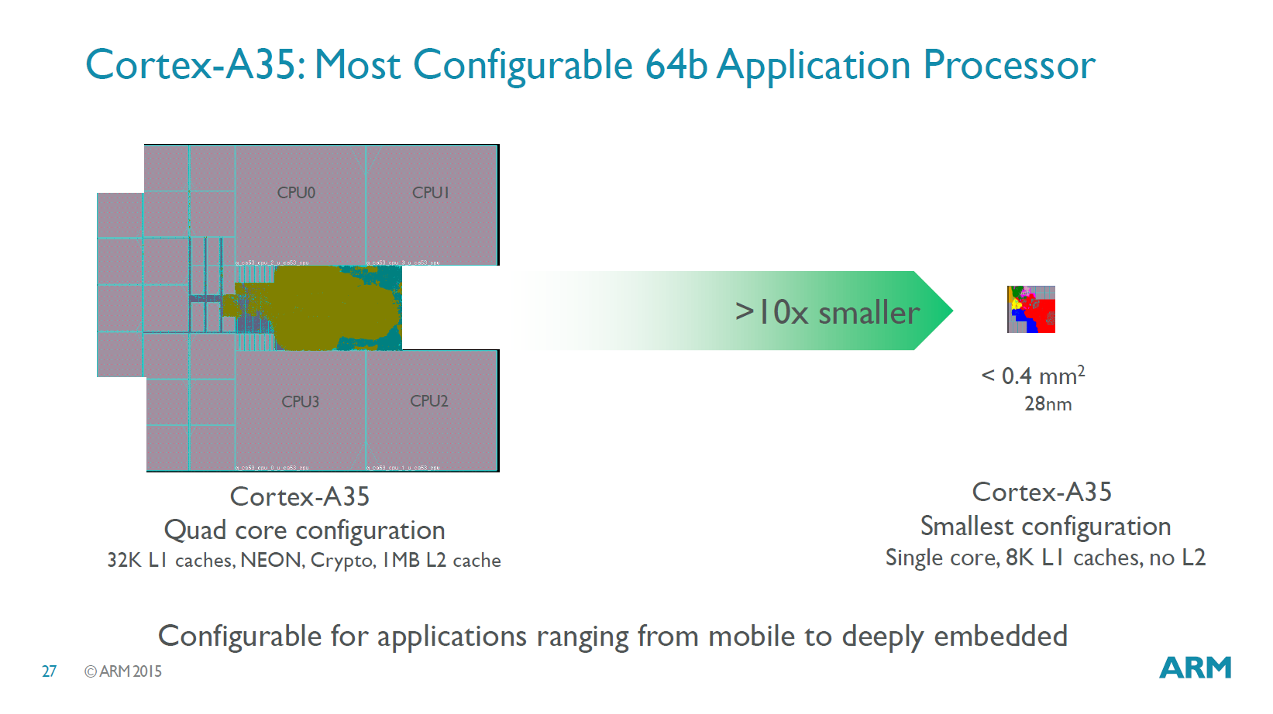
1. Introduction to ARM (4)
Configurability of ARM’s designs [90]
Example: Configuration options of the Cortex-A35 ranging from mobile to deeply
embedded
*

Slide 9
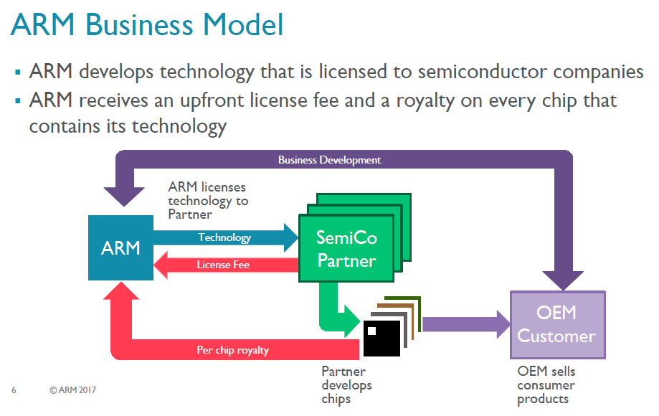
1. Introduction to ARM (5)
ARM's business model [117]
OEM: Original Equipment Manufacturer (e.g. Dell, HP etc).
*

Slide 10
1. Introduction to ARM (6)
ARM’s licensing policy [131] -1
ARM provides either a Cortex license or an Architecture license.
In case of a Cortex license the licensee gets a complete standard microarchitecture
design (IP) with flexible configuration options, e.g. for the sizes of the L1 or L2
caches.
The Architecture license allows using the ARM ISA and needs a complete custom
microarchitecture design that leads to a proprietary processor.
E.g. Apple or Samsung bought an Architecture license, designed their processors
and named them as they liked.
*

Slide 11
1. Introduction to ARM (7)
ARM’s enhanced licensing model called: “Built on ARM Cortex Technology”
[131]
Introduced in 02/2016.
It is available only for lead partners.
The new license agreement allows licensees to request changes of the
microarchitecture and use this customized design in their products.
ARM provides its engineering and design services for implementing the requested
modifications for additional costs.
Under the license's terms, ARM still owns the IP, however the modified
microarchitecture is not shared or made available to other licensees, but
licensees have branding freedom.
An example is Qualcomm’s Kryo 280 processor that is based on ARM’s
Cortex-A73, whereas earlier Qualcomm processors were custom designed
based in an Architecture license.

Slide 12
1. Introduction to ARM (8)
Dominance of ARM designs in the embedded and mobile market
(including smartphones and tablets)
ARM designs dominate recently the embedded and the mobile market
(including smartphones and tablets).
As of 2014 more than 50 billion ARM based processors have been produced
in total, up from 10 billion in 2008 [59], [19], as indicated in the next Figure.
*

Slide 13
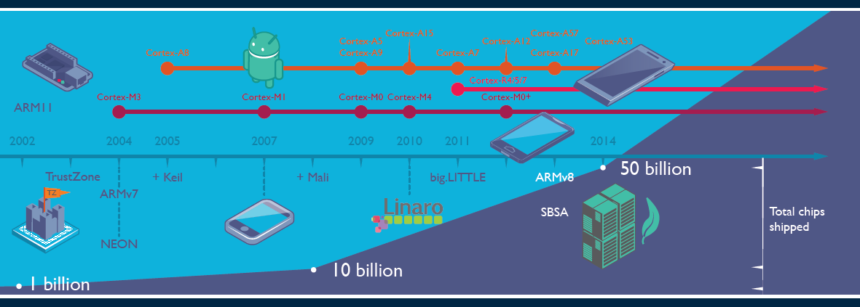
1. Introduction to ARM (9)
Total number of ARM-ISA based chips shipped until 2014 [19]
Keil: Software development tool for embedded processors
Linaro: Nonprofit company, established by ARM, Freescale, IBM, Samsung, ST-Ericsson and TI
to support open source software developers using Linux on SoCs.
SBSA: Server Base System Architecture, a standardized server platform for 64-bit ARM processors.

Slide 14
Number of ARM ISA-based chips shipped per quarter 2016-2019 [135]

Slide 15
1. Introduction to ARM (10)
Historical remarks [60], [61] -1
ARM’s parent company is Acorn Computers (UK).
Two years after the introduction of the IBM PC, Acorn Computers started their
Acorn RISC Machine project in October 1983 to develop an own powerful
processor for a line of business computers.
The acronym ARM was coined originally at this time (1983) from the designation
Acorn RISC Machine.
In 1990 the company Advanced RISC Machines Ltd. (ARM Ltd.) was founded as a
joint venture of Acorn Computers, Apple Computers and VLSI Technology.
Accordingly, also the interpretation of ARM was changed to “Advanced RISC
Machines”.

Slide 16
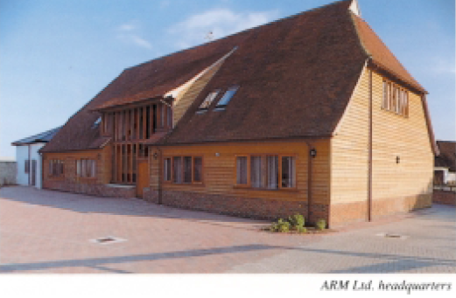
1. Introduction to ARM (11)
Historical remarks -2
Figure: The headquarters of ARM Ltd. about 1990 [62]

Slide 17
1. Introduction to ARM (12)
Historical remarks -3
Finally, in 1998 the company went to the stock exchange and its name was changed
to ARM Holdings plc, to its current designation.

Slide 18
1. Introduction to ARM (13)
Historical remarks -4
Figure: ARM's recent headquarter in Cambridge (UK) [78]

Slide 19
1. Introduction to ARM (14)
Acquisition of ARM by Softbank (Japan)
Announced in 07/2016
Completed in 09/2016
Price: 31 bUSD (ARM's revenues in 2015 ≈ 1.5 bUSD).

Slide 20
1. Introduction to ARM (15)
Acquisition of ARM by NVIDIA from Softbank
Completed in 09/2020
Price: 40 bUSD
NVIDIA aims at “burying x86 PCs” as stated by their CEO (Jen-Hsun in 09/2020
[134]:
"The PC of the future will be made by new OEMs, sold through new
distributors and use a new instruction-set architecture.
ARM will be the most important CPU architecture of the future, and it
already is the fastest growing processor architecture.”

Slide 21
2. Evolution of the ARM ISA

Slide 22
2. Evolution of the ARM ISA (1)
2. Evolution of the ARM ISA
There are eight ARM ISA versions, designated as ARMv1 to ARMv8.
The earliest versions (ARMv1 and ARMv2) provided an address range of only
26 bits, the first ISA version with 32 bit address range was the ARMv3.
We consider the ISA version ARMv3 as ARM’s basic ISA and discuss
its evolution subsequently.
ARM’s ISA versions are described in the related Architecture Reference Manuals,
as illustrated in the next Figure.
*

Slide 23
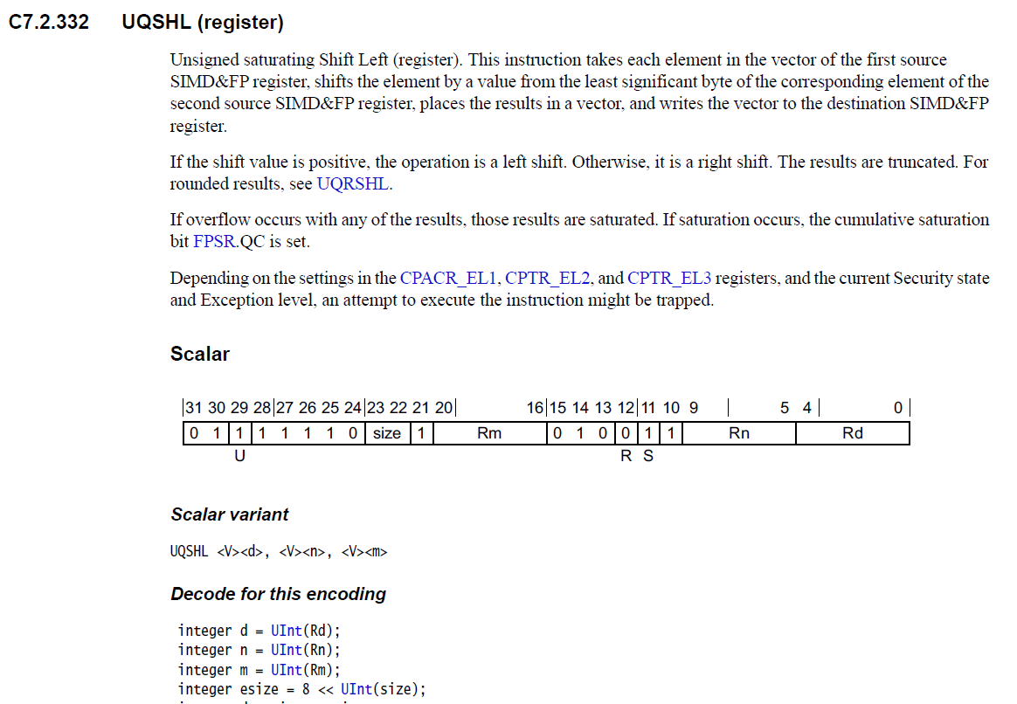
2. Evolution of the ARM ISA (2)
Example: Half page of the ARMv8 Architecture Reference Manual
(1/2 from 6354)

Slide 24
2. Evolution of the ARM ISA (3)
Key features of ARM’s basic ISA
It is a 32-bit RISC ISA that provides 16 32-bit registers, called the core registers.
13 out of them are used as general purpose registers (GPRs), the remaining three
are dedicated registers, as shown below.
Stack pointer
Link register
PC
Figure: The core registers of the ARM ISA (in the ISA versions ARMv3-ARMv7) [63]
The original ISA is capable of processing basically 32-bit scalar FX or logical data.
*

Slide 25
2. Evolution of the ARM ISA (4)
Main extensions introduced in ARM’s basic ISA (simplified) -1
ARM’s ISA extensions
ISA extensions
to enhance
compute capabilities
ISA extensions
to reduce
code size
ISA extensions
to speed up
the execution of bytecodes
ISA extensions
to enhance
security
*

Slide 26
2. Evolution of the ARM ISA (5)
Main extensions introduced in ARM’s basic ISA (simplified) -2 (Based on [64])
AArch32
AArch64
Crypto-graphy ext.
To enhance
security
TrustZone
SVE⁴
To enhance
compute
capabilities
SIMD
Adv. SIMD¹
(NEON)
Adv. SIMD and FP
SIMD
and FP
VFPv1/2
VFPv3/v4²
To speed up
the execution
of bytecodes
Jazelle
(Jazelle DBX)
Jazelle
(ex. by SW)
Jazelle RCT³
(ThumbEE)
To reduce
code size
Thumb
(ARMv4T)
Thumb-2
(ARMv6T2)
ARMv4
ARMv5
ARMv6
ARMv7-A/R
ARMv8-A
Examples
ARM710T
(~1995)
ARM926
(2001)
ARM1176
(2004)
Cortex-A5 - A15
(2005)
Cortex-A53/A57
(2014)
Remarks: These extensions will not be detailed in the lecture.

Slide 27
2. Evolution of the ARM ISA (6)
Main extensions introduced in ARM’s basic ISA to extend compute capabilities
AArch32
AArch64
Crypto-graphy ext.
To enhance
security
TrustZone
SVE⁴
To enhance
compute
capabilities
SIMD
Adv. SIMD¹
(NEON)
Adv. SIMD and FP
SIMD
and FP
VFPv1/2
VFPv3/v4²
To speed up
the execution
of bytecodes
Jazelle
(Jazelle DBX)
Jazelle
(ex. by SW)
Jazelle RCT³
(ThumbEE)
To reduce
code size
Thumb
(ARMv4T)
Thumb-2
(ARMv6T2)
ARMv4
ARMv5
ARMv6
ARMv7-A/R
ARMv8-A
Examples
ARM710T
(~1995)
ARM926
(2001)
ARM1176
(2004)
Cortex-A5 - A15
(2005)
Cortex-A53/A57
(2012)

Slide 28
2. Evolution of the ARM ISA (7)
In contrast: Evolution of Intel’s x86 ISA extensions [136]
Pentium_MMX
(1997)
PII
Klamath,
(1997)
Core
Cannon-Lake,
(2018)
Skylake-X/SP,
(2017)
(2016)

Slide 29
2. Evolution of the ARM ISA (8)
ARM’s ISA extensions introduced to enhance compute capabilities
ARM’s ISA extensions to enhance compute capabilities
The GPR register set is used
to keep FX SIMD data
A secondary register set is added
to keep FP and SIMD data
An SVE register set is added
to keep long SIMD data
It allows to introduce
FX-SIMD instructions
It allows to introduce
FX/FP scalar and SIMD instructions
It allows to introduce
FX/FP SIMD instructions
operating on long SIMD data
ARMv6
ARMv5
ARMv8.2
(Section a)
(Section b)
(Section c)
GPR: General Purpose Register
SVE: Scalable Vector Extension
*

Slide 30
2. Evolution of the ARM ISA (9)
a) GPR register set-based SIMD extensions
ARM’s ISA extensions to enhance compute capabilities
The GPR register set is used
to keep FX SIMD data
A secondary register set is added
to keep FP and SIMD data
An SVE register set is added
to keep long SIMD data
It allows to introduce
FX-SIMD instructions
It allows to introduce
FX/FP scalar and SIMD instructions
It allows to introduce
FX/FP SIMD instructions
operating on long SIMD data
ARMv6
ARMv5
ARMv8.2
(Section a)
(Section b)
(Section c)

Slide 31
2. Evolution of the ARM ISA (10)
a1) The GPR register set based SIMD extension introduced in the ARMv6 ISA
...
ARMv3
Previously 26 bitwide)
ARMv6
GPR register set
32
32
...
13
13
13
Basic ISA
Scalar data
FX32
FX SIMD
extension
32-bit wide
SIMD data
FX8/16 operations
*

Slide 32
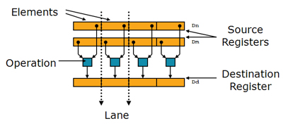
2. Evolution of the ARM ISA (11)
Example: Execution of a 32-bit SIMD instruction on 4 pairs of FX8 data
SIMD instructions perform the same operation on all data elements, as indicated below.
Figure: Execution of a 32-bit SIMD instruction on 4 pairs of FX8 data [11]

Slide 33
2. Evolution of the ARM ISA (12)
Extension of the original 32-bit ISA to 64-bit in the ARMv8 ISA version
Principles of the extension:
substantially extend the original 32-bit GPR and secondary register sets and
introduce new instructions to speed up computations and utilize new register sets
but
provide backwards compatibility with the ARMv7 operational mode in order to preserve the existing 32-bit SW base by introducing the
ARMv8 AArch32 and
ARMv8 AArch64
execution modes.
In the ARMv8 AArch32 execution mode the processor behaves as if it would be
an ARMv7-based processor, i.e. it makes use of the ARMv7 defined register sets
and executes instructions as specified by the ARMv7-A ISA.
In the ARMv8 AArch64 execution mode the processor makes use of the ARMv8
defined register sets and executes instructions as specified by the ARMv8-A ISA.
*

Slide 34
2. Evolution of the ARM ISA (13)
Extension of the GPR register set in the ARMv8 ISA [63], [66] -1
The ARMv8 ISA extends the original GPR register set, as seen in the Figure below.
32-bit wide
64-bit wide
63
31
0
R0
W0
X0
R1
W1
X1
R2
W2
X2
X3
W3
.
.
.
.
.
.
.
.
.
R12
W12
X12
Stack pointer
Link register
PC
W13
R13(SP)
X13
R14(LR)
W14
X14
R15(PC)
.
.
.
.
.
.
W30
X30
W31
Dedicated use
Dedicated use
X31
Z[63-00]: 64-bit FX SIMD data
W[31-00]: 32-bit FX SIMD data
GPRs in the ARMv3-ARMv7 and the
ARMv8 AArch32 execution mode.
GPRs in the ARMv8 AArch64 execution mode.
(32-bit W registers are implemented as the lower part
of the 64-bit X registers).
*

Slide 35
2. Evolution of the ARM ISA (14)
Remarks to the use of the GPRs in the AArch64 mode
In the AArch64 execution mode either 32- or 64-bit FX SIMD data can be
processed in the GPRs.
If 32-bit FX SIMD data is processed in this mode, in assembler instructions
GPRs needs to be referred to as W registers, whereas for 64-bit FX SIMD data,
GPRs are named as X registers.
Nevertheless, there exists only a single GPR register set in the processor,
the W registers are aliased with the lower 32-bits of the X registers, i.e.
the lower 32-bits of the X registers are used as the W registers.

Slide 36
2. Evolution of the ARM ISA (15)
a2) GPR register set based FX SIMD extensions introduced in the ARMv8 ISA
...
ARMv3
Previously 26 bitwide)
ARMv6
ARMv7
ARMv8
(AArch64)
ARMv8
(Aarch32)
GPR register set
32
32
32
32
...
13
13
13
31
Z
W
64
Basic ISA
Scalar FX32 data
FX32
FX32
FX64
FX SIMD
extension
FX SIMD
extensions
32-bit wide
FX SIMD data
32-bit wide
FX SIMD data
32-bit wide
FX SIMD data
in the W registers
64 bit wide
FX SIMD data
in the X registers
FX8/16
operations
FX8/16
operations
FX8/16
operations
FX8/16/32
operations
*

Slide 37
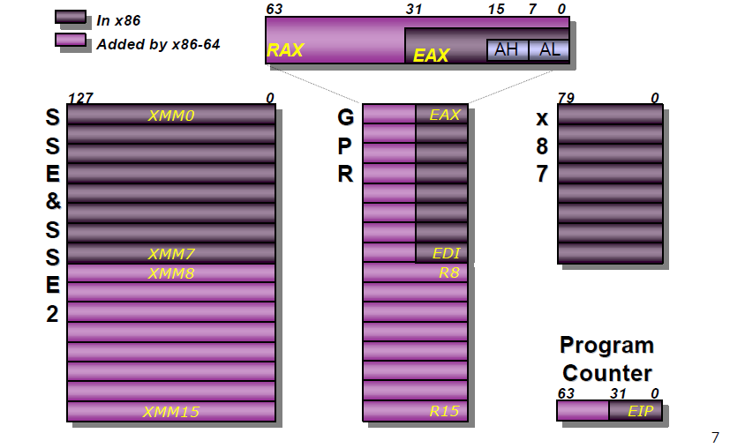
2. Evolution of the ARM ISA (16)
2. Evolution of the ARM ISA (15)
By contrast: Extension of the General Purpose Registers (GPRs) in the
x86-64 ISA [137]
X87 registers: Scalar FP registers
Notes:
37

Slide 38
2. Evolution of the ARM ISA (17)
b) Secondary register set based FP and SIMD extensions -1
ARM’s ISA extensions to enhance compute capabilities
The GPR register set is used
to keep FX SIMD data
A secondary register set is added
to keep FP and SIMD data
An SVE register set is added
to keep long SIMD data
It allows to introduce
FX-SIMD instructions
It allows to introduce
FX/FP scalar and SIMD instructions
It allows to introduce
FX/FP SIMD instructions
operating on long SIMD data
ARMv6
ARMv5
ARMv8.2
(Section a)
(Section b)
(Section c)

Slide 39
2. Evolution of the ARM ISA (18)
Evolution of the secondary register set
ARMv5
ARMv7
(or ARMv8 AArch32 mode)
ARMv8
(AArch64 mode)
FP register set¹
Advanced SIMD
and FP register set¹
SIMD
and FP register set
32
64
128
32
32
32
or
64
or
128
16
16
(Section b1)
(Section b2)
(Section b3)

Slide 40
2. Evolution of the ARM ISA (19)
b1) Secondary register set based FP and SIMD extensions of the ARMv5 ISA
ARMv5
ARMv7
(or ARMv8 AArch32 mode)
ARMv8
(AArch64 mode)
VFP register set¹
Advanced SIMD
and FP register set¹
SIMD
and FP register set
32
64
128
32
32
32
or
or
16
16
64
128
VFPv1/v2 extension
Scalar data
FP32/64
FP vector data serially processed
Up to 8 FP32 or 4 FP64
operations serially executed
VFP: Vector FP

Slide 41
2. Evolution of the ARM ISA (20)
Example: 5-element FP32 vector operation serially processed [65]
E.g.
A
+
B
=
C
In the example the input operands are taken from the registers s10...s14 and
s18...s22, and the result is written into the registers s26...s30.
The execution is sequential (like a hardware implemented subroutine).

Slide 42
2. Evolution of the ARM ISA (21)
b2) Secondary register set based FP and SIMD extensions of the ARMv7 ISA
ARMv5
ARMv7
(or ARMv8 AArch32 mode)
ARMv8
(AArch64 mode)
FP register set¹
Advanced SIMD
and FP register set¹
SIMD
and FP register set
32
64
128
32
32
32
or
or
16
16
64
128
VFPv1/v2 extension
VFPv3/v4² extension
Scalar data
Scalar data
FP32/64
FP16¹/32/64
Serially processed FP vector data
Serially processed FP vector data
Up to 8xFP32 or 4xFP64
operationsc serially executed
Up to 8xFP32 or 4xFP64
operations serially executed
Advanced SIMD (NEON) extension
64/128-bit wide FX/FP SIMD data
¹FP16 supports only data conversion
between FP16 and FP32/FP64.
²VFP4 supports FMA
(Fused Multiply Add)
operations
FX8/16/32/64
FP16¹/32/64 operations
(Only the NEON extension
will be discussed)
*

Slide 43
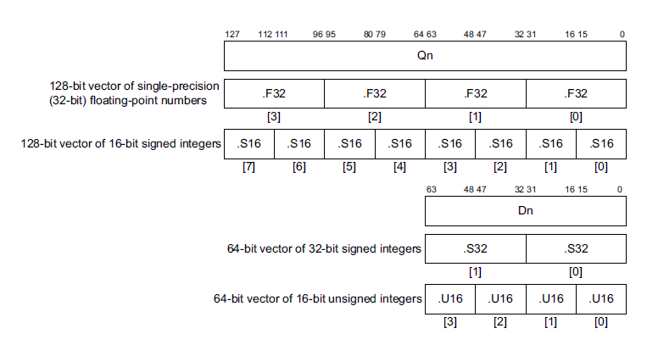
2. Evolution of the ARM ISA (22)
Example vector data formats of the Advanced SIMD (NEON) extension [86]
64-bit signed integer

Slide 44
2. Evolution of the ARM ISA (23)
b3) Secondary register set based FP and SIMD extensions of the ARMv8 ISA
ARMv5
ARMv7
(or ARMv8 AArch32 mode)
ARMv8
(AArch64 mode)
FP register set¹
Advanced SIMD
and FP register set¹
SIMD
and FP register set
32
64
128
32
32
32
or
or
64
16
16
64
128
VFPv1/v2 extension
VFPv3/v4 extension²
SIMD and FP extension
Scalar data
Scalar data
Scalar data
FP32/64
FP16¹/32/64
FP16¹/32/64
Serially processed FP vector data
Serially processed FP vector data
SIMD (vector) data
Up to 8xFP32 or 4xFP64
operationsc serially executed
Up to 8xFP32 or 4xFP64
operations serially executed
64/128-bit wide SIMD data
FX8/16/32/64
FP16³/32/64 operations
Advanced SIMD (NEON) extension
SIMD data
64/128-bit wide SIMD (vector) data
FX8/16/32/64
FP16³/32/64 operations
¹FP16 supports only data conversion
between FP16 and FP32/FP64.
*

Slide 45
2. Evolution of the ARM ISA (24)
c) The SVE register set based SIMD extension -1
ARM’s ISA extensions to enhance compute capabilities
The GPR register set is used
to keep FX SIMD data
A secondary register set is added
to keep FP and SIMD data
An SVE register set is added
to keep long SIMD data
It allows to introduce
FX-SIMD instructions
It allows to introduce
FX/FP scalar and SIMD instructions
It allows to introduce
FX/FP SIMD instructions
operating on long SIMD data
ARMv6
ARMv5
ARMv8.2
(Section a)
(Section b)
(Section c)
SVE: Scalable Vector Extension

Slide 46
2. Evolution of the ARM ISA (25)
The SVE register set based SIMD extension -2
ARM ISA |  | Name of the extensions | The SVE register set based SIMD extension
 |  |  | Available register set | Scalar data types | Vector data types
Name | Year
ARMv8.2 | 2016 | SVE | SVE register set 32 registers each (1...16)x128-bit wide | --- | FX 8/16/32/64/128 FP 16/32/64 (1...16)x128-bit wide FMA available
SVE: Scalable Vector Extension
*

Slide 47
2. Evolution of the ARM ISA (26)
The SVE register set based SIMD extension -3
ARMv8.2
(AArch64 mode)
SVE register set
15
2
1
---
32
128
Up to 16 x 128-bit (Up to 2048-bit)
SVE extension
Up to 16x 128-bit wide
FX/FP SIMD (vector) data
FX8/16/32/64
FP16³/32/64 operations
*

Slide 48
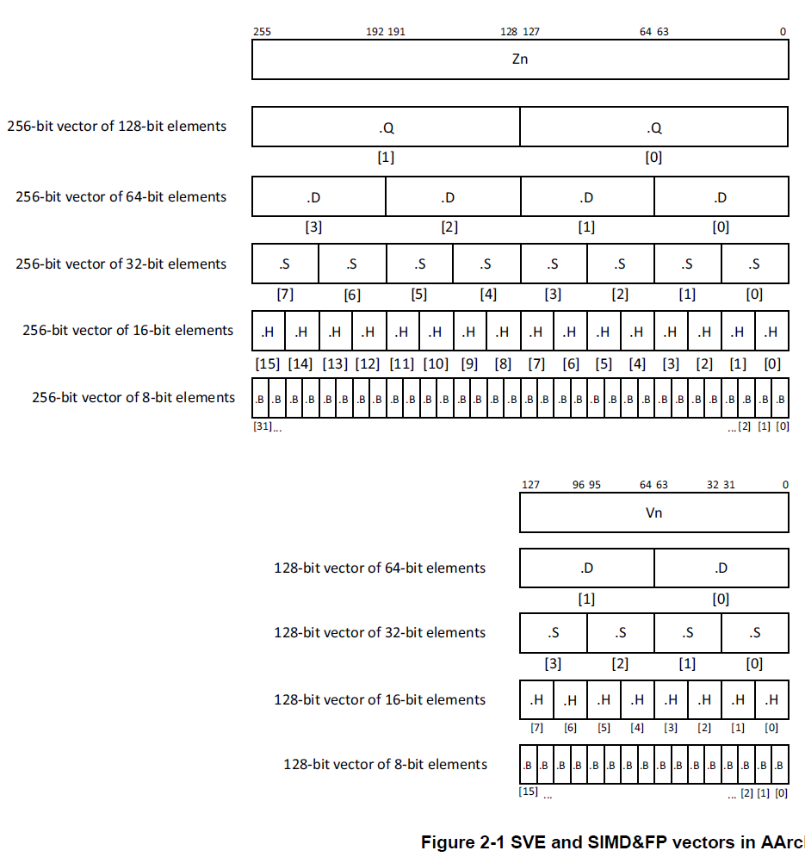
2. Evolution of the ARM ISA (27)
Data types assuming 256- or
128-bit long SVE registers [116]
Possible data types
8-bit: FX
16-bit: FX/FP
32-bit: FX/FP
64-bit: FX/FP
128-bit: FX

Slide 49
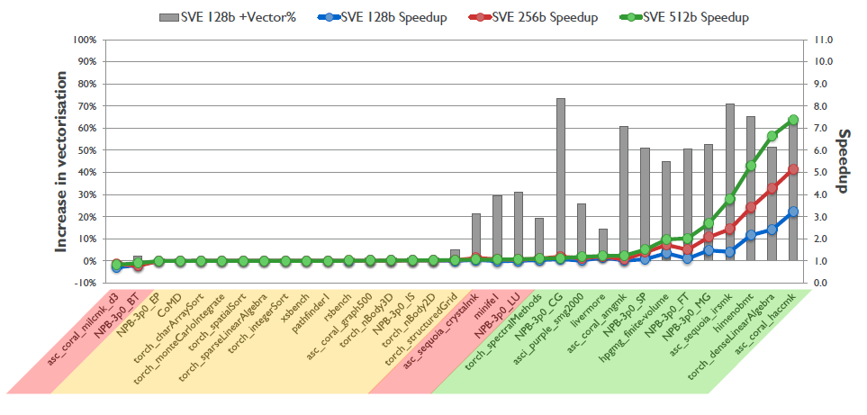
2. Evolution of the ARM ISA (28)
Speed-up potential of SVE [96]

Slide 50
2. Evolution of the ARM ISA (29)
In contrast: Extension of the SIMD register space in the x86 ISA
(Based on [138])
zmm (511-0)
ymm (255-0)
5
4
2
xmm (128-0)
SSE:
xmm0-7
(128-bit)
0
SSE (64-bit)
(xmm0-xmm15)-bit)
(xmm0-mm7)
MMX:
MM0-7
1
AVX/AVX2
ymm0-ymm15)
7
SSE2: xmm0-15
3
AVX-512
(zmm0-zmm31
SSE)
15
AVX-512
(ymm0-ymm31
AVX-512
(xmm0-xmm31)
31
511
255
127
0

Slide 51
2. Evolution of the ARM ISA (30)
Main extensions introduced in ARM’s basic ISA to extend compute capabilities
AArch32
AArch64
Crypto-graphy ext.
To enhance
security
TrustZone
SVE⁴
To enhance
compute
capabilities
SIMD
Adv. SIMD¹
(NEON)
Adv. SIMD and FP
SIMD
and FP
VFPv1/2
VFPv3/v4²
To speed up
the execution
of bytecodes
Jazelle
(Jazelle DBX)
Jazelle
(ex. by SW)
Jazelle RCT³
(ThumbEE)
To reduce
code size
Thumb
(ARMv4T)
Thumb-2
(ARMv6T2)
ARMv4
ARMv5
ARMv6
ARMv7-A/R
ARMv8-A
Examples
ARM710T
(~1995)
ARM926
(2001)
ARM1176
(2004)
Cortex-A5 - A15
(2005)
Cortex-A53/A57
(2012)
Remarks: See on the slide 2.1 Overview (5).

Slide 52
2. Evolution of the ARM ISA (31)
In contrast: Evolution of Intel’s x86 ISA extensions [136]
Pentium_MMX
(1997)
PII
Klamath,
(1997)
Core
Cannon-Lake,
(2018)
Skylake-X/SP,
(2017)
(2016)

Slide 53
3. ARM’s processor lines
3.1 Overview
3.2 Cortex-A models based on the ARMv7/v8.0 ISA
3.3 Cortex-A models based on the ARMv8.2 ISA

Slide 54
3.1 Overview

Slide 55
3.1 Overview (1)
3.1 Overview
ARM’s processors may be subdivided into three groups, according to their
underlying ISAs, as follows.
ARM’s processor lines
Processors based on
the ARMv1 – ARMv2 ISA
Processors based on the ARMv3 – v6 ISA
Processors based on
the ARMv7 – ARMv8/v8.2 ISA
(Earliest ARM processors)
(Early ARM processors)
(ARM’s Cortex processors)
(~ 1985-1990)
(~ 1991-2004)
(Since 2004/2012)
ARM1-ARM3
ARM6xx-ARM11xx
Cortex lines
26-bit address bus
32-bit data buses
32-bit address bus
32-bit data buses
ARMv7: 32-bit
ARMv8 /ARMv8.2: 64-bit
with AArch64 and AArch32 modes
Not discussed
Discussed
*

Slide 56
3.2 Cortex-A models based on the ARMv7/v8.0
3.2.1 Introduction
3.2.2 Overview and main features of Cortex-A models
based on the ARMv7/v8.0 ISA
3.2.3 Evolution of Cortex-A models based on the
ARMv7/v8.0 ISA

Slide 57
3.2.1 Introduction

Slide 58
3.2.1 Introduction (1)
3.2.1 Introduction
Processors based on the ARMv7 or higher ISA versions are designated
as the Cortex family of processors.
The Cortex family was announced in 10/2004, but the ARMv7 ISA was disclosed
a few months later (in 03/2005).
The first Cortex model became the Cortex-M3, launched in 10/2004.
*

Slide 59
3.2.1 Introduction (2)
Profiles of ARM’s Cortex family [6], [7], [113] -1
In the technical specifications of the ARMv7 ISA ARM introduced three family profiles
to have three sub-families of Cortex processors optimized for specific market
segments:
Cortex family profiles
Cortex-A profile
(Application profile)
Cortex-R profile
(Real-time profile)
Cortex-M profile
(Microcontroller profile)
Cortex-A processors
Cortex-R processors
Cortex-M processors
*

Slide 60
3.2.1 Introduction (3)
Profiles of ARM’s Cortex family [6], [7], [113] -2
The Cortex-A (application) profile
Cortex-A processors are intended to run complex OS and user applications, like
processors in smartphones, tablets, netbooks, eBook readers etc.
Their ISA supports now three instruction sets:
the A32 (AArch32),
the T32 (Thumb32) (subset of the A32 with 16-bit instructions)
the A64 (AArch64), introduced later in the ARMv8 ISA version (in 2012)
as the 64-bit extension of the previous 32-bit instruction set.
The Cortex-R (Real-time) profile [113]
Cortex-R processors are used as embedded processors for real time applications,
like mass storage or printer controllers.
Their ISA supports the A32 and T32 instruction sets.
The Cortex-M (Microcontroller) profile [113]
Processors of the M profile are intended to be used as deeply embedded
processors in microcontrollers and cost sensitive applications, like automotive
body electronics, or smart sensors.
Their ISA supports a variant of the T32 instruction set.
It backs writing interrupt handlers in high-level languages.
*

Slide 61
3.2.1 Introduction (4)
Extending the ARM Cortex family with the SecurCore profile in 10/2007
In 10/2007 ARM introduced the SecurCore profile.
Secure Core processors are optimized for smart card and secure applications.
*

Slide 62
3.2.1 Introduction (5)
Overview of
Cortex profiles
and processors
(as of 2015 [6]

Slide 63
3.2.1 Introduction (6)
Remark
According to the general scope of this Lecture Notes, subsequently, we will be
concerned only with the Cortex-A series.

Slide 64
3.2.1 Introduction (7)
Overview of the evolution of the Cortex-A processor models
In 2005 ARM disclosed the ARMv7 ISA with the first Cortex-A model
(the Cortex-A8).
In 2012 ARM unveiled the 64-bit ARMv8 (later renamed to ARMv8.0) ISA and
launched first ARMv8.0 processor models (Cortex-A57/Cortex-A53).
Then in 2017 ARM enhanced its ARMv8.0 ISA by the ARMv8.2 revision and
introduced first models based on the new ISA release (the Cortex-A55
and Cortex-A75 models, as indicated below.
Cortex-A models
Cortex-A models
based on the
ARMv7 ISA
Cortex-A models based on the
ARMv8.0 ISA
Cortex-A models based on the
ARMv8.2 ISA
32-bit architectures
(Announced in 2004)
Supporting big.LITTLE
core clusters since 2010
by specific models
64-bit architectures
(Announced in 2012)
Supporting big.LITTLE
core clusters
64-bit architectures
(Announced in 2017)
Supporting DynamIQ
core clusters
Sections 3.2.2 and 3.2.3
Section 3.3
*

Slide 65
3.2.2 Overview and main features of the Cortex-A models based on the ARMv7/v8.0 ISA

Slide 66
4. Evolution of the Cortex-A series ARMv7/v8.0 ISA-based models (16)
3.2.2 Overview of Cortex-A models based on the ARMv7/v8.0 ISA (6)
3.2.2 Overview of Cortex-A models based on the ARMv7/v8.0 ISA
Cortex-A models based on the ARMv7 ISA and their use [51]
CPU Core | Announced | Available in devices | big.LITTLE support | Target category | Efficiency
Cortex-A8 | 2005 | 2008 | -- | Mainstream | 2,0 DMIPS/MHz
Cortex-A9 | 2007 | 2010 | -- | Mainstream | 2,5 DMIPS/MHz
Cortex-A5 | 2009 | 2011 | -- | Low power | 1,6 DMIPS/MHz
Cortex-A15 | 2010 | Q2/2013 | Yes (with A7) | High-end | 4,0 DMIPS/MHz
Cortex-A7 | 2011 | 2012 | Yes (A15/A17) | Low power | 1,9 DMIPS/MHz
(Cortex-A12) | 2013 | withdrawn | -- | Mainstream) | 3,0 DMIPS/MHz
Cortex-A17 | 2014 | 2015 | Yes (with A7) | Mainstream | 4,0 DMIPS/MHz
DMIPS: Early Synthetic benchmark figure that reflects system (integer) programming.

Slide 67
3.2.2 Overview of Cortex-A models based on the ARMv7/v8.0 ISA (7)
b) Cortex-A models based on the ARMv8.0 ISA and their use [51]
CPU Core | Announced | Available in devices | big.LITTLE support | Target category | Efficiency
Cortex-A53 | 2012 | H2/2014 | Yes (with A57/A72) | Low power | 2,3 DMIPS/MHz
Cortex-A57 | 2012 | 2015 | Yes (with A57) | High-end | 4,8 DMIPS/MHz
Cortex-A53 | 2012 | H2/2014 | Yes (with A57/A72) | Low power | 2,3 DMIPS/MHz
Cortex-A72 | 2015 | 2016 | Yes (with A53) | High-end | 6.3-7.3 DMIPS/MHz
Cortex-A73 | 2016 | 2017 | Yes (with A53/A35) | High-end | 7.4-8.5 DMIPS/MHz

Slide 68
3.2.2 Overview of Cortex-A models based on the ARMv7/v8.0 ISA (1)
1) Performance classes of Cortex-A models based on the ARMv7/v8.0 ISA-1
Performance classes of Cortex-A models based on the ARMv7/v8.0 ISA
High-performance models
Mainstream models
Low-power models
*

Slide 69
3.2.2 Overview of Cortex-A models based on the ARMv7/v8.0 ISA (2)
Performance classes of Cortex-A models based on the ARMv7/v8.0 ISA -2
8
DMIPS/MHz
(Synthetic benchmark figures that
reflect integer programming.
5/2016
Cortex-A73
ARMv8
10 nm
7
ARMv8.0
(64-bit)
ARMv7
(32-bit)
2/2015
Cortex-A72
ARMv8
16 nm
Announced
6
10/2012
Cortex-A57
ARMv8
20/16 nm
5
9/2010
Cortex-A15
ARMv7
32/28 nm
2/2014
Cortex-A17
ARMv7
28 nm
4
6/2013
Cortex-A12
ARMv7
28 nm
High Performance
3
Mainstream
10/2007
Cortex-A9
ARMv7
40 nm
11/2015
Cortex-A35
ARMv8
16/14 nm
2
10/2005
Cortex-A8
ARMv7
65 nm
10/2012
Cortex-A53
ARMv8
20/16 nm
10/2011
Cortex-A7
ARMv7
28 nm
10/2009
Cortex-A5
ARMv7
40 nm
1
Low power
2006
2007
2008
2009
2010
2011
2012
2013
2014
2015
2016

Slide 70
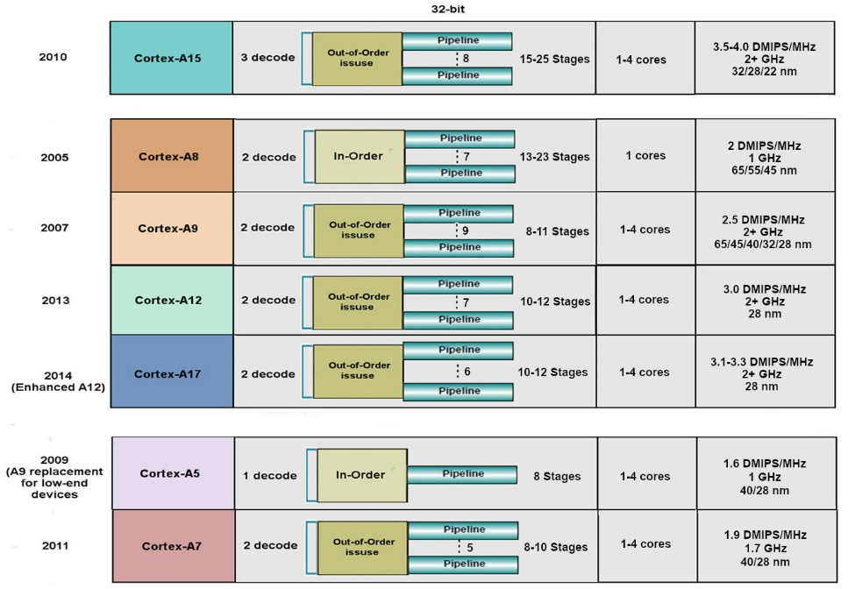
3.2.2 Overview of Cortex-A models based on the ARMv7/v8.0 ISA (3)
2) Core width of ARMv7 ISA based processors [14])
High performance
Mainstream
Low power

Slide 71
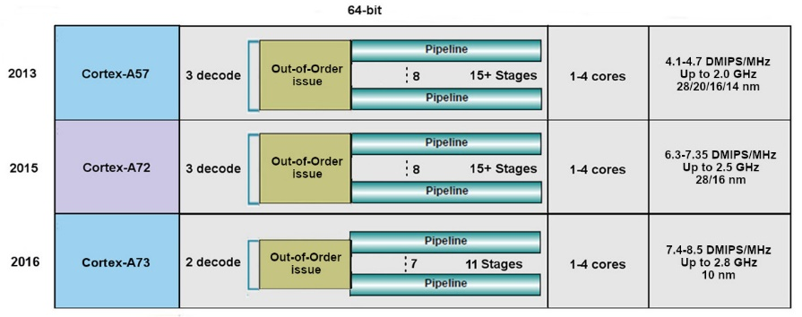
3.2.2 Overview of Cortex-A models based on the ARMv7/v8.0 ISA (4)
Core width of ARMv8 ISA based processors [14])
High performance
Low power

Slide 72
3.2.2 Overview of Cortex-A models based on the ARMv7/v8.0 ISA (5)
Core width of ARMv8 ISA based processors
Note that ARMv7/v8.0 processors have thin cores, as
high performance ARMv7/v8.0 core are typically 3 wide whereas
low power cores or mainstream ARMv7 cores are typically 2 wide.
There are however, two deviations, the high performance Cortex-A73 processor
has only two wide cores and the width of the low power A5’s core is only 1.

Slide 73
3.2.2 Overview of Cortex-A models based on the ARMv7/v8.0 ISA (8)
3) Wide configuration options - Example: The 64-bit low power Cortex-A35
It is a widely configurable application processor, as indicated below.
Figure: Configuration options of the Cortex-A35 [77]
It is configurable for applications ranging from mobiles to deeply embedded.
Target consumption is below 125 mW.

Slide 74
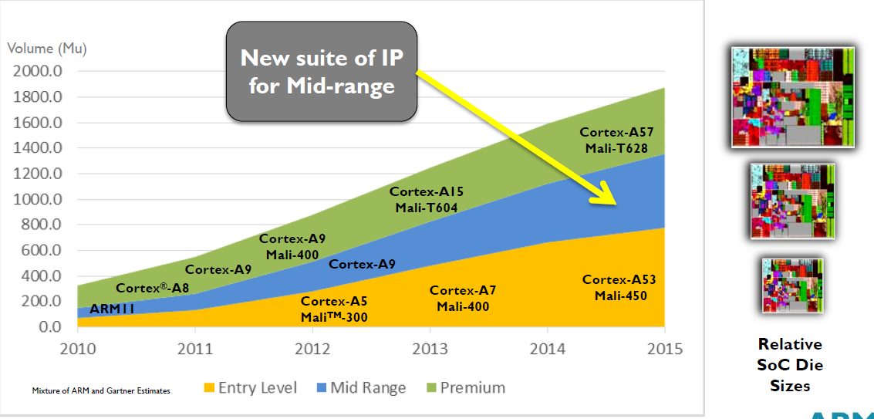
3.2.2 Overview of Cortex-A models based on the ARMv7/v8.0 ISA (9)
Yearly shipment of ARM Cortex-A chips in different performance classes
(data from 2013) [13]

Slide 75
3.2.3 Evolution of Cortex-A models based on the ARMv7/v8.0 ISA

Slide 76
3.2.3 Evolution of Cortex-A models based on the ARMv7/v8.0 ISA (1)
3.2.3 Evolution of key features of Cortex-A models based on the
ARMv7/v8.0 ISA
Key features of Cortex-A models based on the ARMv7/v8.0 ISA (considered)
Word length
of the models
Inclusion of
L2 cache
Multiprocessor
support
Support for big.LITTLE
configurations
(a)
(b)
(c)
(d)
*

Slide 77
3.2.3 Evolution of Cortex-A models based on the ARMv7/v8.0 ISA (2)
a) Evolution of the word length of the models
Word length of the models
ARM’s 32-bit Cortex-A models
ARM’s 64-bit Cortex-A models
They are based on the ARMv7 ISA
They are based on the ARMv8.0 ISA
Cortex-A8 (2005)
Cortex-A9 (2007)
Cortex-A5 (2009)
Cortex-A15 (2010)
Cortex-A7 (2011)
Cortex-A17 (2014)
Cortex-A53 (2012)
Cortex-A57 (2012)
Cortex-A35 (2015)
and subsequent models.
*

Slide 78
3.2.3 Evolution of Cortex-A models based on the ARMv7/v8.0 ISA (3)
b) Evolution of including an L2 cache
Inclusion of an L2 cache
No L2 cache
Optional L2 cache
Mandatory L2 cache
Cortex-A5 (10/2009)
(A9 replacement)
Cortex-A8 (10/2005)
Cortex-A9 (10/2007)
Cortex-A7 (10/2011)
Cortex-A15 (9/2010)
Cortex-A17 (2/2014)
All 64-bit models
*

Slide 79
3.2.3 Evolution of Cortex-A models based on the ARMv7/v8.0 ISA (4)
c) Evolution of multiprocessor support
Multiprocessor support
Single processor designs,
no multiprocessor
capability
Dual designs with two options
A-priory
multiprocessor designs
a single processor option and
a multiprocessor capable option
Cortex-A8 (2005)
Cortex-A5/Cortex-A5 MPCore (2009)
Cortex-A9/Cortex-A9 MPCore (2007)
(Cortex-A12/Cortex-A12 MPCore (2013))¹
Cortex-A15/Cortex-A15 MPCore (2010)
Cortex-A17/Cortex-A17 MPCore (2014)
Cortex-A7 MPCore (2011)
All 64-bit models
(from 2012 on)
ARM v8.0-based processors support multiprocessing and omit the MPCore tag.
¹The model Cortex-A12 was introduced in 6/2013 but became withdrawn
in 10/2014 since its parameters were too close to that of the Cortex-A17, so
subsequently we will leave it out in most parts from our discussion.
*

Slide 80
3.2.3 Evolution of Cortex-A models based on the ARMv7/v8.0 ISA (5)
Remarks on the interpretation of the term MPCore by ARM
ARM introduced the term MPCore in connection while announcing the
ARM11 MPCore in 2004, despite the fact that the ARM11 MPCore was actually
a multicore processor including up to 4 cores rather than a multiprocessor.
Along with the ARM Cortex-A9 MPCore (2007) ARM re-interpreted this term.
The ARM Cortex-A9 introduced 1-4 cores and it had two alternatives
the ARM Cortex-A9 does not support multiprocessor configurations and
the ARM Cortex-A9 MPCore supports multiprocessor configurations.
Subsequently, the MPCore tag has been used to indicate the multiprocessor
capability of a processor.
Finally, beginning with ARM v8.0-based processors all ARM processors were
designed to support multiprocessing and the MPCore tag became omitted.

Slide 81
3.2.3 Evolution of Cortex-A models based on the ARMv7/v8.0 ISA (6)
d) Introducing and spreading of the big.LITTLE technology
ARM revealed the big.LITTLE technology in a White Paper in 09/2011 and
began supporting the big.LITTLE technology along with their advanced 32-bit
(ARMv7) designs, as shown below.
Support of big.LITTLE core clusters
No support for big.LITTLE
core clusters
Support for big.LITTLE
core clusters
First 32-bit (ARMv7) models, such as the
Cortex-A8 (2005)
Cortex-A9 (2007)
Cortex-A5 (2009)
Advanced 32-bit (ARMv7) models, such as the
Cortex-A15 (2011)
Cortex-A7 (2011)
Cortex-A17 (2014)
and all 64-bit (ARMv8) models
*

Slide 82
3.2.3 Evolution of Cortex-A models based on the ARMv7/v8.0 ISA (7)
Principle of the big.LITTLE technology -1 [4]
There are a number of different alternatives how big.LITTLE technology can be
implemented.
Nevertheless, to illustrate the operation of the big.LITTLE technology,
in describing its principle of operation we assume a specific implementation,
when all cores of a cluster operate at the same operating point and either
the big cluster or the LITTLE cluster can be active at the same time.

Slide 83
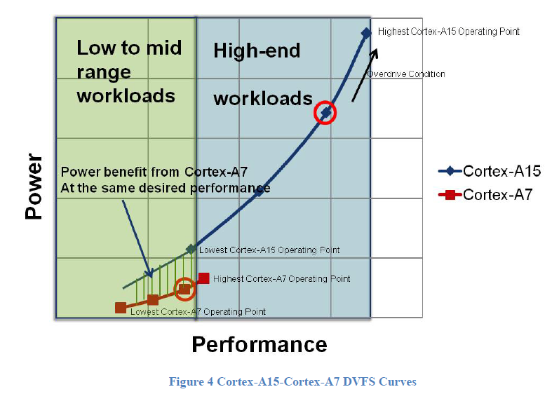
3.2.3 Evolution of Cortex-A models based on the ARMv7/v8.0 ISA (8)
Example: Operating points of a big (Cortex-A15) and a LITTLE core
(Cortex-A7) [3]

Slide 84
3.2.3 Evolution of Cortex-A models based on the ARMv7/v8.0 ISA (9)
Performance and energy efficiency comparison of the Cortex-A15 vs. the
Cortex-A7 cores [3]

Slide 85
3.2.3 Evolution of Cortex-A models based on the ARMv7/v8.0 ISA (10)
Principle of operation under the presumptions stated [4]
Let’s suppose that an appropriate OS routine (e.g. the cpufreq kernel routine of
Linux) tracks the workload and sets the operating point accordingly.
As long as the workload is low enough the scheduler activates the cores
of the „LITTLE” cluster.
If however the workload exceeds the performance capability of the “LITTLE”
cluster, an appropriate switching routine performs a cluster switch by
activating the “big” cluster and migrates the actual workload from the “LITTLE”
cluster to the “big” cluster and switches off the “LITTLE” cluster.
When any time, the workload becomes low enough for the “LITTLE” cluster, the
switching routine accomplishes a cluster switch back.
In this way, at any given time only cores of one cluster can be active,
this kind of the big.LITTLE technology is called Exclusive cluster switching.
*

Slide 86
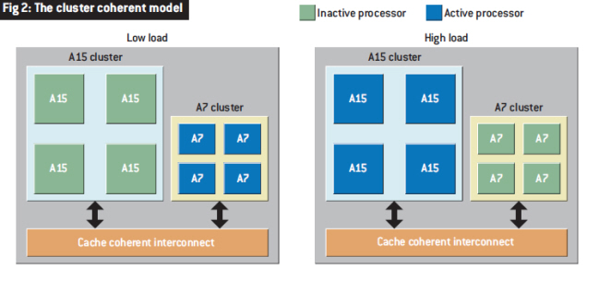
3.2.3 Evolution of Cortex-A models based on the ARMv7/v8.0 ISA (11)
Illustration of the described model of operation [7]
Remark
The presumptions were chosen for a straightforward description of the principle of
operation.
In fact however, most big.LITTLE implementations operate in a more intricate way,
not to be discussed here.

Slide 87
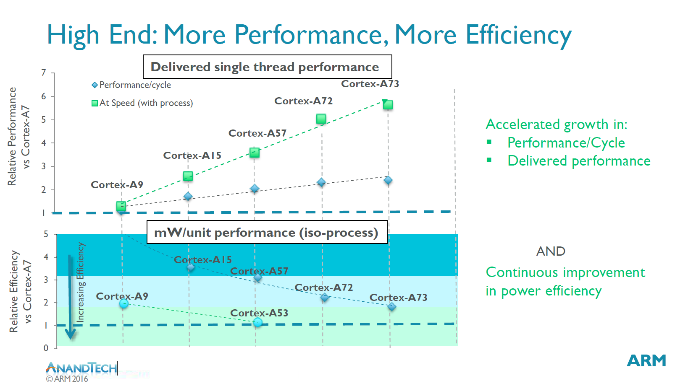
3.2.3 Evolution of Cortex-A models based on the ARMv7/v8.0 ISA (12)
Raising the ST performance, IPC and power efficiency of subsequent models
of the Cortex-A models vs. the A7 [99]
IPC
2007
2016
ST: Single Thread
*

Slide 88
3.2.3 Evolution of Cortex-A models based on the ARMv7/v8.0 ISA (13)
Raising the single thread IPC in Intel’s basic architectures (Based on [124])
2
24%
22%
Per Generation
1.9
20%
Cumulative
1.8
18%
1.7
16%
1.6
14%
12%
1.5
10%
1.4
8%
1.3
6%
1.2
4%
2%
1.1
0%
1
Pentium M Dothan
Core 2
Penryn
NHM (w/o SMT)
WSM
SNB
IVB
HSW
BRW
SKL
(2003)
(2015)
*

Slide 89
3.2.3 Evolution of Cortex-A models based on the ARMv7/v8.0 ISA (14)
Comparing the evolution of single thread IPC in Intel’s and AMD’s Core and
ARM’s Cortex-A models
Note that both Intel and ARM raised the IPC in their Core and Cortex A families,
respectively, only about 2-times in about 10 years.
*

Slide 90
3.2.3 Evolution of Cortex-A models based on the ARMv7/v8.0 ISA (15)
Extensive use of ARMv7-based (32-bit) ARM Cortex-A models in mobiles [18]
 | (SOC) System- On-a-Chip | Notable Product(s) Containing | ARM Cortex-A model | No. of Cores
Apple | A4 | iPhone 4, iPod Touch (4th Gen), iPad (1st Gen), AppleTV (2nd Gen) | Cortex-A8 | 1
 | A5 | iPhone 4S, iPad 2, AppleTV (3rd Gen) | Cortex-A9 | 2
 | A5X | iPad (3rd Gen, Retina Display) | Cortex-A9 | 2
Samsung | Exynos 3 Single | Samsung Galaxy S, Samsung Galaxy Nexus S, | Cortex-A8 | 1
 | Exynos 4 Dual | Samsung Galaxy SII, Samsung Galaxy Note (International) | Cortex-A9 | 2
 | Exynos 4 Quad | Samsung Galaxy SIII | Cortex-A9 | 4
 | Exynos 5 Dual | Chrombook | Cortex-A15 | 2
Nvidia | Tegra | Microsoft Zune HD | (ARM11) | 1
 | Tegra 2 | ASUS Eee Pad Transformer, Samsung Galaxy Tab 10.1, Motorola Xoom, Dell Streak 7 & Pro, Sony Tablet S | Cortex-A9 | 2
 | Tegra 3 | ASUS Transformer Pad 300, ASUS Nexus 7, Acer Iconia Tab A510 & A700, HTC One X | Cortex-A9 | 4
Qualcomm | Snapdragon S1 | Large number of devices | (ARM11)/A5 | 1
Texas Instruments | OMAP 3 | Barnes and Noble Nook Color | Cortex-A8 | 1
 | OMAP 4 | Amazon Kindle Fire, Samsung Galaxy Tab 2, Blackberry Playbook, Samsung Galaxy Nexus, Barnes and Noble Nook Tablet | Cortex-A9 | 2
 | OMAP 5 | N/A | Cortex-A15 | 2

Slide 91
3.2.3 Evolution of Cortex-A models based on the ARMv7/v8.0 ISA (16)
Three design teams working in parallel on Cortex-A processors [92]
8
DMIPS/MHz
Austin (Texas) designs
5/2016
Cortex-A73
ARMv8
10 nm
7
Sophia-Antipolis (France) designs
Announced
Cambridge (UK) designs
2/2015
Cortex-A72
ARMv8
16 nm
6
10/2012
Cortex-A57
ARMv8
20/16 nm
5
9/2010
Cortex-A15
ARMv7
32/28 nm
2/2014
Cortex-A17
ARMv7
28 nm
4
6/2013
Cortex-A12
ARMv7
28 nm
High Performance
3
Mainstream
10/2007
Cortex-A9
ARMv7
40 nm
11/2015
Cortex-A35
ARMv8
16/14 nm
2
10/2012
Cortex-A53
ARMv8
20/16 nm
10/2005
Cortex-A8
ARMv7
65 nm
10/2011
Cortex-A7
ARMv7
28 nm
10/2009
Cortex-A5
ARMv7
40 nm
1
Low power
2006
2007
2008
2009
2010
2011
2012
2013
2014
2015
2016

Slide 92
3.2.3 Evolution of Cortex-A models based on the ARMv7/v8.0 ISA (17)
Addendum
The subsequent Cortex-A models were designed by the following teams:
the Cortex-A75 by the Sophia-Antipolis team,
the Cortex-A76/A77/A78/X1 by the Austin (USA) team and
the Cortex A-55 by the Cambridge (UK) team.

Slide 93
3.2.3 Evolution of Cortex-A models based on the ARMv7/v8.0 ISA (18)
Optional reading: Remarks on the designs of the Cortex-A series (taken from [99])
"...The A15, A57, A72 all belong to the Austin family of microarchitectures, and as one would have guessed from the name, this is because they originated from ARM's Austin CPU design centre.
The A5, A7 and A53 belong to the Cambridge family while the Cortex A12, A17 and today's new A73 belong to the Sophia family, owning its name to the small city of Sophia-Antipolis which houses one of Europe's largest technology parks as well as ARM's French CPU design centre. Referring to their design location is however not enough to disambiguate microprocessor families, as we'll see completely new designs come out from each R&D center. In fact, this has already happened as the A12/17/73 can be seen as a new generation over the preceding the A9 microarchitecture and as such can be referred to as a "second generation Sophia family". This is an important notion to consider as in the future we'll be seeing completely new microarchitectures come out of ARM's various design teams."
"The Cortex A73 being still in the same Sophia family effectively means the design is very much a 64-bit successor to the Cortex A17. The new core effectively inherits some of the main characteristics of its predecessor such as overall µarch philosophy as well as higher-level pipeline elements and machine width. And herein lies the biggest surprise of the Cortex A73 as a A72 successor: Instead of choosing to maintain A72’s 3-wide, or increase the microarchitecture’s decoder width, ARM opted to instead go back to a 2-wide decoder such as found on the current Sophia family. Yet the A73 positions itself a higher-performance and lower-power design compared to the larger A72."

Slide 94
3.2.3 Evolution of Cortex-A models based on the ARMv7/v8.0 ISA (19)
Optional reading: Remarks on the evolution of the Cortex-A series (taken from [99]) -1
There is a brief but essential description of ARM's Cortex series in [99]. Due to its
relevance in the following we will cite parts of it.
"The Cortex A9 was an incredibly important design for ARM as, in my view, it provided the corner-stone for SoC and device vendors to create some of the designs that powered some of the most successful devices that brought with them a turning-point in smartphone performance and experience. Apple’s A5, Samsung’s Exynos 4210/4412, and TI OMAP4430/4460 were all SoCs which made the A9 a very successful CPU micro-architecture.
Following the Cortex A9 we saw the introduction of the Cortex A15. The core was a substantial jump in terms of performance as it provided the single largest IPC improvement in ARM’s Cortex A-profile of application processors. While the A15 represented a large performance boost, it came at significant cost in terms of power efficiency and overall power usage. It took some time for the Cortex A15 to establish itself in the mobile space as the first designs such as the Exynos 5250 and 5410 failed to impress due to bad power efficiency due to various issues.
It’s at this point where ARM introduced big.LITTLE with the argument that one can have the best of both worlds, a high-power performant core together with a low-power high-efficiency core. It was not until late 2014 and 2015 did we finally see some acceptable implementations of A15 big.LITTLE solutions such as the Kirin 920 or Exynos 5422."

Slide 95
3.2.3 Evolution of Cortex-A models based on the ARMv7/v8.0 ISA (20)
Optional reading: Remarks on the evolution of the Cortex-A series (taken from [99]) -2
"The Cortex A57 succeeded the Cortex A15 and was ARM’s first “big” core to employ ARMv8 64-bit ISA. Accompanied by the high-efficiency Cortex A53 cores this represented an important shift not unlike the x86-64 introduction in the desktop PC space well over a decade before. The cores came at a moment where the industry was still at shock of Apple’s introduction of the A7 SoC and Cyclone CPU micro-architecture, beating ARM in terms delivering the first 64-bit ARMv8 silicon. Suddenly everybody in the industry was playing catch-up in trying to bring their own 64-bit products as it was seen as an absolutely required feature-check to remain competitive.
This pressured shift to 64-bit was in my view a crippling blow to many 2015’s SoCs as it forced vendors into employing sub-optimal Cortex A57 and A53 designs. HiSilicon and MediaTek saw an actual regression in performance as flagship SoCs such as the Kirin 930 and Helio X10 had to make due with only A53 cores for performance as they decided against employing A57 cores due to power consumption concerns. The Kirin 930 or the X10 were in effect slower chipsets than their predecessors. Only Samsung was fairly successful in releasing reasonable designs such as the Exynos 5433 and Exynos 7420 – yet these had respectively regressed or barely improved in terms of power efficiency when compared to mature Cortex A15 implementations such as the Exynos 5430. Then of course we had sort of a lost generation of devices due to Qualcomm’s unsuccessful Snapdragon 810 and 808 SoCs, a topic we’ll eventually revisit in our deep dive of the Snapdragon 820 and Exynos 8890."

Slide 96
3.2.3 Evolution of Cortex-A models based on the ARMv7/v8.0 ISA (21)
Optional reading: Remarks on the evolution of the Cortex-A series (taken from [99]) -3
"Some readers will notice I left out the Cortex A12 and A17 – and I did that on purpose in trying to get to my point. The Cortex A12 was unveiled in July 2013 and presented as a successor to the Cortex A9. The core had a relatively short lifetime as it was quickly replaced within 6 months with the Cortex A17 in February 2014 which improved performance and also made the core big.LITTLE compatible with the Cortex A7. The Cortex A17 saw limited adoption in the mobile space. In fact, among the few SoCs such as Rockchip’s RK3288 and some little known chips such as HiSilicon’s Hi3536 multimedia SoC, it was only MediaTek’s MT6595 that saw moderate success in design wins such as Meizu’s MX4.”

Slide 97
3.3 Cortex-A models based on the ARMv8.2 ISA
3.3.1 Main extensions of the ARMv8.2 ISA
3.3.2 The Dynamic core cluster processor architecture
introduced along with the ARMv8.2 ISA
3.3.3 Overview of Cortex-A models based on the
ARMv8.2 ISA
3.3.4 Case example: The extra high performance Cortex-X1

Slide 98
3.3.1 Main extensions of the ARMv8.2 ISA

Slide 99
3.3.1 Main extensions of the ARMv8.2 ISA (1)
3.3.1 Main extensions of the ARMv8.2 ISA-1 [97]
Revision | Released | Main enhancements | Cortex-A processors
ARMv8-A | 10/2011 |  | A32/A35/ A53/A57/ A72/A73
ARMv8.1-A | 12/2014 | Incremental benefits over v8.0 relating to the instruction set, exception model and memory translation
ARMv8.2-A | 03/2017 | Half-precision FP Optional increase of the address space from 48 to 52 bits RAS extensions Statistical profiling to be able to analyze large working sets | A55/A75 (Provides also ARMv8.1 support)
(Only the red enhancements are discussed)
*

Slide 100
3.3.1 Main extensions of the ARMv8.2 ISA (2)
Main extensions of the ARMv8.2 ISA-2 [97]
Revision | Released | Main enhancements | Cortex-A processors
ARMv8.3-A | 12/2017 | Pointer authentication Improvements to the exception model for nested virtualization Small-scale enhancements to the ISA | TBA
ARMv8.4-A | 10/2018 | Cripto extensions Memory partitioning and monitoring capabilities New Secure EL2 state | TBA
ARMv8.5-A | n.a. | Vulnerability Detection Memory Tagging Branch Target Indicators Further small-scale enhancements | TBD

Slide 101
3.3.2 The Dynamic core cluster processor architecture introduced
along with the ARMv8.2 ISA

Slide 102
3.3.2 The Dynamic core cluster processor architecture introduced
along with the ARMv8.2 ISA
Evolution of multicore architectures in mobile processors
Evolution of multicore architectures in mobile processors
Single core CPUs
Multicore CPUs
Symmetrical
multicores
(SMCs)
big.LITTLE
core clusters
DynamIQ
core clusters
SMCs (Symmetrical Multicores) represent the first step in the evolution of CPU core
architectures, as indicated in Figure above.
SMCs are processors with multiple CPU cores operating in parallel (as seen in the
next Figure).

Slide 103
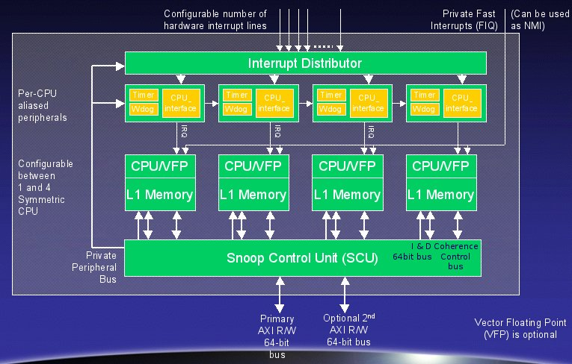
3.3.2 The DynamIQ core cluster (2)
Example of an SMC processor: The ARM11 MPCore processor (2004) [115]
Note: At introduction ARM called the ARM11 MPCore processor SMP (Symmetrical
multicore).
Nevertheless, in 2007 AMD re-interpreted the term MPCore by returning to its de facto
meaning that is: “multiple processors”.
Finally, with the 64-bit ARM v8.0 lines (2012) ARM omitted the MPCore tag and
declared all its Cortex-A models multiprocessor capable.

Slide 104
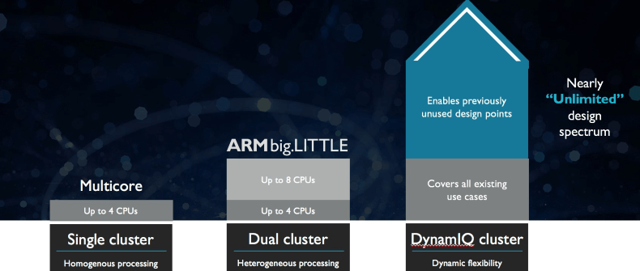
3.3.2 The DynamIQ core cluster (1)
Evolution of ARM’s core cluster technology – Overview [114]
SMP: Symmetrical Multiprocessor
(In ARM’s interpretation
Symmetrical multicore)
SMP
(
)
ARM11 MPCore (2004)
Cortex-A7/A15 (~2011)
Cortex-A55/A75 (~2017)
*

Slide 105
3.3.2 The DynamIQ core cluster (2)
From SMCs (ARM11 MPCore) to the big.LITTLE technology
ARM11 MPCore [115]
big.LITTLE
Cluster of
big cores
Cluster of
LITTLE cores
CPU0
CPU1
CPU0
CPU1
CPU2
CPU3
CPU2
CPU3
Shared L2
Shared L2
Cache coherent interconnect
(2004)
(2011)
Note that compared to ARM11 MPCore, big.LITTLE processors have two different
core clusters and shared L2 caches per core cluster.
*

Slide 106
3.3.2 The DynamIQ core cluster (3)
The road from big.LITTLE core clusters to the DynamIQ core cluster
ARM started working on the DynamIQ core cluster technology in 2013 [98].
DynamIQ core clusters were announced in 03/2017.
They represent the next step in the evolution of core cluster technology.
*

Slide 107
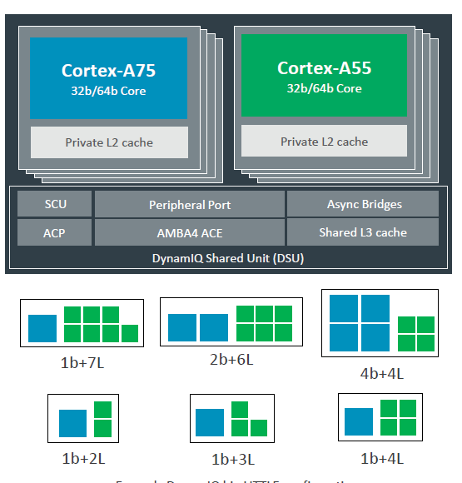
3.3.2 The DynamIQ core cluster (4)
The DynamIQ technology as an evolution of the big.LITTLE technology
First sight
Two big.LITTLE core clusters
A single DynamIQ core cluster (118)
Cluster of
big cores
Cluster of
LITTLE cores
CPU0
CPU1
CPU0
CPU1
CPU2
CPU3
CPU2
CPU3
To cache coherent interconnect through the AMBA4 ACE bus
Shared L2
Shared L2
To
Cache coherent interconnect
Two stand alone clusters
with up to 4 cores (2011)
*

Slide 108
3.3.2 The DynamIQ core cluster (5)
Main enhancements of DynamIQ core clusters vs. the previous big.LITTLE
implementation

Slide 109
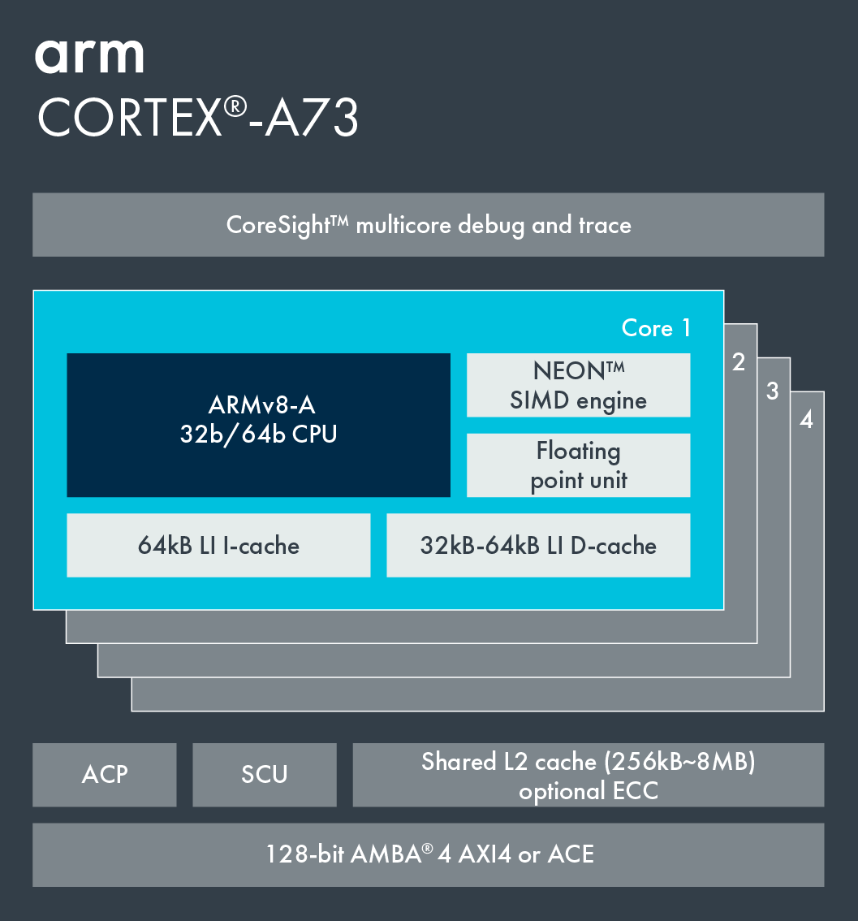
3.3.2 The DynamIQ core cluster (6)
a) Up to two core types with up to 8 CPU cores
big.LITTLE core cluster (2015) [102]
DynamIQ core cluster (2017) [118]
Cortex-A73 core
ARMv8.0 CPU
single CPU type, up to 4 cores/cluster
ARMv8.0 support,
e.g. Cortex-A53/A57/A72/A73
2 CPU types, up to 8 cores /cluster
ARMv8.2 support,
Cortex-A55/75 or subsequent processors
*

Slide 110
3.3.2 The DynamIQ core cluster (6)
a) (cont.) Variable mix of the cores (but up to 4 big cores)
big.LITTLE core cluster (2015) [102]
DynamIQ core cluster (2017) [118]
Cortex-A73 core
ARMv8.0 CPU
2 CPU types with variable mix of the cores, but
up to 4 big cores
*

Slide 111
3.3.2 The DynamIQ core cluster (7)
b) Private (per-core) L2 caches in the CPU cores
big.LITTLE core cluster (2015) [55]
DynamIQ core cluster (2017) [56]
Cortex-A73 core
ARMv8.0 CPU
Shared L2 cache
Private L2 caches, shared L3 cache
*

Slide 112
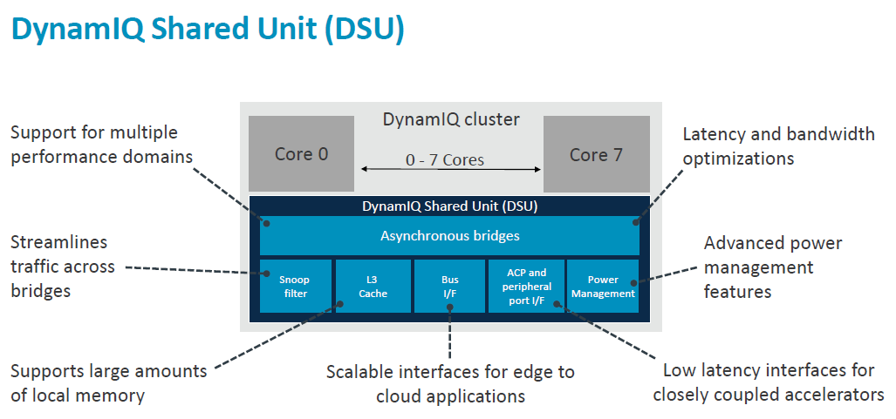
3.3.2 The DynamIQ core cluster (8)
c) DynamIQ Shared Unit (DSU) with a shared L3 cache and snoop filter [106]
(Partitions)
(Per-CPU DVFS control,
Partial L3 power down)
(Up to two 128-bit AMBA 5 ACE,
256-bit AMBA 5 CHI)
Snoop filter: A unit used to speed up coherent memory accesses
*

Slide 113
3.3.2 The DynamIQ core cluster (9)
Reduced cache latencies [106]

Slide 114
3.3.2 The DynamIQ core cluster (10)
d) Capability for partitioning the cores, the L3 cache and ACP ports [98] -1
It is feasible to set up up to four partitions by assigning
the cores,
sections of the L3 cache and
ACP ports
to maximum of 4 partitions, as illustrated in the Figure below.
Figure: Example for partitioning the cores and the L3 cache [98]
ACP: Accelerator Coherency Port, port for not cache coherent sensors and accelerators

Slide 115
3.3.2 The DynamIQ core cluster (10)
d) Capability for partitioning the cores, the L3 cache and ACP ports [98] -2
Partitioning may be unbalanced, e.g. 1 CPU could be assigned 2 GB whereas
the other CPUs the remaining 2 GB (assuming an 8 GB configuration).
The partitions are dynamic and can be created/adjusted during runtime by
the OS or hypervisor.
Partitioning can be useful for embedded systems that run a fixed workload or
applications that require a more deterministic runtime.

Slide 116
3.3.2 The DynamIQ core cluster (12)
e) Finer-grain frequency and voltage control [98]
In case of DynamIQ core clusters
groups of CPUs (i.e. partitions)
can run at different
frequencies and voltages.
*

Slide 117
Summing up the main enhancements of DynamIQ core clusters
Up to two core types with up to 8 ARMv8.2 ISA based CPU cores,
that may be variable be mixed (up to 4 big cores)
Private (per-core) L2 caches in the CPU cores
c) DynamIQ Shared Unit (DSU) with a shared L3 cache and snoop filter
d) Capability for partitioning the cores, the L3 cache and the ACP ports
e) Finer-grain frequency and voltage control

Slide 118
3.3.2 The DynamIQ core cluster (13)
Benefits of the DynamIQ cluster technology:
great flexibility with 2 to 7 LITTLE cores
redesigned memory subsystem with lower access time due to implementing
private L2 caches and a shared L3 cache
improved power efficiency through intelligent power management (EAS)
EAS (Energy Aware Scheduling), not detailed here.
*

Slide 119
3.3.2 The DynamIQ core cluster (14)
Presumption of implementing DynamIQ core clusters
It assumes ARMv8.2 compatible cores, such as the Cortex-A55 and Cortex-A75
to Cortex-A78 as well as the Cortex-X1.

Slide 120
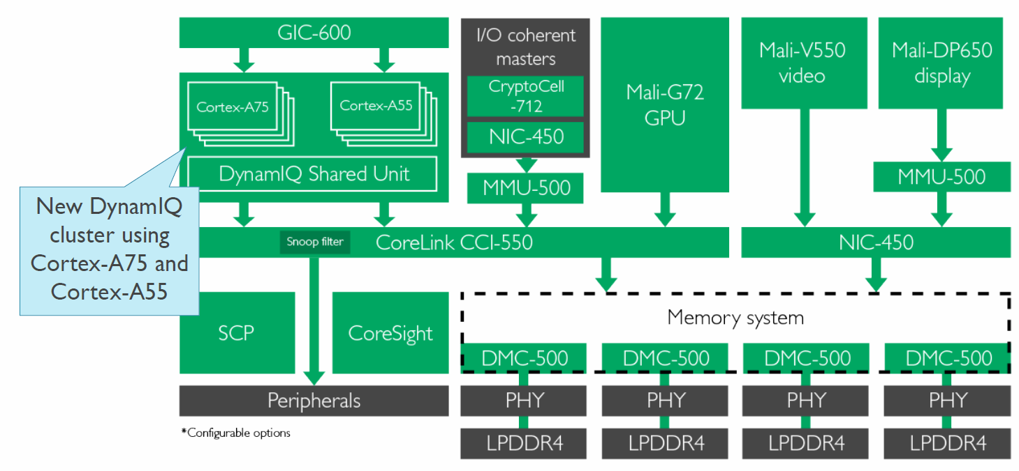
3.3.2 The DynamIQ core cluster (15)
Example of a premium mobile system (in 2018) while using a cache-coherent
ring interconnect [108]
CCI-550: Cache Coherent interconnect
MMU-500: Memory Management Unit (responsible for virtualization and caching)
NIC-450: Network Interconnect (interface converter)
GIC-600: General Interrupt Controller
SCP: System Control Processor

Slide 121
3.3.3 Overview of Cortex-A models based on the
ARMv8.2 ISA

Slide 122
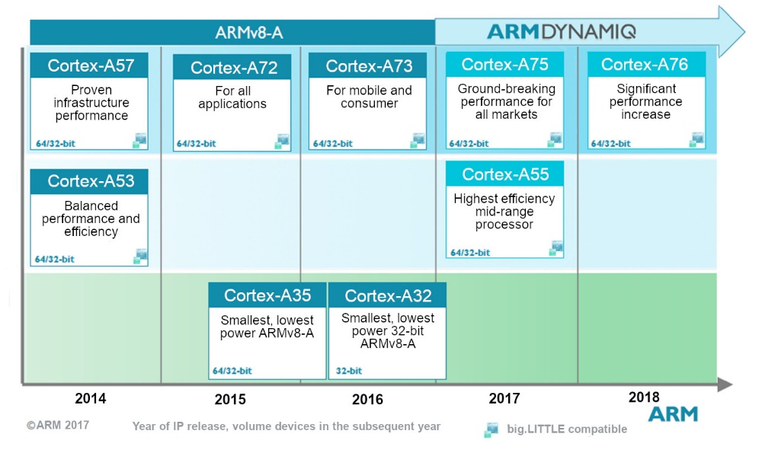
3.3.3 Overview of Cortex-A models based on the ARMv8.2 ISA (1)
3.3.3 Overview of Cortex-A models based on the ARMv8.2 ISA
ARMv8.2-A
A7x
Series
A5x
Series
A3x
Series
Source: ARM

Slide 123
3.3.3 Overview of Cortex-A models based on the ARMv8.2 ISA (2)
Cortex-A models based on the ARMv8.2 ISA and their main features
CPU Core | Announced | Available in devices | Big.LITTLE support | Target category | Efficiency
Cortex-A55 | 2017 | 2018 | Yes (with A75 or higher) | Low-end | ~3 DMIPS/MHz
Cortex-A75 | 2017 | 2018 | Yes (with A55) | High-end | ~8.2-9.5 DMIPS/MHz
Cortex-A76 | 2018 | 2018 | Yes (with A55) | High-end | ~10.7-12.4 DMIPS/MHz
Cortex-A77 | 2019 | 2019 | Yes (with A55) | High-end | n.a.
Cortex-A78 | 2020 | 2021? | Yes (with A55) | High-end | n.a.
Cortex-X1 | 2020 | 2021? | Yes (with A55) | Extra high-end | n.a.

Slide 124
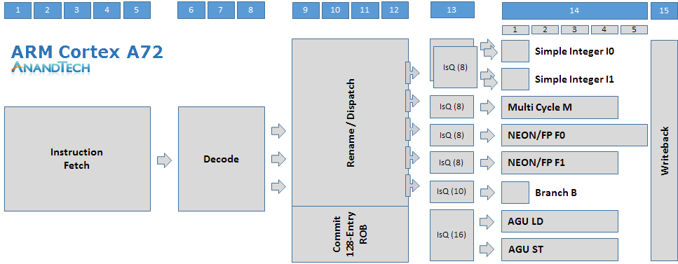
3.3.3 Overview of Cortex-A models based on the ARMv8.2 ISA (3)
Characterizing the width of a processor core (e.g. in Cortex-A7x processors)
Let’s characterize the width of the processor core by its decode-, dispatch- and issue-
rates, interpreted as stated below:
Decode rate
Dispatch rate
Issue rate
Figure: Interpretation of the decode-, dispatch- and issue rates in the Cortex-A72 [92]
*

Slide 125
3.3.3 Overview of Cortex-A models based on the ARMv8.2 ISA (4)
Evolution of the width of the processor cores in Cortex-A7x processors
Cortex model | ISA | Launched in | Target IC techn. | Decode rate | Dispatch rate | Issue rate | ROB size
A72 | ARM 8.0 | 02/2015 | 16 nm | 3 | 5 | 8 | n.a.
A73 | ARM 8.0 | 05/2016 | 10 nm | 2 | 4 | 7 | n.a.
A75 | ARM 8.2 | 05/2017 | 10 nm | 3 | 6 | 8 | 128
A76 | ARM 8.2 | 05/2018 | 12, 7, 5 nm | 4 | 8 | 8 | 128
A77 | ARM 8.2 | 05/2019 | 7, 5 nm | 4 | 10 | 12 | 160
A78 | ARM 8.2 | 2020? | 5 nm | 4 | 6 | 13 | n.a.
X1 | ARM 8.2 | 2020? | 5 nm | 5 | 8 | 15 | 224
ROB: ReOrder Buffer (Out-of-order window) determines the max. number of in-flight
instructions
*

Slide 126
3.3.3 Overview of Cortex-A models based on the ARMv8.2 ISA (5)
Evolution of the width (in terms of the decode rate) of mobile cores
Width of mobile cores
(or of big cores of big.LITTLE or dynamIQ core clusters)
2-wide
3-wide
4-wide
6-wide
ARM
v7 HP Cortex-A15
(2010)
v7 M Cortex-A (2005-09)
v7 LP Cortex-A7 (2011)
(v7 LP Cortex-A5 1-wide (2009))
v8.0 HP Cortex-A-57/72
(2013-15)
v8.0 LP Cortex-A (2013/15)
v8.2 HP Cortex-
A76/77/78
(2018/20/20)
v8.2 HP Cortex-X1
(2020) (5-wide)
v8.0 HP Cortex-A73 (2016)
v8.2 LP Cortex-A55 (2017)
v8.2 HP Cortex-A75
(2017)
Intel
Atom family (2008-15)
Airmont core (2016)
Goldmont core (2016)
Tremont core (2x3) (2020)
AMD
Cat family (2011-2015)
v8 Cyclone (A7) (2013)
and A8-A10 (2014-16)
v8.2 A11 (2017) 7-wide
and subsequent cores
Apple
v7 Cortex-A8 (2009)
v7 Swift (A6) (2012)
Qualcomm
v7 Scorpion
(S1-S3) (2007-10)
v7 Krait
(S4/S400/S60x/S80x)
(2012-14)
v8 Kryo/Kryo 280
(S820/821/835) (2015/2016/2017)
v8.2 Kryo 385
(S845) (2018)
Samsung
v7 Exynos 5
(2013-14)
v8 Exynos 7
(2016)
v8 M1 (2016)
(Exynos 8 Octa)
v8 M2 (2017)
(Exynos 9 Octa)
v8.2 M3 (2018)
(Exynos 9810)
v8.2 M6 (8-wide) (planned/cancelled)
HP: High-Performance
M: Mainstream
LP: Low-Power
*

Slide 127
3.3.3 Overview of Cortex-A models based on the ARMv8.2 ISA (6)
Further microarchitectural enhancements of the Cortex-A7x processors
The A75 introduced FP16 and int8 datatypes to support AI
The A77 introduced a Macro-Op (MOP) cache.
*

Slide 128
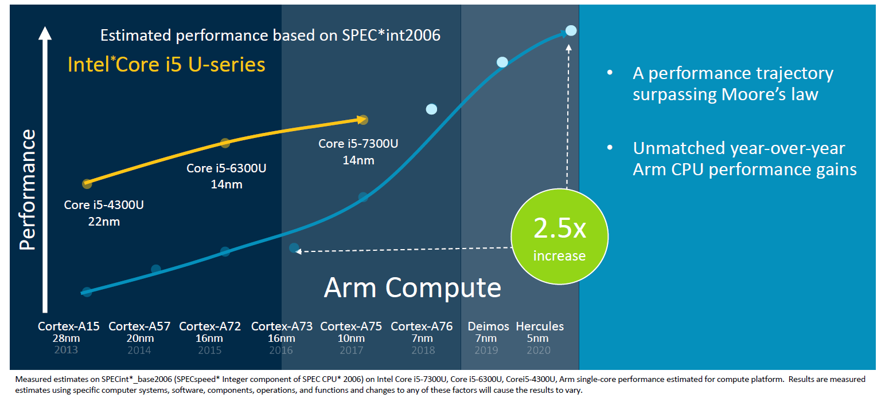
3.3.3 Overview of Cortex-A models based on the ARMv8.2 ISA (7)
ARM’s projection to exceed Intel’s processor performance (from 2018) -1
ARM expected faster performance gains for their planned models than awaited
for Intel’s comparable processors, as shown in the Figure below.
A-78
A-77
Figure: ARM’s projected year-over-year performance gain over Intel’s processors [92]
*

Slide 129
3.3.3 Overview of Cortex-A models based on the ARMv8.2 ISA (8)
ARM’s projection to exceed Intel’s processor performance (from 2018) -2
As seen from the previous Figure, ARM expected their planned Cortex-A77 and
Cortex-A78 processors to provide higher performance than Intel’s comparable
client processors.
Performance results published in 2020 for ARM’s subsequent extreme performance
Cortex-X1 processor allow a comparison between SPECint2006 and SPECFP2006
results for the ARM’s Cortex-X1 and Intel’s Core 10900k (Skylake) processors.
The results (shown subsequently in connection with the extra high performance
Cortex-X1 processor show however, that ARM’s ambitious goals have not yet
been achieved.
*

Slide 130
3.3.4 Case example: The extra high performance Cortex-X1

Slide 131
3.3.4 The extra high performance Cortex-X1 (1)
3.3.4 The extra high performance Cortex-X1
Announced along with the Cortex-A78 in 05/2020.
Both the Cortex-A78 and the Cortex-X1 were designed in the Austin Center and
both are sharing the same basic design blocks, but whereas the A78 is focused
on efficiency the X1 aims at maximizing performance.
The Cortex-X1 is the first member of a new, performance oriented line, called
the Cortex-X line.
The Cortex-X1 line has been introduced within the framework of the Cortex-X
Custom Program.
*

Slide 132
3.3.4 The extra high performance Cortex-X1 (2)
ARM’s Cortex-X Custom Program [127]
It is an evolution of the former “Built on ARM Cortex Technology” licensing model.
It allows the licensee to customize standard ARM Cortex products for performance
first designs.
A possible customization is e.g. increasing the ROB (ReOrder Buffer) size.
Larger ROBs result in higher performance but need more power and larger
Si-area.
The customization requires early engineering collaboration between ARM and the
licensee and is done by ARM.
Under the new scheme ARM maintains the ARM Cortex branding of the cores,
no licensee specific core names are allowed.
The new, extra high-performance Cortex-X series processors are available only
to Cortex-X Custom Program licensees.

Slide 133
3.3.4 The extra high performance Cortex-X1 (3)
Contrasting the design philosophies of the ARM Cortex-A and Cortex-X series
processors [127]
*

Slide 134
3.3.4 The extra high performance Cortex-X1 (4)
Contrasting main features of the Cortex-A78 and Cortex-X1 processors [127]
Note that X1 processors are 5-wide with an issue rate of 8 Mops (Macro-operations
per cycle) whereas A78 processors are only 4 wide and issue 6 Mops.

Slide 135
3.3.4 The extra high performance Cortex-X1 (5)
Remark
Intel increased the front-end width of their processors to 5 only beginning with the
Skylake-processor (in 2015).

Slide 136
3.3.4 The extra high performance Cortex-X1 (6)
Front-end enhancements Cortex-X1 vs. A77 [130]
6 MOPs/cycle
8 MOPs/cycle

Slide 137
3.3.4 The extra high performance Cortex-X1 (7)
Evolution of the width (in terms of the decode rate) of mobile cores
Width of mobile cores
(or of big cores of big.LITTLE or dynamIQ core clusters)
2-wide
3-wide
4-wide
6-wide
ARM
v7 HP Cortex-A15
(2010)
v7 M Cortex-A (2005-09)
v7 LP Cortex-A7 (2011)
(v7 LP Cortex-A5 1-wide (2009))
v8.0 HP Cortex-A-57/72
(2013-15)
v8.0 LP Cortex-A (2013/15)
v8.2 HP Cortex-
A76/77/78
(2018/20/20)
v8.2 HP Cortex-X1
(2020) (5-wide)
v8.0 HP Cortex-A73 (2016)
v8.2 LP Cortex-A55 (2017)
v8.2 HP Cortex-A75
(2017)
Intel
Atom family (2008-15)
Airmont core (2016)
Goldmont core (2016)
Tremont core (2x3) (2019)
AMD
Cat family (2011-2015)
v8 Cyclone (A7) (2013)
and A8-A10 (2014-16)
v8.2 A11 (2017) 7-wide
and subsequent cores
Apple
v7 Cortex-A8 (2009)
v7 Swift (A6) (2012)
Qualcomm
v7 Scorpion
(S1-S3) (2007-10)
v7 Krait
(S4/S400/S60x/S80x)
(2012-14)
v8 Kryo/Kryo 280
(S820/821/835) (2015/2016/2017)
v8.2 Kryo 385
(S845) (2018)
Samsung
v7 Exynos 5
(2013-14)
v8 Exynos 7
(2016)
v8 M1 (2016)
(Exynos 8 Octa)
v8 M2 (2017)
(Exynos 9 Octa)
v8.2 M3 (2018)
(Exynos 9810)
v8.2 M6 (8-wide) (planned/cancelled)
HP: High-Performance
M: Mainstream
LP: Low-Power
*

Slide 138
3.3.4 The extra high performance Cortex-X1 (8)
Comparing ROB sizes of select processors [130]
REORDER BUFFER
Company | Arm | AMD |  | Intel
µarch | Cortex-X1 | Zen | Zen 2 | Coffee Lake | Sunny Cove
Renaming | 8/cycle | 6/cycle | 6/cycle | 4/cycle | 5/cycle
Max In-flight | 224 | 192 | 224 | 224 | 352
Remark
Rob sizes limit the max. number of in-flight instructions.

Slide 139
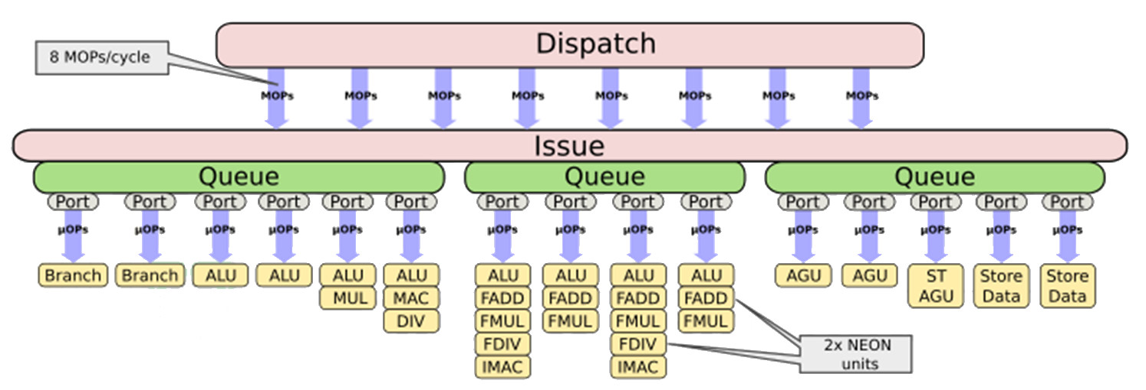
3.3.4 The extra high performance Cortex-X1 (9)
Cortex-X1 back-end enhancements vs. A78 [130]
The Issue stage includes a MOPs (MacroOPs) fusion unit (that fuses two or more
instructions into one to reduce the execution time).
The Issue stage forwards μOps to the Execution units.
No details were revealed about changing the naming.

Slide 140
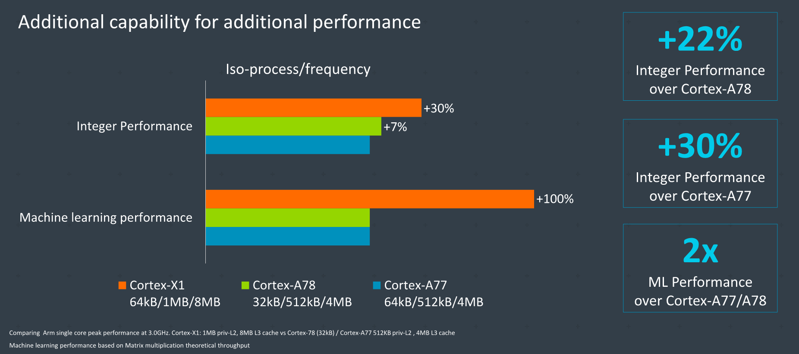
3.3.4 The extra high performance Cortex-X1 (10)
Integer and ML (Machine learning) performance gain of the X1 over the A77
and A78 [127]

Slide 141
3.3.4 The extra high performance Cortex-X1 (11)
Single Thread performance gain of the X1 over the A77 and A78 [127]

Slide 142
3.3.4 The extra high performance Cortex-X1 (12)
SPECint2006 scores and related power/energy consumption [127]
*

Slide 143
3.3.4 The extra high performance Cortex-X1 (13)
Note
The Figure shows that the projected SPECInt2006 performance of ARM’s Cortex-X1
approaches already the scores of Apple’s A13 or Intel’s and AMD’s client processors
(Core-based 10900K Skylake/Zen2-based Ryzen 3950X).
*

Slide 144
3.3.4 The extra high performance Cortex-X1 (14)
SPECfp2006_C/C++ scores and related power/energy consumption [127]
*

Slide 145
3.3.4 The extra high performance Cortex-X1 (15)
Note
The Figure shows that the projected SPECInt2006 performance of ARM’s Cortex-X1
exceeds already Apple’s A13’s score and approaches the performance data of
Intel’s and AMD’s client processors (Core-based 10900K Skylake/Zen2-based Ryzen
3950X).
*

Slide 146
4. References

Slide 147
4. References (1)
[1]: Architecture and Implementation of the ARM Cortex-A8 Microprocessor, Design & Reuse,
http://www.design-reuse.com/articles/11580/architecture-and-implementation-of-the-
arm-cortex-a8-microprocessor.html
[2]: Shimpi A.L., Answered by the Experts: ARM's Cortex A53 Lead Architect, Peter Greenhalgh,
AnandTech, Dec. 17 2013, http://www.anandtech.com/show/7591/answered-by-the-
experts-arms-cortex-a53-lead-architect-peter-greenhalgh
[3]: Hill S., Design of a Reusable 1GHz, Superscalar ARM Processor, Hot Chips-18, Aug. 22 2006,
http://www.hotchips.org/wp-content/uploads/hc_archives/hc18/3_Tues/HC18.S6/HC18.S6T3.
pdf
[4]: Details of a New Cortex Processor Revealed, Cortex-A9, ARM Developers’ Conference,
Oct. 2007, http://rtcgroup.com/arm/2007/presentations/174%20-%20Details%20of%
20a%20New%20Cortex%20Processor%20Revealed%20Cortex-A9.pdf
[5]: ARM Teaching Material, http://www.arm.com/files/ppt/ARM_Teaching_Material.ppt
[6]: ARM Cortex Application Processors, http://www.arm.com/products/processors/index.php
[7]: ARM SecurCore Processors, http://www.arm.com/products/processors/securcore/index.php
[8]: Snyder C.D., ARM Family Expands at EPF, ARM11 Microarchitecture Stretches Pipe to Boost
Frequency, Microprocessor, June 3 2002
[9]: Hirata K., ARM11 MPCore, The streamlined and scalable ARM11 processor core, Jan. 2007,
http://www.aspdac.com/aspdac2007/pdf/archive/7D-2.pdf

Slide 148
4. References (2)
[10]: ARM Introduces The Cortex-M3 Processor To Deliver High Performance In Low-Cost
Applications, Oct. 19 2004, http://www.arm.com/about/newsroom/6750.php
[11]: NEON, ARM Technologies,
http://www.arm.com/products/processors/technologies/neon.php
[12]: Goodacre J., The Evolution of the ARM Architecture Towards Big Data and the Data-Centre,
8th Workshop on Virtualization in High-Performance Cloud Computing (VHPC’13),
Nov. 17-22 2013, http://www.virtical.eu/pub/sc13.pdf
[13]: Ferguson I., Redefining User Experiences, from IoT to Smart Mobile Devices, June 14 2013,
http://www.arm.com/zh/files/event/arm_multimedia_seminar_shenzhen_2013_ianferguson.
pdf
[14]: Goto H., ARM Cortex – A Family Architecture, 2010,
http://pc.watch.impress.co.jp/video/pcw/docs/423/409/p1.pdf
[15]: Stevens H., Introduction to AMBA 4 ACE and big.LITTLE Processing Technology, White Paper,
June 6 2011, http://www.arm.com/files/pdf/CacheCoherencyWhitepaper_6June2011.pdf
[16]: Shimpi A.L., The ARM Diaries, Part 2: Understanding the Cortex A12, AnandTech,
July 17 2013, http://www.anandtech.com/show/7126/the-arm-diaries-part-2-
understanding-the-cortex-a12
[17]: Shimpi A.L., ARM Cortex A17: An Evolved Cortex A12 for the Mainstream in 2015,
AnandTech, Febr. 11 2014, http://www.anandtech.com/show/7739/arm-cortex-a17
[18]: Ryan H., Intel, AMD & ARM Processors, University of Wisconsin DoIT Techstore
https://kb.wisc.edu/showroom/page.php?id=4927

Slide 149
4. References (3)
[19]: Rao A., ARM: a mandatory primer, Element14, 2014
[20]: Mali Performance Efficient Graphics, ARM
http://www.arm.com/products/multimedia/mali-performance-efficient-graphics/index.php
[21]: Cortex-A8 Processor, ARM Cortex-A Series,
http://www.arm.com/products/processors/cortex-a/cortex-a8.php
[22]: Architecture and Implementation of the ARM Cortex-A8 Microprocessor, White Paper,
Oct. 2005, https://www.pixhawk.ethz.ch/_media/software/optimization/neon_whitepaper.pdf
[23]: Shimpi A.L., Understanding the iPhone 3GS, AnandTech, July 7 2009,
http://www.anandtech.com/print/2798/
[24]: The ARM Cortex-A9 Processors, White Paper, Sept. 2009,
http://www.arm.com/files/pdf/armcortexa-9processors.pdf
[25]: Cortex-A9 MPCore, Technical Reference Manual, 2008-2012,
http://infocenter.arm.com/help/topic/com.arm.doc.ddi0407i/DDI0407I_cortex_a9_
mpcore_r4p1_trm.pdf
[26]: Goto H., ARM Cortex-A9r4 Core Block Diagram,
http://pc.watch.impress.co.jp/video/pcw/docs/614/543/08p.pdf
[27]: ARM Unveils Cortex-A9 Processors For Scalable Performance and Low-Power Designs,
Oct. 3 2007, http://www.arm.com/about/newsroom/18688.php
[28]: Goodacre J., The Effect and Technique of System Coherence in ARM Multicore Technology,
http://www.mpsoc-forum.org/previous/2008/slides/8-6%20Goodacre.pdf

Slide 150
4. References (4)
[29]: Goto H., ARM Cortex-A7/A9 vs Bobcat, Atom, 2010,
http://pc.watch.impress.co.jp/img/pcw/docs/487/030/html/9.jpg.html
[30]: Goto H., ARM Cortex-A12 Block Diagram, 2013,
http://pc.watch.impress.co.jp/video/pcw/docs/621/747/gp1.pdf
[31]: Rosinger S., The Top 5 Things to Know about Cortex-A12, ARM Connected Community,
Oct. 26 2013, http://community.arm.com/groups/processors/blog/2013/10/26/the-top-5-
things-to-know-about-cortex-a12
[32]: ARM Cortex-A17 MPCore Processor, Technical Reference Manual, 2014,
http://infocenter.arm.com/help/topic/com.arm.doc.ddi0535b/DDI0535B_cortex_a17_
r1p0_trm.pdf
[33]: Cortex-A17 Processor, ARM Cortex-A Series,
http://www.arm.com/products/processors/cortex-a/cortex-a17-processor.php
[34]: Rosinger S., ARM Cortex-A17/Cortex-A12 processor update, ARM Connected Community,
Oct. 1 2014, http://community.arm.com/groups/processors/blog/2014/09/30/arm-
cortex-a17-cortex-a12-processor-update
[35]: Cortex-A15 Processor, ARM Cortex-A Series,
http://www.arm.com/products/processors/cortex-a/cortex-a15.php
[36]: Lanier T., Exploring the Design of the Cortex-A15 Processor,
http://www.arm.com/files/pdf/AT-Exploring_the_Design_of_the_Cortex-A15.pdf

Slide 151
4. References (5)
[37]: Greenhalgh P., big.LITTLE Processing with ARM Cortex-A15 & Cortex-A7, White Paper,
Sept. 2011, http://www.arm.com/files/downloads/big_LITTLE_Final_Final.pdf
[38]: Stokes J., ARM fills out CPU lineup with Cortex A5, Ars Technica, Oct. 22 2009,
http://arstechnica.com/gadgets/2009/10/arm-fills-out-cpu-lineup-with-cortex-a5/
[39]: Hruska J., ARM Launches New Cortex-A5 As A Bulkward Against Future Atom processors,
Hot Hardware, Oct. 23 2009, http://hothardware.com/News/ARM-Launches-New-
CortexA5-As-A-Bulkward-Against-Future-Atom-processors
[40]: Cortex-A5 Processor, ARM Cortex-A Series,
http://www.arm.com/products/processors/cortex-a/cortex-a5.php
[41]: Bhattacharya A., Small, Quiet, and Cool, Power Efficient Processing with the Cortex-A5
Processor, http://www.arm.com/files/pdf/at2_-_power_efficient_processing_with_the_
cortex-a5_v1.pdf
[42]: Cortex-A5, The smallest, lowest power ARMv7 application processor,
http://www.hitex.co.uk/fileadmin/uk-files/pdf/ARM%20Seminar%20Presentations%
202013/Hitex%20Cortex-A5%20Overview.pdf
[43]: Flautner K., Heterogeneity to the rescue, Nov. 2011,
https://www.bscmsrc.eu/sites/default/files/media/arm-heterogenous-mp-november-2011.
pdf
[44]: Shimpi A.L., ARM's Cortex A7: Bringing Cheaper Dual-Core & More Power Efficient High-End
Devices, AnandTech, Oct. 19 2011, http://www.anandtech.com/show/4991/

Slide 152
4. References (6)
[45]: Cortex-A7 Processor, ARM Cortex-A Series,
http://www.arm.com/products/processors/cortex-a/cortex-a7.php
[46]: Goto H., New design of mid-range CPU that ARM has announced "Cortex-A12", PC Watch,
June 4 2013, http://pc.watch.impress.co.jp/docs/column/kaigai/20130604_602106.html
[47]: Shimpi A.L., ARM's Cortex A57 and Cortex A53: The First 64-bit ARMv8 CPU Cores,
AnandTech, Oct. 30 2012, http://www.anandtech.com/show/6420/arms-cortex-a57-
and-cortex-a53-the-first-64bit-armv8-cpu-cores
[48]: Smith K., Next-Generation Solutions: One Size Does Not Fit All, Nov. 2012,
http://www.armtechforum.com.cn/2012/3_Next-generation_Solutions_One_Size_does_
not_Fit_All.pdf
[49]: Smythe I., Building the future of 64-bit computing with ARMv8-A, June 2014,
http://www.arm.com/files/event/2014_ARM_Multimedia_Seminar_ARM_Ian_Smythe.pdf
[50]: Ferguson I., ARM Servers, Why, Where, when, Nov. 27 2012,
http://openserversummit.com/English/Collaterals/Proceedings/2012/20121127_SA103_
Ferguson.pdf
[51]: Crijns K., ARM: 20 dollar and 64-bit Android smartphones to be expected, Hardware.info,
June 24 2014, http://us.hardware.info/reviews/5386/2/arm-20-dollar-and-64-bit-android-
smartphones-to-be-expected-android-64-bitn
[52]: Scaling Mobile Compute to the Data Centre, MPSoC’13,
http://www.mpsoc-forum.org/previous/2013/slides/2-Goodacre.pdf

Slide 153
4. References (7)
[53]: ARM Launches Cortex-A50 Series, the World's Most Energy-Efficient 64-bit Processors,
TechPowerUp, Oct. 30 2012, http://www.techpowerup.com/174709/arm-launches-cortex-
a50-series-the-worlds-most-energy-efficient-64-bit-processors.html
[54]: Mandyam L., Smartphone Powered Data Centers: Shifting Toward Energy Efficiency,
http://sites.ieee.org/scv-cs/files/2013/03/IEEE-event-April-slide-upload.pdf
[55]: Anthony S., ARM says $20 smartphones coming this year, shows off 64-bit Cortex-A53 and
A57 performance, Extreme Tech, May 6 2014, http://www.extremetech.com/computing/
181935-arm-says-20-smartphones-coming-this-year-shows-off-64-bit-cortex-a53-and-
a57-performance
[56]: Merritt R., ARM stretches out with A5 core, graphics, FPGAs, Oct. 21 2009,
http://www.embedded.com/print/4085371
[57]: Cormie D., The ARM11 Microarchitecture, April 2002
[58]: Exynos 5 Octa, Block Diagram,
http://www.samsung.com/global/business/semiconductor/product/application/detail?
productId=7978&iaId=2341
[59]: Grabham D., From a small Acorn to 37 billion chips: ARM's ascent to tech superpower,
Techradar, July 19 2013, http://www.techradar.com/news/computing/from-a-small-acorn-
to-37-billion-chips-arm-s-ascent-to-tech-superpower-1167034
[60]: The ARM Architecture, http://www.eng.auburn.edu/~strouce/DaTseminar/UniPres07s.pdf
[61]: Wikipedia, ARM architecture, http://en.wikipedia.org/wiki/ARM_architecture

Slide 154
4. References (8)
[62]: Levy M., The History of The ARM Architecture: From Inception to IPO,
http://www.reds.ch/share/cours/ReCo/documents/TheHistoryOfTheArmArchitecture.pdf
[63]: Lemieux J., Introduction to ARM thumb, Embedded, Sept. 24 2003, http://www.embedded.
com/electronics-blogs/beginner-s-corner/4024632/Introduction-to-ARM-thumb
[64]: ARM Processor Architecture,
http://www.arm.com/products/processors/instruction-set-architectures/index.php
[65]: ARM Architecture Reference Manual, ARMv5, DDI0100E, June 2000
[66]: ARM Architecture Reference Manual, ARMv8, 2013, http://www.myir-tech.com/down/arm/
arch/ARMv8-A_Architecture_Reference_Manual_%28Issue_A.a%29.pdf
[67]: Porthouse C., Use ARM DBX hardware extensions to accelerate Java in space-constrained
embedded apps, Embedded, Oct. 18 2007, http://www.embedded.com/design/prototyping-
and-development/4007206/3/PRODUCT-HOW-TO-Use-ARM-DBX-hardware-extensions-to-
accelerate-Java-in-space-constrained-embedded-apps
[68]: ARM Security Technology, Building a Secure System using TrustZone Technology, 2009,
http://infocenter.arm.com/help/topic/com.arm.doc.prd29-genc-009492c/PRD29-GENC-
009492C_trustzone_security_whitepaper.pdf
[69]: ARM Cortex-A53 MPCore Processor Technical Reference Manual, Cryptography Extension,
2013-2014, http://infocenter.arm.com/help/index.jsp?topic=/com.arm.doc.ddi0500e/
CJHDEBAF.html

Slide 155
4. References (9)
[70]: Shilov A., ARM’s high-end ‘Ares’ core for 10nm SoCs may be unveiled next year, KitGuru,
May 16 2015, http://www.kitguru.net/components/cpu/anton-shilov/arms-high-
performance-ares-core-may-be-unleashed-next-year/
[71]: Goto H., ARM Cortex-A57 Block Diagram,
http://images.anandtech.com/doci/8718/Hiroshige.Goto.png
[72]: Wasson S., Inside ARM's Cortex-A72 microarchitecture, TechReport, May 1 2015,
http://techreport.com/review/28189/inside-arm-cortex-a72-microarchitecture
[73]: Citizendium, Java platform, http://en.citizendium.org/wiki/Java_platform
[74]: Wasson S., Samsung's Galaxy Note 4 with the Exynos 5433 processor, TechReport,
01/31/2015, http://techreport.com/review/27539/samsung-galaxy-note-4-with-the-
exynos-5433-processor/2
[75]: Frumusanu A. & Smith R., ARM A53/A57/T760 investigated - Samsung Galaxy Note 4
Exynos Review, AnandTech, February 10, 2015,
http://www.anandtech.com/show/8718/the-samsung-galaxy-note-4-exynos-review
[76]: Riemenschneider F., Intel sei dank: Programmierbare Logik mit 1 GHz takten,
Elektroniknet, 29.10.2013 von Frank Riemenschneider,
http://www.elektroniknet.de/halbleiter/programmierbare-logik/artikel/102160/
[77]: Frumusamu A., ARM Announces New Cortex-A35 CPU - Ultra-High Efficiency For Wearables
& More, AnandTech, November 10, 2015,
http://anandtech.com/show/9769/arm-announces-cortex-a35

Slide 156
4. References (10)
[78]: Quested T., ARM scales up again in Cambridge, Businessweekly, 20 October, 2014,
http://www.businessweekly.co.uk/news/property-and-construction/17695-arm-scales-
again-cambridge#sthash.Pzg7jnpK.dpuf
[79]: ARM Architecture Reference Manual, Thumb-2 Supplement, 2004-2005,
http://read.pudn.com/downloads159/doc/709030/Thumb-2SupplementReferenceManual.pdf
[80]: Wanted: Java bytecode disassembler that shows addresses, opcodes, operands, in hex,
Reverse Engineering, 2013, http://reverseengineering.stackexchange.com/questions/
2036/wanted-java-bytecode-disassembler-that-shows-addresses-opcodes-operands-in-h
[81]: Barr M., KVM: A Small Java Virtual Machine for J2ME, Barr Group, May 4 2016,
http://www.barrgroup.com/Embedded-Systems/How-To/KVM-J2ME-Java-Virtual-Machine
[82]: What is Bytecode ?, March 21 2015,
http://interview-question-and-answers.blogspot.hu/2015/03/what-is-bytecode.html
[83]: The JVM – Java Virtual Machine, Android Developer, May 8 2015,
http://androiddeveloper.co.il/the-jvm-java-virtual-machine/
[84]: Java Virtual Machine, Free Download Java Virtual Machine, How to Download JVM,
Dev Manuals, Sept. 28 2010,
http://www.devmanuals.com/tutorials/java/corejava/javavirtualmachine.html
[85]: Srinivasan K., What is the difference between JRE,JVM and JDK?, Javabeat, Febr. 21 2013,
http://www.javabeat.net/what-is-the-difference-between-jrejvm-and-jdk/

Slide 157
4. References (11)
[86]: ARM Architecture Reference Manual, ARMv7-A and ARMv7-R edition, 2004-2012,
http://liris.cnrs.fr/~mmrissa/lib/exe/fetch.php?media=armv7-a-r-manual.pdf
[87]: Cortex-A7 MPCore, Technical Reference Manual, Rev. r0p3, 2011-2012,
http://infocenter.arm.com/help/topic/com.arm.doc.ddi0464d/DDI0464D_cortex_a7_
mpcore_r0p3_trm.pdf
[88]: Pardoe A., New Innovations in .NET Runtime, dotnetConf, 2014, Jun. 2014,
https://view.officeapps.live.com/op/view.aspx?src=http%3a%2f%2ffiles.channel9.
msdn.com%2fthumbnail%2f47cb5ae5-eb38-404d-80e8-7bae0a4efbaf.pptx
[89]: Cortex-A73 Processor, ARM,
https://www.arm.com/products/processors/cortex-a/cortex-a73-processor.php
[90]: Frumusanu A., ARM Announces New Cortex-A35 CPU - Ultra-High Efficiency For Wearables
& More, AnandTech, Nov. 10, 2015,
http://www.anandtech.com/show/9769/arm-announces-cortex-a35
[91]: Frumusanu A., ARM Reveals Cotex-A72 Architecture Details, AnandTech, Apr. 23, 2015,
http://www.anandtech.com/show/9184/arm-reveals-cortex-a72-architecture-details
[92]: Frumusanu A., The ARM Cortex A73 - Artemis Unveiled, AnandTech, May 29, 2016,
http://www.anandtech.com/show/10347/arm-cortex-a73-artemis-unveiled
[93]: Cortex-A73 Overview, ARM Developer, 2016,
https://developer.arm.com/products/processors/cortex-a/cortex-a73
[94]: Cortex-A35, ARM, 2015,
http://www.arm.com/products/processors/cortex-a/cortex-a35-processor.php

Slide 158
4. References (12)
[95]: Wasson S., Inside ARM's Cortex-A72 microarchitecture - The next-gen CPU core for mobile
devices and servers, Tech Report, May 1, 2015,
http://techreport.com/review/28189/inside-arm-cortex-a72-microarchitecture
[96]: Stephens N., ARMv8-A Next-Generation Vector Architecture for HPC, Hot Chips 2016,
https://community.arm.com/groups/processors/blog/2016/08/22/technology-update-
the-scalable-vector-extension-sve-for-the-armv8-a-architecture
[97]: Brash D., The ARMv8-A architecture and its ongoing development, ARM, 2014
https://community.arm.com/processors/b/blog/posts/the-armv8-a-architecture-and-its-
ongoing-development
[98]: Humrick M., Exploring DynamIQ and ARM’s New CPUs: Cortex-A75, Cortex-A55,
AnandTech, May 29, 2017,
https://www.anandtech.com/show/11441/dynamiq-and-arms-new-cpus-cortex-a75-a55
[99]: Frumusanu A., The ARM Cortex A73 - Artemis Unveiled, AnandTech, May 29, 2016,
http://www.anandtech.com/show/10347/arm-cortex-a73-artemis-unveiled
[100]: Turner C., ARM instruction sets and CPUs for wide ranging applications, ARM Tech Forum,
Taipei, July 4, 2017,
https://www.arm.com/files/event/20170704_ATF_TW_A3.pdf
[101]:Cortex-A75, ARM Developer,
https://developer.arm.com/products/processors/cortex-a/cortex-a75
[102]: Cortex-A73, ARM Developer,
https://developer.arm.com/products/processors/cortex-a/cortex-a73

Slide 159
4. References (13)
[103]: ARM Unveils Cortex-A75, A55 Processors And Mali-G72 GPU, ARM Developer,
https://www.xda-developers.com/arm-unveils-cortex-a75-a55-processors-and-mali-
g72-gpu/
[104]: DynamIQ power management support, Vers. 1.1, ARM ECM 0640541 Oct. 30 2017
[105]: Parris N., Boost SoC performance from edge to cloud ARM CoreLink System IP, ARM,
Nov. 2016,
http://www.armtechforum.com.cn/attached/article/2016ATS_C1_Neil_Parris
20161206151154.pdf
[106]: Greenhalgh P., ARM DynamIQ. Intelligent Solutions Using Cluster Based Multiprocessing,
Hot Chips 29, 2017 Aug. 12,
https://www.slideshare.net/ARMHoldings/arm-dynamiq-intelligent-solutions-using-
cluster-based-multiprocessing
[107]: Wathan G. : Arm DynamIQ: Technology for the next era of compute, ARM Community,
https://community.arm.com/processors/b/blog/posts/arm-dynamiq-technology-for-
the-next-era-of-compute
[108]: Walrath J., ARM Tech Day 2017: DynamIQ, Cortex-A55, A75, and Mali-G72,
PC Perspective, May 29, 2017,
https://www.pcper.com/reviews/General-Tech/ARM-Tech-Day-2017-DynamIQ-
Cortex-A55-A75-and-Mali-G72/Cortex-A75-and-Mali-G72
[109]: Rickards I. and Kucheria A., Energy Aware Scheduling (EAS) progress update, Linaro
Company, Sept. 18, 2015,
http://www.linaro.org/blog/core-dump/energy-aware-scheduling-eas-progress-update/

Slide 160
4. References (14)
[110]: Triggs R., A closer look at ARM’s new Cortex-A75 and Cortex-A55 CPUs, Android Authority,
May 31, 2017
https://www.androidauthority.com/arm-cortex-a75-cortex-a55-breakdown-770380/
[111]: Arm Cortex-A55: Efficient performance from edge to cloud, ARM Community,
https://community.arm.com/processors/b/blog/posts/arm-cortex-a55-efficient-
performance-from-edge-to-cloud
[112]: System Guidance for Infrastructure, ARM Developer,
https://developer.arm.com/products/system-design/system-guidance/system-guidance-
for-infrastructure
[113]: ARM® Architecture Reference Manual ARMv8, for ARMv8-A architecture profile,
ARM DDI 0487A.k_iss10775 (ID092916),2013-2016
https://silver.arm.com/download/ARM_and_AMBA_Architecture/AR150-DA-70000-r0p0-
01eac1/DDI0487A_k_armv8_arm_iss10775.pdf
[114]: Arm DynamIQ: Technology for the next era of compute, ARM Community,
https://community.arm.com/processors/b/blog/posts/arm-dynamiq-technology-for-the-
next-era-of-compute
[115]: ARM unveils multi-processor core with Linux SMP support, LinuxDevices, May 17, 2004,
http://linuxdevices.linuxgizmos.com/arm-unveils-multi-processor-core-with-linux-smp-
support/
[116]: ARM Architecture Reference manual Supplement - The Scalable Vector Extension (SVE),
for ARMv8-A, ARM DDI 0584Ab (ID081717), 21 Aug. 2017,
https://developer.arm.com/docs/ddi0584/latest/arm-architecture-reference-manual-
supplement-the-scalable-vector-extension-sve-for-armv8-a

Slide 161
4. References (15)
[117]: ARM Q4 2016 Roadshow Slides, ARM Holdings, 2017
file:///C:/Users/sima/Downloads/ARM_SB_Q4_2016_Roadshow_Slides_FINAL.pdf
[118]: Triggs R., Everything you need to know about ARM’s DynamIQ, Android Authority,
May 29, 2017,
https://www.androidauthority.com/arm-dynamiq-need-to-know-770349/
[119]: Frumusanu A., Arm's Cortex-A76 CPU Unveiled: Taking Aim at the Top for 7nm,
AnandTech, May 31, 2018,
https://www.anandtech.com/show/12785/arm-cortex-a76-cpu-unveiled-7nm-powerhouse
[120]: Hruska J., ARM’s New Cortex-A76 SoC Targets Windows Laptop Market, ExtremeTech,
May 31, 2018,
https://www.extremetech.com/mobile/270362-arm-cortex-a76-targets-laptop-market
[121]: Humrick M., Exploring DynamIQ and ARM’s New CPUs: Cortex-A75, Cortex-A55,
AnandTech, May 29, 2017,
https://www.anandtech.com/show/11441/dynamiq-and-arms-new-cpus-cortex-a75-
a55/3
[122]: Cortex-A57 Software Optimization Guide, ARM, UAN 0015B, 2016,
http://infocenter.arm.com/help/topic/com.arm.doc.uan0015b/Cortex_A57_Software_
Optimization_Guide_external.pdf
[123]: ASIMD multiply-accumulate instruction, ARM Community, 2016,
https://community.arm.com/processors/f/discussions/7028/asimd-multiply-accumulate-
instruction

Slide 162
4. References (16)
[124]: Gianos C., Intel Xeon Processor E5-2600 v3 Product Family Architectural Overview ,
HPCC'14, Nov. 16 2014
[125]: Frumusanu A., ARM Unveils Client CPU Performance Roadmap Through 2020 – Taking
Intel Head On, AnandTech, Aug. 16, 2018,
https://www.anandtech.com/show/13226/arm-unveils-client-cpu-performance-roadmap
[126]: Frumusanu A., ARM's New Cortex-A77 CPU Micro-architecture: Evolving Performance,
AnandTech, May 27, 2019,
https://www.anandtech.com/show/14384/arm-announces-cortexa77-cpu-ip
[127]: Frumusanu A., Arm's New Cortex-A78 and Cortex-X1 Microarchitectures: An Efficiency and
Performance Divergence, AnandTech, May 26 2020,
https://www.anandtech.com/show/15813/arm-cortex-a78-cortex-x1-cpu-ip-diverging
[128]: Williamson P., Bringing the Digital World into Our New Reality, May 2020,
https://armkeil.blob.core.windows.net/developer/Files/pdf/news/arm-client-mobile-
launch-2020-deck.pdf
[129]: Hill B., Arm Unveils Cortex-A78, Cortex-X1 Architectures: Efficiency And Big Performance
Gains For Next-Gen Mobile Devices, Hot Hardware, May 26 2020,
https://hothardware.com/news/arm-cortex-a78-cortex-x1-mali-g78-snapdragon-875
[130]: Schor D., Arm Cortex-X1: The First From The Cortex-X Custom Program, Wikichip Fuse,
May 26 2020, https://fuse.wikichip.org/news/3543/arm-cortex-x1-the-first-from-the-
cortex-x-custom-program/

Slide 163
4. References (17)
[131]: Frumusanu A., ARM Details Built on ARM Cortex Technology License, AnandTech,
May 29 2016, https://www.anandtech.com/show/10366/arm-built-on-cortex-license
[132]: Caulfield I.M., Pathirane C.A.S., Instruction fusion, US 2017/0123808 A1, May 4 2017,
https://patents.google.com/patent/US20170123808
[133]: Hachman M., ARM challenges Intel in PCs with Deimos and Hercules chips, PC World,
Aug. 16 2018, https://www.pcworld.com/article/3297941/arm-challenges-intel-in-pcs-
with-deimos-and-hercules-chips.html
[134]: Merritt R., Nvidia: ARM smartphones will bury x86 PCs, EDN, Sept. 23, 2020,
https://www.edn.com/nvidia-arm-smartphones-will-bury-x86-pcs/
[135]: Arm's quarterly royalty unit shipments as reported by licensees worldwide from 2016 to
2019, Statista, 2020,
https://www.statista.com/statistics/1131983/arm-based-chip-unit-shipments-as-
reported-by-licensees-worldwide/
[136]: What is Intel AVX-512?, URTech, Nov. 2 2017,
https://www.urtech.ca/2017/11/solved-intel-avx-512/
[137]: Weber F., AMD’s Next Generation Microprocessor Architecture, Oct. 2001,
http://www.datasheetcatalog.org/datasheet/AdvancedMicroDevices/mXsutyv.pdf
[138]: Cutress I., The Intel Skylake-X Review: Core i9 7900X, i7 7820X and i7 7800X Tested,
AnandTech, June 19, 2017,
https://www.anandtech.com/show/11550/the-intel-skylakex-review-core-i9-7900x-i7-
7820x-and-i7-7800x-tested/3

