Slide 1
ARM CPUs - Lecture
Dezső Sima
Nov. 2021
(v6.1)
© Dezső Sima 2021

Slide 2
Remarks to the terminology
The use of the terms processor and CPU needs clarification.
ARM designs functional units of processors, like CPUs, GPUs, NPUs (Neural
Processing Units, MCs (Memory Controllers), on-die interconnects etc. and
markets the IP (Intellectual Property) of their designs to other firms.
By contrast, other firms which are active on the field of processor designs, like
Intel, AMD, Qualcomm etc. design full fledged application processors, partly
based on ARM’s IP (Intellectual Property).
This is the reason, why we prefer to name ARM’s related designs, like the ARM
Cortex-A15, A57, A75, X1, or the Neorverse-N1, X1 etc. models as CPUs,
rather than processors.
*
IP: Intellectual Property (szellemi termék) On-die interconnect: lapkán megvalósított kapcsolóhálózat

Slide 3
ARM ‘s CPUs (2)
Remark to the terminology -2
Concerning the Cortex family of CPUs neither ARM nor the Lecture slides are consequent in using the “A tag” (Application) in the Armvx-A ISA designations.
In any case however, this Chapter discusses only CPUs based on the Armvx-A ISA, regardless, whether the “A tag” is stated or not in the processor designation.

Slide 4
ARM’s CPUs
1. Introduction to ARM
2. Evolution of the ARM ISA
3. Overview of ARM’s CPU line
4. ARM’s early CPUs implementing the ARM v1–v2 ISA
5. ARM’s early CPUs implementing the ARM v3–v6 ISA
6. Cortex-A CPUs implementing the Armv7-v8.0 ISA
7. Cortex-A CPUs implementing the Armv8.2-A ISA
8. Cortex-A CPUs implementing the Armv9-A ISA
9. References
Notes:
4

Slide 5
1. Introduction to ARM

Slide 6
1. Introduction to ARM (1)
1. Introduction to ARM
ARM (ARM Holdings plc) was a British semiconductor design company with
its headquarter in Cambridge, that was first acquired by Softbank (Japan)
in 2016 but recently sold to Nvidia (however the acquisition has not yet been
completed).
.
The company
designs low power
processor components for the embedded, mobile and server market,
such as CPUs, Mali GPUs, Ethos NPUs, Memory Controllers (DMC),
on-chip interconnects etc. as well as
design tools (development studios etc.),
and licences
their IP (Intellectual Property) including their ISA but does not fabricate
semiconductors.
plc: public limited company (a.m. kft)
NPU: Neural Processing Unit
Intellectual Property: szellemi tulajdon
*

Slide 7
1. Introduction to ARM (2)
Example: ARM's IP offer to be used along with the Cortex-A73 CPU [89]
Graphic IP | Other IP | Tools
ARM Mali™-G71 Mali-DP550 (Display processor) Mali-V550 (Video Processor) | ARM CoreLink™ CCI-550 (Cache Coherent Interconnect) CoreLink GIC-500 (Interrupt Controller) CoreLink MMU-500 (System Memory Management Unit for address translations) CoreLink DMC-500/DMC-520 (Dynamic Memory Controller for DRAM control) CoreLink TZC-400 (ARM TrustZone® Controller) ARM CoreSight™ SoC-400 (Debug and Trace) ARM POP™ (Physical IP) | ARM DS-5 Development Studio Fixed Virtual Platforms ARM Versatile™ Express ARM Compiler 6 ARM Fast Models

Slide 8
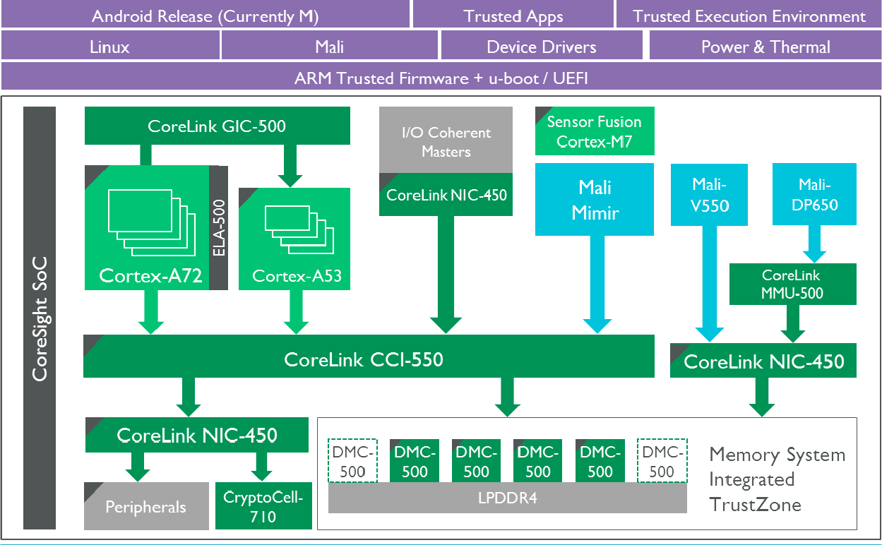
1. Introduction to ARM (3)
Example 1: Cortex-A72/A53 CPUs based mobile (Armv8.0-based, [~2016) [166]
Video
Display

Slide 9
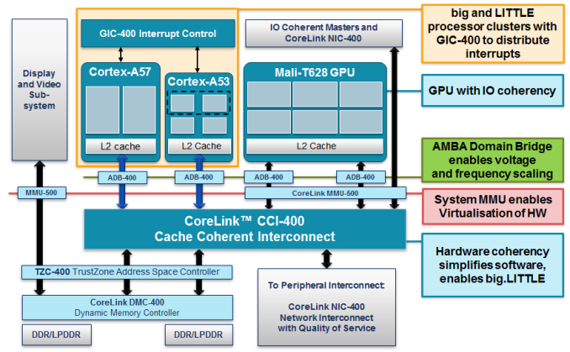
1. Introduction to ARM (4)
Remark: Tasks of the functional units in Cortex-A57/A53 CPUsbased SoC [134]
(Armv8.0-based, 2012)
ADB: AMBA Domain Bridge
(to implement DVFS)
Published by ARM and used in LG's Odin/Nuclun SoC.

Slide 10
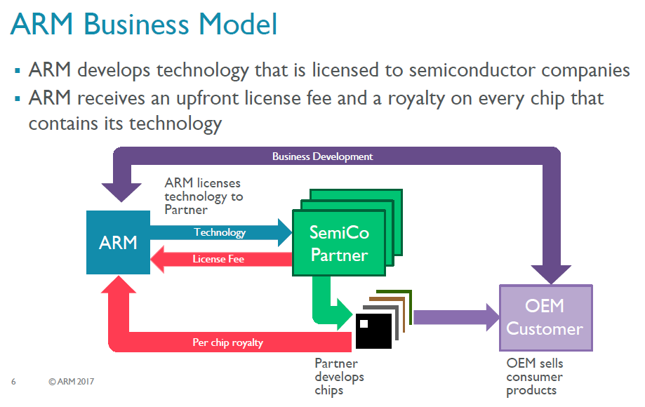
1. Introduction to ARM (5)
ARM's business model [117]
Licence: szabadalom
*

Slide 11
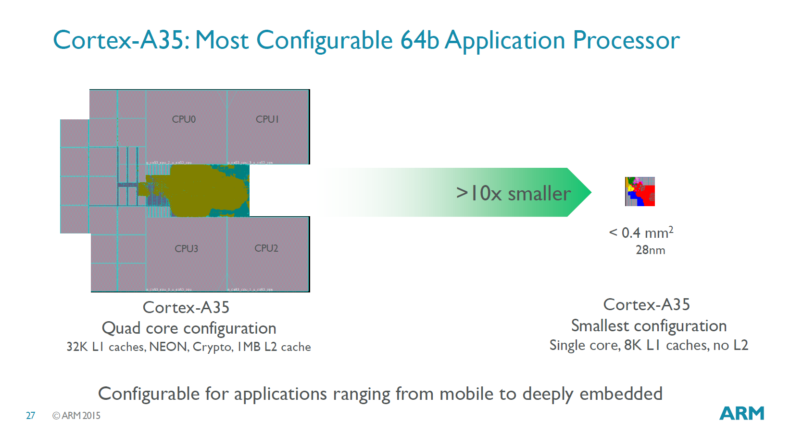
1. Introduction to ARM (6)
Example for the range of configurability of a processor [90]
Configuration options of the Cortex-A35 ranging from mobile to deeply embedded

Slide 12
1. Introduction to ARM (7)
Evolution of the approaches used to circuit design -1 [1]
Approaches to circuit design
Full custom design
Semi custom design
Full synthesizable design
Hand layout of the
entire circuit
The design will be subdivided into
functional units and further on into blocks
and the appropriate implementation technique
(hand layout, structured layout or automated layout)
is chosen for each.
Automated layout of the
entire circuit
Simple scaling, e.g.
from 28 nm to 16 nm
Power/performance
optimized
Implementation time
optimized
Trend

Slide 13
1. Introduction to ARM (8)
Evolution of the approaches used to circuit design -2 [1]
ARM's processor designs before the Cortex-A9 were partly hand layouts and
partly automated layouts.
ARM’s first fully synthesizable design was the Cortex-A9 processor
(announced in 2007).
Recently, automated design tools are typically used for processor design.
Over time more and more advanced standard cell libraries were developed that
have a large variety of design options, e.g. cell types or drive strengths, which
lessens the need for custom design.

Slide 14
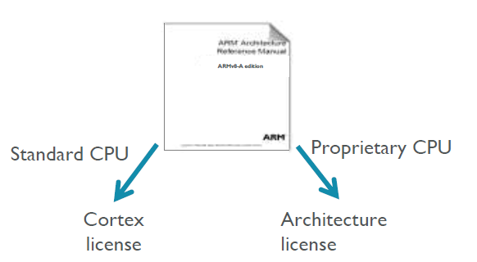
1. Introduction to ARM (9)
ARM’s licensing policy [131] -1
ARM provides either a Cortex license or an Architecture license.
In case of a Cortex license the licensee gets a complete standard microarchitecture
design (IP) with flexible configuration options, e.g. for the sizes of the L1 or L2
caches.
The Architecture license allows using the ARM ISA and the licensee has to design
their custom microarchitecture, which leads to a proprietary CPU.
E.g. Apple or Samsung bought an Architecture license, designed their CPUs
and named them as they liked.
*

Slide 15
1. Introduction to ARM (10)
ARM’s advanced “Built on ARM Cortex Technology” licensing model [131]
Introduced in 02/2016.
It is available only for lead partners.
The new license agreement allows licensees to request changes of the
microarchitecture and use this customized design in their products.
ARM provides its engineering and design services for implementing the requested
modifications for additional costs.
Under the license's terms, ARM still owns the IP, however the modified
microarchitecture is not shared or made available to other licensees.
Licensees have branding freedom.
An example is Qualcomm’s Kryo 280 CPU that is based on ARM’s
Cortex-A73, whereas earlier Qualcomm CPUs were custom designed
based on an Architecture license.
Kryo [krio]

Slide 16
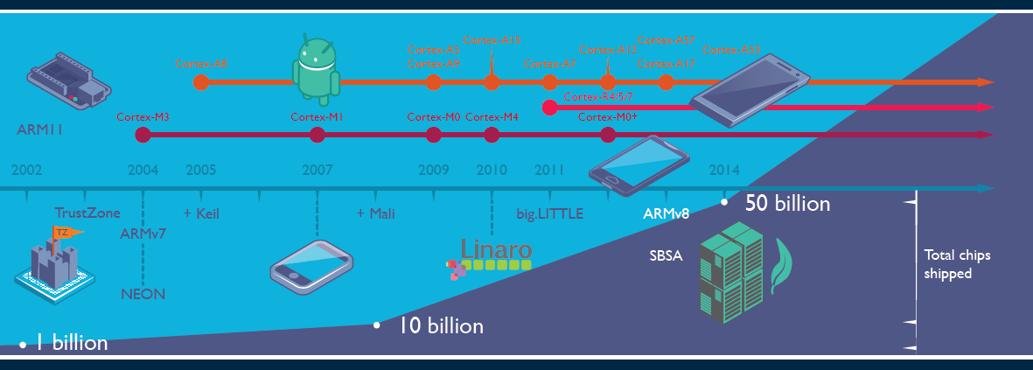
1. Introduction to ARM (11)
Total number of ARM based chips shipped [19]
Keil: Software development tool for embedded processors Cortex R: Real time M: Embedded
Linaro: Nonprofit company, established by ARM, Freescale, IBM, Samsung, ST-Ericsson and TI
to support open source software developers using Linux on SoCs.
SBSA: Server Base System Architecture, a standardized server platform for 64-bit ARM processors.

Slide 17
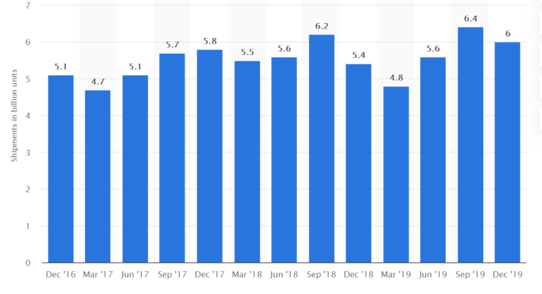
1. Introduction to ARM (12)
Number of ARM ISA-based chips shipped per quarter 2016-2019 [135]

Slide 18
1. Introduction to ARM (13)
Why AMD designs became dominant in the embedded and mobile market?
(including smartphones and tablets)
The ARM ISA is a RISC architecture in contrast to the x86 ISA which is a CISC
ISA.
RISC ISAs are Load/Store architectures which fetch their operands from
registers,
whereas CISC architectures allow operand fetches both from registers and the
memory.
This has two consequences;
CISC instructions are different long, depending on the number of memory
operands to be fetched whereas RISC instructions have equal length
(typically 32-bit) and
b) CISC architectures consume inherently more power since memory fetches
and decoding need more power than register fetches and RISC decoding.
This is the reason why ARM designs dominate recently the embedded and the
mobile market (including smartphones and tablets) and why increasingly more
ARM ISA-based server processor designs appear (e.g. ARM’s Neoverse line).
*

Slide 19
1. Introduction to ARM (14)
Historical remarks -1 [60], [61]
ARM’s parent company is Acorn Computers (UK).
Acorn Computers started their Acorn RISC Machine project in October 1983
to develop an own powerful processor for a line of business computers.
(two years after the introduction of the IBM PC or in the same year as the IBM XT)
The acronym ARM was coined originally at this time (1983) from the designation
Acorn RISC Machine.
In 1990 the company Advanced RISC Machines Ltd. (ARM Ltd.) was founded as a
joint venture of Acorn Computers, Apple Computers and VLSI Technology.
Accordingly, also the interpretation of ARM was changed to “Advanced RISC
Machines”.

Slide 20
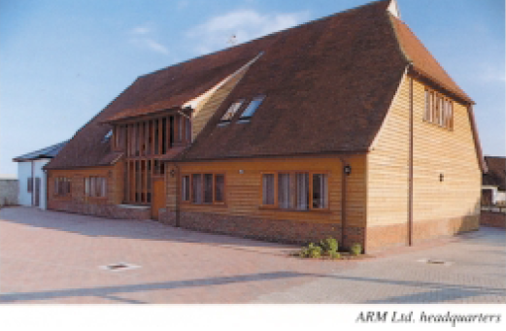
1. Introduction to ARM (15)
Historical remarks -2
Figure: The headquarters of ARM Ltd. about 1990 [62]

Slide 21
1. Introduction to ARM (16)
Historical remarks -3
Finally, in 1998 the company went to the stock exchange and its name was changed
to ARM Holdings plc, to its current designation.
plc: public limited company (nyilvánosan működő rt)

Slide 22

1. Introduction to ARM (17)
Historical remarks -4
Figure: ARM's recent headquarter in Cambridge (UK) [78]

Slide 23
1. Introduction to ARM (18)
Acquisition of ARM by Softbank (Japan)
Announced in 07/2016
Completed in 09/2016
Price: 31 bUSD (ARM's revenues in 2015 ≈ 1.5 bUSD).
*

Slide 24
1. Introduction to ARM (19)
Acquisition of ARM by NVIDIA from Softbank
Announced in 09/2020
Price: 40 bUSD
To be completed in 2022.
NVIDIA aims at “burying x86 PCs” as stated by their CEO (Jen-Hsun in 09/2020
[134]:
"The PC of the future will be made by new OEMs, sold through new
distributors and use a new instruction-set architecture.
ARM will be the most important CPU architecture of the future, and it
already is the fastest growing processor architecture.”
*

Slide 25
2. Evolution of the ARM ISA
2.1 Overview
2.2 ISA extensions introduced to enhance compute capabilities

Slide 26
2.1 Overview

Slide 27
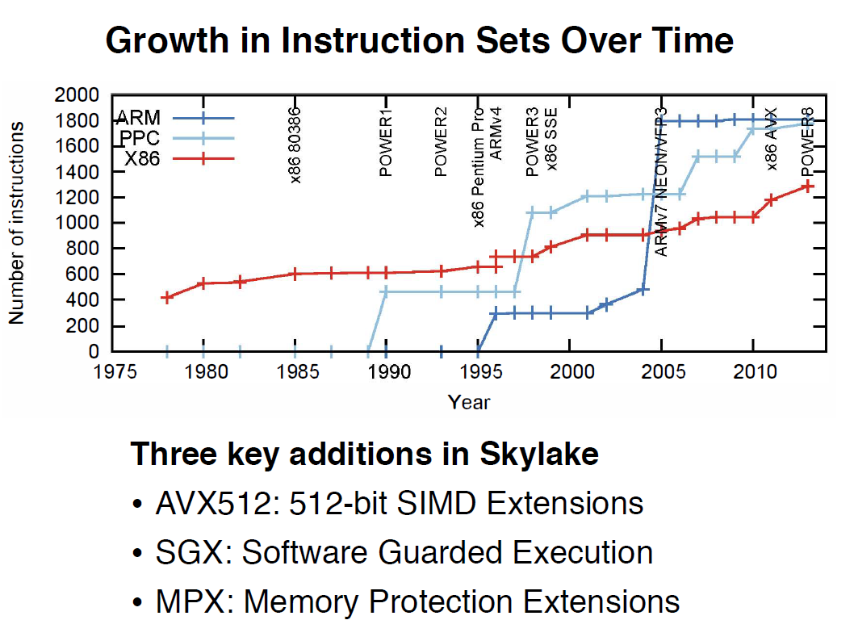
2.1 Overview (1)
2.1 Overview
Growth of instruction sets over time [163]

Slide 28
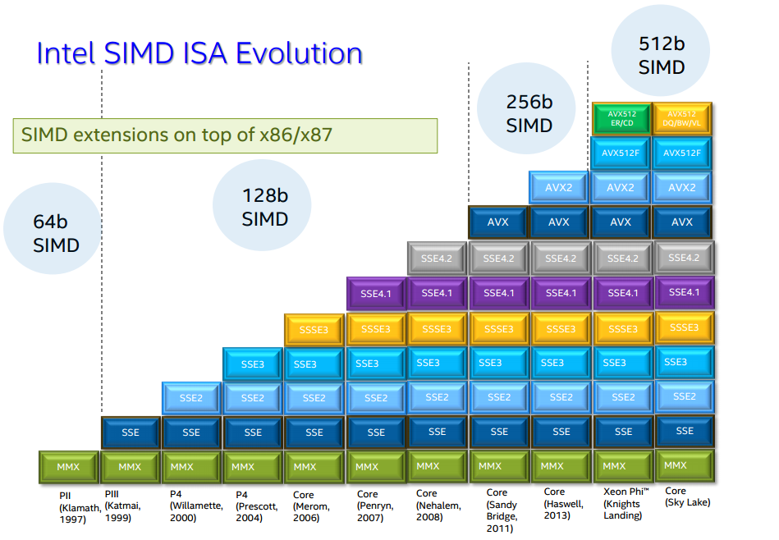
2.1 Overview (2)
Evolution of Intel’s x86 ISA SIMD extensions [142]
Pentium_MMX
(1997)
PII
Klamath,
(1997)
Core
Cannon-Lake,
(2018)
Skylake-X/SP,
(2017)
(2016)

Slide 29
2.1 Overview (3)
Overview of ARM’s ISA versions
Until now there are nine ARM ISA versions, designated as Armv1 to Armv9.
These are described in the related Architecture Reference Manual.
The earliest versions (Armv1 and Armv2) provided an address range of only
26 bits, the first ISA version with 32 bit address range was the Armv3.
Accordingly, we consider the Armv3 ISA version as ARM’s basic ISA and discuss
its evolution subsequently.
*

Slide 30
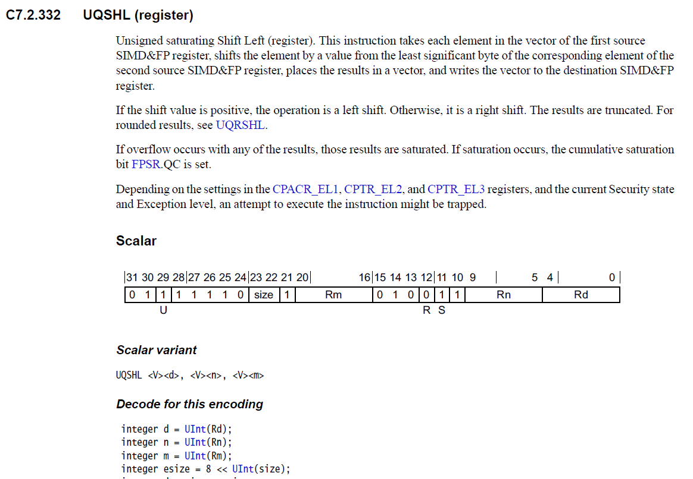
2.1 Overview (4)
Example: Half page of the Armv8 Architecture Reference Manual
(1/2 from 6354)

Slide 31
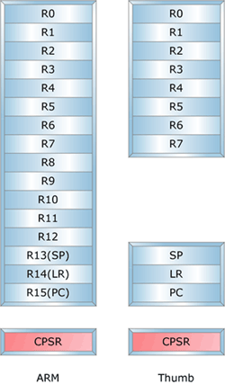
2.1 Overview (5)
Key features of ARM’s basic ISA
It is a 32-bit RISC ISA capable to process basically 32-bit scalar FX or logical data.
The ISA has 16 32-bit registers, called the core registers.
13 out of them are used as general purpose registers (GPRs), the remaining three
are dedicated registers, as shown below.
Stack pointer
Link register
PC
Figure: The core registers of the ARM ISA (in the ISA versions Armv3-Armv7) [63]
*

Slide 32
2.1 Overview (6)
Changing focus of extending the ARM ISA
ARM’s early (26/32-bit) processors were typically used in embedded applications,
where the code size and the execution speed of bytecodes were of importance.
This motivated ARM to introduce enhancements first to reduce code size and then
to speed up the execution of bytecodes.
Subsequently, ARM processors find their way more and more into mobile
application processors where more general workloads were common, including
graphics processing.
This was the motivation for enhancing the compute capabilities with FP and SIMD
(called also vector processing, or NEON processing by ARM) and also for
putting emphasis on security.
At the same time early aspects concerning code size and executing bytecodes
became pointless and their support became dropped.
In the last phase of evolution of the ISA, raising performance and security became
the dominant aspects and induced the introduction of related enhancements
(like the SVE/SVE2 extension, Confidential Compute Architecture or the Memory
Tagging Extension) to be discussed later.
*

Slide 33
2.1 Overview (7)
Main extensions introduced in the ARM’s basic ISA (simplified) -1
ARM’s ISA extensions
ISA extensions
to speed up
the execution of bytecodes
ISA extensions
to reduce
code size
ISA extensions
to enhance
compute capabilities
ISA extensions
to enhance
security
Not discussed
Section 2.2
Not discussed
*

Slide 34
2.1 Overview (8)
Main extensions introduced in the ARM’s basic ISA (simplified) -2
Note: The Thumb extension aims at reducing code size.
AArch32
AArch64
AArch64
Crypto-graph. extension
To enhance
security
TrustZone
Confidential
Compute Arch.
MTE
A32
SVE⁴
(v8.2, opt.)
A64
Aarch32⁵
A64
SVE2
To enhance
compute
capabilities
SIMD
Adv. SIMD¹
(NEON)
VFPv1/2
VFPv3/v4²
To speed up
the execution
of bytecodes
Jazelle
(Jazelle DBX)
Jazelle
(ex. by SW)
Jazelle RCT³
(ThumbEE)
Thumb
(Armv4T)
Thumb-2
(Armv6T2)
T32
(Thumb)
Armv4
Armv5
Armv6
Armv7-A/R
Armv8-A
Armv9-A
ARM710T
(~1995)
ARM10200
(2000)
ARM1136
(2002)
Cortex-A5 - A15
(2005)
Cortex-A53/A57
(2012)
Neoverse N2/V1
Cortex-X2/A510/A710
cores (2021)
Thumb: 16-bit subset of the 32-bit Armv4 ISA For further Remarks see the next slide.

Slide 35
2.1 Overview (9)
Remarks to the introduced extensions
¹The Advanced SIMD architecture extension is commonly referred to as the
NEON technology.
The VFP subset became depricated in the Armv8 ISA.
³Jazelle-RTC (ThumbEE) became depricated in Armv7 Issue C in 10/2011.
⁴The SVE (Scalable Vector Extension) subset became introduced in the
Armv8 ISA as an optional feature, only in 2016.
⁵The AArch32 execution mode is only supported in certain implementations, e.g.
for the Cortex-a510 CPU.

Slide 36
2.2 ISA extensions introduced to enhance compute capabilities
2.2.1 Overview
2.2.2 The GPR register set based SIMD extension
2.2.3 The secondary register set based scalar FP and SIMD
extensions
2.2.4 The SVE register set based SIMD extensions

Slide 37
2.2.1 Overview

Slide 38
2.2.1 Overview (1)
2.2.1 Overview
ARM’s basic ISA (Armv3 – Arm v4) [63], [66]
32-bit wide
Basic register set
R0
R1
R2
.
.
.
R12
R13(SP)
Stack pointer
Link register
PC
R14(LR)
R15(PC)
GPRs in the Armv3-Armv7 ISA
Basic ISA
Scalar data (+Boolean)
FX32
Note: Subsequently we do not follow the evolution of Boolean data types
*

Slide 39
2.2.1 Overview (2)
ISA extensions introduced to enhance compute capabilities
ARM’s ISA extensions
ISA extensions
to speed up
the execution of bytecodes
ISA extensions
to reduce
code size
ISA extensions
to enhance
compute capabilities
ISA extensions
to enhance
security
Not discussed
Section 2.2
Not discussed

Slide 40
2.2.1 Overview (3)
Overview of the ISA extensions introduced to enhance compute capabilities
Note: The Thumb extension aims at reducing code size.
AArch32
AArch64
AArch32
AArch64
AArch64
Crypto-graph. extension
To enhance
security
TrustZone
Confidential
Compute Arch.
MTE
A32
SVE⁴
(v8.2, opt.)
A64
(A32)⁵
A64
SVE2
To enhance
compute
capabilities
SIMD
Adv. SIMD¹
(NEON)
VFPv1/2
VFPv3/v4²
To speed up
the execution
of bytecodes
Jazelle
(Jazelle DBX)
Jazelle
(ex. by SW)
Jazelle RCT³
(ThumbEE)
Thumb
(Armv4T)
Thumb-2
(Armv6T2)
T32
(Thumb)
Armv4
Armv5
Armv6
Armv7-A/R
Armv8-A
Armv9-A
ARM710T
(~1995)
ARM10200
(2000)
ARM1136
(2002)
Cortex-A5 - A15
(2005)
Cortex-A53/A57
(2012)
Neoverse N2/V1
Cortex-X2/A510/A710
cores (2021)
For the Remarks see slide 2.1 Overview (6).

Slide 41
2.2.1 Overview (4)
ARM’s ISA extensions introduced to enhance compute capabilities -1
ISA extensions of RISC processors for enhancing compute capabilities can best be
discussed by specifying the two main components of the ISA extension, that is
a register set underlying the extension (i.e. a register space, e.g. 16x64-bit
registers) and
an instruction subset using this register set.
*

Slide 42
2.2.1 Overview (5)
ARM’s ISA extensions introduced to enhance compute capabilities -2
ARM extended the compute capabilities of their ISA in three steps:
based on the existing GPR register set introducing FX SIMD instructions,
by introducing a second register set along with scalar FP and FX/FP SIMD instructions and finally
c) by introducing a third, very wide register set with related FX/FP SIMD instructions,
as summarized below.
ARM’s ISA extensions to enhance compute capabilities
The GPR register set based
FX SIMD extension
The secondary register set based
scalar FP and SIMD extensions
The SVE register set based
SIMD extensions
It supports
FX-SIMD operations
First it supported only
scalar FP and FP SIMD operations
then also
FX/FP SIMD operations
It supports
FX/FP SIMD operations
on long (up to 16x128-bit) data
Introduced in
Armv6
Armv5
Armv8.2
(2002)
(Section 2.2.2)
(2000)
(Section 2.2.3)
(2016)
(Section 2.2.4)
SVE: Scalable Vector Extension
*

Slide 43
2.2.2 The GPR register set based FX SIMD extension

Slide 44
2.2.2 The GPR register set based FX SIMD extension (1)
2.2.2 The GPR register set based FX SIMD ISA extension
ARM’s ISA extensions to enhance compute capabilities
The GPR register set based
FX SIMD extension
The secondary register set based
scalar FP and SIMD extensions
The SVE register set added
with SIMD extensions
It supports
FX-SIMD operations
First it supported only
scalar FP and FP SIMD operations
then also
FX/FP SIMD operations
It supports
FX/FP SIMD operations
on long (up to 16x128-bit) data
Introduced in
Armv6
Armv5
Armv8.2
(2002)
(Section 2.2.2)
(2000)
(Section 2.2.3)
(2016)
(Section 2.2.4)
SVE: Scalable Vector Extension

Slide 45
2.2.2 The GPR register set based FX SIMD extension (2)
The FX SIMD extension, based on the GPR register set of the Armv6 ISA
...
Armv3
Previously 26 bit wide)
Armv6
GPR register set
32
13
Basic ISA
Scalar data
FX32
Bool32
FX SIMD
extensions
32-bit wide
SIMD data
FX8/16 operations
Note: Subsequently we do not follow the evolution of Boolean data types
*

Slide 46
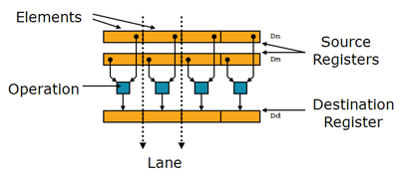
2.2.2 The GPR register set based FX SIMD extension (3)
The GPR register set based SIMD extension, introduced in the Armv6 ISA -1
The introduced FX SIMD extension performs the same FX operation on all FX8 or
FX16 data elements of 32-bit data-words kept in the GPR registers, as indicated
below for FX8 data.
4x FX8
(32-bit wide)
Figure: SIMD operation on 4x FX8 data [11]
It has only a modest performance boosting potential.
Here we note that subsequently, in the Armv7 ISA version, ARM introduced the
secondary register set based advanced SIMD extension (called NEON) to be
discussed later, that provides operations on 64 or 128-bit SIMD data and has a
much higher performance boosting potential than the original GPR register set-based
SIMD extension.
*

Slide 47
2.2.2 The GPR register set based FX SIMD extension (4)
Remark to the GPR register set based SIMD extension of the Armv6 ISA -2
ARM’s GPR register set based SIMD extension, introduced in 2002 is similar to
Intel’ s MMX x86 ISA extension from 1997.

Slide 48
2.2.2 The GPR register set based FX SIMD extension (5)
Enhancing the GPR register set-based ISA extension in the Armv8 ISA (2012) [66]
The Armv8 ISA has two execution modes (AArch32/Aarch64).
The Aarch32 execution mode equals the Armv7 ISA but the Armv8 AArch64 execution mode
expands the number and width of GPRs, as seen in the Figure below.
32-bit wide
32-bit wide
64-bit wide
R0
X0
W0
R1
X1
W1
R2
X2
W2
.
.
.
.
.
.
.
.
.
X3
W3
R12
X12
W12
R13(SP)
Stack pointer
Link register
PC
X13
W13
R14(LR)
X14
W14
R15(PC)
.
.
.
.
.
.
X30
W30
X31
Dedicated use
W31
Dedicated use
32-bit access
64-bit access
GPRs in the Armv3-Armv7 ISA
and in the Armv8 AArch32 execution mode
GPRs in the Armv8 AArch64 execution mode
*

Slide 49
2.2.2 The GPR register set based FX SIMD extension (6)
The GPR register set based SIMD extension introduced in the Armv8 ISA
The AArch64 32-bit mode provides the same FX-SIMD operations as the Armv7 ISA,
but the AArch64 64-bit mode supports both 32-bit and 64-bit SIMD data
manipulations (while data are accessed from the 64-bit GPR registers).
In the AArch64 64-bit mode FX32 operations are also provided beyond FX8/FX16
operations, as indicated in the next Figure.
*

Slide 50
2.2.2 The GPR register set based FX SIMD extension (7)
Enhancing the GPR register set based FX SIMD extension in the Armv8 ISA
...
Armv3
Previously 26 bitwide)
Armv6
Armv7
Armv8
(AArch64)
Armv8
(Aarch32)
GPR register set
32-bit data
64-bit data
32
32
32
32
64
13
31
31
Basic ISA
Scalar data
FX32
SIMD
extension
SIMD data
SIMD data
SIMD data
32-bit wide FX-SIMD FX8/16 operations
32-bit wide FX-SIMD FX8/16 operations
64-bit wide FX-SIMD
FX8/16/32 operations

Slide 51
2.2.3 The secondary register set based scalar FP and SIMD extensions

Slide 52
2.2.3 The secondary register set based scalar FP and SIMD extensions (1)
2.2.3 The secondary register set based scalar FP and SIMD extensions -199
ARM’s ISA extensions to enhance compute capabilities
The GPR register set based
FX SIMD extension
The secondary register set based
scalar FP and SIMD extensions
The SVE register set based
SIMD extensions
It supports
FX-SIMD operations
First it supported only
scalar FP and FP SIMD operations
then also
FX/FP SIMD operations
It supports
FX/FP SIMD operations
on long (up to 16x128-bit) data
Introduced in
Armv6
Armv5
Armv8.2
(2002)
(Section 2.2.2)
(2000)
(Section 2.2.3)
(2016)
(Section 2.2.4)
SVE: Scalable Vector Extension

Slide 53
2.2.3 The secondary register set based scalar FP and SIMD extensions (2)
Introduction and evolution of the secondary register set
Armv5
Armv7
(or Armv8 AArch32 mode)
Armv8
(AArch64 mode)
FP register set¹
Advanced SIMD
and FP register set¹
SIMD
and FP register set
32
64
128
32
32
32
or
or
16
16

Slide 54
2.2.3.1 Secondary reg. set based FP and SIMD extensions - Overview (3)
Remarks
¹Certain models implement only half of the specified register numbers.

Slide 55
2.2.3 The secondary register set based scalar FP and SIMD extensions (3)
Evolution of the secondary register set based scalar FP and SIMD extensions -1
Armv5
Armv7
(or Armv8 AArch32 mode)
Armv8
(AArch64 mode)
FP register set¹
Advanced SIMD
and FP register set¹
SIMD
and FP register set
32
64
128
32
32
32
or
or
16
16
64
128
VFPv1/v2 extension
VFPv3/v4 extension²
Scalar FP extension
Scalar data
Scalar data
Scalar data
FP32/64
FP16¹/32/64
FP16¹/32/64
Serially processed FP vector data
Serially processed FP vector data
Up to 8xFP32 or 4xFP64
operationsc serially executed
Up to 8xFP32 or 4xFP64
operations serially executed
¹FP16 supports only data conversion
between FP16 and FP32/FP64.
Advanced SIMD (NEON) extension
SIMD (Neon) extension
SIMD (vector) data
SIMD (vector) data
VFP: Vector FP
64/128-bit wide SIMD (vector) data
FX8/16/32/64
FP16³/32/64 operations
64/128-bit wide SIMD data
FX8/16/32/64
FP16³/32/64 operations

Slide 56
2.2.3 The secondary register set based scalar FP and SIMD extensions (4)
Evolution of the secondary register set based scalar FP and SIMD extensions -2
Along with the introduction of the Armv8 ISA the secondary register set-based
ISA extensions of the Amv5/v7 ISA became obsolete and only the Armv8 ISA-based
Neon extension is worth of discussing next.

Slide 57
2.2.3 The secondary register set based scalar FP and SIMD extensions (5)
The aim of introducing the NEON extension (already in the Armv7) [11]
NEON is intended to accelerate multimedia and signal processing algorithms
such as video encode/decode, 2D/3D graphics, gaming, speech or image processing.
*

Slide 58
2.2.3 The secondary register set based scalar FP and SIMD extensions (6)
The NEON extension (introduced already in the Armv7 ISA) [11]
NEON instructions operate on 64 or 128-bit wide vector data (SIMD data) held
in the secondary register set.
They perform the same operation on all data elements, as indicated below.
Figure: Execution of SIMD instructions [11]
In the AArch64-mode NEON instructions can refer to
FX8/FX16/FX32/FX64 or
FP16/FP32/FP64
data elements of 64 or 128-bit wide vectors, as illustrated in the next Figure.
Remark
For FP16 data NEON supports only conversions between FP16 and FP32/FP64 data.
FP16 data operations are supported only in the Advanced SIMDv2 option.
*

Slide 59
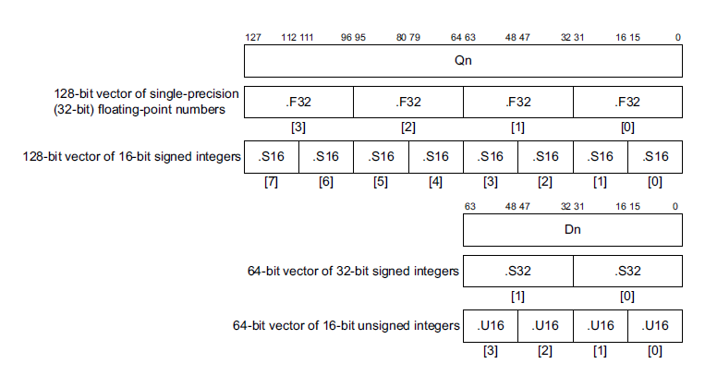
2.2.3 The secondary register set based scalar FP and SIMD extensions (7)
Example vector data formats of the NEON extension [86]

Slide 60
2.2.3 The secondary register set based scalar FP and SIMD extensions (8)
The secondary register set based scalar FP and SIMD extensions - Summary
ARM ISA |  | Name of the extensions | Basic arch. |  | GPR-based FX-SIMD data type extension | Secondary register set based extensions
 |  |  | GPRs | Data type |  | Available reg. set | Scalar data types | Vector (SIMD) data types
Name
Armv1 | 1985 |  | n.a. | FX32
Armv2 | 1989 |  | n.a.
Armv3 | 1991 |  | 13x32
Armv4 | 1996
Armv5 | 2000 | VFP(v1)¹ |  |  |  | FP register set 32x32/16x64 | FP 32/64 | FP 32/64 Serially ex.
 |  | VFP2¹
Armv6 | 2002 | SIMD |  |  | 32-bit wide FX8/16
Armv7 | 2005 | VFPv3² |  |  |  | Adv. SIMD and FP register set 32x64 or 16X128 | +FP 16⁴ | FP 16⁴/32/64 Serially executed
 |  | VFPv4^{2,3,4} |  |  |  |  | + FMA
 |  | Adv. SIMD (NEON)^{4,5} |  |  |  | 32x64 or16x128 |  | 64/128-bit wide FX 8/16/32/64 FP 16⁵/32/64 +FMA⁵
Armv8 | 2012 | AArch32 | 31x64 | FX32/64 | 32-bit wide FX8/16 | 32x64 or 16x128 | FP 16⁴/32/64 | As for Armv7 Adv. SIMD
 |  | AArch64 |  |  | 64-bit wide FX8/16/32 | SIMD and FP register set 32x128 | FX 8/…/64 FP 16⁴/32/64 | As for Armv7 Adv. SIMD

Slide 61
2.2.4 The SVE register set based SIMD extensions

Slide 62
2.2.4 The SVE register set based SIMD extensions (1)
2.2.4 The SVE register set based SIMD extensions -1
ARM’s ISA extensions to enhance compute capabilities
The GPR register set based
SIMD extension
The secondary register set based
FP and SIMD extensions
The SVE register set based
SIMD extensions
It supports
FX-SIMD operations
First it supported only
scalar FP and FP SIMD operations
then also
FX/FP SIMD operations
It supports
FX/FP SIMD operations
on long vector data
Armv6-A
Armv5-A
SVE extension: Armv8.2-A
SVE2 extension: Arm9-A
(2002)
(Section 2.2.2)
(2000)
(Section 2.2.3)
SVE (2016). SVE2 (2021)
(Section 2.2.4)
SVE: Scalable Vector Extension

Slide 63
2.2.4 The SVE register set based SIMD extensions (2)
2.2.4 The SVE register set based SIMD extension-2 [96]
The SVE (Scalable Vector Extension) was announced in 8/2016 (in the Hot Chips
conference) and introduced in the Armv8.2-based ISA, as an optional feature.
Its general specification became available as the ARM Architecture Reference
Manual Supplement - The Scalable Vector Extension (SVE) for Armv8-A
(β version in 3/2017).
SVE is implemented only in the AArch64 version of Armv8.
SVE aims at HPC scientific workloads rather than media or image processing.
It supports both FX and FP SIMD processing.
*

Slide 64
2.2.4 The SVE register set based SIMD extensions (3)
The SVE register set
Introduced in the Armv8. 2 (2016) as an option.
Armv8.2
(AArch64 mode)
SVE register set
128
---
32
(1...16)x 128 bit
*

Slide 65
2.2.4 The SVE register set based SIMD extensions (4)
Designation of the SVE registers [96]
LEN: 1 to 16

Slide 66
2.2.4 The SVE register set based SIMD extensions (5)
Data widths of the SVE registers and SVE instruction operands
Armv8.2
(AArch64 mode)
SVE register set
15.lane
2. lane
1. lane
---
32
128
Up to 16 x 128-bit (Up to 2048-bit)
SVE (2016) /SVE2 (2021) extensions
Up to 16x 128-bit wide lanes
FX/FP SIMD (vector) data
128-bit lane: FX8/16/32/64
FP16³/32/64 operations
The data width must be multiples of 128 bits, up to 16x128-bit.
The 1. lane (128 bits) of the SVE register set is shared with the 32 128-bit
SIMD registers of the Arm8.0 ISA.
*

Slide 67
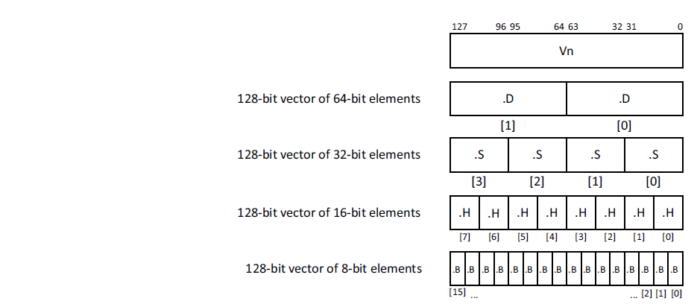
2.2.4 The SVE register set based SIMD extensions (6)
Possible data types per 128-bit [116]
Possible data types
8-bit: FX
16-bit: FX/FP
32-bit: FX/FP
64-bit: FX/FP
128-bit: FX

Slide 68
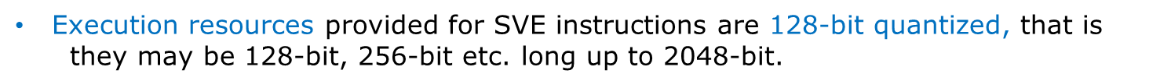
2.2.4 The SVE register set based SIMD extensions (7)
The SVE register set based SIMD extensions - Overview
ARM ISA |  | ISA extension | The SVE register set based SIMD extensions
 |  |  | Available register set | Scalar data types | Vector data types | Instruction subset
Name | Year
Armv8.2 (opt.) | 2016 | SVE | SVE register set 32 registers each (1...16)x128-bit wide | --- | FX 8/16/32/64/128 FP 16/32/64 (1...16)x128-bit wide SIMD data (FMA available) | Small basic instruction subset aiming at HPC workloads (
HPC: High-Performance Computing (computing intensive)
*
SVE: Scalable Vector Extension

Slide 69
2.2.4 The SVE register set based SIMD extensions (8)
Key feature of the SVE extension: Data word length agnostic
programming
The evolution of instruction sets is marked by supporting continuously wider
SIMD execution, e.g. in the x86 ISA first 64-bit then 128-, 256- and lastly
512-bit long SIMD execution.
This way of evolution has however, a drawback as each SIMD extension brought
with it a new subset of instructions, like MMX, SSE, SSE2, SSE3, AVX, AVX512
etc., so in order to utilize the benefits of available wider SIMD execution units
software had be rewritten and recompiled.
SVE amends this problem by the SVE extension, since SVE makes programming
“hardware execution width agnostic” i.e. the programmer doesn’t need to use
different instruction subsets while referencing different long data words and
utilizing different long SIMD units.
*

Slide 70
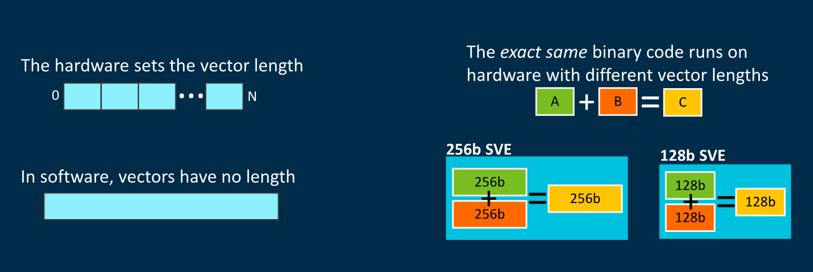
2.2.4 The SVE register set based SIMD extensions (9)
Interpretation of data word length agnostic programming []

Slide 71
2.2.4 The SVE register set based SIMD extensions (10)
Benefits of data word length agnostic programming
SVE simplifies programming and provides portability for binary code between
processors with different SIMD execution widths since instruction execution
will automatically be scaled to the width of the available execution resources.
A further benefit of data word length agnostic programming is that it allows
auto-vectorization by advanced compilers when processing large data sets.
*

Slide 72
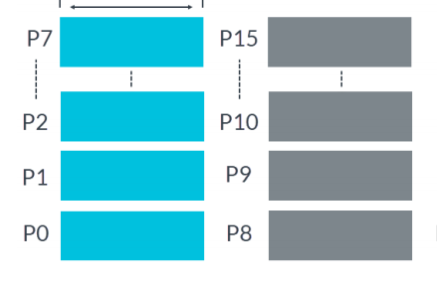
2.2.4 The SVE register set based SIMD extensions (11)
How ARM implements data words agnostic programming? [136]
The introduced SVE extension utilizes Predicate registers as masks to indicate
which active elements of a data word (e.g. which 128-bit lanes) are involved
in the operation.
There exist 16 Predicate registers, as seen below.
P0-P7 are governing predicates for loads, stores, and arithmetic operations,
P8-P15 are extra predicates for loop management.
Up to 16x16 bit
Figure: Predicate registers
*

Slide 73
2.2.4 The SVE register set based SIMD extensions (12)
Specifying the length of the SVE registers [136]
There is a dedicated register for keeping the actual length of the SVE registers,
(not discussed here).

Slide 74
2.2.4 The SVE register set based SIMD extensions (13)
Specifying the length of the data words in the instructions
The Predicate registers are configured as masks for particular data word formats
(e.g. 4x32-bit long data elements, or 8x16-bit data elements.
While writing programs, beyond the operation code, source and destination
registers also an appropriate, previously set Predicate register has to be
specified to identify which data elements should be used in the referenced
SVE registers.
A „1” value of the Predicate register will activate the associated data element,
a „0” value will neglect it.
The next example will demonstrate this.
*

Slide 75
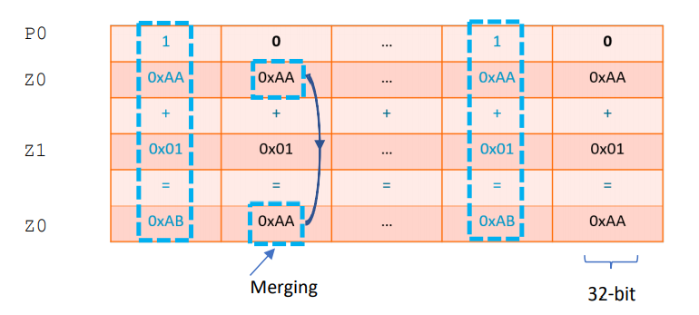
2.2.4 The SVE register set based SIMD extensions (14)
Example: Masking out active data elements from the SVE-registers by
using predicates while performing the zo < z1 + z0 operation [136]
The active elements of the SVE source registers Z0 and Z1 (indicated by the „1” values of the Predicate register P0) are added and the result is written
into the SVE destination register Z0.
The masked out data elements of the SVE source register Z0 are copied into
the SVE destination register Z0.

Slide 76
2.2.4 The SVE register set based SIMD extensions (15)
Remark
Our previous discussion of interpreting the use of Predicate registers is strongly
simplified, for a more detailed explanation we refer to [116] or [136].

Slide 77
2.2.4 The SVE register set based SIMD extensions (16)
The SVE2 SIMD extension
It was introduced in the Armv9-A ISA in 2021 as a mandatory feature.
As long as the SVE extension targeted mainly HPC (High Performance Computing)
workloads, the SVE2 extension has a much richer instruction subset and can be
considered as a future replacement of the recent SIMD extension (called Neon).
*

Slide 78
2.2.4 The SVE register set based SIMD extensions (17)
The SVE register set based SIMD extensions - Overview
ARM ISA |  | ISA extension | The SVE register set based SIMD extensions
 |  |  | Available register set | Scalar data types | Vector data types | Instruction subset
Name | Year
Armv8.2 | 2016 | SVE | SVE register set 32 registers each (1...16)x128-bit wide | --- | FX 8/16/32/64/128 FP 16/32/64 (1...16)x128-bit wide SIMD data (FMA available) | Small basic instruction subset aiming at HPC workloads
Armv9 | 2021 | SVE2
 |  |  |  |  |  | (Vastly enhanced instruction subset aiming at general-purpose workloads
SVE2 provides a large number of instruction set extensions that result in a faster,
more efficient execution on long SIMD data.
Execution resources provided for SVE/SVE2 instructions are 128-bit quantized,
that is they may be 128-bit, 256-bit etc. long up to 2048-bit.
HPC: High-Performance Computing (computing intensive)
*
SVE: Scalable Vector Extension

Slide 79
2.2.4 The SVE register set based SIMD extensions (18)
Implementation of the SVE and SVE2 extensions
Until now SVE has been implemented only by Fujitsu in its A64FX processor.
It is an Armv8.2 ISA-based 48-core processor with 512-bit wide SIMD execution,
manufactured on 7 nm technology, used in the Fugaku supercomputer
(designed by Fujitsu, completed in 03/2021).
This is not surprising, since SVE targets HPC workloads whereas mobiles or
tablets do not run such workloads.
On the other hand, SVE2 is recently (2021) implemented in the Armv9 ISA-
based Neoverse N2 and V1 processor designs which target HPC and servers.
*

Slide 80
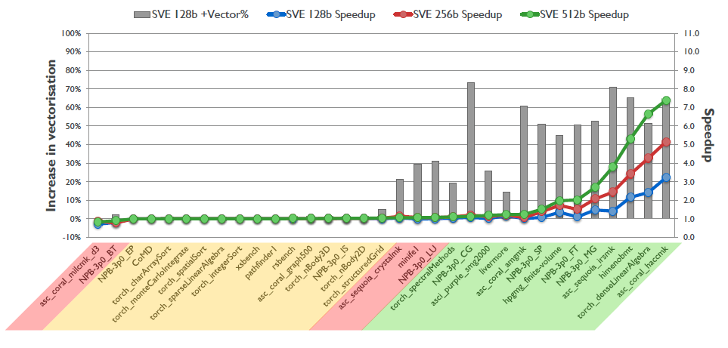
2.2.4 The SVE register set based SIMD extensions (19)
Speed-up potential of SVE [96]

Slide 81
2.2.4 The SVE register set based SIMD extensions (20)
The stunning dynamics of enhancing compute capabilities of the Arm ISA
Note: The Thumb extension aims at reducing code size.
AArch32
AArch64
AArch32
AArch64
AArch64
Crypto-graph. extension
To enhance
security
TrustZone
Confidential
Compute Arch.
MTE
A32
SVE⁴
(v8.2, opt.)
A64
(A32)⁵
A64
SVE2
To enhance
compute
capabilities
SIMD
Adv. SIMD¹
(NEON)
VFPv1/2
VFPv3/v4²
To speed up
the execution
of bytecodes
Jazelle
(Jazelle DBX)
Jazelle
(ex. by SW)
Jazelle RCT³
(ThumbEE)
Thumb
(Armv4T)
Thumb-2
(Armv6T2)
T32
(Thumb)
Armv4
Armv5
Armv6
Armv7-A/R
Armv8-A
Armv9-A
ARM710T
(~1995)
ARM10200
(2000)
ARM1176
(2004)
Cortex-A5 - A15
(2005)
Cortex-A53/A57
(2012)
Neoverse N2/V1
Cortex-X2/A510/A710
cores (2021)
For the Remarks see slide 2.1 Overview (6).

Slide 82
3. Overview of ARM’s CPUs

Slide 83
3. Overview of ARM’s CPUs
3. Overview of ARM’s CPUs
ARM’s CPUs will be discussed while using the following subdivision:
ARM’s CPUs
ARM’s early CPUs
ARM’s Cortex CPUs
ARM’s Neoverse CPUs
CPUs with the
Armv1–v2 ISA
CPUs with the
the Armv3–v6 ISA
CPUs with the
Armv7 – Armv9 ISA
CPUs with the
Armv9 ISA
(Earliest ARM CPUs)
(Early ARM CPUs)
(~ 1985-1990)
(~ 1991-2004)
Since 2004
Since 2021
ARM1-ARM3
ARM6xx-ARM11xx
Mainly target mobiles,
though several vendors
entered the market with
Armv8.0-A or v8.2-A based
server designs as well.
Target infrastructure
(servers, edge)
26-bit address bus
32-bit data buses
32-bit address bus
32-bit data buses
Section 4
Section 5
Sections 6 - 8
Not discussed
in this Chapter
(Sections 4 and 5 and 7.1 will be omitted in the Lecture.

Slide 84
4. CPUs implementing the ARM v1 - v2 ISA
This Section will be omitted in the Lecture.

Slide 85
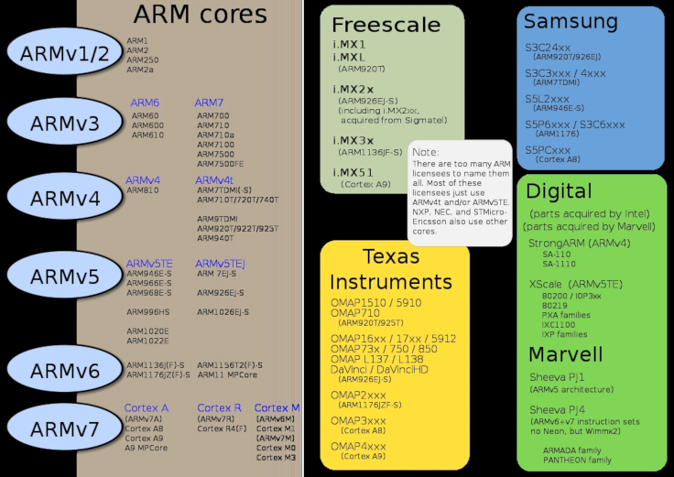
4. Processors implementing the Armv1 - v2 ISA (1)
4. CPUs implementing the Armv1 – v2 ISA -1 [5]

Slide 86
4. Processors implementing the Armv1 - v2 ISA (2)
Remarks
As already discussed in Section 2.1
CPUs based on the ARM ISA versions Armv1 and Armv2 (like ARM1,
ARM2 or ARM3) implement only a 26-bit address bus and a 32-bit data bus.
They are called 26-bit architectures.
By contrast, CPUs based on the Armv3 or higher ISA version support
already a 32-bit address space and are known as 32-bit architectures
up to the Armv7 ISA.
In the Armv8 ISA the AArch64 mode supports already 64-bit addressing.

Slide 87
5. CPUs implementing the Armv3 - v6 ISA
This Section will be omitted in the Lecture.

Slide 88
5. Processors implementing the Armv3 - v6 ISA (1)
5. CPUs implementing the Armv3 - v6 ISA
ARM’s basic ISA (Armv3 – v4) [63], [66]
32-bit wide
Basic register set
R0
R1
R2
.
.
.
R12
R13(SP)
Stack pointer
Link register
PC
R14(LR)
R15(PC)
GPRs in the Armv3-v7 ISA
Basic ISA
Scalar data
FX32
Boole32
Note: Subsequently we do not follow the evolution of Boolean data types

Slide 89
5. Processors implementing the Armv3 - v6 ISA (2)
Main extensions introduced in the Armv4 – ARM v6 ISA versions (simplified)
Note: The Thumb extension aims at reducing code size.
AArch32
AArch64
AArch64
Crypto-graph. extension
To enhance
security
TrustZone
Confidential
Compute Arch.
MTE
A32
SVE⁴
(v8.2, opt.)
A64
Aarch32⁵
A64
SVE2
To enhance
compute
capabilities
SIMD
Adv. SIMD¹
(NEON)
VFPv1/2
VFPv3/v4²
To speed up
the execution
of bytecodes
Jazelle
(Jazelle DBX)
Jazelle
(ex. by SW)
Jazelle RCT³
(ThumbEE)
Thumb
(Armv4T)
Thumb-2
(Armv6T2)
T32
(Thumb)
Armv4
Armv5
Armv6
Armv7-A/R
Armv8-A
Armv9-A
ARM710T
(~1995)
ARM10200
(2000)
ARM1136
(2002)
Cortex-A5 - A15
(2005)
Cortex-A53/A57
(2012)
Neoverse N2/V1
Cortex-X2/A510/A710
cores (2021)
For the Remarks see the next slide.

Slide 90
5. Processors implementing the Armv3 - v6 ISA (3)
Overview of ARM’s CPUs implementing the Armv4 – Armv6 ISA [5]
ARM1156T2F-S
ARM1136JF-S™
ARM1136JF-S™
version
Armv6
ARM1176JZF-S
ARM102xE
ARM1026EJ-S
XScale
Armv5
ARM9x6E
ARM926EJ-S
ARM7TDMI-S
StrongARM
ARM92xT
SC200
ARMV4
SC100
ARM720T
1994
1996
1998
2000
2002
2006
time
2004
XScale is a trademark of Intel Corporation
Notes:
Versions mostly refer to the instruction set that the ARM core executes.
The ARM7, which is still the most often used core in a low-power design, executes the version 4T instruction set. Architectural extensions were added for version 5TE to include DSP instructions, such as 16-bit signed MLA instructions, saturation arithmetic, etc. The ARM926EJ-S and ARM1026EJ-S cores are examples of Version 5 architectures. Version 6 added instructions for doing byte manipulations and graphics algorithms more efficiently. The ARM11 family implemented the Version 6 architecture. Version 7 architectures (which include the Cortex family of cores, such as the Cortex A8, Cortex M3 and Cortex R4) extended the functionality by adding things such as Thumb2, low-power features, and more security.

Slide 91
5. Processors implementing the Armv3 - v6 ISA (4)
5. CPUs implementing the Armv3 –v6 ISA and their use in mobiles [5]

Slide 92
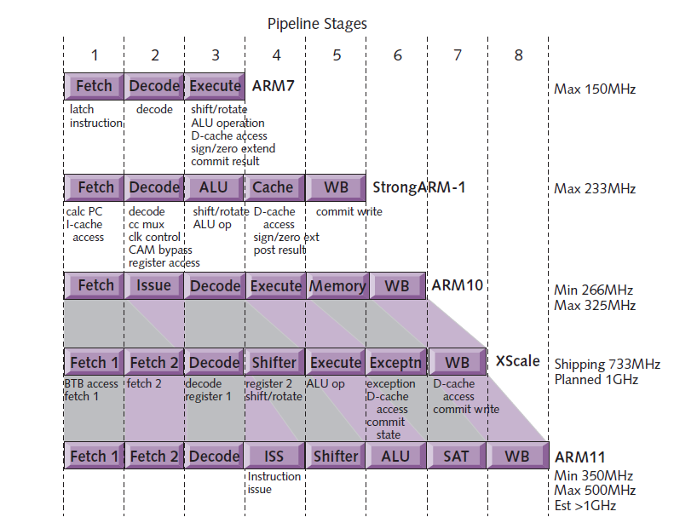
5. Processors implementing the Armv3 - v6 ISA (5)
Evolution of the pipeline length of ARM v4 – v6 based CPUs [8]
Armv4
Armv4
Armv5
Armv5
Armv6

Slide 93
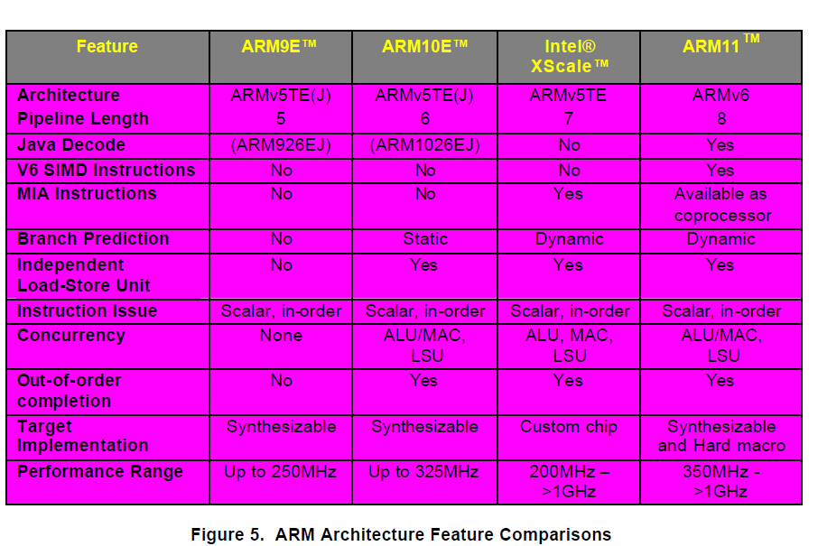
5. Processors implementing the Armv3 - v6 ISA (6)
Main features of the Armv5 – v6 based CPUs (≈1999-2003) [57]

Slide 94
5. Processors implementing the Armv3 - v6 ISA (7)
Introduction of multicore CPUs by ARM: the ARM11 MPCore (Armv6)
07/2003: First public disclosure of the ARM11 MPCore.
05/2004: ARM11 MPCore (multi core ARM11 with 1-4 cores) available for licensing
with an evaluation system for early software development.
It is basically a cache coherent symmetric multicore with up to 4 cores
The ARM11 MPCore incorporates:
the IEM (Intelligent Energy Manager)
It dynamically predicts the required performance and lowers the voltage and
frequency accordingly.

Slide 95
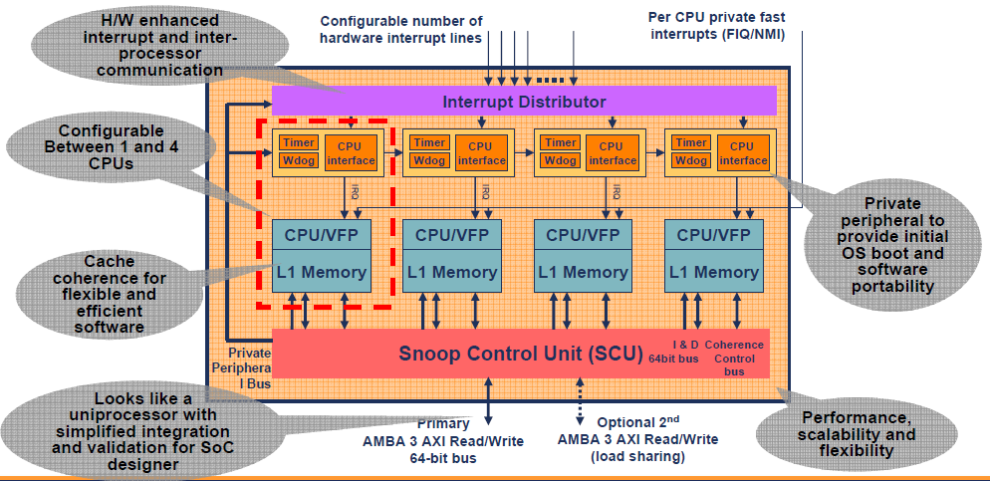
5. Processors implementing the Armv3 - v6 ISA (8)
Block diagram of the ARM11 MPCore [9]
Note that the ARM11 MPCore does not include an L2.

Slide 96
5. Processors implementing the Armv3 - v6 ISA (9)
Remark: Emergence of multi core processors
Year of launching | Dual core design
10/2001 | IBM launches dual core POWER4
11/2002 | IBM launches dual core POWER4+
03/2004 | Sun releases the UltraSPARC IV (Jaguar) dual core processor
05/2004 | ARM announces the availability of the synthetizable ARM11 MPCore quad core processor
05/2004 | IBM launches dual core POWER5
08/2004 | AMD demonstrates first x86 dual core (Opteron) processor
04/2005 | ARM demonstrates the ARM11 MPCore quad core test chip in cooperation with NEC
04/2005 | Intel launches dual core Pentium processors (Pentium D)
04/2005 | AMD launches dual core Opteron server processors
06/2006 | Intel launches their Core 2 line of multicore processors
10/2007 | ARM launches their first multicore Cortex model (the quad core Cortex A9 MPcore)

Slide 97
6. Cortex-A CPUs implementing the Armv7-v8.0-A ISA
6.1 Introduction to the Cortex family of CPUs
6.2 Overview of Cortex-A CPUs implementing the Armv7-v8.0-A ISA
6.3 Evolution of Cortex-A CPUs implementing the Armv7-v8.0-A ISA

Slide 98
6. Cortex-A CPUs implementing the Armv7-v8.0-A ISA
Overview of ARM’s CPUs
ARM’s CPUs will be discussed while using the following subdivision:
ARM’s CPUs
ARM’s early CPUs
ARM’s Cortex CPUs
ARM’s Neoverse CPUs
CPUs with the
Armv1–v2 ISA
CPUs with the
the Armv3–v6 ISA
CPUs with the
Armv7 – Armv9 ISA
CPUs with the
Armv9 ISA
(Earliest ARM CPUs)
(Early ARM CPUs)
(~ 1985-1990)
(~ 1991-2004)
Since 2004
Since 2021
ARM1-ARM3
ARM6xx-ARM11xx
Mainly target mobiles,
though several vendors
entered the market with
Armv8.0-A or v8.2-A based
server designs as well.
Target infrastructure
(servers, edge)
26-bit address bus
32-bit data buses
32-bit address bus
32-bit data buses
Section 4
Section 5
Sections 6 - 8
Not discussed
in this Chapter
(Sections 4, 5 and 7.1 will be omitted in the Lecture.

Slide 99
6.1 Introduction to the Cortex family of CPUs

Slide 100
6.1 Introduction to the Cortex family of CPUs (1)
6.1 Introduction to the Cortex family of CPUs
ARM’s mobile application oriented CPUs implementing the Armv7 or higher ISA
versions are designated as the Cortex family of CPUs.
The Cortex family was announced in 10/2004, without disclosing the Armv7 ISA.
Its first model became the Cortex-M3, launched at the same time.
The Technical Reference Manual of the Armv7 ISA was released in 3/2005.
*

Slide 101
6.1 Introduction to the Cortex family of CPUs (2)
Profiles of ARM’s Cortex family [6], [7], [113] -1
In the technical specifications of the Armv7 ISA ARM introduced three family profiles
to optimize its Cortex family CPUs for specific market segments:
Cortex family profiles
Cortex-A profile
(Application profile)
Cortex-R profile
(Real-time profile)
Cortex-M profile
(Microcontroller profile)
*

Slide 102
6.1 Introduction to the Cortex family of CPUs (3)
Profiles of ARM’s Cortex family [6], [7], [113] -2
The Cortex-A (application) profile
It aims at application processors running mobile OSs and user applications, like
processors in smartphones, tablets, netbooks, eBook readers etc.
At introduction it supported two instruction sets:
the A32 and
the T32 (subset of the A32 with 16-bit instructions)
instruction set.
Subsequently,
the Armv8.0-A ISA introduced 64-bit operation as well while introducing
two execution modes:
the AArch32 execution mode to maintain compatibility with the A32
instruction set and
the AArch64 execution modes, to allow using the new, 64-bit A64
instruction set.
At the same time in the AArch64 mode ARM stopped supporting the
Thumb set, finally
in the Armv9.0-A ISA
ARM terminated the availability of the AArch32 execution mode, as indicated
in the next Figure.
*

Slide 103
6.1 Introduction to the Cortex family of CPUs (4)
Profiles of ARM’s Cortex family [6], [7], [113] -3
The Cortex-R (Real-time) profile [113]
It aims at embedded CPUs for real time applications, like mass storage or
printer controllers.
Supports the A32 and T32 instruction sets.
The Cortex-M (Microcontroller) profile [113]
CPUs of the M profile are optimized for deeply embedded CPUs
aimed at microcontroller and cost sensitive applications, like automotive body
electronics, or smart sensors.
Supports writing interrupt handlers in high-level languages.
It supports a variant of the T32 instruction set.
*

Slide 104
6.1 Introduction to the Cortex family of CPUs (5)
Extending the ARM Cortex family with the SecurCore profile in 10/2007
In 10/2007 ARM introduced the SecurCore profile.
It is optimized for smart card and secure applications.

Slide 105
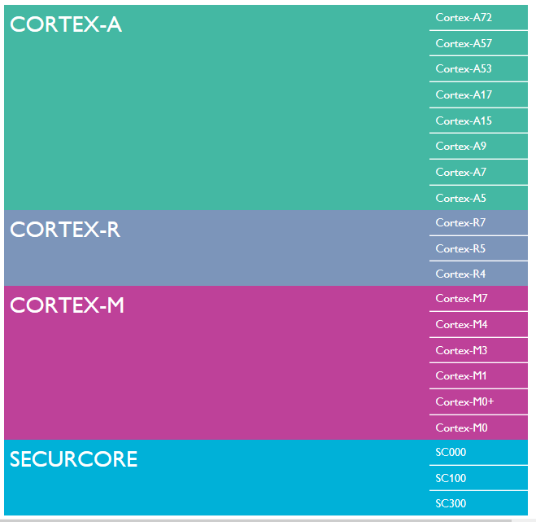
6.1 Introduction to the Cortex family of CPUs (6)
Overview of
Cortex profiles
and CPUs
(as of 2015) [6]

Slide 106
6.1 Introduction to the Cortex family of CPUs (7)
Remark
According to the general scope of this Lecture Notes, subsequently, we will be
concerned only with the Cortex-A series CPUs.

Slide 107
6.1 Introduction to the Cortex family of CPUs (8)
Overview of the evolution of the Cortex-A series CPUs
Cortex-A CPUs
Cortex-A CPUs implementing
the Armv7-A ISA
Cortex-A CPUs implementing
the Armv8.0-A ISA
Cortex-A CPUs implementing
the Armv8.2-A ISA
Cortex-A CPUs implementing
the Armv9-A ISA
32-bit architectures
(announced in 2004)
Supporting big.LITTLE
core clusters
(since 2011,
by specific models)
64-bit architectures
(announced in 2012)
Supporting big.LITTLE
core clusters
64-bit architectures
(announced in 2017)
Supporting DynamIQ
core clusters
64-bit architectures
(announced in 2021)
Supporting Armv9-based
DynamIQ core clusters
First CPUs
Cortex-A8
Cortex-A57/A53
Cortex-A75/A55
Cortex-X2/A710/A510
Section 6.2
Section 7.2
Section 8.2

Slide 108
6.2 Overview of Cortex-A CPUs implementing the Armv7-v8.0-A ISA

Slide 109
6.2 Overview of Cortex-A CPUs implementing the Armv7-v8.0-A ISA (1)
6.2 Overview of Cortex-A CPUs implementing the Armv7-v8.0-A ISA
Performance classes of Cortex-A CPUs implementing the Armv7-v8.0-A ISA-1
Performance classes of Cortex-A CPUs implementing the Armv7-v8.0-A ISA
High-performance CPUs
Mainstream CPUs
Low-power CPUs
*

Slide 110
6.2 Overview of Cortex-A CPUs implementing the Armv7-v8.0-A ISA (2)
Cortex-A CPUs implementing the Armv7-v8.0-A ISA -2 (based on [12])
8
DMIPS/MHz
(Dhrystone MIPS: relative performance of the
DEC VAX 11/780 minicomputer)
(Dhrystone: synthetic benchmark for syst. progr.)
5/2016
Cortex-A73
Armv8
10 nm
7
Armv8.0-A
(64-bit)
Armv7-A
(32-bit)
2/2015
Cortex-A72
Armv8
16 nm
Announced
6
10/2012
Cortex-A57
Armv8
20/16 nm
5
9/2010
Cortex-A15
Armv7
32/28 nm
2/2014
Cortex-A17
Armv7
28 nm
4
6/2013
Cortex-A12
Armv7
28 nm
High Performance
3
Mainstream
10/2007
Cortex-A9
Armv7
40 nm
10/2012
Cortex-A53
Armv8
20/16 nm
11/2015
Cortex-A35
Armv8
16/14 nm
2
10/2005
Cortex-A8
Armv7
65 nm
10/2011
Cortex-A7
Armv7
28 nm
10/2009
Cortex-A5
Armv7
40 nm
1
Low power
2006
2007
2008
2009
2010
2011
2012
2013
2014
2015
2016

Slide 111
4. Evolution of the Cortex-A series Armv7/v8.0 ISA-based models (16)
6.2 Overview of Cortex-A CPUs implementing the Armv7-v8.0-A ISA (3)
Cortex-A CPUs implementing the Armv7-A ISA and their main features [51]
CPU Core | Announced | Available in devices | big.LITTLE support | Target category | Efficiency
Cortex-A8 | 2005 | 2009 | -- | Mainstream | 2,0 DMIPS/MHz
Cortex-A9 | 2007 | 2010 | -- | Mainstream | 2,5 DMIPS/MHz
Cortex-A5 | 2009 | 2011 | -- | Low power | 1,6 DMIPS/MHz
Cortex-A15 | 2010 | Q2/2013 | Yes (with A7) | High-end | 4,0 DMIPS/MHz
Cortex-A7 | 2011 | 2012 | Yes (A15/A17) | Low power | 1,9 DMIPS/MHz
(Cortex-A12) | 2013 | withdrawn | -- | Mainstream) | 3,0 DMIPS/MHz
Cortex-A17 | 2014 | 2015 | Yes (with A7) | Mainstream | 4,0 DMIPS/MHz

Slide 112
6.2 Overview of Cortex-A CPUs implementing the Armv7-v8.0-A ISA (4)
b) Cortex-A CPUs implementing the Armv8.0-A ISA and their main features [51]
CPU Core | Announced | Available in devices | Big.LITTLE suppor | Target category | Efficiency
Cortex-A53 | 2012 | H2/2014 | Yes (with A57/A72) | Low power | 2,3 DMIPS/MHz
Cortex-A57 | 2012 | 2015 | Yes (with A57) | High-end | 4,8 DMIPS/MHz
Cortex-A53 | 2012 | H2/2014 | Yes (with A57/A72) | Low power | 2,3 DMIPS/MHz
Cortex-A72 | 2015 | 2016 | Yes (with A53) | High-end | 6.3-7.3 DMIPS/MHz
Cortex-A73 | 2016 | 2017 | Yes (with A53/A35) | High-end | 7.4-8.5 DMIPS/MHz

Slide 113
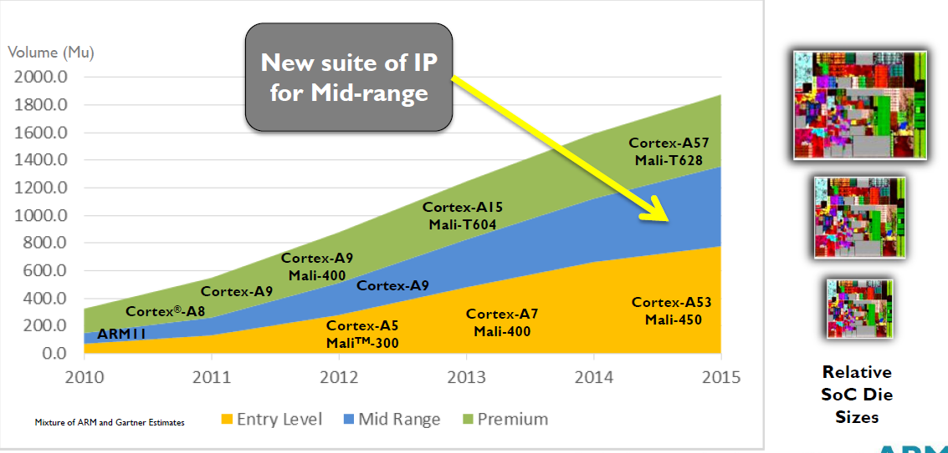
6.2 Overview of Cortex-A CPUs implementing the Armv7-v8.0-A ISA (5)
Yearly shipment of ARM Cortex-A chips in different performance classes
(data from 2013) [13]

Slide 114
6.3 Evolution of Cortex-A CPUs implementing the Armv7-v8.0-A ISA
Not discussed in the Lecture.

Slide 115
6.3 Evolution of Cortex-A CPUs implementing the Armv7-v8.0-A ISA (1)
6.3 Evolution of Cortex-A CPUs implementing the Armv7-v8.0-A ISA
Key features of Armv7 - v8.0-A ISA based Cortex-A CPUs considered
Word length
of the CPUs
Inclusion of
L2 cache
Multicore
design
Support for big.LITTLE
configurations
(a)
(b)
(c)
(d)
*

Slide 116
6.3 Evolution of Cortex-A CPUs implementing the Armv7-v8.0-A ISA (2)
a) Evolution of the word length of the CPUs
Word length of the CPUs
ARM’s 32-bit Cortex-A CPUs
ARM’s 64-bit Cortex-A CPUs
Cortex-A CPUs
implementing the Armv7-A ISA
Cortex-A CPUs
implementing the Armv8.0-A ISA
Cortex-A8 (2005)
Cortex-A9 (2007)
Cortex-A5 (2009)
Cortex-A15 (2010)
Cortex-A7 (2011)
Cortex-A17 (2014)
Cortex-A53 (2012)
Cortex-A57 (2012)
Cortex-A35 (2015)
and subsequent CPUs.
*

Slide 117
6.3 Evolution of Cortex-A CPUs implementing the Armv7-v8.0-A ISA (3)
b) Evolution of including an L2 cache
Inclusion of an L2 cache
No L2 cache
Optional L2 cache
Mandatory L2 cache
Cortex-A5 (10/2009)
Cortex-A8 (10/2005)
Cortex-A9 (10/2007)
Cortex-A7 (10/2011)
Cortex-A15 (9/2010)
Cortex-A17 (2/2014)
All 64-bit CPUs
*

Slide 118
6.3 Evolution of Cortex-A CPUs implementing the Armv7-v8.0-A ISA (4)
c) Evolution of multicore designs
Multicore capability of the Cortex-A series CPUs implementing the Armv7 ISA
Single core designs
Multicore designs (up to 4 cores)
with hardware cache coherency provided
Cortex-A8 (2005)
Cortex-A9 (2007)
Cortex-A5 (2009)
Cortex-A9 MPCore (2007)
Cortex-A5 MPCore (2010)
Cortex-A7 MPCore (2011)
(Cortex-A12 MPCore) (2013)¹
Cortex-A15 (2011)²
Cortex-A15 MPCore (2011)
Cortex-A17 MPCore (2014)
All subsequent, Armv8/v9-based
(64-bit) models are multicores
without indicating it by the MPCore tag.
¹The model Cortex-A12 was introduced in 6/2013, but in subsequent releases ARM enhanced it by
features of the Cortex-A17MPCore (like big.LITTLE support).
As a result its parameters became too close to that of the Cortex-A17, so ARM cancelled the
A12 MPCore designation and removed all related references from its web site in 10/2014.
This is the reason why subsequently we leave this CPU out from the most parts of our discussion.
² ARM released the Technical Reference Manals for both the Cortex/A15 and Cortex/A15 MPCore in the
same time in 2011, nevertheless, no differences can be found between them, e.g. the Cortex A-15
supports cache coherency as well.
*

Slide 119
6.3 Evolution of Cortex-A CPUs implementing the Armv7-v8.0-A ISA (5)
Remarks on the use of the term MPCore by ARM
ARM introduced the term MPCore in connection with the announcement of the
ARM11 MPCore in 2004 and designated it as a multiprocessor design, despite
the fact that the ARM11 MPCore was actually a multicore processor including
up to 4 cores rather than a multiprocessor.
Along with the ARM Cortex-A9 (2007) ARM re-used this term.
The ARM Cortex-A9 model had two alternatives:
the ARM Cortex-A9 which is a single core design and
the ARM Cortex-A9 MPCore which is a multicore designs with up to 4 cores
and hardware cache coherency.
Similarly, the subsequent Cortex-A5 model (2009) had two alternatives,
but beginning with the A7/A15 models, which targeted big.LITTLE
configurations (2011), all subsequent Cortex-A model were multicores
with hardware cache coherency.
Finally, along with the Armv8-A based designs ARM dropped the MPCore tag.

Slide 120
6.3 Evolution of Cortex-A CPUs implementing the Armv7-v8.0-A ISA (6)
d) Evolution of supporting big.LITTLE core clusters
ARM revealed the big.LITTLE technology in a White Paper, in 09/2011.
Accordingly, ARM began supporting the big.LITTLE technology along with their
advanced 32-bit (Armv7) designs, as shown below.
Support of big.LITTLE core clusters
No support for big.LITTLE
core clusters
Support for big.LITTLE
core clusters
First 32-bit (Armv7) CPUs, such as the
Cortex-A8 (2005)
Cortex-A9 (2007)
Cortex-A5 (2009)
Advanced 32-bit (Armv7) CPUs, such as the
Cortex-A15 (2011)
Cortex-A7 (2011)
Cortex-A17 (2014)
and all 64-bit (Armv8) CPUs
*

Slide 121
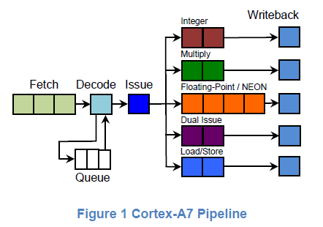
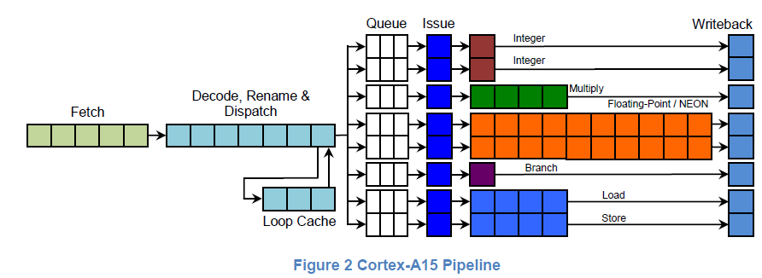
6.3 Evolution of Cortex-A CPUs implementing the Armv7-v8.0-A ISA (6b)
Example of big (Cortex-A15) and LITTLE cores (Cortex-A7) [37]
(2-wide)
5.3 Evolution of Cortex-A CPUs implementing the Armv7-v8.0-A ISA (6)
(3-wide)

Slide 122
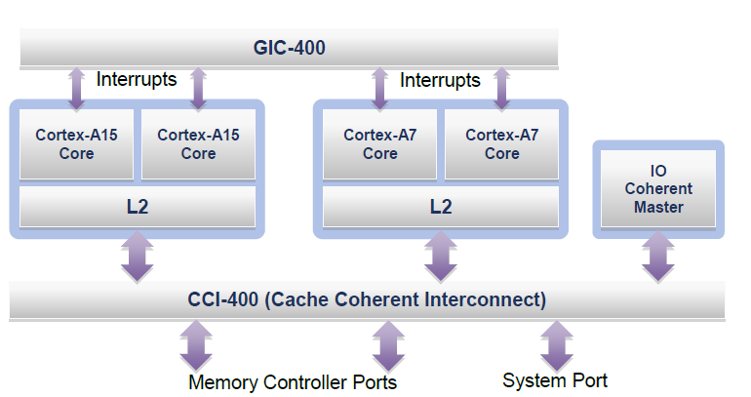
6.3 Evolution of Cortex-A CPUs implementing the Armv7-v8.0-A ISA (6c)
Example: Block diagram of a simple big.LITTLE system
The example system includes a cluster of two Cortex-A15 cores, used as the
big cluster and another cluster of two Cortex-A7 cores, used as the LITTLE,
cluster, as indicated below.
General Interrupt Controller
Figure: An example big.LITTLE system [37]
Both clusters are interconnected by a Cache Coherent Interconnect (CCI-400)
and are served by a General Interrupt Controller (GIC-400), as shown above.

Slide 123
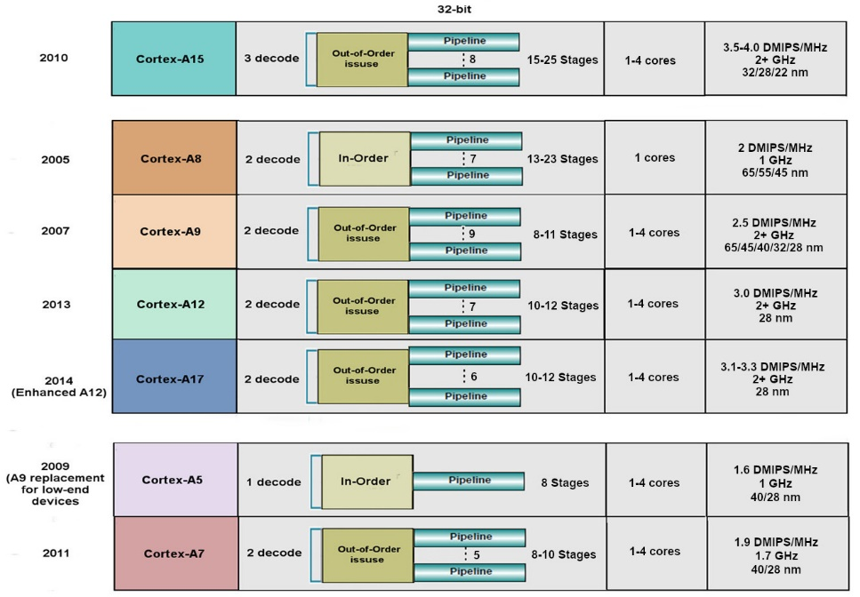
6.3 Evolution of Cortex-A CPUs implementing the Armv7-v8.0-A ISA (7)
Front-end width and back-end widths of Armv7 ISA based cores [14]
32-bit
High performance
Front-end
Back-end
Mainstream
Low power

Slide 124
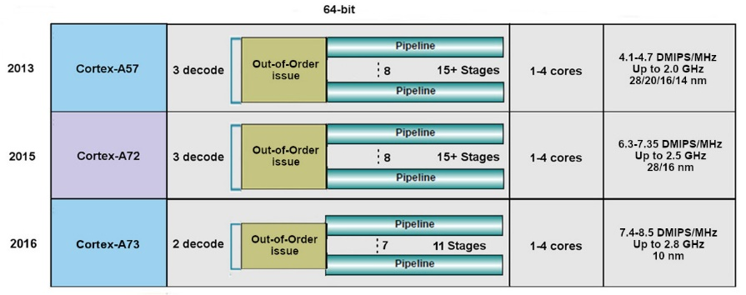
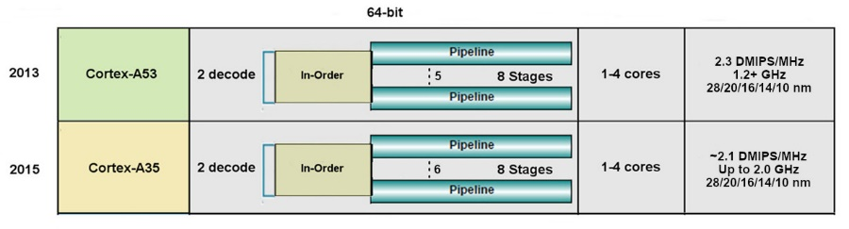
6.3 Evolution of Cortex-A CPUs implementing the Armv7-v8.0-A ISA (8)
Front-end width and back-end widths of Armv8 ISA based cores [14]
64-bit
High performance
Front-end
Back-end
Low power

Slide 125
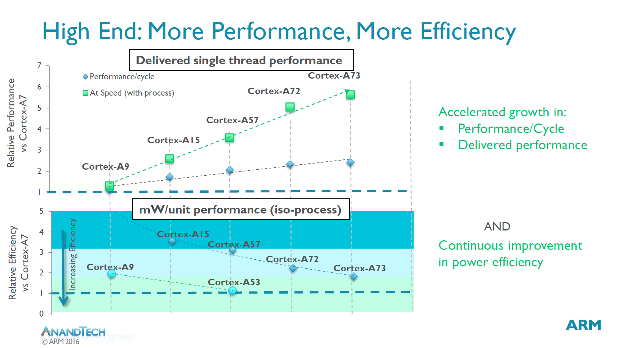
6.3 Evolution of Cortex-A CPUs implementing the Armv7-v8.0-A ISA (9)
Raising the ST performance, IPC and power efficiency of subsequent CPUs
of the Cortex-A line vs. the A7 [99]
IPC
2007
2016
ST: Single Thread
*

Slide 126
6.3 Evolution of Cortex-A CPUs implementing the Armv7-v8.0-A ISA (10)
Raising the single thread IPC in Intel’s basic architectures (Based on [124])
2
24%
22%
Per Generation
1.9
20%
Cumulative
1.8
18%
1.7
16%
1.6
14%
12%
1.5
10%
1.4
8%
1.3
6%
1.2
4%
2%
1.1
0%
1
Pentium M
Dothan
Core 2
Penryn
NHM
(w/o SMT)
WSM
SNB
IVB
HSW
BRW
SKL
(2003)
(2015)
*

Slide 127
6.3 Evolution of Cortex-A CPUs implementing the Armv7-v8.0-A ISA (11)
Comparing the evolution of single thread IPC in Intel’s and AMD’s Core and
ARM’s Cortex-A families
Note that both Intel and ARM raised the IPC in their Core and Cortex A families,
respectively, only about 2-times in about 10 years.
Nevertheless, ARM could raise the relative performance of their CPUs in the considered time interval of about 10 years vs. the “low performance LITTLE A7 core” by more than 5 times (due to higher clock rates).
*

Slide 128
6.3 Evolution of Cortex-A CPUs implementing the Armv7-v8.0-A ISA (12)
Wide configuration options - Example: The 64-bit low power Cortex-A35
It is a widely configurable application CPU, as indicated below.
Figure: Configuration options of the Cortex-A35 [77]
It is configurable for applications ranging from mobiles to deeply embedded.
Target consumption is below 125 mW.

Slide 129
6.3 Evolution of Cortex-A CPUs implementing the Armv7-v8.0-A ISA (13)
Use of Armv7-based (32-bit) ARM Cortex-A CPUs in mobiles [18]
 | (SOC) System- On-a-Chip | Notable Product(s) Containing | ARM Cortex-A CPU | No. of Cores
Apple | A4 | iPhone 4, iPod Touch (4th Gen), iPad (1st Gen), AppleTV (2nd Gen) | Cortex-A8 | 1
 | A5 | iPhone 4S, iPad 2, AppleTV (3rd Gen) | Cortex-A9 | 2
 | A5X | iPad (3rd Gen, Retina Display) | Cortex-A9 | 2
Samsung | Exynos 3 Single | Samsung Galaxy S, Samsung Galaxy Nexus S, | Cortex-A8 | 1
 | Exynos 4 Dual | Samsung Galaxy SII, Samsung Galaxy Note (International) | Cortex-A9 | 2
 | Exynos 4 Quad | Samsung Galaxy SIII | Cortex-A9 | 4
 | Exynos 5 Dual | Chrombook | Cortex-A15 | 2
Nvidia | Tegra | Microsoft Zune HD | (ARM11) | 1
 | Tegra 2 | ASUS Eee Pad Transformer, Samsung Galaxy Tab 10.1, Motorola Xoom, Dell Streak 7 & Pro, Sony Tablet S | Cortex-A9 | 2
 | Tegra 3 | ASUS Transformer Pad 300, ASUS Nexus 7, Acer Iconia Tab A510 & A700, HTC One X | Cortex-A9 | 4
Qualcomm | Snapdragon S1 | Large number of devices | (ARM11)/A5 | 1
Texas Instruments | OMAP 3 | Barnes and Noble Nook Color | Cortex-A8 | 1
 | OMAP 4 | Amazon Kindle Fire, Samsung Galaxy Tab 2, Blackberry Playbook, Samsung Galaxy Nexus, Barnes and Noble Nook Tablet | Cortex-A9 | 2
 | OMAP 5 | N/A | Cortex-A15 | 2

Slide 130
6.3 Evolution of Cortex-A CPUs implementing the Armv7-v8.0-A ISA (14)
Three design teams working in parallel on Cortex-A CPUs [92]
8
DMIPS/MHz
Austin (Texas) designs
5/2016
Cortex-A73
Armv8
10 nm
7
Sophia-Antipolis (France) designs
2/2015
Cortex-A72
Armv8
16 nm
Announced
Cambridge (UK) designs
6
10/2012
Cortex-A57
Armv8
20/16 nm
5
9/2010
Cortex-A15
Armv7
32/28 nm
2/2014
Cortex-A17
Armv7
28 nm
4
6/2013
Cortex-A12
Armv7
28 nm
High Performance
3
Mainstream
10/2007
Cortex-A9
Armv7
40 nm
10/2012
Cortex-A53
Armv8
20/16 nm
11/2015
Cortex-A35
Armv8
16/14 nm
2
10/2005
Cortex-A8
Armv7
65 nm
10/2011
Cortex-A7
Armv7
28 nm
10/2009
Cortex-A5
Armv7
40 nm
1
Low power
2006
2007
2008
2009
2010
2011
2012
2013
2014
2015
2016

Slide 131
6.3 Evolution of Cortex-A CPUs implementing the Armv7-v8.0-A ISA (15)
Addendum
The subsequent Cortex-A CPUs were designed by the following teams:
the Cortex-A75 by the Sophia-Antipolis team,
the Cortex-A76/A77/A78/X1 by the Austin (USA) team and
the Cortex A-55 by the Cambridge (UK) team.

Slide 132
6.3 Evolution of Cortex-A CPUs implementing the Armv7-v8.0-A ISA (16)
Optional reading: Remarks on the designs of the Cortex-A series (taken from [99])
"...The A15, A57, A72 all belong to the Austin family of microarchitectures, and as one would have guessed from the name, this is because they originated from ARM's Austin CPU design centre.
The A5, A7 and A53 belong to the Cambridge family while the Cortex A12, A17 and today's new A73 belong to the Sophia family, owning its name to the small city of Sophia-Antipolis which houses one of Europe's largest technology parks as well as ARM's French CPU design centre. Referring to their design location is however not enough to disambiguate microprocessor families, as we'll see completely new designs come out from each R&D center. In fact, this has already happened as the A12/17/73 can be seen as a new generation over the preceding the A9 microarchitecture and as such can be referred to as a "second generation Sophia family". This is an important notion to consider as in the future we'll be seeing completely new microarchitectures come out of ARM's various design teams."
"The Cortex A73 being still in the same Sophia family effectively means the design is very much a 64-bit successor to the Cortex A17. The new core effectively inherits some of the main characteristics of its predecessor such as overall µarch philosophy as well as higher-level pipeline elements and machine width. And herein lies the biggest surprise of the Cortex A73 as a A72 successor: Instead of choosing to maintain A72’s 3-wide, or increase the microarchitecture’s decoder width, ARM opted to instead go back to a 2-wide decoder such as found on the current Sophia family. Yet the A73 positions itself a higher-performance and lower-power design compared to the larger A72."

Slide 133
6.3 Evolution of Cortex-A CPUs implementing the Armv7-v8.0-A ISA (17)
Optional reading: Remarks on the evolution of the Cortex-A series (taken from [99]) -1
There is a brief but essential description of ARM's Cortex series in [99]. Due to its
relevance in the following we will cite parts of it.
"The Cortex A9 was an incredibly important design for ARM as, in my view, it provided the corner-stone for SoC and device vendors to create some of the designs that powered some of the most successful devices that brought with them a turning-point in smartphone performance and experience. Apple’s A5, Samsung’s Exynos 4210/4412, and TI OMAP4430/4460 were all SoCs which made the A9 a very successful CPU micro-architecture.
Following the Cortex A9 we saw the introduction of the Cortex A15. The core was a substantial jump in terms of performance as it provided the single largest IPC improvement in ARM’s Cortex A-profile of application processors. While the A15 represented a large performance boost, it came at significant cost in terms of power efficiency and overall power usage. It took some time for the Cortex A15 to establish itself in the mobile space as the first designs such as the Exynos 5250 and 5410 failed to impress due to bad power efficiency due to various issues.
It’s at this point where ARM introduced big.LITTLE with the argument that one can have the best of both worlds, a high-power performant core together with a low-power high-efficiency core. It was not until late 2014 and 2015 did we finally see some acceptable implementations of A15 big.LITTLE solutions such as the Kirin 920 or Exynos 5422."

Slide 134
6.3 Evolution of Cortex-A CPUs implementing the Armv7-v8.0-A ISA (18)
Optional reading: Remarks on the evolution of the Cortex-A series (taken from [99]) -2
"The Cortex A57 succeeded the Cortex A15 and was ARM’s first “big” core to employ Armv8 64-bit ISA. Accompanied by the high-efficiency Cortex A53 cores this represented an important shift not unlike the x86-64 introduction in the desktop PC space well over a decade before. The cores came at a moment where the industry was still at shock of Apple’s introduction of the A7 SoC and Cyclone CPU micro-architecture, beating ARM in terms delivering the first 64-bit Armv8 silicon. Suddenly everybody in the industry was playing catch-up in trying to bring their own 64-bit products as it was seen as an absolutely required feature-check to remain competitive.
This pressured shift to 64-bit was in my view a crippling blow to many 2015’s SoCs as it forced vendors into employing sub-optimal Cortex A57 and A53 designs. HiSilicon and MediaTek saw an actual regression in performance as flagship SoCs such as the Kirin 930 and Helio X10 had to make due with only A53 cores for performance as they decided against employing A57 cores due to power consumption concerns. The Kirin 930 or the X10 were in effect slower chipsets than their predecessors. Only Samsung was fairly successful in releasing reasonable designs such as the Exynos 5433 and Exynos 7420 – yet these had respectively regressed or barely improved in terms of power efficiency when compared to mature Cortex A15 implementations such as the Exynos 5430. Then of course we had sort of a lost generation of devices due to Qualcomm’s unsuccessful Snapdragon 810 and 808 SoCs, a topic we’ll eventually revisit in our deep dive of the Snapdragon 820 and Exynos 8890."

Slide 135
6.3 Evolution of Cortex-A CPUs implementing the Armv7-v8.0-A ISA (19)
Optional reading: Remarks on the evolution of the Cortex-A series (taken from [99]) -3
"Some readers will notice I left out the Cortex A12 and A17 – and I did that on purpose in trying to get to my point. The Cortex A12 was unveiled in July 2013 and presented as a successor to the Cortex A9. The core had a relatively short lifetime as it was quickly replaced within 6 months with the Cortex A17 in February 2014 which improved performance and also made the core big.LITTLE compatible with the Cortex A7. The Cortex A17 saw limited adoption in the mobile space. In fact, among the few SoCs such as Rockchip’s RK3288 and some little known chips such as HiSilicon’s Hi3536 multimedia SoC, it was only MediaTek’s MT6595 that saw moderate success in design wins such as Meizu’s MX4.

Slide 136
7. Cortex-A CPUs implementing the Armv8.2-A ISA
7.1 Main extensions of the Armv8.2-A ISA and
the related microarchitecture of the cores
7.2 Overview of Cortex-A CPUs implementing
the Armv8.2-A ISA
Section 7.1 is not discussed in the Lecture.

Slide 137
Cortex-A CPUs implementing the Armv8.2-A ISA (1)
Cortex-A CPUs implementing the Armv8.2-A ISA
Cortex-A CPUs
Cortex-A CPUs implementing
the Armv7-A ISA
Cortex-A CPUs implementing
the Armv8.0-A ISA
Cortex-A CPUs implementing
the Armv8.2-A ISA
Cortex-A CPUs implementing
the Armv9-A ISA
32-bit architectures
(announced in 2004)
supporting big.LITTLE
core clusters
(since 2010,
by specific models)
64-bit architectures
(announced in 2012)
supporting big.LITTLE
core clusters
64-bit architectures
(announced in 2017)
supporting DynamIQ
core clusters
64-bit architectures
(announced in 2021)
supporting Armv9-based
DynamIQ core clusters
First CPUs
Cortex-A8
Cortex-A57/A53
Cortex-A75/A55
Cortex-X2/A710/A510
Section 5
Section 7
Section 8

Slide 138
7.1 Main extensions of the Armv8.2-A ISA and
the related microarchitecture of the cores
7.1.1 Main extensions of the Armv8.2-A ISA
7.1.2 Main extension of the related microarchitectures:
The DynamIQ core cluster
Section 7.1 is not discussed in the Lecture.

Slide 139
7.1 Extensions of Armv8.2-A and the related microarchitecture of the cores
7.1 Main extensions of the Armv8.2-A ISA and the related microarchitecture
of the cores
There are two main extensions to be discussed:
Main extensions of the Armv8.2-A ISA (Section 7.1.1) and
the DynamIQ core cluster being the main extension of the
microarchitecture of ARM 8.2-A ISA-based cores (Section 7.1.2)

Slide 140
7.1.1 Main extensions of the Armv8.2-A ISA

Slide 141
7.1.1 Main extensions of the Armv8.2-A ISA (1)
7.1.1 Main extensions of the Armv8.0-A ISA -1 [97]
Revision | Released | Main enhancements | Cortex-A/ Neoverse CPUs
Armv8-A | 10/2011 |  | A32/A35/ A53/A57/ A72/A73
Armv8.1-A | 12/2014 | Incremental benefits over v8.0-A relating to the instruction set, exception model and memory translation
Armv8.2-A | 01/2016 | Optional increase of the address space from 48 to 52 bits RAS extensions Statistical profiling to be able to analyze large working sets SVE (Scalable Vector Extension) (optional) Half-precision FP (optional) FP16 (BFfloat16) (optional) Dot product of two 32-bit vectors with 4x FX8 data (optional) | A55/A75/76/77 (provide also Armv8.1 support) Neoverse N1, E1

Slide 142
7.1.1 Main extensions of the Armv8.2-A ISA (2)
Main extensions of the Armv8.0 ISA -2 [97]
Revision | Released | Main enhancements | Cortex-A/ Neoverse CPUs
Armv8.3-A | 12/2017 | Pointer authentication Improvements to the exception model for nested virtualization | TBA
Armv8.4-A | 10/2018 | Activity Monitors Extension (AMU) (optional) Cripto extensions Memory partitioning and monitoring capabilities New Secure EL2 state | Neoverse V1
Armv8.5-A | 07/2019 | Spectre and Meltdown Vulnerability Detection Memory Tagging Extension (optional) Random Number Generator Branch Target Identification | TBD
Armv8.6-A | 07/2020 | AMU Extension v1.1 (optional) FP16 (BFloat16) Dot product of two 32-bit vectors with 4x FX8 data | TBD
Armv8.7-A | 01/2021 | Alternate Floating Point Behaviour Support for 64-byte Load/Stores 52-bit Address Space for 4KB/16 KB Translation Granules (Smallest memory blocks) | TBD

Slide 143
7.1.1 Main extensions of the Armv8.2-A ISA (3)
Discussed enhancements of the Armv8.2-A ISA
From the indicated Armv8.2-A enhancements below we briefly discuss the ones
extending the computing capabilities as follows:
a) SVE (Scalable Vector Extension) (optional)
b) Half-precision FP and FP16 (BFfloat16) (both optional)
c) Dot product of two 32-bit vectors with 4x FX8 data (optional)

Slide 144
7.1.1 Main extensions of the Armv8.2-A ISA (4)
a) The SVE (Scalable Vector Extension) (optional)
It allows to introduce FX/FP SIMD instructions operating on long SIMD
(up to 16x128 bit) data with data word length agnostic programming i.e.
without having different instruction subsets for different long data
(e.g. 128/256 or 512-bit long data).
The SVE extension was already discussed in Section 2.2.4.

Slide 145
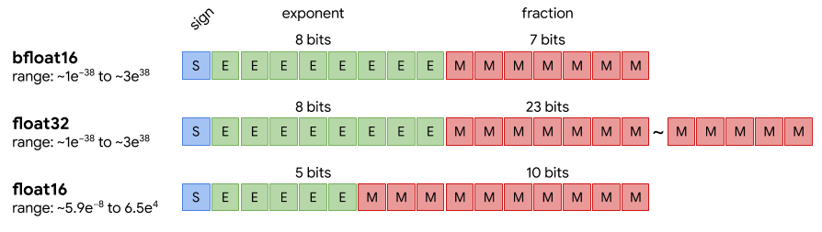
7.1.1 Main extensions of the Armv8.2-A ISA (5)
b) Half-precision FP and FP16 (BFfloat16) (both optional)
In NN processing, weights and activation data may be represented also by short,
even only 8 or 16-bit long data types, such as FP16, bfloat16 (designated
also as Bfloat16) or int8 (known also as Int8) to keep twice or four times more
data in registers or memory and execute up to four times more data compared
to FX32 data.
This was the reason why IEEE introduced the half-precision FP (in 2008) and
Google the bfloat (brain FP) data format in 2018 (see the next Figure).
Figure: FP representation of data used in deep learning [151]
Due to its benefits the bfloat16 (Bfloat16) data type became in a short time
widespread, among others in Intel’s and AMD’s processors.

Slide 146
7.1.1 Main extensions of the Armv8.2-A ISA (6)
Remark
The FP16 (BFfloat16) data format became mandatory in the Armv8.6-A ISA revision.

Slide 147
7.1.1 Main extensions of the Armv8.2-A ISA (7)
c) Dot product of two 32-bit vectors with 4x FX8 data (optional) [152]
The int8MatMul instruction calculates the dot product of the four 8-bit int8
sub-elements of the referenced first 32-bit SIMD data element with
the four 8-bit sub-elements of the referenced second SIMD data element
and accumulates the result into the corresponding 32-bit element of the
destination register (see the Figure below).
There are two versions of the instruction, one with signed 8-bit integers and
another with unsigned integers.
int8_{i1}
int8_{i2}
int8_{i3}
int8_{i4}
int8_{j1}
int8_{j2}
int8_{j3}
int8_{j4}
32-bit SIMD data element
int8MatMul = int8_{i1}*int8_{j1}+ int8_{i2}*int8_{j2}+ int8_{i3}*int8_{j3} + int8_{i4}*int8_{j4}
Figure: Interpretation of the int8MatMul instruction
The int8MatMul instruction is used to speed up matrix multiplications with 8-bit
integers, a common operation needed in NN calculations.
This feature is optional in Armv8.2-A implementations and mandatory in
Armv8.6 implementations.
Dot product: skalár szorzat

Slide 148
7.1.2 Main extension of the related microarchitectures:
The DynamIQ core cluster
This Section will be omitted in the Lecture.

Slide 149
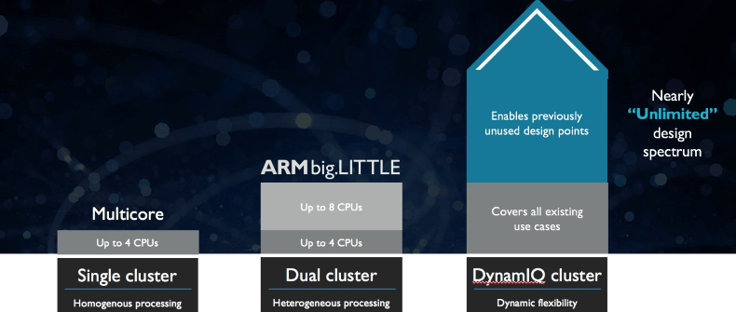
7.1.2 The DynamIQ core cluster (1)
7.1.2 Main extension of the related microarchitectures: The DynamIQ core cluster -1
It is the next step in the evolution of the core cluster technology.
SMP
(
)
ARM11 MPCore (2004)
Cortex-A7/A15 (~2011)
Cortex-A55/A75 (~2017)
Figure: Evolution steps of the core cluster technology [114]

Slide 150
7.1.2 The DynamIQ core cluster (2)
Main extension of the related microarchitectures: The DynamIQ core cluster -2
ARM started working on the DynamIQ core cluster technology in 2013 [98].
DynamIQ was announced in 03/2017.
It is an enhancement of the big.LITTLE technology, as indicated in the next slides.

Slide 151
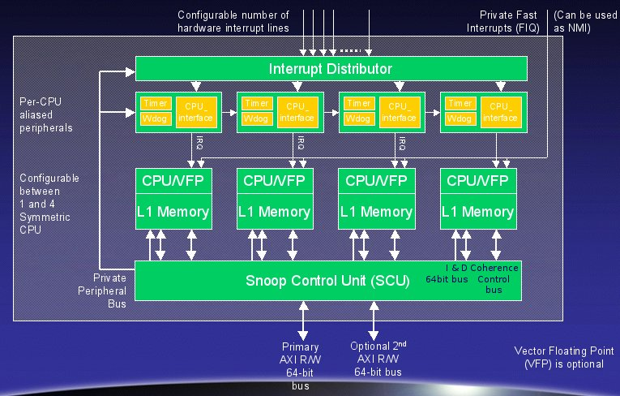
7.1.2 The DynamIQ core cluster (3)
From the ARM11 MPCore to the big.LITTLE technology
ARM11 MPCore [115]
big.LITTLE
Cluster of
big cores
Cluster of
LITTLE cores
CPU0
CPU1
CPU0
CPU1
CPU2
CPU3
CPU2
CPU3
Cache coherent interconnect
(2004)
(2011)

Slide 152
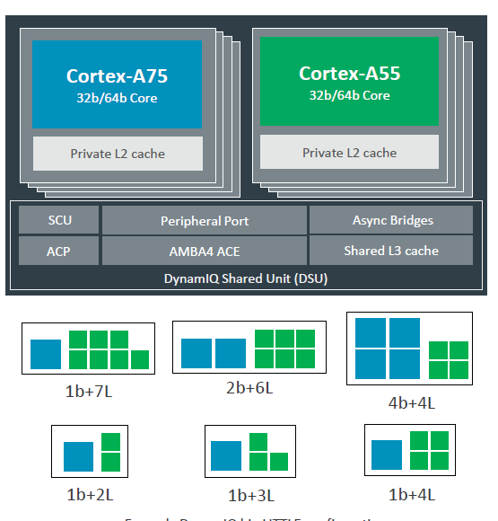
7.1.2 The DynamIQ core cluster (4)
The DynamIQ technology as an evolution of the big.LITTLE technology
big.LITTLE core clusters
A single DynamIQ core cluster [118]
Cluster of
big cores
Cluster of
LITTLE cores
CPU0
CPU1
CPU0
CPU1
CPU2
CPU3
CPU2
CPU3
Cache coherent interconnect
To cache coherent interconnect through the AMBA4 ACE bus
To
Two separate core clusters
with up to 4 cores each (2011)
A single cluster of up to 8 cores of up to two core types
(but up to 4 big cores) (2017)

Slide 153
7.1.2 The DynamIQ core cluster (5)
Main extension of the related microarchitectures: The DynamIQ core cluster -3
Benefits of the DynamIQ cluster technology:
greater flexibility with or without LITTLE cores
redesigned memory subsystem with higher bandwidth and lower access time
improved power efficiency through intelligent power management (EAS)
EAS (Energy Aware Scheduling), not detailed here.

Slide 154
7.1.2 The DynamIQ core cluster (6)
Main extension of the related microarchitectures: The DynamIQ core cluster -4
It assumes Armv8.2-A compatible cores, such as the Cortex-A55 and Cortex-A75
or Cortex-A76.

Slide 155
7.1.2 The DynamIQ core cluster (7)
Main enhancements of DynamIQ core clusters
Up to 8 CPU cores of up to two core types (Armv8.2-A ISA based )
Private (per-core) L2 caches in the CPU cores
c) DynamIQ Shared Unit (DSU) with a shared L3 cache and snoop filter
d) Capability for partitioning the cores, the L3 cache and the ACP ports
e) Finer-grain frequency and voltage control
ACP: Accelerator Coherency Port, port for not cache coherent sensors and accelerators

Slide 156
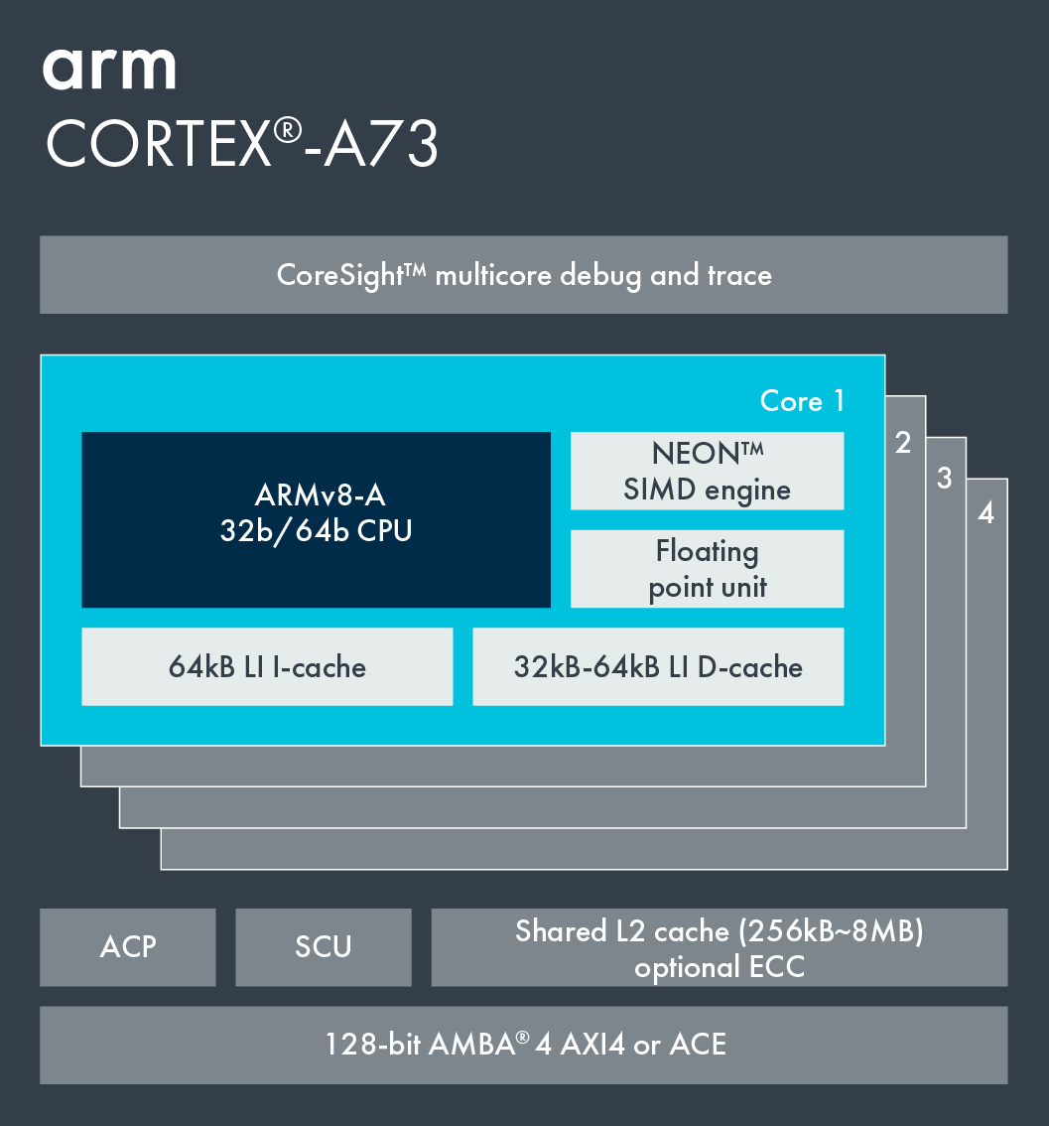
7.1.2 The DynamIQ core cluster (8)
a) Up to 8 CPU cores of up to two core types (Armv8.2-A ISA based)
big.LITTLE core cluster (2015) [102]
DynamIQ core cluster (2017) [118]
Cortex-A73 core
Armv8.0 CPU
Armv8.0-A support,
e.g. Cortex-A53/A57/A72/A73,
single CPU type, up to 4 cores/cluster
Armv8.2-A support,
Cortex-A55/75
2 CPU types, up to 8 cores but only up to 4b/cluster

Slide 157
7.1.2 The DynamIQ core cluster (9)
b) Private (per-core) L2 caches in the CPU cores
big.LITTLE core cluster (2015) [55]
DynamIQ core cluster (2017) [56]
Cortex-A73 core
Armv8.0 CPU
Armv8.0-A support, e.g. Cortex-A53/
A57/A72/A73, up to 4 cores/cluster
Shared L2 cache
Armv8.2-A support, (Cortex-A55/75)
2 CPU types, up to 8 cores but only 4b/cluster
Private L2 caches, shared L3 cache

Slide 158
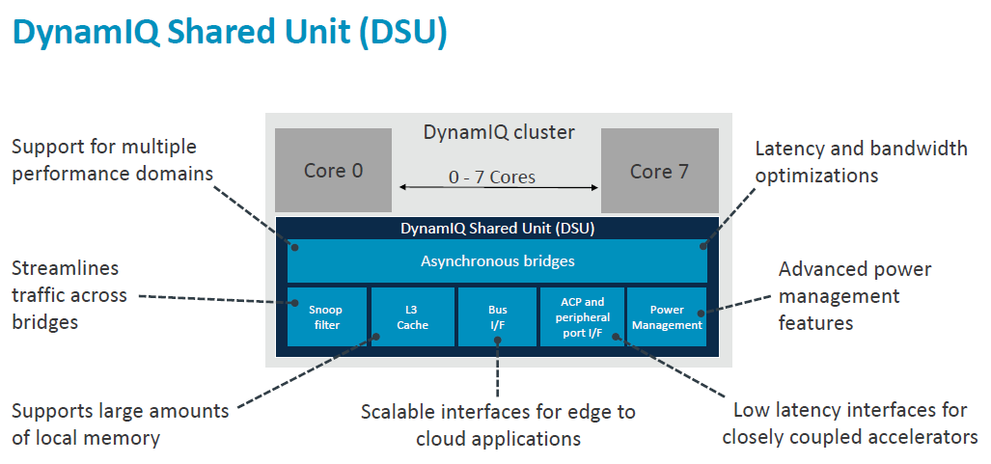
7.1.2 The DynamIQ core cluster (10)
c) DynamIQ Shared Unit (DSU) with a shared L3 cache and snoop filter [106]
(Partitions)
(Per-CPU DVFS control,
Partial L3 power down)
(Up to two 128-bit AMBA 5 ACE,
256-bit AMBA 5 CHI)

Slide 159
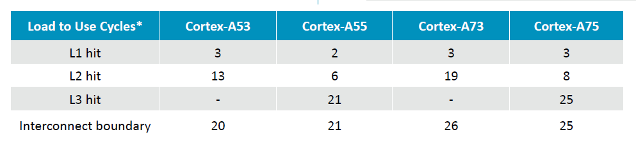
7.1.2 The DynamIQ core cluster (11)
Reduced cache latencies [106]

Slide 160
7.1.2 The DynamIQ core cluster (12)
d) Capability for partitioning the cores, the L3 cache and the ACP ports [98]
It is feasible to set up up to four partitions by assigning
the cores,
sections of the L3 cache and
ACP ports
to maximum of 4 partitions.
Partitioning may be unbalanced, e.g. 1 CPU could be assigned 2 GB whereas
the other CPUs the remaining 2 GB (assuming an 8 GB configuration).
The partitions are dynamic and can be created/adjusted during runtime by
the OS or hypervisor.
Partitioning can be useful for embedded systems that run a fixed workload or
applications that require a more deterministic runtime.
ACP: Accelerator Coherency Port, port for not cache coherent sensors and accelerators

Slide 161
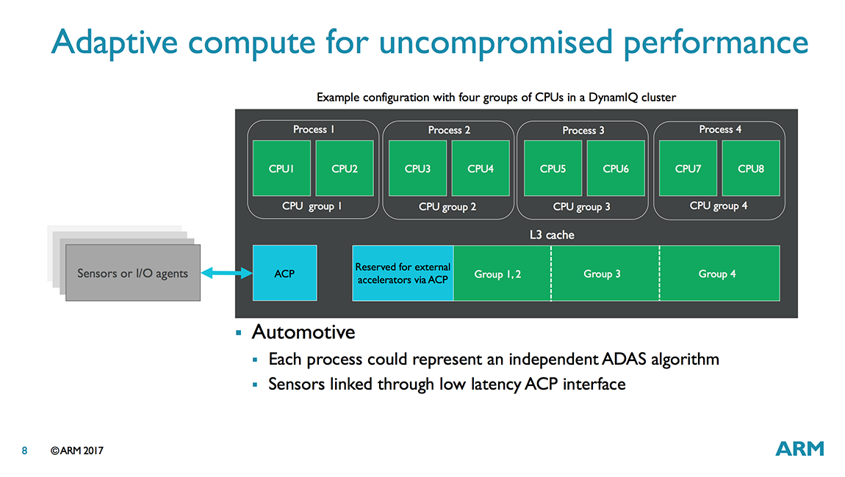
7.1.2 The DynamIQ core cluster (13)
Example for partitioning the cores and the L3 cache [98]
ACP: Accelerator Coherency Port, port for not cache coherent sensors and accelerators

Slide 162
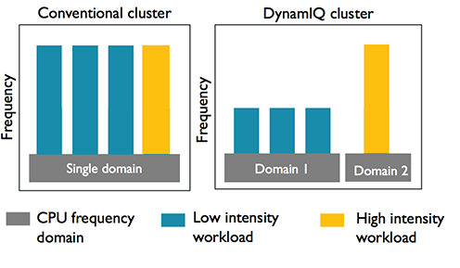
7.1.2 The DynamIQ core cluster (14)
e) Finer-grain frequency and voltage control [98]
In case of DynamIQ core clusters
groups of CPUs (i.e. partitions)
can run at different
frequencies and voltages.

Slide 163
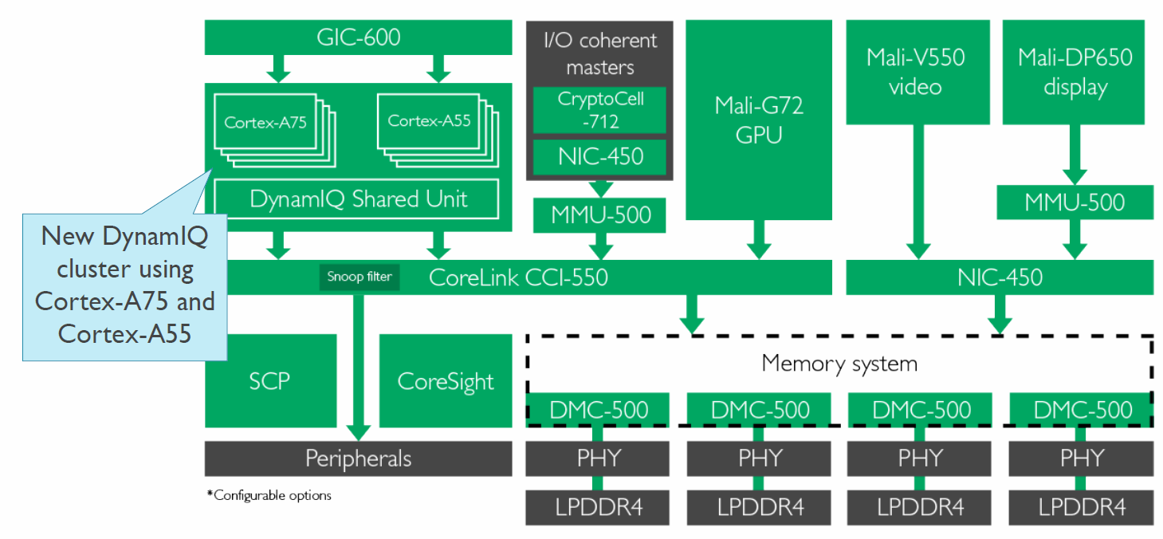
7.1.2 The DynamIQ core cluster (15)
Example of an Armv8.2-A based premium mobile system (2018) [108]
CCI-550: Cache Coherent interconnect
MMU-500: Memory Management Unit (responsible for virtualization and caching)
NIC-450: Network Interconnect (interface converter)
GIC-600: General Interrupt Controller
SCP: System Control Processor

Slide 164
7.2 Overview of Cortex-A CPUs implementing the Armv8.2-A ISA

Slide 165
7.2 Overview of Cortex-A CPUs implementing the Armv8.2-A ISA (1)
7.2 Overview of Cortex-A CPUs implementing the Armv8.2-A ISA
Key features of Arm v8.0-A ISA based Cortex-A CPUs
Word length
of the CPUs
Inclusion of
L2 cache
Multicore
design
Support for big.LITTLE
configurations
Word length: 64 bit
Inclusion of a per cluster L2 cache
Multicore design
Support of big.LITTLE configurations
*

Slide 166
7.2 Overview of Cortex-A CPUs implementing the Armv8.2-A ISA (2)
Key enhancements of Arm v8.2-A ISA based Cortex-A CPUs
a) Up to 8 CPU cores of up to two core types (Armv8.2-A ISA based)
big.LITTLE core cluster (2015) [102]
DynamIQ core cluster (2017) [118]
Cortex-A73 core
Armv8.0 CPU
Armv8.0-A support,
e.g. Cortex-A53/A57/A72/A73,
single CPU type, up to 4 cores/cluster
Armv8.2-A support,
Cortex-A55/75
2 CPU types, up to 8 cores but only up to 4b/cluster

Slide 167
7.2 Overview of Cortex-A CPUs implementing the Armv8.2-A ISA (3)
b) Private (per-core) L2 caches in the CPU cores
big.LITTLE core cluster (2015) [55]
DynamIQ core cluster (2017) [56]
Cortex-A73 core
Armv8.0 CPU
Armv8.0-A support, e.g. Cortex-A53/
A57/A72/A73, up to 4 cores/cluster
Shared L2 cache
Armv8.2-A support, (Cortex-A55/75)
2 CPU types, up to 8 cores but only 4b/cluster
Private L2 caches, shared L3 cache

Slide 168
7.2 Overview of Cortex-A CPUs implementing the Armv8.2-A ISA (4)
c) DynamIQ Shared Unit (DSU) with a shared L3 cache and snoop filter [106]
(Partitions)
(Per-CPU DVFS control,
Partial L3 power down)
(Up to two 128-bit AMBA 5 ACE,
256-bit AMBA 5 CHI)

Slide 169
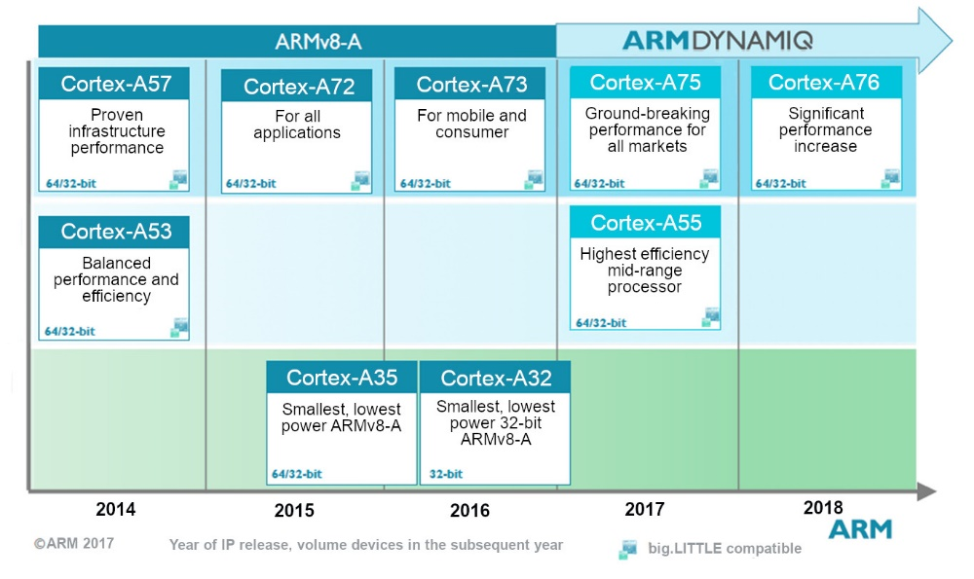
7.2 Overview of Cortex-A CPUs implementing the Armv8.2-A ISA (5)
Overview of Cortex-A CPUs implementing the Armv8.2-A ISA [153]
A75+
Series
A55+
Series
Source: ARM

Slide 170
7.2 Overview of Cortex-A CPUs implementing the Armv8.2-A ISA (6)
Cortex-A CPUs implementing the Armv8.2-A ISA and their key features
CPU Core | Announced | Available in devices | Big.LITTLE support | Target category | Efficiency
Cortex-A55 | 2017 | 2018 | Yes (with A75 or higher) | Low-end | ~3 DMIPS/MHz
Cortex-A75 | 2017 | 2018 | Yes (with A55) | High-end | ~8.2-9.5 DMIPS/MHz
Cortex-A76 | 2018 | 2018 | Yes (with A55) | High-end | ~10.7-12.4 DMIPS/MHz
Cortex-A78 | 2020 | 2021? | Yes (with A55) | High-end | n.a.
Cortex-X1 | 2020 | 2021? | Yes (with A55) | Extra high-end | n.a.

Slide 171
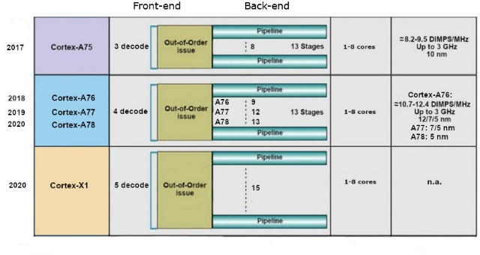
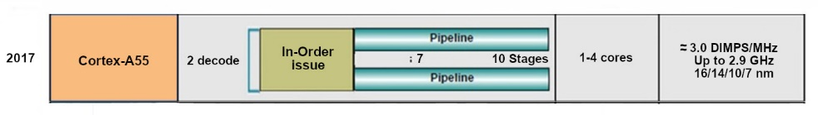
7.2 Overview of Cortex-A CPUs implementing the Armv8.2-A ISA (7)
Widening the front-end and back-end width of Armv8.2-A ISA based cores
High performance
64-bit
Low power

Slide 172
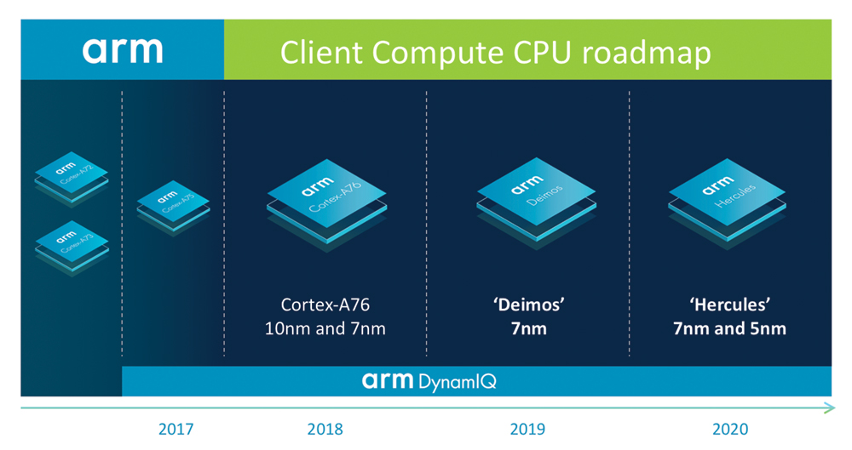
7.2 Overview of Cortex-A CPUs implementing the Armv8.2-A ISA (8)
ARM’s Client Compute CPU roadmap 2019-2020 from 2018 [133]
(A-77)
(A-78)
*

Slide 173
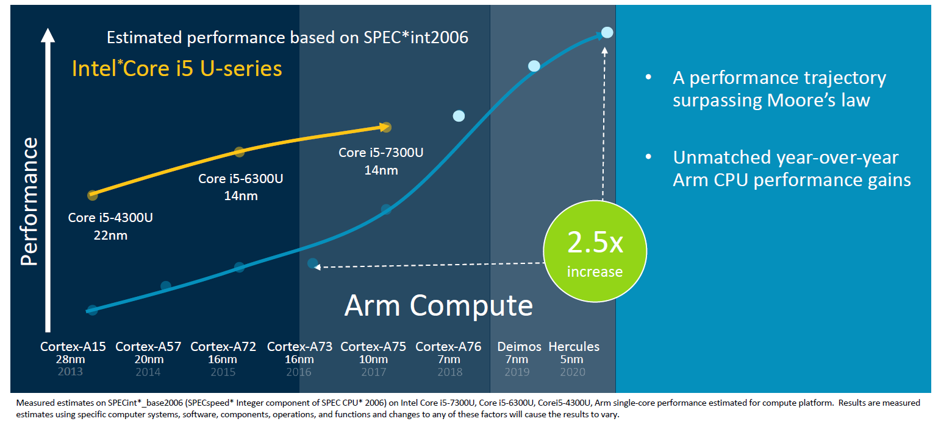
7.2 Overview of Cortex-A CPUs implementing the Armv8.2-A ISA (9)
ARM’s projected performance gain for their planned CPUs
ARM expects faster performance gains for their planned models than awaited
for Intel’s comparable processors, as seen in the Figure below.
A-78
A-77
A-76
Figure: ARM’s projected year-over-year performance gain over Intel’s processors [125]
*

Slide 174
7.2 Overview of Cortex-A CPUs implementing the Armv8.2-A ISA (10)
Evolution of the width of mobile CPU cores -1
Width of mobile cores
(or of big cores of big.LITTLE or dynamIQ core clusters)
2-wide
3-wide
4-wide
5-wide
ARM
v7 HP Cortex-A15
(2010)
v7 Cortex-A (2005-09)
(except 1-wide LP A5 (2009)
and 3-wide HP A15))
v8.0 HP Cortex-A73
(2016)
v8.0 HP Cortex-A (2013-15) (except 2-wide HP Cortex-A73)
v8.0/8.2 LP Cortex-A
(2013/2017)
v8.2 HP Cortex-A75
(2017)
v8.2 HP Cortex-A76
(2018) to
HP Cortex-A78
(2020)
v8.2 HP Cortex-X1
(2020))
Intel
Atom family (2008-15)
Airmont-based Atom core (2016)
AMD
Cat family (2011-2015)
Apple
v7 Cortex-A8 (2009)
v7 Swift (A6) (2012)
Qualcomm
v7 Scorpion
(Snapdragon (S)
S 1-S 3) (2007-10)
v7 Krait
(S 4/S400/S60x/S80x)
(2012-14)
v8 Kryo/Kryo 280
(S 820/821/835) (2015/2016/2017)
v8.2 Kryo 385
(S 845) (2018)
Samsung
v7 Exynos 5
(2013-14)
v8 Exynos 7
(2016)
v8.0 M1 (2016)
(Exynos 8 Octa)
v8 M2 (2017)
(Exynos 9 Octa)
HP: High-Performance/big core
LP: Low-Power
*

Slide 175
7.2 Overview of Cortex-A CPUs implementing the Armv8.2-A ISA (11)
Evolution of the width of mobile CPU cores -2
Width of mobile cores
(or of big cores of big.LITTLE or dynamIQ core clusters)
6-wide
7-wide
8-wide
ARM
Intel
AMD
Apple
v8.0 HP A7-A10X
(2013-2017)
v8.2 HP A11 (2017)
v8.3 HP A12/A12X
(2018)
v8.4 HP A13 (2019)
v8.6 HP A14/M1
(2020)
Qualcomm
Samsung
v8.2 M3 (2018) Exynos 9810)
v8.2 M4 (2019) Exynos 9820)
v8.2 M5 (2019) Exynos 990)
v8.2 M6
(2020)/cancelled
HP: High-Performance/big core
LP: Low-Power
*

Slide 176
7.3 Case example: The extra high performance Cortex-X1

Slide 177
7.3 The extra high performance Cortex-X1 (1)
7.3 The extra high performance Cortex-X1
Announced along with the Cortex-A78 in 05/2020.
Both the Cortex-A78 and the Cortex-X1 were designed in the Austin Center and
both are sharing the same basic design blocks, but whereas the A78 is focused
on efficiency the X1 aims at maximizing performance.
The Cortex-X1 has been introduced within the framework of the Cortex-X Custom
Program (to be discussed subsequently).
The Cortex-X1 is the first member of a new, performance oriented line, called
the Cortex-X line.
*

Slide 178
7.3 The extra high performance Cortex-X1 (2)
ARM’s Cortex-X Custom Program [127]
It is an evolution of the former “Built on ARM Cortex Technology” licensing model.
It allows the licensee to customize standard ARM Cortex products for performance
first designs.
A possible customization is e.g. increasing the ROB (ReOrder Buffer) size.
Larger ROBs result in higher performance but need more power and larger
Si-area.
The customization requires early engineering collaboration between ARM and the
licensee and is done by ARM.
Under the new scheme ARM maintains the ARM Cortex branding of the cores,
no licensee specific core names are allowed.
The new, extra high-performance Cortex-X series CPUs are available only
to Cortex-X Custom Program licensees.
*

Slide 179
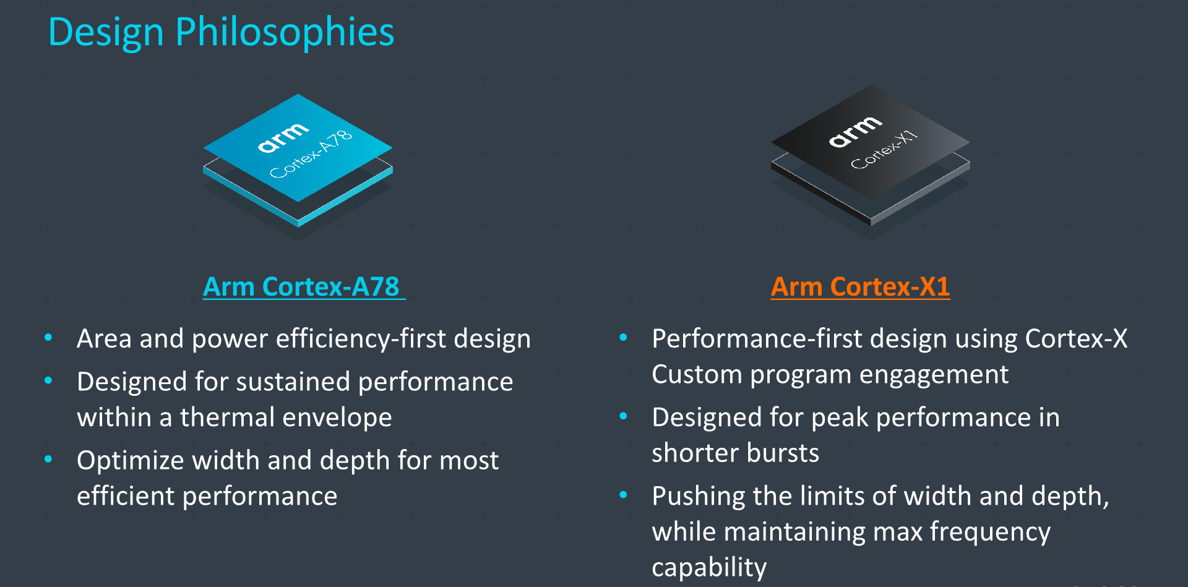
7.3 The extra high performance Cortex-X1 (3)
Contrasting the design philosophies of the ARM Cortex-A and Cortex-X series
CPUs [127]

Slide 180
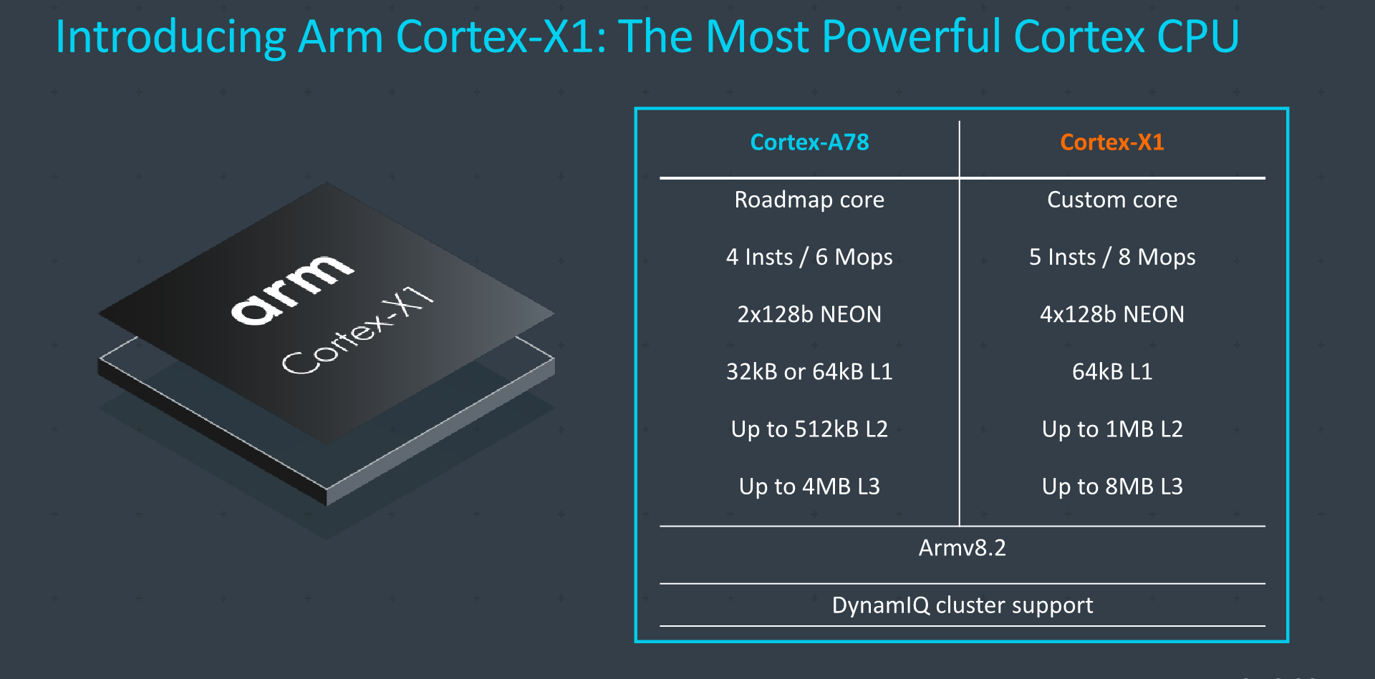
7.3 The extra high performance Cortex-X1 (4)
Contrasting main features of the Cortex-A78 and Cortex-X1 CPUs [127]
D/I¹
D/I¹ D: Decode rate (instr./cycle)
I: Issue rate (Mops/cycle)
Note that X1 CPUs are 5-wide with an issue rate of 8 Mops (Macro-operations
per cycle) whereas A78 CPUs are only 4 wide and issue 6 Mops.
*

Slide 181

7.3 The extra high performance Cortex-X1 (5)
Front-end enhancements Cortex-X1 vs. A77 [130]

Slide 182
7.3 The extra high performance Cortex-X1 (6)
Remark
In contrast: Intel increased the front-end width of their processors to 5, along
with their Skylake-processor (in 2015).

Slide 183

7.3 The extra high performance Cortex-X1 (7)
Cortex-X1 back-end enhancements vs. A78 [130]
The Dispatch stage forwards up to 8 MOPs (MacroOPs) per cycle to the Issue stage
rather than 6.
The Issue stage forwards up to 15 μOps to the Execution units rather than 13.
The Issue stage includes MOPs (MacroOPs) fusion
(fusing two or more MOPs into a single µOP to reduce the execution time).

Slide 184
7.3 The extra high performance Cortex-X1 (8)
Widening the CPU core in Cortex-A7x CPUs
Cortex model | ISA | Launched in | Target IC techn. | Decode rate | Dispatch rate | Issue rate | ROB size
A72 | ARM 8.0 | 02/2015 | 16 nm | 3 | 5 | 8 | n.a.
A73 | ARM 8.0 | 05/2016 | 10 nm | 2 | 4 | 7 | n.a.
A75 | ARM 8.2 | 05/2017 | 10 nm | 3 | 6 | 8 | 128
A76 | ARM 8.2 | 05/2018 | 12, 7, 5 nm | 4 | 8 | 9 | 128
A77 | ARM 8.2 | 05/2019 | 7, 5 nm | 4 | 6 | 12 | 160
A78 | ARM 8.2 | 05/2020 | 5 nm | 4 | 6 | 13 | n.a.
X1 | ARM 8.2 | 05/2020 | 5 nm | 5 | 8 | 15 | 224
Remarks
The A73 and A75 were designed in the Sophia Design Center all others in Austin.
The A72 and a73 support big.LITTLE core clusters the others DynamIQ core clusters.
The A72 introduced instruction fusion.
The A75 introduced FP16 and int8 datatypes to support AI
The A77 introduced a Macro-Op (MOP) cache
ROB: ReOrder Buffer (Out-of-order window) determines the max. number of in-flight
instructions
*

Slide 185
7.3 The extra high performance Cortex-X1 (9)
Comparing ROB sizes of select CPUs [130]
REORDER BUFFER
Company | Arm | AMD |  | Intel
µarch | Cortex-X1 | Zen | Zen 2 | Coffee Lake | Sunny Cove
Renaming | 8/cycle | 6/cycle | 6/cycle | 4/cycle | 5/cycle
Max In-flight | 224 | 192 | 224 | 224 | 352
Remark
Rob sizes limit the max. number of in-flight instructions.

Slide 186

7.3 The extra high performance Cortex-X1 (10)
Integer and ML (Machine learning) performance gain of the X1 over the A77
and A78 [127]

Slide 187

7.3 The extra high performance Cortex-X1 (11)
Single Thread performance gain of the X1 over the A77 and A78 [127]
(Rendering app)

Slide 188

7.3 The extra high performance Cortex-X1 (12)
SPECint2006 scores and related power/energy consumption [127]
(Qualcomm)
(Samsung)
(Huawei)

Slide 189
7.3 The extra high performance Cortex-X1 (13)
Note
The Figure shows that the projected SPECInt2006 performance of ARM’s Cortex-X1
approaches already the scores of Apple’s A13 or Intel’s and AMD’s client processors
(Core-based 10900K Skylake/Zen2-based Ryzen 3950X).
*

Slide 190
7.3 The extra high performance Cortex-X1 (14)
SPECfp2006_C/C++ scores and related power/energy consumption [127]
(Qualcomm)
(Huawei)

Slide 191
7.3 The extra high performance Cortex-X1 (15)
Note
The Figure shows that the projected SPECInt2006 performance of ARM’s Cortex-X1
exceeds already Apple’s A13’s score and approaches the performance data of
Intel’s and AMD’s client processors (Core-based 10900K Skylake/Zen2-based Ryzen
3950X).
*

Slide 192
8. Cortex-A CPUs implementing the Armv9-A ISA
8.1 Main extensions of the Armv9-A ISA and
the related microarchitecture of the cores
8.2 Overview of Cortex-A CPUs implementing
the Armv9-A ISA

Slide 193
8. Cortex-A CPUs implementing the Armv9-A ISA (1)
8. Cortex-A CPUs implementing the Armv9-A ISA
ARM announced the Armv9 ISA in 03/2021.
The first CPU which implemented the Armv9 ISA is the server oriented
Neoverse N2 CPU, introduced in 04/2021 followed by the mobile oriented
Cortex-X2,-A710 and –A510 CPUs, announced in 05/2021.
*

Slide 194

8. Cortex-A CPUs implementing the Armv9-A ISA (2)
Scope of the Armv9 ISA and related application domains, technologies [144]
Arm’s Helium technology is the Vector Extension (MVE) of Arm Cortex-M processor series.

Slide 195
8.1 Main extensions of the Armv9-A ISA and
the related microarchitectures of the cores
8.1.1 Main extensions of the Armv9-A ISA
8.1.2 Main extension of the related microarchitectures:
The Armv9-A based DynamIQ core cluster

Slide 196
8.1.1 Main extensions of the Armv9-A ISA

Slide 197


8.1.1 Main extensions of the Armv9-A ISA (1)
8.1.1 Main extensions of the Armv9 ISA [154], [144] -1
Adv. SIMD (NEON)

Slide 198

8.1.1 Main extensions of the Armv9-A ISA (2)
Main extensions of the Armv9A ISA -2
The Armv9 ISA includes all enhancements introduced in the new releases of the
Armv8 ISA (for compatibility), and introduces a number of few further extensions
as well, as the Figure below indicates on the example of the ARM Neoverse N2 CPU.
Figure: Architectural features supported by the Neoverse N2 CPU [158]

Slide 199
8.1.1 Main extensions of the Armv9-A ISA (3)
Main extensions of the Armv9 ISA [144] -2
The Armv9 ISA is based on the A64 instruction set, but enhances it by important
additions to improve
a) vector and DSP capabilities by introducing SVE2
b) ML (Machine Learning) and
c) the efficiency of multithreaded programming
d) security
as partly indicated in the previous Figures.
DSP: Digital Signal Processing
*

Slide 200
8.1.1 Main extensions of the Armv9-A ISA (4)
Improving vector and DSP capabilities by introducing the SVE2 extension
Previously, ARM introduced the SVE (Scalable Vector Extension) as an optional
feature of the Armv8.2-A ISA in 2016.
It aimed primarily at HPC workloads and did not cover the wide spectrum of
instructions that were provided by the Neon extension.
SVE2, announced in 04/2019, as part of the Armv9 ISA and it mends the
above mentioned deficiency of SVE.
This qualifies SVE2 to become a replacement of the Neon extension.
HPC: High Performance Computing
*

Slide 201
8.1.1 Main extensions of the Armv9-A ISA (5)
Benefits of using the SVE and SVE2 extensions vs. Neon [144]
SVE and SVE2 have two major benefits:
a) They provide variable, quantized vector size from 1x128-bit to 16x128-bit,
and
b) allow word length agnostic programming.
With word length agnostic programming software developers do not need
to use different ISA extensions for different vector lengths (e.g. 128-bit,
256-bit) but may develop basically the same code independently of the
vector length used.
Word length agnostic programming is achieved by using predicate registers
to indicate which active fields of a data word are involved in the operation.
The resulting code can utilize the full width of recent and future execution units
without the need to rewrite or recompile the code.
For more details see Section 2.2.4.
*

Slide 202
8.1.1 Main extensions of the Armv9-A ISA (6)
b) Extensions of the Armv9-A addressing ML (Machine Learning)
ML became widely used in the past few years and its occurrence in workloads is
expected to grow further on in the future.
Thus, it is not surprising that the Armv9-A compulsorily supports
the half-precision FP (FP16) and Google’s BFfloat16 data formats as well as
dot product calculations of two 32-bit vectors each including 4x FX8 data.
These features were introduced as optional enhancements of the Armv8.2-A
release and later on became mandatory in the Armv8.6-A, consequently their
continuous support in the Armv9 ISA was obligatory anyway for providing
upward compatibility.
See Section 7.1.1 for details (but not discussed in the Lecture).
Dot product: Skalár szorzat
*

Slide 203
8.1.1 Main extensions of the Armv9-A ISA (7)
c) Improving the efficiency of multithreaded programming by introducing
the Transactional Memory Extension
In multithreaded programming race conditions occur if two or more threads
may modify shared data in a not controlled way.
If in such cases cores access shared data in the order that is determined by the
thread scheduling algorithm and this may differ from the sequence of
program logic program errors may occur.
Basically, there are two mechanisms to address race conditions in
multithreaded programming, as discussed subsequently:
Race condition: versenyhelyzet
*

Slide 204
8.1.1 Main extensions of the Armv9-A ISA (8)
Basic mechanisms to address race conditions in multithreaded programs
Basic mechanisms to address race conditions in multithreaded programs
Locks
Transactional memory (TM)
Pessimistic approach,
it intends to prevent possible conflicts
by enforcing serialization of transactions
through locks.
Optimistic approach,
it allows access conflicts to occur
but provides a checking and repair mechanism
for managing these conflicts, i.e.
it allows all threads to access shared data simultaneously.
After completing a transaction however,
it will be checked whether a conflict arose,
if yes, the transaction will be rolled back and
replayed in the right order
else the execution continues.
The next Figure contrasts these thread synchronization mechanisms.
*

Slide 205

8.1.1 Main extensions of the Armv9-A ISA (9)
Contrasting lock based and transaction memory (TM) based thread
synchronization [155]
Conflict, to be
repaired
*

Slide 206
8.1.1 Main extensions of the Armv9-A ISA (10)
c1) Locks [156]
The most common way of addressing race conditions is to use locks, called also
monitors, critical sections, mutexes or binary semaphores.
Locks provide a mechanism for ensuring that at any time only one thread can
execute a particular section of code (called critical section) that includes shared
data.
*

Slide 207
8.1.1 Main extensions of the Armv9-A ISA (11)
c2) Transactional memory (TM)
The concept of the transactional memory (TM)
Note that the concept of transactional memory is a kind of speculative execution
of accessing shared data while providing a repair mechanism for occurring
conflicts.
The repair mechanism saves the execution state before the conditional execution
is performed and in case when a conflict occurs restores it and lets continue
execution.
This is basically the same mechanism as the speculative execution of predicted
branches or the speculative execution of loads, i.e. execution of loads before
checking for possible load-store conflicts (loading memory data from a given
address before storing to this address has been completed).
*

Slide 208
8.1.1 Main extensions of the Armv9-A ISA (12)
Implementation of Transactional Memory (TM) in commercial CPUs
From 2009 on a number of commercial CPUs introduced TM, as enlisted below.
Sun’s Rock (2009)
IBM Blue Gene/Q (2011)
IBM’s System/z EC12 (2012)
Intel’s Haswell (2013)
IBM’s POWER8 (2014)
ARM’s Armv9-A based Cortex-A and Neoverse models, such as the Cortex-X2
and Neoverse N2 (2021)

Slide 209
8.1.1 Main extensions of the Armv9-A ISA (13)
d) Extensions of the Armv9-A addressing security (not diacussed)
The Armv9-A ISA release introduces two enhancements in order to improve
security, as follows:
the Confidential Compute Architecture and
the Memory tagging extension.
These extensions are part of ARM’s effort to enhance security of their CPU
designs, as shown below.
ISA extensios introduced to enhance security
The TrustZone extension
The Cryptography extension
The Confidential
Compute Architecture
Memory Tagging
Extension (MTE)
Armv6 (2001)
Armv8.0-A (2012)
Armv9-A (2021)
Armv9-A (2021)
Figure: ARM’s ISA extensions intended to increase security of their CPU designs
We do not discuss the Confidential Compute Memory, whereas the Memory
Tagging Extension will be discussed in the next Section [162].
Tag: Jelzőbitek

Slide 210
8.1.2 Main extension of the related microarchitectures:
the Armv9-A based DynamIQ core cluster

Slide 211
8.1.2 The Armv9-A based DynamIQ core cluster (1)
8.1.2 Main extension of the related microarchitectures: The Armv9-A based
DynamIQ core cluster
Predecessors: big.LITTLE and Armv8.2-A ISA-based DynamIQ core clusters
Armv7-A big.LITTLE core clusters
Armv8.2-A ISA-based DynamIQ core cluster [118]
Cluster of
big cores
Cluster of
LITTLE cores
CPU0
CPU1
CPU0
CPU1
CPU2
CPU3
CPU2
CPU3
Shared L2
Shared L2
To the cache coherent interconnect through the AMBA4 ACE bus
To
Cache coherent interconnect
Two stand alone core clusters
with up to 4 cores (2011)
*

Slide 212
8.1.2 The Armv9-A based DynamIQ core cluster (2)
Enhancements of the Dynamic core cluster vs the foregoing big.LITTLE
core cluster
 | big.LITTLE core clusters | DynamIQ core clusters
Cluster topology | Two stand alone core clusters; the big and the LITTLE core clusters, with up to 4 homogeneous cores each | In a single core cluster up to 8 cores out of two types, big cores and LITTLE cores. 1 to 4 big cores.
Cache architecture | Per cluster shared L2 cache No L3 cache | Per core L2 caches Shared L3 cache
Additional features | -- | Dynamic Shared Unit with major enhancements. See subsequent Figure.
ACP: Accelerator Coherency Port, port for not cache coherent sensors and accelerators
*

Slide 213
8.1.2 The Armv9-A based DynamIQ core cluster (3)
Block diagram of the Armv8.2-A based DynamIQ core cluster [106]
(Partitions)
(Per-CPU DVFS control,
Partial L3 power down)
(up to 4 MB)
(Up to two 128-bit AMBA 5 ACE,
or a single 256-bit AMBA 5 CHI bus)
ACP: Accelerator Coherency Port, port for not cache coherent sensors and accelerators
Snoop filter: Used to speed up cache coherent memory accesses

Slide 214

8.1.2 The Armv9-A based DynamIQ core cluster (4)
Block diagram of the Armv9-A-based DynamIQ core cluster
It is built up up of up to 8 CPUs and the Armv9-A-based DSU.
DynamIQ
core cluster
*

Slide 215
8.1.2 The Armv9-A based DynamIQ core cluster (5)
Overview of the main enhancements of the Armv9-A based DynamIQ
core cluster
it allows to use three core types rather than only two, as before.
Sliced L3 cache, snoop filter and the control logic
Memory Tagging Extension (MTE)
Wider (scalable) bus interface
Subsequently, we discuss the above mentioned enhancements.

Slide 216

8.1.2 The Armv9-A based DynamIQ core cluster (6)
a) Possibility of using three core types rather than only two, as before.
As seen, the new Dynamic core cluster may have up to 8 cores out of 3 core types:
high-performance Cortex-X2 cores (even 8 Cortex-X cores),
the high-efficiency Cortex-A710 big and
the high-efficiency Cortex-A510 LITTLE cores
while the chosen mix of the cores depends on the target device type.
*

Slide 217
8.1.2 The Armv9-A based DynamIQ core cluster (7)
b) Sliced implementation of the L3 cache, snoop filter and the control logic [157]
L3 cache, snoop filter
and control logic is
implemented in slices.
Slices are interconnected
by dual bi-directional
ring buses
(see next slide)
*

Slide 218

8.1.2 The Armv9-A based DynamIQ core cluster (8)
Interconnection of the slices [157]
Ring-based transport network
connects the cores to the
slices and the bus interfaces.
There are dual bi-directional
rings.
Traffic can take either
direction to shorten delay.
*

Slide 219
8.1.2 The Armv9-A based DynamIQ core cluster (9)
Principle of slicing L3 caches
L3 caches
(They are mostly unified and shared)
Not sliced
Sliced
Uniform
cache architecture
Non-uniform
cache architecture
The cache is made up as a single entity, accessible at a single point.
All accesses are equal long (uniform).
The cache is built up of multiple small slices,
properly interconnected, operating independently and in parallel.
In this way, the cache becomes physically distributed, but logically all slices are shared.
Cache accesses may be different long (non-uniform).
C
C
C
C
C
C
L3 slice 0
L3 slice 1
L3 $
L3 slice 2
L3 slice 0
C
C
*

Slide 220

8.1.2 The Armv9-A based DynamIQ core cluster (10)
Major benefits of the sliced L3 caches -1
a) As slices of L3 caches can operate in parallel, sliced caches with n slices,
have in principle an n-times higher memory bandwidth than unsliced caches.
Figure: Raising the L3 cache bandwidth due to parallel operation of DSU slices [157]
*

Slide 221
8.1.2 The Armv9-A based DynamIQ core cluster (11)
Major benefits of the sliced L3 caches -2
b) Smaller cache slices have a lower access time than a large cache.
*

Slide 222
8.1.2 The Armv9-A based DynamIQ core cluster (12)
Consequence of slicing the L3 cache
While accessing sliced caches there are two access patterns:
the requested data is held in the accessed slice, i.e. it can be accessed
with a lower access time, and
b) the requested data is kept in a remote slice, than the access needs a
longer time.
In other words, cache access times are now non uniform, a sliced cache behaves
as a NUCA (Non-Uniform Cache Architecture).

Slide 223
8.1.2 The Armv9-A based DynamIQ core cluster (13)
Increasing the L3 cache size
In addition, the L3 cache size is increased from up to 4 MBs (in the previous
generation) to up to 16 MB for higher performance and lower power consumption.
Also the operation frequency has been raised to achieve higher bandwidth and
lower latencies.

Slide 224
8.1.2 The Armv9-A based DynamIQ core cluster (14)
Remarks to the emergence of sliced L3 caches
Concerning cache slicing client CPUs and ARM’s CPU designs made the same
evolution, namely first homogeneous (not sliced) L3 caches were introduced
and subsequently replaced by sliced designs (as indicated below), primarily
to achieve higher performance (cache bandwidth) due to parallel operation of
the slices.
3-level cache architectures
Per-core, unified
L2 cache
Shared, unified
L3 cache
Not sliced
Sliced
Intel
Core 2 based
Nehalem 4C
(2008)
Core 2 based
Sandy Bridge 4C
(2011),
and subsequent proc.
AMD
K10 Barcelona
(2007)
K17 Zen core-based lines
(2017)
ARM
v8.2-A based CPUs
(2016)
v9-A based CPUs
(2021)
*

Slide 225
8.1.2 The Armv9-A based DynamIQ core cluster (15)
2.5.5 The Memory Tagging Extension (MTE)
Security issues concerning memory accesses
Vulnerability reports state that violations of memory safety (like buffer overflow-based threats) account for the majority of security issues.
According to published figures of Microsoft and Google over 70-75 % of
vulnerabilities are violations of memory safety (see the next Figure) [146]
Memory Tagging Extension aims at amending the vulnerability issue.
Vulnarability: sérülékenység
*

Slide 226

8.1.2 The Armv9-A based DynamIQ core cluster (16)
Principle of memory tagging [144]
Memory tagging is implemented by locks and keys.
Locks are set in the memory and keys are attached to virtual memory addresses.
If the key matches the lock, the access is permitted, if not, an error occurs and
an exception may be generated.
Figure: Using memory locks and
access keys to protect memory
against safety violations.
*

Slide 227
8.1.2 The Armv9-A based DynamIQ core cluster (17)
Principle of the implementation of memory tagging in ARM’s MTE [147]
MTE provides locks to memory locations by adding a four bit tag to each 16 bytes
of the physical memory.
Keys, on the other hand are attached to pointers and thus virtual addresses,
as follows.
Concerning this point, MTE utilizes the fact that Armv8-A architectures do not
make use of the top byte of pointers (virtual addresses).
To implement keys MTE uses the Top Byte Ignore (TBI) feature of Armv8-A
architectures.
When TBI is enabled, the top byte of virtual addresses is ignored for address
translations, instead, four bits of the top bytes are used to store tags as keys.
*

Slide 228

8.1.2 The Armv9-A based DynamIQ core cluster (18)
d) Wider (scalable) bus interface [157]
The Scalable bus interface is vastly enhanced by providing now 1, 2, or 4 256-bit wide
bus interfaces while an updated AMBA CHI bus protocol is used for more bandwidth
and MTE support.
By comparison, the previous
Armv8.2-A based DynamIQ core
cluster provided a 1x256-bit or
2x128-bit wide bus interface.
*

Slide 229
8.1.2 The Armv9-A based DynamIQ core cluster (19)
Scalability of the Armv9-A based DynamIQ core cluster [157]
As the above Figure indicates, the mix of the chosen core types will depend on the
target device type.
*

Slide 230
8.2 Introduced Cortex-A CPUs implementing the Armv9-A ISA

Slide 231
8.2.1 Overview of Armv9-A ISA-based Cortex-A CPUs

Slide 232
8.2.1 Overview of Armv9-A ISA-based Cortex-A CPUs (1)
8.2.1 Overview of Armv9-A ISA-based Cortex-A CPUs -1
ARM provides three types of CPU designs (Cortex-X2/A710/A510) that can be used
to design Armv9-a-based DynamIQ core clusters, to be introduced next.
*

Slide 233

8.2.1 Overview of Armv9-A ISA-based Cortex-A CPUs (2)
Overview of Armv9-A ISA-based Cortex-A CPUs -2 [165]
3.4.1 Main extensions of the Armv9.0 ISA
*

Slide 234

8.2.1 Overview of Armv9-A ISA-based Cortex-A CPUs (3)
Overview of Armv9-A ISA-based Cortex-A CPUs -3 [157]
The Cortex-X2 is the ultimate performance “flagship CPU”.
It has a single CPU core.
Its core has large L1, L2 caches.
Cortex-X2
512 KB/1 MB
*

Slide 235

8.2.1 Overview of Armv9-A ISA-based Cortex-A CPUs (4)
Overview of Armv9-A ISA-based Cortex-A CPUs -4 [157]
Note that both the Cortex-X2 and Cortex-A710 CPUs are single cores rather than core
complexes, whereas the Cortex-A510 has a dual core core module, as seen below.
Cortex-A710
ARM’s merged 510 core complex
consists of two 3-wide Cortex-510 cores with separate front-ends and FX execution units, but with shared vector pipeline, L2 cache and
L2 TLB (Translation Lookaside Buffer).
*

Slide 236

8.2.1 Overview of Armv9-A ISA-based Cortex-A CPUs (5)
Overview of Armv9-A ISA-based Cortex-A CPUs -5 [159]
Armv9-A based DynamIQ core clusters are built up of Cortex-X2/A710/A510 CPUs and a unit that is shared by all CPUs connected to it (called the DSU-110 (DynamIQ Shared Unit-110), as indicated in the next Figure.
Figure: Armv9-A based DynamIQ core cluster with a chosen number of
Cortex-X2/A710/A510 CPUs
Up to 8 CPUs can be connected to the DSU-110, while each Cortex-A510 counts 2.
*

Slide 237
9. References

Slide 238
9. References (1)
[1]: Architecture and Implementation of the ARM Cortex-A8 Microprocessor, Design & Reuse,
http://www.design-reuse.com/articles/11580/architecture-and-implementation-of-the-
arm-cortex-a8-microprocessor.html
[2]: Shimpi A.L., Answered by the Experts: ARM's Cortex A53 Lead Architect, Peter Greenhalgh,
AnandTech, Dec. 17 2013, http://www.anandtech.com/show/7591/answered-by-the-
experts-arms-cortex-a53-lead-architect-peter-greenhalgh
[3]: Hill S., Design of a Reusable 1GHz, Superscalar ARM Processor, Hot Chips-18, Aug. 22 2006,
http://www.hotchips.org/wp-content/uploads/hc_archives/hc18/3_Tues/HC18.S6/HC18.S6T3.
pdf
[4]: Details of a New Cortex Processor Revealed, Cortex-A9, ARM Developers’ Conference,
Oct. 2007, http://rtcgroup.com/arm/2007/presentations/174%20-%20Details%20of%
20a%20New%20Cortex%20Processor%20Revealed%20Cortex-A9.pdf
[5]: ARM Teaching Material, http://www.arm.com/files/ppt/ARM_Teaching_Material.ppt
[6]: ARM Cortex Application Processors, http://www.arm.com/products/processors/index.php
[7]: ARM SecurCore Processors, http://www.arm.com/products/processors/securcore/index.php
[8]: Snyder C.D., ARM Family Expands at EPF, ARM11 Microarchitecture Stretches Pipe to Boost
Frequency, Microprocessor, June 3 2002
[9]: Hirata K., ARM11 MPCore, The streamlined and scalable ARM11 processor core, Jan. 2007,
http://www.aspdac.com/aspdac2007/pdf/archive/7D-2.pdf

Slide 239
9. References (2)
[10]: ARM Introduces The Cortex-M3 Processor To Deliver High Performance In Low-Cost
Applications, Oct. 19 2004, http://www.arm.com/about/newsroom/6750.php
[11]: NEON, ARM Technologies,
http://www.arm.com/products/processors/technologies/neon.php
[12]: Goodacre J., The Evolution of the ARM Architecture Towards Big Data and the Data-Centre,
8th Workshop on Virtualization in High-Performance Cloud Computing (VHPC’13),
Nov. 17-22 2013, http://www.virtical.eu/pub/sc13.pdf
[13]: Ferguson I., Redefining User Experiences, from IoT to Smart Mobile Devices, June 14 2013,
http://www.arm.com/zh/files/event/arm_multimedia_seminar_shenzhen_2013_ianferguson.
pdf
[14]: Goto H., ARM Cortex – A Family Architecture, 2010,
http://pc.watch.impress.co.jp/video/pcw/docs/423/409/p1.pdf
[15]: Stevens H., Introduction to AMBA 4 ACE and big.LITTLE Processing Technology, White Paper,
June 6 2011, http://www.arm.com/files/pdf/CacheCoherencyWhitepaper_6June2011.pdf
[16]: Shimpi A.L., The ARM Diaries, Part 2: Understanding the Cortex A12, AnandTech,
July 17 2013, http://www.anandtech.com/show/7126/the-arm-diaries-part-2-
understanding-the-cortex-a12
[17]: Shimpi A.L., ARM Cortex A17: An Evolved Cortex A12 for the Mainstream in 2015,
AnandTech, Febr. 11 2014, http://www.anandtech.com/show/7739/arm-cortex-a17
[18]: Ryan H., Intel, AMD & ARM Processors, University of Wisconsin DoIT Techstore
https://kb.wisc.edu/showroom/page.php?id=4927

Slide 240
9. References (3)
[19]: Rao A., ARM: a mandatory primer, Element14, 2014
[20]: Mali Performance Efficient Graphics, ARM
http://www.arm.com/products/multimedia/mali-performance-efficient-graphics/index.php
[21]: Cortex-A8 Processor, ARM Cortex-A Series,
http://www.arm.com/products/processors/cortex-a/cortex-a8.php
[22]: Architecture and Implementation of the ARM Cortex-A8 Microprocessor, White Paper,
Oct. 2005, https://www.pixhawk.ethz.ch/_media/software/optimization/neon_whitepaper.pdf
[23]: Shimpi A.L., Understanding the iPhone 3GS, AnandTech, July 7 2009,
http://www.anandtech.com/print/2798/
[24]: The ARM Cortex-A9 Processors, White Paper, Sept. 2009,
http://www.arm.com/files/pdf/armcortexa-9processors.pdf
[25]: Cortex-A9 MPCore, Technical Reference Manual, 2008-2012,
http://infocenter.arm.com/help/topic/com.arm.doc.ddi0407i/DDI0407I_cortex_a9_
mpcore_r4p1_trm.pdf
[26]: Goto H., ARM Cortex-A9r4 Core Block Diagram,
http://pc.watch.impress.co.jp/video/pcw/docs/614/543/08p.pdf
[27]: ARM Unveils Cortex-A9 Processors For Scalable Performance and Low-Power Designs,
Oct. 3 2007, http://www.arm.com/about/newsroom/18688.php
[28]: Goodacre J., The Effect and Technique of System Coherence in ARM Multicore Technology,
http://www.mpsoc-forum.org/previous/2008/slides/8-6%20Goodacre.pdf

Slide 241
9. References (4)
[29]: Goto H., ARM Cortex-A7/A9 vs Bobcat, Atom, 2010,
http://pc.watch.impress.co.jp/img/pcw/docs/487/030/html/9.jpg.html
[30]: Goto H., ARM Cortex-A12 Block Diagram, 2013,
http://pc.watch.impress.co.jp/video/pcw/docs/621/747/gp1.pdf
[31]: Rosinger S., The Top 5 Things to Know about Cortex-A12, ARM Connected Community,
Oct. 26 2013, http://community.arm.com/groups/processors/blog/2013/10/26/the-top-5-
things-to-know-about-cortex-a12
[32]: ARM Cortex-A17 MPCore Processor, Technical Reference Manual, 2014,
http://infocenter.arm.com/help/topic/com.arm.doc.ddi0535b/DDI0535B_cortex_a17_
r1p0_trm.pdf
[33]: Cortex-A17 Processor, ARM Cortex-A Series,
http://www.arm.com/products/processors/cortex-a/cortex-a17-processor.php
[34]: Rosinger S., ARM Cortex-A17/Cortex-A12 processor update, ARM Connected Community,
Oct. 1 2014, http://community.arm.com/groups/processors/blog/2014/09/30/arm-
cortex-a17-cortex-a12-processor-update
[35]: Cortex-A15 Processor, ARM Cortex-A Series,
http://www.arm.com/products/processors/cortex-a/cortex-a15.php
[36]: Lanier T., Exploring the Design of the Cortex-A15 Processor,
http://www.arm.com/files/pdf/AT-Exploring_the_Design_of_the_Cortex-A15.pdf

Slide 242
9. References (5)
[37]: Greenhalgh P., big.LITTLE Processing with ARM Cortex-A15 & Cortex-A7, White Paper,
Sept. 2011, http://www.arm.com/files/downloads/big_LITTLE_Final_Final.pdf
[38]: Stokes J., ARM fills out CPU lineup with Cortex A5, Ars Technica, Oct. 22 2009,
http://arstechnica.com/gadgets/2009/10/arm-fills-out-cpu-lineup-with-cortex-a5/
[39]: Hruska J., ARM Launches New Cortex-A5 As A Bulkward Against Future Atom processors,
Hot Hardware, Oct. 23 2009, http://hothardware.com/News/ARM-Launches-New-
CortexA5-As-A-Bulkward-Against-Future-Atom-processors
[40]: Cortex-A5 Processor, ARM Cortex-A Series,
http://www.arm.com/products/processors/cortex-a/cortex-a5.php
[41]: Bhattacharya A., Small, Quiet, and Cool, Power Efficient Processing with the Cortex-A5
Processor, http://www.arm.com/files/pdf/at2_-_power_efficient_processing_with_the_
cortex-a5_v1.pdf
[42]: Cortex-A5, The smallest, lowest power Armv7 application processor,
http://www.hitex.co.uk/fileadmin/uk-files/pdf/ARM%20Seminar%20Presentations%
202013/Hitex%20Cortex-A5%20Overview.pdf
[43]: Flautner K., Heterogeneity to the rescue, Nov. 2011,
https://www.bscmsrc.eu/sites/default/files/media/arm-heterogenous-mp-november-2011.
pdf
[44]: Shimpi A.L., ARM's Cortex A7: Bringing Cheaper Dual-Core & More Power Efficient High-End
Devices, AnandTech, Oct. 19 2011, http://www.anandtech.com/show/4991/

Slide 243
9. References (6)
[45]: Cortex-A7 Processor, ARM Cortex-A Series,
http://www.arm.com/products/processors/cortex-a/cortex-a7.php
[46]: Goto H., New design of mid-range CPU that ARM has announced "Cortex-A12", PC Watch,
June 4 2013, http://pc.watch.impress.co.jp/docs/column/kaigai/20130604_602106.html
[47]: Shimpi A.L., ARM's Cortex A57 and Cortex A53: The First 64-bit Armv8 CPU Cores,
AnandTech, Oct. 30 2012, http://www.anandtech.com/show/6420/arms-cortex-a57-
and-cortex-a53-the-first-64bit-armv8-cpu-cores
[48]: Smith K., Next-Generation Solutions: One Size Does Not Fit All, Nov. 2012,
http://www.armtechforum.com.cn/2012/3_Next-generation_Solutions_One_Size_does_
not_Fit_All.pdf
[49]: Smythe I., Building the future of 64-bit computing with Armv8-A, June 2014,
http://www.arm.com/files/event/2014_ARM_Multimedia_Seminar_ARM_Ian_Smythe.pdf
[50]: Ferguson I., ARM Servers, Why, Where, when, Nov. 27 2012,
http://openserversummit.com/English/Collaterals/Proceedings/2012/20121127_SA103_
Ferguson.pdf
[51]: Crijns K., ARM: 20 dollar and 64-bit Android smartphones to be expected, Hardware.info,
June 24 2014, http://us.hardware.info/reviews/5386/2/arm-20-dollar-and-64-bit-android-
smartphones-to-be-expected-android-64-bitn
[52]: Scaling Mobile Compute to the Data Centre, MPSoC’13,
http://www.mpsoc-forum.org/previous/2013/slides/2-Goodacre.pdf

Slide 244
9. References (7)
[53]: ARM Launches Cortex-A50 Series, the World's Most Energy-Efficient 64-bit Processors,
TechPowerUp, Oct. 30 2012, http://www.techpowerup.com/174709/arm-launches-cortex-
a50-series-the-worlds-most-energy-efficient-64-bit-processors.html
[54]: Mandyam L., Smartphone Powered Data Centers: Shifting Toward Energy Efficiency,
http://sites.ieee.org/scv-cs/files/2013/03/IEEE-event-April-slide-upload.pdf
[55]: Anthony S., ARM says $20 smartphones coming this year, shows off 64-bit Cortex-A53 and
A57 performance, Extreme Tech, May 6 2014, http://www.extremetech.com/computing/
181935-arm-says-20-smartphones-coming-this-year-shows-off-64-bit-cortex-a53-and-
a57-performance
[56]: Merritt R., ARM stretches out with A5 core, graphics, FPGAs, Oct. 21 2009,
http://www.embedded.com/print/4085371
[57]: Cormie D., The ARM11 Microarchitecture, April 2002
https://www.hashimi.ws/cs214/ref_doc/ARM11%20Microarchitecture%20White%20Paper.
pdf
[58]: Exynos 5 Octa, Block Diagram,
http://www.samsung.com/global/business/semiconductor/product/application/detail?
productId=7978&iaId=2341
[59]: Grabham D., From a small Acorn to 37 billion chips: ARM's ascent to tech superpower,
Techradar, July 19 2013, http://www.techradar.com/news/computing/from-a-small-acorn-
to-37-billion-chips-arm-s-ascent-to-tech-superpower-1167034
[60]: The ARM Architecture, http://www.eng.auburn.edu/~strouce/DaTseminar/UniPres07s.pdf
[61]: Wikipedia, ARM architecture, http://en.wikipedia.org/wiki/ARM_architecture

Slide 245
9. References (8)
[62]: Levy M., The History of The ARM Architecture: From Inception to IPO,
http://www.reds.ch/share/cours/ReCo/documents/TheHistoryOfTheArmArchitecture.pdf
[63]: Lemieux J., Introduction to ARM thumb, Embedded, Sept. 24 2003, http://www.embedded.
com/electronics-blogs/beginner-s-corner/4024632/Introduction-to-ARM-thumb
[64]: ARM Processor Architecture,
http://www.arm.com/products/processors/instruction-set-architectures/index.php
[65]: ARM Architecture Reference Manual, Armv5, DDI0100E, June 2000
[66]: ARM Architecture Reference Manual, Armv8, 2013, http://www.myir-tech.com/down/arm/
arch/Armv8-A_Architecture_Reference_Manual_%28Issue_A.a%29.pdf
[67]: Porthouse C., Use ARM DBX hardware extensions to accelerate Java in space-constrained
embedded apps, Embedded, Oct. 18 2007, http://www.embedded.com/design/prototyping-
and-development/4007206/3/PRODUCT-HOW-TO-Use-ARM-DBX-hardware-extensions-to-
accelerate-Java-in-space-constrained-embedded-apps
[68]: ARM Security Technology, Building a Secure System using TrustZone Technology, 2009,
http://infocenter.arm.com/help/topic/com.arm.doc.prd29-genc-009492c/PRD29-GENC-
009492C_trustzone_security_whitepaper.pdf
[69]: ARM Cortex-A53 MPCore Processor Technical Reference Manual, Cryptography Extension,
2013-2014,
http://infocenter.arm.com/help/index.jsp?topic=/com.arm.doc.ddi0500e/CJHDEBAF.html

Slide 246
9. References (9)
[70]: Shilov A., ARM’s high-end ‘Ares’ core for 10nm SoCs may be unveiled next year, KitGuru,
May 16 2015, http://www.kitguru.net/components/cpu/anton-shilov/arms-high-
performance-ares-core-may-be-unleashed-next-year/
[71]: Goto H., ARM Cortex-A57 Block Diagram,
http://images.anandtech.com/doci/8718/Hiroshige.Goto.png
[72]: Wasson S., Inside ARM's Cortex-A72 microarchitecture, TechReport, May 1 2015,
http://techreport.com/review/28189/inside-arm-cortex-a72-microarchitecture
[73]: Citizendium, Java platform, http://en.citizendium.org/wiki/Java_platform
[74]: Wasson S., Samsung's Galaxy Note 4 with the Exynos 5433 processor, TechReport,
01/31/2015, http://techreport.com/review/27539/samsung-galaxy-note-4-with-the-
exynos-5433-processor/2
[75]: Frumusanu A. & Smith R., ARM A53/A57/T760 investigated - Samsung Galaxy Note 4
Exynos Review, AnandTech, February 10, 2015,
http://www.anandtech.com/show/8718/the-samsung-galaxy-note-4-exynos-review
[76]: Riemenschneider F., Intel sei dank: Programmierbare Logik mit 1 GHz takten,
Elektroniknet, 29.10.2013 von Frank Riemenschneider,
http://www.elektroniknet.de/halbleiter/programmierbare-logik/artikel/102160/
[77]: Frumusamu A., ARM Announces New Cortex-A35 CPU - Ultra-High Efficiency For Wearables
& More, AnandTech, November 10, 2015,
http://anandtech.com/show/9769/arm-announces-cortex-a35

Slide 247
9. References (10)
[78]: Quested T., ARM scales up again in Cambridge, Businessweekly, 20 October, 2014,
http://www.businessweekly.co.uk/news/property-and-construction/17695-arm-scales-
again-cambridge#sthash.Pzg7jnpK.dpuf
[79]: ARM Architecture Reference Manual, Thumb-2 Supplement, 2004-2005,
http://read.pudn.com/downloads159/doc/709030/Thumb-2SupplementReferenceManual.pdf
[80]: Wanted: Java bytecode disassembler that shows addresses, opcodes, operands, in hex,
Reverse Engineering, 2013, http://reverseengineering.stackexchange.com/questions/
2036/wanted-java-bytecode-disassembler-that-shows-addresses-opcodes-operands-in-h
[81]: Barr M., KVM: A Small Java Virtual Machine for J2ME, Barr Group, May 4 2016,
http://www.barrgroup.com/Embedded-Systems/How-To/KVM-J2ME-Java-Virtual-Machine
[82]: What is Bytecode ?, March 21 2015,
http://interview-question-and-answers.blogspot.hu/2015/03/what-is-bytecode.html
[83]: The JVM – Java Virtual Machine, Android Developer, May 8 2015,
http://androiddeveloper.co.il/the-jvm-java-virtual-machine/
[84]: Java Virtual Machine, Free Download Java Virtual Machine, How to Download JVM,
Dev Manuals, Sept. 28 2010,
http://www.devmanuals.com/tutorials/java/corejava/javavirtualmachine.html
[85]: Srinivasan K., What is the difference between JRE,JVM and JDK?, Javabeat, Febr. 21 2013,
http://www.javabeat.net/what-is-the-difference-between-jrejvm-and-jdk/

Slide 248
9. References (11)
[86]: ARM Architecture Reference Manual, Armv7-A and Armv7-R edition, 2004-2012,
http://liris.cnrs.fr/~mmrissa/lib/exe/fetch.php?media=armv7-a-r-manual.pdf
[87]: Cortex-A7 MPCore, Technical Reference Manual, Rev. r0p3, 2011-2012,
http://infocenter.arm.com/help/topic/com.arm.doc.ddi0464d/DDI0464D_cortex_a7_
mpcore_r0p3_trm.pdf
[88]: Pardoe A., New Innovations in .NET Runtime, dotnetConf, 2014, Jun. 2014,
https://view.officeapps.live.com/op/view.aspx?src=http%3a%2f%2ffiles.channel9.
msdn.com%2fthumbnail%2f47cb5ae5-eb38-404d-80e8-7bae0a4efbaf.pptx
[89]: Cortex-A73 Processor, ARM,
https://www.arm.com/products/processors/cortex-a/cortex-a73-processor.php
[90]: Frumusanu A., ARM Announces New Cortex-A35 CPU - Ultra-High Efficiency For Wearables
& More, AnandTech, Nov. 10, 2015,
http://www.anandtech.com/show/9769/arm-announces-cortex-a35
[91]: Frumusanu A., ARM Reveals Cotex-A72 Architecture Details, AnandTech, Apr. 23, 2015,
http://www.anandtech.com/show/9184/arm-reveals-cortex-a72-architecture-details
[92]: Frumusanu A., The ARM Cortex A73 - Artemis Unveiled, AnandTech, May 29, 2016,
http://www.anandtech.com/show/10347/arm-cortex-a73-artemis-unveiled
[93]: Cortex-A73 Overview, ARM Developer, 2016,
https://developer.arm.com/products/processors/cortex-a/cortex-a73
[94]: Cortex-A35, ARM, 2015,
http://www.arm.com/products/processors/cortex-a/cortex-a35-processor.php

Slide 249
9. References (12)
[95]: Wasson S., Inside ARM's Cortex-A72 microarchitecture - The next-gen CPU core for mobile
devices and servers, Tech Report, May 1, 2015,
http://techreport.com/review/28189/inside-arm-cortex-a72-microarchitecture
[96]: Stephens N., Armv8-A Next-Generation Vector Architecture for HPC, Hot Chips 2016,
https://community.arm.com/groups/processors/blog/2016/08/22/technology-update-
the-scalable-vector-extension-sve-for-the-armv8-a-architecture
[97]: Brash D., The Armv8-A architecture and its ongoing development, ARM, 2014
https://community.arm.com/processors/b/blog/posts/the-armv8-a-architecture-and-its-
ongoing-development
[98]: Humrick M., Exploring DynamIQ and ARM’s New CPUs: Cortex-A75, Cortex-A55,
AnandTech, May 29, 2017,
https://www.anandtech.com/show/11441/dynamiq-and-arms-new-cpus-cortex-a75-a55
[99]: Frumusanu A., The ARM Cortex A73 - Artemis Unveiled, AnandTech, May 29, 2016,
http://www.anandtech.com/show/10347/arm-cortex-a73-artemis-unveiled
[100]: Turner C., ARM instruction sets and CPUs for wide ranging applications, ARM Tech Forum,
Taipei, July 4, 2017,
https://www.arm.com/files/event/20170704_ATF_TW_A3.pdf
[101]:Cortex-A75, ARM Developer,
https://developer.arm.com/products/processors/cortex-a/cortex-a75
[102]: Cortex-A73, ARM Developer,
https://developer.arm.com/products/processors/cortex-a/cortex-a73

Slide 250
9. References (13)
[103]: ARM Unveils Cortex-A75, A55 Processors And Mali-G72 GPU, ARM Developer,
https://www.xda-developers.com/arm-unveils-cortex-a75-a55-processors-and-mali-
g72-gpu/
[104]: DynamIQ power management support, Vers. 1.1, ARM ECM 0640541 Oct. 30 2017
[105]: Parris N., Boost SoC performance from edge to cloud ARM CoreLink System IP, ARM,
Nov. 2016,
http://www.armtechforum.com.cn/attached/article/2016ATS_C1_Neil_Parris
20161206151154.pdf
[106]: Greenhalgh P., ARM DynamIQ. Intelligent Solutions Using Cluster Based Multiprocessing,
Hot Chips 29, 2017 Aug. 12,
https://www.slideshare.net/ARMHoldings/arm-dynamiq-intelligent-solutions-using-
cluster-based-multiprocessing
[107]: Wathan G. : Arm DynamIQ: Technology for the next era of compute, ARM Community,
https://community.arm.com/processors/b/blog/posts/arm-dynamiq-technology-for-
the-next-era-of-compute
[108]: Walrath J., ARM Tech Day 2017: DynamIQ, Cortex-A55, A75, and Mali-G72,
PC Perspective, May 29, 2017,
https://www.pcper.com/reviews/General-Tech/ARM-Tech-Day-2017-DynamIQ-
Cortex-A55-A75-and-Mali-G72/Cortex-A75-and-Mali-G72
[109]: Rickards I. and Kucheria A., Energy Aware Scheduling (EAS) progress update, Linaro
Company, Sept. 18, 2015,
http://www.linaro.org/blog/core-dump/energy-aware-scheduling-eas-progress-update/

Slide 251
9. References (14)
[110]: Triggs R., A closer look at ARM’s new Cortex-A75 and Cortex-A55 CPUs, Android Authority,
May 31, 2017
https://www.androidauthority.com/arm-cortex-a75-cortex-a55-breakdown-770380/
[111]: Arm Cortex-A55: Efficient performance from edge to cloud, ARM Community,
https://community.arm.com/processors/b/blog/posts/arm-cortex-a55-efficient-
performance-from-edge-to-cloud
[112]: System Guidance for Infrastructure, ARM Developer,
https://developer.arm.com/products/system-design/system-guidance/system-guidance-
for-infrastructure
[113]: ARM® Architecture Reference Manual Armv8, for Armv8-A architecture profile,
ARM DDI 0487A.k_iss10775 (ID092916),2013-2016
https://silver.arm.com/download/ARM_and_AMBA_Architecture/AR150-DA-70000-r0p0-
01eac1/DDI0487A_k_armv8_arm_iss10775.pdf
[114]: Arm DynamIQ: Technology for the next era of compute, ARM Community,
https://community.arm.com/processors/b/blog/posts/arm-dynamiq-technology-for-the-
next-era-of-compute
[115]: ARM unveils multi-processor core with Linux SMP support, LinuxDevices, May 17, 2004,
http://linuxdevices.linuxgizmos.com/arm-unveils-multi-processor-core-with-linux-smp-
support/
[116]: ARM Architecture Reference manual Supplement - The Scalable Vector Extension (SVE),
for Armv8-A, ARM DDI 0584Ab (ID081717), 21 Aug. 2017,
https://developer.arm.com/docs/ddi0584/latest/arm-architecture-reference-manual-
supplement-the-scalable-vector-extension-sve-for-armv8-a

Slide 252
9. References (15)
[117]: ARM Q4 2016 Roadshow Slides, ARM Holdings, 2017
file:///C:/Users/sima/Downloads/ARM_SB_Q4_2016_Roadshow_Slides_FINAL.pdf
[118]: Triggs R., Everything you need to know about ARM’s DynamIQ, Android Authority,
May 29, 2017,
https://www.androidauthority.com/arm-dynamiq-need-to-know-770349/
[119]: Frumusanu A., Arm's Cortex-A76 CPU Unveiled: Taking Aim at the Top for 7nm,
AnandTech, May 31, 2018,
https://www.anandtech.com/show/12785/arm-cortex-a76-cpu-unveiled-7nm-powerhouse
[120]: Hruska J., ARM’s New Cortex-A76 SoC Targets Windows Laptop Market, ExtremeTech,
May 31, 2018,
https://www.extremetech.com/mobile/270362-arm-cortex-a76-targets-laptop-market
[121]: Humrick M., Exploring DynamIQ and ARM’s New CPUs: Cortex-A75, Cortex-A55,
AnandTech, May 29, 2017,
https://www.anandtech.com/show/11441/dynamiq-and-arms-new-cpus-cortex-a75-
a55/3
[122]: Cortex-A57 Software Optimization Guide, ARM, UAN 0015B, 2016,
http://infocenter.arm.com/help/topic/com.arm.doc.uan0015b/Cortex_A57_Software_
Optimization_Guide_external.pdf
[123]: ASIMD multiply-accumulate instruction, ARM Community, 2016,
https://community.arm.com/processors/f/discussions/7028/asimd-multiply-accumulate-
instruction

Slide 253
9. References (16)
[124]: Gianos C., Intel Xeon Processor E5-2600 v3 Product Family Architectural Overview ,
HPCC'14, Nov. 16 2014
[125]: Frumusanu A., ARM Unveils Client CPU Performance Roadmap Through 2020 – Taking
Intel Head On, AnandTech, Aug. 16, 2018,
https://www.anandtech.com/show/13226/arm-unveils-client-cpu-performance-roadmap
[126]: Frumusanu A., ARM's New Cortex-A77 CPU Micro-architecture: Evolving Performance,
AnandTech, May 27, 2019,
https://www.anandtech.com/show/14384/arm-announces-cortexa77-cpu-ip
[127]: Frumusanu A., Arm's New Cortex-A78 and Cortex-X1 Microarchitectures: An Efficiency and
Performance Divergence, AnandTech, May 26 2020,
https://www.anandtech.com/show/15813/arm-cortex-a78-cortex-x1-cpu-ip-diverging
[128]: Williamson P., Bringing the Digital World into Our New Reality, May 2020,
https://armkeil.blob.core.windows.net/developer/Files/pdf/news/arm-client-mobile-
launch-2020-deck.pdf
[129]: Hill B., Arm Unveils Cortex-A78, Cortex-X1 Architectures: Efficiency And Big Performance
Gains For Next-Gen Mobile Devices, Hot Hardware, May 26 2020,
https://hothardware.com/news/arm-cortex-a78-cortex-x1-mali-g78-snapdragon-875
[130]: Schor D., Arm Cortex-X1: The First From The Cortex-X Custom Program, Wikichip Fuse,
May 26 2020, https://fuse.wikichip.org/news/3543/arm-cortex-x1-the-first-from-the-
cortex-x-custom-program/

Slide 254
9. References (17)
[131]: Frumusanu A., ARM Details Built on ARM Cortex Technology License, AnandTech,
May 29 2016, https://www.anandtech.com/show/10366/arm-built-on-cortex-license
[132]: Caulfield I.M., Pathirane C.A.S., Instruction fusion, US 2017/0123808 A1, May 4 2017,
https://patents.google.com/patent/US20170123808
[133]: Hachman M., ARM challenges Intel in PCs with Deimos and Hercules chips, PC World,
Aug. 16 2018, https://www.pcworld.com/article/3297941/arm-challenges-intel-in-pcs-
with-deimos-and-hercules-chips.html
[134]: The Samsung Exynos 7420 Deep Dive – Inside A Modern 14nm SoC, June 29 2015,
http://monimega.com/blog/2015/06/29/the-samsung-exynos-7420-deep-dive-inside-a-
modern-14nm-soc/
[135]: Hsu D., ARM Cortex-A75 and Cortex-A55, ARM Tech Forum, Shenzen, Jun. 14, 2017,
https://docplayer.net/85228086-Arm-cortex-a75-and-cortex-a55.html
[136]: Introduction to SVE, 2021, 102476_0001_00_en_introduction-to-sve.pdf
[137]: Introduction to Trusted Execution Environment and ARM's TrustZone, #embeddedbits,
https://embeddedbits.org/introduction-to-trusted-execution-environment-tee-arm-trustzone/
[138]: Ngabonziza B., Martin D., Bailey A., Cho H. and Martin S., TrustZone Explained: Architectural
Features and Use Cases, IEEE 2nd International Conference on Collaboration and Internet
Computing, 2016, https://sefcom.asu.edu/publications/trustzone-explained-cic2016.pdf
[139]: Menarini F., Breaking TEE Security Part 1: TEEs, TrustZone and TEEGRIS, Riscure,
Febr. 23 2021, https://www.riscure.com/blog/tee-security-samsung-teegris-part1

Slide 255
9. References (18)
[140]: Carlini M., Kuriakose S.V., Trusted Firmware: Building Secure Firmware Collaboratively,
https://static.sched.com/hosted_files/osseu2020/71/TrustedFirmware_ELC_2020.pdf
[141]: Slava Makkaveev, The Road to Qualcomm TrustZone Apps Fuzzing, Checkpoint,
Nov. 14 2019, https://research.checkpoint.com/2019/the-road-to-qualcomm-trustzone-
apps-fuzzing/
[142]: Eyrolles N., TEE and trust: assessing the security of Arm’s TrustZone, Viaccess-orca,
Febr. 17 2021, https://www.viaccess-orca.com/blog/assessing-the-security-of-arms-trustzone
[143]: Security Analysis of TEEs on TrustZone, Viaccess-orca,
https://www.viaccess-orca.com/hubfs/TEE%20White%20Paper%20final%202021.pdf
[144]: Frumusanu A., Arm Announces Armv9 Architecture: SVE2, Security, and the Next Decade,
AnandTech, March 30 2021, https://www.anandtech.com/print/16584/arm-announces-
armv9-architecture
[145]: Shilov A., Arm Unveils Armv9 Instruction Set Architecture, Tom’s Hardware, March 31 2021,
https://www.tomshardware.com/news/arm-announces-armv9-isa
[146]: Bannister S., Memory Tagging Extension: Enhancing memory safety through architecture,
ARM Community, Aug. 5 2019, https://community.arm.com/developer/ip-products/
processors/b/processors-ip-blog/posts/enhancing-memory-safety
[147]: Armv8.5-A Memory Tagging Extension, White Paper
[148]: Serebryany K., Stepanov E., Shlyapnikov A., Tsyrklevich V., and Vyukov D., Memory Tagging
and how it improves C/C++ memory safety, Febr. 2018,
https://arxiv.org/ftp/arxiv/papers/1802/1802.09517.pdf

Slide 256
9. References (19)
[149]: Marvell PXA986, Notebook Check,
https://www.notebookcheck.net/Marvell-PXA986-Processor.97659.0.html
[150]: Cortex-A9, Phytec, https://www.phytec.in/products/processor-platforms/cortex-a9/
[151]: Teich P., Tearing apart Google’s TPU 3.0 AI coprocessor, TheNextPlatform, Mai 10, 2018,
https://www.nextplatform.com/2018/05/10/tearing-apart-googles-tpu-3-0-ai-coprocessor/
[152]: Arm Architecture Reference Manual Armv8, for Armv8-A architecture profile,
ARM Developer, 2020-2021
[153]: I will take you to the past and present of the mobile phone ARM processor in minutes, no
longer have to worry about my wife and wife let me choose a mobile phone...,
Programmer Sought, https://www.programmersought.com/article/77841675152/
[154]: Morgan T.P., ARM’S V9 Arhitecture Explains Why Nvidia Needs To Buy It, The Next Platform,
March 30 2021, https://www.nextplatform.com/2021/03/30/arms-v9-architecture-
explains-why-nvidia-needs-to-buy-it/
[155]: Gao Y., HPC Workload Performance Tuning on POWER8 with IBM XL Compilers and Libraries,
SPXXL/Scicomp Summer Workshop 2014, http://spscicomp.org/wordpress/wp-content/
uploads/2014/05/gao-IBM-XL-compilers-for-POWER8-Scicomp-2014.pdf
[156]: Morrison V., What Every Dev Must Know About Multithreaded Apps, MSDN Magazine, 2005,
https://msdn.microsoft.com/en-us/magazine/cc163744.aspx
[157]: Frumusanu A., Arm Announces Mobile Armv9 CPU Microarchitectures: Cortex-X2, Cortex-A710
& Cortex-A510, AnandTech, May 25 2021, https://www.anandtech.com/print/16693/arm-
announces-mobile-armv9-cpu-microarchitectures-cortexx2-cortexa710-cortexa510

Slide 257
9. References (20)
[158]: Frumusanu A., Arm Announces Neoverse V1, N2 Platforms & CPUs, CMN-700 Mesh: More
Performance, More Cores, More Flexibility, AnandTech, April 27 2021,
https://www.anandtech.com/print/16640/arm-announces-neoverse-v1-n2-platforms-
cpus-cmn700-mesh
[159]: Dave K., How Arm’s Total Compute solutions will power the next decade of compute,
ARM Community, May 25 2021, https://community.arm.com/developer/ip-products/
processors/b/processors-ip-blog/posts/total-compute-solutions
[160]: Frumusanu A., Arm Announces Neoverse V1 & N2 Infrastructure CPUs: +50% IPC, SVE
Server Cores, AnandTech, Sept. 22 2020, https://www.anandtech.com/show/16073/
arm-announces-neoverse-v1-n2
[161]: Shimpi A.L., AMD Discloses Bobcat & Bulldozer Architectures at Hot Chips 2010, AnandTech,
Aug. 24 2010, https://www.anandtech.com/show/3863/amd-discloses-bobcat-bulldozer-
architectures-at-hot-chips-2010
[162]: Sima D., the Processor Families Knowledge Base, Obuda University, 2021,
https://users.nik.uni-buda.hu//sima/index.html
[163]: Batten C., ECE 4750 Computer Architecture Intel Skylake,
https://www.csl.cornell.edu/courses/ece4750/2016f/handouts/ece4750-section-skylake.pdf
[164]: What is Intel AVX-512?, URTech, Nov. 2 2017,
https://www.urtech.ca/2017/11/solved-intel-avx-512/
[165]: ARM unveils Cortex-X2, A710, A510, new Mali GPUs as it prepares to go 64-bit only,
GSM Arena, 25 May, 2021,
https://www.gsmarena.com/arm_unveils_new_cpu_and_gpu_cores_including_an_a55_
replacement_as_it_prepares_to_go_64bit_only-news-49288.php

Slide 258
[166]: Matta A., White paper: Optimizing Performance for an ARM Mobile Memory Subsystem,
ARM Community Blog, Febr. 16, 2016,
https://community.arm.com/arm-community-blogs/b/architectures-and-processors-blog/
posts/whitepaper-optimizing-performance-for-an-arm-mobile-memory-subsystem

