Slide 1
ARM-ISA-based server processors
Lecture
Dezső Sima
Dec. 2021
(Ver. 1.1)
© Sima Dezső, 2021

Slide 2
ARM ISA-based server processors
1. Recent landscape of data centers
2. Overview of ARM ISA-based server processors
3. ARM’s Neoverse platform family
4. Ampere’s Altra server processor line
5. References
Notes:
2

Slide 3
1. Recent landscape of data centers
Notes:
3

Slide 4
1. Recent landscape of data centers (1)
1. Recent landscape of data centers
Diversification due to spreading of cloud computing and IOT [1]
Enterprise data centers
(before ≈ 2010)
Cloud
computing
IOT
Hyperscale data centers
Enterprise data centers
Edge servers
They serve dynamically changing
demands of video streaming, social media,
cloud computing, software platforms,
and big-data storage.
About 500 hyperscale data centers with
10 000s of servers per data center.
Account for about 50 % of
worldwide capital expenditure
on datacenters
(of ≈ 200 b$/year).
Consume ≈ 1 % of the total
energy generated worldwide.
The serve moderately changing
enterprise demands.
One or a few servers
as a middle layer
between the
cloud/data center
and the
users or IOT devices.
Very large number of
datacenters with up to ≈ 1000
servers per data center.
Account for about 50 % of
worldwide capital expenditure
on datacenters
(of ≈ 200 b$/year).
Consume ≈ 1-2 % of the total
energy generated worldwide.
*

Slide 5
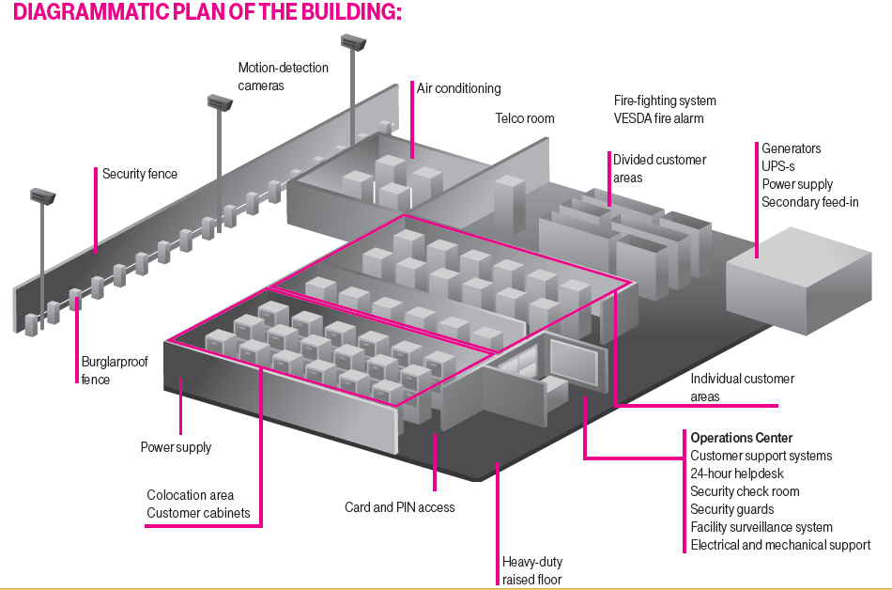
1. Recent landscape of data centers (2)
Layout of TSystem’s datacenter in Budapest (14000 m²) [67]

Slide 6
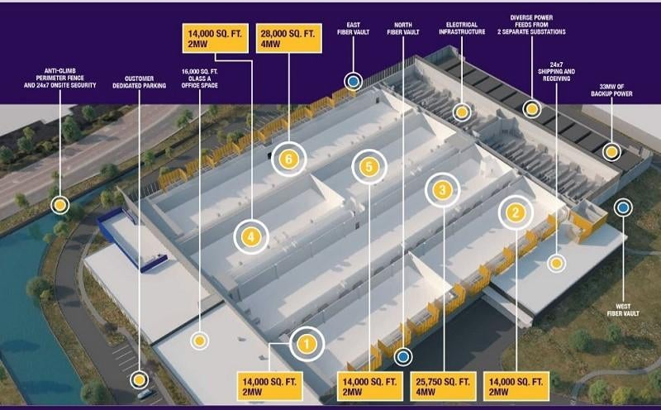
1. Recent landscape of data centers (3)
Part of a hyperscale data center [68]

Slide 7
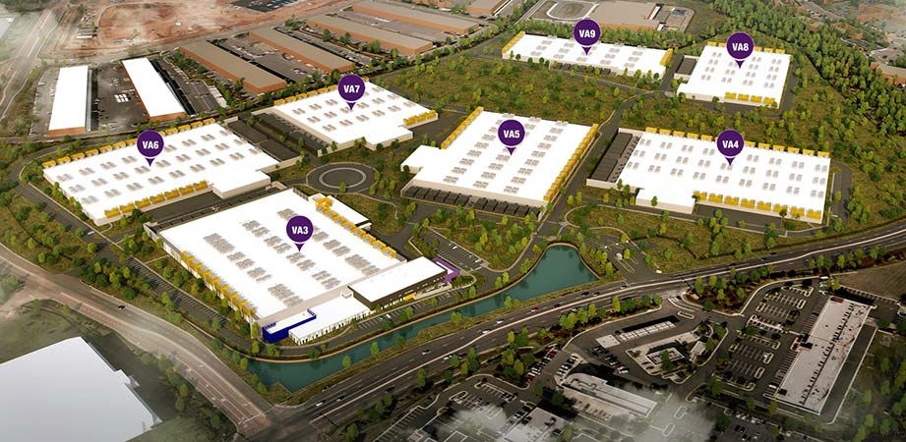
1. Recent landscape of data centers (3b)
Hyperscale data center farm [69]

Slide 8
1. Recent landscape of data centers (4)
Inner view of a large scale data center [3]

Slide 9
1. Recent landscape of data centers (5)
Distinguishing between tier 1 and tier 2 hyperscale data centers [1]
Hyperscale data centers
Tier 1 hyperscale data centers
Tier 2 hyperscale data centers
They are used for
cloud services and social media,
for e.g. AWS, Microsoft Azure,
Google, Facebook, and Alibaba.
They are used for
big cloud providers
including Oracle, IBM, and Apple,
Software as a Service (SaaS)
providers such as SAP, Salesforce,
social media giants like
LinkedIn and Twitter, and
platforms such as Uber, PayPal
and eBay.
≈ 10,000 servers per data center.
Total capital expenditure in 2017:
of $25 billion.
At least 50 000 servers per data server.
Total capital expenditure in 2017:
of $50 billion.
AWS: Amazon Web Services

Slide 10
1. Recent landscape of data centers (6)
Example of a tier 1 hyperscaler: AWS (Amazon Web Services) [4] -1
“AWS have been pioneering the hyperscale field, opening the first hyperscale data center in 2006 based on Jeff Bezos’s (CEO of Amazon) vision to transform Amazon from a retail business into a technology powerhouse that also happens to also offer retail services. It has always been about scale but also about serving the customer better, faster and cheaper, whether they’re buying the latest bestselling novel or purchasing AWS cloud computing services.
In the late 90s, Amazon looked to offer its own e-commerce functionality to large retailers, quickly realizing that, although the idea was sound, the software itself would require development. Amazon started hiring people from Microsoft and IBM to expand its technological capabilities to achieve its aim to be the frontrunner in cloud computing services. The fact that Amazon itself had become very good at fulfilling and shipping orders as well as running its own compute, storage and database services meant they found that they were now highly skilled at running reliable, scalable cost-effective data centers outside of their own commercial need.
From the first hyperscale data center in 2006 to date, AWS now offer 165 fully-featured cloud computing services, varying from hiring a web server or supercomputer, to AI, voice processors, and large-scale media streaming servers. This is available across 69 availability zones within 22 geographic regions with 9 new availability zones and 22 new regions announced.
Today, it is estimated that a third of all Internet users visit an AWS-hosted site daily.”

Slide 11
1. Recent landscape of data centers (7)
Example of a tier 1 hyperscale: AWS (Amazon Web Services) -2
Amazon rents their computing services in form of instances, that are virtual
platforms to be rent, their use is metered.
E.g. EC2 C6gn instances are powered by ARM-based AWS Graviton2 processors, and instances with the following features can be rented.
Instance Size | Virtual CPUs | Memory (GiB) | Instance storage (GiB) | Network Bandwidth (Gbps) | EBS Bandwidth (Gbps)
c6gn.medium | 1 | 2 | EBS-Only | Up to 25 | Up to 9.5
c6gn.large | 2 | 4 | EBS-Only | Up to 25 | Up to 9.5
c6gn.xlarge | 4 | 8 | EBS-Only | Up to 25 | Up to 9.5
c6gn.2xlarge | 8 | 16 | EBS-Only | Up to 25 | Up to 9.5
c6gn.4xlarge | 16 | 32 | EBS-Only | 25 | 9.5
c6gn.8xlarge | 32 | 64 | EBS-Only | 50 | 19
c6gn.12xlarge | 48 | 96 | EBS-Only | 75 | 28.5
c6gn.16xlarge | 64 | 128 | EBS-Only | 100 | 38
Table: Virtual, ARM-based AWS Graviton2 platforms offered by AWS [5]
EBS: Amazon Elastic Block Store is an easy to use, high-performance, block-storage service.

Slide 12
1. Recent landscape of data centers (8)
Edge computing -1 [6], [1]
The notion of edge computing is coined around 2010 in relation with distributed
computing.
Edge computing is a kind of distributed computing, where a cloud or data center
serves a large number of clients, that may be users or IOT devices,
via a network and where computations will be partly delegated to an additional,
intermediate layer, placed on the client side of the network, called shortly
the edge.
With edge computing data gathered by the users or IOT devices will be processed
first on the edge where data is produced or consumed, by means of a user's
computer, IoT device, or edge server, as indicated in the next Figure.
cloud computing: perem számítások
*

Slide 13
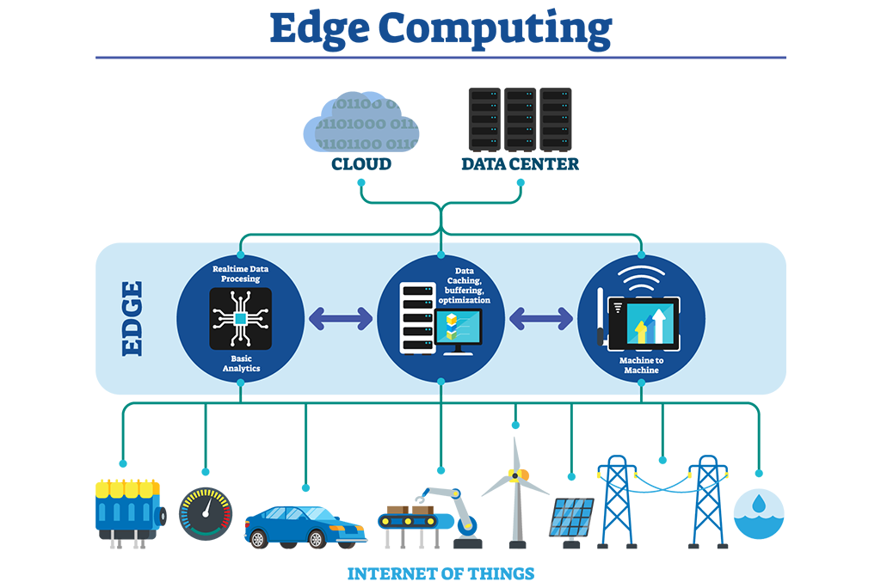
1. Recent landscape of data centers (9)
Principle of edge computing [7]
RT data processing
Data caching,
buffering, optimization
Data analytics
Machine to Machine

Slide 14
1. Recent landscape of data centers (10)
Edge computing -2 [6], [1]
The aim of edge computing is to bring computing as close to the source of data
as possible in order to reduce latency and bandwidth needed in communication
to the cloud or data center.
Edge computing may find its way into manufacturing, retail, banking, hospitality,
healthcare and smart cities.
*

Slide 15
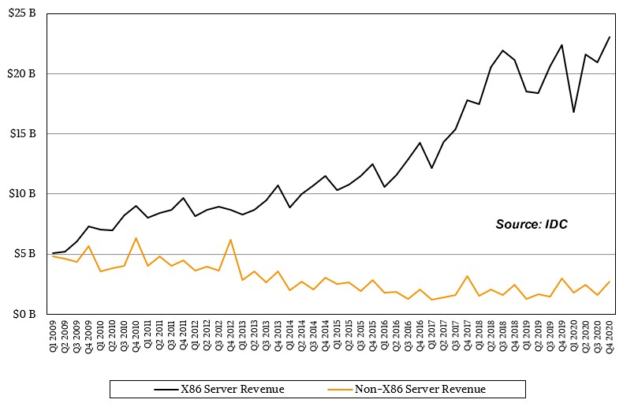
1. Recent landscape of data centers (11)
Quarterly revenues from selling x86 and non-x86 servers [8]

Slide 16
2. Overview of ARM ISA-based server processors
Notes:
16

Slide 17
2. Overview of ARM ISA-based server processors (1)
The motivation for designing ARM ISA-based server processors -1
The ARM ISA is RISC based, in other words it is a Load-Store architecture which
fetches operands from registers while operands are loaded from the memory
to registers, requested operations are performed with register operands, and
operation results are stored back from the registers to the memory (if needed).
By contrast, the x86 ISA is CISC-based, it allows more flexibility in operand
fetching, as operands may be fetched either from registers or immediately from
the memory.
Nevertheless, memory accesses are more energy consuming operations than
register accesses, accordingly CISC processors are less energy efficient than
their RISC peers.
In addition, as CISC ISAs allow to reference both register and memory operands,
and register operands need addresses, CISC ISAs have variable length
instructions whereas RISC ISAs regular, 32-bit long instructions that allow
coding of both register operations and load/store operations.
Obviously, it is a more demanding task to decode variable length instructions than
regular, 32-bit long instructions, for this reason CISC processors need more
complex decoding and more complex front-ends than RISC processor, this fact
boosts power consumption.
All in all, RISC-processors and thus ARM ISA-based processors have the potential
to reduce power consumption vs. CISC processors, this is the main reason why
mobile devices, like phones or tablets, use almost entirely ARM ISA-based
processors.
*

Slide 18
2. Overview of ARM ISA-based server processors (2)
The motivation for designing ARM ISA-based server processors -2
Obviously, when advanced 32-bit ARM-designed processors, such as the Cortex-A9
became available and found their way into smartphones and tablets, also the
motivation arose to develop low-power, ARM ISA-based server processors as well,
all the more as data centers have huge power consumption.
*

Slide 19
2. Overview of ARM ISA-based server processors (3)
Emergence and evolution of ARM ISA-based server processors -1
ARM-ISA-based server processors emerged and evolved in four waves, as
discussed next.
*

Slide 20
2. Overview of ARM ISA-based server processors (4)
The first wave
It was marked by an early proponent of ARM ISA-based server processors, called
Calxeda (founded in 2008).
In 2011 Calxeda announced quad core low power (5W) 32-bit ARM Cortex-A9-
based server nodes, a related interconnection fabric and a software ecosystem
that allowed to build up to 480 core servers.
Nevertheless, after ARM announced their 64-bit Armv8 ISA and related 64-bit
designs (Cortex-A57/A53) Calxeda went bankrupt in 2013.

Slide 21
2. Overview of ARM ISA-based server processors (5)
The second wave -1
In the second wave of the emergence of ARM ISA-based server processors,
first APM (Applied Micro) and then also AMD announced 64-bit Armv8.0 ISA-based
4 or 8-core server processors in 2012, as the next Figure shows.

Slide 22
2. Overview of ARM ISA-based server processors (6)
AMD’s and APM’s activity to design ARM-ISA-based server processors -1
Seattle
AMD
AMD announces
ARM-based processors
Dev. Kit
A1100
K12
80C/7 nm
128C/7 nm
8C/28 nm
32C/16nm
Skylark
QuickSilver
Mystique
Ampere
8C/40 nm
8C/28 nm
APM acquired by Macom, IP bought by Ampere
eMAG 8180
Altra
Altra Max
Storm
Shadowcat
Skylark
(Ares cores)
(Ares cores)
APM
X-Gene
X-Gene2
X-Gene3
16C/16 nm
64C/7 nm
(Applied Micro)
Amazon
AWS
Amazon buys
Anapura Lab
Graviton
Graviton2
(Ares cores)
8C/10 nm
Falcor
Saphira
Qualcomn
Centriq
Firetail
48C/28 nm
32C/4T/16 nm
Vulcan-based
Triton
60C/4T/7 nm
Cavium
ThunderX
ThunderX2
ThunderX3
( Marvel)
Server IP sold
Broadcom
Vulcan
7 nm
7 nm+
5 nm
Ares
Zeus
Perseus
32C/16 nm
Neoverse
N1
V1
N2
Atlas
Maya
Artemis
Prometheus
Enyo
Deimos
Hercules
ARM
A57
A72
A73
A75
A76
A77
A78
Cortex
64-bit
Apollo
Ananke
Hellos
A53
A55
A65-AE
2011
2012
2013
2014
2015
2016
2017
2018
2019
2020
2021

Slide 23
2. Overview of ARM ISA-based server processors (7)
The second wave -2
In fact, AMD intended to sell Cortex-A57-based servers to Amazon, but due to the
lower than expected performance of the Opteron A1100 processor, Amazon
became disinterested and AMD cancelled their associated design activity.
Subsequently, Amazon began to develop their own ARM ISA-based server
processors that resulted in the Graviton line, as seen in the next Figure.

Slide 24
2. Overview of ARM ISA-based server processors (8)
AMD’s and APM’s activity to design ARM-ISA-based server processors -2
Seattle
AMD
AMD announces
ARM-based processors
Dev. Kit
A1100
K12
80C/7 nm
128C/7 nm
8C/28 nm
32C/16nm
Skylark
QuickSilver
Mystique
Ampere
8C/40 nm
8C/28 nm
APM acquired by Macom, IP bought by Ampere
eMAG 8180
Altra
Altra Max
Storm
Shadowcat
Skylark
(Ares cores)
(Ares cores)
APM
X-Gene
X-Gene2
X-Gene3
16C/16 nm
64C/7 nm
(Applied Micro)
Amazon
AWS
Amazon buys
Anapura Lab
Graviton
Graviton2
(Ares cores)
8C/10 nm
Falcor
Saphira
Qualcomn
Centriq
Firetail
48C/28 nm
32C/4T/16 nm
Vulcan-based
Triton
60C/4T/7 nm
Cavium
ThunderX
ThunderX2
ThunderX3
( Marvel)
Server IP sold
Broadcom
Vulcan
7 nm
7 nm+
5 nm
Ares
Zeus
Perseus
32C/16 nm
Neoverse
N1
V1
N2
Atlas
Maya
Artemis
Prometheus
Enyo
Deimos
Hercules
ARM
A57
A72
A73
A75
A76
A77
A78
Cortex
64-bit
Apollo
Ananke
Hellos
A53
A55
A65-AE
2011
2012
2013
2014
2015
2016
2017
2018
2019
2020
2021

Slide 25
2. Overview of ARM ISA-based server processors (9)
The second wave -3
APM (Applied Micro Circuits) developed the X-Gene line of server processors
based on custom designed Armv8.0 cores, but their processor business
was not profitable enough.

Slide 26
2. Overview of ARM ISA-based server processors (9b)
AMD’s and APM’s activity to design ARM-ISA-based server processors -3
Seattle
AMD
AMD announces
ARM-based processors
Dev. Kit
A1100
K12
80C/7 nm
128C/7 nm
8C/28 nm
32C/16nm
Skylark
QuickSilver
Mystique
Ampere
8C/40 nm
8C/28 nm
APM acquired by Macom, IP bought by Ampere
eMAG 8180
Altra
Altra Max
Storm
Shadowcat
Skylark
(Ares cores)
(Ares cores)
APM
X-Gene
X-Gene2
X-Gene3
16C/16 nm
64C/7 nm
(Applied Micro)
Amazon
AWS
Amazon buys
Anapura Lab
Graviton
Graviton2
(Ares cores)
8C/10 nm
Falcor
Saphira
Qualcomn
Centriq
Firetail
48C/28 nm
32C/4T/16 nm
Vulcan-based
Triton
60C/4T/7 nm
Cavium
ThunderX
ThunderX2
ThunderX3
( Marvel)
Server IP sold
Broadcom
Vulcan
7 nm
7 nm+
5 nm
Ares
Zeus
Perseus
32C/16 nm
Neoverse
N1
V1
N2
Atlas
Maya
Artemis
Prometheus
Enyo
Deimos
Hercules
ARM
A57
A72
A73
A75
A76
A77
A78
Cortex
64-bit
Apollo
Ananke
Hellos
A53
A55
A65-AE
2011
2012
2013
2014
2015
2016
2017
2018
2019
2020
2021

Slide 27
2. Overview of ARM ISA-based server processors (10)
The second wave -4
In 2017 APM was acquired by Macom but Macom did not want to continue
developing processors so the vendor sold APM’s compute business along with
the IP of the almost finished X-Gene3 processor design to the newly
established Ampere company.
Ampere finalized the design and brought the X-Gene3 processor successfully
to market under the designation eMAG 8180, as the next Figure shows.

Slide 28
2. Overview of ARM ISA-based server processors (10b)
AMD’s and APM’s activity to design ARM-ISA-based server processors -3
Seattle
AMD
AMD announces
ARM-based processors
Dev. Kit
A1100
K12
80C/7 nm
128C/7 nm
8C/28 nm
32C/16nm
Skylark
QuickSilver
Mystique
Ampere
8C/40 nm
8C/28 nm
APM acquired by Macom, IP bought by Ampere
eMAG 8180
Altra
Altra Max
Storm
Shadowcat
Skylark
(Ares cores)
(Ares cores)
APM
X-Gene
X-Gene2
X-Gene3
16C/16 nm
64C/7 nm
(Applied Micro)
Amazon
AWS
Amazon buys
Anapura Lab
Graviton
Graviton2
(Ares cores)
8C/10 nm
Falcor
Saphira
Qualcomn
Centriq
Firetail
48C/28 nm
32C/4T/16 nm
Vulcan-based
Triton
60C/4T/7 nm
Cavium
ThunderX
ThunderX2
ThunderX3
( Marvel)
Server IP sold
Broadcom
Vulcan
7 nm
7 nm+
5 nm
Ares
Zeus
Perseus
32C/16 nm
Neoverse
N1
V1
N2
Atlas
Maya
Artemis
Prometheus
Enyo
Deimos
Hercules
ARM
A57
A72
A73
A75
A76
A77
A78
Cortex
64-bit
Apollo
Ananke
Hellos
A53
A55
A65-AE
2011
2012
2013
2014
2015
2016
2017
2018
2019
2020
2021

Slide 29
2. Overview of ARM ISA-based server processors (11)
The third wave
In the third wave of the evolution of ARM ISA-based server processors three
vendors; Qualcom, Cavium and Broadcom entered the market with Armv8.0-based
designs around 2015,but neither of these developments became prosperous and
their processor lines were cancelled, as the next Figure shows.

Slide 30
2. Overview of ARM ISA-based server processors (12)
Cancellation of Qualcomm’s, Cavium’s and Broadcom’s server processor lines
Seattle
AMD
AMD announces
ARM-based processors
Dev. Kit
A1100
K12
80C/7 nm
128C/7 nm
8C/28 nm
32C/16nm
Skylark
QuickSilver
Mystique
Ampere
8C/40 nm
8C/28 nm
APM acquired by Macom, IP bought by Ampere
eMAG 8180
Altra
Altra Max
Storm
Shadowcat
Skylark
(Ares cores)
(Ares cores)
APM
X-Gene
X-Gene2
X-Gene3
16C/16 nm
64C/7 nm
(Applied Micro)
Amazon
AWS
Amazon buys
Anapura Lab
Graviton
Graviton2
(Ares cores)
8C/10 nm
Falcor
Saphira
Qualcomn
Centriq
Firetail
48C/28 nm
32C/4T/16 nm
Vulcan-based
Triton
60C/4T/7 nm
Cavium
ThunderX
ThunderX2
ThunderX3
( Marvel)
Server IP sold
Broadcom
Vulcan
7 nm
7 nm+
5 nm
Ares
Zeus
Perseus
32C/16 nm
Neoverse
N1
V1
N2
Atlas
Maya
Artemis
Prometheus
Enyo
Deimos
Hercules
ARM
A57
A72
A73
A75
A76
A77
A78
Cortex
64-bit
Apollo
Ananke
Hellos
A53
A55
A65-AE
2011
2012
2013
2014
2015
2016
2017
2018
2019
2020
2021

Slide 31
2. Overview of ARM ISA-based server processors (13)
The fourth wave -1
Finally, around 2019 the fourth wave entered after ARM introduced their Armv8.2-A-based
Neoverse family of server processor designs, as seen in the subsequent Figure.
*

Slide 32
2. Overview of ARM ISA-based server processors (14)
ARM’s introduction of their Neoverse server processor family
Seattle
AMD
AMD announces
ARM-based processors
Dev. Kit
A1100
K12
80C/7 nm
128C/7 nm
8C/28 nm
32C/16nm
Skylark
QuickSilver
Mystique
Ampere
8C/40 nm
8C/28 nm
APM acquired by Macom, IP bought by Ampere
eMAG 8180
Altra
Altra Max
Storm
Shadowcat
Skylark
(Ares cores)
(Ares cores)
APM
X-Gene
X-Gene2
X-Gene3
16C/16 nm
64C/7 nm
(Applied Micro)
Amazon
AWS
Amazon buys
Anapura Lab
Graviton
Graviton2
(Ares cores)
8C/10 nm
Falcor
Saphira
Qualcomn
Centriq
Firetail
48C/28 nm
32C/4T/16 nm
Vulcan-based
Triton
60C/4T/7 nm
Cavium
ThunderX
ThunderX2
ThunderX3
( Marvel)
Server IP sold
Broadcom
Vulcan
7 nm
7 nm+
5 nm
Ares
Zeus
Perseus
32C/16 nm
Neoverse
N1
V1
N2
Atlas
Maya
Artemis
Prometheus
Enyo
Deimos
Hercules
ARM
A57
A72
A73
A75
A76
A77
A78
Cortex
64-bit
Apollo
Ananke
Hellos
A53
A55
A65-AE
2011
2012
2013
2014
2015
2016
2017
2018
2019
2020
2021

Slide 33
2. Overview of ARM ISA-based server processors (15)
The fourth wave -2
At introduction of the Neoverse family, ARM promised an outstanding yearly
performance growth rate of about 30 %, that actually could even be outperformed,
as seen in the next Figures.
*

Slide 34
2. Overview of ARM ISA-based server processors (16)
ARM’s announced performance rise over Neoverse generations [9]
*

Slide 35
2. Overview of ARM ISA-based server processors (17)
ARM’s performance rise achieved by the Neoverse N1 platform [10]
V1
Platform
2022
(Cortex-A72/
A75-based)
*

Slide 36
2. Overview of ARM ISA-based server processors (18)
The fourth wave -3
In the forth wave of the evolution of ARM ISA-based server processors, two firms
have introduced powerful processors, both based on ARM’s Neoverse N1 designs:
Ampere the Altra processor and
AWS (Amazon Web Services) the Graviton server processor line
(here we note that AWS does not sell their processors but uses them in-house
to provide on-demand cloud services)
as indicated in the next Figure.
*

Slide 37
2. Overview of ARM ISA-based server processors (19)
Ampere and AWS introduced ARM-ISA-based server processor lines
Seattle
AMD
AMD announces
ARM-based processors
Dev. Kit
A1100
K12
80C/7 nm
128C/7 nm
8C/28 nm
32C/16nm
Skylark
QuickSilver
Mystique
Ampere
8C/40 nm
8C/28 nm
APM acquired by Macom, IP bought by Ampere
eMAG 8180
Altra
Altra Max
Storm
Shadowcat
Skylark
(Ares cores)
(Ares cores)
APM
X-Gene
X-Gene2
X-Gene3
16C/16 nm
64C/7 nm
(Applied Micro)
Amazon
AWS
Amazon buys
Anapura Lab
Graviton
Graviton2
(Ares cores)
8C/10 nm
Falcor
Saphira
Qualcomn
Centriq
Firetail
48C/28 nm
32C/4T/16 nm
Vulcan-based
Triton
60C/4T/7 nm
Cavium
ThunderX
ThunderX2
ThunderX3
( Marvel)
Server IP sold
Broadcom
Vulcan
7 nm
7 nm+
5 nm
Ares
Zeus
Perseus
32C/16 nm
Neoverse
N1
V1
N2
Atlas
Maya
Artemis
Prometheus
Enyo
Deimos
Hercules
ARM
A57
A72
A73
A75
A76
A77
A78
Cortex
64-bit
Apollo
Ananke
Hellos
A53
A55
A65-AE
2011
2012
2013
2014
2015
2016
2017
2018
2019
2020
2021

Slide 38
2. Overview of ARM ISA-based server processors (20)
Competitiveness of the recent ARM ISA-based server processors
As a result of a long way of evolution, recent ARM ISA-based designs became now
highly competitive to AMD’s EPYC and Intel’s Scalable Xeon processors, as the next
Figure demonstrates.
*

Slide 39
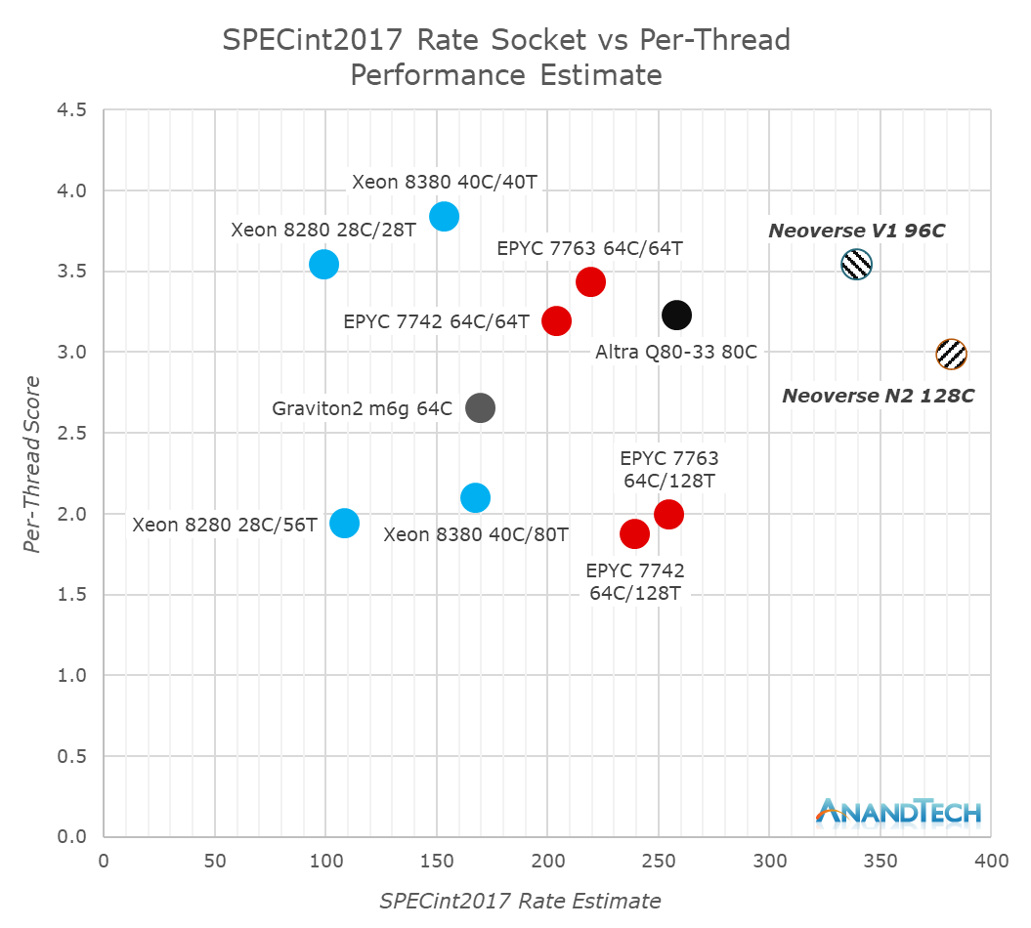
2. Overview of ARM ISA-based server processors (21)
2021 performance results: SPECint2017 rate per socket vs. per-thread [11]
3. gen. scalable (Whitley)
*

Slide 40
2. Overview of ARM ISA-based server processors (22)
Main features of ARM ISA based server processors -1
Vendor | Processor | Released | Cores up to | Threads up to | ARM ISA | Proc. design | Techn. | TDP up to
ARM | Neoverse V1 | 04/2021 | 96 | 96 | V8.2+ | Zeus | 7/5 nm | 350 W
 | Neoverse N1 | 02/2019 | 128 | 128 | v8.2 | Ares | 7 nm | 150 W
 | Neoverse N2 | 04/2021 | 192 | 128 | V9. | Perseus | 5 nm | 350 W
 | (Neoverse E1) | 02/2019 | 32 | 64 | v8.2 | Helios | 7 nm
AWS | Graviton (AL73400) | 11/2018 | 16 | 16 | v8.0 | Cortex-A72 | 16 nm | 110 W?
 | Graviton2 | 05/2020 | 64 | 64 | v8.2 | Neoverse N1 | 7 nm
APM (Applied Micro) | X-Gene | Q4/2012 | 8 | 8 | v8.0 | Custom | 40 nm | 45 W
 | X-Gene2 | 03/2015 | 8 | 8 | v8.0 | Custom | 28 nm | 35 W
 | X-Gene3 | 2017 | 32 | 32 | V8.0 | Custom | 16 nm | 125 W
Ampere | eMAG 8180 | 02/2018 | 32 | 32 | v8.0 | Custom | 16 nm | 125 W
 | Altra | 03/2020 | 80 | 80 | v8.2 | Neoverse-N1 | 7 nm | 250 W
 | Altra Max | 05/2021 | 128 | 128 | V8.2 | Neoverse-N1 | 7 nm | 250 W
Cavium/ Marvell | ThunderX | 09/2015 | 48 | 48 | v8.1 | Cortex-A57 | 28 nm
 | ThunderX2 | 05/2018 | 32 | 128 | v8.1 | Custom (Vulcan) | 14/16 nm | 180 W
 | ThunderX3 | 2020 (cancelled) | 1S: 60 2S: 2x48 | 240 | v8.3 | Custom (Triton) | 7 nm
Qualcomm | Centriq 2400 | 11/2017 | 48 | 48 | v8.0 | Custom | 10 nm | 120 W
HiSilicon | Kunpeng 920 | 01/2019 | 64 | 64 | v8.2 | ARM Ares | 7 nm | 180 W

Slide 41
2. Overview of ARM ISA-based server processors (23)
Main features of ARM ISA based server processors -2
Vendor | Processor | L3 $ | Syst. $ | Interconnect | Memory | PCIe | Sockets
ARM | Neoverse V1 |  | 512 MB | CMN-700 | DDR5-4800 | PCIe 5.0 | 1S/2S
 | Neoverse N1 | ½-4 MB (opt.) | 128 MB | CMN-600 | DDR4-3200 | PCIe 4.0 | 1S/2S
 | Neoverse N2 |  | 512 MB | CMN-700 | DDR5-4800 | PCIe 5.0 | 1S/2S
 | (Neoverse E1) | ½-4 MB (opt.) |  | CMN-600 | DDR4-3200 | PCIe 4.0 | 1S?
AWS | Graviton | -- |  |  |  |  | 1S?
 | Graviton2 | 32 MB |  | CMN-600 | 8xDDR4-3200 | PCIe 4.0 x64 | 1S/2S
APM (Applied Micro) | X-Gene | 8 MB |  | Data Switch | 4xDDR3-1866 | PCIe 3.0 x17 | 1S
 | X-Gene2 | 8 MB |  |  | 4x DDR3-1866 | PCIe 3.0 x17 | 1S
 | X-Gene3 | 32 MB |  | Central switch | 8x DDR3-2666 | PCIe 3.0 x42 | 1S
Ampere | eMAG 8180 | 32 MB |  | Central switch | 8x DDR4-2667 | PCIe 3.0 x42 | 1S
 | Altra |  | 32 MB | CMI (CMN-600?) | 8x DDR4-3200 | PCIe 4.0 x128 | 1S/2S
 | Altra Max |  | 16 MB | CMI (CMN-600?) | 8x DDR4-3200 | PCIe 4.0 x128 | 1S/2S
Cavium/ Marvell | ThunderX | -- |  | Xbar | 4x DDR4-2400 | PCIe 3.0x24 | 1S/2S
 | ThunderX2 | 1 MB/c |  | Ring bus | 8x DDR4-2666 | PCIe 3.0 x56 | 1S/2S
 | ThunderX3 | 1.5 MB/c |  | Ring bus | 8x DDR4-3200 | PCIe 4.0 x64 | 1S/2S
Qualcomm | Centriq2 2400 | 60 MB |  | Qualcomm Ring bus | 6x DDR4- 2667 | PCIe 3.0 x32 | 1S
HiSilicon | Kunpeng 920 (Hi1620) |  |  | ARM ring bus | 8x DDR4-3200 | PCIe 4.0 x40 | 1S/2S

Slide 42
3. ARM’s Neoverse platform family
3. 1 Overview
3.2 The Neoverse N1 processor and platform
Notes:
42

Slide 43
3. 1 Overview
Notes:
43

Slide 44
3. 1 Overview (1)
3.1 Overview
In 2004 ARM introduced the Cortex branding for processors targeting mobile
phones and tablets.
Similarly, in 2018 ARM announced a new branding, called Neoverse for processors
and platforms focused on information infrastructures (datacenters, routers,
switches etc.).
In this way, ARM declared their intention to take a share in the huge cloud and
datacenter market as well.
At the same time ARM introduced the Cosmos branding for previous, Cortex-A72
or Cortex-A75-based platforms, in order to have a reference point.
*

Slide 45
3. 1 Overview (2)
ARM’s Neoverse platform roadmap with expected performance growth,
revealed in 10/2018 -1 [12]
Remark
In a more detailed platform roadmap (shown subsequently) AMD clarifies that the
given performance uplift relates to the Cortex-A72-based platform.

Slide 46
3. 1 Overview (3)
Achieved performance uplift of the implemented Neoverse N1 platform
vs. the Cosmos platform, revealed in 02/2019 [10]
V1
Platform
2022
(Cortex-A72/
A75-based)

Slide 47
3. 1 Overview (4)
Remarks to ARM’s platform performance comparisons -1
While ARM associates the Cosmos platform with the Cortex-A72 and Cortex-A75
processors, there is a significant difference between the Armv8.0 ISA-based
Cortex-A72 with the related ring bus interconnect and the ARM v8.2 ISA-based
Cortex-A75 with the associated 2D mesh-interconnect.
For a recap of the mentioned on-die interconnect techniques, in the next two Figures
we contrast these techniques and the reason why ring bus-based interconnects
gave place to 2D mesh-based interconnects.
*

Slide 48
3. 1 Overview (5)
Contrasting the principles of ring bus- and 2D mesh-based interconnects
Evolution of on-die interconnects in high core count processors (e.g. servers)
Ring bus-based
interconnects
2D mesh-based
interconnect
(for servers)
Shorter
access time
for higher nc
CPU
GPU
A
--
--
--
R
R
R
R
R
R
CC
CC
A
A
CC
CC
IO
IO
R
R
R
R
R
R
CC
CC
CC
A
A
A
CC
IO
IO
Ring bus
R
R
R
R
R
R
CC
CC
A
A
A
CC
CC
IO
IO
R
R
R
R
R
R
CC
CC
CC
CC
MC
MC
MC
P
P
P
R
R
R
R
R
R
MC
MC
MC
P
P
P
MC
--
IO
A: Accelerator (e.g. GPU, NPU) R: Router
CC: Core Cluster, P: Peripherical device
Examples
Intel
Sandy Bridge (CC, on QPI, 2011)
and subsequent processors
Skylake-SP for servers
(CC, UPI, 2017)
Knights Landing for AI, (2016)
ARM
CCN-5xx interconnect for servers
(Cache coherent, 2012)
CMN-6xx Interconnect for servers
(Cache coherent, 2017)

Slide 49
3. 1 Overview (6)
The reason for changing the interconnect topology for servers [13]
Ring
interconnect
Mesh
interconnect
*
*

Slide 50
3. 1 Overview (6b)
Remarks to ARM’s platform performance comparisons -2
The difference between the Cortex-A72 and A75 has to be taken into consideration
when ARM compares the performance of the Cosmos platform with the subsequent
Neoverse Ares platform.
A more detailed platform roadmap (see later) clarifies this point, the given
performance uplift of the Neoverse Ares platform relates to the Cortex-A72
processor-based platform.
*

Slide 51
3. 1 Overview (7)
Achieved performance uplift of the implemented Neoverse V1 platform
vs. the N1 platform, revealed in 04/2020 [11]

Slide 52
3. 1 Overview (8)
Processor and platform segments of the Neoverse brand
Neoverse processor and platform segments
V-Series
processors and platforms
N-Series
processors and platforms
E-Series
processors and platforms
High-performance series
for servers
High-efficiency series (perf./W) for servers
High data throughput series
for 5G devices (routers, switches etc.)
In concert with the above segmentation ARM announced details of their processor
and platform roadmap, as follows:
*

Slide 53
3. 1 Overview (9)
Contrasting design principles of the Neoverse processor and platform
segments [14]
Targets: Performance
Targets: Performance/Power
Targets: Power
*

Slide 54
3. 1 Overview (10)
ARM’s Neoverse processor and platform roadmap from 09/2020 -1 [12]
Armv8.2/no SVE
Armv8.2+/ SVE
Armv9/ SVE2
Announced:
Released:
10/2018
02/2019
02/2019
04/2021

Slide 55
3. 1 Overview (11)
New memory and IO technologies foreseen by the Neoverse roadmap
ARM’s Neoverse platform roadmap reveals an astonishing dynamic evolution of
platform features concerning IO, memory and chip-to-chip interconnects in their
designs following the N1 (Ares) platform, as follows: .
DDR5
HBM2, HBM2e, HBM3
PCIe 5.0
CCIX 1.0, CCIX 1.1, CCIX 2.0
CXL 2.0
Subsequently, we briefly introduce these technologies.

Slide 56
3. 1 Overview (12)
DDR5 -1
Main features of standard DDR memories [15]
Note that new DDR generations appeared in the past in about 4 years intervals,
but DDR5 became standardized 8 years after DDR4, not earlier than 2020.
From generation to generation operating voltages were decreased, from 2.8 V
to 1.1 V.
It is also worth to note that subsequent memory generations typically doubled
the data rate.
*
*

Slide 57
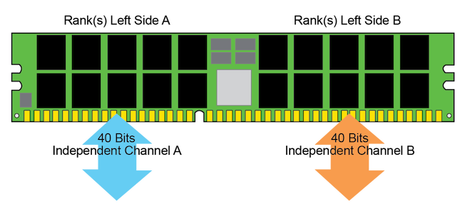
3. 1 Overview (13)
a) DDR5 -2
In 07/2020 JEDEC revealed the DDR5 SDRAM standard.
As shown in the Table on the previous slide, compared to DDR4, DDR5
doubles transfer rates to up to 6.4 GT/s and
reduces operating voltage from 1.2 V to 1.1 V.
Further on, DDR5 introduces a number of innovations (not indicated in the Table), like
dual independent half-width memory channels (2x32 +8 ECC bits,
as seen below),
on-DIMM voltage regulation (instead of on-board regulation), and
retains the 288 pin interface of DDR4 DIMMs nevertheless with modified pinout.
Mass production has been started in Q4/2020.
Figure:
Dual-channels
introduced
in DDR5 [16]
*

Slide 58
3. 1 Overview (14)
Introduction of DDR5 memories in processors
Beyond ARM’s Neoverse N2 and V1 processor designs (released in 04/2021) the
following Intel and AMD processors are expected to support DDR5 and PCIe 5.0:
Intel’s 12. gen. Alder Lake-S big-little (desktop) line, to be released in 09/2021
Intel’s Sapphire Rapid scalable (1S-8S) Xeon server line, to be released in 2021
AMD’s 5 nm Zen 4 cores to be announced in in 2021, to be released in 2022
*

Slide 59
3. 1 Overview (15)
b) HBM2, HBM2e, HBM3
HBM2 and HBM2E (High Bandwidth Memory) are recent updates of HBM memories.
HBM memories are 2.5D packaged stack memories with a very wide data interface
of 1024 bits.
Consequently, as their name suggests they have a high memory bandwidth of
128 GBps to ~ 410 GB per HBM stack.
They are standardized (by JEDEC) and appeared in 2013.
Next we give a short introduction of HBM memories.
*

Slide 60
3. 1 Overview (16)
Example and layout of
HBM memories [17]
HBM memories are 2.5D
stacked DRAM devices.
Stacked memory slices
are connected via TSVs
through-silicon vias
(very thin copper-filled
holes).
There are 4 DRAM slices
per HBM stack.
*

Slide 61
3. 1 Overview (17)
Layout of a HBM stack [18]
Each of the 4 DRAM slices
(dies) has two memory
channels providing
altogether 8 memory
channels/stack.
There is a 128-bit wide
data path per channel,
resulting in a 8x128 =1024
bit datapath per memory
stack.
The memory is clocked by
500 MHz.
Data transferred at DDR rate
(double data rate)
resulting in
a transfer rate of
1 Gbps per data line
per channel.
This amounts to 8x 128x 1 Gbps = 128 GB/s bandwidth/HBM stack.
*

Slide 62
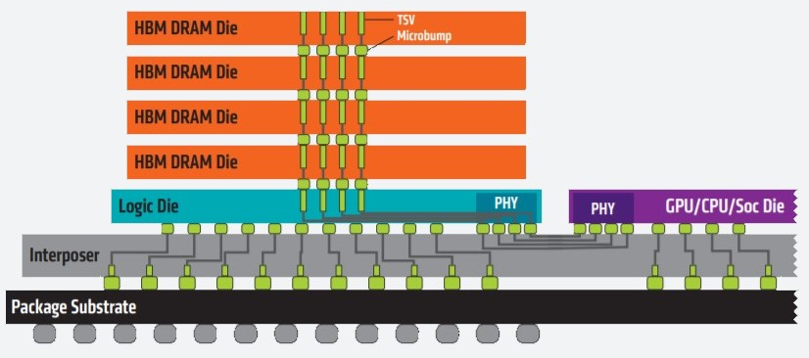
3. 1 Overview (18)
Another view of the layout of HBM stacks [19]
The data bus is bidirectional
Clock and strobe signals: differential signals
DRAM core voltage: 1.2 V
Device power: ~6-7 pJ/bit vs. ~18-22 pJ/bit for GDDR5
Signal count/channel: 212

Slide 63
3. 1 Overview (19)
Evolution of HBM memories
 | HBM | HBM2 | HBM2 | HBM2 (HBM2E) | HBM2 (HBM2E) | HBM3? (Upcoming)
JEDEC Standard | JESD 235 | JESD 235A | JESD 235B | JESD 235C | JESD 235D | ?
Released | 10/2013 | 11/2015 | 11/2018 | 01/2020 | 02/2021 | ?
Max Pin Transfer Rate | 1 Gbps | 2 Gbps | 2.4 Gbps | 2.8/3.2 Gbps | 3.2 Gbps? | 4 Gbps
Max Capacity | 4GB | 8 GB | 24 GB | 24 GB | 24 GB? | 64 GB
Max Bandwidth/ HBM stack | 128 GBps | 256 GBps | 307.2 GBps | 344.4/409.6 GBps | 409.6? GBps | 512 Gbps GBps

Slide 64
3. 1 Overview (20)
c) PCIe 5.0
Evolution of subsequent PCIe generations [20]
PCI Express version | Intro- duced | Line code | Transfer rate in each direction | Throughput in each direction
 |  |  |  | ×1 | ×2 | ×4 | ×8 | ×16
1.0 | 2003 | 8b/10b | 2.5 GT/s | 250 MB/s | 0.50 GB/s | 1.0 GB/s | 2.0 GB/s | 4.0 GB/s
2.0 | 2007 | 8b/10b | 5.0 GT/s | 500 MB/s | 1.0 GB/s | 2.0 GB/s | 4.0 GB/s | 8.0 GB/s
3.0 | 2010 | 128b/130b | 8.0 GT/s | 984.6 MB/s | 1.97 GB/s | 3.94 GB/s | 7.88 GB/s | 15.8 GB/s
4.0 | 2017 | 128b/130b | 16.0 GT/s | 1969 MB/s | 3.94 GB/s | 7.88 GB/s | 15.75 GB/s | 31.5 GB/s
5.0 | 2019 | 128b/130b | 32.0 GT/s | 3938 MB/s | 7.88 GB/s | 15.75 GB/s | 31.51 GB/s | 63.0 GB/s
Beyond ARM’s Neoverse N2 and V1 processor designs (released in 04/2021) the
following Intel and AMD processors are expected to support DDR5 and PCIe 5.0:
Intel’s 12. gen. Alder Lake-S big-little (desktop) line, to be released in 09/2021
Intel’s Sapphire Rapids scalable (1S-8S) Xeon server line, to be released in 2021
AMD’s 5 nm Zen 4 cores to be announced in in 2021, to be released in 2022
*

Slide 65
3. 1 Overview (21)
d) CCIX 1.0, CCIX 1.1, CCIX 2.0
ARM’s detailed Neoverse processor and platform roadmap from 09/2020
reveals that for chip-to-chip interconnections initially, ARM will use the CCIX
(Cache Coherent Interconnect for Accelerators) open standard, but subsequently,
beginning with the Neoverse N2 (to be introduced in 2021) ARM will also support
the CXL (Compute Express Link) standard as well.
Next we give a short introduction to the CCIX interface.
CCIX pronounced See-Six
*

Slide 66
3. 1 Overview (22)
CCIX (Cache Coherent Interconnect for Accelerators)
There are a number of cache coherent chip-to-chip interconnects in use, such as
Vendor/Consortium | Designation |  | Year
AMD | HT | HyperTransport | 2003
Intel | QPI | Quick Path Interconnect | 2008
Intel | UPI | Ultra Path Interconnect | 2017
AMD | IF | Infinity Fabric | 2017
IBM | CAPI | Cache Coherent Accelerator Interface | 2014
Nvidia | NVLink |  | 2014
CCIX Consortium lead by Xilinx | CCIX | Cache Coherence Interconnect for Accelerators | 2018
OpenCAPI Consortium lead by IBM | OpenCAPI | Open Cache Coherent Accelerator Interface | 2016
CXL Consortium lead by Intel | CXL | Compute Express Link | 2019
Table: Cache coherent chip-to-chip interconnects [21]
*

Slide 67
3. 1 Overview (23)
The CCIX (Cache Coherent Interconnect for Accelerators) standard
It was created to maintain cache coherency in a heterogeneous multi-procesor
system consisting of multiple processors, hardware accelerators, such as GPUs,
DSPs, interconnect and IO [22], as indicated in the next Figure.
*

Slide 68
3. 1 Overview (24)
Examples of CCIX-based system topologies [23]

Slide 69
3. 1 Overview (25)
CCIX’s relation to PCIe -1
Most of the chip-to-chip buses run atop the PCI-Express bus transport layer
(exceptions are NVI and OpenCAPI).
The CCIX 1.0 standard is based on the PCIe 4.0 (that has a data rate of 16 GT/s)
and in the extended speed mode it raises data rates to up to 25 GT/s.
The next Figure shows how CCIX is built on the PCIe bus.
*

Slide 70
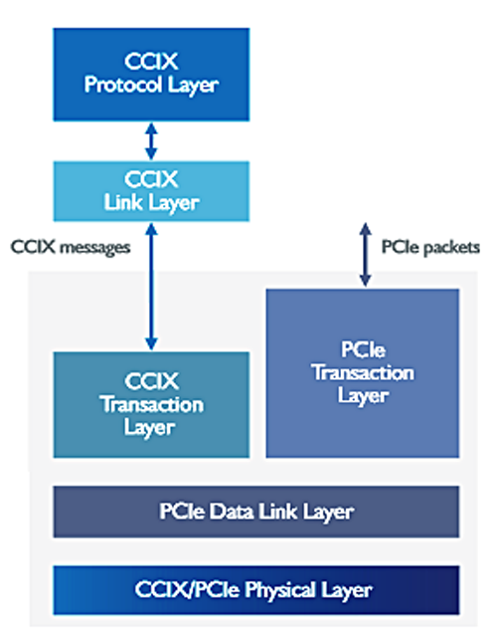
3. 1 Overview (26)
Running the CCIX interconnect atop of the PCIe Data Link Layer [24]
Tranzakciós
réteg
Adatkapcsolati
réteg

Slide 71
3. 1 Overview (26b)
CCIX’s relation to PCIe -2
The subsequent CCIX1.1 release is already based on the PCI 5.0 and supports
even higher data rates, as discussed later.
*

Slide 72
3. 1 Overview (27)
Evolution of the CCIX standard
Standard | CCIX 1.0 | CCIX 1.1 | CCIX 2.0?
Released | 06/2018 | 10/2019 | 2021?
Based on | PCIe 4.0 | PCIe 5.0 | ?
Throughput | 25 GT/s | 32 GT/s | 56 GT/s

Slide 73
3. 1 Overview (28)
e) The CXL (Compute Express Link) in short
CXL is a new, open standard interface for high-speed, low latency interconnects
between host processors and devices like accelerators, memory buffers and
smart I/O devices.
The first version of the CXL specification (CXL 1.0) was released in 03/2019,
it is based on the PCIe 5.0.
The standard is maintained by the CXL Consortium which is broadly supported
in the IT industry.
*

Slide 74
3. 1 Overview (29)
Performance expectations for Neoverse cores vs. traditional cores [12]
(ARM does not specify which processors were taken as references)

Slide 75
3. 1 Overview (30)
Corresponding Cortex-A and Neoverse cores [12]

Slide 76
3.2 The Neoverse N1 processor and platform
Notes:
76

Slide 77
3.2 The Neoverse N1 processor and platform (1)
3.2 The Neoverse N1 processor and platform -1 [12]
Armv8.2/no SVE
Armv8.2+/ SVE
Armv9/ SVE2
Announced:
Released:
10/2018
02/2019
09/2020
04/2021

Slide 78
3.2 The Neoverse N1 processor and platform (2)
The Neoverse N1 processor and platform -2 [12]
Announced in 10/2018, released in 02/2019.
It is a high-efficiency platform in terms of performance/W and
performance/Si area.
It mainly aims at high-performance servers in hyperscale and data centers
running mostly cloud applications.
The Neoverse N1 is based on the Armv8.2-A ISA, it may have up to 128 cores,
and does not support SVE or multithreading.
A core cluster has up to 4 cores.
Cores have four-wide front-ends.
Cores have private L1 (64 KB L1I$, 64 KB L1D$) and private, unified L2 $
(256 KB-1MB), as well as an optional, shared L3$ may be added (512 KB – 4 MB).
The Neoverse N1 presumes an on-chip 2D mesh interconnect (CMN-600).
For chip-to-chip communication it uses CCIX 1.0 interconnects.
Supported memory and IO technologies: DDR4, HBM2, PCIe 4.0, CCIX 1.0.
It provides 60 % ST performance uplift compared to the Cortex-A72
(as indicated in the next Figure).
Neoverse N1 processor designs are used in AWS’s Graviton2 and Ampere’s
Altra processors.
*

Slide 79
3.2 The Neoverse N1 processor and platform (3)
Achieved performance uplift of the implemented Neoverse N1 platform
vs. the Cosmos platform, revealed in 02/2019 [10]
(Cortex-A72

Slide 80
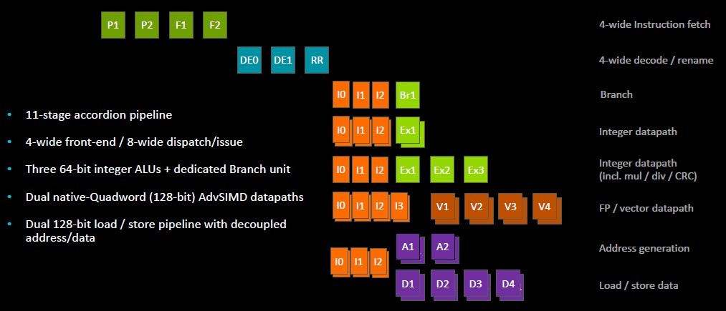
3.2 The Neoverse N1 processor and platform (4)
The Neoverse N1 pipeline [10]

Slide 81
3.2 The Neoverse N1 processor and platform (5)
Neoverse N1 reference designs [26]
*

Slide 82
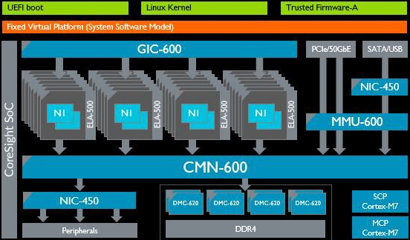
3.2 The Neoverse N1 processor and platform (5)
Neoverse N1 hyperscale reference design for 64 cores [28].
(It is implemented out of dual-core modules).
SCP: System Control Processor MCP: Management Control Processor

Slide 83
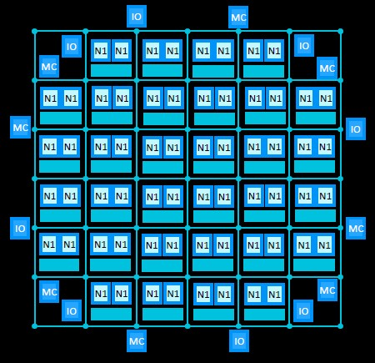
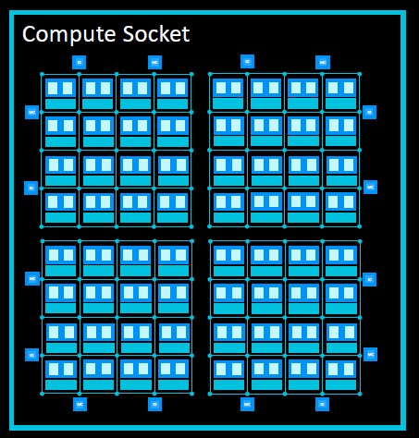
3.2 The Neoverse N1 processor and platform (6)
Physical implementation options of high-core-count Neoverse N1 processors
Physical implementation options of high-core-count Neoverse N1 processors
Monolithic implementation
MCM (Multi Chip Module) implementation
*
Monolithic implementation [12]
MCM implementation with 4 segments [12]

Slide 84
3.2 The Neoverse N1 processor and platform (7)
Remark to the MCM implementation [10]
In case of MCM implementations a chip-to-chip interconnect is needed
to interconnect the dies with the core segments.
As indicated before, ARM provides for this CCIX interconnects (and in future
CXL interconnects).

Slide 85
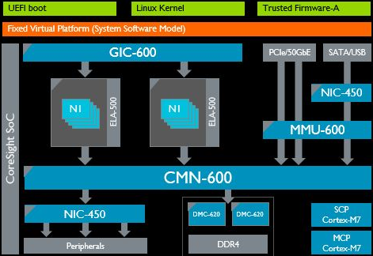
3.2 The Neoverse N1 processor and platform (8)
Neoverse N1 edge reference design for 8 cores [10]
(It is implemented out of quad-core core complexes).
SCP: System Control Processor MCP: Management Control Processor

Slide 86
3.2 The Neoverse N1 processor and platform (9)
Neoverse N1 power-/performance management [12]
Neoverse implements an intelligent power/performance management that is
based on
per-core Activity Monitoring Units (AMUs) and
ARM’s CMI (System Control and Management Interface) specification,
not discussed in this Lecture.

Slide 87
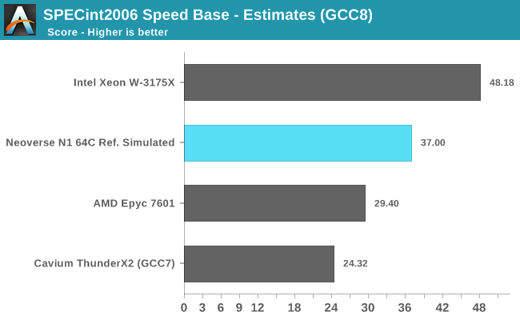
3.2 The Neoverse N1 processor and platform (10)
Performance results for SPECint2006 Speed Base [26]
(Skylake, 56T)
(64C)
(64T)
(32C)

Slide 88
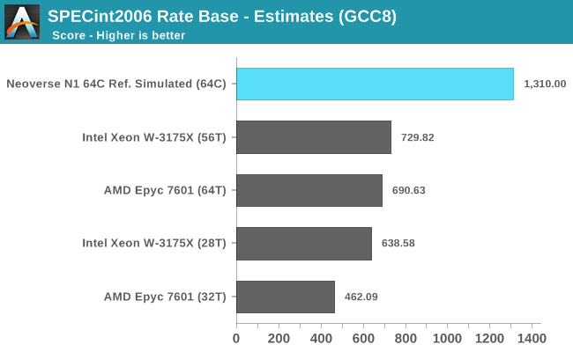
3.2 The Neoverse N1 processor and platform (11)
Performance results for SPECint2006 Rate Base [26]

Slide 89
4. Case example: Ampere’s Altra server processor line
4.1 Overview
4.2 The Ampere Altra (Quicksilver) processor
4.3 The Ampere Altra Max (Mystique) processor
Notes:
89

Slide 90
4.1 Overview
Notes:
90

Slide 91
4.1 Overview (1)
4.1 Overview - Evolution of Ampere’s server processors -1
Seattle
AMD
AMD announces
ARM-based processors
Dev. Kit
A1100
K12
80C/7 nm
128C/7 nm
8C/28 nm
32C/16nm
Skylark
QuickSilver
Mystique
Ampere
8C/40 nm
8C/28 nm
APM acquired by Macom, IP bought by Ampere
eMAG 8180
Altra
Altra Max
Storm
Shadowcat
Skylark
(Ares cores)
(Ares cores)
APM
X-Gene
X-Gene2
X-Gene3
16C/16 nm
64C/7 nm
(Applied Micro)
Amazon
AWS
Amazon buys
Anapura Lab
Graviton
Graviton2
(Ares cores)
8C/10 nm
Falcor
Saphira
Qualcomn
Centriq
Firetail
48C/28 nm
32C/4T/16 nm
Vulcan-based
Triton
60C/4T/7 nm
Cavium
ThunderX
ThunderX2
ThunderX3
( Marvel)
Server IP sold
Broadcom
Vulcan
7 nm
7 nm+
5 nm
Ares
Zeus
Perseus
32C/16 nm
Neoverse
N1
V1
N2
Atlas
Maya
Artemis
Prometheus
Enyo
Deimos
Hercules
ARM
A57
A72
A73
A75
A76
A77
A78
Cortex
64-bit
Apollo
Ananke
Hellos
A53
A55
A65-AE
2011
2012
2013
2014
2015
2016
2017
2018
2019
2020
2021

Slide 92
4.1 Overview (2)
Founding of Ampere
APM’s processor division and IP was purchased through a financial transaction
by a new firm called Ampere, that has been established in 2018 by an ex
Intel-president Renee James.
Recently both Oracle and ARM have a stake in Ampere.
*

Slide 93
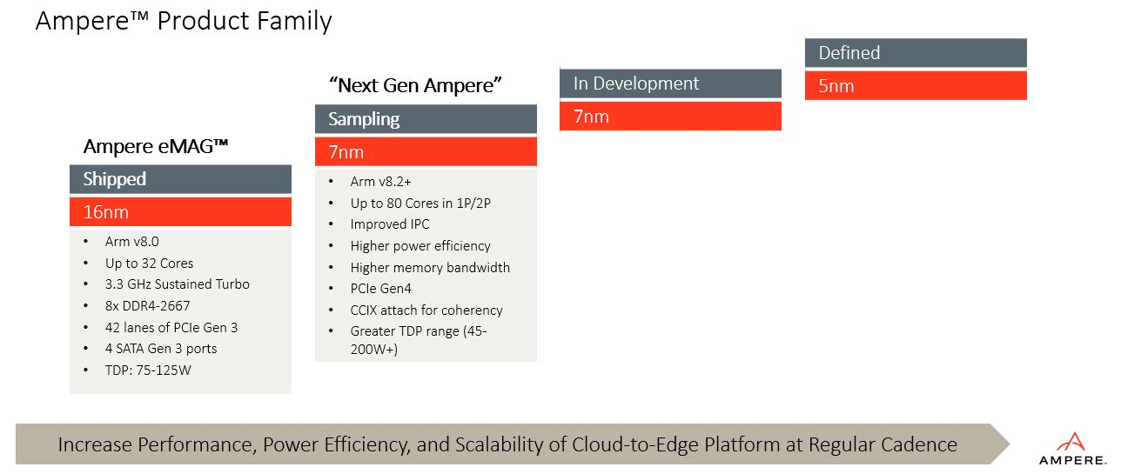
4.1 Overview (3)
Overview of Ampere’s ARM ISA-based processor line (Based on [49])
Ampere Altra Max
Ampere Altra
Ampere eMAG 8180
Called Syrin
Custom core
Arm v8.2+
Up to 128 cores
PCIe Gen4
CCIX attach for coherency
Support for CXS
TDP up to 250 W
05/2021
03/2020
02/2018

Slide 94
4.2 The Amper Altra (Quicksilver) processor
Notes:
94

Slide 95
4.2 The Amper Altra (Quicksilver) processor (1)
4.2 The Ampere Altra (Quicksilver) processor
Introduced in 03/2020.
Up to 80 Neoverse-N1 cores with Armv8.2 features.
Processor elements are interconnected by ARM’s 2D mesh interconnect, called
CMN-600 (Coherent Mesh Network)
Implemented as a large monolithic die of 77x67 mm on TSMC’s 7 nm technology
with an LGA-4926 socket.
*

Slide 96
4.2 The Amper Altra (Quicksilver) processor (2)
Key features of Amper Altra [52]

Slide 97
4.2 The Amper Altra (Quicksilver) processor (3)
Main features of the 80-core Ampere Altra [53]
PROCESSOR SUBSYSTEM
• 80 Arm v8.2+ 64-bit CPU cores (Neoverse N1) up to 3.0 GHz with Sustained Turbo
• 64 KB L1 I-cache, 64 KB L1 D-cache per core
• 1 MB L2 cache per core
• 32 MB System Level Cache (SLC)
• 2x full-width (128b) SIMD execution
• Coherent mesh-based interconnect
– Distributed snoop filtering
MEMORY
• 8x 72-bit DDR4-3200 channels
• ECC, Symbol-based ECC, and DDR4 RAS features
• Up to 16 DIMMs and 4 TB/socket
SYSTEM RESOURCES
• Full interrupt virtualization (GICv3)
• Full I/O virtualization (SMMUv3)
• Enterprise server-class RAS
CONNECTIVITY
• 128 lanes of PCIe Gen4
– 8 x8 PCIe + 4 x16 PCIe/CCIX with Extended Speed Mode (ESM) support
for data transfers at 20/25 GT/s
– 48 controllers to support up to 32 x2 links
• 192 lanes in 2P configuration
• Coherent multi-socket support
• 4 x16 CCIX lanes

Slide 98
4.2 The Amper Altra (Quicksilver) processor (4)
Block diagram of the Ampere Altra [53]
Up to 80 Neoverse-N1 cores
ARM’s CMN-600 cache coherent 2D mesh interconnect with distributed 32 MB system level cache

Slide 99
4.2 The Amper Altra (Quicksilver) processor (5)
Main features of Ampere Altra models [52]
Ampere 1st Gen Altra 'QuickSilver' Product List
AnandTech | Cores | Frequency | TDP | PCIe | DDR4 | Price
Q80-33 (Tested) | 80 | 3.3 GHz | 250 W | 128x G4 | 8 x 3200 | $4050
Q80-30 | 80 | 3.0 GHz | 210 W | 128x G4 | 8 x 3200 | $3950
Q80-26 | 80 | 2.6 GHz | 175 W | 128x G4 | 8 x 3200 | $3810
Q80-23 | 80 | 2.3 GHz | 150 W | 128x G4 | 8 x 3200 | $3700
Q72-30 | 72 | 3.0 GHz | 195 W | 128x G4 | 8 x 3200 | $3590
Q64-33 | 64 | 3.3 GHz | 220 W | 128x G4 | 8 x 3200 | $3810
Q64-30 | 64 | 3.0 GHz | 180 W | 128x G4 | 8 x 3200 | $3480
Q64-26 | 64 | 2.6 GHz | 125 W | 128x G4 | 8 x 3200 | $3260
Q64-24 | 64 | 2.4 GHz | 95 W | 128x G4 | 8 x 3200 | $3090
Q48-22 | 48 | 2.2 GHz | 85 W | 128x G4 | 8 x 3200 | $2200
Q32-17 | 32 | 1.7 GHz | 45 W | 128x G4 | 8 x 3200 | $800

Slide 100
4.2 The Amper Altra (Quicksilver) processor (6)
Comparing x86 and ARM ISA-based 2S server processors [63] -1
Top-of-Stack Competition
 | EPYC 7003 | Amazon Graviton2 | Ampere Altra | Intel Xeon
Platform | Milan | Graviton2 | QuickSilver | Ice Lake
Processor | 7763 | Graviton2 | Q80-33 | 8380
uArch | Zen 3 | Neoverse N1 | Neoverse N1 | Sunny Cove
Cores | 64 | 64 | 80 | 40
TDP | 280 W | ? | 250 W | 270 W
Base Freq | 2450 | 2500 | 3300 | 2300
Turbo Freq | 3500 | 2500 | 3300 | 3400
All-Core | ~3200 | 2500 | 3300 | 3000
L3 Cache | 256 MB | 32 MB | 32 MB | 60 MB
PCIe | 4.0 x128 | ? | 4.0 x128 | 4.0 x64
Chipset | On CPU | ? | On CPU | External
DDR4 | 8 x 3200 | 8 x 3200 | 8 x 3200 | 8 x 3200
DRAM Cap | 4 TB | ? | 4 TB | 4 TB
Optane | No | No | No | Yes
Price | $7890 | N/A | $4050 | $8099

Slide 101
4.2 The Amper Altra (Quicksilver) processor (7)
Comparing x86 and ARM ISA-based 2S server processors [63] -2
As data shows Altra processors with 80 cores have impressive features that is
low TDP values and high base and all core turbo frequencies compared to
AMD’s 64-core 3. gen. EPYC and Intel’s 40-core Ice Lake processors.
*

Slide 102
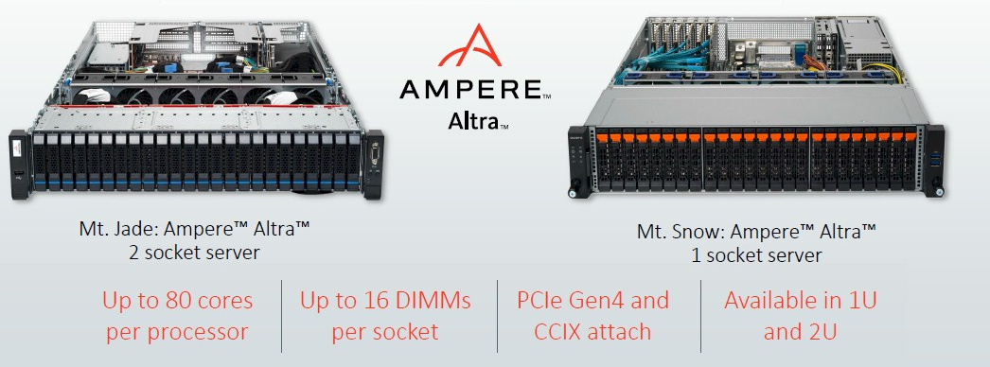
4.2 The Amper Altra (Quicksilver) processor (8)
1S and 2S platforms based on the Altra processors [54]
160 cores
80 cores
Quicksilver processor

Slide 103
4.2 The Amper Altra (Quicksilver) processor (9)
Comparing of SPECint2017 Base Rate MT scores of server processors [63]
NPS4 and SNC1 are
specific BIOS setting
not discussed here)

Slide 104
4.2 The Amper Altra (Quicksilver) processor (10)
Comparing of SPECfp2017 Base Rate MT scores of server processors [63]

Slide 105
4.2 The Amper Altra (Quicksilver) processor (11)
Assessing performance results of Ampere Altra
As above data indicates the 2S Ampere Altra with 2x80 cores has a respectable
performance compared to AMD’s 3. gen. 2S (2x64 core, two-way multithreaded)
EPYC and Intel’s 3. gen. scalable 2S Xeon (2x40 core, two-way multithreaded)
Ice Lake processors.

Slide 106
4.3 The Ampere Altra Max (Mystique) processor
Notes:
106

Slide 107
4.3 The Ampere Altra Max (Mystique) processor (1)
4.3 The Ampere Altra Max (Mystique) processor [64]
Launched in 05/2021.
7 nm technology.
Core count: 128 cores.
Socket and pin-compatible with Altra.
Ampere promises 50 % less power consumption and 1.6x performance gain
per core vs. AMD Rome.
*

Slide 108
4.3 The Ampere Altra Max (Mystique) processor (2)
Main features of the Altra Max [64]

Slide 109
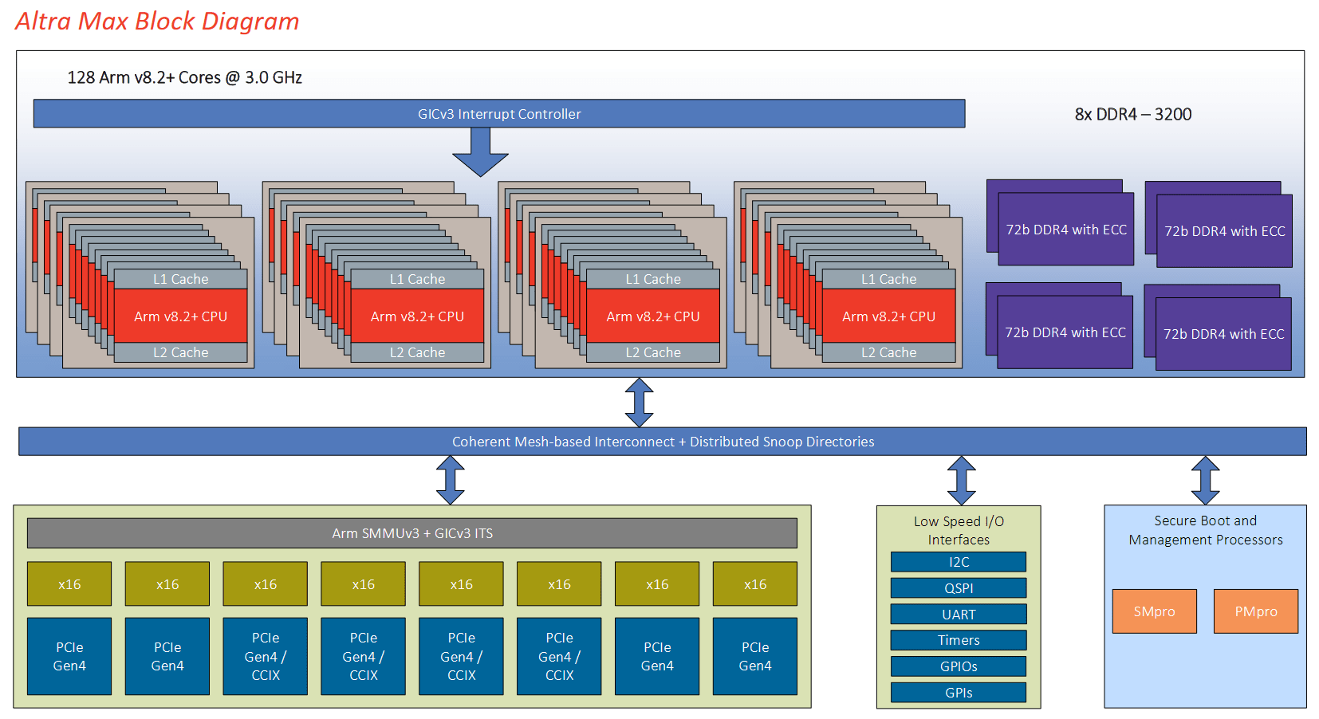
4.3 The Ampere Altra Max (Mystique) processor (3)
Block diagram of Ampere’s 128-core Altra Max server processor [64]
(8x4x4)

Slide 110
Main features of Ampere Altra Max models [65]

Slide 111
SPECint2017 Base Rate MT performance scores of server processors [65]
*

Slide 112
SPECfp2017 Base Rate MT performance scores of server processors [65]
*

Slide 113
Power efficiency (power/core) of selected server processors [66]
Intel Cascade Lake Refresh (14 nm)
Intel Ice Lake (10 nm
AMD Milan (Zen 3)
AMD Rome (Zen 2)
Ampere Altra
Altra Max
*

Slide 114
5. References
Notes:
114

Slide 115
5. References (1)
[1]: AFL Hyperscale, What is Hyperscale?, 2019, https://www.aflhyperscale.com/wp-content/
uploads/2020/06/AFLHS-What-is-Hyperscale-1.2-WQ-1.pdf
[2]: AFL Hyperscale, Understanding Different Types of Data Center, May 11 2020,
https://www.aflhyperscale.com/understanding-different-types-of-data-center/
[3]: Intel Secretly Firefighting a Major CPU Bug Affecting Datacenters?, TechPowerUp,
Jan. 3, 2018, https://www.techpowerup.com/240174/intel-secretly-firefighting-a-major-
cpu-bug-affecting-datacenters#g240174
[4]: AFL Hyperscale, Tiers of Hyperscaler, May 14 2020,
https://www.aflhyperscale.com/tiers-of-hyperscaler/
[5]: Amazon EC2 Instance Types, https://aws.amazon.com/ec2/instance-types/
[6]: Krass P., Meet Intel's new processors for edge computing, Tech Provider Zone, Sept. 23 2020,
https://www.techproviderzone.com/devices/meet-intels-new-processors-for-edge-computing
[7]: Real-Life Use Cases for Edge Computing, IEEE Innovation at work,
https://innovationatwork.ieee.org/real-life-edge-computing-use-cases/
[8]: Morgan T.P., The Prospects for an ARM Server Insurrection, The Next Platform, May 3 2021,
https://www.nextplatform.com/2021/05/03/the-prospects-for-an-arm-server-insurrection/
[9]: Frumusanu A., Arm Announces Neoverse Infrastructure IP Branding & Future Roadmap,
AnandTech, Oct. 16 2018, https://www.anandtech.com/show/13475/arm-announces-
neoverse-infrastructure-ip-branding-future-roadmap

Slide 116
5. References (2)
[10]: Morgan T.P., ARM Goes to War in the Datacenter with „Ares” Designs, The Next Platform,
Febr. 20 2019, https://www.nextplatform.com/2019/02/20/arm-goes-to-war-in-the-
datacenter-with-aries-designs/
[11]: Frumusanu A., Arm Announces Neoverse V1, N2 Platforms & CPUs, CMN-700 Mesh: More
Performance, More Cores, More Flexibility, AnandTech, April 27 2021,
https://www.anandtech.com/print/16640/arm-announces-neoverse-v1-n2-platforms-cpus-
cmn700-mesh
[12]: Frumusanu A., Arm Announces Neoverse V1 & N2 Infrastructure CPUs: +50% IPC, SVE Server
Cores, AnandTech, Sept. 22 2020,
https://www.anandtech.com/show/16073/arm-announces-neoverse-v1-n2
[13]: Parris N., Boost SoC performance from edge to cloud ARM CoreLink System IP, ARM,
Nov. 2016, http://www.armtechforum.com.cn/attached/article/2016ATS_C1_Neil_Parris
20161206151154.pdf
[14]: Kennedy P., Arm Neoverse V1 and N2 Roadmap Update, STH, Sept. 22 2020,
https://www.servethehome.com/arm-neoverse-v1-and-n2-roadmap-update/
[15]: DDR5/4/3/2: How Memory Density and Speed Increased with each Generation of DDR,
Synopsys, Febr. 27 2019, https://blogs.synopsys.com/vip-central/2019/02/27/ddr5-4-3-
2-how-memory-density-and-speed-increased-with-each-generation-of-ddr/
[16]: Smith R., DDR5 Memory Specification Released: Setting the Stage for DDR5-6400 And
Beyond, AnandTech, July 14, 2020,
https://www.anandtech.com/show/15912/ddr5-specification-released-setting-the-stage-
for-ddr56400-and-beyond

Slide 117
5. References (3)
[17]: Jun H., Nam S., Jin H., Lee J-C., Park Y.J., and Lee J.J., High-Bandwidth Memory (HBM) Test
Challenges and Solutions, IEEE Design & Test, Vol. 34, Issue 1, 2017
[18]: High Bandwidth Memory (HBM), DRAM, JESD235A, Jedec Solid State Technology, Nov. 2015,
https://composter.com.ua/documents/JESD235A.pdf
[19]: Harding S., What Are HBM, HBM2 and HBM2E? A Basic Definition, Tom’s Hardware,
April 15 2021, https://www.tomshardware.com/reviews/glossary-hbm-hbm2-high-
bandwidth-memory-definition,5889.html
[20]: PCI Express, Wikipedia, https://en.wikipedia.org/wiki/PCI_Express
[21]: Morgan T.P., Eating The Interconnect Alphabet Soup with Intel’s CXL, The Next Platform,
Sept. 18 2019, https://www.nextplatform.com/2019/09/18/eating-the-interconnect-
alphabet-soup-with-intels-cxl/
[22]: CCIX IP, Cache Coherent Interconnect for Accelerators (CCIX), Cadence,
https://ip.cadence.com/ipportfolio/ip-portfolio-overview/interface-ip/ccix-ip
[23]: Voigt D., Koenen D., Cache Coherent Interface for Accelerators (CCIX), PM Summit,
Jan. 24 2018, San José, CA, https://www.snia.org/sites/default/files/PM-Summit/2018/
presentations/13_PMSummit_18_interconnects_UPDATED.pdf
[24]: Wong W.G., CCIX: Cache Coherent Interconnect for Accelerators, Electronic Design,
Oct. 31 2018, https://www.electronicdesign.com/industrial-automation/article/21807218/
ccix-cache-coherent-interconnect-for-accelerators
[25]: Arm Neoverse N1 Core, Revision: r3p1, Technical Reference Manual

Slide 118
5. References (4)
[26]: Frumusanu A., Arm Announces Neoverse N1 & E1 Platforms & CPUs: Enabling A Huge Jump
In Infrastructure Performance, AnandTech, Febr. 20 2019,
https://www.anandtech.com/print/13959/arm-announces-neoverse-n1-platform
[27]: Pellegrini A. et al., The Arm Neoverse N1 Platform: Building Blocks for the Next-Gen
Cloud-to-Edge Infrastructure SoC, IEEE Micro, Vol. 40, Issue 2, 2020
[28]: Neoverse Reference Design, ARM Developer, https://developer.arm.com/tools-and-software/
development-boards/neoverse-reference-design?_ga=2.220183775.71780618.1619202436-
2021226593.1618858037
[29]: ARM Cortex-A75 Core, Revision: r2p0, Technical Reference Manual, June 03 2017
[30]: Power and Performance Management using Arm, SCMI Specification, White Paper
[31]: Madhu P., Enabling Collaborative Processor Performance Control (CPPC) on Arm Platforms,
linaro.org, 2021, https://static.linaro.org/connect/lvc21/presentations/lvc21-219.pdf
[32]: Rusitoru R., Power Saving and Monitoring Features on Hardware Level, EETHPC 2018,
June 28 2018, http://eethpc.net/wp-content/uploads/2018/06/ARM_EEHPC_ISC18.pdf
[33]: Using bfloat16 with TensorFlow models, Google Cloud,
https://cloud.google.com/tpu/docs/bfloat16
[34]: Arm Architecture Reference Manual Armv8, for Armv8-A architecture profile
https://developer.arm.com/documentation/ddi0487/latest/
[35]: Sandhu T., Arm releases Cortex-A77 CPU for next-gen mobile devices, Hexus, May 27 2019,
https://hexus.net/tech/news/cpu/130757-arm-releases-cortex-a77-cpu-next-gen-
mobile-devices/

Slide 119
5. References (5)
[36]: Schor D., Arm Updates Its Neoverse Roadmap: New BFloat16, SVE Support, WikiChip Fuse,
Sept. 22 2020, https://fuse.wikichip.org/news/4564/arm-updates-its-neoverse-roadmap-
new-bfloat16-sve-support/
[37]: Taneja M., Arm Neoverse N2 Platform: Industry-leading performance and power efficiency
for Cloud-to-Edge infrastructure, ARM Community, April 27 2021,
https://community.arm.com/developer/ip-products/processors/b/processors-ip-blog/posts/
arm-neoverse-n2-industry-leading-performance-efficiency
[38]: Stephens N., Biles S., Boettcher M., Eapen J., The ARM Scalable Vector Extension, IEEE Micro,
Vol, 37, Issue 2. March-April 2017
[39]: Matta A., Arm Neoverse V1 Platform: Unleashing a new performance tier for Arm-based
computing, ARM Community, April 27 2021,
https://community.arm.com/developer/ip-products/processors/b/processors-ip-blog/posts/
neoverse-v1-platform-a-new-performance-tier-for-arm
[40]: De Gelas J., New ARM IP Launched: CMN-600 Interconnect for 128 Cores and DMC-620, an
8Ch DDR4 IMC, AnandTech, Sept. 27 2016,
https://www.anandtech.com/show/10711/arm-cmn-600-dmc-620-128-cores-8-channel-ddr4
[41]: Parris N., Maximizing heterogeneous system performance with ARM interconnect and CCIX,
Teratec, June 2017, https://teratec.eu/library/pdf/forum/2017/Presentations/A7_04_
Forum_TERATEC_2017_%20PARRIS_%20ARM.pdf
[42]: Neoverse E1, ARM Developer,
https://developer.arm.com/ip-products/processors/neoverse/neoverse-e1

Slide 120
5. References (6)
[43]: Sun G., Underhill J., Build cost-effective web & containerized apps on EC2 Arm instances,
2019, https://d1.awsstatic.com/events/reinvent/2019/REPEAT_Build_cost-effective_web_
&_containerized_apps_on_EC2_Arm_instances_CMP329-R.pdf
[44]: Kennedy P., Putting AWS Graviton and its Arm CPU Performance in Context, STH, Nov. 28 2018,
https://www.servethehome.com/putting-aws-graviton-its-arm-cpu-performance-in-context/
[45]: Frumusanu A., Amazon's Arm-based Graviton2 Against AMD and Intel: Comparing Cloud
Compute, AnandTech, March 10 2020, https://www.anandtech.com/show/15578/cloud-
clash-amazon-graviton2-arm-against-intel-and-amd/2
[46]: Morgan T.P., Applied Micro Finds ARM Server Footing, Reaches Higher, The Next Platform,
Oct. 4 2016, https://www.nextplatform.com/2016/10/04/applied-micro-finds-arm-server-
footing-reaches-higher/
[47]: Singh G., Favor G., Yeung A., AppliedMicro X-Gene2, HotChips 2014,
https://old.hotchips.org/wp-content/uploads/hc_archives/hc26/HC26-11-day1-epub/
HC26.11-4-ARM-Servers-epub/HC26.11.430-X-Gene-Singh-AppMicro-HotChips-2014-v5.pdf
[48]: Hollas S., Ampere for the openEDGE, OCP Regional Summit, Sept. 26-27 2019, SlidePlayer,
https://slideplayer.com/slide/17546223/
[49]: Frumusanu A., Avantek's Arm Workstation: Ampere eMAG 8180 32-core Arm64 Review
AnandTech, May 22 2020, https://www.anandtech.com/print/15733/ampere-emag-system-
a-32core-arm64-workstation
[50]: Ampere eMAG 8180 64-bit Arm Processor, Product Brief, 2018,
https://amperecomputing.com/wp-content/uploads/2019/01/eMAG8180_PB_v0.5_20180914.pdf

Slide 121
5. References (7)
[51]: APM883832-X3, X-Gene 3 Multi-Core 64-bit Processor, Applied Micro, 2016,
https://en.wikichip.org/w/images/2/22/832-X3_PB.pdf
[52]: Frumusanu A., The Ampere Altra Review: 2x 80 Cores Arm Server Performance Monster
AnandTech, Dec. 18 2020, https://www.anandtech.com/print/16315/the-ampere-altra-review
[53]: Ampere Altra 64-Bit Multi-Core Arm Processor, Product Brief, Febr. 27 2020,
https://amperecomputing.com/wp-content/uploads/2020/03/Altra_PB_v0.60_20200227.pdf
[54]: Morgan T.P., Ampere Aims for the Clouds with Altra ARM Server Chip, The Next Platform,
March 3 2020, https://www.nextplatform.com/2020/03/03/ampere-aims-for-the-clouds-
with-altra-arm-server-chip/
[55]: Frumusanu A., Hot Chips 2020: Marvell Details ThunderX3 CPUs - Up to 60 Cores Per Die,
96 Dual-Die in 2021, AnandTech, Aug. 17 2020,
https://www.anandtech.com/show/15995/hot-chips-2020-marvell-details-thunderx3
[56]: Aufranc J-L., Cavium ThunderX Server SoC Features up to 48 ARM 64-bit Cores, CNX Software,
June 4 2014, https://www.cnx-software.com/2014/06/04/cavium-thunderx-server-soc-48-
core-armv8/
[57]: De Gelas J., Investigating Cavium's ThunderX: The First ARM Server SoC With Ambition
AnandTech, June 15 2016, https://www.anandtech.com/show/10353/investigating-cavium-
thunderx-48-arm-cores
[58]: INTER-CHIP INTERCONNECT PROTOCOL FOR A MULT-CHP SYSTEM,
US Patent application US 2015/0254.183 A1 Filed: Mar. 7, 2014

Slide 122
5. References (8)
[59]: Sciabá A., CPUs, GPUs, accelerators and memory, HOW Workshop, 18-22 March 2019,
Jefferson Lab, Newport News,
https://indico.cern.ch/event/805578/contributions/3351993/subcontributions/277064/
attachments/1810601/2956858/CPUs_GPUs_accelerators_and_memory.pdf
[60]: De Gelas J., Assessing Cavium's ThunderX2: The Arm Server Dream Realized At Last,
AnandTech, May 23 2018, https://www.anandtech.com/show/12694/assessing-cavium-
thunderx2-arm-server-reality
[61]: Rabin S., ThunderX3 Next Generation ARM-Based Server, Hot Chips 32, 2020
[62]: Frumusanu A., Marvell Refocuses Thunder Server Platforms Towards Custom Silicon Business
AnandTech, Aug. 28 2020, https://www.anandtech.com/show/16049/marvell-refocuses-
thunder-server-platforms-towards-custom-silicon-business
[63]: Frumusanu A., Intel 3rd Gen Xeon Scalable (Ice Lake SP) Review: Generationally Big,
Competitively Small, AnandTech, April 6, 2021,
https://www.anandtech.com/show/16594/intel-3rd-gen-xeon-scalable-review
[64]: Ampere® Altra Max Product Brief, Ampere, June 2021,
https://amperecomputing.com/wp-content/uploads/2021/06/Altra_Max_Rev_A1_PB_v0.55_
2021061261.pdf
[65]: Frumusanu A., The Ampere Altra Max Review: Pushing it to 128 Cores per Socket, AnandTech,
Oct. 7, 2021,
The Ampere Altra Max Review: Pushing it to 128 Cores per Socket - Print View (anandtech.com)
[66]: Amperes server CPUs: After Altra Max with 128 cores, a new architecture follows, Allinfo,
May 20, 2021,
Amperes server CPUs: After Altra Max with 128 cores, a new architecture follows | AllInfo

Slide 123
[67]: Data Centre Budapest (visited on 13. Nov., 2021,
https://www.t-systems.hu/solutions/it-infrastructures/about-adatkozpont-budapest
[68]: Fulton B., How hyperscale data centers are reshaping all of IT, ZDNet, April 5, 2019,
https://www.zdnet.com/article/how-hyperscale-data-centers-are-reshaping-all-of-it/
[69]: RagingWire Opens New VA3 Data Center and Ashburn Data Center Campus in the Heart of
Famed “Data Center Alley”, Ashburn, March 20, 2018,
https://www.ragingwire.com/news/ragingwire-opens-new-va3-data-center-and-ashburn-
data-center-campus

