Slide 1
Intel’s Core 2 family
Overview
Dezső Sima
Vers. 2.1
September 2021
© Dezső Sima 2020

Slide 2
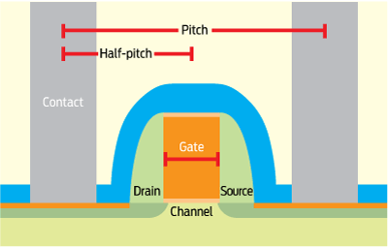
Premiminary remarks (1)
Preliminary remarks for the assessment of the IC fabrication processes of Intel, TSMC
and Samsung
Traditional planar IC process technologies were characterized by the minimum feature size of the
MOSFET transistors.
The minimum feature size was interpreted as the gate length of the MOSFET transistors,
as indicated below:
MOSFET: Metal Oxide Semiconductor Field Effect transistor

Slide 3
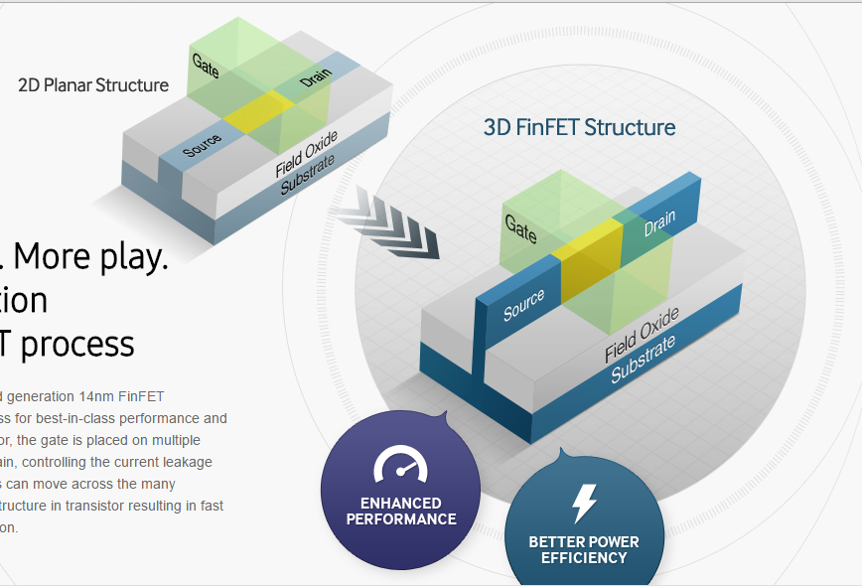
Premiminary remarks (2)
Cont. -1
In 2012 Intel replaced former 2D (planar) MOSFET transistors by 3D FinFET structures
(termed after the “fins” used), as indicated below.
Due to its benefits subsequently 3D FinFET transistor technology became prevalent, i.e. all major
IC vendors (TSMC, Samsung, GlobalFoundries) followed this move.
fin
Figure: Transition from 2D transistor structures
to 3D FinFET structures [338]
IC: Integrated Circuits
FET: Field Effect transistor
MOS: Metal Oxid Semiconductor
TSMC: Taiwanese Semiconductor Manufacturing Company
*

Slide 4
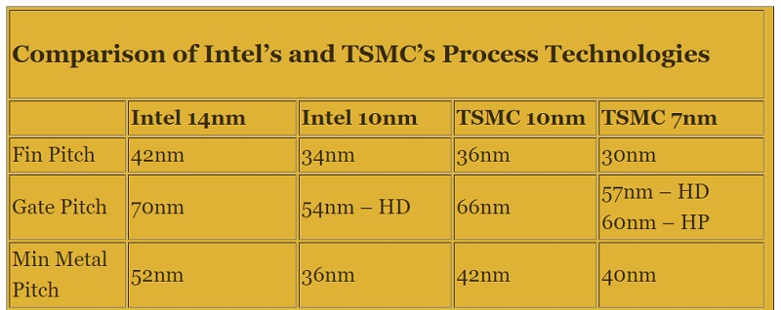
Premiminary remarks (3)
Cont. -2
Characterization of the 3D FinFET transistor structures needs however, a number of parameters
(not detailed here).
In publications however, process technology is usually characterized further on by a single
entity, called process node or simply node, e.g. 10 nm or 7 nm node.
Obviously, this kind of process characterization is not at all exact, for a more reliable
comparison a set of key process parameters should be taken into account, as indicated
for instance in the Table below.
Table: Comparing Intel’s and TSMC’s process technologies [339]
(Node: gyártástechnológia)

Slide 5
Premiminary remarks (4)
Cont. -3
By contrasting main parameters of the fabrication process given in the preceding Table,
it becomes obvious that Intel’s 10 nm technology fits roughly to TSMC’s 7 nm technology.
This is also true for Samsung’s process data [341], so it can be stated that Intel’s 10 nm
IC process is roughly equivalent to TSMC’s and Samsung’s 7 nm technology.
By comparing process node statements relating to different ICs the above discrepancy should
always be taken into account.
*

Slide 6
1. Introduction
1. Overview of the evolution of Intel's Pentium 4 and
Core 2 families
2. Evolution of desktop and laptop processors
3. Evolution of HEDT (High-End Desktop) processors
4. Evolution of high-end 2S server processors
5. Evolution of tablet and smartphone processors
Notes:
6

Slide 7
Overview of the evolution of Intel's Pentium 4 and
Core 2 families
Notes:
7

Slide 8
1. Overview of the evolution of Intel's Pentium 4 and Core 2 families (1)
1. Overview of the evolution of Intel's Pentium 4 and Core 2 families (Based on [3])
The Core 2 family was preceded by the Pentium 4 family.
The Pentium 4 family includes 3 generations and introduced important innovations, as listed below.
Key new features of the ISP
and the microarchitecture
2 YEARS
TICK
TOCK
180nm
11/2000
New microarch.
called Netburst
Pentium 4 /Willamette
2 YEARS
TICK
TOCK
130nm
01/2002
New microarch.,
Hyperthreading (HT)
Pentium 4 /Northwood
TICK
TOCK
90nm
02/2004
New microarch., 64-bit
Dual cores (DC) for the
Pentium D (Smithfield) (05/2005)
2 YEARS
Pentium 4 /Prescott
TICK Pentium 4 (Cedar Mill SC)
Pentium D (Presler DC)
01/2006
2 YEARS
TOCK Core 2
65nm
07/2006
Note
This is a single phase development model, in each generation both technology and
microarchitecture is changed.
*
*

Slide 9
1. Overview of the evolution of Intel's Pentium 4 and Core 2 families (2)
Design target of the Pentium 4 family
At Pentium 4's launch (Nov. 2000) Intel's vice president (Otellini) claimed that the lifespan of the
Netburst microarchitecture would be 7 years and its expected clock frequency would break the
10 GHz mark in 2006 [219].
*

Slide 10
1. Overview of the evolution of Intel's Pentium 4 and Core 2 families (3)
Intel's Pentium 4 family
180 nm
130 nm
90 nm

Slide 11
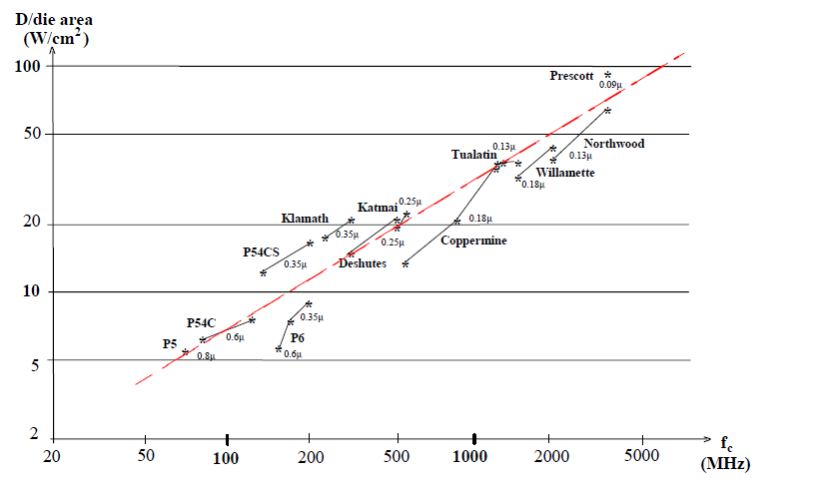
1. Overview of the evolution of Intel's Pentium 4 and Core 2 families (4)
Relative dissipation of Intel's x86 family of processors
Pentium 4
Pentium III
Pentium

Slide 12

1. Overview of the evolution of Intel's Pentium 4 and Core 2 families (5)
Intel's cancellation of 4 GHz Pentium 4 devices and subsequently the Pentium 4 line
In Oct. 2004 Intel's CEO (Chief Executing Officer) admitted that the Pentium 4 family
would not achieve 4 GHz [220].
Figure: In Oct. 2004 Crag Barrett, Intel's then-CEO on his knees to apologize for not achieving the
4GHz mark in front of an audience of 7000 informatics professional at the IT Expo in Orlando [220]

Slide 13
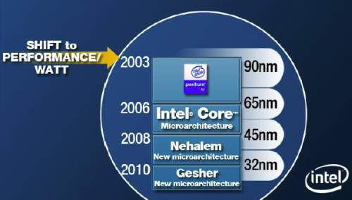
1. Overview of the evolution of Intel's Pentium 4 and Core 2 families (6)
Changing Intel's design paradigm to cope with raising dissipation about 2003
In 2003 Intel shifted the focus of their processor development from the pure performance goal
to the aspect of performance per watt, as stated in a slide from 4/2006, see below.
Figure 1.3: Intel’s plan to develop their manufacturing technology and processor lines
revealed at a shareholder’s meeting back in 4/2006 [74]
*

Slide 14
1. Overview of the evolution of Intel's Pentium 4 and Core 2 families (7)
Remark: A further change of the design paradigm for designing the mobile processors
With the advent of mobile devices (about 2006) a new design paradigm arose for those devices.
Mobile devices require long operating hours i.e. low power consumption, this is contrast to the
design paradigm of traditional processors, as indicated below.
Traditional processors
Tablets and smartphones
High performance/power
(e.g. GFLOPS/Watt)
Low power
(Watt)
(Number of operating hours)
*

Slide 15
1. Overview of the evolution of Intel's Pentium 4 and Core 2 families (8)
Introducing a two-phase development model (Tick-Tock model) for the Core 2 family
The two-phase model reduces the complexity of the development, as
the Tick phase focuses on the reduction of the feature size whereas
the Tock phase focuses on enhancing the microarchitecture.
*

Slide 16
1. Overview of the evolution of Intel's Pentium 4 and Core 2 families (9)
1. Introduction (1)
Overview of the evolution of Intel's Core 2 families - the generations
gen.
2. gen.
3. gen.
4. gen.
5. gen.
Core 2
New
Microarch.
65 nm
Penryn
New
Process
45 nm
Nehalem
New
Microarch.
45 nm
West-
mere
New
Process
32 nm
Sandy
Bridge
New
Microarch.
32 nm
Ivy
Bridge
New
Process
22 nm
Haswell
New
Microarchi.
22 nm
Broad-
well
New
Process
14 nm
TOCK
TICK
TOCK
TICK
TOCK
TICK
TOCK
TICK
(2006)
(2007)
(2008)
(2010)
(2011)
(2012)
(2013)
(2014)
6. gen.
7. gen.
8. gen.¹
9. gen.
10. gen.
¹The 8th generation encompasses
the following processor lines:
Skylake
New
Microarch.
14 nm
Kaby Lake
New
Microarch.
14 nm
Kaby Lake R/G
Coffee Lake
Amber Lake-Y
Whiskey Lake-U
Cannon Lake
14/10 nm
Coffee Lake R
New
Microarch.
14 nm
Ice Lake
Comet Lake
New
Microarch.
10/14 nm
Kaby Lake Refresh
Kaby Lake G with AMD Vega
graphics
Coffee Lake
Amber Lake Y
Whiskey Lake U
(all 14 nm) and
Cannon Lake (10 nm)
TOCK
TOCK
TOCK
TOCK
TOCK
lines [218].
(2015)
(2016)
(2017/18)
(2018)
(2019)
R: Refresh

Slide 17
1. Overview of the evolution of Intel's Pentium 4 and Core 2 families (10)
Overview of the evolution of Intel's Core 2 families - The generations -2
11. gen.
12. gen.
Tiger
Lake
New
Process
10 nm
Alder Lake
New
Microarch.
10 nm
TICK
TOCK
(2020)
(2021)?

Slide 18
1. Overview of the evolution of Intel's Pentium 4 and Core 2 families (11)
1. Introduction (1)
Overview of the evolution of Intel's Core 2 families - The development centers
gen.
2. gen.
3. gen.
4. gen.
5. gen.
Core 2
New
Microarch.
65 nm
Penryn
New
Process
45 nm
Nehalem
New
Microarch.
45 nm
West-
mere
New
Process
32 nm
Sandy
Bridge
New
Microarch.
32 nm
Ivy
Bridge
New
Process
22 nm
Haswell
New
Microarchi.
22 nm
Broad-
well
New
Process
14 nm
TOCK
TICK
TOCK
TICK
TOCK
TICK
TOCK
TICK
Haifa
Oregon
Oregon
Oregon
Haifa
Haifa
Oregon
Oregon
6. gen.
7. gen.
8. gen.¹
9. gen.
10. gen.
¹The 8th generation encompasses
the following processor lines:
Skylake
New
Microarch.
14 nm
Kaby Lake
New
Microarch.
14 nm
Kaby Lake R/G
Coffee Lake
Amber Lake-Y
Whiskey Lake-U
Cannon Lake
14/10 nm
Coffee Lake R
New
Microarch.
14 nm
Ice Lake
Comet Lake
New
Microarch.
10/14 nm
Kaby Lake Refresh
Kaby Lake G with AMD Vega
graphics
Coffee Lake
Amber Lake Y
Whiskey Lake U
(all 14 nm) and
Cannon Lake (10 nm)
TOCK
TOCK
TOCK
TOCK
TOCK
lines [218].
Haifa
Haifa
Haifa
Haifa
Haifa
R: Refresh

Slide 19
1. Overview of the evolution of Intel's Pentium 4 and Core 2 families (12)
1. Introduction (1)
Basic designations of Intel’s processor lines
EE
gen.
4/5/6xxx
2. gen.
2xxx
3. gen.
3xxx
4. gen.
4xxx
5. gen.
5xxx
M/DT
6/7/8/9xxx
i5/i7-xxx
i3/i5/i7-xxx
Core 2
New
Microarch.
65 nm
Penryn
New
Process
45 nm
Nehalem
New
Microarch.
45 nm
West-
mere
New
Process
32 nm
Sandy
Bridge
New
Microarch.
32 nm
Ivy
Bridge
New
Process
22 nm
Haswell
New
Microarchi.
22 nm
Broad-
well
New
Process
14 nm
TOCK
TICK
TOCK
TICK
TOCK
TICK
TOCK
TICK
HEDT
S
X/QX 6xxx
3/5/7xxx
QX 96/97xx
3/5/7xxx
i7-965/975
3/5xxx
980/990
E7-xxx
38/39xx
E3/E5/E7-xxxx
48/49xx
v2
58/59xx
v3
68/69xx
v4
¹The 8th generation
encompasses the following
processor lines:
6. gen.
6xxx
7. gen.
7xxx
8. gen.¹
i9 8xxx
9. gen.
9xxx
10. gen.
10xxx
M/DT
Skylake
New
Microarch.
14 nm
Kaby Lake
New
Microarch.
14 nm
Kaby Lake R/G
Coffee Lake
Amber Lake-Y
Whiskey Lake-U
Cannon Lake
14/10 nm
Coffee Lake R
New
Microarch.
14 nm
Ice Lake
Comet Lake
New
Microarch.
10/14 nm
Kaby Lake Refresh
Kaby Lake G with
AMD Vega graphics
Coffee Lake
Amber Lake Y
Whiskey Lake U
(all 14 nm) and
Cannon Lake (10 nm)
TOCK
TOCK
TOCK
TOCK
TOCK
lines [218].
HEDT
S
i7-78xx/i9-79xx
New designations
i5-76xx/i7-77xx
© Dezső Sima 2020
M: Mobile DT: Desktop HE: High-End S: Server
R: Refresh

Slide 20
1. Overview of the evolution of Intel's Pentium 4 and Core 2 families (13)
Basic microarchitectures and their related shrinks
Presented from the Pentium 4 Prescott core (the third core of Pentium 4) on.
Basic architectures | Basic architectures and their shrinks
Pentium 4 (Prescott) | 2005 90 nm Pentium 4 2006 65 nm Pentium 4
Core 2 | 2006 65 nm Core 2 2007 45 nm Penryn
Nehalem | 2008 45 nm Nehalem 2010 32 nm Westmere
Sandy Bridge | 2011 32 nm Sandy Bridge 2012 22 nm Ivy Bridge
Haswell | 2013 22 nm Haswell 2014 14 nm Broadwell
Skylake | 2015 14 nm Skylake 14 nm Kaby Lake 14 nm Coffee Lake 10 nm Cannon Lake
Icelake | 2019 10 nm Icelake

Slide 21
1. Overview of the evolution of Intel's Pentium 4 and Core 2 families (14)
Evolution of Intel’s IC technology
Pentium 4
Willamette
nm
200
180 nm
Pentium 4
Northwood
180
11/00
01/02
160
Pentium 4
Prescott
140
130 nm
02/04
120
Pentium 4
Cedar Mill
100
90 nm
01/06
80
Penryn
65 nm
11/07
Westmere
60
45 nm
01/10
Ivy Bridge
40
32 nm
04/12
Broadwell
Cannon lake
22 nm
09/14
14 nm
2H/17
20
10 nm
0
2000
2002
2004
2006
2008
2010
2012
2014
2016
2018
On Intel’s Q2 2015 earnings conference call, on July 16 2015, Krzanich, Intel's CEO (Chief Executive Officer) told:
in the second half of 2017, we expect to launch our first 10-nanometer product, code named Cannon Lake.
The last two technology transitions have signaled that our cadence today is closer to 2.5 years than two“ [180].
*

Slide 22
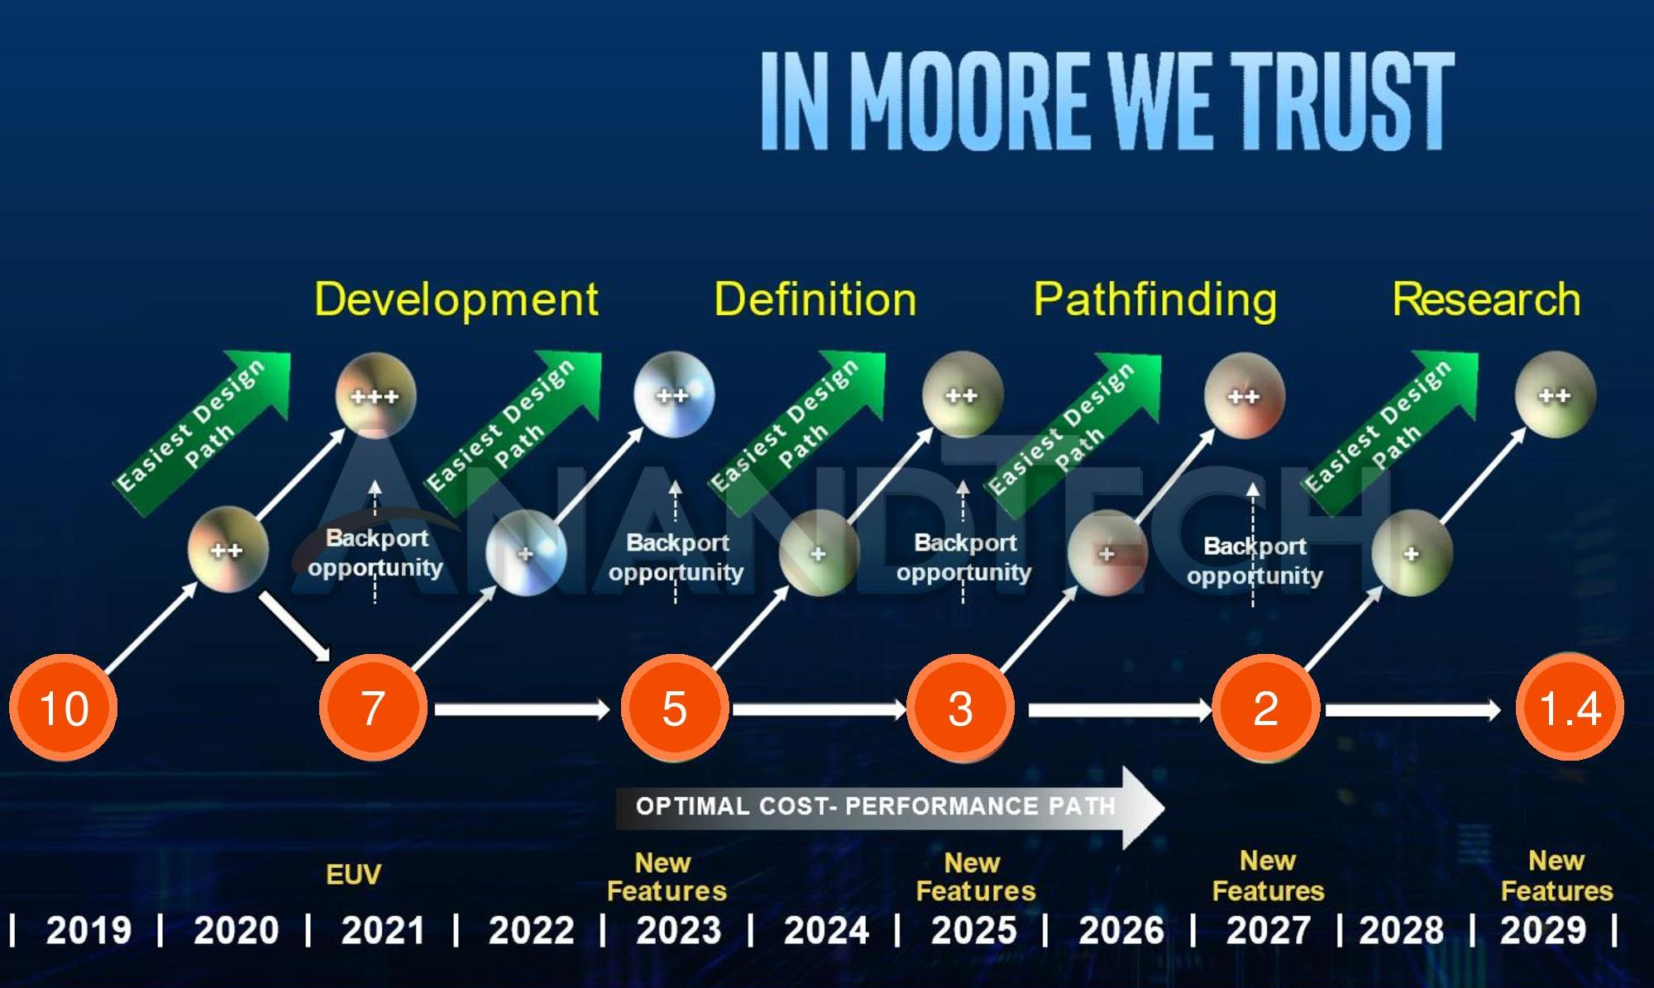
1. Overview of the evolution of Intel's Pentium 4 and Core 2 families (15)
Intel’s astonishing process evolution roadmap from 12/2019 [342]
*

Slide 23
1. Overview of the evolution of Intel's Pentium 4 and Core 2 families (16)
Remark
3 nm distance is equivalent to the extent of 12 Si atoms ordered in line.
(Si atom: ~0.24 nm).

Slide 24
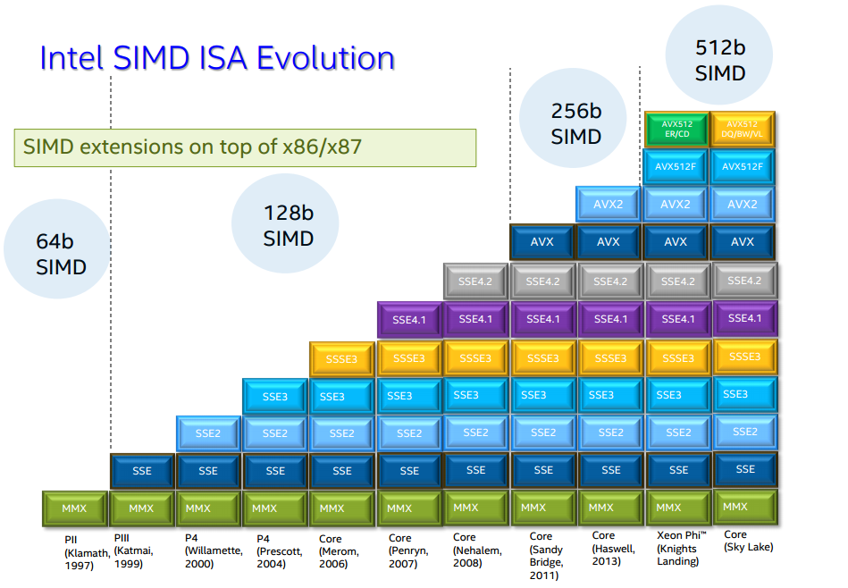
1. Overview of the evolution of Intel's Pentium 4 and Core 2 families (17)
Evolution of Intel’s x86 ISA extensions [42]
Pentium_MMX
(1997)
PII
Klamath,
(1997)
Core
Cannon-Lake,
(2018)
Skylake-X/SP,
(2017)
(2016)

Slide 25
1. Overview of the evolution of Intel's Pentium 4 and Core 2 families (17b)
Key ISA and the microarchitecture innovations of the Core 2 family (based on [3]) -1
Key new features of the ISA
and the microarchitecture
2 YEARS
TICK Pentium 4 ( Cedar Mill)
Pentium D (Presler)
01/2006
2 YEARS
65nm
New microarch.: 4-wide core,
128-bit SIMD FX/FP EUs,
shared L2 , no HT
TOCK Core 2
1G
07/2006
2 YEARS
TICK Penryn Family
11/2007
45nm
New microarch.: 4 cores, integr. MC,
QPI, private L2, (inclusive) L3, HT
TOCK Nehalem
11/2008
TICK Westmere
01/2010
In package integrated GPU
2 YEARS
32nm
2G
New microarch.: 256-bit (FP) AVX,
ring bus, integrated GPU
TOCK Sandy Bridge
01/2011
3G
TICK Ivy Bridge
04/2012
2 YEARS
22nm
New microarch.: 256-bit (FX) AVX2,
L4 cache (discrete eDRAM), TSX
4G
TOCK Haswell
06/2013
5G
Shared Virtual Memory
TICK Broadwell
09/2014
6G
10/2015
New microarch.: 5-wide core,
ISP, Memory Side L4 cache, no FIVR
TOCK Skylake
TOCK Kaby Lake
14nm
08/2016
Optane memory, in KBL G series:
in package integr. CPU, GPU, HBM2
7G
TOCK Kaby Lake Refresh
6 YEARS
8G
14nm
08/2017
8G
6C, (PCHs of S-series DTs support:
USB G2, integr. conn., Optane 2)
TOCK Coffee Lake
10/2017
8G
TOCK Amber/Whiskey Lake
08/2018
9G
10/2018
TOCK Coffee Lake Refresh
8C
10G
08/2019
10C
TOCK Comet Lake

Slide 26
1. Overview of the evolution of Intel's Pentium 4 and Core 2 families (18)
Key ISA and the microarchitecture innovations of the Core 2 family (based on [3]) -1
Key new features of the ISA
and the microarchitecture
8G
TICK Cannon Lake
05/2018
AVX 512
10G
4 YEARS
TOCK Ice Lake
07/2019
New microarchitecture
Thunderbolt 3, WiFi 6
11G
10nm
TOCK Tiger Lake
09/2020
12G
TOCK Alder Lake
??/2022

Slide 27
1. Overview of the evolution of Intel's Pentium 4 and Core 2 families (19)
Key power management innovations of the Core 2 family (based on [3]) -1
Key new features
of the power management
2 YEARS
TICK Pentium 4 ( Cedar Mill)
Pentium D (Presler)
01/2006
2 YEARS
65nm
Clock gating, PECI,
Platform Thermal Control by
3. party controller
TOCK Core 2
1G
07/2006
2 YEARS
TICK Penryn Family
11/2007
EDAT
45nm
Integrated Power Gates, PCU,
Turbo Boost
TOCK Nehalem
11/2008
TICK Westmere
01/2010
2 YEARS
32nm
2G
Turbo Boost 2.0
TOCK Sandy Bridge
01/2011
3G
2 YEARS
TICK Ivy Bridge
04/2012
22nm
4G
06/2013
FIVR
TOCK Haswell
5G
2. gen. FIVR
TICK Broadwell
09/2014
Speed Shift Technology,
Duty Cycle control, No FIVR
except Skylake X
6G
10/2015
TOCK Skylake
7G
14nm
TOCK Kaby Lake
08/2016
Speed Shift Technology v2
8G
6 YEARS
TOCK Kaby Lake Refresh
14nm
08/2017
8G
In H-series: TVB
(Thermal Velocity Boost)
TOCK Coffee Lake
10/2017
8G
TOCK Amber/Whiskey Lake
08/2018
9G
10/2018
TOCK Coffee Lake Refresh
STIM
10G
08/2019
TOCK Comet Lake

Slide 28
1. Overview of the evolution of Intel's Pentium 4 and Core 2 families (20)
Key power management innovations of the Core 2 family (based on [3]) -2
Key new features
of the power management
8G
TICK Cannon Lake
05/2018
10G
FIVR, Dynamic Tuning 2.0
(not discussed)
4 YEARS
TOCK Ice Lake
07/2019
11G
10nm
TOCK Tiger Lake
09/2020
12G
TOCK Alder Lake
??/2022

Slide 29
1. Overview of the evolution of Intel's Pentium 4 and Core 2 families (21)
Raising of the single thread IPC in Intel’s basic architectures (Based on [195])
2
24%
22%
Per Generation
1.9
20%
Cumulative
1.8
18%
1.7
16%
1.6
14%
12%
1.5
10%
1.4
8%
1.3
6%
1.2
4%
2%
1.1
0%
1
Pentium M
Dothan
Core 2
Penryn
NHM
(w/o SMT)
WSM
SNB
IVB
HSW
BRW
SKL
IPC: Instructions
Per Cycle
Note that Intel raised IPC in the Core family only less then 2-times in about 10 years.
Tock models contribute by about 10 %, Tick models by about 5 % for raising IPC.
*

Slide 30
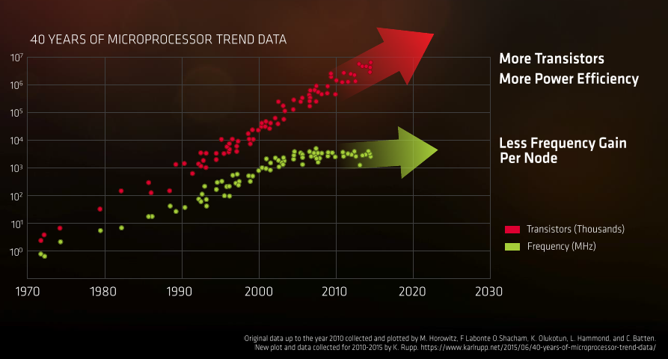
1. Overview of the evolution of Intel's Pentium 4 and Core 2 families (22)
General implications of the evolution of transistor technology [245]
Presentation at AMD's Financial Analyst Day May 16 2017
*

Slide 31


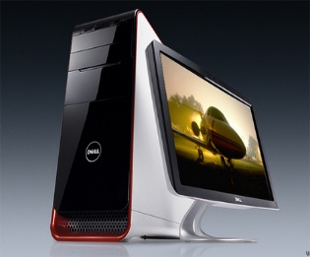
1. Overview of the evolution of Intel's Pentium 4 and Core 2 families (23)
Recent processor categories of Intel
Servers
Desktops/Laptops
(Clients)
Tablets/
HEDTs
(High-End Desktops)
Smartphones
Desktops
(Mobiles)
Xeon E7/E5/E3
Platinum/Gold etc.
Core i7/i9
(Extreme Edition
or X models)
Core i7/i5/i3
(Basic architectures)
Atom lines
(+ LP Core models)
Atom lines
Smarphones
C a n c e l l e d i n 2 0 1 6
Smarphones
Laptops
Tablets
Servers
High-End Desktops
Desktops
Laptops
Tablets
Smartphones
Servers
High-End Desktops
Desktops
Typical config.
Up to 28C
2C - 18C
2C – 10C + G
(Up to 4C - 10C + G)
(by other vendors)
*

Slide 32
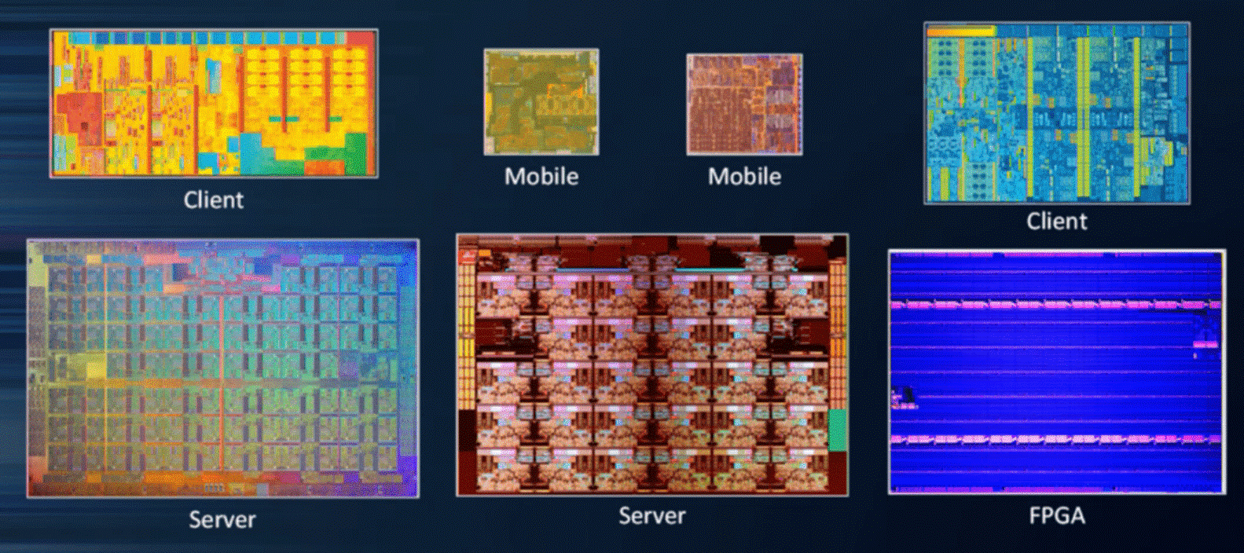
1. Overview of the evolution of Intel's Pentium 4 and Core 2 families (24)
14 nm dies of Intel's different processor categories (not on scale) [247]
Broadwell (2C, 82 mm²)
Skylake (4C, 122 mm²)
Knights Landing (72C, ~680 mm²)
Skylake-SP (28C, ~680 mm²)

Slide 33

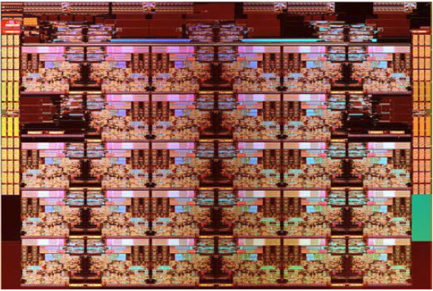
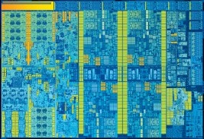
1. Overview of the evolution of Intel's Pentium 4 and Core 2 families (25)
14 nm dies of Intel's different processor categories (approximately on scale) [247]
Broadwell (2C, 82 mm²)
Skylake-SP (28C, ~680 mm²)
Skylake (4C, 122 mm²)

Slide 34
2. Evolution of desktop and laptop processors
Notes:
34

Slide 35
2. Evolution of desktop and laptop processors (1)
2. Evolution of desktop and laptop processors
Recent processor categories of Intel
Servers
HEDTs
(High-End Desktops)
Desktops/Laptops
(Clients)
Tablets/
Smartphones
Desktops
(Mobiles)
Xeon E7/E5/E3
Platinum/Gold etc.
Core i7/i9
(Extreme Edition
or X models)
Core i7/i5/i3
(Basic architectures)
Atom lines
(+ LP Core models)
Atom lines
Smarphones
Smarphones
Laptops
Tablets
Servers
High-End Desktops
Desktops
Laptops
Tablets
Smartphones
Servers
High-End Desktops
Desktops

Slide 36
2. Evolution of desktop and laptop processors (2)
Intel’s Core-based mainstream DT and or laptop platforms
Designation of the platform | MC placem. | Processor | Technology | Max. no. of cores (n_{C}) | Year of intro. | Processor socket | MCH/PCH | Highest mem./ speed | No. of mem. channels
Anchor Creek | MC in NB | Pentium D | 90 nm | 2x1 | 5/2005 | LGA 775 | 945-955 | DD2-667 | 2
Bridge Creek |  | Core 2 | 65 nm | 2C | 6/2006 | LGA 775 | 945-975 | DDR2-800 | 2
Salt Creek |  | Core 2 Quad | 65 nm | 2x2C | 6/2007 | LGA 775 | 3 Series (Bearlake) | DDR3-1067 | 2
Boulder Creek |  | Penryn | 45 nm | 2x2C | 6/2008 | LGA 775 | 4 Series (Eaglelake) | DDR3-1067 | 2
Kings Creek | On-die MC | 2. G. Nehalem (Lynnfield) | 45 nm | 4C | 9/2009 | LGA 1156 | 5 Series (Ibex Peak) | DDR3-1333 | 2
 |  | Westmere (Clarkdale) | 32 nm | 2C+G | 1/2010 | LGA 1156 | 5 Series (Ibex Peak)
 |  | Sandy Bridge | 32 nm | 2C/4C+G | 1/2011 | LGA 1155 | 6 series (Cougar Point) | DDR3-1333 | 2
Sugar Bay
Maho Bay |  | Ivy Bridge | 22 nm | 4C +G | 4/2012 | LGA 1155 | 7 series (Panther Point) | DDR3-1600 | 2
Shark Bay |  | Haswell | 22 nm | 4C+G | 6/2013 | LGA 1155 | 8 Series (Lynx Point) | DDR3-1600 | 2
 |  | Haswell refresh | 22 nm | 4C+G | 5/2014 | LGA 1150 | 9 Series (Wild Cat Point) | DDR3-1666
 |  | Broadwell | 14 nm | 4C+G | 6/2015 | LGA 1150 | 9 Series (Wild Cat Point) | DDR3-1866
 |  | Skylake | 14 nm | 4C+G | 10/2015 | LGA 1151 | Series (Sunrise Point) | DDR4-2133 | 2
 |  | Kaby Lake | 14 nm | 4C + G | 8/2016 | LGA 1151 | 200 Series | DDR4-2400 | 2
 |  | Coffee Lake | 14 nm | 6C +G | 10/2017 | LGA 1151 | 300 Series | DDR4-2666 | 2
 |  | Amber Lake | 14 nm | 2C+G | 8/2018 | BGA 1515 | 300 Series | LPDDR3-2133 | 2
 |  | Whiskey Lake | 14 nm | 4C+G | 8/2018 | BGA 1528 | 300 Series | DDR4-2400 | 2
 |  | Coffee Lake R. | 14 nm | 8C +G | 10/2018 | LGA 1151 | 300 Series | DDR4-2666 | 2
 |  | Comet Lake | 14 nm | 10C + G | 8/2019 | BGA 1528 | 400 Series | DDR4-2666 | 2

Slide 37
2. Evolution of desktop and laptop processors (2b)
Intel’s Core-based mainstream DT and or laptop platforms -2
Designation of the platform | MC placem. | Processor | Technology | Max. no. of cores (n_{C}) | Year of introduction | Processor socket | PCH | Highest mem./ speed | No. of mem. channels
 | On-die MC | Cannon Lake | 10 nm | 2C | 5/2018 | BGA | n.a. | DDR4-2400 | 2
 |  | Ice Lake | 10 nm | 4C | 7/2019 | BGA 1526/1377 | 300-series PCH | DDR4-3733 | 2
 |  | Tiger Lake | 10 nm | 4C | 09/2020 |  |  | LPDDR4x- 4267 | 2

Slide 38
2. Evolution of desktop and laptop processors (3)
Max. number of cores
Designation of the platform | MC placem. | Processor | Technology | Max. no. of cores (n_{C}) | Year of intro. | Processor socket | MCH/PCH | Highest mem./ speed | No. of mem. channels
Anchor Creek | MC in NB | Pentium D | 90 nm | 2x1 | 5/2005 | LGA 775 | 945-955 | DD2-667 | 2
Bridge Creek |  | Core 2 | 65 nm | 2C | 6/2006 | LGA 775 | 945-975 | DDR2-800 | 2
Salt Creek |  | Core 2 Quad | 65 nm | 2x2C | 6/2007 | LGA 775 | 3 Series (Bearlake) | DDR3-1067 | 2
Boulder Creek |  | Penryn | 45 nm | 2x2C | 6/2008 | LGA 775 | 4 Series (Eaglelake) | DDR3-1067 | 2
Kings Creek | On-die MC | 2. G. Nehalem (Lynnfield) | 45 nm | 4C | 9/2009 | LGA 1156 | 5 Series (Ibex Peak) | DDR3-1333 | 2
 |  | Westmere (Clarkdale) | 32 nm | 2C+G | 1/2010 | LGA 1156 | 5 Series (Ibex Peak)
 |  | Sandy Bridge | 32 nm | 2C/4C+G | 1/2011 | LGA 1155 | 6 series (Cougar Point) | DDR3-1333 | 2
Sugar Bay
Maho Bay |  | Ivy Bridge | 22 nm | 4C +G | 4/2012 | LGA 1155 | 7 series (Panther Point) | DDR3-1600 | 2
Shark Bay |  | Haswell | 22 nm | 4C+G | 6/2013 | LGA 1155 | 8 Series (Lynx Point) | DDR3-1600 | 2
 |  | Haswell refresh | 22 nm | 4C+G | 5/2014 | LGA 1150 | 9 Series (Wild Cat Point) | DDR3-1666
 |  | Broadwell | 14 nm | 4C+G | 6/2015 | LGA 1150 | 9 Series (Wild Cat Point) | DDR3-1866
 |  | Skylake | 14 nm | 4C+G | 10/2015 | LGA 1151 | Series (Sunrise Point) | DDR4-2133 | 2
 |  | Kaby Lake | 14 nm | 4C + G | 8/2016 | LGA 1151 | 200 Series | DDR4-2400 | 2
 |  | Coffee Lake | 14 nm | 6C +G | 10/2017 | LGA 1151 | 300 Series | DDR4-2666 | 2
 |  | Amber Lake | 14 nm | 2C+G | 8/2018 | BGA 1515 | 300 Series | LPDDR3-2133 | 2
 |  | Whiskey Lake | 14 nm | 4C+G | 8/2018 | BGA 1528 | 300 Series | DDR4-2400 | 2
 |  | Coffee Lake R. | 14 nm | 8C +G | 10/2018 | LGA 1151 | 300 Series | DDR4-2666 | 2
 |  | Comet Lake | 14 nm | 10C + G | 8/2019 | BGA 1528 | 400 Series | DDR4-2666 | 2

Slide 39
2. Evolution of desktop and laptop processors (3b)
Max. number of cores -2
Designation of the platform | MC placem. | Processor | Technology | Max. no. of cores (n_{C}) | Year of introduction | Processor socket | PCH | Highest mem./ speed | No. of mem. channels
 | On-die MC | Cannon Lake | 10 nm | 2C | 5/2018 | BGA | n.a. | DDR4-2400 | 2
 |  | Ice Lake | 10 nm | 4C | 7/2019 | BGA 1526/1377 | 300-series PCH | DDR4-3733 | 2
 |  | Tiger Lake | 10 nm | 4C | 09/2020 |  |  | LPDDR4x- 4267 | 2

Slide 40
2. Evolution of desktop and laptop processors (4)
No. of memory channels
Designation of the platform | MC placem. | Processor | Technology | Max. no. of cores (n_{C}) | Year of intro. | Processor socket | MCH/PCH | Highest mem./ speed | No. of mem. channels
Anchor Creek | MC in NB | Pentium D | 90 nm | 2x1 | 5/2005 | LGA 775 | 945-955 | DD2-667 | 2
Bridge Creek |  | Core 2 | 65 nm | 2C | 6/2006 | LGA 775 | 945-975 | DDR2-800 | 2
Salt Creek |  | Core 2 Quad | 65 nm | 2x2C | 6/2007 | LGA 775 | 3 Series (Bearlake) | DDR3-1067 | 2
Boulder Creek |  | Penryn | 45 nm | 2x2C | 6/2008 | LGA 775 | 4 Series (Eaglelake) | DDR3-1067 | 2
Kings Creek | On-die MC | 2. G. Nehalem (Lynnfield) | 45 nm | 4C | 9/2009 | LGA 1156 | 5 Series (Ibex Peak) | DDR3-1333 | 2
 |  | Westmere (Clarkdale) | 32 nm | 2C+G | 1/2010 | LGA 1156 | 5 Series (Ibex Peak)
 |  | Sandy Bridge | 32 nm | 2C/4C+G | 1/2011 | LGA 1155 | 6 series (Cougar Point) | DDR3-1333 | 2
Sugar Bay
Maho Bay |  | Ivy Bridge | 22 nm | 4C +G | 4/2012 | LGA 1155 | 7 series (Panther Point) | DDR3-1600 | 2
Shark Bay |  | Haswell | 22 nm | 4C+G | 6/2013 | LGA 1155 | 8 Series (Lynx Point) | DDR3-1600 | 2
 |  | Haswell refresh | 22 nm | 4C+G | 5/2014 | LGA 1150 | 9 Series (Wild Cat Point) | DDR3-1666
 |  | Broadwell | 14 nm | 4C+G | 6/2015 | LGA 1150 | 9 Series (Wild Cat Point) | DDR3-1866
 |  | Skylake | 14 nm | 4C+G | 10/2015 | LGA 1151 | Series (Sunrise Point) | DDR4-2133 | 2
 |  | Kaby Lake | 14 nm | 4C + G | 8/2016 | LGA 1151 | 200 Series | DDR4-2400 | 2
 |  | Coffee Lake | 14 nm | 6C +G | 10/2017 | LGA 1151 | 300 Series | DDR4-2666 | 2
 |  | Amber Lake | 14 nm | 2C+G | 8/2018 | BGA 1515 | 300 Series | LPDDR3-2133 | 2
 |  | Whiskey Lake | 14 nm | 4C+G | 8/2018 | BGA 1528 | 300 Series | DDR4-2400 | 2
 |  | Coffee Lake R. | 14 nm | 8C +G | 10/2018 | LGA 1151 | 300 Series | DDR4-2666 | 2
 |  | Comet Lake | 14 nm | 10C + G | 8/2019 | BGA 1528 | 400 Series | DDR4-2666 | 2

Slide 41
2. Evolution of desktop and laptop processors (4b)
No. of memory channels -2
Designation of the platform | MC placem. | Processor | Technology | Max. no. of cores (n_{C}) | Year of introduction | Processor socket | PCH | Highest mem./ speed | No. of mem. channels
 | On-die MC | Cannon Lake | 10 nm | 2C | 5/2018 | BGA | n.a. | DDR4-2400 | 2
 |  | Ice Lake | 10 nm | 4C | 7/2019 | BGA 1526/1377 | 300-series PCH | DDR4-3733 | 2
 |  | Tiger Lake | 10 nm | 4C | 09/2020 |  |  | LPDDR4x- 4267 | 2

Slide 42
2. Evolution of desktop and laptop processors (5)
Placement of the MC (Memory Controller)
Designation of the platform | MC placem. | Processor | Technology | Max. no. of cores (n_{C}) | Year of intro. | Processor socket | MCH/PCH | Highest mem./ speed | No. of mem. channels
Anchor Creek | MC in NB | Pentium D | 90 nm | 2x1 | 5/2005 | LGA 775 | 945-955 | DD2-667 | 2
Bridge Creek |  | Core 2 | 65 nm | 2C | 6/2006 | LGA 775 | 945-975 | DDR2-800 | 2
Salt Creek |  | Core 2 Quad | 65 nm | 2x2C | 6/2007 | LGA 775 | 3 Series (Bearlake) | DDR3-1067 | 2
Boulder Creek |  | Penryn | 45 nm | 2x2C | 6/2008 | LGA 775 | 4 Series (Eaglelake) | DDR3-1067 | 2
Kings Creek | On-die MC | 2. G. Nehalem (Lynnfield) | 45 nm | 4C | 9/2009 | LGA 1156 | 5 Series (Ibex Peak) | DDR3-1333 | 2
 |  | Westmere (Clarkdale) | 32 nm | 2C+G | 1/2010 | LGA 1156 | 5 Series (Ibex Peak)
 |  | Sandy Bridge | 32 nm | 2C/4C+G | 1/2011 | LGA 1155 | 6 series (Cougar Point) | DDR3-1333 | 2
Sugar Bay
Maho Bay |  | Ivy Bridge | 22 nm | 4C +G | 4/2012 | LGA 1155 | 7 series (Panther Point) | DDR3-1600 | 2
Shark Bay |  | Haswell | 22 nm | 4C+G | 6/2013 | LGA 1155 | 8 Series (Lynx Point) | DDR3-1600 | 2
 |  | Haswell refresh | 22 nm | 4C+G | 5/2014 | LGA 1150 | 9 Series (Wild Cat Point) | DDR3-1666
 |  | Broadwell | 14 nm | 4C+G | 6/2015 | LGA 1150 | 9 Series (Wild Cat Point) | DDR3-1866
 |  | Skylake | 14 nm | 4C+G | 10/2015 | LGA 1151 | Series (Sunrise Point) | DDR4-2133 | 2
 |  | Kaby Lake | 14 nm | 4C + G | 8/2016 | LGA 1151 | 200 Series | DDR4-2400 | 2
 |  | Coffee Lake | 14 nm | 6C +G | 10/2017 | LGA 1151 | 300 Series | DDR4-2666 | 2
 |  | Amber Lake | 14 nm | 2C+G | 8/2018 | BGA 1515 | 300 Series | LPDDR3-2133 | 2
 |  | Whiskey Lake | 14 nm | 4C+G | 8/2018 | BGA 1528 | 300 Series | DDR4-2400 | 2
 |  | Coffee Lake R. | 14 nm | 8C +G | 10/2018 | LGA 1151 | 300 Series | DDR4-2666 | 2
 |  | Comet Lake | 14 nm | 10C + G | 8/2019 | BGA 1528 | 400 Series | DDR4-2666 | 2

Slide 43
2. Evolution of desktop and laptop processors (5b)
Platform topology -2
Designation of the platform | MC placem. | Processor | Technology | Max. no. of cores (n_{C}) | Year of introduction | Processor socket | PCH | Highest mem./ speed | No. of mem. channels
 | On-die MC | Cannon Lake | 10 nm | 2C | 5/2018 | BGA | n.a. | DDR4-2400 | 2
 |  | Ice Lake | 10 nm | 4C | 7/2019 | BGA 1526/1377 | 300-series PCH | DDR4-3733 | 2
 |  | Tiger Lake | 10 nm | 4C | 09/2020 |  |  | LPDDR4x- 4267 | 2

Slide 44
2. Evolution of desktop and laptop processors (6)
Options for integrating the MC (Memory Controller) into a client platform
Placement of the MC (Memory Controller)
MC is integrated
into the NB
(Attaching memory channels
via the NB)
MC is integrated
onto the processor die.
(Attaching memory channels
via the processor)
Processor
Processor r
MC
Memory
FSB
FSB
NB
NB
MC
Memory
SB
SB
NB: North Bridge
SB: South Bridge
*

Slide 45
2. Evolution of desktop and laptop processors (7)
Speeding up the memory rate
Designation of the platform | MC placem. | Processor | Technology | Max. no. of cores (n_{C}) | Year of intro. | Processor socket | MCH/PCH | Highest mem./ speed | No. of mem. channels
Anchor Creek | MC in NB | Pentium D | 90 nm | 2x1 | 5/2005 | LGA 775 | 945-955 | DD2-667 | 2
Bridge Creek |  | Core 2 | 65 nm | 2C | 6/2006 | LGA 775 | 945-975 | DDR2-800 | 2
Salt Creek |  | Core 2 Quad | 65 nm | 2x2C | 6/2007 | LGA 775 | 3 Series (Bearlake) | DDR3-1067 | 2
Boulder Creek |  | Penryn | 45 nm | 2x2C | 6/2008 | LGA 775 | 4 Series (Eaglelake) | DDR3-1067 | 2
Kings Creek | On-die MC | 2. G. Nehalem (Lynnfield) | 45 nm | 4C | 9/2009 | LGA 1156 | 5 Series (Ibex Peak) | DDR3-1333 | 2
 |  | Westmere (Clarkdale) | 32 nm | 2C+G | 1/2010 | LGA 1156 | 5 Series (Ibex Peak)
 |  | Sandy Bridge | 32 nm | 2C/4C+G | 1/2011 | LGA 1155 | 6 series (Cougar Point) | DDR3-1333 | 2
Sugar Bay
Maho Bay |  | Ivy Bridge | 22 nm | 4C +G | 4/2012 | LGA 1155 | 7 series (Panther Point) | DDR3-1600 | 2
Shark Bay |  | Haswell | 22 nm | 4C+G | 6/2013 | LGA 1155 | 8 Series (Lynx Point) | DDR3-1600 | 2
 |  | Haswell refresh | 22 nm | 4C+G | 5/2014 | LGA 1150 | 9 Series (Wild Cat Point) | DDR3-1666
 |  | Broadwell | 14 nm | 4C+G | 6/2015 | LGA 1150 | 9 Series (Wild Cat Point) | DDR3-1866
 |  | Skylake | 14 nm | 4C+G | 10/2015 | LGA 1151 | Series (Sunrise Point) | DDR4-2133 | 2
 |  | Kaby Lake | 14 nm | 4C + G | 8/2016 | LGA 1151 | 200 Series | DDR4-2400 | 2
 |  | Coffee Lake | 14 nm | 6C +G | 10/2017 | LGA 1151 | 300 Series | DDR4-2666 | 2
 |  | Amber Lake | 14 nm | 2C+G | 8/2018 | BGA 1515 | 300 Series | LPDDR3-2133 | 2
 |  | Whiskey Lake | 14 nm | 4C+G | 8/2018 | BGA 1528 | 300 Series | DDR4-2400 | 2
 |  | Coffee Lake R. | 14 nm | 8C +G | 10/2018 | LGA 1151 | 300 Series | DDR4-2666 | 2
 |  | Comet Lake | 14 nm | 10C + G | 8/2019 | BGA 1528 | 400 Series | DDR4-2666 | 2

Slide 46
2. Evolution of desktop and laptop processors (7b)
Speeding up the memory rate -2
Designation of the platform | MC placem. | Processor | Technology | Max. no. of cores (n_{C}) | Year of introduction | Processor socket | PCH | Highest mem./ speed | No. of mem. channels
 | On-die MC | Cannon Lake | 10 nm | 2C | 5/2018 | BGA | n.a. | DDR4-2400 | 2
 |  | Ice Lake | 10 nm | 4C | 7/2019 | BGA 1526/1377 | 300-series PCH | DDR4-3733 | 2
 |  | Tiger Lake | 10 nm |  | 09/2020 |  |  | LPDDR4x- 4267 | 2

Slide 47
2. Evolution of desktop and laptop processors (8)
Key features of the evolution of Intel’s Core-based mainstream DT platforms
Their core count rose soon (already in 2007) to 4 and remained at this figure roughly for 10
years, only then rose Intel core counts first to 6 (Coffee Lake, 2017), subsequently to 8
(Coffee Lake Refresh, 2018) and finally to 10 (Comet Lake S, 2019).
Two memory channels are used to connect memory.
Memory is connected up to the Penryn via the NB thereafter immediately via the processor.
In a 10 years memory speed rise about three to four times.
*

Slide 48
2. Evolution of desktop and laptop processors (9)
Evolution of main features of Intel’s graphics families (based on [174]) -1
Intel Core generation | Graphics generation | Models | Graphics Technology level | No. of graphics slices | No. of EUs | eDRAM | OpenGL version | DirectX version | OpenCL version
Westmere | 5th (Ironlake) | HD |  |  | 12 | -- | 2.1 | 10.1 | n.a.
Sandy Bridge | 6th | HD 2000 | GT1 | 1 (2x3 EU) | 6 |  | 3.1/3.3 | 10.1 | n.a.
 |  | HD 3000 | GT2 | 1 (4x3 EU) | 12
Ivy Bridge | 7th | HD 2500 | GT1 | 1 (6 EU) | 6 | -- | 4.0 | 11.0 | 1.2
 |  | HD 4000 | GT2 | 1 (2x8 EU) | 16
Haswell | 7.5th | HD 4200- HD 4700 | GT2 | 1 (2x10 EU) | 20 | -- | 4.3 | 11.1 | 1.2
 |  | HD 5000 Iris 5100 | GT3 | 2 | 40
 |  | Iris Pro 5200 |  |  |  | 128 MB
Broadwell | 8th | HD 5300- HD 5600 | GT2 | 1 (3x8 EU) | 23/24 | -- | 4.3 | 11.2 | 2.0
 |  | HD 6000 Iris 6100 | GT3 | 2 | 47/48
 |  | Iris Pro 6200 | GT3e | 2 | 48 | 128 MB
Skylake | 9th | HD 510 | GT1 | 1 (3x4 EU) | 12 | -- | 4.4 | 12 | 2.0
 |  | HD 515 | GT1.5 | 1 (3x6 EU) | 18
 |  | HD 520 | GT2 | 1 (3x8 EU) | 24
 |  | HD 535 | GT3 | 2 | 48
 |  | HD 540 | GT3e | 2 | 48 | 64 MB
 |  | HD 580 | GT4e | 3 | 72 | 64/128 MB

Slide 49
2. Evolution of desktop and laptop processors (10)
Evolution of main features of Intel’s graphics families (based on [174]) -2
Intel Core generation | Graphics generation | Models | Graphics Technology level | No. of graphics slices | No. of EUs | eDRAM | OpenGL version | DirectX version | OpenCL version
Westmere | 5th (Ironlake) | HD |  |  | 12 | -- | 2.1 | 10.1 | n.a.
Sandy Bridge | 6th | HD 2000 | GT1 | 1 (2x3 EU) | 6 |  | 3.1/3.3 | 10.1 | n.a.
 |  | HD 3000 | GT2 | 1 (4x3 EU) | 12
Ivy Bridge | 7th | HD 2500 | GT1 | 1 (6 EU) | 6 | -- | 4.0 | 11.0 | 1.2
 |  | HD 4000 | GT2 | 1 (2x8 EU) | 16
Haswell | 7.5th | HD 4200- HD 4700 | GT2 | 1 (2x10 EU) | 20 | -- | 4.3 | 11.1 | 1.2
 |  | HD 5000 Iris 5100 | GT3 | 2 | 40
 |  | Iris Pro 5200 |  |  |  | 128 MB
Broadwell | 8th | HD 5300- HD 5600 | GT2 | 1 (3x8 EU) | 23/24 | -- | 4.3 | 11.2 | 2.0
 |  | HD 6000 Iris 6100 | GT3 | 2 | 47/48
 |  | Iris Pro 6200 | GT3e | 2 | 48 | 128 MB
Skylake | 9th | HD 510 | GT1 | 1 (3x4 EU) | 12 | -- | 4.4 | 12 | 2.0
 |  | HD 515 | GT1.5 | 1 (3x6 EU) | 18
 |  | HD 520 | GT2 | 1 (3x8 EU) | 24
 |  | HD 535 | GT3 | 2 | 48
 |  | HD 540 | GT3e | 2 | 48 | 64 MB
 |  | HD 580 | GT4e | 3 | 72 | 64/128 MB

Slide 50
2. Evolution of desktop and laptop processors (11)
Evolution of main features of Intel’s graphics families (based on [174]) -3
Intel Core generation | Graphics generation | Models | Graphics Technology level | No. of graphics slices | No. of EUs | eDRAM | OpenGL version | DirectX version | OpenCL version
Westmere | 5th (Ironlake) | HD |  |  | 12 | -- | 2.1 | 10.1 | n.a.
Sandy Bridge | 6th | HD 2000 | GT1 | 1 (2x3 EU) | 6 |  | 3.1/3.3 | 10.1 | n.a.
 |  | HD 3000 | GT2 | 1 (4x3 EU) | 12
Ivy Bridge | 7th | HD 2500 | GT1 | 1 (6 EU) | 6 | -- | 4.0 | 11.0 | 1.2
 |  | HD 4000 | GT2 | 1 (2x8 EU) | 16
Haswell | 7.5th | HD 4200- HD 4700 | GT2 | 1 (2x10 EU) | 20 | -- | 4.3 | 11.1 | 1.2
 |  | HD 5000 Iris 5100 | GT3 | 2 | 40
 |  | Iris Pro 5200 |  |  |  | 128 MB
Broadwell | 8th | HD 5300- HD 5600 | GT2 | 1 (3x8 EU) | 23/24 | -- | 4.3 | 11.2 | 2.0
 |  | HD 6000 Iris 6100 | GT3 | 2 | 47/48
 |  | Iris Pro 6200 | GT3e | 2 | 48 | 128 MB
Skylake | 9th | HD 510 | GT1 | 1 (3x4 EU) | 12 | -- | 4.4 | 12 | 2.0
 |  | HD 515 | GT1.5 | 1 (3x6 EU) | 18
 |  | HD 520 | GT2 | 1 (3x8 EU) | 24
 |  | HD 535 | GT3 | 2 | 48
 |  | HD 540 | GT3e | 2 | 48 | 64 MB
 |  | HD 580 | GT4e | 3 | 72 | 64/128 MB
*

Slide 51
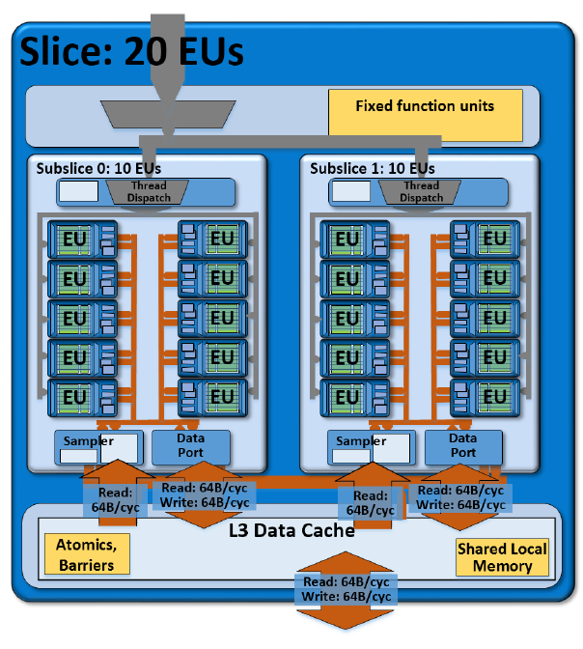
2. Evolution of desktop and laptop processors (12)
Example: A slice of the graphics unit of Haswell (6.5th gen. graphics)
1 slice (GT2): includs 20 EUs [199]

Slide 52
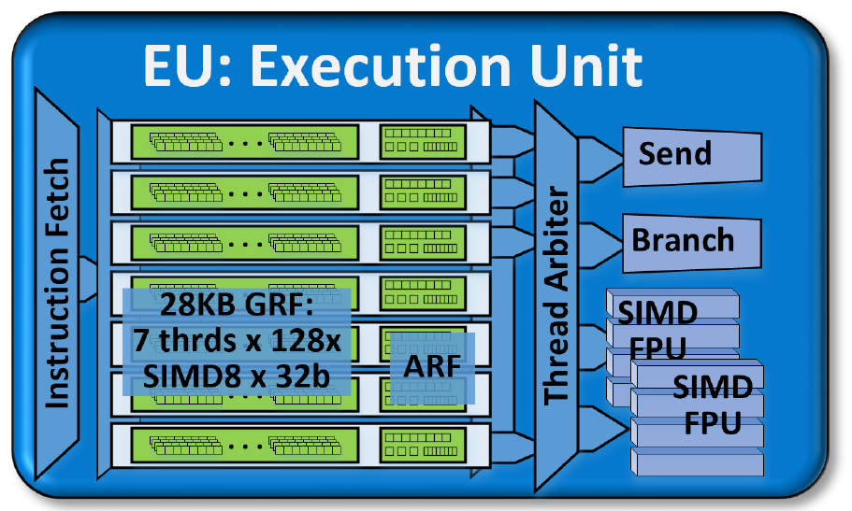
2. Evolution of desktop and laptop processors (13)
Block diagram of an EU of Haswell -1 [199]
SIMD: Single Instruction
Multiple Data
Each EU has four functional units:
Two SIMD FPU units
1 Send unit (Load/Store) and
1 Branch unit.
GRF: General Purpose Register File
ARF: Architecture Register File
An EU issues up to 4 instructions per cycle to the functional units.
*

Slide 53
2. Evolution of desktop and laptop processors (14)
Block diagram of an EU of Haswell -2 [199]
Each SIMD FPUs can execute 4 SP FP. They can execute MAD instructions (Multiply-Add)/cycle.
Thus an EU can execute 2 FPU x SIMD4 x 2 (MAD) = 16 SP FP operations/cycle.
The EU is 7-way multithreaded.
Each thread has 128 32 B registers.
One of the FPUs also supports FX operations (1/2/4/8/16/32 bit wide FX operations).
One of the FPUs also support transcendental math functions.

Slide 54
2. Evolution of desktop and laptop processors (15)
Evolution of main features of Intel’s graphics families (based on [174])
Intel Core generation | Graphics generation | Models | Graphics Technology level | No. of graphics slices | No. of EUs | eDRAM | OpenGL version | DirectX version | OpenCL version
Westmere | 5th (Ironlake) | HD |  |  | 12 | -- | 2.1 | 10.1 | n.a.
Sandy Bridge | 6th | HD 2000 | GT1 | 1 (2x3 EU) | 6 |  | 3.1/3.3 | 10.1 | n.a.
 |  | HD 3000 | GT2 | 1 (4x3 EU) | 12
Ivy Bridge | 7th | HD 2500 | GT1 | 1 (6 EU) | 6 | -- | 4.0 | 11.0 | 1.2
 |  | HD 4000 | GT2 | 1 (2x8 EU) | 16
Haswell | 7.5th | HD 4200- HD 4700 | GT2 | 1 (2x10 EU) | 20 | -- | 4.3 | 11.1 | 1.2
 |  | HD 5000 Iris 5100 | GT3 | 2 | 40
 |  | Iris Pro 5200 |  |  |  | 128 MB
Broadwell | 8th | HD 5300- HD 5600 | GT2 | 1 (3x8 EU) | 23/24 | -- | 4.3 | 11.2 | 2.0
 |  | HD 6000 Iris 6100 | GT3 | 2 | 47/48
 |  | Iris Pro 6200 | GT3e | 2 | 48 | 128 MB
Skylake | 9th | HD 510 | GT1 | 1 (3x4 EU) | 12 | -- | 4.4 | 12 | 2.0
 |  | HD 515 | GT1.5 | 1 (3x6 EU) | 18
 |  | HD 520 | GT2 | 1 (3x8 EU) | 24
 |  | HD 535 | GT3 | 2 | 48
 |  | HD 540 | GT3e | 2 | 48 | 64 MB
 |  | HD 580 | GT4e | 3 | 72 | 64/128 MB
*

Slide 55
2. Evolution of desktop and laptop processors (16)
Evolution of main features of Intel’s graphics families (based on [174]) -4
Intel Core generation | Graphics generation | Models | Graphics Technology level | No. of graphics slices | No. of EUs | eDRAM | OpenGL version | DirectX version | OpenCL version
Westmere | 5th (Ironlake) | HD |  |  | 12 | -- | 2.1 | 10.1 | n.a.
Sandy Bridge | 6th | HD 2000 | GT1 | 1 (2x3 EU) | 6 |  | 3.1/3.3 | 10.1 | n.a.
 |  | HD 3000 | GT2 | 1 (4x3 EU) | 12
Ivy Bridge | 7th | HD 2500 | GT1 | 1 (6 EU) | 6 | -- | 4.0 | 11.0 | 1.2
 |  | HD 4000 | GT2 | 1 (2x8 EU) | 16
Haswell | 7.5th | HD 4200- HD 4700 | GT2 | 1 (2x10 EU) | 20 | -- | 4.3 | 11.1 | 1.2
 |  | HD 5000 Iris 5100 | GT3 | 2 | 40
 |  | Iris Pro 5200 |  |  |  | 128 MB
Broadwell | 8th | HD 5300- HD 5600 | GT2 | 1 (3x8 EU) | 23/24 | -- | 4.3 | 11.2 | 2.0
 |  | HD 6000 Iris 6100 | GT3 | 2 | 47/48
 |  | Iris Pro 6200 | GT3e | 2 | 48 | 128 MB
Skylake | 9th | HD 510 | GT1 | 1 (3x4 EU) | 12 | -- | 4.4 | 12 | 2.0
 |  | HD 515 | GT1.5 | 1 (3x6 EU) | 18
 |  | HD 520 | GT2 | 1 (3x8 EU) | 24
 |  | HD 535 | GT3 | 2 | 48
 |  | HD 540 | GT3e | 2 | 48 | 64 MB
 |  | HD 580 | GT4e | 3 | 72 | 64/128 MB

Slide 56
2. Evolution of desktop and laptop processors (17)
Evolution of main features of Intel’s graphics families (based on [174]) -5
Intel Core generation | Graphics generation | Models | Graphics Technology level | No. of graphics slices | No. of EUs | eDRAM | OpenGL version | DirectX version | OpenCL version
Westmere | 5th (Ironlake) | HD |  |  | 12 | -- | 2.1 | 10.1 | n.a.
Sandy Bridge | 6th | HD 2000 | GT1 | 1 (2x3 EU) | 6 |  | 3.1/3.3 | 10.1 | n.a.
 |  | HD 3000 | GT2 | 1 (4x3 EU) | 12
Ivy Bridge | 7th | HD 2500 | GT1 | 1 (6 EU) | 6 | -- | 4.0 | 11.0 | 1.2
 |  | HD 4000 | GT2 | 1 (2x8 EU) | 16
Haswell | 7.5th | HD 4200- HD 4700 | GT2 | 1 (2x10 EU) | 20 | -- | 4.3 | 11.1 | 1.2
 |  | HD 5000 Iris 5100 | GT3 | 2 | 40
 |  | Iris Pro 5200 |  |  |  | 128 MB
Broadwell | 8th | HD 5300- HD 5600 | GT2 | 1 (3x8 EU) | 23/24 | -- | 4.3 | 11.2 | 2.0
 |  | HD 6000 Iris 6100 | GT3 | 2 | 47/48
 |  | Iris Pro 6200 | GT3e | 2 | 48 | 128 MB
Skylake | 9th | HD 510 | GT1 | 1 (3x4 EU) | 12 | -- | 4.4 | 12 | 2.0
 |  | HD 515 | GT1.5 | 1 (3x6 EU) | 18
 |  | HD 520 | GT2 | 1 (3x8 EU) | 24
 |  | HD 535 | GT3 | 2 | 48
 |  | HD 540 | GT3e | 2 | 48 | 64 MB
 |  | HD 580 | GT4e | 3 | 72 | 64/128 MB

Slide 57
2. Evolution of desktop and laptop processors (18)
Key features of the evolution of Intel’s integrated graphics families
Intel’s graphics implementations are subdivided into
graphics generations (5th to 9th) and
graphics technology levels (GT1-GT4).
Graphics generations are bound to the basic architectures.
The graphics technology levels indicate the number of graphics slices (replicable sets of
graphics EUs) within each graphics generation.
The number of graphics EUs is increasing more or less according to Moore’s rule
(from 12 in 2010 to 72 in 2015).
With the Haswell basic architecture graphics became eDRAM support (first 64 MB
then 128 MB)
There is continuous support of newer versions of graphics APIs and of OpenCL.
*

Slide 58
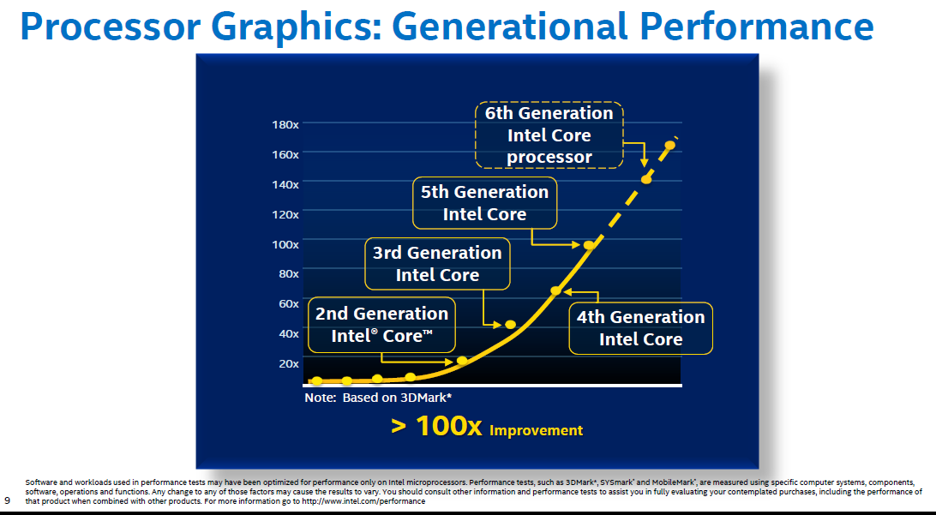
2. Evolution of desktop and laptop processors (19)
Graphics performance increase of subsequent Core generations [196]
Skylake
Broadwell
Haswell
Ivy Bridge
Sandy Bridge

Slide 59
3. Evolution of HEDT (High-End Desktop) processors
Notes:
59

Slide 60
3. Evolution of HEDT (High-End Desktop) processors (1)
3. Evolution of HEDT (High-End DeskTop) processors
Recent processor categories of Intel
Servers
HEDTs
(High-End Desktops)
Desktops/Laptops
(Clients)
Tablets/
Smartphones
Desktops
(Mobiles)
Xeon E7/E5/E3
Platinum/Gold etc.
Core i7/i9
(Extreme Edition
or X models)
Core i7/i5/i3
(Basic architectures)
Atom lines
(+ LP Core models)
Atom lines
Smarphones
Smarphones
Laptops
Tablets
Servers
High-End Desktops
Desktops
Laptops
Tablets
Smartphones
Servers
High-End Desktops
Desktops

Slide 61
3. Evolution of HEDT (High-End Desktop) processors (2)
HEDTs (High-End DeskTops)
They aim at high performance desktops for hardcore gamers and graphics enthusiasts.
*

Slide 62

3. Evolution of HEDT (High-End Desktop) processors (3)
Hardcore gamer scenario [221]

Slide 63
3. Evolution of HEDT (High-End Desktop) processors (4)
1. Introduction -2
What are the main requirements to HEDT lines for supporting multiple (up to 4) discrete graphics
cards vs. mainstream desktops:
more PCIe lanes (typically 8 or 16 lanes per card)
more cores and
more memory channels (to suitably service more cores)
as indicated on the next Figure.
*

Slide 64
3. Evolution of HEDT (High-End Desktop) processors (5)
Number of PCIe lanes -1
Processor | Techn. | Date of intro. | No. of cores up to | Memory attachment | Mem. speed up to | PCIe lanes | No. of mem. channels | MCH | TDP | Processor socket
Core 2 Extreme X6800 | 65 nm | 7/2006 | 2C | Via MCH | DDR3-1066 | 32 PCIe 2.0 on the X38 | 2 | X38 | 65 W | LGA 775
Core 2 Extreme QX 6xxx | 65 nm | 11/2006 | 2x2C |  |  |  |  |  | 130 W | LGA 775
 |  |  |  |  |  |  |  |  | 130 W | LGA 775
Core 2 Extreme QX 9650 (Penryn) | 45 nm | 11/2007 | 2x2C
 |  |  |  |  | DDR3-1600 | 32 PCIe 2.0 on the X48 | 2 | X48 | 136 W | LGA 775
Core 2 Extreme QX 9770 (Penryn) | 45 nm | 3/2008 | 2x2C
1. G. Nehalem EE | 45 nm | 11/2008 | 4C | On-die MC | DDR3-1067 | 36 PCIe 2.0 on the X58 | 3 | X58 (Tylersburg) | 130 W | LGA 1366
Westmere EE | 32 nm | 3/2010 | 6C
 |  |  |  |  |  |  |  |  | 130 W | LGA 1366
Sandy Bridge E | 32 nm | 11/2011 | 6C
 |  |  |  |  | DDR3-1600 | 40 PCIe 2.0 on-die | 4 | X79 (Patsburg) | 130 W/ 150 W | LGA 2011
Ivy Bridge E | 22 nm | 9/2013 | 6C
 |  |  |  |  | DDR3-1866 | 40 PCIe 3.0 on-die | 4 |  | 130 W | LGA 2011
Haswell E | 14 nm | 8/2014 | 8C |  | DDR4-2133 |  | 4 | X99 (Wellsburg) | 140 W | LGA 2011-3
Broadwell E | 14 nm | 5/2016 | 10C
 |  |  |  |  | DDR4-2400 |  | 4 | X99 (Wellsburg) | 140 W | LGA_2011-3
Skylake X | 14 nm | 6/2017 | 18C
 |  |  |  |  | DDR4-2666 | 44 PCI-3.0 on-die | 4 | X299 (Basin Falls) | 140 W | LGA-2066
(Kaby Lake X) | 14 nm | 6/2017 | 4C |  | DDR4-2666 | 16 PCIe 3.0 on-die | 4 | X299 (Basin Falls) | 112 W | LGA-2066
*

Slide 65
3. Evolution of HEDT (High-End Desktop) processors (5b)
Number of PCIe lane -2
Processor | Techn. | Date of intro. | No. of cores up to | Memory attachment | Mem. speed up to | PCIe lanes | No. of mem. channels | MCH | TDP | Processor socket
Skylake-X Refresh | 14 nm | 11/2018 | 18C | On-die MC | DDR4-2666 | 44 PCI-3.0 on-die | 4 | X299 (Basin Falls) | 165 W | LGA-2066
Cascade Lake-X | 14 nm | 11/2019 | 18C |  | DDR4-2933 | 48 PCI-3.0 on-die | 4 | X299 (Basin Falls) | 165 W | LGA-2066
*

Slide 66
3. Evolution of HEDT (High-End Desktop) processors (6)
Core counts -1
Processor | Techn. | Date of intro. | No. of cores up to | Memory attachment | Mem. speed up to | PCIe lanes | No. of mem. channels | MCH | TDP | Processor socket
Core 2 Extreme X6800 | 65 nm | 7/2006 | 2C | Via MCH | DDR3-1066 | 32 PCIe 2.0 on the X38 | 2 | X38 | 65 W | LGA 775
Core 2 Extreme QX 6xxx | 65 nm | 11/2006 | 2x2C |  |  |  |  |  | 130 W | LGA 775
 |  |  |  |  |  |  |  |  | 130 W | LGA 775
Core 2 Extreme QX 9650 (Penryn) | 45 nm | 11/2007 | 2x2C
 |  |  |  |  | DDR3-1600 | 32 PCIe 2.0 on the X48 | 2 | X48 | 136 W | LGA 775
Core 2 Extreme QX 9770 (Penryn) | 45 nm | 3/2008 | 2x2C
1. G. Nehalem EE | 45 nm | 11/2008 | 4C | On-die MC | DDR3-1067 | 36 PCIe 2.0 on the X58 | 3 | X58 (Tylersburg) | 130 W | LGA 1366
Westmere EE | 32 nm | 3/2010 | 6C
 |  |  |  |  |  |  |  |  | 130 W | LGA 1366
Sandy Bridge E | 32 nm | 11/2011 | 6C
 |  |  |  |  | DDR3-1600 | 40 PCIe 2.0 on-die | 4 | X79 (Patsburg) | 130 W/ 150 W | LGA 2011
Ivy Bridge E | 22 nm | 9/2013 | 6C
 |  |  |  |  | DDR3-1866 | 40 PCIe 3.0 on-die | 4 |  | 130 W | LGA 2011
Haswell E | 14 nm | 8/2014 | 8C |  | DDR4-2133 |  | 4 | X99 (Wellsburg) | 140 W | LGA 2011-3
Broadwell E | 14 nm | 5/2016 | 10C
 |  |  |  |  | DDR4-2400 |  | 4 | X99 (Wellsburg) | 140 W | LGA_2011-3
Skylake X | 14 nm | 6/2017 | 18C
 |  |  |  |  | DDR4-2666 | 44 PCI-3.0 on-die | 4 | X299 (Basin Falls) | 140 W | LGA-2066
(Kaby Lake X) | 14 nm | 6/2017 | 4C |  | DDR4-2666 | 16 PCIe 3.0 on-die | 4 | X299 (Basin Falls) | 112 W | LGA-2066
The above HEDT models and lines are unlocked.

Slide 67
3. Evolution of HEDT (High-End Desktop) processors (6b)
Core counts -2
Processor | Techn. | Date of intro. | No. of cores up to | Memory attachment | Mem. speed up to | PCIe lanes | No. of mem. channels | MCH | TDP | Processor socket
Skylake-X Refresh | 14 nm | 11/2018 | 18C | On-die MC | DDR4-2666 | 44 PCI-3.0 on-die | 4 | X299 (Basin Falls) | 165 W | LGA-2066
Cascade Lake-X | 14 nm | 11/2019 | 18C |  | DDR4-2933 | 48 PCI-3.0 on-die | 4 | X299 (Basin Falls) | 165 W | LGA-2066

Slide 68
3. Evolution of HEDT (High-End Desktop) processors (7)
Remark
The Kaby Lake-X models in fact do not fit into the traditional HEDT lines, they are actually the
highest performance models of the Kaby Lake line and are designated as mobile models.

Slide 69
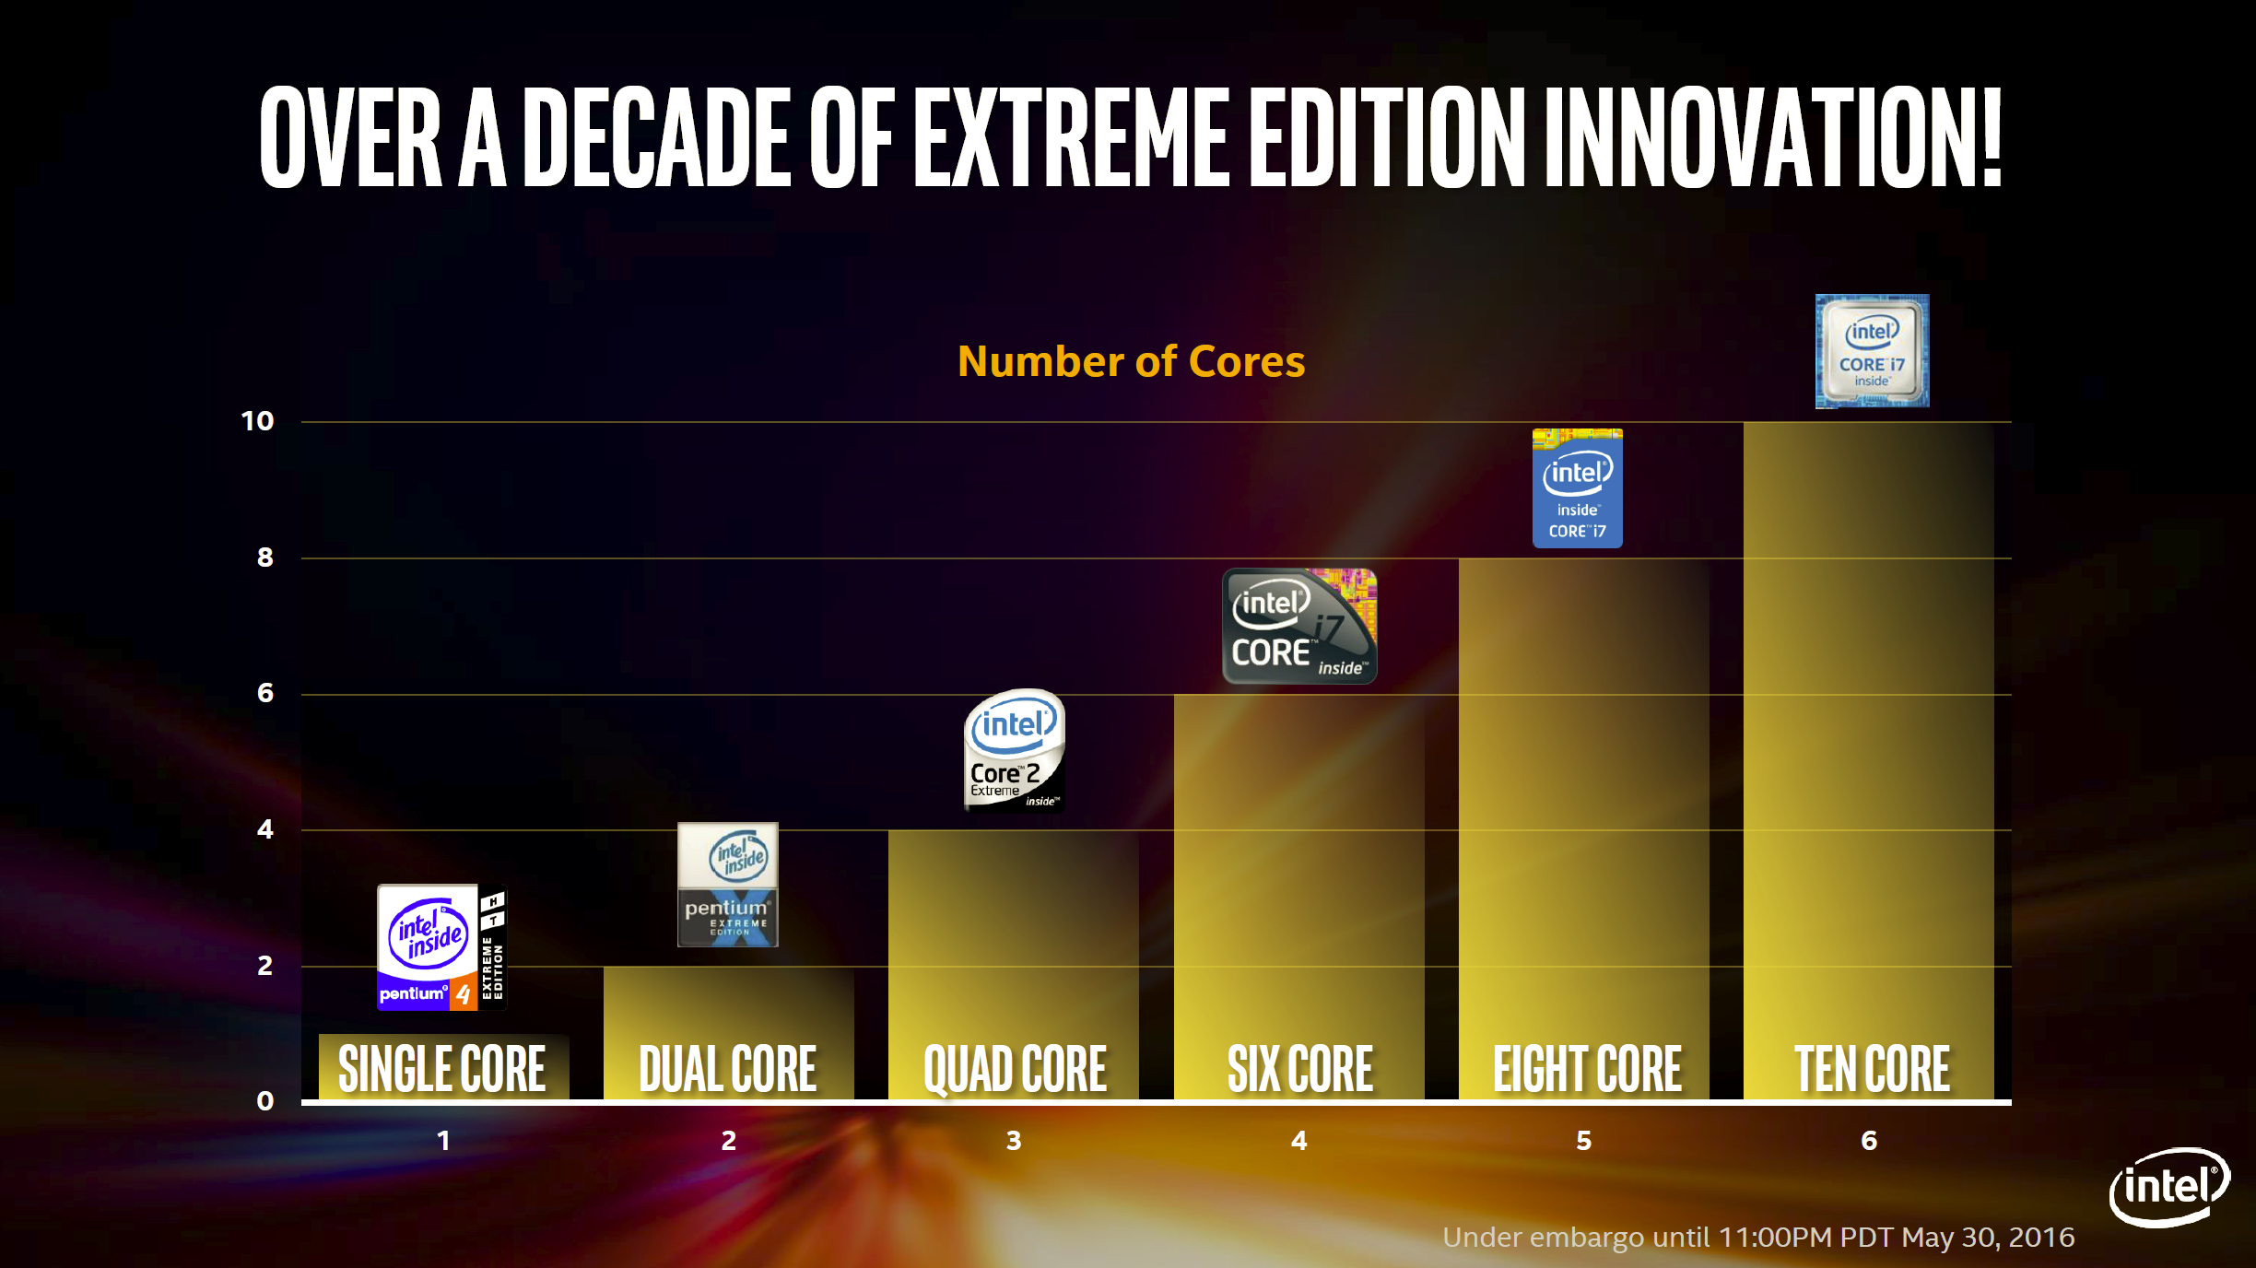
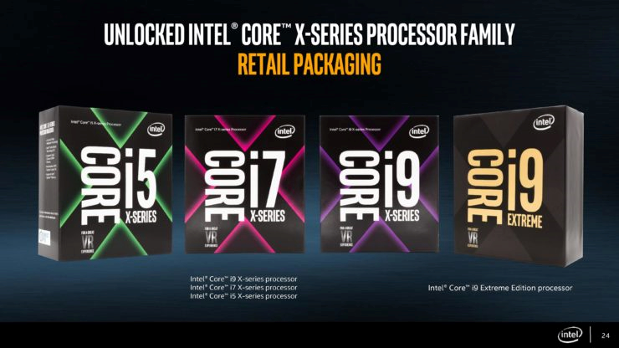

3. Evolution of HEDT (High-End Desktop) processors (8)
Evolution of the core counts in Intel's HEDT lines (Based on [222])
Skylake X
18
Number of cores
Broadwell E
Haswell E
Core 2
Extreme
QX6700
Westmere EE
Core 2
Extreme
X6800
Pentium 4 EE
3.2
18 CORE
2003
2006
2006
2010
2014
2016
2017

Slide 70
3. Evolution of HEDT (High-End Desktop) processors (9)
Number of memory channels -1
Processor | Techn. | Date of intro. | No. of cores up to | Memory attachment | Mem. speed up to | PCIe lanes | No. of mem. channels | MCH | TDP | Processor socket
Core 2 Extreme X6800 | 65 nm | 7/2006 | 2C | Via MCH | DDR3-1066 | 32 PCIe 2.0 on the X38 | 2 | X38 | 65 W | LGA 775
Core 2 Extreme QX 6xxx | 65 nm | 11/2006 | 2x2C |  |  |  |  |  | 130 W | LGA 775
 |  |  |  |  |  |  |  |  | 130 W | LGA 775
Core 2 Extreme QX 9650 (Penryn) | 45 nm | 11/2007 | 2x2C
 |  |  |  |  | DDR3-1600 | 32 PCIe 2.0 on the X48 | 2 | X48 | 136 W | LGA 775
Core 2 Extreme QX 9770 (Penryn) | 45 nm | 3/2008 | 2x2C
1. G. Nehalem EE | 45 nm | 11/2008 | 4C | On-die MC | DDR3-1067 | 36 PCIe 2.0 on the X58 | 3 | X58 (Tylersburg) | 130 W | LGA 1366
Westmere EE | 32 nm | 3/2010 | 6C
 |  |  |  |  |  |  |  |  | 130 W | LGA 1366
Sandy Bridge E | 32 nm | 11/2011 | 6C
 |  |  |  |  | DDR3-1600 | 40 PCIe 2.0 on-die | 4 | X79 (Patsburg) | 130 W/ 150 W | LGA 2011
Ivy Bridge E | 22 nm | 9/2013 | 6C
 |  |  |  |  | DDR3-1866 | 40 PCIe 3.0 on-die | 4 |  | 130 W | LGA 2011
Haswell E | 14 nm | 8/2014 | 8C |  | DDR4-2133 |  | 4 | X99 (Wellsburg) | 140 W | LGA 2011-3
Broadwell E | 14 nm | 5/2016 | 10C
 |  |  |  |  | DDR4-2400 |  | 4 | X99 (Wellsburg) | 140 W | LGA_2011-3
Skylake X | 14 nm | 6/2017 | 18C
 |  |  |  |  | DDR4-2666 | 44 PCI-3.0 on-die | 4 | X299 (Basin Falls) | 140 W | LGA-2066
(Kaby Lake X) | 14 nm | 6/2017 | 4C |  | DDR4-2666 | 16 PCIe 3.0 on-die | 4 | X299 (Basin Falls) | 112 W | LGA-2066

Slide 71
3. Evolution of HEDT (High-End Desktop) processors (9b)
Number of memory channels -2
Processor | Techn. | Date of intro. | No. of cores up to | Memory attachment | Mem. speed up to | PCIe lanes | No. of mem. channels | MCH | TDP | Processor socket
Skylake-X Refresh | 14 nm | 11/2018 | 18C | On-die MC | DDR4-2666 | 44 PCI-3.0 on-die | 4 | X299 (Basin Falls) | 165 W | LGA-2066
Cascade Lake-X | 14 nm | 11/2019 | 18C |  | DDR4-2933 | 48 PCI-3.0 on-die | 4 | X299 (Basin Falls) | 165 W | LGA-2066

Slide 72
3. Evolution of HEDT (High-End Desktop) processors (10)
Number of on-die PCIe lanes and memory channels on Intel's DT and HEDT lines
PCIe lanes provided on the processor die
DT processors: 16 lanes
(1x16 or 2x8 or 1x8+2x4)
HEDT processors: 40+ lanes (typical)
(configurable, e.g. 2x x16 + 1x x8 or 4x x8)
PCIe
2.0
x16/
2x x8
P
Mem.
40
configurable
lanes
P
Mem.
PCIe
2.0
PCIe 2.0 lanes
Periph. Contr.
P55/P67
Periph. Contr.
X79
Intel 2. gen. Nehalem (Lynnfield) (4C), 2 MCh
with P55 (2009)
Intel Sandy Bridge (4C), 2 MCh with P67 (2011)
Intel Sandy Bridge-E (6C), 4 MCh with X79 (2011)
PCIe generation
x16/
2x x8
40-48
configurable
lanes
P
Mem.
PCIe
3.0
P
Mem.
PCIe
3.0
Periph. Contr.
Z77/Z87/Z97/
Z170
Periph. Contr.
X79/Z99/
X299
PCIe 3.0 lanes
40 lanes beginning with
Intel Ivy Bridge (4C), 2 MCh with Z77 PCH (2012)
Intel Haswell (4C), 2 MCh with Z87 PCH (2013)
Intel Broadwell (4C), 2 MCh with Z97 PCH (2015)
Intel Skylake-S (4C), 2 MCh with Z170 PCH (2015)
and subsequent lines
Intel Ivy Bridge-E (6C), 4 MCh with X79 (2013)
44 lanes beginning with
Intel Skylake-X (18C), 4 MCh with X299 (2017)
48 lanes beginning with
*
Intel Cascade Lake-X (18C), 4 MCh with X279 (2019)

Slide 73
3. Evolution of HEDT (High-End Desktop) processors (11)
Unlocked clock multiplier
Intel’s HEDT models are typically unlocked (clock multiplier not fixed) to allow overclocking.
(The clock multiplier multiplies the bus frequency (100/133 MHz) by a number delivered by
the PCU (Power Control Unit).
*

Slide 74
3. Evolution of HEDT (High-End Desktop) processors (12)
TDP (Thermal Design Power) -1
Processor | Techn. | Date of intro. | No. of cores up to | Memory attachment | Mem. speed up to | PCIe lanes | No. of mem. channels | MCH | TDP | Processor socket
Core 2 Extreme X6800 | 65 nm | 7/2006 | 2C | Via MCH | DDR3-1066 | 32 PCIe 2.0 on the X38 | 2 | X38 | 65 W | LGA 775
Core 2 Extreme QX 6xxx | 65 nm | 11/2006 | 2x2C |  |  |  |  |  | 130 W | LGA 775
 |  |  |  |  |  |  |  |  | 130 W | LGA 775
Core 2 Extreme QX 9650 (Penryn) | 45 nm | 11/2007 | 2x2C
 |  |  |  |  | DDR3-1600 | 32 PCIe 2.0 on the X48 | 2 | X48 | 136 W | LGA 775
Core 2 Extreme QX 9770 (Penryn) | 45 nm | 3/2008 | 2x2C
1. G. Nehalem EE | 45 nm | 11/2008 | 4C | On-die MC | DDR3-1067 | 36 PCIe 2.0 on the X58 | 3 | X58 (Tylersburg) | 130 W | LGA 1366
Westmere EE | 32 nm | 3/2010 | 6C
 |  |  |  |  |  |  |  |  | 130 W | LGA 1366
Sandy Bridge E | 32 nm | 11/2011 | 6C
 |  |  |  |  | DDR3-1600 | 40 PCIe 2.0 on-die | 4 | X79 (Patsburg) | 130 W/ 150 W | LGA 2011
Ivy Bridge E | 22 nm | 9/2013 | 6C
 |  |  |  |  | DDR3-1866 | 40 PCIe 3.0 on-die | 4 |  | 130 W | LGA 2011
Haswell E | 14 nm | 8/2014 | 8C |  | DDR4-2133 |  | 4 | X99 (Wellsburg) | 140 W | LGA 2011-3
Broadwell E | 14 nm | 5/2016 | 10C
 |  |  |  |  | DDR4-2400 |  | 4 | X99 (Wellsburg) | 140 W | LGA_2011-3
Skylake X | 14 nm | 6/2017 | 18C
 |  |  |  |  | DDR4-2666 | 44 PCI-3.0 on-die | 4 | X299 (Basin Falls) | 140 W | LGA-2066
(Kaby Lake X) | 14 nm | 6/2017 | 4C |  | DDR4-2666 | 16 PCIe 3.0 on-die | 4 | X299 (Basin Falls) | 112 W | LGA-2066
TDP: Reference value for designing the cooling system.

Slide 75
3. Evolution of HEDT (High-End Desktop) processors (12b)
TDP (Thermal Design Power) -2
Processor | Techn. | Date of intro. | No. of cores up to | Memory attachment | Mem. speed up to | PCIe lanes | No. of mem. channels | MCH | TDP | Processor socket
Skylake-X Refresh | 14 nm | 11/2018 | 18C | On-die MC | DDR4-2666 | 44 PCI-3.0 on-die | 4 | X299 (Basin Falls) | 165 W | LGA-2066
Cascade Lake-X | 14 nm | 11/2019 | 18C |  | DDR4-2933 | 48 PCI-3.0 on-die | 4 | X299 (Basin Falls) | 165 W | LGA-2066

Slide 76
3. Evolution of HEDT (High-End Desktop) processors (13)
Introduction -3
Key features of Intel’s HEDT lines (cont.):
They are equipped with a large number of PCIe lanes (mostly 32 to 48 lanes) to connect
multiple discrete graphics cards vs. only 16 as typical in desktops,
they do not provide integrated graphics, as the installation is assumed to provide high quality
graphics by attaching discrete graphics cards,
they have more cores than desktops have since graphics offers more parallelism than typical
desktop workloads,
they are unlocked and
HEDTs have a higher TDP, mostly of 130 to 165 W vs. 65 to 95 W typical for DT processors.
*

Slide 77
4. Evolution of high-end 2S server processors
Notes:
77

Slide 78
4. Evolution of high-end 2S server processors (1)
4. Evolution of high-end 2S server processors
Recent processor categories of Intel
Servers
HEDTs
(High-End Desktops)
Desktops/Laptops
(Clients)
Tablets/
Smartphones
Desktops
(Mobiles)
Xeon E7/E5/E3
Platinum/Gold etc.
Core i7/i9
(Extreme Edition
or X models)
Core i7/i5/i3
(Basic architectures)
Atom lines
(+ LP Core models)
Atom lines
Smarphones
Smarphones
Laptops
Tablets
Servers
High-End Desktops
Desktops
Laptops
Tablets
Smartphones
Servers
High-End Desktops
Desktops

Slide 79
4. Evolution of high-end 2S server processors (2)
Server platforms classified according to the number of processors supported
Server platforms
Uniprocessor server platforms
(UP-server platforms)
Multiprocessor server platforms
1-processor server platforms
(1-socket server platforms)
Server platforms supporting more than one processor
(Multi-socket server platforms)
2S (DP)
server platforms
4S/8S (MP)
server platforms
Platforms for more than 8 sockets
2- processor server platforms
(2-socket server platforms)
4/8-processor server platforms
(4/8-socket server platforms)
Server platforms for
more than the Intel
supported number of
sockets
(4 or 8 sockets)
They need third party
node controllers
S: Socket
DP: Dual Processor
MP: Multi-Processor
*

Slide 80
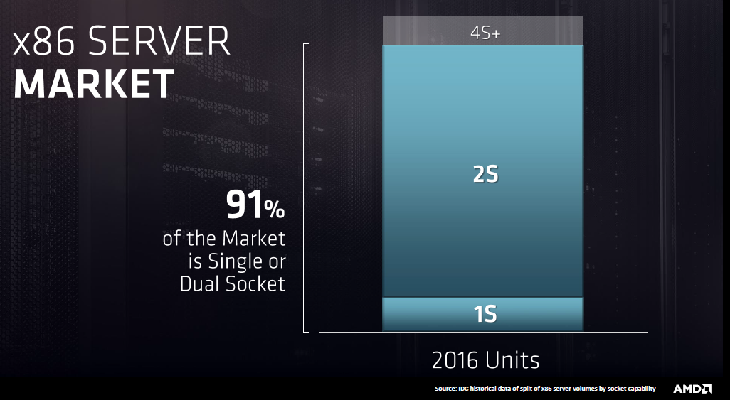
4. Evolution of high-end 2S server processors (3)
Recent market share of 1S and 2S servers [337]
*

Slide 81
4. Evolution of high-end 2S server processors (4)
Key features of Intel’s x86-based HE 2S server processor dies
Platform4 | Core | Techn. | Intro. | High performance Core 2-based multicore 2S server processors | Core count up to | Trans. count [10⁶/10⁹] | Die size [mm²]
 | Pentium 4 Prescott DP | 90 nm | 6/2004 | Xeon DP 90 nm (Nocona) | 1C | 125 | 112
 | Pentium 4 Prescott 2M DP | 90 nm | 10/2005 | Xeon DP 2008 (Paxville DP) | 2x1C | 2x169 | 2x135
Bensley | Pentium 4 Prescott 2M DP | 65 nm | 5/2006 | Xeon 5000 (Dempsey) | 2x1C | 2x188 | 2x81
 | Core2 | 65 nm | 6/2006 | Xeon 5100 (Woodcrest) | 2C | 291 | 143
 | Core2 | 65 nm | 11/2006 | Xeon 5300 (Clovertown) | 2x2C | 2x291 | 2x143
 | Penryn | 45 nm | 11/2007 | Xeon 5400 (Harpertown) | 2x2C | 2x410 | 2x107
Boxboro-EX | Nehalem | 45 nm | 3/2010 | Xeon X6500 (Beckton/Nehalem-EX) | 8C | 2.3 | 513
 | Westmere | 32 nm | 4/2011 | Xeon E7-28xx (Westmere-EX) | 10C | 2.6 | 512
Brickland | Ivy Bridge | 22 nm | 2/2014 | E7-28xx v2 (Ivy Bridge-EX) | 15C | 4.31 | 541
 | Haswell | 22 nm | 9/2014 | E5-2600xx v3 (Haswell-EP) | 18C | 5.69 | 662
 | Broadwell | 14 nm | 4/2016 | E5-26xx v4 (Broadwell-EP) | 22C | 7.2 | 456
Purley | Skylake | 14 nm | 7/2017 | Skylake-SP | 28C | 8.0? | ~694
 | Cascade Lake | 14 nm | 4/2019 | Cascade Lake-SP | 24C | n.a. | n.a.
 | Cascade Lake | 14 nm | 4/2019 | Cascade Lake-AP | 2x28C | n.a. | n.a.
 | Cascade Lake R | 14 nm | 2/2020 | Cascade Lake R | 28C | n.a. | n.a.

Slide 82
4. Evolution of high-end 2S server processors (5)
TDP values and socketing of Intel’s high-end 2S NUMA server processor lines
Platform | HE multicore 2S servers | Techn. | Date of Intro. | Core count (up to) | PCIe | No./speed of mem. channels per socket (up to) | TDP (up to) W | Socket
Tylersburg | Xeon E55xx (Nehalem –EP) Gainestown) | 45 nm | 3/2009 | 4C | 36x PCIe 2.0 (on MCH) | 3x DDR3-1333 | 95 | LGA 1366
Boxboro-EX | Xeon E65xx Nehalem-EX) (Beckton) | 45 nm | 3/2010 | 8C | 36x PCIe 2.0 (on MCH) | 8x DDR3-1066 | 130 | LGA 1567
 | Xeon E7-28xx (Westmere-EX) | 32 nm | 4/2011 | 10C |  | 8x DDR3-1333 | 130
Brickland | E7-28xx v2 (Ivy Bridge-EX) | 22 nm | 2/2014 | 15C | 32x PCIe 3.0 (on proc.) | 8x DDR3-1600 | 155 | LGA 2011-1
Grantley | E5-26xx v3 (Haswell-EP) | 22 nm | 9/2014 | 18C | 40x PCIe 3.0 (on proc.) | 4x DDR4-2133 | 160 | LGA 2011-3
 | E5-26xx v4 (Broadwell-EP) | 14 nm | 4/2016 | 22C |  | 4x DDR4-2400 | 300
Purley | Silver 41xx (Skylake-SP) | 14 nm | 7/2017 | 12C | 48x PCIe 3.0 (on proc.) | 6x DDR4-2400 | 105 | LGA 3647
 | Gold 62xx Cascade Lake-SP | 14 nm | 4/2019 | 24C | 48x PCIe 3.0 (on proc.) | 6x DDR4-2400 | 205
 | Platinum 92xx Cascade Lake-AP | 14 nm | 4/2019 | 2x28 | 40x PCIe 3.0 (on proc.) | 12x DDR4-2933 | 400 | BGA 5903
 | Gold 62xxR Cascade Lake-SP | 14 nm | 2/2020 | 28C | 48x PCIe 3.0 (on proc.) | 6x DDR4-2933 | 205 | LGA 3647
Whitney | Eis Lake-SP | 10 nm | n.a. | 28 | 48?xPCIe4.0 (on proc) | 8x DDR4-3200 | n.a. | LGA 4189

Slide 83
4. Evolution of high-end 2S server processors (6)
Core counts in Intel's high-end 2S server processor lines
Platform4 | Core | Techn. | Intro. | High performance Core 2-based multicore 2S server processors | Core count up to | Trans. count [10⁶/10⁹] | Die size [mm²]
 | Pentium 4 Prescott DP | 90 nm | 6/2004 | Xeon DP 90 nm (Nocona) | 1C | 125 | 112
 | Pentium 4 Prescott 2M DP | 90 nm | 10/2005 | Xeon DP 2008 (Paxville DP) | 2x1C | 2x169 | 2x135
Bensley | Pentium 4 Prescott 2M DP | 65 nm | 5/2006 | Xeon 5000 (Dempsey) | 2x1C | 2x188 | 2x81
 | Core2 | 65 nm | 6/2006 | Xeon 5100 (Woodcrest) | 2C | 291 | 143
 | Core2 | 65 nm | 11/2006 | Xeon 5300 (Clovertown) | 2x2C | 2x291 | 2x143
 | Penryn | 45 nm | 11/2007 | Xeon 5400 (Harpertown) | 2x2C | 2x410 | 2x107
Boxboro-EX | Nehalem | 45 nm | 3/2010 | Xeon X6500 (Beckton/Nehalem-EX) | 8C | 2.3 | 513
 | Westmere | 32 nm | 4/2011 | Xeon E7-28xx (Westmere-EX) | 10C | 2.6 | 512
Brickland | Ivy Bridge | 22 nm | 2/2014 | E7-28xx v2 (Ivy Bridge-EX) | 15C | 4.31 | 541
 | Haswell | 22 nm | 9/2014 | E5-2600xx v3 (Haswell-EP) | 18C | 5.69 | 662
 | Broadwell | 14 nm | 4/2016 | E5-26xx v4 (Broadwell-EP) | 22C | 7.2 | 456
Purley | Skylake | 14 nm | 7/2017 | Skylake-SP | 12C | 8.0? | ~694?
 | Cascade Lake | 14 nm | 4/2019 | Cascade Lake-SP | 24C | n.a. | n.a.
 | Cascade Lake | 14 nm | 4/2019 | Cascade Lake-AP | 2x28C | n.a. | n.a.
 | Cascade Lake R | 14 nm | 2/2020 | Cascade Lake R | 28C | n.a. | n.a.

Slide 84
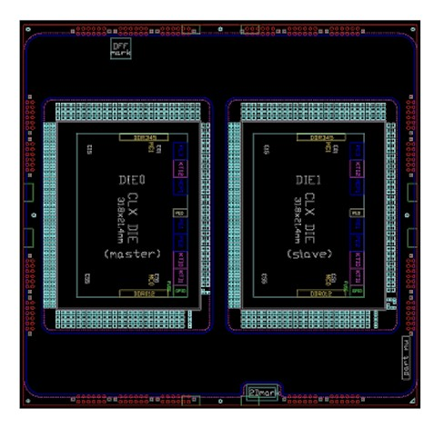
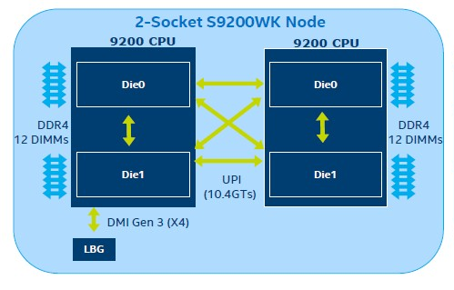
4. Evolution of high-end 2S server processors (7)
Remark to Intel’s 56-core Cascade Lake 9200-AP processor line
With this processor line Intel intends to encounter AMD’s 64-core EPYC Rome line.
The 9200-AP is a dual-chip module with the Cascade Lake-SP dies interconnected properly,
presumable by an UPI bus, and placed into a BGA (Ball Grid Array) package, as indicated in the
left Figure, that will be surface mounted (soldered) onto the mainboard.
Figure: Dual-chip module of the 9200-AP [314]
Dual-socket server based on the 9200-AP [314]
A dual socket server built up of the Cascade Lake 9200-AP (see the Figure on the right) appears
and operates actually as a 4-processor server.

Slide 85
4. Evolution of high-end 2S server processors (8)
The rate of rising core counts in Intel's high-end 2S server processor lines
Core
count
Cascade Lake-AP
(14 nm, 2 dies)
64
*
56
Broadwell-EP
(14 nm)
32
Emergence of
L3 caches in the
Core 2-based DP line
28
Haswell-EP
(22 nm)
24
*
Ivy-Bridge-EX
(22 nm)
18
Westmere-EX
(32 nm)
*
15
*
~2x/4 years
*
Cascade Lake-SP
(14 nm)
12
Nehalem-EX
(45 nm)
*
10
Two-die
implementations
Skylake-SP
(14 nm)
*
8
*
6
53xx
(65 nm)
54xx
(45 nm)
4
*
*
*
*
DP 2.8 GHz
(90 nm)
55xx
(Nehalem-EP)
(45 nm)
~2x/2 years
2
*
*
51xx
(65 nm
2006
2008
2010
2012
2014
2016
2018
Year
*

Slide 86
4. Evolution of high-end 2S server processors (9)
Remarks to the rate of rising core counts in Intel's high-end 2S server processors -1
As the Figure above demonstrates, the core count of Intel’s early L3-less 2S server
processors has doubled roughly biannually.
This is obvious, since the evolving IC technology allowed to double transistor counts
roughly in every new technology node.
Consequently, in L3-less processors twice as many transistors per technology node permit
the doubling of core counts also roughly biannually.
Nevertheless, processors with L3 cache have significantly more transistors and Intel could
double transistor counts on server dies only roughly every four years, as depicted in the
next Figure.
*

Slide 87
4. Evolution of high-end 2S server processors (10)
Evolution of transistor counts of Intel’s Core 2 based HE server processor dies
Transistor
count
(billion)
10
Broadwell-EP
(14 nm)
Emergence of
L3 caches
in the Core 2 line
Haswell-EP
(22 nm)
8
*
6
Ivy-Bridge-EX
(22 nm)
*
4
Westmere-EX
(32 nm)
*
Nehalem-EX
(45 nm)
7400
(45 nm)
*
~2x/4 years
2
*
*
2006
2008
2010
2012
2014
2016
Year
As the above Figure shows, transitor counts rise slower than would be according to Moore’s law. This can presumable be attributed to heat issues caused by the limited power budget.
*

Slide 88
4. Evolution of high-end 2S server processors (11)
The rate of rising memory transfer speeds in Intel’s HE 2S server processors
Transfer rate
(MT/s)
DDR4
3200
DDR4
2666
x
3000
x
x
~ 2*/8 years
x
DDR4
2933
2000
x
DDR4
2400
x
DDR3
1600
AMD
EPYC 2G
1000
~ 2*/4 years
x
DDR3
1333
DDR3
1067
AMD
EPYC
2S
x
500
DDR2
667
x
DDR
400
Emergence of
DDR4 memory
200
Emergence of
DDR3 memory
100
50
≈
2004
05
06
07
08
09
2010
11
12
13
14
15
16
17
18
19
2020
Year
*

Slide 89
4. Evolution of high-end 2S server processors (12)
The rate of rising mem. transfer rates in Intel’s high-end 4S/8S server processors -2
As the above Figure shows, as high-end 2S servers evolved, memory transfer rates
were initially doubled roughly every four years.
But after DDR3 memory emerged the growth rate of memory transfer rate slowed down
to doubling rougly every eight years due to the higher complexity of this technology.
Note that in the considered time interval memory transfer rates have always been risen
at a slower rate than core counts, approximately at the half rate than the core count.
*

Slide 90
4. Evolution of high-end 2S server processors (13)
The requirement for scaling the memory bandwidth with the core count
As cores operate independently from each other the per core memory bandwidth needs
to be preserved, i.e. a processor with n-times more cores as a reference platform requires
n-times higher bandwidth as the reference platform, in other words the memory bandwidth
provided needs to be linearly scaled with the core count.
*

Slide 91
4. Evolution of high-end 2S server processors (14)
Implication of the fact that memory transfer rates are rising slower than core counts
in servers
The per core memory bandwidth of a socket (BW/core) amounts to
BW/core = n_{M} ∗ w ∗ T_{M} /n_{C}
with n_{M}: number of memory channels
w: width of a memory channel (8 byte)
T_{M}: transfer rate of the memory (e.g 2.4 GT/s)
n_{C}: core count.
If in subsequent processor generations memory transfer rates (T_{M}) are rising slower than
core counts (n_{C}), T_{M}/n_{C} the per core memory bandwidth (BW/core) would decrease
(assuming the same number of memory channels, and a memory bandwidth gap will arise.
This can be mended by increasing the number of memory channels (n_{C}) to keep n_{M} ∗ T_{M} /n_{C}
constant.
In other words decreasing T_{M} /n_{C} should be compensated by increasing n_{M} to avoid a
memory bandwidth gap.
This fact is the driving force of the evolution of the memory subsystems of servers.
However, it is an intricate task to raise the number of memory channels, how to solve it,
it will be discussed in the Chapter High-end servers.
The last Figure demonstrates how memory subsystems in Intel’s HE 2S servers evolved
and indicates how far the per core memory bandwidth was preserved vs. the single
core reference platform.
*

Slide 92
4. Evolution of high-end 2S server processors (15)
Relative per core bandwidth in Intel’s 2S server platforms
Platform | Core | Techn. | Date of Intro. | High-end multicore 2S server lines | Core count (up to) | No./speed of mem. channels per socket (up to) | Per core BW rel. to ref. platform
Reference platform | Pentium 4 Prescott DP | 90 nm | 6/2004 | 90 nm Nocona | 1C | 1x DDR2/400 | 1.0
 | Pentium 4 Presc. | 90 nm | 10/2005 | Xeon DP 2.8 (Paxville DP) | 2x1C | 1x DDR2/400 | 0.5
Bensley | Pentium 4 Presc. | 65 nm | 5/2006 | Xeon 5000 (Dempsey) | 2x1C | 2x DDR2/667 | 1.7
 | Core2 | 65 nm | 6/2006 | Xeon 5100 (Woodcrest) | 2C | 2x DDR2/667 | 1.7
 | Core2 | 65 nm | 11/2006 | Xeon 5300 (Clowertown) | 2x2C | 2x DDR2/667 | 0.8
 | Penryn | 45 nm | 11/2007 | Xeon 5400 (Harpertown) | 2x2C | 2x DDR2/667 | 0.8
Tylersburg | Nehalem | 45 nm | 3/2009 | Xeon 55xx (Gainestown) | 4C | 3x DDR3/1333 | 2.5
Boxboro-EX | Nehalem | 45 nm | 3/2010 | Xeon X6500 Nehalem-EX) | 8C | 8x DDR3/1066 | 2.7
 | Westmere | 32 nm | 4/2011 | Xeon E7-28xx (Westmere-EX) | 10C | 8x DDR3/1333 | 2.7
Brickland | Ivy Bridge | 22 nm | 2/2014 | E7-28xx v2 (Ivy Bridge-EX) | 15C | 8x DDR3/1600 | 2.1
Grantley | Haswell | 22 nm | 9/2014 | E5-2600xx v3 (Haswell-EP) | 18C | 4x DDR4/2133 | 1.2
 | Broadwell | 14 nm | 4/2016 | E5-26xx v4 (Broadwell-EP) | 22C | 4x DDR4/2400 | 1.1
Purley | Skylake | 14 nm | 7/2017 | Silver 41xx Skylake-SP) | 28C | 6x DDR4/2400 | 1.3
 | Cascade Lake | 14 nm | 4/2019 | Gold 62xx Skylake-SP) | 28C | 6x DDR4/2933 | 1.6

Slide 93
5. Evolution of tablet and smartphone processors
Notes:
93

Slide 94
5. Evolution of tablet and smartphone processors (1)
5. Evolution of tablet and smartphone processors
Recent processor categories of Intel
Servers
HEDTs
(High-End Desktops)
Desktops/Laptops
(Clients)
Tablets/
Smartphones
Desktops
(Mobiles)
Xeon E7/E5/E3
Platinum/Gold etc.
Core i7/i9
(Extreme Edition
or X models)
Core i7/i5/i3
(Basic architectures)
Atom lines
(+ LP Core models)
Atom lines
Smarphones
Smarphones
Laptops
Tablets
Servers
High-End Desktops
Desktops
Laptops
Tablets
Smartphones
Servers
High-End Desktops
Desktops

Slide 95
5. Evolution of tablet and smartphone processors (2)
Changing the design paradigm for implementing mobile processors
With the advent of mobile devices (about 2006) a new design paradigm arose for those devices.
Mobile devices require long operating hours i.e. low power consumption, this is contrast to the
design paradigm of traditional processors, as indicated below.
Traditional processors
Tablets and smartphones
High performance/power
(e.g. GFLOPS/Watt)
Low power
(Watt)
(Number of operating hours)
*

Slide 96
5. Evolution of tablet and smartphone processors (3)
Key requirements at the introduction of mobile, i.e. low power microarchitectures
Key requirements for low power microarchitectures
Narrow microarchitecture
Low processor clock frequency
*

Slide 97
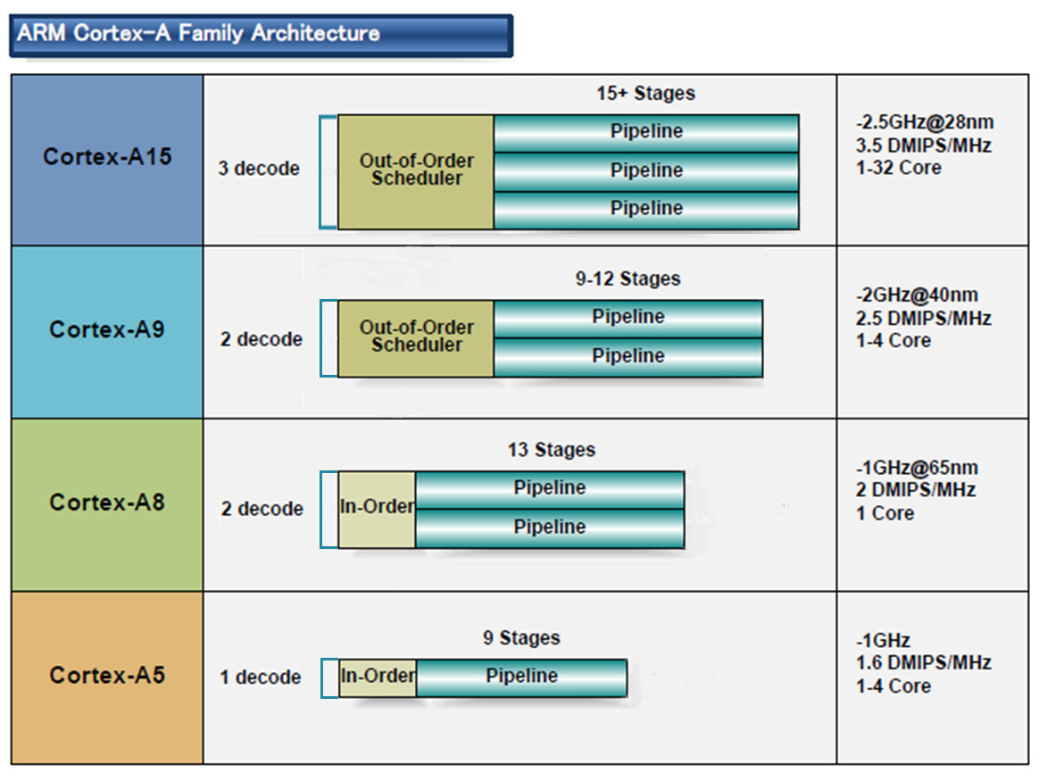
5. Evolution of tablet and smartphone processors (4)
a) Low power CPUs need narrow microarchitectures
Example: Width of ARM’s 32-bit CPUs used in most tablets and smartphones [10]
32-bit
2010
2007
2005
2009
(A9 replacement
for low-end
devices)
*

Slide 98
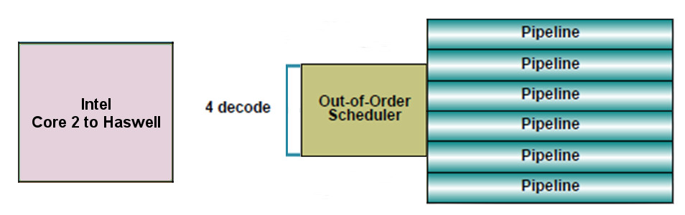
5. Evolution of tablet and smartphone processors (5)
By contrast:
at the same time Intel’s and AMD’s processor lines
were targeting high performance/power (in terms of GFLOPS/Watt) and
implemented 4-wide microarchitectures, as the next example shows:
64-bit
Example: Width of Intel’s Core 2 to Haswell processors underlying servers to laptops [10]
*

Slide 99
5. Evolution of tablet and smartphone processors (6)
Consequences for Intel and AMD-1
Intel’s and AMD’s traditional microarchitectures were not suited for mobile devices.
Both Intel and AMD conceived, designed and introduced new, narrow (e.g. 2-wide) low-power microarchitectures.
*

Slide 100
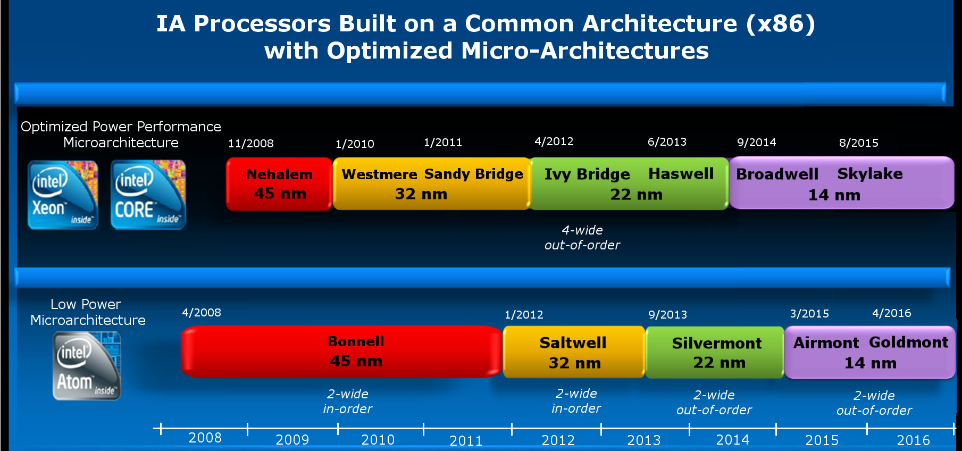
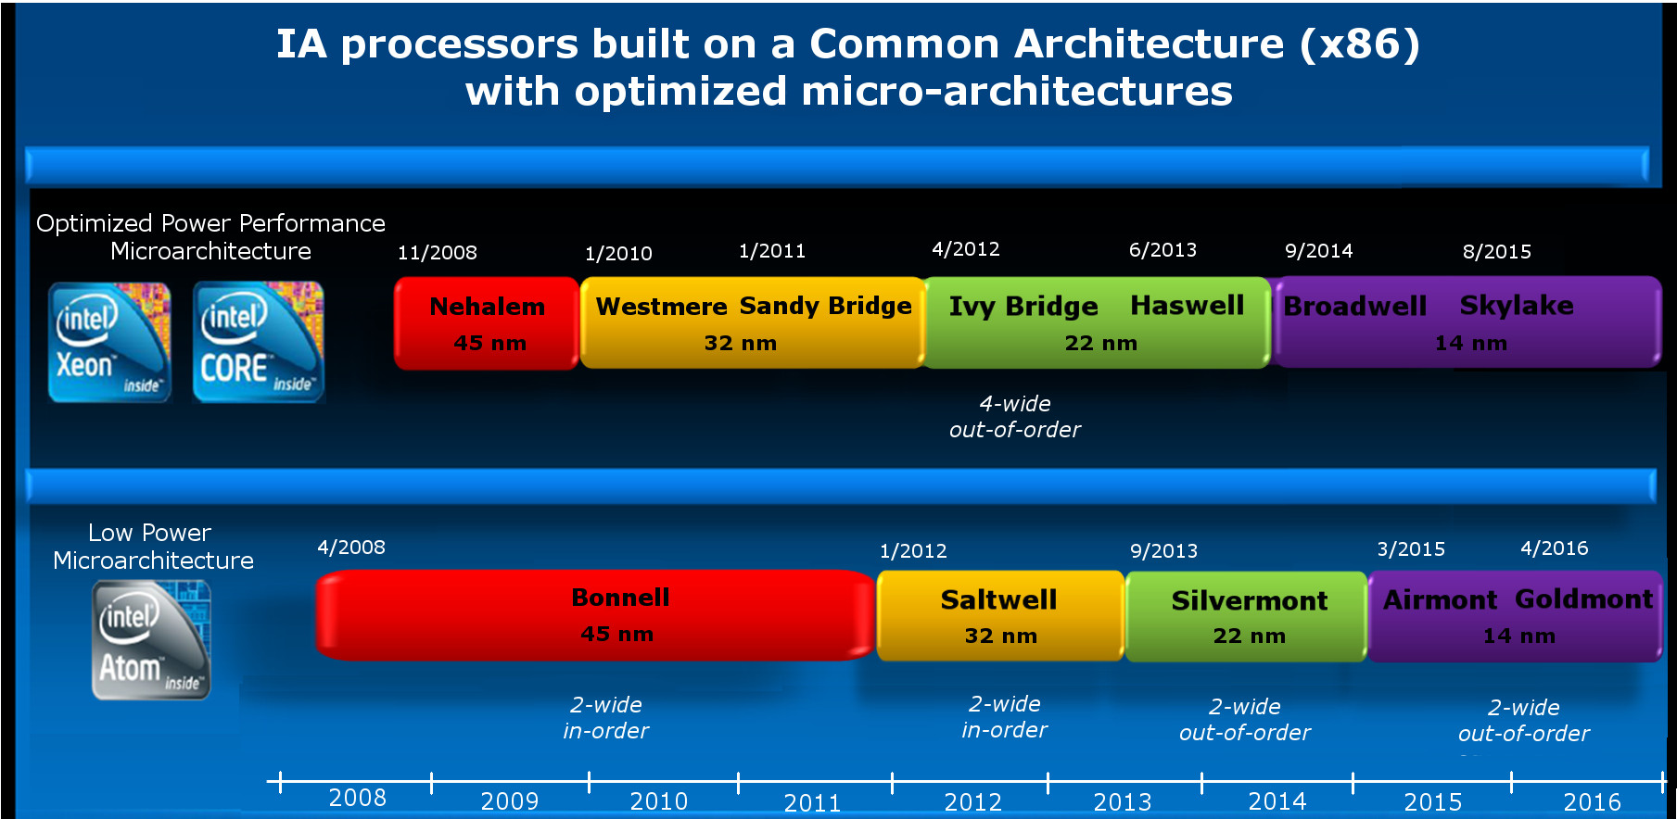
5. Evolution of tablet and smartphone processors (7)
Emergence of Intel’s Atom line aiming for tablets and smartphones (Based on [2])
4-wide
out-of-order
5
2008
2-wide
in-order
2-wide
out-of-order
2-wide
out-of-order
3-wide
out-of-order
2-wide
in-order
2-wide
in order
2-wide
out-of-order

Slide 101
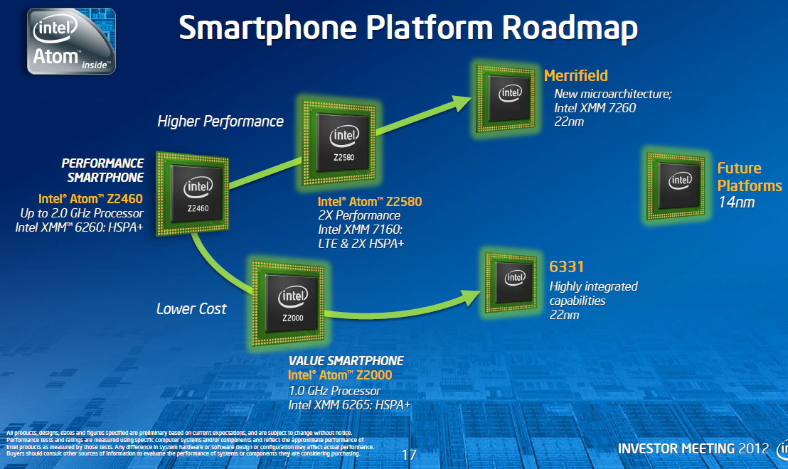
5. Evolution of tablet and smartphone processors (8)
Intel’s Atom-based smartphone platforms (based on [276])
Morganfield
(2016)
Moorefield
(2014)
Merrifield
(2014)
Performance (not to scale)
Clover Trail+
(2013)
Z5xxx
4x Goldmont
14 nm
+XMM 7360
Z35xx
4x Silvermont
22 nm
+XMM 7260/2/35
Medfield
(2012)
Z34x0
2x Silvermont
22 nm
+XMM 7160/7260
Cancelled
in 04/2016
Morestown
(2010)
Z2520-2580
2x Saltwell
32 nm
+XMM 6268/6360/7160
SoFIA
(x3 3G/LTE)
(2015)
Riverton
(2015)
Z2460/2480
1x Saltwell
32 nm
+XMM 6260
Slayton
(2014)
Lexington
(2013)
Z6xx
1x Bonnell
45 nm
+Wireless
module
C31xx/32xx/34xx
2x/4x Silvermont
28 nm
Integrated LTE
3G/4G modem
Z3xxx
2x Airmont
14 nm
Integrated
LTE modem
Z3xxx
2x Silvermont
22 nm
+A-GOLD 620
Z2420
1x Saltwell
32 nm
+XMM 6265
Cancelled
in 04/2016
Planned, not implemented
Eul H., & Bell M., Mobile at Intel, Investor Meeting 2012, Intel,
http://www.cnx-software.com/pdf/Intel_2012/2012_Intel_Investor_Meeting_Eul_Bell.pdf
Planned, not mplemented

Slide 102
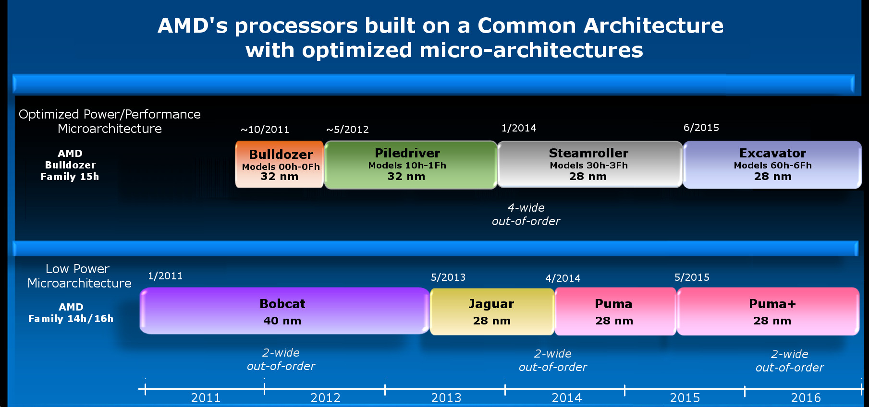
5. Evolution of tablet and smartphone processors (9)
Emergence of AMD's Cat line aiming for tablets and smartphones (Based on [2])
4-wide
out-of-order
4/2014
2-wide
out-of-order
2-wide
out-of-order
2-wide
out-of-order
2014

Slide 103
5. Evolution of tablet and smartphone processors (10)
b) Low power CPUs need to be operated at low base clock frequencies
Traditional client CPUs
Mobile CPUs
High base clock frequency
(typically 2-4 GHz)
Relative low base clock frequency
(typically 1-2 GHz)
( Dd = const x fc x V², in addition higher fc requires about linearly higher higher V)
*

Slide 104
5. Evolution of tablet and smartphone processors (11)
Example: The max. base frequency of Skylake models resulting in different TDPs and
configurations (Based on data from [202])
TDP (W) | No. of cores | Graphics | No. of graphics EUs | eDRAM | Base frequency (GHz)
4.5 | 2 | HD 515 | 18 | -- | 1.2
15 | 2 | HD 540 | 48 | 64 MB | 2.2
15 | 2 | HD 520 | 24 | -- | 2.6
28 | 2 | HD 550 | 48 | 64 MB | 3.3
35 | 4 | HD 530 | 24 | -- | 2.8
45 | 4 | HD 530 | 24 | -- | 2.9
65 | 4 | HD 530 | 24 | -- | 3.4
91 | 4 | -- | -- | -- | 4.2
Note that low TDP can be achieved first of all by reducing the core frequency and limiting
the computer resources (cores, GPU EUs) provided.
*

Slide 105
5. Evolution of tablet and smartphone processors (12)
Worldwide market share of smartphone and tablet application processors in 2015
(based on revenue) [217]
Smartphone application processors worldwide market share 2015 (revenue)
Qualcomm (USA) | 42 %
Apple (USA) | 21 %
MediaTek (Taiwan) | 19 %
Samsung (S. Korea)
Spreadtrum (China)
Tablet application processors worldwide market share 2015 (revenue)
Apple (USA) | 31 %
Qualcomm (USA) | 16 %
Intel (USA) | 14 %
MediaTek (Taiwan)
Samsung (S. Korea)
[Source: Related press releases of Strategy Analytics]
Nevertheless, Intel’s tablet processors results were achieved by paying subsidies for OEMs
(~ 50 $ /processor) to spurn transition from ARM processors to Atom processors.
*

Slide 106
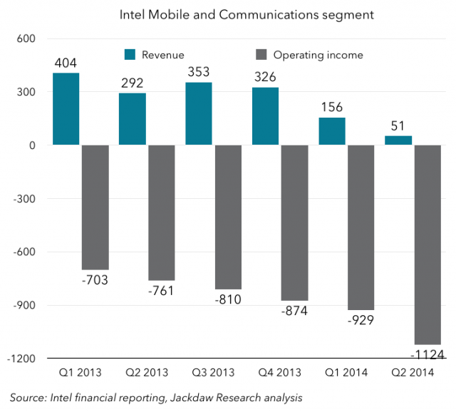
5. Evolution of tablet and smartphone processors (12b)
Intel's losses on mobile development in 2013 - 2014 [74]
Nevertheless, owing to subsidies Intel paid for OEMs, Intel's mobile and communication division
has lost 7 billion $ in the years 2013-2014 , as indicated in the next Figure [83].
Figure: Revenues/operating income of Intel's Mobile and Communications segment [83]

Slide 107
5. Evolution of tablet and smartphone processors (13)
Intel's withdrawal from the smartphone and mobil market [216] -1
Due to their high losses Intel first stopped paying subsidies and then in 4/2016 announced
their withdrawal from the mobile market.
Intel's statement says:
"I can confirm that the changes included canceling the Broxton platform as well as SoFIA
3GX, SoFIA LTE and SoFIA LTE2 commercial platforms to enable us to move resources
to products that deliver higher returns and advance our strategy.
These changes are effective immediately."
*

Slide 108
5. Evolution of tablet and smartphone processors (14)
Cancellation of Intel’s Atom-based smartphone platforms (based on [276])
Morganfield
(2016)
Moorefield
(2014)
Merrifield
(2014)
Performance (not to scale)
Clover Trail+
(2013)
Z5xxx
4x Goldmont
14 nm
+XMM 7360
Z35xx
4x Silvermont
22 nm
+XMM 7260/2/35
Medfield
(2012)
Z34x0
2x Silvermont
22 nm
+XMM 7160/7260
Cancelled
in 04/2016
Morestown
(2010)
Z2520-2580
2x Saltwell
32 nm
+XMM 6268/6360/7160
SoFIA
(x3 3G/LTE)
(2015)
Riverton
(2015)
Z2460/2480
1x Saltwell
32 nm
+XMM 6260
Slayton
(2014)
Lexington
(2013)
Z6xx
1x Bonnell
45 nm
+Wireless
module
C31xx/32xx/34xx
2x/4x Silvermont
28 nm
Integrated LTE
3G/4G modem
Z3xxx
2x Airmont
14 nm
Integrated
LTE modem
Z3xxx
2x Silvermont
22 nm
+A-GOLD 620
Z2420
1x Saltwell
32 nm
+XMM 6265
Cancelled
in 04/2016
Planned, not implemented
Eul H., & Bell M., Mobile at Intel, Investor Meeting 2012, Intel,
http://www.cnx-software.com/pdf/Intel_2012/2012_Intel_Investor_Meeting_Eul_Bell.pdf
Planned, not mplemented

Slide 109
5. Evolution of tablet and smartphone processors (15)
Intel's withdrawal from the smartphone and mobil market [216] -2
At the same time Intel laid off about 12000 employees (~ 11 % of their workforce).
*

Slide 110
5. Evolution of tablet and smartphone processors (16)
AMD’s cancellation of their Cat line in 2015
The last core of AMD's Cat line was the Puma+ core (launched in 6/2015 in the
Carrizo-L APU).
In AMD's 2016 Mobility roadmap there is no sign of an APU powered by the Puma+ core
or a derivative of it belonging to the Cat line.
Instead AMD has been placed emphasis on the Zen architecture that has been launched
in 2017.
*

Slide 111
5. Evolution of tablet and smartphone processors (17)
Nvidia is leaving the smartphone and tablet market in June 2016 [81]
In 6/2016 (at Computex) NVIDIA's CEO J. Huang declared the firm's leaving the
smartphone and tablet market by saying:
: “We are no longer interested in that market”. He adds, “Anybody can build smartphones,
and we’re happy to enjoy these devices, but we’ll let someone else build them”.
Instead NVIDIA became interested in designing in-car computers and car infotainment
systems beyond discrete GPU cards (dGPUs).

Slide 112
5. Evolution of tablet and smartphone processors (18)
Concluding remark: Subsequent evolution of the width of mobile CPU cores
Width of mobile cores
(or of big cores of big.LITTLE or dynamIQ core clusters)
2-wide
3-wide
4-wide
6-wide
ARM
v7 HP Cortex-A15
(2010)
v7 Cortex-A (2005-09)
(except 1-wide LP A5 (2009)
and 3-wide HP A15))
v8.0 HP Cortex-A73
(2016)
v8.0 HP Cortex-A (2013-15) (except 2-wide HP Cortex-A73)
v8.0/8.2 LP Cortex-A
(2013/2017)
v8.2 HP Cortex-A75
(2017)
v8.2 HP Cortex-A76
(2018)
v8.2 HP Cortex-A77
(2019)
v8.2 HP Cortex-X1
(8-wide, 2020)
Intel
Atom family (2008-15)
Airmont-based Atom core (2016)
AMD
Cat family (2011-2015)
Apple
v7 Cortex-A8 (2009)
v7 Swift (A6) (2012)
v8 Cyclone (A7) (2013)
and A8-A10
v8.2 A11 (2017) 7-wide
and subsequent cores
Qualcomm
v7 Scorpion
(S1-S3) (2007-10)
v7 Krait
(S4/S400/S60x/S80x)
(2012-14)
v8 Kryo/Kryo 280
(S820/821/835) (2015/2016/2017)
v8.2 Kryo 385
(S845) (2018)
(A7: Jim Keller)
Samsung
v7 Exynos 5
(2013-14)
v8 Exynos 7
(2016)
v8 M1 (2016)
(Exynos 8 Octa)
v8 M2 (2017)
(Exynos 9 Octa)
v8.2 M3 (2018)
(Exynos 9810)
v8.2 M6 (8-wide) (planned/cancelled)
HP: High-Performance
LP: Low-Power
*

