Slide 1
Recent mobile devices - Lecture
Dezső Sima
Vers. 1.0
November 2022
© Sima Dezső, 2022

Slide 2
1. Recent mobile devices (1)
Preliminary notes
In this Chapter we understand mobile devices basically as touchscreen devices,
like cellphones (feature phones or smartphones), tablets (including 2-in-1 tablets
(called also as 2-in-1 laptops, detachables, convertibles etc.) and also lightweight
laptops (LW laptops) built up on similar, low-power platforms as tablets.
By contrast, we count usual laptops and desktops to client devices which usually
are not touchscreen devices and allow a higher power budget for the processor
then mobile processors (e.g. 28 W TDP or higher).
In addition, we interpret mobile processors as the main processors of mobile devices
in order to distinguish them from other types of processors used in mobiles, like
GPUs (Graphics Processing Units), NPUs (Neural Processing Units) etc.
We note that mobile processors are often called also as application processors (AP).
We use both terms “mobile processors” and “application processors” as synonyms.
Typically, mobile devices use Arm ISA-based processors (see Section 1.2) whereas
client devices x86 ISA-based processors, nevertheless there are x86-based
mobile processors (see Section 3.) and Arm ISA-based client devices as well.
Remark
2-in-1 tablets (called also 2-in-1 laptops, convertibles or detachables), represent
an intermediate device type between tablets and laptops, as these devices can be
used either as stand alone touch screen tablets or as laptops when they are docked
to a keyboard (which is part of the device).

Slide 3
Recent mobile devices
1. Overview of recent mobile devices
2. Recent Arm ISA-based mobile devices
3. Recent x86 ISA-based mobile devices
4. Major historical mobile devices
5. Evolution of the width and performance of mobile CPU cores
6. Appendix: Evolution of Apple’s mobile processors
7. References
Notes:
3

Slide 4
1. Overview of recent mobile devices
Notes:
4

Slide 5
1. Overview of recent mobile devices (1)
Main device categories discussed in the Lecture Notes
Main devices categories discussed in the Lecture Notes
Mobile devices
Client devices
Servers
Usually touchscreen devices,
based typically
on Arm processors,
but there are also
x86-based
mobile devices
Usual laptops and DTs, based typically
on x86 processors,
but there are also
Arm-based
client devices as well
Based typically
on x86 processors,
but there are also
Arm-based
servers as well
Discussed
in this Chapter

Slide 6
1. Overview of recent mobile devices (2)
Distinguishing recent types of mobile devices by the ISA of their application
processors
Distinguishing recent mobile devices by the ISA of their application processors
Arm-ISA based
x86 (Core 2)-based

Slide 7
1. Overview of recent mobile devices (3)
Recap: What are the differences between the Arm and x86 ISAs?
The ARM ISA is a RISC architecture in contrast to the x86 ISA which is a CISC
ISA.
RISC ISAs are Load/Store architectures which fetch their operands from
registers,
whereas CISC architectures are register-memory architectures that allow operand
fetches both from registers and the memory.
This has two consequences;
CISC instructions are different long, depending on the number of memory
operands to be fetched whereas RISC instructions have equal length
(typically 32-bit) and
b) CISC architectures consume inherently more power since memory fetches
and decoding need more power than register fetches and RISC decoding.
This is the reason why ARM designs dominate recently the embedded and the
mobile market (including smartphones and tablets) and why increasingly more
ARM ISA-based server processor designs appear (e.g. ARM’s Neoverse line).

Slide 8
1. Overview of recent mobile devices (4)
Distinguishing recent Arm ISA-based mobile devices by the OS running on them
Distinguishing recent Arm ISA-based mobile devices by the OS running on them
Android
devices
(smartphones
tablets
LW laptops)
iOS
devices
(smartphones
tablets
LW laptops)
Windows
devices
(tablets
LW laptops)
Chrome
devices
(tablets
LW laptops)
(Chromebooks)

Slide 9
1. Overview of recent mobile devices (5)
Distinguishing recent x86 ISA-based mobile devices by the OS running on them
Distinguishing recent x86 ISA-based mobile devices by the OS running on them
Windows
devices
(tablets
LW laptops)
(Surface Pro/Go)
Chrome
devices
(tablets
LW laptops)
(Chromebooks)
While taking into account both aspects mentioned (ISA, OS) we get the following
subdivision of recent mobile devices:

Slide 10
1. Overview of recent mobile devices (6)
Recent types of mobile devices and their key features
Recent types of mobile devices (typically touchscreen devices)
Arm-ISA based
x86 ISA-based
(built on Core 2/Zen)
Android
devices
(smartphones
tablets
LW laptops)
iOS
devices
(smartphones
tablets
LW laptops)
Windows
devices
(tablets
LW laptops)
Chrome
devices
(tablets
LW laptops)
(Chromebooks)
Chrome
devices
(tablets
LW laptops)
(Chromebooks)
Windows
devices
(tablets
LW laptops)
(Surface devices)
Built on Arm ISA-based processors rather than Apple’s designs | Built on Apple’s Axx or Mx processors | Built on Qualcomm’s Snapdragon processors | Built on Arm ISA-based processors (excluded Apple-based) | Built on low power/ performance Core 2/Zen processors | Built on Core 2/Zen processors
They run under Android | (Before 2010: iPhone) | They run under Windows 10/11 | They run under Chrome OS | They run under Chrome OS | They run under Windows 8-11
From ≈ 2008 on | From 2007 on | From 2017 on | From 2012 on | From 2011 on | From 2013 on
(Arm ISA-based processor lines (except Apple’s designs) include Android oriented lines, like Qualcomm’s Snapdragon,
Samsung’s Exynos, MediaTek’s MT6xxx/8xxx or Dimensity and Huawei’s Kirin families.
(2.3)
(2.3)
(2.4)
(2.5)
(3.2)
(3.3)

Slide 11
1. Overview of recent mobile devices (7)
Market share of operating systems running on recent smartphones and tablets
Next we present related statistics published.

Slide 12
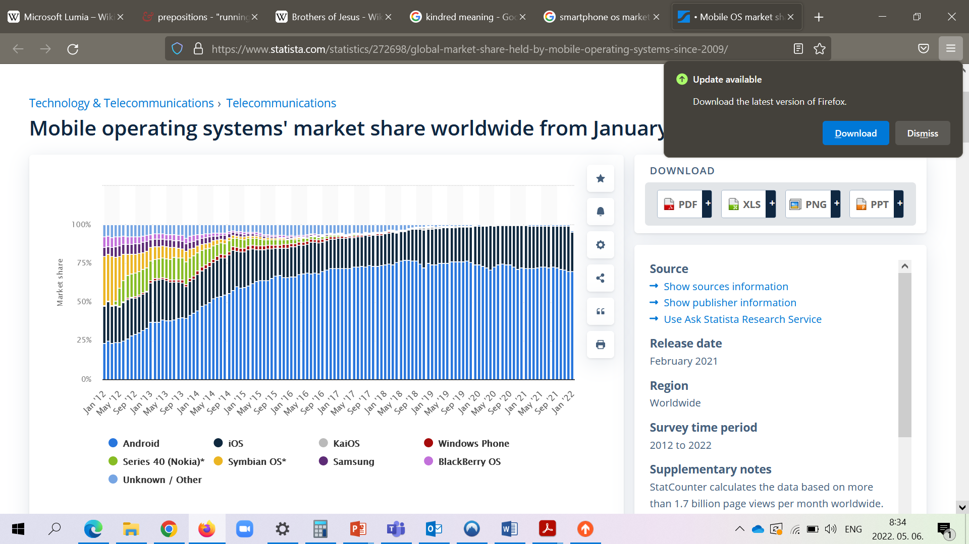
1. Overview of recent mobile devices (8)
a) Smartphone OS market share worldwide by shipments 2012 – 2022 [59]
As the above Figure indicates, initially Nokia’s Symbian OS dominated the market, but
in a few years it diminished, recently about 75 % of smartphones are Android devices,
25 % of smartphones are running under iOS, and no other OSs appear in the statistics.

Slide 13
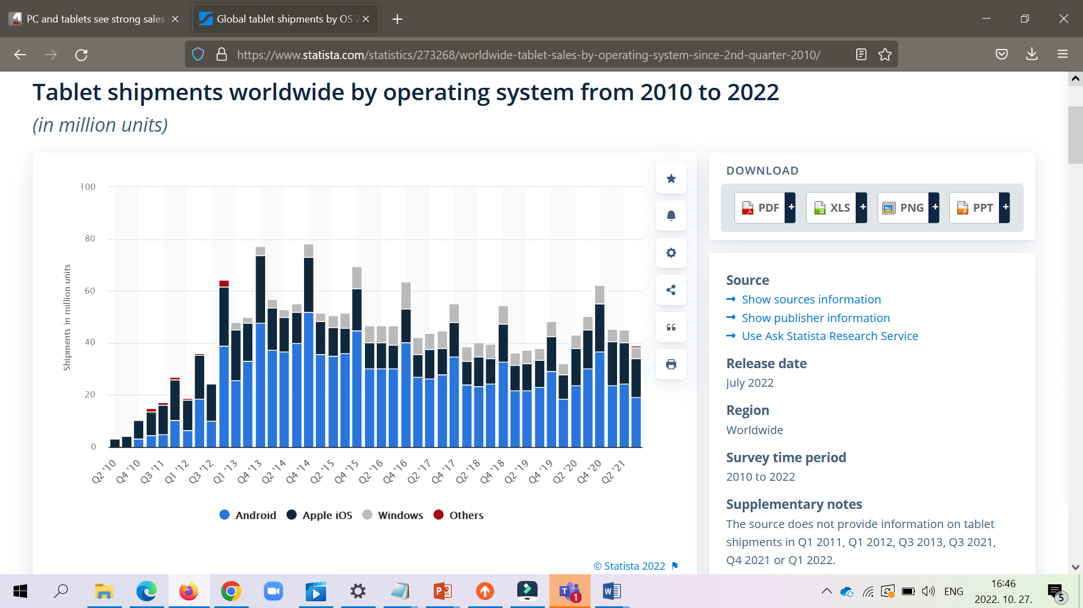
1. Overview of recent mobile devices (9)
b) Tablet OS market share worldwide by shipments 2010-2021 [110]
Above Figure indicates that recently about 50 % of tablets are running under Android
40 % under iOS and 10 % under Windows.
We note that most Windows tablets are x86-based Surface devices from Microsoft, and
only a few % of them are Arm-based, built on Qualcomm’s Snapdragon processors.
As seen, the cited statistics does not include Chrome OS-based Chromebooks, their
market share is indicated in statistics related to notebooks (see next).

Slide 14
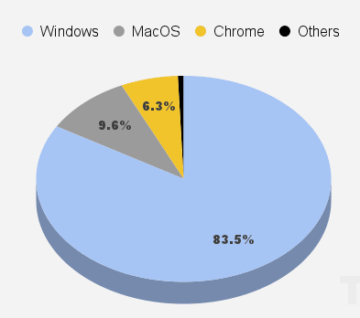
2. Overview of recent mobile devices (10)
Global market share of Chromebook shipments from notebooks in Q1/2022 [108]
Above Figure indicates that Chromebooks (either x86 or Arm-based) cover only a
few % (actually about 6 %) of notebooks shipment, with a declining trend, as stated
elsewhere [109].

Slide 15
2. Recent Arm ISA-based mobile devices
2.1 Overview of Recent Arm ISA-based mobile devices
2.2 Licensing of Arm ISA-based mobile processors
2.3 Recent Arm ISA-based mobile Android and iOS devices
2.4 Arm-based mobile Windows devices
2.5 Arm-based mobile Chrome devices (Chromebooks)
Notes:
15

Slide 16
2.1 Overview of recent Arm ISA-based mobile Android and
iOS devices
Notes:
16

Slide 17
2.1 Overview of recent Arm ISA-based mobile devices (1)
2.1 Overview of recent Arm ISA-based mobile devices
Recent types of mobile devices
Arm-ISA based
x86 ISA-based
(built on Core 2/Zen)
Android
devices
(smartphones
tablets
LW laptops)
iOS
devices
(smartphones
tablets
LW laptops)
Windows
devices
(tablets
LW laptops)
Chrome
devices
(tablets
LW laptops)
(Chromebooks)
Chrome
devices
(tablets
LW laptops)
(Chromebooks)
Windows
devices
(tablets
LW laptops)
(Surface devices)
8
Built on Arm ISA-based processors rather than Apple’s designs | Built on Apple’s Axx or Mx processors | Built on Qualcomm’s Snapdragon processors | Built on Arm ISA-based processors (excluded Apple-based) | Built on low power/ performance Core 2/Zen processors | Built on Core 2/Zen processors
They run under Android | (Before 2010: iPhone) | They run under Windows 10/11 | They run under Chrome OS | They run under Chrome OS | They run under Windows 8-11
From ≈ 2008 on | From 2007 on | From 2017 on | From 2012 on | From 2011 on | From 2013 on
(Arm ISA-based processor lines rather than Apple’s designs include Android oriented lines, like Qualcomm’s
Snapdragon, Samsung’s Exynos, MediaTek’s MT6xxx/8xxx or Dimensity and Huawei’s Kirin families.
(2.3)
(2.3)
(2.4)
(2.5)
(3.2)
(3.3)

Slide 18
2.2 Licensing of Arm ISA-based mobile processors
Notes:
18

Slide 19
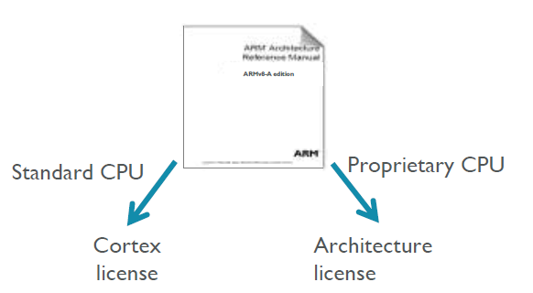
2.2 Licensing of Arm ISA-based mobile processors (1)
2.2 Licensing of Arm ISA-based mobile processors [62]
As ARM holds the patent right of the Arm ISA, every vendor who intends to built
Arm ISA-based processors, previously has to acquire the related patent rights.
There are however two basic options for it:
a) to acquire a Cortex license or
b) to acquire an Architecture license,
as indicated below.
In case of a Cortex license the licensee gets a complete standard microarchitecture
design (IP) with flexible configuration options, e.g. relating to the sizes of the
L1 or L2 caches.
By contrast, the Architecture license allows only using the ARM ISA and the licensee
has to design their custom microarchitecture, which leads to a proprietary CPU.
E.g. Apple or Samsung bought an Architecture license, custom designed their CPUs
and named them as they liked.

Slide 20
2.2 Licensing of Arm ISA-based mobile processors (2)
Which license type did different vendors acquire? -1
The type of license acquired by processor vendors
Acquiring a Cortex license
and using off-the-shelf cores
Acquiring an architecture license
and designing custom cores
Apple
Ax/Mx famiilies
ARM-licenced cores
(until the A5X in 2012)
In-house designed cores
since the A6, 2012
Samsung
Exynos family
ARM licensed cores
up to the Exynos 7 series 2016)
In-house designed big Mongoose cores
but licensed LITTLE cores
between 2016-2020
ARM licensed big cores
beginning with the
Exynos 980 in 2020
Qualcomm
Snapdragon family
ARM licensed cores
until 2008,
then both ARM-licensed
cores and in-house designed
Scorpion and Krait cores
until 2015.
Subsequently, only in-house
designed Kryo cores
(except the X1 big core
in the Snapdragon 888 (2020))
HiSilicon (Huawei)
Kirin family
ARM-licensed cores.
MediaTek
Mtxxxx and
Helio families
ARM licensed cores

Slide 21
2.2 Licensing of Arm ISA-based mobile processors (3)
Which license type have different vendors acquire? -2
As the previous Figure shows, recently only the US-based Apple and Qualcomm use
in-house designed custom cores whereas all other firms off-the-shelf Cortex cores,
licenced from ARM.

Slide 22
2.3 Recent Arm ISA-based mobile Android and iOS devices
Notes:
22

Slide 23
2.3 Recent Arm ISA-based Android and iOS mobile devices (1)
2.3 Recent Arm ISA-based mobile Android and iOS devices ()
Recent types of mobile devices
Arm-ISA based
x86 ISA-based
(built on Core 2/Zen)
Android
devices
(smartphones
tablets
LW laptops)
iOS
devices
(smartphones
tablets
LW laptops)
Windows
devices
(tablets
LW laptops)
Chrome
devices
(tablets
LW laptops)
(Chromebooks)
Chrome
devices
(tablets
LW laptops)
(Chromebooks)
Windows
devices
(tablets
LW laptops)
(Surface devices)
8
Built on Arm ISA-based processors rather than Apple’s designs | Built on Apple’s Axx or Mx processors | Built on Qualcomm’s Snapdragon processors | Built on Arm ISA-based processors (excluded Apple-based) | Built on low power/ performance Core 2/Zen processors | Built on Core 2/Zen processors
They run under Android | (Before 2010: iPhone) | They run under Windows 10/11 | They run under Chrome OS | They run under Chrome OS | They run under Windows 8-11
From ≈ 2008 on | From 2007 on | From 2017 on | From 2012 on | From 2011 on | From 2013 on
(Arm ISA-based processor lines rather than Apple’s designs include Android oriented lines, like Qualcomm’s
Snapdragon, Samsung’s Exynos, MediaTek’s MT6xxx/8xxx or Dimensity and Huawei’s Kirin families.
(2.3)
(2.3)
(2.4)
(2.5)
(3.2)
(3.3)

Slide 24
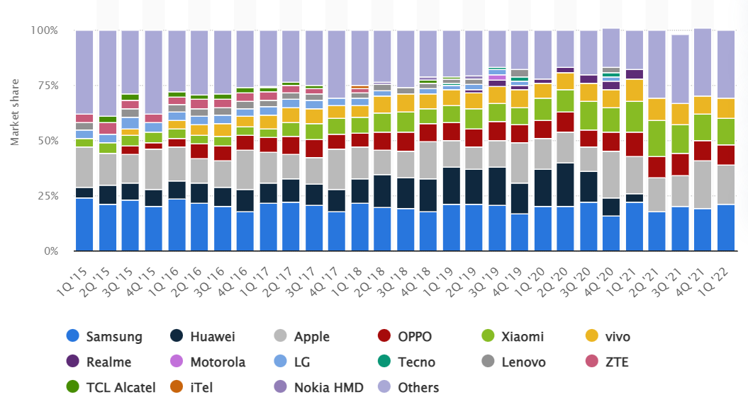
2.3 Recent Arm ISA-based Android and iOS mobile devices (2)
Smartphone market share by shipments worldwide 2015 - 2022 [66]
As seen in the above Figure, recently Samsung, Apple, OPPO, Xiomi and vivo are
the major suppliers of smartphones.
Since the US export restrictions (2020) Huawei lost its notable share in this market.

Slide 25
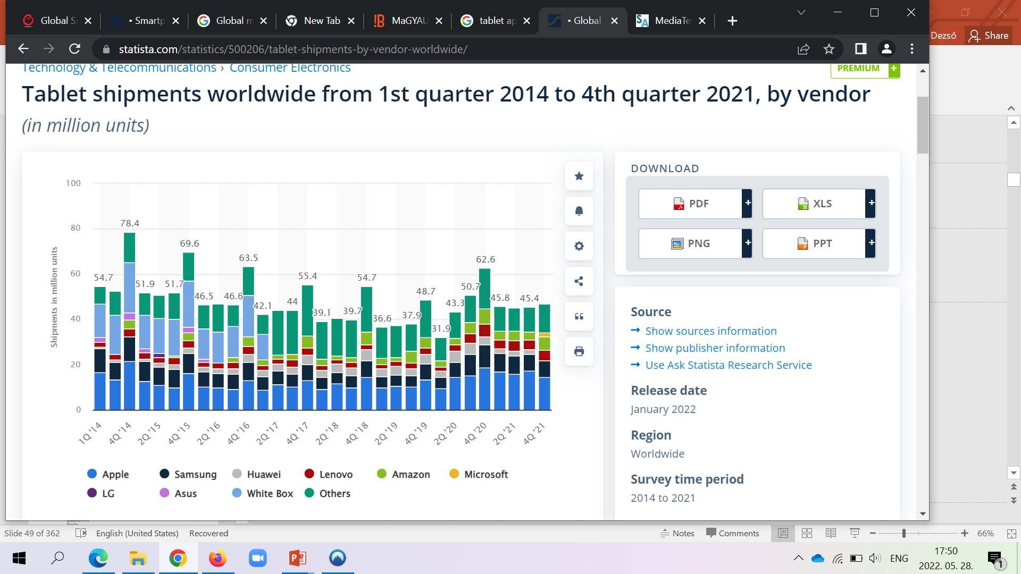
2.3 Recent Arm ISA-based Android and iOS mobile devices (3)
Tablet market share by shipments worldwide (2014 – 2021) [69]
As the above Figure indicates, recently Apple, Samsung, Lenovo, Amazon and Microsoft are the major tablet suppliers while considering unit shipments.
Huawei lost its position due to US export restrictions (2020).

Slide 26
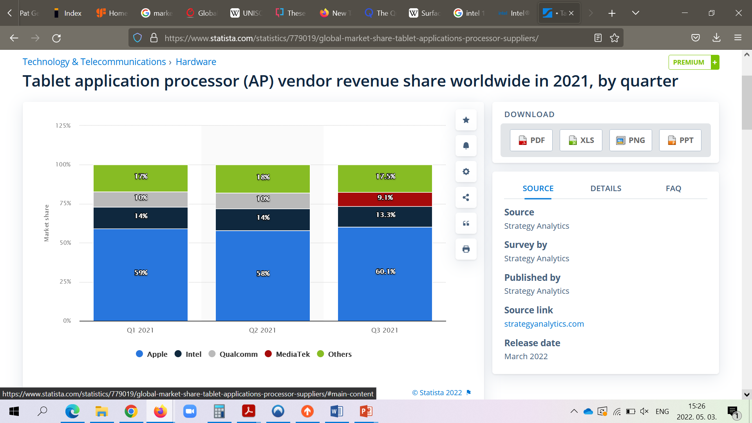
2.3 Recent Arm ISA-based Android and iOS mobile devices (4)
Tablet application processor revenue market share worldwide in 2021 [70]
Nevertheless, if the revenue share of tablet application processors is concerned,
Apple is the leading vendor by far, followed by Intel Qualcomm and MediaTek.

Slide 27
2.3 Recent Arm ISA-based Android and iOS mobile devices (5)
Leading vendors in designing Arm-based application processors
While taking into account both smartphones and tablets it can be stated that
there are three major vendors in designing mobile application processors, as follows:
Apple
Qualcomm and
MediaTek
Remarks
Previously, Huawei belonged also to the major AP suppliers, but US export
regulations recently restrict the firm from importing US-made IC manufacturing
equipment and software tools.
We note also that in the client and server categories Intel is the leading firm for
delivering application processors, followed by AMD with a share of ≈ 25 % in
clients and ≈ 10 % in servers.

Slide 28
2.3 Recent Arm ISA-based Android and iOS mobile devices (6)
Evolution of the CPU configuration of Arm-based mobile processors
There were five main steps of how CPU configurations of mobile processors evolved,
as indicated in the Figure below.
Main evolution steps of CPU configurations in mobile processors
Single core
CPUs
Multicore CPUs
Symmetrical
multicores
big.LITTLE
core clusters
DynamIQ
core clusters
Armv9
DynamIQ
core clusters
CC interconnect
CC interconnect
CC interconnect
CC interconnect
Typical width
32-bit
(≈2000-2010)
32-bit
(~2011-2013)
64-bit
(~2013-2016)
64-bit
(~2018-)
64-bit
(~2021-)
Based on
Up to Armv7
Armv7
Armv8
Armv8.2
Armv9

Slide 29
2.3 Recent Arm ISA-based Android and iOS mobile devices (7)
Main evolution steps of CPU configurations and first processor models implementing them -1
Main evolution steps of CPU configurations in mobile processors
Symmetrical
multicores
big.LITTLE
core clusters
DynamIQ
core clusters
Armv9-A based
DynamIQ
core clusters
32-bit
64-bit
64-bit
64-bit
(Armv7)
(2010-2013)
(Armv8)
(2013-2016)
(Armv8.2)
(2018-2020)
(Armv9)
(2021-)
ARM
HP: Cortex-A15
MS: Cortex-A8/A9/A17
LP: Cortex-A5/A7
HP: Cortex-A57/A72/A73
LP: Cortex-A32/A35
HP: Cortex-A75/
A76/A77/A78/X1
LP: A55
HP: Cortex-X2/X3
MS: A710/A715
LP: A510/A510 v2
Apple
A5 (2011)
(2C)
A10 (2016)
(2+2)C
A11 (2017)
(2+4)C
Samsung
Exynos
4412 4C (2012)
5410 (4+4)C (2013)
5420 (4+4)C (2013)
9810 (2018)
(4+4)C
2200 (2022)
(1+3+4)C
Qualcomm
Snapdragon
8260 2C (2013)
400 4C (2013)
615 (4+4) (2014)
810 (4+4) (2015)
845 (2018)
(4+4)C
8 Gen 1(2022)
(1+3+4)C
Huawei
Kirin
(K3V2 4C (2012))
920 (4+4)) 2014)
980 (2018)
(2+2+4)C
MediaTek
MT6582 4C (2013)
MT6592 8C (2013)
MT8135 (2+2)C (2013)
MT6595 (4+4)C (2014)
Helio P90 (2+6)C (2019)
Dimensity 9000 (1+3+4)C (2021)

Slide 30
2.3 Recent Arm ISA-based Android and iOS mobile devices (8)
Main evolution steps of CPU configurations and first processor models implementing them -2
As the previous Figure indicates major vendors designing application processors
followed the same evolution pattern in enhancing CPU configurations, more or less
in the same time.

Slide 31
2.4 Arm-based mobile Windows devices
Notes:
31

Slide 32
2.4 Arm-based mobile Windows devices (1)
2.4 Arm-based mobile Windows devices
Recent types of mobile devices
Arm-ISA based
x86 ISA-based
(built on Core 2/Zen)
Android
devices
(smartphones
tablets
LW laptops)
iOS
devices
(smartphones
tablets
LW laptops)
Windows
devices
(tablets
LW laptops)
Chrome
devices
(tablets
LW laptops)
(Chromebooks)
Chrome
devices
(tablets
LW laptops)
(Chromebooks)
Windows
devices
(tablets
LW laptops)
(SurfacePro devices)
Built on Arm ISA-based processors rather than Apple’s designs | Built on Apple’s Axx or Mx processors | Built on Qualcomm’s Snapdragon processors | Built on Arm ISA-based processors (excluded Apple-based) | Built on low power/ performance Core 2/Zen processors | Built on Core 2/Zen processors
They run under Android | (Before 2010: iPhone) | They run under Windows 10/11 | They run under Chrome OS | They run under Chrome OS | They run under Windows 8-11
From ≈ 2008 on | From 2007 on | From 2017 on | From 2012 on | From 2011 on | From 2013 on
(Arm ISA-based processor lines rather than Apple’s designs include Android oriented lines, like Qualcomm’s
Snapdragon, Samsung’s Exynos, MediaTek’s MT6xxx/8xxx or Dimensity and Huawei’s Kirin families.
(2.3)
(2.3)
(2.4)
(2.5)
(3.2)
(3.3)

Slide 33
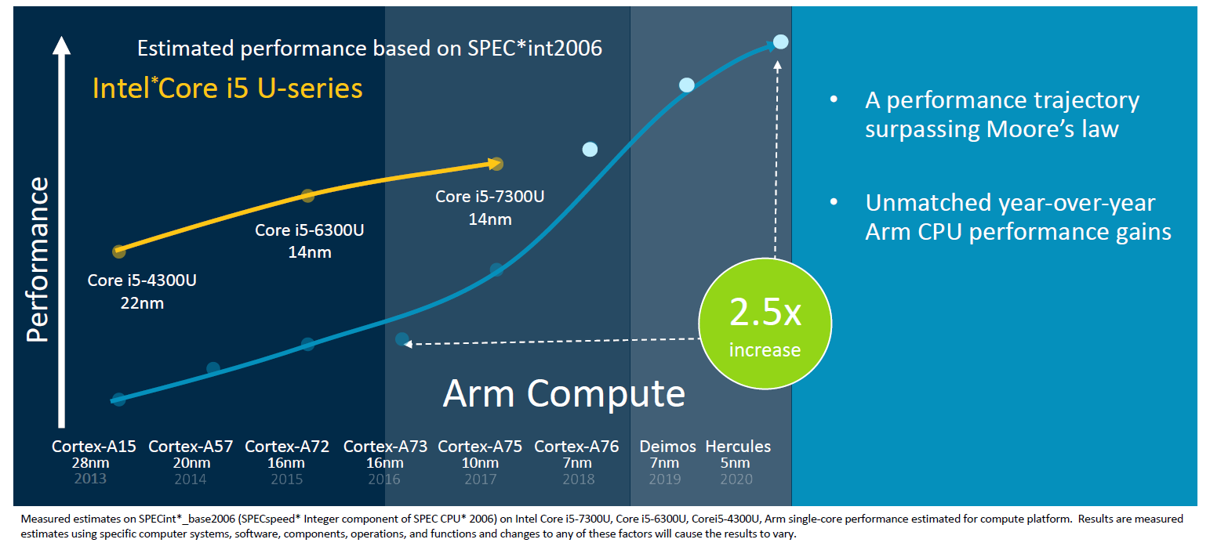
2.4 Arm-based mobile Windows devices (2)
Motivations for designing ARM ISA-based Windows laptops -1
a) Currently ARM ISA-based processors raise their performance at a higher rate than
x86-based processors of the same power budget, as seen below.
Cortex-A78
Cortex-A77
A-78
A-77
A-76
Figure: Expected year-over-year performance gain of ARM cores vs. Intel’s processors (2018) [71]
*

Slide 34
2.4 Arm-based mobile Windows devices (3)
Motivations for designing ARM ISA-based Windows laptops -2
b) ARM ISA-based processors consume considerable less power than their x86-based
competitors of the same performance, hereby allowing fanless, lighter designs with
always-on-always-connected operation (all-day laptops).

Slide 35
2.4 Arm-based mobile Windows devices (4)
Introducing Arm ISA-based Windows laptops
Considering the benefits of low power ARM-based processors Qualcomm and
Microsoft agreed upon a joint development of Windows tablets or 2-in-1 laptops
in 2016.
First result of this cooperation hit the market in 2017 with Snapdragon 835 based
laptops and 2-in-1 laptops running under Windows 10 S (a restricted version of
Windows 10 allowing only 32-bit applications to download and run from the
Microsoft store).
Here we note that Arm ISA-based devices (laptops, 2-in-1 laptops, tablets) are
also called WOA (Windows-on-ARM) devices.

Slide 36
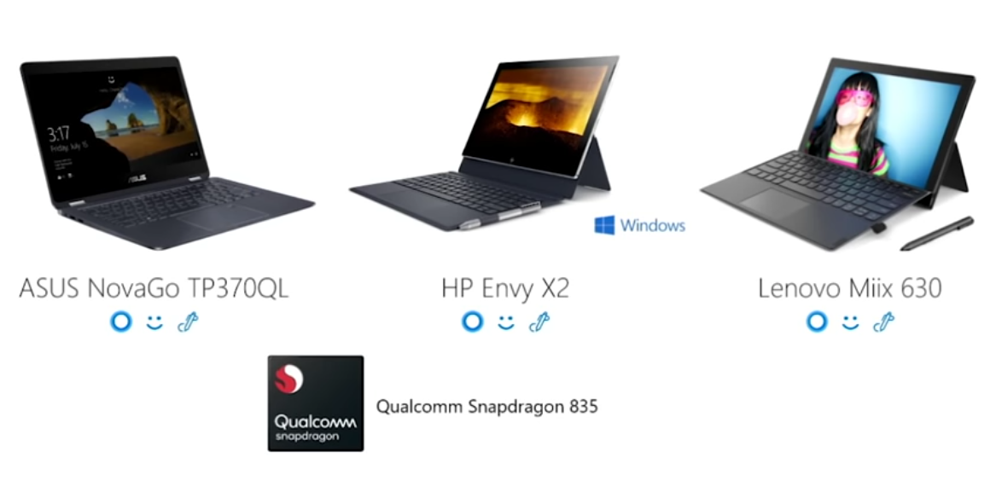
2.4 Arm-based mobile Windows devices (5)
Examples of first gen. Windows 10 laptops based on the Snapdragon 835 [72]
These devices have a very long battery life (e.g. 15 hours) but show a rather poor
performance, as indicated in the next Figure.

Slide 37
2.4 Arm-based mobile Windows devices (6)
Key deficiencies of 1. gen. Arm ISA-based Windows devices []
Arm ISA-based devices had two main deficiencies vs. x86-based systems as follows:
a) compatibility issues while running x86 applications and
b) performance deficits due to emulating 32-bit x86 apps.

Slide 38
2.4 Arm-based mobile Windows devices (7)
a) Compatibility issues of 1. gen Windows tablets while running x86 applications
First gen. Windows laptops are built on the Snapdragon 835 and shipped with
Windows 10 S.
Windows 10 S supported only the Edge browser and let download applications
only from the Microsoft Store, called UWP (Universal Windows Platform) apps.
We note that certain system routines of Windows 10 S, like the kernel or device
drivers were previously recompiled to the Arm ISA, so they run natively under
Windows 10 S (without emulation).
ARM32 or ARM64 applications downloaded from the Microsoft Store, could run
from the start natively as well, whereas
32-bit x86 UPW apps (like Adobe reader) downloaded from the Microsoft Store,
did not need to be recompiled for ARM, but were emulated,
no 64-bit x86 apps were available in the Microsoft Store as UWP apps, but many
of them had 32-bit UWP versions.

Slide 39
2.4 Arm-based mobile Windows devices (8)
Summing up how Windows 10 and applications run on 1. gen. Windows devices
Running system routines and applications on ARM processors
Previously recompiled
system routines and
ARM64 or ARM32 UPW code
downloaded from the Microsoft Store
were executed natively
32-bit x86 UPW apps
downloaded
from the Microsoft Store
were emulated
(converted on-the-fly to ARM code)
Examples
The kernel, device drivers and
built in apps (like Edge, Explorer etc.)
32-bit x86 UPW apps (like Adobe reader)
But 64-bit x86 apps are not supported
ARM32 and ARM64 UWP apps
Notes
All 32-bit x86 apps that were downloaded from the Microsoft Store (UWP apps) were expected
to run without any problems.
After switching to Windows 10 Pro also x86 apps could be downloaded and run but then errors
might be encountered due to a number of reasons, e.g. as x86 drivers could not be used or
the Windows Hypervisor Platform was not supported etc.

Slide 40
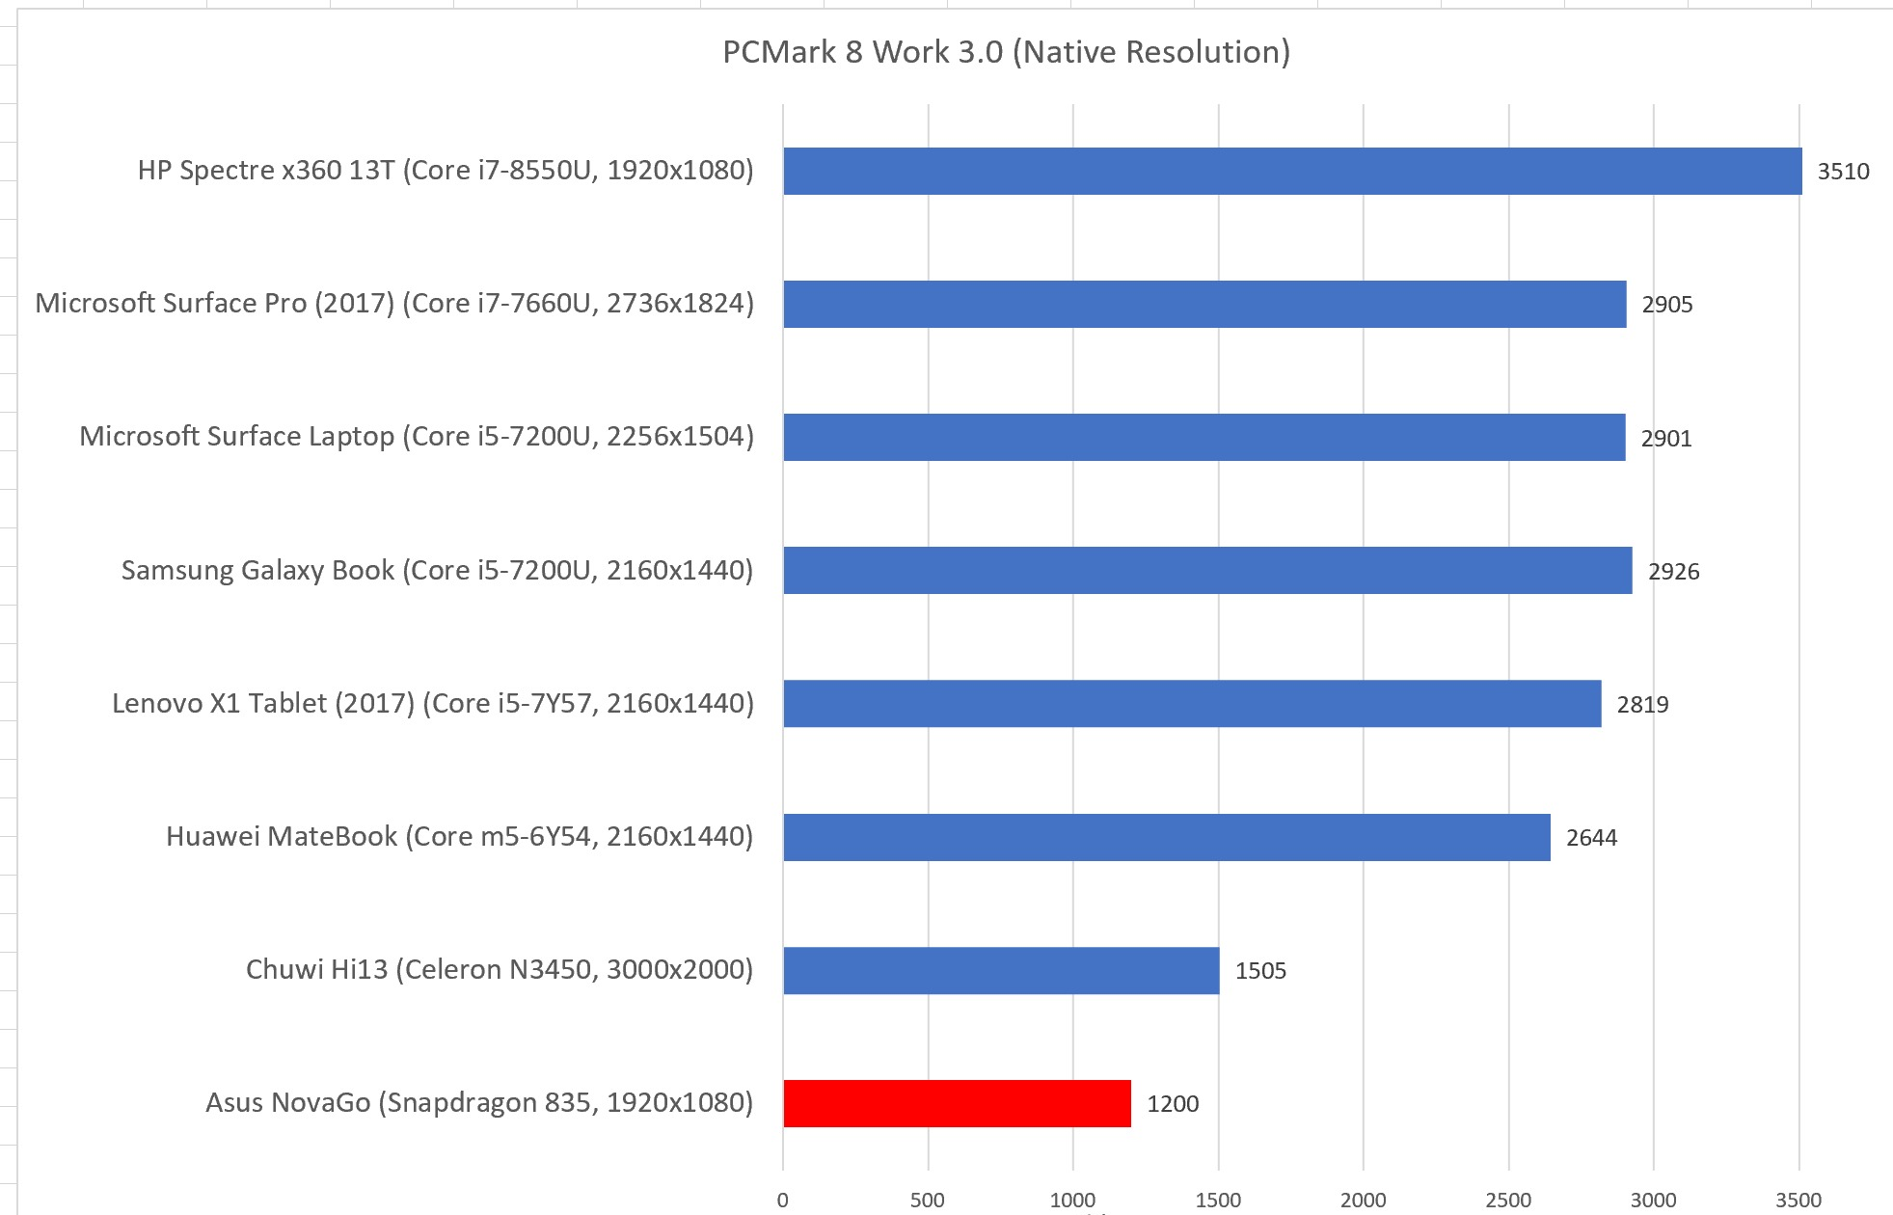
2.4 Arm-based mobile Windows devices (9)
b) Performance deficit of 1. gen. Windows tablets, shown e.g. by PCMark8
performance figures of comparable tablets and laptops -1 [73]

Slide 41
2.4 Arm-based mobile Windows devices (10)
b) Performance deficit of 1. gen. Windows tablets
PCMark8 performance figures of comparable tablets and laptops, shown before [73]
indicate that the performance of 1. gen. Windows tablet leaves much to be desired.

Slide 42
2.4 Arm-based mobile Windows devices (11)
Qualcomm’s effort to raise the performance of their processors intended to be
used in Windows devices
Following the Snapdragon 835 Qualcomm designed a number of processors for
Arm-based Windows devices, as indicated below.
Qualcomm
Snapdragon
*
*
*
*
*
*
*
835
845
850
8cx
8c/7c
8cx Gen2
8cx Gen3
2017
2018
2019
2020
2021
Figure: Qualcomm’s Snapdragon processors designed to run under Windows 10
Both the SC (Single Core) and MC (Multi Core) performance of the developed
processors intended for Windows devices, rose dynamically, as shown in the next
two Figures.

Slide 43
2.4 Arm-based mobile Windows devices (12)
Raising SC performance in Qualcomm’s processors to be used in Windows devices
(Geekbench 5 SC scores vs. Intel’s i5/i7 (15 W) processors, under Windows) [74]
SC: Single core scores (up to)
I7-1265U
2+10C
1800
x
1
1700
I7-1165G7
4C
x
1600
x
1500
I5-1245U
2+10C
1400
I7-1065G7
4C
x
I7-8565U
4C
x
1300
I7-7660U
2C
x
I5-1135G7
4C
1200
I7-7560U
2C
15 W TDP
x
1100
Intel
I7-6600U
2C
x
x
15 W TDP
I5-1035G7
2C
1000
I7-4600U
2C
I7-5600U
2C
x
900
x
x
x
8cx Gen.3
4+4C
(X1)
x
800
x
I5-7300U
2C
7 W TDP
x
700
I7-4500U
2C
x
x
8cx Gen.2
4+4C
(A76)
I5-5300U
2C
8cx
4+4C
(A76)
x
600
8c
4+4C
(A76)
500
x
400
850
4+4C
(A75)
x
300
Qualcomm
835
4+4C
200
(A73)
100
2013
2014
2015
2016
2017
2018
2019
2020
2021
2022
Year

Slide 44
2.4 Arm-based mobile Windows devices (13)
Raising MC performance in Qualcomm’s processors to be used in Windows devices
(Geekbench 5 MC scores vs. Intel’s i5/i7 (15 W) processors, under Windows) [74]
MC: Multi core scores (up to)
I7-1265U
2+8C
8000
x
x
7500
I5-1235U
2+8C
7000
6500
6000
I7-1165G7
4C
5500
x
x
5000
I7-1065G7
4C
x
x
8cx
Gen.3
4+4C
(X1)
4500
I5-1140U
4C
x
x
I7-8565U
4C
4000
I5-1035G7
3500
I7-7660U
2C
3000
I7-6600U
2C
x
Intel
I7-7560U
2C
x
8cx
Gen.2
4+4C
(A76)
2500
I7-4600U
2C
I7-5600U
2C
x
x
I7-4500U
2C
x
x
x
x
8cx
4+4C
(A76)
8c
4+4C
(A76)
2000
x
x
I5-5700U
1500
x
x
850
4+4C
(A75)
x
Qualcomm
835
4+4C
A73
1000
I5-5300U
500
2013
2014
2015
2016
2017
2018
2019
2020
2021
2022
Year

Slide 45
2.4 Arm-based mobile Windows devices (14)
Performance improvement of recent Snapdragon-based Windows devices
The presented Figures indicate a notable SC and MC performance gain for Qualcomm’s
Snapdragon models following the 1. gen. 835 used in Windows devices, nevertheless,
Intel raised their performance scores in a similar high rate, consequently
until now Qualcomm’s processors could not achieve any considerable performance
gain over Intel’s comparable low power processors to become competitive.

Slide 46
2.4 Arm-based mobile Windows devices (15)
Examples of Windows devices using Qualcomm’s and Microsoft’s Arm ISA-based
processors [75]
Generation | Processor model number | Sampling availability | Devices using it
1. gen. | MSM8998 (835) | Q2 2018 | Asus NovaGo HP Envy X2 Lenovo Miix 630 AllView Allbook Q Thomson NEO Z3 Thomson NEO Z3 PRO 13.3
2. gen. | SDM850 | Q3 2018 | Lenovo Yoga C630 WOS Samsung Galaxy Book2 Huawei Matebook E 2019 Thomson NEO Z3 PRO 12.5 MaiBenBen XiaoMai X228
3. gen. | 8cx | Q3 2019 | Samsung Galaxy Book S Lenovo Yoga 5G
 | Microsoft SQ1 | Q3 2019 | Microsoft Surface Pro X
4. gen. | 8cx Gen 2 | 06/2021 | HP Elite Folio Acer Spin 7Samsung Galaxy Book Go 5G
5. gen. | 8cx Gen 3 | 12/2021 | Lenovo ThinkPad X13s

Slide 47
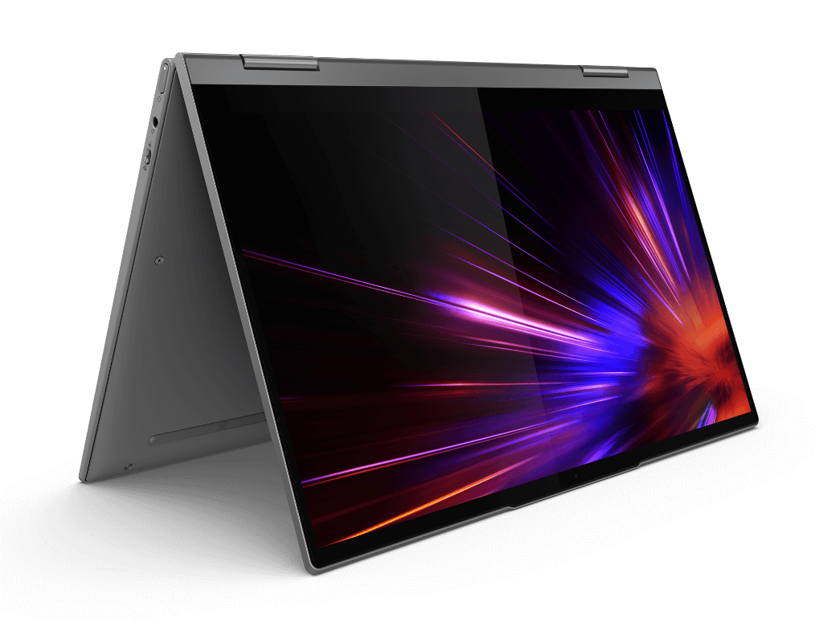
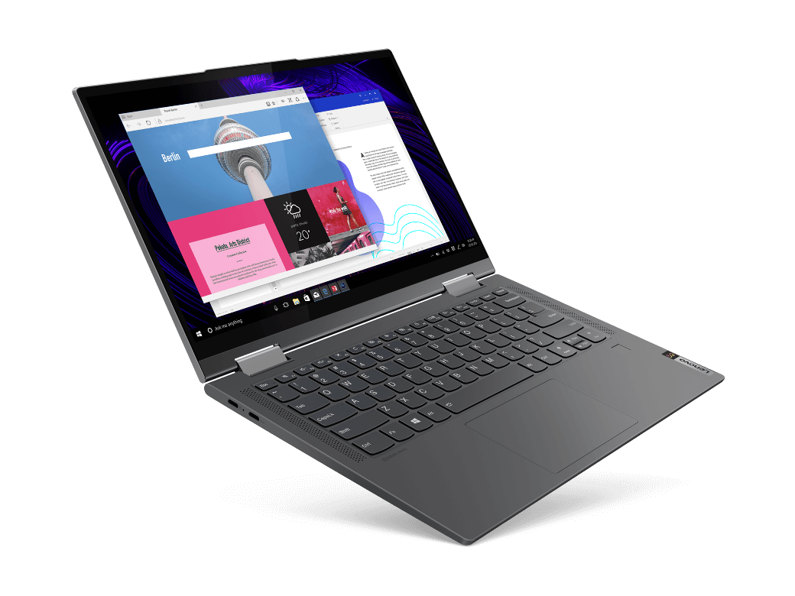
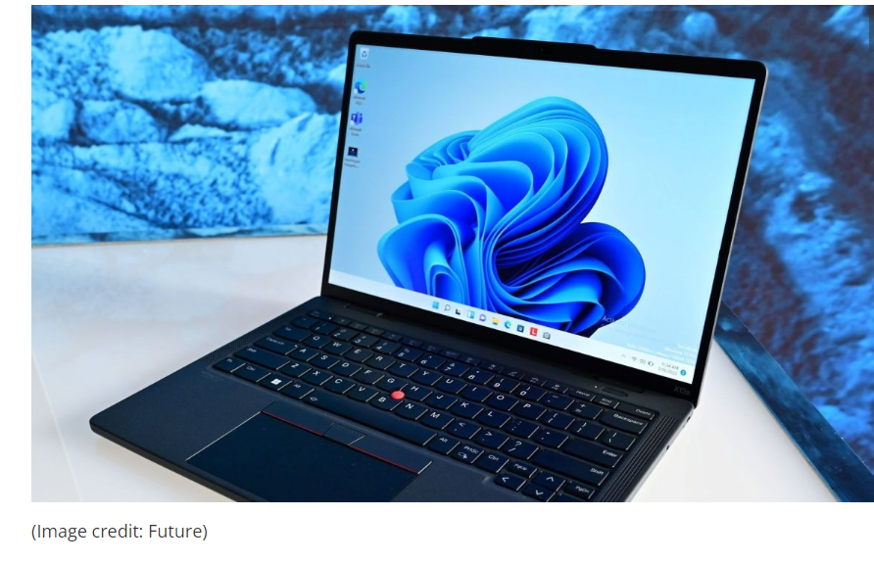
2.4 Arm-based mobile Windows devices (16)
Examples of 3. and 5. gen. Windows laptops based on the Snapdragon 8cx [76]
Lenovo Yoga 5G, World’s first 5G PC, based on Snapdragon 8cx (2020)
Lenovo ThinkPad X13s, based on Snapdragon 8cx Gen3 (2022)
Picture sources: Vendors announcements

Slide 48
2.4 Arm-based mobile Windows devices (17)
Microsoft’s effort to fix compatibility issues of Arm-based Windows devices
In 04/2018 Microsoft replaced Windows 10 S for 2. gen., Qualcomm 850-based
Windows devices by the more efficient S-mode of Windows 10 Home or Windows 10 Pro,
as indicated below.
*
*
*
*
*
*
*
835
845
850
8cx
8c/7c
8cx Gen2
8cx Gen3
*
*
*
Windows 10 S
Windows 10 Home/Pro S mode
Windows 11
2017
2018
2019
2020
2021
Figure: OS support of Arm ISA-based Windows devices
In 10/2021 Microsoft launched Windows 11 (as shown in the above Figure), and
one month later announced the availability of x64 emulation under Windows 11.
Nevertheless, x64 emulation has a few compatibility issues yet, as enlisted next.

Slide 49
2.4 Arm-based mobile Windows devices (18)
Windows 11 constraints of compatibility on ARM-based processors [76]
Drivers for hardware, games and apps will only work if they're designed for a Windows 11 ARM-based PC.
For more info, check with the hardware manufacturer or the developer of the driver.
If a driver doesn’t work, the app or hardware that relies on it won’t work either (at least not fully). Peripherals and devices only work if the drivers they depend on are built into Windows 11, or if the hardware developer has released ARM64 drivers for the device.
Certain games won’t work.
Games and apps won't work if they use a version of OpenGL greater than 3.3, or if they rely on "anti-cheat" drivers that haven't been made for Windows 11 ARM-based PCs.
Check with your game publisher to see if a game will work.
Apps that customize the Windows experience might have problems.
This includes some input method editors (IMEs), assistive technologies, and cloud storage apps. The organization that develops the app determines whether their app will work on a Windows 11 ARM-based PC.
Some third-party antivirus software can’t be installed.
You won't be able to install some third-party antivirus software on a Windows 11 ARM-based PC—unless it’s been made or updated for an ARM-based PC.
However, Windows Security will help keep you safe for the supported lifetime of your Windows 11 device.
Windows Fax and Scan isn’t available.
This feature isn’t available on a Windows 11 ARM-based PC.

Slide 50
2.4 Arm-based mobile Windows devices (19)
Market share of Arm-based Windows notebooks in 2021 [78]
At the time being no reliable data could be found about the market share of Arm-based
Windows notebooks.
Nevertheless, their market share may be estimated to be not more than a few %.

Slide 51
2.4 Arm-based mobile Windows devices (20)
Assessment of recent ARM-ISA-based Windows devices [79], [80] -1
Recent (Armv8.2-based) Windows laptops or 2-in-1 laptops, have the benefit of
long battery life (often 20+ hours) which is substantially longer than that of
x86 processor-based laptops.
Due to their low power consumption these laptops usually provide
always-on-always-connected operation (via LTE (4G) and/or 5G) and
fanless designs that allow to build thin and light devices.
Recent Windows laptops operate under Windows 11 that allows running applications
written for ARM ISA-based processors natively, and emulates both 32-bit and
64-bit x86 apps without considerable speed implications.
Though compatibility issues have largely been removed by the introduction of
Windows 11, certain x86 app compatibility problems remain further on, as
discussed before.
As far as the performance of recent Windows on Arm devices is concerned, their
performance improved considerably vs. their 1. gen. but does not match yet
their x86-based competitors.
Time will show whether or not Windows laptops will become competitive to x86 laptops.

Slide 52
2.5 Arm-based mobile Chrome devices (Chromebooks)
Notes:
52

Slide 53
2.5 Arm-based mobile Chrome devices (Chromebooks) (1)
2.5 Arm-based mobile Chrome devices (Chromebooks) -1
Recent types of mobile devices
Arm-ISA based
x86 ISA-based
(built on Core 2/Zen)
Android
devices
(smartphones
tablets
LW laptops)
iOS
devices
(smartphones
tablets
LW laptops)
Windows
devices
(tablets
LW laptops)
Chrome
devices
(tablets
LW laptops)
(Chromebooks)
Chrome
devices
(tablets
LW laptops)
(Chromebooks)
Windows
devices
(tablets
LW laptops)
(Surface devices)
Built on Arm ISA-based processors rather than Apple’s designs | Built on Apple’s Axx or Mx processors | Built on Qualcomm’s Snapdragon processors | Built on Arm ISA-based processors (excluded Apple-based) | Built on low power/ performance Core 2/Zen processors | Built on Core 2/Zen processors
They run under Android | (Before 2010: iPhone) | They run under Windows 10/11 | They run under Chrome OS | They run under Chrome OS | They run under Windows 8-11
From ≈ 2008 on | From 2007 on | From 2017 on | From 2012 on | From 2011 on | From 2013 on
(Except Apple’s designs, Arm ISA-based processors are Android oriented lines, like Qualcomm’s Snapdragon,
Samsung’s Exynos, MediaTek’s MT6xxx/8xxx or Dimensity and Huawei’s Kirin families.
(2.3)
(2.3)
(2.4)
(2.5)
(3.2)
(3.3)

Slide 54
2.5 Arm-based mobile Chrome devices (Chromebooks) (2)
Arm-based mobile Chrome devices (Chromebooks) -2 [81]
Chromebooks are low-cost tablets or laptops, mostly 2-in-1 laptops that run
under Google’s Chrome OS, which is a stripped-down version of Linux.
Chromebooks are primarily designed while assuming their applications and data
are being held in the cloud.
Consequently, they typically have low power, low performance CPU processors,
small memories (e.g. 4 GB) and a low-capacity (e.g. 16-32 GB) eMMC (embedded
MultiMediaCard background storage.
Due to their low-cost components, Cromebooks mostly cost less than 200 $.
Google Play Store provides access to thousands of apps.
Google announced Cromebooks in 2011, first devices appeared in 2012.
Due to their low price, Cromebooks became rapidly popular,
as discussed later.

Slide 55
2.5 Arm-based mobile Chrome devices (Chromebooks) (3)
Arm-based mobile Chrome devices (Chromebooks) -3 [82]
The vast majority of Chromebooks are Core 2-based x86 devices.
They have typically
higher processing power,
less battery life and
are higher priced
than Arm-based Chromebooks.
These devices are recommended for programmers.
By contrast, Arm-based Chromebooks are appropriate for light workloads, they
consume less power and cost less than Core 2-based Chromebooks.

Slide 56
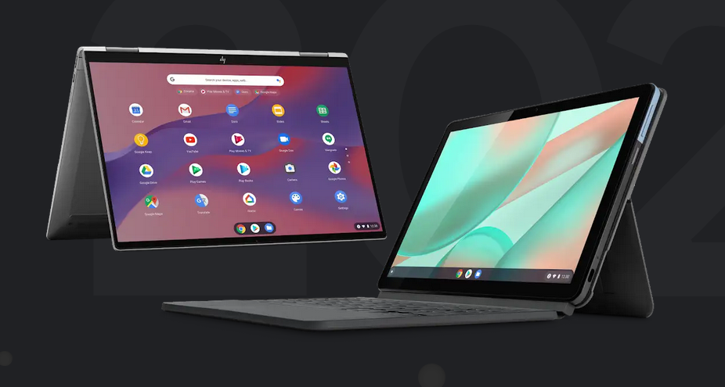
2.5 Arm-based mobile Chrome devices (Chromebooks) (4)
Examples of Chromebooks [83]
Lenovo Chromebook Duet (2020)
HP C1030 Chromebook (2020)

Slide 57
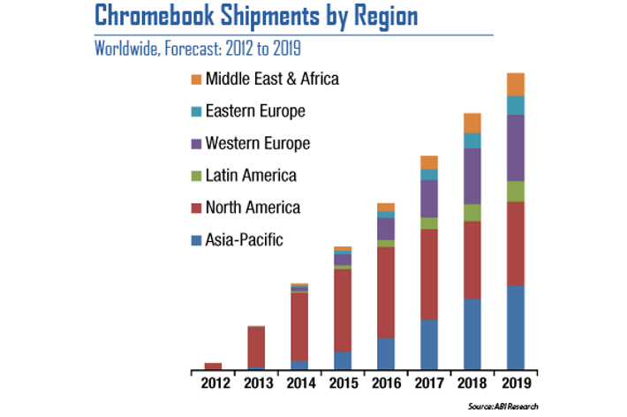
2.5 Arm-based mobile Chrome devices (Chromebooks) (5)
Dynamic increase of Chromebook shipments (qualitative picture) [84]

Slide 58
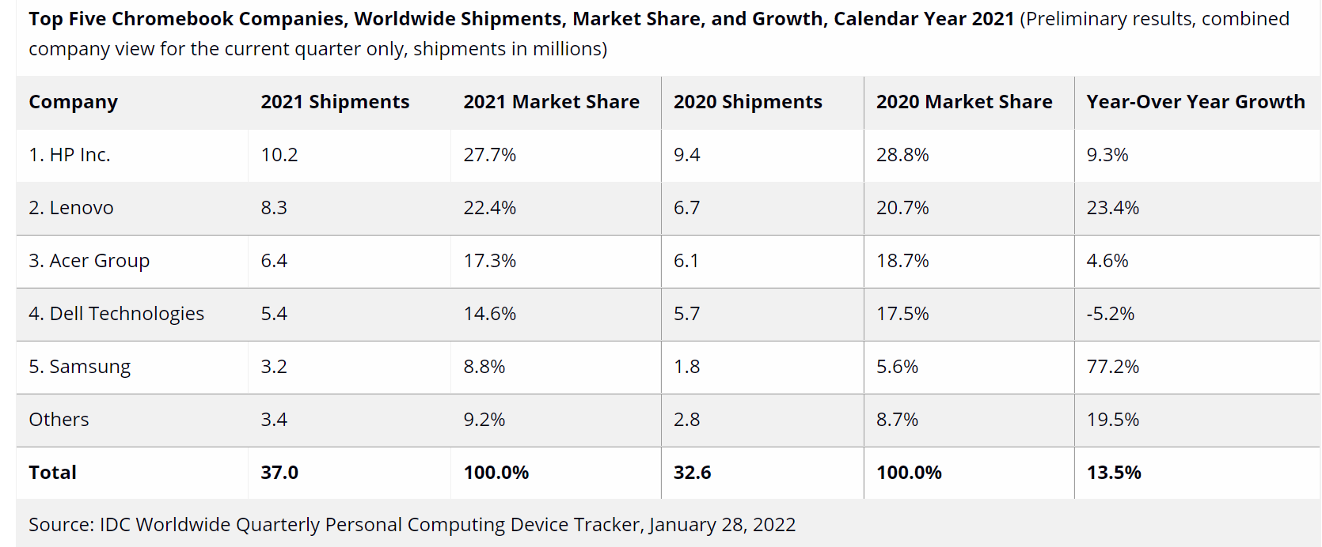
2.5 Arm-based mobile Chrome devices (Chromebooks) (6)
Market share of Chromebook vendors in 2021 [85]

Slide 59
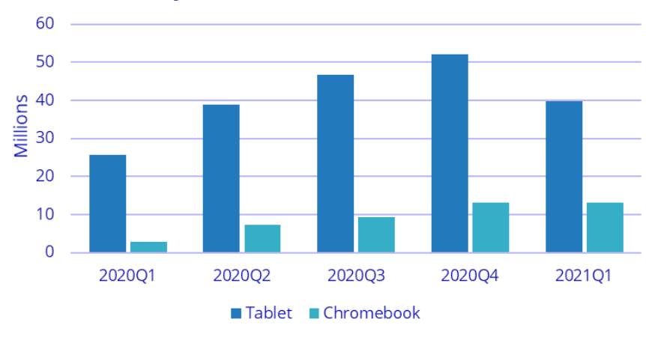
2.5 Arm-based mobile Chrome devices (Chromebooks) (7)
Market share of Chromebooks worldwide by shipments related to global tablet
shipments 2020-2021 [64]
As the cited data reveals, recent shipments of Chrombooks accounts to about 20-25 %
of the tablets sold.

Slide 60
3. Recent x86 ISA-based mobile devices
3.1 Overview of recent x86-based mobile devices
3.2 x86 (Core 2/Zen)-based mobile Chrome devices
(Chromebooks)
3.3 x86 (Core 2/Zen)-based mobile Windows devices
(Surface devices)
Notes:
60

Slide 61
3.1 Overview of recent x86-based mobile devices
Notes:
61

Slide 62
3.1 Overview of recent x86-based mobile devices (1)
3.1 Overview of recent x86-based mobile devices
Recent x86 ISA-based mobile devices
Chrome
devices
(tablets
LW laptops)
(Chromebooks)
Windows
devices
(tablets
laptops)
(Surface devices)
Built on low power/performance Core 2 processors | Built on Core 2 processors
They run under Chrome OS | They run under Windows 8-11
From 2011 on | From 2013 on
Section
(1.3.2)
(1.3.3)

Slide 63
3.2 x86 (Core 2/Zen)-based mobile Chrome devices
(Chromebooks)
Notes:
63

Slide 64
3.2 x86 (Core 2/Zen)-based mobile Chrome devices (Chromebooks) (1)
3.2 x86 (Core 2/Zen)-based mobile Chrome devices (Chromebooks) [82] -1
Recent types of mobile devices
Arm-ISA based
x86 ISA-based
(built on Core 2/Zen)
Android
devices
(smartphones
tablets
LW laptops)
iOS
devices
(smartphones
tablets
LW laptops)
Windows
devices
(tablets
LW laptops)
Chrome
devices
(tablets
LW laptops)
(Chromebooks)
Chrome
devices
(tablets
LW laptops)
(Chromebooks)
Windows
devices
(tablets
LW laptops)
(Surface devices)
Built on Arm ISA-based processors rather than Apple’s designs | Built on Apple’s Axx or Mx processors | Built on Qualcomm’s Snapdragon processors | Built on Arm ISA-based processors (excluded Apple-based) | Built on low power/ performance Core 2/Zen processors | Built on Core 2/Zen processors
They run under Android | (Before 2010: iPhone) | They run under Windows 10/11 | They run under Chrome OS | They run under Chrome OS | They run under Windows 8-11
From ≈ 2008 on | From 2007 on | From 2017 on | From 2012 on | From 2011 on | From 2013 on
(Arm ISA-based processor lines rather than Apple’s designs include Android oriented lines, like Qualcomm’s
Snapdragon, Samsung’s Exynos, MediaTek’s MT6xxx/8xxx or Dimensity and Huawei’s Kirin families.
(2.3)
(2.3)
(2.4)
(2.5)
(3.2)
(3.3)

Slide 65
3.2 x86 (Core 2/Zen)-based mobile Chrome devices (Chromebooks) (2)
3.2 x86 (Core 2/Zen)-based mobile Chrome devices (Chromebooks) [82]
Arm-based Chromebooks were already described in Section 1.2.6, so we do not
repeat here their general features only point out the main differences of Arm-
and x86-based implementations, as follows:
The vast majority of Chromebooks are Core 2 or Zen-based x86 devices.
They have typically
higher processing power,
less battery life and
are higher priced
than Arm-based Chromebooks.
1.3.3 x86 (Core 2)-based tablets/LW laptops
(Chromebooks)
These devices are recommended for programmers.
By contrast, Arm-based Chromebooks are appropriate for light workloads, they
consume less power and cost less than Core 2-based Chromebooks.

Slide 66
3.3 x86 (Core 2/Zen)-based mobile Windows devices
(Surface devices)
Notes:
66

Slide 67
3.3 x86 (Core 2/Zen)-based mobile Windows devices (Surface devices) (1)
3.3 x86 (Core 2/Zen)-based mobile Windows devices (Surface devices) -1
Recent types of mobile devices
Arm-ISA based
x86 ISA-based
(built on Core 2/Zen)
Android
devices
(smartphones
tablets
LW laptops)
iOS
devices
(smartphones
tablets
LW laptops)
Windows
devices
(tablets
LW laptops)
Chrome
devices
(tablets
LW laptops)
(Chromebooks)
Chrome
devices
(tablets
LW laptops)
(Chromebooks)
Windows
devices
(tablets
LW laptops)
(Surface devices)
Built on Arm ISA-based processors rather than Apple’s designs | Built on Apple’s Axx or Mx processors | Built on Qualcomm’s Snapdragon processors | Built on Arm ISA-based processors (excluded Apple-based) | Built on low power/ performance Core 2/Zen processors | Built on Core 2/Zen processors
They run under Android | (Before 2010: iPhone) | They run under Windows 10/11 | They run under Chrome OS | They run under Chrome OS | They run under Windows 8-11
From ≈ 2008 on | From 2007 on | From 2017 on | From 2012 on | From 2011 on | From 2013 on
(Arm ISA-based processor lines rather than Apple’s designs include Android oriented lines, like Qualcomm’s
Snapdragon, Samsung’s Exynos, MediaTek’s MT6xxx/8xxx or Dimensity and Huawei’s Kirin families.
(2.3)
(2.3)
(2.4)
(2.5)
(3.2)
(3.3)

Slide 68
3.3 x86 (Core 2/Zen)-based mobile Windows devices (Surface devices) (2)
x86 (Core 2/Zen)-based mobile Windows devices (Surface devices) -2
In their strive to became a hardware and services company as well, (as announced
in 2012), Microsoft introduced a wide range of Surface devices, like 2-in-1 (touch
screen) tablets, Lightweight (LW) laptops or laptops from 2012 on.
There were however two lines of Surface devices, the Surface line and the Surface Pro line.
First two models of the Surface line were built on Nvidia’s Arm-based Tegra processors
and are running under Windows RT whereas the last model makes use of an Atom
processor and is running under Windows 8.1.
By contrast, all models of the Surface Pro line are built on Intel’s x86-based Core 2
processors and run under different versions of Windows, as the next two Tables indicate.

Slide 69
3.3 x86 (Core 2/Zen)-based mobile Windows devices (Surface devices) (5)
Remark
NVIDIA’s Tegra processors were Armv7-A based and run under Windows RT
which was a modified Windows 8 aiming at the ARMv7-A ISA.
Model | Intro | Processor | Word length | Core nr. | OS
Surface | 10/2012 | Tegra 3 | 32-bit | 4 | Windows RT
Surface 2 | 10/2013 | Tegra 4 | 32-bit | 5 | Windows RT
Surface 3 | 05/2015 | Atom X7-Z8700 Airmont core | 64-bit | 4 | Windows 8.1
Table: Microsoft’s NVIDIA Armv7-A or Intel’s x86 Atom-based Surface tablets
Despite replacing Tegra processors by an x86-based Atom model and the
Windows RT by Windows 8.1 (see below), this line was cancelled due to less
than expected sales figures.

Slide 70
3.3 x86 (Core 2/Zen)-based mobile Windows devices (Surface devices) (4)
Key features of Microsoft’s Surface Pro 2-in-1 Windows tablets built on Intel’s Core 2
Surface Pro 2-in-1 tablets are built on low power Core 2 processors, include 2 to 4
cores and are running under Windows 8 Pro to Windows 11 Home/Pro.
Model | Intro | Processor | Word length | Core count | OS
Surface Pro | 02/2013 | Ivy Bridge i5 | 64-bit | 2 | Windows 8 Pro
Surface Pro 2 | 10/2013 | Haswell i5 | 64-bit | 2 | Windows 8.1 Pro
Surface Pro 3 | 06/2014 | Haswell i3/i5/i7 | 64-bit | 2 | Windows 8.1 Pro
Surface Pro 4 | 10/2015 | Skylake-U i5 | 64-bit | 2 | Windows 10 Pro
Surface Pro 2017 | 06/2017 | Kaby Lake m3 | 64-bit | 2 | Windows 10 Pro
Surface Pro 6 | 10/2018 | Kaby Lake Refr. | 64-bit | 4 | Windows 10 Home
Surface Pro 7 | 10/2019 | Ice Lake i3/i5/i7 | 64-bit | 2/4 | Windows 10 Home
Surface Pro 8 | 10/2020 | Tiger Lake i5/i7 | 64- bit | 2/4 | Windows 11 Home/Pro
Table: Microsoft’s Intel Core 2-based Surface Pro Windows tablets
We note that first Surface Pro models had 10.6 inch displays, whereas later models
were shipped with enlarged displays of 12 or even 13-inch.

Slide 71
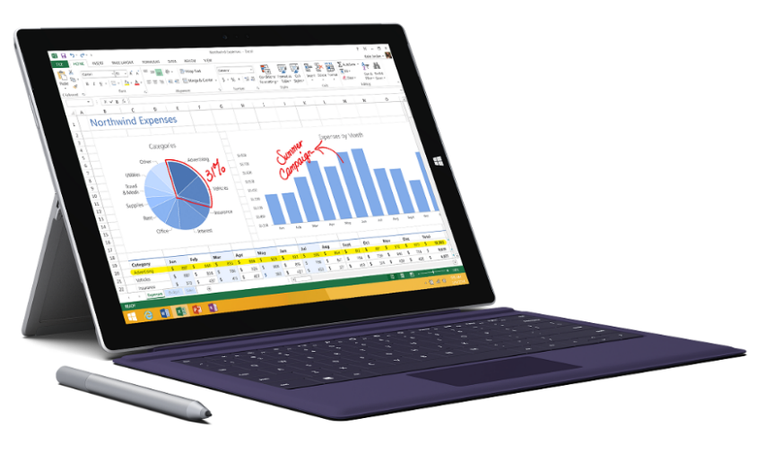
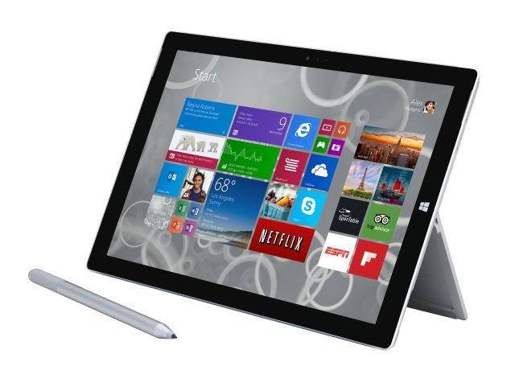
3.3 x86 (Core 2/Zen)-based mobile Windows devices (Surface devices) (3)
Example: Windows Surface Pro 3 2-in-1 tablets (8/2014)
2-in-1 tablet 12”
Aim: Replacing laptops
Intel’s Surface Pro 3
used as a laptop [106]
Intel’s Surface Pro 3
used as a tablet [107]

Slide 72
3.3 x86 (Core 2/Zen)-based mobile Windows devices (Surface devices) (6)
Introduction of a number of Surface devices by Microsoft
Following the Surface and Surface Pro 2-in-1 tablets Microsoft introduced a number
of further Surface devices, like the low-cost, 10-inch Surface Go, the Surface Book
or the Surface Laptop series, not discussed in this Chapter.

Slide 73
3.3 x86 (Core 2/Zen)-based mobile Windows devices (Surface devices) (7)
x86 (Core 2/Zen)-based mobile Windows devices of other manufacturers
Subsequently, a number of OEMs followed suit with x86-based Windows tablets,
like Lenovo or Acer.
At present, x86-based 2-in-1 Windows tablets have a market share of about 10 %
among tablets, as discussed next.

Slide 74
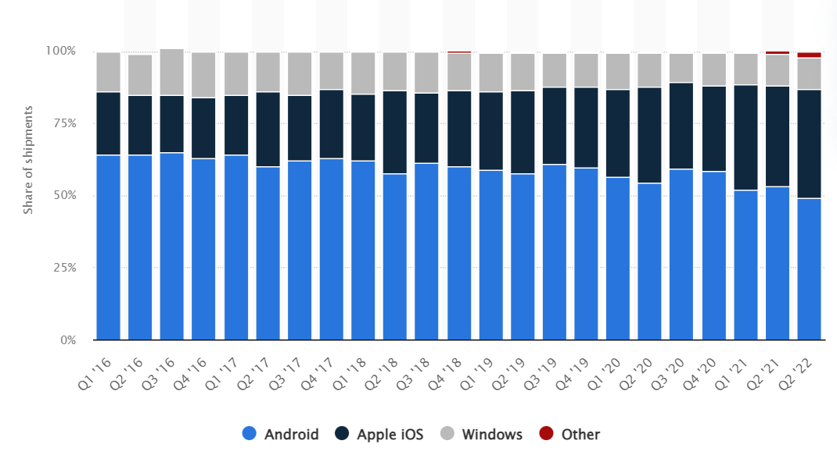
3.3 x86 (Core 2/Zen)-based mobile Windows devices (Surface devices) (8)
Tablet OS market share worldwide 2016-2022 [111]
Grey coloured fields in the Figure represents Windows tablets or 2-in-one tablets.
This field however, include both Arm- and x86-based Windows tablets as well.
As Arm-base Windows tablets only count for a low share within the Windows tablets,
the indicated ≈ 10 % share can be attributed more or less to x86-based Windows tablets.

Slide 75
4. Major historical mobile device types
4.1 Overview of major historical mobile device types
4.2 Arm ISA-based Windows smartphones
4.3 x86 (Atom/Cat)-based Android/Windows
smartphones/tablets
Notes:
75

Slide 76
4.1 Overview of major historical mobile device types
Notes:
76

Slide 77
4.1 Overview of major historical mobile device types (1)
4.1 Overview of major historical mobile device types
In the course of the evolution a number of mobile device types were introduced
and cancelled, like Arm-based smartphones running under Symbian, BlackBerry or
Windows, Intel Atom or AMD Cat-based smartphones or tablets, netbooks, nettops etc.
From all of these, in this Section we briefly overview two mobile types:
Arm-based Windows smartphones and x86 Atom or Cat-based mobile devices.
Mobile device types (cancelled)
Arm-ISA based
x86 Atom/Cat-based
devices
Symbian
smartphones
(Nokia and others,
e.g. Nokia smartphones)
BlackBerry
smartphones
(RIM, e.g.
Pearl smartphones)
Windows
smartphones
(Nokia/Microsoft
Lumia smartphones)
Android/Windows
devices
(smartphones/
LV tablets)
Built by different vendors, like Nokia, Motorola, Sony etc. typically on ARM proc. | the Pearl family was built on Intel’s/Marvel’s XScale processors | Built on Qualcomm’s Snapdragon processors | Built on Atom/Cat processors
They run under various Symbian releases | They run under various BlackBerry releases | They run under Windows Phone 7/8 | Smartphones run under Android, tablets run under Windows 10/Android
≈2001 - ≈2011 (cancelled) | 1999-2013 (cancelled) | 2011-2014 (cancelled) | 2008-2016 (cancelled)

Slide 78
4.2 Arm ISA-based Windows smartphones
Optional reading, not part of the exam.
Notes:
78

Slide 79
4.2 Arm-based Windows smartphones (1)
4.2 Arm-based Windows smartphones -1
Mobile device types (cancelled)
Arm-ISA based
x86 Atom/Cat-based
devices
Symbian
smartphones
(Nokia and others,
e.g. Nokia smartphones)
BlackBerry
smartphones
(RIM, e.g.
Pearl smartphones)
Windows
smartphones
(Nokia/Microsoft
Lumia smartphones)
Android/Windows
devices
(smartphones/
LV tablets)
Built by different vendors, like Nokia, Motorola, Sony etc. typically on ARM proc. | the Pearl family was built on Intel’s/Marvel’s XScale processors | Built on Qualcomm’s Snapdragon processors | Built on Atom/Cat processors
They run under various Symbian releases | They run under various BlackBerry releases | They run under Windows Phone 7/8 | Smartphones run under Android, tablets run under Windows 10/Android
≈2001 - ≈2011 (cancelled) | 1999-2013 (cancelled) | 2011-2014 (cancelled) | 2008-2016 (cancelled)
f)
g)

Slide 80
4.2 Arm-based Windows smartphones (2)
Arm-based Windows smartphones -2
At the time when Arm-based Android smartphones emerged (around 2009) they had
to compete with Symbian (Nokia), iPhone (Apple), BlackBerry (RIM) and Windows
(Microsoft) smartphones, as the next Figure indicates.

Slide 81
4.2 Arm-based Windows smartphones (3)
Worldwide market share of smartphone OSs sold to end users 2009-2018 [56]
*

Slide 82
4.2 Arm-based Windows smartphones (3)
Arm-based Windows smartphones -3
From all of these smartphones only Android and iPhone (renamed to iOS in 2010)
based devices survived.
The fate of Windows smartphones is summarized next.

Slide 83
4.2 Arm-based Windows smartphones (4)
Microsoft's move to enter the phone business
In 2/2011 Nokia tried to improve its unfavorable market position by establishing
a business partnership with Microsoft and adopted Microsoft’s Windows Phone
as its primary platform for their new smartphone line, called Lumia, instead of
Nokia’s original Symbian OS.
9/2013: Microsoft announces their plan to acquire the phone business of Nokia,
including the Lumia brand.
4/2014: Microsoft finalyses the acqisition by paying about 7 billion USD to Nokia,
and taking over about 25000 Nokia employees.
11/2014: Microsoft rebranded the Nokia Lumia line to Microsoft Lumia line.

Slide 84
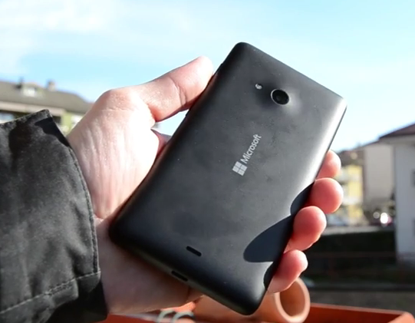
4.2 Arm-based Windows smartphones (5)
The first Microsoft branded Lumia phone (the Lumia 535 from 11/2014) [90]

Slide 85
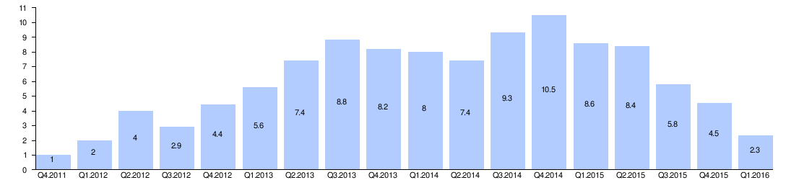
4.2 Arm-based Windows smartphones (6)
The outcome of Microsoft's Nokia deal -1
Microsoft's acquisition of Nokia's phone business did not seriously boost the sale
figures of Windows phone based Lumia devices, as indicated in the Figure below.
Microsoft ackquires
Nokia's phone buiness
Rebranding the Nokia Lumia line
to Microsoft Lumia line
Million
1 % of worldwide
smartphone sales
Figure: Quarterly sale figures of Lumia devices (million units) [90]
(Nokia introduced the Lumia brand for a series of smartphones running Windows phone)
On the contrary, in about two years sale figures desreased below 1 % of the total
world sales of smartphones, as indicated in the Figure.

Slide 86
4.2 Arm-based Windows smartphones (7)
The outcome of Microsoft's Nokia deal -2
Consequences of deminishing sales figures of Windows based Lumia phones
In 7/2015 Microsoft restructured Microsoft Mobile and laid off 7200 employees.
In 5/2016 Microsoft made the decision to sell their feature phone business
to Foxconn (Taiwan), for 350 million USD.
As a consequence, 4500 Microsoft employes were moved to Foxconn.
At the same time Microsoft confirmed that it will continue to develop
Windows 10 Mobile, and support existing Lumia phones and ones built
by third-party phone makers [91].
In 10/2017 Microsoft cancelled Windows 10 Mobile.

Slide 87
4.3 x86 (Atom/Cat)-based Android/Windows smartphones/tablets
Notes:
87

Slide 88
4.3 x86 (Atom/Cat)-based Android/Windows smartphones/tablets (1)
4.3 x86 (Atom/Cat)-based Android/Windows smartphones/tablets -1
Mobile device types (cancelled)
Arm-ISA based
x86 Atom/Cat-based
devices
Symbian
smartphones
(Nokia and others,
e.g. Nokia smartphones)
BlackBerry
smartphones
(RIM, e.g.
Pearl smartphones)
Windows
smartphones
(Nokia/Microsoft
Lumia smartphones)
Android/Windows
devices
(smartphones/
LV tablets)
Built by different vendors, like Nokia, Motorola, Sony etc. typically on ARM proc. | the Pearl family was built on Intel’s/Marvel’s XScale processors | Built on Qualcomm’s Snapdragon processors | Built on Atom/Cat processors
They run under various Symbian releases | They run under various BlackBerry releases | They run under Windows Phone 7/8 | Smartphones run under Android, tablets run under Windows 10/Android
≈2001 - ≈2011 (cancelled) | 1999-2013 (cancelled) | 2011-2014 (cancelled) | 2008-2016 (cancelled)
f)
g)

Slide 89
4.3 x86 (Atom/Cat)-based Android/Windows smartphones/tablets (2)
x86 Atom/Cat-based Android/Windows smartphones/tablets -2
In order to take a foot in the door in the booming mobile processor market, both
Intel and AMD introduced low power x86 ISA-based mobile processor lines,
since their traditional lines were too power hungry for mobile use.
The introduced lines were:
Intel’s Atom line in 2008 and
AMD’s Cat line three years later, in 2011,
as seen in the next two Figures.

Slide 90
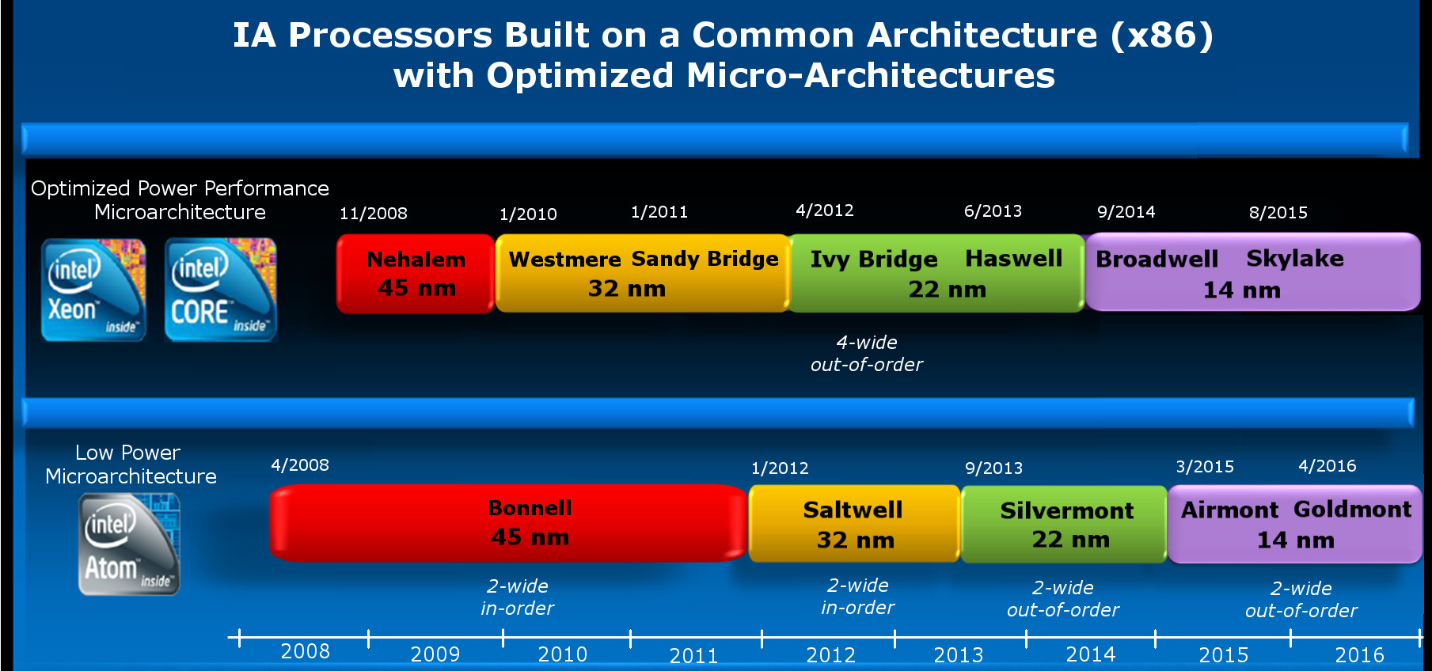
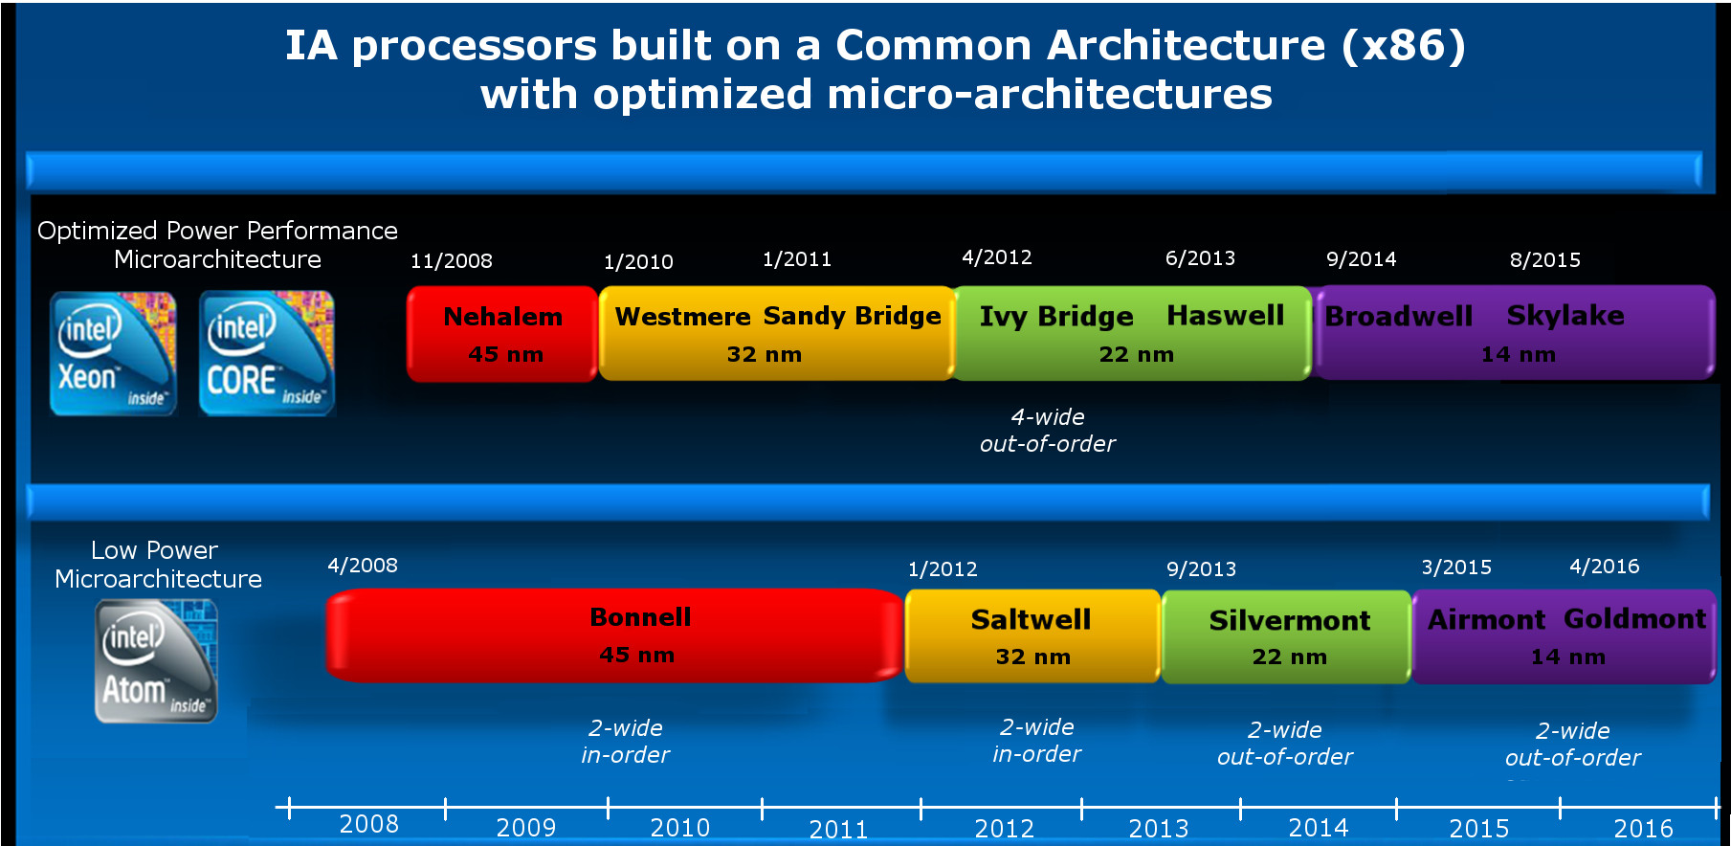
4.3 x86 (Atom/Cat)-based Android/Windows smartphones/tablets (3)
Intel’s x86-based Atom line designed for mobiles (Based on [92])
5-wide
out-of-order
2-wide
in-order
2-wide
out-of-order
2-wide
out-of-order
3-wide
out-of-order

Slide 91
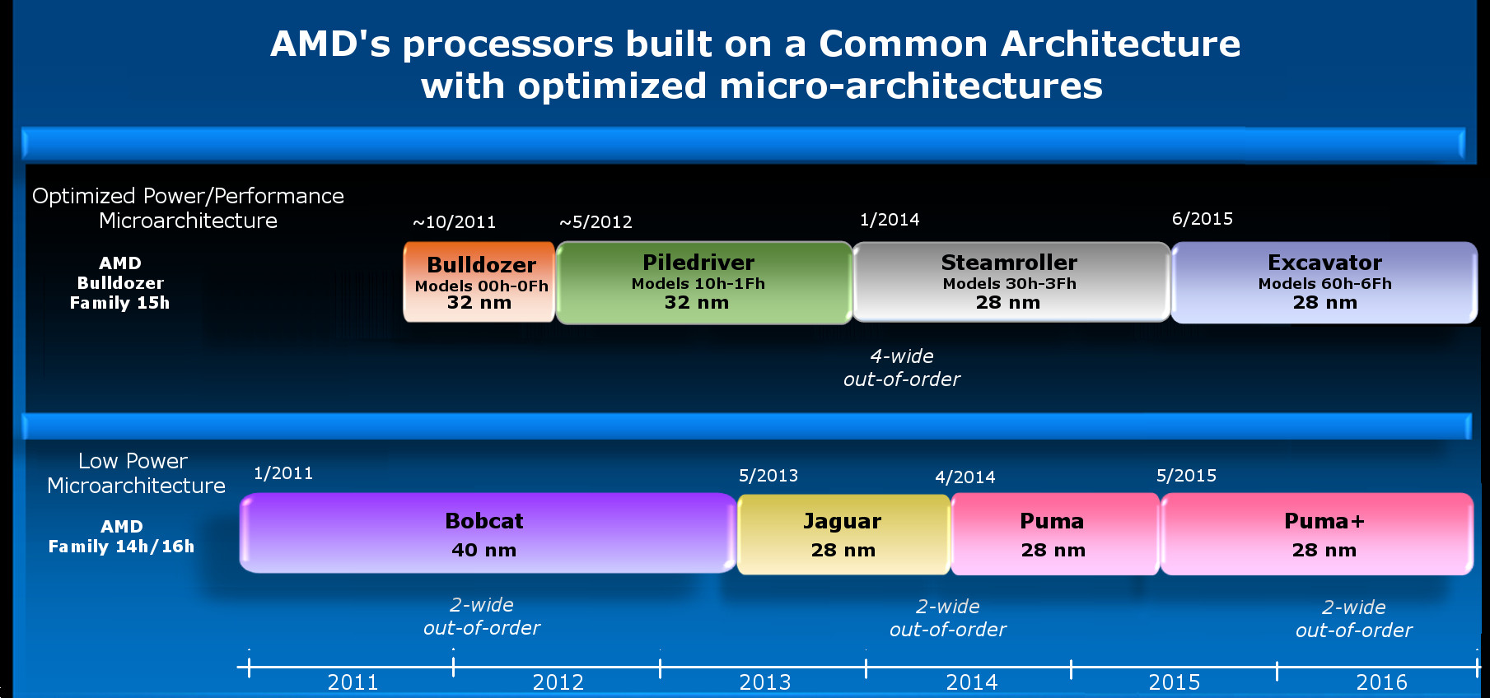
4.3 x86 (Atom/Cat)-based Android/Windows smartphones/tablets (4)
AMD’s x86-based Cat line designed for mobiles
4-wide
out-of-order
4/2014
2-wide
out-of-order
2-wide
out-of-order
2-wide
out-of-order
2014
Note that AMD entered the mobile market 3 years later than Intel.

Slide 92
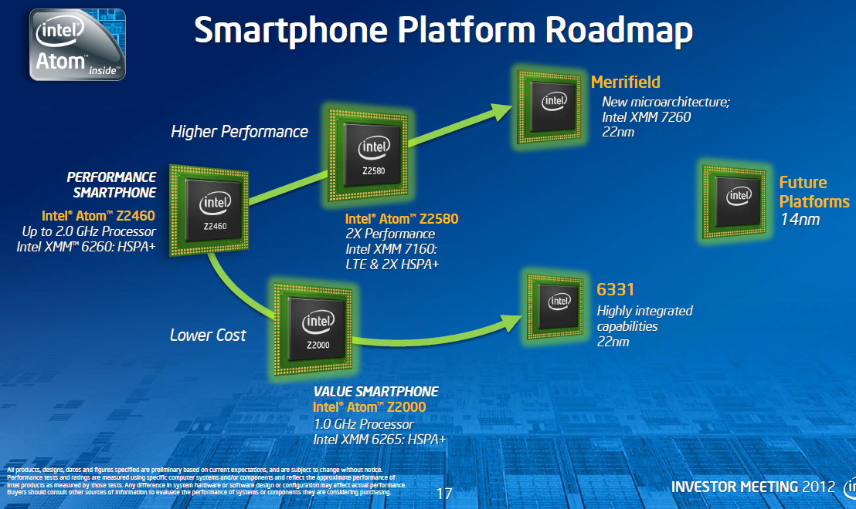
4.3 x86 (Atom/Cat)-based Android/Windows smartphones/tablets (5)
Intel’s x86 Atom-based smartphone processors [93]
Morganfield
(2016)
Moorefield
(2014)
Merrifield
(2014)
Performance (not to scale)
Clover Trail+
(2013)
Z5xxx
4x Goldmont
14 nm
+XMM 7360
Z35xx
4x Silvermont
22 nm
+XMM 7260/2/35
Medfield
(2012)
Z34x0
2x Silvermont
22 nm
+XMM 7160/7260
Cancelled
in 04/2016
Morestown
(2010)
Z2520-2580
2x Saltwell
32 nm
+XMM 6268/6360/7160
SoFIA
(x3 3G/LTE)
(2015)
Riverton
(2015)
Z2460/2480
1x Saltwell
32 nm
+XMM 6260
Slayton
(2014)
Lexington
(2013)
Z6xx
1x Bonnell
45 nm
+Wireless
module
C31xx/32xx/34xx
2x/4x Silvermont
28 nm
Integrated LTE
3G/4G modem
Z3xxx
2x Airmont
14 nm
Integrated
LTE modem
Z3xxx
2x Silvermont
22 nm
+A-GOLD 620
Z2420
1x Saltwell
32 nm
+XMM 6265
Cancelled
in 04/2016
Planned, not mplemented
Planned, not implemented

Slide 93
4.3 x86 (Atom/Cat)-based Android/Windows smartphones/tablets (6)
Worldwide market share of smartphone and tablet processors in 2015
(based on revenue) -1
Smartphone application processors worldwide market share 2015 (revenue)
Qualcomm (USA) | 42 %
Apple (USA) | 21 %
MediaTek (Taiwan) | 19 %
Samsung (S. Korea)
Spreadtrum (China)
Tablet application processors worldwide market share 2015 (revenue)
Apple (USA) | 31 %
Qualcomm (USA) | 16 %
Intel (USA) | 14 %
MediaTek (Taiwan)
Samsung (S. Korea)
[Source: Related press releases of Strategy Analytics]

Slide 94
4.3 x86 (Atom/Cat)-based Android/Windows smartphones/tablets (7)
Worldwide market share of smartphone and tablet processors in 2015
(based on revenue) -2
As far as smartphone processors are concerned Intel achieved less than 1 %
market share in 2014 (in revenue) and could not become one of the 5 largest
suppliers, as the above data reveal.
By tablet processors Intel became the third largest supplier only due to paying
notable subsidies (≈ 50 $ per tablet [a] to OEMs from 2014 on for inspiring
their switching to Atom processors from ARM devices.
Nevertheless, owing to subsidies Intel's mobile and communication division has
lost 7 billion $ only in the years 2013-2014 [b], so their high losses forced Intel
first to stop paying subsidies and then in 4/2016 to announce their withdrawal
from the mobile market.
Intel's statement says [c]:
"I can confirm that the changes included canceling the Broxton platform as well
as SoFIA, 3GX, SoFIA LTE and SoFIA LTE2 commercial platforms to enable us
to move resources to products that deliver higher returns and advance our
strategy.
These changes are effective immediately."
At the same time Intel laid off about 12000 employees (~ 11 % of their workforce).

Slide 95
4.3 x86 (Atom/Cat)-based Android/Windows smartphones/tablets (8)
Intel’s cancellation of their current smartphone platforms in 04/2016 (based on [93])
Morganfield
(2016)
Moorefield
(2014)
Merrifield
(2014)
Performance (not to scale)
Clover Trail+
(2013)
Z5xxx
4x Goldmont
14 nm
+XMM 7360
Z35xx
4x Silvermont
22 nm
+XMM 7260/2/35
Medfield
(2012)
Z34x0
2x Silvermont
22 nm
+XMM 7160/7260
Cancelled
in 04/2016
Morestown
(2010)
Z2520-2580
2x Saltwell
32 nm
+XMM 6268/6360/7160
SoFIA
(x3 3G/LTE)
(2015)
Riverton
(2015)
Z2460/2480
1x Saltwell
32 nm
+XMM 6260
Slayton
(2014)
Lexington
(2013)
Z6xx
1x Bonnell
45 nm
+Wireless
module
C31xx/32xx/34xx
2x/4x Silvermont
28 nm
Integrated LTE
3G/4G modem
Z3xxx
2x Airmont
14 nm
Integrated
LTE modem
Z3xxx
2x Silvermont
22 nm
+A-GOLD 620
Z2420
1x Saltwell
32 nm
+XMM 6265
Cancelled
in 04/2016
Planned, not mplemented
Planned, not implemented

Slide 96
4.3 x86 (Atom/Cat)-based Android/Windows smartphones/tablets (9)
Intel’s cancellation of their x86-based Atom line introduced for mobiles in 04/2016 [92]
5-wide
out-of-order
2-wide
in-order
2-wide
out-of-order
2-wide
out-of-order
3-wide
out-of-order

Slide 97
4.3 x86 (Atom/Cat)-based Android/Windows smartphones/tablets (10)
AMD’s cancellation of their Cat line in 2016
AMD achieved even less market share than Intel on the mobile market, thus
AMD also cancelled their mobile activities in 2016.
Instead, AMD had been placed emphasis on the Zen architecture that has been
launched in 2017.

Slide 98
4.3 x86 (Atom/Cat)-based Android/Windows smartphones/tablets (11)
AMD’s cancellation of their x86-based Cat line introduced for mobiles
4-wide
out-of-order
4/2014
2-wide
out-of-order
2-wide
out-of-order
2-wide
out-of-order
2014

Slide 99
5. Evolution of the width and performance of mobile CPU cores

Slide 100
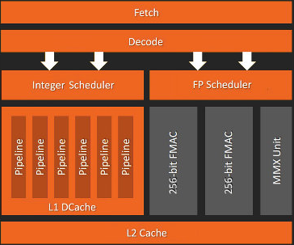
5. Evolution of the width of mobile CPU cores (1)
5. Evolution of the width of mobile CPU cores -1
Interpretation of the notion “width of CPU cores”
Recent CPU cores are typically built up of a sequential front-end and a parallel back-end.
(The front-end operates on bunches of instructions (e.g. 4 instructions) and operates
sequentially, i.e. it fetches, decodes, renames, dispatches instructions in a pipeline fashion.
(The back-end executes individual instructions in parallel by a number of pipelines)
Front-end
(~előfokozatok)
Width of the
microarchitecture
Back-end
(~utófokozat)
Figure: simplified block diagram of the microarchitecture of a recent CPU core
(actually that of ARM’s Zen core [20])
As the width of CPU cores we understand the thinnest stage of the front-end that is usually the width of the decoder stage, which is 4 in the Figure above.

Slide 101
5. Evolution of the width of mobile CPU cores (2)
Importance of the notion “width of the CPU core”
The width of the CPU core and the clock frequency are decisive for the single thread
(ST) performance and the power consumption of the CPU core.
On the other hand, the single thread performance and the core count determine
the multi thread (MT) performance while a given workload is running.
Obviously, the multi thread performance greatly depends on the kind of the workload.

Slide 102
5. Evolution of the width of mobile CPU cores (3)
Width of early mobile processor cores -1
Next two Tables show the core width of ARM’s v7 and Armv8-based Cortex processors,
widely used in mobile devices from the second half of the 2000’s on.

Slide 103
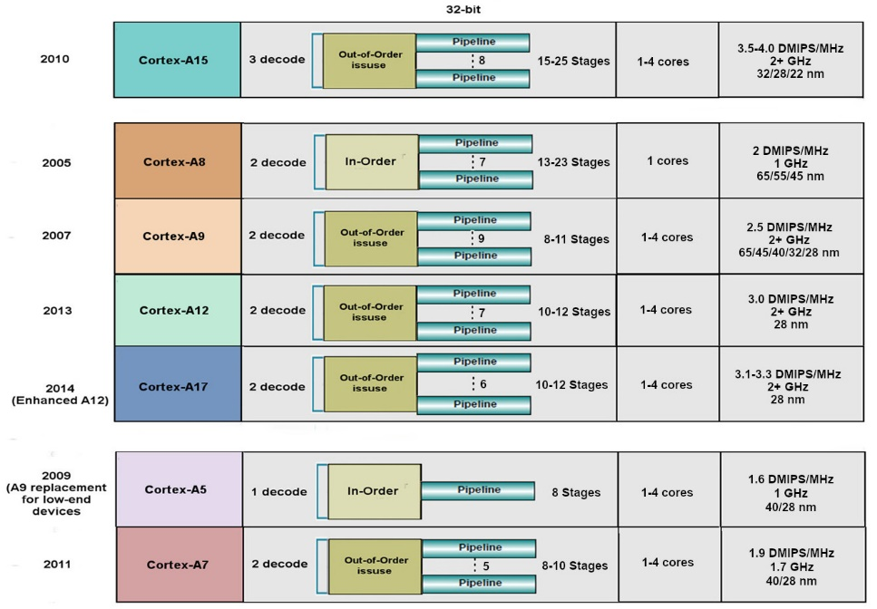
5. Evolution of the width of mobile CPU cores (4)
Example 1: Key features of Armv7 ISA based 32-bit cores (based on [104])
High performance
Mainstream
Low power

Slide 104
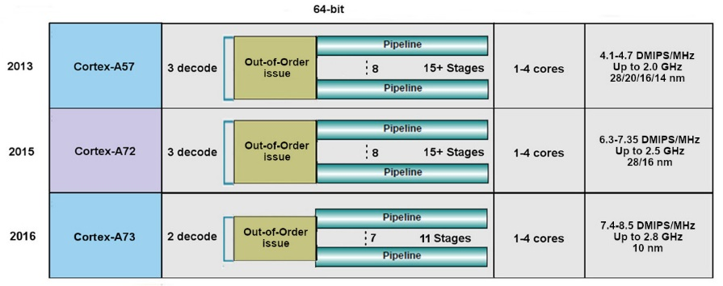
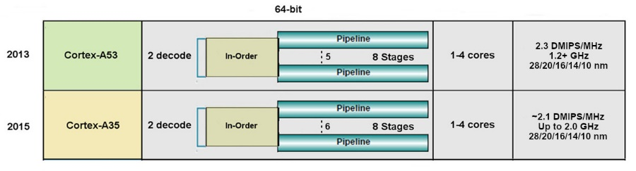
5. Evolution of the width of mobile CPU cores (5)
Example 2: Key features of Armv8.0 ISA based 64-bit cores replacing
Armv7 cores (based on [104])
High performance
Low power

Slide 105
5. Evolution of the width of mobile CPU cores (6)
Width of early mobile processor cores -2
As the Tables indicate, low-power Armv7/v8 cores typically are 2-wide whereas
high-performance cores typically 3-wide.
Correspondingly, Intel’s Atom processors (introduced in 2008) or AMD’s Cat processors
(launched in 2011) were also 2-wide, (except of Intel’s late (2016) 3-wide
Airmont core), in order to hold power consumption low.

Slide 106
5. Evolution of the width of mobile CPU cores (7)
Evolution of the width of ARM’s mobile CPU core designs
In order to raise performance, Armv8.2 ISA based processors became first 4 and
subsequently 5-wide, as the next Table indicates.

Slide 107
5. Evolution of the width of mobile CPU cores (8)
Widening the CPU cores in high-performance Cortex-A7x CPUs
Cortex model | ISA | Launched in | Target IC techn. | Decode rate | Dispatch rate | Issue rate | ROB size
A72 | ARM 8.0 | 02/2015 | 16 nm | 3 | 5 | 8 | n.a.
A73 | ARM 8.0 | 05/2016 | 10 nm | 2 | 4 | 7 | n.a.
A75 | ARM 8.2 | 05/2017 | 10 nm | 3 | 6 | 8 | 128
A76 | ARM 8.2 | 05/2018 | 12, 7, 5 nm | 4 | 8 | 9 | 128
A77 | ARM 8.2 | 05/2019 | 7, 5 nm | 4 | 6 | 12 | 160
A78 | ARM 8.2 | 05/2020 | 5 nm | 4 | 6 | 13 | n.a.
X1 | ARM 8.2 | 05/2020 | 5 nm | 5 | 8 | 15 | 224
Remarks
The A73 and A75 were designed in the Sophia Design Center all others in Austin.
The A72 and a73 support big.LITTLE core clusters the others DynamIQ core clusters.
The A72 introduced instruction fusion.
The A75 introduced FP16 and int8 datatypes to support AI
The A77 introduced a Macro-Op (MOP) cache
ROB: ReOrder Buffer (Out-of-order window) determines the max. number of in-flight
instructions

Slide 108
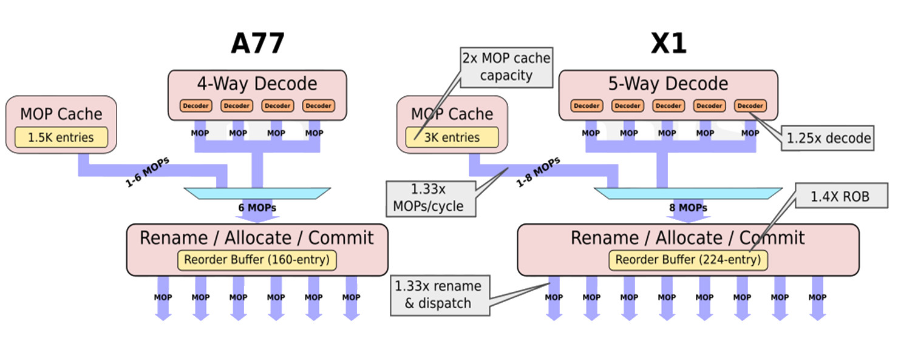
5. Evolution of the width of mobile CPU cores (9)
Transition from 4-wide decoding to 5-wide decoding in ARM’s mobile
CPU designs [105]
(2019)
(2020)
The 1.5K MOP cache, introduced into the A77, stores already decoded macro-
operations (MOPs).
It is employed to re-use already decoded MOPs, e.g. to reduce the cost of missed
branch predictions.

Slide 109
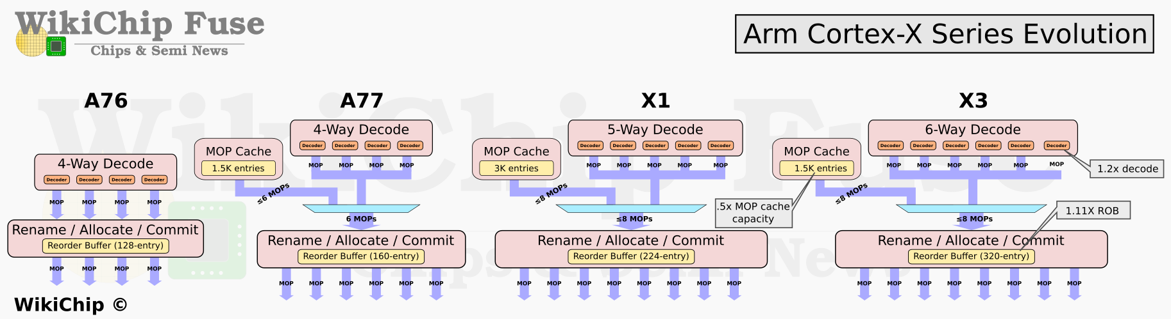

5. Evolution of the width of mobile CPU cores (10)
Transition from 5-wide decoding to 6-wide decoding in ARM’s mobile
CPU designs [112]
$$≤8$$
$$≤8$$

Slide 110
5. Evolution of the width of mobile CPU cores (11)
Evolution of the width of Apple’s mobile CPU cores
Concerning the width of mobile CPUs Apple has a specific position.
In 2013 Apple surprised their competitors with a 6-wide core in their A7 processor.
Since then Apple has the widest CPU cores.
So Apple introduced 7-wide cores in their A11-A12 (in 2017-2018) and lately
even 8-wide cores in their A13/A14/M1 processors (in 2019-2020).
Due to the benefit of significantly wider cores compared to the competition, Apple
owes the performance crown of mobile processors for almost a decade,
as demonstrated in Section 2.6.
As an example for Apple’s wide cores, the next Figure shows the assumed layout
of the 8-wide big core of the Apple A14 (Firestorm core) (2020).

Slide 111
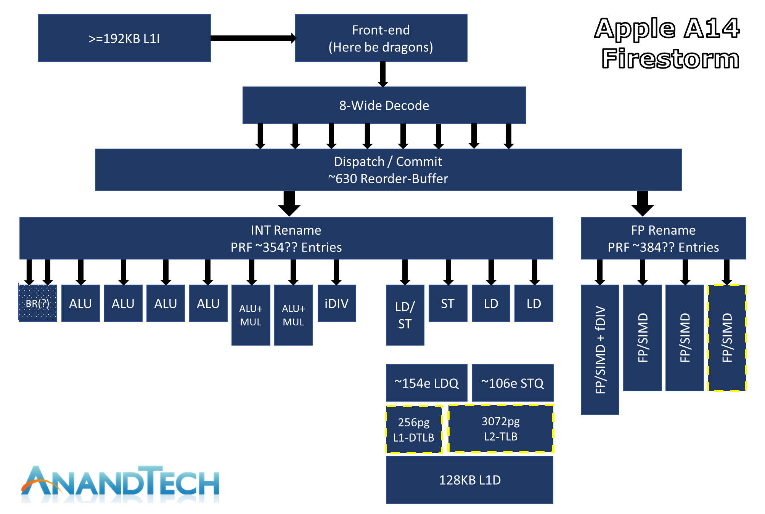
5. Evolution of the width of mobile CPU cores (12)
Example: Assumed layout of the big core of the Apple A14 (Firestorm) (2020) [63]

Slide 112
5. Evolution of the width of mobile CPU cores (13)
Evolution of the width of mobile CPU cores -3
Width of mobile cores
(or of big cores of big.LITTLE or dynamIQ core clusters)
2-wide
3-wide
4-wide
5-wide
ARM
v7 HP Cortex-A15
(2010)
v7 Cortex-A (2005-09)
(except 1-wide LP A5 (2009)
and 3-wide HP A15))
v8.0 HP Cortex-A73
(2016)
v8.0 HP Cortex-A (2013-15) (except 2-wide HP Cortex-A73)
v8.0/8.2 LP Cortex-A
(2013/2017)
v8.2 HP Cortex-A75
(2017)
v8.2 HP Cortex-A76
(2018) to
HP Cortex-A78
(2020)
v8.2 HP Cortex-X1
(2020))
Intel
Atom family (2008-15)
Airmont-based Atom core (2016)
AMD
Cat family (2011-2015)
Apple
v7 Cortex-A8 (2009)
v7 Swift (A6) (2012)
Qualcomm
v7 Scorpion
(S1-S3) (2007-10)
v7 Krait
(S4/S400/S60x/S80x)
(2012-14)
v8 Kryo/Kryo 280
(S820/821/835) (2015/2016/2017)
v8.2 Kryo 385
(S845) (2018)
Samsung
v7 Exynos 5
(2013-14)
v8 Exynos 7
(2016)
v8.0 M1 (2016)
(Exynos 8 Octa)
v8 M2 (2017)
(Exynos 9 Octa)
HP: High-Performance/big core
LP: Low-Power

Slide 113
5. Evolution of the width of mobile CPU cores (14)
Evolution of the width of mobile CPU cores -4
Width of mobile cores
(or of big cores of big.LITTLE or dynamIQ core clusters)
6-wide
7-wide
8-wide
ARM
v9.0 HP Cortex-X3
(2022)
Intel
AMD
Apple
v8.0 HP A7-A10X
(2013-2017)
v8.2 HP A11 (2017)
v8.3 HP A12/A12X
(2018)
v8.4 HP A13 (2019)
v8.5 HP A14/M1
(2020)
Qualcomm
Samsung
v8.2 M3 (2018) Exynos 9810)
v8.2 M4 (2019) Exynos 9820)
v8.2 M5 (2019) Exynos 990)
v8.2 M6
(2020)/cancelled
HP: High-Performance/big core
LP: Low-Power

Slide 114
5. Evolution of the width of mobile CPU cores (15)
Remark
Certain early mobile processors were only 1-wide, like
ARM’s 1176 used in Apple’s iPhone (2007) or
ARM’s Cortex-A5 (2009)
nevertheless, for better clarity these processors were not indicated in the previous
Figure.

Slide 115
5. Evolution of the width of mobile CPU cores (16)
Evolution of the width of CPU cores in Intel’s and AMD’s basic microarchitectures
Width of Intel’s and AMD’s basic microarchitectures
2-wide
3-wide
4-wide
5-wide
6-wide
Intel
Pentium
(1993)
Pentium II (Pentium Pro) 1996)
Pentium III (1999)
Pentium 4 (2000)
Core 2 (2006)
until
Broadwell (2014)
Skylake (2015)
and subsequent
symmetrical multicores
Alder Lake
(2021)
(big.LITTLE
configuration)
AMD
K5 (1996)
K6 (1997)
K7 Athlon (1998)
K8 (Hammer)-based
designs (2003)
K10 (Barcelona/Phenom) based lines (2007)
K10.5 (Shanghai etc.)
based lines (2008)
K15 Bulldozer-based
lines (2011)
Zen-based lines (2017)
Figure: Evolution of the width of CPU cores of Intel’s and AMD’s basic microarchitectures
As the above Figure indicates, recent client processors are up to 6-wide.
This fact is for the first sight surprising, but an apparent contradiction is easily
resolved by. recalling that client processors are typically x86-based CISC processors
with variable instruction word length whereas mobile processors are Arm ISA based
RISC processors with fixed, 32-bit long instructions, whose decoding is a much simpler
task than decoding variable length CISC instructions.

Slide 116
5. Evolution of the width of mobile CPU cores (17)
Contrasting the year-over-year performance gain of Intel’s, Apple’s and Qualcomm’s
mobile processors, based on SC Geekbench 5 scores [74] -1
1800
A15 2+4C
x
x
1700
A14 2+4C
I7-1265U
2+10C
1600
x
1500
1400
I7-1065G7
4C
I7-8565U
4C
x
1300
x
x
I7-7660U
2C
A13 2+4C
1200
I7-7560U
2C
1100
I7-6600U
2C
x
Intel
x
x
A12X 4+4C
x
1000
I7-4600U
2C
I7-5600U
2C
A11 2+4C
888
1+3+4C
900
x
x
x
x
x
A10 2+2C
x
(X1)
800
x
x
A10X 3+3C
865
1+3+4C
700
I7-4500U
2C
A9X 2C
x
x
(A77)
600
x
855
1+3+4C
500
A9 2C
x
A8X 3C
(A76)
400
Apple
x
845
4+4C
x
x
x
300
835
4+4C
(A75)
200
x
820
4+4C
821
4+4C
Qualcomm
(A73)
(SC: Single Core)
100
810
4+4C
2013
2014
2015
2016
2017
2018
2019
2020
2021
Year

Slide 117
5. Evolution of the width of mobile CPU cores (18)
Contrasting the year-over-year performance gain of Intel’s, Apple’s and Qualcomm’s
mobile processors, based on SC Geekbench 5 scores -2
According to the data presented in the previous Figure
Intel raised the SC performance of their 15 W i5 cores at a rate of doubling in
8 years (between 2013 and 2019 (measured by GeekBench 5 scores) whereas
Apple needed only nearly 3 years for doubling the Geekbench 5 SC scores of their
Axx cores.
As Apple could rise the performance of their Ax processors in a significantly higher
rate than Intel, the performance of their low power (15 W TDP) Core 2 processors,
around 2019 Apple’s Ax processors overtook the lead in Geekbench 5 scores
from Intel’s low power i7 cores.
This is an explanation why more and more vendors began designing and
introducing Arm-based processors in the desktops and server market segments.

Slide 118
5. Evolution of the width of mobile CPU cores (19)
Current performance of mobile processors
It is worth comparing both the performance of current mobile processors among
themselves and how their performance relates to client processors.
A recent publication [216] provides a convenient possibility for it by revealing the
performance (given in SPECint2017 scores measured for c/c++ workloads),
the average power consumption [W] and the energy consumed during benchmark
measurement [Joule] of current mobile processors, (see next Figure).
Remark [215]
The SPEC CPU 2017 benchmark package contains SPEC's next-generation, industry-
standardized, CPU intensive suites for comparing compute intensive performance,
stressing a system's processor, memory subsystem and compiler.

Slide 119
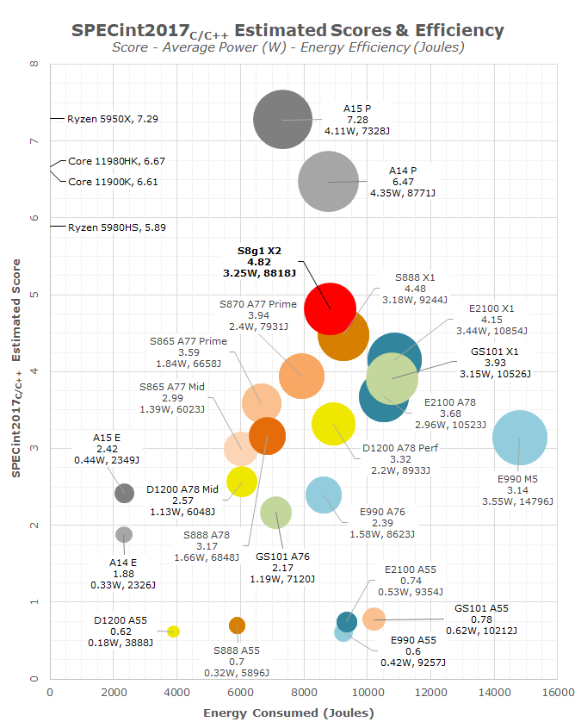
5. Evolution of the width of mobile CPU cores (20)
Performance (measured in SPECint2017 (c/c++) scores), average power (W) and
energy consumption (Joule) of current mobile processors [216] -1
S: Snapdragon (Qualcomm)
E: Exynos (Samsung)
D: Dimensity (MediaTek)
GS101 (Google)

Slide 120
5. Evolution of the width of mobile CPU cores (21)
Performance (measured in SPECint2017 (c/c++) scores), average power (W) and
energy consumption (Joule) of current mobile processors [216] -2
The cited results show the outstanding performance of the big cores of Apple’s
A14 and A15 cores.
The next highest performance provides the X2 core of Qualcomm’s Snapdragon
8 Gen1 processor.
High performance values provide Qualcomm’s further Snapdragon processors
based on the X1 core, whereas A77 or A78-based cores from Samsung or
MediaTek show comparable lower performance.
It is interesting to note that the big cores of Apple’s A14 and A15 processors have
already comparable performance figures with Intel’s and AMD’s client processors,
which have however a much higher power consumption (in the order of 100 W
TDP).

Slide 121
6. Appendix: Evolution of Apple’s mobile processors
Notes:
121

Slide 122
6. Appendix: Evolution of Apple’s mobile processors (1)
6. Appendix: Evolution of Apple’s mobile processors
Apple started their activity in 1976 while designing personal computers (Apple I,
the highly successful Apple II etc.).
The Apple 2 was based on a 8-bit microprocessor (MOS Technology 6502).
When the firm entered the mobile phone market in 1997 they chose Arm ISA-based
processors (actually Armv6-based ARM11 models) as a basis for their designs,
followed by Armv7-based Cortex processors in 2009, as the next Tables indicate.

Slide 123
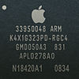



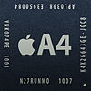
6. Appendix: Evolution of Apple’s mobile processors (2)
Main features of Apple’s 32-bit processors used in their mobile devices (1)
Appl. proc. | Model no. | Image | Node | Die size | CPU | CPU ISA | CPU cache | GPU | Memory (up to) | Intro. | Utilizing devices
 | S5L8900X |  | 90 nm | 72 mm² | 1x ARM1176 412 MHz | ARMv6 | L1i: 16 KB L1d: 16 KB | PowerVR MBX Lite @ 103 MHz | 128 MB 16-bit SCh LPDDR-266 (532 MB/sec) |  | iPhone (2G) iPod Touch (1st gen.) iPhone 3G
 | APL0278 or S5L8720 |  | 65 nm | 36 mm² | 1x ARM1176 412–533 MHz | ARMv6 | L1i: 16 KB L1d: 16 KB | PowerVR MBX Lite @ 103–133 MHz | 32/128 MB 32-bit SCh LPDDR-133 | 9/2008 | iPod Touch (2nd gen.) iPod Nano (4th gen.)
 | APL0298 or S5L8920 |  | 65 nm | 71.8 mm² | 1x Cortex-A8 600 MHz | ARMv7 | L1i: 32 KB L1d: 32 KB L2: 256 KB | PowerVR SGX535 @ 150 MHz (1.2 GFLOPS) | 256 MB 32-bit SCh LPDDR-400 (1.6 GB/sec) | 6/2009 | iPhone 3GS
 | APL2298 or S5L8922 |  | 45 nm | 41.6 mm² | 1x Cortex-A8 600–800 MHz | ARMv7 | L1i: 32 KB L1d: 32 KB L2: 256 KB | PowerVR SGX535 @ 150–200 MHz (1.2–1.6 GFLOPS) | 256 MB 32-bit SCh LPDDR-400 (1.6 GB/sec) | 9/2009 | iPod Touch (3rd gen.)
A4 | APL0398 or S5L8930 |  | 45 nm | 53.3 mm² | 1x Cortex-A8 0.8–1.0 GHz | ARMv7 | L1i: 32 KB L1d: 32 KB L2: 512 KB | PowerVR SGX535 @ 200–250 MHz (1.6–2 GFLOPS) | 256 MB (iPad) 512 MB (iPhone 4) 32-bit DCh LPDDR-400 (3.2 GB/sec) | 3/2010 | iPad (1st gen.) iPhone 4 iPod Touch (4th gen.) Apple TV (2nd gen.)
6/2007
6/2008

Slide 124



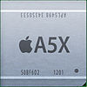

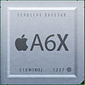
6. Appendix: Evolution of Apple’s mobile processors (3)
Main features of Apple’s 32-bit Ax processors used in their mobile devices (2)
Appl. proc. | Model no. | Image | Node | Die size | CPU | CPU ISA | CPU cache | GPU | Memory (up to) | Intro. | Utilizing devices
A5 | APL0498 or S5L8940 |  | 45 nm | 122.2 mm² | 2x Cortex-A9 0.8–1.0 GHz | ARMv7 | L1i: 32 KB L1d: 32 KB L2: 1 MB | PowerVR SGX543MP2 (2C) @ 200–250 MHz (12.8–16 GFLOPS) | 512 MB 32-bit DCh LPDDR2-800 (6.4 GB/sec) | 3/2011 | iPad 2 iPhone 4S
 | APL2498 or S5L8942 |  | 32 nm HKMG | 69.6 mm² | 2x Cortex-A9 0.8–1.0 GHz | ARMv7 | L1i: 32 KB L1d: 32 KB L2: 1 MB | PowerVR SGX543MP2 (2C) @ 200–250 MHz (12.8–16 GFLOPS) | 512 MB 32-bit DCh LPDDR2-800 (6.4 GB/sec) | 3/2012 | iPad 2 (iPad 2,4) iPod Touch (5th gen.) iPad Mini
 | APL7498 or S5L8947 |  | 32 nm HKMG | 37.8 mm² | 1x Cortex-A9 1.0 GHz | ARMv7 | L1i: 32 KB L1d: 32 KB L2: 1 MB | PowerVR SGX543MP2 (2C) @ 200–250 MHz (12.8–16 GFLOPS) | 512 MB 32-bit DCh LPDDR2-800 (6.4 GB/sec) | 3/2013 | AppleTV 3 (AppleTV3,2)
A5X | APL5498 or S5L8945 |  | 45 nm | 165 mm² | 2x Cortex-A9 1.0 GHz | ARMv7 | L1i: 32 KB L1d: 32 KB L2: 1 MB | PowerVR SGX543MP4 (4C) @ 250 MHz (32 GFLOPS) | 1 GB 32-bit 4Ch LPDDR2-800 (12.8 GB/sec) | 3/2012 | iPad (3rd gen.)
A6 | APL0598 or S5L8950 |  | 32 nm HKMG | 96.7 mm² | 2x Swift 1.3 GHz | ARMv7s | L1i: 32 KB L1d: 32 KB L2: 1 MB | PowerVR SGX543MP3 (3C) @ 266 MHz (25.5 GFLOPS) | 1 GB 32-bit DCh LPDDR2-1066 (8.528 GB/sec) | 9/2012 | iPhone 5 iPhone 5C
A6X | APL5598 or S5L8955 |  | 32 nm HKMG | 123 mm² | 2x Swift 1. GHz | ARMv7s | L1i: 32 KB L1d: 32 KB L2: 1 MB | PowerVR SGX554MP4 (4C) @ 266 MHz (68.1 GFLOPS) | 1 GB 32-bit 4Ch LPDDR2-1066 (17.1 GB/sec) | 10/2012 | iPad (4th gen.)

Slide 125

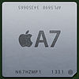


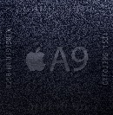
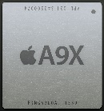
6. Appendix: Evolution of Apple’s mobile processors (4)
Main features of Apple’s 64-bit Ax processors used in their mobile devices (3)
Appl. proc. | Model no. | Image | Node | Die size | CPU | CPU ISA | CPU cache | GPU | Memory (up to) | Intro. | Utilizing devices
A7 | APL0698 or S5L8960 |  | 28 nm HKMG | 102 mm² | 2x Cyclone 1.3 GHz | ARMv8-A | L1i: 64 KB L1d: 64 KB L2: 1 MB LS: 4 MB | PowerVR G6430 (4C) @ 450 MHz (115.2 GFLOPS) | 1 GB 64-bit SCh LPDDR3-1600 (12.8 GB/sec) | 9/2013 | iPhone 5S iPad Mini 2 iPad Mini 3
 | APL5698 or S5L8965 |  | 28 nm HKMG | 102 mm² | 2x Cyclone 1. GHz | ARMv8-A | L1i: 64 KB L1d: 64 KB L2: 1 MB LS: 4 MB | PowerVR G6430 (4C) @ 450 MHz (115.2 GFLOPS) | 1 GB 64-bit SCh LPDDR3-1600 (12.8 GB/sec) | 10/2013 | iPad Air 9.7”
A8 | APL1011 |  | 20 nm HKMG | 89 mm² | 2x Typhoon 1. GHz | ARMv8-A | L1i: 64 KB L1d: 64 KB L2: 1 MB LS: 4 MB | PowerVR GX6450 (4C) @ 450 MHz (115.2 GFLOPS) | 1GB 64-bit SCh LPDDR3-1600 (12.8 GB/sec) | 9/2014 | iPhone 6 iPhone 6 Plus
A8X | APL1012 |  | 20 nm HKMG | 128 mm² | 3xTyphoon 1.5 GHz | ARMv8-A | L1i: 64 KB L1d: 64 KB L2: 2 MB LS: 4 MB | PowerVR GXA6850 (5C) @ 450 MHz (230.4 GFLOPS) | 2 GB 64-bit DCh LPDDR3-1600 (25.6 GB/sec) | 10/2014 | iPad Air 2 9.7”
A9 | APL1022 (TSMC) APL0898 (Samsung) |  | 16 nm FinFET 14 nm FinFET | 104.5 mm² | 2xTwister 1.85 GHz | ARMv8-A | L1i: 64 KB L1d: 64 KB L2: 3 MB LS: 4 MB | PowerVR GT7600 (6C) @ 450 MHz (172.8 GFLOPS) | 2 GB 64-bit SCh LPDDR4-3200 (25.6 GB/sec) | 9/2015 | iPhone 6s iPhone 6s Plus iPhone SE
A9X | APL1021 (TSMC) |  | 16 nm FinFET | 147 mm² | 2xTwister 2.16- 2.26 GHz | ARMv8-A | L1i: 64 KB L1d: 64 KB L2: 3 MB LS: none | PowerVR 7XT series (12C) @ n.a. MHz (345.6 GFLOPS) | 2 GB/4 GB 64-bit DCh LPDDR4-3200 (51.2 GB/sec) | 11/2015 | iPad Pro 9.7" iPad Pro 12.9"
LS: System cache, it services the entire SoC

Slide 126
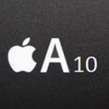
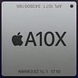
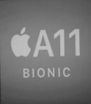
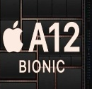
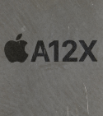
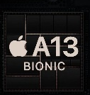
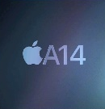
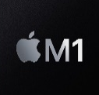
6. Appendix: Evolution of Apple’s mobile processors (5)
Main features of Apple’s 32-bit Ax/Mx processors used in their mobile devices (4)
Appl. proc.S6 | Model no. | Image | Node | Die size | CPU | CPU ISA | CPU cache (big core) | GPU | Memory (up to) | Intro. | Utilizing devices
A10 (Fusion) | APL1W24 |  | 16 nm FinFET | 125 mm² | 2xHurricane (2.34 GHz)+ 2x Zephyr (1.1 GHz?) | ARM v8-A | L1i: 64 KB L1d: 64 KB L2: 3 MB LS: 4 MB | PowerVR GT7600 Plus (6C) @ >650 MHz (>250 GFLOPS) (redesigned) | 2 GB/3 GB LPDDR4 | 9/2016 | iPhone 7 iPhone 7 Plus
A10X (Fusion) | APL1071 (TSMC) |  | 10 nm FinFET | 96.4 mm² | 3xHurricane (2.38 GHz)+ 3x Zephyr (1.1 GHz?) | ARM v8-A | L1i: 64 KB L1d: 64 KB L2: 8 MB LS: none | PowerVR GT7600 Plus (12C) | 3 GB/4 GB LPDDR4 | 6/2017 | iPad Pro 10.5" iPad Pro 12.9“ Apple TV 4K
A11 Bionic | APL1W72 (TSMC) |  | 10 nm FinFET | 88 mm² | 2x Monsoon (2.38 GHz) + 4x Mistral (1.69 GH)z | ARM v8.2-A | L1i: 64 KB L1d: 64 KB L2: 8 MB LS: 4 MB | Apple Custom GPU (3C) | 2 GB/3 GB? LPDDR4X | 9/2017 | iPhone 8 iPhone 8 Plus iPhone X
A12 Bionic | APL1W82 (TSMC) |  | 7 nm FinFET | 83 mm² | 2x Vortex (2.50 GHz) + 4x Tempest (1.59 GHz) | ARM v8.3-A | L1i: 128 KB L1d: 128 KB L2: 6 MB LS: 8 MB | Apple Custom GPU (4C) | 4 GB/3 GB LPDDR4X | 9/2018 | iPhone XS 5.8“ iPhone XS Max iPhone XR 6.1“
A12X Bionic | APL1083 (TSMC) |  | 7 nm FinFET | 122 mm² | 4x Vortex (2.48 GHz) + 4x Tempest (1.59 GHz) | ARM v8.3-A | L1i: 128 KB L1d: 128 KB L2: 6 MB LS: 8 MB | Apple Custom GPU (7C) | 4 GB/6 GB LPDDR4X | 10/2018 | iPad Pro 11“ iPad Pro 12.9“
A13 | APL1083 (TSMC) |  | 7 nm FinFET | 98.5 mm² | 2xLighting (2.66 GHz) + 4x Thunder (1.73 GHz) | ARM v8.4-A | L1i: 128 KB L1d: 128 KB L2: 8 MB LS: 8 MB | Apple Custom GPU (4C) | 3 GB/4 GB LPDDR4X | 09/2019 | iPhone 11/ 11 Pro/Pro Max iPhone SE
A14 | APL1W01 (TSMC) |  | 5 nm FINFET | 88 mm² | 2xFirestorm (3 GHz) + 4x Icestorm (1.82 GHz) | ARM V8.6-A | L1i: 192 KB L1d: 128 KB L2:8 MB LS: 16 MB | Apple Custom GPU (4C) | 4 GB/6 GB LPDDR4X | 10/2020 | iPhone 12, 12 Pro/Pro Max iPad Air (4. gen)
M1 | APL1102 (TSMC) |  | 5 nm FINFET | 119 mm² | 2xFirestorm (3.2 GHz) + 4x Icestorm | ARM V8.6-A | L1i: 192 KB L1d: 128 KB L2: 12 MB LS: 16 MB | Apple Custom GPU (8C) | 8 GB/16 GB LPDDR4X | 11/2020 | MacBook Air, MacBook Pro Mac Mini

Slide 127
6. Appendix: Evolution of Apple’s mobile processors (6)
Evolution of selected features of Apple’s processors
Next we discuss how three key features of Apple’s processors evolved.
These selected features are:
a) decode width
b) clock frequency and
c) performance.

Slide 128
6. Appendix: Evolution of Apple’s mobile processors (7)
a) Evolution of the decode width in Apple’s mobile cores -1
Width of mobile cores
(or of big cores of big.LITTLE or dynamIQ core clusters)
2-wide
3-wide
4-wide
5-wide
ARM
v7 HP Cortex-A15
(2010)
v7 Cortex-A (2005-09)
(except 1-wide LP A5 (2009)
and 3-wide HP A15))
v8.0 HP Cortex-A73
(2016)
v8.0 HP Cortex-A (2013-15) (except 2-wide HP Cortex-A73)
v8.0/8.2 LP Cortex-A
(2013/2017)
v8.2 HP Cortex-A75
(2017)
v8.2 HP Cortex-A76
(2018) to
HP Cortex-A78
(2020)
v8.2 HP Cortex-X1
(2020))
Intel
Atom family (2008-15)
Airmont-based Atom core (2016)
AMD
Cat family (2011-2015)
Apple
v7 Cortex-A8 (2009)
v7 Swift (A6) (2012)
Qualcomm
v7 Scorpion
(S1-S3) (2007-10)
v7 Krait
(S4/S400/S60x/S80x)
(2012-14)
v8 Kryo/Kryo 280
(S820/821/835) (2015/2016/2017)
v8.2 Kryo 385
(S845) (2018)
Samsung
v7 Exynos 5
(2013-14)
v8 Exynos 7
(2016)
v8.0 M1 (2016)
(Exynos 8 Octa)
v8 M2 (2017)
(Exynos 9 Octa)
HP: High-Performance/big core
LP: Low-Power

Slide 129
6. Appendix: Evolution of Apple’s mobile processors (8)
Evolution of the decode width in Apple’s mobile cores -2
Width of mobile cores
(or of big cores of big.LITTLE or dynamIQ core clusters)
6-wide
7-wide
8-wide
ARM
Intel
AMD
Apple
v8.0 HP A7-A10X
(2013-2017)
v8.2 HP A11 (2017)
v8.3 HP A12/A12X
(2018)
v8.4 HP A13 (2019)
v8.6 HP A14/M1
(2020)
Qualcomm
Samsung
v8.2 M3 (2018) Exynos 9810)
v8.2 M4 (2019) Exynos 9820)
v8.2 M5 (2019) Exynos 990)
v8.2 M6
(2020)/cancelled
HP: High-Performance/big core
LP: Low-Power

Slide 130
6. Appendix: Evolution of Apple’s mobile processors (9)
Evolution of the decode width in Apple’s mobile cores -3
As the preceding Figures show, since introduction of the 6-wide A7 in 2013,
Apple’s A series processors have the widest CPU cores.
There was only a single attempt from Samsung to develop an 8-wide M6 processor,
as part of their custom designed Mongoose CPU family, nevertheless, the whole
custom program was shut down in 2019 since Samsung’s Mongoose cores were
not competitive with ARM‘s designs in terms of power efficiency, performance
and Si-area [55].

Slide 131
6. Appendix: Evolution of Apple’s mobile processors (10)
b) Raising the clock frequency of Apple's mobile processors -1
3.2
fc [GHz]
(Up to)
M1
*
3.0
A14
*
5 nm
2.8
A13
2.6
A12
*
A10
A11
*
2.4
*
7 nm
16 nm
*
10 nm
2.2
2.0
A9
1.8
*
≈6x/10 years
16 nm
1.6
A8
1.
A6
A7
*
*
*
20 nm
1.2
32 nm
28 nm
A4
A5
1.0
*
*
45 nm
0.8
iPhone 3GS
0.6
iPhone
iPhone 3G
*
65 nm
0.4
*
90 nm
2006
2008
2010
2012
2014
2016
2018
2020
Year

Slide 132
6. Appendix: Evolution of Apple’s mobile processors (11)
Raising the clock frequency of Apple's mobile processors -2
As seen in the Figure, Apple could increase the basic core frequency of their processors in the considered 10-years interval by more than 6-times.

Slide 133
6. Appendix: Evolution of Apple’s mobile processors (12)
c) Year-over-year performance gain of Intel’s, Apple’s and Qualcomm’s mobile processors
(based on SC Geekbench 5 scores) -1
Apple’s position in the performance race of mobile processors may best be assessed
by comparing the year-over-year performance gain Intel’s low power (15 W TDP),
Qualcomm’s and Apple’s related processors, e.g. by contrasting their Geekbench 5
single core (SC) scores (see next Figure).

Slide 134
6. Appendix: Evolution of Apple’s mobile processors (13)
Contrasting the year-over-year performance gain of Intel’s, Apple’s and Qualcomm’s
mobile processors, based on SC Geekbench 5 scores [74] -1
1800
A15 2+4C
x
x
1700
A14 2+4C
I7-1265U
2+10C
1600
x
1500
1400
I7-1065G7
4C
I7-8565U
4C
x
1300
x
x
I7-7660U
2C
A13 2+4C
1200
I7-7560U
2C
1100
I7-6600U
2C
x
Intel
x
x
A12X 4+4C
x
1000
I7-4600U
2C
I7-5600U
2C
A11 2+4C
888
1+3+4C
900
x
x
x
x
x
A10 2+2C
x
(X1)
800
x
x
A10X 3+3C
865
1+3+4C
700
I7-4500U
2C
A9X 2C
x
x
(A77)
600
x
855
1+3+4C
500
A9 2C
x
A8X 3C
(A76)
400
Apple
x
845
4+4C
x
x
x
300
835
4+4C
(A75)
200
x
820
4+4C
821
4+4C
Qualcomm
(A73)
(SC: Single Core)
100
810
4+4C
2013
2014
2015
2016
2017
2018
2019
2020
2021
Year

Slide 135
6. Appendix: Evolution of Apple’s mobile processors (14)
Year-over-year performance gain of Intel’s, Apple’s and Qualcomm’s mobile processors
(based on SC Geekbench 5 scores) -3
A comparison of the year-over-year SC Geekbench 5 performance gains in the
preceding Figures clearly indicates that Apple raises the performance of their
A series processors notable faster than Intel or Qualcomm the performance
of their processors.
This is in line with ARM’s own estimate for how Apple expects to exceed Intel’s
low power (15 W TDP) i5 series Core 2 processors in performance, as shown
in the next Figure.

Slide 136
6. Appendix: Evolution of Apple’s mobile processors (15)
ARM’s expectations for achieving CPU performance leadership -1
As the Figure below indicates, ARM expects higher year-over-year performance gains
from their processors than from Intel’s comparable low power (15 W TDP) ones.
A-78
A-77
A-76
Figure: Expected year-over-year performance gain of ARM processors vs. Intel’s [71]

Slide 137
6. Appendix: Evolution of Apple’s mobile processors (16)
ARM’s expectations for achieving CPU performance leadership -2
The above expectation may be the incentive for developing Arm-based Windows
devices and servers.

Slide 138
6. Appendix: Evolution of Apple’s mobile processors (17)
Remarks to the introduction of ARM-based Apple processors in Apple’s Mac devices
After the emergence of the Core 2 family in 006, Apple replaced the PowerPC
processors used until then in their iMac/MacBook family of laptops and desktopsű
by Intel’s Core 2 processors.
Nevertheless, in 06/2020 Apple announced their plan to replace Intel’s x86
processors by ARM-based in-house designed M1 processors in their Mac family,
running under macOS 11.0.
First Mac devices built on the M1 processor (13-inch MacBook Pro, MacBook Air,
and Mac mini laptop and desktop models) appeared in 11/2020.

Slide 139
7. References

Slide 140
7. References (1)
[1]: ARM, big.LITTLE Technology, 2014,
http://www.arm.com/products/processors/technologies/biglittleprocessing.php
[2]: Flautner K., Heterogeneity to the rescue, 2011,
https://www.bscmsrc.eu/sites/default/files/media/arm-heterogenous-mp-november-2011.pdf
[3]: Greenhalgh P., Big.LITTLE Processing with ARM Cortex-A15 & Cortex-A7, White Paper,
Sept. 2011, http://www.arm.com/files/downloads/big.LITTLE_Final.pdf
[4]: Variable SMP – A Multi-Core CPU Architecture for Low Power and High Performance, Nvidia,
Whitepaper, 2011, http://www.nvidia.com/content/PDF/tegra_white_papers/tegra-
whitepaper-0911b.pdf
[5]: Klug B., Samsung Announces big.LITTLE MP Support in Exynos 5420, AnandTech,
Sept. 11 2013, http://www.anandtech.com/show/7313/samsung-announces-biglittle-
mp-support-in-exynos-5420
[6]: big.LITTLE MP, Linaro, https://wiki.linaro.org/projects/big.LITTLE.MP#Overview
[7]: Randhawa R., ARM's big.LITTLE systems provide more processing power for less energy,
New Electronics, July 10 2012, http://www.newelectronics.co.uk/electronics-technology/
arms-big-little-systems-provide-more-processing-power-for-less-energy/43563/
[8]: MediaTek Enables ARM big.LITTLE Heterogeneous Multi-Processing Technology in Mobile SoCs,
http://www.mediatek.com/_en/Event/201307_TrueOctaCore/MediaTekEnablesARM
bigLITTLEHMPTechnology.pdf
[9]: Jeff B., Advances in big.LITTLE Technology for Power and Energy Savings, White Paper,
Sept. 2012, http://www.arm.com/files/pdf/Advances_in_big.LITTLE_Technology_for_
Power_and_Energy_Savings.pdf

Slide 141
7. References (2)
[10]: CoreTile Express A15x2 A7x3 Power Management, Application Note 318, April 2013,
http://infocenter.arm.com/help/topic/com.arm.doc.dai0318e/DAI0318E_v2p_ca15_a7_
power_management.pdf
[11]: Kim M., Kim H., Chung H., Lim K., Samsung Exynos 5410 Processor – Experience the
Ultimate Performance and Versatility, White Paper, 2013
[12]: Shin Y., Shin K., Kenkare P., Kashyap R., 28nm high- metal-gate heterogeneous quad-core
CPUs for high-performance and energy-efficient mobile application processor,
2013 IEEE International Solid-State Circuits Conference Digest of Technical Papers,
IEEE, pp.154-155
[13]: Whitwam R., Samsung Exynos 5 Octa 5420 looks to correct past mistakes, shoddy graphics,
Extreme Tech, July 23 2013, http://www.extremetech.com/computing/162090-samsung-
looks-to-correct-past-mistake-with-updated-exynos-5-octa-5420-arm-chip
[14]: Triggs R., Snapdragon 835 unveiled – Everything you need to know, Android Authority,
Jan. 3 2017, https://www.androidauthority.com/qualcomm-details-snapdragon-835-735688
[15]: Grey G., big.LITTLE Software Update, Linaro, July 10 2013,
http://www.linaro.org/blog/hardware-update/big-little-software-update/
[16]: Poirier M., In Kernel Switcher: A solution to support ARM’s new big.LITTLE technology,
Linaro, Embedded Linux Conference, March 1 2013,
https://events.linuxfoundation.org/images/stories/slides/elc2013_poirier.pdf
[17]: Jeff B., big.LITTLE Technology Moves Towards Fully Heterogeneous Global Task Scheduling,
ARM TechCon, Nov. 2013, http://community.arm.com/servlet/JiveServlet/previewBody/
7763-102-1-12076/big.LITTLE%20technology%20moves%20towards%20fully%20
heterogeneous%20Global%20Task%20Scheduling_final%20%28pdf%29.pdf

Slide 142
7. References (3)
[18]: Boudra F., The Linaro IKS code now publicly available, Linaro, May 2 2013,
http://www.linaro.org/blog/releases-blog/the-linaro-iks-code-now-publicly-available/
[19]: Enabling the Next Mobile Computing Revolution with Highly Integrated ARMv8-A based SoCs,
ARM and Qualcomm, 2014,
http://www.arm.com/files/pdf/ARM_Qualcomm_White_paper_Final.pdf
[20]: Hruska J., New leak hints at AMD Zen’s architecture, organization, Extreme Tech, April 29
2015, https://www.extremetech.com/gaming/204523-new-leak-hints-at-amd-zens-
architecture-organization
[21]: Goto H., ARM Cortex – A Family Architecture, 2010,
http://pc.watch.impress.co.jp/video/pcw/docs/423/409/p1.pdf
[22]: Brown J., Under the Hood: Low-cost phone is rich in features, Jan. 7 2008,
https://www.embedded.com/print/4005673
[23]: Wang D., Base band application (MT6218B based platform), 2004,
http://d1.amobbs.com/bbs_upload782111/files_10/ourdev_394557.pdf
[24]: Carey D., Teardown: RIM fields BlackBerry with consumer appeal, EDN Network,
Jan. 22 2007, https://www.edn.com/Home/PrintView?contentItemId=4004648
[25]: Intel PXA27x Processor Family Electrical, Mechanical, and Thermal Specification, Data Sheet,
2005, http://www.penguin.cz/~utx/zaurus/datasheets/CPU/28000304.pdf
[26]: Mathew D.G. Snapdragon Processors, 2014,
https://www.slideshare.net/deepakmathew37/snapdragon-processors

Slide 143
7. References (4)
[27]: Katouzian A., The Qualcomm difference, 2013,
https://www.qualcomm.com/media/documents/files/the-qualcomm-difference.pdf
[28]: Huawei Releases Kirin 620 64-bit Octa Core Processor, Dec. 4 2014,
http://huaweinews.com/2014/12/kirin-620-processor/
[29]: HiKey (LeMaker version) Hardware User Manua,l Version 0.1, December 2015
[30]: Hirata K., ARM11 MPCore, The streamlined and scalable ARM11 processor core, Jan. 2007,
http://www.aspdac.com/aspdac2007/pdf/archive/7D-2.pdf
[31]: Glaskowsky P.: Investigating Intel's Lynnfield mysteries, cnet News, Sept. 21 2009,
http://news.cnet.com/8301-13512_3-10357328-23.html
[32]: Shimpi A.L., Intel's Sandy Bridge Architecture Exposed, Sept. 14 2010,
https://www.anandtech.com/Show/Index/3922?cPage=2&all=False&sort=0&page=
4&slug=intels-sandy-bridge-architecture-exposed
[33]: Kahn O., Valentine B.: Intel Next Generation Microarchitecture Codename Sandy Bridge:
New Processor Innovations, IDF 2010
[34]: Singh T., Zen: A Next-Generation High-Performance x86 Core, Proc. ISSCC 2017, Session 3,
Digital Processors
[35]: Energy Aware Scheduling (EAS) progress update, Linaro, Sept. 18 2015,
https://www.linaro.org/blog/energy-aware-scheduling-eas-progress-update/

Slide 144
7. References (5)
[36]: DynamIQ power management support, Vers. 1.1, ARM ECM 0640541 Oct. 30 2017
[37]: Humrick M., Exploring DynamIQ and ARM’s New CPUs: Cortex-A75, Cortex-A55,
AnandTech, May 29, 2017,
https://www.anandtech.com/show/11441/dynamiq-and-arms-new-cpus-cortex-a75-a55
[38]: Arm DynamIQ: Technology for the next era of compute, ARM Community,
https://community.arm.com/processors/b/blog/posts/arm-dynamiq-technology-for-the-
next-era-of-compute
[39]: ARM unveils multi-processor core with Linux SMP support, LinuxDevices, May 17, 2004,
http://linuxdevices.linuxgizmos.com/arm-unveils-multi-processor-core-with-linux-smp-
support/
[40]: Triggs R., Everything you need to know about ARM’s DynamIQ, Android Authority,
May 29, 2017, https://www.androidauthority.com/arm-dynamiq-need-to-know-770349/
[41]: Greenhalgh P., ARM DynamIQ. Intelligent Solutions Using Cluster Based Multiprocessing,
Hot Chips 29, 2017 Aug. 12,
https://www.slideshare.net/ARMHoldings/arm-dynamiq-intelligent-solutions-using-
cluster-based-multiprocessing
[42]: Parris N., Boost SoC performance from edge to cloud ARM CoreLink System IP, Nov. 2016,
http://www.armtechforum.com.cn/attached/article/2016ATS_C1_Neil_Parris20161206151154.pdf
[43]: System Guidance for Infrastructure, ARM Developer,
https://developer.arm.com/products/system-design/system-guidance/system-guidance-
for-infrastructure

Slide 145
7. References (6)
[44]: Walrath J., ARM Tech Day 2017: DynamIQ, Cortex-A55, A75, and Mali-G72,
PC Perspective, May 29, 2017,
https://www.pcper.com/reviews/General-Tech/ARM-Tech-Day-2017-DynamIQ-Cortex-A55-
A75-and-Mali-G72/Cortex-A75-and-Mali-G72
[45]: Anderson M., Scheduler Options in big.LITTLE Android Platforms, 2015,
http://events.linuxfoundation.org/sites/events/files/slides/GTS_Anderson.pdf
[46]: Cunningham A., MediaTek escalates the multicore madness with a 10-core smartphone SoC,
Ars Technica, May 12 2015, http://arstechnica.com/gadgets/2015/05/mediatek-escalates-
the-multicore-madness-with-a-10-core-smartphone-soc/
[47]: MediaTek CorePilot 3.0, White Paper,
http://cdn-cw.mediatek.com/White%20Papers/MediaTek%20CorePilot%203.0%20White%
20Paper%20PDFCP3WP%200915.pdf
[48]: big.LITTLE Technology: The Future of Mobile, White Paper, 2013,
https://www.arm.com/files/pdf/big_LITTLE_Technology_the_Futue_of_Mobile.pdf
[49]: Rickards I., Kucheria A., Energy Aware Scheduling (EAS) progress update, Linaro,
Sept. 18 2015, https://www.linaro.org/blog/core-dump/energy-aware-scheduling-eas-
progress-update/
[50]: ARM Cortex-A57 MPCore Processor Technical Reference Manual, 2013,
http://infocenter.arm.com/help/index.jsp?topic=/com.arm.doc.ddi0488c/CACDDBBA.html
[51]: Cortex-A73, ARM Developer,
https://developer.arm.com/products/processors/cortex-a/cortex-a73

Slide 146
7. References (7)
[52]: Chung H., Kang M. Cho H.-D., Heterogeneous Multi-Processing Solution of Exynos 5 Octa
with ARM® big.LITTLE™ Technology, White Paper, Samsung, 2012,
https://www.arm.com/files/pdf/Heterogeneous_Multi_Processing_Solution_of_
Exynos_5_Octa_with_ARM_bigLITTLE_Technology.pdf
[53]: GPU GFLOPS, https://gflops.surge.sh/
[54]: Grayson B. & al., Evolution of the Samsung Exynos CPU Microarchitecture,
Proc. 2020 ACM/IEEE 47th Annual International Symposium on Computer Architecture
(ISCA), pp. 40-51, ACM/IEEE, 2020,
https://www.iscaconf.org/isca2020/papers/466100a040.pdf
[55]: Patel I., Samsung Austin R&D Center reveals details of its unreleased Exynos M6 CPU
microarchitecture, XDA Developers, June 4, 2020,
https://www.xda-developers.com/samsung-austin-details-unreleased-exynos-m6-cpu-
microarchitecture/
[56]: Global mobile OS market share in sales to end users from 1st quarter 2009 to 2nd quarter
2018, statista, 2018,
https://www.statista.com/statistics/266136/global-market-share-held-by-smartphone-
operating-systems/
[57]: Global tablet shipments from 2010 to 2018, by operating system, Statista, 2018,
https://www.statista.com/statistics/273268/worldwide-tablet-sales-by-operating-system-
since-2nd-quarter-2010
[58]: Mobile operating systems' market share worldwide from January 2012 to December 2019,
Statista, 02/2020,
https://www.statista.com/statistics/272698/global-market-share-held-by-mobile-operating-
systems-since-2009/

Slide 147
7. References (8)
[59]: Tablet operating systems market share worldwide from 1Q'16 to 1Q'20, Statista, 05/2020,
https://www.statista.com/statistics/273840/global-market-share-of-tablet-operating-
systems-since-2010/
[60]: O'Dea S., Global market revenue share of leading smartphone applications processor vendors
from 2014 to 2019, Statista, 12/05/2020,
https://www.statista.com/statistics/233415/global-market-share-of-applications-processor-
suppliers/
[61]: Tablet operating systems market share worldwide from 1Q'16 to 1Q'21, Statista, Aug. 17, 2021,
https://www.statista.com/statistics/273840/global-market-share-of-tablet-operating-systems-
since-2010/
[62]: Frumusanu A., ARM Details Built on ARM Cortex Technology License, AnandTech,
May 29 2016, https://www.anandtech.com/show/10366/arm-built-on-cortex-license
[63]: Frumunasu A., Apple Announces The Apple Silicon M1: Ditching x86 - What to Expect,
Based on A14, AnandTech, Nov. 10, 2020,
Apple Announces The Apple Silicon M1: Ditching x86 - What to Expect, Based on A14 –
Print View (anandtech.com
[64]: Shaik A. I., Samsung achieved a whopping 496% growth in the Chromebook market, Sammmobile, Apr. 30, 2021,
https://www.sammobile.com/news/samsung-chromebook-market-share-q1-2021/
[65]: Smith E., Strategy Analytics: Microsoft Breaks into Top Five Tablet Vendors amid Strong Productivity Demand, businesswire.com, Jan. 28, 2022,
https://www.businesswire.com/news/home/20220128005257/en/Strategy-Analytics-Microsoft-Breaks-into-Top-Five-Tablet-Vendors-amid-Strong-Productivity-Demand

Slide 148
7. References (9)
[66]: O’Dea S.,Smartphone shipments' share worldwide by vendor from 1st quarter 2015 to 1st quarter 2022, 05/2020, www.statista.com, May 02. 2022.
https://www.statista.com/statistics/632249/global-smartphone-market-share-by-vendor/
[67]: Srivastava S., Qualcomm Leads Market Despite Losing Share to HiSilicon In Q2 2020, www.counterpointresearch.com, 15/09/2020,
https://www.counterpointresearch.com/qualcomm-leads-market-despite-losing-share-to-hisilicon-q2-2020/
[68]: Laricchia F., Tablet shipments market share by vendor worldwide from 2nd quarter 2011 to 1st quarter 2022, Statista, May. 19, 2022,
https://www.statista.com/statistics/276635/market-share-held-by-tablet-vendors/
[69]: Laricchia F., Tablet shipments worldwide from 1st quarter 2014 to 4th quarter 2021, by vendor(in million units), Statista, May. 04, 2022,
https://www.statista.com/statistics/500206/tablet-shipments-by-vendor-worldwide/
[70]: Alsop T., Tablet application processor (AP) vendor revenue share worldwide in 2021, by quarter, Statista, Apr. 20, 2022,
https://www.statista.com/statistics/779019/global-market-share-tablet-applications-processor-suppliers/
[71]: Frumusanu A., ARM Unveils Client CPU Performance Roadmap Through 2020 – Taking
Intel Head On, AnandTech, Aug. 16, 2018,
https://www.anandtech.com/show/13226/arm-unveils-client-cpu-performance-roadmap
[72]: Pulapaka H. and Kishan A., Windows 10 on ARM, Presentation, Microsoft Build 2018, Seattle,
May 7-9, 2018,
https://channel9.msdn.com/Events/Build/2018/BRK2438

Slide 149
7. References (10)
[73]: Hachman M., ARM challenges Intel in PCs with Deimos and Hercules chips, PCWorld,
Aug. 16, 2018,
https://www.pcworld.com/article/3297941/components-processors/arm-challenges-intel-
in-pcs-with-deimos-and-hercules-chips.html
[74]: Geekbench 5 CPU Search, Visited on 20 Dec., 2021,
https://browser.geekbench.com/v5/cpu/search
[75]: https://en.wikipedia.org/wiki/Devices_using_Qualcomm_Snapdragon_systems-on-chip#Snapdragon_865
[76]: Windows ARM-based PCs FAQ, visited on 13/12/2021
Windows ARM-based PCs FAQ (microsoft.com)
[77]: Global Smartphone Application Processor (AP) Market Share: By Quarter, Counterpoint, 01/06/2022,
https://www.counterpointresearch.com/global-smartphone-ap-market-share/
[78]: Purcher J. Arm-based notebook processor revenue set to grow over three-fold in 2021 with Apple taking the early lead with close to 80% Market Share, Patently Apple, Oct. 14, 2021 ,
https://www.patentlyapple.com/2021/10/arm-based-notebook-processor-revenue-set-to-grow-over-three-fold-in-2021-with-apple-taking-the-early-lead-with-close-to-80-m.html
[79]: Bohn D., Why Microsoft has to bet big on an ARM-based Surface, The Verge, Oct. 1 2019,
https://www.theverge.com/2019/10/1/20887386/microsoft-surface-event-pro-7-arm-
windows-laptops
[80]: Johnson K., Windows on ARM revisited: Where are we in 2020?, March 18 2020,
https://www.brianmadden.com/opinion/Windows-on-ARM-revisited

Slide 150
7. References (11)
[81]: Winter J., Google's Chromebook Explored and Explained, https://computers.tutsplus.com/, Feb. 24, 2016,
https://computers.tutsplus.com/tutorials/googles-chromebook-explored-and-explained--cms-25978
[82]: ARM Chromebook vs. x86 Chromebook – which one to buy, https://chromeready.com, Dec. 25, 2021, https://chromeready.com/5932/arm-chromebook-vs-x86-chromebook-which-one-to-buy/
[83]: https://www.google.com/chromebook/10th-birthday/
[84]: Sims G., Chromebook shipments up by 67%, most sold in USA, https://www.androidauthority.com/, Oct. 23, 2014,
https://www.androidauthority.com/chromebook-shipments-up-by-67-percent-542336/
[85]: Mass N., Tablet and Chromebook Shipments Slowed in the Fourth Quarter but Saw Solid Growth for 2021, According to IDC, IDC, Jan. 31, 2022,
https://www.idc.com/getdoc.jsp?containerId=prUS48826122
[86]: Goodacre J., The Evolution of the ARM Architecture Towards Big Data and the Data-Centre,
8th Workshop on Virtualization in High-Performance Cloud Computing (VHPC’13),
Nov. 17-22 2013, http://www.virtical.eu/pub/sc13.pdf
[87]: Perich D., Intel Volume Platforms Technology Leadership, Solutions and Technology Conference, HP World 2004, http://www.openmpe.com/cslproceed/HPW04CD/papers/4194.pdf
[88]: Frumusanu A., Arm's New Cortex-A78 and Cortex-X1 Microarchitectures: An Efficiency and Performance Divergence, AnandTech, May 26 2020, https://www.anandtech.com/show/15813/arm-cortex-a78-cortex-x1-cpu-ip-diverging

Slide 151
7. References (12)
[89]: Cutres I.; Intel’s 10nm Cannon Lake and Core i3-8121U Deep Dive Review; anandtech.com; 25. January 2019.; https://www.anandtech.com/show/13405/intel-10nm-cannon-lake-and-core-i3-8121u-deep-dive-review
[90]: Microsoft Lumia,
https://en.wikipedia.org/wiki/Microsoft_Lumia
[91]: Warren T., Microsoft just hinted it's the end of Lumia phones, The Verge, Mai 18, 2016,
https://www.theverge.com/2016/5/18/11699766/microsoft-lumia-phone-brand
[92]: Smith S.L., Intel Strategy & Technology Update, Barclays Capital Global Technology Conf.,
Dec. 2011, http://files.shareholder.com/downloads/INTC/1576180143x0x526852/c9868a3a-
494e-4506-bcc6-a631aca1fd75/Steve%20Smith%20Barclays%20Dec%202011.pdf
[93]: Eul H., Bell M., Mobile at Intel, Investor Meeting 2012,
http://www.cnx-software.com/pdf/Intel_2012/2012_Intel_Investor_Meeting_Eul_Bell.pdf
[a]: Dilger D., After losing Apple's iPad business, Intel has bled $7 billion while heavily subsidizing cheap x86 Atom Android tablets, https://appleinsider.com, Nov. 16, 2014, https://appleinsider.com/articles/14/11/16/after-losing-apples-ipad-business-intel-has-bled-7-billion-while-heavily-subsidizing-cheap-x86-atom-android-tablets
[b]: Hruska J., How Intel lost the mobile market, part 2: the rise and neglect of Atom,
Extreme Tech, May 4, 2016,
https://www.extremetech.com/computing/227816-how-intel-lost-the-mobile-market-part-
2-the-rise-and-neglect-of-atom
[c]: Smith R. & Cutress I., Intel's Changing Future: Smartphone SoCs Broxton & SoFIA Officially Cancelled, AnandTech, Apr. 29, 2016, https://www.anandtech.com/show/10288/intel-broxton-sofia-smartphone-socs-cancelled

Slide 152
7. References (13)
[94]: Klug B.; Samsung Galaxy Note 2 Review (T-Mobile) - The Phablet Returns; anandtech.com; 24. October 2012.; https://www.anandtech.com/show/6386/samsung-galaxy-note-2-review-t-mobile-/3
[95]: Schor D., Intel Launches 10th Gen Comet Lake Desktop Processors, WikiChip Fuse 20 Apr., 2020, https://fuse.wikichip.org/news/3466/intel-launches-10th-gen-comet-lake-desktop-processors/
[96]: Cutress I. & Frumusanu A., AMD Zen 3 Ryzen Deep Dive Review: 5950X, 5900X, 5800X
and 5600X Tested, AnandTech, Nov. 5, 2020,
https://www.anandtech.com/print/16214/amd-zen-3-ryzen-deep-dive-review-5950x-
5900x-5800x-and-5700x-tested
[97]: Frumusanu A., Arm Announces Mobile Armv9 CPU Microarchitectures: Cortex-X2, Cortex-A710
& Cortex-A510, AnandTech, May 25 2021, https://www.anandtech.com/print/16693/arm-
announces-mobile-armv9-cpu-microarchitectures-cortexx2-cortexa710-cortexa510
[98]: Frumusanu A., Arm Announces Armv9 Architecture: SVE2, Security, and the Next Decade,
AnandTech, March 30 2021, https://www.anandtech.com/print/16584/arm-announces-
armv9-architecture
[99]: Armv8.5-A Memory Tagging Extension, White Paper;
[100]: Frumusanu A., Arm Announces Mobile Armv9 CPU Microarchitectures: Cortex-X2, Cortex- A710 & Cortex-A510, AnandTech, May 25 2021, https://www.anandtech.com/show/16693/arm-announces-mobile-armv9-cpu-microarchitectures-cortexx2-cortexa710-cortexa510
[101]: Cutress I., The Snapdragon 8 Gen 1 Performance Preview: Sizing Up Cortex-X2, AnandTech, Dec. 14. 2021, https://www.anandtech.com/show/17102/snapdragon-8-gen-1-performance-preview-sizing-up-cortex-x2

Slide 153
7. References (14)
[102]: https://www.spec.org/cpu2017/
[103]: Cutress I., The Snapdragon 8 Gen 1 Performance Preview: Sizing Up Cortex-X2, AnandTech, Dec. 14, 2021, https://www.anandtech.com/show/17102/snapdragon-8-gen-1-performance-preview-sizing-up-cortex-x2/2
[104]: Goto H., ARM Cortex – A Family Architecture, 2010,
http://pc.watch.impress.co.jp/video/pcw/docs/423/409/p1.pdf
[105]: Schor D., Arm Cortex-X1: The First From The Cortex-X Custom Program, Wikichip Fuse,
May 26 2020, https://fuse.wikichip.org/news/3543/arm-cortex-x1-the-first-from-the-
cortex-x-custom-program/
[106]: Surface Pro 3 Fact sheet May 2014, Microsoft,
http://www.microsoft.com/global/eu/PublishingImages/Surfacepro3texhspecs.pdf
[107]: Microsoft Surface Pro, NDTV Gadget, May 2014,
http://gadgets.ndtv.com/microsoft-surface-pro-3-1611
[108]: Global Notebook PC Market in Q1 2022, Techloy, Mai 8, 2022,
https://www.techloy.com/global-notebook-pc-market-q1-2022/
[109]: Chromebook shipment share of total notebook shipments worldwide from 2019 to 2022,
Statista, 2022,
https://www.statista.com/statistics/1117651/chromebook-shipment-share-of-total-
notebook-shipments-worldwide/
[110]: Tablet shipments worldwide by operating system from 2010 to 2022, Statista, 1. Sept, 2022,
https://www.statista.com/statistics/273268/worldwide-tablet-sales-by-operating-system-
since-2nd-quarter-2010/

Slide 154
7. References (15)
[111]: Tablet operating systems market share worldwide from 1st quarter 2016 to 2nd quarter,
Statista, July 2022,
https://www.statista.com/statistics/273840/global-market-share-of-tablet-operating-systems-since-2010
[112]: Shore D., Arm Unveils Next-Gen Flagship Core: Cortex-X3, WikiChip Fuse, 28. June, 2022,
https://fuse.wikichip.org/news/6855/arm-unveils-next-gen-flagship-core-cortex-x3/

