Slide 1
AMD’s Zen family
Lecture -2
Dezső Sima
October 2023
(Ver. 3.1)
© Sima Dezső, 2023

Slide 2
Preface
Preface
In this Chapter, we focus on design concepts conceived by AMD for their Zen processors
to surpass Intel’s designs in performance, at least temporarily.
For shortening the subject of this Chapter, we do not discuss how the ISA, the
microarchitecture or power management of Zen processors evolved but lay
emphasis on the evolution of the Zen family itself.
The omitted details are partly discussed in the Chapters dealing with mobile, client
and server processors in general.
Remarks to the terminology
a) The term Zen-based is ambiguous.
It may refer either to Zen core-based processors in general or to its first generation,
in particular.
We resolve this ambiguity by using the term Zen-based if we refer to Zen core-based
(Family 17h-based) processors in general, but designate its first generation
as 1. gen. Zen core-based.
b) In addition, AMD designated laptop processors as mobile ones (like Intel).
In contrast, we assign them to client processors due to their x86 nature.
(Consider here that mobile processors are typically Arm ISA-based).
c) We use the designations Zen families and Zen lines as synonyms.

Slide 3
AMD’s Zen family
1. AMD’s rise, fall and recovery
2. Introduction to AMD’s Zen families
3. Why the multi-die approach is gaining momentum
and how to implement it?
4. The Zen 2 family
5. Evolution of the Zen families
6. Case example: The Zen 4-based Ryzen 7000X Gaming DT line
7. Overview of AMD’s Zen lines
8. References
Notes:
3

Slide 4
1. AMD’s rise, fall and recovery
Notes:
4

Slide 5
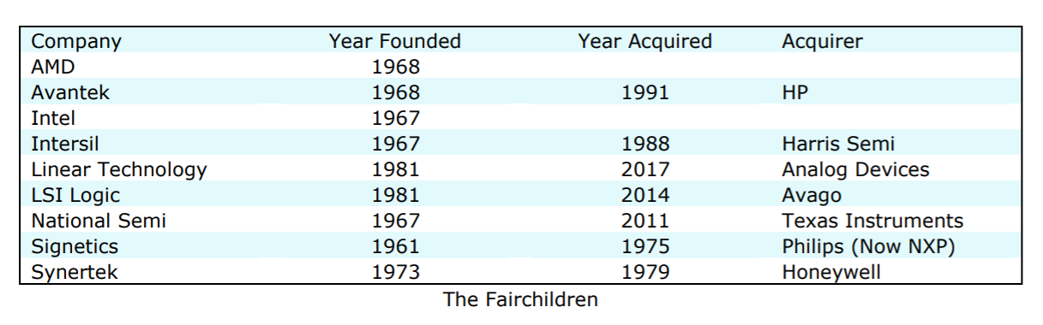
1. AMD’s rise, fall and recovery (1)
1. AMD’s rise, fall and recovery
Emergence and concentration of semiconductor companies in the US [115]
Around 1960, Fairchild became a pioneer in inventing advanced transistor
technologies and integrated circuits (in 1960).
Nevertheless, as scientists employed by Fairchild Semiconductor became frustrated
by the vendor’s management practices, mostly about 1965-1975, they set out
on their own and founded several semiconductor companies, as shown in the
following Table.
Table: Companies founded by former employees of Fairchild [115]
From all the firms founded by former employees of Fairchild, only AMD and Intel
survived.

Slide 6
1. AMD’s rise, fall and recovery (2)
Overview of AMD’s processor lines
Before designing in-house processors, AMD licensed and manufactured Intel’s processors.
AMD’s in-house designed x86 families
32-bit
x86 families
64-bit Hammer
family
Intermediate
families
The Bulldozer
family
The Cat
family
The Zen
family
K5/K6/K7
families
(32-bit
(clients)
1996-2003)
K8/K10/K10.5
families
(08h/10h/10.5h)
(Servers,
clients)
(2003-2009)
Families
11h/12h
(Clients
oriented)
(2008-2011)
Family
15h
(High-performance
oriented)
(2011-2016)
Families
14h/16h
(Low-power
oriented)
(2011-2015)
Family
17h
(Modular design)
(2017- )
K7: Athlon (1999-2003)
Clients: Laptops/DTs
Remarks
The K8 processor is highlighted, as it was AMD’s first 64-bit x86-64 implementation in 2003.

Slide 7
1. AMD’s rise, fall and recovery (3)
AMD’s outstanding innovations around 2000 -1
Historical background:
In the 1990s, CISC processors were 32-bit wide, whereas RISCs were mostly 64-bit.
To enter the 64-bit market, Intel and HP (Hewlett Packard) started HP cooperation
in 1994.
The result of this cooperation was Intel’s and HP’s vision: 64-bit computing would be
VLIW-based.
Accordingly, in 1997, they released the VLIW-based IA-64 ISA (Intel Architecture 64)
and based on it, they developed the 64-bit Itanium line, which became announced
in 1999, targeting high-end DTs to servers.
VLIW: Very Large Instruction Word
(Actually, the IA64 makes use of 128-bit instruction bundles).

Slide 8
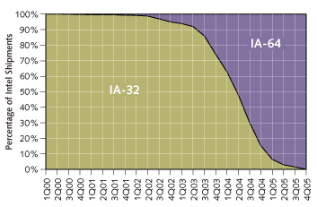
1. AMD’s rise, fall and recovery (4)
Industry analyst’s prediction from 2000 for how IA-64 will supplant IA-32 [211]
As the Figure shows, analysts expected IA64 to penetrate Intel’s processor shipments
already in 2004.

Slide 9
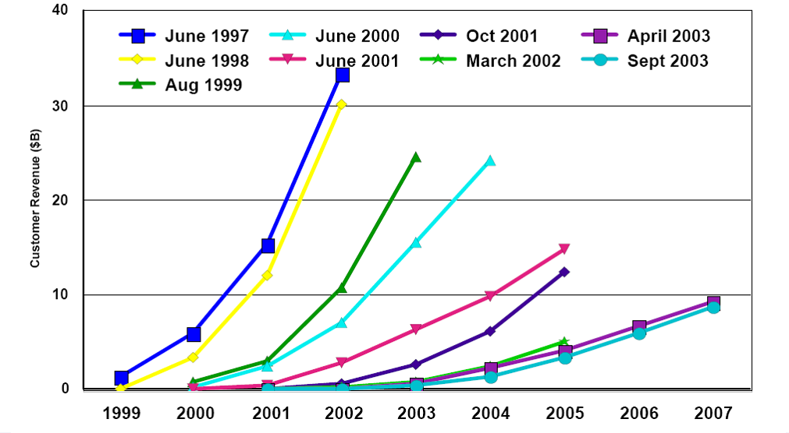
1. AMD’s rise, fall and recovery (5)
Market reception of the first IA-64 processors
By contrast, due to two years delay in shipping (2001) and worse-than-expected performance,
sales expectations of IA64 processors radically flattened in time, as the next Figure shows.
Figure: Sales expectations of the Itanium lines [10]

Slide 10
1. AMD’s rise, fall and recovery (6)
The fate of the IA64-based Itanium line
Due to its lower-than-expected performance and “exotic” ISA, the Itanium line came
to a dead end, and Intel canceled it in 2020.

Slide 11
1. AMD’s rise, fall and recovery (7)
AMD’s outstanding innovations around 2000 -2
Intel’s and HP’s vision for transferring 32-bit CISC computing to 64-bit VLIW computing
were sharply confronted by two outstanding innovations of AMD, as follows.
Downwards compatible extension of the 32-bit x86 ISA to 64-bit, called the
x86-ISA in 1999.
AMD’s goal was clearly formulated in the x86-64 ISA specification from 2000
[210]:
"Ultimately, this technology is designed to help preserve the enterprise
community's enormous financial investment in 32-bit operating systems,
applications, development tools, and support infrastructure while
providing a seamless path to deploy future 64-bit technology."
As AMD pointed out, "Perhaps the most noteworthy feature of AMD's
approach to 64-bit computing is that it is an extension of the 32-bit
environment prevailing in the industry today rather than a radical
departure“, envisioned by Intel’s and HP’s joint IA64 VLIW architecture
concept, released in 1997.

Slide 12
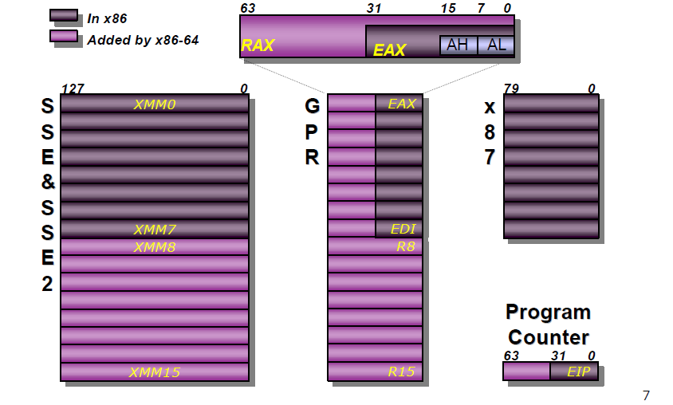
1. AMD’s rise, fall and recovery (8)
Extending the register set in the x86-64 ISA [167]
Based on the extended register set AMD necessarily defined new instructions to
manipulate 64-bit data in the extended register space.
Notes:
12

Slide 13
1. AMD’s rise, fall and recovery (9)
AMD’s outstanding innovations around 2000 -3
b) Developing the Direct Connect Architecture (DCA) concept.
The DCA concept has two components:
b1) Integrating Memory Controllers onto the processor die. (It is not AMD’s invention).
Figure: AMD’s Direct Connect Architecture concept [168]
Benefit: This shortens the access path and thus reduces the access time of the memory,
vs. the previous solution, when memory had been attached via the MCH, as indicated next.

Slide 14
1. AMD’s rise, fall and recovery (10)
Comparing options for connecting memory channels to a client platform
There are two main alternatives how memory channels can directly be connected
to a client platform, as shown below.
Connecting memory channels directly to a client platform
Connecting memory channels
via the MCH
Connecting memory channels
via the processor
MC is integrated
into the MCH.
Data is transferred
between the MCH and
the processor through
the FSB (Front Side Bus)
MC is integrated
onto the processor die.
The MC is usually linked
by an interconnect fabric
to other units (e.g. cores)
of the processor.
Processor
Processor r
MC
Memory
FSB
FSB
MCH
MCH
MC
Memory
ICH
MCH: Memory Control Hub
IOH: IO Control Hub
ICH

Slide 15
1. AMD’s rise, fall and recovery (11)
Remark
Integrating Memory Controllers onto the processor die is not AMD’s invention,
it had been long before introduced and widely used, as the next Table shows.
Options for attaching memory to platforms
Attaching memory to the MCH
Attaching memory to the processor die
Examples
HP PA-7100 (1992)
HP PA-7150 (1994)
and subsequent PA models
HP PA-7000 (1991)
UltraSPARC II (1C) (~1997)
UltraSPARC III (2001)
and all subsequent Sun models
AMD’s K7 lines (1C)
(1999-2003)
Opteron server lines (2C) (2003)
and all subsequent AMD lines
POWER4 (2C) (2001)
POWER5 (2C) (2005)
and subsequent POWER families
Core 2 Duo line (2C) (2006)
and all preceding Intel lines
Core 2 Quad line (2x2C) (2006/2007)
Penryn line (2x2C) (2008)
Nehalem lines (4) (2008)
and all subsequent Intel lines
Montecito (2C) (2006)
Tukwila (4C) (2010)

Slide 16
1. AMD’s rise, fall and recovery (12)
b) Developing the Direct Connect Architecture (DCA) multiprocessor concept cont.
b2) DCA provides up to 3 serial 2B–wide HyperTransport links to interconnect processors in servers as well as processors with the chipset, as shown below.
Figure: AMD’s Direct Connect Architecture concept [168]
The DCA concept lets eliminate the memory bandwidth limitation of the previous solution,
as the next Figure demonstrates.

Slide 17
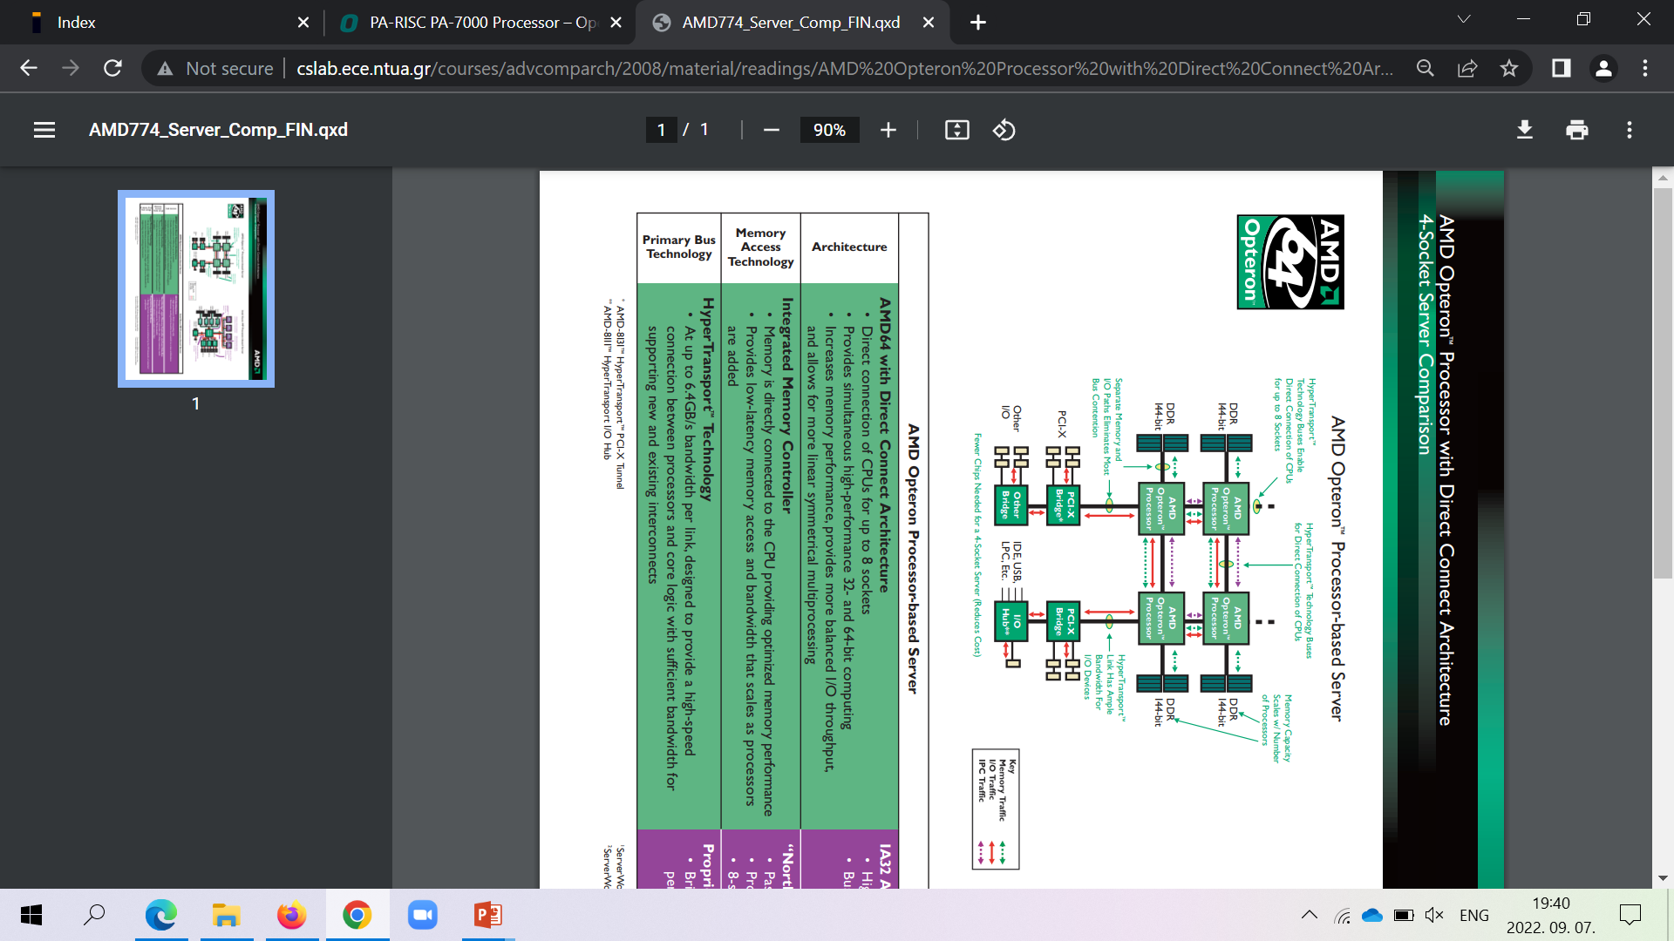
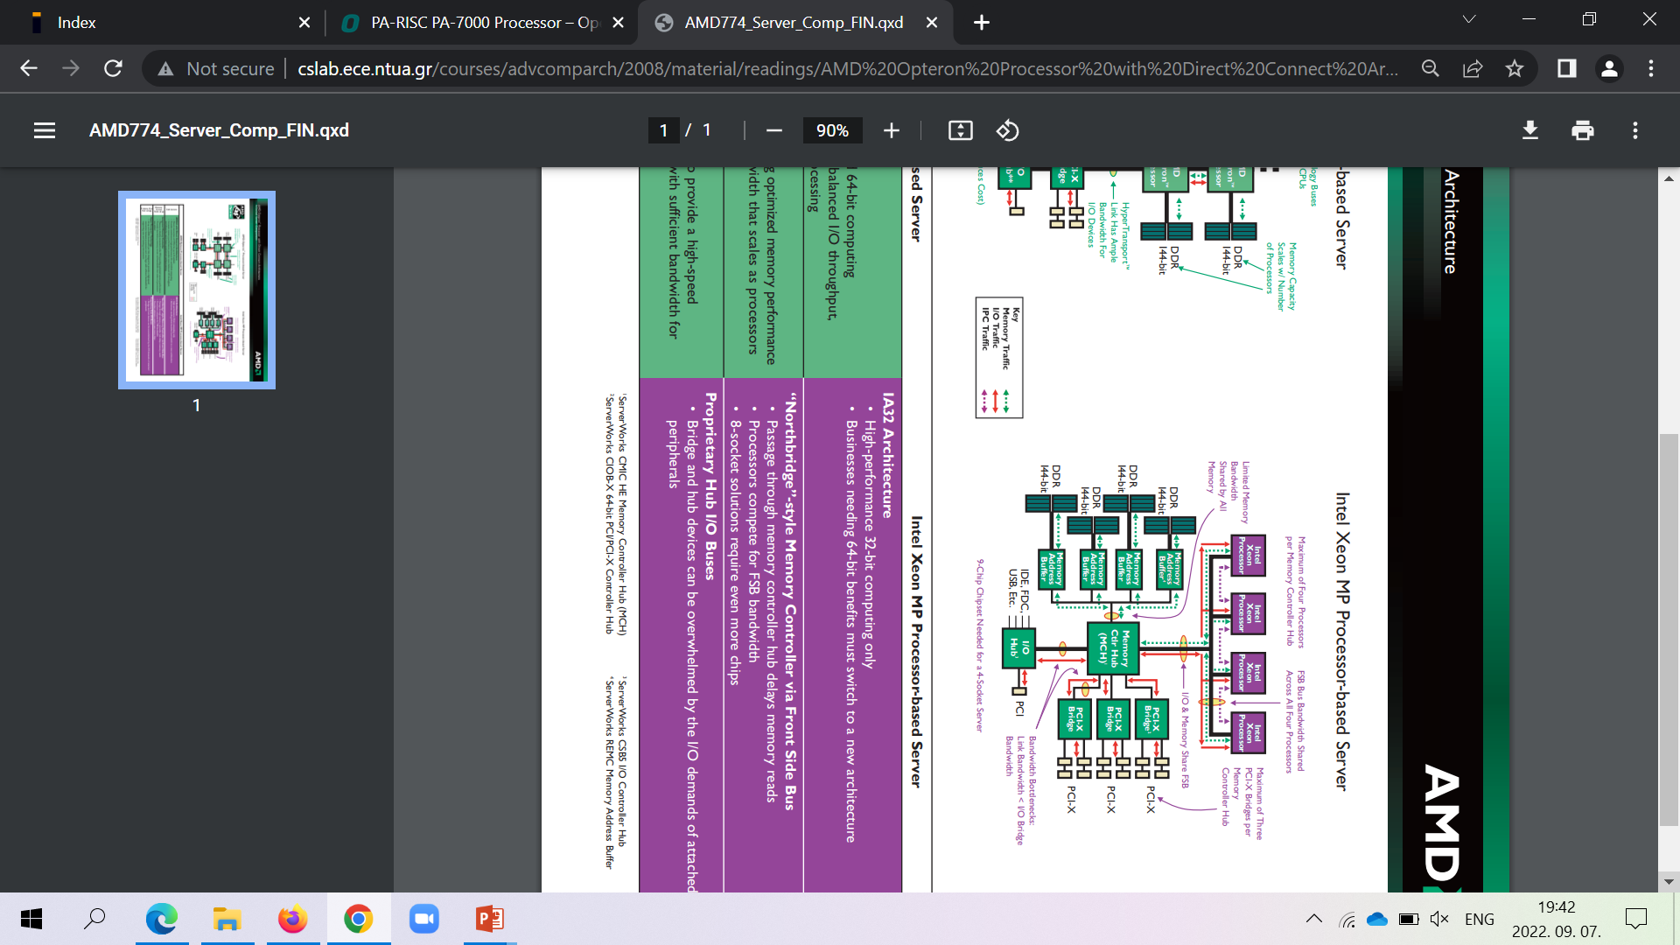
1. AMD’s rise, fall and recovery (13)
Contrasting memory bandwidth issues in a 4S server while attaching memory
via the MCH or directly, via the processors (based on [228])
PCI
As the Figure shows, DCA architectures greatly relieve bandwidth limitations of previous
server platforms with the memory attached via the MCH and the FSB (Front Side Bus).
FSB: Előoldali busz

Slide 18
1. AMD’s rise, fall and recovery (14)
AMD’s outstanding innovations around 2000 -4
When and how AMD implemented the x86-64 ISA extension and the DCA
architecture? -1
In 2002, AMD announced that Microsoft would support the x86-64 ISA.
In 2003, AMD shipped the first K8 server processors implementing the x86-64 ISA
and the DCA architecture.
Subsequently, in 2004, Intel took over AMD’s x86-extension (enforced by
Microsoft’s support of this ISA) and introduced it in their 3. core of the Pentium 4
line (called Prescott).
Nevertheless, Intel followed AMD much later in attaching memory channels
immediately to the processor die, only in their Nehalem line in 2008.
Both AMD’s x86-64 server and subsequent DT processor lines introduced were
superior to Intel’s existing lines [169], and AMD’s market share rose on the world market
from 2003 on, as the next Figure indicates.

Slide 19
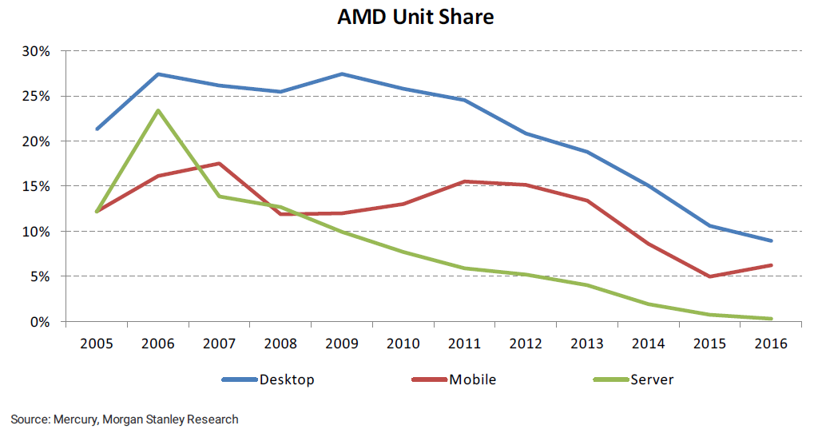
1. AMD’s rise, fall and recovery (15)
AMD's increasing unit shares on the world market 2006-2016 [51]

Slide 20
1. AMD’s rise, fall and recovery (16)
AMD's subsequent decreasing unit shares on the world market 2006-2016 [51] -1
Nevertheless, after taking over AMD’s x86-64 ISA extension and launching the
newly developed Core 2 line in 2006, Intel regained superiority in processor
performance, so subsequently, AMD’s share in the world market started to shrink,
as the following Figure indicates.

Slide 21
1. AMD’s rise, fall and recovery (17)
AMD's subsequent decreasing unit shares on the world market 2006-2016 [51] -2
AMD’s subsequent, decreasing market shares were caused by the superior performance
of Intel’s Core 2-based processors vs. AMD’s next (K10-based) lines.

Slide 22
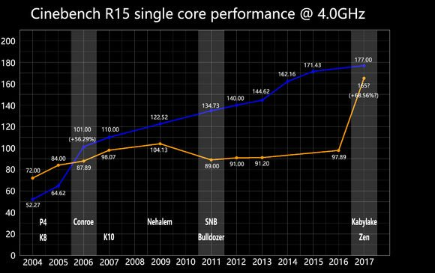
1. AMD’s rise, fall and recovery (18)
The reason for AMD’s decreasing market shares in 2006-2017: Lower single-core
performance vs. Intel, as indicated by Cinebench 15 benchmark scores [89]
(Core 2)
This Figure makes clear why AMD loose their market share to Intel.

Slide 23
1. AMD’s rise, fall and recovery (19)
Remarks on the CineBench benchmark [27]
It is a real-world cross-platform test suite for evaluating CPU and graphics
performance for 3D content creation.
It is based on MAXON's award-winning animation software Cinema 4D.

Slide 24
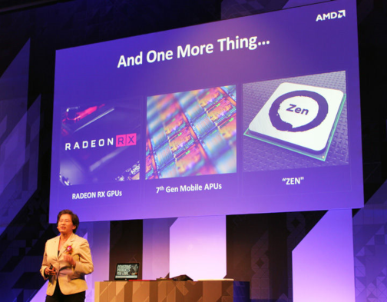
1. AMD’s rise, fall and recovery (20)
Announcing the Zen architecture at Computex 2016 as a turning point
in AMD’s market position [1]

Slide 25
1. AMD’s rise, fall and recovery (21)
AMD’s launching their Zen family and their effort to design the Zen core [11]
AMD launched the Zen family in 2017; this became a turning point in the contest
AMD vs. Intel.
M. Papermaster, CTO of AMD: Up to 300 engineers were working on the Zen core
spending over two million working hours.
Aim: optimizing the power/frequency curve.
CTO: Chief Technology Officer

Slide 26
1. AMD’s rise, fall and recovery (22)
AMD’s rising unit share on the world market after launching the Zen family
2017-2020 [116]
 | 2Q20 | 1Q20 | 4Q19 | 3Q19 | 2Q19 | 1Q19 | 4Q18 | 3Q18 | 2Q18 | 1Q18 | 4Q17 | 3Q17
DT | 19.2% | 18.6% | 18.3% | 18% | 17.1% | 17.1% | 15.8% | 13% | 12.3% | 12.2% | 12.0% | 10.9%
Mobile | 19.9% | 17.1% | 16.2% | 14.7% | 14.1% | 13.1% | 12.2% | 10.9% | 8.8 %
Server | 5.8% | 5.1% | 4.5% | 4.3% | 3.4% | 2.9% | 3.2% | 1.6% | 1.4% | 0.8%
As the Table indicates, AMD continuously raised its unit share in the world market
in all three major market segments, e.g., approximately by doubling their market share
in DTs and mobiles and increasing their market share in servers by more than fivefold.

Slide 27
1. AMD’s rise, fall and recovery (23)
AMD’s achieved performance leadership along with their Zen 3-based lines
AMD’s continuous evolution of the Zen architecture paid off as 7 nm Zen 3-based
processors became the highest-performing processors anew, after about 15 years in 2020,
as the following two examples demonstrate.

Slide 28
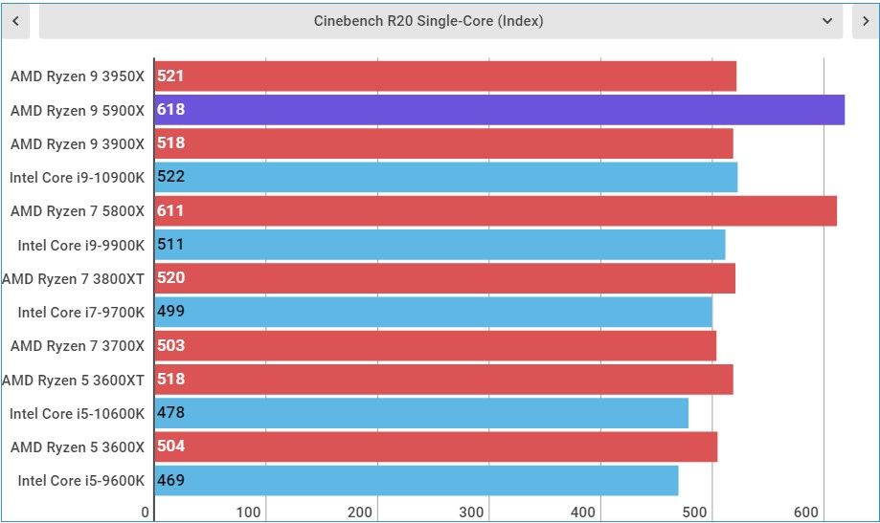
1. AMD’s rise, fall and recovery (24)
AMD’s performance leadership in single core Cinebench R20 benchmark scores
along with their Zen 3-based Ryzen 9 5900 gaming DT processor in 2021 [185]

Slide 29
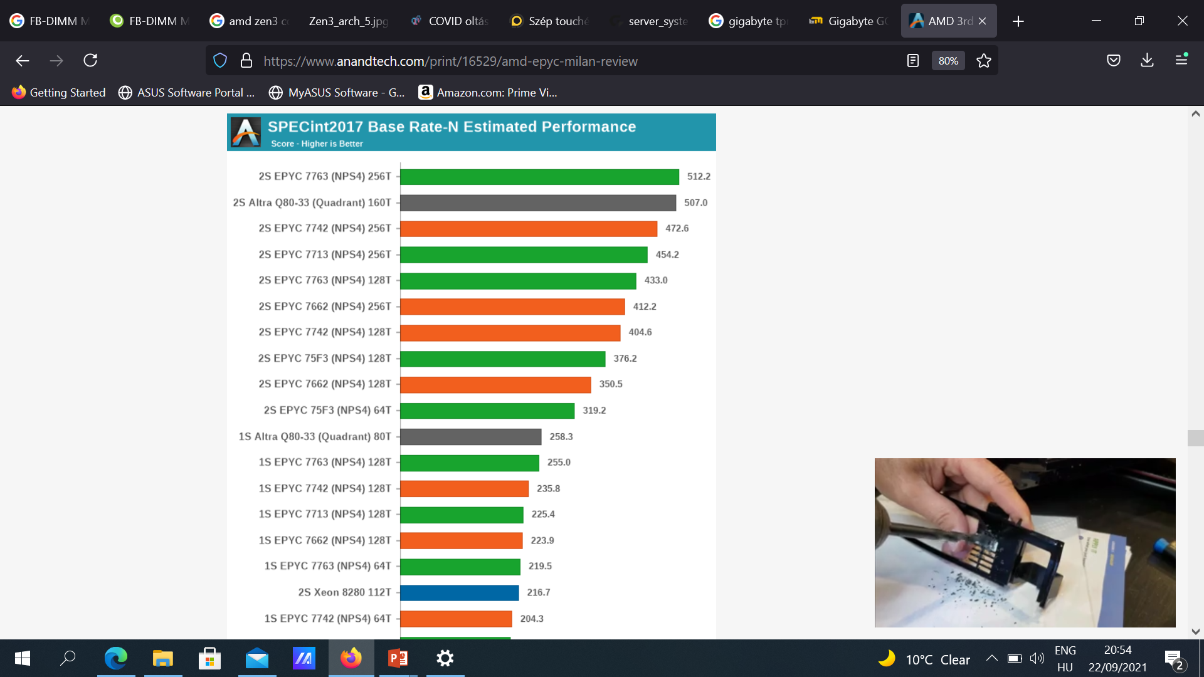
1. AMD’s rise, fall and recovery (25)
AMD’s performance leadership of in SPECint2017 Rate N benchmark along
with their Zen 3-based EPYC server processors in 2021 ([208]
SPECint2017 Rate
integer benchmark
measure the throughput or work
per unit of time.
NPS4 (4 Nodes per Socket) means a given server setting
with 4 processors
(not discussed here).
Base means standard
setting for the
measurements (no tuning
allowed.)
T: Threads
Red columns: Zen 2-based
Green columns: Zen 3-based
Note that emerging ARM-based servers, like Ampere’s 80-core Altra Q80-33 2S servers achieve already competitive performance results, that indicates an upcoming sharpening competition
in this processor category.

Slide 30
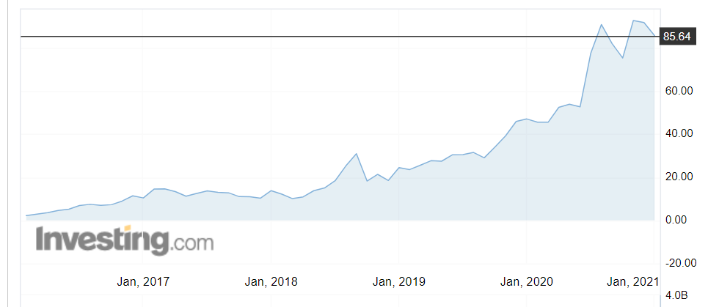
1. AMD’s rise, fall and recovery (26)
AMD’s stock price 2017 - 2021
Along with increasing market shares, AMD’s stock price tremendously rose from about
2 $ in 2016 to more than 80 $ in 2020 when AMD’s processors gained the performance
crown.
Source: Investing.com

Slide 31
1. AMD’s rise, fall and recovery (27)
Subsequent competition between Intel vs. AMD for gaining the performance crown
Since AMD successfully overtook the performance leadership with their Zen 3-based
processors, a tough competition unfolded for the performance crown with alternating
success, as the next Figure shows.
.

Slide 32
1. AMD’s rise, fall and recovery (28)
Alternating performance leadership in gaming DT processors: AMD vs. Intel
Performance
(not to scale)
A: Zen 4
R 7000X3D
A: Zen 4
R 7000X
*
*
*
I: 12th gen.
ALL
I: 13th
gen. RPL
A: Zen 3
R 5000X
*
*
I: 10th gen.
CML
*
I: Core 2
*
A: Athlon 64
*
≈
2003
04
05
06
07
2020
21
22
Year
A: AMD
R: Ryzen
I: Intel
CML: Comet Lake
ALL: Alder Lake
RPL: Raptor Lake

Slide 33
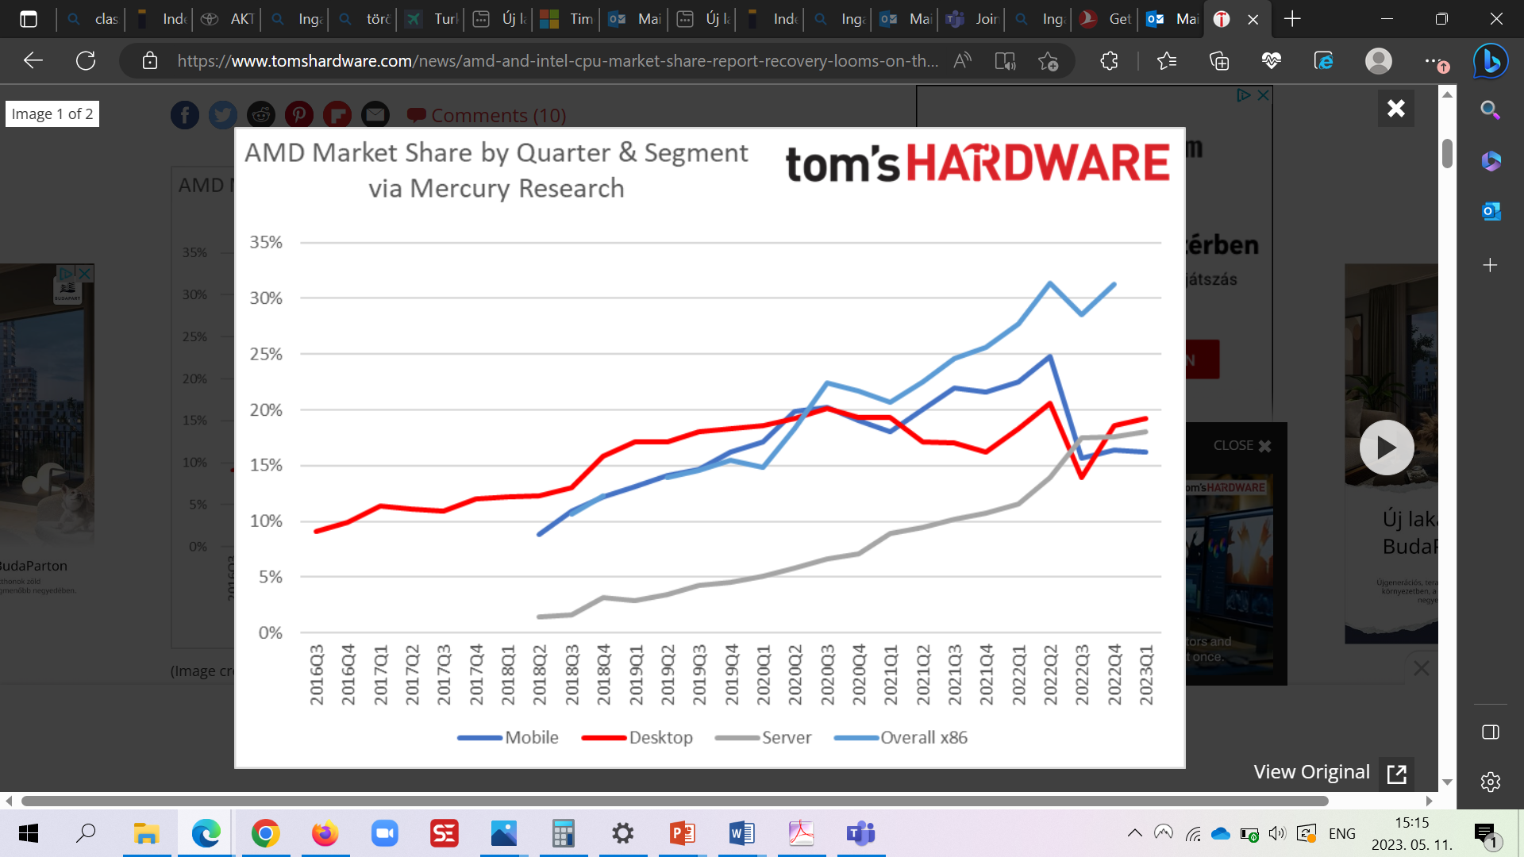
1. AMD’s rise, fall and recovery (29)
AMD’s market share by quarter and segment 2016 Q3-2023 Q1 [233]
As the Figure shows, when Intel announced their Raptor Lake line (in 01/2022), AMD’s
market share in desktop and mobile processors began to decline.

Slide 34
2. Introduction to AMD’s Zen families
Notes:
34

Slide 35
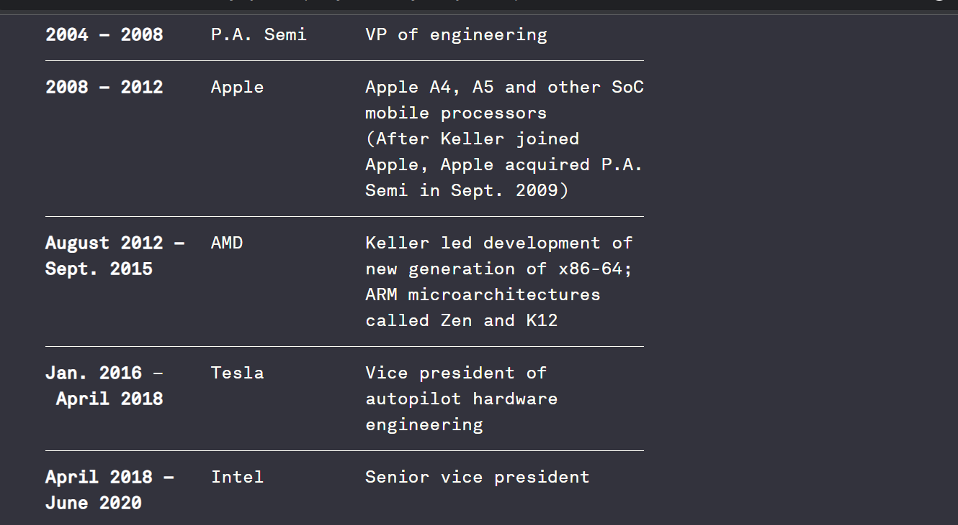

2. Introduction to AMD’s Zen families (0)
2. Introduction to AMD’s Zen families (Preface)
Jim Keller
Junko Yoshida: Jim Keller’s Journey from CPUs to CEO, July 2023

Slide 36
2. Introduction to AMD’s Zen families (0)
About Keller’s philosophy
The intricacies of computer architecture come naturally to Keller. His great challenge was mastering the art, in each new organization, of working with peers and gaining trust from subordinates while ramrodding the job for which he was hired.
His new team at AMD included about 500 people, quickly expanding to 2,500. That’s when Keller hired a consultant. “I’ve never managed that many people,” Keller acknowledged. The consultant had him read “a bunch of management books, and we made plans.”
Keller took on his pursuit of management know-how humbly and methodically.
His advice from that experience: “Search for good management books, read the reviews, buy five of them, read them all. That will give you some ideas. Then, look for some more books to fill in some gaps. Then, you will know more about management than almost anybody.

Slide 37
2. Introduction to AMD’s Zen families (1)
2. Introduction to AMD’s Zen families
In 2017, AMD introduced the 14 nm Zen family, as described earlier.
It was first refreshed by the 12 nm Zen+ family in 2018
and then replaced by the 7 nm Zen 2 family in 2019.
The Zen 2 family is a ground-up redesign of the Zen family; it allowed AMD
to regain the processor performance leadership subsequently, in 2020, vs. Intel
(after about 15 years).
Due to its success, the Zen 2 design has remained the basis for subsequent Zen
generations.

Slide 38
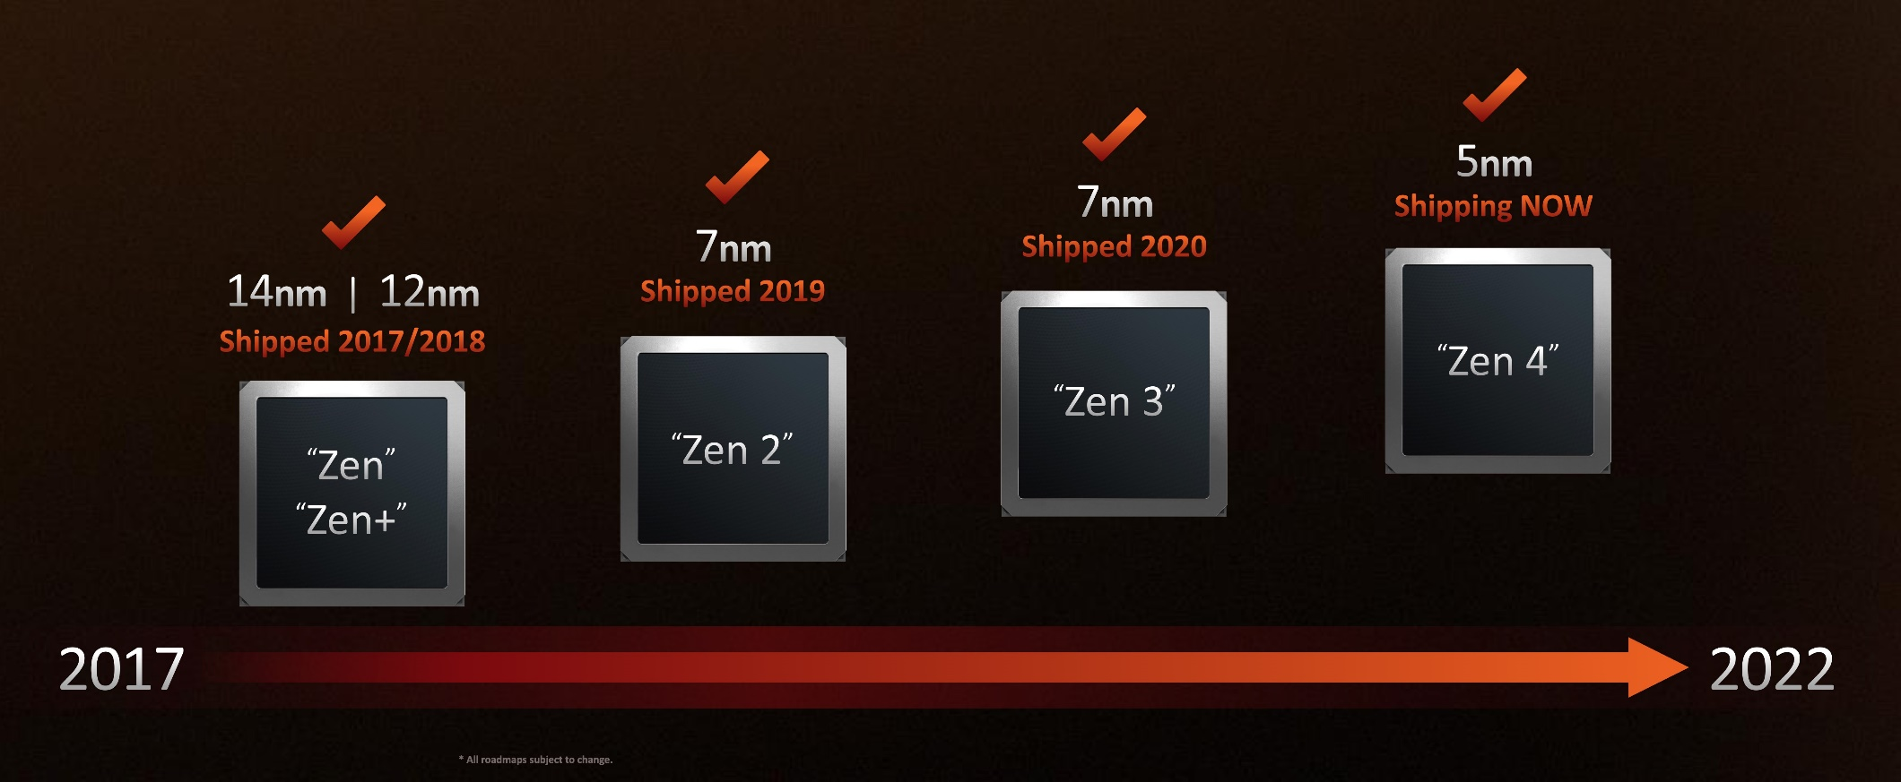
2. Introduction to AMD’s Zen families (2)
Overview of the Zen families [226]
As the above Figure indicates, AMD designed a series of Zen cores designated as
Zen, Zen+, Zen 2 etc.

Slide 39
2. Introduction to AMD’s Zen families (3)
How did AMD enhanced the IC technology of their Zen families ?
Family Introduced | Zen (2017) | Zen+ (2018) | Zen 2 (2019) | Zen 3 (2020) | Zen 3+ (2022) | Zen 4 (2022)
Server processors | 14 nm
HEDT processors |  | 12 nm
Gaming DT processors
DT APU processors |  |  | 7 nm | 7 nm | 6 nm | 4 nm (HS series) 5 nm (HX series)
Laptop APU processors
7 nm (CPU)
14 nm (IO)
7 nm (CPU)
14 nm (IO)
5 nm (CPU)
6 nm (IO)
As above data shows, AMD’s IC technology used to implement the Zen family more or less
follows Moore’s rule.
APU: Accelerated Processing Unit: It is AMD’s terminology for a processor, including a
GPU (Graphics Processing Unit).

Slide 40
2. Introduction to AMD’s Zen families (4)
Key concepts of AMD’s Zen family? -1
Two critical design decisions paved the way to AMD's Zen family's success :
a) The first one is AMD’s multi-die approach vs. the monolithic implementation
of processors.
Nevertheless, this approach has two implications:
1) If processors are built upon multiple dies, an appropriate cache coherent interconnect
is needed to link together multiple dies effectively.
AMD’s answer for it was the Infinity Fabric (IF).
The IF may interconnect multiple processors of a 2S server as well.
2) If processors are built up of multiple dies, obviously, an appropriate packaging
technology is also needed.
AMD developed for it the MCM (Multi-Chip Module) 2D packaging technology.
Later AMD extended it by the 3D V-cache technique (in 2022).
b) AMD’s second salient design decision was to implement the Zen family as a
modular, multi-die design, when all processor types, like client, server, and HEDT
processors are built up of building blocks (dies), similar to Lego.
So, the Zen family was born and entered the market in 2017.

Slide 41
2. Introduction to AMD’s Zen families (5)
How AMD implemented their modular multi-die concept?
First, in the Zen and Zen+-based lines, AMD opted for a homogeneous modular design
while using the same building blocks,
however, with their Zen 2-based processors, AMD changed to a hybrid modular design
with different building blocks, as detailed next.

Slide 42
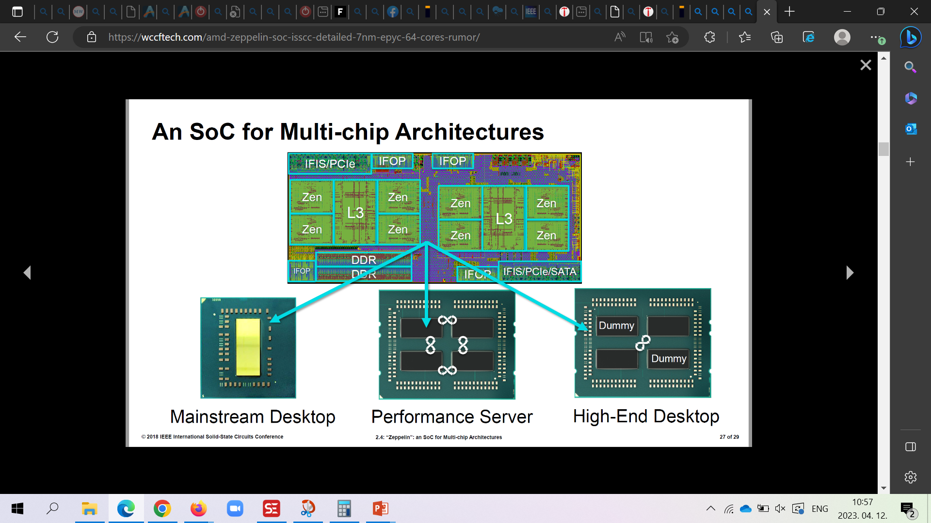
2. Introduction to AMD’s Zen families (6)
a) AMD’s homogeneous, modular multi-die implementation of the Zen/Zen+ families
Homogeneous, modular multi-die implementation means that AMD built up gaming DT-, HEDT
and server processors out of the same die types (single or multiple dies) (2017/2018) [233]
Basic die
(Zeppelin)
Gaming DT (Ryzen 1/2000X)
Server (EPYC)
HEDT (Threadripper)
As seen above, gaming DT processors contain a single die, whereas HEDT- and
server processors include up to 4 basic dies.
This approach is basically modular since, processors are built up of the same
building blocks, except APU dies that include a GPU and are implemented monolithically.

Slide 43
2. Introduction to AMD’s Zen families (7)
b) AMD’s hybrid, modular implementation of the Zen 2 and further lines -1
Beginning with the Zen 2-based processors (2019), AMD changed to a hybrid, modular
approach, with different processor types built up out of a set of different building
blocks (called basic dies).
As basic dies AMD chose the following four die types:
CPU dies (they do not include GPUs)
APU dies (including both CPUs, GPUs, and memory and IO connection)
Two different IO dies (they link together CPU dies and provide memory and IO connection, as shown next.

Slide 44
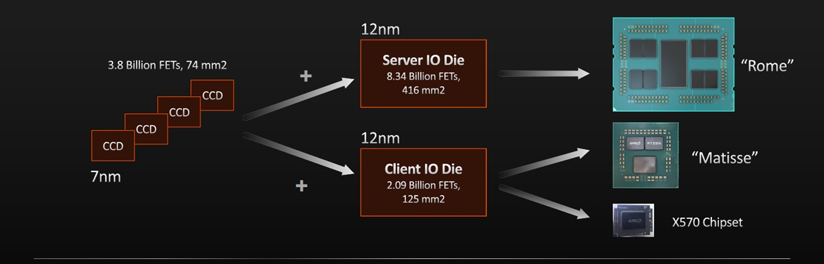
2. Introduction to AMD’s Zen families (8)
AMD’s hybrid, modular implementation of the Zen 2 and further lines -2
How did AMD implement gaming DT-, HEDT- and server processors out of multiple different dies ?
(Server)
(Gaming DT)
Server processors (Rome) as well as HEDT processors (not indicated in the Figure)
are set up of up to 8 CCD dies and a Server IO die, whereas gaming DT processors
(Matisse) include up to two CCD dies and a Client IO die, as seen above.
APU processors (client processors with a GPU) are, however, an exception, as they
remained monolithic, implemented on a single die.

Slide 45
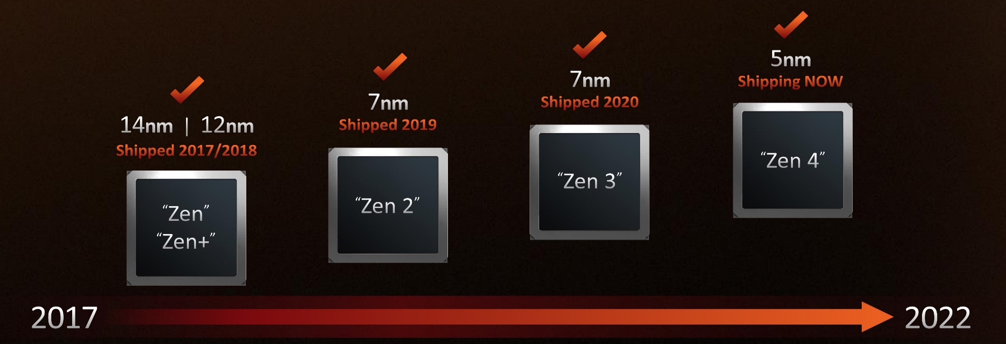
2. Introduction to AMD’s Zen families (9)
Summing up the evolution of AMD’s modular multi-die design approach
underlying the Zen families [226]
a) Homogeneous multi-die
b) Hybrid multi-die
Both are modular designs
AMD's Zen- and Zen+ based processor families used a homogeneous layout, while
later versions opted for a hybrid multi-die layout.
Both approaches are modular, based on building blocks to construct processors.

Slide 46
2. Introduction to AMD’s Zen families (10)
Why has the Zen 2 family an outstanding role within the Zen families?
The Zen 2 family is AMD’s first hybrid, modular multi-die design.
But its importance arises from its success, since its first revision, the Zen 3 family retook
the performance leadership from Intel in 2020.
Consequently, subsequent generations (such as the Zen 3 or Zen 4 families) have followed
the basic design of the Zen 2 family.

Slide 47
2. Introduction to AMD’s Zen families (11)
How will we present the huge field of AMD’s Zen families?
As pointed out, AMD’s critical design decision relating to their Zen family was to
implement it in a multi-die fashion rather than monolithic, like most competing
designs.
Since multi-die designs are expected to gain momentum recently due to their benefits,
Section 3.1 is devoted to the multi-die processor designs in general while
pointing out its benefits.
Sections 3.2 and 3.3 cover two techniques required for multi-die designs: interconnecting
and packaging multiple dies.
Nevertheless, to reduce the length of our discussion, these Sections are restricted to
AMD’s related techniques, that is, to the IF (Infinity Fabric) and 2D MCM, as well as
3D V-cache techniques.
Section 4. will acquaint the reader with the Zen 2 family, that is, with AMD’s first
hybrid multi-die design that underlies all subsequent Zen generations.
Its first update, the Zen 3 family, regained the performance crown from Intel.
In Section 5. we will show how dynamically the Zen family evolved.
Next, Section 6. presents a case example; the chosen one is AMD’s recent Zen 4-based
gaming DT processor line (Ryzen 7000X) since recently this line competes with Intel’s
highest performance 13th gen. Raptor Lake DT line.
Finally, in Section 7. we give an overview of AMD’s Zen families and in Annex 3.
we summarize their key features.

Slide 48
3. Why the multi-die approach is gaining momentum
and how to implement it?
3.1 The multi-die approach – a general view
3.2 AMD’s Infinity Fabric (IF) cache coherent interconnect
3.3 AMD’s MCM 2D and 3D V-cache packaging techniques
Notes:
48

Slide 49
3.1 The multi-die approach – a general view
Notes:
49

Slide 50
3.1 The multi-die approach – a general view (1)
3.1 The multi-die approach – a general view
When AMD’s multi-die approach for implementing processors appeared in 2017,
it was by far not new.
Both Intel and AMD had already designed dual-die processors before 2017.
Moreover, in recent years, the multi-die approach has become increasingly popular for
implementing processors, so it is worth becoming acquainted with this technique
in a broader context.

Slide 51
3.1 The multi-die approach – a general view (2)
A possible approach to overview multi-die processors
Multi-die
processors
Homogeneous
multi-die processors
Hybrid
multi-die processors
The processor is built up of
multiple dies of the same type,
properly interconnected
The processor is built up of
multiple dies of different types,
properly interconnected.

Slide 52
3.1 The multi-die approach – a general view (3)
Homogeneous multi-die processors
It is worth to differentiate homogeneous multi-die processors according to their
purpose, as follows:
Homogeneous
multi-die processors
The processor is built up of
multiple dies of the same type,
properly interconnected
Aiming at an early
market entry
Such designs allowed entering
the dual- or quad-core
processor market earlier
than it would happen
when the needed
IC technology should be
waited for.

Slide 53
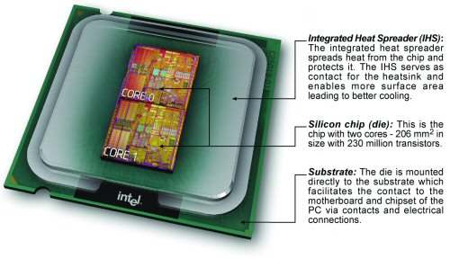
3.1 The multi-die approach – a general view (4)
a) Homogeneous multi-die processors aiming at an early market entry
Example 1: Intel’s first dual-die, dual core DT Pentium D-820 (5/2005) [91], [92]

Slide 54
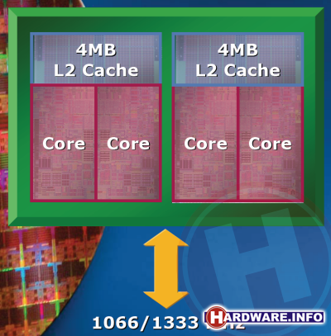
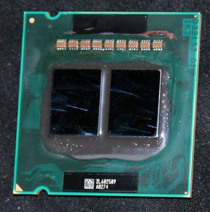
3.1 The multi-die approach – a general view (5)
Example 2: Intel’s dual-die dual- and quad core early server and client processors
Example server processors
Xeon Paxville DP 2.8: (2x1C), 2xDP-enhanced Pentium 4 Prescott, 90 nm (10/2005)
Xeon 5000 (Dempsey): (2x1C) DP, ~ the 65 nm shrink of the 90 nm Paxville DP 2.8 (5/2006)
Xeon 5300 (Clowertown): (2x2C) 2xCore 2-based 65 nm 2C Xeon 5100 (Woodcrest), 11/2006
Xeon 5300
(Clowertown) [4], [5]
Xeon 5400 Harpertown: 2x2C, 2x Core 2-based 45 nm 2C Harpertown (11/2007)
Example client processors
There are further examples of Intel’s dual die Core 2 (65 nm) or Penryn (45 nm) based
dual or quad core client processors as well, that are however not detailed here.

Slide 55
3.1 The multi-die approach – a general view (6)
b) Homogeneous multi-die processors aiming at a higher core count for a more
competitive design
Homogeneous
multi-die processors
The processor is built up of
multiple dies of the same type,
properly interconnected
Aiming at an early
market entry
Aiming at a higher core count
for a more competitive design
Such designs yield processors
with higher core counts than
standard designs offer
to raise competitiveness.
Such designs allowed entering
the dual- or quad core
processor market earlier
than it would happen
when the needed
IC technology should be
waited for.

Slide 56
3.1 The multi-die approach – a general view (7)
Example 1: AMD’s dual-die 12- or 16-core server processors
In the 2010s Intel had more advanced IC technology than AMD; as a consequence
AMD was forced to use dual dies to compete with Intel’s 8 to 18-core server
processors.
Examples
Opteron 6100 (Magny-Course): 2x6C, 2xBulldozer-based 45 nm Istambul die, (3/2010)
Opteron 6200 (Interlagos): 2x8C, 2xBulldozer-based 32 nm Orochi die, (11/2011)
Opteron 6300 (Abu Dhabi): 2x8C, 2xPiledriver-based 32 nm Abu Dhabi die, (11/2012)
Opteron 6400 (Warsaw): 2x8C, 2xPiledriver-based, 32-nm Abu-Dhabi die, (2014)

Slide 57
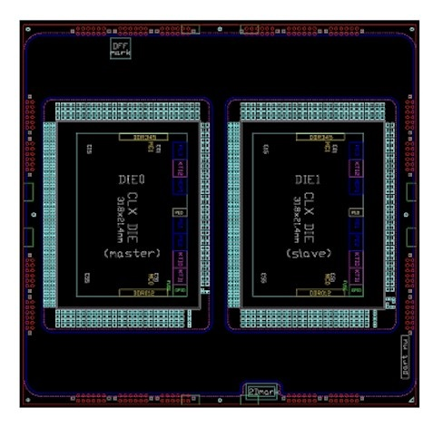
3.1 The multi-die approach – a general view (8)
Example 2: Intel’s dual-die 56-core Cascade Lake 9200-AP processor (2019)
The Cascade Lake 9200-AP is implemented on two (14 nm) Cascade Lake-SP dies
properly interconnected (presumable by a UPI bus) and enclosed into a BGA
(Ball Grid Array) package, as indicated in the Figure below.
Figure: Dual-chip module of the 9200-AP [28]
This design was spurred by AMD’s 64-core 7 nm Zen 2-based server processors
since at that time, Intel offered only up to 28-core designs.
We note that the 9200-AP was sold only for OEMs, as it has to be surface-mounted
(soldered) onto the mainboard rather than to be inserted into a socket.
OEM: Original Equipment Manufacturer (like Dell, hp etc.)

Slide 58
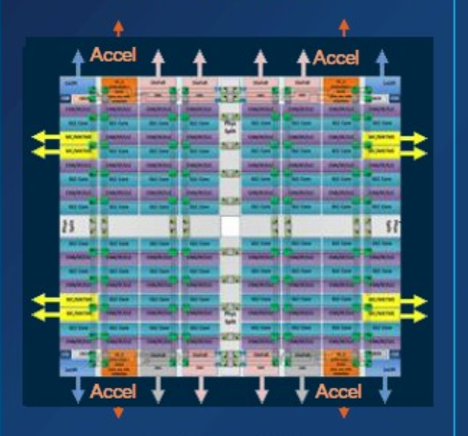
3.1 The multi-die approach – a general view (9)
Example 3: Intel’s quad-die up to 60-core 2S Sapphire Rapids server processor
(2023)
Since 2022 AMD has up to 96-core server processors on the market, whereas Intel’s
offer ended up at 40 cores (Whitley 2021, except a dual-die implementation providing
up to 2x28 cores, as discussed before).
This motivated Intel to design multi-die server processors with up to 60 cores.
Figure: Intel’s up to 60-core
2S Sapphire Rapids server
processor (2023) built up
of four 15-core dies (tiles) [234]

Slide 59
3.1 The multi-die approach – a general view (10)
c) Homogeneous multi-die processors aiming at a modular, lego-like processor design
Homogeneous
multi-die processors
The processor is built up of
multiple dies of the same type,
properly interconnected
Aiming at an early
market entry
Aiming at a competitive
design with higher core count
Aiming at a modular,
lego-like processor design
Such designs yield processors
with higher core counts than
standard designs offer
to raise competitiveness.
Such designs allowed entering
the dual- or quad core
processor market earlier
than it would happen
when the needed
IC technology should be
waited for.
In such designs
a basic die is used
to implement different processor types, such as HEDT or server processors.

Slide 60
3.1 The multi-die approach – a general view (11)
Example: AMD’s Zen and Zen+ families, as HEDT (Threadripper) and server
(EPYC) processors, built up of multiple homogeneous dies (2017/18) [233]
Basic die
(Zeppelin)
Gaming DT (Ryzen 1/2000X)
Server (EPYC)
HEDT (Threadripper)
As seen above, the same basic die is used to implement gaming DT-,HEDT- and server
processors, while gaming DT processors incorporate a single die and up to 8 cores,
whereas HEDT and server processors include up to 4 basic dies and 32 cores.
We note that APU dies (dies with a GPU and 4 CPU cores) are exceptions since AMD
implemented these dies necessarily differently on a single die.

Slide 61
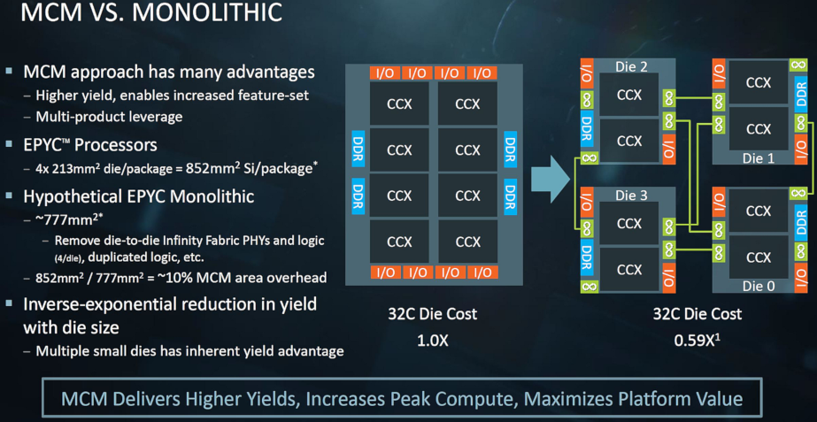
3.1 The multi-die approach – a general view (12)
AMD's cost argumentation for choosing the multi-die approach [7]
(CCX: 4-core Core CompleX)
With the multi-die approach, AMD expects higher yields and lower cost vs. the monolithic implementation.

Slide 62
3.1 The multi-die approach – a general view (13)
Pros and cons of AMD’s homogeneous multi-die approach [3]
Pros
Manufacturing large dies, such as server dies) costs less if they are segmented
into several smaller dies since smaller dies have lower failure rates and thus
higher yields and thus lower costs.
The multi-die approach allows the use of a modular, lego-like design concept for
implementing processors in such a way that processors for different market
segments, like mobiles, desktops, HEDTs, or servers, may be built up basically
from the same set of basic dies, reducing development and manufacturing costs.
In addition, while using a modular concept, in large core count server processors,
memory channels and I/O links are ab ovo linearly scaled with the core count.
Cons
When processors are built up of multiple dies, the dies need to be linked together
by an efficient cache coherent interconnect and control fabric.
This causes additional transfer latencies that degrade performance and gives
rise to extra power consumption.
Multiple dies need to be packed together by 2D/2.5D or 3D packaging technologies
(to be discussed in Section 3.2), this increases fabrication costs.

Slide 63
3.1 The multi-die approach – a general view (14)
Hybrid multi-die processors -1
Multi-die
processors
Homogeneous
multi-die processors
Hybrid
multi-die processors
The processor is built up of
multiple dies of the same type,
properly interconnected
The processor is built up of
multiple dies of different types,
properly interconnected.

Slide 64
3.1 The multi-die approach – a general view (15)
Hybrid multi-die processors -2
Again it is worth to differentiate hybrid multi-die processors according to their purpose,
as follows:
Hybrid
multi-die processors
The processor is built up of
multiple dies of different types,
properly interconnected
They provide in-package integration
instead of on-board interconnection
These designs integrate two dies into a single package; the CPU die and another die that implements a dedicated feature
of the processor (like the GPU).
It is usually a forerunner of the on-die integration of the feature in concern.

Slide 65
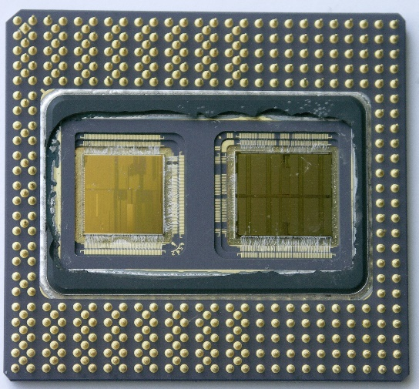
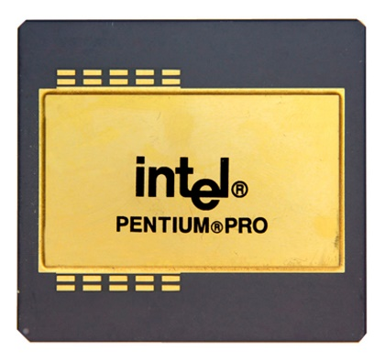
3.1 The multi-die approach – a general view (16)
a) Hybrid, multi-die processors providing in-package integration
Example 1: Intel’s Pentium Pro processor with in-package integrated L2 cache
(1995)
CPU and L2 dies
of the Pentium Pro [235]
The Pentium Pro package [235]
When Intel introduced
an in-package integrated L2 cache
for the Pentium Pro processor,
it became necessary to introduce a bus
interconnecting the CPU and L2 dies,
this bus was named the Back Side Bus.
Then, the link interconnecting the
CPU and the North Bridge became
the Front Side Bus (FSB).
CPU
(600 MHz)
Back Side
Bus
L2
(300 MHz)
(1/4-1 MB)
Front Side Bus (FSB)
)66 MHz)
North
Bridge
Figure: Introduction and interpretation
of the terms Front Side Bus/Back Side Bus

Slide 66
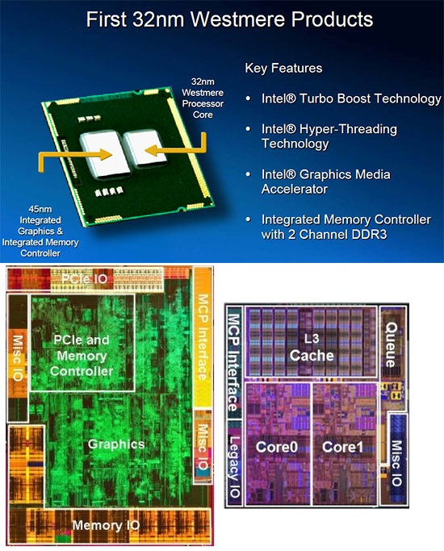
3.1 The multi-die approach – a general view (17)
Example 2: Intel’s dual-die Westmere client processor with in-package integrated
graphics (2010)
This processor was the forerunner of
Intel’s (on-die) integrated graphics
that appeared in the
Sandy Bridge line in 2011.
Figure: Intel’s mobile processor
with in-package integrated graphics
(Arrandale) (2010) [236]

Slide 67
3.1 The multi-die approach – a general view (18)
b) Hybrid, multi-die processors providing an innovative designs
Hybrid
multi-die processors
The processor is built up of
multiple dies of different types,
properly interconnected
They provide in-package integration
instead of on-board interconnection
They provide an innovative design
These designs integrate two dies into a single package; the CPU die and another die that implements a dedicated feature
of the processor (like the GPU).
It is usually a forerunner of the on-die integration of the feature in concern. .
Such designs may have various goals, such as
to achieve a modular, lego-like design or
to allow the implementation of higher-complexity
designs than monolithic implementations would do.

Slide 68
3.1 The multi-die approach – a general view (19)
Examples 1: AMD’s modular, lego-like Zen 2 family (2018) -1
Initially, in their Zen and Zen+ lines AMD chose a homogeneous multi-die approach
while designing a single basic die and implementing gaming DT-, HEDT- and server
processors by different numbers of the basic die, as shown earlier.
By contrast, in their Zen 2 design, AMD switched to the hybrid, multi-die approach,
by designing four basic dies:
a client die with a GPU, called APU (Accelerated Processing Unit) that
implements a full-fledged client processor and is of monolithic design,
a compute die, called CCD (Core Complex Die) and
two types of IO dies, one for clients (client IO die) and another for servers (server IO die),
and implementing server-, HEDT- and gaming DT processors out of multiple computing
and IO dies, as indicated in the next Figure.

Slide 69
3.1 The multi-die approach – a general view (20)
AMD’s modular, lego-like Zen 2 family (2018) -2
(Server)
(Gaming DT)
Note that there is a single CCD die type and two types of IO dies, one for the client
processors (Client IO Die) and another one for server processors (Server IO Die),
since client and server processors have different requirements, e.g., as far as core
counts, memory, or IO bandwidth is considered.
A fourth building block is the APU die, which is a die incorporating a GPU (not shown
in the Figure above).
It is an exception since it is a stand-alone building block implemented on a single die.
Note also that CCDs and IO dies are implemented by different IC processes
to optimize implementation.

Slide 70
3.1 The multi-die approach – a general view (21)
AMD’s modular, lego-like Zen 2 family (2018) -3
Multiple dies are interconnected by the IF (Infinity Fabric), and
processors are socketed by MCM (Multi-Chip Module) 2D packaging, augmented
later on by the 3D V-Cache technique along with the Zen 3 family in 2022.
Both issues mentioned above will be discussed in Sections 3.2 and 3.3).

Slide 71
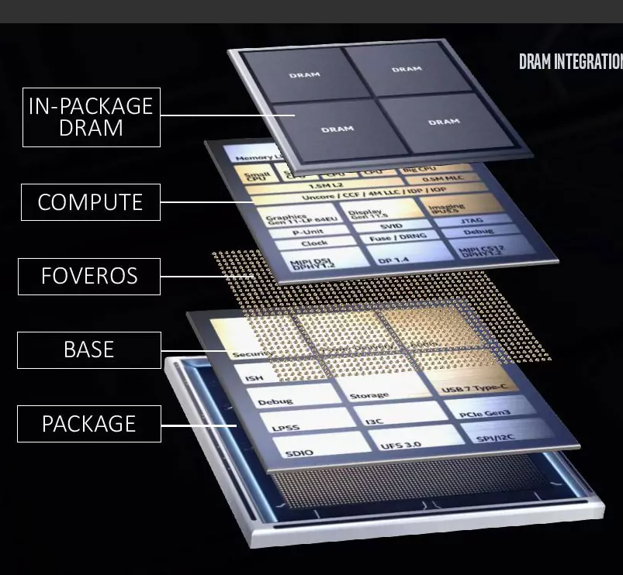
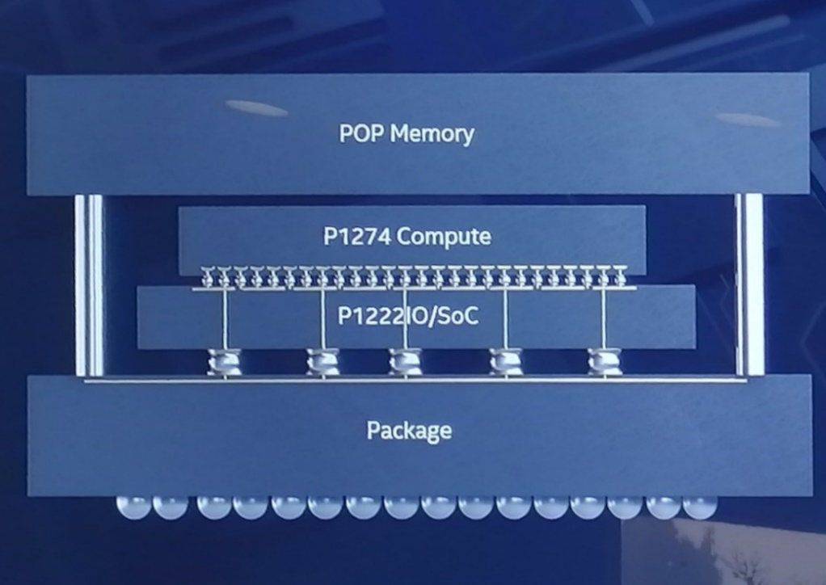
3.1 The multi-die approach – a general view (22)
Example 2: Intel’s big.little Lakefield processor for laptops (2019)
The Lakefield processor includes two dies (a CPU die (called Compute die) and an
IO die (called Base die).
These dies are interconnected by Intel’s 3D packaging technique, designated Foveros.
In addition, a stacked DDR4x POP (Package On Package) memory is included
in the processor, with both packages adequately interconnected.
This processor was hardly utilized; it may instead be considered as a pilot project.
Figure: Main components of the Lakefield processor (2019) [237]

Slide 72
3.1 The multi-die approach – a general view (23)
Implications of the multi-die approach for implementing processors
While using the multi-die technique two additional techniques are needed, as follows:
If a processor is implemented on multiple dies, an appropriate cache coherent interconnect
is needed for linking together multiple dies.
AMD’s answer for this requirement was the Infinity Fabric (IF).
The IF may interconnect multiple processors of a 2S server as well.
If processors are implemented on multiple dies, obviously, an appropriate
packaging technology is also needed.
AMD developed the MCM (Multi-Chip Module) 2D packaging technology for it.
Later, AMD extended it by the 3D V-cache technique (in 2022).

Slide 73
3.2 AMD’s Infinity Fabric (IF) cache coherent interconnect
3.2.1 Overview of the Infinity Fabric
3.2.2 Implementation of the Infinity Fabric (in Annex 1)
Only Section 3.2.1 is discussed, Section 3.2.2 is not part of the Lecture and the exam.
Notes:
73

Slide 74
3.2.1 Overview of the Infinity Fabric
Notes:
74

Slide 75
3.2.1 Overview of the The Infinity Fabric (1)
3.2.1 Overview of the The Infinity Fabric
The Infinity Fabric (IF) is AMD’s cache coherent interconnect and control network
designed along with the Zen core.
The task of the Infinity Fabric is:
to link together system units and
provide system-wide control functions, such as power management
or system security.
IF roots in the HyperTransport bus, it is similar to Intel's QPI or UPI
interconnection technology or ARM's CCN (Cache Coherent Network).

Slide 76
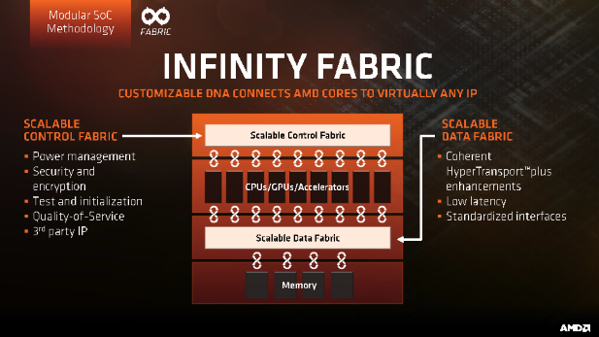
3.2.1 Overview of the The Infinity Fabric (2)
Key parts of AMD’s Infinity Fabric (IF)
Consequently, the Infinity Fabric consists of two key parts:
a Scalable Data Fabric (SDF), and
a Scalable Control Fabric (SCF),
as seen in the next Figure.
Power management
Security and Encryption
Quality of Service
Coherent
advanced
HyperTransport
bus
Low latency
standardized
interfaces
Figure: Key parts of AMD's Infinity Fabric (IF)[19]
SDF: Adatkapcsolat SCF: Vezérlés

Slide 77
3.2.1 Overview of the The Infinity Fabric (3)
The Scalable Data Fabric (SDF) -1
The Scalable Data Fabric (SDF) provides a high-performance cache coherent data
interconnect for all system blocks.
It is a significantly enhanced version of the HyperTransport bus.
Power management
Security and Encryption
Quality of Service
Coherent
advanced
HyperTransport
bus
Low latency
standardized
interfaces
Figure: AMD's Infinity Fabric [19]

Slide 78
3.2.1 Overview of the The Infinity Fabric (4)
The Scalable Data Fabric (SDF) -2
Its task is to interconnect
a) building blocks, like CCX core complexes, memory and IO controllers within a die,
b) different dies within a package via IFOP (IF On-Package) links and
c) two sockets of a 2S server via IFIS (IF Inter-Socket) links,
as the next examples illustrates.

Slide 79
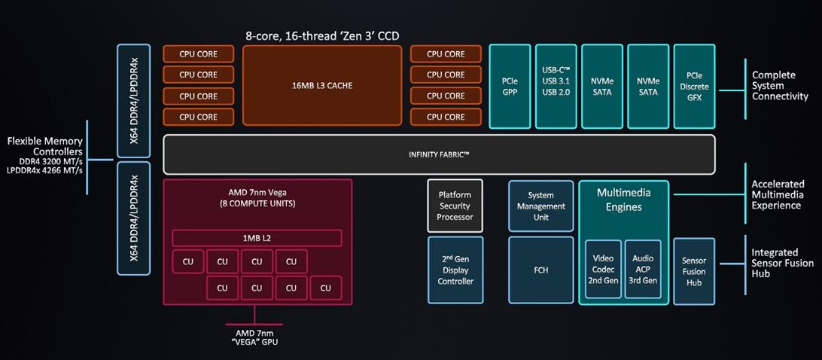
3.2.1 Overview of the The Infinity Fabric (5)
a) Use of IF for interconnecting building blocks within a die
Example: Zen 3-based Ryzen 5000 (Cezanne) mobile APU SoC [213]
FCH: Fusion Controller Hub
(Periféria vezérlő)
APU: Accelerated Processing Unit (in AMD’s terminology a processor with a GPU)
SoC: System on a Chip
CCD: CPU Compute Die

Slide 80
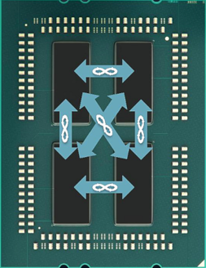
3.2.1 Overview of the The Infinity Fabric (6)
b) Use of IF for interconnecting different dies within a package
Example: Zen-based EPYC server processor [21]
The 4 dies are
8-core Zeppelin dies
Revealed in AMD's EPYC Launch event presentation, June 20 2017

Slide 81
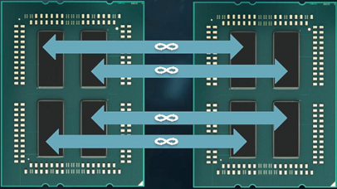
3.2.1 Overview of the The Infinity Fabric (7)
c) Use of IF for interconnecting two sockets of a 2S server
Example: Zen-based EPYC server processor [21]
Socket 1
Socket 2
The 2x4 dies are
8-core Zeppelin dies
Revealed in AMD's EPYC Launch event presentation, June 20 2017

Slide 82
3.2.1 Overview of the The Infinity Fabric (8)
Signaling systems used in buses
Signals
Single ended
Voltage referenced
Differential
Typ.voltage
swings
S+
V_{REF}
S-
V_{CM}
t
t
t
3.3-5 V
600-800 mV
200-300 mV
Signaling
system
used in
TTL (5 V)
FPM/EDO
SSTL
SSTL2 (DDR)
SSTL1.8 (DDR2)
SSTL1.5 (DDR3)
RSL (RDRAM)
FSB
LVDS
PCie
QPI, DMI, ESI
FB-DIMMs
LVTTL (3.3 V)
FPM/EDO
SDRAM
HI 1.5
DRSL
XDR (data)
Smaller voltage swings
LVDS: Low Voltage Differential Signaling LVTTL: Low Voltage TTL
(D)RSL: (Differential) Rambus Signaling Level SSTL: Stub Series Terminated Logic V_{CM}: Common Mode Voltage V_{REF}: Reference Voltage

Slide 83
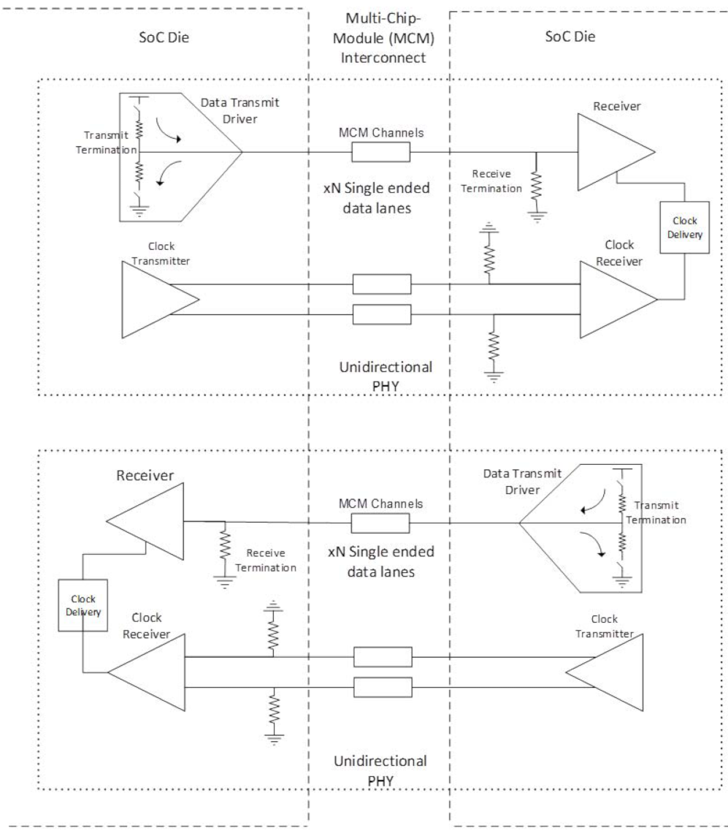
3.2.1 Overview of the The Infinity Fabric (9)
Example: Interconnecting 1.gen. dies by
single-ended data lanes and differential clock lanes [87]
Differential lanes

Slide 84
3.2.1 Overview of the The Infinity Fabric (10)
The Scalable Control Fabric -1
The Scalable Control Fabric is responsible for the system wide
Power management
Security and Encryption
Quality of Service,
as indicated below.
Power management
Security and Encryption
Quality of Service
Coherent
advanced
HyperTransport
bus
Low latency
standardized
interfaces
Figure: AMD's Infinity Fabric [19]

Slide 85
3.2.1 Overview of the The Infinity Fabric (11)
The Scalable Control Fabric -2
The Scalable Control Fabric incorporates central control elements, and
remote embedded elements dispersed in all blocks of the SoC.
The remote embedded elements are mainly sensors monitoring temperature,
speed and voltage.
The data acquired is fed into the central control element and allows to optimize
power management in a closed control loop, as seen in the following Figure.

Slide 86
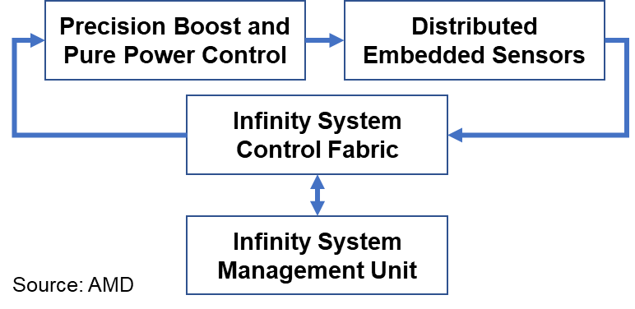
3.2.1 Overview of the The Infinity Fabric (12)
Principle of the operation of Infinity System’s Control Fabric [3]
Control algorithms for AVFS
Over 1000 sensors per CCX
Central Control Element
The system may be customized
by choosing the proper balance between
performance and power consumption

Slide 87
3.3 AMD’s MCM 2D and 3D V-cache packaging techniques
Notes:
87

Slide 88
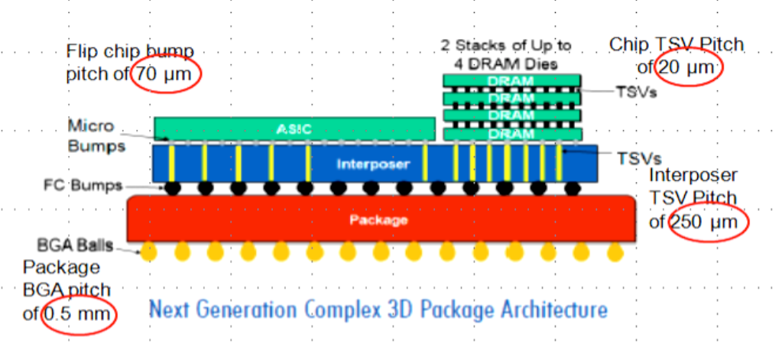
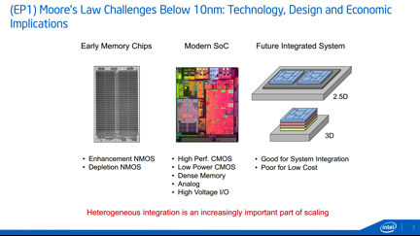
3.3 AMD’s MCM 2D and 3D V-cache packaging techniques (1)
3.3 AMD’s MCM 2D and 3D V-cache packaging techniques
Overview of packaging technologies used by Intel and AMD
Alternatives for in-package integration
2D packaging
(Horizontal die placement)
3D packaging
(Vertical die placement)
Both 2D and 3D packaging
(Horizontal and vertical
die placement
Dies are tiled side-by-side,
interconnected and packaged
Dies are stacked,
interconnected and packaged
Tiled and stacked dies are
interconnected and packaged
Intel’s recent technologies
EMIB
Foveros
Foveros + EMIB
AMD’s recent technologies
MCM
(Multi-chip Module)
3D V-Cache
(L3 stacked over proc. die)
Sources of the Figures: [187], [188]
Tiled: Egymás mellé helyezett
Stacked: Egymásra helyezett

Slide 89
3.3 AMD’s MCM 2D and 3D V-cache packaging techniques (2)
AMD’s MCM packaging to encase multiple dies-1
MCM (Multi-Chip Module) packaging is a kind of 2D packaging, as indicated
in the preceding Figure.
At the time being, however, no details are available about the implementation
technique used by AMD for their MCM technology.
Thus only some illustrations can be presented of how the MCM technology is
used by AMD for implementing Zen processors.

Slide 90
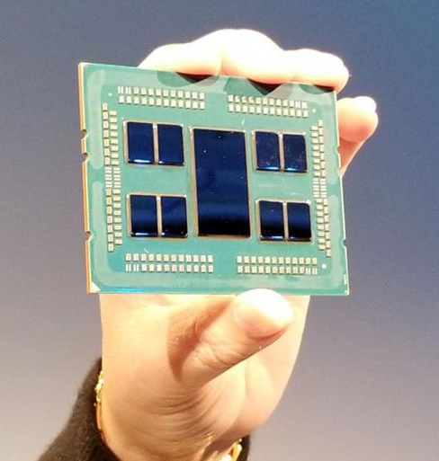
3.3 AMD’s MCM 2D and 3D V-cache packaging techniques (3)
AMD’s MCM packaging to encase multiple dies -2
The Figure below shows how MCM (Multi-Chip Module) technology is used to encase
multiple dies into a package in AMD’s Zen 2-based 64-core EPYC server processor.
Figure: AMD Zen 2-based 64-core EPYC server processor (Source: hothardware. com)

Slide 91
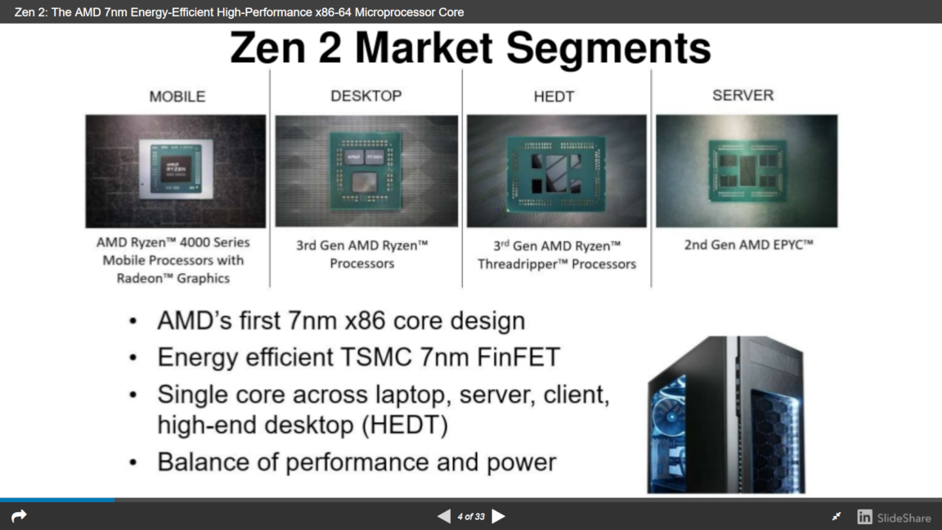
3.3 AMD’s MCM 2D and 3D V-cache packaging techniques (4)
Examples of Zen 2-based processor packages [122]
(1/2)
(No need for MCM packaging)
(4/8)
(2/4/
6/8

Slide 92
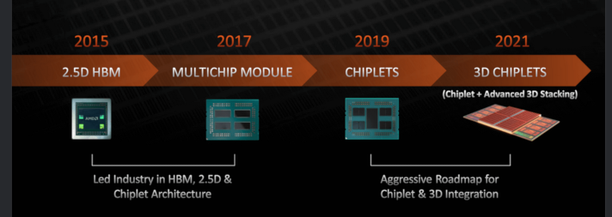
3.3 AMD’s MCM 2D and 3D V-cache packaging techniques (5)
AMD’s multi-die packaging roadmap presented in 08/2021 [212]
3D V-Cache
Zen-based
processors
Zen 2-based
processors
Zen 3-based
processors
Chiplet is AMD’s designation for multiple dies used as components of an MCM processor,
this terminology was introduced along with Zen 2-based processors.
HBM: High Bandwidth Memory (3D-stacked, large (e.g. 32 GB), high-bandwidth (e.g. ≈500 GB/s) memory

Slide 93
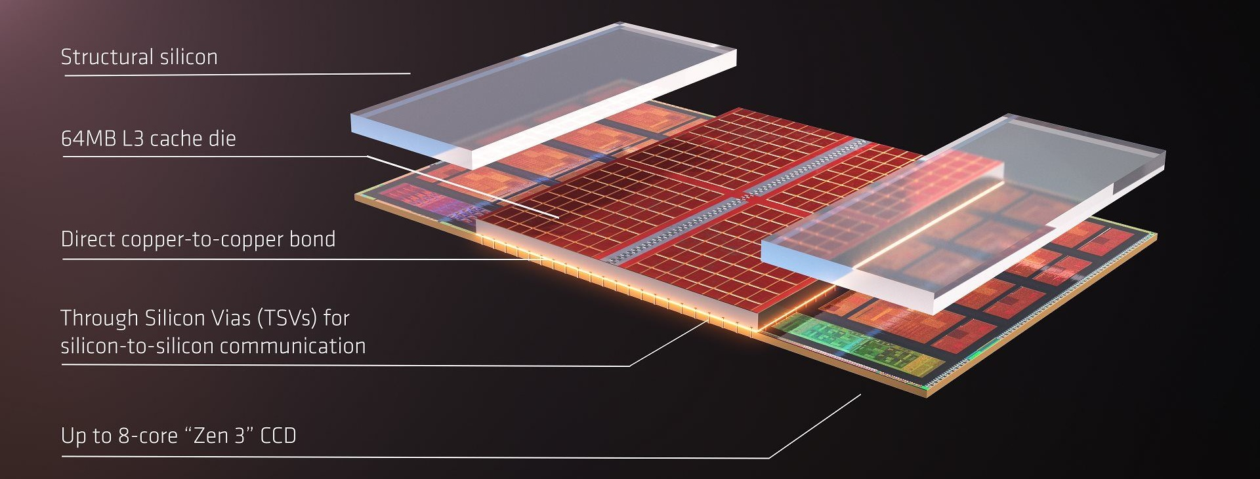
3.3 AMD’s MCM 2D and 3D V-cache packaging techniques (6)
AMD’s 3D V-Cache technology, as announced in 2021 [213]
AMD’s 3D V-Cache technology is a kind of 3D technology used to stack L3 dies on top of
a base die used to increase L3 size, as shown in the Figure below.
In the above Figure, a 64 MB L3 cache die is stacked vertically atop a Zen 3 base die
(called CCD), providing altogether 96 MB shared L3 cache for 8 cores.

Slide 94
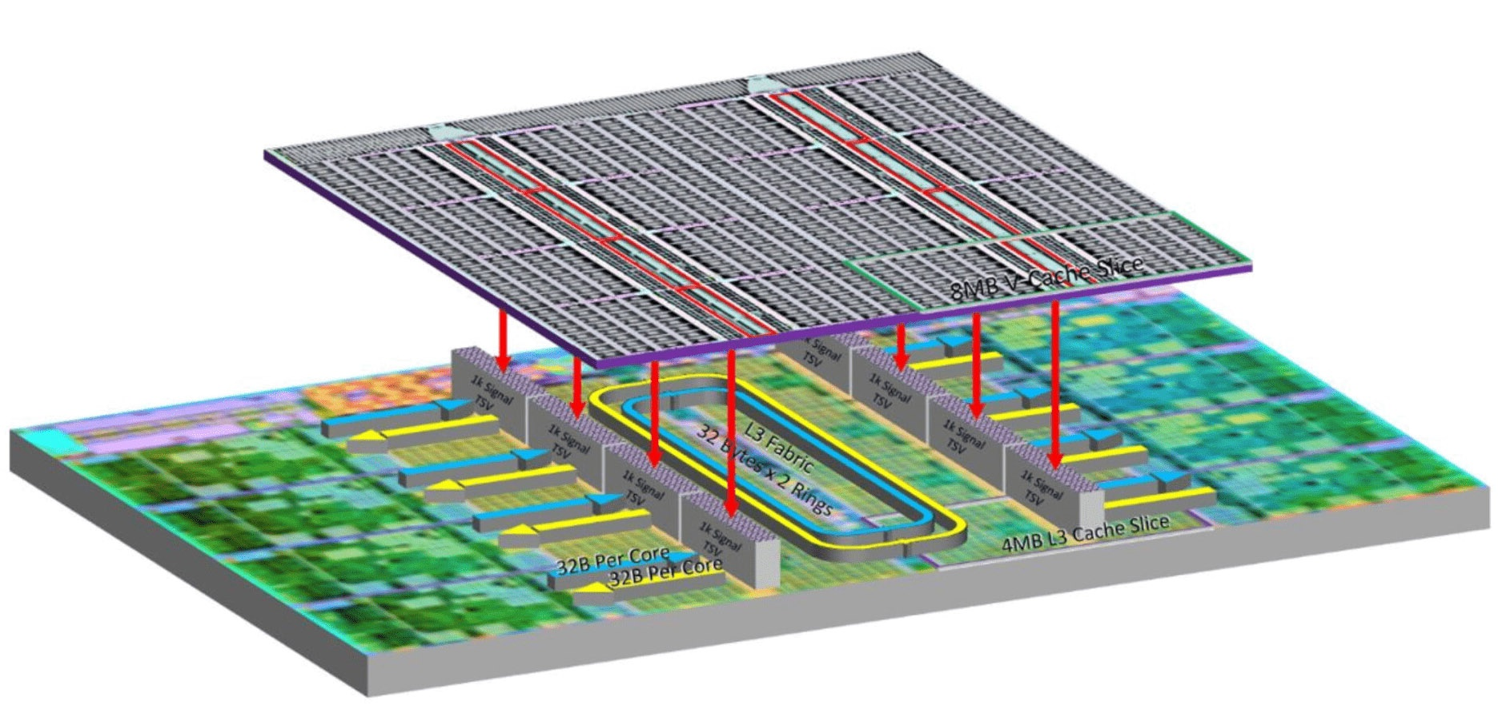
3.3 AMD’s MCM 2D and 3D V-cache packaging techniques (7)
AMD’s first implementation of the 3D V-Cache technology in 2022 -1 [215]
(Zen 3-based Ryzen 7 5800X3D gaming DT processor, 2022)
64 MB L3
4 cores
32 MB on-die L3
The 64 MB 3D V-Cache comprises eight 8 MB L3 "segments" with 1024 contact points per segment.
2x 4x 8 K contact points provide a bandwidth of more than 2 TB/s.
The contact points will be cooper-bonded to the base die.

Slide 95
4. The Zen 2 family
4.1 Introduction to the Zen 2 family
4.2 Basic dies of the Zen 2 family
4.3 The modular, lego-like design approach of the Zen 2 family
Notes:
95

Slide 96
4.1 Introduction to the Zen 2 family
Notes:
96

Slide 97

4.1 Introduction to the Zen 2 family (1)
4.1 Introduction to the Zen 2 family
The Zen 2 family is AMD’s complete redesign of the original Zen architecture, introduced
in 2019 (as shown in the Figure below).
2017/2018
2019-2020
2020-2021
2022-2023
a) Homogeneous multi-die
b) Hybrid multi-die
Both are modular designs

Slide 98
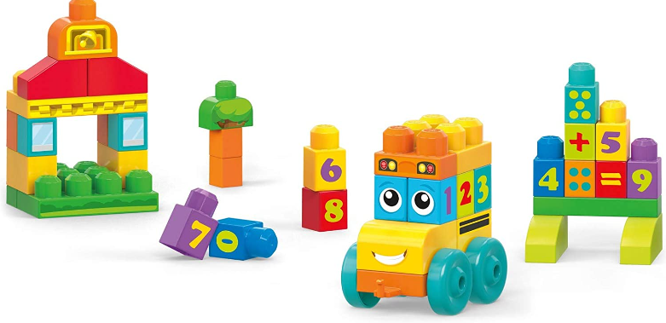
4.1 Introduction to the Zen 2 family (2)
A possible inspiration for AMD for conceiving the Zen 2 family – the toy system
based on lego blocks

Slide 99
4.1 Introduction to the Zen 2 family (3)
Principle of AMD’s modular, hybrid multi-die layout of the Zen 2 line (2019)
This design serves as a foundation for all subsequent Zen generations.
In this case, gaming DT-, HEDT- and server processors are composed of three different die types;
compute dies, called CCDs, and two additional IO dies, as seen below.
(Server)
(Gaming DT)
In particular, server processors (Rome) as well as HEDT processors (not shown in the
Figure) consist of up to 8 CCD dies, and one Server IO die, whereas gaming DT
processors (Matisse) include up to two CCD dies and one Client IO die.
APU processors (client processors with a GPU) are an exception to this approach again,
they are implemented monolithically (on a single die), representing the fourth die type.

Slide 100
4.1 Introduction to the Zen 2 family (4)
Key aspects in carrying out AMD's Zen 2 design
The implementation of Zen 2’s modular, hybrid multi-die design consisted of two
main tasks, as follows:
Conceiving the set of basic dies and
Conceiving how different processor types (like servers, HEDTs, etc.)
are built up out of the designed die set.
In addition, the multi-die design approach requires appropriate techniques for
interconnecting and packaging multiple dies, as discussed earlier.
For these tasks, AMD utilized in the Zen 2 family the IF bus and MCM packaging used
in the original Zen family (see Sections 3.2 and 3.3).
Now, let’s explore AMD’s solutions for the main tasks mentioned above.

Slide 101
4.2 Basic dies of the Zen 2 family
Notes:
101

Slide 102
4.2 Basic dies of the Zen 2 family (1)
n order to meet the demands for memory, input/output, and interconnection, AMD created two separate IO dies.
4.2 Basic dies of the Zen 2 family
What was AMD’s approach in conceiving the basic dies of the Zen 2 family? -1
In gaming, DT-, HEDT- and server processors AMD separated (general purpose)
computing resources from memory and IO management resources, and conceived
two basic die types.
AMD named the dies, including computing resources CCDs (Compute Complex Die)
whereas the dies that implement memory- and IO connectivity: IO dies.
However, processors may need more than one computing die (CCD) to provide higher
core counts, so IO dies got a third task as well (beyond providing memory and IO
connectivity), that is, to interconnect multiple CCD dies if the processor incorporates
more than one CCD.
To meet the different demands of client, HEDT, and server processors for memory, IO,
and interconnection, AMD designed two different IO dies, CIODs (Client IO Dies)
serving client processors and IODs (IO Dies) used for HEDT and server processors.

Slide 103
4.2 Basic dies of the Zen 2 family (2)
What has been AMD’s approach to conceive the basic dies of the Zen 2 family? -2
Please be aware that the processor types mentioned above do not include a GPU.
Consequently, AMD has introduced a fourth die type called APU dies (Accelerated
Processing Unit) to provide client processors with GPU capability.
These APU dies are designed as monoliths, meaning they consist of a single die.
It follows that AMD conceived altogether a set of four basic die types (building blocks)
for their Zen 2 family;
a) CCD dies (Compute Complex Dies)
b) cIOD dies (client IO Dies)
c) IOD dies (IO Dies for servers and HEDTs) and
d) APU dies (Accelerated Processing Units).
Subsequent Sections will provide a closer look at the conceived die types.

Slide 104
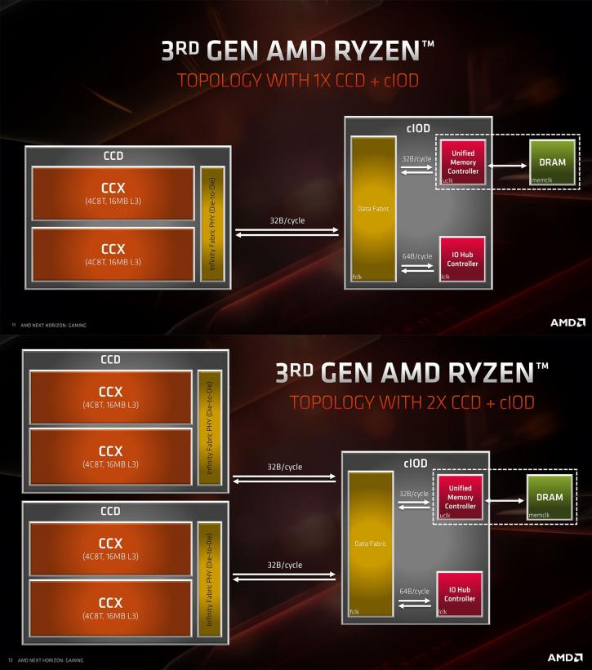
4.2 Basic dies of the Zen 2 family (3)
4.2.1 Zen 2-based computing dies, called CCDs (CPU Compute Dies)
CCDs represent the computing resources of Zen processors, i.e., they include CPU cores
used for general use.
In CCDs, CPU cores are organized in core blocks called CCXs (Core CompleX-es).
Zen 2-based CCDs include two CCX core blocks, of 4 cores each, as indicated in the Figure
below.
32 Byte/cyle
Figure: Layout of a Zen 2-based CCD die [238]
In addition, CCDs also have an IF (Infinity Fabric) port to interconnect them to IO dies.
Next, let’s discuss how Zen 2-based CCXs are built up.

Slide 105
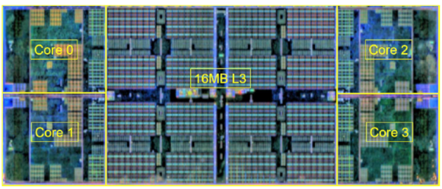
4.2 Basic dies of the Zen 2 family (4)
Zen 2-based CCX core blocks
Zen 2-based CCX core blocks include 4 cores (C₀ to C₃) with private L1/L2 caches and
4 MB L3 cache segments per core, which are interconnected by a crossbar switch,
as indicated below in the schematic layout of Zen 2-based CCXs.
C₃
C₂
L3
L3
4 MB 4 MB
Crossbar (4x4)
4 MB 4 MB
C₀
C₁
7 nm, 74 mm², 3,9 btrs
Figure: Schematic layout and die plot of Zen 2-based CCXs [16]
Through the crossbar switch, each core of the core block can access each L3 cache
segment with the same latency.

Slide 106
4.2 Basic dies of the Zen 2 family (5)
4.2.2 Zen 2-based cIODs (Client IO Dies) -1
Introduction
IO dies (in general) have three main tasks, as mentioned:
to provide memory access,
to implement IO connectivity and
to interconnect CCD dies for achieving higher core counts if needed.
Nevertheless, client and server processors have different requirements, e.g. as far as
the number of cores, required memory, or IO bandwidth is considered, consequently
AMD designed two different IO dies, as shown below.
Types of IO dies
IO dies for clients (cIOD)
IO dies for HEDTs and servers (IOD)
(i.e. for Threarippers and EPIC servers)
cIODs interconnect up to 2 CCDs and
provide memory and IO connectivity.
IODs interconnect up to 8 CCDs and
provide memory and IO connectivity.
Next we give some details of both IO die types mentioned.

Slide 107
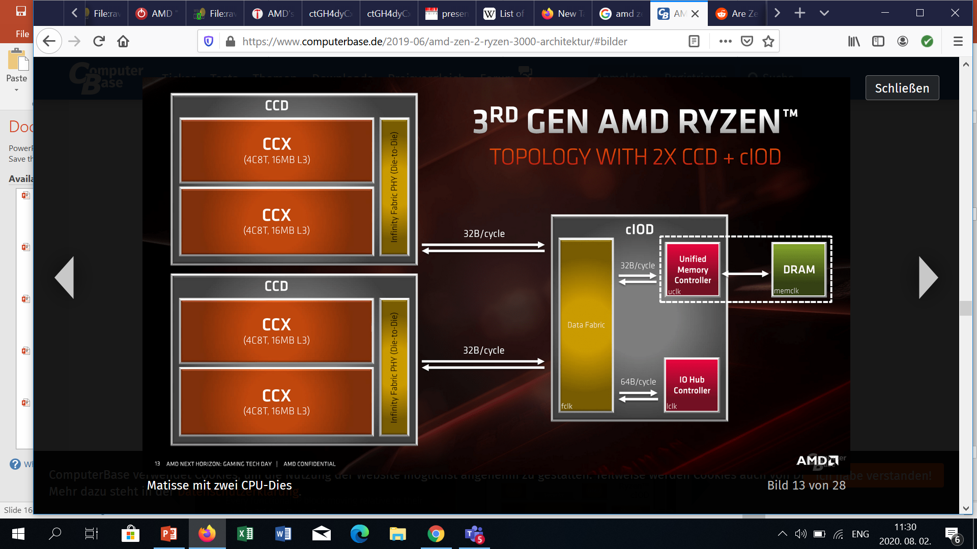
4.2 Basic dies of the Zen 2 family (6)
Zen 2-based cIODs (client IO Dies) -2
They are key parts of gaming DT processors, since they provide:
memory access,
IO connectivity and
interconnection between two CCDs (if there are 2 CCDs in the processor),
as the Figure below illustrates.
Data Fabric
IO
(PCIe/USB)
Figure: Zen 2-based gaming DT processor with two CCD dies (12/16 cores) [137]

Slide 108
4.2 Basic dies of the Zen 2 family (7)
The interconnecting network implemented within the cIOD
Within the cIOD, there is an interconnecting network called the Data Fabric, which is
implemented as a crossbar, interconnecting the CCXs, memory, and IO, as shown in the
Figure below.
Data Fabric
IO
(PCIe/USB)
Figure: Zen 2-based gaming DT processor with two CCD dies (12/16 cores) [137]
How the interconnecting network is utilized is indicated in the following Figure.

Slide 109
4.2 Basic dies of the Zen 2 family (8)
Schematic layout of interconnecting cores in a Zen 2-based 16-core gaming DT
processor (Ryzen 3950X), while omitting memory and IO interconnections
Ci
Ci
Ci
Ci
cIOD
L3 (2x4 MB)
L3 (2x4 MB)
Zen 2 CCX
Crossbar (4x4)
x
Crossbar (4x4)
Zen 2 CCX
L3 (2x4 (MB)
L3 (2x4 (MB)
Ci
Ci
Ci
Ci
(X-bar)
Ci
Ci
Ci
Ci
L3 (2x4 MB)
L3 (2x4 MB)
Zen 2 CCX
Crossbar (4x4)
Crossbar (4x4)
Zen 2 CCX
L3 (2x4 (MB)
L3 (2x4 (MB)
Ci
Ci
Ci
Ci

Slide 110
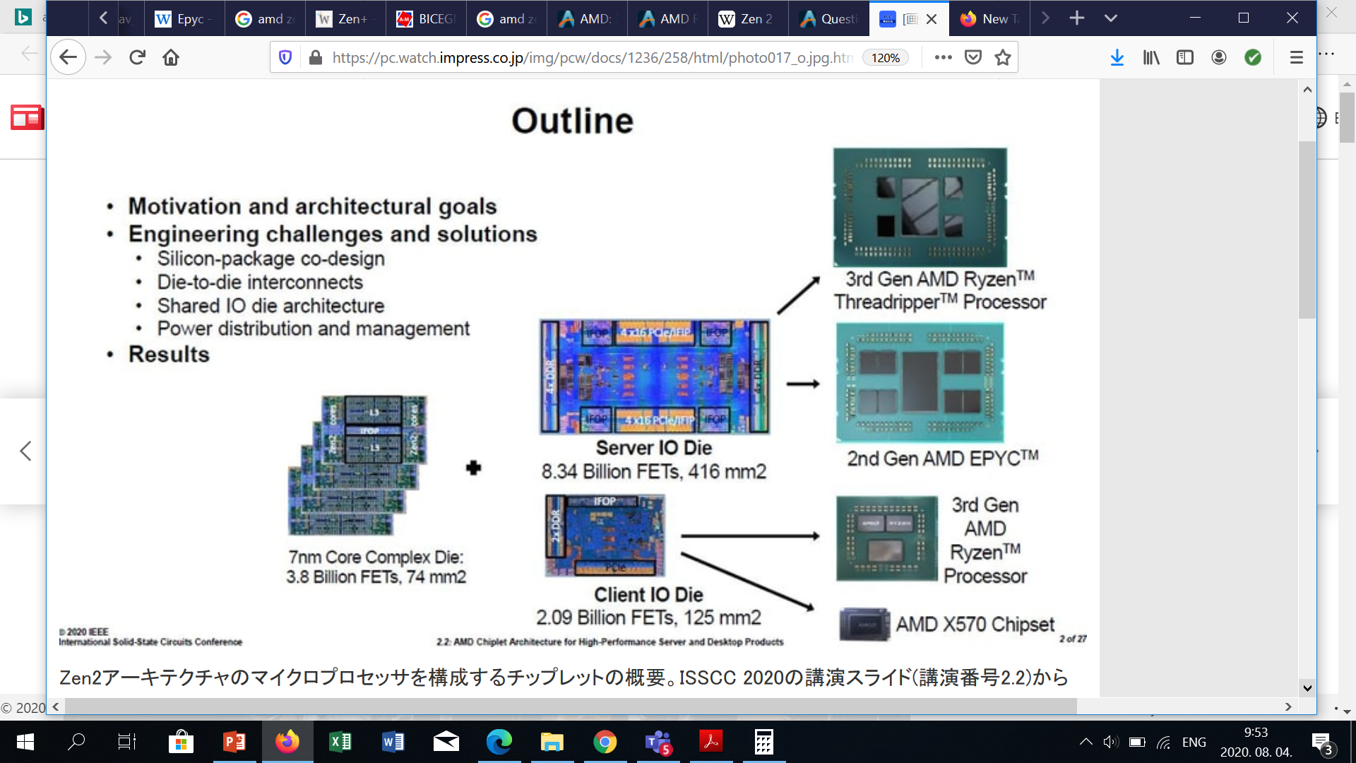
4.2 Basic dies of the Zen 2 family (9)
4.2.3 IOD dies (IO Dies) for servers (EPYCs) and HEDTs (Threadrippers)
Their main tasks are:
to interconnect up to eight CCD dies, thus providing up to 64 cores,
to perform memory access and
to allow IO connectivity,
as the Figure below demonstrates it for Zen 2-based HEDT and server processors.
Zen 2-based
Threadripper processor
7 nm
12 nm
Zen 2-based
EPYC processor
Figure: AMD’s chiplet design for HEDT and server processors [122]

Slide 111
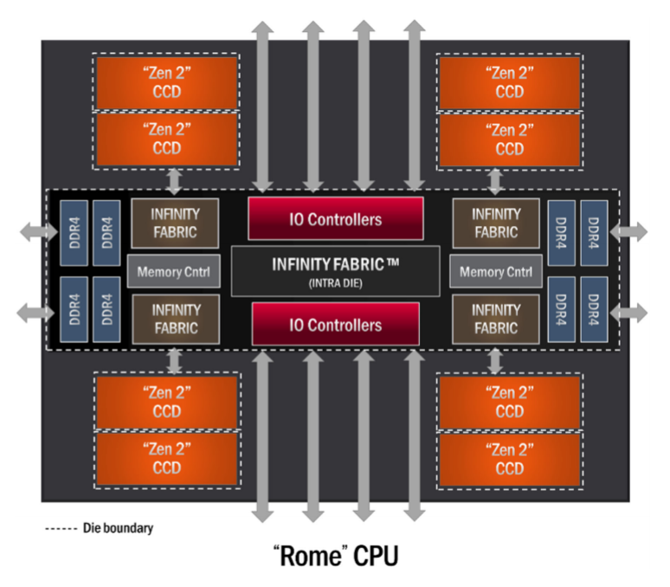
4.2 Basic dies of the Zen 2 family (10)
Internal structure of the IOD of Zen 2-based HEDT and server processors [239]
As the Figure indicates, up to 8 CCDs may be connected to the IOD, whereas the IOD
provides up to 8 DDR4 memory channels and several IO links.

Slide 112
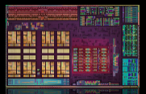
4.2 Basic dies of the Zen 2 family (11)
4.2.4 Zen 2-based APU (Accelerated Processing Unit) dies
APU dies (in general) are used both in DT and mobile APU processors.
The die incorporates all components needed by a complete processor, inclusive of a GPU.
See the example below.
7 nm
156 mm²
9.8 btrs
Figure: Zen 2-based DT APU (Ryzen 4000G/GE)

Slide 113
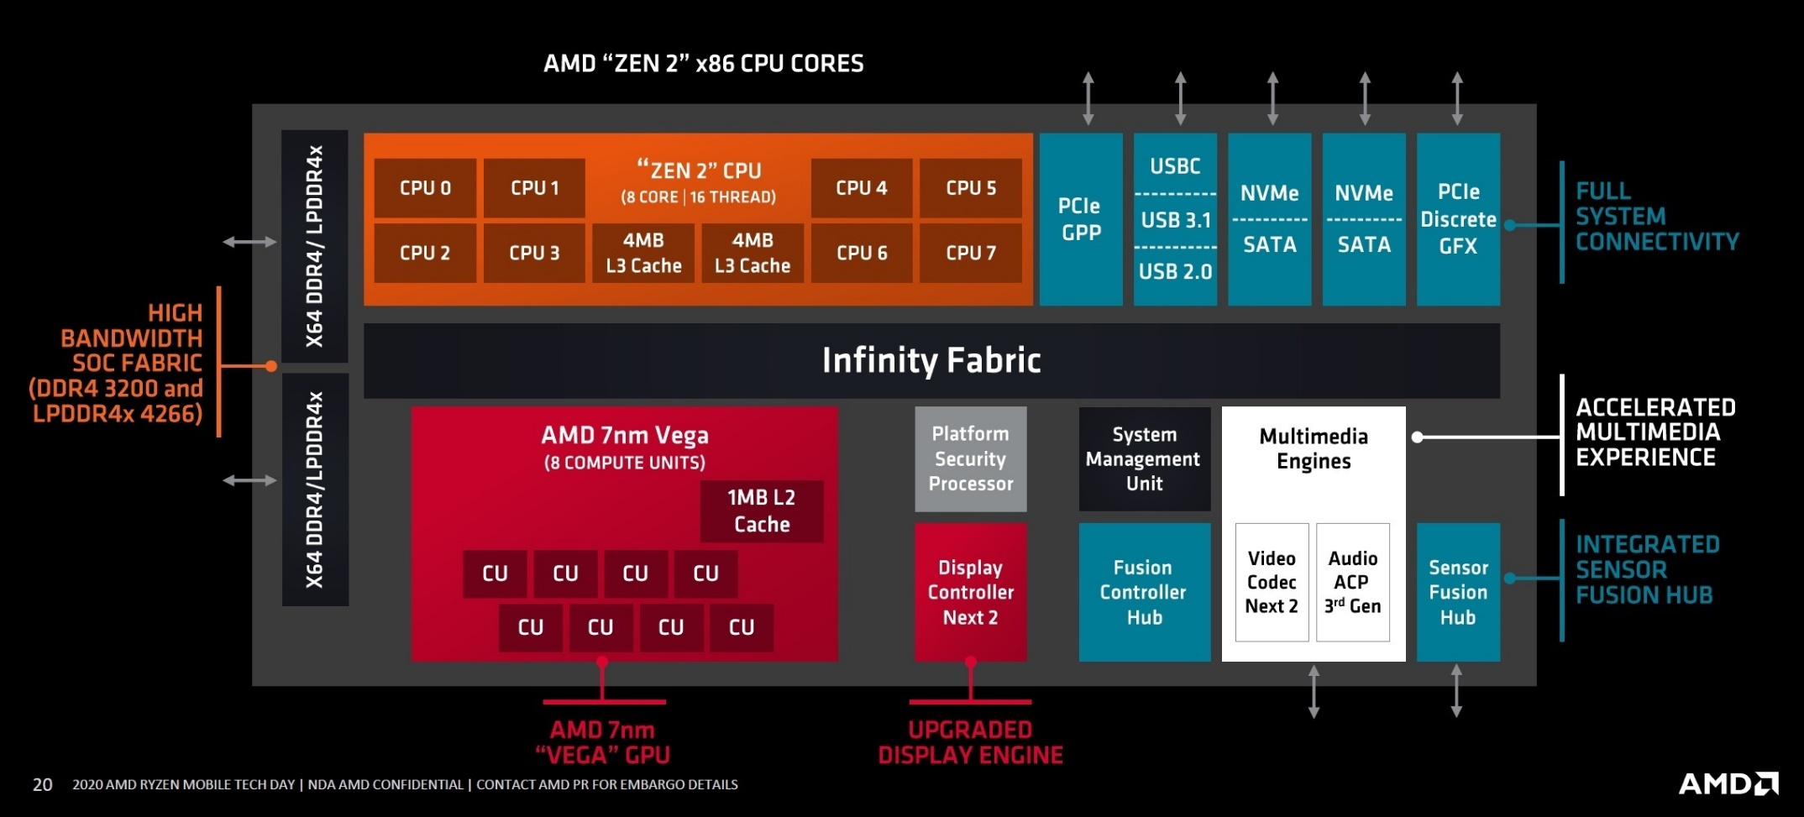
4.2 Basic dies of the Zen 2 family (12)
Block diagram of Zen 2-based APU dies
APU dies contain a complete processor with integrated graphics (GPU), as the Figure
below shows for Zen 2-based APUs.
APU dies (Accelerated Processing Units) are dies including a full fledged processor,
i.e. it incorporates all building blocks needed for a general purpose laptop or
DT processor, especially an integrated GPU (iGPU).
Figure: Block diagram of Zen 2-based 8-core mobile APU SoC (Ryzen 4000 (2020)) [130]
Note that AMD designates processors with integrated graphics as APU processors.

Slide 114




4.2 Basic dies of the Zen 2 family (13)
Resulting die set of the Zen 2 processor family
AMD’s Zen 2 die set
(a)
(b)
(c)
(d)
CCD die
(2 CCX core blocks
with 8 cores +
interconnects)
Client IO die
(cIOD)
(for up to two CCD dies)
TR/server IO die
(IOD)
(for up to 8 CCD dies)
APU die
2 CCX core blocks with 8 cores +
GPU + all units needed by the proc.)
12/14 nm IOD
(see Remark
on the next slide))
7 nm
74 mm²
3.9 btrs
12 nm
125 mm²
2.09 btrs
12/14 nm
416 mm²
8.34 btrs
7 nm
156 mm²
9.8 btrs
[125]
[128]
[127]
CCD: CPU Compute Die
APU: Accelerated Processing Unit

Slide 115
4.2 Basic dies of the Zen 2 family (14)
Remark
The interested reader may find a more detailed description of the basic dies in Annex 2.

Slide 116
4.3 The modular, lego-like design approach of the Zen 2 family
Notes:
116

Slide 117
4.3 The modular, lego-like design approach introduced in the Zen 2 family (1)
4.3 The modular, lego-like design approach introduced in the Zen 2 family
AMD’s die set, i.e. building blocks, conceived for the Zen 2 family
Die set of the Zen 2 family
(a)
(b)
(c)
(d)
CCD die
(2 CCX core blocks
with 8 cores +
interconnects)
Client IO die
(cIOD)
(for up to two CCD dies)
TR/server IO die
(IOD)
(for up to 8 CCD dies)
APU die
2 CCX core blocks with 8 cores +
GPU + all units needed by the proc.)
12/14 nm IOD
(see Remark
on the next slide))
7 nm
74 mm²
3.9 btrs
12 nm
125 mm²
2.09 btrs
12/14 nm
416 mm²
8.34 btrs
7 nm
156 mm²
9.8 btrs
[125]
[128]
[127]
CCD: CPU Compute Die
APU: Accelerated Processing Unit

Slide 118



4.3 The modular, lego-like design approach introduced in the Zen 2 family (2)
AMD’s implemented modular Zen 2-based processor designs
AMD's Zen 2-based processor lines
Laptop APUs
(Ryzen 4xxxH/HS/U)
DT APUs
(Ryzen 4xxxG/GE)
Gaming DTs
(Ryzen 3xxx/X)
HEDTs
(Threadripper 39xxX)
1S/2S servers
(EPYC 7xx2/P)
1 APU die
(up to 8 cores)
1 or 2 CCD die(s)
+1 cIOD die
(up to 2x 8 cores)
2/4/8 CCD dies
+ 1 IOD die
(12/16/24/36/48/ cores)
2/4/6/8 CCD dies
+ 1 IOD die
(8/12/16/24/36/48/64 cores)
(Renoir) [126]
(Matisse) [107]
(Castle Peak) [127]
(Rome) [134]

Slide 119
4.3 The modular, lego-like design approach introduced in the Zen 2 family (3)
Implementation details of Zen 2-based processors
There are three facts that need to be mentioned, as follows:
Dual use of APU dies
Alternative implementations of gaming DT processors
Differences in the implementations of HEDT (Threadripper) and 1S/2S server
(EPYC) processors
Next, let’s address these items.

Slide 120
4.3 The modular, lego-like design approach introduced in the Zen 2 family (4)
a) Dual use of APU dies
APU dies have dual use, as shown below.
Dual use of Zen 2-based APU dies
Use in DT APU processors
(Ryzen 4000/G/GE) (2020)
Use in laptop APU processors
(Ryzen 4000/H/HS/U) (2020)
DT APU processors need PCHs.
They have PGA sockets
(e.g. PGA-1331 sockets,
related platforms are called AM4 platforms)
Laptop APU processors are implemented as SoCs.
They have BGA sockets
(e.g. BGA-1140 sockets
related platform are called FP6 platforms)
DT APU processor
Laptop APU processor
APU die
(Renoire)
APU die
(Renoire)
PCH
We note that AMD stuck to the above layouts of Zen-based DT APU- and laptop APU
processors (2-chip layout vs. SoC) in subsequent Ze generations as well.
SoC: System on a Chip

Slide 121

4.3 The modular, lego-like design approach introduced in the Zen 2 family (5)
b) Alternative implementations of gaming DT processors
Gaming DT processors may include either one or two CCD dies to provide up to 8 or
up to 16 CPU cores, as shown below.
IO
(PCIe/
USB)
IO
(PCIe/
USB)
Figure: Zen 2-based gaming DT configurations with one or two CCD dies [240]

Slide 122
4.3 The modular, lego-like design approach introduced in the Zen 2 family (6)
c) Differences in the implementations of HEDT (Threadripper) and 1S/2S server
(EPYC) processors
Both processor types are built up of 2 to 8 CCD dies and an IO die, but they differ
in several points, as indicated below.
Dual use of server IO dies (IODs) in Zen 2-based processors
Use in HEDT (Threadripper) processors
(Ryzen 3900X/3905WX)
Use in 1S/2S server (EPYC) processors
(EPYC 7002/P)
HEDT processors require PCHs.
They have LGA sockets called SP3r3
(LGA-4094)
Server processors are implemented as SoCs.
They have LGA sockets called SP3
(LGA 4094)
4 DDR4-3200
memory channels
64 PCIe 4.0
lanes
8 DDR4-3200
memory channels
128 PCIe 4.0
lanes
HEDT processor
(Threadripper)
1S/2S processor
(EPYC)
PCH
(Platform Controller HUB)
We note that both sockets are physically the same but differ electrically.
We note also that AMD stuck to the above general layouts of Zen-based HEDT-
and server processors (2-chip layout vs. SoC) in subsequent generations.

Slide 123
4.3 The modular, lego-like design approach introduced in the Zen 2 family (7)
Example 1: Block diagram of a 24/32-core Zen 2-based Threadripper proc. [127]
Threadripper
3960X (24 cores)
3970X (32 cores)
Note that there are 4 CCD dies, 4 DDR4 memory channels and 64 PCIe 4.0 lanes.

Slide 124
4.3 The modular, lego-like design approach introduced in the Zen 2 family (8)
Example 2: Block diagram of a 64-core Zen 2-based Threadripper proc. [134]
Threadripper
3990X (64 cores)
Note that there are 8 CCD dies, 4 DDR4 memory channels and 64 PCIe 4.0 lanes.

Slide 125

4.3 The modular, lego-like design approach introduced in the Zen 2 family (9)
Example 3: Block diagram of a 64-core Zen 2-based EPYC 1S/2S server proc. [110]
Note that there are 8 CCD dies, 8 DDR4 memory channels, and 8x18 SERDES 4.0 lanes.
SERDES (SERializer/DESerializers) lanes may be configured as PCIe, SATA, USB 3, or other serial links.
Motherboard designers may configure SERDES lanes for their specific board designs.

Slide 126

4.3 The modular, lego-like design approach introduced in the Zen 2 family (10)
Overview of Zen 2-based processor packages [122]
Ryzen 4000G/GE DT APU
Ryzen 4000H/HS/U laptop APU)
Ryzen 3000X
(Gaming DT)
Ryzen 3900X
Threadripper (HEDT)
EPYC 7002/P
(1S/2Sserver)

Slide 127
5. Evolution of the Zen families
5.1 Evolution of key components of Zen families over generations
5.2 Main enhancements of dedicated Zen lines
Notes:
127

Slide 128
5. Evolution of the Zen families (1)
5. Evolution of the Zen families
While discussing the evolution of Zen families we point out
the key aspects of the evolution of Zen families over generations and
main enhancements of dedicated Zen product lines.
These issues will be detailed in the next Sections.

Slide 129
5.1 Evolution of key aspects of Zen families over generations
5.1.1 How have Zen cores evolved?
5.1.2 How have CCX core blocks and CCD dies evolved?
5.1.3 How have memory- and PCIe connectivity evolved?
The Lecture will only discuss the Sections 5.1.1 and 5.1.2.
Notes:
129

Slide 130
5.1.1 How have Zen cores evolved?
Notes:
130

Slide 131
5.1.1 How have Zen cores evolved? (1)
5.1.1 How have Zen cores evolved? [13], [170]
Emergence of Zen cores
AMD began planning the Zen microarchitecture after re-hiring Jim Keller,
the famous processor architect, in 2012.
After three years of development, AMD announced the Zen family at their
Financial Analyst Day in 5/2015.
The first details of the Zen architecture were published at the Computex Conference
in 6/2016.
According to M. Papermaster, AMD’s CTO, up to 300 engineers were working
on the core design.
The key design objective was raising IPC rather than power reduction.
Recall that IPC (Instructions Per Cycle) indicates the efficiency of a microarchitecture.
It is strongly workload dependent.
To specify the IPC value of a microarchitecture, IPC scores will be measured on a set
of benchmark programs, and the geometric mean of the results will be given.
CTO: Chief Technology Officer

Slide 132
5.1.1 How have Zen cores evolved? (2)
Main architectural improvements of 1. gen. Zen cores vs. the previous Bulldozer
design
a) Departure from the previous module concept and return to the usual
core structure
b) Introducing multithreading
c) Introducing the SenseMI technology package that includes many innovations,
as detailed next.

Slide 133

5.1.1 How have Zen cores evolved? (3)
a) Departure from the previous module concept and returning to the usual
core structure [14]
With the Zen core, AMD left Bulldozer’s module concept that crammed two integer
blocks and an FP block into a unit and declared them dual cores.
Instead, AMD followed the regular path of implementing full-fledged cores,
as indicated below.
Figure: Contrasting the module concept with the regular core concept [14]

Slide 134

5.1.1 How have Zen cores evolved? (4)
b) Introducing multithreading [10]
As the Figure below shows, in AMD’s implementation of multithreading, both threads
have private PCs and architectural states, whereas the execution resources are shared.

Slide 135

5.1.1 How have Zen cores evolved? (5)
c) Introducing the SenseMI technology package that includes a number of
innovations, as indicated below [10]
Pure power (AVS)
(Adaptive Voltage
Scaling)
Extended Frequency Range
(XFR) (Higher fc for
premium cooling,
like Intel’s TVB)
Neural Net
Prediction
Precision Boost
(Enhanced Turbo Boost
like Intel’s SpeedShift)
Extended Frequency Range
(XFR) (Higher fc for
premium cooling,
like Intel’s TVB)
Smart
Prefetch
To reduce
dissipation
To raise fc
To raise IPC
Here, we do not go into details of the SenseMI technology package, only name Intel’s
corresponding designations excluding AVS, which Intel does not utilize.
AVS: Adaptive Voltage Scaling TVB: Thermal Velocity Boost

Slide 136
5.1.1 How have Zen cores evolved? (6)
Resulting benefits of 14 nm 1st gen. Zen cores vs. the previous 28 nm
Excavator modules
52 % performance improvement (IPC) for single-threaded workloads
Up to 3.7x improvement in performance/Watt

Slide 137
5.1.1 How have Zen cores evolved? (7)
Evolution of the feature size of implementing Zen cores (as of 09/2022) [226]

Slide 138



5.1.1 How have Zen cores evolved? (8)
Evolution of key features of Zen cores [230] -1
Inte
AVX-512
5nm
2017
2022
The Figure above shows the progress made by AMD in improving Zen cores over generations.
They have enhanced features such as the maximum turbo boost frequency, IPC, core
count per CCD, and L2 and L3 cache sizes.
In addition, AMD has introduced new features like SMT, FP-256, AVX-512, and integrated graphics.
These features are detailed in the Figure and further described below.

Slide 139
5.1.1 How have Zen cores evolved? (9)
Evolution of key features of Zen cores [230] -2
The previous Figure points out key features of the evolution of Zen cores from the first
up to the fourth generation.
Accordingly, the main improvements and enhancements of Zen cores are:
Raising the max. Turbo boost frequency from 4.35 to 5.7 GHz.
Increasing IPC by about 15 % per generation.
Increasing the core count of the CCX core blocks from 4 (in Zen up to the
Zen 2-based families) to 8, along with Zen 3-based families.
Enlarging the per-core L2 cache size from ½ MB/core to 1 MB/core.
Enlarging the size of per-core L3 cache segments from 2 MB/core (in Zen-based
families) to 4 MB/core subsequently.
Introducing SMT (Symmetrical Multithreading) already into 1. gen. Zen cores,
Supporting FP-256 operations in Zen 2 cores and FP-512 operations in Zen 4 cores
(nevertheless, performed by FP256 units).
Introducing modest performance RDNA 2 graphics into Zen 4-based gaming DTs.

Slide 140

5.1.1 How have Zen cores evolved? (10)
Per generation IPC improvements of AMD’s Zen cores
+13 %
Zen4
160 %
+19 %
+13 %
+3 %
Figure: Per generation IPC improvements of AMD’s Zen cores [Based on [171]]
The Figure indicates an ~ 15 % average performance uplift per Zen generation.

Slide 141
5.1.1 How have Zen cores evolved? (11)
The state of art: key features of AMD’s latest, Zen 4 core [227]
5 nm technology
1 MB/core L2 caches rather than 512 KB
AVX-512 and VNNI support
Up to 5.7 GHz max turbo boost
+13 % IPC increase over the Zen 3 core
VNNI: Vector Neural Network Instruction (supports NN processing)

Slide 142

5.1.1 How have Zen cores evolved? (12)
Microarchitecture
of Zen 4 cores [241] -1
2 threads/core (SMT)
State of the art branch predictor
Caches
I-cache 32k 8-way
Op-cache 4K instructions
D-cache 32k
L2-cache 1 MB
Decode
4 instr./cycle from decode
9 Macro op/cycle from
cached microcoded
instructions
Dispatch
6 Macro ops/cycle
dispatched to FX or FP units
Execution capabilities
4 FX units
dedicated branch unit
dedicated store data unit
3 address gen. units
3 mem. ops/cycle
max 2 can be stores
2 256-bit FP FMA oper./cycle

Slide 143
5.1.1 How have Zen cores evolved? (13)
Microarchitecture of Zen 4 cores [241] -2
Note that Zen 4 cores
decode up to 4 instructions/cycle,
deliver up to 9 Macro Ops/cycle from the Op cache that holds microcoded
instructions and
dispatch up to 6 Macro operations per cycle.
The decode rate of 4 seems to be quite low when compared to Intel’s processors,
as Intel’s 6. gen. Skylake line has 5-wide decoders or the 12th gen. Alder Lake line
even dual 3-wide decoders.

Slide 144

5.1.1 How have Zen cores evolved? (14)
Remarks to the cache architecture of AMD’s Zen cores -1
Zen cores (in all Zen generations until now (03/2022) have
private 32 KB L1 data and
instruction caches, as well as
private 512 kB L2 caches
up to the Zen 3 cores, but
1 MB L2 caches in Zen 4 cores.
Zen 4 cache hierarchy []
Figure: Zen 4 cache hierarchy [243]

Slide 145
5.1.1 How have Zen cores evolved? (15)
Remarks to the cache architecture of AMD’s Zen cores -2
Zen cores (in all Zen generations until now (03/2022) have
a segmented, L3 cache, shared
by all cores of a CCX core block
with
2 MB/core cache segments in
1. gen. Zen cores and
4 MB/core cache segments
subsequently.
L3 is mostly exclusive to the
L2 cache, it is a slightly
modified victim cache
(keeping removed data from
the L2 cache).
Zen 4 cache hierarchy []
Figure: Zen 4 cache hierarchy [243]

Slide 146
5.1.2 How have CCX core blocks and CCD dies evolved?
Notes:
146

Slide 147
5.1.2 How have CCX core blocks and CCD dies evolved? (1)
5.1.2 How have CCX core blocks and CCD dies evolved?
Before going into details of how AMD developed CCX core blocks and CCD dies,
it is worth discussing why AMD chose core blocks
rather than symmetrical multicores or big.little architectures in their Zen family?
To find an answer to this point, let’s consider possible core arrangements
(core configurations) in multicore processors.

Slide 148
5.1.2 How have CCX core blocks and CCD dies evolved? (2)
Alternative multicore configurations
Alternative multicore configurations
Symmetrical multicores
Homogeneous core blocks
Heterogeneous core blocks
(big.little architectures)
Cores are used as individual items
All cores share an L2 or L3 cache,
All cores are interconnected
Cores are arranged into blocks,
All core blocks are equal
Core blocks share an L2 or L3 cache,
Core blocks are interconnected
Cores are arranged into blocks,
Core blocks have different
performance/power characteristics
but cores share the same ISA.
Core blocks share an L2 or L3 cache
and are interconnected
Ci
Ci
Ci
Ci
Ci
Ci
Ci
Ci
Ci
Shared, segmented L2 or L3
Ci
Ci
Ci
Ci
Interconnection Network (e.g. Ring bus)
Shared L2 or L3
Shared L2 or L3
Shared, segmented L2 or L3
Ci
Ci
Ci
Ci
Ci
Ci
Interconnection Network
Ci
Ci
Ci
Ci
Ci
Ci
Ci
Ci
Shared, segmented L2 or L3
Shared, segmented L2 or L3
Interconnection Network (e.g. Infinity Fabric)

Slide 149
5.1.2 How have CCX core blocks and CCD dies evolved? (3)
Which core configurations are used in Intel’s, AMD’s and ARM’s multicore processors? -1
Alternative multicore configurations
Symmetrical multicores
Homogeneous core blocks
Hybrid core blocks
(big.little architectures)
Typical implementations
Intel
Standard client and server designs,
first with shared L2 then L3 caches,
interconnected by a ring bus
or by a 2D mesh in later server
processors
(up to the 11th gen. Tiger Lake/
Raptor Lake designs (2005-2020)
Lakefield family
(≈ pilot design (2019)
(multi-die implementation)
The 12th gen.
Alder Lake family
with a shared L3 cache and
a ring bus (2021)
(monolithic implementation)
AMD
K8-based designs
with up to 4 cores,
a shared L2 cache and a
crossbar switch (2007-2010)
AMD’s Zen to -Zen 4-based processors
with a shared L3 cache
and first a crossbar switch and
then a ring bus)
(from 2017 on)
K10-based designs
with up to 4 modules,
a shared L3 cache and a
crossbar switch (2007-2016)
ARM
Armv7-based Cortex-A processors
with a shared L2 cache
(~ 2007- 2013)
Armv8.0-based Cortex-A processors
with a shared L2 cache
( ~ 2013-2017)
(monolithic. implementation)

Slide 150
5.1.2 How have CCX core blocks and CCD dies evolved? (4)
Which core configurations are used in Intel’s, AMD’s and ARM’s multicore processors? -2
Above Figure indicates that symmetrical multicores, homogeneous core blocks,
and heterogeneous core blocks (also called hybrid core blocks), i.e., big.little
configurations seem to be the main avenue of evolution.
Considering this evolution path, AMD is also expected to switch to heterogeneous
core blocks, that is to big.little core configurations in their forthcoming Zen 5-based
processors to be manufactured on 3 or 4 nm technology to reduce their processors’
power consumption [224].
Note also that the first core blocks initially had only shared L2 caches.
However, with advancements in IC technology, core blocks were later supported by
shared L3 caches.”
In fact, ARM also switched to shared L3 caches per core block in their subsequent
Armv8.2-based processor implementation (not indicated in our Figure) in 2017.
It’s worth noting that the choice between homogeneous or heterogeneous core blocks
and the decision to implement processors monolithic or on multiple dies, are
independent of each other., i.e., these two aspects are orthogonal.

Slide 151
5.1.2 How have CCX core blocks and CCD dies evolved? (5)
Why AMD chose homogeneous core blocks in their Zen family?
AMD has not disclosed the reasons for their choice.
Nevertheless, it can be assumed that on the one side, AMD avoided symmetrical
multicores due to their poor performance with higher core counts.
This is because higher core counts can lead to increased core-to-core latencies when
interconnected by ring buses or cause a rapid increase in hardware complexity if
crossbar switches are used.
On the other hand, implementing heterogeneous core blocks, i.e., big.little configurations,
might have seemed to be a too complex and risky task for AMD without former
experience and deep background.
Next, let’s discuss how AMD enhanced their CCD dies and CCX core blocks beyond the
Zen 2 generation.

Slide 152

5.1.2 How have CCX core blocks and CCD dies evolved? (6)
How did AMD implement their Zen-/Zen+ based CCX core blocks?
Zen- and Zen+ based core blocks include 4 cores (C₀ to C₃) with private L1/L2 caches
and 2 MB L3 cache segments per core, which are interconnected by a crossbar switch,
as indicated below in the schematic layout and die plot of Zen-/Zen+_based CCXs.
C₃
C₂
L3
L3
2 MB 2 MB
Crossbar (4x4)
2 MB 2 MB
C₀
C₁
Zen-based CCX:14 nm, 44 mm², 1,4 btrs
Zen+-based CCX: 12 nm, 44 nm, 1,4 btrs
Figure: Schematic layout and die plot of Zen- and Zen+-based based CCXs [16]
Through the crossbar switch, each core in the core block can access each L3
cache segment with the same latency.

Slide 153
5.1.2 How have CCX core blocks and CCD dies evolved? (7)
AMD’s enhanced, Zen 2-based CCX core blocks
Zen 2-based core blocks resemble to the previous CCX implementation.
There is only one difference in their layout to be mentioned: AMD increased the L3 cache
segment size to 4 MB per core, as indicated in the schematic layout and die plot
of Zen 2-based CCXs below.
C₃
C₂
L3
L3
4 MB 4 MB
Crossbar (4x4)
4 MB 4 MB
C₀
C₁
7 nm, 74 mm², 3,9 btrs
Figure: Schematic layout and die plot of Zen 2-based CCXs [16]

Slide 154

5.1.2 How have CCX core blocks and CCD dies evolved? (8)
Remark
Remember that CCD dies (CPU Compute Dies), introduced in the Zen 2 family, include
two CCX core blocks, as depicted in the Figure below.
Zen 2-based CCD die
Figure: Zen 2-based CCD die [244]

Slide 155
5.1.2 How have CCX core blocks and CCD dies evolved? (9)
How AMD enhanced CCX core blocks and CCD dies in their Zen 3 family -1
AMD has made three significant enhancements to the previous CCX/CCD design: [171]
As long as Zen 2-based CCX core blocks included four cores, Zen 3-based CCX core blocks
have eight cores (see Figure).
b) While Zen 2-based CCDs are composed of two interconnected CCX core blocks
Zen 3-based CCDs have just a single CCX core block, as indicated in the Figure below.
Zen 2-based CCD die
Zen 3-based CCD die
Figure: Contrasting Zen 2- and Zen 3-based CCX designs [244]
In the new design, each core accesses the 32 MB L3 cache directly rather than only
16 MB, as in the previous design.
This reduces both the memory access time in the 16-to-32 MB access window and
also core-to-core latencies, as discussed later.

Slide 156

5.1.2 How have CCX core blocks and CCD dies evolved? (10)
How AMD enhanced CCX core blocks and CCD dies in their Zen 3 family -1
c) The third major enhancement is the introduction of bi-directional ring buses in Zen 3-based
CCD dies, as indicated below, rather than using a crossbar switch, as before [216].
Its benefit is higher bandwidth and lower latency, as indicated in the Figure below.

Slide 157

5.1.2 How have CCX core blocks and CCD dies evolved? (11)
Layout and die plot of the introduced Zen 3-based CCX core blocks
Accordingly, Zen 3-based CCD dies include a single CCX core block with eight cores,
private L1/L2 caches and 4 MB L3 cache segments per core, interconnected by a
bi-directional ring bus, as shown below, while the ring bus transfers 32 bytes per
cycle in both directions.
C₅
C₆
C₇
C₄
Shared, segmented L3 (4x4 MB)
Bi-directional ring bus
Shared, segmented L3 (4x4 MB)
C₀
C₁
C₂
C₃
7 nm, 80.4 mm², 4.15 btrs
Figure: Schematic layout and die plot of a Zen 3-based CCX incorporated in a CCD [200]

Slide 158
5.1.2 How have CCX core blocks and CCD dies evolved? (12)
The benefit of the new design in lowering core-to-core latencies -1
To demonstrate the benefits of the new design, let’s consider as an example the Zen 3-based
16-core gaming DT processor (Ryzen 5950X).
As discussed in Section 4.2, starting from the Zen 2 family, the CCX core blocks are
interconnected by IO dies, accordingly, in a 16-core gaming DT processor, the two 8-core
Zen 3-based CCX core blocks are linked together by the cIOD to provide 16 cores, as seen
below.
cIOD
Infinity
Fabric
Ci
Ci
Ci
Ci
Ci
Ci
Ci
Ci
Shared, segmented L3 (4x4 MB)
Shared, segmented L3 (4x4 MB)
Bi-directional ring bus
Bi-directional ring bus
Shared, segmented L3 (4x4 MB)
Shared, segmented L3 (4x4 MB)
Ci
Ci
Ci
Ci
Ci
Ci
Ci
Ci
Zen 3 CCX
(Switched
mesh?)
Zen 3 CCX
Figure: Interconnecting 2 CCX core blocks in a Zen 3-based 16-core gaming DT processor

Slide 159

5.1.2 How have CCX core blocks and CCD dies evolved? (13)
The benefit of the new CCX/CCD design in lowering core-to-core latencies -2
For the chosen example (Zen 3-based 16-core Ryzen 5950X gaming DT processor) below,
we show core-to-core latencies, while there are 2 CCX core blocks with 2x16 threads. [171]

Slide 160
5.1.2 How have CCX core blocks and CCD dies evolved? (14)
Benefit of the new CCX/CCD design of the Zen 3 family in lowering core-to-core
latencies -3 [171]
Clearly, in Zen 3-based 16-core gaming DT processors, core-to-core latencies
within the same 8-core (16 thread) CCX are significantly lower than core-to-core
latencies between cores belonging to different core blocks (~18 ns vs. 81 ns).
This is quite obvious since cores within the same core block are accessed via a single
(ring bus) interconnect, whereas cores in remote core blocks via three interconnects
(two ring buses and the IF interconnecting both dies), as the preceding Figure indicates.
To show the benefits of the new CCX/CCD design, next we compare core-to-core
latencies of Zen 2 and Zen 3-based CCXs as presented in the preceding and
subsequent Figures.

Slide 161

5.1.2 How have CCX core blocks and CCD dies evolved? (15)
Core-to-core latencies in Zen 2-based 16-core gaming DT processors
(Ryzen 3950X) [171]
(As seen, the 3950X has four CCX core blocks with 4 cores and 2x4x4 threads each).
For a discussion of core-to-core latencies see the next slide.

Slide 162
5.1.2 How have CCX core blocks and CCD dies evolved? (16)
Benefit of the new CCX/CCD design of the Zen 3 family in lowering core-to-core
latencies -4 [171]
A comparison of both Figures indicate two main improvements:
First, in Zen 3-based CCXs, 50 % of all core-to-core latencies are low (green fields)
whereas this ratio was only 25 % in the previous design.
Second, in Zen 3-based CCXs, core-to-core latencies within the same core block are
significantly lower than previously in Zen 2-based CCXs, only 15-17 ns vs. 30-32 ns,
due to the introduced bidirectional ring buses interconnecting L3 cache segments.

Slide 163
5.1.2 How have CCX core blocks and CCD dies evolved? (17)
Further enhancement of CCX core blocks in Zen 4-based processors
The new design has the same number of cores and the same L3 size, but increases the
L2 cache size from ½ MB to 1 MB per core (see the subsequent Figure).
C₅
C₆
C₇
C₄
Shared, segmented L3 (4x4 MB)
Bi-directional ring bus
Shared, segmented L3 (4x4 MB)
C₀
C₁
C₂
C₃
5 nm, 55 mm², 6.5 btrs
Figure: Schematic layout and die plot of a Zen 4-based CCX core block [245]

Slide 164
5.1.3 How have memory and PCIe connectivity evolved?
The Lecture did not cover Section 5.1.3.
Notes:
164

Slide 165
5.1.3 How have memory and PCIe connectivity evolved? (1)
5.1.3 How have memory and PCIe connectivity evolved?
In this Section, we show how AMD enhanced memory and PCIe technology over
subsequent Zen generations.

Slide 166
5.1.3 How have memory and PCIe connectivity evolved? (2)
Evolution of memory technology in AMD’s Zen families -1
Family Introduced | Zen (2017) | Zen+ (2018) | Zen 2 (2019) | Zen 3 (2020) | Zen 3+ (2022) | Zen 4 (2022)
Server processors | DDR4 |  | DDR4 | DDR4 |  | DDR5
HEDT processors | DDR4 | DDR4 | DDR4 | DDR4 |  | DDR5
Gaming DT processors | DDR4 | DDR4 | DDR4 | DDR4 |  | DDR5
DT APU processors | DDR4 | DDR4 | DDR4 | DDR4 |  | DDR5
Laptop APU processors | DDR4 | DDR4 | DDR4 | DDR4 | DDR5 | DDR5
 |  |  | LPDDE4 | LPDDR4 | LPDDR5 | LPDDR5 (HS series)
AMD’s *first-gen. Zen family and subsequent generations up to and including the Zen 3
family made use of DDR4 technology.
In addition, laptop APUs have higher-speed LPDDR4 memory support in the Zen 2 family.
Next, laptop APUs received DDR5 and LPDDR5 support in the Zen 3+ family in 2022.
Finally, both the DDR5 and LPDDR5 technologies became available for all Zen 4 lines in 2022.
DDR5 support has, however, one restriction; it is exclusive, that is, memory controllers
do not allow attaching DDR4 memory instead, in contrast to Intel’s DDR5 implementations.

Slide 167
5.1.3 How have memory and PCIe connectivity evolved? (3)
Evolution of memory technology in AMD’s Zen families -2
Here, we note that Intel preceded AMD in introducing both DDR5 and PCIe5.0 connectivity,
since these features already appeared one year earlier in the Alder Lake DT line in 2021.

Slide 168
5.1.3 How have memory and PCIe connectivity evolved? (4)
Evolution of PCIe technology in AMD’s Zen families
Family Introduced | Zen (2017) | Zen+ (2018) | Zen 2 (2019) | Zen 3 (2020) | Zen 3+ (2022) | Zen 4 (2022)
Server processors | PCIe 3.0 |  | PCIe 4.0 | PCIe 4.0 |  | PCIe 5.0
HED processors | PCIe 3.0 | PCIe 3.0 | PCIe 4.0 | PCIe 4.0
Gaming DT processors | PCIe 3.0 | PCIe 3.0 | PCIe 4.0 | PCIe 4.0 |  | PCIe 5.0
DT APU processors | PCIe 3.0 | PCIe 3.0 | PCIe 3.0 | PCIe 3.0
Laptop APU processors | PCIe 3.0 | PCIe 3.0 | PCIe 3.0 | PCIe 3.0 | PCIe 4.0 | PCIe 4.0 (HS series)
 |  |  |  |  |  | PCIe 5.0 (HX series)
As data in the above Table shows, server-, HEDT- and gaming DT processors followed
a bit different evolution path than APU processors, as detailed next.
Server-, HEDT- and gaming DT processors first provided PCIe 3.0 connectivity, then
PCIe 4.0 support for Zen 2/3-based and PCIe 5.0 support for Zen 4-based lines.
By contrast, APU lines implemented PCIe 3.0 lanes up to and including Zen 3-based lines,
then, PCIe 4.0 lanes for Zen 3+ and Zen 4-based 7X40HS laptop APU series,
finally, PCIe 5.0 lanes for the Zen 4-based Ryzen 7x40HX laptop APU series.

Slide 169
5.1.3 How have memory and PCIe connectivity evolved? (5)
Summing up the evolution of memory and PCIe technology in the Zen families
The first-generation Zen family implemented DDR4 and PCIe 3.0 technologies in 2017.
About five years later, the Zen family got an essential uplift in connectivity when
Zen 4-based processor lines entered the market with DDR5 and PCIe 5.0 support in
2022.
Here, we note that subsequent memory and PCIe generations roughly double the
transfer rate.

Slide 170
5.1.3 How have memory and PCIe connectivity evolved? (6)
Annex to the Section memory and PCIe connectivity
In order to provide more detailed information on the evolution of the Zen families, we
attach an informative summary of key features of Zen processor lines including
refreshed laptop APU processor implementations as well.

Slide 171


5.1.3 How have memory and PCIe connectivity evolved? (7)
Evolution of key features of AMD’s Zen-based server, HEDT and gaming DT proc.s
(based partly on [246])
(First line: server, second line: HEDT (Threadripper) and third line: gaming DT processor lines)
2017-2018
2018
2019/2020
2020/2022
2022
2022
Naples
Rome
Milan
Genoa
Zen4
5nm
PCIe5
SP3
SP3
SP3
SP5
DDR5
2017-2018
2018-2019
2019-2021
2020-2022
2022
2023
R 1000X
R 2000X/E
R 3000X/XT
R 5000X
R 6000
R 7000X/X3D
R 1000X
R 2000X/E
R 3000X/XT
R 5000X
R 6000
R 7000X
RDNA2
R 2000G/GE
R 600G/GE
R 7040
SP3 etc.: Socket
R 3000G/GE
R 4000G/GE
R 5000G/GE

Slide 172
5.1.3 How have memory and PCIe connectivity evolved? (8)
Evolution of key features of AMD’s Zen-based APU proc. lines (Based partly on [246])
(First line: DT APU processors, second and further lines: laptop APU processors)
2017-2018
2019
2020
2021
2022
2023
R 2000G/GE
R 3000G/GE
R 4000G/GE
R 5000G/GE
R 600G/GE
R 7040G?
RDNA3
R 2000H/U
R 3000H/U
R 4000H/HS/U
R 5000H/HS/U
R 6000H/HS/U
Dragon R. R 7x45HX
R 7040H/HS/U
FP7
FP7r2
DDR5
5
5
FP7r2
F1
F1
R 7x40HS
4 nm
Refreshed lines
RDNA3
FP7/r/8
2021
2022
2021
2022
FP72
R 5000U
R 5x25U
Lucienne: Notable power management enhancements
Barcelo: Minor enhancements for raising performance
2023
Mendocino R7x20U
Mendocino R7x20U
Barcelo R. R. 7x30U
Rembrandt R. R 7x35HS/U
FT6
LPDDR5
FP7

Slide 173
5.2 Main enhancements of dedicated Zen lines
5.2.1 Evolution of graphics in APU lines
5.2.2 Inclusion of graphics in Zen 4-based gaming DT processors
5.2.3 Introduction of the 3D-Vcache technology
in Zen 3-based gaming DT processors
5.2.4 Raising the number of memory channels
in Zen 4-based EPYC server processors
5.2.5 Power management enhancements
in Zen 3-based APU processors
The Lecture did not cover Section 5.2.
Notes:
173

Slide 174
5.2.1 Evolution of graphics in APU lines
Notes:
174

Slide 175
5.2.1 Evolution of graphics in APU lines (1)
5.2.1 Evolution of graphics in APU lines
Family Introduced | Zen (2017) | Zen+ (2018) | Zen 2 (2019) | Zen 3 (2020) | Zen 3+ (2022) | Zen 4 (2022)
DT/laptop APU proc.s | Vega | Vega | Vega | Vega | RDNA2 | RDNA3
According to the table above, APU processors based on Zen to Zen 3 include Vega
graphics, while Zen 3+ processors were improved with RDNA2 technology.
The Zen 4 line, on the other hand, is equipped with RDNA3 GPUs.
However, it's important to note that RDNA3 support was only made available in 2023
for the Ryzen 7x40HS series of laptop APU processors in the Zen 4 line, as shown
in the following Figure.

Slide 176
5.2.1 Evolution of graphics in APU lines (2)
Evolution of key features of AMD’s Zen-based APU proc. lines (Based partly on [246])
(First line: DT APU processors, second and further lines: laptop APU processors)
2017-2018
2019
2020
2021
2022
2023
R 2000G/GE
R 3000G/GE
R 4000G/GE
R 5000G/GE
R 600G/GE
R 7040G?
RDNA3
R 2000H/U
R 3000H/U
R 4000H/HS/U
R 5000H/HS/U
R 6000H/HS/U
Dragon R. R 7x45HX
R 7040H/HS/U
FP7
FP7r2
DDR5
5
5
FP7r2
F1
F1
R 7x40HS
4 nm
Refreshed lines
RDNA3
FP7/r/8
2021
2022
2021
2022
FP72
R 5000U
R 5x25U
Lucienne: Notable power management enhancements
Barcelo: Minor enhancements for raising performance
2023
Mendocino R7x20U
Mendocino R7x20U
Barcelo R. R. 7x30U
Rembrandt R. R 7x35HS/U
FT6
LPDDR5
FP7

Slide 177


5.2.1 Evolution of graphics in APU lines (3)
Performance/Watt improvements of AMD’s subsequent graphics families [247], [248]
Vega
RDNA
RDNA2
RDNA3
As stated in the Figure above, AMD’s subsequent graphics families provide about 50 %
uplift vs. previous families in terms of performance/watt.

Slide 178
5.2.2 Inclusion of graphics in Zen 4-based gaming DT processors
Notes:
178

Slide 179
5.2.2 Inclusion of graphics in Zen 4-based gaming DT processors (1)
5.2.2 Inclusion of graphics in Zen 4-based gaming DT processors (Ryzen 7000X) [249] -1
Unlike Intel’s DT processors, AMD’s previous gaming DT processors typically
did not include GPUs (integrated GPUs) to spare Si area and reduce cost.
Now, AMD’s new Zen 4-based cIOD dies introduced GPUs, as the next Figure shows.

Slide 180

5.2.2 Inclusion of graphics in Zen 4-based gaming DT processors (2)
Inclusion of graphics in Zen 4-based gaming DT processors (Ryzen 7000X) [246] -2
2x CCD
SMU: System Management Unit
cIOD
DCN: Display CoreNext
(Display Engine)
This GPU has, however, modest performance, as it includes only two CUs (Compute Units)
whereas AMD’s Zen 3-based laptop processors incorporate 12 CUs.
AMD’s move was motivated by the fact that Intel’s client processors usually include GPUs.

Slide 181

5.2.2 Inclusion of graphics in Zen 4-based gaming DT processors (3)
Die plot of a Zen 4-based cIOD die [250]
WGP: WorkGroup Processor

Slide 182
5.2.3 Introduction of the 3D-Vcache technology
in Zen 3-based gaming DT processors
Notes:
182

Slide 183
5.2.3 Introduction of the 3D V-Cache technology in gaming DT processors (1)
5.2.3 Introduction of the 3D V-Cache technology in Z3n 3-based gaming DT processors
(2021) [213]
AMD’s 3D V-Cache technology is a kind of 3D technology used to stack L3 dies on top of
a base die to increase L3 size, as shown in the Figure below.
In the above Figure, a 64 MB L3 cache die is stacked vertically atop a Zen 3 base die.
(called CCD), providing altogether 96 MB L3 cache for 8 cores.

Slide 184
5.2.3 Introduction of the 3D V-Cache technology in gaming DT processors (2)
AMD’s first implementation of the 3D V-Cache technology in 2022 -1 [215]
(Zen 3-based Ryzen 7 5800X3D DT processor, 2022)
64 MB L3
4 cores
32 MB on-die L3
The 64 MB 3D V-Cache comprises eight 8 MB L3 "segments" with 1024 contact
points per segment.
2x 8 K contact points provide a bandwidth of more than 2 TB/s.
The contact points will be cooper-bonded to the base die.

Slide 185
5.2.3 Introduction of the 3D V-Cache technology in gaming DT processors (3)
AMD’s first implementation of the 3D V-Cache technology in 2022 -2 [215]
The first processor enhanced with the 3D V-cache technology is the Zen 3-based
Ryzen 7 5800X3D DT processor, launched in 05/2022.
The Ryzen 7 5800X3D has 8 cores, 32+64 MB L3 (achieved by the 3D V-Cache technology,
3.4 GHz base frequency and 105 W TDP.
By contrast, the “simple” 8-core Ryzen 7 5800 has 32 MB L3 cache, 3.8 GHz base
frequency and 105 W TDP.
Note that AMD chose an 8-core processor for their first 3D V-Cache implementation
since an 8-core processor has just a single CPU die and no additional complexity
arises for interconnecting two CPU dies.
Further on, as the enhanced version of 3D V-Cache has the same 105 W TDP value as
its predecessor, its base clock frequency had to be reduced (actually from 3.8 GHz
to 3.4 GHz).
The 3D V-cache enhancement is beneficial, first of all, in gaming applications.

Slide 186
5.2.3 Introduction of the 3D V-Cache technology in gaming DT processors (4)
AMD’s second implementation of the 3D V-Cache technology launched in 2023
It came along with the Zen 4-based Ryzen 7/9 7000X3D DT processors.
The new implementation has two CCD dies + one cIOD, while there is a 64 MB vertically
integrated L3 cache die over one of the CCD dies.
The new 3D series includes three models with up to 16 cores and 32+32+64=128 MB
L3 cache.
As benchmark data shows, AMD’s highest performance 120 W 16-core 3D model
(Ryzen 97950X3D) has typically higher performance for gaming but less performance
for computing-intensive applications than Intel’s highest performance, 150 W
(16+8 core) 13th generation big.little (Raptor Lake) i9-13900KS part (see the
following benchmark results). [251]

Slide 187

5.2.3 Introduction of the 3D V-Cache technology in gaming DT processors (5)
Typical gaming performance of the Ryzen 9 7950X3D [251]
As demonstrated above, AMD’s Ryzen 9 7950X3D has typically higher performance
than the competition.

Slide 188

5.2.3 Introduction of the 3D V-Cache technology in gaming DT processors (6)
Typical computing performance of the Ryzen 9 7950X3D [251]
As demonstrated above, again AMD’s Ryzen 9 7950X3D has typically higher performance
than the competition.

Slide 189
5.2.4 Raising the number of memory channels
in Zen 4-based EPYC server processors
Notes:
189

Slide 190

5.2.4 Raising the number of memory channels in Zen 4-based EPYC server processors (1)
5.2.4 Raising the number of memory channels in Zen 4-based EPYC server processors -1
Zen 2-based server processors have 8 DDR4 memory channels and up to 64 cores,
as seen below [132]
EPYC Rome

Slide 191

5.2.4 Raising the number of memory channels in Zen 4-based EPYC server processors (2)
Raising the number of memory channels in Zen 4-based EPYC server processors -2
By contrast, AMD raised the max. number of CPU cores to 96 in their Zen 4-based
servers (EPYC 7004).
For its implementation, AMD enabled the IOD of the processor to connect up to 12
CPU dies (CCDs) to it, with 8 CPU cores each, as the Figure below shows.
Figure: Components of Zen 4-based server processors [252]

Slide 192
5.2.4 Raising the number of memory channels in Zen 4-based EPYC server processors (3)
Raising the number of memory channels in Zen 4-based EPYC server processors -3
At the same time, AMD increased the number of memory channels to 12.
It is worth noting that Zen 3 servers have 8 memory channels with DDR4-3200 memory,
by contrast, Zen 4 servers have 12 memory channels with DDR5-4800 memory.
Each memory channel has two independent 40-bit (32 data, 8 ECC) DDR5 subchannels.
With the above memory specifications
the per-core memory bandwidth of Zen 3 servers amounts to:
8x3200/64=400 MB,
by contrast,
the per-core memory bandwidth of Zen 4 servers is:
12x4800/96=600 MB
It follows that AMD raised the per-core memory bandwidth of their Zen 4-based
server processors by 50 % vs. the previous generation.
This is remarkable since without increasing the number of memory channels to 12,
the per-core memory bandwidth of Zen 4-based server processors would be
8x4800/96 = 400 MB
i.e. it would remain unchanged vs. Zen 3-based implementations.

Slide 193

5.2.4 Raising the number of memory channels in Zen 4-based EPYC server processors (4)
Providing 12 memory channels by AMD’s IO Dies (IODs) in Zen 4-based
EPYC servers [252]
GMI: Global Memory Interface
(It connects CCX core complexes
to the IO Die)
SCH: Server Control Hub
(It eliminates an external PCH)

Slide 194

5.2.4 Raising the number of memory channels in Zen 4-based EPYC server processors (5)
Example 2S server built up on AMD’s Zen 4-based EPYC 7004 processors [252]

Slide 195
5.2.4 Raising the number of memory channels in Zen 4-based EPYC server processors (6)
Remarks to the CXL (Compute Express Link) ports and the SERDES lanes
CXL is a new open standard for high-speed, high-bandwidth interconnections between the
CPU and IO-devices or the memory.
SERDES (SERializer/DESerializers) lanes may work as PCIe, SATA, USB 3, or other serial links.
Motherboard designers may configure SERDES lanes for their specific board designs.

Slide 196
5.2.5 Power management enhancements
in Zen 3-based APU processors
Notes:
196

Slide 197
5.2.5 Power management enhancements in Zen 3-based APU processors (1)
5.2.5 Power management enhancements in Zen 3-based APU processors
In their Zen 3-based APU lines AMD enhanced power management through two
essential techniques, as follows:
a) Introducing per-core voltage and frequency scaling rather than using only
per-core frequency scaling and
b) Introducing CPPC (Cooperative Processor Performance Control) instead of DVFS
to reduce power consumption of their APU processors.
Next, we describe both techniques mentioned.

Slide 198

5.2.5 Power management enhancements in Zen 3-based APU processors (2)
a) Introducing per-core voltage and frequency scaling rather than using only
per-core frequency scaling -1
According to the following Figure, CPU cores in Zen 2-based APU lines are only
frequency scaled, whereas all cores and the GPU share the same voltage.
(Zen 2-based)
(Zen 3-based)
Figure: Per-core frequency scaling in AMD’s Zen 2-based Ryzen 4000 APU series [253]
In this case, the highest voltage demanded by the cores or the GPU becomes the
selected shared voltage.

Slide 199
5.2.5 Power management enhancements in Zen 3-based APU processors (3)
a) Introducing per-core voltage and frequency scaling rather than using only
per-core frequency scaling -2
In their Zen 3-based Ryzen 5000 APU series, AMD improved this scheme by
implementing per-core voltage and frequency scaling when each core operates
at its optimal voltage, as the subsequent Figure shows.
(Zen 3-based)
Figure: Per-core voltage and frequency scaling in the Zen 3-based Ryzen 5000 APU series [253]
Obviously, per-core voltage and frequency scaling reduces power consumption
compared to the previously used shared voltage scheme.

Slide 200

5.2.5 Power management enhancements in Zen 3-based APU processors (4)
b) Introducing CPPC (Cooperative Processor Performance Control)
instead of DVFS -1
With CPPC (described in the Chapter on Power
management) the power control unit of the
processor takes over the actual power control.
Then, it continuously monitors the performance
demand of the actual workload and implements
a fine-grained voltage/frequency control for the
cores with a vast number of possible working
points (voltage/frequency values).
This is in contrast to DVFS when the OS has
only a few possible working points (called
P-States) and performs a coarse-grained
voltage/frequency control, as indicated
in the Figure on the right.
Fine-grained control results in a more efficient
power management in terms of power
consumption.
Figure: Contrasting the operation
of CPPC and DVFS [253]

Slide 201
5.2.5 Power management enhancements in Zen 3-based APU processors (5)
b) Introducing CPPC (Cooperative Processor Performance Control)
instead of DVFS -2
A further benefit of CPPC is a much improved
responsiveness of the power control since
the power control unit of the processor
(actually a microcontroller) needs only 1-2 ms
to perform voltage/frequency changes, whereas
the OS requires about 30 ms for it, as the Figure
on the right side indicates.
Figure: Improved responsiveness
of CPPC vs. the legacy DVFS scheme,
implemented in AMD’s 5000 series
APU processors [253]

Slide 202
5.2.5 Power management enhancements in Zen 3-based APU processors (6)
b) Enhancing CPPC (Cooperative Processor Performance Control) by the
preferred core technique
In addition, AMD augmented CPPC by the
preferred core technique in their Zen 3-based
Ryzen 5000 APU processor lines.
In this technique, core speeds are measured
during processor testing and the fastest core
is marked as such.
The OS is informed about the fastest core via an
agreed interface and allocates the preferred
core to the active thread in single thread
workloads, as illustrated in the Figure on the right.
Obviously, the preferred core technique raises
single thread performance scores.
Figure: The preferred core technique,
implemented in AMD’s 5000 series
APU processors [253]

Slide 203

5.2.5 Power management enhancements in Zen 3-based APU processors (7)
Power savings achieved by the introduced power management enhancements
AMD states notable power savings along with the implemented and partly discussed
power saving enhancements, as indicated below.
Figure: Power savings due to the discussed enhancements in the Zen 3-based Ryzen 5000 APU line [254]
As indicated, the implemented optimizations reduced the power consumption of the Zen 3-based
Ryzen 5000 APU lines to 77-82 % when under load and to 53 % if idle [254].

Slide 204
6. Case example : The Zen 4-based Ryzen 7000X gaming DT line
Notes:
204

Slide 205

6. Case example: The Zen 4-based Ryzen 7000X gaming DT line (1)
6. Case example: The Zen 4-based Ryzen 7000X gaming DT line [232] -1
Composing Zen 4-based gaming DT- and server processors
Note the large number of transistors used to implement the dies.
AMD's Zen 4 I/O Die Detailed Courtesy of ISSCC Presentation | TechPowerUp

Slide 206
6. Case example: The Zen 4-based Ryzen 7000X gaming DT line (2)
Case example: The Zen 4-based Ryzen 7000X gaming DT line [232] -2
Launched in 09/2022.
Aimed at gaming and is unlocked.
Implemented further on as an MCM package consisting of up to three dies:
one or two eight-core, 5 nm CPU chipset(s) (CCDs), and
one 6 nm IO chiplet (cIOD) with quad 32-bit DDR5 memory controllers and
28 PCIe 5.0 lanes (up from 24 PCIe lanes),
as shown in the next Figure.

Slide 207

6. Case example: The Zen 4-based Ryzen 7000X gaming DT line (3)
Ryzen 7000X series 16-core Gaming DT topology with 2x CCD + cIOD [232]

Slide 208
6. Case example: The Zen 4-based Ryzen 7000X gaming DT line (4)
Contrasting clock rates, memory speed and TDP of Ryzen 7000X/5000X lines [232]
 | Cores Threads | Base freq | Turbo freq | Memory support | L3 Cache | TDP | MSRP
Ryzen 9 7950X | 16C / 32T | 4.5GHz | 5.7GHz | DDR5-5200 | 64 MB | 170 W | $699
Ryzen 9 5950X | 16C / 32T | 3.4 GHz | 4.9 GHz | DDR4-3200 | 64 MB | 105 W | $799
Ryzen 9 7900X | 12C / 24T | 4.7GHz | 5.6GHz | DDR5-5200 | 64 MB | 170 W | $549
Ryzen 9 5900X | 12C / 24T | 3.7 GHz | 4.8 GHz | DDR4-3200 | 64 MB | 105 W | $549
Ryzen 7 7700X | 8C / 16T | 4.5GHz | 5.4GHz | DDR5-5200 | 32 MB | 105 W | $399
Ryzen 7 5800X | 8C / 16T | 3.8 GHz | 4.7 GHz | DDR4-3200 | 32 MB | 105 W | $449
Ryzen 5 7600X | 6C / 12T | 4.7GHz | 5.3GHz | DDR5-5200 | 32 MB | 105 W | $299
Ryzen 5 5600X | 6C / 12T | 3.7 GHz | 4.6 GHz | DDR4-3200 | 32 MB | 65 W | $299
According to the table above, Ryzen 7000 models have higher clock frequencies and
memory speeds, but higher TDP values compared to previous Ryzen 5000 models.

Slide 209
6. Case example: The Zen 4-based Ryzen 7000X gaming DT line (5)
Main enhancements of the Zen 4-based Ryzen 7000X gaming DT processors
vs. the previous, Zen 3-based Ryzen 5000X models -1 [232]
The main enhancements relate to the
a) microarchitecture
b) client IO die (cIOD) and the
c) platform.
These improvements will be discussed next.

Slide 210
6. Case example: The Zen 4-based Ryzen 7000X gaming DT line (6)
a) Main enhancements of the microarchitecture [232]
Support of AVX512 instructions, implemented by 256-bit wide SIMD units, in order
to avoid considerable larger Si areas,
increased L2 cache sizes of 1 MB per core, up from 512 KB.
See the block diagram of the microarchitecture of the Ryzen 7000X gaming DT with the
above enhancements highlighted in the next Figure.

Slide 211

6. Case example: The Zen 4-based Ryzen 7000X gaming DT line (7)
Overview of the microarchitecture of Zen 4 cores [232]

Slide 212

6. Case example: The Zen 4-based Ryzen 7000X gaming DT line (8)
Overview of the cache hierarchy of the Zen 4 microarchitecture [255]
Note that the major difference in this cache architecture is the increased L2 cache size of
1 MB per core, compared to the previous 512 KB.

Slide 213

6. Case example: The Zen 4-based Ryzen 7000X gaming DT line (9)
The result of enhancing the microarchitecture
There was a 13 % IPC uplift of Zen 4 cores vs. the previous Zen 3 core, as seen below.
The Figure ialso ndicates the contributors to the IPC IPC uplift [232].

Slide 214

6. Case example: The Zen 4-based Ryzen 7000X gaming DT line (10)
b) Main enhancements of the client IO die (cIOD) – Overview [232]

Slide 215
6. Case example: The Zen 4-based Ryzen 7000X gaming DT line (11)
Main enhancement of the client IO die (cIOD) – Integrated GPU
Unlike Intel’s DT processors, AMD’s previous, gaming-oriented DT processors
typically did not include integrated GPUs to keep Si area and cost low.
Now, AMD’s new cIODs introduced a modest performance iGPU, as the previous
Figure shows.
This GPU includes only two CUs (Compute Units), whereas AMD’s Zen 3-based
laptop-oriented processors incorporate 12 CUs.

Slide 216
6. Case example: The Zen 4-based Ryzen 7000X gaming DT line (12)
Main enhancement of the client IO die (cIOD) – DDR5, PCIe 5.0 and enhanced IF
4x 32-bit DDR5-5200 memory channels rather than 2x64-bit DDR4-3200 channels
but the new memory controller does not allow connecting DDR4 memory.
28 PCIe 5.0 lanes rather than 24 PCIe 4.0 lanes as implemented previously).
Improved IF (Infinity Fabric).
The new implementation doubles the transfer speed but halves the width of the
communication paths, in this way it keeps the same bandwidth, but reduces
power consumption.

Slide 217
6. Case example: The Zen 4-based Ryzen 7000X gaming DT line (13)
c) Main enhancements of the platform - Introducing the AM5 platform
A new AM5 platform is needed to support DDR5 and PCIe 5.0 connectivity.
It replaces the previous AM4 platform that supported DDR4 and PCIe 4.0 connectivity
. and has been used from 2017 on.
The AM5 platform uses the LGA 1718 socket (Land Grid Array).
This is a departure from PGA sockets, as the AM4 platform still used the PGA 1331
(Pin Grid Array) type of socket.
The Ryzen 7000X line needs 600-series chipsets and motherboards.

Slide 218
6. Case example: The Zen 4-based Ryzen 7000X gaming DT line (14)
Contrasting main features of AMD’s AM4 and AM5 platforms [232]
 | Socket AM4 |  | Socket AM5
Package Type | PGA |  | LGA
Package Size | 40mm x 40mm |  | 40mm x 40mm
Pin count | 1331 |  | 1718
Memory | DDR4 |  | DDR5
PCIe® | 24 Lanes |  | 28 Lanes
Display Interfaces | 3x Dedicated |  | 1x Dedicated, 3x Type-C™(Hybrid GFX support)
USB Support | 4x USB 3.2 (Type-A) |  | 3x USB 3.2 with Type-C™ 1x USB 3.2 (Type-A) 1x USB 2.0
As seen above, the main improvements relate to the package type, pin count, memory
type, as well as the number and type of the PCIe lanes.

Slide 219

6. Case example: The Zen 4-based Ryzen 7000X gaming DT line (15)
Example: Zen 4-based Ryzen 7000X DT platform with the X670 chipset [232]

Slide 220
6. Case example: The Zen 4-based Ryzen 7000X gaming DT line (16)
Performance results
The Zen 4-based Ryzen 9 7950X retook the ST performance crone from Intel’s
12th gen Alder Lake line in 09/2022.
Nevertheless, after Intel introduced their 13th gen. Raptor Lake DT line in 10/2022
both AMD’s Ryzen 7000 and Intel’s Raptor Lake lines are considered having
comparable performance over a wide range of applications [232].
Subsequently we show characteristic performance results as follows:
a/b) Geekbench 5 ST/MT cross-platform CPU benchmark scores
c/d) CineBench R23 ST/MT multimedia content creation cross-platform performance
scores and
e) Gaming performance results.
Geekbench: Cross platform, system benchmark
Cinebench: Cross-platfor,, hardware capabilities

Slide 221

6. Case example: The Zen 4-based Ryzen 7000X gaming DT line (17)
a) GeekBench 5 ST scores of Ryzen 9 7950X and competing processors [232]

Slide 222

6. Case example: The Zen 4-based Ryzen 7000X gaming DT line (18)
b) GeekBench 5 MT scores of Ryzen 9 7950X and competing processors [232]

Slide 223

6. Case example: The Zen 4-based Ryzen 7000X gaming DT line (19)
c) CineBench R23 ST scores of Ryzen 9 7950X and competing processors [232]

Slide 224

6. Case example: The Zen 4-based Ryzen 7000X gaming DT line (20)
d) CineBench R23 MT score of Ryzen 9 7950X and competing processors [232]

Slide 225

6. Case example: The Zen 4-based Ryzen 7000X gaming DT line (21)
e) Gaming performance of Ryzen 9 7950X and competing processors [232]

Slide 226
6. Case example: The Zen 4-based Ryzen 7000X gaming DT line (22)
Assessment of the performance results
Previous performance evaluations show that AMD’s Ryzen 7000X line has typically
higher CPU and content creation performance than Intel’s 12th generation Alder Lake
models.
By contrast, there is no significant difference between AMD’s Ryzen 7000X and Intel’s
12th gen. Alder Lake processors when gaming is concerned; for certain games
Ryzen 7000X processors for others Alder Lake models provide higher performance.

Slide 227

6. Case example: The Zen 4-based Ryzen 7000X gaming DT line (23)
Peak power consumption of the Ryzen 5 7600X and competing processors
while running all the tests [232] -1

Slide 228
6. Case example: The Zen 4-based Ryzen 7000X gaming DT line (24)
Peak power consumption of the Ryzen 5 7600X and competing processors
while running the tests [232] -2
As the above Figure shows, AMD’s Ryzen 7000X models demand considerably less
peak power than Intel’s 12th gen. Alder Lake models.
Certain Intel processors consume even up to twice as much power than their TDP value
(e.g., about up to 250 W vs. 125 W TDP) when running in Turbo mode, whereas
AMD’s processors draw only about 40 % more power than their TDP specification.

Slide 229
7. Overview of AMD’s Zen lines
Notes:
229

Slide 230






7. Overview of AMD’s Zen lines (1)
7. Overview of AMD’s Zen lines -1
Brands of the Zen family, their logos, series and max. core counts [8]
Logo |  | Brand | General Description | Cores up to
Clients (mobile-, DT processors)
 |  | Ryzen 3 | Entry level | 4
 |  | Ryzen 5 | Mid-range | 6
 |  | Ryzen 7 | High-end | 8
 |  | Ryzen 9 | High-end | 16
HEDTs (Enthusiasts/Workstations)
 | Ryzen Threadripper |  | Enthusiasts | 64
2S server processors
 |  | EPYC | High-perf. | 96
Brand: Márkanév

Slide 231
7. Overview of AMD’s Zen lines (2)
Overview of AMD’s Zen lines -2
As already pointed out, there is a fundamental difference in implementing
GPU-less Zen processors (including Zen 4-based gaming DT processors with a
modest performance GPU) and
Zen processors with a GPU, called APUs, are as follows.
GPU-less Zen processors (for gaming DTs, Threadrippers, EPYC servers) typically
include multiple dies (except single die first gen. Zen-based gaming DTs);
in contrast, Zen processors with a GPU (APU processors) are implemented
as single dies.
This is the reason why we discuss the implementation of Zen processors
separately for GPU-less processors and APUs.

Slide 232
7. Overview of AMD’s Zen lines (3)
Overview of AMD’s Zen lines -3
Zen-based processor lines
Zen-based processor lines without a GPU and
the Zen 4-based gaming DT processor line
which includes a modest performance GPU
Zen-based
APU processor lines
1S/2S server
lines
HEDT
lines
Gaming DT
lines
DT APU
lines
Mobile APU
lines
Z
Z+
Z2
Z3
Z3+
Z4
EPYC 7xx1
EPYC 7xx2
EPYC 7xx3
EPYC 8xx4
EPYC 9xx4
Threadripper 19xxX
Threadripper 29xxX
Threadripper 39xxX
Threadripper 59x5WX
Threadripper 79x5WX
R. 3/5/7 1xxx/X
R. 3/5/7 2xxx/X/E
R. 3/5/7/9 3xxx/X/XT
R. 5/7/9 5xxx/X
R. 5/7/9 7xxx/X
R. 3/5 2xxxG/GE
R. 3/5 3xxxG/GE
R. 3/5/7 4xxxG/GE
R. 3/5 5xxxG/GE
R. 3/5/7 2xxx/H/U
R. 3/5/7 3xxx/H/U
R. 3/5/7/9 4xxx/H/U
R. 3/5/7/9 5xxx/H/U
R. 5/7/9 6xxx/H/U
Servers
HEDTs
Clients
R.: Ryzen

Slide 233
7. Overview of AMD’s Zen lines (4)
Packaging of AMD’s Zen-based client processor lines
Ryzen client processor lines
Gaming desktop processor lines
Desktop APU processor lines
PGA/LGA socket
Zen to Zen 3-based: AM4 (PGA-1331)
Zen 4-based DT APU: AM5 (LGA-1718)
Laptop APU processor lines
BGA socket
Zen/Zen+ based: FP5 (BGA-1140)
Zen 2/Zen 3-based: FP6 (BGA-1140)
Zen 3+ based: FP7 (BGA-1140)
Zen 4-based: FP7, FP7r, FP8 (BGA-1140)?
Note AMD’ switched from PGA sockets to LGA sockets in their Zen 4-based DT APU
processor line.
PGA: Pin Grid Array (érintkező tűs tok)
LGA: Land Grid Array (érintkező tüs foglalat)
BGA: Ball Grid Array (forrasztó csúcsos tok)
AM4/AM5: DT platforms
FP5/FP6/FP7: mobile platforms

Slide 234

7. Overview of AMD’s Zen lines (5)
Recent processor package types [169]
PGA
(Pin Grid Array)
LGA
(Land Grid Array)
BGA
(Ball Grid Array)
In the PGA package pins provide the contacts, arranged in a regular array.
LGA packages are essentially the direct opposite of PGAs, the contact pins are on the
socket, whereas contact pads on the package provide the connections.
BGA packages are soldered directly onto the motherboard, so practically they can not
be replaced without proper equipment.
PGA and LGA packages are inserted to their respective sockets.

Slide 235
7. Overview of AMD’s Zen lines (6)
Tagging and TDPs of AMD’s Zen-based client processor lines
Ryzen client processor lines
Desktop (DT) processor lines
PGA/LGA socket
Laptop processor lines
BGA socket
Gaming DT lines
DT APU lines
Untagged lines
X lines
G lines
GE lines
H lines
U lines
65 W
95/105
170 W
65 W
35 W
35/45 W
15 W
Remark
For the laptop processor lines, AMD introduced a new naming scheme in 2023
(see the following Figure).

Slide 236

7. Overview of AMD’s Zen lines (7)
AMD’s new naming scheme for laptop APU processors, introduced in 2023 [256]

Slide 237
7. Overview of AMD’s Zen lines (8)
Architecture names of AMD’s Zen-based client processor lines
Ryzen client processor lines
Gaming DT lines
DT APU lines
Laptop APU lines
Untagged lines
X lines
G lines
GE lines
H lines
U lines
65 W
65/95/105 W
65 W
35 W
35/45 W
15 W
¹ 105/170 W
Gen. | Based on | Models (Architecture) | Models (Architecture)
1. gen. | Zen | R.1000/X | R. 2000G/GE | R. 2000H/U
 |  | (Summit Ridge) | (Raven Ridge)
2. gen. | Zen+ | R. 2000/X/E | R. 3000G/GE | R. 3000H/U
 |  | (Pinnacle Ridge) | (Picasso)
3. gen. | Zen 2 | R. 3000/X/XT | R. 4000G/GE | R. 4000H/U
 |  | (Matisse) | (Renoir)
4. gen. | Zen 3 | R. 5000X | R. 5000G/GE | R. 5000H/HS/HX/U
 |  | (Vermeer) | (Cezanne)
5. gen. | Zen 3+ |  | R. 6000G/GE | R. 6000H/HS/HX/U
 |  |  | (Rembrandt)
6. | Zen 4 | R. 7000X¹
gen. |  | (Raphael)

Slide 238
7. Overview of AMD’s Zen lines (9)
Brand names and related processor designations in AMD’s Zen lines
 | Core | Zen | Zen+ | Zen 2 | Zen 3
 | Technology | 14 nm | 12 nm | 7 nm | 7 nm+
 | Launched in | 2017-2018 | 2018-2019 | 2019-2020 | 2020-2021
 | 2P servers (~120-360 W) | EPYC 7xx1 (Naples arch.) |  | EPYC 7xx2 (Rome arch.) | EPYC 7xx3 (Milan arch.)
 | 1P servers (~120-3600 W) | EPYC 7xx1P (Naples arch.) |  | EPYC 7xx2P (Rome arch.) | EPYC 7xx3P (Milan arch.)
HEDTs | HEDTs (~180-280 W) | Threadripper 19x0X (Whitehaven arch.) | Threadripper 29x0X/WX (Colfax arch.) | Threadripper 39x0X (Castle Peak arch.) | Threadripper 49x0X (Genesis Peak a.)
 | Gaming DTs (~65-170 W) | Ryzen 7/5/3 1xxx/X (Summit Ridge a.) | Ryzen 7/5 2xxx/X (Pinnacle Ridge arch.) | Ryzen 9/7/5/3 3xxx/X (Matisse arch.) | Ryzen 9/7/5 5xxxX (Vermeer arch.)
 | DT APUs (~35-65 W) | Ryzen 5/3 2x00G/GE (Raven Ridge arch.) | Ryzen 5/3 3xxx/G/GE (Picasso arch.) | Ryzen 7/5/3 4xx0G/GE (Renoir arch.) | Ryzen 6xx0G/GE (Rembrandt arch.)
 | Mainstream (~35-55 W) | Ryzen 7/5/3 2x00H (Raven Ridge arch.) | Ryzen 7/5/3 3x00H (Picasso arch.) | Ryzen 9/7/5 4xx0H/HS (Renoir arch.) | Ryzen 9/7/5 5xx0H (Cezanne arch.)
 | Ultra portables (~10-28 W) | Ryzen 7/5/3 2xx0U (Raven Ridge arch.) | Ryzen 7/5/3 3xx0U (Picasso arch.) | Ryzen 7/5/3 4xx0U (Renoir arch.) | Ryzen 7/5/3 5xx0U (Cezanne arch.)
Servers
DTs
Laptops

Slide 239
7. Overview of AMD’s Zen lines (10)
Brand names and related processor designations in AMD’s Zen lines
 | Core | Zen 4
 | Technology | 5/4 nm
 | Launched in | 2022/2023
 | 2P servers (~120-240 W) | EPYC 7xx4 (Genoa arch.)
 | 1P servers (~120-240 W) | EPYC 7xx4P (Genoa arch.)
HEDTs | HEDT (~95-125 W)
 | Gaming DTs (~65-170 W) | Ryzen 9/7/5 7xxxX (Raphael arch.)
 | DT APUs (55 W+) | Ryzen 9/7/5 7045HX (Dragon Range arch.)
 | Mainstream (35-54 W) | Ryzen 7/5/3 7040HS (Phoenix arch.)
 | Ultra portable (10-28 W)
Servers
DTs
Laptops
HP: High Performance
HP: High Performance
HP: High Performance
HP: High Performance

Slide 240

7. Overview of AMD’s Zen lines (11)
AMD’s Pro tagged models [120]
AMD’s Pro technologies feature set provides additional security, manageability,
and business readiness.
Pro-tagged models were introduced in parallel with the standard models in 2017.
As pro-tagged models typically have the same basic parameters as the mainstream
models, they are not included in our Lecture to simplify our presentation.

Slide 241
7. Overview of AMD’s Zen lines (12)
Remark
See Annex 3 for the main features of Zen lines.

Slide 242
Annex 1
3.2.2 Implementation of the Infinity Fabric
Optional reading, not part of the Lecture and the exam.
Notes:
242

Slide 243
Annex 1: Implementation of the Infinity Fabric (1)
Annex 1: Implementation of the Infinity Fabric
2.3.2.1 Implementation of the Scalable Data Fabric
As discussed before, the task of the Scalable Data Fabric is threefold, to interconnect
a) building blocks, like CCX core complexes, memory and IO-controllers within a die,
b) different dies within a package via IFOP (IF On-Package) links and
c) two sockets of a 2S server via IFIS (IF Inter-Socket) links,
Its implementation differs according to its specific task, as follows.

Slide 244

Annex 1: Implementation of the Infinity Fabric (2)
a) Implementation of interconnecting building blocks within a die
Example: In a Zen core-based GPU-less DT processor (Ryzen 1000) [10]
256-bit/cycle
UMC
As indicated above, the interconnect is 256 bit wide in its first generation.

Slide 245
Annex 1: Implementation of the Infinity Fabric (3)
b) Implementing the links that interconnect the dies within a package
(called IFOP links)
IFOP (IF On-Package)
links
The 4 dies are
8-core Zeppelin dies
Revealed in AMD's EPYC Launch event presentation, June 20 2017

Slide 246

Annex 1: Implementation of the Infinity Fabric (4)
Details of IFOP (IF On-Package) links -1
They provide a die-to-die communication path within a package.
Their length is up to 10-20 mm.
IFOP links make use of single-ended signals with differential clocking
(detailed later).
Figure: Example implementation of 1. gen. IFOP links [206]
CAKE: Coherent AMD SocKet Extender (It takes SDF requests, encodes them into 128-bit
serialized packets per clock cycle and forwards them to the IFOP (or IFIP) interface.
Responses are also decoded by the CAKE and are forwarded back to the SDF) [207].

Slide 247
Annex 1: Implementation of the Infinity Fabric (5)
Signaling systems used in buses
Signals
Single ended
Voltage referenced
Differential
Typ.voltage
swings
S+
V_{REF}
S-
V_{CM}
t
t
t
3.3-5 V
600-800 mV
200-300 mV
Signaling
system
used in
TTL (5 V)
FPM/EDO
SSTL
SSTL2 (DDR)
SSTL1.8 (DDR2)
SSTL1.5 (DDR3)
RSL (RDRAM)
FSB
LVDS
PCie
QPI, DMI, ESI
FB-DIMMs
LVTTL (3.3 V)
FPM/EDO
SDRAM
HI 1.5
DRSL
XDR (data)
Smaller voltage swings
LVDS: Low Voltage Differential Signaling LVTTL: Low Voltage TTL
(D)RSL: (Differential) Rambus Signaling Level SSTL: Stub Series Terminated Logic V_{CM}: Common Mode Voltage V_{REF}: Reference Voltage

Slide 248
Annex 1: Implementation of the Infinity Fabric (6)
Example: Implementation of 1.gen. IFOP links with
single-ended data lanes and differential clock lanes [87]
Differential lanes

Slide 249
Annex 1: Implementation of the Infinity Fabric (7)
Details of IFOP (IF On-Package) links -2
Power consumption in the 1. gen.: IF: 2 pJ/bit.
4 transfers/mem. clock.
32 single-ended data lanes per direction.
Figure: Example implementation of 1. gen. IFOP links [206]
CAKE: Coherent AMD SocKet Extender (It takes SDF requests, encodes them into 128-bit
serialized packets per clock cycle and forwards them to the IFOP (or IFIP) interface.
Responses are also decoded by the CAKE and are forwarded back to the SDF) [207].

Slide 250
Annex 1: Implementation of the Infinity Fabric (8)
c) Implementing the links that interconnect two sockets of a 2S server
(called IFIS links)
Socket 1
Socket 2
IFIS (IF Inter-Socket)
links
The 2x4 dies are
8-core Zeppelin dies
Revealed in AMD's EPYC Launch event presentation, June 20 2017

Slide 251

Annex 1: Implementation of the Infinity Fabric (9)
Details of IFIS (IF Inter-socket) links
They provide communication paths between sockets.
Their lengths is > 20 mm.
IFIS links make use of differential signaling.
Power consumption in the 1. gen. IF: 11pJ/bit.
8 transfers/memory clock.
4x16 lanes per direction.
4x16 lanes/dir.
Figure: Example implementation of 1. gen. IFIS links [206]
CAKE: Coherent AMD SocKet Extender (It takes SDF requests, encodes them into 128-bit
serialized packets per clock cycle and forwards them to the IFOP (or IFIP) interface.
Responses are also decoded by the CAKE and are forwarded back to the SDF) [207].

Slide 252
Annex 1: Implementation of the Infinity Fabric (10)
Contrasting main features of 1. gen. IFOP and IFIS links
IFOP (IF On-Package) links
IFIS (IF Inter-Socket) links
They provide a communication path
within a package between dies.
Their length is about 10-20 mm.
IFOP links make use of single-ended signals
with differential clocking (detailed later).
Power consumption (1. gen. (IF): 2 pJ/bit.
4 transfers/mem. clock.
32 data lanes per direction.
They provide a communication path
between sockets.
Their lengths is > 20 mm.
IFIS links make use of differential signaling.
Power consumption (1. gen. IF): 11pJ/bit.
8 transfers/memory clock.
4x16 lanes per direction.
In-band CRC, 8/9 efficient bandwidth
Examples
CAKE: Coherent AMD SocKet Extender
Figure: 1. gen. IFOP link [206]
Figure: 1. gen. IFIS link [206]
CAKE: Coherent AMD SocKet Extender (It takes SDF requests, encodes them into 128-bit
serialized packets per clock cycle and forwards them to the IFOP (or IFIP) interface.
Responses are also decoded by the CAKE and are forwarded back to the SDF) [207].

Slide 253

Annex 1: Implementation of the Infinity Fabric (11)
2. gen. Infinity Fabric (IF)
It has been introduced along with the Zen 2 core in 2019, with major enhancements,
as seen below.
Figure: Major improvements of the 2. gen. IF [103]

Slide 254
Annex 1: Implementation of the Infinity Fabric (12)
3. gen. Infinity Fabric (IF)
In their Zen 4-based implementation AMD doubled the IF link frequency but halved
the width of the communication paths to reduce power consumption while providing
the same bandwidth.

Slide 255
Annex 1: Implementation of the Infinity Fabric (13)
2.3.2.2 Implementation of the Scalable Control Fabric
Principle of the operation of the Scalable Control Fabric as part of the Infinity Fabric [3]
Control algorithms for Turbo Boost and AVFS
Over 1000 sensors per CCX
The system may be customized
by choosing the proper balance between
performance and power consumption
The data acquired is fed into the central control element and allows to optimize
power management in a closed control loop, as seen above.

Slide 256
Annex 2
Basic dies of the Zen 2 family - A more detailed description
a) Zen 2-based CCDs (CPU Compute Dies)
b) Zen 2-based cIODs (client IO Dies)
c) Zen 2-based IODs (IO dies for HEDTs and servers)
d) Zen 2-based APUs (Accelerated Processing Units)
Optional reading, not part of the Lecture and the exam.
Notes:
256

Slide 257
a) Zen 2-based CCDs (CPU Compute Dies)
Notes:
257

Slide 258
Annex 2a: Zen 2-based CCDs (CPU Compute Dies) (1)
a) Zen 2-based CCDs (CPU Compute Dies)
CCDs represent the computing resources of Zen processors, i.e. the CPU cores used
for general use.
In CCDs cores are organized into core blocks, termed as CCXs (Core CompleX-es).
Zen 2-based CCDs include two core blocks, of 4 cores each, as indicated in the Figure below.
32 Byte/cyle
Figure: Layout of a Zen 2-based CCD die [238]
In addition, CCDs have an IF (Infinity Fabric) port as well to interconnect them to IO dies.
Next, let’s discover how Zen 2-based CCXs are built up.
Nevertheless, their layout will be better understood in knowledge of the preceding
Zen and Zen+-based CCXs, so next we turn to these CCX implementations.

Slide 259
Annex 2a: Zen 2-based CCDs (CPU Compute Dies) (2)
How did AMD implement their Zen-/Zen+ based CCX core blocks?
Zen- and Zen+-based core blocks include 4 cores (C₀ to C₃) with private L1/L2 caches
and 2 MB L3 cache segments per core which are interconnected by a crossbar switch,
as indicated below in the schematic layout and die plot of Zen-/Zen+ based CCXs.
C₃
C₂
L3
L3
2 MB 2 MB
Crossbar (4x4)
2 MB 2 MB
C₀
C₁
Zen-based CCX:14 nm, 44 mm², 1,4 btrs
Zen+-based CCX: 12 nm, 44 nm, 1,4 btrs
Figure: Schematic layout and die plot of Zen- and Zen+-based based CCXs [16]
Through the crossbar switch each core of the core block can access each
L3 cache segment with the same latency.

Slide 260
Annex 2a: Zen 2-based CCDs (CPU Compute Dies) (3)
AMD’s enhanced, Zen 2-based CCX core blocks
Zen 2-based core blocks resemble to the previous CCX implementation.
There is only one difference in their layout to be mentioned: AMD increased the L3 cache
segment size to 4 MB per core, as indicated in the schematic layout and die plot
of Zen 2-based CCXs below.
C₃
C₂
L3
L3
4 MB 4 MB
Crossbar (4x4)
4 MB 4 MB
C₀
C₁
7 nm, 74 mm², 3,9 btrs
Figure: Schematic layout and die plot of Zen 2-based CCXs [16]

Slide 261

Annex 2a: Zen 2-based CCDs (CPU Compute Dies) (4)
The 8-core Zen 2-based CCD dies (CPU Compute Dies)
Now we come back to the Zen 2-based CCDs.
Zen 2-based CCDs include two CCX core blocks (i.e. ∑ 8 Zen 2 cores with 2x 16 MB
shared L3 caches) and an IF port needed to interconnect CCDs with IO dies,
as discussed later.
CCX0
Interconnect
CCX1
Figure: Zen 2-based CCD [205]

Slide 262

Annex 2a: Zen 2-based CCDs (CPU Compute Dies) (5)
Die photo of an 8-core Zen 2-based CCD die (CPU Compute Die) [204]
7 nm
3.9 btrs
74 mm²
It consists of 2 CCX core blocks with 2x4 cores, 2x16 MB L3 and an IF (Infinity Fabric) port.

Slide 263
b) Zen 2-based cIODs (client IO Dies)
Notes:
263

Slide 264
Annex 2b: Zen 2-based cIODs (client IO Dies) (1)
b) Zen 2-based cIODs (client IO Dies)
They are key parts of gaming DT processors, since they provide:
memory access,
IO connectivity and
interconnection between two CCDs (if there are 2 CCDs in the processor),
as the Figure below demonstrates.
IO
(PCIe/USB)
Figure: Zen 2-based gaming DT processor with two CCD dies (12/16 cores) [137]

Slide 265
Annex 2b: Zen 2-based cIODs (client IO Dies) (2)
Alternative implementations of gaming DT processors
Gaming DT processors may include either one or two CCD dies to provide either up to 8
or up to 16 CPU cores, as shown below.
IO
(PCIe/
USB)
IO
(PCIe/
USB)
Figure: Zen 2-based gaming DT configurations with one or two CCD dies [240]

Slide 266
Annex 2b: Zen 2-based cIODs (client IO Dies) (3)
The interconnecting network used within the cIOD
Within the cIOD there is an interconnecting network, called the Data Fabric, implemented
as a crossbar, that interconnects the CCXs, memory and IO, as shown in the Figure below.
Data Fabric
IO
(PCIe/USB)
Figure: Zen 2-based gaming DT processor with two CCD dies (12/16 cores) [137]

Slide 267
Annex 2b: Zen 2-based cIODs (client IO Dies) (4)
Schematic layout of interconnecting cores in a Zen 2-based 16-core gaming DT
processor (Ryzen 3950X), while omitting memory and IO interconnections
Ci
Ci
Ci
Ci
cIOD
L3 (2x4 MB)
L3 (2x4 MB)
Zen 2 CCX
Crossbar (4x4)
x
Crossbar (4x4)
Zen 2 CCX
L3 (2x4 (MB)
L3 (2x4 (MB)
Ci
Ci
Ci
Ci
(X-bar)
Ci
Ci
Ci
Ci
L3 (2x4 MB)
L3 (2x4 MB)
Zen 2 CCX
Crossbar (4x4)
Crossbar (4x4)
Zen 2 CCX
L3 (2x4 (MB)
L3 (2x4 (MB)
Ci
Ci
Ci
Ci

Slide 268
Annex 2b: Zen 2-based cIODs (client IO Dies) (5)
Core-to-core latencies in Zen 2-based 16-core gaming DT processors
(Ryzen 3950X) [171] -1
(As seen, The 3950X has four CCX core blocks with 4 cores and 2x4x4 threads each).

Slide 269
Annex 2b: Zen 2-based cIODs (client IO Dies) (6)
Core-to-core latencies in Zen 2-based 16-core gaming DT processors
(Ryzen 3950X) -2 [171]
As data in the above Table shows, core-to-core latencies within the same 4-core
(8 threads) CCX are significantly lower than those between different core blocks
(≈30 vs. 80 ns).
This is quite obvious since accessing cores in different CCX core blocks needs
passing altogether three crossbars (two 4x4 crossbars and the intermediate crossbar)
whereas different cores within the same CCX core block may be accessed via
a single crosratiosbar (see the Figure before).
Note that the ratio of latencies while accessing cores between different CCXs vs.
within the same CCX is approximately 3 to 1, this is quite obvious, since for accessing
cores between different CCXs 3 crossbars need to be passed, whereas only one
when cores within the same CCX should be accessed.
Note also that only 25 % of all core-to-core latencies are low whereas the remaining
75 % high.

Slide 270

Annex 2b: Zen 2-based cIODs (client IO Dies) (7)
Die plot of Zen 2-based cIODs [257]
12 nm, 125 mm², 2.09 btrs

Slide 271

Annex 2b: Zen 2-based cIODs (client IO Dies) (8)
Example: Zen 2-based gaming DT platform (Ryzen 3000) for up to 8 cores
with AMD X570 chipset [128]
cIOD

Slide 272


Annex 2b: Zen 2-based cIODs (client IO Dies) (9)
Zen 2-based gaming DT processors delidded (lid removed)
[a]
[a]
As seen above, Zen 2-based gaming DT processors include either one or two CCD dies
plus a single cIOD to provide up to 8 and up to 16 cores, respectively.
[a] AMD Ryzen 3000 CPU support is already rolling out to compatible motherboards | PCGamesN
AMD: Ryzen 3000-Series CPUs Lack Manual Overclocking Headroom | Tom's Hardware (tomshardware.com)

Slide 273

Annex 2b: Zen 2-based cIODs (client IO Dies) (10)
Routing between two CCDs and the IOD in a Zen 2-based gaming DT processor
with two CCDs (Ryzen 3950X) [103]
CCD
CCD
Mem.
channel
Mem.
channel
IF
IF
cIOD
IO

Slide 274
c) Zen 2-based IODs (IO dies for HEDTs and servers)
Notes:
274

Slide 275
Annex 2c: IODs (IO dies for HEDTs and servers) (1)
c) IODs (IO dies for HEDTs and servers)
They are needed to build up HEDT (Threadripper) and 1S/2S server (EPYC) processors.
Their main tasks are:
to interconnect up to eight CCD dies, thus providing up to 64 cores,
to perform memory access and
to allow IO connectivity,
as the Figure below demonstrates it for Zen 2-based HEDT and server processors.
Zen 2-based
Threadripper processor
7 nm
12 nm
Zen 2-based
EPYC processor
Figure: AMD’s chiplet design for HEDT and server processors [122]

Slide 276
Annex 2c: IODs (IO dies for HEDTs and servers) (2)
Differences between Zen 2-based HEDT (Threadripper) and 1S/2S server (EPYC)
processors
Both processor types are built up of 2 to 8 CCD dies and an IO die, but they differ
in a number of points, as indicated below.
Dual use of server IO dies (IODs) in Zen 2-based processors
Use in HEDT (Threadripper) processors
(Ryzen 3900X/3905WX)
Use in 1S/2S server (EPYC) processors
(EPYC 7002/P)
HEDT processors need PCHs.
They have LGA sockets, called SP3r3
(LGA-4094)
Server processors are implemented as SoCs.
They have LGA sockets, called SP3
(LGA 4094)
4 DDR4-3200
memory channels
64 PCIe 4.0
lanes
8 DDR4-3200
memory channels
128 PCIe 4.0
lanes
HEDT processor
(Threadripper)
1S/2S processor
(EPYC)
PCH
(Platform Controller HUB)
We note that both sockets are physically the same but they differ electrically.
We note also that AMD stuck to the above general layouts of Zen-based HEDT-
and server processors (2-chip layout vs. SoC) in subsequent generations as well.

Slide 277
Annex 2c: IODs (IO dies for HEDTs and servers) (3)
Example 1: Block diagram of a 24/32-core Zen 2-based Threadripper proc. [127]
IFOP link widths:
(Infinity Fabric On Package link)
read: 32 B
write:16 B
Threadripper
3960X (24 cores)
3970X (32 cores)
Note that there are 4 CCD dies, 4 DDR4 memory channels and 64 PCIe 4.0 lanes.

Slide 278
Annex 2c: IODs (IO dies for HEDTs and servers) (4)
Example 2: Block diagram of a 64-core Zen 2-based Threadripper proc. [134]
Threadripper
3990X (64 cores)
IFOP link widths:
(Infinity Fabric On Package link)
read: 32 B
write:16 B
Note that there are 8 CCD dies, 4 DDR4 memory channels and 64 PCIe 4.0 lanes.

Slide 279
Annex 2c: IODs (IO dies for HEDTs and servers) (5)
Example 3: Block diagram of a 64-core Zen 2-based EPYC 1S/2S server proc. [110]
Note that there are 8 CCD dies, 8 DDR4 memory channels and 8x18 SERDES 4.0 lanes.
SERDES (SERializer/DESerializers) lanes may work as PCIe, SATA, USB 3, or other serial links.
Motherboard designers may configure SERDES lanes for their specific board designs.

Slide 280
Annex 2c: IODs (IO dies for HEDTs and servers) (6)
Internal structure of the IOD of Zen 2-based HEDT and server processors [258]
As the Figure indicates up to 8 CCDs may be connected to the IOD whereas the IOD
provides up to 8 DDR4 memory channels and a number of IO links.

Slide 281

Annex 2c: IODs (IO dies for HEDTs and servers) (7)
CCDs (Core Compute Dies) and L3 arrangements of Zen 2-based server
processors (Rome) [114]

Slide 282

Annex 2c: IODs (IO dies for HEDTs and servers) (8)
Picture of a Zen 2-based EPYC server processor (Rome) (11/2018) -2
AMD has already started sampling EPYC 'Rome' processors in about Q3/2018.

Slide 283

Annex 2c: IODs (IO dies for HEDTs and servers) (9)
Example: Zen 2-based Threadripper system block diagram [259]
(Gygabyte G182-C20 for dual displays for PC enthusiasts)
Note that Zen 2-based processors have 4 memory channels, 56 PCIe 4.0 lanes and
a TRX40 PCH.

Slide 284

Annex 2c: IODs (IO dies for HEDTs and servers) (10)
2-socket Zen 2-based EPYC server configuration with 3 IF 2.0 links [110]
Note that the Zen 2-based 2S server does not need PCHs.

Slide 285
d) Zen 2-based APUs (Accelerated Processing Units)
Notes:
285

Slide 286
Annex 2d: Zen 2-based APUs (Accelerated Processing Units) (1)
d) Zen 2-based APUs (Accelerated Processing Units)
APU dies (in general) are used both in DT and mobile APU processors.
The die incorporates all components needed by a complete processor, inclusive of a GPU.
See the Example below.
7 nm
156 mm²
9.8 btrs
Figure: Zen 2-based DT APU (Ryzen 4000G/GE)

Slide 287
Annex 2d: Zen 2-based APUs (Accelerated Processing Units) (2)
Use of AMDs Zen 2-based APU dies
They have dual use, as shown below.
Dual use of Zen 2-based APU dies
Use in DT APU processors
(Ryzen 4000/G/GE) (2020)
Use in laptop APU processors
(Ryzen 4000/H/HS/U) (2020)
DT APU processors need PCHs.
They have PGA sockets
(e.g. PGA-1331 sockets,
related platforms are called AM4 platforms)
Laptop APU processors are implemented as SoCs.
They have BGA sockets
(e.g. BGA-1140 sockets
related platform are called FP6 platforms)
DT APU processor
Laptop APU processor
APU die
(Renoire)
APU die
(Renoire)
PCH
We note that AMD stuck to the above distinction in the layouts of Zen-based DT
APU- and laptop APU processors (2-chip layout vs. SoC) in subsequent Zen
generations as well.

Slide 288

Annex 2d: Zen 2-based APUs (Accelerated Processing Units) (3)
Example 1: Block diagram of a Zen 2-based DT APU platform (Asrock X470D4U) [260]
(This AM4 platform supports both Zen+ and Zen 2-based DT APU processors)
4xPCIe3.0

Slide 289

Annex 2d: Zen 2-based APUs (Accelerated Processing Units) (4)
Example 2: Block diagram of a Zen 2-based laptop APU
(Ryzen 4000U (Renoir)) [136]
Note that AMD’s Zen 2-based laptop processors are SoCs and do not need a chipset.

Slide 290

Annex 2d: Zen 2-based APUs (Accelerated Processing Units) (5)
Block diagram of Zen 2-based APU processor (Ryzen 4000 Renoir) (2020) [130]

Slide 291

Annex 2d: Zen 2-based APUs (Accelerated Processing Units) (6)
Die micrograph of a Zen 2-based APU processor (Ryzen 4000 Renoir) [130]
7 nm, ~ 150 mm², 9.8 billion transistors

Slide 292

Annex 2d: Zen 2-based APUs (Accelerated Processing Units) (7)
Floor plan of a Zen 2-based APU die (Ryzen 4000 Renoir) [261]

Slide 293

Annex 2d: Zen 2-based APUs (Accelerated Processing Units) (8)
Die size of a Zen 2-based APU processor (Ryzen 4000 Renoir) [147]
The Zen 2-based APU processor (Renoir) includes
a single die with up to 8 CPU cores and a GPU on it
Remark: Other publication reveal a bit higher die size (156 mm²) [262].

Slide 294
Annex 2d: Zen 2-based APUs (Accelerated Processing Units) (9)
Overview of Zen 2-based processor packages [122]
Ryzen 4000G/GE DT APU
Ryzen 5000U laptop APU)
Ryzen 3000X
(Gaming DT)
Ryzen 3900X
Threadripper (HEDT)
EPYC 7002/P
(1S/2Sserver)

Slide 295
Annex 3
Main features of Zen lines
Notes:
295

Slide 296
Annex 3: Main features of Zen lines (1)
Main features of AMD's 1S/2S EPYC server lines
 | Zen-based EPYC 7001/P | Zen 2-based EPYC 7002/P | Zen 3-based EPYC 7003/P | Zen 4-based EPYC 7004/P
Architectures | Naples | Rome | Milan | Genoa
Core/Technology | Zen/14 nm | Zen 2/7 mm | Zen 3/7 nm | Zen 4/5 nm
Launched | 06/2017-11/2018 | 08/2019 +09/2019 | 03/2020 | 11/2022
Launched Models | EPYC 7xx1 (2S server) EPYC 7xx1P (1S server) | EPYC 7xx2 (2S server) EPYC 7xx2P (1S server) | EPYC 7xx3 (2S) EPYC 7xF3 (2S) (perf. optimized) EPYC 7xx3P (1S) | EPYC 9xx4 (2S) EPYC 9x74F (2S) (perf. optimized) EPYC 9xx4P (1S)
Layout | MCM (4x Zeppelin die) | MCM (8x CCD dies (with 2x CCX) + one IO die) | MCM (8x CCD dies (with 1xCCX) + one IO die) | MCM (12x CCD dies (with 1xCCX) + one IO die)
Integrated GPU | No | No | No | No
Core count | 32/24/16/8 | 64 to 8 | 64 to 8 | 96 to 16
SMT | SMT | SMT | SMT | SMT
Mem. channels/rate | 8xDDR4-2666 | 8xDDR4-3200 | 8xDDR4-3200 | 12xDDR5-4800
PCie lanes | 1S: 128x PCie 3.0 2S: 64x PCie 3.0 | 128x PCie 4.0 | 128x PCie 4.0 | 128x PCie 5.0
TDP | 120-180 W | 120-240 W | 155-280 W | 200-360 W
Socket | SP3 (LGA 4094) | SP3 (LGA 4094) | SP3 (LGA 4094) | SP5 (LGA 6096)
Chipset | No chipset, SOC | No chipset, SoC | No chipset, SoC | No chipset, SoC

Slide 298
Annex 3: Main features of Zen lines (2)
Main features of AMD’s Threadripper (T) HEDT lines
 | Zen-based T. 1900X | Zen+-based T. 2900X/WX | Zen 2-based T. 3900X/WX | Zen 3-based T. 5900WX
Architecture | Whitehaven | Pinnacle Ridge | Castle Peak | Chagall
Core / Technology | Zen / 14 nm | Zen+ / 12 nm | Zen 2 / 7 nm | Zen 3 / 7 nm
Launched | 08/2017 | 08/2018 / 10/2018 | 11/2019 - 07/2020 | 03/2022
Launched models | 1950X/1920X/ 1900X | 2990WX/2970WX 2950X/2920X | 3990X/3970X/3960X 39x5WX Pro Series | 59x5WX Pro Series
Layout | MCM (2 Zeppelin dies) | MCM (up to 4 Zeppelin dies) | MCM (4/8 CCD with 6/8 cores and one I/O die) | MCM (4/8 CCD with one I/O die)
Integrated GPU | No | No | No | No
Core count | 16/12/8 | 32/24/16/12 | 64/32/24 | 64/32/24/16/12
SMT | SMT | SMT | SMT | SMT
Mem. channels/rate | 4xDDR4-2666 | 4xDDR4-2933 | 4xDDR4-3200 | 8xDDR4-3200
PCie 3.0 lanes | 64x PCie 3.0 | 64x PCie 3.0 | 64x PCie 4.0 | 128x PCie 4.0
TDP | 180 W | 180/250 W | 280 W | 280 W
Socket | TR4 (SP3r2) (LGA-4094) | TR4 (SP3r2) (LGA-4094) | sTRX4 (SP3r3) (LGA-4094) | sWRX8 (LGA-4094)
Chipset | X399 | X399 | TRX40 | TRX40

Slide 299
Annex 3: Main features of Zen lines (3)
Main features of AMD’s Ryzen (R) gaming DT lines
 | Zen-based R. 1000/X | Zen+-based R. 2000/X/E | Zen 2-based R. 3000/X/XT | Zen 3-based R. 5000/X
Architecture | Summit Ridge | Pinnacle Ridge | Matisse | Vermeer
CPU core/technology | Zen/ 14 nm | Zen+/ 12 nm | Zen 2/ 7 nm | Zen 3/ 7 nm
Launched | 03/2017 - 07/2017 | 04/2018 | 07/2019 – 04/2020 | 11/2020
Launched models | Ryzen 7 1x00/X Ryzen 5 1x00/X Ryzen 3 1x00/X | Ryzen 7 2700/X/E Ryzen 5 2600/X/E Ryzen 5 2500/X/E Ryzen 3 2300X | Ryzen 9 39x0/X/XT Ryzen 7 3x00X/XT Ryzen 5 3x00X/XT Ryzen 3x00/X | Ryzen 9 5950X Ryzen 9 5900X Ryzen 7 5700X Ryzen 5 5600X
Layout | Zeppelin die (2x CCX) | Zeppelin die (2x CCX) | Up to 3 dies: 1xCCD +cIOD or 2xCCD + cIOD | Up to 3 dies: 1xCCD +cIOD or 2xCCD + cIOD
Integrated GPU | No | No | No | No
Core count | 8/6/4 | 8/6/4 | 16/12/8/6 | 16/12/8/6
SMT | SMT (except Ryzen 3) | SMT | SMT | SMT
Mem. channels/rate | 2xDDR4-2666 | 2xDDR4-2933 | 2xDDR4-3200 | 2xDDR4-3200
PCie lanes | 20x PCie 3.0 | 20x PCie 3.0 | 20x PCie 4.0 | 20x PCie 4.0
TDP | 65/95 W | 65/95/105 W | 65/95/105 W | 105/65 W
Socket | AM4 (PGA-1331) | AM4 (PGA-1331) | AM4 (PGA-1331) | AM4 (PGA-1331)
Chipset | 300/400-series | 300/400-series | 400/500-series | 400/500-series

Slide 300
Annex 3: Main features of Zen lines (4)
Main features of AMD’s Ryzen gaming DT lines -2
 | Zen 3-based R. 5000/X | Zen 3-based R. 5800X3D | Zen 4-based R. 7000/X | Zen 4-based R7000X3D
Architecture | Vermeer | Vermeer | Raphael | Raphael
CPU core/technology | Zen 3/ 7 nm | Zen 3/ 7nm | Zen 4/ 5 nm | Zen 4/ 5 nm
Launched | 11/2020 | 04/2022 | 09/2022 | 02/2023
Launched models | Ryzen 9 5950X Ryzen 9 5900X Ryzen 7 5700X Ryzen 5 5600X | Ryzen 7 5800X3D | Ryzen 9 7950X Ryzen 9 7900X Ryzen 7 7700X Ryzen 5 7600X | Ryzen 9 7950X3D Ryzen 9 7900X3D Ryzen 7 7800X3D
Layout | Up to 3 dies: 1xCCD +cIOD or 2xCCD + cIOD | 2+1 dies: 1xCCD + cIOD + 64 MB L3 die | Up to 3 dies: 1xCCD + cIOD or 2xCCD + cIOD | Up to 3 + 1 dies 1/2xCCD + cIOD + 64 MB L3 die
Integrated GPU | No | -- | RDNA2 | RDNA2
Core count | 16/12/8/6 | 8 | 16/12/8/6 | 16/12/8
SMT | SMT | Yes | Yes | Yes
Mem. channels/rate | 2xDDR4-3200 | 2xDDR4-3200 | 4xDDR5-5200 | 4xDDR5-5200
PCie lanes | 20x PCie 4.0 | 20x PCIe 4.0 | 24x PCie 5.0 | 24x PCie 5.0
TDP | 105/65 W | 105 W | 170/105 W | 120 W
Socket | AM4 (PGA-1331) | AM4 (PGA-1331) | AM5 (LGA-1718) | AM5 (LGA-1718)
Chipset | 400/500-series | X570 | 600-series | 600-series

Slide 301
Annex 3: Main features of Zen lines (5)
Main features of AMD’s Ryzen (R) DT APU lines
 | Zen-based R. 2000G/GE | Zen+-based R. 3000G/GE | Zen 2-based R.4000G/GE | Zen 3-based R. 5000G/GE
Architecture | Raven Ridge | Picasso | Renoir | Cezanne
CPU core/technology | Zen / 14 nm | Zen+ / 12 nm | Zen 2 / 7 nm | Zen 3 /7 nm
Launched | : 02/2018 - 04/2018 | 07/2019 / 09/2019 | 07/2020 | 08/2021
Launched models | R. 5 2400G/GE R. 3 2200G/GE | R. 5 3400G/GE R. 3 3200G/GE | R. 7 4700G/GE R. 5 4600G/GE R. 3 4300G/GE | R. 7 5700G/GE R. 5 5600G/GE R. 5300G/GE
Layout | CCX + G | CCX + G | 2xCCX + G | CCX + G
Integrated GPU | Vega 11/8 | Vega 11/8 | Vega 8/7/6 | Vega 8/7/6
CPU core count | 4 | 4 | 8/6/4 | 8/6/4
SMT | SMT only for Ryzen 5 | SMT only for Ryzen 5 | SMT | SMT
Mem. channels/ Rate (up to) | 2xDDR4-2933 | 2xDDR4-2933 | 2xDDR4-3200 | 2xDDR4-3200
PCie lanes | 20x PCie 3.0 | 20x PCie 3.0 | 20x PCie 3.0 | 20xPCIe 3.0
TDP | 65/35 W | 65/35 W | 65/35 W | 65/35 W
Socket | AM4 (PGA-1331) | AM4 (PGA-1331) | AM4 (PGA- 1331) | AM4 (PGA-1131)
Chipset | 300/400-series | 300/400-series | 400/500-series | 500-series

Slide 302
Annex 3: Main features of Zen lines (6)
Main features of AMD’s Ryzen 2000/3000/4000 laptop APU lines
 | Zen -based R. 2000H/U | Zen+-based R. 3000H/U | Zen 2-based R. 4000/H/HS/U
Architecture | Raven Ridge | Picasso | Renoir
CPU core/techn.. | Zen / 14 nm | Zen+ / 12 nm | Zen 2 / 7 nm
Launched | 10/2017-09/2018 | 01/2019-09/2019) | 03/2020-05/2020
Launched models | R. 7 2x00H/U R. 5 2x00H/U R. 3 2x00U | R. 7 3xx00/H/U R. 5 3xx0/H/U R. 3 3x00U | R. 9 4900H/HS R. 7 4xx0/H/HS/U R. 5 4xx0/H/HS/U R. 3 4x00U
Layout | Monolithic (CCX + G) | Monolithic (CCX + G) | Monolithic up to 2x CCX + G
Integrated GPU | Vega 3 - 11 | Vega 6 – 11 | Vega 5 - 8
CPU core count | 4/2 | 4 | 8/6/4
SMT | Yes, except Ryzen 3 3x00U | Yes, except Ryzen 3 3300U | Yes, except Ryzen 3 4300U
Mem. channels/rate | 2xDDR4-2400/ 3200 | 2xDDR4-2400 | 2xDDR4-3200/ 4x LPDDR4x-4266
PCie lanes | 8+8 PCie 3.0 | 8+8 PCie 3.0 | 8+12 PCie 3.0
TDP | U:15W H:45 W | U:15W H:35W | U:15W HS: 35W H: 45W
Socket | FP5 (BGA-1140) | FP5 (BGA-1140) | FP6 (BGA-1140)
Chipset | SoC | SoC | SoC

Slide 303
Annex 3: Main features of Zen lines (7)
Main features of AMD’s Ryzen 5000/6000 laptop APU lines
 | Zen 3-based R. 5000H/HS/HX/U | Zen 2-based R. 5000U | Zen 3-based R. 5025U | Zen 3+-based R. 6000H/HS/U
Architecture | Cezanne | Lucienne | Barcelo | Rembrandt
CPU core/techn. | Zen 3¹/Zen 2² / 7 nm | Zen 2/ 7 nm | Zen 3/ 7 nm | Zen 3+/ 6 nm
Launched | 01/2021 | 01/2021 | 01/2022 | 02/2022
Launched models | R. 9 5900H/HS/HX¹ R. 7 5xx0/H/HS/U^{1,2} R. 5 5xx0/H/HS/U^{1,2} R. 3 5300U² | R. 7 5700U R. 5 5500U R. 3 5300U | R. 7 5825U R. 5 5625U R. 3 5425U | R. 9 6900/HS/HX¹ R. 7 6800/H/HS/U^{1,2} R. 5 6600/H/HS/U^{1,2}
Layout | Monolithic | Monolithic | Monolithic | Monolithic
Integrated GPU | Vega 6 -8 | Vega 6-8 | Vega | RDNA2 (Navi)
CPU core count | 8/6/4 | 8/6/4 | 8/7/6 | 8/6
SMT | Yes | Yes | Yes | Yes
Mem. channels/rate | 2xDDR4-3200/ 4x LPDDR4x-4266 | 2xDDR4-3200 2xLPDDR4-4267 | 2xDDR4-3200 2xLPDDR4-4267 | 4xDDR5-4800/ 4x LPDDR5-6400
PCie lanes | 8+12 PCie 3.0 | PCIe3.0 | 16xPCIe3.0 | 16xPCie 4.0
TDP | U:15W HS:35W H: 35W HX: 45+W | U: 15 W | U: 15 W | U:15-28W H/HS:35W HX: 45+W
Socket | FP6 (BGA-1140) | FP6 (BGA-1140) | FP6 (BGA-1140) | FP7 (BGA-1140)
Chipset | SoC | SoC | SoC | SoC

Slide 304
Annex 3: Main features of Zen lines (8)
Main features of AMD’s Ryzen 7000 laptop APU lines
 | Zen 2-based R. 7020U | Zen 3-based R. 7030U | Zen 3+-based R. 7035HS | Zen 4-based R. 7040HS | Zen 4-based R. 7045HX
Architecture | Mendocino | Barcelo-R | Rembeandt-R | Phoenix | Dragon Lake
CPU/techn. | Zen 2/ 6 nm | Zen 3/ 7 nm | Zen 3+/ 6 nm | Zen 4/ 4 nm | Zen 4/ 5 nm
Launched | 09/2022 | 01/2023 | 01/2023 | 01/2023 | Q2/2023
Launched models | R. 5 7520U R. 3 7320U | R. 7 7730U R. 5 7530U R. 3 7330U | R. 7 7735HS/U R. 5 7535HS/U R. 3 7335U | R. 9 7940HS R. 7 7840HS R. 5 7640HS | Ryzen 9 7945HX Ryzen 9 7845HX Ryzen 7 7745HX Ryzen 5 7645HX
Layout | Monolithic | Monolithic | Monolithic | Monolithic | 3 dies
iGPU up to | RDNA2 2 | Vega 6-8 | RDNA2 4-12 | RDNA3 8-12 | RDNA2
CPU cores | 4/2 | 8/6/4 | 8/6/4 | 8/6 | 16/12/8/6
SMT | Yes | Yes | Yes | Yes | Yes
Mem. channels /rate | 4xLPDDR5-5500 | 2xDDR4-3200/ 2xLPDDR4-4267 | 4xDDR5-4800/ 4xLPDDR5-6400 | 4xDDR5-5600/ 4xLPDDR5-7500 | 4xDDR5-5200
PCie lanes | PCIe3.0 | PCIe3.0 | PCIe4.0 | PCIe4.0 | 28x PCIe5.0
TDP | U: 15W | U: 15 W | U:15-28W HS:35W | HS:35-54W | 55-75W
Socket | FT6 (BGA) | FP6 | FP7 | FP7/7r/8 | FL1 (BGA-1718?)
Chipset | SoC | SoC | SoC | SoC | SoC

Slide 305
8. References
Notes:
305

Slide 306
8. References (1)
[1]: Morris J., Computex 2016: AMD inches closer to Zen, announces Polaris graphics and new
APUs, ZD Net, June 1 2016, http://www.zdnet.com/article/computex-2016-amd-inches-
closer-to-zen-announces-polaris-graphics-and-new-apus/
[2]: Chiappetta M., Intel Xeon Scalable Debuts: Dual Xeon Platinum 8176 With 112 Threads
Tested, Hot Hardware, July 11 2017,
https://hothardware.com/reviews/intel-xeon-scalable-processor-family-review
[3]: Teich P., The Heart Of AMD’s EPYC Comeback Is Infinity Fabric, The Next Platform, July 12,
2017,
https://www.nextplatform.com/2017/07/12/heart-amds-epyc-comeback-infinity-fabric/
[4]: Intel quadcore Xeon 5300 review, Nov. 13 2006, Hardware.Info,
http://www.hardware.info/en-US/articles/amdnY2ppZGWa/Intel_quadcore_Xeon_5300_
review
[5]: Wasson S., Intel's Woodcrest processor previewed, The Bensley server platform debuts,
May 23, 2006, The Tech Report, http://techreport.com/articles.x/10021/1
[6]: Wikipedia, IBM z10, https://en.wikipedia.org/wiki/IBM_z10
[7]: Kennedy P., AMD EPYC Infinity Fabric Update and MCM Cost Savings, STH, Aug. 22 2017,
https://www.servethehome.com/amd-epyc-infinity-fabric-update-mcm-cost-savings/
[8]: List of AMD Ryzen microprocessorsZen - Microarchitectures – AMD, Wikipedia,
https://en.wikipedia.org/wiki/List_of_AMD_Ryzen_microprocessors
[9]: Amjad T., AMD Zen CPU Core Implementation Details Shared At ISSCC, SegmentNext,
Febr. 9 2017, https://segmentnext.com/2017/02/09/amd-zen-CPU/

Slide 307
8. References (2)
[10]: Cutress I., The AMD Zen and Ryzen 7 Review: A Deep Dive on 1800X, 1700X and 1700
AnandTech, March 2 2017, http://www.anandtech.com/show/11170/the-amd-zen-and-
ryzen-7-review-a-deep-dive-on-1800x-1700x-and-1700
[11]: Alcorn P., Intel Plays Defense: Inside Its EPYC Slide Deck, Tom’s Hardware, July 17 2017,
http://www.tomshardware.com/reviews/intel-amd-die-fabric-slides,5125-2.html
[12]: Wan S., AMD Releases EPYC Enterprise Processors, eTeknix, 2017,
https://www.eteknix.com/amd-releases-epyc-enterprise-processors/
[13]: Cutress I., AMD Gives More Zen Details: Ryzen, 3.4 GHz+, NVMe, Neural Net Prediction,
& 25 MHz Boost Steps, AnandTech, Dec. 13 2016, http://www.anandtech.com/show/10907/
amd-gives-more-zen-details-ryzen-34-ghz-nvme-neural-net-prediction-25-mhz-boost-steps
[14]: Hruska J., New leak hints at AMD Zen’s architecture, organization, Extreme Tech, April 29
2015, https://www.extremetech.com/gaming/204523-new-leak-hints-at-amd-zens-
architecture-organization
[15]: Clark M., A New x86 Core Architecture for the Next Generation of Computing, Hot Chips 28,
Aug. 23 2016, http://www.hotchips.org/wp-content/uploads/hc_archives/hc28/HC28.23-
Tuesday-Epub/HC28.23.90-High-Perform-Epub/HC28.23.930-X86-core-MikeClark-AMD-
final_v2-28.pdf
[16]: Singh T., Zen: A Next-Generation High-Performance x86 Core, Proc. ISSCC 2017, Session 3,
Digital Processors,
https://ieeexplore.ieee.org/stamp/stamp.jsp?arnumber=7870256
[17]: Goto H., AMD Infinity Fabric, PC Watch, April 6 2017,
http://pc.watch.impress.co.jp/docs/column/kaigai/1053318.html

Slide 308
8. References (3)
[18]: Morgan T. P., AMD Winds Up One-Two Compute Punch For Servers, The Next Platform,
June 19 2017,
https://www.nextplatform.com/2017/06/19/amd-winds-one-two-compute-punch-servers/
[19]: Koduri R., AMD’s 2017 Financial Analyst Day, May 16 2017
[20]: Ung G. M., Ryzen Threadripper review: AMD's monster 1950X stomps on other CPUs,
PC World, Aug. 10 2017, https://www.pcworld.com/article/3214635/components-
processors/ryzen-threadripper-review-we-test-amds-monster-CPU.html
[21]: Cutress I., AMD's Future in Servers: New 7000-Series CPUs Launched and EPYC Analysis,
AnandTech, June 20 2017, http://www.anandtech.com/show/11551/amds-future-in-
servers-new-7000-series-CPUs-launched-and-epyc-analysis/2
[22]: Alcorn P., Intel Core i9-7900X Review: Meet Skylake-X, Tom’s Hardware, June 19 2017,
http://www.tomshardware.com/reviews/intel-core-i9-7900x-skylake-x,5092-2.html
[23]: Cutress I., The AMD Ryzen Threadripper 1950X and 1920X Review: CPUs on Steroids,
AnandTech, Aug. 10 2017, http://www.anandtech.com/show/11697/the-amd-ryzen-
threadripper-1950x-and-1920x-review
[24]: Alcorn P., AMD Ryzen Threadripper 1950X Review, Tom’s Hardware, Aug. 10 2017,
http://www.tomshardware.com/reviews/amd-ryzen-threadripper-1950x-CPU,5167-2.html
[25]: Gasior G., Your guide to the Ryzen AM4 platform and its X370, B350, and A320 chipsets,
March 2 2017, https://rog.asus.com/articles/technologies/your-guide-to-the-ryzen-am4-
platform-and-its-x370-b350-and-a320-chipsets/

Slide 309
8. References (4)
[26]: Ung G. M., Why Ryzen Threadripper has two extra chips, PC World, July 27 2017,
https://www.pcworld.com/article/3211409/computers/why-ryzen-threadripper-has-two-
mysterious-chips.html
[27]: Cinebench, Maxon, https://www.maxon.net/en/products/Cinebench/
[28]: AMD: Threadripper Owns Intel, Seeking Alpha, Aug. 11 2017,
https://seekingalpha.com/article/4097976-amd-threadripper-owns-intel?auth_param=
djq9a:1corga9:7e836bbeb489dc69af8486d4cc569a2e
[29]: A New Day for the Datacenter, Presentation at AMD Financial Analyst Day, May 16 2017,
http://ir.amd.com/phoenix.zhtml?c=74093&p=irol-analystday
[30]: Teich P., The New Server Economies Of Scale For AMD, The Next Platform, July 13 2017,
https://www.nextplatform.com/2017/07/13/new-server-economies-scale-amd/
[31]: Kingsley-Hughes A., AMD EPYC: What you need to know, ZD Net, June 21 2017,
http://www.zdnet.com/article/amd-epyc-what-you-need-to-know/
[32]: MCM-GPU: Multi-Chip-Module GPUs for Continued Performance Scalability, Nvidia,
http://research.nvidia.com/publication/2017-06_MCM-GPU%3A-Multi-Chip-Module-GPUs
[33]: H11DSI-NT Users’s Manual, Supermicro, 2017
[34]: Hruska J., Report: AMD Stealing Significant Market Share, Revenue from Intel, Extremetech
Sept. 6, 2017,
https://www.extremetech.com/computing/255122-european-retailer-shows-amd-stealing
-significant-market-share-revenue-intel

Slide 310
8. References (5)
[35]: Skylake (client) - Microarchitectures - Intel,
https://en.wikichip.org/wiki/intel/microarchitectures/skylake_(client)
[36]: Zen - Microarchitectures - AMD, WikiChip,
https://en.wikichip.org/wiki/amd/microarchitectures/zen
[37]: Kampman J., AMD's Ryzen 7 2700U and Ryzen 5 2500U APUs revealed, TechReport,
Oct. 26, 2017
http://techreport.com/review/32743/amd-ryzen-7-2700u-and-ryzen-5-2500u-apus-revealed
[38]: Cutress I., Ryzen Mobile is Launched: AMD APUs for Laptops, with Vega and Updated Zen,
AnandTech, Oct. 26, 2017,
https://www.anandtech.com/show/11964/ryzen-mobile-is-launched-amd-apus-for-laptops-
with-vega-and-updated-zen
[39]: Day M., Understanding Low Drop Out (LDO) Regulators, Texas Instruments, 2006
http://www.ti.com/lit/ml/slup239/slup239.pdf
[40]: Bright P., CPU competition at last: AMD Ryzen brings 8 cores from just $329, ArsTechnica,
2/22/2017, https://arstechnica.com/information-technology/2017/02/amd-ryzen-arrives-
march-2-8-cores-16-threads-from-just-329
[41]: Processor Programing Reference (PPR) for AMD Family 17h Model 01h, Revision B1 Processors,
54945 Rev. 1.14, April 15, 2017 ,
[42]: Kennedy P., Second AMD Naples Server Pictures and Platform Block Diagram 112 PCie Lanes
Exposed!, ServeTheHome, April 6, 2017,
https://www.servethehome.com/wp-content/uploads/2017/04/AMD-Naples-Server-Block-
Diagram.jpg

Slide 311
8. References (6)
[43]: Infinity Fabric (IF) - AMD, https://en.wikichip.org/wiki/amd/infinity_fabric
[44]: Frumusanu A., ARM Reveals Cotex-A72 Architecture Details, AnandTech, Apr. 23, 2015,
http://www.anandtech.com/show/9184/arm-reveals-cortex-a72-architecture-details
[45]: Lee H-J., Shin Y., Bae S., Kim M., Kim K., 20nm High-K Metal Gate Heterogeneous 64-bit
Quad-core CPUs and Hexa-core GPU for High performance and Energy-efficient Mobile
Application Processor, ISOCC, 2015
[46]: Multi-core and System Coherence Design Challenges, ARM,
http://www.ece.cmu.edu/~ece742/lib/exe/fetch.php?media=arm_multicore_and_system_
coherence_-_cmu.pdf
[47]: Cheng M., NXP QorIQ Product Family Roadmap, Freescale, APF-NET-T0795, April 2013,
http://www.freescale.com/files/training/doc/dwf/DWF13_APF_NET_T0795.pdf
[48]: Kennedy P., AMD Ryzen 5 1600X and 1500X (6-core and 4-core) Announced, STH,
March 2, 2017,
https://www.servethehome.com/amd-ryzen-5-1600x-and-1500x-6-core-and-4-core-
announced/
[49]: ARM Cortex-A57 — So Big is Relative but How Relative is Your Big?, ARM,
https://community.arm.com/soc/b/blog/posts/arm-cortex-a57-so-big-is-relative-but-
how-relative-is-your-big
[50]: Moammer K., AMD Ryzen Architectural Deep-Dive – Ending The Intel Monopoly, WCCFtech,
Feb 15, 2017,
https://wccftech.com/amd-ryzen-architecture-detailed

Slide 312
8. References (7)
[51]: Cho A., Examining AMD Bear Logic, Seeking Alpha, Nov. 6. 2017,
https://seekingalpha.com/article/4121329-examining-amd-bear-logic
[52]: Bright P., Intel to build discrete GPUs, hires AMD’s top graphics guy to do it, ArsTechnica,
11/9 2017,
https://arstechnica.com/gadgets/2017/11/intel-poaches-amds-top-gpu-architect-to-build-
its-own-discrete-graphics-chips
[53]: Alcorn P., Hot Chips 2017: Intel Deep Dives Into EMIB, Hot Chips 2017, August 25, 2017,
http://www.tomshardware.com/news/intel-emib-interconnect-fpga-chiplet,35316.html
[54]: Mardi S., AMD Announces New Ryzen Mobile Processors, TeckKnow, Oct. 26, 2017
https://www.teckknow.com/amd-announces-new-ryzen-mobile-processors/
[55]: Cortex-A73, ARM Developer,
https://developer.arm.com/products/processors/cortex-a/cortex-a73
[56]: ARM Unveils Cortex-A75, A55 Processors And Mali-G72 GPU, ARM Developer,
https://www.xda-developers.com/arm-unveils-cortex-a75-a55-processors-and-mali-
g72-gpu/
[57]: Embedded Multi-die Interconnect Bridge, Intel, 2017,
https://www.intel.com/content/www/us/en/foundry/emib.html
[58]: Mujtaba H., Intel Kaby Lake-G Processors To Pack Fast Discrete GPU and HBM2 Memory –
Will Utilize Multi-Die Package Design, WCCFTech, Apr. 3, 2017
https://wccftech.com/intel-kaby-lake-g-hbm2-gpu-multi-die/

Slide 313
8. References (8)
[59]: Clark M., The "Zen" Architecture, ARM Ryzen Tech Day presentation, 2. March, 2017
[60]: AMD Tech Day, March 2, 2017, AMD Marketing
https://www.reddit.com/r/Amd/comments/5x4hxu/we_are_amd_creators_of_athlon_
radeon_and_other
[61]: Intelligent Energy Management: An SoC design based on ARM926EJ-S, Hot Chips 2003,
https://www.hotchips.org/wp-content/uploads/hc_archives/hc15/2_Mon/5.arm.pdf
[62]: Deo M., Enabling Next-Generation Platforms Using Intel's 3D System, White Paper, Altera,
2017, https://www.altera.com/content/dam/altera-www/global/en_US/pdfs/literature/
wp/wp-01251-enabling-nextgen-with-3d-system-in-package.pdf
[63]: Cutress I., The AMD 2nd Gen Ryzen Deep Dive: The 2700X, 2700, 2600X, and 2600 Tested,
AnandTech, April 19 2018, https://www.anandtech.com/print/12625/amd-second-
generation-ryzen-7-2700x-2700-ryzen-5-2600x-2600
[64]: AMDs 2019er CPU-Generationen heißen "Matisse" (CPU) und "Picasso" (APU), 3D Center,
Sept. 26 2017, http://www.3dcenter.org/news/amds-2019er-CPU-generationen-heissen-
matisse-CPU-und-picasso-apu
[65]: Bassiri S., AMD Ryzen 7 2700X and Ryzen 5 2600X Review, Tweak Town, April 19 2018,
https://www.tweaktown.com/reviews/8602/amd-ryzen-7-2700x-5-2600x-review/index2.html
[66]: Kingsley-Hughes A., AMD's 2nd-generation Ryzen - The ultimate desktop processor, ZD Net,
April 19 2018, https://www.zdnet.com/article/amds-2nd-generation-ryzen-the-ultimate-
desktop-processor/

Slide 314
8. References (9)
[67]: Kennedy P., Intel Optane Memory – 3D XPoint for Client Workloads Launched, STH,
March 27 2017, https://www.servethehome.com/intel-optane-memory-3d-xpoint-client-
workloads-launched/
[68]: Cutress I., AMD Tech Day at CES: 2018 Roadmap Revealed, with Ryzen APUs, Zen+ on 12nm,
Vega on 7nm, AnandTech, Febr. 1 2018, https://www.anandtech.com/print/12233/amd-
tech-day-at-ces-2018-roadmap-revealed-with-ryzen-apus-zen-on-12nm-vega-on-7nm
[69]: Garrou P., IFTLE 329 3D Integration Leaders – Europe; Trolls; More on Intel EMIB, Solid State
Technology, April 6 2017, http://electroiq.com/insights-from-leading-edge/2017/04/iftle-
329-3d-integration-leaders-europe-trolls-more-on-intel-emib/
[70]: Alcorn P., Intel Presents Its AMD EPYC Server Test Results, Tom’s Hardware, Nov. 27 2017,
https://www.tomshardware.com/news/amd-intel-epyc-xeon-benchmarks,35993.html
[71]: R281-Z91, https://b2b.gigabyte.com/Rack-Server/R281-Z91-rev-100#ov
[72]: AMD Introduces New Ryzen Mobile Processors, TechPowerUp, Oct. 26 2017,
https://www.techpowerup.com/forums/threads/amd-introduces-new-ryzen-mobile-
processors.238193/
[73]: Cutress I., The AMD Threadripper 2990WX 32-Core and 2950X 16-Core Review, AnandTech,
August 13, 2018,
https://www.anandtech.com/show/13124/the-amd-threadripper-2990wx-and-2950x-review
[74]: Cutress I., The AMD 2nd Gen Ryzen Deep Dive: The 2700X, 2700, 2600X, and 2600 Tested,
AnandTech, Apr. 19, 2018,
https://www.anandtech.com/show/12625/amd-second-generation-ryzen-7-2700x-2700-
ryzen-5-2600x-2600

Slide 315
8. References (10)
[75]: AMD SenseMI Technology, AMD, 2018,
https://www.amd.com/en/technologies/sense-mi
[76]: Leather A., Frequency boosting could be the hot CPU topic of 2018, bit-tech, April 5, 2018,
https://www.bit-tech.net/blogs/CPU-frequency-boosting-could-be-the-hot-topic-of-2018/1
[77]: Beck N. C al., “Zeppelin”: an SOC for Multi-chip Architectures, Presentation at ISSCC 2018,
Febr. 12, 2018,
https://www.slideshare.net/AMD/isscc-2018-zeppelin-an-soc-for-multichip-architectures
[78]: Schor D., ISSCC 2018: AMD’s Zeppelin; Multi-chip routing and packaging, WikiChip Fuse,
March 24, 2018,
https://fuse.wikichip.org/news/1064/isscc-2018-amds-zeppelin-multi-chip-routing-and-
packaging/
[79]: AMD StoreMI Technology, AMD, 2018, https://www.amd.com/en/technologies/store-mi
[80]: Cutress I., Intel Expands 8th Gen Core: Core i9 on Mobile, Iris Plus, Desktop, Chipsets,
and vPro, AnandTech, April 3 2018, https://www.anandtech.com/show/12607/intel-
expands-8th-gen-core-core-i9-on-mobile-iris-plus-desktop-chipsets-and-vpro
[81]: Raettig N., AMDRyzen 2000/X/E - Spiele-Benchmarks, Taktraten und Preise aufgetaucht,
GameStar, 07-03-2018,
https://www.gamestar.de/artikel/amd-ryzen-2000-benchmarks-taktraten-und-preise,
3326979.html
[82]: Hallock R., Understanding Precision Boost Overdrive in Three Easy Steps,
AMD Communities, 13. Aug. 2018,
https://community.amd.com/community/gaming/blog/2018/08/13/understanding-
precision-boost-overdrive-in-three-easy-steps

Slide 316
8. References (11)
[83]: Gupsterg, Crosshair VII Hero Essential Info Thread, Republic of Gamers, 04-25_2018,
https://rog.asus.com/forum/showthread.php?101617-Crosshair-VII-Hero-Essential-Info-
Thread
[84]: AMD Redefines High-Performance Computing with New Processor and Graphics Products
Preview at CES 2018, AMD, 2018 CES 1/7/2018,
https://www.amd.com/en-us/press-releases/Pages/ces-2018-2018jan07.aspx
[85]: Bott E., Intel Optane: Memory acceleration kicks PCs into warp drive on April 24, ZD Net,
March 27 2017, http://www.zdnet.com/article/intel-optane-memory-acceleration-
modules-to-go-on-sale-april-24/
[86]: Johndms, AMD Extended Frequency Range (XFR) – Explained, Linustechtips, Oct.23, 2017,
https://linustechtips.com/main/topic/850358-amd-extended-frequency-range-xfr-explained/
[87]: Beck, N. & al., "Zeppelin": An SoC for Multichip Architectures, ISSCC 2018, Febr. 12, 2018,
Digest of Technical Papers, pp. 40-42
[88]: Beck, N. & al., "Zeppelin": An SoC for Multichip Architectures, ISSCC 2018, Febr. 12, 2018,
Presentation slides,
https://www.slideshare.net/AMD/isscc-2018-zeppelin-an-soc-for-multichip-architectures
[89]: O Donnell D., OC'd Threadripper 2990WX beat 5.0GHz and topped Cinebench scores...with
caveats, Notebookcheck, Aug. 10, 2018,
https://www.notebookcheck.net/OC-d-Threadripper-2990WX-beat-5-0GHz-and-topped-
Cinebench-scores-with-caveats.321206.0.html
[90]: Gwennap : L., Sandy Bridge Spans Generations, Microprocessor, 9/27/10,
http://www.cs.nyu.edu/courses/fall13/CSCI-GA.3033-008/Microprocessor-Report-
Sandy-Bridge-Spans-Generations-243901.pdf

Slide 317
8. References (12)
[91]: Intel Pentium D 820 Review Overclock Benchmark –Overclocking D820, Xtreview,
2006-05-26, http://xtreview.com/review88.htm
[92]: Douglas J., Intel 8xx series and Paxville Xeon-MP Microprocessors, Hot Chips 17, 2005,
https://www.hotchips.org/wp-content/uploads/hc_archives/hc17/3_Tue/HC17.S8/
HC17.S8T1.pdf
[93]: Mujtaba H., AMD Officially Talks Zen 2 CPU Architecture: Significant Performance Uplift With
2X Throughput, Doubled Core Density With Up To 64 Cores, PCie Gen 4.0 Support, Aiming
Server EPYC Rome 7nm CPUs First, WCCFTech, No. 6, 2018,
https://wccftech.com/amd-zen-2-7nm-CPU-architecture-epyc-rome-and-ryzen-official
[94]: Prickett T., AMD’s Long Road From Naples To Milan Centers On Rome, TheNextPlatform,
Nov. 6, 2018,
https://www.nextplatform.com/2018/11/06/amds-long-road-from-naples-to-milan-centers-
on-rome/
[95]: Prickett T., Intel To Challenge AMD With 48 Core “Cascade Lake” Xeon App, TheNextPlatform,
Nov. 5, 2018,
https://www.nextplatform.com/2018/11/05/intel-to-challenge-amd-with-48-core-cascade-
lake-xeon-ap/
[96]: Schiesser T., Our take on Intel's newly announced Skylake-X Refresh and Xeon W-3175X
28-core, TechSpot, Oct. 10, 2018,
https://www.techspot.com/news/76855-our-take-intel-newly-announced-skylake-x-refresh.
html
[97]: System Guidance for Infrastructure, ARM Developer,
https://developer.arm.com/products/system-design/system-guidance/system-guidance-
for-infrastructure

Slide 318
8. References (13)
[98]: Bouvier D., Delivering A New Level of Visual Performance in an SOC AMD “Raven Ridge” APU,
Hot Chips 30, 2018,
http://www.hotchips.org/archives/2010s/hc30/
[99]: 12LP 12nm FinFET Technology, Product Brief, PB12LP-1.1, GlobalFoundries,
https://www.globalfoundries.com/sites/default/files/product-briefs/pb-12lp-11-web.pdf
[100]: Alcorn P., AMD Launches 3000-series Picasso APUs, new H-Series and A-Series Processors,
TomsHardware, Jan. 6, 2019,
https://www.tomshardware.com/news/amd-3000-series-picasso-apu-ryzen,38290.html
[101]: Chromebook, 2019, https://en.wikipedia.org/wiki/Chromebook
[102]: Cutress I., AMD Ryzen 3rd Gen 'Matisse' Coming Mid 2019: Eight Core Zen 2 with PCie 4.0
on Desktop, AnandTech, Jan. 9, 2019,
https://www.anandtech.com/show/13829/amd-ryzen-3rd-generation-zen-2-PCie-4-eight-
core
[103]: Cutress I., AMD Zen 2 Microarchitecture Analysis: Ryzen 3000 and EPYC Rome, AnandTech,
June 10, 2019,
https://www.anandtech.com/show/14525/amd-zen-2-microarchitecture-analysis-ryzen-
3000-and-epyc-rome
[104]: Sandhu T., AMD Ryzen 9 3950X unveiled - 16 cores and 32 threads for gamers,
June 11, Hexus,
https://manikantareddyd.github.io/blog/dynamic-branch-predictors/
[105]: AMD Ryzen 3000 "Zen 2" BIOS Analysis Reveals New Options for Overclocking & Tweaking,
Techpowerup, March 22, 2019,
https://www.techpowerup.com/253954/amd-ryzen-3000-zen-2-bios-analysis-reveals-
new-options-for-overclocking-tweaking

Slide 319
8. References (14)
[106]: Cinebench, Maxon, https://www.maxon.net/en/products/Cinebench-r20-overview/
[107]: Alcorn P., AMD Ryzen 9 3900X and Ryzen 7 3700X Review: Zen 2 and 7nm Unleashed,
TomsHardware, July 7, 2019,
https://www.tomshardware.com/reviews/ryzen-9-3900x-7-3700x-review,6214.html
[108]: Tayal P., AMD EPYC Rome Cheaper, More Powerful than Intel CPU, Market Realist, Aug. 23,
2019,
https://marketrealist.com/2019/08/amd-epyc-rome-cheaper-more-powerful-than-intel/
[109]: Alcorn P., AMD Unveils 7nm EPYC Rome Processors, up to 64 Cores and 128 Threads
for $6,950, TomsHardware, Aug. 7, 2019,
https://www.tomshardware.com/news/amd-epyc-rome-7000-series-data-center-
processor-zen-2-7nm,40108.html
[110]: Mujtaba H., AMD EPYC Rome Officially Launched: 7nm High-Performance Server CPUs
With More Cores, Higher Frequencies – Best-In-Class Performance, Efficiency, and Value,
WCFTech, Aug. 7, 2019,
https://wccftech.com/amd-epyc-rome-7nm-server-CPU-official-launch-64-core-128-thread
-128-pCie-gen4/
[111]: Larabel M., POWER9 & ARM Performance Against Intel Xeon Cascadelake + AMD EPYC
Rome, Phoronix, Aug. 19, 2019,
https://www.phoronix.com/scan.php?page=article&item=rome-power9-arm&num=4
[112]: De Gelas J., AMD Rome Second Generation EPYC Review: 2x 64-core Benchmarked,
AnandTech, Aug. 7, 2019,
https://www.anandtech.com/show/14694/amd-rome-epyc-2nd-gen/8

Slide 320
8. References (15)
[113]: Larabel M., AMD EPYC 7002 Series Unveiled With Primed Linux Support & Strong Server
Performance, Phoronix, Aug. 9, 2019,
https://www.phoronix.com/scan.php?page=article&item=amd-linux-epyc-7002&num=1
[114]: Mujtaba H., AMD 2nd Gen EPYC Rome Processors Feature A Gargantuan 39.54 Billion
Transistors, IO Die Pictured in Detail, WCCFtech, Oct. 22, 2019,
https://wccftech.com/amd-2nd-gen-epyc-rome-iod-ccd-chipshots-39-billion-transistors/
[115]: EPYC: A Study in Energy Efficient CPU Design, Insight 64, 2018,
https://www.amd.com/system/files/documents/The-Energy-Efficient-AMD-EPYC-Design.pdf
[116]: Alcorn P., AMD Reaches Highest Overall x86 Chip Market Share Since 2013, Tom’s Hardware,
August 2020, https://www.tomshardware.com/news/amd-vs-intel-highest-overall-x86-
chip-market-share?utm_source=notification
[117]: Mujtaba H., AMD Ryzen 4000 CPUs With Zen 3 & Ryzen APUs ‘Renoir’ With Zen 2 Now
Supported By AIDA64, WCCF Tech, Nov. 28 2019,
https://wccftech.com/amd-ryzen-4000-CPU-zen-3-and-zen-2-support-aida64-v620/
[118]: AMD Releases PPR for Family 17h Model 60h, Revision A1 Processor, July 2020,
https://www.coelacanth-dream.com/posts/2020/07/09/amd-ppr-fam17h-model60h/
[119]: Socket TR4, Wikipedia, https://en.wikipedia.org/wiki/Socket_TR4
[120]: Cutress I., AMD Launches 12 Desktop Renoir Ryzen 4000G Series APUs: But You Can’t Buy
Them, AnandTech, July 21 2020, https://www.anandtech.com/show/15921/amd-launches-
12-desktop-renoir-ryzen-4000g-series-apus-but-you-cant-buy-them

Slide 321
8. References (16)
[121]: Annotated hi-res core die shots of Zen 1 and 2, AnandTech, Febr. 23 2020,
https://forums.anandtech.com/threads/annotated-hi-res-core-die-shots-of-zen-1-and-
2.2577382/
[122]: Singh T. & al., Zen 2: The AMD 7nm Energy-Efficient High-Performance x86-64 Microprocessor,
Presentation at Proc. IEEE ISSCC 2020, https://www.smalltechnews.com/archives/92710
[123]: File:raven ridge die (annotated).png, Wikichip,
https://en.wikichip.org/wiki/File:raven_ridge_die_(annotated).png
[124]: First information about the mainboard chipset for AMD's Zen processors, 3D Center,
May 8 2015, https://www.3dcenter.org/news/erste-informationen-zum-mainboard-chipsatz-
fuer-amds-zen-prozessoren
[125]: File:AMD Zen 2 CCD.jpg, Wikichip, https://en.wikichip.org/wiki/File:AMD_Zen_2_CCD.jpg
[126]: Mujtaba H., AMD Ryzen 4000 ‘Renoir’ Desktop APUs Launching on 21st July, Will Include
Ryzen 7 PRO 4750G, Ryzen 5 PRO 4650G & Ryzen 3 PRO 4350G, WCCF Tech, July 7 2020,
https://wccftech.com/amd-ryzen-4000-renoir-desktop-apu-21st-july-official-launch-lineup-
full-specs-detailed/
[127]: Hruska J., AMD Threadripper 3970X, 3960X, and Intel Core i9-10980XE CPUs Tested: Intel
Cuts Prices, AMD Redefines What’s Possible, Extreme Tech, Nov. 25 2019,
https://www.extremetech.com/computing/302546-amd-threadripper-3970x-3960x-intel-
10980xe-cascade-lake-CPU-review
[128]: Nafziger S. and al., AMD Chiplet Architecture for High-Performance Server and Desktop
Products, Proc. 2020 IEEE International Solid-State Circuits Conference (ISSCC) 2020,
pp. 43-44

Slide 322
8. References (17)
[129]: Zen 2 - Microarchitectures - AMD, Wikichip,
https://en.wikichip.org/wiki/amd/microarchitectures/zen_2
[130]: Chiappetta M., AMD Launches Ryzen 4000 Series For Laptops: Zen 2 Mobile Unleashed With
Big Performance Gains, Hot Hardware, March 16 2020,
https://hothardware.com/reviews/amd-ryzen-4000-series-mobile-processors
[131]: Schilling A., IOD of Ryzen and EPYC processors with detailed labeling, Hardware Luxx,
April 27 2020, https://www.hardwareluxx.de/index.php/news/hardware/prozessoren/
52995-iod-von-ryzen-und-epyc-prozessoren-mit-ausfuehrlicher-beschriftung.html
[132]: Schilling A., AMD Rome with 256 MB L3 cache: Two quad-core CCX with 16 MB per chiplet
each, Hardware Luxx, Nov. 26 2018,
https://www.hardwareluxx.de/index.php/news/hardware/prozessoren/47913-amd-rome-
mit-256-mb-l3-cache-zwei-quad-core-ccx-mit-jeweils-16-mb-pro-chiplet.html
[133]: Zen 2, Wikipedia, https://en.wikipedia.org/wiki/Zen_2
[134]: Chiappetta M., AMD Threadripper 3990X Review: A 64-Core Multithreaded Beast Unleashed,
Hot Hardware, Febr. 7 2020,
https://hothardware.com/reviews/amd-ryzen-threadripper-3990x-CPU-review
[135]: Mujtaba H., AMD Ryzen 4000 ‘Renoir’ Notebook CPU Family Officially Launched – Led By The
8 Core Ryzen 9 4900HS, Superior Performance & Value Than Intel Based Notebook Offerings,
WCCF Tech, March 30 2020, https://wccftech.com/amd-ryzen-4000h-notebook-CPU-family-
official-launch-ryzen-9-4900h-ryzen-7-4800h/

Slide 323
8. References (18)
[136]: Wallossek I., Gaming notebooks in a tight spot: Ryzen 4000 APUs in bandwidth limit, Tiger
Lake will probably come with only 4 cores in 2020 for the time being, and Ampere need
more speed, Igor’s Lab, July 23 2020,
https://www.igorslab.de/en/manufacturers-when-gaming-notebooks-in-the-clamp-ryzen-
4000-apus-in-the-bandwidth-limit-tiger-lake-comes-first-with-only-4-cores-2/
[137]: Risska V., Zen 2 architecture: Ryzen 3000 are AMD's most powerful desktop processors,
Computer Base, Nov. 6 2019,
https://www.computerbase.de/2019-06/amd-zen-2-ryzen-3000-architektur/
[138]: AMD Epyc 7002 servers from Lenovo from the end of August, Planet 3D Now, Nov. 8 2019,
https://www.planet3dnow.de/cms/49748-amd-epyc-7002-server-von-lenovo-ab-ende-august/
[139]: Broekhuijsen N., AMD's 64-Core EPYC and Ryzen CPUs Stripped: A Detailed Inside Look,
Tom’s Hardware, Oct. 23 2019, https://www.tomshardware.com/news/amd-64-core-epyc-
CPU-die-design-architecture-ryzen-3000
[140]: Shilov A., AMD Preps New Ryzen 2000-Series CPUs: 45W Ryzen 7 2700E & Ryzen 5 2600E
AnandTech, May 31 2018, https://www.anandtech.com/show/12841/amd-preps-new-
ryzen-2000series-CPUs-45w-ryzen-7-2700e-ryzen-5-2600e
[141]: Cutress I., AMD To Launch New Ryzen 3000 XT CPUs: Zen 2 with More MHz, AnandTech,
June 16 2020, https://www.anandtech.com/show/15854/amd-ryzen-3000-xt-CPUs-zen-2-
more-mhz
[142]: Taillac W., ASRock Rack X470D4U Review AMD Ryzen Meet Server, STH, May 18 2020,
https://www.servethehome.com/asrock-rack-x470d4u-review-amd-ryzen-meet-server/

Slide 324
8. References (19)
[143]: Asztalos O., Nem bonyolította túl az X570-es chipset tervezését az AMD, HWSW, May 24 2019,
https://www.hwsw.hu/hirek/60385/amd-x570-chipset-lapkakeszlet-alaplap-am4-ryzen-
3000-matisse.html
[144]: Hagedoorn H., Ryzen 3000 Ready Chipsets Overview, Guru 3D, June 5 2019,
https://www.guru3d.com/news-story/ryzen-3000-ready-chipsets-overview.html
[145]: Cutress I., AMD Ryzen 3000 APUs: Up to Vega 11, More MHz, Under $150, Coming July 7th
AnandTech, June 10 2019, https://www.anandtech.com/show/14523/amd-ryzen-3000-
apus-up-to-vega-11-more-mhz-under-150
[146]: Cutress I., AMD Details Renoir: The Ryzen Mobile 4000 Series 7nm APU Uncovered,
AnandTech, March 16 2020, https://www.anandtech.com/show/15624/amd-details-renoir-
the-ryzen-mobile-4000-series-7nm-apu-uncovered
[147]: Cutress I., AMD’s Mobile Revival: Redefining the Notebook Business with the Ryzen 9 4900HS
(A Review), AnandTech, April 9 2020, https://www.anandtech.com/print/15708/amds-
mobile-revival-redefining-the-notebook-business-with-the-ryzen-9-4900hs-a-review
[148]: Shilov A., AMD Launches Ryzen 7 2800H & Ryzen 5 2600H APUs for High-Performance Laptops
AnandTech, Sept. 18 2018, https://www.anandtech.com/show/13373/amd-launches-
ryzen-7-2800h-ryzen-5-2600h-apus
[149]: Campbell M., AMD's Ryzen 4000 G-Series desktop CPUs claim efficiency and gaming leadership,
Overclock 3D, July 21 2020, https://www.overclock3d.net/news/CPU_mainboard/amd_s_
ryzen_4000_g-series_desktop_CPUs_claim_efficiency_and_gaming_leadership/1

Slide 325
8. References (20)
[150]: DH5AV_JV_0V Schematics Document, Dec. 25 2017, https://www.innics.com/wp-content/
uploads/2019/06/Acer-Acer-Aspire-3-A315-Compal-LA-G021P-r1.B.pdf
[151]: Ung G.M., Ryzen 4000 CPUs explained: How AMD optimized Zen 2 for laptops, PC World,
March 16 2020, https://www.pcworld.com/article/3530289/ryzen-4000-CPUs-amd-zen-2-
laptops.html
[152]: Alcorn P., AMD Dishes on Ryzen Mobile 'Renoir' 4000 Series: New Ryzen 9 4900H, HS-Series
Chips, Tom’s Hardware, March 16 2020, https://www.tomshardware.com/news/amd-
ryzen-mobile-Renoir-4000-series-9-4900h-hs-series
[153]: Chiappetta M., AMD Beema and Mullins Low Power 2014 APUs Tested, Hot Hardware,
April 29 2014, https://hothardware.com/reviews/amd-beema-and-mullins-mainstream-
and-lowpower-2014-apus-tested?page=2
[154]: Jain A. et al., Power management to change power limits based on device skin temperature,
US Patent, US9958921B2, https://patents.google.com/patent/US9958921B2/en
[155]: Rotem E., Intel Architecture, Code Name Skylake, Deep Dive: A New Architecture to Manage
Power Performance and Energy Efficiency, IDF15, San Francisco, Aug. 2015
[156]: Risska V., Ryzen 4000U / H "Renoir": The technology behind AMD's first 7 nm APU explained,
Computer Base, March 16 2020,
https://www.computerbase.de/2020-03/amd-renoir-CPU-gpu-apu-technik/
[157]: Cutress I., Frumusanu A., Bonshor G., The AMD Ryzen Threadripper 3960X and 3970X
Review: 24 and 32 Cores on 7nm, AnandTech, Nov. 25 2019,
https://www.anandtech.com/print/15044/the-amd-ryzen-threadripper-3960x-and-3970x-
review-24-and-32-cores-on-7nm

Slide 326
8. References (21)
[158]: Cutress I., Bonshor G., The 64 Core Threadripper 3990X CPU Review: In The Midst Of Chaos,
AMD Seeks Opportunity, AnandTech, Febr. 7 2020,
https://www.anandtech.com/print/15483/amd-threadripper-3990x-review
[159]: Cutress I., AMD Announces Ryzen Threadripper Pro: Workstation Parts for OEMs Only,
AnandTech, July 14 2020, https://www.anandtech.com/show/15910/amd-announces-
ryzen-threadripper-pro-workstation-parts-for-oems-only
[160]: AMD Zen 3 Could Bid the CCX Farewell, Feature Updated SMT, TechPowerUp, Oct. 7 2019,
https://www.techpowerup.com/259869/amd-zen-3-could-bid-the-ccx-farewell-feature-
updated-smt
[161]: About the CCIX Consortium, https://www.ccixconsortium.com/about/
[162]: Esteve E., CCIX Protocol Push PCi Express 4.0 up to 25G, SemiWiki, June 8 2017,
https://semiwiki.com/eda/synopsys/6826-ccix-protocol-push-pci-express-4-0-up-to-25g/
[163]: Kennedy P., AMD EPYC 7002 Series Rome Delivers a Knockout, STH, Aug. 7 2019,
https://www.servethehome.com/amd-epyc-7002-series-rome-delivers-a-knockout/
[164]: AMD Releases x86-64™ Architectural Specification; Enables Market Driven Migration to
64-Bit Computing, Aug. 10 2000
hhttp://www.amd.com/us/press-releases/Pages/Press_Release_715.aspx
[165]: AMD Discloses New Technologies At Microporcessor Forum, Oct. 5 1999
http://www.amd.com/us/press-releases/Pages/Press_Release_751.aspx
[166]: AMD and Microsoft Collaborate to further 64-Bit Computing, April 24 2002
http://www.amd.com/us/press-releases/Pages/Press_Release_19906.aspx

Slide 327
8. References (22)
[167]: Weber F., AMD’s Next Generation Microprocessor Architecture, Oct. 2001,
http://www.datasheetcatalog.org/datasheet/AdvancedMicroDevices/mXsutyv.pdf
[168]: Builder’s Guide for AMD Opteron Processor-Based Servers and Workstations, Febr. 2004
http://support.amd.com/us/Processor_TechDocs/30925.pdf
[169]: AMD64 Technology Wins Best Of Show At 2004 Teched, June 1 2004,
http://www.amd.com/us/press-releases/Pages/Press_Release_85830.aspx
[170]: Moammer K., AMD Announces Zen, 40% IPC Improvement Over Excavator – Coming
In 2016, Will Be Arriving To Desktops First, WCCFTECH, Mai 7, 2015,
https://wccftech.com/amd-zen-architecture-release-schedule-revealed-rolled-server-
market/
[171]: Cutress I. & Frumusanu A., AMD Zen 3 Ryzen Deep Dive Review: 5950X, 5900X, 5800X
and 5600X Tested, AnandTech, Nov. 5, 2020,
https://www.anandtech.com/print/16214/amd-zen-3-ryzen-deep-dive-review-5950x-
5900x-5800x-and-5700x-tested
[172]: Shimpi A. L., AMD's Athlon XP: Great performance, poor marketing, AnandTech, Oct. 9,
2001,
https://www.anandtech.com/print/835/
[173]: - AMD Ryzen 9 5950X Review, Techpowerup, Nov 17. 2020,
https://www.techpowerup.com/review/amd-ryzen-9-5950x/
[174]: Cutress I., AMD Ryzen 5000 and Zen 3 on Nov 5th: +19% IPC, Claims Best Gaming CPU,
AnandTech, Oct. 8, 2020,
https://www.anandtech.com/print/16148/amd-ryzen-5000-and-zen-3-on-nov-5th-19-
ipc-claims-best-gaming-CPU

Slide 328
8. References (23)
[175]: Cutress I., AMD Launches Ryzen 5000 Mobile: Zen 3 and Cezanne for Notebooks,
AnandTech, Jan. 12, 2021, https://www.anandtech.com/show/16405/amd-launches- ryzen-5000-mobile-zen-3-and-cezanne-for-notebooks
[176]: Chiapetta M., AMD Ryzen 9 5950X And 5900X ci Review: Zen 3 Dominates,
Hot Hardware, Nov. 5, 2020,
https://hothardware.com/reviews/amd-ryzen-5000-zen-3-processor-review
[177]: Socket AM4 B550 Chipset Motherboards, AMD, https://www.amd.com/en/chipsets/b550
[178]: B550 AORUS MASTER (rev. 1.0), Gygabyte,
https://www.gigabyte.com/Motherboard/B550-AORUS-MASTER-rev-10#kf
[179]: Kiselev V., AMD AM4 Motherboards Selection Guide for Video Editors, Personal View,
Jan. 2019,
http://www.personal-view.com/talks/discussion/21405/amd-am4-motherboards-
selection-guide-for-video-editors/p1
[180]: Chia K., RYZEN 3000: Block diagram (redrawn), Thread 8, Mai 16. 2019,
https://twitter.com/chiakokhua/status/1132733771181113350
[181]: Chiapetta M., AMD Launches Ryzen 4000 Series For Laptops: Zen 2 Mobile Unleashed
With Big Performance Gains, Hot Hardware, March 16, 220,
https://hothardware.com/reviews/amd-ryzen-4000-series-mobile-processors
[182]: Cutress I., AMD Details Renoir: The Ryzen Mobile 4000 Series 7nm APU Uncovered,
AnandTech, March 16, 2020,
https://www.anandtech.com/show/15624/amd-details-renoir-the-ryzen-mobile-4000-
series-7nm-apu-uncovered/4

Slide 329
8. References (24)
[183]: Smith R., AMD's Graphics Core Next Preview: AMD's New GPU, Architected For Compute,
AnandTech, Dec. 21 2011, http://www.anandtech.com/show/4455/amds-graphics-core-
next-preview-amd-architects-for-compute/2
[184]: Introducing RDNA architecture, AMD, Aug. 2019,
https://www.amd.com/system/files/documents/rdna-whitepaper.pdf
[185]: Thomas B., AMD Ryzen 5000 release date, price, benchmarks and specs, TechRadar,
27 Jan.,2021,
https://www.techradar.com/news/amd-ryzen-5000
[186]: Campbell A., AMD's reportedly working on a multi-die RDNA 3 GPU - Navi 31 is MASSIVE!,
Overlock3D, 25 Jan., 2021,
https://overclock3d.net/news/gpu_displays/amd_s_reportedly_working_on_a_multi-die
_rdna_3_gpu_-_navi_31_is_massive/1
[187]: Intel Calls for 3D IC, EE Times, March 5 2015,
https://www.eetimes.com/author.asp?section_id=36&doc_id=1325921&image_number=1
[188]: Marcoux P., 2.5D, Silicon Interposers, Silicon Bridges, Glass Panels, Organic HDI,
http://www.meptec.org/Resources/1%20-%20ALLVIA%20-%20Marcoux.pdf
[189]: Burd T. & al., Zeppelin”: An SoC for Multichip Architectures, IEEE J. of SSC, Vol. 54, No. 1,
Jan. 2019, pp. 133-143
[190]: Tarunr B., AMD "Renoir" Die Annotation Raises Hopes of Desktop Chips Featuring x16
PEG, Techpowerup, June 19, 2020,
https://www.techpowerup.com/268747/amd-renoir-die-annotation-raises-hopes-of-
desktop-chips-featuring-x16-peg

Slide 330
8. References (25)
[191]: Cutress I., AMD Ryzen Mobile 4000: Measuring Renoir’s Die Size, AnandTech, Jan. 14,
2020,
https://www.anandtech.com/show/15381/amd-ryzen-mobile-4000-measuring-renoirs-
die-size
[192]: Cutress I., AMD Ryzen 4000 Mobile APUs: 7nm, 8-core on both 15W and 45W, Coming Q1,
AnandTech, Jan. 6, 2020,
https://www.anandtech.com/print/15324/amd-ryzen-4000-mobile-apus-7nm-8core-on-
both-15w-and-45w-coming-q1
[193]: Mujtaba H., AMD Ryzen 5000 Zen 3 ‘Vermeer’ Undressed, First Ever High-Res Die Shots
Close Ups Pictured & Detailed, WCCFTech, Nov. 9, 2020,
https://wccftech.com/amd-ryzen-5000-zen-3-vermeer-undressed-high-res-die-shots-
close-ups-pictured-detailed/
[194]: Vogel T., AMD Ryzen 5000: Die Zen-3-Architektur im Detail, PCGH, 05.11.2020,
https://www.pcgameshardware.de/Vermeer-Codename-276905/Specials/Zen-3-
analysiert-1361112/
[195]: Mujtaba H., AMD Ryzen 5000 ‘Cezanne’ APU Spotted, Zen 3 & 7 nm Vega Chips To Retain
AM4 Support Till 2021, WCCFTech, Jun. 23, 2020,
https://wccftech.com/amd-ryzen-5000-cezanne-apu-family-spotted-zen-3-CPU-veg-
gpu-cores/
[196]: Pirzada U., AMD Announces Zen 3 Based ‘Cezanne’ Ryzen 5000 Mobility Series Processors,
WCCFTech, Jan. 25, 2021,
https://wccftech.com/amd-announces-zen-3-based-cezanne-ryzen-5000-mobility-
series-processors/

Slide 331
8. References (26)
[197]: Sandhu T., deeper look at AMD 5000 Series Mobile processors, Hexus, Jan. 26, 2021,
https://hexus.net/tech/news/laptop/147336-a-deeper-look-amd-5000-series-mobile-
processors/
[198]: Ryzen 3000 delidded, https://www.youtube.com/watch?v=IPA-oQo3jzE,
Visited on 17. Febr. 2021
[199]: Cutress I., AMD Zen Microarchitecture: Dual Schedulers, Micro-Op Cache and Memory
Hierarchy Revealed, AnandTech, Aug. 18, 2016,
https://www.anandtech.com/print/10578/amd-zen-microarchitecture-dual-schedulers-
micro-op-cache-memory-hierarchy-revealed
[200]: Mujtaba H., AMD Ryzen 5000 Zen 3 ‘Vermeer’ Undressed, First Ever High-Res Die Shots Close Ups
Pictured & Detailed, WCCFTech, Nov. 9, 2020,
https://wccftech.com/amd-ryzen-5000-zen-3-vermeer-undressed-high-res-die-shots-
close-ups-pictured-detailed/
[201]: Alcorn P., Intel Teases Rocket Lake Core i9-11900K, Intends to Retake Gaming Crown
With 19% IPC Increase, Toms Hardware, 11 Jan. 2021,
https://www.tomshardware.com/news/intel-rocket-lake-s-gaming-crown-19-percent-
ipc-increase
[202]: Smith R., AMD's Graphics Core Next Preview: AMD's New GPU, Architected For Compute,
AnandTech, Dec. 21, 2011,
https://www.anandtech.com/show/4455/amds-graphics-core-next-preview-amd-
architects-for-compute
[203]: The Raven Ridge die, Wikichip, visited on 21 Febr. 2021,
https://en.wikichip.org/wiki/File:raven_ridge_die

Slide 332
8. References (27)
[204]: Fritchen F., Photostream, visited on 24. Febr., 2021,
https://www.flickr.com/photos/130561288@N04/48350029156
[205]: Sandhu T., AMD unleashes Zen 3 and reckons it's faster for gaming than Core i9, Hexus,
Oct. 8, 2020,
https://hexus.net/tech/news/CPU/146011-amd-unleashes-zen-3-reckons-faster-gaming-
core-i9/
[205]: Alcorn P., AMD Ryzen 5000 Mobile 'Cezanne' SoC Deep Dive: Zen 3 Powers Into Notebooks,
TomsHardware, Jan. 26, 2021,
AMD Ryzen 5000 Mobile 'Cezanne' SoC Deep Dive: Zen 3 Powers Into Notebooks | Tom's
Hardware (tomshardware.com)
[206]: Infinity Fabric (IF) – AMD, Infinity Fabric (IF) - AMD – WikiChip, visited on 25. Sept., 2021
[207]: Beck N. & al.: "Zeppelin": An SoC for Multichip Architectures, Proc. ISSCC 2018, IEEE,
pp. 40-42
[208]: Cutress I., Frumusanu A., MD 3rd Gen EPYC Milan Review: A Peak vs Per Core Performance
Balance, AnandTech, March 15, 2021,
AMD 3rd Gen EPYC Milan Review: A Peak vs Per Core Performance Balance (anandtech.com)
[209]: AMD Rome – is it for real? Architecture and initial HPC performance, Article Number:
000137696, Dell,
AMD Rome – is it for real? Architecture and initial HPC performance | Dell Hungary
[210]: ZDNet staff: AMD releases its "Hammer“, ZDNet, Aug. 17, 2000,
https://www.zdnet.com/article/amd-releases-its-hammer/
[211]: Gwennap L., Intel's Itanium and IA-64: Technology and Market Forecast, MDR, 2000

Slide 333
8. References (28)
[212]: AMD Investor-Presentation August 2021, AMD,
https://d1io3yog0oux5.cloudfront.net/_c89d59197e1048e82462d576c15bf11a/amd/db/
708/6446/pdf/AMD_Investor+Presentation+August+2021.pdf
[213]: Solca, B., AMD presents more details on Zen 3 3D V-Cache and the future of 3D stacking,
Notebookcheck, Aug. 24, 2021
https://www.notebookcheck.net/AMD-presents-more-details-on-Zen-3-3D-V-Cache-and-
the-future-of-3D-stacking.556527.0.html
[214]: The AMD K8 Processor Architecture, AMD Press material, Dec. 14, 2006,
PPT - The AMD K8 Processor Architecture PowerPoint Presentation, free download –
ID:462091 (slideserve.com)
[215]: Szewczyk C., AMD talks about its upcoming 3D V-Cache design at ISSCC, PC Gamer,
Febr. 2022,
https://www.pcgamer.com/amd-talks-about-its-upcoming-3d-v-cache-design-at-isscc/
[216]: Evers M., Barnes L., Clark M., Next Generation „ZEN 3” Core, AMD, https://hc33.hotchips.org/assets/program/conference/day1/HC2021.C1.2%20AMD%20Mark%20Evers.pdf
[217]: Pomianowski A., AMD RDNA 2 Gaming Architecture, Hot Chips 33, 27. Aug. 2021, IEEE Xplore Full-Text PDF, https://www.servethehome.com/amd-rdna-2-and-epyc-inspired-infinity-cache-at-hot-chips-33/
[218]: AMD claims its Radeon 6000 integrated Radeon 600M RDNA2 GPUs are faster with FSR than NVIDIA’s GTX 1650 Max-Q, 17th Feb 2022, https://videocardz.com/newz/amd-claims-its-radeon-6000-integrated-radeon-600m-rdna2-gpus-are-faster-with-fsr-than-nvidias-gtx-1650-max-q

Slide 334
8. References (29)
[219]: Dr. Wong A., AMD Infinity Cache Explained : L3 Cache Comes To The GPU!, 29. October 2020, https://www.techarp.com/, https://www.techarp.com/computer/amd-infinity-cache-explained/
[220]: Minoso, Comparing Zen 3 to Zen 2,Oct. 2020,
https://community.microcenter.com/discussion/5134/comparing-zen-3-to-zen-2
[221]: Suggs D., Subramony M., Bouvier, D., The AMD “Zen 2” Processor, Publisher: IEEE, 17. February 2020, https://ieeexplore.ieee.org/document/9000513
[222]: Naffziger S., AMD Chiplet Architecture for High-Performance Server and Desktop Products, ISSCC 2020, Presentation,
https://www.slideshare.net/AMD/amd-chiplet-architecture-for-highperformance-server-and-desktop-products
[223]: Btarunr., AMD Zen3+ Architecture and Ryzen 6000 "Rembrandt" Mobile Processors Detailed, https://www.techpowerup.com/, 18. Feb 2022,
https://www.techpowerup.com/292118/amd-zen3-architecture-and-ryzen-6000-rembrandt-mobile-processors-detailed
[224]: Lilly P., MD Patents big.Little Core Task Transition Tech For Ryzen 8000 Zen 5 Processors,
HotHardware, June 13, 2021,
https://hothardware.com/news/amd-patents-biglittle-core-task-transition-ryzen-8000-zen-5
[225]: Pomianowski A., RDNA 2 Gaming Architecture, Hot Chips 33, August 22, 2021,
https://hc33.hotchips.org/assets/program/conference/day2/2021%20Hot%20Chips%
20RDNA2%20Pomianowski%20Final%2020210820.pdf

Slide 335
8. References (30)
[226]: Smith R., AMD Details Ryzen 7000 Launch: Ryzen 7950X and More, Coming Sept. 27th,
AnandTech, Aug. 29, 2022,
https://www.anandtech.com/show/17552/amd-details-ryzen-7000-launch-up-ryzen-7950x-coming-sept-27
[227]: Alcorn P., AMD Zen 4 Ryzen 7000 Specs, Release Date, Benchmarks, Price Listings,
TomsHardware, 31 Aug. 2022,
https://www.tomshardware.com/news/amd-zen-4-ryzen-7000-release-date-specifications-
pricing-benchmarks-all-we-know-specs
[228]: AMD Opteron Processor with Direct Connect Architecture – 4-Socket Server Comparison,
AMD, 2003
[229]: Frumusanu A. & Smith R., ARM A53/A57/T760 investigated - Samsung Galaxy Note 4
Exynos Review, AnandTech, Febr. 10, 2015,
https://www.anandtech.com/show/8718/the-samsung-galaxy-note-4-exynos-review
[230]: Smith R. & Bonshor G., AMD Zen 4 Ryzen 9 7950X and Ryzen 5 7600X Review: Retaking
The High-End, AnandTech, Sept. 26, 2022,
https://www.anandtech.com/show/17585/amd-zen-4-ryzen-9-7950x-and-ryzen-5-7600x-
review-retaking-the-high-end
[231]: P. Gerasimov, Marissa du Bois, and D. Leigh; Game Dev Guide for Alder Lake
Performance Hybrid Architecture; https://intel.com/; 26 Oct. 2021;
https://www.intel.com/content/www/us/en/developer/articles/guide/alder-lake-developer-
guide.html
[232]: Smith R., & Bonshor G., AMD Zen 4 Ryzen 9 7950X and Ryzen 5 7600X Review: Retaking
The High-End, AnandTech, Sept. 26, 2022,
https://www.anandtech.com/show/17585/amd-zen-4-ryzen-9-7950x-and-ryzen-5-7600x-
review-retaking-the-high-end

Slide 336
8. References (31)
[233]: Mujtaba H., AMD Fully Discloses Zeppelin SOC Architecture Details at ISSCC 2018 – 7nm EPYC “Rome” Chips Rumored To Feature Up To 64 Cores, wccftech.com, 13. Feb, 2010, https://wccftech.com/amd-zeppelin-soc-isscc-detailed-7nm-epyc-64-cores-rumor/
[234]: Kennedy P., New Workstation Kingpins Intel Xeon W-3400 Xeon W-2400 and W790 Launch, servethehome.com, 15. Feb, 2023, https://www.servethehome.com/new-workstation-kingpins-intel-xeon-w-3400-xeon-w-2400-and-w790-launch-asus/
[235]: IT HARDWARE HUB, https://ithardwarehub.ca/products/sl25a-intel-pentium-pro-200mhz-66mhz-fsb-1mb-l2-cache-socket-ppga-processor.html
[236]: Chang V., The Promise of HD Graphics - Intel Core i5-661, hardverzone.com.sg, 04. Jan, 2010, https://www.hardwarezone.com.sg/review-promise-hd-graphics-intel-core-i5-661
[237]: Dr. Cutress I., The Intel Lakefield Deep Dive: Everything To Know About the First x86 Hybrid CPU, anandtech.com, 02. Jul, 2020, https://www.anandtech.com/show/15877/intel-hybrid-cpu-lakefield-all-you-need-to-know/2
[238]: Hukalowicz K., AMD Ryzen RAM scaling - performance effect in games - Introduction, guru3d.com, 19. Jun, 2020, https://www.guru3d.com/articles-pages/amd-ryzen-ram-scaling-effect-in-games,1.html
[239]: The AMD &#x201C;Zen 2&#x201D; Processor, https://ieeexplore.ieee.org/stamp/stamp.jsp?arnumber=9000513
[240]: Hill L., AMD Ryzen 9 3900X & Ryzen 7 3700X ‘Zen 2’ CPU Review, kitguru.net, 07. Jul, 2019, https://www.kitguru.net/components/cpu/luke-hill/amd-ryzen-9-3900x-ryzen-7-3700x-zen-2-cpu-review/all/1/

Slide 337
8. References (32)
[241]: Smith R. & Bonshor G., AMD Zen 4 Ryzen 9 7950X and Ryzen 5 7600X Review: Retaking The High-End, anandtech.com, 26. Sept, 2022, https://www.anandtech.com/print/17585/amd-zen-4-ryzen-9-7950x-and-ryzen-5-7600x-review-retaking-the-high-end
[242]: Shilov A., TSMC Readies Five 3nm Process Technologies, Adds FinFlex For Design Flexibility, anandtech.com, 16. Jun, 2022, https://www.anandtech.com/show/17452/tsmc-readies-five-3nm-process-technologies-with-finflex?utm_source=notification
[243]: Dr. Cutress I., AMD Zen 3 Ryzen Deep Dive Review: 5950X, 5900X, 5800X and 5600X Tested, anandtech.com, 05. Nov, 2020, https://www.anandtech.com/show/16214/amd-zen-3-ryzen-deep-dive-review-5950x-5900x-5800x-and-5700x-tested/4
[244]: Zen 3, https://en.wikipedia.org/wiki/Zen_3
[245]: Munger B. & al., The AMD 5nm 5.7GHz x86-64 Microprocessor Core,
Proc. 2023 IEEE International Solid-State Circuits Conference ISSCC 2023 / SESSION 2 / DIGITAL PROCESSORS / 2.1 2.1 “Zen 4”, pp.37-38
[246]: Mujtaba H., Old AMD Ryzen ‘Raphael’ Zen 4 Desktop CPU & AM5 Platform Slides Leaked, Show Just How Much Has Changed Since 2020, wccftech.com, 05. Jun, 2020, https://wccftech.com/old-amd-ryzen-raphael-zen-4-desktop-cpu-am5-platform-slides-leaked-show-just-how-much-has-changed-since-2020/
[247]: btarunr, AMD RDNA2 Graphics Architecture Detailed, Offers +50% Perf-per-Watt over RDNA, techpowerup.com, 06. Mar, 2020, https://www.techpowerup.com/264538/amd-rdna2-graphics-architecture-detailed-offers-50-perf-per-watt-over-rdna

Slide 338
8. References (33)
[248]: Kan M., AMD: RDNA 3 Will Offer a 50%+ Performance-Per-Watt Uplift Over RDNA 2, pcmag.com, 09. Jun, 2022, https://www.pcmag.com/news/amd-rdna-3-will-offer-a-50-plus-performance-per-watt-uplift-over-rdna-2
[249]: Smith R. & Bonshor G. AMD Zen 4 Ryzen 9 7950X and Ryzen 5 7600X Review: Retaking The High-End, anandtech.com, 26. Sep, 2022, https://www.anandtech.com/show/17585/amd-zen-4-ryzen-9-7950x-and-ryzen-5-7600x-review-retaking-the-high-end/6
[250]: Wilson R J., AMD’s 2nd Generation 3D V-Cache Technology Offers Up To 2.5 TB/s Bandwidth, wccftech.com, 07. Mar, 2023, https://wccftech.com/amds-2nd-generation-3d-v-cache-technology-offers-up-to-2-5-tb-s-bandwidth/
[251]: Bonshor G. The AMD Ryzen 9 7950X3D Review: AMD's Fastest Gaming Processor, anandtech.com, 27. Feb, 2023, https://www.anandtech.com/print/18747/the-amd-ryzen-9-7950x3d-review-amd-s-fastest-gaming-processor
[252]: 4th Gen AMD EPYC Processor Architecture, https://www.amd.com/system/files/documents/4th-gen-epyc-processor-architecture-white-paper.pdf
[253]: Dr. Cutress I. AMD's Ryzen 5000 Lucienne: Not Simply Rebranded Ryzen 4000 Renoir, anandtech.com, 26. Jan, 2021, https://www.anandtech.com/show/16451/amds-ryzen-5000-lucienne-not-simply-rebranded-ryzen-4000-renoir-
[254]: Areej, AMD Ryzen 5000 Mobile “Cezanne” Architectural Changes, hardwaretimes.com, 26. Jan 2021, https://www.hardwaretimes.com/amd-ryzen-5000-mobile-cezanne-architectural-changes/

Slide 339
8. References (34)
[255]: Cornerjack, Review: Ryzen R9 7900, R7 7700 and R5 7600, en.overclocking.com, 09. Jan 2023, https://en.overclocking.com/review-ryzen-r9-7900-r7-7700-and-r5-7600/2/
[256]: Sandhu T., The new way to decode AMD Ryzen Mobile CPU model numbers, club386.com, 07. Sep 2022, https://www.club386.com/the-new-way-to-decode-amd-ryzen-mobile-cpu-model-numbers/
[257]: btarunr, AMD "Matisse" and "Rome" IO Controller Dies Mapped Out, techpowerup.com, 27. Apr, 2020, https://www.techpowerup.com/266287/amd-matisse-and-rome-io-controller-dies-mapped-out
[258]: Suggs D; Subramony M; Bouvier M, The AMD “Zen 2” Processor, ieeexplore.ieee.org, 17. Feb 2020, https://ieeexplore.ieee.org/document/9000513
[259]: G182-C20 (rev. 100), gigabyte.com, https://www.gigabyte.com/Enterprise/GPU-Server/G182-C20-rev-100
[260]: X470D4U Block Diagram; https://www.servethehome.com/asrock-rack-x470d4u-review-amd-ryzen-meet-server/x470d4u-block/
[261]: btarunr, AMD "Renoir" Die Annotation Raises Hopes of Desktop Chips Featuring x16 PEG, techpowerup.com, 19. Jun, 2020, https://www.techpowerup.com/268747/amd-renoir-die-annotation-raises-hopes-of-desktop-chips-featuring-x16-peg
[262]: AMD Renoir, techpowerup.com, https://www.techpowerup.com/gpu-specs/amd-renoir.g1058

Slide 340

https://dspace.mit.edu/bitstream/handle/1721.1/143928/Dai-milesdai-meng-eecs-2021-thesis.pdf?sequence=1&isAllowed=y

Slide 341
Intel’s switched mesh interconnect in a 28-core Cascade Lake processor (2019) []
Mesh stop
Ring interconnect
https://dspace.mit.edu/bitstream/handle/1721.1/143928/Dai-milesdai-meng-eecs-2021-thesis.pdf?sequence=1&isAllowed=y

Slide 342

The structure and operation of a mesh stop []
https://dspace.mit.edu/bitstream/handle/1721.1/143928/Dai-milesdai-meng-eecs-2021-thesis.pdf?sequence=1&isAllowed=y
Packets first traverse the vertical ring until they reach the correct row;
at this point they are switched onto the horizontal ring to reach their
destination [21].
A packet is switched from the vertical to the horizontal ring via the transgress buffer.

