Slide 1
ARM’s CPU core designs
Lecture
Dezső Sima
November 2023
(v8.2)
© Dezső Sima 2023

Slide 3
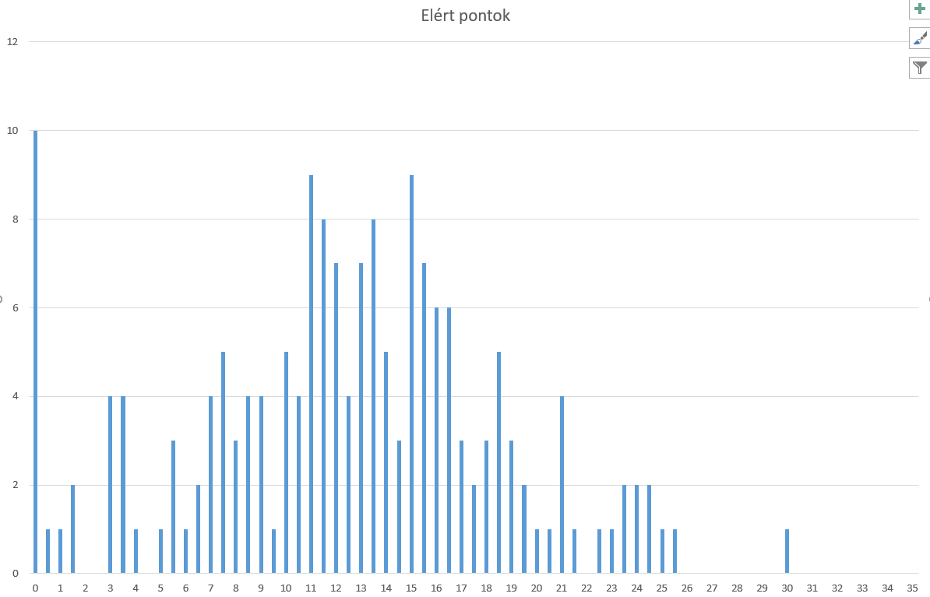
Zh (2023. 10.25) ponteloszlás

Slide 4
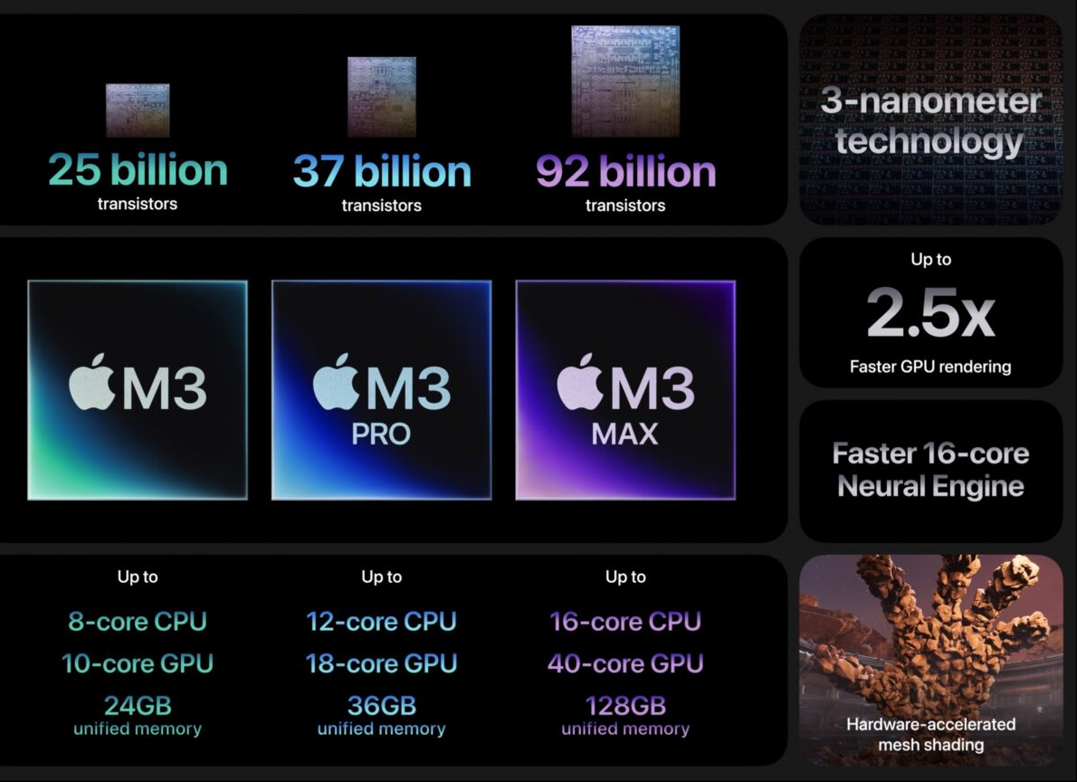
Apple M3 (shipped on 07.10. 2023
4+4
6+6
12+4
https://www.cultofmac.com/

Slide 5
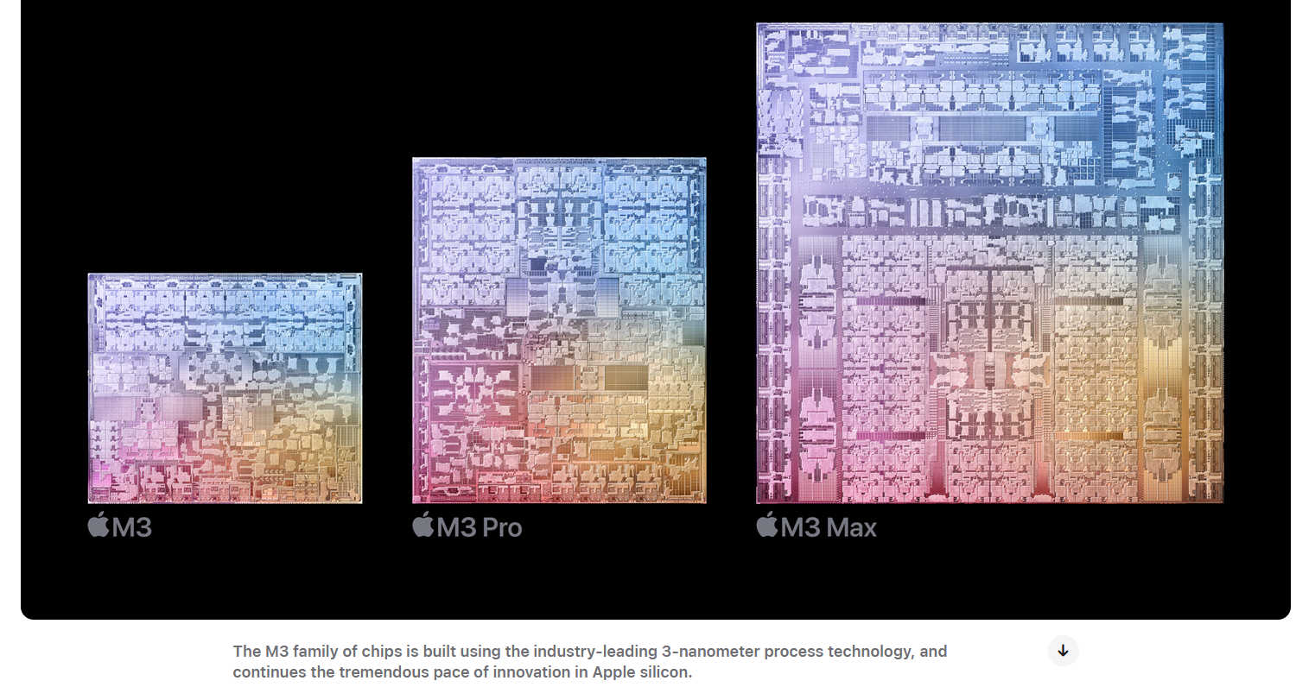
Apple M3 (shipped on 07.10. 2023)
4+4
6+6
12+4

Slide 6
Forword (1)
Remarks to the terminology
The use of the terms processor and CPU needs clarification.
ARM designs functional units of processors, like CPU cores, GPUs, NPUs (Neural
Processing Units), MCs (Memory Controllers), on-die interconnects etc. and
markets the IP (Intellectual Property) of their designs to other firms.
By contrast, other firms, like Intel, AMD, Apple, Samsung, Qualcomm, etc., are
designing full-fledged processors, partly based on ARM’s IP (Intellectual Property)
while fabricating their processors by themselves (e.g., Intel, Samsung) or
let them be produced by external foundries (e.g., TSMC, Samsung).
This is why we use specific terminology when discussing ARM's related designs
(as seen in the next Figure).
IP: Intellectual Property (szellemi termék) On-die interconnect: lapkán megvalósított kapcsolóhálózat

Slide 7
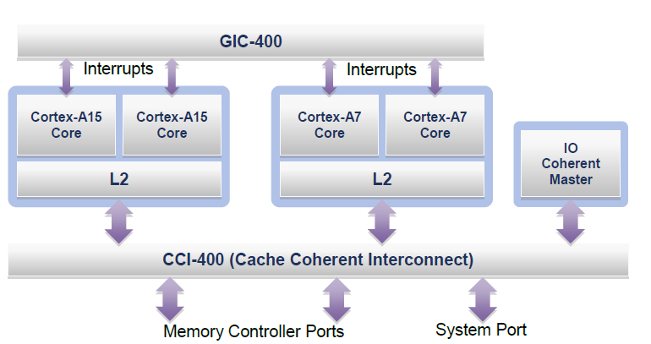
Forword (2)
Illustration of the terminology used
Processor
GIC: General
Interrupt Controller
CPU
Core cluster
CPU core
Figure: An example big.LITTLE processor [37]
CPU cores are the basic building blocks of processors, like ARM’s Cortex-A cores,
multiple CPU cores along with a shared cache may be set up to core clusters,
one or multiple core clusters constitute a CPU and
a CPU augmented by further functional units, like GPUs, NPUs, a Cache Coherent
Interconnect makes up a processor, as demonstrated in the Figure above.

Slide 8
Forword (3)
Remark to the terminology -2
In their presentations and documentation, ARM often designates cores as CPUs.
This Chapter discusses only CPU cores based on the Armvx-A ISA (here, the “A” tag
refers to application-oriented, meaning targeting mobile devices).
Nevertheless, neither ARM nor the Lecture Notes are consequent in using the
“A tag”.
Regardless of whether designations include the “A tag” or not, our Chapter always
refers to Armvx-A ISA-based CPUs.
One more point: This Chapter deals with CPU core designs.
Nevertheless, for brevity, we often abbreviate the term CPU core design to
CPU cores.

Slide 9
ARM’s CPU cores
1. Introduction to ARM
2. How has the Arm ISA evolved?
3. How have ARM’s CPU core designs evolved?
4. References
Notes:
9

Slide 10
1. Introduction to ARM

Slide 11
1. Introduction to ARM (1)
1. Introduction to ARM
ARM (ARM Holdings plc) was a British semiconductor design company based
in Cambridge, later acquired by Softbank (Japan) in 2016.
The company
designs low power processor components for the embedded, mobile and server
market, such as Cortex CPUs, Mali GPUs, Ethos NPUs, Memory Controllers
(DMC), on-chip interconnects etc. as well as
develops related software tools (e.g. development studios etc.),
and licences their IP (Intellectual Property) including their Arm ISA but
does not fabricate semiconductors.
Here, we note that beyond mobile-oriented CPUs, ARM also announced a new
CPU family branding in 2018 as well, called Neoverse for processors and
platforms, aiming at information infrastructures (data centers, routers,
switches, etc.), not discussed in this Lecture.
plc: Public Limited Company (a.m. kft)
NPU: Neural Processing Unit
Intellectual Property: szellemi tulajdon

Slide 12
1. Introduction to ARM (2)
Example 1: ARM's IP offer related to the Cortex-A73 CPU [89]
Graphic IP | Other IP | Tools
ARM Mali™-G71 Mali-DP550 (Display processor) Mali-V550 (Video Processor) | ARM CoreLink™ CCI-550 (Cache Coherent Interconnect) CoreLink GIC-500 (Interrupt Controller) CoreLink MMU-500 (System Memory Management Unit) CoreLink TZC-400 (ARM TrustZone® Controller) CoreLink DMC-500/DMC-520 (Dynamic Memory Controller) ARM CoreSight™ SoC-400 (Debug and Trace) ARM POP™ (Physical IP) | ARM DS-5 Development Studio Fixed Virtual Platforms ARM Versatile™ Express ARM Compiler 6 ARM Fast Models

Slide 13
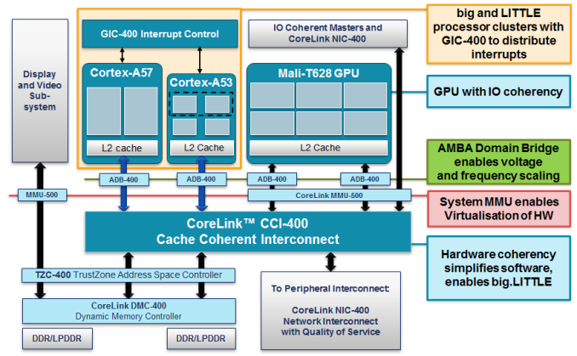
1. Introduction to ARM (3)
Example 2: Armv8.0-based SoC design with Cortex-A57/A53 CPUs and
CCI-400 interconnect (2012) [134]
ADB: AMBA Domain Bridge
(to implement DVFS)
Published by ARM and used in LG's Odin/Nuclun SoC.

Slide 14
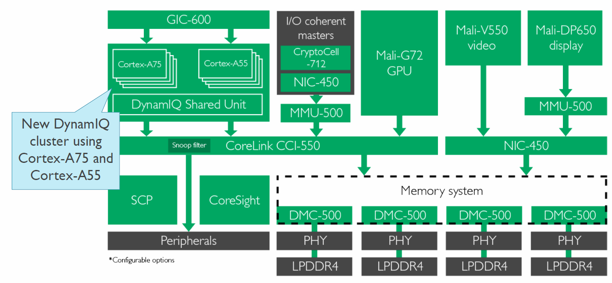
1. Introduction to ARM (4)
Example 3: Armv8.2-based SoC design with Cortex-A75/A55 CPUs and
CCI-550 interconnect (2017) [135]
CCI-550: Cache Coherent interconnect CoreSight: for debug and trace
MMU-500: Memory Management Unit (responsible for virtualization and caching)
NIC-450: Network Interconnect (interface converter)
GIC-600: General Interrupt Controller
SCP: System Control Processor

Slide 15
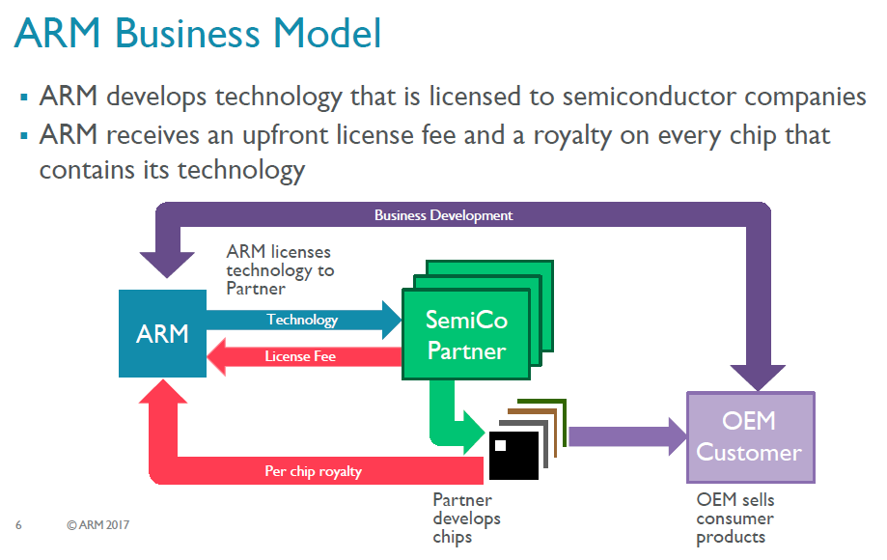
1. Introduction to ARM (5)
ARM's business model [117]
ARM possesses the Arm ISA, develops functional units, and licenses them
to semiconductor companies.
ARM receives an upfront license fee and, subsequently a royalty on every chip that contains
its technology.,
Semiconductor partners fabricate and sell chips to OEMs (Original Equipment
Manufacturers) while OEMs provide feedback to Arm for new design needs.

Slide 16
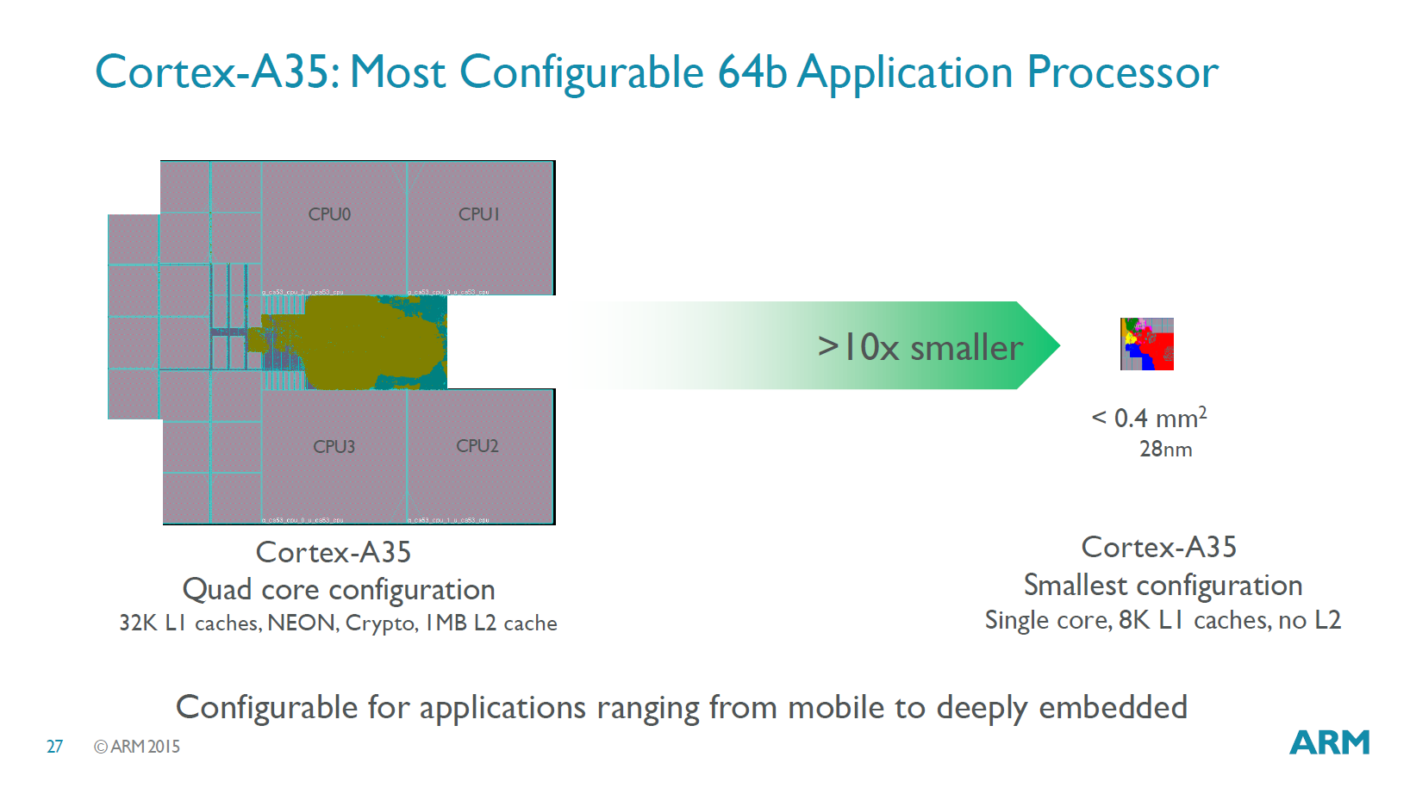
1. Introduction to ARM (6)
Configurability of ARM’s designs
ARM's designs can be customized, allowing e.g., for the selection of
L1/L2/L3 cache sizes or core counts.
The Figure below shows an example of how a Cortex-A35 may be configured
ranging from mobile to deeply embedded use.
Figure: Configuration options of a Cortex-A35 CPU [96]

Slide 17
1. Introduction to ARM (7)
Evolution of the approaches used for circuit design -1 [1]
Approaches to circuit design
Full custom design
Semi custom design
Full synthesizable design
Hand layout of the
entire circuit
The design will be subdivided into
functional units and further on into blocks
and the appropriate implementation technique
(hand layout, structured layout or automated layout)
is chosen for each.
Automated layout of the
entire circuit
Simple scaling, e.g.
from 28 nm to 16 nm
Power/performance
optimized
Implementation time
optimized
Trend

Slide 18
1. Introduction to ARM (8)
Evolution of the approaches used to circuit design -2 [1]
Before designing the Cortex A9 processor, Arm designs were partly hand layouts
and partly automated layouts.
ARM’s first fully synthesizable design was the Cortex-A9 processor (announced in 2007).
Nowadays, automated design tools are commonly used for designing processors.
Over time, more and more advanced standard cell libraries were developed that
have a large variety of design options, e.g., cell types or drive strengths, which
lessens or eliminates the need for custom design.

Slide 19
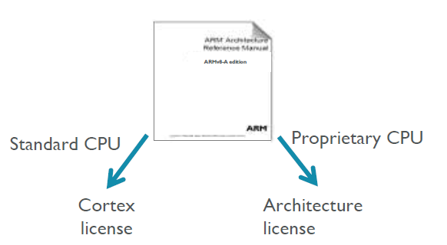
1. Introduction to ARM (9)
ARM’s licensing policy [131] -1
ARM provides either a Cortex licence or an Architecture licence.
In the case of a Cortex license, the licensee gets a complete standard microarchitecture
design (IP) with flexible configuration options, e.g., for the sizes of the L1 or L2
caches.
The Architecture license allows the use of the ARM ISA, and the licensee has to
design their custom microarchitecture, which leads to a proprietary CPU.
E.g., Apple or Samsung bought Architecture licenses, designed their CPUs
, and named them as they liked.

Slide 20
1. Introduction to ARM (10)
ARM’s advanced “Built on ARM Cortex Technology” licensing model [131]
Introduced in 02/2016.
It is available only for lead partners.
The new license agreement allows licensees to request microarchitecture changes
and use this customized design in their products.
ARM provides engineering and design services for implementing the requested
modifications for additional costs.
Under the license’s terms, ARM still owns the IP, however, the modified
microarchitecture is not shared or made available to other licensees.
Licensees have branding freedom.
An example is Qualcomm’s Kryo 280 CPU, which is based on ARM’s Cortex-A73,
whereas earlier Qualcomm CPUs were custom-designed based on an
Architecture license.

Slide 21
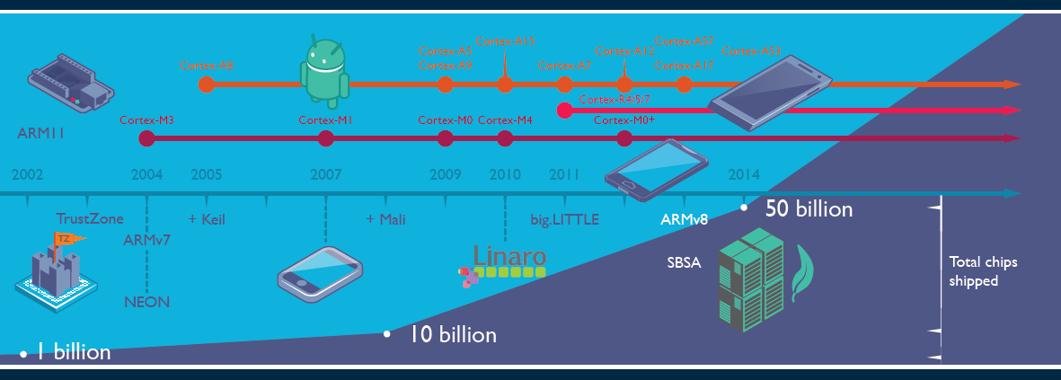
1. Introduction to ARM (11)
Evolution of ARM’s products and the total number of ARM based chips shipped [19]
(Application)
64-bit)
(FF/FP SIMD)
Keil: Software development tool for embedded processors Cortex R: Real time M: Embedded
Linaro: Nonprofit company, established by ARM, Freescale, IBM, Samsung, ST-Ericsson and TI
to support open source software developers using Linux on SoCs.
SBSA: Server Base System Architecture, a standardized server platform for 64-bit ARM processors.

Slide 22
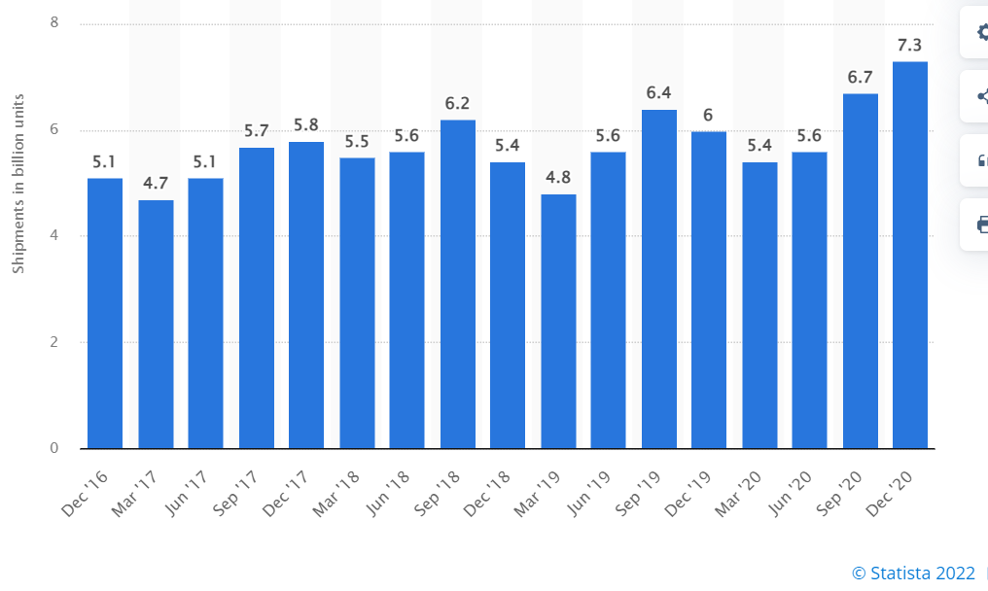
1. Introduction to ARM (12)
Number of ARM ISA-based chips shipped per quarter 2016-2020 [166]

Slide 23
1. Introduction to ARM (13)
Total number of ARM-based chips shipped until 10/2021
As ARM announced, until 10/2021 there were over 200 billion chips shipped with
their ISA [167].

Slide 24
1. Introduction to ARM (14)
Why AMD designs became dominant in the embedded and mobile market?
(including smartphones and tablets)
The ARM ISA is a RISC architecture in contrast to the x86 ISA which is a CISC
ISA.
RISC ISAs are Load/Store architectures which fetch their operands from
registers,
whereas CISC architectures allow operand fetches both from registers and the
memory.
This has two consequences;
CISC instructions are different long, they may be 1 to 15 bytes long, which is partly why they may refer to memory operands, whereas RISC instructions are equal long (typically 4-byte), since they only refer to register operands (except LS instructions, which also can be encoded in 4-bytes).
b) CISC architectures consume inherently more power since memory fetches
and decoding need more power than register fetches and RISC decoding.
This is the reason why ARM designs dominate recently the embedded and the
mobile market (including smartphones and tablets) and why increasingly more
ARM ISA-based server processor designs appear (e.g. ARM’s Neoverse line).

Slide 25
1. Introduction to ARM (15)
Historical remarks -1 [60], [61]
ARM’s parent company is Acorn Computers (UK).
Acorn Computers started their Acorn RISC Machine project in October 1983
to develop a powerful processor for a line of business computers,
(two years after the introduction of the IBM PC).
The acronym ARM was coined originally at this time (1983) from the designation
Acorn RISC Machine.
In 1990, Advanced RISC Machines Ltd. (ARM Ltd.) was founded as a joint venture
of Acorn Computers, Apple Computers, and VLSI Technology.
Accordingly, also the interpretation of ARM was changed to “Advanced RISC
Machines”.

Slide 26
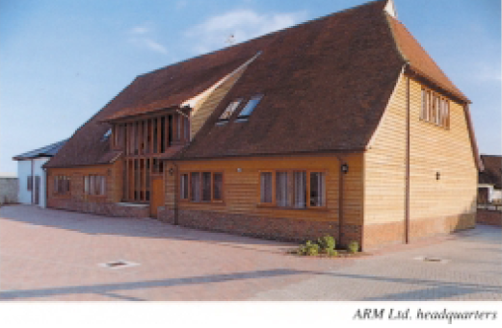
1. Introduction to ARM (16)
Historical remarks -2
Figure: The headquarters of ARM Ltd. about 1990 [62]

Slide 27
1. Introduction to ARM (17)
Optional reading: A brief account of the beginning of ARM [168]
“ARM’s First Chip¹ (from 1992)
Although the ARM processor were developed as a custom device for a highly specific purpose, the team designing it felt that the best way to produce a good custom solution was to produce a processor with good all-round performance. However, it’s interesting to note that the ARM’s architectural fate was sealed accidentally. While most of the RISC processor vendors were designing relatively huge chips (SPARC RISC, Intel i860, AMD 29000, etc.), ARM opted to develop a small-scale processor. One of the reasons the ARM processor was designed as a small-scale solution was that the resources to design it were not sufficient to allow the creation of a large and complex device. While this is now a technical plus for the ARM processor, it began as a necessity for a processor designed by a team of talented, but inexperienced designers (outside of university projects, most team members were programmers and board-level circuit designers) using new tools, some of which were far from state-of-the-art. Despite the unusal working quarters, the motivation and excitement of the small team was high and the company had an open, communicative style that helped maintain the “buzz”.
As with most start-up’s, ARM’s primary goal was to get the first product out; in this case, it was the ARM610, designed specifically for Apple. This product included full 32-bit addressing and endian-ness support, one of many changes requested by Apple in order to use the ARM processor in its planned products. An improved video controller, VIDC20, was also developed as well as a floating-point processor. Apple’s goal was to use the IP product within a hand-held personal organizer processor. The processor became known as ARM600, from which the 20 MHz ARM610 used in the Newton was later derived. At the same time, ARM Ltd.'s software team developed the ARM Cross Development Toolkit, a suite of software that allowed designers working on a range of platforms to use ARM development tools, assembler, compilers, and debugging and emulation programs.”
¹ Armv3 based

Slide 28
1. Introduction to ARM (18)
Historical remarks -3
Finally, in 1998, the company went to the stock exchange, and its name was changed
to ARM Holdings plc, to its current designation.

Slide 29

1. Introduction to ARM (19)
Historical remarks -4
Figure: ARM's recent headquarter in Cambridge (UK) [78]

Slide 30
1. Introduction to ARM (20)
Acquisition of ARM by Softbank (Japan)
Completed in 2016.
Price: 31 bUSD (ARM's revenues in 2015 ≈ 1.5 bUSD).

Slide 31
1. Introduction to ARM (21)
NVIDIA’s intention to acquire ARM from Softbank
Announced in 09/2020
Price: 40 bUSD
To be completed in 2022.
NVIDIA aims at “burying x86 PCs,” as stated by their CEO (Huang) in 09/2020
[134]:
"The PC of the future will be made by new OEMs, sold through new distributors
and use a new instruction-set architecture.
ARM will be the most important CPU architecture of the future, and it already is
the fastest growing processor architecture.”

Slide 32
1. Introduction to ARM (22)
Cancellation of NVIDIA’s plan to acquire ARM [169]
In 02/2022 NVIDIA and Softbank (ARM’s owner) announced the termination of
the planned transaction due to regulatory objections.
At this occasion, Huang, CEO of NVIDIA, stated that “I expect (the) Arm (ISA)
to be the most important CPU architecture of the next decade.”,

Slide 33
2. How has the Arm ISA evolved?
2.1 Overview of the evolution of the Arm ISA
2.2 ISA extensions introduced to enhance compute capabilities
2.3 The SVE register set-based ISA extensions
2.4 Further extensions of the Armv8-A ISA for enhancing compute
capabilities

Slide 34
2.1 Overview of the evolution of the Arm ISA

Slide 35
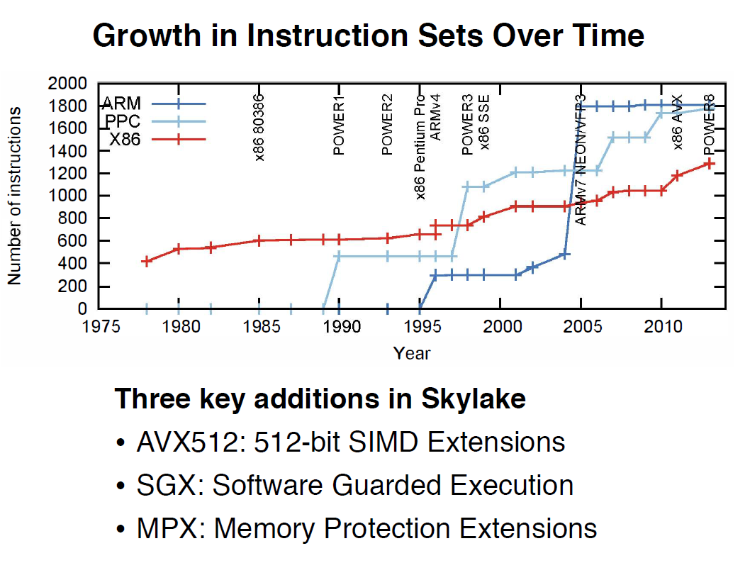
2.1 Overview of the evolution of the Arm ISA (1)
2.1 Overview of the evolution of the Arm ISA
Growth of instruction sets of processors over time [163]
Note in the above Figure that both RISC ISAs (Reduced Instruction Set Computer), such as
IBM’s PPC and the Arm ISA, as well as the x86 CISC (Complex Instruction Set Computer)
ISA evolves continuously.
The number of available instructions in both RISC and CISC ISAs has grown
to over 1000, resulting in a similar number of instructions for both.

Slide 36
2.1 Overview of the evolution of the Arm ISA (2)
Overview of ARM’s ISA versions
As already pointed out, the ARM’s ISA has evolved enormously.
How huge work has been done is indicated by the fact that the recent (2022)
Architecture Reference Manual [171] covers more than 11000 pages.
A half-page excerpt of the manual illustrates this on the next slide.

Slide 37
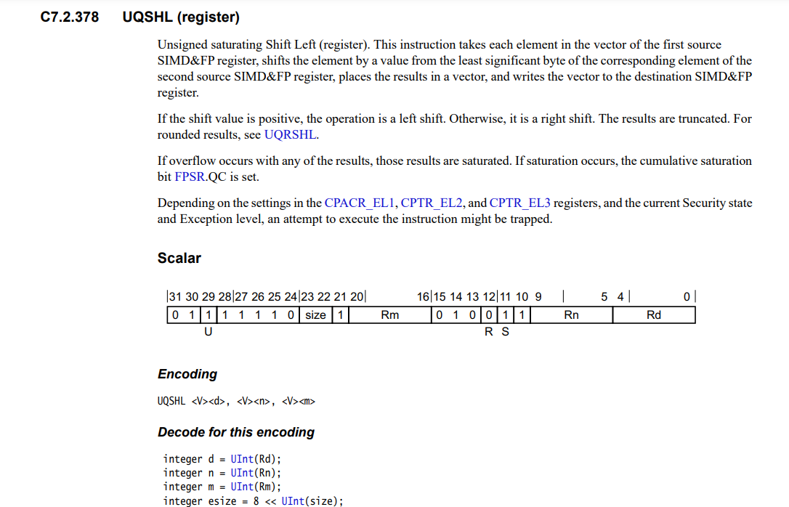
2.1 Overview of the evolution of the Arm ISA (3)
Example: 1/2 page excerpt of the Arm Architecture Reference Manual (2022) [171]
(1/2 from 11530)

Slide 38
2.1 Overview of the evolution of the Arm ISA (4)
Arm ISA versions and the Arm basic ISA
Until now, ARM has released nine major ISA versions, designated as Armv1 to Armv9,
(see the Figure below), which are described in the corresponding Architecture
Reference Manuals.
The earliest versions (Armv1 and Armv2) only provided an address range of
26 bits yet.
The first ISA version with a 32-bit address range became the Armv3, which was
first implemented in 1992 (in the ARM60 processor).
Regarding this, we note that we consider the Armv3 ISA as ARM’s basic ISA, as it was
the first with a 32-bit address range, and discuss its evolution next.
Example CPUs
Armv3
Armv4
Armv5
Armv6
Armv7-A
Armv8.0-A
Armv9-A
ARM60
(1992)
ARM710T
(~1995)
ARM10200
(2000)
ARM1136
(2002)
Cortex-A5-A15
(2005)
Cortex-A55-75/X1
(2018)
Neoverse N2/V1
Cortex-X2/A510/A710
cores (2021)
Figure: Arm ISA versions

Slide 39
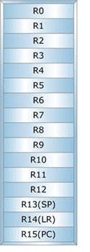
2.1 Overview of the evolution of the Arm ISA (5)
Key features of ARM’s basic ISA
It is a straightforward 32-bit RISC ISA, only capable of processing 32-bit scalar FX
and logical data, since it aims mainly at embedded microcontrollers.
This ISA provides 16 32-bit registers, called the core registers.
13 of them are used as general purpose registers (GPRs), the remaining three
are dedicated, as shown below.
GPR
Stack pointer
Link register
PC
Figure: Core registers in the Armv3-Armv7 ISA versions [63]

Slide 40
2.1 Overview of the evolution of the Arm ISA (6)
In which directions has ARM extended its basic ISA? (A simplified discussion)
Early focus of the Arm ISA extensions (1)
As ARM’s early (26/32-bit) processors were primarily used in embedded applications,
the code size and the execution speed of bytecodes were of importance.
This motivated ARM to introduce enhancements first for reducing code size and
speeding up the execution of bytecodes, as pointed out in the following Figure.
Main directions of extending ARM’s basic ISA
ISA extensions
to reduce
code size
ISA extensions
to speed up
the execution of bytecodes
After focusing on mobiles
these extensions became obsolete
Not discussed
Later, when Arm ISA-based processors became 64-bit, these extensions became
obsolete.

Slide 41
2.1 Overview of the evolution of the Arm ISA (7)
Changing focus of Arm ISA-based processors in the early 2000’s (2)
Next, in the early 2000s, Arm ISA-based processors found their way more and more
into mobiles, so more general workloads, including graphics processing, became
common.
This is why ISA extensions were introduced to enhance compute capabilities via
FP and SIMD processing, as well as to improve security.
Main directions of extending ARM’s basic ISA
ISA extensions
to reduce
code size
ISA extensions
to speed up
the execution of bytecodes
ISA extensions
to enhance
compute capabilities
ISA extensions
to enhance
security
Discussed
subsequently
Not discussed

Slide 42
2.1 Overview of the evolution of the Arm ISA (8)
Overview of the main directions and introduced extensions of ARM’s basic ISA
(For the explanation of the superscripts in the Figure see next slide)
The thumb instruction set aims at reducing code size.
AArch32
AArch64
AArch64
Crypto-graph. extension
To enhance
security
TrustZone
Confidential
Compute Arch.
MTE
A32
SVE⁴
(v8.2, opt.)
A64
Aarch32⁵
A64
SVE2
To enhance
compute
capabilities
SIMD
Adv. SIMD¹
(NEON)
VFPv1/2
VFPv3/v4²
To speed up
the execution
of bytecodes
Jazelle
(Jazelle DBX)
Jazelle
(ex. by SW)
Jazelle RCT³
(ThumbEE)
Thumb⁶
(Armv4T)
Thumb-2
(Armv6T2)
T32
(Thumb)
Armv4
Armv5
Armv6
Armv7-A
Armv8.0-A
Armv9-A
ARM710T
(~1995)
ARM10200
(2000)
ARM1136
(2002)
Cortex-A5 - A15
(2004)
Cortex-A53/A57
(2012)
Neoverse N2/V1
Cortex-X2/A510/A710
cores (2021)

Slide 43
2.1 Overview of the evolution of the Arm ISA (9)
Explanation of the superscripts in the previous Figure
¹Neon technology is ARM’s designation for Advanced SIMD extensions.
²The VFP subset became depricated in the Armv8 ISA.
³Jazelle-RTC (ThumbEE) became depricated in Armv7 Issue C in 10/2011.
⁴The SVE (Scalable Vector Extension) subset became introduced in the
Armv8.2 ISA as an optional feature, only in 2017.
⁵The AArch32 execution mode is only supported in certain implementations, e.g.
in the Cortex-A510 CPU.

Slide 44
2.1 Overview of the evolution of the Arm ISA (10)
The importance of the Armv7 ISA release and major Armv8.x ISA releases
The Armv7 ISA release, announced in 2004, gave rise to the Cortex Family of CPU cores.
These CPU cores became the workhorse of mobile processors of the first decade
of the 2000’s.
In the Armv8.0 ISA revision (in 2012) ARM opened the way for 64-bit processing and
largely extended the register spaces available for computing, as discussed later.
The new 64-bit Armv8.0 ISA introduced two execution modes (AArch32/Aarch64)
in order to provide backward compatibility with the 32-bit Armv7 ISA.
In the Aarch32 execution mode processors behave like Armv7 processors, so they
have the same execution capabilities as provided in the Armv7 ISA, whereas
in the Aarch64 execution mode the processor has a largely extended register space
for executing instructions, compared to the Armv7 ISA, as discussed later.
At the same time early aspects, like reducing code size and speeding up the
execution of bytecodes became pointless and their support was dropped,
as indicated in the previous Figure.
The subsequent major release, the Armv8.2 ISA (not indicated in the preceding
Figure due to space limitations) optionally introduced the SVE (Scalable Vector
Extension) and a number of data formats and instructions to support AI computations,
such as Half precision FP or BFloat (to be discussed later.
These extensions became mandatory in subsequent Arm ISA releases.

Slide 45
2.1 Overview of the evolution of the Arm ISA (11)
The importance of the Armv9 release
The last phase of the ISA evolution, revealed in 2021, is mainly connected to the
Armv9 release and provides enhanced support for AI.
AI support is manifested in further improving performance and security.
As performance is concerned, the Armv9 release made SVE mandatory (while
it was optional from 2017 on) and introduced SVE2 as a mandatory feature
(see Section 2.3).
To improve security, Armv9 introduced the Confidential Compute Architecture
and also Memory Tagging (only the latter is discussed in Section 3.6c).

Slide 46
2.2 ISA extensions introduced to enhance compute capabilities
2.2.1 Overview
2.2.2 Which register sets were introduced in the Arm ISA?
2.2.3 Which new instruction types were introduced based
on the new register spaces?
2.2.4 A closer look at the SVE register set-based
ISA extensions ()

Slide 47
2.2.1 Overview

Slide 48
2.2.1 Overview (1)
2.2.1 Overview
ISA extensions introduced to enhance compute capabilities -1
Main directions of extending the Arm basic ISA
ISA extensions
to reduce
code size
ISA extensions
to speed up
the execution of bytecodes
ISA extensions
to enhance
compute capabilities
ISA extensions
to enhance
security

Slide 49
2.2.1 Overview (2)
The starting point: The Arm basic ISA (Armv3, 1992) [63], [66]
As already discussed and indicated in the Figure below, the Arm basic ISA only provides
13 32-bit wide GPR registers and supports scalar computing with FX32 and Boolean data,
since it is mainly aimed at embedded microcontrollers.
32-bit wide
GPR register set
(Basic ISA)
R0
R1
R2
.
.
.
R12
R13(SP)
Stack pointer
Link register
PC
R14(LR)
R15(PC)
GPRs in the Armv3-Armv7 ISA
Basic ISA
Figure: ARM’s basic ISA
Scalar data (+Boolean)
FX32

Slide 50
2.2.1 Overview (3)
ISA extensions introduced to enhance compute capabilities -2
ARM’s major ISA extensions are based on introduced or extended register sets.
The new register spaces allow to define new instructions for manipulating data within
these register spaces.

Slide 51
2.2.2 Which register sets were introduced in the Arm ISA?

Slide 52
2.2.2 Which register sets were introduced in the Arm ISA? (1)
2.2.2 Which register sets were introduced in the Arm ISA?
In the long history of the Arm ISA, the firm introduced three different register sets,
and typically extended them subsequently, as shown below.
Register sets introduced in the Arm ISA
(GPR register set
of the basic ISA)
Secondary register set
SVE register set
Introduced in
Armv3 (1992)
Armv5 (2000)
(implemented in the FP coprocessor yet)
Armv8.2 (2016), optional
(in the AArch64 mode)
Armv9.0 (2021) mandatory
Extended in
Armv8 (2012)
Armv7 (2004)
(moved into the core)
Armv8 (2012)
(available only in the AArch64 mode)

Slide 53
2.2.2 Which register sets were introduced in the Arm ISA? (2)
Extending the GPR and secondary register sets
As the previous Figure indicates, during the course of the evolution of the ARM ISA
both the GPR and the secondary register space became extended, as discussed next.

Slide 54
2.2.2 Which register sets were introduced in the Arm ISA? (3)
a) Extending the GPR register set in the Armv8 ISA (2012) [63], [66]
The GPR register set was vastly enlarged in the Armv8 ISA in the AArch64 mode (see below).
32-bit wide
32-bit wide
64-bit wide
R0
X0
W0
R1
X1
W1
R2
X2
W2
W3
X3
.
.
.
.
.
.
.
.
.
R12
X12
W12
R13(SP)
Stack pointer
Link register
PC
X13
W13
R14(LR)
X14
W14
R15(PC)
.
.
.
.
.
.
X30
W30
X31
Dedicated use
W31
Dedicated use
32-bit access
64-bit access
GPRs in the Armv3-Armv7 ISA
and in the Armv8 ISA
in the AArch32 execution mode (2012)
GPRs in the Armv8 ISA
in the AArch64 execution mode (2012)

Slide 55
2.2.2 Which register sets were introduced in the Arm ISA? (4)
b) Introducing a secondary register set into the Arm ISA and its extension
For efficient implementation of FP calculations, e.g., in 3D applications, ARM introduced
a secondary register space of 32 x 32-bit in the Armv5 ISA, in 2000, but still
implemented it in the FP coprocessor, as indicated in the Figure below.
Following the widespread use of ARM-based mobile devices, the company introduced
the Armv7 ISA in 2004 with an extended register space of 32x 64 bit.
At the same time, AMD relocated the register space into the CPU core and introduced
64/128-bit SIMD calculations as well to improve processing efficiency.
Finally, in the Armv8 Aarch64 execution mode, ARM widened the secondary register set to
32 x 128-bit in 2012, as illustrated below, to provide better support for 128-bit processing.
(Implemented in
the coprocessor)
(Implemented in
the CPU core)
(Implemented in
the CPU core)
32
64
128
32
32
32
Armv5
Armv7 (or Armv8 AArch32 mode)
Armv8 AArch64 mode
(2000)
(2004)
(2012)
Figure: Introducing a secondary register set into the Arm ISA and its evolution

Slide 56
2.2.2 Which register sets were introduced in the Arm ISA? (5)
ARM’s names of the introduced secondary register set
ARM named the discussed additional register sets in a confusing manner, as indicated below.
FP register set
Advanced SIMD and FP register set
(Extension register set)
SIMD and FP register set
32
64
128
32
32
32
Armv5
Armv7 (or Armv8 AArch32 mode)
Armv8 AArch64 mode
(2000)
(2004)
(2012)
Figure: Evolution and naming of the secondary register set in the Arm ISA
This is the reason why we do not use ARM’s register designations but refer to them
collectively as the secondary register set in this Section.

Slide 57
2.2.2 Which register sets were introduced in the Arm ISA? (6)
c) Introducing the SVE register set into the Arm ISA [96]
The SVE (Scalable Vector Extension) was and introduced in the Armv8.2 ISA in 2017
as an optional feature.
SVE is only implemented in the AArch64 mode of Armv8.2.
SVE aims at HPC scientific workloads rather than media or image processing.
It provides 32 registers (called Z0 – Z31), each up to 16 x 128 bit long
(implementation dependent) to hold data elements, as seen below.
SVE supports both FX- and FP SIMD processing.
SVE register set
128
---
32
(1...16)x 128 bit
Armv8.2 (AArch64 mode)
Figure: The SVE register set

Slide 58
2.2.3 Which new instruction types were introduced based on the new register spaces?

Slide 59
2.2.3 New instruction types introduced based on the new register spaces (1)
2.2.3 Which new instruction types were introduced based on the new
register spaces?
Arm ISA extensions introduced to enhance compute capabilities
GPR reg. set
Secondary register set
SVE register set
FX SIMD
extensions
Scalar FP
extensions
Vector FP
extension
FX/FP SIMD
extensions
Very long FX/FP SIMD
extensions
(Coproc. based)
(Coproc. based)
(Sequentially executed)
(64/128-bit)
(128-2048-bit)
(Neon)
(2005)
(SVE/SVE2)
(2017/2021)
Introduced in
Armv6
(2002)
Armv5
(2000)
Armv5
(2000)
Armv7
(2005)
SVE: Armv8.2 (opt.) (2016)
SVE2: Armv9 (mandatory) (2021)
The GPR register set-based FX SIMD extensions became absorbed into the
secondary register set-based FX/FP SIMD extensions.
The coprocessor-based extensions soon became obsolete.

Slide 60
2.2.3 New instruction types introduced based on the new register spaces (2)
Which Arm ISA extensions are used at present in numeric computations?
From all extensions introduced for enhancing the compute capabilities of the Arm ISA,
recently, only
the 64/128-bit FX/FP SIMD extension (commonly called Neon) and
the 128-2028-bit long FX/FP SIMD extensions, called SVE/SVE2
are of importance, they absorb all previous extensions.
Arm ISA extensions introduced to enhance compute capabilities
GPR reg. set
Secondary register set
SVE register set
FX SIMD
extensions
Scalar FP
extensions
Vector FP
extension
FX/FP SIMD
extensions
Very long FX/FP SIMD
extensions
(Coproc. based)
(Coproc. based)
(Sequentially executed)
(64/128-bit)
(128-2048-bit)
(Neon)
(2005)
(SVE/SVE2)
(2017/2021)

Slide 61
2.2.3 New instruction types introduced based on the new register spaces (3)
Remarks to the evolution of Intel’s x86 ISA SIMD extensions [142] -1
It is worth comparing the evolution of SIMD extensions provided by the x86 ISA with
those introduced by the Arm ISA.
Intel introduced their first multimedia inspired MMX extension in the Pentium M
processor in 1997 while using the 64-bit mantissa part of the FP registers.
Subsequently, Intel defined a dedicated register space in the SSE extension in the
Pentium III (Katmai) core in 1999, as seen in the next Figure.

Slide 62
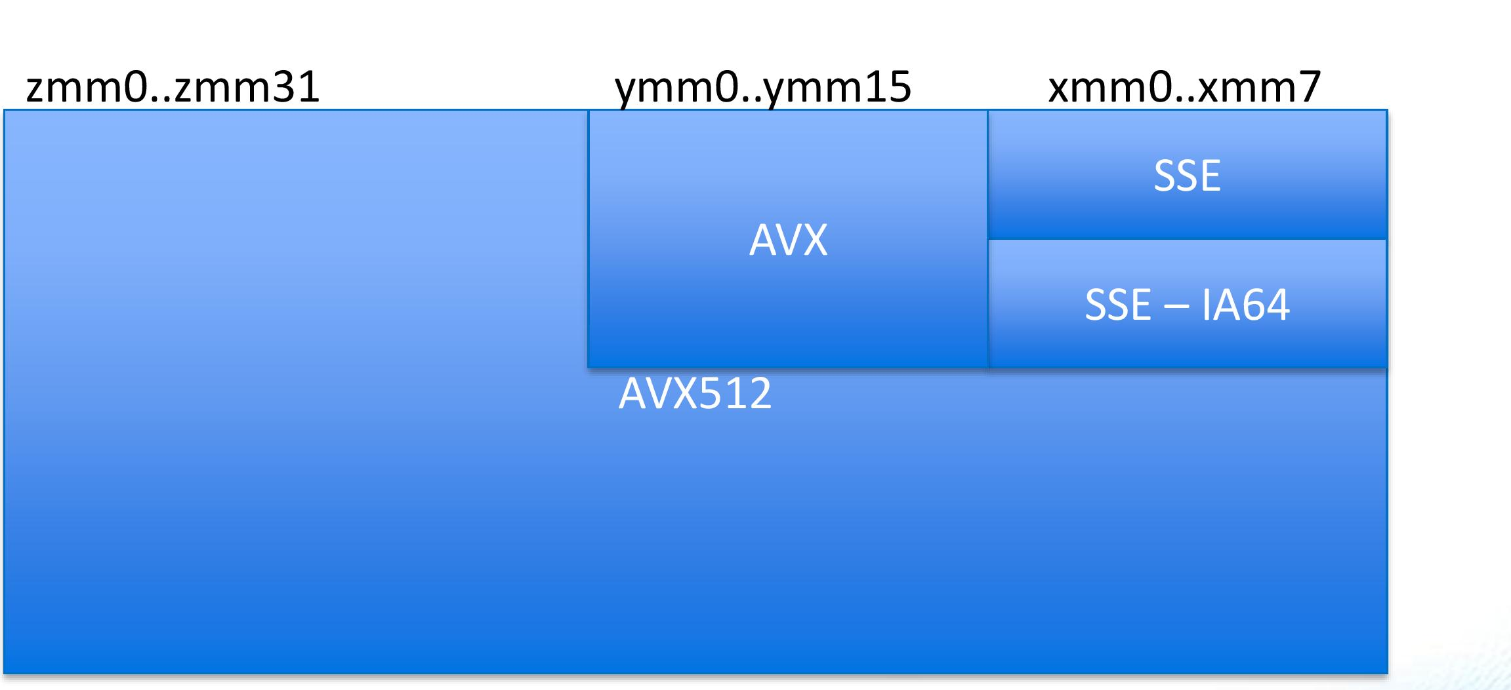
2.2.3 New instruction types introduced based on the new register spaces (4)
Remarks to the evolution of Intel’s x86 ISA SIMD extensions [142] -2
The introduced dedicated register space was 8x128-bit in size.
It was extended in the following three steps:
first to 16x128-bit (in the SSE3 extension, in 2004),
then to 16x256-bit (in the AVX extension, in 2011) and
finally, to 32x512-bit (in the AVX512 extension, in 2017).
The extension was implemented in an aliased way, as discussed next.
zmm (511-0)
ymm (255-0)
xmm (128-0)
SSE (32-bit)
(xmm0-xmm7)
0
AVX/AVX2
ymm0-ymm15)
7
SSE3 (64-bit)
(xmm0-xmm15)
AVX-512
(zmm0-zmm31
15
AVX-512
(ymm0-ymm31
AVX-512
(xmm0-xmm31)
31
511
255
127
0
Figure: Dedicated register space of the x86 ISA for SIMD processing and its extension [180]

Slide 63
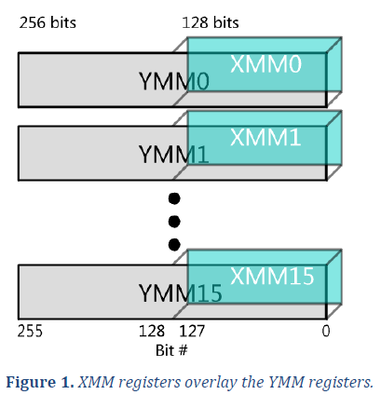
2.2.3 New instruction types introduced based on the new register spaces (5)
Remark
In an aliased extension the lower parts of the extended registers (e.g. 256-bit registers)
are the initial (e.g. 128-bit) registers, as illustrated below.
Figure: Extending the existing 128-bit wide XMM [0, 15] SIMD register set
to the 256-bit YMM [0, 15] register set in an aliased way [181]

Slide 64
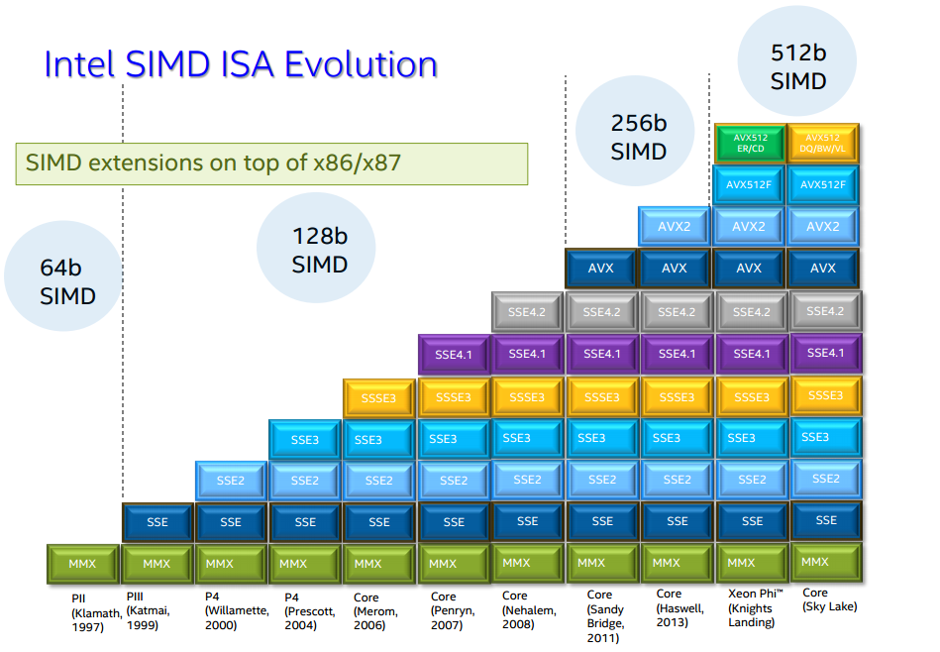
2.2.3 New instruction types introduced based on the new register spaces (6)
Overview of Intel’s x86 ISA SIMD extensions [142]
Based on the register space extensions Intel
introduced the following SIMD extensions
of the x86 ISA:
Pentium_MMX
(1997)
PII
Klamath,
(1997)
Core
Cannon-Lake,
(2018)
Skylake-X/SP,
(2017)
(2016)

Slide 65
2.2.3 New instruction types introduced based on the new register spaces (7)
Summing up Intel’s x86 ISA SIMD extensions [142]
SIMD extensions of Intel’s x86 ISA
MMX SIMD
extensions
SSE SIMD extensions
SSE2.SSE4.2 SIMD extensions
AVX SIMD extension
AVX2 SIMD extension
AVX-512
SIMD extension
64-bit
FX SIMD
128-bit
FP SIMD
128-bit
FX/FP SIMD
256-bit
FP SIMD
256-bit
FX/FP SIMD
512-bit
FX/FP SIMD
Introduced in
DTs/laptops
(Pentium-MMX)
(1997)
(Pentium III)
(1999)
(Pentium 4
Willamette)
(2000)
(Sandy Bridge)
(2011)
(Haswell
(2013)
(Cannon Lake)
(2018)

Slide 66
2.2.3 New instruction types introduced based on the new register spaces (8)
Comparing Intel’s and AMD’s recent SIMD extensions
For SIMD processing, Intel introduced in succession three dedicated register sets
with 16x128-, 16x256- and 32x512-bit registers into their x86-64 ISA, in addition to
the existing general purpose 16x64-bit GPR and 8x80-bit FP architectural register sets.
The extended registers are aliased with the shorter ones, i.e., the smaller registers, and
the lower parts of the extended registers are implemented as the same physical registers.
It is important to note that Intel introduced a new instruction set for each extension.
By contrast, for SIMD processing, AMD introduced two additional distinct register sets;
an up to 32x128-bit secondary register set for the Neon extension and a 32x128
to 2048-bit SVE register set for the SVE/SVE2 instruction extensions.
2.2.3 ISA extensions to einstructionsnhance compinetute capabilities up to the Armv8 release ()

Slide 67
2.2.3 New instruction types introduced based on the new register spaces (9)
The SVE and SVE2 ISA extensions
The SVE extension was introduced as an optional feature in the Armv8.2-A ISA in 2017.
It aims at HPC scientific workloads rather than media or image processing.
SVE is only implemented in the AArch64 version of Armv8.2 and supports both
FX- and FP processing.
The SVE2 became a mandatory extension in the Armv9-A ISA in 2021.
It is a superset of SVE, i.e., it provides all instructions of the SVE.
This extension provides a much broader range of instructions and can be seen
as a potential successor to the recent SIMD extension, known as Neon.

Slide 68
2.2.3 New instruction types introduced based on the new register spaces (10)
Significance of the SVE/SVE2 extensions
As discussed, both the x86 and Arm ISAs support progressively wider SIMD
execution, such as 64-bit, 128-bit, 256-bit, and 512-bit long SIMD processing.
This evolution path has, however, a drawback in the case of the x86 ISA, since
with each new extension, such as MMX, SSE, SSE2, SSE3, AVX, AVX512,
a further subset of instructions is introduced.
So, to utilize the benefits of wider and wider SIMD execution resources, software
had to be rewritten and recompiled.
By contrast, with the SVE extensions, programming becomes "vector length agnostic,"
meaning the programmer no longer needs to use different instruction subsets
for different long ISA extensions.

Slide 69
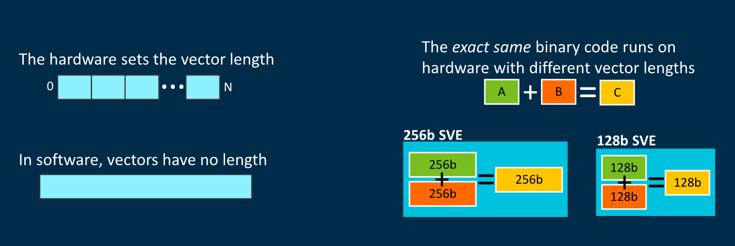
2.2.3 New instruction types introduced based on the new register spaces (11)
Interpretation of vector length agnostic programming [173]
(by different wide execution)
As the Figure above indicates, the same binary code runs on different wide hardware,
i.e. different wide SIMD execution units.

Slide 70
2.2.3 New instruction types introduced based on the new register spaces (12)
Benefits of vector length agnostic (VLA) programming
VLA simplifies programming, allowing binary code to be portable across different
processors with varying wide SIMD execution units, as instruction execution is
automatically scaled to match available resources.
Auto-vectorization: automatically generates SIMD code from loops.

Slide 71
2.2.3 New instruction types introduced based on the new register spaces (13)
The stunning dynamics of enhancing the Arm ISA
The thumb instruction set aims at reducing code size.
AArch32
AArch64
AArch64
Crypto-graph. extension
To enhance
security
TrustZone
Confidential
Compute Arch.
MTE
A32
SVE⁴
(v8.2, opt.)
A64
Aarch32⁵
A64
SVE2
To enhance
compute
capabilities
SIMD
Adv. SIMD¹
(NEON)
VFPv1/2
VFPv3/v4²
To speed up
the execution
of bytecodes
Jazelle
(Jazelle DBX)
Jazelle
(ex. by SW)
Jazelle RCT³
(ThumbEE)
Thumb⁶
(Armv4T)
Thumb-2
(Armv6T2)
T32
(Thumb)
Armv4
Armv5
Armv6
Armv7-A
Armv8.0-A
Armv9-A
ARM710T
(~1995)
ARM10200
(2000)
ARM1136
(2002)
Cortex-A5 - A15
(2005)
Cortex-A53/A57
(2012)
Neoverse N2/V1
Cortex-X2/A510/A710
cores (2021)
For the Remarks see the next slide.

Slide 72
2.2.4 A closer look at the SVE register set-based ISA extensions
(Optional reading, not a part of the exam)

Slide 73
2.2.4 A closer look at the SVE register set-based ISA extensions (1)
2.2.4 A closer look at the SVE register set-based ISA extensions
Based on the SVE (Scalable Vector Extension) register set, which is the third register set
of the ARM ISA, ARM introduced the SVE and SVE2 ISA extensions, to support FX/FP
SIMD operations on long (up to 16x128-bit wide) data, as indicated below.
Register sets provided by the Arm ISA
The GPR register set
The secondary register set
The SVE register set
It supports
FX/ FX-SIMD operations
It supports
scalar FP/vector FP and
FX/FP SIMD operations
It supports
FX/FP SIMD operations
on long (up to 16x128-bit) data
Introduced in
Armv1/Armv6
Armv5/Armv7
Armv8.2
(1985/2002)
(2000/2005)
(2017)
Discussed in the previous Sections
Discussed in this Section
Figure: The SVE register set

Slide 74
2.2.4 A closer look at the SVE register set-based ISA extensions (2)
The SVE register set
The SVE register set consists of 32 Z registers.
Their size is not fixed but depends on the width of the SIMD execution units of the processor.
Nevertheless, it should be a multiple of 128 bits (up to 16 x 128 = 2048 bits).
The actual size of the SVE registers is held in a field of a control register named
LEN, which we won't be discussing here.
The 1. lanes (first 128 bits) of the SVE Z register set are shared with the 32 128-bit
wide SIMD registers (V0-31) of the Armv8.0 ISA, as indicated below.
LEN: 1 to 16
Designation of the SVE registers [96]

Slide 75
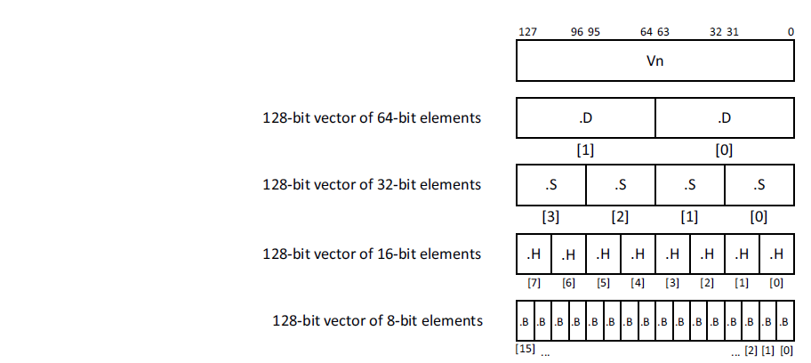
2.2.4 A closer look at the SVE register set-based ISA extensions (3)
Possible data elements per 128-bit lane [116]
Possible data elements
in the 128-bit lanes
8-bit FX
16-bit FX/FP
32-bit FX/FP
64-bit FX/FP
128-bit FX

Slide 76
2.2.4 A closer look at the SVE register set-based ISA extensions (4)
Introduction of the SVE and SVE2 ISA extensions
The SVE extension was introduced in the Armv8.2-A ISA in 2017 as an optional feature,
whereas the SVE2, launched in the Armv9-A ISA in 2021, is mandatory.
The SVE2 is a superset of SVE, i.e., it provides all instructions of the SVE.

Slide 77
2.2.4 A closer look at the SVE register set-based ISA extensions (5)
a) The SVE register set based SVE SIMD extension [96]
The SVE (Scalable Vector Extension) was announced in 2016 (at the Hot Chips
conference) and introduced in the Armv8.2-based ISA in 2017 as an optional feature.
SVE is implemented only in the AArch64 version of Armv8.2 and supports both
FX- and FP processing.
SVE aims at HPC scientific workloads rather than media or image processing.

Slide 78
2.2.4 A closer look at the SVE register set-based ISA extensions (6)
Key feature of the SVE extension: Vector length agnostic programming
As discussed, both the x86 and Arm ISAs support progressively wider SIMD
execution, such as 64-bit, 128-bit, 256-bit, and 512-bit long SIMD processing.
This evolution path has, however, a drawback in the case of the x86 ISA, since
with each new extension, such as MMX, SSE, SSE2, SSE3, AVX, AVX512,
a further subset of instructions is introduced.
So, to utilize the benefits of wider and wider SIMD execution resources, software
had to be rewritten and recompiled.
By contrast, with the SVE extension, programming becomes "vector length agnostic,"
meaning the programmer no longer needs to use different instruction subsets
for different long ISA extensions.

Slide 79
2.2.4 A closer look at the SVE register set-based ISA extensions (7)
Interpretation of vector length agnostic programming [173]
(implemented by masking)
As the Figure above indicates, the same binary code runs on different wide hardware,
i.e. different wide SIMD execution units.

Slide 80
2.2.4 A closer look at the SVE register set-based ISA extensions (8)
Benefits of vector length agnostic (VLA) programming
VLA simplifies programming, allowing binary code to be portable across different
processors with varying SIMD execution units, as instruction execution is
automatically scaled to match available resources.
A further benefit of vector-length agnostic programming is that it allows
auto-vectorization by advanced compilers.
Auto-vectorization: automatically generates SIMD code from loops.

Slide 81
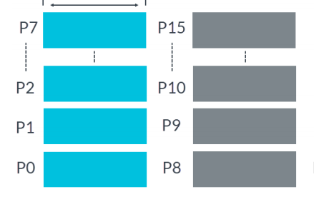
2.2.4 A closer look at the SVE register set-based ISA extensions (9)
How ARM implements data vector length agnostic programming? [136]
The introduced SVE extension utilizes Predicate registers (P registers) as masks
to indicate which active elements of the Z-registers are involved in the operation.
There exist 16 Predicate registers, as seen below.
P0-P7 include predicates for loads, stores, and arithmetic operations,
P8-P15 are extra predicates for loop management.
Up to 16x16 bit
Figure: Predicate registers
Predicate registers hold one bit for each byte available in a Z register.
For example, an implementation providing 1024-bit Z registers has 128-bit wide
Predicate registers.

Slide 82
2.2.4 A closer look at the SVE register set-based ISA extensions (10)
Specifying the word length (vector lengths) in the instructions -1
Predicate registers (1 bit for each byte) are used as masks for data operations.
A „1” value of the Predicate register will activate the associated byte, a „0” value
will neglect it.
The next example demonstrates this.

Slide 83
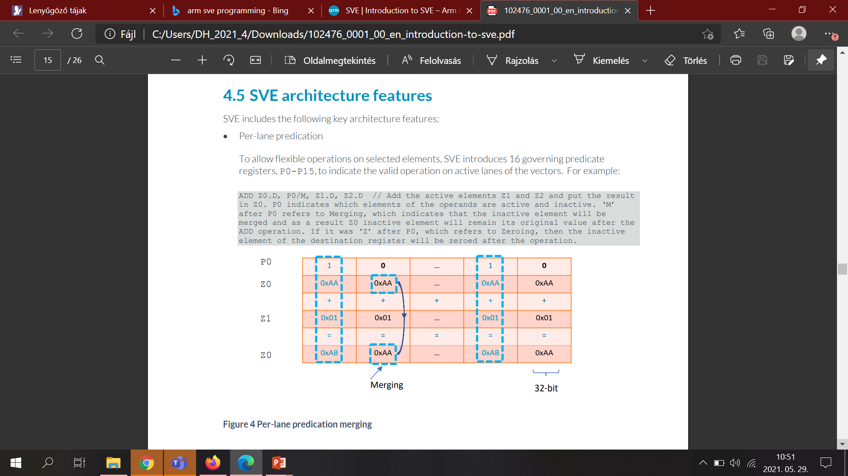
2.2.4 A closer look at the SVE register set-based ISA extensions (11)
Example: Masking out active data elements from the SVE-registers by
using predicates while performing the zo < z1 + z0 operation [136]
1111
0000
1111
0000
The active data elements of the source registers Z0 and Z1 (indicated by the
„1” values per byte in the Predicate register P0) are added and the result is
written into the destination register Z0.
The masked out data elements of the SVE source register Z0 are copied into
the destination register Z0.

Slide 84
2.2.4 A closer look at the SVE register set-based ISA extensions (12)
Specifying the length of vectors (data words) in the instructions -2
When writing programs, in addition to the operation code, the source and destination
registers, a previously set Predicate register must also be specified to identify which
data elements should be used in the referenced SVE registers.

Slide 85
2.2.4 A closer look at the SVE register set-based ISA extensions (13)
Remark
Our previous discussion of interpreting the use of Predicate registers is strongly
simplified, we refer to [116] or [136] for a more detailed explanation.

Slide 86
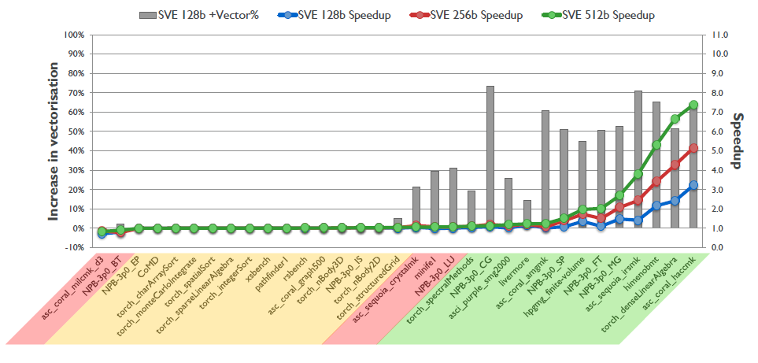
2.2.4 A closer look at the SVE register set-based ISA extensions (14)
Speed-up potential of SVE [96]
As the above Figure indicates, SVE brings real speed-up only for appropriate workloads.

Slide 87
2.2.4 A closer look at the SVE register set-based ISA extensions (15)
b) The 2. generation 128 – 2048-bit FX/FP SIMD extension, called the
SVE2 ISA extension
The SVE2 extension was introduced in the Armv9-A ISA in 2021 as a mandatory feature.
While the previous SVE extension was mainly focused on HPC (High-Performance Computing) workloads, the SVE2 extension provides a much broader range of instructions and can be seen as a potential successor to the recent SIMD extension, known as Neon.

Slide 88
2.2.4 A closer look at the SVE register set-based ISA extensions (16)
Summing up the layout of the SVE register extensions (2017/2021)
Armv8.2 (AArch64 mode)
(optional)
SVE register set
15.lane
2. lane
1. lane
---
32
128
Up to 16 x 128-bit (Up to 2048-bit)
SVE (2017)/SVE2 (2021) extensions
Up to 16x 128-bit wide lanes
FX/FP SIMD (vector) data
Each 128-bit lane holds: FX8/16/32/64
FP16¹/32/64
data elements
The data width must be multiples of 128 bits, up to 16x128-bit.
The 1. lanes (first 128 bits) of the SVE Z register set are shared with the 32 128-bit
wide SIMD registers (V0-31) of the Armv8.0 ISA.
¹: Only data conversions are supported

Slide 89
2.2.4 A closer look at the SVE register set-based ISA extensions (17)
Contrasting the SVE and SVE2 SIMD extensions
ARM ISA |  | ISA extension | The SVE register set based SIMD extensions
 |  |  | Available register set | Scalar data types | Vector data types | Instruction subset
Name | Year
Armv8.2 (optional) | 2017 | SVE | SVE register set 32 registers each (1...16)x128-bit wide | --- | FX 8/16/32/64/128 FP 16/32/64 (1...16)x128-bit wide SIMD data (FMA available) | Small basic instruction subset aiming at HPC workloads
Armv9 (superset of SVE) (mandatory) | 2021 | SVE2
 |  |  |  |  |  | (Vastly enhanced instruction subset aiming at general-purpose workloads
SVE2 is a superset of SVE.
It provides a large number of instruction set extensions that result in a faster,
more efficient execution on long SIMD data.
Execution resources provided for SVE/SVE2 instructions are 128-bit quantized,
that is they may be 128-bit, 256-bit etc. long up to 2048-bit.,
HPC: High-Performance Computing (computing intensive)

Slide 90
2.2.4 A closer look at the SVE register set-based ISA extensions (18)
Implementation of the SVE and SVE2 extensions in processors
Until now SVE has been implemented only by Fujitsu in its A64FX processor.
It is an Armv8.2 ISA-based 48-core processor with 512-bit wide SIMD execution,
manufactured on 7 nm technology, used in the Fugaku supercomputer
(designed by Fujitsu, completed in 03/2021).
This is not surprising, since SVE targets HPC workloads whereas mobiles or
tablets do not run such workloads.
On the other hand, SVE2 is recently (2021) implemented in the Armv9 ISA-based
Neoverse and Cortex designs.

Slide 91
2.2.4 A closer look at the SVE register set-based ISA extensions (19)
Importance of the SVE and SVE2 ISA extensions
These extensions have great importance since they allow
very wide (up to 16x128-bit) vector processing and
vector length agnostic programming,
(when programming is independent of the length of the vectors used).
Further on, the SVE2 extension is expected to replace the previous 64/128-bit
FX/FP-SIMD extension (called Neon).
This is why we discuss these extensions in a separate Section.

Slide 92
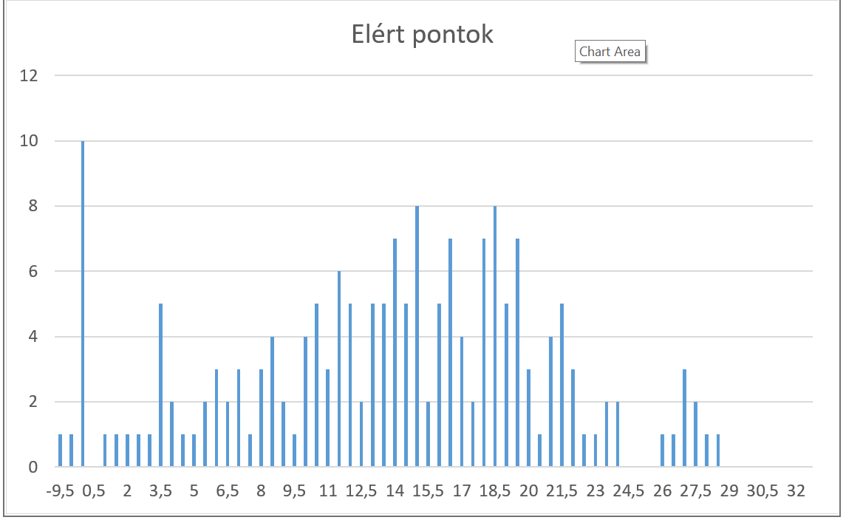

Slide 93
3. How have ARM’s CPU core designs evolved over time?
3.1 ARM’s CPU designs preceding the ARM Cortex family
3.2 Overview of the Cortex family of CPU cores
3.3 Armv7-A ISA-based 32-bit Cortex-A CPUs
3.4 Armv8.0-A ISA-based 64-bit Cortex-A CPUs
3.5 Armv8.2-A ISA-based 64-bit Cortex-A CPUs
3.6 Armv9-A based 64-bit Cortex-A CPUs
3.7 Case example: The core complex of the TCS22 platform
3.8 Summing up: Main evolution steps of Armv7 to
Armv9-based CPU designs in mobile processors

Slide 94
3. How have ARM’s CPU designs evolved? (1)
3. How have ARM’s CPU designs evolved over time?
Overview of ARM’s CPU core designs
ARM’s CPU core designs
ARM’s early CPU cores
ARM’s Cortex-A
CPU cores
ARM’s Neoverse
CPU cores
CPU cores based on the Armv1–v2 ISA
CPU cores based on
the Armv3–v6 ISA
CPU cores based on
the Armv7 – Armv9 ISA
CPU cores based on
the Armv9 ISA
(Earliest ARM cores)
(Early ARM cores)
(~ 1985-1990)
(~ 1991-2004)
Since 2004
Since 2021
ARM1-ARM3
ARM6xx-ARM11xx
Mainly target mobiles,
though several vendors
entered the market with
Armv8.0-A or v8.2-A based
server designs as well.
Target infrastructure
(servers, edge)
26-bit address bus
32-bit data buses
32-bit address bus
32-bit data buses
Section 3.1
Sections 3.2-3.6
Not discussed
in this Chapter
Not discussed
in this Chapter

Slide 95
3. How have ARM’s CPU designs evolved? (2)
Overview of Armv7- to Armv9-based Cortex-A CPU designs
Cortex-A CPUs
based on
the 32-bit Armv7-A ISA
based on
the Armv8.0-A ISA
based on
the Armv8.2-A ISA
based on
the Armv9-A ISA
First CPUs
Cortex-A8
Cortex-A57/A53
Cortex-A75/A55
Cortex-X2/A710/A510
Section 3.3
Section 3.4
Section 3.5
Section 3.6
(Please note that from Section 3, only Subsections 3.2, 3.3.4, 3.6, and 3.8 are
included in the Lecture and the exam.

Slide 96
3.1 ARM’s CPU designs preceding the ARM Cortex family
(Optional reading, not a part of the exam)

Slide 97
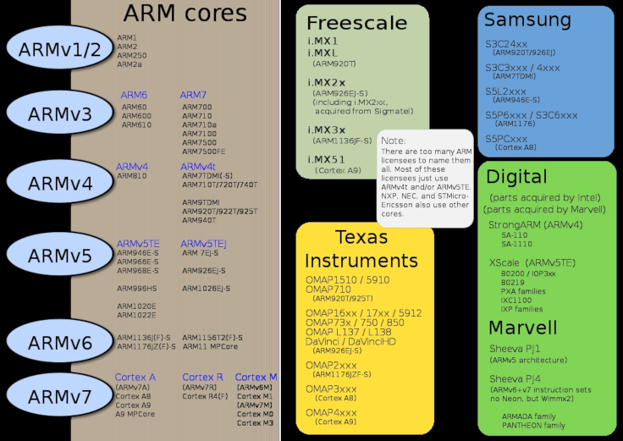
3.1 ARM’s CPU designs preceding the ARM Cortex family (1)
3.1 ARM’s CPU designs preceding the ARM Cortex family
a) Overview of Armv1-Armv2 based CPU cores and their use in mobiles [5]

Slide 98
3.1 ARM’s CPU designs preceding the ARM Cortex family (2)
Remarks to the address spaces supported
As already discussed in Section 2.1:
CPU cores based on the ISA versions Armv1 and Armv2, like the ARM1 or ARM2
cores, only have a 26-bit address bus but a 32-bit data bus.
We call these designs ARM’s 26-bit architectures.
By contrast, Armv3 or higher ISA version based CPU cores already support
a 32-bit address space and are known as 32-bit architectures, up to the
Armv7 ISA.
Then the Armv8 ISA widens the address space to 64-bit, in the AArch64 mode,
giving the way for 64-bit architectures.

Slide 99
3.1 ARM’s CPU designs preceding the ARM Cortex family (3)
b) Overview of Armv3 - Armv6 based CPU cores and their use in mobiles
ARM’s basic ISA (Armv3 – v4) [63], [66]
32-bit wide
Basic register set
R0
R1
R2
.
.
.
R12
R13(SP)
Stack pointer
Link register
PC
R14(LR)
R15(PC)
GPRs in the Armv3-v7 ISA
Basic ISA
Scalar data
FX32
Boole32
Note: Subsequently we do not follow the evolution of Boolean data types

Slide 100
3.1 ARM’s CPU designs preceding the ARM Cortex family (4)
Main extensions introduced in the Armv4 – Armv6 ISA versions (simplified)
The thumb instruction set aims at reducing code size.
AArch32
AArch64
AArch64
Crypto-graph. extension
To enhance
security
TrustZone
Confidential
Compute Arch.
MTE
A32
SVE⁴
(v8.2, opt.)
A64
Aarch32⁵
A64
SVE2
To enhance
compute
capabilities
SIMD
Adv. SIMD¹
(NEON)
VFPv1/2
VFPv3/v4²
To speed up
the execution
of bytecodes
Jazelle
(Jazelle DBX)
Jazelle
(ex. by SW)
Jazelle RCT³
(ThumbEE)
Thumb⁶
(Armv4T)
Thumb-2
(Armv6T2)
T32
(Thumb)
Armv4
Armv5
Armv6
Armv7-A
Armv8.0-A
Armv9-A
ARM710T
(~1995)
ARM10200
(2000)
ARM1136
(2002)
Cortex-A5 - A15
(2005)
Cortex-A53/A57
(2012)
Neoverse N2/V1
Cortex-X2/A510/A710
cores (2021)
For the Remarks see the next slide.

Slide 101
3.1 ARM’s CPU designs preceding the ARM Cortex family (5)
Explanation of the superscripts in the previous Figure
¹The Advanced SIMD architecture extension is commonly referred to as the
NEON technology.
²The VFP subset became depricated in the Armv8 ISA.
³Jazelle-RTC (ThumbEE) became depricated in Armv7 Issue C in 10/2011.
⁴The SVE (Scalable Vector Extension) subset became introduced in the
Armv8.2 ISA as an optional feature, only in 2017.
⁵The AArch32 execution mode is only supported in certain implementations, e.g.
for the Cortex-A510 CPU.

Slide 102
3.1 ARM’s CPU designs preceding the ARM Cortex family (6)
Overview of ARM’s CPU cores implementing the Armv4 – Armv6 ISAs [5]
ARM1156T2F-S
ARM1136JF-S™
ARM1136JF-S™
version
Armv6
ARM1176JZF-S
ARM102xE
ARM1026EJ-S
XScale
Armv5
ARM9x6E
ARM926EJ-S
ARM7TDMI-S
StrongARM
ARM92xT
SC200
ARMV4
SC100
ARM720T
1994
1996
1998
2000
2002
2006
time
2004
XScale is a trademark of Intel Corporation
Notes:
Versions mostly refer to the instruction set that the ARM core executes.
The ARM7, which is still the most often used core in a low-power design, executes the version 4T instruction set. Architectural extensions were added for version 5TE to include DSP instructions, such as 16-bit signed MLA instructions, saturation arithmetic, etc. The ARM926EJ-S and ARM1026EJ-S cores are examples of Version 5 architectures. Version 6 added instructions for doing byte manipulations and graphics algorithms more efficiently. The ARM11 family implemented the Version 6 architecture. Version 7 architectures (which include the Cortex family of cores, such as the Cortex A8, Cortex M3 and Cortex R4) extended the functionality by adding things such as Thumb2, low-power features, and more security.

Slide 103
3.1 ARM’s CPU designs preceding the ARM Cortex family (7)
4.1 Single-core mobile processors (1)
How ARM became involved into implementing mobile processors?
First mobiles, called also cellphones, emerged in the beginning of the 2000’s,
first smartphones in the second half of the 2000’, like RIM’s Blackberry 8100
(2006) or Apple’s iPhone (2007).
The mobile boom evoked the interest by many firms, thus mainly in the second half
of the 2000’s a large number of vendors began to design mobiles while using mostly
either ARM- or in-house designed Arm ISA-based cores, as the Table below indicates.
Vendor | Family | Processor | CPU core | ISA | Year
ARM | ARMx (CPUs) |  | ARM1 Cortex-A5 | Armv1- Armv7 | 1985- 2009
Qualcomm | MSM MSM Snapdragon | MSM2 MSM3000 QSD8250 | Intel 80186 ARM7TDMI Scorpion | x86 (16-bit) Armv4 Armv7 | 1995 1998 2007
MediaTek | MTx | MT6218B | ARM7EjS | Armv3 | 2003
Intel | Atom | Many | Bonnel | x86 (64-bit) | 2008
Huawei | Kirin | K3V1 | ARM926EJ-S | Armv5 | 2009
Apple | -- Ax | S5L8900 A4 | ARM1176jzf-s Cortex-A8 | Armv6 Armv7 | 2007 2010
Samsung | -- Exynos | S3C44B0 3110 | ARM7TDMI Cortex-A8 | Armv4 Armv7 | 2000 2010
AMD | Cat | Many | Bobcat | x86 (64-bit) | 2011
Table: Emergence of single core mobile CPUs

Slide 104
3.1 ARM’s CPU designs preceding the ARM Cortex family (8)
Why could ARM break into the mobile world with their CPU designs?
The crucial point for ARM’s success in penetrating the mobile world is the lower power
consumption of ARM ISA-based designs, that mostly originates from the inherent
advantage of RISC type Arm ISAs vs. CISC type x86 ISAs in power consumption.
This difference arises from the fact that RISC architectures require less power for
decoding and operand fetching, since RISC processors decode fixed length instructions
and fetch operands basically from registers whereas CISC processors decode
variable length instructions and fetch operands both from registers and the memory.

Slide 105
3.1 ARM’s CPU designs preceding the ARM Cortex family (9)
CPU cores implementing the Armv3 – Armv6 ISA and their use in mobiles [5]

Slide 106
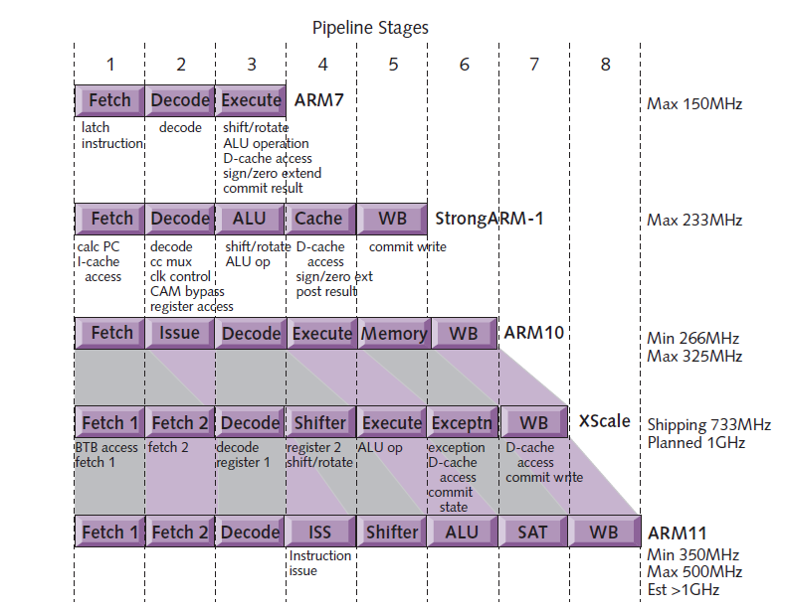
3.1 ARM’s CPU designs preceding the ARM Cortex family (10)
Evolution of the pipeline length of ARM v4 – Armv6 based CPU cores [8]
Armv4
Armv4
Armv5
Armv5
Armv6

Slide 107
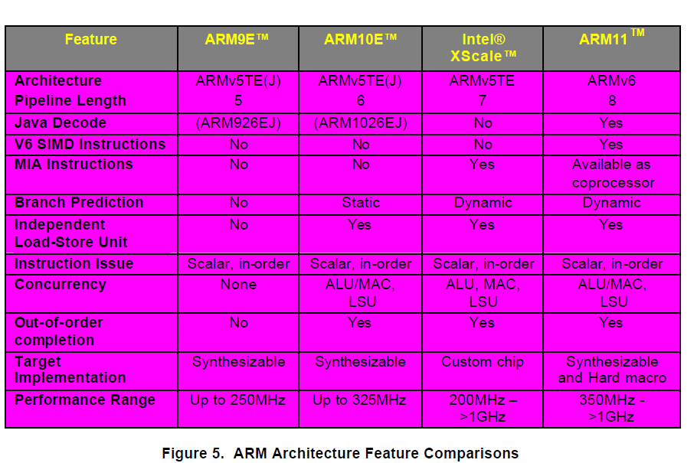
3.1 ARM’s CPU designs preceding the ARM Cortex family (11)
Main features of the Armv5 – Armv6 based CPU cores (≈1999-2003) [57]

Slide 108
3.1 ARM’s CPU designs preceding the ARM Cortex family (12)
Introduction of multicore CPUs by ARM: the ARM11 MPCore (Armv6)
07/2003: First public disclosure of the ARM11 MPCore.
05/2004: ARM11 MPCore (multi core ARM11 with 1-4 cores) available for licensing
with an evaluation system for early software development.
It is basically a cache coherent symmetric multicore with up to 4 cores.
The ARM11 MPCore incorporates the IEM (Intelligent Energy Manager)
It dynamically predicts the required performance and lowers the voltage and
frequency accordingly.

Slide 109
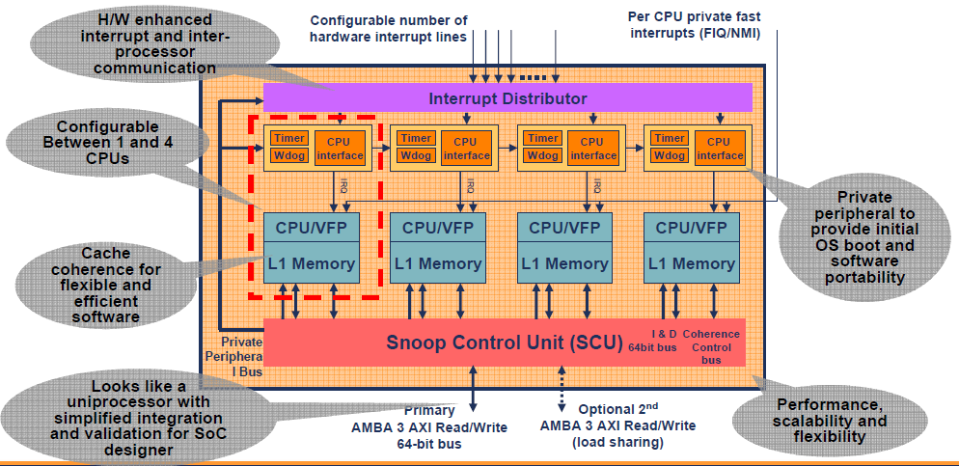
3.1 ARM’s CPU designs preceding the ARM Cortex family (13)
Block diagram of the ARM11 MPCore [9]
Note that the ARM11 MPCore does not include an L2.

Slide 110
3.2 Overview of the Cortex family of CPU cores

Slide 111
3.2 Overview of the Cortex family of CPU cores (1)
3.2 Overview of the Cortex family of CPU cores
In 10/2004 ARM announced the Cortex Family of CPU cores and its first model the
Cortex-M3 (microcontroller) CPU core.
The Cortex brand is used by ARM’s for their low power mobile oriented CPU cores,
based on the Armv7 ISA or later releases.
It is worth noting that ARM announced a second CPU brand in 2018 as well,
called Neoverse for CPU cores to be used in processors focused on information
infrastructures (datacenters, routers, switches etc.), discussed in another Chapter.
brand: márkanév

Slide 112
3.2 Overview of the Cortex family of CPU cores (2)
Profiles of ARM’s Cortex family of CPU cores [6], [7], [113] -1
In the technical specification of the Armv7 ISA ARM introduced three family profiles
to optimize its Cortex family CPU cores for specific market segments:
Profiles of ARM’s Cortex family of CPU cores
Cortex-A profile
(Application profile)
Cortex-R profile
(Real-time profile)
Cortex-M profile
(Microcontroller profile)

Slide 113
3.2 Overview of the Cortex family of CPU cores (3)
Profiles of ARM’s Cortex family of CPU cores [6], [7], [113] -2
The Cortex-A (application) profile
It aims at application processors running mobile OSs and user applications, like
processors in smartphones, tablets, netbooks, eBook readers etc.
At introduction it supported two instruction sets:
the 32-bit A32 and
the 16-bit T32 (Thumb, which is a subset of the A32)
instruction sets.
Subsequently, in 2012 the Armv8-A ISA was released
that supports 64-bit processing and has two execution modes:
the AArch32 execution mode to maintain compatibility with the A32
instruction set and
the AArch64 execution modes, to allow using the new, 64-bit A64
instruction set.
At the same time, in the AArch64 mode ARM terminated the support
of the T32 instruction set, finally
in the Armv9.0-A ISA, released in 2021
ARM withdrew the general availability of the AArch32 execution mode,
as indicated in the next Figure.

Slide 114
3.2 Overview of the Cortex family of CPU cores (4)
Overview of the Cortex CPUs
AArch32
AArch64
AArch64
Crypto-graph. extension
To enhance
security
TrustZone
Confidential
Compute Arch.
MTE
A32
SVE⁴
(v8.2, opt.)
A64
Aarch32⁵
A64
SVE2
To enhance
compute
capabilities
SIMD
Adv. SIMD¹
(NEON)
VFPv1/2
VFPv3/v4²
To speed up
the execution
of bytecodes
Jazelle
(Jazelle DBX)
Jazelle
(ex. by SW)
Jazelle RCT³
(ThumbEE)
Thumb⁶
(Armv4T)
Thumb-2
(Armv6T2)
T32
(Thumb)
Armv4
Armv5
Armv6
Armv7-A
Armv8.0-A
Armv9-A
ARM710T
(~1995)
ARM10200
(2000)
ARM1136
(2002)
Cortex-A5 - A15
(2005)
Cortex-A53/A57
(2012)
Neoverse N2/V1
Cortex-X2/A510/A710
(2021)
For the Remarks see the next slide.

Slide 115
3.2 Overview of the Cortex family of CPU cores (5)
Remarks to the introduced extensions
¹The Advanced SIMD architecture extension is commonly referred to as the
NEON technology.
The VFP subset became depricated in the Armv8 ISA.
³Jazelle-RTC (ThumbEE) became depricated in Armv7 Issue C in 10/2011.
⁴The SVE (Scalable Vector Extension) subset became introduced in the
Armv8 ISA as an optional feature, only in 2017.
⁵The AArch32 execution mode is only supported in certain implementations, e.g.
in the Cortex-A510 CPU.
⁶ The Thumb extension aims at reducing code size.

Slide 116
3.2 Overview of the Cortex family of CPU cores (6)
Profiles of ARM’s Cortex family of CPU cores [6], [7], [113] -3
The Cortex-R (Real-time) profile [113]
It aims at embedded CPUs for real time applications, like mass storage or
printer controllers.
It supports the A32 and T32 instruction sets.
The Cortex-M (Microcontroller) profile [113]
CPUs of the M profile are optimized for deeply embedded CPUs aimed at
microcontroller and cost-sensitive applications, like automotive body electronics
or smart sensors.
It supports writing interrupt handlers in high-level languages.
It maintains a variant of the T32 instruction set.

Slide 117
3.2 Overview of the Cortex family of CPU cores (7)
Extending the ARM Cortex family with the SecurCore profile in 10/2007
In 10/2007 ARM introduced the SecurCore profile.
It is optimized for smart card and secure applications.

Slide 118
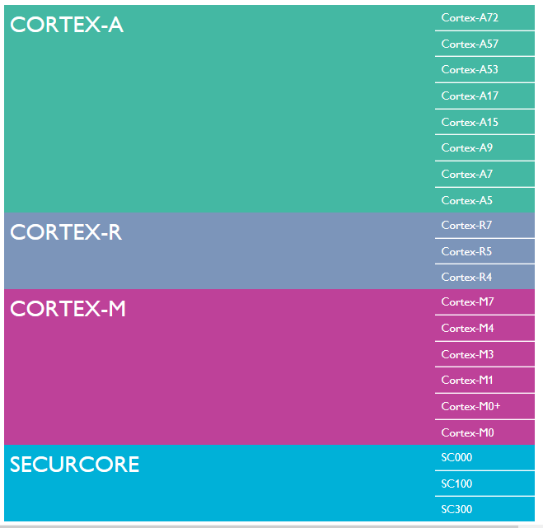
3.2 Overview of the Cortex family of CPU cores (8)
Overview of
Cortex profiles
and related CPU cores
(as of 2015) [6]

Slide 119
3.2 Overview of the Cortex family of CPU cores (9)
Remark
According to the general scope of this Lecture Notes, subsequently, we shall be
concerned only with the Cortex-A series of CPU cores.

Slide 120
3.2 Overview of the Cortex family of CPU cores (10)
Evolution of the Cortex-A family of CPUs
Cortex-A CPUs
based on
the 32-bit Armv7-A ISA
based on
the Armv8.0-A ISA
based on
the Armv8.2-A ISA
based on
the Armv9-A ISA
First CPUs
Cortex-A8
Cortex-A57/A53
Cortex-A75/A55
Cortex-X2/A710/A510
Section 3.3
Section 3.4
Section 3.5
Section 3.6
Only Subsection 3.3.4 and Section 3.6 are discussed in the Lecture and are parts
of the exam.

Slide 121
3.3 Armv7-A ISA-based 32-bit Cortex-A CPUs
3.3.1 Overview of Armv7-based 32-bit CPU designs
3.3.2 Armv7-based 32-bit single-core CPUs
3.3.3 Armv7-based 32-bit symmetrical multicore CPUs
3.3.4 Armv7-based 32-bit big.little CPUs
(Optional reading, not a part of the exam,
except for Subsection 3.3.4)
Notes:
121

Slide 122
3.3.1 Overview of Armv7-based 32-bit CPU designs
Notes:
122

Slide 123
3.3.1 Overview of Armv7-based 32-bit CPU designs (1)
3.3.1 Overview of Armv7-based 32-bit Cortex-A CPU designs
Cortex-A CPUs
based on
the 32-bit Armv7-A ISA
based on
the Armv8.0-A ISA
based on
the Armv8.2-A ISA
based on
the Armv9-A ISA
First CPUs
Cortex-A8
Cortex-A57/A53
Cortex-A75/A55
Cortex-X2/A710/A510
Section 3.3
Section 3.4
Section 3.5
Section 3.7

Slide 124
3.3.1 Overview of Armv7-based 32-bit CPU designs (2)
Overview of Armv7-A ISA-based 32-bit Cortex-A CPUs (based on [12]) -2
8
DMIPS/MHz
(Dhrystone MIPS: relative performance of the
DEC VAX 11/780 minicomputer)
(Dhrystone: synthetic benchmark for syst. progr.)
5/2016
Cortex-A73
Armv8
10 nm
7
Armv8.0-A
(64-bit)
2/2015
Cortex-A72
Armv8
16 nm
Announced
Armv7-A
(32-bit)
6
10/2012
Cortex-A57
Armv8
20/16 nm
5
9/2010
Cortex-A15
Armv7
32/28 nm
2/2014
Cortex-A17
Armv7
28 nm
4
6/2013
Cortex-A12
Armv7
28 nm
High Performance
3
Mainstream
10/2007
Cortex-A9
Armv7
40 nm
10/2012
Cortex-A53
Armv8
20/16 nm
11/2015
Cortex-A35
Armv8
16/14 nm
2
10/2005
Cortex-A8
Armv7
65 nm
10/2011
Cortex-A7
Armv7
28 nm
10/2009
Cortex-A5
Armv7
40 nm
1
Low power
2006
2007
2008
2009
2010
2011
2012
2013
2014
2015
2016

Slide 125
3.3.1 Overview of Armv7-based 32-bit CPU designs (3)
Main features of Armv7 ISA-based Cortex-A CPUs [51]
CPU Core | Announced | Available in devices | Target category | L2 cache | Multicore support (MPCore) | big.LITTLE support | Efficiency DMIPS/MHZ
Cortex-A8 | 2005 | 2009 | Mainstream | Optional | No | -- | 2,0
Cortex-A9 | 2007 | 2010 | Mainstream | Optional | Yes | -- | 2,5
Cortex-A5 | 2009 | 2011 | Low power | No L2 | Yes | -- | 1,6
Cortex-A15 | 2010 | Q2/2013 | High-end | Mandatory | Yes | Yes (with A7) | 4,0
Cortex-A7 | 2011 | 2012 | Low power | Optional | Yes | Yes (A15/A17) | 1,9
(Cortex-A12) | 2013 | withdrawn | Mainstream | -- | Yes | -- | 3,0
Cortex-A17 | 2014 | 2015 | Mainstream | Mandatory | Yes | Yes (with A7) | 4,0

Slide 126
3.3.1 Overview of Armv7-based 32-bit CPU designs (4)
Evolution of Armv7-based 32-bit CPU designs (2005-2014)
Evolution of main features of Armv7-A based 32-bit cores
Inclusion of
an L2 cache
Symmetrical multicore
designs
Support for big.LITTLE
configurations
The L2 cache became first an optional and then a mandatory feature.
All models following the Cortex-A8 became symmetrical multicore enabled, for up to 4 cores.
Along with the A7/A15 models
Cortex-A designs began supporting
big.little CPUs (201 1), where the Cortex-A15 cores are the big cores, whereas Cortex-A7 cores are
the little ones.
As indicated, Armv7-A-based cores were enhanced during their life-span by mandatory
L2 caches, and first, became symmetrical multicore and then big.little designs.

Slide 127
3.3.1 Overview of Armv7-based 32-bit CPU designs (5)
Armv7-based 32-bit CPU designs in mobile processors
Armv7-based 32-bit CPU designs in mobile processors
Single-core
CPUs
Symmetrical multicore
CPUs
big-little
CPUs
Typical Armv7 CPUs
CC interconnect
CC interconnect
Cortex-A8
Cortex-A9
Cortex-A7/A15
(≈2007-2012)
(~2011-2013)
(~2013-2016)

Slide 128
3.3.2 Armv7-based 32-bit single-core CPUs
Notes:
128

Slide 129
3.3.2 Armv7-based 32-bit single-core CPUs (1)
3.3.2 Armv7-based 32-bit single-core CPUs
Armv7-based 32-bit CPU designs in mobile processors
Single-core
CPUs
Symmetrical multicore
CPUs
big-little
CPUs
Typical Armv7 CPUs
CC interconnect
CC interconnect
Cortex-A8
Cortex-A9
Cortex-A7/A15
(≈2007-2012)
(~2011-2013)
(~2013-2016)

Slide 130
3.3.2 Armv7-based 32-bit single-core CPUs (2)
Use of Armv7-based 32-bit CPUs in single core mobile processors -1
Armv7-based 32-bit CPU designs in mobile processors
Single-core
processors
Symmetrical
multicores
bit big-little
core clusters
CC interconnect
CC interconnect
Armv7-A
CPUs
Cortex-A8/A9
Cortex-A5/A9
HP: Cortex-A15/A17
LP: Cortex-A7
Apple
APL2298 1C (2009)
A5 (2011)
(2C)
Samsung
Exynos
3110 1C (2010)
4412 4C (2012)
7 7580 2x4C (2015)
5410 (4+4)C (2013)
5420 (4+4)C (2013)
Qualcomm
Snapdragon
QSD8250 1C (2007)
(A8-based Scorpion core)
8260 2C (2013)
400 4C (2013)
Huawei
Kirin
(K3V2 4C (2012)
620 2x4C (2014)
920 (4+4)) 2014)
MediaTek
MT6515 1C (2012)
MT6575 1C (2012)
MT6582 4C (2013)
MT6592 2x4C (2013)
MT8135 (2+2)C (2013)
MT6595 (4+4)C (2014)

Slide 131
3.3.2 Armv7-based 32-bit single-core CPUs (3)
Use of Armv7-based 32-bit CPUs in single core mobile processors -2
As the precious Figure shows, Armv7-based single-core processors appeared
around 2007 and 2012 and were mostly built on the Cortex-A8 core.

Slide 132
3.3.3 Armv7-based 32-bit symmetrical multicore CPUs
Notes:
132

Slide 133
3.3.3 Armv7-based 32-bit symmetrical multicore CPUs (1)
3.3.3 Armv7-based 32-bit symmetrical multicore CPUs
Armv7-based 32-bit CPU designs in mobile processors
Single-core
CPUs
Symmetrical multicore
CPUs
big-little
CPUs
CC interconnect
CC interconnect
Typical Armv7 CPUs
Cortex-A8
Cortex-A9
Cortex-A7/A15
(≈2007-2012)
(~2011-2013)
(~2013-2016)

Slide 134
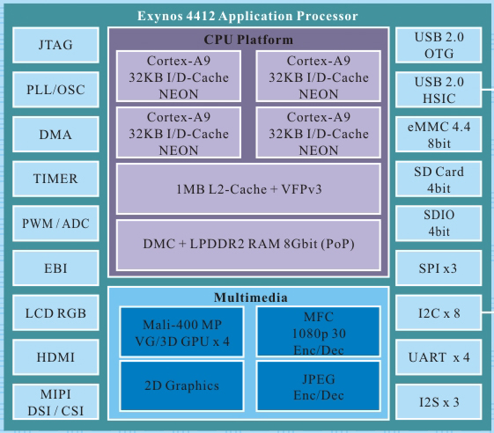
3.3.3 Armv7-based 32-bit symmetrical multicore CPUs (2)
Armv7-based 32-bit symmetrical multicore CPUs
CPUs implemented as symmetrical multicores have multiple CPU cores operating
in parallel, like the cores in the Figure below.
Example
Figure: Example of a symmetrical multicore processor [184]
(actually, Samsung’s Exynos 4412 mobile processor, 2012)

Slide 135
3.3.3 Armv7-based 32-bit symmetrical multicore CPUs (3)
Aim of introducing symmetrical multicores
Their aim is to raise performance by providing multiple CPU cores for execution
(rather than increasing reliability by multiple cores).

Slide 136
3.3.3 Armv7-based 32-bit symmetrical multicore CPUs (4)
When were Armv7-based 32-bit symmetrical multicore processors emerged
in mobile processors?
Below, we show when single-core processors gave way to Armv7-based symmetrical multicores.
Single-core processors
Symmetrical multi-core processors
ARM
Cortex-A8
Cortex-A5/A9
Apple
APL2298 1C (2009)
A5 (2011)
(2C)
Samsung
Exynos
3110 1C (2010)
4412 4C (2012)
Qualcomm
Snapdragon
QSD8250 1C (2007)
(A8-based Scorpion core)
8260 2C (2013)
400 4C (2013)
Huawei
Kirin
(K3V2 4C (2012)
MediaTek
MT6515 1C (2012)
MT6575 1C (2012)
MT6582 4C (2013)
MT6592 2x4C (2013)
As the above Figure indicates, Armv7-based symmetrical multicores replaced
single-core designs in mobile processors around 2010 – 2013.
This move happened about five years later than in desktop processors since first
dual-core desktop processors first appeared around 2005, such as Intel’s Pentium D (2005),
Core 2 (2006) or AMD’s K8-based Toledo (2005).

Slide 137
3.3.3 Armv7-based 32-bit symmetrical multicore CPUs (5)
Evolution of core counts in Armv7-based 32-bit symmetrical multicores
in mobile processors
First symmetrical multicores were typically dual core CPUs, but soon they became enhanced
to higher core counts, as seen below.
Core counts in Armv7-based 32-bit mobile processors with symmetrical multicores
2-cores
3-cores
4-cores
8-cores
Apple
A5 (2011)
(2x Cortex-A9)
A7 (2013)
(2x 64-bit Cyclone)
Samsung
Exynos
Exynos 3250 (2011)
2x Cortex-A7
Exynos 4412 (2012)
4x Cortex-A9
Qualcomm
Snapdragon
S200 (2013)
2x Cortex-A7
S400 (2013)
4x Cortex-A7
Huawei
Kirin
K3V2 (2012)
(4x Cortex-A9)
MediaTek
MT6572 (2013)
2x Cortex-A7
MT6582 (2013)
4x Cortex-A7
MT6592 (2013)
2x4 Cortex-A7
After the model designations, we indicate the release dates of the first models of the related lines
with the number of cores.

Slide 138
3.3.3 Armv7-based 32-bit symmetrical multicore CPUs (6)
Typical implementations of Armv7-based symmetrical multicores -1
a) Implementation of Armv7-based dual- and quad-core-core symmetrical multicores
Armv7-based dual- and quad-core symmetrical CPUs are built with private L1 caches
and a shared (inclusive) L2 cache, as shown below:
C0
C0
C0
C0
C0
C0
L1I/L1D
L1I/L1D
L1I/L1D
L1I/L1D
L1I/L1D
L1I/L1D
L2
L2
L2
L2
2-way core cluster with shared L2
4-way core cluster with shared L2
By contrast, Armv7-based octa-core processors including the same type of cores
(i.e., homogeneous multicores) have a different implementation, as discussed next.

Slide 139
3.3.3 Armv7-based 32-bit symmetrical multicore CPUs (7)
Typical implementations of Armv7-based symmetrical multicores -2
b) Implementation of Armv7-based octa-core symmetrical multicores
Armv7-based octa-core CPUs with the same type of cores are implemented as
dual, quad-core core blocks (clusters), with an L2 cache shared by all four cores
of the core block, as depicted in the Figure below.
Ci
Ci
Ci
Ci
Ci
Ci
Ci
Ci
Octa-core CPU implemented
as dual quad-core core blocks
E.g. 32-bit MediaTek’s MT6592 (2013)
Huawei’s Kirin 620 (2014)
Samsung’s Exynos 7 7580 (2015)
Shared, segmented L2
Shared, segmented L2
Interconnection Network (e.g. Crossbar)
Figure: Implementation of Armv7-based octa-core CPUs including the same type of cores

Slide 140
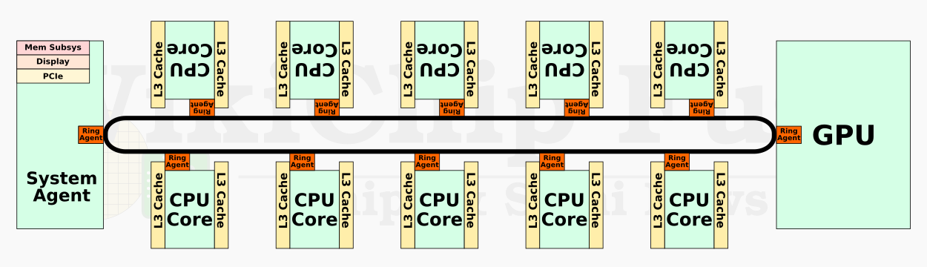
3.3.3 Armv7-based 32-bit symmetrical multicore CPUs (8)
Remark
Intel’s x86-based client or server processors are traditionally (up to the 11th gen.
Tiger Lake family), built up as symmetrical multicores,
as depicted below for the 10-core 10th gen. Comet Lake client processor.
Cache-coherent ring bus
Figure: Intel’s 10th gen. Comet Lake processor built up as a homogeneous
symmetrical multicore [187]
This kind of CPU implementation differs from AMD’s Zen-based or Armv7-based
homogeneous symmetrical multicore designs, since cores of the latter CPUs
are organized into 4-core core blocks.
Note that starting with their 12th generation Alder Lake family, Intel switched
to big.LITTLE processing with heterogeneous core blocks in 2021, as will be
briefly discussed in the next Section.

Slide 141
3.3.3 Armv7-based 32-bit symmetrical multicore CPUs (9)
Use of Armv7-based 32-bit CPUs in symmetrical multicore mobile processors
Armv7-based CPU designs in mobile processors
Single-core
processors
Symmetrical
multicores
big-little
core clusters
CC interconnect
CC interconnect
Armv7-A
CPUs
Cortex-A8/A9
Cortex-A5/A9
HP: Cortex-A15/A17
LP: Cortex-A7
Apple
APL2298 1C (2009)
A5 (2011)
(2C)
Samsung
Exynos
3110 1C (2010)
4412 4C (2012)
7 7580 2x4C (2015)
5410 (4+4)C (2013)
5420 (4+4)C (2013)
Qualcomm
Snapdragon
QSD8250 1C (2007)
(A8-based Scorpion core)
8260 2C (2013)
400 4C (2013)
Huawei
Kirin
(K3V2 4C (2012)
620 2x4C (2014)
920 (4+4)) 2014)
MediaTek
MT6515 1C (2012)
MT6575 1C (2012)
MT6582 4C (2013)
MT6592 2x4C (2013)
MT8135 (2+2)C (2013)
MT6595 (4+4)C (2014)

Slide 142
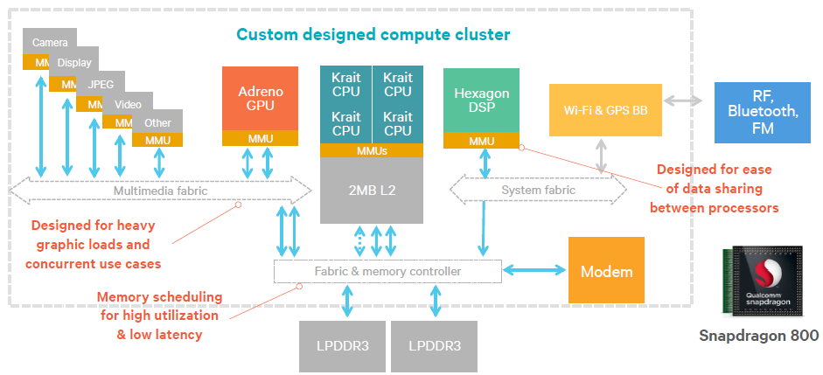
3.3.3 Armv7-based 32-bit symmetrical multicore CPUs (10)
Example: Block diagram of a 32-bit quad-core symmetrical multicore
(Qualcomm’s Snapdragon 800 SOC) (2013) [185]

Slide 143
3.3.4 Armv7-based 32-bit big.little CPUs
This Subsection is part of the Lecture and the exam.
Notes:
143

Slide 144
3.3.4 Armv7-based 32-bit big.little CPUs (1)
3.3.4 Armv7-based 32-bit big.little CPUs
Armv7-based 32-bit CPU designs in mobile processors
Single-core
CPUs
Symmetrical multicore
CPUs
big-little
CPUs
CC interconnect
CC interconnect
Typical Armv7 CPUs
Cortex-A8
Cortex-A9
Cortex-A7/A15
(≈2007-2012)
(~2011-2013)
(~2013-2016)

Slide 145
3.3.4 Armv7-based 32-bit big.little CPUs (2)
big.LITTLE core clusters-based mobile processors -2
This evolution was triggered by ARM's announcement of the big.LITTLE processing
scheme in 2011.

Slide 146
3.3.4 Armv7-based 32-bit big.little CPUs (3)
Use of Armv7-A based 32-bit big.little CPU design in mobile processors -1
Overview of Armv7 A-based CPU designs and their use in mobile processors
Single-core
CPUs
Symmetrical
multicore CPUs
big.little
CPUs (core clusters)
CC interconnect
CC interconnect
ARM CPUs
Cortex-A8/A9
Cortex-A5/A9
HP: Cortex-A15/A17
LP: Cortex-A7
Apple
APL 2298 1C (2009)
A5 (2011)
(2C)
Samsung
Exynos
3110 1C (2010)
4412 4C (2012)
5410 (4+4)C (2013)
5420 (4+4)C (2013)
Qualcomm
Snapdragon
QSD8250 1C (2007)
(A8-based Scorpion core)
8260 2C (2013)
400 4C (2013)
Huawei
Kirin
(K3V2 4C (2012)
920 (4+4)) 2014)
MediaTek
MT6515 1C (2012)
MT6575 1C (2012)
MT6582 4C (2013)
MT6592 2x4C (2013)
MT8135 (2+2)C (2013)
MT6595 (4+4)C (2014)

Slide 147
3.3.4 Armv7-based 32-bit big.little CPUs (4)
Use of Armv7-A based 32-bit big.little CPU design in mobile processors -2
The previous Figure shows that 32-bit big.LITTLE CPUs were introduced in Armv7-based
processors primarily around 2013-2014.

Slide 148
3.3.4 Armv7-based 32-bit big.little CPUs (5)
Remarks to introducing the big.LITTLE technology in x86-based processors as well
In 2020, Intel entered the client market with two Lakefield processor models, which
are big. LITTLE CPU design with one big and 4 LITTLE cores.
The Lakefield processors (with 7 W TDP) were implemented in the 3D packaging
technology and intended to be used in 2-in-1 or LW laptops.
This processor was more or less a pivot one without a generation identifier.
Subsequently, in 2021, Intel introduced an improved big.LITTLE processor
family, called the 12th gen. Alder Lake family fabricated in Intel 7 technology.
Alder Lake processors have up to 8 big and up to 8 LITTLE cores.
Its design goal is to cover all processor segments, from mobiles to servers.
Next, in 2022, Intel launched its 13th gen. Raptor Lake family with up to 8 big cores
and up to 16 little cores, manufactured further on in Intel 7 technology.
AMD is also rumored to be switching to big.LITTLE architectures, with their
Zen 5-based processors, expected to be launched in 2024.
LW: Lightweight

Slide 149
3.3.4 Armv7-based 32-bit big.little CPUs (6)
The rationale for big.LITTLE processing [190]
The main objective of big.LITTLE technology is to reduce power consumption.
Its concept is based on the recognition that the workload of smartphone or tablet processors dynamically changes, i.e., high-intensity processor demands alternate with low-intensity processor demands, as shown in a subsequent Figure.
When
high-intensity loads run on powerful but power-hungry cores, whereas
low-intensity loads on less powerful but less power-hungry cores
the total power consumption can be reduced.

Slide 150
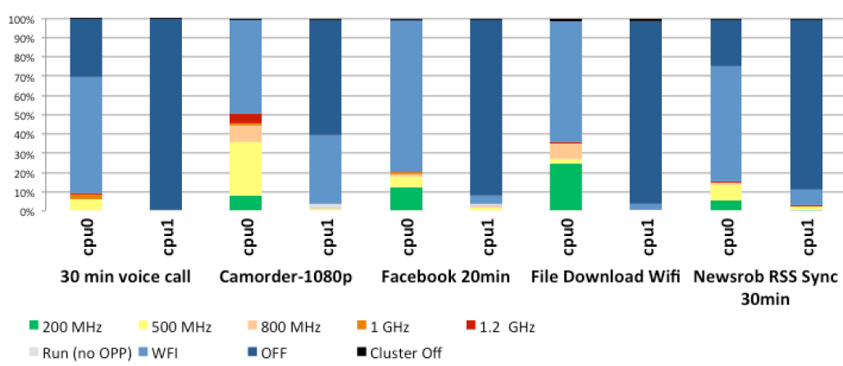
3.3.4 Armv7-based 32-bit big.little CPUs (7)
Example: Percentage of time spent in different processor states for less demanding
workloads in a dual-core mobile device [191] -1
(Core)
WFI: Waiting for Interrupt
The graph above shows the percentage of time spent in DVFS (active) states,
in idle states and shutdown states in a dual core Cortex-A9 based mobile device.
In the diagram, the red color indicates the highest, green the lowest frequency
operating points whereas colors in between represent intermediate frequencies.
Light blue means that the core is idling for Waiting for Interrupt (WFI), dark blue
indicates that the core or both cores are shut down.

Slide 151
3.3.4 Armv7-based 32-bit big.little CPUs (8)
Example: Percentage of time spent in DVFS states for low intensity
use cases in a mobile device [191] -2
As seen in the diagram, both cores spend most of their time idle, shut down, or
light intensity states, so there is a significant headroom for power saving when
less powerful but less power-hungry cores are used for light intensity, idle, or
shut down phases of the operation.

Slide 152
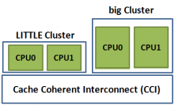
3.3.4 Armv7-based 32-bit big.little CPUs (9)
Remark: The big.LITTLE technology is an alternative task distribution policy
in heterogeneous multicore processors
Task distribution policies in heterogeneous multicore processors
Master/slave
processing
Task forwarding
to a dedicated accelerator
Task migration
to different kind of CPUs
Heterogeneous
master/slave processing
Heterogeneous
attached processing
Heterogeneous
big.LITLE processing
There is a master core (MCP)
and a number of slave cores.
The master core organizes
the operation of the slave cores
to execute a task
Beyond a CPU there are
dedicated accelerators,
like a GPU, available.
An instructon will be
forwarded to an accelerator
when it is capable of executing
this instruction more efficiently
than the CPU.
There are two or more clusters of cores, with
different power/performance characteristics,
e.g. two clusters; a LITTLE and a big one.
Cores of the LITTLE cluster execute
less demanding tasks and consume
less power, whereas cores of the big
cluster execute more demanding tasks
with higher power consumption.
MPC
Slave cores
CPU
GPU
E.g. the Cell processor from
IBM/Sony/Toshiba (2006).
Widely used in mobiles.
Widely used in mobiles.

Slide 153

3.3.4 Armv7-based 32-bit big.little CPUs (10)
Principle of implementing big.LITTLE processing -1 [192]

Slide 154
3.3.4 Armv7-based 32-bit big.little CPUs (11)
Principle of implementing big.LITTLE processing -2
Let’s have two or more clusters of architecturally identical cores in a processor.
E.g. let’s consider two clusters including four cores each;
a cluster of low performance/low power cores, termed as the llittle cores and
a cluster of higher performance, higher power cores, termed as the big cores,
as seen in the Figure below.
Cluster of
big cores
Cluster of
LITTLE cores
CPU0
CPU1
CPU0
CPU1
Figure: A big.LITTLE configuration
consisting of two core clusters
CPU2
CPU3
CPU2
CPU3
Cache coherent interconnect
To memory
Let’s interconnect these clusters by a cache coherent interconnect to have
a multicore processor, as indicated in the Figure above.

Slide 155
3.3.4 Armv7-based 32-bit big.little CPUs (12)
Principle of implementing big.LITTLE processing -3 [193]
There are several alternatives how big.LITTLE technology can be implemented,
as discussed in another Chapter of this Lecture Notes.
Nevertheless, to give a conceivable description of its principle of operation, we assume a specific implementation called “exclusive cluster switching” when
at any time either the big or the LITTLE core cluster is operating and
all cores of the big or little cluster operate at the same operating point
i.e., at the same clock frequency and core voltage,
as indicated in the next Figure.

Slide 156
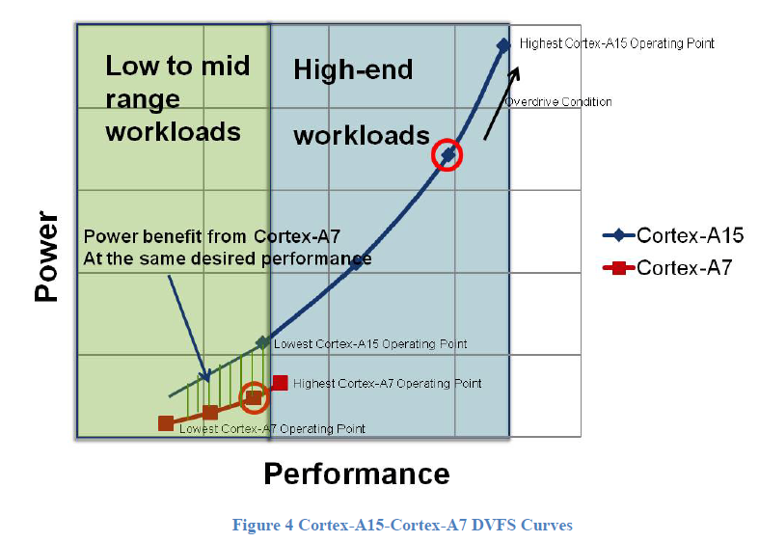
3.3.4 Armv7-based 32-bit big.little CPUs (13)
Example: Operating points of a multiprocessor built up of two core clusters:
one of LITTLE cores (Cortex-A7) and one of big cores (Cortex-A15), as
described above [194]

Slide 157
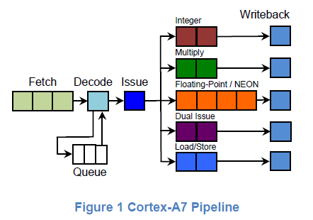
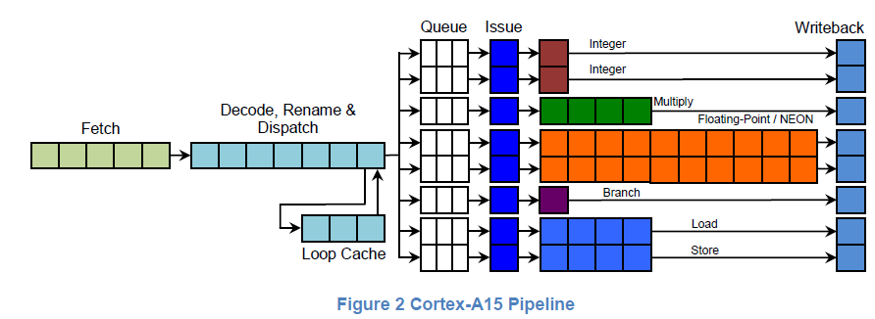
3.3.4 Armv7-based 32-bit big.little CPUs (14)
Examples of big (Cortex-A15) and LITTLE cores (Cortex-A7) [194]

Slide 158
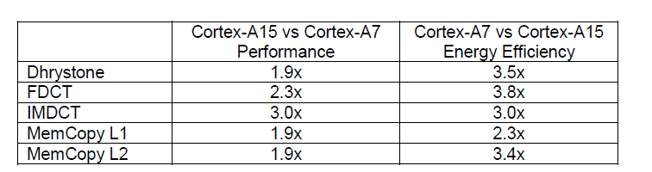
3.3.4 Armv7-based 32-bit big.little CPUs (15)
Performance and energy efficiency comparison of the Cortex-A15 vs. the
Cortex-A7 cores while running different workloads [194]

Slide 159
3.3.4 Armv7-based 32-bit big.little CPUs (16)
Principle of operation [193]
Let’s suppose that an appropriate OS routine (e.g., the cpufreq kernel routine
of Linux) tracks the workload and selects the operating points accordingly.
As long as the OS routine estimates that the actual workload can be tackled
by the cores of the „little” cluster, it activates only the cores of this cluster.
If, however, the workload exceeds the performance capability of the LITTLE core
cluster, it activates the high-performance cores of the “big” cluster and performs
a cluster switch by migrating the actual workload from the cores of the “little”
cluster to the cores of the “big” cluster, and switches off the cores of the
“little” cluster.
On the other hand, if the OS recognizes that the workload can be managed
by the cores of the “little” cluster alone, it initiates a cluster switch back
to the “LITTLE” cluster in a similar way as described above.
In this way, at any given time, only cores of one cluster can be active, and the
the choice of which cluster is activated depends on the intensity of the workload.
This kind of the big.little technology is called Exclusive cluster switching.

Slide 160
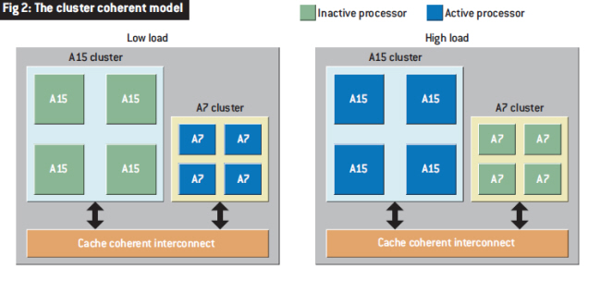
3.3.4 Armv7-based 32-bit big.little CPUs (17)
Illustration of the described model of operation [195]
Note that at low load the LITTLE (A7) and at high load the big (A15) cluster is
operational.

Slide 161
3.4 Armv8.0-A ISA-based 64-bit Cortex-A CPUs
(Optional reading, not a part of the exam)
Notes:
161

Slide 162
3.4 Armv8.0-A ISA-based 64-bit Cortex-A CPUs (1)
3.4 Armv8.0-A ISA-based 64-bit Cortex-A CPUs
Cortex-A CPUs
based on
the 32-bit Armv7-A ISA
based on
the Armv8.0-A ISA
based on
the Armv8.2-A ISA
based on
the Armv9-A ISA
First CPUs
Cortex-A8
Cortex-A57/A53
Cortex-A75/A55
Cortex-X2/A710/A510
Section 3.3
Section 3.4
Section 3.5
Section 3.7

Slide 163
3.4 Armv8.0-A ISA-based 64-bit Cortex-A CPUs (2)
Overview of Armv8.0-A ISA-based 64-bit Cortex-A CPUs -2 (based on [12])
8
DMIPS/MHz
(Dhrystone MIPS: relative performance of the
DEC VAX 11/780 minicomputer)
(Dhrystone: synthetic benchmark for syst. progr.)
5/2016
Cortex-A73
Armv8
10 nm
7
Armv8.0-A
(64-bit)
2/2015
Cortex-A72
Armv8
16 nm
Announced
Armv7-A
(32-bit)
6
10/2012
Cortex-A57
Armv8
20/16 nm
5
9/2010
Cortex-A15
Armv7
32/28 nm
2/2014
Cortex-A17
Armv7
28 nm
4
6/2013
Cortex-A12
Armv7
28 nm
High Performance
3
Mainstream
10/2007
Cortex-A9
Armv7
40 nm
10/2012
Cortex-A53
Armv8
20/16 nm
11/2015
Cortex-A35
Armv8
16/14 nm
2
10/2005
Cortex-A8
Armv7
65 nm
10/2011
Cortex-A7
Armv7
28 nm
10/2009
Cortex-A5
Armv7
40 nm
1
Low power
2006
2007
2008
2009
2010
2011
2012
2013
2014
2015
2016

Slide 164
3.4 Armv8.0-A ISA-based 64-bit Cortex-A CPUs (3)
Main features of Armv8.0-A ISA-based 64-bit Cortex-A CPUs [51]
CPU Core | Announced | Available in devices | Target category | L2 cache | Multicore support (MPCore) | big.LITTLE support | Efficiency DMIPS/MHZ
Cortex-A53 | 2012 | H2/2014 | Low power | Mandatory | Yes | Yes | 2,3
Cortex-A57 | 2012 | H2/2014 | High-end |  |  |  | 4,8
Cortex-A72 | 2015 | 2016 | High-end |  |  |  | 6.3-7.3
Cortex-A73 | 2016 | 2017 | High-end |  |  |  | 7.4-8.5
As indicated, Armv8.0-based cores are 64-bit designs and have the same features
as late Armv7-based ones.

Slide 165
3.4 Armv8.0-A ISA-based 64-bit Cortex-A CPUs (4)
Use of 64-bit Armv8.0-based CPUs in mobile processors
Armv8.0 based processors were used either in symmetrical multicore or big.little
CPU designs, as indicated in the Figure below.
64-bit Armv8.0-Arm9.0-based CPU designs in mobile processors
Symmetrical
multicores
big.little
core clusters
DynamIQ
core clusters
Armv9-A based
DynamIQ core clusters
CC interconnect
CC interconnect
CC interconnect
CC interconnect
ARM ISA
Armv8.0
Armv8.0
Armv8.2
Armv9.0
ARM cores
Cortex-A53
HP: Cortex-A57/
A72/A73
LP: A53
HP: Cortex-A75/A76/
A77/A78/X1
LP: A55
HP: Cortex-X2
MS: A-710
LP: A-510
As both symmetrical multicore and big. little CPU designs have been discussed previously
in Sections 3.3.3 and 3.3.4, we do not delve into the details of these designs here.

Slide 166
3.4 Armv8.0-A ISA-based 64-bit Cortex-A CPUs (5)
Use of 64-bit Armv8.0-based CPUs in mobile processors -1
64-bit Armv8.0-Arm9.0-based CPU designs in mobile processors
Symmetrical
multicores
big.little
core clusters
DynamIQ
core clusters
Armv9-A based
DynamIQ core clusters
CC interconnect
CC interconnect
CC interconnect
CC interconnect
ARM ISA
Armv8.0
Armv8.0
Armv8.2
Armv9.0
ARM cores
Cortex-A5/A9
HP: Cortex-A57/
A72/A73
LP: A53
HP: Cortex-A75/A76/
A77/A78/X1
LP: A55
HP: Cortex-X2
MS: A-710
LP: A-510
Processors
Apple
A7 (2013)
2C
A10 (2016)
(2+2)C (Armv8.1)
A11 (2017)
(2+4)C
Samsung
Exynos
7 7580 (2015)
8C
8 8890 (2016)
(4+4)C
9810 (2018)
(4+4)C
2200 (2022)
(1+3+4)C
Qualcomm
Snapdragon
410 (2014)
4C
439 (2018)
(4 +4)C
845 (2018)
(4+4)C
8 Gen 1(2022)
(1+3+4)C
Huawei
Kirin
620 (2014)
2x4C
650 (2016)
(4+4)C
980 (2018)
(2+2+4)C
MediaTek
MT6735 (2015)
4C
MT6750 (2016)
(4+4)C
Helio P90 (2+6)C (2019)
Dimensity 9000 (1+3+4)C (2021)

Slide 167
3.4 Armv8.0-A ISA-based 64-bit Cortex-A CPUs (6)
Use of 64-bit Armv8.0-based CPUs in mobile processors -2
As the previous Figure shows, Armv8.0-based processors appeared first as
symmetrical multicores rather than as big.little designs, around 2013 and 2016,
respectively, and were mostly built on the Cortex-A53 and A57 cores.

Slide 168
3.5 Armv8.2-A ISA-based 64-bit Cortex-A CPUs
a
(Optional reading, not a part of the exam)
Notes:
168

Slide 169
3.5 Armv8.2-A ISA-based 64-bit Cortex-A CPUs (1)
3.5 Armv8.2-A ISA-based 64-bit Cortex-A CPUs
Around 2018, the Armv8.2 revision was issued and 64-bit big.LITTLE core clusters
gave way to dynamIQ core clusters to benefit from greater design flexibility and
improve power efficiency.
DynamiQ core cluster may include up to 8 cores from two core types (as seen below).
64-bit Armv8.0-Arm9.0-based CPU designs in mobile processors
Symmetrical
multicores
big.little
core clusters
DynamIQ
core clusters
Armv9-A based
DynamIQ core clusters
CC interconnect
CC interconnect
CC interconnect
CC interconnect
ARM ISA
Armv8.0
Armv8.0
Armv8.2
Armv9.0
ARM cores
Cortex-A5/A9
HP: Cortex-A57/
A72/A73
LP: A53
HP: Cortex-A75/A76/
A77/A78/X1
LP: A55
HP: Cortex-X2
MS: A-710
LP: A-510
Figure: Emergence of CPU designs built up on Armv8.2-based DynamIQ core clusters

Slide 170
3.5 Armv8.2-A ISA-based 64-bit Cortex-A CPUs (2)
Let’s became acquainted with DynamIQ core clusters -1
ARM started working on the DynamIQ core cluster technology in 2013 [202].
It was released in 03/2017 along with the Armv8.2-A ISA.
The DynamIQ core cluster technology is an enhancement of the big.LITTLE design,
as indicated in the following slides.

Slide 171
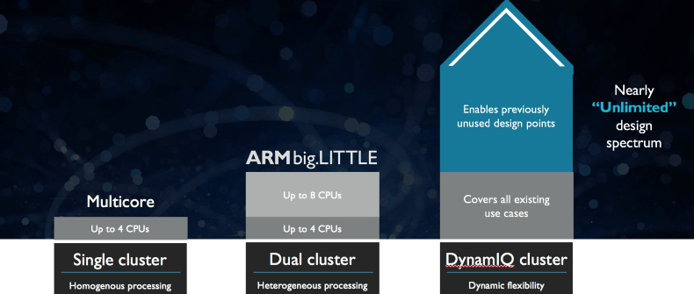
3.5 Armv8.2-A ISA-based 64-bit Cortex-A CPUs (3)
Let’s became acquainted with DynamIQ core clusters -2
It represents the third step in the evolution of the core cluster technology.
SMP
(
)
ARM11 MPCore (2004)
Cortex-A7/A15 (~2011)
Cortex-A55/A75 (~2017)
Figure: Evolution steps of the core cluster technology [203]

Slide 172
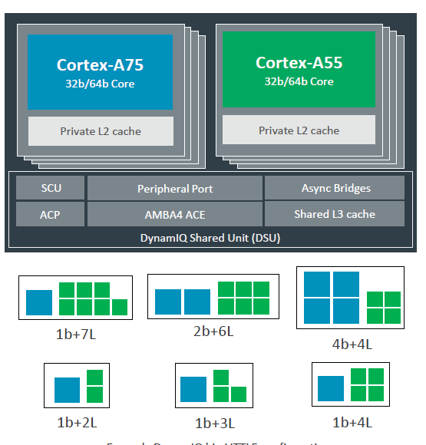
3.5 Armv8.2-A ISA-based 64-bit Cortex-A CPUs (4)
DynamIQ core clusters contrasted with big.little core clusters – an overview
big and LITTLE core clusters
A single DynamIQ core cluster [205]
Cluster of
big cores
Cluster of
LITTLE cores
CPU0
CPU1
CPU0
CPU1
CPU2
CPU3
CPU2
CPU3
L2 cache
L2 cache
To cache coherent interconnect through the AMBA4 ACE bus
To
Cache coherent interconnect
(2011)
Key features
Based on Armv7/v8-A (2011)
Dual clusters, up to 4 cores each
Based on Armv8.2-A (2017)
Single cluster, up to 8 cores (up to 4b), two core types
with different core mixes (but up to 4 big cores)

Slide 173
3.5 Armv8.2-A ISA-based 64-bit Cortex-A CPUs (5)
What are the key enhancements of the DynamIQ core clusters?
Up to 8 Armv8.2-A based cores instead of up to 4 Armv7/v8.0-A based cores
Private (per-core) L2 caches instead of a shared L2 cache
c) DynamIQ Shared Unit (DSU) with a shared L3 cache and snoop filter
Next, we will be discussing the improvements mentioned above.

Slide 174
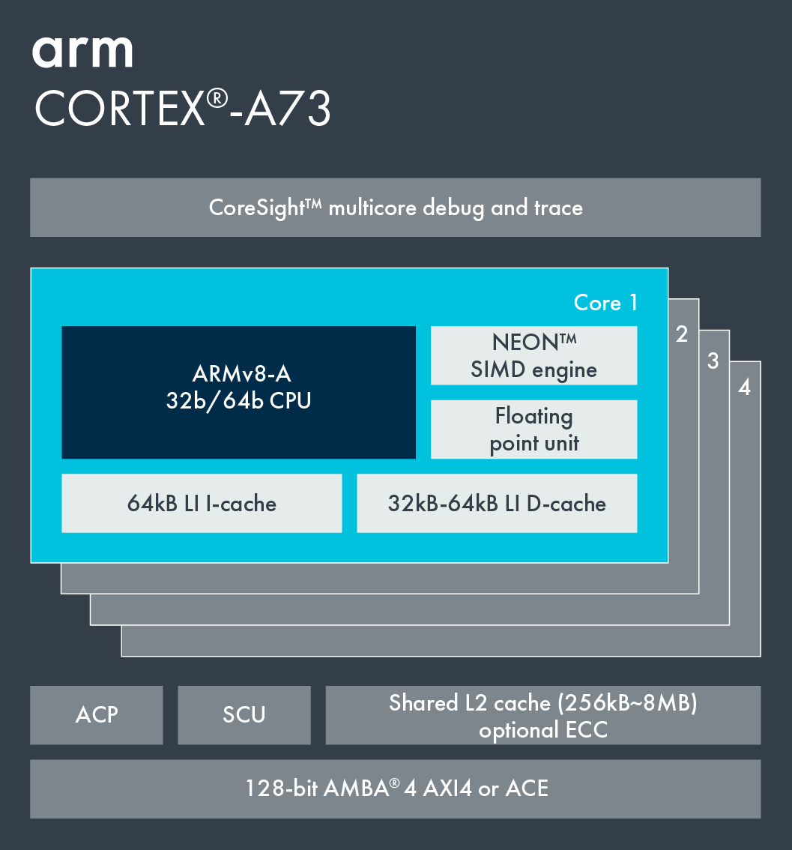
3.5 Armv8.2-A ISA-based 64-bit Cortex-A CPUs (6)
a) Up to 8 Armv8.2-A based cores instead of up to 4 Armv7/v8.0-based cores
big or LITTLE core cluster (2015) [206]
DynamIQ core cluster (2017) [205]
Cortex-A73 core
Armv8.0 CPU
Armv7/v8.0-A support,
e.g. Cortex-A53/A57/A72/A73,
single core type, up to 4 cores/cluster
Armv8.2-A support,
2 core types, up to 8 cores but only up to 4b/cluster,
Cortex-A75/55 and subsequent Cortex-A7x cores

Slide 175
3.5 Armv8.2-A ISA-based 64-bit Cortex-A CPUs (7)
Use of Armv8.2-A based cores in DynamIQ core clusters
DynamIQ core clusters assume two types of Armv8.2-A compatible cores, such as
high performance Cortex-A75/A76/A77/A78/X1 and
low performance/High efficiency Cortex-A55
cores.

Slide 176
3.5 Armv8.2-A ISA-based 64-bit Cortex-A CPUs (8)
b) Private (per-core) L2 caches instead a shared L2 cache
big or LITTLE core cluster (2015) [206]
DynamIQ core cluster (2017) [205]
Cortex-A73 core
Armv8.0 CPU
Armv8.0-A support, e.g. Cortex-A53/
A57/A72/A73, up to 4 cores/cluster
Shared L2 cache
Armv8.2-A support, (Cortex-A55/75)
2 CPU types, up to 8 cores but only 4b/cluster
Private L2 caches

Slide 177
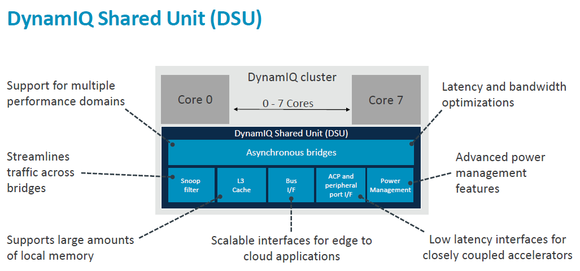
3.5 Armv8.2-A ISA-based 64-bit Cortex-A CPUs (9)
c) DynamIQ Shared Unit (DSU) with a shared L3 cache and snoop filter [207]
(Partitions)
(Snoop filter)
(Per-core DVFS control,
Partial L3 power down)
(L3 cache)
(Up to two 128-bit AMBA 5 ACE,
or up to two 256-bit AMBA 5 CHI bus)

Slide 178
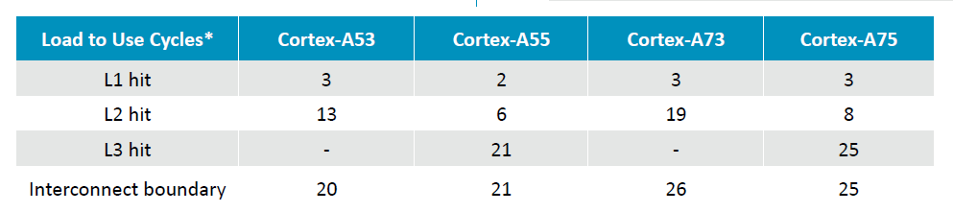
3.5 Armv8.2-A ISA-based 64-bit Cortex-A CPUs (10)
Reduced cache latencies in DynamIQ core clusters-based systems (in cycles) [207]

Slide 179
3.5 Armv8.2-A ISA-based 64-bit Cortex-A CPUs (11)
Main benefits of DynamIQ core clusters
greater flexibility due to up to two core types and up to 8 cores with different mixes
redesigned cache subsystem with lower access times
improved power efficiency through intelligent power management (EAS)
(Energy Aware Scheduling). It’s not detailed here.

Slide 180
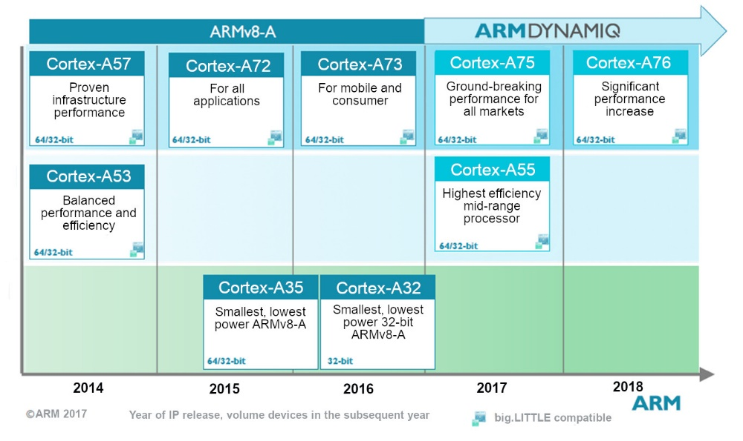
3.5 Armv8.2-A ISA-based 64-bit Cortex-A CPUs (12)
Introduction of Armv8.2-A based Cortex-A cores [153]
Armv8.0-A
Armv8.2-A
A7x
Series
A5x
Series
A3x
Series
Source: ARM

Slide 181
3.5 Armv8.2-A ISA-based 64-bit Cortex-A CPUs (13)
Main features of Armv8.2 based Cortex-A cores
Cortex model | ISA | Launched in | Target IC techn. | Decode rate | Dispatch rate | Issue rate | ROB size
A55 | Armv8.2 | 05/2017 | 10 nm | 2 | 2 | 2 | -- (In-order design)
A75 | Armv8.2 | 05/2017 | 10 nm | 3 | 6 | 8 | 128
A76 | Armv8.2 | 05/2018 | 12, 7, 5 nm | 4 | 8 | 9 | 128
A77 | Armv8.2 | 05/2019 | 7, 5 nm | 4 | 6 | 12 | 160
A78 | Armv8.2 | 05/2020 | 5 nm | 4 | 6 | 13 | 160
X1 | Armv8.2 | 05/2020 | 5 nm | 5 | 8 | 15 | 224
*

Slide 182
3.5 Armv8.2-A ISA-based 64-bit Cortex-A CPUs (14)
Use of 64-bit Armv8.2-based Cortex-A cores in mobile processors
Symmetrical
multicores
big.little
core clusters
DynamIQ
core clusters
Armv9-A based
DynamIQ core clusters
CC interconnect
CC interconnect
CC interconnect
CC interconnect
ARM ISA
Armv8.0
Armv8.0
Armv8.2
Armv9.0
ARM cores
Cortex-A5/A9
HP: Cortex-A57/
A72/A73
LP: A53
HP: Cortex-A75/A76/
A77/A78/X1
LP: A55
HP: Cortex-X2
MS: A-710
LP: A-510
Processors
Apple
A7 (2013)
2C
A10 (2016)
(2+2)C (Armv8.1)
A11 (2017)
(2+4)C
Samsung
Exynos
7 7580 (2015)
8C
8 8890 (2016)
(4+4)C
9810 (2018)
(4+4)C
2200 (2022)
(1+3+4)C
Qualcomm
Snapdragon
410 (2014)
4C
439 (2018)
(4 +4)C
845 (2018)
(4+4)C
8 Gen 1(2022)
(1+3+4)C
Huawei
Kirin
620 (2014)
2x4C
650 (2016)
(4+4)C
980 (2018)
(2+2+4)C
MediaTek
MT6735 (2015)
4C
MT6750 (2016)
(4+4)C
Helio P90 (2+6)C (2019)
Dimensity 9000 (1+3+4)C (2021)

Slide 183
3.5 Armv8.2-A ISA-based 64-bit Cortex-A CPUs (15)
Example of an Armv8.2-A based premium mobile system (2018) [209]
CCI-550: Cache Coherent Interconnect CoreSight: Test/debug unit
MMU-500: Memory Management Unit (responsible for virtualization and caching)
NIC-450: Network Interconnect (interface converter)
GIC-600: General Interrupt Controller
SCP: System Control Processor

Slide 184
3.6 Armv9-A based 64-bit Cortex-A CPUs

Slide 185
3.6 Armv9-A based 64-bit Cortex-A CPUs (1)
3.6 Armv9-A based 64-bit Cortex-A CPUs -1
64-bit Armv8.0-Arm9.0-based CPU designs in mobile processors
Symmetrical
multicores
big.little
core clusters
DynamIQ
core clusters
Armv9-A based
DynamIQ core clusters
CC interconnect
CC interconnect
CC interconnect
CC interconnect
ARM ISA
Armv8.0
Armv8.0
Armv8.2
Armv9.0
ARM cores
Cortex-A5/A9
HP: Cortex-A57/
A72/A73
LP: A53
HP: Cortex-A75/A76/
A77/A78/X1
LP: A55
HP: Cortex-X2
MS: A-710
LP: A-510
Introduced
(2007-2011)
(2013)
(2018)
(2021)

Slide 186
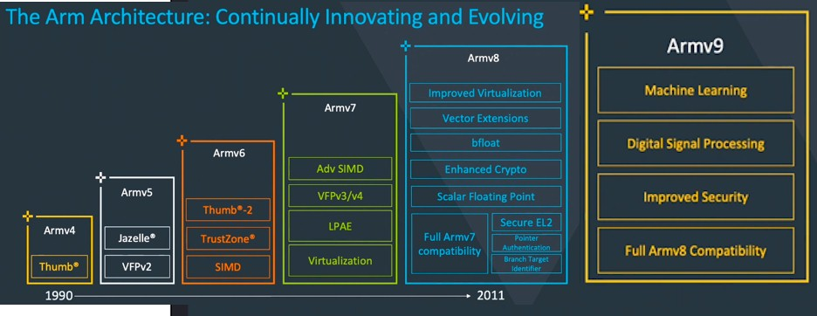
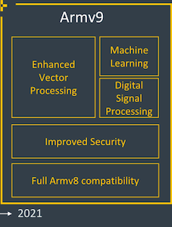
3.6 Armv9-A based 64-bit Cortex-A CPUs (2)
4.5 Armv9-A based DynamIQ core clusters-based mobile processors (1)
Armv9-A based 64-bit Cortex-A CPUs -2
In 03/2021 ARM announced the Armv9-A ISA, later renamed Armv9.0 ISA.
This revision enhanced vector processing, ML, and security (as indicated below),
and introduced Armv9-A-based DynamIQ core clusters (as detailed in this
Section).
(SVE2)
Adv. SIMD (NEON)
Figure: Evolution of the Arm ISA after the Armv3 release

Slide 187
3.6 Armv9-A based 64-bit Cortex-A CPUs (3)
Armv9.2-A ISA and CPUs based on the Armv9.2-A
In 05/2023, ARM released the Armv9.2 ISA update with several minor enhancements
of the Armv9.0 version (not discussed here).
In the following, we will describe Armv9.0-A and Armv9.2-A-based CPUs together
as Armv9-A-based CPUs.

Slide 188
3.6 Armv9-A based 64-bit Cortex-A CPUs (4)
Armv9-A based DynamIQ core clusters -1
Armv9-A-based DynamiQ core clusters are the next step in the evolution of
CPU configurations.
The new core clusters may include three core types out of 8 cores, instead of only
two, as in previous Armv8.2 DynamIQ core clusters, and provide additional
enhancements, as discussed subsequently.

Slide 189
3.6 Armv9-A based 64-bit Cortex-A CPUs (5)
From v7-based big.little to v8.2-based DynamIQ core clusters
big and LITTLE core clusters
A single DynamIQ core cluster [205]
Cluster of
big cores
Cluster of
LITTLE cores
CPU0
CPU1
CPU0
CPU1
CPU2
CPU3
CPU2
CPU3
L2 cache
L2 cache
To cache coherent interconnect through the AMBA4 ACE bus
To
Cache coherent interconnect
(2011)
Key features
Based on Armv7/v8-A (2011)
Dual clusters, up to 4 cores each
Based on Armv8.2-A (2017)
Single cluster, up to 8 cores (up to 4b), two core types
with different core mixes (but up to 4 big cores)

Slide 190
3.6 Armv9-A based 64-bit Cortex-A CPUs (6)
The DynamIQ Shared Unit of the DynamIQ core clusters [207]
(Partitions)
(Per-segment DVFS,
Partial L3 power down)
(up to 4 MB)
(Up to two 128-bit AMBA 5 ACE, or
up to two 256-bit AMBA 5 CHI bus)
ACP: Accelerator Coherency Port, port for not cache coherent sensors and accelerators
Snoop filter: (Kémlelő szürő) Cores send data request to all other cores, cores snoop all requests,
respond if appropriate, snoop filters used to speed up cache coherency management

Slide 191
3.6 Armv9-A based 64-bit Cortex-A CPUs (7)
What are the key enhancements of the Armv9-A based DynamIQ core clusters?
Use of up to three core types rather than only two, as before.
Sliced L3 caches, snoop filter, and the control logic.
The memory Tagging Extension (MTE).
Wider (scalable) bus interfaces.
Subsequently, we discuss the enhancements mentioned above.

Slide 192
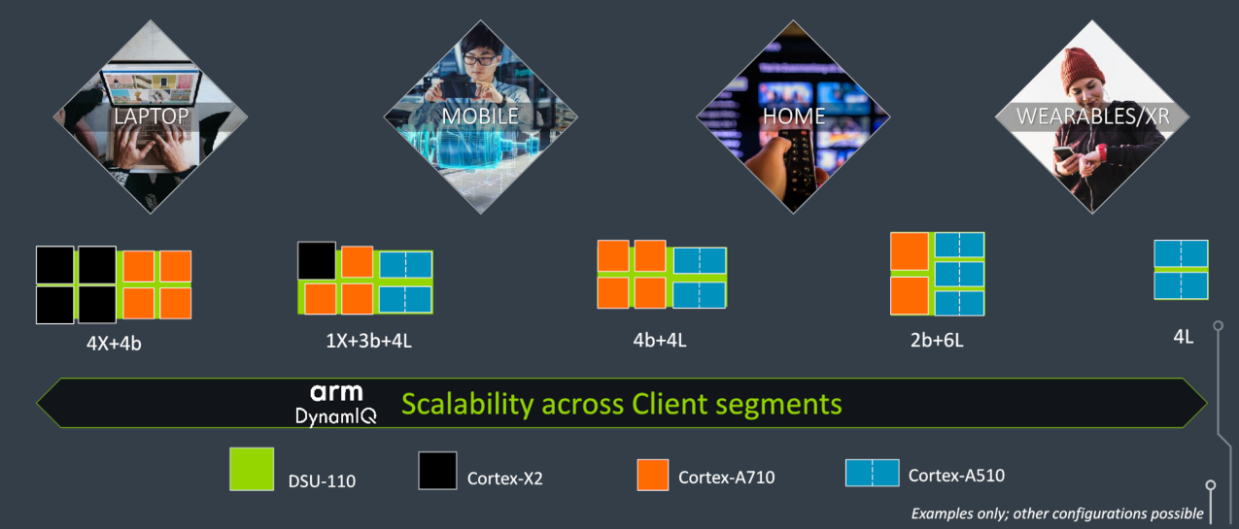
3.6 Armv9-A based 64-bit Cortex-A CPUs (8)
a) Possible use of three core types rather than two as in DynamIQ core clusters [210]
As seen, the new DynamIQ core cluster may have up to 8 cores out of 3 core types:
high-performance Cortex-X2 cores (even 8 Cortex-X cores),
high-efficiency Cortex-A710 big and
higher-efficiency Cortex-A510 LITTLE cores,
while the mix of the cores depends on the device type that is being targeted.

Slide 193
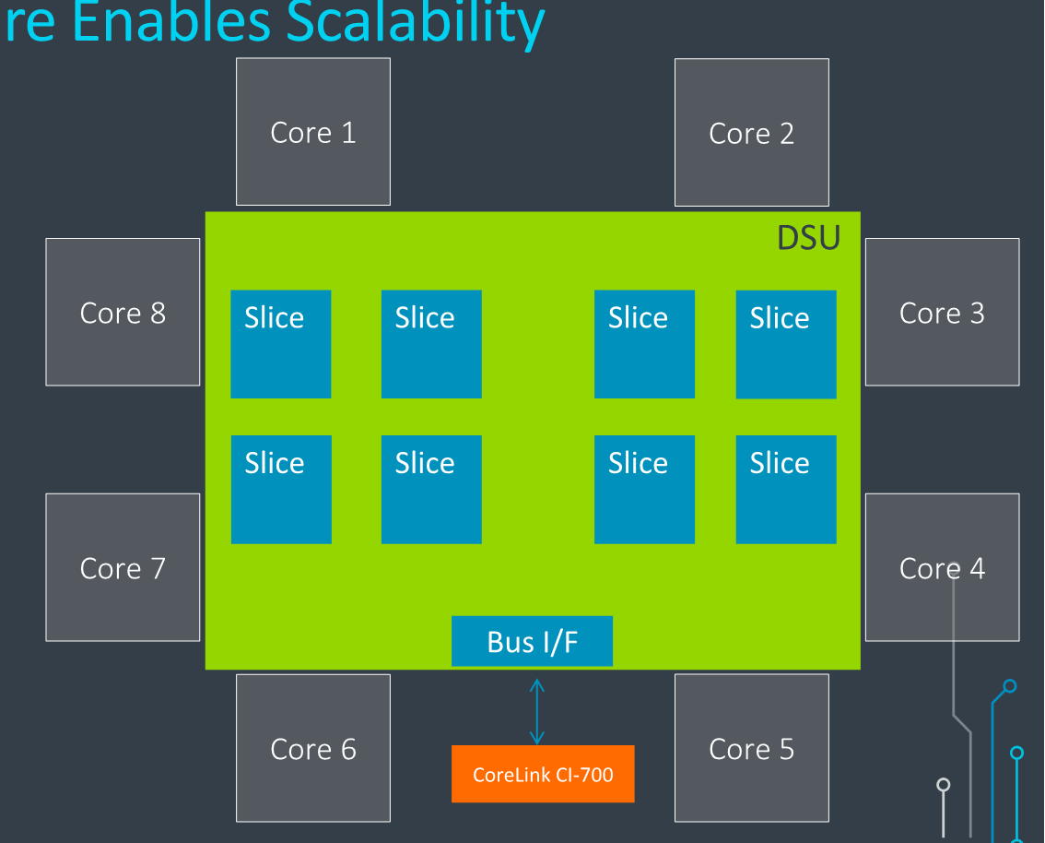
3.6 Armv9-A based 64-bit Cortex-A CPUs (9)
b) Sliced L3 cache, snoop filter and the control logic [210]
The L3 cache, snoop filter, and control logic are sliced, as indicated in the Figure
below.
Figure: Sliced implementation
of the L3 cache, snoop filter
and the control logic

Slide 194
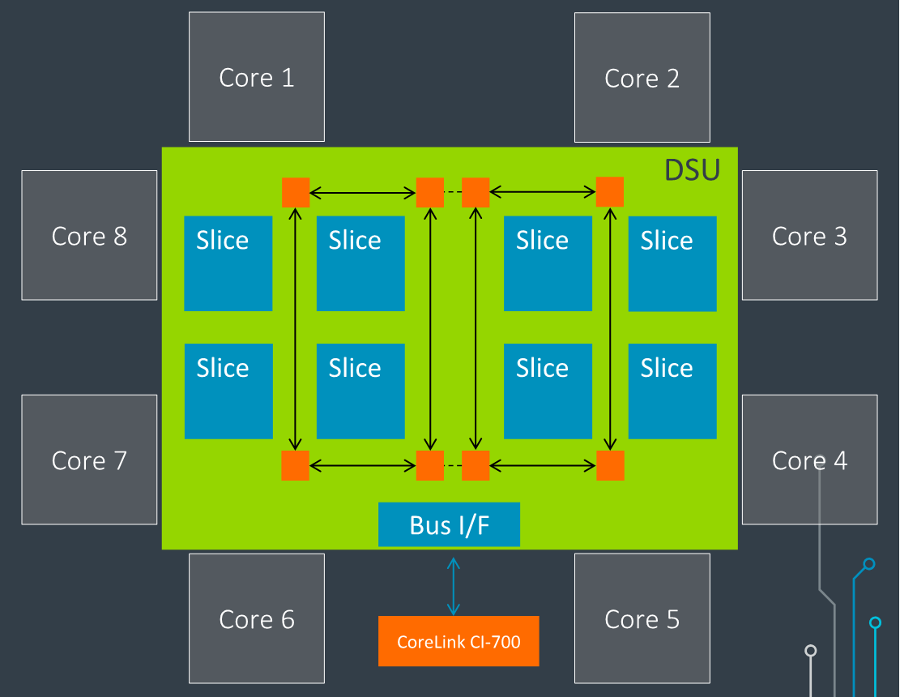
3.6 Armv9-A based 64-bit Cortex-A CPUs (10)
Interconnection of the slices [210]
Ring-based transport network
connects the cores to the
slices and the bus interface.
There are dual bi-directional
rings.
Traffic can take either direction
to shorten the delay.

Slide 195
3.6 Armv9-A based 64-bit Cortex-A CPUs (11)
Principle of sliced L3 caches
L3 caches
(They are mostly unified (for instructions and data) and shared by all cores)
Not sliced
Sliced
Uniform
cache architecture
Non-uniform
cache architecture
The cache is made up of a single entity, accessible at a single point.
All accesses are equally long (uniform).
The cache is made up of multiple interconnected slices (segments) that operate independently, allowing for parallel access.
However, cache accesses may be non-uniform,
i.e., they may vary in length.
C
C
C
C
C
C
L3 slice 0
L3 slice 1
L3 $
L3 slice 2
L3 slice 0
C
C

Slide 196

3.6 Armv9-A based 64-bit Cortex-A CPUs (12)
Major benefits of sliced L3 caches -1
1) As slices of L3 caches can operate in parallel, sliced caches with n slices,
have, in principle, an n-times higher memory bandwidth than unsliced caches.
Figure: Raising the L3 cache bandwidth due to parallel operating cache slices [210]

Slide 197
3.6 Armv9-A based 64-bit Cortex-A CPUs (13)
Major benefits of the sliced L3 caches -2
2) Smaller cache slices have a lower access time than a large cache.

Slide 198
3.6 Armv9-A based 64-bit Cortex-A CPUs (14)
Consequence of slicing the L3 cache – non-uniform cache accesses
While accessing sliced caches there are two access patterns:
the requested data is held in the accessed slice, i.e., it can be accessed
with a lower access time and
b) the requested data is kept in a remote slice, then the access needs a
longer time.
It follows that cache access times are now non-uniform; a sliced cache behaves
as a NUCA (Non-Uniform Cache Architecture).

Slide 199
3.6 Armv9-A based 64-bit Cortex-A CPUs (15)
Additional improvements: Increasing the L3 cache size and clock frequency
In addition, the size of the L3 cache is raised from up to 4 MBs (in the previous
generation) to up to 16 MB to achieve higher performance and lower power
consumption.
Also, the operation frequency of the L3 cache has been increased to achieve
higher bandwidth and lower latencies.

Slide 200
3.6 Armv9-A based 64-bit Cortex-A CPUs (16)
Remarks to the emergence of sliced L3 caches
It is worth noting that L3 caches in Intel’s or AMD’s client and ARM’s mobile Cortex
cores followed the same evolution paths,
namely, all firms mentioned initially used homogeneous (not sliced) L3 caches but
later shifted to sliced ones (as indicated below), primarily for higher performance
(cache bandwidth) due to parallel operating slices.
3-level cache architectures
Per-core, unified
L2 cache
Shared, unified
L3 cache
Not sliced
Sliced
Intel
Core 2 based
Nehalem 4C
(2008)
Core 2 based
Sandy Bridge 4C
(2011),
and subsequent proc.
AMD
K10 Barcelona
(2007)
K17 Zen core-based lines
(2017)
ARM
v8.2-A based cores
(2016)
v9-A based cores
(2021)

Slide 201
3.6 Armv9-A based 64-bit Cortex-A CPUs (17)
c) The Memory Tagging Extension (MTE)
Security issues concerning memory accesses
According to published figures of Microsoft and Google, over 70-75 % of
vulnerabilities come from memory safety issues (like buffer overflow-
based threats) [211]
Memory Tagging Extension aims at amending memory vulnerability.

Slide 202

3.6 Armv9-A based 64-bit Cortex-A CPUs (18)
Principle of memory tagging [202]
Memory tagging is implemented by locks and keys.
Locks are set in the memory and keys are attached to virtual memory addresses.
If the key matches the lock, the access is permitted, if not, an error occurs and
an exception is generated.
Figure: Using memory locks and
access keys to protect memory
against safety violations.

Slide 203

3.6 Armv9-A based 64-bit Cortex-A CPUs (19)
Principle of the implementation of memory tagging in ARM’s MTE -1 [212]
MTE provides locks to memory locations by adding a four bit tag to each 16 bytes
of the physical memory.
The tags are implemented in the System Level Cache (SLC) of the CI-700 (not discussed).
(CI: Coherent Interconnect)
Top byte of the adress

Slide 204
3.6 Armv9-A based 64-bit Cortex-A CPUs (20)
Principle of the implementation of memory tagging in ARM’s MTE -2 [212]
Keys, on the other hand are attached to pointers and thus to the virtual addresses,
as follows.
Concerning this point, MTE utilizes the fact that Armv8-A architectures do not
make use of the top byte of pointers (virtual addresses).
Top byte of the adress

Slide 205

3.6 Armv9-A based 64-bit Cortex-A CPUs (21)
d) Wider (scalable) bus interface [210]
The Scalable bus interface to the Cache Coherent Interconnect (CI-700) is vastly
enhanced by providing now 1, 2, or 4 256-bit wide bus interfaces while an updated
AMBA CHI bus protocol is used for more bandwidth and MTE support.
By comparison, the previous
Armv8.2-A based DynamIQ core
cluster provided a 2x256-bit or
2x128-bit wide bus interface
(implementation dependent).

Slide 206
3.6 Armv9-A based 64-bit Cortex-A CPUs (22)
Armv9-based Cortex-A CPUs
Armv9-based Cortex-A CPUs are the Armv9.0-A and Arm9.2-A based DynamIQ
Core Complexes.
They include up to three core types, called the
big
middle and
little
cores.
Above core types are implemented as the
Cortex-X series cores
Cortex-A700 series cores and the
Cortex-A500 series cores,
as indicated in the following Figure.

Slide 207

3.6 Armv9-A based 64-bit Cortex-A CPUs (23)
Three series of Armv9-A ISA based Cortex-A cores -1 [217]
The Cortex-X series are maximum performance big cores for single thread burst workloads.
The Cortex-A700 series are middle cores, balanced for efficiency and performance, for
multi-core workloads.
The Cortex-A500 series are efficient little cores, for background and lightweight workloads.

Slide 208
3.6 Armv9-A based 64-bit Cortex-A CPUs (24)
Three series of Armv9-A ISA based Cortex-A cores -2 [217]
The Cortex-X and Cortex-A700 series cores are traditional single-core CPUs, whereas
the Cortex-500 series are dual-core core complexes (modules), including dual FX cores
and double, shared NEON/SVE2 SIMD units with an L2 cache, as shown in the following
Figure.,

Slide 209

3.6 Armv9-A based 64-bit Cortex-A CPUs (25)
First Armv9.0-based Cortex-X and Cortex-A700 series cores: the Cortex-X2
and the Cortex-A710 cores (2021) [217]
Cortex-X2
Cortex-A710
512 KB/1 MB

Slide 210
3.6 Armv9-A based 64-bit Cortex-A CPUs (26)
Remark to the Cortex-X series
The Cortex-X series was introduced in 2020 as a series of extremely high-performance
cores, along with the Cortex-X Custom Program, to be described next.

Slide 211
3.6 Armv9-A based 64-bit Cortex-A CPUs (27)
ARM’s Cortex-X Custom Program (2020) [127]
It is an enhancement of the former “Built on ARM Cortex Technology” licensing model.
The licensee is enabled to customize standard ARM Cortex products for
performance-first designs.
A possible customization is, e.g., increasing the ROB (ReOrder Buffer) size.
Larger ROBs result in higher performance but need more power and larger
Si-area.
The customization requires early engineering collaboration between ARM and the
licensee and is done by ARM.
Under the new scheme, ARM maintains the ARM Cortex branding of the cores;
no licensee-specific core names are allowed.
The new, extra high-performance Cortex-X series CPUs are available only
to Cortex-X Custom Program licensees.
The first member of the Cortex-X series is the Armv8.2-based Cortex-X core (2020).
Customization: testre-szabás

Slide 212

3.6 Armv9-A based 64-bit Cortex-A CPUs (28)
First Armv9.0-based Cortex-A500 series core complex (module): the
Cortex-A510 (2021) [217]
Cortex-A710
ARM’s Cortex-A510 core complex (or core module) includes dual FX cores with
per core front-ends and execution units, but with shared dual, 64-bit or 128-bit
wide shared NEON/SVE2 execution units, further on, up to 512 KB L2 cache,
as indicated in the Figure above.

Slide 213

3.6 Armv9-A based 64-bit Cortex-A CPUs (29)
Remark to ARM’s Cortex-500 series core modules
ARM’s Cortex-500 core modules reflect basically the same concept as AMD’s
Bulldozer modules from 2011.
There is a notable difference in both concepts, because the A510 has separate
front-ends, but AMD’s modules do not.
AMD’s design style has the drawback of lowering FP and SIMD performance, which
became detrimental to the fate of the Bulldozer line of processors.
ARM justifies its module concept by pointing out that reducing FP- and SIMD performance
seems not so unfavorable for the little cores since FP and vector workloads
are expected to run on big CPU cores rather than on little cores.
Figure: AMD’s module concept introduced in the
Buldozer line in 2011 [161]

Slide 214

3.6 Armv9-A based 64-bit Cortex-A CPUs (30)
How may three core types be utilized for efficient big.little processing?
The power-performance curves of the cores reveal the answer.
Cortex-X3
Cortex-A715
Cortex-A510
Figure: Power-performance curves of 2. gen. Armv9.0-based cores [220]
While continuously selecting the optimal core for execution, processor efficiency is optimized.

Slide 215
3.6 Armv9-A based 64-bit Cortex-A CPUs (31)
Introducing the Total Compute Solutions (TCSs) concept along with the
Armv9.0-A ISA
TCSs are Armv9-based optimized platforms, announced in 05/2021.
They have four essential components:
the Cortex cores,
the DSU (DynamIQ Shared Unit)
a Mali GPU and
the CoreLink data interconnect.
ARM updates their TCSs yearly and indicates the year of introduction with a suffix
in the designation, such as TCS21, TCS22, etc.
As we are focusing on Armv9-A-based DynamIQ core clusters, we will only
be concerned with Armv9-A-based cores and DynamIQ Shared Units (DSUs), while
neglecting Mali GPUs and the CoreLink data interconnects.
In the following Figure, we show the core- and DSU components of the first
introduced TCS21 platform and compare their performance and efficiency with
previous implementations.

Slide 216

3.6 Armv9-A based 64-bit Cortex-A CPUs (32)
Introduction of the Armv9.0-based Total Compute Solutions (TCS) platform
concept in 2021 [217]
3.4.1 Main extensions of the Armv9.0 ISA
Note that the TCS21 platform includes not only the cores but also the DSU 110
(DynamIQ Shared Unit), an interconnect network (CoreLink), and a GPU (Mali 710).

Slide 217

3.6 Armv9-A based 64-bit Cortex-A CPUs (33)
The role of the Armv9-based DynamIQ Core clusters [217]
DynamIQ core clusters are the backbones of Armv9-based Total Compute Solutions.
Their key components are Armv9-based cores and the DSU (DynamIQ Shared Unit).
The max. core count depends on the TCS platform generation, as discussed later.
When considering the max. core count, cores of Cortex-A500 modules count 2.
As an example, the Figure below indicates key components of the first-generation
Armv9-based DynamIQ core clusters, which include up to 8 Cortex-X2/A710/A510
cores and the DSU-110 DynamIQ Shared Unit.
Figure: Armv9.0 based DynamIQ core cluster with up to 8 Cortex-X2/A710/A510 cores
and the DSU-110 DynamIQ Shared Unit
We note that the DSU-110 also includes a shared, up to 16 MB-sized L3 cache.

Slide 218

3.6 Armv9-A based 64-bit Cortex-A CPUs (34)
Use of an Armv9-based DynamIQ core cluster in a mobile SoC [178]
Mali (GPU)
Ethos (NPU)
DynamIQ
core cluster
CI-700: It provides a fully coherent, system-level cache and snoop filter.
NI-700: It is a scalable and highly configurable packetized Network-on-Chip (NoC) interconnect
with a 30 percent wire count reduction compared to a traditional crossbar.

Slide 219

3.6 Armv9-A based 64-bit Cortex-A CPUs (35)
Evolution of ARM’s TCS generations [218]
Next, we provide more details of how TCS generations evolved.

Slide 220
3.6 Armv9-A based 64-bit Cortex-A CPUs (36)
Contrasting key components of the preceding Armv8.2-based Cortex-X1
platform and the subsequent Armv9.0-based TCS21 platform
Cortex-X1-based platform
(Announced in connection with the Cortex Custom Program)
Supports both the AArch32/64 execution modes)
Intro | Arm ISA | Big core | Middle core | Little core | DSU
05/2020 | Armv8.2 | Cortex-X1 | -- | Cortex-A55 | DSU Up to 8 cores (Up to 4 big cores) Up to 4 MB L3
TCS21 (Total Compute Solutions 21 Platform)
(Only the Cortex-710 CPU supports both the AArch32/64 execution modes)
Intro | Arm ISA | Big core | Middle core | Little core | DSU
05/2021 | Armv9.0 | Cortex-X2 Single core | Cortex-A710 Single core | Cortex-A510 Dual-core module | DSU-110 Up to 8 cores (Up to 8x X2) Up to 8 MB L3

Slide 221
3.6 Armv9-A based 64-bit Cortex-A CPUs (37)
Evolution of key components of ARM’s TCS generations
TCS22 (Total Compute Solutions 22 Platform) G715 Mali GPU
(Only the updated Cortex-A510 core module supports both the Aarch32/64 modes)
Intro | Arm ISA | Big core | Middle core | Little core | DSU
06/2022 | Armv9.0 | Cortex-X3 | Cortex-A715 | Updated Cortex-A510 | Updated DSU-110 Up to 12 cores (Up to 8 X3 + 4 A715 cores) Up to 16 MB L3
TCS23 (Total Compute Solutions 23 Platform) with G720 Mali GPU
(Only Aarch64 support)
Intro | Arm ISA | Big core | Middle core | Little core | DSU
05/2023 (announced) | Armv9.2 | Cortex-X4 Up to 2 MB L3 (instead of 1 MB) | Cortex-A720 | Cortex-A520 | DSU-120 Up to 14 cores (Up to 10xX4 + 4x A720 cores) Up to 32 MB L3

Slide 222
3.6 Armv9-A based 64-bit Cortex-A CPUs (38)
Increasing core counts and L3 cache sizes in ARM’s TCS generations
As the previous Tables indicate, ARM notably enhanced their DynamIQ core clusters
in two main aspects:
a) The max. number of the supported cores was raised from 8 (TCS21) first to 10) TCS22)
and then to 14 (TCS23).
b) The max. size of the L3 cache has been doubled in each new generation, as follows:
 | X1-based DSU | TCS21 DSU110 | TCS21 DSU110 | TCS21 DSU110
L3 cache size (up to) | 4 MB | 8 MB | 16 MB | 32 MB
Table: Increasing maximum L3 cache sizes in the DSU Units

Slide 223
3.6 Armv9-A based 64-bit Cortex-A CPUs (39)
How much performance and efficiency uplift has AMD achieved by the cores of the
introduced TCS platforms vs. previous implementations? [217], [219], [220]
 | Uplift achieved by the cores vs. the previous implementation
Platform | Cortex-X-series cores in performance | Cortex-A700-series cores in efficiency | Cortex-A500-series cores in efficiency
TCS21 | 30 % | 30 % | 35 %
TCS22 | 22 % | 20 % | -5 %
TCS23 | 15 % | 20 % | 22 %
Cumulated uplift | 1.82x | 1.87x | 1.56x
Remarks
Upon first glance, it is surprising that the updated Cortex-A510 core module of the
TCS22 platform is 5% less efficient than its predecessor.
This is explained by the fact that the updated core module provides support for both
AArch32 and AArch64, whereas the previous core module A510 only supported AArch64.

Slide 224
3.6 Armv9-A based 64-bit Cortex-A CPUs (40)
Evolution of the Cortex-X core series
As pointed out previously, the Cortex-X series cores are ARM’s flagship client cores,
so their evolution is an intriguing issue.
This is why we first summarize key features of subsequent generations of ARM
Cortex-X cores and then illustrate how ARM raised their performance through
widening the core width.

Slide 225
3.6 Armv9-A based 64-bit Cortex-A CPUs (41)
Evolution of key features of Cortex-X cores [219]
Arm Cortex-X Evolution | Cortex-X4 (2023-2024) | Cortex-X3 (2022) | Cortex-X2 (2021) | Cortex-X1 (2020)
Expected mobile clock speed | ~3.4 GHz | ~3.3GHz | ~3.0GHz | ~3.0GHz
Instruction decode width | 10? | 6 | 5 | 5
Instruction pipeline length | n.a. | 9 | 10 | 11
OoO Execution Window | 768 2x384 | 640 (2x 320) | 576 (2x 288) | 448 (2x 224)
Integer Execution Units | 8x ALU (6 SX + 2 MX) | 6x ALU (4 SX + 2 MX) | 4x ALU (2 SX + 2 MX) | 4x ALU (2 SX + 2 MX)
FP/SIMD Execution Units | 4 | 4 | 4 | 4
Branch Units | 3 | 2 | 2 | 2
L1 cache | 64KB | 64KB | 64KB | 64KB
L2 cache | Up to 2MB | 512KB / 1MB | 512KB / 1MB | 512KB / 1MB
SX ALU: Single-cycle ALU MX ALU: Multi-cycle ALU (for Mul. od Div.)

Slide 226




3.6 Armv9-A based 64-bit Cortex-A CPUs (42)
Widening the front-end width in Arm’s Cortex-A X series cores [217]
$$≤4$$
$$≤6$$
$$≤8$$
$$≤8$$
As shown above, ARM widened the decode width from 4 to 6 in their high-performance
cores considered above.
Along with widening the front ends of the cores, ARM also introduced MOP caches
(in the A77 core) to raise the efficiency of instruction decoding and then increased
their access width from 6 to 8.
As a result, ARM could raise the dispatch rate of their cores first from 4 to 6
and, subsequently, from 6 to 8.
In addition, it is informative to contrast the evolution of the core width in mobile
cores designed by various vendors (see the following Figure).

Slide 227
3.6 Armv9-A based 64-bit Cortex-A CPUs (43)
Evolution of the width of mobile CPU cores -1
Width of mobile cores
(or of big cores of big.LITTLE or dynamIQ core clusters)
2-wide
3-wide
4-wide
5-wide
ARM
v7 HP Cortex-A15
(2010)
v7 Cortex-A (2005-09)
(except 1-wide LP A5 (2009)
and 3-wide HP A15))
v8.0 HP Cortex-A73
(2016)
v8.0 HP Cortex-A (2013-15) (except 2-wide HP Cortex-A73)
v8.0/8.2 LP Cortex-A
(2013/2017)
v8.2 HP Cortex-A75
(2017)
v8.2 HP Cortex-A76
(2018) to
HP Cortex-A78
(2020)
v8.2 HP Cortex-X1
(2020))
Intel
Atom family (2008-15)
Airmont-based Atom core (2016)
AMD
Cat family (2011-2015)
Apple
v7 Cortex-A8 (2009)
v7 Swift (A6) (2012)
Qualcomm
v7 Scorpion
(S1-S3) (2007-10)
v7 Krait
(S4/S400/S60x/S80x)
(2012-14)
v8 Kryo/Kryo 280
(S820/821/835) (2015/2016/2017)
v8.2 Kryo 385
(S845) (2018)
Samsung
v7 Exynos 5
(2013-14)
v8 Exynos 7
(2016)
v8.0 M1 (2016)
(Exynos 8 Octa)
v8 M2 (2017)
(Exynos 9 Octa)
HP: High-Performance/big core
LP: Low-Power

Slide 228
3.6 Armv9-A based 64-bit Cortex-A CPUs (44)
Evolution of the width of mobile CPU cores -2
Width of mobile cores
(or of big cores of big.LITTLE or dynamIQ core clusters)
6-wide
7-wide
8-wide
ARM
v9.0 HP Cortex-X3
(2022)
Intel
AMD
Apple
v8.0 HP A7-A10X
(2013-2017)
v8.2 HP A11 (2017)
v8.3 HP A12/A12X
(2018)
v8.4 HP A13 (2019)
v8.5 HP A14/M1
(2020)
Qualcomm
Samsung
v8.2 M3 (2018) Exynos 9810)
v8.2 M4 (2019) Exynos 9820)
v8.2 M5 (2019) Exynos 990)
v8.2 M6
(2020)/cancelled
HP: High-Performance/big core
LP: Low-Power

Slide 229
3.6 Armv9-A based 64-bit Cortex-A CPUs (45)
Evolution of the width of mobile CPU cores -3
As the above Figures show, while widening the front-end of the X3 core to 6,
ARM could catch up with Samsung’s Exynos M5 core, nevertheless, it trails Apple’s
recent cores that are up to 8 wide.

Slide 230
3.6 Armv9-A based 64-bit Cortex-A CPUs (46)
Use of Armv9-A based cores in mobile processors
Armv9-A based DynamIQ core clusters
Armv9.0-A based
DynamIQ core clusters
Armv9.2-A based
DynamIQ core clusters
(2021-)
(2022-)
(2023-)
ARM
HP: Cortex-X2 (64-bit)
MS: Cortex-A710 (32/64-bit)
LP: Cortex-A510. (64-bit)
HP: Cortex-X3 (64-bit)
MS: Cortex-A715 (64-bit)
LP: Cortex-A510 v2 64 32-bit)
HP: Cortex-X4 (64-bit)
MS: Cortex-A720 (64-bit)
LP: Cortex-A520 64-bit)
Apple
Samsung
Exynos
2200 (2022)
(1+3+4)C
Qualcomm
Snapdragon
8 Gen 1 (2022)
(1+3+4)C
8 Gen 2 (2022)
(1+4+3)C
Huawei
Kirin
MediaTek
Dimensity 9000 (1+3+4)C (2021)
Dimensity 9200 (1+3+4)C (2022)

Slide 231
3.7 Case example: The core complex of the TCS22 platform
(Optional reading, not a part of the exam)

Slide 232

3.7 Case example: The core complex of the TCS22 platform (1)
3.7 Case example: The core complex of the TCS22 platform
Components of the Core Complex in the TCS22 platform -1 [221]
As shown above the, TSC22 platform includes the Cortex-X3 big, the Cortex-A715
middle cores, the Cortex-A510 little core module, and the related DSU-110
DynamIQ Shared Unit.

Slide 233

3.7 Case example: The core complex of the TCS22 platform (2)
The DynamIQ core complex, as part of a TCS22-based mobile SoC [222]

Slide 234

3.7 Case example: The core complex of the TCS22 platform (3)
The DynamIQ Core Complex, as part of a TCS22-based mobile SoC [223]
Remarks
The Cortex-R82 is a high-performance 64-bit real-time processor that aims at
mobile modem and storage controller applications.
The Cortex-M85 is a 64-bit processor with integrated security capability and
supports AI as well.

Slide 235
3.7 Case example: The core complex of the TCS22 platform (4)
The DynamIQ Core Complex of the TCS22 platform -2 [221]
Subsequently, we describe key features of the Core Complex of the TSC22 platform
in the sequence:
a) Cortex-X3
b) Cortex-A715 and
c) Updated Cortex-A510 CPUs as well as the
d) Updated DSU-110 DynamIQ Shared Unit.

Slide 236
3.7 Case example: The core complex of the TCS22 platform (5)
a) The high-performance Cortex-X3 core -1
It focuses on performance, by contrast, the Cortex-A715 CPU on balanced
performance and efficiency, whereas the refreshed Cortex-A510 core module
on efficiency.
The Cortex-X3 is expected to be used predominantly in premium, large-screen
mobiles and laptops.

Slide 237
3.7 Case example: The core complex of the TCS22 platform ()
The high-performance Cortex-X3 core -2
Beginning with Armv9.0-A based cores ARM cancelled Aarch32 support
(except in the Cortex-A 710).
Consequently, in the Cortex-X2 core, ARM designers removed the circuitry used
for implementing the AArch32 execution mode.
Subsequently, the new Cortex-X3 design already was optimized for the AArch64
mode.
The optimization covered most parts of the microarchitecture, including
instruction fetching,
instruction decoding,
branch prediction,
data prefetching,
instruction cache bandwidth,
MOP (Macro-Operation) cache,
OOO (Out-Of-Order) window size (ROB size)
Number of integer execution units.
From all of the enhancements enlisted above, subsequently, we only point out
one aspect, namely the widening of the X3 core vs. the X2 core, while showing
how this move fits into the evolution of the front-end width of ARM cores
(from Armv8.2 to Armv9.0 –based cores).

Slide 238
3.7 Case example: The core complex of the TCS22 platform (6)
Widening the front-end width in Arm’s Cortex-A/X series cores [217]
$$≤4$$
$$≤6$$
$$≤8$$
$$≤8$$
As the above Figure indicates, ARM widened the decode width from 4 to 6 in their
high-performance Cortex-A76 to Cortex-X3 core family.
In parallel with widening the front-ends of the cores, ARM also introduced
MOP caches (along with the A77 core) to raise the efficiency of instruction
decoding and increased their access width from 6 to 8.
As a result, in the considered cores, the dispatch rate could be raised first from 4
to 6 and then to 8.

Slide 239

3.7 Case example: The core complex of the TCS22 platform (7)
Microarchitecture of the Cortex-X3 core [223]

Slide 240

3.7 Case example: The core complex of the TCS22 platform (8)
IPC uplift of Cortex-X3 cores vs. the previous Cortex-X2 cores [217]
As the above Figure indicates, ARM achieved about 10 % performance boost in
SPECint_base2006 benchmark scores (measured on a set of real world applications,
while calculating the geometric mean of the results).

Slide 241

3.7 Case example: The core complex of the TCS22 platform (9)
b) The balanced efficiency and performance Cortex-A715 big core
The Cortex-715 is the successor of the Cortex-A710, as indicated in the Figure below.
Figure: The sequence of ARM’s big and little cores [218]

Slide 242
3.7 Case example: The core complex of the TCS22 platform (10)
Key differences between ARM’s Cortex-A715 and Cortex-A710 cores
Unlike the Cortex-710 the Cortex-715 does not support the 32-bit AArch32
execution mode.
Consequently, all circuitry needed for the 32-bit mode could be removed, which
, e.g., dramatically simplifies the decoder design.
The Cortex-715 has a 5-wide decoder, which is an upgrade from the previous 4-wide
decoder of the Cortex-A710, allowing a wider front end.
Further, it lacks an MOP cache, as depicted in the following Figure.

Slide 243

3.7 Case example: The core complex of the TCS22 platform (11)
Contrasting the front-ends of the Cortex-A715 and Cortex-A710 cores [218]

Slide 244

3.7 Case example: The core complex of the TCS22 platform (12)
Microarchitecture of the Cortex-A715 [223]

Slide 245

3.7 Case example: The core complex of the TCS22 platform (13)
Power-performance curves of the Cortex-A715 and A710 cores [218]
Obviously, the new design allows higher performance at the same power consumption
or provides the same performance at a lower power consumption.

Slide 246

3.7 Case example: The core complex of the TCS22 platform (14)
ARM’s power/performance statements relating to their Cortex-A715 vs. the
Cortex-A710 cores [218]

Slide 247
3.7 Case example: The core complex of the TCS22 platform (15)
c) The high efficiency updated Cortex-A510 little core module
It is a refreshed version of the Armv9.0-A based Cortex-A510.
In big.little mobile designs it is expected to be employed as the little CPU.
In contrast to the 1. gen. Cortex-A510, the updated version optionally supports
the AArch32 ISA to allow its use in legacy mobile or IoT designs.
Unlike the Cortex-X2/X3 and Cortex-A710/715 CPUs the Cortex-A510/updated A510
is a dual core module, as already mentioned and indicated in the next Figure.

Slide 248

3.7 Case example: The core complex of the TCS22 platform (16)
Example for substituting four “ordinary” little cores in an Armv8.2-A based
CPU by dual Armv9-A based A510 core modules [157]

Slide 249
3.7 Case example: The core complex of the TCS22 platform (17)
Architecture of the Cortex-A510/and updated A510 core modules [157]
Cortex-A710
ARM’s Cortex-A510/updated 510 core complexes consist of two Cortex-510 FX cores
with separate front-ends and scalar execution units, while both cores share
dual 64- or 128-bit wide NEON and SVE2 execution units and a L2 cache,
as indicated above.
Both cores have a 3-wide in-order front-end, as seen in the next Figure.

Slide 250

3.7 Case example: The core complex of the TCS22 platform (18)
Architecture of the Cortex-A510/updated A510 core modules -2 [224]
Both CPUs have a 3-wide in-order front-end, as seen below.

Slide 251

3.7 Case example: The core complex of the TCS22 platform (19)
Assumed microarchitecture of the Cortex-A510 core module [221]

Slide 252

3.7 Case example: The core complex of the TCS22 platform (20)
Components of the updated DSU-110 DynamIQ Shared Unit [225]
As indicated above, the DSU includes Arvv9.0-based cores, the shared L3 cache,
and further units, not discussed here.
The max core count is 12.
The shared L3 cache is up to 16 MB sized.

Slide 253
3.8 Summing up: Main evolution steps of Armv7 to Armv9-based CPU designs in mobile processors

Slide 254
3.8 Main evolution steps of Armv7-v9 based CPU designs in mobile processors (1)
3.8 Summing up: Main evolution steps of Armv7 to Armv9-based CPU designs
in mobile processors
Next, we give an overview of the main steps of how ARM’s Cortex-A CPUs
evolved.

Slide 255
3.8 Main evolution steps of Armv7-v9 based CPU designs in mobile processors (2)
Emergence of single-core Armv7-based 32-bit CPUs in mobile processors -1
How have Armv7-based CPUs appeared in mobile devices?
During the second half of the 2000s, an increasing number of vendors
began using the Cortex-A8 CPU in their smartphones, leading to ARM’s
dominance in mobile processors, as indicated in the next Figure.
The Cortex-A8 CPU was a single-core design.
Armv7-based 32-bit CPU designs in mobile processors
Single-core
CPUs
Typical Armv7 CPUs
Cortex-A8
(≈2007-2012)

Slide 256
3.8 Main evolution steps of Armv7-v9 based CPU designs in mobile processors (3)
Emergence of single-core Armv7-based 32-bit CPUs in mobile processors -2
Armv7-based 32-bit CPU designs in mobile processors
Single-core
processors
Armv7-A
CPUs
Cortex-A8 (~2007)
Apple
APL2298 1C (2009)
Samsung
Exynos
3110 1C (2010)
Qualcomm
Snapdragon
QSD8250 1C (2007)
(A8-based Scorpion core)
Huawei
Kirin
MediaTek
MT6515 1C (2012)
MT6575 1C (2012)
Next, symmetrical multicore CPUs emerged and evolved, as shown
in the next Figure.

Slide 257
3.8 Main evolution steps of Armv7-v9 based CPU designs in mobile processors (4)
Emergence of Armv7-based 32-bit symmetrical multicore CPUs and their
evolution
Evolution of Armv7-based 32-bit symmetrical multicore CPUs up to the
Armv8.0-based 64-bit big.little designs in mobile processors
32-bit symmetrical
multicores
32-bit big-little
core clusters
64-bit symmetrical
multicores
64-bit big.little
core clusters
CC interconnect
CC interconnect
CC interconnect
CC interconnect
ARM ISA
Armv7
Armv7
Armv8.0
Armv8.0
ARM CPUs
Cortex-A5/A8/A9
HP: Cortex-A15/A17
LP: Cortex-A7
Cortex-A53
HP: Cortex-A57/
A72/A73
LP: A53
Processors
Apple
A5 (2011)
(2C)
A7 (2013)
2C
A10 (2016)
(2+2)C (Armv8.1)
Samsung
Exynos
4412 4C (2012)
7 7580 2x4C (2015)
5410 (4+4)C (2013)
5420 (4+4)C (2013)
7 7580 (2015)
8C
8 8890 (2016)
(4+4)C
Qualcomm
Snapdragon
8260 2C (2013)
400 4C (2013)
410 (2014)
4C
439 (2018)
(4 +4)C
Huawei
Kirin
(K3V2 4C (2012)
620 2x4C (2014)
920 (4+4)) 2014)
620 (2014)
2x4C
650 (2016)
(4+4)C
MediaTek
MT6582 4C (2013)
MT6592 2x4C (2013)
MT8135 (2+2)C (2013)
MT6595 (4+4)C (2014)
MT6735 (2015)
4C
MT6750 (2016)
(4+4)C

Slide 258
3.8 Main evolution steps of Armv7-v9 based CPU designs in mobile processors (5)
Transferring Armv7-based 32-bit symmetrical multicores to Armv8.0 64-bit
big.LITTLE designs along two alternative paths -1
Let’s recognize that processor vendors have transitioned from Armv7-based 32-bit
symmetrical multicores to Armv8.0-based 64-bit big.LITTLE CPU designs in two
consecutive steps along two different paths, as indicated below.
Apple A7 (2013)
Samsung E7 7580 (2015)
Qualcomm 410 (2015)
Huawei 620 (2014)
MediaTek MT6735 (2015)
Apple A5 (2011)
Samsung 4412 (2012)
Qualcomm 8260 (2013)
Huawei K3V2 (2012)
MediaTek MT6582 (2013)
Apple A10 (2016)
Samsung E8 8890 (2016)
Qualcomm 439 (2018)
Huawei 650 (2016)
MediaTek MT6750 (2016)
Armv8.0 64-bit symmetrical
multicore CPU
Armv7 32-bit symmetrical
multicore CPU
Armv8.0 64-bit big.LITTLE
CPU
Samsung 4412 (2012)
Huawei K3V2 (2012)
MediaTek 6582 (2013)
Armv7 32-bit
big.LITTLE
CPU/
Samsung E. 8 8890 (2016)
Huawei 650 (2016)
MediaTek MT6750 (2016)
Samsung 5410 (2013)
Huawei 920 (2014)
MediaTek MT8135 (2013)

Slide 259
3.8 Main evolution steps of Armv7-v9 based CPU designs in mobile processors (6)
Transferring Armv7-based 32-bit symmetrical multicores to Armv8.0 64-bit
big.LITTLE designs along two alternative paths -2
As the previous Figure indicates,
some vendors first switched to Armv8-based 64-bit symmetrical multicores and then
to the 64-bit big.LITTLE configuration,
other vendors, as well as the same vendors in different product lines, first
transitioned to Armv7-based 32-bit big.LITTLE designs, and then to Armv8-based
64-bit CPU architectures.
The reason for transferring CPU designs from Armv7-based 32-bit symmetrical
multicores to Armv8.0-based 64-bit big.LITTLE designs in two steps is,
to reduce the huge complexity and risk that arises when two new technologies
(64-bit and big.LITTLE architecture) are introduced simultaneously.
This is similar to Intel’s Tik-Tok development model for transferring a given Core 2
processor design to a scaled-down design with a new microarchitecture in two
consecutive steps, as discussed in the related Chapter.

Slide 260
3.8 Main evolution steps of Armv7-v9 based CPU designs in mobile processors (7)
Transferring Armv7-based 32-bit symmetrical multicores to Armv8.0 64-bit
big.LITTLE designs along two alternative paths -3
Consequently, it seems to be justified if we consider the
Armv7-based 32-bit big.little and the
Armv8.0-based 64-bit symmetrical multicore
CPU designs intermittent, as both lead to the major evolution step of
Armv8.0-based 64-bit big.little CPU designs and were shortly replaced
by Armv8.0-based big.little designs.
By contrast, the evolution steps:
Armv7-based 32-bit symmetrical multicore and the
Armv8.0-based 64-bit big.little
CPU designs may be designated as major evolution steps as they mark CPU
designs without and with two innovative technologies (Armv8.0-based 64-bit
and big.little architectures), and all major mobile vendors implemented them.

Slide 261
3.8 Main evolution steps of Armv7-v9 based CPU designs in mobile processors (8)
Two major steps in the evolution of mobile CPUs: Transfer from Armv7-based 32-bit
symmetrical multicores to Armv8.0-based 64-bit big.little CPUs
Major steps in the evolution of mobile CPUs: transfer from Armv7-based 32-bit symmetrical multicores to Armv8.0-based 64-bit big.little CPUs
32-bit symmetrical
multicores
64-bit big.little
core clusters
CC interconnect
CC interconnect
ARM ISA
Armv8.0
ARM CPUs
Cortex-A5/A8/A9
HP: Cortex-A57/
A72/A73
LP: A53
Processors
Apple
A5 (2011)
(2C)
A10 (2016)
(2+2)C (Armv8.1)
Samsung
Exynos
4412 4C (2012)
7 7580 2x4C (2015)
8 8890 (2016)
(4+4)C
Qualcomm
Snapdragon
8260 2C (2013)
400 4C (2013)
439 (2018)
(4 +4)C
Huawei
Kirin
(K3V2 4C (2012)
620 2x4C (2014)
650 (2016)
(4+4)C
MediaTek
MT6582 4C (2013)
MT6592 2x4C (2013)
MT6750 (2016)
(4+4)C

Slide 262
3.8 Main evolution steps of Armv7-v9 based CPU designs in mobile processors (9)
Summing up: The primary evolution path of Cortex-A based CPUs -1
Along with the just identified two major evolution steps, the primary evolution paths
of Armv7 to Armv9.0-based CPUs in mobile processors stands out as follows:
Cortex-A CPUs
Single-core CPUs
then
32-bit symmetrical
multicore CPUs
64-bit
big.little CPUs
DynamIQ
core clusters
based CPUs
Armv9 DynamIQ
core clusters
based CPUs
based on
the Armv7-A ISA
based on
the Armv8.0-A ISA
based on
the Armv8.2-A ISA
based on
the Armv9-A ISA
CC interconnect
CC interconnect
CC interconnect
CC interconnect
First CPUs
Cortex-A8
(~2007-10) ~2011-13)
Cortex-A57/A53
(~2016)
Cortex-A75/A55
(~2017-2019)
Cortex-X2/A710/A510
(~2021-2022)
Section 3.3
Section 3.4
Section 3.5
Section 3.6
Figure: Primary evolution paths of Armv7 to Armv9.0-based Cortex-A CPUs

Slide 263
3.8 Main evolution steps of Armv7-v9 based CPU designs in mobile processors (10)
Current performance of mobile processors
It is worth comparing the performance of current mobile processors among
themselves and in relation to client processors.
A recent publication [216] provides a convenient possibility for it by revealing the
performance (given in SPECint2017 scores, measured for c/c++ workloads),
the average power consumption [W] and the energy consumed during benchmark
measurement [Joule] of current mobile processors, (see next Figure).
Remark [215]
The SPEC CPU 2017 benchmark package is SPEC's next-generation, industry-standard
CPU-intensive suite for comparing performance, while stressing the CPU, memory
subsystem, and compiler.

Slide 264

3.8 Main evolution steps of Armv7-v9 based CPU designs in mobile processors (11)
Performance (measured in SPECint2017 (c/c++) scores), average power (W) and
energy consumption (Joule) of current mobile processors [216] -1
S: Snapdragon (Qualcomm)
E: Exynos (Samsung)
D: Dimensity (MediaTek)
GS101 (Google)

Slide 265
3.8 Main evolution steps of Armv7-v9 based CPU designs in mobile processors (12)
Performance (measured in SPECint2017 (c/c++) scores), average power (W) and
energy consumption (Joule) of current mobile processors [216] -2
The cited results show the outstanding performance of the big cores of Apple’s
A14 and A15 cores.
The next highest performance provides the X2 core of Qualcomm’s Snapdragon
8 Gen1 processor.
Qualcomm’s X1-based Snapdragon processors offer the next highest performance,
whereas Samsung’s’ or MediaTek’s A77 or A78-based cores show comparable
lower performance.
It's worth noting that the large cores of Apple's A14 and A15 processors already
display similar performance levels to those of Intel’s and AMD's client processors.
Nevertheless, client processors have significantly higher power consumption,
with a TDP of around 100 W.

Slide 266
4. References

Slide 267
4. References (1)
[1]: Architecture and Implementation of the ARM Cortex-A8 Microprocessor, Design & Reuse,
http://www.design-reuse.com/articles/11580/architecture-and-implementation-of-the-
arm-cortex-a8-microprocessor.html
[2]: Shimpi A.L., Answered by the Experts: ARM's Cortex A53 Lead Architect, Peter Greenhalgh,
AnandTech, Dec. 17 2013, http://www.anandtech.com/show/7591/answered-by-the-
experts-arms-cortex-a53-lead-architect-peter-greenhalgh
[3]: Hill S., Design of a Reusable 1GHz, Superscalar ARM Processor, Hot Chips-18, Aug. 22 2006,
http://www.hotchips.org/wp-content/uploads/hc_archives/hc18/3_Tues/HC18.S6/HC18.S6T3.
pdf
[4]: Details of a New Cortex Processor Revealed, Cortex-A9, ARM Developers’ Conference,
Oct. 2007, http://rtcgroup.com/arm/2007/presentations/174%20-%20Details%20of%
20a%20New%20Cortex%20Processor%20Revealed%20Cortex-A9.pdf
[5]: ARM Teaching Material, http://www.arm.com/files/ppt/ARM_Teaching_Material.ppt
[6]: ARM Cortex Application Processors, http://www.arm.com/products/processors/index.php
[7]: ARM SecurCore Processors, http://www.arm.com/products/processors/securcore/index.php
[8]: Snyder C.D., ARM Family Expands at EPF, ARM11 Microarchitecture Stretches Pipe to Boost
Frequency, Microprocessor, June 3 2002
[9]: Hirata K., ARM11 MPCore, The streamlined and scalable ARM11 processor core, Jan. 2007,
http://www.aspdac.com/aspdac2007/pdf/archive/7D-2.pdf

Slide 268
4. References (2)
[10]: ARM Introduces The Cortex-M3 Processor To Deliver High Performance In Low-Cost
Applications, Oct. 19 2004, http://www.arm.com/about/newsroom/6750.php
[11]: NEON, ARM Technologies,
http://www.arm.com/products/processors/technologies/neon.php
[12]: Goodacre J., The Evolution of the ARM Architecture Towards Big Data and the Data-Centre,
8th Workshop on Virtualization in High-Performance Cloud Computing (VHPC’13),
Nov. 17-22 2013, http://www.virtical.eu/pub/sc13.pdf
[13]: Ferguson I., Redefining User Experiences, from IoT to Smart Mobile Devices, June 14 2013,
http://www.arm.com/zh/files/event/arm_multimedia_seminar_shenzhen_2013_ianferguson.
pdf
[14]: Goto H., ARM Cortex – A Family Architecture, 2010,
http://pc.watch.impress.co.jp/video/pcw/docs/423/409/p1.pdf
[15]: Stevens H., Introduction to AMBA 4 ACE and big.LITTLE Processing Technology, White Paper,
June 6 2011, http://www.arm.com/files/pdf/CacheCoherencyWhitepaper_6June2011.pdf
[16]: Shimpi A.L., The ARM Diaries, Part 2: Understanding the Cortex A12, AnandTech,
July 17 2013, http://www.anandtech.com/show/7126/the-arm-diaries-part-2-
understanding-the-cortex-a12
[17]: Shimpi A.L., ARM Cortex A17: An Evolved Cortex A12 for the Mainstream in 2015,
AnandTech, Febr. 11 2014, http://www.anandtech.com/show/7739/arm-cortex-a17
[18]: Ryan H., Intel, AMD & ARM Processors, University of Wisconsin DoIT Techstore
https://kb.wisc.edu/showroom/page.php?id=4927

Slide 269
4. References (3)
[19]: Rao A., ARM: a mandatory primer, Element14, 2014
[20]: Mali Performance Efficient Graphics, ARM
http://www.arm.com/products/multimedia/mali-performance-efficient-graphics/index.php
[21]: Cortex-A8 Processor, ARM Cortex-A Series,
http://www.arm.com/products/processors/cortex-a/cortex-a8.php
[22]: Architecture and Implementation of the ARM Cortex-A8 Microprocessor, White Paper,
Oct. 2005, https://www.pixhawk.ethz.ch/_media/software/optimization/neon_whitepaper.pdf
[23]: Shimpi A.L., Understanding the iPhone 3GS, AnandTech, July 7 2009,
http://www.anandtech.com/print/2798/
[24]: The ARM Cortex-A9 Processors, White Paper, Sept. 2009,
http://www.arm.com/files/pdf/armcortexa-9processors.pdf
[25]: Cortex-A9 MPCore, Technical Reference Manual, 2008-2012,
http://infocenter.arm.com/help/topic/com.arm.doc.ddi0407i/DDI0407I_cortex_a9_
mpcore_r4p1_trm.pdf
[26]: Goto H., ARM Cortex-A9r4 Core Block Diagram,
http://pc.watch.impress.co.jp/video/pcw/docs/614/543/08p.pdf
[27]: ARM Unveils Cortex-A9 Processors For Scalable Performance and Low-Power Designs,
Oct. 3 2007, http://www.arm.com/about/newsroom/18688.php
[28]: Goodacre J., The Effect and Technique of System Coherence in ARM Multicore Technology,
http://www.mpsoc-forum.org/previous/2008/slides/8-6%20Goodacre.pdf

Slide 270
4. References (4)
[29]: Goto H., ARM Cortex-A7/A9 vs Bobcat, Atom, 2010,
http://pc.watch.impress.co.jp/img/pcw/docs/487/030/html/9.jpg.html
[30]: Goto H., ARM Cortex-A12 Block Diagram, 2013,
http://pc.watch.impress.co.jp/video/pcw/docs/621/747/gp1.pdf
[31]: Rosinger S., The Top 5 Things to Know about Cortex-A12, ARM Connected Community,
Oct. 26 2013, http://community.arm.com/groups/processors/blog/2013/10/26/the-top-5-
things-to-know-about-cortex-a12
[32]: ARM Cortex-A17 MPCore Processor, Technical Reference Manual, 2014,
http://infocenter.arm.com/help/topic/com.arm.doc.ddi0535b/DDI0535B_cortex_a17_
r1p0_trm.pdf
[33]: Cortex-A17 Processor, ARM Cortex-A Series,
http://www.arm.com/products/processors/cortex-a/cortex-a17-processor.php
[34]: Rosinger S., ARM Cortex-A17/Cortex-A12 processor update, ARM Connected Community,
Oct. 1 2014, http://community.arm.com/groups/processors/blog/2014/09/30/arm-
cortex-a17-cortex-a12-processor-update
[35]: Cortex-A15 Processor, ARM Cortex-A Series,
http://www.arm.com/products/processors/cortex-a/cortex-a15.php
[36]: Lanier T., Exploring the Design of the Cortex-A15 Processor,
http://www.arm.com/files/pdf/AT-Exploring_the_Design_of_the_Cortex-A15.pdf

Slide 271
4. References (5)
[37]: Greenhalgh P., big.LITTLE Processing with ARM Cortex-A15 & Cortex-A7, White Paper,
Sept. 2011, http://www.arm.com/files/downloads/big_LITTLE_Final_Final.pdf
[38]: Stokes J., ARM fills out CPU lineup with Cortex A5, Ars Technica, Oct. 22 2009,
http://arstechnica.com/gadgets/2009/10/arm-fills-out-cpu-lineup-with-cortex-a5/
[39]: Hruska J., ARM Launches New Cortex-A5 As A Bulkward Against Future Atom processors,
Hot Hardware, Oct. 23 2009, http://hothardware.com/News/ARM-Launches-New-
CortexA5-As-A-Bulkward-Against-Future-Atom-processors
[40]: Cortex-A5 Processor, ARM Cortex-A Series,
http://www.arm.com/products/processors/cortex-a/cortex-a5.php
[41]: Bhattacharya A., Small, Quiet, and Cool, Power Efficient Processing with the Cortex-A5
Processor, http://www.arm.com/files/pdf/at2_-_power_efficient_processing_with_the_
cortex-a5_v1.pdf
[42]: Cortex-A5, The smallest, lowest power Armv7 application processor,
http://www.hitex.co.uk/fileadmin/uk-files/pdf/ARM%20Seminar%20Presentations%
202013/Hitex%20Cortex-A5%20Overview.pdf
[43]: Flautner K., Heterogeneity to the rescue, Nov. 2011,
https://www.bscmsrc.eu/sites/default/files/media/arm-heterogenous-mp-november-2011.
pdf
[44]: Shimpi A.L., ARM's Cortex A7: Bringing Cheaper Dual-Core & More Power Efficient High-End
Devices, AnandTech, Oct. 19 2011, http://www.anandtech.com/show/4991/

Slide 272
4. References (6)
[45]: Cortex-A7 Processor, ARM Cortex-A Series,
http://www.arm.com/products/processors/cortex-a/cortex-a7.php
[46]: Goto H., New design of mid-range CPU that ARM has announced "Cortex-A12", PC Watch,
June 4 2013, http://pc.watch.impress.co.jp/docs/column/kaigai/20130604_602106.html
[47]: Shimpi A.L., ARM's Cortex A57 and Cortex A53: The First 64-bit Armv8 CPU Cores,
AnandTech, Oct. 30 2012, http://www.anandtech.com/show/6420/arms-cortex-a57-
and-cortex-a53-the-first-64bit-armv8-cpu-cores
[48]: Smith K., Next-Generation Solutions: One Size Does Not Fit All, Nov. 2012,
http://www.armtechforum.com.cn/2012/3_Next-generation_Solutions_One_Size_does_
not_Fit_All.pdf
[49]: Smythe I., Building the future of 64-bit computing with Armv8-A, June 2014,
http://www.arm.com/files/event/2014_ARM_Multimedia_Seminar_ARM_Ian_Smythe.pdf
[50]: Ferguson I., ARM Servers, Why, Where, when, Nov. 27 2012,
http://openserversummit.com/English/Collaterals/Proceedings/2012/20121127_SA103_
Ferguson.pdf
[51]: Crijns K., ARM: 20 dollar and 64-bit Android smartphones to be expected, Hardware.info,
June 24 2014, http://us.hardware.info/reviews/5386/2/arm-20-dollar-and-64-bit-android-
smartphones-to-be-expected-android-64-bitn
[52]: Scaling Mobile Compute to the Data Centre, MPSoC’13,
http://www.mpsoc-forum.org/previous/2013/slides/2-Goodacre.pdf

Slide 273
4. References (7)
[53]: ARM Launches Cortex-A50 Series, the World's Most Energy-Efficient 64-bit Processors,
TechPowerUp, Oct. 30 2012, http://www.techpowerup.com/174709/arm-launches-cortex-
a50-series-the-worlds-most-energy-efficient-64-bit-processors.html
[54]: Mandyam L., Smartphone Powered Data Centers: Shifting Toward Energy Efficiency,
http://sites.ieee.org/scv-cs/files/2013/03/IEEE-event-April-slide-upload.pdf
[55]: Anthony S., ARM says $20 smartphones coming this year, shows off 64-bit Cortex-A53 and
A57 performance, Extreme Tech, May 6 2014, http://www.extremetech.com/computing/
181935-arm-says-20-smartphones-coming-this-year-shows-off-64-bit-cortex-a53-and-
a57-performance
[56]: Merritt R., ARM stretches out with A5 core, graphics, FPGAs, Oct. 21 2009,
http://www.embedded.com/print/4085371
[57]: Cormie D., The ARM11 Microarchitecture, April 2002
https://www.hashimi.ws/cs214/ref_doc/ARM11%20Microarchitecture%20White%20Paper.
pdf
[58]: Exynos 5 Octa, Block Diagram,
http://www.samsung.com/global/business/semiconductor/product/application/detail?
productId=7978&iaId=2341
[59]: Grabham D., From a small Acorn to 37 billion chips: ARM's ascent to tech superpower,
Techradar, July 19 2013, http://www.techradar.com/news/computing/from-a-small-acorn-
to-37-billion-chips-arm-s-ascent-to-tech-superpower-1167034
[60]: The ARM Architecture, http://www.eng.auburn.edu/~strouce/DaTseminar/UniPres07s.pdf
[61]: Wikipedia, ARM architecture, http://en.wikipedia.org/wiki/ARM_architecture

Slide 274
4. References (8)
[62]: Levy M., The History of The ARM Architecture: From Inception to IPO,
http://www.reds.ch/share/cours/ReCo/documents/TheHistoryOfTheArmArchitecture.pdf
[63]: Lemieux J., Introduction to ARM thumb, Embedded, Sept. 24 2003, http://www.embedded.
com/electronics-blogs/beginner-s-corner/4024632/Introduction-to-ARM-thumb
[64]: ARM Processor Architecture,
http://www.arm.com/products/processors/instruction-set-architectures/index.php
[65]: ARM Architecture Reference Manual, Armv5, DDI0100E, June 2000
[66]: ARM Architecture Reference Manual, Armv8, 2013, http://www.myir-tech.com/down/arm/
arch/Armv8-A_Architecture_Reference_Manual_%28Issue_A.a%29.pdf
[67]: Porthouse C., Use ARM DBX hardware extensions to accelerate Java in space-constrained
embedded apps, Embedded, Oct. 18 2007, http://www.embedded.com/design/prototyping-
and-development/4007206/3/PRODUCT-HOW-TO-Use-ARM-DBX-hardware-extensions-to-
accelerate-Java-in-space-constrained-embedded-apps
[68]: ARM Security Technology, Building a Secure System using TrustZone Technology, 2009,
http://infocenter.arm.com/help/topic/com.arm.doc.prd29-genc-009492c/PRD29-GENC-
009492C_trustzone_security_whitepaper.pdf
[69]: ARM Cortex-A53 MPCore Processor Technical Reference Manual, Cryptography Extension,
2013-2014,
http://infocenter.arm.com/help/index.jsp?topic=/com.arm.doc.ddi0500e/CJHDEBAF.html

Slide 275
4. References (9)
[70]: Shilov A., ARM’s high-end ‘Ares’ core for 10nm SoCs may be unveiled next year, KitGuru,
May 16 2015, http://www.kitguru.net/components/cpu/anton-shilov/arms-high-
performance-ares-core-may-be-unleashed-next-year/
[71]: Goto H., ARM Cortex-A57 Block Diagram,
http://images.anandtech.com/doci/8718/Hiroshige.Goto.png
[72]: Wasson S., Inside ARM's Cortex-A72 microarchitecture, TechReport, May 1 2015,
http://techreport.com/review/28189/inside-arm-cortex-a72-microarchitecture
[73]: Citizendium, Java platform, http://en.citizendium.org/wiki/Java_platform
[74]: Wasson S., Samsung's Galaxy Note 4 with the Exynos 5433 processor, TechReport,
01/31/2015, http://techreport.com/review/27539/samsung-galaxy-note-4-with-the-
exynos-5433-processor/2
[75]: Frumusanu A. & Smith R., ARM A53/A57/T760 investigated - Samsung Galaxy Note 4
Exynos Review, AnandTech, February 10, 2015,
http://www.anandtech.com/show/8718/the-samsung-galaxy-note-4-exynos-review
[76]: Riemenschneider F., Intel sei dank: Programmierbare Logik mit 1 GHz takten,
Elektroniknet, 29.10.2013 von Frank Riemenschneider,
http://www.elektroniknet.de/halbleiter/programmierbare-logik/artikel/102160/
[77]: Frumusamu A., ARM Announces New Cortex-A35 CPU - Ultra-High Efficiency For Wearables
& More, AnandTech, November 10, 2015,
http://anandtech.com/show/9769/arm-announces-cortex-a35

Slide 276
4. References (10)
[78]: Quested T., ARM scales up again in Cambridge, Businessweekly, 20 October, 2014,
http://www.businessweekly.co.uk/news/property-and-construction/17695-arm-scales-
again-cambridge#sthash.Pzg7jnpK.dpuf
[79]: ARM Architecture Reference Manual, Thumb-2 Supplement, 2004-2005,
http://read.pudn.com/downloads159/doc/709030/Thumb-2SupplementReferenceManual.pdf
[80]: Wanted: Java bytecode disassembler that shows addresses, opcodes, operands, in hex,
Reverse Engineering, 2013, http://reverseengineering.stackexchange.com/questions/
2036/wanted-java-bytecode-disassembler-that-shows-addresses-opcodes-operands-in-h
[81]: Barr M., KVM: A Small Java Virtual Machine for J2ME, Barr Group, May 4 2016,
http://www.barrgroup.com/Embedded-Systems/How-To/KVM-J2ME-Java-Virtual-Machine
[82]: What is Bytecode ?, March 21 2015,
http://interview-question-and-answers.blogspot.hu/2015/03/what-is-bytecode.html
[83]: The JVM – Java Virtual Machine, Android Developer, May 8 2015,
http://androiddeveloper.co.il/the-jvm-java-virtual-machine/
[84]: Java Virtual Machine, Free Download Java Virtual Machine, How to Download JVM,
Dev Manuals, Sept. 28 2010,
http://www.devmanuals.com/tutorials/java/corejava/javavirtualmachine.html
[85]: Srinivasan K., What is the difference between JRE,JVM and JDK?, Javabeat, Febr. 21 2013,
http://www.javabeat.net/what-is-the-difference-between-jrejvm-and-jdk/

Slide 277
4. References (11)
[86]: ARM Architecture Reference Manual, Armv7-A and Armv7-R edition, 2004-2012,
http://liris.cnrs.fr/~mmrissa/lib/exe/fetch.php?media=armv7-a-r-manual.pdf
[87]: Cortex-A7 MPCore, Technical Reference Manual, Rev. r0p3, 2011-2012,
http://infocenter.arm.com/help/topic/com.arm.doc.ddi0464d/DDI0464D_cortex_a7_
mpcore_r0p3_trm.pdf
[88]: Pardoe A., New Innovations in .NET Runtime, dotnetConf, 2014, Jun. 2014,
https://view.officeapps.live.com/op/view.aspx?src=http%3a%2f%2ffiles.channel9.
msdn.com%2fthumbnail%2f47cb5ae5-eb38-404d-80e8-7bae0a4efbaf.pptx
[89]: Cortex-A73 Processor, ARM,
https://www.arm.com/products/processors/cortex-a/cortex-a73-processor.php
[90]: Frumusanu A., ARM Announces New Cortex-A35 CPU - Ultra-High Efficiency For Wearables
& More, AnandTech, Nov. 10, 2015,
http://www.anandtech.com/show/9769/arm-announces-cortex-a35
[91]: Frumusanu A., ARM Reveals Cotex-A72 Architecture Details, AnandTech, Apr. 23, 2015,
http://www.anandtech.com/show/9184/arm-reveals-cortex-a72-architecture-details
[92]: Frumusanu A., The ARM Cortex A73 - Artemis Unveiled, AnandTech, May 29, 2016,
http://www.anandtech.com/show/10347/arm-cortex-a73-artemis-unveiled
[93]: Cortex-A73 Overview, ARM Developer, 2016,
https://developer.arm.com/products/processors/cortex-a/cortex-a73
[94]: Cortex-A35, ARM, 2015,
http://www.arm.com/products/processors/cortex-a/cortex-a35-processor.php

Slide 278
4. References (12)
[95]: Wasson S., Inside ARM's Cortex-A72 microarchitecture - The next-gen CPU core for mobile
devices and servers, Tech Report, May 1, 2015,
http://techreport.com/review/28189/inside-arm-cortex-a72-microarchitecture
[96]: Stephens N., Armv8-A Next-Generation Vector Architecture for HPC, Hot Chips 2016,
https://community.arm.com/groups/processors/blog/2016/08/22/technology-update-
the-scalable-vector-extension-sve-for-the-armv8-a-architecture
[97]: Brash D., The Armv8-A architecture and its ongoing development, ARM, 2014
https://community.arm.com/processors/b/blog/posts/the-armv8-a-architecture-and-its-
ongoing-development
[98]: Humrick M., Exploring DynamIQ and ARM’s New CPUs: Cortex-A75, Cortex-A55,
AnandTech, May 29, 2017,
https://www.anandtech.com/show/11441/dynamiq-and-arms-new-cpus-cortex-a75-a55
[99]: Frumusanu A., The ARM Cortex A73 - Artemis Unveiled, AnandTech, May 29, 2016,
http://www.anandtech.com/show/10347/arm-cortex-a73-artemis-unveiled
[100]: Turner C., ARM instruction sets and CPUs for wide ranging applications, ARM Tech Forum,
Taipei, July 4, 2017,
https://www.arm.com/files/event/20170704_ATF_TW_A3.pdf
[101]:Cortex-A75, ARM Developer,
https://developer.arm.com/products/processors/cortex-a/cortex-a75
[102]: Cortex-A73, ARM Developer,
https://developer.arm.com/products/processors/cortex-a/cortex-a73

Slide 279
4. References (13)
[103]: ARM Unveils Cortex-A75, A55 Processors And Mali-G72 GPU, ARM Developer,
https://www.xda-developers.com/arm-unveils-cortex-a75-a55-processors-and-mali-
g72-gpu/
[104]: DynamIQ power management support, Vers. 1.1, ARM ECM 0640541 Oct. 30 2017
[105]: Parris N., Boost SoC performance from edge to cloud ARM CoreLink System IP, ARM,
Nov. 2016,
http://www.armtechforum.com.cn/attached/article/2016ATS_C1_Neil_Parris
20161206151154.pdf
[106]: Greenhalgh P., ARM DynamIQ. Intelligent Solutions Using Cluster Based Multiprocessing,
Hot Chips 29, 2017 Aug. 12,
https://www.slideshare.net/ARMHoldings/arm-dynamiq-intelligent-solutions-using-
cluster-based-multiprocessing
[107]: Wathan G. : Arm DynamIQ: Technology for the next era of compute, ARM Community,
https://community.arm.com/processors/b/blog/posts/arm-dynamiq-technology-for-
the-next-era-of-compute
[108]: Walrath J., ARM Tech Day 2017: DynamIQ, Cortex-A55, A75, and Mali-G72,
PC Perspective, May 29, 2017,
https://www.pcper.com/reviews/General-Tech/ARM-Tech-Day-2017-DynamIQ-
Cortex-A55-A75-and-Mali-G72/Cortex-A75-and-Mali-G72
[109]: Rickards I. and Kucheria A., Energy Aware Scheduling (EAS) progress update, Linaro
Company, Sept. 18, 2015,
http://www.linaro.org/blog/core-dump/energy-aware-scheduling-eas-progress-update/

Slide 280
4. References (14)
[110]: Triggs R., A closer look at ARM’s new Cortex-A75 and Cortex-A55 CPUs, Android Authority,
May 31, 2017
https://www.androidauthority.com/arm-cortex-a75-cortex-a55-breakdown-770380/
[111]: Arm Cortex-A55: Efficient performance from edge to cloud, ARM Community,
https://community.arm.com/processors/b/blog/posts/arm-cortex-a55-efficient-
performance-from-edge-to-cloud
[112]: System Guidance for Infrastructure, ARM Developer,
https://developer.arm.com/products/system-design/system-guidance/system-guidance-
for-infrastructure
[113]: ARM® Architecture Reference Manual Armv8, for Armv8-A architecture profile,
ARM DDI 0487A.k_iss10775 (ID092916),2013-2016
https://silver.arm.com/download/ARM_and_AMBA_Architecture/AR150-DA-70000-r0p0-
01eac1/DDI0487A_k_armv8_arm_iss10775.pdf
[114]: Arm DynamIQ: Technology for the next era of compute, ARM Community,
https://community.arm.com/processors/b/blog/posts/arm-dynamiq-technology-for-the-
next-era-of-compute
[115]: ARM unveils multi-processor core with Linux SMP support, LinuxDevices, May 17, 2004,
http://linuxdevices.linuxgizmos.com/arm-unveils-multi-processor-core-with-linux-smp-
support/
[116]: ARM Architecture Reference manual Supplement - The Scalable Vector Extension (SVE),
for Armv8-A, ARM DDI 0584Ab (ID081717), 21 Aug. 2017,
https://developer.arm.com/docs/ddi0584/latest/arm-architecture-reference-manual-
supplement-the-scalable-vector-extension-sve-for-armv8-a

Slide 281
4. References (15)
[117]: ARM Q4 2016 Roadshow Slides, ARM Holdings, 2017
file:///C:/Users/sima/Downloads/ARM_SB_Q4_2016_Roadshow_Slides_FINAL.pdf
[118]: Triggs R., Everything you need to know about ARM’s DynamIQ, Android Authority,
May 29, 2017,
https://www.androidauthority.com/arm-dynamiq-need-to-know-770349/
[119]: Frumusanu A., Arm's Cortex-A76 CPU Unveiled: Taking Aim at the Top for 7nm,
AnandTech, May 31, 2018,
https://www.anandtech.com/show/12785/arm-cortex-a76-cpu-unveiled-7nm-powerhouse
[120]: Hruska J., ARM’s New Cortex-A76 SoC Targets Windows Laptop Market, ExtremeTech,
May 31, 2018,
https://www.extremetech.com/mobile/270362-arm-cortex-a76-targets-laptop-market
[121]: Humrick M., Exploring DynamIQ and ARM’s New CPUs: Cortex-A75, Cortex-A55,
AnandTech, May 29, 2017,
https://www.anandtech.com/show/11441/dynamiq-and-arms-new-cpus-cortex-a75-
a55/3
[122]: Cortex-A57 Software Optimization Guide, ARM, UAN 0015B, 2016,
http://infocenter.arm.com/help/topic/com.arm.doc.uan0015b/Cortex_A57_Software_
Optimization_Guide_external.pdf
[123]: ASIMD multiply-accumulate instruction, ARM Community, 2016,
https://community.arm.com/processors/f/discussions/7028/asimd-multiply-accumulate-
instruction

Slide 282
4. References (16)
[124]: Gianos C., Intel Xeon Processor E5-2600 v3 Product Family Architectural Overview ,
HPCC'14, Nov. 16 2014
[125]: Frumusanu A., ARM Unveils Client CPU Performance Roadmap Through 2020 – Taking
Intel Head On, AnandTech, Aug. 16, 2018,
https://www.anandtech.com/show/13226/arm-unveils-client-cpu-performance-roadmap
[126]: Frumusanu A., ARM's New Cortex-A77 CPU Micro-architecture: Evolving Performance,
AnandTech, May 27, 2019,
https://www.anandtech.com/show/14384/arm-announces-cortexa77-cpu-ip
[127]: Frumusanu A., Arm's New Cortex-A78 and Cortex-X1 Microarchitectures: An Efficiency and
Performance Divergence, AnandTech, May 26 2020,
https://www.anandtech.com/show/15813/arm-cortex-a78-cortex-x1-cpu-ip-diverging
[128]: Williamson P., Bringing the Digital World into Our New Reality, May 2020,
https://armkeil.blob.core.windows.net/developer/Files/pdf/news/arm-client-mobile-
launch-2020-deck.pdf
[129]: Hill B., Arm Unveils Cortex-A78, Cortex-X1 Architectures: Efficiency And Big Performance
Gains For Next-Gen Mobile Devices, Hot Hardware, May 26 2020,
https://hothardware.com/news/arm-cortex-a78-cortex-x1-mali-g78-snapdragon-875
[130]: Schor D., Arm Cortex-X1: The First From The Cortex-X Custom Program, Wikichip Fuse,
May 26 2020, https://fuse.wikichip.org/news/3543/arm-cortex-x1-the-first-from-the-
cortex-x-custom-program/

Slide 283
4. References (17)
[131]: Frumusanu A., ARM Details Built on ARM Cortex Technology License, AnandTech,
May 29 2016, https://www.anandtech.com/show/10366/arm-built-on-cortex-license
[132]: Caulfield I.M., Pathirane C.A.S., Instruction fusion, US 2017/0123808 A1, May 4 2017,
https://patents.google.com/patent/US20170123808
[133]: Hachman M., ARM challenges Intel in PCs with Deimos and Hercules chips, PC World,
Aug. 16 2018, https://www.pcworld.com/article/3297941/arm-challenges-intel-in-pcs-
with-deimos-and-hercules-chips.html
[134]: The Samsung Exynos 7420 Deep Dive – Inside A Modern 14nm SoC, June 29 2015,
http://monimega.com/blog/2015/06/29/the-samsung-exynos-7420-deep-dive-inside-a-
modern-14nm-soc/
[135]: Hsu D., ARM Cortex-A75 and Cortex-A55, ARM Tech Forum, Shenzen, Jun. 14, 2017,
https://docplayer.net/85228086-Arm-cortex-a75-and-cortex-a55.html
[136]: Introduction to SVE, 2021, 102476_0001_00_en_introduction-to-sve.pdf
[137]: Introduction to Trusted Execution Environment and ARM's TrustZone, #embeddedbits,
https://embeddedbits.org/introduction-to-trusted-execution-environment-tee-arm-trustzone/
[138]: Ngabonziza B., Martin D., Bailey A., Cho H. and Martin S., TrustZone Explained: Architectural
Features and Use Cases, IEEE 2nd International Conference on Collaboration and Internet
Computing, 2016, https://sefcom.asu.edu/publications/trustzone-explained-cic2016.pdf
[139]: Menarini F., Breaking TEE Security Part 1: TEEs, TrustZone and TEEGRIS, Riscure,
Febr. 23 2021, https://www.riscure.com/blog/tee-security-samsung-teegris-part1

Slide 284
4. References (18)
[140]: Carlini M., Kuriakose S.V., Trusted Firmware: Building Secure Firmware Collaboratively,
https://static.sched.com/hosted_files/osseu2020/71/TrustedFirmware_ELC_2020.pdf
[141]: Slava Makkaveev, The Road to Qualcomm TrustZone Apps Fuzzing, Checkpoint,
Nov. 14 2019, https://research.checkpoint.com/2019/the-road-to-qualcomm-trustzone-
apps-fuzzing/
[142]: Eyrolles N., TEE and trust: assessing the security of Arm’s TrustZone, Viaccess-orca,
Febr. 17 2021, https://www.viaccess-orca.com/blog/assessing-the-security-of-arms-trustzone
[143]: Security Analysis of TEEs on TrustZone, Viaccess-orca,
https://www.viaccess-orca.com/hubfs/TEE%20White%20Paper%20final%202021.pdf
[144]: Frumusanu A., Arm Announces Armv9 Architecture: SVE2, Security, and the Next Decade,
AnandTech, March 30 2021, https://www.anandtech.com/print/16584/arm-announces-
armv9-architecture
[145]: Shilov A., Arm Unveils Armv9 Instruction Set Architecture, Tom’s Hardware, March 31 2021,
https://www.tomshardware.com/news/arm-announces-armv9-isa
[146]: Bannister S., Memory Tagging Extension: Enhancing memory safety through architecture,
ARM Community, Aug. 5 2019, https://community.arm.com/developer/ip-products/
processors/b/processors-ip-blog/posts/enhancing-memory-safety
[147]: Armv8.5-A Memory Tagging Extension, White Paper
[148]: Serebryany K., Stepanov E., Shlyapnikov A., Tsyrklevich V., and Vyukov D., Memory Tagging
and how it improves C/C++ memory safety, Febr. 2018,
https://arxiv.org/ftp/arxiv/papers/1802/1802.09517.pdf

Slide 285
4. References (19)
[149]: Marvell PXA986, Notebook Check,
https://www.notebookcheck.net/Marvell-PXA986-Processor.97659.0.html
[150]: Cortex-A9, Phytec, https://www.phytec.in/products/processor-platforms/cortex-a9/
[151]: Teich P., Tearing apart Google’s TPU 3.0 AI coprocessor, TheNextPlatform, Mai 10, 2018,
https://www.nextplatform.com/2018/05/10/tearing-apart-googles-tpu-3-0-ai-coprocessor/
[152]: Arm Architecture Reference Manual Armv8, for Armv8-A architecture profile,
ARM Developer, 2020-2021
[153]: I will take you to the past and present of the mobile phone ARM processor in minutes, no
longer have to worry about my wife and wife let me choose a mobile phone...,
Programmer Sought, https://www.programmersought.com/article/77841675152/
[154]: Morgan T.P., ARM’S V9 Arhitecture Explains Why Nvidia Needs To Buy It, The Next Platform,
March 30 2021, https://www.nextplatform.com/2021/03/30/arms-v9-architecture-
explains-why-nvidia-needs-to-buy-it/
[155]: Gao Y., HPC Workload Performance Tuning on POWER8 with IBM XL Compilers and Libraries,
SPXXL/Scicomp Summer Workshop 2014, http://spscicomp.org/wordpress/wp-content/
uploads/2014/05/gao-IBM-XL-compilers-for-POWER8-Scicomp-2014.pdf
[156]: Morrison V., What Every Dev Must Know About Multithreaded Apps, MSDN Magazine, 2005,
https://msdn.microsoft.com/en-us/magazine/cc163744.aspx
[157]: Frumusanu A., Arm Announces Mobile Armv9 CPU Microarchitectures: Cortex-X2, Cortex-A710
& Cortex-A510, AnandTech, May 25 2021, https://www.anandtech.com/print/16693/arm-
announces-mobile-armv9-cpu-microarchitectures-cortexx2-cortexa710-cortexa510

Slide 286
4. References (20)
[158]: Frumusanu A., Arm Announces Neoverse V1, N2 Platforms & CPUs, CMN-700 Mesh: More
Performance, More Cores, More Flexibility, AnandTech, April 27 2021,
https://www.anandtech.com/print/16640/arm-announces-neoverse-v1-n2-platforms-
cpus-cmn700-mesh
[159]: Dave K., How Arm’s Total Compute solutions will power the next decade of compute,
ARM Community, May 25 2021, https://community.arm.com/developer/ip-products/
processors/b/processors-ip-blog/posts/total-compute-solutions
[160]: Frumusanu A., Arm Announces Neoverse V1 & N2 Infrastructure CPUs: +50% IPC, SVE
Server Cores, AnandTech, Sept. 22 2020, https://www.anandtech.com/show/16073/
arm-announces-neoverse-v1-n2
[161]: Shimpi A.L., AMD Discloses Bobcat & Bulldozer Architectures at Hot Chips 2010, AnandTech,
Aug. 24 2010, https://www.anandtech.com/show/3863/amd-discloses-bobcat-bulldozer-
architectures-at-hot-chips-2010
[162]: Sima D., the Processor Families Knowledge Base, Obuda University, 2021,
https://users.nik.uni-buda.hu//sima/index.html
[163]: Batten C., ECE 4750 Computer Architecture Intel Skylake,
https://www.csl.cornell.edu/courses/ece4750/2016f/handouts/ece4750-section-skylake.pdf
[164]: What is Intel AVX-512?, URTech, Nov. 2 2017,
https://www.urtech.ca/2017/11/solved-intel-avx-512/
[165]: ARM unveils Cortex-X2, A710, A510, new Mali GPUs as it prepares to go 64-bit only,
GSM Arena, 25 May, 2021,
https://www.gsmarena.com/arm_unveils_new_cpu_and_gpu_cores_including_an_a55_
replacement_as_it_prepares_to_go_64bit_only-news-49288.php

Slide 287
4. References (21)
[166]: https://www.statista.com/statistics/1131983/arm-based-chip-unit-shipments-as-reported-by-licensees-worldwide/
[167]: Shilov A.; Over 200 Billion Arm-Based Chips Shipped;tomshardware.com; October 20, 2021; https://www.tomshardware.com/news/over-200-billion-of-arm-chips-shipped
[168]: http://reds.heig-vd.ch/share/cours/reco/documents/thehistoryofthearmarchitecture.pdf
[169]: NVIDIA and SoftBank Group Announce Termination of NVIDIA’s Acquisition of Arm Limited; nvidianews; February 7. 2022.; https://nvidianews.nvidia.com/news/nvidia-and-softbank-group-announce-termination-of-nvidias-acquisition-of-arm-limited
[170]: Intel 64 and IA-32 Architectures Software Developer’s Manual Volume 1: Basic
Architecture, Order Number: 253665-067US, May 2018,
http://kib.kiev.ua/x86docs/SDMs/253665-067.pdf
[171]: Arm® Architecture Reference Manual for A-profile architecture ARM DDI 0487H.a (ID020222), 2022
[172]: Anderson M., ARM Neon Instruction Set and Why You Should Care, Presentation on Embedded Linux Conference, April 11-13, 2011, San Francisco,
https://elinux.org/images/4/40/Elc2011_anderson_arm.pdf
[173]: Frumusanu A.; Arm Announces Neoverse V1, N2 Platforms & CPUs, CMN-700 Mesh: More Performance, More Cores, More Flexibility; anadetech.com; April 27. 2021.; https://www.anandtech.com/Show/Index/16640?cPage=4&all=False&sort=0&page=5&slug=arm-announces-neoverse-v1-n2-platforms-cpus-cmn700-mesh

Slide 288
4. References (22)
[174]: Understanding the Armv8.x and Armv9.x extensions, Issue 2.1,ARM, 102378, 2021
https://documentation-service.arm.com/static/618bfdbbf45f0b1fbf3a7d58?token=
[175]: Triggs R.; Arm Cortex-X1 and Cortex-A78 CPUs: Big cores with big differences; androidauthority.com; May 26. 2020.; https://www.androidauthority.com/arm-cortex-x1-cortex-a78-1119666/
[176]: The Qualcomm Snapdragon 888 has been officially introduced: It will be the most powerful 5G chip in the world; chinaplanets.com; 08 December 2020.; https://chinaplanets.com/qualcomm-snapdragon-888-official/
[177]: Frumusanu A.; Arm Announces Mobile Armv9 CPU Microarchitectures: Cortex-X2, Cortex-A710&Cortex-A510.; anadtech.com; May 25. 2021.; https://www.anandtech.com/show/16693/arm-announces-mobile-armv9-cpu-microarchitectures-cortexx2-cortexa710-cortexa510
[178]: McGregor J.; Arm Upgrades Its Entire Portfolio of Pc and Mobile IP; eetasia.com; 31. May 2021.; https://www.eetasia.com/arm-upgrades-its-entire-portfolio-of-pc-and-mobile-ip/
[179]: Molka D., Performance Analysis of Complex Shared Memory Systems, ResearchGate,
March 2017, https://www.researchgate.net/publication/315703632_Performance_Analysis_
of_Complex_Shared_Memory_Systems
[180]: Intel 64 and IA-32 Architectures Software Developer’s Manual Volume 1: Basic
Architecture, Order Number: 253665-067US, May 2018,
http://kib.kiev.ua/x86docs/SDMs/253665-067.pdf
[181]: Lomont C., Introduction to Intel Advanced Vector Extensions, Intel, 23 May 2011,
https://software.intel.com/sites/default/files/m/d/4/1/d/8/Intro_to_Intel_AVX.pdf

Slide 289
4. References (23)
[182]: Carey D., Teardown: RIM fields BlackBerry with consumer appeal, EDN Network,
Jan. 22 2007, https://www.edn.com/Home/PrintView?contentItemId=4004648
[183]: Intel PXA27x Processor Family Electrical, Mechanical, and Thermal Specification, Data Sheet,
2005, http://www.penguin.cz/~utx/zaurus/datasheets/CPU/28000304.pdf
[184]: Klug B.; Samsung Galaxy Note 2 Review (T-Mobile) - The Phablet Returns; anandtech.com; 24. October 2012.; https://www.anandtech.com/show/6386/samsung-galaxy-note-2-review-t-mobile-/3
[185]: Katouzian A., The Qualcomm difference, 2013,
https://www.qualcomm.com/media/documents/files/the-qualcomm-difference.pdf
[186]: MT6592 Octa-Core Smartphone Application Processor, Technical Brief, July 6 2013,
http://www.datasheet4u.com/datasheet-pdf/Mediatek/MT6592/pdf.php?id=844976
[187]: Schor D., Intel Launches 10th Gen Comet Lake Desktop Processors, WikiChip Fuse 20 Apr., 2020, https://fuse.wikichip.org/news/3466/intel-launches-10th-gen-comet-lake-desktop-processors/
[188]: Cutress I. & Frumusanu A., AMD Zen 3 Ryzen Deep Dive Review: 5950X, 5900X, 5800X
and 5600X Tested, AnandTech, Nov. 5, 2020,
https://www.anandtech.com/print/16214/amd-zen-3-ryzen-deep-dive-review-5950x-
5900x-5800x-and-5700x-tested
[189]: Hirata K., ARM11 MPCore, The streamlined and scalable ARM11 processor core, Jan. 2007,
http://www.aspdac.com/aspdac2007/pdf/archive/7D-2.pdf
[190]: ARM, big.LITTLE Technology, 2014,
http://www.arm.com/products/processors/technologies/biglittleprocessing.php

Slide 290
4. References (24)
[191]: Jeff B., Advances in big.LITTLE Technology for Power and Energy Savings, White Paper,
Sept. 2012, http://www.arm.com/files/pdf/Advances_in_big.LITTLE_Technology_for_
Power_and_Energy_Savings.pdf
[192]: big.LITTLE MP, Linaro, https://wiki.linaro.org/projects/big.LITTLE.MP#Overview
[193]: Variable SMP – A Multi-Core CPU Architecture for Low Power and High Performance, Nvidia,
Whitepaper, 2011, http://www.nvidia.com/content/PDF/tegra_white_papers/tegra-
whitepaper-0911b.pdf
[194]: Greenhalgh P., Big.LITTLE Processing with ARM Cortex-A15 & Cortex-A7, White Paper,
Sept. 2011, http://www.arm.com/files/downloads/big.LITTLE_Final.pdf
[195]: Randhawa R., ARM's big.LITTLE systems provide more processing power for less energy,
New Electronics, July 10 2012, http://www.newelectronics.co.uk/electronics-technology/
arms-big-little-systems-provide-more-processing-power-for-less-energy/43563/
[196]: Cunningham A., MediaTek escalates the multicore madness with a 10-core smartphone SoC,
Ars Technica, May 12 2015, http://arstechnica.com/gadgets/2015/05/mediatek-escalates-
the-multicore-madness-with-a-10-core-smartphone-soc/
[197]: MediaTek CorePilot 3.0, White Paper,
http://cdn-cw.mediatek.com/White%20Papers/MediaTek%20CorePilot%203.0%20White%
20Paper%20PDFCP3WP%200915.pdf
[198]: Kim M., Kim H., Chung H., Lim K., Samsung Exynos 5410 Processor – Experience the
Ultimate Performance and Versatility, White Paper, 2013
[199]: CoreTile Express A15x2 A7x3 Power Management, Application Note 318, April 2013,
http://infocenter.arm.com/help/topic/com.arm.doc.dai0318e/DAI0318E_v2p_ca15_a7_
power_management.pdf

Slide 291
4. References (25)
[200]: Energy Aware Scheduling (EAS) progress update, Linaro, Sept. 18 2015,
https://www.linaro.org/blog/energy-aware-scheduling-eas-progress-update/
[201]: ARM Cortex-A57 MPCore Processor Technical Reference Manual, 2013,
http://infocenter.arm.com/help/index.jsp?topic=/com.arm.doc.ddi0488c/CACDDBBA.html
[202]: Frumusanu A., Arm Announces Armv9 Architecture: SVE2, Security, and the Next Decade,
AnandTech, March 30 2021, https://www.anandtech.com/print/16584/arm-announces-
armv9-architecture
[203]: Arm DynamIQ: Technology for the next era of compute, ARM Community,
https://community.arm.com/processors/b/blog/posts/arm-dynamiq-technology-for-the-
next-era-of-compute
[204]: ARM unveils multi-processor core with Linux SMP support, LinuxDevices, May 17, 2004,
http://linuxdevices.linuxgizmos.com/arm-unveils-multi-processor-core-with-linux-smp-
support/
[205]: Triggs R., Everything you need to know about ARM’s DynamIQ, Android Authority,
May 29, 2017, https://www.androidauthority.com/arm-dynamiq-need-to-know-770349/
[206]: Cortex-A73, ARM Developer,
https://developer.arm.com/products/processors/cortex-a/cortex-a73
[207]: Greenhalgh P., ARM DynamIQ. Intelligent Solutions Using Cluster Based Multiprocessing,
Hot Chips 29, 2017 Aug. 12,
https://www.slideshare.net/ARMHoldings/arm-dynamiq-intelligent-solutions-using-
cluster-based-multiprocessing
[208]: Humrick M., Exploring DynamIQ and ARM’s New CPUs: Cortex-A75, Cortex-A55,
AnandTech, May 29, 2017,
https://www.anandtech.com/show/11441/dynamiq-and-arms-new-cpus-cortex-a75-a55

Slide 292
4. References (26)
[209]: Walrath J., ARM Tech Day 2017: DynamIQ, Cortex-A55, A75, and Mali-G72,
PC Perspective, May 29, 2017,
https://www.pcper.com/reviews/General-Tech/ARM-Tech-Day-2017-DynamIQ-Cortex-A55-
A75-and-Mali-G72/Cortex-A75-and-Mali-G72
[210]: Frumusanu A., Arm Announces Mobile Armv9 CPU Microarchitectures: Cortex-X2, Cortex-A710
& Cortex-A510, AnandTech, May 25 2021, https://www.anandtech.com/print/16693/arm-
announces-mobile-armv9-cpu-microarchitectures-cortexx2-cortexa710-cortexa510
[211]: Bannister S., Memory Tagging Extension: Enhancing memory safety through architecture,
ARM Community, Aug. 5 2019, https://community.arm.com/developer/ip-products/
processors/b/processors-ip-blog/posts/enhancing-memory-safety
[212]: Armv8.5-A Memory Tagging Extension, White Paper;
[213]: Frumusanu A., Arm Announces Mobile Armv9 CPU Microarchitectures: Cortex-X2, Cortex- A710 & Cortex-A510, AnandTech, May 25 2021, https://www.anandtech.com/show/16693/arm-announces-mobile-armv9-cpu-microarchitectures-cortexx2-cortexa710-cortexa510
[214]: Frumusanu A., Arm Announces Mobile Armv9 CPU Microarchitectures: Cortex-X2, Cortex-A710
& Cortex-A510, AnandTech, May 25 2021, https://www.anandtech.com/print/16693/arm-
announces-mobile-armv9-cpu-microarchitectures-cortexx2-cortexa710-cortexa510
[215]: https://www.spec.org/cpu2017/
[216]: Cutress I., The Snapdragon 8 Gen 1 Performance Preview: Sizing Up Cortex-X2, AnandTech, Dec. 14, 2021, https://www.anandtech.com/show/17102/snapdragon-8-gen-1-performance-preview-sizing-up-cortex-x2/2

Slide 293
4. References (27)
[217]: Bedi A., ARM Community blogs, Architectures and Processors blog, The foundation of Total Compute: First Armv9 Cortex CPUs, https://community.arm.com/,May 25, 2021, https://community.arm.com/arm-community-blogs/b/architectures-and-processors-blog/posts/first-armv9-cpu-cores
[218]: Pradhan S., ARM Community blogs, Architectures and Processors blog, Arm Cortex-X4 advances frontiers of CPU performance, https://community.arm.com/, May 29, 2023, https://community.arm.com/arm-community-blogs/b/announcements/posts/cortex-x4-cpu-performance
[219]: Triggs R., Arm Cortex-X3 and Cortex-A715: Next-gen CPUs redefined, https://www.androidauthority.com/, Apr 18, 2023, https://www.androidauthority.com/arm-cortex-x3-cortex-a715-3178608/
[220]: The Armv9 CPU Compute Foundation for TCS23, May 29, 2023, https://images.anandtech.com/doci/18871/Arm%20Client%20Tech%20Days%20CPU%20Presentation_Final-12.png
[221]: Hall C., Arm Cortex X3 Vc Cortex A715, https://trendblog.net/, Jun 29, 2022, https://trendblog.net/arm-cortex-x3-vc-cortex-a715/
[222]: Dave K., ARM Community blogs, Announcements, Arm Total Compute Solutions 2022: Supercharging visual experiences for next-generation devices, , https://community.arm.com/, Jun 28, 2022, community.arm.com/arm-community-blogs/b/announcements/posts/second-generation-arm-total-compute-solutions
[223]: Aufranc J-L., Arm unveils Cortex-X3 and Cortex-A715 Armv9 cores, improves Cortex-A510 efficiency, https://www.cnx-software.com/, Jun 29, 2022, https://www.cnx-software.com/2022/06/29/arm-cortex-x3-cortex-a715-armv9-cores-improves-cortex-a510-efficiency/

Slide 294
4. References (26)
[224]: Wikichip, https://en.wikichip.org/wiki/File:a510-decode.svg
[225]: Arm® DynamIQ™ Shared Unit-110 Technical Reference Manual, file:///C:/Users/NIK/Downloads/arm_dsu_110_trm_102639_0201_01_en.pdf

