Slide 1
ARM System Architectures
Dezső Sima
Vers. 1.5
April 2016

Slide 2
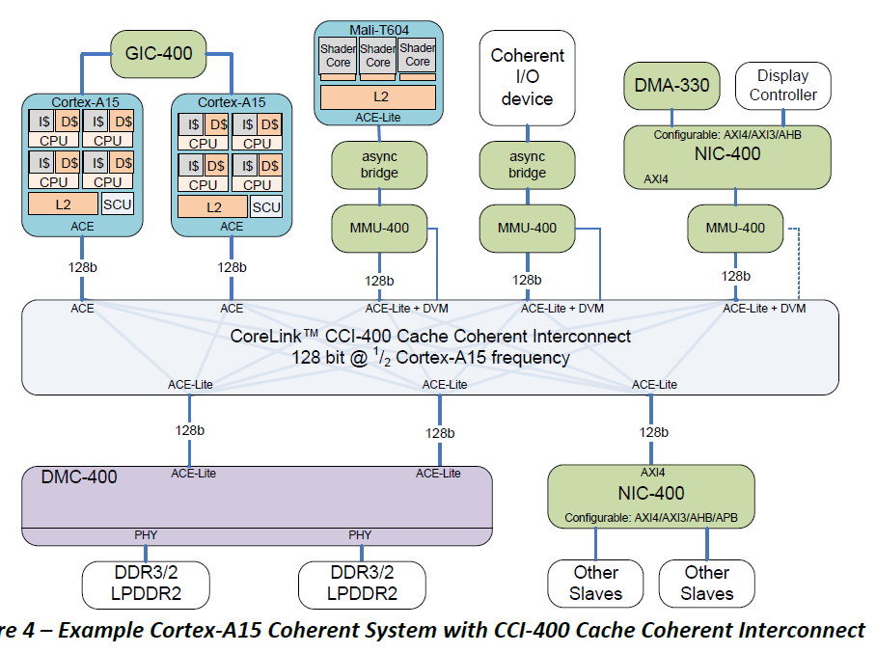
ARM system architectures - Introduction (1)
Example 1: SoC based on the cache coherent CCI-400 interconnect [2]
(Generic Interrupt Controller)
(GPU)
(Network Interconnect)
(Memory
Management Unit)
(DVM: Distributed
Virtual Memory)
(Dynamic Memory Controller)

Slide 3
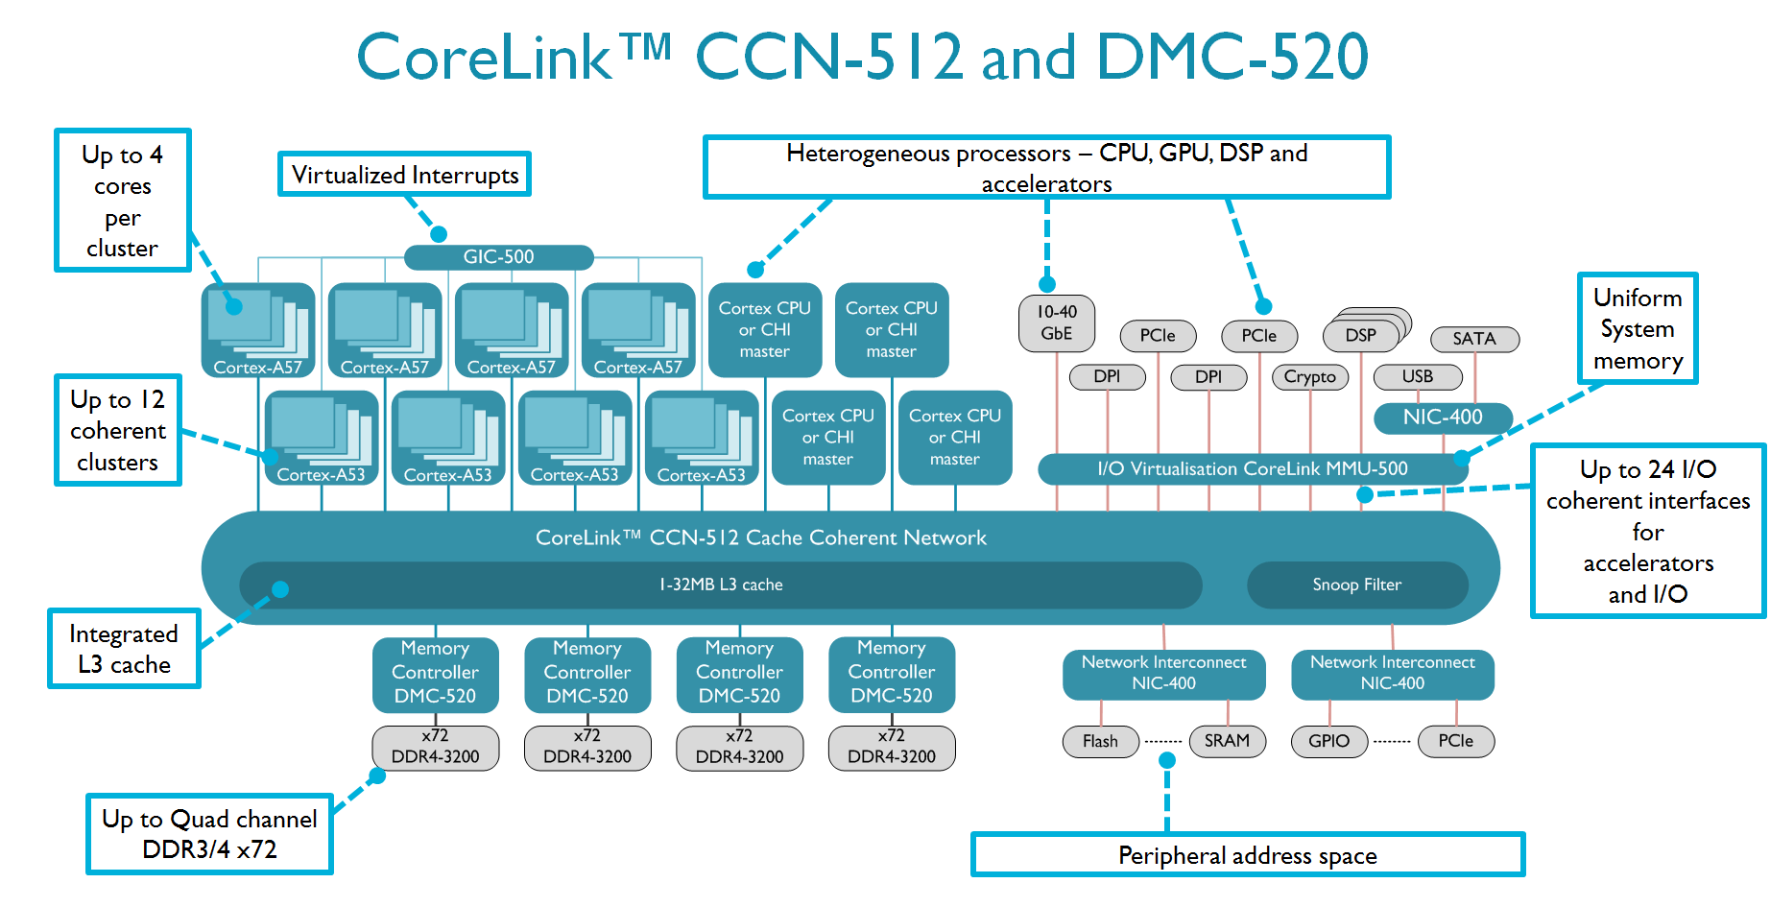
ARM system architectures - Introduction (2)
Example 2: SOC based on the cache-coherent CCN-512 interconnect [52]

Slide 4
ARM system architectures
1. The AMBA bus
2. ARM's interconnects
3. Overview of the evolution of ARM's platforms
4. References

Slide 5
1. The AMBA bus
1.1 Introduction to the AMBA BUS
1.2 The AMBA 1 protocol family
1.3 The AMBA 2 protocol family
1.4 The AMBA 3 protocol family
1.5 The AMBA 4 protocol family
1.6 The AMBA 5 protocol family

Slide 6
1.1 Introduction to the AMBA bus
1.1.1 Introduction to the AMBA protocol family
1.1.2 Evolution of the AMBA protocol family
1.1.3 Evolution of ARM's Cortex-A family

Slide 7
1.1.1 Introduction to the AMBA protocol family (1)
1.1.1 Introduction to the AMBA protocol family [1]
The AMBA bus (Advanced Microcontroller Bus Architecture) is an open-standard,
(royalty free) interconnection specification for SoC (System-on-Chip) designs,
developed by ARM, first published in 9/1995.
It is now the de facto standard for interconnecting functional blocks in 32/64-bit
SoC designs, including smartphones and tablets.
Since its announcement AMBA went through a number or major enhancements,
designated as AMBA revisions 1 to 5 (up to date), as shown in the next Figure.

Slide 8
1.1.1 Introduction to the AMBA protocol family (2)
Overview of the AMBA protocol family (based on [2])
(9/1995)
(5/1999)
(6/2003)
(3/2010)
(6/2013)
AMBA 1
ARMv4
AMBA 2
(~ ARMv5)
AMBA 3
(ARMv6)
AMBA 4
(ARMv7)
AMBA 5
(ARMv8)
(ARM7)
(ARM7/9)
(ARM11,
Cortex-A8/A9/A5)
(Cortex-A15/A7
ARM big.LITTLE)
(Cortex-
A53/A57/A72/A35)
Coherent
Hub Inteface
CHI
(10/2011)
AMBA Coherency
Extensions Protocol
ACE
ACE-Lite
Advanced
eXtensible Interface
Accelerator Coherency Port
AXI3
AXI4
ACP
AXI4-Lite
AMBA
High Performance Bus
AHB
(3/2001)
AXI4-Stream
Multi-layer AHB
ML AHB
Advanced System Bus
ASB
AHB-Lite
Advanced
Peripheral Bus
APB
APB2
APB v1.0
APB v2.0
(9/2004)
(6/2006)
(3/2012)
Advanced
Trace Bus
ATB
ATB v1.0
ATB v1.1
≈
1995
2000
2010
2013

Slide 9
1.1.2 Evolution of the AMBA protocol family

Slide 10
1.1.2 Evolution of the AMBA protocol family (1)
1.1.2 Evolution of the AMBA protocol family - Overview
AMBA 5
(Cortex
A57/A53/A72/A35)
AMBA 4
6/2013
(Cortex-A15/A7
ARM big.LITTLE)
CHI
Complete redesign
Layered architecture
Non blocking
packet-based bus
Support of L3
New node names
10/2011
ACE™
AMBA 3
(ARM11,
Cortex-A8/A9/A5)
Extension of the
AXI4 i.f. by 3 channels
to provide system wide
cache coherency
3/2010
AMBA 2
AXI4
(ARM7/9)
AMBA 1
(ARM7)
6/2003
Burst lengths of
up to 256 beats
Quality of Service
signaling (QoS)
5/1999
AXI3
9/1995
AHB™
Complete redesign
Burst based transactions
Channel concept
with 5 channels
for reads and writes
Out-of-order transactions
Optional signaling for
low power operation
Non-cache-coherent
interconnects
ASB™
Split transactions with
overlapping address
and data phases
of multiple masters
Three stage pipelining
Wider data bus options
Using only
uni-directional signals
Using only the rising edge
Supporting both full and
I/O coherency
Coherency domains
Memory barrier transactions
Support of DVM
Snoop filters
Cache coherent interconnects
Only a single master
can be active at a time
Daa element and burst
transfers
Bi-directional data bus
Using both clock edges
≈
1995
2000
2010
2013

Slide 11
1.1.2 Evolution of the AMBA protocol family (2)
Evolution from a 32-bit parallel bus to packet-based bus
AMBA 5
(Cortex
A57/A53/A72/A35)
AMBA 4
6/2013
(Cortex-A15/A7
ARM big.LITTLE)
CHI
Complete redesign
Layered architecture
Non blocking
packet-based bus
Support of L3
New node names
10/2011
AMBA 3
ACE™
(ARM11,
Cortex-A8/A9/A5)
Extension of the
AXI4 i.f. by 3 channels
to provide system wide
cache coherency
AMBA 2
AMBA 1
(ARM7)
(ARM7/9)
3/2010
6/2003
AXI4
9/1995
5/1999
AXI3
AHB™
Burst lengths of
up to 256 beats
Quality of Service
signaling (QoS)
ASB™
Complete redesign
Burst based
transactions
Channel concept
with 5 channels
for reads and writes
Out-of-order transactions
Optional signaling for
low power operation
Non-cache-coherent
interconnects
32-bit wide parallel bus
with 8/16-bit options
Multiple masters/slaves,
but only a single master
can be active at a time
Data element and burst
transfers
Two stage pipelining
Bi-directional data bus
Using both clock edges
Wider data bus options
Wider burst transfers
Split transactions with
overlapped address
and data phases
of multiple masters
Three stage pipelining
Using only
uni-directional signals
Using only the rising
edge
Supporting both full and
I/O coherency
Coherency domains
Memory barrier transactions
Support of DVM
Snoop filters
Cache coherent interconnects
≈
1995
2000
2010
2013

Slide 12
1.1.2 Evolution of the AMBA protocol family (3)
Evolution from data element based bus to burst based bus
AMBA 5
(Cortex
A57/A53/A72/A35)
AMBA 4
6/2013
(Cortex-A15/A7
ARM big.LITTLE)
CHI
Complete redesign
Layered architecture
Non blocking
packet-based bus
Support of L3
New node names
10/2011
AMBA 3
ACE™
(ARM11,
Cortex-A8/A9/A5)
Extension of the
AXI4 i.f. by 3 channels
to provide system wide
cache coherency
AMBA 2
AMBA 1
(ARM7)
(ARM7/9)
3/2010
6/2003
AXI4
9/1995
5/1999
AXI3
AHB™
Burst lengths of
up to 256 beats
Quality of Service
signaling (QoS)
ASB™
Complete redesign
Burst based
transactions
Channel concept
with 5 channels
for reads and writes
Out-of-order transactions
Optional signaling for
low power operation
Non-cache-coherent
interconnects
32-bit wide parallel bus
with 8/16-bit options
Multiple masters/slaves,
but only a single master
can be active at a time
Data element and burst
transfers
Two stage pipelining
Bi-directional data bus
Using both clock edges
Wider data bus options
Wider burst transfers
Split transactions with
overlapped address
and data phases
of multiple masters
Three stage pipelining
Using only
uni-directional signals
Using only the rising
edge
Supporting both full and
I/O coherency
Coherency domains
Memory barrier transactions
Support of DVM
Snoop filters
Cache coherent interconnects
≈
1995
2000
2010
2013

Slide 13
1.1.2 Evolution of the AMBA protocol family (4)
Increased parallelism achieved in the transfers
AMBA 5
(Cortex
A57/A53/A72/A35)
AMBA 4
6/2013
(Cortex-A15/A7
ARM big.LITTLE)
CHI
Complete redesign
Layered architecture
Non blocking
packet-based bus
Support of L3
New node names
10/2011
AMBA 3
ACE™
(ARM11,
Cortex-A8/A9/A5)
Extension of the
AXI4 i.f. by 3 channels
to provide system wide
cache coherency
AMBA 2
AMBA 1
(ARM7)
(ARM7/9)
3/2010
6/2003
AXI4
9/1995
5/1999
AXI3
AHB™
Burst lengths of
up to 256 beats
Quality of Service
signaling (QoS)
ASB™
Complete redesign
Burst based
transactions
Channel concept
with 5 channels
for reads and writes
Out-of-order transactions
Optional signaling for
low power operation
Non-cache-coherent
interconnects
32-bit wide parallel bus
with 8/16-bit options
Multiple masters/slaves,
but only a single master
can be active at a time
Data element and burst
transfers
Two stage pipelining
Bi-directional data bus
Using both clock edges
Wider data bus options
Wider burst transfers
Split transactions with
overlapped address
and data phases
of multiple masters
Three stage pipelining
Using only
uni-directional signals
Using only the rising
edge
Supporting both full and
I/O coherency
Coherency domains
Memory barrier transactions
Support of DVM
Snoop filters
Cache coherent interconnects
≈
1995
2000
2010
2013

Slide 14
1.1.3 Evolution of ARM's Cortex-A series

Slide 15
1.1.3 Overview of ARM's Cortex-A family (1)
1.1.3 Evolution of ARM's Cortex-A series (based on [3])
7
DMIPS/MHz
2/2015
Cortex-A72
ARMv8
16 nm
6
Announced
10/2012
Cortex-A57
ARMv8
20/16 nm
5
9/2010
Cortex-A15
ARMv7
32/28 nm
2/2014
Cortex-A17
ARMv7
28 nm
4
High Performance
3
Mainstream
10/2007
Cortex-A9
ARMv7
40 nm
10/2005
Cortex-A8
ARMv7
65 nm
10/2012
Cortex-A53
ARMv8
20/16 nm
11/2015
Cortex-A35
ARMv8
28 nm
2
10/2011
Cortex-A7
ARMv7
28 nm
10/2009
Cortex-A5
ARMv7
40 nm
1
Low power
DMIPS (Dhrystone MIPS): Benchmark score
(≈ VAX 11/780s perfprmance)
2006
2007
2008
2009
2010
2011
2012
2013
2014
2015

Slide 16
1.2 The AMBA 1 protocol family
1.2.1 Overview
1.2.2 The ASB bus

Slide 17
1.2.1 Overview (1)
1.2.1 Overview (based on [2])
(9/1995)
(5/1999)
(6/2003)
(3/2010)
(6/2013)
AMBA 1
(ARM7)
AMBA 2
AMBA 3
AMBA 4
AMBA 5
(ARM7/9)
(ARM11,
Cortex-A8/A9/A5)
(Cortex-A15/A7
ARM big.LITTLE)
(Cortex-
A57/A53/A72/A35)
Coherent
Hub Inteface
CHI
(10/2011)
AMBA Coherency
Extensions Protocol
ACE
ACE-Lite
Advanced
eXtensible Interface
Accelerator Coherency Port
AXI3
AXI4
ACP
AXI4-Lite
AMBA
High Performance Bus
AHB
(3/2001)
AXI4-Stream
Multi-layer AHB
ML AHB
Advanced System Bus
ASB
AHB-Lite
Advanced
Peripheral Bus
APB
APB2
APB v1.0
APB v2.0
(9/2004)
(6/2006)
(3/2012)
Advanced
Trace Bus
ATB
ATB v1.0
ATB v1.1
≈
1995
2000
2010
2013

Slide 18
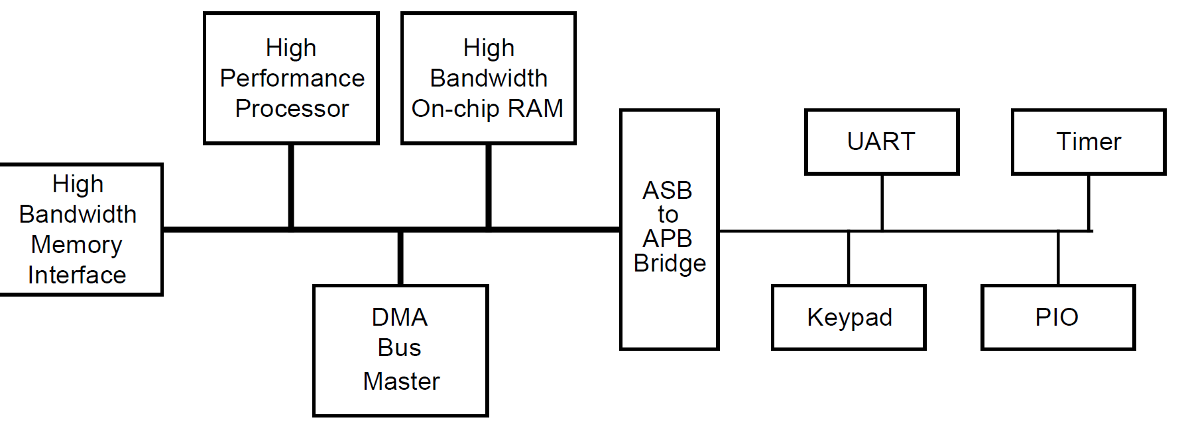
1.2.1 Overview (2)
A typical AMBA 1 system (9/1995) - Overview [4]
ASB
APB
As seen in the above Figure the AMBA 1 protocol family (AMBA Revision 1.0)
includes
the ASB (Advanced System Bus) and
the APB (Advanced Peripheral Bus)
specification.
The ASB bus interconnects high-performance system modules whereas
the APB bus targets to attach low-speed peripherals.

Slide 19
1.2.2 The ASB bus (1)
1.2.2 The ASB bus
Main features of the ASB bus
AMBA 5
(Cortex
A57/A53/A72/A35)
AMBA 4
6/2013
(Cortex-A15/A7
ARM big.LITTLE)
CHI
Complete redesign
Layered architecture
Non blocking
packet-based bus
Support of L3
New node names
10/2011
AMBA 3
ACE™
(ARM11,
Cortex-A8/A9/A5)
Extension of the
AXI4 i.f. by 3 channels
to provide system wide
cache coherency
AMBA 2
AMBA 1
(ARM7)
(ARM7/9)
3/2010
6/2003
AXI4
9/1995
5/1999
AXI3
AHB™
Burst lengths of
up to 256 beats
Quality of Service
signaling (QoS)
ASB™
Complete redesign
Burst based
transactions
Channel concept
with 5 channels
for reads and writes
Out-of-order transactions
Optional signaling for
low power operation
Non-cache-coherent
interconnects
32-bit wide parallel bus
with 8/16-bit options
Multiple masters/slaves,
but only a single master
can be active at a time
Data element and burst
transfers
Two stage pipelining
Bi-directional data bus
Using both clock edges
Wider data bus options
Wider burst transfers
Split transactions with
overlapped address
and data phases
of multiple masters
Three stage pipelining
Using only
uni-directional signals
Using only the rising
edge
Supporting both full and
I/O coherency
Coherency domains
Memory barrier transactions
Support of DVM
Snoop filters
Cache coherent interconnects
≈
1995
2000
2010
2013

Slide 20
1.2.2 The ASB bus (2)
Main features of the operation of the ASB bus
The ASB bus is a 32-bit wide parallel bus with narrower (16 and 8 bit) options.
It supports multiple masters and slaves, nevertheless only a single master
might be active at a time.
This is the main limitation of the ASB bus.
c) It allows both data element and burst transfers (see details later).
Burst transfer is implemented as a specific case of data element transfer
(it is implemented actually as data element transfer with continuation).

Slide 21
1.2.2 The ASB bus (3)
a) Bus width (designated as transfer size) [4]
The ASB protocol allows the following bus widths:
8-bit (byte)
16-bit (halfword) and
32-bit (word)
The actual bus width is encoded in the BSIZE[1:0] signals that are driven by the
active bus master [a].
By contrast, subsequent protocols allows in addition significantly longer transfer
sizes, as discussed later.

Slide 22
1.2.2 The ASB bus (4)
b) Transfer types supported [4]
There are three possible transfer types on the ASB, as follows:
Data element transfers (called non sequential transfers):
used to transfer single data elements or the first transfer of a burst.
Burst transfers (called sequential transfers):
used for data element transfers within a burst.
Then the address is computed from the previous transfer.
Address only transfers:
used when no data movement is required, like for idle cycles or for bus master
handover cycles.

Slide 23
1.2.2 The ASB bus (5)
c) Multi-master operation [4]
The ASB bus supports multi master operation by using an arbiter and a simple
request/grant (kérvényez/odaítél) mechanism.

Slide 24
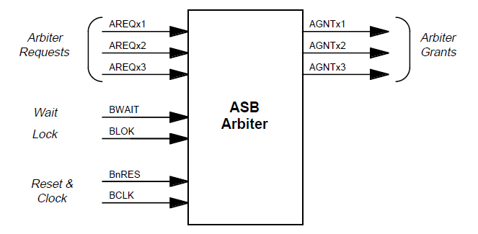
1.2.2 The ASB bus (6)
The request/grant lines [4]
To implement arbitration each bus master has
a request line (AREQxi) and
a grant line (GNTxi)
as indicated in the Figure below.
To Prevent
arbitration
Figure: Block diagram of the ASB arbiter [4]
Further on, there are two lines (BWAIT and BLOK) to prevent arbitration,
as long as a transfer is going on (e.g. a burst transfer)

Slide 25
1.2.2 The ASB bus (7)
Arbitration [4]
Task of the arbiter is to select the highest priority bus master from the competing
ones.
The arbiter samples all request signals (AREQx) on the falling edge of clock
(BCLK) and selects the highest priority request signal (AGNTx) in every clock
cycle by using an internal priority scheme.
The choice of a priortiy scheme is left over to the application.
A new bus master will however only become granted when the current transfer
completes in time (as indicated by the BWAIT signal) and no burst transfer is
in progress, (as indicated by the shared lock signal (BLOK).
Arbitration for the next bus cycle is performed in parallel with the current transfer
thus the ASB bus implements a two stage pipelining.

Slide 26
1.2.2 The ASB bus (8)
Principle of the operation of the ASB bus (simplified) [4]
The arbiter determines which master is granted access to the bus, based on a
given priority scheme.
When granted, a master monopolizes the bus as long as the transfer (data
element transfer or burst transfer) is in progress.
The granted master initiates a transfer by providing the address, control and
in case of writes also the write data onto the bus.
The decoder uses the high order address lines to select the desired bus slave.
The slave provides a transfer response back to the bus master indicating e.g.
whether read data is ready or the master has yet to wait for read data, etc.
If the transfer response indicates ready, the bus master can capture read data
or it indicates that the slave has already received write data.
This completes a data element transfer, whereas a burst transfer continues as
long as all data elements are transferred.
After completing the transfer the master relinquishes the bus and the arbiter
hands over the bus to the master selected.

Slide 27
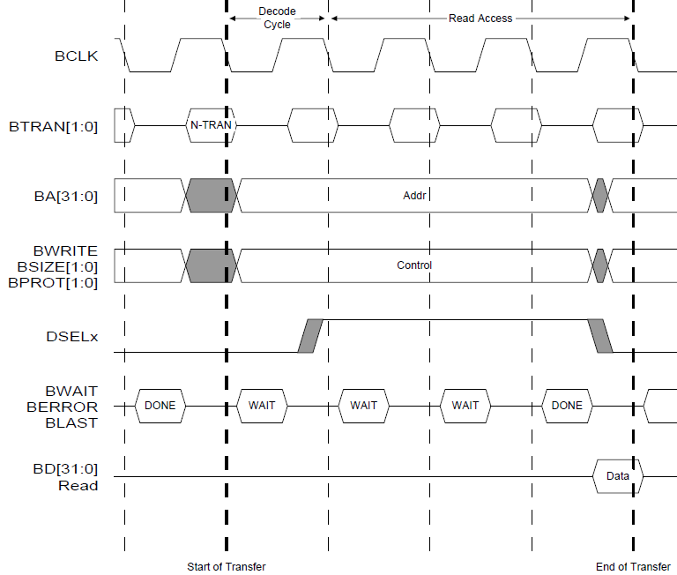
1.2.2 The ASB bus (9)
Example 1: Reading a data element with wait states inserted [4]
The transfer begins at the
falling edge of the BCLK
signal after the previous
transfer has completed,
as indicated by the
BWAIT signal “DONE”.
The high order address
lines (BA[31:0] select
a bus slave.
The BTRAN[1:0] and
BWRITE[1:0] signals
specify the operation
to be done (N.TRAN)
at the start of the
transfer.
The BSIZE[1:0] signals
determine the transfer
size (bus width).
After the slave can
provide the read data,
it signals it by BWAIT
“DONE” and
it sends the read data.
This completes the read
access.

Slide 28
1.2.2 The ASB bus (10)
Remarks
In the ASB protocol the falling edge of the clock captures the signal value,
whereas in the subsequent AHB protocol the rising edge does it.
Shaded areas in the timing diagrams mark undefined signal values, i.e. the signal
can assume any value within the shaded area.

Slide 29
1.2.2 The ASB bus (11)
Example 2: Reading burst data -1 [4]
A burst transfer is initiated like a data element transfer with the BTRAN[1:0]
signal indicating N-TRAN, as seen in the subsequent Figure).
A burst will begin when the BTRAN[1:0] signal indicates sequential transfer
(S-TRAN) and will continue as long as the BTRAN[1:0] signal specifies it
or an extraordinary event (e.g. an error) occurs.
We note that the ASB protocol does not explicitly limit the length of a burst.
By contrast, subsequent bus revisions (AHB, AXI) limit the max. burst length
to 16 (AHB) or 256 (AXI) transfers.
The burst transfer completes when the BTRAN[1:0] signal asserted by the master,
does not more indicate a sequential continuation.
For a burst transfer (sequential transfer) the control information (as indicated
by the BWRITE and BSIZE signals) remains obviously the same as specified
in the first (non-sequential) transfer opening the burst.
Within the burst, addresses of the data transfers are calculated from the
previous address (A) and the transfer size.
E.g. for a burst of word transfers subsequent addresses would be A, A+4, A+8
etc.

Slide 30
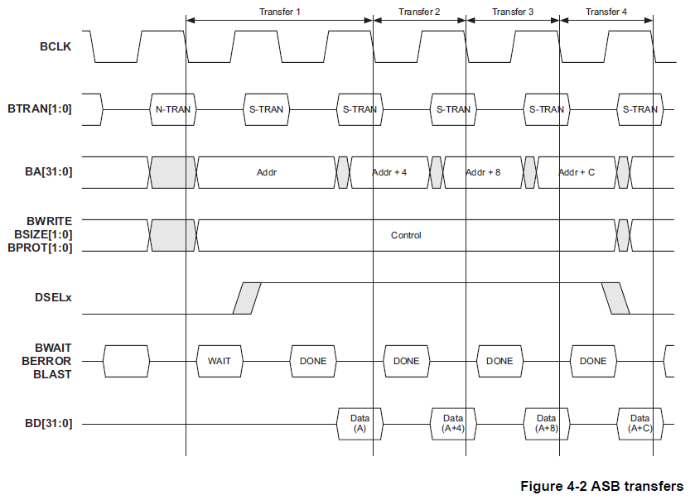
1.2.2 The ASB bus (12)
Example 2: Reading burst data -2 [4]

Slide 31
1.2.2 The ASB bus (13)
Remark: Interpretation of specific interface signals referred to in this Section -1
BTRAN | Transfer Type Description
00 | Address only transfer (used when no data movement is required, e.g. for idle cycles or for changing the bus master, called handover operation)
01 | Reserved
10 | Non-sequential transfer (N-TRAN) (used for single data element transfers and as a first transfer of a burst)
11 | Sequential transfer (S-TRAN) (used for successive transfers within a burst)
BWRITE | Write or Read operation
1 | Write operation
0 | Read operation
BPROT | Protection control
 | Additional two bit information sent to the decoder for protection purposes. Most bus slaves will not use these signals.

Slide 32
1.2.2 The ASB bus (14)
Remark: Interpretation of specific interface signals referred to in this Section -2
BSIZE | Transfer Width
00 | Byte
01 | Half word (16-bits)
10 | Word (32-bits)
11 | Reserved
BLOK | Bus arbitration locking (Shared bus lock signal) (This signal indicates that the following transfer is indivisible from the current transfers and no other bus master should be given access to the bus
1 | Arbiter will keep the same master granted
0 | Arbiter will grant the highest priority master requesting the bus.
BWAIT | Wait response (This signal is driven by the selected bus slave and indicates if the current transfer has been completed or not)
1 | WAIT (A further bus cycle is required)
0 | DONE (The transfer may be completed in the current bus cycle)

Slide 33
1.2.2 The ASB bus (15)
Main features of the circuit design of the ASB bus [5] -1
Using beyond uni-directional lines also of a bi-directional data bus BD[31:0]
b) Utilizing both edges of the clock signal

Slide 34
1.2.2 The ASB bus (16)
Using beyond uni-directional lines also a bi-directional data bus BD[31:0]
The next figures illustrate this.

Slide 35
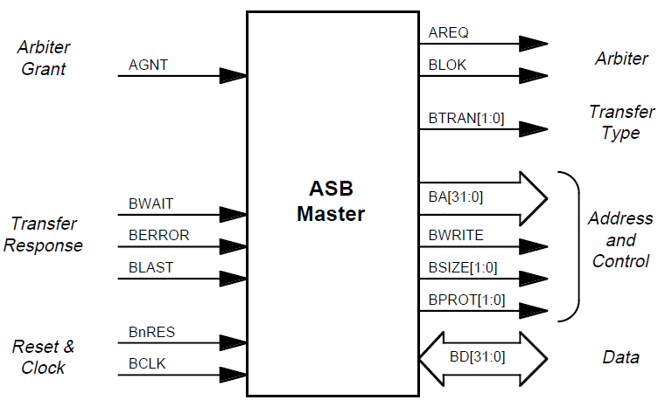
1.2.2 The ASB bus (17)
Interface signals of ASB masters [4]

Slide 36
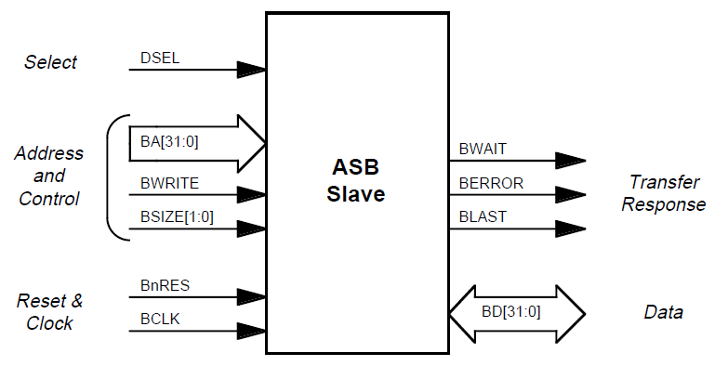
1.2.2 The ASB bus (18)
Interface signals of ASB slaves [4]

Slide 37
1.2.2 The ASB bus (19)
Drawback of using a bi-directional data bus [5]
Many design tools do not support Bi-directional buses and their typical
representation by tri-state logic circuits.
Remark
Bi-directional buses are implemented typically by means of tri-state logic.
In tri-state logic the low value of the enable input switches the logic gate into
a high impedance state else it allows a traditional operation.
enable read
Master
Slave
enable write
Figure: Implementation of a bi-directional bus line by using tri-state logic

Slide 38
1.2.2 The ASB bus (20)
b) Utilizing both edges of the clock signal [5]
Utilizing both edges of the clock imposes higher complexity, for this reason most
ASIC design and synthesis tools support only designs with rising edges.
We note that the subsequent release of the AMBA interface standard termed the
AHB bus amends both of the deficiencies mentioned.

Slide 39
1.3 The AMBA 2 protocol family
1.3.1 Overview
1.3.2 The AHB bus

Slide 40
1.3.1 Overview (1)
1.3 The AMBA 2 protocol family (based on [2])
1.3.1 Overview
(9/1995)
(5/1999)
(6/2003)
(3/2010)
(6/2013)
AMBA 1
(ARM7)
AMBA 2
AMBA 3
AMBA 4
AMBA 5
(ARM7/9)
(ARM11,
Cortex-A8/A9/A5)
(Cortex-A15/A7
ARM big.LITTLE)
(Cortex-
A57/A53/A72/A35)
Coherent
Hub Inteface
CHI
(10/2011)
AMBA Coherency
Extensions Protocol
ACE
ACE-Lite
Advanced
eXtensible Interface
Accelerator Coherency Port
AXI3
AXI4
ACP
AXI4-Lite
AMBA
High Performance Bus
AHB
(3/2001)
AXI4-Stream
Multi-layer AHB
ML AHB
Advanced System Bus
ASB
AHB-Lite
Advanced
Peripheral Bus
APB
APB2
APB v1.0
APB v2.0
(9/2004)
(6/2006)
(3/2012)
Advanced
Trace Bus
ATB
ATB v1.0
ATB v1.1
≈
1995
2000
2010
2013

Slide 41
1.3.2 The AHB bus (1)
1.3.2 The AHB bus
Main enhancements of the AHB bus [5] -1
AMBA 5
(Cortex
A57/A53/A72/A35)
AMBA 4
6/2013
(Cortex-A15/A7
ARM big.LITTLE)
CHI
Complete redesign
Layered architecture
Non blocking
packet-based bus
Support of L3
New node names
10/2011
AMBA 3
ACE™
(ARM11,
Cortex-A8/A9/A5)
Extension of the
AXI4 i.f. by 3 channels
to provide system wide
cache coherency
AMBA 2
AMBA 1
(ARM7)
(ARM7/9)
3/2010
6/2003
AXI4
9/1995
5/1999
AXI3
AHB
Burst lengths of
up to 256 beats
Quality of Service
signaling (QoS)
ASB
Complete redesign
Burst based
transactions
Channel concept
with 5 channels
for reads and writes
Out-of-order transactions
Optional signaling for
low power operation
Non-cache-coherent
interconnects
32-bit wide parallel bus
with 8/16-bit options
Multiple masters/slaves,
but only a single master
can be active at a time
Data element and burst
transfers
Two stage pipelining
Bi-directional data bus
Using both clock edges
Wider data bus options
Wider burst transfers
Split transactions with
overlapped address
and data phases
of multiple masters
Three stage pipelining
Using only
uni-directional signals
Using only the rising
edge
Supporting both full and
I/O coherency
Coherency domains
Memory barrier transactions
Support of DVM
Snoop filters
Cache coherent interconnects
≈
1995
2000
2010
2013

Slide 42
1.3.2 The AHB bus (2)
Key enhancement of the operation of the AHB bus [5] -2
a) Wider data bus options
b) Wider burst transfers
c) Split transactions

Slide 43
1.3.2 The AHB bus (3)
a) Wider data bus options
In addition to the 8-, 16- and 32-bit data bus widths supported by the ASB bus,
the AHB bus supports bus widths up to 1024-bit.

Slide 44
1.3.2 The AHB bus (4)
b) Wider burst transfers
As long as the ASB protocol supports 8-, 16- and 32-bit wide transfers,
the AHB additionally supports wider data transfers of 64- and 128-bit.

Slide 45
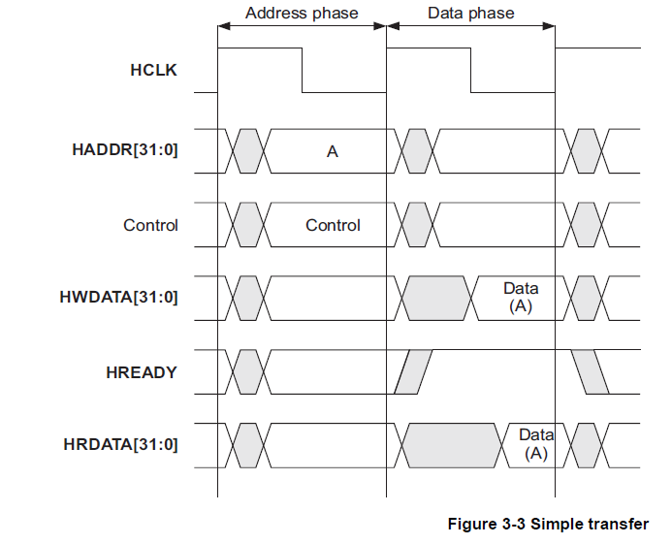
1.3.2 The AHB bus (5)
c) Split transactions -1
Transactions are subdivided into two phases, into the address and the data
phases, as shown below assuming that the slave does not insert wait states.
In the Address phase the master transfers the address and control information
to the slave, whereas in the Data phase either the master sends write data
to the slave or the slave sends read data to the master.
Figure: Example of a split read or write transaction without wait states [6]

Slide 46
1.3.2 The AHB bus (6)
Split transactions -2
Address, control or data information is captured by the rising edge of the clock.
This is in contrast to the ASB bus where the falling edge of the clock is active.
Splitting the transfer into two phases allows overlapping the address phase
of any transfer with the data phase of transfers originating from another
master, as illustrated later.
Figure: Example of a split read or write transaction without wait states [6]

Slide 47
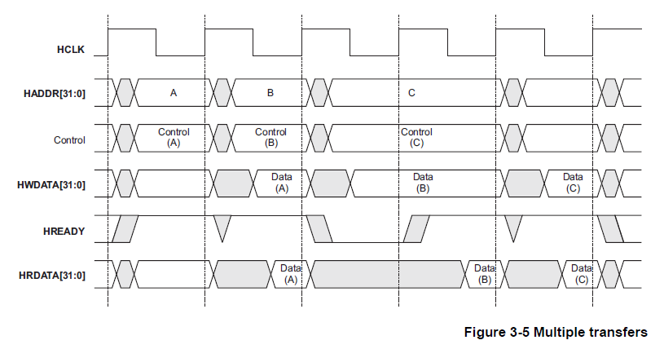
1.3.2 The AHB bus (7)
Concurrent operation utilizing split transactions
As an example the Figure below shows that the Address phase of Master B is
overlapped with the Data phase (either with the write data or read data phase)
of Master A.
In addition, arbitration for the next transfer marks a third stage of pipelining.
Figure: Example of multiple (read or write) transactions with pipelining [6]

Slide 48
1.3.2 The AHB bus (8)
Main enhancements of the circuit design of the AHB bus vs. the ASB bus [5]
a) Using only uni-directional signals (also for data buses, in contrast to the ASB
protocol).
b) Using only the rising edge of the bus clock (in contrast to the ASB protocol where
both edges are used).

Slide 49
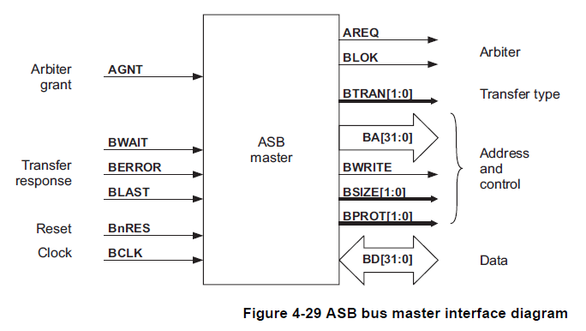
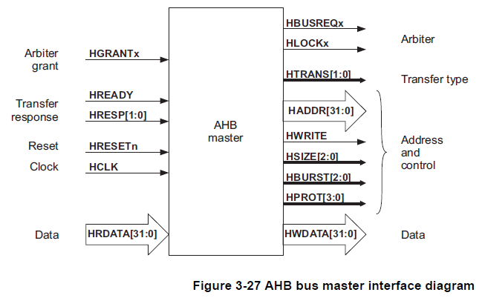
1.3.2 The AHB bus (9)
a) Using only uni-directional signals -1
The AHB protocol makes use only of uni-directional data buses, as shown below.
Figure: Interface signals
of ASB bus masters [4]
Figure: Interface signals
of AHB bus masters [6]

Slide 50
1.3.2 The AHB bus (10)
Using only uni-directional signals -2
Benefit
This widens the choice of available ASIC design tools.

Slide 51
1.3.2 The AHB bus (11)
b) Using only the rising edge of the bus clock
Benefit
This easies circuit synthesis.

Slide 52
1.4 The AMBA 3 protocol family
1.4.1 Overview
1.4.2 The AXI3 bus (Advanced eXtensible Interface)

Slide 53
1.4.1 Overview (1)
1.4 The AMBA 3 protocol family (based on [2])
1.4.1 Overview
(9/1995)
(5/1999)
(6/2003)
(3/2010)
(6/2013)
AMBA 1
(ARM7)
AMBA 2
AMBA 3
AMBA 4
AMBA 5
(ARM7/9)
(ARM11,
Cortex-A8/A9/A5)
(Cortex-A15/A7
ARM big.LITTLE)
(Cortex-
A57/A53/A72/A35)
Coherent
Hub Inteface
CHI
(10/2011)
AMBA Coherency
Extensions Protocol
ACE
ACE-Lite
Advanced
eXtensible Interface
Accelerator Coherency Port
AXI3
AXI4
ACP
AXI4-Lite
AMBA
High Performance Bus
AHB
(3/2001)
AXI4-Stream
Multi-layer AHB
ML AHB
Advanced System Bus
ASB
AHB-Lite
Advanced
Peripheral Bus
APB
APB2
APB v1.0
APB v2.0
(9/2004)
(6/2006)
(3/2012)
Advanced
Trace Bus
ATB
ATB v1.0
ATB v1.1
≈
1995
2000
2010
2013

Slide 54
1.4.2 The AXI3 bus (1)
1.4.2 The AXI3 bus (Advanced eXtensible Interface) [15]
It is a complete redesign of the AHB bus.
A large number of companies took part in the development of AXI, including
Ericson, HP, Motorola, NEC, QUALCOMM, Samsung,Synopsys, Toshiba.
The AXI bus specification became very complex and underwent a number of
revisions, from the original Issue A (2013) to the Issue E (2013) [15].

Slide 55
1.4.2 The AXI3 bus (2)
Main enhancements of the AXI3 bus [15] -1
AMBA 5
(Cortex
A57/A53/A72/A35)
AMBA 4
6/2013
(Cortex-A15/A7
ARM big.LITTLE)
CHI
Complete redesign
Layered architecture
Non blocking
packet-based bus
Support of L3
New node names
10/2011
AMBA 3
ACE™
(ARM11,
Cortex-A8/A9/A5)
Extension of the
AXI4 i.f. by 3 channels
to provide system wide
cache coherency
AMBA 2
AMBA 1
(ARM7)
(ARM7/9)
3/2010
6/2003
AXI4
9/1995
5/1999
AXI3
AHB™
Burst lengths of
up to 256 beats
Quality of Service
signaling (QoS)
ASB™
Complete redesign
Burst based
transactions
Channel concept
with 5 channels
for reads and writes
Out-of-order transactions
Optional signaling for
low power operation
Non-cache-coherent
interconnects
32-bit wide parallel bus
with 8/16-bit options
Multiple masters/slaves,
but only a single master
can be active at a time
Data element and burst
transfers
Two stage pipelining
Bi-directional data bus
Using both clock edges
Wider data bus options
Wider burst transfers
Split transactions with
overlapped address
and data phases
of multiple masters
Three stage pipelining
Using only
uni-directional signals
Using only the rising
edge
Supporting both full and
I/O coherency
Coherency domains
Memory barrier transactions
Support of DVM
Snoop filters
Cache coherent interconnects
≈
1995
2000
2010
2013

Slide 56
1.4.2 The AXI3 bus (3)
Key enhancements of the AXI3 bus [15]
a) burst-based transactions,
b) the channel concept for performing reads and writes,
c) support for out-of-order transactions,
d) non-cache coherent interconnects.

Slide 57
1.4.2 The AXI3 bus (4)
a) Burst-based transactions
In the AXI protocol (actually in the AXI3) all transfers are specified as burst transfers.
Each read or write burst is given by two parameters, these are
the burst length (number of data transfers within the bursts) and
the burst size (the width of the data paths, i.e. the maximum number of
data bytes to be transfered in each beat of the burst)
Burst length (up to 16) and burst size (1 - 128 byte) are specified by dedicated
signal lines.

Slide 58
1.4.2 The AXI3 bus (5)
b) The channel concept for performing reads and writes
The channel concept incorporates four sub-concepts, as follows:
b1) Splitting reads and writes (actually read bursts and write bursts) into two and
three transactions, respectively.
b2) Providing dedicated channels for each type of transactions.
b3) Providing a handshake mechanism for synchronizing individual transactions.
b4) Identifying individual transactions by a tag to allow reassambling transactions
that belong to the same read or write operation.

Slide 59
1.4.2 The AXI3 bus (6)
b1) Splitting reads and writes (actually read bursts and write bursts)
into two and three transactions, respectively
A read burst is split into the following two transactions:
A read address transaction and
a read data transaction accompanied by a read response signal.
A write burst is split into the following three transactions:
A write address transaction,
a write data transaction and
a write response transaction.
We designate the above elementary components of executing reads and writes as
transactions since each of them is synchronized by its own by means of
handshaking using appropriate synchronizing signals, as detailed later.

Slide 60
1.4.2 The AXI3 bus (7)
b2) Providing dedicated channels for each type of transactions
Each different type of transaction is carried out over a dedicated channel, accordingly,
there are two read and three write channels, as indicated in the next Figure.
Dedicated channels provided for each type of transactions
Read channels
Write channels
The Read address channel
The Read data channel
The Write address channel
The Write data channel
The Write response channel

Slide 61
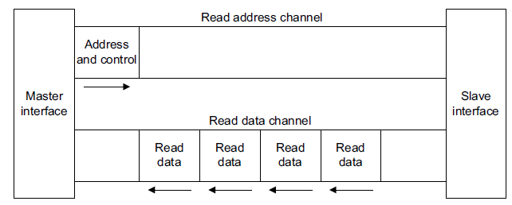
1.4.2 The AXI3 bus (8)
Read channels -2
The layout of the read channels of the AXI protocol:
Figure: The channel architecture for reads [15]
Remark
In addition to the Read data channel there is a two bit read response signal
indicating the status of each transaction (e.g. succesful, slave error etc.).

Slide 62
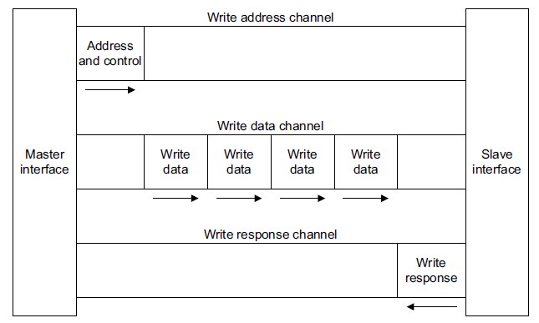
1.4.2 The AXI3 bus (9)
Write channels -2
The lyout of the write channels of the AXI protocol:
Figure: The channel architecture for writes []
Figure: The channel architecture for writes [15]

Slide 63
1.4.2 The AXI3 bus (10)
b3) Providing a handshake mechanism for synchronizing individual
transactions
Each of the five independent channels carries beyond the set of information signals
also two synchronization signals, the VALID and READY signals that implement a
two-way handshake mechanism.
The VALID signal
It is generated by the information source to indicate when the information sent
(address, data or control information) becomes available on the channel.
The READY signal
It is generated by the destination to indicate when it can accept the information.

Slide 64
1.4.2 The AXI3 bus (11)
b4) Identifying individual transactions to allow grouping of transactions
that belong to the same read or write operation -1
In each channel each transaction is identified by a four-bit long ID tag.
Based on the ID tags transactions with the same tag number will be ordered
to individual read or write operations, as indicated in the next Figure.

Slide 65
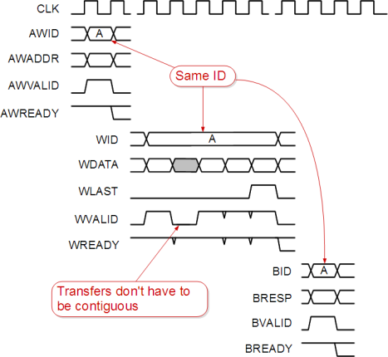
1.4.2 The AXI3 bus (12)
Example: Identification of the three transactions constituting an AXI
write burst [8]
Address and control
transaction
Write data
transaction
Write response
transaction

Slide 66
1.4.2 The AXI3 bus (13)
c) Support for out-of-order transactions
ID tags allow multi-master out-of-order transactions to increase performance
compared to the previous AHB protocol.
Out-of-order transactions means the ability
to issue multiple outstanding transfers and
to complete transactions out-of-order,
as indicated below.
Out-of-order transactions
Issuing multiple
outstanding transfers
Completing transactions
out-of-order

Slide 67
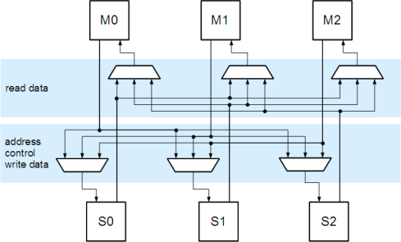
1.4.2 The AXI3 bus (14)
d) Non-cache-coherent interconnects
Interconnecting bus masters and slaves in ASB and AHB based SoCs
Prior to introducing the AXI bus, bus masters and slaves were interconnected
by using shared buses and multiplexers, as indicated below for three AMB
bus masters and three slaves.
Figure: Interconnecting three AHB bus masters and three slaves by means of
shared buses and multiplexers

Slide 68
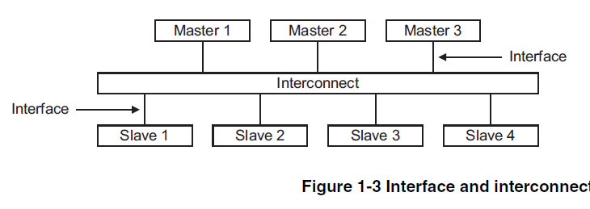
1.4.2 The AXI3 bus (15)
Announcing AXI bus based interconnects as system components
In 5/2004 (i.e. one year after introducing the AXI bus) ARM announced the
availability of dedicated system building blocks termed as interconnects,
as seen below.
Interconnecting AXI bus masters and slaves
Implementing the interconnection by using buses and multiplexers as basic building blocks
Implementing the interconnection by using interconnects as system components
Typical use: AHB based SoCs [8]
Typical use: Subsequent AXI based SoCs [16]
As the AXI bus specification does not support hardware cache coherency,
also AXI3 or AXI4 based interconnects do not provide hardware cache coherency.

Slide 69
1.4.2 The AXI3 bus (16)
Remarks
ARM announced AXI bus based interconnects about one year later than the
AXI bus, thus early AXI based SoCs had to interconnect bus masters and
slaves in the same way as previous AHB based systems, i.e. by shared buses
and multiplexers.
Obviously, such implementations had to provide inteconnections for all five
AXI channels.
AXI bus based interconnects are discussed in Section 2.2.

Slide 70
1.5 The AMBA 4 protocol family
1.5.1 Overview
1.5.2 The AXI4 bus
1.5.3 The ACE bus
1.5.4 The ACE-Lite bus

Slide 71
1.5.1 Overview (1)
1.5 The AMBA 4 protocol family (based on [2])
1.5.1 Overview
(9/1995)
(5/1999)
(6/2003)
(3/2010)
(6/2013)
AMBA 1
(ARM7)
AMBA 2
AMBA 3
AMBA 4
AMBA 5
(ARM7/9)
(ARM11,
Cortex-A8/A9/A5)
(Cortex-A15/A7
ARM big.LITTLE)
(Cortex-
A57/A53/A72/A35)
Coherent
Hub Inteface
CHI
(10/2011)
AMBA Coherency
Extensions Protocol
ACE
ACE
ACE-Lite
Advanced
eXtensible Interface
Accelerator Coherency Port
AXI3
AXI4
AXI4
ACP
AXI4-Lite
AMBA
High Performance Bus
AHB
(3/2001)
AXI4-Stream
Multi-layer AHB
ML AHB
Advanced System Bus
ASB
AHB-Lite
Advanced
Peripheral Bus
APB
APB2
APB v1.0
APB v2.0
(9/2004)
(6/2006)
(3/2012)
Advanced
Trace Bus
ATB
ATB v1.0
ATB v1.1
≈
1995
2000
2010
2013

Slide 72
1.5.2 The AXI4 bus (1)
1.5.2 The AXI4 bus
The AXI4 and AXI4-Lite interfaces were published in 3/2010 [22].

Slide 73
1.5.2 The AXI4 bus (2)
Key enhancement of the AXI4 bus vs. the AXI3 bus
Quality of Service (QoS) signaling introduced.

Slide 74
1.5.2 The AXI4 bus (3)
Quality of Service (QoS) signaling [25]
AXI4 extends the AXI3 protocol by two 4-bit QoS signal lines (called the ARQOS
and AWQOS).
The first group of the QoS signal lines (ARQOS 0-3) is associated to the
read address channel and a 4-bit signal is sent for each read transaction,
whereas
a second group of signal lines (AWQOS 0-3) is associated to the write
address channel and a 4-bit signal is sent for each write transaction.
These signals can be used as priority indicators for each associated read or write
transaction.
Higher values indicate higher priority.
A default value of 0b0000 indicates that the interface is not participating in any
QoS scheme.
The AXI4 protocol does not include an exact interpretation of the priority signals,
instead each actual implementation can define how these signal are used to
provide quality of service criteria, like max. access time etc.

Slide 75
1.5.3 The ACE bus (1)
1.5.3 The ACE bus [15], [2]
It was released in 10/2011.
The MPCore technology (2004) provides coherency for multicore single processors
(in ARM's technology it is called multiprocessors with up to 4 processors).
The ACE bus extends coherency to multiprocessors built up of multicores
(in ARM terminology multiple CPU core clusters, e.g. to two CPU core clusters
each with 4 cores).
ACE is not limited to provide coherency between identical CPU core clusters
but it can support coherency also for dissimilar CPU clusters and also
I/O coherency for accelerators and DMA (see later).
The Cortex-A15 MPCore processor was the first ARM processor to support
AMBA 4 ACE.

Slide 76
1.5.3 The ACE bus (2)
Main enhancements of the ACE bus [15]
AMBA 5
(Cortex
A57/A53/A72/A35)
AMBA 4
6/2013
(Cortex-A15/A7
ARM big.LITTLE)
CHI
Complete redesign
Layered architecture
Non blocking
packet-based bus
Support of L3
New node names
10/2011
AMBA 3
ACE™
(ARM11,
Cortex-A8/A9/A5)
Extension of the
AXI4 i.f. by 3 channels
to provide system wide
cache coherency
AMBA 2
AMBA 1
(ARM7)
(ARM7/9)
3/2010
6/2003
AXI4
9/1995
5/1999
AXI3
AHB™
Burst lengths of
up to 256 beats
Quality of Service
signaling (QoS)
ASB™
Complete redesign
Burst based
transactions
Channel concept
with 5 channels
for reads and writes
Out-of-order transactions
Optional signaling for
low power operation
Non-cache-coherent
interconnects
32-bit wide parallel bus
with 8/16-bit options
Multiple masters/slaves,
but only a single master
can be active at a time
Data element and burst
transfers
Two stage pipelining
Bi-directional data bus
Using both clock edges
Wider data bus options
Wider burst transfers
Split transactions with
overlapped address
and data phases
of multiple masters
Three stage pipelining
Using only
uni-directional signals
Using only the rising
edge
Supporting both full and
I/O coherency
Coherency domains
Memory barrier transactions
Support of DVM
Snoop filters
Cache coherent interconnects
≈
1995
2000
2010
2013

Slide 77
1.5.3 The ACE bus (3)
Key enhancements of the ACE bus [15]
Extension of the AXI4 interface to provide system wide cache coherency
b) Supports two types of coherency: full coherency and I/O coherency
c) Supports Distributed Virtual Memory
d) It introduces snoop filters and
e) cache coherent interconnects.

Slide 78
1.5.3 The ACE bus (4)
Extension of the AXI4 interface to provide system wide cache
coherency -1
The introduced cache coherency model supports multiple masters with privat caches, as indicated in the next Figure.
Master
Master
Master
Up to 4 cores
Cache
Cache
Cache
L2 cache
Interconnect
Main
Memory
Figure: Assumed cache model of the ACE protocol [28]
A five state cache coherency model specifies possible states of any cache line.
The cache line state determines what actions are required when the cache line
is accessed.

Slide 79
1.5.3 The ACE bus (5)
Extension of the AXI4 interface to provide system wide cache
coherency -2
The Chapter on ARM cache consistency provides details on the five state cache model
introduced with the ACE protocol.

Slide 80
1.5.3 The ACE bus (6)
b) Supporting two types of coherency: full coherency and I/O coherency
The AXI4 protocol supports two types of coherency, called the full and I/O-coherency.
Main features of full and I/O coherency are contrasted in the next Figure.
Types of coherency
Full coherency
(Two-way coherency)
I/O coherency
One-way coherency)
Provided by the ACE interface.
The ACE interface is designed to provide
full hardware coherency between CPU clusters
(processors) that include caches.
With full coherency, any shared access
to memory can ‘snoop’ into the other cluster’s caches
to see if the data is already there;
if not, it is fetched from higher level of the
memory system (L3 cache, if present or
external main memory (DDR).
Provided by the ACE-Lite interface.
The ACE-Lite interface is designed to provide
hardware coherency for system masters
that do not have caches of their own or
have caches but do not cache sharable data.
Examples: DMA engines, network interfaces
or GPUs.
Figure: Main features of full and I/O coherency [29]

Slide 81
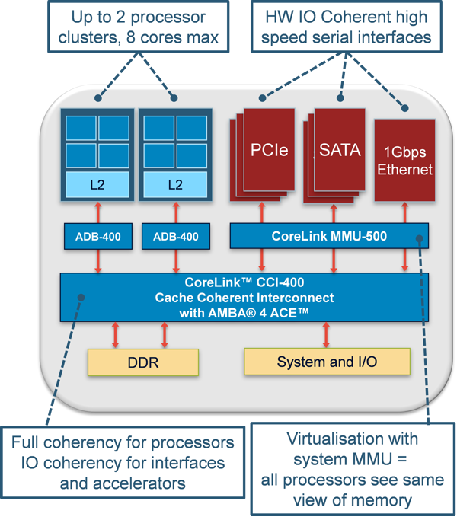
1.5.3 The ACE bus (7)
Example 1: Full coherency for processors, I/O coherency for I/O interfaces
and accelerators [54]

Slide 82
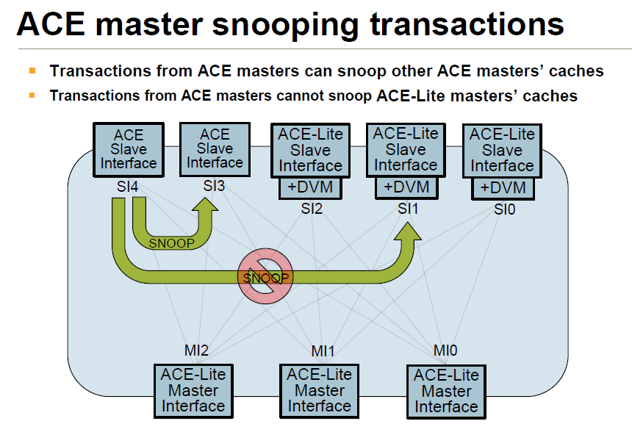
1.5.3 The ACE bus (8)
Example 2: Snooping transactions in case of full coherency [28]
ACE Masters
ACE Lite Masters

Slide 83
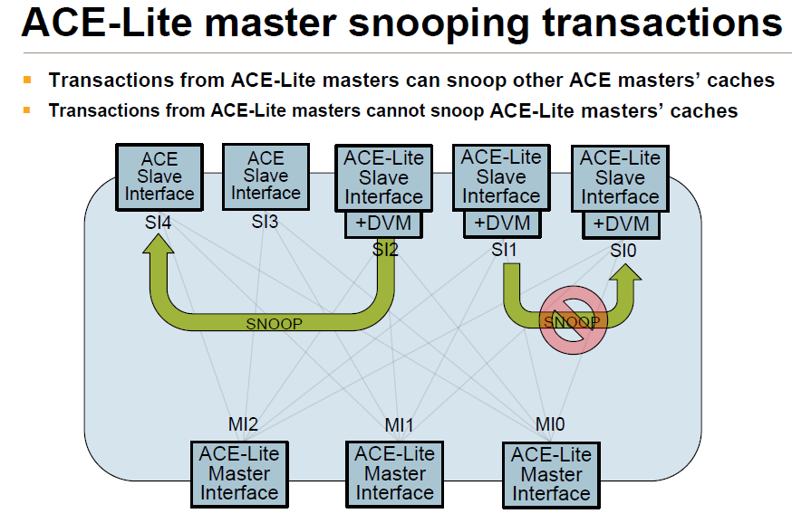
1.5.3 The ACE bus (9)
Example 3: Snooping transactions in case of I/O coherency [28]
ACE Masters
ACE Lite Masters

Slide 84
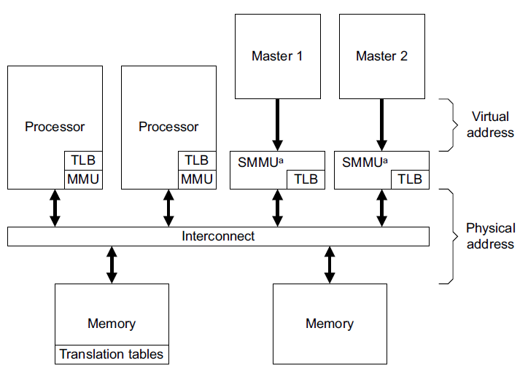
1.5.3 The ACE bus (10)
c) Support for Distributed Virtual Memory (DVM) [25]
Multiprocessors supporting DVM share a single set of MMU page tables
with the page tables kept in the memory, as seen in the Figure below.
TLBs (Translation Look-Aside Buffer) are caches of MMU page tables including
the most recent VA to PA translations performed by the associated MMU.
(VA)
SMMU: System MMU
(PA)
Figure: Example of a multiprocessor (multi-cluster system) supporting DVM [25]

Slide 85
1.5.3 The ACE bus (11)
Maintenance of page tables [2]
DVM support requires proper maintenace for system-wide page tables.
This means: when one master updates its TLB it needs to invalidate all TLBs
that may contain a stale copy of the considered MMU page table entry.
AMBA 4 (ACE) supports this by providing broadcast invalidation messages
for TLBs.
DVM messages are sent on the Read channel of ACE (using the ARSNOOP
signaling).
A system MMU should make use of the TLB invalidation messages to ensure
that its entries are up-to-date.

Slide 86
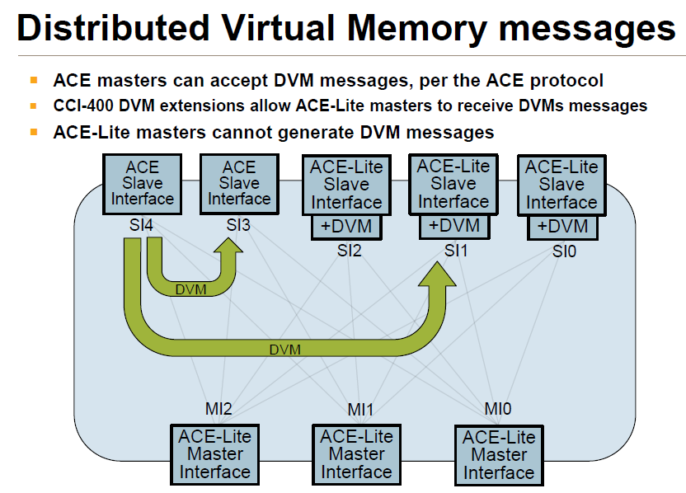
1.5.3 The ACE bus (12)
Example for DVM messages [28]
ACE Masters
ACE Lite Masters

Slide 87
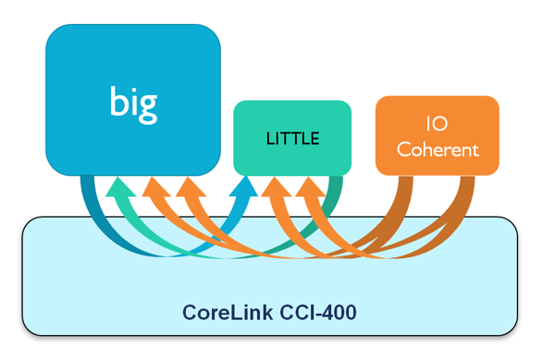
1.5.3 The ACE bus (13)
d) Snoop filters [31] -1
The simplest way to provide hardware cache coherency is to broadcast
snoop requests to all related caches before performing memory transactions
to shared data.
When a cache receives a snoop request, it looks up its tag array to see whether
it has the required data and sends back a reply accordingly.
As an example, the Figure below indicates possible snoop requests generated by
a big and a LITTLE processor cluster and an I/O coherent agent.
Note that I/O coherent agents do not include caches, thus they generate but
do not receive snoop requests.
Figure: Possible snoop requests generated in a big.LITTLE platform with
cache-coherent I/O agents (like DMAs) [31]

Slide 88
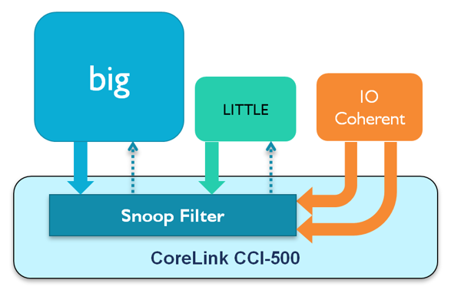
1.5.3 The ACE bus (14)
Snoop filters [31] -2
For most workloads however, the majority of the snoop requests will fail to find
copies of the requested data in the cache in question.
Accordingly, a large number of the snoop requests innecesserily consumes link
bandwidth and energy.
A solution of this problem is introducing snoop filters.
A snoop filter maintains a directory of the cache contents and eliminates the need
to send a snoop request if the target cache does not include the requested data,
as indicated in the nex Figure below.
Figure: Using a snoop filter to reduce snoop traffic [31]

Slide 89
1.5.3 The ACE bus (15)
Snoop filters [31] -3
The principle of the implemented snoop filter is as follows:
A tag for all cached lines of shared memory is stored in a directory maintained
in the snoop filter kept in the interconnect.
The snoop filter monitors the snoop address and the snoop response channels.
All accesses to shared data will look up the directory generating one of two
possible responses:
HIT: meaning that data is on-chip, then a vector is provided pointing to
the core cluster with the data
MISS: meaning that the requested data isn't on-chip, it needs to be
fetched from the memory
In this way a large number of snoop requests will be eliminated.

Slide 90
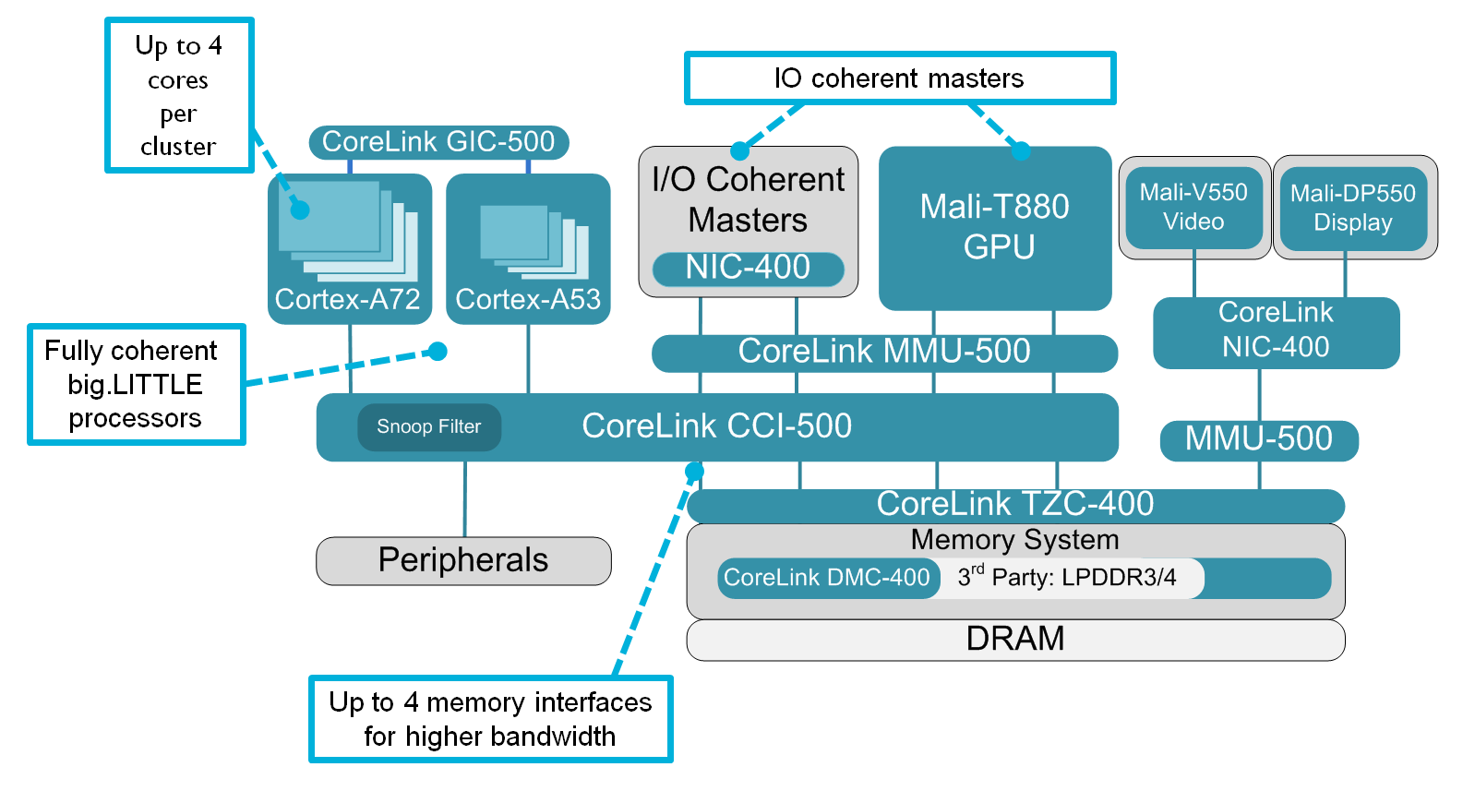
1.5.3 The ACE bus (16)
Example: Introduction of snoop filters in the CCI-500 cache-coherent
interconnect [32]

Slide 91
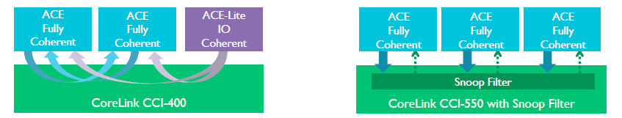
1.5.3 The ACE bus (17)
Benefits of using snoop filters [33]
Main benefits
It needs one central snoop instead of broadcasting snoops to many caches.
It allows further system scaling (i.e. to implement a higher number of
fully coherent processor clusters) as it does not imply a quadratic increase
of snoops.
It results in less power consumption as it strongly reduces the number of
snoops required,
as indicated in the Figure below.
Broadcasting snoops
Use of a snoop filter
Figure: Snoop broadcasting vs. using a snoop filter [33]

Slide 92
1.5.3 The ACE bus (18)
e) Cache coherent interconnects -1
Along with the ACE interface ARM developed also cache-coherent interconnects
that provide system wide cache coherency.
The previous interconnect family was based on the AXI3 bus interface and
did not support cache cocherency for multiprocessors, (in ARM's terminology
for more multi cluster CPUs).
By contrast, cache coherent interconnects, like the CCI-400, controll all
transactions to shared memory areas and provide for the necessary actions
for assuring system wide cache coherency.
The next Figure shows an example for a cache-coherent interconnect.

Slide 93
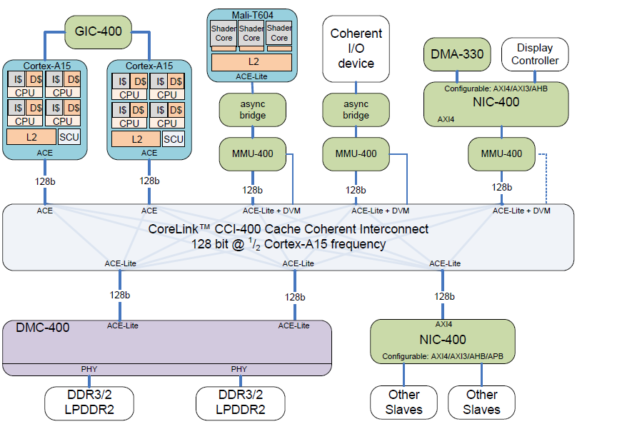
1.5.3 The ACE bus (19)
Example cache-coherent interconnect, the CCI-400 [2]

Slide 94
1.5.3 The ACE bus (20)
Cache coherent interconnects -2
ARM's cache-coherent interconnects are discussed in Section 2.3

Slide 95
1.5.3 The ACE bus (21)
Implementation of the ACE interface
ARM implemented the AMBA 4 ACE (AMBA with Coherency Extensions) interface
by extending the AMBA4 AXI (AXI4) interface by
3 further channels and
a number of additional signals
in order to provide system wide cache coherency, as the next Figure indicates.

Slide 96
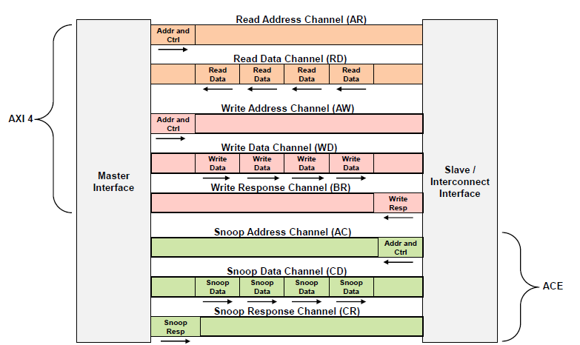
1.5.3 The ACE bus (22)
Extending the AXI 4 interface by three channels to get the ACE interface [72]

Slide 97
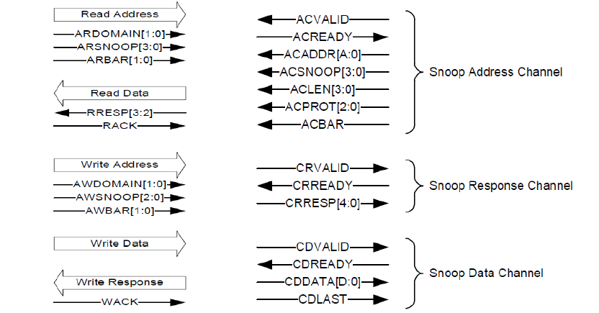
1.5.3 The ACE bus (23)
Signals of the snoop channels and additional signals constituting the
AMBA 4 (ACE) interface [28]
(ACADDR)
(CRRESP)
(CDDATA)
Additional signals
Additional channels
ACADDR[A:0]: e.g. ACADDR[43:0]

Slide 98
1.5.3 The ACE bus (24)
Additional snoop channels in the ACE interface [28]
The Snoop Address Channel is an input channel to a cached master for
providing the address and the associated control information for a snoop
request (arriving from the interconnect).
The Snoop Response Channel is used by the snooped master to signal the
response to a snoop request, e.g. to indicate that it holds the requested
cache line.
The Snoop Data Channel is an output channel from the snooped master
to transfer snoop data to the interconnect in case when the snooped master
holds the requested cache line.

Slide 99
1.5.3 The ACE bus (25)
Remark
With the introduction of the AMBA 4 (ACE) specification supporting hardware cache
coherency ARM modified the designation of their AMBA compliant PrimeCell
system units while introducing designations resembling the function of the units,
like
DMC-400 (Dynamic Memory Controller) or
CCI-400 (Cache Coherent interconnect)

Slide 100
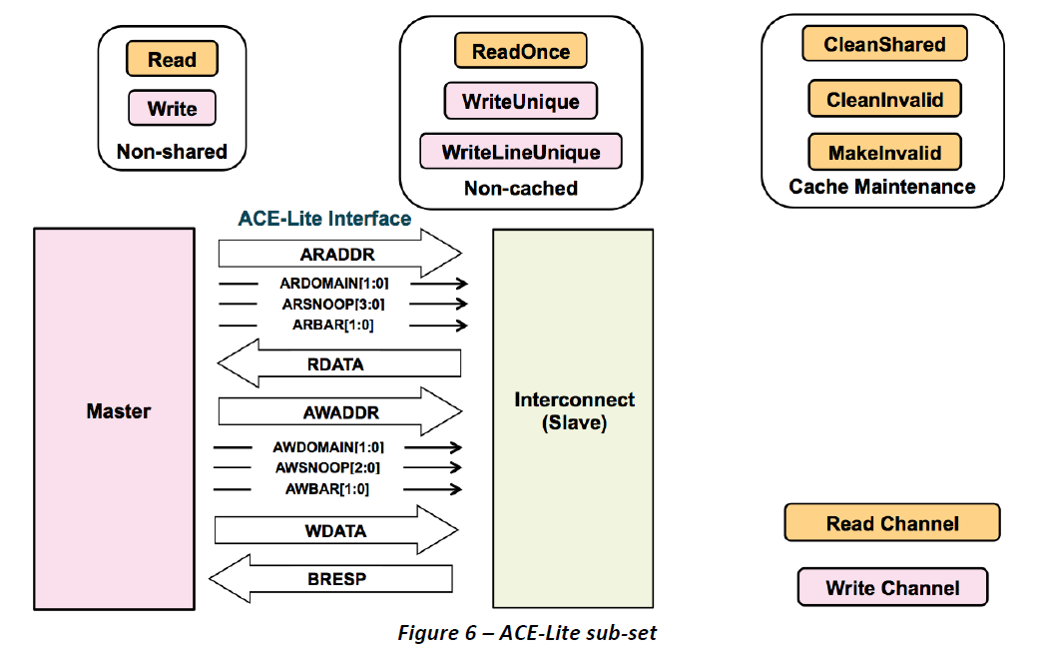
1.5.4 The ACE-Lite bus (1)
1.5.4 The ACE-Lite bus [2] -1
ACE-Lite is a subset of ACE.
It is used to connect masters that do not have hardware coherent caches.
It makes use of the five AXI channels and the additional ACE signals to the
read address and write address channels, but do not employ further ACE signals
or the three snoop channels, as the next Figure shows.
The ACE-Lite interface [2]

Slide 101
1.5.3 The ACE bus (2)
The ACE-Lite bus [2] -2
ACE-Lite enables interfaces such as Gigabit Ethernet to directly read and write
cached data shared with the CPU.
It is the preferred technique for coherent I/O and should be used where feasible
rather than the ACP (Accelerator Coherency Port) port (not discussed in this
Chapter9 to reduce power consumption and increase performance.

Slide 102
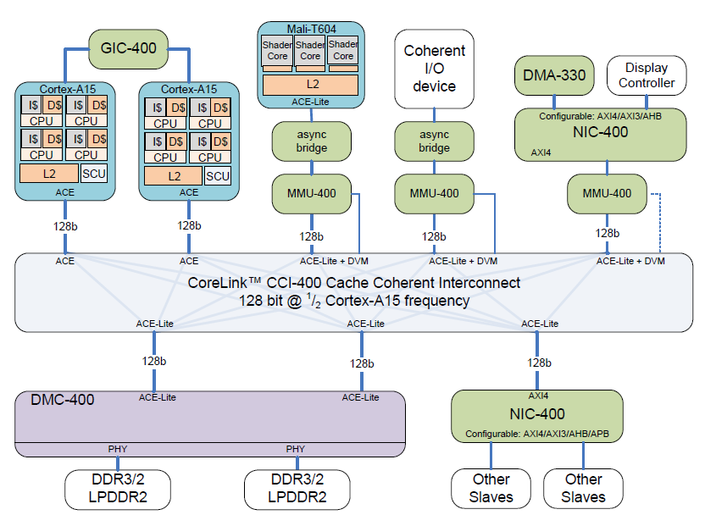
1.5.3 The ACE bus (3)
Example: Use of the ACE-Lite bus in a CCI-400 based SOC [2]
DVM: Distributed
Virtual Memory

Slide 103
1.6 The AMBA 5 protocol family
1.6.1 Overview
1.6.2 The CHI bus
1.6.3 For comparison: Intel's QPI bus (Not discussed)

Slide 104
1.6.1 Overview (1)
1.6 The AMBA 5 protocol family (based on [2])
1.6.1 Overview
(9/1995)
(5/1999)
(6/2003)
(3/2010)
(6/2013)
AMBA 1
(ARM7)
AMBA 2
AMBA 3
AMBA 4
AMBA 5
(ARM7/9)
(ARM11,
Cortex-A8/A9/A5)
(Cortex-A15/A7
ARM big.LITTLE)
(Cortex-
A57/A53/A72/A35)
Coherent
Hub Inteface
CHI
(10/2011)
AMBA Coherency
Extensions Protocol
ACE
ACE-Lite
Advanced
eXtensible Interface
Accelerator Coherency Port
AXI3
AXI4
ACP
AXI4-Lite
AMBA
High Performance Bus
AHB
(3/2001)
AXI4-Stream
Multi-layer AHB
ML AHB
Advanced System Bus
ASB
AHB-Lite
Advanced
Peripheral Bus
APB
APB2
APB v1.0
APB v2.0
(9/2004)
(6/2006)
(3/2012)
Advanced
Trace Bus
ATB
ATB v1.0
ATB v1.1
≈
1995
2000
2010
2013

Slide 105
1.6.1 Overview (2)
The AMBA 5 protocol family [35]
The AMBA5 CHI was announced in 6/2013.
Developed by ARM with the participation of leading industry partners, including
ARM semiconductor partners, third party IP providers and the EDA industry.
It targets server and networking applications based on ARMv8 processors,
such as the Cortex-A5x or the Cortex-A72 models.
We point out that ARMv8 processors have either the AMBA 5 CHI or the
AMBA 4 ACE interface to the cache coherent interconnect, as options.
Recently,
the AMBA 5 CHI interface is used only in server oriented platforms,
along with the CCN-5xx Cache Coherent Nework, whereas
the AMBA 4 ACE interface is utilized in mobile platforms along with the
CCI-4xx Cache Coherent Interface,
as shown in the next Figures.

Slide 106
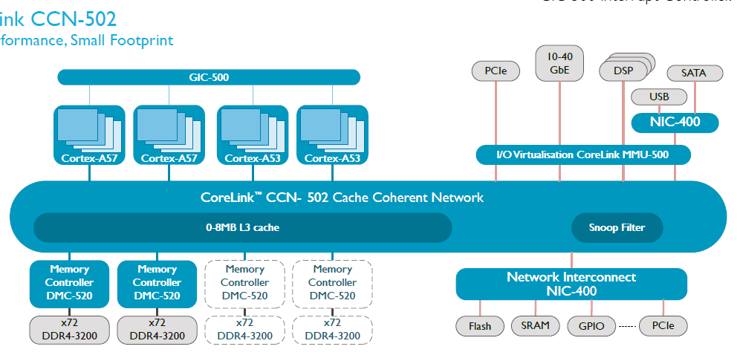
1.6.1 Overview (3)
Use of the AMBA 5 CHI interface in ARM's CCN-502 based server platform [36]
4xCHI
9xACE-Lite/AXI4

Slide 107
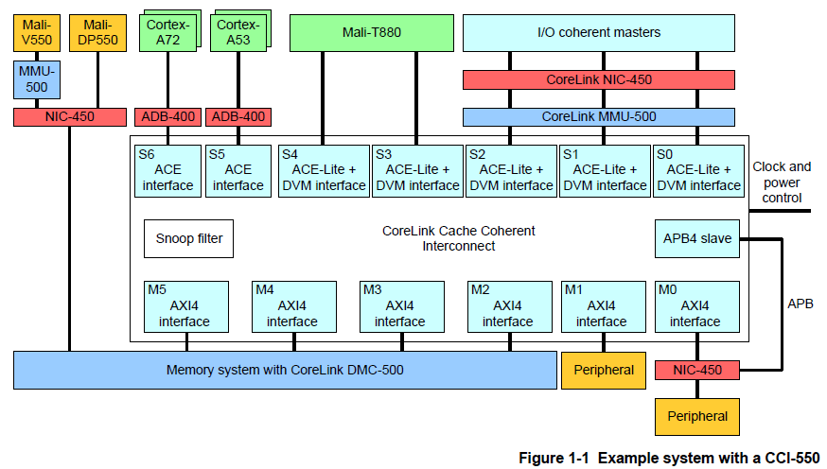
1.6.1 Overview (4)
Use of AMBA 4 interfaces in ARM's recent mobile platforms [34]
In contrast to the server platforms, ARM's recent mobile platforms make still use of
the AMBA 4 ACE interface, like the one seen in the next Figure.
Figure: CCI-550 interconnect based based mobile platform [34]

Slide 108
1.6.2 The CHI bus (1)
1.6.2 The CHI bus
Key features of the CHI bus -1
AMBA 5
(Cortex
A57/A53/A72/A35)
AMBA 4
6/2013
(Cortex-A15/A7
ARM big.LITTLE)
CHI
Complete redesign
Layered architecture
Non blocking
packet-based bus
Support of L3
New node names
10/2011
AMBA 3
ACE™
(ARM11,
Cortex-A8/A9/A5)
Extension of the
AXI4 i.f. by 3 channels
to provide system wide
cache coherency
AMBA 2
AMBA 1
(ARM7)
(ARM7/9)
3/2010
6/2003
AXI4
9/1995
5/1999
AXI3
AHB™
Burst lengths of
up to 256 beats
Quality of Service
signaling (QoS)
ASB™
Complete redesign
Burst based
transactions
Channel concept
with 5 channels
for reads and writes
Out-of-order transactions
Optional signaling for
low power operation
Non-cache-coherent
interconnects
32-bit wide parallel bus
with 8/16-bit options
Multiple masters/slaves,
but only a single master
can be active at a time
Data element and burst
transfers
Two stage pipelining
Bi-directional data bus
Using both clock edges
Wider data bus options
Wider burst transfers
Split transactions with
overlapped address
and data phases
of multiple masters
Three stage pipelining
Using only
uni-directional signals
Using only the rising
edge
Supporting both full and
I/O coherency
Coherency domains
Memory barrier transactions
Support of DVM
Snoop filters
Cache coherent interconnects
≈
1995
2000
2010
2013

Slide 109
1.6.2 The CHI bus (2)
Key features of the CHI bus -2
Until now ARM did not reveal the AMBA 5 CHI specification.
So subsequently we sum up only those features of AMBA 5 CHI that have been
published until now from various sourses.
These are:
a) Layered architecture
b) Non-blocking packet based interface
c) Support for L3 caches
d) New node names

Slide 110
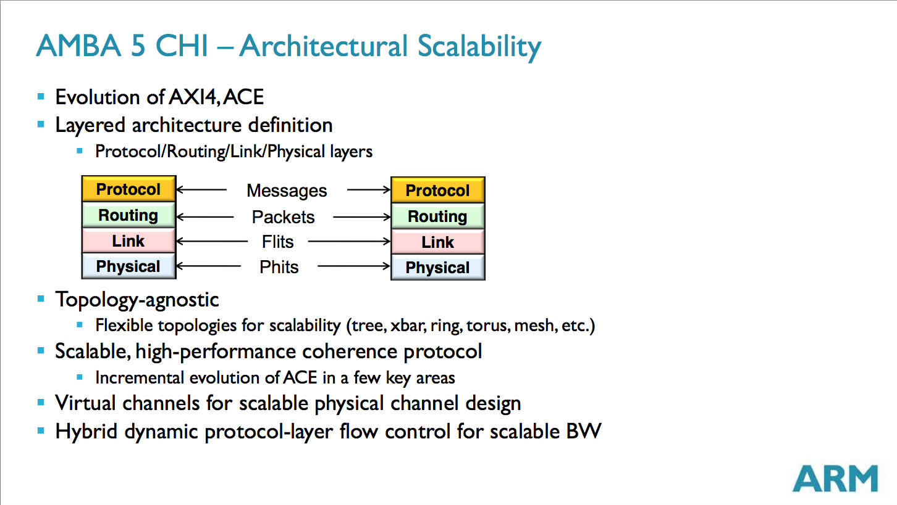
1.6.2 The CHI bus (3)
a) Layered architecture [37]
CHI is built up of four layers, the protocol, the routing, the link, and the physical
layers, as seen in the Figure below.
Protokol réteg
Forgalomirányítási réteg
Adatkapcsolati réteg
Fizikai réteg
Flits: Flow control units (Forgalomszabályozási egységek)
Phits: Physical units (Fizikai egységek)
Figure: Layered architecture of the CHI interface [37]
Packets are built up of Flits whereas Flits are made up of Phits, that represent
the smallest piece of information that can be transmitted as an entitiy on a link.

Slide 111
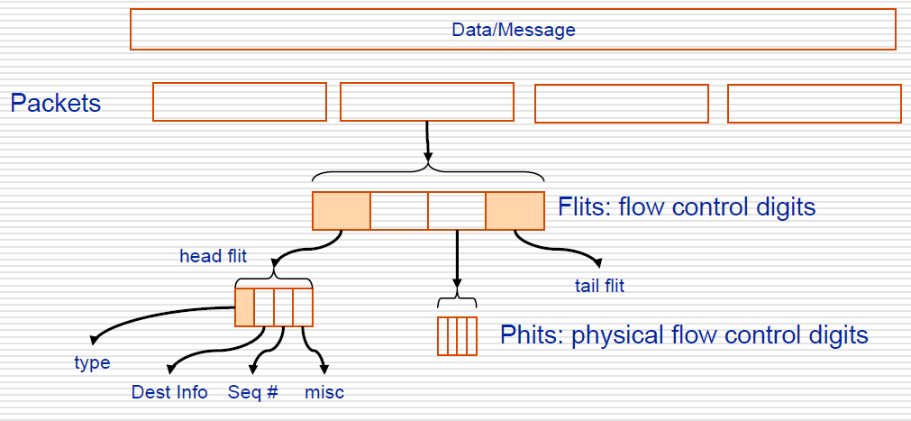
1.6.2 The CHI bus (4)
Remark
Hierarchical structuring of data to be transmitted (in general) [Based on 66]
Messages
Packets
Flits: Flow control units
Phits: Physical units
While flits and phits are fixed size, messages and packets may be variable
size.

Slide 112
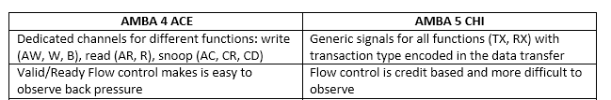
1.6.2 The CHI bus (5)
b) Non-blocking packet based interface
The AMBA 5 CHI is a packet based interface
that makes use of generic signals for all functions with the transaction type
encoded in the data transfer and
it is non-blocking due to the credit based flow control employed,
(to be discussed subsequently).
See the Table below for contrasting these features with the related features of the
AMBA 4 ACE interface.
Table: Contrasting main features of message transfers in AMBA 4 CHI and
AMBA 5 interfaces CHI [39]

Slide 113
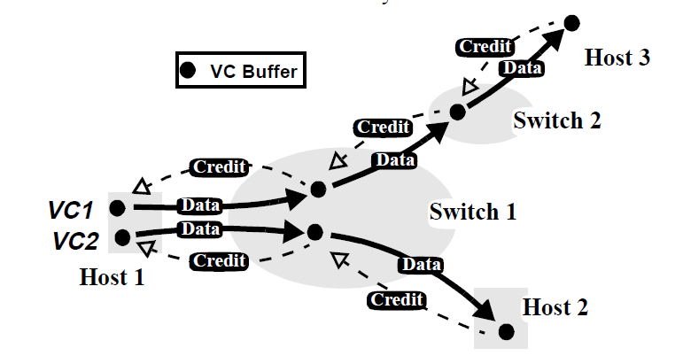
1.6.2 The CHI bus (6)
Remark on credit based flow control
It aims at avoiding blockings during forwarding data due to congestion.
Principle of the credit based flow control is that data units, such as flits, are
forwarded in a connection from one node to another only if the receiver node
sends a credit for the transmitter node signaling that there is a buffer slot ready
for the data to be forwarded, as indicated in the Figure below.
VC: Virtual conection
Figure: Principle of credit-based flow control [42]

Slide 114
1.6.2 The CHI bus (7)
c) Support for L3 caches
The CHI interface supports the use of L3 caches assuming that the L3 cache is
integrated into the cache-coherent interconnect.
This feature has been implemented until now only along with the CCN-5xx line
of interconnects targeting server platforms, as shown below.
4xCHI
9xACE-Lite/AXI4
Figure: The CCN-502 interconnect based server oriented platform [36]

Slide 115
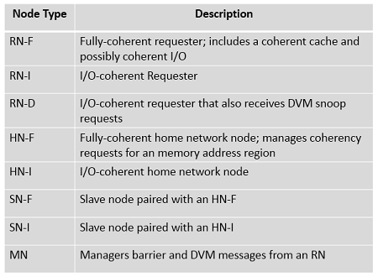
1.6.2 The CHI bus (8)
d) New node names [38]
To reference subjects of transactions, AXI and ACE use the Master and Slave
designations, but CHI prefers the node name, like Request Node, Home Node,
Slave Node, and Miscellaneous Node.
All these nodes are referenced by shorthand abbreviations, as shown in the
Table below.
Table: Node names used with CHI [38]

Slide 116
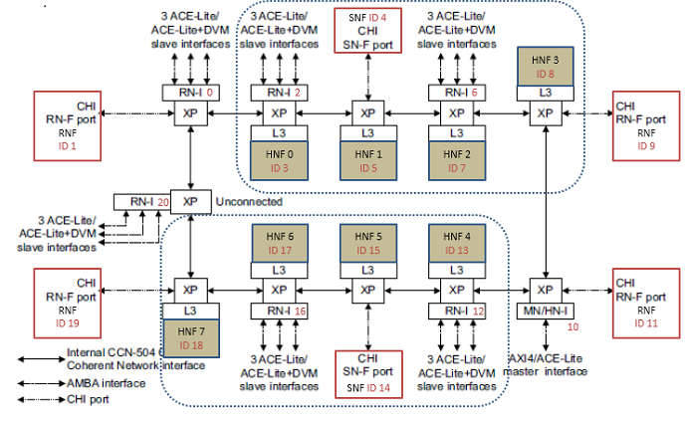
1.6.2 The CHI bus (9)
Example for new node designations in case of the ring interconnect fabric
of the CCN-504 [39]
RN-F: Fully coherent requester (Core cluster)
SN-F: Slave node, paired with a fully coherent requester (Memory controller)

Slide 117
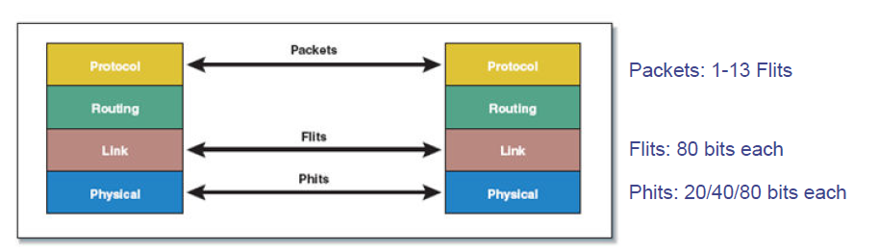
1.6.3 For comparison: Intel's QPI bus (1)
1.6.3 For comparison: Intel's QPI bus (Not discussed in the lecture)
Intel's QPI has a similar layered structure as the CHI bus, as seen below.
Packets
Flits
Phits
Figure: Layered architecture of Intel's QPI [70]

Slide 118
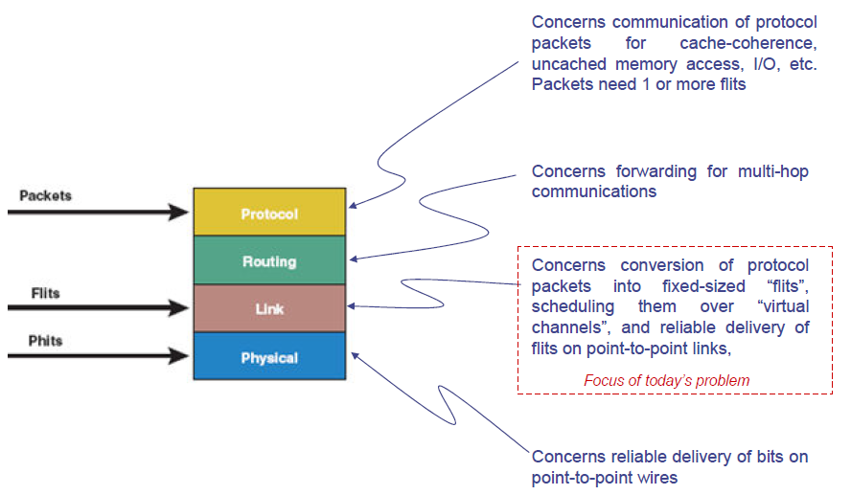
1.6.3 For comparison: Intel's QPI bus (2)
Main tasks of the layers of the communication protocol of QPI [70]

Slide 119
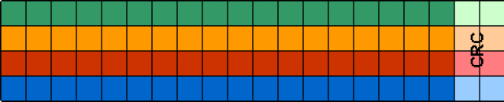
1.6.3 For comparison: Intel's QPI bus (3)
Remark 2 -2
A Phit contains all bits transferred by the Physical layer on a single clock edge,
that is 20 bits for a full width link, 10 bits for a half width and 5 bits for a
quarter width link implementation).
A Flit is always 80 bits long regardless of the link width, so the number of
Phits needed to transmit a Flit will varies on the link width.
Figure: An 80-bit long Flit of Intel's QPI [67]

Slide 120
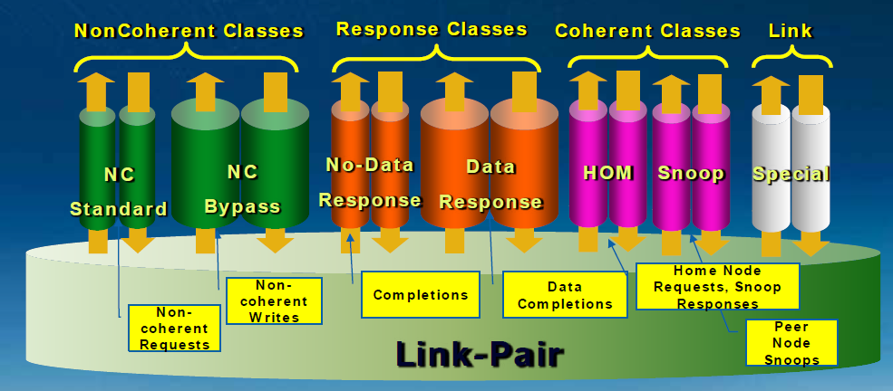
1.6.3 For comparison: Intel's QPI bus (4)
Message classes
In the QPI protocol, protocol events are grouped into message classes.
There are the following seven message classes defined [67]:
Figure: Message classes defined for the QPI [67]
Messages are subdivided into packets.

Slide 121
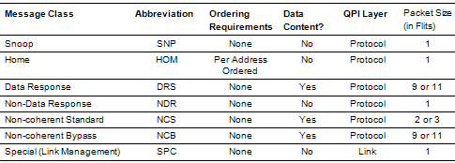
1.6.3 For comparison: Intel's QPI bus (5)
Main features of the message classes [68]

Slide 122
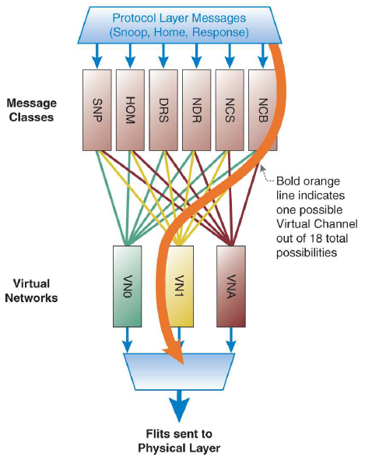
1.6.3 For comparison: Intel's QPI bus (6)
Sending messages over virtual channels to the Link layer [67]
Link layer

Slide 123
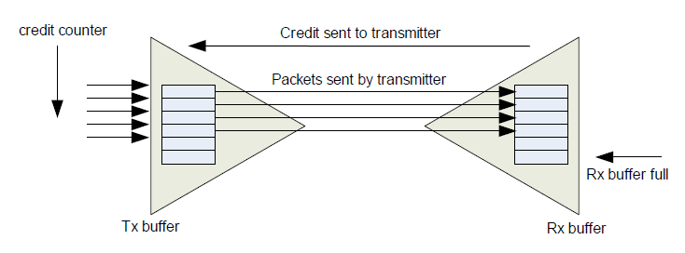
1.6.3 For comparison: Intel's QPI bus (7)
Credit-based flow control [69]
To avoid deadlocks sending of packets or flits is credit based.
This means:
During initialization, a sender is given a number of credits for each available
channel to send packets, or Flits to a receiver.
Whenever a packet or Flit is sent to the receiver over a channel, the sender
decrements its related credit counter by one credit.
Credits are returned from the receiver link layer after it has gated the data
sent, freed the related buffer and is ready to receive more information.
Figure: Principle of credit based flow control in Intel's QPI [69]

Slide 124
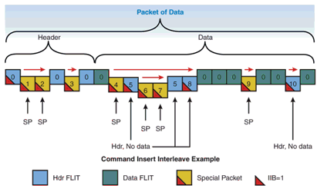
1.6.3 For comparison: Intel's QPI bus (8)
Example of an QPI packet with interleaved command insert packets [8]
There are three command insert packets, labeled 5, 8, 10 where packet 5
comprises two flits.
Furthermore, special packets 6 and 7 are interleaved between the flits of the
command insert packet.

Slide 125
1.6.3 For comparison: Intel's QPI bus (9)
Remark
The HyperTransport and PCI express buses are also packet based (serial) buses
nevetheless they do not use the Flit and Phit constructs.

Slide 126
2. ARM’s interconnects
2.1 Introduction
2.2 ARM's non-cache-coherent interconnects
2.3 ARM’s cache-coherent interconnects

Slide 127
2.1 Introduction

Slide 128
2.1.1 Introduction to interconnects

Slide 129
2.1.1 Introduction to interconnects (1)
2.1.1 Introduction to interconnects
There are different kinds of interconnects, as indicated in the next Figure.
Interconnects
On-die interconnects
Used typically to build a processor or SoC
Intra-node interconnects
Used typically to buid
clusters of servers or
clusters of nodes
(supercomputers)

Slide 130
2.1.1 Introduction to interconnects (2)
On-die interconnects
Proposed first by researchers of Stanford University in 2001 [71].
Main types of on-die interconnects:
On-die interconnects
Used typically to build a processor or SoC
Single-level
on-die interconnects
Two-level
on-die interconnects
All cores and other system agents,
e.g. L3 cache segments,
memory controllers, etc. are
interconnected by the same circuit.
Cores of a core cluster (up to 4 cores)
are interconnected by a first level circuit,
then core clusters and other system agents,
e.g. L3 cache segments,
memory controllers, etc. are
interconnected by a second circuit.
Examples
Intel's ring interconnect
for 4 cores or more
introduced in the
Sandy Bridge (2011)
Intels 2D-interconnect
e.g. in the 72-core
Knights Landing (2015)
ARM's interconnects

Slide 131
2.1.1 Introduction to interconnects (3)
Single level on-die interconnects
On-die interconnects
Used typically to build a processor or SoC
Single-level
on-die interconnects
Two-level
on-die interconnects
All cores and other system agents,
e.g. L3 cache segments,
memory controllers, etc. are
interconnected by the same circuit.
Cores of a core cluster (up to 4 cores)
are interconnected by a first level circuit,
then core clusters and other system agents,
e.g. L3 cache segments,
memory controllers, etc. are
interconnected by a second circuit.
Examples
Intel's ring interconnect
for 4 cores or more
introduced in the
Sandy Bridge (2011)
Intels 2D-interconnect
e.g. in the 72-core
Knights Landing (2015)
ARM's interconnects

Slide 132
2.1.1 Introduction to interconnects (4)
Example 1 of a single level on-die interconnect:
Intel's ring bus for the 4 core Sandy Bridge (2011) [58]
System Agent
The ring has six bus stops for
interconnecting
four cores
four L3 slices
the GPU and
the System Agent
The four cores and the
L3 slices share the same
interfaces.

Slide 133
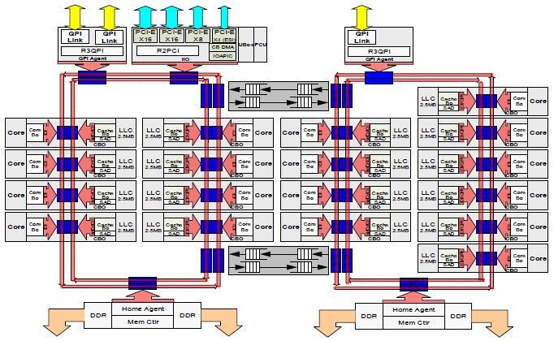
2.1.1 Introduction to interconnects (5)
Example 2 of a single level on-die interconnect:
Intel's dual ring interconnect for the 18-core Haswell-EX (2015) [59]

Slide 134
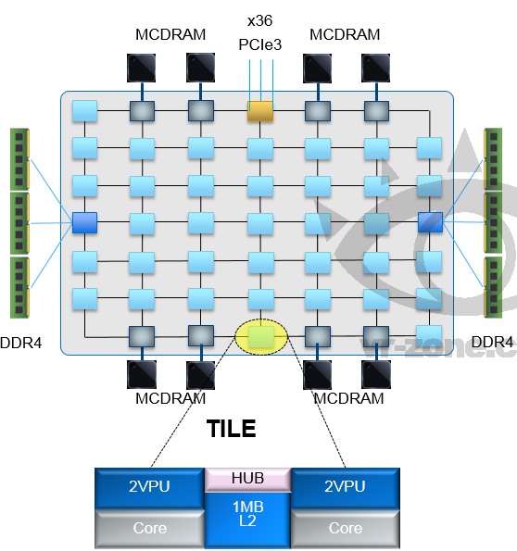
2.1.1 Introduction to interconnects (6)
Example 3 of a single level on-die interconnect: Intel's 2D-interconnect
in the 72-core Knights Landing (implemented in 36 tiles) (2015) [60]
Up to 72 Silvermont (Atom) cores
in 36 tiles
4 threads/core
2 512 bit vector units
2D mesh architecture
6 channels DDR4-2400,
up to 384 GB,
8/16 GB high bandwidth on-package
MCDRAM memory, >500 GB/s
36 lanes PCIe 3.0
200 W TDP

Slide 135
2.1.1 Introduction to interconnects (7)
Two-level on-die interconnects
On-die interconnects
Used typically to build a processor or SoC
Single-level
on-die interconnects
Two-level
on-die interconnects
All cores and other system agents,
e.g. L3 cache segments,
memory controllers, etc. are
interconnected by the same circuit.
Cores of a core cluster (up to 4 cores)
are interconnected by a first level circuit,
then core clusters and other system agents,
e.g. L3 cache segments,
memory controllers, etc. are
interconnected by a second circuit.
Examples
Intel's ring interconnect
for 4 cores or more
introduced in the
Sandy Bridge (2011)
Intels 2D-interconnect
e.g. in the 72-core
Knights Landing (2015)
ARM's interconnects
ARM's on-die interconnects are built up of two levels
the first level interconnects a cluster of cores (up to 4 cores)
the second level interconnects core clusters and other system components,
as shown subsequently.

Slide 136
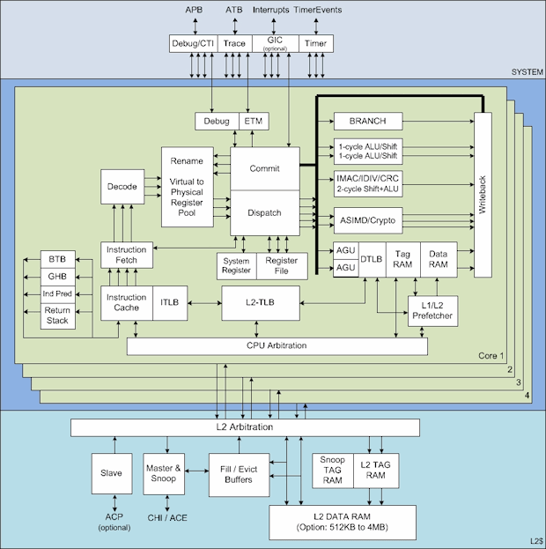
2.1.1 Introduction to interconnects (8)
Example: ARM's first level interconnect in the 4-core Cortex-A72 (2015) [61]
APB
ATB
Interrupts
Source: ARM

Slide 137

2.1.1 Introduction to interconnects (9)
ARM's 2. level interconnect in the Juno development platform [62]

Slide 138

2.1.1 Introduction to interconnects (10)
Die micrograph of ARM's Juno development platform [57]

Slide 139
2.1.1 Introduction to interconnects (11)
Intranode interconnects
Interconnects
On-die interconnects
Used typically to build a processor or SoC
Intra-node interconnects
Used typically to buid
clusters of servers or
clusters of nodes
(supercomputers)
Typically implemented as racks
Often called fabrics
Examples
Ologic's TrueScale
InfiniBand based
interconnection fabric (2008)
Intel's Omni-Path (2015)

Slide 140

2.1.1 Introduction to interconnects (12)
Example: Server cluster with InfiniBand based interconnect fabric [63]
Servers/nodes
s
Interconnect Fabric
s
Storage

Slide 141

2.1.1 Introduction to interconnects (13)
Omni-Path host adapter (to be inserted into a PCIe slot) [64]

Slide 142

2.1.1 Introduction to interconnects (14)
48-port Omni-Path switch in an 1U rack [65]

Slide 143
2.1.2 Introduction to ARM's interconnects

Slide 144
2.1.2 Introduction to ARM's interconnects (1)
2.1.2 Introduction to ARM's interconnects
Evolution of ARM's interconnection topologies used for SoCs
Interconnection topologies used for SoCs
Shared bus and multiplexers
based interconnections
Crossbar-based
interconnections
(called interconnects)
Ringbus-based
interconnections
(called interconnects)
(E.g. Two-layer interconnection
for dual transactions at a time)
[before 2004]
(from 2004 on)
(from 2012 on)
P
GPU
P
GPU
Crossbar
Ring
M
Per.
M
Per.
Typical use: AHB based SoCs [8]

Slide 145

2.1.2 Introduction to ARM's interconnects (2)
ARM's interconnects
ARM's interconnects are dedicated system components (available as IPs) that provide
the needed connections between the major system components, such as
core clusters, accelerators, memory, I/O etc, as indicated in the Figure below [28].
.
Figure: The role of an interconnect [28]

Slide 146
2.1.2 Introduction to ARM's interconnects (3)
Designation of the interface ports on ARM's interconnects
Masters: Interface ports initiating data requests e.g. to the memory or other
peripherals.
Slaves: interface ports receiving data requests e.g. from processors, the GPU,
DMAs or the LCD, as indicated in the Figure below.
ACE Masters
ACE-Lite Masters
.
ACE-Lite Slaves
Figure: Designation of the interface ports [28]

Slide 147
2.1.2 Introduction to ARM's interconnects (4)
Overview of ARM’s on-die interconnects
ARM’s on-die interconnects
ARM’s non-cache-coherent interconnects
ARM’s cache-coherent interconnects
Underlying bus systems: AXI3 or AXI4.
These buses do not support cache coherency.
Underlying bus systems: ACE or CHI.
These buses do support cache coherency.
Cache coherency (e.g. for DMA units)
is maintained by software.
This generates higher coherency traffic
and is less efficient in terms of
performance and power consumption.
Cache coherency is maintained
by hardware.
This generates less coherency traffic
and is more efficient in terms of
performance and power consumption.
They are crossbar based.
They are either crossbar or ring bus based.
They are used only for uniprocessors.
They are used typically for multiprocessors.
Section 2.2
Section 2.3

Slide 148
2.2 ARM's non-cache-coherent interconnects
2.2.1 Overview
2.2.2 ARM's non-cache-coherent interconnects based on
the AMBA 3 AXI (AXI3) bus
2.2.3 ARM's non-cache-coherent interconnects based on
the AMBA 4 AXI (AXI4) bus

Slide 149
2.2.1 Overview

Slide 150
2.2.1 Overview (1)
2.2.1 Overview -1
Main features
Underlying bus systems: AXI3 or AXI4.
These buses do not support cache coherency.
Cache coherency (e.g. for DMA units) is maintained by software.
This generates higher coherency traffic and is less efficient in terms of
performance and power consumption.
They are crossbar based.
They are used only for uniprocessors.

Slide 151
2.2.1 Overview (2)
Overview -2
ARM’s non-cache-coherent interconnects
ARM’s non-cache-coherent interconnects
based on the AMBA 3 AXI (AXI3) bus
ARM’s non cache cache-coherent interconnects based on the AMBA 4 (AXI4) bus
PL300 (2004)
NIC-301 (2006)
NIC-400 (2010)
(It is part of the CoreLink 400 system)
Typical use in
ARM11,
Cortex-A8/A9/A5
Cortex-A15/A7
SoCs
SoCs

Slide 152
2.2.2 ARM’s non-cache-coherent interconnects
based on the AMBA 3 AXI (AXI3) bus

Slide 153
2.2.2 ARM’s non-cache-coherent interconnects based on the AXI3 bus(1)
2.2.2 ARM’s non-cache-coherent interconnects based on the AMBA 3 AXI
(AXI3) bus
ARM’s non-cache-coherent interconnects
They make use of the AMBA AXI (AXI3 or AXI4) bus.
ARM’s non-cache-coherent interconnects
based on the AMBA 3 AXI (AXI3) bus
ARM’s non cache cache-coherent interconnects based on the AMBA 4 (AXI4) bus
PL300 (2004)
NIC-301 (2006)
NIC-400 (2010)
(It is part of the CoreLink 400 system)
Typical use in
ARM11,
Cortex-A8/A9/A5
Cortex-A15/A7
SoCs
SoCs

Slide 154
2.2.2 ARM’s non-cache-coherent interconnects based on the AXI3 bus(2)
Main features of ARM's AXI3 based non-cache-coherent interconnects
Main features | PL-300 | NIC-301 | NIC-400
Date of introduction | 06/2004 | 05/2006 | 08/2012
Supported processor models (Cortex-Ax MPCore) | ARM11 | A8/A9/A5 | A15/A7
No. of slave ports | Configurable | Configurable (1-128) | Configurable (1-64)
Type of slave ports | AXI3 | AXI3/AHB-Lite | AXI3/AXI4/AHB-Lite
Width of slave ports | 32/64-bit | 32/64/128/256-bit | 32/64/128/256-bit
No. of master ports | Configurable | Configurable (1-64) | Configurable (1-64)
Type of master ports | AXI3 | AXI3/AHB-Lite/APB2/3 | AXI3/AXI4/AHB-Lite/ APB2/3/4
Width of master ports | 32/64-bit | 32/64/128/256-bit (APB only 32-bit) | 32/64/128/256-bit (APB only 32-bit)
Integrated snoop filter | No | No | No
Interconnect topology | Swithes | Switches | Switches
Fitting memory controllers | PL-340 | PL-341/DMC-340/1/2 | DMC-400

Slide 155

2.2.2 ARM’s non-cache-coherent interconnects based on the AXI3 bus(3)
High level block diagram of ARM's first (AXI3-based) interconnect
(the PL300) [40]

Slide 156

2.2.2 ARM’s non-cache-coherent interconnects based on the AXI3 bus(4)
Example: NIC-301 based platform with a Cortex-A9 processor [41]
L2C: L2 cache controller
QoS: Quality of Service
DMC: Dynamic Memory
Controller
The NIC-301 was
ARM's next
interconnect
following the PL300

Slide 157
2.2.3 ARM’s non-cache-coherent interconnects
based on the AMBA 4 AXI (AXI4) bus

Slide 158
2.2.3 ARM’s non-cache-coherent interconnects based on the AXI4 bus(1)
2.2.3 ARM’s non-cache-coherent interconnect based on the AMBA 4 AXI
(AXI4) bus
ARM’s non-cache-coherent interconnects
They make use of the AMBA AXI (AXI3 or AXI4) bus.
ARM’s non-cache-coherent interconnects
based on the AMBA 3 AXI (AXI3) bus
ARM’s non cache cache-coherent interconnects based on the AMBA 4 (AXI4) bus
PL300 (2004)
NIC-301 (2006)
NIC-400 (2010)
(It is part of the CoreLink 400 system)
Typical use in
ARM11,
Cortex-A8/A9/A5
Cortex-A15/A7
SoCs
SoCs

Slide 159
2.2.3 ARM’s non-cache-coherent interconnects based on the AXI4 bus(2)
CoreLink 400 System components
Name | Product | Headline features
NIC-400 | Network interconnect | Non-cache-coherent interconnect
CCI-400 | Cache-coherent Interconnect | Cache-coherent interconnect supporting dual clusters of Cortex – A15/A17/A12/A7 2 128-bit ACE-Lite master ports 3 128-bit ACE-lite slave ports
DMC-400 | Dynamic Memory Controller | Dual channel LPDDR3/2/LPDDR2 X32 memory controller
MMU-400 | System Memory Management | Up to 40 bit virtual addresses ARMv7 virtualizations extensions compliant
GIC-400 | Generic Interrupt Controller | Share interrupts across clusters, ARMv7 virtualization extensions compliant
ADB-400 | AMBA Domain Bridge | It can optionally be used between components to integrate multiple power domains or clock domains for implementing DVFS
TZC-400 | TrustZone Address Space Controller | Prevents illegal access to protected memory regions

Slide 160
2.2.3 ARM’s non-cache-coherent interconnects based on the AXI4 bus(3)
Main features of ARM's AXI4 based non-cache-coherent interconnect
Main features | PL-300 | NIC-301 | NIC-400
Date of introduction | 06/2004 | 05/2006 | 08/2012
Supported processor models (Cortex-Ax MPCore) | ARM11 | A8/A9/A5 | A15/A7
No. of slave ports | Configurable | Configurable (1-128) | Configurable (1-64)
Type of slave ports | AXI3 | AXI3/AHB-Lite | AXI3/AXI4/AHB-Lite
Width of slave ports | 32/64-bit | 32/64/128/256-bit | 32/64/128/256-bit
No. of master ports | Configurable | Configurable (1-64) | Configurable (1-64)
Type of master ports | AXI3 | AXI3/AHB-Lite/APB2/3 | AXI3/AXI4/AHB-Lite/ APB2/3/4
Width of master ports | 32/64-bit | 32/64/128/256-bit (APB only 32-bit) | 32/64/128/256-bit (APB only 32-bit)
Integrated snoop filter | No | No | No
Interconnect topology | Swithes | Switches | Switches
Fitting memory controllers | PL-340 | PL-341/DMC-340/1/2 | DMC-400

Slide 161

2.2.3 ARM’s non-cache-coherent interconnects based on the AXI4 bus(4)
Example 1: NIC-400 based platform with a Cortex-A7 processor [43]
L2C: L2 cache controller
DMA: DMA cotroller
MMU: Memory Management
Unit
DMC: Dynamic Memory
Controller

Slide 162

2.2.3 ARM’s non-cache-coherent interconnects based on the AXI4 bus(5)
Internal structure of a NIC-400 Network Interconnect [44]

Slide 163
2.3 ARM’s cache-coherent interconnects
2.3.1 Overview
2.3.2 ARM's cache-coherent interconnects based on the
AMBA 4 ACE bus
2.3.3 ARM's cache-coherent interconnects based on the
AMBA 5 CHI bus

Slide 164
2.3.1 Overview

Slide 165
2.3.1 Overview (1)
2.3.1 Overview -1
The MPCore technology announced with the ARM11 MPCore family (2004)
introduced hardware supported cache coherency for multicore processors.
Nevertheless, for maintaining hardware supported cache coherency for
multiprocessors (multiple core clusters in ARM's terminology) ARM needed
to expand their AMBA 3 AXI (AXI3) bus system with appropriate cache
coherency extensions.
The required extensions (three snoop channels and a number of further signals)
were provided by the ACE (AMBA Coherency Extensions) protocol specification
introduced as part of the AMBA 4 protocol family in 2/2010, as indicated in the
next Figure.

Slide 166
2.3.1 Overview (2)
Extending the AXI interface by three snoop channels and further signal lines
in the ACE interface [28]
(ACADDR)
(CRRESP)
(CDDATA)
Additional signals
Additional channels

Slide 167
2.3.1 Overview (3)
Overview -2
The AMBA 4 ACE and the subsequent AMBA 5 CHI bus provide the foundations for
cache coherent interconnects, to be discussed next.
Note
ACE is not limited to maintain coherency between identical CPU core clusters
but it can support coherency also for dissimilar CPU clusters or for a GPU or
also maintain I/O coherency for accelerators.

Slide 168
2.3.1 Overview (4)
Overview of ARM’s cache-coherent interconnects
Main features
Underlying bus systems: AMBA 4 ACE or AMBA 5 CHI.
These buses do support hardware cache coherency.
This generates less coherency traffic and is more efficient in terms of
performance and power consumption.
They are either crossbar or ring bus based.
They are used typically for multiprocessors.

Slide 169
2.3.1 Overview (5)
Overview of ARM’s cache-coherent interconnects
ARM’s cache-coherent interconnects
ARM’s cache-coherent interconnects
based on the AMBA 4 ACE bus
ARM’s cache-coherent interconnects
based on the AMBA 5 CHI bus
They are used for mobiles
They are used for servers
Provide ACE slave ports for core clusters
Provide CHI slave ports for core clusters
No integrated L3 cache
Integrated L3 cache
First models (CCI-400/500) support both
Cortex A7/A15/A17 and A50 series processors,
the CCI-550 support only A50 series processors.
Support only Cortex-A50 series processors
The first model (CCI-400) does not include
a snoop filter, subsequent models do.
All models include a snoop filter.
The interconnect fabric is implemented
as a crossbar
The interconnect fabric is implemented
as a ring bus, termed internally as Dickens
Examples
CCI-400 (2010)
CCI-500 (2014)
CCI-550 (2015)
CCN-502 (2014)
CCN-504 (2012)
CCN-508 (2013)
CCN-512 (2014)
(See Section 2.3.2)
(See Section 2.3.3)

Slide 170
2.3.2 ARM’s cache-coherent interconnects
based on the AMBA 4 ACE bus

Slide 171
2.3.2 ARM’s cache-coherent interconnects based on the ACE bus (1)
2.3.2 ARM’s cache-coherent interconnects based on the AMBA 4 ACE bus
Main features
They are targeting mobiles.
They do not have L3 caches.
They are built up internally as crossbars.
ARM’s cache-coherent interconnects based on the AMBA 4 ACE bus
ARM’s cache-coherent interconnect
belonging to the CoreLink 400 family
ARM’s cache-coherent interconnects
belonging to the CoreLink 500 family
It does not include a snoop filter.
They include a snoop filter to reduce snoop traffic.
Typical use in
Cortex-A7/A15/A53/A53
Cortex-A53/A57/A72
SoCs
SoCs
Models
CCI-400 (2010)
CCI-500 (2014)
CCI-550 (2015)
Fully coherent
CPU clusters
up to
2
4
6
No. of
LPDDR 4/3
memory channels
2
4
6

Slide 172
2.3.2 ARM’s cache-coherent interconnects based on the ACE bus (2)
ARM’s cache-coherent interconnects belonging to the CoreLink 400 family
ARM’s cache-coherent interconnects based on the AMBA 4 ACE bus
ARM’s cache-coherent interconnect
belonging to the CoreLink 400 family
ARM’s cache-coherent interconnects
belonging to the CoreLink 500 family
It does not include a snoop filter.
They include a snoop filter to reduce snoop traffic.
Typical use in
Cortex-A7/A15/A53/A53
Cortex-A53/A57/A72
SoCs
SoCs
Models
CCI-400 (2010)
CCI-500 (2014)
CCI-550 (2015)
Fully coherent
CPU clusters
up to
2
4
6
No. of
LPDDR 4/3
memory channels
2
4
6
Suitable for big.LITTLE
configurations

Slide 173
2.3.2 ARM’s cache-coherent interconnects based on the ACE bus (3)
CoreLink 400 System components (targeting mobiles)
Name | Product | Headline features
NIC-400 | Network interconnect | Non-cache-coherent interconnect
CCI-400 | Cache-coherent Interconnect | Cache-coherent interconnect supporting dual clusters of Cortex – A7/A15/A17/A53/A57 2 128-bit ACE-Lite master ports 3 128-bit ACE-lite slave ports
DMC-400 | Dynamic Memory Controller | Dual channel LPDDR3/2/LPDDR2 X32 memory controller
MMU-400 | System Memory Management | Up to 40 bit virtual addresses ARMv7 virtualizations extensions compliant
GIC-400 | Generic Interrupt Controller | Share interrupts across clusters, ARMv7 virtualization extensions compliant
ADB-400 | AMBA Domain Bridge | It can optionally be used between components to integrate multiple power domains or clock domains for implementing DVFS
TZC-400 | TrustZone Address Space Controller | Prevents illegal access to protected memory regions

Slide 174
2.3.2 ARM’s cache-coherent interconnects based on the ACE bus (4)
Main features of ARM's cache-coherent ACE bus based CCI-400 interconnect
It is used for mobiles
Main features | CCI-400 | CCI-500 |  | CCI-550
Date of introduction | 10/2010 | 11/2014 |  | 10/2015
Supported processor models (Cortex-Ax MPCore) | A7/A15/A17/ A53/A57 | A7/15/A17 /A53/A57/A72 |  | A53/A573/A72 and next proc.
No. of fully coherent ACE slave ports for CPU clusters (of 4 cores) | 2 | 1-4 |  | 1-6
No of I/O-coherent ACE-Lite slave ports | 1-3 | 0-6 (max 7 slave ports) |  | 0-6 (max 7 slave ports)
No. of ACE-Lite master ports for memory channels | 1-2 ACE-Lite DMC-500 (LPDDR4/3) | 1-4 AXI4 DMC-500 (LPDDR4/3 |  | 1-6 AXI4 DMC-500 (LPDDR4/3)
No. of I/O-coherent master ports for accelerators and I/O | 1 ACE-Lite | 1-2 AXI4 |  | 1-3 (max 7 master ports)
Data bus width | 128-bit | 128-bit |  | 128-bit
Integrated L3 cache | No | No |  | No
Integrated snoop filter | No, broadcast snoop coherency | Yes, there is a directory of caches content, to reduce snoop traffic
Interconnect topology | Switches | Switches | Switches

Slide 175
2.3.2 ARM’s cache-coherent interconnects based on the ACE bus (5)
Block diagram of the CCI-400 [28]
.

Slide 176

2.3.2 ARM’s cache-coherent interconnects based on the ACE bus (6)
Internal architecture
of the CCI-400
cache-coherent
Interconnect [45]

Slide 177
2.3.2 ARM’s cache-coherent interconnects based on the ACE bus (7)
Example 1: Dual Cortex-A15 SoC based on the CCI-400 interconnect [2]
(Generic Interrupt Controller)
(GPU)
(Network Interconnect)
(Memory
Management Unit)
(DVM: Distributed
Virtual Memory)
(Dynamic Memory Controller)

Slide 178

2.3.2 ARM’s cache-coherent interconnects based on the ACE bus (8)
Example 2: Cortex-A57/A53 SoC based on the CCI-400 interconnect [56]
ADB: AMBA Domain Bridge
(to implement DVFS)

Slide 179
2.3.2 ARM’s cache-coherent interconnects based on the ACE bus (9)
Die micrograph ARM's Juno SoC including a dual core-A57 and quad core
Cortex-A53 as well as a Mali-T624 GPU [57]

Slide 180
2.3.2 ARM’s cache-coherent interconnects based on the ACE bus (10)
Use of ARM's CCI-400 interconnect IPs by major SOC providers
Use of ARM's interconnect IPs targeting mobiles
Use of ARM’s CCI-400 IP in mobiles of major manufacturers
Use of own proprietary interconnect
in the mobiles of major manufacturers
Samsung Exynos 5 Octa 5410 (2013)
Samsung Exynos 5 Octa 5420 (2013) .
Samsung Exynos 7 Octa 7420 (2015)
MediaTek MT6595 (2014)
Rockchip RK3288 (2014)
Huawei Kirin 950 (2015)
MediaTek Coherent System Interconnect (MCSI)
in MediaTek MT6797 (2015)
SamsungCoherent Interconnect (SCI)
in Exynos 8 Octa 8890 (2015)

Slide 181
2.3.2 ARM’s cache-coherent interconnects based on the ACE bus (11)
ARM’s cache-coherent interconnects belonging to the CoreLink 500 family
ARM’s cache-coherent interconnects based on the AMBA 4 ACE bus
ARM’s cache-coherent interconnect
belonging to the CoreLink 400 family
ARM’s cache-coherent interconnects
belonging to the CoreLink 500 family
It does not include a snoop filter.
They include a snoop filter to reduce snoop traffic.
Typical use in
Cortex-A7/A15/A53/A53
Cortex-A53/A57/A72
SoCs
SoCs
Models
CCI-400 (2010)
CCI-500 (2014)
CCI-550 (2015)
Fully coherent
CPU clusters
up to
2
4
6
No. of
LPDDR 4/3
memory channels
2
4
6
Suitable for big.LITTLE
configurations

Slide 182
2.3.2 ARM’s cache-coherent interconnects based on the ACE bus (12)
Operation of snoop filters
See Section 1.5.7f.

Slide 183
2.3.2 ARM’s cache-coherent interconnects based on the ACE bus (13)
CoreLink 500 System components
Name | Product | Headline features
CCI-500 CCI-550 | Cache-Coherent Interconnects | Supports up to 4 core clusters and up to 4 memory channels Supports up to 6 core clusters and up tp 6 memory channels They support Cortex-A7/A15/A17/A53/A57/A72 processors They include a snoop filter to reduce snoop traffic
DMC-500 | Dynamic Memory Controllers | Supports LPDDR4/3 up to LPDDR4-2133 X32
MMU-500 | System Memory Management | Up to 48 bit virtual addresses Adds ARMv8 virtualization support but supports also A15/A7 page table formats
GIC-500 | Generic Interrupt Controller | Share interrupts across clusters, ARMv8 virtualization extensions compliant

Slide 184
2.3.2 ARM’s cache-coherent interconnects based on the ACE bus (14)
Main features of ARM's cache-coherent ACE bus based CCI-500 interconnects
They are used for mobiles
Main features | CCI-400 | CCI-500 |  | CCI-550
Date of introduction | 10/2010 | 11/2014 |  | 10/2015
Supported processor models (Cortex-Ax MPCore) | A7/A15/A17/ A53/A57 | A7/15/A17 /A53/A57/A72 |  | A53/A573/A72 and next proc.
No. of fully coherent ACE slave ports for CPU clusters (of 4 cores) | 2 | 1-4 |  | 1-6
No of I/O-coherent ACE-Lite slave ports | 1-3 | 0-6 (max 7 slave ports) |  | 0-6 (max 7 slave ports)
No. of ACE-Lite master ports for memory channels | 1-2 ACE-Lite DMC-500 (LPDDR4/3) | 1-4 AXI4 DMC-500 (LPDDR4/3 |  | 1-6 AXI4 DMC-500 (LPDDR4/3)
No. of I/O-coherent master ports for accelerators and I/O | 1 ACE-Lite | 1-2 AXI4 |  | 1-3 (max 7 master ports)
Data bus width | 128-bit | 128-bit |  | 128-bit
Integrated L3 cache | No | No |  | No
Integrated snoop filter | No, broadcast snoop coherency | Yes, there is a directory of cach contents, to reduce snoop traffic
Interconnect topology | Switches | Switches | Switches

Slide 185
2.3.2 ARM’s cache-coherent interconnects based on the ACE bus (15)
Example 1: Cache coherent SOC based on the CCI-500 interconnect [32]

Slide 186
2.3.3 ARM’s cache-coherent interconnects
based on the AMBA 5 CHI bus

Slide 187
2.3.3 ARM’s cache-coherent interconnects based on the CHI bus (1)
2.3.3 ARM’s cache-coherent interconnects based on the AMBA 5 CHI bus
Main features
They are targeting enterprise computing.
Typically, they use the packet based AMBA 5 CHI interface between the core
clusters and the interconnect
Level 3 cache (up to 32 MB) with a snoop filter
They have ring architectures.
Recently, there are four related implementations:
the CCN-502 (Core Coherent Network–502) (2014)
the CCN-504 (Core Coherent Network–504) (2012)
the CCN-508 (Core Coherent Network-508) (2013) and
the CCN-512 (Core Coherent Network–504) (2014)
These interconnects are part of the CoreLink 500 system.

Slide 188
2.3.3 ARM’s cache-coherent interconnects based on the CHI bus (2)
CoreLink 500 System components
Name | Product | Headline features
CCN-502 CCN-504 CCN-508 CCN-512 | Cache Coherent Interconnects | Supports up to 4 core clusters and up to 4 memory controllers Supports up to 4 core clusters and up to 2 memory controllers Supports up to 8 core clusters and up to 4 memory controllers Supports up to 12 core clusters and up to 4 memory controllers They include a snoop filter to reduce snoop traffic and may include an L3 cache
DMC-520 | Dynamic Memory Controllers | DDR4/3 up to DDR4-3200 X72
MMU-500 | System Memory Management | Up to 48 bit virtual addresses Adds ARMv8 virtualization support but supports also A15/A7 page table formats
GIC-500 | Generic Interrupt Controller | Share interrupts across clusters, ARMv8 virtualization extensions compliant

Slide 189

2.3.3 ARM’s cache-coherent interconnects based on the CHI bus (3)
Key parameters of ARM's cache-coherent interconnects based on the
CHI bus (simplified) [47]

Slide 190
2.3.3 ARM’s cache-coherent interconnects based on the CHI bus (4)
Main features of ARM's cache coherent CHI bus based CCN-5xx interconnects
They are targeting enterprise computing.
Main features | CCN-502 | CCN-504 | CCN-508 | CCN-512
Date of introduction | 12/2014 | 10/2012 | 10/2013 | 10/2014
Supported processors (Cortex-Ax) | A57/A53 | A15/A57/A53 | A57/A53 and next proc. | A57/A53 and next proc.
No. of fully coherent slave ports for CPU clusters (of up to 4 cores) | 4 (CHI) | 4 (AXI4/CHI) | 8 (CHI) | 12 (CHI)
No. of I/O-coherent slave ports for accelerators and I/O | 9 ACE-Lite/AXI4 | 18 ACE-Lite/AXI4 /AXI3 | 24 ACE-Lite/AXI4 | 24 ACE-Lite/AXI4
Integrated L3 cache | 0-8 MB | 1-16 MB | 1-32 MB | 1-32 MB
Integrated snoop filter | Yes | Yes | Yes | Yes
Support of memory controllers (up to) | 4x DMC-520 (DDR4/3 up to DDR4-3200) | 2x DMC-520 (DDR4/3 up to DDR4-3200) | 4x DMC-520 (DDR4/3 up to DDR4-3200) | 4x DMC-520 (DDR4/3 up to DDR4-3200)
DDR bandwidth up to | 102.4 GB/s | 51.2 GB/s | 102.4 GB/s | 102.4 GB/s
Interconnect topology | Ring | Ring (Dickens) | Ring | Ring
Sustained interconnect bandwidth | 0.8 Tbps | 1 Tbps | 1.6 Tbps | 1.8 Tbps
Technology | n.a. | 28 nm | n.a. | n.a.

Slide 191

2.3.3 ARM’s cache-coherent interconnects based on the CHI bus (5)
Example 1: SOC based on the cache-coherent CCN-504 interconnect [48]

Slide 192


2.3.3 ARM’s cache-coherent interconnects based on the CHI bus (6)
The ring interconnect fabric of the CCN-504 (dubbed Dickens) [49]
Remark: The Figure indicates only 15 ACE-Lite slave ports and 1 master port
whereas ARM's specifications show 18 ACE-Lite slave ports and 2 master ports.

Slide 193
2.3.3 ARM’s cache-coherent interconnects based on the CHI bus (7)
Example 2: SOC based on the cache-coherent CCN-512 interconnect [52]

Slide 194
3. Overview of the evolution of ARM's platforms

Slide 195
3. Overview of the evolution of ARM’s platforms (1)
3. Overview of the evolution of ARM's platforms
Subsequently, we give an overview about the main steps of how ARM's platforms
evolved.

Slide 196
3. Overview of the evolution of ARM’s platforms (2)
The first introduced AMBA bus (1996)
ARM7xx
CPU
L1I
L1D
UART
Timer
Memory controller
ASB
APB
Bridge
APB
Keypad
Memory
DMA
Bus Master
PIO
ASB (Advanced System Bus)
APB (Advanced Peripheral Bus)
High performance
Multiple bus masters/slaves
Single transaction at a time
Low power
Multiple peripheral
Single transaction at a time

Slide 197
3. Overview of the evolution of ARM’s platforms (3)
Allowing multiple transactions at a time on the AHB bus (2001)
AHB bus specification
AHB-Lite
specification
[2001]
Original AHB
specification
[1999]
Multi-layer AHB
specification
[2001]
Single master,
single transaction at a time
Multiple masters,
single transaction at a time
Multiple masters,
multiple transactions at a time
Lower cost and performance
Higher cost and performance
Principle of the interconnect
(Only the Master to Slave direction shown)
AHB
Master
AHB
Slave
AHB
Master
AHB
Slave
AHB
Master
AHB
Slave
AHB
Master
AHB
Slave
Shared bus
Crossbar

Slide 198
3. Overview of the evolution of ARM’s platforms (4)
Introduction of an external L2 cache based on the AHB-Lite interface (2003)
ARM926/1136
CPU
ARM7xx
L1I
L1D
CPU
AHB-Lite
64-bit
AHB-Lite
64-bit
L1I
L1D
UART
L2 cache contr.
(L210) + L2 data
APB
UART
Memory controller
APB
Bridge
Timer
Memory controller
APB
Bridge
Timer
APB
64-bit
AHB
Keypad
Keypad
Memory
DMA
Bus Master
PIO
Memory
DMA
Bus Master
PIO

Slide 199
3. Overview of the evolution of ARM’s platforms (5)
Introduction of an interconnect along with the AMBA AXI interface (2004)
ARM926/1136
ARM1156/1176
GPU
CPU
Mali-200
CPU
L1I
L1D
L1I
L1D
AXI3
32/64-bit
AXI3
32/64-bit
AHB-Lite
64-bit
AHB-Lite
64-bit
L2 cache contr.
(L210) + L2 data
APB
UART
L2 cache contr. (PL300)
+ L2 data
Memory controller
APB
Bridge
Timer
AXI3 64-bit
AXI3 64-bit
AXI3
64-bit
AHB
Interconnect PL300
Keypad
Memory
DMA
Bus Master
PIO
AXI3 32-bit
Memory controller (PL-340)
Memory (SDRAM/DDR/LPDDR)

Slide 200
3. Overview of the evolution of ARM’s platforms (6)
Intro. of integrated L2, dual core clusters and Cache Coherent Interconnect
based on the ACE bus (2011)
Cortex-A9 MPcore
Generic Interrupt Controller
Cortex-A7 or higher
CPU0
CPU3
GPU
Generic Interrupt Controller
L1I
L1D
Mali-400
L1I
L1D
L2
Quad core
A15
Quad core
A7
GPU
Mali-620
Snoop Control Unit (SCU)
L2
AXI3 64-bit
AXI3 64-bit (opt.)
MMU-400
L2 cache contr. (L2C-310) + L2 data
L2
SCU
L2
SCU
AXI3 64-bit
AXI3 64--bit
AXI3
ACE 128bit
ACE 128-bit
ACE-Lite
Networl Interconnect (NIC-310)
(Configurable data width: 32 - 256-bit)
Cache Coherent Interconnect (CCI-400)
128-bit @ ½ Cortex-A15 frequency
AXI3
AXI3
ACE-Lite 128-bit
ACE-Lite 128-bit
Memory controller (PL-340)
Memory controller (DMC-400)
DFI2.1
DFI2.1
Memory (SDRAM/DDR/LPDDR)
DR3/2/LPDDR2
DDR3/2/LPDDR2

Slide 201
3. Overview of the evolution of ARM’s platforms (7)
Introduction of up to 4 core clusters, a Snoop Filter and up to 4
memory channels for mobile platforms (2014)
Cortex-A7 or higher
up to
4
Cortex-A53/A57 etc.
Generic Interrupt Controller
Generic Interrupt Controller
Quad core
A15
Quad core
A7
GPU
Quad core
A57
Quad core
A57
GPU
Mali-620
Mali-T880
L2
L2
L2
SCU
L2
SCU
MMU-400
L2
SCU
L2
SCU
MMU-400
ACE-Lite
128-bit
ACE-Lite
128-bit
ACE 128bit
ACE 128-bit
ACE 128-bit
ACE 128-bit
Cache Coherent Interconnect (CCI-400)
128-bit @ ½ Cortex-A15 frequency
Cache Coherent Interconnect (CCI-500)
128-bit @ ½ Cortex-A15 frequency
with Snoop Filter
ACE-Lite 128-bit
ACE-Lite 128-bit
AXI4 128-bit
AXI4 128-bit
Memory controller (DMC-400)
DMC-400
DMC-400
DFI2.1
DFI2.1
Up to 4
DFI 2.1
DFI 2.1
DR3/2/LPDDR2
DDR3/2/LPDDR2
DR3/2/LPDDR2
DR3/2/LPDDR2

Slide 202
3. Overview of the evolution of ARM’s platforms (8)
Introduction of up to six memory channels for up to 4 core clusters
for mobile platorms (2015)
up to
4
up to
4
Cortex-A53/A57 etc.
Cortex-A53/A57 etc.
Generic Interrupt Controller
Generic Interrupt Controller
Quad core
A57
Quad core
A53
GPU
Quad core
A57
Quad core
A53
GPU
Mali-T880
Mali-T880
L2
L2
L2
SCU
L2
SCU
MMU-400
L2
SCU
L2
SCU
MMU-500
ACE-Lite
128-bit
ACE-Lite
128-bit
ACE 128-bit
ACE 128-bit
ACE 128-bit
ACE 128-bit
Cache Coherent Interconnect (CCI-500)
128-bit @ ½ Cortex-A15 frequency
with Snoop Filter
Cache Coherent Interconnect (CCI-550)
128-bit @ ½ Cortex-A15 frequency
with Snoop Filter
AXI4 128-bit
AXI4 128-bit
AXI4 128-bit
AXI4 128-bit
DMC-400
DMC-400
DMC-500
DMC-500
Up to 4
Up to 6
DFI 2.1
DFI 2.1
DFI 4.0
DFI 4.0
DR3/2/LPDDR2
DR3/2/LPDDR2
LPDDR3/LPDDR4
LPDDR3/LPDDR4

Slide 203
3. Overview of the evolution of ARM’s platforms (9)
Introduction of an L3 cache in server platforms but only dual mem. channels
for server platforms (2012)
up to
4
up to
4
Cortex-A53/A57 etc.
Cortex-A53/A57 etc.
Generic Interrupt Controller
Generic Interrupt Contr. (GIC_500)
Quad core
A15
Quad core
A15
GPU
Quad core
A57
Quad core
A35
GPU
Mali-T880
Mali-T880
L2
L2
L2
SCU
L2
SCU
MMU-500
L2
SCU
L2
SCU
MMU-500
ACE-Lite
128-bit
ACE-Lite
128-bit
ACE 128-bit
ACE 128-bit
ACE or CHI
ACE or CHI
Cache Coherent Interconnect (CCI-550)
128-bit @ ½ Cortex-A15 frequency
with Snoop Filter
Cache Coherent Interconnect (CCN-504)
with L3 cache and Snoop Filter
AXI4 128-bit
AXI4 128-bit
CHI
CHI
DMC-500
DMC-500
DMC-520
DMC-520
DFI 4.0
Up to 6
DFI 4.0
DFI 3.0
DFI 3.0
LPDDR3/LPDDR4
LPDDR3/LPDDR4
DDR3/4/LPDDR3
DDR3/4/LPDDR3

Slide 204
3. Overview of the evolution of ARM’s platforms (10)
Introduction of up to 12 core clusters and up to 4 memory channels
for server platforms (2014)
up to
4
up to
12
Cortex-A53/A57 etc.
Cortex-A53/A57 etc.
Generic Interrupt Contr. (GIC_500)
Generic Interrupt Contr. (GIC_500)
Quad core
A57
Quad core
A35
GPU
Quad core
A72
Quad core
A72
GPU
Mali-T880
Mali-T880
L2
L2
L2
SCU
L2
SCU
MMU-500
L2
SCU
L2
SCU
MMU-500
ACE-Lite
128-bit
ACE-Lite
128-bit
ACE or CHI
ACE or CHI
ACE or CHI
ACE or CHI
Cache Coherent Interconnect (CCN-504)
with L3 cache and Snoop Filter
Cache Coherent Interconnect (CCN-512)
with L3 cache and Snoop Filter
CHI
CHI
CHI
CHI
DMC-520
DMC-520
DMC-520
DMC-520
DFI 3.0
DFI 3.0
DFI 3.0
Up to 4
DFI 3.0
DDR3/4/LPDDR3
DDR3/4/LPDDR3
DDR3/4/LPDDR3
DDR3/4/LPDDR3

Slide 205
4. References

Slide 206
4. References (1)
[1]: Wikipedia, Advanced Microcontroller Bus Architecture,
https://en.wikipedia.org/wiki/Advanced_Microcontroller_Bus_Architecture
[2]: Stevens A., Introduction to AMBA 4 ACE and big.LITTLE Processing Technology, White Paper,
June 6 2011, http://www.arm.com/files/pdf/CacheCoherencyWhitepaper_6June2011.pdf
[3]: Goodacre J., The Evolution of the ARM Architecture Towards Big Data and the Data-Centre,
8th Workshop on Virtualization in High-Performance Cloud Computing (VHPC’13),
Nov. 17-22 2013, http://www.virtical.eu/pub/sc13.pdf
[4]: AMBA Advanced Microcontroller Bus Architecture Specification, Issued: April 1997,
Document Number: ARM IHI 0001D
https://www.yumpu.com/en/document/view/31043439/advanced-microcontroller-bus-
architecture-specification/3
[5]: Andrews J.R., Co-Verification of Hardware and Software for ARM SoC Design, Elsevier, 2005,
http://samples.sainsburysebooks.co.uk/9780080476902_sample_790660.pdf
[6]: AMBA Specification (Rev 2.0), May 13 1999,
https://silver.arm.com/download/download.tm?pv=1062760
[7]: Sinha R., Roop P., Basu S., Correct-by-Construction Approaches for SoC Design, Springer, 2014
[8]: Harnisch M., Migrating from AHB to AXI based SoC Designs, Doulos, 2010,
http://www.doulos.com/knowhow/arm/Migrating_from_AHB_to_AXI/
[9]: Shankar D., Comparing AMBA AHB to AXI Bus using System Modeling, Design & Reuse,
http://www.design-reuse.com/articles/24123/amba-ahb-to-axi-bus-comparison.html
[10]: ARM Launches Multi-Layer AHB and AHB-Lite, Design & Reuse, March 19 2001,
http://www.design-reuse.com/news/856/arm-multi-layer-ahb-ahb-lite.html

Slide 207
4. References (2)
[11]: AMBA 3 AHB-Lite Protocol Specification v1.0, ARM IHI 0033A, 2001, 2006,
http://www.eecs.umich.edu/courses/eecs373/readings/ARM_IHI0033A_AMBA_AHB-
Lite_SPEC.pdf
[12]: ARM AMBA 3 AHB-Lite Bus Protocol, Cortex MO – System Design,
http://old.hipeac.net/system/files/cm0ds_2_0.pdf
[13]: Multi-layer AHB Overview, DVI 0045A, 2001 ARM Limited,
http://pdf.datasheetarchive.com/indexerfiles/Datasheets-SL1/DSASL001562.pdf
[14]: Multi-Layer AHB, AHB-Lite,
http://www.13thmonkey.org/documentation/ARM/multilayerAHB.pdf
[15]: AMBA AXI and ACE Protocol Specification, ARM IHI 0022E (ID022613), 2003, 2013
[16]: AMBA AXI Protocol Specification, v1.0, ARM IHI 0022B, 2003, 2004,
http://nineways.co.uk/AMBAaxi_fullspecification.pdf
[17]: Jayaswal M., Comparative Analysis of AMBA 2.0 and AMBA 3 AXI Protocol-Based Subsystems,
ARM Developers’ Conference & Design Pavilion 2007, http://rtcgroup.com/arm/2007/
presentations/179%20-%20Comparative%20Analysis%20of%20AMBA%202.0%20and%
20AMBA%203%20AXI%20Protocol-Based%20Subsystems.pdf
[18]: CoreSight Architecture Specification, v1.0, ARM IHI 0029B, 2004, 2005
[19]: AMBA 3 ATB Protocol Specification, v1.0, ARM IHI 0032A, 2006

Slide 208
4. References (3)
[20]: AMBA 3 APB Protocol Specification, v1.0, ARM IHI 0024B, 2003, 2004,
http://web.eecs.umich.edu/~prabal/teaching/eecs373-f11/readings/ARM_AMBA3_APB.pdf
[21]: The ARM Cortex-A9 Processors, White Paper, Sept. 2009,
https://www.element14.com/community/servlet/JiveServlet/previewBody/54580-102-1-
273638/ARM.Whitepaper_1.pdf
[22]: AMBA AXI Protocol Specification, v2.0, ARM IHI 0022C, 2003-2010
[23]: AMBA AXI4-Stream Protocol Specification, v1.0, ARM IHI 0051A (ID030510), 2010
[24]: AMBA AXI4 - Advanced Extensible Interface, XILINX, 2012,
http://www.em.avnet.com/en-us/design/trainingandevents/Documents/X-Tech%202012%
20Presentations/XTECH_B_AXI4_Technical_Seminar.pdf
[25]: AMBA AXI and ACE Protocol Specification, ARM IHI 0022D (ID102711), Oct. 28 2011
http://www.gstitt.ece.ufl.edu/courses/fall15/eel4720_5721/labs/refs/AXI4_specification.pdf
[26]: AMBA APB Protocol Specification, v2.0, ARM IHI 0024C (ID041610), 2003-2010
[27]: AMBA 4 ATB Protocol Specification, ATBv1.0 and ATBv1.1, ARM IHI 0032B (ID040412), 2012
[28]: Multi-core and System Coherence Design Challenges,
http://www.ece.cmu.edu/~ece742/f12/lib/exe/fetch.php?media=arm_multicore_and_
system_coherence_-_cmu.pdf
[29]: Parris N., Extended System Coherency - Part 1 - Cache Coherency Fundamentals, 2013,
https://community.arm.com/groups/processors/blog/2013/12/03/extended-system-
coherency--part-1--cache-coherency-fundamentals

Slide 209
4. References (4)
[30]: Memory access ordering - an introduction, March 22 2011,
https://community.arm.com/groups/processors/blog/2011/03/22/memory-access-
ordering--an-introduction
[31]: Parris N., Extended System Coherency - Part 3 – Increasing Performance and Introducing
CoreLink CCI-500, ARM Connected Community Blog, Febr. 3 2015,
https://community.arm.com/groups/processors/blog/2015/02/03/extended-system-
coherency--part-3--corelink-cci-500
[32]: CoreLink CCI-500 Cache Coherent Interconnect,
http://www.arm.com/products/system-ip/interconnect/corelink-cci-500.php
[33]: Orme W., Sharma M., Exploring System Coherency and Maximizing Performance of Mobile
Memory Systems, ARM Tech Symposia China 2015, Nov. 2015,
http://www.armtechforum.com.cn/attached/article/ARM_System_Coherency20151211110911.
pdf
[34]: ARM CoreLink CCI-550 Cache Coherent Interconnect, Technical Reference Manual, 2015,
2016,
http://infocenter.arm.com/help/topic/com.arm.doc.100282_0001_01_en/corelink_cci550_
cache_coherent_interconnect_technical_reference_manual_100282_0001_01_en.pdf
[35]: SoC Design - 5 Things you probably didn’t know about AMBA 5 CHI, India Semiconductor
Forum, Oct. 17 2013, http://www.indiasemiconductorforum.com/arm-chipsets/36392-
soc-design-5-things-you-probably-didn%92t-know-about-amba-5-chi.html
[36]: CoreLink CCN-502,
https://www.arm.com/products/system-ip/interconnect/corelink-ccn-502.php

Slide 210
4. References (5)
[37]: Myslewski R., ARM targets enterprise with 32-core, 1.6TB/sec bandwidth beastie,
The Register, May 6 2014, http://www.theregister.co.uk/2014/05/06/arm_corelink_ccn_
5xx_on_chip_interconnect_microarchitecture/
[38]: Andrews J., Optimization of Systems Containing the ARM CoreLink CCN-504 Cache Coherent
Network, Nov. 22 2014,
http://www.carbondesignsystems.com/virtual-prototype-blog/running-bare-metal-software-
on-the-arm-cortex-a57-with-amba-5-chi-and-the-ccn-504-cache-coherent-network
[39]: Andrews J., System Address Map (SAM) Configuration for AMBA 5 CHI Systems with
CCN-504,
ARM Connected Community Blog, March 31 2015,
https://community.arm.com/groups/soc-implementation/blog/2015/03/31/system-
address-map-sam-configuration-for-amba-5-chi-systems-with-ccn-504
[40]: PrimeCell AXI Configurable Interconnect (PL300), Technical Reference Manual, 2004-2005,
http://infocenter.arm.com/help/topic/com.arm.doc.ddi0354b/DDI0354.pdf
[41]: Kaye R., Building High Performance, Power Efficient Cortex and Mali systems with ARM
CoreLink, http://www.arm.com/files/pdf/AT_-_Building_High_Performance_Power_
Efficient_Cortex_and_Mali_systems_with_ARM_CoreLink.pdf
[42]: Kung H.T., Blackwell T., Chapman A., Credit-Based Flow Control for ATM Networks: Credit
Update Protocol, Adaptive Credit Allocation, and Statistical Multiplexing,
Proc. ACM SIGCOMM ‚94 Symposium on Communications Architectures, Protocols and
Applications, 1994

Slide 211
4. References (6)
[43]: ARM CoreLink 400 & 500 Series System IP, Dec. 2012,
http://www.armtechforum.com.cn/2012/7_ARM_CoreLink_500_Series_System_IP_for_
ARMv8.pdf
[44]: ARM CoreLink NIC-400 Network Interconnect, Technical Reference Manual, 2012-2014,
http://infocenter.arm.com/help/topic/com.arm.doc.ddi0475e/DDI0475E_corelink_
nic400_network_interconnect_r0p3_trm.pdf
[45]: CoreLink CCI-400 Cache Coherent Interconnect, Technical Reference Manual, 2011,
http://infocenter.arm.com/help/topic/com.arm.doc.ddi0470c/DDI0470C_cci400_r0p2_trm.
pdf
[46]: CoreLink CCI-550 Cache Coherent Interconnect,
https://www.arm.com/products/system-ip/interconnect/corelink-cci-550-cache-coherent-
interconnect.php
[47]: ARM CoreLink Cache Coherent Network (CCN) Family,
https://www.arm.com/files/pdf/ARM-CoreLink-CCN-Family-Flyer.pdf
[48]: CoreLink CCN-504 Cache Coherent Network,
http://www.arm.com/products/system-ip/interconnect/corelink-ccn-504-cache-coherent-
network.php
[49]: Cheng M., Freescale QorlQ Product Family Roadmap, APF-NET-T0795, April 2013,
http://www.nxp.com/files/training/doc/dwf/DWF13_APF_NET_T0795.pdf
[50]: CoreLink CCN-508,
https://www.arm.com/products/system-ip/interconnect/corelink-ccn-508.php

Slide 212
4. References (7)
[51]: Filippo M., Sonnier D., ARM Next-Generation IP Supporting Avago High-End Networking,
http://www.hotchips.org/wp-content/uploads/hc_archives/hc26/HC26-11-day1-epub/
HC26.11-4-ARM-Servers-epub/HC26.11.420-High-End-Network-Flippo-ARM_LSI%
20HC2014%20v0.12.pdf
[52]: CoreLink CCN-512,
https://www.arm.com/products/system-ip/interconnect/corelink-ccn-512.php
[53]: Intel Q67 Express Chipset, http://www.intel.com/content/www/us/en/chipsets/mainstream-
chipsets/q67-express-chipset.html
[54]: Parris N., Extended System Coherency - Part 2 - Implementation, big.LITTLE, GPU Compute
and Enterprise, ARM Connected Community Blog, Febr. 17 2014,
https://community.arm.com/groups/processors/blog/2014/02/17/extended-system-
coherency--part-2--implementation
[55]: Zhao J., Parris N., Building the Highest-Efficiency, Lowest-Power, Lowest-Cost Mobile Devices,
http://www.armtechforum.com.cn/2013/2_BuildingHighEndEmbeddedSoCsusingEnergy
EfficientApplicationProcessors.pdf
[56]: The Samsung Exynos 7420 Deep Dive – Inside A Modern 14nm SoC, June 29 2015,
http://monimega.com/blog/2015/06/29/the-samsung-exynos-7420-deep-dive-inside-a-
modern-14nm-soc/
[57]: Lacouvee D., Fact or Fiction: Android apps only use one CPU core, May 25 2015,
http://www.androidauthority.com/fact-or-fiction-android-apps-only-use-one-cpu-core-
610352/

Slide 213
4. References (8)
[58]: Yuffe M., Knoll E., Mehalel M., Shor J., Kurts T., A fully integrated multi-CPU, GPU and
memory controller 32nm processor, ISSCC, Febr. 20-24 2011, pp. 264-266
[59]: Morgan T. P., Intel Puts More Compute Behind Xeon E7 Big Memory, The Platform,
May 5 2015, http://www.theplatform.net/2015/05/05/intel-puts-more-compute-behind-
xeon-e7-big-memory/
[60]: Anthony S., Intel unveils 72-core x86 Knights Landing CPU for exascale supercomputing,
http://www.extremetech.com/extreme/171678-intel-unveils-72-core-x86-knights-landing
-cpu-for-exascale-supercomputing
[61]: Wasson S., Inside ARM's Cortex-A72 microarchitecture, TechReport, May 1 2015,
http://techreport.com/review/28189/inside-arm-cortex-a72-microarchitecture
[62]: 64 Bit Juno ARM® Development Platform, ARM, 2014,
https://www.arm.com/files/pdf/Juno_ARM_Development_Platform_datasheet.pdf
[63]: Reducing Time to Design, QLogic TrueScale InfiniBand Accelerates Product Design,
Technology Brief, QLOGIC, 2009,
http://www.qlogic.com/Resources/Documents/TechnologyBriefs/Switches/tech_brief_
reducing_time_to_design.pdf
[64]: Wasson S., Intel reveals details of its Omni-Path Architecture interconnect, TechReport,
Aug. 26 2015,
http://techreport.com/news/28908/intel-reveals-details-of-its-omni-path-architecture-
interconnect
[65]: Kennedy P., Supermicro releases new high-density storage and Omni-Path products,
ServeTheHome, Nov. 16 2015,
http://www.servethehome.com/supermicro-releases-new-high-density-storage-and-omni
-path-products/

Slide 214
4. References (9)
[66]: Yalamanchili S., ECE 8813a: Design & Analysis of Multiprocessor Interconnection
Network, Georgia Institute of Technology, 2010
http://users.ece.gatech.edu/~sudha/academic/class/Networks/Lectures/2%20-%20Flow
%20Control/FlowControl.pdf
[67: Safranek, R., Intel® QuickPath Interconnect, Overview, Hot Chips 21 (2009),
http://www.hotchips.org/wp-content/uploads/hc_archives/hc21/1_sun/
HC21.23.1.SystemInterconnectTutorial-Epub/HC21.23.120.Safranek-Intel-QPI.pdf
[68] Safranek R, Moravan M., QuickPath Interconnect: Rules of the Revolution, Dr.Dobbs G
parallel, Nov.4 2009,
http://www.drdobbs.com/go-parallel/article/print?articleId=221600290
[69]: An Introduction to the Intel QuickPath Interconnect, Document Number: 320412-001US,
January 2009,
http://www.intel.com/content/www/us/en/io/quickpath-technology/quick-path-
interconnect-introduction-paper.html
[70]: Nikhil R. S., A programming/specification and verification problem based on the Intel QPI
protocol (“QuickPath Interconnect”), IFIP Working Group 2.8, 27th meeting, Shirahama,
Japan April 2010,
http://www.cs.ox.ac.uk/ralf.hinze/WG2.8/27/slides/rishiyur1.pdf
[71]: Dally W. J. and Towles B., Route Packets, Not Wires: On-Chip Interconnection Networks,
DAC 2001, June 18-22, 2001,
http://cva.stanford.edu/publications/2001/onchip_dac01.pdf
[72]: Varghese R., Achieving Rapid Verification Convergence, Synopsys User Group Conf., 2012
http://www.probell.com/SNUG/India%202012/Tutorials/WA1.1_Tutorial_AMBA_ACE_VIP
.pdf

Slide 215

ARM
14 nm
AMD Unveils Next Gen 14nm Polaris 11 And Polaris 10 GPUs – To Deliver The “Most Revolutionary Jump In Performance”
Read more: http://wccftech.com/amd-unveils-polaris-11-10-gpu/#ixzz44OtdH7jJ

Slide 216
https://www.synopsys.com/Community/SNUG/Silicon%20Valley/Pages/snug-2016-keynote-finfet.aspx

