Slide 1
The mobile boom
Sima Dezső
2014 December
(Ver. 2.1)
© Sima Dezső, 2014

Slide 2
Contents
1. The traditional computer market
2. The smartphone boom
3. The tablet boom
4. Requirements of mobile devices
5. How the dominant traditional IT firms cope with the mobile boom?
6. Conclusions
7. References

Slide 3
1. The traditional computer market (1)
1. The traditional computer market
Main computer market segments around 2000
Servers
Desktops
Embedded
computer devices
E.g.
Intel’s Xeon lines
AMD’s Opteron lines
Intel’s Pentium 4 lines
AMD’s Athlon lines
ARM’s lines
Major trend in the first half of the 2000’s: spreading of laptops (first mobile devices)
Main computer market segments around 2005
Servers
Desktops
Laptops
Embedded
computer devices
E.g.
Intel’s Xeon lines
AMD’s Opteron lines
Intel’s Pentium 4 lines
AMD’s Athlon64 lines
Intel’s Celeron lines
AMD’s Duron lines
ARM’s lines

Slide 4
1. The traditional computer market (2)
Yearly worldwide sales and Compound Annual Growth Rates (CAGR)
of desktops and mobiles (laptops) around 2005 [1]
CAGR 17%
CAGR 5%
Source: IDC March 2006

Slide 5
1. The traditional computer market (3)
Market positions of leading processor firms before the mobile boom

Slide 6
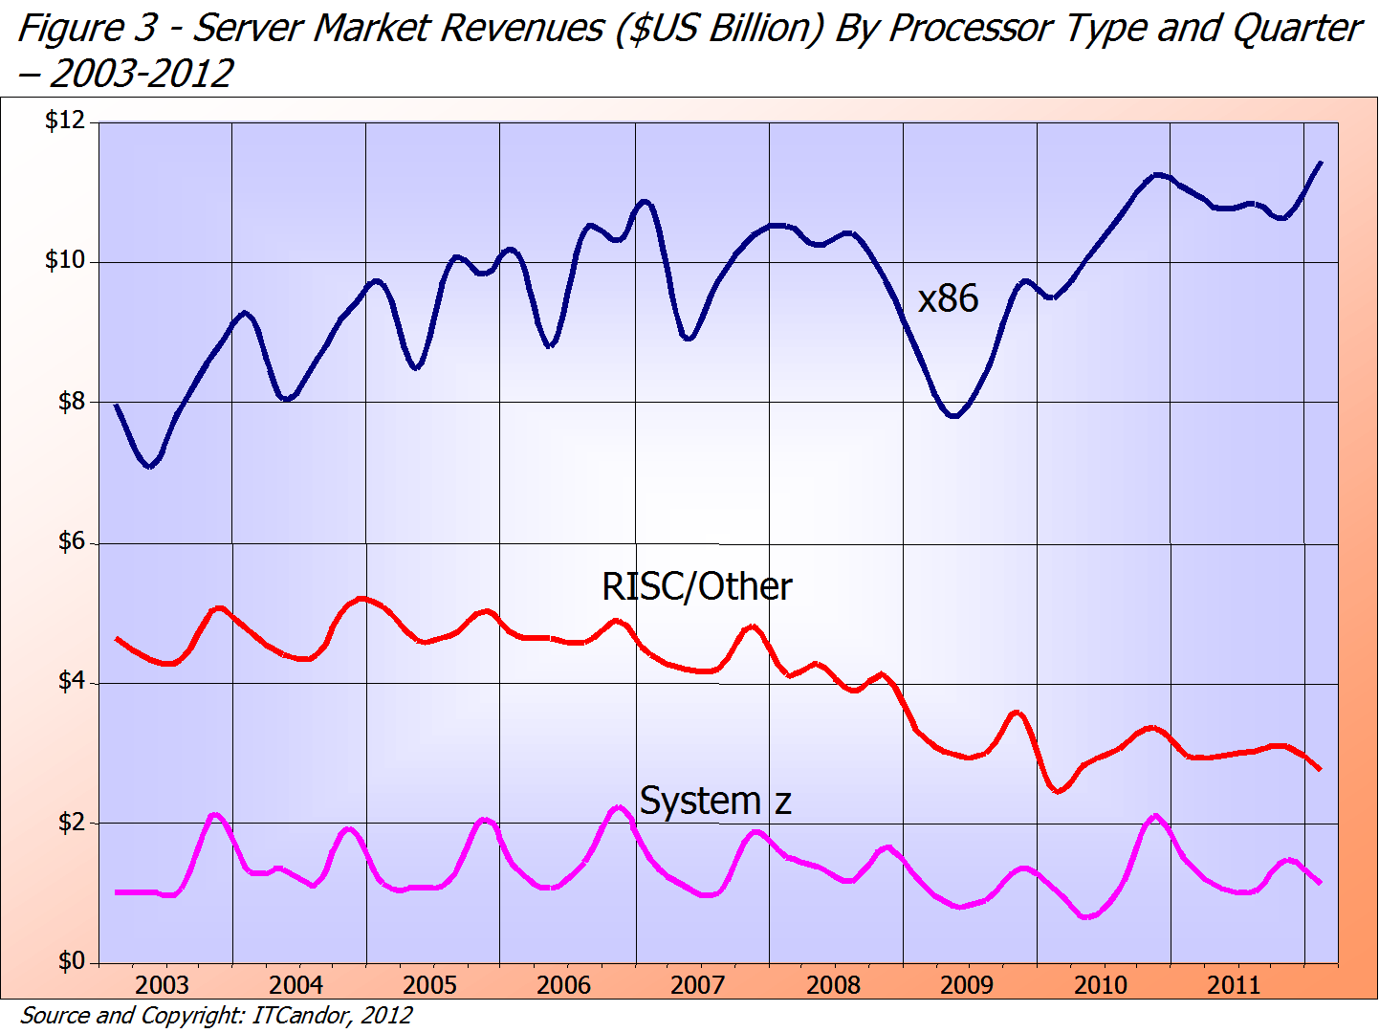
1. The traditional computer market (4)
Server market revenues by processor type ($US Billion) – 2003-2012 [14]
≈75 %
Intel/AMD
IBM POWER/Sun etc.
IBM
≈18 %
≈ 7 %

Slide 7
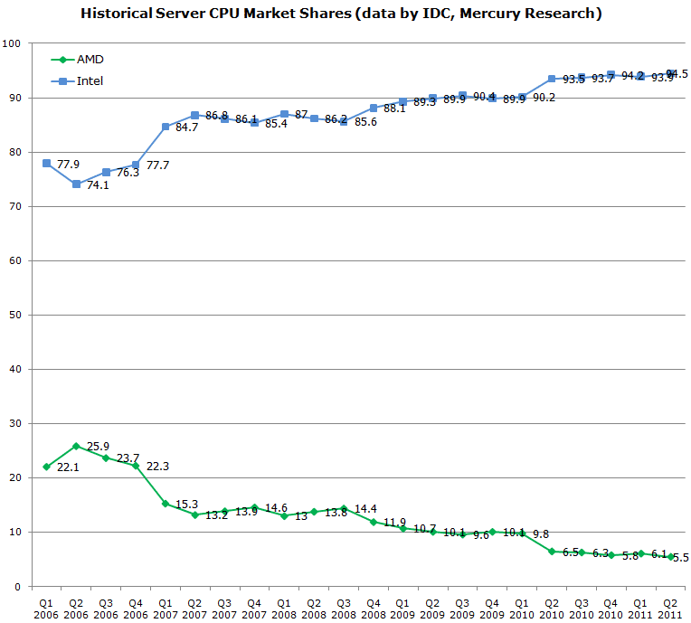
1. The traditional computer market (5)
x86 server market share of Intel and AMD [17]
Penryn MP
Nehalem-EX DP/MP
Penryn DP
Core 2 Quad DP
Core 2 DP
K10 Barcelona MP
K10 Shanghai MP
K10 Istambul MP
K10 Magny Course MP
Source: IDC,
Mercury Research

Slide 8
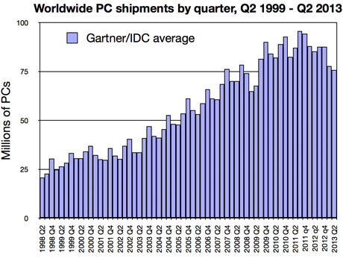
1. The traditional computer market (6)
Worldwide PC shipments by quarter, Q2 1999 – Q2 2013 [18]

Slide 9
1. The traditional computer market (7)
Market share of Intel and AMD in desktops and traditional notebooks
Both in the desktop and notebook segments
Intel’s market share is ≈ 80 %, whereas
AMD’s share remains about 20 % [15], [16].

Slide 10
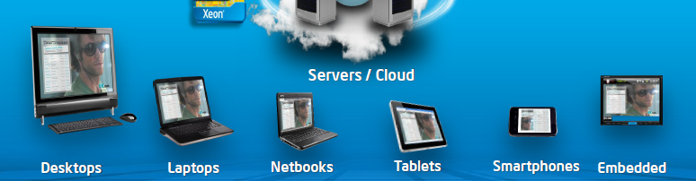
1. The traditional computer market (8)
Diversification of mobile devices mainly after 2005 [2]
The mobile boom

Slide 11
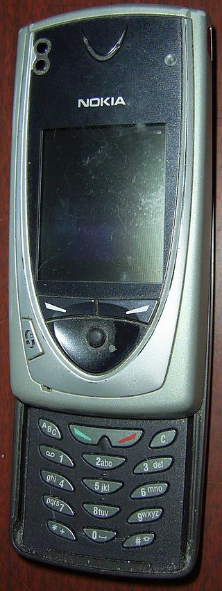
2. The smartphone boom (1)
Emergence of smartphones-1
Forerunners of smartphones emerged already
at the beginning of the 2000’s, like Nokia’s 7650
(shipped in 2002).
The 7650 became the first widely available phone
with camera and color screen but supported
no video.
It was the first Nokia phone running under
the Symbian OS.
Figure: Nokia’s 7650 [39]

Slide 12
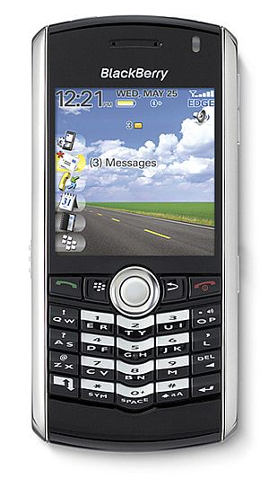
2. The smartphone boom (2)
Emergence of smartphones-2
The emergence of smartphones is often
contributed to the BlackBerry Pearl 8100
line of the Canadian firm RIM
(Research in Motion)[5].
This phone – shipped in 2006 - supported
beyond a camera also video and became
very popular in the US.
It was run under the BlackBerry OS.
Figure: RIM’s BlackBarry Perl 8100
(2006) [38]

Slide 13
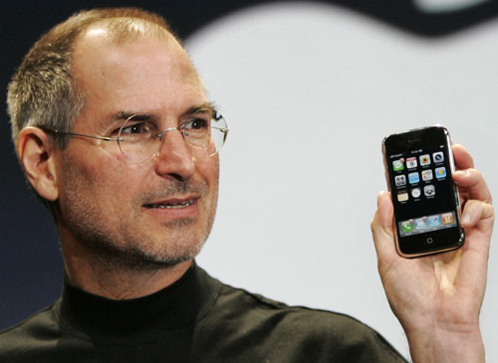
2. The smartphone boom (3)
Early spread of smartphones-1
In 2007 Apple’s iPhone gave a strong momentum for rapid spreading of
smartphones.
It run under the iPhone OS (renamed later to iOS in 2010).
Figure: Steve Jobs introducing the iPhone at MacWorld Expo in 1/2007 [47]

Slide 14
2. The smartphone boom (3a)
Remark
After the introduction of iPhone (2007) Steve Ballmer (CEO of Microsoft) said in an
interview [20]:
“There's no chance that the iPhone is going to get any significant market share.
No chance…
But if you actually take a look at the 1.3 billion phones that get sold, I'd prefer
to have our software in 60% or 70% or 80% of them, than I would to have 2%
or 3%, which is what Apple might get”.

Slide 15
2. The smartphone boom (4)
Early spread of smartphones-2
Google’s Android was unveiled also in 2007 with first Android-powered phones
sold in 10/2008 [6].

Slide 16
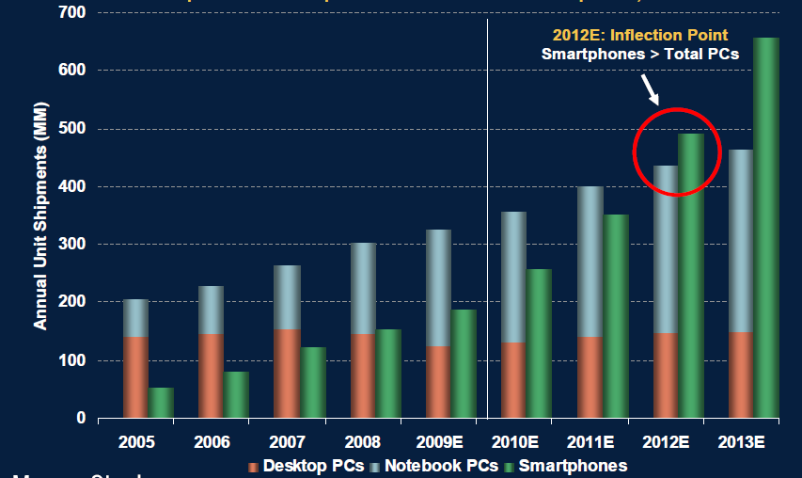
2. The smartphone boom (5)
Worldwide unit shipments of PCs vs. smartphones 2005-2013 [37]
PCs: Desktop PCs + notebook PCs

Slide 17
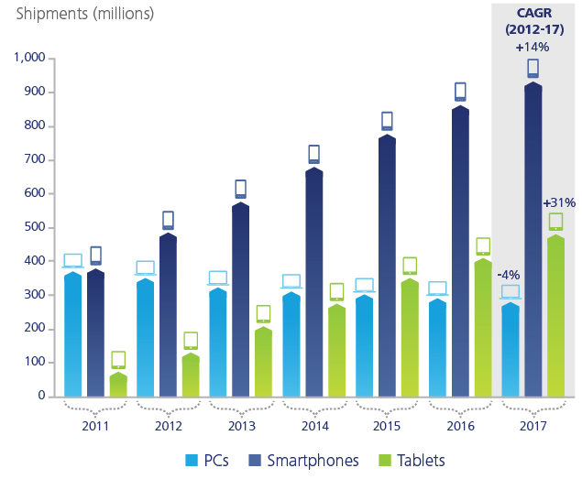
2. The smartphone boom (6)
Worldwide unit shipment estimates of PCs vs. smartphones 2011-2017 [28]
Source: Gartner

Slide 18
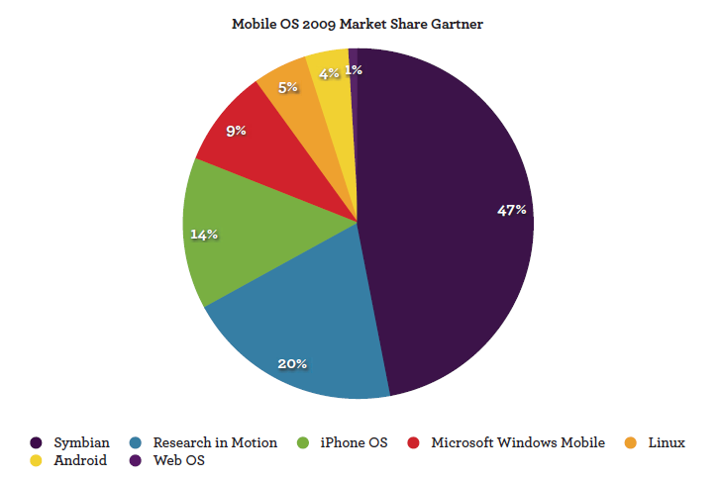
2. The smartphone boom (7)
Worldwide market share of smartphone OSs in 2009 [41]
Google
MS
Nokia
Apple
RIM
(BlackBerry)

Slide 19
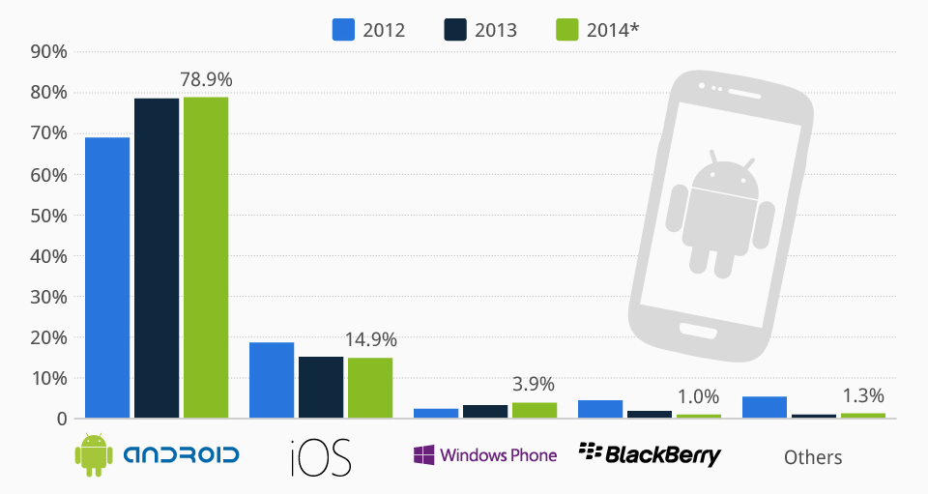
2. The smartphone boom (8)
Worldwide market share of smartphone OSs in 2012-2014 [42]

Slide 20
2. The smartphone boom (9)
1Q/2014 vs. 4Q/2013 worldwide smartphone suppliers [40]
Rank of 1Q14 | Company | Country | 1Q14 | 4Q13 | Growth
1 | Samsung | S. Korea | 34.9% | 31.8% | ↑
2 | Apple | US | 13.6% | 19.4% | ↓
3 | Lenovo + Motorola | China + US | 7.5% | 4.3% | ↑
4 | Huawei | China | 5.2% | 4.0% | ↑
5 | LG | S. Korea | 4.4% | 4.2% | ↑
6 | Sony | Japan | 4.0% | 4.1% | ―
7 | Xiaomi | China | 4.0% | 3.2% | ↑
8 | Coolpad | China | 3.7% | 3.6% | ―
9 | ZTE | China | 3.1% | 3.0% | ―
10 | Gionee | China | 2.3% | 2.6% | ↓
 | Others |  | 17.3% | 19.7% | ↓
 | Total |  | 100.0% | 100.0%

Slide 21
2. The smartphone boom (10)
Main features of SOCs used in smartphones and tablets about 2011/2012 [44]
SoC | Process Node | CPU | GPU | Memory Bus | Release
Apple A5 | 45nm | 2 x ARM Cortex A9 w/ MPE @ 1GHz | PowerVR SGX 543MP2 | 2 x 32-bit LPDDR2 | Now
NVIDIA Tegra 2 | 40nm | 2 x ARM Cortex A9 @ 1GHz | GeForce | 1 x 32-bit LPDDR2 | Now
NVIDIA Tegra 3/Kal-El | 40nm | 4 x ARM Cortex A9 w/ MPE @ ~1.3GHz | GeForce++ | 1 x 32-bit LPDDR2 | Q4 2011
Samsung Exynos 4210 | 45nm | 2 x ARM Cortex A9 w/ MPE @ 1.2GHz | ARM Mali-400 MP4 | 2 x 32-bit LPDDR2 | Now
Samsung Exynos 4212 | 32nm | 2 x ARM Cortex A9 w/ MPE @ 1.5GHz | ARM Mali-400 MP4 | 2 x 32-bit LPDDR2 | 2012
ST-Ericsson NovaThor LP9600 (Nova A9600) | 28nm | 2 x ARM Cortex-A15 @ 2.5GHz | IMG PowerVR Series 6 (Rogue) | Dual Memory | 2013
ST-Ericsson Novathor L9540 (Nova A9540) | 32nm | 2 x ARM Cortex A9 @ 1.85GHz | IMG PowerVR Series 5 | 2 x 32-bit LPDDR2 | 2H 2012
ST-Ericsson NovaThor U9500 (Nova A9500) | 45nm | 2 x ARM Cortex A9 @ 1.2GHz | ARM Mali-400 MP1 | 1 x 32-bit LPDDR2 | Now
ST-Ericsson NovaThor U8500 | 45nm | 2 x ARM Cortex A9 @ 1.0GHz | ARM Mali-400 MP1 | 1 x 32-bit LPDDR2 | Now
TI OMAP 4430 | 45nm | 2 x ARM Cortex A9 w/ MPE @ 1.2GHz | PowerVR SGX 540 | 2 x 32-bit LPDDR2 | Now
TI OMAP 4460 | 45nm | 2 x ARM Cortex A9 w/ MPE @ 1.5GHz | PowerVR SGX 540 | 2 x 32-bit LPDDR2 | Q4 11 - 1H 12
TI OMAP 4470 | 45nm | 2 x ARM Cortex A9 w/ MPE @ 1.8GHz | PowerVR SGX 544 | 2 x 32-bit LPDDR2 | 1H 2012
TI OMAP 5 | 28nm | 2 x ARM Cortex A15 @ 2GHz | PowerVR SGX 544MPx | 2 x 32-bit LPDDR2 | 2H 2012
Qualcomm MSM8x60 | 45nm | 2 x Scorpion @ 1.5GHz | Adreno 220 | 1 x 32-bit LPDDR2* | Now
Qualcomm MSM8960 | 28nm | 2 x Krait @ 1.5GHz | Adreno 225 | 2 x 32-bit LPDDR2 | 1H 2012

Slide 22
2. The smartphone boom (11)
Smartphone application processors market share in revenues Q1/2014 [43]
Vendor | Market share | Processor line | Core | ISA
Qualcomm (USA) | 53 % | Snapdragon 200-800 | Qualcomm designed Krait cores ARM Cortex A line | ARMv7 ARMv7/v8
Apple (USA) | 16 % | Apple A6 Apple A7 | ARM Cortex A8 Apple designed Cyclone core | ARMv7 ARMv8
MediaTek (Taiwan) | 13 % | MT6595 MT67xx | 4xARM Cortex A7/ 4xA17 (ARM big.LITTLE) 4xARM Cortex A53/4x A57 (ARM big.LITTLE) | ARMv7 ARMv8
Samsung (S. Korea) |  | Exynos | ARM Cortex A line | ARMv7
Spreadtrum (China) |  | SC77xx/88xx | ARM Cortex A5/A7 | ARMv7

Slide 23
2. The smartphone boom (12)
Main features of the Qualcomm Snapdragoon lines
Model | Released | Technology | CPU | Word length bit | Clock rate (up to) | Connectivity
810 | H2/2014 | 20 nm | ARM Cortex A57 (QC) + ARM Cortex A53 (QC) | 32/64 | na. | integrated LTE + RF
808 | H1/2015 | 20 nm | ARM Cortex A57 (DC) + ARM Cortex A53 (QC) | 32/64 | na. | integrated LTE + RF
805 | Q1/2014 | 28 nm | Krait 450 (QC) | 32 | 2.7 GHz | integrated LTE + RF
801 | Q4/2013 | 28 nm | Krait 400 (QC) | 32 | 2.5 GHz | integrated LTE + RF
800 | Q2/2013 | 28 nm | Krait 400 (QC) | 32 | 2.3 GHz | integrated LTE + RF
615 | Q3/2014 | 28 nm | ARM Cortex A53 (QC) + ARM Cortex A53 (QC) | 32/64 | 1.7 GHz 1.0 GHz | integrated LTE + RF
602 | Q1/2014 | 28 nm | Krait 300 (QC) | 32 | 1.5 GHz | integrated WiFi
600 | Q1/2013 | 28 nm | Krait 300 (QC) | 32 | 1.9 GHz | integrated WiFi
410 | 1H/2014 | 28 nm | ARM Cortex A53 (QC) + | 32/64 | 1.4 GHz | integrated LTE + RF
400 | Q4/2013 | 28 nm | Krait 300 (QC) or ARM Cortex A7 (QC) | 32 | 1.7 GHz 1.4 GHz | integrated LTE + RF
200 | 2013 | 28 nm | ARM Cortex A5 (QC) or ARM Cortex A7 (QC) | 32 | 1.4 GHz 1.2 GHz | integrated 3G + RF

Slide 24
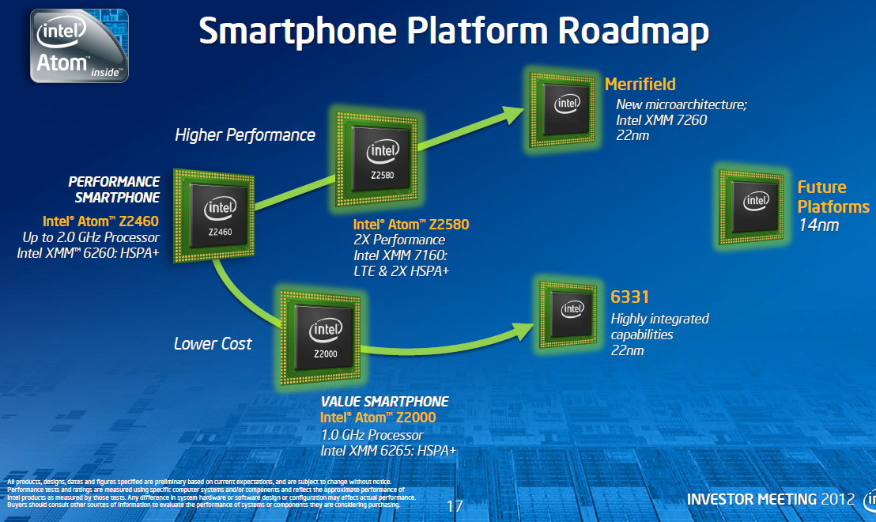
2. The smartphone boom (13)
Morganfield
(2015?)
Intel’s Atom platforms targeting smartphones
(based on [33])
Moorefield
(2014)
Merrifield
(2014)
Performance (not to scale)
Clover Trail+
(2013)
Z5xxx
4xGoldmont
14 nm
+XMM 7360
Medfield
(2012)
Z35xx
4xSilvermont
22 nm
+XMM 7260/2/35
Morestown
(2010)
Z34x0
2xSilvermont
22 nm
+XMM 7160/7260
Z2580-2520
2xSaltwell
32 nm
+XMM 6268/6360/7160
Riverton
(2015)
Z2480/2460
1xSaltwell
32 nm
+XMM 6260
Binghampton
(2016)
Slayton
(2014)
Z6xx
1xBonnell
45 nm
+Wireless
module
Lexington
(2013)
Zxxxx
2xAirmont
14 nm
+?
Z3xxx
2xSilvermont
22 nm
+A-GOLD 620
Zxxx
2xAirmont
14 nm
+?
Z2420
1xSaltwell
32 nm
+XMM 6265

Slide 25
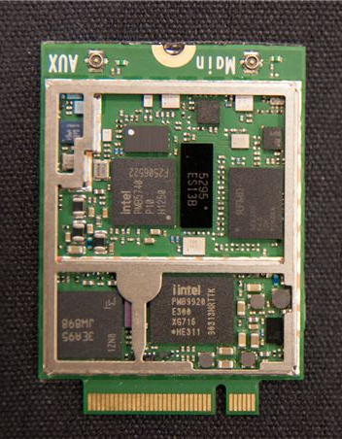
2. The smartphone boom (14)
Intel’s XMM line
3G/4G modem + transceiver implemented as two chips
Transceiver
3G/4G modem
Figure: Implementation
example of the two chip
XMM7160 [46]

Slide 26
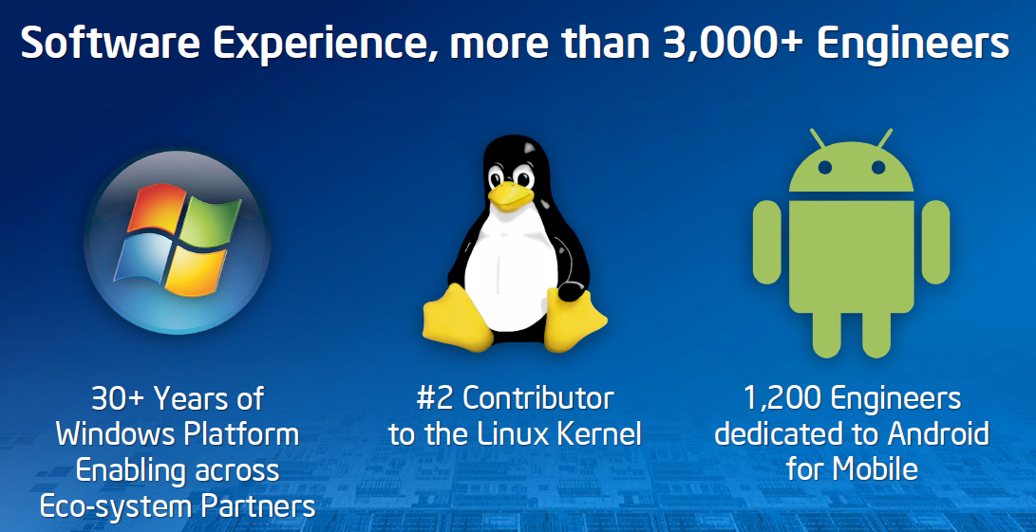
2. The smartphone boom (15)
Intel’s effort to optimize their devices from the software point of view
In their 2012 Investor meeting (5/2012) Intel revealed that more than 3000
engineers are working on OS support, among them about 1200 engineers
are dedicated to Android, as indicated below [11].

Slide 27
2. The smartphone boom (16)
Intel’s share in smartphone application processors
Note that despite great efforts Intel could not yet become one of the 5 largest
suppliers of smartphone application processors.
E.g. in 1H2012 Intel achieved not more than 0.2 % unit shipment share in
smartphones [45].

Slide 28
3. The tablet boom (1)
Emergence of tablets
Visioning tablets
Tablets were envisioned by Steve Jobs already in 1983 saying
”Apple’s strategy is really simple. What we want to do is we want to put an
incredibly great computer in a book that you can carry around with you and learn
how to use in 20 minutes.
... And we really want to do it with a radio link in it so you don’t have to hook up
to anything and you’re in communication with all of these larger databases and
other computers” [19].

Slide 29
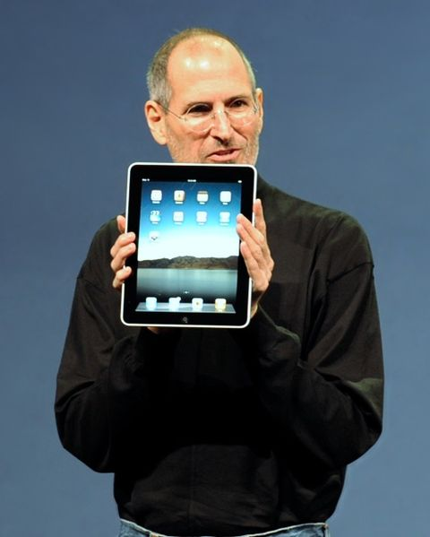
3. The tablet boom (2)
Designs giving the final push for rapid spreading of tablets around 2010
From 2009 on: Android-based tablets arrived the market from many vendors.
2010: Apple’s iPad with 9.7 “ screen, touch screen and Wi-Fi or additionally wireless
3G broadband internet connection (mobile internet connection), operating under
iOS [12].
Figure: Steve Jobs introducing the iPad in 2010 [12]

Slide 30
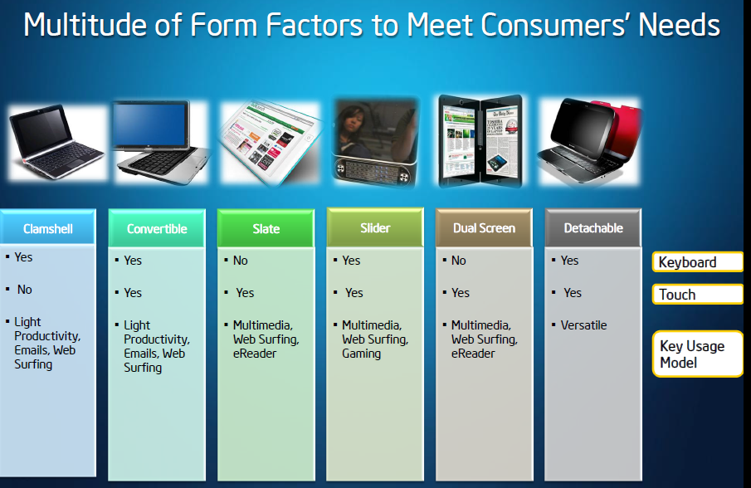
3. The tablet boom (3)
Implementation alternatives of tablets-1 [8]

Slide 31
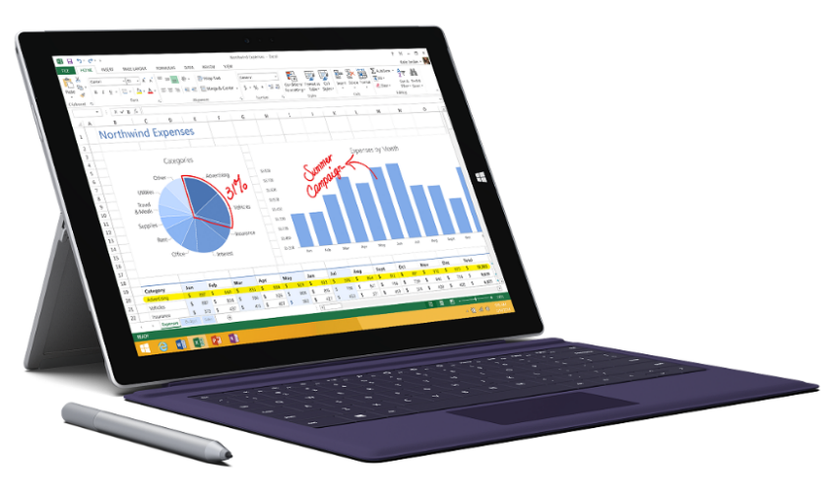
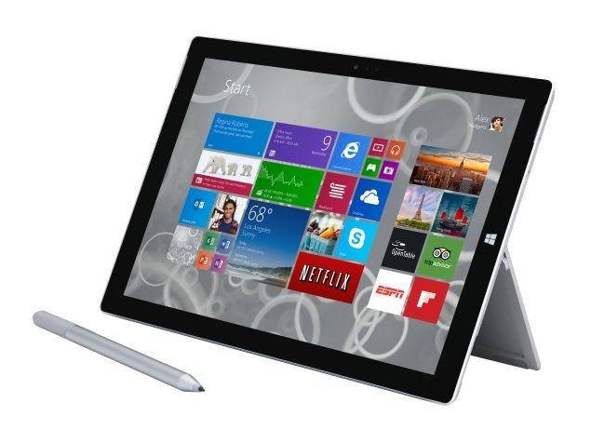
3. The tablet boom (4)
Implementation alternatives of tablets-2 [8]
2 in 1 tablets
Example: Windows Surface Pro 3 (8/2014)
Aim: Replacing laptops
Intel’s Surface Pro 3
used as a laptop [22]
Intel’s Surface Pro 3
used as a tablet [23]

Slide 32
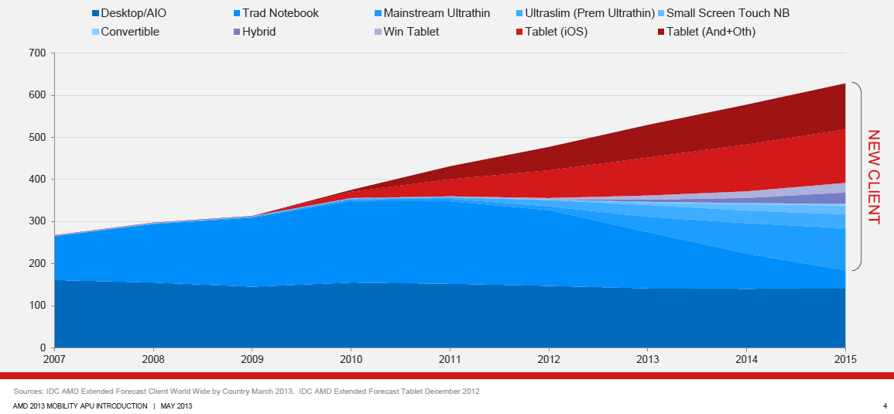
3. The tablet boom (5)
Rapid increase of tablet sales in the first half of the 2010’s
Besides smartphones, tablets and all their alternative designs (that provide also keyboard/mouse input, such as convertibles or 2 in 1 designs) have recently the highest growth potential, as indicated in the Figure below (12/1012) [3].
Tablets
Notebooks
Desktops
Figure: Yearly worldwide sales figures of desktops, notebooks and tablets [3]

Slide 33
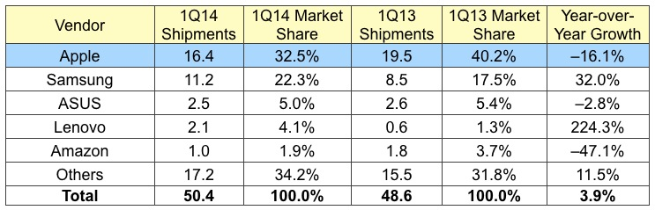
3. The tablet boom (6)
1Q/2014 worldwide tablet sales [31]
(Shipments in million units)

Slide 34
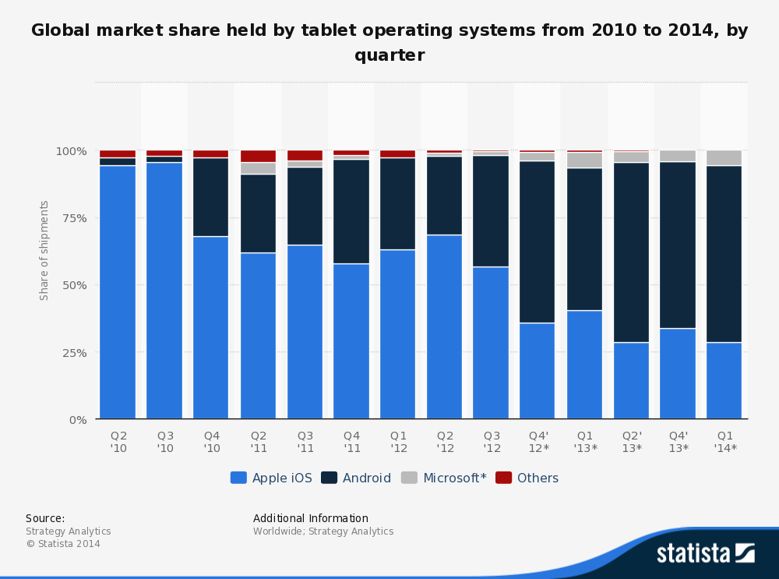
3. The tablet boom (7)
Global market share of tablet OS shipments from 2010 to 2014 by quarter [25]

Slide 35
3. The tablet boom (8)
1Q/2014 worldwide tablet sales [31]
(Shipments in million units)

Slide 36
3. The tablet boom (9)
Willow Trail
(2015?)
Intel’s platforms targeting tablets
(based on [33])
Cherry Trail
(2014?)
Bay Trail
(2013)
Performance (not to scale)
Clover Trail
(2012)
Z5xxx
4xGoldmont
14 nm
+XMM 7360
W/A
Oak Trail
(2011)
Z4xxx
4xAirmont
14 nm
+XMM 7160/7260
W/A
Menlow
(2008)
Z37x0
4xSilvermont
22 nm
+XMM 6260/7160
W/A
Z2760
2xSaltwell
32 nm
+XMM 6260
W
Sophia LTE
(2015)
Z670/650
1xBonnell
45 nm
+ no XMM
W/MeeGo/A
Sophia 3G
(2014?)
Z5xx
1xBonnell
45 nm
+ no XMM
W/Moblin
Zxxx
4xSilvermont
22 nm
integrated LTE
Zxxxx
2xSilvermont
22 nm
integrated 3G

Slide 37
3. The tablet boom (10)
Worldwide market share of tablet application processors in 2013
(based on revenue) [34]
Smartphone application processors worldwide market share 2013 (revenue) [b]
Qualcomm (USA) | 53 %
Apple (USA) | 16 %
MediaTek (Taiwan) | 13 %
Samsung (S. Korea)
Spreadtrum (China)
Tablet application processors worldwide market share 2013 (revenue) [b]
Apple (USA) | 37 %
Qualcomm (USA) | 11 %
Samsung (S. Korea) | 10 %

Slide 38
3. The tablet boom (11)
Intel’s share in tablet application processors [35], [36]
In 2013 Intel sold about 10 million tablet chips, that amounts to about 5 % market
share in that year (relating to ~ 195 million tablets shipped).
Nevertheless, Intel plans to sell 40 million chips for smart phones and tablets
in 2014 by paying subsidies for OEMs to use Intel’s processors.

Slide 39
4.Requirements of mobile devices (1)
4. Requirements of mobile devices (tablets, smartphones)
Two aspects discussed:
4.1 Low power operation
4.2 Touch screen oriented operating systems for mobiles

Slide 40
4.Requirements of mobile devices (2)
4.1 Low power operation
Contrasting the design paradigms of traditional and mobile processors
Traditional processors
Tablets and smartphones
High performance/power
(e.g. GFLOPS/Watt)
Low power
(Watt)
(Number of operating hours)
In this point let’s focus on the microarchitecture of CPUs (processor cores)

Slide 41
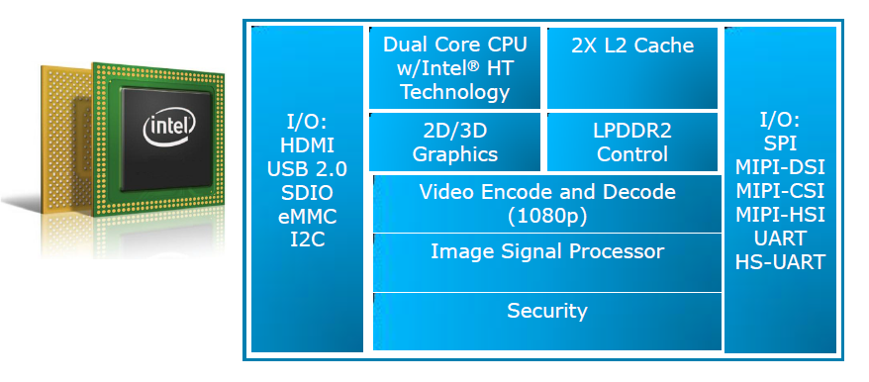
4.Requirements of mobile devices (3)
Example: Block diagram of Intel’s Cloverview (Z2760) tablet processor (2012)
[13]

Slide 42
4.Requirements of mobile devices (4)
Key criteria for low power microarchitectures
Key criteria for low power microarchitectures
Narrow microarchitecture
Low processor clock frequency
(Section 4.1.1)
(Section 4.1.2)

Slide 43
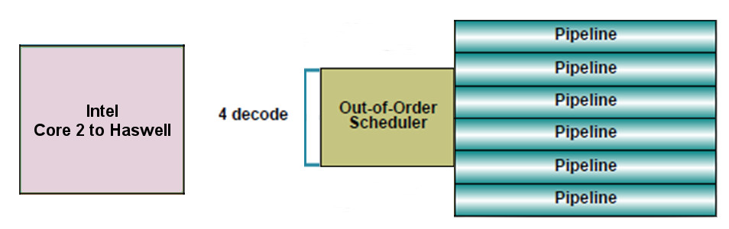
4.Requirements of mobile devices (5)
4.1.1 “Narrow” microarchitectures
Microarchitecture of Intel’s and AMD’s recent traditional processors
aims at high performance/power (in terms of GFLOPS/Watt)
consequently
have wide microarchitectures, as the next example shows:
64-bit
Example: Width of Intel’s Core 2 (2006) to Haswell (2013) processors underlying
servers to laptops [10]
We note that AMD introduced 4-wide microarchitectures five years later, along with
the Bulldozer line in 2011.

Slide 44
4.Requirements of mobile devices (6)
Microarchitectures of mobile processors
To reduce power consumption low power microarchitectures are narrower than
recent traditional processors, as the next Figure demonstrates.

Slide 45
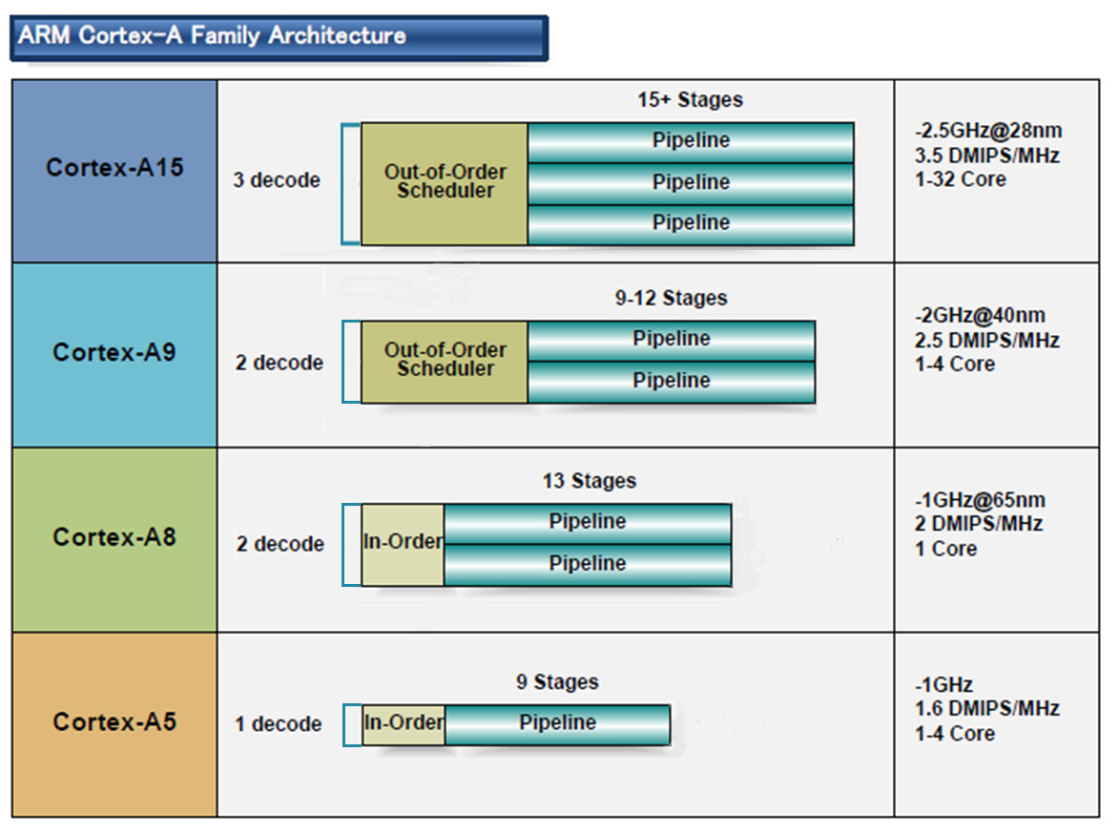
4.Requirements of mobile devices (7)
Microarchitecture of ARM CPUs underlying most tablets and smartphones [10]
32-bit
2010
2007
2005
2009
(A9 replacement
for low-end
devices)

Slide 46
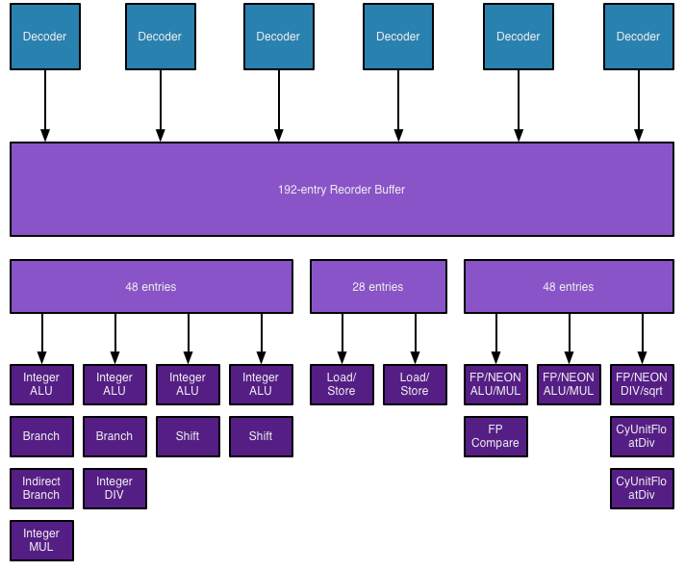
4.Requirements of mobile devices (8)
Block diagram of Apples A7 (Cyclone) core (2014) [48]

Slide 47
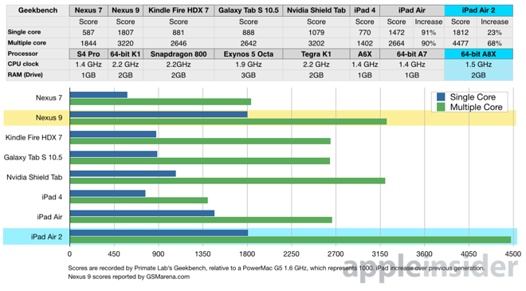
4.Requirements of mobile devices (9)
<img src="http://cdn1.appleinsider.com/gallery/10856-3294-PadAir2vsNexus9-l.png">
]
Geekbench results of recent tablets [49]

Slide 48
4.Requirements of mobile devices (10)
Implications of the extremely high performance figures of Apple’s A8X-based
iPad Air 2 [50]
Intel not only lost Apple as a perspective buyer of their chips for the iPad line,
but the iPad Air 2 also severely hit the perspective of their not so successful
Atom line.
Texas Instruments OMAP family powers Kindle Fire and a variety of Samsung’s
Galaxy Tab models.
The failure of competing against Apple caused TI to leave the consumer
application processor business entirely.
NVIDIA’s Tegra 4 chips were not successful, so the firm announced that they
will abandon the phone market.
With Apple’s iPad Air 2 NVIDIA’s subsequent 64-bit K1 chip including 192 GPU
ALUs became a very powerful rival that incorporates 256 ALUs.
As a consequence, NVIDIA appears close to giving up their tablet interests.

Slide 49
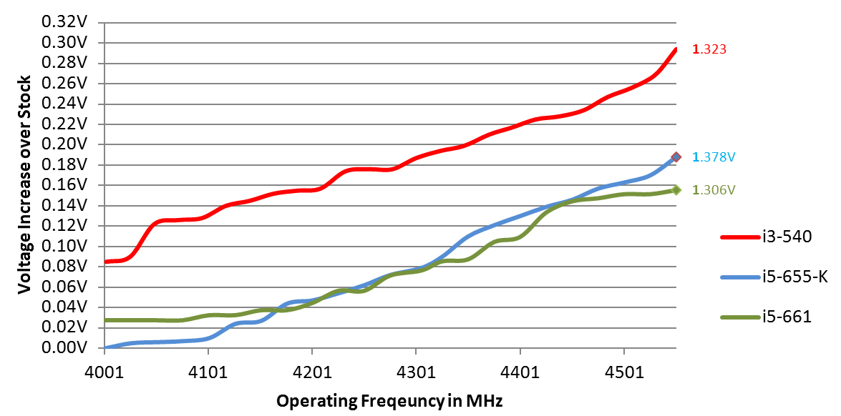
4.Requirements of mobile devices (11)
4.1.2 Low clock frequency-1
Basics
D = const x fc x Vdd²
In addition: higher fc requires higher Vdd (Vdd ≈ const x fc).
Figure: Core voltage (Vdd) vs. clock frequency (fc) for Intel’s Westmere processors [26]

Slide 50
4.Requirements of mobile devices (12)
Low clock frequency-2
It follows
Higher fc
higher Vdd
higher D
Traditional CPUs
Mobile CPUs
High base clock frequency
(typically 2-4 GHz)
Relative low base clock frequency
(typically 1-2 GHz)

Slide 51
4.Requirements of mobile devices (13)
4.2 Mobile touch screen oriented operating systems
Traditional notebooks, PCs and servers
Tablets and smartphones
Windows versions and
Linux or Linux alternatives
Mainly Android and iOS

Slide 52
5. How the dominant traditional IT firms cope with the mobile boom? (1)
(1)
5.1 Intel’s and AMD’s response to the mobile boom-1
Intel’s and AMD’s traditional CPUs are designed for high performance/power,
consequently they are wide and power hungry,
but mobile devices require low power consumption, so
Intel’s and AMD’s traditional microarchitectures are not suited for mobile devices.

Slide 53
5. How the dominant traditional IT firms cope with the mobile boom? (2)
(1)
Total shipments of PCs vs. smartphones/tablets 2011-2017 (estimates) [28]
Smartphone and tablet shipments
will vastly exceed PC shipments
(desktops and notebooks)
in a few years
Source: Gartner (2013)

Slide 54
5. How the dominant traditional IT firms cope with the mobile boom? (3)
Intel’s and AMD’s response to the mobile boom-2
If Intel and AMD want to avoid shrinking market shares on the overall processor market
and benefit from the rapidly increasing mobile market
they need processors that are competitive with ARM designed ones.
Intel and AMD were forced
to introduce novel narrow (e.g. 2-wide) low-power microarchitectures
for their CPUs and
clock them at a relative lower rate.

Slide 55
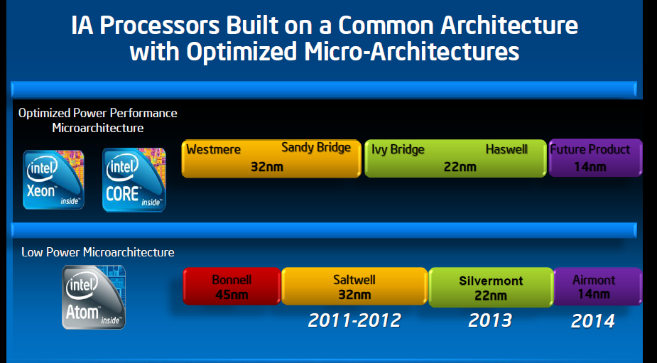
5. How the dominant traditional IT firms cope with the mobile boom? (4)
Evolution of Intel’s basic architectures [2]
4-wide
out-of-order
2008
2-wide
in-order
2-wide
in order
2-wide
out-of-order
??

Slide 56
5. How the dominant traditional IT firms cope with the mobile boom? (5)
Evolution of AMD’s basic architectures
Optimized Power/Performance
Microarchitecture
~10/2011
~5/2012
1/2014
AMD
Bulldozer
Family 15h
Bulldozer
Models 00h-0Fh
32nm
Piledriver
Models 10h-1Fh
32 nm
Steamroller
Models 30h-3Fh
28nm
4-wide
out-of-order
Low Power
Microarchitecture
1/2011
5/2013
4/2014
AMD
Family 14h/16h
Bobcat
40nm
Jaguar
28nm
Puma
28nm
2-wide
out-of-order
2-wide
out-of-order
2-wide
out-of-order
2011
2012
2013
2014

Slide 57
5. How the dominant traditional IT firms cope with the mobile boom? (6)
(1)
Power reduction
In addition, both Intel and AMD place great emphasis on the reduction of power
consumption.
To illustrate this we show a list of AMD’s power management techniques introduced
in a timeframe of about five years.

Slide 58
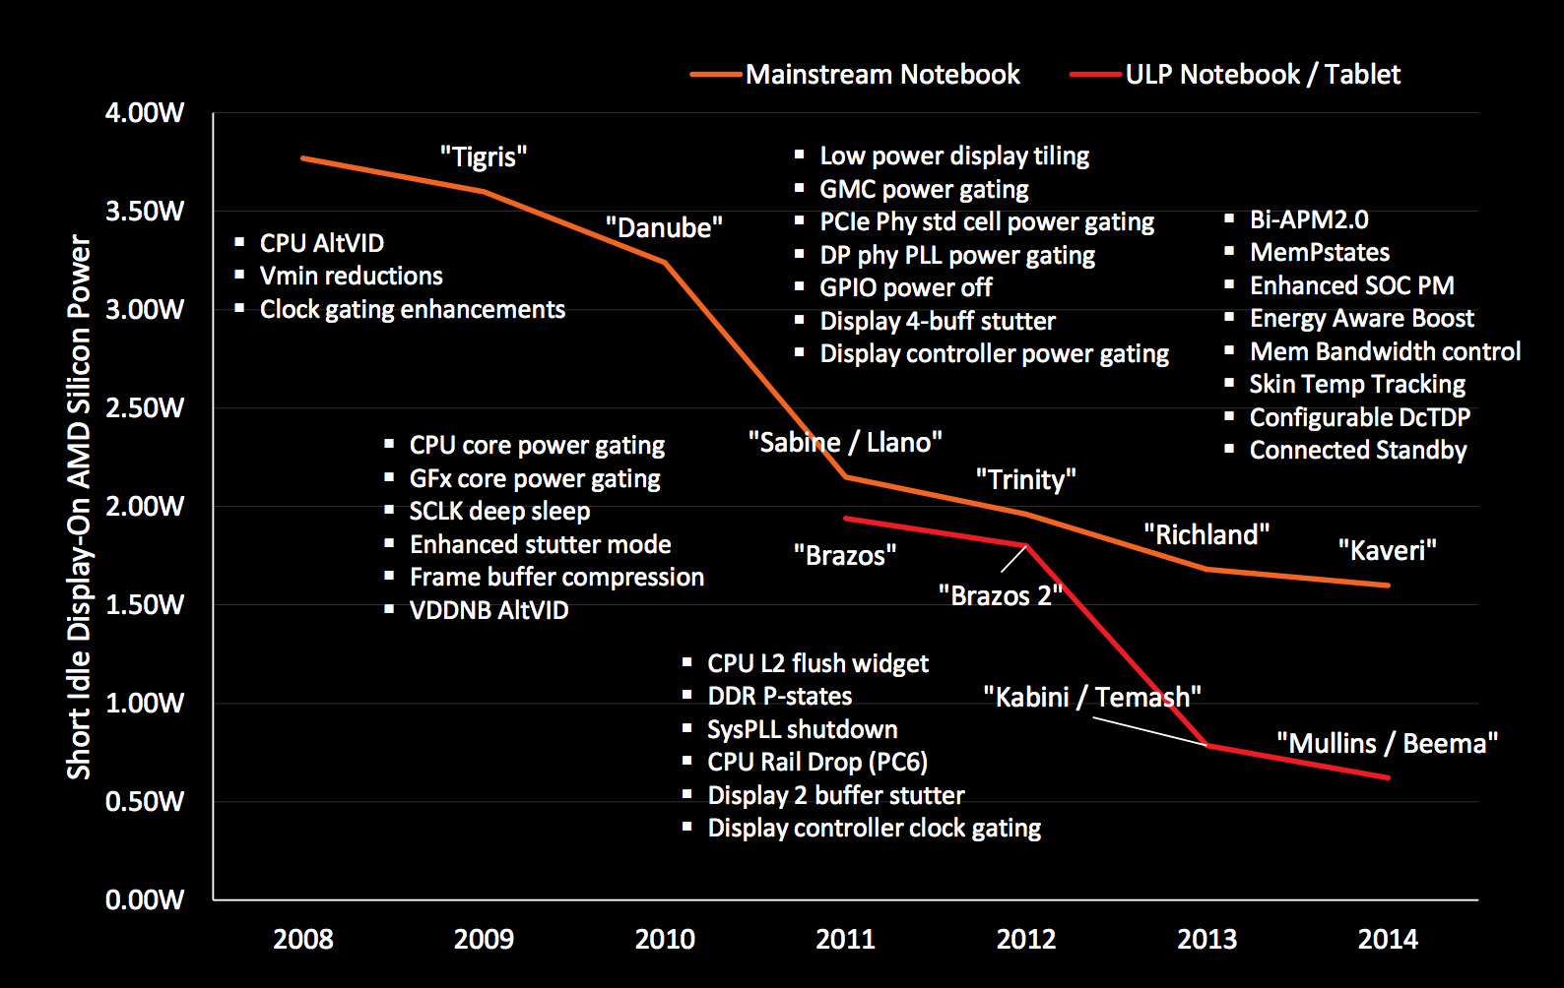
5. How the dominant traditional IT firms cope with the mobile boom? (7)
AMD’s technologies developed to reduce power consumption (2008-2014) [27]

Slide 59
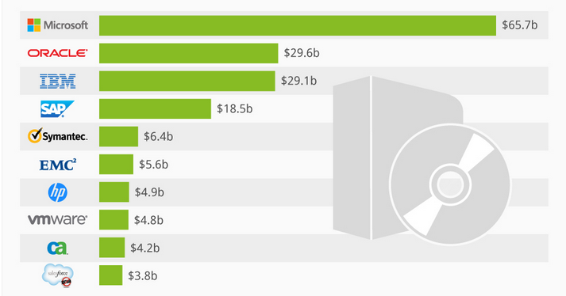
5. How the dominant traditional IT firms cope with the mobile boom? (8)
(1)
5.2 Microsoft’s response to the mobile boom-1
Worldwide software revenues in 2013 [25]

Slide 60
5. How the dominant traditional IT firms cope with the mobile boom? (9)
(1)
5.2 Microsoft’s response to the mobile boom-2
2010: Windows Phone 7 (later Windows Phone 8)
2012: Windows 8: aim to cover PCs, notebooks and also tablets
2013: Windows 8.1
2014 Windows 8.1 with Bing for low cost devices
2014 Windows 9??? (skipped?)
2014 Windows 10 Technical Preview
Windows 8 was Microsoft’s try to cover the whole spectrum of computers from
server and workstations through desktops and notebooks till touchscreen tablets
by a single OS.
Market reflections: Windows Phone 7 and Windows 8 earned moderate success,
Android and iOS dominate further on the market.
In 5/2014 Microsoft announced that Windows 8.1 with Bing will be delivered
for hardware manufacturers for free.
Windows 8.1 with Bing is the same as the standard version with one difference,
it ships with Internet Explorer as the search engine.

Slide 61
5. How the dominant traditional IT firms cope with the mobile boom? (10)
(1)
5.2 Microsoft’s response to the mobile boom-3
Ballmer (CEO of Microsoft in 9/2012):
“I think that in a back-looking view, people would say we were a software company.
That's kind of how we were born.
I think when you look forward, our core capability will be software, (but)
you'll probably think of us more as a devices-and-services company.” [22]
Transitioning Microsoft into a devices-and-services company
2012: Surface/Windows Pro (2/2013) Windows tablets
2013: Xbox One game console (8 AMD Jaguar cores,
(successor to Xbox 360)
2013 Surface 2/Surface Pro 2 Windows tablets
2013: Microsoft purchases Nokia’s phone business
2014 Surface 3 Windows tablet

Slide 62
5. How the dominant traditional IT firms cope with the mobile boom? (11)
(1)
Microsoft’s Surface tablets-1 [30]
Microsoft manufacturers two lines of Surface tablets.
The ARM-based Surface line is equipped with Tegra chips and competes against
the iPad and Galaxy tabs.
It runs under Windows RT that strongly constrains its applications and sales
potential.
On the other hand, the Intel Core 2 based Surface Pro line are aimed to compete
with high-end laptops.

Slide 63
5. How the dominant traditional IT firms cope with the mobile boom? (12)
(1)
Microsoft’s Surface tablets-2
Main features of Microsoft’s Surface tablet lines
Model | Intro | Processor | Word length | Core nr. | OS
Surface | 10/2012 | Tegra 3 | 32-bit | 4 | Windows RT
Surface 2 | 10/2013 | Tegra 4 | 32-bit | 5 | Windows RT/Windows 8.1
Table: Microsoft’s ARM-based Surface RT /Surface 2 tablets
The exclusivity of Windows RT drastically limits app availability, and is one of the main reasons why sales of Surface tablets remained lower than expected [21].
Model | Intro | Processor | Word length | Core nr. | OS
Surface Pro | 2/2013 | Ivy Bridge i5 | 64-bit | 2 | Windows 8 Pro
Surface Pro 2 | 10/2013 | Haswell i5 | 64-bit | 2 | Windows 8.1 Pro
Surface Pro 3 | 6/2014 | Haswell i3/i5/i7 | 64-bit | 2 | Windows 8.1 Pro
Table: Microsoft’s Intel Core 2-based Surface Pro tablets

Slide 64
5. How the dominant traditional IT firms cope with the mobile boom? (13)
(1)
Windows Surface Pro 3 (8/2014)
2 in 1 tablet 12”
Aim: Replacing laptops
Intel’s Surface Pro 3
used as a laptop [22]
Intel’s Surface Pro 3
used as a tablet [23]

Slide 65
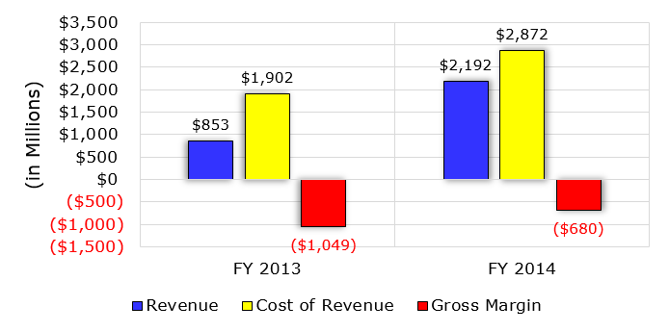
5. How the dominant traditional IT firms cope with the mobile boom? (14)
(1)
Financial performance of Microsoft’s Surface business [24]

Slide 66
6. Conclusions (1)
6. Conclusions-1
Informatics came into a transitional phase
new paradigms
new devices
new players
Established companies have to respond early, quick and in an appropriate way
to the new challenges, else…
8/2010 Intel acquires Infineon’s (former Siemens) Wireless Solutions business
8/2011 Google acquires Motorola Mobility
9/2013 Microsoft purchases Nokia’s phone business
9/2013 BlackBerry lays off 4500 employees (~ 40% of their workforce)
1/2014 Lenovo acquires Motorola Mobility from Google

Slide 67
6. Conclusions (2)
Conclusions-2
Even the largest IT firms have a hard time to cope with as indicated by
resignation of AMD’s, Intel’s and Microsoft’s CEOs (Chief Execution Officers):
1/2011 AMD: Dirk Meyer
11/2012 Intel: Paul Otellini
8/2013 Microsoft: Steve Ballmer
But it is also an opportunity and challenge for individuals and institutions
to catch up with the progress and make benefit of it.

Slide 68
7. References (1)
[1]: Bártfai D., Merre felé tartanak a hardverek?, Aug. 22-24 2007
[2]: Smith S.L., Intel Strategy & Technology Update, Barclays Capital Global Technology Conf.,
Dec. 2011, http://files.shareholder.com/downloads/INTC/1576180143x0x526852/c9868a3a-
494e-4506-bcc6-a631aca1fd75/Steve%20Smith%20Barclays%20Dec%202011.pdf
[3]: AMD 2013 Mobility APU Introduction, May 22 2013,
http://www.slideshare.net/AMD/amd-2013-mobility-apu-introduction-deck-final-for-lp
[4]: Frommer D., CHART OF THE DAY: Smartphone Sales To Beat PC Sales By 2011,
Business Insider, Aug. 21 2009, http://www.businessinsider.com/chart-of-the-day-
smartphone-sales-to-beat-pc-sales-by-2011-2009-8
[5]: Wikipedia, BlackBerry Pearl, http://en.wikipedia.org/wiki/BlackBerry_Pearl
[6]: Wikipedia, Android (operating system),
http://en.wikipedia.org/wiki/Android_%28operating_system%29
[7]: Ciufo C.A., Tizen OS for Smartphones – Intel’s Biggest Bet Yet, Jan. 4 2013,
http://eecatalog.com/caciufo/2013/01/04/samsung-hedges-apple-google-bets-with-intels-
html5-based-tizen/
[8]: Introduction of the Next Generation Intel Atom Processor, Oak Trail Z670, 4/2011,
http://newsroom.intel.com/docs/DOC-1976
[9]: Apple Maintains 48 Percent Share of Global Branded Tablet Shipments in Q1 2013,
Strategy Analytics, April 25 2013, Boston,
http://www.strategyanalytics.com/default.aspx?mod=pressreleaseviewer&a0=5351

Slide 69
7. References (2)
[10]: Goto H., ARM Cortex – A Family Architecture, 2010,
http://pc.watch.impress.co.jp/video/pcw/docs/423/409/p1.pdf
[11]: Eul H., Bell M., Mobile at Intel, Investor Meeting 2012,
http://www.cnx-software.com/pdf/Intel_2012/2012_Intel_Investor_Meeting_Eul_Bell.pdf
[12]: Wikipedia, iPad, http://en.wikipedia.org/wiki/IPad
[13]: Tablet Platforms with Next Generation Intel Atom Processor and Microsoft Windows 8,
IDF 2012
[14]: The $15.3 Billion Server Market – Surprisingly Buoyant In Q1 2012, IT Candor, July 3 2012,
http://www.itcandor.com/server-q112/
[15]: Shah A., Intel Loses Laptop Chip Market Share to AMD in Q3, PC World, Nov. 3 2011,
http://www.pcworld.com/article/243114/intel_loses_laptop_chip_market_share_to_amd_
in_q3.html
[16]: Perry D., AMD Steals Market Share From Intel, Tom’s Hardware, March 16 2012,
http://www.tomshardware.com/news/amd-intel-cpu-processor,15041.html
[17]: Shilov A., AMD Shows Off Opteron "Interlagos" Again: No Performance Benchmarks,
No Design Wins, No Launch Date Announced, Xbit Labs, Aug. 3 2011,
http://www.xbitlabs.com/news/cpu/display/20110803103016_AMD_Shows_Off_Opteron_
Interlagos_Again_No_Performance_Benchmarks_No_Design_Wins_No_Launch_Date_
Announced.html
[18]: Arthur C., PC business still waning as Microsoft's Windows 8 fails to lift it, 11 July 2013,
http://www.theguardian.com/technology/2013/jul/11/pc-business-microsoft-windows-8

Slide 70
7. References (3)
[19]: Golson J., Steve Jobs Envisioned the iPad in 1983, MacRumors, Oct. 2, 2012,
http://www.macrumors.com/2012/10/02/steve-jobs-envisioned-the-ipad-in-1983/
[20]: Yarow J., Steve Ballmer's Biggest Mistakes As CEO Of Microsoft, Business Insider, Aug. 27
2013,
http://www.businessinsider.com/steve-ballmers-most-epic-mistakes-as-ceo-of-microsoft-
2013-8?op=1
[21]: Arora, P., Microsoft Is Not Killing The Surface RT Lineup? Seeking Alpha, Aug. 25 2014,
http://www.macrumors.com/2012/10/02/steve-jobs-envisioned-the-ipad-in-1983/
[22]: Surface Pro 3 Fact sheet May 2014, Microsoft,
http://www.microsoft.com/global/eu/PublishingImages/Surfacepro3texhspecs.pdf
[23]: Microsoft Surface Pro, NDTV Gadget, May 2014,
http://gadgets.ndtv.com/microsoft-surface-pro-3-1611
[24]: Guenette S., Nearly $2 Billion In The Hole, Microsoft Continues To Dive Deeper Into Tablets,
Seeking Alpha, Aug. 8, 2014,
http://seekingalpha.com/article/2402725-nearly-2-billion-in-the-hole-microsoft-continues
-to-dive-deeper-into-tablets
[25]: Deskovich V., Microsoft: A Monopoly No More? Seeking Alpha, Jul. 11, 2014
http://seekingalpha.com/article/2309835-microsoft-a-monopoly-no-more
[26]: Gill R., Intel’s Core i5-655K & Core i7-875K: Overclocked and Analyzed, AnandTech,
May 28 2010, http://www.anandtech.com/show/3742/intels-core-i5655k-core-i7875k-
overclocked-and-analysed-/2
[27]: Shimpi A. L., AMD Beema/Mullins Architecture & Performance Preview, AnandTech,
April 29, 2014, http://www.anandtech.com/show/7974/amd-beema-mullins-architecture-
a10-micro-6700t-performance-preview

Slide 71
7. References (4)
[28]: Wilson S., & Wigginton C., Making open innovation work in mobile - Insights from the
semiconductor industry, Deloitte University Press, July 24v2013,
http://dupress.com/articles/making-open-innovation-work-in-mobile/
[30]: Arora P., Wait, Microsoft Is Not Killing The Surface RT Lineup? Seeking Alpha, Aug. 25, 2014,
http://seekingalpha.com/article/2447735-wait-microsoft-is-not-killing-the-surface-rt-lineup
[31]: Hodgins K., Apple Maintains Narrowing Lead in Tablet Market Share, MacRumors, May 1,
http://www.macrumors.com/2014/05/01/apple-tablet-market-share-1q14
[32]: Arora P., Wait, Microsoft Is Not Killing The Surface RT Lineup? Seeking Alpha, Aug. 25, 2014,
http://seekingalpha.com/article/2447735-wait-microsoft-is-not-killing-the-surface-rt-lineup
[33]: Eul H., & Bell M., Mobile at Intel, Investor Meeting 2012, Intel,
http://www.cnx-software.com/pdf/Intel_2012/2012_Intel_Investor_Meeting_Eul_Bell.pdf
[34]: Qualcomm dominates smartphone chip and baseband, tablet processor markets, Mobile
Europe, February 17 2014
http://www.mobileeurope.co.uk/Press-Wire/qualcomm-dominates-smartphone-chip-and
-baseband-tablet-processor-markets
[35]: Gartner Says Worldwide Tablet Sales Grew 68 Percent in 2013, With Android Capturing 62
Percent of the Market, Gartner, Newsroom, March 3, 2014,
http://www.gartner.com/newsroom/id/2674215
[36]: Trefis Team, Why Intel Can Gain Additional Share In The Mobile Market, Forbes, 5/09/2014
http://www.forbes.com/sites/greatspeculations/2014/05/09/why-intel-can-gain-additional-
share-in-the-mobile-market

Slide 72
7. References (5)
[37]: Meeker M., Devitt S., Vu L., Internet Trends, CM Summit, Morgan Stanley, New York,
June 7, 2010, http://demo.tizra.com/Morgan-Stanley-Internet-Trends-June-7-2010/3
[38]: Hardy E., BlackBerry Pearl 8100 Review, Brighthand, November 15 2006,
http://www.brighthand.com/phonereview/blackberry-pearl-8100-review/
[39]: Nokia 7650, Wikipedia, http://en.wikipedia.org/wiki/Nokia_7650
[40]: Bokil-Paranjape S., Worldwide smartphone sales hit 267 million in Q1 2014: Trend Force, Phonearena,
April 18 2014, http://www.fonearena.com/blog/101450/worldwide-smartphone-sales-hit-267-million-in
-q1-2014-trend-force.html
[41]: Grifiths H., How the ubiquity of today’s smartphones make an ideal platform for delivering
campus-based services, Ombiel, 2010,
http://www.rms-inc.com/files/datasheets/Ombiel_Whitepaper.pdf
[42]: Richter F., Android To Retain Big Lead In Maturing Smartphone Market, Statista, March 4
2014, http://www.statista.com/chart/1961/smartphone-market-share-2014
[43]: Smartphone Apps Processor Revenue Reached $4.7 Billion in Q1 2014 says Strategy
Analytics, Strategy Analytics, July 14 2014,
http://www.strategyanalytics.com/default.aspx?mod=pressreleaseviewer&a0=5543
[44]: Klug B. & Shimpi A. L., Qualcomm's New Snapdragon S4: MSM8960 & Krait Architecture
Explored, AnandTech, Oct. 7 2011, http://www.anandtech.com/show/4940/qualcomm-
new-snapdragon-s4-msm8960-krait-architecture
[45]: Lomas N., Report: Intel Gained Just 0.2% Of Smartphone Chip Market In 1H As Qualcomm
Milked LTE Lead, Tech Crunch, Oct. 5 2012, http://techcrunch.com/2012/10/05/report-
intel-gained-just-0-2-of-smartphone-chip-market-in-1h-as-qualcomm-milked-lte-lead

Slide 73
7. References (6)
[46]: Klug B., Intel XMM7160 LTE Modem Demonstrated on Live Network, AnandTech, Sept. 11
2013, http://www.anandtech.com/show/7321/intel-xmm7160-lte-modem-demonstrated-
on-live-network
[47]: Bocha, Apple iPhone megateszt, Mobilarena, 2007-07-23,
http://mobilarena.hu/teszt/apple_iphone_megateszt_a_bunbeeses_almaja/bevezeto.html
[48]: Shimpi A.L., Apple's Cyclone Microarchitecture Detailed, AnandTech, March 31 2014,
http://www.anandtech.com/show/7910/apples-cyclone-microarchitecture-detailed
[49]: Dilger D.E., Apple's new A8X powered iPad Air 2 smokes new Android tablets, including
Nvidia's Tegra K1 Shield Tablet [u], Apple Insider, Oct. 21 2014,
http://appleinsider.com/articles/14/10/21/apples-new-a8x-powered-ipad-air-2-smokes-
new-android-tablets-including-nvidias-tegra-k1
[50]: Dilger D.E., Apple Inc. A8X iPad chip causing big problems for Intel, Qualcomm, Samsung
and Nvidia, Apple Insider, Nov. 14 2014,
http://appleinsider.com/articles/14/11/15/apple-inc-a8x-ipad-chip-causing-big-problems-
for-intel-qualcomm-samsung-and-nvidia

