Slide 1
Evolution of Intel’s
transistor technology
45 nm – 14 nm
Dezső Sima
Vers. 1.1
September 2015

Slide 2
Contents
1. Overview of the evolution of Intel’s basic microarchitectures
2. The high-k + metal gate transistor
3. The 22 nm 3D Tri-Gate transistor
4. The 14 nm 3D Tri-Gate transistor

Slide 3
1. Overview of the evolution of Intel’s basic microarchitectures
Notes:
3

Slide 4
1. Overview of the evolution of Intel’s basic microarchitectures-1
1. Overview of the evolution of Intel’s basic microarchitectures (Based on [1])
1. gen.
2. gen.
3. gen.
4. gen.
5. gen.
6. gen.
Core 2
New
Microarch.
65 nm
Penryn
New
Process
45 nm
Nehalem
New
Microarch.
45 nm
West-
mere
New
Process
32 nm
Sandy
Bridge
New
Microarch.
32 nm
Ivy
Bridge
New
Process
22 nm
Haswell
New
Microarchi.
22 nm
Broad-
well
New
Process
14 nm
Skylake
New
Microarchi.
14 nm
TOCK
TICK
TOCK
TICK
TOCK
TICK
TOCK
TICK
TOCK
Figure 1.1: Intel’s Tick-Tock development model (Based on [1])

Slide 5
1. Overview of the evolution of Intel’s basic microarchitectures-2
Evolution of Intel’s process technologies [82]
2014
2016?
New transistor
structures
High K +
Metalgate
Tri Gate
1. gen.
Tri Gate
2. gen.
Related
proc. family
Penryn
Ivy Bridge
Broadwell

Slide 6
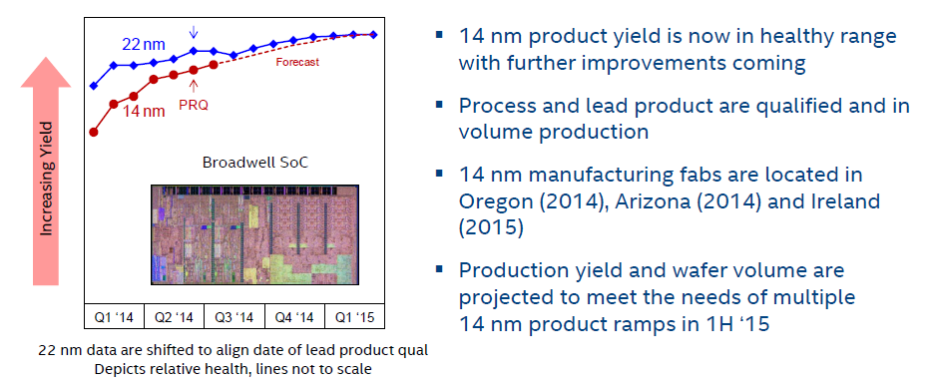
1. Overview of the evolution of Intel’s basic microarchitectures-3
Intel’s relative yield trends of their 14 nm technology vs. their 22 nm technology [154]

Slide 7
1. Overview of the evolution of Intel’s basic microarchitectures-4
The cadence of Intel’s technology transitions [179]
Pentium 4
Willamette
nm
200
180 nm
Pentium 4
Northwood
180
11/00
01/02
160
Pentium 4
Prescott
140
130 nm
02/04
120
Pentium 4
Cedar Mill
100
90 nm
01/06
80
Penryn
65 nm
11/07
Westmere
60
45 nm
01/10
Ivy Bridge
40
32 nm
04/12
Broadwell
Cannonlake
22 nm
09/14
14 nm
2H/17
20
10 nm
0
2000
2002
2004
2006
2008
2010
2012
2014
2016
2018
On Intel’s Q2 2015 earnings conference call, on July 16 2015, Krzanich: in the second half of 2017, we expect to launch our first 10-nanometer product, code named Cannonlake.
The last two technology transitions have signaled that our cadence today is closer to 2.5 years than two“ [180].

Slide 8
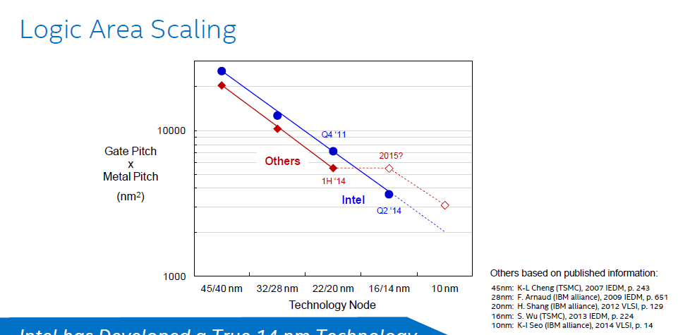
1. Overview of the evolution of Intel’s basic microarchitectures-5
Intel’s lead in IC technology according to [154]
Others:
TSMC (Taiwan)
Globalfoundries (Abu Dhabi)
( IBM Microelectronic)
Samsung Semiconductor
(South Korea)
Source: Intel 08/2014

Slide 9
2. The high-k + metal gate transistor
Notes:
9

Slide 10
2. The high-k + metal gate transistor-1
2. The high-k + metal gate transistor
1. gen.
2. gen.
3. gen.
4. gen.
5. gen.
6. gen.
Core 2
New
Microarch.
65 nm
Penryn
New
Process
45 nm
Nehalem
New
Microarch.
45 nm
West-
mere
New
Process
32 nm
Sandy
Bridge
New
Microarch.
32 nm
Ivy
Bridge
New
Process
22 nm
Haswell
New
Microarchi.
22 nm
Broad-
well
New
Process
14 nm
Skylake
New
Microarchi.
14 nm
TOCK
TICK
TOCK
TICK
TOCK
TICK
TOCK
TICK
TOCK
Figure: Intel’s Tick-Tock development model (Based on [1])
Introduced along with the Penryn family of processors in 2007.

Slide 11
2. The high-k + metal gate transistor-2
The need to introduce new transistor design [21]
Sub-threshold =
Source-Drain
Figure 3.1.1: Dynamic and static power dissipation trends in chips [21]

Slide 12
2. The high-k + metal gate transistor-3
Structure of the high-k + metal gate transistors [23]

Slide 13
2. The high-k + metal gate transistor-4
Benefits of the high-k + metal gate transistors [23], [24]

Slide 14
3. The 22 nm 3D Tri-Gate transistor
Notes:
14

Slide 15
3. The 22 nm 3D Tri-Gate transistor-1
3. The 22 nm 3D Tri-Gate transistor-1
1. gen.
2. gen.
3. gen.
4. gen.
5. gen.
6. gen.
Core 2
New
Microarch.
65 nm
Penryn
New
Process
45 nm
Nehalem
New
Microarch.
45 nm
West-
mere
New
Process
32 nm
Sandy
Bridge
New
Microarch.
32 nm
Ivy
Bridge
New
Process
22 nm
Haswell
New
Microarchi.
22 nm
Broad-
well
New
Process
14 nm
Skylake
New
Microarchi.
14 nm
TOCK
TICK
TOCK
TICK
TOCK
TICK
TOCK
TICK
TOCK
Figure: Intel’s Tick-Tock development model (Based on [1])
Introduced along with the Ivy Bridge family of processors in 2012.

Slide 16
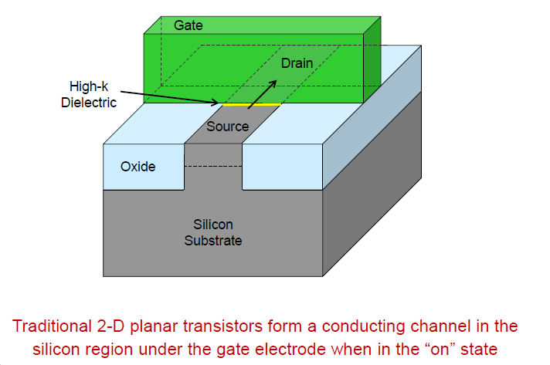
3. The 22 nm 3D Tri-Gate transistor-2
The traditional planar transistor [82]

Slide 17
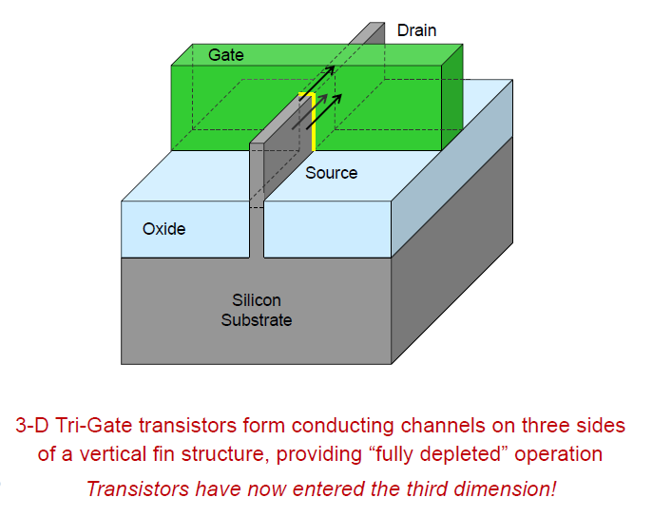
3. The 22 nm 3D Tri-Gate transistor-3
The 22 nm 3D Tri-Gate transistor-2 [82]
fin
The designation “tri-gate” originates from the fact that now the gate has three sides.

Slide 18
3. The 22 nm 3D Tri-Gate transistor-4
The 22 nm Tri-Gate transistor-3 [82]

Slide 19
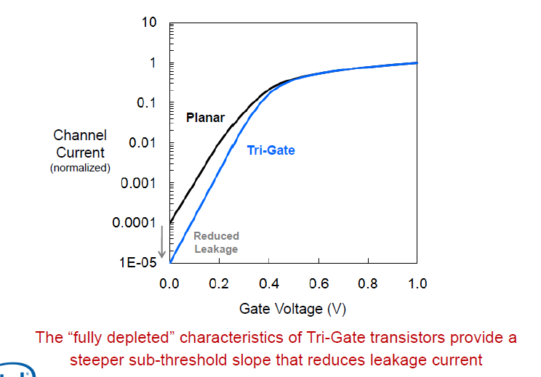
3. The 22 nm 3D Tri-Gate transistor-5
Switching characteristics of the traditional planar and tri-gate transistors [82]

Slide 20
3. The 22 nm 3D Tri-Gate transistor-6
Gate delay of the traditional planar and tri-gate transistors [82]
Gate delay: time difference between output signal and input signal of a gate (n x ps)

Slide 21
3. The 22 nm 3D Tri-Gate transistor-7
Intel’s 22 nm manufacturing fabs [82]

Slide 22
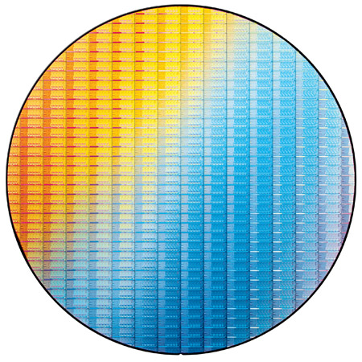
3. The 22 nm 3D Tri-Gate transistor-8
22 nm Ivy Bridge chips on a 300 mm wafer [82]

Slide 23
4. The 14 nm 3D Tri-Gate transistor
Notes:
23

Slide 24
4. The 14 nm 3D Tri-Gate transistor-1
4. The 14 nm 3D Tri-Gate transistor-1
1. gen.
2. gen.
3. gen.
4. gen.
5. gen.
6. gen.
Core 2
New
Microarch.
65 nm
Penryn
New
Process
45 nm
Nehalem
New
Microarch.
45 nm
West-
mere
New
Process
32 nm
Sandy
Bridge
New
Microarch.
32 nm
Ivy
Bridge
New
Process
22 nm
Haswell
New
Microarchi.
22 nm
Broad-
well
New
Process
14 nm
Skylake
New
Microarchi.
14 nm
TOCK
TICK
TOCK
TICK
TOCK
TICK
TOCK
TICK
TOCK
Figure: Intel’s Tick-Tock development model (Based on [1])
Introduced along with the Broadwell family of processors in 2014

Slide 25
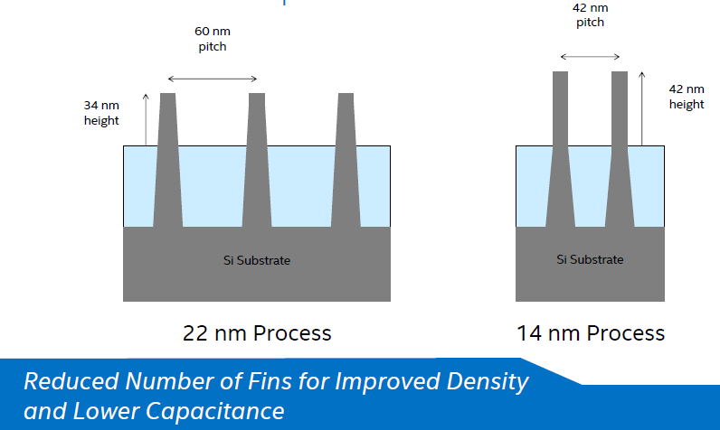
4. The 14 nm 3D Tri-Gate transistor-2
14 nm 2 generation Tri-gate transistors with fin improvement [154]

Slide 26

4. The 14 nm 3D Tri-Gate transistor-3
14 nm Broadwell SOC yield trend [154]

Slide 27
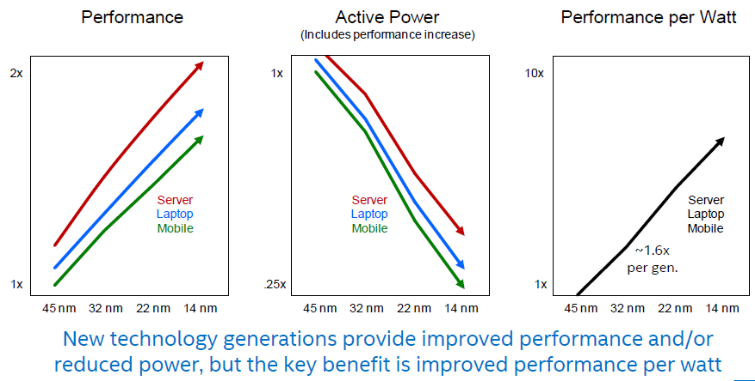
4. The 14 nm 3D Tri-Gate transistor-4
Benefits of reducing the feature size [154]

Slide 28
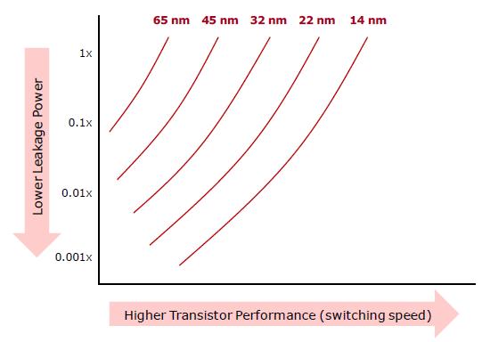
4. The 14 nm 3D Tri-Gate transistor-4
Leakage power vs clock speed for smaller feature sizes [154]
f_{c} > V_{c}
V_{c} > I_{l} > D_{s}

Slide 29
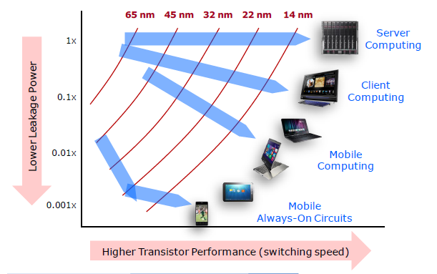
4. The 14 nm 3D Tri-Gate transistor-5
Leakage power vs. clock speed for smaller feature sizes in different product sectors [154]

