Slide 1
Manycore
processors
Sima Dezső
2015. October
Version 6.2

Slide 2
Manycore processors (1)
Manycore processors
Multicore processors
Homogeneous
processors
Heterogeneous
processors
Traditional
MC processors
Manycore
processors
2 ≤ n ≈≤ 16 cores
with n ≈> 16 cores
Mobiles
Desktops
Servers
General purpose
computing
Experimental/prototype/
production systems

Slide 3
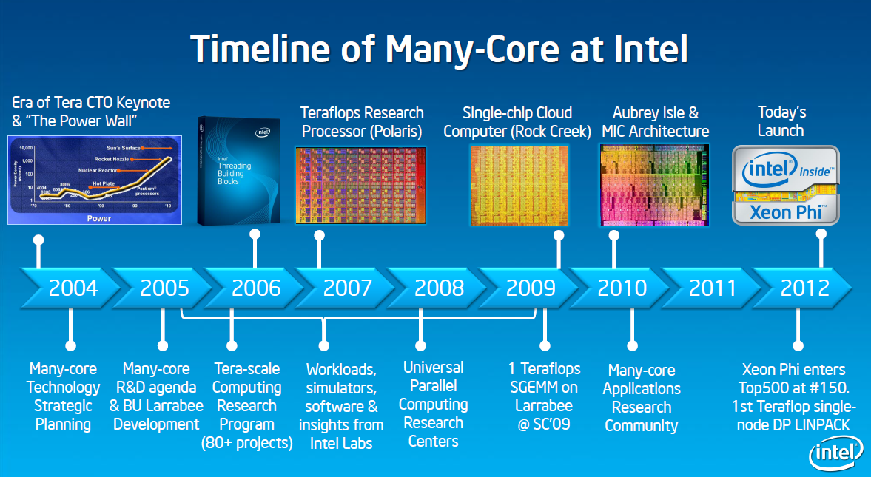
2. Manycore processors (2)
Overview of Intel’s manycore processors [1]
Knights Corner
Xeon Phi
80 core Tile
SCC
Knights Ferry

Slide 4
Manycore processors
1. Intel’s Larrabee
2. Intel’s 80-core Tile processor
3. Intel’s SCC (Single Chip Cloud Computer)
4. Intel’s MIC (Many Integrated Core)/Xeon Phi family
5. References

Slide 5
1. Intel’s Larrabee

Slide 6
1. Intel’s Larrabee (1)
1. Intel’s Larrabee -1 [1]
Knights Corner
Xeon Phi
80 core Tile
SCC
Knights Ferry

Slide 7
1. Intel’s Larrabee (2)
Intel’s Larrabee -2
Begin of the Larrabee project: 2005
Named after Larrabee State Park situated in the state of Washington.
Goal: Design of a manycore processor family for graphics and HPC applications
Stand alone processor rather than add-on card
First public presentation in a workshop: 12/2006
First public demonstration at IDF (San Francisco) in 9/2009.
Expected performance: 0.4 – 1 TFLOPS (for 16 – 24 cores)
Cancelled in 12/2009 but the development continued for HPC applications resulting in the
the Xeon Phi family of add-on cards.

Slide 8
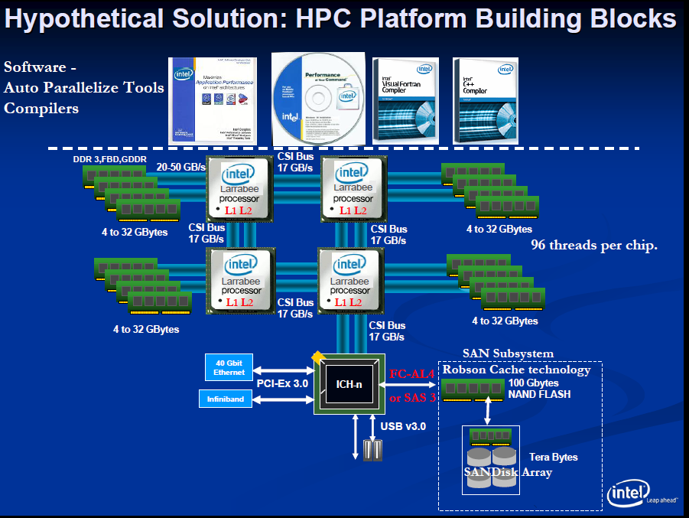
1. Intel’s Larrabee (3)
System architecture of Larrabee aiming at HPC (based on a presentation in 12/2006) [2]
CSI: Common System Interface
(QPI)

Slide 9
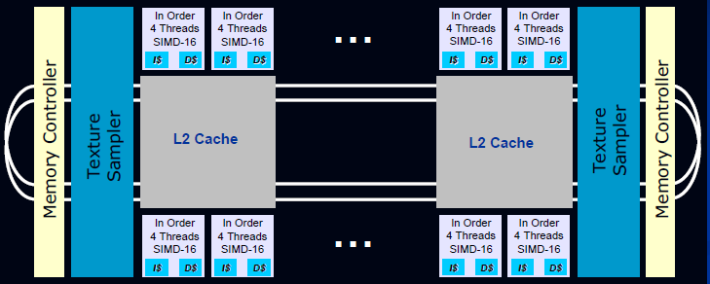
1. Intel’s Larrabee (4)
The microarchitecture of Larrabee [2]
It is based on a bi-directional ring interconnect.
It has a large number (24-32) of enhanced Pentium cores (4-way multithreaded,
SIMD-16 (512-bit) extension).
Larrabee includes a coherent L2 cache, built up of 256 kB/core cache segments.

Slide 10
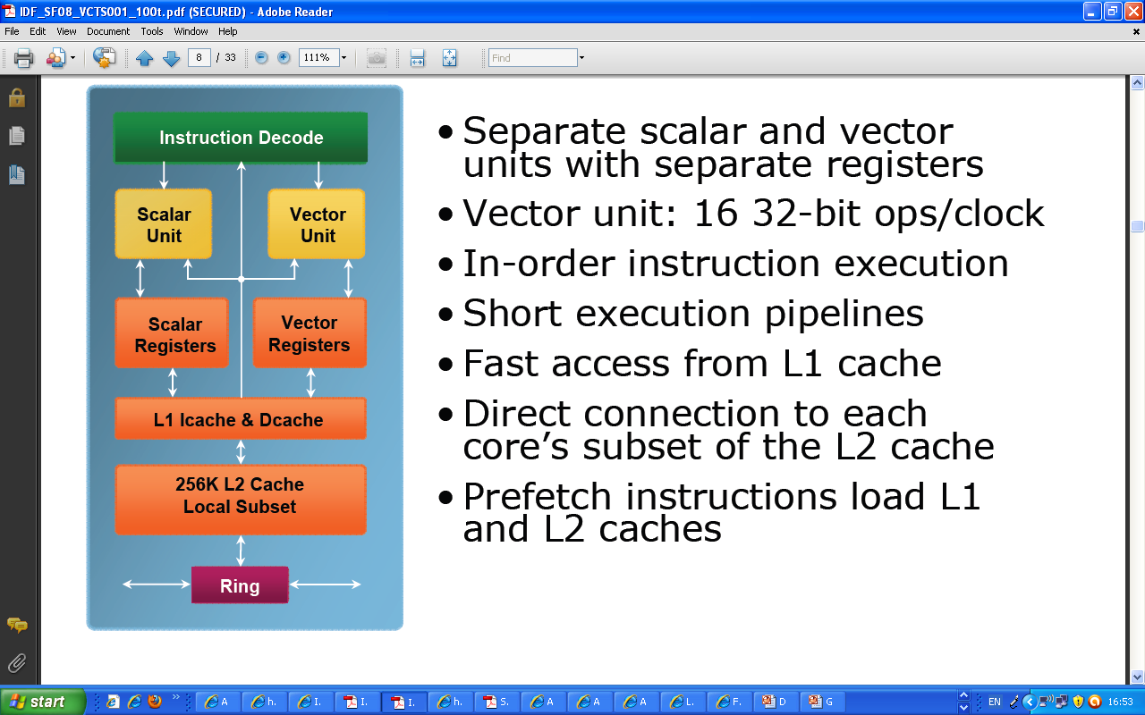
1. Intel’s Larrabee (5)
Block diagram of a Larrabee core [4]

Slide 11
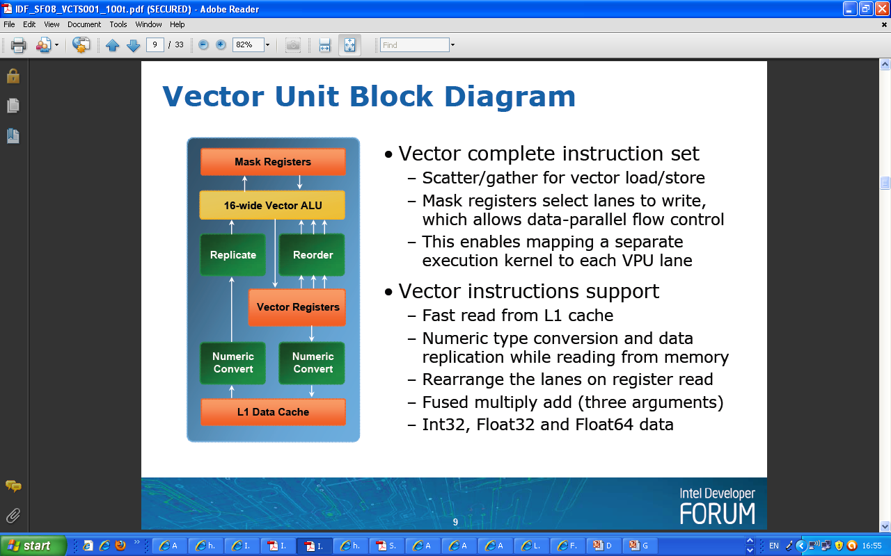
1. Intel’s Larrabee (6)
Block diagram of Larrabee’s vector unit [4]
16 x 32 bit

Slide 12
1. Intel’s Larrabee (7)
Design specifications of Larrabee and Sandy bridge (aka Gesher) [2]

Slide 13
1. Intel’s Larrabee (8)
Cancelling Larrabee [29]
In 12/2009 Intel decided to cancel Larrabee.
The reason was
Larrabee’s hardware and software design lagged behind schedule and
GPU evolution surpassed Larrabee’s performance potential.
E.g. AMD shipped in 2009 already GPU cards with 2.72 TFLOPs (the Radeon 5870)
whereas Larrabee planned performance score was 0.2 – 1.0 TFLOPS.
Nevertheless, for HPC applications Intel continued to develop Larrabee.
This resulted in the Xeon Phi line, to be discussed in Section 4).

Slide 14
2. Intel’s 80-core Tile processor

Slide 15
2. Intel’s 80-core Tile processor (1)
2. Intel’s 80-core Tile processor [1]
Positioning Intel’s 80-core Tile processor
Knights Corner
Xeon Phi
80 core Tile
SCC
Knights Ferry

Slide 16
2. Intel’s 80-core Tile processor (2)
Introduction to Intel’s 80-core Tile processor
It is one project from Intel’s Tera-Scale Initiative.
Announced at IDF 9/2006
Delivered in 2/2007
Goals
1+ SP FP TFLOPS @ < 100 W
Design a prototype of a high performance, scalable 2D mesh interconnect.
Explore design methodologies for “networks on a chip”.
Notes:
Based on ideas of the NOC processor (Network-on-Chip): hundreds of processing elements with integrated on-die communication)
FPMA: FP Multiply-Add

Slide 17
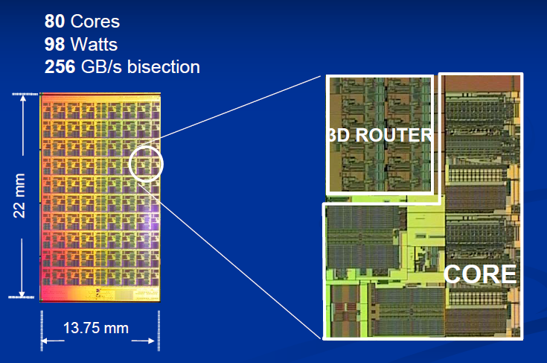
2. Intel’s 80-core Tile processor (3)
The 80-core Tile processor [2]
65 nm, 100 mtrs, 275 mm²

Slide 18
2. Intel’s 80-core Tile processor (4)
Key design features -1
2D on-chip communication network

Slide 19
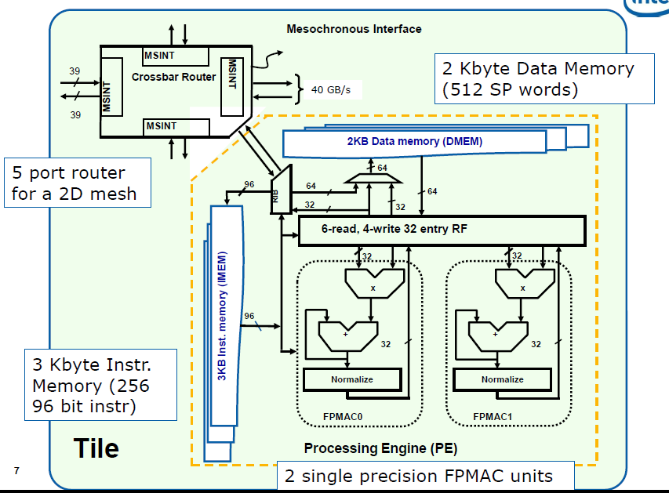
2. Intel’s 80-core Tile processor (5)
The 80 core “Tile” processor [14]
FP Multiply-Accumulate
(AxB+C)

Slide 20
2. Intel’s 80-core Tile processor (6)
Key design features -2
2D on-chip communication network
All memory is distributed to the cores (no need for cache coherency)

Slide 21
2. Intel’s 80-core Tile processor (7)
The 80 core “Tile” processor [14]
FP Multiply-Accumulate
(AxB+C)

Slide 22
2. Intel’s 80-core Tile processor (8)
Key design features -3
2D on-chip communication network
All memory is distributed to the cores (no need for cache coherency)
Very limited execution resources (two SP FP MAC units)

Slide 23
2. Intel’s 80-core Tile processor (9)
The 80 core “Tile” processor [14]
FP Multiply-Accumulate
(AxB+C)

Slide 24
2. Intel’s 80-core Tile processor (10)
Key design features -4
2D on-chip communication network
All memory is distributed to the cores (no need for cache coherency)
Very limited execution resources (two SP FP MAC units)
Very restricted instruction set (12 instructions)

Slide 25
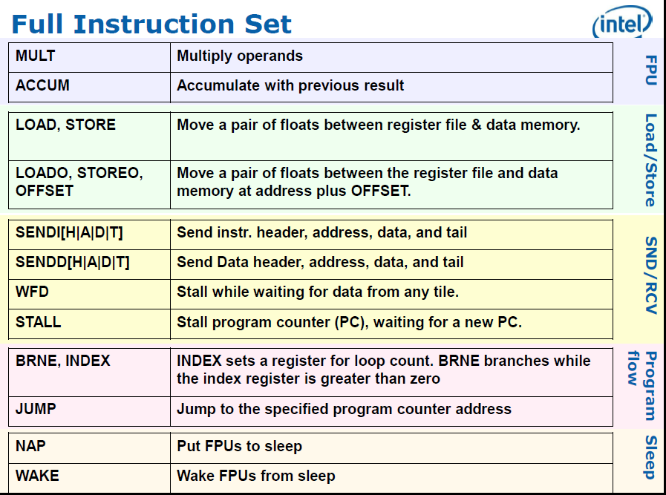
2. Intel’s 80-core Tile processor (11)
The full instruction set of the 80-core Tile processor [14]

Slide 26
2. Intel’s 80-core Tile processor (12)
Key design features -5
2D on-chip communication network
All memory is distributed to the cores (no need for cache coherency)
Very limited execution resources (two SP FP MAC units)
Very restricted instruction set (12 instructions)
Dissipation control by letting sleep and wake up the cores

Slide 27
2. Intel’s 80-core Tile processor (13)
The full instruction set of the 80-core Tile processor [14]

Slide 28
2. Intel’s 80-core Tile processor (14)
Key design features -6
2D on-chip communication network
All memory is distributed to the cores (no need for cache coherency)
Very limited execution resources (two SP FP MAC units)
Very restricted instruction set (12 instructions)
Dissipation control by letting sleep and wake up the cores
Anonymous message passing (sender not identified) into the instruction or data memory

Slide 29
2. Intel’s 80-core Tile processor (15)
The 80 core “Tile” processor [14]
FP Multiply-Accumulate
(AxB+C)

Slide 30
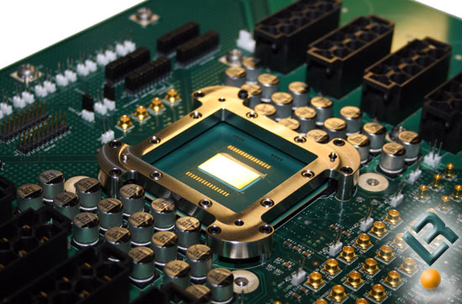
2. Intel’s 80-core Tile processor (16)
On board implementation of the 80-core Tile Processor [15]

Slide 31
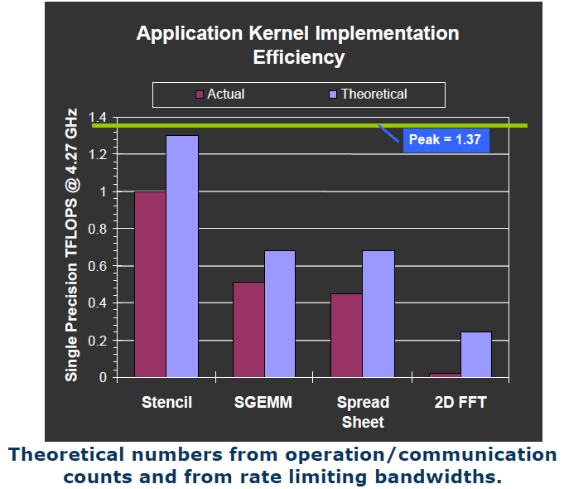
2. Intel’s 80-core Tile processor (17)
Achieved performance figures of the 80-core Tile processor [14]

Slide 32
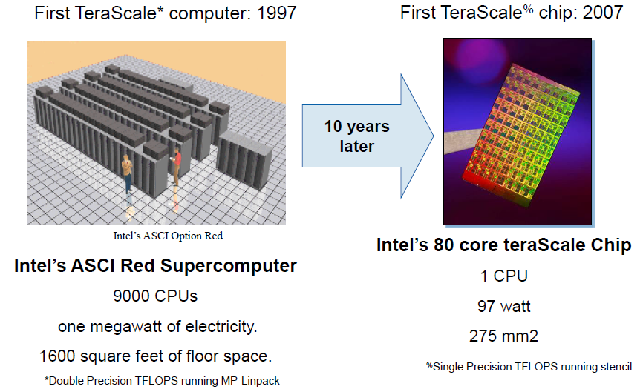
2. Intel’s 80-core Tile processor (18)
Contrasting the first TeraScale computer and the first TeraScale chip [14]
(Pentium II)

Slide 33
3. Intel’s SCC (Single-Chip Cloud Computer)

Slide 34
3. Intel’s SCC (Single-Chip Cloud Computer) (1)
3. Intel’s SCC (Single-Chip Cloud Computer)
Positioning Intel’s SCC [1]
Knights Corner
Xeon Phi
80 core Tile
SCC
Knights Ferry

Slide 35
3. Intel’s SCC (Single-Chip Cloud Computer) (2)
Introduction to Intel’s SCC
12/2009: Announced as a research project
9/2010: Many-core Application Research Project (MARC) initiative started on the SCC
platform
Designed in Braunschweig and Bangalore

Slide 36
3. Intel’s SCC (Single-Chip Cloud Computer) (3)
Key design features of SCC -1
24 tiles with 48 enhanced Pentium cores
2D on-chip interconnection network

Slide 37
3. Intel’s SCC (Single-Chip Cloud Computer) (4)
SCC overview [44]

Slide 38
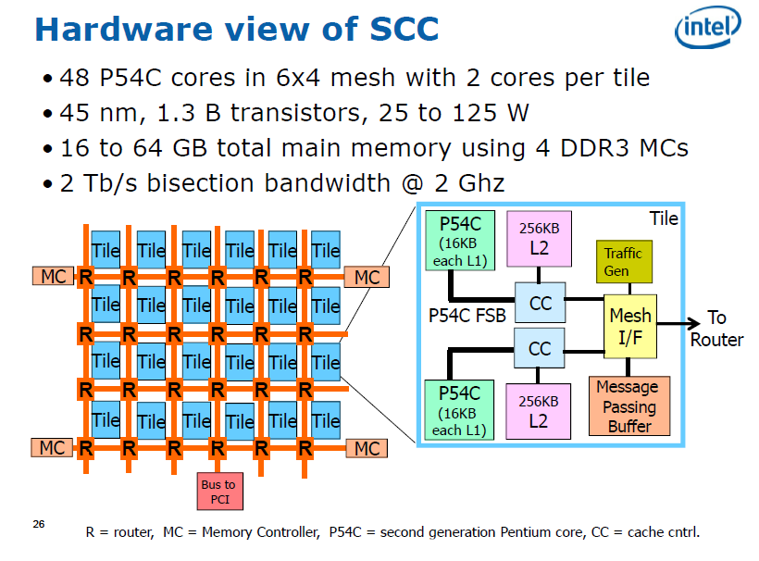
3. Intel’s SCC (Single-Chip Cloud Computer) (5)
Hardware overview [14]
(0.6 µm)

Slide 39
3. Intel’s SCC (Single-Chip Cloud Computer) (6)
System overview [14]
(Joint Test Action Group)
Standard Test Access Port

Slide 40
3. Intel’s SCC (Single-Chip Cloud Computer) (7)
Key design features of SCC -2
2D on-chip communication network
Enhanced Pentium cores
Both private and shared off-chip memory, it needs maintaining cache coherency
Software based cache coherency (by maintaining per core page tables)

Slide 41
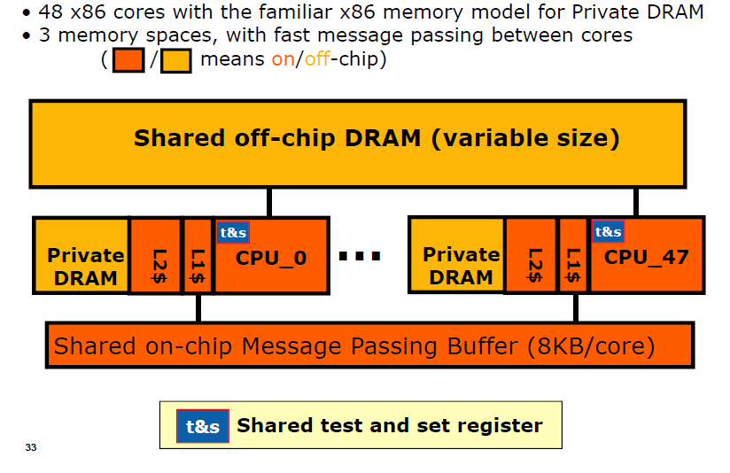
3. Intel’s SCC (Single-Chip Cloud Computer) (8)
Programmer’s view of SCC [14]

Slide 42
3. Intel’s SCC (Single-Chip Cloud Computer) (9)
Key design features of SCC -3
2D on-chip communication network
Enhanced Pentium cores
Both private and shared off-chip memory, it needs maintaining cache coherency
Software based cache coherency (by maintaining per core page tables)
Message passing (by providing per core message passing buffers)

Slide 43
3. Intel’s SCC (Single-Chip Cloud Computer) (10)
Programmer’s view of SCC [14]

Slide 44
3. Intel’s SCC (Single-Chip Cloud Computer) (11)
Dual-core SCC tile [14]
GCU: Global Clocking Unit
MIU: Mesh Interface Unit

Slide 45
3. Intel’s SCC (Single-Chip Cloud Computer) (12)
Key design features of SCC -4
2D on-chip communication network
Enhanced Pentium cores
Both private and shared off-chip memory, it needs maintaining cache coherency
Software based cache coherency (by maintaining per core page tables)
Message passing (by providing per core message passing buffers)
DVFS (Dynamic Voltage and Frequency Scaling) based dissipation control
Software library to support message passing and DVFS

Slide 46
3. Intel’s SCC (Single-Chip Cloud Computer) (13)
Dissipation management of SCC -1 [16]

Slide 47
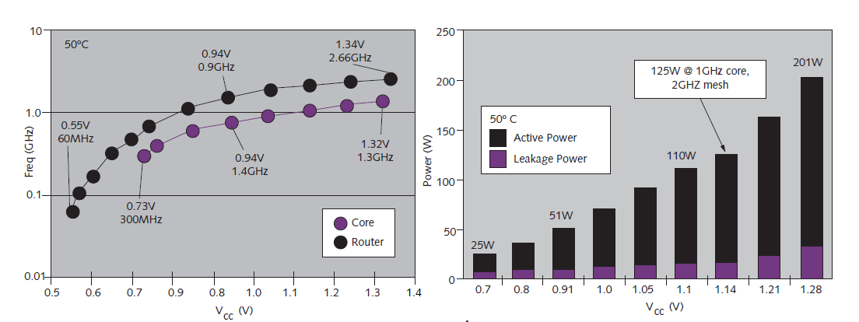
3. Intel’s SCC (Single-Chip Cloud Computer) (14)
Dissipation management of SCC -2 [16]
A software library supports both message-passing and DVFS based power management.

Slide 48
4. Intel’s MIC (Many Integrated Cores)/Xeon Phi
4.1 Overview
4.2 The Knights Ferry prototype system
4.3 The Knights Corner line
4.4 Use of Xeon Phi Knights Corner coprocessors
in supercomputers
4.5 The Knights Landing line

Slide 49
4.1 Overview
Notes:
49

Slide 50
4.1 Overview (1)
4.1 Overview
Positioning Intel’s MIC (Many Integrated Cores)/Xeon Phi family
Knights Corner
Xeon Phi
80 core Tile
SCC
Knights Ferry

Slide 51
4.1 Overview (2)
4.1 Overview of Intel’s MIC (Many Integrated Cores)/Xeon Phi family
05/10
06/12
Branding
MIC
(Many Integrated Cores)
Renamed to
Xeon Phi
05/10
45 nm/32 cores
SP: 0.75 TFLOPS
DP: --
Prototype
Knights Ferry
Knights Corner
05/10
22 nm/>50 cores
(announced)
11/12
22 nm/60 cores
SP: na
DP: 1.0 TFLOPS
06/13
22 nm/57/61 cores
SP: na
DP: > 1 TFLOPS
1. gen.
Knights
Corner
Xeon Phi 5110P
Xeon Phi
3120/7120
Knights Landing
06/13
Knights Landing
09/15
2. gen.
Xeon Phi
??
Xeon Phi
??
14 nm/? cores
SP: na
DP: ~ 3 TFLOPS
14 nm/72 cores
SP: na
DP: ~ 3 TFLOPS
06/12
Open source SW for
Knights Corner
Software
support
2010
2011
2012
2013
2014
2015

Slide 52
4.1 Overview (3)
Introduction of the MIC line and the Knights Ferry prototype system
They were based mainly on their ill-fated Larrabee project and partly on results of their SCC
(Single Cloud Computer) development.
Both introduced at the International Supercomputing Conference in 5/2010.
Figure: The introduction of Intel’s MIC (Many Integrated Core) architecture [5]

Slide 53
4.2 The Knights Ferry prototype system
Notes:
53

Slide 54
4.2 The Knights Ferry prototype system (1)
4.2 The Knights Ferry prototype system
05/10
06/12
Branding
MIC
(Many Integrated Cores)
Renamed to
Xeon Phi
05/10
45 nm/32 cores
SP: 0.75 TFLOPS
DP: --
Prototype
Knights Ferry
Knights Corner
05/10
22 nm/>50 cores
(announced)
11/12
22 nm/60 cores
SP: na
DP: 1.0 TFLOPS
06/13
22 nm/57/61 cores
SP: na
DP: > 1 TFLOPS
1. gen.
Knights
Corner
Xeon Phi 5110P
Xeon Phi
3120/7120
Knights Landing
06/13
Knights Landing
09/15
2. gen.
Xeon Phi
??
Xeon Phi
??
14 nm/? cores
SP: na
DP: ~ 3 TFLOPS
14 nm/72 cores
SP: na
DP: ~ 3 TFLOPS
06/12
Open source SW for
Knights Corner
Software
support
2010
2011
2012
2013
2014
2015

Slide 55
4.2 The Knights Ferry prototype system (2)
Main features of the Knights Ferry prototype system
Knights Ferry is targeting exclusively HPC and is implemented as an add-on card
(connected via PCIe 2.0x16).
By contrast Larrabee aimed both HPC and graphics and was implemented as a stand alone
unit.
Intel made the prototype system available for developers.
At the same time Intel also announced a consumer product of the MIC line, designated as
the Knights Corner, as indicated in the previous Figure.

Slide 56
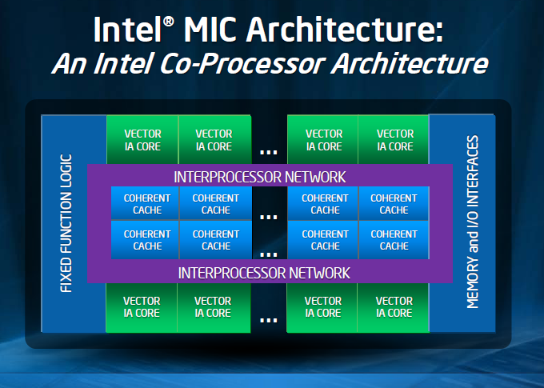
4.2 The Knights Ferry prototype system (3)
The microarchitecture of the Knights Ferry prototype system
It is a bidirectional ring based architecture with 32 Pentium-like cores and
a coherent L2 cache built up of 256 kB/core segments, as shown below.
Internal name of the
Knights Ferry processor:
Aubrey Isles
Figure: Microarchitecture of the Knights Ferry [5]

Slide 57
4.2 The Knights Ferry prototype system (4)
Comparing the microarchitectures of Intel’s Knights Ferry and the Larrabee
Microarchitecture of Intel’s Knight Ferry
(published in 2010) [5]
Microarchitecture of Intel’s Larrabee
(published in 2008) [3]

Slide 58
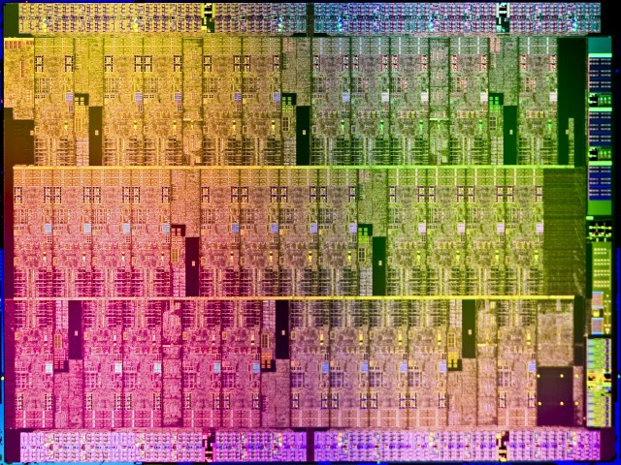
4.2 The Knights Ferry prototype system (5)
Die plot of Knights Ferry [18]

Slide 59
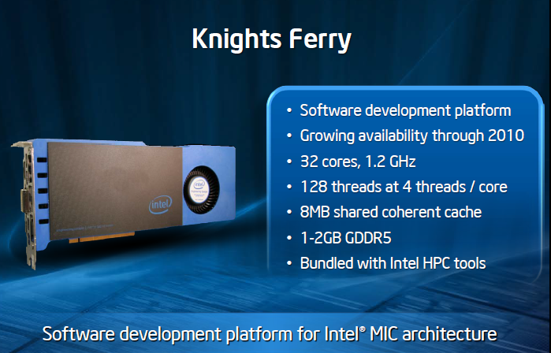
4.2 The Knights Ferry prototype system (6)
Main features of Knights Ferry
Figure: Knights Ferry at its debut at the International Supercomputing Conference in 2010 [5]

Slide 60
4.2 The Knights Ferry prototype system (7)
 | Intel’s Xeon Phi, formerly Many Integrated Cores (MIC) line
Core type | Knights Ferry | 5110P | 3120 | 7120
Based on | Aubrey Isle core
Introduction | 5/2010 | 11/2012 | 06/2013 | 06/2013
Processor
Technology/no. of transistors | 45 nm/2300 mtrs/684 mm² | 22 nm/ ~ 5 000 mtrs | 22 nm | 22 nm
Core count | 32 | 60 | 57 | 61
Threads/core | 4 | 4 | 4 | 4
Core frequency | Up to 1.2 GHz | 1.053 GHz | 1.1 GHz. | 1.238 GHz.
L2/core | 256 kByte/core | 512 kByte/core | 512 kB/core | 512 kB/core
Peak FP32 performance | > 0.75 TFLOPS | n.a. | n.a. | n.a.
Peak FP64 performance | -- | 1.01 TFLOPS | 1.003 TFLOPS | > 1.2 TFLOPŐS
Memory
Mem. clock | 5 GT/s? | 5 GT/s | 5 GT/s | 5.5 GT/s
No. of memory channels | 8 | Up to 16 | Up to 12 | Up to 16
Mem. bandwidth | 160 GB/s? | 320 GB/s | 240 GB/s | 352 GB/s
Mem. size | 1 or 2 GByte | 2 GByte | 6 GB | 16 GB
Mem. type | GDDR5 | GDDR5 | GDDR5 | GDDR5
System
ECC | no ECC | ECC | ECC | ECC
Interface | PCIe2.0x16 | PCIe2.0x16 | PCIe 2.0x16 | PCIe 2.0x16
Slot request | Single slot | Single slot | n.a. | n.a.
Cooling | Active | Active | Passive / Active cooling | Passive / Active cooling
Power (max) | 300 W | 245 W | 300 W | 300 W
Table 4.1: Main features of Intel’s Xeon Phi line [8], [13]

Slide 61
4.2 The Knights Ferry prototype system (8)
Significance of Knights Ferry
Knights Ferry became the software development platform for the MIC line, renamed later to
become the Xeon Phi line.
Figure: Knights Ferry at its debut at the International Supercomputing Conference in 2010 [5]

Slide 62
4.2 The Knights Ferry prototype system (9)
Main benefit of the MIC software platform
It eliminates the need for dual programming environments and allows to use a common
programming environment with Intel’s x86 architectures, as indicated below [5].

Slide 63
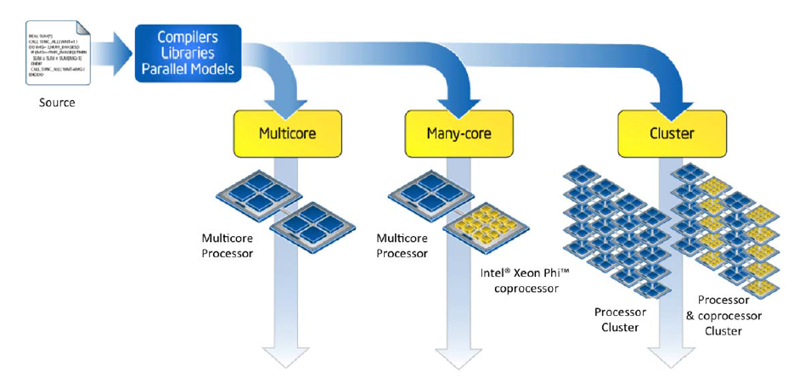
4.2 The Knights Ferry prototype system (10)
Principle of Intel’s common software development platform for multicores, many-cores
and clusters [10]

Slide 64
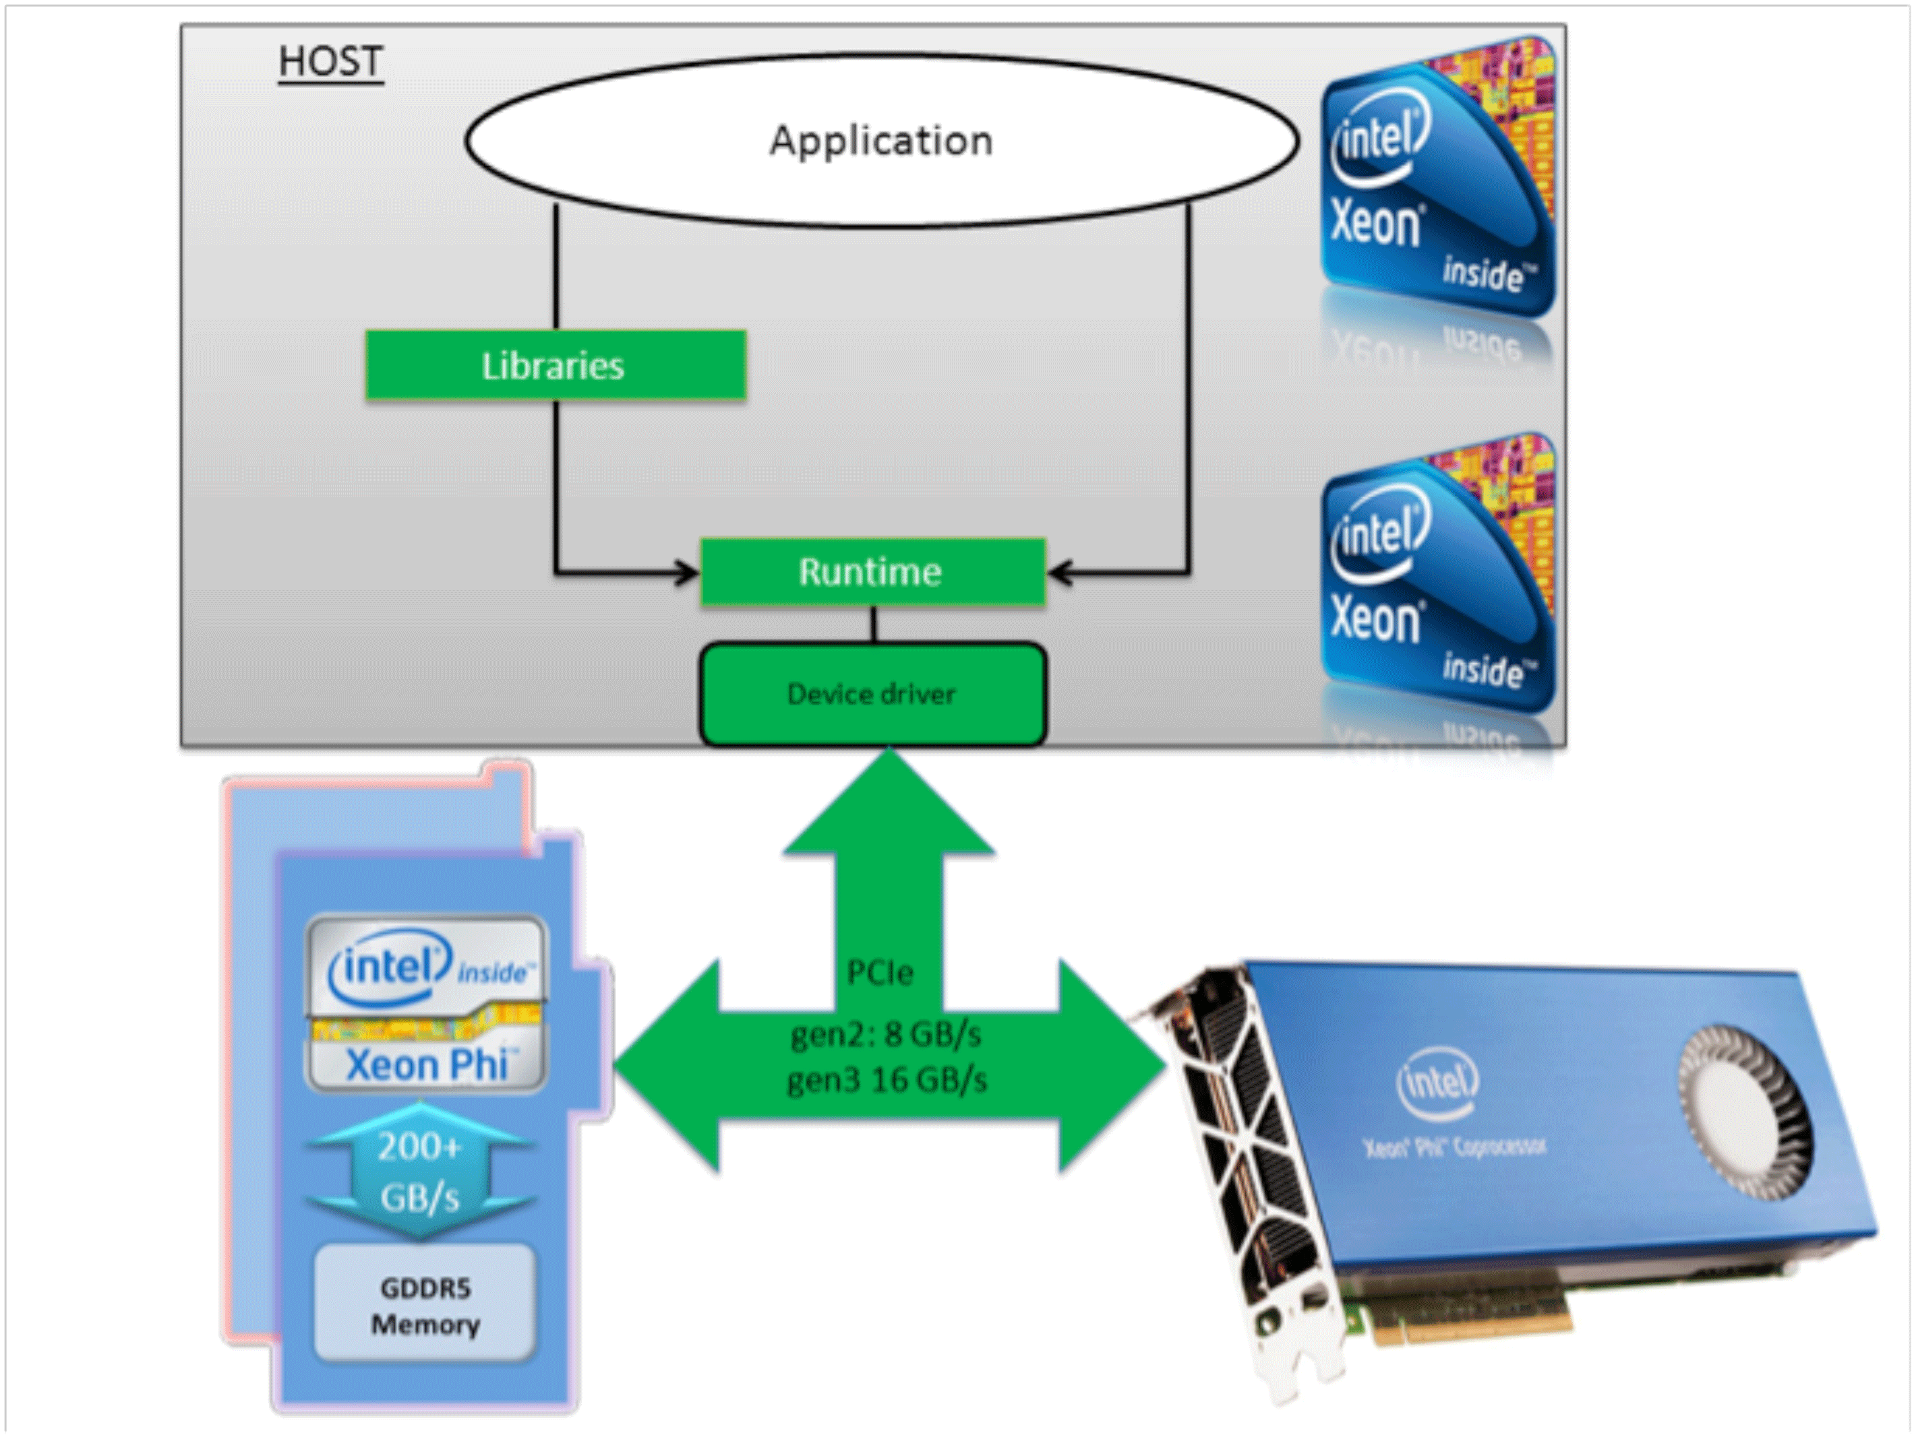
4.2 The Knights Ferry prototype system (11)
Principle of programming of the MIC/Xeon Phi [30]

Slide 65
4.2 The Knights Ferry prototype system (12)
Approaches to program the Xeon Phi [30]
There are different options to program the Xeon Phi, including
a) Using pragmas to augment existing code for offloading work from the host processor to the
Xeon Phi coprocessor,
b) recompiling source code to run it directly on the coprocessor or
c) accessing the coprocessor as an accelerator through optimized libraries, such as Intel’s MKL
Math Kernel Library).

Slide 66
4.2 The Knights Ferry prototype system (13)
Main steps of programming a task to run on the Xeon Phi [30]
Transfer the data via the PCIe bus to the memory of the coprocessor,
distribute the work to be done to the cores of the coprocessor by initializing a large enough
number of threads,
perform the computations and
copy back the result from the coporcessor to the host computer.

Slide 67
4.2 The Knights Ferry prototype system (14)
Renaming the MIC branding to Xeon Phi branding and providing open source software
support -1
Then in 6/2012 Intel renamed the MIC branding to Xeon Phi to emphasize the coprocessor nature
of their DPAs and also to emphasize the preferred type of the companion processor.
At the same time Intel also made open source software support available for the Xeon Phi line,
as indicated in the Figure.

Slide 68
4.2 The Knights Ferry prototype system (15)
Renaming the MIC branding to Xeon Phi and providing open source software support -2
05/10
06/12
Branding
MIC
(Many Integrated Cores)
Renamed to
Xeon Phi
05/10
45 nm/32 cores
SP: 0.75 TFLOPS
DP: --
Prototype
Knights Ferry
Knights Corner
05/10
22 nm/>50 cores
(announced)
11/12
22 nm/60 cores
SP: na
DP: 1.0 TFLOPS
06/13
22 nm/57/61 cores
SP: na
DP: > 1 TFLOPS
1. gen.
Knights
Corner
Xeon Phi 5110P
Xeon Phi
3120/7120
Knights Landing
06/13
Knights Landing
09/15
2. gen.
Xeon Phi
??
Xeon Phi
??
14 nm/? cores
SP: na
DP: ~ 3 TFLOPS
14 nm/72 cores
SP: na
DP: ~ 3 TFLOPS
06/12
Open source SW for
Knights Corner
Software
support
2010
2011
2012
2013
2014
2015

Slide 69
4.3 The Knights Corner line

Slide 70
4.3 The Knights Corner line (1)
4.3 The Knights Corner line [1]
Knights Corner
Xeon Phi
80 core Tile
SCC
Knights Ferry

Slide 71
4.3 The Knights Corner line (2)
4.3 The Knights Corner line
Next, in 11/2012 Intel introduced the first commercial product of the Xeon Phi line, designated as
the Xeon Phi 5110P with immediate availability, as shown in the next Figure.

Slide 72
4.3 The Knights Corner line (3)
Announcing the Knights Corner consumer product
05/10
06/12
Branding
MIC
(Many Integrated Cores)
Renamed to
Xeon Phi
05/10
45 nm/32 cores
SP: 0.75 TFLOPS
DP: --
Prototype
Knights Ferry
Knights Corner
05/10
22 nm/>50 cores
(announced)
11/12
22 nm/60 cores
SP: na
DP: 1.0 TFLOPS
06/13
22 nm/57/61 cores
SP: na
DP: > 1 TFLOPS
1. gen.
Knights
Corner
Xeon Phi 5110P
Xeon Phi
3120/7120
Knights Landing
06/13
Knights Landing
09/15
2. gen.
Xeon Phi
??
Xeon Phi
??
14 nm/? cores
SP: na
DP: ~ 3 TFLOPS
14 nm/72 cores
SP: na
DP: ~ 3 TFLOPS
06/12
Open source SW for
Knights Corner
Software
support
2010
2011
2012
2013
2014
2015

Slide 73
4.3 The Knights Corner line (4)
Target application area and implementation
Target application area
Highly parallel HPC workloads
Implementation
as an add-on card connected to a Xeon server via an PCIex16 bus, as shown below.

Slide 74
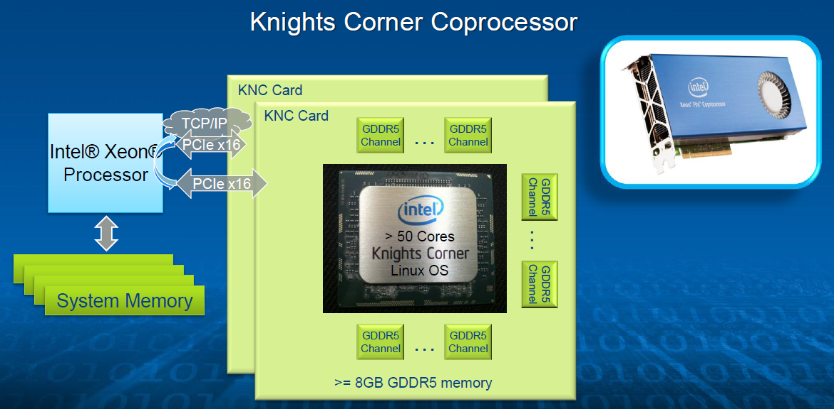
4.3 The Knights Corner line (5)
The system layout of the Knights Corner (KCN) DPA [6]

Slide 75
4.3 The Knights Corner line (6)
Programming environment of the Xeon Phi family [6]
It has a general purpose programming environment
Runs under Linux
Runs applications written in Fortran, C, C++, OpenCL 1.2 (in 2/2013 Beta)…
x86 design tools (libraries, compilers, Intel’s VTune, debuggers etc.)

Slide 76
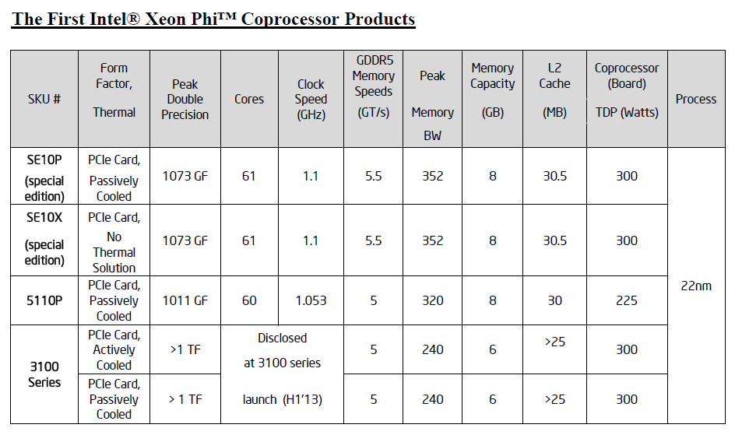
4.3 The Knights Corner line (7)
First introduced or disclosed models of the Xeon Phi line [7]
n
(nx1/2)
3200
Remark
The SE10P/X subfamilies are intended for customized products, like those used in supercomputers,
such as the TACC Stampede, built in Texas Advanced Computing Center (2012).

Slide 77
4.3 The Knights Corner line (8)
 | Intel’s Xeon Phi, formerly Many Integrated Cores (MIC) line
Core type | Knights Ferry | 5110P | 3120 | 7120
Based on | Aubrey Isle core
Introduction | 5/2010 | 11/2012 | 06/2013 | 06/2013
Processor
Technology/no. of transistors | 45 nm/2300 mtrs/684 mm² | 22 nm/ ~ 5 000 mtrs | 22 nm | 22 nm
Core count | 32 | 60 | 57 | 61
Threads/core | 4 | 4 | 4 | 4
Core frequency | Up to 1.2 GHz | 1.053 GHz | 1.1 GHz. | 1.238 GHz.
L2/core | 256 kByte/core | 512 kByte/core | 512 kB/core | 512 kB/core
Peak FP32 performance | > 0.75 TFLOPS | n.a. | n.a. | n.a.
Peak FP64 performance | -- | 1.01 TFLOPS | 1.003 TFLOPS | > 1.2 TFLOPŐS
Memory
Mem. clock | 5 GT/s? | 5 GT/s | 5 GT/s | 5.5 GT/s
No. of memory channels | 8 | Up to 16 | Up to 12 | Up to 16
Mem. bandwidth | 160 GB/s? | 320 GB/s | 240 GB/s | 352 GB/s
Mem. size | 1 or 2 GByte | 2 GByte | 6 GB | 16 GB
Mem. type | GDDR5 | GDDR5 | GDDR5 | GDDR5
System
ECC | no ECC | ECC | ECC | ECC
Interface | PCIex2.016 | PCIe2.0x16 | PCIe 2.0x16 | PCIe 2.0x16
Slot request | Single slot | Single slot | n.a. | n.a.
Cooling | Active | Active | Passive / Active cooling | Passive / Active cooling
Power (max) | 300 W | 245 W | 300 W | 300 W
Table 4.1: Main features of Intel’s Xeon Phi line [8], [13]

Slide 78
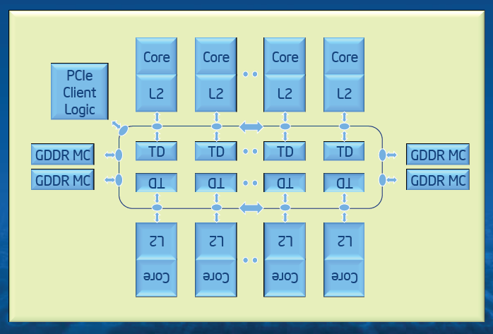
4.3 The Knights Corner line (9)
The microarchitecture of Knights Corner [6]
It is a bidirectional ring based architecture like its predecessors the Larrabee and Knights Ferry,
with an increased number (60/61) of significantly enhanced Pentium cores and a coherent
L2 cache built up of 256 kB/core segments, as shown below.
Figure: The microarchitecture of Knights Corner [6]

Slide 79
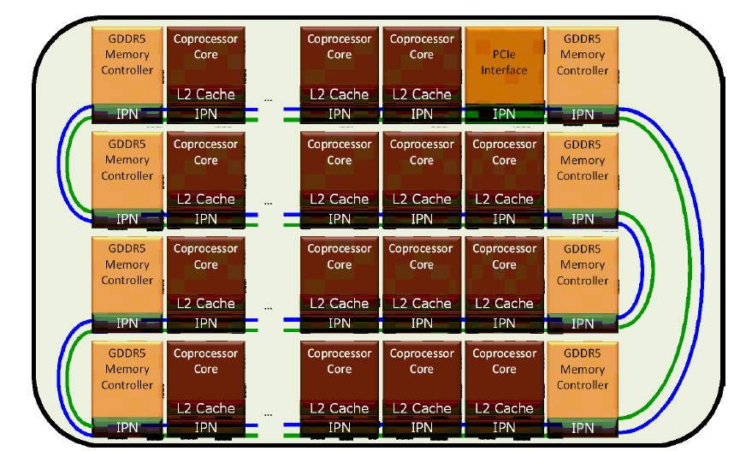
4.3 The Knights Corner line (10)
The layout of the ring interconnect on the die [8]

Slide 80
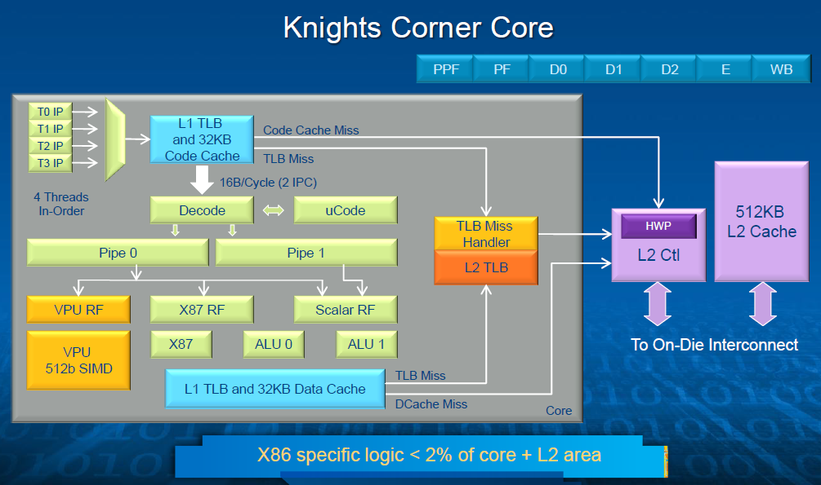
4.3 The Knights Corner line (11)
Block diagram of a core of the Knights Corner [6]
Heavily customized Pentium P54C

Slide 81
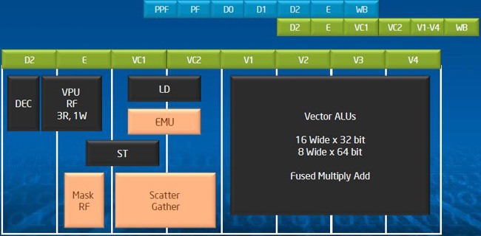
4.3 The Knights Corner line (12)
Block diagram and pipelined operation of the Vector unit [6]
EMU: Extended Math Unit
It can execute transcendental operations such as reciprocal, square root, and log,
thereby allowing these operations to be executed in a vector fashion [6]

Slide 82
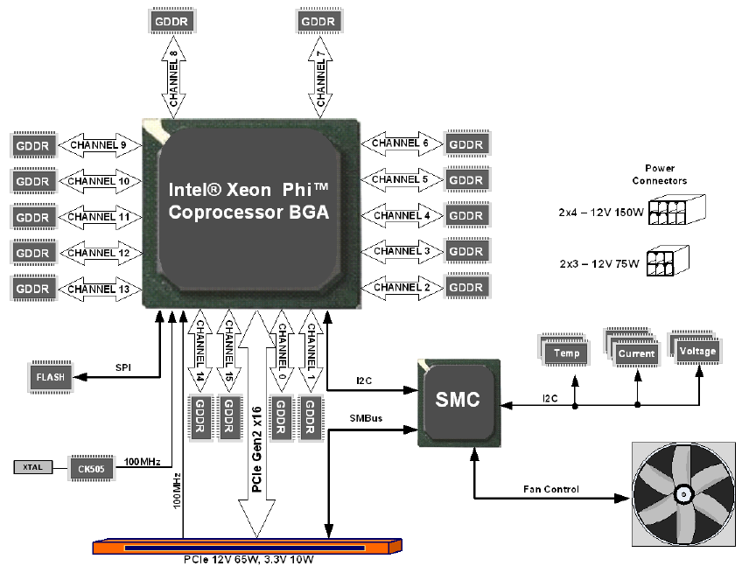
4.3 The Knights Corner line (13)
System architecture of the Xeon Phi co-processor [8]
SMC: System Management Controller

Slide 83
4.3 The Knights Corner line (14)
Remark
The System Management Controller (SMC) has three I2C interfaces to implement a thermal
control and a status information exchange.
For details see the related Datasheet [8].

Slide 84
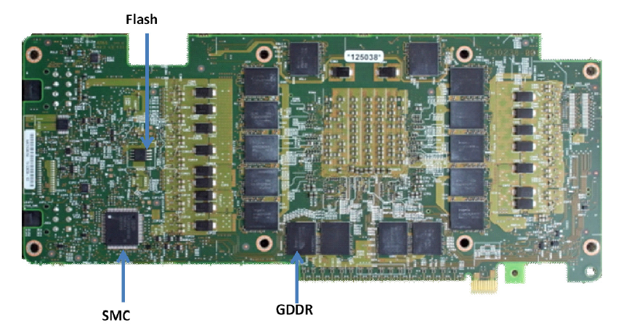
4.3 The Knights Corner line (15)
The Xeon Phi coprocessor board (backside) [8]

Slide 85
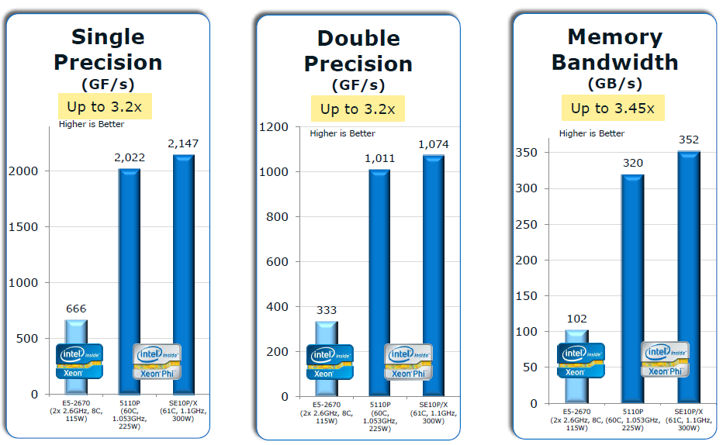
4.3 The Knights Corner line (16)
Peak performance of the Xeon Phi 5110P and SE10P/X vs. a 2-socket Intel Xeon server
[11]
The reference system is a 2-socket Xeon server with two Intel Xeon E5-2670 processors
(Sandy Bridge-EP: 8 cores, 20 MB L3 cache, 2.6 GHz clock frequency, 8.0 GT/s QPI speed,
DDR3 with 1600 MT/s).

Slide 86
4.3 The Knights Corner line (17)
Further models of the Knight Corner line introduced in 06/2013 [8], [13]
 | Intel’s Xeon Phi, formerly Many Integrated Cores (MIC) line
Core type | Knights Ferry | 5110P | 3120 | 7120
Based on | Aubrey Isle core
Introduction | 5/2010 | 11/2012 | 06/2013 | 06/2013
Processor
Technology/no. of transistors | 45 nm/2300 mtrs/684 mm² | 22 nm/ ~ 5 000 mtrs | 22 nm | 22 nm
Core count | 32 | 60 | 57 | 61
Threads/core | 4 | 4 | 4 | 4
Core frequency | Up to 1.2 GHz | 1.053 GHz | 1.1 GHz. | 1.238 GHz.
L2/core | 256 kByte/core | 512 kByte/core | 512 kB/core | 512 kB/core
Peak FP32 performance | > 0.75 TFLOPS | n.a. | n.a. | n.a.
Peak FP64 performance | -- | 1.01 TFLOPS | 1.003 TFLOPS | > 1.2 TFLOPS
Memory
Mem. clock | 5 GT/s? | 5 GT/s | 5 GT/s | 5.5 GT/s
No. of memory channels | 8 | Up to 16 | Up to 12 | Up to 16
Mem. bandwidth | 160 GB/s? | 320 GB/s | 240 GB/s | 352 GB/s
Mem. size | 1 or 2 GByte | 2 GByte | 6 GB | 16 GB
Mem. type | GDDR5 | GDDR5 | GDDR5 | GDDR5
System
ECC | no ECC | ECC | ECC | ECC
Interface | PCIex2.016 | PCIe2.0x16 | PCIe 2.0x16 | PCIe 2.0x16
Slot request | Single slot | Single slot | n.a. | n.a.
Cooling | Active | Active | Passive / Active cooling | Passive / Active cooling
Power (max) | 300 W | 245 W | 300 W | 300 W

Slide 87
4.4 Use of Xeon Phi Knights Corner coprocessors
in supercomputers

Slide 88
4.4 Use of Xeon Phi Knights Corner coprocessors in supercomputers (1)
4.4 Use of Xeon Phi Knights Corner coprocessors in supercomputers [22]
As of 06/2014 62 of the top 500 supercomputers make use of accelerator/co-processor technology, trend increasing.
44 use NVIDIA chips
2 AMD chips
17 Intel MIC technology (Xeon Phi)
Out of the systems incorporating Intel’s Xeon Phi chips the most impressive ones are
the no. 1 system, Tianhe-2 (China) and
the no. 7 system, Stampede (USA).

Slide 89
4.4 Use of Xeon Phi Knights Corner coprocessors in supercomputers (2)
The Tianhe-2 (Milky Way-2) supercomputer [23]
As of 06/2004 the Tianhe-2 is the fastest supercomputer of the world with a
sustained peak performance of 33.86 PFLOPS and
theoretical peak performance of 54.9 PFLOPS.
It was built by China's National University of Defense Technology (NUDT) in collaboration
with a Chinese IT firm.
It is installed in the National Supercomputer Center in Guangzhou, in Southwest of China.
Tianhe-2 became operational in 6/2013, two years before schedule.
OS: Kylin Linux
Fortran, C, C++, and Java compilers, OpenMP (API for shared memory multiprocessing)
Power consumption: 17.8 MWatt

Slide 90
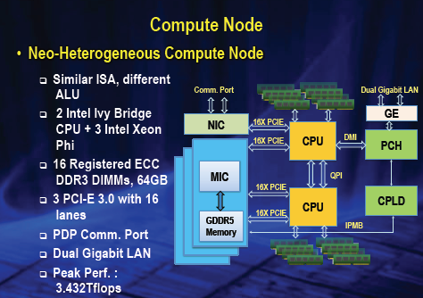
4.4 Use of Xeon Phi Knights Corner coprocessors in supercomputers (3)
Block diagram of a compute node of the Tianhe-2 [23]

Slide 91
4.4 Use of Xeon Phi Knights Corner coprocessors in supercomputers (4)
Key features of a compute node [23]
Tianhe-2 includes 16000 nodes.
Each node consists of
2 Intel Ivy Bridge (E5-2692v2, 12 cores, 2.2GHz) processors and
3 Intel Xeon Phi accelerators (57 cores, 4 threads per core).
The peak performance
of the 2 Ivy Bridge processors is: 2 x 0.2112 = 0.4224 TFLOPS and
of the 3 Xeon Phi processors is: 3 x 1.003 = 3.009 TFLOPS
of a node: 3.43 TFLOPS
of 16000 nodes: 16000 x 3.43 = 54.9 PFLOPS.

Slide 92
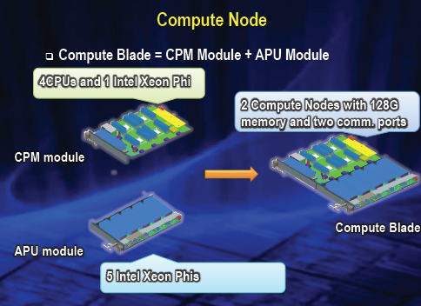
4.4 Use of Xeon Phi Knights Corner coprocessors in supercomputers (5)
Compute blade [23]
A Compute blade includes two nodes, but is built up of two halfboards, as indicated below.

Slide 93
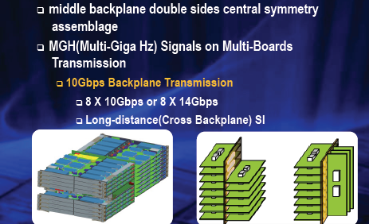
4.4 Use of Xeon Phi Knights Corner coprocessors in supercomputers (6)
Structure of a compute frame (rack) [23]
Note that the two halfboards of a blade are interconnected by a middle backplane.

Slide 94
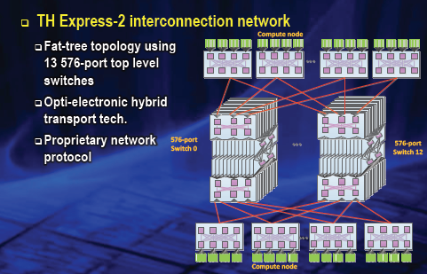
4.4 Use of Xeon Phi Knights Corner coprocessors in supercomputers (7)
The interconnection network [23]

Slide 95
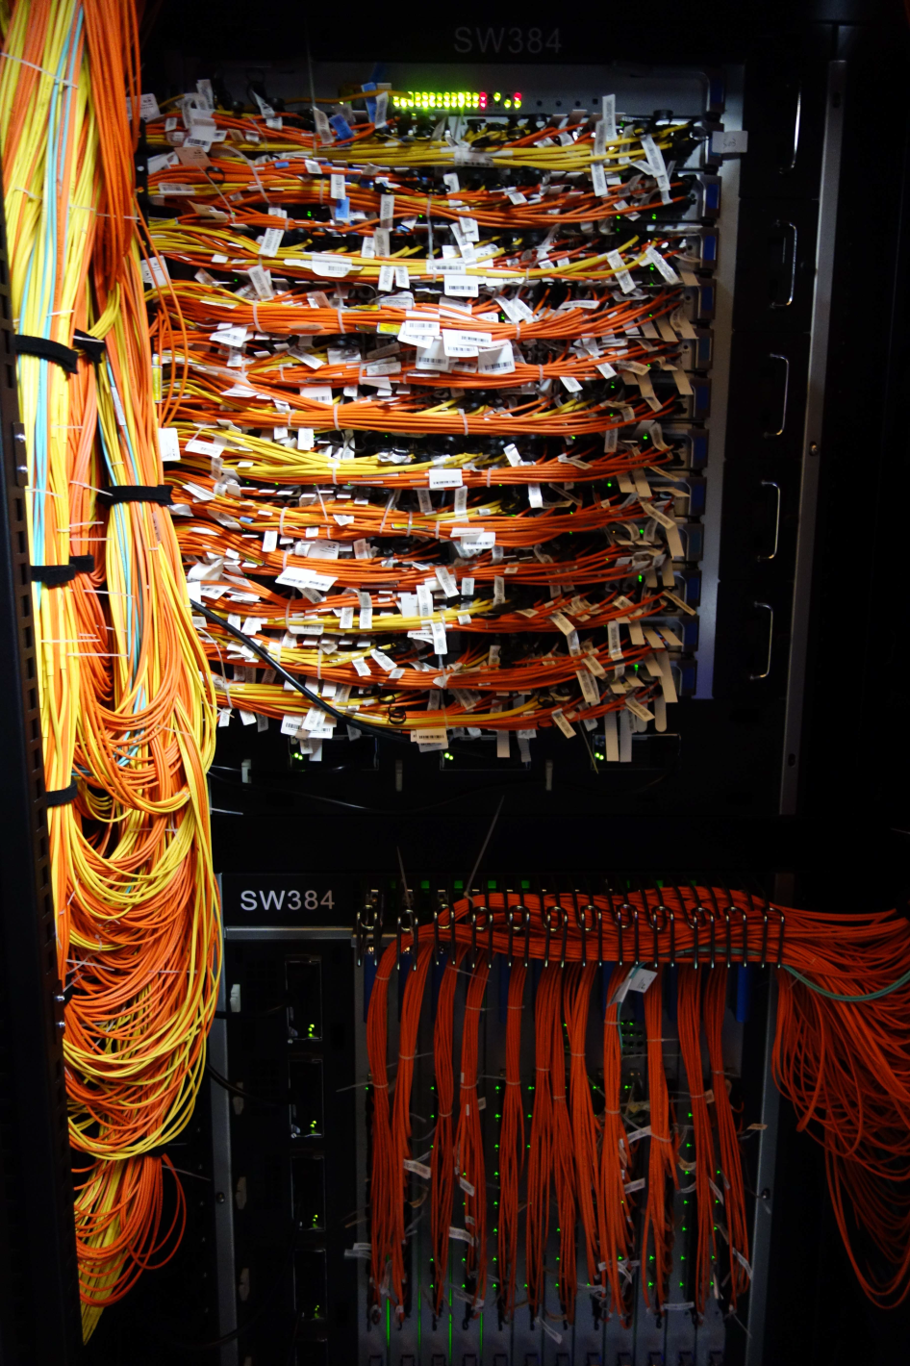
4.4 Use of Xeon Phi Knights Corner coprocessors in supercomputers (8)
Implementation of the interconnect [23]

Slide 96
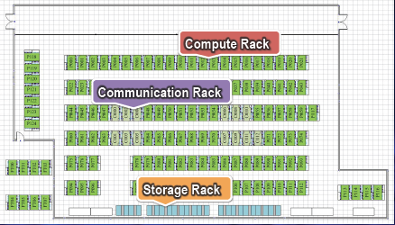
4.4 Use of Xeon Phi Knights Corner coprocessors in supercomputers (9)
Rack rows of the Tianhe-2 supercomputer [23]

Slide 97

4.4 Use of Xeon Phi Knights Corner coprocessors in supercomputers (10)
View of the Tianhe-2 supercomputer [24]

Slide 98
4.5 The Knights Landing line

Slide 99
4.5 The Knights Landing line (1)
4.5 The Knights Landing line
Revealed at the International Supercomputing Conference (ISC13) in 06/2013.
It is the second generation Xeon Phi product.
Implemented in 14 nm technology.

Slide 100
4.5 The Knights Landing line (2)
Announcing the Knights Landing 2. gen. Xeon Phi product in 06/2013
05/10
06/12
Branding
MIC
(Many Integrated Cores)
Renamed to
Xeon Phi
05/10
45 nm/32 cores
SP: 0.75 TFLOPS
DP: --
Prototype
Knights Ferry
Knights Corner
05/10
22 nm/>50 cores
(announced)
11/12
22 nm/60 cores
SP: na
DP: 1.0 TFLOPS
06/13
22 nm/57/61 cores
SP: na
DP: > 1 TFLOPS
1. gen.
Knights
Corner
Xeon Phi 5110P
Xeon Phi
3120/7120
Knights Landing
06/13
Knights Landing
09/15
2. gen.
Xeon Phi
??
Xeon Phi
??
14 nm/? cores
SP: na
DP: ~ 3 TFLOPS
14 nm/72 cores
SP: na
DP: ~ 3 TFLOPS
06/12
Open source SW for
Knights Corner
Software
support
2010
2011
2012
2013
2014
2015

Slide 101
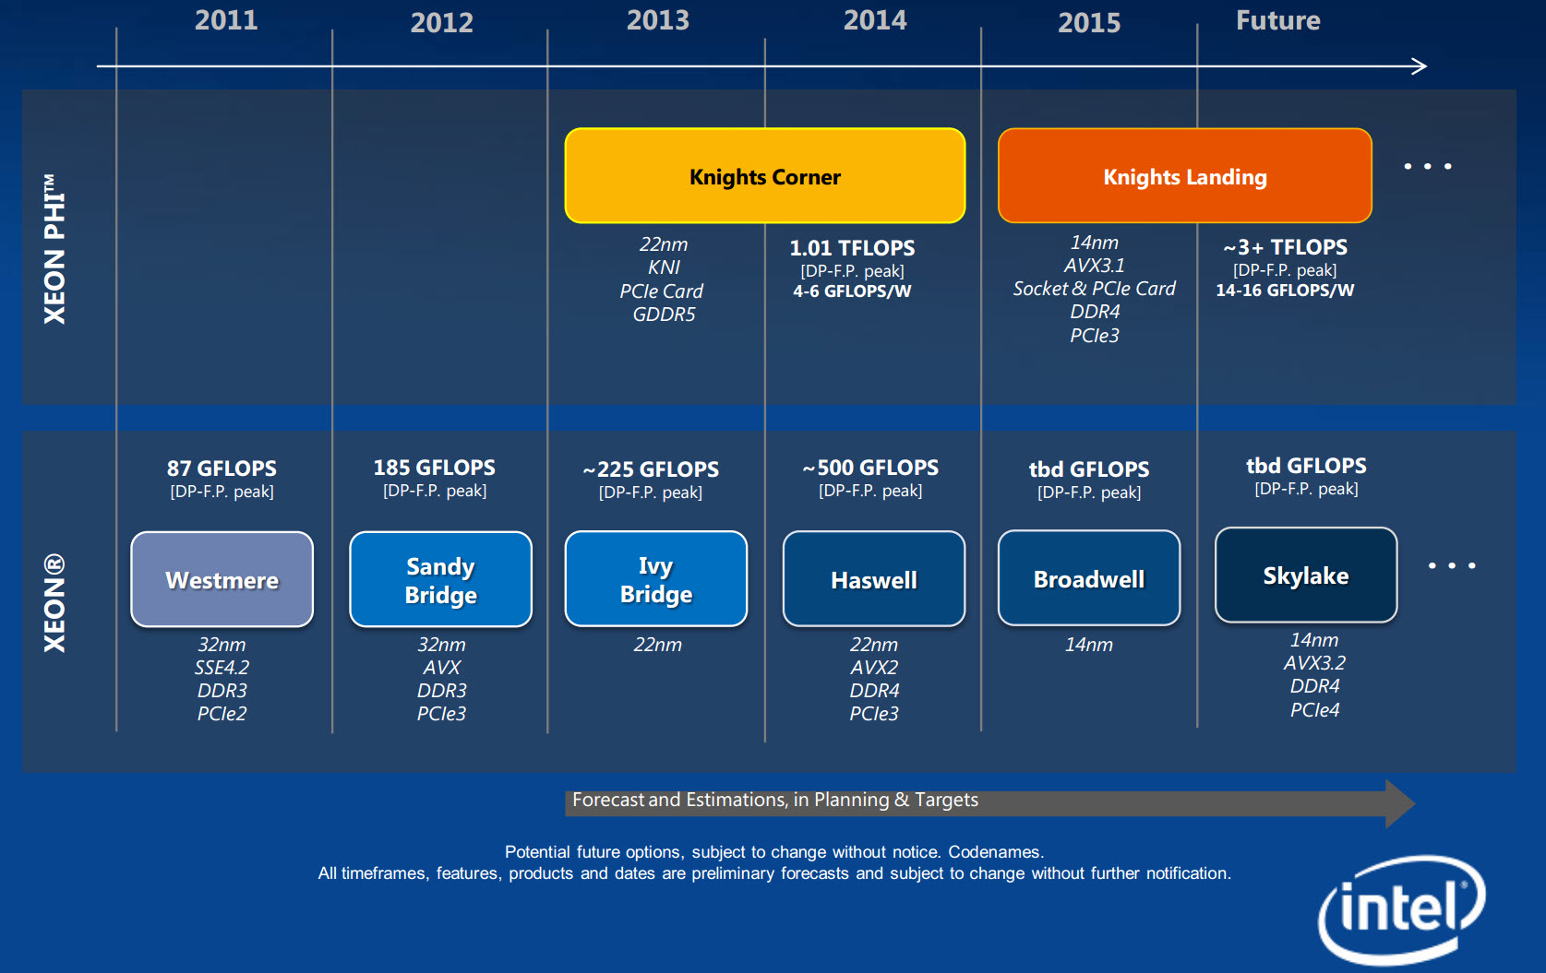
4.5 The Knights Landing line (3)
The Knights Landing line as revealed on a roadmap from 2013 [17]

Slide 102
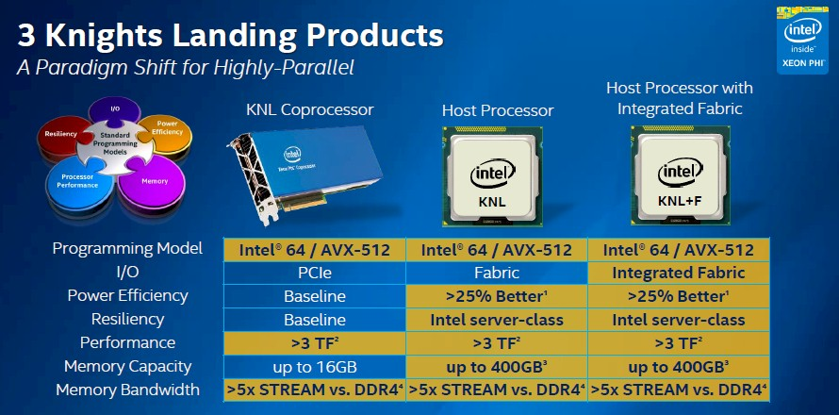
4.5 The Knights Landing line (4)
Knights Landing implementation alternatives
Three implementation alternatives
PCIe 3.0 coprocessor (accelerator) card
Stand alone processor without (in-package integrated) interconnect fabric and
Stand alone processor with (in-package integrated) interconnect fabric,
as indicated in the next Figure.
Figure: Implementation alternatives of Knights Landing [31]
Will debut in H2/2015

Slide 103
4.5 The Knights Landing line (5)
Purpose of the socketed Knights Landing alternative [20]
The socketed alternative allows to connect Knights Landing processors to other processors
via the QPI as opposed to the slower PCIe 3.0 interface.
It targets HPC clusters and supercomputers.

Slide 104
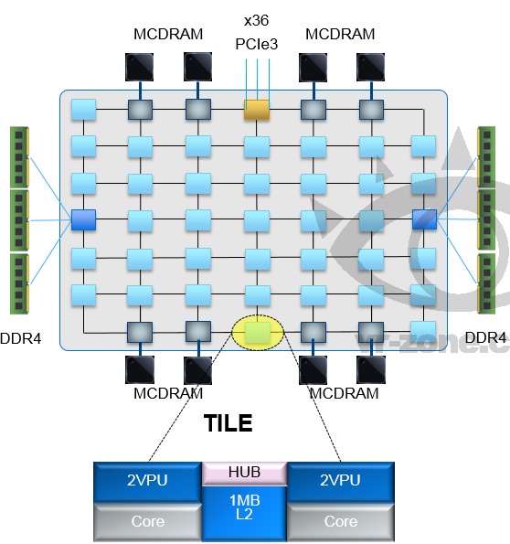
4.5 The Knights Landing line (6)
Layout and key features of the Knights Landing processor [18]
Up to 72 Silvermont (Atom) cores
4 threads/core
2 512 bit vector units
2D mesh architecture
6 channels DDR4-2400,
up to 384 GB,
8/16 GB high bandwidth on-package
MCDRAM memory, >500 GB/s
36 lanes PCIe 3.0
200 W TDP
MCDRAM: Multi-Channel DRAM

Slide 105
4.5 The Knights Landing line (7)
Use of Silvermont x86 cores instead of enhanced Pentium P54C cores [20]
The Silvermont cores of the Atom family are far more capable than the old Pentium cores and
should significantly improve the single threaded performance.
The Silvermont cores are modified to incorporate 512-bit AVX units, allowing AVX-512
operations that makes the bulk of Knights Landing’s computing performance.

Slide 106
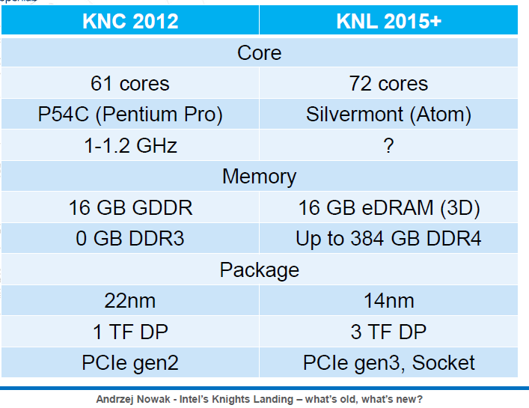
4.5 The Knights Landing line (8)
Contrasting key features of Knights Corner and Knights Landing [32]

Slide 107
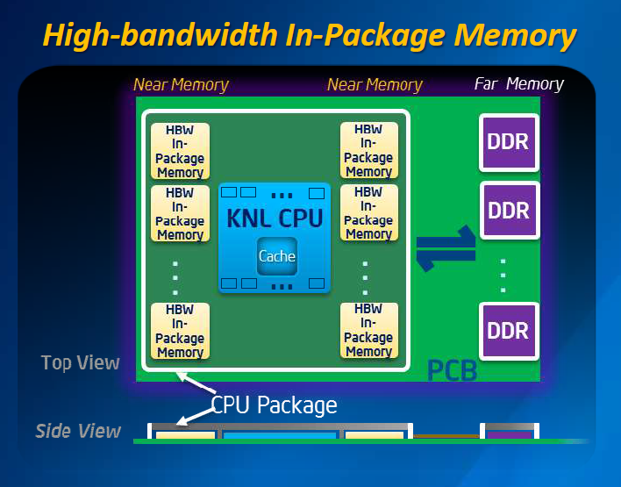
4.5 The Knights Landing line (9)
Use of High Bandwidth (HBW) In-Package memory in the Knights Landing [19]

Slide 108
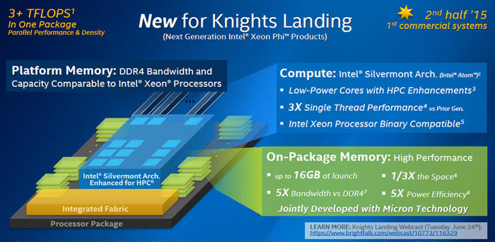
4.5 The Knights Landing line (10)
Implementation of Knights Landing [20]

Slide 109
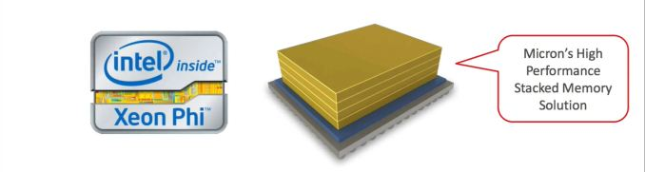
4.5 The Knights Landing line (11)
Introducing in-package integrated MCDRAMs-1 [20]
In cooperation with Micron Intel introduces in-package integrated Multi Channel DRAMs
in the Knights Landing processor, as indicated below.
Image Courtesy InsideHPC.com
The MCDRAM is a variant of HMC (Hybrid Memory Cube).

Slide 110
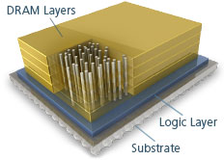
4.5 The Knights Landing line (12)
HMC (Hybrid Memory Cube) [21]-1
HMC is a stacked memory.
It consists of
a vertical stack of DRAM dies that are connected using TSV (Through-Silicon-Via)
interconnects and
a high speed logic layer that handles all DRAM control within the HMC, as indicated
in the Figure below.
TSV interconnects
Figure: Main parts of a HMC memory [21]

Slide 111
4.5 The Knights Landing line (13)
HMC (Hybrid Memory Cube) [21]-2
HMC allows a tight coupling the memory with CPUs, GPUs resulting in a significant
improvement of efficiency and power consumption.
System designers have two options to use HMC
as either “near memory” mounted directly adjacent to the processor
(e.g. in the same package) for increasing performance or
as a “far memory” for increasing power efficiency.
Remarks
The HMC technology was developed by Micron Technology Inc.
Micron and Samsung founded the HMC Consortium (HMCC) in 10/2011 to working out
specifications.
HMCC is led by eight industry leaders including Altera, ARM, IBM, SK Hynix, Micron,
Open-Silicon, Samsung, and Xilinx and intends to achieve broad agreement of HMC
standards.
The HMC 1.0 Specification was released in 4/2013.
Recent relase (10/2015) is HMC 2.1.
Beyond Intel also NVIDIA plans to introduce the HMC technology in their Pascal processor.

Slide 112
4.5 The Knights Landing line (14)
Introducing in-package integrated MCDRAMs-2 [20]
In Knights Landing Intel and Micron developed a variant of HMC called MCDRAM by replacing
the standard HMD interface with a custom interface.
The resulting MCDRAM can be scaled up to 16 GB size and offers up to 500 GB/s memory
bandwidth (nearly 50 % more than Knights Corner’s GDDR5).

Slide 113
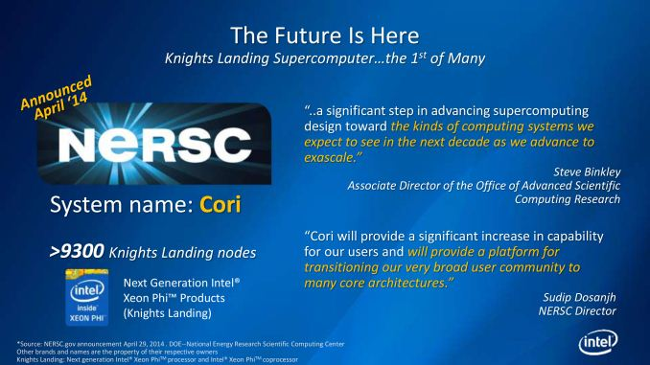
4.5 The Knights Landing line (15)
First Knights Landing based supercomputer plan [20]
Intel is involved in developing its first Knights Landing supercomputer for the National Energy
Research Scientific Computing Center (NERSC).
The new supercomputer will be designated as Cori and it will include >9300 Knights Landing
nodes, as indicated below.
Availability: ~ 09/2016.

Slide 114
4.5 The Knights Landing line (16)
Comparing features of Intel’s many core processors
Interconnection style
Layout of the main memory

Slide 115
4.5 The Knights Landing line (17)
Interconnection style of Intel’s many core processors
Interconnection style of Intel’s many core processors
Ring interconnect
2D grid
Larrabee (2006): 24-32 cores
Tile processor (2007): 80 cores
SCC (2010): 48 cores
Xeon Phi
Knights Ferry (2010): 32 cores
Knights Corner (2012): 57-61 cores
Xeon Phi
Knights Landing (2H/2015?): 72 cores
(As of 1/2015 no details available)

Slide 116

4.5 The Knights Landing line (18)
Layout of the main memory in Intel’s many core processors
Layout of the main memory
Traditional implementation
Distributed memory on the cores
Larrabee (2006): 24-32 cores
4 32-bit GDDR5 memory channels
attached to the ring
Tile processor (2007): 80 cores
Separate 2 kB/3 kB data and
instruction memories on each tile
SCC (2010): 48 cores
4 64-bit DDR3-800 memory channels
attached to the 2D grid
Xeon Phi
Knights Ferry (2010): 32 cores
8 32-bit GDDR5 5GT/s? memory channels
attached to the ring
Knights Corner (2012): 57-61 cores
Up to 16 32-bit GDDR5 5 /5.5 GT/s memory channels
attached to the ring
Knights Landing (2H/2015?): 72 cores
6 64-bit DDR4-2400 memory channels
attached to the 2D grid
+ Proprietary on-package MCDRAM (Multi-Channel DRAM)
with 500 GB/s bandwidth attached to the 2D grid

Slide 117
5. References

Slide 118
5. References (1)
[1]: Timeline of Many-Core at Intel, intel.com,
http://download.intel.com/newsroom/kits/xeon/phi/pdfs/Many-Core-Timeline.pdf
[2]: Davis E., Tera Tera Tera, Presentation on the ”Taylor Model Workshop’06”, Dec. 2006,
http://bt.pa.msu.edu/TM/BocaRaton2006/talks/davis.pdf
[3]: Seiler L. & al., Larrabee: A Many-Core x86 Architecture for Visual Computing,
ACM Transactions on Graphics, Vol. 27, No. 3, Article 18, Aug. 2008, http://www.student.
chemia.uj.edu.pl/~mrozek/USl/wyklad/Nowe_konstrukcje/Siggraph_Larrabee_paper.pdf
[4]: Seiler L., Larrabee: A Many-Core Intel Architecture for Visual Computing, IDF 2008
[5]: Skaugen K., Petascale to Exascale, Extending Intel’s HPC Commitment, ISC 2010,
http://download.intel.com/pressroom/archive/reference/ISC_2010_Skaugen_keynote.pdf
[6]: Chrysos G., Intel Xeon Phi coprocessor (codename Knights Corner), Hot Chips,
Aug. 28 2012, http://www.hotchips.org/wp-content/uploads/hc_archives/hc24/
HC24-3-ManyCore/HC24.28.335-XeonPhi-Chrysos-Intel.pdf
[7]: Intel Xeon Phi Coprocessor: Pushing the Limits of Discovery, 2012,
http://download.intel.com/newsroom/kits/xeon/phi/pdfs/Intel-Xeon-Phi_Factsheet.pdf
[8]: Intel Xeon Phi Coprocessor Datasheet, Nov. 2012, http://www.intel.com/content/dam/
www/public/us/en/documents/product-briefs/xeon-phi-datasheet.pdf
[9]: Hruska J., Intel’s 50-core champion: In-depth on Xeon Phi, ExtremeTech, July 30 2012,
http://www.extremetech.com/extreme/133541-intels-64-core-champion-in-depth-on-xeon-phi/2

Slide 119
5. References (2)
[10]: Reinders J., An Overview of Programming for Intel Xeon processors and Intel Xeon Phi,
coprocessors, 2012, http://software.intel.com/sites/default/files/article/330164/
an-overview-of-programming-for-intel-xeon-processors-and-intel-xeon-phi-coprocessors.pdf
[11]: Intel Xeon Phi Product Family Performance, Rev. 1.1, Febr. 15 2013,
http://www.intel.com/content/dam/www/public/us/en/documents/performance-briefs/
xeon-phi-product-family-performance-brief.pdf
[12]: Stampede User Guide, TACC, 2013,
http://www.tacc.utexas.edu/user-services/user-guides/stampede-user-guide
[13]: The Intel Xeon Phi Coprocessor 5110P, Highly-parallel Processing for Unparalleled Discovery,
Product Brief, 2012
[14]: Mattson T., The Future of Many Core Computing: A tale of two processors, Jan. 2010,
https://openlab-mu-internal.web.cern.ch/openlab-mu-internal/00_news/news_pages/
2010/10-08_Intel_Computing_Seminar/SCC-80-core-cern.pdf
[15]: Kirsch N., An Overview of Intel's Teraflops Research Chip, Legit Reviews, Febr. 13 2007,
http://www.legitreviews.com/article/460/1/
[16]: Rattner J., „Single-chip Cloud Computer”, An experimental many-core processor from
Intel Labs, 2009,
http://download.intel.com/pressroom/pdf/rockcreek/SCC_Announcement_JustinRattner.pdf
[17]: Iyer T., Report: Intel Skylake to Have PCIe 4.0, DDR4, SATA Express, July 3, 2013
http://www.tomshardware.com/news/Skylake-Intel-DDR4-PCIe-SATAe,23349.html

Slide 120
5. References (3)
[18]: Anthony S., Intel unveils 72-core x86 Knights Landing CPU for exascale supercomputing,
Extremetech, November 26 2013,
http://www.extremetech.com/extreme/171678-intel-unveils-72-core-x86-knights-landing
-cpu-for-exascale-supercomputing
[19]: Radek, Chip Shot: Intel Reveals More Details of Its Next Generation Intel Xeon Phi Processor
at SC'13, Intel Newsroom, Nov 19, 2013,
http://newsroom.intel.com/community/intel_newsroom/blog/2013/11/19/chip-shot-at
-sc13-intel-reveals-more-details-of-its-next-generation-intelr-xeon-phi-tm-processor
[20]: Smith R., Intel’s "Knights Landing" Xeon Phi Coprocessor Detailed, AnandTech, June 26 2014,
http://www.anandtech.com/show/8217/intels-knights-landing-coprocessor-detailed
[21]: A Revolution in Memory, Micron Technology Inc.,
http://www.micron.com/products/hybrid-memory-cube/all-about-hmc
[22]: TOP500 supercomputer site, http://top500.org/lists/2014/06/
[23]: Dongarra J., Visit to the National University for Defense Technology Changsha, China,
Oak Ridge National Laboratory, June 3, 2013,
http://www.netlib.org/utk/people/JackDongarra/PAPERS/tianhe-2-dongarra-report.pdf
[24]: Owano N., Tianhe-2 supercomputer at 31 petaflops is title contender, PHYS ORG,
June 10 2013,
http://phys.org/news/2013-06-tianhe-supercomputer-petaflops-title-contender.html

Slide 121
5. References (4)
[25]: Schmid P., The Pentium D: Intel's Dual Core Silver Bullet Previewed, Tom’s Hardware,
April 5 2005, http://www.tomshardware.com/reviews/pentium-d,1006-2.html
[26]: Moore G.E., No Exponential is Forever…, ISSCC, San Francisco, Febr. 2003,
http://ethw.org/images/0/06/GEM_ISSCC_20803_500pm_Final.pdf
[27]: Howse B., Smith R., Tick Tock On The Rocks: Intel Delays 10nm, Adds 3rd Gen 14nm Core
Product "Kaby Lake„, AnandTech, July 16 2015,
http://www.anandtech.com/show/9447/intel-10nm-and-kaby-lake
[28]: Intel's (INTC) CEO Brian Krzanich on Q2 2015 Results - Earnings Call Transcript, Seeking
Alpha, July 15 2015, http://seekingalpha.com/article/3329035-intels-intc-ceo-brian-
krzanich-on-q2-2015-results-earnings-call-transcript?page=2
[29]: Jansen Ng, Intel Cancels Larrabee GPU, Focuses on Future Graphics Projects, Daily Tech,
Dec. 6 2009, http://www.dailytech.com/Intel+Cancels+Larrabee+GPU+Focuses+on+
Future+Graphics+Projects/article17040.htm
[30]: Farber R., Programming Intel's Xeon Phi: A Jumpstart Introduction, Dr. Dobb’s, Dec. 10 2012,
http://www.drdobbs.com/parallel/programming-intels-xeon-phi-a-jumpstart/240144160
[31]: Morgan T.P., Momentum Building For Knights Landing Xeon Phi, The Platform, July 13 2015,
http://www.theplatform.net/2015/07/13/momentum-building-for-knights-landing-xeon-phi/
[32]: Nowak A., Intel’s Knights Landing – what’s old, what’s new?, April 2 2014,
http://indico.cern.ch/event/289682/session/6/contribution/23/material/slides/0.pdf

Slide 122
5. References (5)
[33]: Wardrope I., High Performance Computing - Driving Innovation and Capability, 2013,
http://www2.epcc.ed.ac.uk/downloads/lectures/IanWardrope.pdf
[34]: QLogic TrueScale InfiniBand, the Real Value, Solutions for High Performance Computing,
Technology Brief, 2009,
http://www.transtec.de/fileadmin/Medien/pdf/HPC/qlogic/qlogic_techbrief_truescale.pdf
[35]: InfiniBand , Digital Waves, http://www.digitalwaves.in/infiband.html
[36]: Deploying HPC Cluster with Mellanox InfiniBand Interconnect Solutions, Reference Design,
June 2014, http://www.mellanox.com/related-docs/solutions/deploying-hpc-cluster-with-
mellanox-infiniband-interconnect-solutions.pdf
[37]: Paz O., InfiniBand Essentials Every HPC Expert Must Know, April 2014, SlideShare,
http://www.slideshare.net/mellanox/1-mellanox
[38]: Wright C., Henning P., Bergen B., Roadrunner Tutorial, An Introduction to Roadrunner,
and the Cell Processor, Febr. 7 2008,
http://www.lanl.gov/orgs/hpc/roadrunner/pdfs/Roadrunner-tutorial-session-1-web1.pdf
[39]: Kahle J.A., Day M.N., Hofstee H.P., Johns C.R., Maeurer T.R., Shippy D., Introduction to the
Cell multiprocessor, IBM J. Res. & Dev., Vol. 49, No. 4/5, July/Sept. 2005,
http://www.cs.utexas.edu/~pingali/CS395T/2013fa/papers/kahle.pdf
[40]: Clark S., Haselhorst K., Imming K., Irish J., Krolak D., Ozguner T., Cell Broadband Engine
Interconnect and Memory Interface, Hot Chips 2005,
http://www.hotchips.org/wp-content/uploads/hc_archives/hc17/2_Mon/HC17.S1/HC17.S1T2.pdf

Slide 123
5. References (6)
[41]: Blachford N., Cell Architecture Explained, v.02, 2005,
http://www.blachford.info/computer/Cell/Cell2_v2.html
[42]: Ricker T., World's fastest: IBM's Roadrunner supercomputer breaks petaflop barrier using
Cell and Opteron processors, Engadget, June 9 2008, http://www.engadget.com/2008/
06/09/worlds-fastest-ibms-roadrunner-supercomputer-breaks-petaflop
[43]: Roadrunner System Overview,
http://www.spscicomp.org/ScicomP14/talks/Grice-RR.pdf
[44]: Steibl S., Learning from Experimental Silicon like the SCC, ARCS 2012 (Architecture of
Computing Systems, 02. 28 – 02. 03 2012,
http://www.arcs2012.tum.de/ARCS_Learning_from_Exprimental_Silicon.pdf

