Slide 1
big.LITTLE technology
Dezső Sima
Vers. 2.0
December 2016

Slide 2
big.LITTLE technology
1. Introduction to the big.LITTLE technology
2. Exclusive cluster migration
3. Inclusive cluster migration
4. Exclusive core migration
5. Global task scheduling (GTS)
6. Supporting GTS in OS kernels
7. References

Slide 3
1. Introduction to the big.LITTLE technology
1.1 The rationale for big.LITTLE processing
1.2 Principle of big.LITTLE processing
1.3 Implementation of the big.LITTLE technology

Slide 4
1.1 The rationale for big.LITTLE processing
Notes:
4

Slide 5
1.1 The rationale for big.LITTLE processing (1)
1.1 The rationale for big.LITTLE processing [1]
big.LITTLE technology aims at power reduction.
The technology is based on the recognition that smartphones and tablets have
dynamically changing usage patterns, i.e. tasks with different processing
intensities alternate, such as high intensity tasks, like games and low intensity
tasks, like audio, e-mail etc.
The idea of the big.LITTLE technology is that power consumption of the chip could be reduced when
high intensity tasks would run on suitable powerfull but power hungry
whereas low intensity tasks on less powerful and less power hungry cores.

Slide 6
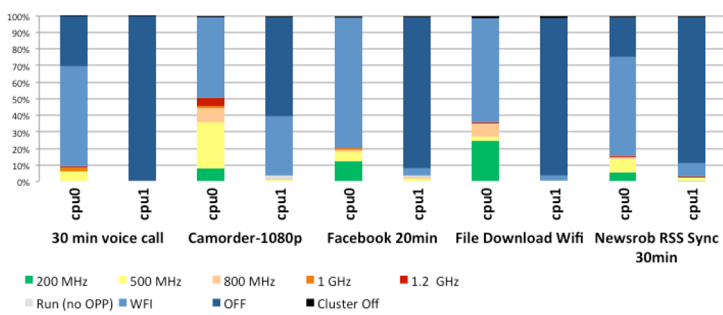
1.1 The rationale for big.LITTLE processing (2)
Example: Percentage of time spent in DVFS states for low intensity
use cases in a dual core mobile device [9] -1
(Core)
WFI: Waiting for Interrupt
The graph below shows the percentage of time spent in DVFS states, and in idle
and shutdown states in a dual core Cortex-A9 based mobile device.
In the diagram, the red color indicates the highest, green the lowest frequency operating point whereas colors in between represent intermediate frequencies.
Light blue means that the core is idling for Waiting for Interrupt (WFI), dark blue
indicates that the core is shut down, dark blue means: both cores are shut down.

Slide 7
1.1 The rationale for big.LITTLE processing (3)
Example: Percentage of time spent in DVFS states for low intensity
use cases in a mobile device [9] -2
As seen in the diagram, both cores spend most on their time in idle, shut down or
light intensity operating points, thus there is a large headroom for power saving
through the big.LITTLE technology.

Slide 8
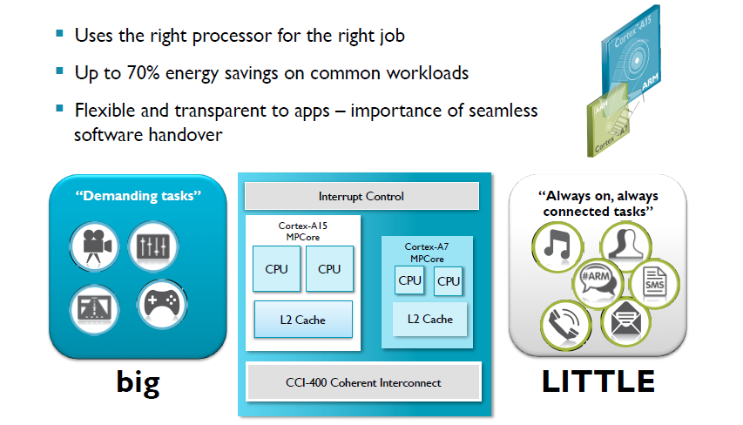
1.1 The rationale for big.LITTLE processing (4)
Expected results of using the big and LITTLE technology [2]

Slide 9
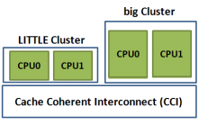
1.1 The rationale for big.LITTLE processing (5)
big.LITTLE technology as an option of task distribution policy in
heterogeneous multicore processors
Task distribution policies in heterogeneous multicore processors
Master/slave
processing
Task forwarding
to a dedicated accelerator
Task migration
to different kind of CPUs
Heterogeneous
master/slave processing
Heterogeneous
attached processing
Heterogeneous
big.LITLE processing
There is a master core (MCP)
and a number of slave cores.
The master core organizes
the operation of the slave cores
to execute a task
Beyond a CPU there are
dedicated accelerators,
like a GPU available.
The CPU forwards an instructon
to an accelerator
when it is capable to execute
this instruction more efficiently
than the CPU.
There two or more clusters of cores,
e.g. two clusters; a LITTLE and a big one.
Cores of the LITTLE cluster execute
less demanding tasks and consume
less power, whereas cores of the big
cluster execute more demanding tasks
with higher power consumption.
MPC
Slave cores
CPU
GPU

Slide 10
1.2 Principle of big.LITTLE processing
Notes:
10

Slide 11

1.2 Principle of big.LITTLE processing (1)
1.2 Principle of big.LITTLE processing -1 [6]

Slide 12
1.2 Principle of big.LITTLE processing (2)
Principle of big.LITTLE processing -2
Let’s have two or more clusters of architecturally identical cores in a processor.
As an example let’s take two clusters;
a cluster of low performance/low power cores, termed as the LITTLE cores and
a cluster of higher performance higher power cores, termed as the big cores,
as seen in the Figure below.
Cluster of
big cores
Cluster of
LITTLE cores
CPU0
CPU1
CPU0
CPU1
Figure: A big.LITTLE configuration
consisting of two clusters
CPU2
CPU3
CPU2
CPU3
Cache coherent interconnect
To memory
Let’s interconnect these clusters by a cache coherent interconnect to have
a multicore processor, as indicated in the Figure.

Slide 13
1.2 Principle of big.LITTLE processing (3)
Principle of operation -1 [4]
There are a number of different alternatives how big.LITTLE technology can be
implemented and operate, as discussed later.
Nevertheless, to give a conceivable description of the big.LITTLE technology,
in describing its principle of operation we will restrict ourselves to a
specific implementation, called exclusive cluster switching as detailed in
Section 1.3.
Furthermore let us suppose that all cores of a cluster operate at the same
operating point (i.e. at the same clock frequency and core voltage) while
there are a few operating points available for both the LITTLE and the big core
clusters, as indicated in the next Figure.

Slide 14
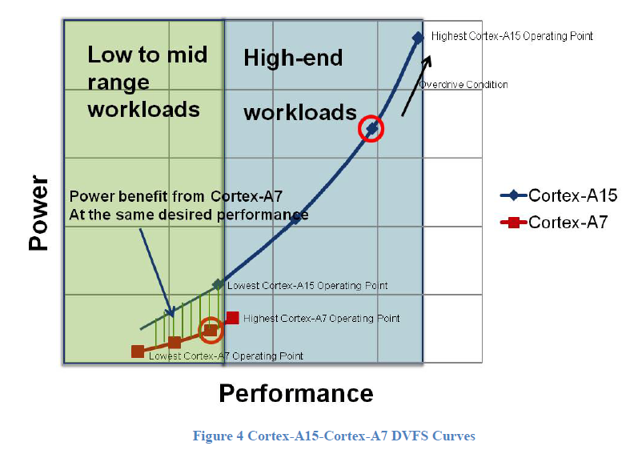
1.2 Principle of big.LITTLE processing (4)
Example: Operating points of a multiprocessor built up of two core clusters:
one of LITTLE cores (Cortex-A7) and one of big cores (Cortex-A15), as
described above [3]

Slide 15
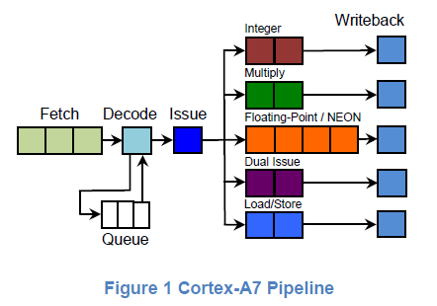
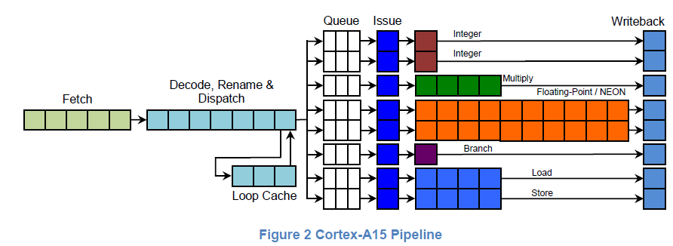
1.2 Principle of big.LITTLE processing (5)
Example big (Cortex-A15) and LITTLE cores (Cortex-A7) [3]
2
3

Slide 16
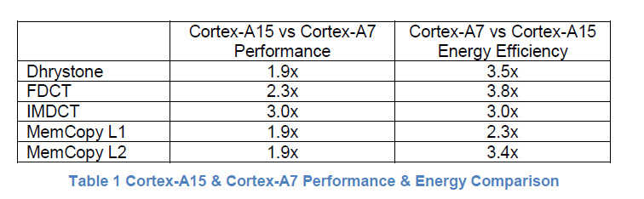
1.2 Principle of big.LITTLE processing (6)
Performance and energy efficiency comparison of the Cortex-A15 vs. the
Cortex-A7 cores [3]

Slide 17
1.2 Principle of big.LITTLE processing (7)
Principle of operation -2 [4]
Let’s suppose that an appropriate OS routine (e.g. the cpufreq kernel routine of
Linux) tracks the workload and sets the operating point accordingly.
In the assumed task scheduling mode, the scheduler activates only the cores
of the low power, low performance „LITTLE” cluster as long as this cluster
can tackle the actual workload.
If however the workload exceeds the performance capability of the LITTLE core
cluster, an appropriate switching routine activates the cluster of
high performance high power “big” cores, performs a cluster switch by
migrating the actual workload to the cores of the big cluster and switches off
the cores of the LITTLE cluster.
In this way, at any given time only cores of one cluster can be active,
this kind of the big.LITTLE technology is called Exclusive cluster switching.
Again, the working point of the big cores will be chosen according to the
workload demand.
When any time the actual workload becomes less then a given lower limit
of the big core cluster, the scheduler activates again the cluster of the LITTLE
cores etc.

Slide 18
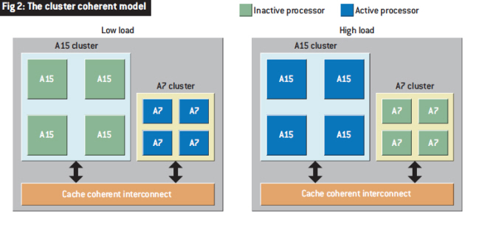
1.2 Principle of big.LITTLE processing (8)
Illustration of the described model of operation [7]
Note that at low load the LITTLE (A7) and at high load the big (A15) cluster is
operational.

Slide 19
1.3 Implementation of the big.LITTLE technology
Notes:
19

Slide 20
1.3 Implementation of the big.LITTLE technology (1)
1.3 Implementation of the big.LITTLE technology
Hardware requirements of big.LITTLE systems [1]
big and LITTLE cores of a big.LITTLE system need to satisfy a few requirements
for a seamless operation, such as
the big and LITTLE CPU cores must be architecturally identical,
i.e. they must have the same ISA, i.e. run the same instructions and
support the same ISA extensions, like virtualization, address space etc. and
both core clusters must be fully cache coherent to support task migration.
Recommended core pairings are
 | 1st Generation: ARMv7 (32-bit, 40-bit physical) | 2nd Generation: ARMv8 (32-bit/64-bit)
High-performance CPU core (big) | Cortex-A15, Cortex-A17 | Cortex-A57, Cortex-A72/73
High-efficiency CPU core (LITTLE) | Cortex-A7 | Cortex-A53
In each of the core combinations above, the big and LITTLE clusters can each
have up to four cores.

Slide 21
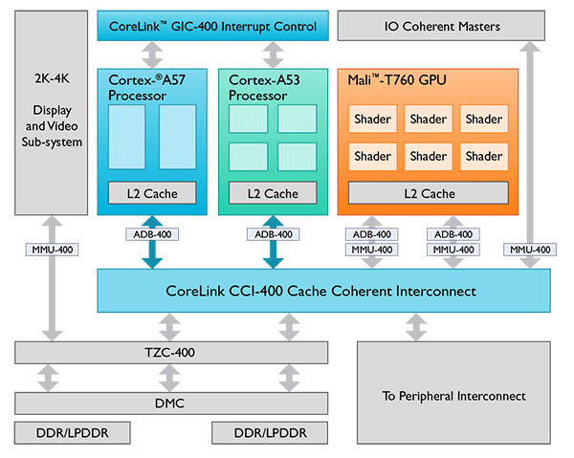
1.3 Implementation of the big.LITTLE technology (2)
Example block diagram of a two cluster big.LITTLE SOC design [1]
ADB-400: AMBA Domain Bridge
AMBA: Advanced Microcontroller Bus Architecture
MMU-400: .system Memory Management Unit
TZC: Trust Zone Address Space Controller

Slide 22
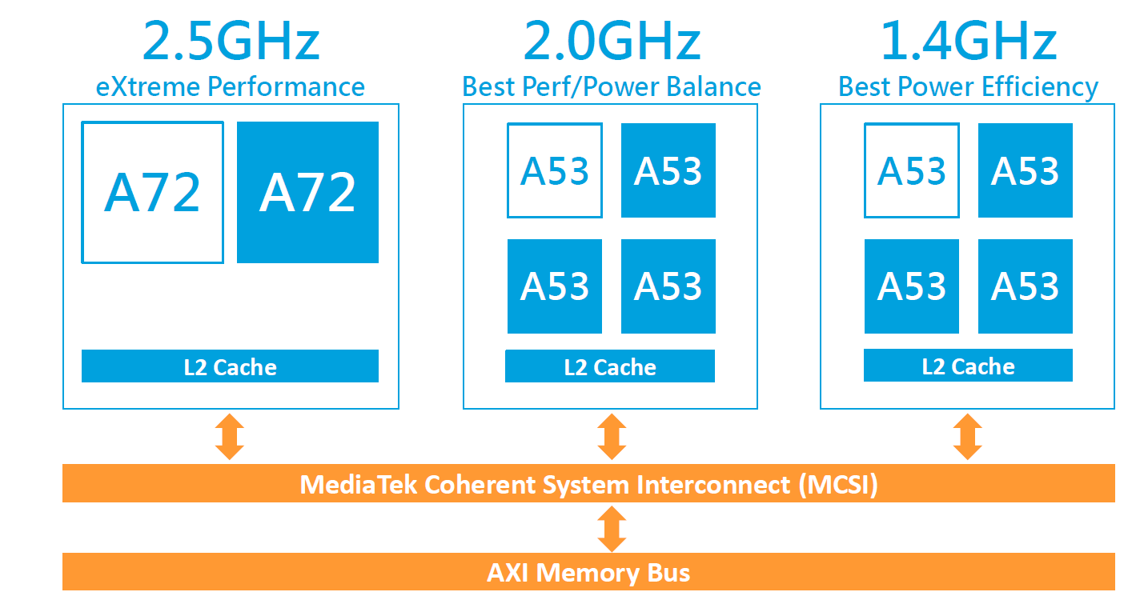
1.3 Implementation of the big.LITTLE technology (3)
Implementation of big.LITTLE systems built on three clusters
First three cluster (10-core) implementation (Q1/2016): MediaTek Helio X20 (6797) .
In this case, there are two A53 clusters with different maximum clock frequencies
and different performance-power characteristics, as indicated in the next Figures.
Figure: Three cluster big.LITTLE implementation in MediaTek's Helio X20 [46]

Slide 23
1.3 Implementation of the big.LITTLE technology (4)
Power-performance characteristics of the three clusters [47]

Slide 24
1.3 Implementation of the big.LITTLE technology (5)
Required software support of the big.LITTLE technology
The big.LITTLE technology needs appropriate software support, e.g. to monitor
the workload, task scheduling, perform task migrations etc.
The software needed will be provided by the SOC supplier for the OEMs, usually
in form of kernel patches.
In this chapter we will not go into details of the software required by the
big.LITTLE technology, but refer to the Section 6. and the related literature.

Slide 25
1.3 Implementation of the big.LITTLE technology (6)
Design space of the implementation of the big.LITTLE technology
In our discussion of the big.LITTLE technology we identify three basic design aspects,
as follows:
Implementation of the big-LITTLE technology
No. of core clusters
and no. of cores per cluster
Basic scheme of
task scheduling
Options for supplying
core frequencies and voltages
These aspects will be discussed subsequently.

Slide 26
1.3 Implementation of the big.LITTLE technology (7)
Design space of the implementation of the big.LITTLE technology
In our discussion of the big.LITTLE technology we identify three basic design aspects,
as follows:
Implementation of the big-LITTLE technology
No. of core clusters
and no. of cores per cluster
Basic scheme of
task scheduling
Options for supplying
core frequencies and voltages
These aspects will be discussed subsequently.

Slide 27
1.3 Implementation of the big.LITTLE technology (8)
a) Number of core clusters and number of cores per cluster
Number of core clusters
and number of cores per cluster
Dual core clusters used
Three core clusters used
Example
configurations
4 + 4
2 + 2
1 + 4
4 + 4 + 2
4 + 2 + 4
Cluster of
big cores
Cluster of
LITTLE cores
running at
a lower core
frequeency
Cluster of
LITTLE cores
running at a
higher core
fequency
Cluster of
big cores
Cluster of
LITTLE cores
CPU0
CPU1
CPU0
CPU1
CPU0
CPU1
CPU0
CPU1
CPU2
CPU3
CPU2
CPU3
CPU2
CPU3
CPU2
CPU3
CPU2
CPU3
Cache coherent interconnect
Cache coherent interconnect
Memory
Memory

Slide 28
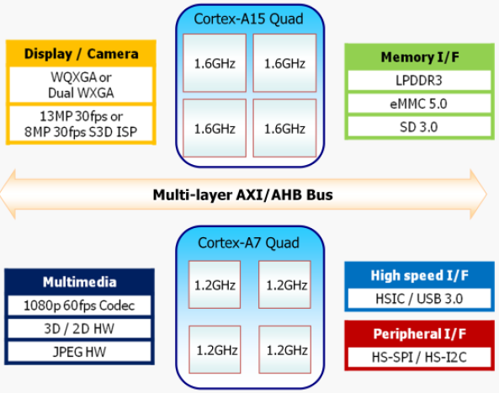
1.3 Implementation of the big.LITTLE technology (9)
Example 1: Dual core clusters, 4+4 cores: Samsung Exynos Octa 5410 [11]
It is the world’s first octa core mobile processor.
Announced in 11/2012, launched in some Galaxy S4 models in 4/2013.
Figure: Block diagram of Samsung’s Exynos 5 Octa 5410 [11]

Slide 29
1.3 Implementation of the big.LITTLE technology (10a)
Example 2: Dual core clusters, 1+4 cores in Nvidia's
Tegra 3 with one A9 LP + four A9 (2011) and
Tegra 4 with one A15 LP + four A15 cores (2013).
Cluster of
high performance cores
CPU0
CPU1
“Cluster” of
a single
low power
core
It is called Nvidia's
Variable SMP
CPU2
CPU3
CPU0
Cache coherent interconnect
The A15 LP is an A15 running on a reduced clock rate.

Slide 30
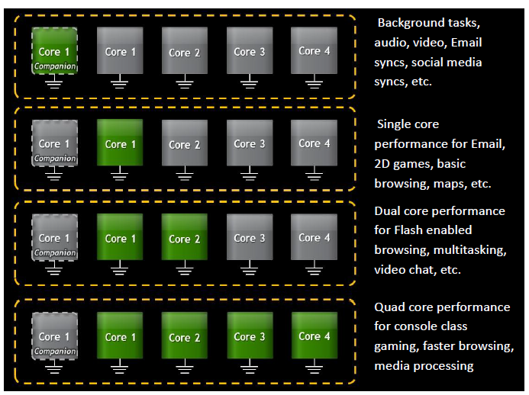
1.3 Implementation of the big.LITTLE technology (10b)
Illustration of the operation of Nvidia’s Variable SMP [4]

Slide 31
1.3 Implementation of the big.LITTLE technology (11)
Example 3: Three core clusters, 2+4+4 cores: Helio X20 (MediaTek MT6797)
This is the world's first three cluster 10-core big.LITTLE implementation.
All cores in the clusters run at the same clock frequency, as shown below.
Announced in 9/2015, launched in HTC One A9 (Taiwan) in 11/20015.
Figure: Three cluster big.LITTLE implementation in MediaTek's Helio X20 [46]

Slide 32
1.3 Implementation of the big.LITTLE technology (12)
b) Basic scheme of task scheduling
Implementation of the big-LITTLE technology
No. of core clusters
and no. of cores per cluster
Basic scheme of
task scheduling
Options for supplying
core frequencies and voltages

Slide 33
1.3 Implementation of the big.LITTLE technology (13)
Basic scheme of task scheduling
Migrating tasks
between big.LITTLE clusters or
between cores of big.LITTLE core pairs
Exclusive or inclusive big.LITTLE execution
This aspect decides wheather tasks
are migrated on cluster or core basis
This aspect states wheather
ececution resources, i.e. clusters or cores,
are scheduled exclusively or inclusively

Slide 34
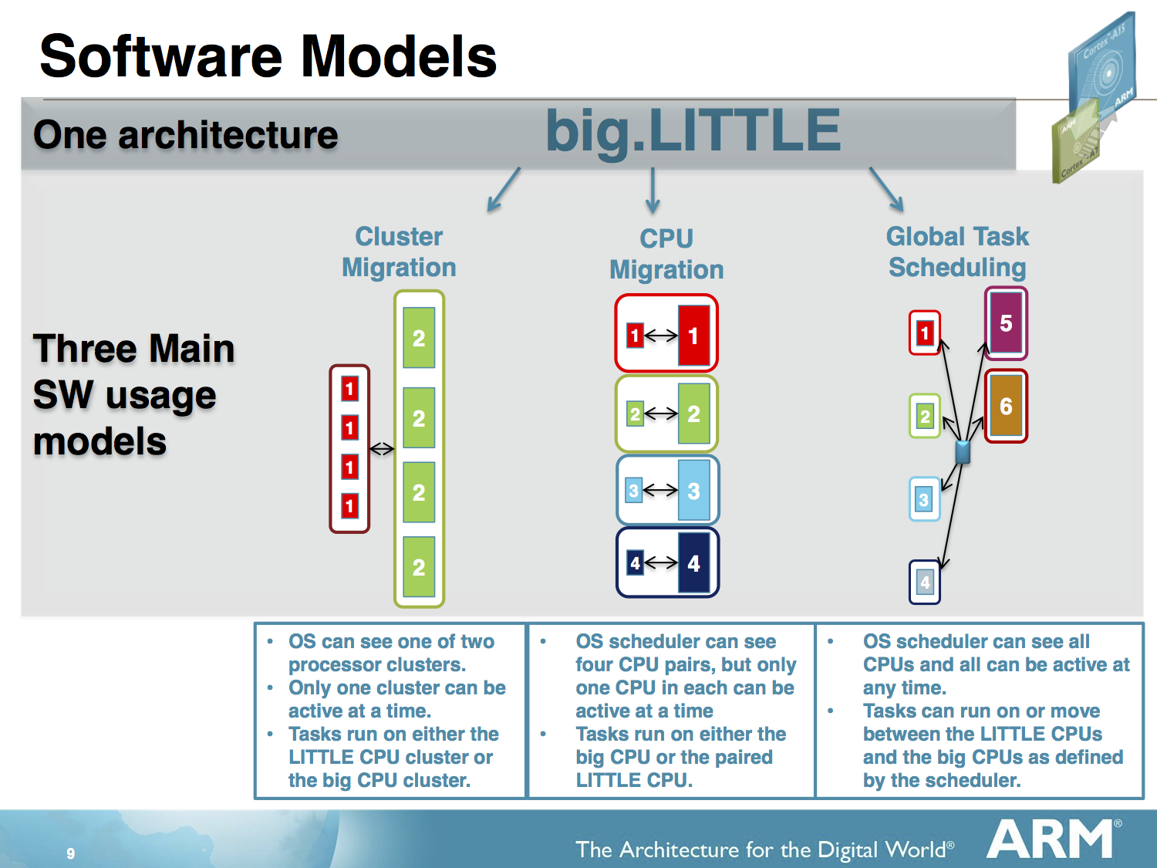
1.3 Implementation of the big.LITTLE technology (14)
Migrating tasks between big.LITTLE clusters or between cores of
big.LITTLE core pairs
Migrating tasks between big.LITTLE clusters or between cores of big.LITTLE core pairs
Cluster migration
Core migration
E.g. big.LITTLE processing
with excusive cluster migration
E.g. big.LITTLE processing
with exclusive core migration
Clusters are sets of cores.
Tasks will be migrated between
clusters of cores.
Tasks are migrated between
individual cores, e.g. between LITTLE and
big cores of core pairs of LITTLE and big cores,
as indicated in the Figure.

Slide 35
1.3 Implementation of the big.LITTLE technology (15)
b) Exclusive or inclusive big.LITTLE execution
Exclusive or inclusive big.LITTLE execution
Exclusive use of
big and LITTLE
clusters or cores
Inclusive use of
big and LITTLE
clusters or cores
At any time
either the big or the LITTLE execution resources
are in use as indicated next for both
the cluster and core migration model
For high workloads
both the big and the LITTLE execution resources
are in use as indicated next for both
the cluster and core migration model

Slide 36
1.3 Implementation of the big.LITTLE technology (16)
Use case 1: Exclusive or inclusive use of clusters (assuming two clusters)
Exclusive or inclusive use of clusters
Exclusive use of
big and LITTLE clusters
Inclusive use of
big and LITTLE clusters
At any time
either the big or the LITTLE cluster is in use
For low workloads only the LITTLE
but for high workloads both the
big and the LITTLE clusters are in use
Low load
High load
Low load
High load
Cluster of
big cores
Cluster of
big cores
Cluster of
big cores
Cluster of
big cores
Cluster of
LITTLE cores
CPU0
CPU1
Cluster of
LITTLE cores
CPU0
CPU1
Cluster of
LITTLE cores
CPU0
CPU1
Cluster of
LITTLE cores
CPU0
CPU1
CPU0
CPU1
CPU0
CPU1
CPU0
CPU1
CPU0
CPU1
CPU2
CPU3
CPU2
CPU3
CPU2
CPU3
CPU2
CPU3
CPU2
CPU3
CPU2
CPU3
CPU2
CPU3
CPU2
CPU3
Cache coherent interconnect
Cache coherent interconnect
Cache coherent interconnect
Cache coherent interconnect
Exclusive cluster migration
Inclusive cluster migration

Slide 37
1.3 Implementation of the big.LITTLE technology (17)
Use case 2: Exclusive or inclusive use of cores (assuming two clusters)
Exclusive or inclusive use of cores
Exclusive use of cores
in big.LITTLE core pairs
Inclusive use of all
big and LITTLE cores
The big and LITTLE cores are ordered in pairs.
In each core pair
either the big or the LITTLE core is in use.
Both big and LITTLE cores may be used
at the same time.
A global scheduler allocates the workload
appropriately for all available
big and the LITTLE cores.
Global scheduler
Exclusive core migration [48]
Global Task Scheduling [48]

Slide 38
1.3 Implementation of the big.LITTLE technology (18)
Basic design space of task scheduling in the big.LITTLE technology
Implementation of task scheduling in the big-LITTLE technology
Cluster migration
Core migration
Exclusive use
of the clusters
Inclusive use
of the clusters
Exclusive use of cores
in big.LITTLE core pairs
Inclusive use of all cores
in all clusters
Exclusive
cluster migration
Inclusive
cluster migration
Exclusive
core migration
In Kernel Switcher
(IKS)
Global Task scheduling
(GTS)
Variable SMP (by Nvidia)
Heterogeneous Multi-Processing
(HMP)
Described first in ARM’s
White Paper (2011) [3]
Described first in
ARM/Linaro EAS project
(2015) [49]
Described first in ARM’s
White Paper (2012) [9]
Described first in ARM’s
White Paper (2011) [3]
Used first in
Nvidia’s Tegra 3 (2011)
(1 A9 LP + 4 A9 cores)
Tegra 4 (2013)
(1 A15 LP core + 4 A15 cores)
No known
implementation
ARM/Linaro
EAS project
in progress
(2013-)
Implemented by Linaro
on ARM’s experimental
TC2 system (2013)
(3 A7 + 2 A15 cores)
Mediatek MT8135 (2013)
(2 A7 + 2 A 15 cores)
Samsung HMP on
Exynos 5 Octa 5420 (2013)
(4 A7 + 4 A15 cores)
Samsung Exynos 5
Octa 5410 (2013)
(4 A7 + 4 A15 cores)
Allwinner UltraOcta A80 (2014)
(4 A7 + 4 A15 cores)
Qualcomm Snapdragon S 808 (2014)
(4 A53 + 2 A57 cores)

Slide 39
1.3 Implementation of the big.LITTLE technology (19)
c) Options for supplying core frequencies and voltages
Implementation of the big-LITTLE technology
No. of core clusters
and cores per cluster
Basic scheme of
task scheduling
Options for supplying
core frequencies and voltages

Slide 40
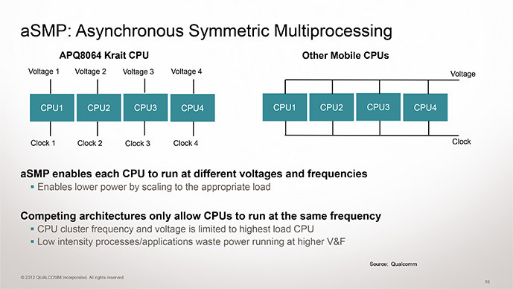
1.3 Implementation of the big.LITTLE technology (20)
Options for supplying core frequencies and voltages-1
Options for supplying core frequencies and voltages in clusters
Common core frequency
common core voltage
Per core core frequency
common core voltage
Per core clock frequency
per core core voltage
Examples in mobiles
Used within clusters
of big.LITTLE configurations, e.g.
ARM’s big.LITTLE technology (2011)
Nvidia’s vSMP technology (2011)
Typical in ARM’s design
in their Cortex line
No known implementation
Qualcomm Snapdragon family
with the Scorpion and then the
Krait and Kryo cores (since 2011)

Slide 41
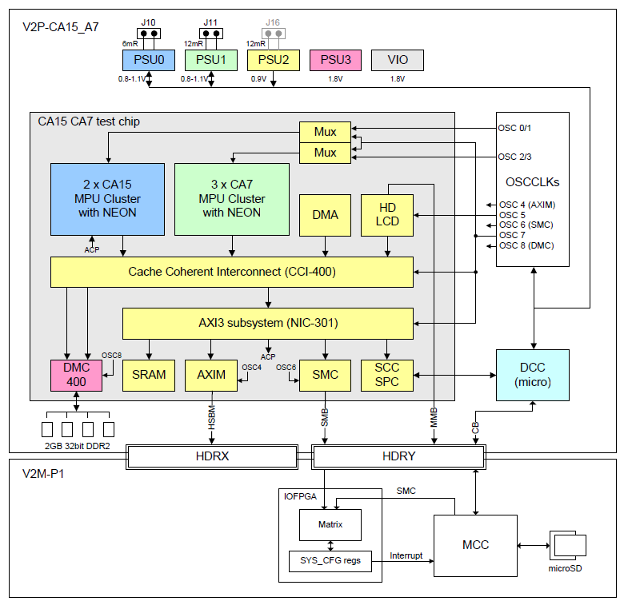
1.3 Implementation of the big.LITTLE technology (21)
Example 1: Common core frequencies and voltages in ARM’s test chip [10]
PSU: Power Supply Unit
DCC: Cortex-M3

Slide 42
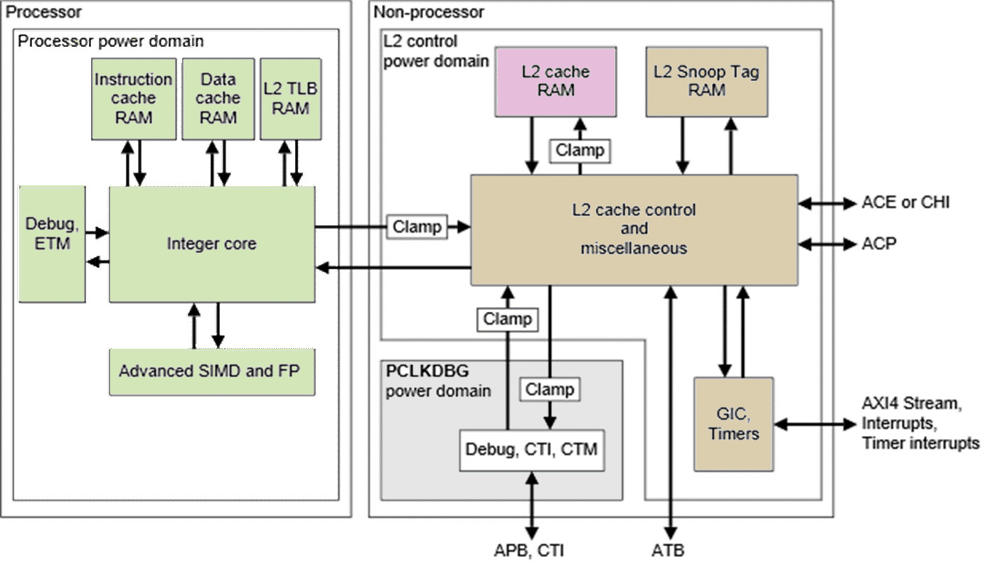
1.3 Implementation of the big.LITTLE technology (22)
Example 2: Per core power domains in the Cortex A-57 MPcore [50]
Note: Each core has a separate power domain

Slide 43
2. Exclusive cluster migration
Will not discussed.

Slide 44
2. Exclusive cluster migration (1)
2. Exclusive cluster migration
Implementation of task scheduling in the big-LITTLE technology
Cluster migration
Core migration
Exclusive use
of the clusters
Inclusive use
of the clusters
Exclusive use of cores
in big.LITTLE core pairs
Inclusive use of all cores
in all clusters
Exclusive
cluster migration
Inclusive
cluster migration
Exclusive
core migration
In Kernel Switcher
(IKS)
Global Task scheduling
(GTS)
Nvidia’s Variable SMP
Heterogeneous Multi-Processing
(HMP)
Described first in ARM’s
White Paper (2011) [3]
Described first in
ARM/Linaro EAS project
(2015) [49]
Described first in ARM’s
White Paper (2012) [9]
Described first in ARM’s
White Paper (2011) [3]
Used first in
Nvidia’s Tegra 3 (2011)
(1 A9 LP + 4 A9 cores)
Tegra 4 (2013)
(1 LP core + 4 A15 cores)
No known
implementation
ARM/Linaro
EAS project
in progress
(2013-)
Implemented by Linaro
on ARM’s experimental
TC2 system (2013)
(3 A7 + 2 A15 cores)
Mediatek MT8135 (2013)
(2 A7 + 2 A 15 cores)
Samsung HMP on
Exynos 5 Octa 5420 (2013)
(4 A7 + 4 A15 cores)
Samsung Exynos 5
Octa 5410 (2013)
(4 A7 + 4 A15 cores)
Allwinner UltraOcta A80 (2014)
(4 A7 + 4 A15 cores)
Qualcomm Snapdragon S 808 (2014)
(4 A53 + 2 A57 cores)

Slide 45
2. Exclusive cluster migration (2)
Principle of the exclusive cluster migration-1
For simplicity, let’s have two clusters of cores, as usual, e.g. with 4 cores each;
a cluster of low power/low performance cores, termed as the LITTLE cores and
a cluster of high performance high power cores, termed as the big cores,
as indicated below.
Cluster of
big cores
Cluster of
LITTLE cores
CPU0
CPU1
CPU0
CPU1
CPU2
CPU3
CPU2
CPU3
Cache coherent interconnect
To memory
Use the cluster of “LITTLE” cores for less demanding workloads, whereas
the cluster of “big” cores for more demanding workloads, as indicated in
the next Figure.

Slide 46
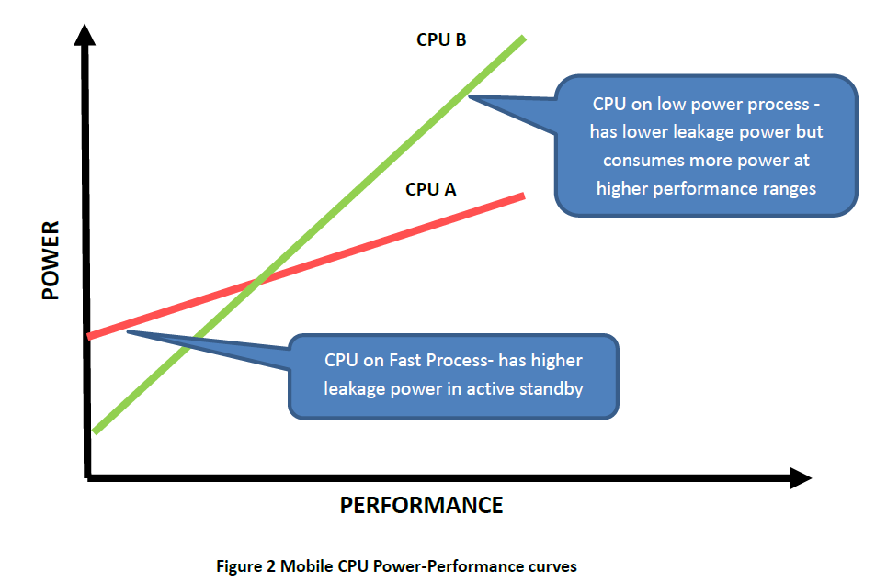
2. Exclusive cluster migration (3)
Principle of the exclusive cluster migration-2 [4]
The OS (e.g. the Linux cpufreq routine) tracks the load for all cores in the cluster.
As long as the actual workload can be executed by the low power, low performance
cluster, this cluster will be activated.
If however the workload requires more performance than available with the cluster
of LITTLE cores (CPU A in the Figure), an appropriate routine performs a switch
to the cluster of high performance high power “big” cores (CPU B).
LITTLE cores
big cores

Slide 47
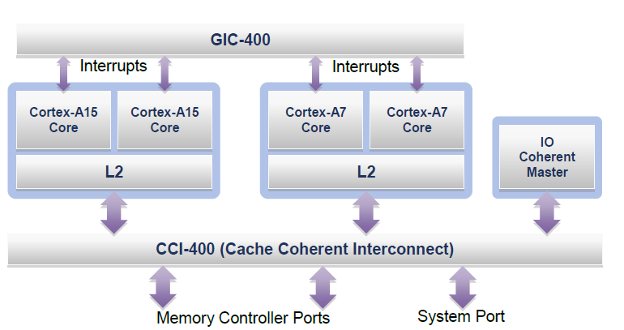
2. Exclusive cluster migration (4)
Main components of an example system
The example system includes a cluster of two Cortex-A15 cores, used as the
big cluster and another cluster of two Cortex-A7 cores, used as the LITTLE,
cluster, as indicated below.
General Interrupt Controller
Figure: An example system assumed while discussing exlusive cluster migration [3]
Both clusters are interconnected by a Cache Coherent Interconnect (CCI-400)
and are served by a General Interrupt Controller (GIC-400), as shown above.

Slide 48
2. Exclusive cluster migration (5)
Pipelines of the “big” Cortex-15 and the “LITTLE” Cortex-A7 cores [3]
Cortex-A7
Cortex-A15

Slide 49
2. Exclusive cluster migration (6)
Contrasting performance and energy efficiency of the Cortex-A15 and
Cortex-A7 cores [3]

Slide 50
2. Exclusive cluster migration (7)
Voltage domains and clocking scheme of the V2P-CA15_CA7 test chip [10]
DCC: Cortex-M3

Slide 51
2. Exclusive cluster migration (8)
Implementation of DVFS in case of Cortex-A15/Cortex-CA7 clusters [10]
Based on the referred Application Note, it can be assumed that both the Cortex-A15
and Cortex-A7 processor cores have global DVFS (Dynamic Voltage and Frequency
Scaling), i.e. all cores of a cluster run at the same scalable operating point, i.e.
at the same but variable clock frequency and core voltage.

Slide 52
2. Exclusive cluster migration (9)
Running applications with a given set of operating points [3]
The operating points of both clusters are used as a continuum during DVFS.
While the Cortex-A7 cluster is active the OS can tune the operating points as it
would do in case of a single application processor.
Once the Cortex-A7 cluster is at its highest operating point and the OS requires
more performance, a task migration will be invoked to the Cortex-A15 cluster.
In this way, low and medium intensity applications will run with high energy
on the Cortex-A7 cluster whereas high intensity applications will be executed on
the high performance Cortex-A15 cluster.
While the Cortex-A15 cluster is active the OS can tune the operating points as it
would do in case of a single application processor.

Slide 53
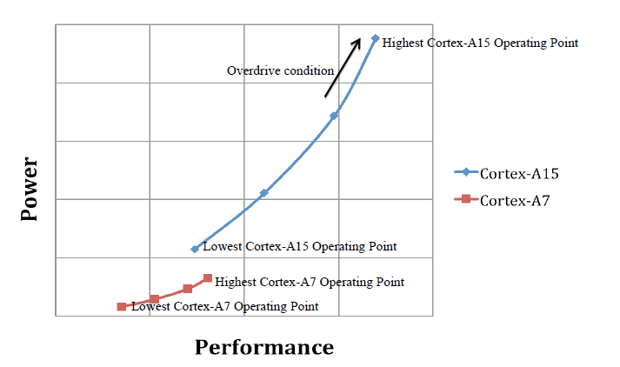
2. Exclusive cluster migration (10)
Operating points of the Cortex-A15 and Cortex-A7 cores [3]

Slide 54
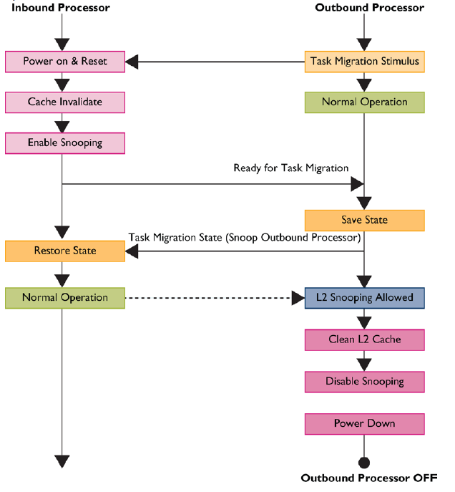
2. Exclusive cluster migration (11)
The process of cluster switching [3]
Currently inactive
cluster
Currently active
cluster

Slide 55
2. Exclusive cluster migration (12)
The time needed for task migration [3]
According to ARM [3] the time needed to migrate tasks between the two clusters
is about 20 µs, i.e. about 20 000 cycles while the processor operates at 1 GHz.

Slide 56
2. Exclusive cluster migration (13)
Implementation example: Samsung Exynos Octa 5410 [11]
It is the world’s first octa core processor.
Announced in 11/2012, launched in some Galaxy S4 models in 4/2013.
Figure: Block diagram of Samsung’s Exynos 5 Octa 5410 [11]

Slide 57
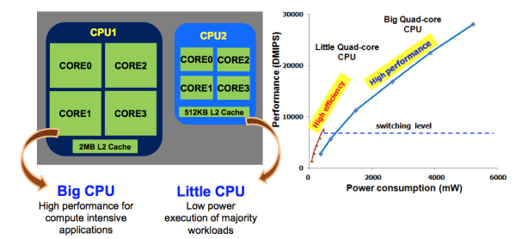
2. Exclusive cluster migration (14)
Operation of the Exynos 5 Octa 5410 using exclusive cluster switching [12]
It was revealed at the International Solid-State Circuit Conference (ISSCC) in 2/2013,
without specifying the chip designation.

Slide 58
2. Exclusive cluster migration (15)
Remark
According to sources there was a troublesome bug in the CCI-400 coherent bus
interface [13].
Thus, Samsung disabled the coherency between the two clusters, and as a
consequence after cluster switches they need to invalidate all caches.
Obviously, this has impeded performance and battery life.

Slide 59
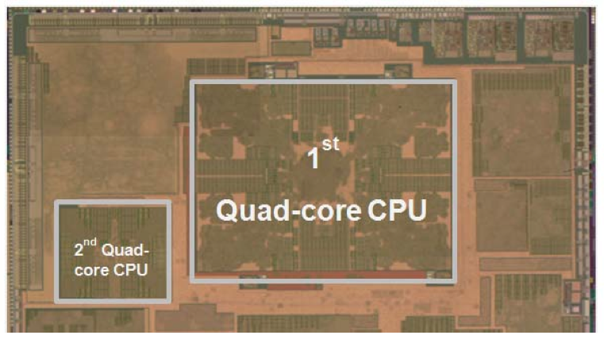
2. Exclusive cluster migration (16)
Assumed die photo of Samsung’s Exynos 5 Octa 5410 [12]
It was revealed at the International Solid-State Circuit Conference (ISSCC) in 2/2013
without specifying the chip designation.

Slide 60
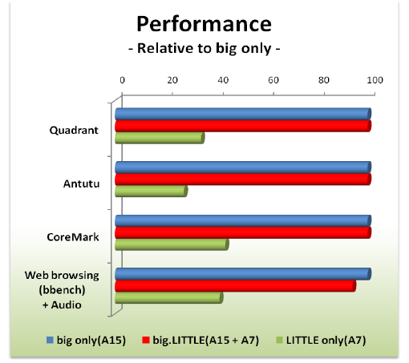
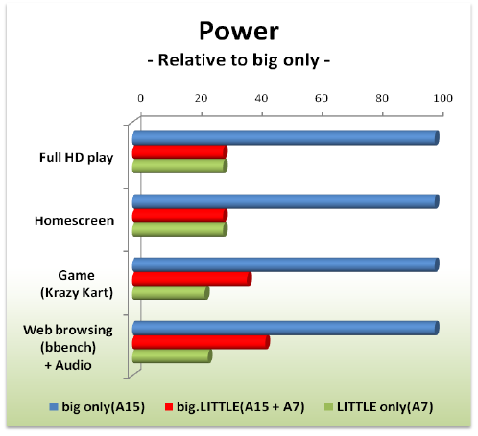
2. Exclusive cluster migration (17)
Performance and power results of the Exynos 5 Octa 5410 [11]

Slide 61
2. Exclusive cluster migration (18)
Nvidia’s variable SMP
Nvidia preferred to implement exclusive cluster migration with a “LITTLE” cluster
including only a single core, and a “big” cluster with four cores, as indicated in
the next Figure.
E.g.
CPU0
CPU1
“Cluster” of
a single
low power
core
Cluster of
high performance cores
CPU2
CPU3
CPU0
Cache coherent interconnect
Figure: Example layout of Nvidia’s variable SMP
Nvidia designates this implementation of big-LITTLE technology as variable SMP.
It was implemented early in the Tegra 3 (2011) with one A9 LP + four A9
cores and subsequently in the Tegra 4 (2013) with one A15 LP + four A15 cores.

Slide 62
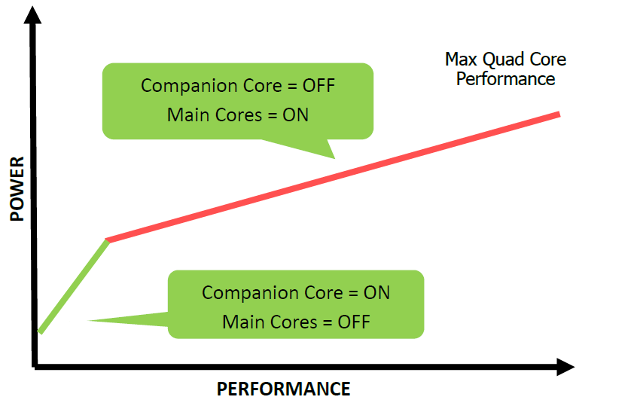
2. Exclusive cluster migration (19)
Power-Performance curve of Nvidia’s variable SMP [4]
Note that in the Figure the “LITTLE” core is designated as “Companion core”
whereas the “big” cores as “Main cores”.

Slide 63
2. Exclusive cluster migration (20)
Illustration of the operation of Nvidia’s Variable SMP [4]
Implemented in the Tegra 3 (2011) and Tegra 4 (2013).

Slide 64
2. Exclusive cluster migration (21)
Remark [52]
The cluster switch approach was the default scheduler in Android 4.2.2.

Slide 65
3. Inclusive cluster migration
Will not discussed.

Slide 66
3. Inclusive cluster migration (1)
3. Inclusive cluster migration
Implementation of task scheduling in the big-LITTLE technology
Cluster migration
Core migration
Exclusive use
of the clusters
Inclusive use
of the clusters
Exclusive use of cores
in big.LITTLE core pairs
Inclusive use of all cores
in all clusters
Exclusive
cluster migration
Inclusive
cluster migration
Exclusive
core migration
In Kernel Switcher
(IKS)
Global Task scheduling
(GTS)
Nvidia’s Variable SMP
Heterogeneous Multi-Processing
(HMP)
Described first in ARM’s
White Paper (2011) [3]
Described first in
ARM/Linaro EAS project
(2015) [49]
Described first in ARM’s
White Paper (2012) [9]
Described first in ARM’s
White Paper (2011) [3]
Used first in
Nvidia’s Tegra 3 (2011)
(1 A9 LP + 4 A9 cores)
Tegra 4 (2013)
(1 LP core + 4 A15 cores)
No known
implementation
ARM/Linaro
EAS project
in progress
(2013-)
Implemented by Linaro
on ARM’s experimental
TC2 system (2013)
(3 A7 + 2 A15 cores)
Mediatek MT8135 (2013)
(2 A7 + 2 A 15 cores)
Samsung HMP on
Exynos 5 Octa 5420 (2013)
(4 A7 + 4 A15 cores)
Samsung Exynos 5
Octa 5410 (2013)
(4 A7 + 4 A15 cores)
Allwinner UltraOcta A80 (2014)
(4 A7 + 4 A15 cores)
Qualcomm Snapdragon S 808 (2014)
(4 A53 + 2 A57 cores)

Slide 67
3. Inclusive cluster migration (2)
3. Inclusive cluster migration
Until now no commercial implementation became known using inclusive
core migration.
Nevertheless, since 2013 ARM and Linaro pursue a development project,
called Energy Aware Scheduling (EAS) to provide a generic energy model
based scheduling approach that supports a broad range of current and
future CPU topologies, including SMP, multi-cluster SMP (e.g. 8-core
Cortex-A53 products), as well as traditional ARM big.LITTLE configurations.
EAS assumes a platform with inclusive cluster migration, as indicated in the
next Figure.

Slide 68
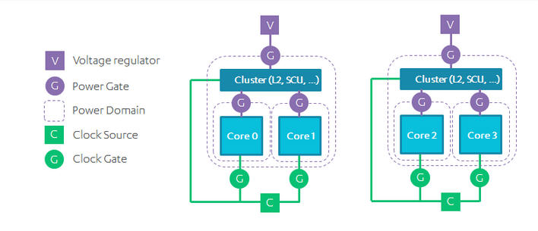
3. Inclusive cluster migration (3)
Assumed platform for EAS (Energy Aware Scheduling) [49]
The assumed platform would have the following voltage and frequency domains:
Figure: Assumed plaform for EAS (Energy Aware Scheduling)
Ideally, each cluster will operate at its own separate independent frequency and
voltage.
By lowering the voltage and frequency, there is a substantial power saving.
This allows the per-cluster power/performance to be accurately controlled, and
tailored to the workload being executed.

Slide 69
4. Exclusive core migration
Will not discussed.

Slide 70
4. Exclusive core migration (1)
4. Exclusive core migration
Implementation of task scheduling in the big-LITTLE technology
Cluster migration
Core migration
Exclusive use
of the clusters
Inclusive use
of the clusters
Exclusive use of cores
in big.LITTLE core pairs
Inclusive use of all cores
in all clusters
Exclusive
cluster migration
Inclusive
cluster migration
Exclusive
core migration
In Kernel Switcher
(IKS)
Global Task scheduling
(GTS)
Nvidia’s Variable SMP
Heterogeneous Multi-Processing
(HMP)
Described first in ARM’s
White Paper (2011) [3]
Described first in
ARM/Linaro EAS project
(2015) [49]
Described first in ARM’s
White Paper (2012) [9]
Described first in ARM’s
White Paper (2011) [3]
Used first in
Nvidia’s Tegra 3 (2011)
(1 A9 LP + 4 A9 cores)
Tegra 4 (2013)
(1 LP core + 4 A15 cores)
No known
implementation
ARM/Linaro
EAS project
in progress
(2013-)
Implemented by Linaro
on ARM’s experimental
TC2 system (2013)
(3 A7 + 2 A15 cores)
Mediatek MT8135 (2013)
(2 A7 + 2 A 15 cores)
Samsung HMP on
Exynos 5 Octa 5420 (2013)
(4 A7 + 4 A15 cores)
Samsung Exynos 5
Octa 5410 (2013)
(4 A7 + 4 A15 cores)
Allwinner UltraOcta A80 (2014)
(4 A7 + 4 A15 cores)
Qualcomm Snapdragon S 808 (2014)
(4 A53 + 2 A57 cores)

Slide 71
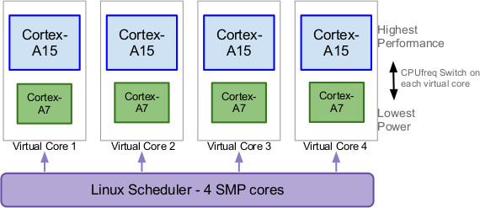
4. Exclusive core migration (2)
Principle of exclusive core migration-1
Linaro developed a model for task scheduling on big.LITTLE SOCs, called
IKS (In Kernel Switcher) and designed an appropriate Linux kernel patch
(LSK 3.10 (Linaro Stable Kernel) for an experimental system.
IKS builds core pairs from the cores of the big and LITTLE core clusters, e.g. from
Cortex-A15 and Cortex-A7 cores, and treats each core pair, consisting of a big
and a LITTLE core, as a single virtual core, as indicated in the next Figure.
Figure: Virtual cores of a 4x Cortex-A15 and 4x Cortex-A7 big.LITTLE SOC [15]

Slide 72
4. Exclusive core migration (3)
Principle of exclusive core migration-2
The Linux kernel schedules then the tasks to the virtual cores.
For each core pair the cpufreq driver of the Linux kernel controls whether the
LITLE core (for low power) or the big core (for maximum performance) should
be activated.
An important feature of IKS is that it relies on existing Linux kernel scheduling
mechanisms and thus is easy to implement.

Slide 73
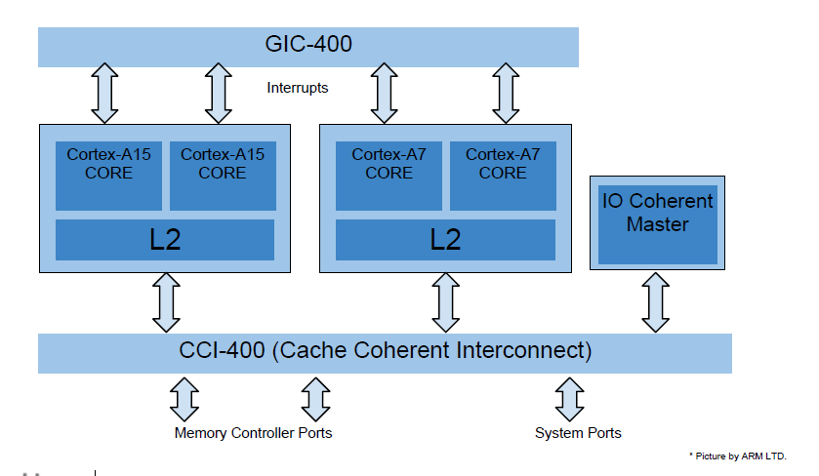
4. Exclusive core migration (4)
Experimental implementation of IKS on a 2x Cortex-A15 and 2x Cortex-A7
big.LITTLE configuration [16]

Slide 74
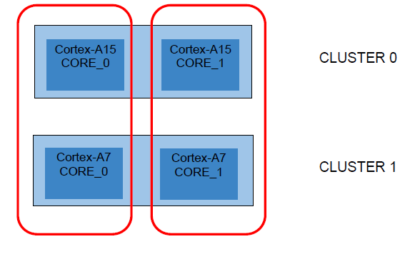
4. Exclusive core migration (5)
Virtual cores of the experimental implementation of IKS on a
2x Cortex-A15 and 2x Cortex-A7 big.LITTLE configuration [16]
Virtual core 0
Virtual core 1

Slide 75
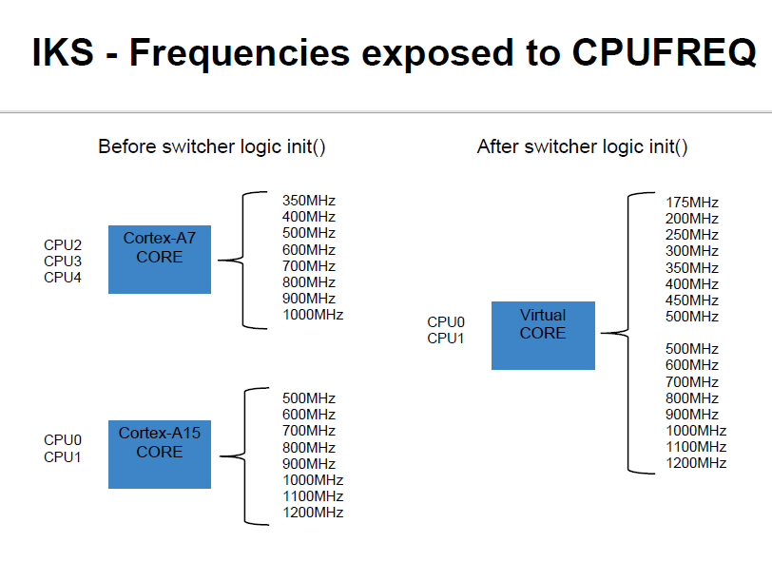
4. Exclusive core migration (6)
Operating points of the virtual cores-1 [16]
The Cortex-A15 and Cortex-A7 SOCs have originally the following operating points:
Figure: Operation points of the Cortex-A15 and Cortex-A7 SOCs [16]

Slide 76
4. Exclusive core migration (7)
Operating points of the virtual cores-2 [16]
For a seamless continuation of the operating points of both SOCs the original
operating points of the Cortex-A7 will be modified, actually halved, during the
initialization of the IKS, as shown below.
Operating points of the LITTLE core
Operating points of the big core

Slide 77
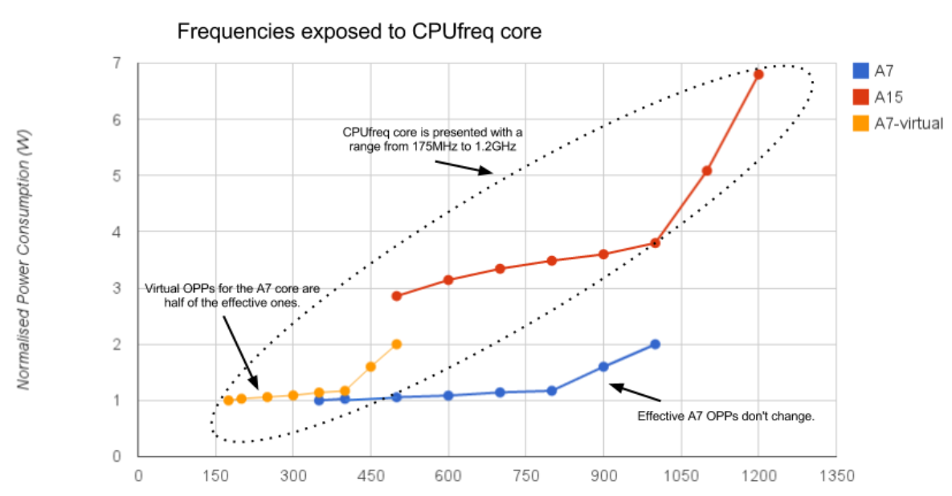
4. Exclusive core migration (8)
Operating points of the virtual cores-3 [16]
As a result the Linux kernel sees the following operating points of the virtual cores:

Slide 78
4. Exclusive core migration (9)
Switching between big and LITTLE cores [16]
Let’s suppose that at a given time a virtual core runs at 200 MHz.
Then the LITTLE core is active and its big core pair (A15) is shut down.
When subsequently, the frequency governor requests a core frequency of, let say
1000 MHz, this request cannot be satisfied by the LITTLE core (A7) and the
CPUfreq driver of the kernel instructs the Switcher to perform a core switch
from the LITTLE core to the big core.
The switching process is detailed in the next three Figures.
Here we note that in the Figures the currently active core is termed as the
“outbound” core whereas the target core as the “inbound” core.

Slide 79
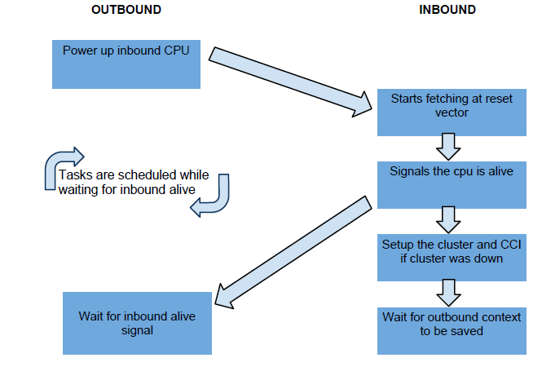
4. Exclusive core migration (10)
The core switching process-1 [16]

Slide 80
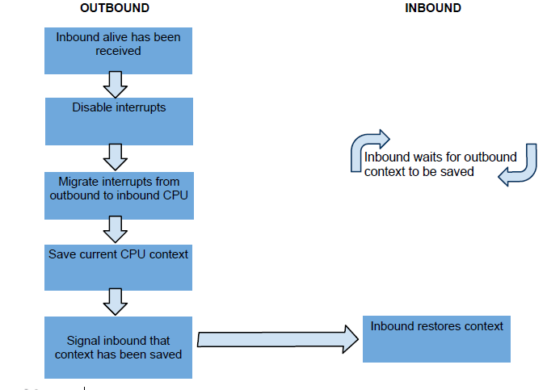
4. Exclusive core migration (11)
The core switching process-2 [16]

Slide 81
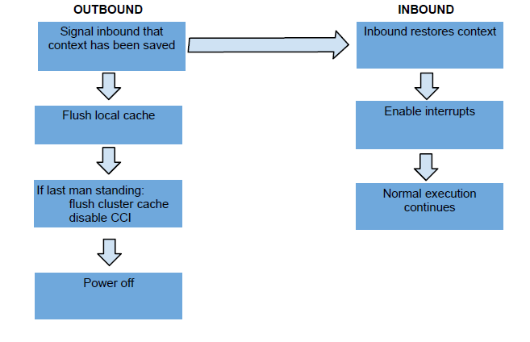
4. Exclusive core migration (12)
The core switching process-3 [16]

Slide 82
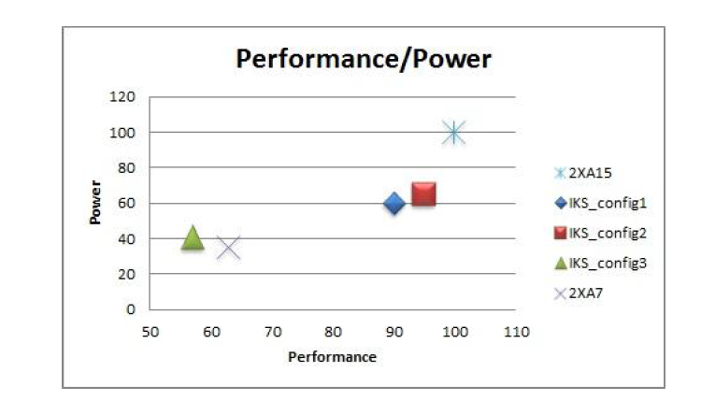
4. Exclusive core migration (13)
Measured results of IKS-1 [16]
Performance/power results of the experimental IKS system are shown below.
The data contrasts performance/power values of IKS (implemented in three
configurations) with a system including only two Cortex-A15 or two Cortex-A7.
Figure: Measured performance/power results of IKS [16]

Slide 83
4. Exclusive core migration (14)
Measured results of IKS-2 [16]
As the Figure shows, achieved results are not very convincing.
This can be the reason why no commercial implementation became known
using IKS yet.

Slide 84
5. Global task scheduling (GTS)

Slide 85
5. Global Task Scheduling (GTS) (1)
5. Global taks scheduling (GTS) -1
Implementation of task scheduling in the big-LITTLE technology
Cluster migration
Core migration
Exclusive use
of the clusters
Inclusive use
of the clusters
Exclusive use of cores
in big.LITTLE core pairs
Inclusive use of all cores
in all clusters
Exclusive
cluster migration
Inclusive
cluster migration
Exclusive
core migration
In Kernel Switcher
(IKS)
Global Task scheduling
(GTS)
Nvidia’s Variable SMP
Heterogeneous Multi-Processing
(HMP)
Described first in ARM’s
White Paper (2011) [3]
Described first in
ARM/Linaro EAS project
(2015) [49]
Described first in ARM’s
White Paper (2012) [9]
Described first in ARM’s
White Paper (2011) [3]
Used first in
Nvidia’s Tegra 3 (2011)
(1 A9 LP + 4 A9 cores)
Tegra 4 (2013)
(1 LP core + 4 A15 cores)
No known
implementation
ARM/Linaro
EAS project
in progress
(2013-)
Implemented by Linaro
on ARM’s experimental
TC2 system (2013)
(3 A7 + 2 A15 cores)
Mediatek MT8135 (2013)
(2 A7 + 2 A 15 cores)
Samsung HMP on
Exynos 5 Octa 5420 (2013)
(4 A7 + 4 A15 cores)
Samsung Exynos 5
Octa 5410 (2013)
(4 A7 + 4 A15 cores)
Allwinner UltraOcta A80 (2014)
(4 A7 + 4 A15 cores)
Qualcomm Snapdragon S 808 (2014)
(4 A53 + 2 A57 cores)

Slide 86
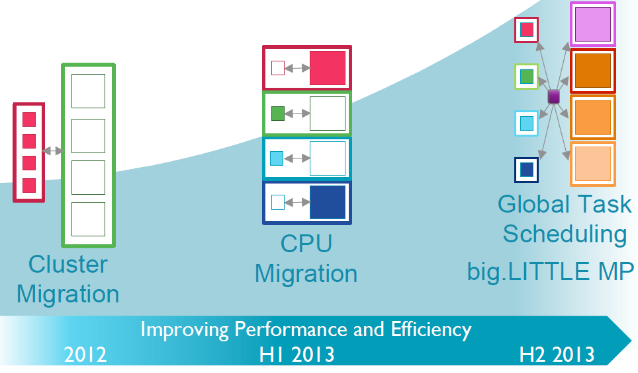
5. Global Task Scheduling (GTS) (2)
Global taks scheduling (GTS) -2
Global taks scheduling (GTS) or big.LITTLE MP in ARM’s terminology, can be
considered as the final step of the evolution of the big.LITTLE technology,
as indicated below [17].

Slide 87
5. Global Task Scheduling (GTS) (3)
Principle of GTS [8], [5]
OS (e.g. a modified Linux scheduler) tracks the average load
of each task.
The OS scheduler has all cores of both clusters or of all three
clusters at its disposal and can schedule tasks to any core
at any time.
There are many options for the layout of the scheduoing policy,
to be discussed later in this Section.

Slide 88
5. Global Task Scheduling (GTS) (4)
Example block diagram of a big.LITTLE SOC with GTS [1]
TZC: TrustZone Address Space
Controller
DMC: Dynamic Memory
Controller

Slide 89
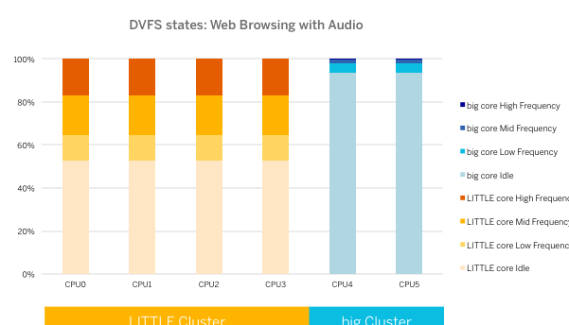
5. Global Task Scheduling (GTS) (5)
Core residency at various DVFS frequency states of a 2 big/4 LITTLE
GTS configuration for web browsing with audio [19]

Slide 90
5. Global Task Scheduling (GTS) (6)
Key benefits of GTS over IKS [18]
Finer grained scheduling of workloads.
Ability to easily support non-symmetric configurations, such as (2+4) ones.
higher peak performance through the ability to use all cores simultaneously.
Higher performance/Watt vs. IKS.
ARM reported about 10 % higher performance/Watt figures over IKS on a
range of benchmarks.
MediaTek CorePilot™ Heterogeneous Multi-Processing Technology White Paper

Slide 91
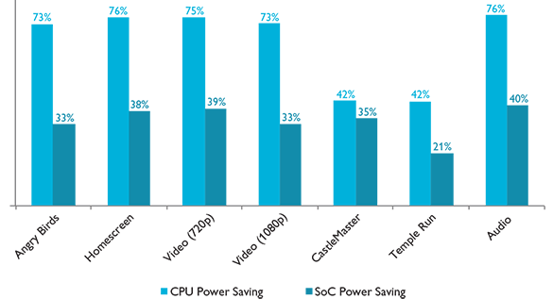
5. Global Task Scheduling (GTS) (7)
Achieved power saving with GTS on a 4x Cortex-A15 + 4 x Cortex-A7
configuration vs. a 4x Cortex-A15 configuration
Figure: Measured CPU and SoC power savings on a 4x Cortex-A15 4x∙Cortex-A7
big.LITTLE MP SoC relative to a 4x Cortex-A15 SoC for different applications [1]

Slide 92
5. Global Task Scheduling (GTS) (8)
Overview of big.LITTLE implementations with GTS
Model | Year | Cores | Techn. | Integrated modem
Samsung Exynos 5 Octa 5420 | 2013 | 4x A7 + 4x A15 | 28 nm | no
Samsung Exynos 5 Octa 5422 | 2014 | 4x A7 + 4x A15 | 28 nm | no
Samsung Exynos 5 Octa 5260 | 2014 | 4x A7 + 2x A15 | 28 nm | no
Samsung Exynos 5 Octa 5430 | 2014 | 4x A7 + 4x A15 | 20 nm | no
Samsung Exynos 5 Octa 5433 | 2014 | 4x A53 + 4x A57 | 20 nm | no
Samsung Exynos 7 Octa 7420 | 2015 | 4x A53 + 4x A57 | 14 nm | no
Samsung Exynos 8 Octa 8890 | 2015 | 4x A53 + 4x M1 | 14 nm | yes
Qualcomm Snapdagon S 808 | 2014 | 4x A53 + 2x A57 | 20 nm | no
Qualcomm Snapdagon S 810 | 2015 | 4x A53 + 4x A57 | 20 nm | no
Qualcomm Snapdagon S 820 | 2016 | 2x Kryo 1.7 GHz + 2x Kryo 2.2 GHz | 14 nm FnFET | no
MediaTek MT8135 | 2013 | 2x A7 + 2x A15 | 28 nm | no
MediaTek MT6595 | 2014 | 4x A7 + 4x A17 | 28 nm | yes
MediaTek MT6797 | 2015 | 8x A53+ 2x A57 | 20 nm | yes
Renesas MP 6530 | 2013 | 2x A7 + 2x A15 | 28 nm | yes
Allwinner UltraOcta A80 | 2014 | 4x A7 + 4x A15 | 28 nm | no

Slide 93
5. Global Task Scheduling (GTS) (9)
Main features of Samsung’s mobile SOCs in big.LITTLE configuration
SoC |  | CPU |  |  |  | GPU | Memory technology | Availability | Utilizing devices (examples)
Model number | fab | Instr. set | Microarch. | cores | fc (GHz)
Exynos 5 Octa (Exynos 5410) | 28 nm HKMG | ARMv7 | Cortex-A15+ Cortex-A7^{[1]} | 4+4 | 1.6 1.2 | IT PowerVR SGX544MP3 @ 480 MHz 49 GFLOPS | 32-bit DCh LPDDR3-800 (12.8 GB/sec) | Q2 2013 | Samsung Galaxy S4 I9500, ZTE Grand S II TD,
Exynos 5 Octa (Exynos 5420) | 28 nm HKMG |  | Cortex-A15+ Cortex-A7⁽²⁾ | 4+4 | 1.8–1.9 1.3 | ARM Mali-T628 MP6 @ 533 MHz; 109 GFLOPS | 32-bit DCh LPDDR3e-933 (14.9 GB/sec) | Q3 2013 | Samsung Chromebook 2 11.6", Samsung Galaxy Note 3/Note 10.1/Note Pro 12.2, Samsung Galaxy Tab Pro/Tab S
Exynos 5 Octa (Exynos 5422) | 28 nm HKMG |  | Cortex-A15+ Cortex-A7^{[2]} | 4+4 | 1.9-2.1 1.3-1.5 | ARM Mali-T628 MP6 @ 533 MHz (109 Gflops) | 32-bit DCh LPDDR3/DDR3-933 (14.9 GB/sec) | Q2 2014 | Samsung Galaxy S5 (SM-G900H),
Exynos 5 Octa (Exynos 5800) | 28 nm HKMG |  | Cortex-A15+ Cortex-A7^{[2]} | 4+4 | 2.1 1.3 | ARM Mali-T628 MP6 @ 533 MHz | 32-bit DCh LPDDR3/DDR3-933 (14.9 GB/sec) | Q2 2014 | Samsung Chromebook 2 13,3"
Exynos 5 Hexa (Exynos 5260) | 28 nm HKMG |  | Cortex-A15+ Cortex-A7^{[2]} | 2+4 | 1.7 1.3 | ARM Mali-T624 @ 600 MHz | 32-bit DCh LPDDR3-800 (12.8 GB/sec) | Q2 2014 | Galaxy Note 3 Neo, Samsung Galaxy K zoom
Exynos 5 Octa (Exynos 5430) | 20 nm HKMG |  | Cortex-A15+ Cortex-A7^{[2]} | 4+4 | 1.8-2.0 1.3-1.5 | ARM Mali-T628 MP6 @ 600 MHz; 122 GFLOPS | 32-bit DCh LPDDR3e/DDR3-1066 (17.0 GB/sec) | Q3 2014 | Samsung Galaxy Alpha (SM-G850F),
Exynos 5 Octa (Exynos 5433 | 20 nm HKMG | ARMv8-A | Cortex-A57+ Cortex-A53^{[2]} | 4+4 | 1.9 1.3 | Mali-T760 MP6 @ 700 MHz; 206 GFLOPS (FP16) | 32-bits DCh LPDDR3-825 (13.2 GB/s) | Q3/Q4 2014 | Samsung Galaxy Note 4 (SM-N910C)
Exynos 7 Octa (Exynos 7420) | 14 nm FinFET | ARMv8-A | Cortex-A57+ Cortex-A53^{[2]} | 4+4 | 2.1 1.5 | Mali-T760 MP8 @ 772 MHz; 227 GFLOPS (FP16) | 32-bits DCh LPDDR4-1552 (25.6 GB/s) | Q2 2015 | Samsung Galaxy S6/ S6 Edge
Exynos 8 Octa (Exynos 8890) | 14 nm FinFET | ARMv8-A | Mongoose- Cortex-A53^{[2]} | 4+4 | 2.3 n.a. | Mali-T880 MP12 @ | n.a. | Q4 2015 | Smsung Galaxy S7
^{[1]} big.LITTLE configuration with exclusive core migration ^{[2]} big.LITTLE configuration with GTS

Slide 94
6. Supporting GTS in OS kernels
6.1 Overview
6.2 OS support for GTS provided by ARM/Linaro
6.3 MediaTek's CorePilot releases
6.4 Quacomm's big.LITTLE schedulers
Only Sections 6.1 and 6.2.2 will be discussed.

Slide 95
6.1 Overview

Slide 96
6.1 Overview (1)
6.1 Overview
big.LITTLE technology needs suitable OS support to schedule tasks to the right
computing resources for achieving the least power consumption.
It is stated that "software represents the Achilles' heel of the technology and
severely limits its potential [53].
ARM and Linaro jointly develop OS support fo GTS, these became available
first as Linux or Android patch sets, later also they can be included into
the mainstream Linux or - Android kernel.
As an example, ARM/Linaro's IPA (Intelligent Power Management) became first
available as a Linaro patch set in 09/2014 and then it was included into
Linux 4.10 in 8/2015.
Subsequently, all major big.LITTLE suppliers provided their own software support
for GTS, next we give an overview of them.
Remark
Linaro is a non-profit foundation of interested firms to foster open source Linux
packages optimized for ARM architectures.

Slide 97
6.1 Overview (2)
Overview of supporting GTS in the OS kernel (announced or used)
ARM big.LITTLE MP
(Global Task Scheduling)
(~06/2013)
ARM/Linaro EAS
(Energy Aware Scheduling)
(development yet in progress)
ARM/Linaro
ARM IPA
(Inteligent Power Allocation)
(10/2014)
MediaTek CorePilot 2.0
(on Helio X10 (MT6595)
(03/2015)
MediaTek CorePilot 1.0
(on MT8135)
(07/2013)
MediaTek
MediaTek CorePilot 3.0
(on Helio X20 (MT6797)
(05/2015)
Qualcomm’s
Energy Aware Scheduling
(on Snapdragoon 610/615
(02/2014))
Qualcomm
Symphony System Manager
(on Snapdragoon 820)
(11/2015)
Qualcomm
Samsung's big.LITTLE HMP
(≈ARM's big.LITTLE MP)
(on Exynos 5 models)
(09/2013)
Samsung
2013
2014
2015

Slide 98
6.1 Overview (3)
Main dimensions of GTS schedulers
Main dimensions of GTS schedulers
Scope of GTS
Power awareness of GTS
This aspect decides about the set of
execution units
to be included into scheduoing
This aspect decides wheather scheduoing
takes into account or not
power considerations

Slide 99
6.1 Overview (4)
Scope of GTS scheduling
Scope of GTS scheduling
(Including only the CPU cores, also the GPU or other accelerators into GTS)
Scheduling only
the big.LITTLe
CPU cores
Scheduling both
the big.little
CPU cores + GPU
Scheduling the
big-LITTLE
CPU cores + GPU
+ accelerators
Examples
ARM IPA
(Intelligent Power Allocation
in Linux 4.2) (2015)
Used in Samsung’s
Exynos Octa models (2013-)
ARM big.LITTLE mp
(detailed in [17] (2013)
MediaTek CorePilot 1.0
(on MT8135)
(with Adaptive Thermal
Control (Throttling), 2013)
MediaTek CorePilot 2.0
(on Helio X10 (MT6595)
(with Adaptive Thermal
Control (Throttling), 2015)
MediaTek CorePilot 3.0
(on Helio X20 (MT6797)
2015)
Qualcomm’s
Energy Aware Scheduling
(on Snapdragoon 610/615/
808/810)(2014/2015)
Qualcomm
Symphony System Manager
(on Snapdragoon 820)
2015

Slide 100
6.1 Overview (5)
Power awareness of GTS scheduling
Power arareness of GTS scheduling
Not power aware
scheduling
Power aware scheduling
Examples
ARM big.LITTLE MP
(detailed in [17] (2013)
ARM IPA
(Intelligent Power Allocation
in Linux 4.2), (2015)
Used in Samsung’s
Exynos 5 models (2013-)
MediaTek CorePilot 1.0
(on MT8135)
(with Adaptive Thermal
Control (Throttling), 2013)
MediaTek CorePilot 2.0
(on Helio X10 (MT6595)
(with Adaptive Thermal
Control (Throttling), 2015)
MediaTek CorePilot 3.0
(on Helio X20 (MT6797) 2015)
Qualcomm’s
Energy Aware scheduling
(on Snapdragoon 610/615/
808/810) (2014/2015)
Qualcomm
Symphony System Manager
(on Snapdragoon 820)
(2015)

Slide 101
6.1 Overview (6)
Scope and power awareness of GTS schedulers
Scope of GTS scheduling
(Including only the CPU cores, also the GPU or other accelerators into GTS)
Scheduling only
the big.LITTLE
CPU cores
Scheduling both
the big.LITTLE
CPU cores + GPU
Scheduling the
big-LITTLE
CPU cores + GPU
+ accelerators
ARM big.LITTLE MP
(detailed in [17] (2013)
MediaTek CorePilot 1.0
(on MT8135)
(with Adaptive Thermal
Control (Throttling), 2013)
MediaTek CorePilot 2.0
(on Helio X10 (MT6595)
(with Adaptive Thermal
Control (Throttling), 2015)
Power arareness of GTS scheduling
Power aware
scheduling
Not power aware scheduling
ARM iPA
(Intelligent Power Allocation)
(in Linux 4.2, 2015)
Used in Samsung’s
Exynos Octa (2014-)
Qualcomm’s
Energy Aware Scheduling
(on Snapdragoon 610/615/
808/810) (2014/2015)
MediaTek CorePilot 3.0
(on Helio X20 (MT6797)
2015)
Qualcomm
Symphony System Manager
(on Snapdragoon 820) (2015)

Slide 102
6.2 OS support for GTS provided by ARM/Linaro

Slide 103
6.2 OS support for GTS provided by ARM/Linaro (1)
6.2 OS support for GTS provided by ARM/Linaro
ARM big.LITTLE MP
(Global Task Scheduling)
(~06/2013)
ARM/Linaro EAS
(Energy Aware Scheduling)
(development yet in progress)
ARM/Linaro
ARM IPA
(Inteligent Power Allocation)
(10/2014)
MediaTek CorePilot 2.0
(on Helio X10 (MT6595)
(03/2015)
MediaTek CorePilot 1.0
(on MT8135)
(07/2013)
MediaTek
MediaTek CorePilot 3.0
(on Helio X20 (MT6797)
(05/2015)
Qualcomm’s
Energy Aware Scheduling
(on Snapdragoon 610/615
(02/2014))
Qualcomm
Symphony System Manager
(on Snapdragoon 820)
(11/2015)
Qualcomm
Samsung's big.LITTLE HMP
(≈ARM's big.LITTLE MP)
(on Exynos 5 models)
(09/2013)
Samsung
2013
2014
2015

Slide 104
6.2 OS support for GTS provided by ARM/Linaro (2)
6.2.1 ARM big.LITTLE MP (Global Task Scheduling)
For scheduling tasks on big.LITTLE mobile systems ARM developed a Linux
kernel modification that became included into the Linux 3.10.33 (03/2014),
called the ARM MP patch set.
There is also an Android v3.10 patch set for GTS from AOSP.

Slide 105
6.2 OS support for GTS provided by ARM/Linaro (3)
Principle of operation of GTS -1
The ARM developed patch set disables the classic load balancing between the
CPU cores and substitutes it by a big.LITTLE specific routine, as indicated below.
Figure: Disabling the classic load balancing in Linux and substituting it by a
big.LITTLE specific routine [54]

Slide 106
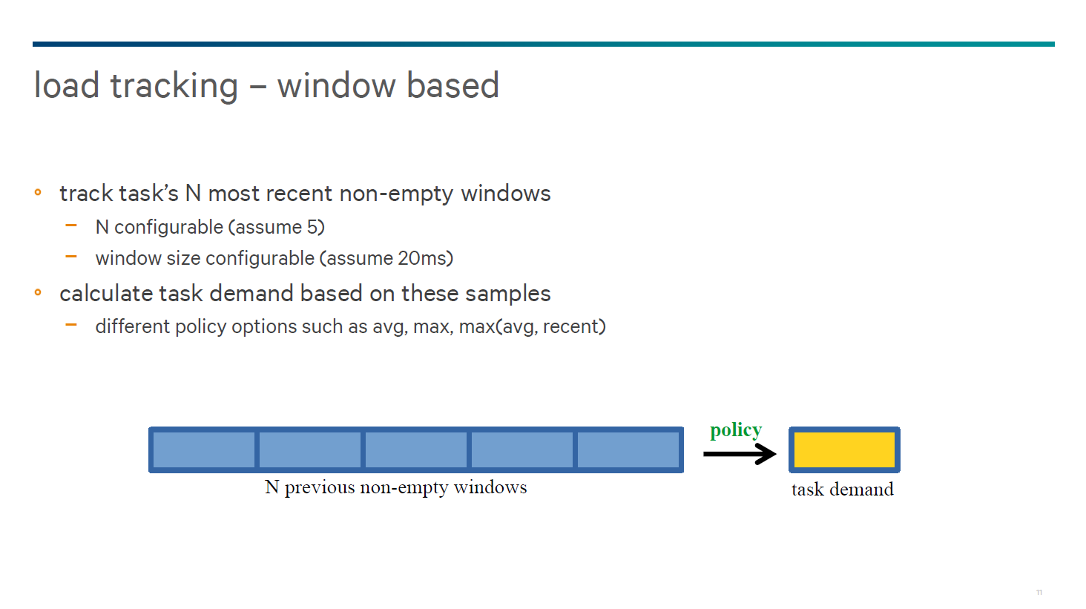
6.2 OS support for GTS provided by ARM/Linaro (4)
Principle of operation of GTS -2
The scheduling is based on a load tracker while scheduling decisions will be
accomplished on the calculated load.
The load tracker performs a window based per-entity (task) load tracking and
calculates the load as outlined below.
Figure: Widow based per entitiy load tracking [55]
The load (task demand) over the windows is weighted such that that the last
window is weighted highest and previous loads by a given decay factors.

Slide 107
6.2 OS support for GTS provided by ARM/Linaro (5)
Illustration of calculated avarage load [54]

Slide 108
6.2 OS support for GTS provided by ARM/Linaro (6)
Principle of operation of GTS -3
There are two migration thresholds on the task load and the scheduler operates
accordingly, as indicated in the Figure.
Figure: Basic principle of migrating tasks in GTS [54]

Slide 109
6.2 OS support for GTS provided by ARM/Linaro (7)
6.2.2 ARM IPA (Intelligent Power Allocation)
It is a thermal management based scheduling approach for big-LITTLE mobil
topologies covering both the big.LITTLE CPU-cores the GPU and available data
accelerators (the latter not shown in the first Figure).

Slide 110
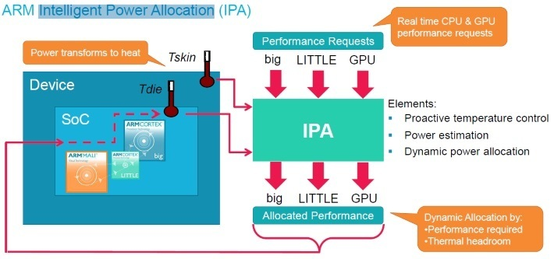
6.2 OS support for GTS provided by ARM/Linaro (8)
Principle of operation of IPA -1
IPA tracks the performance requests of the actors such as the big and LITTLE
CPU cores, the GPU as well as other accelerators, derived from clock cycle
utilization, and dynamically allocates performance as far as the available
temperature headroom it allows, as indicated below.
Figure: Principle of operation of IPA [56]

Slide 111
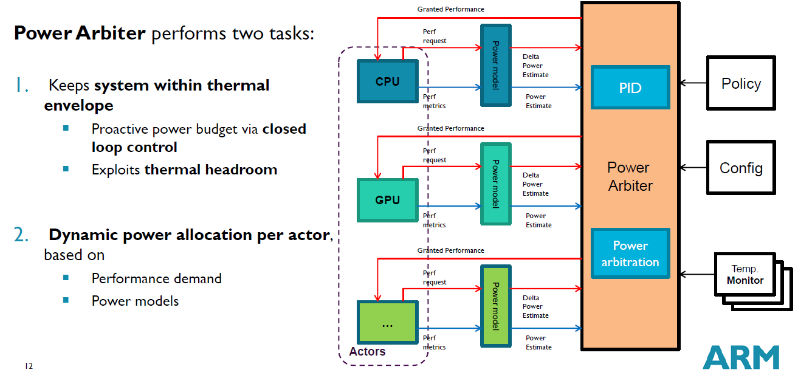
6.2 OS support for GTS provided by ARM/Linaro (9a)
Principle of operation of the Power arbiter of IPA [57]

Slide 112
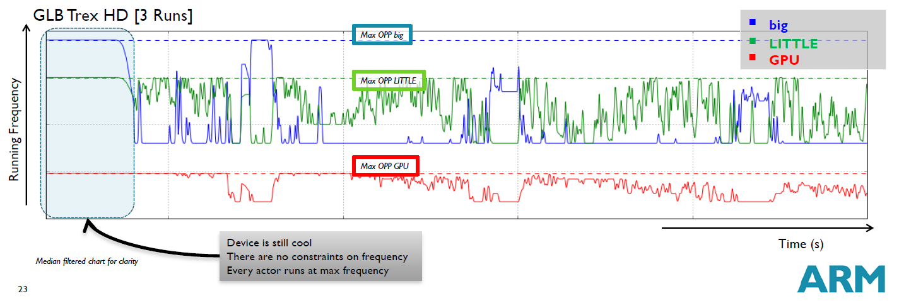
6.2 OS support for GTS provided by ARM/Linaro (9b)
IPA in operation [56]

Slide 113
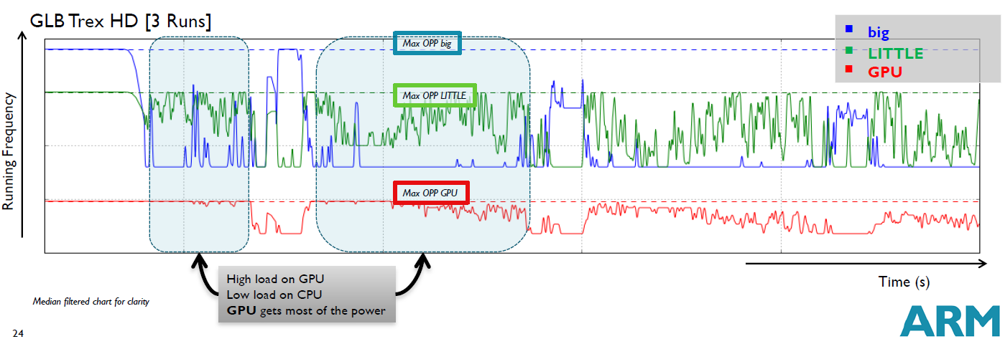
6.2 OS support for GTS provided by ARM/Linaro (9c)
IPA in operation [56]

Slide 114
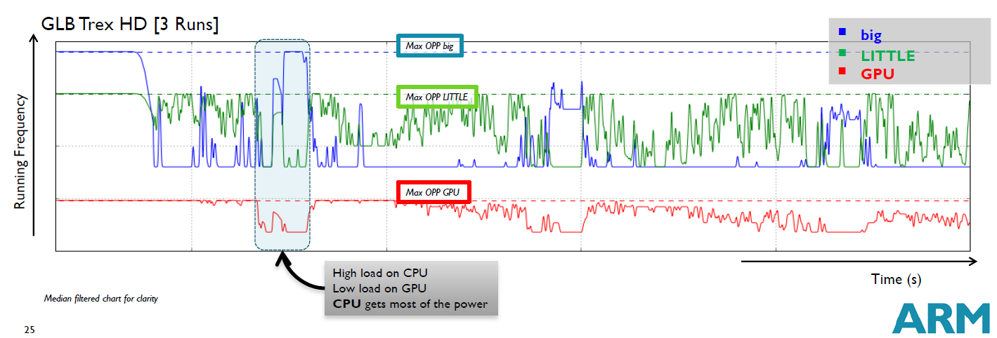
6.2 OS support for GTS provided by ARM/Linaro (9d)
IPA in operation [56]

Slide 115
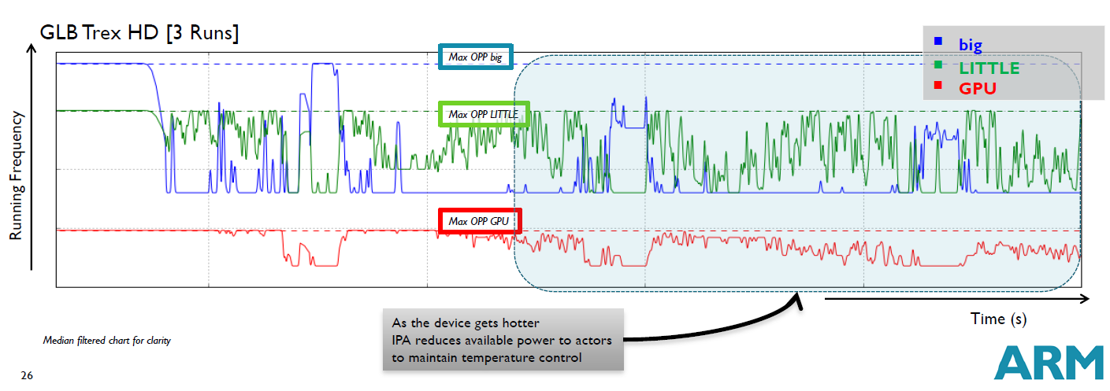
IPA in operation [56]

Slide 116
6.2 OS support for GTS provided by ARM/Linaro (10)
Principle of operation of IPA -1 [58]
Based on a power model the performance requests are converted into requested
power.
The power model used gives an interrelationsship between working parameter,
like clock frequency and the related power consumption.
Based on the readings of the available temperature sensors (Tdie, Tskin), IPA
estimates the available power budget.
IPA then allocates the available power budget to each actor based on the
requested performance.

Slide 117
6.2 OS support for GTS provided by ARM/Linaro (11)
Availability and use of IPA
As open source software IPA has been released as the big.LITTLE MP patch set
from Linaro.
It became included also into mainline Linux 4.2 in 08/2015.
It may easily be deployed in Linux-based devices including Android.
IPA is typically used in Samsung's Exynos models, starting with the
Exynos 5 5422 (2014).

Slide 118
6.2 OS support for GTS provided by ARM/Linaro (12)
6.2.3 Energy Aware Scheduling (EAS) from ARM and Linaro
Motivation for the EAS project
It became recognized in 2013 that power management in Linux is implemented
by different, largely uncordinated kernel routins, such as
the task scheduler
the routine managing idle states (CPUidle) and
the routine performing DVFS (CPUFreq),
as indicated in the next Figure.
This makes platform adaptation difficult and tuning difficult

Slide 119
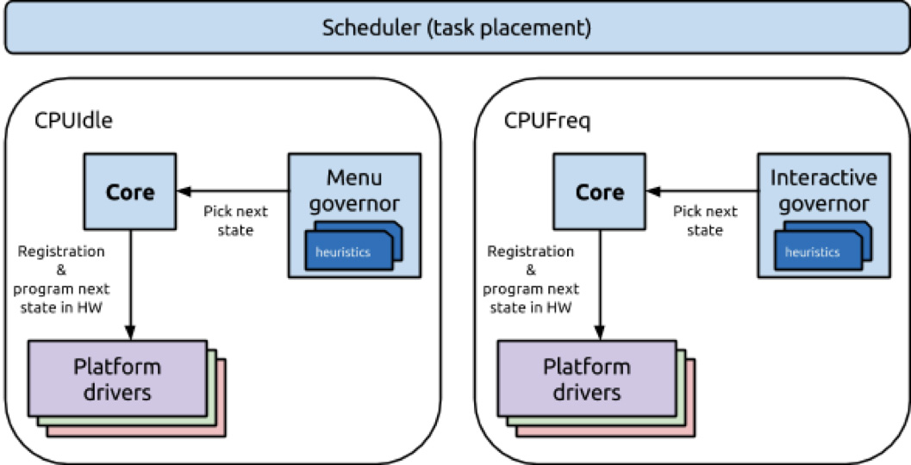
6.2 OS support for GTS provided by ARM/Linaro (13)
Uncordinated operation of the Scheduler, the CPUIdle and CPUFreq routines [59]
As indicated in the Figure, the scheduler, CPUFreq and CPUIdle subsystems
work in isolation, i.e. uncorrellated with each other.
The scheduler tries to balance the load across all cores, unregarded the
power costs, while the CPUFreq and CPUIdle subsystems are trying to save
power by scaling down fc of the cores or idling them, respectively.

Slide 120
6.2 OS support for GTS provided by ARM/Linaro (14)
The aim of EAS
EAS is aimed to provide a generic, energy aware task scheduling, based on a
well grounded energy model rather than on magic tunables present in the
recent power managenent framework (like upper and lower limits for migrating
tasks between cores, etc..
A generic energy model based approach is expected to support a broad range of
current and future CPU topologies, including SMP, multi-cluster SMP
(e.g. 8-core Cortex-A53 products), as well as traditional ARM big.LITTLE.
In this model the scheduler directs both the CPUFreq and CPUIdle subsystems,
as seen in the next Figure.

Slide 121
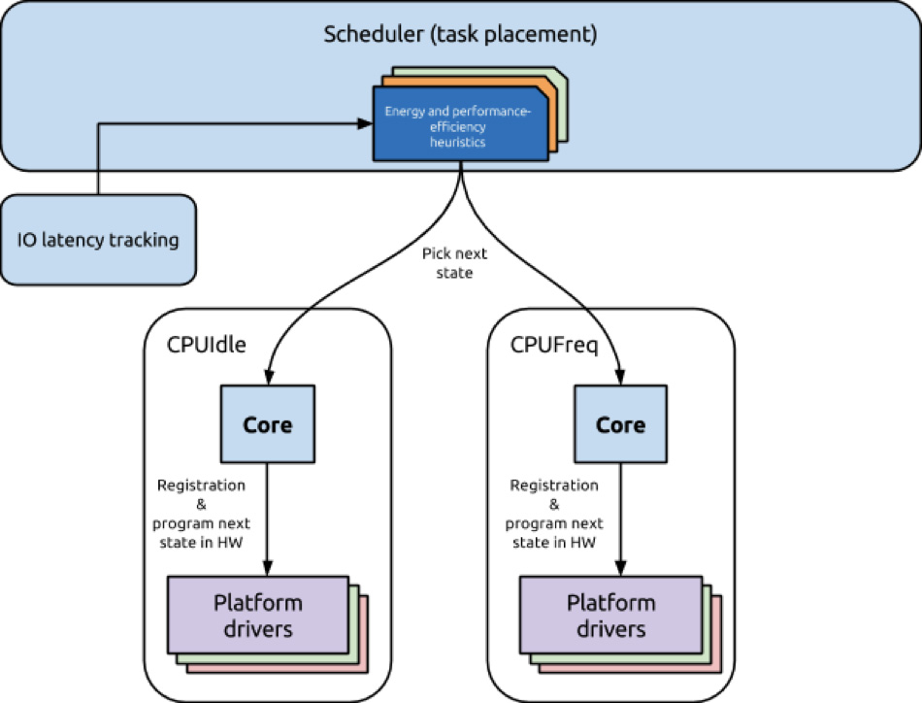
6.2 OS support for GTS provided by ARM/Linaro (15)
Coordinated operation of the scheduler, the CPUIdle and CPUFreq
subsystems in EAS [59]

Slide 122
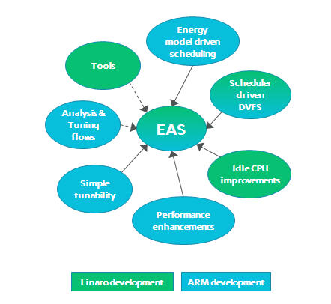
6.2 OS support for GTS provided by ARM/Linaro (16)
Joint development of EAS subsystems by ARM and Linaro [59]

Slide 123
6.2 OS support for GTS provided by ARM/Linaro (17)
Status of the EAS development
At present (11/2015) EAS development is in progress yet.

Slide 124
6.3 MediaTek’s CorePilot releases

Slide 125
6.3 MediaTek's CorePilot releases (1)
6.3 Mediatek's CorePilot releases
ARM big.LITTLE MP
(Global Task Scheduling)
(~06/2013)
ARM/Linaro EAS
(Energy Aware Scheduling)
(development yet in progress)
ARM/Linaro
ARM IPA
(Inteligent Power Allocation)
(10/2014)
MediaTek CorePilot 2.0
(on Helio X10 (MT6595)
(03/2015)
MediaTek CorePilot 1.0
(on MT8135)
(07/2013)
MediaTek
MediaTek CorePilot 3.0
(on Helio X20 (MT6797)
(05/2015)
Qualcomm’s
Energy Aware Scheduling
(on Snapdragoon 610/615
(02/2014))
Qualcomm
Symphony System Manager
(on Snapdragoon 820)
(11/2015)
Qualcomm
Samsung's big.LITTLE HMP
(≈ARM's big.LITTLE MP)
(on Exynos 5 models)
(09/2013)
Samsung
2013
2014
2015

Slide 126
6.3 MediaTek's CorePilot releases (2)
6.3.1 CorePilot (1.) [33]
It is based on the open-source GTS technology, designated big.LITTLE MP,
developed by ARM.
It was introduced along with the MT8135 in 07/2013.
CorePilot integrates thermal and power management into task scheduling and
consists accordingly of the following three parts:
adaptive thermal management
interactive power management and
advanced scheduler algorithms,
as indicated in the next Figure.

Slide 127
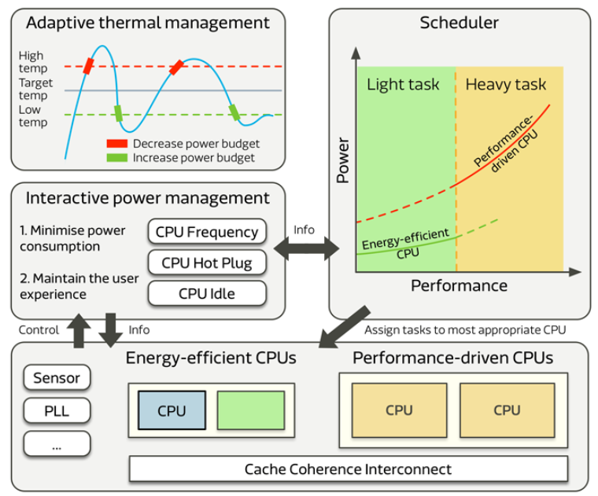
6.3 MediaTek's CorePilot releases (3)
Overview of the operation of CorePilot [33]

Slide 128
6.3 MediaTek's CorePilot releases (4)
a) Adaptive Thermal Management [37]
Power, thermal and performance (PTP) detectors are placed within the CPU
to sense operating conditions.
Adaptive Thermal Management monitors sensed data and allows the device
to use the available voltage margin either to increase performance or lower
power consumption when possible.
According to MediaTek this technology allows for a 23% increase in
clock speed or up to 41% power savings, depending on the SoC operating
conditions.

Slide 129
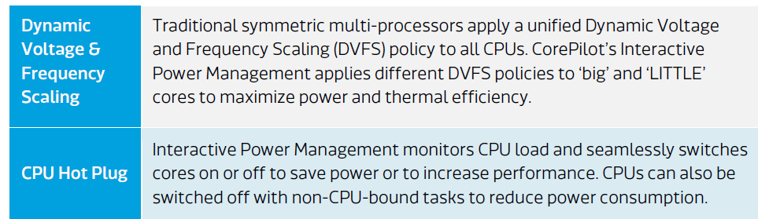
6.3 MediaTek's CorePilot releases (5)
b) Interactive Power Management [33]
CorePilot’s Interactive Power Manager reduces the amount of power and heat
generated by the cores via two main modules.
The DVFS (Dynamic Voltage and Frequency Scaling) module automatically
adjusts the frequency and voltage of cores on the fly, while the CPU Hot Plug
module switches cores on and off on demand, as summarized below.

Slide 130
6.3 MediaTek's CorePilot releases (6)
c) Scheduler Algorithms [33]
With Symmetric Multi-Processing (SMP), the Completely Fair Scheduler (CFS) of
the Linux kernel implements currently the most common scheduling algorithm,
it distributes the workload equally among CPU cores.
In case of Heterogeneous Multi-Processing, however, employing CFS can cause
performance degradation, since tasks do not efficiently match to CPU core
capabilities.
MediaTek’s CorePilot, on the other hand, is based on a true heterogeneous
compute model by using a scheduling algorithm that assigns tasks to two
different schedulers, according to their priority — the Heterogeneous Multi-
Processing (HMP) scheduler and the Real-Time (RT) scheduler.

Slide 131

6.3 MediaTek's CorePilot releases (7)
MediaTek’s HMP Scheduler
It is responsible for assigning normal-priority tasks to the big.LITTLE CPU core
clusters and performs four main functions, as follows.
Figure: Key components of MediaTek’s HPM scheduler [33]

Slide 132
6.3 MediaTek's CorePilot releases (8)
MediaTek’s RT Scheduler [33]
The RT scheduler assigns high-priority real-time tasks that require a fast response
to the big.LITTLE cluster.
The RT scheduler has a higher priority than the HMP scheduler.
MediaTek has modified its design such that the highest priority tasks are assigned
to high performance CPU cores whereas lesser priority real-time tasks to other
available CPU cores.

Slide 133
6.3 MediaTek's CorePilot releases (9)
First use cases of MediaTek’s CorePilot in big.LITTLE configurations
MT8135 2xCortex-A15 + 2x Cortex-A7 (7/2013) for Android tablets
World’s first big.LITTLE chipset with inclusive core migration
MT6592 8x Cortex-A7 (Q4/2013) for smartphones
World’s first octa core symmetrical multicore chipset with HSPA+ connectivity
MT6595 4x Cortex-A17 + 4x Cortex-A7 (7/2014) for smartphones
World’s first octa core big.LITTLE 4G LTE chipset with inclusive core migration

Slide 134
6.3 MediaTek's CorePilot releases (10)
6.3.2 CorePilot 2.0
Introduced along with MediaTek's first 64-bit SOC, the Helio X10 (MT6795)
in 3/2015.
It extends the scope of the scheduler also to the GPU by including the Device
Fusion technology.
With the Device Fusion technology CorePilot 2.0 decides which task will perform
better on which computing device and dispatches workloads expressed in
OpenCL to the suitable computing device (CPU cores or GPU) or to both types,
as shown below.
Figure: Dispatch options in the Deive Fusion technology [60]

Slide 135
6.3 MediaTek's CorePilot releases (11)
Expected benefits of CorePilot 2.0
MediaTek states that CorePilot promises up to 146% performance increase and up to
18 % lower energy consumtion when compared to using CPU or GPU only
architectures [60].

Slide 136
6.3 MediaTek's CorePilot releases (12)
6.3.3 CorePilot 3.0 [61]
Introduced along with MediaTek's first three cluster SOC, the Helio X20
(MT6797) in 05/2015.
CorePilot 3.0 enhances the scheduler to cope with three clusters of CPU cores
as well as with the GPU while managing related power and temperature issues,
as before (see the subsequent Figures).
Figure MediaTek's three cluster big.LITTLE architecture [47]

Slide 137
6.3 MediaTek's CorePilot releases (13)
First implementation of MediaTek's 10 core (deka core) processor
(the Helio X20 (MT6797)) [46]
Announced in 05/2015, first apppearance in smartphones in Q4/2015.

Slide 138
6.3 MediaTek's CorePilot releases (14)
Block diagram of CorePilot 3.0 [47]

Slide 139
6.3 MediaTek's CorePilot releases (15)
Principle of operation of CorePilot 3.0 [47]
CorePilot 3.0 periodically calculates the allowable power budget of the SOC
components based on temperature data and form factor (e.g. smartphone)
heat up conditions and allocates it to the CPU cores available in three clusters
and the GPU in a similar way, as before.
In addition, thermal management prevents temperature spikes by proactively
predicting temperature-rise bursts and limiting the temperature-rise speed.
Furthermore, CorePilot 3.0 introduces the Fast DVFS technology by increasing the
samplinng rate up to 40 times.

Slide 140
6.3 MediaTek's CorePilot releases (16)
The Fast DVFS technology
Figure: Benefits of the Fast DVFS technology [47]
Fast DVFS technology more rapidly increases clock frequency if needed to execute
higher workload - providing better responsiveness, and more swiftly reduces clock
frequency - if workload decreases - that results in power saving, as the above
figure demonstrates.

Slide 141
6.4 Qualcomm's big.LITTLE schedulers

Slide 142
6.4 Qualcomm's big.LITTLE schedulers (1)
6.4 Qualcomm's big.LITTLE schedulers
ARM big.LITTLE MP
(Global Task Scheduling)
(~06/2013)
ARM/Linaro EAS
(Energy Aware Scheduling)
(development yet in progress)
ARM/Linaro
ARM IPA
(Inteligent Power Allocation)
(10/2014)
MediaTek CorePilot 2.0
(on Helio X10 (MT6595)
(03/2015)
MediaTek CorePilot 1.0
(on MT8135)
(07/2013)
MediaTek
MediaTek CorePilot 3.0
(on Helio X20 (MT6797)
(05/2015)
Qualcomm’s
Energy Aware Scheduling
(on Snapdragoon 610/615
(02/2014))
Qualcomm
Symphony System Manager
(on Snapdragoon 820)
(11/2015)
Qualcomm
Samsung's big.LITTLE HMP
(≈ARM's big.LITTLE MP)
(on Exynos 5 models)
(09/2013)
Samsung
2013
2014
2015

Slide 143
6.4 Qualcomm's big.LITTLE schedulers (2)
6.4.1 Qualcomm's Power aware scheduler
It was introduced with the Snapdragoon 610/615 processors in 2014.
It is an enhancement of the ARM/Linaro GTS.
Qualcomm's Power aware scheduler covers three tasks, as follows:
a) load tracking
b) power module
c) hmp scheduler

Slide 144
6.4 Qualcomm's big.LITTLE schedulers (3)
a) Load tracking
Tracking CPU demand is critical for an efficient scheduling.
GTS determines per task CPU demand by tracking CPU load in the N most recent
non-empty windows (for e.g. N = 5 with a window size of 20 ms) and calculates
the CPU load by decaying subsequent CPU loads e.g. by geometric weights of
1/2^{i} .
The load calculation will be performed according to given policies, e.g.
max. battery life, etc.
Figure: Principle of calculating task loads in N-subsequent windows in GTS [62]
The drawback of this kind of load tracking is
too long ramp-up time for cpu-bound tasks and
too long decay time for idle tasks.
For this reason Qualcomm modified load tracking as follows.

Slide 145
6.4 Qualcomm's big.LITTLE schedulers (4)
Load tracking in Qualcomm's Energy Aware Scheduler
Qualcomm's Energy Aware Scheduler does not make use of decaying loads
measured in the windows, but calculates loads according to a number of
policies, as indicated in the next Figure.
Figure: Load tracking in Qualcomm's Energy Aware Scheduler [62]

Slide 146

6.4 Qualcomm's big.LITTLE schedulers (5)
b) Power model
This model provides the interrelationsship between the core frequency and the
execution efficiency in terms of mW/MIPS, as shown below.
Figure: Power model in Qualcomm's Energy Aware Scheduler [62]

Slide 147
6.4 Qualcomm's big.LITTLE schedulers (6)
c) The hmc scheduler
Based on the available information on computing demand, energy impact on
core performance etc. the hmc scheduler allocates tasks to the cores and
migrates the tasks between cores if necssary.

Slide 148
6.4 Qualcomm's big.LITTLE schedulers (7)
6.4.2 Qualcomm's Symphony System Manager (SSM) -1 [63]
It was introduced along with the Kryo core based Snapdragoon 820 in 11/2015.
The Snapdragoon 820 is built up as a quad core big.LITTLE configuration including
2 Kryo cores running at up to 2.2 GHz and
2 Kryo cores running at up to 1.7 GHz.
The 820 uses Qualcomm's SSM as an intelligent resource manager that spreads
control of task scheduling and power management to the entire chip.

Slide 149
6.4 Qualcomm's big.LITTLE schedulers (8)
Qualcomm's Symphony System Manager (SSM) -2 [64]
SSM achieves this by scheduling tasks to the right computing resources, such as
(big or LITTLE Kryo cores, GPU or accelerators) by taking into account
the required load and needed energy consumption to perform it.
For example, when a user is taking a picture, SSM powers up the right
components (CPU, Spectra ISP, GPU and memory system) and directs them to
run at the needed frequency as long as required.
In this way SSM chooses the most efficient and effective combination of cores
and accelerators to perform a task as quickly as possible, with the least power
consumption.
At the time of writing this Section no detailed information is available of SSM.

Slide 150
7. References

Slide 151
7. References (1)
[1]: ARM, big.LITTLE Technology, 2014,
http://www.arm.com/products/processors/technologies/biglittleprocessing.php
[2]: Flautner K., Heterogeneity to the rescue, 2011,
https://www.bscmsrc.eu/sites/default/files/media/arm-heterogenous-mp-november-2011.pdf
[3]: Greenhalgh P., Big.LITTLE Processing with ARM Cortex-A15 & Cortex-A7, White Paper,
Sept. 2011, http://www.arm.com/files/downloads/big.LITTLE_Final.pdf
[4]: Variable SMP – A Multi-Core CPU Architecture for Low Power and High Performance, Nvidia,
Whitepaper, 2011, http://www.nvidia.com/content/PDF/tegra_white_papers/tegra-
whitepaper-0911b.pdf
[5]: Klug B., Samsung Announces big.LITTLE MP Support in Exynos 5420, AnandTech,
Sept. 11 2013, http://www.anandtech.com/show/7313/samsung-announces-biglittle-
mp-support-in-exynos-5420
[6]: big.LITTLE MP, Linaro, https://wiki.linaro.org/projects/big.LITTLE.MP#Overview
[7]: Randhawa R., ARM's big.LITTLE systems provide more processing power for less energy,
New Electronics, July 10 2012, http://www.newelectronics.co.uk/electronics-technology/
arms-big-little-systems-provide-more-processing-power-for-less-energy/43563/
[8]: MediaTek Enables ARM big.LITTLE Heterogeneous Multi-Processing Technology in Mobile SoCs,
http://www.mediatek.com/_en/Event/201307_TrueOctaCore/MediaTekEnablesARM
bigLITTLEHMPTechnology.pdf
[9]: Jeff B., Advances in big.LITTLE Technology for Power and Energy Savings, White Paper,
Sept. 2012, http://www.arm.com/files/pdf/Advances_in_big.LITTLE_Technology_for_
Power_and_Energy_Savings.pdf

Slide 152
7. References (2)
[10]: CoreTile Express A15x2 A7x3 Power Management, Application Note 318, April 2013,
http://infocenter.arm.com/help/topic/com.arm.doc.dai0318e/DAI0318E_v2p_ca15_a7_
power_management.pdf
[11]: Kim M., Kim H., Chung H., Lim K., Samsung Exynos 5410 Processor – Experience the
Ultimate Performance and Versatility, White Paper, 2013
[12]: Shin Y., Shin K., Kenkare P., Kashyap R., 28nm high- metal-gate heterogeneous quad-core
CPUs for high-performance and energy-efficient mobile application processor,
2013 IEEE International Solid-State Circuits Conference Digest of Technical Papers,
IEEE, pp.154-155
[13]: Whitwam R., Samsung Exynos 5 Octa 5420 looks to correct past mistakes, shoddy graphics,
Extreme Tech, July 23 2013, http://www.extremetech.com/computing/162090-samsung-
looks-to-correct-past-mistake-with-updated-exynos-5-octa-5420-arm-chip
[14]: Smith C., These are the Galaxy S5’s next-gen processors, BGR, Febr. 26 2014,
http://bgr.com/2014/02/26/galaxy-s5-processor-snapdragon-801-exynos-5422/
[15]: Grey G., big.LITTLE Software Update, Linaro, July 10 2013,
http://www.linaro.org/blog/hardware-update/big-little-software-update/
[16]: Poirier M., In Kernel Switcher: A solution to support ARM’s new big.LITTLE technology,
Linaro, Embedded Linux Conference, March 1 2013,
https://events.linuxfoundation.org/images/stories/slides/elc2013_poirier.pdf
[17]: Jeff B., big.LITTLE Technology Moves Towards Fully Heterogeneous Global Task Scheduling,
ARM TechCon, Nov. 2013, http://community.arm.com/servlet/JiveServlet/previewBody/
7763-102-1-12076/big.LITTLE%20technology%20moves%20towards%20fully%20
heterogeneous%20Global%20Task%20Scheduling_final%20%28pdf%29.pdf

Slide 153
7. References (3)
[18]: Boudra F., The Linaro IKS code now publicly available, Linaro, May 2 2013,
http://www.linaro.org/blog/releases-blog/the-linaro-iks-code-now-publicly-available/
[19]: Enabling the Next Mobile Computing Revolution with Highly Integrated ARMv8-A based SoCs,
ARM and Qualcomm, 2014,
http://www.arm.com/files/pdf/ARM_Qualcomm_White_paper_Final.pdf
[20]: Exynos 5 Hexa, Samsung, http://www.samsung.com/global/business/semiconductor/
product/application/detail?productId=7979&iaId=2341
[21]: Exynos 5 Octa, Samsung, http://www.samsung.com/global/business/semiconductor/
minisite/Exynos/w/solution.html#?v=octa_5430
[22]: Jonnalagadda H., Samsung announces 64-bit Exynos 7 Octa with significant performance
improvements, Android Central, Oct. 16 2014, http://www.androidcentral.com/samsung-
officially-announces-64-bit-exynos-7-octa-significant-performance-improvements
[23]: Frumusanu A., Samsung's Exynos 5433 is an A57/A53 ARM SoC, AnandTech, Sept. 16 2014,
http://www.anandtech.com/show/8537/samsungs-exynos-5433-is-an-a57a53-arm-soc
[24]: Sawant N., From 10 million chipsets to 350 million: Decoding MediaTek’s amazing rise,
Tech2, Nov. 25 2014, http://tech.firstpost.com/news-analysis/interview-dr-finbarr-moynihan-
discusses-mediateks-future-plans-india-rd-centres-expanding-verticals-242436.html
[25]: Blancas J., MediaTek prepara arsenal para el 2015, incluye SoCs de 64-bits, Xataka,
Aug. 18 2014, http://www.xataka.com.mx/celulares-y-smartphones/mediatek-prepara-
arsenal-para-el-2015-incluye-socs-de-64-bits

Slide 154
7. References (4)
[26]: China Smartphone chips: LTE changes the balance, Global Markets Research, June 11 2014,
https://www.nomura.com/events/china-investor-forum/resources/upload/China_
Smartphone_chips.pdf
[27]: Tu F., An analysis of next-gen CPUs: MediaTek MT6732 MT6752 and MT6595, Gizmochina,
June 23 2014, http://www.gizmochina.com/2014/06/23/an-analysis-of-next-gen-cpus-
mediatek-mt6732-mt6752-and-mt6595/
[28]: MT6595 Octa-Core Smartphone Application Processor, Technical Brief, Dec. 31 2013
[29]: MT6589 HSPA+ Smartphone Application Processor, Technical Brief, Sept. 26 2012,
http://www.datasheet4u.com/datasheet/M/T/6/MT6589_MediaTek.pdf.html
[30]: MediaTek True Octa-Core, Position Paper,
http://multicorechina.files.wordpress.com/2013/07/mediatektrueocta-corepositionpaper.pdf
[31]: MT6592 Octa-Core Smartphone Application Processor, Technical Brief, July 6 2013,
http://www.datasheet4u.com/datasheet-pdf/Mediatek/MT6592/pdf.php?id=844976
[32]: Lin T.Y., MediaTek MT8135 SoC - Heterogeneous big.LITTLE Processing for Mainstream,
Aug. 7 2013, http://community.arm.com/groups/processors/blog/2013/08/07/mediatek-
mt8135-soc--heterogeneous-biglittle-processing-for-mainstream
[33]: MediaTek CorePilot, Heterogeneous Multi-Processing Technology,
http://cdn-cw.mediatek.com/MediaTek_CorePilot.pdf
[34]: Shivram R.V., e-MMC (Embedded MultiMedia Card), Richiervs, June 13 2012,
http://richiervs.blogspot.hu/2012/06/e-mmc-embedded-multimedia-card.html

Slide 155
7. References (5)
[35]: 32 GB EMMC Memory Micro SD card Connection, 320 Volt,
http://320volt.com/en/32-gb-emmc-bellege-sd-kart-baglantisi/
[36]: Englert J., SOC Royal Rumble! iPad Air 2 vs. Nexus 9 vs. China Tablet SOCS, Mobile Droid,
2014, http://www.mobiledroid.co.uk/blog/soc-royal-rumble-ipad-air-2-vs-nexus-9-vs-
china-tablet-socs/
[37]: Wang, A., Lin T.Y., Ouyang S., Huang W.H., Heterogeneous multi-processing quad-core CPU
and dual-GPU design for optimal performance, power, and thermal tradeoffs in a 28nm
mobile application processor, ISSCC, 2014
[38]: Renesas Mobile Introduces Ground-Breaking Quad Core ARM Cortex-A15/Cortex-A7
CPU-based Communication Processor with Integrated LTE Cat-4 Modem, Febr. 14 2013,
http://www.renesas.com/press/news/2013/news20130214b.jsp
[39]: A80 Octa-Core Block Diagram, Allwinner Technology, 2014,
http://www.allwinnertech.com/en/clq/processora/A80.html
[40]: Walton J., State of the Part: SoC Manufacturers, AnandTech, Aug. 19 2014,
http://www.anandtech.com/show/8389/state-of-the-part-soc-manufacturers
[41]: Wikipedia, Allwinner Technology,
http://en.wikipedia.org/wiki/Allwinner_Technology
[42]: Demerjian C., Allwinner shows off 8-core A80 SoC for the mid-range, Semi Accurate,
Febr. 7 2014, http://semiaccurate.com/2014/02/07/allwinner-shows-8-core-a80-soc-
mid-range/

Slide 156
7. References (6)
[43]: Merritt R., Chinese SoC firm plans IPO to push mobile roadmap, EET Asia, Nov. 13 2013,
http://www.eetasia.com/ART_8800691924_499489_NT_3a5a522f.HTM
[44]: Wikipedia, MediaTek, http://en.wikipedia.org/wiki/MediaTek
[45]: MediaTek is repositioning itself with the new MT6732 and MT6752 SoCs for the “super-mid
market” just being born, plus new wearable technologies for wPANs and IoT are added for
the new premium MT6595 SoC, Lazure, March 4 2014,
http://lazure2.wordpress.com/2014/03/04/mediatek-is-repositioning-itself-with-the-new-
mt6732-and-mt6752-socs-for-the-super-mid-market-just-being-born-plus-new-wearable-
technologies-for-wpans-and-iot-are-added-for-the-new-prem/
[46]: Cunningham A., MediaTek escalates the multicore madness with a 10-core smartphone SoC,
Ars Technica, May 12 2015, http://arstechnica.com/gadgets/2015/05/mediatek-escalates-
the-multicore-madness-with-a-10-core-smartphone-soc/
[47]: MediaTek CorePilot 3.0, White Paper,
http://cdn-cw.mediatek.com/White%20Papers/MediaTek%20CorePilot%203.0%20White%
20Paper%20PDFCP3WP%200915.pdf
[48]: big.LITTLE Technology: The Future of Mobile, White Paper, 2013,
https://www.arm.com/files/pdf/big_LITTLE_Technology_the_Futue_of_Mobile.pdf
[49]: Rickards I., Kucheria A., Energy Aware Scheduling (EAS) progress update, Linaro,
Sept. 18 2015, https://www.linaro.org/blog/core-dump/energy-aware-scheduling-eas-
progress-update/

Slide 157
7. References (7)
[50]: ARM Cortex-A57 MPCore Processor Technical Reference Manual, 2013,
http://infocenter.arm.com/help/index.jsp?topic=/com.arm.doc.ddi0488c/CACDDBBA.html
[51]: Watts C., Flynn D., Interoperability Developer’s Forum, Oct. 21 2004,
https://www.synopsys.com/Community/Interoperability/Documents/devforum_pres/
2004oct/lpf/01-ARM-IEM.pdf
[52]: Anderson M., Scheduler Options in big.LITTLE Android Platforms, 2015,
http://events.linuxfoundation.org/sites/events/files/slides/GTS_Anderson.pdf
[53]: Frumusanu A., Smith R., ARM A53/A57/T760 investigated - Samsung Galaxy Note 4 Exynos
Review, AnandTech, Febr. 10 2015,
http://www.anandtech.com/show/8718/the-samsung-galaxy-note-4-exynos-review
[54]: Poirier M., LCA14-104: GTS- A solution to support ARM’s big.LITTLE technology,
SlideShare, March 23 2014,
http://www.slideshare.net/linaroorg/lca14-104-gtsasolutiontoarmsbiglittletechnology
[55]: Ho J., Frumusanu A., Understanding Qualcomm's Snapdragon 810: Performance Preview,
AnandTech, Febr. 12 2015,
http://www.anandtech.com/show/8933/snapdragon-810-performance-preview/4
[56]: Sims G., ARM’s Intelligent Power Allocation adds some more clever to thermal management,
Android Authority, Oct. 13 2014,
http://www.androidauthority.com/arms-intelligent-power-allocation-536244/
[57]: ARM Intelligent Power Allocation, 2014,
http://www.armtechforum.com.cn/2014/sz/C-1_ARMIntelligentPowerAllocation.pdf

Slide 158
7. References (8)
[58]: Agrawal P., Power allocation based thermal management, Gmane, Febr. 27 2014,
http://article.gmane.org/gmane.linux.power-management.general/43243
[59]: Kucheria A., Energy-Aware Scheduling (EAS) Project, Linaro, Jan. 27 2015,
https://www.linaro.org/blog/core-dump/energy-aware-scheduling-eas-project/
[60]: MediaTek CorePilot 2.0, White Paper,
http://cdn-cw.mediatek.com/White%20Papers/MediaTek_CorePilot%202.0_Final.pdf
[61]: MediaTek Launches the MediaTek Helio X20: The World’s First Mobile SoC Featuring
Tri-Cluster CPU Architecture, May 12 2015,
http://www.mediatek.com/en/news-events/mediatek-news/mediatek-launches-the-
mediatek-helio-x20-the-worlds-first-mobile-soc-featuring-tri-cluster-cpu-architecture/
[62]: Muckle S., A QuIC Take on Energy-Aware Scheduling, Slideshare, Sept. 18 2014,
http://www.slideshare.net/linaroorg/lcu14-406-a-quick-take-on-energyaware-scheduling
[63]: Snapdragon 820 Processor, Qualcomm,
https://www.qualcomm.com/products/snapdragon/processors/820
[64]: Snapdragon 820 and Kryo CPU: heterogeneous computing and the role of custom compute,
Qualcomm, Sept. 2 2015, https://www.qualcomm.com/news/snapdragon/2015/09/02/
snapdragon-820-and-kryo-cpu-heterogeneous-computing-and-role-custom

