Slide 1
Intel’s Core2 family – The TOCK lines I
Introduction and the Core 2 line
Dezső Sima
Vers. 3.0
August 2018

Slide 2
Contents
1. Introduction
2. The Core 2 line
3. The Nehalem line
4. The Sandy Bridge line
5. The Haswell line
6. The Skylake line
7. The Kaby Lake line
8. The Kaby Lake Refresh line
9. The Coffee Lake line
10. The Cannon Lake line (outlook)

Slide 3
1. Introduction
1.1 Overview of the evolution of Intel's Pentium 4 and
Core 2 families
1.2 Evolution of desktop and laptop processors
1.3 Evolution of HEDs (High-End desktops)
1.4 Evolution of high-end 4S/8S servers
1.5 Evolution of tablet and smartphone processors
Notes:
3

Slide 4
1.1 Overview of the evolution of Intel's Pentium 4 and Core 2 families
Notes:
4

Slide 5
1.1 Overview of the evolution of Intel's Pentium 4 and Core 2 families (1)
1.1 Overview of the evolution of Intel's Pentium 4 and Core 2 families (Based on [3])
The Core 2 family was preceded by the Pentium 4 family
The Pentim 4 family introduced important innovations, but gave rise to far reaching implications,
as detailed next.
Key new features of the ISP
and the microarchitecture
2 YEARS
TICK
TOCK
180nm
11/2000
New microarch.
called Netburst
Pentium 4 /Willamette
2 YEARS
TICK
TOCK
130nm
01/2002
New microarch.,
Hyperthreading (HT)
Pentium 4 /Northwood
TICK
TOCK
90nm
02/2004
New microarch., 64-bit
Dual cores (DC) for the
Pentium D (Smithfield) (05/2005)
2 YEARS
Pentium 4 /Prescott
TICK Pentium 4 (Cedar Mill SC)
Pentium D (Presler DC)
01/2006
2 YEARS
TOCK Core 2
65nm
07/2006
Note
This is a single phase development model, in each generation both technology and
microarchitecture is changed.
*

Slide 6
1.1 Overview of the evolution of Intel's Pentium 4 and Core 2 families (2)
Design target of the Pentium 4 family
At Pentium 4's launch (Nov. 2000) Intel's vice president (Otellini) claimed the lifespan of the
Netburst microarchitecture to be 7 years and expected its clock frequency to break the
10 GHz mark in 2006 [219].

Slide 7
1.1 Overview of the evolution of Intel's Pentium 4 and Core 2 families (3)
Intel's Pentium 4 family
180 nm
130 nm
90 nm

Slide 8
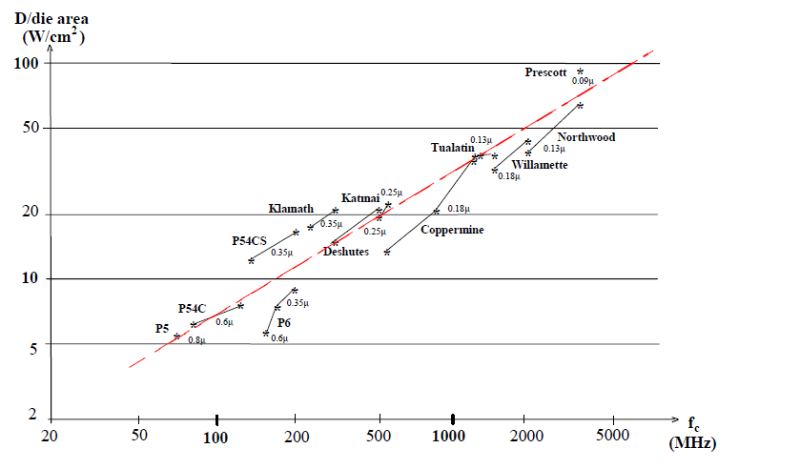
1.1 Overview of the evolution of Intel's Pentium 4 and Core 2 families (4)
Relative dissipation of Intel's x86 family of processors
Pentium 4
Pentium III
Pentium

Slide 9

1.1 Overview of the evolution of Intel's Pentium 4 and Core 2 families (5)
Intel's cancellation of 4 GHz Pentium 4 devices and subsequently the Pentium 4 line
In Oct. 2004 Intel's CEO (Chief Executing Officer) admitted that the Pentium 4 family
would not achieve 4 GHz [220]. f
Figure: In Oct. 2004 Crag Barrett, Intel's then-CEO on his knees to apologize for not achieving the
4GHz mark in front of an audience of 7000 informatics professional at the IT Expo in Orlando [220]

Slide 10
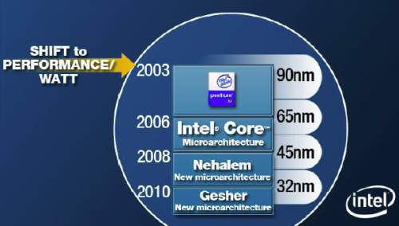
1.1 Overview of the evolution of Intel's Pentium 4 and Core 2 families (6)
Changing Intel's design paradigm to cope with raising dissipation about 2003
In 2003 Intel shifted the focus of their processor development from the pure performance goal
to the aspect of performance per watt, as stated in a slide from 4/2006, see below.
Figure 1.3: Intel’s plan to develop their manufacturing technology and processor lines
revealed at a shareholder’s meeting back in 4/2006 [74]
*

Slide 11
1.1 Overview of the evolution of Intel's Pentium 4 and Core 2 families (7)
Remark: A further change of the design paradigm for designing the mobile processors
With the advent of mobile devices (about 2006) a new design paradigm arose for those devices.
Mobile devices require long operating hours i.e. low power consumption, this is contrast to the
design paradigm of traditional processors, as indicated below.
Traditional processors
Tablets and smartphones
High performance/power
(e.g. GFLOPS/Watt)
Low power
(Watt)
(Number of operating hours)
*

Slide 12
1.1 Overview of the evolution of Intel's Pentium 4 and Core 2 families (8)
Introducing a two-phase development model (Tick-Tock model)for the Core 2 family
The two-phase model reduces the complexity of the development, as
the Tick phase focuses on the reduction of the feature size whereas
the Tock phase focuses on enhancing the microarchitecture.
*

Slide 13
1.1 Overview of the evolution of Intel's Pentium 4 and Core 2 families (9)
1. Introduction (1)
1.1.2 Overview of the evolution of Intel's Pentium 4 and Core 2 families - The generations
gen.
2. gen.
3. gen.
4. gen.
5. gen.
Core 2
New
Microarch.
65 nm
Penryn
New
Process
45 nm
Nehalem
New
Microarch.
45 nm
West-
mere
New
Process
32 nm
Sandy
Bridge
New
Microarch.
32 nm
Ivy
Bridge
New
Process
22 nm
Haswell
New
Microarchi.
22 nm
Broad-
well
New
Process
14 nm
TOCK
TICK
TOCK
TICK
TOCK
TICK
TOCK
TICK
Haifa
Oregon
Oregon
Oregon
Haifa
Haifa
Oregon
Oregon
6. gen.
7. gen.
8. gen.¹
9. gen.
¹Astonishingly, the 8th generation encompasses
beyond Kaby Lake Refresh also the
Kaby Lake G with AMD Vega graphics
Coffee Lake and
10 nm Cannon Lake designs [218].
Skylake
New
Microarch.
14 nm
Kaby Lake
New
Microarch.
14 nm
Kaby Lake
Refresh
New
Microarch.
14 nm
Ice
Lake?
New
Process
10 nm
Remark
The Haifa (Israel) Development Center
was also responsible for the 8080 and
Pentium M (Banias, Dothan, Jonah
(Core Solo/Core Duo)) processors
TOCK
TOCK
TOCK
TICK
Haifa
Haifa
Haifa

Slide 14
1.1 Overview of the evolution of Intel's Pentium 4 and Core 2 families (10)
1. Introduction (1)
Overview of the evolution of Intel's Pentium 4 and Core 2 families - the generations
gen.
2. gen.
3. gen.
4. gen.
5. gen.
Core 2
New
Microarch.
65 nm
Penryn
New
Process
45 nm
Nehalem
New
Microarch.
45 nm
West-
mere
New
Process
32 nm
Sandy
Bridge
New
Microarch.
32 nm
Ivy
Bridge
New
Process
22 nm
Haswell
New
Microarchi.
22 nm
Broad-
well
New
Process
14 nm
TOCK
TICK
TOCK
TICK
TOCK
TICK
TOCK
TICK
(2006)
(2007)
(2008)
(2010)
(2011)
(2012)
(2013)
(2014)
6. gen.
7. gen.
8. gen.¹
9. gen.
¹Astonishingly, the 8th generation encompasses
Skylake
New
Microarch.
14 nm
Kaby Lake
New
Microarch.
14 nm
Kaby Lake
Refresh
New
Microarch.
14 nm
Ice
Lake?
New
Process
10 nm
beyond Kaby Lake Refresh also the
Kaby Lake G with AMD Vega graphics
Coffee Lake and
10 nm Cannon Lake designs [218].
TOCK
TOCK
TOCK
TICK
(2015)
(2016)
(2017)
(2018)

Slide 15
1.1 Overview of the evolution of Intel's Pentium 4 and Core 2 families (11)
1. Introduction (1)
Basic designations of Intel’s processor lines
EE
gen.
4/5/6xxx
2. gen.
2xxx
3. gen.
3xxx
4. gen.
4xxx
5. gen.
5xxx
M/DT
6/7/8/9xxx
i5/i7-xxx
i3/i5/i7-xxx
Core 2
New
Microarch.
65 nm
Penryn
New
Process
45 nm
Nehalem
New
Microarch.
45 nm
West-
mere
New
Process
32 nm
Sandy
Bridge
New
Microarch.
32 nm
Ivy
Bridge
New
Process
22 nm
Haswell
New
Microarchi.
22 nm
Broad-
well
New
Process
14 nm
TOCK
TICK
TOCK
TICK
TOCK
TICK
TOCK
TICK
HED
S
X/QX 6xxx
3/5/7xxx
QX 96/97xx
3/5/7xxx
i7-965/975
3/5xxx
980/990
E7-xxx
38/39xx
E3/E5/E7-xxxx
48/49xx
v2
58/59xx
v3
68/69xx
v4
6. gen.
(6xxx)
7. gen.
(7xxx)
8. gen.¹
(8xxx)
9. gen.
M/DT
¹Astonishingly, the 8th generation encompasses
Skylake
New
Microarch.
14 nm
Kaby Lake
New
Microarch.
14 nm
Kaby Lake
Refresh
New
Microarch.
14 nm
Ice Lake?
New
Process
10 nm
beyond Kaby Lake Refresh also the
Kaby Lake G with AMD Vega graphics
Coffee Lake and
10 nm Cannon Lake designs [218].
TOCK
TOCK
TOCK
TICK
HED
S
i7-78xx/i9-79xx
v5/SP
v6

Slide 16
1.1 Overview of the evolution of Intel's Pentium 4 and Core 2 families (12)
Basic microarchitectures and their related shrinks
Considered from the Pentium 4 Prescott core (the third core of Pentium 4) on.
Basic architectures | Basic architectures and their shrinks
Pentium 4 (Prescott) | 2005 90 nm Pentium 4 2006 65 nm Pentium 4
Core 2 | 2006 65 nm Core 2 2007 45 nm Penryn
Nehalem | 2008 45 nm Nehalem 2010 32 nm Westmere
Sandy Bridge | 2011 32 nm Sandy Bridge 2012 22 nm Ivy Bridge
Haswell | 2013 22 nm Haswell 2014 14 nm Broadwell
Skylake | 2015 14 nm Skylake 14 nm Kaby Lake 14 nm Coffee Lake 10 nm Cannon Lake
Icelake | 2019? 10 nm Icelake

Slide 17
1.1 Overview of the evolution of Intel's Pentium 4 and Core 2 families (13)
Evolution of Intel’s IC technology
Pentium 4
Willamette
nm
200
180 nm
Pentium 4
Northwood
180
11/00
01/02
160
Pentium 4
Prescott
140
130 nm
02/04
120
Pentium 4
Cedar Mill
100
90 nm
01/06
80
Penryn
65 nm
11/07
Westmere
60
45 nm
01/10
Ivy Bridge
40
32 nm
04/12
Broadwell
Cannon lake
22 nm
09/14
14 nm
2H/17
20
10 nm
0
2000
2002
2004
2006
2008
2010
2012
2014
2016
2018
2018
On Intel’s Q2 2015 earnings conference call, on July 16 2015, Krzanich, Intel's CEO (Chief Executive Officer) told:
in the second half of 2017, we expect to launch our first 10-nanometer product, code named Cannonlake.
The last two technology transitions have signaled that our cadence today is closer to 2.5 years than two“ [180].
*

Slide 18
1.1 Overview of the evolution of Intel's Pentium 4 and Core 2 families (14)
Intel’s two-phase development model (Tick-Tock model) used for the Core 2 lines -21
Key new features of the ISP
and the microarchitecture
2 YEARS
TICK Pentium 4 ( Cedar Mill)
Pentium D (Presler)
01/2006
2 YEARS
65nm
New microarch.: 4-wide core,
128-bit SIMD FX/FP EUs,
shared L2 , no HT
TOCK Core 2
07/2006
TICK Penryn Family
11/2007
2 YEARS
45nm
New microarch.: 4 cores, integr. MC,
QPI, private L2, (inclusive) L3, HT
TOCK Nehalem
11/2008
TICK Westmere
01/2010
In package integrated GPU
2 YEARS
32nm
New microarch.: 256-bit (FP) AVX,
ring bus, integrated GPU
TOCK Sandy Bridge
01/2011
TICK Ivy Bridge
04/2012
2 YEARS
22nm
New microarch.: 256-bit (FX) AVX2,
L4 cache (discrete eDRAM), TSX
TOCK Haswell
06/2013
TICK Broadwell
09/2014
Shared Virtual Memory
4 YEARS
TOCK Skylake
10/2015
New microarch.: 5-wide core,
ISP, Memory Side L4 cache
14nm
TOCK Kaby Lake
08/2016
Optane memory, in KBL G series:
in package integr. CPU, GPU, HBM2
TOCK Coffee Lake
10/2017
(USB Gen. 2, integr. conn., Optane 2)
TICK Cannonlake
05/2018
AVX512
?? YEARS
10nm
TOCK Icelake
??/2019
Figure is based on [3])
*

Slide 19
1.1 Overview of the evolution of Intel's Pentium 4 and Core 2 families (14b)
Intel’s two-phase development model (Tick-Tock model) used for the Core 2 lines -21
Key new features of the ISP
and the microarchitecture
2 YEARS
TICK Pentium 4 ( Cedar Mill)
Pentium D (Presler)
01/2006
2 YEARS
65nm
New microarch.: 4-wide core,
TOCK Core 2
07/2006
TICK Penryn Family
11/2007
2 YEARS
45nm
TOCK Nehalem
11/2008
TICK Westmere
01/2010
2 YEARS
32nm
TOCK Sandy Bridge
01/2011
TICK Ivy Bridge
04/2012
2 YEARS
22nm
TOCK Haswell
06/2013
TICK Broadwell
09/2014
4 YEARS
TOCK Skylake
10/2015
New microarch.: 5-wide core,
14nm
TOCK Kaby Lake
08/2016
TOCK Coffee Lake
10/2017
TICK Cannonlake
05/2018
?? YEARS
10nm
TOCK Icelake
??/2019
Figure is based on [3])
*

Slide 20
1.1 Overview of the evolution of Intel's Pentium 4 and Core 2 families (14c)
Intel’s two-phase development model (Tick-Tock model) used for the Core 2 lines -21
Key new features of the ISP
and the microarchitecture
2 YEARS
TICK Pentium 4 ( Cedar Mill)
Pentium D (Presler)
01/2006
2 YEARS
65nm
128-bit SIMD FX/FP EUs,
TOCK Core 2
07/2006
TICK Penryn Family
11/2007
2 YEARS
45nm
TOCK Nehalem
11/2008
TICK Westmere
01/2010
2 YEARS
32nm
New microarch.: 256-bit (FP) AVX,
TOCK Sandy Bridge
01/2011
TICK Ivy Bridge
04/2012
2 YEARS
22nm
New microarch.: 256-bit (FX) AVX2,
TOCK Haswell
06/2013
TICK Broadwell
09/2014
4 YEARS
TOCK Skylake
10/2015
14nm
TOCK Kaby Lake
08/2016
TOCK Coffee Lake
10/2017
TICK Cannonlake
05/2018
AVX512
?? YEARS
10nm
TOCK Icelake
??/2019
Figure is based on [3])
*

Slide 21
1.1 Overview of the evolution of Intel's Pentium 4 and Core 2 families (14d)
Intel’s two-phase development model (Tick-Tock model) used for the Core 2 lines -21
Key new features of the ISP
and the microarchitecture
2 YEARS
TICK Pentium 4 ( Cedar Mill)
Pentium D (Presler)
01/2006
2 YEARS
65nm
shared L2
TOCK Core 2
07/2006
TICK Penryn Family
11/2007
2 YEARS
45nm
, private L2, (inclusive) L3
TOCK Nehalem
11/2008
TICK Westmere
01/2010
2 YEARS
32nm
TOCK Sandy Bridge
01/2011
TICK Ivy Bridge
04/2012
2 YEARS
22nm
L4 cache (discrete eDRAM)
TOCK Haswell
06/2013
TICK Broadwell
09/2014
4 YEARS
TOCK Skylake
10/2015
Memory Side L4 cache
14nm
TOCK Kaby Lake
08/2016
TOCK Coffee Lake
10/2017
TICK Cannonlake
05/2018
?? YEARS
10nm
TOCK Icelake
??/2019
Figure is based on [3])
*

Slide 22
1.1 Overview of the evolution of Intel's Pentium 4 and Core 2 families (14e)
Intel’s two-phase development model (Tick-Tock model) used for the Core 2 lines -21
Key new features of the ISP
and the microarchitecture
2 YEARS
TICK Pentium 4 ( Cedar Mill)
Pentium D (Presler)
01/2006
2 YEARS
65nm
no HT
TOCK Core 2
07/2006
TICK Penryn Family
11/2007
2 YEARS
45nm
HT
TOCK Nehalem
11/2008
TICK Westmere
01/2010
2 YEARS
32nm
TOCK Sandy Bridge
01/2011
TICK Ivy Bridge
04/2012
2 YEARS
22nm
TOCK Haswell
06/2013
TICK Broadwell
09/2014
4 YEARS
TOCK Skylake
10/2015
14nm
TOCK Kaby Lake
08/2016
TOCK Coffee Lake
10/2017
TICK Cannonlake
05/2018
?? YEARS
10nm
TOCK Icelake
??/2019
Figure is based on [3])
*

Slide 23
1.1 Overview of the evolution of Intel's Pentium 4 and Core 2 families (14f)
Intel’s two-phase development model (Tick-Tock model) used for the Core 2 lines -21
Key new features of the ISP
and the microarchitecture
2 YEARS
TICK Pentium 4 ( Cedar Mill)
Pentium D (Presler)
01/2006
2 YEARS
65nm
TOCK Core 2
07/2006
TICK Penryn Family
11/2007
2 YEARS
45nm
TOCK Nehalem
11/2008
TICK Westmere
01/2010
2 YEARS
32nm
integrated GPU
TOCK Sandy Bridge
01/2011
TICK Ivy Bridge
04/2012
2 YEARS
22nm
TOCK Haswell
06/2013
TICK Broadwell
09/2014
4 YEARS
TOCK Skylake
10/2015
ISP
14nm
TOCK Kaby Lake
08/2016
TOCK Coffee Lake
10/2017
TICK Cannonlake
05/2018
?? YEARS
10nm
TOCK Icelake
??/2019
Figure is based on [3])
*

Slide 24
1.1 Overview of the evolution of Intel's Pentium 4 and Core 2 families (15)
Intel’s two-phase development model (Tick-Tock model) used for the Core 2 lines -2
Key new features
in power management
2 YEARS
TICK Pentium 4 ( Cedar Mill)
Pentium D (Presler)
01/2006
2 YEARS
65nm
Clock gating, PECI,
Platform Thermal Control by
3. party controller
TOCK Core 2
07/2006
2 YEARS
TICK Penryn Family
11/2007
EDAT
45nm
Integrated Power Gates, PCU,
Turbo Boost
TOCK Nehalem
11/2008
TICK Westmere
01/2010
2 YEARS
32nm
TOCK Sandy Bridge
01/2011
Turbo Boost 2.0
2 YEARS
TICK Ivy Bridge
04/2012
22nm
FIVR
TOCK Haswell
06/2013
TICK Broadwell
09/2014
2. gen. FIVR
Speed Shift Technology,
Duty Cycle control, No FIVR
(except Skylake X)
4 YEARS
TOCK Skylake
10/2015
14nm
TOCK Kaby Lake
08/2016
Speed Shift Technology v2
TOCK Coffee Lake
10/2017
In H-series: TVB
(Thermal Velocity Boost)
TICK Cannonlake
05/2018
10nm
TOCK Icelake
??/2019
Figure is based on [3])
*

Slide 25
1.1 Overview of the evolution of Intel's Pentium 4 and Core 2 families (15b)
Intel’s two-phase development model (Tick-Tock model) used for the Core 2 lines -2
Key new features
in power management
2 YEARS
TICK Pentium 4 ( Cedar Mill)
Pentium D (Presler)
01/2006
2 YEARS
65nm
Clock gating
TOCK Core 2
07/2006
2 YEARS
TICK Penryn Family
11/2007
45nm
Integrated Power Gates
TOCK Nehalem
11/2008
TICK Westmere
01/2010
2 YEARS
32nm
TOCK Sandy Bridge
01/2011
2 YEARS
TICK Ivy Bridge
04/2012
22nm
TOCK Haswell
06/2013
TICK Broadwell
09/2014
4 YEARS
TOCK Skylake
10/2015
14nm
TOCK Kaby Lake
08/2016
TOCK Coffee Lake
10/2017
TICK Cannonlake
05/2018
10nm
TOCK Icelake
??/2019
Figure is based on [3])
*

Slide 26
1.1 Overview of the evolution of Intel's Pentium 4 and Core 2 families (15c)
Intel’s two-phase development model (Tick-Tock model) used for the Core 2 lines -2
Key new features
in power management
2 YEARS
TICK Pentium 4 ( Cedar Mill)
Pentium D (Presler)
01/2006
2 YEARS
65nm
PECI,
Platform Thermal Control by
3. party controller
TOCK Core 2
07/2006
2 YEARS
TICK Penryn Family
11/2007
45nm
PCU
TOCK Nehalem
11/2008
TICK Westmere
01/2010
2 YEARS
32nm
TOCK Sandy Bridge
01/2011
2 YEARS
TICK Ivy Bridge
04/2012
22nm
TOCK Haswell
06/2013
TICK Broadwell
09/2014
Speed Shift Technology,
Duty Cycle control,
4 YEARS
TOCK Skylake
10/2015
14nm
TOCK Kaby Lake
08/2016
Speed Shift Technology v2
TOCK Coffee Lake
10/2017
TICK Cannonlake
05/2018
10nm
TOCK Icelake
??/2019
Figure is based on [3])
*

Slide 27
1.1 Overview of the evolution of Intel's Pentium 4 and Core 2 families (15d)
Intel’s two-phase development model (Tick-Tock model) used for the Core 2 lines -2
Key new features
in power management
2 YEARS
TICK Pentium 4 ( Cedar Mill)
Pentium D (Presler)
01/2006
2 YEARS
65nm
TOCK Core 2
07/2006
2 YEARS
TICK Penryn Family
11/2007
EDAT
45nm
Turbo Boost
TOCK Nehalem
11/2008
TICK Westmere
01/2010
2 YEARS
32nm
TOCK Sandy Bridge
01/2011
Turbo Boost 2.0
2 YEARS
TICK Ivy Bridge
04/2012
22nm
TOCK Haswell
06/2013
TICK Broadwell
09/2014
4 YEARS
TOCK Skylake
10/2015
14nm
TOCK Kaby Lake
08/2016
TOCK Coffee Lake
10/2017
TICK Cannonlake
05/2018
10nm
TOCK Icelake
??/2019
Figure is based on [3])
*

Slide 28
1.1 Overview of the evolution of Intel's Pentium 4 and Core 2 families (15e)
Intel’s two-phase development model (Tick-Tock model) used for the Core 2 lines -2
Key new features
in power management
2 YEARS
TICK Pentium 4 ( Cedar Mill)
Pentium D (Presler)
01/2006
2 YEARS
65nm
TOCK Core 2
07/2006
2 YEARS
TICK Penryn Family
11/2007
45nm
TOCK Nehalem
11/2008
TICK Westmere
01/2010
2 YEARS
32nm
TOCK Sandy Bridge
01/2011
2 YEARS
TICK Ivy Bridge
04/2012
22nm
FIVR
TOCK Haswell
06/2013
TICK Broadwell
09/2014
2. gen. FIVR
No FIVR
(except Skylake X)
4 YEARS
TOCK Skylake
10/2015
14nm
TOCK Kaby Lake
08/2016
TOCK Coffee Lake
10/2017
TICK Cannonlake
05/2018
10nm
TOCK Icelake
??/2019
Figure is based on [3])
*

Slide 29
1.1 Overview of the evolution of Intel's Pentium 4 and Core 2 families (16)
Raising of the single thread IPC in Intel’s basic architectures (Based on [195])
2
24%
22%
Per Generation
1.9
20%
Cumulative
1.8
18%
1.7
16%
1.6
14%
12%
1.5
10%
1.4
8%
1.3
6%
1.2
4%
2%
1.1
0%
1
Pentium M
Dothan
Core 2
Penryn
NHM
(w/o SMT)
WSM
SNB
IVB
HSW
BRW
SKL
Note that Intel raised IPC in the Core family only less then 2-times in about 10 years.
Tock models contribute by about 10 %, Tick models by about 5 % for raising IPC.
*

Slide 30
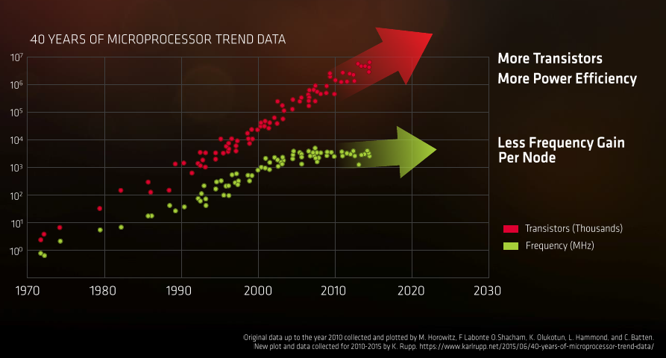
1.1 Overview of the evolution of Intel's Pentium 4 and Core 2 families (17)
General implications of the evolution of transistor technology [245]
Presentation at AMD's Financial Analyst Day May 16 2017
*

Slide 31

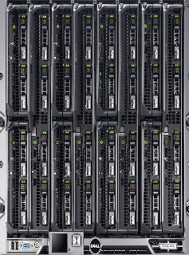
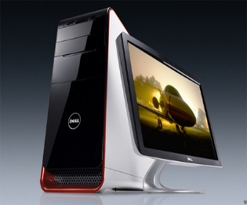
1.1 Overview of the evolution of Intel's Pentium 4 and Core 2 families (18)
Recent processor categories of Intel
Servers
HEDs
(High-End Desktops)
Desktops/Laptops
(Client computing)
Tablets
Smartphones
Desktops
Xeon E7/E5/E3
Platinum/Gold etc.
Core i7/i9
(Extreme Edition
or X models)
Core i7/i5/i3
(Basic architectures)
Atom lines
(+ LP Core models)
Atom lines
Smarphones
C a n c e l l e d i n 2 0 1 6
Smarphones
Laptops
Tablets
Servers
High-End Desktops
Desktops
Laptops
Tablets
Smartphones
Servers
High-End Desktops
Desktops
Typical config.
Up to 28C
2C - 18C
2C - 6C + G
(Up to 4C - 10C + G)
(by other vendors)
*

Slide 32
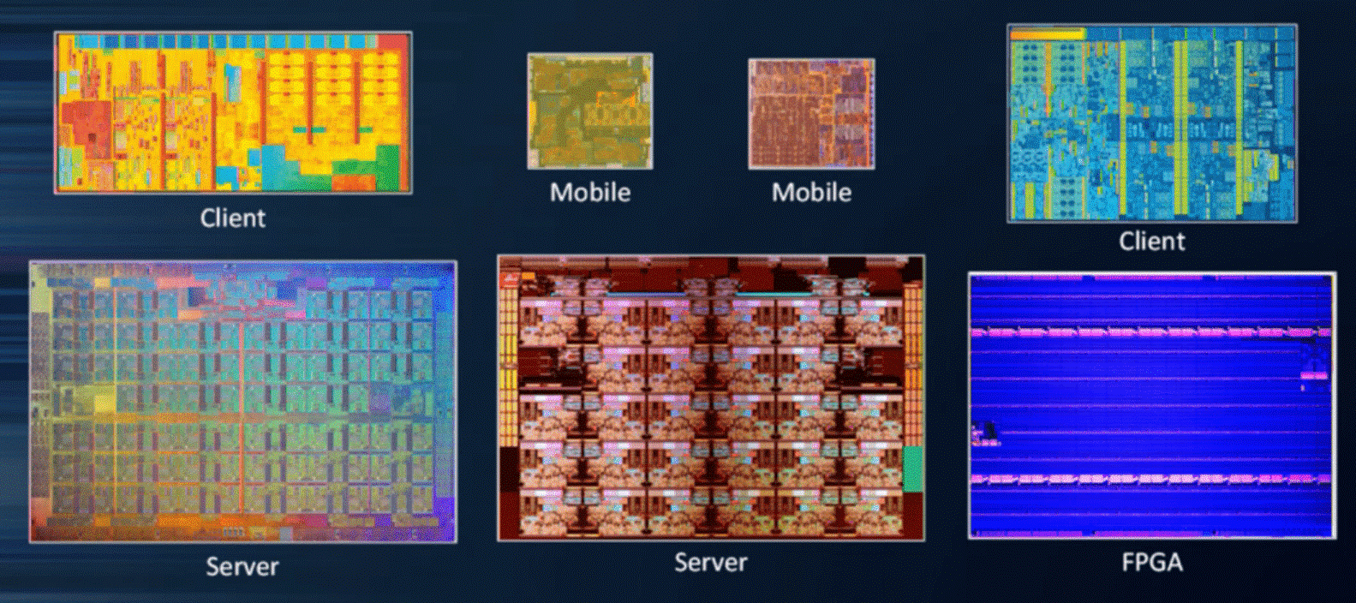
1.1 Overview of the evolution of Intel's Pentium 4 and Core 2 families (19)
14 nm dies of Intel's different processor categories (not on scale) [247]
Broadwell (2C, 82 mm²)
Skylake (4C, 122 mm²)
Knights Landing (72C, ~680 mm²)
Skylake-SP (28C, ~680 mm²)

Slide 33

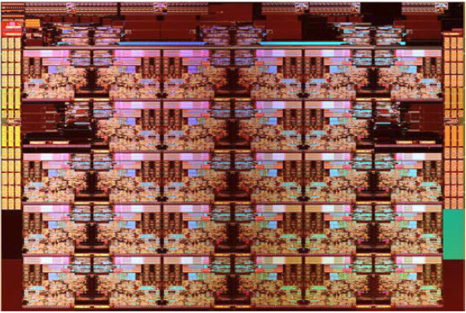
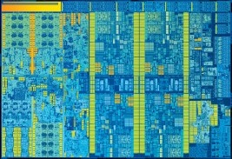
1.1 Overview of the evolution of Intel's Pentium 4 and Core 2 families (19)
14 nm dies of Intel's different processor categories (approximately on scale)
[247]
Broadwell (2C, 82 mm²)
Skylake-SP (28C, ~680 mm²)
Skylake (4C, 122 mm²)

Slide 34
1.2 Evolution of desktop and laptop processors
Notes:
34

Slide 35
1.2 Evolution of desktop and laptop processors (1)
1.2 Evolution of desktop and laptop processors
Recent processor categories of Intel
Servers
HEDs
(High-End Desktops)
Desktops/Laptops
(Client computing)
Tablets
Smartphones
Desktops
Xeon E7/E5/E3
Platinum/Gold etc.
Core i7/i9
(Extreme Edition
or X models)
Core i7/i5/i3
(Basic architectures)
Atom lines
(+ LP Core models)
Atom lines
Smarphones
Smarphones
Laptops
Tablets
Servers
High-End Desktops
Desktops
Laptops
Tablets
Smartphones
Servers
High-End Desktops
Desktops

Slide 36
1.2 Evolution of desktop and laptop processors (2)
Intel’s Core-based mainstream DT platforms
Designation of the platform | Platform topology | Processor | Technology | Max. no. of cores (n_{C}) | Year of introduction | Processor socket | MCH/PCH | Highest mem./ speed | No. of mem. channels
Anchor Creek | Off-die MC | Pentium D | 90 nm | 2x1 | 5/2005 | LGA 775 | 945-955 | DD2-667 | 2
Bridge Creek |  | Core 2 | 65 nm | 2C | 6/2006 | LGA 775 | 945-975 | DDR2-800 | 2
Salt Creek |  | Core 2 Quad | 65 nm | 2x2C | 6/2007 | LGA 775 | 3 Series (Bearlake) | DDR3-1067 | 2
Boulder Creek |  | Penryn | 45 nm | 2x2C | 6/2008 | LGA 775 | 4 Series (Eaglelake) | DDR3-1067 | 2
Kings Creek | On-die MC | 2. G. Nehalem (Lynnfield) | 45 nm | 4C | 9/2009 | LGA 1156 | 5 Series (Ibex Peak) | DDR3-1333 | 2
 |  | Westmere (Clarkdale) | 32 nm | 2C+G | 1/2010 | LGA 1156 | 5 Series (Ibex Peak)
 |  | Sandy Bridge | 32 nm | 2C/4C+G | 1/2011 | LGA 1155 | 6 series (Cougar Point) | DDR3-1333 | 2
Sugar Bay
Maho Bay |  | Ivy Bridge | 22 nm | 4C +G | 4/2012 | LGA 1155 | 7 series (Panther Point) | DDR3-1600 | 2
Shark Bay |  | Haswell | 22 nm | 4C+G | 6/2013 | LGA 1155 | 8 Series (Lynx Point) | DDR3-1600 | 2
 |  | Haswell refresh | 22 nm | 4C+G | 5/2014 | LGA 1150 | 9 Series (Wild Cat Point) | DDR3-1666
 |  | Broadwell | 14 nm | 4C+G | 6/2015 | LGA 1150 | 9 Series (Wild Cat Point) | DDR3-1866
 |  | Skylake | 14 nm | 4C+G | 10/2015 | LGA 1151 | Series (Sunrise Point) | DDR4-2133 | 2
 |  | Kaby Lake | 14 nm | 4C + G | 8/2016 | LGA 1151 | 200 Series | DDR4-2400 | 2
 |  | Coffee Lake | 14 nm | 6C+G | 10/2017 | LGA 1151 | 300 Series | DDR4-2666 | 2

Slide 37
1.2 Evolution of desktop and laptop processors (3)
Max. number of cores
Designation of the platform | Platform topology | Processor | Technology | Max. no. of cores (n_{C}) | Year of introduction | Processor socket | MCH/PCH | Highest mem./ speed | No. of mem. channels
Anchor Creek | Off-die MC | Pentium D | 90 nm | 2x1 | 5/2005 | LGA 775 | 945-955 | DD2-667 | 2
Bridge Creek |  | Core 2 | 65 nm | 2C | 6/2006 | LGA 775 | 945-975 | DDR2-800 | 2
Salt Creek |  | Core 2 Quad | 65 nm | 2x2C | 6/2007 | LGA 775 | 3 Series (Bearlake) | DDR3-1067 | 2
Boulder Creek |  | Penryn | 45 nm | 2x2C | 6/2008 | LGA 775 | 4 Series (Eaglelake) | DDR3-1067 | 2
Kings Creek | On-die MC | 2. G. Nehalem (Lynnfield) | 45 nm | 4C | 9/2009 | LGA 1156 | 5 Series (Ibex Peak) | DDR3-1333 | 2
 |  | Westmere (Clarkdale) | 32 nm | 2C+G | 1/2010 | LGA 1156 | 5 Series (Ibex Peak)
 |  | Sandy Bridge | 32 nm | 2C/4C+G | 1/2011 | LGA 1155 | 6 series (Cougar Point) | DDR3-1333 | 2
Sugar Bay
Maho Bay |  | Ivy Bridge | 22 nm | 4C +G | 4/2012 | LGA 1155 | 7 series (Panther Point) | DDR3-1600 | 2
Shark Bay |  | Haswell | 22 nm | 4C+G | 6/2013 | LGA 1155 | 8 Series (Lynx Point) | DDR3-1600 | 2
 |  | Haswell refresh | 22 nm | 4C+G | 5/2014 | LGA 1150 | 9 Series (Wild Cat Point) | DDR3-1666
 |  | Broadwell | 14 nm | 4C+G | 6/2015 | LGA 1150 | 9 Series (Wild Cat Point) | DDR3-1866
 |  | Skylake | 14 nm | 4C+G | 10/2015 | LGA 1151 | Series (Sunrise Point) | DDR4-2133 | 2
 |  | Kaby Lake | 14 nm | 4C + G | 8/2016 | LGA 1151 | 200 Series | DDR4-2400 | 2
 |  | Coffee Lake | 14 nm | 6C +G | 10/2017 | LGA 1151 | 300 Series | DDR4-2666 | 2

Slide 38
1.2 Evolution of desktop and laptop processors (4)
Number of memory channels
Designation of the platform | Platform topology | Processor | Technology | Max. no. of cores (n_{C}) | Year of introduction | Processor socket | MCH/PCH | Highest mem./ speed | No. of mem. channels
Anchor Creek | Off-die MC | Pentium D | 90 nm | 2x1 | 5/2005 | LGA 775 | 945-955 | DD2-667 | 2
Bridge Creek |  | Core 2 | 65 nm | 2C | 6/2006 | LGA 775 | 945-975 | DDR2-800 | 2
Salt Creek |  | Core 2 Quad | 65 nm | 2x2C | 6/2007 | LGA 775 | 3 Series (Bearlake) | DDR3-1067 | 2
Boulder Creek |  | Penryn | 45 nm | 2x2C | 6/2008 | LGA 775 | 4 Series (Eaglelake) | DDR3-1067 | 2
Kings Creek | On-die MC | 2. G. Nehalem (Lynnfield) | 45 nm | 4C | 9/2009 | LGA 1156 | 5 Series (Ibex Peak) | DDR3-1333 | 2
 |  | Westmere (Clarkdale) | 32 nm | 2C+G | 1/2010 | LGA 1156 | 5 Series (Ibex Peak)
 |  | Sandy Bridge | 32 nm | 2C/4C+G | 1/2011 | LGA 1155 | 6 series (Cougar Point) | DDR3-1333 | 2
Sugar Bay
Maho Bay |  | Ivy Bridge | 22 nm | 4C +G | 4/2012 | LGA 1155 | 7 series (Panther Point) | DDR3-1600 | 2
Shark Bay |  | Haswell | 22 nm | 4C+G | 6/2013 | LGA 1155 | 8 Series (Lynx Point) | DDR3-1600 | 2
 |  | Haswell refresh | 22 nm | 4C+G | 5/2014 | LGA 1150 | 9 Series (Wild Cat Point) | DDR3-1666
 |  | Broadwell | 14 nm | 4C+G | 6/2015 | LGA 1150 | 9 Series (Wild Cat Point) | DDR3-1866
 |  | Skylake | 14 nm | 4C+G | 10/2015 | LGA 1151 | Series (Sunrise Point) | DDR4-2133 | 2
 |  | Kaby Lake | 14 nm | 4C + G | 8/2016 | LGA 1151 r1 | 200 Series (Union Point) | DDR4-2400 | 2
 |  | Coffee Lake | 14 nm | 6C +G | 10/2017 | LGA 1151 r2 | 300 Series | DDR4-2666 | 2

Slide 39
1.2 Evolution of desktop and laptop processors (5)
Platform topology
Designation of the platform | Platform topology | Processor | Technology | Max. no. of cores (n_{C}) | Year of introduction | Processor socket | MCH/PCH | Highest mem./ speed | No. of mem. channels
Anchor Creek | Off-die MC | Pentium D | 90 nm | 2x1 | 5/2005 | LGA 775 | 945-955 | DD2-667 | 2
Bridge Creek |  | Core 2 | 65 nm | 2C | 6/2006 | LGA 775 | 945-975 | DDR2-800 | 2
Salt Creek |  | Core 2 Quad | 65 nm | 2x2C | 6/2007 | LGA 775 | 3 Series (Bearlake) | DDR3-1067 | 2
Boulder Creek |  | Penryn | 45 nm | 2x2C | 6/2008 | LGA 775 | 4 Series (Eaglelake) | DDR3-1067 | 2
Kings Creek | On-die MC | 2. G. Nehalem (Lynnfield) | 45 nm | 4C | 9/2009 | LGA 1156 | 5 Series (Ibex Peak) | DDR3-1333 | 2
 |  | Westmere (Clarkdale) | 32 nm | 2C+G | 1/2010 | LGA 1156 | 5 Series (Ibex Peak)
 |  | Sandy Bridge | 32 nm | 2C/4C+G | 1/2011 | LGA 1155 | 6 series (Cougar Point) | DDR3-1333 | 2
Sugar Bay
Maho Bay |  | Ivy Bridge | 22 nm | 4C +G | 4/2012 | LGA 1155 | 7 series (Panther Point) | DDR3-1600 | 2
Shark Bay |  | Haswell | 22 nm | 4C+G | 6/2013 | LGA 1155 | 8 Series (Lynx Point) | DDR3-1600 | 2
 |  | Haswell refresh | 22 nm | 4C+G | 5/2014 | LGA 1150 | 9 Series (Wild Cat Point) | DDR3-1666
 |  | Broadwell | 14 nm | 4C+G | 6/2015 | LGA 1150 | 9 Series (Wild Cat Point) | DDR3-1866
 |  | Skylake | 14 nm | 4C+G | 10/2015 | LGA 1151 | Series (Sunrise Point) | DDR4-2133 | 2
 |  | Kaby Lake | 14 nm | 4C + G | 8/2016 | LGA 1151 | 200 Series | DDR4-2400 | 2
 |  | Coffee Lake | 14 nm | 6C +G | 10/2017 | LGA 1151 | 300 Series | DDR4-2666 | 2

Slide 40
1.2 Evolution of desktop and laptop processors (6)
Changing the basic platform topology of MP platforms from SMP to NUMA -2
Basic platform topologies of multiprocessors
classified according to their memory architecture
SMPs
(Symmetrical MultiProcessor)
NUMAs
Multiprocessors (Multi socket system)
with Uniform Memory Access (UMA)
Multiprocessors (Multi socket system)
with Non-Uniform Memory Access
All processors access main memory by the same
mechanism, (e.g. by individual FSBs and an MCH).
A particular part of the main memory can be accessed
by each processor immediately, other parts remotely.
Typical examples
Processor
Processor
Processor
QPI
Processor
QPI
QPI
FSB
E.g. DDR3-1333
IOH¹
E.g. DDR3-1333
MCH
E.g. DDR2-533
ESI
ESI
ICH
ICH
¹ICH: I/O hub
ESI: Enterprise System Interface
*

Slide 41
1.2 Evolution of desktop and laptop processors (7)
Speeding up the memory rate
Designation of the platform | Platform topology | Processor | Technology | Max. no. of cores (n_{C}) | Year of introduction | Processor socket | MCH/PCH | Highest mem./ speed | No. of mem. channels
Anchor Creek | Off-die MC (SMP) | Pentium D | 90 nm | 2x1 | 5/2005 | LGA 775 | 945-955 | DD2-667 | 2
Bridge Creek |  | Core 2 | 65 nm | 2C | 6/2006 | LGA 775 | 945-975 | DDR2-800 | 2
Salt Creek |  | Core 2 Quad | 65 nm | 2x2C | 6/2007 | LGA 775 | 3 Series (Bearlake) | DDR3-1067 | 2
Boulder Creek |  | Penryn | 45 nm | 2x2C | 6/2008 | LGA 775 | 4 Series (Eaglelake) | DDR3-1067 | 2
Kings Creek | On-die MC (NUMA) | 2. G. Nehalem (Lynnfield) | 45 nm | 4C | 9/2009 | LGA 1156 | 5 Series (Ibex Peak) | DDR3-1333 | 2
 |  | Westmere (Clarkdale) | 32 nm | 2C+G | 1/2010 | LGA 1156 | 5 Series (Ibex Peak)
 |  | Sandy Bridge | 32 nm | 2C/4C+G | 1/2011 | LGA 1155 | 6 series (Cougar Point) | DDR3-1333 | 2
Sugar Bay
 |  | Ivy Bridge | 22 nm | 4C +G | 4/2012 | LGA 1155 | 7 series (Panther Point) | DDR3-1600 | 2
 |  | Haswell | 22 nm | 4C+G | 6/2013 | LGA 1155 | 8 Series (Lynx Point) | DDR3-1600 | 2
 |  | Haswell refresh | 22 nm | 4C+G | 5/2014 | LGA 1150 | 9 Series (Wild Cat Point) | DDR3-1666
 |  | Broadwell | 14 nm | 4C+G | 6/2015 | LGA 1150 | 9 Series (Wild Cat Point) | DDR3-1866
 |  | Skylake | 14 nm | 4C+G | 10/2015 | LGA 1151 | Series (Sunrise Point) | DDR4-2133 | 2
 |  | Kaby Lake | 14 nm | 4C + G | 8/2016 | LGA 1151 | 200 Series | DDR4-2400 | 2
 |  | Coffee Lake | 14 nm | 6C? +G | 10/2017 | LGA 1151 | 300 Series | DDR4-2666 ? | 2

Slide 42
1.2 Evolution of desktop and laptop processors (8)
Key features of the evolution of Intel’s Core-based mainstream DT platforms
Their core count rose soon (already in 2007) to 4 and remain at this figure.
Two memory channels are used to connect memory.
Memory is connected up to the Penryn via the MCH thereafter immediately via the processor.
In a 10 year period memory speed rose about three to four times.
*

Slide 43
1.2 Evolution of desktop and laptop processors (9)
Evolution of main features of Intel’s graphics families (based on [174]) -1
Intel Core generation | Graphics generation | Models | Graphics Technology level | No. of graphics slices | No. of EUs | eDRAM | OpenGL version | DirectX version | OpenCL version
Westmere | 5th (Ironlake) | HD |  |  | 12 | -- | 2.1 | 10.1 | n.a.
Sandy Bridge | 6th | HD 2000 | GT1 | 1 (2x3 EU) | 6 |  | 3.1/3.3 | 10.1 | n.a.
 |  | HD 3000 | GT2 | 1 (4x3 EU) | 12
Ivy Bridge | 7th | HD 2500 | GT1 | 1 (6 EU) | 6 | -- | 4.0 | 11.0 | 1.2
 |  | HD 4000 | GT2 | 1 (2x8 EU) | 16
Haswell | 7.5th | HD 4200- HD 4700 | GT2 | 1 (2x10 EU) | 20 | -- | 4.3 | 11.1 | 1.2
 |  | HD 5000 Iris 5100 | GT3 | 2 | 40
 |  | Iris Pro 5200 |  |  |  | 128 MB
Broadwell | 8th | HD 5300- HD 5600 | GT2 | 1 (3x8 EU) | 23/24 | -- | 4.3 | 11.2 | 2.0
 |  | HD 6000 Iris 6100 | GT3 | 2 | 47/48
 |  | Iris Pro 6200 | GT3e | 2 | 48 | 128 MB
Skylake | 9th | HD 510 | GT1 | 1 (3x4 EU) | 12 | -- | 4.4 | 12 | 2.0
 |  | HD 515 | GT1.5 | 1 (3x6 EU) | 18
 |  | HD 520 | GT2 | 1 (3x8 EU) | 24
 |  | HD 535 | GT3 | 2 | 48
 |  | HD 540 | GT3e | 2 | 48 | 64 MB
 |  | HD 580 | GT4e | 3 | 72 | 64/128 MB

Slide 44
1.2 Evolution of desktop and laptop processors (10)
Evolution of main features of Intel’s graphics families (based on [174]) -2
Intel Core generation | Graphics generation | Models | Graphics Technology level | No. of graphics slices | No. of EUs | eDRAM | OpenGL version | DirectX version | OpenCL version
Westmere | 5th (Ironlake) | HD |  |  | 12 | -- | 2.1 | 10.1 | n.a.
Sandy Bridge | 6th | HD 2000 | GT1 | 1 (2x3 EU) | 6 |  | 3.1/3.3 | 10.1 | n.a.
 |  | HD 3000 | GT2 | 1 (4x3 EU) | 12
Ivy Bridge | 7th | HD 2500 | GT1 | 1 (6 EU) | 6 | -- | 4.0 | 11.0 | 1.2
 |  | HD 4000 | GT2 | 1 (2x8 EU) | 16
Haswell | 7.5th | HD 4200- HD 4700 | GT2 | 1 (2x10 EU) | 20 | -- | 4.3 | 11.1 | 1.2
 |  | HD 5000 Iris 5100 | GT3 | 2 | 40
 |  | Iris Pro 5200 |  |  |  | 128 MB
Broadwell | 8th | HD 5300- HD 5600 | GT2 | 1 (3x8 EU) | 23/24 | -- | 4.3 | 11.2 | 2.0
 |  | HD 6000 Iris 6100 | GT3 | 2 | 47/48
 |  | Iris Pro 6200 | GT3e | 2 | 48 | 128 MB
Skylake | 9th | HD 510 | GT1 | 1 (3x4 EU) | 12 | -- | 4.4 | 12 | 2.0
 |  | HD 515 | GT1.5 | 1 (3x6 EU) | 18
 |  | HD 520 | GT2 | 1 (3x8 EU) | 24
 |  | HD 535 | GT3 | 2 | 48
 |  | HD 540 | GT3e | 2 | 48 | 64 MB
 |  | HD 580 | GT4e | 3 | 72 | 64/128 MB

Slide 45
1.2 Evolution of desktop and laptop processors (11)
Evolution of main features of Intel’s graphics families (based on [174]) -3
Intel Core generation | Graphics generation | Models | Graphics Technology level | No. of graphics slices | No. of EUs | eDRAM | OpenGL version | DirectX version | OpenCL version
Westmere | 5th (Ironlake) | HD |  |  | 12 | -- | 2.1 | 10.1 | n.a.
Sandy Bridge | 6th | HD 2000 | GT1 | 1 (2x3 EU) | 6 |  | 3.1/3.3 | 10.1 | n.a.
 |  | HD 3000 | GT2 | 1 (4x3 EU) | 12
Ivy Bridge | 7th | HD 2500 | GT1 | 1 (6 EU) | 6 | -- | 4.0 | 11.0 | 1.2
 |  | HD 4000 | GT2 | 1 (2x8 EU) | 16
Haswell | 7.5th | HD 4200- HD 4700 | GT2 | 1 (2x10 EU) | 20 | -- | 4.3 | 11.1 | 1.2
 |  | HD 5000 Iris 5100 | GT3 | 2 | 40
 |  | Iris Pro 5200 |  |  |  | 128 MB
Broadwell | 8th | HD 5300- HD 5600 | GT2 | 1 (3x8 EU) | 23/24 | -- | 4.3 | 11.2 | 2.0
 |  | HD 6000 Iris 6100 | GT3 | 2 | 47/48
 |  | Iris Pro 6200 | GT3e | 2 | 48 | 128 MB
Skylake | 9th | HD 510 | GT1 | 1 (3x4 EU) | 12 | -- | 4.4 | 12 | 2.0
 |  | HD 515 | GT1.5 | 1 (3x6 EU) | 18
 |  | HD 520 | GT2 | 1 (3x8 EU) | 24
 |  | HD 535 | GT3 | 2 | 48
 |  | HD 540 | GT3e | 2 | 48 | 64 MB
 |  | HD 580 | GT4e | 3 | 72 | 64/128 MB

Slide 46
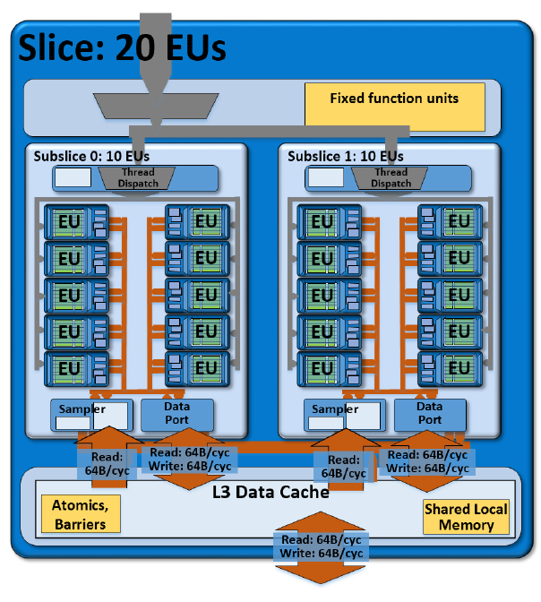
1.2 Evolution of desktop and laptop processors (12)
Example: A slice of the graphics unit of Haswell (6.5th gen. graphics)
1 slice (GT2): includs 20 EUs [199]

Slide 47
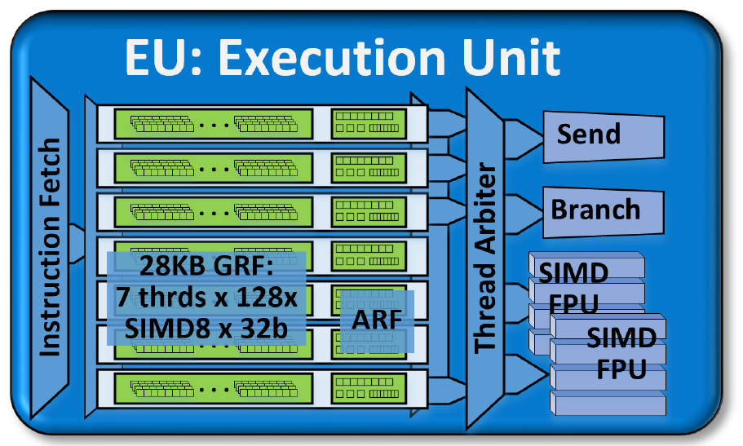
1.2 Evolution of desktop and laptop processors (13)
Block diagram of an EU of Haswell -1 [199]
SIMD: Single Instruction
Multiple Data
Each EU has four functional units:
Two SIMD FPU units
1 Send unit (Load/Store) and
1 Branch unit.
An EU issues up to 4 instructions per cycle to the functional units.
*

Slide 48
1.2 Evolution of desktop and laptop processors (14)
Block diagram of an EU of Haswell -2 [199]
Each SIMD FPUs can execute 4 SP FP They can execute MAD instructions (Multiply-Add)/cycle.
Thus an EU can execute 2 FPU x SIMD4 x 2 (MAD) = 16 SP FP operations/cycle.
The EU is 7-way multithreaded.
Each thread has 128 32 B registers.
One of the FPUs also supports FX operations (1/2/4/8/16/32 bit wide FX operations).
One of the FPUs also support transcendental math functions.

Slide 49
1.2 Evolution of desktop and laptop processors (15)
Evolution of main features of Intel’s graphics families (based on [174])
Intel Core generation | Graphics generation | Models | Graphics Technology level | No. of graphics slices | No. of EUs | eDRAM | OpenGL version | DirectX version | OpenCL version
Westmere | 5th (Ironlake) | HD |  |  | 12 | -- | 2.1 | 10.1 | n.a.
Sandy Bridge | 6th | HD 2000 | GT1 | 1 (2x3 EU) | 6 |  | 3.1/3.3 | 10.1 | n.a.
 |  | HD 3000 | GT2 | 1 (4x3 EU) | 12
Ivy Bridge | 7th | HD 2500 | GT1 | 1 (6 EU) | 6 | -- | 4.0 | 11.0 | 1.2
 |  | HD 4000 | GT2 | 1 (2x8 EU) | 16
Haswell | 7.5th | HD 4200- HD 4700 | GT2 | 1 (2x10 EU) | 20 | -- | 4.3 | 11.1 | 1.2
 |  | HD 5000 Iris 5100 | GT3 | 2 | 40
 |  | Iris Pro 5200 |  |  |  | 128 MB
Broadwell | 8th | HD 5300- HD 5600 | GT2 | 1 (3x8 EU) | 23/24 | -- | 4.3 | 11.2 | 2.0
 |  | HD 6000 Iris 6100 | GT3 | 2 | 47/48
 |  | Iris Pro 6200 | GT3e | 2 | 48 | 128 MB
Skylake | 9th | HD 510 | GT1 | 1 (3x4 EU) | 12 | -- | 4.4 | 12 | 2.0
 |  | HD 515 | GT1.5 | 1 (3x6 EU) | 18
 |  | HD 520 | GT2 | 1 (3x8 EU) | 24
 |  | HD 535 | GT3 | 2 | 48
 |  | HD 540 | GT3e | 2 | 48 | 64 MB
 |  | HD 580 | GT4e | 3 | 72 | 64/128 MB
*

Slide 50
1.2 Evolution of desktop and laptop processors (16)
Evolution of main features of Intel’s graphics families (based on [174]) -4
Intel Core generation | Graphics generation | Models | Graphics Technology level | No. of graphics slices | No. of EUs | eDRAM | OpenGL version | DirectX version | OpenCL version
Westmere | 5th (Ironlake) | HD |  |  | 12 | -- | 2.1 | 10.1 | n.a.
Sandy Bridge | 6th | HD 2000 | GT1 | 1 (2x3 EU) | 6 |  | 3.1/3.3 | 10.1 | n.a.
 |  | HD 3000 | GT2 | 1 (4x3 EU) | 12
Ivy Bridge | 7th | HD 2500 | GT1 | 1 (6 EU) | 6 | -- | 4.0 | 11.0 | 1.2
 |  | HD 4000 | GT2 | 1 (2x8 EU) | 16
Haswell | 7.5th | HD 4200- HD 4700 | GT2 | 1 (2x10 EU) | 20 | -- | 4.3 | 11.1 | 1.2
 |  | HD 5000 Iris 5100 | GT3 | 2 | 40
 |  | Iris Pro 5200 |  |  |  | 128 MB
Broadwell | 8th | HD 5300- HD 5600 | GT2 | 1 (3x8 EU) | 23/24 | -- | 4.3 | 11.2 | 2.0
 |  | HD 6000 Iris 6100 | GT3 | 2 | 47/48
 |  | Iris Pro 6200 | GT3e | 2 | 48 | 128 MB
Skylake | 9th | HD 510 | GT1 | 1 (3x4 EU) | 12 | -- | 4.4 | 12 | 2.0
 |  | HD 515 | GT1.5 | 1 (3x6 EU) | 18
 |  | HD 520 | GT2 | 1 (3x8 EU) | 24
 |  | HD 535 | GT3 | 2 | 48
 |  | HD 540 | GT3e | 2 | 48 | 64 MB
 |  | HD 580 | GT4e | 3 | 72 | 64/128 MB

Slide 51
1.2 Evolution of desktop and laptop processors (176)
Evolution of main features of Intel’s graphics families (based on [174]) -5
Intel Core generation | Graphics generation | Models | Graphics Technology level | No. of graphics slices | No. of EUs | eDRAM | OpenGL version | DirectX version | OpenCL version
Westmere | 5th (Ironlake) | HD |  |  | 12 | -- | 2.1 | 10.1 | n.a.
Sandy Bridge | 6th | HD 2000 | GT1 | 1 (2x3 EU) | 6 |  | 3.1/3.3 | 10.1 | n.a.
 |  | HD 3000 | GT2 | 1 (4x3 EU) | 12
Ivy Bridge | 7th | HD 2500 | GT1 | 1 (6 EU) | 6 | -- | 4.0 | 11.0 | 1.2
 |  | HD 4000 | GT2 | 1 (2x8 EU) | 16
Haswell | 7.5th | HD 4200- HD 4700 | GT2 | 1 (2x10 EU) | 20 | -- | 4.3 | 11.1 | 1.2
 |  | HD 5000 Iris 5100 | GT3 | 2 | 40
 |  | Iris Pro 5200 |  |  |  | 128 MB
Broadwell | 8th | HD 5300- HD 5600 | GT2 | 1 (3x8 EU) | 23/24 | -- | 4.3 | 11.2 | 2.0
 |  | HD 6000 Iris 6100 | GT3 | 2 | 47/48
 |  | Iris Pro 6200 | GT3e | 2 | 48 | 128 MB
Skylake | 9th | HD 510 | GT1 | 1 (3x4 EU) | 12 | -- | 4.4 | 12 | 2.0
 |  | HD 515 | GT1.5 | 1 (3x6 EU) | 18
 |  | HD 520 | GT2 | 1 (3x8 EU) | 24
 |  | HD 535 | GT3 | 2 | 48
 |  | HD 540 | GT3e | 2 | 48 | 64 MB
 |  | HD 580 | GT4e | 3 | 72 | 64/128 MB

Slide 52
1.2 Evolution of desktop and laptop processors (18)
Key features of the evolution of Intel’s integrated graphics families
Intel’s graphics implementations are subdivided into
graphics generations (5th to 9th) and
graphics technology levels (GT1-GT4).
Graphics generations are bound to the basic architectures.
The graphics technology levels indicate the number of graphics slices (replicable sets of
graphics EUs) within each graphics generation.
The number of graphics EUs is increasing more or less according to Moore’s rule
(from 12 in 2010 to 72 in 2015).
With the Haswell basic architecture graphics became eDRAM support (first 64 MB
then 128 MB)
There is continuous support of newer versions of graphics APIs and of OpenCL.
*

Slide 53
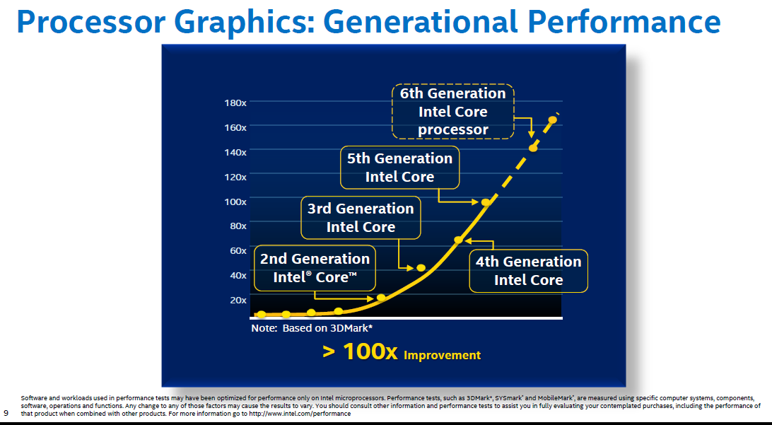
1.2 Evolution of desktop and laptop processors (19)
Graphics performance increase of subsequent Core generations [196]
Skylake
Broadwell
Haswell
Ivy Bridge
Sandy Bridge

Slide 54
1.3 Evolution of HEDs (High-End desktops)
Notes:
54

Slide 55
1.3 Evolution of HEDs (High-End desktops) (1)
1.3 Evolution of HEDs (High-End desktops)
Recent processor categories of Intel
Servers
HEDs
(High-End Desktops)
Desktops/Laptops
(Client computing)
Tablets
Smartphones
Desktops
Xeon E7/E5/E3
Platinum/Gold etc.
Core i7/i9
(Extreme Edition
or X models)
Core i7/i5/i3
(Basic architectures)
Atom lines
(+ LP Core models)
Atom lines
Smarphones
Smarphones
Laptops
Tablets
Servers
High-End Desktops
Desktops
Laptops
Tablets
Smartphones
Servers
High-End Desktops
Desktops

Slide 56
1.3 Evolution of HEDs (High-End desktops) (2)
HEDs (High-End Desktops)
They aim at high performance desktops for hardcore gamers and graphics enthusiasts.
*

Slide 57

1.3 Evolution of HEDs (High-End desktops) (3)
Hardcore gamer scenario [221]

Slide 58
1.3 Evolution of HEDs (High-End desktops) (4)
1. Introduction -2
Key features of Intel’s HED lines to support multiple (up to 4) discrete graphics cards:
They typically provide vs. mainstream desktops
more PCIe lanes (either on the PCH or on the die)
more cores and
more memory channels (to appropriately service more processing resources)
as indicated on the next Figure.
*

Slide 59
1.3 Evolution of HEDs (High-End desktops) (5)
Number of PCIe lanes
Processor | Techn. | Date of intro. | No. of cores up to | Memory attachment | Mem. speed up to | PCIe lanes | No. of mem. channels | MCH | TDP | Processor socket
Core 2 Extreme X6800 | 65 nm | 7/2006 | 2C | Via MCH | DDR3-1066 | 32 PCIe 2.0 on the X38 | 2 | X38 | 65 W | LGA 775
Core 2 Extreme QX 6xxx | 65 nm | 11/2006 | 2x2C |  |  |  |  |  | 130 W | LGA 775
 |  |  |  |  |  |  |  |  | 130 W | LGA 775
Core 2 Extreme QX 9650 (Penryn) | 45 nm | 11/2007 | 2x2C
 |  |  |  |  | DDR3-1600 | 32 PCIe 2.0 on the X48 | 2 | X48 | 136 W | LGA 775
Core 2 Extreme QX 9770 (Penryn) | 45 nm | 3/2008 | 2x2C
1. G. Nehalem EE | 45 nm | 11/2008 | 4C | On-die MC | DDR3-1067 | 36 PCIe 2.0 on the X58 | 3 | X58 (Tylersburg) | 130 W | LGA 1366
Westmere EE | 32 nm | 3/2010 | 6C
 |  |  |  |  |  |  |  |  | 130 W | LGA 1366
Sandy Bridge E | 32 nm | 11/2011 | 6C
 |  |  |  |  | DDR3-1600 | 40 PCIe 2.0 on-die | 4 | X79 (Patsburg) | 130 W/ 150 W | LGA 2011
Ivy Bridge E | 22 nm | 9/2013 | 6C
 |  |  |  |  | DDR3-1866 | 40 PCIe 3.0 on-die | 4 |  | 130 W | LGA 2011
Haswell E | 14 nm | 8/2014 | 8C |  | DDR4-2133 |  | 4 | X99 (Wellsburg) | 140 W | LGA 2011-3
Broadwell E | 14 nm | 5/2016 | 10C
 |  |  |  |  | DDR4-2400 |  | 4 | X99 (Wellsburg) | 140 W | LGA_2011-3
Skylake X | 14 nm | 6/2017 | 18C
 |  |  |  |  | DDR4-2666 | 44 PCI-3.0 on-die | 4 | X299 (Basin Falls) | 140 W | LGA-2066
(Kaby Lake X) | 14 nm | 6/2017 | 4C |  | DDR4-2666 | 16 PCIe 3.0 on-die | 4 | X299 (Basin Falls) | 112 W | LGA-2066
The above HED models and lines are unlocked.
*

Slide 60
1.3 Evolution of HEDs (High-End desktops) (6)
Number of on-die memory channels and PCIe lanes provided on Intel's DT and HED lines
PCIe lanes provided on the processor die
DT processors: 16 lanes
(1x16 or 2x8 or 1x8+2x4)
HED processors: 40 lanes (typical)
(configurable, e.g. 2x x16 + 1x x8 or 4x x8)
PCIe
2.0
x16/
2x x8
P
Mem.
40
configurable
lanes
P
Mem.
PCIe 2.0
PCIe 2.0 lanes
Periph. Contr.
P55/P67
Periph. Contr.
X79
Intel 2. gen. Nehalem (Lynnfield) (4C), 2 MCh
with P55 (2009)
Intel Sandy Bridge (4C), 2 MCh with P67 (2011)
Intel Sandy Bridge-E (6C), 4 MCh with X79 (2011)
PCIe generation
x16/
2x x8
40
configurable
lanes
P
Mem.
PCIe
3.0
P
Mem.
PCIe 3.0
Periph. Contr.
Z77/Z87/Z97/
Z170
Periph. Contr.
X79/Z99/
X299
PCIe 3.0 lanes
Intel Ivy Bridge (4C), 2 MCh with Z77 PCH (2012)
Intel Haswell (4C), 2 MCh with Z87 PCH (2013)
Intel Broadwell (4C), 2 MCh with Z97 PCH (2015)
Intel Skylake-S (4C), 2 MCh with Z170 PCH (2015)
Intel Ivy Bridge-E (6C), 4 MCh with X79 (2013)
Intel Haswell-E (8C) 4 MCh with X79 (2014)
Intel Broadwell-E (10C) 4 MCh with X99 (2016)
Intel Skylake-X (10C) 4 MCh with X299 (2017)
(44 PCIe lanes!)
*

Slide 61
1.3 Evolution of HEDs (High-End desktops) (7)
Core counts
Processor | Techn. | Date of intro. | No. of cores up to | Memory attachment | Mem. speed up to | PCIe lanes | No. of mem. channels | MCH | TDP | Processor socket
Core 2 Extreme X6800 | 65 nm | 7/2006 | 2C | Via MCH | DDR3-1066 | 32 PCIe 2.0 on the X38 | 2 | X38 | 65 W | LGA 775
Core 2 Extreme QX 6xxx | 65 nm | 11/2006 | 2x2C |  |  |  |  |  | 130 W | LGA 775
 |  |  |  |  |  |  |  |  | 130 W | LGA 775
Core 2 Extreme QX 9650 (Penryn) | 45 nm | 11/2007 | 2x2C
 |  |  |  |  | DDR3-1600 | 32 PCIe 2.0 on the X48 | 2 | X48 | 136 W | LGA 775
Core 2 Extreme QX 9770 (Penryn) | 45 nm | 3/2008 | 2x2C
1. G. Nehalem EE | 45 nm | 11/2008 | 4C | On-die MC | DDR3-1067 | 36 PCIe 2.0 on the X58 | 3 | X58 (Tylersburg) | 130 W | LGA 1366
Westmere EE | 32 nm | 3/2010 | 6C
 |  |  |  |  |  |  |  |  | 130 W | LGA 1366
Sandy Bridge E | 32 nm | 11/2011 | 6C
 |  |  |  |  | DDR3-1600 | 40 PCIe 2.0 on-die | 4 | X79 (Patsburg) | 130 W/ 150 W | LGA 2011
Ivy Bridge E | 22 nm | 9/2013 | 6C
 |  |  |  |  | DDR3-1866 | 40 PCIe 3.0 on-die | 4 |  | 130 W | LGA 2011
Haswell E | 14 nm | 8/2014 | 8C |  | DDR4-2133 |  | 4 | X99 (Wellsburg) | 140 W | LGA 2011-3
Broadwell E | 14 nm | 5/2016 | 10C
 |  |  |  |  | DDR4-2400 |  | 4 | X99 (Wellsburg) | 140 W | LGA_2011-3
Skylake X | 14 nm | 6/2017 | 18C
 |  |  |  |  | DDR4-2666 | 44 PCI-3.0 on-die | 4 | X299 (Basin Falls) | 140 W | LGA-2066
(Kaby Lake X) | 14 nm | 6/2017 | 4C |  | DDR4-2666 | 16 PCIe 3.0 on-die | 4 | X299 (Basin Falls) | 112 W | LGA-2066
The above HED models and lines are unlocked.

Slide 62
Remark
The Kaby Lake-X models in fact do not fit into the traditional HED line, they are actually the
highest performance models of the KabyLake line and are designated as mobile models.

Slide 63
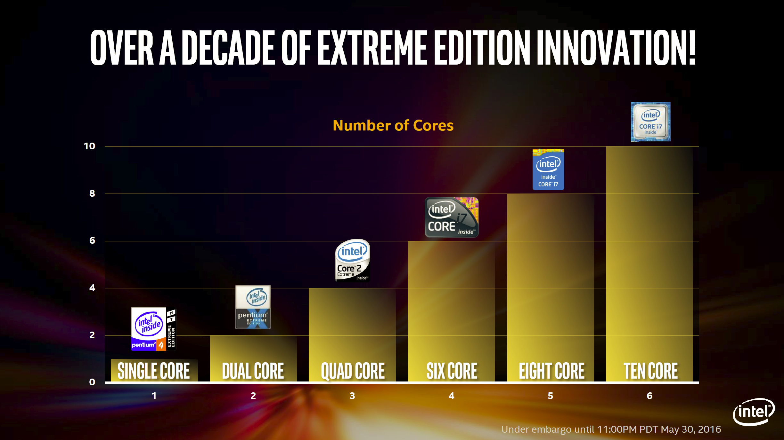
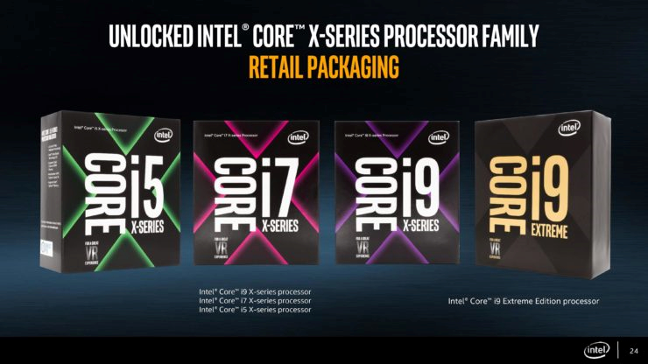

1.3 Evolution of HEDs (High-End desktops) (8)
Evolution of the core counts in Intel's HED lines (Based on [222])
Skylake X
18
Number of cores
Broadwell E
Haswell E
Core 2
Extreme
QX6700
Westmere EE
Core 2
Extreme
X6800
Pentium 4 EE
3.2
18 CORE
2003
2006
2006
2010
2014
2016
2017

Slide 64
1.3 Evolution of HEDs (High-End desktops) (9)
Number of memory channels
Processor | Techn. | Date of intro. | No. of cores up to | Memory attachment | Mem. speed up to | PCIe lanes | No. of mem. channels | MCH | TDP | Processor socket
Core 2 Extreme X6800 | 65 nm | 7/2006 | 2C | Via MCH | DDR3-1066 | 32 PCIe 2.0 on the X38 | 2 | X38 | 65 W | LGA 775
Core 2 Extreme QX 6xxx | 65 nm | 11/2006 | 2x2C |  |  |  |  |  | 130 W | LGA 775
 |  |  |  |  |  |  |  |  | 130 W | LGA 775
Core 2 Extreme QX 9650 (Penryn) | 45 nm | 11/2007 | 2x2C
 |  |  |  |  | DDR3-1600 | 32 PCIe 2.0 on the X48 | 2 | X48 | 136 W | LGA 775
Core 2 Extreme QX 9770 (Penryn) | 45 nm | 3/2008 | 2x2C
1. G. Nehalem EE | 45 nm | 11/2008 | 4C | On-die MC | DDR3-1067 | 36 PCIe 2.0 on the X58 | 3 | X58 (Tylersburg) | 130 W | LGA 1366
Westmere EE | 32 nm | 3/2010 | 6C
 |  |  |  |  |  |  |  |  | 130 W | LGA 1366
Sandy Bridge E | 32 nm | 11/2011 | 6C
 |  |  |  |  | DDR3-1600 | 40 PCIe 2.0 on-die | 4 | X79 (Patsburg) | 130 W/ 150 W | LGA 2011
Ivy Bridge E | 22 nm | 9/2013 | 6C
 |  |  |  |  | DDR3-1866 | 40 PCIe 3.0 on-die | 4 |  | 130 W | LGA 2011
Haswell E | 14 nm | 8/2014 | 8C |  | DDR4-2133 |  | 4 | X99 (Wellsburg) | 140 W | LGA 2011-3
Broadwell E | 14 nm | 5/2016 | 10C
 |  |  |  |  | DDR4-2400 |  | 4 | X99 (Wellsburg) | 140 W | LGA_2011-3
Skylake X | 14 nm | 6/2017 | 18C
 |  |  |  |  | DDR4-2666 | 44 PCI-3.0 on-die | 4 | X299 (Basin Falls) | 140 W | LGA-2066
(Kaby Lake X) | 14 nm | 6/2017 | 4C |  | DDR4-2666 | 16 PCIe 3.0 on-die | 4 | X299 (Basin Falls) | 112 W | LGA-2066
The above HED models and lines are unlocked.

Slide 65
1.3 Evolution of HEDs (High-End desktops) (10)
Unlocked clock multiplier
Processor | Techn. | Date of intro. | No. of cores up to | Memory attachment | Mem. speed up to | PCIe lanes | No. of mem. channels | MCH | TDP | Processor socket
Core 2 Extreme X6800 | 65 nm | 7/2006 | 2C | Via MCH | DDR3-1066 | 32 PCIe 2.0 on the X38 | 2 | X38 | 65 W | LGA 775
Core 2 Extreme QX 6xxx | 65 nm | 11/2006 | 2x2C |  |  |  |  |  | 130 W | LGA 775
 |  |  |  |  |  |  |  |  | 130 W | LGA 775
Core 2 Extreme QX 9650 (Penryn) | 45 nm | 11/2007 | 2x2C
 |  |  |  |  | DDR3-1600 | 32 PCIe 2.0 on the X48 | 2 | X48 | 136 W | LGA 775
Core 2 Extreme QX 9770 (Penryn) | 45 nm | 3/2008 | 2x2C
1. G. Nehalem EE | 45 nm | 11/2008 | 4C | On-die MC | DDR3-1067 | 36 PCIe 2.0 on the X58 | 3 | X58 (Tylersburg) | 130 W | LGA 1366
Westmere EE | 32 nm | 3/2010 | 6C
 |  |  |  |  |  |  |  |  | 130 W | LGA 1366
Sandy Bridge E | 32 nm | 11/2011 | 6C
 |  |  |  |  | DDR3-1600 | 40 PCIe 2.0 on-die | 4 | X79 (Patsburg) | 130 W/ 150 W | LGA 2011
Ivy Bridge E | 22 nm | 9/2013 | 6C
 |  |  |  |  | DDR3-1866 | 40 PCIe 3.0 on-die | 4 |  | 130 W | LGA 2011
Haswell E | 14 nm | 8/2014 | 8C |  | DDR4-2133 |  | 4 | X99 (Wellsburg) | 140 W | LGA 2011-3
Broadwell E | 14 nm | 5/2016 | 10C
 |  |  |  |  | DDR4-2400 |  | 4 | X99 (Wellsburg) | 140 W | LGA_2011-3
Skylake X | 14 nm | 6/2017 | 18C
 |  |  |  |  | DDR4-2666 | 44 PCI-3.0 on-die | 4 | X299 (Basin Falls) | 140 W | LGA-2066
(Kaby Lake X) | 14 nm | 6/2017 | 4C |  | DDR4-2666 | 16 PCIe 3.0 on-die | 4 | X299 (Basin Falls) | 112 W | LGA-2066
The above HED models and lines are unlocked.

Slide 66
1.3 Evolution of HEDs (High-End desktops) (11)
TDP (Thermal Design Power)
Processor | Techn. | Date of intro. | No. of cores up to | Memory attachment | Mem. speed up to | PCIe lanes | No. of mem. channels | MCH | TDP | Processor socket
Core 2 Extreme X6800 | 65 nm | 7/2006 | 2C | Via MCH | DDR3-1066 | 32 PCIe 2.0 on the X38 | 2 | X38 | 65 W | LGA 775
Core 2 Extreme QX 6xxx | 65 nm | 11/2006 | 2x2C |  |  |  |  |  | 130 W | LGA 775
 |  |  |  |  |  |  |  |  | 130 W | LGA 775
Core 2 Extreme QX 9650 (Penryn) | 45 nm | 11/2007 | 2x2C
 |  |  |  |  | DDR3-1600 | 32 PCIe 2.0 on the X48 | 2 | X48 | 136 W | LGA 775
Core 2 Extreme QX 9770 (Penryn) | 45 nm | 3/2008 | 2x2C
1. G. Nehalem EE | 45 nm | 11/2008 | 4C | On-die MC | DDR3-1067 | 36 PCIe 2.0 on the X58 | 3 | X58 (Tylersburg) | 130 W | LGA 1366
Westmere EE | 32 nm | 3/2010 | 6C
 |  |  |  |  |  |  |  |  | 130 W | LGA 1366
Sandy Bridge E | 32 nm | 11/2011 | 6C
 |  |  |  |  | DDR3-1600 | 40 PCIe 2.0 on-die | 4 | X79 (Patsburg) | 130 W/ 150 W | LGA 2011
Ivy Bridge E | 22 nm | 9/2013 | 6C
 |  |  |  |  | DDR3-1866 | 40 PCIe 3.0 on-die | 4 |  | 130 W | LGA 2011
Haswell E | 14 nm | 8/2014 | 8C |  | DDR4-2133 |  | 4 | X99 (Wellsburg) | 140 W | LGA 2011-3
Broadwell E | 14 nm | 5/2016 | 10C
 |  |  |  |  | DDR4-2400 |  | 4 | X99 (Wellsburg) | 140 W | LGA_2011-3
Skylake X | 14 nm | 6/2017 | 18C
 |  |  |  |  | DDR4-2666 | 44 PCI-3.0 on-die | 4 | X299 (Basin Falls) | 140 W | LGA-2066
(Kaby Lake X) | 14 nm | 6/2017 | 4C |  | DDR4-2666 | 16 PCIe 3.0 on-die | 4 | X299 (Basin Falls) | 112 W | LGA-2066
The above HED models and lines are unlocked.

Slide 67
1.3 Evolution of HEDs (High-End desktops) (12)
Introduction -3
Key features of Intel’s HED lines (cont.):
They are equipped with a large number of PCIe lanes (typically 32 to 44) to connect
multiple discrete graphics cards vs. 16 typical in desktops,
they do not provide integrated graphics, as it is assumed that the installation is intended
to provide high quality graphics by attaching discrete graphics cards,
they have more cores than desktops than graphics offers more parallelism than typical
desktop workloads,
they are unlocked and
HEDs have a higher TDP of 130 to 150 W vs. 65 to 95 W typical for DT processors.
*

Slide 68
1.4 Evolution of high-end 4S/8S servers
Notes:
68

Slide 69
1.4 Evolution of high-end 4S/8S servers (1)
1.4 Evolution of high-end 4S/8S servers
Recent processor categories of Intel
Servers
HEDs
(High-End Desktops)
Desktops/Laptops
(Client computing)
Tablets
Smartphones
Desktops
Xeon E7/E5/E3
Platinum/Gold etc.
Core i7/i9
(Extreme Edition
or X models)
Core i7/i5/i3
(Basic architectures)
Atom lines
(+ LP Core models)
Atom lines
Smarphones
Smarphones
Laptops
Tablets
Servers
High-End Desktops
Desktops
Laptops
Tablets
Smartphones
Servers
High-End Desktops
Desktops

Slide 70
1.4 Evolution of high-end 4S/8S servers (2)
Server platforms classified according to the number of processors supported
Server platforms
Uniprocessor server platforms
(UP-server platforms)
Multiprocessor server platforms
1-processor server platforms
(1-socket server platforms)
Server platforms supporting more than one processor
(Multi-socket server platforms)
2S (DP)
server platforms
4S/8S (MP)
server platforms
Platforms for more than 4 or 8 sockets
2- processor server platforms
(2-socket server platforms)
4/8-processor server platforms
(4/8-socket server platforms)
Server platforms for
more than the Intel
supported number of
sockets
(4 or 8 sockets)
They need third party
node controllers
*

Slide 71
1.4 Evolution of high-end 4S/8S servers (3)
Intel’s high-end 4S/8S server platforms built up of multicore processors -- Overview
 | Core | Techn. | Intro. | High-end 4S/8S server processor lines | Core count | Chipset | Proc. socket
Truland MP | Pentium 4 MP Prescott | 90 nm | 3/2005 | 90 nm Pentium 4 MP (Potomac) | 1C | E8500 + ICH5 | LGA 604
 | Pentium 4 Presc. | 90 nm | 11/2005 | 7000 (Paxville MP) | 2x1C | E8501 + ICH5
 | Pentium 4 Presc. | 65 nm | 8/2006 | 7100 (Tulsa) | 2x1C
Caneland | Core2 | 65 nm | 9/2007 | 7200 (Tigerton DC) 7300 (Tigerton QC) | 2C 2x2C | E7300 (Clarksboro)+ 631x/632x ESB | LGA 604
 | Penryn | 45 nm | 9/2008 | 7400 (Dunnington) | 6C
Boxboro-EX | Nehalem | 45 nm | 3/2010 | 7500 (Beckton/ Nehalem-EX) | 8C | 7500 + ICH10 | LGA 1567
 | Westmere | 32 nm | 4/2011 | E7-8800 (Westmere-EX) | 10C
 | Sandy Bidge | 32 nm
Brickland | Ivy Bridge | 22 nm | 2/2014 | E7-8800 v2 (Ivy Bridge-EX) | 15C | C602J (Patsburg J) | LGA 2011-1
 | Haswell | 22 nm | 5/2015 | E7-8800 v3 (Haswell-EX) | 18C
 | Broadwell | 14 nm | 6/2016 | E7-8800 v4 (Broadwell-EX) | 24C
Purley | Skylake | 14 nm | 7/2017 | Platinum 8100 (Skylake-SP) | 28C | C620 (Lewisburg) | LGA 3647

Slide 72
1.4 Evolution of high-end 4S/8S servers (4)
a) The rate of rising core counts in Intel's high-end 4S/8S server processors -1
 | Core | Techn. | Intro. | High-end 4S/8S server processor lines | Core count | Chipset | Proc. socket
Truland MP | Pentium 4 MP Prescott | 90 nm | 3/2005 | 90 nm Pentium 4 MP (Potomac) | 1C | E8500 + ICH5 | LGA 604
 | Pentium 4 Presc. | 90 nm | 11/2005 | 7000 (Paxville MP) | 2x1C | E8501 + ICH5
 | Pentium 4 Presc. | 65 nm | 8/2006 | 7100 (Tulsa) | 2x1C
Caneland | Core2 | 65 nm | 9/2007 | 7200 (Tigerton DC) 7300 (Tigerton QC) | 2C 2x2C | E7300 (Clarksboro)+ 631x/632x ESB | LGA 604
 | Penryn | 45 nm | 9/2008 | 7400 (Dunnington) | 6C
Boxboro-EX | Nehalem | 45 nm | 3/2010 | 7500 (Beckton/ Nehalem-EX) | 8C | 7500 + ICH10 | LGA 1567
 | Westmere | 32 nm | 4/2011 | E7-8800 (Westmere-EX) | 10C
 | Sandy Bidge | 32 nm
Brickland | Ivy Bridge | 22 nm | 2/2014 | E7-8800 v2 (Ivy Bridge-EX) | 15C | C602J (Patsburg J) | LGA 2011-1
 | Haswell | 22 nm | 5/2015 | E7-8800 v3 (Haswell-EX) | 18C
 | Broadwell | 14 nm | 6/2016 | E7-8800 v4 (Broadwell-EX) | 24C
Purley | Skylake | 14 nm | 7/2017 | Platinum 8100 (Skylake-SP) | 28C | C620 (Lewisburg) | LGA 3647

Slide 73
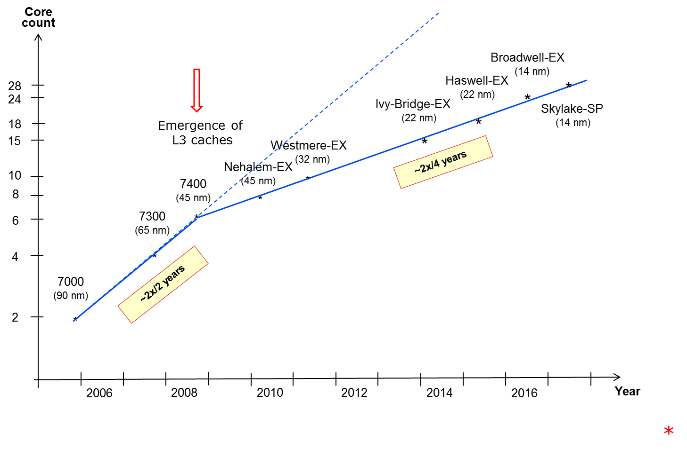
1.4 Evolution of high-end 4S/8S servers (5)
a) The rate of rising core counts in Intel's high-end 4S/8S server processors -2
(P4)
*

Slide 74
1.4 Evolution of high-end 4S/8S servers (6)
Remarks to the rate of rising core counts in Intel's high-end 4S/8S server processors -1
(Not discussed)
As the Figure above demonstrates, the core count of Intel’s early L3-less 4S server
processors has doubled roughly biannually.
This is obvious, since the evolving IC technology allowed to double transistor counts
roughly in every new technology node.
Consequently, in L3-less processors twice as many transistors per technology node permit
the doubling of core counts also roughly biannually.
When L3 caches first appeared in the Xeon 7400 within Intel’s Core 2 based server
processors, the transistor count rose to 1.9 billion from 582 million in the L3-less Xeon
7300, as indicated in Table below.
Model | Technology | Date of introduction | Core count | L3 cache | Transistors (million) | Die area (mm²)
7300 | 65 nm | 9/2007 | 2x2 | -- | 582 | 286
7400 | 45 nm | 8/2008 | 6 | 16 MB | 1900 | 503
Nehalem-EX | 45 nm | 3/2010 | 8 | 8x3 MB | 2300 | 513
Westmere-EX | 32 nm | 4/2011 | 10 | 10x3 MB | 2600 | 512
Ivy Bridge-EX | 22 nm | 2/2014 | 15 | 15x2.5 MB | 4310 | 541
Haswell-EX | 22 nm | 5/2015 | 18 | 18x2.5 MB | 5700 | 662
Broadwell-EX | 14 nm | 6/2016 | 24 | 24x2.5 MB | 7200 | 456
Table: Rising transistor counts in Intel's high-end 4S/8S server processsors

Slide 75
1.4 Evolution of high-end 4S/8S servers (7)
Die plot of the Xeon 7400 MP implementing 16 MB L3 cache [215]
2 cores
3 MB MLC
3 MB MLC
2 cores
Thermal
sensors
4 MB LLC
Address pad
Tags
Tags
8 MB L3
3 MB L2/2 cores
Data pad
3 MB MLC
4 MB LLC
2 cores
4 MB LLC
4 MB LLC

Slide 76
1.4 Evolution of high-end 4S/8S servers (8)
Remarks to the rate of rising core counts in Intel's high-end 4S/8S server processors -2
However, to place twice as many cores onto the die with the same L3 size per core
in every technology node, would need to double this already high transistor count
in every technology node.
Nevertheless, mainly due to power restrictions Intel could raise transistor counts on server
dies only at the modest rate of doubling roughly every four years, as above Table reveals,
leading to doubling core counts approximately every four years, as depicted in the above
Figure.
Recently, the nascent lengthening of the cadence of IC technology transitions also
contributes to reducing the rate at which the core count can be increased.
Model | Technology | Date of introduction | Core count | L3 cache | Transistors (million) | Die area (mm²)
7300 | 65 nm | 9/2007 | 2x2 | -- | 582 | 286
7400 | 45 nm | 8/2008 | 6 | 16 MB | 1900 | 503
Nehalem-EX | 45 nm | 3/2010 | 8 | 8x3 MB | 2300 | 513
Westmere-EX | 32 nm | 4/2011 | 10 | 10x3 MB | 2600 | 512
Ivy Bridge-EX | 22 nm | 2/2014 | 15 | 15x2.5 MB | 4310 | 541
Haswell-EX | 22 nm | 5/2015 | 18 | 18x2.5 MB | 5700 | 662
Broadwell-EX | 14 nm | 6/2016 | 24 | 24x2.5 MB | 7200 | 456
Table: Rising transistor counts in Intel's high-end 4S/8S server processors

Slide 77
1.4 Evolution of high-end 4S/8S servers (9)
Remarks to the rate of rising core counts in Intel's high-end 4S/8S server processors -3
Core
count
Broadwell-EX
(14 nm)
28
Haswell-EX
(22 nm)
*
24
Emergence of
L3 caches
in the Core 2 line
Ivy-Bridge-EX
(22 nm)
*
Skylake-SP
(14 nm)
18
*
15
Westmere-EX
(32 nm)
*
Nehalem-EX
(45 nm)
~2x/4 years
10
7400
(45 nm)
*
8
*
6
7300
(65 nm)
*
4
*
(P4)
~2x/2 years
7000
(90 nm)
2
*
*
(P4)
7100
(65 nm
16 MB L3)
2006
2008
2010
2012
2014
2016
Year
*

Slide 78
1.4 Evolution of high-end 4S/8S servers (10)
Remarks to the rate of rising core counts in Intel's high-end 4S/8S server processors -3
There are however, two anomalies to be mentioned.
First, the Xeon 7100 has less cores than expected by the trend for Intel’s early server
processors, simply due to the fact that it was implemented with a 16 MB L3 cache.
Second, the Xeon 7400 has already an L3 cache, nevertheless it fits to the trend line of
L3 cache-less processors.
The reason is a roughly doubled die area with reduced feature size vs. the preceding
Xeon 7300 (see Table above) which allows to implement a 16 MB L3 cache in addition to
the 6 cores without restricting the core count.
Subsequent server processors were then implemented nearly on the same die area
as the Xeon 7400, (as indicated in Table 1), so these processors fit already to the linear
trend with reduced slope.
Model | Technology | Date of introduction | Core count | L3 cache | Transistors (million) | Die area (mm²)
7300 | 65 nm | 9/2007 | 2x2 | -- | 582 | 286
7400 | 45 nm | 8/2008 | 6 | 16 MB | 1900 | 503
Nehalem-EX | 45 nm | 3/2010 | 8 | 8x3 MB | 2300 | 513
Westmere-EX | 32 nm | 4/2011 | 10 | 10x3 MB | 2600 | 512
Ivy Bridge-EX | 22 nm | 2/2014 | 15 | 15x2.5 MB | 4310 | 541
Haswell-EX | 22 nm | 5/2015 | 18 | 18x2.5 MB | 5700 | 662
Broadwell-EX | 14 nm | 6/2016 | 24 | 24x2.5 MB | 7200 | 456
Table: Rising transistor counts in Intel's high-end 4S/8S server processsors

Slide 79
2. Evolution of 4S/8S high-end servers (11)
b) The rate of rising memory transfer rates in Intel’s DT and high-end server processors -1
Transfer rate
(MT/s)
IB
DDR4/2400
DDR4/2133
3000
DDR3
1600
x
DDR3/1866
*
2000
DDR3
1333
x
*
x
DDR4
2666
DDR3
1067
x
*
DDR4
1866
~ 2*/4 years
DDR2
800
*
DDR3/4
1866
*
x
DDR3
1600
1000
DDR2
667
*
DDR2
533
*
DDR3
1067
~ 2*/8 years
DDR
400
*
x
500
DDR
333
*
DDR2
667
DDR
266
x
*
DDR
400
Emergence of
DDR4 memory
*
4S/8S
DT
*
Emergence of
DDR3 memory
200
100
50
≈
2000
01
02
03
04
05
06
07
08
09
2010
11
12
13
14
15
16
17
Year

Slide 80
1.4 Evolution of high-end 4S/8S servers (12)
The rate of rising mem. transfer rates in Intel’s high-end 4S/8S server processors -2
As the above Figure shows, in the course of the evolution of high-end 4S/8S servers
memory transfer rate has initially been doubled roughly every four years.
But after DDR3 memory emerged the growth rate of memory transfer rate slowed down
to doubling rougly every eight years due to the higher complexity of this technology.
Note that in the considered time interval memory transfer rate has always been risen
at a slower rate than core count, approximately at the half rate than the core count.
*

Slide 81
1.4 Evolution of high-end 4S/8S servers (13)
The requirement for scaling the memory bandwidth with the core count
As each core may operate independently from each other the memory bandwidth provided
needs to be linearly scaled with the core count, i.e. a processor with n-times more cores
as a reference platform requires n-times higher bandwidth as the reference platform.
*

Slide 82
1.4 Evolution of high-end 4S/8S servers (14)
Implication of the fact that memory transfer rates are rising slower than core counts
in servers
Over generations both the core count and the memory transfer rate are raising.
But the memory transfer rate of the reference platform rises slower than the core count,
thus the per core memory bandwidth will decrease since the memory bandwidth amounts to
the product of the transfer rate and the width of the memory interface (assuming that
no other changes become effective).
In other words, in the course of processor evolution a memory bandwidth gap arises that
needs to be removed by implementing appropriately more memory channels.
Thus removing the memory bandwidth gap more memory channels are needed,
this is the driving force of the evolution of server memory subsystems.
Since it is not at all a straightforward task to raise the number of memory channels,
one of the focal points of server evolution is how to resolve the memory bandwidth gap
by enhancing the memory subsystem.
In the chapter on high-end 4S/8S servers we will discuss possible avenues of coping
with this point.
*

Slide 83
1.5 Evolution of tablet and smartphone processors
Notes:
83

Slide 84
1.5 Evolution of tablet and smartphone processors (1)
1.5 Evolution of tablet and smartphone processors
Recent processor categories of Intel
Servers
HEDs
(High-End Desktops)
Desktops/Laptops
(Client computing)
Tablets
Smartphones
Desktops
Xeon E7/E5/E3
Platinum/Gold etc.
Core i7/i9
(Extreme Edition
or X models)
Core i7/i5/i3
(Basic architectures)
Atom lines
(+ LP Core models)
Atom lines
Smarphones
Smarphones
Laptops
Tablets
Servers
High-End Desktops
Desktops
Laptops
Tablets
Smartphones
Servers
High-End Desktops
Desktops

Slide 85
1.5 Evolution of tablet and smartphone processors (1b)
Changing the design paradigm for implementing mobile processors
With the advent of mobile devices (about 2006) a new design paradigm arose for those devices.
Mobile devices require long operating hours i.e. low power consumption, this is contrast to the
design paradigm of traditional processors, as indicated below.
Traditional processors
Tablets and smartphones
High performance/power
(e.g. GFLOPS/Watt)
Low power
(Watt)
(Number of operating hours)
*

Slide 86
1.5 Evolution of tablet and smartphone processors (2)
Key requirements at the introduction of mobile, i.e. low power microarchitectures
Key requirements for low power microarchitectures
Narrow microarchitecture
Low processor clock frequency
*

Slide 87
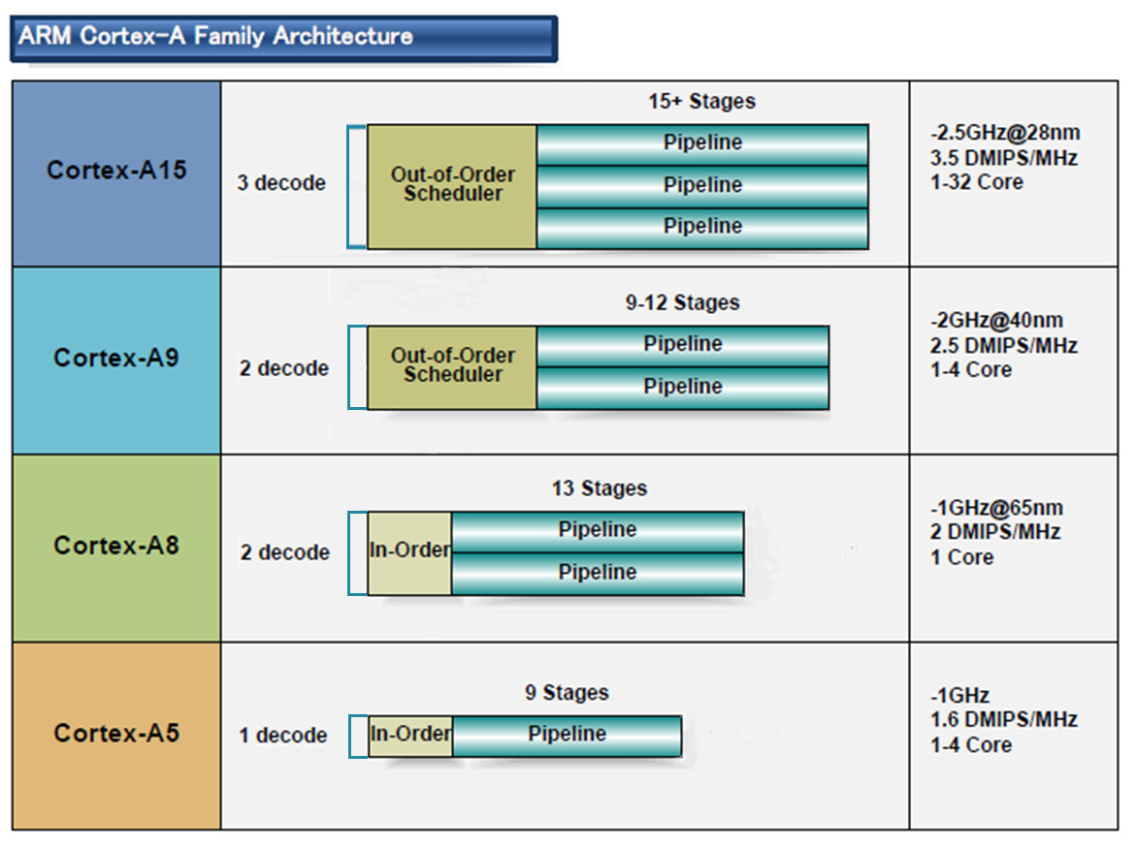
1.5 Evolution of tablet and smartphone processors (3)
a) Low power CPUs need narrow microarchitectures
Example: Width of ARM’s early, 32-bit CPUs used in most tablets and smartphones [10]
32-bit
2010
2007
2005
2009
(A9 replacement
for low-end
devices)
*

Slide 88
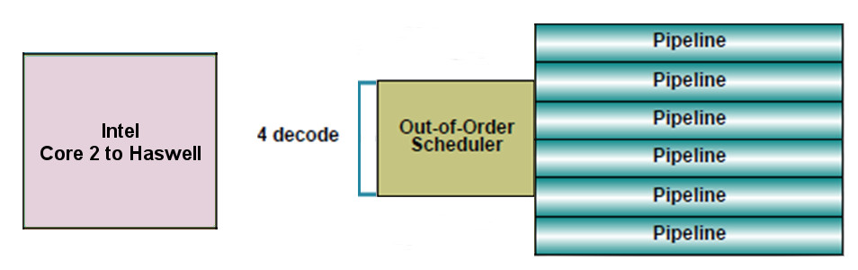
1.5 Evolution of tablet and smartphone processors (4)
By contrast:
Intel’s and AMD’s recent processor lines
aims at high performance/power (in terms of GFLOPS/Watt)
accordingly
have 4-wide microarchitectures, as the next example shows:
64-bit
Example: Width of Intel’s Core 2 to Haswell processors underlying servers to laptops [10]
*

Slide 89
1.5 Evolution of tablet and smartphone processors (5)
Consequences for Intel and AMD-1
Intel’s and AMD’s traditional microarchitectures are not suited for mobile devices.
Both Intel and AMD conceived, designed and introduced new, narrow (e.g. 2-wide) low-power microarchitectures.
*

Slide 90
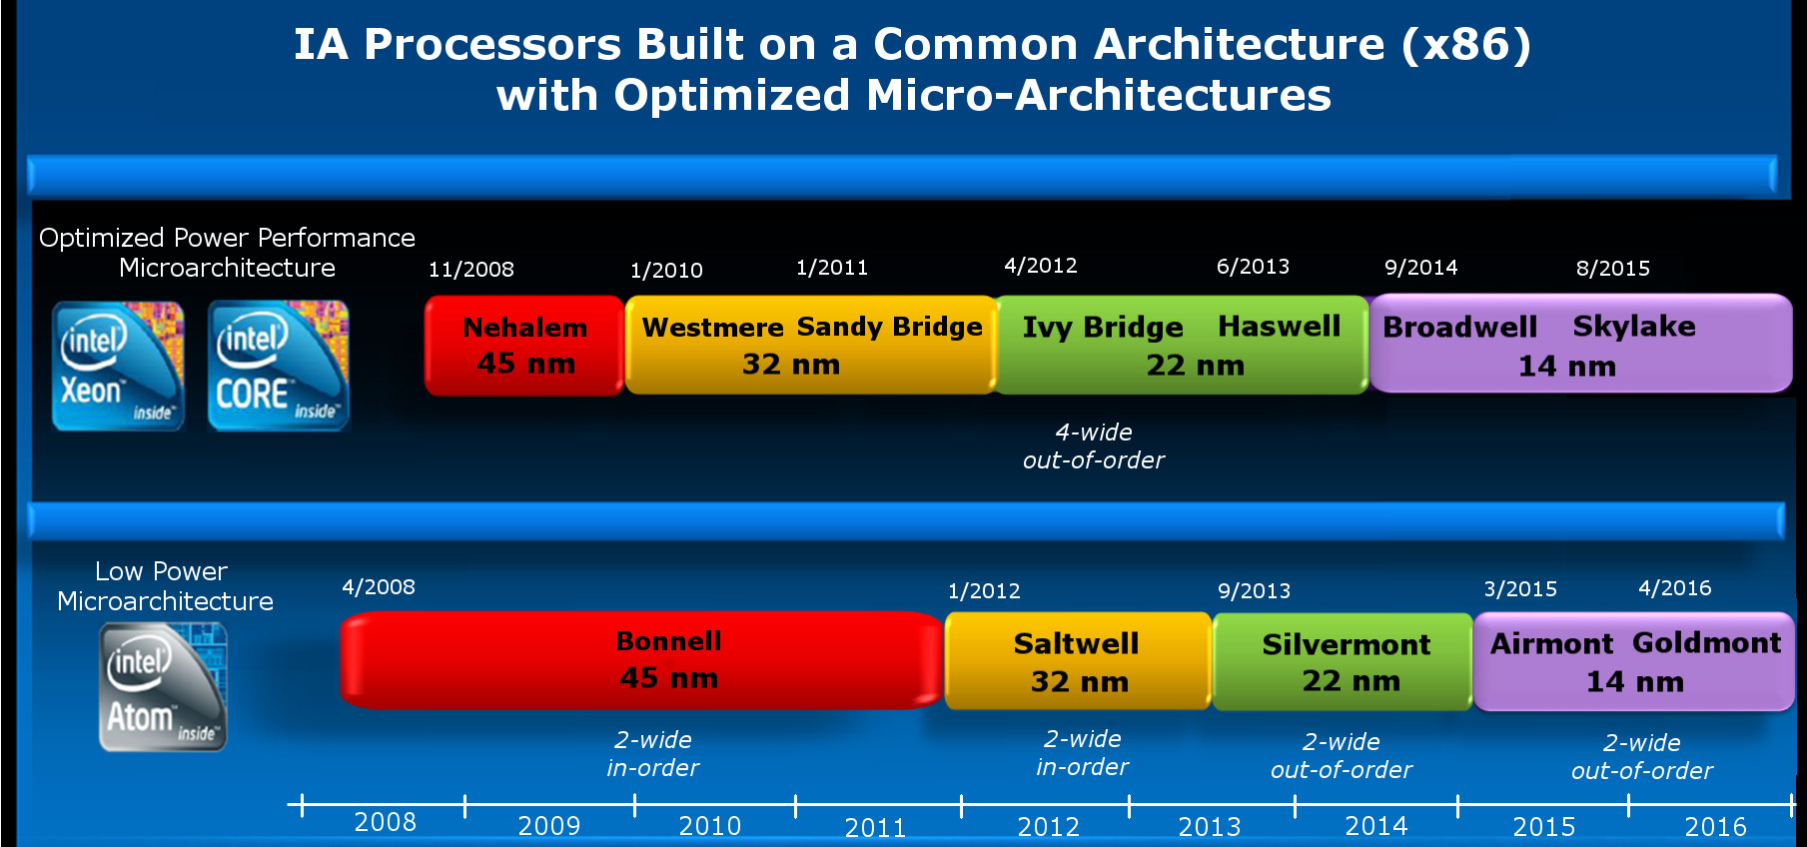
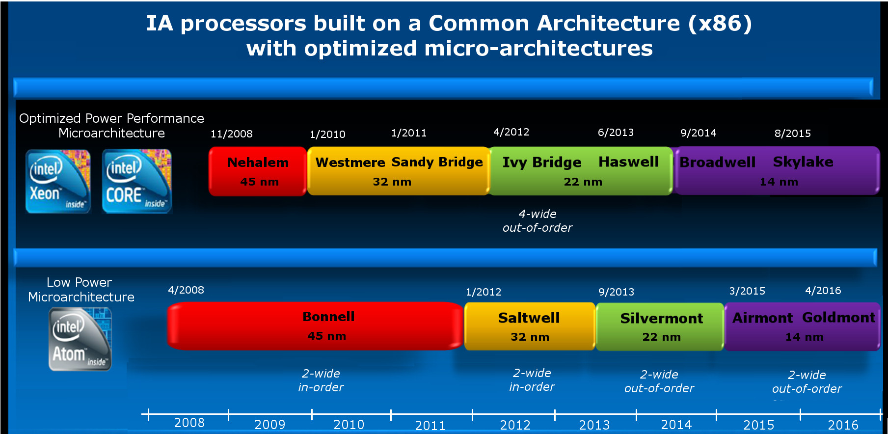
1.5 Evolution of tablet and smartphone processors (6)
Emergence of Intel’s Atom line aiming for tablets and smartphones (Based on [2])
4-wide
out-of-order
5
2008
2-wide
in-order
2-wide
out-of-order
2-wide
out-of-order
3-wide
out-of-order
2-wide
in-order
2-wide
in order
2-wide
out-of-order

Slide 91
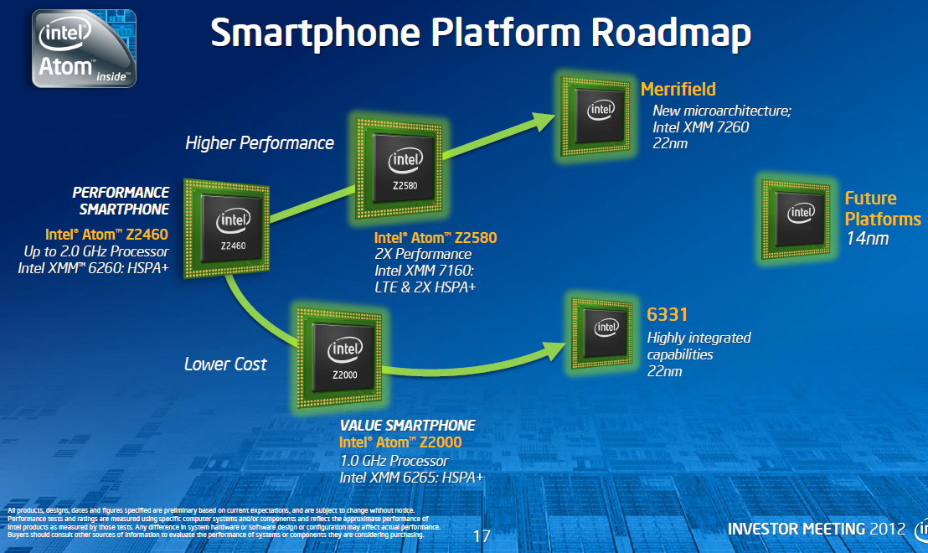
1.5 Evolution of tablet and smartphone processors (6b)
Intel’s Atom-based smartphone platforms (based on [276])
Morganfield
(2016)
Moorefield
(2014)
Merrifield
(2014)
Performance (not to scale)
Clover Trail+
(2013)
Z5xxx
4x Goldmont
14 nm
+XMM 7360
Z35xx
4x Silvermont
22 nm
+XMM 7260/2/35
Medfield
(2012)
Z34x0
2x Silvermont
22 nm
+XMM 7160/7260
Cancelled
in 04/2016
Morestown
(2010)
Z2520-2580
2x Saltwell
32 nm
+XMM 6268/6360/7160
SoFIA
(x3 3G/LTE)
(2015)
Riverton
(2015)
Z2460/2480
1x Saltwell
32 nm
+XMM 6260
Slayton
(2014)
Lexington
(2013)
Z6xx
1x Bonnell
45 nm
+Wireless
module
C31xx/32xx/34xx
2x/4x Silvermont
28 nm
Integrated LTE
3G/4G modem
Z3xxx
2x Airmont
14 nm
Integrated
LTE modem
Z3xxx
2x Silvermont
22 nm
+A-GOLD 620
Z2420
1x Saltwell
32 nm
+XMM 6265
Cancelled
in 04/2016
Planned, not implemented
Eul H., & Bell M., Mobile at Intel, Investor Meeting 2012, Intel,
http://www.cnx-software.com/pdf/Intel_2012/2012_Intel_Investor_Meeting_Eul_Bell.pdf
Planned, not mplemented

Slide 92
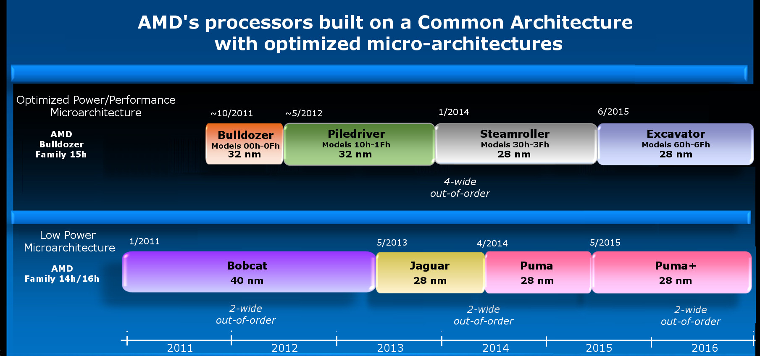
1.5 Evolution of tablet and smartphone processors (6c)
Emergence of AMD's Cat line aiming for tablets and smartphones (Based on [2])
4-wide
out-of-order
4/2014
2-wide
out-of-order
2-wide
out-of-order
2-wide
out-of-order
2014

Slide 93
1.5 Evolution of tablet and smartphone processors (7)
b) Low power CPUs need to be operated at low base clock frequencies
Traditional CPUs
Mobile CPUs
High base clock frequency
(typically 2-4 GHz)
Relative low base clock frequency
(typically 1-2 GHz)
( Dd = const x fc x V², in addition higher fc requires about linearly higher higher V)
*

Slide 94
1.5 Evolution of tablet and smartphone processors (8)
Example: The max. base frequency of Skylake models resulting in different TDPs and
configurations (Based on data from [202])
TDP (W) | No. of cores | Graphics | No. of graphics EUs | eDRAM | Base frequency (GHz)
4.5 | 2 | HD 515 | 18 | -- | 1.2
15 | 2 | HD 540 | 48 | 64 MB | 2.2
15 | 2 | HD 520 | 24 | -- | 2.6
28 | 2 | HD 550 | 48 | 64 MB | 3.3
35 | 4 | HD 530 | 24 | -- | 2.8
45 | 4 | HD 530 | 24 | -- | 2.9
65 | 4 | HD 530 | 24 | -- | 3.4
91 | 4 | -- | -- | -- | 4.2
Note that low TDP can be achieved first of all by reducing the core frequency and limiting
the computer resources (cores, GPU EUs) provided.
*

Slide 95
1.5 Evolution of tablet and smartphone processors (9)
Worldwide market share of smartphone and tablet application processors in 2015
(based on revenue) [217]
Smartphone application processors worldwide market share 2015 (revenue)
Qualcomm (USA) | 42 %
Apple (USA) | 21 %
MediaTek (Taiwan) | 19 %
Samsung (S. Korea)
Spreadtrum (China)
Tablet application processors worldwide market share 2015 (revenue)
Apple (USA) | 31 %
Qualcomm (USA) | 16 %
Intel (USA) | 14 %
MediaTek (Taiwan)
Samsung (S. Korea)
[Source: Related press releases of Strategy Analytics]
*

Slide 96
1.5 Evolution of tablet and smartphone processors (10)
Intel's withdrawal from the smartphone and mobil market [216]
In 4/2016 Intel announced their withdrawal from the mobil market.
Intel's statement says:
"I can confirm that the changes included canceling the Broxton platform as well as SoFIA
3GX, SoFIA LTE and SoFIA LTE2 commercial platforms to enable us to move resources
to products that deliver higher returns and advance our strategy.
These changes are effective immediately."
At the same time Intel laid off about 12000 employees (~ 11 % of their workforce).
*

Slide 97
1.5 Evolution of tablet and smartphone processors (11)
AMD’s cancellation of their Cat line in 2015
The last core of AMD's Cat line was the Puma+ core (launched in 6/2015 in the
Carrizo-L APU).
In AMD's 2016 Mobility roadmap there is no sign of an APU powered by the Puma+ core
or a derivative of it belonging to the Cat line.
Instead AMD has been placed emphasis on the Zen architecture that has been launched
in 2017.
*

Slide 98
1.5 Evolution of tablet and smartphone processors (12)
NVidia's leaving the smartphone and tablet market in June 2016 [81]
In 6/2016 (at Computex) NVIDIA's CEO J. Huang declared the firm's leaving the
smartphone and tablet market by saying:
: “We are no longer interested in that market”. He adds, “Anybody can build smartphones,
and we’re happy to enjoy these devices, but we’ll let someone else build them”.
Instead NVIDIA became interested in designing in-car computers and car infotainment
systems.

Slide 99
2. The Core 2 line
2.1 Introduction
2.2 Major innovations of the Core 2 line
2.3 Performance leadership change between
Intel and AMD achieved by the Core 2
2.4 Die plot of the Core 2
2.5 Overview of Core 2 based processor lines
(Not discussed)
Notes:
99

Slide 100
2.1 Introduction
Notes:
100

Slide 101
2.1 Introduction (1)
2.1 Introduction-1
The Pentium 4 line was cancelled due to unmanageable high dissipation figures
of its third core (the 90 nm Prescott core)
(caused primarily by the design philosophy of the line
that preferred clock frequency over core efficiency for increasing performance).
For the development of the next processor line dissipation became the key design issue.
The next line became based primarily on the Pentium M – Intel’s first mobile line
since for its designs dissipation reduction was a key issue.
(The Pentium M line was a 32-bit line with 3 subsequent cores, designed at
Intel’s Haifa Research and Development Center) thus the Core 2 was developed also there.
The Haifa team had no experience with multithreading.
The Core microarchitecture does not support multithreading.

Slide 102
2.1 Introduction (2)
2.1 Introduction-2
The Core 2 is Intel’s 1. generation new microarchitecture, it is using 65 nm line width.
First delivered in 6/2006.
Figure 4.1.1: Intel’s Tick-Tock development model (Based on [1])
1. gen.
2. gen.
3. gen.
4. gen.
5. gen.
6. gen.
Core 2
New
Microarch.
65 nm
Penryn
New
Process
45 nm
Nehalem
New
Microarch.
45 nm
West-
mere
New
Process
32 nm
Sandy
Bridge
New
Microarch.
32 nm
Ivy
Bridge
New
Process
22 nm
Haswell
New
Microarchi.
22 nm
Broad-
well
New
Process
14 nm
Skylake
New
Microarchi.
14 nm
TOCK
TICK
TOCK
TICK
TOCK
TICK
TOCK
TICK
TOCK
Figure : Intel’s Tick-Tock development model (Based on [1])

Slide 103
2.1. Introduction (3)
The Core 2 line -1
Key new features of the ISP
and the microarchitecture
2 YEARS
TICK Pentium 4 ( Cedar Mill)
Pentium D (Presler)
01/2006
2 YEARS
65nm
New microarch.: 4-wide core,
128-bit SIMD FX/FP EUs,
shared L2 , no HT
TOCK Core 2
07/2006
TICK Penryn Family
11/2007
2 YEARS
45nm
New microarch.: 4 cores, integr. MC,
QPI, private L2, (inclusive) L3, HT
TOCK Nehalem
11/2008
TICK Westmere
01/2010
In package integrated GPU
2 YEARS
32nm
New microarch.: 256-bit (FP) AVX,
ring bus, integrated GPU
TOCK Sandy Bridge
01/2011
TICK Ivy Bridge
04/2012
2 YEARS
22nm
New microarch.: 256-bit (FX) AVX2,
L4 cache (discrete eDRAM), TSX
TOCK Haswell
06/2013
TICK Broadwell
09/2014
Shared Virtual Memory
4 YEARS
TOCK Skylake
10/2015
New microarch.: 5-wide core,
ISP, Memory Side L4 cache, no FIVR
14nm
Optane memory, in KBL G series:
in package integr. CPU, GPU, HBM2
TOCK Kaby Lake
08/2016
TOCK Coffee Lake
10/2017
(USB Gen. 2, integr. conn., Optane 2)
TICK Cannonlake
05/2018
AVX512
?? YEARS
10nm
TOCK Icelake
??/2019
Figure is based on [3])

Slide 104
2.1. Introduction (3b)
The Core 2 line -2
Key new features
in power management
2 YEARS
TICK Pentium 4 ( Cedar Mill)
Pentium D (Presler)
01/2006
2 YEARS
65nm
Clock gating, PECI,
Platform Thermal Control by
3. party controller
TOCK Core 2
07/2006
2 YEARS
TICK Penryn Family
11/2007
EDAT
45nm
Integrated Power Gates, PCU,
Turbo Boost
TOCK Nehalem
11/2008
TICK Westmere
01/2010
2 YEARS
32nm
TOCK Sandy Bridge
01/2011
Turbo Boost 2.0
2 YEARS
TICK Ivy Bridge
04/2012
22nm
TOCK Haswell
06/2013
FIVR
TICK Broadwell
09/2014
2. gen. FIVR
Speed Shift Technology,
Duty Cycle control, No FIVR
(except Skylake X)
4 YEARS
TOCK Skylake
10/2015
14nm
TOCK Kaby Lake
08/2016
Speed Shift Technology v2
TOCK Coffee Lake
10/2017
In H-series: TVB
(Thermal Velocity Boost)
TICK Cannonlake
05/2018
10nm
TOCK Icelake
??/2019
Figure is based on [3])
*

Slide 105
2.2 Major innovations of the Core 2 line
2.2.1 4-wide core
2.2.2 128-bit SIMD and FP units
2.2.3 Smart L2 cache
2.2.4 Innovations in power management
Notes:
105

Slide 106
2.2.1 4-wide core (1)
2.2 Major innovations of the Core 2 line
2.2.1 4-wide core
It means 4-wide front end and retire unit.
This is the key benefit of the Core 2 family.
By contrast
both Intel’s previous Pentium 4 family and AMD’s K8 have only 3-wide cores,
as the next Figures show.

Slide 107
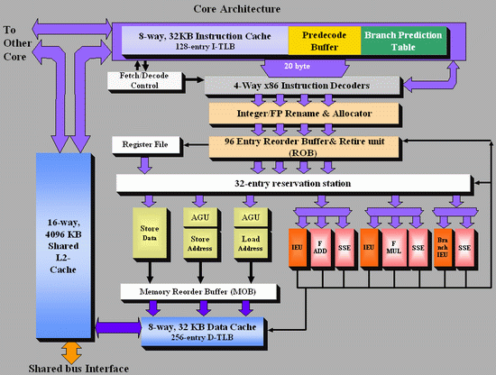
2.2.1 4-wide core (2)
Figure 2.2.1.1: Block diagram of Intel’s Core 2 microarchitecture [3]

Slide 108
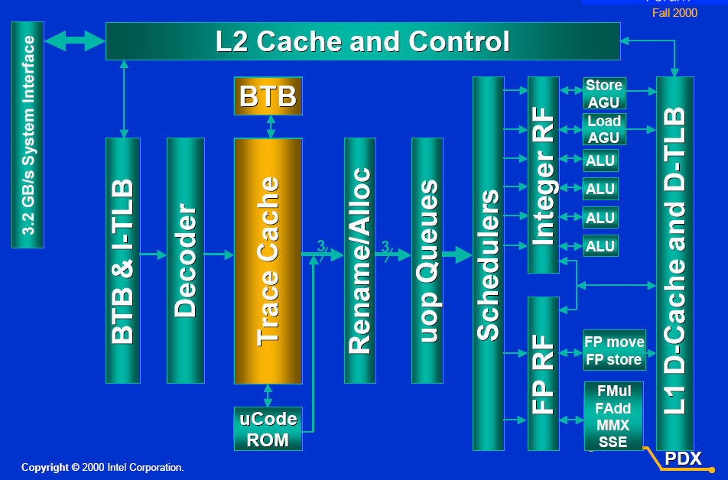
2.2.1 4-wide core (3)
Figure 2.2.1.2: Block diagram of Intel’s Pentium 4 microarchitecture [5]
Retire width: 3 instr./cycle

Slide 109
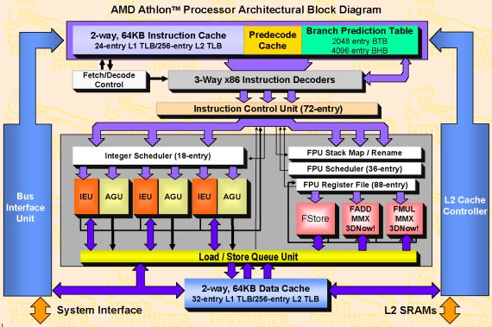
2.2.1 4-wide core (4)
Figure 2.2.1.3: Block diagram of AMD’s Athlon microarchitecture [4]

Slide 110
2.2.2 128-bit wide SIMD and FP units (1)
2.2.2 128-bit wide SIMD and FP units
a) Overview of the x86 ISA extensions in Intel’s processor lines
They aim at providing enhanced media support.

Slide 111
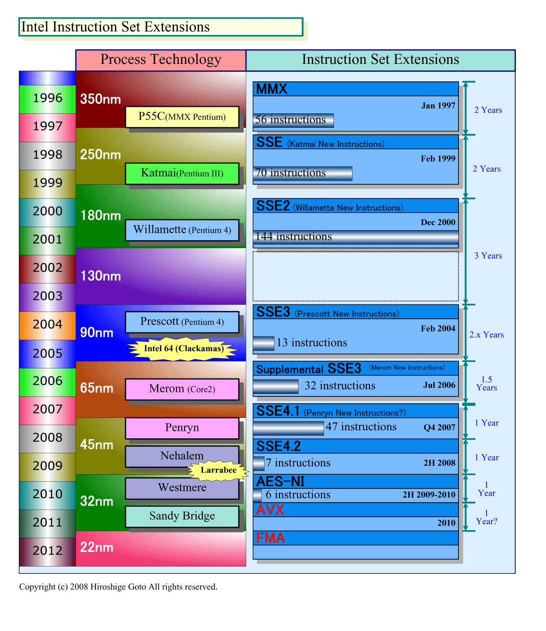
2.2.2 128-bit wide SIMD and FP units (2)
Overview of Intel’s x86 ISA extensions (based on [18])
Pentium III
MultiMedia eXtensions
Streaming SIMD Extensions
Pentium 4
Northwood (Pentium 4)
Core 2
Advanced Encryption Standard
Advanced Vector Extension
Ivy Bridge
Fused Multiply-Add instr.

Slide 112
2.2.2 128-bit wide SIMD and FP units (3)
Register spaces provided by Intel’s x86 ISA extensions (based on [18])
Pentium MMX
8 MM registers (64-bit),
aliased on the FP Stack registers
Pentium III
8 XMM registers (128-bit)
Pentium 4
16 XMM registers (128-bit)
Northwood (Pentium4)
Norhwood
Northwood (Pentium4)
Core 2
16 YMM registers (256-bit)
Ivy Bridge

Slide 113
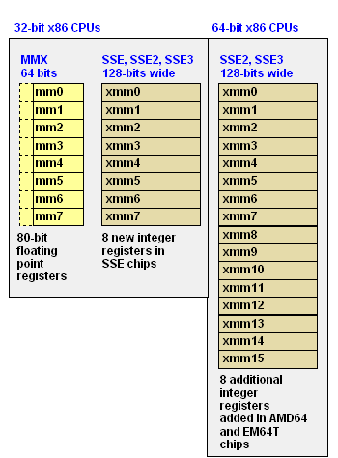
2.2.2 128-bit wide SIMD and FP units (4)
Illustration of the available SIMD register spaces of the MMX to SSE3/SSSE3 ISA
extensions in 32- and 64-bit ISAs [162]

Slide 114
2.2.2 128-bit wide SIMD and FP units (5)
Intel’s x86 ISA extensions - the operations introduced (based on [18])
Pentium III
64-bit FX SIMD with
32/16/8-bit operands (ops)
Support of MM
128-bit FX, FP SIMD with
32/16/8-bit FX, 32-bit FP ops.
Support of MM/3D
Pentium 4
128-bit FX, FP SIMD with
64/32/16/8-bit FX, 64/32-bit FP,
Support for MPEG-2, video, MP3
Northwood (Pentium4)
Norhwood
DSP-oriented FP enhancements,
enhanced thread manipulation
Core 2
Diverse arithmetic enhancements
Media acceleration
(video encoding, MM, gaming)
Accelerated string/text manip.,
appl. targeted acceleration
Accelerated encription operations
256-bit FP SIMD with
64/32-bit FP
Ivy Bridge

Slide 115
2.2.2 128-bit wide SIMD and FP units (6)
Overview of the Supplemental Streaming SIMD Extension (SSSE3) of the Core 2 ISA
[161]
SSSE3 provide 32 instructions (represented by 14 mnemonics) to accelerate computations on
packed integers.
These include:
• Twelve instructions that perform horizontal addition or subtraction operations (operations
on adjacent numbers.
• Six instructions that evaluate absolute values.
• Two instructions that perform multiply and add operations and speed up the evaluation
of dot products.
• Two instructions that accelerate packed-integer multiply operations and produce integer
values with scaling.
• Two instructions that perform a byte-wise, in-place shuffle according to the second
shuffle control operand.
• Six instructions that negate packed integers in the destination operand if the signs of the
corresponding element in the source operand is less than zero.
• Two instructions that align data from the composite of two operands.

Slide 116
2.2.2 128-bit wide SIMD and FP units (7)
SIMD execution resources in Intel’s basic processors (based on [18])
Pentium III
2 x 32-bit FX MMX EUs
2 x 32-bit MMX,
2 x 32-bit SSE EUs
Pentium 4
1 full + 1 simple (moves/stores)
64-bit FP/SSE EUs
Northwood (Pentium 4)
Core 2
2 x 128-bit FP EUs +
3 x 128-bit SSE EUs
256-bit SSE EUs
Ivy Bridge

Slide 117
2.2.2 128-bit wide SIMD and FP units (8)
b) Contrasting the number of 128-bit wide execution units in Intel’s Pentium 4, Core 2
and AMD’s K8 -1
The Core 2 has 128-bit wide and more FP and SSE execution units than Pentium 4 or AMD’s K8,
as detailed below.
Core 2
two 128-bit FP units
three 128-bit SSE units
Pentium 4
single 64-bit FP/SSE unit
single 64-bit FP/SSE move unit
AMD K8
two 64-bit FP/SSE units
single 64-bit FP/SSE move unit
The next Figure demonstrates it.

Slide 118
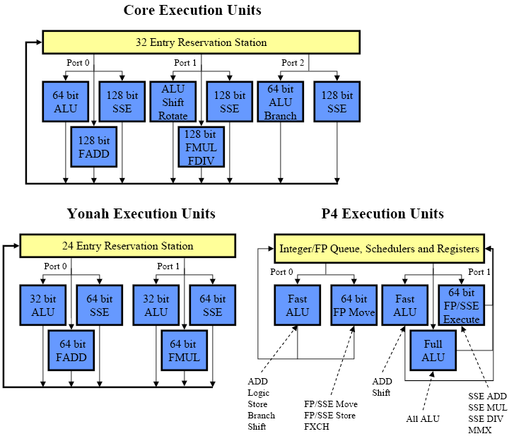
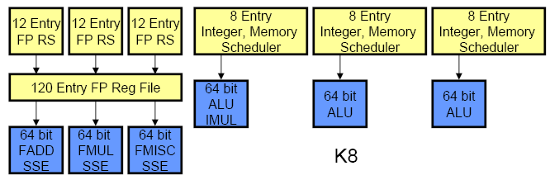
2.2.2 128-bit wide SIMD and FP units (9)
b) Contrasting the number of 128-bit wide execution units in Intel’s Pentium 4, Core 2
and AMD’s K8 -2 [159], [160]
K8 Execution Units
FP/SSE

Slide 119
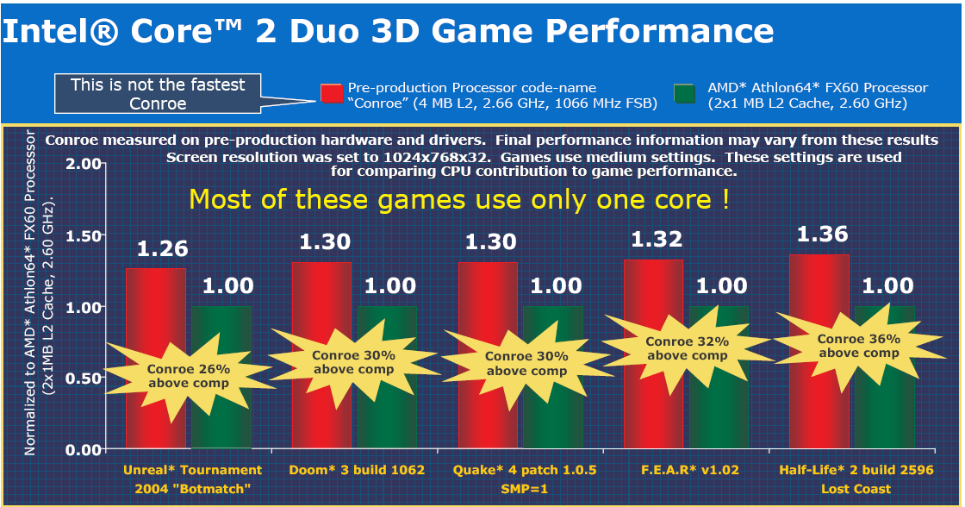
2.2.2 128-bit wide SIMD and FP units (10)
Core 2’s achieved performance boost for gaming apps vs. AMD’s Athlon 64 FX60 [13]

Slide 120
2.2.3 Shared L2 cache (1)
2.2.3 Shared L2 cache
In the Core 2 Intel makes use a shared L2 cache instead of private L2 caches and designates it
as smart L2 cache, as shown below.
Private
Shared
Core1
Core2
Core1
Core2
L2
Cache
L2
Cache
L2 Cache
Pentium 4-based DCs
Core 2-based DCs
Figure 2.2.3.1: Core’s shared L2 cache vs. Pentium 4’s private L2 caches

Slide 121
2.2.3 Shared L2 cache (2)
Benefits of shared caches vs. private caches
Dynamic cache allocation to the individual cores
Data sharing (no replicated data)
+ 2x bandwidth to L1 caches.

Slide 122
2.2.3 Shared L2 cache (3)
Drawbacks of shared caches
Shared caches combine memory access patterns
Reduce the efficiency of hardware prefetching vs private caches.
Choice between shared and private caches
Design decision depending on
whether benefits or drawbacks dominate as far as performance is concerned.
Trend
Core 2 prefers a shared L2 cache
Nehalem prefers private L2 caches
POWER5 prefers shared L2 cache
POWER6 prefers private L2 caches
This trend is due to the fact that efficient data prefetching became more important than
dynamic cache allocation or data sharing.

Slide 123
2.2.3 Shared L2 cache (4)
Intensive use of hardware prefetchers -1 [9]
Remarks
Intel’s first on-die L2 cache debuted only about two years earlier (8/1998),
in the second core of the Pentium II based Celeron line (called the Mendocino core,
built on 250 nm technology, with an L2 size of 128 KB)^{1,2}.
Intel’s first hardware prefetcher appeared subsequently in the Pentium 4 family,
associated with the L2 cache (one instruction and one data prefetcher (11/2000).
Principle of operation of the L2 hardware prefetcher
it monitors data access patterns and prefetches data automatically into the L2 cache,
it attempts to stay 256 bytes ahead of the current data access location,
the prefetcher remembers the history of cache misses to detect concurrent,
independent data streams that it tries to prefetch ahead of its use.
¹ The first Celeron model debuted in 4/1998, it was the low cost alternative to Pentium II,
and was designated as Cavington.
It was manufactured on 250 nm, run at 266 MHz, did not include an L2 cache and had 7.5 mtrs.
The second core of the Celeron line was launched in 8/1998 already with an L2 cache, run
at 266 and 300 MHz and incorporated 19,2 mtrs.
²Note: The debut of L2 was corrected in 29/10/2014.

Slide 124
2.2.3 Shared L2 cache (5)
Intensive use of hardware prefetchers -2 [11]
8 prefetchers in the two-core processor
2 data and 1 L1 instruction prefetchers per core,
able to handle multiple simultaneous patterns.
2 prefetchers in the L2 cache
tracking multiple access patterns per core.

Slide 125
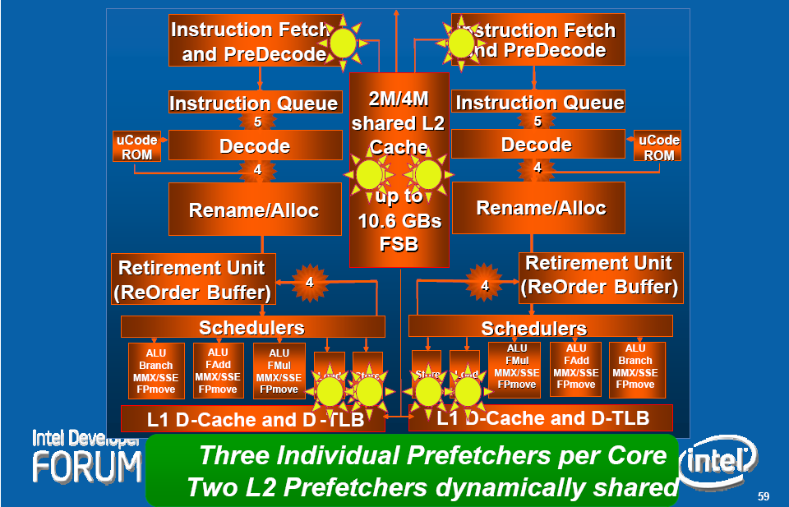
2.2.3 Shared L2 cache (6)
Hardware prefetchers in the Core 2 microarchitecture
Figure 2.2.3.2: Hardware prefetchers within the Core 2 microarchitecture [11]

Slide 126
2.2.4 Innovations in power management (1)
2.2.4 Innovations in power management
Shutting off not needed functional units of the processor
Platform Thermal Control

Slide 127
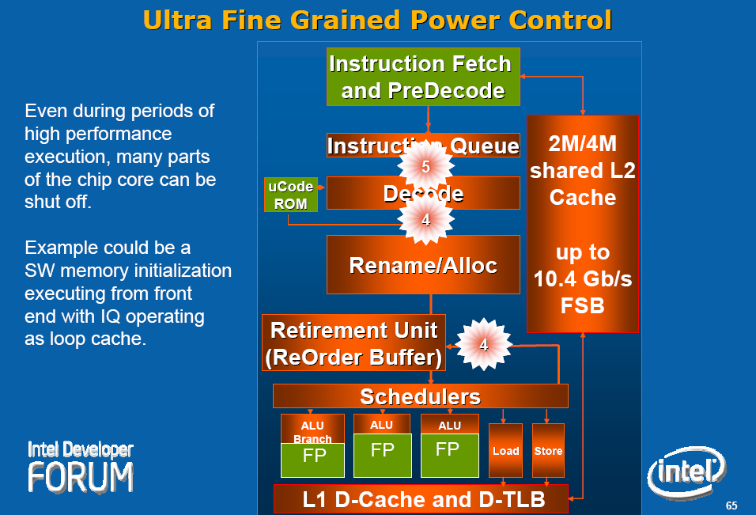
2.2.4 Innovations in power management (2)
Shutting off not needed functional units of the processor by clock gating [11]
Green units not needed
for the given operation,
they can be shut off.

Slide 128
2.2.4 Innovations in power management (3)
Platform Thermal Control [11], [20]
Digital
Thermal Sensors
(DTS) on the dies,
instead of
analog diodes,
providing
digital data,
scanned by
dedicated logic.
PECI
(Platform Environment Control Interface)
A single wire proprietary interface with
transfer rates of 2 kbit/s-2 Mbit/s)
DTSs report the difference between the
current temperature and the throttle point,
at which the processor reduces speed.

Slide 129
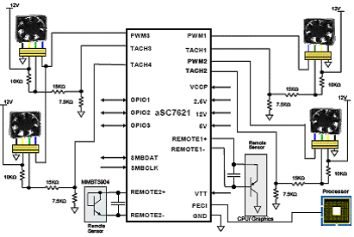
2.2.4 Innovations in power management (4)
Possible solution for the Platform Thermal Control Manager [88]
(ASIC (Application Specific IC/Microcontroller)
(Remote Sensor
CPU/Graphics)
(Remote Sensor)
Figure 2.2.4.1: The aSC7621 hardware monitor with fan control and PECI from Andigilog

Slide 130
2.3 Performance leadership change between Intel and AMD achieved by the Core 2
Notes:
130

Slide 131
2.3 Performance leadership change between Intel and AMD (1)
Performance leadership change between Intel and AMD achieved by the Core 2
In 2003 AMD introduced their K8-based processors implementing
the 64-bit x86 ISA and
the direct connect architecture concept, that includes
integrated memory controllers and
high speed point-to-point serial buses (the HyperTransport bus)
used to connect processors to processors and processors to south bridges.
AMD’s K8-based processors became the performance leader, first of all on the DP and MP
server market, where the 64-bit direct connect architecture has clear benefits
vs Intel’s 32-bit Pentium 4 based processors using shared FSBs to connect processors
to north bridges.

Slide 132
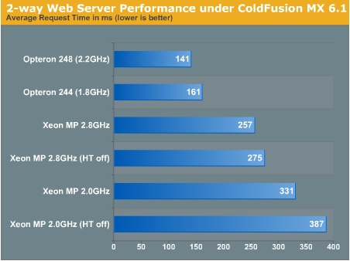
2.3 Performance leadership change between Intel and AMD (2)
Example 1: DP web-server performance comparison (2003)
Figure 2.3.1: DP web server performance comparison: AMD Opteron 248 vs. Intel Xeon 2.8 [6]

Slide 133
2.3 Performance leadership change between Intel and AMD (3)
Example 2: Summary assessment of extensive benchmark tests contrasting
dual Opterons vs dual Xeons (2003) [7]
“In the extensive benchmark tests under Linux Enterprise Server 8 (32 bit as well as 64 bit),
the AMD Opteron made a good impression.
Especially in the server disciplines, the benchmarks (MySQL, Whetstone, ARC 2D, NPB, etc.)
show quite clearly that the Dual Opteron puts the Dual Xeon in its place”.

Slide 134
2.3 Performance leadership change between Intel and AMD (4)
This situation has completely changed in 2006 when Intel introduced their Core 2
microarchitecture,
The Core 2 has
a 4-wide front-end and retire unit compared to the 3-wide K8,
two 128-bit FP units and three 128-bit SSE units compared to
two 64-bit FP/SSE units and a single 64-bit FP/SSE move unit available in the K8.
This and further enhancements of the Core microarchitecture, detailed subsequently,
resulted in record breaking performance figures.
Intel regained performance leadership vs AMD.

Slide 135
2.3 Performance leadership change between Intel and AMD (5)
Example: DP web-server performance comparison (2006)
Webserver Performance
 | MSI K2-102A2M Opteron 275 | MSI K2-102A2M Opteron 280 | Opteron 280 vs. Opteron 275 | Extrapolated Opteron 3 GHz | Xeon 5160 3 GHz
Jsp - Peak | 144 | 154 | 7% | 182 | 230
AMP - Peak | 984 | 1042 | 6% | 1178 | 1828
Jsp: Java Server Page performance
AMP: Apache/MySQL/PHP
Figure 2.2.1.8: DP web server performance comparison:
AMD Opteron 275/280 vs. Intel Xeon 5160 [8]
Remark
Both web-server benchmark results were published from the same source (AnandTech)

Slide 136
2.4 Die plot of the Core 2
Notes:
136

Slide 137
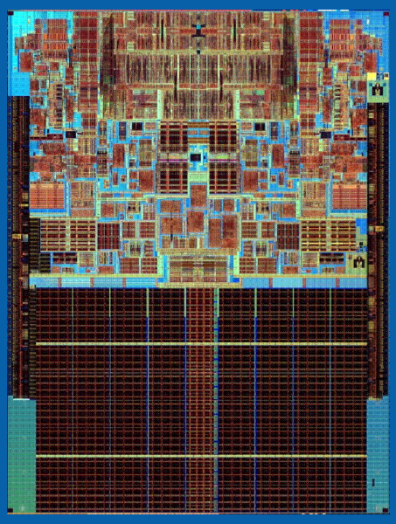
2.4 Die plot of the Core 2 (1)
2.4 Die plot of the Core 2 [163]
143 mm²
291 mtrs

Slide 138
2.5 Overview of Core 2 based processor lines
Notes:
138

Slide 139
2.5 Overview of Core 2 based processor lines (1)
2.5 Overview of Core 2 based processor lines
Mobiles
T5xxx/T7xxx, 2C ,Merom 8/2006
Desktops
E6xxx/E4xxx, 2C, Core 2 Duo, (Conroe) 7/2006
X6800 Core 2 Extreme, 2C, (Conroe) 7/2006
E6xxx/E4xxx, Core 2 Duo, 2C, (Allendale) 1/2007
Q6xxx Core 2 Quad, 2x2C (Kentsfield) (2xConroe) 1/2007
QX6xxx Core 2 Extreme Quad, 2x2C, (Kentsfield XE) 11/2006
Servers
UP-Servers
30xx, 2C, Conroe, 9/2006
30xx, 2C, Allendale 1/2007
32xx, 2x2C, Kentsfield (2xConroe) 1/2007
DP-Servers
51xx, 2C Woodcrest, 6/2006
53xx, 2x2, Clowertown, (2xWoodcrest) 11/2006
MP-Servers
72xx, 2C, Tigerton DC, (2xMP-enhanced SC Woodcrest) 9/2007
73xx, 2x2C, Tigerton QC, (2xMP-enhanced DC Woodcrest) 9/2007
Based on [43]

Slide 140
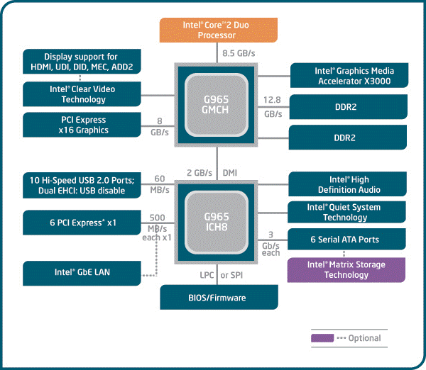
2.5 Overview of Core 2 based processor lines (2)
Example Core 2 system architecture [223]

Slide 142
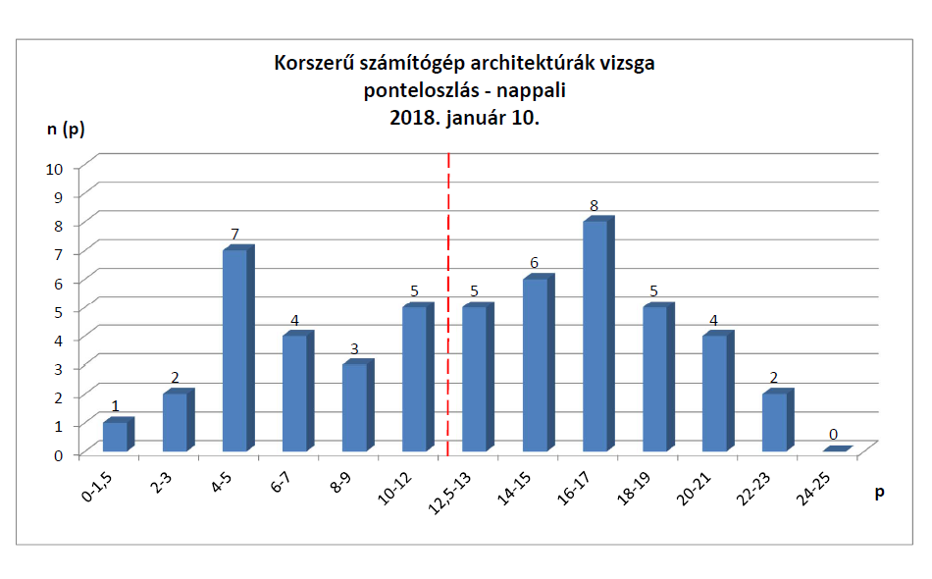

Slide 143
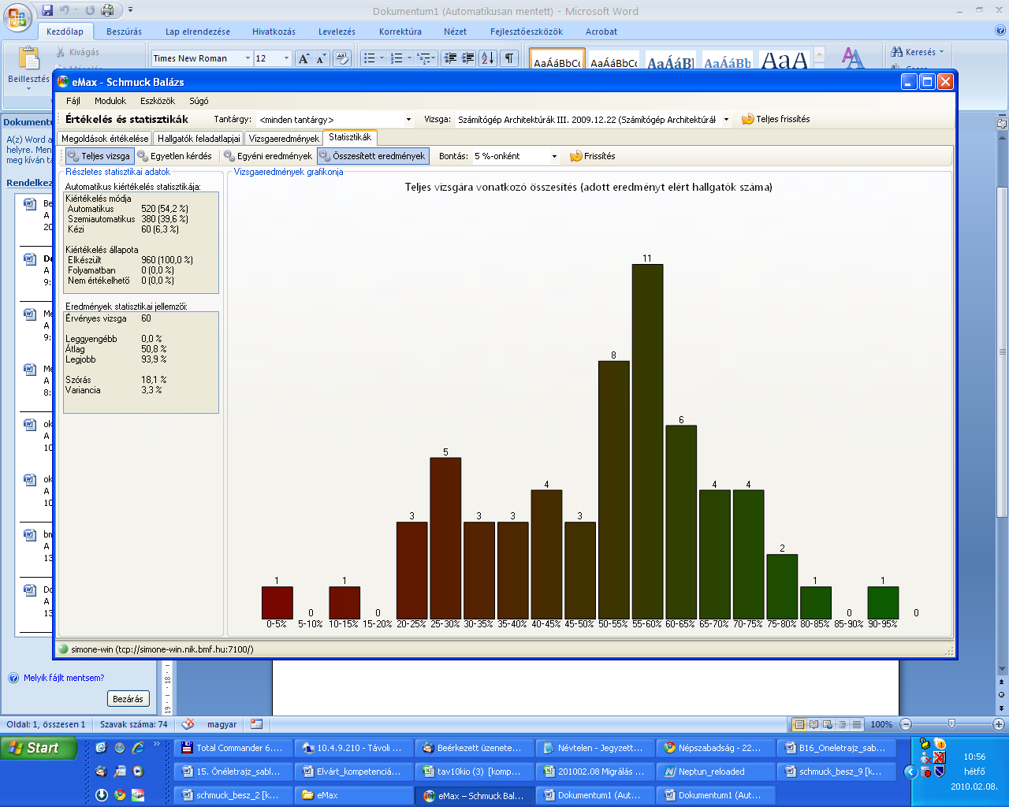
Számítógép architektúrák III. BSc
2009. december 22.

