Slide 1
Intel’s Core 2 family - TOCK lines II
Nehalem to Haswell
Dezső Sima
Vers. 3.11
August 2018

Slide 2
Contents
1. Introduction
2. The Core 2 line
3. The Nehalem line
4. The Sandy Bridge line
5. The Haswell line
6. The Skylake line
7. The Kaby Lake line
8. The Kaby Lake Refresh line
9. The Coffee Lake line
10. The Cannon Lake line

Slide 3
3. The Nehalem line
3.1 Introduction to the 1. generation Nehalem line
(Bloomfield)
3.2 Major innovations of the 1. gen. Nehalem line
3.3 Major innovations of the 2. gen. Nehalem line
(Lynnfield)
Notes:
3

Slide 4
3.1 Introduction to the 1. generation Nehalem line (Bloomfield)
Notes:
4

Slide 5
3.1 Introduction to the 1. generation Nehalem line (Bloomfield) (1)
3.1 Introduction to the 1. generation Nehalem line (Bloomfield)
Developed at Hillsboro, Oregon, at the site where the Pentium 4 was designed.
Experiences with HT
Nehalem became a multithreaded design.
The design effort took about five years and required thousands of engineers
(Ronak Singhal, lead architect of Nehalem) [37].
The 1. gen. Nehalem line targets DP servers, yet its first implementation appeared in the
desktop segment (Core i7-9xx (Bloomfield)) 4C in 11/2008
Figure 4.1.1: Intel’s Tick-Tock development model (Based on [1])
1. gen.
2. gen.
3. gen.
4. gen.
5. gen.
6. gen.
Core 2
New
Microarch.
65 nm
Penryn
New
Process
45 nm
Nehalem
New
Microarch.
45 nm
West-
mere
New
Process
32 nm
Sandy
Bridge
New
Microarch.
32 nm
Ivy
Bridge
New
Process
22 nm
Haswell
New
Microarchi.
22 nm
Broad-
well
New
Process
14 nm
Skylake
New
Microarchi.
14 nm
TOCK
TICK
TOCK
TICK
TOCK
TICK
TOCK
TICK
TOCK
Figure : Intel’s Tick-Tock development model (Based on [1])
*

Slide 6
3.1 Introduction to the 1. generation Nehalem line (Bloomfield) (2)
Nehalem lines
1. generation Nehalem processors
2. generation Nehalem processors
Mobiles
Mobiles
Core i7-9xxM (Clarksfield) 4C 9/2009
Core i7-8xxQM (Clarksfield) 4C 9/2009
Core i7-7xxQM (Clarksfield) 4C 9/2009
Desktops
Desktops
Core i7-9x0 (Bloomfield) 4C 11/2008
Core i7-8xx (Lynnfield) 4C 9/2009
Core i5-7xx (Lynnfield) 4C 9/2009
HED
Core i7-965 (Bloomfield) 4C 11/2008
Core i7-975 (Bloomfield) 4C 7/2009
Servers
Servers
UP-Servers
UP-Servers
35xx (Bloomfield) 4C 3/2009
34xx (Lynnfield) 4C 9/2009
C35xx (Jasper forest¹) 4C 2/2010
DP-Servers
DP-Servers
55xx (Gainestown) (Nehalem-EP) 4C 3/2009
C55xx (Jasper forest¹) 2C/4C 2/2010
Based on [44]
¹Jasper forest: Embedded UP or DP server

Slide 7
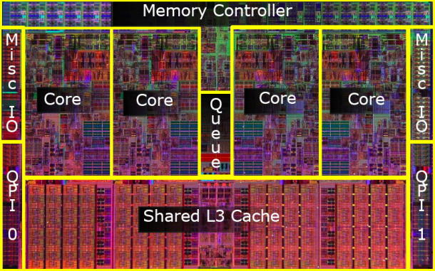
3.1 Introduction to the 1. generation Nehalem line (Bloomfield) (3)
Die shot of the 1. generation Nehalem desktop processor (Bloomfield) [45]
(8 MB)
Die shot of the Bloomfield chip [45]
Note
Both the desktop oriented Bloomfield chip and the DP server oriented Gainestown chip have
the same layout.
The Bloomfield die has two QPI bus controllers, in spite of the fact that they are not needed
for the desktop part.
In the Bloomfield die one of the controllers is simply not activated [45], whereas both are
active in the DP alternative (Gainestown).
*

Slide 8
3.1 Introduction to the 1. generation Nehalem line (Bloomfield) (4)
The Nehalem line -1
Key new features of the ISP
and the microarchitecture
2 YEARS
TICK Pentium 4 ( Cedar Mill)
Pentium D (Presler)
01/2006
2 YEARS
65nm
New microarch.: 4-wide core,
128-bit SIMD FX/FP EUs,
shared L2 , no HT
TOCK Core 2
07/2006
TICK Penryn Family
11/2007
2 YEARS
45nm
New microarch.: 4 cores, integr. MC,
QPI, private L2, (inclusive) L3, HT
TOCK Nehalem
11/2008
TICK Westmere
01/2010
In package integrated GPU
2 YEARS
32nm
New microarch.: 256-bit (FP) AVX,
ring bus, integrated GPU
TOCK Sandy Bridge
01/2011
TICK Ivy Bridge
04/2012
2 YEARS
22nm
New microarch.: 256-bit (FX) AVX2,
L4 cache (discrete eDRAM), TSX
TOCK Haswell
06/2013
TICK Broadwell
09/2014
Shared Virtual Memory
4 YEARS
TOCK Skylake
10/2015
New microarch.: 5-wide core,
ISP, Memory Side L4 cache, no FIVR
14nm
TOCK Kaby Lake
08/2016
Optane memory, in KBL G series:
in package integr. CPU, GPU, HBM2
TOCK Coffee Lake
10/2017
(USB Gen. 2, integr. conn., Optane 2)
TICK Cannonlake
05/2018
AVX512
?? YEARS
10nm
TOCK Icelake
??/2019
Figure is based on [3])
*

Slide 9
3.1 Introduction to the 1. generation Nehalem line (Bloomfield) (4B)
The Nehalem line -2
Key new features
in power management
2 YEARS
TICK Pentium 4 ( Cedar Mill)
Pentium D (Presler)
01/2006
2 YEARS
65nm
Clock gating, PECI,
Platform Thermal Control by
3. party controller
TOCK Core 2
07/2006
2 YEARS
TICK Penryn Family
11/2007
EDAT
45nm
Integrated Power Gates, PCU,
Turbo Boost
TOCK Nehalem
11/2008
TICK Westmere
01/2010
2 YEARS
32nm
TOCK Sandy Bridge
01/2011
Turbo Boost 2.0
2 YEARS
TICK Ivy Bridge
04/2012
22nm
TOCK Haswell
06/2013
FIVR
TICK Broadwell
09/2014
2. gen. FIVR
Speed Shift Technology,
Duty Cycle control, No FIVR
(except Skylake X)
4 YEARS
TOCK Skylake
10/2015
14nm
TOCK Kaby Lake
08/2016
Speed Shift Technology v2
TOCK Coffee Lake
10/2017
In H-series: TVB
(Thermal Velocity Boost)
TICK Cannonlake
05/2018
10nm
TOCK Icelake
??/2019
Figure is based on [3])
*

Slide 10
3.2 Major innovations of the 1. generation Nehalem line
3.2.1 Integrated memory controller
3.2.2 QuickPath Interconnect bus (QPI)
3.2.3 New cache architecture
3.2.4 Simultaneous Multithreading
3.2.5 Enhanced power management
3.2.6 New socket
Notes:
10

Slide 11
3.2 Major innovations of the 1. generation Nehalem line (1)
3.2 Major innovations of the 1. generation Nehalem line [54]
The Major incentive for designing the microarchitecture of Nehalem: support of 4 cores.
4 cores need however twice as much bandwidth as dual core processors, to maintain the
per core memory bandwidth.
Two memory channels used for dual core processors are more or less the limit attachable to
the north bridge due to physical and electrical limitations.
Consequently, to provide enough bandwidth for 4 cores, a new memory design was necessary.
Major innovations of the 1. generation 4-core Nehalem line
Integrated memory controller
(Section 3.2.1)
QuickPath Interconnect bus (QPI)
(Section 3.2.2)
New cache architectureure
(Section 3.2.3)
• Simultaneous Multithreading (SMT)
(Section 3.2.4)
SSE 4.2 ISA extension
(Not detailed)
Enhanced power management
(Section 3.2.5)
Advanced virtualization
(Not detailed)
New socket
(Section 3.2.6)
(8 MB)
Figure 3.2.1: Die photo of the Bloomfield/Gainestown chip
*

Slide 12
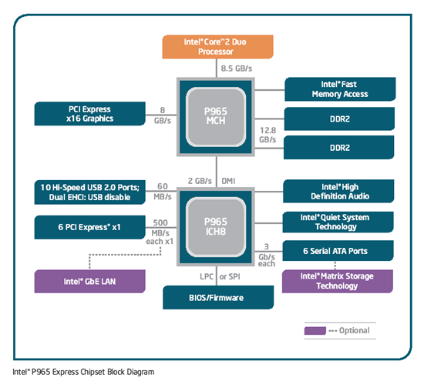
3.2.1 Integrated memory controller (1)
3.2.1 Integrated memory controller
Traditional system architectures, as shown below for the Core 2 Duo processor, can
implement not more than two high speed memory channels connected to the MCH
due to electrical and physical constraints, to be discussed in Chapter on Intel’s Servers.
Two memory channels can however, provide enough bandwidth only for up to dual core processors.
Figure: Core 2 Duo based
platform [166]
*

Slide 13
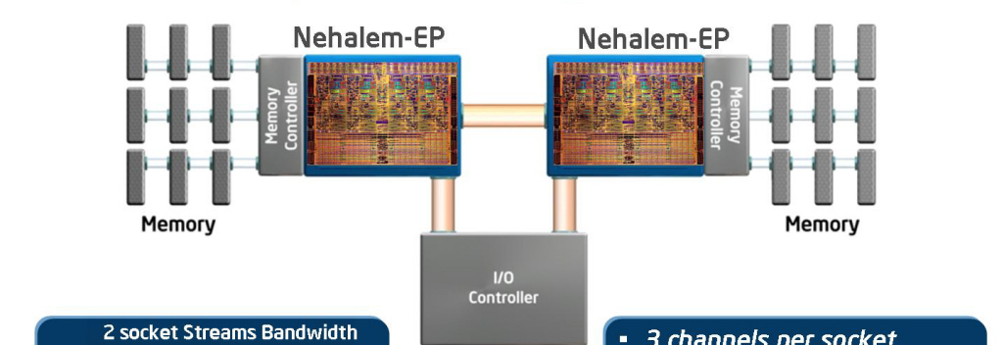
3.2.1 Integrated memory controller (2)
The need for integrated memory controller in a dual processor QC Nehalem platform
n cores
n times higher memory bandwidth need per processor
New design for attaching memory: placing memory controllers on the dies
DDR3
DDR3
Figure 3.2.1.1: Integrated memory controller of Nehalem [33]
*

Slide 14
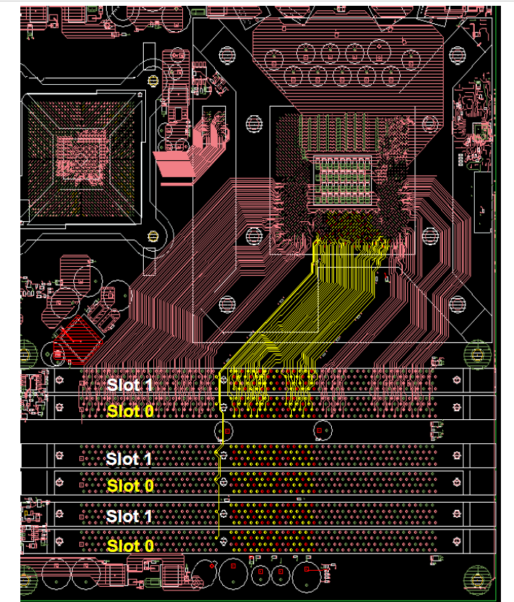
3.2.1 Integrated memory controller (2b)
Connecting 3 DDR3
memory channels to the
processor socket [242]

Slide 15
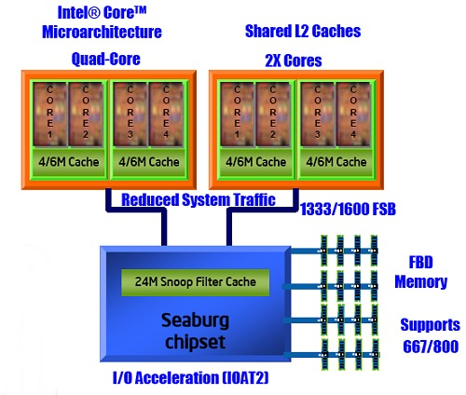
3.2.1 Integrated memory controller (2c)
Alternative solution: Connecting memory via (connected via low-line count serial
differential interfaces)
(Harpertown (2x2 cores, 45 nm Penryn) based DP server processor [277]
Harpertown
(45 nm, 2 chips
in the same package)
FB-DIMM memory
(connected via
low-line count
serial differential
interfaces)

Slide 16
3.2.1 Integrated memory controller (3)
Benefits and drawback of integrated memory controllers
Benefits
Low memory access latency
important for memory intensive apps.
Drawback of integrated memory controllers
Processor becomes memory technology dependent
For an enhanced memory solution (e.g. for increased memory speed)
a new processor modification is needed.
*

Slide 17
3.2.1 Integrated memory controller (4)
Non Uniform Memory Access (NUMA) architectures
It is a consequence of using integrated memory controllers in case of multi-socket servers
Local memory access
Remote memory access
Figure 3.2.1.2: Non Uniform Memory Access (NUMA) in multi-socket servers [1]
Advanced multi-socket platforms use NUMA
Remote memory access latency ~ 1.7 x longer than local memory access latency
Demands a fast processor-to-processor interconnection to relay memory traffic (QPI)
Operating systems have to modify memory allocation strategies + related APIs
*

Slide 18
3.2.1 Integrated memory controller (4b)
Remark: Classification of multiprocessor server platforms according to their
memory architecture
Multiprocessor server platforms
classified according to their memory architecture
SMPs
(Symmetrical MultiProcessor)
NUMAs
Multiprocessors (Multi socket system)
with Uniform Memory Access (UMA)
Multiprocessors (Multi socket system)
with Non-Uniform Memory Access
All processors access main memory by the same
mechanism, (e.g. by individual FSBs and an MCH).
Each processor is allocated a part of the main memory
(with the related memory space), called the local memory,
whereas the rest is considered as the remote memory.
Typical examples
Processor
Processor
Processor
QPI
Processor
QPI
QPI
FSB
E.g. DDR3-1333
IOH¹
E.g. DDR3-1333
MCH
E.g. DDR2-533
ESI
ESI
ICH
ICH
¹ICH: I/O hub
ESI: Enterprise System Interface
*

Slide 19
3.2.1 Integrated memory controller (5)
Memory latency comparison: Nehalem vs Penryn [1]
Harpertown: Quad-Core Penryn based server (Xeon 5400 series)

Slide 20
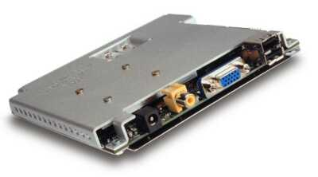
3.2.1 Integrated memory controller (6)
Remark
Intel’s Timna – a forerunner to integrated memory controllers [34]
Timna (announced in 1999, due to 2H 2000, cancelled in Sept. 2000)
Developed in Intel’s Haifa Design and Development Center.
Low cost microprocessor with integrated graphics and memory controller
(for Rambus DRAMs).
Due to design problems and lack of interest from many vendors,
Intel finally cancelled Timna in Sept. 2000.
Figure 3.2.1.4: The low cost (<600 $) Timna PC [40]

Slide 21
3.2.1 Integrated memory controller (7)
Point of attaching memory
Point of attaching memory
Attaching memory to the MCH
Attaching memory to the processor(s)
Examples
UltraSPARC II (1C) (~1997)
UltraSPARC III (2001)
and all subsequent Sun lines
AMD’s K7 lines (1C) (1999-2003)
Opteron server lines (2C) (2003)
and all subsequent AMD lines
POWER4 (2C) (2001)
POWER5 (2C) (2005)
and subsequent POWER families
PA-8800 (2004)
PA-8900 (2005)
and all previous PA lines
Core 2 Duo line (2C) (2006)
and all preceding Intel lines
Core 2 Quad line (2x2C) (2006/2007)
Penryn line (2x2C) (2008)
Nehalem lines (4) (2008)
and all subsequent Intel lines
Montecito (2C) (2006)
Tukwila (4C) (2010)
*

Slide 22
3.2.1 Integrated memory controller (8)
Main features of the dual processor QC Nehalem platform
DDR3
DDR3
Figure 3.2.1.1: Integrated memory controller of Nehalem [33]
3 channels per socket
Up to 3 DIMMs per channel (impl. dependent)
DDR3-800, 1066, 1333
Supports both RDIMMs and UDIMMs (impl. dependent)
Nehalem-EP (Efficient Performance):
Designation of the server line
*

Slide 23
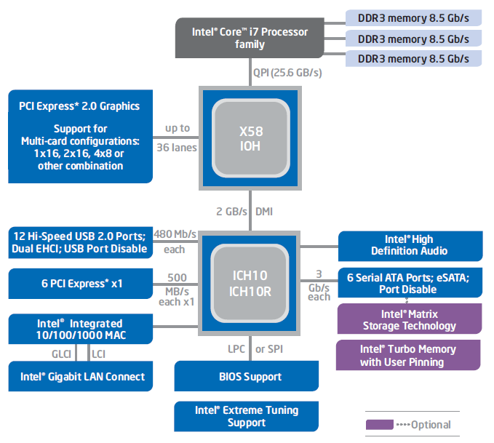
3.2.1 Integrated memory controller (9)
1. generation Nehalem (called Bloomfield)-based desktop platform [249]

Slide 24
3.2.2 QuickPath Interconnect bus (QPI) (1)
3.2.2 QuickPath Interconnect bus (QPI) -1
Its debut is strongly motivated by the introduction of integrated memory controllers, since
in multiprocessors accessing data held remotely (to a given processor) needs a high-speed
processor-to-processor interconnect.
Such an interconnect will be implemented as a serial, differential point-to-point bus, called
the Quick Path Interconnect (QPI) bus, similarly to AMD’s HyperTransport bus, used to
connect processors to processors or processors to north bridges.
Formerly, the QPI bus was designated as the Common System Interface bus (CSI bus).
*

Slide 25
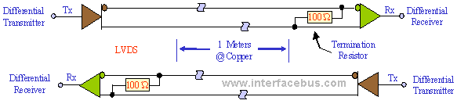
3.2.2 QuickPath Interconnect bus (QPI) (2)
Principle of differential interconnections [170]
*

Slide 26
3.2.2 QuickPath Interconnect bus (QPI) (3)
3.2.2 QuickPath Interconnect bus (QPI)- 2
It consists of 2 unidirectional links, one in each directions, called the TX and RX
(T for Transmit, R for Receive).
*

Slide 27
3.2.2 QuickPath Interconnect bus (QPI) (4)
Signals of the QuickPath Interconnect bus (QPI bus) [22]
Each unidirectional link comprises 20 data lanes and a clock lane, with
each lane consisting of a pair of differential signals.
TX Unidirectional link
RX Unidirectional link
16 data
2 protocol
2 CRC
(Lane: Vonalpár)
(DDR data transfer)

Slide 28
3.2.2 QuickPath Interconnect bus (QPI) (5)
Signaling systems used in buses
Signals
Single ended
Voltage referenced
Differential
Typ.voltage
swings
S+
V_{REF}
S-
V_{CM}
t
t
t
3.3-5 V
600-800 mV
200-300 mV
Signaling
system
used in
TTL (5 V)
FPM/EDO
SSTL
SSTL2 (DDR)
SSTL1.8 (DDR2)
SSTL1.5 (DDR3)
RSL (RDRAM)
FSB
LVDS
PCIe
QPI, DMI, ESI
FB-DIMMs
LVTTL (3.3 V)
FPM/EDO
SDRAM
HI 1.5
DRSL
XDR (data)
Smaller voltage swings
LVDS: Low Voltage Differential Signaling LVTTL: Low Voltage TTL
(D)RSL: (Differential) Rambus Signaling Level SSTL: Stub Series Terminated Logic V_{CM}: Common Mode Voltage V_{REF}: Reference Voltage
*

Slide 29
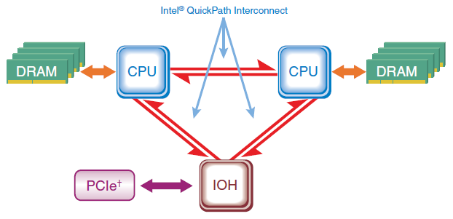
3.2.2 QuickPath Interconnect bus (QPI) (6)
QPI based DP server architecture [169] -1
Note
First generation Nehalem (Bloomfield) supports only DP configurations.

Slide 30
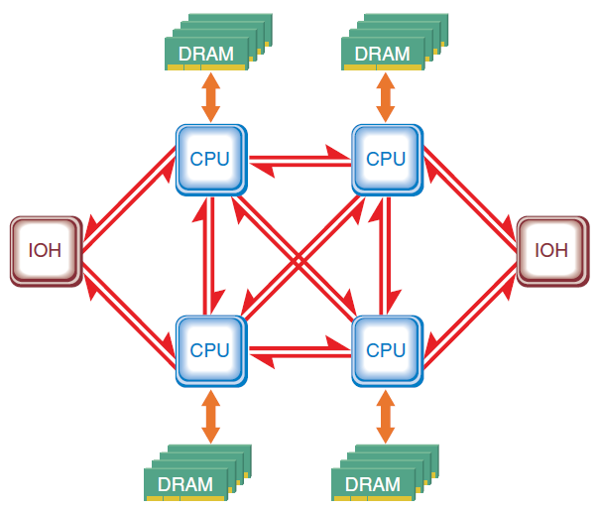
3.2.2 QuickPath Interconnect bus (QPI) (7)
QPI based MP server architecture [169] -2

Slide 31
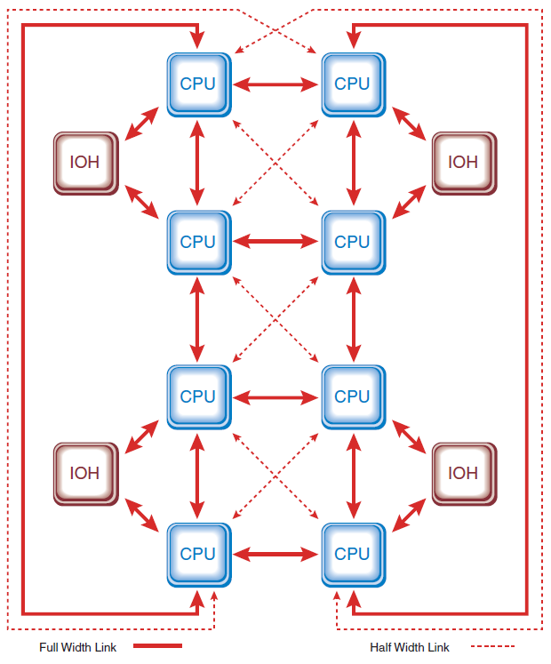
3.2.2 QuickPath Interconnect bus (QPI) (8)
QPI based 8-processor system architecture [169] -3

Slide 32
3.2.2 QuickPath Interconnect bus (QPI) (9)
Contrasting the QPI with the FSB and other serial buses
Fastest FSB
Parallel, 8 Byte data width, QDR, up to 400 MHz clock, voltage ref. signaling 12.8 GB/s data rate
Serial links
Unidirectional point-to-point links, 2 Byte data width, DDR data rate, differential signaling
QPI | Base clock | Platforms | Data rate (up to) (in each dir.) | Year
QPI | 3.2 GHz | Nehalem (server/desktop) | 12.8 GB/s | 2008
QPI 1.1 | 4.0 GHz | Sandy Bridge EN/EP Ivy Bridge-EN/EP/EX Westmere EN/EP/EX | 16.0 GB/s | 2010-14
QPI 1.1 | 4.8 GHz | Haswell EN/EP/EX Broadwell EN/EP/EX | 19.2 GB/s | 2014-16
UPI | Base clock | Platforms | Data rate (up to) (in each dir.) | Year
UPI | 5.2 GHz | Skylake-SP | 20.8 GB/s | 2017
HT | Base clock | Platforms (first implemented in) | Data rate (up to) (in each dir.) | Year
HT 1.0 | 0.8 GHz | K8-based mobile Athlon 64/Opteron | 3.2 GB/s | 2003
HT 2.0 | 1.0 GHz | K8-based Athlon 64 desktop | 4.0 GB/s | 2004
HT 3.0 | 2.6 GHz | K10.5-based Phenom X4 desktop | 8.0 GB/s | 2007
HT 3.1 | 3.2 GHz | K10.5-based Magny Course server | 12.8 GB/s | 2010

Slide 33
3.2.3 New cache architecture (1)
3.2.3 New cache architecture
In multiprocessors with NUMA architectures remote memory accesses have long access times,
this strengthen the need for an enhanced cache system.
The cache system can be enhanced by introducing a three level cache system, enabled
by the 45 nm technology used.
2-level cache hierarchy
(Penryn)
3-level cache hierarchy
(Nehalem)
Core
Core
Core
Core
Core
32 kB/32 KB
L1 Caches
L1 Caches
L1 Caches
L1 Caches
L1 Caches
32 kB/32 KB
4 MB
Shared/
two cores
L2 Cache
L2 Cache
L2 Cache
L2 Cache
256 KB
Private
L3 Cache
Up to 8 MB
Inclusive
Figure 3.2.3.1: The 3-level cache architecture of Nehalem (based on [1])
*
*

Slide 34
3.2.3 New cache architecture (2)
Key features of the new 3-level cache architecture
a) Using private L2 caches
b) Changed L2 cache size
c) Use of an inclusive L3 cache

Slide 35
3.2.3 New cache architecture (3)
a) Using private L2 caches
The L2 cache is private again rather than shared as in the Core and Penryn processors
Private L2
Shared L2
Pentium 4
Core
Penryn
Nehalem
Assumed reason for returning to the private scheme
Private caches allow a more effective hardware prefetching than shared ones, since
Hardware prefetchers look for memory access patterns.
Private L2 caches have more easily detectable memory access patterns
than shared L2 caches.
*

Slide 36
3.2.3 New cache architecture (4)
Remark
The POWER family had the same evolution path as above
Private L2
Shared L2
POWER4
POWER5
POWER6

Slide 37
3.2.3 New cache architecture (5)
b) Changed L2 cache sizes
Without an L3 cache the optimum L2 cache size is the maximum L2 size feasible on the die.
With an L3 cache available the optimum L2 size becomes about ¼ or ½ MB in the systems
discussed.
2-level cache hierarchy
(Penryn)
3-level cache hierarchy
(Nehalem)
Core
Core
Core
Core
Core
32 kB/32 KB
L1 Caches
L1 Caches
L1 Caches
L1 Caches
L1 Caches
32 kB/32 KB
4 MB
Shared/
two cores
L2 Cache
L2 Cache
L2 Cache
L2 Cache
256 KB
Private
L3 Cache
Up to 8 MB
Inclusive
Figure 3.2.3.1: The 3-level cache architecture of Nehalem (based on [1])
Remark
The optimum cache size provides the highest system performance, since on the one side
higher cache sizes lower the rate of cache misses on the other increase the cache access time.
*

Slide 38
3.2.3 New cache architecture (6)
c) Use of an inclusive L3 cache
The L3 cache is inclusive rather than exclusive
like in a number of competing designs, such as UltraSPARC IV+ (2005), POWER5 (2005),
POWER6 (2007), POWER7 (2010), POWER8 (2014), AMD’s K10-based processors (2007).
(An inclusive L3 cache includes the L2 cache content.)
Intel’s argumentation for inclusive caches [38]
Inclusive L3 caches prevent L2 snoop traffic for L3 cache misses since
with inclusive L3 caches an L3 cache miss means that the referenced data
doesn’t exist in any core’s L2 caches, thus no L2 snooping is needed.
By contrast, with exclusive L3 caches the referenced data may exist in any
of the L2 caches, thus L2 snooping is required,
as indicated in the next Figure.
*

Slide 39
3.2.3 New cache architecture (7)
Benefit of inclusive L3 caches -1 (based on [209])
Inclusive L3
Exclusive L3
Core
Core
Core
Core
Core
Core
Core
Core
L1 Caches
L1 Caches
L1 Caches
L1 Caches
L1 Caches
L1 Caches
L1 Caches
L1 Caches
L2 Caches
L2 Caches
L2 Cache
L2 Cache
L2 Caches
L2 Caches
L2 Cache
L2 Cache
L3 Cache
L3 Cache
Miss
Miss
It is guaranteed that data is not on die
All other cores must be checked (snooped)!
*

Slide 40
3.2.3 New cache architecture (8)
Benefit of inclusive L3 caches -2 (based on [209])
Note: For higher core counts L2 snooping becomes a more demanding task and overshadows the
benefits arising from the more efficient cache use of the explicit cache scheme.
*

Slide 41
3.2.3 New cache architecture (9)
Introduction of L3 caches in other processor lines
Vendor | Model | Core count | L2 MB | Year of intro. |  | Model | Core count | L3 | Year of intro
IBM | POWER3 II | 1C | 16 MB off-chip | 1999 |  | POWER4 | 2C | 32 MB off-chip | 2001
 |  |  |  |  |  | POWER5 | 2C | 36 MB off-chip | 2004
 |  |  |  |  |  | POWER6 | 2C | 32 MB off-chip | 2007
 |  |  |  |  |  | POWER7 | 8C | 8X4MB on-chip | 2010
AMD | K8 Santa Rosa | 2C | 2x1 MB on-chip | 2006 |  | K10 Barcelona | 4C | 2 MB on-chip | 2007
Intel | Penryn | 2C | 6 MB on-chip | 2008 |  | Nehalem | 4C | 8 MB on-chip | 2008
*

Slide 42
3.2.3 New cache architecture (10)
Remark
In the Skylake-SP server processor (2017) both
the L2/L3 cache sizes were changed and also
the inclusion policy from inclusive to non-inclusive (different from exclusive)

Slide 43
3.2.3 New cache architecture (10)
The notions of “Uncore” [1] and “System Agent”
SA
Subsequently, Intel introduced the notion of System Agent (SA), it is the L3 cache-less part of Uncore.
*

Slide 44
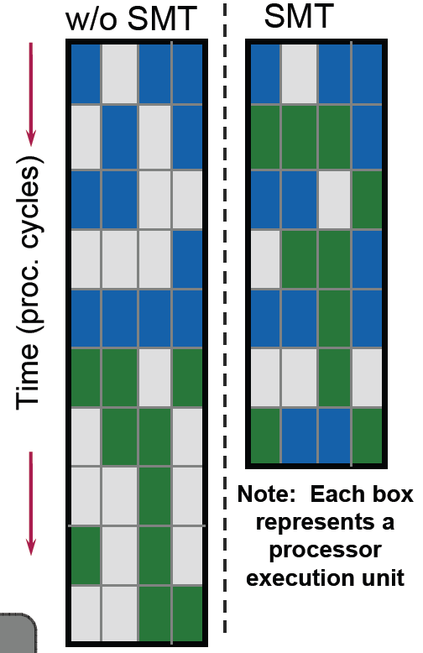
3.2.4 Simultaneous Multithreading (SMT) (1)
3.2.4 Simultaneous Multithreading (SMT)
In Nehalem Intel re-implemented SMT (since Core 2/Penryn did not support SMT)
SMT: two-way multithreading (two threads at the same time)
Each issue slot may be filled now from two threads.
Benefits
A 4-wide core is fed more efficiently (from 2 threads).
Hides latency of a single tread.
More performance with low (e.g. 5%) additional
die area cost.
May provide significant performance increase on
dedicated applications, as seen in the next Figure.
Figure 3.2.4.1: Simultaneous Multithreading (SMT) of Nehalem [1]
*

Slide 45
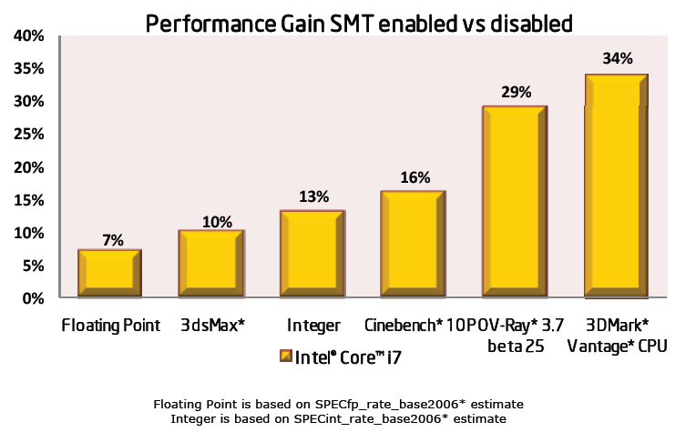
3.2.4 Simultaneous Multithreading (SMT) (2)
Performance gains achieved by Nehalem’s SMT [1]

Slide 46
3.2.5.1 Introduction (1)
3.2.5 Enhanced power management
3.2.5.1 Introduction
Having 4 cores instead of two clearly results in higher power consumption and this
puts greater emphasis on a more sophisticated power management.
Innovations introduced to encounter this challenge:
Integrated power gates (to significantly reduce power consumption)
Integrated Power Control Unit (PCU) (to implement the complex task of power management)
Turbo Boost technology (to convert power headroom to higher performance)
Above innovations will be discussed while we give a brief introduction into the wide spectrum
of power management technics.
Power consumption: energia fogyasztás
Power management: fogyasztás kezelés/disszipáció kezelés
Power gates: áramellátás kapu
*

Slide 47
3.2.5.1 Introduction (2)
Approaches and key technologies of power management in computers
Approaches for the power management of computers
(Strongly simplified)
Reducing power consumption
at the circuit level
(Achieved by circuit design)
PM at the platform level
(ACPI-based, achieved by system design)
Clock gating
Power gating
PM of the processor
(Nehalem)
PM of CPU cores
PM of idle CPU cores
PM of active CPU cores
Reducing power consumption
of idle CPU cores
Reducing the
power consumption
of active CPU cores
Utilizing the power headroom
of a proc. package
to raise performance
C-state management
(ACPI-based)
DVFS
by means of a PCU
Turbo Boost Technology
(Nehalem)
(Nehalem)
*

Slide 48
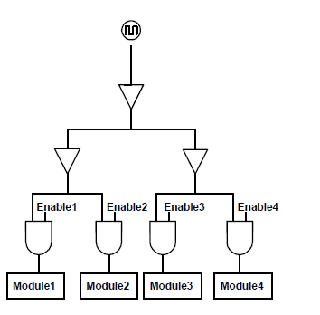
3.2.5.2 Clock gating (1)
3.2.5.2 Clock gating
Eliminates dynamic dissipation of unused circuits by switching off their clocking.
Clock gating was introduced in the late 1990s e.g. in DEC processor designs
(in the Alpha 21264 (1996) for gating the FP unit or the StrongARM SA110 (1996)),
designated at that time as conditional clocking.
Soon fine-grained clock gating became widely used, e.g. in Intel's Pentium 4 (2000) or
Pentium M (Banias) (2003).
Recently, fine-grained clock-gating is a pervasively used technique in processors.
Figure: Principle of clock gating [278]
*

Slide 49
3.2.5.3 Power gating (1)
3.2.5.3 Power gating [32]
Power gating means switching off unused units from the power supply by power transistors.
It eliminates both static and dynamic dissipation of unused units.
Power switches
It is a precondition of an efficient Turbo Boost technology, since it eliminates both static and
dynamic dissipation of idle cores and thus enlarges notable the power headroom.
Power gating: áramellátás kapuzása
*

Slide 50
3.2.5.3 Power gating (2)
Remark: Introducing power gating by different processor vendors
Intel introduced power gating along with their Nehalem microarchitecture in 2008,
subsequently many other processor vendors followed them, as the Table below shows.
Vendor | Family | Year of intro.
Intel | Nehalem | 2008
 | Westmere | 2010
 | Sandy Bridge | 2011
 | Ivy Bridge | 2012
 | Skylake | 2015
 | Atom families | 2010 - 2016
AMD | K12-based Llano K14-based Bobcat K15-based Bulldozer families | 2011 2011 2011 - 2015
IBM | POWER7+ | 2012
 | POWER8 (Iintegrated PG and DVFS) | 2014
Table: Introduction of power gating
Power gating: áramellátás kapuzása

Slide 51
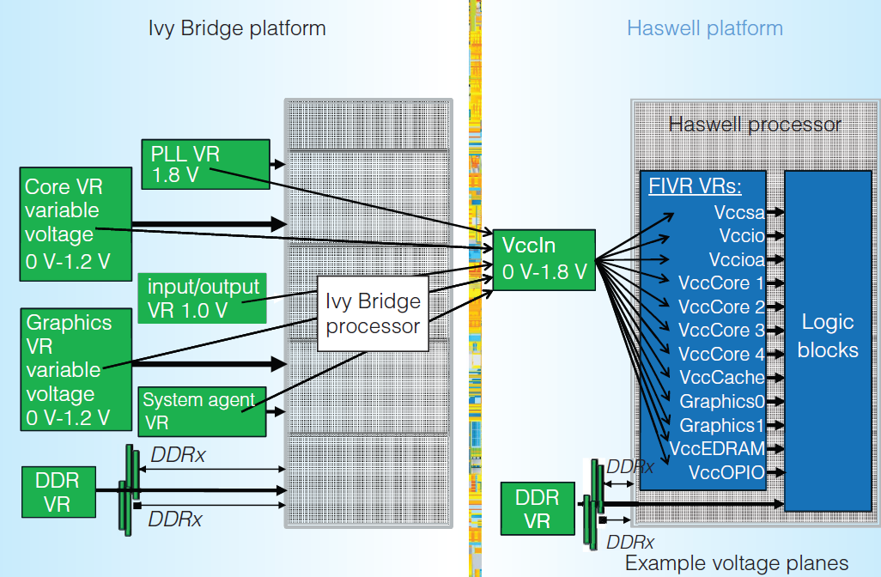
3.2.5.3 Power gating (3)
Integrated voltage regulators (FIVR) took over the task of power gates
Integrated voltage regulators
(as introduced in Intel's
Haswell and Broadwell-based lines)
allow to switch off units individually
so they supersede the use of power gating,
as the Figure on the right shows.
Figure: Use of integrated voltage regulators in Intel's Haswell processor (2014) [279]

Slide 52
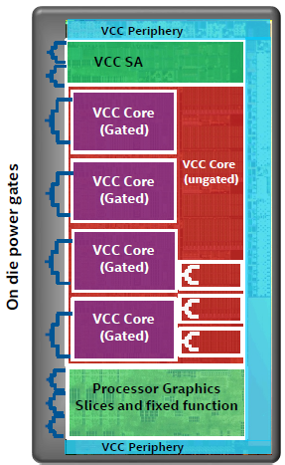
3.2.5.3 Power gating (4)
Reuse of power gating after Intel has suspended the implementation of integrated
voltage regulators in their Skylake line (2015)
Integrated voltage regulators (FIVR), introduced
into the Haswell and Broadwell lines unduly increased
dissipation and thus reduced clock frequency.
This is the reason why Intel omitted integrated
voltage regulators in their subsequent Skylake line,
as indicated in the Figure on the right.
Figure: Reintroducing power gating in Intel's
Skylake line [280]

Slide 53
3.2.5.4 The ACPI standard (1)
3.2.5.4 The ACPI standard
Power management can efficiently be supported by the OS, since the task scheduler “sees” the utilization of the cores or threads and this “knowledge” can be utilized for power
management, as discussed later.
OS support requires a standard interface for power management between the processor and
the OS.
This need gave birth to power management standards.
*

Slide 54
3.2.5.4 The ACPI standard (1b)
Evolution of power management standards
Power management standards
(SL technology)
Advanced
Power Management
(APM)
Advanced Configuration
and Power Interface
(ACPI)
Introduced
10/1990
01/1992
12/1996
Vendor
Intel
Intel and Microsoft
Intel, Microsoft,
Compaq, Phoenix and Toshiba
A set of PM techniques
Open standard i.f.
between OS and BIOS
Open standard i.f.
between OS and HW
Typ. CPU scaling
SFS
DFS
DVFS
Done basically
for CPU:
for devices:
by SMM
by SMM
by OSPM/BIOS
by BIOS/OSPM/OS handlers
by OSPM
by OSPM
386SL (embedded)
486SL (embedded)
486 family (since 06/1993)
Pentium M and
subsequent processors
First proc. supp.
Pentium
First Intel’s
chipset supp.:
420EX
420ZX
430FX with PIIX
430HX/430VX with PIIX3
430TX with PIIX4 (ACPI 1.0)
OS support:
No OS support
needed
Windows 95 (08/1995)
Windows 98 (06/1998)
Windows 98 (ACPI 1.0) (06/1998)
Windows XP SP1 (ACPI 2.0) (02/2002)

Slide 55
3.2.5.4 The ACPI standard (2)
Emergence of the ACPI standard and its OS support
08/1995
05/1999
Consumer
products
W 95
W 98SE
ACPI 1.0
Introduction of OS support of DVFS
02/2000
10/2001
01/2007
End of 2009
Desktops/
Laptops
W 2000 Prof.
W XP
W Vista
W 7
ACPI 1.0
ACPI 1.0b
SP1 (09/2002): ACPI 2.0¹
ACPI 3.0
ACPI 3.0
02/2000
04/2003
02/2008
Servers
W 2000 Server
W Server 2003
W Server 2008
ACPI 1.0
ACPI 2.0¹
ACPI 3.0
07/1996
Corporate
products
W NT 4.0
12/1996
07/2000
09/2004
06/2009
12/2011
ACPI 1.0
ACPI 2.0
ACPI 3.0
ACPI 4.0
ACPI 5.0
1995
2000
2005
2010
¹: Windows XP and Windows Server 2003 do not support all of the ACPI 2.0 specification [281]

Slide 56
3.2.5.4 The ACPI standard (3)
Support of multicores and multithreading in ACPI 3.0 and its OS support
08/1995
05/1999
Consumer
products
W 95
W 98SE
ACPI 1.0
Support of multicores and multithreading
02/2000
10/2001
01/2007
End of 2009
Desktops/
Laptops
W 2000 Prof.
W XP
W Vista
W 7
ACPI 1.0
ACPI 1.0b
SP1 (09/2002): ACPI 2.0¹
ACPI 3.0
ACPI 3.0
02/2000
04/2003
02/2008
Servers
W 2000 Server
W Server 2003
W Server 2008
ACPI 1.0
ACPI 2.0¹
ACPI 3.0
07/1996
Corporate
products
W NT 4.0
12/1996
07/2000
09/2004
06/2009
12/2011
ACPI 1.0
ACPI 2.0
ACPI 3.0
ACPI 4.0
ACPI 5.0
1995
2000
2005
2010
¹: Windows XP and Windows Server 2003 do not support all of the ACPI 2.0 specification [281]

Slide 57
3.2.5.4 The ACPI standard (4)
Support of hardware controlled performance states (SpeedShift technology) in ACPI 5.0
08/1995
05/1999
Consumer
products
W 95
W 98SE
ACPI 1.0
02/2000
10/2001
01/2007
End of 2009
Desktops/
Laptops
W 2000 Prof.
W XP
W Vista
W 7
ACPI 1.0
ACPI 1.0b
SP1 (09/2002): ACPI 2.0¹
ACPI 3.0
ACPI 3.0
02/2000
04/2003
02/2008
Servers
W 2000 Server
W Server 2003
W Server 2008
ACPI 1.0
ACPI 2.0¹
ACPI 3.0
07/1996
Corporate
products
W NT 4.0
Hardware controlled performance states
(Intel Speed Shift technology)
12/1996
07/2000
09/2004
06/2009
12/2011
ACPI 1.0
ACPI 2.0
ACPI 3.0
ACPI 4.0
ACPI 5.0
1995
2000
2005
2010
¹: Windows XP and Windows Server 2003 do not support all of the ACPI 2.0 specification [281]

Slide 58
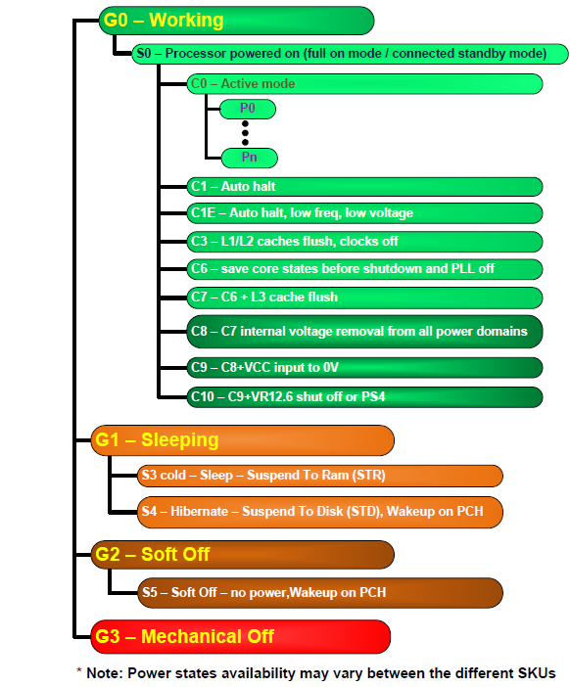
3.2.5.4 The ACPI standard (5)
Example: ACPI states in
Haswell-based mobiles [282]
Pi: Performance states
(active states, since ACPI 2.0))
Ci: Idle states
(C4…Cn states since ACPI 2.0)
Gi: Global states
Si: System Sleep states
G1: OS-initiated, system context is saved,
no rebooting needed.
G2/Soft off: OS-initiated shut down.
Power supply remains on,
system context is not saved,
the system must be restarted.
G3/Mechanical off: Entered by
activating a mechanical switch.
The system must be restarted.
*

Slide 59
3.2.5.5 C-state management (1)
3.2.5.5 C-state management
Idle periods of instruction execution allow to reduce power consumption, e.g. by clock gating,
power gating, switching off caches etc.
To allow managing idle states by means of OSs in a standardized way, ACPI introduced sog.
C-states.
*

Slide 60
3.2.5.5 C-state management (2)
Introduction to C-states -1
Version 1.0 of the ACPI standard introduced the C1 .. C3 idle states in 1996.
Additional idle states C4 .. ..Cn were defined in version 2.0 of this standard in 2000,
as indicated in the next Figure.
We note that the ACPI standard details the idle states C1 to C3 but does not give a detailed specification for the C4 ...Cn states, thus the C4 and higher states may be specified differently from vendor to vendor and from processor line to processor line.

Slide 61
3.2.5.5 C-state management (3)
Example: ACPI states in
Haswell-based mobiles [282]
Pi: Performance states
(active states, since ACPI 2.0))
Ci: Idle states
(C4…Cn states since ACPI 2.0)
Gi: Global states
Si: System Sleep states
G1: OS-initiated, system context is saved,
no rebooting needed.
G2/Soft off: OS-initiated shut down.
Power supply remains on,
system context is not saved,
the system must be restarted.
G3/Mechanical off: Entered by
activating a mechanical switch.
The system must be restarted.

Slide 62
3.2.5.5 C-state management (4)
Introduction to C-states -2
Higher numbered C-states designate increasingly deeper sleep states.
Deeper sleep states provide higher power savings but require higher enter and exit times,
as seen in the next Figure.
*

Slide 63
3.2.5.5 C-state management (5)
Power consumption vs. transfer latency of C-states
Higher numbered C states i.e. deeper idle states, result in lower power consumption
but cause increasingly longer transit latencies (enter plus exit times), as indicated below
for the C-states C1 - C6.
Power consumption
C0
D e e p e r i d l e s t a t e s
C1
C2
C3
C4
C5
C6
Enter + exit latency
Figure: Power consumption vs. transfer latency of C-states

Slide 64
3.2.5.5 C-state management (6)
Example: Dissipation and enter + exit latencies of idle states in Intel’s
Penryn-based Core 2 Duo Mobile processors (e.g. T9xxx) (2008) [283]
Dissipation
40
35W
C0: Working
30
~15 μs for PLL
stabilization
(after switching on)
Not designated latencies
usually < 1 µs
~100-200 μs for
entering/exiting
C6
20
12.5W
11.8W
C1: Auto C2: Stop
Halt Grant
C3: Sleep
10
5.5W
5
C3: Deep Sleep
1.7W
1.3W
0.3W
C4: Deeper Sleep
C5: Enh.
Deeper Sleep
C6: Deep
Power Down
Enter + exit
latency
(rough estimate)
Stop execution
Stop proc. clocking
but service snoops
latch interrupts
L1 caches are
flushed into the
L2 cache
No snnops
No latching of
interrupts
L2 partially flushed
Vcc lowered
(until both the
cores and the
L2 cache retain
their state)
Both cores
save their
architectural states
in on-die SRAMs
Vcc deep below the
core retention voltage
Stop PLL
(BCLK)
L2 entirely flushed
Vcc further lowered
(until the cores
retain their state)
Stop proc. clocking
C1-C3 Dissipation values in the Highest Frequency Mode), FSB: 800í MT/s

Slide 65
3.2.5.5 C-state management (8)
Example: ACPI C-states in Intel’s mobile Penryn-based processors [26]
C6 Idle state
Intelligent
heuristics decides
when enter into.

Slide 66
3.2.5.5 C-state management (9)
Remark
While mobile processors are the most sensitive processor class concerning power
consumption, these processors typically spearhead C-state management.
By contrast, desktop and server processors support often only a subset of C-states
provided by mobiles, e.g. Haswell mobile processors support C1 to C10 idle states whereas
Haswell desktops and servers only the C1 to C6 idle states.
Subsequent processor lines usually introduce more idle states with more and more
sophisticated power preservation techniques.
*

Slide 67
3.2.5.5 C-state management (10)
C-states and invoked power saving actions in ACPI-compliant PCU-based
C-state management in multi-core mobile processors
Power
consumption
C0: Normal
C1: Auto Halt
C1E: Auto Halt +
lowest fc, Vcc
Core C3
Package C3
Core C6
Package C6
Core C7
Package C7
Core C8
Package C8
Core C10
Package C10
2. gen. Nehalem (Lynnfield) Mobile (2009), Westmere Mobile (2010),
Broadwell Mobile (2015)
Wake-up time
Sandy Bridge Mobile (2011), Ivy Bridge Mobile (2012)
Haswell Mobile (2014), Skylake Mobile (2015), Kaby Lake Mobile (2016)
Core level
power saving
approach
(per core
action)
Stop instr. exec.
Stop Core clock
Service snoops
Latch interrupts
Flush L1, L2
into the L3
Stop core PLL
Core saves
its arch. state
into an SRAM
Then Vcc 0
Stop core PLL
As Core C6, but
last core entering
Core C7, should
start flushing L3
by N-ways to mem.
As Core C6 state
As Core C6 state
Processor level
power saving
approach
(package
actions)
Snoop L3 cache
L3 cache is
snoopable
All uncore clocks
stopped
Most uncore
voltages 0
If L3 entirely
flushed, voltage
from the L3 cache
will be removed
Voltage removed
from all
power domains
VR is set to
low power state,
near shut off.

Slide 68
3.2.5.5 C-state management (11)
C-states and invoked power saving actions
in ACPI-compliant PCU-based
C-state management in multi-cores
(simplified)
C1
Stop instruction execution
L1
L1
L1
L1
C0
Cn
L2
L2
C3
Flush
C3
Flush
L3
Stop core clocking
Stop core clocking
C6
C0
SRAM
C6
Cn
SRAM
Stop core PLL
Stop core PLL
Vcc
0
Vcc
0
L3
C7
Last core into C6:
Flush N-ways
Memory
PC7
If L3 entirely flushed: VL3 0
For all power domains: V 0
VR low power state
PC8
PC: Package C-state
PC10

Slide 69
3.2.5.5 C-state management (12)
Main approaches to implement idle state management
Idle state management
Intel's SL technology
ACPI-compliant idle state management
(C-state management)
The SB recognizes PM requests,
like timeouts etc. and asserts
the SMI# interrupt pin to notify the processor.
In response, the processor enters the SMM mode,
saves its internal state and the BIOS installed
SMM handler performs idle state management.
The last instruction of the SMM code lets restore
the processor state and exit the SMM mode.
OS recognizes idle periods of instruction execution
and instructs the processor to manage C-states
through a software interface
(via MWAIT(Ci) or P_LVLi I/O READ instructions).
Interrupts let exit C-states
and enter the C0 operating state.
ACPI-compliant SB-based
C-state management
ACPI-compliant PCU-based
C-state management
Control logic of the SB
is basically responsible
for managing C-states
On-die PCU
is basically responsible
for managing C-states
Use in Intel's processors
From the 386SL (1990) on
up to the embedded Pentium VRT
(1998)
From the mobile Pentium II (1998) on
up to the
1. gen. Nehalem (Bloomfield)
-based lines (2008)
From the 2. gen. Nehalem
(Lynnfield)-based lines on
(2009)
Section 5.2
Section 5.3
Section 5.4
SMM: System Management Mode
SB: South Bridge
PCU: Power Control Unit
*

Slide 70
3.2.5.5 C-state management (13)
Principle of ACPI-based idle-state management
OS recognizes idle periods of instruction execution and instructs the processor to manage
C-states through a software interface (dedicated instructions).
The processor performs the requested C-state transition.
Interrupts let exit C-states and enter the C0 operating state.
*

Slide 71
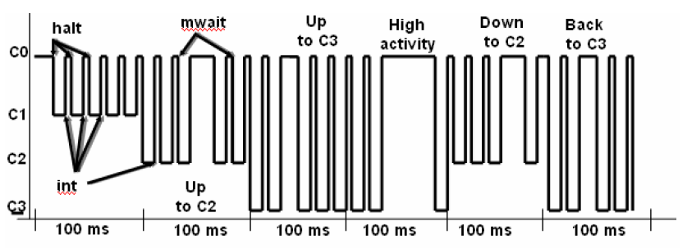
3.2.5.5 C-state management (14)
Managing C-state transitions by the OSPM (OS Power Manager)
The OSPM scheduler recognizes that no work is to do for the processor, evaluates the rate
of idle time in time windows (of e.g. 20 ms) and initiates a transition to a target C-state
according to the actual utilization rate in the considered time window, e.g. by sending
instructions to the processor.
The following example will illustrate this.
LVL_2
Example: Managing C-states by the OSPM [284]

Slide 72
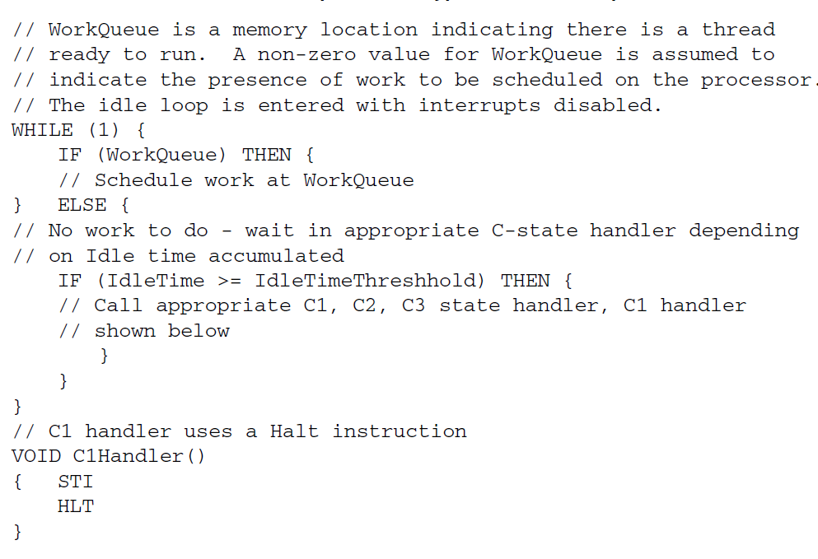
3.2.5.5 C-state management (15)
A typical OS idle loop as a basis for managing C-states [285]

Slide 73
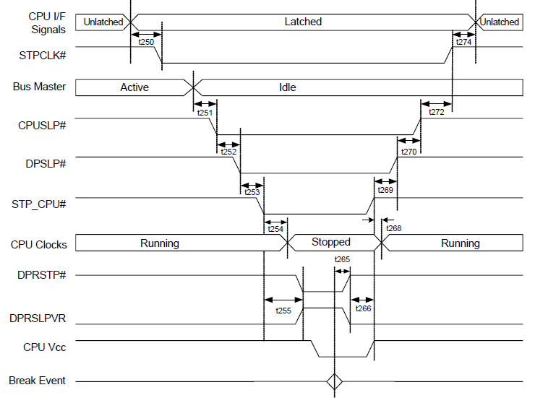
3.2.5.5 C-state management (16)
Example: Signal sequence generated by the SB (ICH-8) to enter/exit the C4-state
in a Core 2 Duo Mobile Penryn-based platform [286]
STPCLK# stops the processing
of I/F signals instead it lets
to latch them for later processing
Sent to the CPU,
stops CPU clocking
CPU_SLP = SLP#, to the CPU
to enter C3 Sleep, forbids
snoops to bus masters
Asserts before and deasserts
after STPCPU# stops PLL
STP_CPU# = DPSLP#
Sent to the CPU, stops PLL
A copy of the DPRSLPVR
Sent to the VRM
(Voltage Regulator
Module) to lower Vcc
to Vcc4 (to a low value)

Slide 74
3.2.5.5 C-state management (17)
C-state management by the PCU
In the course of the evolution of processors typically the PCU took over the role of the SB
coordinating the C-ctate requests
and performing the activities needed to implement C-state transitions.
In Intel’s Core 2 family this happened beginning with the 2. generation Nehalem line
(called Lynnfield) in 2009.
This point will not be further detailed here.
*

Slide 75
3.2.5.6 DVFS based on a PCU (Power Control Unit) (1)
3.2.5.6 DVFS based on a PCU (Power Control Unit)
Reducing the power consumption of active CPU cores
Static technique
Dynamic techniques
SVFS
DFS
DVFS
Hardware Controlled
Performance States
AVFS
Examples
SpeedStep in
Mobile Pentium III (2000)
Mobile Pentium 4 (2002)
(Northwood based)
EIST in
Pentium M
(Banias) (2003)
and subsequent lines
Intel
Speed Shift in
Skylake (2015)
VIA
LongHaul 1.0 in
C3 Samuel (2000)
LongHaul 2.0 in
C3 Samuel 2 step. 1 (2001)
Adaptive PowerSaver
in Nano (2008)
PowerNow! and
Cool'n'Quiet
technologies
in mobiles/desktops
and servers (since 2000)
AVFS in
Excavator-based
Carizzo (2015)
Pure Power in
Ryzen (2017)
AMD
405LP (2002)
Dynamic Power
Performance Scaling in
PowerPC 750GX (2004)
PowerPC 970xx (2004)
Energy Scale
in POWER6
(2007) and
subsequent
processors
IBM
PowerPC 750FX
(2003)
Exynos 4 (2012)
(used in Galaxy III)
ASV in
Exynos 7420 (2015)
(used in Galaxy S6)
Samsung
ARM/National
IEM IP (2002)

Slide 76
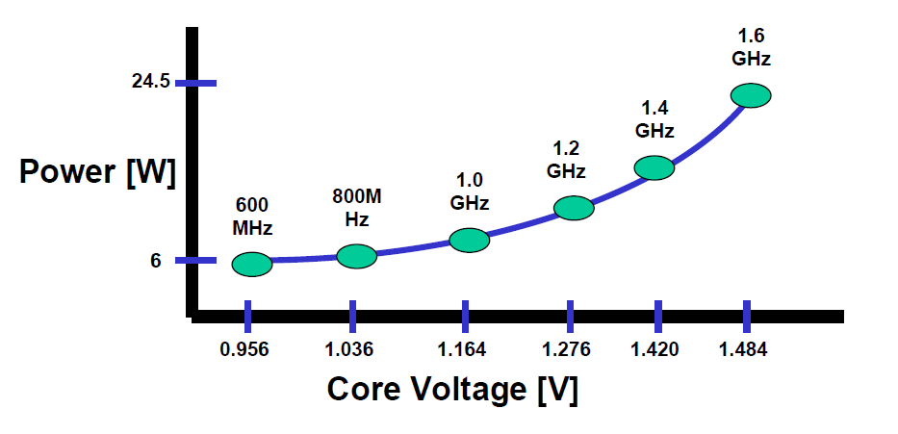
3.2.5.6 DVFS based on a PCU (Power Control Unit) (2)
Principle of DVFS (Dynamic Voltage and Frequency Scaling) -1
Principle of operation (assuming a multithreaded single core processor):
DVFS scales the clock frequency of the cores just high enough to run the load to be executed
on them to save power.
In other words, lower than expected core utilization will be exploited to reduce core frequency.
In multithreaded processors, core frequency will be set according to the most active thread.
DVFS is implemented based on the ACPI P-states (Performance states), introduced in ACPI 2.0.
P-states are operating points of the processor, specified by {fc, Vcc}, with the highest
performance P-state designated as P1 (or sometimes as P0), as shown below.
P1
P2
P6
Example: Operating points of Intel’s Pentium M processor (~2003)
used in Intel’s DVFS technology, designated as Enhanced SpeedStep technology [210]
*
*

Slide 77
3.2.5.6 DVFS based on a PCU (Power Control Unit) (3)
Principle of DVFS (Dynamic Voltage and Frequency Scaling) -2
DVFS typically scales down both the clock frequency (fc) and the core voltage (Vcc)
as far as feasible without noticeable lengthening the run time of the workload, in order to
reduce power consumption, as indicated below.
Vcc
P0
Vcc0
●
Workload
P1
●
Highest
power
consumption
Vcc1
P2
Vcc2
●
.
.
Pn
Vccn
●
Both fc and Vdd will be scaled
according to the workload intensity.
Vcc is chosen with a guard band
according to the actual fc values.
Lowest
power
consumption
..
fc
fcn
fc2
fc1
fc0
Figure: Principle of DVFS
In this sense, DVFS is a demand based scaling of the clock frequency and voltage of the cores.

Slide 78
3.2.5.6 DVFS based on a PCU (Power Control Unit) (4)
Principle of DVFS (Dynamic Voltage and Frequency Scaling) -3
DVFS may be directed either by the OS or otherwise (e.g. by the PCU (Power Control
Unit) by reading performance counters to calculate utilization and performing all operations
needed).
Subsequently, we assume OS directed DVFS.
*

Slide 79
3.2.5.6 DVFS based on a PCU (Power Control Unit) (5)
Implementing DVFS in Intel’s processors
First implemented in the Pentium M (Banias) in 2003, designated as EIST (Enhanced Intel
SpeedStep Technology).
Intel enhanced their DVFS implementation in the Pentium M (Yonah) in 2006 with two 64-bit
hardware counters (per thread), used to help OS to calculate thread/core utilization.
*

Slide 80
3.2.5.6 DVFS based on a PCU (Power Control Unit) (6)
Main tasks of the implementation of DVFS (assuming multithreading)
Main tasks of OS directed DVFS implementation (assuming multithreading)
Determination of
the thread utilization
by the OS
Coordination of
target P-states
(by the OS or proc.)
Accomplishing the
fc, Vcc transitions
by the processor
Based on the value of
thread utilization
determination of
the target P-state
by the OS
Communicating
the target P-state
by the OS
to the processor
*

Slide 81
3.2.5.6 DVFS based on a PCU (Power Control Unit) (7)
Determination of thread utilization and the target P-state by the OS (simplified) [287] -1
The processor has two Model Specific Registers (MSRs) per thread, that are actually 64-bit
counters (called also logical processor).
One of the counters (IA32_MPERF MSR (0xE7h)) increments in proportion to the base
frequency,
the other one (IA32_APERF MSR (0xE8h)) increments in proportion to actual performance.
These counters are updated only when the targeted processor is in the C0 state.
Based on the readings of these counters the OS determines the utility rate (%) of the thread
as the ratio of the readings (actual/base).
The OS has a list of available P states for the cores (specifying fc and needed Vcc).
From the available P-states the OS selects the lowest possible to service the actual load
(i.e. utility rate).

Slide 82
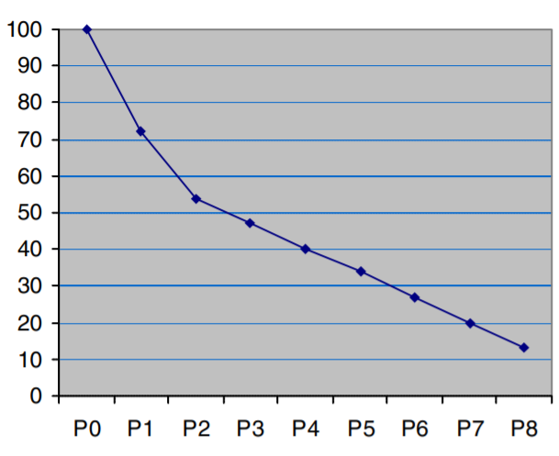
3.2.5.6 DVFS based on a PCU (Power Control Unit) (8)
Example allocation of P-states to the rate of core utilization while running a thread [289]
Core utilization %

Slide 83
3.2.5.6 DVFS based on a PCU (Power Control Unit) (8b)
Coordination of P-states
OS handles P-states of threads.
If multiple threads are running on the same core, the target P-state (coordinated P-state)
needs to be the P-state of the most demanding thread.
In addition, if multiple cores are supplied by a common voltage or common clock, a
coordination of the requested P-states for the cores is needed.
Then the target P-state of the cores becomes the P-state of the most demanding core.
Nevertheless we do not discuss further on this point.

Slide 84
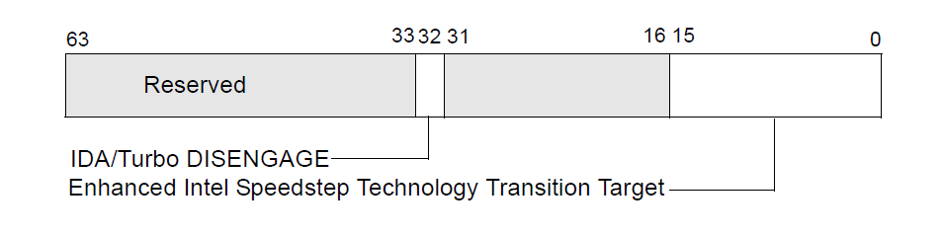
3.2.5.6 DVFS based on a PCU (Power Control Unit) (9)
Communicating the target P-state by the OS to the processor (simplified) [287]
If the new P-state differs from the actual one, the OS writes the selected P-state
to a given MSR (bits 0-15 of IA32_PERF_CTL (199h)) available for the thread,
(actually, bits [15:8] specify the target multiplier ratio e.g. 34 for 34 x 133 MHz) and
bits [7:0] the target core voltage, in a suitable coding).
IA_PERF_CTL
Multiplier
Vcc
8
7
Figure: Use of the IA32_PERF_CTL (199h) MSR to set a new P-state [287]
The PCU (Power Control Unit) takes notice of the state transition request and performs it
by setting the PLL associated to the core running the considered thread and setting also
the Voltage Regulator and initiating the transition.
Remark: The 64-bit counters used for determine thread utilization were introduced in 2006
in the Pentium M Core Duo (Yonah) processor., based on an Intel patent [288].
*

Slide 85
3.2.5.6 DVFS based on a PCU (Power Control Unit) (10)
Implementing DVFS by means of the introduced Integrated Power Control unit (PCU) [32]
With four cores the power consumption of the chip needs to be manages as an entity.
This task will be overtaken by a dedicated microcontroller implemented on the die.
It is also used for implementing the Turbo Boost Mode.
VR
IA32_PERF_CTL MSR
I
*

Slide 86
3.2.5.6 DVFS based on a PCU (Power Control Unit) (11)
Remark
There are two improvements of DVFS:
Hardware controlled performance states
passing over the control of DVFS from the OS to the PCU, to get a faster and finer
frequency and voltage scaling (introduced in Skylake (2015))
AVFS (Adaptive Voltage and Frequency Scaling)
to get a more efficient scaling, to be discussed along with AMD’s Zen processors.
*

Slide 87
3.2.5.6 DVFS based on a PCU (Power Control Unit) (12)
Remark: DVFS is one of the technologies used to reduce power consumption of active CPU cores
Reducing the power consumption of active CPU cores
Static technique
Dynamic techniques
SVFS
DFS
DVFS
Hardware Controlled
Performance States
AVFS
Examples
SpeedStep in
Mobile Pentium III (2000)
Mobile Pentium 4 (2002)
(Northwood based)
EIST in
Pentium M
(Banias) (2003)
and subsequent lines
Intel
Speed Shift in
Skylake (2015)
VIA
LongHaul 1.0 in
C3 Samuel (2000)
LongHaul 2.0 in
C3 Samuel 2 step. 1 (2001)
Adaptive PowerSaver
in Nano (2008)
PowerNow! and
Cool'n'Quiet
technologies
in mobiles/desktops
and servers (since 2000)
AVFS in
Excavator-based
Carizzo (2015)
Pure Power in
Ryzen (2017)
AMD
405LP (2002)
Dynamic Power
Performance Scaling in
PowerPC 750GX (2004)
PowerPC 970xx (2004)
Energy Scale
in POWER6
(2007) and
subsequent
processors
IBM
PowerPC 750FX
(2003)
Exynos 4 (2012)
(used in Galaxy III)
ASV in
Exynos 7420 (2015)
(used in Galaxy S6)
Samsung
ARM/National
IEM IP (2002)

Slide 88
3.2.5.7 Nehalem’s Turbo Boost technology (1)
3.2.5.7 Nehalem’s Turbo Boost technology -1
The Turbo Boost technology is strongly connected to the notion of the TPD
(Thermal Design Power) value.
*

Slide 89
3.2.5.7 Nehalem’s Turbo Boost technology (1b)
Remark
The TDP (Thermal Design Power) is the design value for the power consumption of the
processor (package), given in W.
The TDP value of a processor model reflects the maximum power consumed by realistic,
power intensive applications.
It serves as a reference value for designing the cooling system of the platform.
The cooling system (called also thermal solution) of a platform has to be designed such
that it should guarantee that the chip, more precisely the junction temperature (Tj)
does not exceed a given limit (Tjmax, e.g. 90 ºC⁾ while the processor dissipates TDP
(given usually in Watts).
*

Slide 90
3.2.5.7 Nehalem’s Turbo Boost technology (2)
3.2.5.7 Nehalem’s Turbo Boost technology -1
If actually, the processor dissipates less than its TDP value a power headroom arises.
Turbo Boost technology converts power headroom to higher performance by raising,
by raising the clock frequency of the active cores.
Power headroom: hőtartalék
*

Slide 91
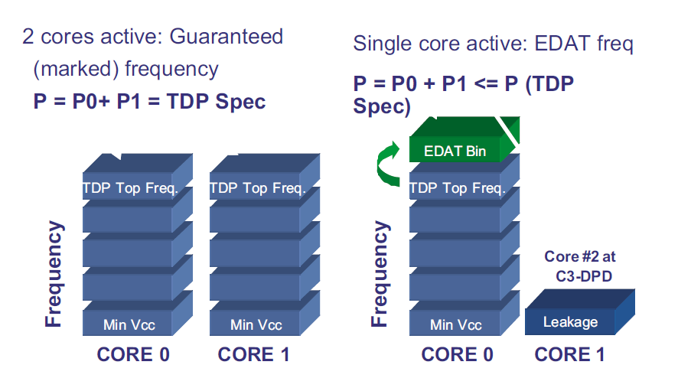
3.2.5.7 Nehalem’s Turbo Boost technology (3)
Intel’s forerunner of implementing Turbo Boost technology in Nehalem:
EDAT in Penryn-based mobiles
In its dual core Penryn-based mobile processors (Core 2 Duo Mobile) Intel introduced already
a less intricate technology than the Turbo Boost technology for utilizing available
power headroom for raising single-thread performance, termed as the (EDAT)
Enhanced Dynamic Acceleration Technology, but only for mobile processors.
EDAT's operation is based also on the ACPI standard (Advanced Configuration and Power
Interface).
Principle of operation: If one of the dual cores is idle and given conditions are met, EDAT will
increase clock frequency of the active core by 1 bin (typically 266 MHz for an FSB of 533 MHz
or 333 MHz for an FSB of 666 MHz.
The operation is controlled by dedicated EDAT logic.
Figure: Principle of the operation of EDAT [246]
*

Slide 92
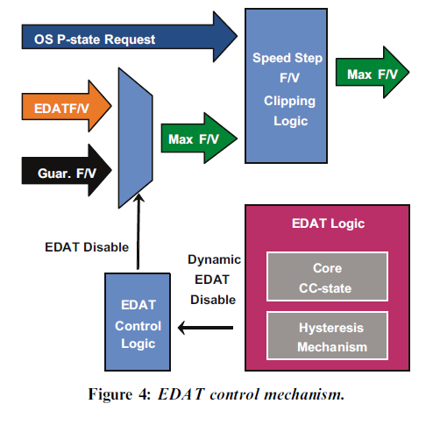
3.2.5.7 Nehalem’s Turbo Boost technology (4)
Implementation of EDAT
EDAT logic considers a core “active” if it is in ACPI C0 or C1 states, whereas cores in the C3
to C6 ACPI states are considered as “idle”.
EDAT becomes activated if
one one the two cores becomes idle
the OS requests the highest P state for the active core and
power consumption remains below the TDP (Thermal Design Power).
+1 bin
CC: Core C-state
F/V: Frequency/Voltage
Figure: Principle of implementation of EDAT [246]
*

Slide 93
3.2.5.7 Nehalem’s Turbo Boost technology (5)
Extending the operation of EDAT to Penryn-based quad-core mobile processors
Penryn based quad-core processors are in fact MCMs (Multi Chip Modules) with two chips
properly interconnected mounted in the same package.
In this case each of both chips can activate EDAT independently from each other, if one of
their cores becomes idle, and the total power consumption remains below TDP.
This technology is also designated as Dual EDAT.

Slide 94
3.2.5.7 Nehalem’s Turbo Boost technology (6)
Remark
Intel designates EDAT also as
IDA (Intel Dynamic Acceleration Technology) in dual-core Penryn-based mobile processors or
Dual Dynamic Acceleration Technology in quad-core (2x2-core) Penryn-based mobile
processors.

Slide 95
3.2.5.7 Nehalem’s Turbo Boost technology (7)
Nehalem's Turbo Boost technology as an enhancement of Penryn's EDAT
Nehalem has already a PCU (Power Control Unit) that is responsible
for controlling the core frequencies and core voltages and also
for checking the power dissipation of the whole package and if needed take appropriate
actions.
Nehalem's Turbo Boost implementation enhances EDAT's operation threefold:
the PCU may increase the clock frequency of the active cores independently from the
number of active cores, even if all cores are active presuming a light workload,
or more precisely that certain conditions to be discussed later, are met.
c) The Turbo Boost technology is no more restricted to mobile platforms,
as discussed subsequently.
*

Slide 96
3.2.5.7 Nehalem’s Turbo Boost technology (8)
Principle of the operation of
Nehalem's Turbo Boost technology (2) [52]
Zero power for
inactive cores
by power gating
The Turbo mode uses the power headroom (unused power up to the TDP limit) of the proc. package.
*

Slide 97
3.2.5.7 Nehalem’s Turbo Boost technology (9)
Precondition for activating the Turbo Boost technology
The PCU activates the Turbo Boost technology if
the actual workload needs the highest performance state (P0),
the actual power consumption is less then the TDP, (i.e. there is a power headroom)
the actual current is less than a given limit and
also the die temperature is below a given limit.
*

Slide 98
3.2.5.7 Nehalem’s Turbo Boost technology (10)
b) Principle of operation of Turbo Boost [51] -1
If the above conditions for activating the Turbo Boost technology are fulfilled
the PCU automatically steps up core frequency in a closed loop by one bin (133.33 MHz
for the Nehalem family) as long as it reaches the max. ratio of the frequency multiplier
held in the MSR 1ADh for 1, 2, 3 or active cores, as seen in the next Figure.
The internal register MSR 1ADH is interpreted as follows:
MSR 1ADh (in the Nehalem family)
Bits 31-24 | Bits 23-16 | Bits 15-08 | Bits 07-00
Max. ratio with 4 active cores | Max. ratio with 3 active cores | Max. ratio with 2 active cores | Max. ratio with 1 active core
E.g. in the Nehalem DT i7-975 (Base clock: 3.33 GHz)
+1 bin | +1 bin | +1 bin | +2 bin
3.46 GHz | 3.46 GHz | 3.46 GHz | 3.6 GHz
Multiplier:
Max. turbo fc
The actual turbo boost frequency results as the product of the given max. ratio times
the bus clock frequency (133.33 MHz in this case).
In each step the PCU sets the PLLs (Phase Locked Loop) of the cores and the VR
(Voltage Regulator) to the appropriate values.
*

Slide 99
3.2.5.7 Nehalem’s Turbo Boost technology (11)
b) Principle of operation of Turbo Boost [51] -2
Maximum turbo frequencies are factory configured and kept in form of multiplier vaiues
in the internal registers (MSR 1ADH) of the processor, they can be read by the PCU or OS.
*

Slide 100
3.2.5.7 Nehalem’s Turbo Boost technology (12)
Remarks
In subsequent processors the turbo mode achieved a higher clock boost, as seen below
for a Sandy Bridge-E HED processor [243].
i7-3970X (Sandy Bridge-E), base clock: 3.50 GHz
No of active cores | 1C | 2C | 3C | 4C | 5C | 6C
Bins (1 bin: 100 MHz) | 5 | 5 | 3 | 3 | 1 | 1
Turbo clock frequency | 4.0 GHz | 4.0 GHz | 3.80 GHz | 3.80 GHz | 3.60 GHz | 3.60 GHz

Slide 101
3.2.5.7 Nehalem’s Turbo Boost technology (13)
Determination of the number of active cores
The PCU monitors the activity of all 4 cores.
The PCU considers a core active if it is in the C0 (active) or C1 (Halt) state and
inactive if it is in the C3 or the C6 state, it is the same differentiation as was done in EDAT.
*

Slide 102
3.2.5.7 Nehalem’s Turbo Boost technology (14)
Checking current, power consumption and temperature vs. specified limits [53], [50]
To check power and temperature limits the PCU samples the current power consumption
and die temperature in 5 ms intervals [53].
Power consumption is determined by monitoring the processor current at its input pins as well
as the associated voltage (Vcc) and calculating the power consumption as a moving average.
The junction temperature of the cores are monitored by DTSs (Digital Thermal Sensors) with
an error of ± 5 % [50].
When any factory configured limit is surpassed (the power consumption of the processor
or the junction temperature of any core) the PCU automatically steps down core frequency
in increments of e.g. 133 MHz.
*

Slide 103
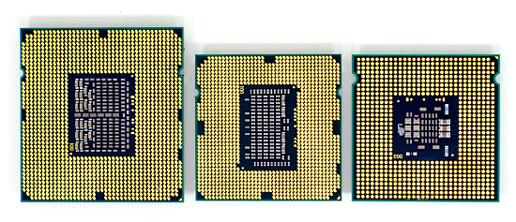
3.2.6 New sockets (1)
3.2.6 New sockets [167]
LGA-775
(Core 2)
LGA-1366
(Bloomfield)
LGA-1156
(Lynnfield)
A new socket became necessary since attaching three DDR3 memory channels needs 3x240
additional lines.
*

Slide 104
3.3 Major innovations of the 2. generation Nehalem line (Lynnfield)
Notes:
104

Slide 105
3.3 Major innovations of the 2. generation Nehalem line (Lynnfield) (1)
Nehalem lines
Nehalem lines
1. generation Nehalem processors
1. generation Nehalem processors
2. generation Nehalem processors
2. generation Nehalem processors
Mobiles
Mobiles
Core i7-9xxM (Clarksfield) 4C 9/2009
Core i7-8xxQM (Clarksfield) 4C 9/2009
Core i7-7xxQM (Clarksfield) 4C 9/2009
Desktops
Desktops
Core i7-9x0 (Bloomfield) 4C 11/2008
Core i7-8xx (Lynnfield) 4C 9/2009
Core i5-7xx (Lynnfield) 4C 9/2009
HED
Core i7-965 (Bloomfield) 4C 11/2008
Core i7-975 (Bloomfield) 4C 7/2009
Servers
Servers
UP-Servers
UP-Servers
35xx (Bloomfield) 4C 3/2009
34xx (Lynnfield) 4C 9/2009
C35xx (Jasper forest¹) 4C 2/2010
DP-Servers
DP-Servers
55xx (Gainestown) (Nehalem-EP) 4C 3/2009
C55xx (Jasper forest¹) 2C/4C 2/2010
Based on [44]
¹Jasper forest: Embedded UP or DP server
*

Slide 106
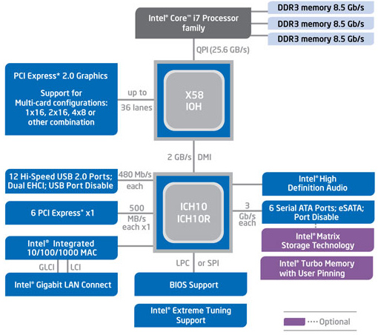
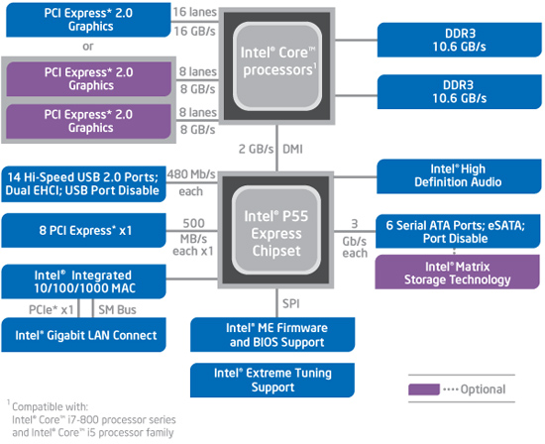
3.3 Major innovations of the 2. generation Nehalem line (Lynnfield) (2)
Major innovations of the 2. generation Nehalem line (Lynnfield) (1) [46]
The Lynnfield chip is a major redesign of the Bloomfield chip targeting desktops and laptops,
resulting in a cheaper and more efficient two-chip system solution.
Major innovations
a) It provides only 16 PCIe 2.0 lanes rather than 36 lanes for attaching graphics cards.
PCIe lanes are attached immediately to the processor rather than to the north bridge,
as in the previous generation.
The Bloomfield based platform (X58 + ICH10 / LGA-1366)
The Lynnfield based platform (P55 / LGA-1156)
*

Slide 107
3.3 Major innovations of the 2. generation Nehalem line (Lynnfield) (3)
Evolution of the topology and type of available PCIe lanes for graphics cards
Topology of PCIe lanes provided for graphics cards
PCIe lanes
on both the NB and the SB
PCIe lanes
on the NB
PCIe lanes
on the PCH
PCIe lanes
on the processor
Conroe-based
Core 2 Duo 65 nm (2006)
Core 2 Quad 65 nm (2006)
on 965 family NB (2006)
and on Series 3 NB (2007)
PCIe 1.0
lanes
Trend
Penryn-based
Core 2 Duo 45 nm (2008)
Core 2 Quad45 nm (2008)
on Series 4 NB (2008)
Type of available PCIe lanes
2. G. Nehalem (Lynnfield)
(2009)
Sandy Bridge (2011)
Sandy Bridge-E (2011)
PCIe 2.0
lanes
G. Nehalem
(Bloomfield)-based
on X58 NB (2008)
PCIe 3.0
lanes
Ivy Bridge (2012)
Ivy-Bridge-E (2013)
Haswell (2013)
Haswell-E (2014) tp
Skylake (2015)
*

Slide 108
3.3 Major innovations of the 2. generation Nehalem line (Lynnfield) (4)
Number of on-die memory channels and PCIe lanes provided on Intel's DT and HED lines
PCIe lanes provided on the processor die
DT processors: 16 lanes
(1x16 or 2x8 or 1x8+2x4)
HED processors: 40 lanes (typical)
(configurable, e.g. 2x x16 + 1x x8 or 4x x8)
PCIe
2.0
x16/
2x x8
P
Mem.
40
configurable
lanes
P
Mem.
PCIe 2.0
PCIe 2.0 lanes
Periph. Contr.
P55/P67
Periph. Contr.
X79
Intel 2. gen. Nehalem (Lynnfield) (4C), 2 MCh
with P55 (2009)
Intel Sandy Bridge (4C), 2 MCh with P67 (2011)
Intel Sandy Bridge E (6C), 4 MCh with X79 (2011)
PCIe generation
x16/
2x x8
40/44
configurable
lanes
P
Mem.
PCIe
3.0
P
Mem.
PCIe 3.0
Periph. Contr.
Z77/Z87/Z97/
Z170
Periph. Contr.
X79/Z99/
X299
PCIe 3.0 lanes
Intel Ivy Bridge (4C), 2 MCh with Z77 PCH (2012)
Intel Haswell (4C), 2 MCh with Z87 PCH (2013)
Intel Broadwell (4C), 2 MCh with Z97 PCH (2015)
Intel Skylake-S(4C), 2 MCh with Z170 PCH (2015)
Intel Ivy Bridge E (6C), 4 MCh with X79 (2013)
Intel Haswell E (8C) 4 MCh with X79 (2014)
Intel Broadwell E (10C) 4 MCh with X99 (2016)
Intel Skylake X (10C) 4 MCh with X299 (2017)
(44 PCIe lanes!)
*

Slide 109
3.3 Major innovations of the 2. generation Nehalem line (Lynnfield) (5)
Major innovations of the 2. generation Nehalem line (Lynnfield) (2) [46]
b) While connecting PCIe lanes directly to the processor, the previous north bridge has
less functions and thus it can be integrated with the south bridge, to a PCH (Peripheral
Control Hub), yielding a two chip solution.
c) While connecting PCI lanes directly to the processor less bandwidth is needed between the
processor and the PCH, thus, the high bandwidth QPI bus can be replaced by a DMI interface
(i.e. by 4 PCIe lanes).
The Bloomfield based platform (X58 + ICH10 / LGA-1366)
The Lynnfield based platform (P55 / LGA-1156)
*

Slide 110
3.3 Major innovations of the 2. generation Nehalem line (Lynnfield) (6)
Major innovations of the 2. generation Nehalem line (Lynnfield) (3) [46] (cont.)
d) It supports only two DDR3 memory channels instead of three as in the previous solution.
e) Its socket needs less connections (LGA-1156) than the Bloomfield chip (LGA-1366).
All in all the Lynnfield chip is a cheaper and more effective successor of the Bloomfield chip,
aiming primarily for mobiles and desktops
The Bloomfield based platform (X58 + ICH10 / LGA-1366)
The Lynnfield based platform (P55 / LGA-1156)
*

Slide 111
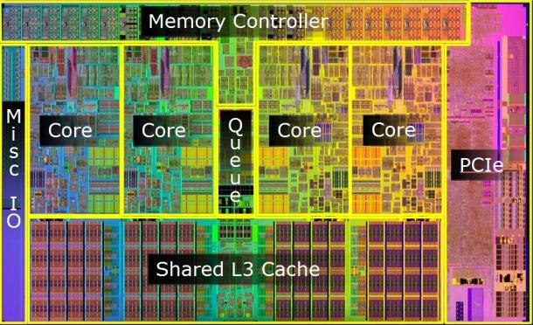
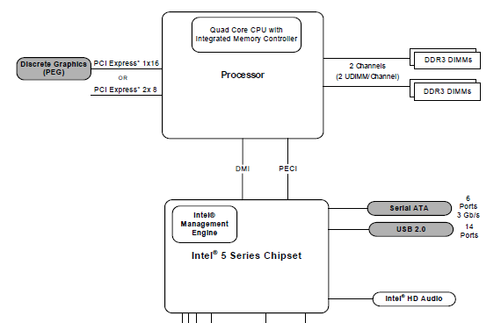
3.3 Major innovations of the 2. generation Nehalem line (Lynnfield) (7)
Die photos of the 1. and 2. gen.
Nehalem desktop chips
First generation: Bloomfield chip (11/2008)
(45 nm, 263 mm², 731 mtrs, LGA-1366)
[45], [46], [47]
Second generation: Lynnfield chip (9/2009)
45 nm, 296 mm², 774 mtrs, LGA-1156) [45] [46] [48]

Slide 112
4. The Sandy Bridge line
4.1 Introduction
4.2 Major innovations of the Sandy Bridge line vs.
the 1. generation Nehalem line
4.3 Example for a Sandy Bridge based desktop
platform with the H67 chipset
Notes:
112

Slide 113
4.1 Introduction
Notes:
113

Slide 114
4.1 Introduction (1)
4.1 Introduction
Sandy Bridge is Intel’s next new microarchitecture using 32 nm line width.
Designed by Intel's Haifa design center, originally called Gesher.
First delivered in 1/2011.
It is termed also as Intel’s second generation Core processors.
Figure 4.1.1: Intel’s Tick-Tock development model (Based on [1])
1. gen.
2. gen.
3. gen.
4. gen.
5. gen.
6. gen.
Core 2
New
Microarch.
65 nm
Penryn
New
Process
45 nm
Nehalem
New
Microarch.
45 nm
West-
mere
New
Process
32 nm
Sandy
Bridge
New
Microarch.
32 nm
Ivy
Bridge
New
Process
22 nm
Haswell
New
Microarchi.
22 nm
Broad-
well
New
Process
14 nm
Skylake
New
Microarchi.
14 nm
TOCK
TICK
TOCK
TICK
TOCK
TICK
TOCK
TICK
TOCK
Figure : Intel’s Tick-Tock development model (Based on [1])
*

Slide 115
4.1. Introduction (2)
The Sandy Bridge line -1
Key new features of the ISP
and the microarchitecture
2 YEARS
TICK Pentium 4 ( Cedar Mill)
Pentium D (Presler)
01/2006
2 YEARS
65nm
New microarch.: 4-wide core,
128-bit SIMD FX/FP EUs,
shared L2 , no HT
TOCK Core 2
07/2006
TICK Penryn Family
11/2007
2 YEARS
45nm
New microarch.: 4 cores, integr. MC,
QPI, private L2, (inclusive) L3, HT
TOCK Nehalem
11/2008
TICK Westmere
01/2010
In package integrated GPU
2 YEARS
32nm
New microarch.: 256-bit (FP) AVX,
ring bus, integrated GPU
TOCK Sandy Bridge
01/2011
TICK Ivy Bridge
04/2012
2 YEARS
22nm
New microarch.: 256-bit (FX) AVX2,
L4 cache (discrete eDRAM), TSX
TOCK Haswell
06/2013
TICK Broadwell
09/2014
Shared Virtual Memory
4 YEARS
TOCK Skylake
10/2015
New microarch.: 5-wide core,
ISP, Memory Side L4 cache, no FIVR
14nm
TOCK Kaby Lake
08/2016
Optane memory, in KBL G series:
in package integr. CPU, GPU, HBM2
TOCK Coffee Lake
10/2017
(USB Gen. 2, integr. conn., Optane 2)
TICK Cannonlake
05/2018
AVX512
?? YEARS
10nm
TOCK Icelake
??/2019
Figure is based on [3])
*

Slide 116
4.1. Introduction (2B)
The Sandy Bridge line -2
Key new features
in power management
2 YEARS
TICK Pentium 4 ( Cedar Mill)
Pentium D (Presler)
01/2006
2 YEARS
65nm
Clock gating, PECI,
Platform Thermal Control by
3. party controller
TOCK Core 2
07/2006
2 YEARS
TICK Penryn Family
11/2007
EDAT
45nm
Integrated Power Gates, PCU,
Turbo Boost
TOCK Nehalem
11/2008
TICK Westmere
01/2010
2 YEARS
32nm
TOCK Sandy Bridge
01/2011
Turbo Boost 2.0
2 YEARS
TICK Ivy Bridge
04/2012
22nm
TOCK Haswell
06/2013
FIVR
TICK Broadwell
09/2014
2. gen. FIVR
Speed Shift Technology,
Duty Cycle control, No FIVR
(except Skylake X)
4 YEARS
TOCK Skylake
10/2015
14nm
TOCK Kaby Lake
08/2016
Speed Shift Technology v2
TOCK Coffee Lake
10/2017
In H-series: TVB
(Thermal Velocity Boost)
TICK Cannonlake
05/2018
10nm
TOCK Icelake
??/2019
Figure is based on [3])
*

Slide 117
4.1 Introduction (3)
Overview of the Sandy Bridge family
The Sandy Bridge family
Sandy Bridge
Up to 4 cores
(This Section)
Sandy Bridge-E
HEDs
Up to 6 cores
(Not discussed)
Sandy Bridge-EN/EP
Up to 8 cores
(Not discussed)
Mobiles
Core i3-23xxM, 2C, 2/2011
Core i5-24xxM//25xxM, 2C, 2/2011
Core i7-26xxQM/27xxQM/28xxQM, 4C, 1/2011
Core i7 Extreme-29xxXM , 4C, Q1 2011
Sandy Bridge-EN
(Entry)
(Socket: LGA 1356)
Sandy Bridge-EP
(Efficient Performance)
(Socket: LGA 2011)
Desktops
Core i3-21xx, 2C, 2/2011
Core i5-23xx 4C+G, 1/2011
Core i5/24xx/25xx, 4C+G, 1/2011
Core i7-26xx, 4C+G, 1/2011
Core i7-2700K, 4C+G10/2011
Core i7-3960X EE, 6C, 11/2011
Core i7-3930K, 6C, 11/2011
Core i7-3820, 4C, 11/2011
Servers
Microservers
E3 1220L/1230L/1260L, 2C/4C, 4/2011
UP-Servers
E3 12x0, 4C, 4/2011
E3 12x5, 4C+G, 4/2011
E5-14xx 4/6C, 5/2012
E5-16xx 4/6C, 3/2012
DP-Servers
E5-24xx 4/6/8C, 5/2012
E5-26xx 4/6/8C, 3/2012
MP-Servers
Based on [62] and [63]
E5-46xx 4/6/8C, 5/2012
Notes:
ridge-ex

Slide 118
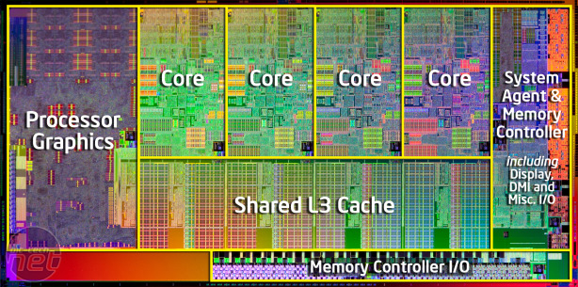
4.1 Introduction (4)
Main functional units of Sandy Bridge [96]
256 KB L2
(9 clk)
256 KB L2
(9 clk)
256 KB L2
(9 clk)
256 KB L2
(9 clk)
256 KB L2
(9 clk)
256 KB L2
(9 clk)
256 KB L2
(9 clk)
Hyperthreading
AES Instr.
VMX Unrestrict.
20 nm² / Core
32K L1D (3 clk)
AVX 256 bit
4 Operands
8 MB
@ 1.0 1.4 GHz
(to L3 connected)
(25 clk)
256 b/cycle Ring Architecture
PCIe 2.0
DDR3-1600
25.6 GB/s
32 nm process / ~225 nm² die size. 995 mtrs, 85W TDP
Remark
Intel designates the integrated GPU as Processor Graphics (PG)

Slide 119
4.2 Major innovations of the Sandy Bridge line vs.
the 1. generation Nehalem line
4.2.1 Overview
4.2.2 Extension of the ISA by the 256-bit
AVX instruction set
4.2.3 New microarchitecture of the cores
4.2.4 On die ring interconnect bus
4.2.5 On die graphics unit
4.2.6 Turbo Boost 2.0 technology
Notes:
119

Slide 120
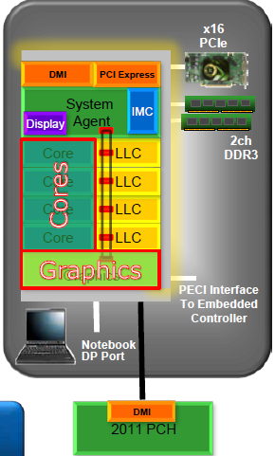
4.2.1 Overview (1)
4.2 Major innovations of the Sandy Bridge line vs. the 2. generation Nehalem line [61]
4.2.1 Overview
Extension of the ISA by the 256-bit
AVX instruction set (Section 4.2.2)
New microarchitecture for the cores
(Section 4.2.3)
On die ring interconnect bus
(Section 4.2.4)
On-die graphics unit
(Section 4.2.5)
Turbo Boost technology 2.0
(Section 4.2.6)
*

Slide 121
4.2.2 Extension of the ISA by the AVX instruction set (1)
4.2.2 Extension of the ISA by the 256-bit AVX instruction set
AVX: Advanced Vector Extensions
In the course of ISA extensions Intel expanded
the previous 128-bit SSE SIMD instruction set (introduced with the Pentium III in 1999)
by the 256-bit AVX SIMD instruction set in the Sandy Bridge, as follows:
Remark
The 256-bit AVX instruction set is then expanded to the AVX512 instruction set
in the 14 nm Skylake-SP server processor (2017) and
in the 10 nm Cannon Lake mobile (notebook) processor (2018)
*

Slide 122
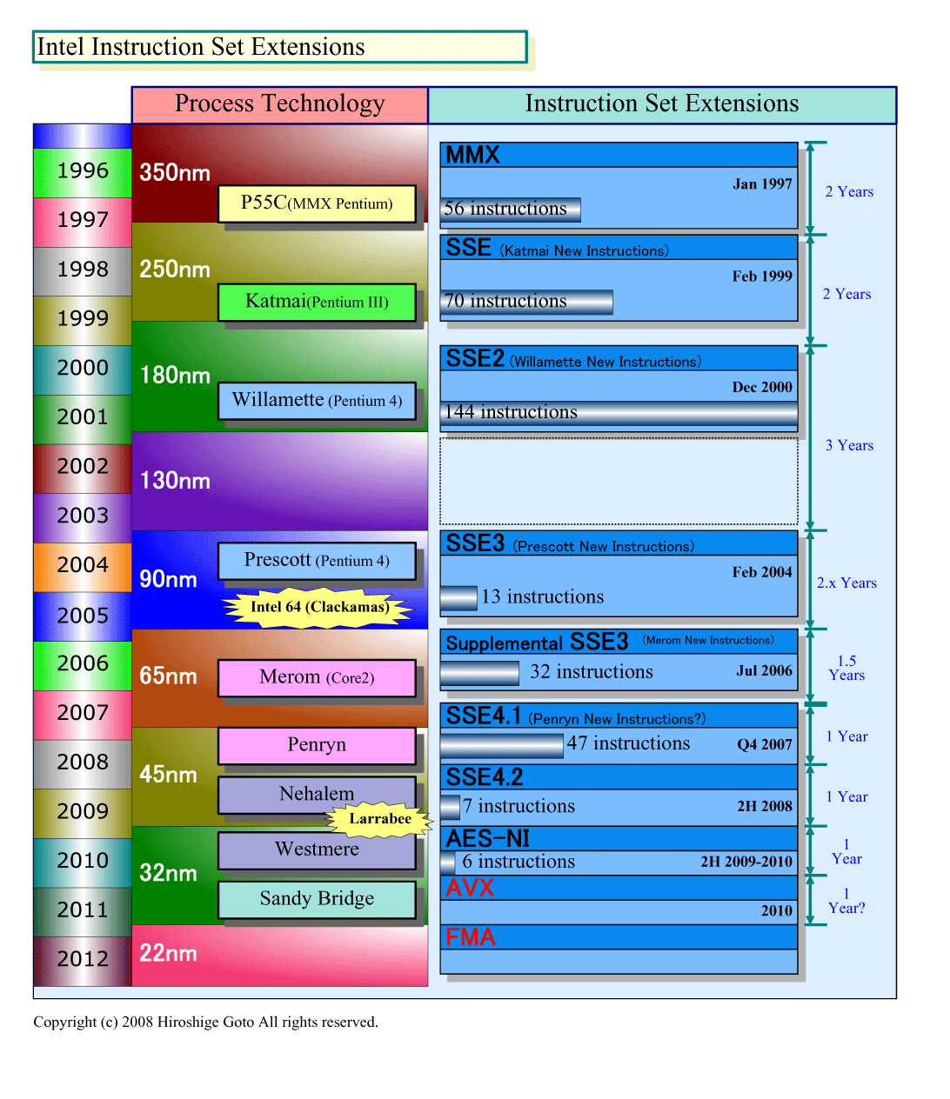
4.2.2 Extension of the ISA by the AVX instruction set (2)
Width of Intel’s subsequent SIMD extensions (Based on [18])
Pentium III
64-bit
128-bit
Pentium 4
Northwood (Pentium4)
Norhwood
Northwood (Pentium4)
Core 2
256-bit
Ivy Bridge

Slide 123
4.2.2 Extension of the ISA by the AVX instruction set (3)
The 256-bit AVX extension
It includes
Extension
of the 128-bit wide XMM [0, 15] SIMD register set to the 256-bit YMM [0, 15] register set.
b) Extension
of the 128-bit SSE instruction set to the 256-bit instruction set.
*

Slide 124
4.2.2 Extension of the ISA by the AVX instruction set (4)
Available SIMD register sets in Intel’s subsequent SIMD extensions (Based on [18])
Available register set
Pentium III
8 MM registers (64-bit),
aliased on the FP Stack registers
8 XMM registers (128-bit)
Pentium 4
16 XMM registers (128-bit)
Northwood (Pentium4)
Norhwood
Northwood (Pentium4)
Core 2
16 YMM registers (256-bit)
Ivy Bridge

Slide 125
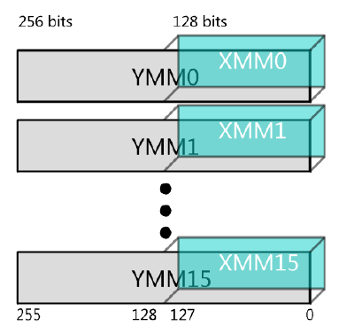
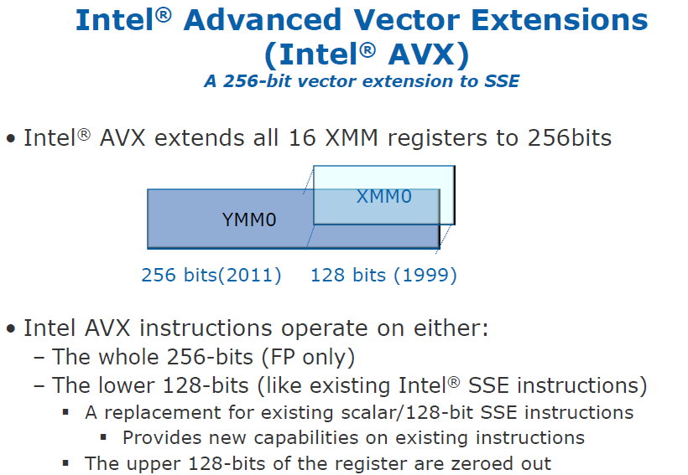
4.2.2 Extension of the ISA by the AVX instruction set (5)
Extension of the 128-bit wide XMM [0, 15] SIMD register set to the 256-bit
YMM [0, 15] register set [97], [168]
*

Slide 126
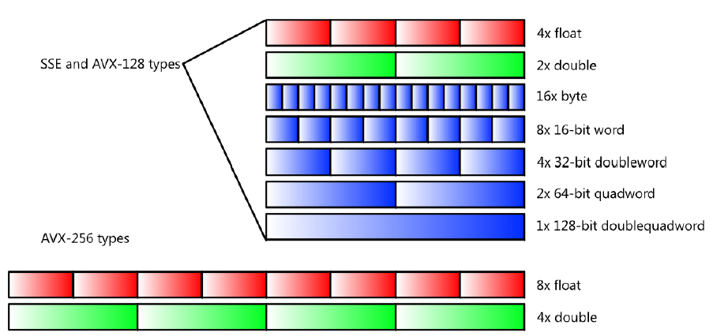
4.2.2 Extension of the ISA by the AVX instruction set (6)
b) Extension of the 128-bit SSE instruction set
Supported data types [168]
FP
float
FX
float

Slide 127
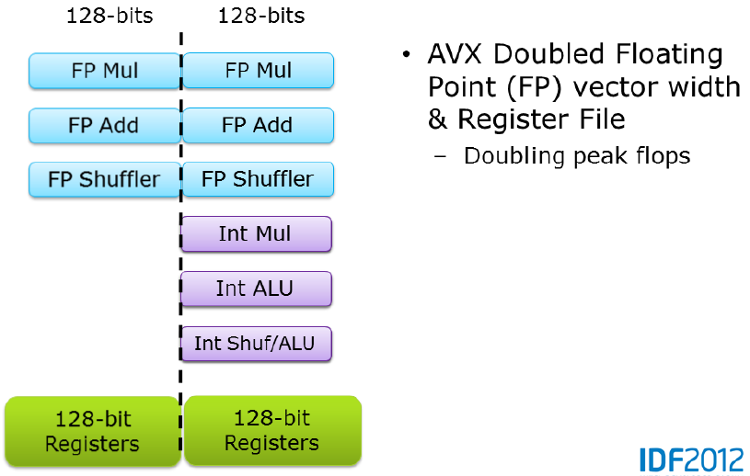
4.2.2 Extension of the ISA by the AVX instruction set (7)
Note
AVX doubled only FP vector width, as indicated in the Figure below [97].
AVX doubled FP vector width
and register file width
Doubling peak FLPOPS
*

Slide 128
4.2.2 Extension of the ISA by the AVX instruction set (8)
Implementation of AVX -1
To implement 256-bit FP operations Intel did not widen related data paths and FP execution units
to 256 bit, instead designers made use of two 128-bit data paths and two 128-bit
FP execution units in the same time, as indicated in the next Figure [98].
Sandy Bridge do not support FMA operations but it can execute up to 8 DP FP or 16 SP FP
operations (additionally 4 DP SP operations or 8 SP FP operations can be executed over the
Port 5).

Slide 129
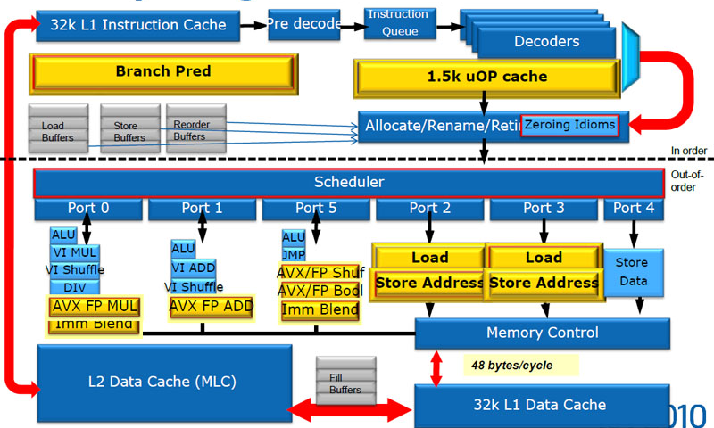
4.2.2 Extension of the ISA by the AVX instruction set (9a)
Implementation of AVX -2
Intel redesigned large parts of the microarchitecture of the cores, as indicated by yellow boxes
in the Figure below.
Figure 4.2.2.1: Microarchitecture of the cores of Sandy Bridge [64]

Slide 130
4.2.2 Extension of the ISA by the AVX instruction set (9b)
SIMD execution resources in Intel’s basic processors (based on [18])
Pentium III
2 x 32-bit FX MMX EUs
2 x 32-bit MMX,
2 x 32-bit SSE EUs
Pentium 4
1 full + 1 simple (moves/stores)
64-bit FP/SSE EUs
Northwood (Pentium 4)
Core 2
2 x 128-bit FP EUs +
3 x 128-bit SSE EUs
2x128-bit FP EUs
Ivy Bridge

Slide 131
4.2.3 New microarchitectures of the cores (1)
4.2.3 New microarchitecture of the cores
Intel redesigned large parts of the microarchitecture of the cores, as indicated by yellow boxes
in the Figure below.
Figure: Microarchitecture of the cores of Sandy Bridge [64]

Slide 132
4.2.3 New microarchitectures of the cores (2a)
The micro-op cache [213] -1

Slide 133
4.2.3 New microarchitectures of the cores (2b)
The micro-op cache [213] -2
It can hold 1.5 K micro-operations (micro-ops).
Assuming an average x86 instruction length of 3.5 byte the micro-op cache is equivalent to
an instruction cache of about 5.2 kB.
The micro-op cache replaces Nehalem's loop-buffer that also stores micro-ops, nevertheless
only up to 28 items.
The micro-op cache holds already decoded instructions.
Thus instructions whose micro-ops are already available in the micro-op cache do not need
to be fetched, predecoded, decoded and converted to micro-ops a new.
Here we assume that the micro-op cache has its own branch unit to follow instruction traces.
According to Intel, the hit rate of the micro-op cache is about 80 %.
This raises performance and reduces power consumption.
*

Slide 134
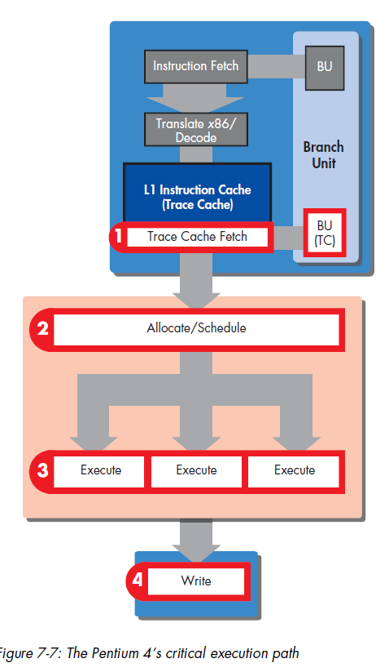
4.2.3 New microarchitectures of the cores (3)
Remark
The micro-op cache is similar to Intel's Trace Cache
introduced in their Pentium 4 family in 2000.
12 K microoperations
Figure: Trace Cache of the Pentium 4 [214]

Slide 135
4.2.3 New microarchitectures of the cores (4)
Here we do not want to go into details of the microarchitecture, but refer to two very detailed
descriptions [64], [98].

Slide 136
4.2.4 On-die ring interconnect bus (1)
4.2.4 On die ring interconnect bus [66]
System Agent
The ring has six bus stops for
interconnecting
four cores
four L3 slices
the GPU and
the System Agent
The four cores and the
L3 slices share the same
interfaces.
*

Slide 137
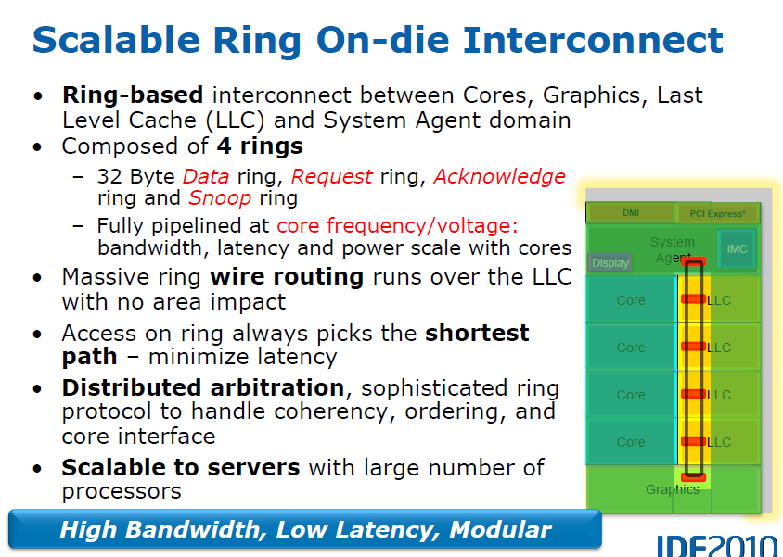
4.2.4 On-die ring interconnect bus (2)
Main feature of the on-die interconnect bus [64]
• It operates at core frequency (One stop/clock)
The four rings need a considerable amount of
wiring and routing.
As the routing runs in the upper metal layers
over the LLC, thus the rings have no real
impact on the die area.
*

Slide 138
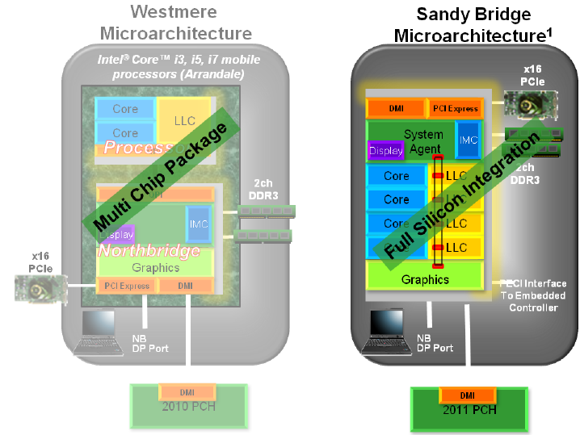
4.2.5 On die graphics unit (1)
4.2.5 On die graphics unit [99]
Evolution of graphics implementation from Westmere to Sandy Bridge [99]
*

Slide 139
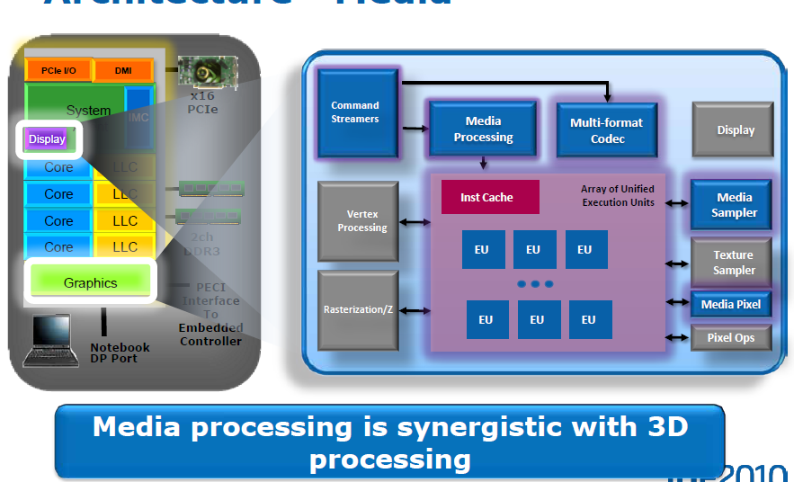
4.2.5 On die graphics unit (2)
Support of both media and graphics processing by the graphics unit [99]

Slide 140
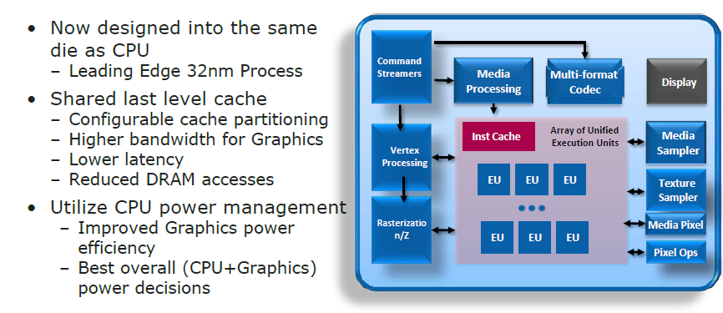
4.2.5 On die graphics unit (3)
8.2.5 On die graphics unit (1)
Main features of the on die graphics unit [99]
GT1: 6 or GT2: 12 EUs

Slide 141
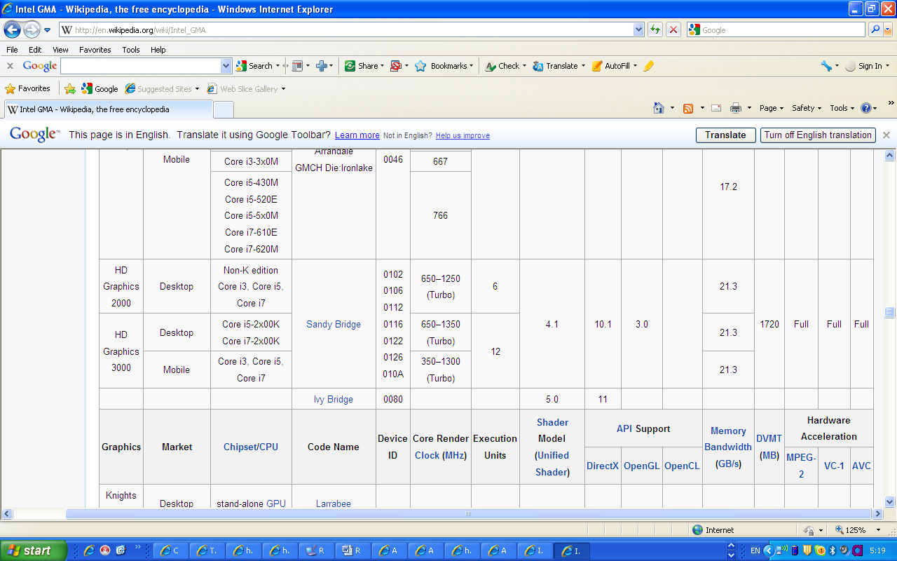
4.2.5 On die graphics unit (4)
8.2.5 On die graphics unit (1)
Specification data of the HD 2000 and HD 3000 graphics [100]
(GT1)
(GT2)
-
*

Slide 142
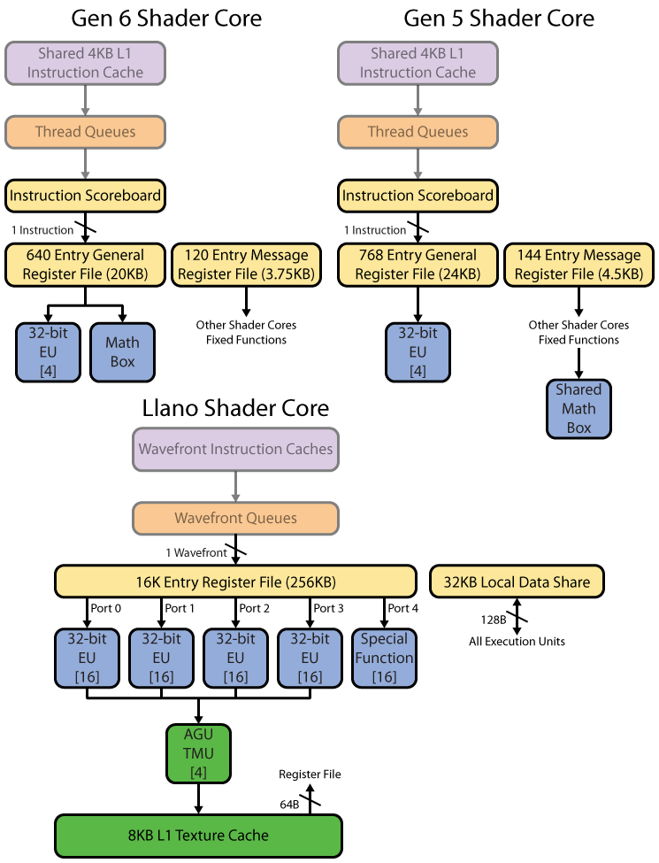
4.2.5 On die graphics unit (5)
Execution units (EU) of the graphics unit in Sandy Bridge [197]
Each EU is basically a 4-wide SP FP SIMD unit intended to operate on 4-component data
(RGBA), capable of executing 2-operation MAD instructions and also FX instructions.
EUs are 5-way multithreaded for GT2 graphics and 4-way multithreaded for GT1 graphics.
Each thread has a register set of 120 x 256 bit registers.
There is also a fixed function Math Box for executing transcendental, e.g. trigonometric
instructions and also FP divide.
The EUs do not support DP FP operations.
4 x SP FP
MAD (AxB+C)
GT: Graphics Technology level
RGBA: RGB Alpha (opacity)
Figure: Block diagram of an EU of the graphics unit of Sandy Bridge
*

Slide 143
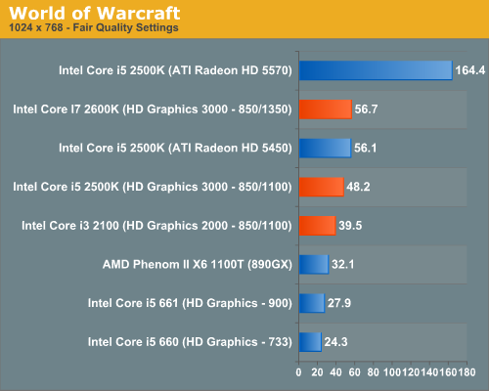
4.2.5 On die graphics unit (6)
Performance comparison of the Sandy Bridge’s graphics: gaming [101]
HD 5570
400 ALUs
i5/i7 2xxx/3xxx:
Sandy Bridge
i5 6xx
Arrandale
frames per sec

Slide 144
4.2.6 Turbo Boost technology 2.0 (1)
4.2.6 Turbo Boost 2.0 technology [64]
Designated also as the 2.0 generation Turbo Boost technology.
The concept utilizes the real temperature response of processors to power changes
in order to increase the extent of overclocking [64].
Cooler
Thermal capacitance
*

Slide 145
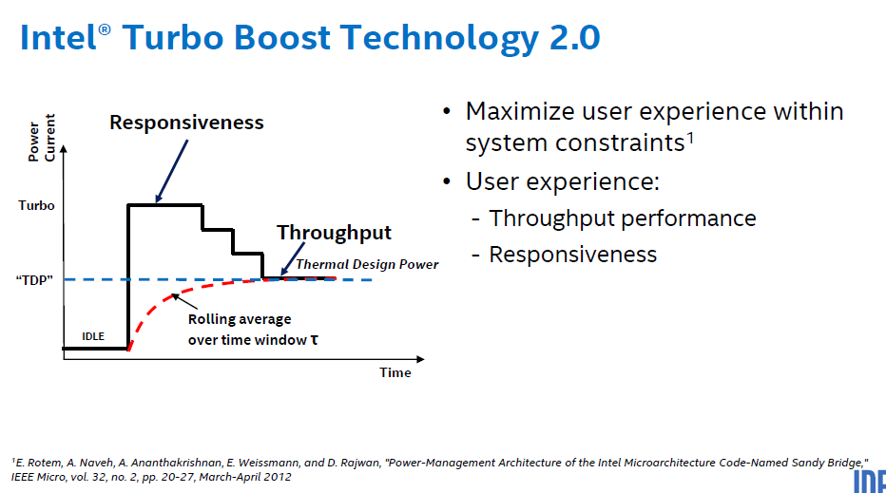
4.2.6 Turbo Boost technology 2.0 (2)
Aim of Intel’s Turbo Boost Technology 2.0 [198]
User experience: Felhasználói élmény
Responsiveness: Reakcióképesség
Throughput: Áteresztőképesség/Teljesítmény
*

Slide 146
4.2.6 Turbo Boost technology 2.0 (3)
Principle of the implementation of Turbo Boost 2.0 [64]
Based on the real temperature response
the thermal energy budget accumulated during idle periods
can be utilized to push the core beyond the TDP for short periods of time (e.g. for 20 sec).
Stepped
voltage
transitions
30-60sec
Multiple algorithms manage in parallel
current, power and
die temperature. [64]
*

Slide 147
4.2.6 Turbo Boost technology 2.0 (3b)
Introduction of the Turbo Boost 3.0 (aka Turbo Boost Max 3.0) technology in the
Broadwell-E line (2016) [248]
Turbo Boost Max 3.0 offers an additional 100 to 200 MHz clock boost for single threaded
applications.
Max. core speeds are measured during testing the chip.
The core with the highest possible clock speed is called the "favored core".
It will be activated for Turbo Boosting in case when only a single core is needed.
It needs BIOS and OS support.
Remarks to the Turbo Boost Max 3.0 technology
In practice, motherboard manufacturers often didn't support it or they doe disabled it in the
BIOS by default.
If users intend to make use of it they have to install the drivers and the BIOS as well.

Slide 148
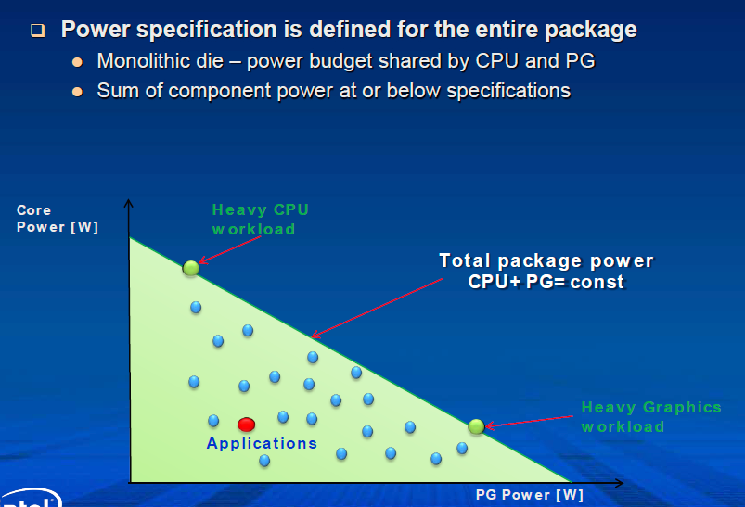
4.2.6 Enhanced Turbo Boost technology (4)
Intelligent power sharing between the cores and the processor graphics (PG) [64]
CPU
(CPU = const - PG)
Figure: Power sharing between CPU and GPU [207]
*

Slide 149
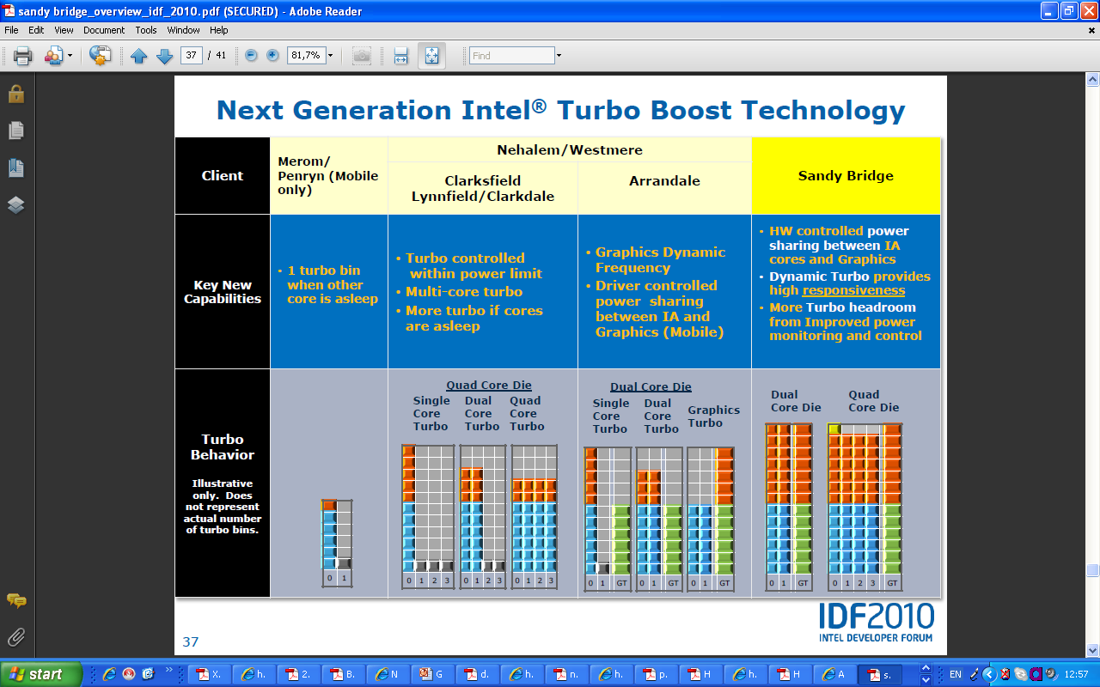
4.2.6 Enhanced Turbo Boost technology (5)
[61]
(EDAT)
Penryn
(EDAT)
Nehalem
Westmere
NHM/M
WSM/M
Penryn/M
Nehalem/M (Clarksfield)
Nehalem/D (Lynnfield)
Westmere/M (Arrandale)
Westmere/D (Clarkdale)
NHM/D
WSM/D

Slide 150
4.2.6 Enhanced Turbo Boost technology (6)
Remark
Active cores run at the same clock frequency and share the same power plane.
Idle cores may be shut down by power gates.
*

Slide 151
4.3 Example for a Sandy Bridge based desktop
platform with the H67 chipset
Notes:
151

Slide 152
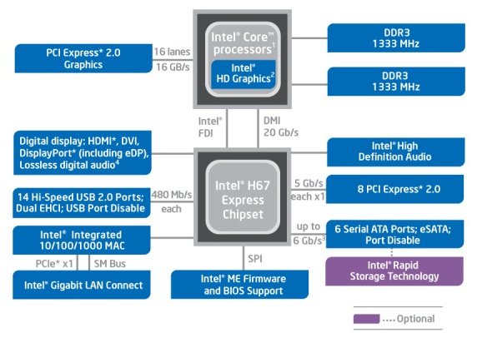
4.3 Example for a Sandy Bridge based desktop platform with the H67 chipset (1)
4.3 Example for a Sandy Bridge based desktop platform with the H67 chipset [102]
FDI: Flexible Display Interface

Slide 153
5. The Haswell line
5.1 Introduction
5.2 Major enhancements of the Haswell line vs.
the Sandy Bridge line
5.3 Major innovations of the Haswell line
5.4 Haswell based mobile and desktop processors
5.5 Haswell based server processors
Only Section 5.1 is discussed!
Notes:
153

Slide 154
5.1 Introduction
Notes:
154

Slide 155
5.1 Introduction (1)
5.1 Introduction
Haswell processors are termed also as the 4. gen. Intel Core processors, as indicated below.
Figure 4.1.1: Intel’s Tick-Tock development model (Based on [1])
1. gen.
2. gen.
3. gen.
4. gen.
5. gen.
6. gen.
Core 2
New
Microarch.
65 nm
Penryn
New
Process
45 nm
Nehalem
New
Microarch.
45 nm
West-
mere
New
Process
32 nm
Sandy
Bridge
New
Microarch.
32 nm
Ivy
Bridge
New
Process
22 nm
Haswell
New
Microarchi.
22 nm
Broad-
well
New
Process
14 nm
Skylake
New
Microarchi.
14 nm
TOCK
TICK
TOCK
TICK
TOCK
TICK
TOCK
TICK
TOCK
Figure : Intel’s Tick-Tock development model (Based on [1])
Launched: 6/2013 at Computex.

Slide 156
5.1 Introduction (2)
The Haswell line
Launched in 06/2013
22 nm IC technology
The Haswell refresh processors [176]
A second wave of Haswell processors, called the Haswell refresh processors launched in
5/2014.
They do not provide any significant changes vs. the first released processors.
Actually, the manufacturing process could be made more efficient and this resulted in slight
improvements in clock speeds.
A third wave of Haswell processors, called the Devil's Canon line launched in 6/2014.
They provide higher clock speeds vs. the previous processors.
DP/MP servers (Haswell-EP, Haswell-EX)
They were launched later, in 09/2014 and 05/2015, as indicated subsequently.
*

Slide 157
5.1 Introduction (3)
The Haswell line -1
Key new features of the ISP
and the microarchitecture
2 YEARS
TICK Pentium 4 ( Cedar Mill)
Pentium D (Presler)
01/2006
2 YEARS
65nm
New microarch.: 4-wide core,
128-bit SIMD FX/FP EUs,
shared L2 , no HT
TOCK Core 2
07/2006
TICK Penryn Family
11/2007
2 YEARS
45nm
New microarch.: 4 cores, integr. MC,
QPI, private L2, (inclusive) L3, HT
TOCK Nehalem
11/2008
TICK Westmere
01/2010
In package integrated GPU
2 YEARS
32nm
New microarch.: 256-bit (FP) AVX,
ring bus, integrated GPU
TOCK Sandy Bridge
01/2011
TICK Ivy Bridge
04/2012
2 YEARS
22nm
New microarch.: 256-bit (FX) AVX2,
L4 cache (discrete eDRAM), TSX
TOCK Haswell
06/2013
TICK Broadwell
09/2014
Shared Virtual Memory
4 YEARS
TOCK Skylake
10/2015
New microarch.: 5-wide core,
ISP, Memory Side L4 cache, no FIVR
14nm
TOCK Kaby Lake
08/2016
Optane memory, in KBL G series:
in package integr. CPU, GPU, HBM2
TOCK Coffee Lake
10/2017
(USB Gen. 2, integr. conn., Optane 2)
TICK Cannonlake
05/2018
AVX512
?? YEARS
10nm
TOCK Icelake
??/2019
Figure is based on [3])
*

Slide 158
5.1 Introduction (3b)
The Haswell line -2
Key new features
in power management
2 YEARS
TICK Pentium 4 ( Cedar Mill)
Pentium D (Presler)
01/2006
2 YEARS
65nm
Clock gating, PECI,
Platform Thermal Control by
3. party controller
TOCK Core 2
07/2006
2 YEARS
TICK Penryn Family
11/2007
EDAT
45nm
Integrated Power Gates, PCU,
Turbo Boost
TOCK Nehalem
11/2008
TICK Westmere
01/2010
2 YEARS
32nm
TOCK Sandy Bridge
01/2011
Turbo Boost 2.0
2 YEARS
TICK Ivy Bridge
04/2012
22nm
TOCK Haswell
06/2013
FIVR
TICK Broadwell
09/2014
2. gen. FIVR
Speed Shift Technology,
Duty Cycle control, No FIVR
(except Skylake X)
4 YEARS
TOCK Skylake
10/2015
14nm
TOCK Kaby Lake
08/2016
Speed Shift Technology v2
TOCK Coffee Lake
10/2017
In H-series: TVB
(Thermal Velocity Boost)
TICK Cannonlake
05/2018
10nm
TOCK Icelake
??/2019
Figure is based on [3])
*

Slide 159
5.1 Introduction (4)
Key new features of the ISP and the microarchitecture
a) 256-bit (FX) AVX2 ISA extension
b) On-package eDRAM L4 cache
c) FIVR (Fully Integrated Voltage Regulator)
d) TSX (Transactional Synchronization Extensions)
*

Slide 160

5.1 Introduction (5)
a) 256-bit (FX) AVX2 ISA extension [97]
FMA: Fused Multiply-Add
*

Slide 161

5.1 Introduction (6)
b) On-package eDRAM L4 cache [124]
eDRAM chip
*

Slide 162

5.1 Introduction (7)
c) FIVR (Fully Integrated Voltage Regulator)
FIVR integrates legacy power delivery onto the package and the die, as shown below for
Intel's Haswell processor [178]
Figure: Integrating legacy power delivery onto the package and the die with FIVR [178]
This consolidates five platform VRs into one and thus greatly simplifies mainboard design.
*

Slide 163
5.1 Introduction (8)
d) TSX (Transactional Synchronization Extensions)
Haswell also introduced a further new feature, the Transactional Synchronization Extensions
(TSX) that was debuted on selected Haswell models (SKUs).
TSX supports Transactional Memory in hardware (to be discussed later in the Chapter
high end MP servers).
Nevertheless, in August 2014 Intel announced a bug in the TSX implementation on all current
steppings of all Haswell models an disabled the TSX feature on affected CPUs via a microcode
update.
Subsequently, TSX became enabled first on a Broadwell model (Core M-5Y70) in 11/2014
then on the Haswell-EX in 5/2015.
SKU: Stock Keeping Unit
*

Slide 164
5.1 Introduction (9)
Addressing race conditions of thread execution while accessing memory
Basically there are two mechanisms to address race conditions in multithreaded programs,
as indicated below:
Basic mechanisms to address races in multithreaded programs
Locks
Transactional memory (TM)
Pessimistic approach,
it intends to prevent possible conflicts
by enforcing serialization of transactions
through locks.
Optimistic approach,
it allows access conflicts to occur
but provides a checking and repair mechanism
for managing these conflicts, i.e.
it allows all threads to access shared data simultaneously
but after completing a transaction,
it will be checked whether a conflict arose,
if yes, the transaction will be rolled back and
then replayed if feasible else
executed while using locks.
The next Figure illustrates these synchronization mechanisms.

Slide 165

5.1 Introduction (10)
Illustration of lock based and transaction memory (TM) based thread synchronization
[126]
Conflict, to be
repaired

Slide 166
5.1 Introduction (9)
Additional platform related innovations
a) Connecting the displays directly to the processor
b) On-package integrated CPU and PCH for mobile processors
*

Slide 167

5.1 Introduction (10)
a) Connecting the displays directly to the processor [145]
*

Slide 168

5.1 Introduction (11)
b) On-package integrated CPU and PCH for mobile processors [204]
BGA: Ball Grid Array
SPD: Scenario Design Point
PGA: Pin Grid array
*

Slide 169
5.1 Introduction (12)
Overview of the Haswell family
The Haswell family
Haswell
(LGA1150)
Up to 4 cores
(This Section)
Haswell-E
(LGA2011)
Up to 8 cores (HEDs)
(Not discussed here)
Haswell-EP
(LGA2011)
Up to 18 cores
(Not discussed here)
Haswell-EX
(LG2011)
Up to 18 cores
(Not discussed here)
Mobiles (SoCs)
Core i7-49xx/48xx/472x/471x/470x, 4C+G, HT, 6/2013 and 5/2014
Core i7-46xx/45xx, 2C+G, HT, 5/2013 and 6/2014
Core i5-43xx/42xx U/Y, 2C+G, HT, 6/2013 and 5/2014
Core i3-41xx/40xx, 2C+G, HT, 6/2013 and 5/2014
Desktops (2-chip designs)
Core i7-479x/478x/477x,476x, 4C+G, HT, 6/2013 and 5/2014
Core i5-46xx/45xx/44xx, 4C+G, HT, 6/2013 and 5/2014
Core i3-43xx/41xx, 2C+G, HT, 6/2013, 5/2014 and 3/2015
i7-5960X/5930K/5820K, 6/8 C, 8/2014
Servers
(Not discussed here)
Notes:
ridge-ex

Slide 170
5.1 Introduction (13)
Single thread IPC in Intel’s basic architectures [195]
20%
Per Generation
1.8
18%
Cumulative
1.7
16%
1.6
14%
12%
1.5
10%
1.4
8%
1.3
6%
1.2
4%
2%
1.1
0%
1
Core 2
Penryn
WSM
SNB
IVB
HSW
BRW
Pentium M
Dothan
NHM (w/o SMT)
*

Slide 171
5.2 Major enhancements of the Haswell line vs.
the Sandy Bridge line
5.2.1 Overview
5.2.2 ISA extension (of the cores) by the AVX2
instruction set
5.2.3 Enhanced microarchitecture for the cores
5.2.4 Enhanced graphics
Notes:
171

Slide 172

5.2.1 Overview (1)
5.2 Major enhanchements of the Haswell line vs. the Sandy Bridge line
5.2.1 Overview
ISA extension by the AVX2
instruction set (Section 5.2.2)
Enhanced microarchitecture for the cores
(Section 5.2.3)
Enhanced graphics (Section 5.2.4)
*

Slide 173
5.2.2 ISA extension by the AVX2 instruction set (1)
5.2.2 ISA extension by the AVX2 instruction set -1 [97]
FMA: Fused Multiply-Add
*

Slide 174

5.2.2 ISA extension by the AVX2 instruction set (2)
ISA extension by the AVX2 instruction set -2 [80]

Slide 175

5.2.2 ISA extension by the AVX2 instruction set (3)
Example for calculating D = A x B + C with 8 32-bit data vectors by using the AVX2
ISA extension [212]

Slide 176

5.2.2 ISA extension by the AVX2 instruction set (4)
Remark
Reduced core frequency while running AVX instructions
When the processor detects AVX instructions it signals it to the PCU (Power Control Unit).
Then the PCU delivers higher core voltage that however increases the dissipation.
At the same time while executing AVX instructions the PCU reduces the clock frequency
of the processor. to remain within the TDP limit and avoid overheating.
The higher voltage will remain for 1 ms after the last AVX instruction completes and
, subsequently the core voltage will return to its nominal value defined by the TDP.
Related to this, Intel added two AVX frequencies for their Haswell- EP (E5-1600 and E5-2600
line of processors, as follows and demonstrated in an example.
AVX base: it is the minimum frequency for workloíds using AVX instructions.
AVX max all core Turbo: it is the maximum frequency for workloads using all cores
for executing AVX instructions.
Figure: Core frequency limits in Haswell-EP and
previous lines [212]
(128-bit execution)

Slide 177

5.2.2 ISA extension by the AVX2 instruction set (5)
Example: Core frequency limits for Intel's E5-2699 v3 processor [212]
AVX Frequency Range Example – E5-2699 v3

Slide 178

5.2.2 ISA extension by the AVX2 instruction set (6)
Evolution of the AVX ISA extensions [97]

Slide 179

5.2.2 ISA extension by the AVX2 instruction set (7)
Expected future evolution of AVX [165]

Slide 180

5.2.3 Enhanced microarchitecture for the cores (1)
5.2.3 Enhanced microarchitecture for the cores [80]

Slide 181

5.2.3 Enhanced microarchitecture for the cores (2)
Buffer sizes of subsequent generations of the Core processors [80]

Slide 182

5.2.3 Enhanced microarchitecture for the cores (3)
Cache sizes, latencies and bandwidth values of subsequent Core generations [122]

Slide 183

5.2.3 Enhanced microarchitecture for the cores (4)
Issue rate and execution unit enhancements of Haswell [165]
FMA: Fused Multiply-Add (a x b+c)

Slide 184
5.2.4 Enhanced graphics (1)
5.2.4 Enhanced graphics
To compete with AMD’s advanced graphics solutions Intel put a great emphasis on enhancing
Haswell’s integrated graphics.
Main features of the new graphics units: are termed as Iris Pro and Iris graphics.
Sliced graphics architecture to allow scaling of EUs
Inclusion of eDRAM in high-end units.
*

Slide 185

5.2.4 Enhanced graphics (2)
a) Introduction of sliced graphics architecture
The new graphics architecture of Haswell is sliced, to allow scaling of EUs by using one or two slices/unit.
Each slice has two sub-slices, with up to 10 EUs/sub-slice, as indicated in the Figure below.
Figure: A sub-slice with 10 EUs
of the graphics unit of Haswell [199]
*

Slide 186

5.2.4 Enhanced graphics (3)
A slice of the graphics unit of Haswell including two sub-slices with 20 EUs [199]
*

Slide 187

5.2.4 Enhanced graphics (4)
The architecture of a GT3 graphics unit of Haswell including two slices with 40 EUs [199]

Slide 188

5.2.4 Enhanced graphics (5)
Block diagram of an EU of Haswell -1 [199]
Each EU has four functional units:
Two SIMD FPU units
1 Send unit (Load/Store) and
1 Branch unit.
An EU issues up to 4 instructions per cycle to the functional units.
*

Slide 189
5.2.4 Enhanced graphics (6)
Block diagram of an EU of Haswell -2 [199]
Each SIMD FPUs can execute 4 SP FP or 1/2/4/8/16/32 bit wide FX operations.
They can execute MAD instructions (Multiply-Add) per cycle.
Thus an EU can execute 2 FPU x SIMD4 x 2 (MAD) = 16 SP FP operations/cycle.
The EU is 7-way multithreaded.
Each thread has 128 32 B registers.
One of the FPUs also supports FX operations.
One of the FPUs also support transcendental math functions.

Slide 190
5.2.4 Enhanced graphics (7)
Interpretation of the notions Graphics Technology (GT) for the Haswell line and
subsequent lines
GT1 designates graphics with a single slice and reduces execution resources (less sub-slices
or less EUs per sub-slice)
GT2 designates graphics with a single slice (e.g. 20 EUs in the Haswell line)
GT3 designates graphics with dual slices (e.g. 40 EUs in the Haswell line)
GT4 designates graphics with triple slices.
*

Slide 191
5.2.4 Enhanced graphics (8)
Introducing the notions Iris/Iris Pro graphics
Intel designates their
high-end graphics as Iris graphics and
high-end graphics enhanced with embedded DRAM (eDRAM) as Iris Pro graphics.
The inclusion of eDRAM will be indicated also in the GT naming by supplementing the GT level
by the letter “e”, so GT3e designates GT3 level with eDRAM.
Haswell’s Iris graphics unit
(They incorporate two slices with altogether 40 EUs
Iris graphics unit
Iris Pro graphics unit
It is not enhanced by an
on package integrated eDRAM
It is enhanced by a 128 MB sized
on package integrated eDRAM
*

Slide 192
5.2.4 Enhanced graphics (9)
b)Inclusion of eDRAM in high-end graphics units
It will be discussed in Section 5.3.1

Slide 193
5.2.4 Enhanced graphics (10)
Evolution of main features of Intel’s graphics families
Intel Core generation | Graphics generation | Models | Graphics Technology level | No. of graphics slices | No. of EUs | eDRAM | OpenGL version | DirectX version | OpenCL version
Westmere | 5th (Ironlake) | HD |  |  | 12 | -- | 2.1 | 10.1 | n.a.
Sandy Bridge | 6th | HD 2000 | GT1 | 1 (2x3 EU) | 6 |  | 3.1/3.3 | 10.1 | n.a.
 |  | HD 3000 | GT2 | 1 (4x3 EU) | 12
Ivy Bridge | 7th | HD 2500 | GT1 | 1 (6 EU) | 6 | -- | 4.0 | 11.0 | 1.2
 |  | HD 4000 | GT2 | 1 (2x8 EU) | 16
Haswell | 7.5th | HD 4200- HD 4700 | GT2 | 1 (2x10 EU) | 20 | -- | 4.3 | 11.1 | 1.2
 |  | HD 5000 Iris 5100 | GT3 | 2 | 40
 |  | Iris Pro 5200 |  |  |  | 128 MB
Broadwell | 8th | HD 5300- HD 5600 | GT2 | 1(3x8 EU) | 23/24 | -- | 4.3 | 11.2 | 2.0
 |  | HD 6000 Iris 6100 | GT3 | 2 | 47/48
 |  | Iris Pro 6200 | GT3e | 2 | 48 | 128 MB
Skylake | 9th | HD 510 | GT1 | 1 (3x4 EU) | 12 | -- | 4.4 | 12 | 2.0
 |  | HD 515 | GT1.5 | 1 (3x6 EU) | 18
 |  | HD 520 | GT2 | 1 (3x8 EU) | 24
 |  | HD 535 | GT3 | 2 | 48
 |  | HD 540 | GT3e | 2 | 48 | 64 MB
 |  | HD 580 | GT4e | 3 | 72 | 64/128 MB

Slide 194

5.2.4 Enhanced graphics (11)
Evolving integrated graphics in Intel’s processor generations [250]
GT2
GT3
GT2
GT3
GT3e
Note that evolving processor graphics is Intel’s primary interest to compete with NVIDIA and AMD.

Slide 195

5.2.4 Enhanced graphics (12)
Graphics performance increase of subsequent Core generations [117]
Haswell
Ivy Bridge
Sandy Bridge

Slide 196
5.3 Major innovations of the Haswell line
5.3.1 In-package eDRAM cache
5.3.2 FIVR (Fully Integrated Voltage Regulator)
5.3.3 TSX (Transactional Synchronization Extensions)
Notes:
196

Slide 197
5.3 Major innovations of the Haswell line (1)
5.3 Major innovations of the Haswell line
On-package e-DRAM cache (Section 5.3.1)
FIVR (Fully Integrated Voltage Regulator) (Section 5.3.2)
TSX (Transactional Synchronization Extensions) (Section 5.3)
*

Slide 198

5.3.1 On-package eDRAM cache (1)
5.3.1 On-package eDRAM cache [117]
*

Slide 199
5.3.1 On-package eDRAM cache (2)
Principle of operation [117]
The on package eDRAM, designated also as Crystallwell, it operates as a true 4th level cache
of the memory hierarchy.
It acts as a victim buffer to the L3 cache, in the sense that anything evicted from the
L3 cache immediately goes into the L4 cache.
Both CPU and GPU requests are cached.
The cache partitioning between CPU and GPU is dynamic.
If the GPU is not in use the whole L4 cache may be devoted the CPU, in this case the CPU
has a 128 MB L4 cache.
Access latency after an L3 miss is 30 – 32 ns.
The L4 cache is capable of delivering 50 GB/s in each direction.
The Crystallwell die consumes between 0.5 and 1.0 W if idle and between 3.5 and 4.5 W
under full load.
The PCU (Power Control Unit) of the processor takes over the power management of the
eDRAM, beyond the power management of the CPU cores, GPU, L3 cache etc.
*

Slide 200
5.3.1 On-package eDRAM cache (3)
Implemented in-package eDRAM [124]
eDRAM chip

Slide 201

5.3.1 On-package eDRAM cache (4)
Memory latency vs. access range in a memory system with eDRAM cache (L4) [117]
Memory
L4
L3
L2
L1
Ivy Bridge
Ivy Haswel with Chrystallwelll
Ivy Haswell without CRW

Slide 202
5.3.2 FIVR (Fully Integrated Voltage Regulator) (1)
5.3.2 FIVR (Fully Integrated Voltage Regulator) -1
Before introducing FIVR into the Haswell family, motherboards for Intel processors had to provide
6 different voltage regulators (VRs) to supply different voltages to the CPU cores, graphics (Gfx),
System Agent (SA), IO, PLL and Memory, as indicated in the next Figure.
Figure: Voltage Regulators (VRs) needed in motherboards of Intel processors before introducing
FIVRs [178]
*

Slide 203
5.3.2 FIVR (Fully Integrated Voltage Regulator) (2)
FIVR (Fully Integrated Voltage Regulator) -2
FIVR integrates legacy power delivery onto the package and the die, as shown below for
intel's Haswell processor [178]
Figure: Integrating legacy power delivery onto the package and the die with FIVR [178]
This consolidates five platform VRs into one and thus greatly simplifies mainboard design.
*

Slide 204
5.3.2 FIVR (Fully Integrated Voltage Regulator) (3)
Contrasting power delivery in Ivy Bridge and Haswell platforms [149]
*

Slide 205

5.3.2 FIVR (Fully Integrated Voltage Regulator) (4)
Implementation of the voltage planes in desktop and mobile Haswell processors [173]

Slide 206

5.3.2 FIVR (Fully Integrated Voltage Regulator) (5)
Functional partitioning of Haswell’s FIVR implementation [150]
FIVR is built up of two stages.
The first stage of the voltage regulator converts
from the PSU or battery voltage (12V)
to approximately 1.8V, which is distributed
across the microprocessor die.
The second conversion stage is comprised of
between 8 and 31 (depending on the
product) FIVRs, which are 140MHz
synchronous multiphase buck converters
with up to 16 phases.
12 V
First stage
Second stage
Functional partitioning

Slide 207
5.3.2 FIVR (Fully Integrated Voltage Regulator) (6)
Partitioning of the implementation [150]
The first stage is on the
motherboard.
The inductors and the mid-frequency
decoupling capacitors are placed on
the package.
The power FETs, control circuitry and
high frequency decoupling are
on the die.
Each FIVR is independently
programmable to achieve optimal
operation given the requirements
of the domain it is powering.
The settings are optimized by the
Power Control Unit (PCU), which
specifies the input voltage, output
voltage, number of operating
phases, and a variety of other
settings to minimize the total
power consumption of the die.

Slide 208




5.3.2 FIVR (Fully Integrated Voltage Regulator) (7)
Principle of operation of the Buck converter [151]
Q: MOSFET
Drive circuit:
E.g. PWM modulated
(Pulse Width Modulated)
Figure: Block diagram of the Buck converter [151]
On state
Off state
Figure: Operation of the Buck converter [151]

Slide 209

5.3.2 FIVR (Fully Integrated Voltage Regulator) (8)
Enhancing the buck converter to synchronous n-phase buck design to reduce ripple [152]
Fig. 9: Principle of a synchronous n-phase buck converter [152]

Slide 210

5.3.2 FIVR (Fully Integrated Voltage Regulator) (9)
Simplified block diagram of a single voltage plane in the FIVR domain of Haswell [150]
VID: Parallel Voltage Identification code

Slide 211

5.3.2 FIVR (Fully Integrated Voltage Regulator) (10)
Board space saving with Haswell’s FIVR vs. Ivy Bridge’s voltage regulator [149]

Slide 212
5.3.2 FIVR (Fully Integrated Voltage Regulator) (11)
FIVR and per-core P-state control
FIVR obviously provides an appropriate technique to deliver per-core core voltages and thus
its use can greatly simplify the implementation of per-core P-state control.
Despite this fact only the server and workstation oriented Haswell-EP lines (including the
Xeon E5-1600 v3, the Xeon E5 2600 v3 and Xeon E5-4600 v3 processor lines) make use
of this feature, as seen in the next slide for the Xeon E5-2600 v3, whereas mobile,
desktop or Haswell-E oriented lines do not.
By contrast, all cores on Ivy Bridge and previous generations, run at the same frequency
and are supplied by the same voltage.
Avaialable per-core PLLs are needed to be able to switch off PLLs of individual cores while
PLLs of other cores are active.
We note that per-core P-state needs additional BIOS and OS support for scheduling the
cores.
Moreover, according to available documentation the high-end Haswell-EX server line do not
implement FIVR at all presumable due to heat problems.
*

Slide 213

5.3.2 FIVR (Fully Integrated Voltage Regulator) (12)
Per Core P-State (PCPS) management in Intel’s E5-2600 v3 (Haswell-EP) [172]
*

Slide 214
5.3.2 FIVR (Fully Integrated Voltage Regulator) (13)
Assessment of FIVR - its benefits [178]

Slide 215
5.3.2 FIVR (Fully Integrated Voltage Regulator) (14)
Assessment of FIVR - its drawbacks [178]
FIVR clearly increases the power dissipation of the processor package and thus it has a
limiting effect on the TDP and consequently on the performance.
*

Slide 216

5.3.2 FIVR (Fully Integrated Voltage Regulator) (15)
Remark
In their subsequent Broadwell family (9/2014) Intel introduced the 2nd generation FIVR with 3DL
design [155]
of about 30 % [224]
3DL: 3D Layering
PCB: Printed Circuit Board
Caps: Capacitors
LVR: Linear Voltage Generator

Slide 217
5.3.2 FIVR (Fully Integrated Voltage Regulator) (16)
The future of FIVR
Due to its drawbacks, after using FIVR in Broadwell, Intel decided to remove it in their upcoming Skylake and Kaby Lake processors.
Accordingly, related motherboards need again to provide appropriate power delivery.
Nevertheless, sources state that in the subsequent 10 nm Cannonlake processors, due to
in 2017, Intel will anew make use of the FIVR technology probably as future FIVR designs
will achieve higher efficiency and thus generate less heat [211].
*

Slide 218
5.3.3 TSX (Transactional Synchronization Extensions) (1)
5.3.3 TSX (Transactional Synchronization Extensions)
Haswell also introduced a further new feature, called the Transactional Synchronization Extensions
(TSX) that was debuted on selected Haswell models (SKUs)..
TSX supports Transactional Memory in hardware (to be discussed later in the Chapter
high end MP servers).
Nevertheless, in August 2014 Intel announced a bug in the TSX implementation on all current
steppings of all Haswell models an disabled the TSX feature on affected CPUs via a microcode
update.
Subsequently, TSX became enabled first on a Broadwell model (Core M-5Y70) in 11/2014
then on the Haswell-EX in 5/2015.
SKU: Stock Keeping Unit
*

Slide 219
5.4 Haswell based mobile and desktop processors
Notes:
219

Slide 220
5.4 Haswell based mobile and desktop processors (1)
5.4 Haswell based mobile and desktop processors
The Haswell family
Haswell
(Micro PGA946/LGA1150)
Mobiles and desktops
Haswell-E
(LGA2011)
High end desktops
(HEDs)
Haswell-EN
(LGA1150)
Microservers/
UP servers
Haswell-EP
(LGA2011)
Efficient performance servers, workstations
Haswell-EX
(LG2011)
High-end servers
Up to 4 cores
i3/i5/i7 designations
Up to 8 cores
i7 designation
Up to 4 cores
E3 designation
Up to 18 cores
E5 designation
Up to 18 cores
E7 designation
Mobiles (SoCs)
Core i7-49xx/48xx/472x/471x/470x, 4C+G, HT, 6/2013 and 5/2014
Core i7-46xx/45xx, 2C+G, HT, 5/2013 and 6/2014
Core i5-43xx/42xx U/Y, 2C+G, HT, 6/2013 and 5/2014
Core i3-41xx/40xx, 2C+G, HT, 6/2013 and 5/2014
Desktops¹ (2 chips, z97 PCH)
Core i7-479x/478x/477x,476x, 4C+G, HT, 6/2013 and 5/2014
Core i5-46xx/45xx/44xx, 4C+G, HT, 6/2013 and 5/2014
Core i3-43xx/41xx, 2C+G, HT, 6/2013, 5/2014 and 3/2015
i7-5960X/5930K/5820K, 6/8 C, 8/2014
¹Additionally, in 6/2016 Intel introduced the Devil's Canon line, consisting of the i3-4360K, i5-4690K and
i7-4790K models.
Notes:
ridge-ex

Slide 221
5.4 Haswell based mobile and desktop processors (2)
Interpretation of the model suffixes of the mobile and desktop lines [205]
Interpretation of the mobile suffixes
M – mobile processor (Socket G3 (PGA 946))
Q – quad-core
U – ultra-low power (BGA 1168 packaging)
X – "extreme"
Y – extreme low-power (BGA 1168 packaging)
E / H – BGA 1364 packaging
Interpretation of the desktop suffixes
K – unlocked (adjustable CPU multiplier up to 63x)
S – performance-optimized lifestyle (low power with 65 W TDP)
T – power-optimized lifestyle (ultra low power with 35–45 W TDP)
R – BGA packaging / High-performance GPU (currently Iris Pro 5200 (GT3e))
X – extreme performance (adjustable CPU ratio with no ratio limit)
BGA packaging (Ball Grid Array): for soldering
LGA packaging (Land Grid Array): removable
PGA packaging (Pin Grid Array): removable

Slide 222
5.4 Haswell based mobile and desktop processors (3)
Main features of first introduced Haswell-based mobile Core i7 M-Series processors [125]
Intel 4th Gen Core i7 M-Series Mobile Processors
Model | Core i7-4930MX | Core i7-4900MQ | Core i7-4800MQ | Core i7-4702MQ | Core i7-4700MQ
Cores/Threads | 4/8 | 4/8 | 4/8 | 4/8 | 4/8
CPU Base Freq | 3.0 | 2.8 | 2.7 | 2.2 | 2.4
Max SC Turbo | 3.9 | 3.8 | 3.7 | 3.2 | 3.4
Max DC Turbo | 3.8 | 3.7 | 3.6 | 3.1 | 3.3
Max QC Turbo | 3.7 | 3.6 | 3.5 | 2.9 | 3.2
TDP | 57W | 47W | 47W | 37W | 47W
HD Graphics | 4600 | 4600 | 4600 | 4600 | 4600
GPU Clock | 400-1350 | 400-1300 | 400-1300 | 400-1150 | 400-1150
L3 Cache | 8MB | 8MB | 6MB | 6MB | 6MB
DDR3/DDR3L | 1600 | 1600 | 1600 | 1600 | 1600
vPro/TXT/VT-d | Yes | Yes | Yes | No | No
Intel SBA | No | No | No | Yes | Yes
Price | $1096 | $568 | $378
SBA: Small Business Advantage (Enhanced security and productivity)

Slide 223
5.4 Haswell based mobile and desktop processors (4)
Main features of first issued Haswell-based Core i7 desktop processors [126]
Intel 4th Gen Core i7 Desktop Processors
Model | Core i7-4770K | Core i7-4770 | Core i7-4770S | Core i7-4770T | Core i7-4770R | Core i7-4765T
Cores/Threads | 4/8 | 4/8 | 4/8 | 4/8 | 4/8 | 4/8
CPU Base Freq | 3.5 | 3.4 | 3.1 | 2.5 | 3.2 | 2.0
Max Turbo | 3.9 (Unlocked) | 3.9 | 3.9 | 3.7 | 3.9 | 3.0
Test TDP | 84W | 84W | 65W | 45W | 65W | 35W
HD Graphics | 4600 | 4600 | 4600 | 4600 | Iris Pro 5200 | 4600
GPU Max Clock | 1250 | 1200 | 1200 | 1200 | 1300 | 1200
L3 Cache | 8MB | 8MB | 8MB | 8MB | 6MB | 8MB
DDR3 Support | 1333/1600 | 1333/1600 | 1333/1600 | 1333/1600 | 1333/1600 | 1333/1600
vPro/TXT/VT-d/SIPP | No | Yes | Yes | Yes | No | Yes
Package | LGA-1150 | LGA-1150 | LGA-1150 | LGA-1150 | BGA | LGA-1150
Price | $339 | $303 | $303 | $303 |  | $303

Slide 224

5.4 Haswell based mobile and desktop processors (5)
Die plot of a quad core Haswell processor [121]

Slide 225

5.4 Haswell based mobile and desktop processors (6)
Die plot of a dual core Haswell processor [177]

Slide 226
5.4 Haswell based mobile and desktop processors (7)
In package integrated CPU and PCH for mobile processors [204]
BGA: Ball Grid Array
SPD: Scenario Design Point
PGA: Pin Grid array
*

Slide 227
5.4 Haswell based mobile and desktop processors (8)
Example of a Haswell-based desktop platform [145]

Slide 228
5.4 Haswell based mobile and desktop processors (9)
Innovative feature of certain 8. gen. DT PCHs of Haswell processors –
use of Flexible I/O (Flex I/O) lanes, called also High-Speed I/O (HSIO) lanes
Beginning with certain 8th gen. DT PCHs (supporting the Haswell line of processors
(Q87/Z87/H87) Intel introduced a new I/O bus architecture that is based on serial,
differential, high-speed Flex I/O lanes called also as High-Speed I/O lanes (HSIO lanes).
The advantage of Flex I/O lanes is that they can be configured as PCIe*, USB 3.0 or SATA
lanes in accordance with the I/O needs of a platform.
As an example the next Figure shows the mapping of the Flex I/O lanes of 8th generation
PCHs to PCIe*, USB 3.0 or SATA lanes.
*

Slide 229

5.4 Haswell based mobile and desktop processors (10)
Example: Mapping of the Flex I/O lanes (ports) to PCIe*, USB 3.0 or SATA lanes
in the 8 Series PCH family -1 [251]
*

Slide 230
5.4 Haswell based mobile and desktop processors (11)
Example: Mapping of the Flex I/O lanes (ports) to PCIe*, USB 3.0 or SATA lanes
in the 8 Series PCH family -2 [251]
As the above Figure shows 8th gen. PCHs provide 18 differential lanes that are split between
PCIe*, USB 3.0 or SATA lanes.
Three of the available PCHs (Q87/B87/H87) can be configured as follows the others not.
As seen, 4 differential pairs are multiplexed:
2 multiplexed differential pairs can be configured to be used as PCIe port 1, 2 or
USB3 port 3, 4, and
the other 2 differential pairs can be set to serve as PCIe port 1, ly or SATA port 4, 5.
The Flexible I/O is configured through soft straps, i.e. by setting configuration parameters
suitably in the system software.

Slide 231
5.4 Haswell based mobile and desktop processors (12)
Remark
Intel’s Flex I/O is presumable implemented by means of embedded FPGAs as a paper of a
former Intel design engineer indicates it [252].

Slide 232

5.4 Haswell based mobile and desktop processors (13)
Integer and FP performance of subsequent generations of desktop processors [127]
Haswell
Ivy Bridge
Sandy Bridge

Slide 233
5.4 Haswell based mobile and desktop processors (14)
Note
As the AVX2 extension of the Haswell processors introduces 256-bit FX operations, this line
has a considerable higher integer performance than previous Core generations.

Slide 234

5.4 Haswell based mobile and desktop processors (15)
Graphics performance of subsequent generations of desktop processors [127]
Haswell
Ivy Bridge
Sandy Bridge

Slide 235


5.4 Haswell based mobile and desktop processors (16)
The Devil's Canon refreshment of the Haswell DT line
Intel introduced the Haswell mobile and desktop lines in 6/2013.
In 5/2014 Intel released refreshed models of the Haswell lines with higher clock frequencies
due to improvements of the process technology, as usual in Intel's lines [225].
Westmere
Sandy Bridge
2. gen.
Ivy Bridge
3. gen.
Haswell
4.gen.
Devil’s Canon
4. gen.
Subsequently, in 06/2014 Intel launched two new refreshed desktop models, designated
as the Devil's Canon models with higher clock frequencies, as depicted next [226].
Note that the Devil’s Canon models
have the same generation as the
related Haswell models

Slide 236
5.4 Haswell based mobile and desktop processors (17)
Main features of the Devil's Canon DT models [226]
Intel Core i5 and i7
 | i5-3570K | i5-4670K | i5-4690K | i7-3770K | i7-4770K | i7-4790K
Core Name | Ivy Bridge | Haswell | Devil's Canyon | Ivy Bridge | Haswell | Devil's Canyon
Release | April 2012 | June 2013 | June 2014 | April 2012 | June 2013 | June 2014
Socket | 1155 | 1150 | 1150 | 1155 | 1150 | 1150
CPU Frequency | 3400 |  | 3500 | 3500 |  | 4000
CPU Turbo | 3800 |  | 3900 | 3900 |  | 4400
L3 Cache | 6 MB |  |  | 8 MB
TDP | 77 W | 84 W | 88 W | 77 W | 84 W | 88 W
Threads | 4 |  |  | 8
AVX 2.0 | No | Yes |  | No | Yes
FMA3 | No | Yes |  | No | Yes
TSX-NI | No |  | Yes | No |  | Yes
VT-d | No |  | Yes | No |  | Yes
IGP | HD 4000 | HD 4600 |  | HD 4000 | HD 4600
IGP Frequency | 650 | 350 |  | 650 | 350
IGP Turbo | 1150 | 1200 |  | 1150 | 1250
Memory | DDR3-1600
Price | $230 | $235 | $240 | $330 | $335 | $340

Slide 237
5.4 Haswell based mobile and desktop processors (18)
Enhancements of the Devil's Canon models -1 [226]
New Thermal Interface Material, made with a Next Generation Polymer (NGPTIM)
Additional capacitors on the underside for smoother power delivery,
as indicated in the next Figure.

Slide 238

5.4 Haswell based mobile and desktop processors (19)
Enhancements of the Devil's Canon models -2 [226]

Slide 239
5.5 Haswell based server processors
Notes:
239

Slide 240
5.5 Haswell based server processors (1)
Overview of the Haswell server family
The Haswell family
Haswell
(LGA1150)
Up to 4 cores
(This Section)
Haswell-E
(LGA2011)
Up to 8 cores (HEDs)
(Not discussed here)
Haswell-EP
(LGA2011)
Up to 18 cores
(Not discussed here)
Haswell-EX
(LG2011)
Up to 18 cores
(Not discussed here)
Servers
Microservers
E3-1275L/1265L v3, 4C+G, HT, 6/2013 and 5/2014
E3-1240L/1230L/1220L v3, 2C/4C, HT, 6/2013 and 5/2014
UP Servers
E3-12x5/12x6 v3, 4C+G, HT, 6/2013 and 5/2014
E3-12x0/12x1 v3, 4C, HT, 6/2013 and 5/2014
Workstations
E5-16xx v3, 4/6/8, 9/2014
DP-Servers
E5-26xx v3, 4/6/8/10/12/14/16/18C, 9/2014
MP-Servers
E5-46xx v3, 6/10/12/14/16/18C, 6/2015
E7-48xx v3, 8/10/12/14, 5/2015
E7-88xx v3, 4/10/16/18C, 5/2015

Slide 241
5.5 Haswell based server processors (2)
Note
As far as Haswell-based processors are considered
mobiles, desktops, microservers and UP servers include two or four cores,
high-end desktops (E-series) 6 to 8 cores whereas
workstations, DP and MP servers typically more, up to 18 cores,
as indicated in the above overviews.
*

