Slide 1
Interconnects
Dezső Sima
Nov. 2018
(Ver. 1.0)
© Sima Dezső, 2018

Slide 2
1. Functional classification of interconnects
In the lecture only Section 1. will be discussed.

Slide 3
1. Functional classification of interconnects (1)
1. Functional classification of interconnects
Interconnects are the skeletons of processors, processor platforms or even
processor clusters.
There are however, a large number of different interconnects used.
Subsequently, we give a possible classification used also in discussing this
subject.

Slide 4
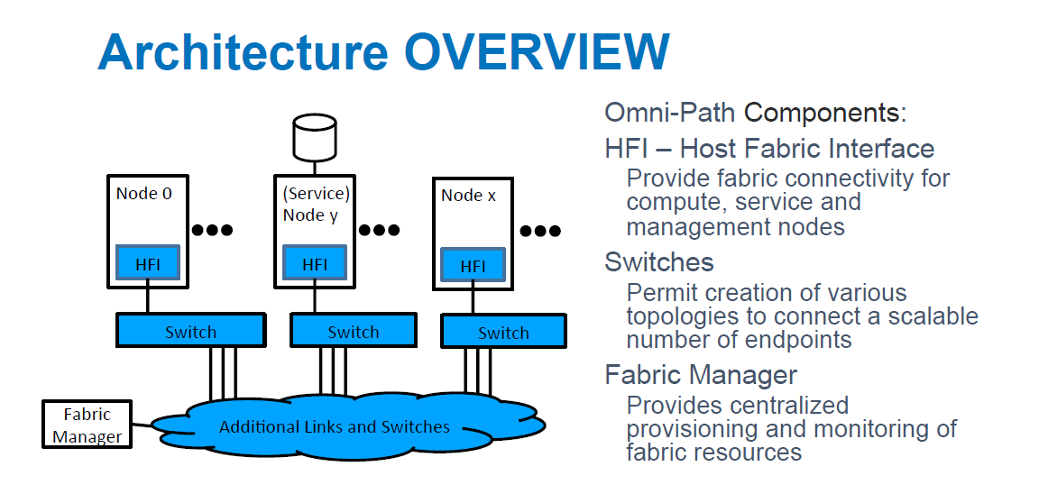
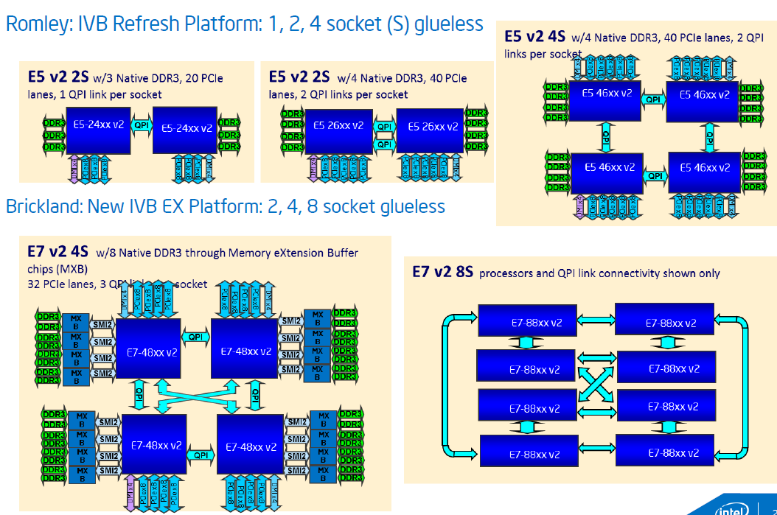
1. Functional classification of interconnects (2)
Functional classification of interconnects
Functional classification of interconnects
Intra-processor
interconnects
Inter-processor
interconnects
Cluster
interconnects
Interconnects the functional
units of a processor
Interconnects processors
within a server
(e.g. DP/MP servers) [2]
Interconnects nodes
(e.g. 2P/4P servers) of a processor cluster [3]
GPU
M
P
Disp
.
Per./
IO

Slide 5
1. Functional classification of interconnects (3)
Intra-processor interconnects
Intra-processor interconnects
Off-die intra-processor interconnects
On-die intra-processor interconnects
Used to interconnect
functional units of a processor off-die
Used to interconnect
functional units of a processor on-die
P
CC
--
A
--
IO
GPU
NB
M
Ring bus
Per./IO
SB
Per./IO
Per./IO
MC
---
Per.
CC: Core Cluster
MC: Memory Controller

Slide 6
1. Functional classification of interconnects (4)
Off-die intra-processor interconnects
Off-die intra-processor interconnects (discussed)
Bus-based
off-die interconnects
(in the 1980’/1990’s)
Chipset-based
off-die interconnects
(since about 2000)
Transactions on a shared bus.
.
Transactions on a set of dedicated links.
Multiple transactions at a time.
8088/286/386
P
Processor
KBD
Memory/
Main memory
GPU
NB
M
Bus controller
(DRAM/FPM)
ISA
Per./IO
SB
Per./IO
Monitor
WD
FD
PP
SP
Multi-I/O
card
Adapter
Adapter
Adapter
Adapter
Adapter
Per./IO
I/O devices
E.g. Intel’s Pentium 4 or early Core 2-based platforms (2000/2006)
E.g. Intel’s early desktop platforms (since 1981)

Slide 7
1. Functional classification of interconnects (5)
On-die intra-processor interconnects -1
On-die intra-processor interconnects
Shared bus
based interconnects
Crossbar-based
interconnects
Higher
performance
for higher nc
Core
--
GPU
P
---
GPU
Bus
Crossbar
M
---
Per./IO
M
--
Per.
Examples
Intel
Nehalem (CC, on QPI, 2008)
ARM
AHB based SoCs
(non CC, ~2001) [8]
PL-300 interconnect
(non CC, on AXI3, 2004)
through the CCI 550 interconnect
(CC, on ACE, 2015)
CC: Cache Coherent

Slide 8
1. Functional classification of interconnects (6)
On-die interconnects -2
Topology of on-die interconnects
Ring bus-based
interconnect topology
2D mesh-based
interconnect topology
Less cost
for higher nc
Shorter
access time
for higher nc
CC
--
A
--
IO
R
R
R
R
R
R
CC
CC
A
A
IO
IO
R
R
R
R
R
R
CC
CC
A
A
IO
IO
Ring
R
R
R
R
R
R
CC
CC
A
A
IO
IO
R
R
R
R
R
R
MC
MC
MC
P
P
P
MC
---
Per.
R
R
R
R
R
R
MC
MC
MC
P
P
P
CC: Core Cluster
A: Accelerator (e.g. GPU, NPU)
nc: Core count
Examples
Intel
Sandy Bridge (CC, on QPI, 2011)
Skylake-SP for servers
(CC, UPI, 2017)
Knights Landing for AI, (2016)
ARM
CCN-5xx interconnect for servers
(CC, on CHI, 2012)
CMN-6xx Interconnect for servers
(CC, on CHI, 2017)
*

Slide 9
2. Intra-processor interconnects
2.1 Overview of intra-processor interconnects
2.2 Off-die intra-processor interconnects
2.3 On-die intra-processor interconnects
2.4 Use of both off-die and on-die interconnects

Slide 10
2.1 Overview of intra-processor interconnects

Slide 11
2.1 Overview of intra-processor interconnects (1)
2.1 Overview of intra-processor interconnects -1
Main types of system interconnects
Intra-processor
interconnects
Inter-processor
interconnects
Cluster
interconnects
Interconnects the functional
units of a processor
Interconnects processors
within a server
(e.g. DP/MP servers) [2]
Interconnects nodes
(e.g. 2P/4P servers) of a processor cluster [3]
GPU
M
P
Disp
.
Per./
IO

Slide 12
2.1 Overview of intra-processor interconnects (2)
Overview of intra-processor interconnects -2
They provide the links required within a single processor platform, as indicated in the
Figure below.
GPU
M
P
Disp.
Per./
IO
Figure: The intra-processor interconnect provides the necessary links
within a single processor platform
Note
In case of multicores the intra-processor interconnect needs to provide
interconnections between the cores or core clusters (if core clusters are used).

Slide 13
2.1 Overview of intra-processor interconnects (3)
Design aspects affecting the implementation of the intra-processor
interconnect in multicore processors
a) Use of individual CPU cores or CPU core clusters (CC) in multicore processors
b) Support of cache coherency (this aspect will not be discussed)
c) Implementing intra-processor interconnects off-die, on-die or even both
off-die and on-die
Design aspects affecting the implementation of the intra-processor
interconnect in multicore processors
Use of individual CPU cores
or CPU core clusters (CC)
in multicore processors
Support of cache coherency
Implementing intra-processor interconnects off-die, on-die or even both off-die and on-die
Not discussed

Slide 14
2.1 Overview of intra-processor interconnects (4)
Use of individual CPU cores or CPU core clusters (CC) in multicore
processors
Use of individual CPU cores or CPU core clusters (CC) in multicore processors
Use of single CPU cores
Use of CPU core clusters (CC)
Single-level interconnects
for the CPU cores
Single or two-level interconnects
for the CPU cores

Slide 15
2.1 Overview of intra-processor interconnects (5)
Use of single CPU cores or CPU core clusters in multicore processors
Use of single CPU cores or CPU core clusters in multicore processors
Use of single CPU cores
Use of CPU core clusters
Use of core clusters
of 2 CPU cores
Use of core clusters
of 4 CPU cores
Use of core clusters
of 8 CPU cores
ARM
ARM11 MPCore (2004)
ARM Cortex-A9 MPCore
as an option (2007)
ARMv7 based processors
as an option (2009-2014)
ARMv8.0 based processors
as default (2012-2016)
ARMv8.2 based processors
as default (2017)
Intel
Intel’s typical choice
in multicores except
those indicated here
(2006-)
Intel’s “modules” in
Silvermont and next cores based
Atom processors (2013- 2016)
Intel “tiles” in Silvermont
core based Knights Landing
processors (2015)
AMD
AMD’s Families 08h,
10h/11h/12h/14h/16h
(2003-2015)
AMD’s “compute modules”
in the Family 15h (Bulldozer)
line (2011-2015)
AMD’s CCX modules
in Zen processors (2017-)
IBM
IBM POWER 4 to 8
(2001-2014)
IBM’s “SMT4/8 core” in the
POWER9 (2017)

Slide 16
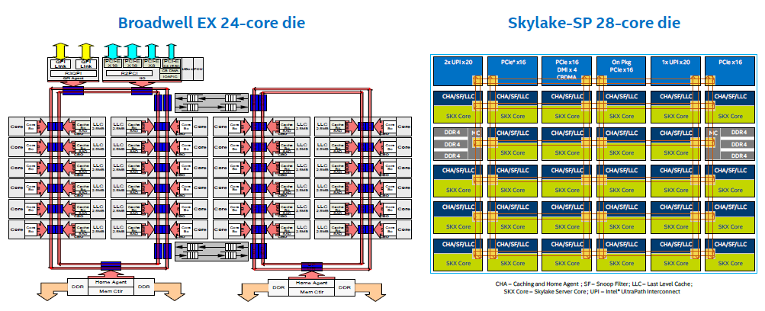
2.1 Overview of intra-processor interconnects (6)
Example 1: Use of single CPU cores in Intel’s Core 2 family [25]

Slide 17
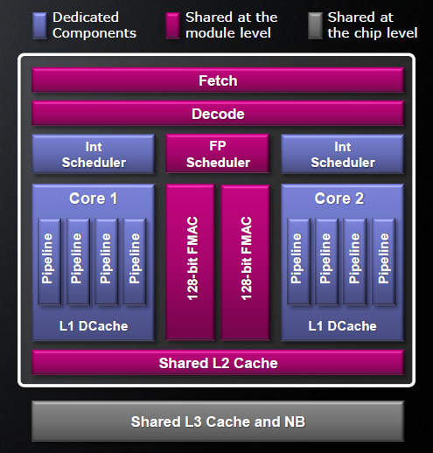
2.1 Overview of intra-processor interconnects (7)
Example 2: Use of core clusters of dual CPU cores (called modules)
in AMD’s Bulldozer line (from 2011 on) [26]
The Bulldozer “module” does not have two entire cores, it has dedicated FX
components to each core but also shared components for both cores, as seen in the
Figure below.
Figure: The 2-core Bulldozer “module” with dedicated and shared components [26]

Slide 18
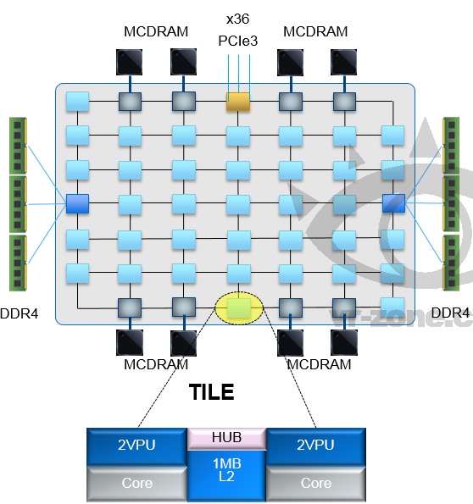
3.1 Overview of intra-processor interconnects (8)
Example 3: Use of core clusters of 2 CPU cores (called tiles)
in Intel’s 72-core Knights Landing processor (2015) [27]
Up to 72 Silvermont (Atom) cores
4 threads/core
2 512 bit Vector Processing Units (VPU)
2D mesh architecture
6 channels DDR4-2400,
up to 384 GB,
8/16 GB high bandwidth on-package
MCDRAM memory, >500 GB/s
36 lanes PCIe 3.0
200 W TDP
Note that the communication Hub and the 1 MB L2
are shared by both cores

Slide 19
2.1 Overview of intra-processor interconnects (9)
Example 4: Use of core clusters of 4 cores in ARM’s ARM11 Mpcore
and Cortex-A MPCore processors (from 2004 on)
Early Core Cluster
Advanced Core Cluster
CPU
core
L1 I/D
CPU
core
L1 I/D
CPU
core
L1 I/D
CPU
core
L1 I/D
CPU
core
L1 I/D
CPU
core
L1 I/D
CPU
core
L1 I/D
CPU
core
L1 I/D
SCU
L2 $ with SCU
To the interconnect
To the interconnect
ARM11 MPCore (2004)
Cortex-A7/A8/A9/A7 MPCore
(L2 $ optional)
(2005-2011)
Cortex-A15/A17 MPCore
(L2 $ mandatory)
(2010/2014)
all ARMv8.0 models
(L2 $ mandatory)
(2012-2016)
SCU: Snoop Control Unit

Slide 20
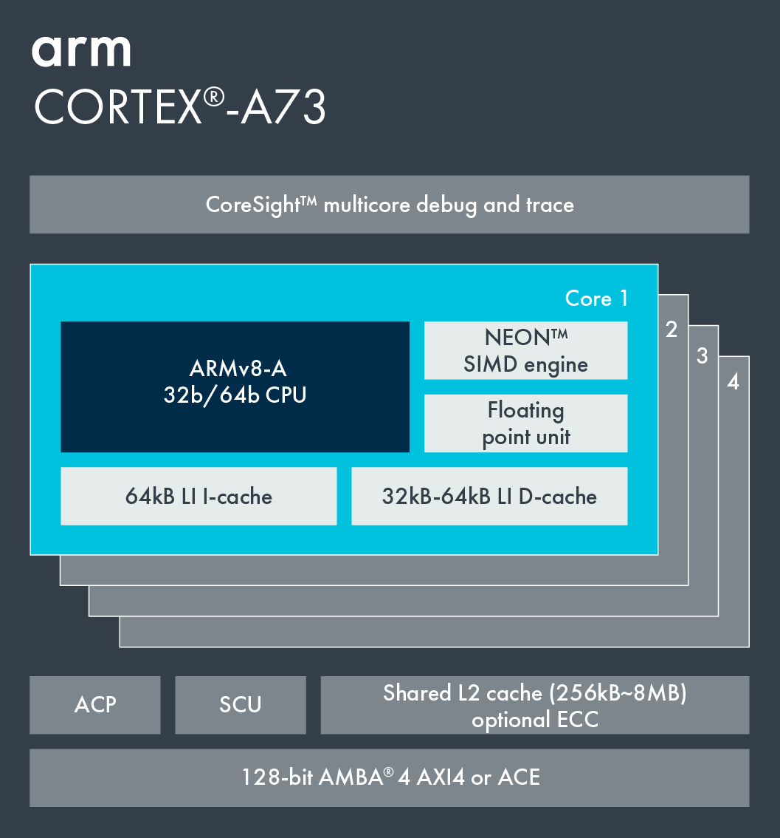
2.1 Overview of intra-processor interconnects (10)
The ARM Cortex-A73 core cluster of up to 4 cores (2015) [28]
Cortex-A73 core
ARMv8.0 CPU
Shared units
ACP: Accelerator Coherency Port (an AXI 64-bit slave port which
can be connected to a DMA engine or a non-cached
coherent master (Source: ARM).
SCU: Snoop Control Unit
AMBA 4 AXI4/ACE: Interface

Slide 21
2.1 Overview of intra-processor interconnects (11)
Note
ARM’s core clusters will be included (one or more) into the application processors
of smartphones or tablets.

Slide 22
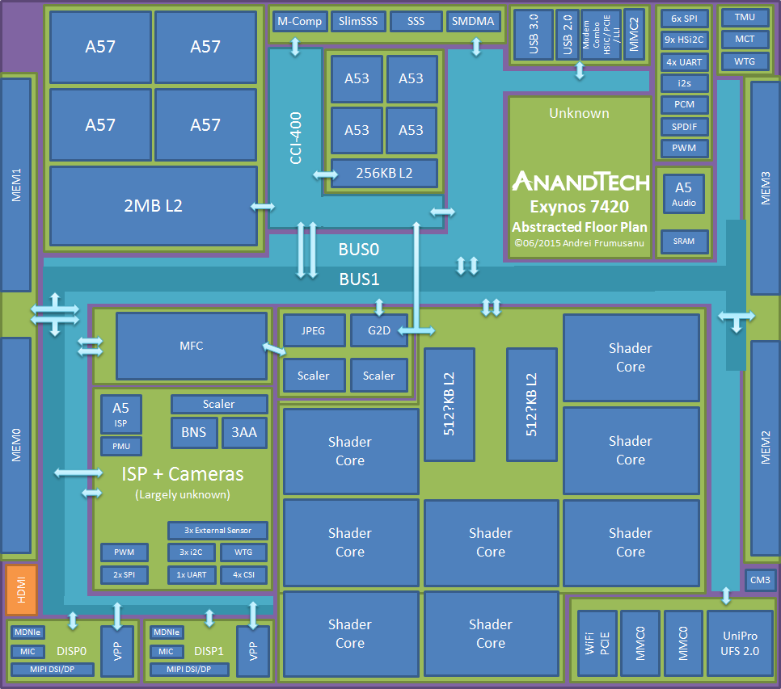
2.1 Overview of intra-processor interconnects (12)
Example for including two core clusters into an application processor
(Samsung's Exynos 7 Octa 7420 processor with two ARM core clusters) [29]
2x
16 bit
2x
16 bit

Slide 23
2.1 Overview of intra-processor interconnects (13)
Example 5: ARM’s DynamIQ Core Cluster of up to 8 cores (2017)
Early Core Cluster
(Up to 4 cores)
Advanced Core Cluster
(Up to 4 cores)
DynamIQ Core Cluster
(Up to 8 cores)
CPU
core
L1 I/D
CPU
core
L1 I/D
CPU
core
L1 I/D
CPU
core
L1 I/D
CPU
core
L1 I/D
CPU
core
L1 I/D
CPU
core
L1 I/D
CPU
core
L1 I/D
CPU1
core
L1 I/D
L2 $
CPU1
core
L1 I/D
L2 $
CPU2
core
L1 I/D
L2 $
CPU2
core
L1 I/D
L2 $
..
..
SCU
L2 $ with SCU
L3 $ with SCU
To the interconnect
To the interconnect
To the interconnect
ARM11 MPCore (2004)
Cortex-A7/A8/A9/A7 MPCore
(L2 $ optional)
(2005/2007/2011)
Cortex-A15/A17 MPCore
(L2 $ mandatory)
(2010/2014)
all ARMv8.0 models
(L2 $ mandatory)
(2012-2016)
Cortex-A55/7A5/A76
(2017/2017/2018)

Slide 24
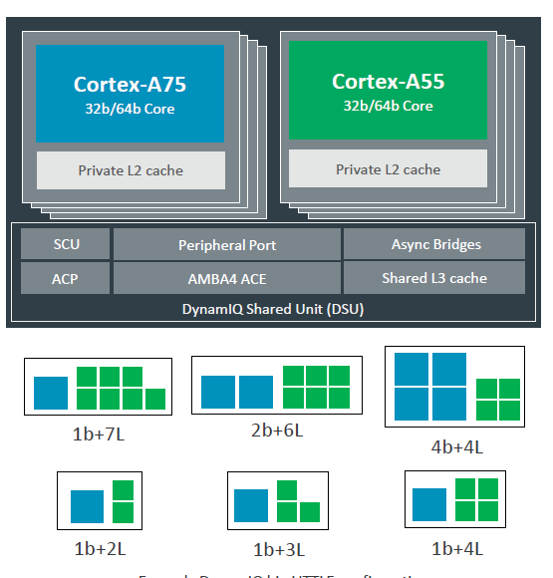
2.1 Overview of intra-processor interconnects (14)
Contrasting the 8-core DynamIQ Core Cluster vs.the previous 4-core cluster
big.LITTLE Core Cluster (2015) [28]
DynamIQ Core Cluster (2017) [30]
Cortex-A73 core
ARMv8.0 CPU
ARMv8.0 support, e.g. Cortex-A53/
A57/A72/A73, up to 4 cores/cluster
Shared L2 cache
ARMv8.2 support, (Cortex-A55/75/76)
2 CPU types, up to 8 cores but up to 4 b core/cluster
Private L2 caches, shared L3 cache
*

Slide 25
2.1 Overview of intra-processor interconnects (15)
b) Support of cache coherency in intra-processor interconnects
Support of cache coherency in intra-processor interconnects
Non cache-coherent
interconnects
Cache coherent
interconnects
Early interconnects
All recent interconnects
Note that all recent interconnects support cache coherency.
Maintaining cache coherency is however a complex issue of its own and it
will not be discussed in this Chapter.

Slide 26
2.1 Overview of intra-processor interconnects (16)
c) Implementing intra-processor interconnects off-die, on-die or even
partly off-die and partly on-die
Off-die or on-die intra-processor interconnects
Off-die interconnects
On-die interconnects
Used to interconnect
functional units of a processor off-die
Used to interconnect
functional units of a processor on-die
P
CC
--
A
--
IO
GPU
NB
M
Ring bus
Per./IO
SB
Per./IO
Per./IO
MC
---
Per.
CC: Core Cluster
MC: Memory Controller

Slide 27
2.1 Overview of intra-processor interconnects (17)
Note
There is also feasible to use partially off-die and partially on-die interconnects.
In this case, e.g. cores, the GPU and L3 cache segments are interconnected in
the processor on-die whereas other agents, like I/O off-die, as discussed in
Section 2.3.4.

Slide 28
2.2 Off-die intra-processor interconnects
2.2.1 Overview
2.2.2 Bus-based off-die interconnects
2.2.3 Chipset-based off-die interconnects

Slide 29
2.2.1 Overview

Slide 30
2.2.1 Overview (1)
2.2.1 Overview
Off-die intra-processor interconnects (discussed)
Bus-based
off-die interconnects
(in the 1980’/1990’s)
Chipset-based
off-die interconnects
(since about 2000)
Transactions on a shared bus.
.
Transactions on a set of dedicated links.
Multiple transactions at a time.
8088/286/386
P
Processor
KBD
Memory/
Main memory
GPU
NB
M
Bus controller
(DRAM/FPM)
ISA
Per./IO
SB
Per./IO
Monitor
WD
FD
PP
SP
Multi-I/O
card
Adapter
Adapter
Adapter
Adapter
Adapter
Per./IO
I/O devices
E.g. Intel’s Pentium 4 or early Core 2-based platforms (2000/2006)
E.g. Intel’s early desktop platforms (since 1981)

Slide 31
2.2.2 Bus-based off-die interconnects

Slide 32
2.2.2 Bus-based off-die interconnects (1)
2.2.2 Bus-based off-die interconnects
They are the most straightforward type of interconnects.
They provide transactions on a shared bus.
In early implementations bus based interconnects allowed only single
transactions at a time, advanced implementations allow also overlapped
transactions by introducing split transfers.
Bus-based interconnects were used
in early desktop platforms (in the 1980‘s and 1990’s) and also
as on-die interconnects in early smartphones and tablets (in the second half
of the 1990’s),
as indicated next.

Slide 33
2.2.2 Bus-based off-die interconnects (2)
Bus-based off-die interconnects -1
They were the first type of interconnects used, as indicated in the next Figure.
Topology of Intel’s desktop interconnects
ISA bus-based
PCI bus-based
Hub-based
Simple
w/ATA,
USB
w/AGP,
ATA,USB
Early
implem.
Next
implem.
8088/80286/
80386-
based PCs
486 and early
Pentium
based PCs
Mature
Pentium
based PCs
Early PII
and PIII
based PCs
Mature
PIII/P4
based PCs
P4 Prescott
based PCs
Intel 420
chipsets
Mature
Intel 430
chipsets
Intel 440XX
chipsets
Intel 8xx
chipsets
Intel 915xx
chipsets
Evolution

Slide 34
2.2.2 Bus-based off-die interconnects (3)
Example: ISA bus-based platform topology
8088/80286/80386
Processor
KBD
Memory/
Main memory
Bus controller
(DRAM/FPM)
ISA
Monitor
WD
FD
PP
SP
Multi-I/O card
Adapter
Adapter
Adapter
Adapter
Adapter
I/O devices
ISA: Industry Standard Association
Used typically in 8088/80286/80386-based PCs (since 1981 in IBM PCs)

Slide 35
2.2.2 Bus-based off-die interconnects (4)
Historical remark: Evolution of bus based interconnects to hub-based interconnects
in Intel’s desktop platforms
ISA bus-based platforms evolved to hub based platforms in a few steps while
the 8/16 bit wide ISA bus was substituted by the higher performance 32 bit
PCI bus,
PCI bus based chipsets emerged and
step by step more and more I/O devices became attached to the chipset
components rather than to the PCI bus, in other words the chipset took
step by step over the role of the PCI bus.
Intel pursued this evolution by introducing and enhancing their 4xx chipset
family and then replacing their PCI bus-based 4xx chipset family by the
already hub based 8xx chipset family.
In this respect the 4xx chipset family can be considered as a forrunner of the
recent hub-based chipsets.
In connection with this move Intel also renamed the System controller of their
early platforms to MCH (Memory Controller Hub, dubbed also as the North
Bridge) and the I/O Controller to IOH (I/O Controller Hub, named also as the
South Bridge).
The subsequent series of Figures indicates main steps of this evolution.
Note that the word hub originally means the central part of a wheel or in figurative
sense the central part of something.

Slide 36
2.2.2 Bus-based off-die interconnects (5)
a) Early PCI bus-based platform with Intel 420 chipset
486
Processor bus
82425EX
L2 cache
System
Main memory
controller
(FPM/EDO)
PCI bus
82426EX
Peripheral
PCI device
controller
adapter
ISA bus
ISA device
(Legacy and/or
adapter
slow devices)
Used typically in 486 and early Pentium-based PCs along with Intel 420 and early 430 chipsets (1989)

Slide 37
2.2.2 Bus-based off-die interconnects (6)
PCI-based platform with IDE/ATA and USB ports with Intel’s 430 chipsets
Pentium
Processor bus
82430
L2 cache
System
Main memory
controller
(FPM/EDO/SDRAM)
PCI bus
PIIX
PIIX: PCI ISA IDE XCELERATOR
IDE/(ATA/33)
IDE port: First on the 430FX (Triton, 1995)
ATA/33: First on the 430TX (1997)
USB: First on the 430VX (Triton III, 1996)
Peripheral
PCI device
USB
controller
adapter
ISA bus
ISA device
(Legacy and/or
adapter
slow devices)
Used typically in mature Pentium-based PCs with mature Intel 430 chipsets (~1995)

Slide 38
2.2.2 Bus-based off-die interconnects (7)
c) PCI-based platform with AGP, IDE/ATA and USB ports and Intel’s 440
chipset
Pentium II/
Pentium II has an in-package integrated L2,
Pentium III has on-die integrated L2
Pentium III
Processor bus
82440
AGP
System
Main memory
controller
(EDO/SDRAM)
PCI bus
PIIX4
2xIDE/ATA33/66
PCI device
(Legacy and/or
Peripheral
adapter
slow devices)
controller
2xUSB
ISA bus
ISA device
adapter
Used typically in Pentium II and early Pentium III-based PCs with Intel 440xx chipsets (~1998/1999)

Slide 39
2.2.2 Bus-based off-die interconnects (8)
d) Early hub-based platform with Intel’s 845 chipset
Pentium 4
(Willamette)
Processor bus
System controller renamed to
MCH (Memory Controller Hub)
(called also as North Bridge)
82845
AGP
MCH
Main memory
(DDR/DDR2
Peripheral Controller to
ICH (I/O Controller Hub)
(called also as South Bridge)
Hub interface
ICH2-5
2xIDE/
LPC
Used typically in Pentium 4-based systems with Intel 845 chipsets (~2000)
ATA 33/66/100
Super I/O (KBD, MS, FD, SP, PP, IR)
ICH
AC'97
2x/4x USB
PCI bus
PCI to ISA
PCI device
bridge
adapter
ISA bus
ISA device
(Legacy and/or
adapter
slow devices)

Slide 40
2.2.2 Bus-based off-die interconnects (9)
e) Advanced hub-based system architecture with Intel 915xx chipset and
replacing the parallel PCI bus by the serial PCIe bus
Pentium 4
(Prescott)
Processor bus
829xx
PCI E.x16
MCH
Main memory
(DDR/DDR2)
Hub interface
ICH6/7
Used typically in Pentium 4 (Prescott)-based platforms with Intel’s 9xx chipsets (2004)
1xIDE/
PCI E.x1 (1x/2x)
ATA 33/66/100
8x USB
LAN 10/100
IOH
LPC (KBD, MS, FD, SP, PP, IR)
AC'97
4x SATA
HDAI
PCI bus
PCI device
adapter

Slide 41
2.2.2 Bus-based off-die interconnects (10)
Chipset-based off-die interconnects -1
Chipsets provide a set of dedicated point-to-point interconnections.
They allow multiple transactions at a time on different point-to-point paths.

Slide 42
2.2.3 Chipset-based off-die interconnects

Slide 43
2.2.3 Chipset-based off-die interconnects (1)
2.2.3 Chipset-based off-die interconnects
Example of a chipset-based interconnect
(actually of a Core 2 based desktop interconnect providing integrated graphics)
P
Core 2 (2006)
Discrete
graphics
dGPU
PCIe
or
NB
w/GPU
M
Integrated
graphics
Displ.
Per./
IO.
SB
Per./
IO
--
Per./
IO
--
Figure: Chipset-based off-die interconnect

Slide 44
2.2.3 Chipset-based off-die interconnects (2)
Chipset-based off-die interconnects -2
Chipsets are parts of platforms.
Historically, a number of platform categories evolved.
Recently, the most important platform categories are as follows:
Recent most important platform categories
Servers
HEDs
Desktops
Notebooks
Tablets
Smartphones
Further on, typically in each chipset category dominant processor firms have
their specific chipset families, e.g. for the desktop category recently Intel has
its Core 2 based desktop chipset family.
Notable exceptions are recent tablet- and smartphone platforms since these
platforms are usually built around SoC processors and do not need chipsets.
As far as server/HED/desktop and notebook processor families are concerned
recently Intel’s and AMD’s related families dominate the market.

Slide 45
2.2.3 Chipset-based off-die interconnects (3)
Chipset-based off-die interconnects -3
While discussing chipset based interconnects we will focus on a single example,
that is on Intel’s Core 2-based desktop platforms, further on we will consider
the platform option that supports integrated graphics.
It is worth discussing the evolution path of this desktop chipset family.
In order to simplify our discussion, however we will focus on the evolution
of the platform topology and do not take into account further issues, like
memory type, memory transfer rate, PCIe type etc.

Slide 46
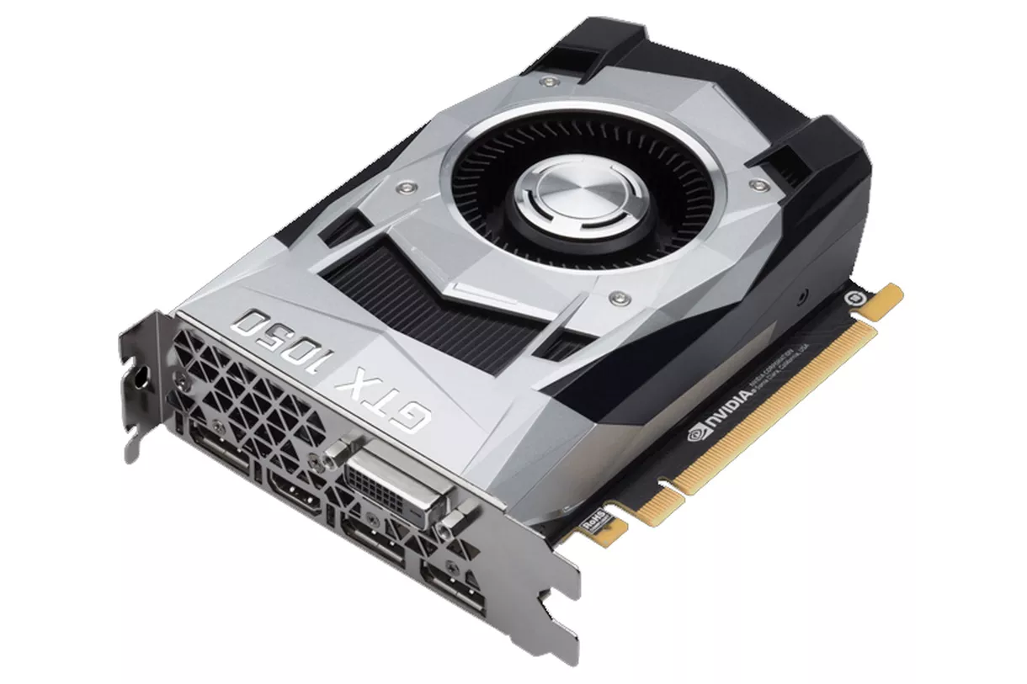
2.2.3 Chipset-based off-die interconnects (4)
Evolution of the topology of Intel’s Core 2-based desktop platforms with
integrated graphics (strongly simplified) -1
Preminilary note
Graphics cards (dGPU) provide display output, as seen e.g. below.
Figure: Example graphics card with 16xPCIe 3.0 input and DP, HDMI, DVI
display outputs (actually NVIDIA’s GTX1050) [31]

Slide 47
2.2.3 Chipset-based off-die interconnects (5)
Evolution of the topology of Intel’s Core 2-based desktop platforms
with integrated graphics -1
P
P
M
Discrete
graphics
dGPU
PCIe
NB
wGPU
M
dGPU
PCIe
NB
or
Integrated
graphics
Displ.
Per./
IO.
SB
Per./
IO
Per./
IO.
SB
Per./
IO
--
Per./
IO
--
--
Per./
IO
--
Initial Core-2 based desktop platform.
Memory Controller placed on-die.
Examples
Nehalem 1. gen. (2008)
6-core Westmere (Golfstown) (2010)
Core 2 (2006)
Penryn (2007)
(Specific NB models support integrated graphics
like the one seen above)
(As an exception no NB model supports
integrated graphics)

Slide 48
2.2.3 Chipset-based off-die interconnects (6)
Evolution of the topology of Intel’s Core 2-based desktop platforms
with integrated graphics -2
dGPU
PCIe
P
M
dGPU
PCIe
P
GPU
M
FDI
(not used)
DMI
FDI
DMI
Displ.
PCH
w/GPU
Per./
IO
Displ.
PCH
Per./
IO
--
Per./
IO
--
--
Per./
IO
--
PCIe interconnection placed on-die.
An extra link (FDI) is provided (but not needed)
as a preparation for (in P) integrated graphics
(In-package or on-die) integrated graphics,
FDI interconnection needed between display and GPU.
Examples
2. gen. Nehalem (Lynnfield) (2009)
2-core Westmere (Arrandale)
(with in-package integrated graphics
and a PCH model supporting integrated graphics) (2010)
Sandy Bridge (with on-die integrated graphics and
most PCH models supporting integrated graphics) (2011)
Ivy Bridge with on-die integrated graphics and
all PCH models supporting integrated graphics (2012)
FDI: Flexible Display Interface
DMI: Direct Media Interface (4x PCIe 2.0)
PCH: Periphery Control Hub

Slide 49
2.2.3 Chipset-based off-die interconnects (7)
Evolution of the topology of Intel’s Core 2-based desktop platforms
with integrated graphics support -3
dGPU
PCIe
dGPU
PCIe
P
GPU
M
P
GPU
M
Displ.
Displ.
FDI
DMI
DMI
Per./
IO
VGA
PCH
Per./
IO
Per./
IO
PCH
Per./
IO
--
Per./
IO
--
--
Per./
IO
--
Display interconnection placed on-die.
PCH provides still VGA, this is why FDI is needed.
PCH doesn’t provide any more VGA output,
this is why no FDI interconnection path is needed.
Examples
Examples
Haswell-based desktop platform (2013)
Broadwell-based desktop platform (2015)
From Skylake-based desktop platform on (2015)

Slide 50
2.2.3 Chipset-based off-die interconnects (8)
Contrasting Intel’s recent Core 2-based desktop platforms with recent SoC
implementations of mobile platforms
dGPU
PCIe
dGPU
PCIe
P
GPU
M
P
GPU
M
Displ.
Displ.
DMI
Per./
IO
PCH
Per./
IO
--
Per./
IO
--
--
Per./
IO
--
SOC implementation (in-package integration of two dies)
for mobile platforms
Examples
From Skylake-based desktop platform on (2015)
From Haswell-based mobile platforms on (2013)

Slide 51
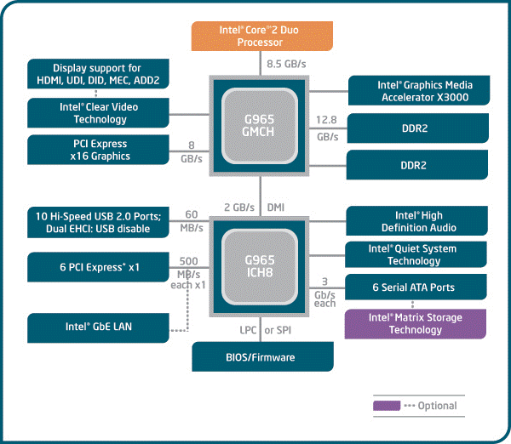
2.2.3 Chipset-based off-die interconnects (9)
Example 1: Core 2-based desktop platform with integrated graphics (2006)
[32]

Slide 52
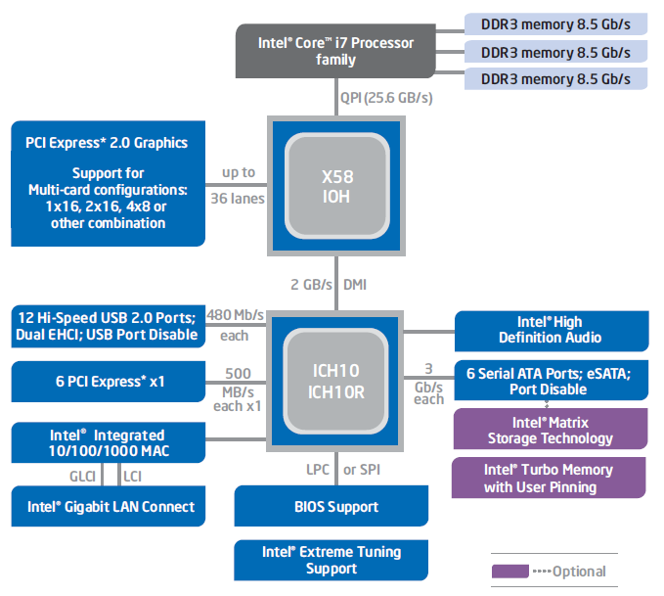
2.2.3 Chipset-based off-die interconnects (10)
Example 2: 1. generation Nehalem-based desktop platform (2008) [33]
(Bloomfield)
No support for integrated graphics
(as it targets high-end desktops with
discrete graphics).

Slide 53
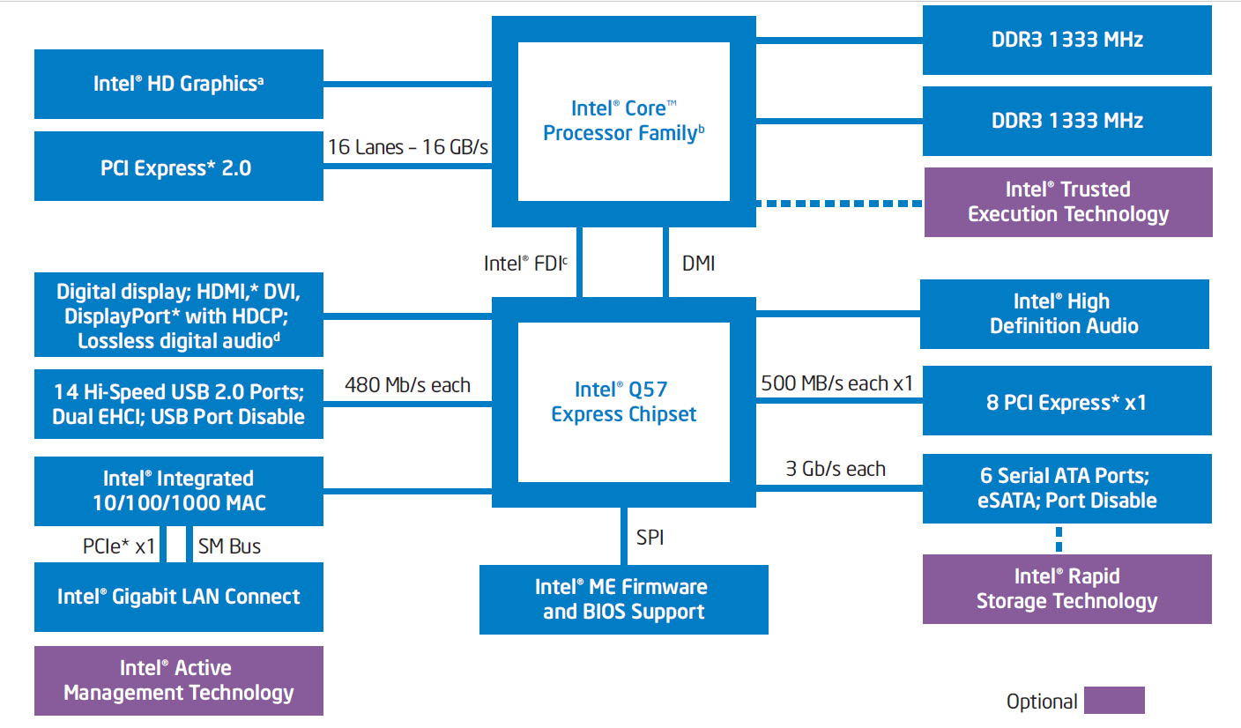
2.2.3 Chipset-based off-die interconnects (11)
Example 3: 2. gen. Nehalem-based desktop platform with integrated
graphics (2009) [34]
(Lynnfield)
(Not used)

Slide 54
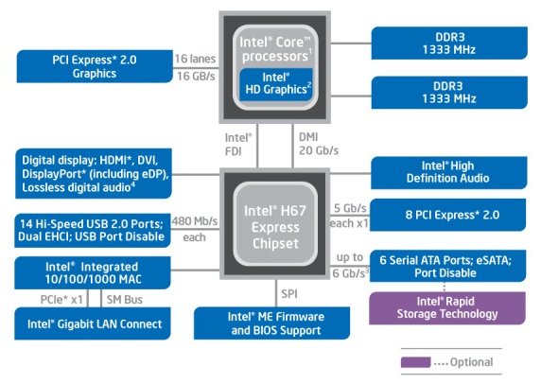
2.2.3 Chipset-based off-die interconnects (12)
Example 4: Sandy Bridge-based desktop platform with integrated graphics
(2011) [35]
FDI: Flexible Display Interface

Slide 55
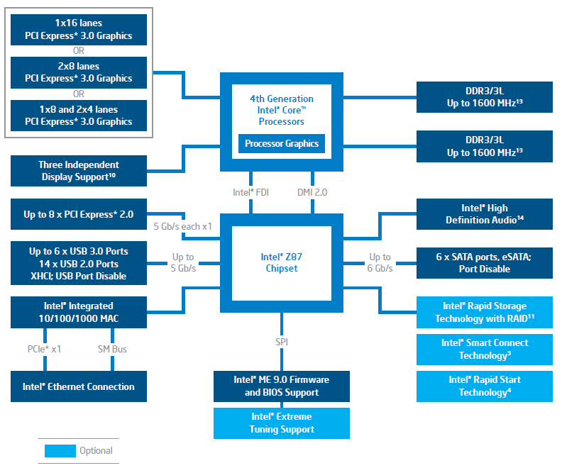
2.2.3 Chipset-based off-die interconnects (13)
Example 5: Haswell-based desktop platform with integrated graphics (2013)
[36]
VGA

Slide 56
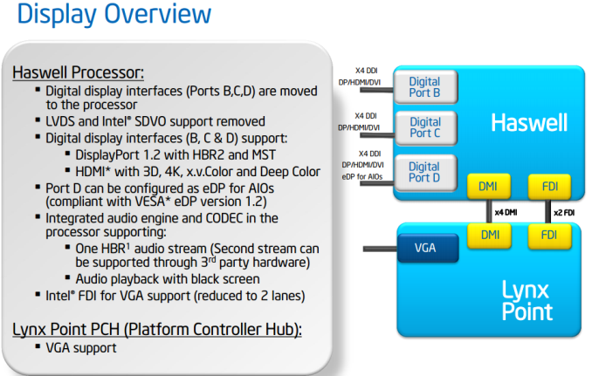
2.2.3 Chipset-based off-die interconnects (14)
Display support of Haswell-based desktop platforms [37]
Intel 8 Series
Chipset

Slide 57
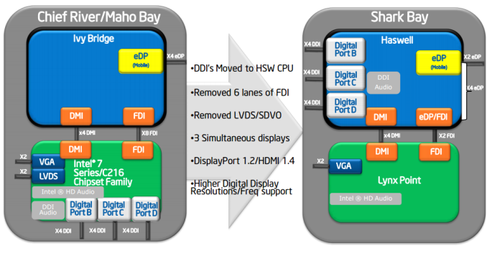
2.2.3 Chipset-based off-die interconnects (15)
Remark
Note that Series 7 PCHs already provide 3 digital display ports plus + an analog VGA
port, as seen below.
Intel 8 Series
Chipset Family
Figure: Evolution of display support in Ivy Bridge and Haswell based platforms [37]

Slide 58
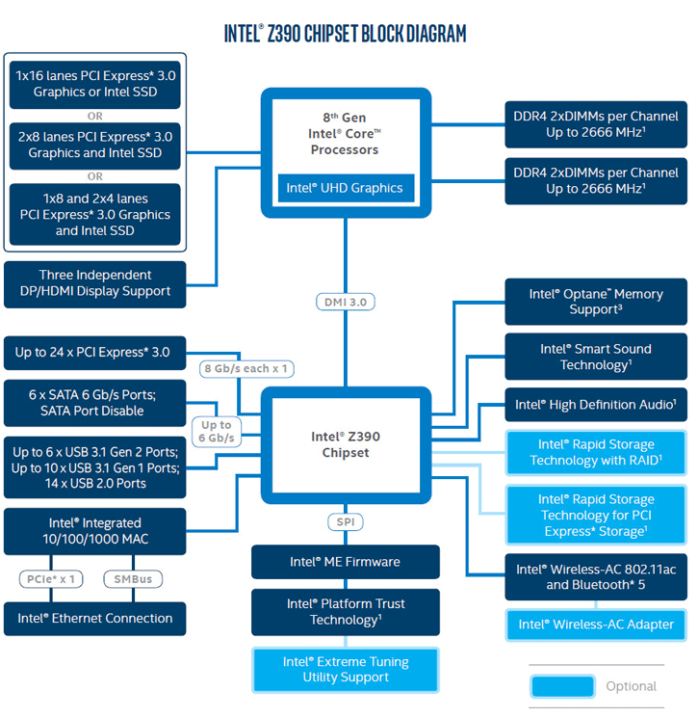
2.2.3 Chipset-based off-die interconnects (16)
Example 6: (Kaby Lake refresh/Coffee Lake/Cannon Lake)-based desktop
platform with integrated graphics [2017] [38]
No FDI
No VGA

Slide 59
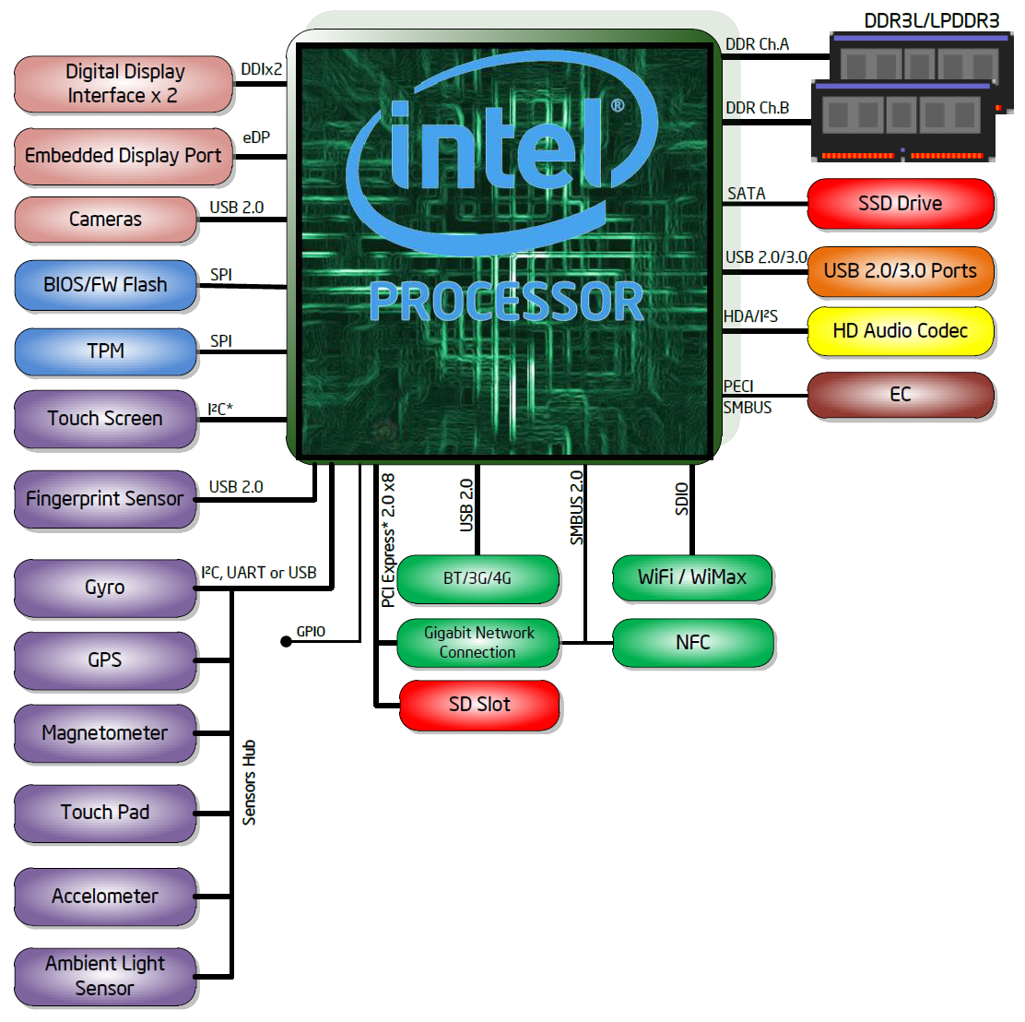
2.2.3 Chipset-based off-die interconnects (17)
Example 7: In contrast: Haswell-based notebook platform already became
SoCs (2013) [39]

Slide 60
2.3 On-die intra-processor interconnects
2.3.1 Introduction to on-die intra-processor interconnects
2.3.2 Bus-based on-die interconnects
2.3.3 Crossbar-based on-die interconnects
2.3.4 Ringbus-based on-die interconnects
2.3.5 2D mesh-based on-die interconnects

Slide 61
2.3.1 Introduction to on-die intra-processor interconnects

Slide 62
2.3.1 Introduction to on-die intra-processor interconnects (1)
2.3.1 Introduction to on-die intra-processor interconnects
On-die interconnects were proposed first by researchers of Stanford University
in 2001.
Key features of on-die intra-processor interconnects (discussed)
Single- or two level implementation
of the on-die interconnect
Topology of the
on-die interconnect
Single-level
on-die interconnects
Two-level
on-die interconnects
Used typically in processors
built up of single cores
Used typically in processors
built up of core clusters

Slide 63
2.3.1 Introduction to on-die intra-processor interconnects (2)
a) Single or-two-level implementation of the on-die interconnect
Single or two level implementation of the on-die interconnect
Used typically to build a processor or SoC
Single-level
on-die interconnects
Two-level
on-die interconnects
Examples
Intel's ring interconnect
for 4 cores or more
introduced in the
Sandy Bridge (2011)
Intels 2D-interconnect
e.g. in the 72-core
Knights Landing (2015)
ARM's interconnects

Slide 64
2.3.1 Introduction to on-die intra-processor interconnects (3)
Single level on-die inter-processor interconnects
Single- or two level implementation of the on-die interconnect
Used typically within a processor or to build a SoC
Single-level
on-die interconnects
Two-level
on-die interconnects
Examples
Intel's ring interconnect
for 4 cores or more
introduced in the
Sandy Bridge (2011)
Intels 2D-interconnect
e.g. in the 72-core
Knights Landing (2015)
ARM's interconnects
for core clusters:
for the ARM11 MP (2006) and
for the Cortex line
beginning with the
Cortex-A9 (2007)

Slide 65
2.3.1 Introduction to on-die intra-processor interconnects (4)
Example 1 for single level on-die interconnect:
Intel's ring bus for the 4 core Sandy Bridge (2011) [40]
System Agent
The ring has six bus stops for
interconnecting
four cores
four L3 slices
the GPU and
the System Agent
The four cores and the
L3 slices share the same
interfaces.

Slide 66
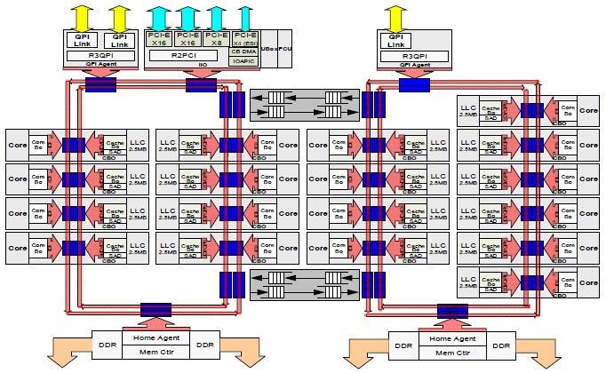
2.3.1 Introduction to on-die intra-processor interconnects (5)
Example 2 for single level on-die interconnect:
Intel's dual ring interconnect for the 18-core Haswell-EX (2015) [41]

Slide 67
2.3.1 Introduction to on-die intra-processor interconnects (6)
Example 3 for single level on-die interconnect: Intel's 2D-interconnect
in the 72-core Knights Landing (implemented in 36 tiles) (2015) [27]
Up to 72 Silvermont (Atom) cores
in 36 tiles
4 threads/core
2 512 bit vector units
2D mesh architecture
6 channels DDR4-2400,
up to 384 GB,
8/16 GB high bandwidth on-package
MCDRAM memory, >500 GB/s
36 lanes PCIe 3.0
200 W TDP

Slide 68
2.3.1 Introduction to on-die intra-processor interconnects (7)
Two-level on-die interconnects
Single- or two level implementation of the on-die interconnect
Used typically to build a processor or SoC
Single-level
on-die interconnects
Two-level
on-die interconnects
Examples
Intel's ring interconnect
for 4 cores or more
introduced in the
Sandy Bridge (2011)
Intels 2D-interconnect
e.g. in the 72-core
Knights Landing (2015)
ARM's interconnects
for core clusters (CC)
ARM's on-die interconnects are built up of two levels
the first level interconnects a cluster of cores (up to 4 cores)
the second level interconnects core clusters and other system components,
as shown subsequently.

Slide 69
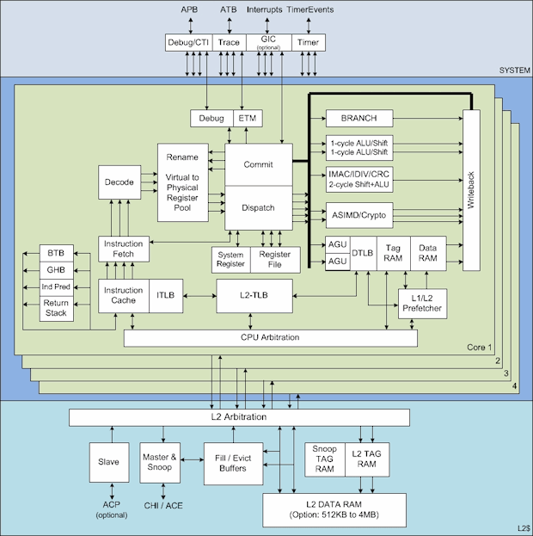
2.3.1 Introduction to on-die intra-processor interconnects (8)
Example: 1. level interconnect in ARM’s 4-core CC of Cortex-A72 (2015) [42]
APB
ATB
Interrupts
CC: Core Cluster
Source: ARM

Slide 70
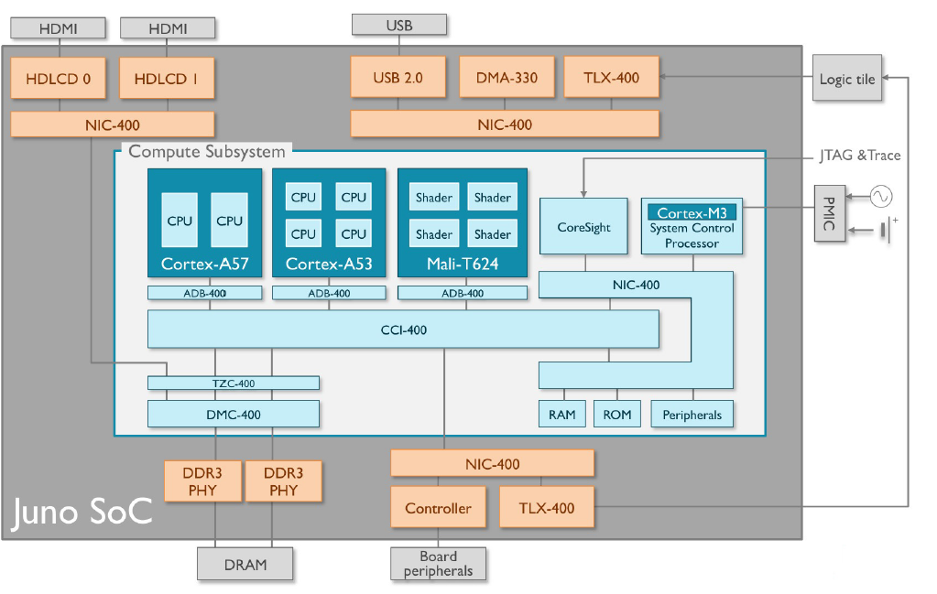
2.3.1 Introduction to on-die intra-processor interconnects (9)
ARM's 2. level interconnect in the Juno development platform [43]
CCI: Cache Coherent Interconnect

Slide 71
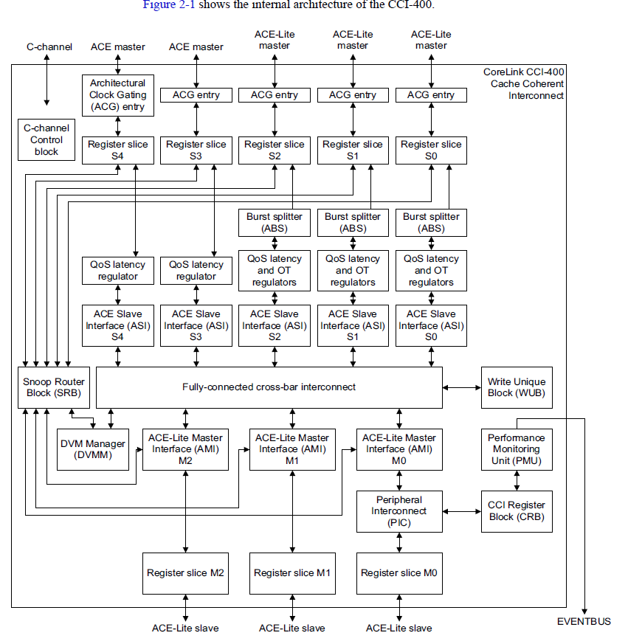
2.3.1 Introduction to on-die intra-processor interconnects (10)
Internal architecture
of the CCI-400
cache-coherent
Interconnect [44]

Slide 72
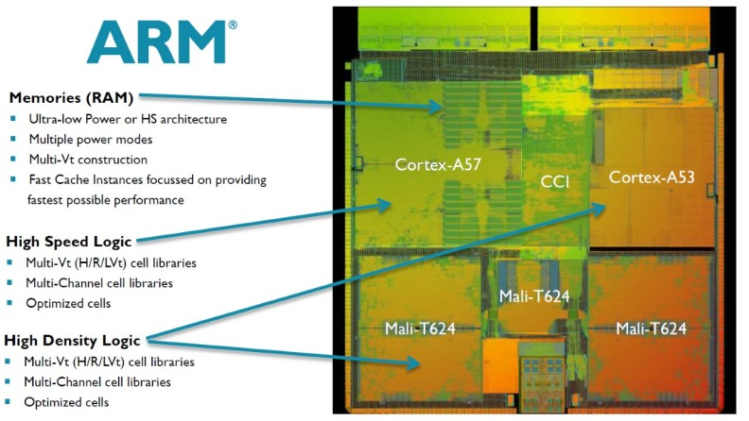
2.3.1 Introduction to on-die intra-processor interconnects (11)
On-die implementation of the CCI-400 in the ARM's Juno development platform [45]

Slide 73
2.3.1 Introduction to on-die intra-processor interconnects (12)
b) Topology of on-die interconnects
Topology of on-die interconnects
Shared bus based
Crossbar-based
Ring bus-based
2D-mesh-based

Slide 74
2.3.1 Introduction to on-die intra-processor interconnects (13)
Evolution of the topology of on-die interconnects -1
Topology of on-die interconnects
Shared bus
based interconnects
Crossbar-based
interconnects
Higher
performance
for higher nc
Core
--
GPU
P
---
GPU
Bus
Crossbar
M
---
Per./IO
M
--
Per.
Examples
Intel
Nehalem (CC, on QPI, 2008)
ARM
AHB based SoCs
(non CC, ~2001) [8]
PL-300 interconnect
(non CC, on AXI3, 2004)
through the CCI 550 interconnect
(CC, on ACE, 2015)
CC: Cache Coherent

Slide 75
2.3.1 Introduction to on-die intra-processor interconnects (14)
Evolution of the topology of on-die interconnects -2
Topology of on-die interconnects
Ring bus-based
interconnect topology
2D mesh-based
interconnect topology
Less cost
for higher nc
Shorter
access time
for higher nc
CC
--
A
--
IO
R
R
R
R
R
R
CC
CC
A
A
IO
IO
R
R
R
R
R
R
CC
CC
A
A
IO
IO
Ring
R
R
R
R
R
R
CC
CC
A
A
IO
IO
R
R
R
R
R
R
MC
MC
MC
P
P
P
MC
---
Per.
R
R
R
R
R
R
MC
MC
MC
P
P
P
CC: Core Cluster
A: Accelerator (e.g. GPU, NPU)
nc: Core count
Examples
Intel
Sandy Bridge (CC, on QPI, 2011)
Skylake-SP for servers
(CC, UPI, 2017)
Knights Landing for AI, (2016)
ARM
CCN-5xx interconnect for servers
(CC, on CHI, 2012)
CMN-6xx Interconnect for servers
(CC, on CHI, 2017)
*

Slide 76
2.3.2 Bus-based on-die interconnects

Slide 77
2.3.2 Bus-based on-die interconnects (1)
2.3.2 Bus-based on-die interconnects
They are the most straightforward type of on-die interconnects.
They provide transactions on a shared bus.
Early implementations of bus-based interconnects allowed only single
transactions at a time, more advanced implementations allow also
overlapped transactions by introducing split transfers.
Bus-based on-die interconnects were typically used
in early smartphones and tablets (in the second half of the 1990’s)
in single core devices,
as indicated next in Examples 1 and 2.
Remark
Astonishingly enough, also IBM’s more recent POWER8 server processor makes use
of a bus based on-die interconnect as a related patent shows (see Example 3).

Slide 78
2.3.2 Bus-based on-die interconnects (2)
Example 1: ARM’s AMBA1 and AMBA2 bus-based interconnect standards
(except the ML AHB bus (Multilevel AHB bus)-based interconnects)
Introduction to the AMBA interconnect open standard family [46]
The AMBA (Advanced Microcontroller Bus Architecture) standard was originally
intended to be as a bus-based interconnect standard for microcontrollers,
as its name indicates but it became the de facto standard for interconnecting
functional blocks in SOC (System-On-a-Chip) designs for smartphones and
tablets.
AMBA is a royalty-free open-standard.
It was originally published about 1996 and went through a number or major
enhancements, designated as AMBA revisions 1 to 5 (up to date), as shown
in the subsequent Figure.
Roughly speaking
AMBA’s first two revisions (AMBA1 and AMBA2) supported bus-based
interconnects,
the next two revisions (AMBA 3 and AMBA 4) crossbar-based interconnects,
whereas
the subsequent design (AMBA5) already ring bus-based interconnects,
as indicated more detailed in the next Figure.

Slide 79
2.3.2 Bus-based on-die interconnects (3)
Support of different interconnect topologies by the AMBA interconnect
standard family [47]
(1996)
(5/1999)
(6/2003)
(3/2010)
(6/2013)
Revision
AMBA1
AMBA2
AMBA3
AMBA4
AMBA5
Used in
(ARM7/9)
(ARM11,
Cortex-A9)
(Cortex-A15/A7
ARM big.LITTLE)
(Cortex
A57/A53)
Coherent
Hub Inteface
CHI
(10/2011)
AMBA Coherency
Extensions Protocol
Bus based interconnects
ACE™
ACE-Lite
Advanced
eXtensible Interface
AXI3
AXI4
Bus-based InCn
AXI4-Lite
Crossbar-based
(not CC) InCn
AMBA
High Performance Bus
AHB™
AXI4-Stream
(5/1999)
Crossbar-based
(CC InCn)
Multi-layer AHB
ML AHB
(3/2001)
Advanced System Bus
ASB™
AHB-Lite
(3/2001)
Ring-bus-based
(CC InCn)
Advanced
Peripheral Bus
APB™
APB2
APB v1.0
APB v2.0
CC: Cache Coherent
InCn: Interconnect
(9/2004)
(6/2006)
(3/2012)
Advanced
Trace Bus
ATB
ATB v1.0
ATB v2.0
≈
1995
2000
2010

Slide 80
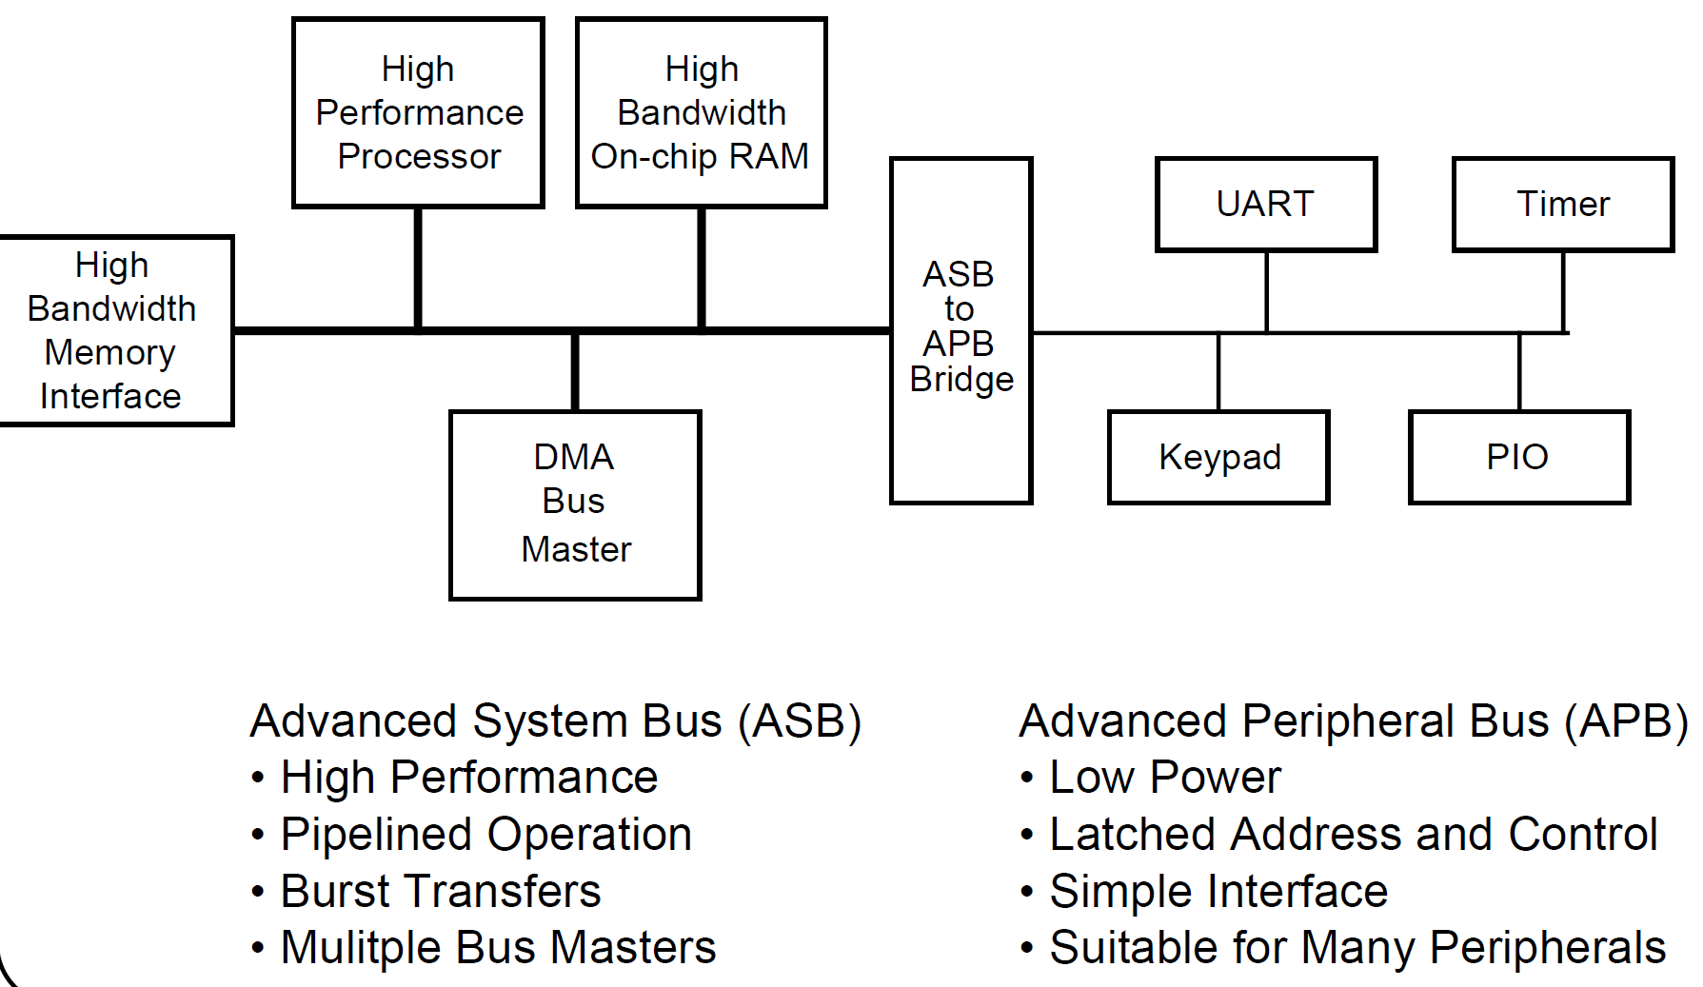
2.3.2 Bus-based on-die interconnects (4)
A typical AMBA1 system [48]
ASB
APB

Slide 81
2.3.2 Bus-based on-die interconnects (5)
Main features of the ASB bus [48]
a) The ASB bus is a high performance parallel bus, more precisely a high performance
bus IP utilizable for SOC designers.
b) Bus operation supports
multiple masters,
burst transfers and
pipelining in two stages (as bus granting and bus transfers may be performed
in parallel).
Nevertheless, there is a limitation of the ASB bus as only a single master
might be active at a time.
c) The interface signals include
mostly uni-directional lines, like the address, control or transfer response lines,
but the data lines carrying write and read data between the masters and the
slaves are bi-directional.
In addition the data line of the APB bus is also bi-directional.
d) The ASB protocol makes use of both edges of the clock signal.

Slide 82
2.3.2 Bus-based on-die interconnects (6)
The APB bus (Advanced Peripheral Bus) -1 [48]
It appears as a local secondary bus encapsulated as a single slave device,
as indicated below.
ASB
APB
Figure: A typical AMBA system [48]

Slide 83
2.3.2 Bus-based on-die interconnects (7)
Main features of the APB bus [48]
The APB bus is a simple, low-power extension to the system bus which builds on
ASB signals directly.
It does not support pipelining.

Slide 84
2.3.2 Bus-based on-die interconnects (8)
Remark
The AMBA2 standard is an enhancement of the AMBA1 in order to
increase performance, e.g. by supporting split transactions for allowing
in-parallel transfers and
allow a more straightforward implementation, e.g. by using only
uni-directional signals (also for data buses, in contrast to the ASB protocol).

Slide 85
2.3.2 Bus-based on-die interconnects (9)
The AHB bus
Main enhancements of the AHB bus vs. the ASB bus [49]
a) Spit transactions.
This allows enhanced pipelining on the bus by overlapping the address and
data phases of transactions from different bus masters.
b) Enhanced burst transactions.
c) Wider data bus options (termed as transfer size alternatives).
d) Using only uni-directional signals (also for data buses, in contrast to the ASB
protocol).
e) Using only the rising edge of the bus clock (in contrast to the ASB protocol where
both edges are used).

Slide 86
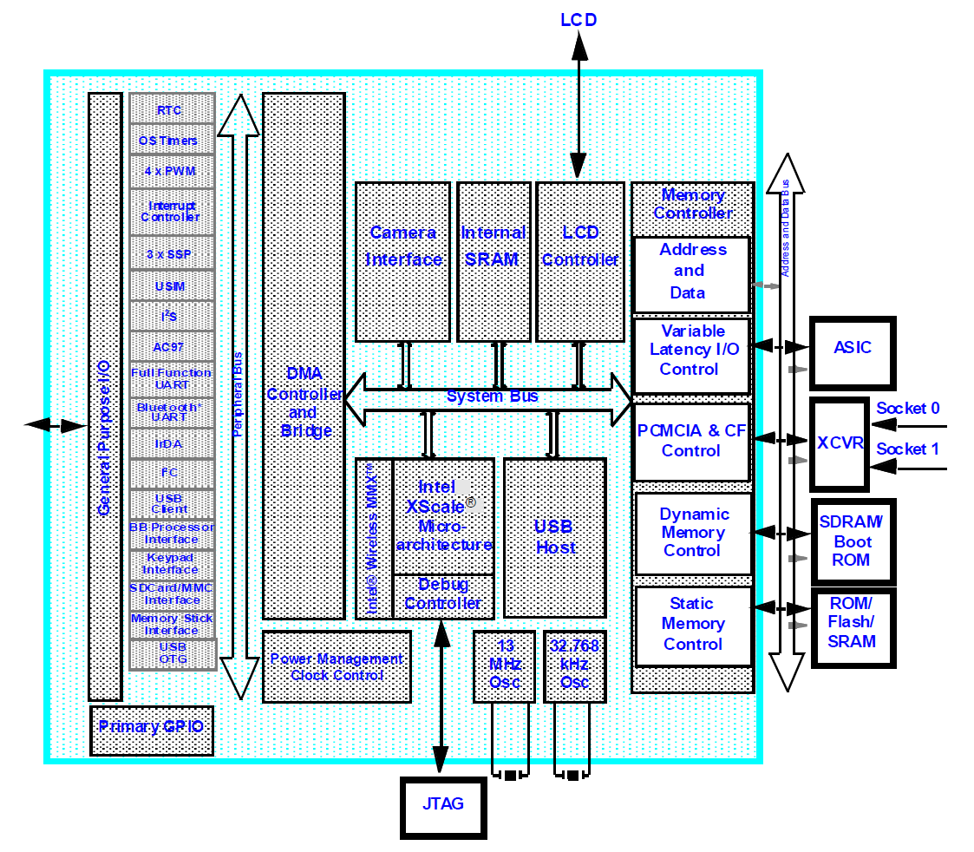
2.3.2 Bus-based on-die interconnects (10)
Example 2: Intel’s PXA27x used originally in the Blackberry Pearl 8100 [50]

Slide 87
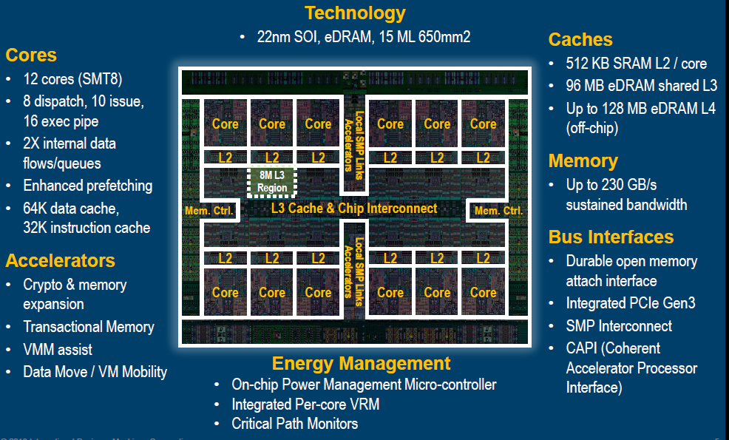
2.3.2 Bus-based on-die interconnects (11)
Example 3: IBM’s POWER8 server bus (2014) -1
The POWER8 has 12 cores arranged on the die as indicated below.
Figure: Layout of the POWER8 die [51]

Slide 88
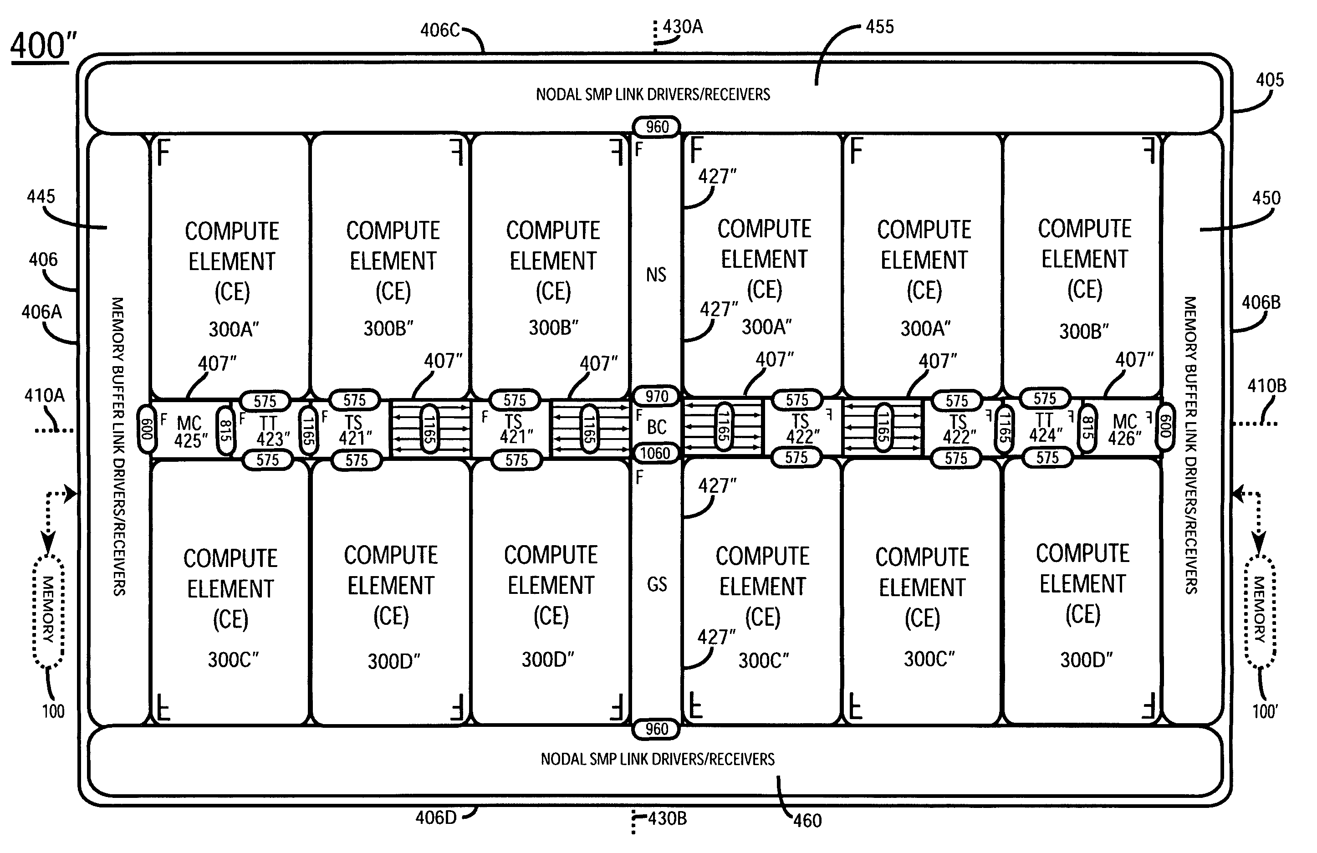
2.3.2 Bus-based on-die interconnects (12)
Example 3: IBM’s POWER8 server bus (2014) -2
In IBM’s technical documentation no details could be found about the on-die bus,
nevertheless an IBM patent [52] reveals the following details:

Slide 89
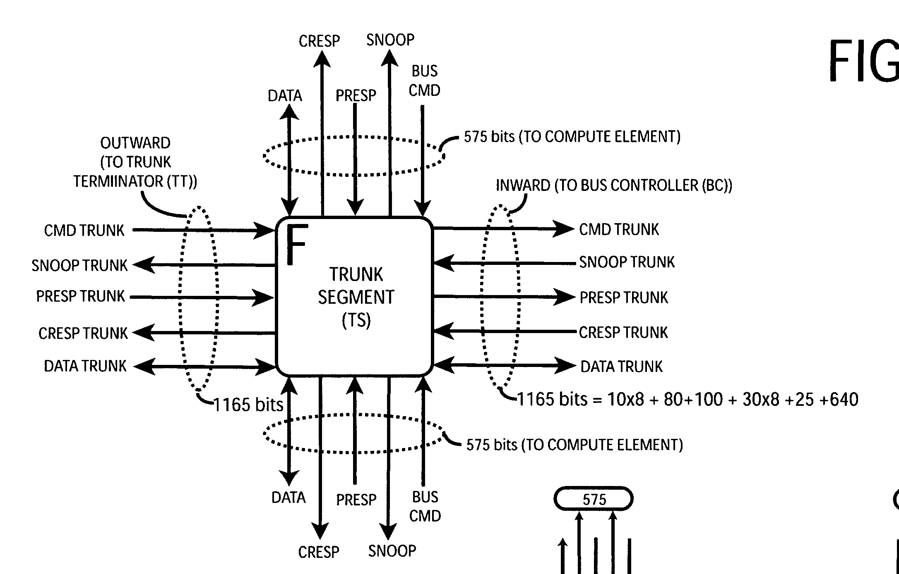
2.3.2 Bus-based on-die interconnects (13)
Example 3: IBM’s POWER8 server bus (2014) -3
According to this patent IBM made use of a complex bus consisting of trunk
segments, that acts as a path through for the signals, and interconnects
horizontally the neighboring trunk segments and
vertically the top and bottom Compute Element (core and L3 cache segment)
with a given trunk segment.
To the top Compute Element
PRESP Partial Response
CREPS Combined Response
To the bottom Compute Element
Figure: Trunk segment of the POWER8 bus [52]

Slide 90
2.3.2 Bus-based on-die interconnects (14)
Example 3: IBM’s POWER8 server bus (2014) -4
Note that the POWER8 makes use of a very complex bus, that transfers
horizontally 1165 bits and
vertically 575 bits.

Slide 91
2.3.3 Crossbar-based on-die interconnects

Slide 92
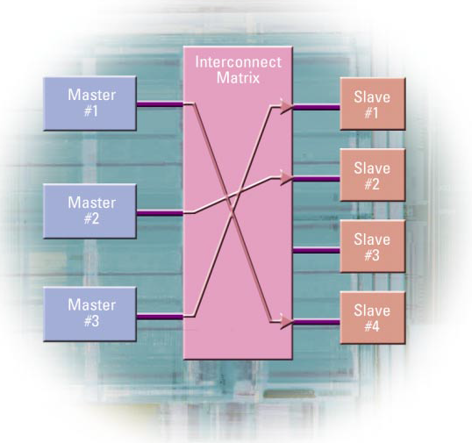
2.3.3 Crossbar-based on-die interconnects (1)
2.3.3 Crossbar-based on-die interconnects
They provide point-to-point connections from a number of sources to a number of
sinks via appropriated links by means of a crossbar switch (interconnect matrix),
as indicated in the Figure below (for better clarity we show only one direction). [53]

Slide 93
2.3.3 Crossbar-based on-die interconnects (2)
Support of cache coherency
Support of cache coherency in crossbar-based interconnects
Non cache coherent
interconnects
Cache coherent
interconnects
Early, straightforward implementations
Advanced implementations
Cache coherency is maintained by software.
Induces higher coherency traffic.
Is less effective in terms of
performance and power consumption.
Cache coherency is maintained by hardware.
Induces less coherency traffic.
Is more effective in terms of
performance and power consumption
Examples
ARM
PL-300 (2004)
NIC-301 (2006)
NIC-400 (2010)
CCI-400 (2010)
CCI-500 (2014)
CCI-550 (2015)
Intel
Nehalem (2008)

Slide 94
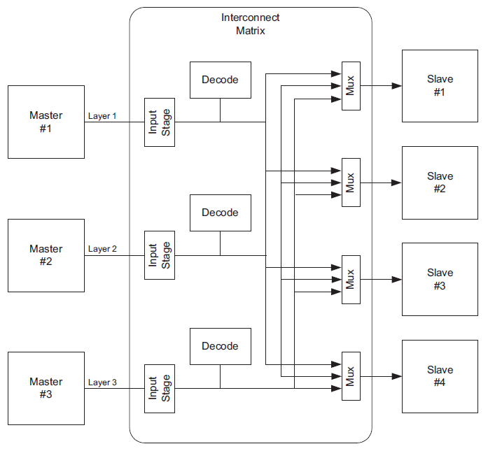
2.3.3 Crossbar-based on-die interconnects (3)
Implementation of the crossbar switch
It can be built up by buses as well as multiplexers and demultiplexers, as shown in
the Figure below (only for the Master to Slave direction [54].
Multi-layer AHB
Overview
DVI 0045A
ARM Limited. 2001
Figure: Implementation of the crossbar switch in the Master to Slave direction [54]

Slide 95
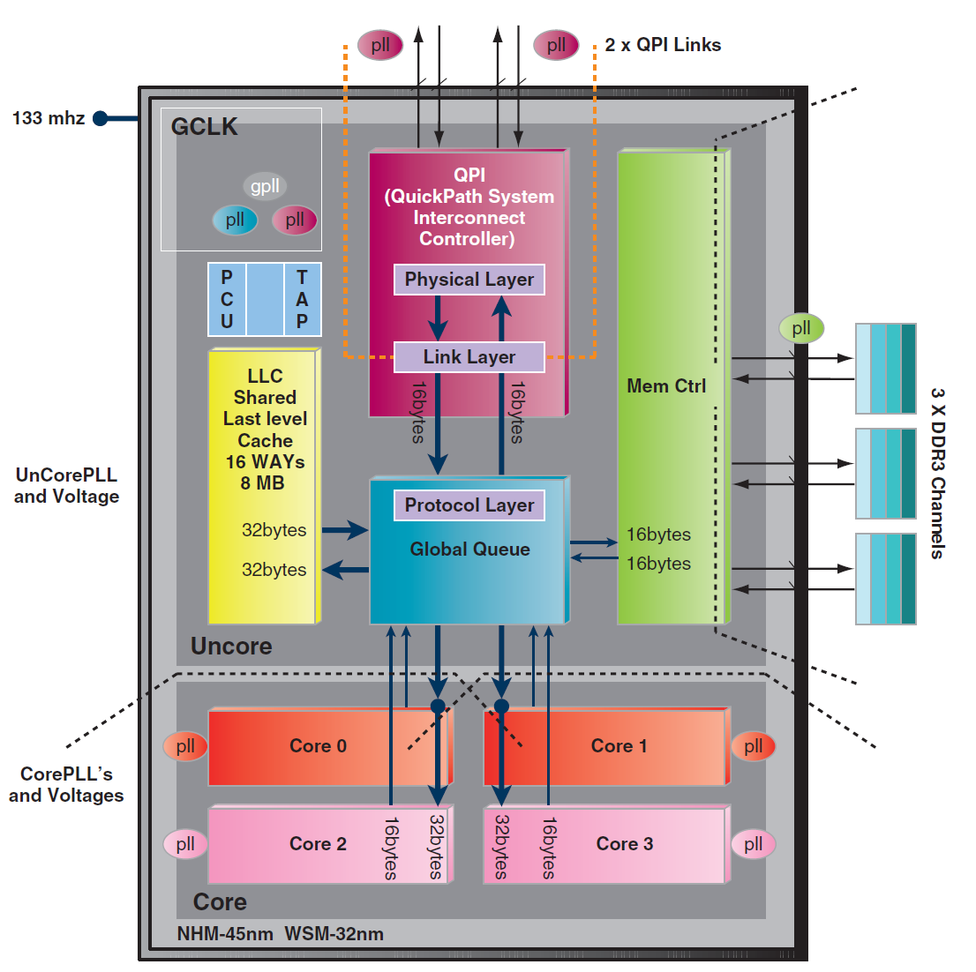
2.3.3 Crossbar-based on-die interconnects (4)
Example 1: Five-way crossbar switch in Intel’s Nehalem based Xeon 5500
processor (2010)
(Crossbar)

Slide 96
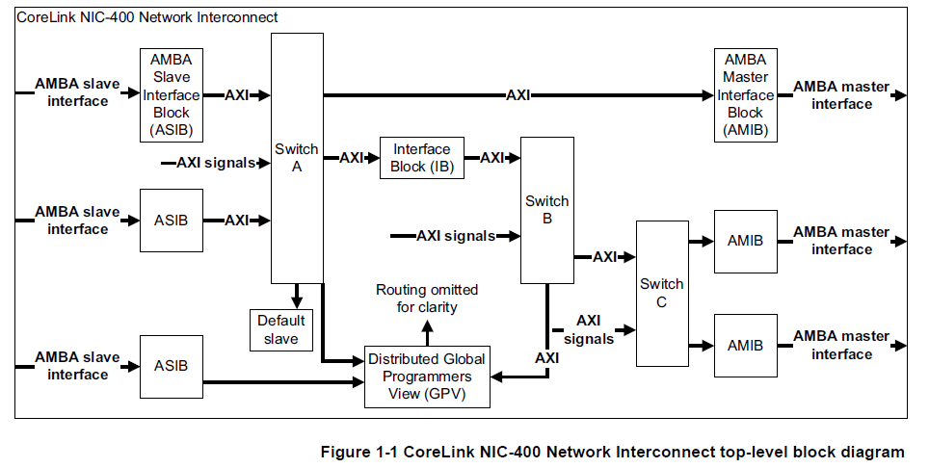
2.3.3 Crossbar-based on-die interconnects (5)
Example 2: Internal structure of ARM’s NIC-400 crossbar-based,
non cache coherent interconnect with AXI4 links (2010) [55]
NIC: Network Interconnect

Slide 97
2.3.3 Crossbar-based on-die interconnects (6)
ARM’s bus standards underlying their non cache coherent crossbar-based
on-die interconnects
(1996)
(5/1999)
(6/2003)
(3/2010)
(6/2013)
Revision
AMBA1
AMBA2
AMBA3
AMBA4
AMBA5
Used in
(ARM7/9)
(ARM11,
Cortex-A9)
(Cortex-A15/A7
ARM big.LITTLE)
(Cortex
A57/A53)
Coherent
Hub Inteface
Non cache coherent
crossbar-based
CHI
(10/2011)
AMBA Coherency
Extensions Protocol
ACE™
ACE-Lite
Advanced
eXtensible Interface
AXI3
AXI4
Bus-based InCn
AXI4-Lite
Crossbar-based
(not CC) InCn
AMBA
High Performance Bus
AHB™
AXI4-Stream
(5/1999)
Crossbar-based
(CC InCn)
Multi-layer AHB
ML AHB
(3/2001)
Ring-bus
or 2D mesh-based
(CC InCn)
Advanced System Bus
ASB™
AHB-Lite
(3/2001)
Advanced
Peripheral Bus
APB™
APB2
APB v1.0
APB v2.0
CC: Cache Coherent
InCn: Interconnect
(9/2004)
(6/2006)
(3/2012)
Advanced
Trace Bus
ATB
ATB v1.0
ATB v2.0
≈
1995
2000
2010

Slide 98
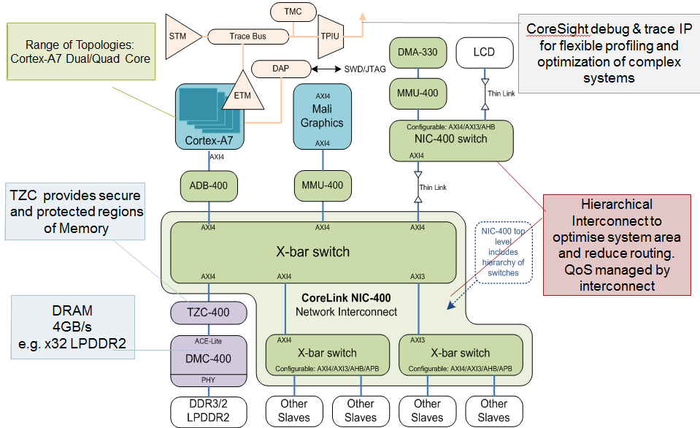
2.3.3 Crossbar-based on-die interconnects (7)
NIC-400 based entry-level smartphone platform [56]

Slide 99
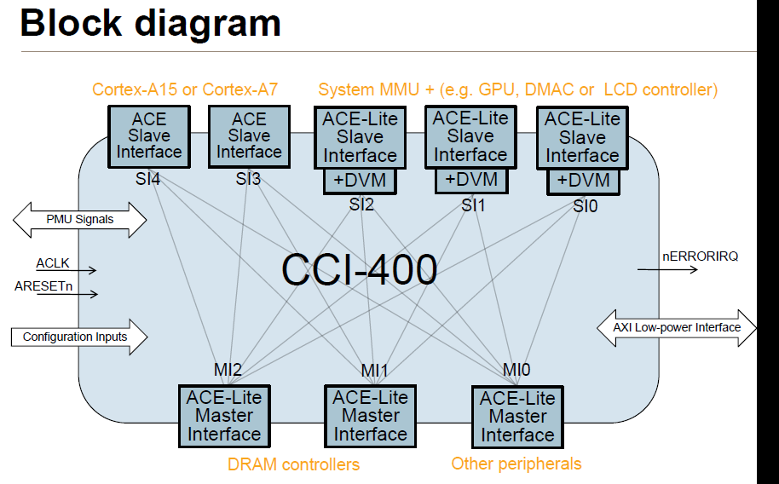
2.3.3 Crossbar-based on-die interconnects (8)
Example 3: ARM’s cache coherent, crossbar based CCI-400 interconnect
with ACE links (2011) [57]
.
CCI: Cache Coherent Interconnect
Remark
Interface ports receiving data requests e.g. from processor cores, the GPU, DMAs
or the LCD, are called Slaves whereas those initiating data requests e.g. to the
memory or other peripherals are designated as Masters, as indicated in the Figure
above.

Slide 100
2.3.3 Crossbar-based on-die interconnects (9)
ARM’s bus standards underlying their cache coherent, crossbar-based
on-die interconnects
(1996)
(5/1999)
(6/2003)
(3/2010)
(6/2013)
Revision
AMBA1
AMBA2
AMBA3
AMBA4
AMBA5
Used in
(ARM7/9)
(ARM11,
Cortex-A9)
(Cortex-A15/A7
ARM big.LITTLE)
(Cortex
A57/A53)
Coherent
Hub Inteface
Cache coherent
crossbar-based
CHI
(10/2011)
AMBA Coherency
Extensions Protocol
ACE™
ACE-Lite
Advanced
eXtensible Interface
AXI3
AXI4
Bus-based InCn
AXI4-Lite
Crossbar-based
(not CC) InCn
AMBA
High Performance Bus
AHB™
AXI4-Stream
(5/1999)
Crossbar-based
(CC InCn)
Multi-layer AHB
ML AHB
(3/2001)
Advanced System Bus
ASB™
AHB-Lite
(3/2001)
Ring-bus or
2D mesh-based
(CC InCn)
Advanced
Peripheral Bus
APB™
APB2
APB v1.0
APB v2.0
CC: Cache Coherent
InCn: Interconnect
(9/2004)
(6/2006)
(3/2012)
Advanced
Trace Bus
ATB
ATB v1.0
ATB v2.0
≈
1995
2000
2010

Slide 101
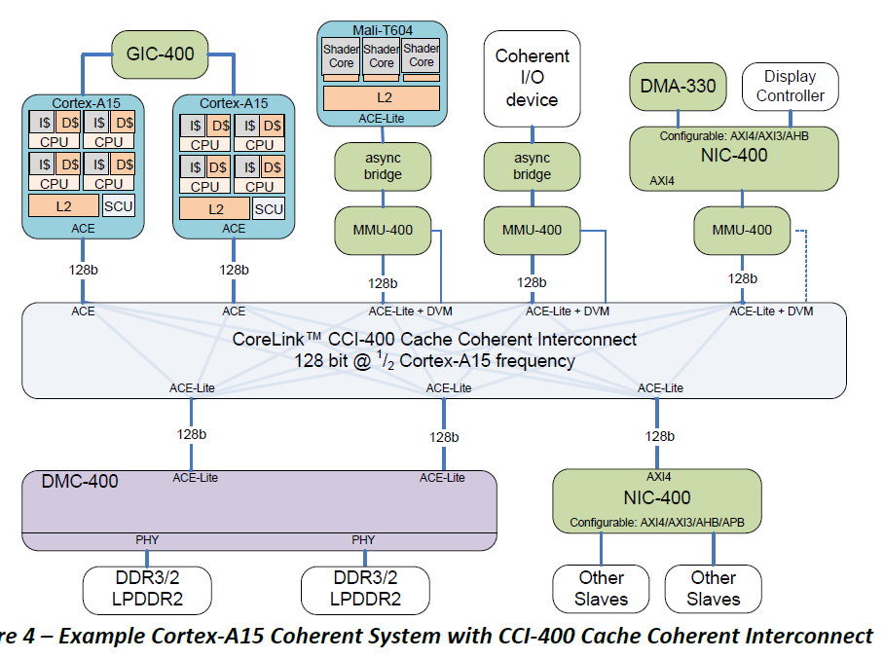
2.3.3 Crossbar-based on-die interconnects (10)
Smartphone platform based on the cache coherent CCI-400 interconnect [47]
(Generic Interrupt Controller)
(GPU)
(Network Interconnect)
(Memory
Management Unit)
(DVM: Distributed
Virtual Memory)
(Dynamic Memory Controller)

Slide 102
2.3.4 Ringbus-based on-die interconnects

Slide 103
2.3.4 Ringbus-based on-die interconnects (1)
2.3.4 Ring bus-based on-die interconnects
For higher core counts or higher number of data sources and sinks (like cores (CC),
accelerators (A), I/O links etc.) the implementation cost of on-die crossbar-based
interconnects raises quadratic and a ring bus-based interconnect becomes more
attractive, as indicated below.
Crossbar-based
interconnect topology
[from 2004 on]
Ringbus-based
interconnect topology
[from 2012 on]
CC
--
A
--
IO
CC
A
IO
--
--
Cross bar
Less cost
Ring
for higher nc
MC
--
Per.
MC
---
Per.
Examples
ARM's interconnects
for mobiles
nc: Core count
ARM's interconnects
for servers
PL-300 (2004)
CCI-400 (2011)
CCN-504 (2012)
CCN-508 (2013)

Slide 104
2.3.4 Ringbus-based on-die interconnects (2)
Emergence of ring-bus based on-die interconnects
IBM/Toshiba/Sony
Cell
(8C)
Graphics/HPC
Intel
Larrabee
(16C-24C)
Graphics/HPC)
Xeon Phi
Knights Ferry
(32C)
HPC
Xeon Phi
Knights Corner
(~60C)
HPC
Westmere-EX
(10C)
Servers
and subsequent
server processors
Sandy Bridge
(!C+GPU
DT/mobiles
and subsequent
processors
ARM
CCN-504
CCN-508
CCN-502
CCN-512
2006
2008
2010
2012
2014
Year

Slide 105
2.3.4 Ringbus-based on-die interconnects (3)
Example 1: The ring bus of Intel’s 4-core Sandy Bridge (2011) [40]
System Agent
The ring has six bus stops for
interconnecting
four cores
four L3 slices
the GPU and
the System Agent
The four cores and the
L3 slices share the same
interfaces.

Slide 106
2.3.4 Ringbus-based on-die interconnects (4)
Example 2: Dual ring buses of Intel's 18-core Haswell-EX (2015) [41]

Slide 107
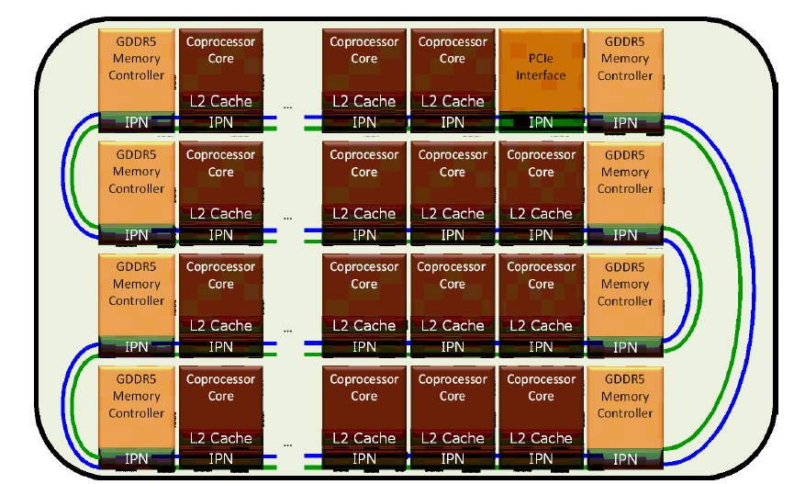
2.3.4 Ringbus-based on-die interconnects (5)
Example 3: Ring interconnect of Intel’s 57-61 core Xeon Phi
Knights Corner (2012) [58]

Slide 108
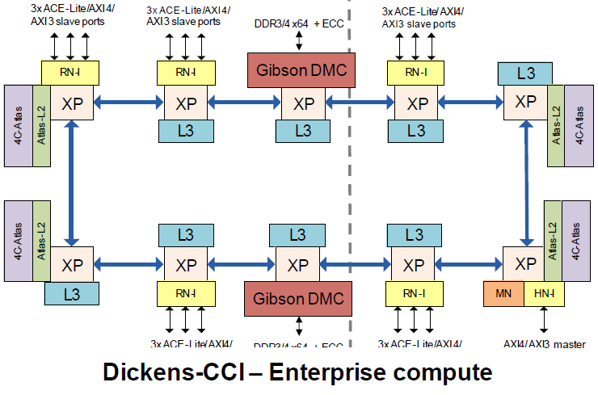
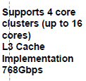
2.3.4 Ringbus-based on-die interconnects (6)
Example 4: The ring bus of ARM’s CCN-504 (dubbed Dickens)
cache coherent interconnect [59]
Remark: The Figure indicates only 15 ACE-Lite slave ports and 1 master port
whereas ARM's specifications show 18 ACE-Lite slave ports and 2 master ports.

Slide 109
2.3.4 Ringbus-based on-die interconnects (7)
ARM’s bus standards underlying their cache coherent, ringbus-based
on-die interconnects
(1996)
(5/1999)
(6/2003)
(3/2010)
(6/2013)
Revision
AMBA1
AMBA2
AMBA3
AMBA4
AMBA5
Used in
(ARM7/9)
(ARM11,
Cortex-A9)
(Cortex-A15/A7
ARM big.LITTLE)
(Cortex
A57/A53)
Coherent
Hub Inteface
Cache coherent
ringbus or 2D mesh-based
CHI
(10/2011)
AMBA Coherency
Extensions Protocol
ACE™
ACE-Lite
Advanced
eXtensible Interface
AXI3
AXI4
Bus-based InCn
AXI4-Lite
Crossbar-based
(not CC) InCn
AMBA
High Performance Bus
AHB™
AXI4-Stream
(5/1999)
Crossbar-based
(CC InCn)
Multi-layer AHB
ML AHB
(3/2001)
Advanced System Bus
ASB™
AHB-Lite
(3/2001)
Ring-bus or
2D mesh-based
(CC InCn)
Advanced
Peripheral Bus
APB™
APB2
APB v1.0
APB v2.0
CC: Cache Coherent
InCn: Interconnect
(9/2004)
(6/2006)
(3/2012)
Advanced
Trace Bus
ATB
ATB v1.0
ATB v2.0
≈
1995
2000
2010

Slide 110
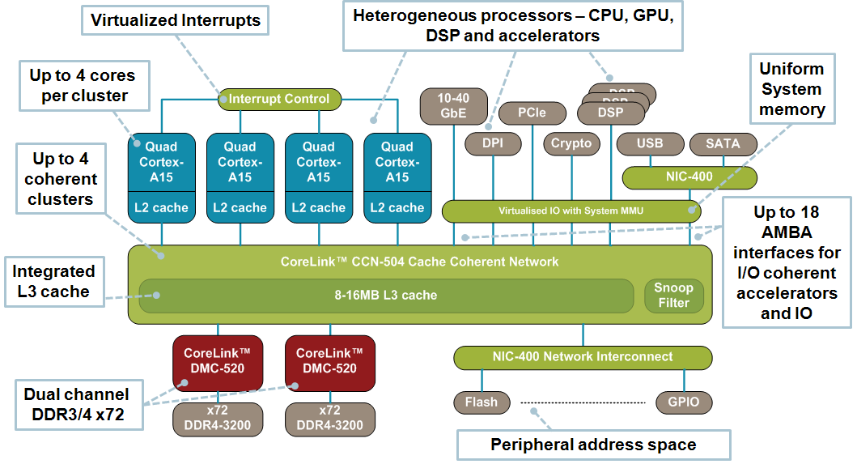
2.3.4 Ringbus-based on-die interconnects (8)
Mobile platform based on the cache-coherent CCN-504 interconnect [60]

Slide 111
2.3.5 2D mesh-based on-die interconnects

Slide 112
2.3.5 2D mesh-based on-die interconnects (1)
2.3.5 2D mesh-based on-die interconnects -1
Ring interconnects cause high core-to-core transfer times for large core counts, e.g.
for 24-cores, as indicated in the Figure below [25]
Ring-bus of Intel’s
24-core Broadwell-EX
server processor [25]

Slide 113
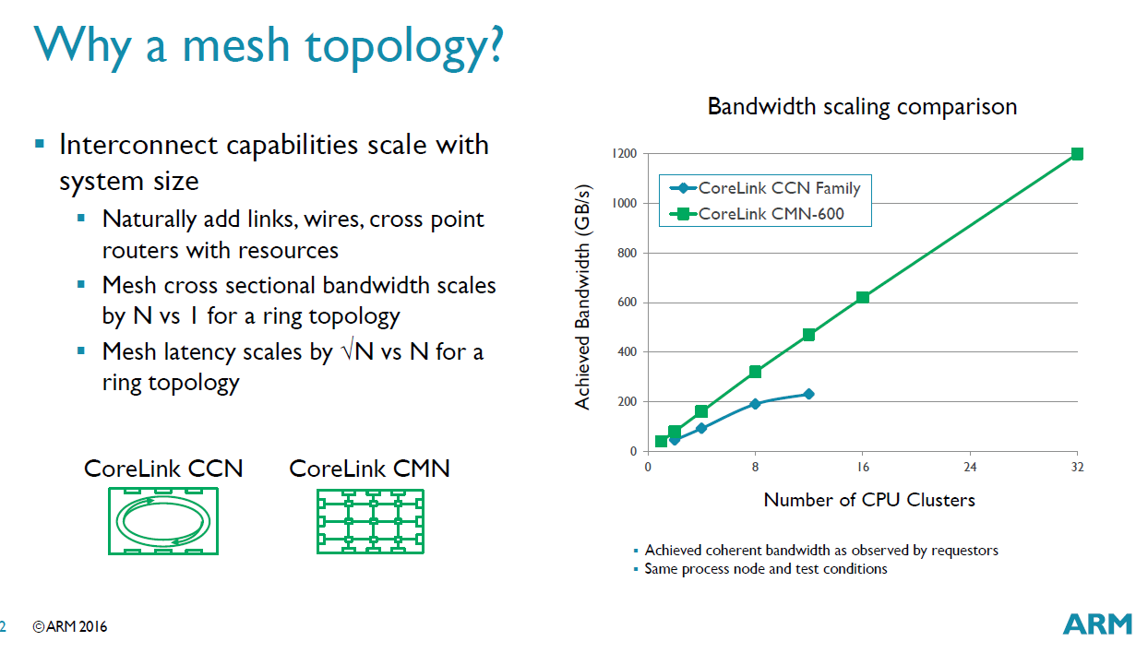
2.3.5 2D mesh-based on-die interconnects (2)
2D mesh-based on-die interconnects -2
Long core-to-core transfer times may limit performance, as seen in the Figure
below for ARM’s interconnects [61], this motivated the introduction of 2D mesh
interconnects.
Ring
interconnect
Mesh
interconnect
*

Slide 114
2.3.5 2D mesh-based on-die interconnects (3)
Move from ringbus-based interconnects to 2D mesh-based interconnects -1
Ringbus-based
interconnect topology
[from 2012 on]
2D mesh-based
interconnect topology
[from 2016 on]
CC
--
A
--
IO
R
R
R
R
R
R
CC
CC
A
A
IO
IO
Higher performance
for high core counts
R
R
R
R
R
R
CC
CC
A
A
IO
IO
Ring
R
R
R
R
R
R
CC
CC
A
A
IO
IO
R
R
R
R
R
R
MC
MC
MC
P
P
P
MC
---
Per.
R
R
R
R
R
R
MC
MC
MC
P
P
P
ARM's interconnects
for servers
ARM's interconnects
for servers
CCN-500
CMN-600
*

Slide 115
2.3.5 2D mesh-based on-die interconnects (4)
Move from ringbus-based interconnects to 2D mesh-based interconnects -2
Interconnection style of many and multi-core processors
Ring architecture
Mesh (2D grid) architecture
Sony/Toshiba/IBM Cell (2006): 8 cores
Tile processor (2007): 80 cores
SCC (2010): 48 cores
Intel
Larrabee (2009). 24-32 cores (cancelled)
Xeon Phi
Knights Ferry (2010): 32 cores
Knights Corner (2012): 57-61 cores
Nehalem-EX (Beckton) (2010) up to 8 cores
All Sandy Bridge lines (2011) up to 8 cores
All Ivy Bridge lines (from 2012 on) up to 15 cores
to
All Broadwell lines (from 2014 on) up to 24 cores
Skylake (2015) up to 4 cores
Xeon Phi
Knights Landing (2016): up to 72 cores
Skylake-X (HED) (2017) up to 18 cores
Skylake-SP (2017) up to 28 cores
IBM
POWER9 (2017)
(ARM CCN504 (2012) to CCN512 (2014) Interconnect
CMN6xx (2016) Interconnect)

Slide 116
2.3.5 2D mesh-based on-die interconnects (5)
Example 1: 2D mesh in Intel’s 72-core Knights Landing processor (2016) [27]
Up to 72 Silvermont (Atom) cores
4 threads/core
2 512 bit vector units
2D mesh architecture
6 channels DDR4-2400,
up to 384 GB,
8/16 GB high bandwidth on-package
MCDRAM memory, >500 GB/s
36 lanes PCIe 3.0
200 W TDP

Slide 117
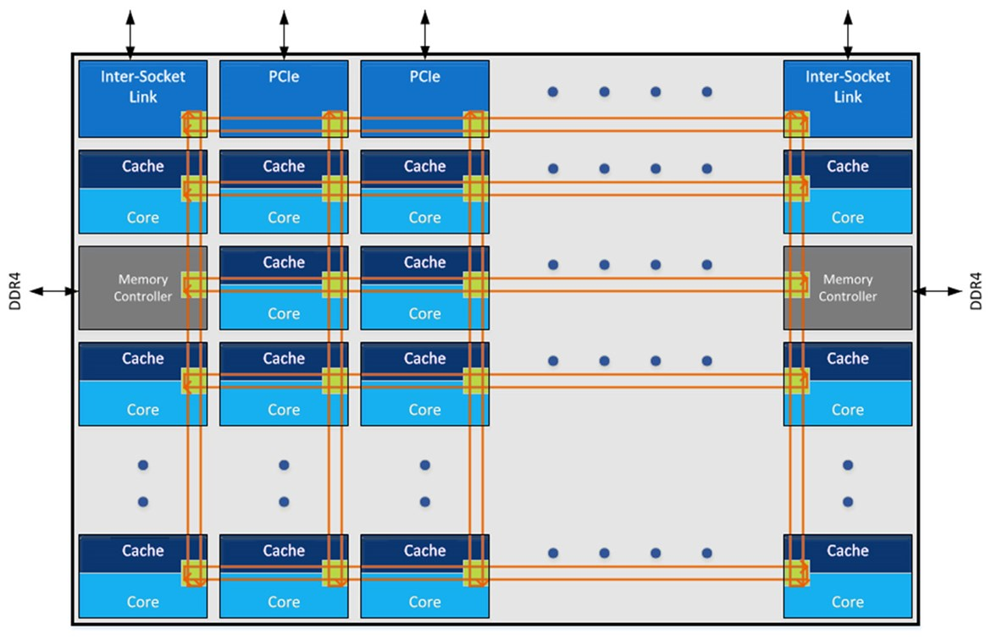
2.3.5 2D mesh-based on-die interconnects (6)
Example 2: 2D mesh in Intel’s up to 28-core Xeon Skylake-SP (2017) [62]

Slide 118
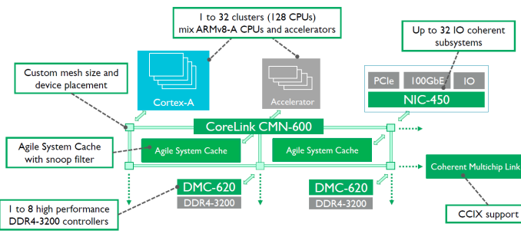
2.3.5 2D mesh-based on-die interconnects (7)
Example 3: 2D mesh in ARM’s CMN-6xx cache coherent interconnect (2016)
[63]

Slide 119
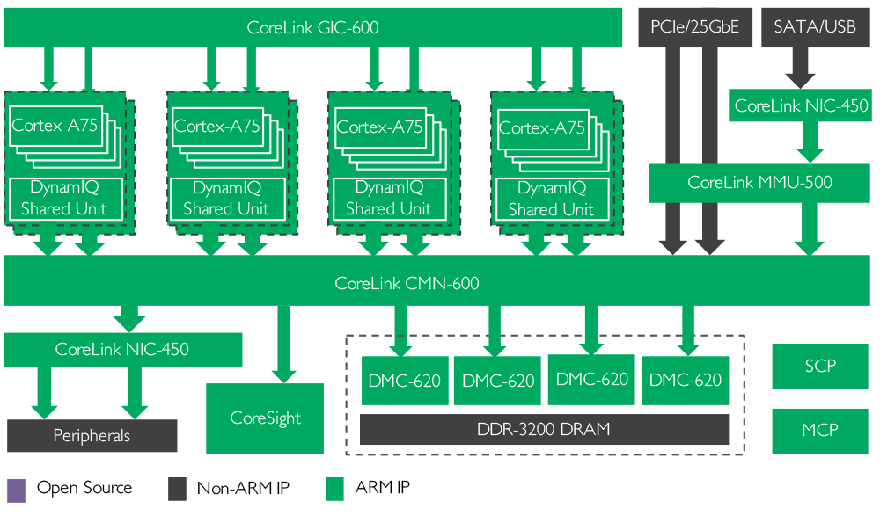
2.3.5 2D mesh-based on-die interconnects (8)
Use of ARM’s 2D mesh interconnect (CMN-600) to build a server [64]
*
10711syste

Slide 120
2.3.5 2D mesh-based on-die interconnects (9)
Power consumption of on-die interconnects
We note that 2D interconnects have considerable more power consumption than
ring bus interconnects, as the next example shows.

Slide 121
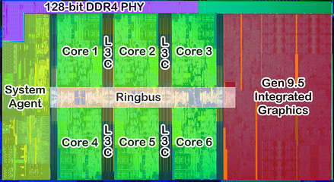
2.3.5 2D mesh-based on-die interconnects (10)
Example 1: Layout of Intel’s 6-core Coffee Lake 8700K using a ring bus [77]

Slide 122
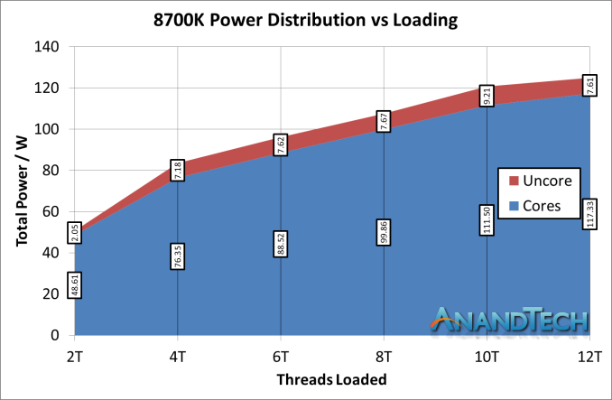
2.3.5 2D mesh-based on-die interconnects (11)
Breakdown of power consumption between the cores and the IF in Intel’s
6-core Coffee Lake 8700K processor using a ring bus [73]

Slide 123
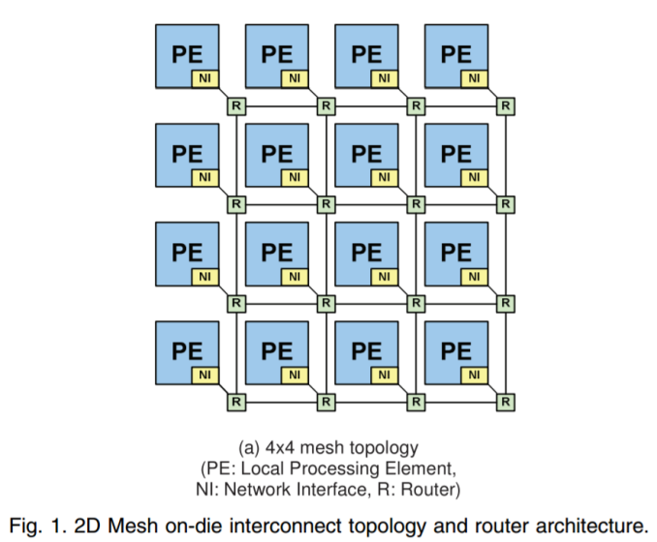
2.3.5 2D mesh-based on-die interconnects (12)
Example 2: Layout of a 4x4 2D mesh [73]

Slide 124
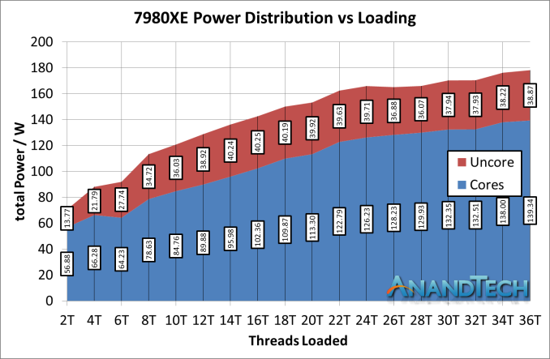
2.3.5 2D mesh-based on-die interconnects (13)
Breakdown of power consumption between the cores and the IF in Intel’s
18-core Skylake X 7980XE processor using a 2D mesh [73]
Note that the 2D mesh of the 7980X differs from that shown before.

Slide 125
2.4 Use of both off-die and on-die interconnects

Slide 126
2.4 Use of both off-die and on-die interconnects (1)
2.4 Use of both off-die and on-die interconnects
Multicores imply a new requirement, that is to provide core-to-to communication,
in other words to allow interactions, like synchronization or data exchange
between cores.
In case of on-die intra-processor interconnects this requirement needs to
taken into consideration by default.
Nevertheless, off-die interconnects need to be augmented for multicores
appropriately by an on-die interconnect.
Subsequently, we show two examples for this.

Slide 127
2.4 Use of both off-die and on-die interconnects (2)
Example 1 for using both off-die and crossbar-based on-die interconnect
in Intel’s desktops [40]
dGPU
PCIe
P
M
FDI
(not used)
DMI
Displ.
PCH
w/GPU
Per./
IO
--
Per./
IO
--
(Crossbar)
PCIe interconnection placed on-die.
An extra link (FDI) is provided
(but not needed) as a preparation
for integrated graphics
2. gen. Nehalem (Lynnfield) (2009)

Slide 128
2.4 Use of both off-die and on-die interconnects (3)
Example 2 for using both off-die and ring-based on-die interconnect
in Intel’s desktops [40]
FDI
dGPU
PCIe
P
GPU
M
FDI
DMI
Displ.
PCH
Per./
IO
--
Per./
IO
--
Integrated graphics
(in-package or on-die)
FDI interconnection needed between
display and GPU.
2-core Westmere (Arrandale)
(with in-package integrated graphics
and a PCH model supporting integrated graphics) (2010)
Sandy Bridge (with on-die integrated graphics and
a PCH model supporting integrated graphics) (2011)
Ivy Bridge with on-die integrated graphics and
all PCH models supporting integrated graphics (2012)

Slide 129
4. Inter-processor interconnects
4.1 Overview of inter-processor interconnects
4.2 One or two level interconnects between sockets
4.3 Inter-processor interconnect topologies
4.4 Layout of the interconnect links

Slide 130
4.1 Overview of inter-processor interconnects

Slide 131
4.1 Overview of inter-processor interconnects (1)
4.1 Overview of inter-processor interconnects -1
Main functional levels of interconnects
Intra-processor
interconnects
Inter-processor
interconnects
Inter-node
interconnects
Interconnects the functional
units of a processor
Interconnects processors
within a server
(e.g. DP/MP servers) [2]
Interconnects nodes
(e.g. 2P/4P servers) of a processor cluster [3]
GPU
M
P
Disp
.
Per./
IO

Slide 132
4.1 Overview of inter-processor interconnects (2)
Overview of inter-processor interconnects -2
They interconnect processors of a multiprocessor, as seen e.g. below [2].
Intel’s Entry and Efficient Performance (Romley) platform options
Intel’s Ivy Bridge-based High-end (Brickland) platform options

Slide 133
4.1 Overview of inter-processor interconnects (3)
Key aspects of inter-processor interconnects
Key aspects of the inter-processor interconnects (discussed)
One- or two level
processor interconnects
Partially or fully connected
mesh
Layout of the
interconnect links
Section 3.2
Section 3.3
Section 3.4

Slide 134
3.2 One or two level inter-processor interconnects

Slide 135
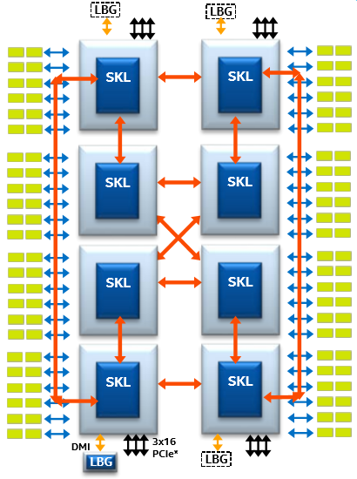
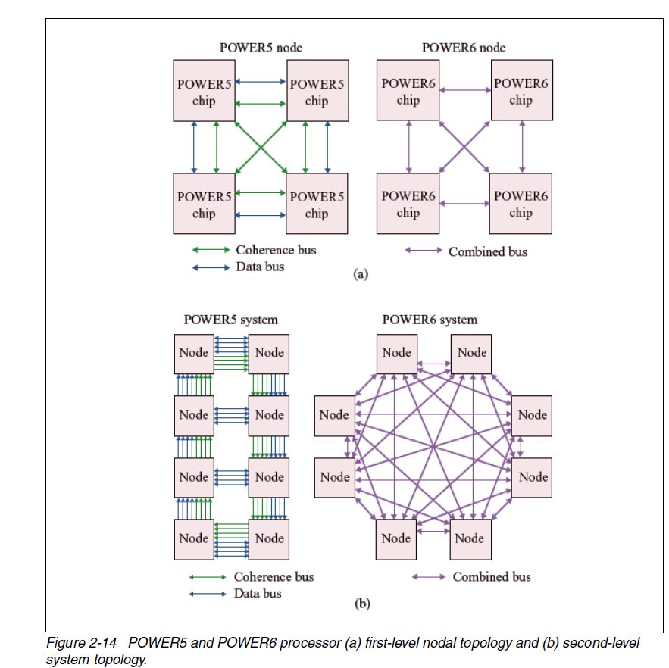
3.2 One or two level inter-processor interconnects (1)
3.2 One or two level inter-processor interconnects
One or two level inter-processor interconnects
One-level interconnects
Two-level interconnects
Processors are directly interconnected, e.g. [65]
(SKL: Skylake-SP Xeon)
Processors are interconnected first into nodes,
e.g. into nodes with 4 processors each,
and the nodes are also properly interconnected, e.g. [66]
Typical use
Intel’s and AMD’s 2S to 8S servers and
IBM’s entry level servers
IBM’s high-end servers with 16 or more processors

Slide 136
3.3 Inter-processor interconnect topologies

Slide 137
3.3 Inter-processor interconnect topologies (1)
3.3 Inter-processor interconnect topologies
We consider this subject separately for one and two level interconnects.
Inter-processor interconnect topologies
Inter-processor interconnect topologies
of one level interconnects
Inter-processor interconnect topologies
of two level interconnects
Typically used in entry or “effective performance”
oriented server platforms
Typically used in IBM’s high-performance
oriented server platforms

Slide 138
3.3 Inter-processor interconnect topologies (2)
Inter-processor interconnect topologies of one-level interconnects
Inter-processor interconnect topologies
of one-level interconnects
Partially connected mesh
Fully connected mesh
Examples for 4S servers [2]
Typically used in entry or “efficient performance”
oriented platforms
Typically used in high-performance
oriented platforms

Slide 139
3.3 Inter-processor interconnect topologies (3)
Inter-processor interconnect topologies of two-level interconnects
Inter-processor interconnect topologies
of two-level interconnects
1. level inter-processor interconnect topology
of two-level interconnects
2. level inter-processor interconnect topology
of two-level interconnects

Slide 140
3.3 Inter-processor interconnect topologies (4)
1. level inter-processor interconnect topology of two-level interconnects
Typically, IBM’s high level POWER servers make use of two-level inter-processor
interconnect topologies.
Usually, these servers are built up of 4-processor nodes interconnected by a full mesh,
as seen below for IBM’s POWER6 servers.
Figure: IBM POWER6 4-processor server node interconnected by a full mesh (2008)
[66]

Slide 141
3.3 Inter-processor interconnect topologies (5)
2. level inter-processor interconnect topology of two-level interconnects
2. level inter-processor interconnect topology
of two-level interconnects (examples)
Ringbus-based interconnect
Fully connected mesh interconnect
Figure: 2. level ringbus-based interconnect
of POWER5 systems (2004) [66]
(There are additional data links to reduce latency)
Figure: 2. level fully connected mesh-based interconnect
of POWER6 systems (~2007) [66]

Slide 142
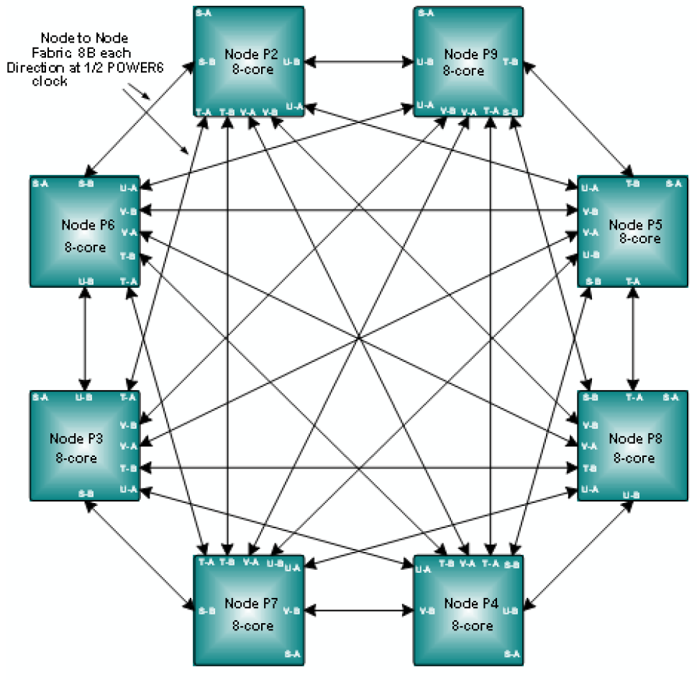
3.3 Inter-processor interconnect topologies (6)
More detailed 2. level interconnect of the POWER6-based POWER 595 [66]
We note that
the four processors of a node
are designated by S, T, U, V.
Each processor has two links,
for inter-node connections,
termed A and B.
Thus each node has 8 links for
node-to-node connections:
SA, SB, TA etc.
Seven of these links are used to
connect a given node to the
seven other nodes in an
8-node system, as indicated
left.
Thus up to two hops are
needed from a given processor
to another (up to one hop
in the source node and up to
another hop in the destination
node).

Slide 143

3.3 Inter-processor interconnect topologies (7)
2. Example for second level interconnect in POWER8-based IBM’s E880
systems (2014) [67]
3 A-buses per processor: Inter-node links
to processors external to a node
(They provide a fully connected mesh
for any given processor to any given processor
via intra-node links (if needed) and two switches,
(designated by T).
3 X-buses per processor:
Intra-node links
to processors within a node
(called Drawer).
(They provide a
fully connected mesh
between processors
building a node).

Slide 144
3.4 Layout of the interconnect links

Slide 145
3.4 Layout of the interconnect links (1)
3.4 Layout of the interconnect links
Clearly, links of recent interconnects have to support cache coherency of the
entire platform.
Vital interconnect links used in multicore multi-socket servers:
Vendor | Server family | Interconnect link
Intel | Xeon (from Nehalem to Broadwell) | QPI (Quick Path Interconnect)
Intel | Xeon Skylake-SL | UPI (Ultra Path Interconnect
AMD | Opteron | HT (HyperTransport)
IBM | POWER7/8 | Not disclosed (except in patents)

Slide 146
3.4 Layout of the interconnect links (2)
Example 1: Intel’s QPI bus (Quick Path Interconnect bus)
Key features: Layered protocol
Key features of the physical layer: Unidirectional point-to-point links,
2-Byte data width, DDR data rate, differential signaling
Evolution of the QPI bus
QPI | Base clock | Platforms | Data rate (up to) (in each dir.) | Year
QPI | 3.2 GHz | Nehalem (server/desktop) | 12.8 GB/s | 2008
QPI 1.1 | 4.0 GHz | Sandy Bridge EN/EP Ivy Bridge-EN/EP/EX Westmere EN/EP/EX | 16.0 GB/s | 2010-14
QPI 1.1 | 4.8 GHz | Haswell EN/EP/EX Broadwell EN/EP/EX | 19.2 GB/s | 2014-16
Replacing the QPI bus by the UPI (Ultra Path Interconnect) bus)
UPI | Base clock | Platforms | Data rate (up to) (in each dir.) | Year
UPI | 5.2 GHz | Skylake-SP | 20.8 GB/s | 2017

Slide 147

3.4 Layout of the interconnect links (3)
QPI’s layered communication protocol and main tasks of the layers [68]
ibm powernik

Slide 148
3.4 Layout of the interconnect links (4)
Physical layer of the QPI bus [69]
TX Unidirectional link
RX Unidirectional link
16 data
2 protocol
2 CRC
(DDR data transfer)

Slide 149

3.4 Layout of the interconnect links (5)
Transfer entities of the QPI protocol [68]
Packets
Messages)
Flits
Phits
A Phit contains all bits transferred by the Physical layer on a single clock edge,
that is 20 bits for a full width (20 lanes), 10 bits for a half width and 5 bits
for a quarter width link implementation).
A Flit is always 80 bits long regardless of the link width, so the number of
Phits needed to transmit a Flit will varies on the link width.

Slide 150

3.4 Layout of the interconnect links (6)
A 80-bit long Flit of Intel’s QPI [70]
A Flit includes 72 bits of payload + 8 bits of CRC.

Slide 151

3.4 Layout of the interconnect links (7)
Message classes in the QPI protocol
In the QPI protocol protocol events are grouped into message classes.
There are the following seven message classes defined [70]:
Figure: Message classes defined for the QPI [67]
Messages are subdivided into packets.

Slide 152

3.4 Layout of the interconnect links (8)
Main features of the message classes [71]

Slide 153

3.4 Layout of the interconnect links (9)
Sending messages over virtual channels to the Link layer [69]
Link layer

Slide 154

3.4 Layout of the interconnect links (10)
Credit-based flow control [72]
Avoiding deadlocks while sending packets or flits is credit based.
This means:
During initialization, a sender is given a number of credits for each available
channel to send packets, or Flits to a receiver.
Whenever a packet or Flit is sent to the receiver over a channel, the sender
decrements its related credit counter by one credit.
Credits are returned from the receiver link layer after it has gated the data
sent, freed the related buffer and is ready to receive more information.
Figure: Principle of credit based flow control in Intel's QPI [72]

Slide 155

3.4 Layout of the interconnect links (11)
Example of a QPI packet with interleaved “command insert” packets [71]
There are three “command insert” packets, labeled 5, 8, 10 where packet 5
comprises two flits.
Furthermore, special packets 6 and 7 are interleaved between the flits of the
“command insert” packet.

Slide 156
3.4 Layout of the interconnect links (12)
Example 2: IBM’s 2-level, local and global inter-processor links in in the
POWER8-based E880 systems -1 [67]
IBM makes use of local and
global links in their 2-level
inter-processor interconnects,
as indicated on the right.
Intra-node local links
(1. level links)
Inter-node global links
(2. level links)

Slide 157
3.4 Layout of the interconnect links (13)
ventor
  Charles Francis Marino
  John Thomas Holloway, Jr.
  Praveen S. Reddy
  William John Starke
Example 2: IBM’s 2-level, local and global inter-processor links in the
POWER8-based E880 systems -1 [52]
IBM didn’t disclose any details of the links used, however a related patent granted
to IBM [] allows certain assumptions:
Both the 1. level (intra-node or local) and the 2. level (inter-node or global) links
are point-to-point interconnects.
Individual links (one of three) include a large number of signals (in the order
of 300) as the cited patent discloses (see next Figure):

Slide 158


3.4 Layout of the interconnect links (14)
1. level (designated in the Figure as nodal) and 2. level (global) links
revealed in the related patent [52]

Slide 159
3.4 Layout of the interconnect links (15)
IBM’s 2-level, local and global inter-processor links in the POWER8-based
E880 systems -2 [67]
According to [] the transfer rate of the 1. level links is 76.8 GB/s.
By taking into account the clock rate of about 4 GHz of the discussed system,
and the large number of bits per link (~300) 16B wide datapaths can be
assumed.
Based on the large number of lines per link it can also be speculated that not
differential signaling but voltage referenced signaling was used to reduce
dissipation similarly as in Intel’s Skylake-SP memory links.

Slide 160
5. Cluster interconnects

Slide 161
5. Cluster interconnects (1)
5. Cluster interconnects -1
Main functional levels of interconnects
Intra-processor
interconnects
Inter-processor
interconnects
Inter-node
interconnects
Interconnects the functional
units of a processor
Interconnects processors
within a server
(e.g. DP/MP servers) [2]
Interconnects nodes
(e.g. 2P/4P servers) of a processor cluster [3]
GPU
M
P
Disp
.
Per./
IO

Slide 162

5. Cluster interconnects (2)
Cluster interconnects -2
With higher number of nodes (that may include one or a few (e.g. 4) processors), direct meshes between the nodes become more and more complex as n nodes
require for a full mesh n * (n-1)/2 bidirectional links (as seen in the Figure below).
Consequently, for processor clusters that have a large number
(e.g. many tens, hundreds or
thousands) of nodes direct
meshes between the nodes
are not more practicable.
Figure: Direct connect full mesh of an
8-node multiprocessor (actually IBM’s
Power 595 8-node multiprocessor) [66]

Slide 163
5. Cluster interconnects (3)
Remark
Processor clusters are used for HPC or for enterprises purposes (e.g. large
database systems).
In fact, about 40 % of the top 500 computers are processor clusters of many
hundreds or thousands of nodes.

Slide 164

5. Cluster interconnects (4)
Cluster interconnects -2
For the reason discussed before, nodes of a processor cluster are not more
interconnected directly by a partial or full mesh but indirectly via switches,
as e.g. indicated below.
Figure: Interconnecting nodes of a cluster that is subdivided into subnets, indirectly,
by switches [73]

Slide 165
5. Cluster interconnects (5)
Cluster interconnects -3
Processor clusters is a complex topics of its own, we don’t go into details.
Instead we provide a glimpse of it by showing examples of particular points of it.

Slide 166
5. Cluster interconnects (6)
High speed interconnection technologies used in cluster interconnects
Ethernet
Fibre channel (FC) (to connect SANs (Storage Area Networks) to servers)
InfiniBand (IB)
Intel’s OmniPath

Slide 167
5. Cluster interconnects (7)
Evolution of InfiniBand based high speed interconnect technology to
Intel’s OmniPath
Infiniband (InfiniBand Trade Association. 1999)
TrueScale (Qlogic 2008)
(HPC Enhanced version of InfiniBand)
1/2012 Intel acquires QLogic’s TrueScale business
At the 2014 International Supercomputing Conference Intel announces both
Knights Landing and
the OmniScale interconnect fabric
11/2014 Intel renames OmniScale to OmniPath
06/2016 Intel's Knights Landing line with in-package integrated OmniPath host channel adapter
07/2017 Intel's Xeon Skylake-SP line with in-package integrated OmniPath host channel adapter

Slide 168

5. Cluster interconnects (8)
Omni-Path host adapter (to be inserted into a PCIe slot) [74]

Slide 169

5. Cluster interconnects (9)
48-port Omni-Path switch in an 1U rack [75]

Slide 170


5. Cluster interconnects (10)
Evolution of the implementation of Host Channel Adapters (HCAs) called
Host Fabric Interfaces (HFIs) in OmniPath in Intel’s processors
Implementation alternatives of the Host Fabric Interfaces (HFI)
Implementation
on a separate card
In-package integration
(Implementation as a
Multi-Chip Package (MCM))
On-chip integration
Examples:
Previous systems
with TrueScale
1. Gen. Knights Landing
with OmniPath HCA
Skylake-F
2. Gen. Knights Landing
with OmniPath HCA
*

Slide 171

5. Cluster interconnects (11)
System software needed for a cluster interconnect fabric [76]

Slide 172
5. References

Slide 173
5. References (1)
[1]: Intel Calls for 3D IC, EE Times, March 5 2015,
https://www.eetimes.com/author.asp?section_id=36&doc_id=1325921&image_number=1
[2]: Esmer I., Ivybridge Server Architecture: A Converged Server, Aug. 2014, Hot Chips 2014,
http://www.hotchips.org/wp-content/uploads/hc_archives/hc26/HC26-12-day2-epub/
HC26.12-8-Big-Iron-Servers-epub/HC26.13.832-IvyBridge-Esmer-Intel-IVB%20Server%
20Hotchips2014.pdf
[3]: Supermicro Motherboards, MNL-1594X6QT8, User Manual,
https://www.supermicro.com/manuals/motherboard/C606_602/MNL-1594.pdf
[4]: Lau J., MCM, SiP, SoC, and Heterogeneous Integration Defined and Explained, 3DInCities,
Aug. 7 2017, https://www.3dincites.com/2017/08/mcm-sip-soc-and-heterogeneous-
integration-defined-and-explained/
[5]: Intel quadcore Xeon 5300 review, Nov. 13 2006, Hardware.Info,
http://www.hardware.info/en-US/articles/amdnY2ppZGWa/Intel_quadcore_Xeon_5300_review
[6]: Wasson S., Intel's Woodcrest processor previewed, The Bensley server platform debuts,
May 23, 2006, The Tech Report, http://techreport.com/articles.x/10021/1
[7]: Teich P., The Heart Of AMD’s Epyc Comeback Is Infinity Fabric, The Next Platform, July 12 2017,
https://www.nextplatform.com/2017/07/12/heart-amds-epyc-comeback-infinity-fabric/
[8]: Kennedy P., AMD EPYC Infinity Fabric Update and MCM Cost Savings, STH, Aug. 22 2017,
https://www.servethehome.com/amd-epyc-infinity-fabric-update-mcm-cost-savings/
[9]: MCM-GPU: Multi-Chip-Module GPUs for Continued Performance Scalability, Nvidia,
http://research.nvidia.com/publication/2017-06_MCM-GPU%3A-Multi-Chip-Module-GPUs

Slide 174
5. References (2)
[10]: Altavilla D., Intel Arrandale Core i5 and Core i3 Mobile Unveiled, Hot Hardware, Jan. 4 2010,
http://hothardware.com/Reviews/Intel-Arrandale-Core-i5-and-Core-i3-Mobile-Unveiled
[11]: Stoerchle M., IBM System z10 Technologie, 2008,
https://www.guug.de/lokal/muenchen/2008-11-10/IBM_System_z_guug.pdf
[12]: Scansen D., Intel Launches Next Generation of Microprocessors, Engineering, June 10 2013,
http://www.engineering.com/ElectronicsDesign/ElectronicsDesignArticles/ArticleID/
5838/Intel-Launches-Next-Generation-of-Microprocessors.aspx
[13]: Mujtaba H., Intel Knights Landing Further Detailed – 16 GB High-Bandwidth On-Package
Memory, 384 GB DDR4 System Memory Support and 8 Billion Transistors, WCCF Tech,
March 26 2015, https://wccftech.com/intel-knights-landing-detailed-16-gb-highbandwidth-
ondie-memory-384-gb-ddr4-system-memory-support-8-billion-transistors/
[14]: Maxfield M., Design How-To, 2D vs. 2.5D vs. 3D ICs, EE Times, April 8 2012,
https://www.eetimes.com/document.asp?doc_id=1279540
[15]: Solberg V., 2.5D and 3D Semiconductor Package Technology: Evolution and Innovation,
http://www.circuitinsight.com/pdf/2.5d_3d_semiconductor_package_technology_ipc.pdf
[16]: Conolly C., „Intel Paxville Dual Core Xeon and the ASsus PVL-D Intel 7520,” Oct. 2005,
http://www.gamepc.com/labs/view_content.asp?id=paxville&page=1
[17]: Douglas J., „Intel 8xx series and Paxville Xeon-MP Microprocessors,”
http://www.hotchips.org/archives/hc17/3_Tue/HC17.S8/HC17.S8T1.pdf
[18]: Alcorn P., Hot Chips 2017: Intel Deep Dives Into EMIB, Tom’s Hardware, Aug. 25 2017,
https://www.tomshardware.com/news/intel-emib-interconnect-fpga-chiplet,35316.html

Slide 175
5. References (3)
[19]: Marcoux P., 2.5D, Silicon Interposers, Silicon Bridges, Glass Panels, Organic HDI,
http://www.meptec.org/Resources/1%20-%20ALLVIA%20-%20Marcoux.pdf
[20]: Mahajan R., Sankman R., et al., Embedded Multi-die Interconnect Bridge (EMIB) -- A High
Density, High Bandwidth Packaging Interconnect, IEEE 66th ECTC, 2016
[21]: Pirzada U., Intel and Altera Develop World’s First HBM2, 2.5D Stacked, SiPs With Integrated
Stratix 10 FPGA and SoC Solution, WCCF Tech, Nov. 17 2015,
https://wccftech.com/intel-altera-offering-hbm2-fpga-sip-stratix-10/
[22]: Demerjian C., Intel Kaby-G with “Not AMD” Radeon Vega M graphics fleshed out, Semi
Accurate, Jan. 7 2018, https://semiaccurate.com/2018/01/07/intel-kaby-g-not-amd-
radeon-vega-m-graphics-fleshed/
[23]: Embedded Multi-die Interconnect Bridge, Intel,
https://www.intel.com/content/www/us/en/foundry/emib.html
[24]: von Appen S., Hotti M., Hybrid Memory Cube, Micron Technology Inc., July 2017
[25]: Kumar A., Trivedi M., Intel Xeon Scalable Processor Architecture Deep Dive, June 12 2017,
https://www.primeline-solutions.de/files/intel-xeon-scalable-architecture-deep-dive_1.pdf
[26]: Heidekrüger A., CPU / GPU Technologies Now and Future, 2010,
http://www.hpcadvisorycouncil.com/events/2011/switzerland_workshop/pdf/Presentations/
Day%202/10_AMD_CPU.pdf
[27]: Anthony S., Intel unveils 72-core x86 Knights Landing CPU for exascale supercomputing,
Extremetech, Nov. 26 2013, http://www.extremetech.com/extreme/171678-intel-unveils-
72-core-x86-knights-landing-cpu-for-exascale-supercomputing

Slide 176
5. References (4)
[28]: Anthony S., ARM says $20 smartphones coming this year, shows off 64-bit Cortex-A53 and
A57 performance, Extreme Tech, May 6 2014,
http://www.extremetech.com/computing/181935-arm-says-20-smartphones-coming-
this-year-shows-off-64-bit-cortex-a53-and-a57-performance
[29]: Frumusanu A., The Samsung Exynos 7420 Deep Dive - Inside A Modern 14nm SoC,
AnandTech, June 29 2015, http://www.anandtech.com/show/9330/exynos-7420-deep-dive
[30]: Merritt R., ARM stretches out with A5 core, graphics, FPGAs, Oct. 21 2009,
http://www.embedded.com/print/4085371
[31]: Etienne S., Nvidia’s GTX 1050 3GB graphics card will cater to the budget PC gamer,
The Verge, May 23 2018, https://www.theverge.com/circuitbreaker/2018/5/23/17384410/
nvidia-gtx-1050-card-budget-diy-pc-gaming
[32]: Pikalov S., Intel 965 Express Chipsets with Official Support for Core 2 Duo/Extreme,
IXBT Labs, Sept. 14 2006, http://ixbtlabs.com/articles2/mainboard/i965-chipset.html
[33]: Intel X58 Express Chipset Product Brief, Intel, 2008,
https://www.intel.com/Assets/PDF/prodbrief/x58-product-brief.pdf
[34]: Intel Q57 Express Chipset Product Brief, Intel, 2009,
http://www.hard-net.de/info_wissen/chipsatz/intel/Q57.pdf
[35]: Intel Q67 Express Chipset, http://www.intel.com/content/www/us/en/chipsets/mainstream-
chipsets/q67-express-chipset.html

Slide 177
5. References (5)
[36]: Unparalleled Performance and Responsiveness, Product Brief, Intel Z87 Chipset, 2013,
http://www.intel.com/content/dam/www/public/us/en/documents/product-briefs/
z87-chipset-brief.pdf
[37]: Cutress I., Intel Z87 Motherboard Review with Haswell: Gigabyte, MSI, ASRock and ASUS,
AnandTech, June 27 2013, https://www.anandtech.com/show/6989/intel-z87-
motherboard-review-with-haswell-gigabyte-msi-asrock-and-asus-at-200
[38]: Kampman J., Intel product brief spills the beans on the Z390 chipset, Tech Report,
May 14 2018, https://techreport.com/news/33634/intel-product-brief-spills-the-beans-
on-the-z390-chipset
[39]: Intel Core M Processor Family Datasheet, Sept. 2014,
https://www.intel.in/content/dam/www/public/us/en/documents/datasheets/core-m-
processor-family-datasheet-vol-1.pdf
[40]: Yuffe M., Knoll E., Mehalel M., Shor J., Kurts T., A fully integrated multi-CPU, GPU and
memory controller 32nm processor, ISSCC, Febr. 20-24 2011, pp. 264-266
[41]: Morgan T. P., Intel Puts More Compute Behind Xeon E7 Big Memory, The Platform,
May 5 2015, http://www.theplatform.net/2015/05/05/intel-puts-more-compute-behind-
xeon-e7-big-memory/
[42]: Wasson S., Inside ARM's Cortex-A72 microarchitecture, TechReport, May 1 2015,
http://techreport.com/review/28189/inside-arm-cortex-a72-microarchitecture
[43]: 64 Bit Juno ARM® Development Platform, ARM, 2014,
https://www.arm.com/files/pdf/Juno_ARM_Development_Platform_datasheet.pdf

Slide 178
5. References (6)
[44]: CoreLink CCI-400 Cache Coherent Interconnect, Technical Reference Manual, 2011,
http://infocenter.arm.com/help/topic/com.arm.doc.ddi0470c/DDI0470C_cci400_r0p2_trm.pdf
[45]: Lacouvee D., Fact or Fiction: Android apps only use one CPU core, May 25 2015,
http://www.androidauthority.com/fact-or-fiction-android-apps-only-use-one-cpu-core-
610352/
[46]: Wikipedia, Advanced Microcontroller Bus Architecture,
https://en.wikipedia.org/wiki/Advanced_Microcontroller_Bus_Architecture
[47]: Stevens A., Introduction to AMBA 4 ACE and big.LITTLE Processing Technology, White Paper,
June 6 2011, https://www.arm.com/files/pdf/CacheCoherencyWhitepaper_6June2011.pdf
[48]: AMBA, Advanced Microcontroller Bus Architecture Specification, Document Number:
ARM IHI 0001D, April 1997
[49]: Andrews J. R., Co-Verification of Hardware and Software for ARM SoC Design,
Elsevier Inc. 2005
[50]: Intel PXA270 Processor Data Sheet, 2006, https://docs.toradex.com/100210-colibri-arm-
som-pxa270-electrical-mechanical-specification.pdf
[51]: Stuecheli J., POWER8, Hot Chips, 2013, http://www.hotchips.org/wp-content/uploads/
hc_archives/hc25/HC25.20-Processors1-epub/HC25.26.210-POWER-Studecheli-IBM.pdf
[52]: US7917730B2 patent, inventors Marino C.F. et al., Processor chip with multiple computing
elements and external i/o interfaces connected to perpendicular interconnection trunks
communicating coherency signals via intersection bus controller, Assignee IBM, 2011,
https://patents.google.com/patent/US7917730

Slide 179
5. References (7)
[53]: Multi-Layer AHB, AHB-Lite,
http://www.13thmonkey.org/documentation/ARM/multilayerAHB.pdf
[54]: Multi-layer AHB Overview, DVI 0045A, ARM Limited, 2001,
http://pdf.datasheetarchive.com/indexerfiles/Datasheets-SL1/DSASL001562.pdf
[55]: ARM CoreLink NIC-400 Network Interconnect, Technical Reference Manual, Rev. r0p3,
2012-2014, https://static.docs.arm.com/ddi0475/e/DDI0475E_corelink_nic400_network_
interconnect_r0p3_trm.pdf
[56]: ARM Cortex-A7, http://www.arm.com/products/processors/cortex-a/cortex-a7.php
[57]: Multi-core and System Coherence Design Challenges,
http://www.ece.cmu.edu/~ece742/f12/lib/exe/fetch.php?media=arm_multicore_and_
system_coherence_-_cmu.pdf
[58]: Intel Xeon Phi Coprocessor Datasheet, Nov. 2012, http://www.intel.com/content/dam/
www/public/us/en/documents/product-briefs/xeon-phi-datasheet.pdf
[59]: Cheng M., Freescale QorlQ Product Family Roadmap, APF-NET-T0795, April 2013,
https://www.nxp.com/files-static/training/doc/dwf/DWF13_APF_NET_T0795.pdf
[60]: CoreLink CCN-504 Cache Coherent Network,
http://www.arm.com/products/system-ip/interconnect/corelink-ccn-504-cache-coherent-
network.php
[61]: Parris N., Boost SoC performance from edge to cloud ARM CoreLink System IP, ARM,
Nov. 2016, http://www.armtechforum.com.cn/attached/article/2016ATS_C1_Neil_Parris
20161206151154.pdf

Slide 180
5. References (8)
[62]: Chiappetta M., Intel Xeon Scalable Debuts: Dual Xeon Platinum 8176 With 112 Threads
Tested, Hot Hardware, July 11 2017,
https://hothardware.com/reviews/intel-xeon-scalable-processor-family-review
[63]: De Gelas J., New ARM IP Launched: CMN-600 Interconnect for 128 Cores and DMC-620, an
8Ch DDR4 IMC, AnandTech, Sept. 27 2016, https://www.anandtech.com/show/10711/
arm-cmn-600-dmc-620-128-cores-8-channel-ddr4
[64]: System Guidance for Infrastructure, ARM Developer,
https://developer.arm.com/products/system-design/system-guidance/system-guidance-
for-infrastructure
[65]: De Gelas J., Cutress I., Sizing Up Servers: Intel's Skylake-SP Xeon versus AMD's EPYC
7000 - The Server CPU Battle of the Decade?, AnandTech, July 11 2017,
https://www.anandtech.com/show/11544/intel-skylake-ep-vs-amd-epyc-7000-cpu-battle-
of-the-decade/23
[66]: IBM Power 595 Technical Overview and Introduction, Red Paper, Aug. 2008,
http://www.redbooks.ibm.com/redpapers/pdfs/redp4440.pdf
[67]: IBM Power Systems E870 and E880 Technical Overview and Introduction, Red Paper,
Dec. 2014, http://www.redbooks.ibm.com/redpapers/pdfs/redp5137.pdf
[68]: Nikhil R. S., A programming/specification and verification problem based on the Intel QPI
protocol (“QuickPath Interconnect”), IFIP Working Group 2.8, 27th meeting, Shirahama,
Japan April 2010,
http://www.cs.ox.ac.uk/ralf.hinze/WG2.8/27/slides/rishiyur1.pdf

Slide 181
5. References (9)
[69]: Ng P. K., “High End Desktop Platform Design Overview for the Next Generation Intel
Microarchitecture (Nehalem) Processor,” IDF Taipei, TDPS001, 2008,
http://intel.wingateweb.com/taiwan08/published/sessions/TDPS001/FA08%20IDF-
Taipei_TDPS001_100.pdf
[70]: Safranek R., Intel QuickPath Interconnect Overview, Hot Chips 21, 2009,
https://www.hotchips.org/wp-content/uploads/hc_archives/hc21/1_sun/HC21.23.1.
SystemInterconnectTutorial-Epub/HC21.23.120.Safranek-Intel-QPI.pdf
[71]: Safranek R., Moravan M., QuickPath Interconnect: Rules of the Revolution, Dr. Dobbs Go
parallel, Nov. 4 2009,
http://www.drdobbs.com/go-parallel/article/print?articleId=221600290
[72]: An Introduction to the Intel QuickPath Interconnect, Document Number: 320412-001US,
Jan. 2009, http://www.intel.com/content/www/us/en/io/quickpath-technology/quick-
path-interconnect-introduction-paper.html
[73]: Fiber Transceiver Solution,
http://www.fiber-optic-transceiver-module.com/things-you-should-know-about-infiniband.html
[74]: Wasson S., Intel reveals details of its Omni-Path Architecture interconnect, TechReport,
Aug. 26 2015, http://techreport.com/news/28908/intel-reveals-details-of-its-omni-path-
architecture-interconnect
[75]: Kennedy P., Supermicro releases new high-density storage and Omni-Path products,
ServeTheHome, Nov. 16 2015, http://www.servethehome.com/supermicro-releases-new-
high-density-storage-and-omni-path-products/
[76]: Birrittella M. S., Intel Omni-Path Architecture Technology Overview, August 2015,
http://www.hoti.org/hoti23/slides/rimmer.pdf

Slide 182
5. References (10)
[77]: Intel Core i5-8600 3.1 GHz Review, TechPower, Apr. 25, 2018,
https://www.techpowerup.com/reviews/Intel/Core_i5_8600/3.html
[78]: Alcorn P., Intel Plays Defense: Inside Its EPYC Slide Deck, Tom’s Hardware, July 17, 2017,
https://www.tomshardware.com/reviews/intel-amd-die-fabric-slides,5125-3.html
[79]: Microsystems Integration, Aug. 28-Sept. 2 2014,
http://www.colorado.edu/engineering/MCEN/MCEN5166/Lectures/MI_2_iPhone2_
1st2ndPKG_2014_Aug28.pdf
[80]: Dreiza M., Kim J.S., Smith L., Campos D., Saugier E. Jarvinen P., Joint Project for Mechanical
Qualification of Next Generation High Density Package-on-Package (PoP) with Through
Mold Via Technology, EMPC2009 – 17th European Microelectronics & Packaging Conference,
June 16 2009, Rimini, Italy
[81]: Apple A4 Teardown. iFixit,
https://www.ifixit.com/Teardown/Apple+A4+Teardown/2204

