Slide 1
Intel’s Ice Lake line
Dezső Sima
(This is part of a series of Lecture notes describing subsequent lines of Intel’s
Core 2 family, available on my homepage).
August 2019
Vers. 3.0
© Sima Dezső, 2019

Slide 2
Contents (1)
1. Introduction
2. The Core 2 line
3. The Nehalem line
4. The Sandy Bridge line
5. The Haswell line
6. The Skylake line
7. The Kaby Lake line
8. The Kaby Lake Refresh mobile line
9. The Coffee Lake line
10. The Amber Lake and Whiskey Lake mobile lines
11. The Coffee Lake Refresh DT line

Slide 3
Contents (2)
12. The Cannon Lake mobile line
13. The Ice Lake mobile line
14. The Comet Lake mobile line
15. References

Slide 4
13. The Ice Lake mobile line
13.1 Introduction to the Ice Lake mobile line
13.2 Major innovations of the Ice Lake mobile line
13.3 Performance assessment
Notes:
4

Slide 5
13.1 Introduction to the Ice Lake mobile line
Notes:
5

Slide 6
13.1 Introduction to the Ice Lake mobile line (1)
1. Introduction (1)
13.1 Introduction to the Ice Lake line -1
gen.
2. gen.
3. gen.
4. gen.
5. gen.
Core 2
New
Microarch.
65 nm
Penryn
New
Process
45 nm
Nehalem
New
Microarch.
45 nm
West-
mere
New
Process
32 nm
Sandy
Bridge
New
Microarch.
32 nm
Ivy
Bridge
New
Process
22 nm
Haswell
New
Microarchi.
22 nm
Broad-
well
New
Process
14 nm
TOCK
TICK
TOCK
TICK
TOCK
TICK
TOCK
TICK
(2006)
(2007)
(2008)
(2010)
(2011)
(2012)
(2013)
(2014)
6. gen.
7. gen.
8. gen.¹
9. gen.
10. gen.
¹The 8th generation encompasses
the following processor lines:
Skylake
New
Microarch.
14 nm
Kaby Lake
New
Microarch.
14 nm
Kaby Lake R/G
Coffee Lake
Amber Lake-Y
Whiskey Lake-U
Cannon Lake
14/10 nm
Coffee Lake R
New
Microarch.
14 nm
Ice Lake
Comet Lake
New
Microarch.
10 nm
Kaby Lake Refresh
Kaby Lake G with AMD Vega
graphics
Coffee Lake
Amber Lake Y
Whiskey Lake U
(all 14 nm) and
Cannon Lake (10 nm)
TOCK
TOCK
TOCK
TOCK
TICK
lines [218].
(2015)
(2016)
(2017/18)
(2018)
(2019)
R: Refresh

Slide 7
13.1 Introduction to the Ice Lake mobile line (2)
Introduction to the Ice Lake line [296] -2
Announced in 12/2018 at Intel’s Architecture Day, launched in 08/2019.
In Mai 2019 Intel already sampled Ice Lake processors to major costumers,
first systems incorporating these processor are expected before the end of 2019.
Manufactured on Intel’s 10 nm technology.
It is built on Sunny Cove cores paired with Gen11 graphics.
Sunny Cove cores offer increased single-threaded performance and new
instructions.
The Ice Lake processor includes integrated Thunderbolt 3 controller and supports
WiFi 6 by means of the related Series 300 chipsets.
*

Slide 8
13.1 Introduction to the Ice Lake mobile line (3)
Introduction to the Ice Lake line -3 (based on [3])
Key new features of the ISA
and the microarchitecture
2 YEARS
8 G
08/2018
2 YEARS
TICK Cannon Lake
10nm
AVX 512
10 G
New microarchitecture
Thunderbolt 3, WiFi (by chipset)
TOCK ICE Lake
07/2019

Slide 9
13.1 Introduction to the Ice Lake mobile line (4)
Introduction to the Ice Lake line -4 (based on [3])
Key new features
of the power management
2 YEARS
8 G
08/2018
2 YEARS
TICK Cannon Lake
10nm
10 G
FIVR, Dynamic Tuning 2.0
(not discussed)
TICK ICE Lake
07/2019
Note that Ice Lake brought back FIVR (Fully Integrated Voltage Regulator) after
it has been cancelled in the Skylake line.

Slide 10
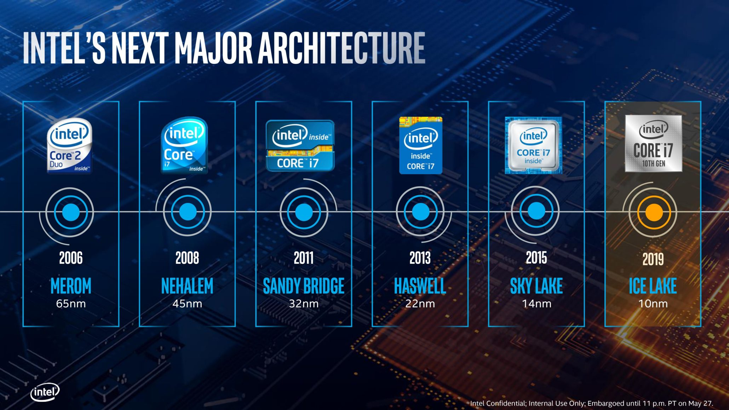
13.1 Introduction to the Ice Lake mobile line (5)
Intel’s major architectures of the Core 2 family [303]

Slide 11
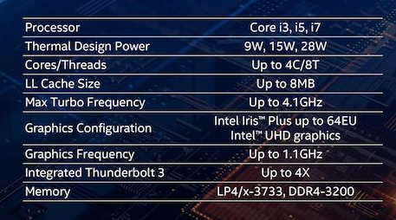
13.1 Introduction to the Ice Lake mobile line (6)
Main features of the 10th gen. Ice Lake mobile line [304]

Slide 12
13.1 Introduction to the Ice Lake mobile line (7)
Comparing main features of the 10th gen. Ice Lake line with previous lines
[325]
Core i7-1065G7 |  | Core i7-8565U | Core i7-8550U | Core i3-8130U | Core i3-8121U
Ice Lake | Line | Whiskey Lake | Kaby Lake-R | Kaby Lake | Cannon Lake
10+ | Process | 14++ | 14+ | 14+ | 10
08/2019 |  | 08/2018 | 08/2017 | 08/2016 | 08/2019
4C / 8T | Cores | 4C / 8T | 4C / 8T | 2C / 4T | 2C / 4T
1.3 GHz | Base Freq | 1.8 GHz | 1.8 GHz | 2.2 GHz | 2.2 GHz
3.9 GHz | 1C Turbo | 4.6 GHz | 4.0 GHz | 3.4 GHz | 3.2 GHz
Gen11 | GPU uArch | Gen9.5 | Gen9.5 | Gen9.5 | -
64 | GPU EUs | 24 | 24 | 24 | -
1.10 GHz | GPU Freq | 1.15 GHz | 1.15 GHz | 1.00 GHz | -
AVX-512 | AVX | AVX2 | AVX2 | AVX2 | AVX-512
15 W | TDP | 15 W | 15 W | 15 W | 15 W
2x 4GB LPDDR4X 3733 | DRAM | 2x 4GB LPDDR3 2133 | 2x 8GB LPDDR3 2133 | 2x 4GB DDR4 2400 | 2x 4GB DDR4 2400

Slide 13
13.1 Introduction to the Ice Lake mobile line (8)
The Y and U series of Ice Lake processors
Y-series target passively cooled devices (TDP = 5 W), whereas
U-series aims at actively cooled devices (TDP = 15 W at present).
Devices: e.g. thin notebooks or tablets
*

Slide 14
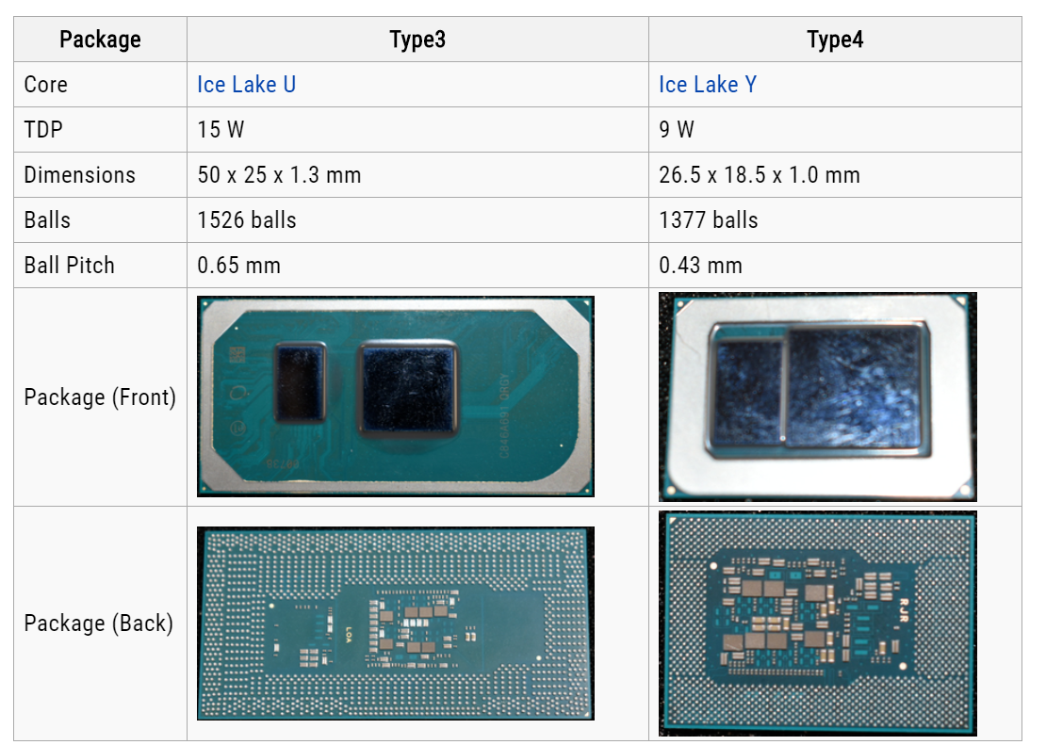
13.1 Introduction to the Ice Lake mobile line (9)
Packaging of Ice Lake U- and Y-series [305]
28/15 W
9 W

Slide 15
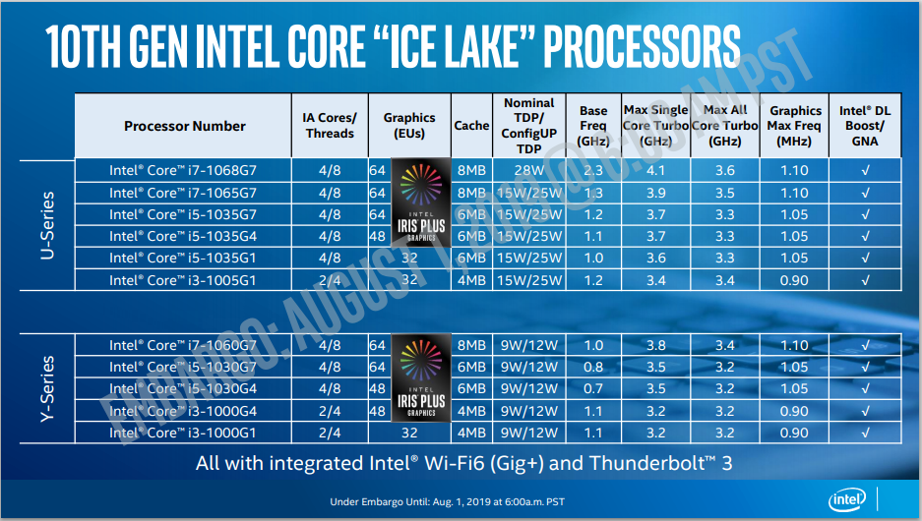
13.1 Introduction to the Ice Lake mobile line (10)
Main features of Intel’s 10 nm Ice Lake U- and Y series mobile models [322]
DL: Deep Learning
GNA = Gaussian Neural Accelerator

Slide 16
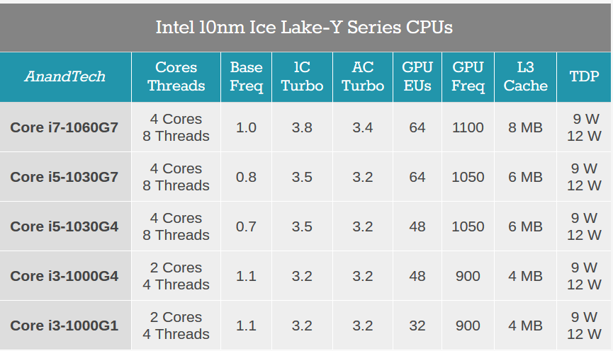
13.1 Introduction to the Ice Lake mobile line (11)
Introducing graphics qualifying tags in the model names
The graphics qualifying tag indicates the graphics performance, first of all, the number
of graphics processing units (GPU EUs), as exemplified below for the Ice Lake
U series processors.
Model name
GPU
EUs
Table: Model names and number of GPU EUs in Intel’s Ice Lake U series models [314]
*

Slide 17
13.1 Introduction to the Ice Lake mobile line (12)
TDP/cTDP
TDP: Thermal Design Power: Reference dissipation for designing the cooler
The processor dissipates as many Watts as indicated by the TDP value
wile running compute intensive workloads.
This is not the maximum possible dissipation that will be generated by
“power viruses”, i.e. programs written to consume the maximum power.
cTDP: Configurable TDP: increased TDP for higher clock rate but assumes a
suitable (higher performance) cooler.
*

Slide 18
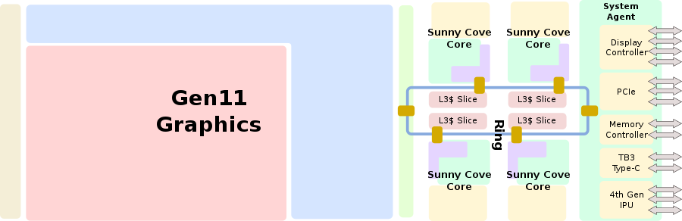
13.1 Introduction to the Ice Lake mobile line (13)
Layout of the up to 4 core Ice Lake processor [305]
TB3: Thunderbolt 3
IPU: Image Processing Unit

Slide 19
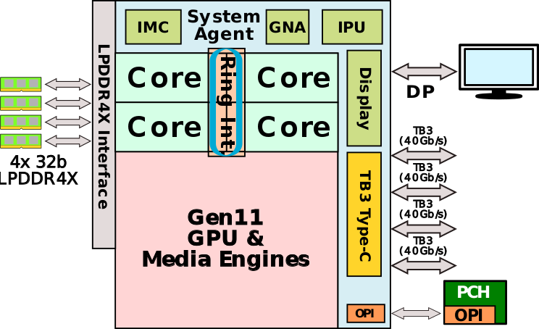
13.1 Introduction to the Ice Lake mobile line (14)
Major functional blocks of the Ice Lake processor [305]
IMC: Integrated Memory Controller
GNA: Gaussian Neural Accelerator
(for speeding up inferences)
IPU: 4th generation Image Processing Unit
TB3: Thunderbolt 3 (High-speed IO)
OPI: On-Package Interconnect

Slide 20
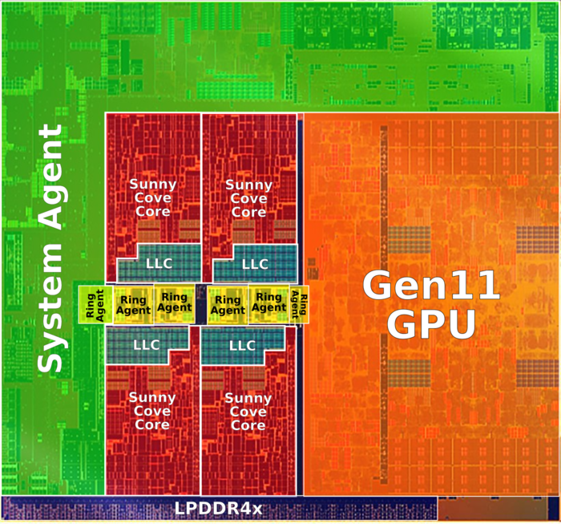
13.1 Introduction to the Ice Lake mobile line (15)
Floor plan of an Ice Lake die [305]

Slide 21
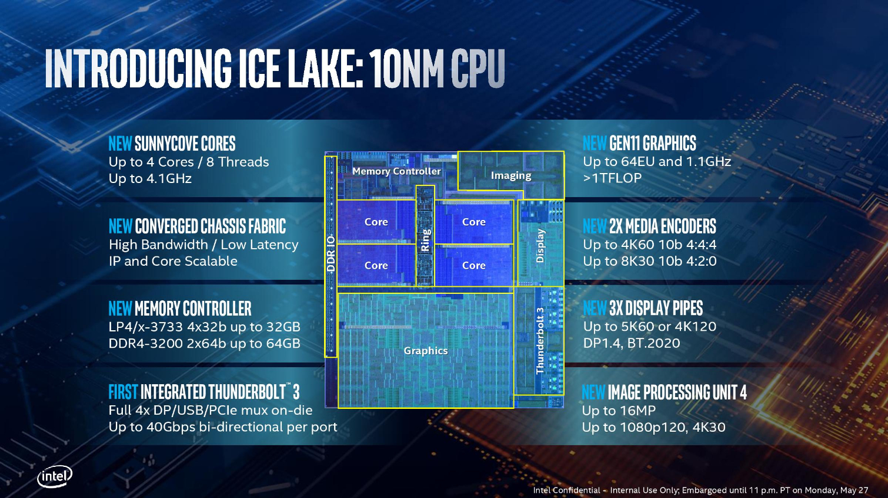
13.1 Introduction to the Ice Lake mobile line (16)
New features of the Ice Lake processor [306]

Slide 22
13.1 Introduction to the Ice Lake mobile line (17)
Major innovations of the Ice Lake line (discussed subsequently)
The Sunny Cove core (Section 13.2.1)
Generation 11 graphics (Section 13.2.2)
LP4x memory controller (Section 13.2.3)
On-die integrated Thunderbolt 3 (Section 13.2.4)
WiFi 6 support (not indicated in the Figure above since this feature is provided
by the 300-series chipset) (Section 13.2.5)
*

Slide 23
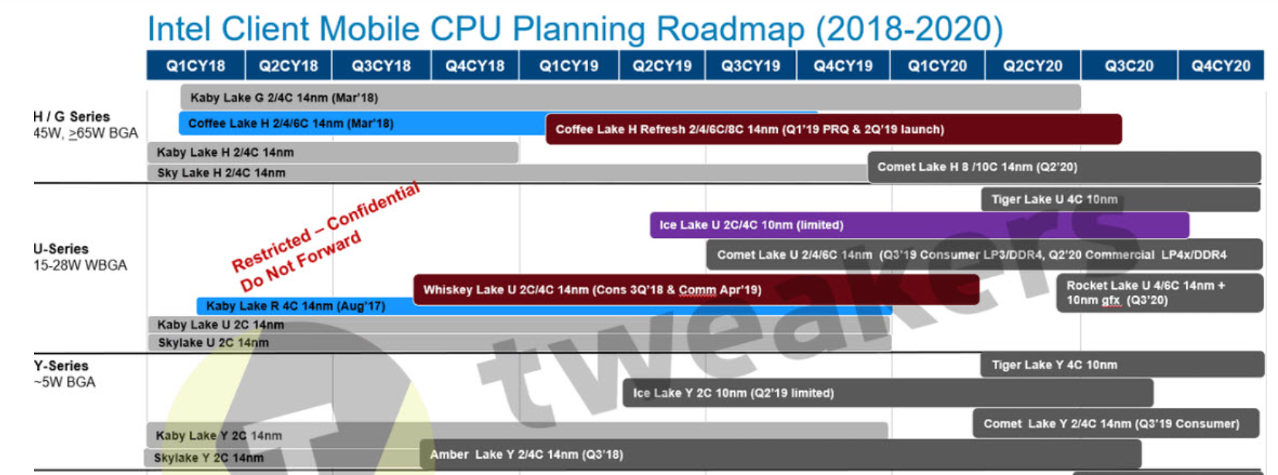
13.1 Introduction to the Ice Lake mobile line (18)
Remark: Intel’s leaked client CPU roadmap 2018 – 2020 [307]

Slide 24
13.2 Major innovations of the Ice Lake line
13.2.1 The Sunny Cove core
13.2.2 Gen. 11 graphics
13.2.3 WiFi 6 support
13.2.4 On-die integrated Thunderbolt 3
13.2.5 WiFi 6 support
Notes:
24

Slide 25
13.2.1 The Sunny Cove core
Notes:
25

Slide 26
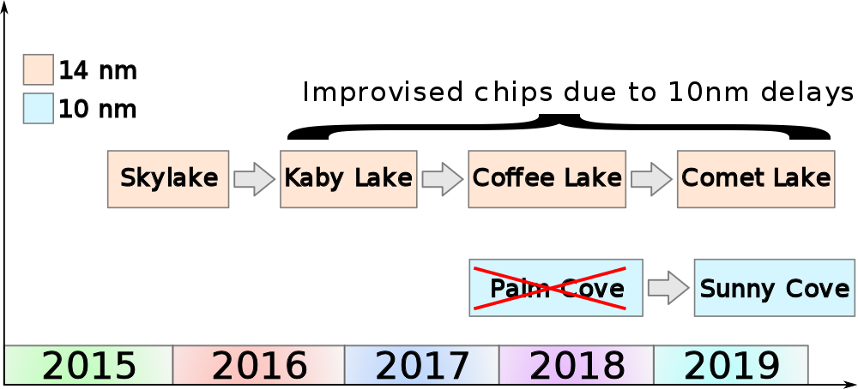
13.2.1 The Sunny Cove core (1)
13.2.1 The Sunny Cove core
Positioning the Sunny Cove core within Intel’s Core 2 cores [308]

Slide 27
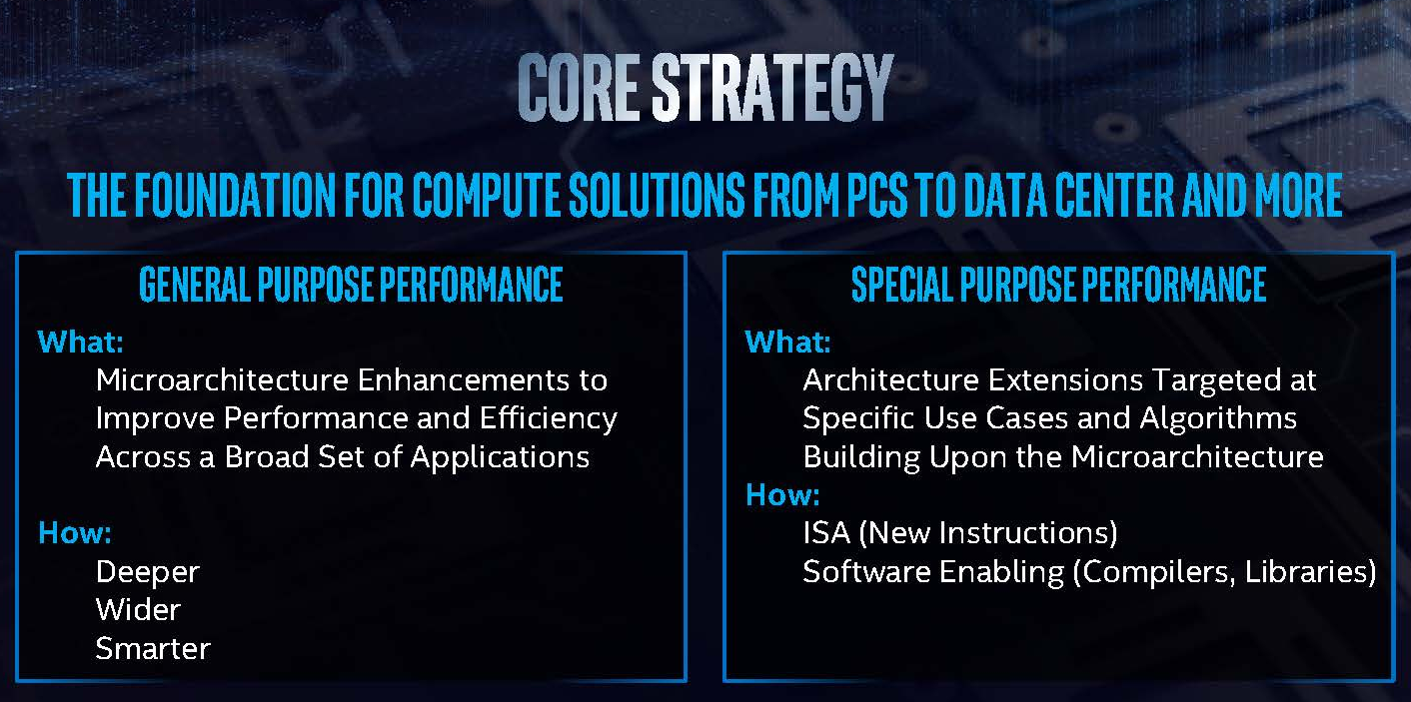
13.2.1 The Sunny Cove core (2)
Major enhancements of the Sunny Cove core
Dual objectives for increasing processor performance [296]

Slide 28
13.2.1 The Sunny Cove core (3)
a) Microarchitecture enhancements to improve general purpose performance
Main areas of microarchitecture enhancements
a1) wider issue and execution
(for processing more instructions per clock),
a2) deeper key structures, including caches
(for providing more parallelism per clock cycle) and
a3) smarter units
(for processing more instructions or data per cycle)
*

Slide 29
13.2.1 The Sunny Cove core (4)
a1) Wider issue and execution -1
7 additional execution units
2 additional issue ports

Slide 30
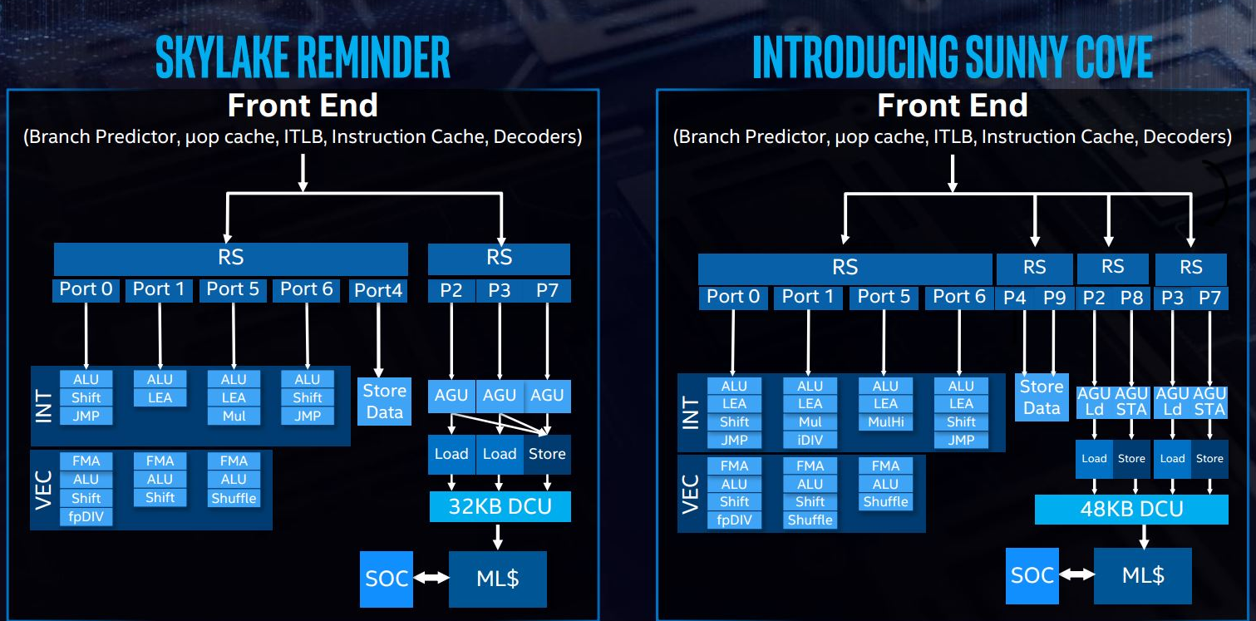
13.2.1 The Sunny Cove core (5)
a1/1 More issue ports
Sunny Cove provides 10 issue ports up from 8 being in the Skylake core (see below).
DCU: Data Cache Unit
Figure: Contrasting the back-ends of Skylake and Sunny Cove [297]

Slide 31
13.2.1 The Sunny Cove core (6)
a1) Wider issue and execution -2
This results in
more powerful numeric calculations and
issuing dual loads and dual stores rather than dual loads a single store
per cycle,

Slide 32
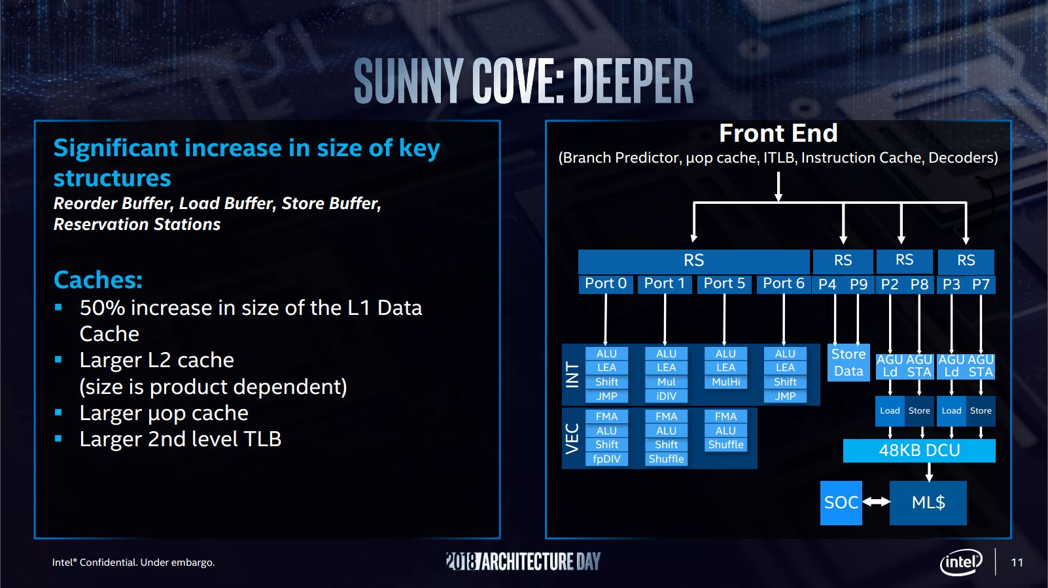
13.2.1 The Sunny Cove core (7)
a1/2) Deeper key structures, including caches
(for providing more parallelism per clock cycle) [297]
(now 48 KB vs 32 KB)
(512KB vs 256 KB)
(2304 vs 1536)

Slide 33
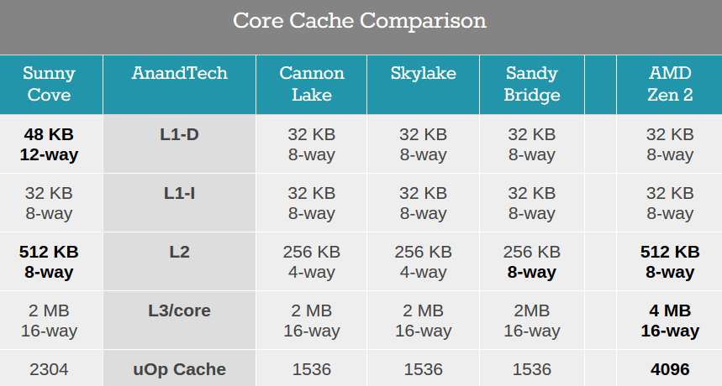
13.2.1 The Sunny Cove core (8)
Comparing cache sizes of major processor lines [314]
*

Slide 34
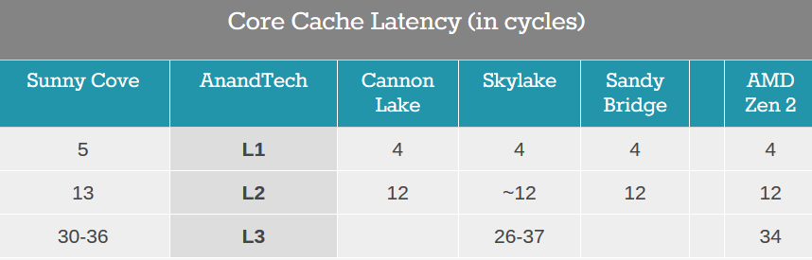
13.2.1 The Sunny Cove core (9)
Comparing cache latencies of major processor lines [314]
*

Slide 35
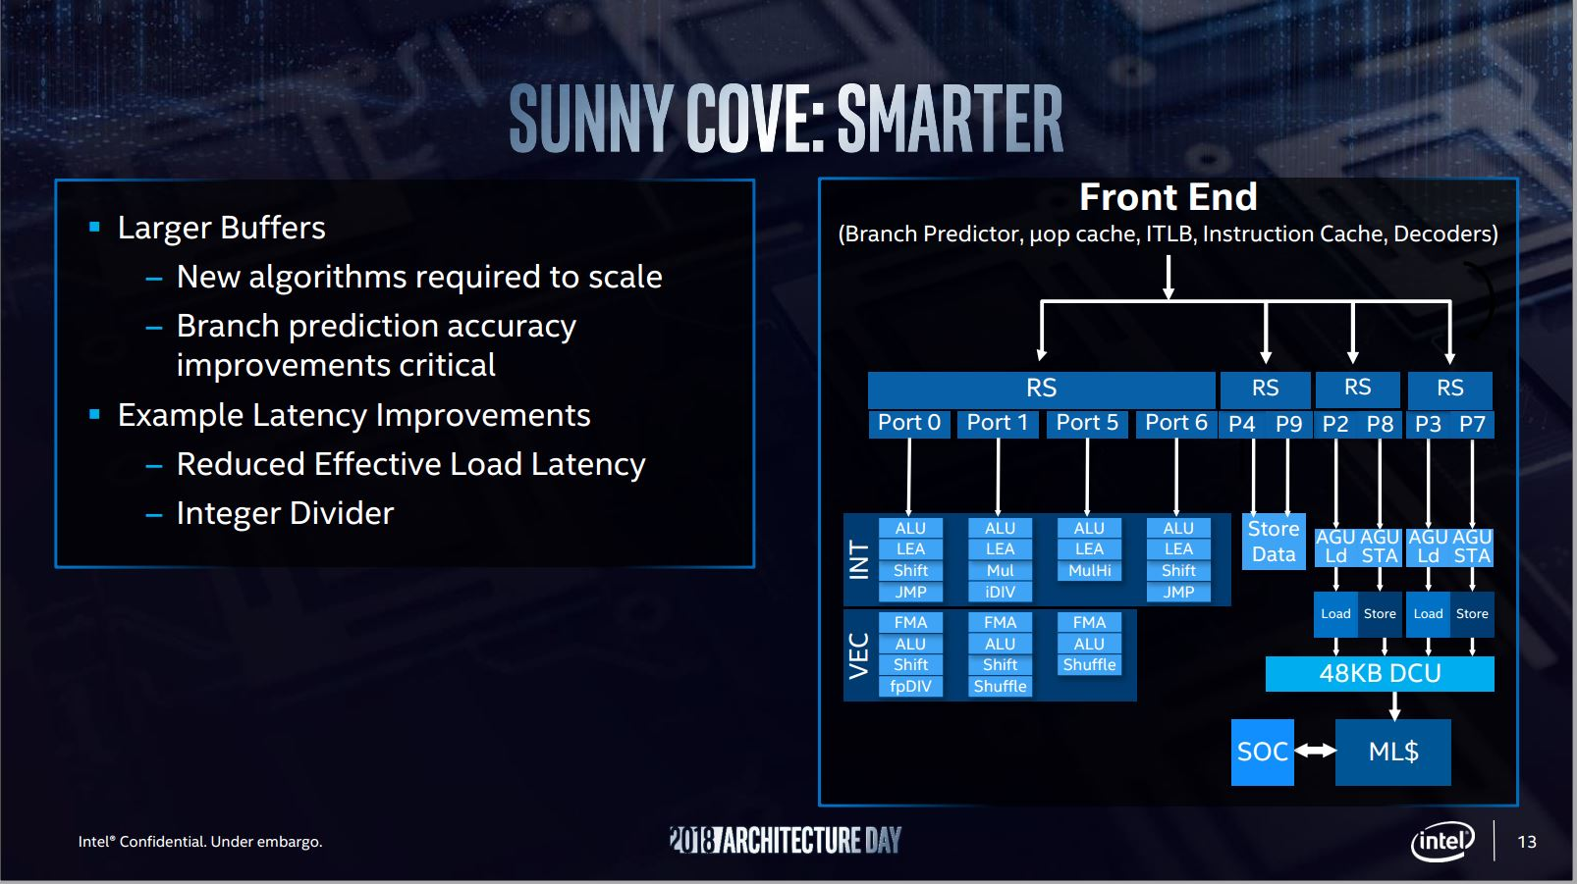
13.2.1 The Sunny Cove core (10)
a1/3) Smarter units (for processing more instructions or data) [297] -1

Slide 36
13.2.1 The Sunny Cove core (11)
a1/3) Smarter units (for processing more instructions or data) -2
In this respect Intel improved branch prediction accuracy, with additional latency
improvements, like load latency and implemented a new, faster integer divider
unit.
*

Slide 37
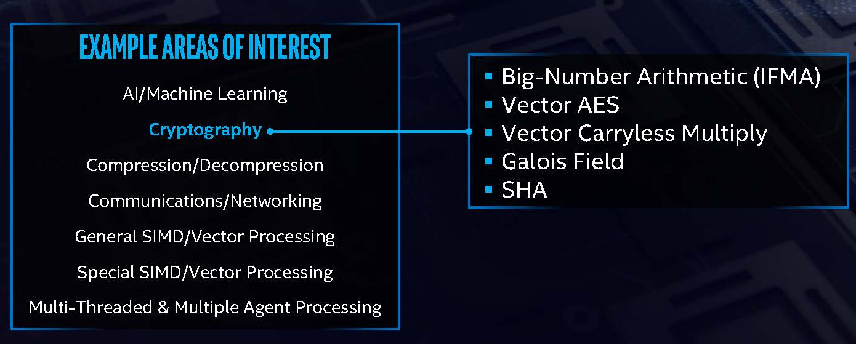
13.2.1 The Sunny Cove core (12)
b) Enhancements to improve special purpose performance
These enhancements include ISA and microarchitecture extensions to improve
performance for specific application domains and algorithms [296], [297]
Figure: Special domains of interest in improving performance of Sunny Cove [297]
*

Slide 38
13.2.1 The Sunny Cove core (13)
ISA extensions [296], [297]
In addition to the microarchitecture enhancements Sunny Cove introduces the
following ISA (architecture) extensions:
new instructions to speed up special fields of interest (as shown before),
57 bits linear address space,
52-bits physical address space, allowing to address 4 PetaByte per socket,
five levels of paging tables, up from four,
new security modes, including User Mode Instruction Prevention,
that forbids (if enabled) the execution of certain instructions if the
Current Privilege Level (CPL) is greater than 0.
Then user space applications can no longer access system-wide settings,
such as the global and local descriptor tables, the task register and
the interrupt descriptor table, and
new security instructions (see next).

Slide 39
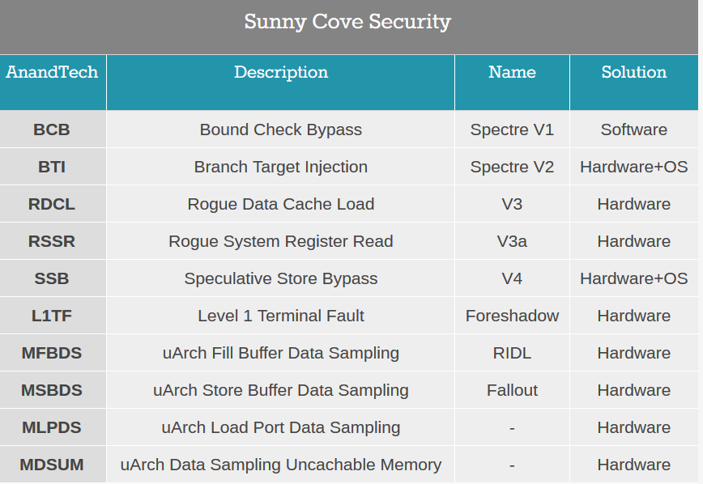
13.2.1 The Sunny Cove core (14)
Sunny Cove’s new security instructions [314]

Slide 40
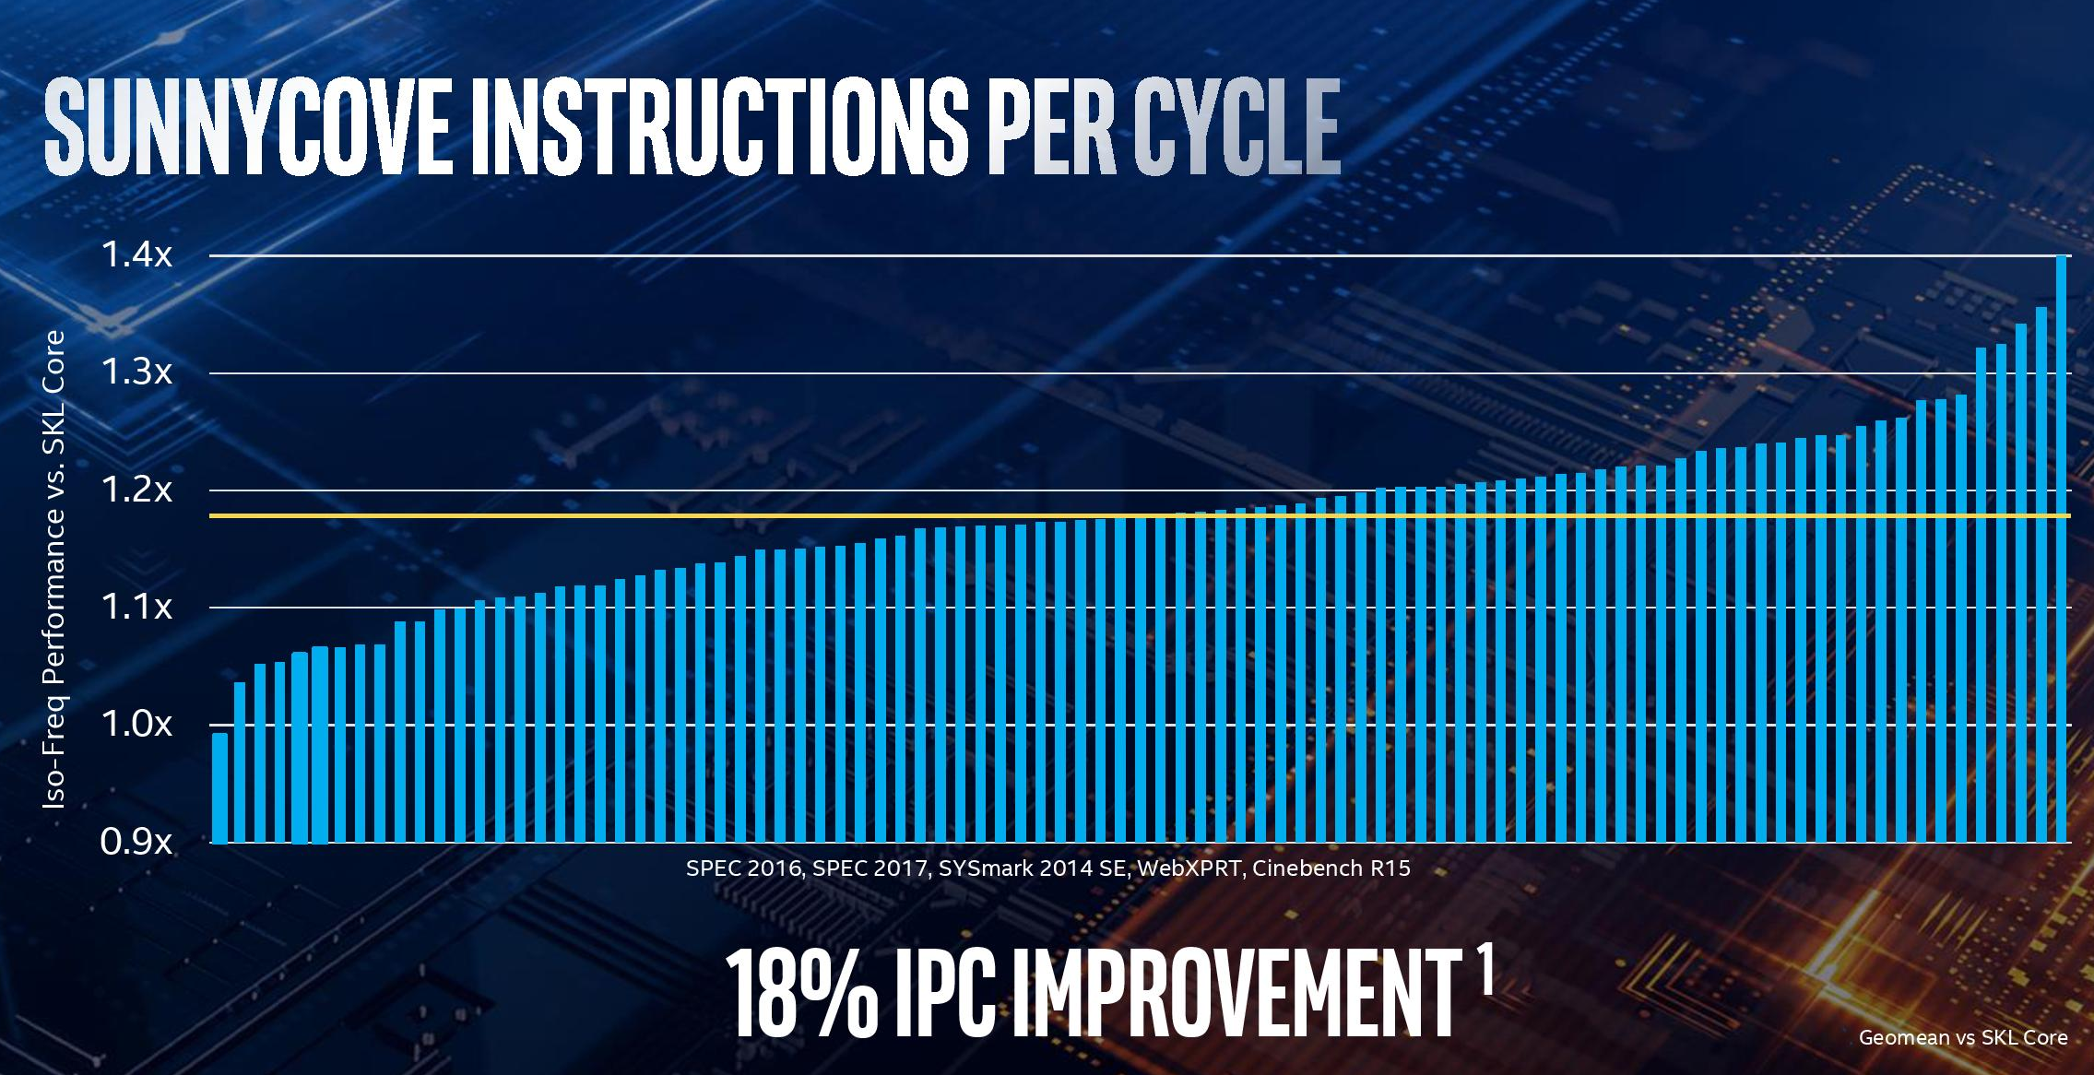
13.2.1 The Sunny Cove core (15)
IPC improvements of the Sunny Cove core vs. the Skylake core [304]
Skylake: 2015
*

Slide 41
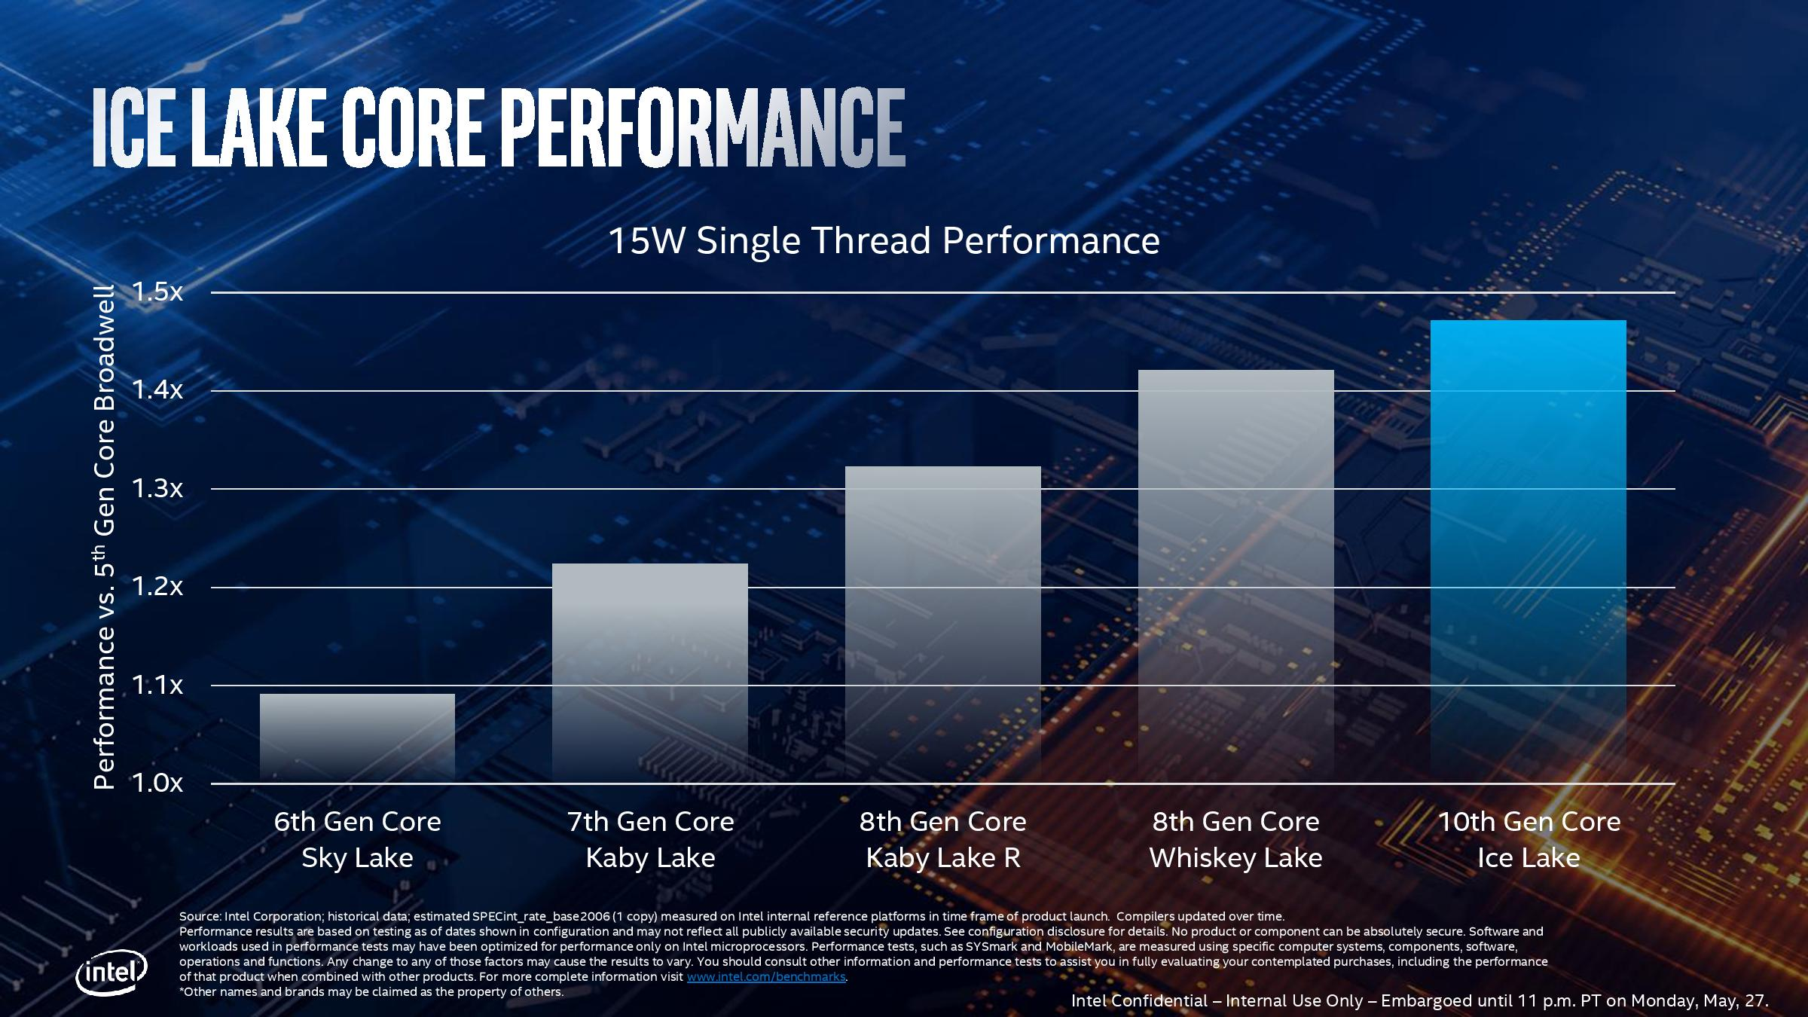
13.2.1 The Sunny Cove core (16)
Increasing single thread performance over Core 2 family generations [325] -1
vs. Broadwell (2014)
Broadwell: 2014

Slide 42
13.2.1 The Sunny Cove core (17)
Increasing single thread performance over Core 2 family generations [314] -2
When compared to the previous generation Whiskey Lake processors, Ice Lake brings
only a moderate performance gain (1.47 vs. 1.42 resulting in about 3.5 %).

Slide 43
13.2.2 Gen. 11 graphics
Notes:
43

Slide 44
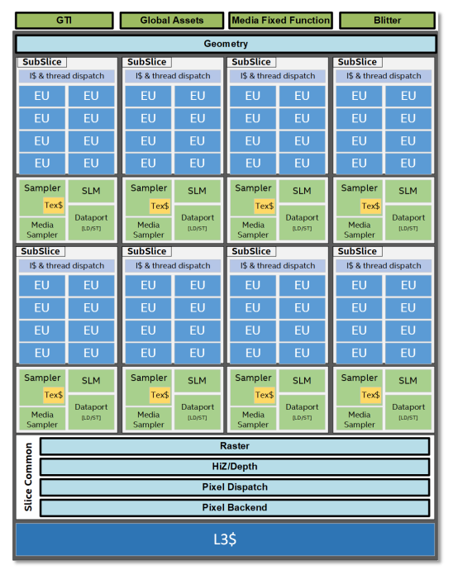
13.2.2 Gen. 11 graphics (1)
13.2.2 Gen. 11 graphics
Gen. 11 has a redesigned
architecture, as seen on the
next slides.
The slide incorporates 8 sub-slices
with 8 EUs each.
Figure: G7 level Gen. 11 graphics
[326]

Slide 45
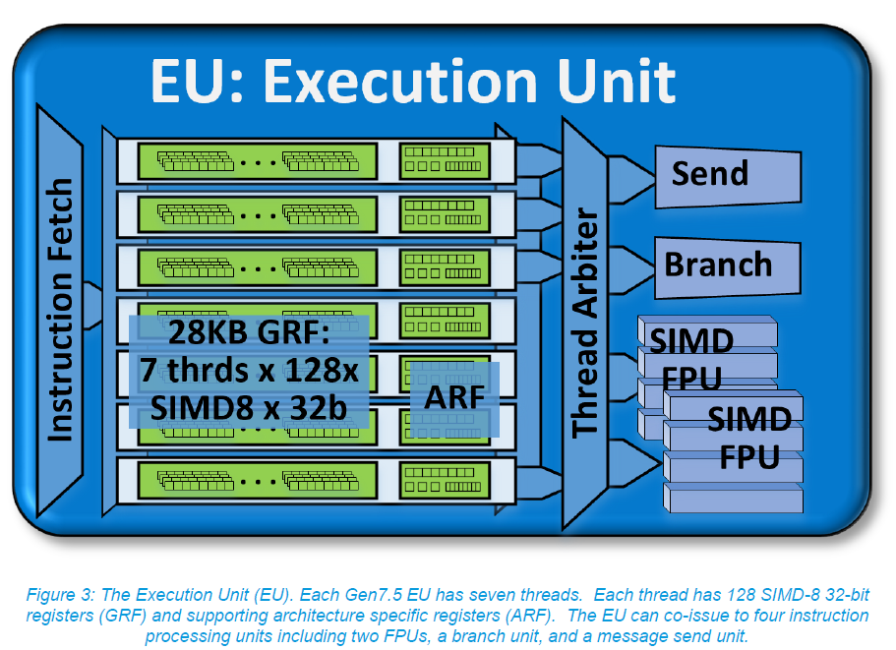
13.2.2 Gen. 11 graphics (2)
Comparing the Execution Units of Intel’s graphics generations 5 – 9.5 and 11
Execution Units (SIMD FPUs) implemented in
Intel’s graphics generations 5 -9.5 []a
Execution Units (ALUs) implemented in
Intel’s graphics generation 11 [236]
Each EU can execute 16 SP FP32 operations.
Each EU can execute 16 SP FP32 or
32 HP (Half Precision) FP16 operations.
This supports NN processing.

Slide 46
13.2.3 DDR4x memory
Notes:
46

Slide 47
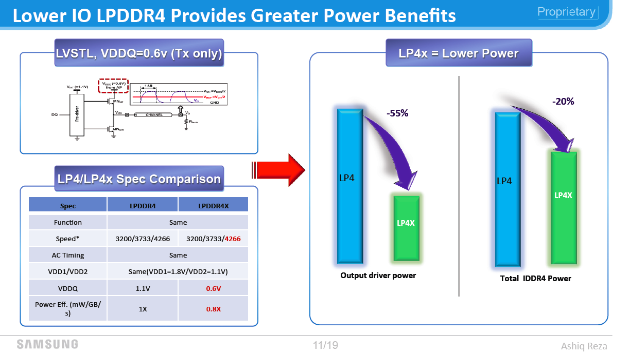
13.2.3 DDR4x memory (1)
13.2.3 DDR4 memory
Power reduction by LPDDR4x
Figure: Power reduction by using
LPDDR4x memory [323]

Slide 48
13.2.4 On-die integrated Thunderbolt 3
Notes:
48

Slide 49
13.2.4 On-die integrated Thunderbolt 3 (1)
13.2.4 On-die integrated Thunderbolt 3
Motivations for developing a new IO standard [309]
As laptops became more and more thinner, shrinking to less than ½ inch in depth,
previously used IO-ports, like VGA, HDMI or USB Type A ports can no more
fit into these slick notebooks.
Thus a need arose for thinner ports, like USB-C (USB Type C) or mini HDMI.
To provide fast and small IO ports Intel introduced In collaboration with Apple
the Thunderbolt IO interconnection standard that appeared first in Apple
notebooks in 2011.
*

Slide 50
13.2.4 On-die integrated Thunderbolt 3 (2)
Evolution of the Thunderbolt standard [309]
Thunderbolt and its update, Thunderbolt 2 (2014) make use of the same
connector and socket as Mini DisplayPort (MDP).
Nevertheless, recent laptops usually provide USB-C ports so the implementation of
Thunderbolt (1 or 2) ports needs additional space and cost, this prevented its
widespread use.
To mitigate this drawback, Thunderbolt 3 standard replaced the Mini DisplayPort
by the ubiquitous USB-C port.
This merges the benefits of the fast Thunderbolt 3 standard with the widespread
use of the USB-C port.
*

Slide 51
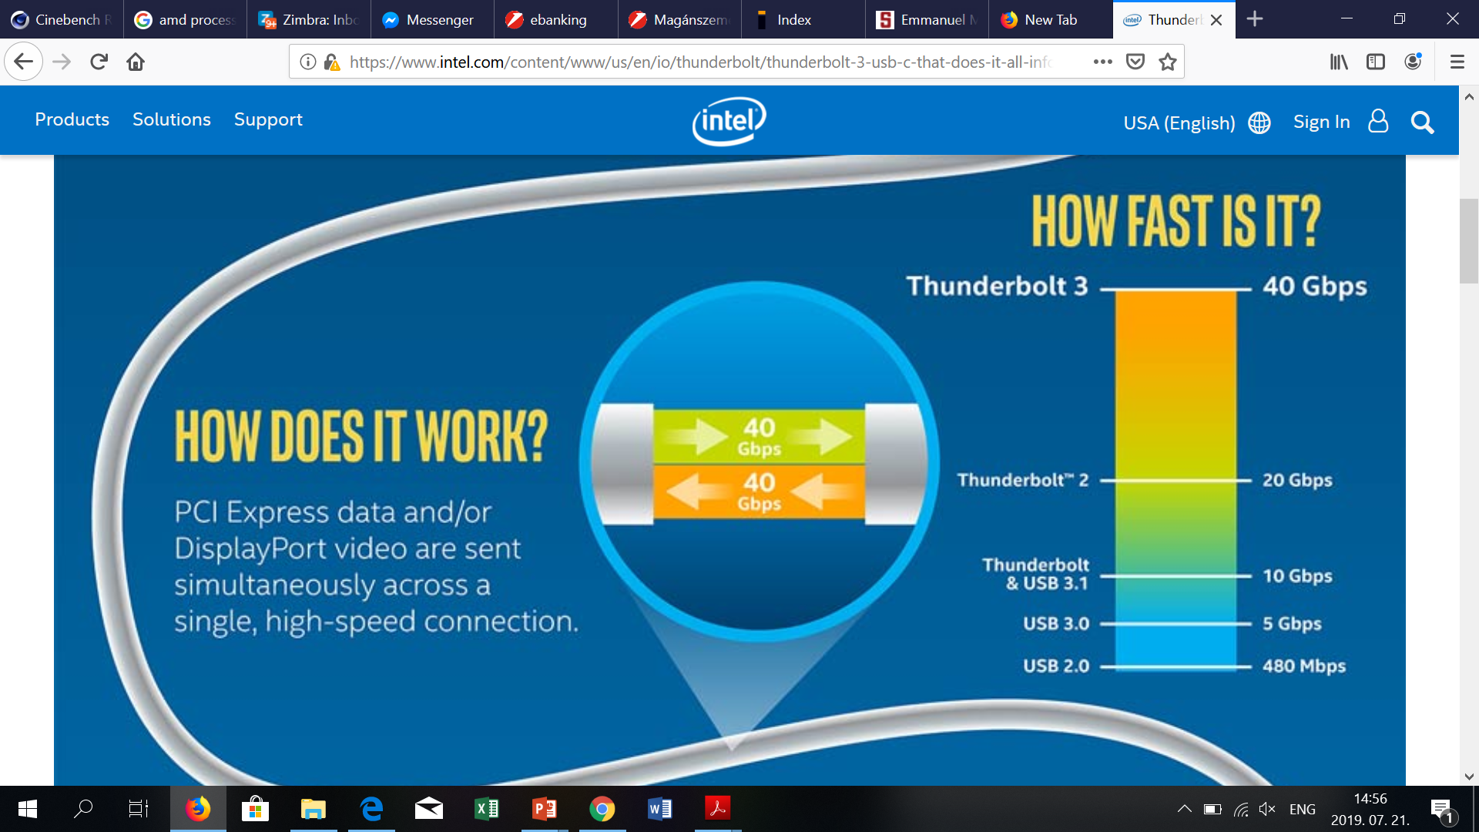
13.2.4 On-die integrated Thunderbolt 3 (3)
Data transfer rates supported by the Thunderbolt and USB standards [311]

Slide 52
13.2.4 On-die integrated Thunderbolt 3 (4)
Marking the availability of Thunderbolt 3 on connectors and sockets [309]
Note that while USB-C and Thunderbolt 3 have the same physical connectors and
sockets, Thunderbolt 3 has a different controller than USB-3 and Thunderbolt 3
does not operate via the USB-C circuitry.
Ports that only support USB-C but not Thunderbolt 3 will likely remain more
common at least for the next time.
To indicate Thunderbolt 3 support, USB-C connectors and sockets supporting
Thunderbolt 3 are designated by a lightning bolt icon, as seen e.g. in the
next Figures.
*

Slide 53
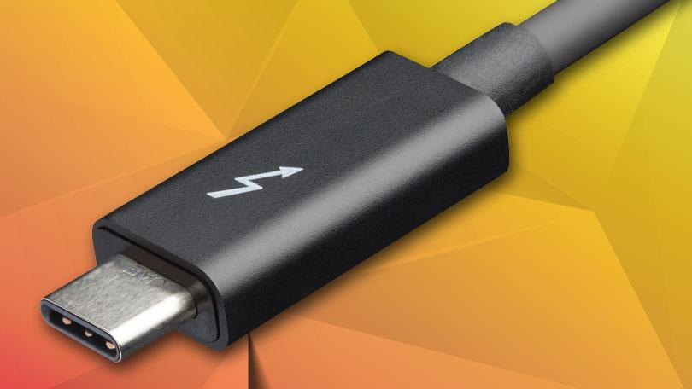
13.2.4 On-die integrated Thunderbolt 3 (5)
Thunderbolt 3 connector [309]
The original Thunderbolt and Thunderbolt 2 interfaces use Mini DisplayPort-shaped
connectors, i.e. they are incompatible with any USB port.
By contrast, Thunderbolt 3 is designed to be compatible with USB-C connectors,
sockets and USB-C cables.

Slide 54
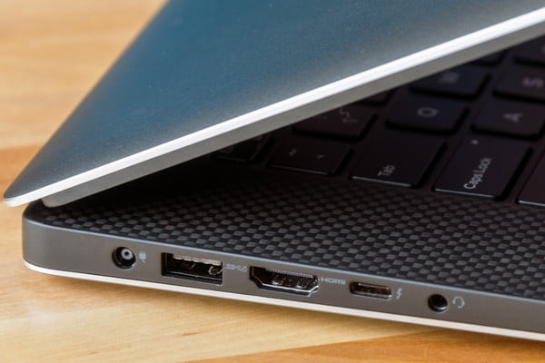
13.2.4 On-die integrated Thunderbolt 3 (6)
Thunderbolt 3 socket [310]

Slide 55
13.2.4 On-die integrated Thunderbolt 3 (7)
Use of Thunderbolt 3
Example use cases of Thunderbolt 3 [310]
Transmit data at a rate of 40 Gbps.
Output video to two 4K monitors at 60 Hz.
Charge smartphones and most laptops.
Connect to an external GPU (unless it’s been blocked by the manufacturer).
*

Slide 56
13.2.4 On-die integrated Thunderbolt 3 (8)
Spreading of the Thunderbolt technology [312]
Recently (3/2019), Thunderbolt 3 is common on high-end Windows laptops.
The number of PCs shipped with Thunderbolt doubles annually, now with
tens of millions sold.
The number of Thunderbolt peripherals available doubles also at the
same rate, with many hundred certified products offered on the market.
Recent Thunderbolt implementations are discrete while using on-board
Thunderbolt 3 controllers.
Intel’s Ice Lake processors are the first that provide a fully integrated
Thunderbolt 3 implementation.
This obviously will spur the spread of the Thunderbolt technology.

Slide 57
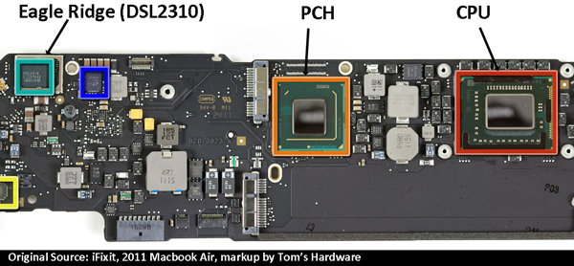
13.2.4 On-die integrated Thunderbolt 3 (9)
Example of a discrete Thunderbolt implementation
(actually in Apple’s Macbook Air (2011) [313]
(1. gen. Thunderbolt controller)

Slide 58
13.2.4 On-die integrated Thunderbolt 3 (10)
Example of an integrated Thunderbolt 3 implementation
(actually on Intel’s Ice Lake processor die (2019) [306]
*

Slide 59
13.2.4 On-die integrated Thunderbolt 3 (11)
Thunderbolt 3 cables [309]
Recently, Thunderbolt 3 cables are made of copper wires.
The simplest cables are passive and are identical to USB-C cables but do support
data transfers only up to 20 Gbps.
Data transfer rates of 40 Gbps however, need active cables that include integrated
chips.

Slide 60
13.2.5 WiFi 6 support
Notes:
60

Slide 61
13.2.5 WiFi 6 support (1)
13.2.5 WiFi 6 support -1
Series 300 chipsets provide also Intel’s first WiFi 6 implementation, called
WiFi 6 Gig+ as part of their “Integrated connectivity” technology, that
partially integrates the Wi-Fi/BT/RF module onto the PCH, as discussed
later in this Section.
It complies to the IEEE 802.11ax standard (see the next Table).
*

Slide 62
13.2.5 WiFi 6 support (2)
Evolution of the IEEE 802.11 WiFi standard (Based on [264]
Standard | Approved in | Frequency band | Band-width | MIMO technology | OFDMA coding | Data rate (up to)
11.b | 1999 | 2.4 GHz | 22 MHz | no | no | 11 Mb/s
11.a | 1999 | 5 GHz | 20 MHz | no | no | 54 Mb/s
11.g | 2002 | 2.4 GHz | 20 GHz | no | no | 54 Mb/s
11.n | 2007 | 2.4/5 GHz | 20 MHz | MIMO up to 4 streams (in downlink) | no | 288.8 Mb/s
 |  |  | 40 MHz |  |  | 600 Mb/s
11.ac (WiFi 5) | 2013 | 5 GHz | 20 MHz | MIMO up to 8 streams (in downlink) | no | 346.8 Mb/s
 |  |  | 40 MHz |  |  | 800 Mb/s
 |  |  | 80 MHz |  |  | 1733.2 Mb/s
 |  |  | 160 MHz |  |  | 3466.8 Mb/s
11.ax (WiFi 6) | 2019 | 2.4/5/6 GHz | 160 MHz? | MIMO up to 8 streams (in up and downlink) | OFDMA | Up to 10.53 Gb/s
MIMO: Multiple-Input Multiple-Output OFDMA: Orthogonal Frequency Division Multiple Access

Slide 63
13.2.5 WiFi 6 support (3)
Integrated WiFi 6 support -2
WifFi 6 is expected to provide 4x the transfer rate of WiF 5.
Main contributors of the speed up are:
a) MIMO technology and
b) the (OFDMA) Orthogonal Frequency Division Multiple Access modulation,
*

Slide 64
13.2.5 WiFi 6 support (4)
a) MIMO technology
MIMO technology is implemented in this case also in the downlink.

Slide 65
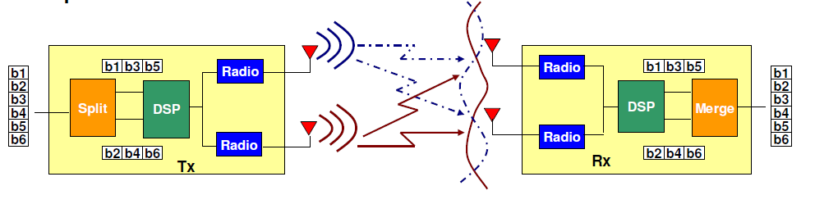
13.2.5 WiFi 6 support (5)
Recap: Principle of the MIMO technology -1
MIMO (Multiple-Input Multiple-Output) was introduced in the IEEE 801.11n WiFi
amendment in order to significantly raise data rate.
It assumes multiple antennas both at the transmitter and the receiver and
supports multiple communication channels for transmitting multiple data streams
simultaneously, e.g. 2 data streams, as the Figure below shows.
In the MIMO technology the transmitter splits the data stream to be transmitted
into sub-streams, these will be in transmitted in parallel over available channels
and then merged in the receiver, as indicated in the Figure.
Figure: Principle of the MIMO technology [266]
*

Slide 66
13.2.5 WiFi 6 support (6)
Recap: Principle of the MIMO technology -2
The 801.11n supports up to 4 whereas the 801.11ac and 11ax up to 8
parallel data streams.
In actual implementations the number of available transmitter and receiver
antennas (channels) is usually given in the form of nTmR or nxm, e.g. 2T2R
or 2x2.
*

Slide 67
13.2.5 WiFi 6 support (7)
b) (OFDMA) Orthogonal Frequency Division Multiple Access modulation
It is a multi-user version of the orthogonal frequency-division multiplexing
(OFDM) modulation scheme (not further discussed).
The multi-user feature of OFDM divides up the bandwidth among the
wireless devices without waiting, instead of forcing devices to wait
their turn to become active.
This reduces network latency by about 75 % compared to Wi-Fi 5
(802.11ac).

Slide 68
13.2.5 WiFi 6 support (8)
Integrated WiFi 6 support -3
WiFi 6 is implemented in form of Intel’s Integrated connectivity (CNVi), introduced
in Intel’s 8th generation chipsets supporting select Coffee Lake processors (2017).

Slide 69
13.2.5 WiFi 6 support (9)
Recap: Intel’s Integrated connectivity (CNVi) -1
Intel’s Integrated connectivity relates to partially integrating 802.11ac Wi-Fi 5,
BT and RF blocks onto the PCH, as detailed later in this section.
It was introduced in the 300 series PCHs of the Coffee Lake line (2017).
Traditionally, there is a Wi-Fi/BT/RF module that is placed apart from the
processor, e.g. on an M.2 card or as a chip mounted onto the mainboard.
With “Integrated connectivity” Intel partially integrates the Wi-Fi/BT/RF module
onto the PCH.
In this kind of implementation” Intel places expensive functional blocks of the
Wi-Fi/BT/RF module, such as the logic, MAC (Multiplier-Accumulator) and
memory onto the PCH, into a block called Pulsar, whereas other parts of the
module, like the PHY (Physical layer) and RF remain on a companion RF module
(CRF), dubbed Jefferson Peak, as seen below.
The CRF module is implemented on an M.2 card and is interconnected with the
PCH via an Intel proprietary bus, called the CNVio interface, as shown below.
*

Slide 70
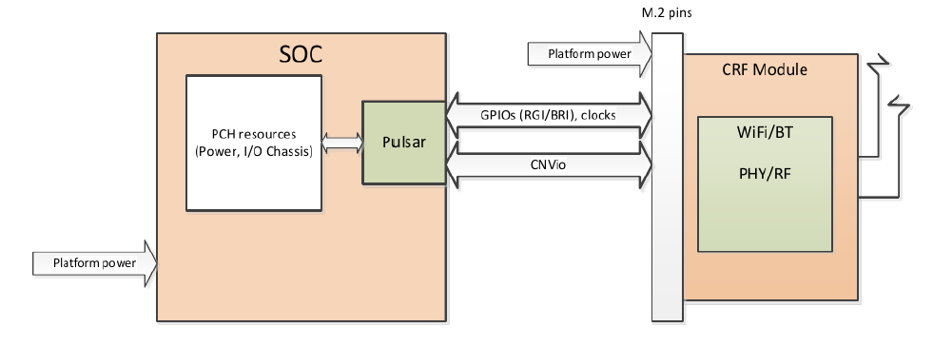
13.2.5 WiFi 6 support (10)
Intel’s 2T2R 802.11ac implementation called Integrated connectivity (CNVi)
[267]
PCH
(Jefferson Peak)
Pulsar
(Integr.
blocks)
(Companion
RF Module)

Slide 71
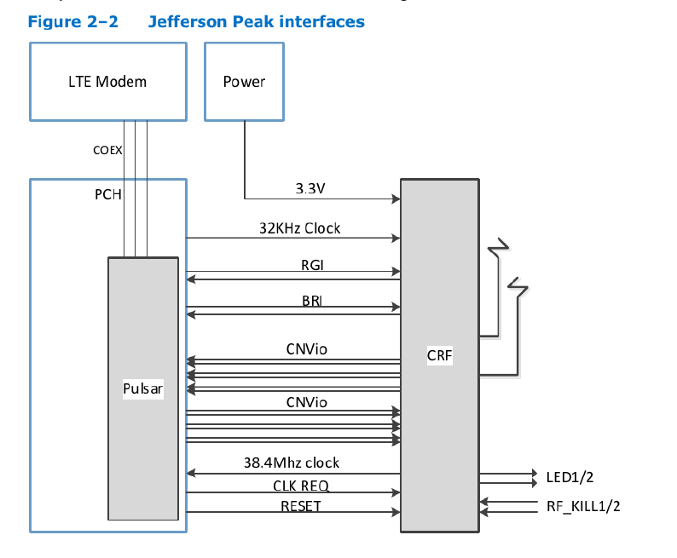
13.2.5 WiFi 6 support (11)
Recap: Interfacing the Companion RF module (CRF) to the PCH [267]
RGI: Radio Generic Interface, between CRF and Pulsar
BRI: Bluetooth Radio Interface, between CRF and Pulsar
CNVio: Proprietary Intel interface between CRF and Pulsar
The Intel proprietary CNVio bus
has two data lanes
and one clock for each direction.
Both data and clock signals are
differential, 100 Ώ signals.
Total number of the signals is
12 (6 pairs, 3 per direction).

Slide 72
13.2.5 WiFi 6 support (12)
Recap: Intel’s Integrated connectivity (CNVi) -2 [253]
Integrated connectivity is supported by the 300 series PCHs of the Coffee Lake
line, both by the DT and mobile PCH models, (except the earlier (10/2017)
launched Z370 PCH).
As part of their Integrated connectivity technology Intel provides a number of
CRF modules, including
the AC-9560 (2T2R module, the only vPro enabled CRF),
The AC-9462 (a 1T1R module), and
The AC-9461 (a low-end 1T1R module).
All three CRFs are supported by Linux, Chrome OS, and Windows 10.

Slide 73
13.2.5 WiFi 6 support (13)
Recap: Intel’s Integrated connectivity implementation of 2T2R 802.11ac
Wi-Fi [253]
This feature supports 160 MHz channel bandwidth and yields data rates up to
1733 Mb/s.
According to Intel, this speed is 12x faster than 1T1R 802.11n support provided
by low cost WiFi solutions and twice as much as most 2T2R solutions available
on the market.
We note that 2T2R support needs the AC9650 CRF, other models listed above
do not implement it (only the 1T1R mode with lower data rates).
Due to its additional costs (of about 15 $) only a few motherboards enable
the Integrated connectivity feature.

Slide 74
13.2.5 WiFi 6 support (14)
Remark 1
Intel introduced Integrated connectivity already in 12/2017 in their low power
power oriented Atom line (in the Gemini SOC platform with Goldmont Plus cores
sold as the low cost Pentium and Celeron models).
Remark 2
It can be presumed that Integrated connectivity aims at increasing Intel’s revenue,
since with it the Wi-Fi/BT/RF modules have to be bought from Intel as well.
*

Slide 75
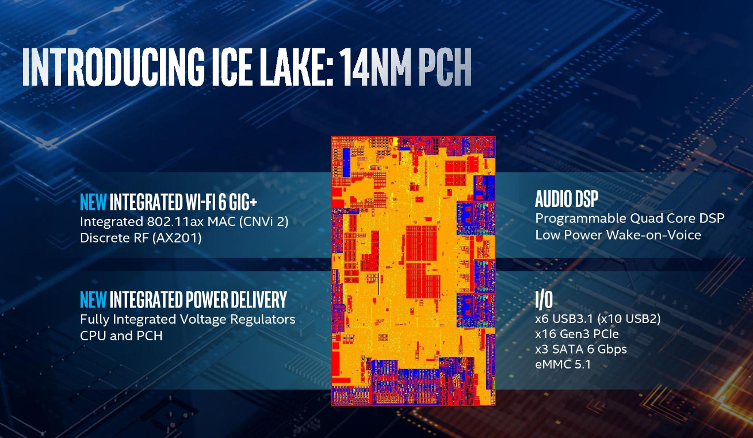
13.2.5 WiFi 6 support (15)
Implementation of integrated WiFi 6 GiG+ in the PCH of Ice Lake [306]

Slide 76
13.3 Performance assessment
Notes:
76

Slide 77
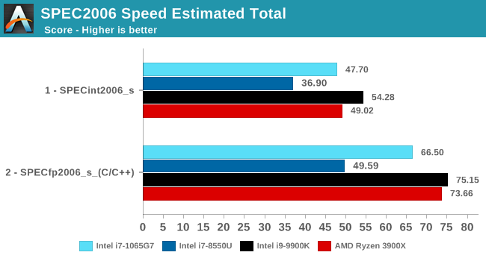
13.3 Performance assessment ()
13.3 Performance assessment
SPEC2006 performance of Intel’s Ice Lake U series processors [314]
(Ice Lake)
(15 W)
(Kaby Lake R)
(15 W)
(Coffee Lake-S)
(95 W)
Zen-based)
(105 W)

Slide 78
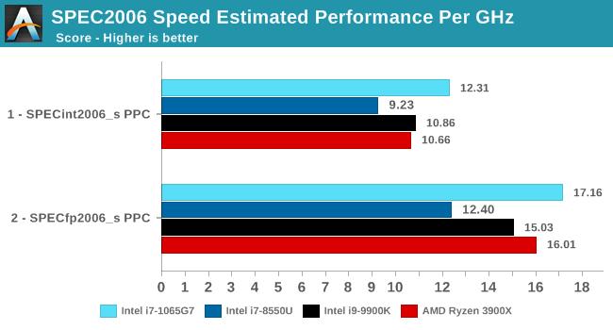
13.3 Performance assessment (2)
SPEC2006 efficiency (performance/GHz) of Intel’s Ice Lake U series
processors [314]
(Ice Lake)
(15 W)
(Kaby Lake R)
(15 W)
(Coffee Lake-S)
(95 W)
Zen-based)
(105 W)
*

Slide 79
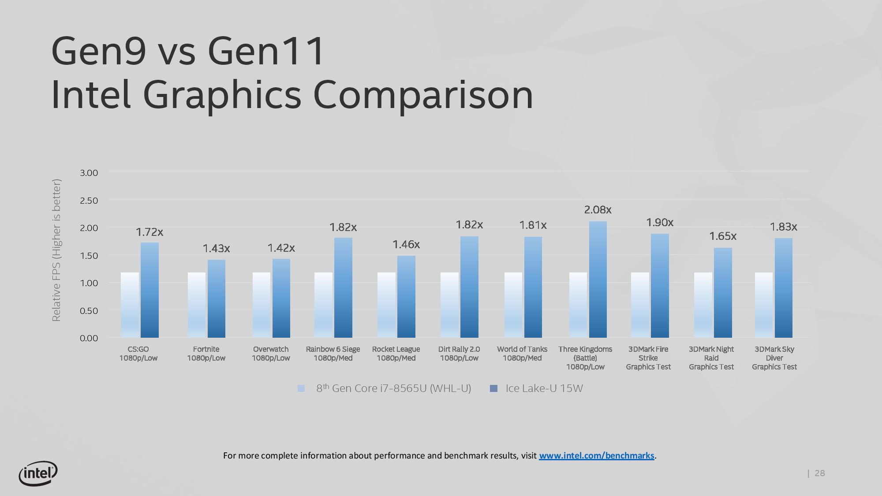
13.3 Performance assessment (3)
Improvements of Gen11 graphics on Ice Lake vs. Gen9 graphics on
Whiskey Lake (released by Intel) [304]

Slide 80
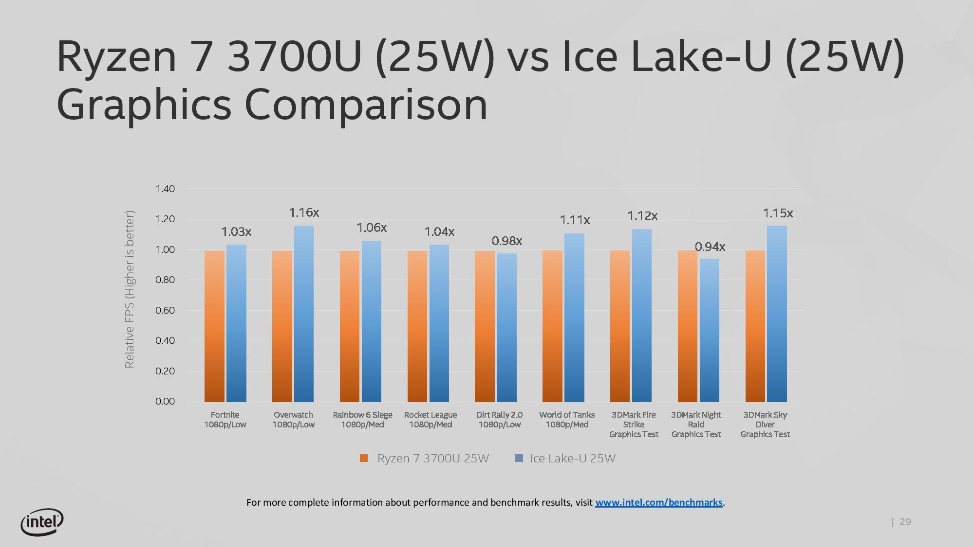
13.3 Performance assessment (4)
Graphics performance: Ryzen 7 3700U (25 W) vs. Ice Lake-U (25 W)
(released by Intel) [304]

