Slide 1
Client processors - 1
Overview
Dezső Sima
August 2019
(Ver. 1.1)
© Sima Dezső, 2019

Slide 2
1. Overview of client processors
1.1 Introduction
1.2 Milestones of the evolution of DT and LT processors
prior arriving the Core 2 family
1.3 Desktop and laptop processor lines covered
1.4 CPU core count of desktops and laptops
Notes:
2

Slide 3
1.1 Introduction
Notes:
3

Slide 4

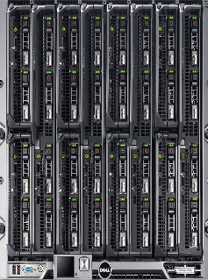
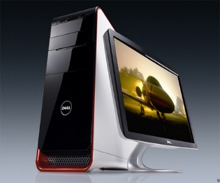
1.1 Introduction (1)
1.1 Introduction
Recent computer categories
Recent computer categories
Servers
HEDs
(High-End Desktops)
Desktops
Laptops
Tablets
Smartphones
Desktops
Smarphones
Desktops
Desktops
Laptops
Tablets
Servers
High-End Desktops
*

Slide 5
1.1 Introduction (2)
Recent processor categories
Recent processor categories
Server
processors
HED processors
(High-End Desktop)
Desktop
processors
Laptop
(Notebook)
processors
Tablet
processors
Smartphone
processors
Desktops
Example
Intel processors:
(Client processors)
(Mobile processors)
Xeon E7/E5/E3
Platinum/Gold etc.
Core i9/i7
(Extreme Edition
or X models)
Core i7/i5/i3
(Basic architectures)
Atom lines
(+ LP Laptop
models)
Atom lines
Smarphones
Smarphones
Laptops
Tablets
Desktops
(Intel and AMD
designates them
also as mobile
processors)
Tablets
Smartphones
(Intel’s/AMD’sdesignation: Mobiles)
Servers
High-End Desktops
Desktops
*

Slide 6
1.1 Introduction (3)
Remarks to the terminology
In line with the literature we use the designations laptop and notebook
interchangeable.
Further on, to simplify our discussion, we refer to both desktops and
laptops/notebooks as client processors or DT/LT processors.
We note that both Intel and AMD designate their processors targeting laptops or
tablets as mobile processors, so vendor-specific data cited in this Chapter
needs to be interpreted accordingly.
By contrast, in this series of Lecture notes we use the term “mobile processors”
differently, we interpret this term such that it covers tablet- and smartphone
processors and special Chapters of our Lecture notes are devoted to
different aspects of mobile processors.
*

Slide 7
1.1 Introduction (4)
Remarks to the layout of this lecture notes
Why laptops are discussed along with desktops in this Chapter, rather than with
tablets and smartphones even when laptops are mobile devices such as tablets
and smartphones?
For the time being desktops and laptops are typically based on x86 processors.
Desktops and laptops build a continuum where desktops provide higher performance
and power consumption whereas laptops utilize less power hungry processors that
are obviously, less powerful.
On the other hand, tablets and smartphones are built typically on ARM ISA-based
processors.
Here we make two comments:
Previously, both Intel and AMD tried to offer X86 processors for tablets and smartphones that failed and both vendors cancelled their related efforts in 2016.
Recently, there is an opposite move, that is introducing ARM ISA based processors for laptops or tablets that are intended to run under Windows 10 (e.g. from Qualcomm).
*

Slide 8
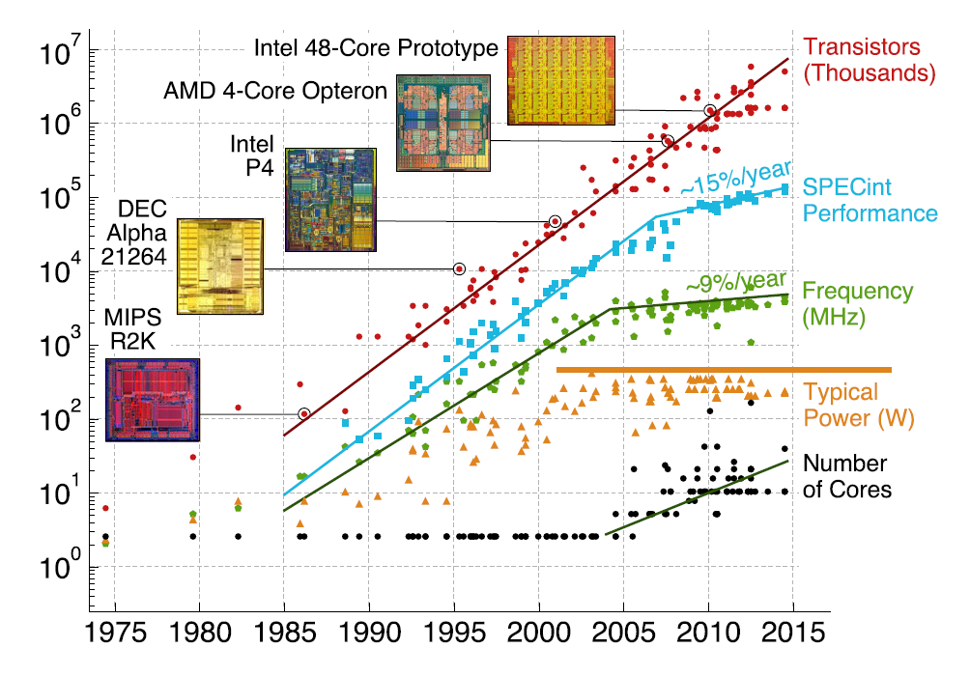
1.1 Introduction (5)
Power constraints being one of the basic limitations of processors [1]

Slide 9
1.1 Introduction (6)
Typical TDP values of desktop and laptop processors
Processor category |  | TDP | Intel’s usual tags
Servers |  | ≈85-200 W
HEDs |  | ≈100-150 W | X
 | High perf. | ≈70-95 W | K
 | Mainstream | ≈50-65 W | S
 | Low power | ≈35-45W | T
 | High perf. | ≈45 W | H/HQ
 | Mainstream | ≈25-35 W | U
 | Ultra-thin | ≈15 W | U
Tablets |  | ≈5 W | Y/m
Desktops
Notebooks
*

Slide 10
1.1 Introduction (7)
Remarks
The total dissipation of fan-less tablets needs to be less than 3-7 W, mainly
depending on the display size and thickness.
There are also fan-less notebooks, they are implemented primarily with
tablet processors, but they obviously suffer from low performance.
*

Slide 11
1.1 Introduction (8)
Example: Relationship between TDP and core frequency in models of the
Skylake line (Based on data from [19])
TDP (W) | No. of cores | Graphics | No. of graphics EUs | eDRAM | Base frequency (GHz)
4.5 | 2 | HD 515 | 18 | -- | 1.2
15 | 2 | HD 540 | 48 | 64 MB | 2.2
15 | 2 | HD 520 | 24 | -- | 2.6
28 | 2 | HD 550 | 48 | 64 MB | 3.3
35 | 4 | HD 530 | 24 | -- | 2.8
45 | 4 | HD 530 | 24 | -- | 2.9
65 | 4 | HD 530 | 24 | -- | 3.4
91 | 4 | -- | -- | -- | 4.2
Note that high performance and low power consumption are antagonistic requirements.
E.g. low power consumption (i.e. TDP) can be achieved first of all by reduced core
frequency and computer resources (core, GPU, Eus) and results in lower performance.

Slide 12
1.2 Milestones of the evolution of desktop and laptop processors prior the Core 2 family
Notes:
12

Slide 13
1.2 Milestones of the evolution of DT and LT processors (1)
1.2 Milestones of the evolution of DT and LT processors prior arriving
the Core 2 family
In this respect we point out four major steps of the evolution, as follows:
a) Emergence of 64-bit RISC processors (in the middle of the 1990’s)
b) Decline of RISC processors (from the end of 1990’ on)
c) Emergence of 64-bit CISC processors (AMD: 2003, Intel: 2004)
d) Emergence of the multicore era (Intel/AMD: 2005)
*

Slide 14
1.2 Milestones of the evolution of DT and LT processors (2)
a) Emergence of 64-bit RISC processors
RISC processors made their move to 64 bit already a couple of years earlier than
their CISC counterparts, that is mostly around the middle of the 1990s, as the
table below indicates.
Vendor | 64-bit ISA | Proc. model | Introduced
DEC | Alpha AXP | Alpha 2064 | 1992
Sun | SPARC V9 | UltraSPARC | 1995
HP | PA-RISC | PA-8000 | 1996
Apple, IBM, Motorola | PowerPC | PowerPC 620 | 1997
Table: Emergence of 64-bit RISC processors
*

Slide 15
1.2 Milestones of the evolution of DT and LT processors (3)
b) Decline of RISC processors -1
At the end of the 1990s clock speeds of CISC processors (Intel’s Pentium and
AMD’s Athlon lines) surpassed that of contemporary RISC’s from HP, MIPS, DEC
(Alpha line) and others, as shown in the next Figure.
*

Slide 16
1.2 Milestones of the evolution of DT and LT processors (4)
Raising clock speeds of CISC processors (Intel’s Pentium and AMD’s Athlon)
vs. RISC processors of various vendors in 1995-2000 [2]
Pentium
AMD
Alpha
Sun
HP

Slide 17
1.2 Milestones of the evolution of DT and LT processors (5)
Decline of RISC processors -2
At the end of the 1990’s also the performance of 32-bit CISC processors caught up
with that of 64-bit RISC processors and rose at a more steeper rate, as the Figure
below shows.
SPECint95base: x86 vs RISC
35
60%
667 MHz
21264
30
575 MHz
21264
50%
700 MHz
AMD Athlon
25
40%
600 MHz
21164
600 MHz
21164
RISC
20
450 MHz
PII Xeon
30%
x86
15
500 MHz
21164
333 MHz
PII
20%
Delta
10
300 MHz
21164
300 MHz
PII
200 MHz
PPro
10%
5
133 MHz
Pentium
0
0%
Sep-95
Dec-96
Jul-97
Mar-98
Nov-98
Aug-99
Source: Microprocessor Report and AMD Preliminary Results
Figure: Evolution of FX performance of RISC and CISC processors in 1995-2000 [3]

Slide 18
1.2 Milestones of the evolution of DT and LT processors (6)
Decline of RISC processors -3
Due to the more and more serious handycap of RISC processors in terms of
clock speed and performance, vendors one of the other cancelled their respective
RISC lines (see the Table below) and abandoned their RISC developments.
Vendor | Proc. line | Year of cancellation
MIPS | R-line | 1998
DEC | Alpha-line | 2001
HP | PA-8000 | 2005
Apple, IBM, Motorola | PowerPC line | 2005
Table: Cancellation of RISC developments and lines
*

Slide 19
1.2 Milestones of the evolution of DT and LT processors (7)
c) Emergence of 64-bit CISC processors
The next milestone in the evolution of DT and laptop processors was widening
the width of CISC processors from 32-bit to 64-bit in the first halve of the 2000.
This move was started by AMD’ 64-bit extension of the x86 ISA, announced
as early as 1999 [176], designated it as the x86-64 extension and implemented
first in their K8 (Hammer) processors line in 2003.
Intel followed suit in 2004 by adopting AMD’s 64-bit x86 ISA extension (while
calling it EM64T, but renamed to Intel 64 in 2006) and transforming their
entire processor spectrum from 32- to 64 bit, as the next Figure shows it for
the server segment.
EMT is the abbreviation of Extended Memory Technology, later renamed to
*

Slide 20
1.2 Milestones of the evolution of DT and LT processors (8)
Intel’s move to 64-bit [4]
*

Slide 21
1.2 Milestones of the evolution of DT and LT processors (9)
Remarks to Intel’s move to 64-bit
For years Intel denied their secret 64-bit x86 development, pursued in Oregon
(called Yamhill, after a river in Oregon), since a new 64-bit architecture would
bring an “in-house competition” to Intel’s and hp’ jointly developed 64-bit
Itanium line (designated as IA64).
A noteworthy indicator for Intel’s move to 64 bit was the fact that Intel’s third
Pentium 4 core (Prescott) had more than twice as many transistors than Intel’s
previous second generation core (Northwood), in fact 125 million transistors
vs. 55 million.
This could not be justified by Prescott’s 1 MB large L2 caches vs. Northwood’s
512 KB L2 caches alone, as indicated in the next Figure.
*

Slide 22
1.2 Milestones of the evolution of DT and LT processors (10)
Intel's Pentium 4 family
180 nm
130 nm
90 nm

Slide 23
1.2 Milestones of the evolution of DT and LT processors (11)
d) Emergence of the multicore era
An important step in the evolution of processors was the emergence of the multicore
era mostly around 2005, as demonstrated by the next two Figures.
*

Slide 24
1.2 Milestones of the evolution of DT and LT processors (12)
Emergence of dual core processors
Year of launching | Dual core design
12/2001 | IBM launches dual core POWER4
11/2002 | IBM launches dual core POWER4+
05/2004 | ARM announces the availability of the synthetisable ARM11 MPCore quad core processor
05/2004 | IBM launches dual core POWER5
08/2004 | AMD demonstrates first x86 dual core (Opteron) processor
04/2005 | ARM demonstrates the ARM11 MPCore quad core test chip in cooperation with NEC
04/2005 | Intel launches dual core Pentium processors (Pentium D)
04/2005 | AMD launches dual core Opteron server processors
06/2006 | Intel launches the dual core Core 2 family

Slide 25
1.2 Milestones of the evolution of DT and LT processors (13)
Intel’s move to multicores [5]
Pentium 4
Core 2
Source: A. Loktu: Itanium 2 for Enterprise Computing
http://h40132.www4.hp.com/upload/se/sv/Itanium2forenterprisecomputing.pps

Slide 26
1.2 Milestones of the evolution of DT and LT processors (14)
The DT and laptop market at arrival of Intel’s Core 2 family
As a result of the outlined evolution, when Intel’s 64-bit dual-core Core 2 family
entered the market in 2006,
there was no notable RISC competition in the client sector and
concerning CISC processors, only AMD’s 64-bit, partly dual-core processor lines (K8) challenged Intel.
*

Slide 27
1.3 Desktop and laptop processor lines covered
Notes:
27

Slide 28
1.3 Desktop and notebook processor lines covered (1)
1.3 Desktop and laptop processor lines covered
Designations of Intel’s client processor models of the Core 2 processor family
EE
gen.
4/5/6xxx
2. gen.
2xxx
3. gen.
3xxx
4. gen.
4xxx
5. gen.
5xxx
LT/DT
6/7/8/9xxx
i5/i7-xxx
i3/i5/i7-xxx
Core 2
New
Microarch.
65 nm
Penryn
New
Process
45 nm
Nehalem
New
Microarch.
45 nm
West-
mere
New
Process
32 nm
Sandy
Bridge
New
Microarch.
32 nm
Ivy
Bridge
New
Process
22 nm
Haswell
New
Microarchi.
22 nm
Broad-
well
New
Process
14 nm
TOCK
TICK
TOCK
TICK
TOCK
TICK
TOCK
TICK
6. gen.
+m7/5/3 6xxx
7. gen.
+m3 7xxx
¹The 8th generation
includes the following
processor lines:
8. gen.¹
+i9/m3 8xxx
9. gen.
i9/i7/i5 9xxx
10. gen.
i7/i5/i3 10xxx
Skylake
New
Microarch.
14 nm
Kaby Lake
New
Microarch.
14 nm
Kaby Lake R/G
Coffee Lake
Amber Lake-Y
Whiskey Lake-U
Cannon Lake
14/10 nm
Coffee Lake R
New
Microarch.
14 nm
Ice Lake
Comet Lake
New
Microarch.
10 nm
Kaby Lake Refresh
Kaby Lake G with
AMD Vega graphics
Coffee Lake
Amber Lake Y
Whiskey Lake U
(all 14 nm) and
Cannon Lake (10 nm)
TOCK
TOCK
TOCK
TOCK
TICK
lines [218].
R: Refresh

Slide 29
1.3 Desktop and notebook processor lines covered (2)
Example: Subfamilies of the Skylake family aiming different target areas
The Skylake family
Skylake Mobiles¹
(SOCs)
BGA 1515/1440/1356
Skylake Desktops
(2-chip designs)
LGA 1151
100 series PCH
Skylake-E
(2-chip designs)
LGA 2066
X299 PCH
Skylake Microservers
(SOCs/2-chip designs)
BGA 1440/LGA 1151
C230 PCH
Skylake-SP
(2S servers)
(2-chip designs)
LGA 3647
C620 series PCH
Up to 4 cores + G
m3/m5/m7 models
i3/i5/i7 models
Up to 4 cores + G
i3/i5/i7 models
Up to 10 cores
i7 models
4 cores w/without G
E3 models
Up to 28 cores
Platinum/Gold/Silver/Bronze
models
¹ According to Intel’s terminology, actually Laptops/Notebooks.
Notes:
ridge-ex

Slide 30
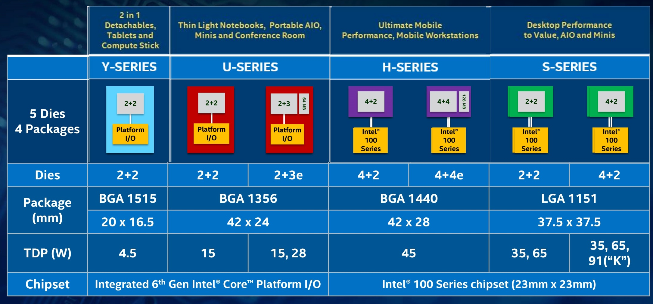
1.3 Desktop and notebook processor lines covered (3)
Example: Processor series within the Skylake-based client processors [19]
BGA: Ball Grid Array (to be soldered)
LGA: Land Grid Array (to be socketed)
e: eDRAM (L4 for graphics)
5 dies: 2+2/2+3/2+4/4+4/e
Dies: No. of cores and GT levels, e.g. 2+2 means: 2 cores + GT 2 graphics, etc.

Slide 31
1.3 Desktop and notebook processor lines covered (4)
The Skylake (6th Gen) mobile and desktop models – Overview -1
Mobiles (SoC designs)
4.5 W Core M-line (Y-line) (BGA1515)
Core m7-6Y7x, 2C+HD 515, HT, 10/2015
Core m5-6Y5x, 2C+HD 515, HT, 10/2015
Core m3-6Y3x, 2C+HD 515, HT, 10/2015
15 W U-line (SoC, BGA1356)
Core i7-66x0U/65x0U, 2C+HD 515, HT, 10/2015
Core i5-63x0U/62x0U, 2C+HD 515, HT, 10/2015
Core i3-6100U, 2C+HD 515, HT, 10/2015
28 W U-line (SoC, BGA1356)
Core i7-65x7U, 2C+HD 550, HT, 10/2015
Core i5-62x7U, 2C+HD 550, HT, 10/2015
Core i3-61x7U, 2C+HD 550, HT, 10/2015
45 W HQ/H-lines (BGA1440)
Core i7-6920HQ/6820HQ/6700HQ, 4C+HD 530, HT, 10/2015
Core i5-6440HQ/6300HQ, 4C+HD 530, HT, 10/2015
Core i3-6100H, 2C+HD 530, HT, 10/2015
Q: Quad-core
SoC: System on Chip

Slide 32
1.3 Desktop and notebook processor lines covered (5)
The Skylake (6th Gen) mobile and desktop models – Overview -2
Desktops (2-chip designs, 100 Series chipset)
35 W S-lines (LGA 1151)
Core i7-6700T 4C+HD 530, HT, 10/2015
Core i5-6600T/6500T/6400T, 4C+HD 530, HT, 10/2015
Core i3-6300T/6100T, 2C+HD 530, HT, 10/2015
65 W S-lines (LGA 1151)
Core i7-6700, 4C+HD 530, HT, 10/2015
Core i5-6600/6500/6400 4C+HD 530, HT, 10/2015
Core i3-6320/6300/6100, 2C+HD 530, HT, 10/2015
91 W S-lines, unlocked (LGA1151)
Core i7-6700K/6600K, 4C, HT, 8/2015

Slide 33
1.3 Desktop and notebook processor lines covered (6)
Overview of AMD’s processor lines
AMD’s in-house designed x86 families
32-bit
x86 families
64-bit
x86 families
The Hammer
family
Intermediate
families
The Bulldozer
family
The Cat
family
The Zen
family
K5/K6/K7
families
(32-bit
Mobile/DT)
1996-2003)
K8/K10/K10.5
families
(08h/10h/10.5h)
(64-bit
x86 family)
(2003-2009)
Families
11h/12h
(Mobile/DT
oriented)
(2008-2011)
Family
15h
(High-performance
oriented)
(2011-2016)
Families
14h/16h
(Low-power
oriented)
(2011-2015)
Family
17h
(Modular design)
(2017- )
Remark
Before the K5 AMD manufactured (licensed) Intel designed processors rather than own designs

Slide 34
1.3 Desktop and notebook processor lines covered (7)
Overview of AMD’s 64-bit K8 – Family 10.5h processor lines
 |  | 2003-2007 | 2007-2008 | 2008-2011 | 2009 | 2009
 |  | K8 (Hammer) | K10 (Barcelona) | K10.5 (Shanghai) | K10.5 (Istanbul) | K10.5 (Magny- Course)
 | 4P servers | See Section 4 | Barcelona (834x-836x)) | Shanghai (837x-839x) | Istambul (8410-8430) | Magny-Course (6100)
 | 2P servers |  | Barcelona (234x-236x) | Shanghai (237x-239x) | Istambul (241x-243x) | Lisbon (4100)
 | 1P servers |  | Budapest (135x-136x) | Suzuka (138x-139x)
 | High perf. (~80-120W) |  | Phenom X4-X2 | Phenom II X4-X2 | Phenom II X6-X4
 | Mainstream (~60-90W) | Athlon 64 Athlon 64 X2 | Athlon X2 | Athlon II X4-X2
 | Value (~40-60W) | Sempron |  | Sempron
 | High perf. (~30-40W) | Turion 64 X2 (TL 6/5) Turion 64 (ML/MT) |  | Phenom II (N/P 9xx-6xx) Turion II Ultra (M6xx) Turion II (M/N/P 5xx)
 | Mainstream (~20-30W) | Athlon 64 X2 (TK-5x/4x) Athlon 64 (2xxx+-4xxx+) |  | Athlon II (M/N/P 3xx) Sempron (M1xx)
 | Ultraportable (~10-20W) | Mobile Sempron (2xxx+-4xxx+) Sempron 2100 fanless |  | Turion II Neo (K6xx) Athlon II Neo (K1xx) V-series (V1xx)
Embedded (~10-20W) |  |  |  | Turion II Neo X2 Athlon II Neo X2 Athlon II Neo
S e r v e r s
D e s k t o p s
M o b I l e s

Slide 35
1.3 Desktop and notebook processor lines covered (8)
Overview of AMD’s Intermediate (Family 11h – Family 12h) processor lines
 | Launched in | 2008-2009 | 2011
 |  | Family 11h (Griffin) | Family 12h (Llano)
 | 4P servers
 | 2P servers
 | 1P servers
 | (85-140 W)
 | High perf. (~95-125 W)
 | Mainstream (~65-100 W) |  | Llano A8/A6/A4/E2 Sempron X2
 | Entry level (40-60 W)
 | High perf. (~30-60 W) | Turion X2 Ultra (ZM-xx) Turion X2 (RM-xx) | Llano A8 M
 | Mainstream/Entry (~20-30 W) | Athlon X2 (QL-xx) Sempron (SI-xx) | Llano A6/A4/E2 M
 | Ultra portable (~10-15 W) | Turion Neo X2 (L6xx) Turion X2 (RM-xx) Athlon Neo X2 (L3xx) Sempron (200U/210U)
Tablet (~5 W)
Embedded (~10 – 20 W) |  | Turion Neo X2 (L6xx) Athlon Neo X2 (L3xx) Sempron (200U/210U)
Servers
Desktops
Notebooks

Slide 36
1.3 Desktop and notebook processor lines covered (9)
Overview of AMD’s Family 15h (Bulldozer)-based processor lines
 | Launched in | 2011 | 2012 | 2013 | 2013 | 2015 | 2016
 |  | Family 15h (00h-0Fh) (Bulldozer) | Family 15h (10h-1Fh) (Piledriver) | Family 15h (10h-1Fh) (Piledriver v.2) | Family 15h (30h-3Fh) (Steamroller) | Family 15h (60h-6Fh) (Excavator v.1) | Family 15h (77h-3Fh) (Excavator v.2)
 | 4P servers (85-140 W) | Interlagos | Abu Dhabi
 | 2P servers (85-140 W) | Valencia | Seoul
 | 1P servers (85-140 W) | Zurich | Delhi
 | High perf. (~95-125 W) | Zambezi FX-Series | Vishera FX-Series
 | Mainstream (~65-95 W) |  | Trinity A10-A4 | Richland A10/A8/A6/A4 | Kaveri A10/A8
 | Mainstream (~25-35 W) |  | Trinity A10/A8/A6M | Richland A10/A8/A6M | Kaveri FX/A10/A8P |  | Bristol Ridge FX/A12/A10P
 | Ultra-thin (~10 – 15 W) |  | Trinity A10/A6M | Richland A10/A8/A6/A4M | A8 Pro/A8(B) A6 Pro/A6(B) | Carrizo FX/A10/A8P | Bristol Ridge FX/A12/A10P Stoney Ridge A9/A6
Tablets (~5 W)
Servers
Desktops
Notebooks

Slide 37
1.3 Desktop and notebook processor lines covered (10)
Overview of AMD’s Family 14h and 16h (Cat-based) processor lines
 | Launched in | 2011 | 2012 | 2013 | 2014 | 2015
 |  | Family 14h (00h-0Fh) (Bobcat) | Family 14h (00h-0Fh) (Bobcat) | Family 16h (00h-0Fh) (Jaguar) | Family 16h (30h-3Fh) (Puma+) | Family 16h (30h-3Fh) (Puma+
 | 4P servers
 | 2P servers
 | 1P servers
 | (85-140 W)
 | High perf. (~95-125 W)
 | Mainstream (~65-100 W)
 | Mainstream (~25-35 W)
 | Ultra-thin (~10-15 W) | Zacate E-Series Ontario C-Series | Zacate E1/E2 | Kabini A/E-Series | Beema A/E-Series | Carrizo-L A/L-Series
Tablet (~5 W) |  | Desna Z-Series |  | Temash A Series | Mullins A Series/E1
Servers
Desktops
Notebooks

Slide 38
1. Introduction (5)
1.3 Desktop and notebook processor lines covered (11)
Overview of AMD’s Zen-based (Family 17h-based) processor lines
 | Launched in | 2017-2018 | 2018 | 2019
 |  | Family 17h (00h-0Fh) (Zen) | Family 17h (00h-0Fh) (Zen+) | Family 17h (xxh-xxh) (Zen 2)
 | 4P servers
 | 2P servers | Naples (EPYC 7xx1) |  | Rome (EPYC 7xx2)
 | 1P servers | Naples (EPYC 7xx1P) |  | Rome (7002P)
 | (85-140 W)
 | High perf. (HED) without GPU (~180-250 W) | Whitehaven (ThreadRipper) (TR 1xxxX) | Colfax ThreadRipper (TR 2xxxX/WX)
 | Mainstream without GPU ((~65-95 W) | Summit Ridge (Ryzen 7/5/3 1xxx/1xxxX) | Pinnacle Ridge (Ryzen 7/5 2xxx/2xxxX) | Matisse (Ryzen 5/3xxx/ 9/7/5 3xxxX/
 | Mainstream with GPU (APU) ((~65-95 W) | Raven Ridge (Ryzen 5/3 2xxxG
 | Mainstream (~25-35 W) | Raven Ridge (Ryzen 5/3 2xxxGE | Picasso (Ryzen 7/5 3x50H)
 | Ultra-thin (~10-15 W) | Raven Ridge (Ryzen 7/5/3 2x00U) | Picasso (Ryzen 7/5/3 3x00U)
Tablet (~5 W)
Servers
Desktops
Notebooks

Slide 39
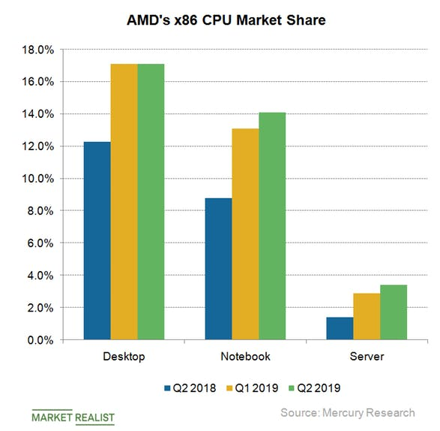
1.3 Desktop and notebook processor lines covered (12)
AMD’s x86 CPU market share Q2/2018 – Q2/2019 [242]

Slide 40
1.4 CPU core count of desktops and laptops
Notes:
40

Slide 41
1.4 CPU core count of desktops and laptops (1)
Max. core counts of GPU-less desktop and laptop processors
Core
count
12
v
Ryzen
3000
10
8
v
v
v
v
Bulldozer
Zambezi
(4 CM)
Piledriver
Vishera
(4 CM)
X
Ryzen
1000
Ryzen
2000
6
(Core 2
Quad)
Nehalem
1. G.
Nehalem
2. G.
Subsequent DTs
include GPUs
X
4
v
v
v
v
Phenom
(Pentium D)
Core 2
2
v
v
v
Athlon 64X2
2008
Intel: (): Dual Chip Modules
AMD CM: Core Modules
2006
2010
2012
2014
2016
2018
Year
*

Slide 42
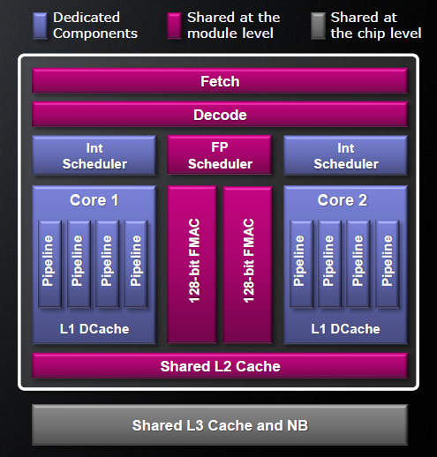
1.4 CPU core count of desktops and laptops (2)
Remark: Concept of the Compute Modules (CM) employed in the Bulldozer line
AMD’s Compute Module (CM) represents – roughly speaking - two cores.
Nevertheless, these cores have shared and per-core components, as indicated in the
Figure below.
Shared components are jointly
used by both cores either at the
module level or at the chip level,
as shown in the Figure on the right.
The front-ends of both cores and the
L2 cache are shared at the module
level, the L3 cache and the North
Bridge (NB) are shared by all CMs
at the chip level.
The FX back-ends of the cores are
implemented on a per core basis,
they are the per-core components
of the CM.
Obviously, Compute Modules provide
less performance than two traditional
cores.
Figure: Concept of the Compute Module of the Bulldozer line [10]
*

Slide 43
1.4 CPU core count of desktops and laptops (4)
Max. core counts of desktop and laptop processors with integrated GPUs
Core
count
Coffee Lake R.
8
v
Coffee Lake
6
v
Sandy Bridge
Kaby Lake
4
v
v
v
v
v
v
v
v
v
v
v
v
v
v
v
X
v
v
Llano
Ryzen
APU
(Westmere)
2
v
Intel (): On-package integrated
2006
2008
2010
2012
2014
2016
2018
Year
*

Slide 44
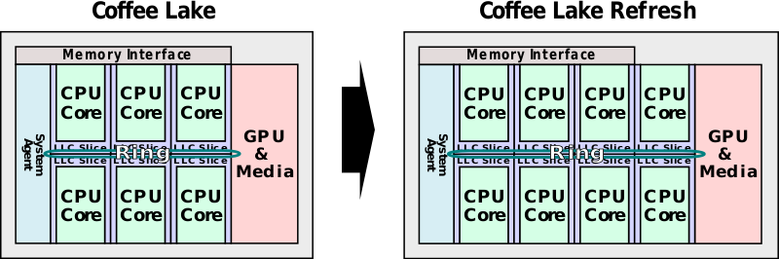
1.4 CPU core count of desktops and laptops (5)
Intel’s up to 6-core 8th generation Coffee Lake and up to 8-core 9th generation
Coffee Lake Refresh series [6]
*

Slide 45
1.4 CPU core count of desktops and laptops (6)
Why desktops and laptops typically provided not more than four cores
for a long time?
An early investigation of Wall from 1990 [7] revealed that general purpose workloads
(of that time), typically did not provide more exploitable parallelism than 4 to 6,
as the next Figure depicts.
*

Slide 46
1.4 CPU core count of desktops and laptops (7)
Wall’s results concerning the available parallelism in typical workloads [7]
Assumed ambitious hardware model
Available parallelism in an ambitious hardware model

Slide 47
1.4 CPU core count of desktops and laptops (8)
In contrast: Evolution of core counts in mobile processors
CPU architecture of mobile processors
Single CPU core
Multiple CPU cores
Symmetrical
multicores
big.LITTLE
core clusters
DynamIQ
core clusters
Exclusive cluster allocation
Inclusive
core allocation
(GTS)
Apple
ARM1176 (2007)
until A4 (2010)
A5 (2011)
(2C)
A10 (2016)
(2+2)C
A11 (2017)
(2+4)C
Samsung
Exynos
3110 (2010)
3250 2C (2011)
4412 4C (2012)
5410 (2013)
(4+4)C
5420 (2013)
(4+4)C
9810 (2018)
(4+4)C
Qualcomm
Snapdragon
MSM 7225 (2007)
8260 2C (2013)
400 4C (2013)
808 (2+4)C (2014)
810 (4+4)C (2015)
845 (2018)
(4+4)C
855 (2018)
(1+3+4)C
Huawei
Kirin
(K3V1) (2009)
(K3V2 4C (2012))
920 (4+4)C (2014)
MediaTek
MT6218B
(2003)
MT6582 4C (2013)
MT6592 8C (2013)
MT6595 (4+4)C (2014)

Slide 48
1.4 CPU core count of desktops and laptops (9)
Why mobiles have higher core counts than desktops or laptops?
As long as desktops and laptops have usually not more than 4 cores due to the
restricted extent of parallelism, as revealed by Wall [7], mobile processors typically
have a much broader spectrum of workloads with a higher level of exploitable
parallelism than general purpose workloads.
*

