Slide 1
Client processors – 6-1
Power management
Dezső Sima
October 2019
(Ver. 1.1)
© Sima Dezső, 2019

Slide 2
Contents
6.1 Significance of power management in processors
6.2 Reducing power consumption at the circuit level
6.3 Power management at the platform level - Overview
6.4 Reducing power consumption of idle CPU cores
6.5 Reducing power consumption of active CPU cores
6.6 Utilizing the power headroom of processor packages
to raise performance

Slide 3
6.1 Significance of power management in processors
Notes:
3

Slide 4
6.1 Significance of power management in processors (1)
6.1 Significance of power management in processors
Power consumption of processors - basics
Power consumption of processors
Dynamic power consumption
(Dynamic dissipation)
Static power consumption
(Static dissipation)
Power consumption of active transistors.
Caused by loading the dynamic capacitor (C_{dyn})
of the processor and discharging it per clock cycle.
Power consumption of idle transistors.
Caused by the leakage current (I_{leak})
flowing through the closed transistors.
Dynamic power consumption: D_{s}
D_{d} = const. * C_{dyn}∗V_{CC}² ∗ f_{c}
Static power consumption: D_{s}
D_{s} = V_{CC} ∗ I_{leak}
with V_{cc}: Core voltage
f_{c}: Clock frequency
Total power consumption = Dynamic power consumption + Static power consumption =
= D_{d} + D_{s} = const.* C_{dyn}∗ f_{c} * V_{CC}² + V_{CC} ∗ I_{leak}
*

Slide 5
6.1 Significance of power management in processors (2)
Remark: Simplified calculation of the Dynamic power consumption (D_{d}) -1
Active transistors can be modeled by the following circuit:
R_{s}
V_{CC}
C_{dyn}
R
I
V_{C}
ΔT
Clock
Figure: Model of the active transistors of a processor
The capacitor will be charged and discharged in each clock pulse, as seen in the
next Figure.
*

Slide 6
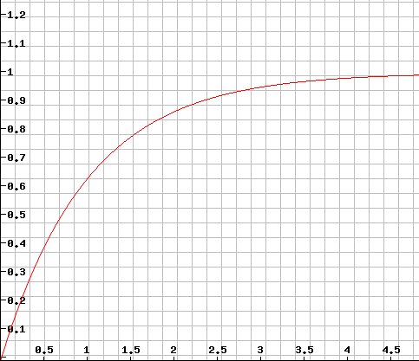





6.1 Significance of power management in processors (3)
Remark: Simplified calculation of the Dynamic power consumption (D_{d}) -2
Raising the voltage on the capacitor that is charged over a resistance
Vc
(V_{CC} = 1 V)
$${Vc=1− e}^{−t/τ}$$
$${VC=VCC ∗ (1− e}^{−t/τ})$$
$$with τ=RS ∗ Cdyn$$
For V_{CC} = 1 V:
$${VC=1− e}^{−t/τ}$$
$$t/τ$$

Slide 7
6.1 Significance of power management in processors (4)
Remark: Simplified calculation of the Dynamic power consumption (D_{d}) -3
Active transistors can be modelled by the following circuit:
R_{s}
V_{CC}
C_{dyn}
R
I
V_{CC}
ΔT
Clock
Figure: Model of the active transistors of a processor
While loading the capacitor C_{dyn} the charge Q will be accumulated and then discharged
over the resistor R during the halve clock period:
Q = C_{dyn} * V_{cc} = I * ΔT
ΔT = ½ * 1/f_{c}
Thus the dynamic dissipation is:
D_{d} = V_{cc} * I = V_{cc} * C_{dyn} * V_{cc}/(1/2 * 1/f_{c}) =
= 2 * C_{dyn} * V_{cc}² * f_{c}
D_{d}= const. * C_{dyn} * V_{cc}² * f_{c}
I.e.
*

Slide 8
6.1 Significance of power management in processors (5)
Characterizing the power consumption of processors by the TDP value
(Thermal Design Power)
TDP (Thermal Design Power) is the power consumption of a processor (package)
specified in datasheets, given usually in W.
It can be interpreted as the maximum power consumed by the processor
while running realistic, power intensive applications.
It serves as a reference value for designing the cooling system of the platform.
The cooling system (called also thermal solution) of a platform should guarantee
that the chip, more precisely the junction temperature (Tj) of the transistors
on the die does not exceed a given limit (Tjmax, e.g. 90 ºC⁾ while the processor
dissipates TDP Watts.
*

Slide 9
6.1 Significance of power management in processors (6)
Typical TDP values of desktop and notebook processors
Processor category |  | TDP | Intel’s usual tags
Servers |  | ≈85-200 W
HEDs |  | ≈100-150 W | X
 | High perf. | ≈70-95 W | K
 | Mainstream | ≈50-65 W | S
 | Low power | ≈35-45W | T
 | High perf. | ≈45 W | H/HQ
 | Mainstream | ≈25-35 W | U
 | Ultra-thin | ≈15 W | U
Tablets |  | ≈5 W | Y/m
Desktops
Notebooks
*

Slide 10
6.1 Significance of power management in processors (7)
How TDP limits the basic clock rate?
As an example data on Intel’s Skylake DT and mobile processors show
how DTP limits the base clock frequency
Models | TDP (W) | No. of cores | Graphics | No. of graphics EUs | eDRAM | Max. Base frequency (GHz)
6Yxx | 4.5 | 2 | HD 515 | 18 | -- | 1.2
I7-6xxxU | 15 | 2 | HD 540 | 48 | 64 MB | 2.2
I3/I5/i7-6xxxU | 15 | 2 | HD 520 | 24 | -- | 2.6
I3/I5/i7-6xxxU | 28 | 2 | HD 550 | 48 | 64 MB | 3.3
I3/i5/i7-6xxxT I3-6xxxH | 35 | 4 2 | HD 530 | 24 | -- | 2.8 2.7
I5/i7-6xxxHQ | 45 | 4 | HD 530 | 24 | -- | 2.9
I3-6xxx | 47 | 4 | HD 530 | 24 | -- | 2.9
I5/i7-6xxx | 65 | 4 | HD 530 | 24 | -- | 3.4
I5/i7-6xxxK | 91 | 4 | HD 530 | 24 | -- | 4.2
Table: Base clock frequency vs. TDP in Intel’s Skylake DT and mobile lines [19]

Slide 11
6.1 Significance of power management in processors (8)
Rising the power density (W/cm²) in Intel's Pentium 4 family
≈ Limit of air cooling
*

Slide 12
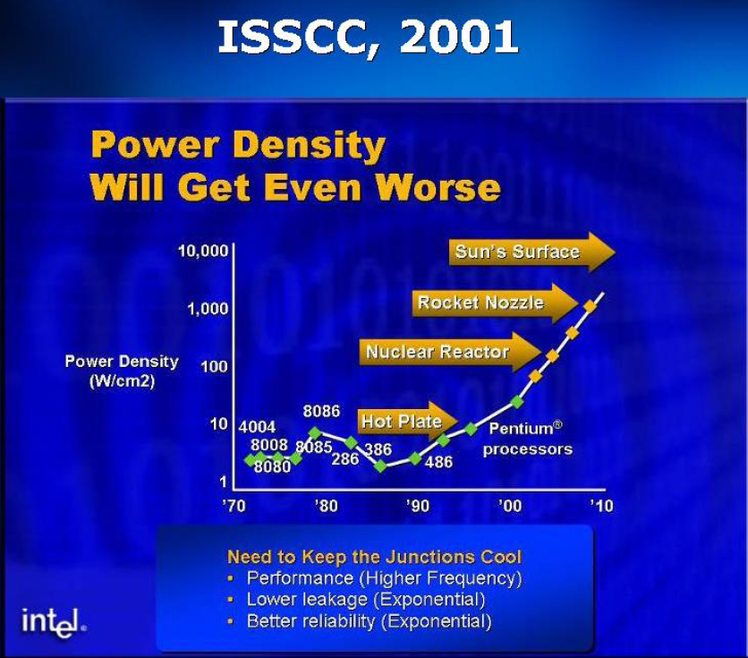
6.1 Significance of power management in processors (9)
Recognising the impact of rising power density (W/cm²) in Intel processors
at the conference IEDM 2002 (A. Groove, Intel) [176]
A. Groove Keynote at IEDM Dec. 2002
IEDM: International Electron Device Meeting

Slide 13
6.1 Significance of power management in processors (10)
Remark: Intel’s expectations for their Pentium 4 family
Intel released its Pentium 4 family in 2000 while stating that the family will hit
a clock rate of 10 GHz and a life time of 10 years.
In a keynote speech at Intel Developer Forum, Fall 2001 Paul Otellini, Intel’s CEO
at that time declared: “And we're convinced that the microarchitecture that the
Pentium 4 embodies will be able to scale to 10 gigahertz over its lifetime.” [177].
Nevertheless, Intel never reached 4 GHz and was forced to cancel the Pentium 4
line after a lifecycle of about 4 years in 2004.
*

Slide 14
6.1 Significance of power management in processors (11)
Introduction and withdrawal of Intel's P4 family due to overheating

Slide 15
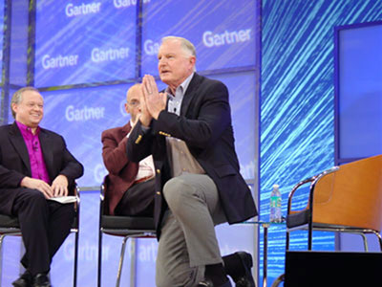
6.1 Significance of power management in processors (12)
Intel's apology for cancelling the Power 4 family [178]
During an interview on stage at Gartner Group’s Fall Symposium/IT Expo in
Orlando Intel’s then Chief Executive Officer Craig Barrett got down on his knees.
In front of an audience of about 7000 information-technology professionals,
Barrett asked their forgiveness for the Santa Clara company latest product
slip up, the cancellation of its 4 GHz Pentium 4 family in Oct. 2004.
Picture: Oct. 2004 Intel's CEO apologizes for cancelling the Pentium 4 family [178]

Slide 16
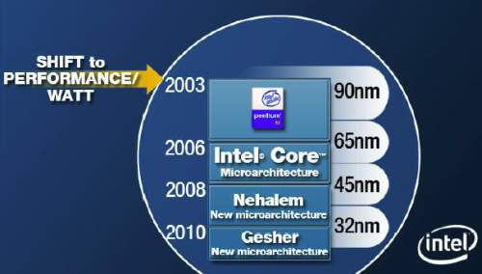
6.1 Significance of power management in processors (13)
Shifting Intel's design paradigm from performance orientation
to power efficiency orientation to cope with raising dissipation
In 2003 Intel shifted their focus of processor development from the pure performance
goal to power efficiency, as stated in a slide from 4/2006.
Power efficiency is understood as the performance per watt, given e.g. in GFLOPS/W.
Razin A., Core, Nehalem, Gesher. Intel: New Architecture Every Two Years,
Xbit Laboratories, April 28 2006,
http://www.xbitlabs.com/news/cpu/display/20060428162855.html
Figure: Intel’s plan for developing their manufacturing technology and processor lines
revealed at a shareholder’s meeting back in 4/2006 [179]
*

Slide 17
6.1 Significance of power management in processors (14)
Evolution of processor design paradigms
Processor design paradigms
High performance
oriented design paradigm
High performance per Watt
oriented design paradigm
Low power consumption
oriented design paradigm
Expressed in
E.g. GFLOPS
E.g. GFLOPS/Watt
E.g. Watt
Examples
Client
processors
Until about Intel’s
Pentium 4
(≈ 2004)
From Intel’s Core 2 line on
(2006)
Mobile
processors
ARM ISA-based
processor lines
Intel’s Atom line
(2008-2016)
AMD’s Cat line
(2011-2016)
*

Slide 18
6.1 Significance of power management in processors (15)
Initiatives to reduce power consumption
The Energy Star initiative to reduce the energy consumption
AMD's initiative to achieve 25x energy efficiency increase between 2014-2020

Slide 19

6.1 Significance of power management in processors (16)
The Energy Star initiative to reduce the energy consumption [180] -1
It was established in 1992 by the US Environmental Protection Agency (EPA)
to generate awareness of energy saving in different processor categories, like
desktops, laptops etc.
The 5. version of this initiative was released in 2009.
The 5. version provides different formulae for calculating the annual Typical Energy
Consumption (TEC) in inactive states for different processor classes and gives
maximal TEC figures for using the Energy Star sticker.
*

Slide 20
6.1 Significance of power management in processors (17)
Remark: The formula for calculating the TEC figure for laptops
in the 5. version of the Energy Star initiative [180] -1
For example the formula for calculating the TEC figure for laptops is:
TEC = (8760/1000) * (Poff * 60% + Psleep * 10% + Pidle * 30%)
where
there are 8760 hours/year
all Px values are power consumption values in Watts
Poff: It relates to the Off-state, i.e. to the ACPI S4 (Suspend to disk)
or S5 (Soft off) states, where applicable.
Psleep: It relates to the Sleep state, i.e. to the ACPI S3 state (Suspend
to RAM state).
Pidle: It relates to the Idle state, i.e. to the state when activity is limited to
basic applications that the system starts by default, see next Figure.
E.g.: Poff = 1W, PSleep = 1.7W, Pidle = 10W
The TEC limit depends on the laptop configuration.
E.g. The TEC limit for the lowest configuration laptop is 40.0 kWhours.
Laptops with lower TEC values as the related TEC limit may carry the Energy Star
sticker.
*

Slide 21
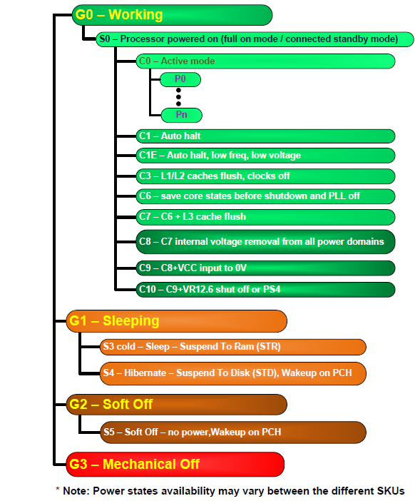
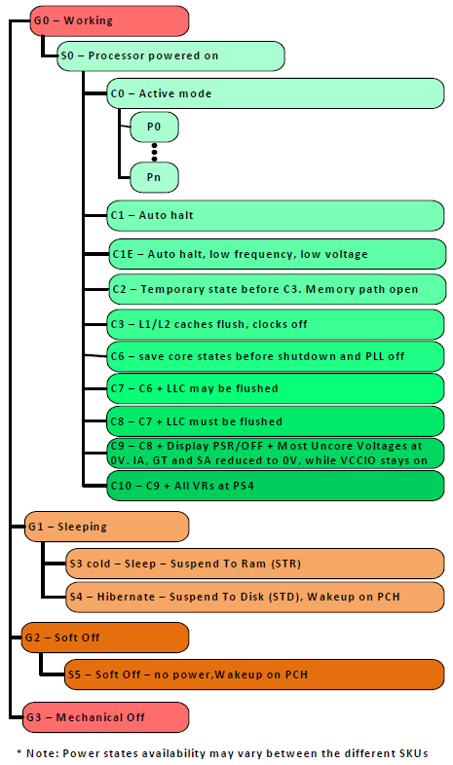
6.1 Significance of power management in processors (18)
Inactive states of the ACPI standard referenced in the Energy Star initiative
[181]
Pi: Performance states
(active states, since ACPI 2.0))
Ci: Idle states
C1…C3 given in ACPI 1.0
(C4…Cn states since ACPI 2.0)
C1
C2
Gi: Global states
Cn
Si: System Sleep states
G1: OS-initiated, system context
saved, no rebooting needed.
G2/Soft off: OS-initiated shut down.
Power supply remains on,
system context is not saved,
the system must be restarted.
G3/Mechanical off: Entered by
activating a mechanical switch.
The system must be restarted.
*

Slide 22
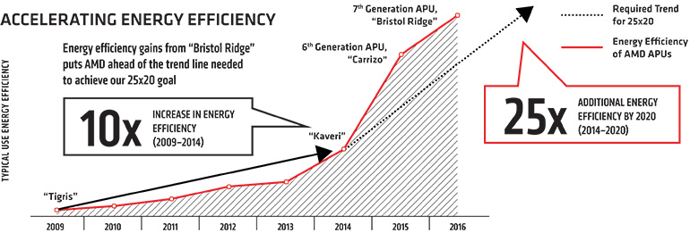
6.1 Significance of power management in processors (19)
AMD's initiative to achieve 25x energy efficiency increase between
2014-2020, announced in 2014 [182] [183]
Note
The term energy efficiency is used also for supercomputers, there is a "Green500"
list maintained.
*

Slide 23
6.1 Significance of power management in processors (20)
Approaches and key techniques of power management in computers
Approaches for power management of computers
(Strongly simplified)
Reducing power consumption
at the circuit level
(Achieved by circuit design)
PM at the platform level
(ACPI-based, achieved by system design)
Clock gating
Power gating
PM of the processor
PM of CPU cores
PM of idle CPU cores
PM of active CPU cores
Reducing
power consumption
of idle CPU cores
Reducing
power consumption
of active CPU cores
Utilizing the power headroom
of a proc. package
to raise performance
C-state management
DVFS/CPPC/AVFS
Turbo Boost Technology
CPPC: Collaborative Processor Power Control
*

Slide 24
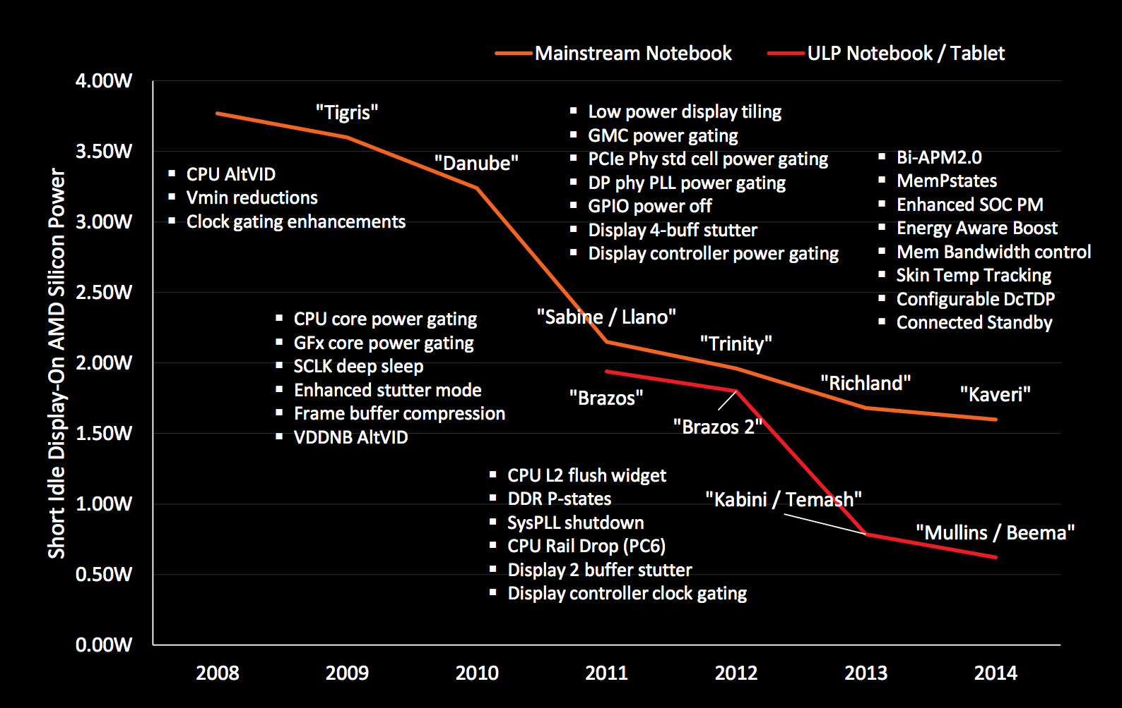
6.1 Significance of power management in processors (21)
AMD’s techniques developed for reducing the power consumption of a
computer at the circuit and platform levels (2008-2014) [184]

Slide 25
6.2 Reducing power consumption at the circuit level
6.2.1 Clock gating
6.2.2 Power gating

Slide 26
6.2.1 Clock gating

Slide 27
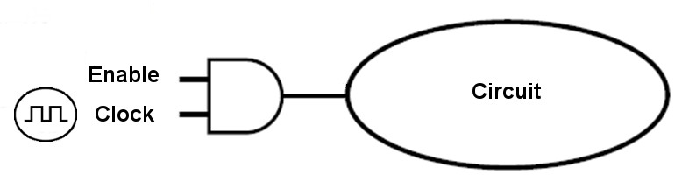
6.2.1 Clock gating (1)
6.2.1 Clock gating
It is a technique used to reduce dynamic power by disabling clocking to
currently not needed circuits.
Clocking is disabled by inserting AND gates (i.e. controlled on/off switches) that
are called clock gaters into the clock distribution network, as indicated below.
Circuit
Clock gater
Figure: Principle of clock gating
*

Slide 28
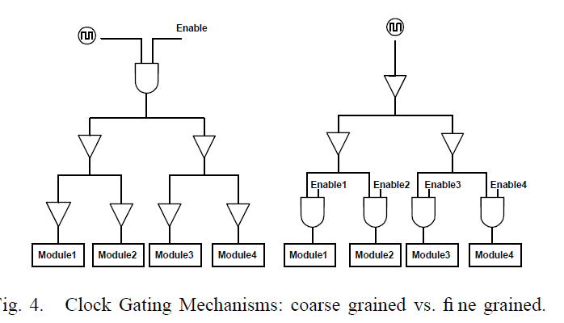
6.2.1 Clock gating (2)
Fine-grained or coarse grained clock gating -1
Clock gating can be applied either in a fine-grained or a coarse-grained fashion,
as the next Figure shows.
Fine-grained clock gating
Coarse-grained clock gating
Figure: Kinds of clock gating [185]
*

Slide 29
6.2.1 Clock gating (3)
Fine-grained or coarse grained clock gating -2
Fine-grained clock gating allows to save power in different parts of circuits whereas
coarse-grained clock gating is used to disable clocking of currently idle units or
parts of them (e.g. an FP unit as long as only FX instructions are processed.

Slide 30
6.2.1 Clock gating (4)
Use of clock gating
Clock gating was introduced in the second half of the 1990s e.g. in DEC processor
designs (in the Alpha 21264 (1996) for gating the FP unit or the StrongARM
SA110 (1996)), designated at that time as conditional clocking.
Soon clock gating became widely used, e.g. in Intel's Pentium 4 (2000) or
Pentium M (Banias) (2003).
Recently, clock-gating is a pervasive technique used in processors.
*

Slide 31
6.2.2 Power gating

Slide 32
6.2.2 Power gating (1)
6.2.2 Power gating
Principle of power gating [186]
Power gating switches off idle units on the die (like a core) from the power supply
by means of power transistors (sleep transistors) to eliminate both dynamic and
static power consumption caused by leakage currents.
Figure: Principle of power gating [186]
(Power gating: Tápellátás kapuzása)
*

Slide 33
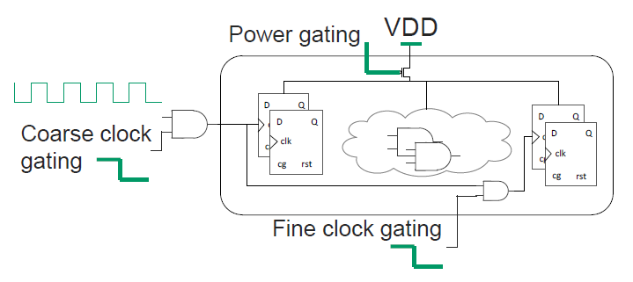
6.2.2 Power gating (2)
Advantage of power gating over clock gating
Clock gating eliminates only the dynamic part of power consumption whereas
power gating eliminates both the dynamic and static part of power consumption
of a unit, as indicated in the figure below.
Figure: Contrasting clock gating and power gating [184]
*

Slide 34
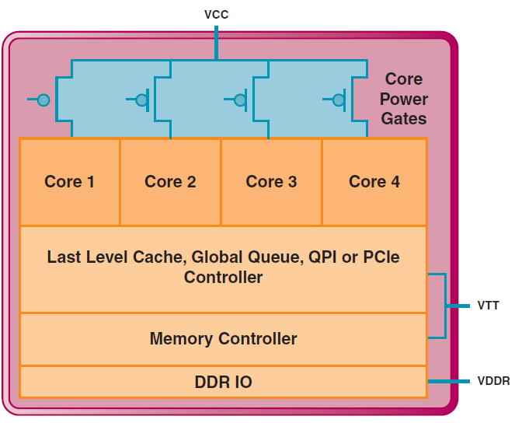
6.2.2 Power gating (3)
Use of power gating for switching off idle cores in a multicore processor
In a multicore processor power gating allows to switch off individual, not used cores,
as indicated below.
VR
VR
VR
Figure: Power gating in the 4-core Nehalem, implemented with a common voltage rail
[187]

Slide 35
6.2.2 Power gating (4)
Power gating as a precondition for implementing the Turbo Boost technology
The Turbo Boost technology needs a high enough power headroom to be efficient.
Power gating eliminates both static and dynamic dissipation of idle cores, in this
way it largely increases the power headroom of lightly loaded or idle processors.
Thus, power gating can be considered as a precondition for the implementation
of Turbo Boost technology since clock gating alone does not provide enough
headroom for a noteworthy increase of the clock frequency.
*

Slide 36
6.2.2 Power gating (5)
Introduction of power gating in main computer families
Vendor | Family | Year of intro.
Intel | Nehalem | 2008
 | Westmere | 2010
 | Sandy Bridge | 2011
 | Ivy Bridge | 2012
 | Skylake | 2015
 | Atom families | 2010 - 2016
AMD | K12-based Llano K14-based Bobcat K15-based Bulldozer families | 2011 2011 2011 - 2015
IBM | POWER7+ | 2012
 | POWER8 (Iintegrated PG and DVFS) | 2014

Slide 37
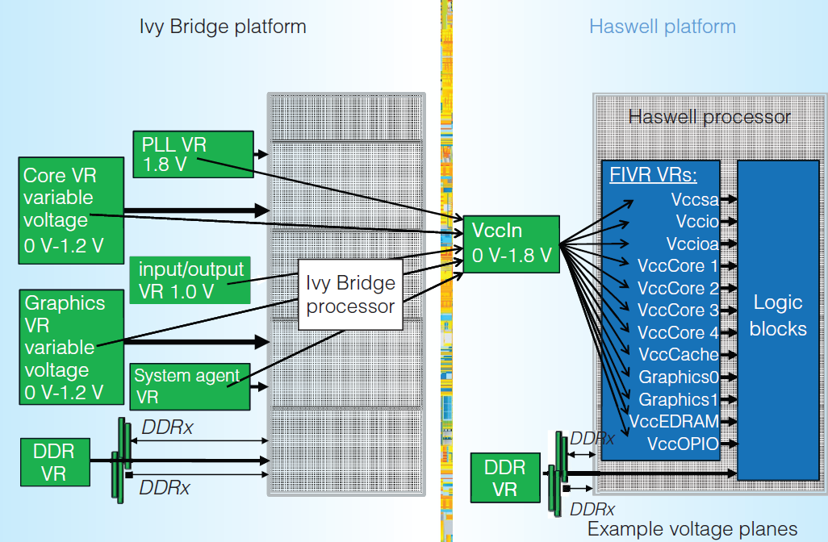
6.2.2 Power gating (6)
Replacing power gating by integrated voltage regulators
Integrated voltage regulators
were introduced in Intel's
Haswell (2013) and Broadwell
(2014) lines (under the name of
FIVR (Fully Integrated Voltage
Regulator).
They allow to switch off units
individually so they make
power gating superfluous,
as the Figure on the right shows.
Figure: Use of integrated voltage regulators in Intel's Haswell processor [188]
*

Slide 38
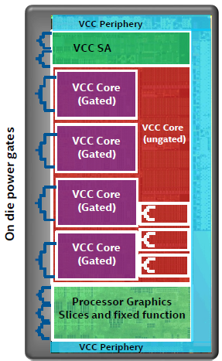
6.2.2 Power gating (7)
Reuse of power gating after Intel has suspended the implementation
of integrated voltage regulators in their Skylake line (2015)
As integrated voltage regulators, introduced
into the Haswell and Broadwell lines, caused
increased dissipation and thus reduced
clock frequency, in their subsequent
Skylake line Intel omitted integrated
voltage regulators and reintroduced power
gating, as indicated in the Figure on the right.
Then in 2019 in their Ice Lake line Intel
brought back integrated voltage regulators.
Figure: Reintroducing power gating in Intel's
Skylake line [90]
*

Slide 39
6.2.2 Power gating (7b)
Reintroducing integrated voltage regulators and suspending power gating
a new
In their Ice Lake line (2019) Intel implemented integrated voltage regulators again
and discontinued using power gating.

Slide 40
6.2.2 Power gating (8)
Extent of the use of power gating (PG)
Extent of the use of power gating (PG)
PG covers
only the CPU cores
PG covers
beyond CPU cores also other units
(like the L3, GPU, MC etc.)
Intel's early PG solution in the
Nehalem (2008) processor line
Intel's PG solution in the
Westmere and Sandy Bridge lines
(cores, L3 cache) (2010/2011)
Intel's PG solution in the
Ivy Bridge line
(cores, PCIe, memory controller) (2012)
Intel's PG solution
since Lincroft-based Atom lines
(cores, graphics cores, video decoder/
encoder, display controller) (2010-2016)
AMD's PG solutions in
the Bulldozer (2011), Llano (2011)
and Bobcat (2011) lines
(cores, graphics core and controller,
PCIe controller, video decoder)
as well as in subsequent processors
*

Slide 41
6.2.2 Power gating (9)
Example for power gating the cores in Intel's Nehalem family (2008) [187]
VR
VR
VR
Note that Vcc is power-gated.
VR: Voltage Regulator

Slide 42
6.2.2 Power gating (10)
Example for power gating further functional units as well rather than only
the cores in AMD's Llano line (2011) [127]
In Llano AMD power-gates virtually all units, such as
the Graphics Core (GFX)
the Graphics Memory Controller (GMC)
the Unified Video Decoder (UVD)
the x16 PCIe Expansion Graphics Controller.
AON: Always ON – refers to logic that is not power-gated
Figure: Use of power gating beyond CPU cores and L2 caches in Llano [127]
The GFX and GMC units have dynamic (hardware) power gating whereas other units
have static power-gating, i.e. power gating is controlled by their drivers.
Note that in the above case the VddNB (Northbridge) rail is power-gated.

Slide 43
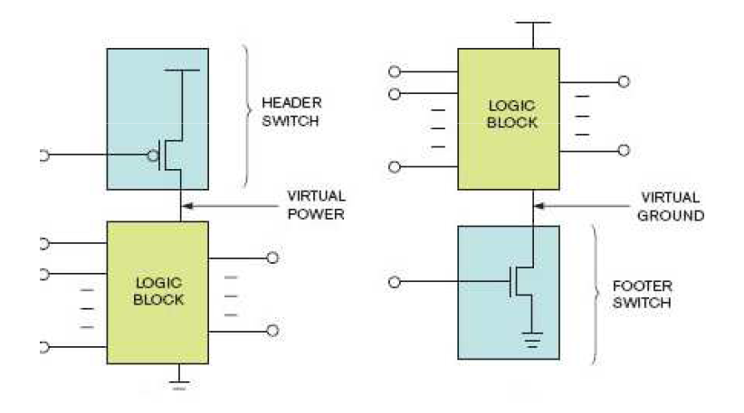
6.2.2 Power gating (11)
Implementing power gating: Alternatives for isolating the power supply
To implement power gating either Vcc (Vdd) or Vss (ground) can be isolated,
as indicated in the next Figure [189].
Isolate Vcc (Vdd)
Isolate Vss
Vcc (Vdd)
Vss

Slide 44
6.2.2 Power gating (12)
Use of alternatives for isolating the power supply
Intel and AMD employ different alternatives for isolating the power supply,
as indicated below.
Alternatives to isolate power supply
Switch off the Vcc (Vdd) voltage
Switch off Vss (ground)
Intel's solution
in the Nehalem and subsequent
processor families
AMD's solution for switching off cores
in the Bulldozer and Llano based
as well as subsequent processor lines
of these families
AMD's solution for switching off cores
in the Bobcat and subsequent processor lines
AMD's solution for switching off idle units rather than cores (e.g. graphics units
in the Bulldozer and Llano based
as well as subsequent processor lines of these families

Slide 45
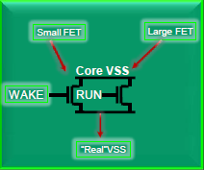
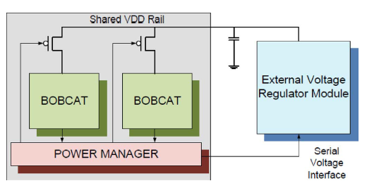
6.2.2 Power gating (13)
Examples for isolating the power supply
Isolating Vcc (Vdd) in Intel's Nehalem (2008) [187]
Isolating Vss in AMD's Bulldozer (2011) [190]
Isolating Vcc (Vdd) in AMD's Bobcat (2011) [13]

Slide 46
6.2.2 Power gating (14)
Necessary operations prior to switching off cores by means of power gating
Obviously, before a core can be powered off
its (write back) caches need to be flushed (i.e. modified cache lines need to be
written back into the next level cache if available else into the main memory)
and
its execution state needs to be preserved (either in the main memory, in the
next level cache (if existent) or in an SRAM that has an independent power
supply).
In addition, to reduce power consumption further on, typically
core clocking will be halted and
the PLL is switched off.
*

Slide 47
6.2.2 Power gating (15)
Alternatives for saving the execution state of a core
Alternatives for saving the execution state of a core
Saving the execution state
of the core
into the main memory
Saving the execution state
of the core
into the cache system
Saving the execution state
of the core
into an on-die SRAM
Intel
Nehalem (2008)
Westmere (2010)
Sandy Bridge (2011)
Haswell (2013)
Broadwell (2015)
Skylake (2015)
Atom line (2010-2016)
Power gating (1)
AMD
Llano (2011)
Bulldozer (2011)
Piledriver (2012)
Steamroller (2013)
Excavator (2015)
Jaguar (2013)
(microcode controlled
either into the L1 cache or
the main memory)
Puma (2014)
(into the L1 cache)
(L1 cache is subsequently
saved in L2,
L2 to DRAM)
Bobcat (2011)
Jaguar (2013)
(either into the L1 cache or
the main memory)

