Slide 1
Client processors - 6
Power management
Dezső Sima
October 2019
(Ver. 1.1)
© Sima Dezső, 2019

Slide 2
Contents
6.1 Significance of power management in processors
6.2 Reducing power consumption at the circuit level
6.3 Power management at the platform level - Overview
6.4 Reducing power consumption of idle CPU cores
6.5 Reducing power consumption of active CPU cores
6.6 Utilizing the power headroom of processor packages
to raise performance

Slide 3
6.6 Utilizing the power headroom of processor packages
to raise performance
6.6.1 Introduction
6.6.2 Intel’s Turbo Boost technologies
6.6.3 AMD’s Turbo Boost technologies
Notes:
3

Slide 4
6.6 Utilizing the power headroom of processor packages to raise performance
6.6 Utilizing the power headroom of processor packages to raise performance
Approaches for power management of computers
(Strongly simplified)
Reducing power consumption
at the circuit level
(Achieved by circuit design)
Platform level PM
(ACPI-based, achieved by system design)
Clock gating
Power gating
PM of the processor
PM of CPU cores
PM of idle CPU cores
PM of active CPU cores
Reducing
power consumption
of idle CPU cores
Reducing
power consumption
of active CPU cores
Utilizing the power headroom
of a proc. package
to raise performance
C-state management
DVFS/CPPC/AVFS
Turbo Boost Technology
(ACPI-based)
CPPC: Collaborative Processor Power Control
*

Slide 5
6.6.1 Introduction
Notes:
5

Slide 6
6.6.1 Introduction (1)
6.6.1 Introduction
Intel introduced the Turbo Boost technology in their Nehalem line in 2008,
designated also as the 1. gen. Turbo Boost technology.
It is described in Section 6.6.2.1.
There are two enhancements of this technology:
the Turbo Boost 2.0, introduced in the Sandy Bridge line (2011), see Section
6.6.2.2 and
the Turbo Boost 3.0 (aka Turbo Boost Max 3.0) introduced in the Broadwell-E
HED line (2016), see Section 6.6.2.3.
Also AMD implemented the Turbo Boost technology, called the Turbo Core
technology, nevertheless with a delay of at least two years.
A brief cover of AMD’s Turbo Boost activities can be found in Section 6.6.3.
*

Slide 7
6.6.2 Intel’s Turbo Boost technologies
6.6.2.1 Intel’s 1. gen. Turbo Boost technology
6.6.2.2 Intel’s 2. gen. Turbo Boost technology
6.6.2.3 Intel’s 3. gen. Turbo Boost technology
Notes:
7

Slide 8
6.6.2.1 Intel’s 1. gen. Turbo Boost technology
Notes:
8

Slide 9
6.6.2.1 Intel’s 1. gen. Turbo Boost technology (1)
6.6.2.1 Intel’s 1. gen. Turbo Boost technology -1
The Turbo Boost technology is strongly connected to the notion of the TDP
(Thermal Design Power) value of a processor, this is the reason why we recap it
subsequently.
*

Slide 10
6.6.2.1 Intel’s 1. gen. Turbo Boost technology (2)
Interpretation of the notion of TDP (Thermal Design Power)
The TDP (Thermal Design Power) value is the planned power consumption
of the processor (package), given typically in W.
The TDP value of a processor model reflects the maximum power consumed
by realistic, power intensive applications.
It serves as a reference value for designing the cooling system of the platform.
The cooling system (called also thermal solution) of a platform has to be designed
such that it should guarantee that the chip, more precisely the junction
temperature (Tj) of the transistors does not exceed a given limit (Tjmax,
e.g. 90 ºC⁾ while the processor dissipates as much power as the TDP value
indicates (given usually in Watts).
*

Slide 11
6.6.2.1 Intel’s 1. gen. Turbo Boost technology (3)
Approximate TDP values of desktop and notebook processors
TDP |  | Intel’s usual tags
Servers (~85-200 W)
 | High perf. (~70-95 W) | K
 | Mainstream (~50-65 W) | S
 | Low power (~35-45W) | T
 | High perf. (≈ 45 W) | H/HQ
 | Mainstream/ Entry level (≈ 25-35 W) | U
 | Ultra-thin (≈ 15 W) | U
Tablets (≈5 W) |  | Y/m
Desktops
Notebooks
*

Slide 12
6.6.2.1 Intel’s 1. gen. Turbo Boost technology (4)
The TDP value of a processor as the key limiter of the basic clock rate
TDP is the key limiter of the clock rate of processors, as the example below
for Intel’s Skylake DT and mobile processors demonstrates.
Models | TDP (W) | No. of cores | Graphics | No. of graphics EUs | eDRAM | Max. Base frequency (GHz)
6Yxx | 4.5 | 2 | HD 515 | 18 | -- | 1.2
I7-6xxxU | 15 | 2 | HD 540 | 48 | 64 MB | 2.2
I3/I5/i7-6xxxU | 15 | 2 | HD 520 | 24 | -- | 2.6
I3/I5/i7-6xxxU | 28 | 2 | HD 550 | 48 | 64 MB | 3.3
I3/i5/i7-6xxxT I3-6xxxH | 35 | 4 2 | HD 530 | 24 | -- | 2.8 2.7
I5/i7-6xxxHQ | 45 | 4 | HD 530 | 24 | -- | 2.9
I3-6xxx | 47 | 4 | HD 530 | 24 | -- | 2.9
I5/i7-6xxx | 65 | 4 | HD 530 | 24 | -- | 3.4
I5/i7-6xxxK | 91 | 4 | HD 530 | 24 | -- | 4.2
Table: Dependence of the max. base clock frequency on the TDP value in Intel’s Skylake line [19]

Slide 13
6.6.2.1 Intel’s 1. gen. Turbo Boost technology (5)
Intel’s 1. gen. Turbo Boost technology -2
If actually, a processor dissipates less than its TDP value, a power headroom
arises.
Turbo Boost technology converts power headroom to higher performance
by raising the clock frequency of the active cores.
Power headroom: hőtartalék
*

Slide 14
6.6.2.1 Intel’s 1. gen. Turbo Boost technology (6)
Illustration of the operation of Intel’s
1. gen. Turbo Boost technology,
introduced in the Nehalem family (2008) [217]
Zero power for
inactive cores
by power gating
Turbo mode uses the power headroom (unused power of the package up to the TDP).
*

Slide 15
6.6.2.1 Intel’s 1. gen. Turbo Boost technology (7)
Intel’s 1. gen. Turbo Boost technology -3
Nehalem introduced a PCU (Power Control Unit)
for accomplishing OS directed voltage and frequency transitions needed
by the DVFS technique,
for implementing the Turbo Boost technology, and also
for checking the power dissipation of the whole package and if needed
to take appropriate actions.
*

Slide 16
6.6.2.1 Intel’s 1. gen. Turbo Boost technology (8)
Principle of Intel’s 1. gen. Turbo Boost technology as implemented in the
Nehalem processor
In case when
the actual workload requests the highest performance state (P0),
there is a power headroom, that is the actual power consumption is less
then the TDP value,
the actual current is less than a given limit and
also the die temperature is below a given limit
the PCU converts available power headroom into higher performance by raising
clock rate and core voltage of the active cores up to a given limit.
The peak Turbo frequency depends on the number of active cores, the less cores
are active the higher is the Turbo Boost frequency, thus in the next Figure
P0 1C is the highest Turbo Boost rate.
*

Slide 17
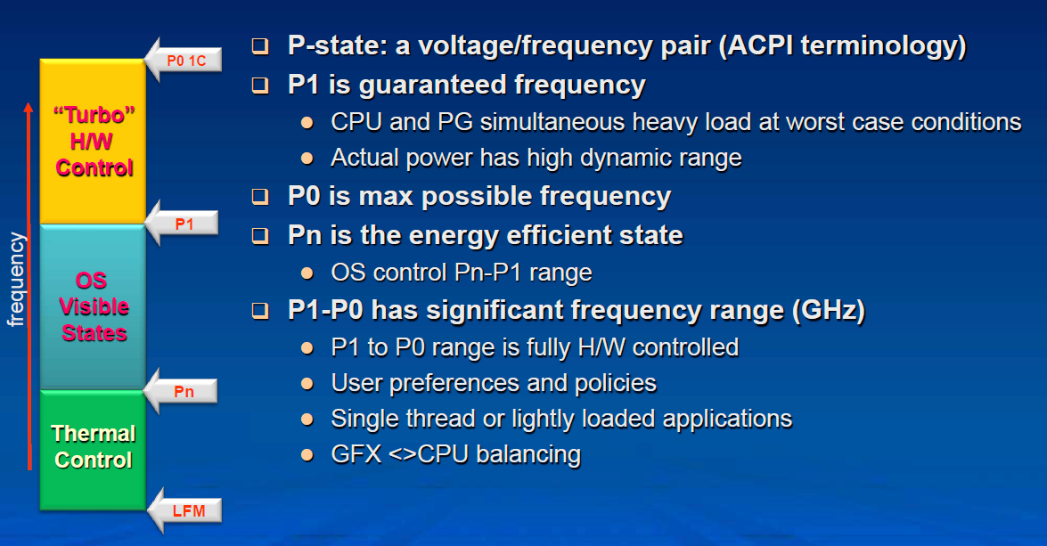
6.6.2.1 Intel’s 1. gen. Turbo Boost technology (9)
The Turbo Boost mode as part of the processor’s power management [219]

Slide 18
6.6.2.1 Intel’s 1. gen. Turbo Boost technology (10)
Implementation of Intel’s 1. gen. Turbo Boost technology [218] -1
If the discussed conditions for activating the Turbo Boost technology are met
the PCU automatically steps up core frequency in a closed loop by one bin
(133.33 MHz for the Nehalem family) in each step as long as it reaches
the max. boost ratio of the frequency multiplier that is held in the MSR 1ADh
for 1, 2, 3 or 4 active cores, as seen in the next Figure.
The internal register MSR 1ADH is interpreted as follows:
MSR 1ADh (in the Nehalem family)
Bits 31-24 | Bits 23-16 | Bits 15-08 | Bits 07-00
Max. ratio with 4 active cores | Max. ratio with 3 active cores | Max. ratio with 2 active cores | Max. ratio with 1 active core
E.g. in the Nehalem DT i7-975 (Base clock: 3.33 GHz)
26 (+1 bin) | 26 (+1 bin) | 26 (+1 bin) | 27 (+2 bin)
3.46 GHz | 3.46 GHz | 3.46 GHz | 3.6 GHz
Multiplier:
Max. turbo fc

Slide 19
6.6.2.1 Intel’s 1. gen. Turbo Boost technology (11)
Implementation of Intel’s 1. gen. Turbo Boost technology [218] -2
The actual turbo boost frequency results as the product of the given ratio
times the bus clock frequency (133.33 MHz in this case).
In each step the PCU sets the PLLs (Phase Locked Loop) of the cores and the VR
(Voltage Regulator) to the appropriate values.
*

Slide 20
6.6.2.1 Intel’s 1. gen. Turbo Boost technology (12)
Implementation of Intel’s 1. gen. Turbo Boost technology [218] -3
Maximum turbo frequencies are factory configured and kept in form of multiplier
values in the internal registers (MSR 1ADH) of the processor, they can be read
by the PCU or OS.
*

Slide 21
6.6.2.1 Intel’s 1. gen. Turbo Boost technology (13)
Remarks
In subsequent processors the turbo mode achieved a higher clock boost, as seen
below for a Sandy Bridge-E HED processor [220].
i7-3970X (Sandy Bridge-E), base clock: 3.50 GHz
No of active cores | 1C | 2C | 3C | 4C | 5C | 6C
Multiplier | 40 | 40 | 38 | 38 | 36 | 36
Bins (1 bin: 100 MHz) | +5 | +5 | +3 | +3 | +1 | +1
Turbo clock frequency | 4.0 GHz | 4.0 GHz | 3.80 GHz | 3.80 GHz | 3.60 GHz | 3.60 GHz

Slide 22
6.6.2.1 Intel’s 1. gen. Turbo Boost technology (14)
Determination of the number of active cores
The PCU monitors the activity of all 4 cores.
The PCU considers a core active if it is in the C0 (active) or C1 (Halt) state and
inactive if it is in the C3 or the C6 state.
*

Slide 23
6.6.2.1 Intel’s 1. gen. Turbo Boost technology (15)
Checking current, power consumption and temperature vs. specified limits
[221], [222]
To check power and temperature limits the PCU samples the current power
consumption and die temperature in 5 ms intervals [221].
Power consumption is determined by monitoring the processor current at its
input pins as well as the associated voltage (Vcc) and calculating the power
consumption as a moving average.
The junction temperature of the cores are monitored by DTSs (Digital Thermal
Sensors) with an error of ± 5 % [222].
When any factory configured limit is surpassed (the power consumption of the
processor or the junction temperature of any core) the PCU automatically
steps down core frequency in increments of 100 or 133 MHz, depending on the
value of the bus frequency.
*

Slide 24
6.6.2.1 Intel’s 1. gen. Turbo Boost technology (16)
Example: Real time sensors in Intel’s Nehalem proc.s [205] -1
IA32_PERF_CTL MSR
I
*

Slide 25
6.6.2.1 Intel’s 1. gen. Turbo Boost technology (17)
Remark
All active cores run at the same clock frequency and share the same power plane.
Idle cores are shut down by power gates (in Haswell and Broadwell processors
or by integrated voltage regulators in Skylake and subsequent lines that omit
integrated voltage regulators).
*

Slide 26
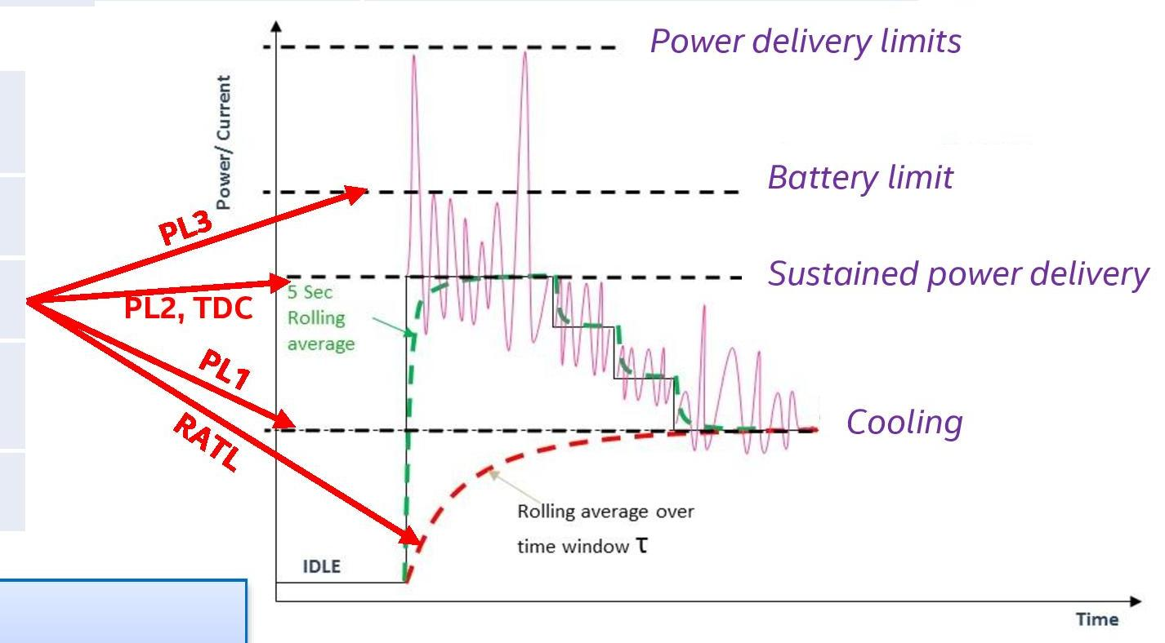
6.6.2.1 Intel’s 1. gen. Turbo Boost technology (18)
Defined power levels (PL) in the Turbo Boost technology [223] -1
Current
PL1: The cooling limit, it is effectively the TDP value.
Here the power (and frequency) is limited by the available cooling.

Slide 27
6.6.2.1 Intel’s 1. gen. Turbo Boost technology (19)
Defined power levels (PL) in the Turbo Boost technology [223] -2
Current
PL2: The max. sustainable power that the processor is capable of drawing indefinitely.
It limits the peak turbo rate of the processor that is given for running all cores
at maximum turbo frequency (for all cores).

Slide 28
6.6.2.1 Intel’s 1. gen. Turbo Boost technology (20)
Defined power levels (PL) in the Turbo Boost technology [223] -3
Current
PL3: Battery protection current limit

Slide 29
6.6.2.1 Intel’s 1. gen. Turbo Boost technology (21)
Defined power levels (PL) in the Turbo Boost technology [223] -4
E.g. for Intel’s Core i9-9900X HED PL2 is 210 W for running all 8 cores at 4.7 GHz
vs. the 95 W TDP needed for running all cores at the base frequency of 3.6 GHz).
This however requires an appropriate cooling.
Remark
TDC is the Thermal Design Current, i.e. the sustainable current that the processor
is capable of drawing indefinitely.

Slide 30
6.6.2.1 Intel’s 1. gen. Turbo Boost technology (22)
Remark
Although the Turbo Boost technology was introduced in the Nehalem family (2008),
Intel’s previous Penryn family has already implemented a similar technology,
called EDAT (Enhanced Dynamic Acceleration Technology) in 2007.
First Penryn processors included dual cores, and introduced the C6 idle state.
In the C6 idle state the core saved its context into an SRAM and the control
circuitry could switch off its supply voltage.
EDAT logic considered a core being in the ACPI C0 or C1 states “active”, whereas
cores in the C3 to C6 ACPI states were considered “idle”.
EDAT became activated if
one of the two cores became idle
the OS requested the highest P state for the active core and
power consumption remained below the TDP (Thermal Design Power).
When EDAT became active, control circuitry increased the clock frequency by 1 bin.
1 bin equates to ½ of the FSB clock frequency (266 MHz for an FSB of 533 MHz or
333 MHz for an FSB of 666 MHz).
Here we note that Penryn was a symmetrical multicore yet where cores were
attached by the FSB.
EDAT was controlled by dedicated EDAT circuitry and was implemented only in
mobile models of the Penryn family.

Slide 31
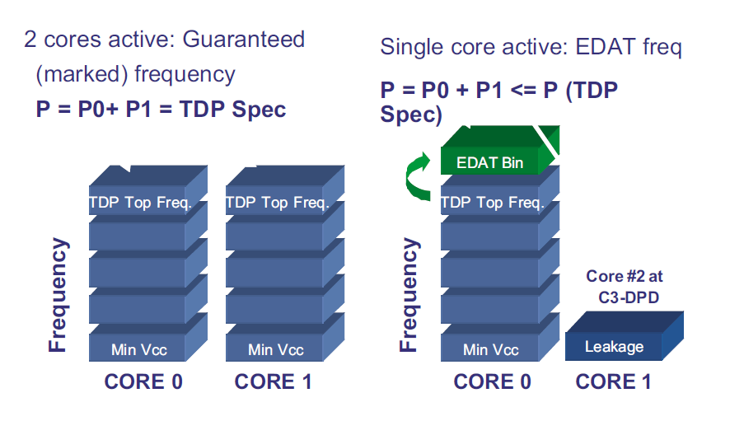
6.6.2.1 Intel’s 1. gen. Turbo Boost technology (23)
Principle of the operation of EDAT
C3-DPD is in fact the C6 idle state.
EDAT bin: 266 MHz for an FSB of 533 MHz or 333 MHz for an FSB of 666 MHz.
Figure: Principle of the operation of EDAT [224]
*

Slide 32
6.6.2.2 Intel’s 2. gen. Turbo Boost technology
Notes:
32

Slide 33
6.6.2.2 Intel’s 2. gen. Turbo Boost technology (1)
6.6.2.2 Intel’s 2. gen. Turbo Boost technology [22]
Named also as Turbo Boost 2.0 technology, implemented in the Sandy Bridge (2011).
The concept utilizes the real temperature response of the processor to power changes
(due to the “thermal mass of the “cooler) and raises processor performance
in a time burst until the package temperature slowly rises to its allowed limit. [22].
Cooler
Thermal capacitance
*

Slide 34
6.6.2.2 Intel’s 2. gen. Turbo Boost technology (2)
Principle of the implementation of Intel’s 2. gen. Turbo Boost technology [22]
Based on the real temperature response the thermal energy budget accumulated
during idle periods (i.e. “coolness”) can be utilized to raise the performance
of the core beyond its TDP-limited value for short periods of time (e.g. for 40 sec).
C0 Turbo state
Stepped
voltage/frequency
Transitions
to reduce noise
30-60sec
Multiple algorithms are used to manage in parallel
current, power and
die temperature. [22]
Rolling average
power
over time window
*

Slide 35
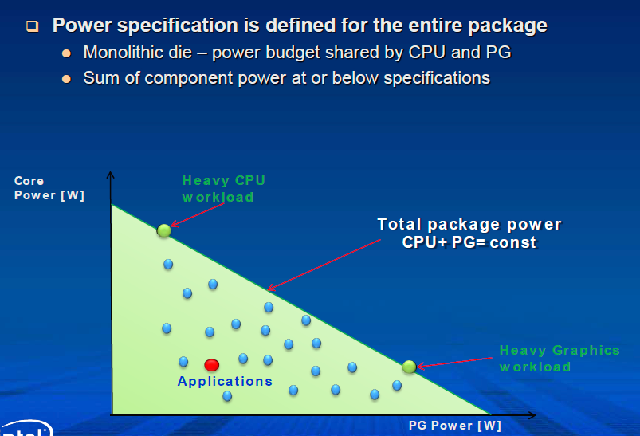
6.6.2.2 Intel’s 2. gen. Turbo Boost technology (3)
Intelligent power sharing between the CPU cores and the processor graphics
(PG) [22]
CPU
(CPU = const - PG)
Figure: Power sharing between CPU and GPU [219]
*

Slide 36
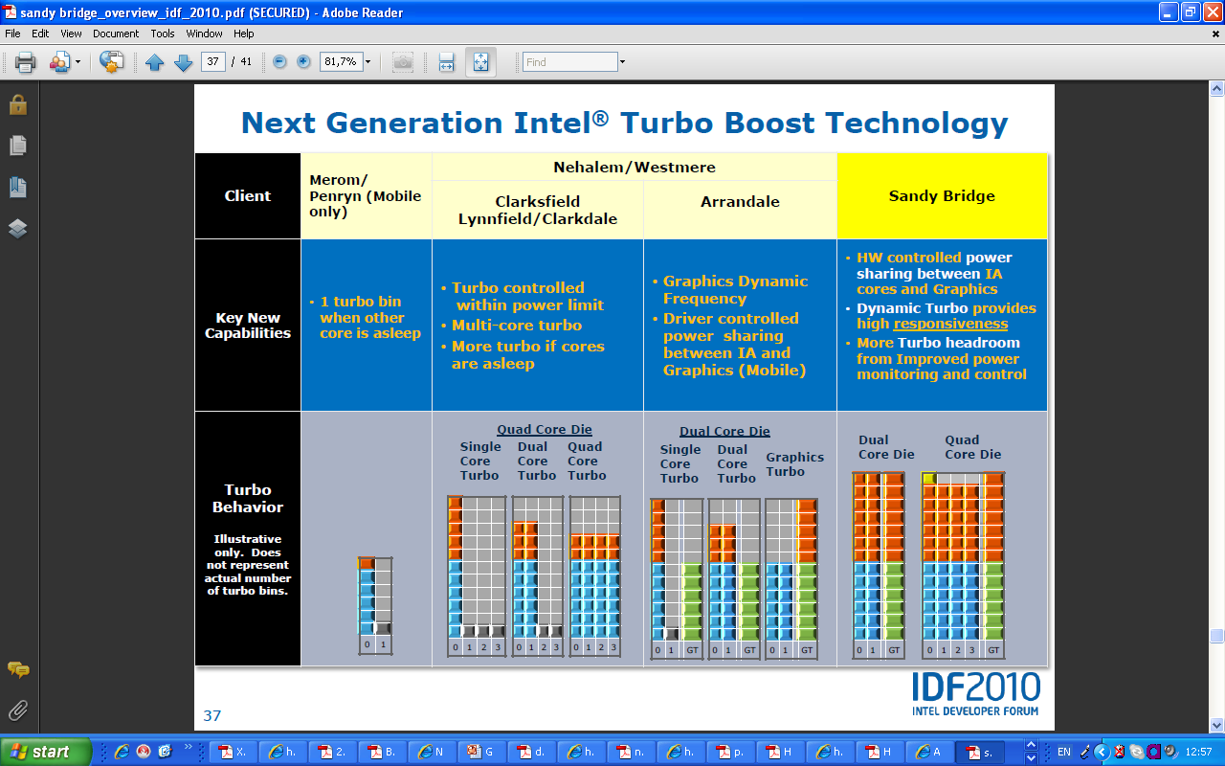
6.6.2.2 Intel’s 2. gen. Turbo Boost technology (4)
Key features of Intel’s Turbo Boost techniques in subsequent families [208]
(EDAT)
Penryn
(EDAT)
Nehalem
Westmere
NHM/M
WSM/M
Penryn/M
Nehalem/M (Clarksfield)
Nehalem/D (Lynnfield)
Westmere/M (Arrandale)
Westmere/D (Clarkdale)
NHM/D
WSM/D
M: Mobile D: Desktop

Slide 37
6.6.2.3 Intel’s 3. gen. Turbo boost technology
Notes:
37

Slide 38
6.6.2.3 Intel’s 3. gen. Turbo Boost technology (1)
6.6.2.3 Intel’s 3. gen. Turbo Boost technology -1
It is designated also as the Turbo Boost 3.0 or Turbo Boost Max 3.0 Technology.
It is an enhancement to the Turbo Boost 2.0 technology that was introduced in the
Sandy Bridge microarchitecture and was introduced in the Broadwell-E line.
The Turbo Boost 2.0 technology raises the base frequency of all active cores
in case of a light workload as far as the TDP allows it.
By contrast the Turbo Boost 3.0 technology aims at increasing the performance
of single threaded applications.
To achieve this, during processor testing Intel determines the max. clock speeds
of all cores and arrranges the cores into a list according to their max
clock speed, as seen in the next Figure, where core 9 is the highest speed core.
*

Slide 39
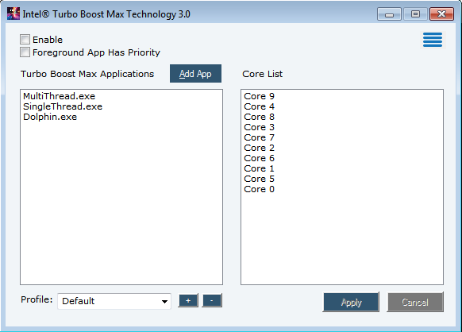
6.6.2.3 Intel’s 3. gen. Turbo Boost technology (2)
Example core speed list used in the Turbo Boost 3.0 mode [225]

Slide 40
6.6.2.3 Intel’s 3. gen. Turbo Boost technology (3)
Intel’s 3. gen. Turbo Boost technology [225] -2
The core list is written into the processor (presumable into an MSR).
For single threaded workloads the fastest core (termed the favored core)
will be activated.
Intel Turbo Boost Max Technology 3.0 is available only on select Intel processors¹,
typically on the X-series HED lines and needs Windows 10 x64 – RS5 Edition
or later.
Intel claims that using Turbo Boost 3.0 in the Broadwell-E HED line can boost
the performance of single-threaded applications by about 15 % [226],
as seen in the next Table.
¹Intel processors supporting Turbo Boost 3.0 (stand 07/2019)
Intel Core i7-69xx/68xx Processor Family
Intel Core i9-7900X/i9-7920X/i9-7940X/i9-7960X/i9-7980XE/i7-7820X/i7-9800X
Intel Core i9-9820X/i9-99x0XE/i9-99x0X
Intel Xeon Processor E5-1600 v4 Product Family (single-socket only)
*

Slide 41
6.6.2.3 Intel’s 3. gen. Turbo Boost technology (4)
Example: Turbo 2.0 and Turbo 3.0 frequencies of Broadwell-E models [227]
 | Cores/threads | Base clock GHz | Turbo 2.0 clock GHz | Turbo 3.0 clock Ghz
I7-6950X | 10/20 | 3.0 | 3.5 | 4.0
I7-6900K | 8/16 | 3.2 | 3.7 | 4.0
I7-6850K | 6/12 | 3.6 | 3.8 | 4.0
I7-6800K | 6/12 | 3.4 | 3.6 | 3.8
Remarks to the Turbo Boost Max 3.0 technology
In practice, motherboard manufacturers often didn't support it or they do disable
it in the BIOS by default.
If users intend to make use of it they have to install the drivers and the BIOS
as well.

Slide 42
6.6.2.3 Intel’s 3. gen. Turbo Boost technology (5)
Thermal Velocity Boost (TVB) – an innovative feature introduced in the
8. gen. Core i9-8950HK (2018) [228]
TVB is a means to raise Turbo Boost frequencies, given in specifications,
further on by 100 or 200 MHz.
Principle of TVB
If the temperature of the CPU is less than a certain limit (53⁰C)
single core turbo frequency will be raised by 200 MHz and
multi-core turbo frequency by 100 MHz.
Obviously, TVB will be more likely applicable in OEM designs with efficient cooling.
We note here that due to the complex manufacturing process, parameters
of individual processors have a variation, so certain processors may be
more inclined to allow activating TVB than others.
Actually, the Turbo Boost values indicated by Intel already are the increased
values assuming the use of TVB, this however is a questionable praxis
since the usability of TVB can not be guaranteed in all cases.
Presumable, in connection with this, Intel declines to specify per-core
turbo frequencies by declaring
“Intel specifies only base and single-core turbo frequencies for its processors
and no longer discloses turbo frequencies beyond this level of detail,
as it is proprietary to Intel.”
*

Slide 43
6.6.2.3 Intel’s 3. gen. Turbo Boost technology (6)
Remark
Intel’s Thermal Velocity Boost (TVB) technology is similar to AMD’s
XFR (eXtended Frequency Range) technology introduced in the Ryzen desktop line
in 03/2017.
XFR provides an automated overclocking over the max. Turbo Boost frequency
if there is a premium cooler system and the operating conditions of the processor
(e.g. temperature data) allow it.
In contrast to Intel, however AMD lists separately the max turbo and the XFR
frequencies.

Slide 44
6.6.3 AMD’s Turbo Core technologies
6.6.3.1 AMD’s 1. gen. Turbo Core technology
6.6.3.2 AMD’s 2. gen. Turbo Core technology
6.6.3.3 AMD’s STAPM technology
6.6.3.4 AMD’s Precision Boost technology
6.6.3.5 AMD’s Precision Boost 2 technology
(Section 6.6.3 Not discussed in the Lecture)
Notes:
44

Slide 45
6.6.3 AMD’s Turbo Core technologies
6.6.3 AMD’s Turbo Boost technologies
Precision Boost 2
v
Precision Boost
v
STAPM
v
2. gen.Turbo Core
v
Turbo Core
v
2009
2010
2011
2012
2013
2014
2015
2016
2017
2018
2019
2020

Slide 46
6.6.3.1 AMD’s 1. gen. Turbo Core technology
Notes:
46

Slide 47
6.6.3.1 AMD’s Turbo Core technologies (1)
6.6.3.1 AMD’s 1. gen. Turbo Core technology -1
It appeared in K10.5 Istambul-based up to 6 core Phenom II X6 DT series
in 4/2010.
This processor did not yet support power-gating.
Much less power headroom could be utilized for the Turbo core technology.
Beyond the base clock frequency there was only a single higher frequency value,
the turbo frequency.
Due to the small amount of power headroom available Turbo core became
seldom activated and if so, only for short times, as shown in the next Figure.

Slide 48
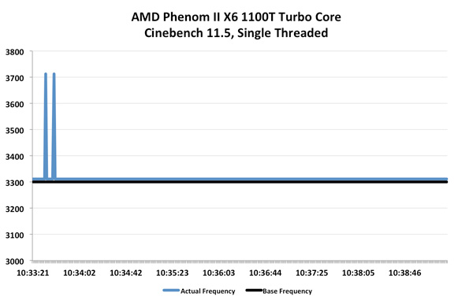
6.6.3.1 AMD’s Turbo Core technologies (2)
Example: Operation of AMD’s 1. gen. Turbo Core technology in their K10.5
Istambul-based Phenom II X6 DT processor with up to 6 cores [229]

Slide 49
6.6.3.1 AMD’s Turbo Core technologies (3)
AMD’s 1. generation Turbo Core technology -2
The Turbo Core technology has been implemented in select K10.5 Istambul-based
Phenom II X6 series (04/2010).
(Supporting models are ending with the letter T).
The introduction of the Turbo Core technology became feasible in this series
since these processors were manufactured by Global Foundries already
by the 45 nm high-k fabrication process.
The 45 nm process technology results in less leakage thus a higher power
headroom will be available for idle cores.

Slide 50
6.6.3.1 AMD’s Turbo Core technologies (4)
Principle of operation
In the case when
three or more cores enter the idle state (Boost eligible state) and
the active cores are in the P0 state,
idle cores (cores in the Boost eligible state) will be placed into the low power,
low clock frequency state.
In this state cores are clocked only at 800 MHz and their supply voltage
becomes decreased to a lower value.
Then up to three active cores will be switched into the PO Boost state.
In this state both their supply voltage and clock speed will be increased.
The frequency boost is up to 500 MHz, that can be utilized in single or
light threaded applications.

Slide 51
6.6.3.1 AMD’s Turbo Core technologies (5)
Comparing AMD’s Turbo Core implementation in their Phenom II X6 DT
with Intel’s Turbo Boost implementation in their Nehalem line (2008)
AMD’s Turbo Core technology, as implemented in their Phenom II X6 DT line is
less efficient than Intel’s Turbo Boost, as implemented in their Nehalem lines
(2008) [117].
One of the key differences is that in their Nehalem lines Intel already made use
of the efficient C6 idle state for completely shutting down inactive cores
through using power gates, so there is a larger power headroom that can be
utilized by the active cores in the Turbo mode.
Missing the C6 state and power gates can be the reason why AMD do not allows
to switch more than 3 cores into the Turbo Core mode.
Nevertheless, in their subsequent lines (K12-based Llano, K14-based Bobcat and
K15-based Bulldozer), introduced in 2011, also AMD implemented the C6 state
along with power gates and improved significantly the efficiency of their
Turbo Core technology.

Slide 52
6.6.3.1 AMD’s Turbo Core technologies (6)
P-state transition sequences in AMD’s first Turbo Core technology [230]

Slide 53
6.6.3.1 AMD’s Turbo Core technologies (7)
Resulting performance gain when using Turbo Core technology [230]

Slide 54
6.6.3.1 AMD’s Turbo Core technologies (8)
AMD’s enhanced 1. gen. Turbo Core implementation in their Bulldozer family
Subsequently AMD implemented an enhanced version of their 1. gen.
Turbo Core technology in Bulldozer-based servers and desktops
(Interlagos, Zambezi) in 10/2011.
These processors do already support power-gating.
Accordingly, much more headroom remains for utilizing Turbo core.
This implementation provides beyond the base clock frequency two turbo levels,
The 8-core Turbo frequency becomes activated if all cores are active but
there remains a power headroom up to the TDP, and
the 4-core Turbo frequency can be activated if at least half of the cores are
in the CC6 state and the active cores request max. performance.
For single threaded applications the active core will run basically at the 8-core
Turbo frequency and if there remains enough headroom to the TDP even
at the the 4-core Turbo frequency, as demonstrated below.

Slide 55
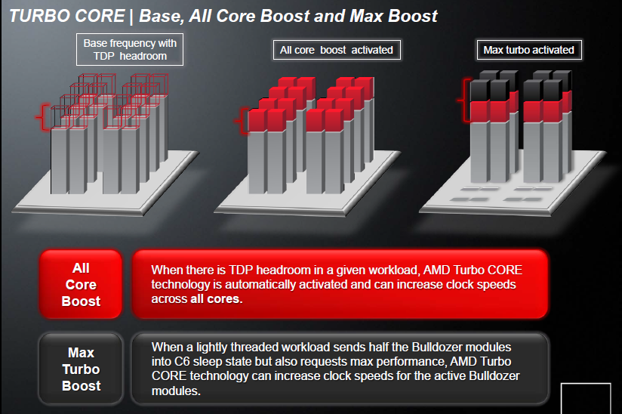
6.6.3.1 AMD’s Turbo Core technologies (9)
Principle of operation of AMD’s 1. gen. Turbo Core technology,
as introduced in the Bulldozer family [190]

Slide 56
6.6.3.1 AMD’s Turbo Core technologies (10)
Nominal, 8-core Turbo, and 4-core Max Turbo frequencies in AMD’s
Zambezi DT line [229]
AMD FX-series processors
Name | Nominal Frequency | 8-core Turbo frequency | 4-core Max Turbo frequency | TDP | Cores | Level 2 cache | Level 3 cache | Northbridge Frequency | SRP
FX-8150* | 3.6GHz | 3.9GHz | 4.2GHz | 125W | 8 | 8MB | 8MB | 2.2GHz | $245
FX-8120* | 3.1GHz | 3.4GHz | 4GHz | 95W/ 125W | 8 | 8MB | 8MB | 2.2GHz | $205
FX-8100 | 2.8GHz | 3.1GHz | 3.7GHz | 95W | 8 | 8MB | 8MB | 2GHz | Unknown
FX-6100* | 3.3GHz | 3.6GHz | 3.9GHz | 95W | 6 | 6MB | 8MB | 2GHz | $165
FX-4170 | 4.2GHz | None | 4.3GHz | 125W | 4 | 4MB | 8MB | 2.2GHz | Unknown
FX-B4150 | 3.8GHz | 3.9GHz | 4GHz | 95W | 4 | 4MB | 8MB | 2.2GHz | Unknown
FX-4100* | 3.6GHz | 3.7GHz | 3.8GHz | 95W | 4 | 4MB | 8MB | 2GHz | $115

Slide 57
6.6.3.2 AMD’s 2. gen. Turbo Core technology
Notes:
57

Slide 58
6.6.3.2 AMD’s 2. gen. Turbo Core technology (1)
6.6.3.2 AMD’s 2. gen. Turbo Core technology
Based on a patent filed in 2008 by Naffziger (one of AMD’s key processor
architects) [231], AMD introduced a greatly improved 2. generation Turbo Core
technique in all of their main processor families in 2011/2012, that is in the
Llano APU line (Family 12h) APU line (06/2011)
1. gen. Cat (Bobcat)-based Ontario/Zacate APU lines (01/2011) and
2. gen. Bulldozer (Piledriver)-based Trinity APU line (09/2012).
The 2. gen. Turbo Core technology introduces
power gating,
the C6 core idle state and
a System Manager Unit (SMU) that is based on a 32-bit microprocessor
(actually the Lattice Miki LM32 microprocessor)
Note that these innovations were introduced by Intel’s Nehalem family already
in 2008 (the C6 idle state even in the previous Penryn family in 2007).

Slide 59
6.6.3.2 AMD’s 2. gen. Turbo Core technology (2)
Principle of operation of the 2. gen. Turbo Core technique -1
Based on the cited patent, [232] these processors have a digital power monitor
that scans the activity level of a large number of relevant events in each core
(e.g. 95 in each Llano core) and the GPU, such as FX and FP operations,
L1/L2 cache accesses etc. and based on these activity readings the Turbo Core
Manager (actually the SMU) calculates the power dissipation values for each
core plus the GPU by using a set of appropriate weights.
These data allow to determine also the dissipation of the entire chip, as indicated
in the next Figure.
The above briefly described technique is sad to be accurate to within 2% across
a broad range of application types [232].

Slide 60
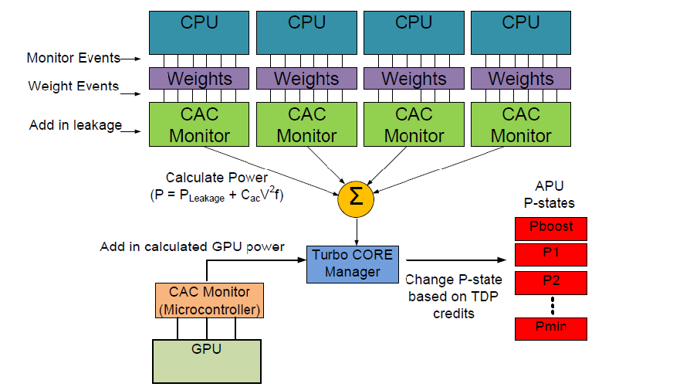
6.6.3.2 AMD’s 2. gen. Turbo Core technology (3)
Example: Simplified layout of Llano’s digital power monitor [127]
CAC: AC capacitance (C_{ac}) termed also as switching capacitance
(it models the switching behavior of a unit)

Slide 61
6.6.3.2 AMD’s 2. gen. Turbo Core technology (4)
Principle of operation of the 2. gen. Turbo Core technique -2
Based on the calculated power consumption of the socket the Turbo Core Manager
determines the actual energy margin to the target TDP as the difference
between the actual power consumption of the cores and the chip and the
related TDP figure.
Positive margins indicate power headroom
Negative margins indicate power overage
A power headroom can be utilized for increasing the clock frequency (for Turbo
boost)
Power overages, on the other hand, initiate throttling (clock reduction) of the
cores or even the GPU.
Turbo boosting behaves differently in the first implementations (in the Llano,
and Ontario or Zacate lines) and the subsequent implementations (beginning
with the Trinity line).
In the first 2. gen. Turbo Core implementations, when the OS requests higher
CPU performance for particular cores and there is a power headroom
available, the Turbo Core Manager initiates a clock frequency increase for the
related core.
Note that only the clock frequencies of the cores may be increased, but the
clock frequency of the GPU can not be boosted, not even in case when the
CPU cores are not fully utilized or are inactive.

Slide 62
6.6.3.2 AMD’s 2. gen. Turbo Core technology (5)
Advanced implementation of the 2. gen. Turbo Core technology in the
2. gen Bulldozer (Piledriver)-based Trinity APU line [233]
The major enhancement of the 2. gen. Turbo Core technology of the Trinity line
vs. the Llano APU line is that the Trinity APU implements a bi-directional turbo
management, unlike the Llano APU that could boost only the core frequencies.
This allows now to increase also the clock frequency of the GPU when there is a
heavy GPU load and enough power headroom is available, as the following
Figure demonstrates it for the dual-module (4 cores) Trinity A10-4600M
mobile APU.

Slide 63
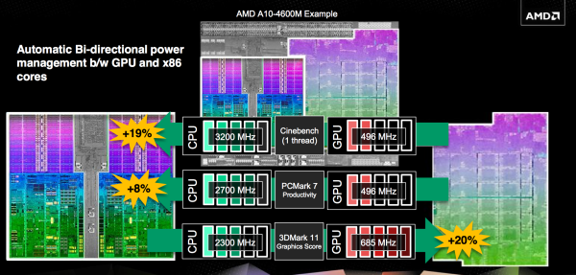
6.6.3.2 AMD’s 2. gen. Turbo Core technology (6)
Example: Bi-directional Turbo Core implementation in the 2. gen. Turbo Core
technology in the 2. gen Bulldozer (Piledriver)-based Trinity APU line [233]
We note that
the compute modules have a base clock frequency of 2300 MHz that can be
boosted up to 3200 MHz, in steps of 100 MHz, whereas
the GPU has a base clock frequency of 496 MHz that can be raised to 685 MHz.

Slide 64
6.6.3.3 AMD’s STAPM (Skin Temperature Aware Power Management)
technology
Notes:
64

Slide 65
6.6.3.3 AMD’s STAPM (Skin Temperature Aware Power Management) (1)
AMD’s STAPM (Skin Temperature Aware Power Management) technology -1
It is AMD’s 3. gen. Turbo Boost technology.
This technology is similar to Intel’s 2. gen. Turbo Boost technology, as it takes
into account the chassis temperature, i.e. the “thermal mass” of the chassis.
AMD designates this chassis temperature aware Turbo Boost technology as
Skin Temperature Aware Power Management (STAPM).
STAPM raises performance by boosting CPU and/or GPU frequencies as long as
the estimated platform’s skin temperature remains below a specified limit.
This allows an additional performance improvement when the device chassis is
“cold” after switch off or in light loaded time intervals of the processor.
Here we note that compared to Intel’s 2. gen. Turbo Boost technology AMD’s
STAPM technology appeared with a time delay of about 3 years.

Slide 66
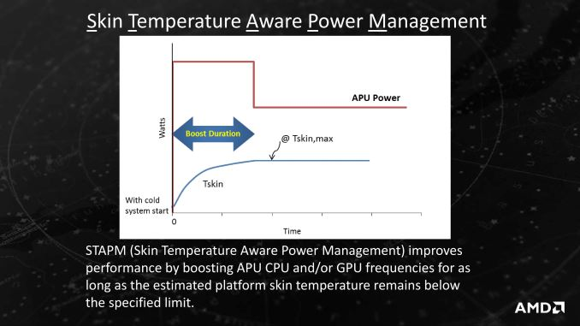
6.6.3.3 AMD’s STAPM (Skin Temperature Aware Power Management) (2)
Principle of AMD’s STAPM (Skin Temperature Aware Power Management)
[122]

Slide 67
6.6.3.3 AMD’s STAPM (Skin Temperature Aware Power Management) (3)
AMD’s STAPM (Skin Temperature Aware Power Management) technology -2
AMD introduced STAPM both in their mainline (Bulldozer-based) and low power
Cat line for laptop models in the middle of the 2010’s, more precisely along with
the Puma+-based Beema and Mullins lines (4/2014) and
the Excavator v1-based Carizo line (06/2015).
AMD continued to implement the STAPM technology in their Zen-based laptop
processors.

Slide 68
6.6.3.3 AMD’s STAPM (Skin Temperature Aware Power Management) (4)
Performance increase resulting from using the STAPM technology
Since most use cases for mobile devices are short in duration, STAMP results
often in notable performance increase, as seen in the Figure below for a
subsequent STAPM implementation [234].
Figure: Performance improvements for STAPM in AMD’s Excavator v2
(Family 15h Models 70h-7Fh)-based Bristol Ridge processors (05/2016) [234]

Slide 69
6.6.3.3 AMD’s STAPM (Skin Temperature Aware Power Management) (5)
Remark [234]
Further on, as the STAPM technology allows the cores or the GPU to run faster,
the time to completion will be shorter.
Then the additional power needed for higher clock frequencies is easily compensated
by reduced power consumption resulting from setting processor or platform
components sooner into idle states.

Slide 70
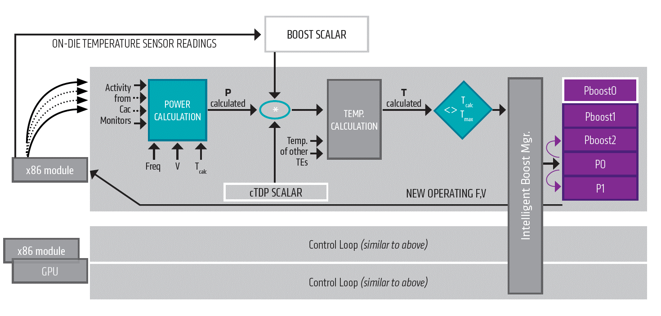
6.6.3.3 AMD’s STAPM (Skin Temperature Aware Power Management) (6)
Assumed principle of the implementation pf STAPM [235]
(Static power)
TE: Thermal Entity
Here we do not want to go into details, but refer to the source of the publication.

Slide 71
6.6.3.4 AMD’s Precision Boost technology
Notes:
71

Slide 72
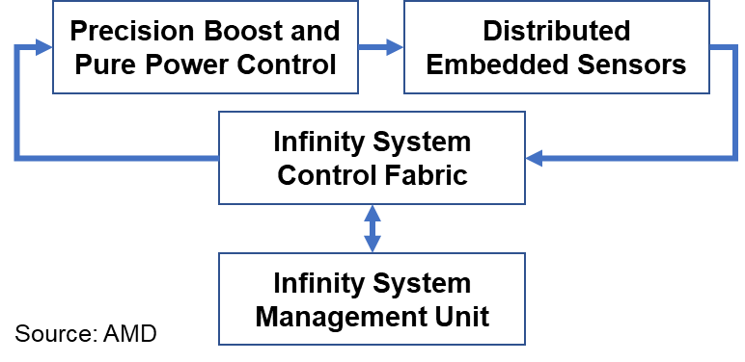
6.6.3.4 AMD’s Precision Boost technology (1)
6.6.3.4 AMD’s Precision Boost technology -1
It is AMD’s 4. gen. Turbo Boost technology
AMD enhanced their Turbo Core technology in the subsequent Zen-based
1. gen. DT Ryzen (03/2017) and ThreadRipper lines (08/2017), their enhanced
technology is designated as the Precision Boost technology.
It makes use of the same closed loop control mechanism as AMD's Pure Power
technology (that is AVS), as indicated in the Figure below:
Figure: The closed loop control mechanism for Pure Power (i.e. AVS) and Precision Boost (i.e. Turbo Boost) [213]

Slide 73
6.6.3.4 AMD’s Precision Boost technology (2)
AMD’s Precision Boost technology -2
Specific features of the Precision Boost technology:
a) Kind of specifying the Turbo Boost frequencies
b) Fine grained tuning of the clock frequency (in 25 MHz steps)
*

Slide 74
6.6.3.4 AMD’s Precision Boost technology (3)
a) Kind of specifying the Precision Boost frequency [161]
Precision Boost makes use of two Turbo Boost frequencies,
one higher value for
for up to two active cores (in DTs), respectively
for up to four active cores (in the ThreadRipper line), whereas
a lower value for more active cores, as specified above.
The next two Figures illustrate this.
*

Slide 75
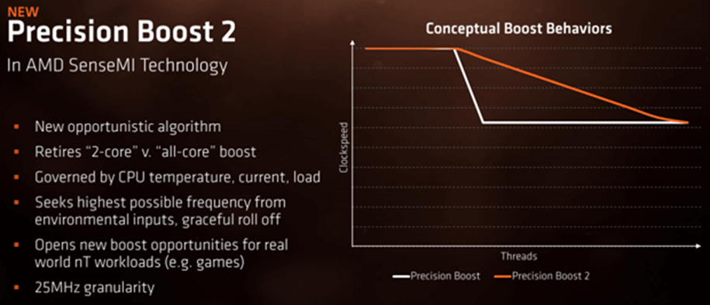
6.6.3.4 AMD’s Precision Boost technology (4)
Boost behavior in the Precision Boost technology
Up to two active cores
Up to four active cores
4.0 GHz
4.0 GHz
More than two active cores
More than four active cores
3.7 GHz
Figure: Boost behavior of the
Ryzen DT lines [161]
Figure: Boost behavior of the
ThreadRipper line (based on [161])

Slide 76
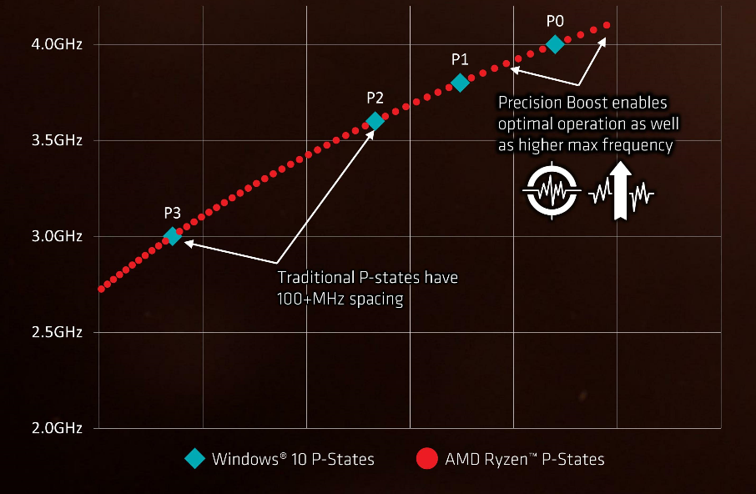
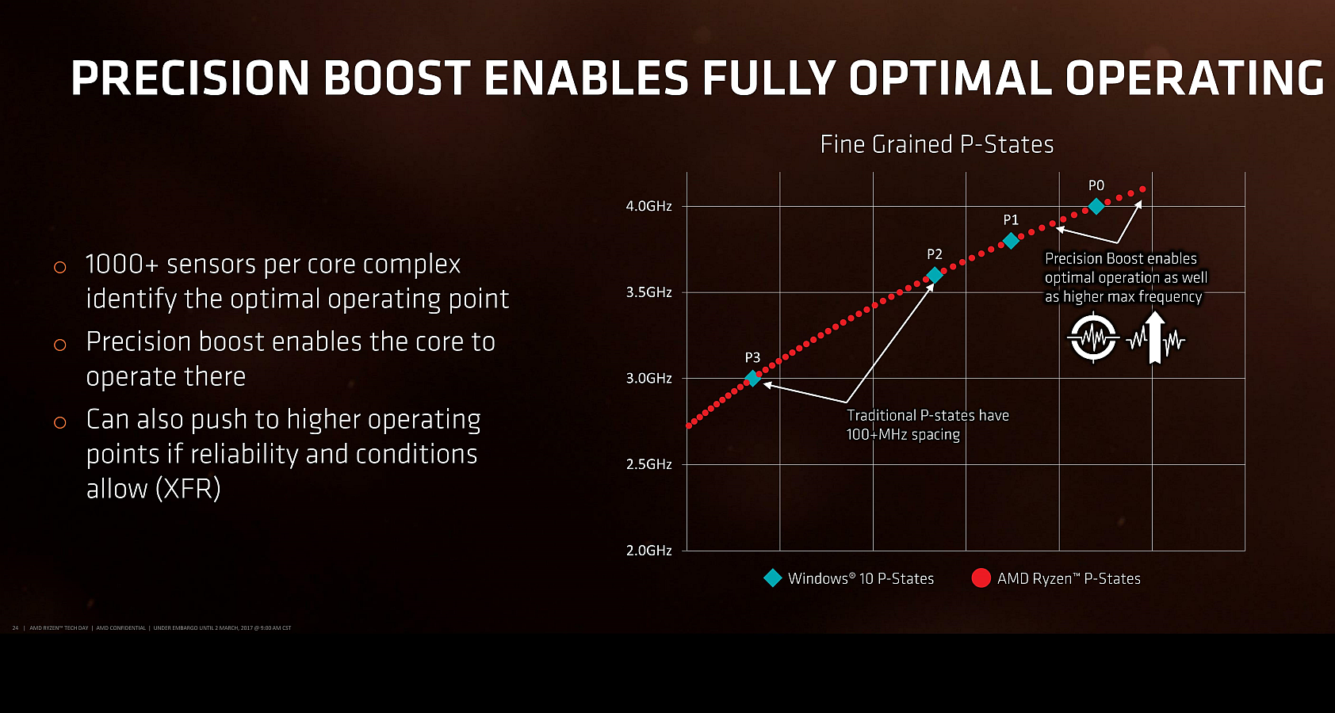
6.6.3.4 AMD’s Precision Boost technology (5)
b) Fine grained tuning of the clock frequency (in 25 MHz steps) [101]
Precision
Boost
XFR
*

Slide 77
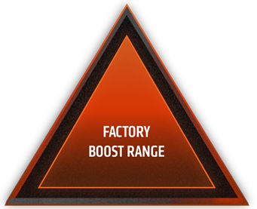
6.6.3.4 AMD’s Precision Boost technology (6)
Assumed principle of fine grained tuning
While using Precision Boost all active cores operate at the same clock frequency
and core voltage.
Fine grained tuning will be performed by the SMU microprocessor that raises the
core voltage and the clock frequency (in 25 MHz steps) whereas checks whether
the limiting factors, including the temperature, SoC power and VRM current
(and with it the socket power consumption) remain in the factory boost range.
Temp
SoC
power
VRM
current
SMU: System Management Unit
Figure: Conceptual view of extending the limiters of Precision Boost with PBO [236]

Slide 78
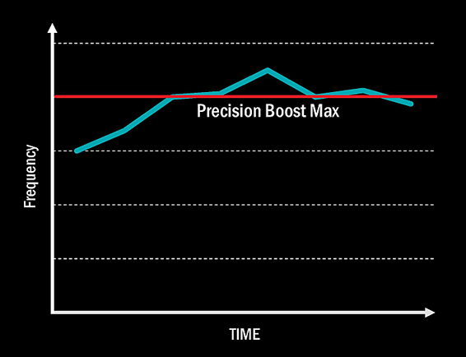
6.6.3.4 AMD’s Precision Boost technology (7)
Introducing the XFR technology (eXtended Frequency Range) technology
for raising the clock frequency over the Turbo boost frequency - XFR
The XFR (eXtended Frequency Range) technology presumes a high performance
(premium) cooler system to keep die temperature within the given limit [101].
XFR provides an automated overclocking over the max. Turbo Boost frequency if there
is a premium cooler system and the operating conditions of the processor (e.g.
temperature data) allow it.
With XFR enabled the
processor may boost clock
frequency by 50 to 200 MHz
above the advertised
max. Turbo Boost frequency.
Figure: Principle of operation of XFR [101]
*

Slide 79
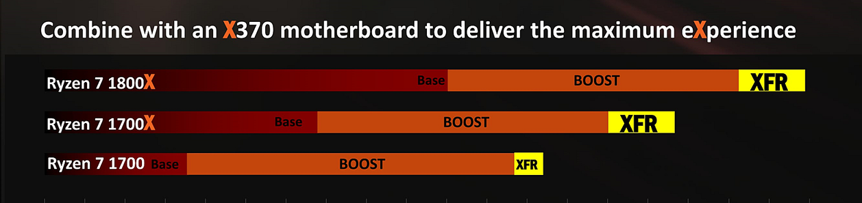
6.6.3.4 AMD’s Precision Boost technology (8)
Additional boost of clock frequencies by the XFR technology [101]

Slide 80
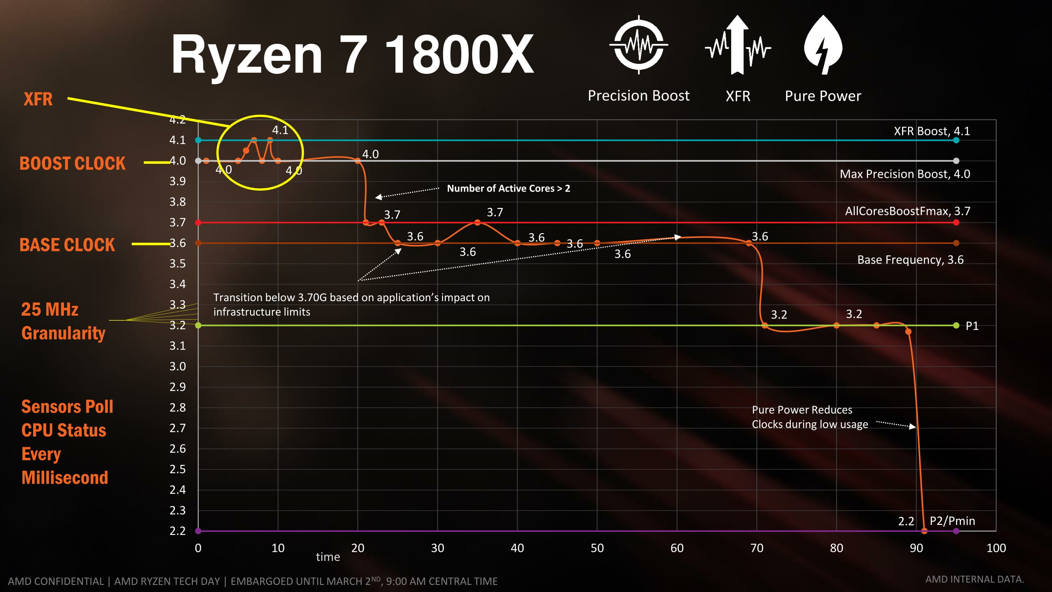
6.6.3.4 AMD’s Precision Boost technology (9)
Example frequency scaling in AMD’s Ryzen 7 1800X DT line [101]

Slide 81
6.6.3.4 AMD’s Precision Boost technology (10)
Remark
AMD’s Precision Boost technology (2017) is similar to Intel’s Thermal Velocity Boost
(TVB) technology (2018).

Slide 82
6.6.3.5 AMD’s Precision Boost 2 technology
Notes:
82

Slide 83
6.6.3.5 AMD’s Precision Boost 2 technology (1)
AMD’s Precision Boost 2 technology
It is AMD’s 5. gen. Turbo Boost technology.
Precision Boost 2 has been introduced in a number of Zen-based series, as follows:
Ryzen mobile APU series (Zen (Raven Ridge)-based, 14 nm, 10/2017)
Ryzen DT APU series (Zen+ (Pinnacle Ridge)-based, 12 nm 4/2018)
2. gen. Ryzen DT series (Zen+ (Pinnacle Ridge)-based, 12 nm, 4/2018) and
2. gen. ThreadRipper series, (Zen+ (Pinnacle Ridge)-based, 12 nm, 8/2018).

Slide 84
6.6.3.5 AMD’s Precision Boost 2 technology (2)
Deficiency of the boost behavior of the implemented Precision Boost
technology [237]
The step-like reduction of the boost frequency while entering more active threads
can unfavorable impact performance, especially in games.
In this case several additional threads could often be spawned in addition to the
one or two main threads and while the additional threads frequently do not
contribute as much to the performance they can cause the boost frequency
significantly drop.
This could partly explain the moderate performance of AMD’s Zen-based
processors in certain gain titles and other benchmarks compared to Intel.
In order to mend this deficiency, in their Precision Boost 2. technology AMD
implemented a gradual decrease of the boost frequency along with raising
the number of the active threads, as illustrated next.

Slide 85
6.6.3.5 AMD’s Precision Boost 2 technology (3)
Boost behavior in the Precision Boost technology
Up to two active cores
Up to four active cores
4.0 GHz
4.0 GHz
More than two active cores
More than four active cores
3.7 GHz
Figure: Boost behavior of the
Ryzen DT lines [161]
Figure: Boost behavior of the
ThreadRipper line (based on [161])

Slide 86
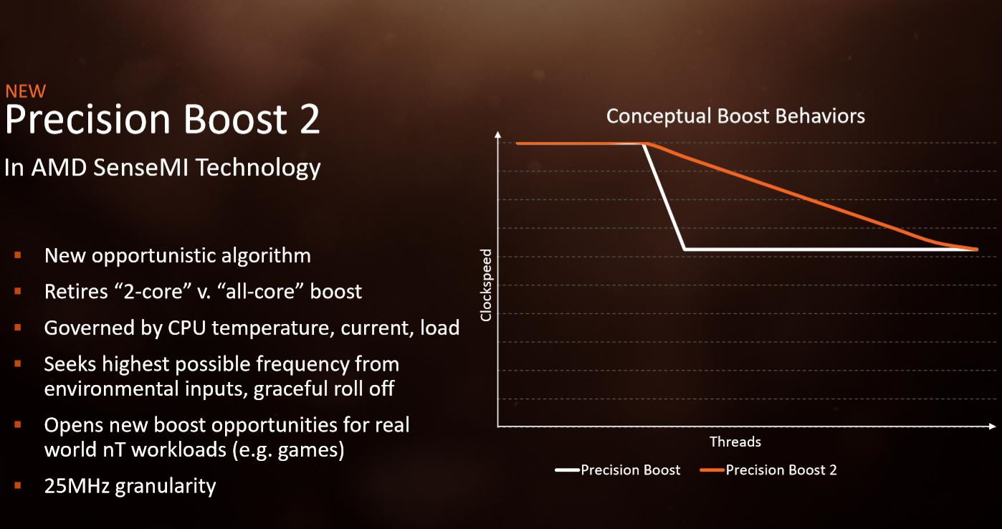
6.6.3.5 AMD’s Precision Boost 2 technology (4)
Enhanced boost behavior in the Precision Boost 2 technology [237]
n-

Slide 87
6.6.3.5 AMD’s Precision Boost 2 technology (5)
Principle of operation of Precision Boost 2 [238]
Precision Boost 2 technology raises the clock frequency for any active core count
as much as given limits (defined by factory boost settings) allow it.
The limiting factors are
SoC power (“Total Platform Limit”): the maximum amount of power the
CPU can draw before boost levels off (measured in Watts)
VRM current (“TDC Limit”): the maximum amount of current the motherboard
is allowed to deliver to the CPU after warming up to a steady-state
temperature before boost levels off
EDC current Limit - Electrical Design Current, maximum peak current that
can be delivered by the motherboard' voltage regulator (VRM) for a short
time, as a spike
Temp (°C): measured in degrees Celsius, the maximum temperature the CPU
die can reach before boost levels off.

Slide 88
6.6.3.5 AMD’s Precision Boost 2 technology (6)
Conceptual view of implementing Precision Boost 2 [236]
Temp
SoC
power
VRM
current
The inner triangle illustrates the factory boost range settings, the blue circles
represent actual operating points of the key limiting factors.
Clock frequency and core voltage of all active cores will be increased in 25 MHz
steps as long as one of the limiting factors reach the factory setting.

Slide 89
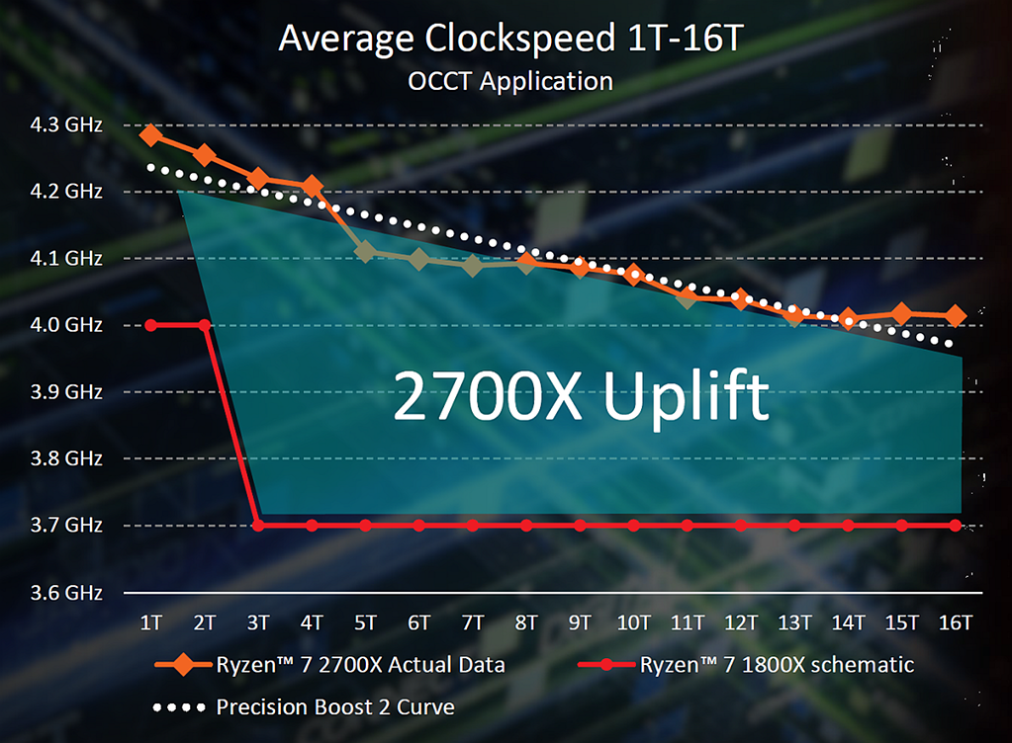
6.6.3.5 AMD’s Precision Boost 2 technology (7)
Precision Boost 2 technology as implemented in the 2. gen Ryzen DT line [239]
Boost behavior with Precision Boost 2
in the 2. gen. Ryzen Desktop line

Slide 90
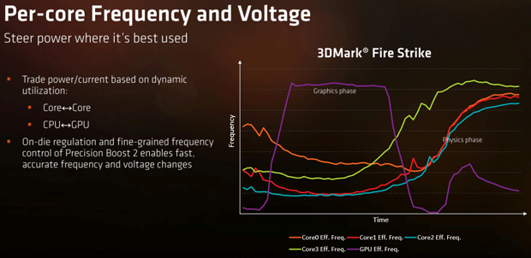
6.6.3.5 AMD’s Precision Boost 2 technology (8)
Example for integrated per-core frequency and voltage management
in Precision Boost 2 [161]

Slide 91
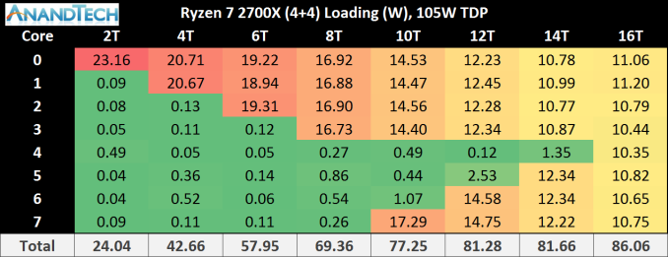
6.6.3.5 AMD’s Precision Boost 2 technology (9)
Power consumption of the cores while raising the number of active cores
in the Ryzen 7 2700X 2. gen. desktop [239]
There are up to two active CCX units with up to 4 active cores/unit.
Green figures: not loaded cores - Yellow to red figures: loaded cores
Red figures appearing for few active cores indicate that in this case presumably
die temperature will constrain turbo clock frequency and determine the related
power consumption, whereas for yellow figures, seeing at many active cores,
the total power consumption limits clock frequency.

Slide 92
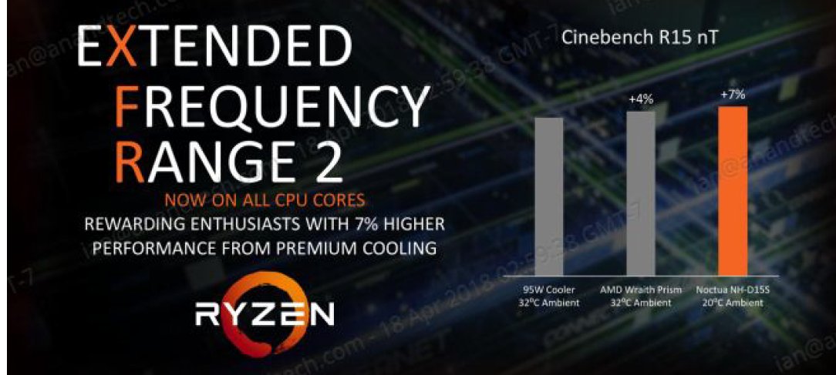
6.6.3.5 AMD’s Precision Boost 2 technology (10)
The XFR2 (eXtended Frequency Range) technology [239]
In the previous generation certain processor models could raise clock frequency
over the turbo boost frequency by 50 to 200 MHz if a premium cooling system
was used.
XFR2 allows a higher clock frequency boost assuming a premium cooling system
and a CPU temperature below 60 C⁰.

Slide 93
6.6.3.5 AMD’s Precision Boost 2 technology (11)
Introducing the Precision Boost Overdrive (PBO) technology [236]
It is a new feature of 2. gen. Ryzen DT and 2. gen. ThreadRipper processors,
aiming at increasing multihreaded performance.
It requires however the use of specific chipsets, as follows
in case of the 2. gen. DT series the series 400 chipsets (X470/B450) or
in case of the 2. gen. ThreadRipper series the X399 chipset
and the Ryzen Master overdrive utility release 1.3 or higher.
Unlike traditional overlocking while PBO is activated both Precision Boost 2 and
XFR2 (eXtended Frequency Range) remains enabled.

Slide 94
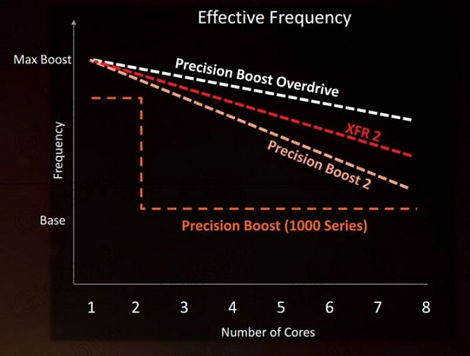
6.6.3.5 AMD’s Precision Boost 2 technology (12)
Relative merit of PBO [240]

Slide 95
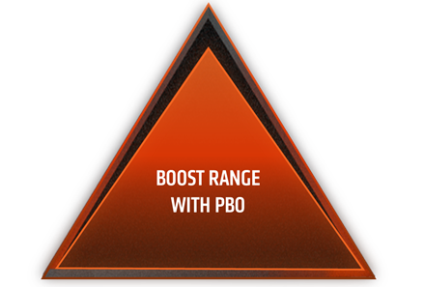
6.6.3.5 AMD’s Precision Boost 2 technology (13)
Principle of operation of PBO [238]
When PBO is activated by means of the Ryzen Master overlocking utility the factory settings that determine the operation limits of Precision Boost 2 will be overwritten and the processor will operate outside the factory settings.
Temp
Temp
SoC
power
VRM
current
SoC
power
VRM
current
Figure: Conceptual view of extending the limiters of Precision Boost with PBO [238]
Note that the temperature limit with PBO remains unchanged.

Slide 96
6.6.3.5 AMD’s Precision Boost 2 technology (14)
Example for extending the limiters of Precision Boost with PBO [238]
For the 2. gen. Ryzen 2700X DT with 105 W TDP the default limits of
Precision Boost 2 are as follows:
PPT (Total Platform Limit): 141.75 W
TDC (Thermal Design Current): 95 A
EDC Electrical Design Current: 140 A and
Tjmax (Die temperature): 85⁰ C.
When Precision Boost Overdrive mode is enabled the operation limiters will
be raised as given below:
PPT (Total Platform Limit): 1000 W
TDC (Thermal Design Current): 114 A
EDC Electrical Design Current: 168 A and
Tjmax (Die temperature): 85⁰ C.
Nevertheless, with enabling the PBO mode invalidates AMD’s warranty.

Slide 97
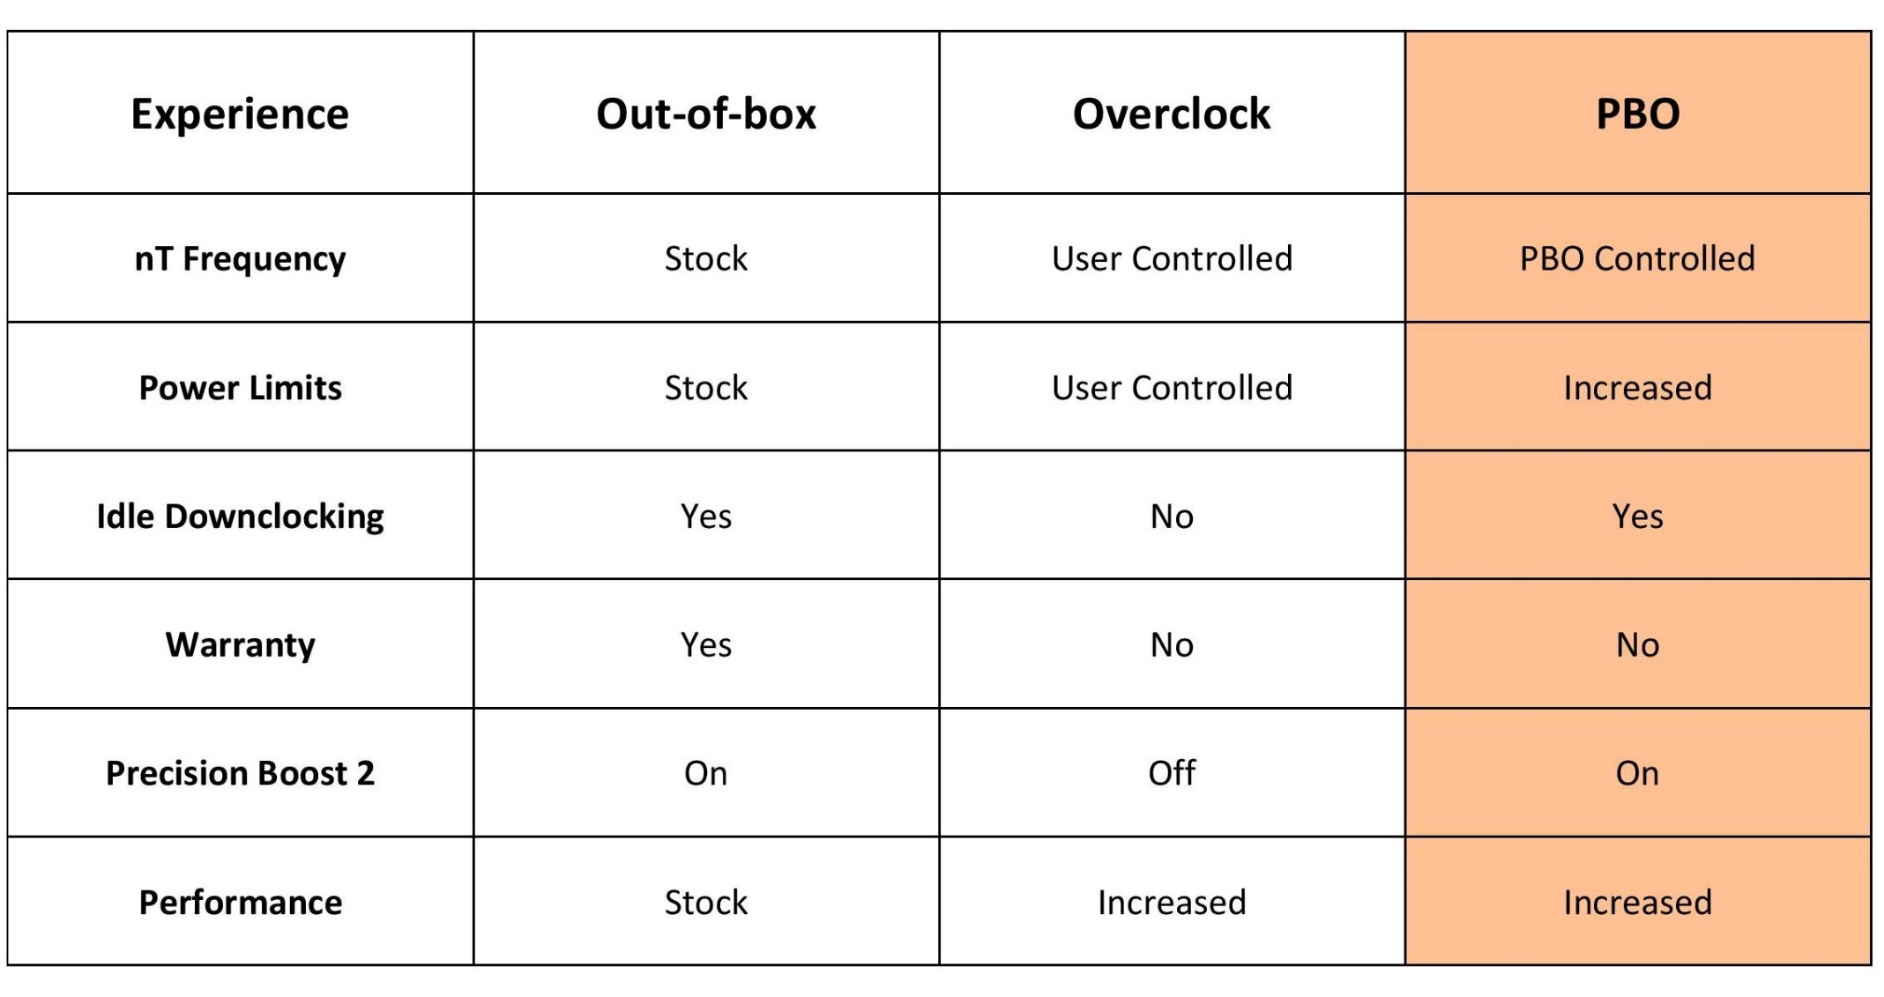
6.6.3.5 AMD’s Precision Boost 2 technology (15)
Contrasting implications of using overclocking and PBO [241]

Slide 98
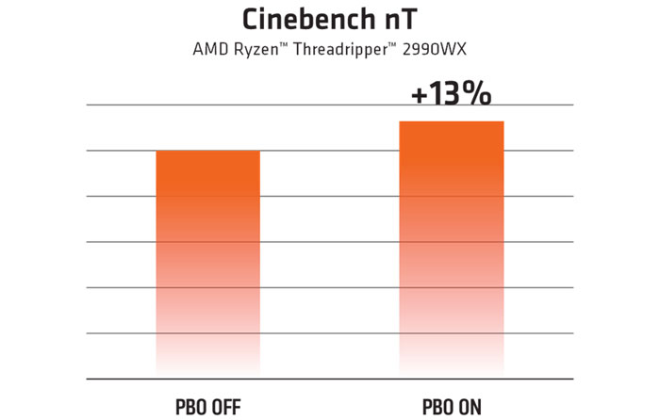
6.6.3.5 AMD’s Precision Boost 2 technology (16)
Example performance improvement achieved by employing PBO
in a ThreadRipper 2990WX for a multithreaded benchmark [236]

