Slide 1
The mobile boom
Sima Dezső
Nov. 2019
(Ver. 2.5)
© Sima Dezső, 2019

Slide 2
Contents
1. Emergence and spread of smartphones
2. Emergence and spread of tablets
3. Key requirements of mobile devices
4. How leading IT vendors addressed the mobile boom?
5. Conclusions
6. References

Slide 3
1. Emergence and spread of smartphones
Notes:
3

Slide 4
1. Emergence and spread of smartphones ()
1. Emergence and spread of smartphones
The traditional computer market around 1995
Main computer market segments around 1995
Servers
Desktops
Embedded
computer devices
E.g.
Intel’s Xeon lines
Intel’s Pentium lines
AMD’s K5, K6 lines
ARM’s lines
Around 1995: spreading of multimedia, graphics and internet and
emergence of laptops (aka notebooks) (portable computers).
Desktops
Laptops
(notebooks)
Since about 1995
*

Slide 5
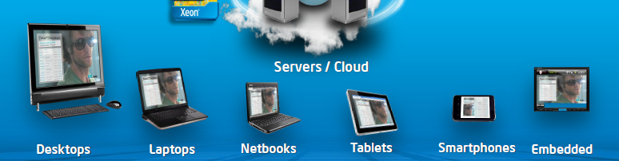
1. Emergence and spread of smartphones (1)
Emerging of mobile devices, first smartphones (≈2006) then tablets (≈2010)
[2]
The mobile boom
Netbooks: Small size laptops (e.g. with a display size of 10" or smaller.)

Slide 6
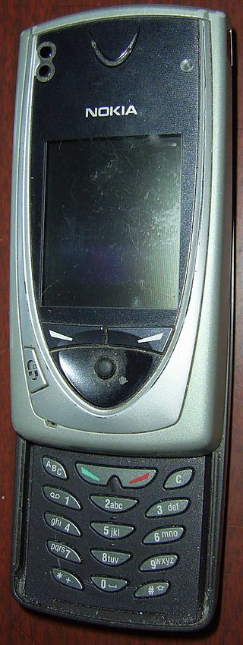
1. Emergence and spread of smartphones (2)
Emergence of smartphones-1
Forerunners of smartphones emerged already
at the beginning of the 2000’s, like Nokia’s 7650
(shipped in 2002).
The 7650 became the first widely available phone
with camera and color screen but supported
no video.
It was the first Nokia phone running under
the Symbian OS.
Figure: Nokia’s 7650 [39]

Slide 7
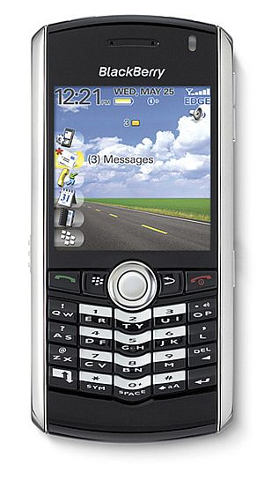
1. Emergence and spread of smartphones (3)
Emergence of smartphones-2
The emergence of smartphones is often
contributed to the BlackBerry Pearl 8100
line of the Canadian firm RIM
(Research in Motion)[5].
This phone – shipped in 2006 - supported
beyond a camera also video and became
very popular in the US.
It was run under the BlackBerry OS.
Figure: RIM’s BlackBarry Perl 8100
(2006) [38]
*

Slide 8
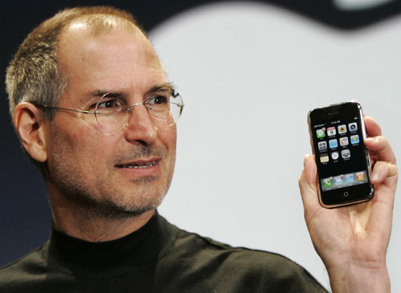
1. Emergence and spread of smartphones (4)
Early spread of smartphones-1
In 2007 Apple’s iPhone gave a strong momentum for rapid spreading of
smartphones.
It run under the iPhone OS (renamed later to iOS in 2010).
Figure: Steve Jobs introducing the iPhone at MacWorld Expo in 1/2007 [47]
*

Slide 9
1. Emergence and spread of smartphones (5)
Remark
After the introduction of iPhone (2007) Steve Ballmer (CEO of Microsoft) said in an
interview [20]:
“There's no chance that the iPhone is going to get any significant market share.
No chance…
But if you actually take a look at the 1.3 billion phones that get sold, I'd prefer
to have our software (Windows Phone) in 60% or 70% or 80% of them, than
I would to have 2% or 3%, which is what Apple might get”.

Slide 10
1. Emergence and spread of smartphones (6)
Early spread of smartphones-2
Google’s Android was unveiled also in 2007 with first Android-powered phones
sold in 10/2008 [6].
*

Slide 11
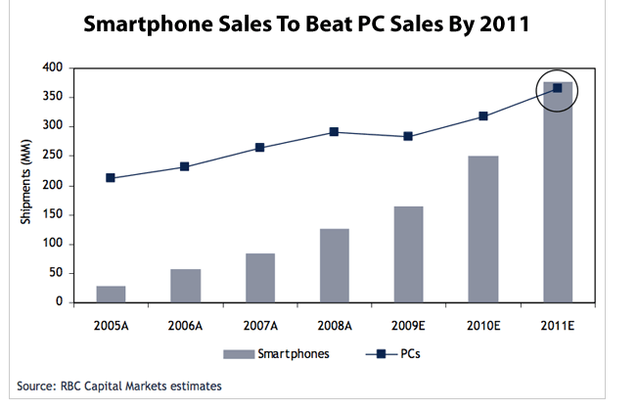
1. Emergence and spread of smartphones (7)
Emergence and rapid increase of smartphone sales 2005-2011 [4]
PC sales: Desktop + Notebook sales
A: Actual values
E: Estimated

Slide 12
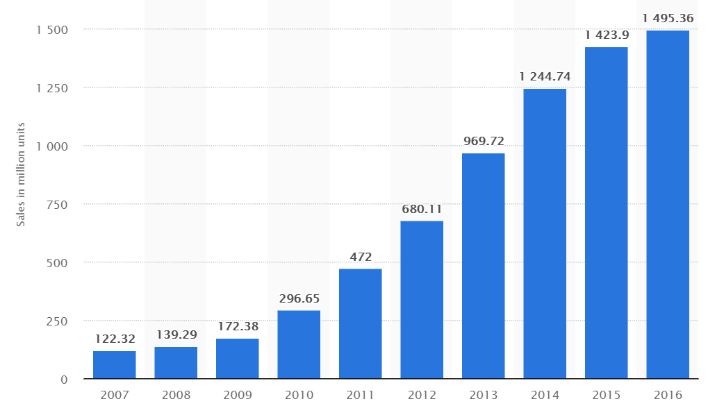
1. Emergence and spread of smartphones (8)
Worldwide unit shipments of smartphones 2007-2016 [28]

Slide 13
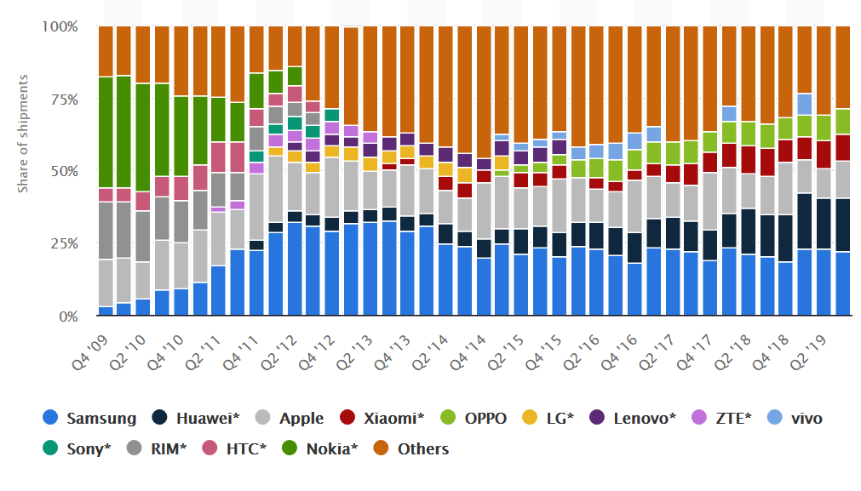
1. Emergence and spread of smartphones (10)
Worldwide smartphone market share 2009-2019 (in unit shipments) [108]

Slide 14
1. Emergence and spread of smartphones (11)
Worldwide market share of smartphone OSs to end users in 2009-2015 [42]
*

Slide 15
1. Emergence and spread of smartphones (12)
Remember
After the introduction of iPhone (2007) Steve Ballmer (CEO of Microsoft) said in an
interview [20]:
“There's no chance that the iPhone is going to get any significant market share.
No chance…
But if you actually take a look at the 1.3 billion phones that get sold, I'd prefer
to have our software in 60% or 70% or 80% of them, than I would to have 2%
or 3%, which is what Apple might get”.

Slide 16
1. Emergence and spread of smartphones (14)
Worldwide market share of application processors in 1H 2017 used in
smartphones (based on revenue) [71]
Vendor | Market share | Processor lines (examples) | ISA
Qualcomm (USA) | 42 % | Snapdragon line 200-805 Snapdragoon 808-845 | ARMv7 ARMv8
Apple (USA) | 18 % | Apple A4-A6X Apple A7-A11 | ARMv7 ARMv8
MediaTek (Taiwan) | 18 % | Helio x10 Helio X20 | ARMv7 ARMv8
Samsung (S. Korea) |  | Exynos 5 line Exynos 7/8/9 | ARMv7 ARMv8
[Source: Strategy Analytics]
ARMv7: 32-bit
ARMv8: 64-bit
*

Slide 17
2. Emergence and spread of smartphones (15)
Main features of the Qualcomm Snapdragoon lines
Model | Released | Technology | CPU | Word length bit | Clock rate (up to) | Connectivity
835 | Q2/2017 | 10 nm | 4+4 Kryo 280 | 64 | 2.45 GHz | integrated LTE + RF
821 | Q3/2016 | 14 nm | 2+2 Kryo | 64 | 1.4 GHz | integrated LTE + RF
820 | Q4/2015 | 14 nm | 2+2 Kryo | 64 | 2.2 GHz | integrated LTE + RF
810 | H2/2014 | 20 nm | 4x ARM Cortex A57 + 4x ARM Cortex A53 | 64 | 2.0 GHz | integrated LTE + RF
808 | H1/2015 | 20 nm | 2x ARM Cortex A57 + 4x ARM Cortex A53 | 64 | 2.0 GHz | integrated LTE + RF
805 | Q1/2014 | 28 nm | 4x Krait 450 | 32 | 2.7 GHz | integrated LTE + RF
801 | Q4/2013 | 28 nm | 4x Krait 400 | 32 | 2.5 GHz | integrated LTE + RF
800 | Q2/2013 | 28 nm | 4x Krait 400 | 32 | 2.3 GHz | integrated LTE + RF
600 | Q1/2013 | 28 nm | 4x Krait 300 | 32 | 1.9 GHz | integrated WiFi
410 | 1H/2014 | 28 nm | 4x ARM Cortex A53 | 64 | 1.4 GHz | integrated LTE + RF
400 | Q4/2013 | 28 nm | 4x Krait 300 or 4x ARM Cortex A7 | 32 | 1.7 GHz 1.4 GHz | integrated LTE + RF
200 | 2013 | 28 nm | 4x ARM Cortex A5 or 4x ARM Cortex A7 | 32 | 1.4 GHz 1.2 GHz | integrated 3G + RF
RF: Radio Frequency Front End implemented as a separate chip

Slide 18
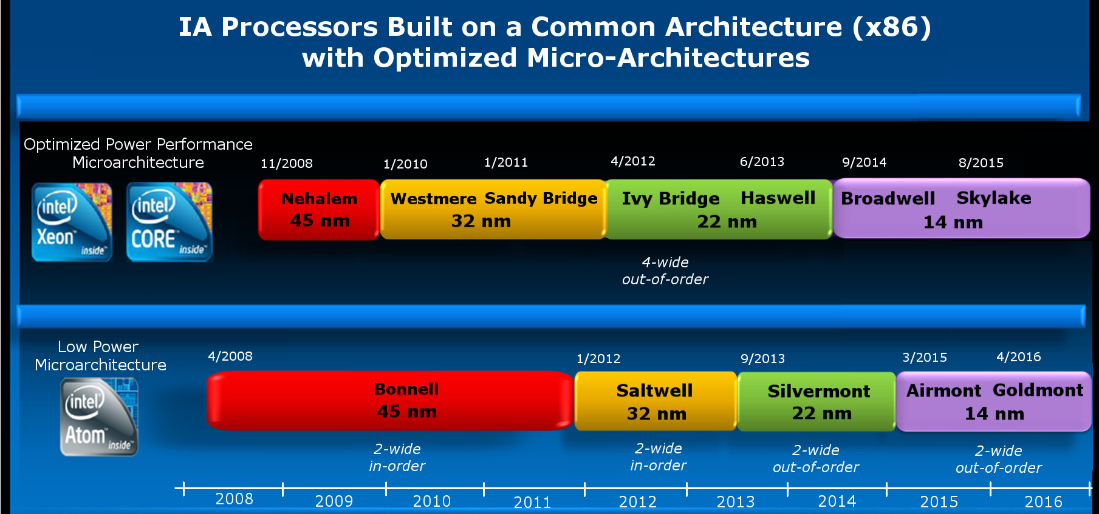
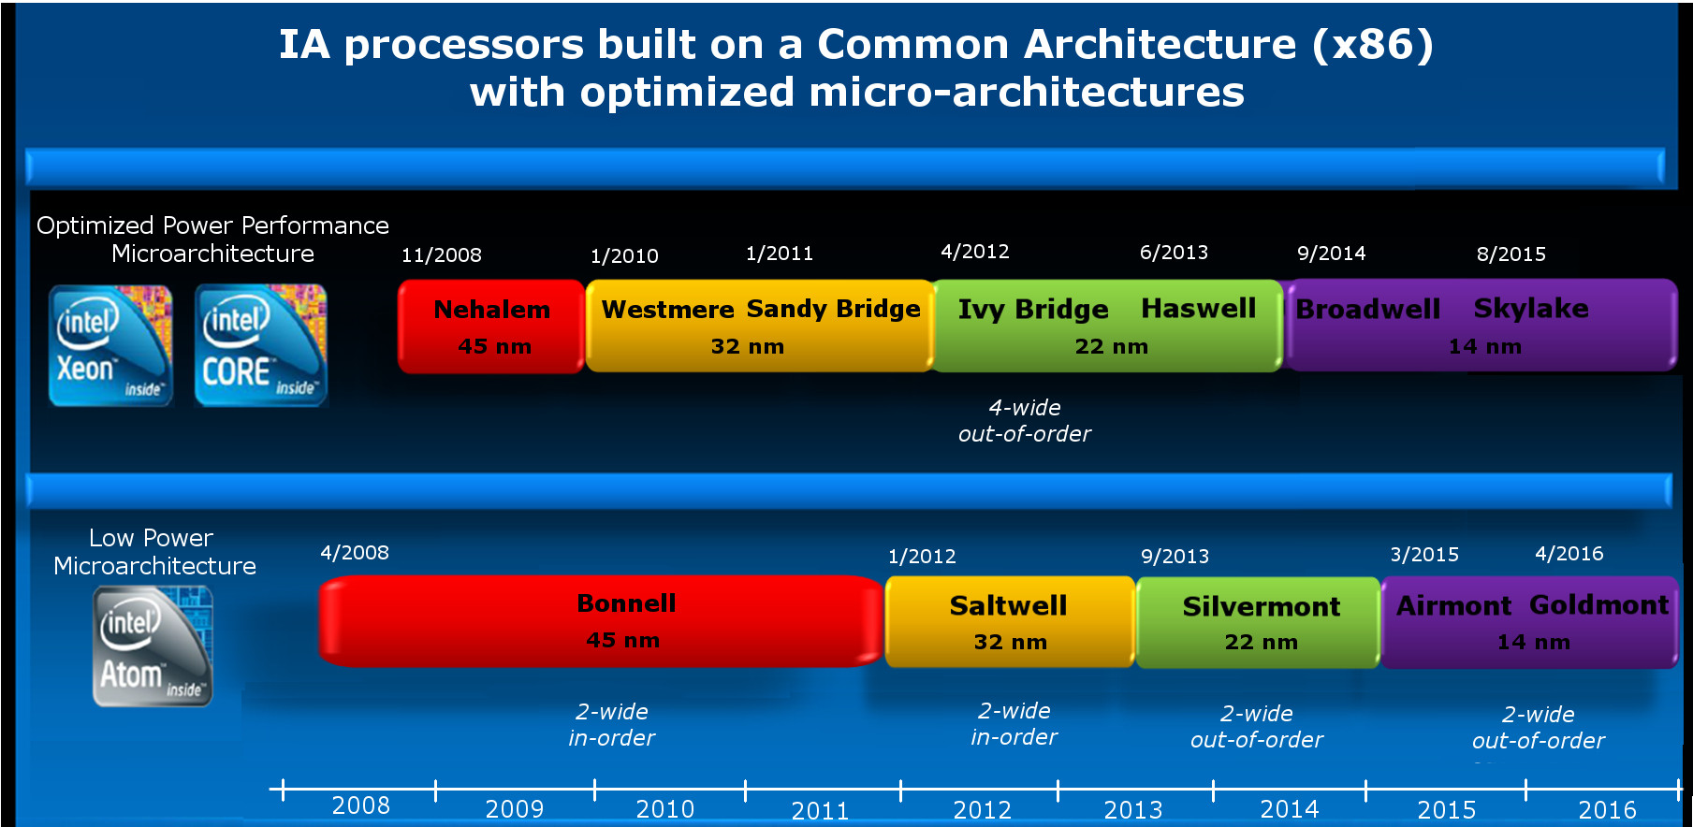
1. Emergence and spread of smartphones (16)
Intel's efforts to enter the mobile market [Based on 2]
Introduction of the Atom line targeting the mobile market
2-wide
in-order
2-wide
out-of-order
2-wide
out-of-order
3-wide
out-of-order

Slide 19
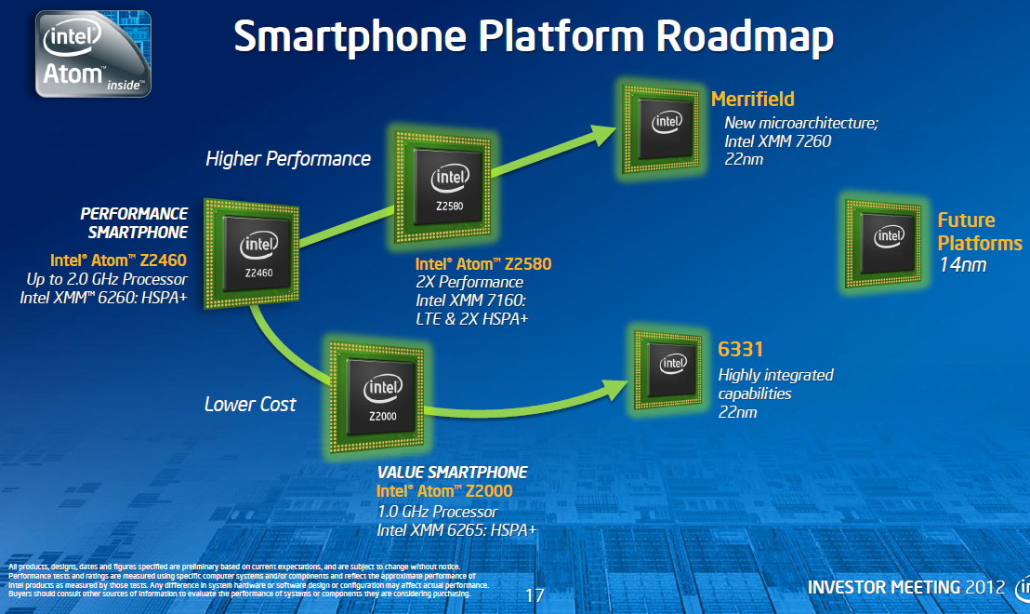
1. Emergence and spread of smartphones (17)
Intel’s Atom platforms targeting smartphones (based on [11])
Morganfield
(2016)
Moorefield
(2014)
Merrifield
(2014)
Performance (not to scale)
Clover Trail+
(2013)
Z5xxx
4x Goldmont
14 nm
+XMM 7360
Z35xx
4x Silvermont
22 nm
+XMM 7260/2/35
Medfield
(2012)
Z34x0
2x Silvermont
22 nm
+XMM 7160/7260
Cancelled
in 04/2016
Morestown
(2010)
Z2520-2580
2x Saltwell
32 nm
+XMM 6268/6360/7160
SoFIA
(x3 3G/LTE)
(2015)
Riverton
(2015)
Z2460/2480
1x Saltwell
32 nm
+XMM 6260
Slayton
(2014)
Lexington
(2013)
Z6xx
1x Bonnell
45 nm
+Wireless
module
C31xx/32xx/34xx
2x/4x Silvermont
28 nm
Integrated LTE
3G/4G modem
Z3xxx
2x Airmont
14 nm
Integrated
LTE modem
Z3xxx
2x Silvermont
22 nm
+A-GOLD 620
Z2420
1x Saltwell
32 nm
+XMM 6265
Cancelled
in 04/2016
Planned, not mplemented
Planned, not implemented

Slide 20
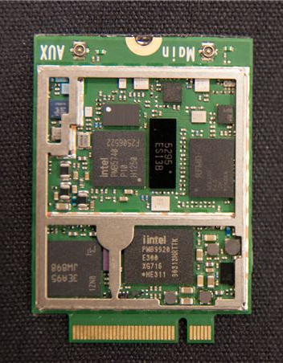
1. Emergence and spread of smartphones (18)
Intel’s XMM line including a 3G/4G modem and a transceiver (on two chips)
RF Transceiver
3G/4G modem
Figure: Implementation
example of the
XMM7160 [46]

Slide 21
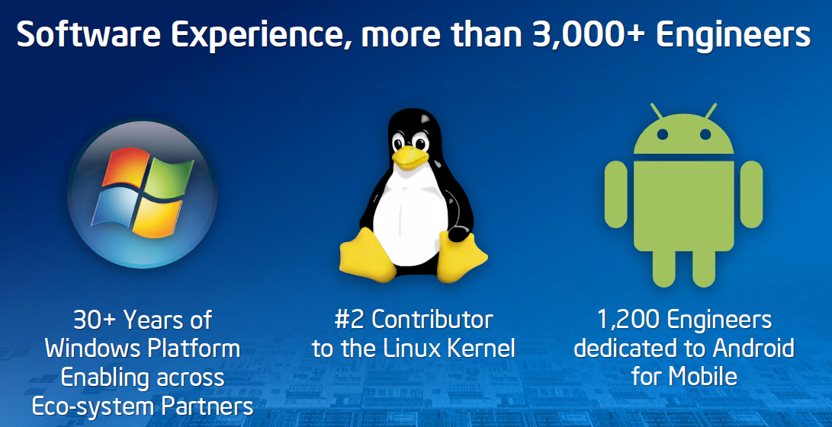
1. Emergence and spread of smartphones (19)
Intel’s effort to optimize their devices from the software point of view
In their 2012 Investor meeting (5/2012) Intel revealed that more than 3000
engineers are working on OS support, among them about 1200 engineers
are dedicated to Android, as indicated below [11].

Slide 22
1. Emergence and spread of smartphones (20)
Intel’s share in smartphone application processors in 2014 [54]
Despite great efforts Intel could not become one of the 5 largest suppliers
of smartphone application processors.
According to industry sources in 2014 Intel achieved less than 1 % share in revenue
in smartphone application processors.
*

Slide 23
1. Emergence and spread of smartphones (21)
Intel's withdrawal from the mobile market
In 4/2016 Intel announced their withdrawal from the mobile market.
*

Slide 24
2. Emergence and spread of tablets
Notes:
24

Slide 25
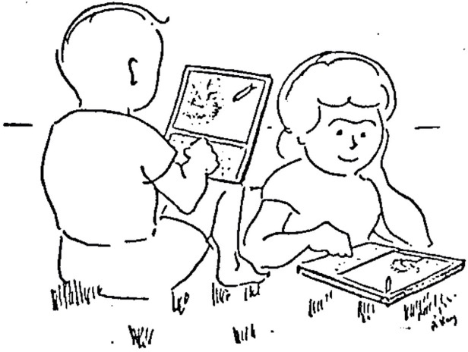
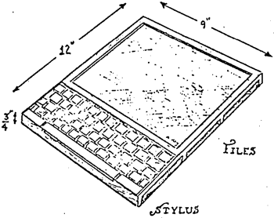
2. Emergence and spread of tablets (1)
2. Emergence and spread of tablets
An early vision of tablets targeting children - the Dynabook []
In 1972 at the ACM National Conference Alan Kay from the Xerox Palo Alto Research
Center (PARC) introduced a Personal Computer for Children, called the Dynabook.
(Intel 8008: 1972).
Picture of a DynaBook
Picture of two kids sitting in the grass with Dynabooks
“This note speculates about the emergence of personal, portable information manipulators and their effects when used by both children and adults. Although it should be read as science fiction, current trends in miniaturization and price reduction almost guarantee that many of the notions discussed will actually happen in the near future."
*

Slide 26
2. Emergence and spread of tablets (2)
Steve Jobs vision of tablets
In a talk given at the Center for Design Innovation Steve Jobs envisioned tablets
already in 1983 saying
”Apple’s strategy is really simple. What we want to do is we want to put an
incredibly great computer in a book that you can carry around with you and learn
how to use in 20 minutes.
... And we really want to do it with a radio link in it so you don’t have to hook up
to anything and you’re in communication with all of these larger databases and
other computers” [19].
*

Slide 27
2. Emergence and spread of tablets (3)
The relation of the Dynabook and iPad [73]
We note that Steve Jobs and Apple engineers visited PARC in 1979.
In an interview in 2010 while asking "whether he felt that Jobs had stolen
the idea for the iPad" Kay denied such a thought.
He said that "Jobs has known about the Dynabook idea and the interim-Dynabook
machine (called the PARC Alto) for several decades".
But there is a difference in the usage models of Dynabook and IPad.
Dynabook represented an idea of active computing e.g. with children
programming it by means of its keyboard in Smalltalk.
By contrast, iPad is built for passive computing while using applications
downloaded e.g. from the App Store.

Slide 28
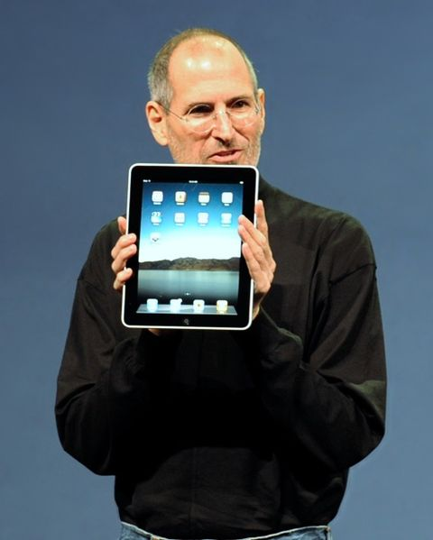
2. Emergence and spread of tablets (4)
Designs leading to the rapid spreading of tablets around 2010
From 2009 on Android-based tablets arrived the market from many vendors.
In 2010 Apple’s iPad was introduced with 9.7 “ screen, touch screen and Wi-Fi or
additionally wireless 3G broadband internet connection (mobile internet connection),
operating under iOS [12].
Figure: Steve Jobs introducing the iPad in 2010 [12]
*

Slide 29
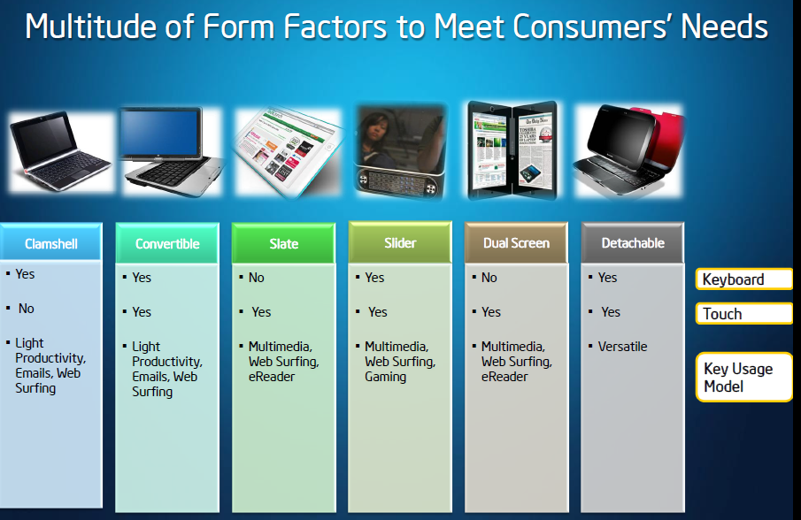
2. Emergence and spread of tablets (5)
Implementation alternatives of tablets -1 [8]

Slide 30
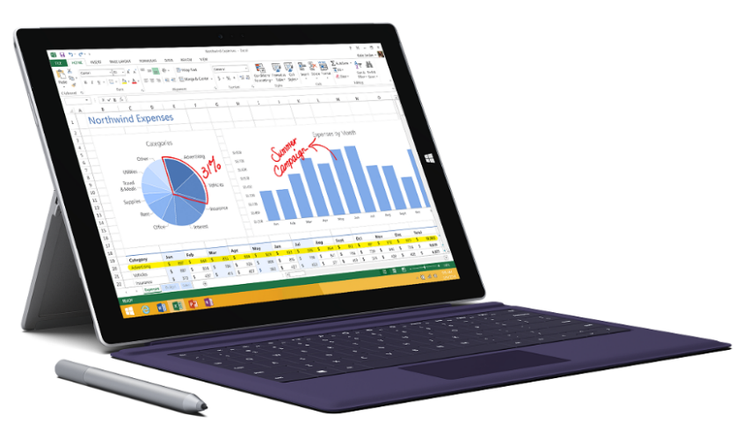
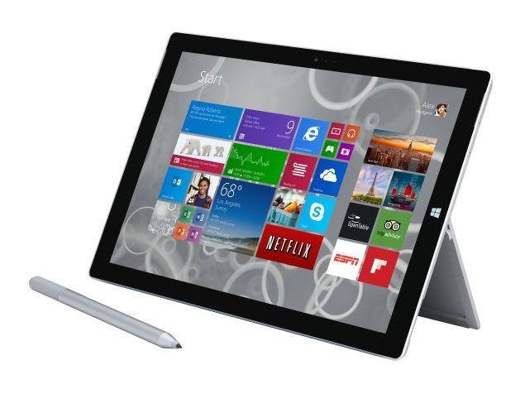
2. Emergence and spread of tablets (6)
Implementation alternatives of tablets -2 [8]
2 in 1 tablets (≈ attachable keyboard + touchscreen)
Example: Windows Surface Pro 3 (8/2014)
Aim: Replacing laptops
Intel’s Surface Pro 3
used as a laptop [22]
Intel’s Surface Pro 3
used as a tablet [23]

Slide 31
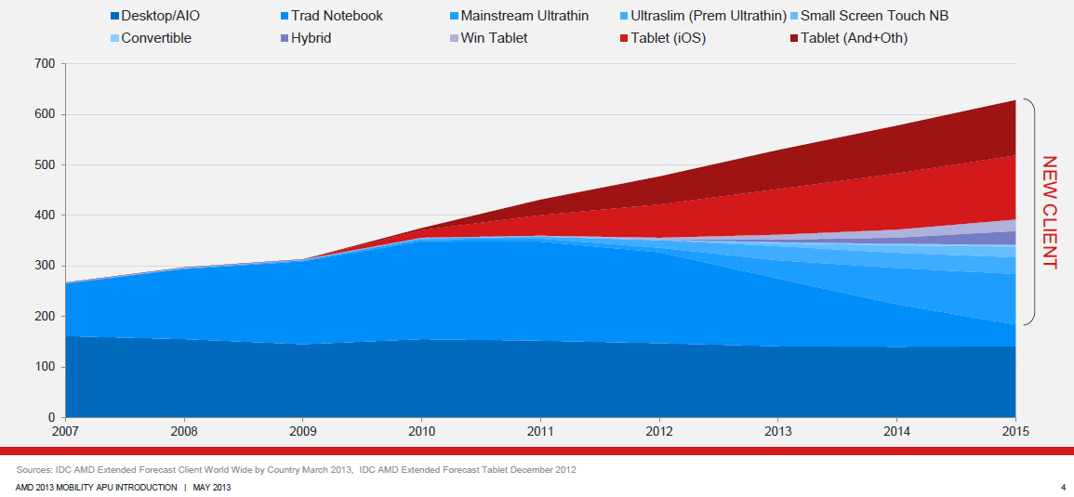
2. Emergence and spread of tablets (7)
Rapid increase of tablet sales in the first half of the 2010’s
Besides smartphones, tablets and all their alternative designs (that provide also keyboard/mouse input, such as convertibles or 2 in 1 designs) have recently the highest growth potential, as indicated in the Figure below (12/1012) [3].
Tablets
Notebooks
Desktops
Figure: Yearly worldwide sales figures of desktops, notebooks and tablets [3]

Slide 32
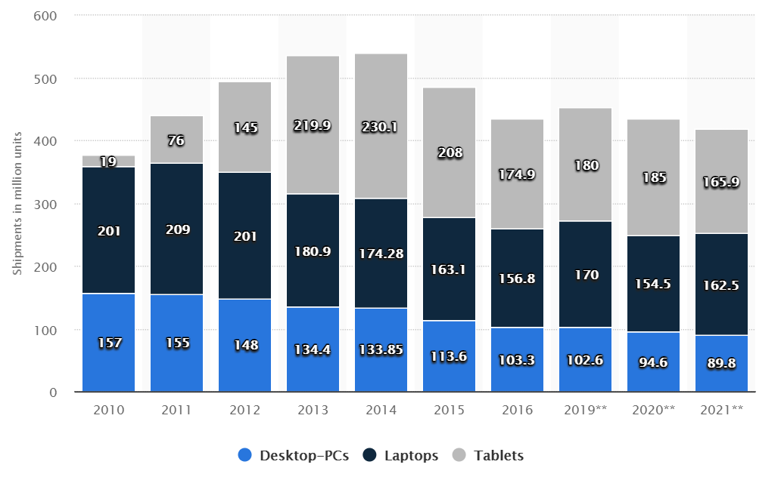
2. Emergence and spread of tablets (8)
Worldwide shipment of desktop PCs, laptops and tablets from 2010 to 2016
as well as sale forecasts until 2021 (in million units) [35]
Source: Gartner

Slide 33
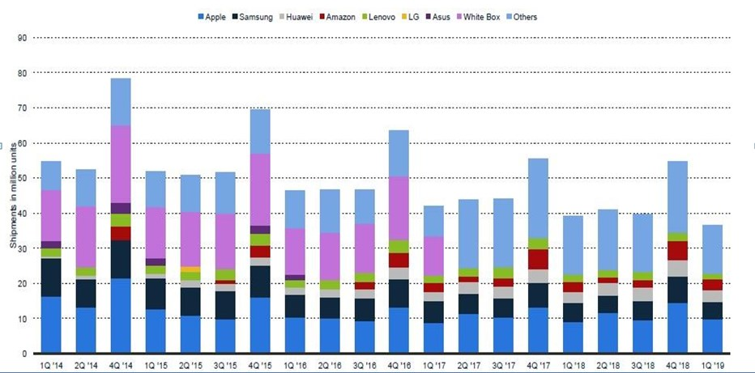
2. Emergence and spread of tablets (9)
Worldwide tablet shipments in million units Q1/2014 – Q1/2019 [109]
https://www.ejectejecteject.com/statistics/24-tablet-market-share-statistics-and-analysis/

Slide 34
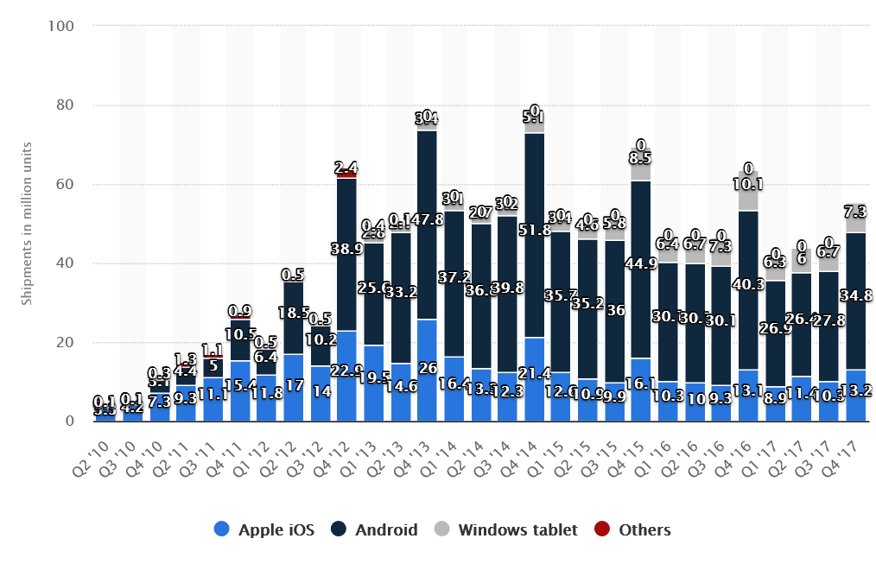
2. Emergence and spread of tablets (10)
Global shipments of tablet OSs in million units Q2/2010-Q4/2017 2020 [94]

Slide 35
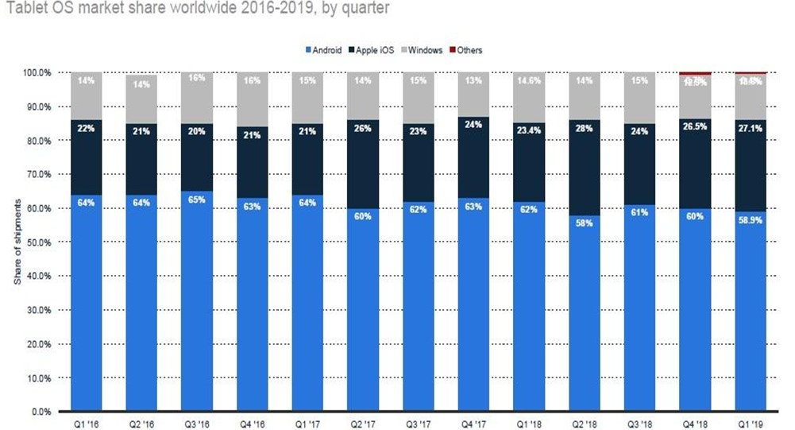
2. Emergence and spread of tablets (11)
Global market share of tablet OSs Q1/2016-Q1/2019 [109]
https://www.ejectejecteject.com/statistics/24-tablet-market-share-statistics-and-analysis/

Slide 36
2. Emergence and spread of tablets (12)
Intel's platforms targeting tablets (based on [11])
Willow Trail
(2016)
Cherry Trail
(2015)
Bay Trail
(2013)
Performance (not to scale)
Clover Trail
(2012)
Z5xxx
4x Goldmont
14 nm
+XMM 7360
W/A
Oak Trail
(2011)
Z4xxx
4x Airmont
14 nm
+XMM 7160/7260
W/A
Menlow
(2008)
Z37x0
2x/4x Silvermont
22 nm
+XMM 6260/7160
W/A
Cancelled
in 04/2016
Z2760
2x Saltwell
32 nm
+XMM 6260
W
Z650/670
1x Bonnell
45 nm
+ no XMM
W/MeeGo/A
Z5xx
1x Bonnell
45 nm
+ no XMM
W/Moblin
W: Windows
A: Android
(Clover Trail+ (2013) not shown in the Figure!)
(It is used both for tablets and smartphones)
(Z2520-2580))
(A )

Slide 37
2. Emergence and spread of tablets (13)
Intel’s share in tablet application processors [35], [36], [56]
Intel ’s subsidies paid for OEMs
In the first years of 2010 Intel paid significant subsidies (~ 50 $/tablet) to
netbook and tablet manufacturers to achieve their switch from ARM based
processors to x86 Atom processors.
Achieved market share in 2015 due to paying subsidies
In 2015 Intel achieved the 3. place in the worldwide market share in
tablet application processor revenue, as the Table below shows.
Tablet application processors worldwide market share 2015 (revenue) [57]
Apple (USA) | 31 %
Qualcomm (USA) | 16 %
Intel (USA) | 14 %
MediaTek (Taiwan)
Samsung (S. Korea)
Table: Worldwide market share of application processors used in tablets in 2015
(based on revenue)
Subsidy: szubvenció
*

Slide 38
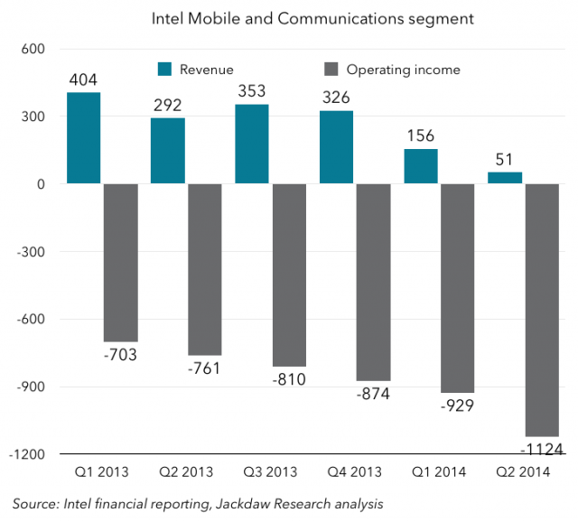
2. Emergence and spread of tablets (14)
Intel's losses on the mobile development in 2013 - 2014 [74]
Nevertheless, owing to subsidies Intel's mobile and communication division has lost
7 billion $ in the years 2013-2014 , as indicated in the next Figure [83].
Figure: Revenues/operating income of Intel's Mobile and Communications segment [83]

Slide 39
2. Emergence and spread of tablets (15)
Intel's withdrawal from the mobile market
Due to their high losses Intel first stopped paying subsidies and then in 4/2016
announced their withdrawal from the mobile market.
*

Slide 40
3. Key requirements of mobile devices (tablets, smartphones)
Notes:
40

Slide 41
3. Key requirement of mobile devices (tablets, smartphones)
3. Key requirements of mobile devices (tablets, smartphones)
Key requirements of mobile devices (tablets, smartphones)
Low power operation
Connectivity
(3G/4G/Wi-Fi)
(Section 3.1)
(Section 3.2)
*

Slide 42
3.1 Low power operation
Notes:
42

Slide 43
3.1 Low power operation (1)
3.1 Low power operation
It will be expressed
either by specifying the power consumption, e.g. the TDP value of
the processor in Watt,
or in in length of the operating hours of the device under given conditions.
Power consumption = Active power (C_{dyn}∗V_{CC}² ∗ f_{c}) + Leakage power (V_{CC} ∗ I_{leak})
*

Slide 44
3.1 Low power operation (2)
Contrasting the design paradigms of traditional and mobile processors
Traditional processors
Tablets and smartphones
High performance/power
(Power efficiency)
(e.g. GFLOPS/Watt)
Low power consumption
(Watt)
(Number of operating hours)
*

Slide 45
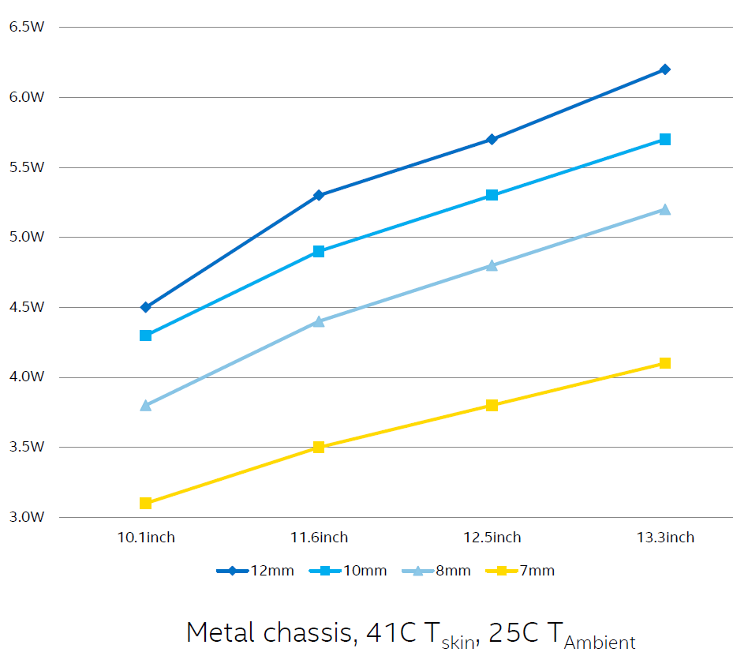
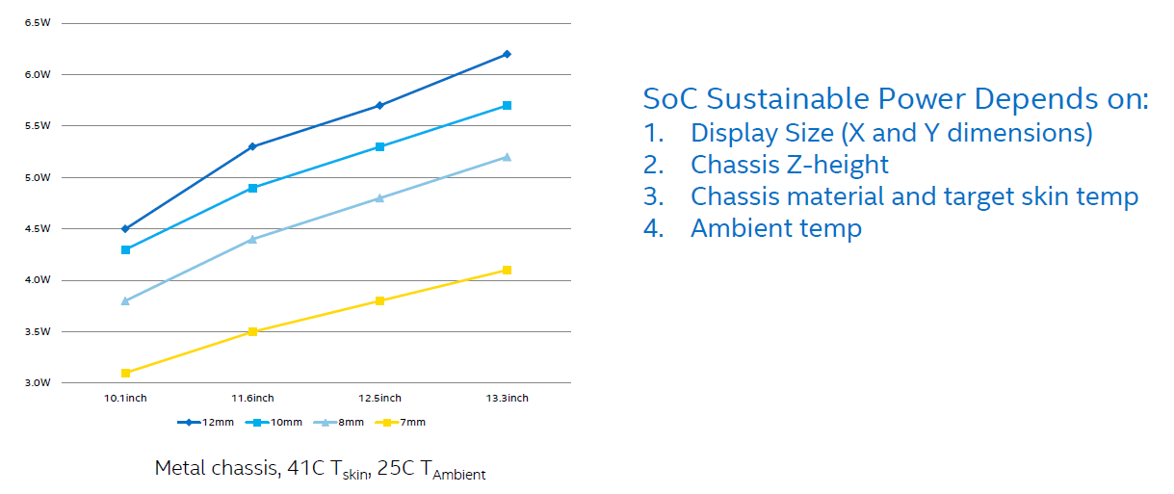
3.1 Low power operation (3)
Sustainable power for fanless tablets [78]
*

Slide 46
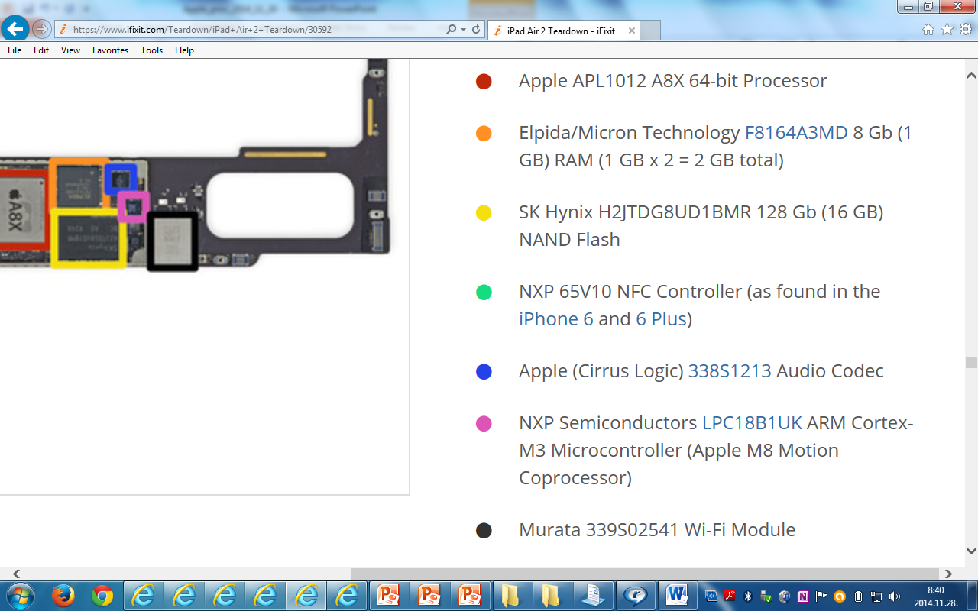
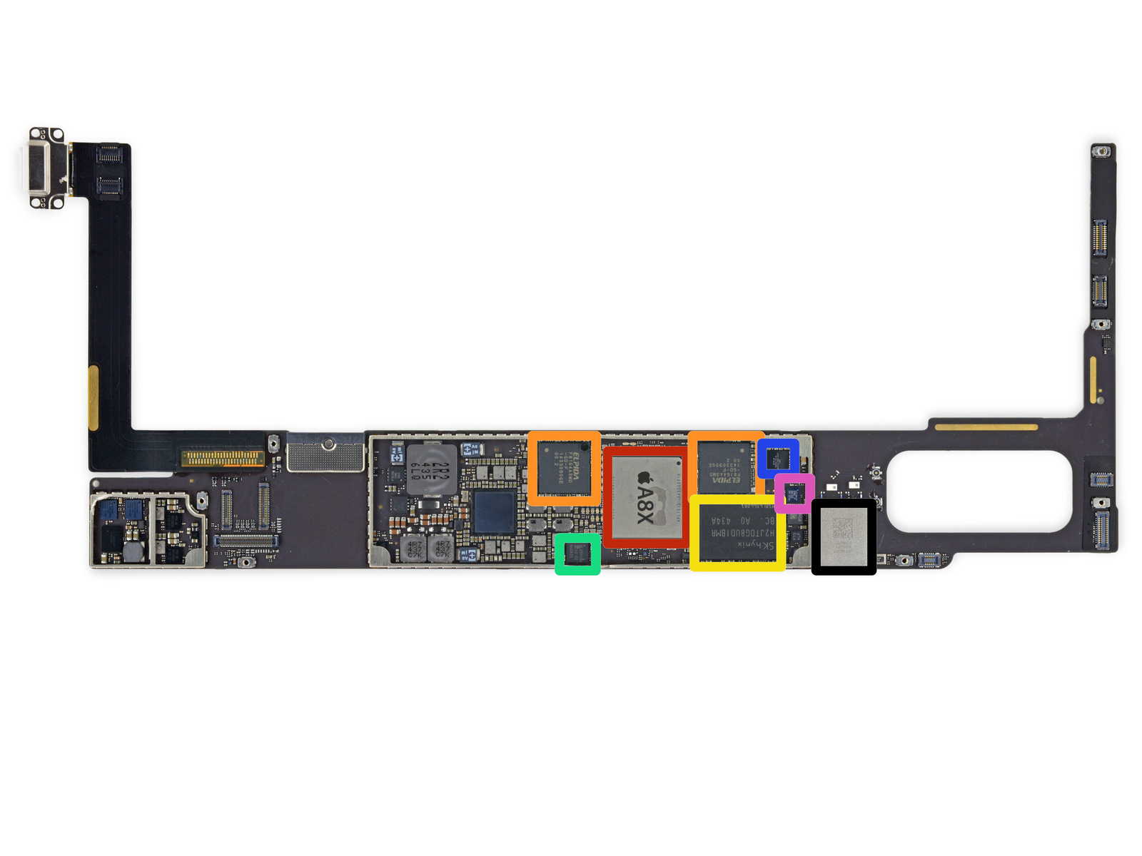
3.1 Low power operation (4)
Total platform power consumption
It results from the power consumption of the SOC, Flash memory, co-processors etc.
i.e. from any circuit that is mounted on the motherboard.
Figure: Example: one side of the iPad Air 2 motherboard [79]

Slide 47
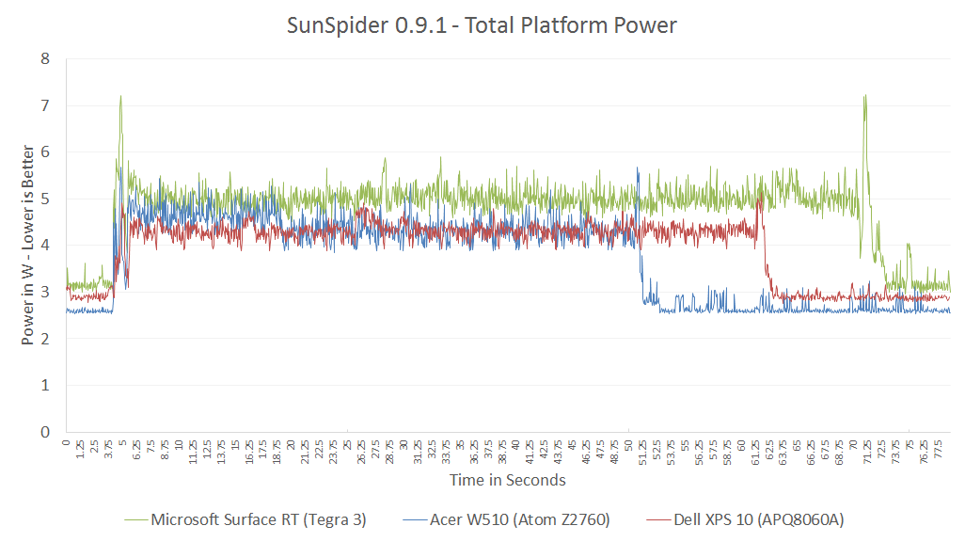
3.1 Low power operation (5)
Example: Total power consumption of tablets
while running the (SunSpider 0.9.1 benchmark) [80]
SunSpider, is a mid-length JavaScript benchmark.
Nvidia
T30
Intel
Atom
Qualcomm
S4
NVidia T30
4+1x Cortex A9, 1.3 GHz)
Intel Atom Z2760
(2C, 1.8 GHz)
Qualcomm S4 (APQ8060A)
(2C 1.5 GHz)

Slide 48
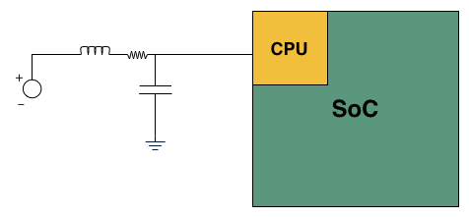
3.1 Low power operation (6)
Measuring the power consumption of a CPU [80]
e.g. 20 mΩ
Basic LC filter modified with an inline resistor

Slide 49
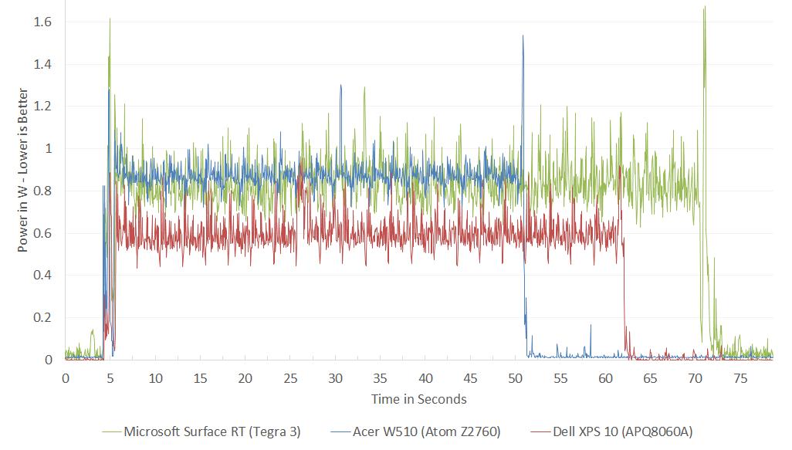
3.1 Low power operation (7)
Example: Power consumption of CPUs while running the (SunSpider 0.9.1
benchmark) [80]
Intel
Atom
Nvidia
T30
Qualcomm
S4
SunSpider, is a mid-length JavaScript benchmark.
In the power consumption of Qualcomm's S4
the L2 cache is not taken into account.
NVidia T30
4+1x Cortex A9, 1.3 GHz)
Intel Atom Z2760
(2C, 1.8 GHz)
Qualcomm S4 (APQ8060A)
(2C 1.5 GHz)
*

Slide 50
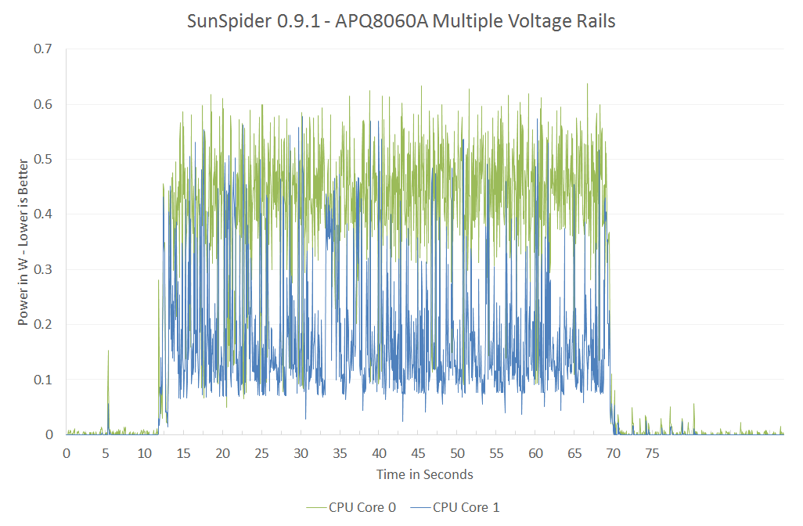
3.1 Low power operation (8)
Remark to the power management of the referenced processors [80]
The cores in both the dual core Atom and 4+1 core NVIDIA's Tegra 3 share the
same voltage and frequency during power management.
By contrast, the dual core Qualcomm's S4 make use of per core voltage and
frequency scaling, as indicated below.
In addition L2 has a separate voltage rail and can be power managed separately.
Figure: Power consumption of the S4 while running the Sunspider 0.9.1 benchmark [80]

Slide 51
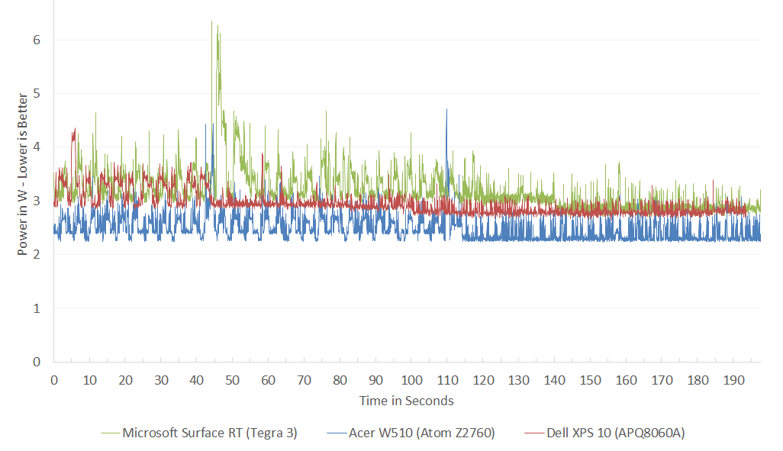
3.1 Low power operation (9)
Example: Total idle power consumption of tablets [80]
Nvidia
T30
Qualcomm
S4
Intel
Atom
NVidia T30
4+1x Cortex A9, 1.3 GHz)
Intel Atom Z2760
(2C, 1.8 GHz)
Qualcomm S4 (APQ8060A)
(2C 1.5 GHz)

Slide 52
3.1 Low power operation (10)
Battery sizes of tablets - examples
Apple iPad: 32.4 Wh
Apple iPad Air: 32.4 Wh
Microsoft Surface RT: 31.5 Wh
Acer Iconia W510: 3.54 Ah (4.7 V)
Dell XPS 10: 28 Wh

Slide 53
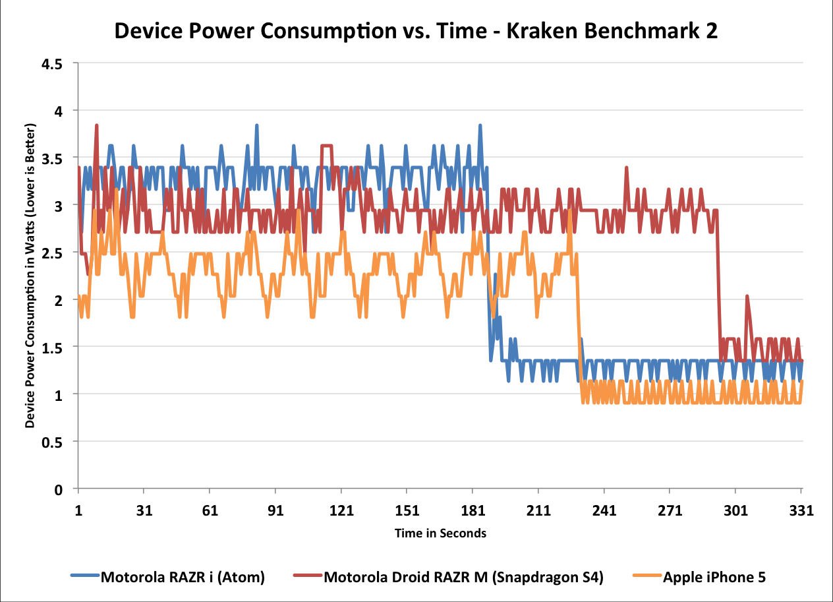
3.1 Low power operation (11)
Example: Power consumption of smartphones while running the
(Kraken Benchmark 2 [80]
Intel
Atom Z2460
Qualcomm
S4
Apple
A6
*
1.6 GHz Atom Z2460 (x86-32)
1.5 GHz 2C MSM8960 (Krait 200, ARMv7)
1.3 GHz 2C A6 (Swift, ARMv7)

Slide 54
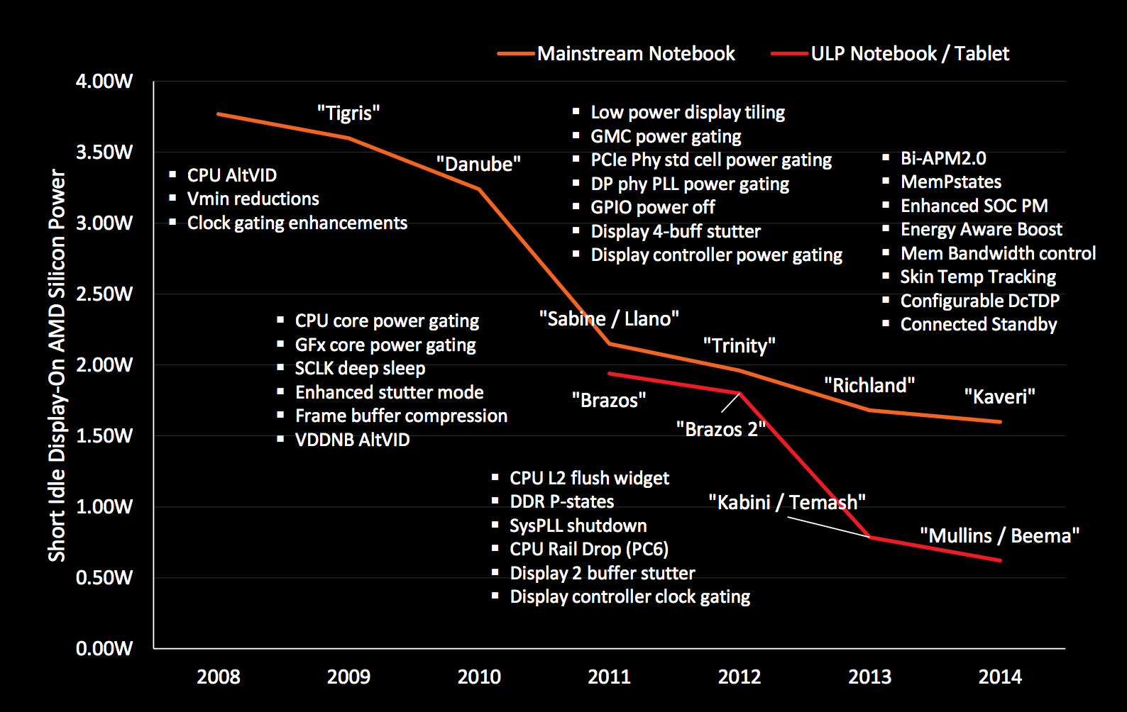
3.1 Low power operation (12)
Example: AMD’s technologies to reduce power consumption (2008-2014) [27]

Slide 55
3.1 Low power operation (13)
Achieving low power consumption
In this point let’s focus on the microarchitecture of CPUs (processor cores).
*

Slide 56
3.1 Low power operation (14)
Key enablers of low power microarchitectures
Key enablers of low power microarchitectures
Narrow microarchitecture
Low clock frequency
(Section 3.1.2)
(Section 3.1.3)
*

Slide 57
3.1 Low power operation (15)
3.1.2 “Narrow” microarchitectures -1
Obviously, a narrow microarchitecture consumes less power than a wider one.
What does a narrow microarchitecture mean?
*

Slide 58
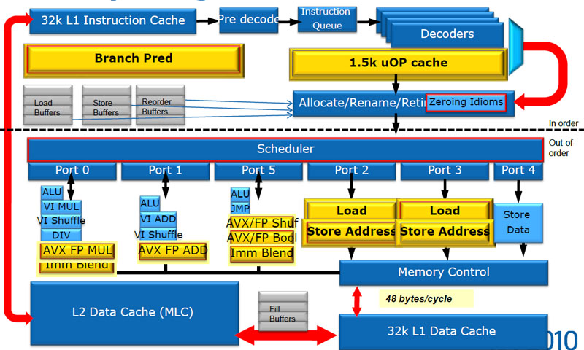
3.1 Low power operation (16)
Example for the "width of a microarchitecture"
In-order
Front end
Out-of-order
parallel
Back end
Microarchitecture of the cores of Sandy Bridge [90]

Slide 59
3.1 Low power operation (17)
3.1.2 “Narrow” microarchitectures -2
A suitable characteristics of the width of a microarchitecture is the width of its
front end, that can be characterized by the decode width.
We note that in a well designed microarchitecture all subsystems, like fetching,
decoding, renaming dispatching or issuing instructions are appropriately
fitted to each other.
To achieve low power consumption first application processors used in tablets
and smartphones were "thin" designs with a typical decode width of 2,
as shown in the next Figure.
*

Slide 60
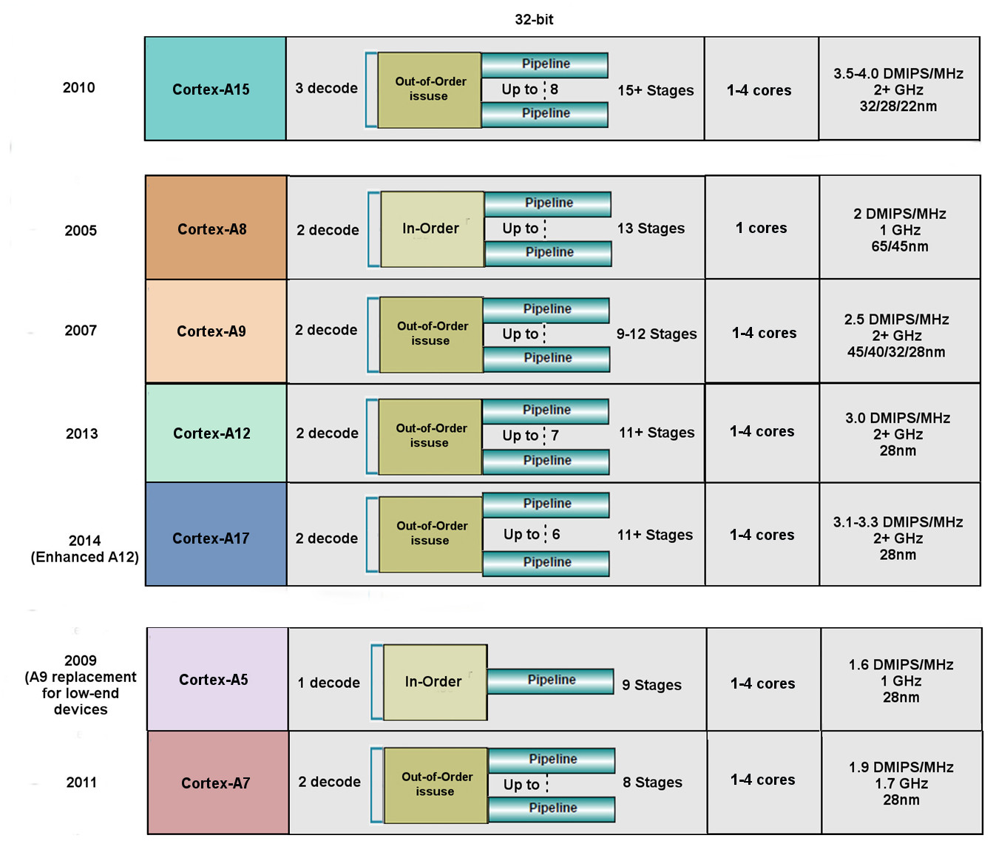
3.1 Low power operation (18)
Key features of ARMv7 ISA based early microarchitectures (based on [14])
High performance
Mainstream
Low power

Slide 61
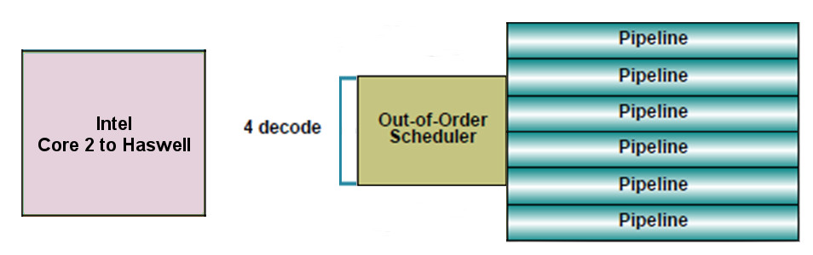
3.1 Low power operation (19)
“Narrow” microarchitectures -3
We note that at the same time Intel's mainline processors had a 4-wide
microarchitecture, as indicated below, to provide high performance/power
(in terms of GFLOPS/Watt).
64-bit
Intel
Core 2
to
Broadwell
Figure: Width of Intel’s Core 2 (2006) to Broadwell (2014) microarchitetures
underlying servers to laptops [10]

Slide 62
3.1 Low power operation (20)
Remarks
Evolution of the decode width in Intel's mainstream microarchitectures
up to the Pentium 4 (2000): 3-wide
beginning with the Core 2 (2006): 4-wide
beginning with the Skylake (2015): 5-wide
By contrast AMD's microarchitectures remained 3-wide until the K15 Bulldozer line
arrived (2011).
This fact was a significant contributor to Intel's performance superiority.
*

Slide 63
3.1 Low power operation (21)
Evolution of the width of mobile cores -1
Advancements in IC technology and power management allowed to widen the
microarchitecture of mobiles without noticeable raising their power consumption,
as follows.
*

Slide 64
3.1 Low power operation (22)
Evolution of the width of mobile cores -2
Width of mobile cores (or of big cores of big.LITTLE or dynamIQ core clusters)
2-wide
3-wide
4-wide
6-wide
ARM
v7 ISA based
(32-bit) Cortex-A cores
except the Cortex-A15)
(2005-2009)
v8 ISA-based
Cortex-A73 (2016)
v7 ISA based
(32-bit) Cortex-A15
(2010)
v8 ISA-based
(64-bit) Cortex-A line,
except the Cortex-A73 (2012-)
v8 ISA-based
Cortex-A76 (2018)
Intel
Atom family
(2008-2016)
AMD
Cat family
(2011-2015)
Apple
Cortex-A8 (2009)
A6 (Swift (2012)
A7 (Cyclone (2013)
and subsequent cores
Qualcomm
Scorpion v7 ISA
(S1-S3) (2007-2010)
Krait v7 ISA
(S4/S400/S60x/S80x)
(2012-2014)
Kryo/Kryo 280 v8 ISA
(S820/821/835) (2015/2016/2017)
Kryo 385 v8.2 ISA
(S845) (2018)
Samsung
Exynos 5 v7 ISA
(2013-2014)
/Exynos 7 v8 ISA
(2016)
M1 core v8 ISA (2016)
(Exynos 8 Octa)
M2 core v8 ISA (2017)
(Exynos 9 Octa)
M3 core v8.2 ISA (2018)
(Exynos 9810)
*

Slide 65
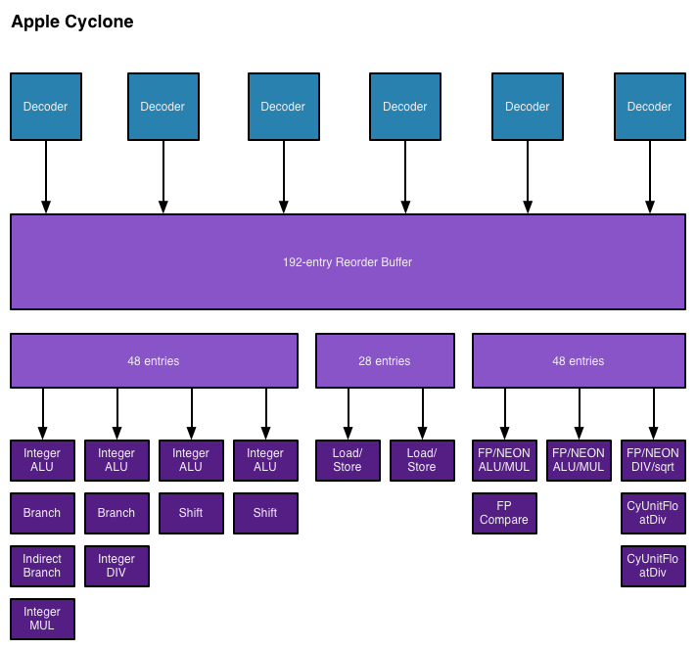
3.1 Low power operation (23)
Example: Apple’s Cyclone core, introduced in the A7 SOC (2013) [48]

Slide 66
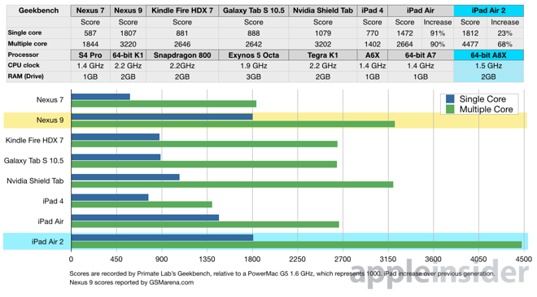
3.1 Low power operation (24)
The performance of Apple's Cyclone based tablets while running the
Geekbench 3.2 benchmark [49]
2013
2014
2 Cyclone
cores
K1
3 Typhoon
cores
A8X

Slide 67
3.1 Low power operation (25)
Implications of the extremely high performance of Apple’s A8X-based
iPad Air 2 (including 3 Typhoon cores) (2014) [50]
Intel lost Apple as a perspective buyer of their chips for the iPad line,
and the iPad Air 2 also severely hit the perspective of their not so successful
Atom line.
Due to missing market success, at last Intel cancelled their mobile application
processor activities in 04/2016.
*

Slide 68
3.1 Low power operation (26)
NVidia's leaving the smartphone and tablet market in June 2016 [81]
NVIDIA’s Tegra 4 chips were not successful, so the firm announced in 05/2014
that they will abandon the phone market.
Apple’s iPad Air 2 with its A8X processor and its GPU with 256 EUs became a very
powerful rival to NVIDIA's subsequent 64-bit K1 chip including a GPU with
192 EUs.
As a consequence, NVIDIA also gave up their tablet interests.
In 6/2016 (at Computex) NVIDIA's CEO J. Huang declared the firm's leaving the
smarphone and tablet market by saying:
: “We are no longer interested in that market”. He adds, “Anybody can build
smartphones, and we’re happy to enjoy these devices, but we’ll let someone else
build them”.
Instead NVIDIA became interested in designing in-car computers and car
infotainment systems.
*

Slide 69
3.1 Low power operation (26b)
Remark
According to [106] Apple’s A10 (used in the iPhone 7 (2016) introduced an even
wider (7-wide) microarchitecture, and Apple’s subsequent processors up to
the latest A13 (Bionic 2019) chip (used in the iPhone 11 and iPhone 11 Pro)
have a 7-wide front-end.
The A13 is the most powerful mobile processor to date.

Slide 70
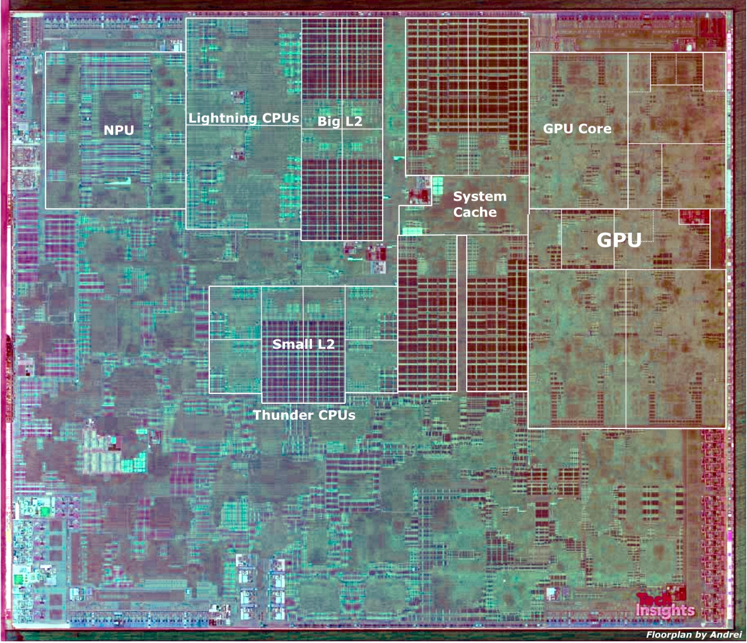
3.1 Low power operation (26c)
Floorplan of Apple’s A13 processor [107]
7+ nm technology, 98 mm2, 8.5 billion transistors []

Slide 71
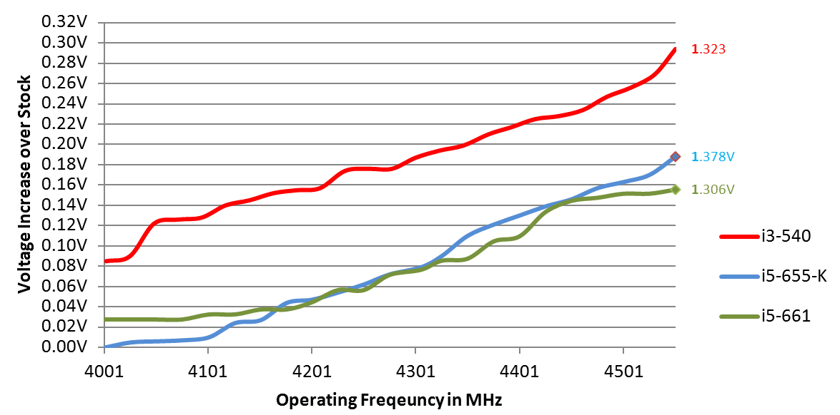
3.1 Low power operation (27)
3.1.3 Low clock frequency-1
Basics
Active power consumption = C_{dyn}∗V_{CC}² ∗ f_{c}
In addition: higher fc requires higher V_{CC} (V_{CC} ≈ const x f_{C}).
Figure: Core voltage (V_{CC}) vs. clock frequency (f_{C}) for Intel’s Westmere processors [26]

Slide 72
3.1 Low power operation (28)
Low clock frequency-2
It follows
Higher f_{C}
higher V_{CC}
higher D
D ≈ f_{C}³
Traditional CPUs
Mobile CPUs
Higher allowed power budget
Low power consumption
Relative high base clock frequency
(typically 2-4 GHz)
Relative low base clock frequency
(typically 1-2 GHz)
*

Slide 73
3.1 Low power operation (29)
Example: Base frequency of Skylake models with different TDPs and
configurations (Based on data from [58])
TDP (W) | No. of cores | Graphics | No. of graphics EUs | eDRAM | Base frequency up to (GHz)
4.5 | 2 | HD 515 | 18 | -- | 1.2
15 | 2 | HD 540 | 48 | 64 MB | 2.2
15 | 2 | HD 520 | 24 | -- | 2.6
28 | 2 | HD 550 | 48 | 64 MB | 3.3
35 | 4 | HD 530 | 24 | -- | 2.8
45 | 4 | HD 530 | 24 | -- | 2.9
65 | 4 | HD 530 | 24 | -- | 3.4
91 | 4 | -- | -- | -- | 4.2
Note that low TDP can be achieved first of all by reducing the core frequency and
limiting the computer resources (cores, GPU EUs) provided.
*

Slide 74
3.2 Connectivity
Notes:
74

Slide 75
3.2 Connectivity (1)
3.2 Connectivity
Connectivity may include (depending on the model features)
LAN connectivity
Wi-Fi connectivity (coined after Hi-Fi)
mobile broadband connectivity (recently 3G/4G).
Subsequently, we will focus only on the mobile broadband connectivity.

Slide 76
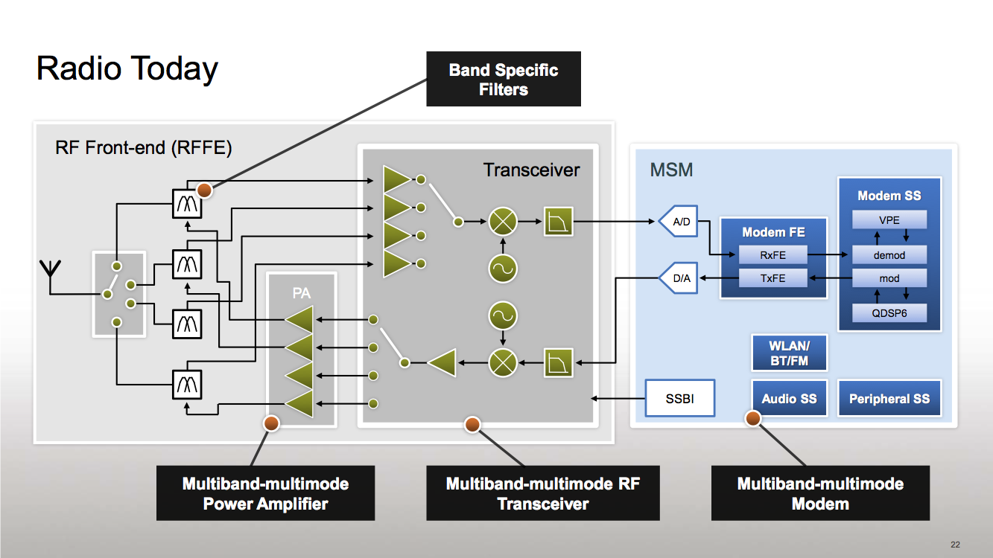
3.2 Connectivity (2)
Simplified view of a platform providing mobile broadband connectivity [59]
RF
Modem + Application Processor
(if integrated implementation)
Modem: Actually a baseband
processor that runs under a
proprietary real-time OS).
It has two functions:
LNA
Mixers
to performe modulation/
demodulation and
to manage the
communication
according to a protocol
(DSP)
PA: Power Amplifier LNA: Low Noise Amplifier Transceiver: Transmitter/Receiver
Multiband: multiple frequency bands, e.g. 900/1800 MHz
Multimode: 3G/ 4G (LTE)
*

Slide 77
3.2 Connectivity (3)
Integration of the application processor and the modem
Integrating the modem onto the application processor die results in less costs and
shorter time to market.
Qualcomm pioneered this move designing integrated parts already about 1996.
Integration of the application processor and the modem
Use of discrete
application processor and modem
Use of integrated
application processor and modem
Qualcomm’s MSM product offerings
since ~ 1996
including their Snapdragon families
MediaTek’s 81xx line (2013)
MediaTek’s 6xxx/8xxx families (since ~ 2009)
except the 81xx line
NVIDIA’s Tegra 2-4, K1 (since 2011)
NVIDIA’s Tegra 4i (2014)
Samsung’s Exynos 3/4/5/7 families
(since ~ 2010)
Samsung’s Exynos 8 Octa 8890
(2015)
E.g.
Intel’s Atom line (2008)
except recent Atom X3 (Sophia (2015)
Intel’s Atom X3 (Sophia) (2015)
Apple’s own processor designs
(Swift (2012), Cyclone (2013)
*

Slide 78
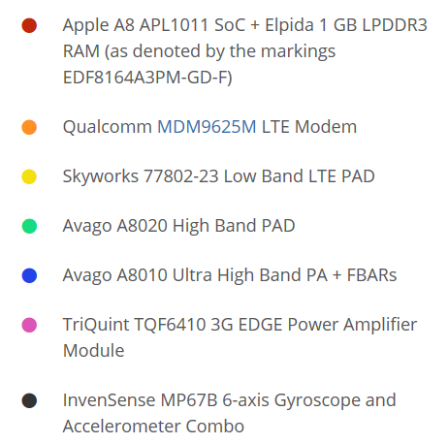
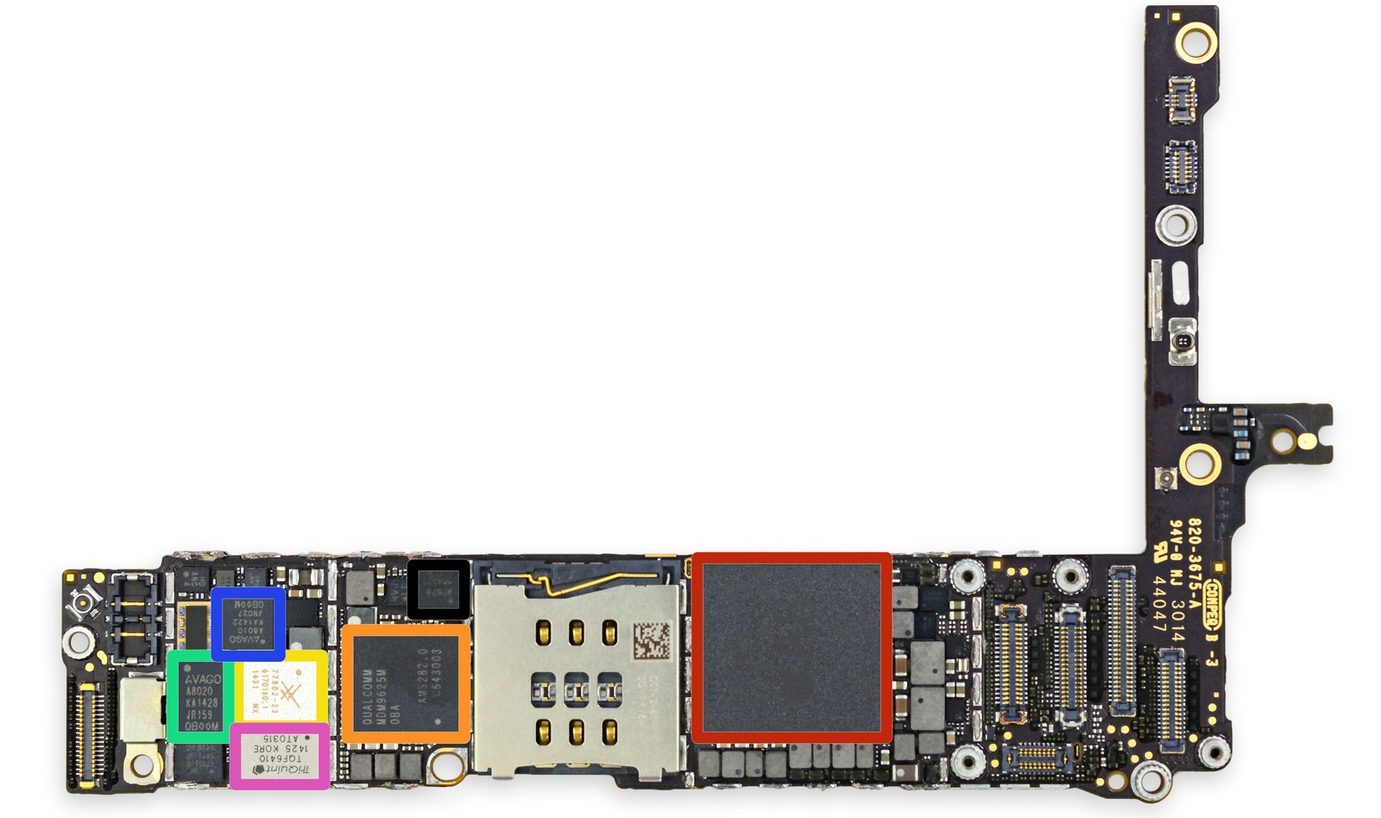
3.2 Connectivity (4)
Example of using discrete application processor and modem: The iPhone 6+
The front side of the
logic board [60]
PAD: Integrated Power Amplifier-Duplexer

Slide 79
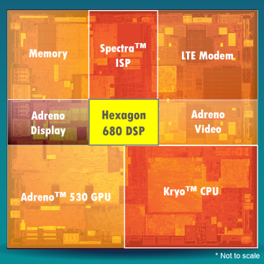
3.2 Connectivity (5)
Example of using an integrated application processor and a modem
(Qualcomm’s Snapdragon 820) [61]

Slide 80
4. How leading IT vendors addressed the mobile boom?
4.1 Intel’s response to the mobile boom
4.2 AMD’s response to the mobile boom
4.3 Microsoft’s response to the mobile boom
Notes:
80

Slide 81
4.1 Intel’s response to the mobile boom
Notes:
81

Slide 82
4.1 Intel’s response to the mobile boom (1)
4.1 Intel’s response to the mobile boom-1
Intel’s and AMD’s traditional CPUs are designed for high performance/power,
but mobile devices require low power consumption, consequently
Intel’s and AMD’s traditional microarchitectures are not suited for mobile devices.
*

Slide 83
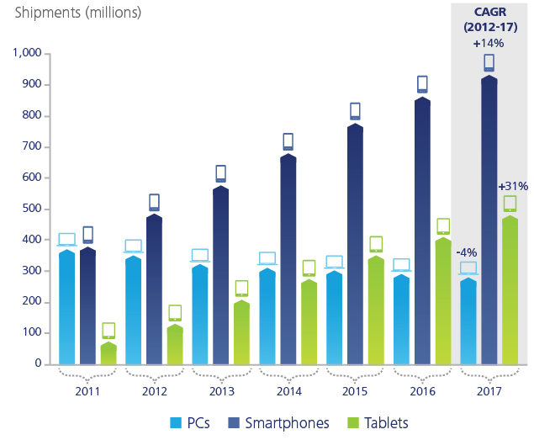
4.1 Intel’s response to the mobile boom (2)
(1)
Dynamic increase of smartphone and tablet shipments vs. PCs (2011-2017)
[28]
Smartphone and tablet shipments
will vastly exceed PC shipments
(desktops and notebooks)
in a few years
Source: Gartner (2013)

Slide 84
4.1 Intel’s response to the mobile boom (3)
Intel’s and AMD’s response to the mobile boom-2
To avoid shrinking market shares on the global processor market
and benefit from the rapidly increasing mobile market
Intel and AMD needed processors that are competitive with ARM based designs.
Thus Intel and AMD were forced
to introduce new, narrow (i.e. 2-wide), low-power microarchitectures
for their CPUs and
clock them at a relative low rate.
*

Slide 85
4.1 Intel’s response to the mobile boom (4)
Evolution of Intel’s basic microarchitectures [Based on 2]
2-wide
in-order
2-wide
out-of-order
2-wide
out-of-order
3-wide
out-of-order

Slide 86
4.1 Intel’s response to the mobile boom (5)
The fate of Intel’s low power Atom line
This issue was already reviewed in Sections 1 and 2 while discussing the emergence
and evolution of smartphones and tablets.

Slide 87
4.2 AMD’s response to the mobile boom
Notes:
87

Slide 88
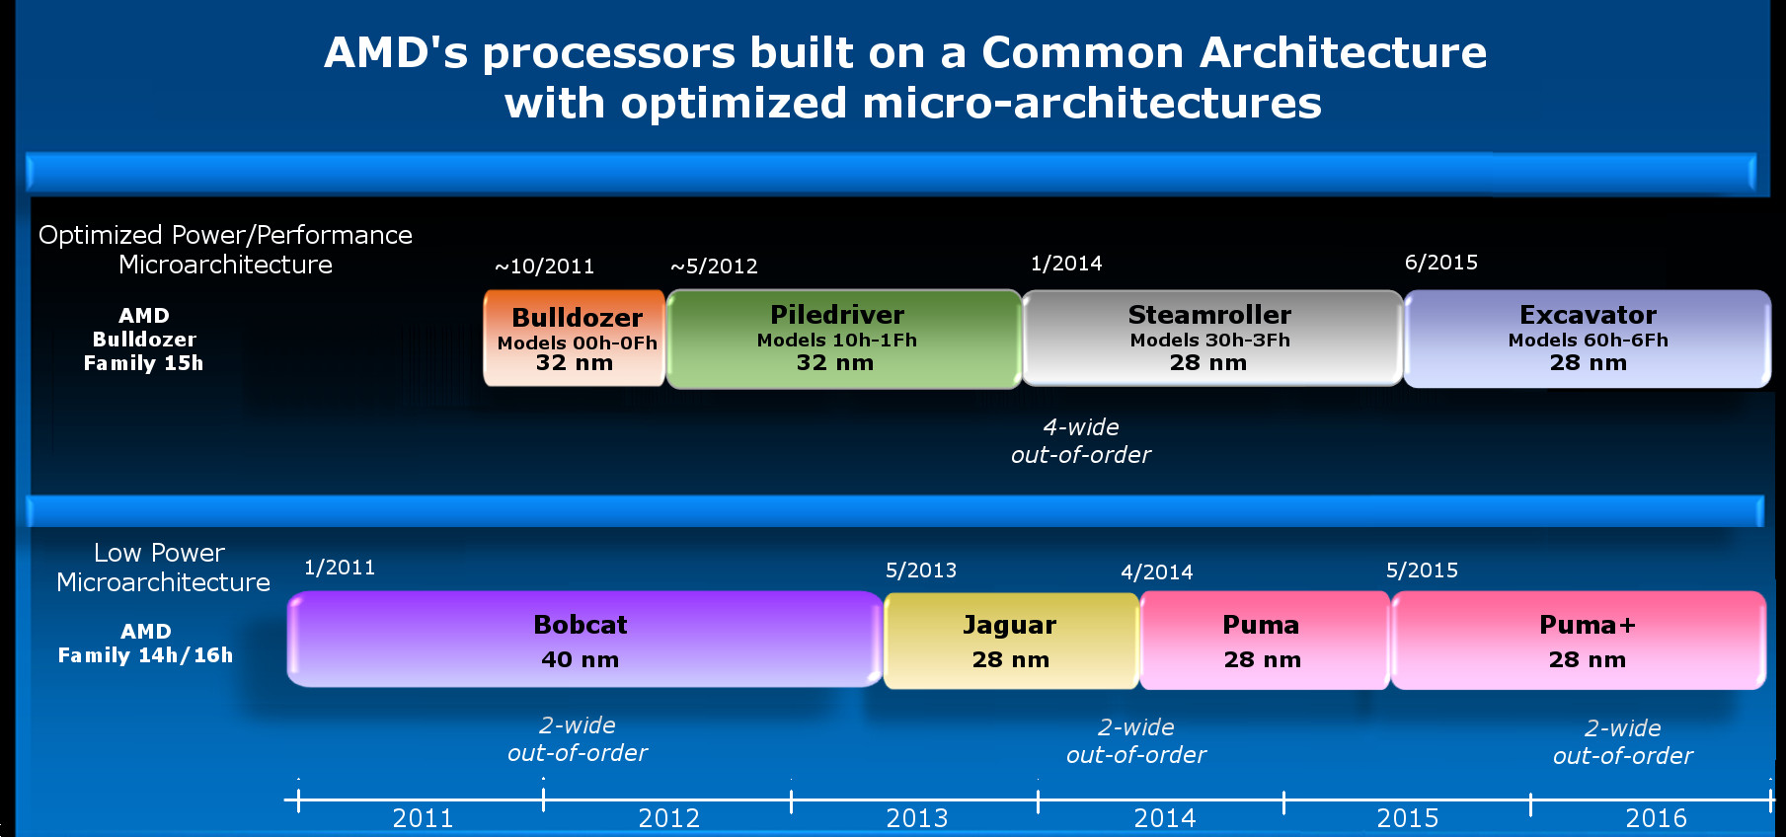
4.2 AMD’s response to the mobile boom (1)
4.2 AMD’s response to the mobile boom
Evolution of AMD’s basic microarchitectures
4-wide
out-of-order
4/2014
2-wide
out-of-order
2-wide
out-of-order
2-wide
out-of-order
2014

Slide 89
4.2 AMD’s response to the mobile boom (2)
Cancellation of AMD's Cat line in 2015
Neither Intel nor AMD became successful on the mobile market, so beyond
Intel also AMD cancelled their activities on this market.
The last core of AMD's Cat line was the Puma+ core (launched in 6/2015 in the
Carrizo-L APU).
In AMD's 2016 Mobility roadmap there is no sign of an APU powered by the
Puma+ core or a derivative of a core belonging to the Cat line, as seen in the
next Figure.
Instead AMD placed emphasis on Zen core based products in the mobile sector.
*

Slide 90
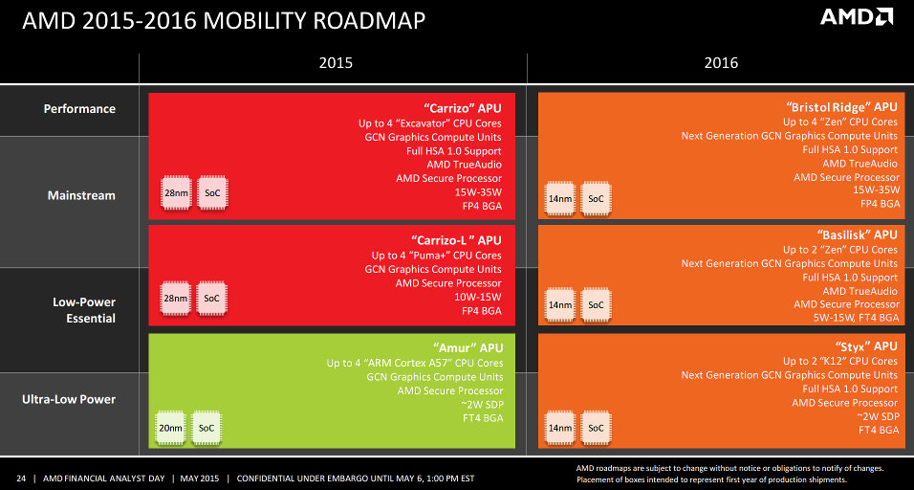
4.2 AMD’s response to the mobile boom (3)
AMD's leaked mobility roadmap for 2015-2016 without indicating the
Puma core for 2016 [87]

Slide 91
4.2 AMD’s response to the mobile boom (4)
Use of AMD’s low power Jaguar and Puma architectures in game consoles
Most recent game consoles are based on AMD’s low power Jaguar architecture,
including
Nintendo Wii U (2012)
Sony Playstation 4 (2013)
Microsoft Xbox One (2013)
Microsoft Xbox One S (2016)
Microsoft Xbox One X (2017)
Ataribox (2017).
These consoles have a noticeable global market share, as indicated in the next
Figure.
*

Slide 92
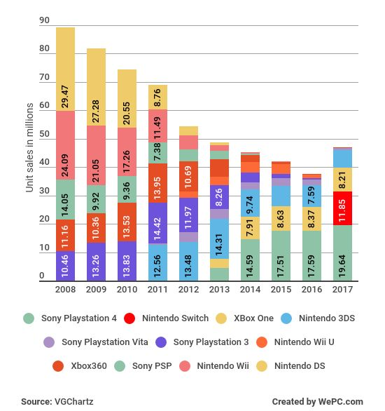
4.2 AMD’s response to the mobile boom (5)
Global unit sales of current generation video game consoles 2008-2017 [105]
(in million units)
With AMD’s processors
Nintendo Wii U (2012)
Sony Playstation 4 (2013)
Microsoft Xbox One (2013)
Microsoft Xbox One S (2016)
Microsoft Xbox One X (2017)
Ataribox (2017).

Slide 93
4.3 Microsoft’s response to address the mobile boom
Notes:
93

Slide 94

4.3 Microsoft’s response to the mobile boom (1)
4.3 Microsoft’s response to address the mobile boom -1
Worldwide software revenues in 2017 (billion US $) [103]
(GDP of Hungary in 2017: ~ 140 billion US $)

Slide 95
4.3 Microsoft’s response to the mobile boom (2)
Microsoft's response to address the mobile boom -2
Microsoft's response to address the mobile boom
Introducing
Windows for
smartphones
Widening the scope
of Windows to cover also touchscreen tablets
Widening the scope
of Windows to cover also ARM processors
Microsoft’s vision to become a
devices and services
company
(Subsection a)
(Subsection b)
(Subsection c)
(Subsection d)
*

Slide 96
4.3 Microsoft’s response to the mobile boom (3)
a) Introducing Windows for smartphones
2003 Windows Mobile 2003
It was based on the kernel of Microsoft's Windows CE.
Windows CE was an OS for embedded devices, optimized for minimal
memory).
2004-2008 Subsequent releases up to Windows Mobile 6.5.
2010 Windows Phone 7
Nokia's Lumia smartphone series, starting with the Lumia 800 (2011),
were based on Qualcomm's processors but run under the
Windows Phone (later the Windows 10 Mobile) OSs.
Windows Phone 7 earned moderate success.
Subsequent versions:
2010 Windows Phone 8
2014 Windows Phone 8.1
2015 Windows 10 Mobile
Despite Microsoft's efforts, Windows based phone OSs could not
achieve notable market share, as indicated in the next Figure.
Finally, in 10/2017 Microsoft cancelled Windows 10 Mobile.

Slide 97
4.3 Microsoft’s response to the mobile boom (4)
Global market share of leading smartphone OSs in terms of sales figures
to end users from Q1 2009 to Q2 2018 [42]
*

Slide 98
4.3 Microsoft’s response to the mobile boom (5)
b) Widening the scope of Windows to cover also touchscreen tablets -1
Windows 8 was Microsoft’s first try to cover the whole spectrum of computers
from servers through desktops and notebooks till touchscreen tablets
by a single OS.
It has a new, tiles-based start menu, but the classic start menu can be reinstalled,
as seen in the next Figure.

Slide 99


4.3 Microsoft’s response to the mobile boom (6)
Tiles-based touchscreen and reinstalled “classic menu” of Windows 8 [104]

Slide 100
4.3 Microsoft’s response to the mobile boom (7)
b) Widening the scope of Windows to cover also touchscreen tablets -2
Market reflections: Windows 8 earned moderate success, Android and iOS
dominated further on the market for smartphones and tablets.
Windows 8.1 is an upgrade for Windows 8.
It allows to switch between the tile-based Start menu and the classic
desktop menu.
In 5/2014 Microsoft announced Windows 8.1 with the search engine Bing.
It will be delivered for hardware manufacturers for free.

Slide 101
4.3 Microsoft’s response to the mobile boom (8)
b) Widening the scope of Windows to cover also touchscreen tablets -3
Windows 10 is released in 07/2015, it allows to choose between desktop or
tablet modes in the updated Start menu.
To encourage its adoption Microsoft made it available free of charge during its
first year of availability to users with genuine copies of Windows 7/Windows 8.1.

Slide 102

4.3 Microsoft’s response to the mobile boom (9)
Worldwide market share of desktop Windows versions [91]
Win7
Win10
Win8.1
WinXP
Win8
Vista

Slide 103
4.3 Microsoft’s response to the mobile boom (10)
c) Widening the scope of Windows to cover also ARM-based processors
In 10/2017 Microsoft released a new update (the Fall Creators Update) to
Windows 10 desktop S- or Pro versions that enables Windows 10 to run on ARM
processors by emulating x86 apps.
Also Microsoft started a cooperation with Qualcomm (largest producer of mobile
application processors) with the goal that laptops and 2-in-1 devices based on
Qualcomm’s Snapdragon 835 processor should be capable to run under
Microsoft’s updated Windows 10 OS, called Windows 10 on ARM.
First laptops and 2-in-1 devices arrived on the market in Q1/2018.
Details on the emulation (slides 101-108) are not part of the lecture.
*

Slide 104
4.3 Microsoft’s response to the mobile boom (11)
Windows 10 for ARM
Windows 10 desktop (Pro and S editions) with the Fall Creators Update (released
in 10/2017) can run on ARM64 (AArch64) processors.
The low power nature of ARM CPUs allows PCs running under Windows 10 to
become always on, always connected PCs.
Always on, always connected devices are a new category of devices.
They provide the simplicity and mobility of a phone and capability of a PC.
E.g. they can receive notifications and synchronize data all the time, even in sleep
mode.
*

Slide 105

4.3 Microsoft’s response to the mobile boom (12)
Running built in Windows apps, the kernel and drivers on Windows 10 on ARM
Built in apps (like Edge, Explorer etc.), the kernel and device drivers are all recompiled and run as native ARM64 or ARM32 code on an ARM processor,
as indicated below.
Figure: Use of recompiled ARM64 (ARM32) code under Windows 10 on ARM [97]

Slide 106
4.3 Microsoft’s response to the mobile boom (13)
Running UWP and x86 Win32 apps under Windows 10 on ARM [102]
UWP (Universal Windows Platform) apps are available from the Microsoft Store.
All ARM32 UPW apps are run by Windows 10 on ARM natively without any
emulation.
By contrast, x86 UWP apps will run under emulation.
x86 Win32 apps (32-bit apps) (like Adobe reader) don’t have to be recompiled
for ARM, they will be emulated.
x64 Win32 apps (64-bit apps) are not supported, but the vast majority of apps
all have x86 (i.e. 32-bit) versions.
Remark: In Microsoft’s terminology
x86: indicates 32-bit x86
x64: indicates 64-bit X86

Slide 107
4.3 Microsoft’s response to the mobile boom (14)
x86 Win32 emulation (simplified) -1 [98]
x86 apps are emulated using a custom x86 to ARM CPU emulator from
Microsoft.
The emulation does not happen directly to ARM code but to an abstract machine
(virtual machine) called WOW (Windows on Windows) abstraction layer, as
indicated in the next Figure.

Slide 108

4.3 Microsoft’s response to the mobile boom (15)
Windows 10 emulation on an ARM processor vs. native processing [98]
NT Layer DLL"
(NT kernel functions)

Slide 109
4.3 Microsoft’s response to the mobile boom (16)
x86 Win32 emulation (simplified) -2 [98]
WOW is an existing abstraction layer to provide compatibility between different
Windows versions, used e.g. for 16-bit emulation on x86 (32-bit) hardware or
for x86 (32-bit) emulation on x64 hardware.
The emulator quickly translates blocks of machine code to the abstraction layer
at runtime.
In a second step the abstract code of the virtual machine will be executed on the
host processor (Just-In-Time or JIT compilation).
It is completely transparent to users and developers.
This process is similar as translating Java to Java byte-code and executing
the byte-code in a second step.
Remark: Microsoft’s terminology
x86: 32-bit x86
x64: 64-bit X86

Slide 110
4.3 Microsoft’s response to the mobile boom (17)
x86 Win32 emulation (simplified) -3 [98]
The emulation is speeded up
by caching and optimizing previously translated code and using
CHPE (Compiled Hybrid Portable Executives) DLLs (ARM64 code (binaries)),
as indicated in the next Figure.
DLL: Dynamic Link Library
(It provides the functionality of the OS in a modularized form).

Slide 111
4.3 Microsoft’s response to the mobile boom (18)
Windows 10 emulation on an ARM processor vs. native processing [98]
NT Layer DLL"
(NT kernel functions)

Slide 112
4.3 Microsoft’s response to the mobile boom (19)
Key limitations of Windows 10 on ARM (as of 11/2018) [101]
x64 apps aren't supported (as already mentioned).
The Windows Hypervisor Platform is not supported, consequently any virtual
machines using Hyper-V on an ARM device will not run.
OpenGL versions later than 1.1 or that require hardware-accelerated OpenGL
don't work, accordingly, certain games do not run.

Slide 113
4.3 Microsoft’s response to the mobile boom (20)
Microsoft's and Qualcomm's cooperation to allow running Windows 10
on Snapdragon 835
Announced in 8/2016
Benefit for Qualcomm
Use of Snapdragon 835 also in laptops.
Benefit for Microsoft
Gaining higher market share in laptop OSs.
Benefit for laptop designs vs. x86 systems
extended battery life,
fan-less designs and
lighter devices
but recent implementations suffer sever limitations as described before.
In 5/2017 major OEMs (including ASUS, HP and Lenovo) announced to develop
Snapdragon 835 based laptops running under Windows 10 and including the
x16 LTE modem (providing 1 Gbit download rate) and all-day battery life [92].
*

Slide 114

4.3 Microsoft’s response to the mobile boom (21)
First Windows 10 notebooks based on the Snapdragon 835
In Q1 2018 three vendors launched Windows 10 laptops or 2-in-1 devices
based on Qualcomm’s Snapdragon 835 processor, as shown below.
These devices have a very long battery life (e.g. 15 hours) but show a rather poor
performance, as indicated in the next Figure.
Figure: First Windows 10 devices based on Snapdragon 835, launched in Q1/2018 [97]

Slide 115

4.3 Microsoft’s response to the mobile boom (22)
Performance figures for PCMark8 of comparable tablets and laptops [95]

Slide 116
4.3 Microsoft’s response to the mobile boom (23)
Qualcomm’s efforts for enhancing the performance of their application
processors intended to be used in Windows 10 laptops [95]
The 10 nm Snapdragon 835 (2017) aims at always on, always connected
Windows 10 laptops and 2-in-1 devices.
It is based on ARM’s Cortex-A73 design (2016).
Qualcomm’s subsequent, still 10 nm Snapdragon 850, that targets only
Windows 10 devices provides about 30 % higher performance and needs about
20 % less power than its predecessor.
It is based on the Cortex-A75 design.
Subsequent designs will be based on the Cortex-A76 design.
Remark
Always on, always connected devices are a new category of devices.
They provide the simplicity and mobility of a phone and capability of a PC.
They can receive notifications and synchronize data all the time, even in sleep
mode.
(Always on, always connected: Folyamatosan bekapcsolt és folyamatos
internet-kapcsolattal rendelkező)

Slide 117




4.3 Microsoft’s response to the mobile boom (23b)
Windows 10 notebooks based on the Snapdragon 850
Lenovo Yoga C630
(08/2018)
Galaxy Book 2
(10/2018)
Huawei Matebook E 2019
(04/2019)
Driver and
Compatibility
issues yet.
Weibu H116QA-MT
(10/2019)

Slide 118

4.3 Microsoft’s response to the mobile boom (24)
ARM’s intention to enter the PC market
Based on SPECInt 2006 benchmark results and related estimations ARM expects
Cortex-A76-based processors to provide the same performance than Intel’s 7. gen.
(Kaby Lake based) i5-7300U processors, see Figure.
Figure: Performance comparison: ARM’s Cortex-A76 vs. Intel Core i5-7300U [99]
*

Slide 119

4.3 Microsoft’s response to the mobile boom (25)
ARM’s Client Compute CPU roadmap 2019-2020 [99]
Cortex-A77
*

Slide 120

4.3 Microsoft’s response to the mobile boom (26)
ARM’s projected performance gain for their planned processors
ARM expects faster performance gains for their planned models than awaited
for Intel’s comparable processors, as seen in the Figure below.
Figure: ARM’s projected year-over-year performance gain over Intel’s processors [100]
*

Slide 121
4.3 Microsoft’s response to the mobile boom (27)
ARM’s plan for entering the PC market
Based on the steep performance rise of their processors AMD intends to enter the
Intel dominated laptop and 2-in-1 sector, in particular with processors targeting
always-on and always connected devices where power consumption dominantly
matters.
*

Slide 122
4.3 Microsoft’s response to the mobile boom (28)
d) Microsoft's vision to become a devices and services company
Ballmer (CEO of Microsoft in 9/2012):
“I think that in a back-looking view, people would say we were a software company.
That's kind of how we were born.
I think when you look forward, our core capability will be software, (but)
you'll probably think of us more as a devices-and-services company.” [22]
Microsoft's vision to become a devices-and-services company
Microsoft's activities to become a devices and services company
Taking part in
the game console market
Introduction of the
Surface line of tablets
Entering the
phone business
(Subsection d1)
(Subsection d2)
(Subsection d3)
*

Slide 123

4.3 Microsoft’s response to the mobile boom (29)
d1) Microsoft's participation in the game console market
Microsoft created a family of video game consoles, dubbed as Xbox.
Main models of the Xbox family
2001: The original Xbox
2005: Xbox 360
2013: Xbox One
2016: Xbox One S
2017: Xbox One X
Picture: The original Xbox console with the Controller
Source of the picture: https://en.wikipedia.org/wiki/Xbox
*

Slide 124

4.3 Microsoft’s response to the mobile boom (30)
Global unit sales of current generation video game consoles 2008-2014 [64]
(in million units)

Slide 125
4.3 Microsoft’s response to the mobile boom (31)
d2) Introduction of the Surface family of tablets
Microsoft’s Surface family of tablets
Surface lines
Surface Pro lines
Since 2012
Since 2013
First Surface tablets are NVIDIA’s Tegra based
and run under Windows RT.
Recent Surface tablets are Intel’s Atom based
and are running under Windows 8.1
Surface Pro tablets are Core 2 based
and run under Windows 8.1
or subsequent Windows versions
Less expensive models
High end models
*

Slide 126
4.3 Microsoft’s response to the mobile boom (32)
Overview of Microsoft’s Surface tablets -1
Main features of Microsoft’s Surface tablet line
Model | Intro | Processor | Word length | Core nr. | OS
Surface | 10/2012 | Tegra 3 | 32-bit | 4 | Windows RT
Surface 2 | 10/2013 | Tegra 4 | 32-bit | 5 | Windows RT
Surface 3 | 05/2015 | Atom X7-Z8700 Airmont core | 64-bit | 4 | Windows 8.1
Table: Microsoft’s ARM/Intel Atom-based Surface tablets
Note that NVidia's Tegra processors are 32-bit ARMv7-A based.
Windows RT was a modified version of Windows 8 that targeted the ARMv7-A ISA.
The exclusivity of Windows RT drastically limits app availability, and is one of the main reasons why sales of Surface tablets remained lower than expected [21].
In 2015 Microsoft dropped production of devices based on Windows RT.

Slide 127
4.3 Microsoft’s response to the mobile boom (33)
Overview of Microsoft’s Surface tablets -2
Main features of Microsoft’s Surface Pro tablet line
Model | Intro | Processor | Word length | Core count | OS
Surface Pro | 02/2013 | Ivy Bridge i5 | 64-bit | 2 | Windows 8 Pro
Surface Pro 2 | 10/2013 | Haswell i5 | 64-bit | 2 | Windows 8.1 Pro
Surface Pro 3 | 06/2014 | Haswell i3/i5/i7 | 64-bit | 2 | Windows 8.1 Pro
Surface Pro 4 | 10/2015 | Skylake-U i5 | 64-bit | 2 | Windows 10 Pro
Surface Pro 2017 | 06/2017 | Kaby Lake m3 | 64-bit | 2 | Windows 10 Pro
Surface Pro 6 | 10/2018 | Kaby Lake Refr. | 64-bit | 4 | Windows 10 Home
Surface Pro 7 | 10/2019 | Ice Lake i3/i5/i7 | 64-bit | 2/4 | Windows 10 Home
Table: Microsoft’s Intel Core 2-based Surface Pro tablets

Slide 128
4.3 Microsoft’s response to the mobile boom (34)
Example: Windows Surface Pro 3 (8/2014)
2 in 1 tablet 12”
Aim: Replacing laptops
Intel’s Surface Pro 3
used as a laptop [22]
Intel’s Surface Pro 3
used as a tablet [23]

Slide 129

4.3 Microsoft’s response to the mobile boom (35)
Further Surface products [84]
Surface Book: Laptop
Surface Studio: 28” touch screen display for content creation
Surface Hub: Wall-mounted 55” or 84” touchscreen device

Slide 130
4.3 Microsoft’s response to the mobile boom (36)
Optional reading on Microsoft’s activities toward ARM-based processors (96]
“Windows on ARM isn't new: from Windows Phone to Windows RT to Windows IoT, Microsoft has had multiple systems that take Windows beyond the familiar Intel and AMD processors. Older versions of Windows ran on PowerPC, Alpha, Itanium, and MIPS, after all, and in 2009 an unofficial internal project had Windows 7 running on ARM. Development continued for ARMv7 32-bit processors with VFP floating point, NEON (ARM's version of Intel's SSE instructions for processing data in parallel) and the Thumb-2 instruction set.
But when that shipped as Windows RT, it only ran apps that had been specifically written and compiled for ARM using only the WinRT APIs.
But when that shipped as Windows RT, it only ran apps that had been specifically written and compiled for ARM using only the WinRT APIs. The idea was to turn Windows in a OS that was designed for mobile -- like iOS -- to get better security and battery life. But not running standard Windows programs -- either recompiled or in emulation -- was an artificial limitation (although designing Windows RT devices just for Store apps meant they used rather underpowered Tegra SOCs.
Although the first systems to go on sale will all come with Windows 10 S, which only runs apps that come from the Store, those Store apps can include standard desktop x86 apps that have been packaged up for distribution through the Store. There's also a free upgrade to Windows 10 Pro -- not a special or limited version of Windows, but the full Windows 10 Pro that Microsoft has compiled for ARM.
Install Windows 10 Pro and you can install standard Windows applications.”

Slide 131
4.3 Microsoft’s response to the mobile boom (37)
d3) Microsoft's move to enter the phone business -1
In the beginning of 2011 the sales figures of mobiles running Google's Android
surpassed those running under Nokia's Symbian.
Figure: Global market share (in terms of sales figures) of leading smartphone OSs
to end users from Q1 2009 to Q2 2018 [42]
*
*

Slide 132
4.3 Microsoft’s response to the mobile boom (37b)
d3) Microsoft's move to enter the phone business -2
In 2/2011 Nokia tried to improve its unfavorable market position by establishing
a business partnership with Microsoft and adopted Microsoft’s Windows Phone
as its primary platform for their new smartphone line, called Lumia.
9/2013: Microsoft announces their plan to acquire the phone business of Nokia,
including the Lumia brand.
4/2014: Microsoft finalyses the acqisition by paying about 7 billion USD to Nokia,
and taking over about 25000 Nokia employees.
11/2014: Microsoft rebranded the Nokia Lumia line to Microsoft Lumia line.
*

Slide 133

4.3 Microsoft’s response to the mobile boom (38)
The first Microsoft branded Lumia phone (the Lumia 535 from 11/2014) [85]

Slide 134

4.3 Microsoft’s response to the mobile boom (39)
The outcome of Microsoft's Nokia deal -1
Microsoft's acquisition of Nokia's phone business did not seriously boost the sale
figures of Windows phone based Lumia devices, as indicated in the Figure below.
Microsoft ackquires
Nokia's phone buiness
Rebranding the Nokia Lumia line
to Microsoft Lumia line
1 % of worldwide
smartphone sales
Figure: Quarterly sale figures of Lumia devices (million units) [85]
(Nokia introduced the Lumia brand for a series of smartphones running Windows phone)
On the contrary, in about two years sale figures desreased below 1 % of the total
world sales of smartphones, as indicated in the Figure.

Slide 135
4.3 Microsoft’s response to the mobile boom (40)
The outcome of Microsoft's Nokia deal -2
Consequences of deminishing sales figures of Windows based Lumia phones
In 7/2015 Microsoft restructured Microsoft Mobile and laid off 7200 employees.
In 5/2016 Microsoft made the decision to sell their feature phone business
to Foxconn (Taiwan), for 350 million USD.
As a consequence, 4500 Microsoft employes were moved to Foxconn.
At the same time Microsoft confirmed that it will continue to develop
Windows 10 Mobile, and support existing Lumia phones and ones built
by third-party phone makers [86].
In 10/2017 Microsoft cancelled Windows 10 Mobile.
*

Slide 136
5. Conclusions
Notes:
136

Slide 137
5. Conclusions (1)
5. Conclusions -1
Informatics came into a transitional phase
new paradigms
new devices
new players
*

Slide 138
5. Conclusions (2)
Conclusions- 2
Established companies have to respond early, quick and in an appropriate way
to the new challenges, else…
8/2010 Intel acquires Infineon’s (former Siemens) Wireless Solutions business
8/2011 Google acquires Motorola Mobility
9/2013 Microsoft decides to purchase Nokia’s phone business
9/2013 BlackBerry lays off 4500 employees (~ 40% of their workforce)
6/2014 Broadcom decides to exit the baseband business
~ 2015 AMD leaves the mobile market
4/2016 Intel leaves the mobile market
5/2016 NVIDIA declares that they will moving out from the smartphone market

Slide 139
5. Conclusions (3)
Conclusions -3
Even the largest IT firms have a hard time to cope with as indicated by
resignation of AMD’s, Intel’s and Microsoft’s CEOs (Chief Execution Officers):
1/2011 AMD: Dirk Meyer
11/2012 Intel: Paul Otellini
8/2013 Microsoft: Steve Ballmer
But it is also an opportunity and challenge for individuals and institutions
to catch up with the progress and make benefit of it.
*

Slide 140
6. References
Notes:
140

Slide 141
6. References (1)
6. References
[1]: Bártfai D., Merre felé tartanak a hardverek?, Aug. 22-24 2007
[2]: Smith S.L., Intel Strategy & Technology Update, Barclays Capital Global Technology Conf.,
Dec. 2011, http://files.shareholder.com/downloads/INTC/1576180143x0x526852/c9868a3a-
494e-4506-bcc6-a631aca1fd75/Steve%20Smith%20Barclays%20Dec%202011.pdf
[3]: AMD 2013 Mobility APU Introduction, May 22 2013,
http://www.slideshare.net/AMD/amd-2013-mobility-apu-introduction-deck-final-for-lp
[4]: Frommer D., CHART OF THE DAY: Smartphone Sales To Beat PC Sales By 2011,
Business Insider, Aug. 21 2009, http://www.businessinsider.com/chart-of-the-day-
smartphone-sales-to-beat-pc-sales-by-2011-2009-8
[5]: Wikipedia, BlackBerry Pearl, http://en.wikipedia.org/wiki/BlackBerry_Pearl
[6]: Wikipedia, Android (operating system),
http://en.wikipedia.org/wiki/Android_%28operating_system%29
[7]: Ciufo C.A., Tizen OS for Smartphones – Intel’s Biggest Bet Yet, Jan. 4 2013,
http://eecatalog.com/caciufo/2013/01/04/samsung-hedges-apple-google-bets-with-intels-
html5-based-tizen/
[8]: Introduction of the Next Generation Intel Atom Processor, Oak Trail Z670, 4/2011,
http://newsroom.intel.com/docs/DOC-1976
[9]: Apple Maintains 48 Percent Share of Global Branded Tablet Shipments in Q1 2013,
Strategy Analytics, April 25 2013, Boston,
http://www.strategyanalytics.com/default.aspx?mod=pressreleaseviewer&a0=5351

Slide 142
6. References (2)
[10]: Goto H., ARM Cortex – A Family Architecture, 2010,
http://pc.watch.impress.co.jp/video/pcw/docs/423/409/p1.pdf
[11]: Eul H., Bell M., Mobile at Intel, Investor Meeting 2012,
http://www.cnx-software.com/pdf/Intel_2012/2012_Intel_Investor_Meeting_Eul_Bell.pdf
[12]: Wikipedia, iPad, http://en.wikipedia.org/wiki/IPad
[13]: Tablet Platforms with Next Generation Intel Atom Processor and Microsoft Windows 8,
IDF 2012
[14]: The $15.3 Billion Server Market – Surprisingly Buoyant In Q1 2012, IT Candor, July 3 2012,
http://www.itcandor.com/server-q112/
[15]: Shah A., Intel Loses Laptop Chip Market Share to AMD in Q3, PC World, Nov. 3 2011,
http://www.pcworld.com/article/243114/intel_loses_laptop_chip_market_share_to_amd_
in_q3.html
[16]: Perry D., AMD Steals Market Share From Intel, Tom’s Hardware, March 16 2012,
http://www.tomshardware.com/news/amd-intel-cpu-processor,15041.html
[17]: Shilov A., AMD Shows Off Opteron "Interlagos" Again: No Performance Benchmarks,
No Design Wins, No Launch Date Announced, Xbit Labs, Aug. 3 2011,
http://www.xbitlabs.com/news/cpu/display/20110803103016_AMD_Shows_Off_Opteron_
Interlagos_Again_No_Performance_Benchmarks_No_Design_Wins_No_Launch_Date_
Announced.html
[18]: Arthur C., PC business still waning as Microsoft's Windows 8 fails to lift it, 11 July 2013,
http://www.theguardian.com/technology/2013/jul/11/pc-business-microsoft-windows-8

Slide 143
6. References (3)
[19]: Golson J., Steve Jobs Envisioned the iPad in 1983, MacRumors, Oct. 2, 2012,
http://www.macrumors.com/2012/10/02/steve-jobs-envisioned-the-ipad-in-1983/
[20]: Yarow J., Steve Ballmer's Biggest Mistakes As CEO Of Microsoft, Business Insider, Aug. 27
2013,
http://www.businessinsider.com/steve-ballmers-most-epic-mistakes-as-ceo-of-microsoft-
2013-8?op=1
[21]: Arora, P., Microsoft Is Not Killing The Surface RT Lineup? Seeking Alpha, Aug. 25 2014,
http://www.macrumors.com/2012/10/02/steve-jobs-envisioned-the-ipad-in-1983/
[22]: Surface Pro 3 Fact sheet May 2014, Microsoft,
http://www.microsoft.com/global/eu/PublishingImages/Surfacepro3texhspecs.pdf
[23]: Microsoft Surface Pro, NDTV Gadget, May 2014,
http://gadgets.ndtv.com/microsoft-surface-pro-3-1611
[24]: Guenette S., Nearly $2 Billion In The Hole, Microsoft Continues To Dive Deeper Into Tablets,
Seeking Alpha, Aug. 8, 2014,
http://seekingalpha.com/article/2402725-nearly-2-billion-in-the-hole-microsoft-continues
-to-dive-deeper-into-tablets
[25]: Deskovich V., Microsoft: A Monopoly No More? Seeking Alpha, Jul. 11, 2014
http://seekingalpha.com/article/2309835-microsoft-a-monopoly-no-more
[26]: Gill R., Intel’s Core i5-655K & Core i7-875K: Overclocked and Analyzed, AnandTech,
May 28 2010, http://www.anandtech.com/show/3742/intels-core-i5655k-core-i7875k-
overclocked-and-analysed-/2
[27]: Shimpi A. L., AMD Beema/Mullins Architecture & Performance Preview, AnandTech,
April 29, 2014, http://www.anandtech.com/show/7974/amd-beema-mullins-architecture-
a10-micro-6700t-performance-preview

Slide 144
6. References (4)
[28]: Wilson S., & Wigginton C., Making open innovation work in mobile - Insights from the
semiconductor industry, Deloitte University Press, July 24v2013,
http://dupress.com/articles/making-open-innovation-work-in-mobile/
[30]: Arora P., Wait, Microsoft Is Not Killing The Surface RT Lineup? Seeking Alpha, Aug. 25, 2014,
http://seekingalpha.com/article/2447735-wait-microsoft-is-not-killing-the-surface-rt-lineup
[31]: Hodgins K., Apple Maintains Narrowing Lead in Tablet Market Share, MacRumors, May 1,
http://www.macrumors.com/2014/05/01/apple-tablet-market-share-1q14
[32]: Arora P., Wait, Microsoft Is Not Killing The Surface RT Lineup? Seeking Alpha, Aug. 25, 2014,
http://seekingalpha.com/article/2447735-wait-microsoft-is-not-killing-the-surface-rt-lineup
[33]: Eul H., & Bell M., Mobile at Intel, Investor Meeting 2012, Intel,
http://www.cnx-software.com/pdf/Intel_2012/2012_Intel_Investor_Meeting_Eul_Bell.pdf
[34]: Qualcomm dominates smartphone chip and baseband, tablet processor markets, Mobile
Europe, February 17 2014
http://www.mobileeurope.co.uk/Press-Wire/qualcomm-dominates-smartphone-chip-and
-baseband-tablet-processor-markets
[35]: Gartner Says Worldwide Tablet Sales Grew 68 Percent in 2013, With Android Capturing 62
Percent of the Market, Gartner, Newsroom, March 3, 2014,
http://www.gartner.com/newsroom/id/2674215
[36]: Trefis Team, Why Intel Can Gain Additional Share In The Mobile Market, Forbes, 5/09/2014
http://www.forbes.com/sites/greatspeculations/2014/05/09/why-intel-can-gain-additional-
share-in-the-mobile-market

Slide 145
6. References (5)
[37]: Meeker M., Devitt S., Vu L., Internet Trends, CM Summit, Morgan Stanley, New York,
June 7, 2010, http://demo.tizra.com/Morgan-Stanley-Internet-Trends-June-7-2010/3
[38]: Hardy E., BlackBerry Pearl 8100 Review, Brighthand, November 15 2006,
http://www.brighthand.com/phonereview/blackberry-pearl-8100-review/
[39]: Nokia 7650, Wikipedia, http://en.wikipedia.org/wiki/Nokia_7650
[40]: Bokil-Paranjape S., Worldwide smartphone sales hit 267 million in Q1 2014: Trend Force,
Phonearena, April 18 2014, http://www.fonearena.com/blog/101450/worldwide-
smartphone-sales-hit-267-million-in-q1-2014-trend-force.html
[41]: Grifiths H., How the ubiquity of today’s smartphones make an ideal platform for delivering
campus-based services, Ombiel, 2010,
http://www.rms-inc.com/files/datasheets/Ombiel_Whitepaper.pdf
[42]: Global mobile OS market share in sales to end users from 1st quarter 2009 to 2nd quarter
2018, statista, 2018,
https://www.statista.com/statistics/266136/global-market-share-held-by-smartphone-
operating-systems/
[43]: Smartphone Apps Processor Revenue Reached $4.7 Billion in Q1 2014 says Strategy
Analytics, Strategy Analytics, July 14 2014,
http://www.strategyanalytics.com/default.aspx?mod=pressreleaseviewer&a0=5543
[44]: Klug B. & Shimpi A. L., Qualcomm's New Snapdragon S4: MSM8960 & Krait Architecture
Explored, AnandTech, Oct. 7 2011, http://www.anandtech.com/show/4940/qualcomm-
new-snapdragon-s4-msm8960-krait-architecture
[45]: Lomas N., Report: Intel Gained Just 0.2% Of Smartphone Chip Market In 1H As Qualcomm
Milked LTE Lead, Tech Crunch, Oct. 5 2012, http://techcrunch.com/2012/10/05/report-
intel-gained-just-0-2-of-smartphone-chip-market-in-1h-as-qualcomm-milked-lte-lead

Slide 146
6. References (6)
[46]: Klug B., Intel XMM7160 LTE Modem Demonstrated on Live Network, AnandTech, Sept. 11
2013, http://www.anandtech.com/show/7321/intel-xmm7160-lte-modem-demonstrated-
on-live-network
[47]: Bocha, Apple iPhone megateszt, Mobilarena, 2007-07-23,
http://mobilarena.hu/teszt/apple_iphone_megateszt_a_bunbeeses_almaja/bevezeto.html
[48]: Shimpi A.L., Apple's Cyclone Microarchitecture Detailed, AnandTech, March 31 2014,
http://www.anandtech.com/show/7910/apples-cyclone-microarchitecture-detailed
[49]: Dilger D.E., Apple's new A8X powered iPad Air 2 smokes new Android tablets, including
Nvidia's Tegra K1 Shield Tablet [u], Apple Insider, Oct. 21 2014,
http://appleinsider.com/articles/14/10/21/apples-new-a8x-powered-ipad-air-2-smokes-
new-android-tablets-including-nvidias-tegra-k1
[50]: Dilger D.E., Apple Inc. A8X iPad chip causing big problems for Intel, Qualcomm, Samsung
and Nvidia, Apple Insider, Nov. 14 2014,
http://appleinsider.com/articles/14/11/15/apple-inc-a8x-ipad-chip-causing-big-problems-
for-intel-qualcomm-samsung-and-nvidia
[51]: De Gelas J., The Intel Xeon E7-8800 v3 Review: The POWER8 Killer?, AnandTech,
May 8, 2015, http://www.anandtech.com/show/9193/the-xeon-e78800-v3-review
[52]: Global PC shipments from 1st quarter 2009 to 2nd quarter 2015, by vendor (in million units),
Statista, http://www.statista.com/statistics/263393/global-pc-shipments-since-1st-
quarter-2009-by-vendor/

Slide 147
6. References (7)
[53]: Gartner Says Worldwide Smartphone Sales Recorded Slowest Growth Rate Since 2013,
Gartner, Newsroom, Aug. 20 2015, http://www.gartner.com/newsroom/id/3115517
[54]: Leswing K., Asus Zenfone 2 Preview: Intel's Best Chance In Years To Break Into
Smartphones, International Business Time, May 19 2015,
http://www.ibtimes.com/asus-zenfone-2-preview-intels-best-chance-years-break-
smartphones-1929726
[55]: Richter F., Tablets to Outsell PCs Worldwide by 2015, Statista, Febr. 28 2014,
http://www.statista.com/chart/1138/tablet-and-pc-shipment-forecast/
[56]: Dilger D. E., After losing Apple's iPad business, Intel has bled $7 billion while heavily
subsidizing cheap x86 Atom Android tablets, Appleinsider, November 16, 2014,
http://appleinsider.com/articles/14/11/16/after-losing-apples-ipad-business-intel-has-
bled-7-billion-while-heavily-subsidizing-cheap-x86-atom-android-tablets
[57]: Smartphone and tablet processor market share in 2014, May 7 2015
http://mobilesemi.blogspot.hu/2015/05/smartphone-and-tablet-processor-market.html
[58]: Cutress I., The Intel Skylake Mobile and Desktop Launch, with Architecture Analysis,
AnandTech, Sept. 1 2015, http://www.anandtech.com/show/9582/intel-skylake-mobile-
desktop-launch-architecture-analysis
[59]: Klug B., The State of Qualcomm's Modems - WTR1605 and MDM9x25, AnandTech,
Jan. 4 2013, http://www.anandtech.com/print/6541/the-state-of-qualcomms-modems-
wtr1605-and-mdm9x25
[60]: iPhone 6 Plus Teardown, iFixit,
https://www.ifixit.com/Teardown/iPhone+6+Plus+Teardown/29206

Slide 148
6. References (8)
[61]: Ho J., Qualcomm Details Hexagon 680 DSP in Snapdragon 820: Accelerated Imaging,
AnandTech, August 24, 2015, http://www.anandtech.com/print/9552/qualcomm-details-
hexagon-680-dsp-in-snapdragon-820-accelerated-imaging
[62]: QSC6055/QSC6065/QSC6075/QSC6085 Hardware Training, Introductions and Device
Overview, 80-VC881-21 Rev. A, April 2007,
http://www.droid-developers.org/images/3/3c/Qsc6085-overview.pdf
[63]: James D., Inside Today’s Systems & Chips: A Survey of the Past Year, Chipworks, 2013,
http://theconfab.com/wp-content/uploads/2014/dick_james_confab14.pdf
[64]: Global unit sales of current generation video game consoles from 2008 to 2014 (in million
units), Statista, http://www.statista.com/statistics/276768/global-unit-sales-of-video-
game-consoles/
[65]: CPU Benchmarks, Passmark Software, 10th june 2016,
http://www.cpubenchmark.net/market_share.html
[66]: Anchorite, AMD Is A Threat To Intel's X86 Market Share, Not Vice Versa, Seeking Alpha,
Jun. 10, 2016 ,
http://seekingalpha.com/article/3981352-amd-threat-intels-x86-market-share-vice-versa?
auth_param=djq9a:1blm8ut:579a4c85ebfd66607461f023a383c45c
[67]: Gartner Says Five of Top 10 Worldwide Mobile Phone Vendors Increased Sales in
Second Quarter of 2016, Gartner, Aug. 19, 2016,
http://www.gartner.com/newsroom/id/3415117
[68]: Jan C.-H., RF CMOS Technology Scaling in High-k/Metal Gate Era for RF SoC (System-on-
Chip) Applications, IEDM ’10, San Francisco 2010,
http://www.intel.com.br/content/dam/doc/technology-brief/32nm-soc-with-rf-cmos-
technology-presentation.pdf

Slide 149
6. References (9)
[69]: Smartphone Vendor Market Share, 2017 Q1, IDC ,
https://www.idc.com/promo/smartphone-market-share/vendor
[70]: Smartphone OS Market Share, 2017 Q1, IDC,
https://www.idc.com/promo/smartphone-market-share/os
[71]: Apple Tied with MediaTek for the #2 Spot in the Global Smartphone Applications Processor
Market, Patently Apple, 2107,
http://www.patentlyapple.com/patently-apple/2017/10/apple-tied-with-mediatek-for-the-
2-spot-in-the-global-smartphone-applications-processor-market.html
[72]: Kay A. C., (Xerox Palo Alto Research Center) A Personal Computer for Children of All Ages,
Proceedings of the ACM National Conference, Boston Aug. 1972 Vol. 1 Article No. 1.
[73]: Gruener W., Did Steve Jobs Steal The iPad? Genius Inventor Alan Kay Reveals All, Tom's
Hardware, April 17, 2010,
http://www.tomshardware.com/news/alan-kay-steve-jobs-ipad-iphone,10209.html
[74]: Triggs R., Intel is losing billions on mobile development, Android Authority, April 16, 2014,
https://www.androidauthority.com/intel-losing-billions-on-mobile-369148/
[75]: Shipment forecast of laptops, desktop PCs and tablets worldwide from 2010 to 2021
(in million units), Statista,
https://www.statista.com/statistics/272595/global-shipments-forecast-for-tablets-laptops
-and-desktop-pcs/
[76]: Worldwide Tablet Shipments Decline More Than 12% in Second Quarter as the Market
Shifts Its Focus Toward Productivity, IDC, 01 Aug 2016,
https://www.idc.com/getdoc.jsp?containerId=prUS41632416

Slide 150
6. References (10)
[77]: Dilger D. E.: IDC offers a rosy forecast for Microsoft Surface, reminiscent of its 2012
Windows Phone outlook, Appleinsider, Dec. 02, 2015,
http://appleinsider.com/articles/15/12/02/idc-offers-a-rosy-forecast-for-microsoft-surface-
reminiscent-of-its-2012-windows-phone-outlook
[78]: Jourdan S., Broadwell Microarchitecture Disclosures, Intel, Aug. 11, 2014,
http://download.intel.com/newsroom/kits/14nm/pdfs/Intel_14nm_New_uArch.pdf
[79]: iPad Air 2 Teardown, iFixit,
https://www.ifixit.com/Teardown/iPad+Air+2+Teardown/30592
[80]: Shimpi A. L., The ARM vs x86 Wars have Begun: In-Depth Power Analysis of Atom,
Krait C Cortex A15, AnandTech, Jan. 4, 2013,
https://www.anandtech.com/show/6536/arm-vs-x86-the-real-showdown
[81]: Nguyen H., NVIDIA Definitely “Not Interested” In Building Smartphones SoCs, Ubrergizmo,
06/04/2016,
http://www.ubergizmo.com/2016/06/nvidia-not-interested-smartphones-soc/
[82]: Smith R. and Cutress I., Intel's Changing Future: Smartphone SoCs Broxton & Sophia
Officially Cancelled, AnandTech, April 29, 2016,
https://www.anandtech.com/show/10288/intel-broxton-sofia-smartphone-socs-cancelled
[83]: Hruska J., How Intel lost the mobile market, part 2: the rise and neglect of Atom,
Extreme Tech, May 4, 2016,
https://www.extremetech.com/computing/227816-how-intel-lost-the-mobile-market-part-
2-the-rise-and-neglect-of-atom
[84]: Surface Pro (2017),
https://en.wikipedia.org/wiki/Surface_Pro_(2017)

Slide 151
6. References (11)
[85]: Microsoft Lumia,
https://en.wikipedia.org/wiki/Microsoft_Lumia
[86]: Warren T., Microsoft just hinted it's the end of Lumia phones, The Verge, Mai 18, 2016,
https://www.theverge.com/2016/5/18/11699766/microsoft-lumia-phone-brand
[87]: Tyson M., Leaked slides show AMD desktop and mobility roadmaps for 2016, Hexus,
April 30, 2015,
http://hexus.net/tech/news/cpu/82813-leaked-slides-show-amd-desktop-mobility-
roadmaps-2016/
[88]: Tablet operating systems' market share worldwide from 2013 to 2020, Statista, 2017,
https://www.statista.com/statistics/272446/global-market-share-held-by-tablet-operating-
systems/
[89]: Number of smartphones sold to end users worldwide from 2007 to 2016 (in million units),
Statista, 2017
https://www.statista.com/statistics/263437/global-smartphone-sales-to-end-users-since-
2007/
[90]: Kahn O., Valentine B.: Intel Next Generation Microarchitecture Codename Sandy Bridge:
New Processor Innovations, IDF 2010
[91]: Desktop Windows Version Market Share Worldwide, Statcounter, Nov. 2016 - Nov. 2017,
http://gs.statcounter.com/os-version-market-share/windows/desktop/worldwide
[92]: Qualcomm Announces Flagship Companies to Build Windows 10 PCs Powered by
Snapdragon, Qualcomm, Press Release, May 31 2017
https://www.qualcomm.com/news/releases/2017/05/31/qualcomm-announces-flagship-
companies-build-windows-10-pcs-powered

Slide 152
6. References (12)
[93]: Warren T., Microsoft is bringing Windows desktop apps to mobile ARM processors,
The Verge, Dec. 7, 2016,
https://www.theverge.com/2016/12/7/13866936/microsoft-windows-10-arm-desktop-
apps-support-qualcomm
[94]: Global tablet shipments from 2010 to 2018, by operating system, Statista, 2018,
https://www.statista.com/statistics/273268/worldwide-tablet-sales-by-operating-system-
since-2nd-quarter-2010
[95]: Hachman M., ARM challenges Intel in PCs with Deimos and Hercules chips, PCWorld,
Aug. 16, 2018,
https://www.pcworld.com/article/3297941/components-processors/arm-challenges-intel-
in-pcs-with-deimos-and-hercules-chips.html
[96]: Branscombe M., Windows 10 on ARM: S versus Pro, emulation and 64-bit app support,
ZDNet, February 5, 2018,
Windows 10 on ARM: S versus Pro, emulation and 64-bit app support
[97]: Pulapaka H. and Kishan A., Windows 10 on ARM, Presentation, Microsoft Build 2018, Seattle,
May 7-9, 2018,
https://channel9.msdn.com/Events/Build/2018/BRK2438
[98]: Kishan A. and Pulapaka H., Windows 10 on ARM, Presentation, Microsoft Build 2017, Seattle,
May 11, 2017,
https://channel9.msdn.com/Events/Build/2017/P4171
[99]: Accelerating mobile and laptop performance: Arm, ARM Newsroom, 2018,
https://www.arm.com/company/news/2018/08/accelerating-mobile-and-laptop-performance

Slide 153
6. References (13)
[100]: Frumusanu A., Arm Unveils Client CPU Performance Roadmap Through 2020, AnandTech,
Aug. 16, 2018,
https://www.anandtech.com/show/13226/arm-unveils-client-cpu-performance-roadmap
[101]: Limitations of apps and experiences on ARM, Microsoft, Windows Dev. Center, ‎02‎/‎15‎/‎2018,
https://docs.microsoft.com/en-us/windows/uwp/porting/apps-on-arm-limitations
[102]: Windows 10 on ARM, Windows Dev Center, ‎02‎/‎15‎/‎2018,
https://docs.microsoft.com/en-us/windows/uwp/porting/apps-on-arm
[103]: Menear H., Top 10 enterprise software companies, GigabitMagazine, Apr 19, 2018,
https://www.gigabitmagazine.com/top10/top-10-enterprise-software-companies-0
[104]: How To Start Windows 8 In Desktop Mode, WebPro Education, July 28, 2014,
https://www.youtube.com/watch?v=7QmNb6TnyuM
[105]: Johnson B., Photostream, https://www.flickr.com/photos/154918400@N05/42748177621
[106]: Frumusanu A., The iPhone XS & XS Max Review: Unveiling the Silicon Secrets, AnandTech,
Oct. 5, 2018,
https://www.anandtech.com/show/13392/the-iphone-xs-xs-max-review-unveiling-the-
silicon-secrets
[107]: Frumunanu A., The Apple iPhone 11, 11 Pro & 11 Pro Max Review: Performance, Battery,
& Camera Elevated, AnandTech, Oct. 16, 2019,
https://www.anandtech.com/show/14892/the-apple-iphone-11-pro-and-max-review/2

Slide 154
6. References (14)
[108]: Holst A., Global market share held by leading smartphone vendors from 4th quarter 2009
to 3rd quarter 2019, Statista, Nov 11, 2019,
https://www.statista.com/statistics/271496/global-market-share-held-by-smartphone-
vendors-since-4th-quarter-2009
[109]: 24 Tablet Market Share Statistics and Analysis, ejectejecteject, Dec. 2019,
https://www.ejectejecteject.com/statistics/24-tablet-market-share-statistics-and-analysis/

