Slide 1
Óbudai Egyetem
Neumann János Informatikai Kar
.NET Gadgeteer – Accelerator module

Slide 2
Overview
The exercise
Hardware configuration
Writing the program
Individual work
Study questions

Slide 3
1. The exercise
The goal of the lab is to introduce the usage of the .Net Gadgeteer accelerometer module.
Hardware Needed:
FEZ Spider panel
1 db TE35 Display modul
1 db Accel G248 modul
Operation:
We will visualize the accelerations measured by the 3 axes of the sensor on the display. The display will be divided into three horizontal parts, where we will display the measured values of the directions X, Y and Z, respectively, as a function of time. If the display gets full, the drawing restarts after erasing.

Slide 4
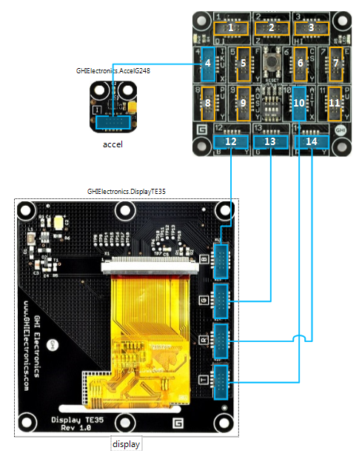
2. Hardware configuration
Let’s assemble the following configuration:

Slide 5
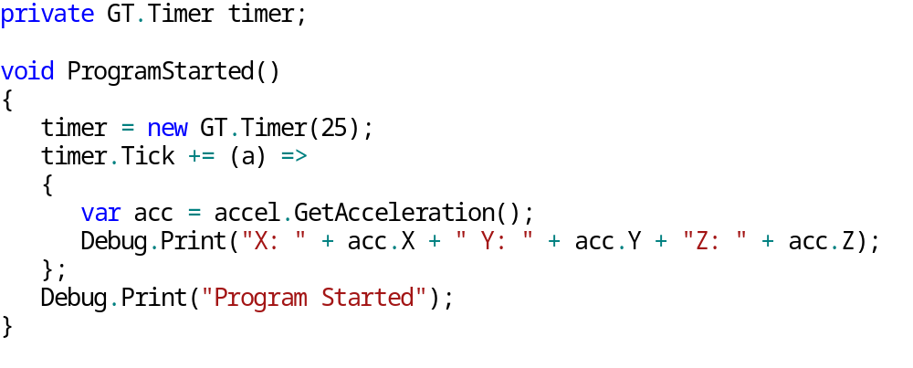
3. Writing the program
Usage of the sensor:
Explanation:
An event is not available for tracking the sensor values, so we will cyclically query the actual data with the help of a timer. The values change between 1 and -1.
There is a variety of choices to read the desired data:
  GetX(), GetY(), GetZ()
  GetXYZ(out double x, out double y, out double z)
  GetAcceleration() : returns a struct with the values of the x,y and z axis’ values.

Slide 6
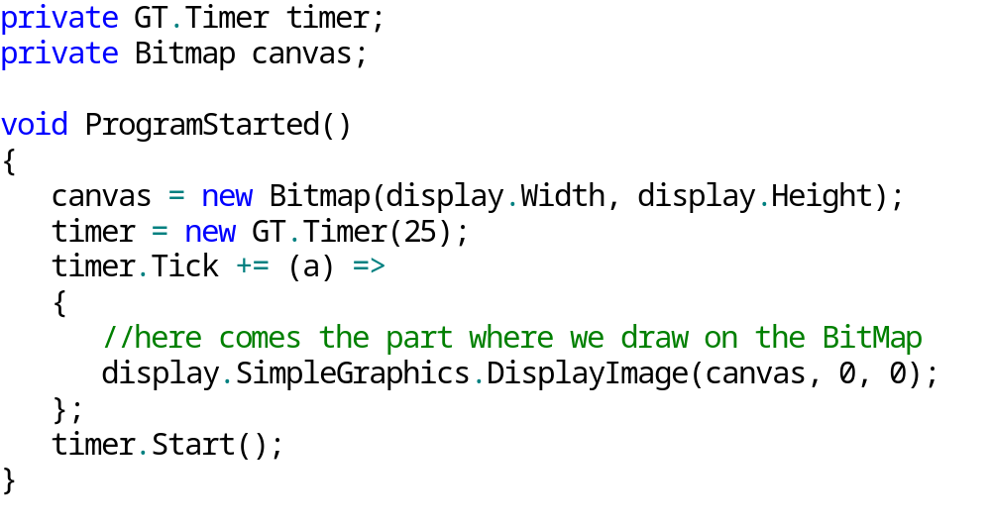
3. Writing the program
Drawing
Extend the ProgramStarted() method with the following lines:
Drawing will be done with BitMap, in order to eliminate flickering on the screen.
The above code should contain the drawing logic, in which we query the sensor’s current state, and draw it to the screen.

Slide 7
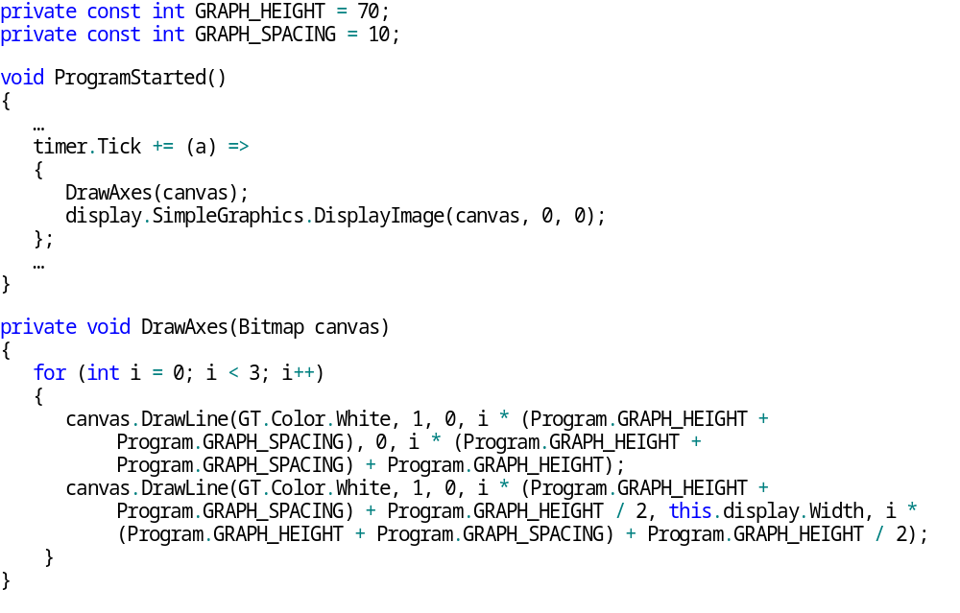
3. A program megírása
Axes (1)

Slide 8
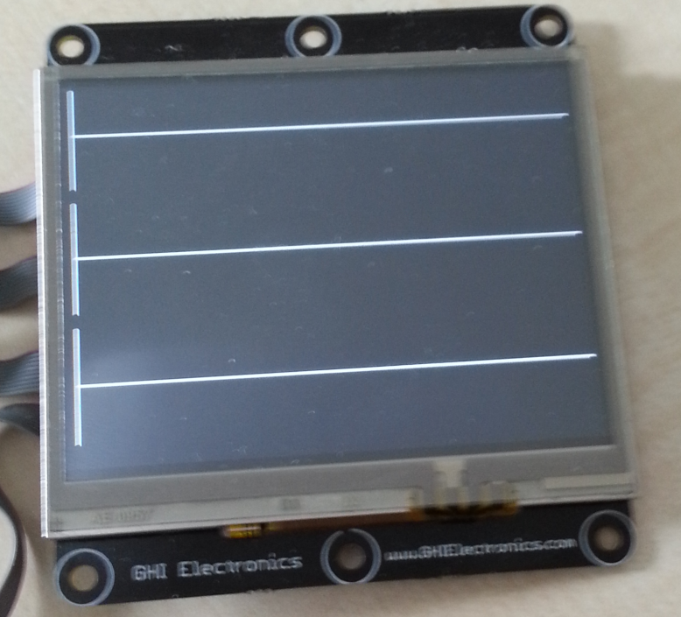
3. Writing the program
Axes (2)
We introduced two constants, one of which represents the height of the axes, the other the distance between them.
In the DrawAxes() method we display the axes with the help of a cycle. The first line draws the vertical lines, and the second line draws the horizontal lines to the BitMap.

Slide 9
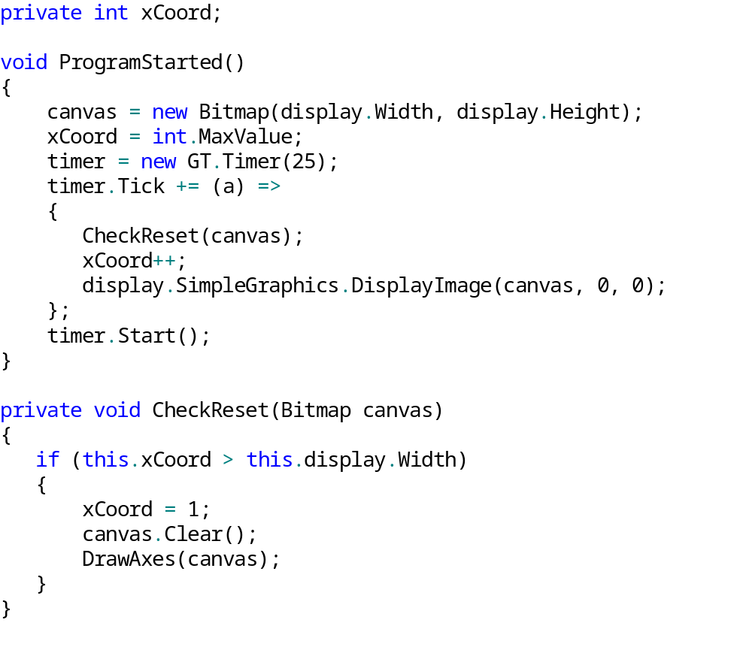
3. Writing the program
Checking the edges of the screen:
Transform the existing code:

Slide 10
3. Writing the program
Checking the edges of the screen(2)
The variable named xCoord will follow the changes of the number of values on the X axis. We will increment it by 1 in every period.
CheckReset() will make sure that drawing won’t happen outside the screen.
If the display is filled, we set XCoord’s value to 1, erase the Bitmap, and draw the axes.
xCoord will get an initial value which is certainly higher than the width of the display, so that the screen will be erased before drawing the axes.

Slide 11
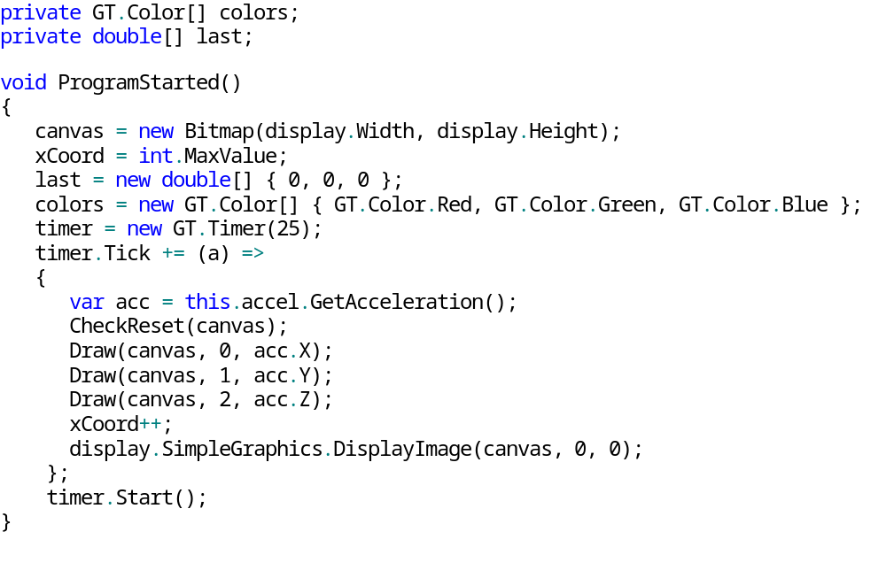
3. Writing the program
Displaying the values(1)
Extend the existing code with the following:

Slide 12
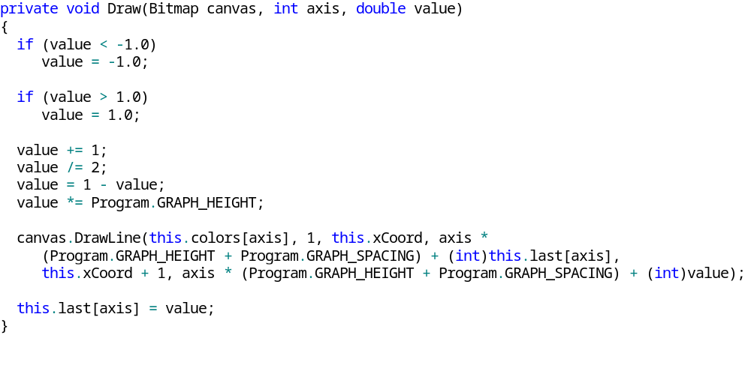
3. Writing the program
Displaying the values(2)
Contents of the Draw method:

Slide 13
3. Writing the program
Displaying the values (3)
The array called last will contain the previous values of x, y and z.
The colors array will contain the colors for displaying:
  0 = X - Red, 1 = Y - Green, 2 = Z – Blue
The Draw() method’s parameters are the BitMap, the number of the axis, and the current value of that axis. First we check if the value is between the borders, then we normalize. After this we draw a line with the use of the current and the previous data. In the end we store the current value in the last array.
In the timer Tick event we get the values from the sensor, than we call the Draw() method for all axes.

Slide 14
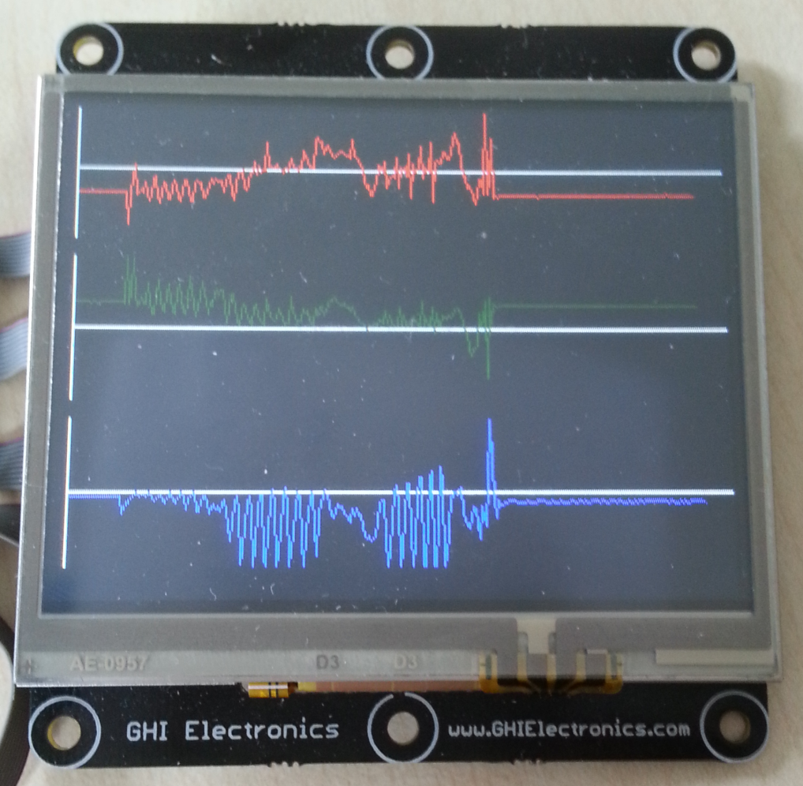
3. Writing the program
Displaying the values(4)
Running the code we have so far:

Slide 15
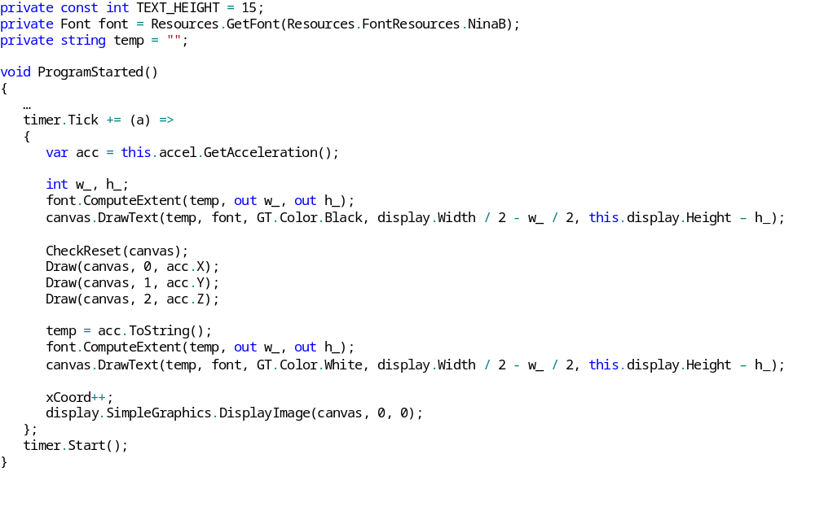
3. Writing the program
Displaying the values(1)
Modify the program to also be able to display the values as numbers:

Slide 16
3. Writing the program
Displaying the values(2)
We use the ToString() method of the structure returned by GetAcceleration. We display this string in the bottom of the screen, adjusted to the middle.
In the variable named font we will get the desired Font type from the resources.
The ComputeExtent returns the height and width of the given string, which we can use for the positioning.
As we don’t erase the screen in every cycle, we have to erase the numbers separately. The way we are going to do this is that we will display the string in white, and when we don’t need it anymore, we will display it again in black.
temp will contain the string displayed in the previous cycle.

Slide 17
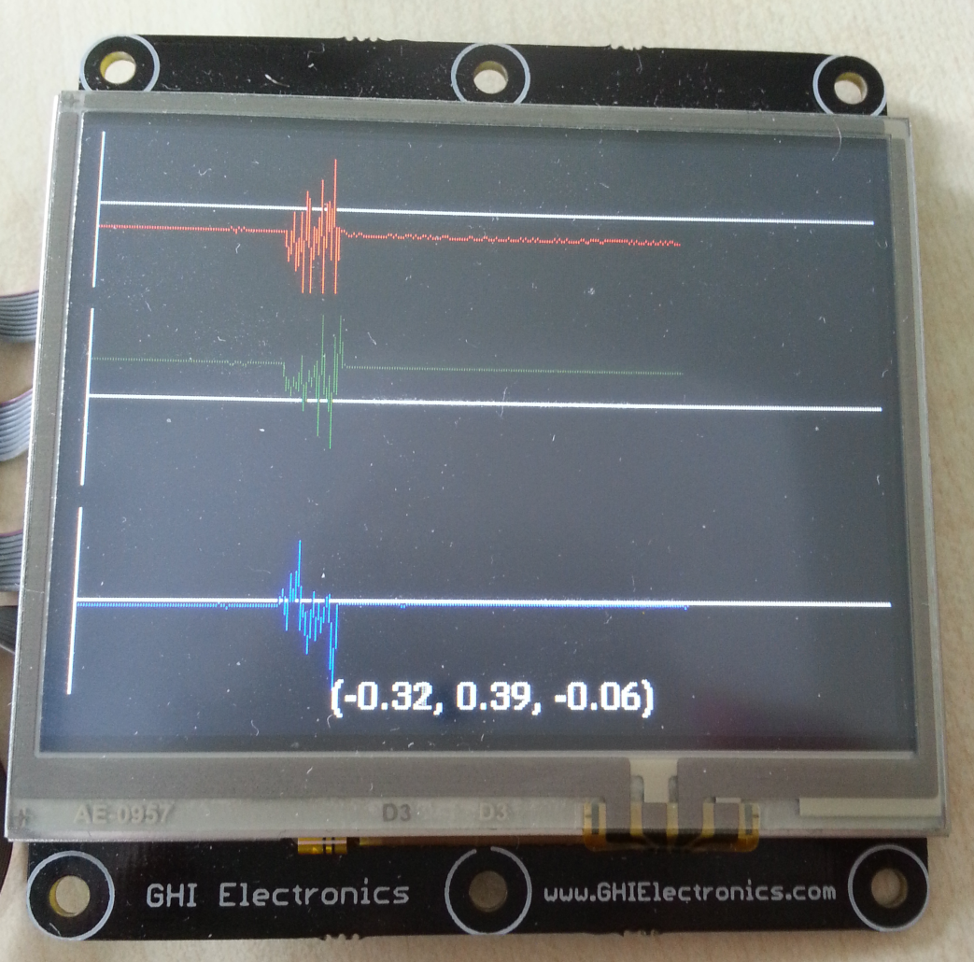
3. Writing the program
Displaying the values(3)
What we have so far:

Slide 18
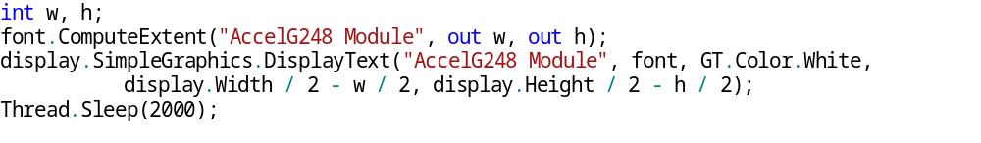
3. Writing the program
Last touch
Insert the following code block to the beginning of the ProgramStarted() method:
The above code will display „AccelG248 Module” for 2 seconds.

Slide 19
4. Individual exercise
Create the following game:
A red ball has to be controlled by the accelerometer module. (DrawEllipse)
The ball can’t leave the screen.
Place a random number of holes on the screen. If the ball touches one of these holes, the game is over.
The ball starts on the right side of the screen.
Use BitMap for the drawing.
Use classes!
The goal of the game is to move the ball from one side of the screen to the other, whilst avoiding the holes.

Slide 20
5. Study Questions
In what ways can we get the current values of the sensor?
If we set the sensor up on any of it’s axes, we can see that acceleration is not 0 on that axis. Why is that?

