Slide 1
Intelligent Systems
Self-learning navigation.

Slide 2
Navigation
The aim of the navigation is to reach a certain point/destination. During the movement there are factors that should be considered:
  The movement options of the robot
  The resource that is needed for the movement
  Time
  Mechanical properties
  Terrain
Known / Unknown Terrain

Slide 3
Navigation
Avoiding obstacles and path finding:
    Rule-based algorithm.
      Modified/advanced rule-based algorithm.
      Neural-based algorithm.
      Experiance based algorithm.
    Wavefront propagation algorithm.
      Modified/Advanced Wavefront propagation algorithm.
    GVD-based, graph traversal algorithm.

Slide 4
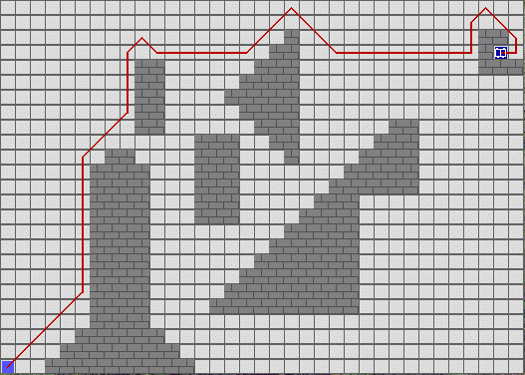
Navigáció
    Rule-based algorithm.
    Based on each position a decesion has to be written.
    E.g.: Destination is in front of us, go forward.
    It is not guaranteed it will find the destination.

Slide 5
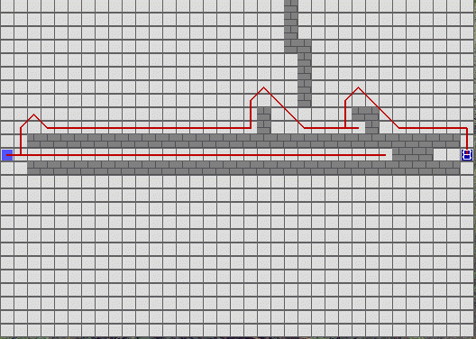
Navigáció
    Modified/advanced rule-based algorithm
    It can save steps into its memory.
    It is not guaranteed it will find the destination.

Slide 6
Self-learning (Experience based) navigation
The table of rules will be updated by getting more and more experience instead of doing it manually.
We define the robot’s possible movements and the situations the robot should handle.
The possible movements and the treated situtations will give a 2D array (table of rules). (4x4)
  Right, left, up, down (in which direction the destination).
  Right, left, up, down are the possible movements.
  We are not dealing with obstacles right now (We are using an „empty” map).

Slide 7
Self-learning (Experience based) navigation
Steps of the navigation:
  Initially the robot’s table of rules is empty
  Determine the important directions
    Where is the destination (point/cell) comparing to the robot’s location?
    This gives one row to the table of rules.
  From the table of rules the best possible „choice/step” should be determined for a given direction.
    The maximum value should be chosen from the row.
    The index of the maximum value will give the next step, no matter how good or bad that step is.
  After a step it should be examined whether we stepped closer to the destination or farther
    If we moved(stepped) closer, then the chosen rule’s goodness value should be increased.
    If we moved(stepped) farther, then the chosen rule’s goodness value should be decremented.
  On a new attempt(run) the table of rules will be saved (The table of rules will be the experience ).

Slide 8
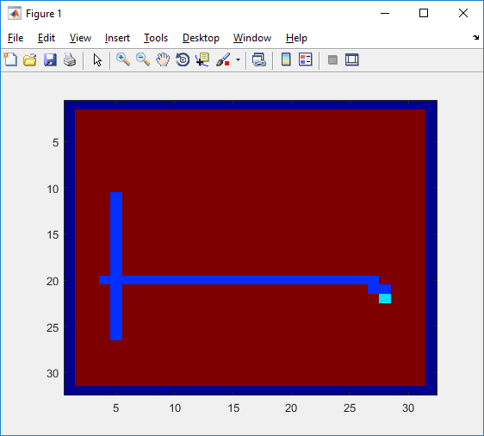
Self-learning (Experience based) navigation– Initially the table of rules is empty.

Slide 9
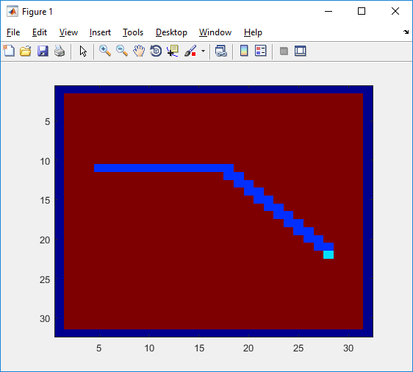
Self-learning (Experience based) navigation – On a new attempt(run) the robot uses its expereince.

Slide 10
Self-learning (Experience based) navigation
Advantages?
  Works on known and unknown terrain.
Disadvantages?
  There is no guarantee it will find the destination.
  We don’t know whether the destination is reachable or not.

Slide 11
Matlab
Upon start the program will ask whether to delete the table of rules or not (table of rules is always empty on the first start).
Loading the basemap (32d.png)
  Red (255,0,0) cell: Robot
  Green (0,255,0) cell: Destination
  White cells (255,255,255): Empty cell
  Black cells (0,0,0): Obstacle
Matlab converts this picture (array) into a 2D array, in which the following values are included/given:
  emptyVal=0;
  finishVal=-1;
  robotVal=-2;
  pathVal=-2.5;
  obstacleVal=-3;

Slide 12
Matlab
The new table of rules is created (min. 4x4)
  %rows and columns of the table of rules
  directions=4;
  movements=4;
  %directions (Where is the destination?)
  dirRight=1;
  dirLeft=2;
  dirUp=3;
  dirDown=4;
  %movements (Where can we step?)
  moveRight=1;
  moveLeft=2;
  moveUp=3;
  moveDown=4;

Slide 13
Matlab
Main loop:
%% let's learn!
robotPos=startPos;
while(norm(robotPos)~=norm(finishPos))
The program will run until the robot reaches the destination.
Q1: Will the robot always find the destination?
Q2: Is there something that ensures the robot will stop if there is no path?

Slide 14
1. Task
Determine the directionIndex, comparing to the robot’s location the direction to the destination
2. Task
Determine the movementIndex, chosing the step with the greatest goodness value to a given direction (from the the rules)
3. Task
Calculate the new step, increment or decrement the value of the variable newPos’ row and column.
4. Task
Check the distance if the robot moved closer to the destination => confirm the rule, if we are farther => decrease rule
Matlab will do the other necessary steps (Steps, visualization, etc.)

