Slide 1
Neural Networks
http://mobil.nik.uni-obuda.hu/en/intsys_lab/

Slide 2
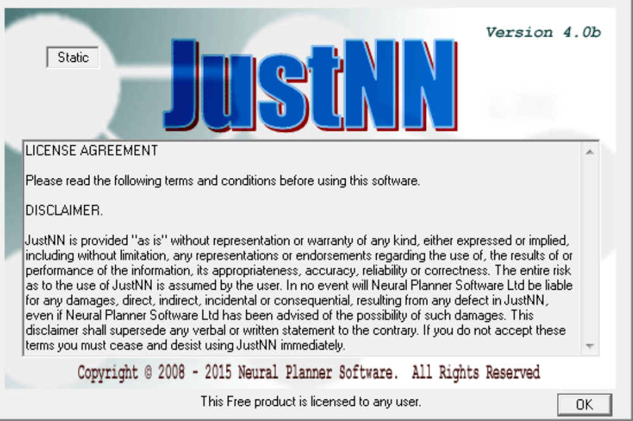
Introduction
The exercises will be solved by the help of JusNN program.
http://www.justnn.com/
Free to download.

Slide 3
Tip
The program has some premade networks that can be examined.
Initializate the weights.
Examine the network before and after the teaching phase.

Slide 4
Hello world (First task)
The network should determine the parity of a four bit number.
The LSB should be examined.
  1 – odd
  0 – even
The inputs can be logical (bool) variables or integers (int).
  For the state of simplicity we will use integers.
The output can be text.
  Easier to visualize.

Slide 5
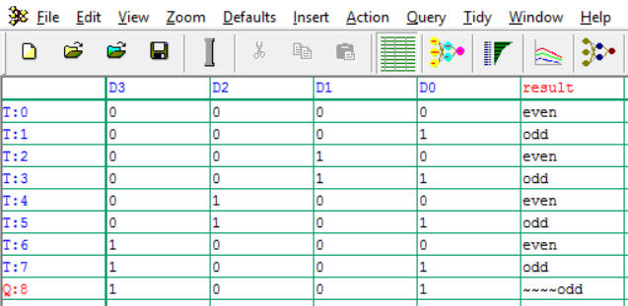
Hello world

Slide 6
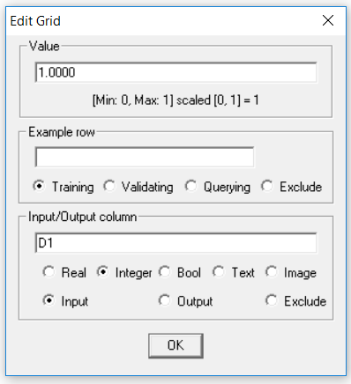
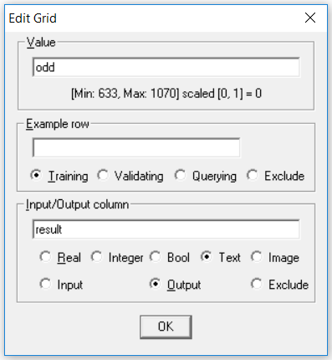
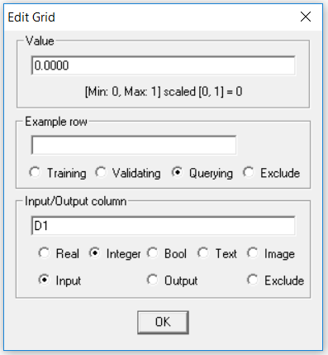
Data fields

Slide 7
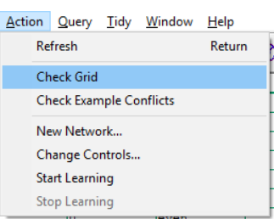
Lets create our first network
After filling every field we can create our first nnetwork.
  Requirements: training set should exist, input, output should be set
If all requirements are set properly we can create it, otherwise the icon will be unavailable.
  The program checks the data we had given.
    Action -> check grid

Slide 8
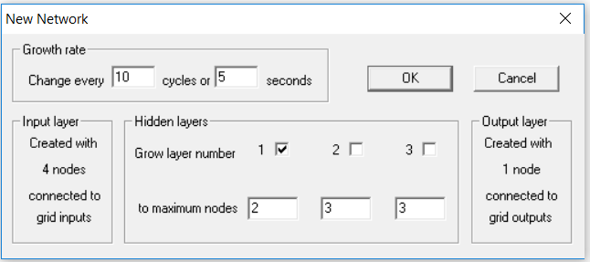
The network

Slide 9
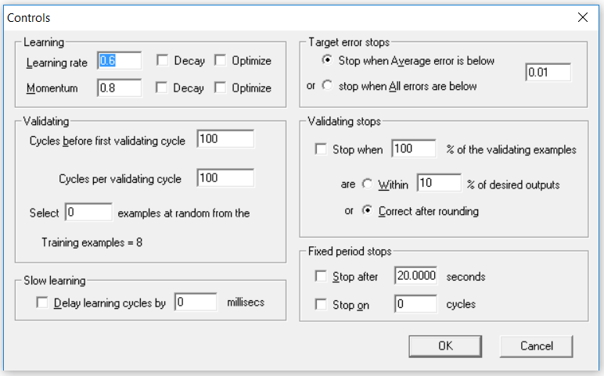
The network

Slide 10
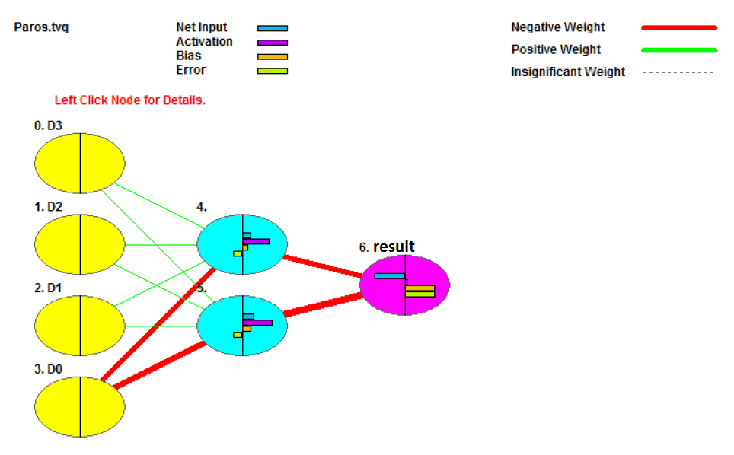
The network

Slide 11
After the learning process
The network with the default options almost immediately learns/”memorize” the „pattern”.
Check the result on a diagram.

Slide 12
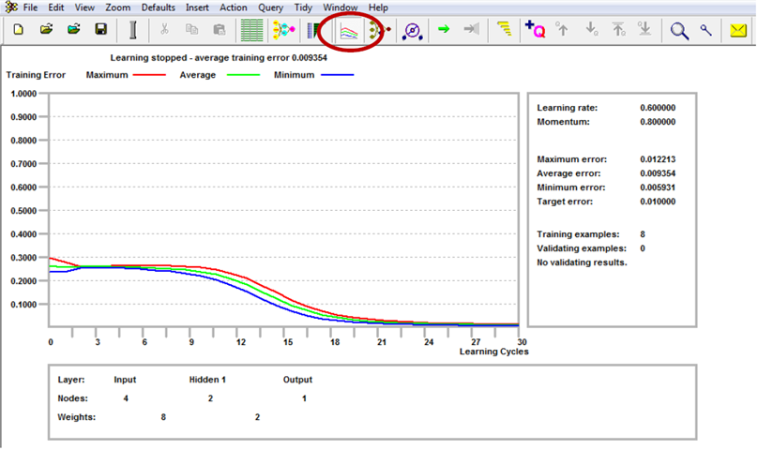

Slide 13
Conclusion
Notice that we didn’t list all the 16 possible training set, but the program will give a valid solution to all possible „combinations”.
Also consider the importance of weights.
From the network representation we can see that the D0 bit has the most important task to decide the parity.

Slide 14
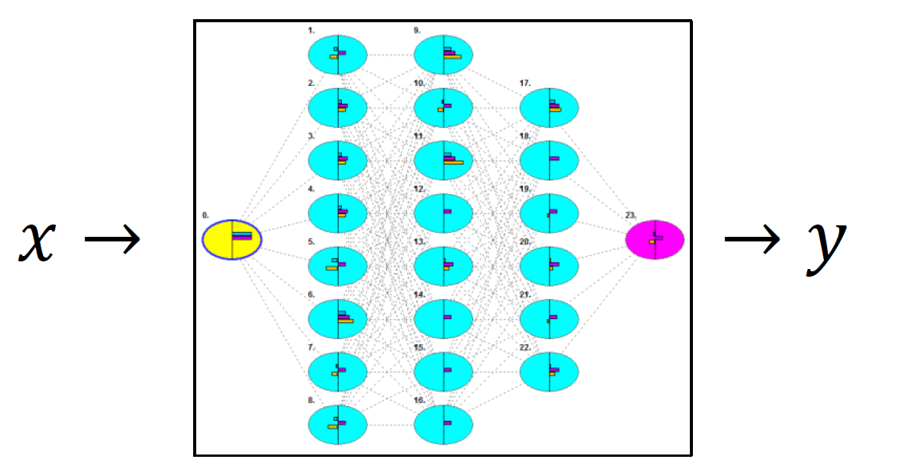
Second task
Create a neural network that can solve the following transfer function: y=2*x^2+5*x-10.
Where x should be between -10 and 10.

Slide 15
First step
Lets create the representative training set.
Input data fields should be set to Real.
Input data field should be set to Real.

Slide 16
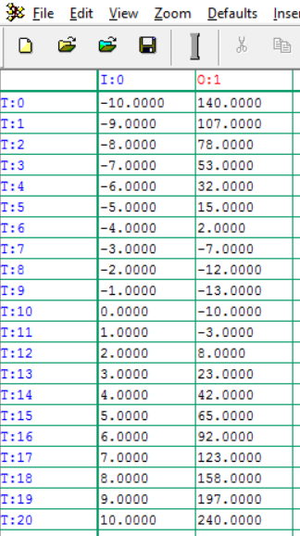
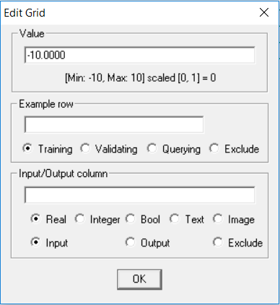
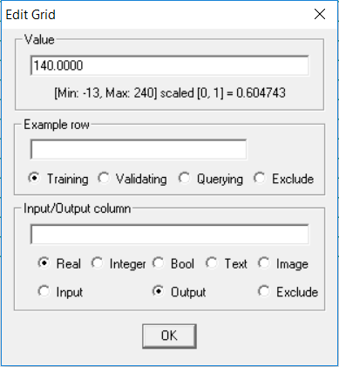
Training set

Slide 17
Second step
Create the the querying fields.
  After the learning phase we can see the network’s result here.
First it is advisable to give the same values that were given for inputs.

Slide 18
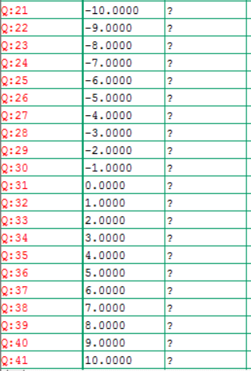
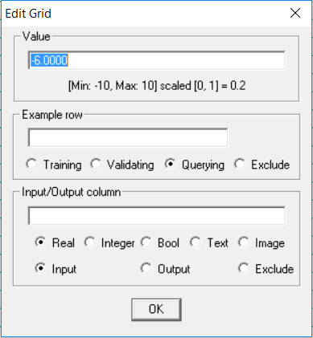
Querying fields

Slide 19
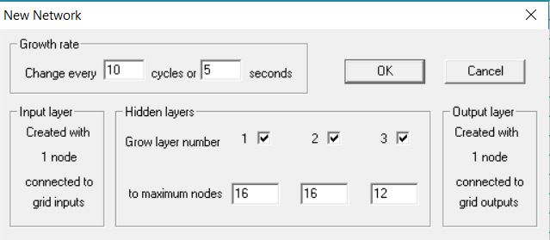
Third step
Create the network.

Slide 20
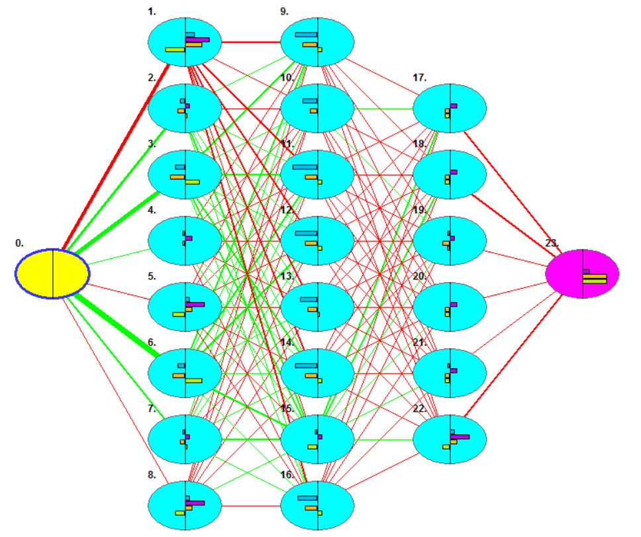

Slide 21
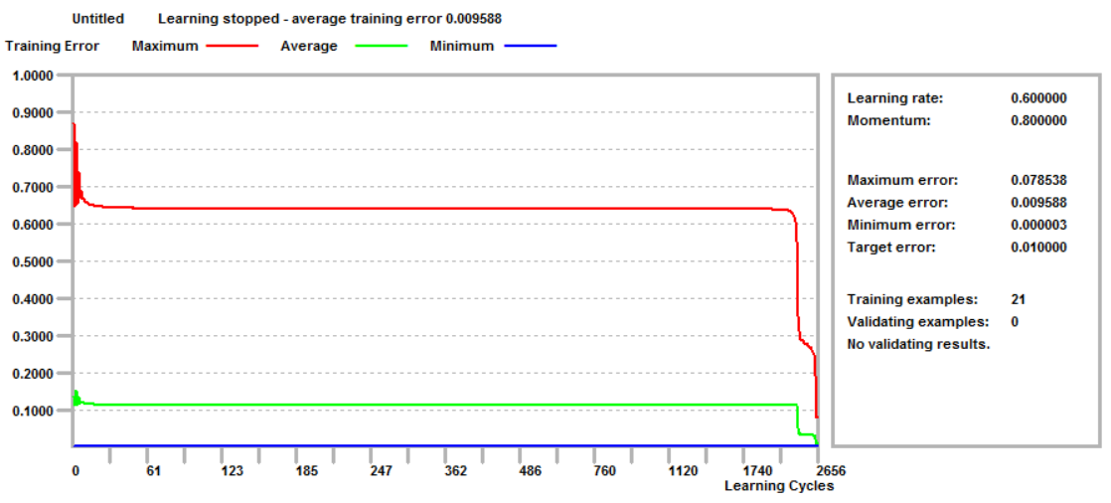
Fourth Step

Slide 22
Fifth Step
Check the network’s results and compare them to the ideal results.
Open an excel and type the values you got.
Create a diagram on which you can see the ideal results and the network’s results.

Slide 23
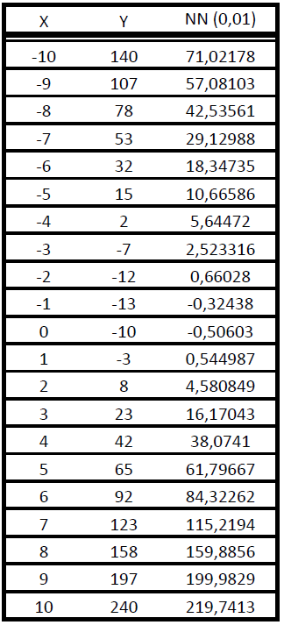
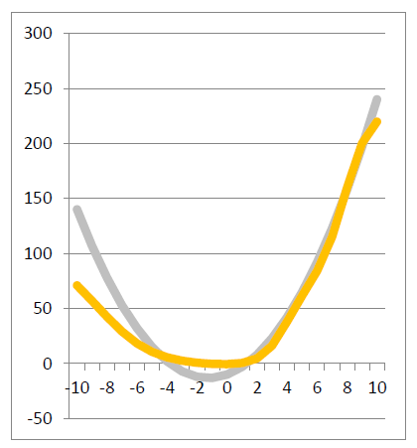
Results

Slide 24
Increase the accuracy of the network
In order to increase the accuracy of the network the average error should be decreased.
  Setting from 0.01 to 0.00001 will make it accurate enough to get ideal results.
The learning process will take more time (Trade-off time vs accuracy).
Lets re-teach the network.

Slide 25
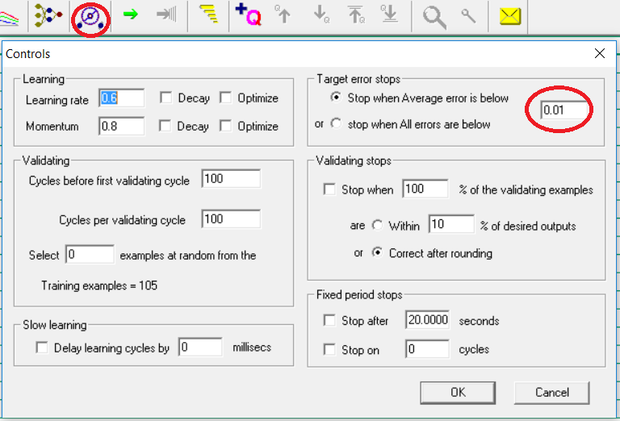
Re-teaching the network

Slide 26
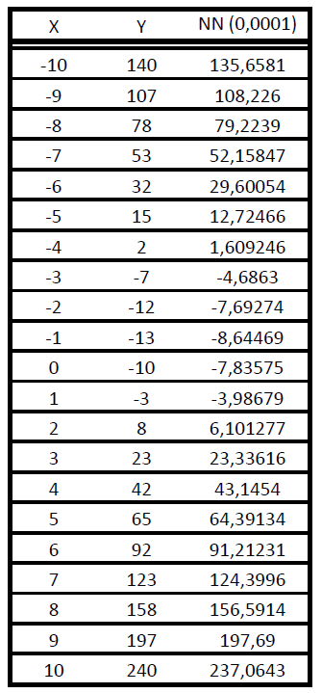
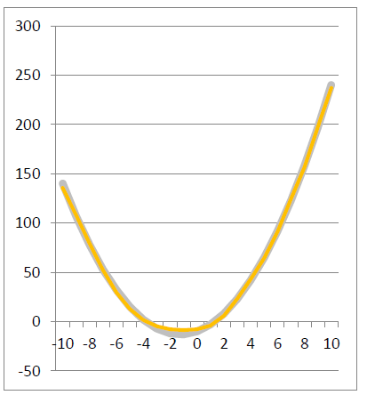
Check the results

Slide 27
Conclusion
It can be seen that the network gave an almost tottaly accurate result to all x(s).
It will work if x is greater or less than the sample that we gave or tested.
Notice that the transfer function was never mentioned to the network.

Slide 28
Third task (free fall)
Create a nnetwork that can learn the laws of free fall, without specifying the specific context of free fall.
Give a representative training set to the network based on an example.
In this example a ball will be dropped from 1,2,3 meter tall building and the time was noticed when the ball hit the floor.

Slide 29
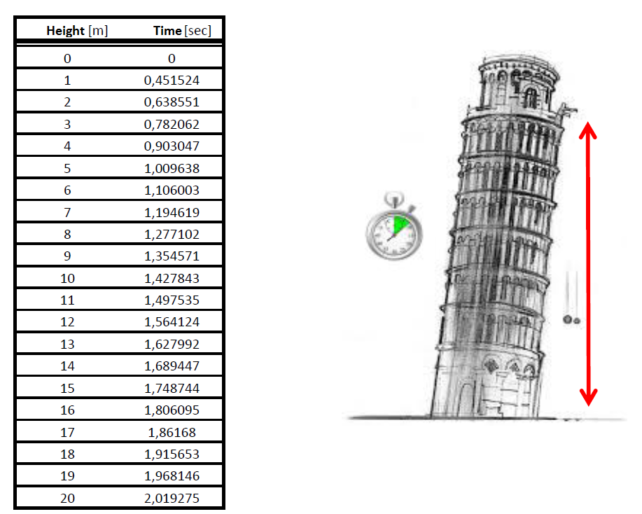

Slide 30
Steps
First – Create the training set (input, output, checking fields).
  Input, output should be set to Real.
Second – Create the querying fields.
  It is adviceable to use the same data first that were used for the input.
Third – Create the network.
Fourth – Check the network’s results and the ideal results in an excel.
Sixth – Handle the accuracy problem of the network.

Slide 31
Fourth task (projectile motion)
Create a nnetwork that can learn the laws of projectile motion without specifying the specific context of projectile motion.
The network should be able to calculate how far will a basbell bat fly with a base speed and angle from us.
Give a representative training set to the network based on an example.
In this example the angle will be between 0 and 90 degree and the base speed will be tested with these angles(on speed 0,10,20,30m/sec).

Slide 32
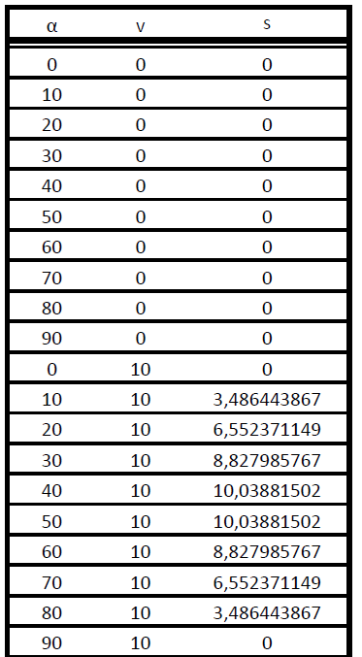
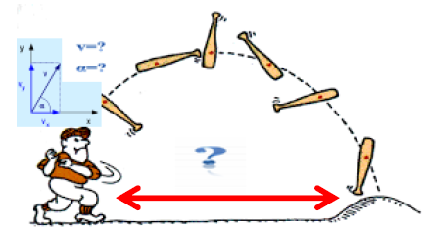
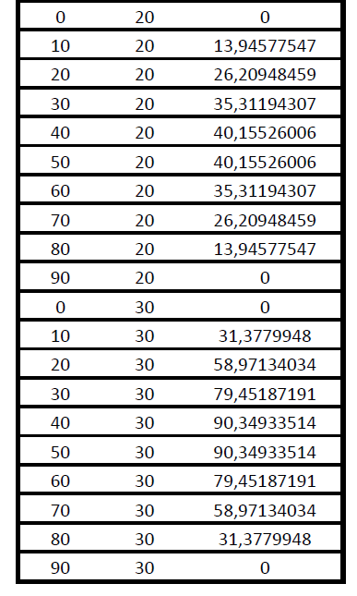
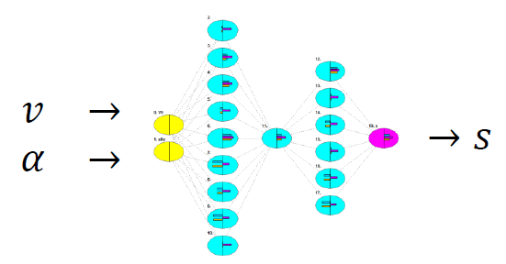

Slide 33
Steps
First – Create the training set (input, output, querying fields).
  Input, output should be set to Real.
Second – Create the querying fields.
  It is adviceable to use the same data first that were used for the input.
Third – Create the network.
Fourth – Check the network’s results and the ideal results in an excel.
Sixth – Handle the accuracy problem of the network.

