Slide 1
Intelligent Systems
mobil.nik.uni-obuda.hu/en/intsys_lab/
2017. Spring

Slide 2
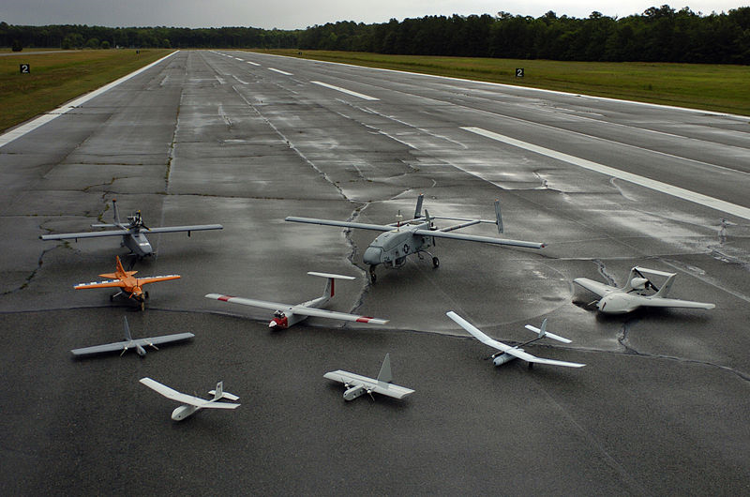
UAV

Slide 3
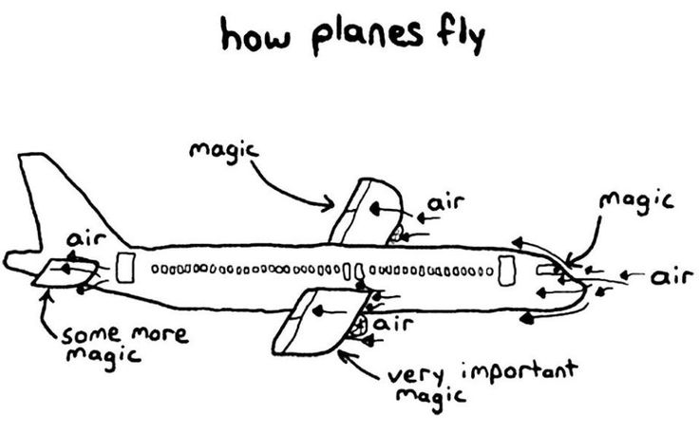

Slide 4
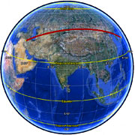
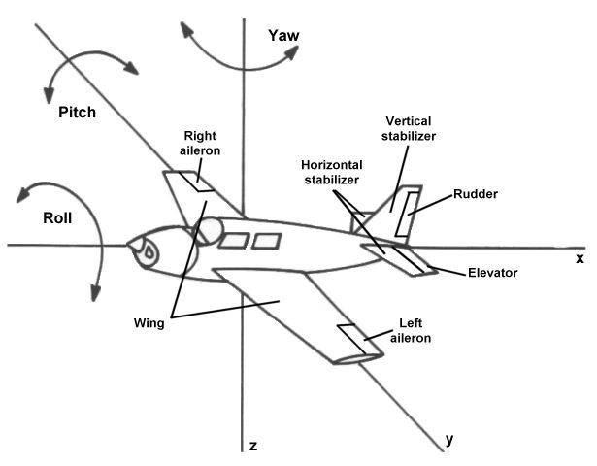
UAV based navigation
Course
  Planned path.
Bearing
  Direction of travel
  (Comparing to North).
Heading
  To which direction
  the nose of the plane points
  (Comparing to North).
http://www.paddlinglight.com/articles/technique/navigation-course-bearings-and-headings/

Slide 5
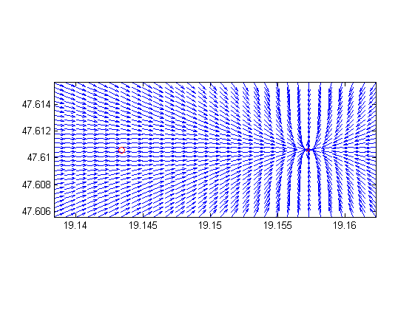
UAV based navigation
Waypoints

Slide 6
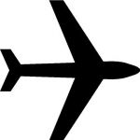
UAV based navigation
North
Dest.
Start
(Angle error: between -180° and +180° degree!)
http://www.movable-type.co.uk/scripts/latlong.html

Slide 7
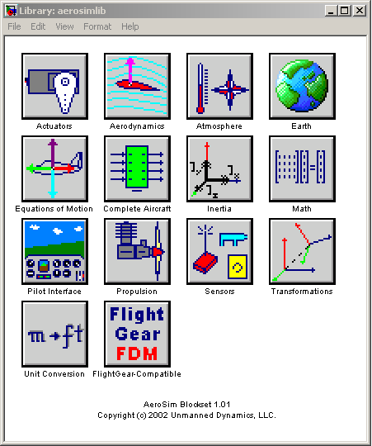
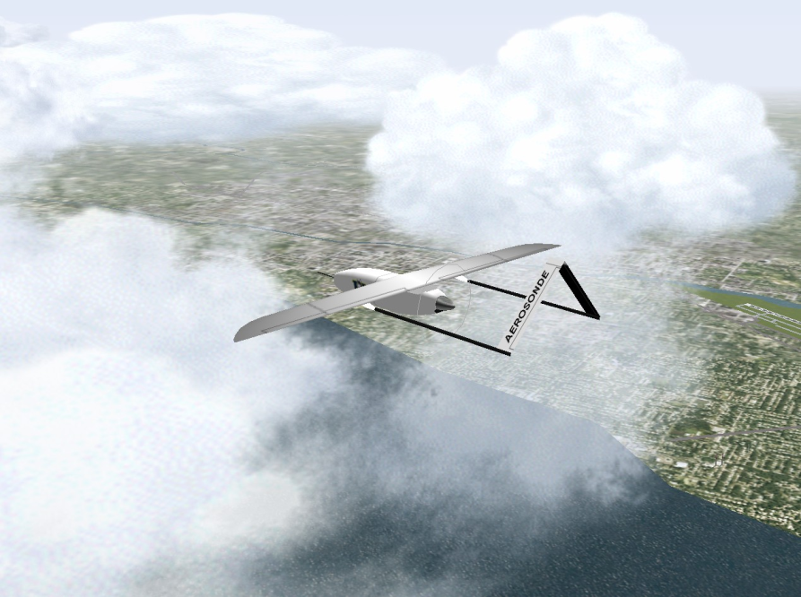
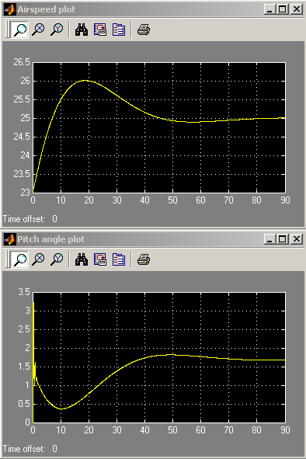
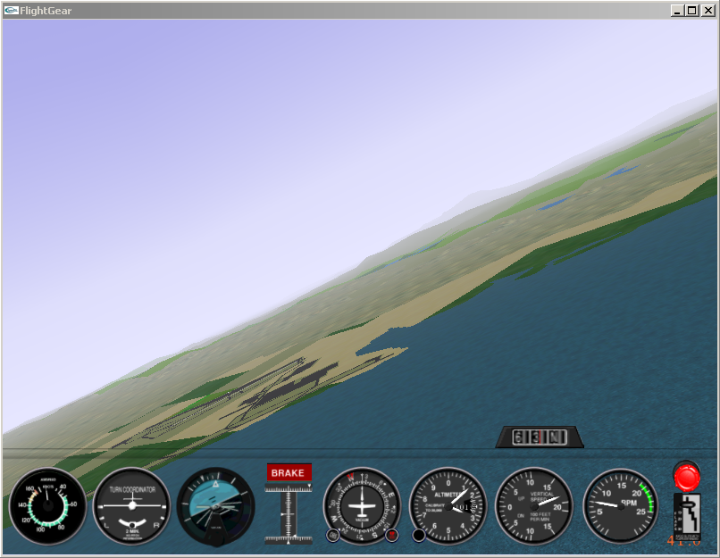
Aerosim

Slide 8
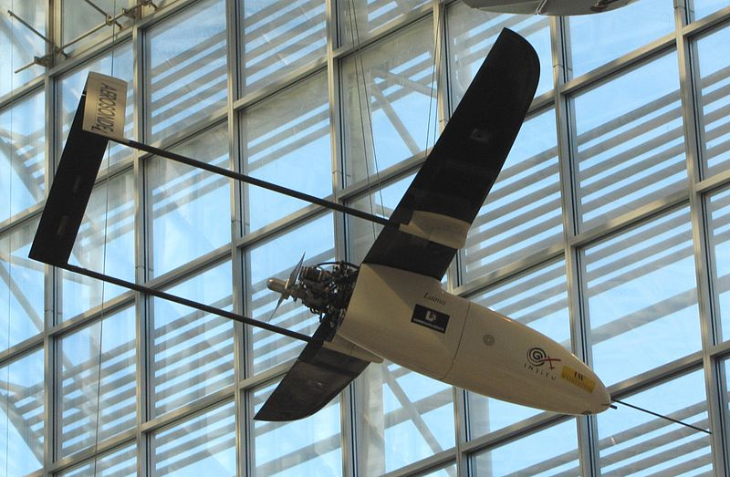
Aerosim model:
Aerosonde „Laima” UAV
http://www.barnardmicrosystems.com/UAV/milestones/atlantic_crossing_1.html

Slide 9
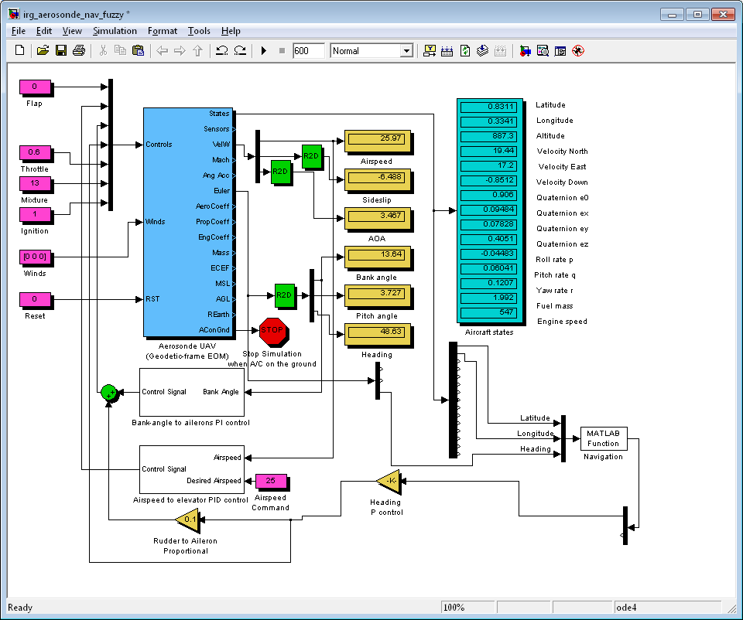
Input – measured data through sensors
navigation.m
P controller
Output - error
Control signal

Slide 10
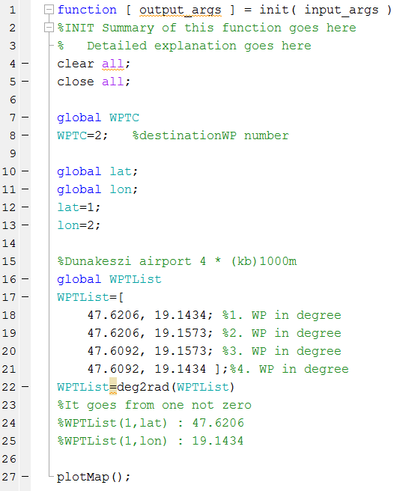
Initilaziation
Init.m

Slide 11
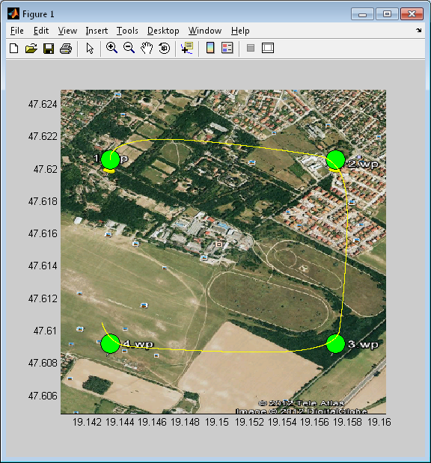
Navigáció

Slide 12
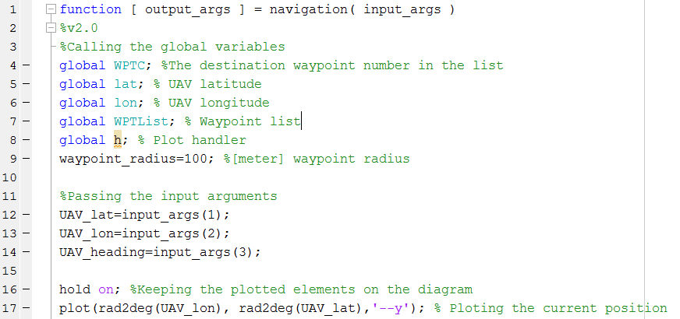
Navigation.m

Slide 13
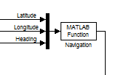
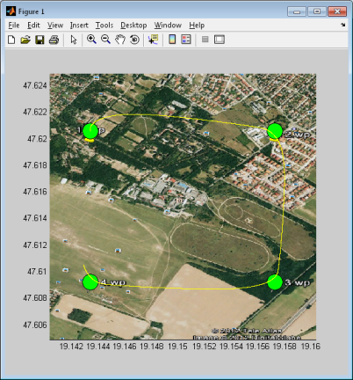
Navigation.m

Slide 14
1. Task
In a given point (UAV) calculate the desired bearing.
2. Task
Calculate the distance with the „same” method.
3. Task
Increment the waypoints. If the WPDistance is smaller than the WPRadius
4. Task
Angle error (Difference of the desired and real bearing, between -Pi...+Pi (-180...+180°))

