Slide 1
Intelligent Systems
Wavefront propagation based navigation.

Slide 2
Navigation
Avoiding obstacles and path finding:
    Rule-based algorithm.
      Modified/advanced rule-based algorithm.
      Neural-based algorithm.
      Experiance based algorithm.
    Wavefront propagation algorithm.
      Modified/Advanced Wavefront propagation algorithm.
    GVD-based, graph traversal algorithm.

Slide 3
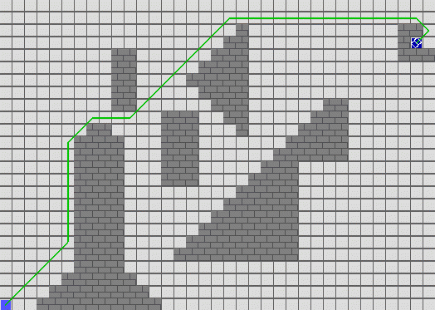
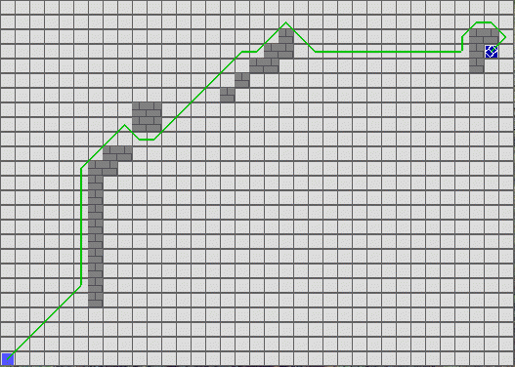
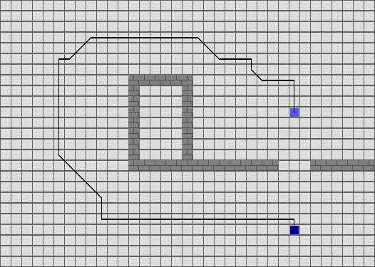
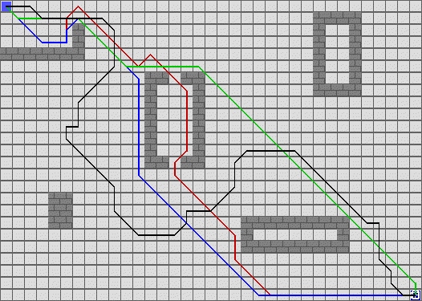
Navigáció
    Wavefront propagation algorithm.
    If there exists a path, it will find it (always).

Slide 4
Navigáció
    Wavefront propagation algorithm.(Unknown Terrian)
    If there exist a path, it will find it (always), but it is not guaranteed it will be the shortest.

Slide 5
Matlab frameprogram
Loading the basemap (32d.png)
  Red (255,0,0) cell: Robot
  Green (0,255,0) cell: Destination
  White cells (255,255,255): Empty cell
  Black cells (0,0,0): Obstacles
Matlab converts this picture (array) into a 2D array, in which the following values are included/given:
  emptyVal=0;
  finishVal=-1;
  robotVal=-2;
  pathVal=-2.5;
  obstacleVal=-3;
  Wavefront cells = cells with positive values

Slide 6
Matlab frameprogram
newWavefrontCells=1;
while(newWavefrontCells>0
%The cycle will run until it finds an empty cell that a wave can reach
%What is the solution for stopping the propagation if a wave have reached the robot?
newWavefrontCells=0;
cloneMap=map;
…
% 1. Task
% - Propagating wavefronts
% - In every cycle only one new wave should be handled
% - To search after empty cells surrounded by wavefront cells
% - Vertically and Horizontally it „costs” 2, diagonally 3. Attempting for step
% with minimal „cost”.
% - The first step should be handled, where the desitnation cell should be surrounded (-1 ) with a wave
% - Pay attentaion to increase the value of the new cells in the wavefront (newWavefrontCells)!

Slide 7
Matlab frameprogram
After the wavefront propagation the frameprogram examines whether there is a wavefront in the robot’s ambient. (8 surrounding cells).
If yes, then there exists a path.
Find the shortest path.

Slide 8
Matlab frameprogram
if (pathavailable)
globalMax=max(map(:));
if localMax>0
pathcomplete=0;
robotPos(1)=startPos(1);
robotPos(2)=startPos(2);
while(~pathcomplete)
% 2. Task
% Search for the shortest path
% The robot’s actual position (robotPos) should be examined (8 surrounding cells) and the wavefront with the lowest value should be chosen (minWave)
% The movement and tracing are done by the frameprogram

Slide 9
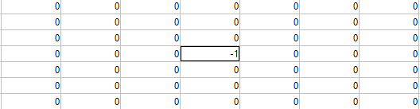
Initial state – Destination: (-1)

Slide 10
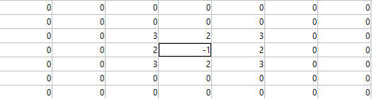
First wave

Slide 11

Second wave

Slide 12
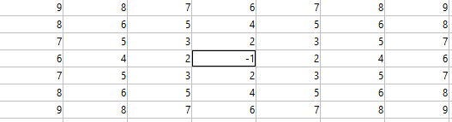
Third wave

Slide 13
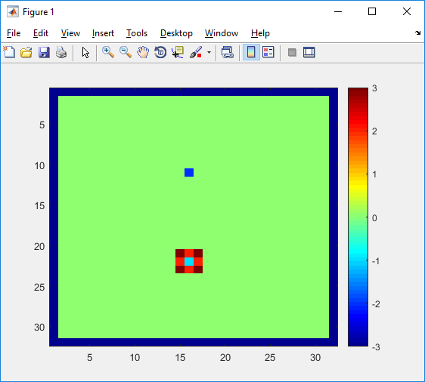
Wavefront propagation based navigation- (First wave)

Slide 14
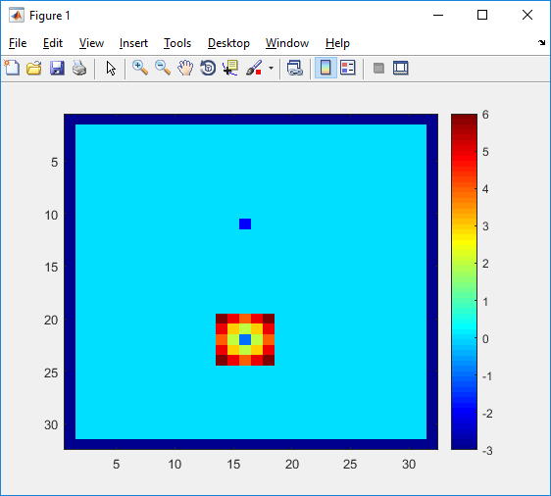
Wavefront propagation based navigation- (Second wave)

Slide 15
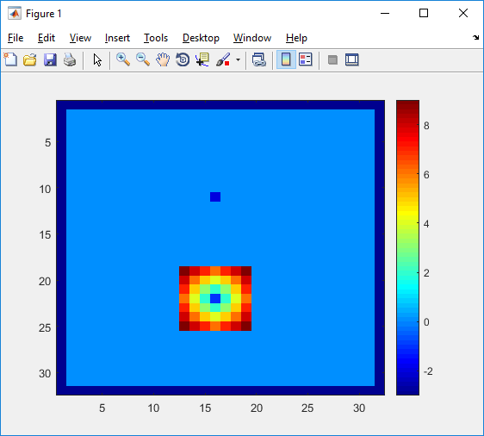
Wavefront propagation based navigation- (Third wave)

Slide 16
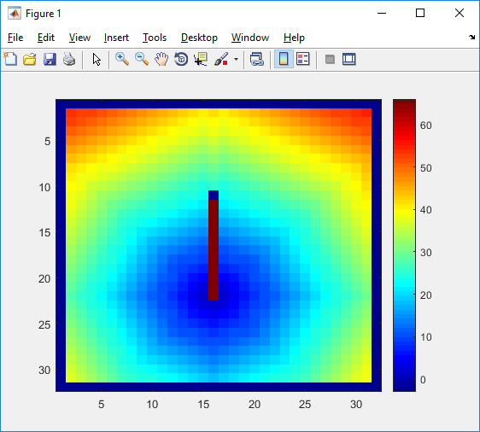
Finally

Slide 17
Wavefront propagation based navigation- Properties
If the wavefront reaches the robot: There path is existing.
The robot in the ambient searches the smallest wave cell and steps there (8 surrounding cells).
After a finite number of steps through the shortest path (we examine the diagonal steps too and we are in known terrain) it reaches the destination.

Slide 18
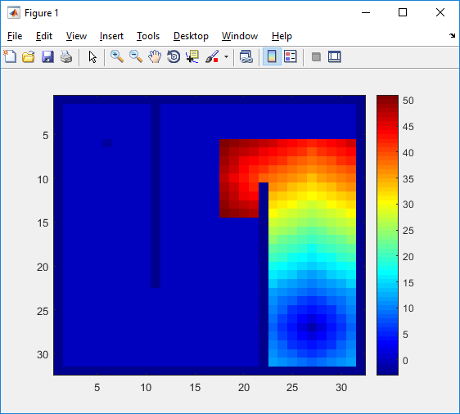
Wavefront propagation based navigation- (With obstacles)

Slide 19
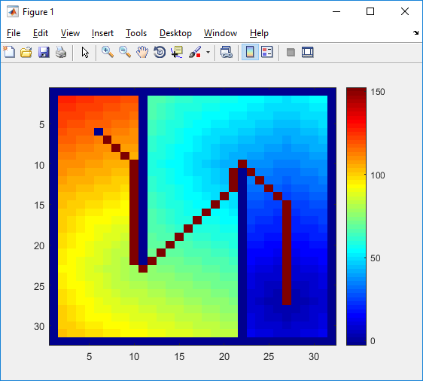
Wavefront propagation based navigation- (With obstacles)

