Slide 1
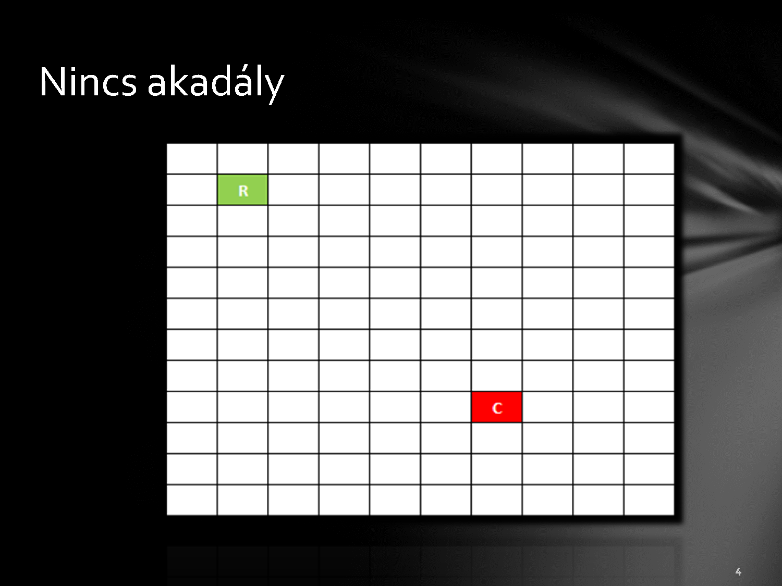

Without obstacles

Slide 2
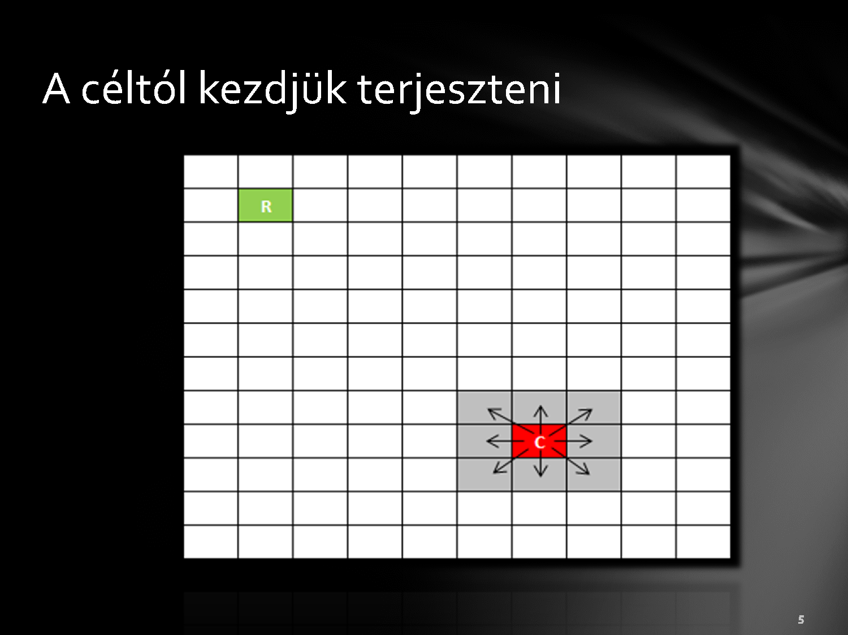
We start to propagate from the destination

Slide 3
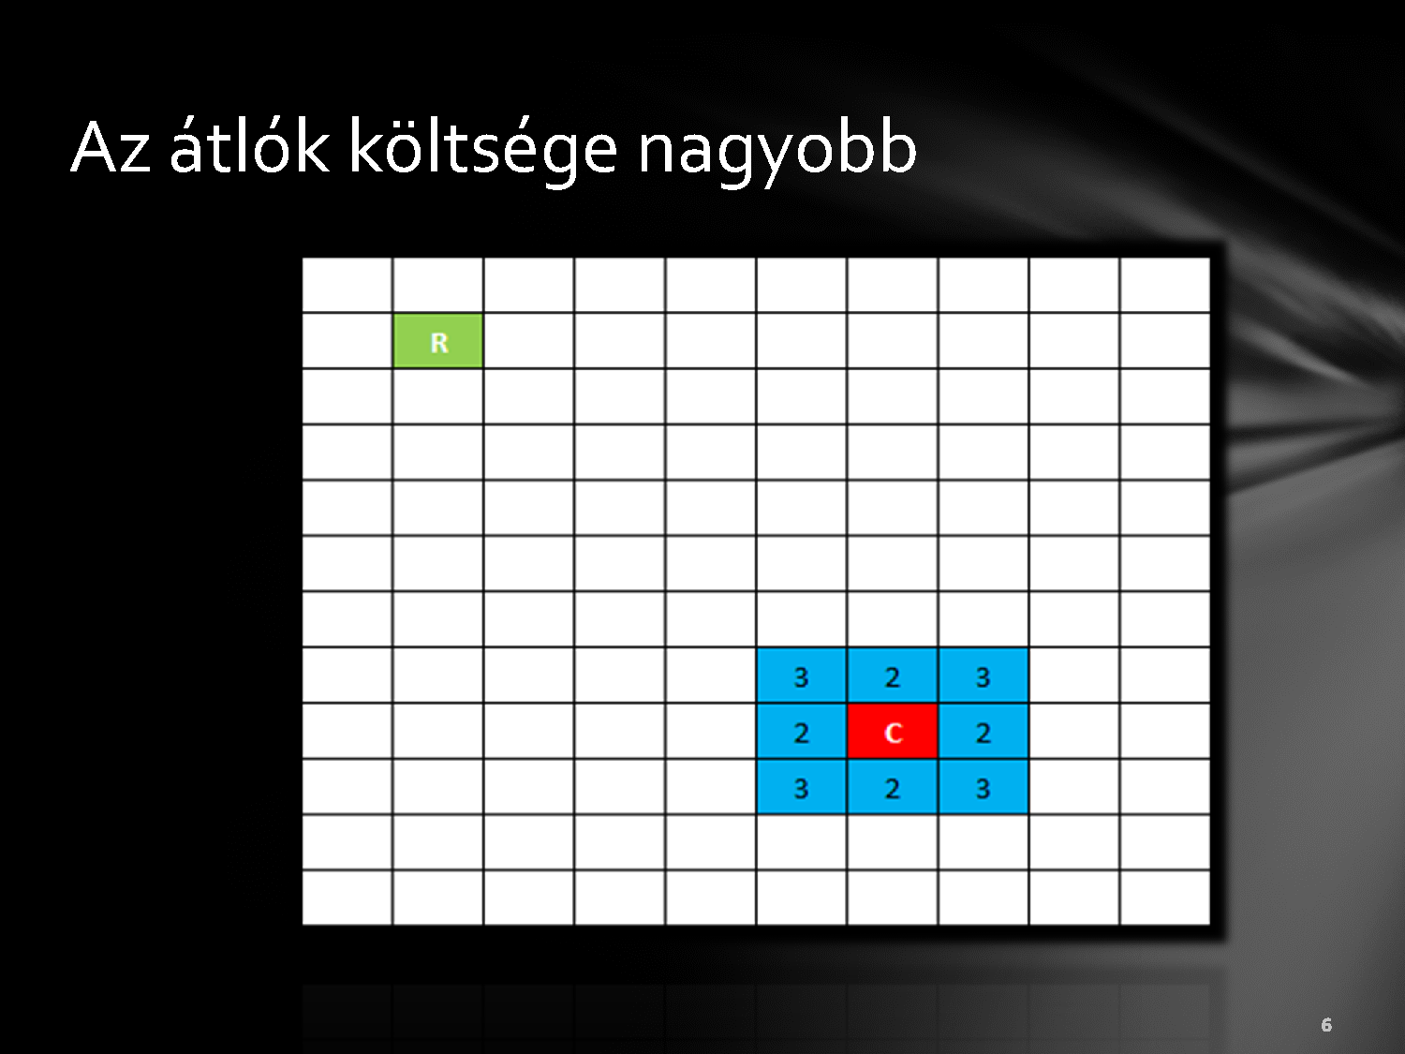
Diagonals cost more

Slide 4

We expand to the surrounding cells.

Slide 5
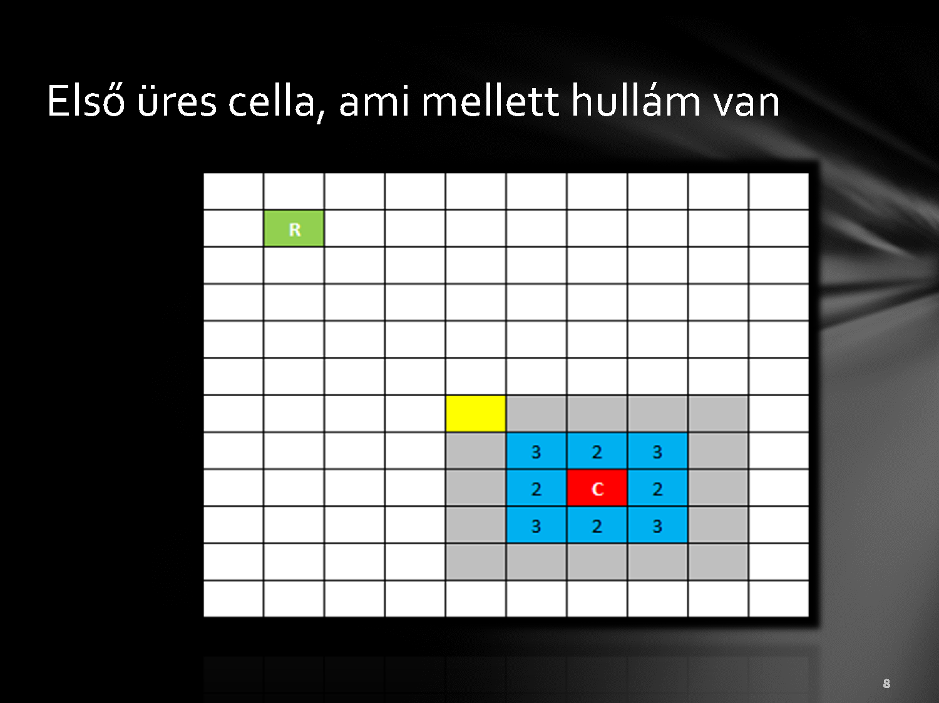
The first empty cell next to the wave

Slide 6
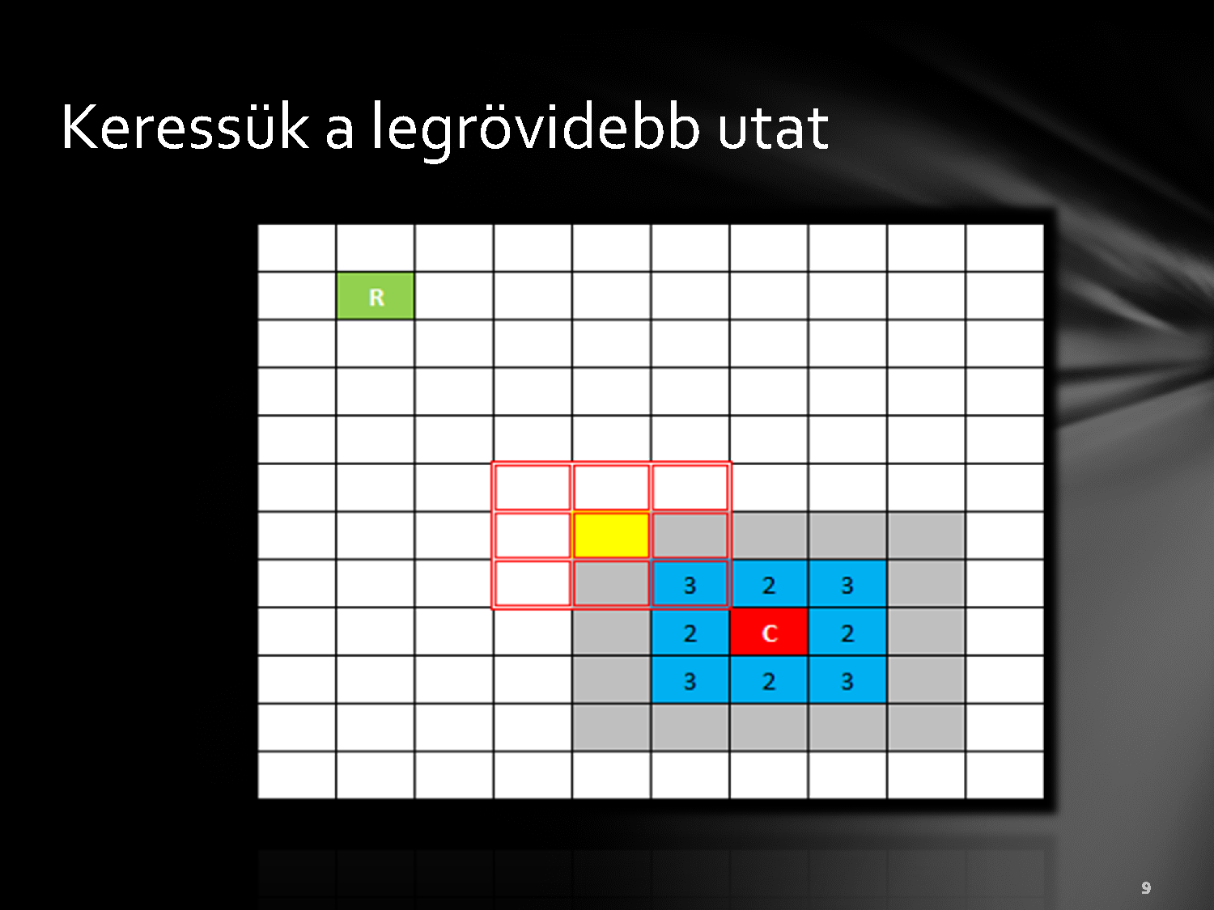
Seraches for the shortest path

Slide 7
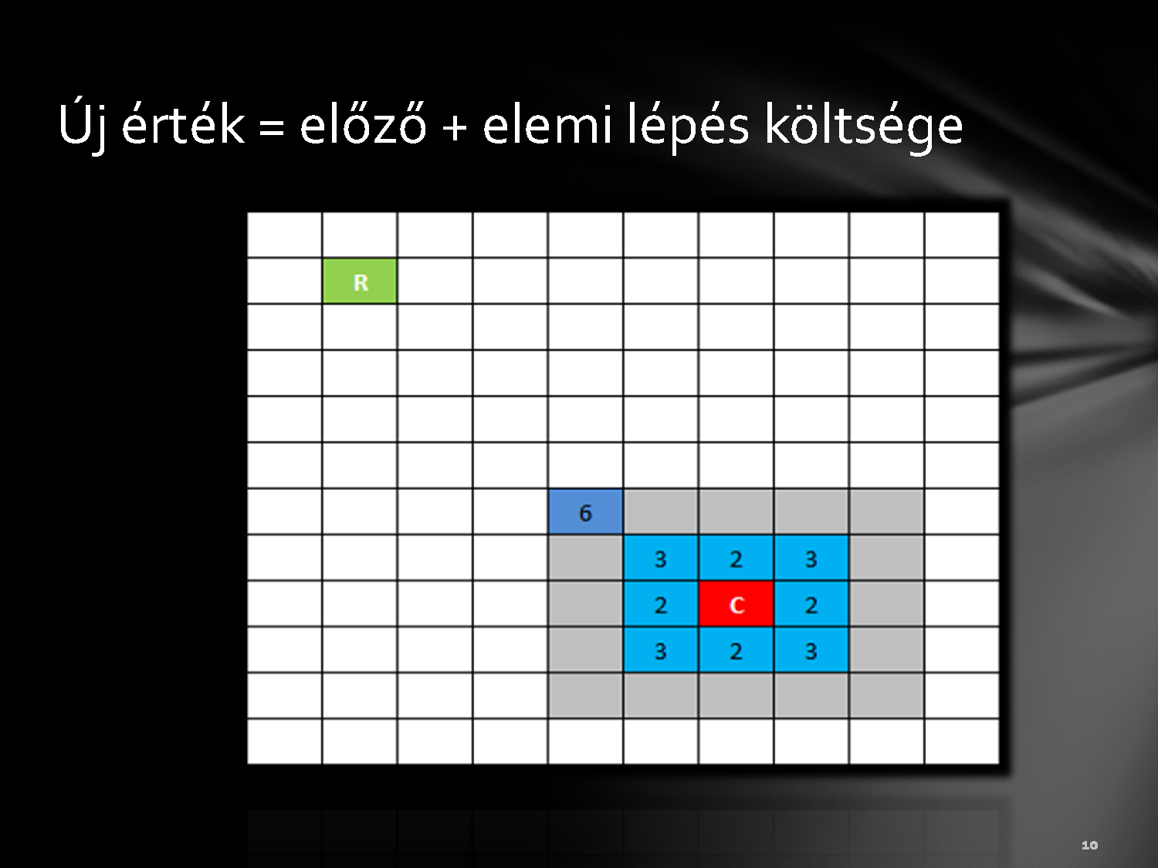
New value = previous + cost of the step

Slide 8

Next cell

Slide 9
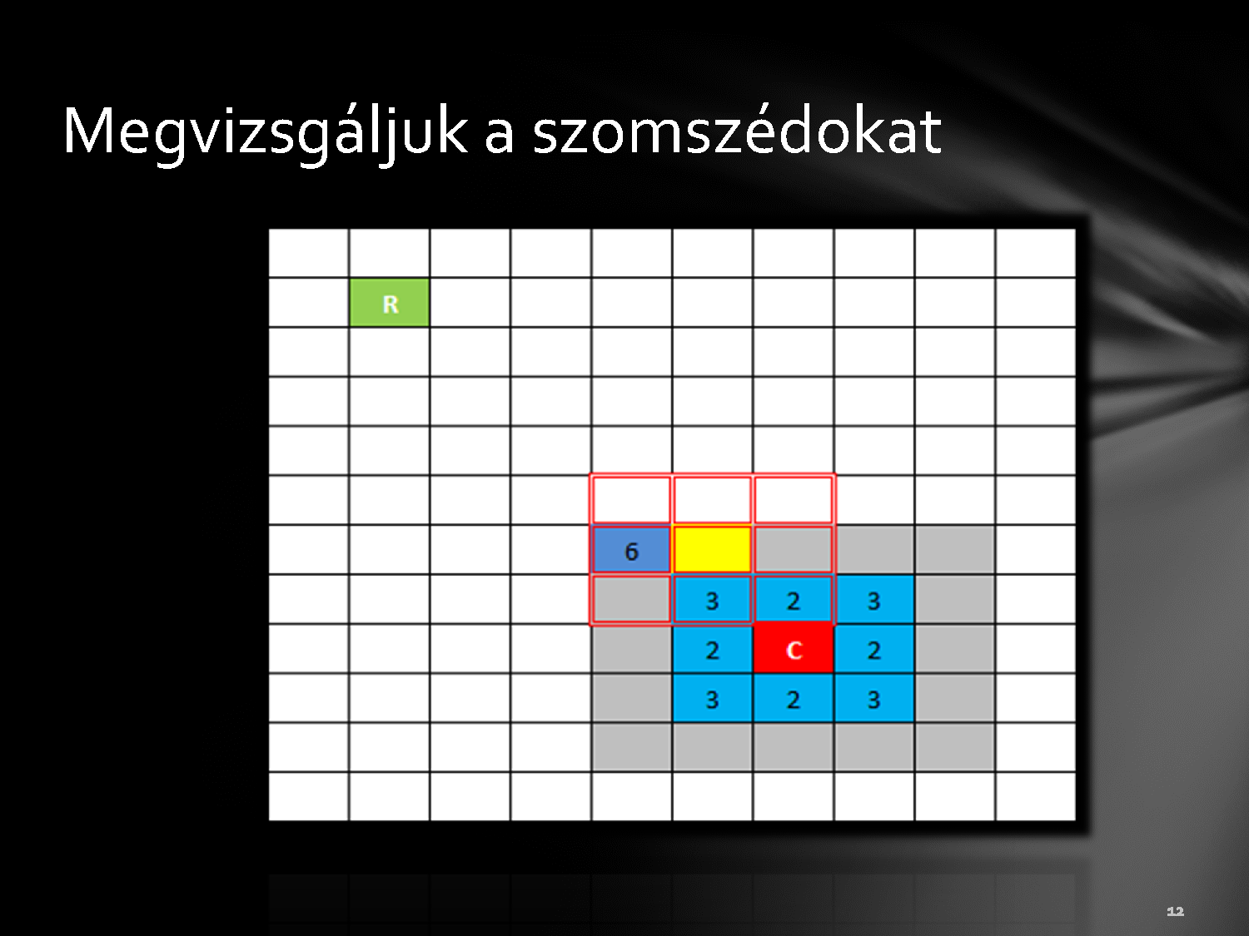
Examine the neighbours

Slide 10
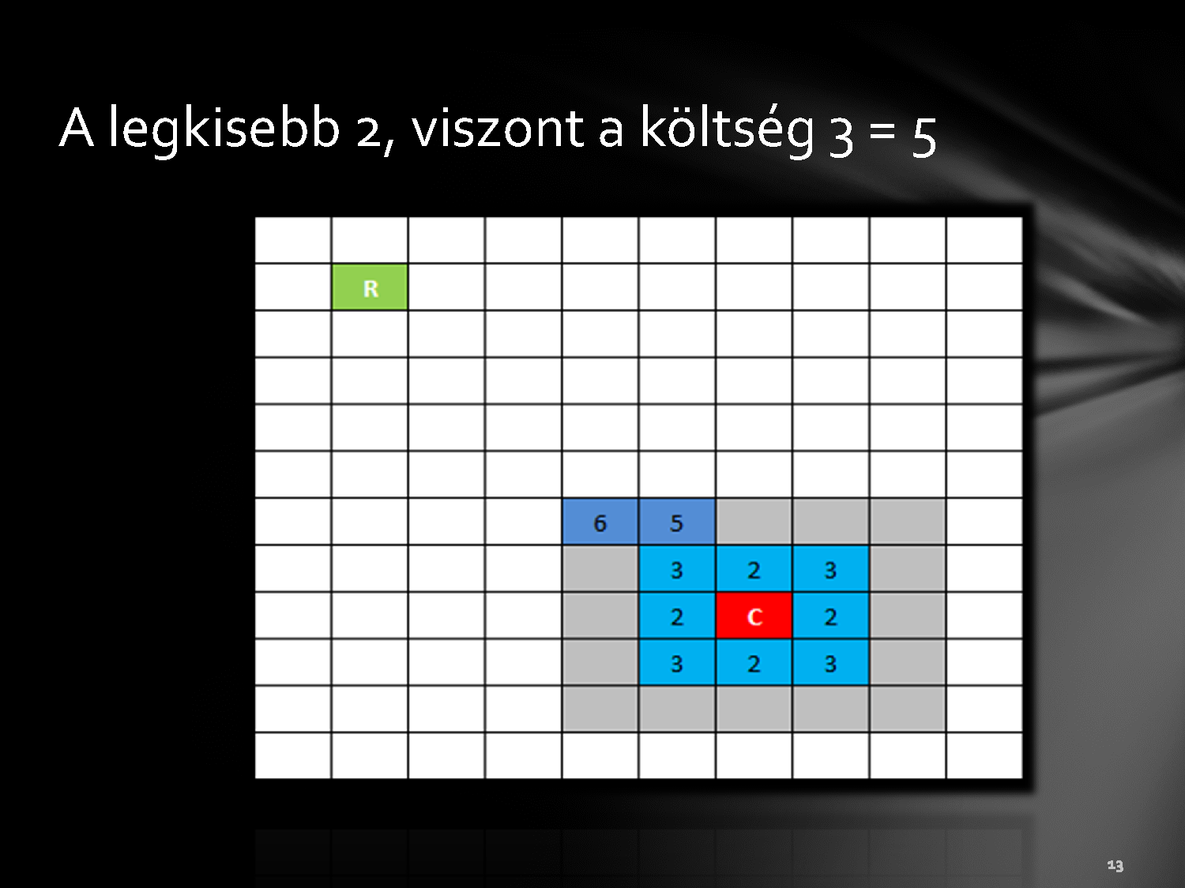
The smallest is two but the cost is three

Slide 11


Slide 12

Two is the smallest from the neighbours

Slide 13

The cost of the move is two so the next value is four

Slide 14
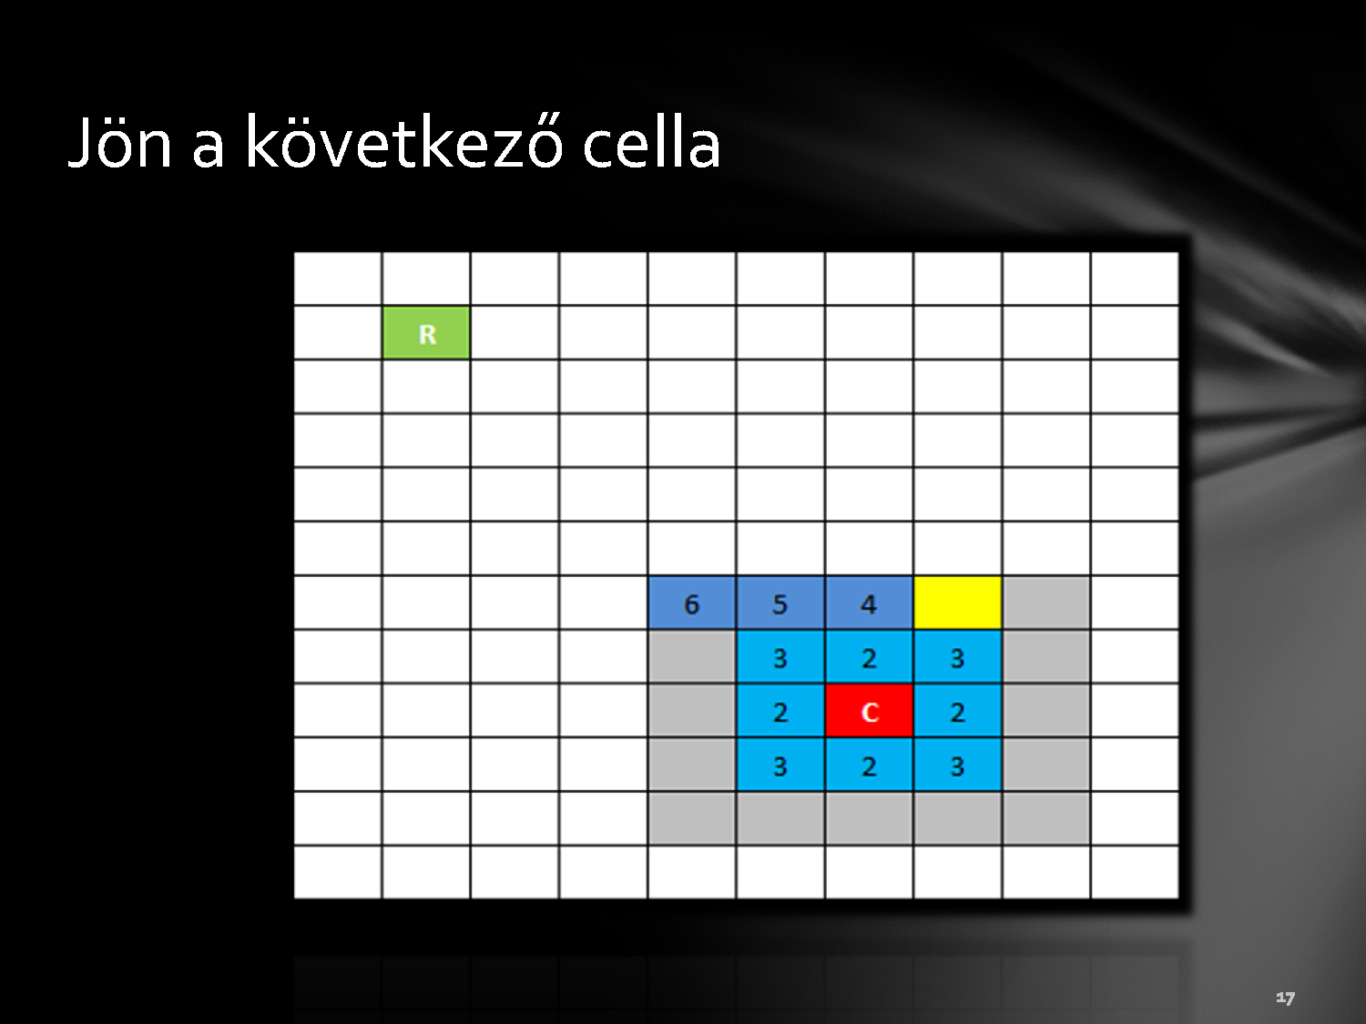

Slide 15


Slide 16

Smallest + cost

Slide 17
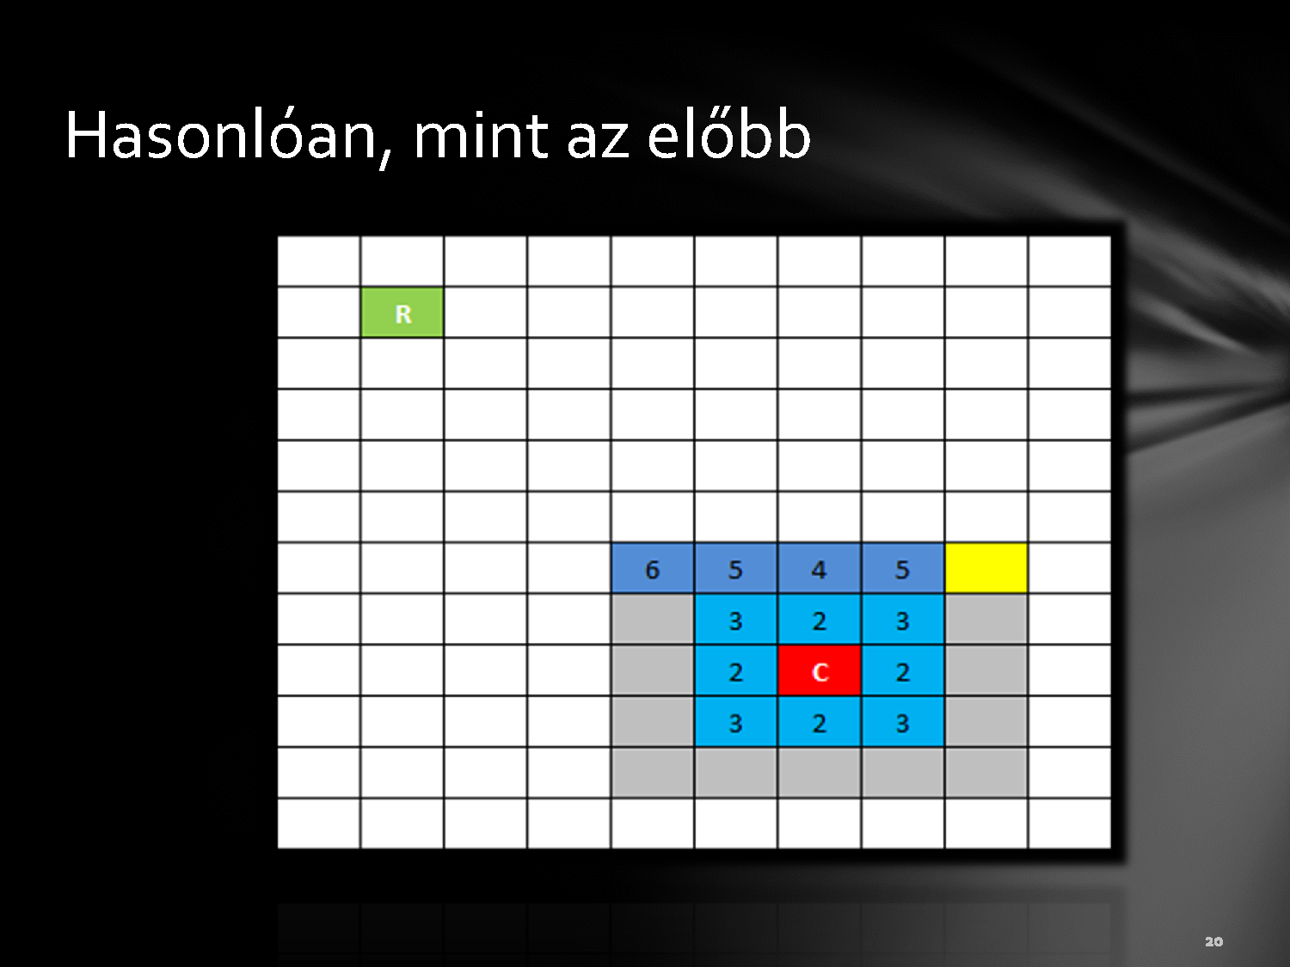

Slide 18
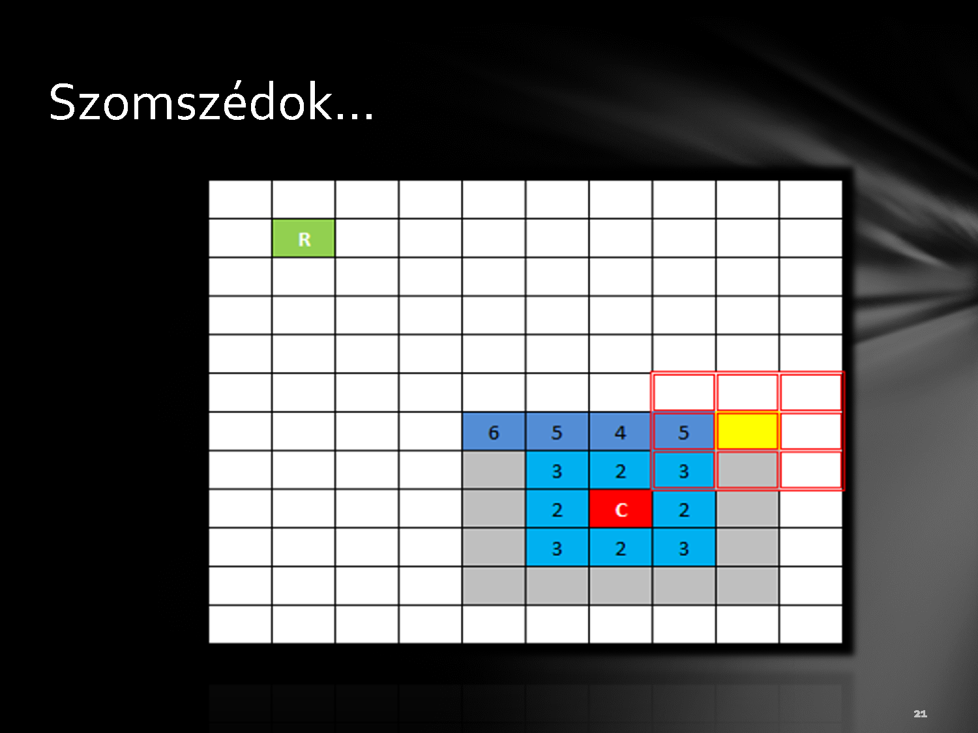

Slide 19
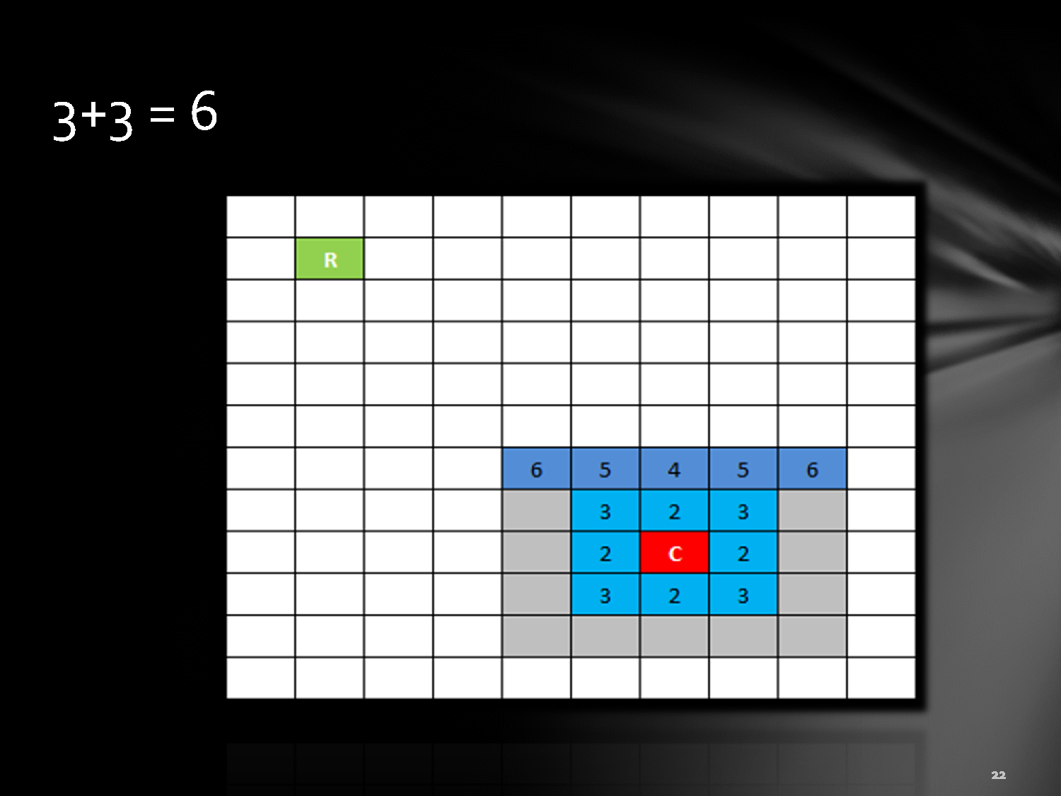
3+3=6

Slide 20
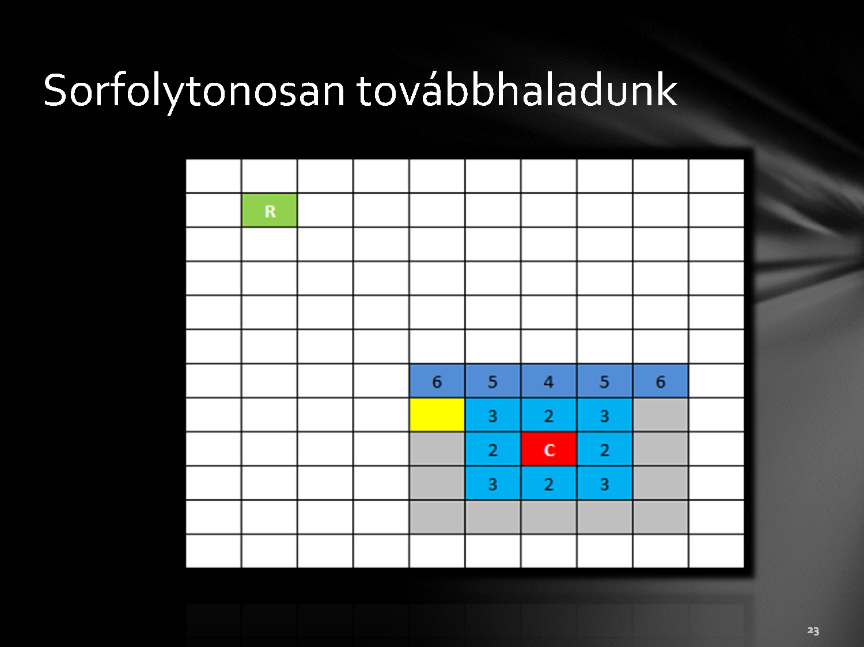
Next row

Slide 21
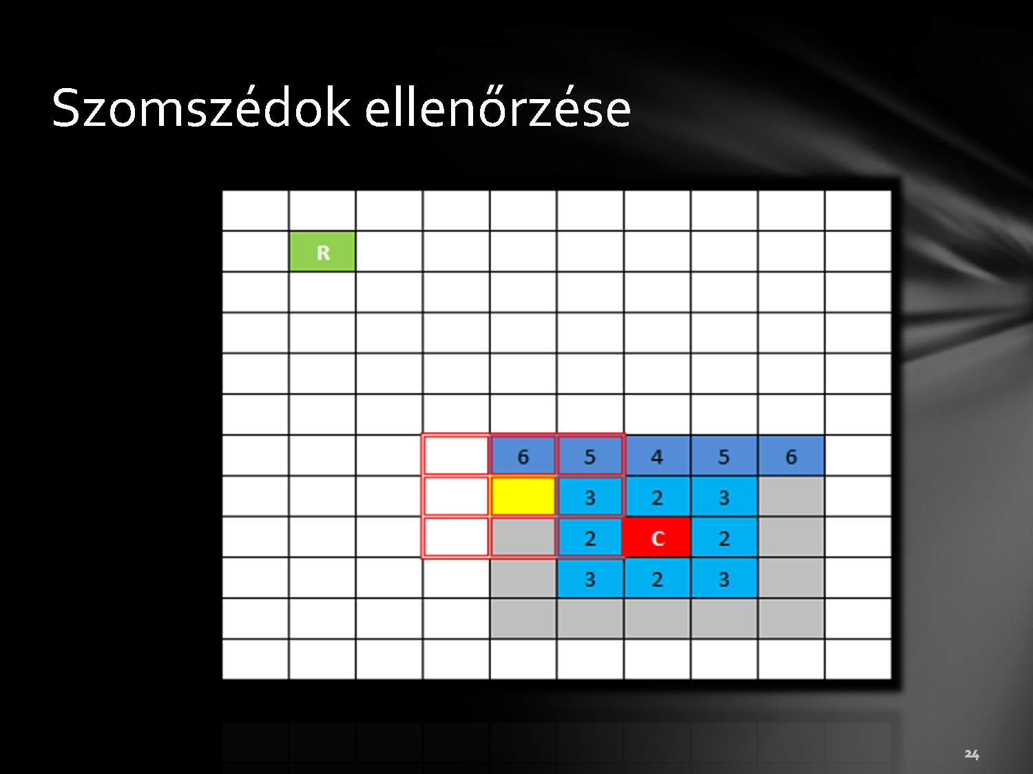
Examining the neighbours

Slide 22

2+3 = 5

Slide 23


Slide 24
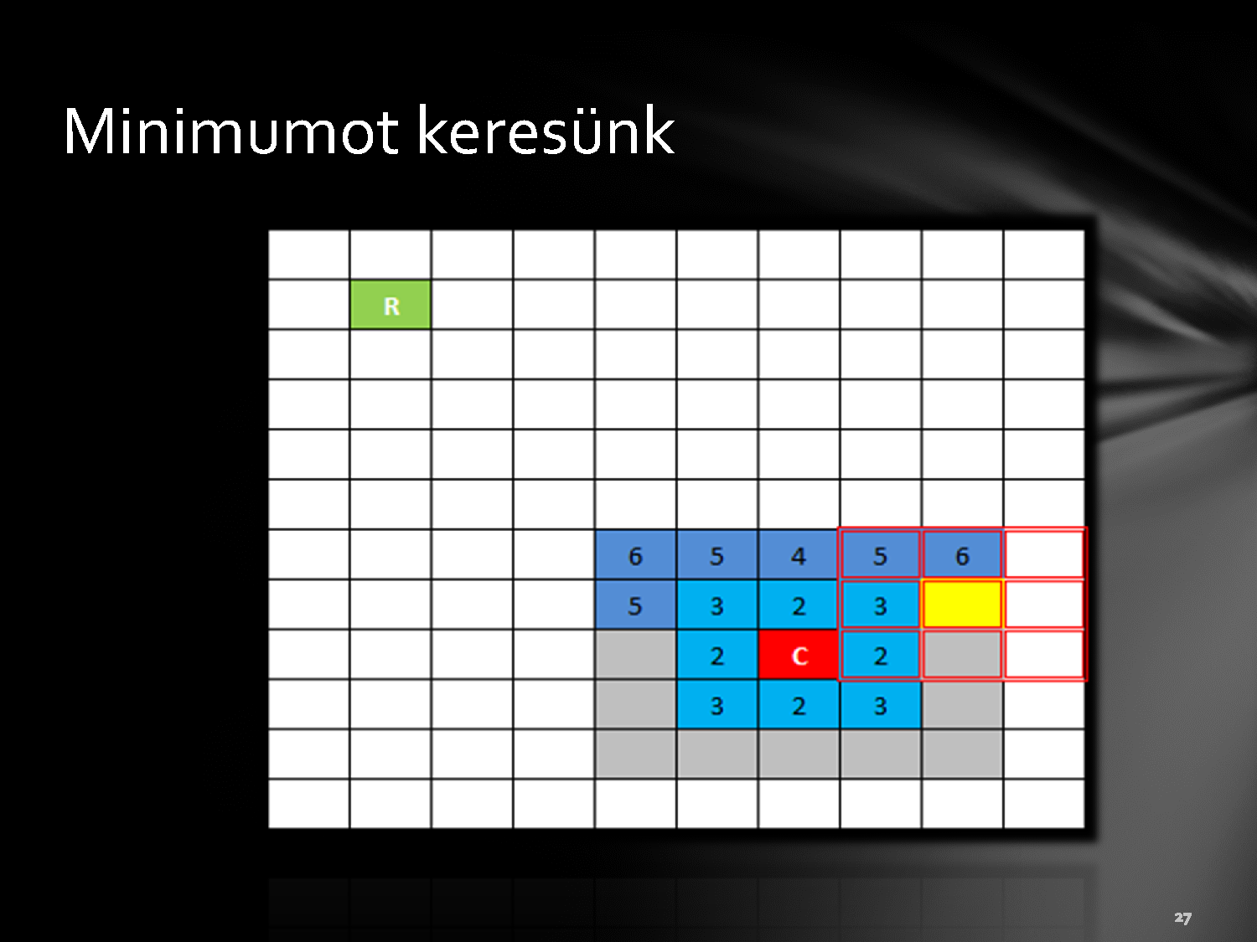
We are searching the minimum value

Slide 25
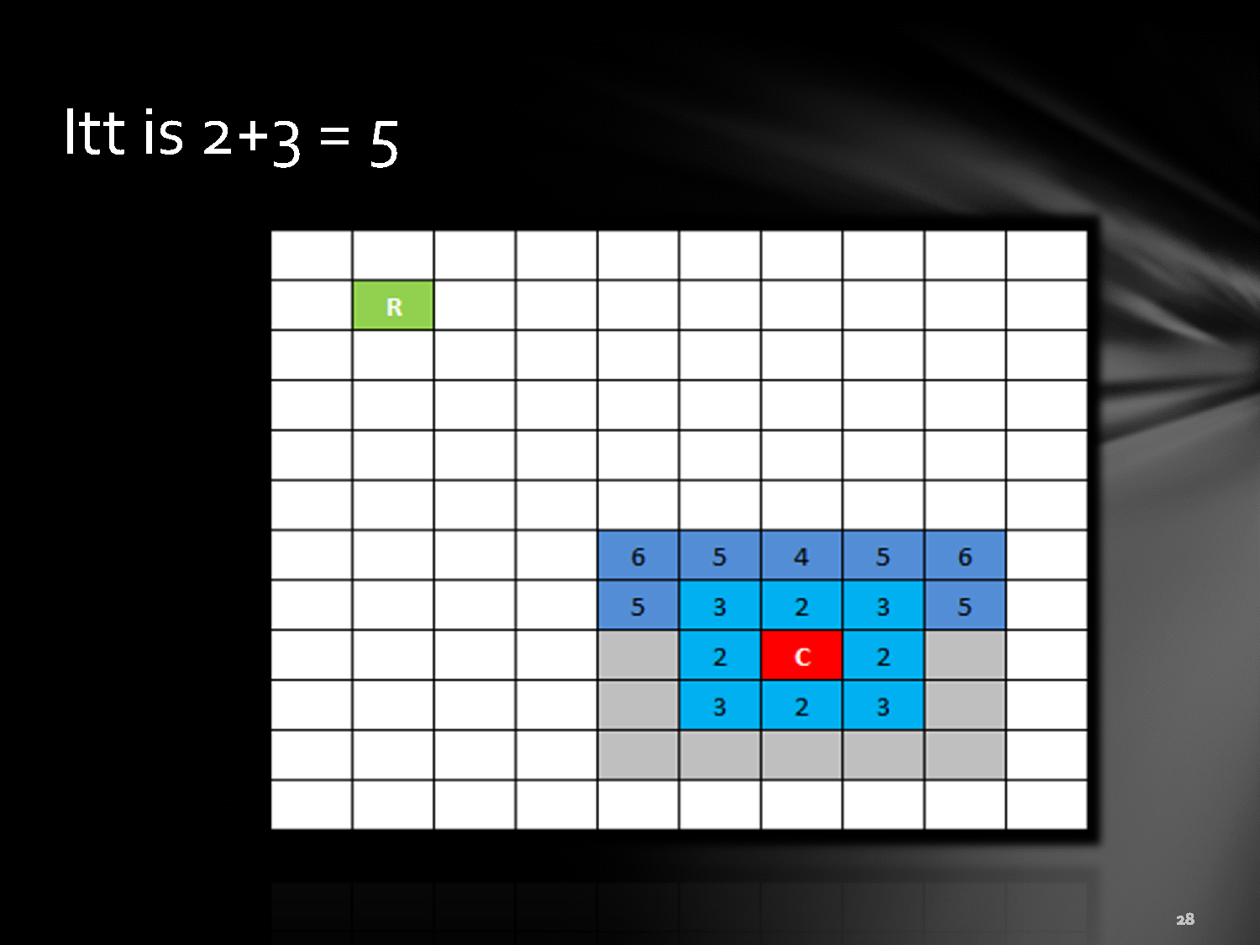
2+3 = 5

Slide 26
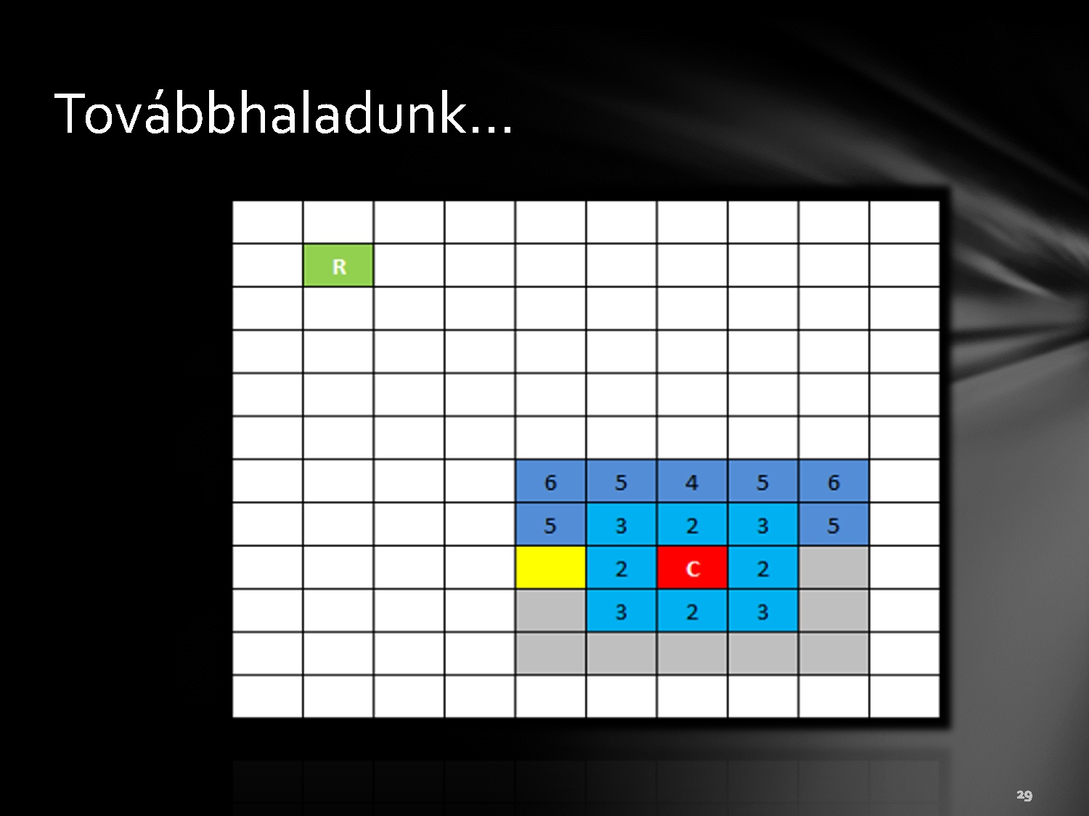

Slide 27
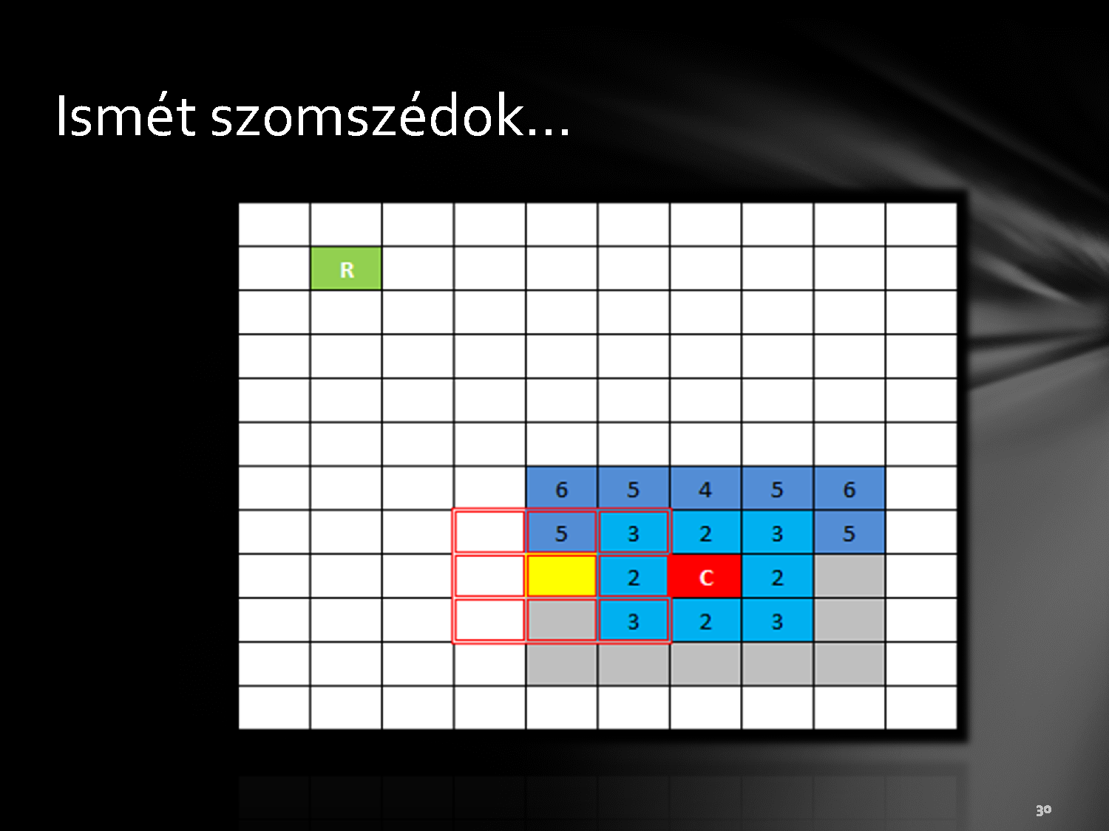

Slide 28
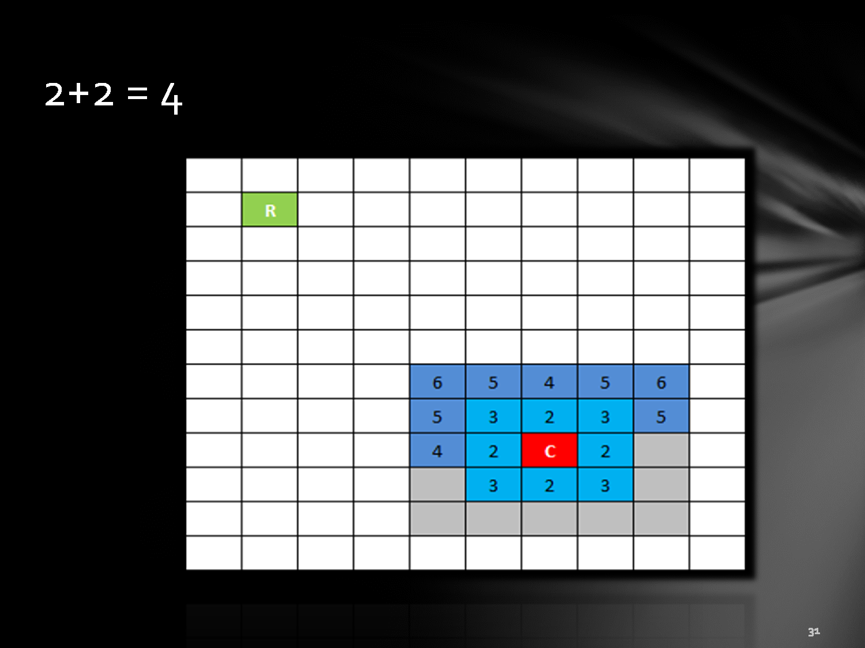
2+2 = 4

Slide 29
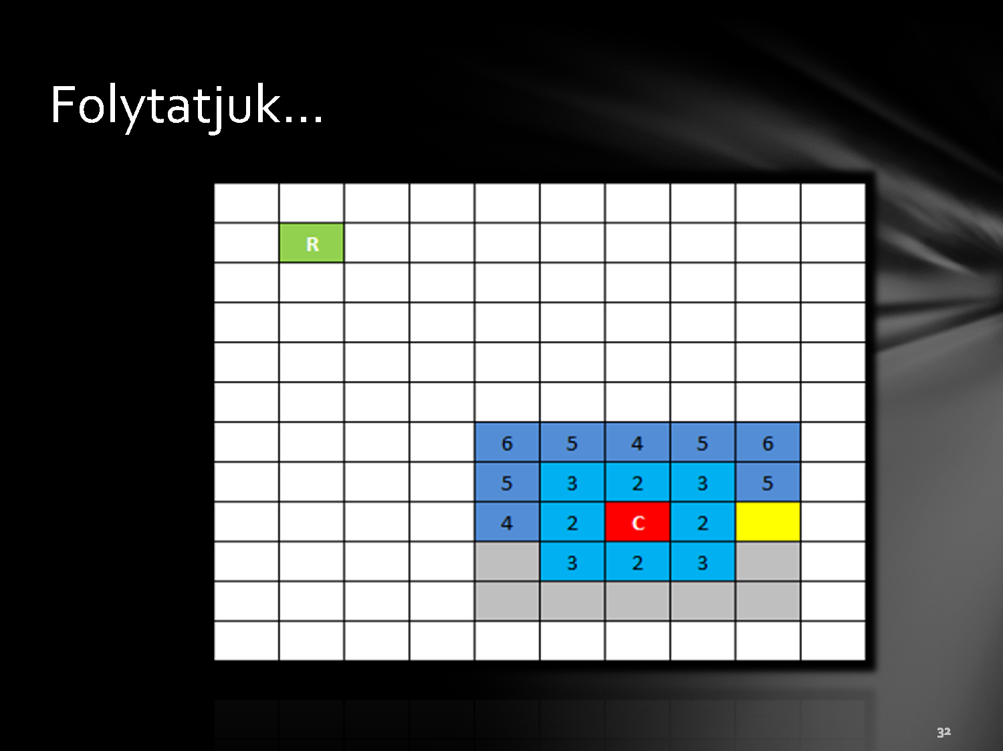

Slide 30
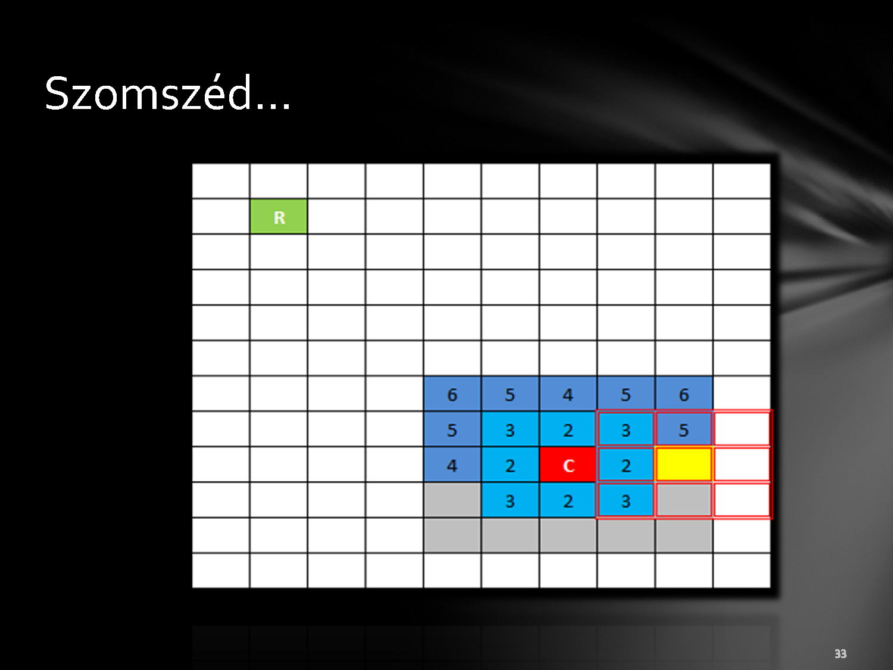

Slide 31
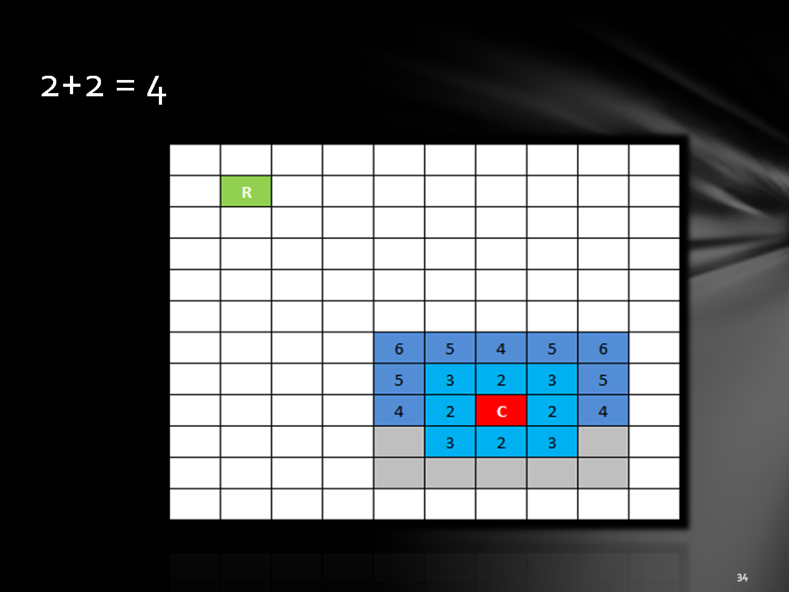
2+2 = 4

Slide 32
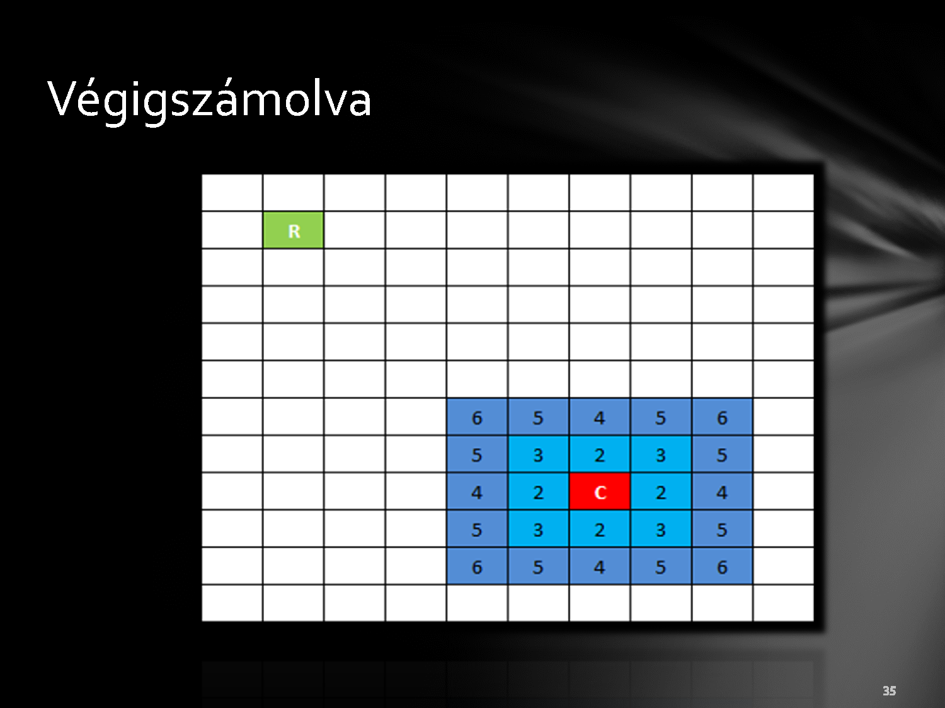

Slide 33
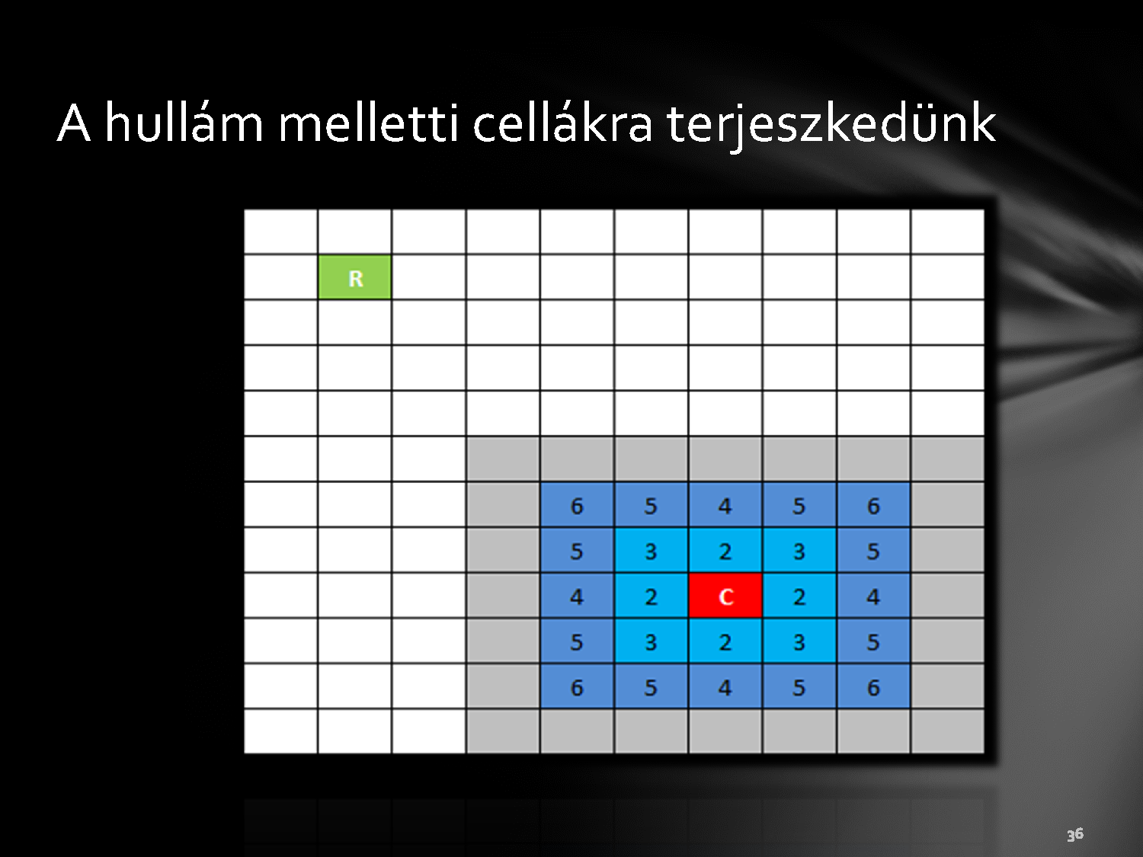
Propagates a new wave to the next cells

Slide 34

The first empty cell next to the wave

Slide 35
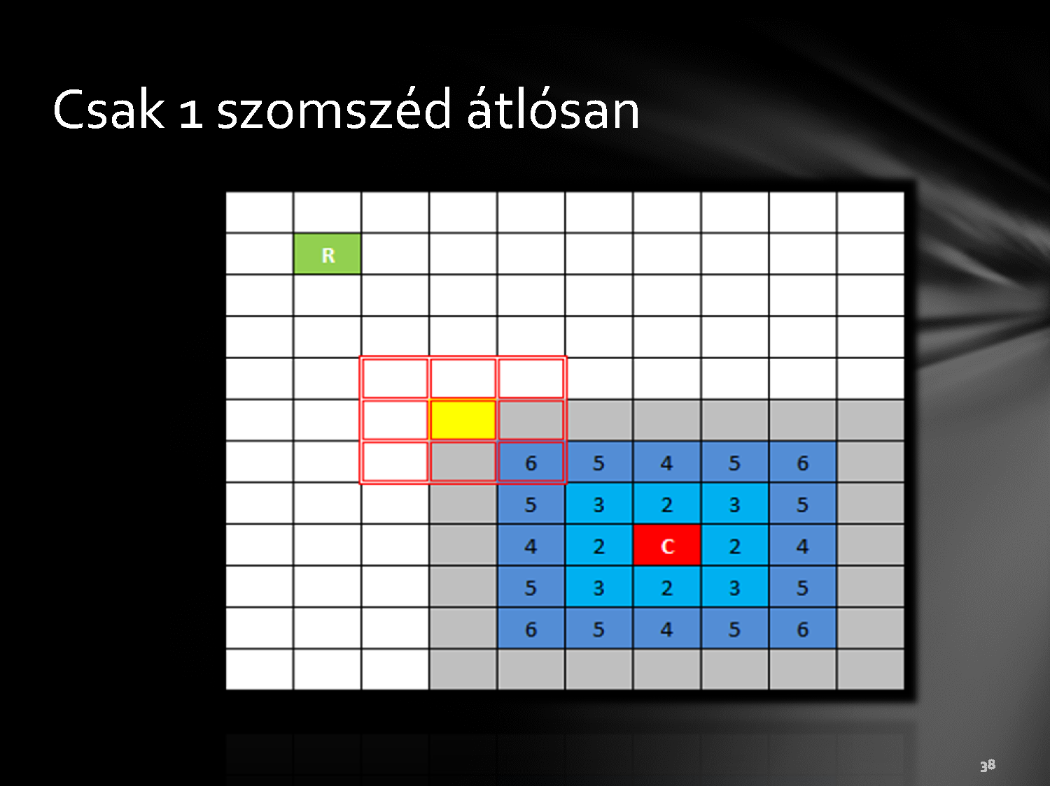
Only one neighbor diagonally

Slide 36
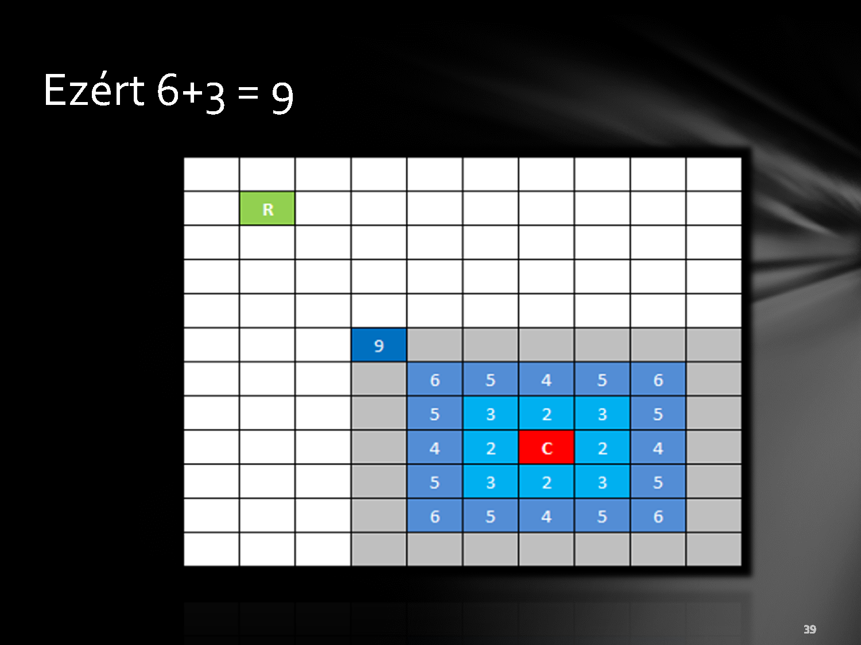
Therefore 6+3 = 9

Slide 37


Slide 38

5+3 = 8

Slide 39
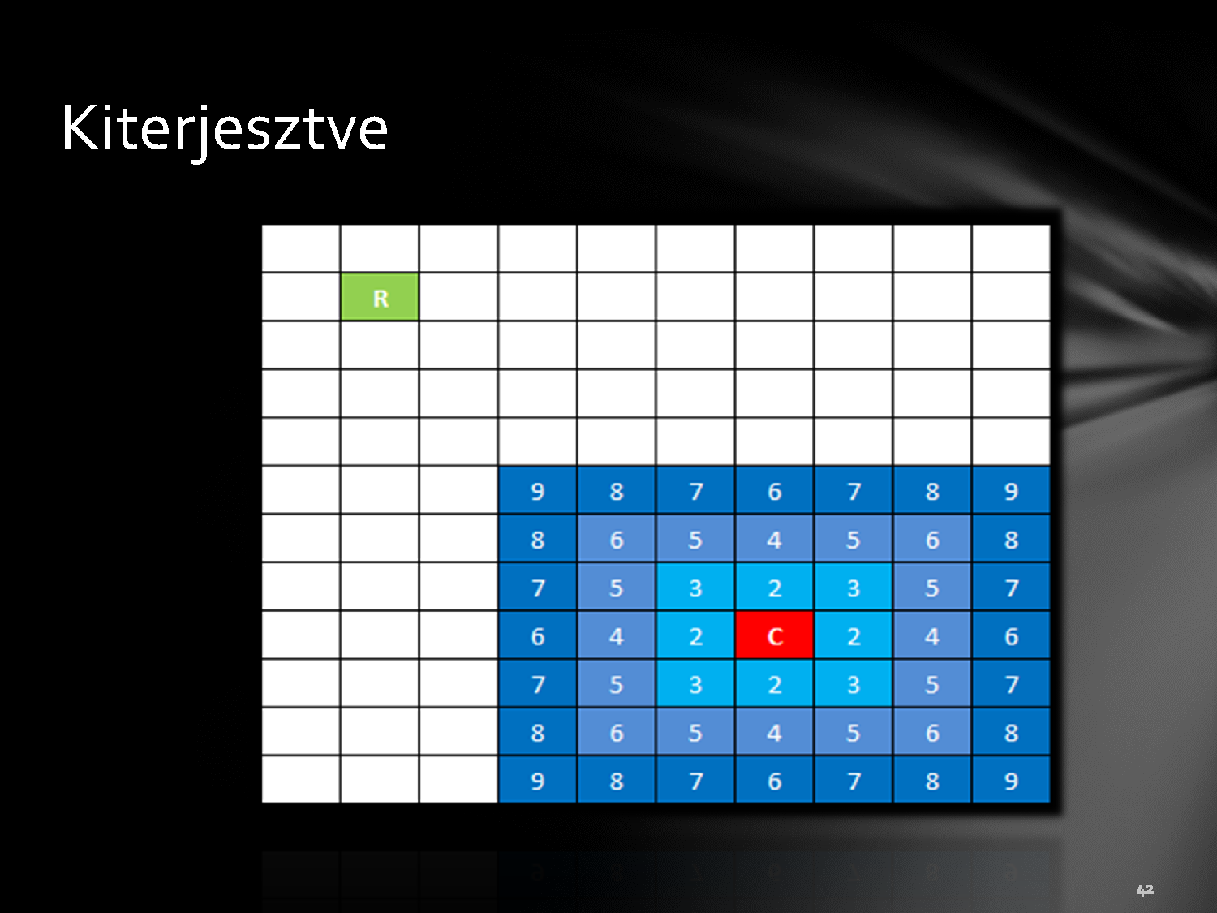
Full wave

Slide 40

New wave

Slide 41
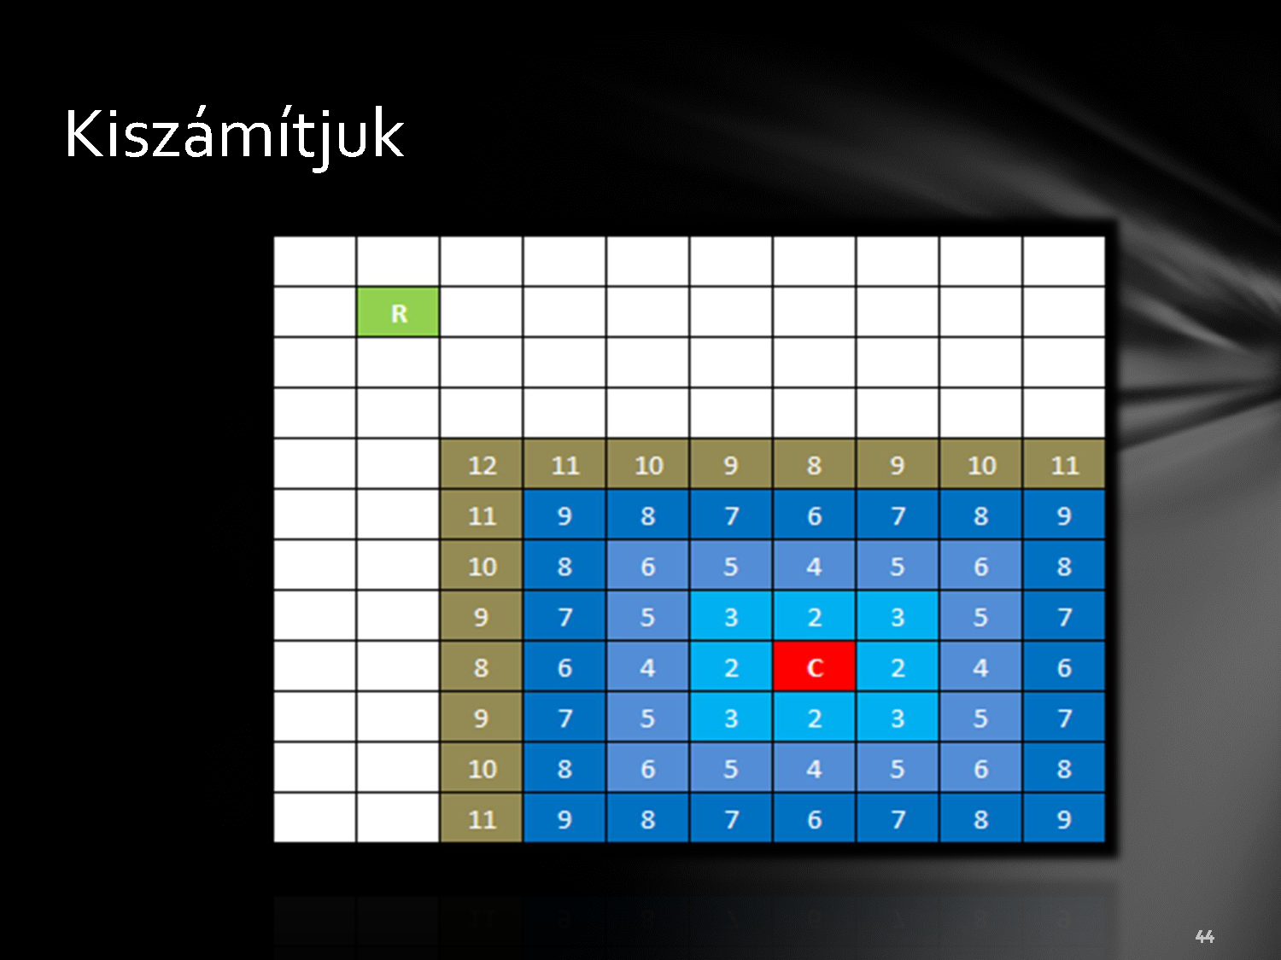

Slide 42
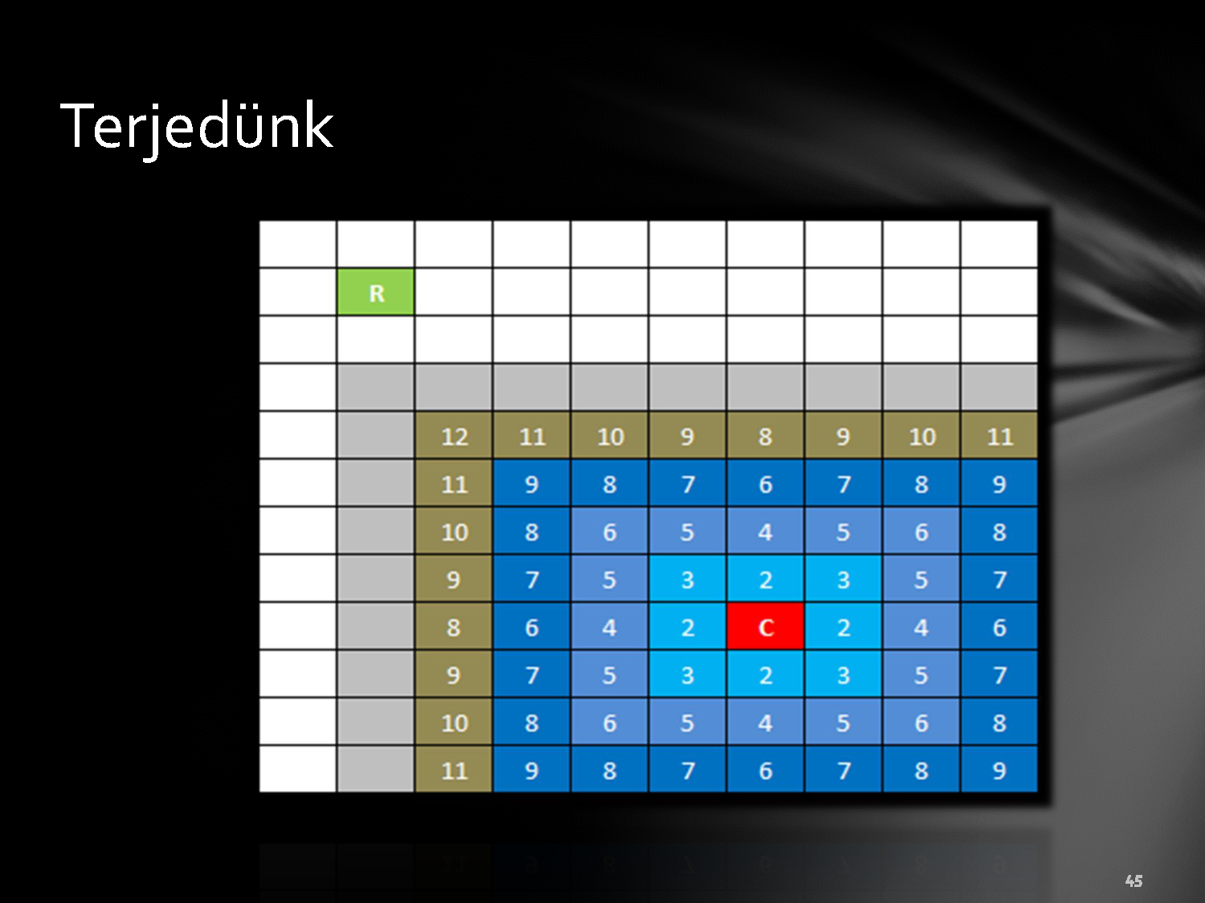

Slide 43
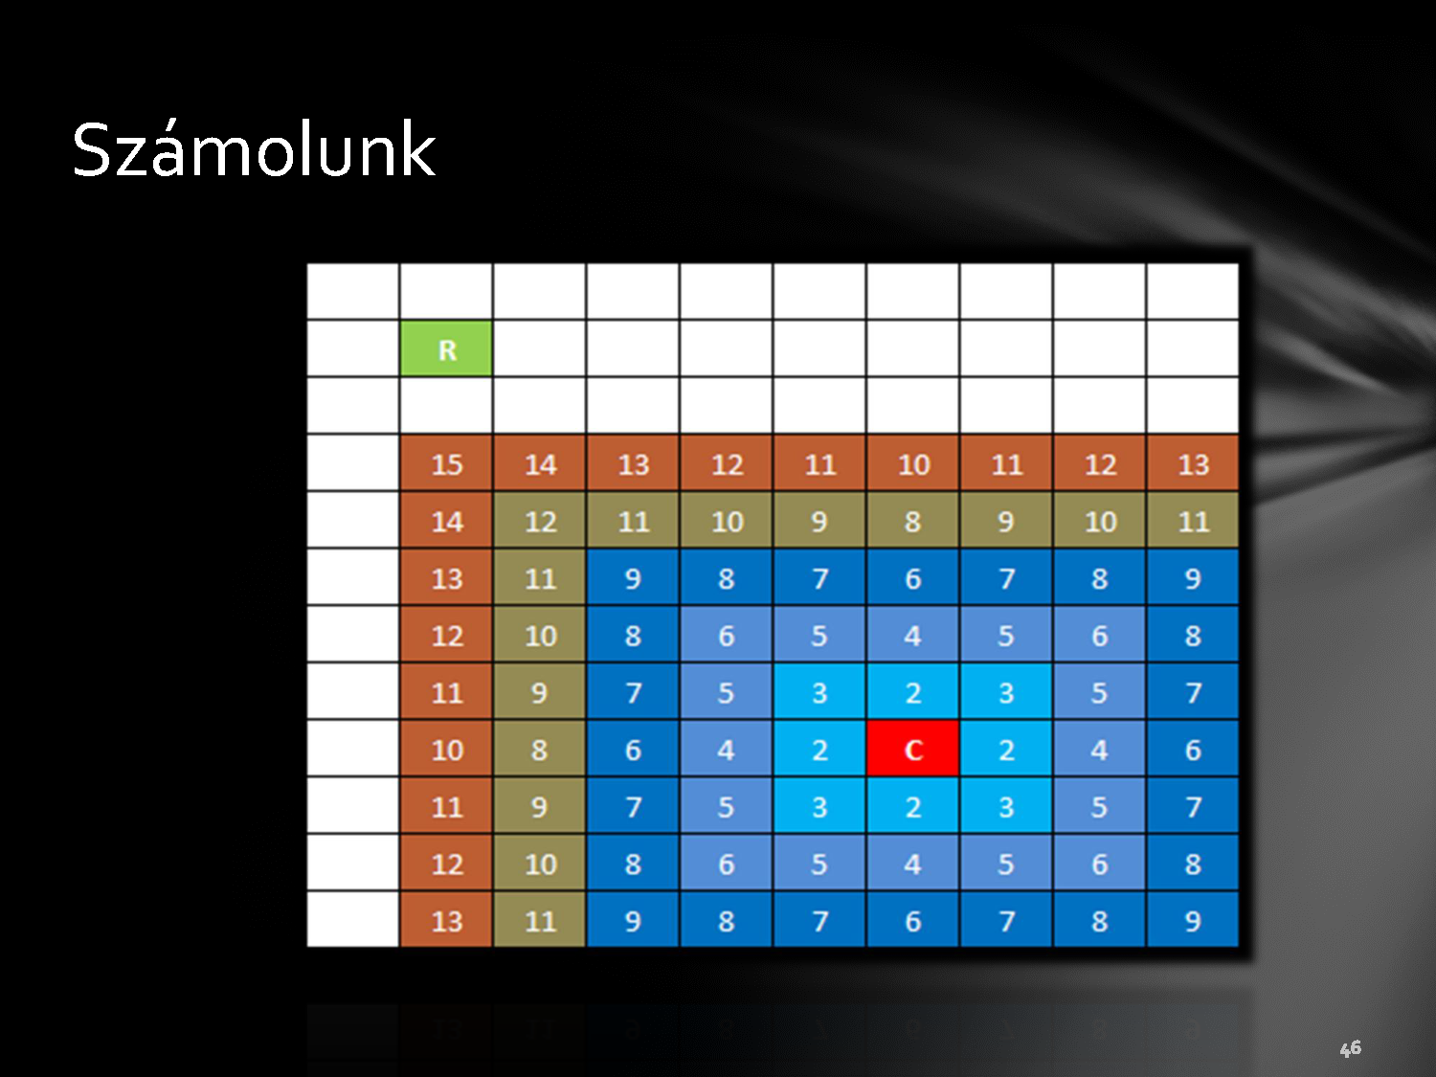

Slide 44
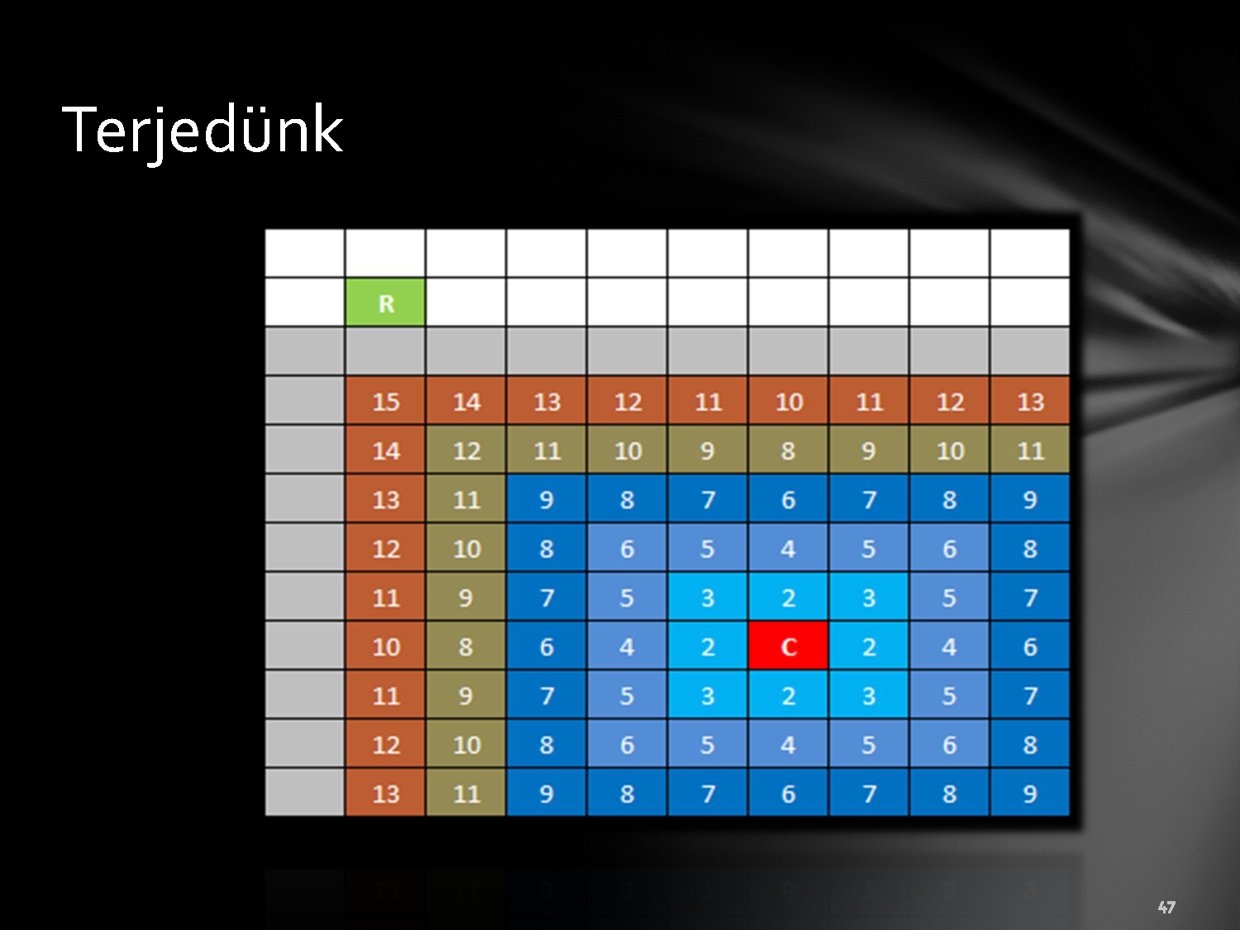

Slide 45
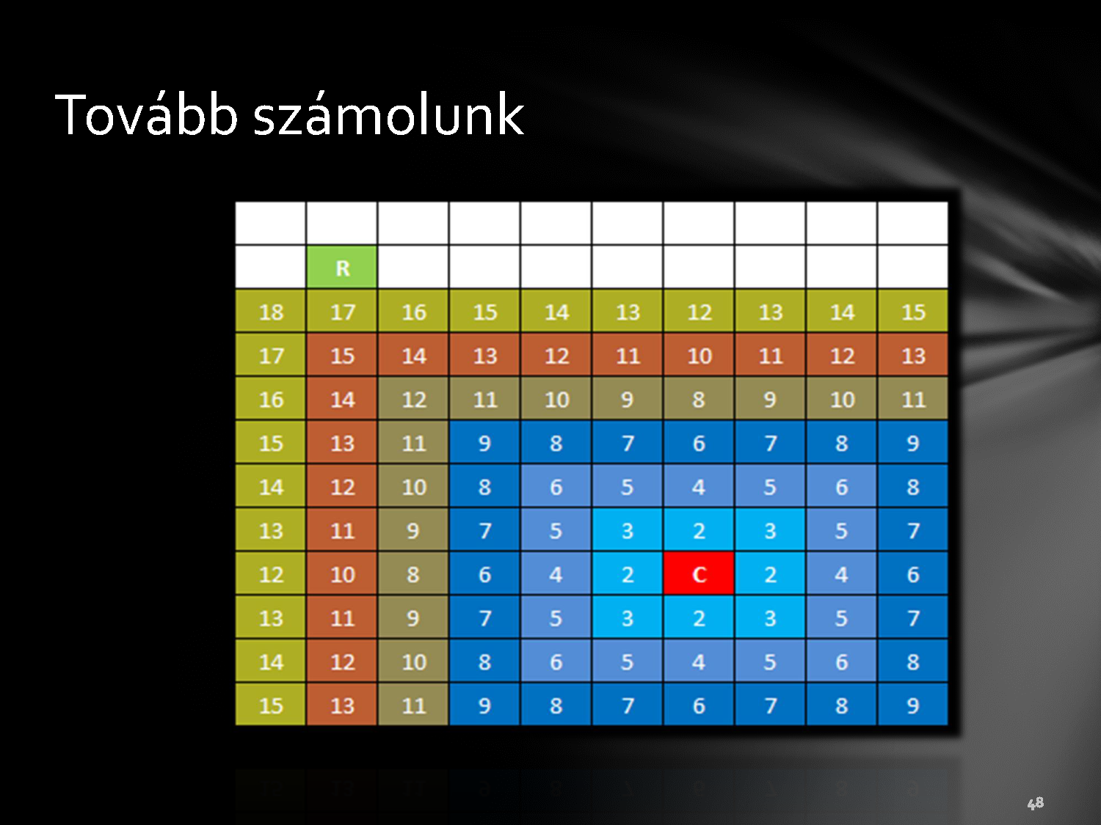

Slide 46

The wave reaches the robot

Slide 47
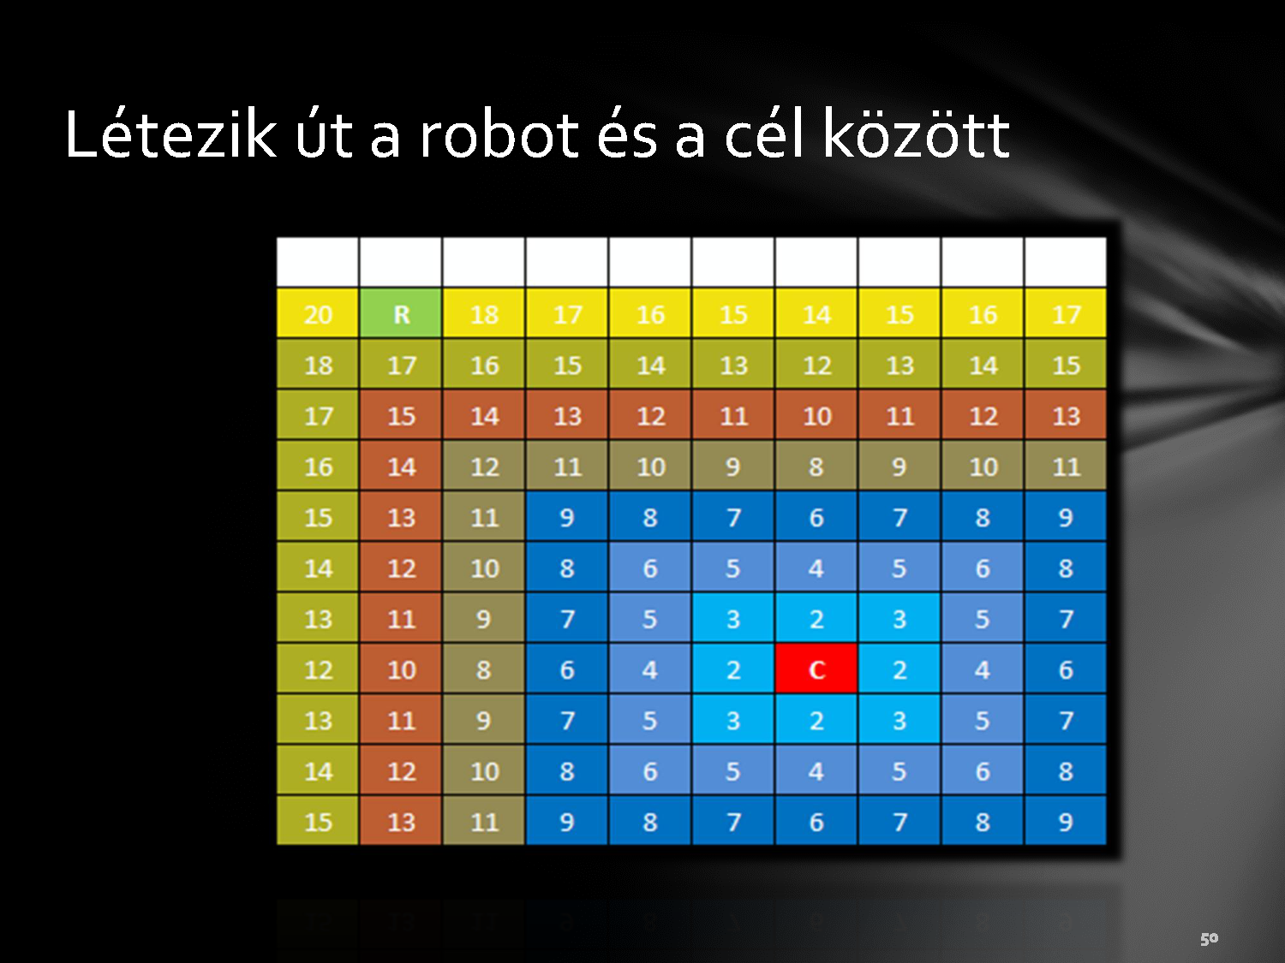
There exists a path between the starting point and the destination

Slide 48

The robot examines the neighbors

Slide 49

Steps to the lowest one

Slide 50
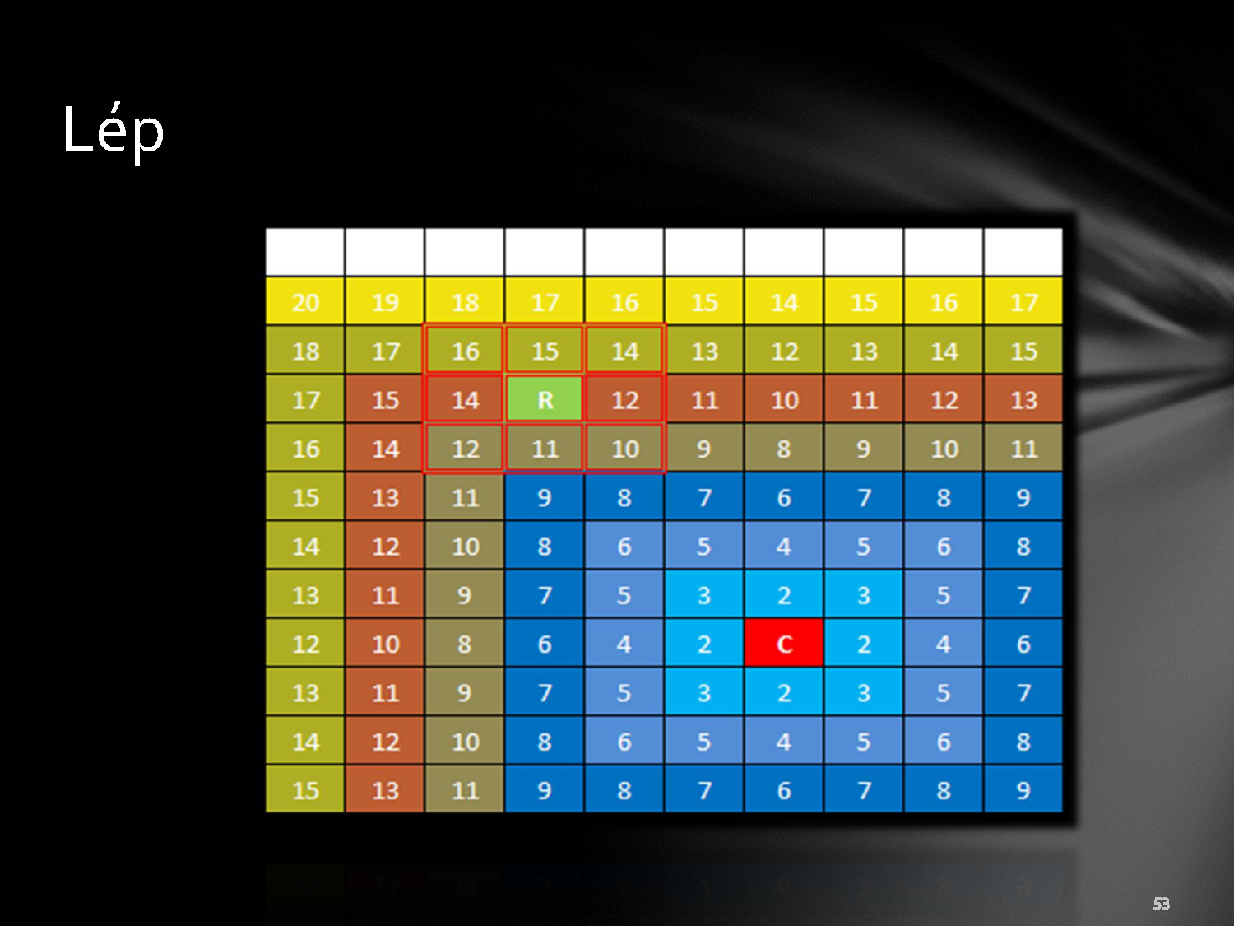

Slide 51


Slide 52


Slide 53


Slide 54

The destination is in its ambient

Slide 55

Reached it

Slide 56
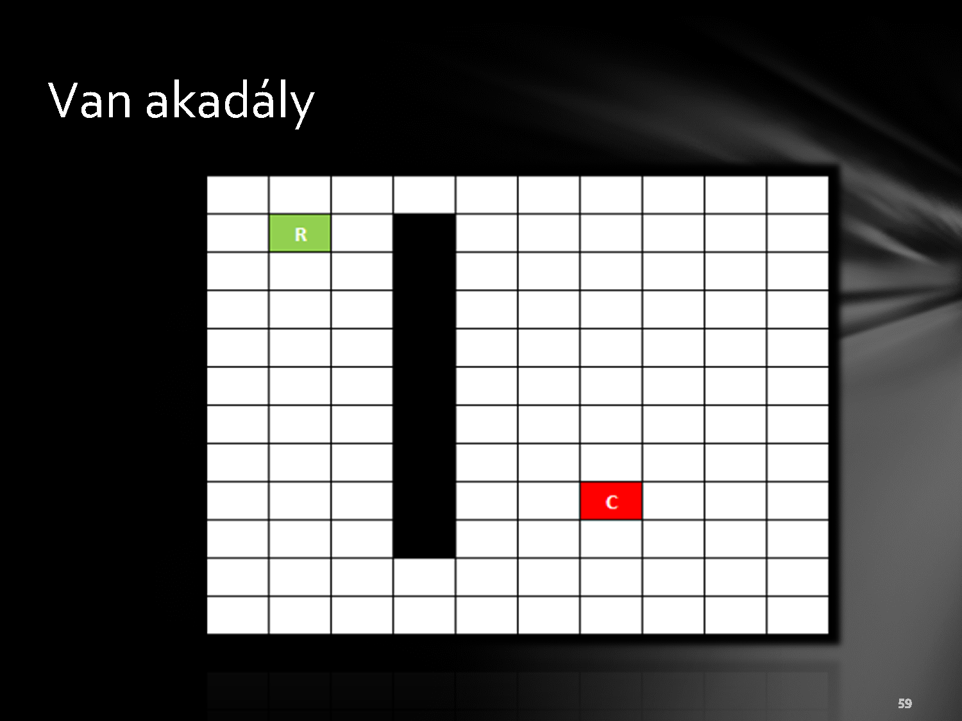
With obstacle

Slide 57
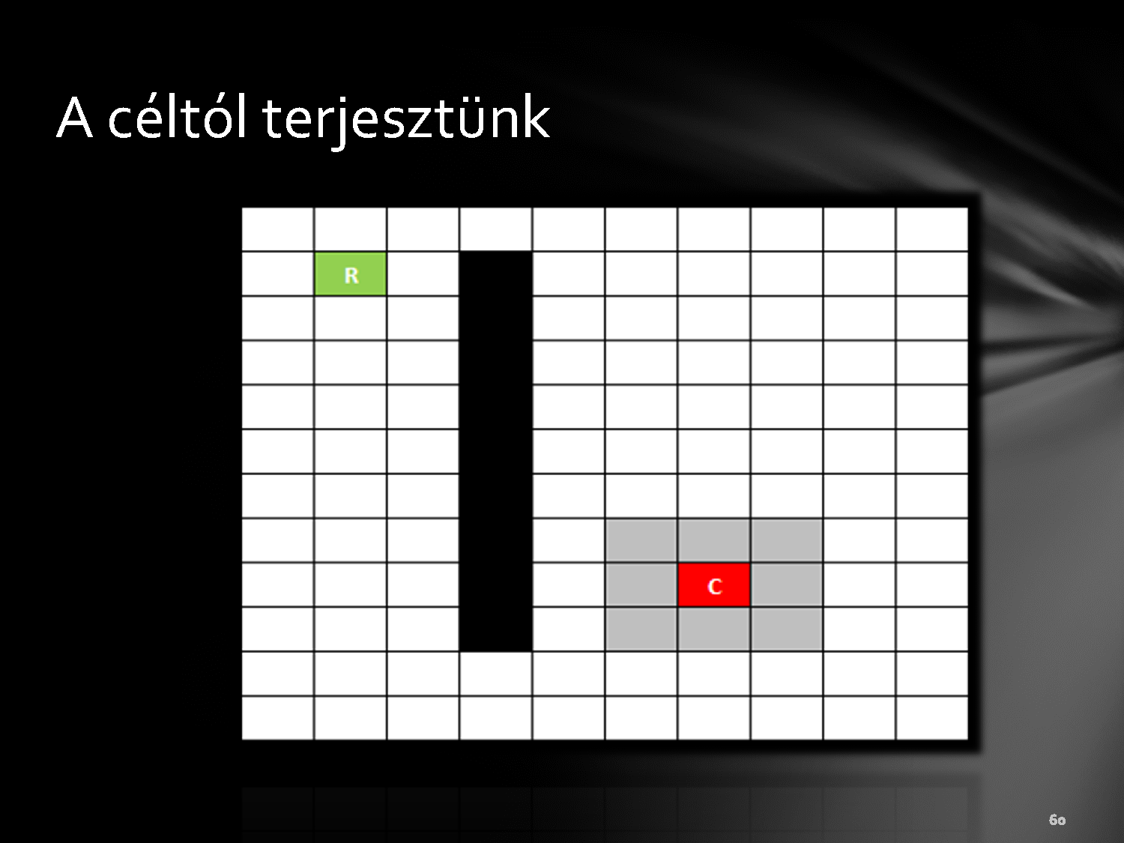
The propagation starts from the destination

Slide 58
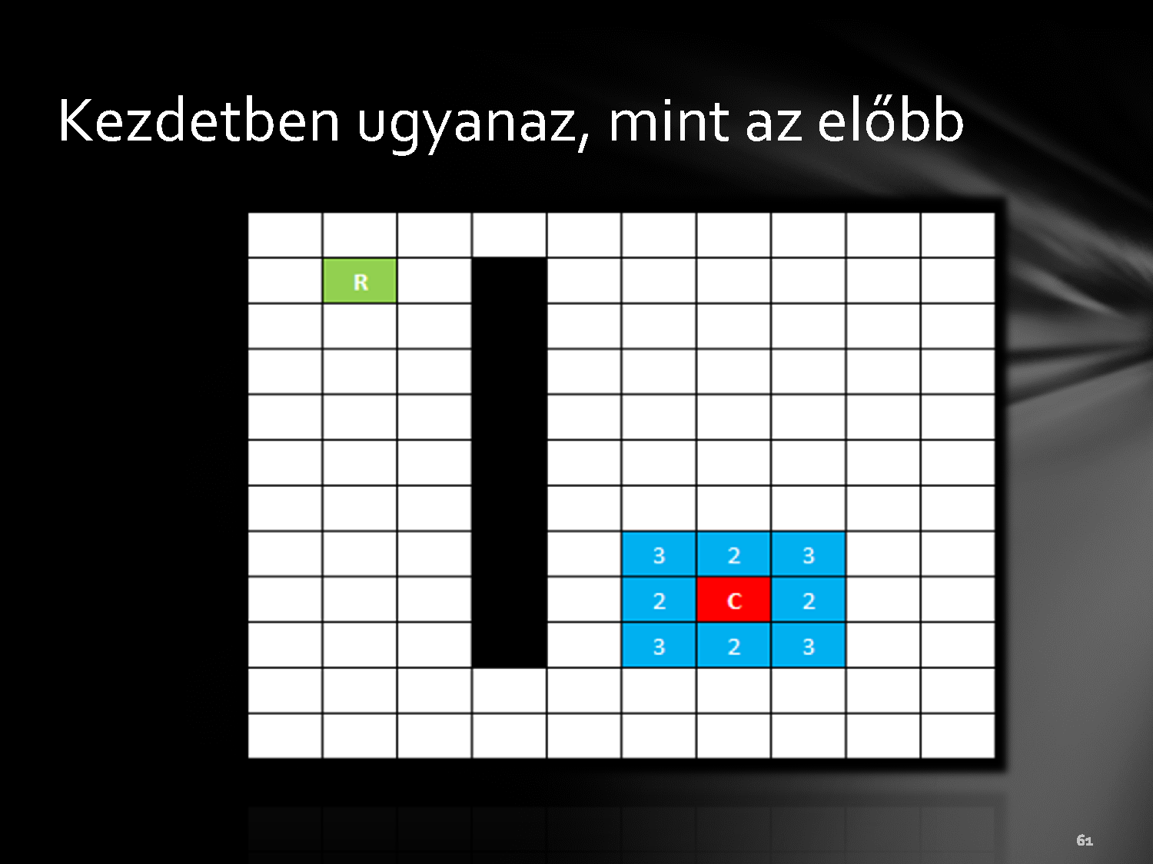
Same method like without obstacles

Slide 59
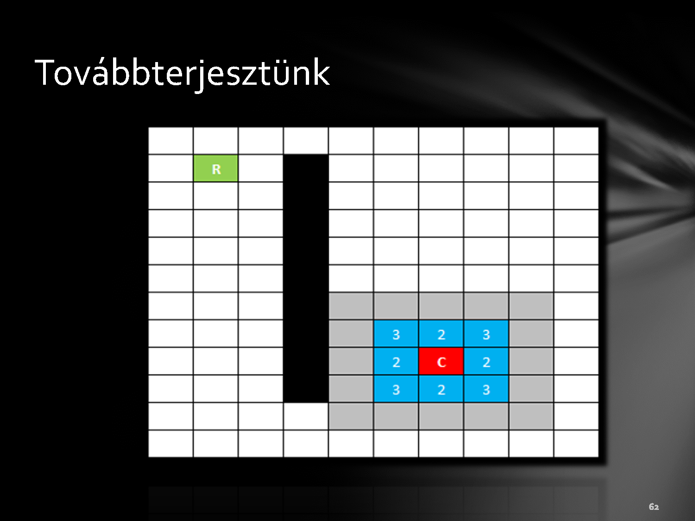

Slide 60
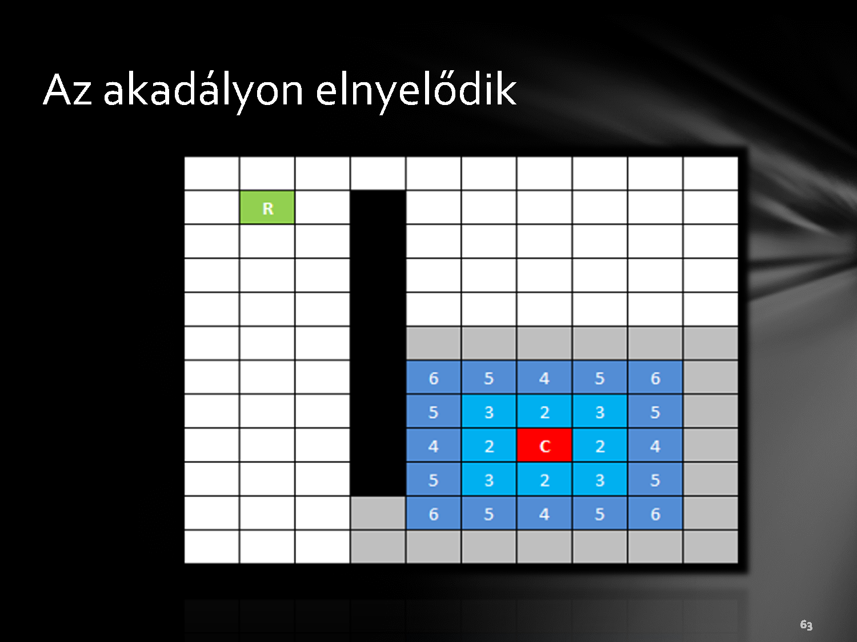

Slide 61
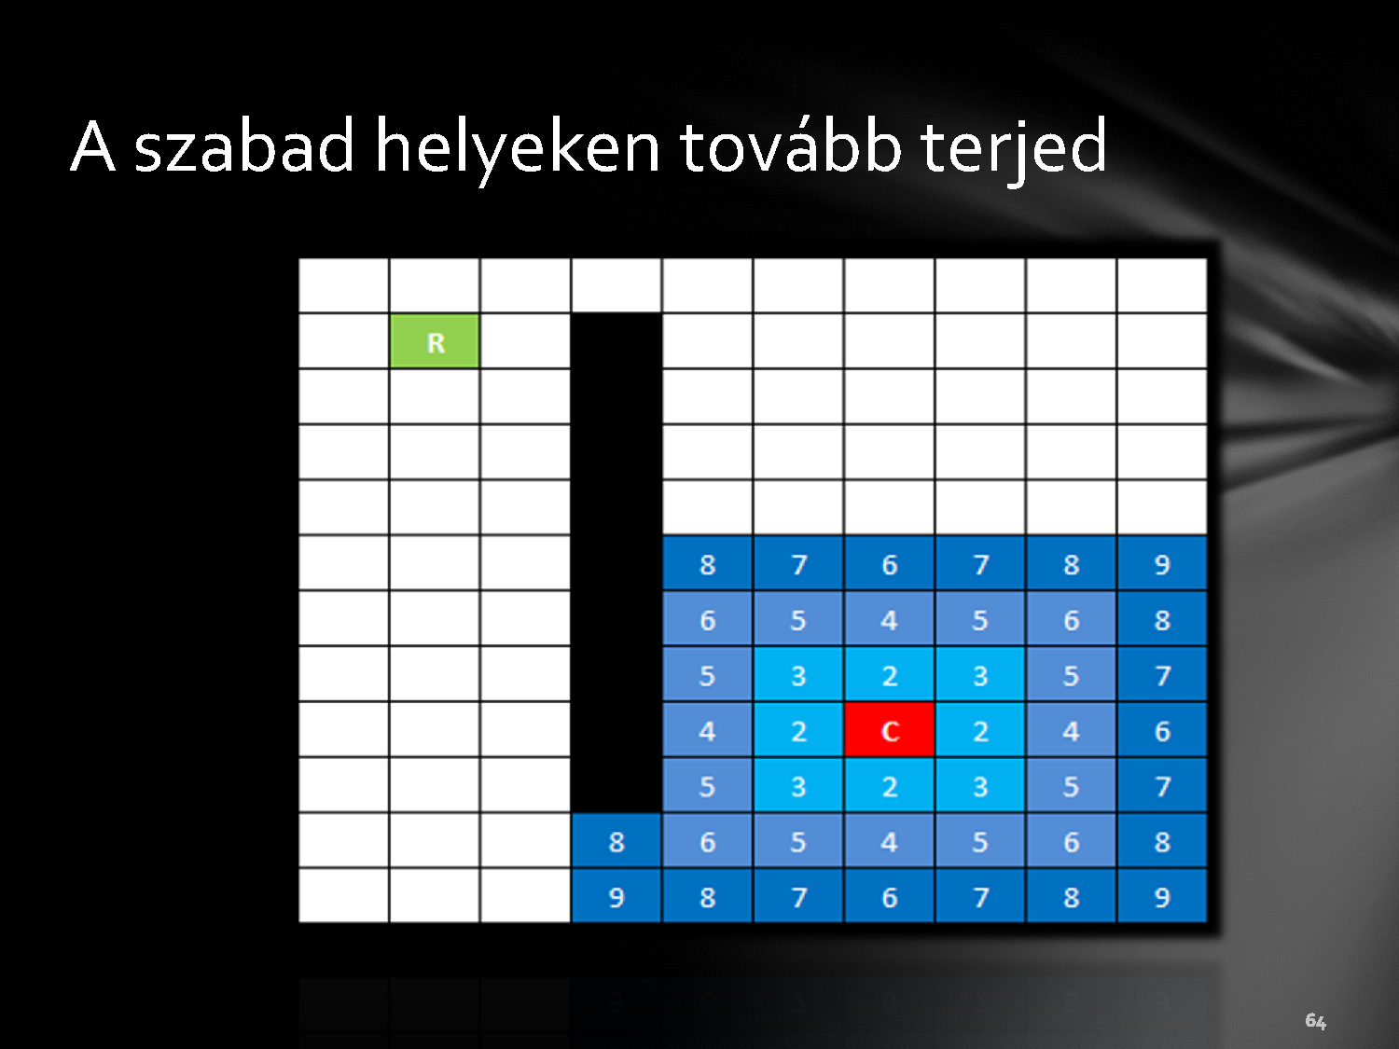

Slide 62
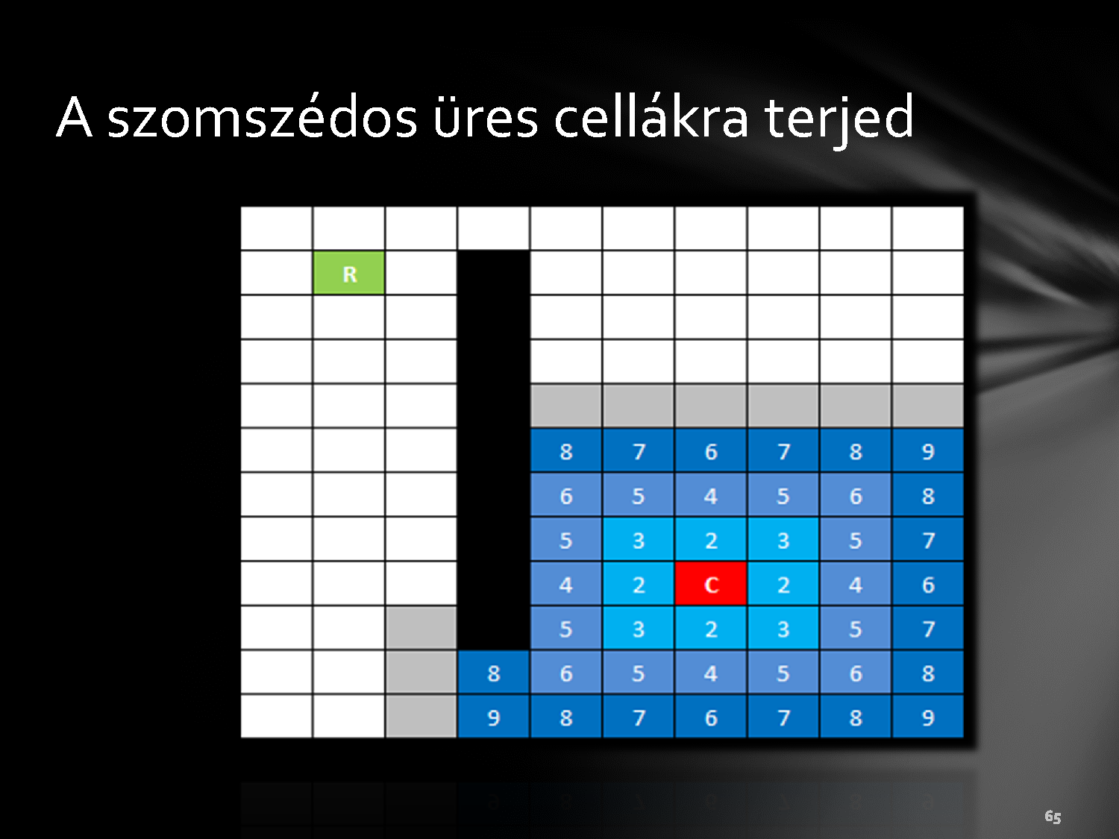

Slide 63
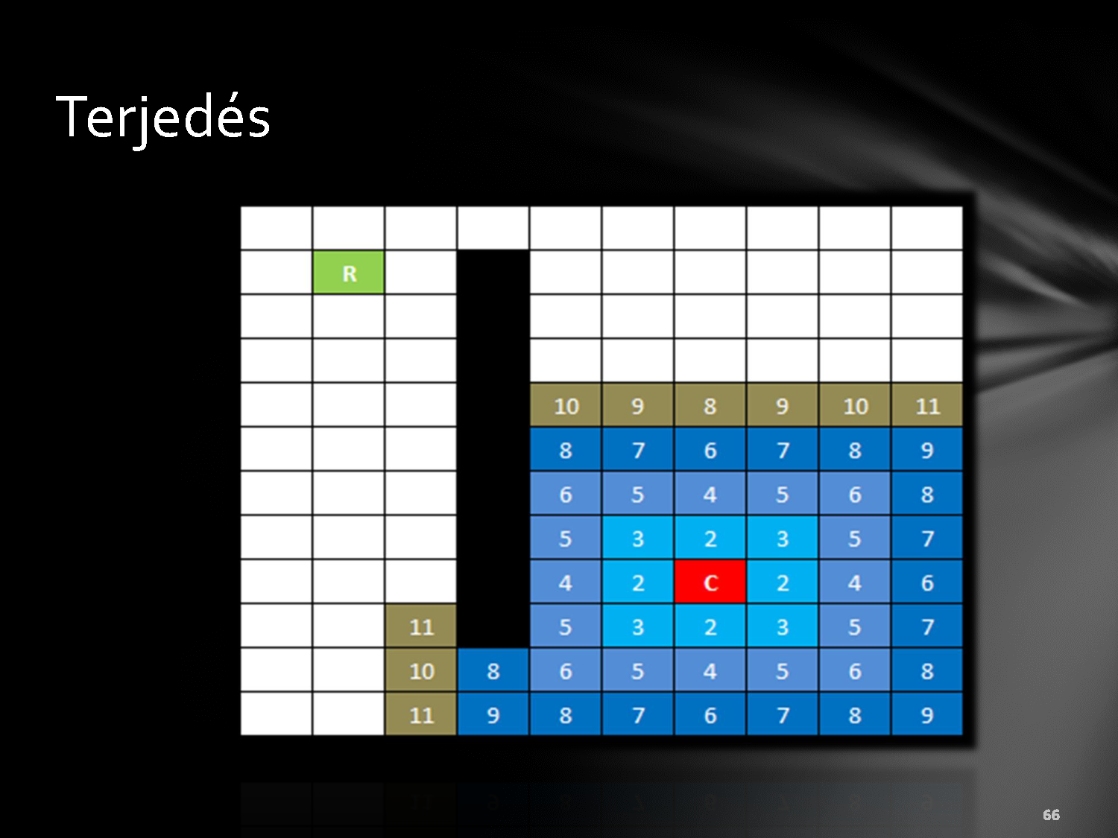

Slide 64
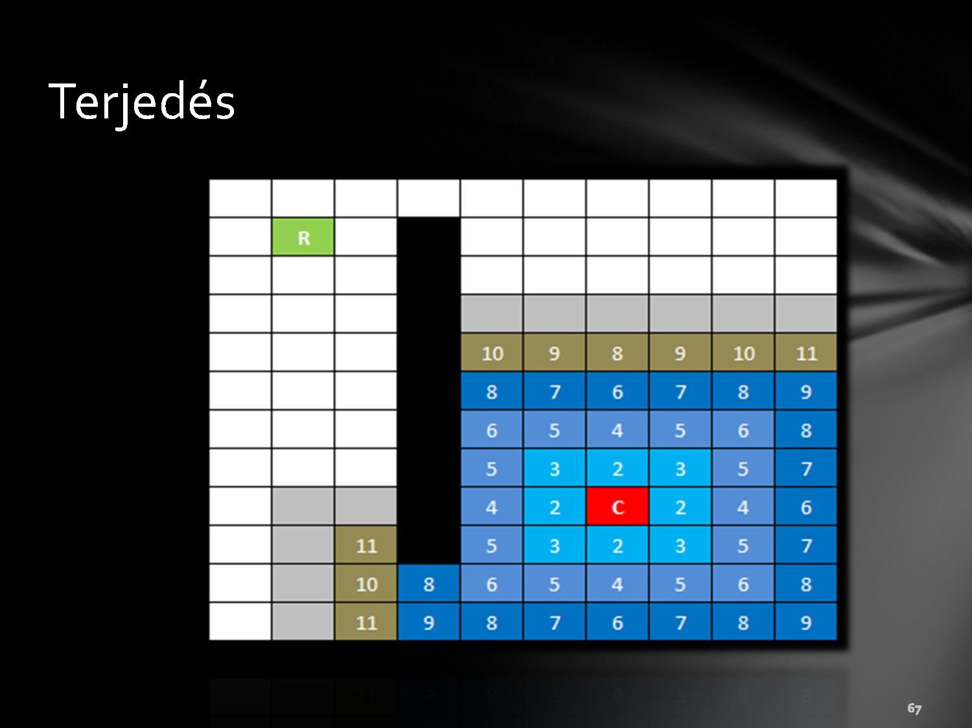

Slide 65
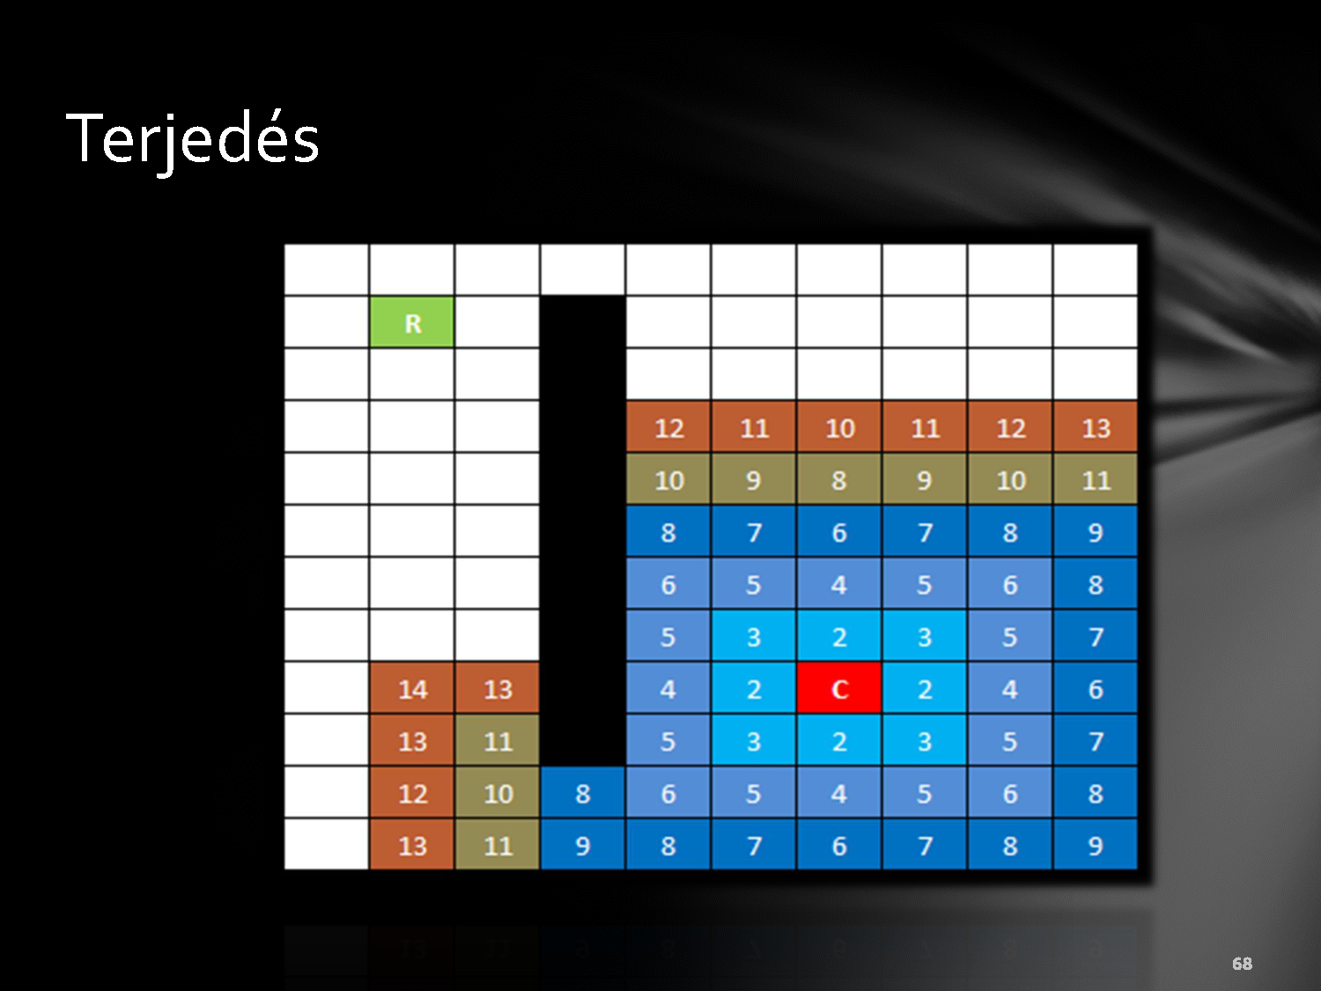

Slide 66
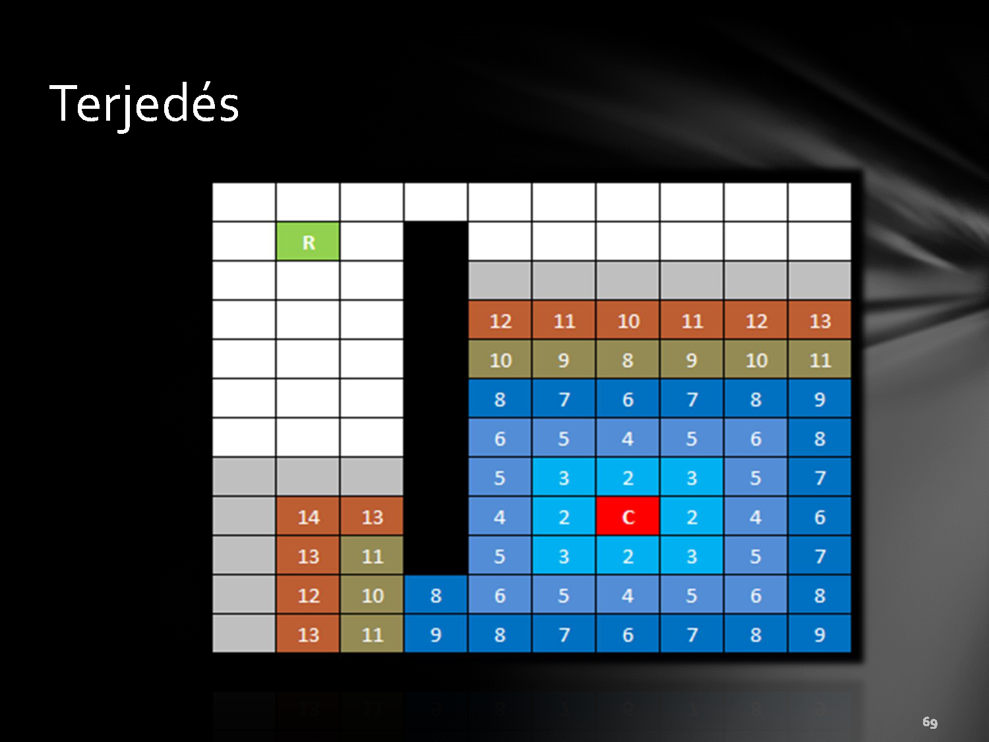

Slide 67
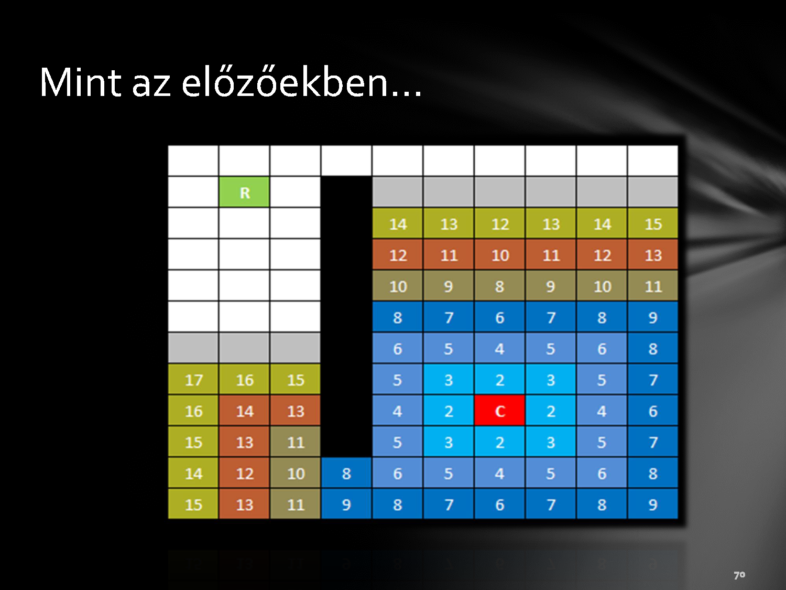

Slide 68
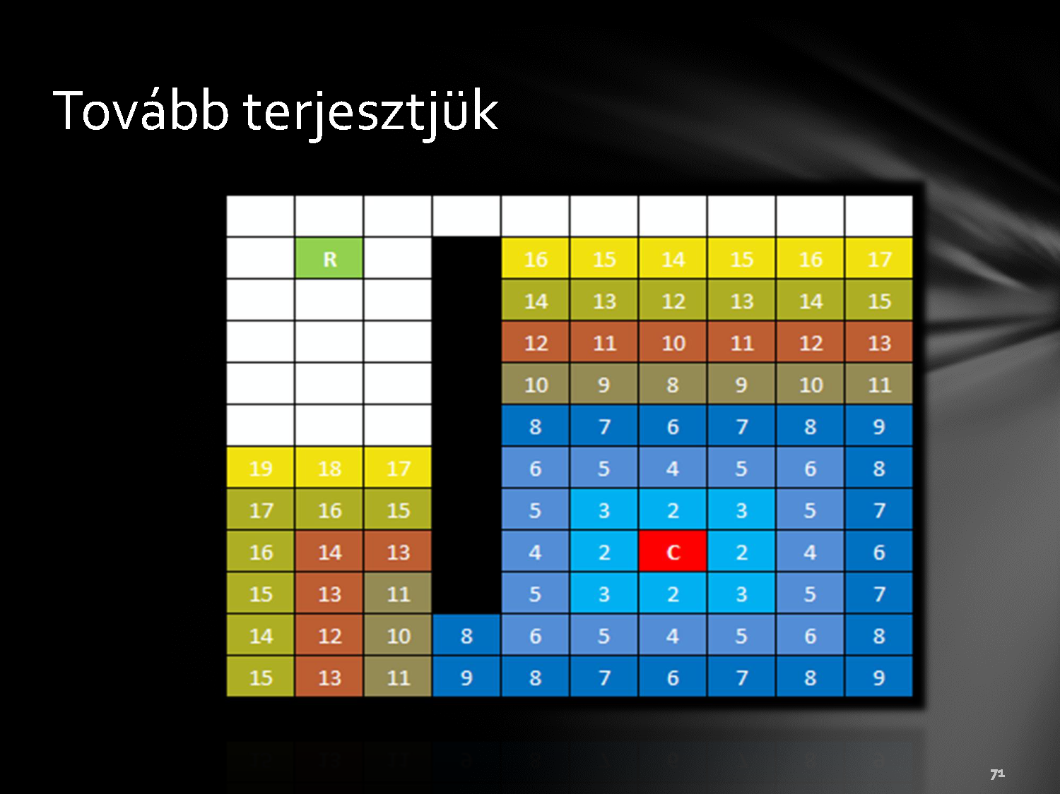

Slide 69
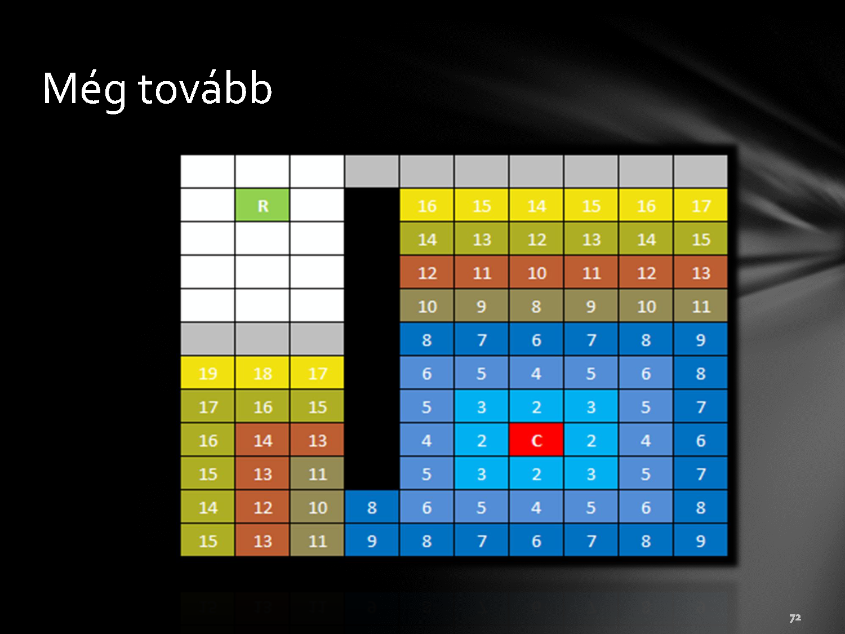

Slide 70
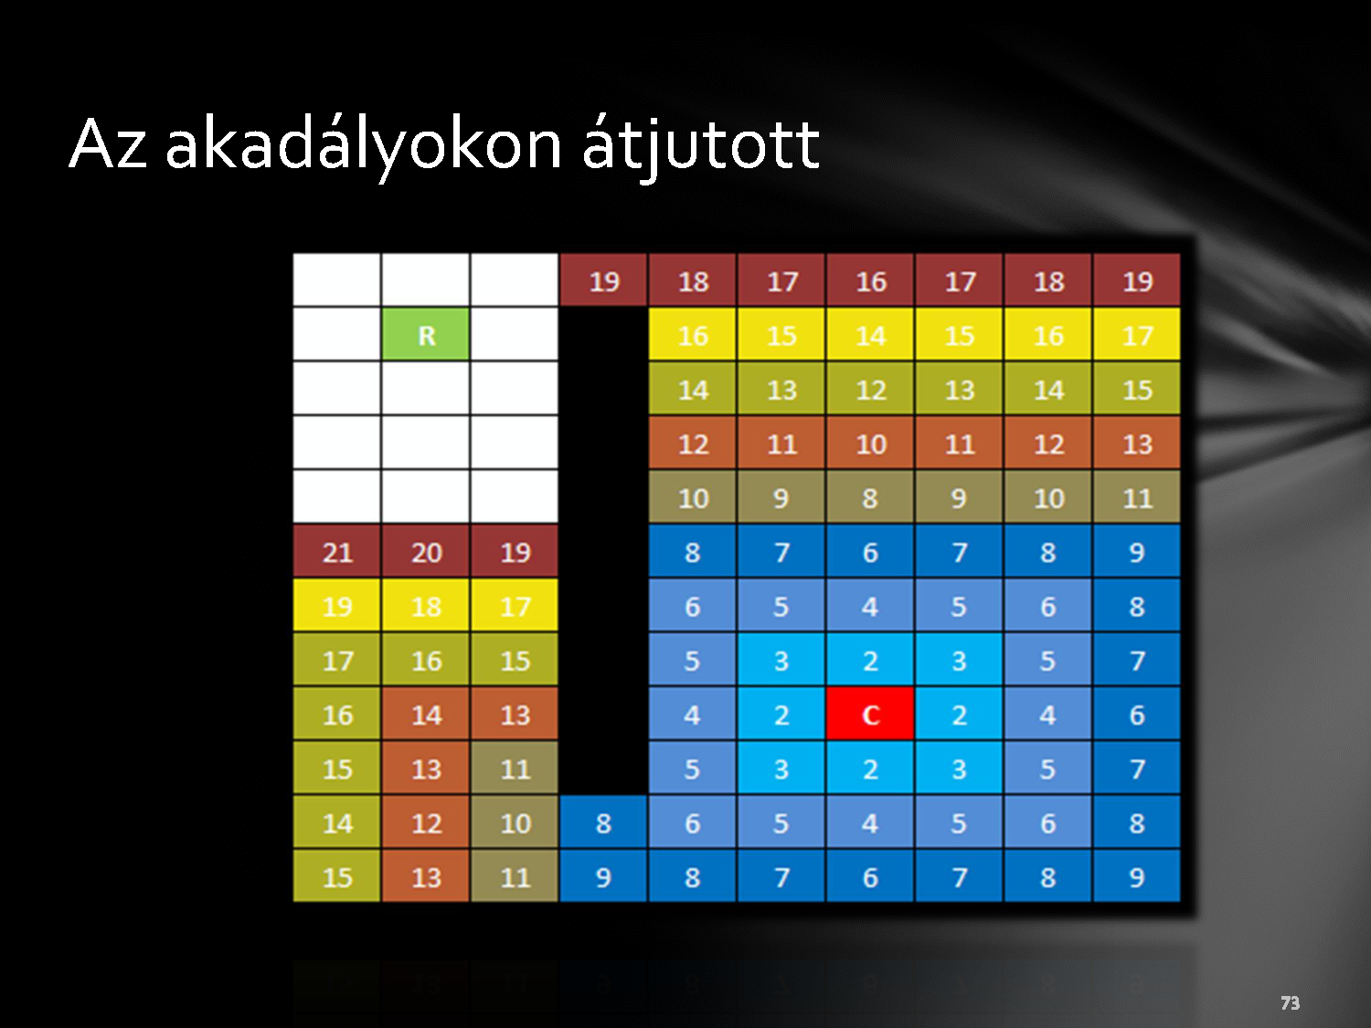
The obstacle is passed

Slide 71
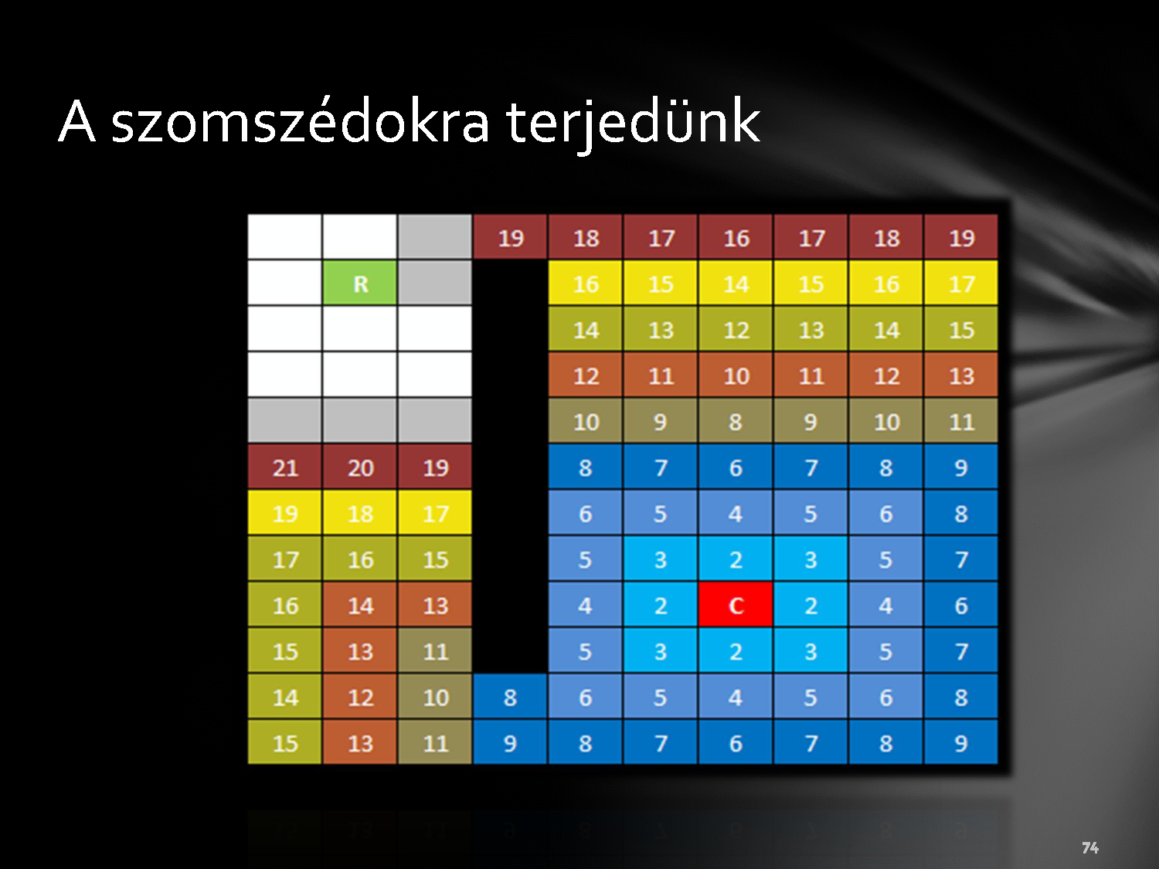
Examine the neighbours

Slide 72


Slide 73


Slide 74

The robot has been reached

Slide 75


Slide 76


Slide 77


Slide 78


Slide 79


Slide 80


Slide 81


Slide 82


Slide 83


Slide 84

The destination is in the robot’s scope

Slide 85


Slide 86

Comments
The methodology is algorithmic
Once more the operation:
1)We start to propagate from the destination
2) Searching for empty cells with wavefronts in the neighborhood
3) Checking the surrounding cells, searching for lowest cost
4) Identifying the value of the new cell (previous + cost of the step)
Repeating steps 2-4 until we reach the robot or we could expand further
Once we have reached the robot:
We find the cell with the lowest value and make a step towards it
We repeat the first point until we won’t reach the destination

