Slide 1
Intelligent Systems
2017 Spring
1. Practise

Slide 2
Matlab
http://mathworks.com
http://o365.uni-obuda.hu
https://io.uni-obuda.hu/matlab

Slide 3
Command Window
Commands
More commands -> .m file
; mark
  If the mark is placed the command will be done but the result will not be visualized/shown.
  If the mark is not placed the command will be done and the result will be visualized/shown.
Comment %
Indexing from 1
Help help ☺

Slide 4
Operations
Array operations
+ addition
- subtraction
.* multiplication by elements
./ division by elements
.^ Exponential by elements
Matrix operations
+ addition
- subtraction
* multiplication
/ division
^ Exponential

Slide 5
Relational and logical operators
< less
> greater
<= less or equal
>= greater or equal
== equal
~= not equal (!!!!!!!)
& and
| or
~ negation
xor exclusive or

Slide 6
Workspace variables
>> clear %deletion of variables
>> clc %clear of the command window

Slide 7
Representation of strings
>> disp('String')

Slide 8
Vectors, arrays
>> a=[1 2 3 4]
a =
1 2 3 4
>> b=[1 2 3 4]'
b =
1
2
3
4

Slide 9
Vectors, arrays
>> a=[1 2; 3 4]
a =
1 2
3 4
>> b=[1 2; 3 4]'
b =
1 3
2 4

Slide 10
Vectors, arrays
>> zeros(2)
ans =
0 0
0 0
>> ones(2)
ans =
1 1
1 1
>> eye(2) % identity matrix
ans =
1 0
0 1
>> rand(2)
ans =
0.8147 0.1270
0.9058 0.9134

Slide 11
Vectors, arrays
a(:) %All elemenets – 1D
a(:,:) %All elements – 2D
a(1,1) %1,1 element
a(:,1) %1st column (all x, 1. y)
a(1,:) %1st row
size - dimension of the array
length - length of the vector

Slide 12
Series
>> a=[20:30]
a =
20 21 22 23 24 25 26 27 28 29 30
>> a(1:3)
ans =
20 21 22
>> b=[0:0.1:0.5]
b =
0 0.1000 0.2000 0.3000 0.4000 0.5000

Slide 13
Control structures
if condition
instructions
elseif condition
instructions
else
instructions
end
For loop:
for i = 1:N
%for start:step:end
instructions;
end
While loop:
while condition
instructions;
end

Slide 14
Task
x=[1,2,3;4,5,6;7,8,9]
Find the min and max value and give their indexes too.

Slide 15
Task
Check wheather a string and the same string flipped or reversed is a palindrom or not.
String = ’dad’
Hint: fliplr

Slide 16
Task
map=zeros(50,50);
robot=[25,25];
Place the robot on the map (value 1 represents the robot).
The robot should be at the middle.

Slide 17
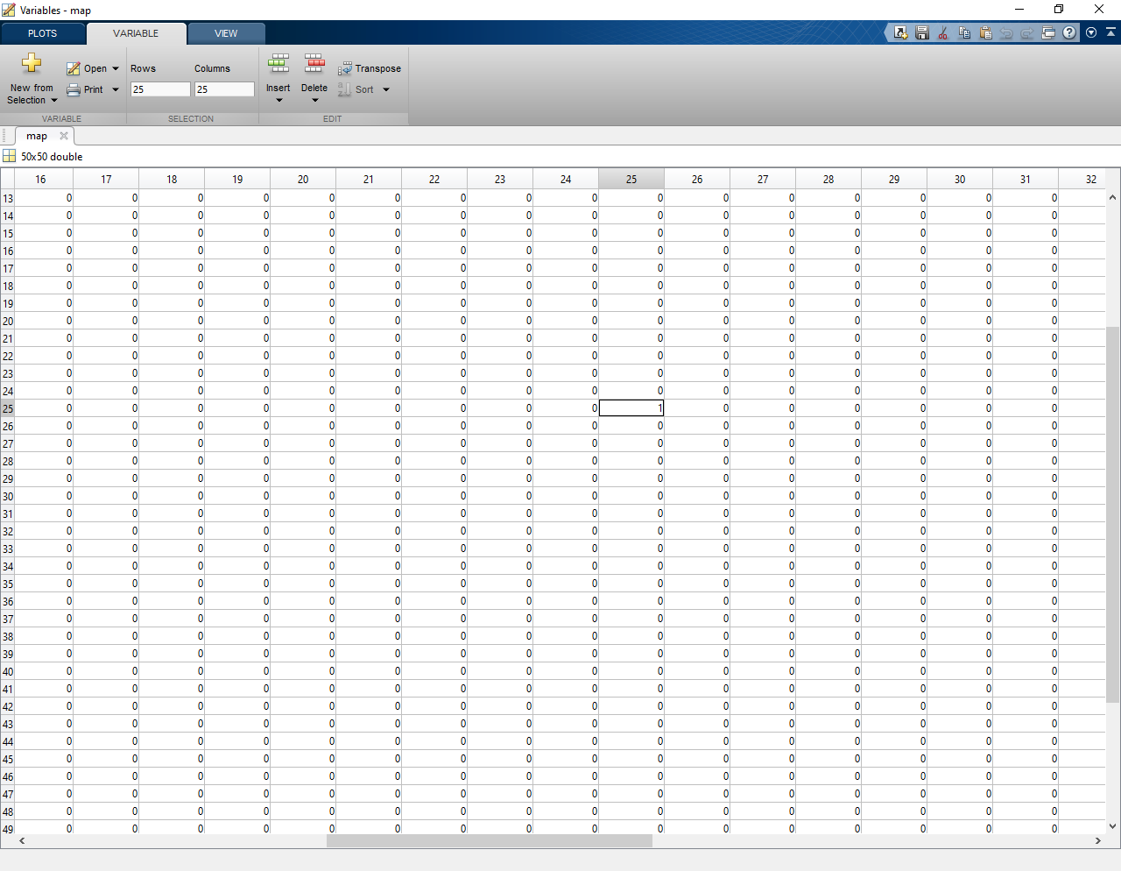
The content of the map variable (workspace)

Slide 18
Display:
imagesc(map)
Optional color scale:
colorbar;

Slide 19
Task
Put a border around the map
The border’s value should be 2

Slide 20
Task
The robot should move.
10 step forward, then 10 step right!
Automatically update the image through a for loop.
Slow down the steps with the pause method:
  pause(0.1); %100ms

Slide 21
Task
Around the robot there should be a border at the end. (8 cells) The border’s value is 2.

Slide 22
Task
Calculate the distance the robot made from the start and end point.
Hint:
n = norm(v) returns the 2-norm or Euclidean norm of vector v.

