Slide 1
Intelligent Systems
2017 Spring
Agenda (per weeks):
Matlab review and Mobile robots (path finder I.)
  Theory
Mobile robots (path finder II.)
  Experience based
Mobile robots (path finder III.)
  Wavefront method
Mobile robots (path finder IV.)
  Plane
Genetic algorithms I.
  Theory
Genetic algorithms II.
  Implementation of selection.
Neural networks I.
Neural networks II.

Slide 2
Requirements
Final mark (From László Kutor) / Signature:
The student can get a final mark only if the attendance is above 70% and passes the laboratory tests.

Slide 3
Tests
Two tests:
  (Should be on the) 7th week.
  (Should be on the) 13th week.
On the 14th week there will be a replacement test.
If somebody fails on the last week’s test (>50%), the student has to sign up for a signature retake exam through neptun during the exam period (Based on the TVSZ).

Slide 4
Materials: mobil.nik.uni-obuda.hu/en/

Slide 5
Mobile robots (path finder I.)

Slide 6
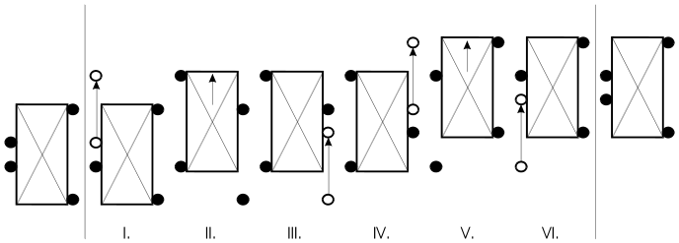
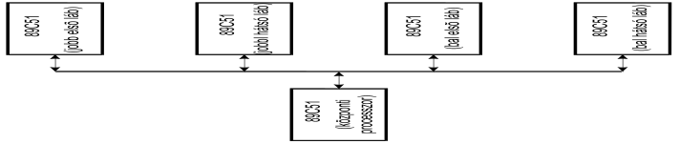
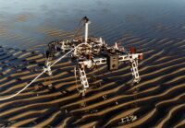
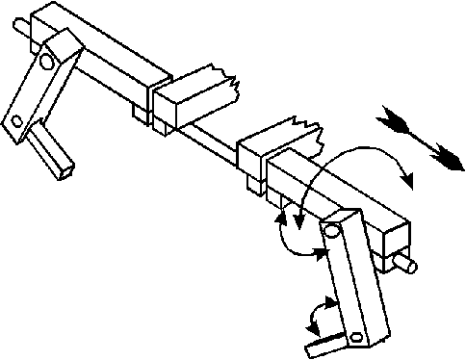
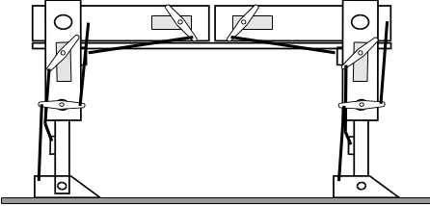
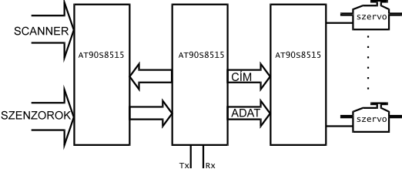
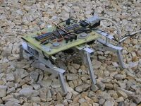
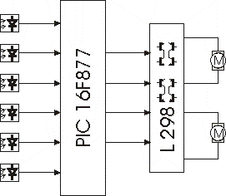
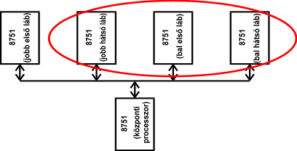
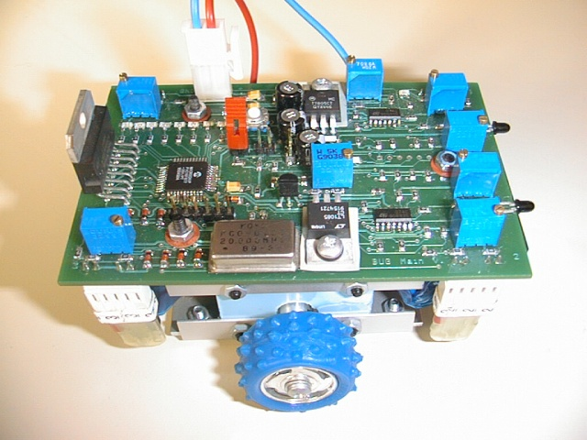
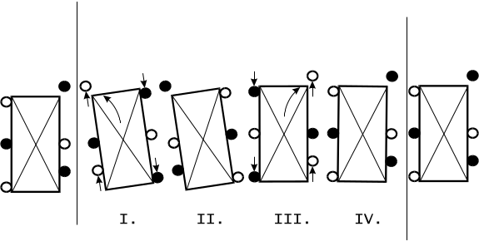
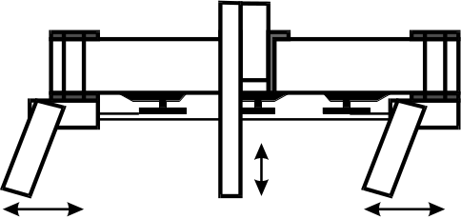

Slide 7
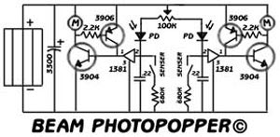
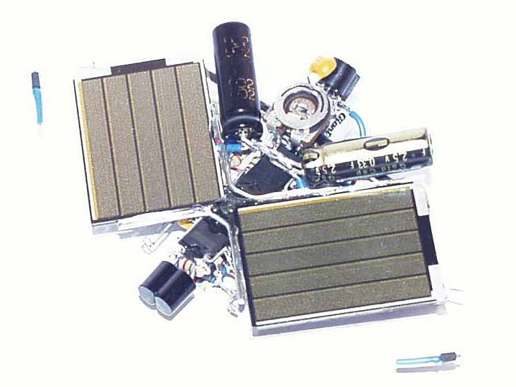
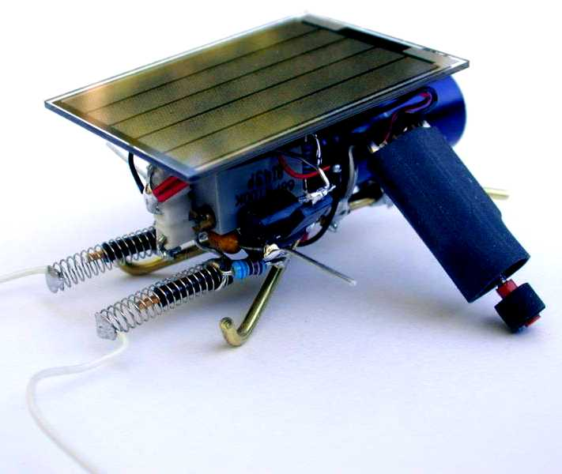
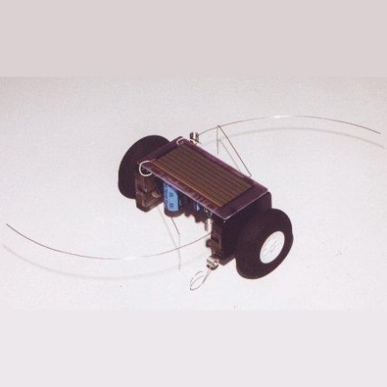
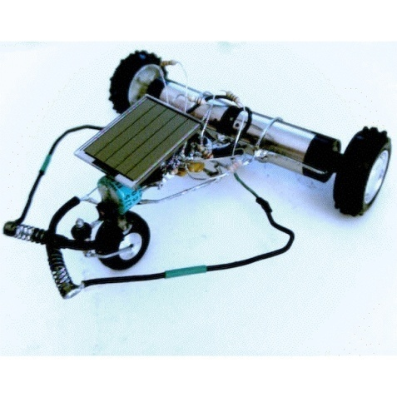
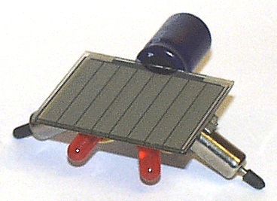
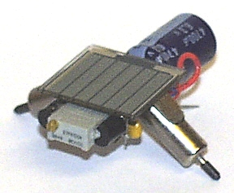
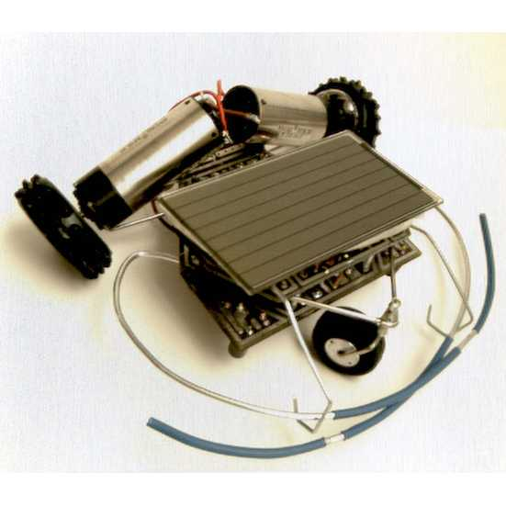
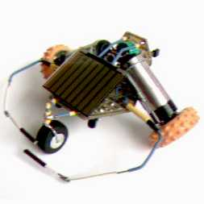
BEAM robots
B – Biology
  Prepared according a biological sample,
E – Electronics
  Electronically operated,
A – Aesthetics
  Nicely designed,
M – Mechanics
  Mechanics.

Slide 8
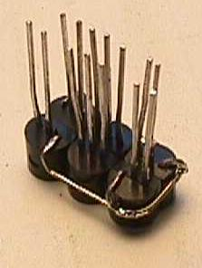
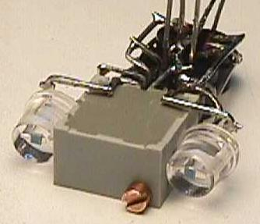
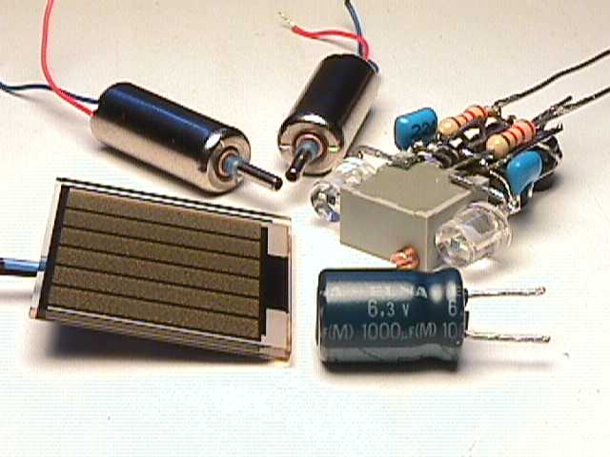
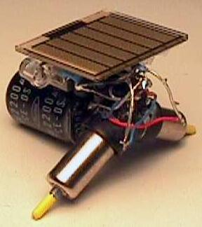
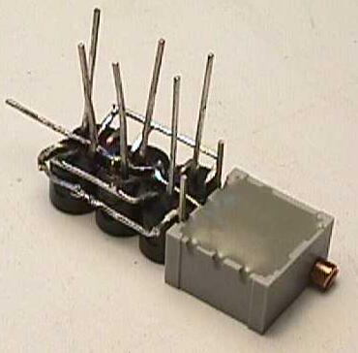
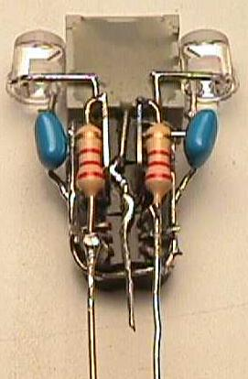
BEAM robots
B – Biology
  Prepared according a biological sample,
E – Electronics
  Electronically operated,
A – Aesthetics
  Nicely designed,
M – Mechanics
  Mechanics.

Slide 9
Robot or automata?
What is the difference between a robot and automata?
 | Automata | Robot
Programmable | + | +
Sensors | + | +
Readable/Writeable memory | - | +
Adaptation ability | - | +
Learning ability | - | +

Slide 10
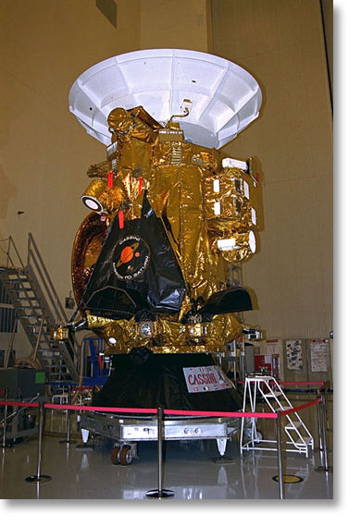

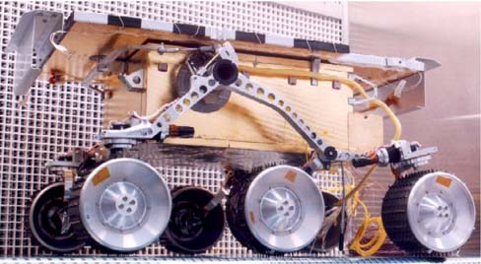
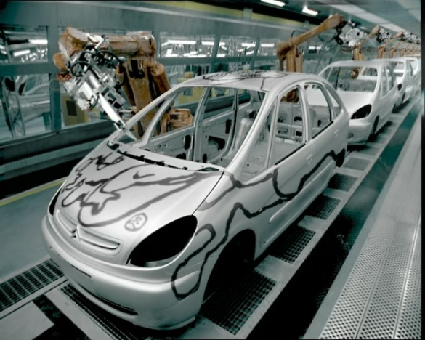
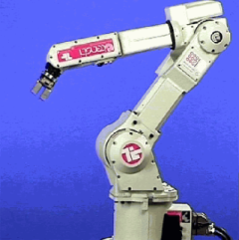
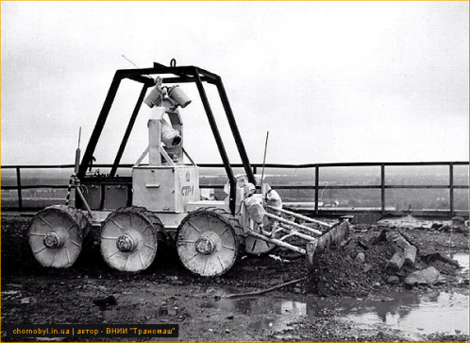
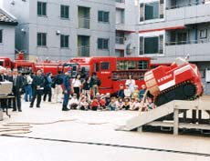
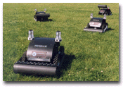
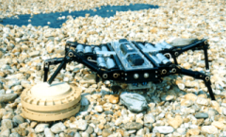
Usage of Robots
Space exploration
  Space probes
  Landing units
  Mobile earth exploring units
Factory robots
  Assembling robots
    Weldering
    Mechanics
    Painting
  Maintenance robots
Disaster response robots
  Firefighter
  Scout (Chemical or radiation on polluted area)
Military Robots
  Mine sweeper, extermination/destroyer

Slide 11
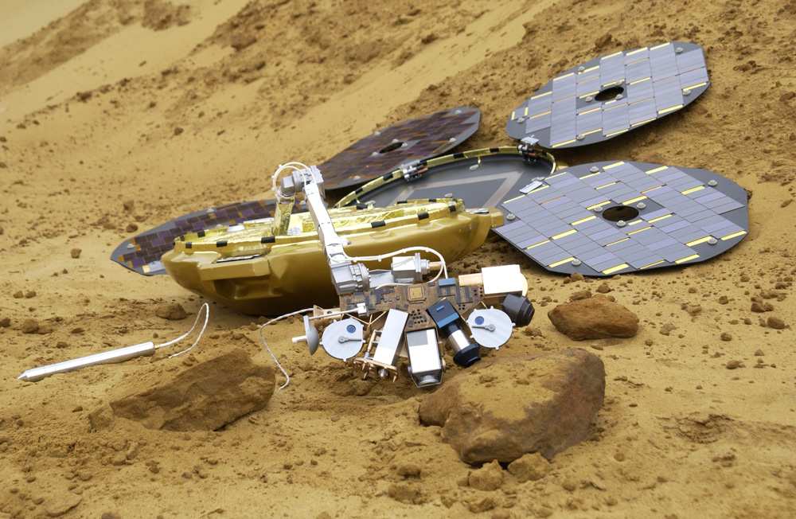
Usage Of Robots

Slide 12
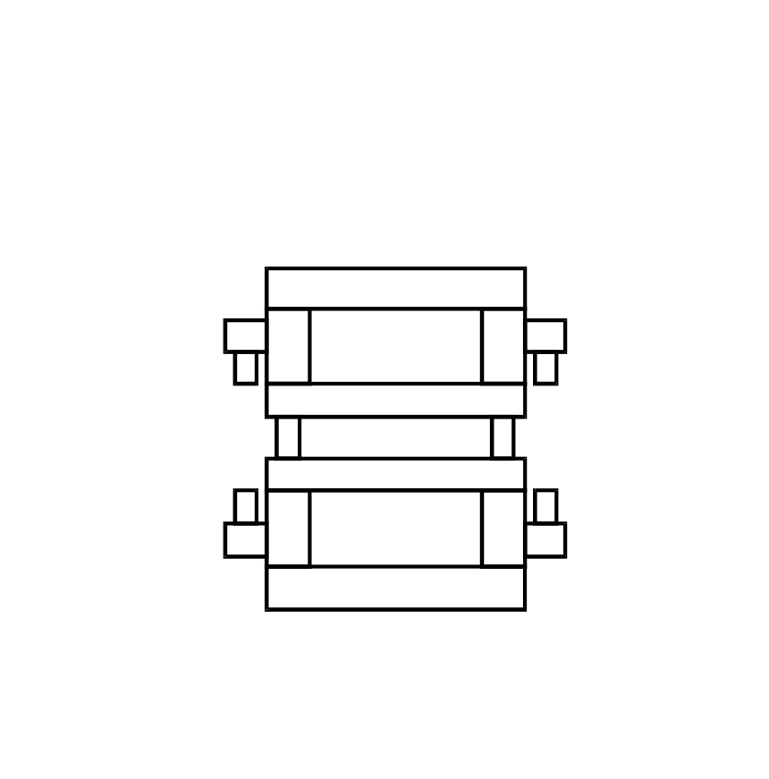
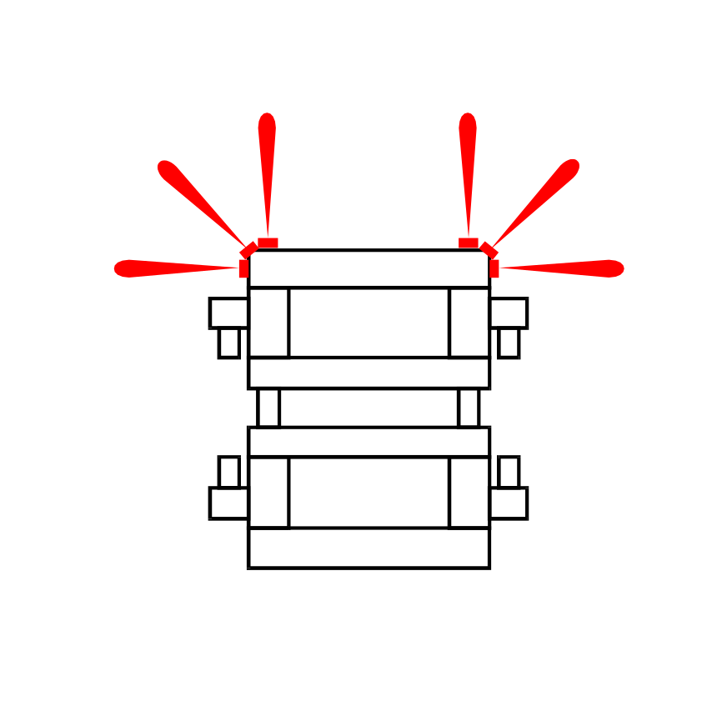
Sensors
The basic function of sensors is to receive infromation from the ambient and to transmit it to the central system.

Slide 13
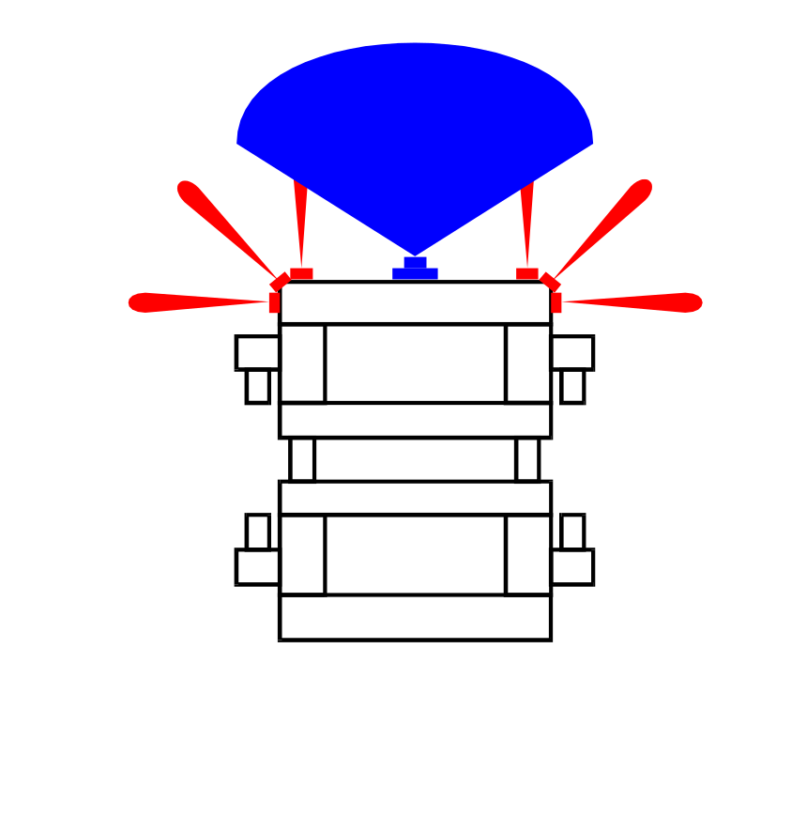
Sensors
The basic function of sensors is to receive information from the ambient and to transmit it to the central system.
Infrared-reflective sensor :
Fast and easy processing
(There is an obstacle / There is no obstacle)
Ultrasound / Laser rangefinder
Similar like the infrared, but it can measure the distance.

Slide 14
Sensors
The basic function of sensors is to receive information from the ambient and to transmit it to the central system.
Infrared-reflective sensor :
Fast and easy processing
(There is an obstacle / There is no obstacle)
Ultrasound / Laser rangefinder:
Similar like the infrared, but it can give the distance.
Camera:
Large amount of data
(min. 640x480x8 bit)
Image processing
Slow, complex, compute-intensive
Provides detaild information about the obstacle

Slide 15
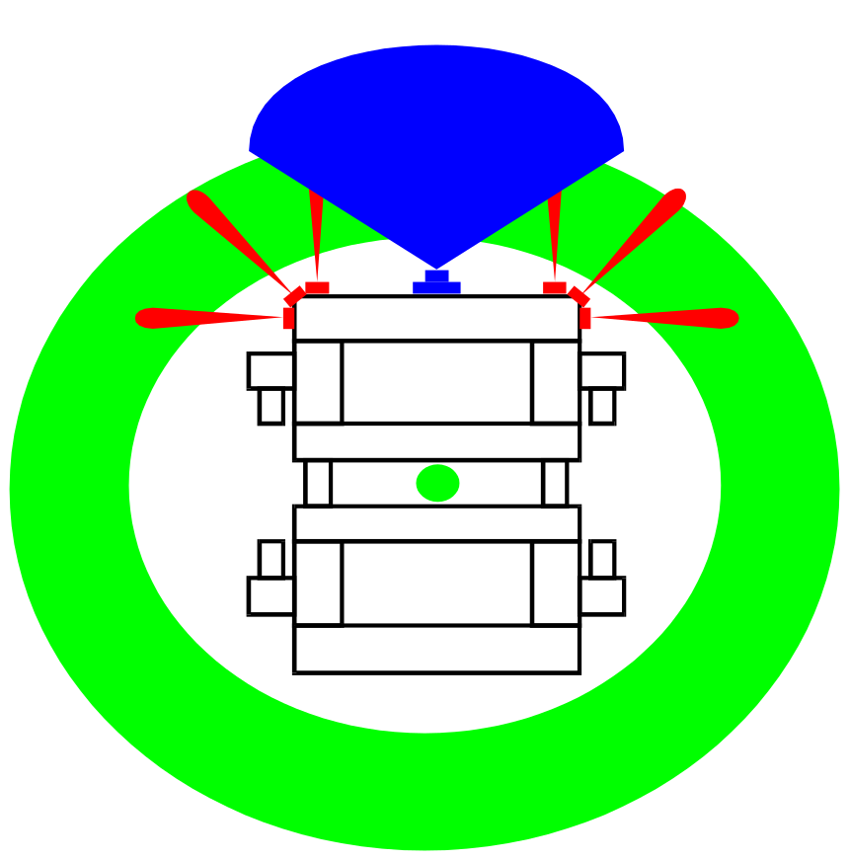
Sensors
The basic function of sensors is to receive information from the ambient and to transmit it to the central system.
Infrared-reflective sensor :
Fast and easy processing
(There is an obstacle / There is no obstacle)
Ultrasound / Laser rangefinder:
Similar like the infrared, but it can give the distance.
Camera:
Large amount of data
(min. 640x480x8 bit)
Image processing
Slow, complex, compute-intensive
Provides detaild information about the obstacle

Slide 16
Sensors
The basic function of sensors is to receive information from the ambient and to transmit it to the central system.
Infrared-reflective sensor :
Fast and easy processing
(There is an obstacle / There is no obstacle)
Ultrasound / Laser rangefinder:
Similar like the infrared, but it can give the distance.
Camera:
Large amount of data
(min. 640x480x8 bit)
Image processing
Slow, complex, compute-intensive
Provides detaild information about the obstacle
360° Camera
Distortion, bigger coveraged area->
less information

Slide 17
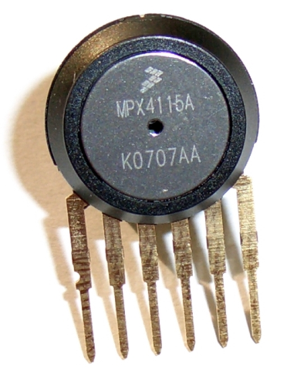

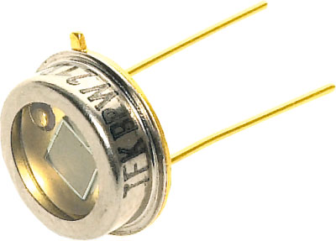
Sensors
The basic function of sensors is to receive information from the ambient and to transmit it to the central system.
Types of sensors:
  Passive
    The passive sensors detect physical characteristics of the environment, E.g.:
      Temperature
      Pressure
      Sound

Slide 18
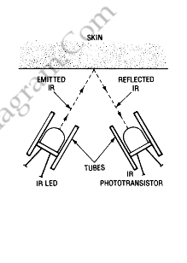
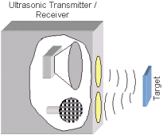
Sensors
The basic function of sensors is to receive information from the ambient and to transmit it to the central system.
Types of sensors:
  Passive
    The passive sensors detect physical characteristics of the environment, E.g.:
      Temperature
      Pressure
      Sound
  Active
    The active sensors emit a measurable signal and detect its reflection.
    E.g.:
      Radars
      Light sensors that require light, Cameras
      Ultrasound / Laser rangefinder

Slide 19
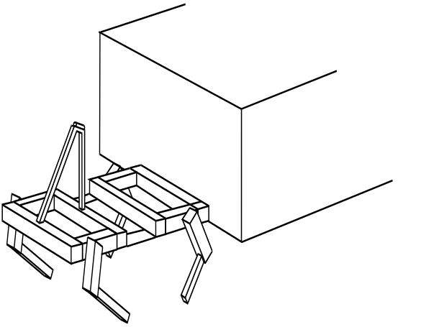
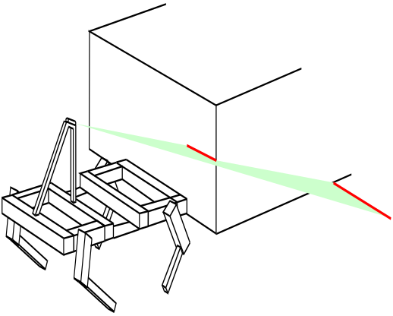
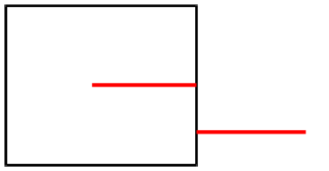
Sensors
The basic function of sensors is to receive information from the ambient and to transmit it to the central system.

Slide 20
Sensors
The basic function of sensors is to receive information from the ambient and to transmit it to the central system.
Structured light
Projected sample (e.g. laser stripe)
Based on the deformation of the sample its possible to measure the distance to the obstacle
~Kinect

Slide 21
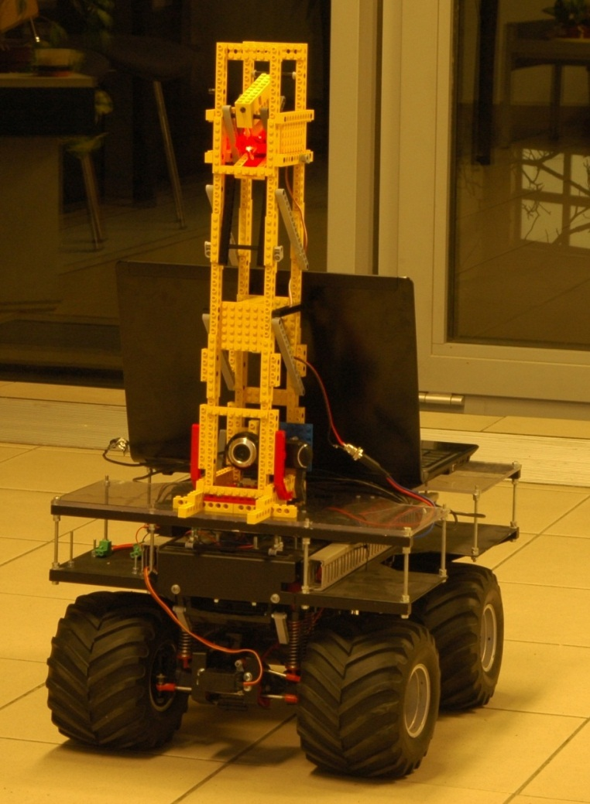
Szenzorok
http://nik.uni-obuda.hu/somlyai/robot/

Slide 22
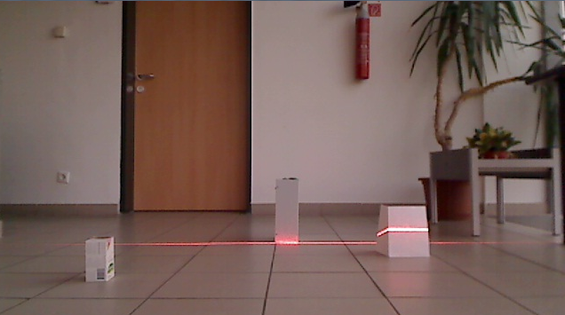
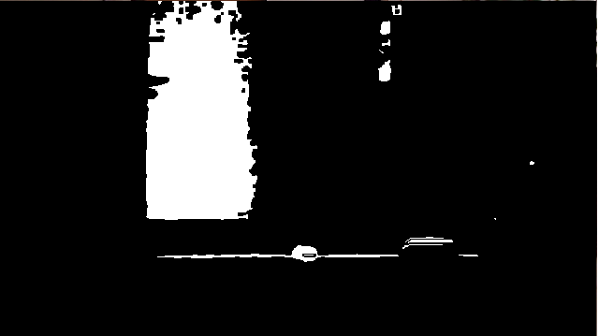

Szenzorok
http://nik.uni-obuda.hu/somlyai/robot/

Slide 23

http://nik.uni-obuda.hu/somlyai/robot/

Slide 24
Intelligent Sensors
Properties of Intelligent sensors:
  Self-calibration
  Self Diagnosis
  Dynamic sensitivity
  Programming, remote control

Slide 25
Navigation
The aim of the navigation is to reach a certain point/destination. During the movement there are factors that should be considered:
  The movement options of the robot
  The resource that is needed for the movement
  Time
  Mechanical properties
  Terrain
Known / Unknown Terrain

Slide 26
Navigation
Avoiding obstacles and path finding:
    Rule-based algorithm.
    Modified/advanced rule-based algorithm.
    Neural-based algorithm.
    Experiance based algorithm.
    Wavefront propagation algorithm.
    Modified/Advanced Wavefront propagation algorithm.
    GVD-based, graph traversal algorithm.

Slide 27

Navigáció
    Rule-based algorithm.
    Based on each position a decesion has to be written.
    E.g.: Destination is in front of us, go forward.
    It is not guaranteed it will find the destination.

Slide 28

Navigáció
    Modified/advanced rule-based algorithm
    It can save steps into its memory.
    It is not guaranteed it will find the destination.

Slide 29





Navigáció
    Neural-based algorithm
    ~Rule-based + neural network

Slide 30
Navigáció
    Wavefront propagation algorithm.
    If there exists a path, it will find it (always).

Slide 31
Navigáció
    Wavefront propagation algorithm.(Unknown Terrian)
    If there exist a path, it will find it (always), but it is not guaranteed it will be the shortest.

Slide 32
Navigáció
    GVD algorithm.
    Safest path.
    If there exist a path, it will find it (always).

Slide 33
Navigáció
    Comparison of different algorithms

