Slide 1
Óbudai Egyetem
Neumann János Informatikai Kar
.NET Gadgeteer - Introduction

Slide 2
Overview
What is .NET Gadgeteer?
FEZ Spider Starter Kit
Usage of the Starter Kit / Main board
Simple Gadgeteer application
Review questions

Slide 3
1. What is .NET Gadgeteer?
Microsoft .NET Gadgeteer is a rapid prototyping platform for small electronic gadgets and embedded hardware devices.
It combines the advantages of object-oriented programming, solderless assembly of electronics using a kit of hardware modules, and quick physical enclosure fabrication using computer-aided design.
The platform is built on the .NET Micro Framework, which allows small devices to be programmed in the C# language and make use of Visual Studio’s programming and debugging tools.

Slide 4
1. What is .NET Gadgeteer?
What type of tools necessary to do .NET Gadgeteer application?
Hardware components:
  Main board (pl.: Fez Spider, Fez Hydra, Sytech NANO)
  USB Client DP module (“Red module”) >> Power supply and debug interface
  Miscellaneous modules for testing (eg.: sensors, displays, LEDs, input devices, connectivity etc.)
  The FEZ Spider Starter Kit includes all of these.
Software components:
  Microsoft Visual Studio 2012 (free version: Visual C# 2012 Express)
  .NET Micro Framework SDK
  Manufacturer dependent drivers

Slide 5
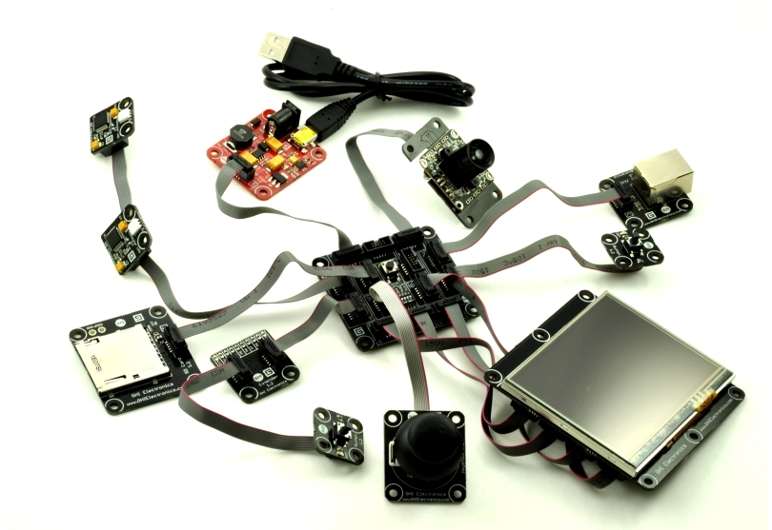
2. FEZ Spider Starter Kit
The FEZ Spider Starter Kit includes
FEZ Spider Main board
Display TE35 Module (3.5’’ touchscreen)
USB Client DP module („Red module”)
Camera module
2x Multicolor LED module
2x Button module
Ethernet J11D module
SD card module
USB Host module
Extender module
Josytick module
Ribbon cable

Slide 6
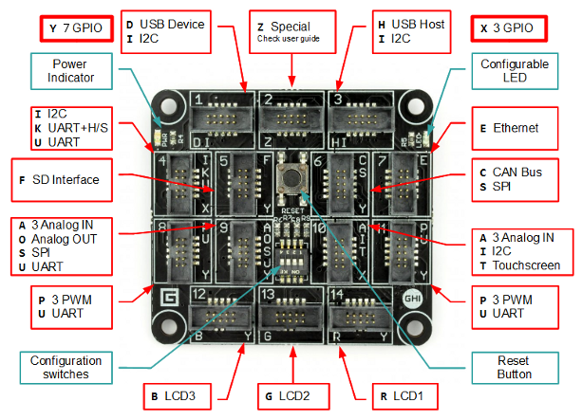
2. FEZ Spider Starter Kit
FEZ Spider Mainboard
14 types of .NET Gadgeteer compatible sockets that include:
X, Y, A, C, D, E, F, H, I, K, O, P, S, T, U, R, G, B, Z
Configurable on-board LED
Configurable modules
EMX module:

Slide 7
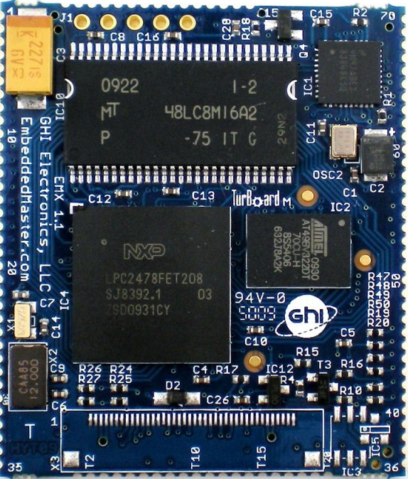
2. FEZ Spider Starter Kit
Az EMX modul
Az EMX is a System on Module (SoM), what contains the following hardware:
  ARM processor
  Flash memory
  RAM
  Ethernet
  etc.
The EMX module runs the .NET Micro Framework and the GHI Electronics extension libraries.

Slide 8
2. FEZ Spider Starter Kit
EMX module specification
  72MHz 32-bit ARM7 processor
  4.5 MB Flash memory
  16 MB RAM
  LCD controller
  TCP/IP Stack SSL, HTTP, TCP, UDP, DHCP support
  Ethernet, WiFi driver and PPP (GPRS/ 3G modem), and DPWS
  USB host
  USB Device with specialized libraries to emulate devices like thumb-drive, virtual COM (CDC), mouse, keyboard
  76 GPIO Pin
  2 SPI (8/16bit)
  I2C
  4 UART
  2 CAN channels
  7 10-bit analog input
  10-bit Analog output (capable of WAV audio playback)
  4-bit SD/MMC memory card interface
  6 PWM
  OneWire interface (available on any IO)
  Built-in Real Time Clock (RTC) with the suitable crystal
  Processor register access
  OutputCompare for generating waveforms with high accuracy
  RLP allowing users to load native code (C/Assembly) for real-time requirements
  Extended double-precision math class
  FAT File System
  Cryptography (AES és XTEA)
  Low power and hibernate support
  In-field update (from SD, network or other)

Slide 9
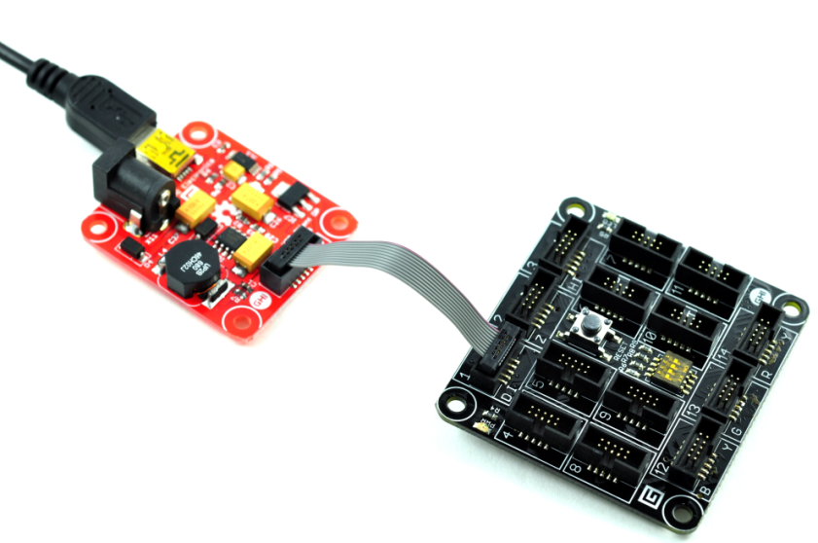
3. Usage of the mainboard
The main board
A FEZ Spider main board contains14 slot for connecting the modules (socket).
Reset button to reboot the system.
USB Client Dual Power module gives the necessary power from USB or DC power supply

Slide 10
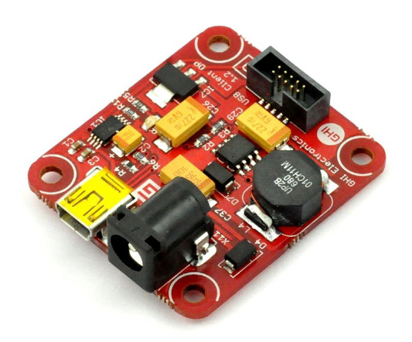
3. Usage of the mainboard
The „Red Module”
This module provides the power supply to the FEZ Spider Mainboard and its connected devices. It also enables to debug the program.
Connect the red USB Device module to socket number 1 on the FEZ Spider Mainboard, which is the only socket that has the letter D – that is the only socket we can connect!
When plugging or unplugging
any module into a FEZ Spider
socket, always make sure that power
is not connected, by unplugging either
end of the mini USB cable.

Slide 11
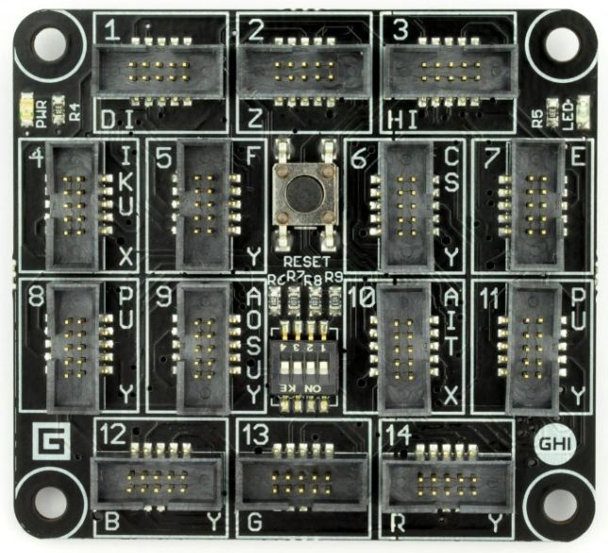
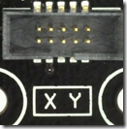
3. Usage of the mainboard
Slot marks on the panels and the sensors (1)
On the FEZ Spider Mainboard and on the back of each modules we can see marks that indicate how to connect them. There are the:
  slot number
  letter(s) to identify the compatibility of electrical and the communication connection.

Slide 12
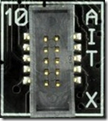
3. Usage of the mainboard
Slot marks on the panels and the sensors(2)
On the left example module there are X and Y label we can connect to any socket that has X or Y label on it (one character should match).
Make sure you only the same letter slots!!!!

Slide 13
4. Simple Gadgeteer application
Task 1
Let’s make a Gadgeteer app which is blinking a led after a given button pressed.

Slide 14
4. Simple Gadgeteer application
Solution for Task 1
Connect the “Red module” to the FEZ Spider Mainboard socket number 1 (that is the only socket labelled with ‘D’, do not use other).
Now we can connect the further test modules (always check the labelling!).
Warning!!!!
When plugging or unplugging any module into a FEZ Spider socket, always make sure that power is not connected, by unplugging either end of the mini USB cable!

Slide 15
4. Simple Gadgeteer application
Connecting the components (1)
We need the following modules for the application:
Multicolor LED
Button

Slide 16
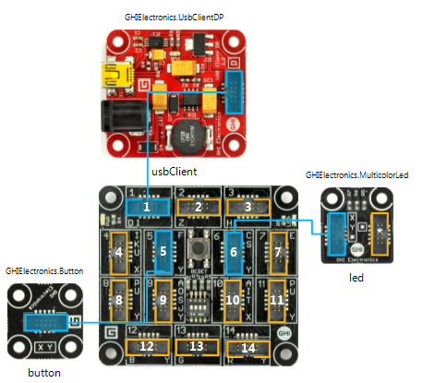
4. Simple Gadgeteer application
Connecting the components (2)
Connect the modules as shown below:

Slide 17
4. Simple Gadgeteer application
Connecting the Starter Kit with PC
Connect the red module to the USB cable then to the USB to the computer.
On power the main board boots up, than starts the (previous) program on it.
Via Visual Studio the new program can be deployed and it is possible to debug you program, as well.

Slide 18
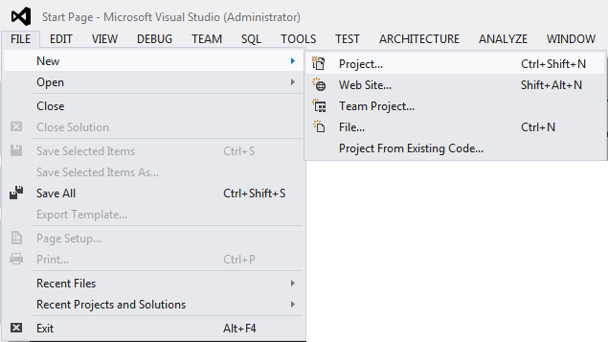
4. Simple Gadgeteer application
Creating new project (1)
In Visual Studio 2012: File → New → Project…

Slide 19
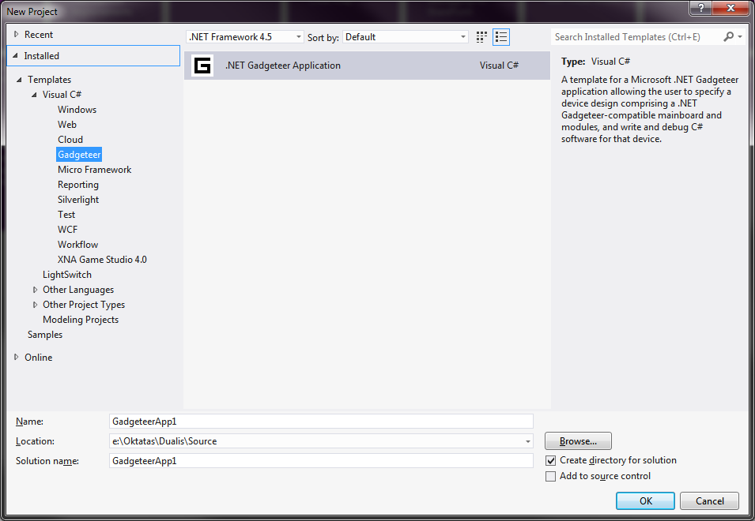
4. Simple Gadgeteer application
Creating new project (2)
On the pop up window choose: „Visual C#/Gadgeteer/.NET Gadgeteer Application”.
Give the project name in the „Name” textbox.
Declare the location in the
“Location” textbox.

Slide 20
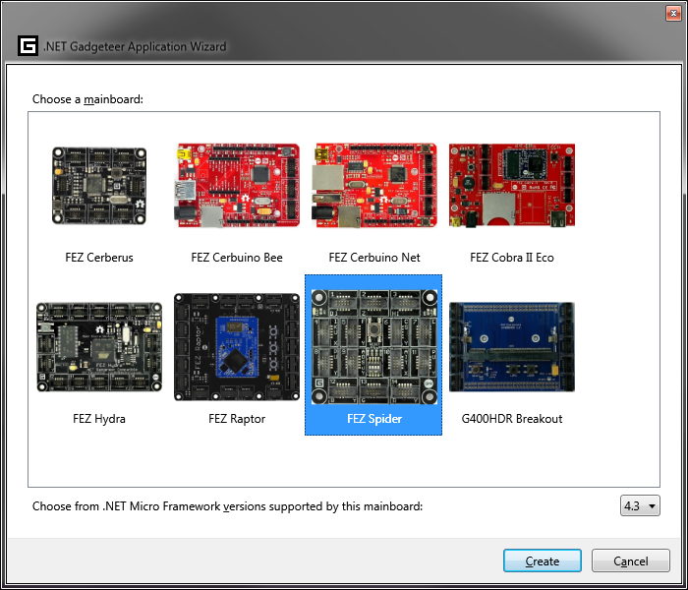
4. Simple Gadgeteer application
Creating new project (3)
Choose the right Mainboard and the .NET Micro Framework version.
(Mainboard: FEZ Spider,
Framework version: 4.3).

Slide 21
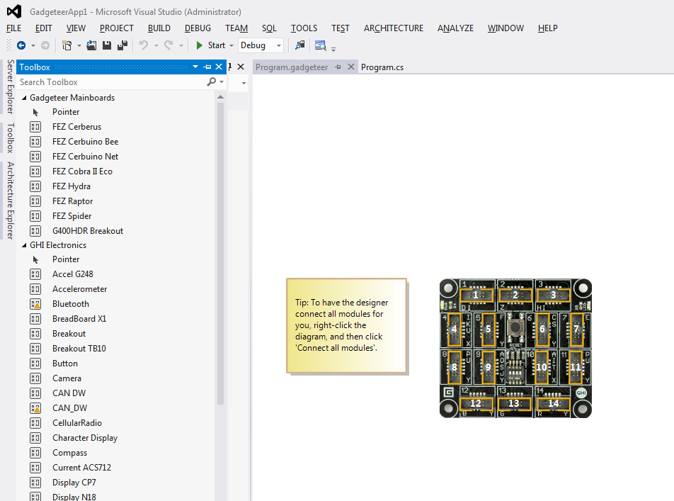
4. Simple Gadgeteer application
Creating new project (4)
The new project file contains the choosen main board by default.
From the Toolbox we can search and pick the desired components.

Slide 22
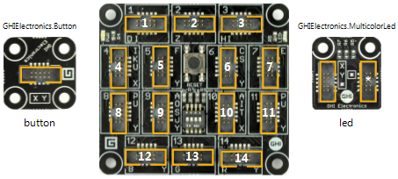
4. Simple Gadgeteer application
Graphical designer (1)
The deployment of the modules in the designer must meet with the real life realization.
Drag and drop a Button and a MulticolorLED component from the Toolbox to the graphical designer.

Slide 23
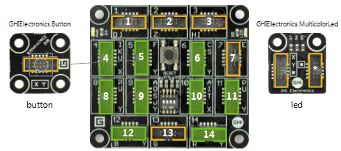
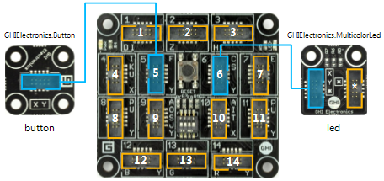
4. Simple Gadgeteer application
Graphical designer (2)
First select the socket on the Button (yellowish rectangle).
We can see the suggested (compatible) slots – green filled rectangles (we used slot no.5 in for the hardware, we do it in the designer so).
Same way we connect the MulticolorLED to slot no. 6.
Completed connection represented as a blue line.
Now, the Visual Studio knows how our hardware looks like, it can help to make the coding part.

Slide 24
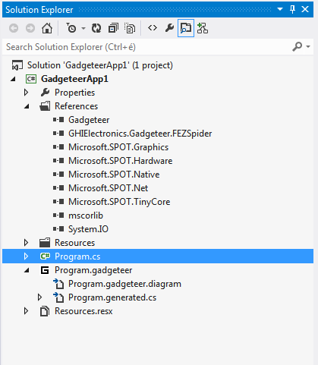
4. Simple Gadgeteer application
Coding (1)
In the Solution Explorer double click on the Program.cs source file.

Slide 25
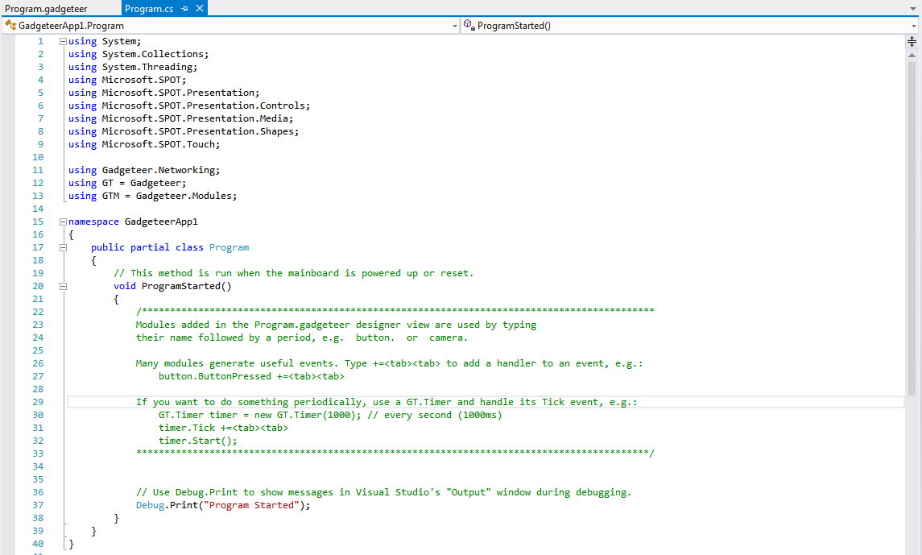
4. Simple Gadgeteer application
Coding (2)
Opening the Program.cs source file the Program class is shown.
It contains a Program Class and a ProgramStarted() method. It runs first after deployment (Start Debugging).

Slide 26
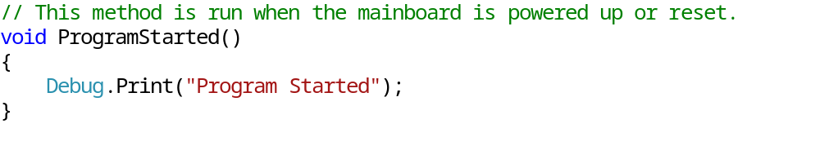
4. Simple Gadgeteer application
Coding (3)
The ProgramStarted() method contains the Debug.Print() call:
We can also start the application pressing F5:
  The compiler translates our code to an executable code for the device.
  Then it uploads the program to the device.
  The device restarts and boots with our application.
  It calls the ProgramStarted() method.
The Debug.Print() method call displays the “Program Started” message on the Output Window.

Slide 27
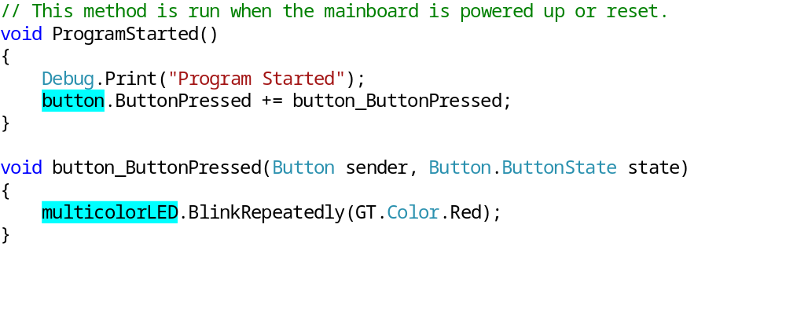
4. Simple Gadgeteer application
Coding (4)
Our designed configuration can be reached as objects in the program code.
The objects are instantiated as they were placed in the graphical designer.
Every component is representing one object (instance), and contains fields, methods, etc.

Slide 28
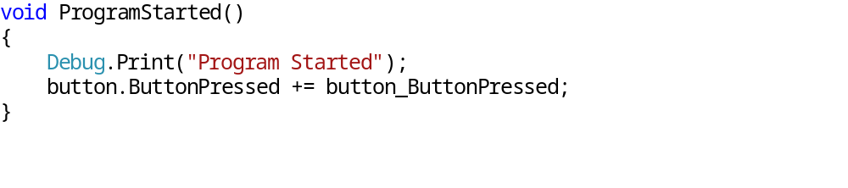
4. Simple Gadgeteer application
Coding (5)
Lets extend the ProgramStarted() method as below:
To handle the button click (button component) the object need to subscribe to the ButtonPressed event. We add a button_ButtonPressed method as a parameter (+=, Press TAB twice). Pressing the button this method will be called.
We can see the implementation on the next slide.

Slide 29
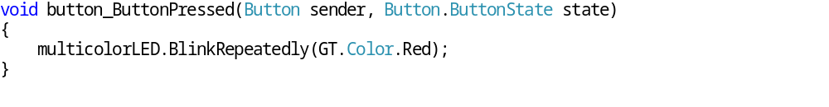
4. Simple Gadgeteer application
Coding (6)
Implementation of the button_ButtonPressed() method:
  As soon as the user presses the button module, this method will be executed, the sender parameter contains the references for the button and state holds the actual state of the button.
  By pressing the button the LED will continuously blink. Its color is given as GT.Color.Red.

Slide 30
5. Review questions
What type of tools are necessary to create a .NET Gadgeteer application?
What are the roles of the labels on Mainboard and on test modules?
What are the steps to create new Gadgeteer project?
What is the role ProgramStarted() method?
How do you subscribe and implement the event for button press?

