Slide 1
Óbudai Egyetem
Neumann János Informatikai Kar
.NET Gadgeteer – Simple Modules

Slide 2
Overview
Exercise with simple modules
  LED, button
Basics of Timer settings
  System.Threading.Timer
  Gadgeteer.Timer
Review questions

Slide 3
1. Exercise with simple modules
Task 1
Create a configuration, with 2 LEDs and 2 buttons (arrange them as one of each placed on the left and one of each on the right). If the right button is pressed the LED on the right turns to blue, similarly by pressing the left button the LED on the left turns to blue. In case of both the button is being pressed both the LEDs turn to red. By releasing the two buttons the LEDs turn off (thus a LED will be on if the related button is pressed).

Slide 4
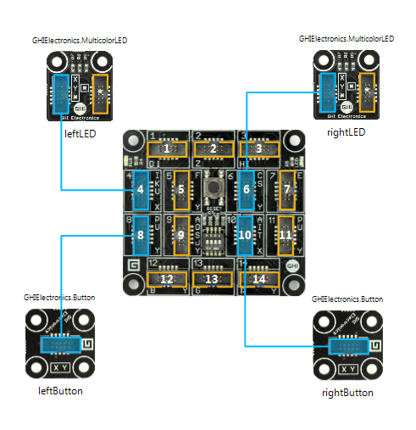
1. Exercise with simple modules
Configuration
Using the modules and the cables connect them as follows:

Slide 5
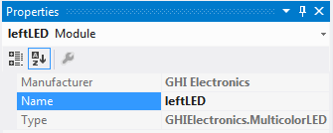
1. Exercise with simple modules
Creating the application
Start a new Gadgeteer project, then do the same configuration in the graphical designer.
Name the components in the Properties sub-window:
  Left LED: leftLED
  Left button: leftButton
  Right LED: rightLED
  Right button: rightButton
We can reference to the components based on their given names.

Slide 6
1. Exercise with simple modules
Event handling
In case of pressing a button the event of the button object will be raised:
Releasing the button the ButtonReleased the event below is raised:
Both events type are ButtonEventHandler:
  sender: the particular button which raised the event
  state: the state of the button
To subscribe for event handling the method should meet with the signature of the ButtonEventHandler delegate.

Slide 7
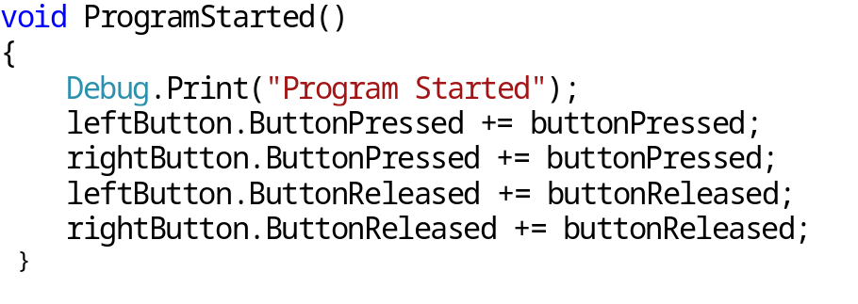
1. Exercise with simple modules
Coding
In the Solution Explorer window open our Program.cs source file.
In order to let the application to react for the button press or release event it has to subscribe on the relevant event handler. It is done in the ProgramStarted() method.
The even handling done with a common event handler method.
+= for adding the method to the event handler. Double TAB to shortcut our and generate method.

Slide 8
1. Exercise with simple modules
Implementing the event handler (1)
After the subscription we do the implementation.
With the “sender” parameter it can be monitored which button triggered the event.
The state of the given button can be checked by using the “Pressed” property. It is true while the button is pressed and false when it is not pressed.
You can turn on and off the LED modules and specify the color of the LED light. Some examples:
  led. TurnRed(): the LED light is red.
  led.TurnBlue(): the LED light is blue.
  led.TurnColor(Color color): the color parameter defines the LED light’s color
  led.TurnOff(): turns off the LED

Slide 9
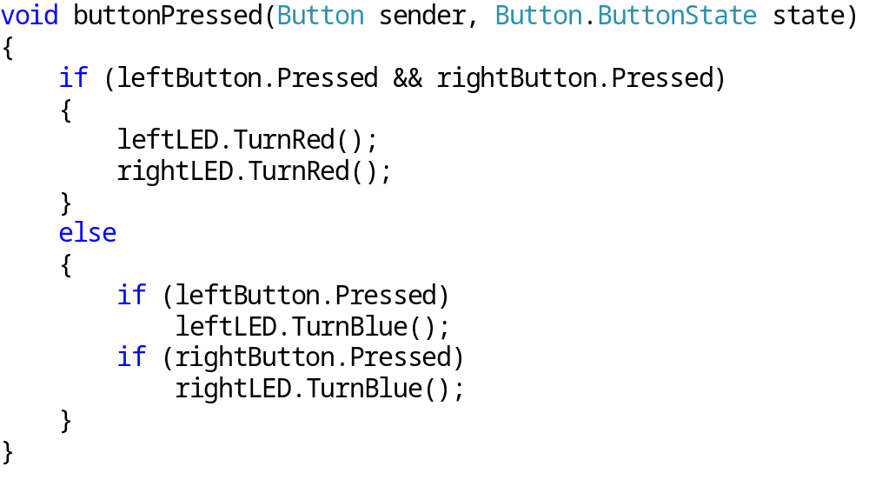
1. Exercise with simple modules
Implementing the event handler (2)
The button press event handler:

Slide 10
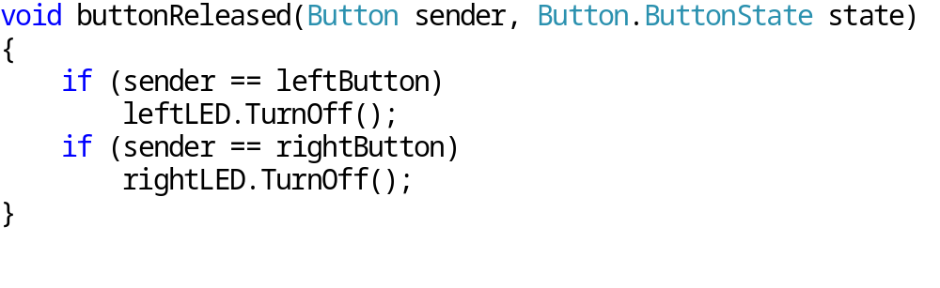
1. Exercise with simple modules
Implementing the event handler (3)
The event handler of the button release:
Run the application (F5) to verify it runs correctly.

Slide 11
2. Basics of Timer settings
Timer options
With the help of the Timers we can create periodically repeating or delayed method calls.
There are two types of timer available:
  System.Threading.Timer
  Gadgeteer.Timer

Slide 12
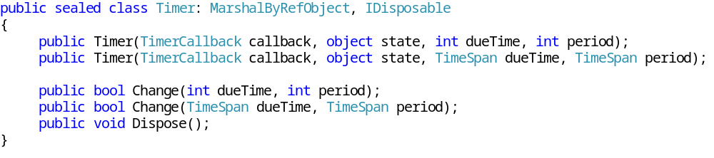
2. Basics of Timer settings
System.Threading.Timer (1)
It allows the method to be called in a given interval:
Constructors parameters:
  callback: is a TimerCallback delegate, which represents the method we wish to call periodically.
  state: arbitrary object, what can be used during the method callback.
  dueTime: the time interval what the system wait before the Timer started [ms], 0 for immediate start.
  period: the time interval in-between the method calls [ms]
The Change method let us to modify the timing parameters after the instantiation – dueTime and period.

Slide 13
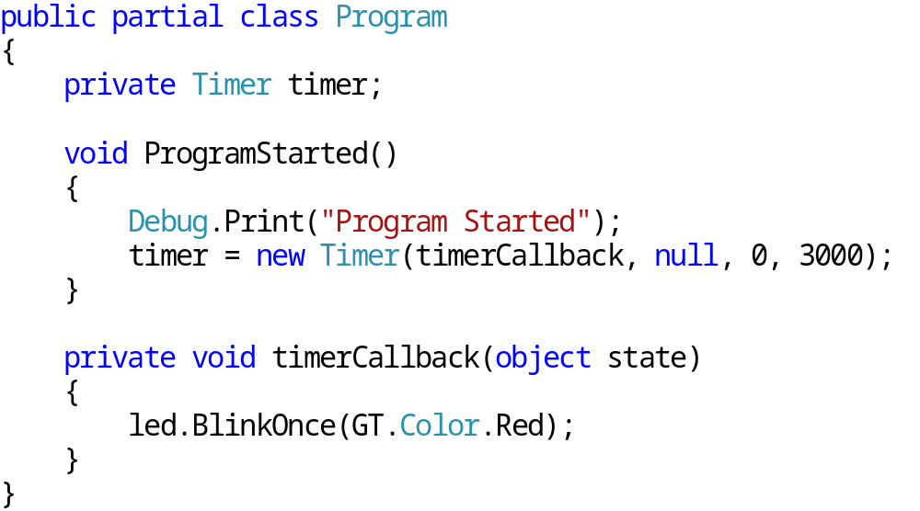
2. Basics of Timer settings
System.Threading.Timer (2)
Short example:
Note the signature of the TickEventHandler delegate!

Slide 14
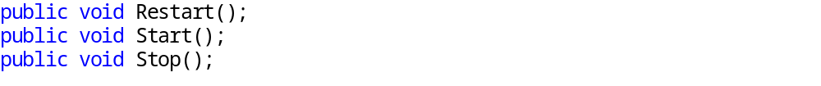
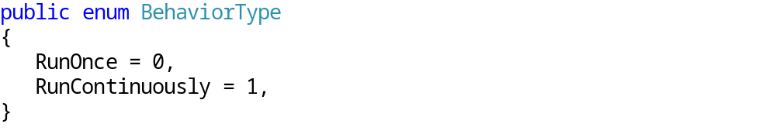
2. Basics of Timer settings
Gadgeteer.Timer (1)
It is a simpler variant of the Microsoft.SPOT.DispatcherTimer
It is simple to start, restart and stop.
Enumerates behavior types
  RunOnce: starts and calls the Tick event in the given interval, then stops („alarm clock”).
  RunContinuously: continuously calls the Tick event in the given period of time.
Both behavior call the Tick event:

Slide 15
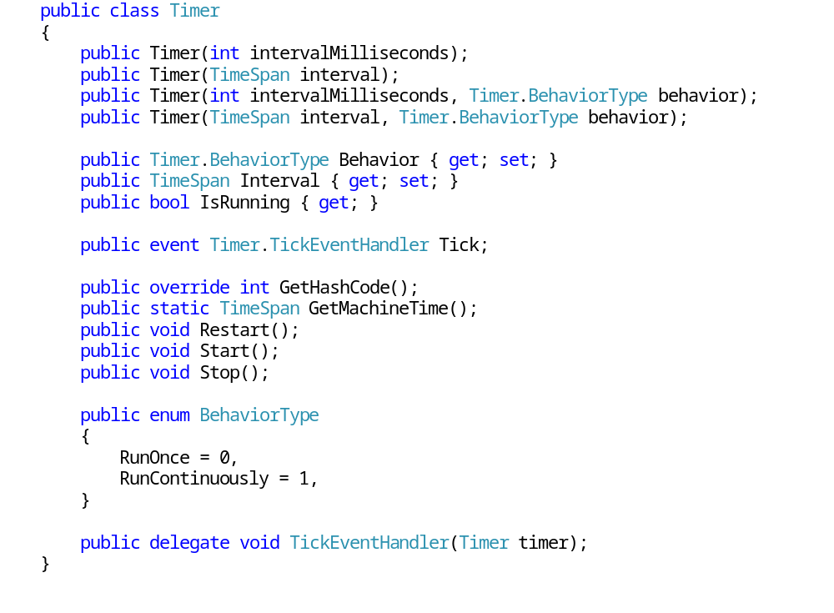
2. Basics of Timer settings
A Gadgeteer.Timer (2)

Slide 16
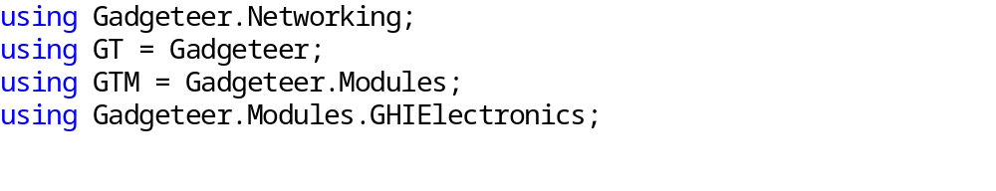
2. Basics of Timer settings
Gadgeteer.Timer (3)
After creating the project there are several Gadgeteer namespace reference appears:
For the sake of simplicity and to avoid the multiple name collision there is a “GT” alias for Gadgeteer.
The usage of GT alias: The classes of Gadgeteer are available as GT.Timer instead of Gadgeteer.Timer.

Slide 17
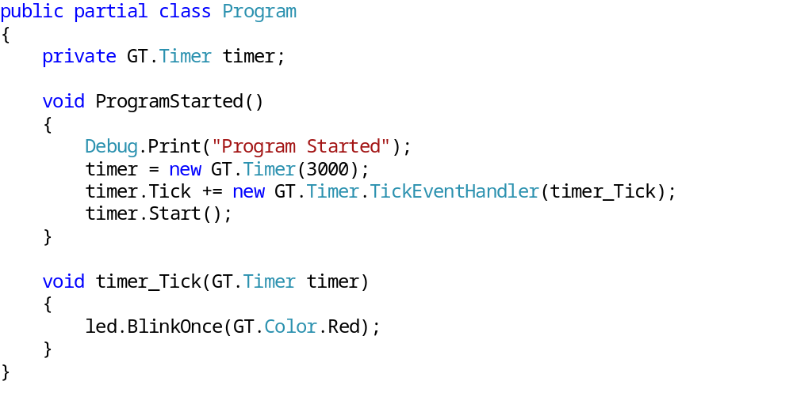
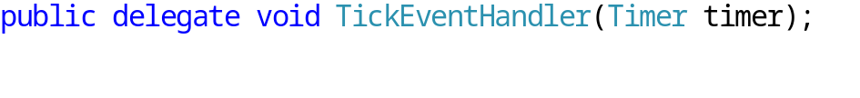
2. Basics of Timer settings
Gadgeteer.Timer (4)
Short example:
Note the signature of the TickEventHandler delegate!

Slide 18
3. Review questions
Explain how you implement the button press and release in the program code!
Describe how the System.Threading.Timer works!
Describe how the Gadgeteer.Timer works!
Compare the two type of timers!

