Slide 1
Óbudai Egyetem
Neumann János Informatikai Kar
.NET Gadgeteer – Graphical Display I.

Slide 2
Overview
Graphical display (TE35 Display)
Basics of drawing
Graphical stopper application

Slide 3
1. Graphical display (TE35 Display)
Characteristics of TE35
320x240 pixel resolution
Works as touchscreen
Sockets: R, G, B, T
  R, G, B: additive color system
  T (touch): recognize the touch
Connect the TE35 display R, G, B, and T slots to the Mainboard (10, 12, 13, 14 slots)!
Always connect the T socket to the Mainboard otherwive we get NullReferenceException!

Slide 4
1. Graphical display (TE35 Display)
The DisplayTE35 class
The DisplayTE35 class represents the graphical display.
Properties:
  Width: the screen width in pixels
  Height: the screen height in pixels
  SimpleGraphics: simple graphical operations such as: text, simple shapes, image drawing. Implements the SimpleGraphicsInterface.
  WPFWindow: is a WPF Window implementation for complex display/drawing tasks. Furthermore it facilitate the .NET MicroFramework controllers (StackPanel, Canvas, etc.) to be placed/embedded on the layout.

Slide 5
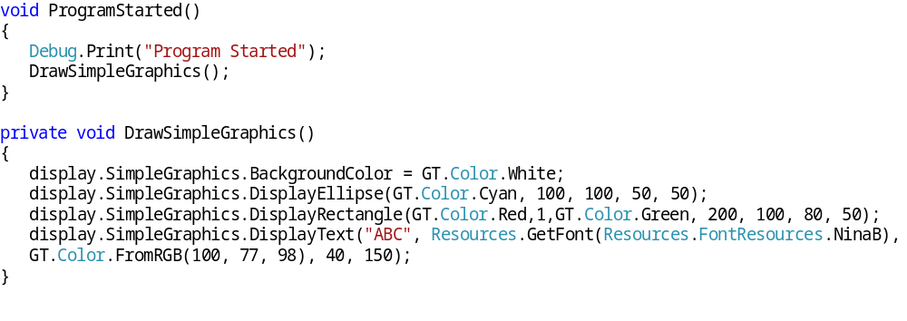
2. Basics of drawing
Drawing with the help of SimpleGraphics interface
We can access a SimpleGraphics instance with the DisplayTE35 object that helps with drawing:

Slide 6
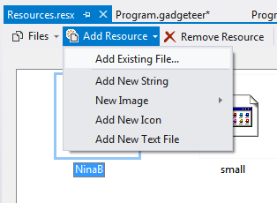
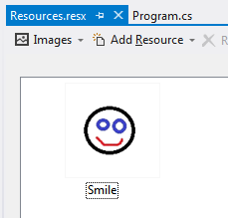
2. Basics of drawing
Attaching image to the Resources
To display image we do not need storing module if the image is placed in the resources:
  In the „Solution Explorer” window, double click on the „Resources.resx” item.
  In the pop up window different resource can be attached.
  Click on „Add Resource/Add Existing File…”
  In the new window select an image (supported formats: jpg, bmp, gif). Name the image.

Slide 7
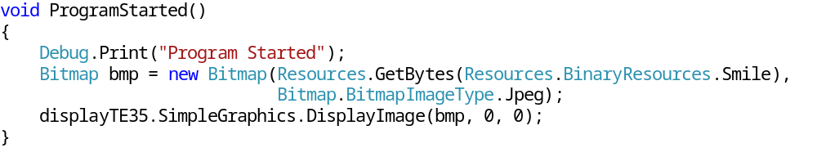
2. Basics of drawing
Displaying the image
The embedded content of Resources class will be available after compilation. Referencing to image by its name.
  We need compile first, because the Resources class contents’ ID is generated after compilation.
  To access the resources done by their identifiers, in some other cases by defining their types.
Displaying image on the screen done by DisplayImage() method:

Slide 8
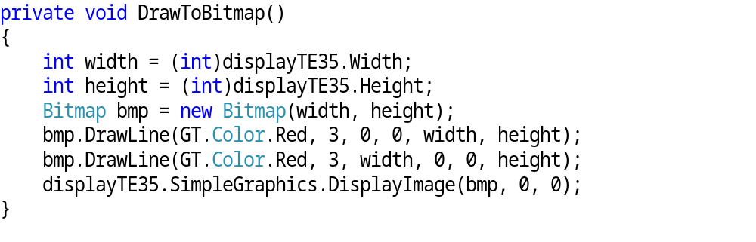
2. Basics of drawing
Image drawing
It is possible to draw on a bitmap object, then the modified object will be displayed on the screen.
Double Buffering technique based on the same principle.
Drawing on a bitmap the top left corner will be the origin, the size of the bitmap will determine the area for drawing.
The following method draws on a bitmap then displays the drawing:

Slide 9
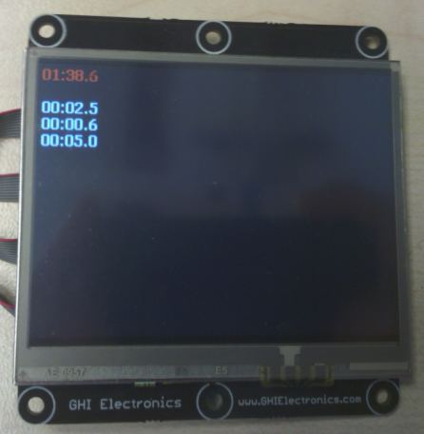
3. Graphical stopper application
Task
Create a simple stopper using the graphical display:
  By pressing a button the stopper starts.
  If the timing started, by pressing the button again the timing stops and the elapsed time displayed on the screen.
  By pressing the button third time the measured time should be stored (and kept on the screen), the stopper restarts.
  Three measured time are displayed.
Actual measured time
Previously measured times

Slide 10
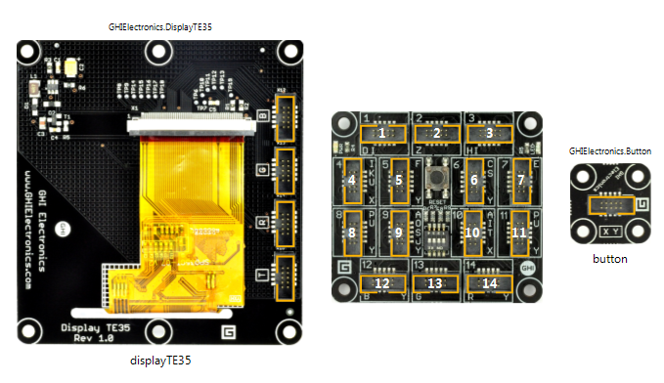
3. Graphical stopper application
The configuration
Create a new Gadgeteer project, and name it Stopper.
Complete the following configuration in the graphical designer:

Slide 11

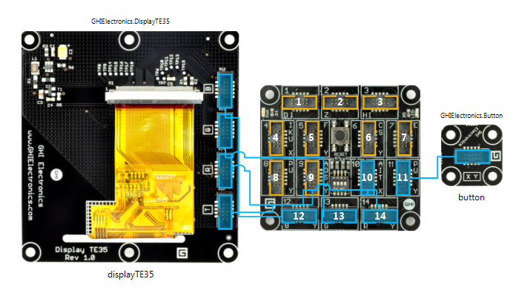
3. Graphical stopper application
Connecting the modules
The designer is capable to connect all modules automatically:
  Right click then select„Connect All modules”:
  The result of the automatic connection can be seen below, do the physical configuration according to the designer:

Slide 12
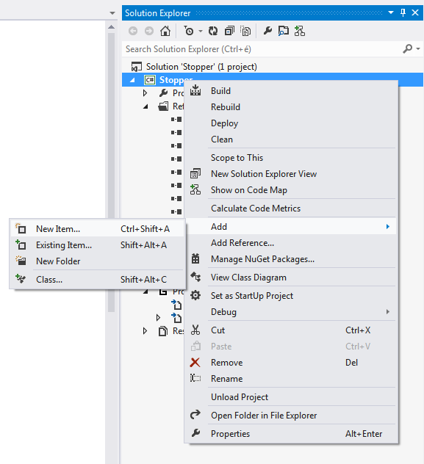
3. Graphical stopper application
Adding a new code file (1)
  A class can represent the Stopper itself, to be so create a new code file. Right click on the Stopper project then select “Add/New Item…”:

Slide 13
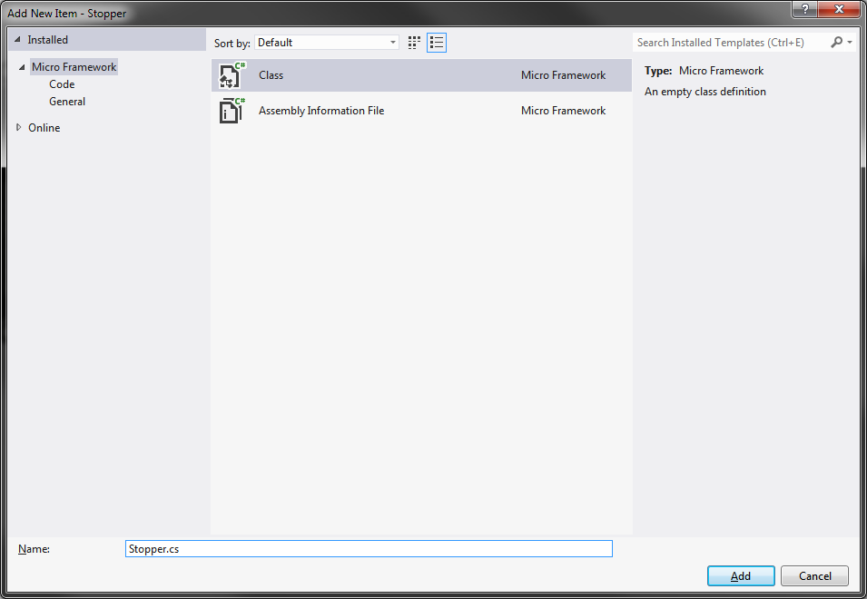
3. Graphical stopper application
Adding a new code file (2)
In the pop up window choose the „Class” item, name it as(„Name”): Stopper.cs, then click on the „Add” button.

Slide 14
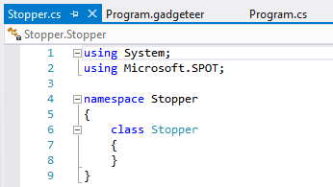
3. Graphical stopper application
Adding a new code file (3)
The new file has the Stopper class’ initial definition:

Slide 15
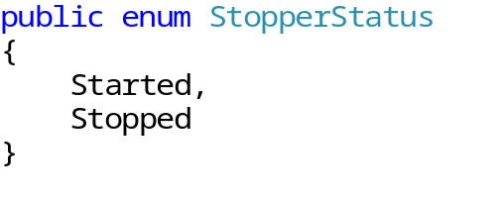
3. Graphical stopper application
Define the state types
To define the device state type we need a StopperStatus enumerator:
Explanation:
  Started: started state
  Stopped: stopped state

Slide 16
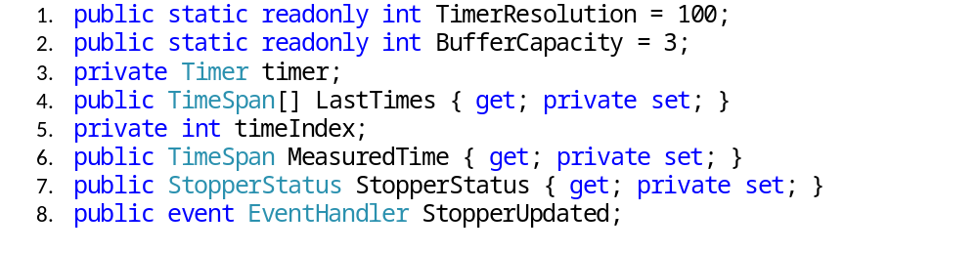
3. Graphical stopper application
Defining the fields
Explanation:
  Timer resolution (in this case 100 ms)
  The number of measurement results.
  Timer object to measure the elapsed time.
  The array to store the measured results.
  Variable to index the array.
  The currently measured time.
  The state of the stopper.
  Event handler to notify the Timer.

Slide 17
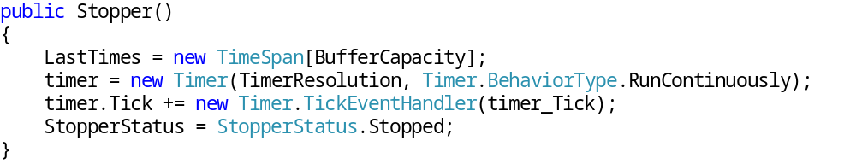
3. Graphical stopper application
The constructor
With the constructor we define the necessary objects and initialize the field(s):
Explanation:
  The array for storing the measurements is instantiated.
  Instantiation of the timer: it takes two arguments, the TimerResolution determines the time interval of calling the Tick event, the Timer.BehaviorType.RunContinuously parameter set it continuously repeating.
  We subscribe to the timer.Tick and define the timer_Tick method what will be implemented later.
  We set the status of stopper to Stopped state by default.

Slide 18
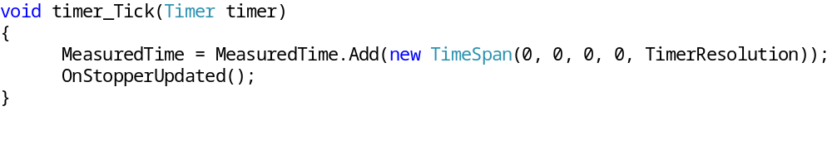
3. Graphical stopper application
Time measurement
The elapsed time is done by the timer_Tick method:
Explanation:
  The actually measured time is increased by the amount of TimerResolution, so the MeasuredTime stores the elapsed time since the button press.
  By calling the OnStopperUpdated() we notify the StopperUpdated event. See on the next page.

Slide 19
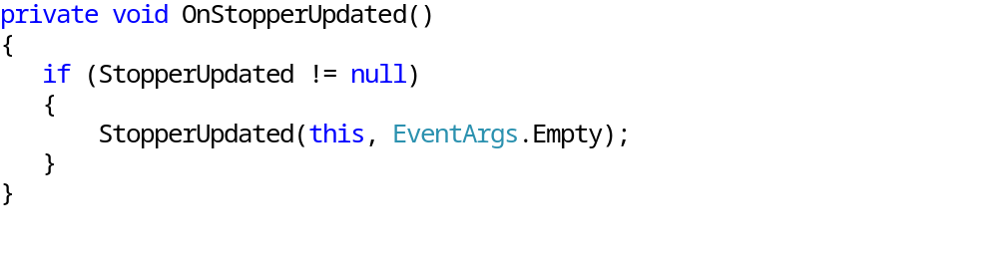
3. Graphical stopper application
The stopper update event
When a unit of time elapsed (TimeResolution = 100ms) the StopperUpdated event is notified by the method below:
Explanation:
  The OnStopperUpdated method raise the StopperUpdated event if the number of subscribers are not null (StopperUpdated != null). The parameters of the event: the instance reference (this) and no argument (Eventargs.Empty).

Slide 20
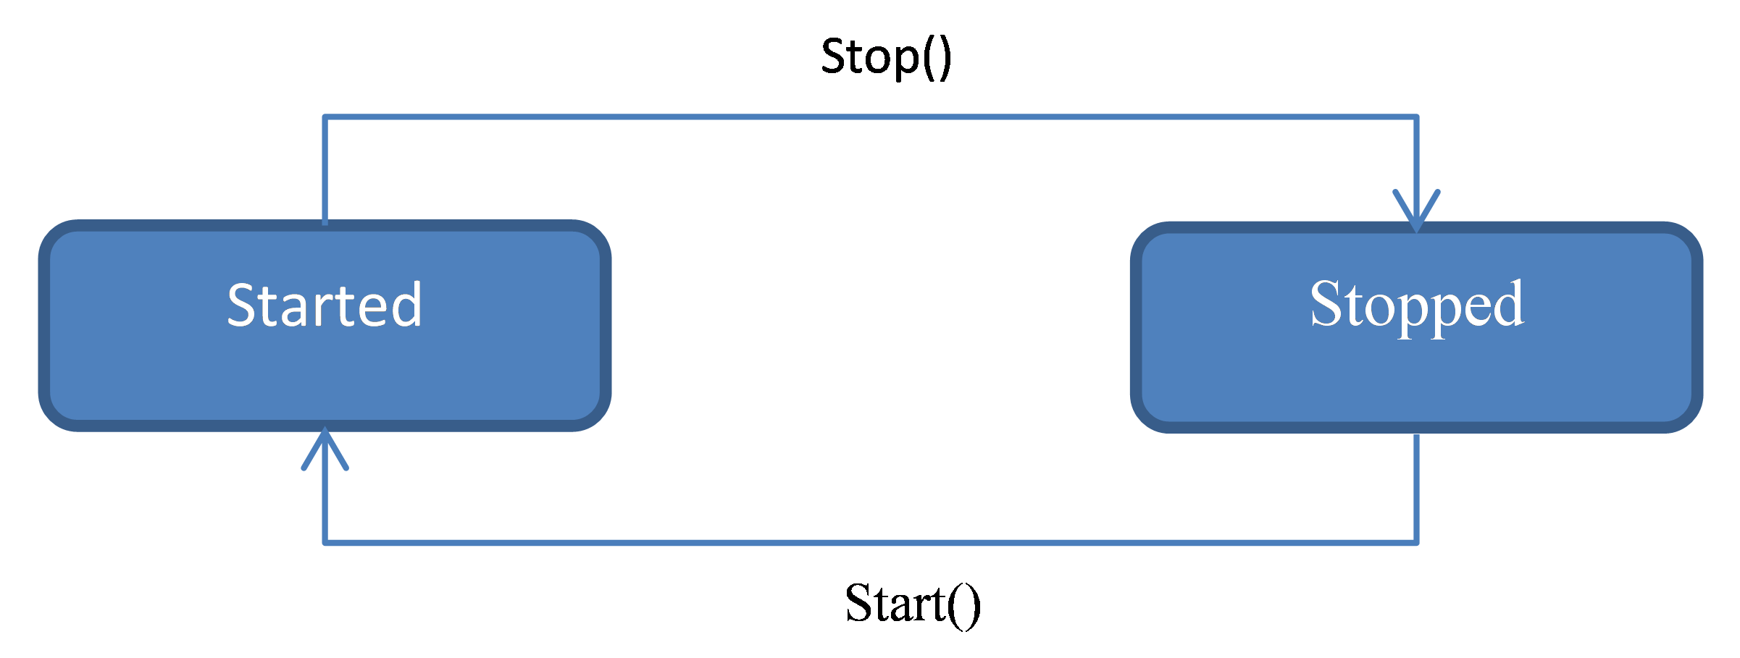
3. Graphical stopper application
Status change
Two method controls the status of the stopper:
  Start(): starts the stopper and switches to the Started state
  Stop(): stops the stopper and switches to the Stopped state
  To simplify the control the NextState method is added, which will do the next state transition based on the current state.

Slide 21
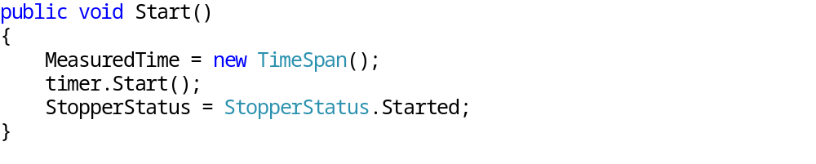
3. Graphical stopper application
Starting the stopper
The measurements starts by calling the Start():
Explanation:
  At start of the measurement we reset the measured time (as creating a new instance).
  Then the timer starts.
  The device status gets the Started state.

Slide 22
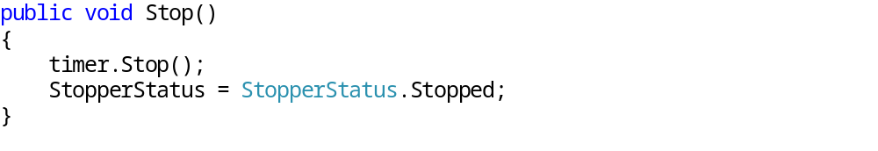
3. Graphical stopper application
Stopping the stopper
The measurements stops by calling the Stop():
Explanation:
  The timer stopped.
  The device status gets the Stopped state.

Slide 23
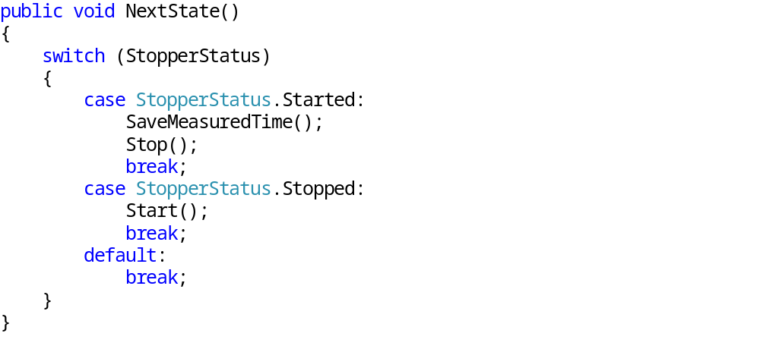
3. Graphical stopper application
Status change
The state transition is set by the NextState() method:
Explanation:
  Based on the actual state the timing starts or stops. In case of stopping the MeasuredTime is saved >> SaveMeasuredTime().

Slide 24
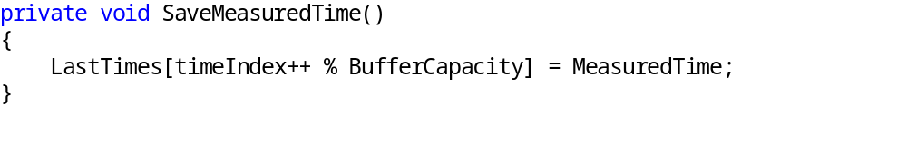
3. Graphical stopper application
Saving the measured time
To save the measured time implement SaveMeasuredTime() method:
Explanantion:
  The LastTimes array will store the next measured time. The indexing done with a division with remainder. The remainder is the index.

Slide 25
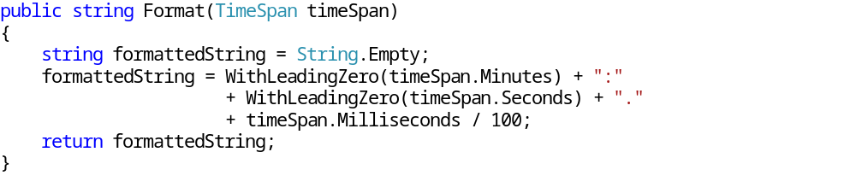
3. Graphical stopper application
String formatting (1)
To display the measured time we do string conversion and string formatting:
A .NET Micro Framework String class does not include Format() method, so we create our format method. It requires one parameter and its type is TimeSpan.
The method returns with a string as: minute:second.millisecond with leading zeros.

Slide 26
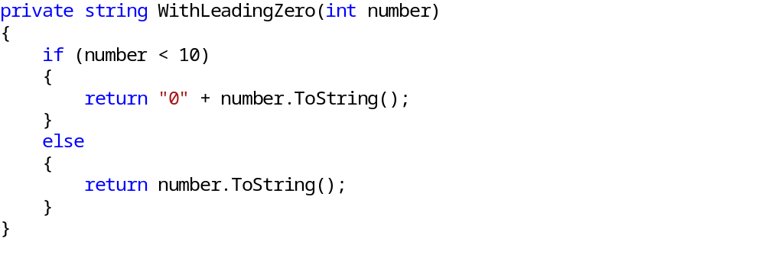
3. Graphical stopper application
String formatting (2)
The WithLeadingZero(int number) add a 0 to the one digit numbers:
The function’s parameter is an integer, and it returns with a string, if the parameter is lower than 10 then a 0 is placed to the front.

Slide 27
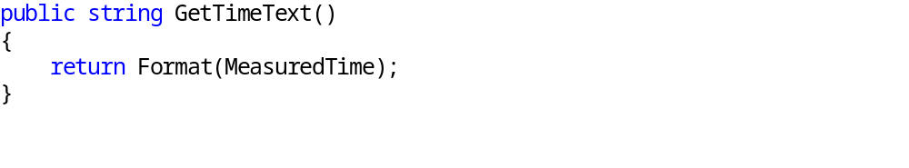
3. Graphical stopper application
Getting the measured time as string
The measured time by the stopper need to be sent to the display as a string. A GetTimeText() is introduced additionally:
The function calls the Format(TimeSpan timeSpan) method passing the actual measured time as parameter and returns the with a string.

Slide 28
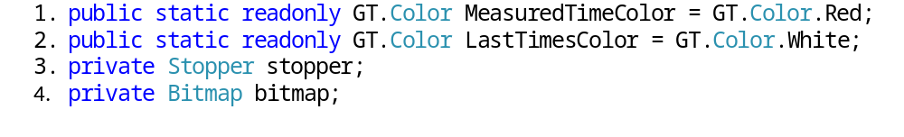
3. Graphical stopper application
Fields in the program class
Explanation
  The color of the actual time measure of the stopper.
  The color of the stored measured time.
  Stopper object.
  A bitmap object for drawing - flickerless.

Slide 29
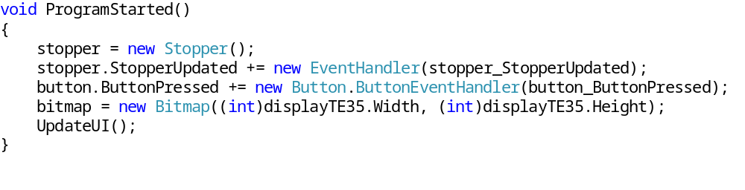
3. Graphical stopper application
Program class – initialization (1)
First the ProgramStarted() method is implemented:
Explanation:
  The stopper object is instantiated, we will need its features.
  With the stopper_StopperUpdated method we subscribe to the StopperUpdated event of the instance. >> Update the UI.
  To handle the button press we subscribe with the button_ButtonPressed method to the ButtonPressed event.

Slide 30
3. Graphical stopper application
Program class – initialization (2)
Explanation:
  By instantiating the bitmap object it takes two parameters what determines the image size. To take the graphical display size, we get the display object’s properties: display.Width , display.Height.
  Last step to call the UpdateUI() method to refresh the screen. It is implemented later.

Slide 31
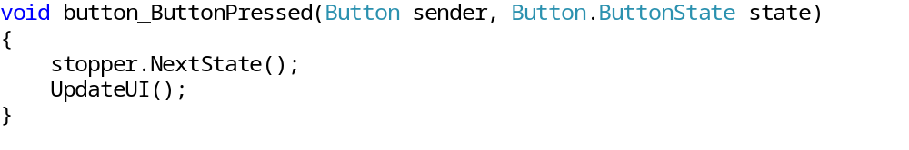
3. Graphical stopper application
Program class – button press handling
The user raise the ButtonPressed event of the button object by pressing the button. The button_ButtonPressed method is subscribed for it, it is implemented as follows:
Explanation:
  The stopper gets the next state.
  Updating the user interface.

Slide 32
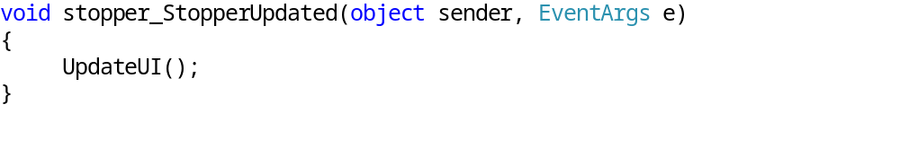
3. Graphical stopper application
Program class – frissítési esemény kezelése
When the time is updated the stopper class raise the StopperUpdated event. This is handled by stopper_StopperUpdated method:
Explanation:
  As the measured time updated the stopper object raise the event, the user interface is redrawn.

Slide 33
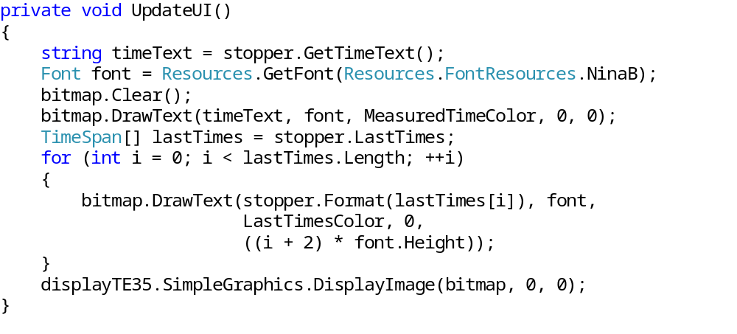
3. Graphical stopper application
Program class – update the user interface (1)
The user interface update is done by the UpdateUI() method. Every drawing operation is done by one bitmap, then displays on the graphical screen. With this solution we can avoid the “flickering”:

Slide 34
3. Graphical stopper application
Program class – update the user interface (2)
Explanation:
  We take the measured time from the stopper in string format.
  The graphical text display we need a Font type object, it will be stored in a local Font variable and it is referenced to an embedded resource.
  Before the drawing is we clear it.
  Next we draw on the bitmap the currently measured time – bitmap.DrawText(…).
  We iterate through the stored measured times and draw them on the bitmap similarly as the current measured time.
  After the drawing we display it as a bitmap image on the screen.

Slide 35

3. Graphical stopper application
The application
To run the application press F5.

