Slide 1
Óbudai Egyetem
Neumann János Informatikai Kar
.NET Gadgeteer – Graphical Display II.

Slide 2
Overview
Window based visualization
  The Window class
  UIElement – class hierarchy
  UIElement class
  Simple controllers: StackPanel, Canvas
  Using custom controls

Slide 3
1. Window based visualization
The Window class
The Window class represents a simple window, what allows us to place different “graphic control” and to display graphics on the screen.
We can add to the window any UIElement descendants, and it is possible to create custom UIElement.
The Window instance available by getting the DisplayTE35 module’s WPFWindow property:
  The WPFWindow was constructed in a similar way as the .NET Framework WPF components but it only contains a small subset of those features.
  XAML is not supported, the components have to be generated in the program code.

Slide 4
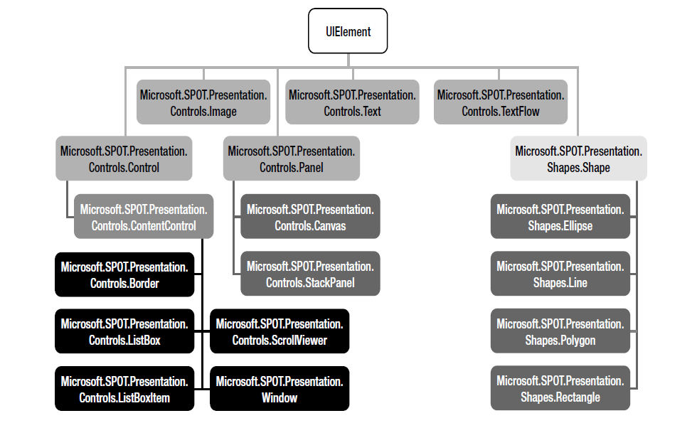
1. Window based visualization
UIElement – class hierarchy

Slide 5
1. Window based visualization
UIElement class
The UIElement is the base/ancestor class for every visual components.
It provides event handlers, functions and properties such as: visibility, size, drawing, alignment, screen touch event handlers, etc.
There are three main types of controllers:
  Static controllers: elements which are not capable to have any child, eg.: Text, Bitmap
  Content controllers: elements which are capable to have exactly one child eg.: ListBoxItem, Border, Window, etc.
  Panels: elements which are capable to have multiple number of children, eg.: Canvas, StackPanel. The StackPanel provides a specific way to arrange the items on the window.

Slide 6
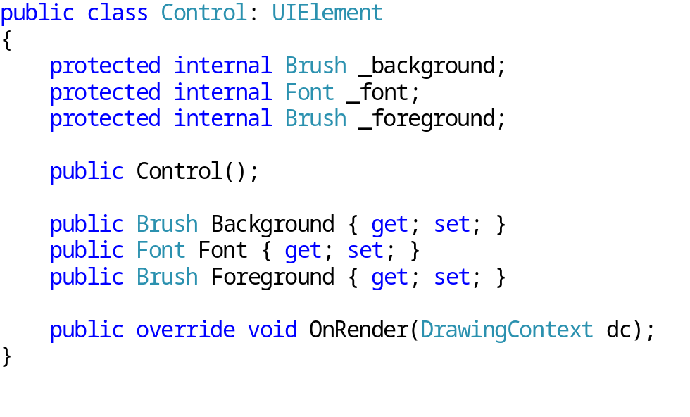
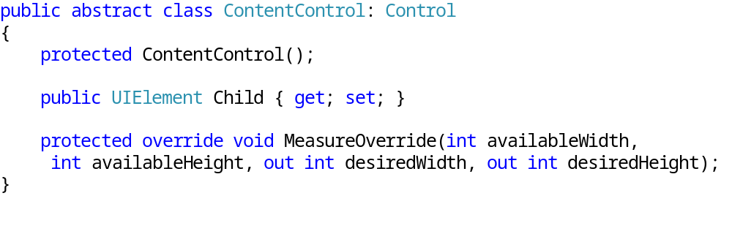
1. Window based visualization
Control, ContentControl

Slide 7
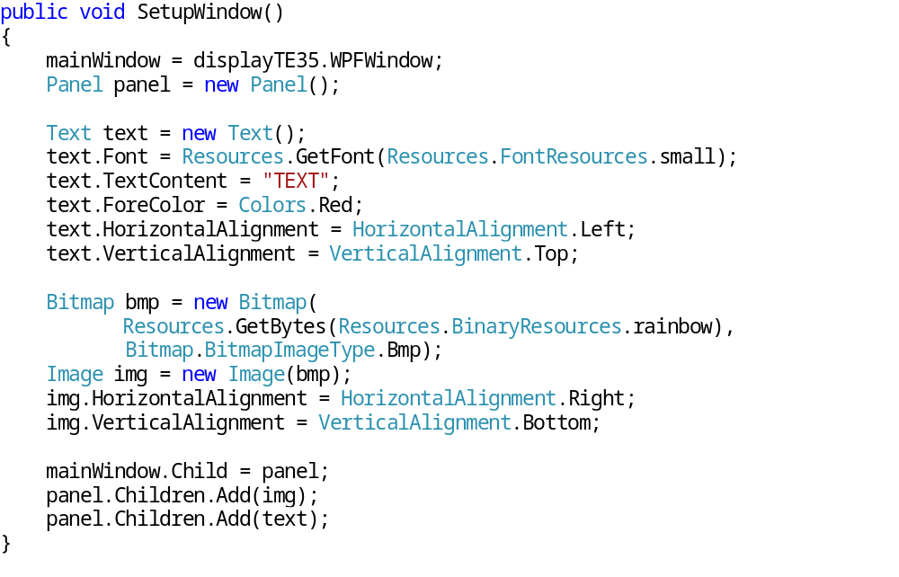
1. Window based visualization
Panel, StackPanel (1)

Slide 8
1. Window based visualization
Panel, StackPanel (2)
The UIElements can be placed in different ways on the panel (align to left, - to right, -to center).
Pixel based access not possible.
StackPanel is the descendant of the Panel class, the elements will placed under each other, depending the order of child addition. The vertical alignment is possible but the horizontal is done in the given order (as it was added).

Slide 9
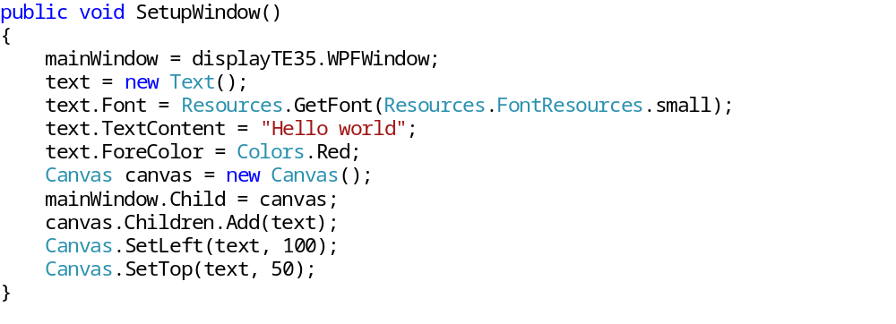
1. Window based visualization
Canvas (1)
With the help of the Canvas class we have a canvas on the window.
Canvas operates on pixel based access, the children of the canvas can be placed arbitrarily – SetLeft(), SetTop() methods used usually.

Slide 10
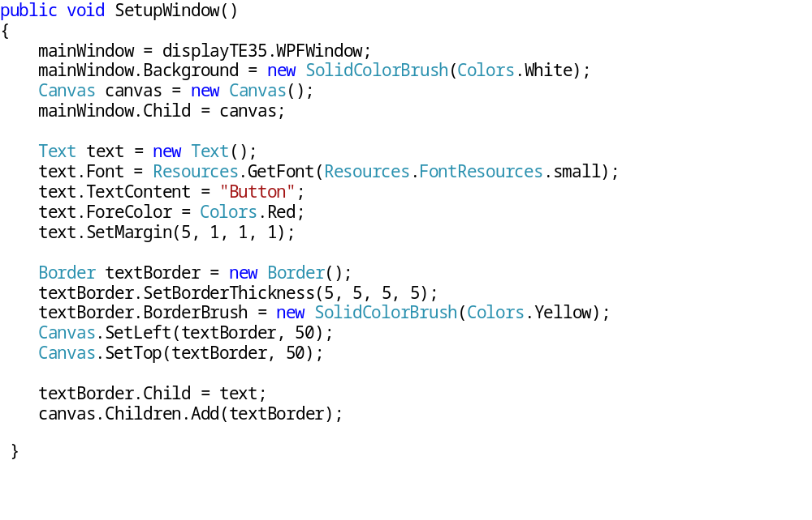
1. Window based visualization
Background, Border – Canvas (2)

Slide 11

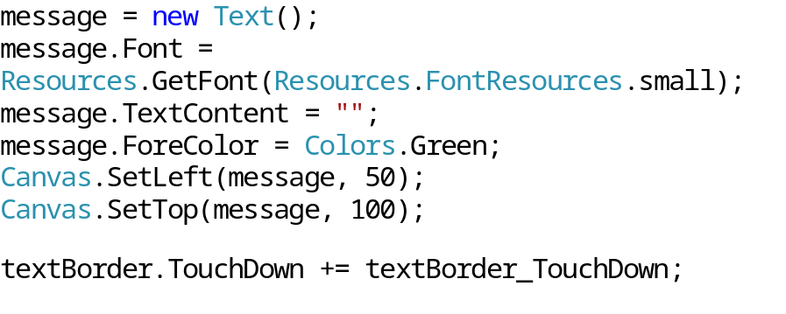
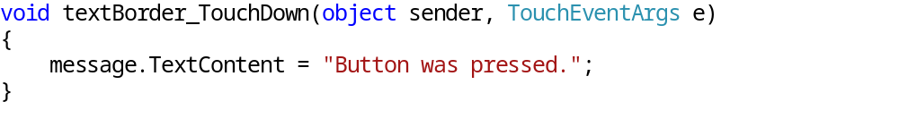
1. Window based visualization
Event handling
In the previous example a button was made. Using the touch screen as an interface and pressing the button (its area) the program should display a message!
  Lets define a Text type, message field!
  Extend the SetupWindow() method creating the object as below and subscribe to the textBorder.TouchDown event:
  Lets implement the event handler method:

Slide 12
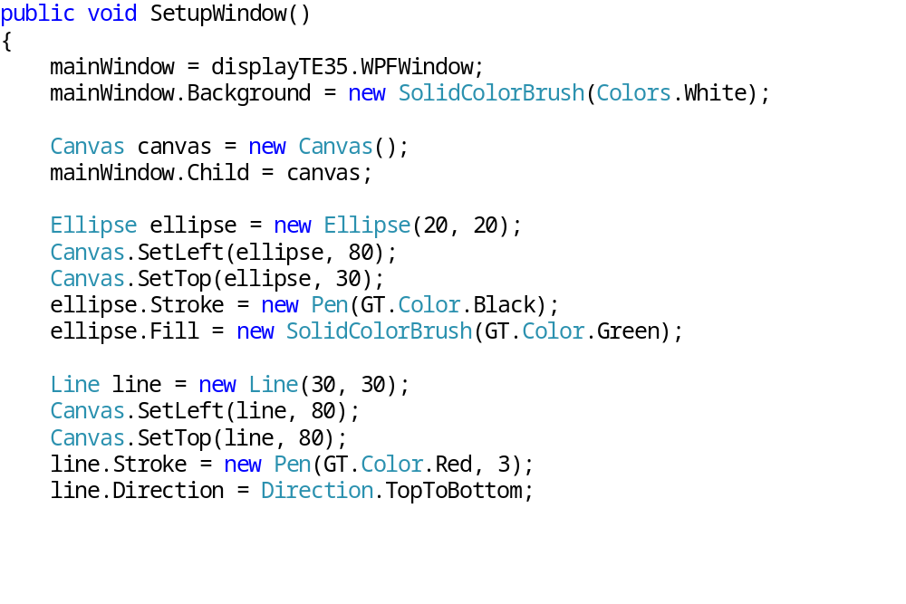
1. Window based visualization
Graphical shapes (1)

Slide 13
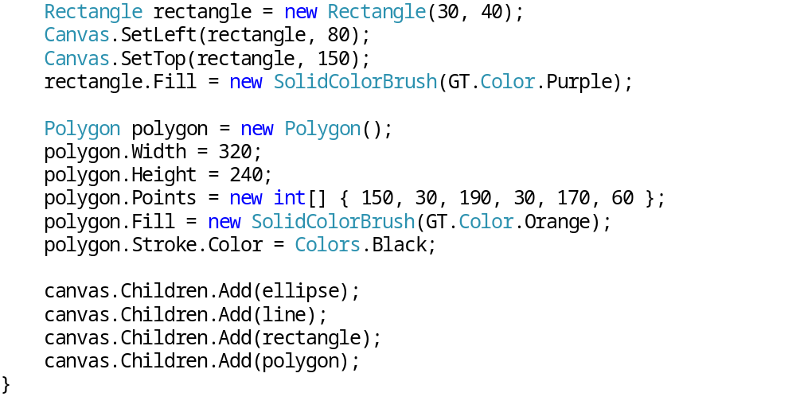
1. Window based visualization
Graphical shapes (2)

Slide 14
1. Window based visualization
Using custom controls
Choosing the right control is depending on what we want to do but it is handy to inherit from the right control:
  UIElement: the drawing is completely custom
  Control: the drawing is custom and the control has background
  ContentControl: the control contains children items, there is no need for organizing these items.
  Panel: the Panel let us to organize the children elements.

Slide 15
1. Window based visualization
Organizing and measuring the elements
The following methods do the placement/allocation:
  The MeasureOverride method called to identify the available space for the elements, and the desired space to place them. The method input parameters are the following: available width and height, the output parameters are the: desired width and height (in case of picture – the size of the picture, for text – the sufficient space for the character chain). To fill the maximal available space for each element the desired sizes must be sufficient.
  After determining the sizes the virtual ArrangeOverride method is called, which will adjust the final sizes based on the previous method’s output. The Panel control is using this method to place its children to the right place.

Slide 16
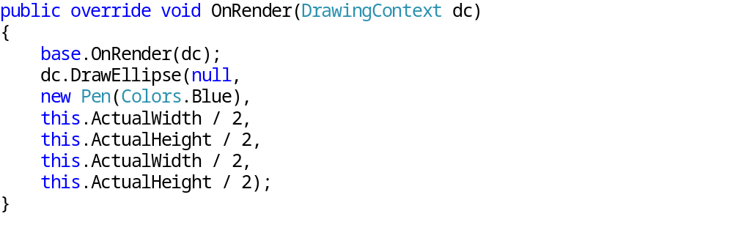
1. Window based visualization
Drawing with custom control
For custom drawing we need to define the OnRender virtual method:
The taken parameter is a DrawingContext object, the type helps us to draw the given element:

Slide 17
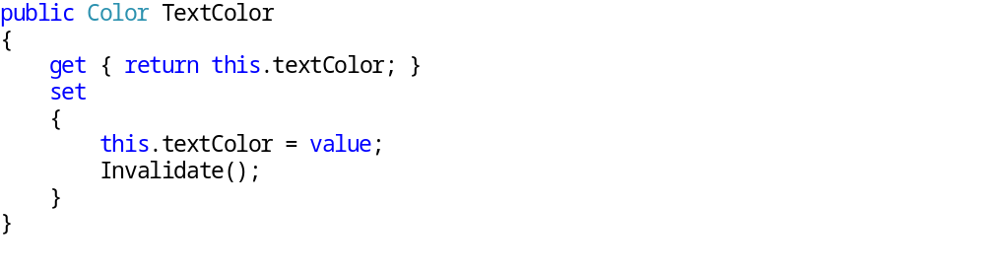
1. Window based visualization
Extend them with properties
If we want to extend the custom control, which will affect the display, update operation is necessary:
In the example above we defined a color for text property. If this property changes the element will be redrawn with the Invalidate() method.
Knowing that the added property will change the element size, then the InvalidateMeasure() need to be called.
If the added property affect the layout of the elements the InvalidateArrange() should be called.

Slide 18
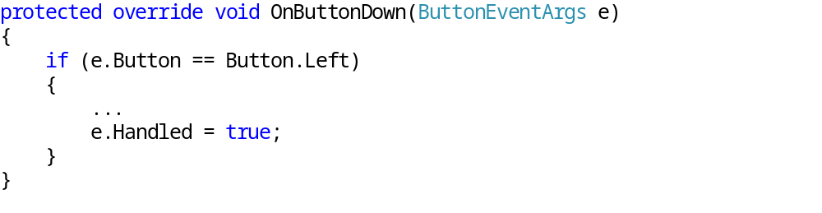
1. Window based visualization
Event handling for custom controls
To handling an event it is worth to use the Handled parameter, it notifies the parent objects does not need to process it:

Slide 19
Review questions
Compare the Window based visualization with the SimpleGraphics way!
Describe the UIElement class hierarchy!
How do we create custom graphic control, and what type of options we have in the descendant chain?
Extending the properties of a custom control, what are the things we wish to mind?

