Slide 1
ÓBUDA UNIVERSITY
John von Neumann Faculty of Informatics
.NET Gadgeteer – Joystick module

Slide 2
Introduction
Using the Joystick module
  Event handling
  Reading the status and position
Creation of an example application
Questions for preparation

Slide 3
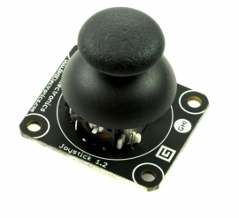
1. Using the Joystick module
Parameters of the Joystick
Position of the Joystick (along the X and Y axis)
  Values may be taken in the interval of [-1,1] on both axis. Zero (0,0) means default position.
  Hint: GetPostion();
Button state of Joystick: pressed/released
  Hint: IsPressed property

Slide 4

1. Using the Joystick module
Event Handling
The Press Event of the button of the Joystick is listened to by two Event handlers:
  JoystickPressed: Triggered if button is pressed
  JoystickReleased: Triggered if button is released
The JoystickEventHandler delegate:
  sender: Joystick object that triggers the event
  state: the state of the button when the event is triggered

Slide 5
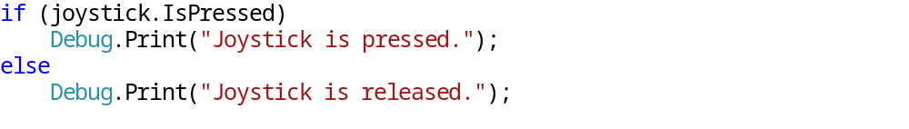
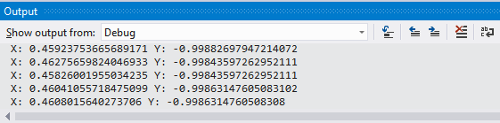
1. Using the Joystick module
Accessing status and position(1)
IsPressed property is used to read the state of the Joystick at any arbitrary moment. (True = Pressed; False = Released)
GetPosition() method is used to return the position of the Joystick (x;y coordinates) at any arbitrary moment.

Slide 6
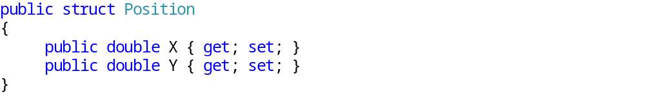
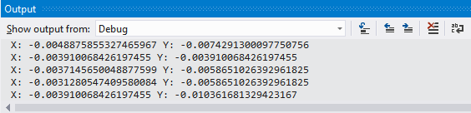
1. Using the Joystick module
Accessing status and position(2)
Accessing the current position of the Joystick we get an instance of the Position struct which has got two double fields corresponding to X and Y axis.
  Reading the values minor noises may appear so one must never compare values using many decimal numbers or the equals sign (‘=‘). Bear in mind that even if the Joystick is in its default positon the GetPosition() will NOT return (0,0).

Slide 7
2. Creation of an example application
Exercise
Create an application that constantly displays the current state of the Joystick.
  Represent the shift along the X and Y axis textually.
  Display whether the Joystick is pressed or not.
  Display a marker (line) which corresponds to direction of the shift.

Slide 8
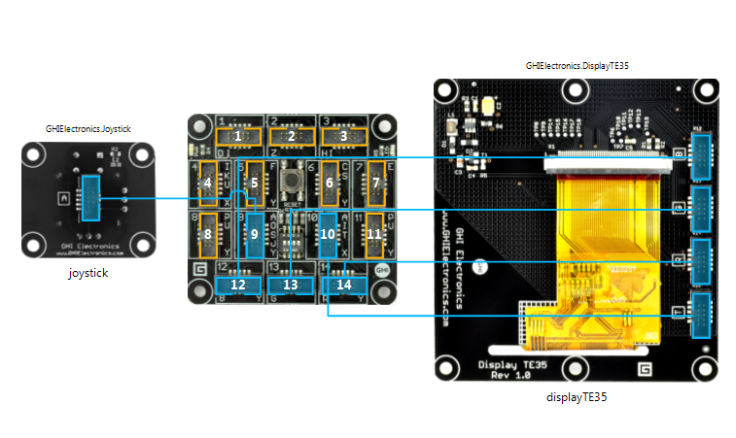
2. Creation of an example application
Configuration
You need the configuration shown below:

Slide 9
2. Creation of an example application
Plan of the application
You need to get the state of the Joystick continuously. For that, use a timer which operates in periodic mode.
In order to avoid the Screen from flashing all the time, declare a Bitmap and do all the necessary drawings on it, then display it on the Screen (double buffering)
Watch out, the values of the Joystick are not always precise. Hence, the default position is not the (0,0) coordinate either.

Slide 10
2. Creation of an example application
Steps to take
Declare the fields
Initialize
  Bitmap
  Timer
  Calculate with the auxiliary variables
Start Timer
Get the state and display it
  Check the Position of the Joystick
  Check the state of the Joystick
  Draw the state (parameters, direction) on the Bitmap
  Display the Bitmap

Slide 11
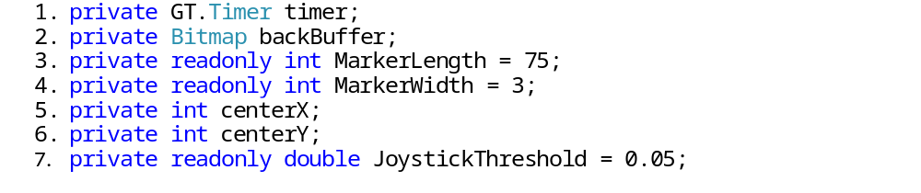
2. Creation of an example application
Declare the fields
Explanation:
  Instance of the Timer
  Bitmap object for drawing
  Length of the marker (line) representing the direction of the shift
  Width of the marker (line) representing the direction of the shift
  Horizontal coordinate of the center of the Screen
  Vertical coordinate of the center of the Screen
  Threshold for the minimal shift of the Joystick

Slide 12
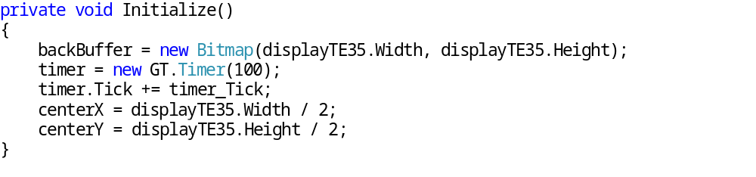
2. Creation of an example application
Initialization
Explanation:
  The Bitmap object is instantiated such that it fits to the measures of the Screen.
  The Timer object is instantiated with 100ms of periodic time. (i.e. the Tick event will be invoked 10 times in every second.)
  centerX and center are auxiliary variables to store the coordinates of the center of the Screen. The fixed end of the marker line is on this coordinate.

Slide 13
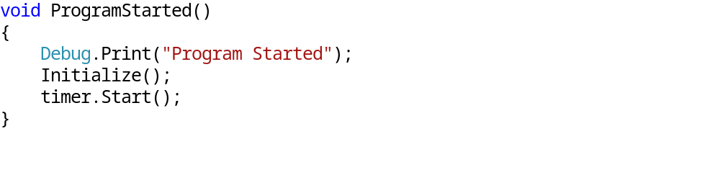
2. Creation of an example application
Starting the timer
After the initialization the timer is started
When the timer starts the timer_Tick method is invoked 10 times a second. Multiple tasks are to be implemented there.

Slide 14
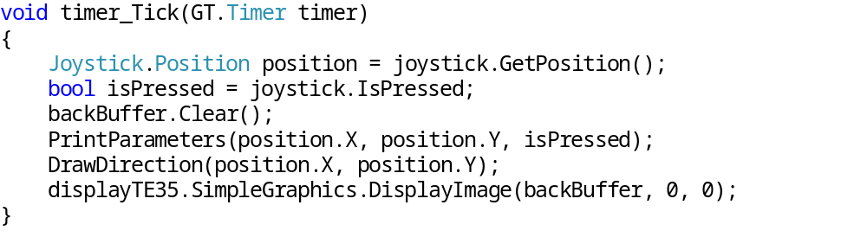
2. Creation of an example application
Getting and displaying the state(1)
Must be repeated continuously so that we can display the state in real-time.
Explanation:
  The shift and state of the Joystick is returned by the GetPosition() method and the IsPressed property.
  After erasing the Bitmap, the previously acquired values are drawn using the PrintParameters() and DrawDirection() methods.
  The Bitmap is displayed through the DisplayImage() method.

Slide 15
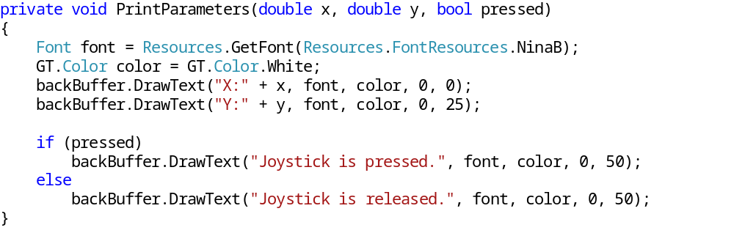
2. Creation of an example application
Getting and displaying the state(2)
Printing parameters:
Explanation:
  Represent the shift along the X and Y axis textually on the Bitmap
  Represent the state of Joystick the textually with the help the pressed variable.

Slide 16
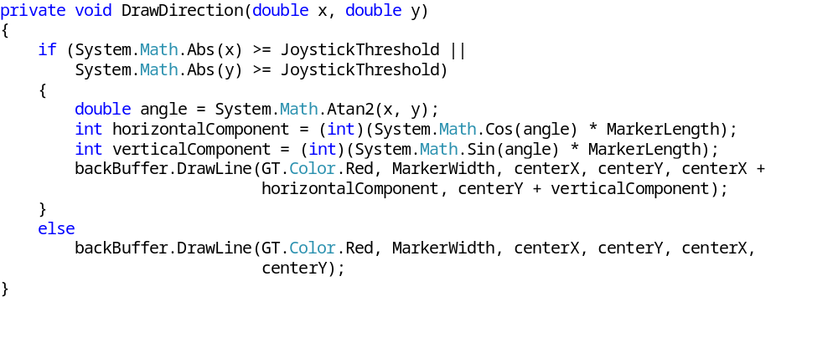
2. Joystick példaprogram készítése
Getting and displaying the state(3)
Drawing the direction:
Explanation
  The shift along the axis is compared to threshold number.
  Ha az elmozdulás mértéke valamely tengely mentén meghaladja a küszöbszámot, akkor kirajzolásra kerül az irány, egyébként egy pont jelenik meg a képernyő közepén If the value of the shift exceeds the threshold on any axis, the direction marker is drawn. Otherwise, only a point is drawn.

Slide 17
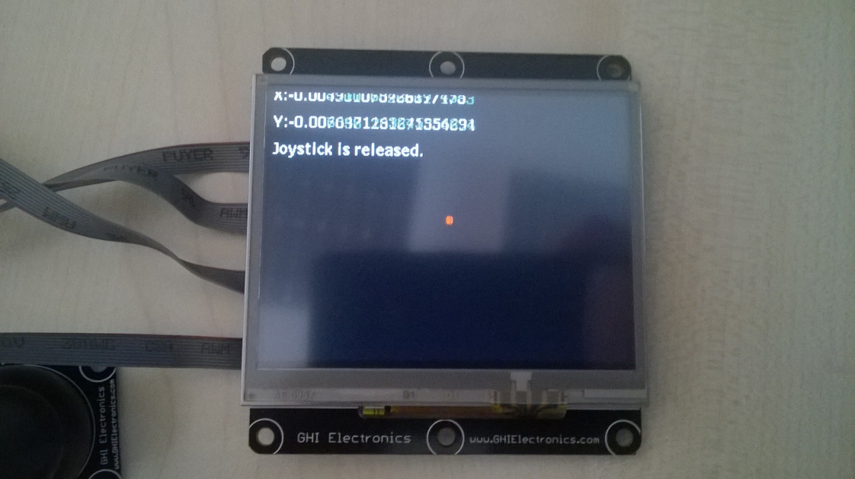
2. Joystick példaprogram készítése
Application in use

Slide 18
3. Questions for preparation
What techniques do know to acquire the state of the button of the Joystick?
How can you get the current shift along the x and y axis? How would you work with this value?
What is that you should always pay attention to while working with the shift values?

