Slide 1
Client processors – 8.1
Select platform issues
Dezső Sima
November 2020
(Ver. 2.2)
© Sima Dezső, 2020

Slide 2
8.1 Select platform issues
1. Connecting memory channels to client platforms
2. Using Optane memory
3. Implementing PCIe ports
4. Implementing USB ports
5. Implementing Thunderbolt ports
6. Wi-Fi 6 support
7. Physical implementation of client processors

Slide 3
1. Connecting memory channels to client platforms
Notes:
3

Slide 4
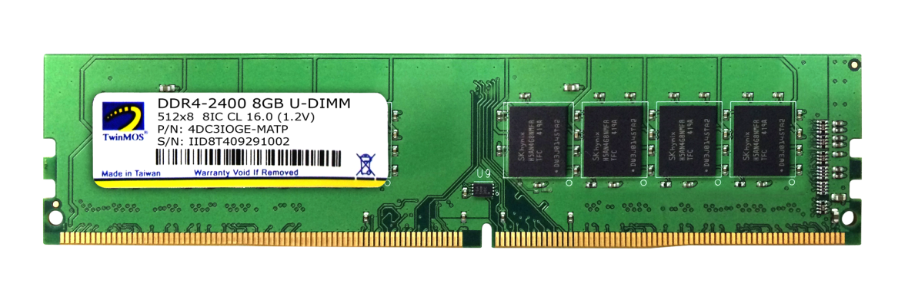
1. Connecting memory channels to client platforms (1)
1. Connecting memory channels to client platforms
Recap: DIMMs, DRAM interfaces and memory channels
Memory chips are placed on DIMMs (Dual-In-Line Memory Modules).
Figure: Example: DDR4 DIMM
DIMMs have wide parallel interfaces.
SDRAM to DDR4 DIMM interfaces have separate address and bidirectional,
64-bit wide data buses to read or write 64 data bits per clock cycle.
Consequently, SDRAM to DDR4 DIMMs are said to be 64-bit wide (data bits).
By contrast, DDR5 DIMMs provide 2x32-bit wide data-interfaces (see next).
Typically, memories used in client platforms do not support ECC (Error
Checking and Correction), except Ryzen CPUs with select motherboards.
By contrast, HEDTs and servers typically need DDR memories with ECC support
to protect the precision of numeric calculations.
*

Slide 5
1. Connecting memory channels to client platforms (2)
Connecting DIMMs to client platforms -2
Due to their parallel interfaces DIMMs need a large number of pins; e.g. 168 for
SDRAM or 284 for DDR5, as the next Figures show.
*

Slide 6
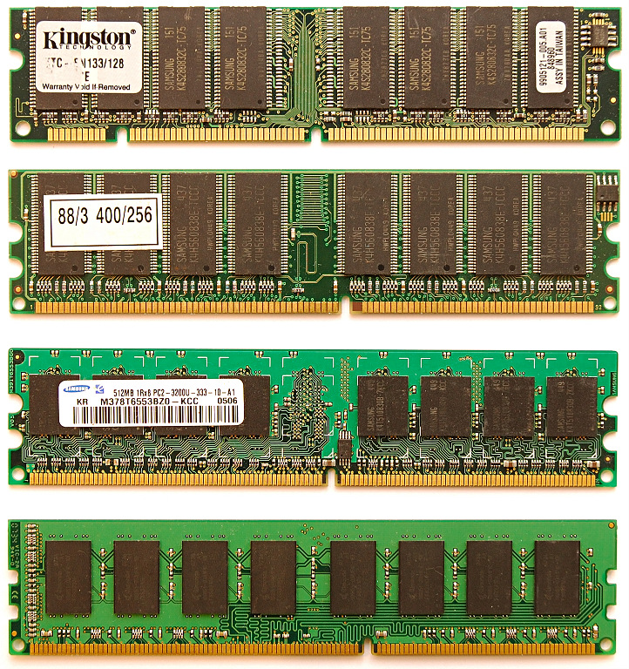
1. Connecting memory channels to client platforms (3)
Width of DRAM interfaces
(Pin counts of DIMMs) -1
SDRAM
(SDR)
168-pin
All these DIMMs
are 8-byte wide
(+8-bit if ECC
supported)
DDR
184-pin
DDR2
240-pin
DDR3
240-pin
DDR4
284-pin
ECC: Error Checking and Correction
*
Notes:
6

Slide 7
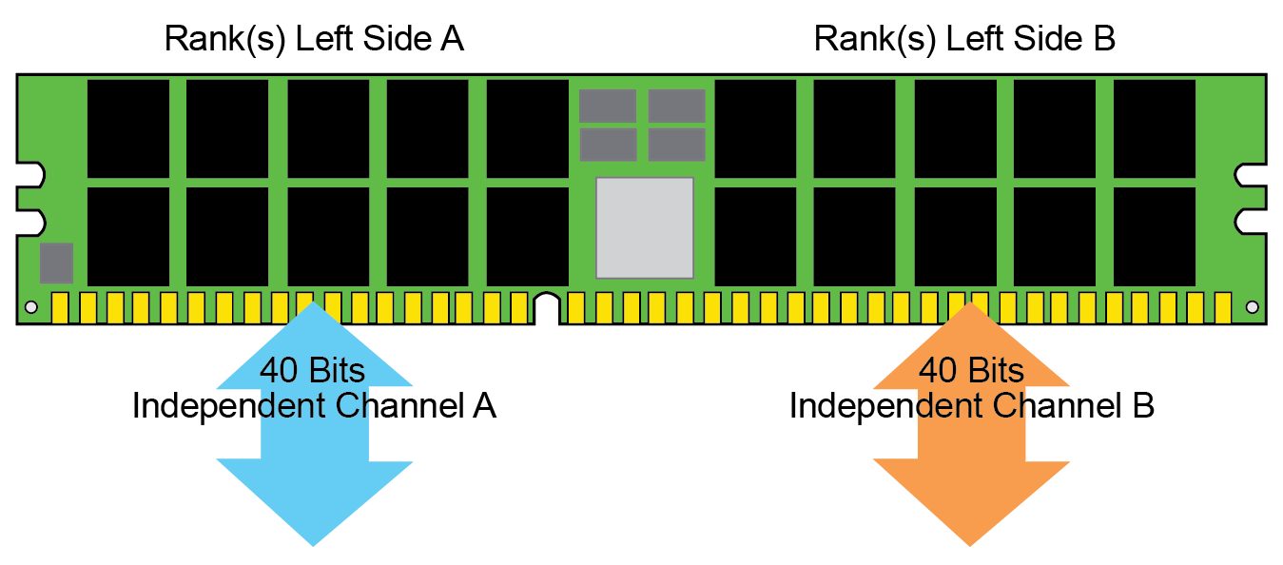
1. Connecting memory channels to client platforms (4)
Width of DRAM interfaces
(Pin counts of DIMMs) -2
DDR5 DIMMs
are 2x4-byte wide
+2x8-bit if ECC
supported [292].
DDR5
284-pin
*

Slide 8
1. Connecting memory channels to client platforms (5)
Connecting DIMMs to client platforms -1
Memory transfers are managed by the MC (Memory Controller), it is included
in earlier platforms in the MCH and in recent platforms in the processor.
In client platforms DIMMs and the MC are interconnected directly, via the
parallel DIMM interface, called also the DRAM interface, as seen in the next
Figure.
DRAM if.
DIMMs
Platform
MC
Memory
channels
Memory
Figure: Interconnecting DIMMs and the MC
The links interconnecting DIMMs and the MC are designated as the memory
channels.
MCH: Memory Control Hub (aka North Bridge)
*

Slide 9
1. Connecting memory channels to client platforms (6)
Key aspects of connecting memory channels to client platforms
Key aspects (discussed) of connecting memory channels to client platforms
Where to connect
memory channels?
Section a)
Type of the memory
connected
Section b)
Number of memory channels
connected
Section c)
*

Slide 10
1. Connecting memory channels to client platforms (7)
a) Where to connect memory channels?
There are two main alternatives where to connect memory channel to a client
platform, as shown below.
Connecting memory channels directly to a client platform
Connecting memory channels
via the MCH
MC is integrated
into the MCH.
Data is transferred
between the MCH and
the processor through
the FSB (Front Side Bus)
Processor
FSB
MCH
MC
Memory
ICH
MCH: Memory Control Hub
IOH: IO Control Hub
*

Slide 11
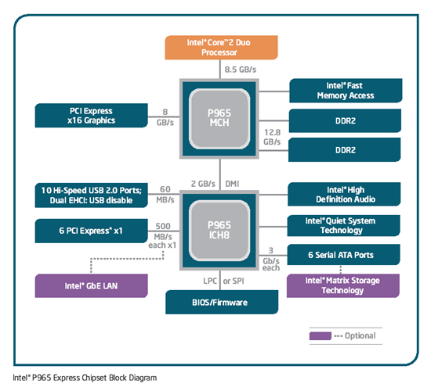
1. Connecting memory channels to client platforms (8)
Example 1: Connecting memory channels via the MCH
(actually in Intel’s Core 2 Duo based platform (2006)) [158]
FSB: 1066 MT/s
DDR2-800
Figure: Core 2 Duo based platform [158]

Slide 12
1. Connecting memory channels to client platforms (9)
Alternatives for connecting memory channels directly to a client platform
There are two main alternatives how memory channels can directly be connected
to a client platform, as shown below.
Connecting memory channels directly to a client platform
Connecting memory channels
via the MCH
Connecting memory channels
via the processor
MC is integrated
into the MCH.
Data is transferred
between the MCH and
the processor through
the FSB (Front Side Bus)
MC is integrated
onto the processor die.
The MC is usually linked
by an interconnect fabric
to other units (e.g. cores)
of the processor.
Processor
Processor r
MC
Memory
FSB
FSB
MCH
MCH
MC
Memory
ICH
MCH: Memory Control Hub
IOH: IO Control Hub
ICH
*

Slide 13
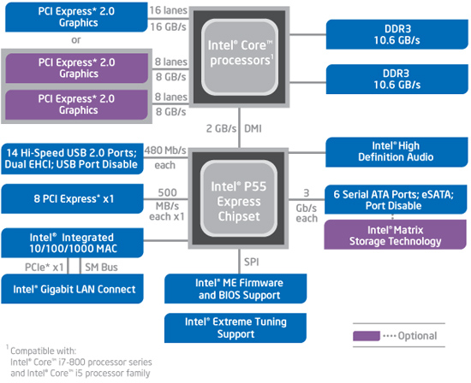
1. Connecting memory channels to client platforms (10)
Example 2: Connecting memory channels via the processor
(actually in Intel’s 2. gen. Nehalem based platform (2009)) [159]

Slide 14
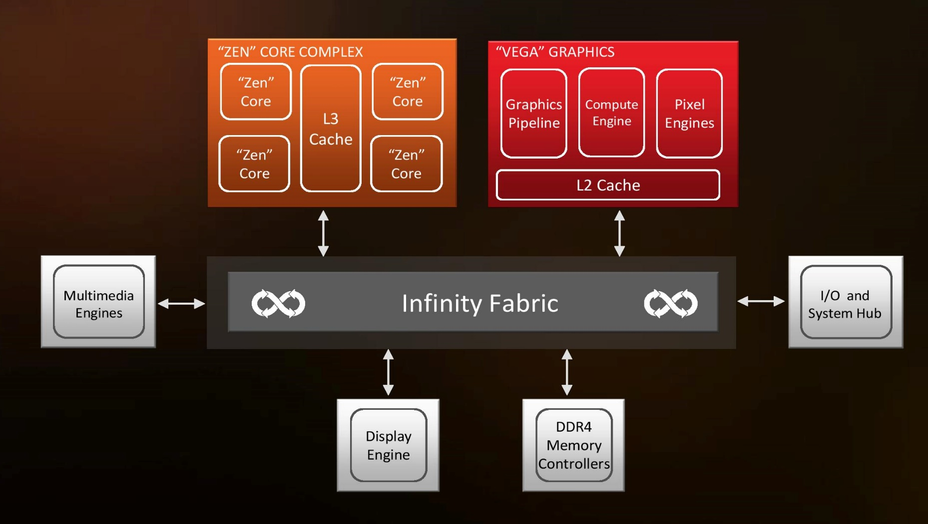
1. Connecting memory channels to client platforms (11)
Example 3: Attaching memory channels via the processor (and on the die
via an interconnect fabric, e.g. in AMD’s Zen-based APU) (2017)) [161]
(IF)
Dual
channels
The IF (Infinity Fabric) is a cache coherent interconnect that services 6 clients
in the above example, it is basically crossbar-based.

Slide 15
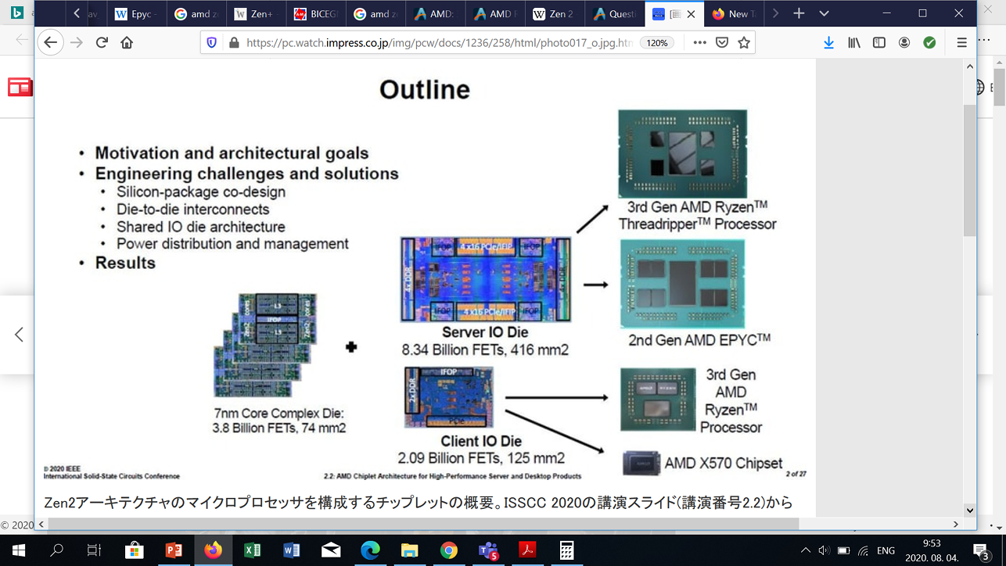
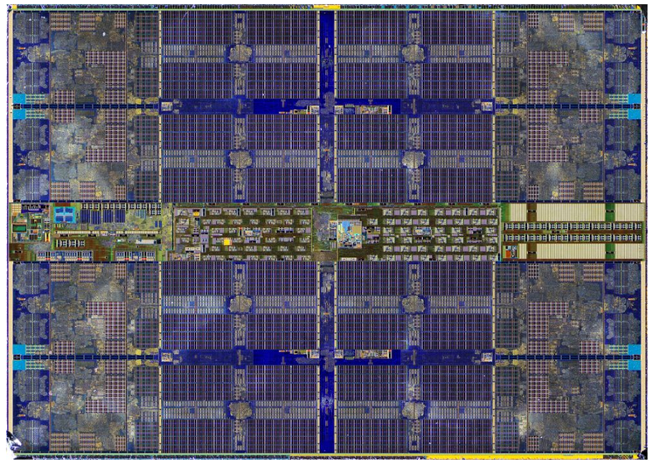
1. Connecting memory channels to client platforms (12)
Remark to connecting memory to the processor in chiplet-based designs
In chiplet-based designs, such as AMD’s 3. gen. Zen-2 based GPU-less client
processors, the processor is implemented on two or three dies, one or two CCD
dies and one IO die.
In this case memory channels are connected further on to the processor, such
that the memory channels are attached to the IO-die rather than to the CCD die
that incorporates the CPU cores.
3. gen. Zen2-based GPU-less (Matisse) processor (2019)
(with a single CCD die) [293], [125]
Memory
Memory
controller
Client IO die
(12 nm)
GPU-less 8-core CCD die
(7-nm)

Slide 16
1. Connecting memory channels to client platforms (13)
Benefits of connecting memory channels directly to a client platform
In the course of processor evolution connecting memory to the processor became
the standard solution due its benefits in terms of shorter access latency and higher
available memory bandwidth in multiprocessors (as the subsequent Figure shows).
*

Slide 17
1. Connecting memory channels to client platforms (14)
Example for connecting memory directly via the processors of a 4S server
(actually, in Intel’s Skylake-SP based up to 28-core Purley server platform)
(2017)
Platinum 8100
(Skylake-SP)
28C
PCIe 3.0
PCIe 3.0
40
40
Skylake-SP 28C
UPI
Skylake-SP 28C
UPI
UPI
UPI
UPI
Skylake-SP 28C
Skylake-SP 28C
UPI
40
DMI3
4xPCIe3
40
PCIe 3.0
PCIe 3.0
C621? PCH
(Lewisburg)
ME
Directly connected,
up to DDR4-2666 memory
3 x UPI up to 10.4 GT/s

Slide 18
1. Connecting memory channels to client platforms (15)
Evolution of connecting memory channels directly to a client platform
Connecting memory channels directly to a client platform
Connecting memory channels
via the MCH
Connecting memory channels
via the processor
MC is integrated
into the MCH.
Data is forwarded
between the MCH and
the processor through
the FSB (Front Side Bus)
MC is integrated
onto the processor die.
The MC is usually linked
by an interconnect fabric
to other units (e.g. cores)
of the processor.
Used
by AMD
Up to the K7 line
(1999-2003)
From the K8 (Hammer) line on
(2003)
by Intel
Up to the Penryn line
(Up to 2007)
From the Nehalem line on
(2008)
Note: AMD began attaching memory channels via the processor very early
in 2003, 5 years before Intel.
MC: Memory Controller
*

Slide 19
1. Connecting memory channels to client platforms (16)
b) Type of the memory connected
Recent client platforms make mostly use of standard DDR or low-power DDR
memories, as indicated below.
Types of the memory connected
Standard DDR memories
Low-power DDR memories (LPDDR)
Section b1
Section b2
*

Slide 20
1. Connecting memory channels to client platforms (17)
b1) Standard DDR memories
Since about 2000 DDR (Double Data Rate) memories dominate client processor
memories.
The evolution of DDR memories technology resulted until now in five DDR memory
generations, as seen below.
Type of standard DDR memories
DDR
DDR2
DDR3
DDR4
DDR5

Slide 21
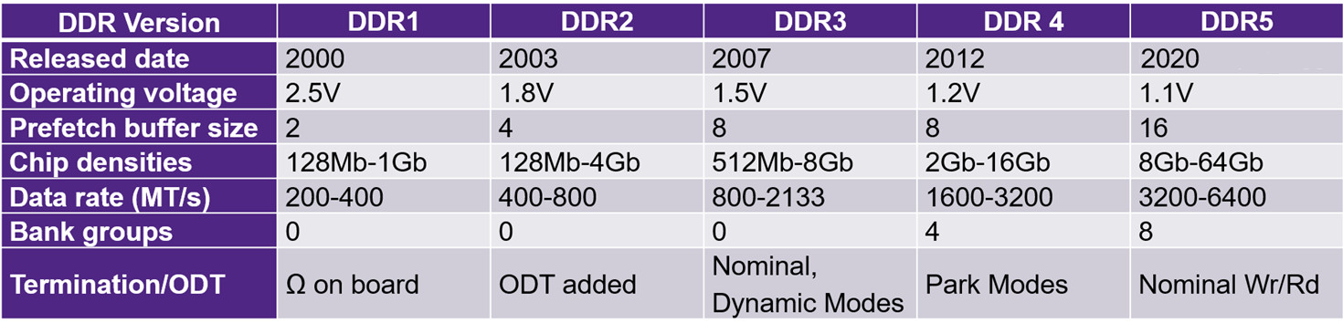
1. Connecting memory channels to client platforms (18)
Main features of standard DDR memories [242]
Note that new DDR generations appeared in the past in about 4 years interval,
but DDR5 become standardized not earlier than 2020.
From generation to generation operating voltages were decreased, from 2.8 V
to 1.1 V.
It is also worth to note that subsequent memory generations typically doubled
the data rate.
*

Slide 22
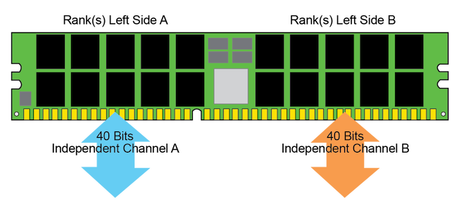
1. Connecting memory channels to client platforms (19)
Remarks to the DDR5 memory
In 07/2020 JEDEC revealed the DDR5 SDRAM standard.
As shown in the Table on the previous slide, compared to DDR4 DDR5
doubles transfer rates to up to 6.4 GT/s,
reduces operating voltage from 1.2 V to 1.1 V and
Further on it introduces a number of innovations (not indicated in the Table), like
dual independent half-width memory channels (2x32 +8 ECC bits,
as seen below),
on-DIMM voltage regulation (instead of on-board regulation),and
retains the 288 pin interface of DDR4 nevertheless with modified pinout.
Mass production will start in Q4/2020.
Figure:
Dual-channels
introduced
in DDR5 [292]
*

Slide 23
1. Connecting memory channels to client platforms (20)
Evolution of transfer rates of standard DDR memories in Intel’s Core 2 family
MT/s
4266
3733
3458
3200
*
*
2793
DDR4 ~ 2x /8 years
2666
*
2400
*
2133
*
1862
1600
*
*
DDR3 ~ 2x /8 years
1333
*
*
1066
*
*
≈
N1
N2
IB
HW
BW
SKL4
KBL
CFL
ICL
TGL
PN
SB
08
09
2010
11
12
13
14
2015
16
17
18
19
2020
Year
As the Figure indicates DDR3/4 memories double data rate in about 4 years.

Slide 24
1. Connecting memory channels to client platforms (21)
b2) Low-power DDR memories (LPDDR)
LPDDR (Low-power DDR) memories have less power consumption than standard
DDR memories by two modifications:
LPDDR memories apply lower supply voltages than standard DDR memories,
e.g. LPDDR4 memories need 1.1 V supply voltage whereas DDR4
memories operate at 1.2 V.
b) As long as standard DDR memories have 64-bit wide data buses, LPDDR
memories implement 16- or 32-bit wide channels.
LPDDR4 and LPDDR5 memories may implement even multiple memory
channels (up to four 16-bit or two 32-bit channels) in a package.
Low-power DDR memories were first standardized around 2009 by the
standardization organization JEDEC (Joint Electron Device Engineering Council)
and termed as LPDDR (referred to later also as LPDDR1).
Subsequently, JEDEC issued next generation standards, designated as LPDDR2
(2013) to LPDDR5 (2020), as shown in the next Table.
*

Slide 25
1. Connecting memory channels to client platforms (22)
Types and main features of subsequent LPDDR generations [243] -1
LP-DDR | 1 | 1E | 2 | 2E | 3 | 3E | 4 | 4X | 5
Memory array clock (MHz) | 200 | 266.7 | 200 | 266.7 | 200 | 266.7 | 200 | 266.7 | ?
Data width | x16/x32 |  | x16/x32 |  | x16/x32 |  | up to 4 x16
I/O bus clock frequency (MHz) | 200 | 266.7 | 400 | 533.3 | 800 | 1067 | 1600 | 2133 | 3200
Data transfer rate (max.) (MT/s) | 400 | 533.3 | 800 | 1067 | 1600 | 2133 | 3200 | 4267 | 6400
Supply voltage(s) | 1.8 V |  | 1.2 V |  | 1.2 V |  | 1.1 V | 0.6 V, 1.1 V | 0.5 V, 1.05 V
Note that the maximum data rates of the common LPDDR generations equal
those of the standard DDR memories, although they operate at lower supply
voltages.
The E-versions (used in Apple MacBooks and gaming laptops) provide higher data
rates by overclocking the memory clock.

Slide 26
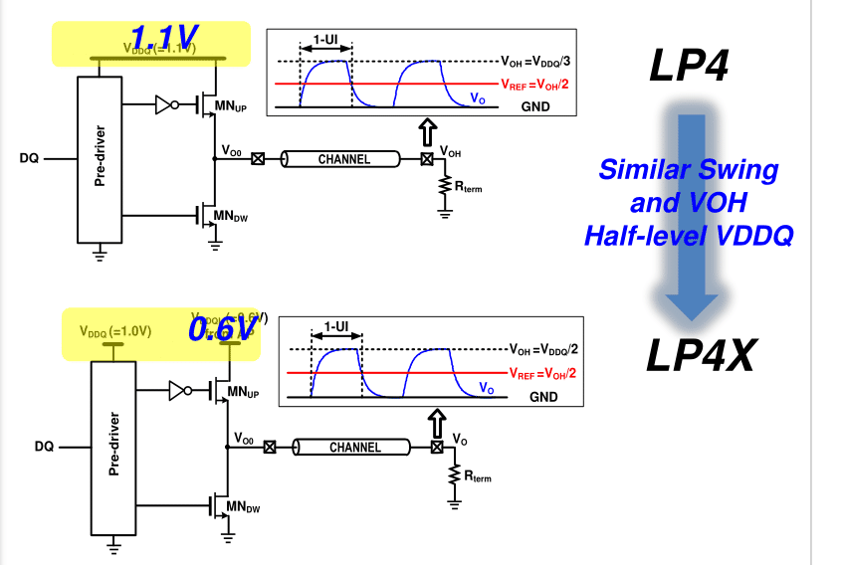
1. Connecting memory channels to client platforms (23)
Main features of the LPDDR4X memory [243] -2
The LPDDR4X-version was proposed by Samsung.
This LPDDR4X version achieves additional power saving by detaching and
reducing the I/O-voltage (VDDQ) (see the Figure below) from 1.1 V, as used
in LPDDR4 memories to 0.6 V.
Figure: The idea
of LPDDR4X [286]
*

Slide 27
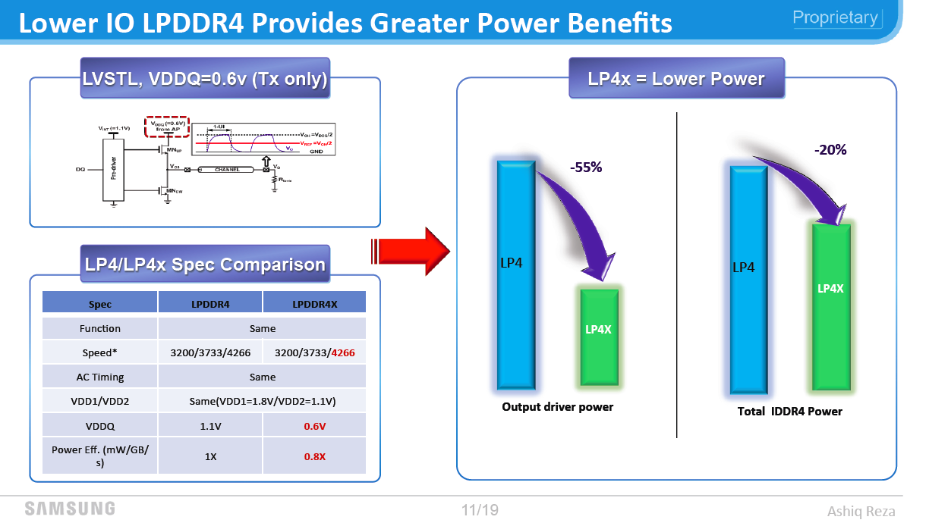
1. Connecting memory channels to client platforms (24)
Power reduction achieved by the LPDDR4x memory [244]
Power reduction by LPDDR4x
The price to pay for the enhanced speed is the need for a further voltage level
in the power supply.

Slide 28
1. Connecting memory channels to client platforms (25)
Standardization and use of the LPDDR4X memory [243] -2
The LPDDR4X version was standardized by JEDEC in 2017.
LPDDR4X is supported among others in Intel’s low-power oriented Ice Lake (2019)
and UP4 class Tiger Lake processors (2020).

Slide 29
1. Connecting memory channels to client platforms (26)
Use of LPDDR memories in client processors -1
Originally, LPDDR4 memories aimed at smartphones and tablets but subsequently
they became supported by client processors as well, as exemplified by the next
Figure for Intel’s client processors.
*

Slide 30
1. Connecting memory channels to client platforms (27)
Evolution of transfer rates of LPDDR memories in Intel’s Core 2 family
MT/s
4266
*
LPDDR4
3733
*
3458
3200
*
*
2793
DDR4 ~ 2x /8 years
2666
*
LPDDR4X
2400
*
*
2133
*
*
*
1862
LPDDR3
1600
DDR3 ~ 2x /8 years
*
*
*
*
*
1333
*
*
1066
*
*
CFL-H
≈
SKL4
KBL
CFL
ICL
TGL
PN
N1
N2
SB
IB
HW
BW
08
09
2010
11
12
13
14
2015
16
17
18
19
2020
Year

Slide 31
1. Connecting memory channels to client platforms (28)
Use of LPDDR memories in client processors -2
The previous Figure shows that in Intel’s Core 2 family the Broadwell line was
the first supporting the LPDDR3 memory.
Note that initially the data rates of LPDDR3 memories lagged behind the speed of
standard DDR3 memories.
However, this situation has changed when Intel introduced LPDDR4X memories
in their Ice Lake (2019) and Tiger Lake (2020) lines, in these lines LPDDR4X
memory speeds supersede data rates of standard DDR4 memories.
*

Slide 32
1. Connecting memory channels to client platforms (29)
c) Number of memory channels connected to a client platform
Typically, client processors implement dual 64-bit memory channels.
This seems to provide a good balance between execution resources assuming a low
number of cores (usually 4 to 8) and the need for supplying data from memory.
Presumably, with arriving DDR5 memories, memory connection will change
to quad 32-bit memory channels.
*

Slide 33
2. Using Optane memories
2.1 Brief overview of the flash memories
2.2 Optane memories
Notes:
33

Slide 34
2. Using Optane memories (1)
2. Using Optane memories
Optane memories have been introduced to enhance or replace HDDs or SSDs.
SSDs are flash memories, so before discussing Optane memories in Section 2.2
we give a brief overview of the preceding flash memories in Section 2.1.
HDD: Hard Disk Drive (2.5”/3.5”, recently mostly: 256/512/1024 or more GB)
SSD: Solid-State Drive (recently mostly: 128/256/512/1014 GB)
*

Slide 35
2.1 Brief overview of the flash memories
Notes:
35

Slide 36
2.1 Brief overview of the flash memories (1)
2.1 Brief overview of the flash memories
Flash memories are a kind of EEPROM (Electrically Erasable Programmable Memories).
They are
non-volatile (in contrast to the volatile DRAMs),
data can only be stored in blocks, typically ½ KB - 2 KB thus they are used
as back-up memories of client or server platforms.
The name “flash memory” was coined to reflect to the erasure process when
an entire block of data needs to be erased at the same time instead of a data
element, resembling to flashing a camera.
As back-up memories they are called SSDs (Solid State Drives) in contrast to the
mechanical, spinning HDDs (Hard Disk Drives).
Nevertheless, they wear out over time, in other words they have restricted
durability meaning that the number of times cells of a data block can be written
and erased without higher hazard of data loss is limited roughly to a million.
Non-volatile: Nem-felejtő
*

Slide 37
2.1 Brief overview of the flash memories (2)
Basic types of flash memories
Basic types of flash memories
NAND flash memories
NOR flash memories
Due to their features (not discussed here) as back-up storage NAND flash memories
are used.
Implementation of the memory cells in NAND flash memories [245]
SLCs
(Single-Level Cells)
2D structure,
1 bit per memory cell)
(~2006)
MLCs
(Multi-Level Cells)
2D structure,
2 bits per memory cell
(~2009)
TLCs
(Triple-Level Cells)
3D structure,
3 bits per memory cell)
(~2016)
QLCs
(Quad-Level Cells)
3D structure,
4 bits per memory cell)
(~2018)
*

Slide 38
2.1 Brief overview of the flash memories (3)
Interfacing NAND SSDs
In 2001 the SATA (Serial ATA) HDD interface standard was released to have a
faster and cheaper interface than the ATA HDD interface used at that time.
SATA needed only 7 interface lines rather than 40 or 80 as required by ATA.
At the same time ATA was renamed to PATA (Parallel ATA).
Due to its benefits, SATA became subsequently predominant first for HDDs and
after their appearance also for SSD drives.
Upcoming SATA revisions raised the transfer speed from 150 MB/s (SATA I) to
300 MB/s (SATA II) and finally to 600 MB/s (SATA III),
Nonetheless, transfer rates of NAND SSDs increasingly exceeded those allowed
by the SATA interface and thus the SATA standard became a limiting factor
for NAND SSDs.
Consequently, a new interface standard was needed to utilize the speed potential
of NAND SSDs.
The new open, interface standard emerged in 2011, it was named NVMe
(Non-Volatile Memory Express).
NVMe attaches NAND SSDs to platforms directly through the PCIe bus rather than
through the SATA interface (hence the suffix “e” in the standards name).
This allows a substantial boost in transfer speeds, as will be shown subsequently.
Recent NAND SSDs have either the older SATA or the newer and faster NVMe
interface.
*

Slide 39
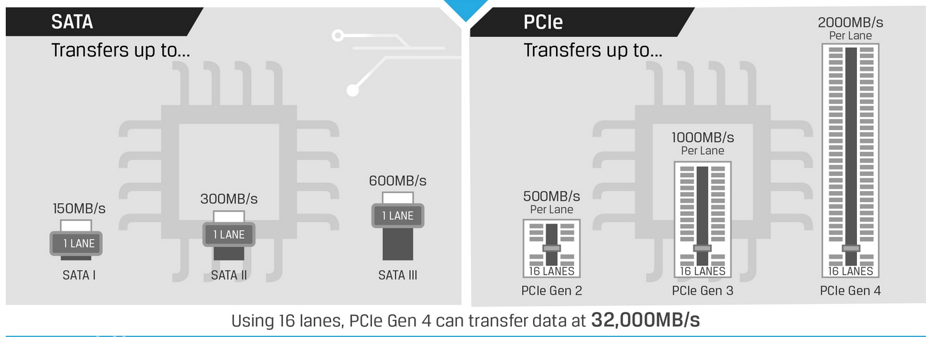
2.1 Brief overview of the flash memories (4)
Max. data transfer rates of the SATA vs. the PCIe interface used by the
NVMe standard [246]
~
~
NVMe makes use of PCIe Gen 3 x4.
Thus NVMe x4 has a maximum transfer rate of ~ 4x1 GB/s = 4 GB/s
(see max. transfer rates of PCIe generations on the next Table).

Slide 40
2.1 Brief overview of the flash memories (5)
Evolution of transfer rates/per direction in subsequent PCIe generations
PCI Express version | Intro- duced | Line code | Transfer rate in each direction | Throughput in each direction
 |  |  |  | ×1 | ×2 | ×4 | ×8 | ×16
1.0 | 2003 | 8b/10b | 2.5 GT/s | 250 MB/s | 0.50 GB/s | 1.0 GB/s | 2.0 GB/s | 4.0 GB/s
2.0 | 2007 | 8b/10b | 5.0 GT/s | 500 MB/s | 1.0 GB/s | 2.0 GB/s | 4.0 GB/s | 8.0 GB/s
3.0 | 2010 | 128b/130b | 8.0 GT/s | 984.6 MB/s | 1.97 GB/s | 3.94 GB/s | 7.88 GB/s | 15.8 GB/s
4.0 | 2017 | 128b/130b | 16.0 GT/s | 1969 MB/s | 3.94 GB/s | 7.88 GB/s | 15.75 GB/s | 31.5 GB/s
5.0 | 2019 | 128b/130b | 32.0 GT/s[ | 3938 MB/s | 7.88 GB/s | 15.75 GB/s | 31.51 GB/s | 63.0 GB/s
Typically used by NVMe

Slide 41
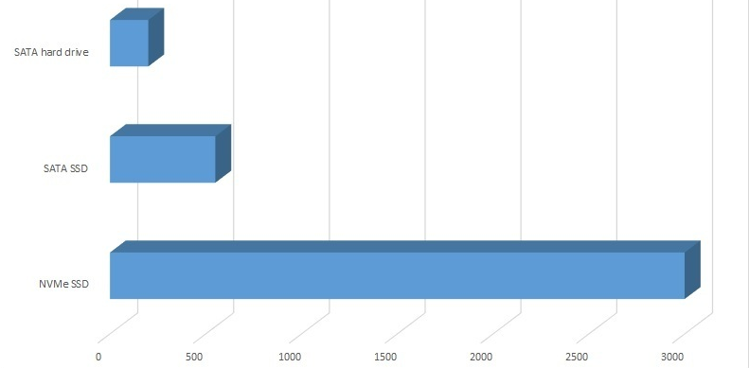
2.1 Brief overview of the flash memories (6)
Example: Sustained throughput of SATA HDDs, SATA SSDs and NvMe SSDs
[MB/s] [247]
SATA HDD
SATA SSD
NVMe SSD
HDD = 200MB/s, SATA SSD = 550MB/s, NVMe SSD = 3GB/s
Throughput: sávszélesség (adatmennyiség/s)

Slide 42
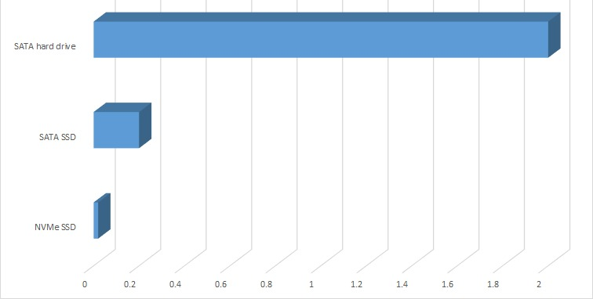
2.1 Brief overview of the flash memories (7)
Example: Read latencies of SATA HDDs, SATA SSDs and NVMe SSDs [ms]
[247]
SATA HDD
SATA SSD
NVMe SSD
SATA HDD: 2-5 ms seek, SATA SSD: 0.2 ms read latency, NVMe SSD: 0.02 ms read latency

Slide 43
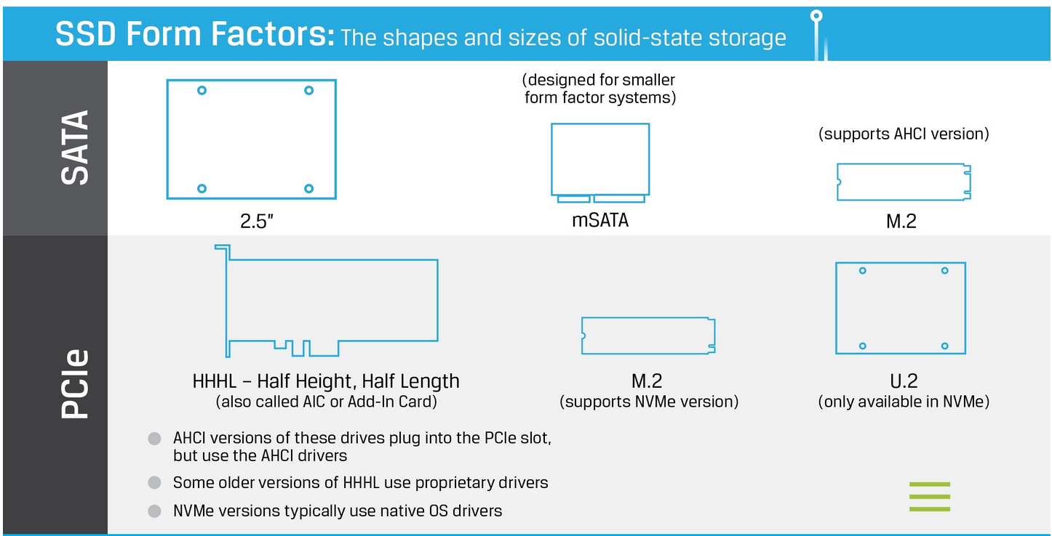
2.1 Brief overview of the flash memories (8)
Form factors of SATA and NVMe (PCIe-based) memory cards [246]
NVMe
AHCI: Advanced Host Controller Interface ( an Intel interface standard introduced
about 2004, improves storage management features of SATA, but its use is limited
to Intel chipsets).

Slide 44
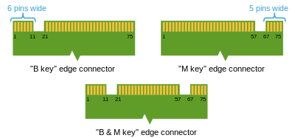
2.1 Brief overview of the flash memories (9)
The M.2 interface standard
It is an interface specification for internally mounted expansion cards and
associated connectors from PCI-SIG, its 1. version was issued in 2013.
It replaces the mSATA standard while providing different module widths and
lengths (e.g. 22x60 or 22x80 mm).
The M.2 standard is particularly suited for small devices, like thin laptops/tablets.
There are three edge-connector types on M.2 cards, called
B key edge connector (mostly for SATA)
M key edge connector and
B and M key edge connector
as seen below.
PCIx2
PCIx4
Figure: M.2
edge connectors [248]
*

Slide 45
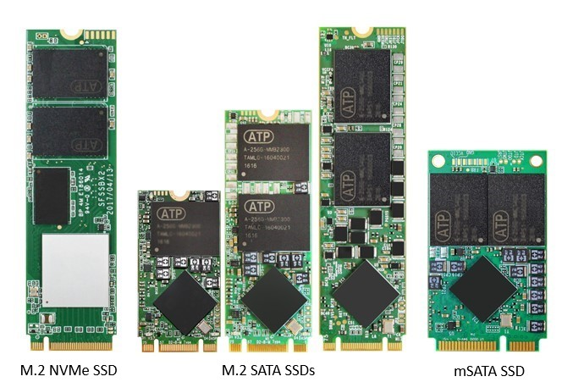
2.1 Brief overview of the flash memories (10)
Examples for M.2 card form factors contrasted to mSATA [249]
NVMe: Non-Volatile Memory express
SATA: Serial ATA
mSATA: miniSATA

Slide 46
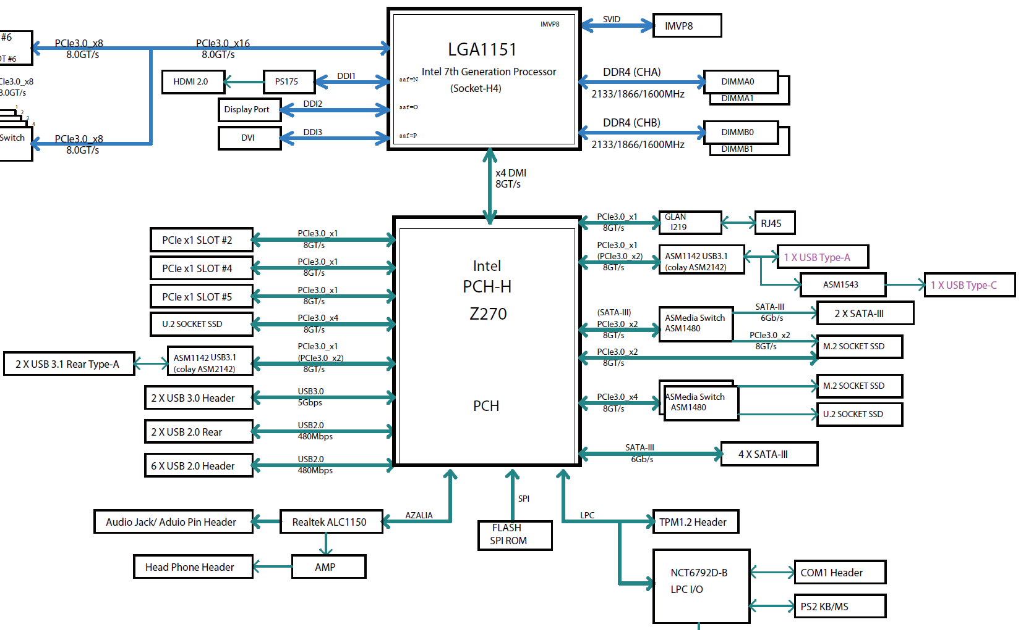
2.1 Brief overview of the flash memories (11)
Example: Attaching two M.2 modules to a Kaby Lake S-series DT processor
Figure: Block diagram of Supermicro’s MNL-1909
motherboard [257]

Slide 47
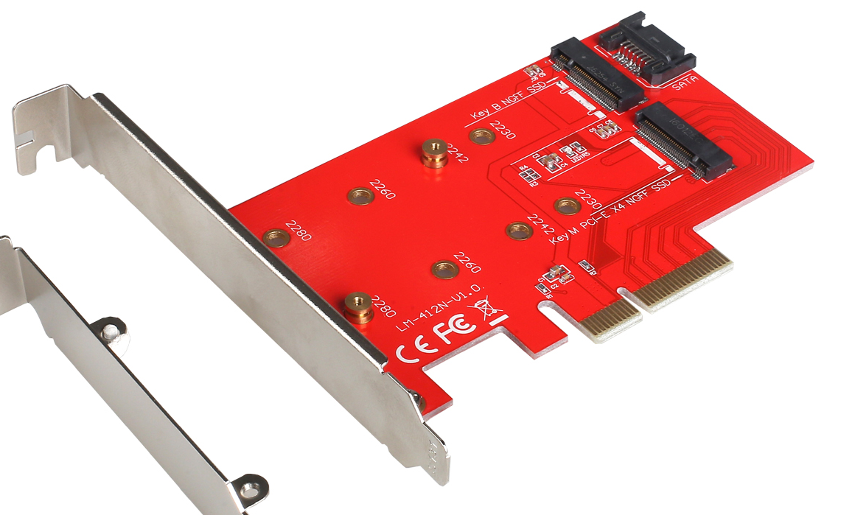
2.1 Brief overview of the flash memories (12)
Example of a PCIe 3.0 add-in card for connecting dual M.2 SATA cards [285]
(~ 120 x 92 mm)

Slide 48
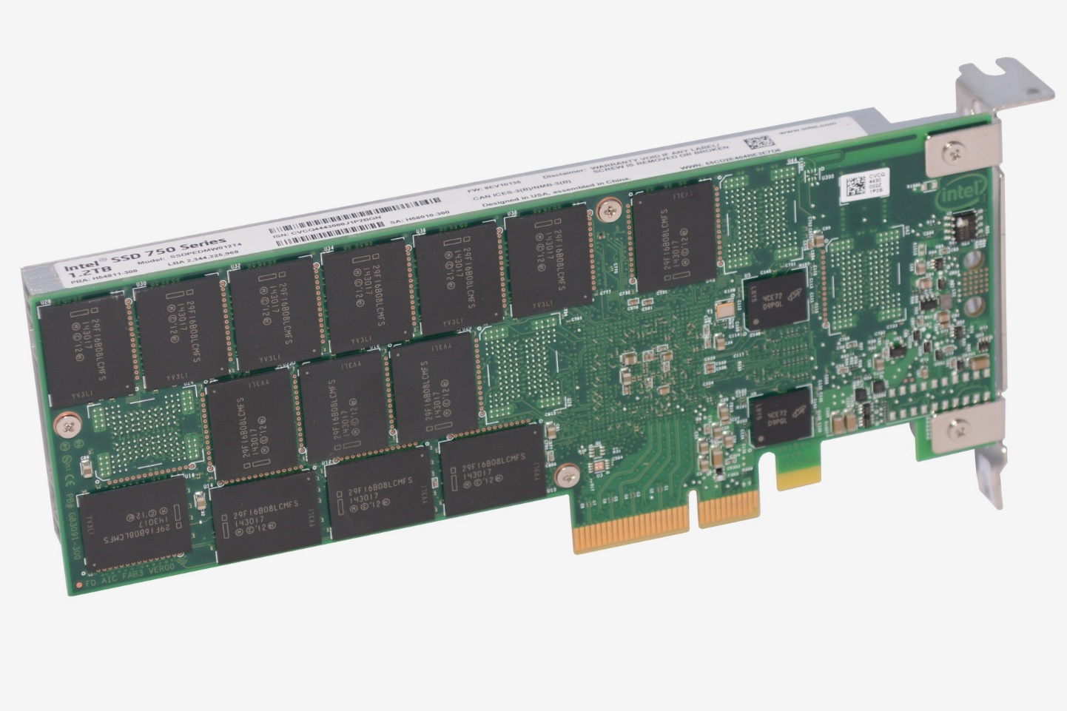
2.1 Brief overview of the flash memories (13)
Example of a HHHL (Half High Half Length) PCIe 3.0 x4 add-in card to attach
an NVMe SSD (actually Intel’s 1.2 TB SSD 750) [250]
(~ 174 x 53 mm)

Slide 49
2.1 Brief overview of the flash memories (14)
Remarks to the terminology of flash memories
While referring to SSD memory drives in data sheets or publications, usually,
the designation flash memory is omitted and a reference is given to their
interface, such as SATA SSD, NVMe SSD, or even only the interface type is
stated, such as SATA or NVMe drive.
A reference to the kind of how memory cells were implemented is stated only
if it is considered to be a distinctive or advanced characteristic of the drive,
for instance QLC 3D NAND memory.

Slide 50
2.2 Optane memories
Notes:
50

Slide 51
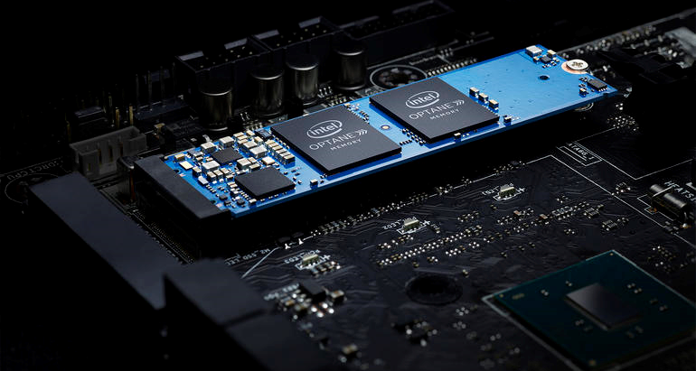
2.2 Optane memories (1)
2.2 The Optane memory
“Optane” memory is Intel’s trademark.
These memories are based on the 3D XPoint memory technology, announced by
Intel and Micron in 2015.
3D Xpoint (Cross-Point) memories are Phase Change Memories (PCM).
Figure: Optane memory mounted on an M.2 card and installed on a mainboard [251]

Slide 52
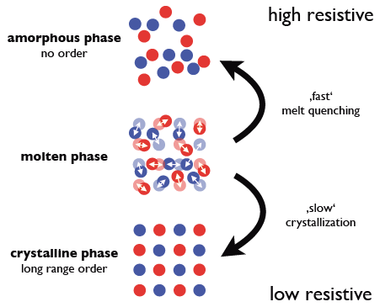
2.2 Optane memories (2)
Remarks to the principle of operation of Phase Change Memories (PCMs) [252]
3D Xpoint memories are a kind of phase change memories (PCMs) meaning that
some alloys (of Ge, As, Sb and Te) may have two stable states with distinct
resistivity, one with a high resistivity and another with a low resistivity,
as indicated in the Figure below.
These states can be manipulated by
heating and cooling the material
e.g. through applying a voltage across
a section of the material.
Through applying an appropriate voltage
either the high resistive or the low
resistive state can be achieved.
These states correspond to the 1 or 0
state representing data.
Once written, the states remain stable
i.e. the memory behaves non-volatile.
The PCM memory can be read by a
suitable voltage resulting in a low or
high current.
Figure: Two stable phases of specific alloys [252]
Alloy: Ötvözet
As: Arsenic Sb: Antimony Te: Tellurium Phase change: Fázis
*

Slide 53
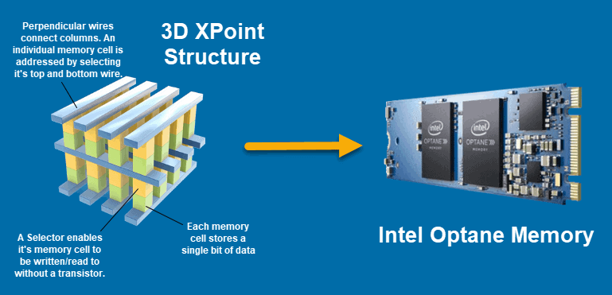
2.2 Optane memories (3)
3D XPoint memories -1
3DXPoint memories are implemented as stackable matrix structures with 1-bit
memory cells at the cross-points, as indicated in the Figure below.
Reading or writing is done by applying appropriate voltages on the selector lines.
*
Figure: Structure of 3DXPoint memories (called Optane memories by Intel) [253]

Slide 54
2.2 Optane memories (4)
Key features of 3DXPoint memories
3DXPoint memories
are stackable,
non-volatile
SSD memories
have a matrix organization and
bit-level addressing capability.
They can be considered as a memory medium between DRAM memories and
traditional NAND SSD memories.
Non-volatile: Nem-felejtő
*

Slide 55
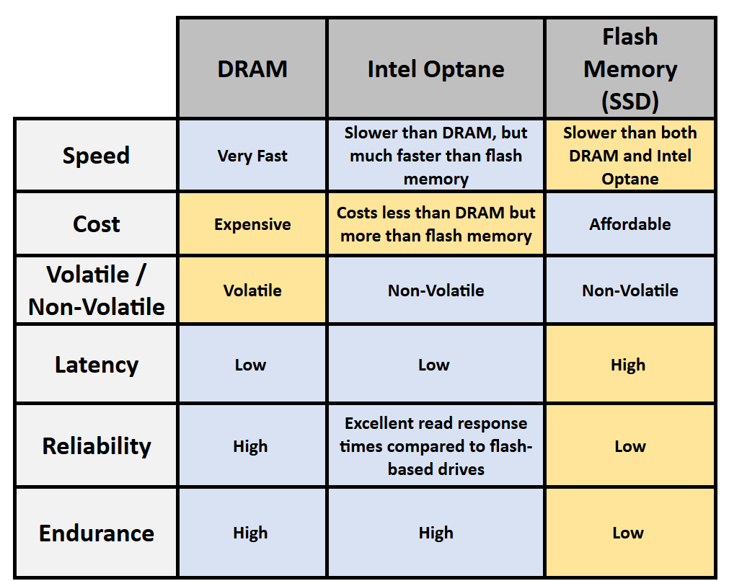
2.2 Optane memories (5)
Contrasting main features of Intel’s Optane, DRAMs and NAND flash
memories [253]

Slide 56
2.2 Optane memories (6)
Main benefits and price of Optane memories
Their key benefits vs. traditional NAND SSD devices are.
much lower latency,
higher throughput and
orders of magnitude higher endurance (measured e.g. in the number of
times the memory can be written and erased without expecting data loss).
Its price lays between DDR memory and traditional NAND SSD prices
*

Slide 57
2.2 Optane memories (7)
Use of Optane memories
Use of Optane memories
Use of Optane memories
in data centers
Use of Optane memories
in client platforms
(Section a)
(Section b)
*

Slide 58
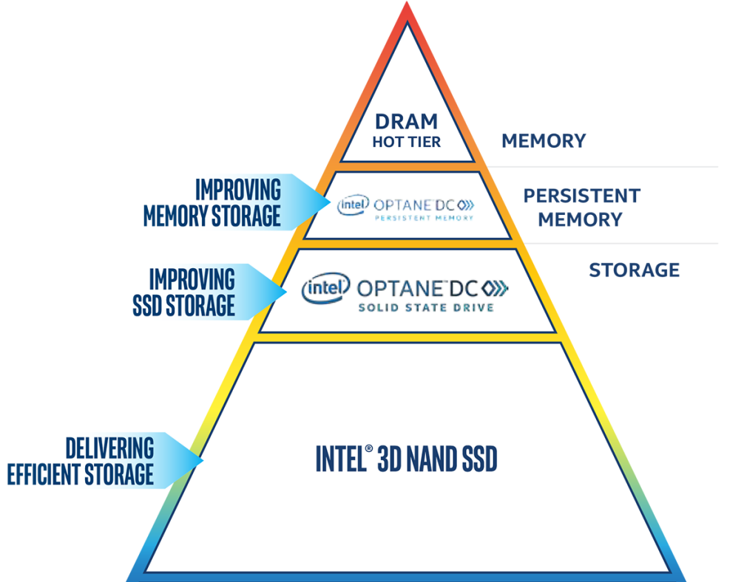
2.2 Optane memories (8)
a) Use of Optane memories in data centers -1
Use of Optane memories in data centers
Use as DRAM memory extension
Use as faster SSD than NAND SSD
DC: Data Center

Slide 59
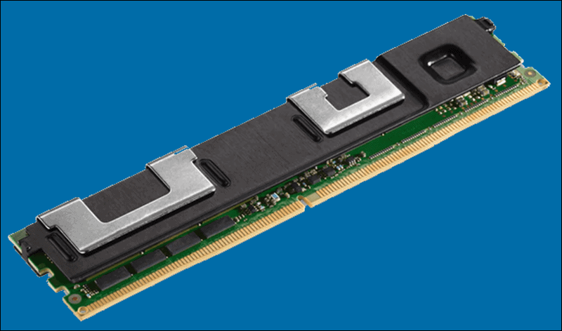
2.2 Optane memories (9)
Use of Optane memories in data centers -2
Use of Optane memories in data centers
Use for DRAM memory extension
Optane memories are implemented
as memory cards to be inserted
into the server DIMM slots.
It extends memory size and adds non-volatibility.
Data can safely be kept on the Optane
module without copying it back to HDD.
Example
Intel’s Optane DCPMM memory modules (2019)
(Data Center Persistent Memory Modules) [253]
128/256/512 GB modules

Slide 60
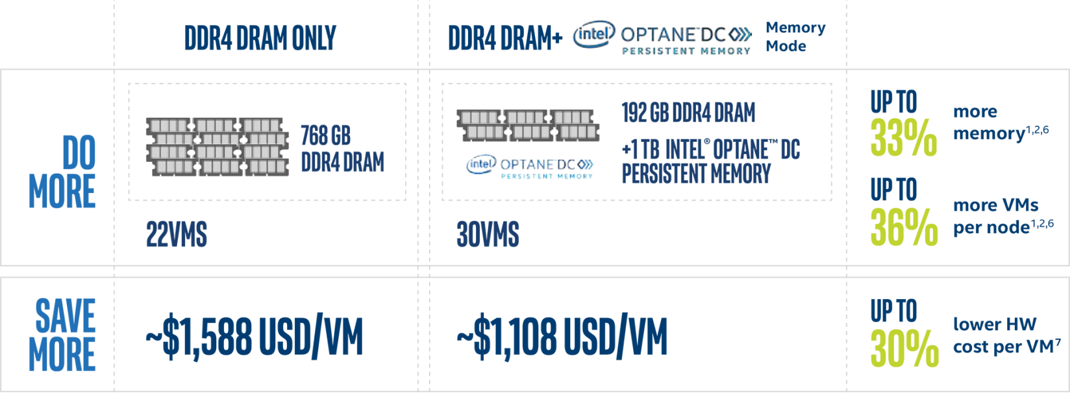
2.2 Optane memories (10)
Example for using Optane memory as DRAM extension [254]
VM: Virtual Machine

Slide 61
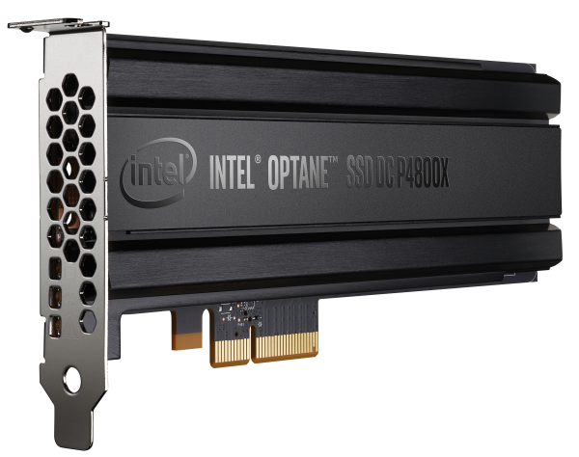
2.2 Optane memories (11)
Use of Optane memories in data centers -3
Use of Optane memories in data centers
Use as DRAM memory extension
Use as faster SSD than NAND SSD
They have lower access latency and provide higher throughput and endurability than SSD drives.
Examples
Intel Optane DC P4800x PCIe 3.0 x4 NVMe (2017) [255]
Micron X100, PCIe 3.0 x16 i.f. (2019)
375 GB – 1.5 TB (1000-2000 $)
PCIe interface with standard NVMe protocol

Slide 62
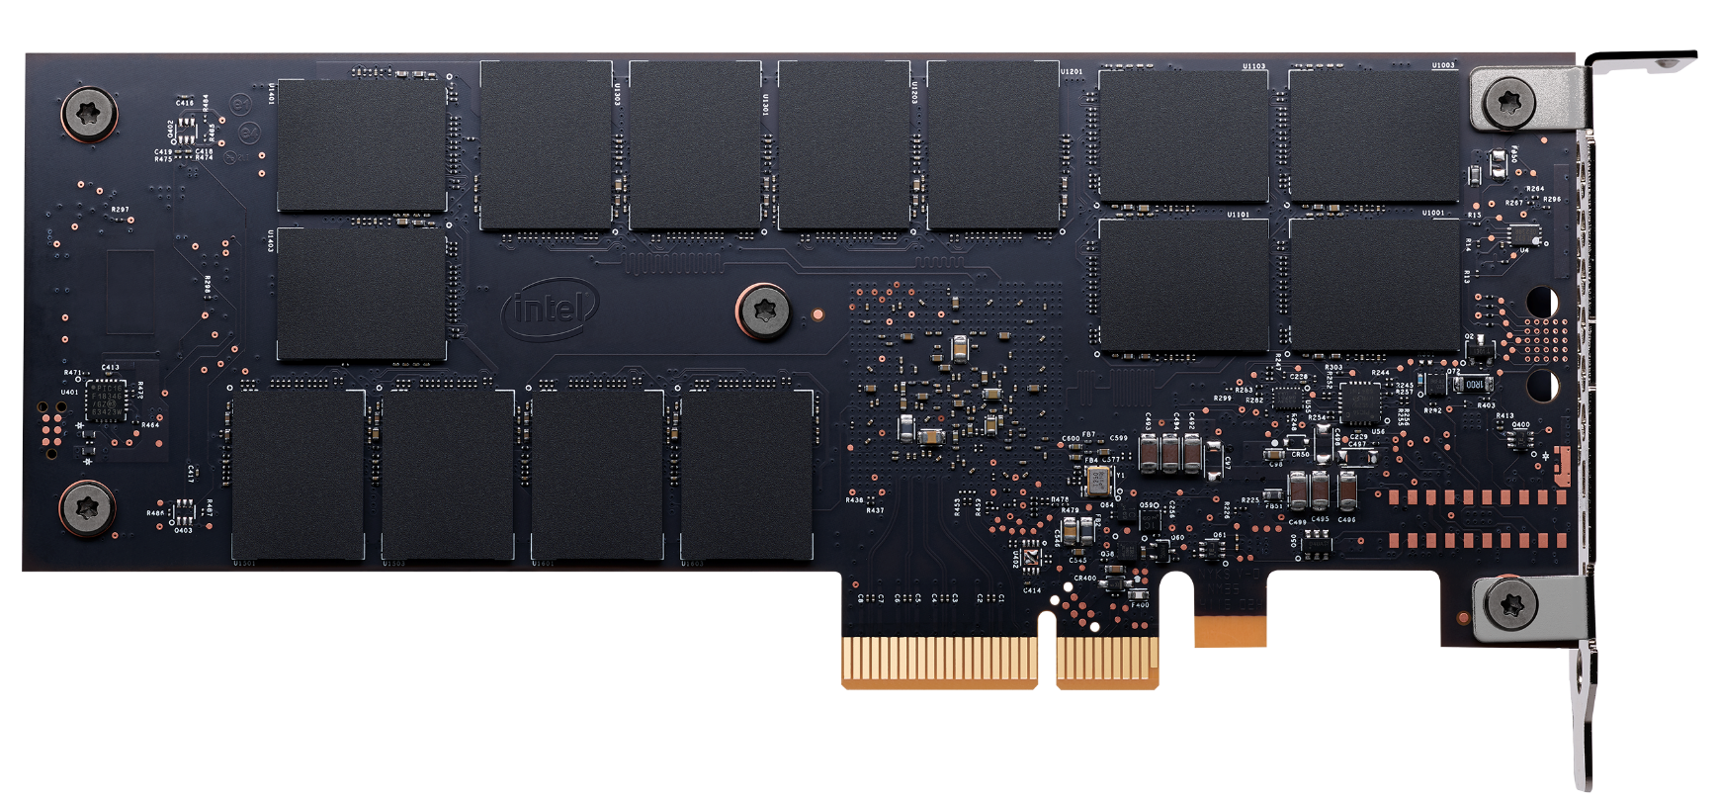
2.2 Optane memories (12)
Example: Intel’s Optane DC P4800X (375GB) SSD on a PCIe card
with NVMe interface [255]
DC: means datacenter

Slide 63
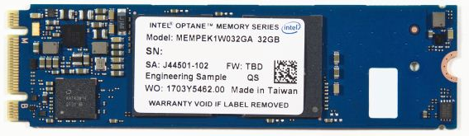
2.2 Optane memories (13)
b) Use of Optane memories in client platforms -1
Use of Optane memories in client platforms
Used as a cache for a SATA HDD,
implemented as an add-on memory card
1. gen. used as a cache for a
SATA HDD boot drive,
2. gen. used as a cache for a
SATA HDD data drive.
Implemented on an M.2 card (22 x 80 mm)
PCIe 3.0 x2, NVMe standard interface
Examples
1. gen.: Intel Optane Memory Series (2017) [256]
2. gen.: Intel Optane Memory M10 Series (2018)
gen.: 16/32 GB Optane memory
gen.: 16/32/64 GB Optane memory
~50 - 200 $
*

Slide 64
2.2 Optane memories (14)
Contrasting the use of Intel’s 1. and 2. gen. Optane memory cards as HDD
caches in client platforms
 | 1. generation | 2. generation
Storage system assumed | SATA HDD Boot drive and Optane memory | Fast SATA SSD Boot drive, a large SATA HDD data drive and Optane memory
Principle of operation | Optane memory serves as a cache of the Boot drive (SATA HDD) | Optane memory serves as a cache of the large SATA HDD data drive
Processor support | 7. gen. (Kaby Lake DTs) i3,i5,i7 | 8. gen. (Coffee Lake, except Y-series) Celeron, Pentium, i3,i5,i7,
Optane cache memory used | Optane Memory Series (16/32 GB) | Optane Memory M10 Series (16/32/64 GB)
PCH support | 200-series PCH or later | 300-series PCH
Driver | RST 15.5 or later | RST 17.2.0.1009 or later
OS | Windows 10 64-bit | Windows 10 64-bit
Intro | 2017 | 2018
Note that using Optane memories in client platforms require appropriate PCH, driver,
BIOS (not specified in the above Table) and OS support.
RST: Rapid Storage Technology (Intel)
*

Slide 65
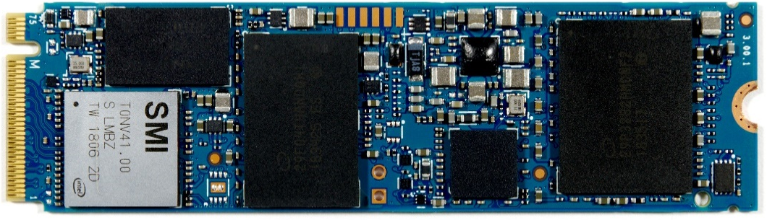
2.2 Optane memories (15)
Use of Optane memories in client platforms -2
Use of Optane memories in client platforms
Use as a cache to a SATA HDD,
implemented as an add-on M.2 memory card
Use as one component of an
SSD + Optane M.2 memory module
Used as a cache for an SSD drive with
NVMe standard interface (QLC 3D NAND)
while both the NAND drive and the Optane
memory are placed on the same M.2 card.
Implemented on an M.2 card (22 x 80 mm)
PCIe 3.0 x4, NVMe standard interface
Example
Intel Optane Memory H10 Series (2019) [258]
256 GB SSD with 16 GB Optane
512 GB SSD with 32 GB Optane
1 TB SSD with 32 GB Optane
~100 - 250 $
*

Slide 66
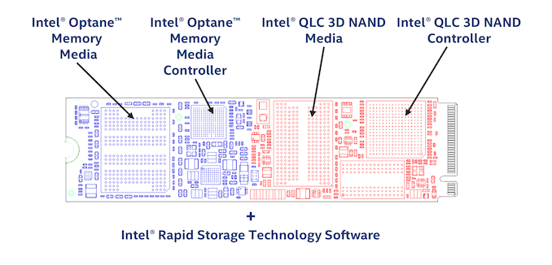
2.2 Optane memories (16)
Example: Main parts of Intel’s Optane Memory H10 Series (2019)
placed on an M.2 card [258]

Slide 67
3. Implementing PCIe ports
Notes:
67

Slide 68
3. Implementing PCIe ports (1)
3. Implementing PCIe ports
Evolution of the PCIe interface standard
The serial PCIe bus was developed to replace the slow, parallel PCI bus.
Intel started the development work, but soon various industry partners joined
and the 1. version of the PCIe bus was announced in 2003.
Until now five PCIe versions were released, as shown in the next Table.
*

Slide 69
3. Implementing PCIe ports (2)
Main features of subsequent PCIe generations [165]
PCI Express version | Intro- duced | Line code | Transfer rate in each direction | Throughput in each direction
 |  |  |  | ×1 | ×2 | ×4 | ×8 | ×16
1.0 | 2003 | 8b/10b | 2.5 GT/s | 250 MB/s | 0.50 GB/s | 1.0 GB/s | 2.0 GB/s | 4.0 GB/s
2.0 | 2007 | 8b/10b | 5.0 GT/s | 500 MB/s | 1.0 GB/s | 2.0 GB/s | 4.0 GB/s | 8.0 GB/s
3.0 | 2010 | 128b/130b | 8.0 GT/s | 984.6 MB/s | 1.97 GB/s | 3.94 GB/s | 7.88 GB/s | 15.8 GB/s
4.0 | 2017 | 128b/130b | 16.0 GT/s | 1969 MB/s | 3.94 GB/s | 7.88 GB/s | 15.75 GB/s | 31.5 GB/s
5.0 | 2019 | 128b/130b | 32.0 GT/s | 3938 MB/s | 7.88 GB/s | 15.75 GB/s | 31.51 GB/s | 63.0 GB/s
Note: Each PCIe generation doubles the throughput (except the 3. one).
Calculation of the throughput for 8b/10b coding (e.g. for PCIe 1.0):
Throughput [byte] = (2.5 GT/s x 8/10)/8 = 250 MB
Calculation of the throughput for 128b/130b coding (e.g. for PCIe 3.0):
Throughput [byte] = (8.0 GT/s x 128/130)/8 = 984.6 MB
*

Slide 70
3. Implementing PCIe ports (3)
3. Implementing PCIe ports in client platforms
Client platforms provide now typically
16 PCIe ports to allow connecting a single discrete graphics card (dGPU) and
a number of further ports to attach SSDs, LAN controllers etc. through
x1, x2, x4-wide links.
PCIe ports may be implemented either on the chipset or the processor or
both, as discussed subsequently.
As an example the next Figure shows a platform that provides
16 PCIe ports on the processor, for connecting a discrete graphics card
(dGPU) as well as
2x 4 PCIe ports for SSDs and 1x PCIe port for a GLAN (Gigabit LAN) controller
on the Platform Controller Hub (PCH).
*

Slide 71
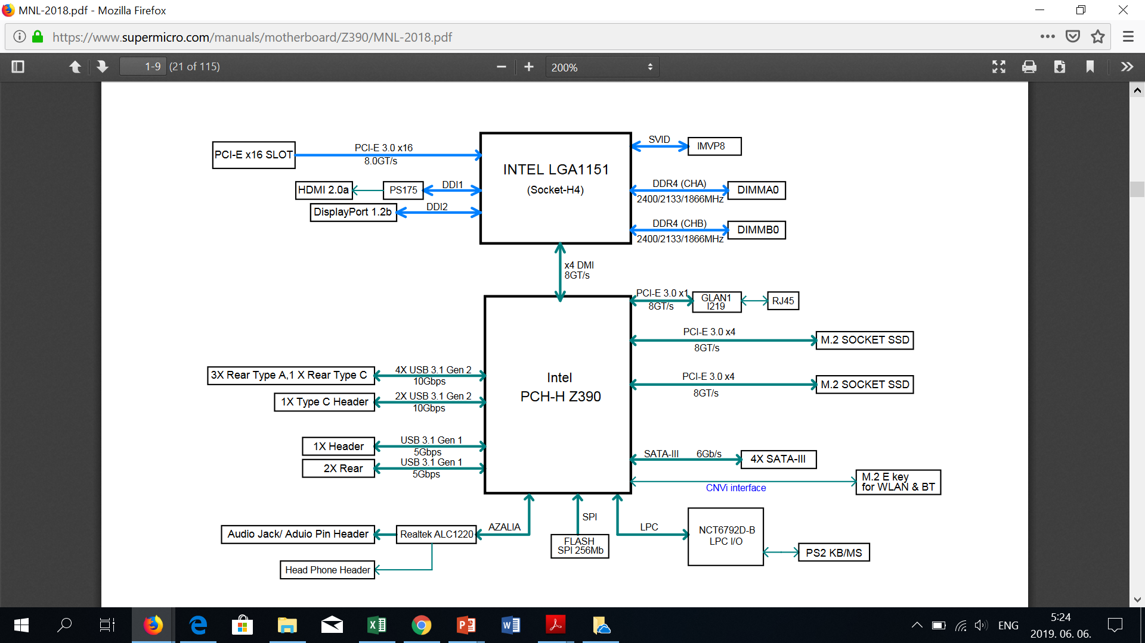
3. Implementing PCIe ports (4)
Example: Block diagram of Intel’s 8th/9th^{th} gen. DT platform providing
16 PCIe ports on the processor and further PCIe ports on the PCH [259]

Slide 72
3. Implementing PCIe ports (5)
Key aspects of implementing PCIe ports on client platforms
Key aspects of implementing PCIe ports on client platforms (discussed)
Where to provide
PCIe ports on the platform?
Type of implemented
PCIe ports
Number of implemented PCIe ports
(Section a)
(Section b)
(Section c)
*

Slide 73
3. Implementing PCIe ports (6)
a) Where to provide PCIe ports on the platform?
Where to provide PCIe ports on the platform?
PCIe ports
on the chipset
16 PCIe ports for the dGPU
on the processor
further PCIe ports on the chipset
PCIe ports
on the processor
dGPU: Discrete GPU
*

Slide 74
3. Implementing PCIe ports (7)
Evolution of providing PCIe ports on a client platform
Where to provide PCIe ports on the platform?
PCIe ports
on the chipset
16 PCIe ports for the dGPU
on the processor
further PCIe ports on the chipset
PCIe ports
on the processor
Processor
FSB
PCIe
MCH
ICH
Intel
Core 2 (2006) to
1. gen. Nehalem (2008)
PCIe
x16 or 2x x8
AMD
K8 (2005) to
K10 Fam. 11h (2011)
PCIe
further ports
*
MCH: Memory Control Hub (North Bridge) ICH: IO Control Hub (South Bridge)

Slide 75
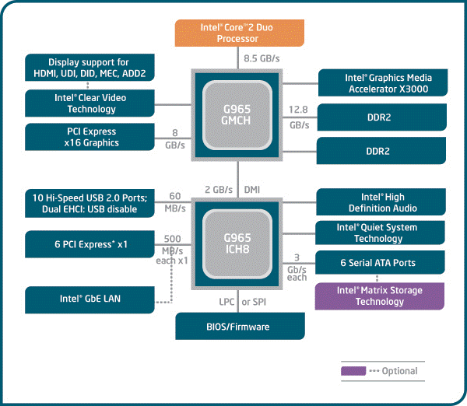
3. Implementing PCIe ports (8)
Example 1: Providing PCIe ports on the chipset (Core 2 platform, 2006)
[260]

Slide 76
3. Implementing PCIe ports (9)
Evolution of providing PCIe ports on a client platform
Where to provide PCIe ports on the platform?
PCIe ports
on the chipset
16 PCIe ports for the dGPU
on the processor
further PCIe ports on the chipset
PCIe ports
on the processor
Processor
Processor
PCIe
FSB
Interface
PCIe
PCIe
MCH
PCH
ICH
Intel
Core 2 (2006) to
1. gen. Nehalem (2008)
2. gen. Nehalem (2009)
and subsequent DTs
PCIe
x16 or 2x x8
AMD
K8 (2005) to
K10 Fam. 11h (2011)
Bobcat (2011) and
subsequent GPU-less DTs
PCIe
further ports
*
MCH: Memory Control Hub (North Bridge) ICH: IO Control Hub (South Bridge)
PCH: Platform Controller Hub

Slide 77
3. Implementing PCIe ports (10)
Consequences of moving PCIe ports for dGPUs from the MCH to the
processor -1
There are two aftermaths of moving both the memory- and the x16/x20 PCIe
connection needed for the dGPU to the processor
After both relevant tasks of the MCH (North Bridge) became delegated to the
processor, the “reduced-function” MCH can now easily be integrated with the
IOH into a single chip, often called the PCH (Platform Controller Hub).
In this way implementing x16 PCIe ports for the dGPU directly on the processor
gave rise to the emergence of 2-chip platforms, as the preceding Figures show
in the beginning of the 2010’s.
Remarks to the timeline of this evolution
First, vendors started connecting memory to the processor in the beginning of
the 2000’s.
E.g. AMD started this move early, already in their x86-64 based Opteron server
line in 2003.
Intel followed suit 5-years later in their Nehalem line (2008).
In a second step 16 PCIe ports, needed for connecting a dGPU were placed from
the MCH (aka North Bridge) to the processor both by Intel and AMD about 2010.

Slide 78
3. Implementing PCIe ports (11)
Consequences of moving PCIe ports for dGPUs from the MCH to the
processor -2
b) A second consequence of placing the 16 PCIe ports for the dGPU from the MCH to
the processor is that now the 16 PCIe lanes bypass the MCH, thus less
bandwidth is needed between the processor and the chipset.
Then the previously used wide FSB (Front Size Bus) can be replaced by a
much narrower link typically consisting of 4 PCIe lanes (called differently,
e.g. DMI (Direct Media Interface) in Intel platforms).

Slide 79
3. Implementing PCIe ports (12)
Example 2: Providing 16 PCIe ports for the dGPU on the processor and further
PCIe ports on the chipset on Intel’s 8/9 gen. DT platform (2017/18) [259]

Slide 80
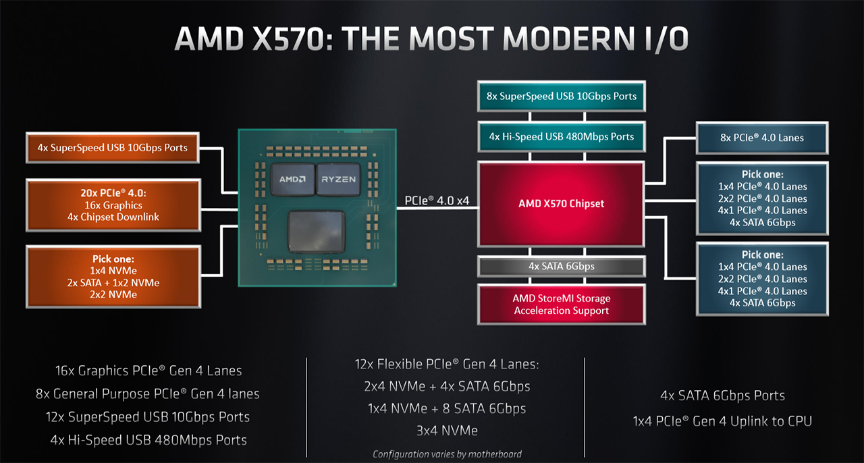
3. Implementing PCIe ports (13)
Example 3: Providing 16 PCIe ports for the dGPU on the processor and further
PCIe ports on the chipset on AMD Zen2-based Ryzen 3000 platforms (2019)
[261]

Slide 81
3. Implementing PCIe ports (14)
Evolution of providing PCIe ports on a client platform
Where to provide PCIe ports on the platform?
PCIe ports
on the chipset
16 PCIe ports for the dGPU
on the processor
further PCIe ports on the chipset
PCIe ports
on the processor
Processor
PCIe
PCIe
Processor
Processor
FSB
Interface
PCIe
PCIe
MCH
PCH
ICH
PCIe
x16 or 2x x8
PCIe
further ports
Intel
Core 2 (2006) to
1. gen. Nehalem (2008)
2. gen. Nehalem (2009)
and subsequent DTs
AMD
K8 (2005) to
K10 Fam. 11h (2011)
Bobcat (2011) and
subsequent GPU-less DTs
Zen-based laptop/DT APUs (2017)
*
MCH: Memory Control Hub (North Bridge) ICH: IO Control Hub (South Bridge)
PCH: Platform Controller Hub

Slide 82
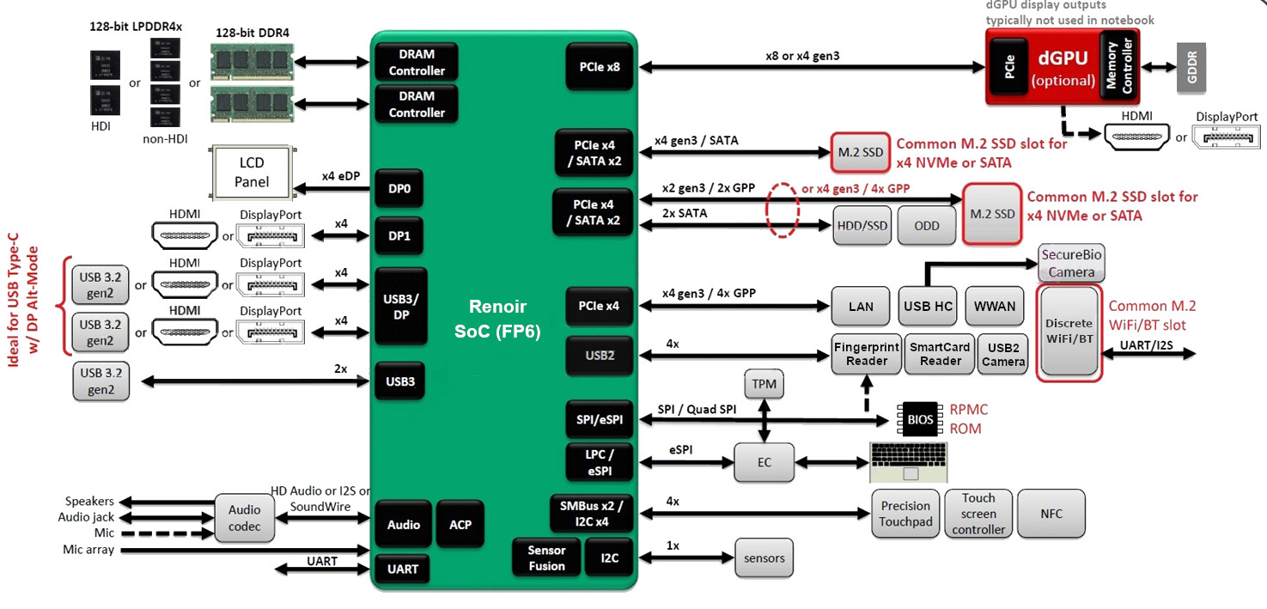
3. Implementing PCIe ports (15)
Example 4: Providing PCIe ports on the processor in a platform for AMD’s
3. gen. Ryzen 4000 (Renoir) mobile APU processors (2020) [262]
Note that AMD’s Zen-based mobile processors are SoCs and do not need a chipset.

Slide 83
3. Implementing PCIe ports (16)
b) Type of implemented PCIe ports
Type of implemented PCIe ports
PCIe 1.0
ports
PCIe 2.0
ports
PCIe 3.0
ports
PCIe 4.0
ports
(2003)
(2007)
(2010)
(2017)
*

Slide 84
3. Implementing PCIe ports (17)
Evolution of subsequent PCIe generations [165]
PCI Express version | Intro- duced | Line code | Transfer rate in each direction | Throughput in each direction
 |  |  |  | ×1 | ×2 | ×4 | ×8 | ×16
1.0 | 2003 | 8b/10b | 2.5 GT/s | 250 MB/s | 0.50 GB/s | 1.0 GB/s | 2.0 GB/s | 4.0 GB/s
2.0 | 2007 | 8b/10b | 5.0 GT/s | 500 MB/s | 1.0 GB/s | 2.0 GB/s | 4.0 GB/s | 8.0 GB/s
3.0 | 2010 | 128b/130b | 8.0 GT/s | 984.6 MB/s | 1.97 GB/s | 3.94 GB/s | 7.88 GB/s | 15.8 GB/s
4.0 | 2017 | 128b/130b | 16.0 GT/s | 1969 MB/s | 3.94 GB/s | 7.88 GB/s | 15.75 GB/s | 31.5 GB/s
5.0 | 2019 | 128b/130b | 32.0 GT/s | 3938 MB/s | 7.88 GB/s | 15.75 GB/s | 31.51 GB/s | 63.0 GB/s

Slide 85
3. Implementing PCIe ports (18)
Evolution of providing PCIe ports in Intel’s and AMD’s client platforms -1
Where to connect PCIe ports
PCIe ports
on the chipset
16 PCIe ports for the dGPU
on the processor, further
PCIe lanes mostly on the chipset
PCIe ports
on the processor
PCIe 1.0 ports
2005: AMD
2006: Intel
PCIe 2.0 ports
PCIe 2.0 ports
2007: Intel
2008: AMl
2009 (Intel)
2011 (AMD)
Type of available PCIe ports
PCIe 3.0 ports
(AMD: GPU-less DTs)
PCIe 3.0 ports
(AMD: APUs)
2012: Intel
2014: AMD
2017: AMD
PCIe 4.0 ports
2019: AMD
2020: Intel
*

Slide 86
3. Implementing PCIe ports (19)
Evolution of providing PCIe ports in Intel’s and AMD’s client platforms -2
Note the sequence of introducing PCIe enhancements by Intel and AMD.
a) It was AMD that introduced PCIe 1.0 before Intel in a period of time when
AMD was highly innovative (e.g. introduction of x86-64 ISA, attaching memory
direct to the processor).
b) Subsequently, after launching the Core 2 family Intel took the leadership and
introduced both PCIe 2.0 and PCIe 3.0 two years earlier than AMD.
c) In recent years, with their Zen family AMD made great progress in innovation
and succeeded to introduced PCIe 4.0 earlier than Intel.
*

Slide 87
3. Implementing PCIe ports (20)
Implementing PCIe ports in Intel’s Core 2-based client processor lines
Where to implement PCIe ports on the platform?
PCIe ports
on the chipset
16 PCIe ports for the dGPU
on the processor, further
PCIe lanes mostly on the chipset
PCIe ports
on the processor
PCIe 1.0
ports
Core 2 (2006)
Core 2 Quad (2006)
with 965/Series 3 NB
Penryn (2007)
Penryn Quad (2008)
with Series 4 NB
PCIe 2.0
ports
2. G. Nehalem
(Lynnfield) (2009)
Sandy Bridge (2011)
G. Nehalem
(Bloomfield) (2008)
with X58 NB
Type of implemented PCIe ports
Ivy Bridge (2012)
Haswell (2013)
Skylake (2015)
and further lines
PCIe 3.0
ports
PCIe 4.0
ports
Tiger Lake (2020)

Slide 88
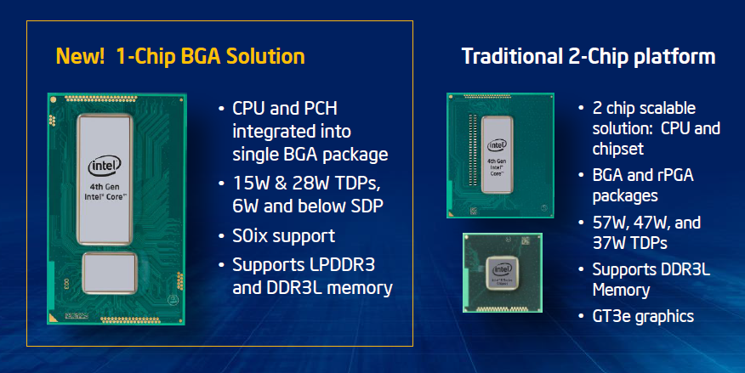
3. Implementing PCIe ports (21)
Remarks to Intel’s implementation of PCIe ports
Since their Haswell line (2013) Intel implements their low-power processors as SoCs
by placing both the processor and the PCH into the same package, as seen below.
This solution however, provides PCIe ports further on both on the processor and the
PCH.
Figure: Introducing SoC packages for low-power processors in Intel’s Haswell line [287]

Slide 89
3. Implementing PCIe ports (22)
Evolution of implementing PCIe ports in AMD’s client processor lines
Implementing PCIe ports in AMD’s processor lines
PCIe ports
on the chipset
16 PCIe ports for the dGPU
on the processor, further
PCIe lanes mostly on the chipset
PCIe ports
on the processor
PCIe 1.0
ports
K8 with 6xx NB (2005)
Bobcat (2011)
Fam. 12h (Llano) (2012)
Piledriver (2012)
Jaguar (2013)
Puma (2014)
PCIe 2.0
ports
K10 with 7xx NB (2008)
Fam. 11h (Griffin)
with 7xxM NB (2011)
Type of implemented PCIe ports
Steamroller (2014)
Excavator 2015/2016)
PCIe 3.0
ports
In GPU-less DTs:
Zen-based lines (2017)
Zen+-based (2018)
In laptop/DT APUs:
Zen-based lines (2017)
Zen+-based (2018)
Zen2-based (2020)
PCIe 4.0
ports
Zen 2-based lines (2019)

Slide 90
3. Implementing PCIe ports (23)
c) Number of implemented PCIe ports
Client platforms typically provide 16 PCIe ports for attaching a discrete graphics
card (dGPU).
This is in contrast e.g. to HEDTs, as HEDTS have mostly 32 to 48 PCIe ports
to allow attaching multiple (2-4) graphics cards.
Client platforms provide further on (often 8 - 16) PCIe ports for connecting
e.g. storage (for instance SSDs, Optane memory), LAN controllers etc.
In addition, two chip platforms need typically 4 extra PCIe lanes to interconnect
the PCH and the processor.
*

Slide 91
4. Implementing USB 4 ports
(Already discussed along with the Tiger Lake processor)
Notes:
91

Slide 92
4. Implementing USB 4 ports (1)
4. Implementing USB 4 ports -1 [263]
USB (Universal Serial Bus) was introduced in 1996 as an industry standard serial,
packetized communication link for interconnecting personal computers and
peripherals.
The standard covers the specification for communication protocols, connectors
and cables.
USB standards are maintained by a non-profit organization (called USB-IF
(USB-Implementer Forum)) established by major IT vendors including Apple,
Hewlett-Packard, Intel and Microsoft.
They are royalty free open standards.
Data rates and standard sockets of subsequent USB releases are shown in the
next Figure.
*

Slide 93
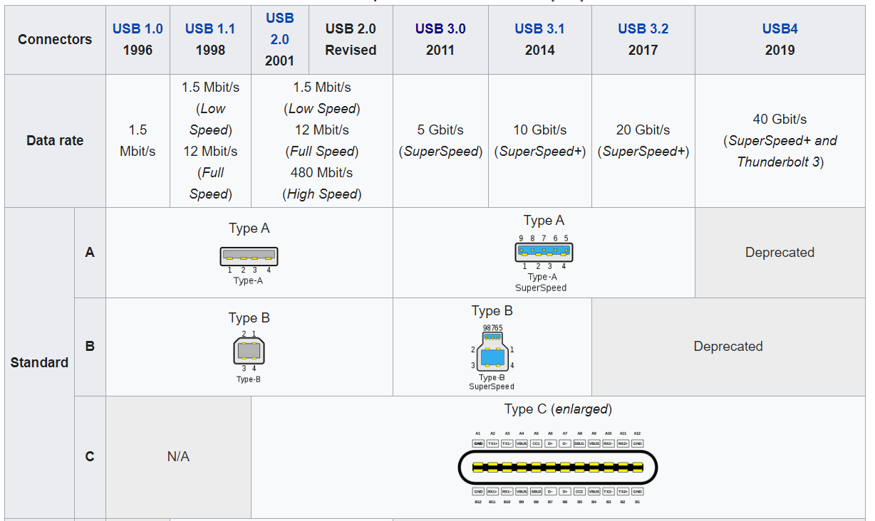
4. Implementing USB 4 ports (2)
Data rates and standard connectors of subsequent USB standards [264]
2010
2013
10 Gb/s
(Only over
type C)
Only
10 Gb/s

Slide 94
4. Implementing USB 4 ports (3)
Remarks to the evolution of the USB standard [265]
USB 3.0 (2010) SuperSpeed transfer rate of up to 5 Gb/s introduced.
The USB 3.0 specification recommends that the Standard-A USB
receptacle have a blue insert.
USB 3.1 (2013) has two alternatives:
USB 3.1 Gen. 1 (the same as USB 3.0) and
USB 3.1 Gen 2 with the SuperSpeed+ transfer rate of up to
10 GB/s.
USB 3.2 (2017) Two new SuperSpeed+ transfer modes over dual lanes with transfer
rates of 10 Gb/s and 20 Gb/s only over USB-C connectors.
USB 4.0 (2019) Based on the Thunderbolt 3 standard.
Transfer speeds: up to 40 Gb/s.

Slide 95
4. Implementing USB 4 ports (4)
Implementing USB 4 ports -2 [263]
USB 4 is a major step in the evolution of the standard.
It is based on Intel’s Thunderbolt 3 protocol and supports data transfers
up to 40 Gb/s.
USB 4 was announced in 03/2019, ratified in 09/2019.
The first processor implementing USB 4 was Intel’s Tiger Lake (09/2020),
although USB4 support was not indicated on the Figure stating Tiger Lake’s
enhancements.
*

Slide 96
4. Implementing USB 4 ports (5)
Principle of operation of USB 4 [266]
USB 4 by itself doesn’t provide any dedicated data transfer mechanism, instead
it supports tunneling data according to a number of protocols, like previous
USB 3, Thunderbolt 3 or DP (Display Port) 1.4a protocols.
As an illustration, the next Table shows the supported USB data transfer modes
and related features.
*

Slide 97
4. Implementing USB 4 ports (6)
USB 4 data transfer modes, logos and main features [266]
Marketing name |  | Logo | Specifications | Old specifications | Encoding | Nominal speed
 |  |  |  |  |  | Gbit/s | GB/s
SuperSpeed USB 5Gbps |  |  | USB 3.2 Gen 1×1 | USB 3.0, USB 3.1 Gen 1 | 8b/10b | 5 | 0.5
SuperSpeed USB 10Gbps |  |  | USB 3.2 Gen 2×1 | USB 3.1 Gen 2 | 128b/132b | 10 | 1.2
N/A |  |  | USB 3.2 Gen 1×2 |  | 8b/10b | 10 | 1.0
SuperSpeed USB 20Gbps |  |  | USB 3.2 Gen 2×2 |  | 128b/132b | 20 | 2.4
N/A |  |  | USB4 Gen 2×1 |  | 64b/66b^{[a]} | 10 | 1.2
N/A |  |  | USB4 Gen 3×1 |  | 128b/132b^{[a]} | 20 | 2.4
USB4 20Gbps |  |  | USB4 Gen 2×2 |  | 64b/66b^{[a]} | 20 | 2.4
USB4 40Gbps |  |  | USB4 Gen 3×2 |  | 128b/132b^{[a]} | 40 | 4.8

Slide 98
4. Implementing USB 4 ports (7)
Contrasting USB 4 and TB 4 -1
USB 4 and TB 4 are now two competing standards with almost similar features
but vendors have dissimilar aspects for choosing one or the another.
Contrasting USB 4 and TB 4
USB 4
TB 4
Developed
by
USB-IF (USB-Implementer Forum)
including major IT firms
Intel in cooperation with Apple
Trademark
USB-IF
Intel
Royalty
Royalty free
Royalty free (since 2017)
Max. data rate
40 Mb/s
40 Mb/s
Physical interface
USB-C
USB-C
Power delivery capability
Yes
Yes
External display
driving capability
Yes
Yes
Windows 10 support
Yes
Yes

Slide 99
4. Implementing USB 4 ports (8)
Contrasting USB 4 and TB 4 -2
As their marketing materials reveal Intel intends to displace USB 4 in favor of TB 4.
Time will show which of both standards will succeed.

