Slide 1
Client processors – 8.2
Select platform issues
Dezső Sima
November 2020
(Ver. 2.2)
© Sima Dezső, 2020

Slide 2
8.2 Select platform issues
1. Connecting memory channels to client platforms
2. Using Optane memory
3. Implementing PCIe ports
4. Implementing USB ports
5. Implementing Thunderbolt ports
6. Wi-Fi 6 support
7. Physical implementation of client processors

Slide 3
5. Implementing Thunderbolt ports
5.1 Introduction to the Thunderbolt IO standard
5.2 The Thunderbolt 3 standard and its implementation
5.3 The Thunderbolt 4 standard and its implementation
(Already discussed along with the Tiger Lake processor)
Notes:
3

Slide 4
5.1 Introduction to the Thunderbolt IO standard
Notes:
4

Slide 5
5.1 Introduction to the Thunderbolt IO standard (1)
5.1 Introduction to the Thunderbolt IO standard -1
Motivations for developing the Thunderbolt IO standard [267]
As laptops became more and more thinner, shrinking to less than ½ inch in depth,
previously used IO-ports, like VGA, HDMI or USB Type A ports can no more
fit into these slick notebooks.
Thus a need arose for thinner ports, like USB-C (USB Type C) or mini HDMI.
To provide fast and small IO ports Intel developed in collaboration with Apple
the Thunderbolt (TB) IO interconnection standard.
*

Slide 6
5.1 Introduction to the Thunderbolt IO standard (2)
Introduction to the Thunderbolt IO standard -2
The TB standard specifies a fast serial bus, that is competing against USB.
Intel owns the IP (Intellectual Property), but Apple may use TB without
restrictions due to their cooperation in the standard development.
To encourage wide adoption Intel made the TB standard royalty free in 2017.
Nevertheless, using the TB logo needs previous certification by Intel.
*

Slide 7
5.1 Introduction to the Thunderbolt IO standard (3)
Evolution of the Thunderbolt standard up to Thunderbolt 3 [267]
Thunderbolt first appeared in Apple’s MacBook Pro laptop in 2011.
Thunderbolt and its update, Thunderbolt 2 (2014) make use of the same
connector and socket as Mini DisplayPort (MDP).
Nevertheless, recent laptops usually provide USB-C ports so the implementation
of Thunderbolt (1 or 2) ports needed additional space and cost, preventing
its widespread use.
To mitigate this drawback, Thunderbolt 3 standard replaced the Mini DisplayPort
by the ubiquitous USB-C port.
This merges the benefits of the fast Thunderbolt 3 standard with the widespread
use of the USB-C port.
*

Slide 8
5.2 The Thunderbolt 3 standard and its implementation
Notes:
8

Slide 9
5.2 The Thunderbolt 3 standard and its implementation (1)
5.2 The Thunderbolt 3 standard and its implementation [267]
Thunderbolt 3 (TB 3) makes use of the same physical interface as USB 3 but it
needs a dedicated controller since TB 3 operates according to a different protocol
than USB 3.
To indicate Thunderbolt 3 support, USB-C connectors and sockets supporting
Thunderbolt 3 are marked by a lightning bolt icon, as seen e.g. in the next
Figures.
*

Slide 10
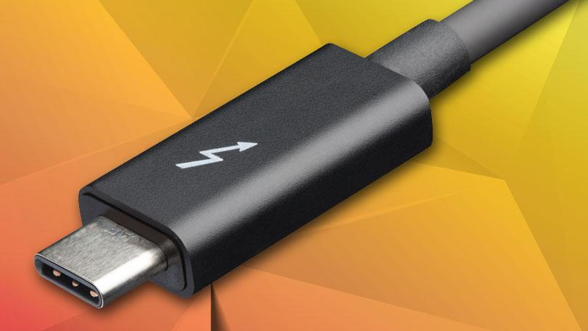
5.2 The Thunderbolt 3 standard and its implementation (2)
Thunderbolt 3 connector [267]

Slide 11
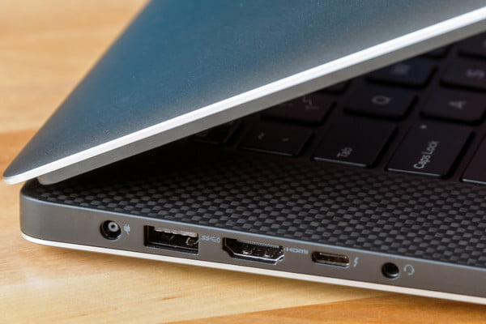
5.2 The Thunderbolt 3 standard and its implementation (3)
Thunderbolt 3 socket [268]

Slide 12
5.2 The Thunderbolt 3 standard and its implementation (4)
Data transfer rates supported by the Thunderbolt and USB standards [269]

Slide 13
5.2 The Thunderbolt 3 standard and its implementation (5)
Use cases of Thunderbolt 3
Example use cases of Thunderbolt 3 [268]
Transmit data at a rate of 40 Gbps.
Output video to two 4K monitors at 60 Hz.
Charge smartphones and most laptops.
Connect to an external GPU (unless it has been blocked by the manufacturer).

Slide 14
5.2 The Thunderbolt 3 standard and its implementation (6)
Spreading of the TB 3 technology [270]
TB 3 made its debut in Intel’s Ice Lake line (in 2019).
In Q1/2019 TB 3 is common on high-end Windows laptops.
The number of PCs shipped with TB 3 support doubles annually, now with
tens of millions sold.
The number of TB 3 peripherals available doubles also at the same rate, with
many hundred certified products offered on the market.
Intel’s Ice Lake provides a fully integrated TB 3 implementation whereas previous
implementations used discrete on-board TB controllers, as seen in the next
Figure.

Slide 15
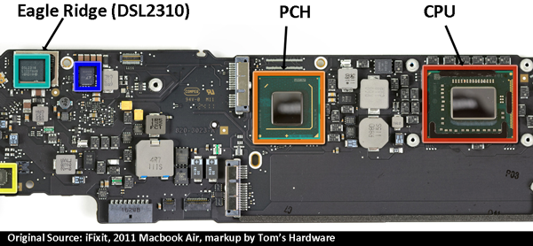
5.2 The Thunderbolt 3 standard and its implementation (7)
Example of a discrete Thunderbolt implementation
(actually in Apple’s Macbook Air (2011) [271]
(1. gen. Thunderbolt controller)

Slide 16
5.2 The Thunderbolt 3 standard and its implementation (8)
Example for using external TB controllers to connect SATA discs to an
Apple Mac platform [275]
RC: Light Ridge TB controller

Slide 17
5.2 The Thunderbolt 3 standard and its implementation (9)
Example of integrating the Thunderbolt 3 controller onto the die
(actually on Intel’s Ice Lake processor die (2019) [272]

Slide 18
5.2 The Thunderbolt 3 standard and its implementation (10)
Thunderbolt 3 cables [267]
Recently, Thunderbolt 3 cables are made of copper wires.
The simplest cables are passive and are identical to USB-C cables but do support
data transfers only up to 20 Gbps.
Data transfer rates of 40 Gbps however, need active cables that include integrated
chips.

Slide 19
5.3 The Thunderbolt 4 standard and its implementation
Notes:
19

Slide 20
5.3 The Thunderbolt 4 standard and its implementation (1)
5.3 The Thunderbolt 4 standard and its implementation [273] -1
Both TB 3 and TB 4 make use of USB-C connectors and sockets, unlike previous
TB versions.
Nevertheless, there is a big difference in implementing TB 3 and TB 4.
TB 3 has the same physical interface as USB 3 but it needs a dedicated controller
since TB 3 does not operate via USB 3 circuitry., as previously mentioned.
In contrast, TB 4 is a superset of TB 3, USB 3x and USB 4, meaning that any TB 4
Type-C socket is able to accept also TB 3, USB 3x and USB 4 connectors.
Intel introduced TB 4 in its Tiger Lake line in 9/2020.
*

Slide 21
5.3 The Thunderbolt 4 standard and its implementation (2)
Intel’s introduction of Thunderbolt 4 (07/2020) [284]

Slide 22
5.3 The Thunderbolt 4 standard and its implementation (3)
Replacing USB ports by TB 4 ports [273]

Slide 23
5.3 The Thunderbolt 4 standard and its implementation (4)
Replacing USB cables by TB 4 cables [273]

Slide 24
5.3 The Thunderbolt 4 standard and its implementation (5)
Data transfer rates supported by Thunderbolt and USB standards
(based on [269])
Thunderbolt 4
Thunderbolt 3
USB 4
Thunderbolt 2 &USB3.2
*

Slide 25
5.3 The Thunderbolt 4 standard and its implementation (6)
Main features of the Thunderbolt 3/4 and USB 3/4 standards [274]
 | Thunderbolt 4 | Thunderbolt 3 | USB4 | USB 3/DP
1 universal port | ✓ | ✓
40Gb/s cables up to 2 meters | ✓
Min PC speed requirement | 40Gb/s | 40Gb/s | 20Gb/s (40Gb/s is optional) | 10Gb/s
Min PC video requirement | 2 x 4K displays or 1 x 8K display | 1 x 4K display | 1 display (no min resolution) | 1 display (no min resolution)
PC charging port required | At least one
PC wake from sleep w/TB dock connected | Required
Min PC port power for accessories | 15W | 15W | 7.5W | 4.5W
Thunderbolt networking | ✓ | ✓
Mandatory certification for PCs and accessories | ✓ | ✓
USB4 specification | Compliant | Compatible | Compliant | Compatible

Slide 26
5.3 The Thunderbolt 4 standard and its implementation (7)
TB 4 branding and logos [273]

Slide 27
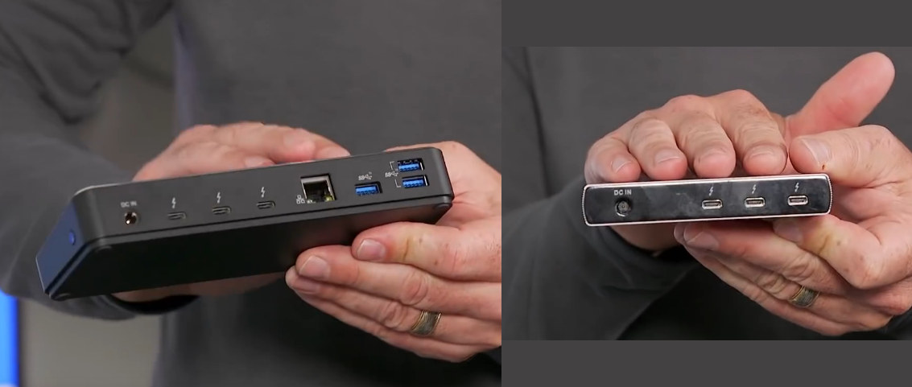
5.3 The Thunderbolt 4 standard and its implementation (8)
Main requirements for certification of the TB 4 logo [273]
For using the TB logo on their devices vendors need certification by Intel.
A certification will be provided, if third parties approve the fulfillment of given
requirements, including
support for TB 4 docks with four TB 4 ports,
PC Charging on at least one port (for laptops up to 100 W)
Figure: TB4 docks with one input port connected over a cable to a laptop for data, video, and power, and offering three downstream TB 4 ports [289]

Slide 28
5.3 The Thunderbolt 4 standard and its implementation (9)
Processor accessories with possible Thunderbolt interfaces [273]

Slide 29
5.3 The Thunderbolt 4 standard and its implementation (10)
Introducing Thunderbolt 4 support by Intel [270]
As in their previous Ice Lake line Intel integrated the TB 4 controller onto the
processor die.
In addition, Intel provides TB 4 host controllers for use in desktops, laptops etc.
for OEMs (called Maple Ridge JHL8540 and JHL 8340).
*

Slide 30
6. Wi-Fi 6 support
Notes:
30

Slide 31
6. Wi-Fi 6 support ()
6. Wi-Fi 6 support [294]
Wi-Fi is an abbreviation of Wireless Fidelity.
Wi-Fi is standardized by the IEEE (Institute of Electrical and Electronics Engineers)
802 Standard Committee that is responsible for LAN standardization.
It is the IEEE 802.11 protocol family that specifies the set of MAC (Media Access
Control) and PHY (physical layer) protocols for implementing WLANs (Wireless
Local Area Networks).
Until now there are six releases of the 802.11 WLAN protocol family (Wi-Fi 1 to
Wi-Fi 6), their main features are summarized in the next Table.

Slide 32
6. Wi-Fi 6 support (2)
Evolution of the IEEE 802.11 Wi-Fi standard (Based on [276]) -1
Standard | Approved in | Frequency bands | Band-width | MIMO technology | Modulation | Data rate (up to)
11.b (Wi-Fi 1) | 1999 | 2.4 GHz | 22 MHz | no | DSSS | 11 Mb/s
11.a (Wi-Fi 2) | 1999 | 5 GHz | 20 MHz | no | OFDM | 54 Mb/s
11.g (Wi-Fi 3) | 2003 | 2.4 GHz | 20 GHz | no | OFDM | 54 Mb/s
11.n (Wi-Fi 4) | 2009 | 2.4/5 GHz | 20 MHz | MIMO up to 4 streams (in downlink) | OFDM | 288.8 Mb/s
 |  |  | 40 MHz |  |  | 600 Mb/s
11.ac (Wi-Fi 5) | 2013 | 5 GHz | 20 MHz | MIMO up to 8 streams (in downlink) | OFDM | 346.8 Mb/s
 |  |  | 40 MHz |  |  | 800 Mb/s
 |  |  | 80 MHz |  |  | 1733.2 Mb/s
 |  |  | 160 MHz |  |  | 3466.8 Mb/s
11.ax (Wi-Fi 6) | 2019 | 2.4/5/6 GHz | 20 MHz 40 MHz 80 MHz 80+80 MHz | MIMO up to 8 streams (in up and downlink) | OFDMA | 10.53 Gb/s
MIMO: Multiple-Input Multiple-Output
Direct-Sequence Spread Spectrum
OFDM: Orthogonal Frequency Division Multiplexing
OFDMA: Orthogonal Frequency Division Multiple Access

Slide 33
6. Wi-Fi 6 support (3)
Key innovations contributing to increasing the data rates in the IEEE 802.11
Wi-Fi standard family
As the previous Table shows, maximum data rates raised substantially in
subsequent Wi-Fi releases from 11 Mb/s to 10.53 Gb/s, almost 1000 times
in about 20 years, i.e. there were roughly doubling every two years.
This immense increase of data rates can mainly be contributed to the following
three innovations:
The MIMO technology
Widening the frequency band and
Enhancing the modulation scheme

Slide 34
6. Wi-Fi 6 support (4)
a) The MIMO technology
Standard | Approved in | Frequency bands | Band-width | MIMO technology | Modulation | Data rate (up to)
11.b (Wi-Fi 1) | 1999 | 2.4 GHz | 22 MHz | no | DSSS | 11 Mb/s
11.a (Wi-Fi 2) | 1999 | 5 GHz | 20 MHz | no | OFDM | 54 Mb/s
11.g (Wi-Fi 3) | 2003 | 2.4 GHz | 20 GHz | no | OFDM | 54 Mb/s
11.n (Wi-Fi 4) | 2009 | 2.4/5 GHz | 20 MHz | MIMO up to 4 streams (in downlink) | OFDM | 288.8 Mb/s
 |  |  | 40 MHz |  |  | 600 Mb/s
11.ac (Wi-Fi 5) | 2013 | 5 GHz | 20 MHz | MIMO up to 8 streams (in downlink) | OFDM | 346.8 Mb/s
 |  |  | 40 MHz |  |  | 800 Mb/s
 |  |  | 80 MHz |  |  | 1733.2 Mb/s
 |  |  | 160 MHz |  |  | 3466.8 Mb/s
11.ax (Wi-Fi 6) | 2019 | 2.4/5/6 GHz | 20 MHz 40 MHz 80 MHz 80+80 MHz | MIMO up to 8 streams (in up and downlink) | OFDMA | 10.53 Gb/s
MIMO: Multiple-Input Multiple-Output
Direct-Sequence Spread Spectrum
OFDM: Orthogonal Frequency Division Multiplexing
OFDMA: Orthogonal Frequency Division Multiple Access

Slide 35
6. Wi-Fi 6 support (5)
Principle of the MIMO technology -1
MIMO (Multiple-Input Multiple-Output) was introduced in Wi-Fi 4 (IEEE 801.11n
Wi-Fi amendment) in order to significantly raise data rate.
It assumes multiple antennas both at the transmitter and the receiver and
multiple communication channels for transmitting multiple data streams
simultaneously, e.g. 2 data streams, as the Figure below shows.
In the MIMO technology the transmitter splits the data stream to be transmitted
into sub-streams, these will be in transmitted in parallel over available channels
and then merged in the receiver, as indicated in the Figure.
Figure: Principle of the MIMO technology [277]
*

Slide 36
6. Wi-Fi 6 support (6)
Principle of the MIMO technology -2
Wi-Fi 4 (801.11n) supports up to 4 whereas Wi-Fi 5 (801.11ac and Wi-Fi 6
801.11ax) up to 8 parallel data streams in downlinks.
In addition, Wi-Fi 6 (801.11x) allows up to 8 parallel data streams also in uplinks.
In actual implementations the number of available transmitter and receiver
channels is usually given in the form of nTmR or nxm, e.g. 2T2R or 2x2.
*

Slide 37
6. Wi-Fi 6 support (7)
b) Widening the frequency band -1
Standard | Approved in | Frequency bands | Band-width | MIMO technology | Modulation | Data rate (up to)
11.b (Wi-Fi 1) | 1999 | 2.4 GHz | 22 MHz | no | DSSS | 11 Mb/s
11.a (Wi-Fi 2) | 1999 | 5 GHz | 20 MHz | no | OFDM | 54 Mb/s
11.g (Wi-Fi 3) | 2003 | 2.4 GHz | 20 GHz | no | OFDM | 54 Mb/s
11.n (Wi-Fi 4) | 2009 | 2.4/5 GHz | 20 MHz | MIMO up to 4 streams (in downlink) | OFDM | 288.8 Mb/s
 |  |  | 40 MHz |  |  | 600 Mb/s
11.ac (Wi-Fi 5) | 2013 | 5 GHz | 20 MHz | MIMO up to 8 streams (in downlink) | OFDM | 346.8 Mb/s
 |  |  | 40 MHz |  |  | 800 Mb/s
 |  |  | 80 MHz |  |  | 1733.2 Mb/s
 |  |  | 160 MHz |  |  | 3466.8 Mb/s
11.ax (Wi-Fi 6) | 2019 | 2.4/5/6 GHz | 20 MHz 40 MHz 80 MHz 80+80 MHz | MIMO up to 8 streams (in up and downlink) | OFDMA | 10.53 Gb/s
MIMO: Multiple-Input Multiple-Output
Direct-Sequence Spread Spectrum
OFDM: Orthogonal Frequency Division Multiplexing
OFDMA: Orthogonal Frequency Division Multiple Access

Slide 38
6. Wi-Fi 6 support (8)
b) Widening the frequency band -2
A major dimension in the evolution of the Wi-Fi standard is the substantial
widening frequency band first from 20 MHz to 40 MHz, next to 80 MHz and
then even to 160 MHz, this results roughly in doubling, quadrupling etc. of the
maximum data rate.
*

Slide 39
6. Wi-Fi 6 support (9)
c) Enhancing the modulation scheme -1
Standard | Approved in | Frequency bands | Band-width | MIMO technology | Modulation | Data rate (up to)
11.b (Wi-Fi 1) | 1999 | 2.4 GHz | 22 MHz | no | DSSS | 11 Mb/s
11.a (Wi-Fi 2) | 1999 | 5 GHz | 20 MHz | no | OFDM | 54 Mb/s
11.g (Wi-Fi 3) | 2003 | 2.4 GHz | 20 GHz | no | OFDM | 54 Mb/s
11.n (Wi-Fi 4) | 2009 | 2.4/5 GHz | 20 MHz | MIMO up to 4 streams (in downlink) | OFDM | 288.8 Mb/s
 |  |  | 40 MHz |  |  | 600 Mb/s
11.ac (Wi-Fi 5) | 2013 | 5 GHz | 20 MHz | MIMO up to 8 streams (in downlink) | OFDM | 346.8 Mb/s
 |  |  | 40 MHz |  |  | 800 Mb/s
 |  |  | 80 MHz |  |  | 1733.2 Mb/s
 |  |  | 160 MHz |  |  | 3466.8 Mb/s
11.ax (Wi-Fi 6) | 2019 | 2.4/5/6 GHz | 20 MHz 40 MHz 80 MHz 80+80 MHz | MIMO up to 8 streams (in up and downlink) | OFDMA | 10.53 Gb/s
MIMO: Multiple-Input Multiple-Output
DSSS: Direct-Sequence Spread Spectrum
OFDM: Orthogonal Frequency Division Multiplexing
OFDMA: Orthogonal Frequency Division Multiple Access

Slide 40
6. Wi-Fi 6 support (10)
Enhancing the modulation scheme -2 [278], [295]
Unlike Wi-Fi 1, Wi-Fi 2 employs the OFDM (Orthogonal Frequency Division
Multiplexing) modulation technique mainly to increase data rates.
OFDM makes use of a large number of carriers, each one with a low bit rate.
This modulation scheme is very resilient to selective fading or interferences and
provides high spectral efficiency.
About 20 years later Wi-Fi 6 replaced the OFDM modulation technique by
its multi-user enhancement, called the OFDMA (Orthogonal Frequency
Division Multiple Access) modulation scheme.
The multi-user feature of OFDMA divides the bandwidth among the wireless
devices instead of forcing them to wait their turn to become active are
allowed to use the full bandwidth.
This reduces network latency by about 75 % compared to Wi-Fi 5 (802.11ac).
Remark
Due to the diverging scopes of processor architectures and wireless communication
techniques, here we do not go into any details of the modulation schemes mentioned,
but only give a brief overview of their evolution.

Slide 41
6. Wi-Fi 6 support (11)
Further enhancements of Wi-Fi 6 (801.11ax) [278]
The Wi-Fi 6 standard opens the use of the 6 GHz band in addition to the
previously allocated 2.4 and/or 5 GHz frequency bands.
Products supporting also the 6 GHz frequency band are marked by the
Wi-Fi 6E (or in case of Intel by the Wi-Fi 6 Gig+) branding.

Slide 42
6. Wi-Fi 6 support (12)
Approval of the Wi-Fi 6 standard and certification of Wi-Fi 6 products
In 09/2019 Wi-Fi Alliance, the organization which oversees the implementation
of the Wi-Fi standards, approved the Wi-Fi 6 draft standard and began
certifying Wi-Fi 6 capable products that may carry the logo shown below.
Figure: The certification logo of Wi-Fi 6 [279]
Among the first devices certified was Intel’s AX200 Wi-Fi Adapter for laptops and
desktops indicating Intel’s capability of supporting the Wi-Fi 6 technology.

Slide 43
6. Wi-Fi 6 support (13)
Intel’s implementation of Wi-Fi 6
Intel debuted their Wi-Fi 6 technology already along with their 10. gen.
Ice Lake processors (08/2019), i.e. before approving the standard.
Intel’s Wi-Fi 6 implementation makes use of the previously introduced partial
integration of the combined Wi-Fi 5/Bluetooth (BT)/RF module, called Integrated
connectivity (CNVi).
Next we describe the 1. gen. Integrated connectivity, that was introduced along
with Wi-Fi 5 in Series 300 chipsets serving Intel’s 8th generation Coffee Lake
processors (10/2017) both for the DT and mobile PCH models (except the first
launched Z370 PCH (10/2017)).
Intel’s Wi-Fi 6 implementation will be omitted in the Lecture.

Slide 44
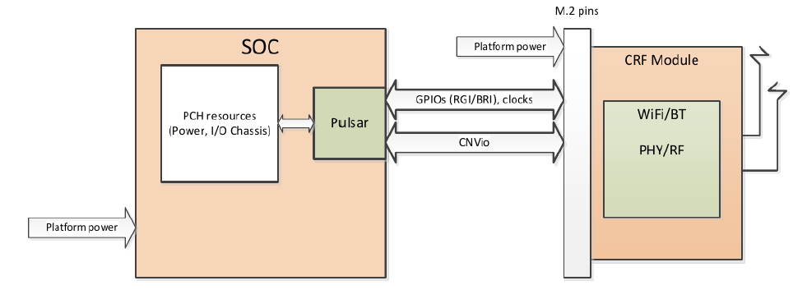
6. Wi-Fi 6 support (14)
Intel’s 1. gen. Integrated connectivity (CNVi) -1
Traditionally, there is a Wi-Fi/BT/RF module that is placed apart from the
processor, e.g. on an M.2 card or as a chip mounted onto the mainboard.
With “Integrated connectivity” Intel partially integrates the Wi-Fi/BT/RF module
onto the PCH.
In this kind of implementation Intel places analog functional blocks of the
Wi-Fi/BT/RF module, such as the logic, MAC (Multiplier-Accumulator) and
memory onto the PCH, into a block called Pulsar, whereas other parts of the
module, like the PHY (Physical layer) and RF units remain on a separate
Companion RF module (CRF), dubbed Jefferson Peak, as shown below.
PCH
(Jefferson Peak)
Pulsar
(Integr.
blocks)
(Companion
RF Module)
Figure: Intel’s 1. gen. Integrated connectivity (CNVi) solution [280]

Slide 45
6. Wi-Fi 6 support (15)
Intel’s 1. gen. Integrated connectivity (CNVi) -3
The CRF module is interconnected with the PCH via an Intel proprietary bus,
called the CNVio interface, as shown below.

Slide 46
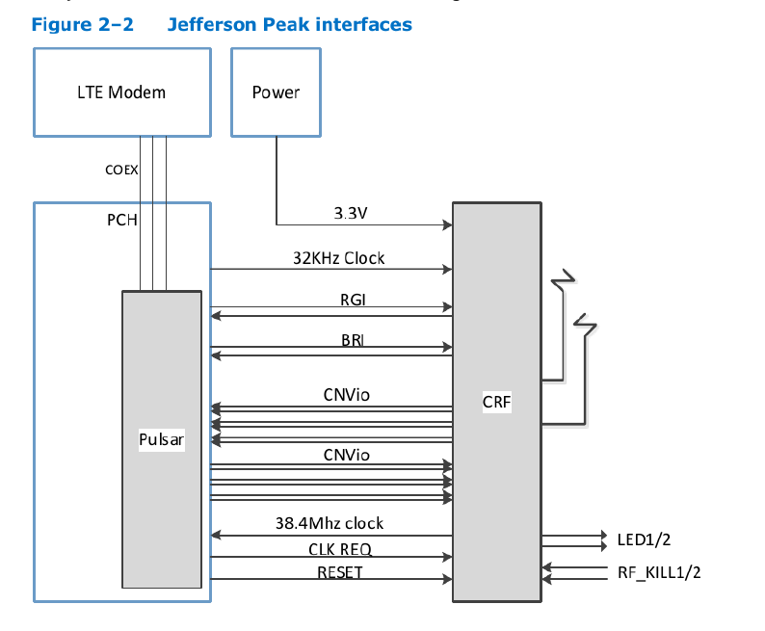
6. Wi-Fi 6 support (16)
Interfacing the Companion RF module (CRF) to the PCH in Intel’s 1. gen.
Integrated connectivity scheme [280]
RGI: Radio Generic Interface, between CRF and Pulsar
BRI: Bluetooth Radio Interface, between CRF and Pulsar
CNVio: Proprietary Intel interface between CRF and Pulsar
The Intel proprietary CNVio bus
has two data lanes
and one clock for each direction.
Both data and clock signals are
differential signals.
Total number of the signal lines
is 12 (6 pairs, 3 per direction).

Slide 47
6. Wi-Fi 6 support (17)
Intel’s 1. gen. Integrated connectivity (CNVi) -4 [228]
As part of their Integrated connectivity technology Intel provides a number of
Wi-Fi 5/BT/RF CRF modules, including
the AC-9560 (2T2R module, the only vPro enabled CRF),
The AC-9462 (a 1T1R module), and
The AC-9461 (a low-end 1T1R module).
The CRF modules are implemented as M.2 cards (2230 or 1216 if soldered down)
(length x width).
Though these M.2 cards can be inserted into standard M.2 slots, they are only
compatible with dedicated CNVi interfaces.
All three CRFs are supported by Linux, Chrome OS, and Windows 10.

Slide 48
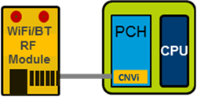
6. Wi-Fi 6 support (18)
Intel’s 2. gen. Integrated connectivity (CNVi2)
Intel’s 10. gen. Ice Lake processors (2019) implement Wi-Fi 6 in form of 2. gen.
. Integrated connectivity.
The 2. gen. Integrated connectivity needs a new Wi-Fi 6 Wi-Fi 6/BT module
(AX201) that is interconnected with the PCH via the redesigned CNVi-2 interface,
as indicated in the Figures below.
CNVi-2
Intel Wi-Fi 6 AX201
Figure: 2. gen. Integrated connectivity
as introduced in Intel’s Ice Lake (2019) [281]
Picture: The AX201 Wi-Fi 6/BT module
(Source: Amazon.com)

Slide 49
6. Wi-Fi 6 support (19)
Remark to AMD’s Wi-Fi 6 support [282]
Until now AMD did not announce any Wi-Fi 6 implementation of their own.
Recently, AMD-based motherboards and laptops employ a wireless solution from
a third-party vendor, like Intel or Realtek.
Allegedly, however [282] AMD will start a collaboration with MediaTek to develop
customized Wi-Fi 6 chips for notebooks.

Slide 50
7. Physical implementation of client processors
7.1 Processor sockets and packages
7.2 Physical implementation of Intel’s Core-based
client processor lines
Notes:
50

Slide 51
7.1 Processor sockets and packages
Notes:
51

Slide 52
7.1 Processor sockets and packages (1)
7.1 Processor sockets and packages
Socket
Package
It houses the processor (package)
and provides the electrical contacts
for each of the pins or balls of the package.
It is mounted on the motherboard.
Includes the die or dies.
Provides electrical contacts
for the socket (pins or balls).
The package is inserted into the socket.
Socket
Socket: Foglalat
Package: Tok
*

Slide 53
7.1 Processor sockets and packages (2)
Recent processor package types [169]
PGA
(Pin Grid Array)
LGA
(Land Grid Array)
BGA
(Ball Grid Array)
In the PGA package pins provide the contacts, arranged in a regular array.
LGA packages are essentially the direct opposite of PGAs, the contact pins are on the
socket, whereas contact pads on the package provide the connections.
BGA packages are soldered directly onto the motherboard, so practically they can not
be replaced without proper equipment.
PGA and LGA packages are inserted to their respective sockets.
*

Slide 54
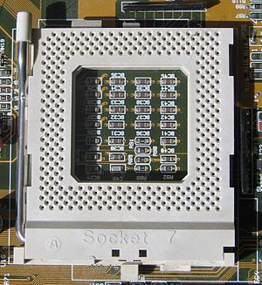
7.1 Processor sockets and packages (3)
Respective socket types
Example of a PGA socket
It is actually a ceramic Socket 7 with 321 pins for Pentium processors [170]

Slide 55
7.1 Processor sockets and packages (4)
Example of an LGA socket
It is actually an LGA-1155 socket for Sandy Bridge/Ivy Bridge processors [171]

Slide 56
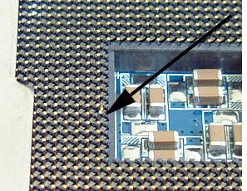
7.1 Processor sockets and packages (5)
Example: Picture of an LGA-775 socket with a dislodged pin (blown up) [172]

Slide 57
7.1 Processor sockets and packages (6)
Sockets without and with processor (i.e. package) [168]

Slide 58
7.1 Processor sockets and packages (7)
Comparing benefits and drawbacks of PGA and LGA sockets [173]
Advantages of PGA sockets:
PGA sockets (and thus motherboards) can hardly be damaged by processor
misalignments.
(More durable motherboards).
It is much easier to repair bent pins on a PGA package than restore an
LGA socket.
(Slightly better repairability).
Advantages of LGA sockets:
Processors are less likely to be damaged by mishandling and drops,
because of no fragile pins.
(More durable processors).
LGA pins are smaller in physical size, allowing for more pins in the same
amount of space.
(More space efficient).
All in all, both LGA and PGA sockets have their respective pros and cons,
nevertheless, over time both Intel and AMD preferred LGA sockets to PGA
sockets, as the subsequent Table indicates.
The reason is perhaps that LGA sockets are smaller and can more conveniently,
be used, although a slightly bent pin can ruin the socket, but this can be
avoided by inserting the processor extra carefully into the socket.
*

Slide 59
7.1 Processor sockets and packages (8)
Examples for processors with PGA or LGA sockets
PGA sockets
LGA sockets
Intel
Socket 7 for Intel Pentium (1993)
Socket 423 for Intel Pentium 4
Willamette (2000)
Northwood (2002)
Socket 603/604 for Intel
Pentium 4-based Xeon lines (2001)
LGA 775 for Intel Pentium 4 Prescott) (2004)
Socket T (LGA-775) for Intel Core 2 (2006)
Sockets of Intel’s subsequent processors
AMD
Socket A for AMD Athlon (2000)
Socket 940 for AMD Opteron (2003)
Socket 939 for AMD Athlon 64 (2004)
Socket AM3 (940/941) for AMD
Phenom II (K10) (2007)
Sockets of AMD’s subsequent processors
including the Ryzen family (2017)
AMD’s Threadripper and EPYC families (2017)

Slide 60
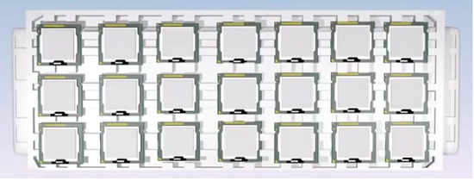
7.1 Processor sockets and packages (9)
Remark: Boxed and tray processors [174]
As the name implies, boxed processors ship in attractive retail packaging and
contain only one CPU.
End-users usually buy boxed processors through authorized retailers.
Tray processors ship in polystyrene trays and usually come in lots of 10.
Companies that manufacture or repair computers usually purchase trays of
processors from distributors or wholesalers.
Figure: Boxed processors
Figure: Tray processors
Wholesalers: A company that sells goods in large quantities to retailers.
*

Slide 61
7.2 Physical implementation of Intel’s Core-based
client processor lines
Notes:
61

Slide 62
7.2 Physical implementation of Intel’s Core-based client processor lines (1)
7.2 Physical implementation of Intel’s Core-based client processor lines
Naming schemes of client processors in Intel’s Core lines [296]
Intel’s recently used regular scheme for naming client processors is as follows:
Historical remark to the introduction of Intel’s naming scheme for client processors
The above naming scheme appeared first in Intel’s Sandy Bridge line (in 2011)
although the i5, i7 modifiers were introduced already earlier in the Nehalem line
(in 2008, with 3-digit model identifiers yet).
*

Slide 63
7.2 Physical implementation of Intel’s Core-based client processor lines (2)
Mostly used suffixes and their interpretations in Intel’s client lines
Mobile suffixes
Y: low-power (11.5/13 W, SoC) along with regular naming (i3/i5/i7-nxxxY)
extreme low power (4.5/5 W SoC with the irregular naming m3/m5/m7-nYxx)
U: ultra-low power (typically 15/28 W, SoC)
H: high-performance mobile (typically 35/45 W)
M: mobile processor (35/45 W)
MX: extreme performance mobile processor (57 W)
Q: quad-core
Desktop suffixes
T – power-optimized models (ultra low power with 35/45 W TDP)
S – performance-optimized models (low power with 65 W TDP)
R – BGA packaging / High-performance (GT3e) GPU with on-package eDRAM)
K – unlocked (adjustable CPU multiplier (60-95 W)
SoC: System on a Chip (egylapkás rendszer)
*

Slide 64
7.2 Physical implementation of Intel’s Core-based client processor lines (3)
Irregular naming schemes introduced by Intel for their client processors
Intel introduced two irregular naming schemes for their client processors, as follows:
Naming scheme for extreme low power client processors
Processors with the m3/m5/m7 brand modifiers were introduced along with
the 6. gen. Skylake line in 2015.
They have a TDP value of 4.5/5 W rather than 11.5/13 W as typical for the
models designated by the regular naming scheme of client processors.
Referenced processors target ultra-thin notebooks, 2-in-1 detachables or
similar devices:
Remark
The Broadwell line (2014), preceding the Skylake line has already introduced extreme
low power client processors with a TDP value of 4.5 W, they were named
Core M-5Yxx processors.

Slide 65
7.2 Physical implementation of Intel’s Core-based client processor lines (4)
b) Naming scheme of Intel’s 10th gen. 10 nm Ice Lake client processors
The Ice Lake client processor introduced Gx graphics tags in the model
designations, as seen below.
(10 nm)
(14 nm)
Figure: Naming scheme of Intel’s 10th gen. client processors [288]
Graphics tags indicate the graphics performance level of the related models,
as the next Table shows.
*

Slide 66
7.2 Physical implementation of Intel’s Core-based client processor lines (5)
Graphics tags introduced in the model designations of the Ice Lake line
(2019) [181]

Slide 67
7.2 Physical implementation of Intel’s Core-based client processor lines (6)
Introducing 1-chip platforms by integrating CPUs and PCHs into a single
BGA package, beginning with Haswell’s mobiles (2013) [175]
Haswell
SoC
BGA: Ball Grid Array
SDP: Scenario Design Point
PGA: Pin Grid array
*

Slide 68
7.2 Physical implementation of Intel’s Core-based client processor lines (7)
TDP values, Optane support and socket types of Intel’s mostly used mobile
processor series of the Core 2 family (3rd to 9th gen.)
 |  | m3/m5/m7-nYxx | i3/i5/i7-nxxx
Gen. | Mobiles | Y | Y | U | H/HQ | M/QM/MX | B | G
3 | Ivy Bridge |  | 13 BGA-1023 | 17/25 BGA-1023 |  | 35/45/55 PGA-988
4 | Haswell |  | 11.5 BGA-1168 | 15/28 BGA-1168 | 37/47 BGA-1364 | 37/47/57 PGA-946 |  | FIVR introduced
5 | Broadwell | 4.5 BGA-1234 |  | 15/28 BGA-1168 | 47 BGA-1364
6 | Skylake | 4.5 BGA-1515 |  | 15/28 BGA-1356 | 35/45 BGA1440 |  |  | FIVR omitted
7 | Kaby Lake | 4.5 BGA-1515 |  | 15/28 O.¹ BGA-1356 | 35/45 BGA-1440 |  |  | 100 BGA-2270 (Vega)
8 | Coffee Lake |  |  | 15/28 O. BGA-1528 | 45 O. BGA-1440 | 45 O. BGA-1440 | 65 O. BGA-1440
9 | Coffee Lake Refr. |  |  | 15/28 O. BGA-1528 | 45 O. BGA-1440 | 45 O. BGA-1440
Typical use
Ultra thin laptops
Laptops
Laptops (35-45 W)/Desktops
O: Optane support
¹: In selected models
n: generation (3..9)
SoC
2 chips

Slide 69
7.2 Physical implementation of Intel’s Core-based client processor lines (8)
Remarks to the previous Table (not discussed)
Due to space limitations the Table does not include three less important 8. gen.
Skylake-based lines.
The missing entries are as follows:
The Kaby Lake Refresh line has only U series processors and has the same TDP
and socket specifications as Kaby Lake U series processors.
The Amber Lake line has only Y series processors with 5 and 7 W TDP
and BGA 1515 sockets.
The Whiskey Lake line has only U series processors with 15 or 28 W TDP
and BGA 1528 sockets and Optane support.

Slide 70
7.2 Physical implementation of Intel’s Core-based client processor lines (9)
TDP values, Octane support and socket types of Intel’s mostly used mobile
processor series of the Core 2 family (10th to 11th gen.)
 |  | i3/i5/i7-nxxx
Gen. | Mobiles | Y | U4 | U3 | U | H/HQ
10 | Comet Lake | 7 BGA1377 |  |  | 15 O. BGA-1528 | 45 O. BGA-1440
10 | Ice Lake | 9 O. BGA-1377? |  |  | 15 O. BGA-1526 |  | FIVR Thunderbolt 3.0
11 | Tiger Lake |  | 7-15 O. BGA-1598 | 12-28 O. BGA-1449 |  |  | Thunderbolt 4.0 contr. onto die
12 | Alder Lake?
Typical use
Ultra thin laptops
Laptops
Laptops (35-45 W)/Desktops
O: Optane support
n: generation (10-11)
SoCs
2 chips
O: Optane support

Slide 71
7.2 Physical implementation of Intel’s Core-based client processor lines (10)
Remarks to why Intel several times changed the socketing of their processors?
FIVR (Fully Integrated Voltage Regulation) was introduced along with the 4. gen.
Haswell line, this called for modifying socketing.
Nevertheless, beginning with the 6. gen. Sky Lake line Intel omitted FIVR due to
its additional power consumption, thus again a modification in socketing took
place.
Subsequently, the 10. gen. 10 nm Ice Lake line implemented FIFR again, and in
addition it integrated the Thunderbolt 3.0 controller onto the die, this gave rise
to a modification of the socketing anew.
Finally, in their 11. gen. Tigerlake line Intel implemented the Thunderbolt 4.0
controller onto the processor die, this lead to a new socketing scheme again.

Slide 72
7.2 Physical implementation of Intel’s Core-based client processor lines (11)
TDP values, Optane support and socket types of Intel’s mostly used desktop
processor series of the Core 2 family (3rd to 10th gen.)
 |  | i3/i5/i7-nxxx
Gen. | Desktops | T | S | C | P | R (eDRAM) | -- | K
3 | Ivy Bridge | 35/45 LGA-1155 | 65 LGA-1155 |  |  |  | 55/77 LGA-1155 | 77 LGA-1155
4 | Haswell (FIVR) | 35/45 LGA-1150 | 65 LGA-1150 |  |  | 65 BGA-1364 | 54/84 LGA-1150 | 84/88 LGA-1150
5 | Broadwell |  |  | 65 LGA-1150 |  | 65 BGA-1364
6 | Skylake (FIVR X) | 35 LGA-1151 |  |  | 54 LGA-1151 | 65 BGA-1440 | 51/65 LGA-1151 | 91 LGA-1151
7 | Kaby Lake | 35 O. LGA-1151 |  |  |  |  | 51/65 O. LGA-1151 | 60/91 O. LGA-1151
8 | Coffee Lake (6C) | 35 O. LGA-1151v2 |  |  |  |  | 62/65 O. LGA-1151v2 | 91/95 O. LGA-1151v2
9 | Coffee Lake Refr. | 35 O. LGA-1151v2 |  |  |  |  | 62/65 O. LGA-1151v2 | 91/95 O. LGA-1151v2
10 | Comet Lake | 35 O. LGA-1200 |  |  |  |  | 65 O. LGA-1200 | 125 O. LGA-1200
Typical use
Laptops
/desktops
Desktops
8-10. gen F tag means: Lack of GPU, but the same price
2 chips (all)
O: Optane support

Slide 73
7.2 Physical implementation of Intel’s Core-based client processor lines (12)
Remark: Differences between the LGA 1151 and the LGA 1151v2 DT ball maps
introduced in the Coffee Lake DT lines (not discussed) [283]
(CL)
LGA 1151
LGA 1151 v2
Beyond other changes the new socket has more V_{SS} contacts (black) for ground
(146 up from 128) and more V_{CC} contacts (red) for power (391 up from 377)
to provide more current for up to 6 cores (CL) or up to 8 cores (CLR) instead of 4.

Slide 74
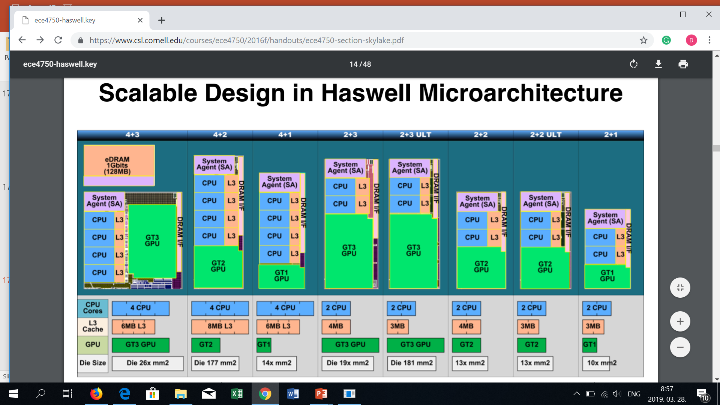
7.2 Physical implementation of Intel’s Core-based client processor lines (13)
Example 1: 7 alternative die designs of 4. gen. Haswell’s DT and mobile
models [89]

Slide 75
7.2 Physical implementation of Intel’s Core-based client processor lines (14)
Example 2: 5 alternative die designs of 6. gen. Skylake’s DT and mobile
models [19]
BGA: Ball Grid Array (to be soldered)
LGA: Land Grid Array (to be inserted)
Dies are characterized by the no. of cores and GT levels, e.g. 2+2 means: 2 cores + GT 2
Graphics Technology level, etc.

