Slide 1
AMD’s Zen processor family
(Family 17h)
Lecture
Dezső Sima
August 2020
(Ver. 3.0)
© Sima Dezső, 2020

Slide 2
AMD’s Zen processor family (Family 17h)
1. Introduction
2. The Zen core
3. Building blocks of Zen-based processors
4. Introduction to the Infinity Fabric
5. References
Notes:
2

Slide 3
1. Introduction
Notes:
3

Slide 4
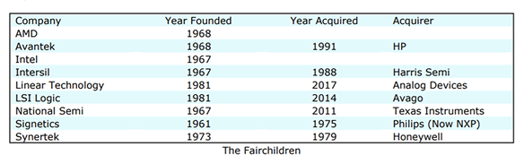
1. Introduction (1)
Concentration of semiconductor companies through acquisitions in the US
In 1961 integrated circuits were invented by Fairchild.
Many entrepreneurial technologists employed by Fairchild Semiconductor
became frustrated by the vendors management practices and set out on their
own.
This is the reason why the decade from 1965 to 1975 saw an explosion of new
semiconductor companies.
Table: Companies established by former Fairchild employees [115]
*

Slide 5
1. Introduction (2)
1. Introduction
Overview of AMD’s processor lines
AMD’s in-house designed x86 families
32-bit
x86 families
The Hammer
family
Intermediate
families
The Bulldozer
family
The Cat
family
The Zen
family
K5/K6/K7
families
(32-bit
Mobile/DT)
1996-2003)
K8/K10/K10.5
families
(08h/10h/10.5h)
(64-bit
x86 family)
(2003-2009)
Families
11h/12h
(Mobile/DT
oriented)
(2008-2011)
Family
15h
(High-performance
oriented)
(2011-2016)
Families
14h/16h
(Low-power
oriented)
(2011-2015)
Family
17h
(Modular design)
(2017- )
K7: Athlon (1999-2003)
Remark
Before the in-house designed K5, AMD licensed and manufactured Intel designed processors.

Slide 6
1. Introduction (3)
AMD’s outstanding achievements in the beginning of the 2000’s -1
Extending the 32-bit x86 ISA to 64-bit x86-ISA [164]
At the beginning of the 2000’s the CISC processors were 32-bit wide,
nevertheless, in 1997 Intel and hp (Hewlett Packard) jointly announced
a new 64-bit VLIW-based ISA, called the IA-64 to replace 32-bit designs.
In 10/1999 AMD surprisingly announced their x86-64 ISA extension, that
became released in 8/2000.
AMD’s goal was clearly formulated at revealing the x86-64 ISA specification
in 8/2000:
"Ultimately this technology is designed to help preserve the enterprise
community's enormous financial investment in 32-bit operating systems,
applications, development tools and support infrastructure while
providing a seamless path to deploy future 64-bit technology."
"Perhaps the most noteworthy feature of AMD's approach to 64-bit
computing is that it is an extension to the 32-bit environment prevailing
in the industry today rather than a radical departure“, as envisioned
by Intel’s and HP’s joint IA64 VLIW architecture concept, released
in 1997.
The release encouraged the software community to begin incorporating
x86-64 technology into operating systems, applications, drivers and
development tools.
VLIW: Very Long Instruction Word
*

Slide 7
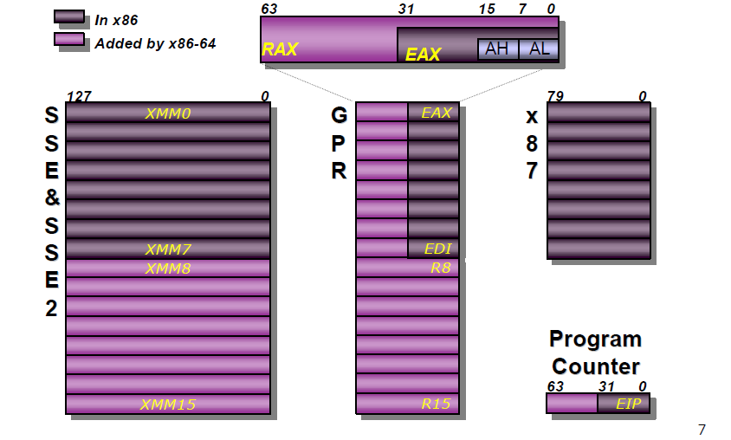
1. Introduction (4)
The programmer’s model of the introduced register set in the x86-64 ISA
[167]
Notes:
7

Slide 8
1. Introduction (5)
AMD’s outstanding achievements in the beginning of the 2000’s -2
b) Developing the Direct Connect Architecture (DCA) multiprocessor concept
It originates from 10/1999 [165].
It is characterized by
an Integrated Memory Controller
to eliminate the memory bottleneck
up to 3 serial 2B–wide HyperTransport links
for chip-to-chip-communication
to eliminate the FSB bottleneck [167].
These links interconnect processors
in DP (2P) and MP (4P) multiprocessors
as well as processors with the chipset.
Figure: AMD’s Direct Connect Architecture
concept [168]
*

Slide 9
1. Introduction (6)
AMD’s outstanding achievements in the beginning of the 2000’s -3
4/2002 AMD announces Microsoft support for their x86-64 family [166].
4/2003 First shipment of K8 processors (the Sledgehammer line of Opteron
servers).
Both the introduced server and subsequent desktop processors were superior
to Intel’s existing Pentium 4 based processors [169].
Nevertheless, in 2006 Intel launched their Core 2 family and Core 2 processors overtook the performance crown from AMD’s processors.
*

Slide 10
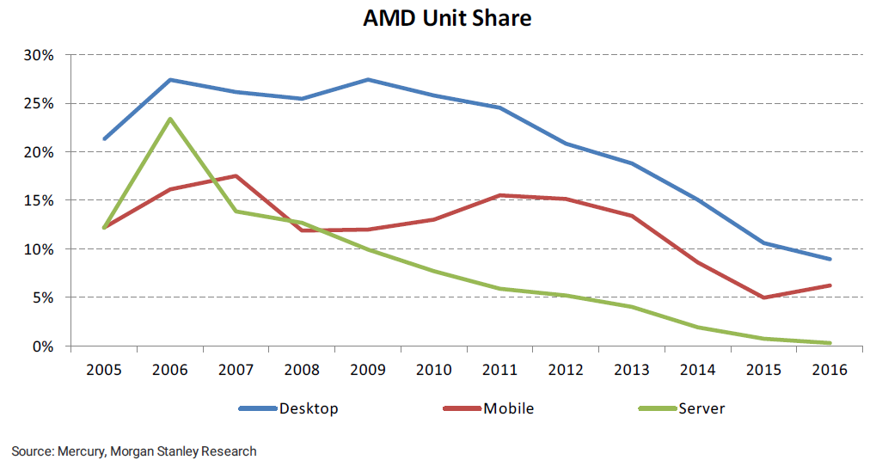
1. Introduction (7)
1. Introduction
AMD's unit shares on the world market [51]

Slide 11
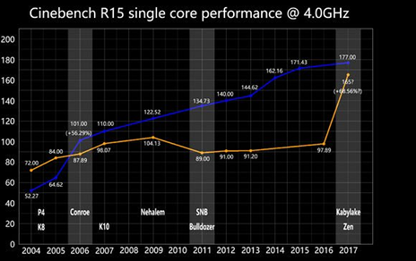
1. Introduction (8)
Efficiency of Intel and AMD CPUs - 2004 to 2017 [89]
(Core 2)
Cinebench: Cross-platform benchmark for testing hardware capabilities of computers.

Slide 12
1. Introduction (9)
AMD’s worldwide market unit share since introducing the Zen family [116]
 | 2Q20 | 1Q20 | 4Q19 | 3Q19 | 2Q19 | 1Q19 | 4Q18 | 3Q18 | 2Q18 | 1Q18 | 4Q17 | 3Q17
DT | 19.2% | 18.6% | 18.3% | 18% | 17.1% | 17.1% | 15.8% | 13% | 12.3% | 12.2% | 12.0% | 10.9%
Mobile | 19.9% | 17.1% | 16.2% | 14.7% | 14.1% | 13.1% | 12.2% | 10.9% | 8.8%
Server | 5.8% | 5.1% | 4.5% | 4.3% | 3.4% | 2.9% | 3.2% | 1.6% | 1.4% | 0.8%

Slide 13
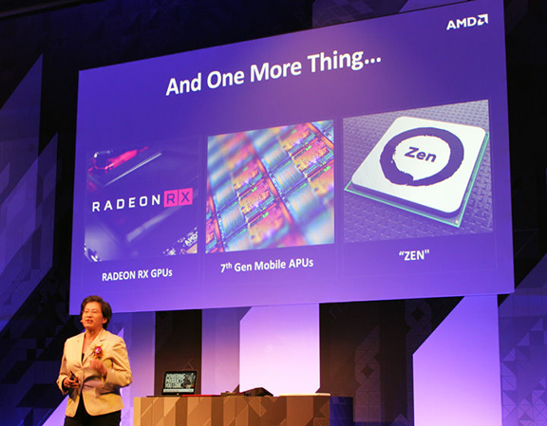
1. Introduction (10)
Announcing details of the Zen architecture at Computex 6/2016 [1]

Slide 14
1. Introduction (11)
AMD’s effort to design the Zen core [10]
2012: Jim Keller begins working by AMD.
M. Papermaster, CTO of AMD: Up to 300 engineers were working on the Zen core
spending over two million working hours (500 man-year).
CTO: Chief Technology Officer

Slide 15
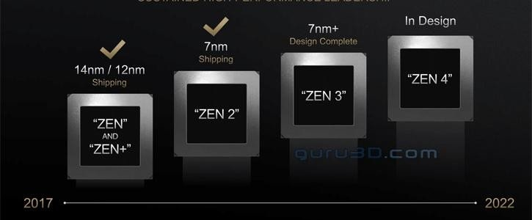
1. Introduction (12)
Evolution of AMD’s basic CPU architecture (as of 11/2019) [117]
*

Slide 16






1. Introduction (13)
Processor brands, logos and supported technologies of the Zen series [8]
(Main technologies are discussed in Section 2.1.1)
Logo |  | Family | General Description | Differentiating Features
 |  |  |  | Cores up to | Unlocked | AVX2 | SMT | XFR | IGP | ECC | MP
Mainstream
 |  | Ryzen 3 | Entry level | 4 | ✔ | ✔ | ✘ | ✔ | ✔/✘ | ✔ | ✘
 |  | Ryzen 5 | Mid-range | 6 | ✔ | ✔ | ✔ | ✔ | ✔/✘ | ✔ | ✘
 |  | Ryzen 7 | High-end | 8 | ✔ | ✔ | ✔ | ✔ | ✔/✘ | ✔ | ✘
 |  | Ryzen 9 | High-end | 16 | ✔ | ✔ | ✔ | ✔ | ✔/✘ | ✔ | ✘
Enthusiasts / Workstations
 | Ryzen Thread ripper |  | Enthusiasts | 64 | ✔ | ✔ | ✔ | ✔ | ✘ | ✔ | ✘
Servers
 |  | EPYC | High-perf. | 64 | ✘ | ✔ | ✔ |  | ✘ | ✔ | ✔
SMT: Symmetrical MultiThreading XFR: Extended Frequency Range IGP: Integrated GPU MP: Multiprocessor

Slide 17
1. Introduction (14)
Brand names of AMD’s Zen-based (Family 17h-based) processor lines
 | Core | Zen | Zen+ | Zen2 | Zen3
 | Technology | 14 nm | 12 nm | 7 nm | 7 nm+
 | Launched in | 2017-2018 | 2018-2019 | 2019-2020 | 2020-2021
 | 2P servers (~120-240 W) | EPYC 7xx1 (Naples arch.) |  | EPYC 7xx2 (Rome arch.) | EPYC 7xx3? (Milan arch.)
 | 1P servers (~120-240 W) | EPYC 7xx1P (Naples arch.) |  | EPYC 7xx2P (Rome arch.) | EPYC 7xx3? (Milan arch.)
HEDTs | HEDTs (~95-125 W) | ThreadRipper 19x0X (Whitehaven arch.) | ThreadRipper 29x0X/WX (Colfax arch.) | ThreadRipper 39x0X (Castle Peak arch.) | ThreadRipper 49x0X (Genesis Peak a.)
 | GPU-less (~65-95 W) | Ryzen 7/5/3 1xxx/X (Summit Ridge a.) | Ryzen 7/5 2xxx/X (Pinnacle Ridge arch.) | Ryzen 9/7/5/3 3xxx/X (Matisse arch.) | Ryzen 9/7/5/3 4xxxX (Vermeer a.)
 | APUs (~35-65 W) | Ryzen 5/3 2x00G/GE (Raven Ridge arch.) | Ryzen 5/3 3xxx/G/GE (Picasso arch.) | Ryzen 7/5/3 4xx0G/GE (Renoir arch.)
 | Mainstream (~35-55 W) | Ryzen 7/5/3 2x00H (Raven Ridge arch.) | Ryzen 7/5/3 3x00H (Picasso arch.) | Ryzen 9/7/5 4xx0H/HS (Renoir arch.) | Ryzen 9/7/5 5xx0H (Cezanne arch.)
 | Ultra portable (~10-25 W) | Ryzen 7/5/3 2xx0U (Raven Ridge arch.) | Ryzen 7/5/3 3xx0U (Picasso arch.) | Ryzen 7/5/3 4xx0U (Renoir arch.) | Ryzen 7/5/3 5xx0U (Cezanne arch.)
Servers
DTs
Notebooks
APU: Accelerated Processing Unit (CPU +GPU) TDP: Thermal Design Power

Slide 18
1. Introduction (15)
Family 17h model designations [118]
Family17h Processor | Core | Family Model
Whitehaven Naples | Zen | 1h
Raven Ridge | Zen | 11h
Pinaccle Ridge | Zen+ | 8h
Picasso | Zen+ | 18h
Castle Peak Rome | Zen 2 | 31h
Renoir | Zen 2 | 60h-67h
Lucienne? | Zen 2 | 67h?
Matisse | Zen 2 | 71h

Slide 19
1. Introduction (16)
Max. core/thread counts of AMD’s Zen-based (Family 17h) processor lines
 | Core | Zen | Zen+ | Zen2 | Zen3
 | Technology | 14 nm | 12 nm | 7 nm | 7 nm+
 | Launched in | 2017-2018 | 2018-2019 | 2019-2020 | 2020-2021
 | 2P servers (~120-240 W) | EPYC 7xx1 (32C/64T) |  | EPYC 7xx2 (64C/128T) | EPYC 7xx3?
 | 1P servers (~120-240 W) | EPYC 7xx1P (32C/64T) |  | EPYC 7xx2P (64C/128T) | EPYC 7xx3?
HEDTs | HEDTs (~95-125 W) | Threadripper 19x0X 16C/32T | Threadripper 29x0X/WX 32C/64T | Threadripper 39x0X 64C/128T | Threadripper 49x0X 64C/128T
 | GPU-less (~65-95 W) | Ryzen 7/5/3 1x00/X 8C/16T | Ryzen 7/5/3 2x00/X/E/AF 8C/16T | Ryzen /7/5/3 3xx0X/XT 16C/32T | Ryzen 9/7/5 4xx0?
 | APU (~35-65 W) | Ryzen 5/3 2x00G/GE 4C/8T+G | Ryzen 5/3 3x00G/GE 4C/8T+G | Ryzen 7/5/3 4xx0G/GE 8C/16T+G
 | Mainstream (~35-55 W) | Ryzen 7/5/3 2x00H 4C/8T+G | Ryzen 7/5/3 3x00G/GE 4C/8T+G | Ryzen 9/7/5 4xx0H/S 8C/16T | Ryzen 9/7/5 5xx0H ?C/T
 | Ultra portable (~10-25 W) | Ryzen 7/5/3 2x00U 4C/8T+G | Ryzen 7/5/3 3xx0U 4C/8T+G | Ryzen 7/5/3 4xx0U 8C/16T+G | Ryzen 7/5/3 4xx0U ?C/T
Servers
DTs
Notebooks

Slide 20
1. Introduction (17)
AMD’s 1S/2S EPYC server lines
 | 1. gen. EPYC | 2. gen. EPYC
Architectures | Naples | Rome
Core / Technology | Zen / 14 nm | Zen2 / 7 mm
Launched | 06/2017-11/2018 | 08/2019 -09/2019
Launched Models | EPYC 7xx1 (2S server) EPYC 7xx1P (1S server) | EPYC 7xx2 (2S server) EPYC 7xx2P (1S server)
Layout | MCM (4x Zeppelin die) | MCM (up to 8 CCD dies and one IO die)
Integrated GPU | No | No
Core count | 8/16/24/32 | 8 to 64
SMT | SMT | SMT
Mem. channels/rate | 8xDDR4-2666 | 8xDDR4-3200
PCIe lanes | 1S: 128x PCIe 3.0 2S: 64x PCIe 3.0 | 128x PCIe 4.0
TDP | 120-180 W | 120-240 W
Socket | SP3 (LGA 4094) | SP3 (LGA 4094)
Chipset | No chipset, SOC | No chipset, SoC

Slide 21
1. Introduction (18)
AMD’s Threadripper HEDT lines
 | 1. gen. Threadripper | 2. gen. Threadripper | 3.gen. Threadripper
Architecture | Whitehaven | Pinnacle Ridge | Castle Peak
Core / Technology | Zen / 14 nm | Zen+ / 12 nm | Zen2 / 7 nm
Launched | 08/2017 | 08/2018 / 10/2018 | 11/2019 - 02/2020
Launched models | 1950X/1920X/ 1900X | 2990WX/2970WX 2950X/2920X | 3990X/3970X/3960X 39x5WX
Layout | MCM (2 Zeppelin dies) | MCM (up to 4 Zeppelin dies) | MCM (4/8 CCD with 6/8 cores and one I/O die)
Integrated GPU | No | No | No
Core count | 8/12/16 | 12/16/24/32 | 24/32/64
SMT | SMT | SMT
Mem. channels/rate | 4xDDR4-2666 | 4xDDR4-2933 | 4xDDR4-3200
PCIe 3.0 lanes | 64x PCIe 3.0 | 64x PCIe 3.0 | 64x PCIe 4.0
TDP | 180 W | 180/250 W | 280 W
Socket | TR4 (SP3r2) (LGA 4094) | TR4 (SP3r2) (LGA 4094) | sTRX4 (SP3r3) (LGA 4094)
Chipset | X399 | X399 | TRX40

Slide 22
1. Introduction (19)
Remarks to the SP3 server socket and the TR4 (SP3r2) HEDT sockets [119]
Both sockets are physically identical but electrically incompatible.
As long as socket SP3 is used for the 1. or 2. gen. EPYC server line that has a
SoC design and thus doesn't require a chipset, socket TR4 (SP3r2) supports
AMD’s 1. or 2. gen. Threadripper line and requires a compatible chipset to
provide improved functionality, e.g. series 300 or 400 chipsets.

Slide 23
1. Introduction (20)
AMD’s GPU-less Ryzen DT lines (except Pro series)
 | 1. gen. GPU-less Ryzen DT line | 2. gen. GPU-less Ryzen DT line | 3. gen. GPU-less Ryzen DT line
Architecture | Summit Ridge | Pinnacle Ridge | Matisse
Core / Technology | Zen / 14 nm | Zen+ / 12 nm | Zen 2 / 7 nm
Launched | 03/2017 - 07/2017 | 04/2018 | 07/2019 – 04/2020
Launched models | Ryzen 7 1x00/X Ryzen 5 1x00/X Ryzen 3 1x00/X | Ryzen 7 2700/X/E Ryzen 5 2600/X/E Ryzen 5 2500/X/E Ryzen 3 2300X | Ryzen 9 39x0/XX/T Ryzen 7 3x00X/XT Ryzen 5 3x00X/XT Ryzen 3x00/X
Layout | Zeppelin die (2x CCX) | Zeppelin die (2x CCX) | Up to 2 CCD dies with 2x4 cores + IO-die (cIOD)
Integrated GPU | No | No | No
Core count | 4/6/8 | 4/6/8 | 4 -16
SMT | SMT (except Ryzen 3) | SMT | SMT
Mem. channels/rate | 2xDDR4-2666 | 2xDDR4-2933 | 2xDDR4-3200
PCIe 3.0 lanes | 24x PCIe 3.0 | 24x PCIe 3.0 | 24x PCIe 4.0
TDP | 65/95 W | 65/95/105 W | 65/95/105 W
Socket | AM4 (PGA 1331) | AM4 (PGA 1331) | AM4 (PGA 1331)
Chipset | 300/400-series | 300/400-series | 400/500-series

Slide 24
1. Introduction (21)
AMD’s Ryzen DT APU lines (except Pro series)
 | gen. Ryzen DT APU line | 2. gen. Ryzen DT APU line | 3. gen. Ryzen DT APU line
Architecture | Raven Ridge | Picasso | Renoir
Core / Technology | Zen / 14 nm | Zen+ / 12 nm | Zen2 /7 nm
Launched | : 02/2018 - 04/2018 | 07/2019 – 09/2019 | 07/2020
Launched models | Ryzen 5 2400G/GE Ryzen 3 2200G/GE | Ryzen 5 3400G/GE Ryzen 3 3200G/GE | Ryzen 7 4700G/GE Ryzen 5 4600G/GE Ryzen 3 4300G/GE
Layout | CCX + G | CCX + G | CCX+G
Integrated GPU | Vega 11/8 | Vega 11/8 | Vega 8 - 3
Core count | 4 | 4 | 8/6/4
SMT | SMT only for Ryzen 5 | SMT only for Ryzen 5 | SMT
Mem. channels/ Rate (up to) | 2xDDR4-2933 | 2xDDR4-2933 | 2xDDR4-3200
PCIe lanes | 8x PCIe 3.0 | 8x PCIe 3.0 | 8x PCIe 3.0
TDP | 35 - 65 W | 35 - 65 W | 35 – 65 W
Socket | AM4 (PGA 1331) | AM4 (PGA 1331) | AM4 (PGA 1331)
Chipset | 300/400-series | 300/400-series | 400/500-series

Slide 25
1. Introduction (22)
AMD’s Ryzen mobile APU lines (except Pro series)
 | 1. gen. Ryzen mobile APU line | 2. gen. Ryzen mobile APU line | 3. gen. Ryzen mobile APU line
Architecture | Raven Ridge | Picasso | Renoir
Core / techn. | Zen / 14 nm | Zen+ / 12 nm | Zen2 / 7 nm
Launched | 10/2017-09/2018 | 01/2019-09/2019) | 03/2020-05/2020
Launched models | Ryzen 7 2x00U/H Ryzen 5 2x00U/H Ryzen 3 2x00U | Ryzen 7 3xx00/U/H Ryzen 5 3xx0/U/H Ryzen 3 3x00U | Ryzen 9 4900H/HS Ryzen 7 4xx0/U/H/HS Ryzen 5 4xx0/U/H/HS Ryzen 3 4x00U
Layout | MCM (CCX + G) | MCM (CCX + G) | Monolithic up to 2x CCX + G
Integrated GPU | Vega 3 - 11 | Vega 6 – 11 | Vega 5 - 8
Core count | 2/4 | 4 | 4/6/8
SMT | No SMT for Ryzen 3 3x00U | No SMT for Ryzen 3 3300U | No SMT for Ryzen 3 4300U
Mem. channels/rate | 2xDDR4-2400/ 3200 | 2xDDR4-2400 | 2xDDR4-2400/ 2x LPDDR4-4266
PCIe 3.0 lanes | 16 | 16 | 16
TDP | U:15W H:45 W | U:15W H:35W | U:15W H:45W HS: 35W
Socket | FP5 (BGA1140) | FP5 (BGA1140) | FP6 (BGA??)
Chipset | SoC | SoC | SoC

Slide 26
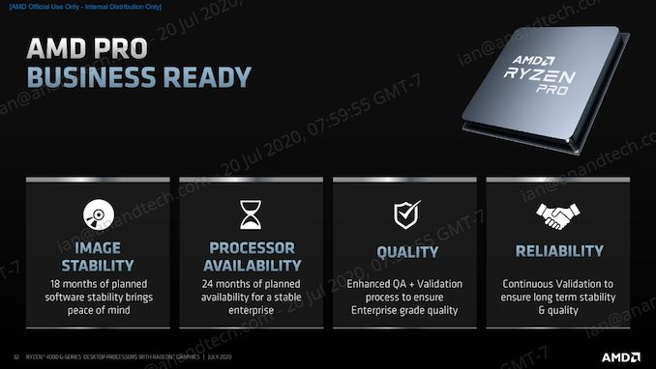
1. Introduction (23)
AMD’s Pro tagged models [120]
AMD’s Pro technology provides additional security, manageability, and quality.
Pro tagged models were introduced in parallel with the standard models in 2017.
To simplify our presentation Pro models are not indicated since their basic parameters
are usually the same as those of the mainstream models.
It is similar as Intel’s vPro technology introduced in 2006.
*

Slide 27
1. Introduction (23b)
AMD’s key design decisions chosen for the Zen family
Modular (lego-like) design approach
Meaning that processors intended for different application domains, such as
laptops, desktops, HEDTs or servers are built up of the same die set.
It will be discussed in Section 3.
b) Using the MCM (Multi-Chip Module) approach.
Meaning that multiple dies are packaged into single chips, called MCMs.
Note that the modular (lego-like) design approach necessitates the MCM
technology.
*

Slide 28
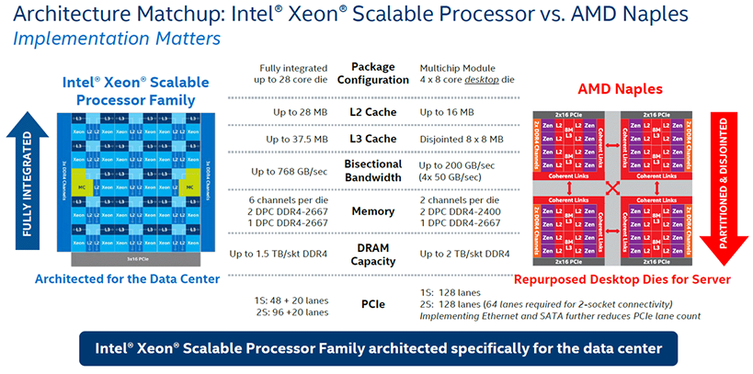
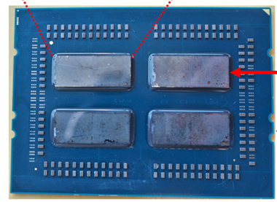
1. Introduction (24)
Additional benefit of the MCM approach by multicore processors (e.g. servers)
Design paradigms for implementing multicore processors
Monolithic implementation
MCM (Multi-Chip-Module) implementation
All cores are implemented
on the same die
Cores are implemented on a multiple dies,
these dies are properly interconnected and
mounted into the same package
Example
Intel's Skylake-SP (2017) [2]
AMD's EPYC (2017) processor [2], [3]
Up to 28 cores
Up to 4x8 cores
Single
package
*

Slide 29
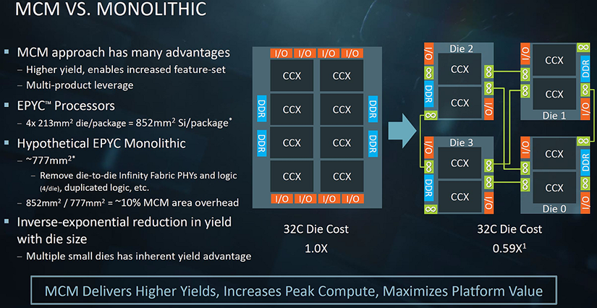
1. Introduction (25)
AMD's cost argumentation for the MCM layout over the monolithic one [7]
Presented by AMD at the Hot Chips Conference in Aug. 2017
*

Slide 30
1. Introduction (26)
Pros and cons of a modular processor design [3]
Pros
It is more economical to manufacture large core count and therefore large dies
if they will be segmented into a number of smaller dies.
By proper desing memory channels and I/O may become linearly scaled with
the die count.
Processors for different market segments may be implemented in a modular
way by including various numbers of the same die.
Cons
High die-to-die transfer latencies arise that degrade performance.
*

Slide 31
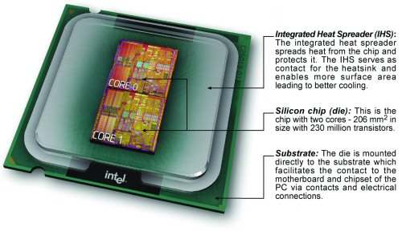
1. Introduction (27)
Example of Intel’s early MCM design (Dual core DT Pentium D-820) (5/2005))
[91], [92]

Slide 32
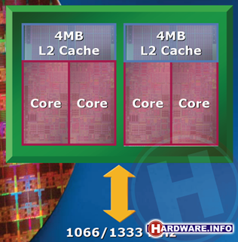
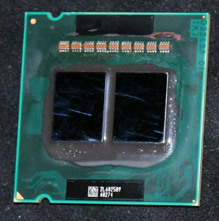
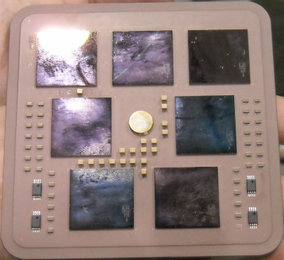
1. Introduction (28)
Further examples for MCM designs of server processors
Intel
Paxville DP 2.8 (2x1C), 2xDP-enhanced Pentium 4 Prescott (10/2005)
Xeon 5000 (Dempsey), (2x1C), ~ the 65 nm shrink of the 90 nm Paxville DP 2.8 (5/2006)
Xeon 5300
(Clowertown) [4], [5]
Xeon 5300 (Clowertown) (2x2C) 2xCore 2-based 65 nm Xeon 5100 (Woodcrest), 11/2006
Xeon 5400 Harpertown 2x2C, 2x Core 2-based 45 nm 2C Harpertown (11/2007)
AMD
Opteron 6100 (Magny-Course) 2x6C, 2xBulldozer-based 45 nm Istambul die, (3/2010)
Opteron 6200 (Interlagos), 2x8C, 2xBulldozer-based 32 nm Orochi die, (11/2011)
Opteron 6300 (Abu Dhabi), 2x8C, 2xPiledriver-based 32 nm Abu Dhabi die, (11/2012)
Opteron 6400 (Warsaw), 2x8C, 2xPiledriver-based, 32-nm Abu-dhabi die, (2014)
IBM
POWER4, 2C on 4 chips, 180 nm, (12/2001)
z10, 10/2008) 5x4C,(up to 17C), 65 nm (10/2008)
z10 [6]
5 proc. dies
2 mem. control dies

Slide 33
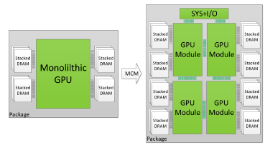
1. Introduction (29)
NVIDIA's possible future use of MCMs, revealed in a research paper [32]

Slide 34
2. The Zen core
(Discussing the Zen+ and Zen2 cores is omitted)
Notes:
34

Slide 35
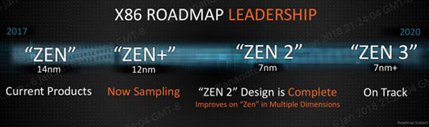
2. Zen cores (1)
2. The Zen core
Roadmap of the Zen core as published in 2/2018 [68]
Current products
*

Slide 36
2.1 The Zen core (1)
Design of the Zen core [13], [170]
AMD began planning the Zen microarchitecture after re-hiring Jim Keller, the
famous processor architect, in 2012.
Announced at AMD's Financial Analyst Day in 5/2015.
First details of the Zen architecture were published at the Computex Conference
in 6/2016.
According to M. Papermaster, CTO of AMD up to 300 engineers were working
on the core design.
*
*

Slide 37
2.1 The Zen core (2)
Key architectural innovations and enhancements of the Zen core [13]
1) Key architectural improvements
To raise performance and reduce power consumption AMD enhanced the microarchitecture of the Zen core in many ways, first of all by
the departure from the module concept of the previous Bulldozer family and
returning to the usual core structure,
b) introducing a large Micro-op cache (2K instructions),
c) introducing multithreading and
c) introducing the SenseMI technology packet
as will be discussed subsequently.
*

Slide 38
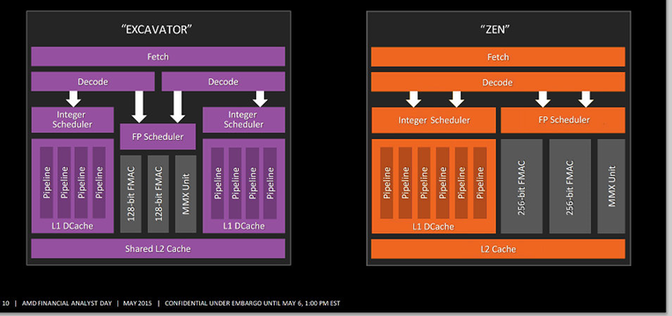
2.1 The Zen core (3)
Departure from the module concept of the previous Bulldozer family and
returning to the usual core structure [14]
With Zen AMD departed from the Bulldozer design style cramming two integer parts
and an FP part into a module and declaring the module as being dual cores and
followed the regular way of building up cores.
*

Slide 39
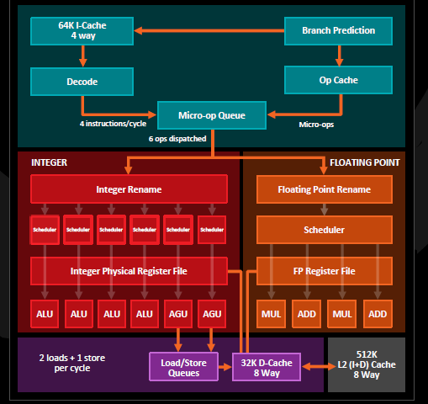
2. The Zen core (4)
b) Introducing a large Micro-Op cache (2K instructions) [15]
Micro
8 macro-ops/cycle
4 ops dispatched

Slide 40
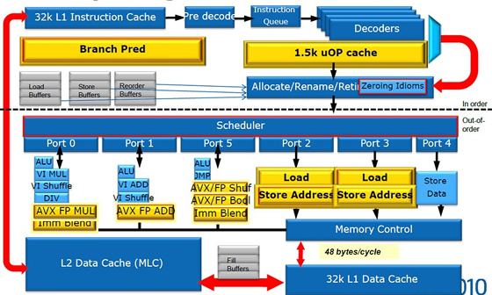
2. The Zen core (5)
By contrast: The Micro-op cache introduced in Intel’s Sandy Bridge (2011)
[90]

Slide 41
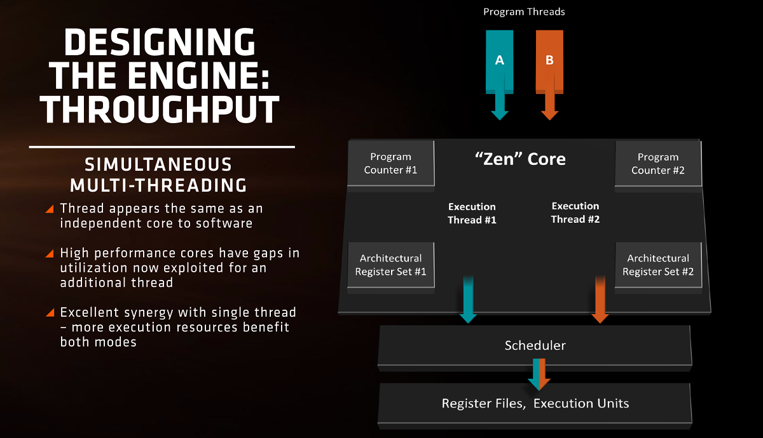
2. The Zen core (6)
c) Introducing multithreading [10]

Slide 42
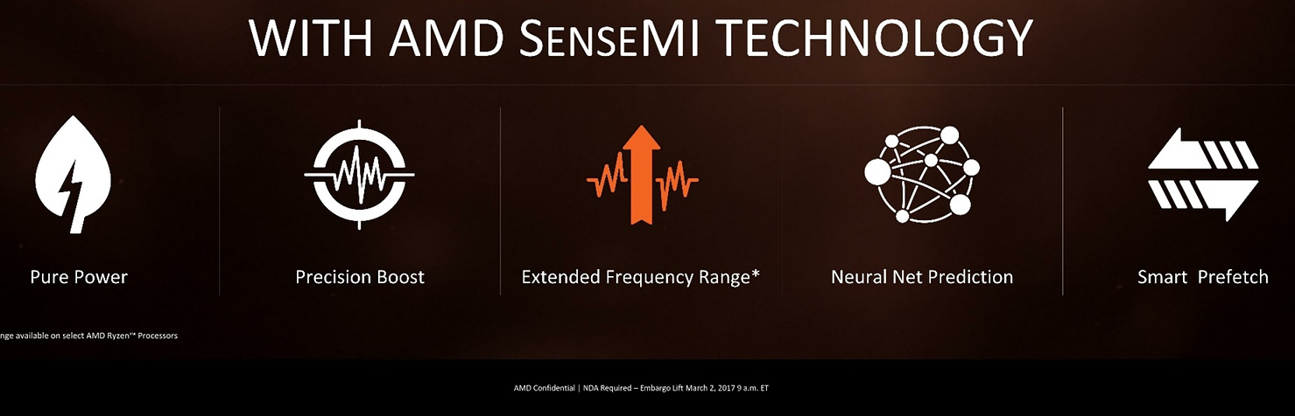
2. The Zen core (7)
d) Introducing the SenseMI technology package
Innovations introduced within the Zen core [10]
Pure power
(AVS)
Precision Boost
(Enhanced Turbo Boost
like Intel’s SpeedShift)
if there is a thermal headroom
Extended Frequency Range
(XFR) (Higher fc for
premium cooling,
like Intel’s TVB)
Neural Net in
Instruction prefetch
Smart
Prefetch
To reduce
dissipation
To raise fc
To raise IPC
Not discussed
Not discussed
See
subsequently
AVS: Adaptive Voltage Scaling
TVB: Thermal Velocity Boost

Slide 43
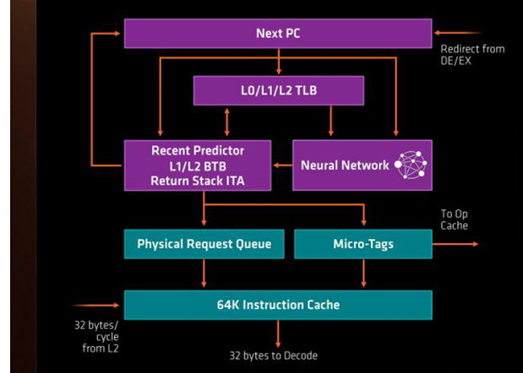
2. The Zen core (8)
d1) Neural-net improved instruction prefetch (Part of Sense MI) [10]

Slide 44
2. The Zen core (8b)
d) Introducing the SenseMI technology package
Innovations introduced within the Zen core [10]
Pure power
(AVS)
Precision Boost
(Enhanced Turbo Boost
like Intel’s SpeedShift)
if there is a thermal headroom
Extended Frequency Range
(XFR) (Higher fc for
premium cooling,
like Intel’s TVB)
Neural Net in
instruction prefetch
Smart
Prefetch
To reduce
dissipation
To raise fc
To raise IPC
Not discussed
Not discussed
See
subsequently
AVS: Adaptive Voltage Scaling
TVB: Thermal Velocity Boost

Slide 45
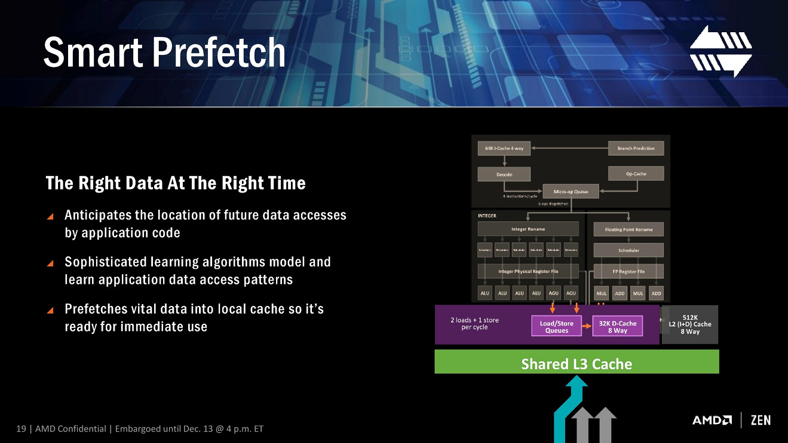
2. The Zen core (9)
d2) Smart prefetch (Part of Sense MI) [10]

Slide 46
2. The Zen core (10)
2) Key architectural enhancements of the Zen core
a) Wider μop dispatch
Six-issue FX execution (up from 4)
Quad-issue FP execution (up from 3)
b) Deeper key structures (such as queues) of the microarchitecture

Slide 47
2. The Zen core (11)
a) Wider μop dispatch
Six-issue FX execution (up from 4) - Quad-issue FP execution (up from 3)
4 ops dispatched
6 ops dispatched
4 ops dispatched

Slide 48
2. The Zen core (12)
b) Deeper key structures (such as queues) of the microarchitecture
Feature | Zen | Excavator
ROB size (duplicated for each thread) | 192 | 128
ROB throughput | 8 instr./cyle | 4 instr./cycle
Integer scheduler size | 84 | 48
FP scheduler size | 96 | 60
Load Queue | 72 | 44
Store Queue | 44 | 32
ROB: ReOrder Buffer
*

Slide 49
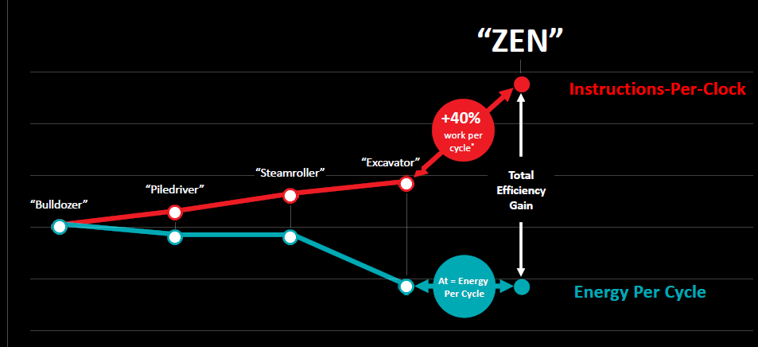
2. The Zen core (13)
IPC improvements of the Bulldozer Family and the Zen architecture [15]
3/2017
(14 nm)
Typical IPC increase: 15 % vs. previous family
6/2015
(28 nm)
1/2014
(28 nm)
11/2012
(32 nm)
11/2011
(32 nm)
*

Slide 50
3. Building blocks of Zen-based processors
3.1 Introduction
3.2 Building blocks of 1. gen. (Zen-based) processors
3.3 Building blocks of 2. gen. (Zen+ based) processors
3.4 Building blocks of 3. gen. (Zen2-based) processors
Notes:
50

Slide 51
3.1 Introduction
Notes:
51

Slide 52
3. 1 Introduction (1)
3.1 Introduction
The Zen family (Family 17h) has a hierarchical, three-level modular structure.
The three levels of the hierarchy are:
core level
core block level and
die level.
The building blocks at these levels are:
at the core level: Zen cores
at the core block level: CCXs (Core CompleX), including 4 or 8 cores with
L3 cache segments, and
at the die level: various die level building blocks.
As an example we show the building blocks of the 1. gen. Zen lines.
*

Slide 53
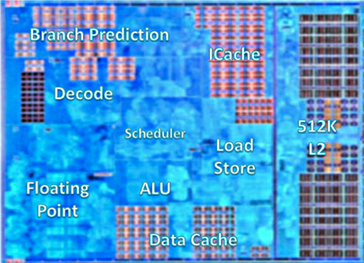
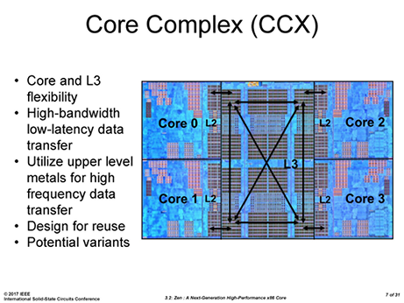
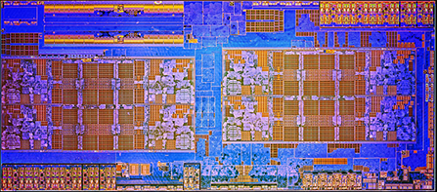
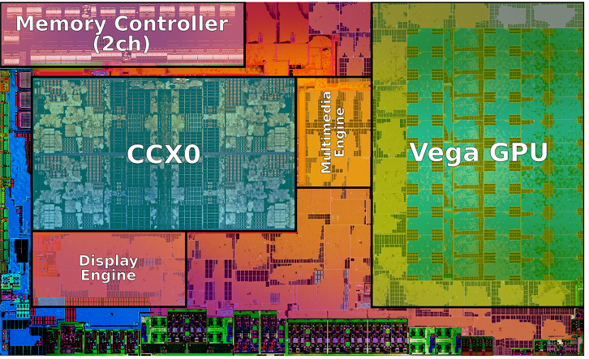
3. 1 Introduction (2)
Hierarchy of building blocks of AMD's 1. gen. (Zen-based) processor lines
Core level:
Zen core [8]
Core block level:
Zen-based CCX
(including 4 cores and L3) [9]
GPU-less die (has 2x CCX core blocks)
APU die (1 CCX core block + GPU)
Die level
building blocks
CCX0
CCX1
(Zeppelin die) [10]
(Raven Ridge die) [123]
APU: Accelerated Processing Unit (CPU + GPU)
*

Slide 54
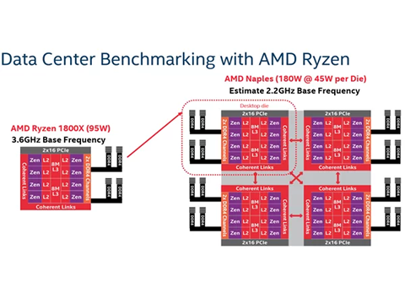
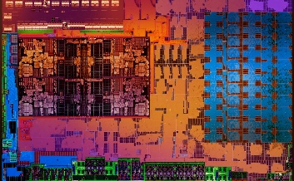
3. 1 Introduction (3)
Example: Modular design of AMD's 1. gen (Zen-based) processor lines
AMD's 1. gen. (Zen-based) processor lines
Mobiles
(Ryzen 2xxx/U/H)
DT APUs
(Ryzen 2xxxG/GE)
GPU-less DTs
(Ryzen 1xxx/X)
HEDTs
(Threadripper 19xxX)
1S/2S servers
(EPYC 7xx1/P)
Single CCX +
Vega GPU [54]
Zeppelin die
(2x CCX)
2 Zeppelin dies
interconnected by the IF,
implemented as an MCM
4 Zeppelin dies
interconnected by the IF,
implemented as an MCM
(Raven Ridge) [98]
(Summit Ridge) [11]
(Naples) [11]
IF: Infinity Fabric
White Haven) [11]
*

Slide 55
3. 1 Introduction (4)
Brand names of AMD’s Zen-based (Family 17h-based) processor lines
 | Core | Zen | Zen+ | Zen2 | Zen3
 | Technology | 14 nm | 12 nm | 7 nm | 7 nm+
 | Launched in | 2017-2018 | 2018-2019 | 2019-2020 | 2020-2021
 | 2P servers (~120-240 W) | EPYC 7xx1 (Naples arch.) |  | EPYC 7xx2 (Rome arch.) | EPYC 7xx3? (Milan arch.)
 | 1P servers (~120-240 W) | EPYC 7xx1P (Naples arch.) |  | EPYC 7xx2P (Rome arch.) | EPYC 7xx3? (Milan arch.)
HEDTs | HED (~95-125 W) | ThreadRipper 19x0X (Whitehaven arch.) | ThreadRipper 29x0X/WX (Colfax arch.) | ThreadRipper 39x0X (Castle Peak arch.) | ThreadRipper 49x0X (Genesis Peak a.)
 | GPU-less (~65-95 W) | Ryzen 7/5/3 1xxx/X (Summit Ridge a.) | Ryzen 7/5 2xxx/X (Pinnacle Ridge arch.) | Ryzen 9/7/5/3 3xxx/X (Matisse arch.) | Ryzen 9/7/5/3 4xxxX (Vermeer a.)
 | APU (~35-65 W) | Ryzen 5/3 2x00G/GE (Raven Ridge arch.) | Ryzen 5/3 3xxx/G/GE (Picasso arch.) | Ryzen 7/5/3 4xx0G/GE (Renoir arch.)
 | Mainstream (~35-55 W) | Ryzen 7/5/3 2x00H (Raven Ridge arch.) | Ryzen 7/5/3 3x00H (Picasso arch.) | Ryzen 9/7/5 4xx0H/HS (Renoir arch.) | Ryzen 9/7/5 5xx0H (Cezanne arch.)
 | Ultra portable (~10-25 W) | Ryzen 7/5/3 2xx0U (Raven Ridge arch.) | Ryzen 7/5/3 3xx0U (Picasso arch.) | Ryzen 7/5/3 4xx0U (Renoir arch.) | Ryzen 7/5/3 5xx0U (Cezanne arch.)
Servers
DTs
Notebooks

Slide 56
3. 1 Introduction (4b)
Note
As a consequence of the modular design typically, AMD has to implement MCM
(Multi-Chip Module) packages, as already discussed before.

Slide 57
3. 1 Introduction (5)
Two comments to the modular design of AMD’s Zen family -1
1) In each of the Zen generations DT APUs, mainstream and ultraportable laptops
include the same die.
*

Slide 58
3. 1 Introduction (6)
Brand names of AMD’s Zen-based (Family 17h-based) processor lines
 | Core | Zen | Zen+ | Zen2 | Zen3
 | Technology | 14 nm | 12 nm | 7 nm | 7 nm+
 | Launched in | 2017-2018 | 2018-2019 | 2019-2020 | 2020-2021
 | 2P servers (~120-240 W) | EPYC 7xx1 (Naples arch.) |  | EPYC 7xx2 (Rome arch.) | EPYC 7xx3? (Milan arch.)
 | 1P servers (~120-240 W) | EPYC 7xx1P (Naples arch.) |  | EPYC 7xx2P (Rome arch.) | EPYC 7xx3? (Milan arch.)
HEDTs | HED (~95-125 W) | ThreadRipper 19x0X (Whitehaven arch.) | ThreadRipper 29x0X/WX (Colfax arch.) | ThreadRipper 39x0X (Castle Peak arch.) | ThreadRipper 49x0X (Genesis Peak a.)
 | GPU-less (~65-95 W) | Ryzen 7/5/3 1xxx/X (Summit Ridge a.) | Ryzen 7/5 2xxx/X (Pinnacle Ridge arch.) | Ryzen 9/7/5/3 3xxx/X (Matisse arch.) | Ryzen 9/7/5/3 4xxxX (Vermeer a.)
 | APU (~35-65 W) | Ryzen 5/3 2x00G/GE (Raven Ridge arch.) | Ryzen 5/3 3xxx/G/GE (Picasso arch.) | Ryzen 7/5/3 4xx0G/GE (Renoir arch.)
 | Mainstream (~35-55 W) | Ryzen 7/5/3 2x00H (Raven Ridge arch.) | Ryzen 7/5/3 3x00H (Picasso arch.) | Ryzen 9/7/5 4xx0H/HS (Renoir arch.) | Ryzen 9/7/5 5xx0H (Cezanne arch.)
 | Ultra portable (~10-25 W) | Ryzen 7/5/3 2xx0U (Raven Ridge arch.) | Ryzen 7/5/3 3xx0U (Picasso arch.) | Ryzen 7/5/3 4xx0U (Renoir arch.) | Ryzen 7/5/3 5xx0U (Cezanne arch.)
Servers
DTs
Notebooks

Slide 59
3. 1 Introduction (7)
Comments to the modular design of AMD’s Zen family -2
1) In each of the Zen generations DT APUs, mainstream and ultraportable laptops
include the same die.
Nevertheless, whereas DT APU processors have PGA sockets and need a PCH
mobile processors are implemented as SoCs, need no external chipsets and
have BGA sockets for soldering.
PCH: Peripheral Controller Hub SoC: System-on-Chip (Egy-chipes rendszer)
*

Slide 60
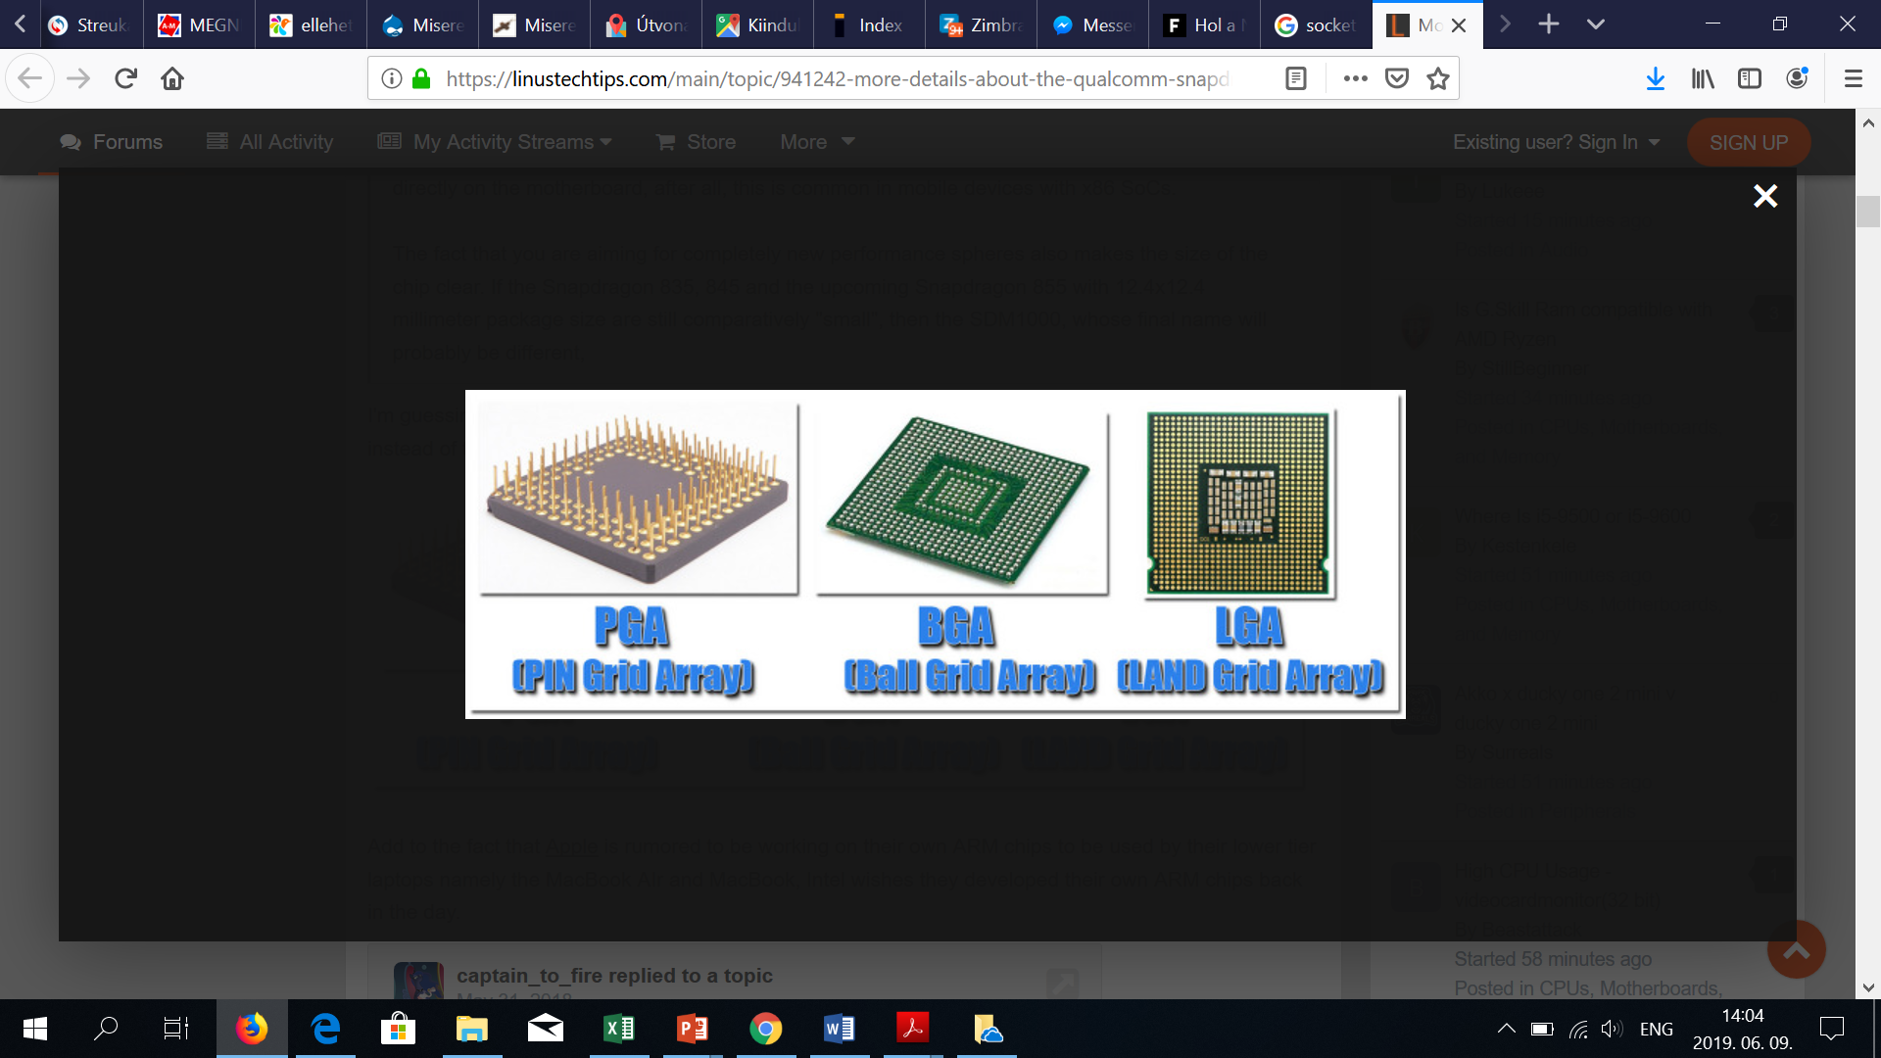
3. 1 Introduction (8)
Recent processor package types [169]
PGA
(Pin Grid Array)
LGA
(Land Grid Array)
BGA
(Ball Grid Array)
In the PGA package pins provide the contacts, arranged in a regular array.
LGA packages are essentially the direct opposite of PGAs, the contact pins are on the
socket, whereas contact pads on the package provide the connections.
BGA packages are soldered directly onto the motherboard, so practically they can not
be replaced without proper equipment.
*

Slide 61
3. 1 Introduction (97)
Comments to the modular design of AMD’s Zen family -2
By referring to the table below we make three comments:
1) All the Zen-based processors for DT APUs, mainstream and ultraportable
laptops include the same die in all three generations.
Nevertheless, whereas DT APU processors have PGA sockets and need a chipset
mobile processors are implemented as SoCs, need no external chipsets and
have BGA sockets for soldering.
2) Both the Threadripper and EPYC processors have the same LGA sockets
(LGA 4094) that are physically identical but electrically not compatible.
*

Slide 62
3.2 Building blocks of 1. gen. (Zen-based) processors
Notes:
62

Slide 63
3.2 Building blocks of 1. gen. (Zen-based) processors (1)
Hierarchy of building blocks of AMD's 1. gen. (Zen-based) processor lines
Core level:
Zen core [8]
Core block level:
(a) Zen-based CCX core block
(including 4 cores and L3) [9]
(b): GPU-less die (2x CCX blocks)
(c): APU die (1 CCX block + GPU)
Die level
building blocks
CCX0
CCX1
(Zeppelin die)
(4.8 billion transistors, 213 mm² [10])
(Raven Ridge die) [123]
(4.94 billion transistors, 209.8 mm²)
*

Slide 64
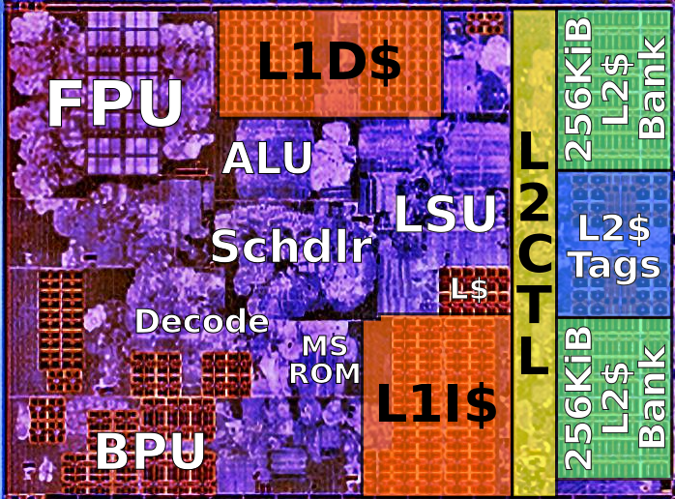
3.2 Building blocks of 1. gen. (Zen-based) processors (2)
a) The Zen core [36]
7 mm² area, L2: 512 KiB; 1.5 mm²/core

Slide 65
3.2 Building blocks of 1. gen. (Zen-based) processors (2b)
b) The Zen-based CCX core block -1 [16]
The CCX (CPU-CompleX) core block has 4 cores, it is the basic building block
of all Zen-based processor lines.
In 1. to 3. gen. CCXs each core has a private 512 kB L2 cache.
All 4 cores share an 8 MB L3 cache that is split into 4 slices (see the Figure below)
by low-order address interleaving.
2 MB L3
cache slice(core)
Figure: The CCX core block [16]
*

Slide 66
3.2 Building blocks of 1. gen. (Zen-based) processors (3)
The Zen-based CCX core block -2 [15]
There is an internal crossbar interconnections between the L3 cache segments,
(see previous Figure), thus each core can access each L3 cache segment
with the same average latency.
The L3 cache is mostly exclusive to the L2 cache, it is actually a victim cache
for the L2 cache.
2 MB L3
cache slice(core)
Figure: The CCX core block [16]
The CCX core block includes 1.4 billion transistors on a die area of 44 mm².
*

Slide 67
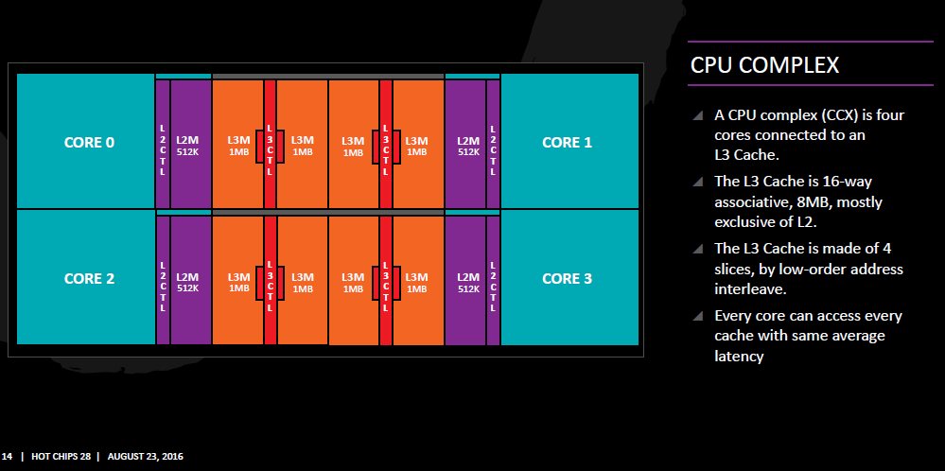
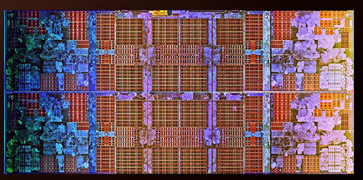
3.2 Building blocks of 1. gen. (Zen-based) processors (4)
Block diagram and die photo of the Zen-based CCX core block [15], [59]

Slide 68
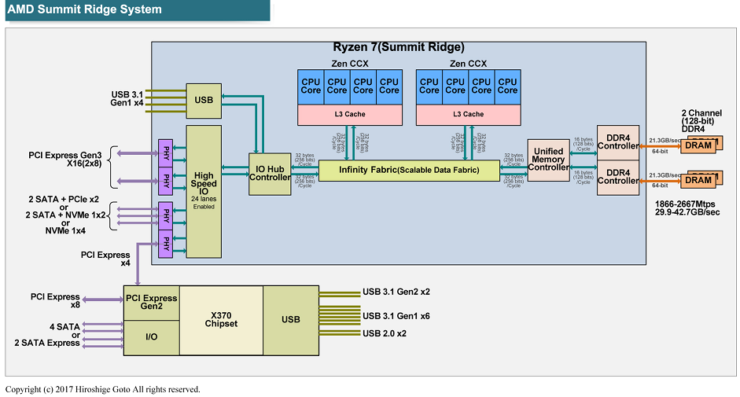
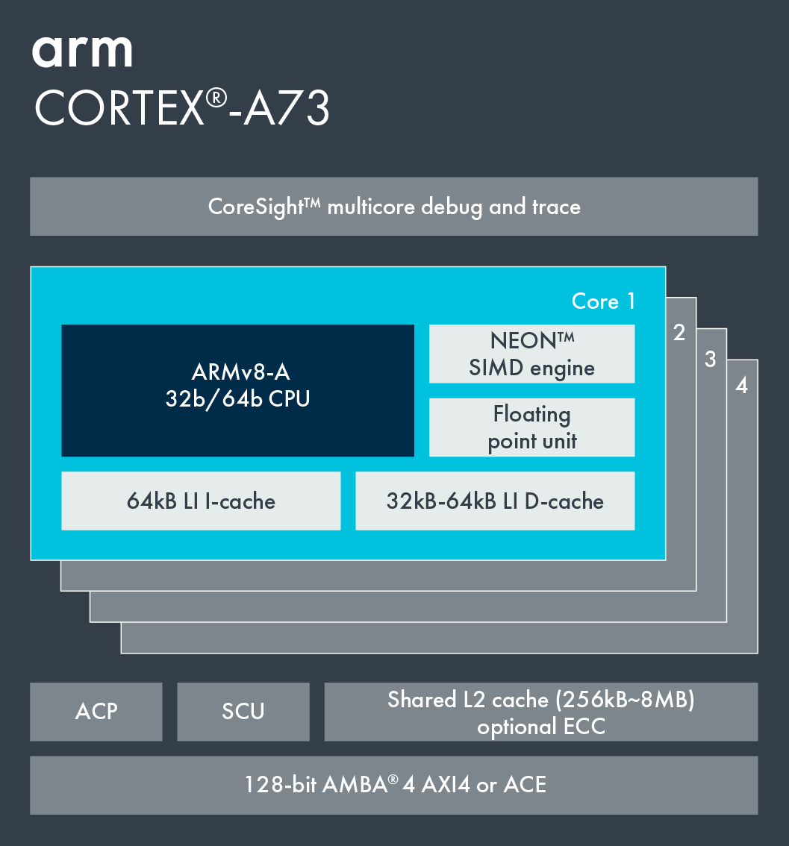
3.2 Building blocks of 1. gen. (Zen-based) processors (5)
Comparing AMD's Zen-based CCX and ARM's MPCore (actually Cortex-A 73)
Cortex-A73 core
ARMv8.0 CPU
(8 MB)
(2017)
In 1. gen. 64-bit processors (2012) [55]
(Cortex-A53/A57/A72/A73)
ACP: Accelerator Coherence Port
(to connect non-cached
coherent data sources)
SCU: Snoop Control Unit
(Provides coherence
within the the processor)
ECC: Error Correcting Code
AMBA: Advanced Microcontroller
Bus Architecture
(On-chip bus standard
for SoC) designs)
ACE: AXI Coherency Extensions
AMBA4 cache coherent interface
(Used in big.LITTLE systems
for smartphones, tablets, etc.)
AXI4: Advanced eXtensible Interface
(Not cache coherent interface)
*

Slide 69
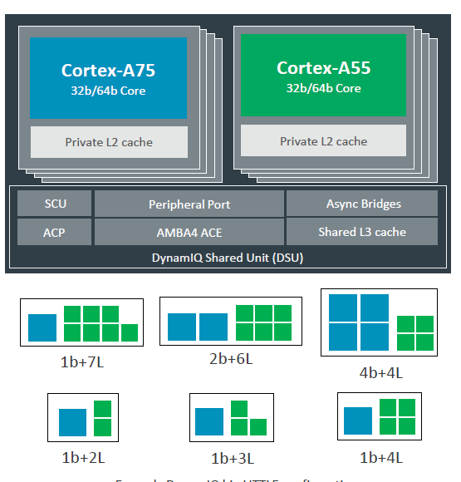
3.2 Building blocks of 1. gen. (Zen-based) processors (6)
Comparing AMD’s Zen-based CCX and ARM’s 2. gen. core clusters (DynamIQ)
(8 MB)
(2017)
(2017) [56]
ARMv8.2 support, (Cortex-A55/75), up to 8 cores
Shared L3 cache, partial L3 cache power down,
Private L2 caches
*

Slide 70
3.2 Building blocks of 1. gen. (Zen-based) processors (7)
c1) The Zen-based GPU-less Zeppelin die
It is based on two CCX blocks connected together by the Infinity Fabric, as seen below.
256-bit/cycle
UMC
Figure: Block diagram of the Zeppelin die based GPU-less Ryzen 7 DT processor [17]
*

Slide 71
3.2 Building blocks of 1. gen. (Zen-based) processors (8)
Embedding Zen-based Zeppelin blocks into Threadripper or EPYC proc.s [88]
UMC: Unified Memory Controller
CCM Cache-Coherent Master
IOMS: IO Master-Slave
SMU: System Management Unit
CAKE. Coherent AMD SocKet Extender
IF SCF: IF Scalable Control Fabric
IFOP: IF On-Package interconnect link
IFIS: IF Inter-Socket interconnect link

Slide 72
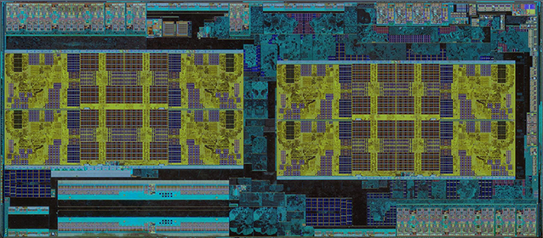
3.2 Building blocks of 1. gen. (Zen-based) processors (9)
Die photograph of the Zen-based 14 nm Zeppelin die (Ryzen die) [78]

Slide 73
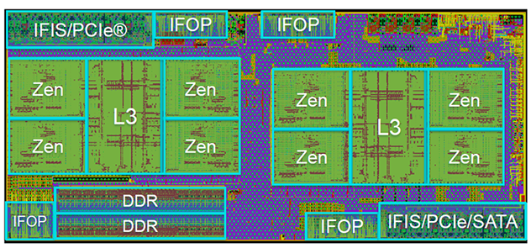
3.2 Building blocks of 1. gen. (Zen-based) processors (10)
Floorplan of the Zen-based 14 nm Zeppelin die (Ryzen die) [77] -1
4xSouth-
bridge
4x USB 3.1 Gen 1
IFIS: Infinity Fabric InterSocket/PCIe Gen 3 x16
IFOP: Infinity Fabric On-Package x4

Slide 74
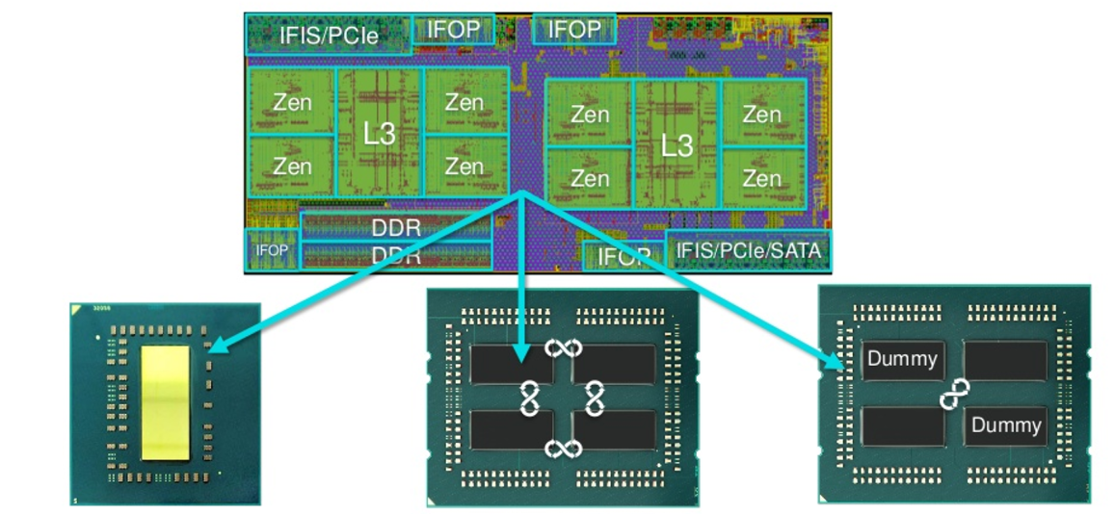
3.2 Building blocks of 1. gen. (Zen-based) processors (11)
Use of Zeppelin dies in AMD’s 1. gen. (GPU-less) processor lines [77]
GPU-less DT
1S/2S server
HEDT

Slide 75
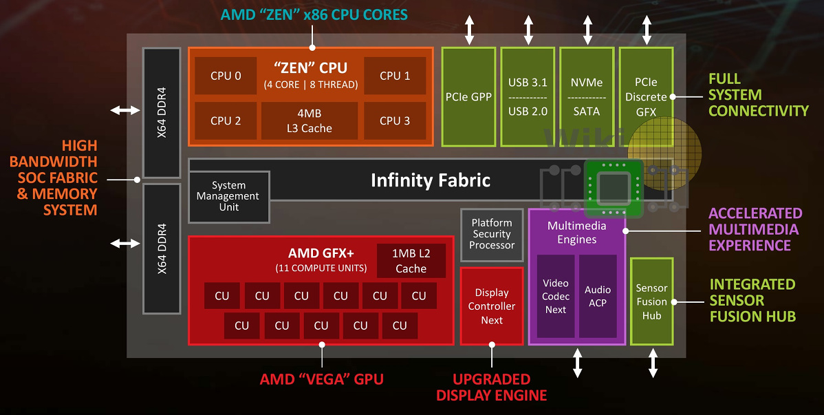
3.2 Building blocks of 1. gen. (Zen-based) processors (12)
c2) The Zen-based APU die (1 CCX + GPU)
Called the Raven Ridge die, used in 1. gen. mobile and DT APU lines.
Figure: Block diagram of the Raven Ridge die [98]

Slide 76
3.2 Building blocks of 1. gen. (Zen-based) processors (13)
Modular design of AMD's 1. gen (Zen-based) processor lines
AMD's 1. gen. (Zen-based) processor lines
(a): Mobiles
(Ryzen 2xxx/U/H)
(a): DT APUs
(Ryzen 2xxxG/GE)
(b): GPU-less DTs
(Ryzen 1xxx/X)
(c): HEDTs
(Threadripper 19xxX)
(d): 1S/2S servers
(EPYC 7xx1/P)
Single CCX +
Vega GPU [54]
Zeppelin die
(2x CCX)
2 Zeppelin dies
interconnected by the IF,
implemented as an MCM
4 Zeppelin dies
interconnected by the IF,
implemented as an MCM
(Raven Ridge) [98]
(Summit Ridge) [11]
(Naples) [11]
IF: Infinity Fabric
White Haven) [11]
*

Slide 77
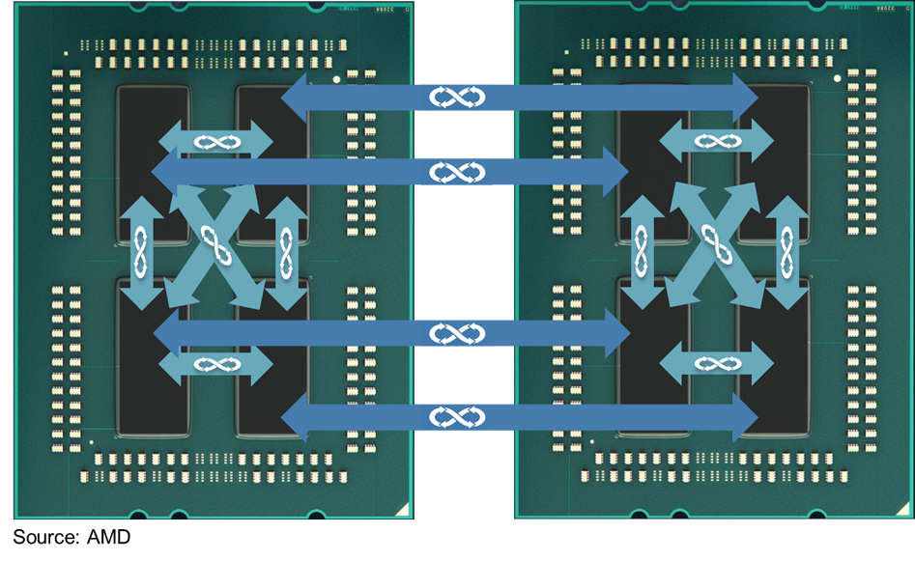
3.2 Building blocks of 1. gen. (Zen-based) processors (14)
Interconnecting dies within a socket and interconnecting two sockets
of in a 1. gen. 2S server by means of the Infinity Fabric (IF) [3]
IFIS: IF Inter-Socket interconnect links
IFOP: Infinity Fabric On-Package links

Slide 78
3.3 Building blocks of 2. gen. (Zen+ based) processors
Notes:
78

Slide 79
3.3 Building blocks of 2. gen. (Zen+ based) processors (1)
3.3 Building blocks of 2. gen. (Zen+ based) processors -1
There are only a few differences between AMD’s 1. and 2. gen. building blocks, as
follows:
2. gen. building blocks make use of the Zen+ core that is the 12 nm shrink of
the 1. gen. Zen core.
b) 2. gen. die-level building blocks are designated as follows:
the APU die (CCX + GPU) is termed as the Picasso die
the GPU-less die (2x CCX) is named: the Pinnacle Ridge
c) The 2. gen. Threadripper line includes up to 4 Pinnacle Ridge dies to provide
up to 32 cores rather than 2 as in the 1. gen. Threadripper line.
*

Slide 80
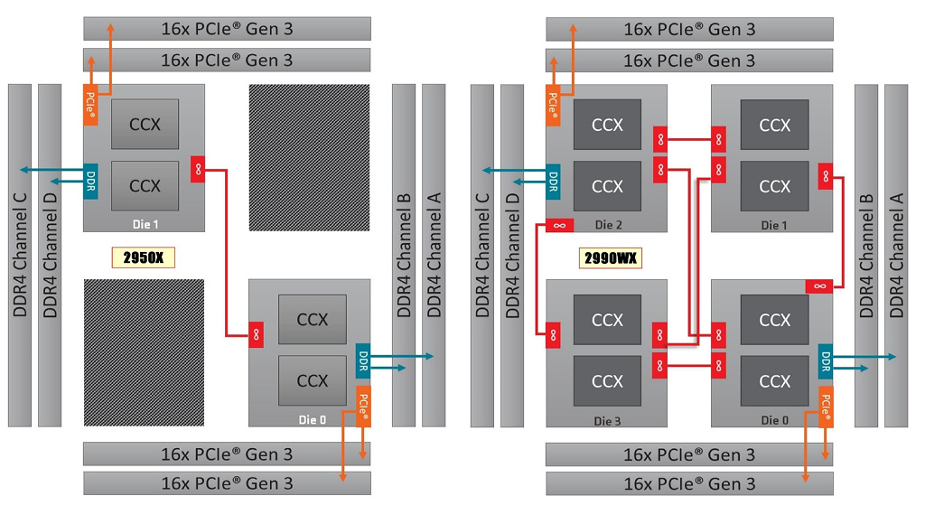
3.3 Building blocks of 2. gen. (Zen+ based) processors (2)
2. gen. Threadripper processor models [73] -1
12/16 cores
24/32 cores
TR 2950: 8+8 cores
TR 2920: 6+6 cores
TR 2990WX: 8+8+8+8 cores
TR 2970WX: 6+6+6+6 cores

Slide 81
3.3 Building blocks of 2. gen. (Zen+ based) processors (3)
3.3 Building blocks of 2. gen. (Zen+ based) processors -2
There are only a few differences between AMD’s 1. and 2. gen. building blocks, as
follows:
2. gen. building blocks make use of the Zen+ core that is the 12 nm shrink of
the 1. gen. Zen core.
b) 2. gen. die-level building blocks are designated as follows:
the APU die (CCX + GPU) is termed as the Picasso die
the GPU-less die (2x CCX) is named: the Pinnacle Ridge
c) The 2. gen. Threadripper line includes up to 4 Pinnacle Ridge dies to provide
up to 32 cores rather than 2 as in the 1. gen. Threadripper line.
d) AMD did not introduced Zen+ core based server processors.
*

Slide 82
3.3 Building blocks of 2. gen. (Zen+ based) processors (4)
Modular design of AMD's 2. gen (Zen+ based) processor lines
AMD's 2. gen. (Zen-based) processor lines
Mobiles
(Ryzen 3xxx/U/H)
DT APUs
(Ryzen 3xxxG/GE)
GPU-less DT APUs
(Ryzen 2xxx/X)
HEDTs
(ThreadRipper 29xxX)
1S/2S servers
--
Single CCX +
Vega GPU [54]
(2x CCX)
Up to 4 Pinnacle Ridge dies
interconnected by the IF,
implemented as an MCM
(Picasso) [98]
(Pinnacle Ridge [11]
IF: Infinity Fabric
(Colfax [11]

Slide 83
3.4 Building blocks of 3. gen. (Zen2 based) processors
Notes:
83

Slide 84
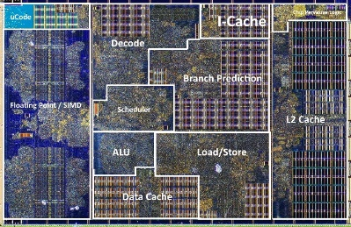
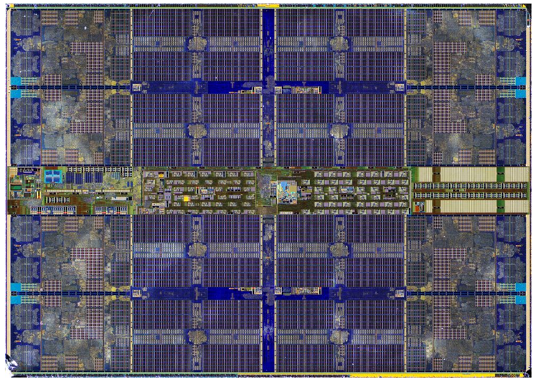
3.4 Building blocks of 3. gen. (Zen2 based) processors (1)
3.4 Building blocks of 3. gen. (Zen2-based) processors
Core level:
Zen2 core [122]
Core block level:
Zen2-based CCX core block
(including 8 cores and L3) [144]
Die level
building blocks
*

Slide 85
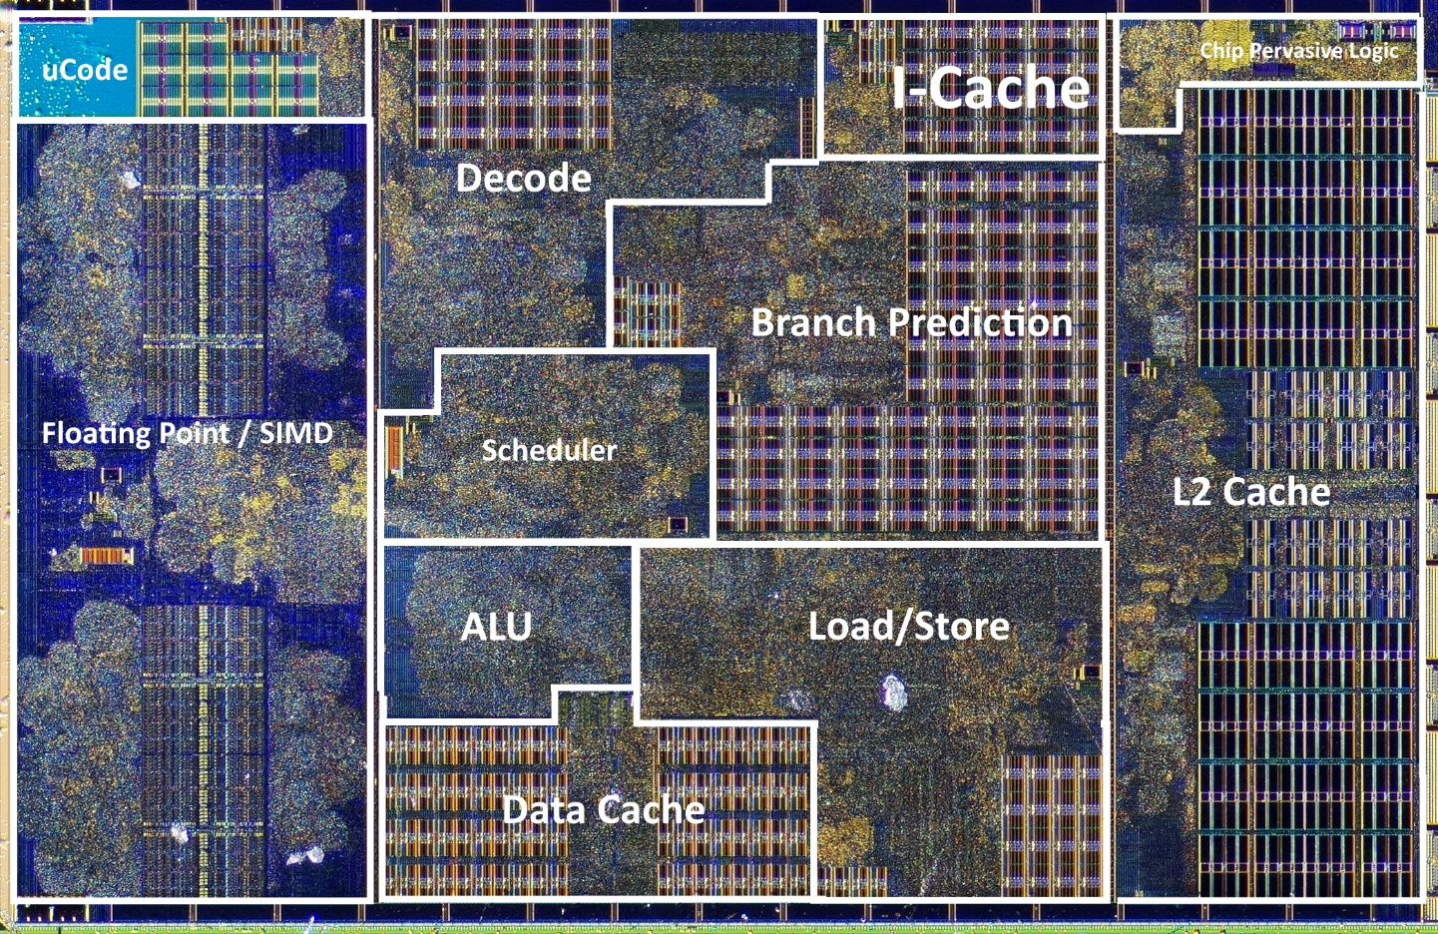
3.4 Building blocks of 3. gen. (Zen2 based) processors (1)
a) The Zen2 core [121]
7 nm
L2: 512 KB
15% instructions-per-cycle (IPC) improvement [290]

Slide 86
3.4 Building blocks of 3. gen. (Zen2 based) processors (2)
b) The Zen2-based CCX core block [122]
The Zen2-based CCX (CPU-CompleX) core block
has 8 cores
each core has a private 512 kB L2
all 8 cores share an 32 MB L3 cache that is split into 8 slices (see the Figure
below), slices are low-order address interleaved (összefésülve).
Note: AMD doubled the L3 size of the 3. gen. CCX from 2 MB to 4 MB/segment.
Figure: The Zen2-based CCX core block [125]
The Zen2-based CCX core block includes 3.9 billion transistors..
*

Slide 87
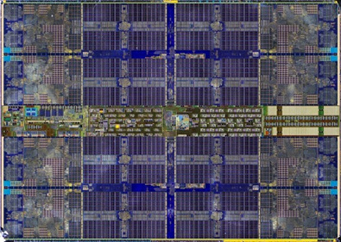
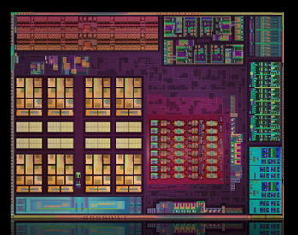
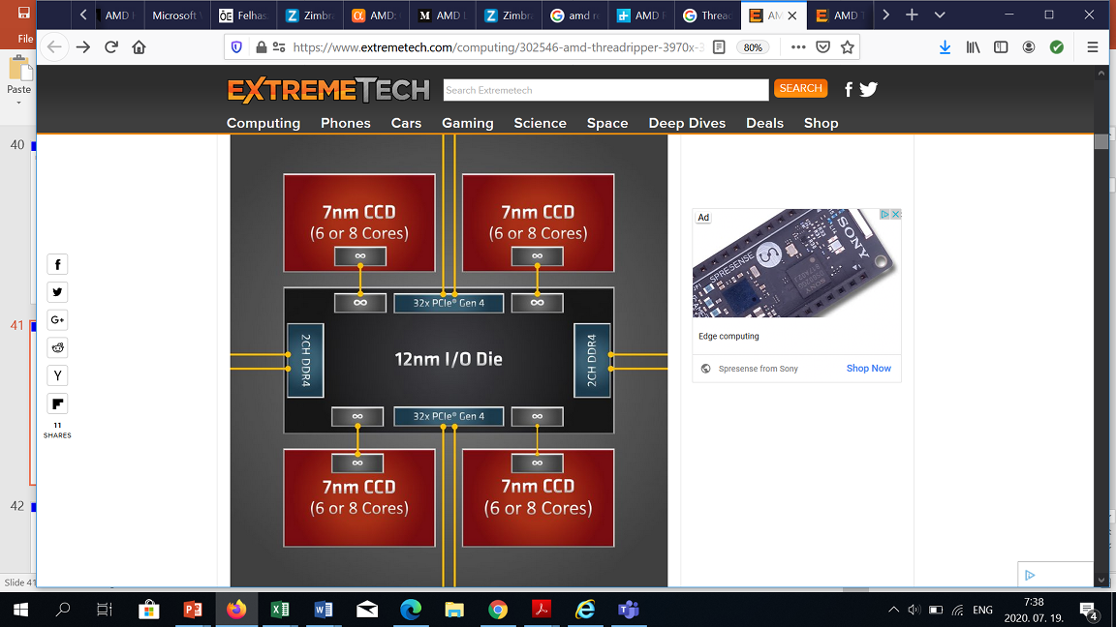
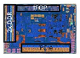
3.4 Building blocks of 3. gen. (Zen2 based) processors (3)
c) Die-level building blocks of AMD's 3. gen. (Zen2-based) processor lines
Die level building blocks of AMD's 3. gen. (Zen2-based) processor lines
(c1): 7 nm 8-core
GPU-less CCD die
(includes the CCX core block)
(c2): 7 nm 8-core CCD APU die
(CCX + GPU)
(c3): 14 nm TR/server IO die
(IOD)
CCD: CPU Compute Die
IOD: IO Die
12/14 nm IOD
(see remark)
[125]
[126]
[127]
(c4): 12 nm client IO die
(cIOD)
[128]
*

Slide 88
3.4 Building blocks of 3. gen. (Zen2 based) processors (4)
Remark to the implementation of the IOD [133], [127]
AMD has two variants of the Threadripper/server I/O die, both manufactured
by GlobalFoundries.
One alternative is manufactured on the 14 nm process, it has more features, is
used for the EPYC Rome server and the Threadripper processors (IOD) and
provides interconnect for up to 8 CCXs.
The other is fabricated on the 12 nm process, is used for 3. gen. GPU-less Ryzen
DT processors (IOD) and provides interconnect for up to two CCXs.

Slide 89
3.4 Building blocks of 3. gen. (Zen2 based) processors (5)
c1) 7 nm 8-core GPU-less CCD die (includes the CCX core block [129]
~ 74 mm², 3.9 billion transistors
It has 4 MB L3 cache segments/core i.e. 32 MB L3 cache all in all.
*

Slide 90

3.4 Building blocks of 3. gen. (Zen2 based) processors (6)
c2) 7 nm 8-core CCD APU die (CCX core block + GPU) (the Renoir APU die)
[130]
~ 150 mm², 9.8 billion transistors

Slide 91

3.4 Building blocks of 3. gen. (Zen2 based) processors (7)
c3) 12/14 nm Threadripper/server IOD die
~ 416 mm², 8.34 billion transistors
PHY: Physical Layer
SerDes:
Serializer/Deserializer
Figure: Flour plan of the 14 nm server IOD [131]

Slide 92

3.4 Building blocks of 3. gen. (Zen2 based) processors (8)
Block diagram of the Threadripper/server IOD [132]

Slide 93

3.4 Building blocks of 3. gen. (Zen2 based) processors (9)
c4) 12 nm client IO die (cIOD)
~ 125 mm², 2.09 billion transistors
Figure: Die micrograph of the cIOD (used in GPU-less Ryzen DT processors [133]

Slide 94

3.4 Building blocks of 3. gen. (Zen2 based) processors (10)
Use of die level building blocks to implement Zen2-based GPU-less
EPYC, Threadripper and Ryzen DT processors [122]

Slide 95



3.4 Building blocks of 3. gen. (Zen2 based) processors (11)
Modular concept of AMD’s 3. gen. (Zen2-based) processor lines
AMD's 3. gen. (Zen2-based) processor lines
Mobiles
(Ryzen 4xxxU/H/HS)
DT APUs
(Ryzen 4xxxG/GE)
GPU-less DTs
(Ryzen 3xxx/X)
HEDTs
(ThreadRipper 39xxX)
1S/2S servers
(EPYC 7xx2/P)
1 CCD APU die
(up to 8 cores)
1 or 2 CCD die(s)
+1 cIOD die
(up to 16 cores)
24/32C: 4x 6/8/-core CCD dies
+ 1 IOD die
64C: 8x 8-core CCD dies
+ 1 IOD die
24/32C: 4x 4/6/-core CCD dies
+ 1 IOD die
48/64C: 8x 4/6-core CCD dies
+ 1 IOD die
(Renoir) [126]
(Matisse) [107]
(Castle Peak) [127]
(Rome) [134]
*

Slide 96

3.4 Building blocks of 3. gen. (Zen2 based) processors (12)
Remark: Activating different numbers of CCD dies in 3. gen. (Zen2-based)
EPYC server processors [128]
Figure: Interconnecting 8/6/4/2 CCD dies with 6/8 cores each and the IOD [128]
Note: Different 2. gen. EPYC (Rome) models do not populate all CCD places to
optimize cost.
*

Slide 97

3.4 Building blocks of 3. gen. (Zen2 based) processors (13)
Examples of Zen2-based processor packages [122]
(1/2)
(4/8)
(2/4/
6/8

Slide 98

3.4 Building blocks of 3. gen. (Zen2 based) processors (14)
Example 1: 3. gen. (Zen2-based) GPU-less Ryzen 3000 DT processor
with AMD X570 chipset [128]

Slide 99


3.4 Building blocks of 3. gen. (Zen2 based) processors (15)
Example 2: Block diagram of a 3. gen. (Zen2-based) 1S server processor
[138]
BMC: Baseboard Management Controller
Note: No chipset is needed.
PCIe Riser card [291]

Slide 100
3.4 Building blocks of 3. gen. (Zen2 based) processors (16)
Transistor counts and die sizes of Zen2-based building blocks and processors
[139]
Part | Total transistor count | Total die size
CCD | 3.9 billion | 74 mm²
IOD (Epyc) | 8.34 billion | 416 mm²
cIOD (Ryzen) | 2.09 billion | 125 mm²
EPYC | 8x3.9+8.34 = 39.54 billion | 8x74+416 = 1.008 mm²
Ryzen GPU-less DT (up to 8 cores) | 3.9+2.09 = 5.99 billion | 74+125 = 199 mm²
Ryzen GPU-less DT (up to 16 cores) | 2x3.9+2.09 = 9.89 billion | 2x74+125 = 273 mm²

Slide 101
4. Introduction to the Infinity Fabric
Notes:
101

Slide 102
4.1 Introduction to the Infinity Fabric (1)
4. Introduction to the Infinity Fabric -1
AMD's IF (Infinity Fabric) is a cache coherent interconnection network that is
introduced along with the Zen core for linking together system units
and also for providing system wide control functions, such as power
management or system security.
IF’s roots are in the HyperTransport bus, it is similar to Intel's QPI or UPI
interconnection technology or ARM's CCN (Cache Coherent Network).
*

Slide 103

4.1 Introduction to the Infinity Fabric (2)
Introduction to the Infinity Fabric -2
The Infinity Fabric consists of two key parts, a Scalable Control Fabric, and a
Scalable Data Fabric, as seen in the next Figure.
Power management
Security and Encryption
Test and initialization
Quality of Service
Coherent
advanced
HyperTransport
bus
Low latency
standardized
interfaces
Figure: AMD's Infinity Fabric [19]
*

Slide 104
4.1 Introduction to the Infinity Fabric (3)
The Scalable Control Fabric -1
The Scalable Control Fabric is responsible for the system wide
Power management
Security and Encryption
Test and initialization
Quality of Service,
as indicated below.
Power management
Security and Encryption
Test and initialization
Quality of Service
Coherent
advanced
HyperTransport
bus
Low latency
standardized
interfaces
Figure: AMD's Infinity Fabric [19]
*

Slide 105
4.1 Introduction to the Infinity Fabric (4)
The Scalable Control Fabric -2
The Scalable Control Fabric incorporates a central control element, and
remote embedded elements dispersed in all blocks of the SoC.
The remote embedded elements are mainly sensors monitoring temperature,
clock speed and voltage.
Data acquired is fed into the central control element and allows to optimize
power management etc. in a closed control loop, as seen in the next Figure.
Closed control loop: Zárt hurkú szabályozókör
*

Slide 106

4.1 Introduction to the Infinity Fabric (5)
Principle of the operation of Infinity System’s Control Fabric [3]
Control algorithms for AVFS
Over 1000 sensors per CCX
The system may be customized
by choosing the proper balance between
performance and power consumption
*

Slide 107
4.1 Introduction to the Infinity Fabric (6)
The Scalable Data Fabric (SDF) -1
The Scalable Data Fabric provides a high performance cache coherent data
pathway for interconnecting all system blocks.
It is a greatly enhanced version of the HyperTransport bus.
Power management
Security and Encryption
Test and initialization
Quality of Service
Coherent
advanced
HyperTransport
bus
Low latency
standardized
interfaces
Figure: AMD's Infinity Fabric [19]
*

Slide 108
4.1 Introduction to the Infinity Fabric (7)
The Scalable Data Fabric (SDF) -2
It supports three types of interconnects between
a) building blocks, like CCXs, memory and IO-controllers within a die,
*

Slide 109
4.1 Introduction to the Infinity Fabric (8)
Example: Interconnecting two CCX building blocks and other units on the
same die in a 1. gen. Ryzen 7 (Summit Ridge) DT processor [17]
SDF: 256 bits/cycle
1333 MT/s (Mem. clock)
SDF implements a crossbar-type on-die interconnect.
Note: Bandwidth of the SDF: 256 bit x 1333 MT/s = 42.667 GB/s (bidirectional)
Bandwidth of 2 DDR4-2666 memory channels: 2x 8x 2666 MT/s = 42.667 GB/s

Slide 110
4.1 Introduction to the Infinity Fabric( 9)
The Scalable Data Fabric (SDF) -3
It interconnects
a) building blocks, like CCXs, memory and IO-controllers within a die,
b) different dies within a socket via IFOP (IF On-Package) links
*

Slide 111

4.1 Introduction to the Infinity Fabric (10)
Example: Interconnecting dies within a package via IFOP links
in a 1. gen. EPYC server processor [21]
IFOP (IF On-Package)
links
The 4 dies are
8-core Zeppelin dies
Revealed in AMD's EPYC Launch event presentation, June 20 2017

Slide 112
4.1 Introduction to the Infinity Fabric (11)
The Scalable Data Fabric (SDF) -4
It interconnects
a) building blocks, like CCXs, memory and IO-controllers within a die,
b) different dies within a socket via IFOP (IF On-Package) links and
c) two sockets of a 2S server via IFIS (IF Inter-Socket) links,
as detailed subsequently.
*

Slide 113

4.1 Introduction to the Infinity Fabric (12)
Example: Interconnecting two sockets of a server via IFIS links,
in a 1. gen. 2S EPYC server processor [21]
Socket 1
Socket 2
IFIS (IF Inter-Socket)
links
The 2x4 dies are
8-core Zeppelin dies
Revealed in AMD's EPYC Launch event presentation, June 20 2017

Slide 114
4.1 Introduction to the Infinity Fabric (13)
The Scalable Data Fabric (SDF) -5
A single protocol is used for on-die, die-to-die and socket-to socket data transfers.
*

Slide 115
5. References
Notes:
115

Slide 116
5. References (1)
[1]: Morris J., Computex 2016: AMD inches closer to Zen, announces Polaris graphics and new
APUs, ZD Net, June 1 2016, http://www.zdnet.com/article/computex-2016-amd-inches-
closer-to-zen-announces-polaris-graphics-and-new-apus/
[2]: Chiappetta M., Intel Xeon Scalable Debuts: Dual Xeon Platinum 8176 With 112 Threads
Tested, Hot Hardware, July 11 2017,
https://hothardware.com/reviews/intel-xeon-scalable-processor-family-review
[3]: Teich P., The Heart Of AMD’s EPYC Comeback Is Infinity Fabric, The Next Platform, July 12 2017,
https://www.nextplatform.com/2017/07/12/heart-amds-epyc-comeback-infinity-fabric/
[4]: Intel quadcore Xeon 5300 review, Nov. 13 2006, Hardware.Info,
http://www.hardware.info/en-US/articles/amdnY2ppZGWa/Intel_quadcore_Xeon_5300_
review
[5]: Wasson S., Intel's Woodcrest processor previewed, The Bensley server platform debuts,
May 23, 2006, The Tech Report, http://techreport.com/articles.x/10021/1
[6]: Wikipedia, IBM z10, https://en.wikipedia.org/wiki/IBM_z10
[7]: Kennedy P., AMD EPYC Infinity Fabric Update and MCM Cost Savings, STH, Aug. 22 2017,
https://www.servethehome.com/amd-epyc-infinity-fabric-update-mcm-cost-savings/
[8]: - List of AMD Ryzen microprocessorsZen - Microarchitectures – AMD, Wikipedia,
https://en.wikipedia.org/wiki/List_of_AMD_Ryzen_microprocessors
[9]: Amjad T., AMD Zen CPU Core Implementation Details Shared At ISSCC, SegmentNext,
Febr. 9 2017, https://segmentnext.com/2017/02/09/amd-zen-cpu/

Slide 117
5. References (2)
[10]: Cutress I., The AMD Zen and Ryzen 7 Review: A Deep Dive on 1800X, 1700X and 1700
AnandTech, March 2 2017, http://www.anandtech.com/show/11170/the-amd-zen-and-
ryzen-7-review-a-deep-dive-on-1800x-1700x-and-1700
[11]: Alcorn P., Intel Plays Defense: Inside Its EPYC Slide Deck, Tom’s Hardware, July 17 2017,
http://www.tomshardware.com/reviews/intel-amd-die-fabric-slides,5125-2.html
[12]: Wan S., AMD Releases EPYC Enterprise Processors, eTeknix, 2017,
https://www.eteknix.com/amd-releases-epyc-enterprise-processors/
[13]: Cutress I., AMD Gives More Zen Details: Ryzen, 3.4 GHz+, NVMe, Neural Net Prediction,
& 25 MHz Boost Steps, AnandTech, Dec. 13 2016, http://www.anandtech.com/show/10907/
amd-gives-more-zen-details-ryzen-34-ghz-nvme-neural-net-prediction-25-mhz-boost-steps
[14]: Hruska J., New leak hints at AMD Zen’s architecture, organization, Extreme Tech, April 29
2015, https://www.extremetech.com/gaming/204523-new-leak-hints-at-amd-zens-
architecture-organization
[15]: Clark M., A New x86 Core Architecture for the Next Generation of Computing, Hot Chips 28,
Aug. 23 2016, http://www.hotchips.org/wp-content/uploads/hc_archives/hc28/HC28.23-
Tuesday-Epub/HC28.23.90-High-Perform-Epub/HC28.23.930-X86-core-MikeClark-AMD-
final_v2-28.pdf
[16]: Singh T., Zen: A Next-Generation High-Performance x86 Core, Proc. ISSCC 2017, Session 3,
Digital Processors
[17]: Goto H., AMD Infinity Fabric, PC Watch, April 6 2017,
http://pc.watch.impress.co.jp/docs/column/kaigai/1053318.html

Slide 118
5. References (3)
[18]: Morgan T. P., AMD Winds Up One-Two Compute Punch For Servers, The Next Platform,
June 19 2017,
https://www.nextplatform.com/2017/06/19/amd-winds-one-two-compute-punch-servers/
[19]: Koduri R., AMD’s 2017 Financial Analyst Day, May 16 2017
[20]: Ung G. M., Ryzen Threadripper review: AMD's monster 1950X stomps on other CPUs,
PC World, Aug. 10 2017, https://www.pcworld.com/article/3214635/components-
processors/ryzen-threadripper-review-we-test-amds-monster-cpu.html
[21]: Cutress I., AMD's Future in Servers: New 7000-Series CPUs Launched and EPYC Analysis,
AnandTech, June 20 2017, http://www.anandtech.com/show/11551/amds-future-in-
servers-new-7000-series-cpus-launched-and-epyc-analysis/2
[22]: Alcorn P., Intel Core i9-7900X Review: Meet Skylake-X, Tom’s Hardware, June 19 2017,
http://www.tomshardware.com/reviews/intel-core-i9-7900x-skylake-x,5092-2.html
[23]: Cutress I., The AMD Ryzen Threadripper 1950X and 1920X Review: CPUs on Steroids,
AnandTech, Aug. 10 2017, http://www.anandtech.com/show/11697/the-amd-ryzen-
threadripper-1950x-and-1920x-review
[24]: Alcorn P., AMD Ryzen Threadripper 1950X Review, Tom’s Hardware, Aug. 10 2017,
http://www.tomshardware.com/reviews/amd-ryzen-threadripper-1950x-cpu,5167-2.html
[25]: Gasior G., Your guide to the Ryzen AM4 platform and its X370, B350, and A320 chipsets,
March 2 2017, https://rog.asus.com/articles/technologies/your-guide-to-the-ryzen-am4-
platform-and-its-x370-b350-and-a320-chipsets/

Slide 119
5. References (4)
[26]: Ung G. M., Why Ryzen Threadripper has two extra chips, PC World, July 27 2017,
https://www.pcworld.com/article/3211409/computers/why-ryzen-threadripper-has-two-
mysterious-chips.html
[27]: Cinebench, Maxon, https://www.maxon.net/en/products/cinebench/
[28]: AMD: Threadripper Owns Intel, Seeking Alpha, Aug. 11 2017,
https://seekingalpha.com/article/4097976-amd-threadripper-owns-intel?auth_param=
djq9a:1corga9:7e836bbeb489dc69af8486d4cc569a2e
[29]: A New Day for the Datacenter, Presentation at AMD Financial Analyst Day, May 16 2017,
http://ir.amd.com/phoenix.zhtml?c=74093&p=irol-analystday
[30]: Teich P., The New Server Economies Of Scale For AMD, The Next Platform, July 13 2017,
https://www.nextplatform.com/2017/07/13/new-server-economies-scale-amd/
[31]: Kingsley-Hughes A., AMD EPYC: What you need to know, ZD Net, June 21 2017,
http://www.zdnet.com/article/amd-epyc-what-you-need-to-know/
[32]: MCM-GPU: Multi-Chip-Module GPUs for Continued Performance Scalability, Nvidia,
http://research.nvidia.com/publication/2017-06_MCM-GPU%3A-Multi-Chip-Module-GPUs
[33]: H11DSI-NT Users’s Manual, Supermicro, 2017
[34]: Hruska J., Report: AMD Stealing Significant Market Share, Revenue from Intel, Extremetech
Sept. 6, 2017,
https://www.extremetech.com/computing/255122-european-retailer-shows-amd-stealing
-significant-market-share-revenue-intel

Slide 120
5. References (5)
[35]: Skylake (client) - Microarchitectures - Intel,
https://en.wikichip.org/wiki/intel/microarchitectures/skylake_(client)
[36]: Zen - Microarchitectures - AMD, WikiChip,
https://en.wikichip.org/wiki/amd/microarchitectures/zen
[37]: Kampman J., AMD's Ryzen 7 2700U and Ryzen 5 2500U APUs revealed, TechReport,
Oct. 26, 2017
http://techreport.com/review/32743/amd-ryzen-7-2700u-and-ryzen-5-2500u-apus-revealed
[38]: Cutress I., Ryzen Mobile is Launched: AMD APUs for Laptops, with Vega and Updated Zen,
AnandTech, Oct. 26, 2017,
https://www.anandtech.com/show/11964/ryzen-mobile-is-launched-amd-apus-for-laptops-
with-vega-and-updated-zen
[39]: Day M., Understanding Low Drop Out (LDO) Regulators, Texas Instruments, 2006
http://www.ti.com/lit/ml/slup239/slup239.pdf
[40]: Bright P., CPU competition at last: AMD Ryzen brings 8 cores from just $329, ArsTechnica,
2/22/2017, https://arstechnica.com/information-technology/2017/02/amd-ryzen-arrives-
march-2-8-cores-16-threads-from-just-329
[41]: Processor Programing Reference (PPR) for AMD Family 17h Model 01h, Revision B1 Processors,
54945 Rev. 1.14, April 15, 2017 ,
[42]: Kennedy P., Second AMD Naples Server Pictures and Platform Block Diagram 112 PCIe Lanes
Exposed!, ServeTheHome, April 6, 2017,
https://www.servethehome.com/wp-content/uploads/2017/04/AMD-Naples-Server-Block-
Diagram.jpg

Slide 121
5. References (6)
[43]: Infinity Fabric (IF) - AMD, https://en.wikichip.org/wiki/amd/infinity_fabric
[44]: Frumusanu A., ARM Reveals Cotex-A72 Architecture Details, AnandTech, Apr. 23, 2015,
http://www.anandtech.com/show/9184/arm-reveals-cortex-a72-architecture-details
[45]: Lee H-J., Shin Y., Bae S., Kim M., Kim K., 20nm High-K Metal Gate Heterogeneous 64-bit
Quad-core CPUs and Hexa-core GPU for High performance and Energy-efficient Mobile
Application Processor, ISOCC, 2015
[46]: Multi-core and System Coherence Design Challenges, ARM,
http://www.ece.cmu.edu/~ece742/lib/exe/fetch.php?media=arm_multicore_and_system_
coherence_-_cmu.pdf
[47]: Cheng M., NXP QorIQ Product Family Roadmap, Freescale, APF-NET-T0795, April 2013,
http://www.freescale.com/files/training/doc/dwf/DWF13_APF_NET_T0795.pdf
[48]: Kennedy P., AMD Ryzen 5 1600X and 1500X (6-core and 4-core) Announced, STH,
March 2, 2017,
https://www.servethehome.com/amd-ryzen-5-1600x-and-1500x-6-core-and-4-core-
announced/
[49]: ARM Cortex-A57 — So Big is Relative but How Relative is Your Big?, ARM,
https://community.arm.com/soc/b/blog/posts/arm-cortex-a57-so-big-is-relative-but-
how-relative-is-your-big
[50]: Moammer K., AMD Ryzen Architectural Deep-Dive – Ending The Intel Monopoly, WCCFtech,
Feb 15, 2017,
https://wccftech.com/amd-ryzen-architecture-detailed

Slide 122
5. References (7)
[51]: Cho A., Examining AMD Bear Logic, Seeking Alpha, Nov. 6. 2017,
https://seekingalpha.com/article/4121329-examining-amd-bear-logic
[52]: Bright P., Intel to build discrete GPUs, hires AMD’s top graphics guy to do it, ArsTechnica,
11/9 2017,
https://arstechnica.com/gadgets/2017/11/intel-poaches-amds-top-gpu-architect-to-build-
its-own-discrete-graphics-chips
[53]: Alcorn P., Hot Chips 2017: Intel Deep Dives Into EMIB, Hot Chips 2017, August 25, 2017,
http://www.tomshardware.com/news/intel-emib-interconnect-fpga-chiplet,35316.html
[54]: Mardi S., AMD Announces New Ryzen Mobile Processors, TeckKnow, Oct. 26, 2017
https://www.teckknow.com/amd-announces-new-ryzen-mobile-processors/
[55]: Cortex-A73, ARM Developer,
https://developer.arm.com/products/processors/cortex-a/cortex-a73
[56]: ARM Unveils Cortex-A75, A55 Processors And Mali-G72 GPU, ARM Developer,
https://www.xda-developers.com/arm-unveils-cortex-a75-a55-processors-and-mali-
g72-gpu/
[57]: Embedded Multi-die Interconnect Bridge, Intel, 2017,
https://www.intel.com/content/www/us/en/foundry/emib.html
[58]: Mujtaba H., Intel Kaby Lake-G Processors To Pack Fast Discrete GPU and HBM2 Memory –
Will Utilize Multi-Die Package Design, WCCFTech, Apr. 3, 2017
https://wccftech.com/intel-kaby-lake-g-hbm2-gpu-multi-die/

Slide 123
5. References (8)
[59]: Clark M., The "Zen" Architecture, ARM Ryzen Tech Day presentation, 2. March, 2017
[60]: AMD Tech Day, March 2, 2017, AMD Marketing
https://www.reddit.com/r/Amd/comments/5x4hxu/we_are_amd_creators_of_athlon_radeon_
and_other
[61]: Intelligent Energy Management: An SoC design based on ARM926EJ-S, Hot Chips 2003,
https://www.hotchips.org/wp-content/uploads/hc_archives/hc15/2_Mon/5.arm.pdf
[62]: Deo M., Enabling Next-Generation Platforms Using Intel's 3D System, White Paper, Altera,
2017, https://www.altera.com/content/dam/altera-www/global/en_US/pdfs/literature/
wp/wp-01251-enabling-nextgen-with-3d-system-in-package.pdf
[63]: Cutress I., The AMD 2nd Gen Ryzen Deep Dive: The 2700X, 2700, 2600X, and 2600 Tested,
AnandTech, April 19 2018, https://www.anandtech.com/print/12625/amd-second-
generation-ryzen-7-2700x-2700-ryzen-5-2600x-2600
[64]: AMDs 2019er CPU-Generationen heißen "Matisse" (CPU) und "Picasso" (APU), 3D Center,
Sept. 26 2017, http://www.3dcenter.org/news/amds-2019er-cpu-generationen-heissen-
matisse-cpu-und-picasso-apu
[65]: Bassiri S., AMD Ryzen 7 2700X and Ryzen 5 2600X Review, Tweak Town, April 19 2018,
https://www.tweaktown.com/reviews/8602/amd-ryzen-7-2700x-5-2600x-review/index2.html
[66]: Kingsley-Hughes A., AMD's 2nd-generation Ryzen - The ultimate desktop processor, ZD Net,
April 19 2018, https://www.zdnet.com/article/amds-2nd-generation-ryzen-the-ultimate-
desktop-processor/

Slide 124
5. References (9)
[67]: Kennedy P., Intel Optane Memory – 3D XPoint for Client Workloads Launched, STH,
March 27 2017, https://www.servethehome.com/intel-optane-memory-3d-xpoint-client-
workloads-launched/
[68]: Cutress I., AMD Tech Day at CES: 2018 Roadmap Revealed, with Ryzen APUs, Zen+ on 12nm,
Vega on 7nm, AnandTech, Febr. 1 2018, https://www.anandtech.com/print/12233/amd-
tech-day-at-ces-2018-roadmap-revealed-with-ryzen-apus-zen-on-12nm-vega-on-7nm
[69]: Garrou P., IFTLE 329 3D Integration Leaders – Europe; Trolls; More on Intel EMIB, Solid State
Technology, April 6 2017, http://electroiq.com/insights-from-leading-edge/2017/04/iftle-
329-3d-integration-leaders-europe-trolls-more-on-intel-emib/
[70]: Alcorn P., Intel Presents Its AMD EPYC Server Test Results, Tom’s Hardware, Nov. 27 2017,
https://www.tomshardware.com/news/amd-intel-epyc-xeon-benchmarks,35993.html
[71]: R281-Z91, https://b2b.gigabyte.com/Rack-Server/R281-Z91-rev-100#ov
[72]: AMD Introduces New Ryzen Mobile Processors, TechPowerUp, Oct. 26 2017,
https://www.techpowerup.com/forums/threads/amd-introduces-new-ryzen-mobile-
processors.238193/
[73]: Cutress I., The AMD Threadripper 2990WX 32-Core and 2950X 16-Core Review, AnandTech,
August 13, 2018,
https://www.anandtech.com/show/13124/the-amd-threadripper-2990wx-and-2950x-review
[74]: Cutress I., The AMD 2nd Gen Ryzen Deep Dive: The 2700X, 2700, 2600X, and 2600 Tested,
AnandTech, Apr. 19, 2018,
https://www.anandtech.com/show/12625/amd-second-generation-ryzen-7-2700x-2700-
ryzen-5-2600x-2600

Slide 125
5. References (10)
[75]: AMD SenseMI Technology, AMD, 2018,
https://www.amd.com/en/technologies/sense-mi
[76]: Leather A., Frequency boosting could be the hot CPU topic of 2018, bit-tech, April 5, 2018,
https://www.bit-tech.net/blogs/cpu-frequency-boosting-could-be-the-hot-topic-of-2018/1
[77]: Beck N. C al., “Zeppelin”: an SOC for Multi-chip Architectures, Presentation at ISSCC 2018,
Febr. 12, 2018,
https://www.slideshare.net/AMD/isscc-2018-zeppelin-an-soc-for-multichip-architectures
[78]: Schor D., ISSCC 2018: AMD’s Zeppelin; Multi-chip routing and packaging, WikiChip Fuse,
March 24, 2018,
https://fuse.wikichip.org/news/1064/isscc-2018-amds-zeppelin-multi-chip-routing-and-
packaging/
[79]: AMD StoreMI Technology, AMD, 2018, https://www.amd.com/en/technologies/store-mi
[80]: Cutress I., Intel Expands 8th Gen Core: Core i9 on Mobile, Iris Plus, Desktop, Chipsets,
and vPro, AnandTech, April 3 2018, https://www.anandtech.com/show/12607/intel-
expands-8th-gen-core-core-i9-on-mobile-iris-plus-desktop-chipsets-and-vpro
[81]: Raettig N., AMDRyzen 2000/X/E - Spiele-Benchmarks, Taktraten und Preise aufgetaucht,
GameStar, 07-03-2018,
https://www.gamestar.de/artikel/amd-ryzen-2000-benchmarks-taktraten-und-preise,
3326979.html
[82]: Hallock R., Understanding Precision Boost Overdrive in Three Easy Steps,
AMD Communities, 13. Aug. 2018,
https://community.amd.com/community/gaming/blog/2018/08/13/understanding-
precision-boost-overdrive-in-three-easy-steps

Slide 126
5. References (11)
[83]: Gupsterg, Crosshair VII Hero Essential Info Thread, Republic of Gamers, 04-25_2018,
https://rog.asus.com/forum/showthread.php?101617-Crosshair-VII-Hero-Essential-Info-
Thread
[84]: AMD Redefines High-Performance Computing with New Processor and Graphics Products
Preview at CES 2018, AMD, 2018 CES 1/7/2018,
https://www.amd.com/en-us/press-releases/Pages/ces-2018-2018jan07.aspx
[85]: Bott E., Intel Optane: Memory acceleration kicks PCs into warp drive on April 24, ZD Net,
March 27 2017, http://www.zdnet.com/article/intel-optane-memory-acceleration-
modules-to-go-on-sale-april-24/
[86]: Johndms, AMD Extended Frequency Range (XFR) – Explained, Linustechtips, Oct.23, 2017,
https://linustechtips.com/main/topic/850358-amd-extended-frequency-range-xfr-explained/
[87]: Beck, N. & al., "Zeppelin": An SoC for Multichip Architectures, ISSCC 2018, Febr. 12, 2018,
Digest of Technical Papers, pp. 40-42
[88]: Beck, N. & al., "Zeppelin": An SoC for Multichip Architectures, ISSCC 2018, Febr. 12, 2018,
Presentation slides,
https://www.slideshare.net/AMD/isscc-2018-zeppelin-an-soc-for-multichip-architectures
[89]: O Donnell D., OC'd Threadripper 2990WX beat 5.0GHz and topped Cinebench scores...with
caveats, Notebookcheck, Aug. 10, 2018,
https://www.notebookcheck.net/OC-d-Threadripper-2990WX-beat-5-0GHz-and-topped-
Cinebench-scores-with-caveats.321206.0.html
[90]: Gwennap : L., Sandy Bridge Spans Generations, Microprocessor, 9/27/10,
http://www.cs.nyu.edu/courses/fall13/CSCI-GA.3033-008/Microprocessor-Report-
Sandy-Bridge-Spans-Generations-243901.pdf

Slide 127
5. References (12)
[91]: Intel Pentium D 820 Review Overclock Benchmark –Overclocking D820, Xtreview,
2006-05-26, http://xtreview.com/review88.htm
[92]: Douglas J., Intel 8xx series and Paxville Xeon-MP Microprocessors, Hot Chips 17, 2005,
https://www.hotchips.org/wp-content/uploads/hc_archives/hc17/3_Tue/HC17.S8/
HC17.S8T1.pdf
[93]: Mujtaba H., AMD Officially Talks Zen 2 CPU Architecture: Significant Performance Uplift With
2X Throughput, Doubled Core Density With Up To 64 Cores, PCIe Gen 4.0 Support, Aiming
Server EPYC Rome 7nm CPUs First, WCCFTech, No. 6, 2018,
https://wccftech.com/amd-zen-2-7nm-cpu-architecture-epyc-rome-and-ryzen-official
[94]: Prickett T., AMD’s Long Road From Naples To Milan Centers On Rome, TheNextPlatform,
Nov. 6, 2018,
https://www.nextplatform.com/2018/11/06/amds-long-road-from-naples-to-milan-centers-
on-rome/
[95]: Prickett T., Intel To Challenge AMD With 48 Core “Cascade Lake” Xeon App, TheNextPlatform,
Nov. 5, 2018,
https://www.nextplatform.com/2018/11/05/intel-to-challenge-amd-with-48-core-cascade-
lake-xeon-ap/
[96]: Schiesser T., Our take on Intel's newly announced Skylake-X Refresh and Xeon W-3175X
28-core, TechSpot, Oct. 10, 2018,
https://www.techspot.com/news/76855-our-take-intel-newly-announced-skylake-x-refresh.
html
[97]: System Guidance for Infrastructure, ARM Developer,
https://developer.arm.com/products/system-design/system-guidance/system-guidance-
for-infrastructure

Slide 128
5. References (13)
[98]: Bouvier D., Delivering A New Level of Visual Performance in an SOC AMD “Raven Ridge” APU,
Hot Chips 30, 2018,
http://www.hotchips.org/archives/2010s/hc30/
[99]: 12LP 12nm FinFET Technology, Product Brief, PB12LP-1.1, GlobalFoundries,
https://www.globalfoundries.com/sites/default/files/product-briefs/pb-12lp-11-web.pdf
[100]: Alcorn P., AMD Launches 3000-series Picasso APUs, new H-Series and A-Series Processors,
TomsHardware, Jan. 6, 2019,
https://www.tomshardware.com/news/amd-3000-series-picasso-apu-ryzen,38290.html
[101]: Chromebook, 2019, https://en.wikipedia.org/wiki/Chromebook
[102]: Cutress I., AMD Ryzen 3rd Gen 'Matisse' Coming Mid 2019: Eight Core Zen 2 with PCIe 4.0
on Desktop, AnandTech, Jan. 9, 2019,
https://www.anandtech.com/show/13829/amd-ryzen-3rd-generation-zen-2-pcie-4-eight-
core
[103]: Cutress I., AMD Zen 2 Microarchitecture Analysis: Ryzen 3000 and EPYC Rome, AnandTech,
June 10, 2019,
https://www.anandtech.com/show/14525/amd-zen-2-microarchitecture-analysis-ryzen-
3000-and-epyc-rome
[104]: Sandhu T., AMD Ryzen 9 3950X unveiled - 16 cores and 32 threads for gamers,
June 11, Hexus,
https://manikantareddyd.github.io/blog/dynamic-branch-predictors/
[105]: AMD Ryzen 3000 "Zen 2" BIOS Analysis Reveals New Options for Overclocking & Tweaking,
Techpowerup, March 22, 2019,
https://www.techpowerup.com/253954/amd-ryzen-3000-zen-2-bios-analysis-reveals-
new-options-for-overclocking-tweaking

Slide 129
5. References (14)
[106]: Cinebench, Maxon, https://www.maxon.net/en/products/cinebench-r20-overview/
[107]: Alcorn P., AMD Ryzen 9 3900X and Ryzen 7 3700X Review: Zen 2 and 7nm Unleashed,
TomsHardware, July 7, 2019,
https://www.tomshardware.com/reviews/ryzen-9-3900x-7-3700x-review,6214.html
[108]: Tayal P., AMD EPYC Rome Cheaper, More Powerful than Intel CPU, Market Realist, Aug. 23,
2019,
https://marketrealist.com/2019/08/amd-epyc-rome-cheaper-more-powerful-than-intel/
[109]: Alcorn P., AMD Unveils 7nm EPYC Rome Processors, up to 64 Cores and 128 Threads
for $6,950, TomsHardware, Aug. 7, 2019,
https://www.tomshardware.com/news/amd-epyc-rome-7000-series-data-center-
processor-zen-2-7nm,40108.html
[110]: Mujtaba H., AMD EPYC Rome Officially Launched: 7nm High-Performance Server CPUs
With More Cores, Higher Frequencies – Best-In-Class Performance, Efficiency, and Value,
WCFTech, Aug. 7, 2019,
https://wccftech.com/amd-epyc-rome-7nm-server-cpu-official-launch-64-core-128-thread
-128-pcie-gen4/
[111]: Larabel M., POWER9 & ARM Performance Against Intel Xeon Cascadelake + AMD EPYC
Rome, Phoronix, Aug. 19, 2019,
https://www.phoronix.com/scan.php?page=article&item=rome-power9-arm&num=4
[112]: De Gelas J., AMD Rome Second Generation EPYC Review: 2x 64-core Benchmarked,
AnandTech, Aug. 7, 2019,
https://www.anandtech.com/show/14694/amd-rome-epyc-2nd-gen/8

Slide 130
5. References (15)
[113]: Larabel M., AMD EPYC 7002 Series Unveiled With Primed Linux Support & Strong Server
Performance, Phoronix, Aug. 9, 2019,
https://www.phoronix.com/scan.php?page=article&item=amd-linux-epyc-7002&num=1
[114]: Mujtaba H., AMD 2nd Gen EPYC Rome Processors Feature A Gargantuan 39.54 Billion
Transistors, IO Die Pictured in Detail, WCCFtech, Oct. 22, 2019,
https://wccftech.com/amd-2nd-gen-epyc-rome-iod-ccd-chipshots-39-billion-transistors/
[115]: EPYC: A Study in Energy Efficient CPU Design, Insight 64, 2018,
https://www.amd.com/system/files/documents/The-Energy-Efficient-AMD-EPYC-Design.pdf
[116]: Alcorn P., AMD Reaches Highest Overall x86 Chip Market Share Since 2013, Tom’s Hardware,
August 2020, https://www.tomshardware.com/news/amd-vs-intel-highest-overall-x86-
chip-market-share?utm_source=notification
[117]: Mujtaba H., AMD Ryzen 4000 CPUs With Zen 3 & Ryzen APUs ‘Renoir’ With Zen 2 Now
Supported By AIDA64, WCCF Tech, Nov. 28 2019,
https://wccftech.com/amd-ryzen-4000-cpu-zen-3-and-zen-2-support-aida64-v620/
[118]: AMD Releases PPR for Family 17h Model 60h, Revision A1 Processor, July 2020,
https://www.coelacanth-dream.com/posts/2020/07/09/amd-ppr-fam17h-model60h/
[119]: Socket TR4, Wikipedia, https://en.wikipedia.org/wiki/Socket_TR4
[120]: Cutress I., AMD Launches 12 Desktop Renoir Ryzen 4000G Series APUs: But You Can’t Buy
Them, AnandTech, July 21 2020, https://www.anandtech.com/show/15921/amd-launches-
12-desktop-renoir-ryzen-4000g-series-apus-but-you-cant-buy-them

Slide 131
5. References (16)
[121]: Annotated hi-res core die shots of Zen 1 and 2, AnandTech, Febr. 23 2020,
https://forums.anandtech.com/threads/annotated-hi-res-core-die-shots-of-zen-1-and-
2.2577382/
[122]: Singh T. & al., Zen 2: The AMD 7nm Energy-Efficient High-Performance x86-64 Microprocessor,
Presentation at Proc. IEEE ISSCC 2020, https://www.smalltechnews.com/archives/92710
[123]: File:raven ridge die (annotated).png, Wikichip,
https://en.wikichip.org/wiki/File:raven_ridge_die_(annotated).png
[124]: First information about the mainboard chipset for AMD's Zen processors, 3D Center,
May 8 2015, https://www.3dcenter.org/news/erste-informationen-zum-mainboard-chipsatz-
fuer-amds-zen-prozessoren
[125]: File:AMD Zen 2 CCD.jpg, Wikichip, https://en.wikichip.org/wiki/File:AMD_Zen_2_CCD.jpg
[126]: Mujtaba H., AMD Ryzen 4000 ‘Renoir’ Desktop APUs Launching on 21st July, Will Include
Ryzen 7 PRO 4750G, Ryzen 5 PRO 4650G & Ryzen 3 PRO 4350G, WCCF Tech, July 7 2020,
https://wccftech.com/amd-ryzen-4000-renoir-desktop-apu-21st-july-official-launch-lineup-
full-specs-detailed/
[127]: Hruska J., AMD Threadripper 3970X, 3960X, and Intel Core i9-10980XE CPUs Tested: Intel
Cuts Prices, AMD Redefines What’s Possible, Extreme Tech, Nov. 25 2019,
https://www.extremetech.com/computing/302546-amd-threadripper-3970x-3960x-intel-
10980xe-cascade-lake-cpu-review
[128]: Nafziger S. and al., AMD Chiplet Architecture for High-Performance Server and Desktop
Products, Proc. 2020 IEEE International Solid-State Circuits Conference (ISSCC) 2020,
pp. 43-44

Slide 132
5. References (17)
[129]: Zen 2 - Microarchitectures - AMD, Wikichip,
https://en.wikichip.org/wiki/amd/microarchitectures/zen_2
[130]: Chiappetta M., AMD Launches Ryzen 4000 Series For Laptops: Zen 2 Mobile Unleashed With
Big Performance Gains, Hot Hardware, March 16 2020,
https://hothardware.com/reviews/amd-ryzen-4000-series-mobile-processors
[131]: Schilling A., IOD of Ryzen and EPYC processors with detailed labeling, Hardware Luxx,
April 27 2020, https://www.hardwareluxx.de/index.php/news/hardware/prozessoren/
52995-iod-von-ryzen-und-epyc-prozessoren-mit-ausfuehrlicher-beschriftung.html
[132]: Schilling A., AMD Rome with 256 MB L3 cache: Two quad-core CCX with 16 MB per chiplet
each, Hardware Luxx, Nov. 26 2018,
https://www.hardwareluxx.de/index.php/news/hardware/prozessoren/47913-amd-rome-
mit-256-mb-l3-cache-zwei-quad-core-ccx-mit-jeweils-16-mb-pro-chiplet.html
[133]: Zen 2, Wikipedia, https://en.wikipedia.org/wiki/Zen_2
[134]: Chiappetta M., AMD Threadripper 3990X Review: A 64-Core Multithreaded Beast Unleashed,
Hot Hardware, Febr. 7 2020,
https://hothardware.com/reviews/amd-ryzen-threadripper-3990x-cpu-review
[135]: Mujtaba H., AMD Ryzen 4000 ‘Renoir’ Notebook CPU Family Officially Launched – Led By The
8 Core Ryzen 9 4900HS, Superior Performance & Value Than Intel Based Notebook Offerings,
WCCF Tech, March 30 2020, https://wccftech.com/amd-ryzen-4000h-notebook-cpu-family-
official-launch-ryzen-9-4900h-ryzen-7-4800h/

Slide 133
5. References (18)
[136]: Wallossek I., Gaming notebooks in a tight spot: Ryzen 4000 APUs in bandwidth limit, Tiger
Lake will probably come with only 4 cores in 2020 for the time being, and Ampere need
more speed, Igor’s Lab, July 23 2020,
https://www.igorslab.de/en/manufacturers-when-gaming-notebooks-in-the-clamp-ryzen-
4000-apus-in-the-bandwidth-limit-tiger-lake-comes-first-with-only-4-cores-2/
[137]: Risska V., Zen 2 architecture: Ryzen 3000 are AMD's most powerful desktop processors,
Computer Base, Nov. 6 2019,
https://www.computerbase.de/2019-06/amd-zen-2-ryzen-3000-architektur/
[138]: AMD Epyc 7002 servers from Lenovo from the end of August, Planet 3D Now, Nov. 8 2019,
https://www.planet3dnow.de/cms/49748-amd-epyc-7002-server-von-lenovo-ab-ende-august/
[139]: Broekhuijsen N., AMD's 64-Core EPYC and Ryzen CPUs Stripped: A Detailed Inside Look,
Tom’s Hardware, Oct. 23 2019, https://www.tomshardware.com/news/amd-64-core-epyc-
cpu-die-design-architecture-ryzen-3000
[140]: Shilov A., AMD Preps New Ryzen 2000-Series CPUs: 45W Ryzen 7 2700E & Ryzen 5 2600E
AnandTech, May 31 2018, https://www.anandtech.com/show/12841/amd-preps-new-
ryzen-2000series-cpus-45w-ryzen-7-2700e-ryzen-5-2600e
[141]: Cutress I., AMD To Launch New Ryzen 3000 XT CPUs: Zen 2 with More MHz, AnandTech,
June 16 2020, https://www.anandtech.com/show/15854/amd-ryzen-3000-xt-cpus-zen-2-
more-mhz
[142]: Taillac W., ASRock Rack X470D4U Review AMD Ryzen Meet Server, STH, May 18 2020,
https://www.servethehome.com/asrock-rack-x470d4u-review-amd-ryzen-meet-server/

Slide 134
5. References (19)
[143]: Asztalos O., Nem bonyolította túl az X570-es chipset tervezését az AMD, HWSW, May 24 2019,
https://www.hwsw.hu/hirek/60385/amd-x570-chipset-lapkakeszlet-alaplap-am4-ryzen-
3000-matisse.html
[144]: Hagedoorn H., Ryzen 3000 Ready Chipsets Overview, Guru 3D, June 5 2019,
https://www.guru3d.com/news-story/ryzen-3000-ready-chipsets-overview.html
[145]: Cutress I., AMD Ryzen 3000 APUs: Up to Vega 11, More MHz, Under $150, Coming July 7th
AnandTech, June 10 2019, https://www.anandtech.com/show/14523/amd-ryzen-3000-
apus-up-to-vega-11-more-mhz-under-150
[146]: Cutress I., AMD Details Renoir: The Ryzen Mobile 4000 Series 7nm APU Uncovered,
AnandTech, March 16 2020, https://www.anandtech.com/show/15624/amd-details-renoir-
the-ryzen-mobile-4000-series-7nm-apu-uncovered
[147]: Cutress I., AMD’s Mobile Revival: Redefining the Notebook Business with the Ryzen 9 4900HS
(A Review), AnandTech, April 9 2020, https://www.anandtech.com/print/15708/amds-
mobile-revival-redefining-the-notebook-business-with-the-ryzen-9-4900hs-a-review
[148]: Shilov A., AMD Launches Ryzen 7 2800H & Ryzen 5 2600H APUs for High-Performance Laptops
AnandTech, Sept. 18 2018, https://www.anandtech.com/show/13373/amd-launches-
ryzen-7-2800h-ryzen-5-2600h-apus
[149]: Campbell M., AMD's Ryzen 4000 G-Series desktop CPUs claim efficiency and gaming leadership,
Overclock 3D, July 21 2020, https://www.overclock3d.net/news/cpu_mainboard/amd_s_
ryzen_4000_g-series_desktop_cpus_claim_efficiency_and_gaming_leadership/1

Slide 135
5. References (20)
[150]: DH5AV_JV_0V Schematics Document, Dec. 25 2017, https://www.innics.com/wp-content/
uploads/2019/06/Acer-Acer-Aspire-3-A315-Compal-LA-G021P-r1.B.pdf
[151]: Ung G.M., Ryzen 4000 CPUs explained: How AMD optimized Zen 2 for laptops, PC World,
March 16 2020, https://www.pcworld.com/article/3530289/ryzen-4000-cpus-amd-zen-2-
laptops.html
[152]: Alcorn P., AMD Dishes on Ryzen Mobile 'Renoir' 4000 Series: New Ryzen 9 4900H, HS-Series
Chips, Tom’s Hardware, March 16 2020, https://www.tomshardware.com/news/amd-
ryzen-mobile-Renoir-4000-series-9-4900h-hs-series
[153]: Chiappetta M., AMD Beema and Mullins Low Power 2014 APUs Tested, Hot Hardware,
April 29 2014, https://hothardware.com/reviews/amd-beema-and-mullins-mainstream-
and-lowpower-2014-apus-tested?page=2
[154]: Jain A. et al., Power management to change power limits based on device skin temperature,
US Patent, US9958921B2, https://patents.google.com/patent/US9958921B2/en
[155]: Rotem E., Intel Architecture, Code Name Skylake, Deep Dive: A New Architecture to Manage
Power Performance and Energy Efficiency, IDF15, San Francisco, Aug. 2015
[156]: Risska V., Ryzen 4000U / H "Renoir": The technology behind AMD's first 7 nm APU explained,
Computer Base, March 16 2020,
https://www.computerbase.de/2020-03/amd-renoir-cpu-gpu-apu-technik/
[157]: Cutress I., Frumusanu A., Bonshor G., The AMD Ryzen Threadripper 3960X and 3970X
Review: 24 and 32 Cores on 7nm, AnandTech, Nov. 25 2019,
https://www.anandtech.com/print/15044/the-amd-ryzen-threadripper-3960x-and-3970x-
review-24-and-32-cores-on-7nm

Slide 136
5. References (21)
[158]: Cutress I., Bonshor G., The 64 Core Threadripper 3990X CPU Review: In The Midst Of Chaos,
AMD Seeks Opportunity, AnandTech, Febr. 7 2020,
https://www.anandtech.com/print/15483/amd-threadripper-3990x-review
[159]: Cutress I., AMD Announces Ryzen Threadripper Pro: Workstation Parts for OEMs Only,
AnandTech, July 14 2020, https://www.anandtech.com/show/15910/amd-announces-
ryzen-threadripper-pro-workstation-parts-for-oems-only
[160]: AMD Zen 3 Could Bid the CCX Farewell, Feature Updated SMT, TechPowerUp, Oct. 7 2019,
https://www.techpowerup.com/259869/amd-zen-3-could-bid-the-ccx-farewell-feature-
updated-smt
[161]: About the CCIX Consortium, https://www.ccixconsortium.com/about/
[162]: Esteve E., CCIX Protocol Push PCI Express 4.0 up to 25G, SemiWiki, June 8 2017,
https://semiwiki.com/eda/synopsys/6826-ccix-protocol-push-pci-express-4-0-up-to-25g/
[163]: Kennedy P., AMD EPYC 7002 Series Rome Delivers a Knockout, STH, Aug. 7 2019,
https://www.servethehome.com/amd-epyc-7002-series-rome-delivers-a-knockout/
[164]: AMD Releases x86-64™ Architectural Specification; Enables Market Driven Migration to
64-Bit Computing, Aug. 10 2000
hhttp://www.amd.com/us/press-releases/Pages/Press_Release_715.aspx
[165]: AMD Discloses New Technologies At Microporcessor Forum, Oct. 5 1999
http://www.amd.com/us/press-releases/Pages/Press_Release_751.aspx
[166]: AMD and Microsoft Collaborate to further 64-Bit Computing, April 24 2002
http://www.amd.com/us/press-releases/Pages/Press_Release_19906.aspx

Slide 137
5. References (21)
[167]: Weber F., AMD’s Next Generation Microprocessor Architecture, Oct. 2001,
http://www.datasheetcatalog.org/datasheet/AdvancedMicroDevices/mXsutyv.pdf
[168]: Builder’s Guide for AMD Opteron Processor-Based Servers and Workstations, Febr. 2004
http://support.amd.com/us/Processor_TechDocs/30925.pdf
[169]: AMD64 Technology Wins Best Of Show At 2004 Teched, June 1 2004,
http://www.amd.com/us/press-releases/Pages/Press_Release_85830.aspx
[170]: Moammer K., AMD Announces Zen, 40% IPC Improvement Over Excavator – Coming
In 2016, Will Be Arriving To Desktops First, WCCFTECH, Mai 7, 2015,
https://wccftech.com/amd-zen-architecture-release-schedule-revealed-rolled-server-
market/

