Slide 1
Client processors - 6
Power management
Dezső Sima
November 2020
(Ver. 1.3)
© Sima Dezső, 2020

Slide 2
Contents
6.1 Significance of power management in processors
6.2 Power management at the circuit level
6.3 Power management at the platform level - Overview
6.4 Reducing power consumption of idle CPU cores
6.5 Reducing power consumption of active CPU cores
6.6 Utilizing the power headroom of processor packages
to raise performance

Slide 3
6.1 Significance of power management in processors
Notes:
3

Slide 4
6.1 Significance of power management in processors (1)
6.1 Significance of power management in processors -1
Processor evolution (and design) has two main directions:
raising processor performance and
reducing power consumption.
The power budget allocated to a processor limits its performance, as will be
discussed later.
*

Slide 5
6.1 Significance of power management in processors (1b)
6.1 Significance of power management in processors -2
Power consumption of processors - basics
Power consumption of processors
Dynamic power consumption
(Dynamic dissipation)
Static power consumption
(Static dissipation)
It is the power dissipated by the active transistors.
Caused while loading the dynamic capacitor (C_{dyn})
of the processor and discharging it per clock cycle.
It is the power dissipated by the idle transistors.
Caused by the leakage current (I_{leak})
flowing through the closed transistors.
Dynamic power consumption: D_{s}
D_{d} = const. * C_{dyn}∗V_{CC}² ∗ f_{c}
Static power consumption: D_{s}
D_{s} = V_{CC} ∗ I_{leak}
with V_{cc}: Core voltage
f_{c}: Clock frequency
Total power consumption = Dynamic power consumption + Static power consumption =
= D_{d} + D_{s} = const.* C_{dyn}∗ f_{c} * V_{CC}² + V_{CC} ∗ I_{leak}
*

Slide 6
6.1 Significance of power management in processors (2)
Remark: Simplified calculation of the Dynamic power consumption (D_{d}) -1
Active transistors can be modeled by the following circuit:
R_{s}
V_{CC}
C_{dyn}
R
I
V_{C}
ΔT
Clock
Figure: Model of the active transistors of a processor
The capacitor will be charged and discharged in each clock pulse, as seen in the
next Figure.
*

Slide 7
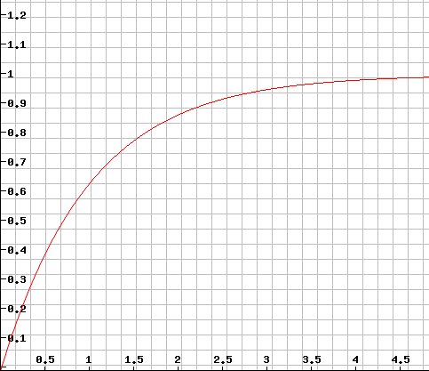





6.1 Significance of power management in processors (3)
Remark: Simplified calculation of the Dynamic power consumption (D_{d}) -2
Raising the voltage on the capacitor that is charged over a resistance
Vc
(V_{CC} = 1 V)
$${Vc=1− e}^{−t/τ}$$
$${VC=VCC ∗ (1− e}^{−t/τ})$$
$$with τ=Rs ∗ Cdyn$$
For V_{CC} = 1 V:
$${VC=1− e}^{−t/τ}$$
$$t/τ$$

Slide 8
6.1 Significance of power management in processors (4)
Remark: Simplified calculation of the Dynamic power consumption (D_{d}) -3
Let’s model all active transistors on a die by the following circuit:
R_{s}
V_{CC}
C_{dyn}
R
I
V_{CC}
ΔT
Clock
Figure: Model of the active transistors of a processor
While loading the capacitor C_{dyn} the charge Q will be accumulated and then discharged
over the resistor R during the halve clock period:
Q = C_{dyn} * V_{cc} = I * ΔT
ΔT = ½ * 1/f_{c}
Thus the dynamic dissipation is:
D_{d} = V_{cc} * I = V_{cc} * C_{dyn} * V_{cc}/ ΔT = C_{dyn} * V_{cc}² /(1/2 * 1/f_{c}) =
= 2 * C_{dyn} * V_{cc}² * f_{c}
D_{d}= const. * C_{dyn} * V_{cc}² * f_{c}
I.e.
*

Slide 9
6.1 Significance of power management in processors (5)
Characterizing the power consumption of processors by the TDP value
(Thermal Design Power)
TDP (Thermal Design Power) is the power consumption of a processor (package)
specified in datasheets, given usually in W.
It can be interpreted as the maximum power consumed by the processor
while running realistic, power intensive applications.
We note that realistic, power intensive applications should not be mixed up with
specific applications written to draw maximum power, called power viruses.
TDP serves as an indication to the power budget allocated to a processor,
at the same time it is a reference value for designing the cooling system
of the platform.
The cooling system (called also thermal solution) of a platform should guarantee
that the chip, more precisely the junction temperature (Tj) of the transistors
on the die does not exceed a given limit (Tjmax, e.g. 90 ºC⁾ while the processor
dissipates TDP Watts.
TDP: Tervezési hőérték
*

Slide 10
6.1 Significance of power management in processors (5b)
The notion of cTDP (configurable TDP)
It was introduced by Intel in 2012 (in their Ivy Bridge line and later on also
by AMD in their Kaveri line in 2014).
cTDP provides a flexibility for OEMs to build laptops or desktops compared to
designs based on a processor with a fixed TDP.
cTDP allows to choose a TDP value for a design from a TDP interval between a
lowest and highest value, instead of a fixed figure, e.g. 12 W to 28 W instead
of 15 W.
Choosing a lower TDP will result in a more quiet device with less performance
and power consumption whereas a higher TDP vice versa.
Nevertheless, if an OEM chooses a higher TDP it has to provide an enhanced
cooling solution as well compared to that the nominal TDP value would require.
*

Slide 11
6.1 Significance of power management in processors (6)
Typical TDP values of desktop and notebook processors
Processor category |  | TDP | Intel’s usual tags
Servers |  | ≈85-200 W
HEDs |  | ≈100-150 W | X
 | High perf. | ≈70-95 W | K
 | Mainstream | ≈50-65 W | S
 | Low power | ≈35-45W | T
 | High perf. | ≈45 W | H/HQ
 | Mainstream | ≈25-35 W | U
 | Ultra-thin | ≈15 W | U
Tablets |  | ≈5 W | Y/m
Desktops
Notebooks
*

Slide 12
6.1 Significance of power management in processors (7)
How TDP (allowed power budget) limits the basic clock rate?
As an example data on Intel’s Skylake DT and mobile processors show
how DTP limits the base clock frequency
Models | TDP (W) | No. of cores | Graphics | No. of graphics EUs | eDRAM | Max. Base frequency (GHz)
6Yxx | 4.5 | 2 | HD 515 | 18 | -- | 1.2
I7-6xxxU | 15 | 2 | HD 540 | 48 | 64 MB | 2.2
I3/I5/i7-6xxxU | 15 | 2 | HD 520 | 24 | -- | 2.6
I3/I5/i7-6xxxU | 28 | 2 | HD 550 | 48 | 64 MB | 3.3
I3/i5/i7-6xxxT I3-6xxxH | 35 | 4 2 | HD 530 | 24 | -- | 2.8 2.7
I5/i7-6xxxHQ | 45 | 4 | HD 530 | 24 | -- | 2.9
I3-6xxx | 47 | 4 | HD 530 | 24 | -- | 2.9
I5/i7-6xxx | 65 | 4 | HD 530 | 24 | -- | 3.4
I5/i7-6xxxK | 91 | 4 | HD 530 | 24 | -- | 4.2
Table: Base clock frequency vs. TDP in Intel’s Skylake DT and mobile lines [19]

Slide 13
6.1 Significance of power management in processors (8)
Rising the power density D [W/cm²] in Intel's Pentium 4 family
≈ Limit of air cooling
Pentium
4
Pentium 3
*

Slide 14
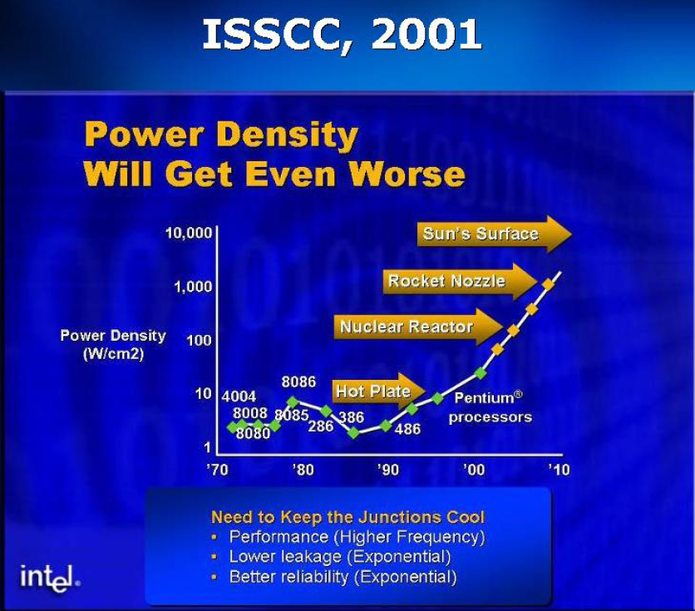
6.1 Significance of power management in processors (9)
Recognising the impact of rising power density (W/cm²) in Intel processors
at the IDM conference 2002 (A. Groove, Intel) [176]
A. Groove Keynote at IEDM Dec. 2002
IEDM: International Electron Device Meeting

Slide 15
6.1 Significance of power management in processors (10)
Remark: Intel’s expectations for their Pentium 4 family
Intel released its Pentium 4 family in 2000 while stating that the family will hit
a clock rate of 10 GHz and a life time of 10 years.
In a keynote speech at Intel Developer Forum, Fall 2001 Paul Otellini, Intel’s CEO
at that time declared: “And we're convinced that the microarchitecture that the
Pentium 4 embodies will be able to scale to 10 Gigahertz over its lifetime.” 177].
Nevertheless, Intel never reached 4 GHz and was forced to cancel the Pentium 4
line after a lifecycle of about 4 years in 2004, as the next Figure shows.
*

Slide 16
6.1 Significance of power management in processors (11)
Introduction and withdrawal of Intel's P4 family due to overheating

Slide 17

6.1 Significance of power management in processors (12)
Intel's apology for cancelling the Power 4 family [178]
During an interview on stage at Gartner Group’s Fall Symposium/IT Expo in
Orlando Intel’s then Chief Executive Officer Craig Barrett got down on his knees.
In front of an audience of about 7000 information-technology professionals,
Barrett asked their forgiveness for the Santa Clara company latest product
slip up, the cancellation of its 4 GHz Pentium 4 family in Oct. 2004.
Picture: Oct. 2004 Intel's CEO apologizes for cancelling the Pentium 4 family [178]

Slide 18
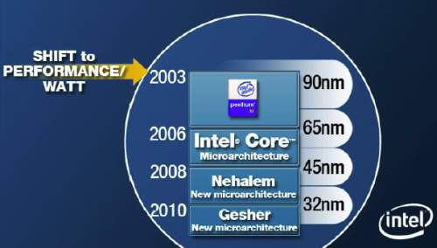
6.1 Significance of power management in processors (13)
Shifting Intel's design paradigm from performance orientation
to power efficiency orientation to cope with raising dissipation
In 2003 Intel shifted their focus of processor development from the pure performance
goal to power efficiency, as stated in a slide from 4/2006.
Power efficiency is understood as the performance per watt, given e.g. in GFLOPS/W.
Razin A., Core, Nehalem, Gesher. Intel: New Architecture Every Two Years,
Xbit Laboratories, April 28 2006,
http://www.xbitlabs.com/news/cpu/display/20060428162855.html
Figure: Intel’s plan for developing their manufacturing technology and processor lines
revealed at a shareholder’s meeting back in 4/2006 [179]
*

Slide 19
6.1 Significance of power management in processors (14)
Evolution of processor design paradigms
Processor design paradigms
High performance
oriented design paradigm
High performance per Watt
oriented design paradigm
Low power consumption
oriented design paradigm
Expressed in
E.g. GFLOPS
E.g. GFLOPS/Watt
E.g. Watt
Examples
Client
processors
Until about Intel’s
Pentium 4
(≈ 2004)
From Intel’s Core 2 line on
(2006)
Mobile
processors
ARM ISA-based
processor lines
Intel’s Atom line
(2008-2016)
AMD’s Cat line
(2011-2016)
*

Slide 20
6.1 Significance of power management in processors (15)
Initiatives to reduce power consumption
The Energy Star initiative to reduce the energy consumption
AMD's initiative to achieve 25x energy efficiency increase between 2014-2020

Slide 21

6.1 Significance of power management in processors (16)
The Energy Star initiative to reduce energy consumption [180] -1
It was established in 1992 by the US Environmental Protection Agency (EPA)
to generate awareness of energy saving in different processor categories, like
desktops, laptops etc.
The 5. version of this initiative was released in 2009.
The 5. version provides different formulae for calculating the annual Typical Energy
Consumption (TEC) in inactive ACPI states for different processor classes and
gives maximal TEC figures for using the Energy Star sticker.
ACPI: Advanced Configuration and Power Interface (open standard, originally developed by Intel, Microsoft and Toshiba in 1996).
*

Slide 22
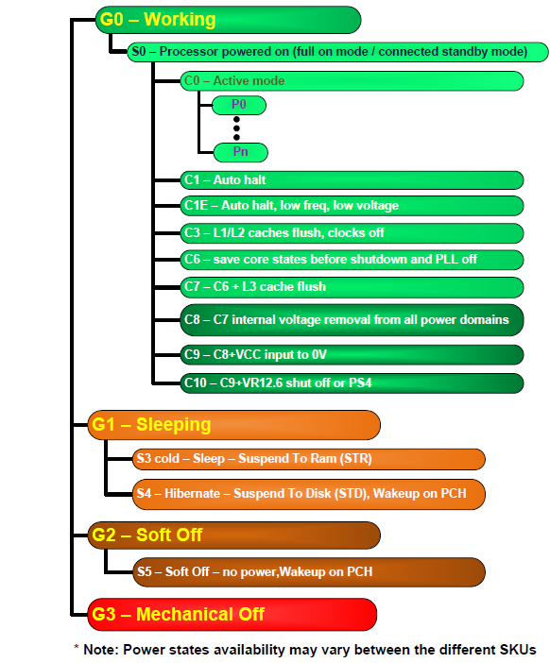
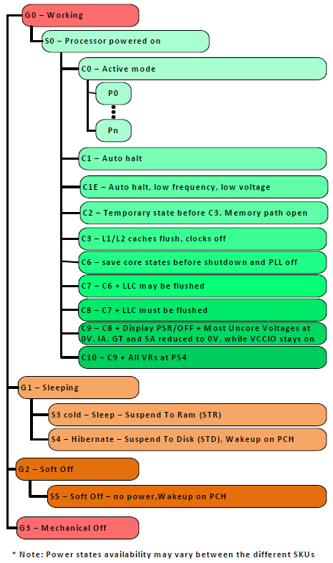
6.1 Significance of power management in processors (17)
Inactive ACPI standard states referenced in the Energy Star initiative [181]
Gi: Global states
G0: Working state
Pi: Performance states
(active states, since ACPI 2.0))
Ci: Idle states
C1…C3 given in ACPI 1.0
(C4…Cn states since ACPI 2.0)
C1
C2
Cn
G1: OS-initiated, system context
saved, no rebooting needed.
G2/Soft off: OS-initiated shut down.
Power supply remains on,
system context is not saved,
the system must be restarted.
G3/Mechanical off: Entered by
activating a mechanical switch.
The system must be restarted.
S3-S5: System Sleep states
*
*

Slide 23
6.1 Significance of power management in processors (18)
Remark: The formula for calculating the TEC figure for laptops
in the 5. version of the Energy Star initiative [180]
For example the formula for calculating the TEC figure for laptops is:
TEC = (8760/1000) * (Poff * 60% + Psleep * 10% + Pidle * 30%) [kWhours]
where
there are 8760 hours/year
all Px values are power consumption values in Watts
Poff: It relates to the Off-state, i.e. to the ACPI S4 (Hibernate -
Suspend to disk or S5 (Soft off) states, where applicable.
Psleep: It relates to the Sleep state, i.e. to the ACPI S3 state (Sleep -
Suspend to RAM state).
Pidle: It relates to the Ci Idle states, i.e. to states when activity is limited to
basic applications that the system starts by default.
E.g.: Poff = 1W, PSleep = 1.7W, Pidle = 10W
The TEC limit depends on the laptop configuration.
E.g. The TEC limit for the lowest configuration laptop is 40.0 kWhours.
Laptops with lower TEC values as the related TEC limit may carry the Energy Star
sticker.

Slide 24
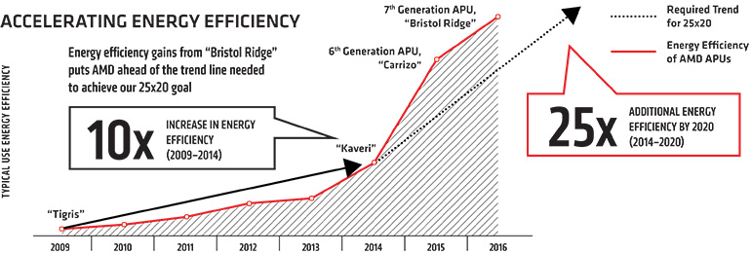
6.1 Significance of power management in processors (19)
AMD's initiative to achieve 25x energy efficiency increase in 2014-2020 -1
Announced: in 2014
Energy efficiency: Performance/Watt
Figure: Previous results and goals of AMD’s 25x energy efficiency increase initiative
[182], [183]
Tigris: AMD’s notebook platform
*

Slide 25
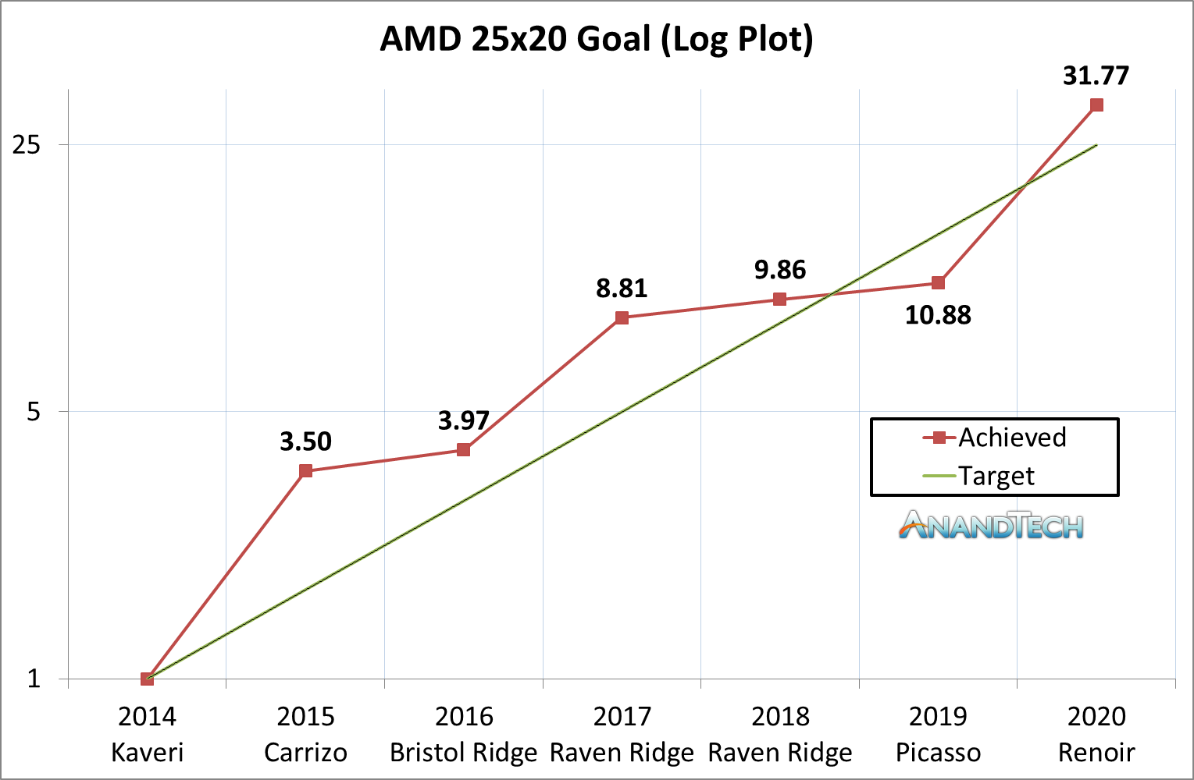
6.1 Significance of power management in processors (20)
AMD's initiative to achieve 25x energy efficiency increase in 2014-2020 -2
In 06/2020 AMD’s statement: goals of their 25x energy efficiency increase
initiative were achieved, the Zen 2-based Ryzen 7 4800H client processor
beat the company's baseline measurements by 31.7 times.
Figure: AMD’s achievement in increasing energy efficiency [356]
*

Slide 26
6.1 Significance of power management in processors (21)
AMD's initiative to achieve 25x energy efficiency increase in 2014-2020 -3
Note
Energy efficiency is extremely important also for supercomputers, there is list
maintained indicating the most energy efficient supercomputers, called the
"Green500“ list.
*

Slide 27
6.1 Significance of power management in processors (22)
Approaches and key techniques of power management in computers
Approaches for power management (PM) of computers
(Strongly simplified)
PM at the circuit level
(Reducing power consumption
by appropriate circuit design)
PM at the processor level
PM at the platform level
(ACPI-based, achieved by
system design)

Slide 28
6.1 Significance of power management in processors (23)
Approaches and key techniques of power management in computers
Approaches for power management (PM) of computers
(Strongly simplified)
PM at the circuit level
(Reducing power consumption
by appropriate circuit design)
PM at the processor level
PM at the platform level
(ACPI-based, achieved by
system design)
PM of CPU cores
Clock gating
Power gating
PM of idle CPU cores
PM of active CPU cores
Reducing
power consumption
of idle CPU cores
Reducing
power consumption
of active CPU cores
Utilizing the power headroom
of a proc. package
to raise performance
C-state management
DVFS/CPPC/AVFS
Turbo Boost Technology
(ACPI-based)
CPPC: Collaborative Processor Performance Control
(DVFS, CPPC: ACPI-based)
*

Slide 29
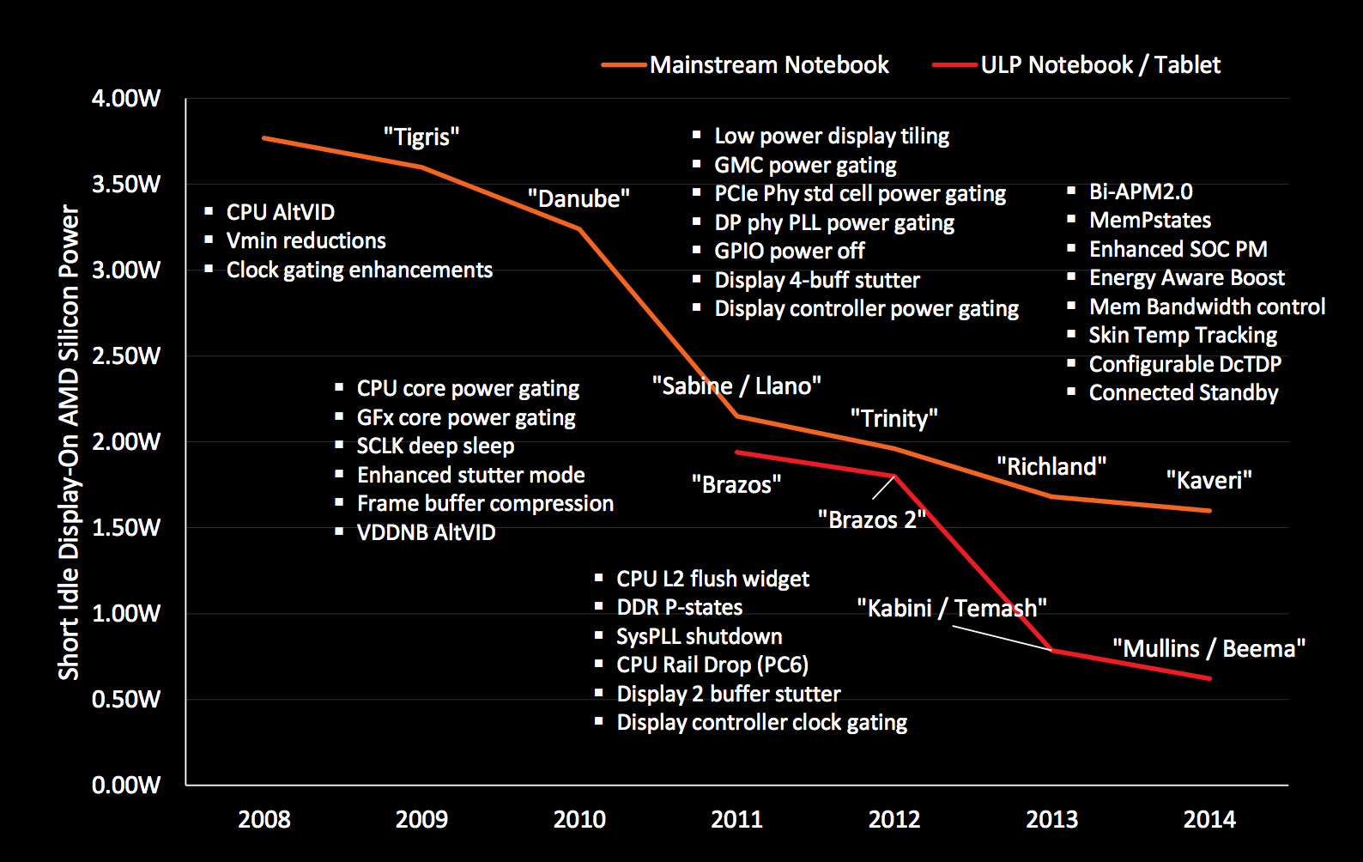
6.1 Significance of power management in processors (24)
AMD’s techniques developed for reducing the power consumption of a
computer at the circuit and platform levels (2008-2014) [184]

Slide 30
6.2 Power management at the circuit level
6.2.1 Clock gating
6.2.2 Power gating

Slide 31
6.2.1 Clock gating

Slide 32
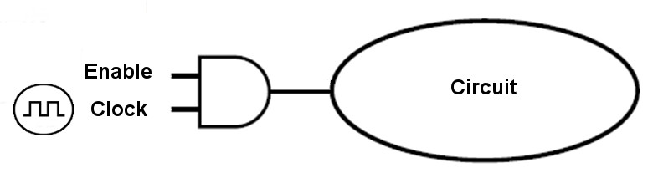
6.2.1 Clock gating (1)
6.2.1 Clock gating
It is a technique used to reduce dynamic power by disabling clocking to
currently not needed circuits.
Clocking is disabled by inserting AND gates (i.e. controlled on/off switches) that
are called clock gaters into the clock distribution network, as indicated below.
Circuit
Clock gater
Figure: Principle of clock gating
*

Slide 33
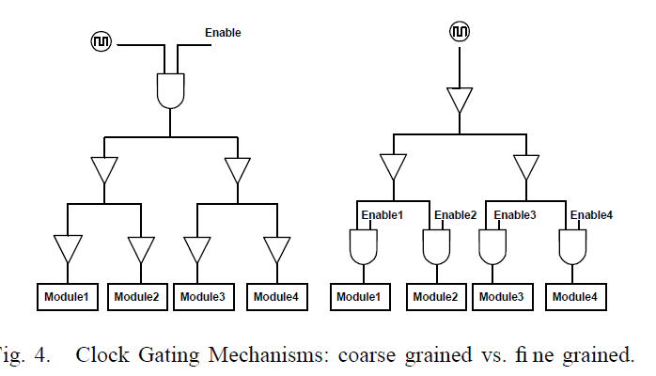
6.2.1 Clock gating (2)
Fine-grained or coarse grained clock gating -1
Clock gating can be applied either in a fine-grained or a coarse-grained fashion,
as the next Figure shows.
Fine-grained clock gating
Coarse-grained clock gating
Figure: Kinds of clock gating [185]
*

Slide 34
6.2.1 Clock gating (3)
Fine-grained or coarse grained clock gating -2
Fine-grained clock gating allows power saving at low logic level, whereas
coarse-grained clock gating is used to disable clocking of currently idle units or
parts of them (e.g. an FP unit as long as only FX instructions are processed.
*

Slide 35
6.2.1 Clock gating (4)
Use of clock gating
Clock gating was introduced very early, in the second half of the 1990s e.g.
in DEC processor designs (like the Alpha 21264 (1996) for gating the FP unit or
the StrongARM SA110 (1996)), designated at that time as conditional clocking.
Soon clock gating became widely spread, e.g. in Intel's Pentium 4 (2000) or
Pentium M (Banias) (2003).
Recently, clock-gating is a pervasive technique used in processors.
*

Slide 36
6.2.2 Power gating

Slide 37
6.2.2 Power gating (1)
6.2.2 Power gating
Principle of power gating [186]
Power gating switches off idle units on the die (like a core) from the power supply
by means of power transistors (sleep transistors) to eliminate both dynamic and
static power consumption caused by leakage currents.
Figure: Principle of power gating [186]
(Power gating: Tápellátás kapuzása)
*

Slide 38
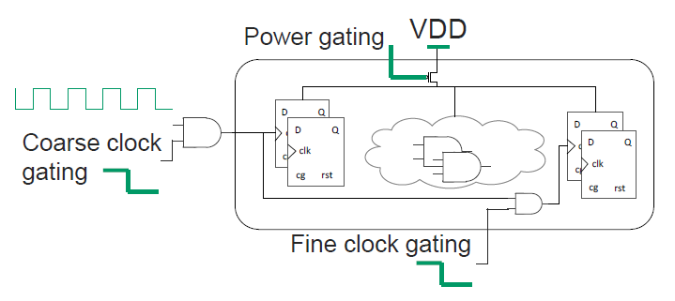
6.2.2 Power gating (2)
Advantage of power gating over clock gating
Clock gating eliminates only the dynamic part of power consumption whereas
power gating eliminates both the dynamic and static part of power consumption
of a unit, as indicated in the figure below.
Figure: Contrasting clock gating and power gating [184]
*

Slide 39
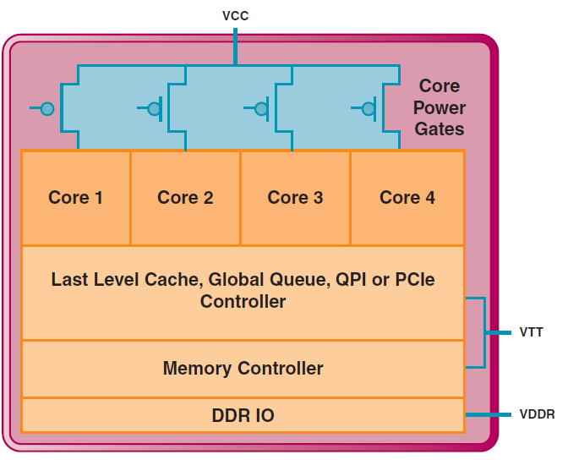
6.2.2 Power gating (3)
Use of power gating for switching off idle cores in a multicore processor
In a multicore processor power gating allows to switch off individual, not used cores,
as indicated below.
VR
VR
VR
Figure: Power gating of a 4-core processor, implemented with a common voltage rail
for the cores [187] VR: Voltage Regulator

Slide 40
6.2.2 Power gating (4)
Power gating as a precondition for implementing the Turbo Boost technology
The Turbo Boost technology utilizes the actual power headroom of processors.
Consequently, the Turbo Boost technology can only be efficient if there is a
high enough power headroom at hand.
Since power gating eliminates both static and dynamic dissipation of idle cores,
it largely raises the power headroom of lightly loaded or idle processors.
Thus, power gating can be considered as a precondition for the implementation
of Turbo Boost technology since clock gating alone does not provide enough
headroom for a noteworthy increase of the clock frequency.
Power headroom: (Hőtartalék) It is the difference between the TDP and the actual
power consumption
*

Slide 41
6.2.2 Power gating (5)
6.2.1 Clock gating (4)
zh 2020 10. 28 ()
Introduction of power gating in main computer families
Vendor | Family | Year of intro.
Intel | Nehalem | 2008
 | Westmere | 2010
 | Sandy Bridge | 2011
 | Ivy Bridge | 2012
 | Skylake | 2015
 | Atom families | 2010 - 2016
AMD | K12-based Llano K14-based Bobcat K15-based Bulldozer families | 2011 2011 2011 - 2015
IBM | POWER7+ | 2012
 | POWER8 (Iintegrated PG and DVFS) | 2014

Slide 42
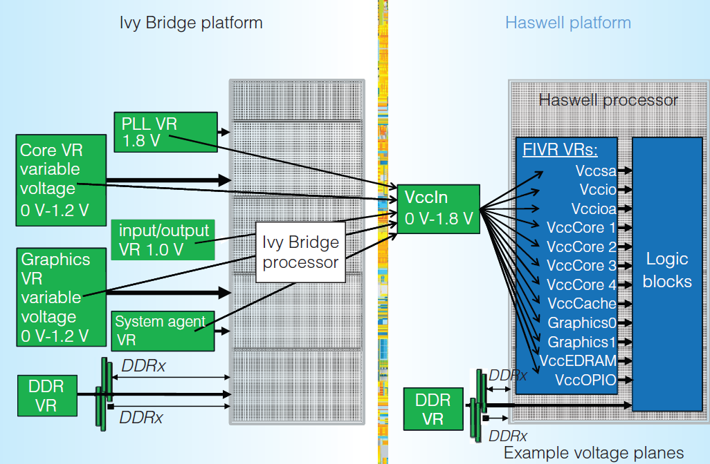
6.2.2 Power gating (6)
Replacing power gating by integrated voltage regulators
Integrated voltage regulators
(called by Intel FIVR (Fully Integrated
Voltage Regulator) is a technology
to generate supply voltages individually
to different units of a processor, by
integrating parts of the Voltage Regulator
onto the processor chip.
Integrated voltage regulators allow to
supply zero-voltage as well, i.e.
to switch off individual units, so they
make power gating superfluous,
as the Figure on the right shows.
Integrated voltage regulators were
introduced in Intel's Haswell and
Broadwell-lines (2013/2014) but
thereafter their use was suspended
temporarily (until arriving the
Ice Lake processor (2019) due to their
additional power consumption that
reduced the power budget available
for the instruction execution.
Figure: Use of integrated voltage regulators in Intel's Haswell processor [188]
*

Slide 43
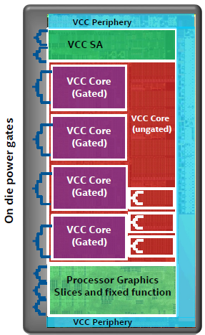
6.2.2 Power gating (7)
Reuse of power gating after Intel has suspended the implementation
of integrated voltage regulators in their Skylake line
As integrated voltage regulators, introduced
into the Haswell and Broadwell lines, caused
increased dissipation and thus reduced
clock frequency, in their subsequent
Skylake line Intel omitted integrated
voltage regulators and reintroduced power
gating, as indicated in the Figure on the right.
Then in 2019 in their Ice Lake line Intel
brought back integrated voltage regulators.
Figure: Reuse of power gating in Intel's
Skylake line [90]
*

Slide 44
6.2.2 Power gating (8)
Extent of the use of power gating (PG)
Extent of the use of power gating (PG)
PG covers
only the CPU cores
PG covers
beyond CPU cores also other units
(like the L3, GPU, MC etc.)
Intel's early PG solution in the
Nehalem (2008) processor line
Intel's PG solution in the
Westmere and Sandy Bridge lines
(cores, L3 cache) (2010/2011)
Intel's PG solution in the
Ivy Bridge line
(cores, PCIe, memory controller) (2012)
Intel's PG solution
since Lincroft-based Atom lines
(cores, graphics cores, video decoder/
encoder, display controller) (2010-2016)
AMD's PG solutions in
the Bulldozer (2011), Llano (2011)
and Bobcat (2011) lines
(cores, graphics core and controller,
PCIe controller, video decoder)
as well as in subsequent processors
*

Slide 45
6.2.2 Power gating (9)
Example for power gating only the cores in Intel's Nehalem family (2008)
[187]
VR
VR
VR
Note that Vcc is power-gated.
VR: Voltage Regulator

Slide 46
6.2.2 Power gating (10)
Example for power gating further functional units as well rather than only
the cores in AMD's Llano line (2011) [127]
In Llano AMD power-gates virtually all units, such as
the Graphics Core (GFX)
the Graphics Memory Controller (GMC)
the Unified Video Decoder (UVD)
the x16 PCIe Expansion Graphics Controller.
AON: Always ON – refers to logic that is not power-gated
Figure: Use of power gating beyond CPU cores and L2 caches in Llano [127]
The GFX and GMC units have dynamic (hardware) power gating whereas other units
have static power-gating, i.e. power gating is controller by their drivers.
Note that in theabove case the VddNB (Northbridge) rail is power-gated.

Slide 47
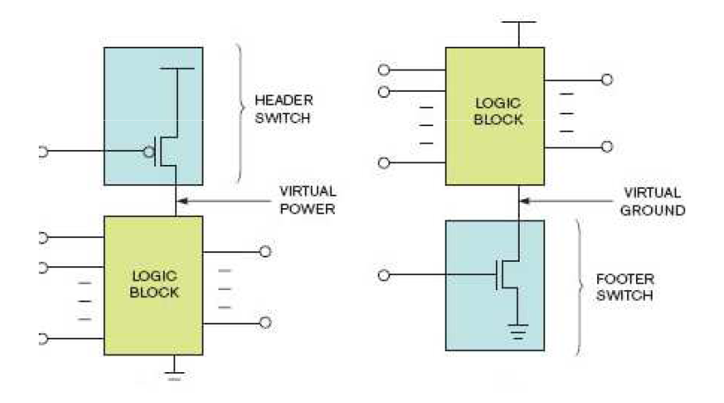
6.2.2 Power gating (11)
Implementing power gating: Alternatives for isolating the power supply
To implement power gating either Vcc (Vdd) or Vss (ground) can be isolated,
as indicated in the next Figure [189].
Isolate Vcc (Vdd)
Isolate Vss
Vcc (Vdd)
Vss

Slide 48
6.2.2 Power gating (12)
Use of alternatives for isolating the power supply
Intel and AMD employ different alternatives for isolating the power supply,
as indicated below.
Alternatives to isolate power supply
Switch off the Vcc (Vdd) voltage
Switch off Vss (ground)
Intel's solution
in the Nehalem and subsequent
processor families
AMD's solution for switching off cores
in the Bulldozer and Llano based
as well as subsequent processor lines
of these families
AMD's solution for switching off cores
in the Bobcat and subsequent processor lines
AMD's solution for switching off idle units rather than cores (e.g. graphics units
in the Bulldozer and Llano based
as well as subsequent processor lines of these families

Slide 49
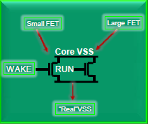
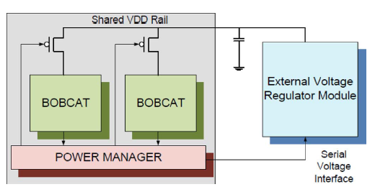
6.2.2 Power gating (13)
Examples for isolating the power supply
Isolating Vcc (Vdd) in Intel's Nehalem (2008) [187]
Isolating Vss in AMD's Bulldozer (2011) [190]
Isolating Vcc (Vdd) in AMD's Bobcat (2011) [13]

Slide 50
6.2.2 Power gating (14)
Necessary operations prior to switching off cores by means of power gating
Obviously, before a core can be powered off
its (write back) caches need to be flushed
(i.e. modified cache lines need to be written back into the next level cache
if available else into the main memory) and
the execution states of the cores need to be preserved
(either in the main memory, in the next level cache (if existent) or in an
SRAM that has an independent power supply).
In addition, to reduce power consumption further on, typically also
core clocking will be halted and
the PLL is switched off.
*

Slide 51
6.2.2 Power gating (15)
Use of the alternatives for saving the execution state of a core
Alternatives for saving the execution state of a core
Saving the execution state
of the core
into the main memory
Saving the execution state
of the core
into the last level cache
Saving the execution state
of the core
into an on-die SRAM
Intel
Penryn (2007)
Nehalem (2008)
Westmere (2010)
Sandy Bridge (2011)
Haswell (2013)
Broadwell (2015)
Skylake (2015)
Atom line (2010-2016)
Power gating (1)
AMD
Llano (2011)
Bulldozer (2011)
Piledriver (2012)
Steamroller (2013)
Excavator (2015)
Jaguar (2013)
(either into the L1 cache or
the main memory)
Puma (2014)
(into the L1 cache)
Bobcat (2011)
Jaguar (2013)
(either into the L1 cache or
the main memory)

Slide 52
6.3 Power management at the platform level - Overview
Notes:
52

Slide 53
6.3 Power management at the platform level – Overview (1)
6.3 Power management at the platform level - Overview
Approaches for power management (PM) of computers
(Strongly simplified)
PM at the circuit level
(Reducing power consumption
by appropriate circuit design)
PM at the processor level
PM at the platform level
(ACPI-based, achieved by
system design)
PM of CPU cores
Clock gating
Power gating
PM of idle CPU cores
PM of active CPU cores
Reducing
power consumption
of idle CPU cores
Reducing
power consumption
of active CPU cores
Utilizing the power headroom
of a proc. package
to raise performance
C-state management
DVFS/CPPC/AVFS
Turbo Boost Technology
(ACPI-based)
CPPC: Collaborative Processor Performance Control
(DVFS, CPPC: ACPI-based)
*

Slide 54
6.3 Power management at the platform level – Overview (2)
The need for a standard for power managing computers
Power management of processors or I/O devices (like memory, HD, SSD etc.)
needs typically a concerted effort of both system software (like OS, BIOS)
and hardware to accomplish PM actions on devices of various vendors.
Accordingly, PM standards emerged, first by Intel, targeting PM of processors
in the 1990s, then as a cooperative effort by Intel and Microsoft.
Finally, in 1996 a group of interested vendors, including Intel, Microsoft, Compaq,
and others adopted the ACPI (Advanced Configuration and Power Interface)
standard, that covers both configuration issues (like hot plug) and PM of the
entire platform.
The next Figure summarizes this evolution.
*

Slide 55
6.3 Power management at the platform level – Overview (3)
Evolution of power management standards
Power management standards
(SL technology)
Advanced
Power Management
(APM)
Advanced Configuration
and Power Interface
(ACPI)
Introduced
10/1990
01/1992
12/1996
Vendor
Intel
Intel and Microsoft
Intel, Microsoft,
Compaq, Phoenix and Toshiba
A set of PM techniques
Open standard i.f.
between OS and BIOS
Open standard i.f.
between OS and HW
Typ. CPU scaling
SFS
DFS
DVFS
Done basically
for CPU:
for devices:
by SMM
by SMM
by OSPM/BIOS
by BIOS/OSPM/OS handlers
by OSPM
by OSPM
386SL (embedded)
486SL (embedded)
486 family (since 06/1993)
Pentium M and
subsequent processors
First proc. supp.
Pentium
First Intel’s
chipset supp.:
420EX
420ZX
430FX with PIIX
430HX/430VX with PIIX3
430TX with PIIX4 (ACPI 1.0)
OS support:
No OS support
needed
Windows 95 (08/1995)
Windows 98 (06/1998)
Windows 98 (ACPI 1.0) (06/1998)
Windows XP SP1 (ACPI 2.0) (02/2002)

Slide 56
6.3 Power management at the platform level – Overview (4)
Emergence and evolution of the ACPI standard
The ACPI standard became widely accepted and underwent an intensive evolution,
as the next Figures show.
*

Slide 57
6.3 Power management at the platform level – Overview (5)
Emergence of the ACPI standard and its OS support
08/1995
05/1999
Consumer
products
W 95
W 98SE
ACPI 1.0
Introduction of OS support of DVFS (Dynamic Voltage and Frequency Scaling)
02/2000
10/2001
01/2007
End of 2009
Desktops/
Laptops
W 2000 Prof.
W XP
W Vista
W 7
ACPI 1.0
ACPI 1.0b
SP1 (09/2002): ACPI 2.0¹
ACPI 3.0
ACPI 3.0
02/2000
04/2003
02/2008
Servers
W 2000 Server
W Server 2003
W Server 2008
ACPI 1.0
ACPI 2.0¹
ACPI 3.0
07/1996
Corporate
products
W NT 4.0
12/1996
07/2000
09/2004
06/2009
12/2011
ACPI 1.0
ACPI 2.0
ACPI 3.0
ACPI 4.0
ACPI 5.0
1995
2000
2005
2010
*
¹: Windows XP and Windows Server 2003 do not support all of the ACPI 2.0 specification [191]

Slide 58
6.3 Power management at the platform level – Overview (6)
Support of multicores and multithreading in ACPI 3.0 and its OS support
08/1995
05/1999
Consumer
products
W 95
W 98SE
ACPI 1.0
Support of multicores and multithreading
02/2000
10/2001
01/2007
End of 2009
Desktops/
Laptops
W 2000 Prof.
W XP
W Vista
W 7
ACPI 1.0
ACPI 1.0b
SP1 (09/2002): ACPI 2.0¹
ACPI 3.0
ACPI 3.0
02/2000
04/2003
02/2008
Servers
W 2000 Server
W Server 2003
W Server 2008
ACPI 1.0
ACPI 2.0¹
ACPI 3.0
07/1996
Corporate
products
W NT 4.0
12/1996
07/2000
09/2004
06/2009
12/2011
ACPI 1.0
ACPI 2.0
ACPI 3.0
ACPI 4.0
ACPI 5.0
1995
2000
2005
2010
*
¹: Windows XP and Windows Server 2003 do not support all of the ACPI 2.0 specification [191]

Slide 59
6.3 Power management at the platform level – Overview (7)
Support of Collaborative Processor Performance Control in ACPI 5.0
08/1995
05/1999
Consumer
products
W 95
W 98SE
ACPI 1.0
02/2000
10/2001
01/2007
End of 2009
Desktops/
Laptops
W 2000 Prof.
W XP
W Vista
W 7
ACPI 1.0
ACPI 1.0b
SP1 (09/2002): ACPI 2.0¹
ACPI 3.0
ACPI 3.0
02/2000
04/2003
02/2008
Servers
W 2000 Server
W Server 2003
W Server 2008
ACPI 1.0
ACPI 2.0¹
ACPI 3.0
07/1996
Corporate
products
W NT 4.0
Collaborative Processor Performance Control
(Intel Speed Shift technology)
12/1996
07/2000
09/2004
06/2009
12/2011
ACPI 1.0
ACPI 2.0
ACPI 3.0
ACPI 4.0
ACPI 5.0
1995
2000
2005
2010
¹: Windows XP and Windows Server 2003 do not support all of the ACPI 2.0 specification [191]

Slide 60
6.3 Power management at the platform level – Overview (8)
Subsequent revisions of the ACPI standard
Revision 5.1 was released in 7/2014, in includes an update of CPPC
(Collaborative Processor Performance Control), called CPPC2.
The next update, Revision 6.0 appeared in 4/2015.
Subsequent revisions are:
ACPI 6.1 (1/2016)
ACPI 6.2 (5/2017)
ACPI 6.3 (1/2019)

Slide 61
6.3 Power management at the platform level – Overview (9)
PM of CPU cores
PM at the platform level covers a wide variety of techniques targeting power
management of platform elements, like the processor, memory, HD- or
SSD-devices etc.
From those, we will discuss only the processor level PM in a stand alone Section.
Processor level PM extends virtually to all elements of the processors, like the
cores, GPU (if available), memory controller, PCI controller etc.
From all of these processor components, subsequently, we focus only on the
cores, and will discuss first the PM of idle cores followed by sections concerned
with the PM of active cores, as highlighted in the next Figure.
*

Slide 62
6.3 Power management at the platform level – Overview (10)
Power management of CPU-cores - Overview
Approaches for power management (PM) of computers
(Strongly simplified)
PM at the circuit level
(Reducing power consumption
by appropriate circuit design)
PM at the processor level
PM at the platform level
(ACPI-based, achieved by
system design)
PM of CPU cores
Clock gating
Power gating
PM of idle CPU cores
PM of active CPU cores
Reducing
power consumption
of idle CPU cores
Reducing
power consumption
of active CPU cores
Utilizing the power headroom
of a proc. package
to raise performance
C-state management
DVFS/CPPC/AVFS
Turbo Boost Technology
(ACPI-based)
CPPC: Collaborative Processor Performance Control
(DVFS, CPPC: ACPI-based)
*

Slide 63
6.4 Reducing power consumption of idle CPU cores
6.4.1 Introduction to the ACPI C-states
6.4.2 Overview of ACPI-compliant C-state management
in Intel’s mobile lines
6.4.3 PCU-based C-state management
in Intel’s multithreaded multicore mobile lines
6.4.4 Evolution of C-state management in Intel's mobile lines
Section 6.4 will not be discussed.
Notes:
63

Slide 64
6.4 Reducing power consumption of idle CPU cores (1)
6.4 Reducing power consumption of idle CPU cores -1
Approaches for power management (PM) of computers
(Strongly simplified)
PM at the circuit level
(Reducing power consumption
by appropriate circuit design)
PM at the processor level
PM at the platform level
(ACPI-based, achieved by
system design)
PM of CPU cores
Clock gating
Power gating
PM of idle CPU cores
PM of active CPU cores
Reducing
power consumption
of idle CPU cores
Reducing
power consumption
of active CPU cores
Utilizing the power headroom
of a proc. package
to raise performance
C-state management
DVFS/CPPC/AVFS
Turbo Boost Technology
(ACPI-based)
CPPC: Collaborative Processor Performance Control
(DVFS, CPPC: ACPI-based)

Slide 65
6.4 Reducing power consumption of idle CPU cores (2)
Reducing power consumption of idle CPU cores -2
By power managing idle CPU cores their power consumption can be reduced.
Its implementation is based on the ACPI defined C-states.
Bevor discussing how it is done, first we give an introduction to the ACPI
C-states.

Slide 66
6.4.1 Introduction to the ACPI C-states
Notes:
66

Slide 67
6.4.1 Introduction to the ACPI C-states (1)
6.4.1 Introduction to the ACPI C-states -1
C-states, more precisely the C1 – C3 states, have been introduced in the ACPI
standard 1.0 (in 1996) whereas additional C-states, the C4…Cn states ere defined
in the ACPI 2.0 standard (in 2000)), as seen in the next Figure.

Slide 68
6.4.1 Introduction to the ACPI C-states (2)
ACPI idle states C1 – Cn [181]
Pi: Performance states
(active states, since ACPI 2.0))
Ci: Idle states
C1 … C3 states since ACPI 1.0,
C4 … Cn states since ACPI 2.0
C1
C2
Gi: Global states
Cn
Si: System Sleep states
G1: OS-initiated, system context
saved, no rebooting needed.
G2/Soft off: OS-initiated shut down.
Power supply remains on,
system context is not saved,
the system must be restarted.
G3/Mechanical off: Entered by
activating a mechanical switch.
The system must be restarted.
*

Slide 69
6.4.1 Introduction to the ACPI C-states (3)
Introduction to C-states -2
We point out that the ACPI standard does not give a detailed specification
for the C4 ...Cn states, rather than standardizing the C4 … C4 states the ACPI
standard declares these states (called bewilderingly as additional processor
power states) as higher numbered Ci states that provide higher power savings
along with longer enter and exit latencies.
It follows that e.g. the C4 or C6 state may be specified differently from vendor
to vendor even from processor line to processor line.

Slide 70
6.4.1 Introduction to the ACPI C-states (4)
Introduction to C-states -3
In idle states the processor is powered on but does not execute instructions.
This allows to reduce power consumption by various techniques, such as
clock gating, power gating, reducing or switching off the supply voltage of
actually idle cores or caches etc..
Idle states are characterized by two key parameters: the power reduction
they provide and the time needed to enter and exit to and from an idle state.

Slide 71
6.4.1 Introduction to the ACPI C-states (5)
Power consumption vs. transfer latency of subsequent C-states
As stated before, higher numbered C states (deeper idle states) have lower power
consumption but increasingly longer transit latencies (enter plus exit times),
as indicated below for the C-states C1 - C6.
Power consumption
C0
D e e p e r i d l e s t a t e s
C1
C2
C3
C4
C5
C6
Enter + exit latency
Figure: Power consumption vs. transfer latency of C-states

Slide 72
6.4.1 Introduction to the ACPI C-states (6)
Example 1: Power consumption vs. enter + exit latencies of C states
in Intel's 130 nm Mobile Pentium 4 processor (2002)
Power consumption [W]
40
32W
(C0: TDP, else max values)
C0: Working
30
20
~ 20 FSB cycles
~100 FSB cycles
~30 μs for PLL stabilisation
na.
≈
7.5 W
7.5 W
7.5 W
10
C1: Auto Halt
C2: Stop Grant
C3: Sleep
5.0 W
5
5
5
C3: Deep Sleep
2.9 W
C4: Deeper Sleep
Stop execution
Stop proc. clock
but service snoops
latch interrupts
Stop execution
Stop proc. clock
but service snoops
latch interrupts
Stop servicing
snoops
Stop latching
interrupts
Enter + exit latency
(rough estimate)
Stop PLL
Reduce Vcc until
the retention voltage
of the L2 cache (V_{cc4})
Remark: fc = 2 GHz, FSB = 400 MHz (Northwood-based)
845MP/MZ

Slide 73
6.4.1 Introduction to the ACPI C-states (7)
Example 2: Power consumption vs. enter + exit latencies of C-states
in Intel's 45 nm Penryn-based Mobile processor (T9xxx) (2008) -1
[192]
40
Power consumption
35W
C0: Working
30
~15 μs for PLL
stabilization
Not designated latencies
usually < 1 µs
~100-420 μs for
entering/exiting
C6
20
12.5W
11.8W
C1: Auto C2: Stop
Halt Grant
C3: Sleep
10
5.5W
5
C3: Deep Sleep
1.7W
1.3W
0.3W
C4: Deeper Sleep
C5: Enh.
Deeper Sleep
C6: Deep
Power Down
Enter + exit
latency
(rough estimate)
Stop execution
Stop proc. clock
but service snoops
latch interrupts
L1 caches are
flushed into the
L2 cache
No snnops
No latching of
interrupts
L2 partially flushed
Vcc lowered
(until both the
cores and the
L2 cache retain
their state)
Both cores
save their
architectural states
in on-die SRAMs
Vcc deep below the
core retention voltage
Stop proc. PLL
L2 entirely flushed
Vcc further lowered
(until the cores
retain their state)

Slide 74
6.4.1 Introduction to the ACPI C-states (8)
Example 2: Power consumption vs. enter + exit latencies of C-states
in Intel's 45 nm Penryn-based Mobile processor (T9xxx) (2008) -2
Note that the C6 state has a significantly lower power consumption (0.3 W) than
the C4 state (1.7 W) providing headroom for introducing a forerunner of the
Turbo Boost technology, called EDAT (discussed in Section 6.2).

Slide 75
6.4.2 Overview of ACPI-compliant C-state management
in Intel’s mobile lines
It will not be discussed.
Notes:
75

Slide 76
6.4.2 ACPI-compliant C-state management in Intel’s mobile lines (1)
6.4.2 Overview of ACPI-compliant C-state management in Intel’s mobile lines
Principle of ACPI-compliant C-state management in Intel’s mobile lines
OS recognizes idle periods of instruction execution and instructs the processor
to manage C-states through a software interface.
Interrupts let exit C-states and enter the C0 operating state.
This is summarized in the next Figure, along with the overview of their
implementation alternatives.

Slide 77
6.4.2 ACPI-compliant C-state management in Intel’s mobile lines (2)
Implementation alternatives of ACPI-compliant C-state management
in Intel’s mobile lines
ACPI-compliant C-state management
in Intel’s mobile lines
OS recognizes idle periods of instruction execution
and instructs the processor to manage C-states
through a software interface.
Interrupts let exit C-states
and enter the C0 operating state.
SB-based C-state management
in Intel’s single- and dual-core
mobile lines
PCU-based C-state management
in Intel’s multithreaded multicore
mobile lines
Control logic of the SB
is basically responsible
for managing C-states
On-die PCU
is basically responsible
for managing C-states
From the mobile Pentium II (1998) on
up to
Penryn-based mobiles (2008)
From the 2. gen. Nehalem
(Lynnfield)-based lines on
(2009)
SB: South Bridge
PCU: Power Control Unit

Slide 78
6.4.2 ACPI-compliant C-state management in Intel’s mobile lines (3)
Early, SB-based implementation of ACPI-based C-state management
employed in Intel’s single- and dual-core mobile processors -2
Intel’s early C-state management was based on the SB since early idle state
management was based on idle time counters, implemented in the SB,
indicating long inactivity of periphery units, like HD devices.
SB-based C-state management covered Intel’s single- and dual core mobile
processors, introduced between 1998 and 2008, as summarized in the Figure
above.

Slide 79
6.4.2 ACPI-compliant C-state management in Intel’s mobile lines (4)
Positioning Intel’s early, SB-based implementation of ACPI-based C-state
management
ACPI-compliant C-state management
in Intel’s mobile lines
OS recognizes idle periods of instruction execution
and instructs the processor to manage C-states
through a software interface.
Interrupts let exit C-states
and enter the C0 operating state.
SB-based C-state management
in Intel’s single- and dual-core
mobile lines
PCU-based C-state management
in Intel’s multithreaded multicore
mobile lines
Control logic of the SB
is basically responsible
for managing C-states
On-die PCU
is basically responsible
for managing C-states
From the mobile Pentium II (1998) on
up to
Penryn-based mobiles (2008)
From the 2. gen. Nehalem
(Lynnfield)-based lines on
(2009)
SB: South Bridge
PCU: Power Control Unit

Slide 80
6.4.2 ACPI-compliant C-state management in Intel’s mobile lines (5)
Advanced, PCU-based implementation of ACPI-based C-state management
employed in Intel’s multithreaded multicore lines
Next, along with their 2. generation Nahalem-based client lines (called Lynnfield)
Intel moved C-state management control to the processor, since the Nehalem
line introduced a powerful dedicated microcontroller with the performance of a
486 processor, called Power Control Unit (PCU).
PCU-based C-state management covers Intel’s multithreaded multicore lines
up to now, as seen in the next Figure.

Slide 81
6.4.2 ACPI-compliant C-state management in Intel’s mobile lines (6)
Positioning Intel’s PCU-based implementation of ACPI-based C-state
management
ACPI-compliant C-state management
in Intel’s mobile lines
OS recognizes idle periods of instruction execution
and instructs the processor to manage C-states
through a software interface.
Interrupts let exit C-states
and enter the C0 operating state.
SB-based C-state management
in Intel’s single- and dual-core
mobile lines
PCU-based C-state management
in Intel’s multithreaded multicore
mobile lines
Control logic of the SB
is basically responsible
for managing C-states
On-die PCU
is basically responsible
for managing C-states
From the mobile Pentium II (1998) on
up to
Penryn-based mobiles (2008)
From the 2. gen. Nehalem
(Lynnfield)-based lines on
(2009)
SB: South Bridge
PCU: Power Control Unit

Slide 82
6.4.2 ACPI-compliant C-state management in Intel’s mobile lines (7)
Implementation alternatives of ACPI-based C-state management -5
From both evolution phases of implementing C-state management in Intel’s
mobile line, subsequently we will discuss only the more advanced PCU
(Power Control Unit)-based implementation.

Slide 83
6.4.3 PCU-based C-state management
in Intel’s multithreaded multicore mobile lines
It will not be discussed.
Notes:
83

Slide 84
6.4.3 PCU-based C-state management in Intel's mobile lines (1)
6.4.3 PCU-based C-state management in Intel's multithreaded multicore
mobile lines -1
ACPI-compliant C-state management
in Intel’s mobile lines
OS recognizes idle periods of instruction execution
and instructs the processor to manage C-states
through a software interface.
Interrupts let exit C-states
and enter the C0 operating state.
SB-based C-state management
in Intel’s single and dual-core
mobile lines
PCU-based C-state management
in Intel’s multithreaded multicore
mobile lines
Control logic of the SB
is basically responsible
for managing C-states
On-die PCU
is basically responsible
for managing C-states
From the mobile Pentium II (1998) on
up to the
Penryn-based mobile lines (2008)
From the 2. gen. Nehalem
(Lynnfield)-based lines on
(2009)
Section 5.3
Section 5.4
SB: South Bridge
PCU: Power Control Unit

Slide 85
6.4.3 PCU-based C-state management in Intel's mobile lines (2)
PCU-based C-state management in Intel's multithreaded multicore
mobile lines -2
Intel introduced PCUs (Power Control Units) to accomplish power management
(i.e. P-state management, C-state management, the Turbo Boost technology etc.)
along with integrating memory controllers onto the processor die first in their
Nehalem line in 2008.
Subsequently, first mobiles with PCU-based C-state management arouse along with
the 2. generation Nehalem (Lynnfield) line of processors in 2009.
(Note here that the first generation Nehalem family was server oriented and
did not cover mobile models, whereas both generations introduced multithreading
into the Core 2 family).

Slide 86
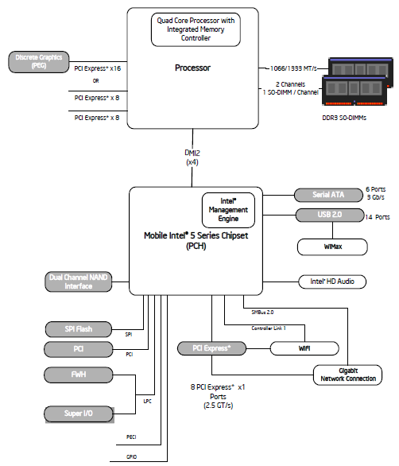
6.4.3 PCU-based C-state management in Intel's mobile lines (3)
Example 1: 2. gen Nehalem (Lynnfield)
based two-chip mobile platform
Intel's i7-900M (2009) [193]

Slide 87
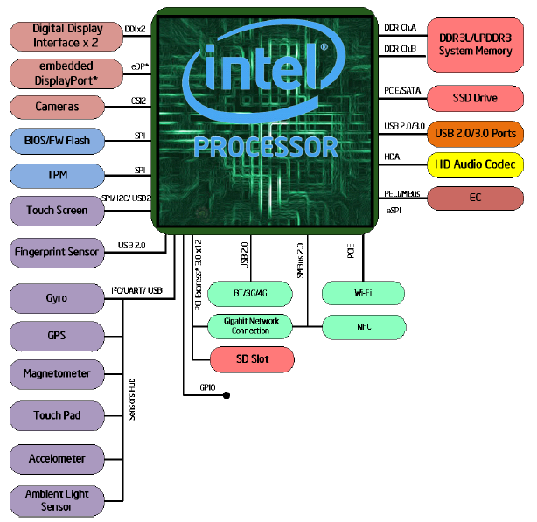
6.4.3 PCU-based C-state management in Intel's mobile lines (4)
Example 2: Skylake-based single-chip mobile platform Intel's i7-6xxxU SoC
(2015) [194]

Slide 88
6.4.3 PCU-based C-state management in Intel's mobile lines (5)
Main enhancements of the Nehalem-based multithreaded multi-core
processor lines aiming at power management
c) Utilizing power gating to switch off idle cores individually
The subsequent Haswell and Broadwell lines introduced integrated voltage
regulators, these replaced power gating, but after integrated power gating
was omitted due to additional dissipation in the Skylake line, Intel made use
of power gating anew to switch off idle cores.
b) Introducing on-die Power Control Units (PCUs)
(implemented actually as dedicated 32-bit microprocessors)
c) Introducing the Turbo Boost technology.
d) Implementing power management for the introduced L3 cache

Slide 89
6.4.3 PCU-based C-state management in Intel's mobile lines (6)
Main tasks of PCU-directed C-state management in Intel's multi-core
multi-threaded mobile lines -Overview
Main tasks of PCU-directed C-state management in Intel's multi-core multi-threaded mobile lines
(from the mobile 2. gen. Nehalem (Lynnfield)-based lines (2009)
a) Recognizing the length
of thread idleness
in time windows
by the OSPM
c) OSPM communicates
the target C-state
of the thread
to the processor
via a software interface
e) The PCU performs
the needed control
operations to accomplish
the transition to
the target core and
package C-state
b) Decision for the new
C-state of the thread
by the OSPM, based on the
length of thread idleness
and C-state history
d) The PCU coordinates
thread C-states
for multithreaded cores
and core C-states
in multicores if cores use
common resources
(e.g. Vcc or L3)

Slide 90
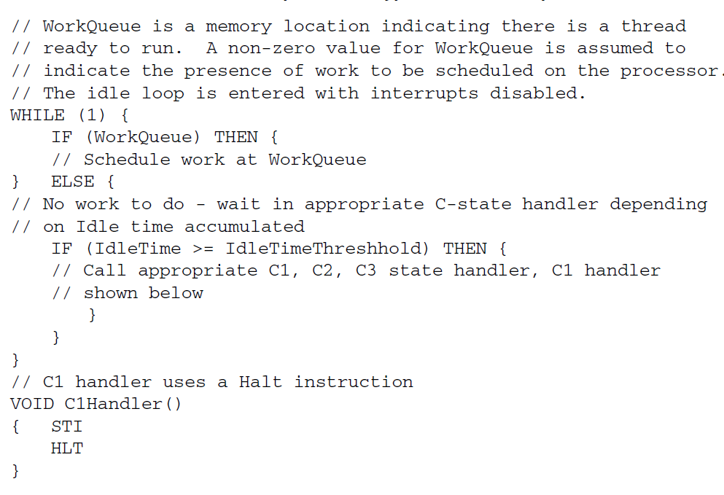
6.4.3 PCU-based C-state management in Intel's mobile lines (7)
a/b) Recognizing the length of thread idleness and determine the next
C-state
The OSPM recognizes the length of thread idleness for each thread in a loop,
as indicated below [195].
The above program segment shows only C1 – C3 states, higher states are
managed basically in the same way.

Slide 91
6.4.3 PCU-based C-state management in Intel's mobile lines (8)
c) OSPM communicates the target C-state of the thread to the processor
via a software interface -1
The OSPM has basically two software interfaces to communicate the target
C-state of the thread to the processor.
The primary interface is introduced along with the Core and Core 2 families and
is given by
the MWAIT(Cx) instructions [x denotes here the C-state level]
and the EAX and ECX MSRs (Machine Specific Registers),
as follows:

Slide 92
6.4.3 PCU-based C-state management in Intel's mobile lines (9)
The MWAIT Hints and MWAIT Extension MSR registers [196]
Bits | Description
3:0 | Sub C-state within a C-state, indicated by bits [7:4]
7:4 | Target C-state Value of 0 means C1; Value of 1 means C2 and so on Value of 01111B means C0 Note: Target C states for MWAIT extensions are processor-specific C-states, not ACPI C-states
31: 8 | Reserved
Table: MWAIT Hints MSR register (EAX)
Bits | Description
0 | Treat interrupts as break events even if masked (e.g., even if EFLAGS.IF=0). May be set only if CPUID.05H:ECX[bit 1] = 1.
31: 1 | Reserved
Table: MWAIT Extension MSR register (ECX)

Slide 93
6.4.3 PCU-based C-state management in Intel's mobile lines (10)
OSPM communicates the target C-state of the thread to the processor
via a software interface -2
The OSPM may also use a secondary, in fact ACPI interface by issuing the legacy
LVL-x I/O read instructions to the Processor Control Block registers of the SB,
called Level x registers, but these instructions will not be executed in the processor
but converted to MWAIT(Cx) instructions.

Slide 94
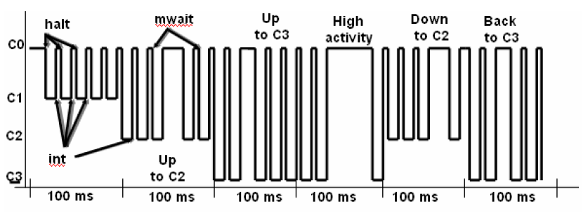
6.4.3 PCU-based C-state management in Intel's mobile lines (11)
Example for initiating C-state transitions by the OS Power Manager (OSPM)
The OSPM scheduler recognizes when no work is to do for the processor,
evaluates the rate of idle time in time windows (of e.g. 100 ms) and initiates
a transition to a target C-state according to the actual and prior utilization
in the time window, by sending MWAIT(Cx) instructions to the processor.
The following example will illustrate this.
Instructions to enter C states
MWAIT
(C3)
MWAIT
(C3)
MWAIR
(C3)
MWAIT
(C2)
MWAIT
(C2)
LVL_2
Example: Initiating C-state transitions by the OSPM [197]
int: interrupt

Slide 95
6.4.3 PCU-based C-state management in Intel's mobile lines (12)
d) The PCU coordinates thread C-states for multithreaded cores and
core C-states in multicores if cores use common resources (e.g. Vcc or L3)
The OSPM monitors individual threads and requests individual thread C-states.
On the other hand, threads that are running on the same core, share basic
per core resources, like L1 and L2 caches.
Therefore, for managing Core C-states the states of all threads running on
the same core need to be taken into consideration, in other words C-states
of the threads running on the same core need to be coordinated, as indicated
below.
Figure: Coordination of C-states of the threads running on the same core [198]

Slide 96
6.4.3 PCU-based C-state management in Intel's mobile lines (13)
Coordination of thread C-states resulting in core C-states
The coordination of thread C-states result in core C-state.
The general rule for coordinating thread C-states is as follows:
The lowest numbered thread state running on a core determines the core's
C-state.
E.g. if Thread 0 requests C1 state while Thread 1 the C3 state, this results
in a core C1 state.
It is the CPU that takes over the coordination of thread C-states resulting in
core C-states.

Slide 97
6.4.3 PCU-based C-state management in Intel's mobile lines (14)
Coordination of core C-states resulting in package C-states
There is a further need for coordinating the C-states of all cores within a processor
if there are common resources for all cores, like Vcc or the L3 cache.
Result of the coordination is the package C-state of the processor, as indicated below.
Figure: Coordination of core C-states resulting in a package C-state [198]
The general rule for the coordination of core C-states resulting in package C-states
is as follows:
A package C-state is determined by the lowest numbered core state.
E.g. if core 0 requests C1 state while core 1 requests C3 state, the resulting
package state will be the C1 package state, as indicated in the next Table.

Slide 98
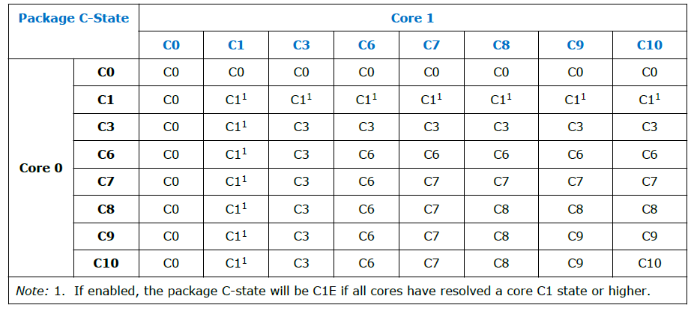
6.4.3 PCU-based C-state management in Intel's mobile lines (15)
Example: Coordination of core C-states resulting in package C-states
in Haswell-based dual-core mobile processors [181]
Note that the package C-state is determined by the C-state of the less idle core.

Slide 99
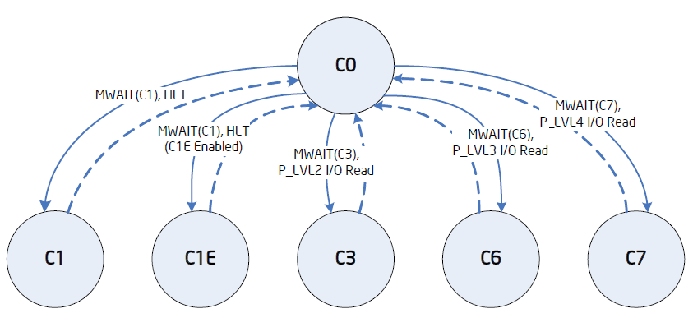
6.4.3 PCU-based C-state management in Intel's mobile lines (16)
e) The PCU performs the needed control operations to accomplish
the transition to the target core and package C-state
e1) Entering and exit requested Core C-states [198]

Slide 100
6.4.3 PCU-based C-state management in Intel's mobile lines (17)
Example: Package C-states
in Haswell-based mobiles
[181]

Slide 101
6.4.3 PCU-based C-state management in Intel's mobile lines (18)
e2) Core and package C-states and invoked power saving actions in PCU-
based C-state management in Intel’s multithreaded multicore mobile lines
Power
consumption
C0: Normal
C1: Auto Halt
C1E: Auto Halt +
lowest fc, Vcc
Core C3
Package C3
Core C6
Package C6
Core C7
Package C7
Core C8
Package C8
Core C10
Package C10
2. gen. Nehalem (Lynnfield) Mobile (2009), Westmere Mobile (2010),
Broadwell Mobile (2015)
Wake-up time
Sandy Bridge Mobile (2011), Ivy Bridge Mobile (2012)
Haswell Mobile (2014), Skylake Mobile (2015), Kaby Lake Mobile (2016)
Core level
power saving
approach
(per core
action)
Stop instr. exec.
Stop Core clock
Service snoops
Latch interrupts
Flush L1, L2
into the L3
Stop core PLL
Core saves
its arch. state
into an SRAM
Then Vcc 0
Stop core PLL
As Core C6, but
last core entering
Core C7, should
start flushing L3
by N-ways to mem.
As Core C6 state
As Core C6 state
Processor level
power saving
approach
(package
actions)
Snoop L3 cache
L3 cache is
snoopable
All uncore clocks
stopped
Most uncore
voltages 0
If L3 entirely
flushed, voltage
from the L3 cache
will be removed
Voltage removed
from all
power domains
VR is set to
low power state,
near shut off.

Slide 102
6.4.3 PCU-based C-state management in Intel's mobile lines (19)
Core C1-C7 states and Package
PC7-PC10 states as well as invoked
power saving actions in PCU-based
C-state management in multithreaded
multi-core mobile lines (simplified)
C1
Stop instruction execution
L1
L1
L1
L1
C0
Cn
L2
L2
C3
Flush
C3
Flush
L3
Stop core clocking
Stop core clocking
C6
C0
SRAM
C6
Cn
SRAM
Stop core PLL
Stop core PLL
Vcc
0
Vcc
0
L3
C7
Last core into C6:
Flush N-ways
Memory
PC7
If L3 entirely flushed: VL3 0
For all power domains: V 0
VR low power state
PC8
PC10

Slide 103
6.4.3 PCU-based C-state management in Intel's mobile lines (20)
Remark: Utilizing PCUs and the C6 idle state for implementing core parking -1
[199], [200]
Core parking is a new processor power reduction feature introduced in the
Windows 7 and Windows Server 2008 R2 OSs in 2009.
With core parking the PCU (Power Control Unit) of the processor and the OS
scheduler work together to dynamically adjust the number of cores that are
running threads (in a not detailed way).
The PCU chooses a minimum number of cores on which threads can be scheduled
by the OS.
The other cores are considered to be parked, the OS does not schedule any
threads on them and they can be dropped into a deep idle state, e.g. into the
C6 idle state.
If needed, parked cores can be re-activated.
The benefit of core parking is that parked cores being e.g. in the C6 idle state
have a very low power consumption.
In this way, core parking can increase power efficiency during lower usage
periods of the processor because parked cores can drop into a low-power state.

Slide 104
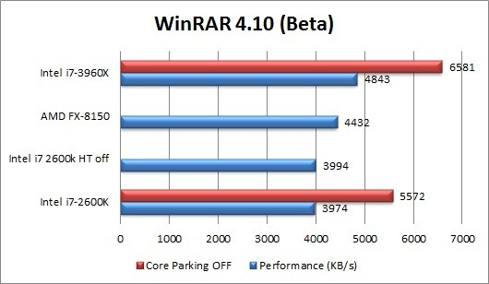
6.4.3 PCU-based C-state management in Intel's mobile lines (21)
Remark: Utilizing PCUs and the C6 idle state for implementing core parking -2
[199], [200]
On the other hand, the availability of less cores can reduce processor
performance in more demanding workloads, as indicated in the Figure below.
Figure: Example for performance reduction while running a demanding workload
with core parking enabled [201]

Slide 105
6.4.3 PCU-based C-state management in Intel's mobile lines (22)
Remark: Utilizing PCUs and the C6 idle state for implementing core parking -3
[199], [200]
Core parking can be tuned by specifying the minimum and maximum percentage
of unparked (i.e. for scheduling available) cores for every power plane
separately by appropriate PM settings.
By setting the minimum number of unparked cores to 100 % core parking can
simply be disabled.
Whether or not the tradeoff between power reduction and performance
implications result in a more or less efficient system is highly dependent on
the processor and the workload and need to be individually investigated.
With the introduction of the Speed Shift technology Intel announced that the
PCU will overtake the responsibility both for frequency scaling and core parking.

Slide 106
6.4.3 PCU-based C-state management in Intel's mobile lines (23)
Remark
There are some contradictions in the C-state descriptions of the datasheets
relating to different models.
Accordingly, there is a certain uncertainty in our descriptions as well.

Slide 107
6.4.4 Evolution of C-state management in Intel's
mobile lines
It will not be discussed.
Notes:
107

Slide 108
6.4.4 Evolution of C-state management in Intel's mobile lines (1)
6.4.4 Evolution of C-state management in Intel's mobile lines
Simplified overview, where some issues, like snooping or interrupt handling omitted.

Slide 109
6.4.4 Evolution of C-state management in Intel's mobile lines (2)
Evolution of C-state management in Intel's mobile lines
SB-based
in single core proc.
SB-based in dual-core processors
PCU-based in multithreaded
multi-core processors
Stop instruction execution
Stop core clocking
C1
Stop instr. exec.
Stop proc. clocking
C1
C1
Stop instruction execution
C0
C1
L1
L1
L1
C3
Stop all clocks
Stop PLL
L1
L1
C0
Cn
L1
L1
L1
C4
Vcc
Vcc4
C3
Flush
Flush
L2
L2
L2
C3
Flush
C3
Flush
PC3
2. core:
Flush
N-ways/Entirely
L3
Memory
Stop core clock
Stop core clock
Stop CPU PLL, stop FSB clock
C6
C0
SRAM
C6
Cn
SRAM
PC4
Vcc
Vcc4
Stop core PLL
Stop core PLL
Vcc
0
Vcc
0
PC4'
If L2 flushed:
Vcc
Vcc5
L3
C6
C0
SRAM
C1
SRAM
C7
Last core into C6:
Flush N-ways
PC6
After C0, C1
saved:
Vcc
Vcc6
Memory
Vcc4: Retention V of L3
Vcc5: Retention V of the cores
Vcc6: A low V (V: Voltage)
PC7
If L3 entirely flushed: VL3 0
For all power domains: V 0
VR low power state
Vcc4 : Retention V of L2
PC8
PC10

Slide 110
6.5.1 Overview (1)
6.5.1 Overview -1
Approaches for power management (PM) of computers
(Strongly simplified)
PM at the circuit level
(Reducing power consumption
by appropriate circuit design)
PM at the processor level
PM at the platform level
(ACPI-based, achieved by
system design)
PM of CPU cores
Clock gating
Power gating
PM of idle CPU cores
PM of active CPU cores
Reducing
power consumption
of idle CPU cores
Reducing
power consumption
of active CPU cores
Utilizing the power headroom
of a proc. package
to raise performance
C-state management
DVFS/CPPC/AVFS
Turbo Boost Technology
(ACPI-based)
CPPC: Collaborative Processor Performance Control
(DVFS, CPPC: ACPI-based)
*

Slide 111
6.5 Reducing power consumption of active CPU cores
6.5.1 Overview
6.5.2 DVFS (Dynamic Voltage and Frequency Scaling)
6.5.3 CPPC (Collaborative Processor Performance Control)
6.5.4 AVFS (Adaptive Voltage or Frequency Scaling)
Notes:
111

Slide 112
6.5.1 Overview
Notes:
112

Slide 113
6.5.1 Overview (1)
6.5.1 Overview -1
Approaches for power management (PM) of computers
(Strongly simplified)
PM at the circuit level
(Reducing power consumption
by appropriate circuit design)
PM at the processor level
PM at the platform level
(ACPI-based, achieved by
system design)
PM of CPU cores
Clock gating
Power gating
PM of idle CPU cores
PM of active CPU cores
Reducing
power consumption
of idle CPU cores
Reducing
power consumption
of active CPU cores
Utilizing the power headroom
of a proc. package
to raise performance
C-state management
DVFS/CPPC/AVFS
Turbo Boost Technology
(ACPI-based)
CPPC: Collaborative Processor Performance Control
(DVFS, CPPC: ACPI-based)
*

Slide 114
6.5.1 Overview (2)
Overview -2
There are three basic techniques for reducing the power consumption of active
CPU cores:
DVFS: Dynamic Voltage and Frequency Scaling
CPPC: Cooperative Processor Performance Control
AVFS: Adaptive Voltage and Frequency Scaling
These techniques will be described in the next Sections.
CPPC: Kooperatív processzor teljesítmény vezérlés
*

Slide 115
6.5.2 DVFS (Dynamic Voltage and Frequency Scaling)
Notes:
115

Slide 116
6.5.2 DVFS (Dynamic Voltage and Frequency Scaling (1)
6.5.2 DVFS (Dynamic Voltage and Frequency Scaling)
Principle of DVFS (assuming a single threaded single core)
DVFS is based on two relationships:
a) Dynamic power consumption is given by:
Dd = const. * Vcc² * fc
with Vcc: core voltage
fc: clock frequency
b) The core voltage (Vcc) needed for generating the clock frequency (fc) is
nearly linearly proportional with the clock frequency (fc).
Vcc = const. * fc
If follows then that
Dd = const. * fc³.
Since Dd very strongly rises with fc, the idea of DVFS is to scale down fc
as far as possible, that is as far as scaling down of fc does not lengthen
noticeably the run time of the actual workload, and lower Vcc appropriately,
i.e. to the value needed for the reduced fc.
This principle will be applied in subsequent time windows of, say 100 ms, to reduce
dynamic power consumption.
*

Slide 117
6.5.2 DVFS (Dynamic Voltage and Frequency Scaling (2)
Principle of the implementation of DVFS -1
DVFS is implemented based on P-states (Performance states) defined by the
2. release of the ACPI standard, as indicated in the next Figure.
*

Slide 118
6.5.2 DVFS (Dynamic Voltage and Frequency Scaling (3)
ACPI P (Performance) states P0 – Pn [181]
Pi: Performance states
(active states, since ACPI 2.0))
Ci: Idle states
(C4…Cn states since ACPI 2.0)
C1
C2
Gi: Global states
Cn
Si: System Sleep states
G1: OS-initiated, system context
saved, no rebooting needed.
G2/Soft off: OS-initiated shut down.
Power supply remains on,
system context is not saved,
the system must be restarted.
G3/Mechanical off: Entered by
activating a mechanical switch.
The system must be restarted.
*

Slide 119
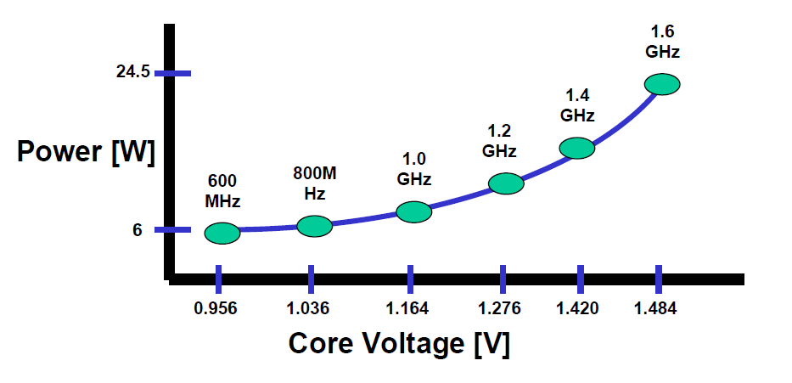
6.5.2 DVFS (Dynamic Voltage and Frequency Scaling (4)
Principle of the implementation of DVFS -2
P-states are possible operating points (Vcc and fc pairs) of a core while running
under DVFS.
An example below will illustrate this.
P1
P2
P6
Example: Operating points of Intel’s Pentium M processor (~2003)
*

Slide 120
6.5.2 DVFS (Dynamic Voltage and Frequency Scaling (5)
Principle of the implementation of DVFS -3
Now it is the task of the OS to determine how far the operating point (P state)
of the core (assuming momentarily single core operation) can be shifted
downwards (i.e. how far fc and Vcc can be reduced) without noticeable
lengthening the run time of the actual workload.
To do this the OS will assess the utilization rate of the core in subsequent
time windows (of. e.g. 100 ms) while running the actual workload and
will choose the P-states that is needed to perform this workload without
noticeable lengthening the run time.
E.g. if a core recently runs at 2 GHz but is utilized only by 50 %, each second
clock cycle is wasted and the clock frequency can be reduced to 1 GHz without
worsening the user experience.
Then the OS selects the optimal working point from a given list of possible
working points (fc, Vcc values) by looking for the P-state with a core frequency
of at least 1 GHz.
*

Slide 121
6.5.2 DVFS (Dynamic Voltage and Frequency Scaling (6)
Principle of the implementation of DVFS -4
Subsequently, the OS forwards the specification of the requested P-state to the
processor via a register interface that is defined by the ACPI standard, and finally,
the PCU (Power Control Unit) of the CPU will accomplish the required P-state
transition, as detailed subsequently.
*

Slide 122
6.5.2 DVFS (Dynamic Voltage and Frequency Scaling (7)
Principle of the implementation of DVFS -5
While implementing DVFS the OS continuously sets the Pi operating point to its lowest
possible value that is feasible without noticeable lengthening the run time of the
workload, in order to keep power consumption as low as possible, as indicated below.
Vcc
P0
Vcc0
●
Workload
P1
●
Highest
power
consumption
Vcc1
P2
Vcc2
●
.
.
Pn
Vccn
●
Both fc and Vdd will be scaled
according to the workload intensity.
Vcc is chosen with a guard band
according to the actual fc values.
Lowest
power
consumption
..
fc
fcn
fc2
fc1
fc0
Figure: Principle of DVFS
Note that DVFS is a sort of demand based scaling of the clock frequency and
core voltage.
*

Slide 123
6.5.2 DVFS (Dynamic Voltage and Frequency Scaling (8)
Remark
We note that certain early DVFS implementations (notable from AMD in about 2000)
were not ACPI-based but proprietary.
Nevertheless, we do not want to go into any details.

Slide 124
6.5.2 DVFS (Dynamic Voltage and Frequency Scaling (9)
Main tasks of the implementation of DVFS (assuming multiple cores and
multithreading)
In a multithreaded core the OS allocates tasks to threads rather than to cores.
Then the OS has to determine thread utilization rather than core utilization.
Main tasks of OS directed DVFS implementation (assuming multiple cores and multithreading)
a) Determination of
the thread utilization
by the OS
c) Coordination of target P-states
if there are multiple threads
per core or multiple cores
(by the OS or proc.)
e) Accomplishing the
fc, Vcc transitions
by the PCU of the
processor
b) Based on the calculated
thread utilization
determination of
the target P-state
by the OS
d) Communicating
the target P-state
by the OS
to the processor
*

Slide 125
6.5.2 DVFS (Dynamic Voltage and Frequency Scaling (10)
a) Determination of thread utilization by the OS (simplified) [202] -1
Recent processors have two Model Specific Registers (MSRs) per thread
(called also logical processors), that are actually 64-bit counters.
These counters are updated only when the related processor is in the C0 state.
One of the counters (IA32_MPERF MSR (0xE7h)) will be incremented in proportion
to the base frequency,
the other one (IA32_APERF MSR (0xE8h)) will be incremented in proportion
to the actual clock frequency (performance).
Now the OS calculates the thread utilization (in %) in the actual time window
as the rate of the actual count and the base count taken in this window.
Remark: The 64-bit counters used to determine thread utilization were introduced
in the Pentium M Core Duo (Yonah) processor in 2006, based on an Intel patent
[203]. Previous EIST implementations used Windows performance counters instead.
*

Slide 126
6.5.2 DVFS (Dynamic Voltage and Frequency Scaling (11)
b) Based on the calculated thread utilization determination of the target
P-state by the OS
The OS has a list of available P states of the cores (specifying fc and needed Vcc).
From the available P-states the OS selects the lowest possible to service the
actual load (i.e. utility rate).
*

Slide 127
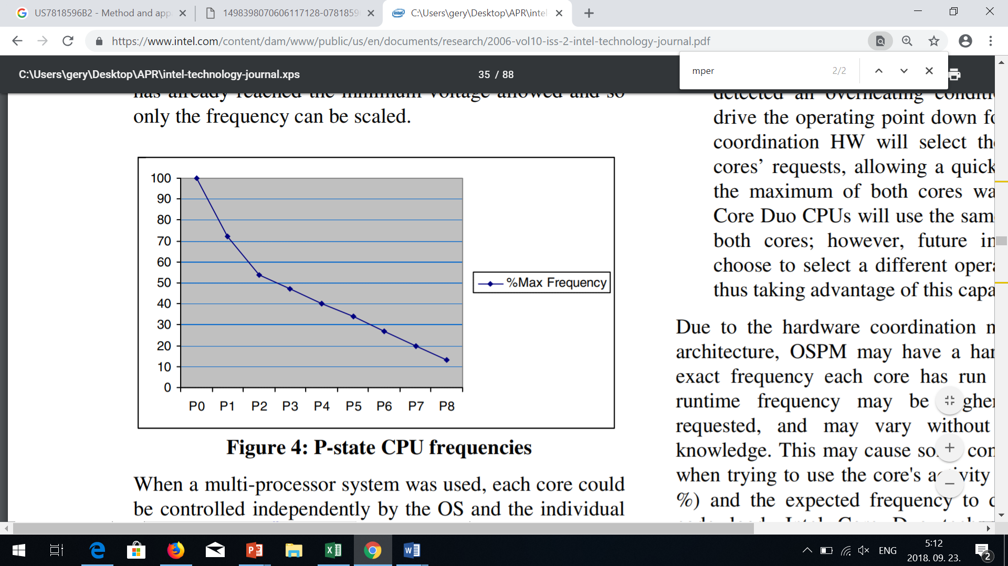
6.5.2 DVFS (Dynamic Voltage and Frequency Scaling (12)
Example allocation of a P-state to the actual thread utilization [204]
Core utilization %
Thread utilization %
Actual thread utilization %
*

Slide 128
6.5.2 DVFS (Dynamic Voltage and Frequency Scaling (13)
c) Coordination of target P-states if there are multiple threads per core
or cores
If there are multiple threads running on the same core, the target P-state
(coordinated P-state) of the core will be the P-state of the most demanding
thread running on that core.
In addition, if the processor has multiple cores and they are supplied by a
common voltage or common clock, all the related cores will run the same
voltage or clock frequency.
In this case a coordination of the requested P-states for the cores is needed
and the target P-state of the core group becomes the P-state of the most
demanding core.
In some processors individual cores may be separately power managed, then
obviously there is no need to coordinate the P-states of the cores.
*

Slide 129
6.5.2 DVFS (Dynamic Voltage and Frequency Scaling (14)
Example for the coordination of P-states in a dual-core multithreaded
processor if the cores are supplied by a common voltage [198]
Figure: Example for coordination of P-states in a dual-core multithreaded processor
if the cores are supplied by a common voltage [198]
Obviously, the P-state of the most demanding thread running on the dual-core
processor will determine the target P-state (coordinated P-state) of the processor.

Slide 130
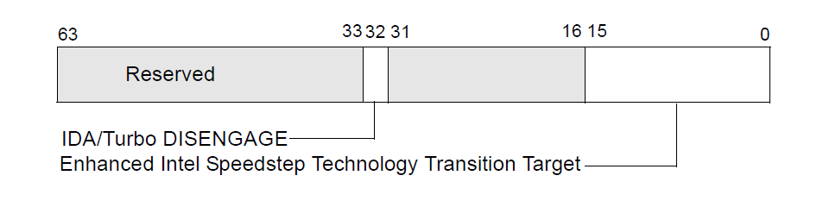
6.5.2 DVFS (Dynamic Voltage and Frequency Scaling (15)
d) Communicating the target P-state by the OS to the processor (simplified)
[202]
If the new P-state differs from the actual one, the OS writes a proprietary code
that identifies the target P-state, to a given MSR
(bits 0-15 of IA32_PERF_CTL (MSR 199h)) available for the core.
(Typically, bits [15:8] specify the target multiplier of the core clock (e.g. 34 for
34 x 133 MHz) and bits [7:0] the target core voltage, in a suitable coding).
IA_PERF_CTL
Multiplier
Vcc
8
7
Figure: Use of the IA32_PERF_CTL (MSR 199h) MSR to set a new P-state [202]
*

Slide 131
6.5.2 DVFS (Dynamic Voltage and Frequency Scaling (16)
e) Accomplishing the fc, Vcc transitions by the PCU of the processor
The PCU (Power Control Unit) takes notice of the state transition request and
performs it by setting the PLL associated to the core running the considered
thread and setting also the Voltage Regulator suitably.
*

Slide 132
6.5.2 DVFS (Dynamic Voltage and Frequency Scaling (17)
Example: Accomplishing P-state transitions in Intel’s Nehalem proc.s [205] -1
The clock frequency will be generated by PLLs, based on the Bus clock (133 MHz)
multiplied by the clock multiplier that is read out from the IA_PERF_CTL register.
Note that each core’s clock frequency (red lines) can individually be set.
IA32_PERF_CTL MSR
I
PLL: Phase Locked Loop
(Fáziszárt hurok)
Figure: Accomplishing P-state transitions in Intel’s Nehalem-based processors [205]
*

Slide 133
6.5.2 DVFS (Dynamic Voltage and Frequency Scaling (18)
Example: Accomplishing P-state transitions in Intel’s Nehalem proc.s [205] -2
The PCU sends also the appropriate voltage value to the Voltage Regulator (VR)
that is read out from the IA_PERF_CTL register for setting the core voltage
needed.
As shown, all 4 cores are supplied by the same core voltage (yellow lines).
IA32_PERF_CTL MSR
I
*
Figure: Accomplishing P-state transitions in Intel’s Nehalem-based processors [205]

Slide 134
6.5.2 DVFS (Dynamic Voltage and Frequency Scaling (19)
Remark 1
There were two prior techniques:
SVFS (Static Voltage Scaling)
The processor has two voltage and frequency points, according to whether
it is connected to the mains or the voltage is supplied by the battery.
DFS (Dynamic Frequency Scaling)
The processor scales only the core frequency according to the workload
intensity to reduce power consumption.
Nevertheless, we do not discuss further on these techniques, only show their
use in the next Figure.

Slide 135
6.5.2 DVFS (Dynamic Voltage and Frequency Scaling (20)
Further techniques for reducing the power consumption of active CPU cores
Reducing the power consumption of active CPU cores
Static technique
Dynamic techniques
SVFS
DFS
DVFS
CPPC
AVFS
Examples
SpeedStep in
Mobile Pentium III (2000)
Mobile Pentium 4 (2002)
(Northwood based)
EIST in
Pentium M
(Banias) (2003)
and subsequent lines
Intel
Speed Shift in
Skylake (2015)
VIA
LongHaul 1.0 in
C3 Samuel (2000)
LongHaul 2.0 in
C3 Samuel 2 step. 1 (2001)
Adaptive PowerSaver
in Nano (2008)
PowerNow! and
Cool'n'Quiet
technologies
in mobiles/desktops
and servers (since 2000)
CPPC support in
the Zen 2-based
Ryzen 3000 line
(2019)
AVFS in
Excavator-based
Carizzo (2015)
Pure Power in
Ryzen (2017)
C
AMD
405LP (2002)
Dynamic Power
Performance Scaling in
PowerPC 750GX (2004)
PowerPC 970xx (2004)
Energy Scale
in POWER6
(2007) and
subsequent
processors
IBM
PowerPC 750FX
(2003)
Exynos 4 (2012)
(used in Galaxy III)
ASV in
Exynos 7420 (2015)
(used in Galaxy S6)
Samsung
ARM/National
IEM IP (2002)

Slide 136
6.5.2 DVFS (Dynamic Voltage and Frequency Scaling (21)
Remark 2
There are two direct improvements of DVFS:
CPPC (Collaborative Processor Performance Control)
In CPPC the PCU takes over the power management control from the OS
as used in case of the DVFS, to get a faster and more precise frequency and
voltage scaling (introduced in Skylake (2015)), to be discussed in Section 6.5.3).
AVFS (Adaptive Voltage and Frequency Scaling)
AVFS replaces the worst case design approach of DVFS by an adaptive approach,
to achieve a more efficient voltage and frequency scaling, it is discussed in
Section 6.5.4.
The next Figure indicates processor lines utilizing both techniques mentioned.
CPPC: Kooperatív processzor teljesítmény vezérlés
*

Slide 137
6.5.2 DVFS (Dynamic Voltage and Frequency Scaling (22)
Use of DVFS to reduce power consumption of active CPU cores
Reducing the power consumption of active CPU cores
Static technique
Dynamic techniques
SVFS
DFS
DVFS
CPPC
AVFS
Examples
SpeedStep in
Mobile Pentium III (2000)
Mobile Pentium 4 (2002)
(Northwood based)
EIST in
Pentium M
(Banias) (2003)
and subsequent lines
Intel
Speed Shift in
Skylake (2015)
VIA
LongHaul 1.0 in
C3 Samuel (2000)
LongHaul 2.0 in
C3 Samuel 2 step. 1 (2001)
Adaptive PowerSaver
in Nano (2008)
PowerNow! and
Cool'n'Quiet
technologies
in mobiles/desktops
and servers (since 2000)
CPPC support in
the Zen 2-based
Ryzen 3000 line
(2019)
AVFS in
Excavator-based
Carizzo (2015)
Pure Power in
Ryzen (2017)
AMD
405LP (2002)
Dynamic Power
Performance Scaling in
PowerPC 750GX (2004)
PowerPC 970xx (2004)
Energy Scale
in POWER6
(2007) and
subsequent
processors
IBM
PowerPC 750FX
(2003)
Exynos 4 (2012)
(used in Galaxy III)
ASV in
Exynos 7420 (2015)
(used in Galaxy S6)
Samsung
ARM/National
IEM IP (2002)

Slide 138
6.5.2 DVFS (Dynamic Voltage and Frequency Scaling (23)
Note that Intel and also AMD (in their recent Zen 2-based or newer lines) opted for
the CPPC technique to enhance DVFS.
By contrast, in IBM’s server lines, AMD’s previous lines and ARM’s as well as
Samsung’s mobile processor lines AVFS has been preferred rather than CPPC.

Slide 139
6.5.3 CPPC (Collaborative Processor Performance Control)
Notes:
139

Slide 140
6.5.3 CPPC (Collaborative Processor Performance Control) (1)
6.5.3 CPPC (Collaborative Processor Performance Control) -1)
Reducing the power consumption of active CPU cores
Static technique
Dynamic techniques
SVFS
DFS
DVFS
CPPC
AVFS
Examples
SpeedStep in
Mobile Pentium III (2000)
Mobile Pentium 4 (2002)
(Northwood based)
EIST in
Pentium M
(Banias) (2003)
and subsequent lines
Speed Shift in
Skylake (2015)
Intel
VIA
LongHaul 1.0 in
C3 Samuel (2000)
LongHaul 2.0 in
C3 Samuel 2 step. 1 (2001)
Adaptive PowerSaver
in Nano (2008)
PowerNow! and
Cool'n'Quiet
technologies
in mobiles/desktops
and servers (since 2000)
CPPC support in
the Zen 2-based
Ryzen 3000 line
(2019)
AVFS in
Excavator-based
Carizzo (2015)
Pure Power in
Ryzen (2017)
AMD
405LP (2002)
Dynamic Power
Performance Scaling in
PowerPC 750GX (2004)
PowerPC 970xx (2004)
Energy Scale
in POWER6
(2007) and
subsequent
processors
IBM
PowerPC 750FX
(2003)
Exynos 4 (2012)
(used in Galaxy III)
ASV in
Exynos 7420 (2015)
(used in Galaxy S6)
Samsung
ARM/National
IEM IP (2002)

Slide 141
6.5.3 CPPC (Collaborative Processor Performance Control) (2)
CPPC (Collaborative Processor Performance Control) -2
This technology is based on a new processor performance control method
introduced in the ACPI 5.0 standard (2011), called the Collaborative Processor
Performance Control (CPPC).
If CPPC is implemented, it supersedes the previous ACPI 2.0 based DVFS
technology.
Intel introduced CPPC in their Skylake family (2015) and designated it as the
Speed Shift technology.
CPPC needs OS support, nevertheless OS support became available only after
launching the Skylake Family, in the Windows 10 2015 Fall Update.
The Collaborative Processor Performance Control technology is not bound to
Intel’s processors, also AMD introduced it in their Zen 2-based Ryzen 3000
DT line (2019).
In their Zen 2-based Ryzen 3000 line AMD made use of a new revision of the
CPPC standard, called CPPC2, released in ACPI 5.1 (2014).
CPPC: Kooperatív processzor teljesítmény vezérlés
*

Slide 142
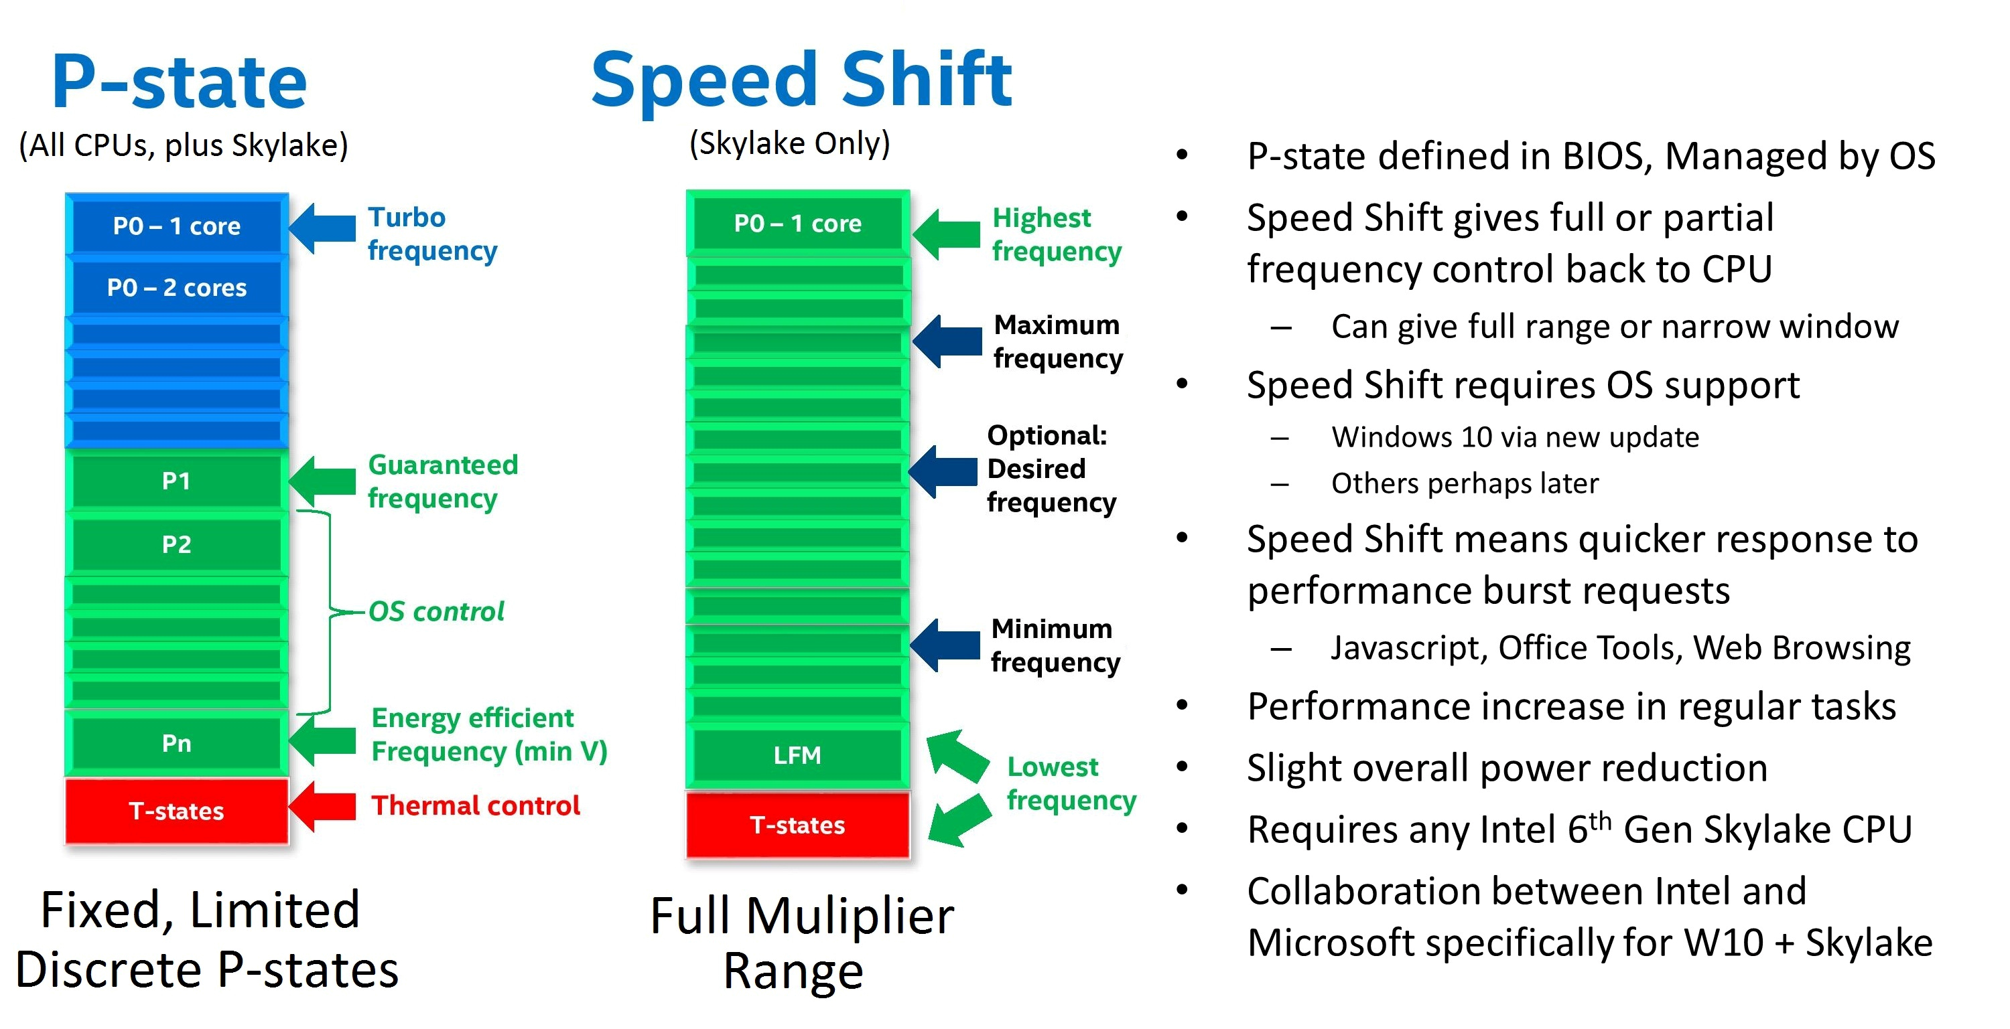
6.5.3 CPPC (Collaborative Processor Performance Control) (3)
Contrasting Intel's EIST and Speed Shift technologies -1
In Intel's EIST (DVFS) technology (2003)
ACPI 2.0-based DVFS
the OS assesses the actual rate of utilization
of CPU cores or threads (if multithreading)
(until 2006: by counting idle clock cycles
during scheduling - in time windows,
since 2006: by reading out two counters
(actually 2 MSRs: the IA32_MPERF and
IA32_APERF registers),
chooses the requested fc, Vcc (P-state),
forwards their identifiers to two MSRs
of the processor, (the IA32_PERF_CTL
and IA32_PERF_STATUS MSRs) and
finally, the PCU sets the requested P-state.
The drawback of this mechanism is a long
control cycle and the fact that
DVFS provides only a few P-states
for frequency control, in other words
it implements a coarse grained
frequency control.
(PMU control)
Figure: BIOS declared P-states [206]
MSRs (Model-Specific Registers), introduced in the Intel's 80386 line, are registers
that are not necessarily available in subsequent lines of a processor family.
*

Slide 143
6.5.3 CPPC (Collaborative Processor Performance Control) (4)
Contrasting Intel's EIST and Speed Shift technologies -2
HCPS
By contrast, in the Speed Shift technology
ACPI 5.0-based CPPC
the OS and the processor collaborate
in controlling processor performance
such that the OS provides user
supplied control hints to the
processor,
then transfers the power control
to the Power Control Unit (PCU)
of the processor and
the PCU autonomously controls
the performance states (fc and Vcc
settings) while performing
performance/energy efficiency
optimizations as well.
(OS sets
the limits)
Autonomous
control
by the PCU
A larger number of clock multiplier defined
frequency levels [206]
*

Slide 144
6.5.3 CPPC (Collaborative Processor Performance Control) (5)
Operation of the Speed Shift technology (more detailed)
First the OS provides control hints for the processor including min. or max.
performance, energy or performance preference etc.
Then the OS transfers performance control to the PCU.
The PCU assesses the performance request of the application in the same way
as the OS before, by reading the IA32_MPERF MSR and IA32_APERF MSR
registers.
Nevertheless, the PCU does not derive the requested fc and Vcc values alone
from the performance request of the application but carries out also
performance/energy efficiency optimizations as well [206].
If needed, the PCU coordinates the performance requests of threads belonging
to the same processors or performance requests of cores if they are supplied
by the same core voltage as done before.
Finally, the PCU accomplishes setting the Vcc and fc values in the same way
as before.
The OS has the possibility to monitor the power management accomplished
by the PCU by reading a specific MSR register (the IA32_HWP_STATUS register).
If necessary, there is also a mechanism provided for the OS to overtake
the performance control from the PCU (not discussed here).

Slide 145
6.5.3 CPPC (Collaborative Processor Performance Control) (6)
Further significant difference between EIST and the Speed Shift technology
In the EIST technology there are only a few discrete fc values available
(according to the P-states defined).
By contrast, the Speed Shift technology may use every frequency multiplier
value for setting fc (as fc = multiplier * fbus), as indicated in the next Figure.
This allows a significantly finer frequency control than before with the EIST
technology.
*

Slide 146
6.5.3 CPPC (Collaborative Processor Performance Control) (7)
Contrasting Intel’s EIST (DVFS) and SpeedStep (CPPC) PM technologies
Intel’s EIST (DVFS) + Turbo Boost
Intel’s SpeedStep (EIST)
PCU control
(OS sets
the limits)
(DVFS)
PCU control
Figure: BIOS declared
P-states [206]
A larger number of clock multiplier
defined frequency levels [206]

Slide 147
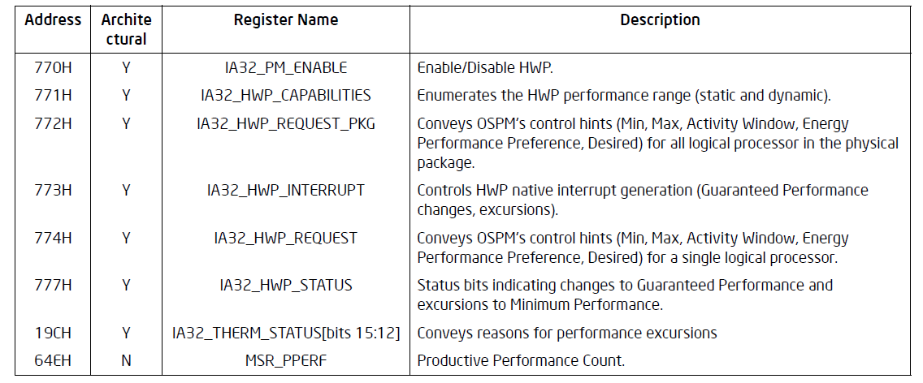
6.5.3 CPPC (Collaborative Processor Performance Control) (8)
MSRs used for Intel's Speed Shift technology -1
Intel defined a set of MSRs to support Speed Shift technology, as seen below.
Table: MSRs defined by Intel to support the Speed Shift technology [202]
HWP means Hardware Performance control, actually Speed Shift technology
(another name for CPPC used by Intel’s documentations).

Slide 148
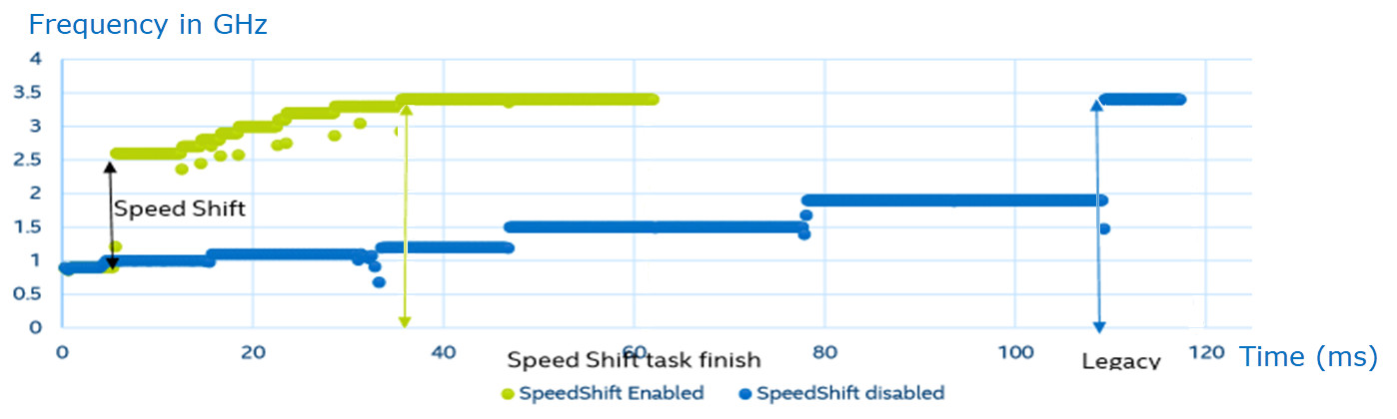
6.5.3 CPPC (Collaborative Processor Performance Control) (9)
Speeding up frequency transitions by using Intel's Speed Shift technology
in the 6. gen. Skylake line (2015) while running a representative task [206]
In the above example a frequency transition to the maximum core frequency
(3.5 GHz) needs without the SpeedShift technology 110 ms (blue line), and
with the SpeedShift technology (yellow-green line) only 35 ms.
This indicates that Speed Shift technology notable reduces the time needed
to perform frequency transitions.
*

Slide 149
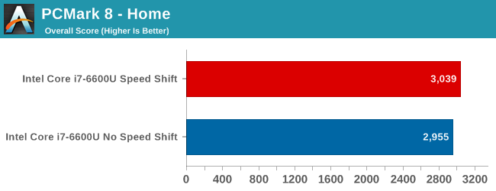
6.5.3 CPPC (Collaborative Processor Performance Control) (10)
Example 1: Performance increase achieved by the Speed Shift technology
while running the PCMark 8 - Home benchmark program [207]
The PCMark 8 Home edition is an industry standard benchmark for Windows 8
and Windows 7 apps, it covers real-world tasks and scenarios that reflect
PC usage in the home [207].
As seen, enabling the Speed Shift technology results in this case in a very small
gain of about 1.5 % [206].

Slide 150
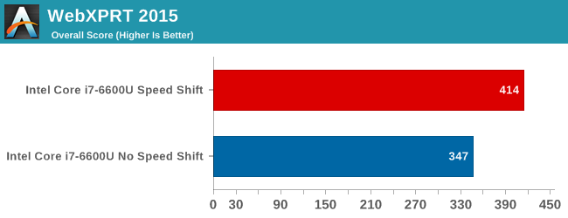
6.5.3 CPPC (Collaborative Processor Performance Control) (11)
Example 2: Performance increase achieved by the Speed Shift technology
while running the WebXPRT 2015 benchmark program [206]
WebXPRT covers six HTML5- and JavaScript-based workloads like Photo
Enhancement, Organize Albums, Stock Option Pricing, Sales Graphs.
For these applications Speed Shift technology results in a gain of about 20 %.

Slide 151
6.5.3 CPPC (Collaborative Processor Performance Control) (12)
Enhancing the Speed Shift technology in Intel's 7. generation Kaby Lake line
In their next generation Kaby Lake line (2017) Intel redesigned their Speed Shift
implementation and achieved a remarkable gain in speeding up clock frequency
transitions, as indicated in the next Figure.
*

Slide 152
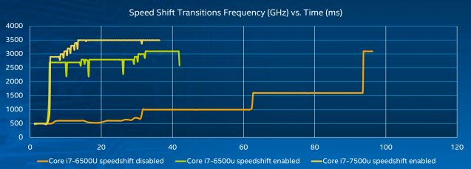
6.5.3 CPPC (Collaborative Processor Performance Control) (13)
Speeding up frequency transitions by using Intel's Speed Shift technology
in the 7. gen. Kaby Lake line (2016) while running a representative task
[208]
As the Figure shows with the enhanced implementation the max. clock frequency
will be achieved in about 10 ms rather than 35 ms as in the previous 6. gen.
Sky Lake line [208].

Slide 153
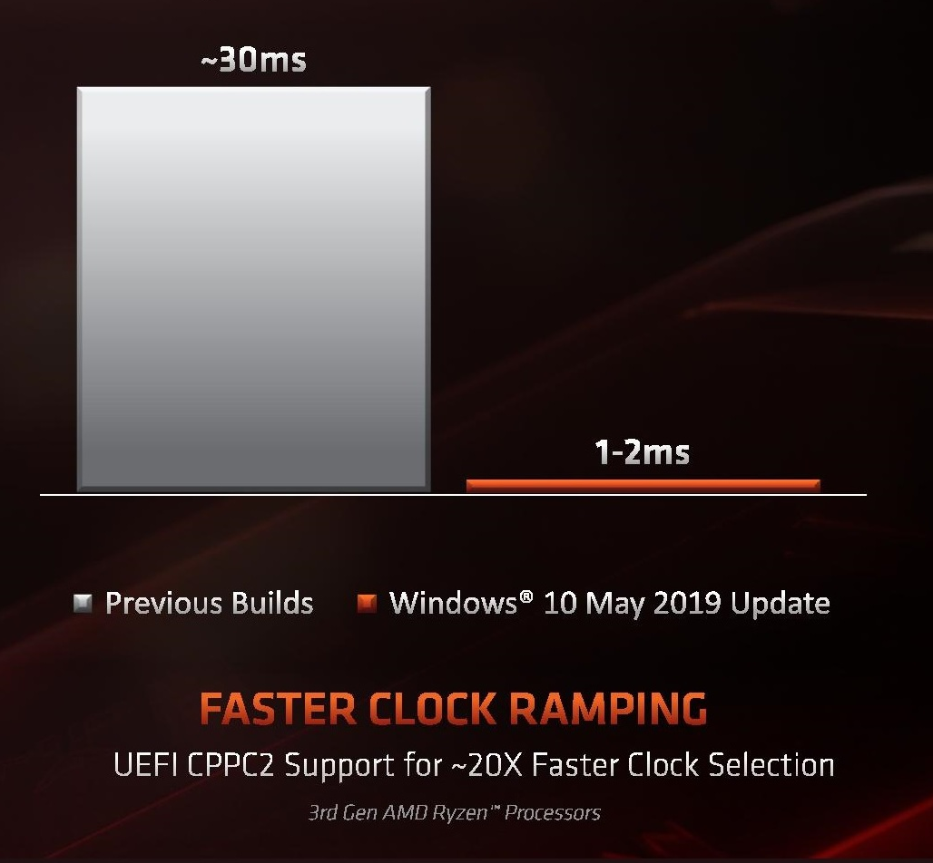
6.5.3 CPPC (Collaborative Processor Performance Control) (14)
AMD’s implementation of Collaborative Processor Performance Control
Along with their Zen 2-based Ryzen 3000 DT line (7/2019) also AMD implemented
the Collaborative Processor Performance Control Revision 2, called CPPC2.
No dedicated name for this technique became published so far.
Its use requires Windows 10 May 2019 update and a new BIOS release (7/2019)
supporting CPPC2.
AMD’s implementation is said
to provide a very fast clock
ramping of about 1–2 ms,
as the Figure on the right
indicates.
This time is much shorter than
Intel’s published figure for the
7. gen. Kaby Lake line (2016)
of about 15 ms.
Figure: Clock ramping in AMD’s
Zen 2-based Ryzen 3000 line
(2019) [209]
UEFI: Universal Extensible Firmware
Interface (replaces BIOS)
*

Slide 154
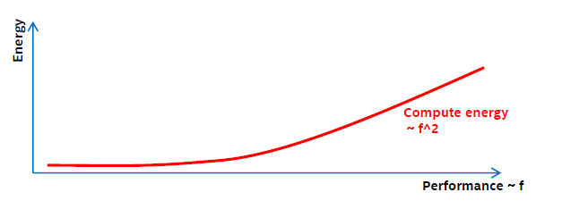
6.5.3 CPPC (Collaborative Processor Performance Control) (15)
Enhancing Intel’s Speed Shift technology by Duty cycle control [210] -1
(Optional reading)
While running applications
dynamic dissipation: ~ f³
runtime: ~ 1/f
total energy consumption originating from the dynamic dissipation: ~ f²
with f denoting the clock frequency.
As the performance is proportional with f, the energy consumption arising from the
dynamic dissipation is proportional to the square of the frequency (f), as seen below.
Figure: Dependence of energy consumption arising from the dynamic dissipation
(designated as Compute energy in the Figure) on the performance (~ f)

Slide 155
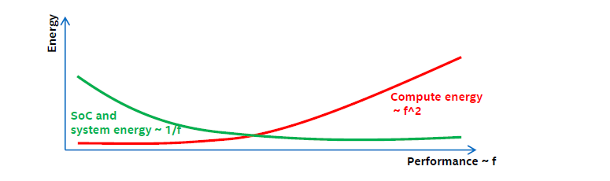
6.5.3 CPPC (Collaborative Processor Performance Control) (16)
Enhancing Intel’s Speed Shift technology by Duty cycle control [210] -2
On the other hand
the energy consumption originating from the static dissipation is proportional to
the runtime.
The runtime is inversely proportional to the frequency (f).
Consequently, the energy consumption arising from the static dissipation is
inversely proportional to the frequency (f) which is proportional to the
performance, as indicated in the Figure below.
Figure: Dependence of energy consumption originating from the static dissipation
and system power (designated as SoC and system energy in the Figure) on the performance (~ f) [210]

Slide 156
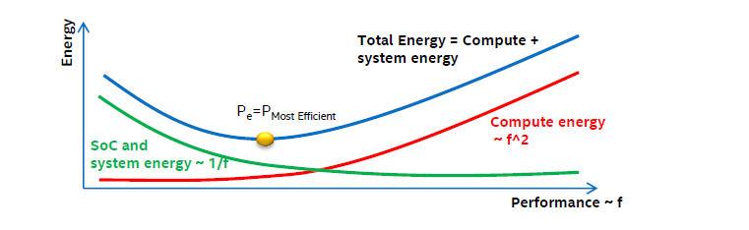
6.5.3 CPPC (Collaborative Processor Performance Control) (17)
Enhancing Intel’s Speed Shift technology by Duty cycle control [210] -3
As a consequence, the total energy consumption originating from both the
dynamic dissipation and
static dissipation as well as system power consumption
has a minimum, as indicated in the Figure below.
Figure: Dependence of energy consumption originating from both the dynamic dissipation (designated as the Compute energy in the Figure) and the static dissipation and system power (designated as SoC and system energy in the Figure) on the performance
Obviously, the min. energy consumption point (Pe) is the most efficient working point
of a core of the processor.

Slide 157
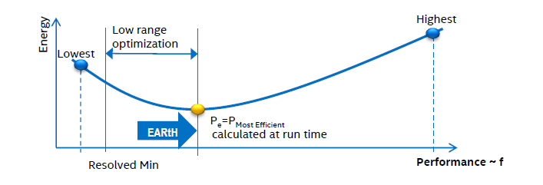
6.5.3 CPPC (Collaborative Processor Performance Control) (18)
Power management including duty cycle control [210] -1
Frequency will be lowered as far as possible until the Pe working point is reached.
Pe will be calculated every ms based on the workload and system characteristics.
There is no benefit when the system is clocked below the Pe point, as it would
increase the energy consumption.
Therefore, a so called EARtH algoritm overrides lower P requests and sets f
according to Pe.
The EARtH algorithm is activated only if it is possible to enter the package
sleep state.
Figure: Power management including duty cycle control [210]

Slide 158
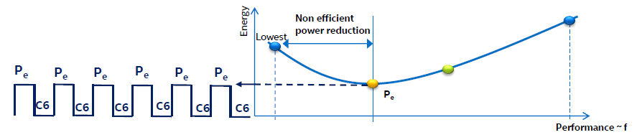
6.5.3 CPPC (Collaborative Processor Performance Control) (19)
Power management including duty cycle control [210] -2
Operating the processor below the Pe point would increase the total energy
consumption due to the static power component.
In this region a more efficient technique to reduce power for low power demand
is turning the processor package on and off about 1000 times/sec, called
duty cycling, as shown in the Figure below.
Figure: Principle of duty cycling, used to reduce energy consumption below Pe
Then with the rate of the duty time (running at a performance corresponding
to Pe) the resulting performance can be scaled with the performance demand.
In the off-state the processor is in the C6 package idle state.
See the next Figure for the actions needed to set the processor into the package
C6 state.

Slide 159
6.5.3 CPPC (Collaborative Processor Performance Control) (20)
Power saving measures in C1 to C6 idle states
C1
Stop instruction execution
L1
L1
L1
L1
C0
Cn
L2
L2
C3
Flush
C3
Flush
L3
Stop core clocking
Stop core clocking
C6
C0
SRAM
C6
Cn
SRAM
(Intel’s solution)
Stop core PLL
Stop core PLL
Vcc
0
Vcc
0
To set Vcc to 0 (i.e. to switch off cores) needs typically power gating or integrated
voltage regulators.
The package C6 state is entered when all cores have already entered the C6
core state.

Slide 160
6.5.4 AVFS (Adaptive Voltage or Frequency Scaling)
Notes:
160

Slide 161
6.5.4 AVFS (Adaptive Voltage or Frequency Scaling) (1)
6.5.4 AVFS (Adaptive Voltage or Frequency Scaling) -1
Reducing the power consumption of active CPU cores
Static PM
of active CPU cores
Dynamic PM of active CPU cores
SVFS
DFS
DVFS
CPPC
AVFS
Examples
SpeedStep in
Mobile Pentium III (2000)
Mobile Pentium 4 (2002)
(Northwood based)
EIST in
Pentium M
(Banias) (2003)
and subsequent lines
Intel
Speed Shift in
Skylake (2015)
VIA
LongHaul 1.0 in
C3 Samuel (2000)
LongHaul 2.0 in
C3 Samuel 2 step. 1 (2001)
Adaptive PowerSaver
in Nano (2008)
PowerNow! and
Cool'n'Quiet
technologies
in mobiles/desktops
and servers (since 2000)
CPPC support in
the Zen 2-based
Ryzen 3000 line
(2019)
AVFS in
Excavator-based
Carizzo (2015)
Pure Power in
Ryzen (2017)
AMD
405LP (2002)
Dynamic Power
Performance Scaling in
PowerPC 750GX (2004)
PowerPC 970xx (2004)
Energy Scale
in POWER6
(2007) and
subsequent
processors
IBM
PowerPC 750FX
(2003)
Exynos 4 (2012)
(used in Galaxy III)
ASV in
Exynos 7420 (2015)
(used in Galaxy S6)
Samsung
ARM/National
IEM IP (2002)

Slide 162
6.5.4 AVFS (Adaptive Voltage or Frequency Scaling) (2)
6.5.4 AVFS (Adaptive Voltage or Frequency Scaling) -2
Note that first Intel and then also AMD have enhanced DVFS by CPPC whereas
IBM, Samsung and previously also AMD preferred AVFS.

Slide 163
6.5.4 AVFS (Adaptive Voltage or Frequency Scaling) (3)
DVFS (Dynamic Voltage and Frequency Scaling) (recap)
With DVFS the OS first typically assesses the actual workload and scales down fc
(and Vcc) as far as feasible without noticeable lengthening the runtime, while
choosing the appropriate Pi (fc and Vcc) working point from a look-up table.
In the look-up table Vcc is determined a priory at chip testing such that fc
should be maintained also under worst case conditions, i.e. Vc is determined
with a guard band.
Vcc
Look-up table
P0
P0: f0, Vcc0
P1: f1, Vcc1
P2: f2, Vcc2
.
.
Pn: fn, Vccn
Vcc0
●
Workload
P1
●
Highest
power
consumption
Vcc1
P2
Figure:
Principle of DVFS
●
Vcc2
.
.
Pn
Vccn
●
fc will be scaled according to the
workload intensity.
Vcc is chosen to maintain fc
with a guard band.
Lowest
power
consumption
..
fc
fcn
fc2
fc1
fc0
*

Slide 164
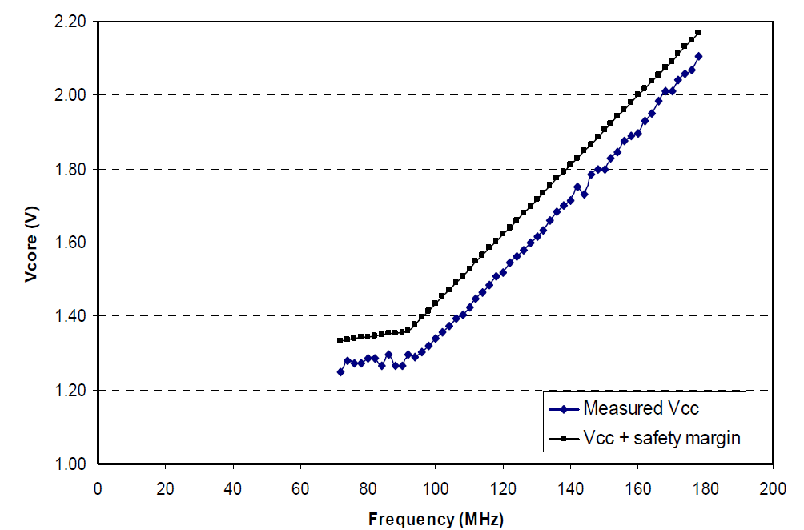
6.5.4 AVFS (Adaptive Voltage or Frequency Scaling) (4)
Example: Minimal (measured) and specified core voltage (Vcc) needed
for sustaining a given core frequency (fc) [208]
Guard band
(safety margin)

Slide 165
6.5.4 AVFS (Adaptive Voltage or Frequency Scaling) (5)
Considerations for choosing the (worst case) guard band in DVFS
In a worst case approach the guard band has to be chosen to compensate
for all possible variations, including
process variations (P) resulting from uncertainties of the fabrication process,
voltage variations (V) resulting from power supply inaccuracies, voltage
drops due to overloads etc.)
temperature variations (T),
aging.
E.g.: Process dependent min. core voltage levels needed to assure an expected
clock frequency may vary in different parts, as illustrated below.
Part
distribution
Vmin
1.2 V
1.0 V
0.9 V
Figure: Process dependent min. core voltage levels at a given core frequency [211]
*

Slide 166
6.5.4 AVFS (Adaptive Voltage or Frequency Scaling) (6)
Min. Vcc and guard band needed in DVFS (based on [211])
Min. Vcc
including a
conservative
guard band
(1.4 V)
1.2 v+GB)
Vcc
(Needed to assure a given fc)
Guard band (GB) to address
voltage variations,
temperature variations,
aging etc.
Min. Vcc
for slow parts
(1.2 V)
1.2 V
1.0 V
Min. Vcc
for fast parts
(0.8 V)
0.8 V

Slide 167
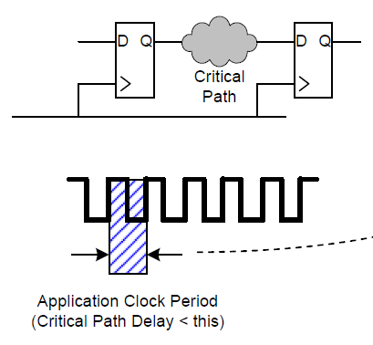
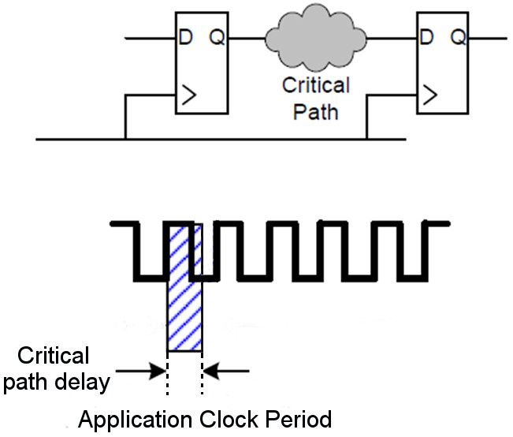
6.5.4 AVFS (Adaptive Voltage or Frequency Scaling) (7)
The aim of introducing AVFS instead of DVFS
In fact, the guard band can substantially be reduced if Vcc is selected not
according to its worst case conditions, while taking into account a number of
possible aspects, but is determined “on the spot” for a given platform.
This can be done e.g. by considering a “critical path” on the processor die and
taking into account that the rising edge of the clock lets start the signal flowing
through the critical path and thereafter the next rising edge of the clock
(in the pictured situation) will read in the signal available at the input of the
flip-flop, as indicated in the Figure below.
Clock
Figure: Considering a critical path on the processor die [211]
Now, if the signal delay through the critical path is less than the clock period,
the flip-flop will gate in a correct signal value.
In this case probably, the clock frequency may even be increased.

Slide 168
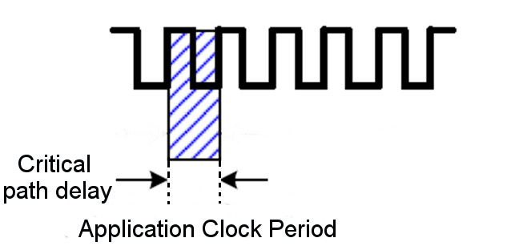
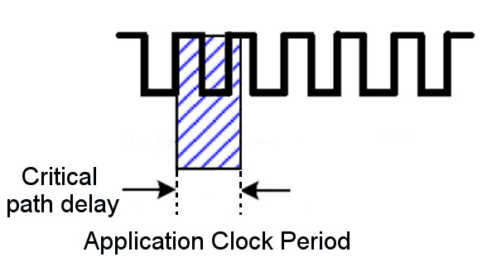
6.5.4 AVFS (Adaptive Voltage or Frequency Scaling) (8)
Principle of operation of a critical path monitor (based on [211])
Let’s compare the signal delay through a critical path of the processor with the
clock period.
Clock
Clock period
Clock period
Clock period
If the delay is less than
the clock period:
If the delay equals
the clock period:
If the delay is higher than
the clock period:
the clock edge arrives
in due time,
fc can be increased or
Vcc can be decreased
voltage is
correctly adjusted to
clock speed
the clock edge arrives
later than needed,
fc needs to be decreased or
Vcc needs to be increased
Utilized for AVFS
*

Slide 169
6.5.4 AVFS (Adaptive Voltage or Frequency Scaling) (9)
Using critical path monitors to reduce the guard band by replacing the
worst case a priory determination of Vcc by on spot measurement
Now, if the processor includes one or more critical path monitors that are capable
to indicate whether the operation is stable enough, then the AVFS control unit
can reduce Vcc and thus power consumption in a closed loop up to the point
(with a small guard band) that is just needed for the clock frequency fc
at present.
In this way with AVFS the actually needed min. Vcc will be determined on the spot
by a closed-loop measurement (with a small guard band) rather than as done
with DVFS during die testing in a worst case fashion with a large guard band.
Obviously, the above principle can also be used vice versa to determine the
max. possible fc at a given Vcc to raise performance.

Slide 170
6.5.4 AVFS (Adaptive Voltage or Frequency Scaling) (10)
Contrasting DVF and AVFS
AVFS vs. DVFS
DVFS
AVFS
(Dynamic Voltage and Frequency Scaling)
(Adaptive Voltage and Frequency Scaling)
Aim: reduce guard band and thus
either reduce dissipation or raise performance
DVFS is performed in an open loop.
AVFS is performed in a closed loop.
It means that the OS scales down
core frequency (fc)
according to the actual workload
and determines core voltage (Vcc)
statically, from a look-up table.
Vcc was determined previously
at chip testing while
a large guard band
is taken into account
to compensate for possible
PVT variations and aging.
It means that first the OS scales down
core frequency (fc) and core voltage (Vcc)
according to the actual workload
similarly to DVFS.
Then however, the processor
reduces the guard band as far as possible
by on-spot closed-loop measurement
while using critical path monitors.
that are capable to indicate instable
processor operation.
The reduced guard band can be utilized
either for decreasing Vcc or increasing fc.
PVT: Process, Voltage, Temperature
*

Slide 171
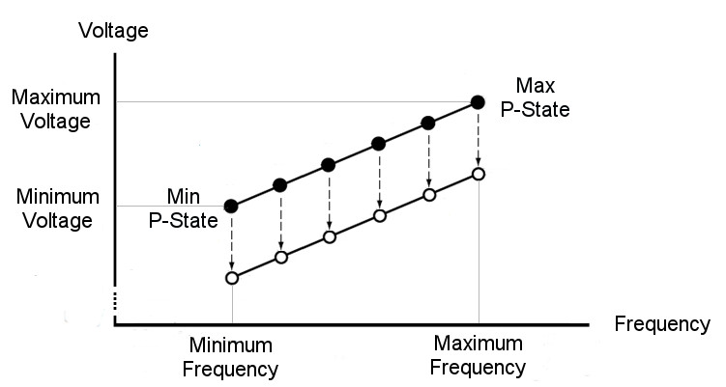
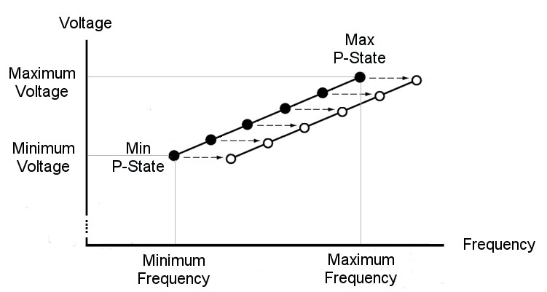
6.5.4 AVFS (Adaptive Voltage or Frequency Scaling) (11)
Alternatives of AVFS (Adaptive Voltage or Frequency Scaling)
There are two possible use cases how guard band reduction can be utilized in AVFS
Use cases of AVFS to exploit guard band reduction
AVS
(Adaptive Voltage Scaling)
AFS
(Adaptive Frequency Scaling)
It is also called Undervolting.
It is also called Overclocking).
AVFS is used to reduce Vcc
at a given fc (P-state)
to a min. allowed value.
AVFS is used to increase fc
at a given Vcc (P-state)
to the max. allowed value.
*

Slide 172
6.5.4 AVFS (Adaptive Voltage or Frequency Scaling) (12)
Overview of introduced AVFS implementations
(02/2015)
(03/2017)
AMD
Carizzo
Ryzen
lines
(Q1/2015)
HiSilicon (Huawei)
Kirin 930
(Q2/2015)
Samsung
Exynos
7420
(02/2008)
(2/2011)
(2/2012)
TI
OMAP3
OMAP4
OMAP5
(10/2007)
(2/2010)
(4/2014)
IBM
POWER6
POWER7
POWER8
/05/2008)
Via
Adaptive
PowerSaver
in Nano
(06/2004)
National
PowerWise
(macrocell)
2003
2004
2005
2006
2007
2008
2009
2010
2011
2012
2013
2014
2015
2016

Slide 173
6.5.4 AVFS (Adaptive Voltage or Frequency Scaling) (13)
Further details of the implementation of AVFS
(Optional reading)

Slide 174
6.5.4 AVFS (Adaptive Voltage or Frequency Scaling) (13b)
Overview and key control technique of introduced AVFS technologies
Vendor | Designation | Used in | Introduced | Controlled by
National | PowerWise | (Macrocell) | 06/2004 | HPM (Hardware Perf. Monitors) (Critical path delay)
VIA | Adaptive PowerSaver | Nano | 11/2008 | Temperature headroom (Temperature sensors)
IBM | Adaptive Energy Management | POWER6 POWER7 POWER8 | 07/2007 02/2010 04/2014 | Critical Path Monitors
TI | SmartReflex | OMAP 3 OMAP4 OMAP5 | 02/2008 02/2011 02/2012 | Voltage Controlled Oscillator
Samsung | Adaptive Scaling Voltage | Exynos 7420 | Q2/2015 | Critical Path Monitors
AMD | Adaptive Frequency and Voltage scaling | Excavator-based Carizzo | 02/2015 | Replica paths (Critical Path monitors)
HiSilicon (Huawei) | AVS+ technology | Kirin 930 | Q1/2015 | HPM (Hardware Performance Monitors (no details revealed)
AMD | Pure Power | RyZen | Q1/2017 | Temperature, speed and voltage monitors

Slide 175
6.5.4 AVFS (Adaptive Voltage or Frequency Scaling) (14)
Principle of the implementation of AVFS -1 (based on [211])
Timing requirement for correct operation of digital circuits [211]
Vcc
fc
Critical path delay
Correct operation: if critical path delay ≤ application clock period
Basic relations
Application Clock Period decreases with higher fc (it needs higher Vcc).
Application Clock Period increases with lower fc (it needs lower Vcc).
Critical path delay decreases with higher Vcc.
Critical path delay increases with lower Vcc

Slide 176
6.5.4 AVFS (Adaptive Voltage or Frequency Scaling) (15)
Principle of implementation of AVFS
Processor dies have a large number of sensors, typically critical path monitors
(assumed subsequently) for checking circuit delays.
Critical path monitors provide output codes characterizing the actual delay on
them to a power controller.
The power controller, typically a microprocessor, periodically senses the output
signals of the critical path monitors and sets the supply voltage (in case of AVS)
or the clock frequency (in case of AFS) accordingly in a closed loop
to reduce supply voltage (in case of AVS) or
to increase clock frequency (in case of AFS)
as far as the actual circuit and environmental parameters (including
temperature, aging etc.) allow.

Slide 177
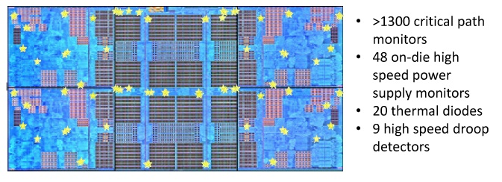
6.5.4 AVFS (Adaptive Voltage or Frequency Scaling) (16)
Example: Sensors implemented on a CCX die (4-core Core CompleX)
in AMD’s Zen processors to support AVS [212]
Critical path monitors overlook processor speed (clock frequency), they
allow to reduce core voltage in a controlled way as far as possible whereby
a given clock frequency remains maintained.
Critical path monitors: kritikus áramköri szakaszok sebességét ellenörző monitorok

Slide 178
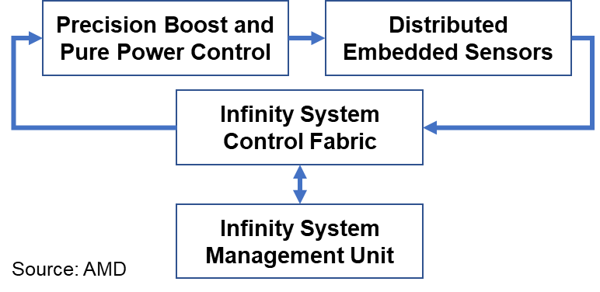
6.5.4 AVFS (Adaptive Voltage or Frequency Scaling) (17)
Example: Closed-loop control in AMD’s Zen processors to implement AVS [213]
Precision Boost: AVS
Pure Power Control: Turbo Boost
Microcontroller

Slide 179
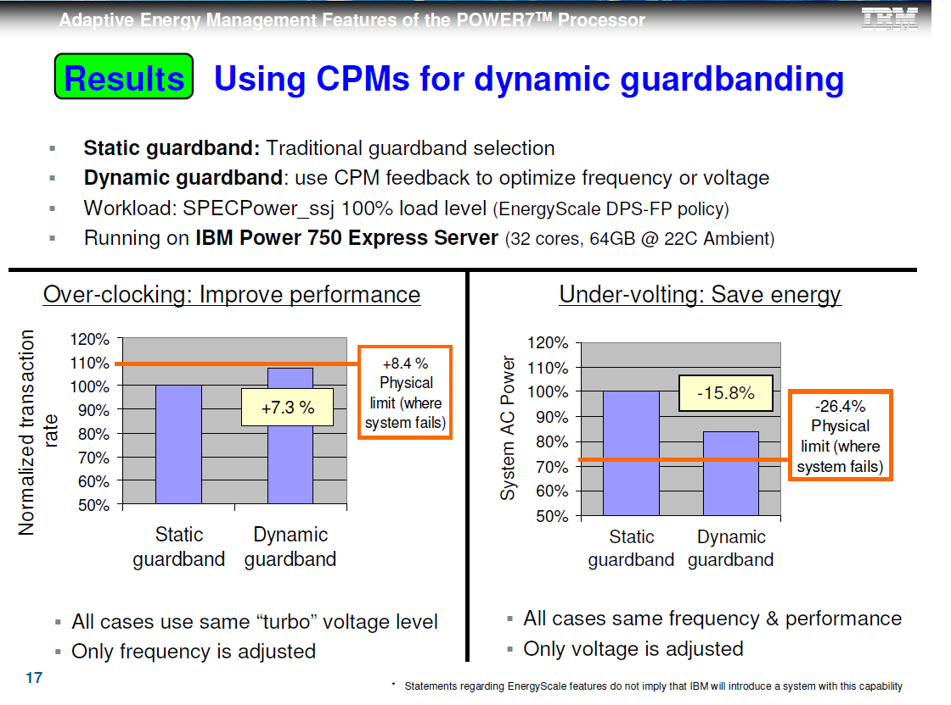
6.5.4 AVFS (Adaptive Voltage or Frequency Scaling) (18)
Example: Achieved gains in both use cases of AVFS in an IBM server [214]
AVS (Used for undervolting)
AFS (Used for overclocking)
cores
cores
Static guardband: Traditional worst case guardband.
Dynamic guardband: Use of AVFS to optimize voltage (AVS) or frequency (AFS)
(Workload: SPECPower_ssj 100 % load level (Energyscale DPS.-FP policy))
(Running on IBM Power 750 Express Server (32 cores, 64 GB, 22 C ambient temperature))

Slide 180
6.5.4 AVFS (Adaptive Voltage or Frequency Scaling) (19)
Remark: Coping with voltage droops -1 [215] (in the Lecture not discussed)
The supply voltage of microprocessors shows significant fluctuations caused by
fast changes in the current demand, including voltage droops in response to
workload variations, as indicated in the next Figure.

Slide 181
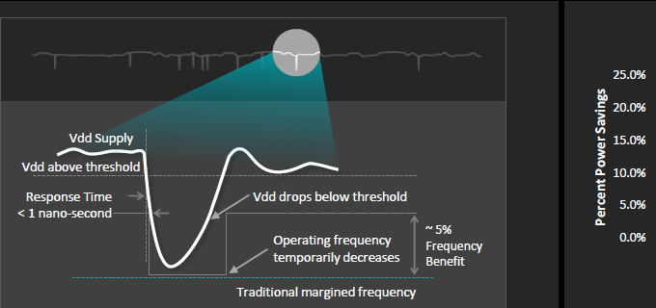
6.5.4 AVFS (Adaptive Voltage or Frequency Scaling) (20)
Variations of the supply voltage, including voltage droops [215]
http://www.goldfries.com/downloadables/AMD_Carrizo.pdf

Slide 182

6.5.4 AVFS (Adaptive Voltage or Frequency Scaling) (21)
Variations of the supply voltage, including voltage droops -2 [216]
These short voltage variations including voltage droops, may amount to
100 to 200 mV, as indicated below.
Figure: Voltage droop in the supply voltage [216]

Slide 183
6.5.4 AVFS (Adaptive Voltage or Frequency Scaling) (22)
Coping with voltage droops -2 [216]
To address voltage droops a large extra margin of 10 to 15 % needs to be added
to the ideal, voltage variations free min. voltage values needed to guarantee
a given fc.
This additional voltage margin gives rise to wasting power.
To avoid excess power consumption due to voltage droops a number of
techniques were introduced, including those used for Intel's Itanium Montecito
(2006), Nehalem (2008) and AMD's Steamroller-based Kaveri (2014)
processors, summarized in.
From these we show AMD's solution, called Adaptive Clocking System,
introduced in the Steamroller based Kaveri desktop and mobile processor,
in 2014.

Slide 184
6.5.4 AVFS (Adaptive Voltage or Frequency Scaling) (23)
AMD's Adaptive Clocking System -1 [216]
AMD's solution is based on a droop detector and a clock stretcher.
The droop detector is implemented as a delay line built up of 40 delay cells,
as shown below.

Slide 185

6.5.4 AVFS (Adaptive Voltage or Frequency Scaling) (24)
The droop detector in AMD's Adaptive Clocking System [216]
Figure: Droop detector [216]
DLL FSM: Delay Locked Loop Finite State Machine
PLL: Phased Locked Loop
PD: Phase Detector (generates a voltage signal which represents
the difference in phase between two signal inputs.)

Slide 186
6.5.4 AVFS (Adaptive Voltage or Frequency Scaling) (25)
AMD's Adaptive Clocking System -2 [216]
The delay line is designed so that at nominal voltage the rising edge travels to
the end.
As the supply voltage drops the rising edge lags and the phase detector will be
triggered to indicate the delay.
A detected voltage drop will be forwarded to the clock stretcher that reduces
the clock speed, as shown below.

Slide 187
6.5.4 AVFS (Adaptive Voltage or Frequency Scaling) (26)
Adaptive Clocking System in AMD's Excavator-based Carizzo [215]
The response time of the Clock stretcher is less than 1 ns, as shown below.
Figure: Reducing the clock frequency due to a voltage drop in AMD's Excavator-based
Carizzo [215]

Slide 188

6.5.4 AVFS (Adaptive Voltage or Frequency Scaling) (27)
Power saving achieved in AMD's Adaptive Clocking System that addresses
also voltage droops, in the Steamroller-based Kaveri [215]

Slide 189
6.6 Utilizing the power headroom of processor packages
to raise performance
6.6.1 Introduction
6.6.2 Intel’s Turbo Boost technologies
6.6.3 AMD’s Turbo Boost technologies
Section 6.6.3 will not be discussed.
Notes:
189

Slide 190
6.6 Utilizing the power headroom of processor packages to raise performance
6.6 Utilizing the power headroom of processor packages to raise performance
Approaches for power management (PM) of computers
(Strongly simplified)
PM at the circuit level
(Reducing power consumption
by appropriate circuit design)
PM at the processor level
PM at the platform level
(ACPI-based, achieved by
system design)
PM of CPU cores
Clock gating
Power gating
PM of idle CPU cores
PM of active CPU cores
Reducing
power consumption
of idle CPU cores
Reducing
power consumption
of active CPU cores
Utilizing the power headroom
of a proc. package
to raise performance
C-state management
DVFS/CPPC/AVFS
Turbo Boost Technology
(ACPI-based)
CPPC: Collaborative Processor Power Control
(DVFS, CPPC: ACPI-based)
*

Slide 191
6.6.1 Introduction
Notes:
191

Slide 192
6.6.1 Introduction (1)
6.6.1 Introduction
Intel introduced the Turbo Boost technology in their Nehalem line in 2008,
designated also as the 1. gen. Turbo Boost technology.
It is described in Section 6.6.2.1.
There are two enhancements of this technology:
the Turbo Boost 2.0, introduced in the Sandy Bridge line (2011), see Section
6.6.2.2 and
the Turbo Boost 3.0 (aka Turbo Boost Max 3.0) introduced in the Broadwell-E
HED line (2016), see Section 6.6.2.3.
Also AMD implemented the Turbo Boost technology, called the Turbo Core
technology, nevertheless with a delay of at least two years.
A brief cover of AMD’s Turbo Boost activities can be found in Section 6.6.3.
*

Slide 193
6.6.2 Intel’s Turbo Boost technologies
6.6.2.1 Intel’s 1. gen. Turbo Boost technology
6.6.2.2 Intel’s 2. gen. Turbo Boost technology
6.6.2.3 Intel’s 3. gen. Turbo Boost technology
6.6.2.4 Further evolution of Intel’s Turbo Boost technology
Notes:
193

Slide 194
6.6.2 Intel’s Turbo Boost technologies (1)
6.6.2 Intel’s Turbo Boost technologies
The 1.-3. generations of the Turbo Boost technology are strongly connected to the
notion of the TDP (Thermal Design Power) value of a processor, this is the reason
why we recap it subsequently.
*

Slide 195
6.6.2 Intel’s Turbo Boost technologies (2)
Interpretation of the notion of TDP (Thermal Design Power)
The TDP (Thermal Design Power) of a processor model is a design parameter
that specifies the power budget allocated to the processor (package), given
typically in W.
It can be interpreted as the maximum power consumed by realistic, power
intensive applications.
The TDP serves as a reference value for designing the cooling system
of the platform.
The cooling system (called also thermal solution) of a platform has to be designed
such that it should guarantee that the chip, more precisely the junction
temperature (Tj) of the transistors on the die does not exceed a given limit
(Tjmax, e.g. 90 ºC⁾ while the processor dissipates as much power as the TDP
value indicates.
TDP: Tervezési hőérték
*

Slide 196
6.6.2 Intel’s Turbo Boost technologies (3)
Approximate TDP values of desktop and notebook processors
TDP |  | Intel’s usual tags
HEDTs/Servers (~85-200 W)
 | High perf. (~70-95 W) | K
 | Mainstream (~50-65 W) | S
 | Low power (~35-45W) | T
 | High perf. (≈ 45 W) | H/HQ
 | Mainstream/ Entry level (≈ 25-35 W) | U
 | Ultra-thin (≈ 15 W) | U
Tablets (≈5 W) |  | Y/m
Desktops
Notebooks
*

Slide 197
6.6.2 Intel’s Turbo Boost technologies (4)
The TDP value of a processor as the key limiter of the basic clock rate
TDP is the key limiter of the clock rate of processors, as the example below
for Intel’s Skylake DT and mobile processors demonstrates.
Models | TDP (W) | No. of cores | Graphics | No. of graphics EUs | eDRAM | Max. Base frequency (GHz)
6Yxx | 4.5 | 2 | HD 515 | 18 | -- | 1.2
I7-6xxxU | 15 | 2 | HD 540 | 48 | 64 MB | 2.2
I3/I5/i7-6xxxU | 15 | 2 | HD 520 | 24 | -- | 2.6
I3/I5/i7-6xxxU | 28 | 2 | HD 550 | 48 | 64 MB | 3.3
I3/i5/i7-6xxxT I3-6xxxH | 35 | 4 2 | HD 530 | 24 | -- | 2.8 2.7
I5/i7-6xxxHQ | 45 | 4 | HD 530 | 24 | -- | 2.9
I3-6xxx | 47 | 4 | HD 530 | 24 | -- | 2.9
I5/i7-6xxx | 65 | 4 | HD 530 | 24 | -- | 3.4
I5/i7-6xxxK | 91 | 4 | HD 530 | 24 | -- | 4.2
Table: Dependence of the max. base clock frequency on the TDP value in Intel’s Skylake line [19]

Slide 198
6.6.2.1 Intel’s 1. gen. Turbo Boost technology
Notes:
198

Slide 199
6.6.2.1 Intel’s 1. gen. Turbo Boost technology (5)
Intel’s 1. gen. Turbo Boost technology -1
Principle of operation
The processor is designed for a given TDP value.
If actually, a processor dissipates less than its TDP value, a power headroom
arises.
The Turbo Boost technology converts power headroom to higher performance
by raising the clock frequency of the active cores.
Power headroom: hőtartalék
*

Slide 200
6.6.2.1 Intel’s 1. gen. Turbo Boost technology (6)
Illustration of the operation of Intel’s
1. gen. Turbo Boost technology,
introduced in the Nehalem family [217]
Zero power for
inactive cores
by power gating
*
Turbo mode uses the power headroom (unused power of the package up to the TDP).

Slide 201
6.6.2.1 Intel’s 1. gen. Turbo Boost technology (7)
Intel’s 1. gen. Turbo Boost technology -2
Along with the Turbo Boost technology Nehalem introduced a PCU (Power
Control Unit) to perform three tasks:
to accomplish OS directed voltage and frequency transitions needed
for the DVFS technique,
to implement the Turbo Boost technology, and also
to continuously check current and power dissipation of the package
as well as the die temperature and if needed to take appropriate measures.
*

Slide 202
6.6.2.1 Intel’s 1. gen. Turbo Boost technology (8)
Principle of Intel’s 1. gen. Turbo Boost technology
The processor switches to the Turbo mode when the following four conditions
are met:
the OS requests the highest performance state (P0)) while processing the
actual workload,
there remains a power headroom, i.e. the actual power consumption is less
then the TDP value,
the actual current is less than a given limit and
also the die temperature is below a given limit
Then the PCU (Power Control Unit) converts available power headroom into
higher performance by raising clock rate and core voltage of the active cores
to the Turbo boost frequency.
The Turbo boost frequency depends actually on the number of active cores,
the less cores are active the higher is the Turbo Boost frequency, thus P0 1C is
the highest Turbo Boost rate, as indicated in the next Figure.
*

Slide 203

6.6.2.1 Intel’s 1. gen. Turbo Boost technology (9)
The Turbo Boost mode as part of the processor’s power management [219]
LFM: Low Frequency Mode

Slide 204
6.6.2.1 Intel’s 1. gen. Turbo Boost technology (10)
Setting turbo boost frequencies (P0 1C etc.) in processors
Turbo boost frequencies (P0 C1 etc.) are factory determined, they are given
as frequency multiplier values related to the bus frequency (100 or 133.33 MHz)
and are written into one internal register (MSR 1ADH) of the processor.
As an example, assuming 133.33 MHz bus frequency, the frequency multiplier
value of 27 results in a clock frequency of 27 x 133.33 MHz = 3.6 GHz.
The MSR 1ADH holds the determined multiplier values for different number of
active cores in subsequent fields, as for example the Table below indicates it.
MSR 1ADh (in the Nehalem line of client processors)
Bits 31-24 | Bits 23-16 | Bits 15-08 | Bits 07-00
Ratio for 4 active cores | Ratio for 3 active cores | Ratio for 2 active cores | Ratio for 1 active core
E.g. in the Nehalem DT i7-975: (Base clock: 3.33 GHz, bus clock: 133.33 MHz)
26 | 26 | 26 | 27
3.46 GHz | 3.46 GHz | 3.46 GHz | 3.6 GHz
Multiplier:
Turbo boost fc
Table: Multiplier values kept in the MSR 1ADH for a given 4-core processor [354]
The MSR 1ADH can be read by the PCU or OS.
MSR: Model-Specific Register

Slide 205
6.6.2.1 Intel’s 1. gen. Turbo Boost technology (11)
Implementation of Intel’s 1. gen. Turbo Boost technology [218] -1
If the discussed 4 conditions for activating the Turbo Boost technology are fulfilled
first the PCU finds out how many cores are active momentarily.
It considers a core active if it is in the C0 (active) or C1 (Halt) state and inactive
if it is in the C3 or the C6 (or higher) idle states.
Based on the number of active cores the PCU reads out the associated frequency
multiplier value from the MSR 1ADH register and the related core voltage code
(from an unspecified place).
Then the PCU raises first the core voltage by sending the voltage code to the
VR (Voltage Regulator) and increments the frequency multiplier stepwise.
As a result the PLL (Phase Locked Loop) raises the clock frequency by the bus
frequency (100 or 133.33 MHz) called one bin.
Accordingly one bin equals typically the value of the bus frequency, i.e. 100 or
133.33MHz, (e.g. 133 MHz in the Nehalem line or 100 MHz in the Sandy Bridge
line).
The PCU repeats this process until the actual multiplier value equals the
multiplier value read out from the MSR 1ADH, unless any operating limit
(see next) is met.
The resulting turbo boost frequency will be the product of the multiplier value
read out from the MSR 1ADH register and the bus frequency.

Slide 206
6.6.2.1 Intel’s 1. gen. Turbo Boost technology (12)
Checking operating conditions during processor operation [221], [222]
The PCU continuously checks whether power and temperature remain below
specified limits.
To check power and temperature limits the PCU samples the actual power
consumption and die temperature in 5 ms intervals [221].
Power consumption is determined by monitoring the processor current at its
input pins as well as the associated voltage (Vcc) and calculating the power
consumption as a moving average.
Die temperature is monitored by DTSs (Digital Thermal Sensors) with an error
of ± 5 % [222].
This ensures that the junction temperature of the transistors remains below a
given limit (e.g. 90 C⁰.
When any factory configured limits is surpassed (the power consumption of the
processor or the junction temperature of any core) the PCU automatically
steps down core frequency in increments of 100 or 133 MHz, depending on the
value of the bus frequency.
*

Slide 207
6.6.2.1 Intel’s 1. gen. Turbo Boost technology (13)
Example: The PCU of Intel’s Nehalem processor [205] -1
IA32_PERF_CTL MSR
I
PLL: Phase-Locked Loop (Fázis-zárt hurok)
*

Slide 208
6.6.2.1 Intel’s 1. gen. Turbo Boost technology (14)
Remark 1
All active cores run at the same clock frequency and share the same power plane.
*

Slide 209
6.6.2.1 Intel’s 1. gen. Turbo Boost technology (15)
Remark 2
Idle cores are shut down either by power gates or by Integrated voltage regulators,
as follows:
by power gates (from the Nehalem line until the Ivy Bridge line), then
by Integrated voltage regulators (called FIVR) (in the Haswell and Broadwell
lines), next again
by power gates (in the Sky Lake and Sky Lake based 8. and 9. gen. lines), and
finally anew
by Integrated voltage regulators (beginning with the Ice Lake line).

Slide 210
6.6.2.1 Intel’s 1. gen. Turbo Boost technology (16)
Remark 3 (optional reading)
Intel’s Turbo Boost technology was introduced in the Nehalem family (2008), but
previously the Penryn family already implemented a similar, more straightforward
technology, called EDAT (Enhanced Dynamic Acceleration Technology) in 2007.
First Penryn processors included dual cores, and introduced the C6 idle state.
Before entering the C6 idle state, the core saved its context into an SRAM and the
control circuitry switch off its supply voltage (Note: no power gating yet).
EDAT logic considered a core being in the ACPI C0 or C1 states “active”, whereas
cores in the C3 to C6 ACPI states were considered “idle”.
EDAT became activated if
one of the two cores became idle
the OS requested the highest P state for the active core and
power consumption remained below the TDP (Thermal Design Power).
When EDAT became active, control circuitry increased the clock frequency by 1 bin.
1 bin equated to ½ of the FSB clock frequency (266 MHz for an FSB of 533 MHz or
333 MHz for an FSB of 666 MHz).
Here we note that Penryn was a symmetrical multicore yet where cores were
attached by the FSB.
EDAT was controlled by dedicated EDAT circuitry and was implemented only in
mobile models of the Penryn family.

Slide 211

6.6.2.1 Intel’s 1. gen. Turbo Boost technology (17)
Principle of the operation of EDAT
Figure: Principle of the operation of EDAT [224]
C3-DPD is in fact the C6 idle state.
EDAT bin: 266 MHz for an FSB of 533 MHz or 333 MHz for an FSB of 666 MHz.
*

Slide 212
6.6.2.2 Intel’s 2. gen. Turbo Boost technology
Notes:
212

Slide 213
6.6.2.2 Intel’s 2. gen. Turbo Boost technology (1)
6.6.2.2 Intel’s 2. gen. Turbo Boost technology (Turbo Boost 2.0) [22]
The concept utilizes the real temperature response of processors to power changes,
as the “thermal mass of the cooler” lets raise die temperature only delayed.
In the meantime, until package temperature achieves its allowed limit, processor
performance can be raised by increasing clock rate and core voltage [22].
Thermal capacitance
Cooler
*

Slide 214
6.6.2.2 Intel’s 2. gen. Turbo Boost technology (2)
Principle of the implementation of Intel’s 2. gen. Turbo Boost technology [22]
Based on the real temperature response the built up thermal budget accumulated
during idle periods (i.e. “coolness”) can be utilized to raise processor performance
beyond its TDP-limited value for short periods of time (e.g. for 40 sec).
C0 Turbo state
Stepped
voltage/frequency
transitions
1. gen.
Turbo Boost
“TDP”
30-60sec
Multiple algorithms are used to manage in parallel
current, power and
die temperature. [22]
Rolling average
die temperature
over a time window
*

Slide 215
6.6.2.1 Intel’s 1. gen. Turbo Boost technology (13)
Remark
The Turbo boost 1.0 technology allows processor power consumption to raise
up to the TDP value.
By contrast, the Turbo boost 2.0 technology allows processor power consumption
to raise beyond the TDP value, nevertheless only for a limited time (nx10 s).
Consequently, Turbo boost 2.0 results in higher turbo boost clock frequencies than
the Turbo boost 1.0 technology.
In addition, Intel’s Sandy Bridge line introduced power gating and power gating
is helpful to raise power headroom, that contributes also to higher turbo boost
frequencies.
The Table below demonstrates this for a 6-core Sandy Bridge-E HEDT processor
[220].
i7-3970X (Sandy Bridge-E), base clock: 3.50 GHz
No of active cores | 1C | 2C | 3C | 4C | 5C | 6C
Multiplier | 40 | 40 | 38 | 38 | 36 | 36
Bins (1 bin: 100 MHz) | +5 | +5 | +3 | +3 | +1 | +1
Turbo clock frequency | 4.0 GHz | 4.0 GHz | 3.80 GHz | 3.80 GHz | 3.60 GHz | 3.60 GHz
Table: Turbo multipliers of the 6-core Sandy Bridge-E processor i7-3970X [220]
*

Slide 216

6.6.2.1 Intel’s 2. gen. Turbo Boost technology (3)
Defined power levels (PL) in the Turbo Boost technology [223] -1
Current
TDP
(Temperature)
RATL: Running Average Thermal Limit
PL1: The cooling limit, it is effectively the TDP value.
Here the power (and frequency) is limited by the available cooling.

Slide 217
6.6.2.1 Intel’s 2. gen. Turbo Boost technology (4)
Defined power levels (PL) in the Turbo Boost technology [223] -2
Current
TDP
PL2: It is needed for running all cores at maximum turbo frequency (P0 nC).

Slide 218
6.6.2.1 Intel’s 2. gen. Turbo Boost technology (5)
Defined power levels (PL) in the Turbo Boost technology [223] -3
E.g. for Intel’s Core i9-9900X HED PL2 is 210 W for running all 8 cores at 4.7 GHz
vs. the 95 W TDP needed for running all cores at the base frequency of 3.6 GHz).
This however requires an appropriate cooling.

Slide 219
6.6.2.1 Intel’s 2. gen. Turbo Boost technology (6)
Defined power levels (PL) in the Turbo Boost technology [223] -4
Current
TDP
PL3: Power limit arising from the battery protection current limit
TDC: The Thermal Design Current, i.e. the sustainable current that the processor
is capable of drawing indefinitely. (Turbo módhoz igényelt áram)

Slide 220

6.6.2.2 Intel’s 2. gen. Turbo Boost technology (7)
Intelligent power sharing between the CPU cores and the processor graphics
(PG) [22]
CPU
(CPU = const - PG)
Figure: Power sharing between CPU and GPU [219]
*

Slide 221

6.6.2.2 Intel’s 2. gen. Turbo Boost technology (8)
Key features of Intel’s Turbo Boost techniques in subsequent families [208]
(EDAT)
Penryn
(EDAT)
Nehalem
Westmere
NHM/M
WSM/M
Penryn/M
Nehalem/M (Clarksfield)
Nehalem/D (Lynnfield)
Westmere/M (Arrandale)
Westmere/D (Clarkdale)
NHM/D
WSM/D
M: Mobile D: Desktop

Slide 222
6.6.2.3 Intel’s 3. gen. Turbo boost technology
Notes:
222

Slide 223
6.6.2.3 Intel’s 3. gen. Turbo Boost technology (1)
6.6.2.3 Intel’s 3. gen. Turbo Boost technology -1
It is designated also as the Turbo Boost 3.0 or Turbo Boost Max 3.0 Technology.
It is an enhancement to the Turbo Boost 2.0 technology that aims at raising
single thread performance.
In the Turbo Boost 2.0 technology the OS allocates cores to threads without
making any distinction among the cores.
By contrast, in the Turbo Boost 3.0 technology the OS is aware of the fastest
core and in single threaded applications it allocates the fastest core to the
thread to be executed in order to raise single thread performance.
To achieve this, Intel determines the max. clock speeds of all cores during
processor testing and arrranges the cores into a list according to their max.
clock speed, as seen in the next Figure, where core 9 is the highest speed core.
*

Slide 224

6.6.2.3 Intel’s 3. gen. Turbo Boost technology (2)
Example core speed list used in the Turbo Boost 3.0 mode [225]

Slide 225
6.6.2.3 Intel’s 3. gen. Turbo Boost technology (3)
Intel’s 3. gen. Turbo Boost technology [225] -2
The core list is written into the processor (presumable into an MSR) and is
available to the OS.
In single threaded applications the OS looks then for the fastest core (called also
the favored core) and allocates it to the thread to be executed.
Intel claims that Turbo Boost 3.0 can boost the performance of single-threaded
applications in the Broadwell-E HEDT line up to 15 % [226], as seen
in the next Table.
*

Slide 226
6.6.2.3 Intel’s 3. gen. Turbo Boost technology (4)
Example: Turbo 2.0 and Turbo 3.0 frequencies of Broadwell-E models [227]
 | Cores/threads | Base clock (all cores) GHz | Turbo 2.0 core (single core) GHz | Turbo 3.0 clock (single core) GHz
I7-6950X | 10/20 | 3.0 | 3.5 | 4.0
I7-6900K | 8/16 | 3.2 | 3.7 | 4.0
I7-6850K | 6/12 | 3.6 | 3.8 | 4.0
I7-6800K | 6/12 | 3.4 | 3.6 | 3.8
Remarks to the Turbo Boost Max 3.0 technology
In practice, motherboard manufacturers often didn't support it or they do disable
it in the BIOS by default.
If users intend to make use of it they have to install the drivers and the BIOS
as well.

Slide 227
6.6.2.3 Intel’s 3. gen. Turbo Boost technology (5)
Intel’s 3. gen. Turbo Boost technology [225] -3
Intel’s Turbo Boost Max Technology 3.0 is available only on select Intel processors¹,
typically on the X-series HEDT lines and needs Windows 10 x64 – RS5 Edition
or later.
¹Intel processors supporting Turbo Boost 3.0 (stand 07/2019)
Intel Core i7-69xx/68xx Processor Family
Intel Core i9-7900X/i9-7920X/i9-7940X/i9-7960X/i9-7980XE/i7-7820X/i7-9800X
Intel Core i9-9820X/i9-99x0XE/i9-99x0X
Intel Xeon Processor E5-1600 v4 Product Family (single-socket only)
*

Slide 228
6.6.2.4 Further evolution of Intel’s Turbo Boost technology
Notes:
228

Slide 229
6.6.2.4 Further evolution of Intel’s Turbo Boost technology (1)
6.6.2.4 Further evolution of Intel’s Turbo Boost technology
There are two recent developments of Intel’s Turbo Boost technology to be discussed,
revealed along with the Tiger Lake line (09/2020).
a) Increasing the power level consumed in Intel’s Turbo Power mode
b) Redesigned power control system

Slide 230
6.6.2.4 Further evolution of Intel’s Turbo Boost technology (2)
a) Increasing the power level consumed in Intel’s Turbo Power mode -1
As discussed earlier, since the 2. gen. Turbo mode, power consumption of the
processors exceeds the TDP value, as indicated in the Figure below.
If all cores are running in 2. gen. turbo mode, the required power level is called
PL2 (designated as “Sustained power delivery” in the Figure below).
TDP
Figure: Consumed power of a processor if all cores are running in Turbo mode []
*

Slide 231

6.6.2.4 Further evolution of Intel’s Turbo Boost technology (3)
Increasing the power level PL2 consumed in Intel’s Turbo Power mode -2
In the course of Turbo Boost evolution Intel continuously raised the power level
of Turbo mode over the TDP, as the Figure below indicates.
TDP
Figure: Rise of the Turbo Boost power level (PL2) consumed in Intel’s processors [297]
As an example the turbo power level of processors with a TDP of 15 W rose over years to 19 W,
then to 35 W, in the Ice Lake to 44 W and in the Tiger Lake processor even to 50 W [297].
*

Slide 232

6.6.2.4 Further evolution of Intel’s Turbo Boost technology (4)
Example for strongly increased turbo power level: Intel’s UP3/UP4 class
Tiger Lake models [297]
SFF: Small Form Factor
cTDP: configurable TDP

Slide 233
6.6.2.4 Further evolution of Intel’s Turbo Boost technology (5)
The notion of cTDP (configurable TDP)
It was introduced by Intel in 2012 (in their Ivy Bridge line and later on also
by AMD in their Kaveri line in 2014).
cTDP provides a flexibility for OEMs to build laptops or desktops compared to
designs based on a processor with a fixed TDP.
cTDP allows to choose a TDP value for a design from an interval between a
lowest and highest value, instead of a fixed figure, e.g. from 12 W to 28 W
instead of 15 W.
Lower TDP values obviously allow OEMs to build devices with reduced power
consumption and performance and vice versa.
Choosing lower TDP values may result in more quiet devices, if they have active
cooling, on the other hand if an OEM chooses a higher TDP, it has to provide
an enhanced cooling solution compared to the mainstream designs.
*

Slide 234

6.6.2.4 Further evolution of Intel’s Turbo Boost technology (6)
Example: Base and turbo boost frequencies of Intel’s UP3 class Tiger Lake
models [297]

Slide 235
6.6.2.4 Further evolution of Intel’s Turbo Boost technology (7)
Example: Base and turbo boost frequencies of Intel’s UP3 class Tiger Lake
models [297]

Slide 236
6.6.2.4 Further evolution of Intel’s Turbo Boost technology (8)
b) Redesigned SoC power control system
Announced along with Intel’s 11. gen. Tiger Lake line in 09/2020.
System performance will be maximized while taking into account actual physical
characteristics of the device (e.g. chassis temperature).
(In some aspects similar to AMD’s STAPM (Skin Temperature Aware Power
Management) introduced in 2014 in their Puma+ laptop line.
Presumably, it replaces CPPC (Cooperative Processor Performance Control), but
until now Intel did not disclosed detailed information about the new scheme.
The only available overview of the new power control system is at present
as follows:

Slide 237

6.6.2.4 Further evolution of Intel’s Turbo Boost technology (9)
Intel’s redesigned power control scheme [297]
DTT (Dynamic Tuning Technology): Power delivery mechanism between CPUs and
an on-package GPU

Slide 238
6.6.2.4 Further evolution of Intel’s Turbo Boost technology (10)
Principle of operation of the redesigned power control [297]
The new principle of operation no more is based on the TDP, but on performance
requirement of the workload on the one side and system constraints on the
other, including power and temperature limits of the die and the chassis.
As previously, the requested clock frequency will be determined according to the
workload needs.
The OS provides hints about the user preferences.
The actual power consumption will be calculated from the measured current and
core voltage values and will be limited by system constraints, such as chassis
temperature.
In addition, die temperature will be sensed and checked against a temperature
limit.
It is then the task of the power control system to calculate and set the actual
clock frequency (and core voltage) while balancing between performance
request, power consumption and system constraints.
Until now however, Intel did not reveal any further details about their new power
power system.

Slide 239
6.6.3 AMD’s Turbo Core technologies
6.6.3.1 AMD’s 1. gen. Turbo Core technology
6.6.3.2 AMD’s 2. gen. Turbo Core technology
6.6.3.3 AMD’s STAPM technology
6.6.3.4 AMD’s Precision Boost technology
6.6.3.5 AMD’s Precision Boost 2 technology
(Section 6.6.3 not discussed in the Lecture)
Notes:
239

Slide 240
6.6.3 AMD’s Turbo Core technologies
6.6.3 AMD’s Turbo Boost technologies
Precision Boost 2
v
Precision Boost
v
STAPM
v
2. gen.Turbo Core
v
Turbo Core
v
2009
2010
2011
2012
2013
2014
2015
2016
2017
2018
2019
2020

Slide 241
6.6.3.1 AMD’s 1. gen. Turbo Core technology
Notes:
241

Slide 242
6.6.3.1 AMD’s Turbo Core technologies (1)
6.6.3.1 AMD’s 1. gen. Turbo Core technology -1
It appeared in K10.5 Istambul-based up to 6 core Phenom II X6 DT series
in 4/2010.
This processor did not yet support power-gating.
Much less power headroom could be utilized for the Turbo core technology.
Beyond the base clock frequency there was only a single higher frequency value,
the turbo frequency.
Due to the small amount of power headroom available Turbo core became
seldom activated and if so, only for short times, as shown in the next Figure.

Slide 243

6.6.3.1 AMD’s Turbo Core technologies (2)
Example: Operation of AMD’s 1. gen. Turbo Core technology in their K10.5
Istambul-based Phenom II X6 DT processor with up to 6 cores [229]

Slide 244
6.6.3.1 AMD’s Turbo Core technologies (3)
AMD’s 1. generation Turbo Core technology -2
The Turbo Core technology has been implemented in select K10.5 Istambul-based
Phenom II X6 series (04/2010).
(Supporting models are ending with the letter T).
The introduction of the Turbo Core technology became feasible in this series
since these processors were manufactured by Global Foundries already
by the 45 nm high-k fabrication process.
The 45 nm process technology results in less leakage thus a higher power
headroom will be available for idle cores.

Slide 245
6.6.3.1 AMD’s Turbo Core technologies (4)
Principle of operation
In the case when
three or more cores enter the idle state (Boost eligible state) and
the active cores are in the P0 state,
idle cores (cores in the Boost eligible state) will be placed into the low power,
low clock frequency state.
In this state cores are clocked only at 800 MHz and their supply voltage
becomes decreased to a lower value.
Then up to three active cores will be switched into the PO Boost state.
In this state both their supply voltage and clock speed will be increased.
The frequency boost is up to 500 MHz, that can be utilized in single or
light threaded applications.

Slide 246
6.6.3.1 AMD’s Turbo Core technologies (5)
Comparing AMD’s Turbo Core implementation in their Phenom II X6 DT
with Intel’s Turbo Boost implementation in their Nehalem line (2008)
AMD’s Turbo Core technology, as implemented in their Phenom II X6 DT line is
less efficient than Intel’s Turbo Boost, as implemented in their Nehalem lines
(2008) [117].
One of the key differences is that in their Nehalem lines Intel already made use
of the efficient C6 idle state for completely shutting down inactive cores
through using power gates, so there is a larger power headroom that can be
utilized by the active cores in the Turbo mode.
Missing the C6 state and power gates can be the reason why AMD do not allows
to switch more than 3 cores into the Turbo Core mode.
Nevertheless, in their subsequent lines (K12-based Llano, K14-based Bobcat and
K15-based Bulldozer), introduced in 2011, also AMD implemented the C6 state
along with power gates and improved significantly the efficiency of their
Turbo Core technology.

Slide 247
6.6.3.1 AMD’s Turbo Core technologies (6)
P-state transition sequences in AMD’s first Turbo Core technology [230]

Slide 248
6.6.3.1 AMD’s Turbo Core technologies (7)
Resulting performance gain when using Turbo Core technology [230]

Slide 249
6.6.3.1 AMD’s Turbo Core technologies (8)
AMD’s enhanced 1. gen. Turbo Core implementation in their Bulldozer family
Subsequently AMD implemented an enhanced version of their 1. gen.
Turbo Core technology in Bulldozer-based servers and desktops
(Interlagos, Zambezi) in 10/2011.
These processors do already support power-gating.
Accordingly, much more headroom remains for utilizing Turbo core.
This implementation provides beyond the base clock frequency two turbo levels,
The 8-core Turbo frequency becomes activated if all cores are active but
there remains a power headroom up to the TDP, and
the 4-core Turbo frequency can be activated if at least half of the cores are
in the CC6 state and the active cores request max. performance.
For single threaded applications the active core will run basically at the 8-core
Turbo frequency and if there remains enough headroom to the TDP even
at the the 4-core Turbo frequency, as demonstrated below.

Slide 250

6.6.3.1 AMD’s Turbo Core technologies (9)
Principle of operation of AMD’s 1. gen. Turbo Core technology,
as introduced in the Bulldozer family [190]

Slide 251
6.6.3.1 AMD’s Turbo Core technologies (10)
Nominal, 8-core Turbo, and 4-core Max Turbo frequencies in AMD’s
Zambezi DT line [229]
AMD FX-series processors
Name | Nominal Frequency | 8-core Turbo frequency | 4-core Max Turbo frequency | TDP | Cores | Level 2 cache | Level 3 cache | Northbridge Frequency | SRP
FX-8150* | 3.6GHz | 3.9GHz | 4.2GHz | 125W | 8 | 8MB | 8MB | 2.2GHz | $245
FX-8120* | 3.1GHz | 3.4GHz | 4GHz | 95W/ 125W | 8 | 8MB | 8MB | 2.2GHz | $205
FX-8100 | 2.8GHz | 3.1GHz | 3.7GHz | 95W | 8 | 8MB | 8MB | 2GHz | Unknown
FX-6100* | 3.3GHz | 3.6GHz | 3.9GHz | 95W | 6 | 6MB | 8MB | 2GHz | $165
FX-4170 | 4.2GHz | None | 4.3GHz | 125W | 4 | 4MB | 8MB | 2.2GHz | Unknown
FX-B4150 | 3.8GHz | 3.9GHz | 4GHz | 95W | 4 | 4MB | 8MB | 2.2GHz | Unknown
FX-4100* | 3.6GHz | 3.7GHz | 3.8GHz | 95W | 4 | 4MB | 8MB | 2GHz | $115

Slide 252
6.6.3.2 AMD’s 2. gen. Turbo Core technology
Notes:
252

Slide 253
6.6.3.2 AMD’s 2. gen. Turbo Core technology (1)
6.6.3.2 AMD’s 2. gen. Turbo Core technology
Based on a patent filed in 2008 by Naffziger (one of AMD’s key processor
architects) [231], AMD introduced a greatly improved 2. generation Turbo Core
technique in all of their main processor families in 2011/2012, that is in the
Llano APU line (Family 12h) APU line (06/2011)
1. gen. Cat (Bobcat)-based Ontario/Zacate APU lines (01/2011) and
2. gen. Bulldozer (Piledriver)-based Trinity APU line (09/2012).
The 2. gen. Turbo Core technology introduces
power gating,
the C6 core idle state and
a System Manager Unit (SMU) that is based on a 32-bit microprocessor
(actually the Lattice Miki LM32 microprocessor)
Note that these innovations were introduced by Intel’s Nehalem family already
in 2008 (the C6 idle state even in the previous Penryn family in 2007).

Slide 254
6.6.3.2 AMD’s 2. gen. Turbo Core technology (2)
Principle of operation of the 2. gen. Turbo Core technique -1
Based on the cited patent, [232] these processors have a digital power monitor
that scans the activity level of a large number of relevant events in each core
(e.g. 95 in each Llano core) and the GPU, such as FX and FP operations,
L1/L2 cache accesses etc. and based on these activity readings the Turbo Core
Manager (actually the SMU) calculates the power dissipation values for each
core plus the GPU by using a set of appropriate weights.
These data allow to determine also the dissipation of the entire chip, as indicated
in the next Figure.
The above briefly described technique is sad to be accurate to within 2% across
a broad range of application types [232].

Slide 255

6.6.3.2 AMD’s 2. gen. Turbo Core technology (3)
Example: Simplified layout of Llano’s digital power monitor [127]
CAC: AC capacitance (C_{ac}) termed also as switching capacitance
(it models the switching behavior of a unit)

Slide 256
6.6.3.2 AMD’s 2. gen. Turbo Core technology (4)
Principle of operation of the 2. gen. Turbo Core technique -2
Based on the calculated power consumption of the socket the Turbo Core Manager
determines the actual energy margin to the target TDP as the difference
between the actual power consumption of the cores and the chip and the
related TDP figure.
Positive margins indicate power headroom
Negative margins indicate power overage
A power headroom can be utilized for increasing the clock frequency (for Turbo
boost)
Power overages, on the other hand, initiate throttling (clock reduction) of the
cores or even the GPU.
Turbo boosting behaves differently in the first implementations (in the Llano,
and Ontario or Zacate lines) and the subsequent implementations (beginning
with the Trinity line).
In the first 2. gen. Turbo Core implementations, when the OS requests higher
CPU performance for particular cores and there is a power headroom
available, the Turbo Core Manager initiates a clock frequency increase for the
related core.
Note that only the clock frequencies of the cores may be increased, but the
clock frequency of the GPU can not be boosted, not even in case when the
CPU cores are not fully utilized or are inactive.

Slide 257
6.6.3.2 AMD’s 2. gen. Turbo Core technology (5)
Advanced implementation of the 2. gen. Turbo Core technology in the
2. gen Bulldozer (Piledriver)-based Trinity APU line [233]
The major enhancement of the 2. gen. Turbo Core technology of the Trinity line
vs. the Llano APU line is that the Trinity APU implements a bi-directional turbo
management, unlike the Llano APU that could boost only the core frequencies.
This allows now to increase also the clock frequency of the GPU when there is a
heavy GPU load and enough power headroom is available, as the following
Figure demonstrates it for the dual-module (4 cores) Trinity A10-4600M
mobile APU.

Slide 258

6.6.3.2 AMD’s 2. gen. Turbo Core technology (6)
Example: Bi-directional Turbo Core implementation in the 2. gen. Turbo Core
technology in the 2. gen Bulldozer (Piledriver)-based Trinity APU line [233]
We note that
the compute modules have a base clock frequency of 2300 MHz that can be
boosted up to 3200 MHz, in steps of 100 MHz, whereas
the GPU has a base clock frequency of 496 MHz that can be raised to 685 MHz.

Slide 259
6.6.3.3 AMD’s STAPM (Skin Temperature Aware Power Management)
technology
Notes:
259

Slide 260
6.6.3.3 AMD’s STAPM (Skin Temperature Aware Power Management) (1)
AMD’s STAPM (Skin Temperature Aware Power Management) technology -1
It is AMD’s 3. gen. Turbo Boost technology.
This technology is similar to Intel’s 2. gen. Turbo Boost technology, as it takes
into account the chassis temperature, i.e. the “thermal mass” of the chassis.
AMD designates this chassis temperature aware Turbo Boost technology as
Skin Temperature Aware Power Management (STAPM).
STAPM raises performance by boosting CPU and/or GPU frequencies as long as
the estimated platform’s skin temperature remains below a specified limit.
This allows an additional performance improvement when the device chassis is
“cold” after switch off or in light loaded time intervals of the processor.
Here we note that compared to Intel’s 2. gen. Turbo Boost technology AMD’s
STAPM technology appeared with a time delay of about 3 years.

Slide 261

6.6.3.3 AMD’s STAPM (Skin Temperature Aware Power Management) (2)
Principle of AMD’s STAPM (Skin Temperature Aware Power Management)
[122]

Slide 262
6.6.3.3 AMD’s STAPM (Skin Temperature Aware Power Management) (3)
AMD’s STAPM (Skin Temperature Aware Power Management) technology -2
AMD introduced STAPM both in their mainline (Bulldozer-based) and low power
Cat line for laptop models in the middle of the 2010’s, more precisely along with
the Puma+-based Beema and Mullins lines (4/2014) and
the Excavator v1-based Carizo line (06/2015).
AMD continued to implement the STAPM technology in their Zen-based laptop
processors.

Slide 263
6.6.3.3 AMD’s STAPM (Skin Temperature Aware Power Management) (4)
Performance increase resulting from using the STAPM technology
Since most use cases for mobile devices are short in duration, STAMP results
often in notable performance increase, as seen in the Figure below for a
subsequent STAPM implementation [234].
Figure: Performance improvements for STAPM in AMD’s Excavator v2
(Family 15h Models 70h-7Fh)-based Bristol Ridge processors (05/2016) [234]

Slide 264
6.6.3.3 AMD’s STAPM (Skin Temperature Aware Power Management) (5)
Remark [234]
Further on, as the STAPM technology allows the cores or the GPU to run faster,
the time to completion will be shorter.
Then the additional power needed for higher clock frequencies is easily compensated
by reduced power consumption resulting from setting processor or platform
components sooner into idle states.

Slide 265

6.6.3.3 AMD’s STAPM (Skin Temperature Aware Power Management) (6)
Assumed principle of the implementation pf STAPM [235]
(Static power)
TE: Thermal Entity
Here we do not want to go into details, but refer to the source of the publication.

Slide 266
6.6.3.4 AMD’s Precision Boost technology
Notes:
266

Slide 267
6.6.3.4 AMD’s Precision Boost technology (1)
6.6.3.4 AMD’s Precision Boost technology -1
It is AMD’s 4. gen. Turbo Boost technology
AMD enhanced their Turbo Core technology in the subsequent Zen-based
1. gen. DT Ryzen (03/2017) and ThreadRipper lines (08/2017), their enhanced
technology is designated as the Precision Boost technology.
It makes use of the same closed loop control mechanism as AMD's Pure Power
technology (that is AVS), as indicated in the Figure below:
Figure: The closed loop control mechanism for Pure Power (i.e. AVS) and Precision Boost (i.e. Turbo Boost) [213]

Slide 268
6.6.3.4 AMD’s Precision Boost technology (2)
AMD’s Precision Boost technology -2
Specific features of the Precision Boost technology:
a) Kind of specifying the Turbo Boost frequencies
b) Fine grained tuning of the clock frequency (in 25 MHz steps)

Slide 269
6.6.3.4 AMD’s Precision Boost technology (3)
a) Kind of specifying the Precision Boost frequency [161]
Precision Boost makes use of two Turbo Boost frequencies,
one higher value for
for up to two active cores (in DTs), respectively
for up to four active cores (in the ThreadRipper line), whereas
a lower value for more active cores, as specified above.
The next two Figures illustrate this.

Slide 270

6.6.3.4 AMD’s Precision Boost technology (4)
Boost behavior in the Precision Boost technology
Up to two active cores
Up to four active cores
4.0 GHz
4.0 GHz
More than two active cores
More than four active cores
3.7 GHz
Figure: Boost behavior of the
Ryzen DT lines [161]
Figure: Boost behavior of the
ThreadRipper line (based on [161])

Slide 271


6.6.3.4 AMD’s Precision Boost technology (5)
b) Fine grained tuning of the clock frequency (in 25 MHz steps) [101]
Precision
Boost
XFR
*

Slide 272

6.6.3.4 AMD’s Precision Boost technology (6)
Assumed principle of fine grained tuning
While using Precision Boost all active cores operate at the same clock frequency
and core voltage.
Fine grained tuning will be performed by the SMU microprocessor that raises the
core voltage and the clock frequency (in 25 MHz steps) whereas checks whether
the limiting factors, including the temperature, SoC power and VRM current
(and with it the socket power consumption) remain in the factory boost range.
Temp
SoC
power
VRM
current
SMU: System Management Unit
Figure: Conceptual view of extending the limiters of Precision Boost with PBO [236]

Slide 273

6.6.3.4 AMD’s Precision Boost technology (7)
Introducing the XFR technology (eXtended Frequency Range) technology
for raising the clock frequency over the Turbo boost frequency - XFR
The XFR (eXtended Frequency Range) technology presumes a high performance
(premium) cooler system to keep die temperature within the given limit [101].
XFR provides an automated overclocking over the max. Turbo Boost frequency if there
is a premium cooler system and the operating conditions of the processor (e.g.
temperature data) allow it.
With XFR enabled the
processor may boost clock
frequency by 50 to 200 MHz
above the advertised
max. Turbo Boost frequency.
Figure: Principle of operation of XFR [101]
*

Slide 274

6.6.3.4 AMD’s Precision Boost technology (8)
Additional boost of clock frequencies by the XFR technology [101]

Slide 275

6.6.3.4 AMD’s Precision Boost technology (9)
Example frequency scaling in AMD’s Ryzen 7 1800X DT line [101]

Slide 276
6.6.3.4 AMD’s Precision Boost technology (10)
Remark
AMD’s Precision Boost technology (2017) is similar to Intel’s Thermal Velocity Boost
(TVB) technology (2018).

Slide 277
6.6.3.5 AMD’s Precision Boost 2 technology
Notes:
277

Slide 278
6.6.3.5 AMD’s Precision Boost 2 technology (1)
AMD’s Precision Boost 2 technology
It is AMD’s 5. gen. Turbo Boost technology.
Precision Boost 2 has been introduced in a number of Zen-based series, as follows:
Ryzen mobile APU series (Zen (Raven Ridge)-based, 14 nm, 10/2017)
Ryzen DT APU series (Zen+ (Pinnacle Ridge)-based, 12 nm 4/2018)
2. gen. Ryzen DT series (Zen+ (Pinnacle Ridge)-based, 12 nm, 4/2018) and
2. gen. ThreadRipper series, (Zen+ (Pinnacle Ridge)-based, 12 nm, 8/2018).

Slide 279
6.6.3.5 AMD’s Precision Boost 2 technology (2)
Deficiency of the boost behavior of the implemented Precision Boost
technology [237]
The step-like reduction of the boost frequency while entering more active threads
can unfavorable impact performance, especially in games.
In this case several additional threads could often be spawned in addition to the
one or two main threads and while the additional threads frequently do not
contribute as much to the performance they can cause the boost frequency
significantly drop.
This could partly explain the moderate performance of AMD’s Zen-based
processors in certain gain titles and other benchmarks compared to Intel.
In order to mend this deficiency, in their Precision Boost 2. technology AMD
implemented a gradual decrease of the boost frequency along with raising
the number of the active threads, as illustrated next.

Slide 280
6.6.3.5 AMD’s Precision Boost 2 technology (3)
Boost behavior in the Precision Boost technology
Up to two active cores
Up to four active cores
4.0 GHz
4.0 GHz
More than two active cores
More than four active cores
3.7 GHz
Figure: Boost behavior of the
Ryzen DT lines [161]
Figure: Boost behavior of the
ThreadRipper line (based on [161])

Slide 281

6.6.3.5 AMD’s Precision Boost 2 technology (4)
Enhanced boost behavior in the Precision Boost 2 technology [237]
n-

Slide 282
6.6.3.5 AMD’s Precision Boost 2 technology (5)
Principle of operation of Precision Boost 2 [238]
Precision Boost 2 technology raises the clock frequency for any active core count
as much as given limits (defined by factory boost settings) allow it.
The limiting factors are
SoC power (“Total Platform Limit”): the maximum amount of power the
CPU can draw before boost levels off (measured in Watts)
VRM current (“TDC Limit”): the maximum amount of current the motherboard
is allowed to deliver to the CPU after warming up to a steady-state
temperature before boost levels off
EDC current Limit - Electrical Design Current, maximum peak current that
can be delivered by the motherboard' voltage regulator (VRM) for a short
time, as a spike
Temp (°C): measured in degrees Celsius, the maximum temperature the CPU
die can reach before boost levels off.

Slide 283
6.6.3.5 AMD’s Precision Boost 2 technology (6)
Conceptual view of implementing Precision Boost 2 [236]
Temp
SoC
power
VRM
current
The inner triangle illustrates the factory boost range settings, the blue circles
represent actual operating points of the key limiting factors.
Clock frequency and core voltage of all active cores will be increased in 25 MHz
steps as long as one of the limiting factors reach the factory setting.

Slide 284

6.6.3.5 AMD’s Precision Boost 2 technology (7)
Precision Boost 2 technology as implemented in the 2. gen Ryzen DT line [239]
Boost behavior with Precision Boost 2
in the 2. gen. Ryzen Desktop line

Slide 285

6.6.3.5 AMD’s Precision Boost 2 technology (8)
Example for integrated per-core frequency and voltage management
in Precision Boost 2 [161]

Slide 286

6.6.3.5 AMD’s Precision Boost 2 technology (9)
Power consumption of the cores while raising the number of active cores
in the Ryzen 7 2700X 2. gen. desktop [239]
There are up to two active CCX units with up to 4 active cores/unit.
Green figures: not loaded cores - Yellow to red figures: loaded cores
Red figures appearing for few active cores indicate that in this case presumably
die temperature will constrain turbo clock frequency and determine the related
power consumption, whereas for yellow figures, seeing at many active cores,
the total power consumption limits clock frequency.

Slide 287

6.6.3.5 AMD’s Precision Boost 2 technology (10)
The XFR2 (eXtended Frequency Range) technology [239]
In the previous generation certain processor models could raise clock frequency
over the turbo boost frequency by 50 to 200 MHz if a premium cooling system
was used.
XFR2 allows a higher clock frequency boost assuming a premium cooling system
and a CPU temperature below 60 C⁰.

Slide 288
6.6.3.5 AMD’s Precision Boost 2 technology (11)
Introducing the Precision Boost Overdrive (PBO) technology [236]
It is a new feature of 2. gen. Ryzen DT and 2. gen. ThreadRipper processors,
aiming at increasing multihreaded performance.
It requires however the use of specific chipsets, as follows
in case of the 2. gen. DT series the series 400 chipsets (X470/B450) or
in case of the 2. gen. ThreadRipper series the X399 chipset
and the Ryzen Master overdrive utility release 1.3 or higher.
Unlike traditional overlocking while PBO is activated both Precision Boost 2 and
XFR2 (eXtended Frequency Range) remains enabled.

Slide 289

6.6.3.5 AMD’s Precision Boost 2 technology (12)
Relative merit of PBO [240]

Slide 290

6.6.3.5 AMD’s Precision Boost 2 technology (13)
Principle of operation of PBO [238]
When PBO is activated by means of the Ryzen Master overlocking utility the factory settings that determine the operation limits of Precision Boost 2 will be overwritten and the processor will operate outside the factory settings.
Temp
Temp
SoC
power
VRM
current
SoC
power
VRM
current
Figure: Conceptual view of extending the limiters of Precision Boost with PBO [238]
Note that the temperature limit with PBO remains unchanged.

Slide 291
6.6.3.5 AMD’s Precision Boost 2 technology (14)
Example for extending the limiters of Precision Boost with PBO [238]
For the 2. gen. Ryzen 2700X DT with 105 W TDP the default limits of
Precision Boost 2 are as follows:
PPT (Total Platform Limit): 141.75 W
TDC (Thermal Design Current): 95 A
EDC Electrical Design Current: 140 A and
Tjmax (Die temperature): 85⁰ C.
When Precision Boost Overdrive mode is enabled the operation limiters will
be raised as given below:
PPT (Total Platform Limit): 1000 W
TDC (Thermal Design Current): 114 A
EDC Electrical Design Current: 168 A and
Tjmax (Die temperature): 85⁰ C.
Nevertheless, with enabling the PBO mode invalidates AMD’s warranty.

Slide 292

6.6.3.5 AMD’s Precision Boost 2 technology (15)
Contrasting implications of using overclocking and PBO [241]

Slide 293

6.6.3.5 AMD’s Precision Boost 2 technology (16)
Example performance improvement achieved by employing PBO
in a ThreadRipper 2990WX for a multithreaded benchmark [236]

